Slide 1








Introduction to
Sustainability and ESG Data Analytics
Sustainability and ESG Data Analytics
1131ESGDA01
MBA, IM, NTPU (M5265) (Fall 2024)
Wed 2, 3, 4 (9:10-12:00) (B3F17)
Min-Yuh Day, Ph.D,
Professor
Institute of Information Management, National Taipei University
https://web.ntpu.edu.tw/~myday
https://meet.google.com/miy-fbif-max
2024-09-11

Slide 2











Min-Yuh Day, Ph.D.
Professor, Information Management, NTPU
Visiting Scholar, IIS, Academia Sinica
Ph.D., Information Management, NTU
Director, Intelligent Financial Innovation Technology, IFIT Lab, IM, NTPU
Director, Fintech and Green Finance Research Center, NTPU
Division Director, Sustainable Development, Sustainability Office, NTPU
Artificial Intelligence, Financial Technology, Big Data Analytics,
Data Mining and Text Mining, Electronic Commerce

Slide 3
Course Syllabus
National Taipei University
Academic Year 113, 1st Semester (Fall 2024)
Course Title: Sustainability and ESG Data Analytics
Instructor: Min-Yuh Day
Course Class: MBA, IM, NTPU (3 Credits, Elective)
Details
  In-Class and Distance Learning EMI Course
  (3 Credits, Elective, One Semester) (M5265)
Time & Place: Wed, 2, 3, 4, (9:10-12:00) (B3F17)
Google Meet: https://meet.google.com/miy-fbif-max
https://meet.google.com/miy-fbif-max

Slide 4


Course Objectives
Understand the fundamental concepts of sustainability and ESG data analytics.
Equip with Hands-on practices of sustainability and ESG data analytics.
Integrate innovative thinking of big data analysis to enhance the operational model of sustainable development.
In the context of sustainability, use data analysis to formulate responses to sustainable issues and cultivate students' ability to extract management-relevant data analysis skills from the data.

Slide 5
The Course Includes
Sustainable Development Goals (SDGs)
SDG4｜Quality Education
SDG7｜Affordable and Clean Energy
SDG8｜Decent Work and Economic Growth
SDG9｜Industry, Innovation and Infrastructure
SDG11｜Sustainable Cities and Communities
SDG12｜Responsible Consumption and Production
SDG13｜Climate Action
SDG17｜Partnerships for the Goals

Slide 6
Course Outline
This course introduces the fundamental concepts and hands-on practices of Sustainability and ESG Data Analytics.
Topics include
  Introduction Sustainability and ESG Data Analytics
  Environmental, Social, and Governance (ESG) in Net-Zero Digital Transformation
  Data Science for Sustainability and ESG
  Web 3.0 and Big Data Analysis in Fintech, Green Finance, Sustainable Finance
  Task Force on Climate-Related Financial Disclosures (TCFD) and En-Roads Interactive
  ESG Data Gathering, Analysis, and Visualization
  ESG Data Reporting, Corporate Sustainability Reports
  ESG Data Verification
  Energy Star Reporting and Data Disclosure
  Artificial Intelligence of things (AIoT) in ESG and Sustainability Applications
  Generative AI for ESG Rating and Reporting Generation
  Case Study on Sustainability and ESG Data Analytics

Slide 7
Core Competence
Exploring new knowledge in information technology, system development and application 80 %
Internet marketing planning ability 10 %
Thesis writing and independent research skills 10 %

Slide 8
Four Fundamental Qualities
Professionalism
  Creative thinking and Problem-solving 40 %
  Comprehensive Integration 40 %
Interpersonal Relationship
  Communication and Coordination 10 %
  Teamwork 5 %
Ethics
  Honesty and Integrity 0 %
  Self-Esteem and Self-reflection 0 %
International Vision
  Caring for Diversity 0 %
  Interdisciplinary Vision 5 %

Slide 9
College Learning Goals
Ethics/Corporate Social Responsibility
Global Knowledge/Awareness
Communication
Analytical and Critical Thinking

Slide 10
Department Learning Goals
Information Technologies and
System Development Capabilities
Internet Marketing Management Capabilities
Research capabilities

Slide 11
Syllabus
Week Date Subject/Topics
1 2024/09/11 Introduction Sustainability and ESG Data Analytics
2 2024/09/18 Environmental, Social, and Governance (ESG) in
Net-Zero Digital Transformation
3 2024/09/25 Data Science for Sustainability and ESG
4 2024/10/02 Case Study on Sustainability and ESG Data Analytics I
5 2024/10/09 Web 3.0 and Big Data Analysis in Fintech, Green and
Sustainable Finance
6 2024/10/16 Task Force on Climate-Related Financial Disclosures (TCFD)
and En-Roads Interactive

Slide 12
Syllabus
Week Date Subject/Topics
7 2024/10/23 ESG Data Gathering, Analysis, and Visualization
8 2024/10/30 Midterm Project Report
9 2024/11/06 Self-Learning
10 2024/11/13 ESG Data Reporting; Corporate Sustainability Reports
11 2024/11/20 ESG Data Verification
12 2024/11/27 Case Study on Sustainability and ESG Data Analytics II

Slide 13
Syllabus
Week Date Subject/Topics
13 2024/12/04 Artificial Intelligence of things (AIoT) in
ESG and Sustainability Applications
14 2024/12/11 Generative AI for ESG Rating and Reporting Generation
15 2024/12/18 Final Project Report I
16 2024/12/25 Final Project Report II

Slide 14
Course and Teaching Features
Combine Web3.0 to introduce basic concepts of big data analysis, research topics, and practical operations.
Provide theories and tools for data integration and communication planning.
Apply to analyze data from various domains and present analysis results through data visualization.
Expected Social Impact:
Learn from data analysis, cultivating the ability to analyze responses when facing sustainable issues and risks.
Train talents who possess basic concepts of big data analysis, research topics, practical operations, and practical abilities in sustainable data analysis.

Slide 15
Innovative Teaching Strategies
USR (University Social Responsibility) Local Connection and Collaboration
Group Learning
Problem-Based Learning (PBL)
Thematic Teaching
Learning by Thinking Teaching Method

Slide 16
Evaluation Methods
Individual Presentation 60 %
Group Presentation 10 %
Case Report 10 %
Class Participation 10 %
Assignment 10 %

Slide 17
Required Texts
Cino Robin Castelli, Cyril Shmatov (2022),
Quantitative Methods for ESG Finance, Wiley

Slide 18
Reference Books
Simon Thompson (2023), Green and Sustainable Finance: Principles and Practice in Banking, Investment and Insurance, 2nd Edition, Kogan Page.
Chrissa Pagitsas (2023), Chief Sustainability Officers At Work: How CSOs Build Successful Sustainability and ESG Strategies, Apress.
Hariom Tatsat, Sahil Puri, Brad Lookabaugh (2020), Machine Learning and Data Science Blueprints for Finance: From Building Trading Strategies to Robo-Advisors Using Python, O'Reilly Media
Aurélien Géron (2022), Hands-On Machine Learning with Scikit-Learn, Keras, and TensorFlow: Concepts, Tools, and Techniques to Build Intelligent Systems, 3rd Edition, O’Reilly Media.
Chris Kelliher (2022), Quantitative Finance With Python: A Practical Guide to Investment Management, Trading, and Financial Engineering, Chapman and Hall/CRC.
Abdullah Karasan (2021), Machine Learning for Financial Risk Management with Python: Algorithms for Modeling Risk, O’Reilly Media.
Numa Dhamani and Maggie Engler (2024), Introduction to Generative AI, Manning.
Denis Rothman (2024), Transformers for Natural Language Processing and Computer Vision - Third Edition: Explore Generative AI and Large Language Models with Hugging Face, ChatGPT, GPT-4V, and DALL-E 3, 3rd ed. Edition, Packt Publishing.

Slide 19
Other References
GRI (Global Report Initiative):
https://www.globalreporting.org/
CDP (Carbon Disclosure Project):
https://www.cdp.net/
SASB (Sustainability Accounting Standards Board):
https://sasb.org/
ISSB (International Sustainability Standards Board):
https://www.ifrs.org/groups/international-sustainability-standards-board/
TCFD (Task Force on Climate-related Financial Disclosures):
https://www.fsb-tcfd.org/
Research Papers

Slide 20
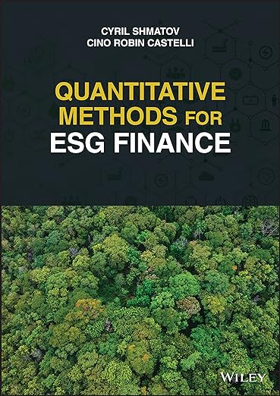
Cino Robin Castelli, Cyril Shmatov (2022),
Quantitative Methods for ESG Finance,
Wiley
Source: https://www.amazon.com/Quantitative-Methods-Finance-Robin-Castelli/dp/1119903807/

Slide 21
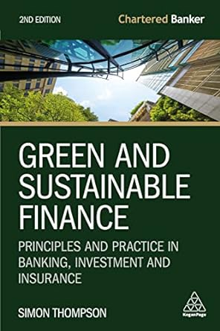
Simon Thompson (2023),
Green and Sustainable Finance:
Principles and Practice in Banking, Investment and Insurance,
2nd Edition, Kogan Page.
Source: https://www.amazon.com/Green-Sustainable-Finance-Principles-Investment/dp/1398609242/

Slide 22

Chrissa Pagitsas (2023),
Chief Sustainability Officers At Work:
How CSOs Build Successful Sustainability and ESG Strategies,
Apress.
Source: https://www.amazon.com/Chief-Sustainability-Officers-Work-Successful/dp/1484278658/

Slide 23

Numa Dhamani and Maggie Engler (2024),
Introduction to Generative AI,
Manning
Source: Numa Dhamani and Maggie Engler (2024), Introduction to Generative AI, Manning
https://www.amazon.com/Introduction-Generative-AI-Numa-Dhamani/dp/1633437191/

Slide 24

Denis Rothman (2024),
Transformers for Natural Language Processing and Computer Vision:
Explore Generative AI and Large Language Models with Hugging Face, ChatGPT, GPT-4V, and DALL-E 3,
3rd Edition, Packt Publishing
Source: https://www.amazon.com/Transformers-Natural-Language-Processing-Computer/dp/1805128728

Slide 25

Aurélien Géron (2022),
Hands-On Machine Learning with Scikit-Learn, Keras, and TensorFlow: Concepts, Tools, and Techniques to Build Intelligent Systems,
3rd Edition, O’Reilly Media.
Source: https://www.amazon.com/Hands-Machine-Learning-Scikit-Learn-TensorFlow/dp/1098125975

Slide 26

GRI (Global Report Initiative)
https://www.globalreporting.org/

Slide 27

CDP (Carbon Disclosure Project)
https://www.cdp.net/

Slide 28

SASB (Sustainability Accounting Standards Board)
https://sasb.org/

Slide 29

ISSB (International Sustainability Standards Board)
https://www.ifrs.org/groups/international-sustainability-standards-board/

Slide 30

TCFD
(Task Force on Climate-related Financial Disclosures)
https://www.ifrs.org/sustainability/tcfd/
https://www.fsb-tcfd.org/

Slide 31
Sustainability and
ESG Data Analytics

Slide 32


















Sustainable Development Goals (SDGs)
Source: https://sdgs.un.org/goals

Slide 33
Evolution of Sustainable Finance Research
Topic
SDGs:
Sustainable Development Goals
SDGs
Innovative Financial Instrument
Impact Investing
ESG: Environmental, Social, and Governance
CSR: Corporate Social Responsibility
Conscious Capitalism
Climate Financing
Carbon Financing
Green Financing
Ethical Investing
Socially Responsible Investing
1986
1995
2005
2015
2020
Source: Kumar, S., Sharma, D., Rao, S., Lim, W. M., & Mangla, S. K. (2022). Past, present, and future of sustainable finance:
Insights from big data analytics through machine learning of scholarly research. Annals of Operations Research, 1-44.

Slide 34

Sustainable Development Goals (SDGs) and 5P
Partnership
Peace
Prosperity
People
Planet
Source: Folke, Carl, Reinette Biggs, Albert V. Norström, Belinda Reyers, and Johan Rockström. "Social-ecological resilience and biosphere-based sustainability science.”Ecology and Society 21, no. 3 (2016).

Slide 35

ESG to 17 SDGs
Source: Henrik Skaug Sætra (2021) "A Framework for Evaluating and Disclosing the ESG Related Impacts of AI with the SDGs." Sustainability 13, no. 15 (2021): 8503.

Slide 36

ESG to 17 SDGs
Source: https://sustainometric.com/esg-to-sdgs-connected-paths-to-a-sustainable-future/

Slide 37
Generative AI for
ESG Applications

Slide 38

AI, ML, DL, Generative AI
Source: Jeong, Cheonsu. "A Study on the Implementation of Generative AI Services Using an Enterprise Data-Based LLM Application Architecture." arXiv preprint arXiv:2309.01105 (2023).

Slide 39

Sustainable Productivity:
Finance ESG
Source: Huang, Ziqi, Yang Shen, Jiayi Li, Marcel Fey, and Christian Brecher (2021). "A survey on AI-driven digital twins in Industry 4.0: Smart manufacturing and advanced robotics." Sensors 21, no. 19: 6340.

Slide 40

Sustainable Resilient Manufacturing
ESG
Source: Huang, Ziqi, Yang Shen, Jiayi Li, Marcel Fey, and Christian Brecher (2021). "A survey on AI-driven digital twins in Industry 4.0: Smart manufacturing and advanced robotics." Sensors 21, no. 19: 6340.

Slide 41
ESG Indexes
MSCI ESG Index
Dow Jones Sustainability Indices (DJSI)
FTSE ESG Index

Slide 42

MSCI ESG Rating Framework
Source: https://www.msci.com/documents/1296102/21901542/ESG-Ratings-Methodology-Exec-Summary.pdf

Slide 43

MSCI ESG Key Issue Hierarchy
Source: https://www.msci.com/documents/1296102/21901542/ESG-Ratings-Methodology-Exec-Summary.pdf

Slide 44

MSCI Governance Model Structure
Source: https://www.msci.com/documents/1296102/21901542/ESG-Ratings-Methodology-Exec-Summary.pdf

Slide 45

MSCI Hierarchy of ESG Scores
Source: https://www.msci.com/documents/1296102/21901542/ESG-Ratings-Methodology-Exec-Summary.pdf

Slide 46

DJSI S&P Global ESG Score
Source: DJSI, S&P Global Corporate Sustainability Assessment (CSA), https://www.spglobal.com/esg/solutions/data-intelligence-esg-scores

Slide 47

FTSE Russell ESG Ratings
Source: https://www.ftserussell.com/data/sustainability-and-esg-data/esg-ratings

Slide 48


Sustainalytics
ESG Risk Ratings
Analyst-based
approach
Sustainalytics’ ESG Risk Ratings measure a company’s exposure to industry-specific material ESG risks and how well a company is managing those risks.
Source: https://www.sustainalytics.com/esg-data

Slide 49

Truvalue
ESG Ranks
TruValue Labs
Machine-based approach
Truvalue Labs applies AI to analyze over 100,000 sources and uncover ESG risks and opportunities hidden in unstructured text.
The ESG Ranks data service produces an overall company rank based on industry percentile leveraging the 26 ESG categories defined by the Sustainability Accounting Standards Board (SASB).
The data feed covers 20,000+ companies with more than 13 years of history.
Source: :https://developer.truvaluelabs.com/data/esg-ranks

Slide 50

Analyst-driven vs. AI-driven ESG
Sustainalytics
Truvalue Labs
Source: Mark Tulay (2020), Man vs. machine: A tale of two sustainability ratings systems, GreenBiz, https://www.greenbiz.com/article/man-vs-machine-tale-two-sustainability-ratings-systems

Slide 51

Analyst based
ESG Research
AI based
ESG Research
Source: https://www.esganalytics.io/insights/how-data-is-accelerating-esg

Slide 52

ESG Analytics: NLP Taxonomy
Source: https://www.esganalytics.io/insights/how-data-is-accelerating-esg

Slide 53

Top
ESG Reporting Software
Environmental, Social and Governance (ESG) Reporting software or Sustainability software helps organizations manage their operational data, evaluate their impact on the environment and provide reporting to perform audits.
Source: https://www.softwarereviews.com/categories/environmental-social-and-governance-reporting

Slide 54
Transformer Models
Transformer
Encoder
Decoder
DistilBERT
BERT
T5
GPT
RoBERTa
BART
GPT-2
CTRL
XLM-R
XLM
M2M-100
GPT-3
ALBERT
BigBird
GPT-Neo
GPT-J
ELECTRA
mT0
BLOOM
BLOOMZ
DeBERTa
ChatGPT
GPT-4
Source: Lewis Tunstall, Leandro von Werra, and Thomas Wolf (2022), Natural Language Processing with Transformers: Building Language Applications with Hugging Face, O'Reilly Media.

Slide 55

Large Language Models (LLMs)
Source: Hadi, Muhammad Usman, Rizwan Qureshi, Abbas Shah, Muhammad Irfan, Anas Zafar, Muhammad Bilal Shaikh, Naveed Akhtar, Jia Wu, and Seyedali Mirjalili. "Large language models: a comprehensive survey of its applications, challenges, limitations, and future prospects." Authorea Preprints (2023).

Slide 56

Four Paradigms in NLP (LM)
Transfer Learning: Pre-training, Fine-Tuning (FT)
GAI: Pre-train, Prompt, and Predict (Prompting)
Source: Pengfei Liu, Weizhe Yuan, Jinlan Fu, Zhengbao Jiang, Hiroaki Hayashi, and Graham Neubig. (2023) "Pre-train, prompt, and predict: A systematic survey of prompting methods in natural language processing." ACM Computing Surveys 55, no. 9 (2023): 1-35.

Slide 57
Generative AI
Text, Image, Video, Audio Applications

Slide 58
Comparison of Generative AI and Traditional AI
Feature | Generative AI | Traditional AI
Output type | New content | Classification/Prediction
Creativity | High | Low
Interactivity | Usually more natural | Limited

Slide 59
Generative AI
Generative AI: The Art of Creation
Definition: AI systems capable of creating new content
Characteristics: Creativity, interactivity

Slide 60
Popular Generative AI
OpenAI ChatGPT (GPT-4o, GPT-4)
Claude.ai (Claude 3.5)
Google Gemini
Chat.LMSys.org
Perplexity.ai
ChatPDF
Stable Diffusion
Video: D-ID, Synthesia
Audio: Speechify

Slide 61
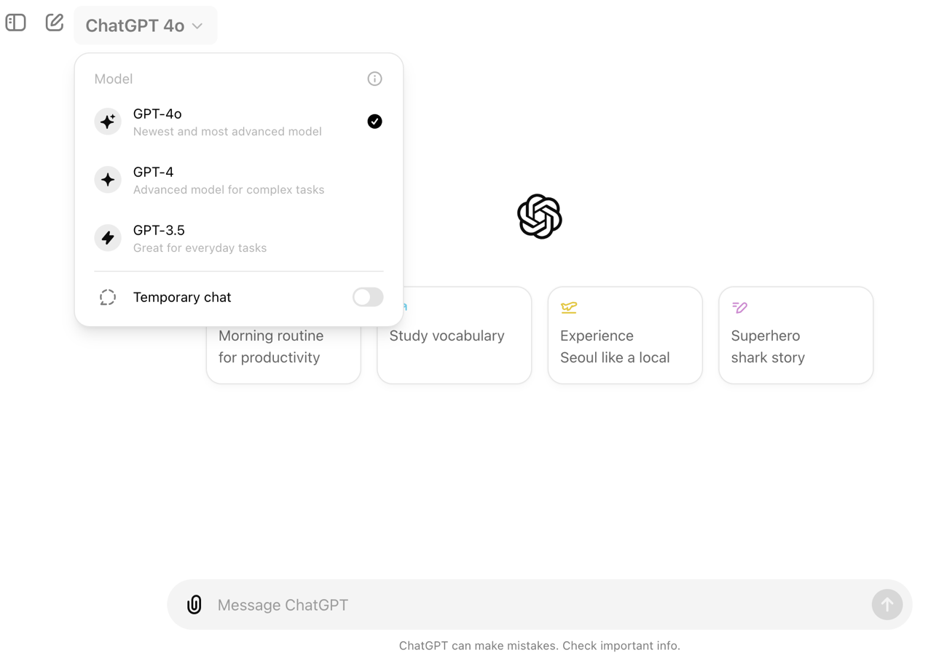
OpenAI ChatGPT (GPT-4o, GPT-4)
https://chat.openai.com/

Slide 62
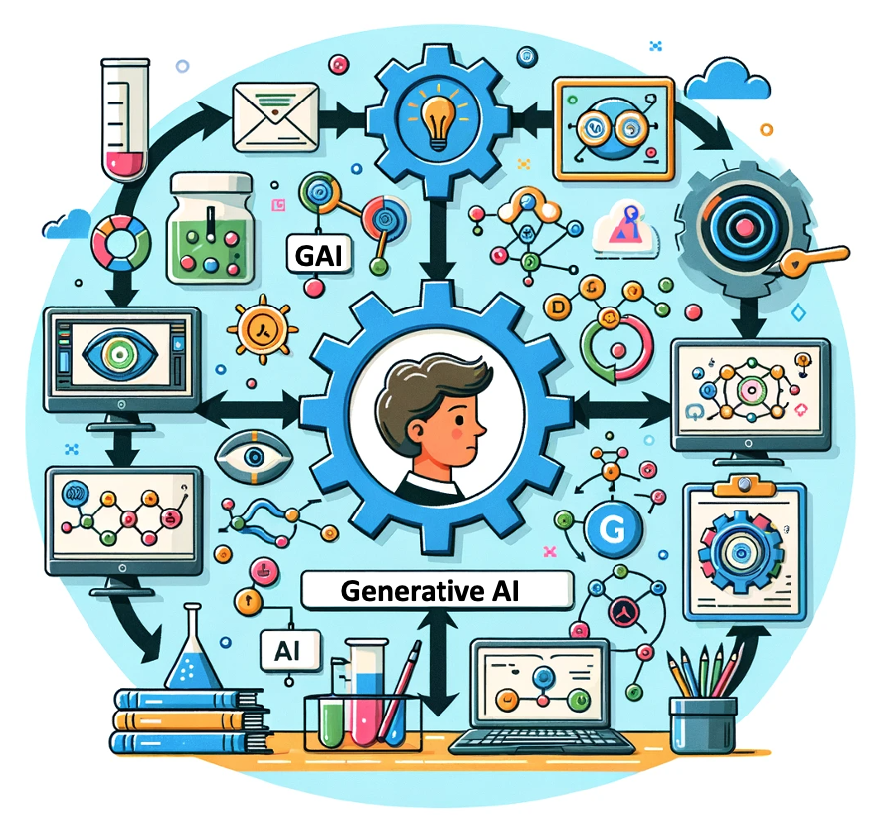
OpenAI ChatGPT (GPT-4) DALL·E 3
Vector graphic of a flowchart depicting the integration of
generative AI in the education process,
from content creation to
virtual experiments,
personalized learning, and innovative learning.
https://chat.openai.com/

Slide 63
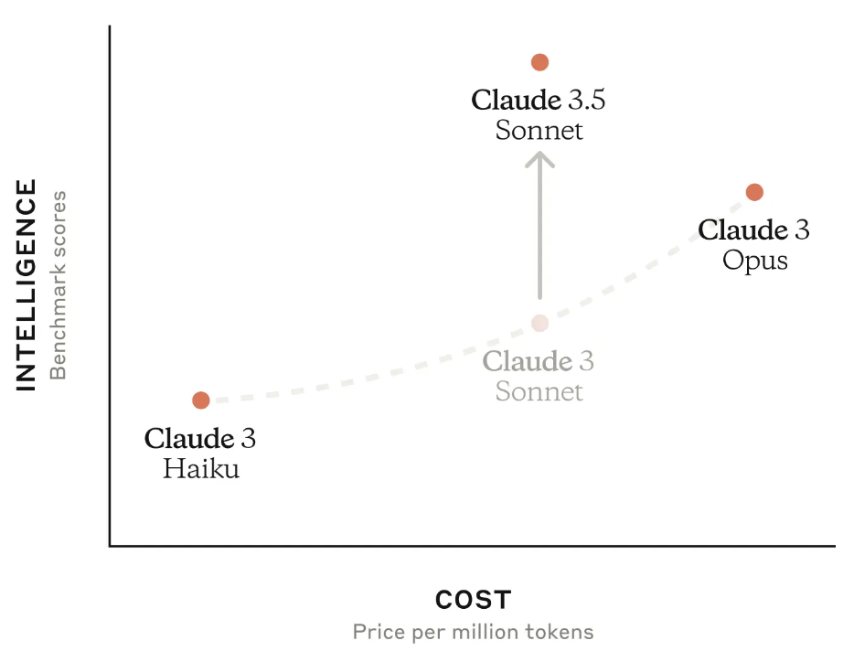
Claude 3.5 Sonnet
Source: https://www.anthropic.com/news/claude-3-5-sonnet

Slide 64
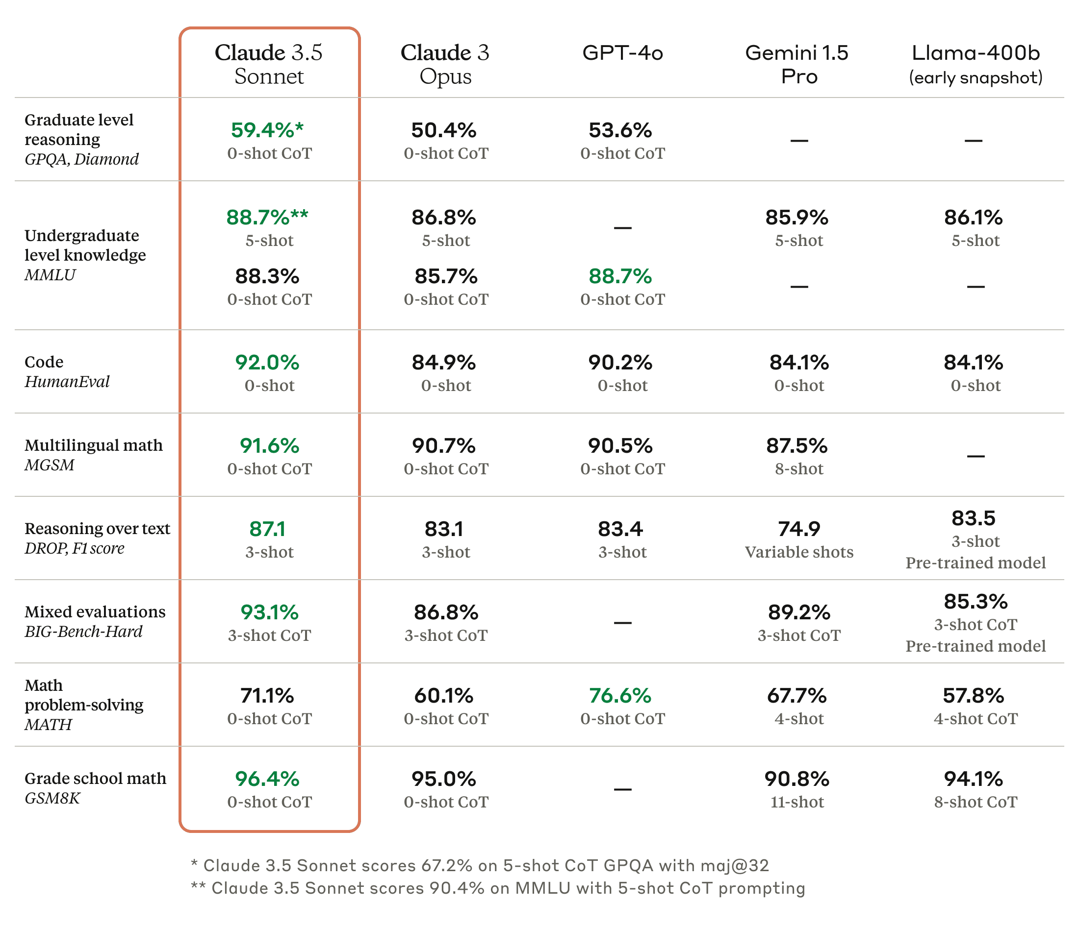
Claude 3.5, GPT-4o, Gemini 1.5 Pro
Source: https://www.anthropic.com/news/claude-3-5-sonnet

Slide 65
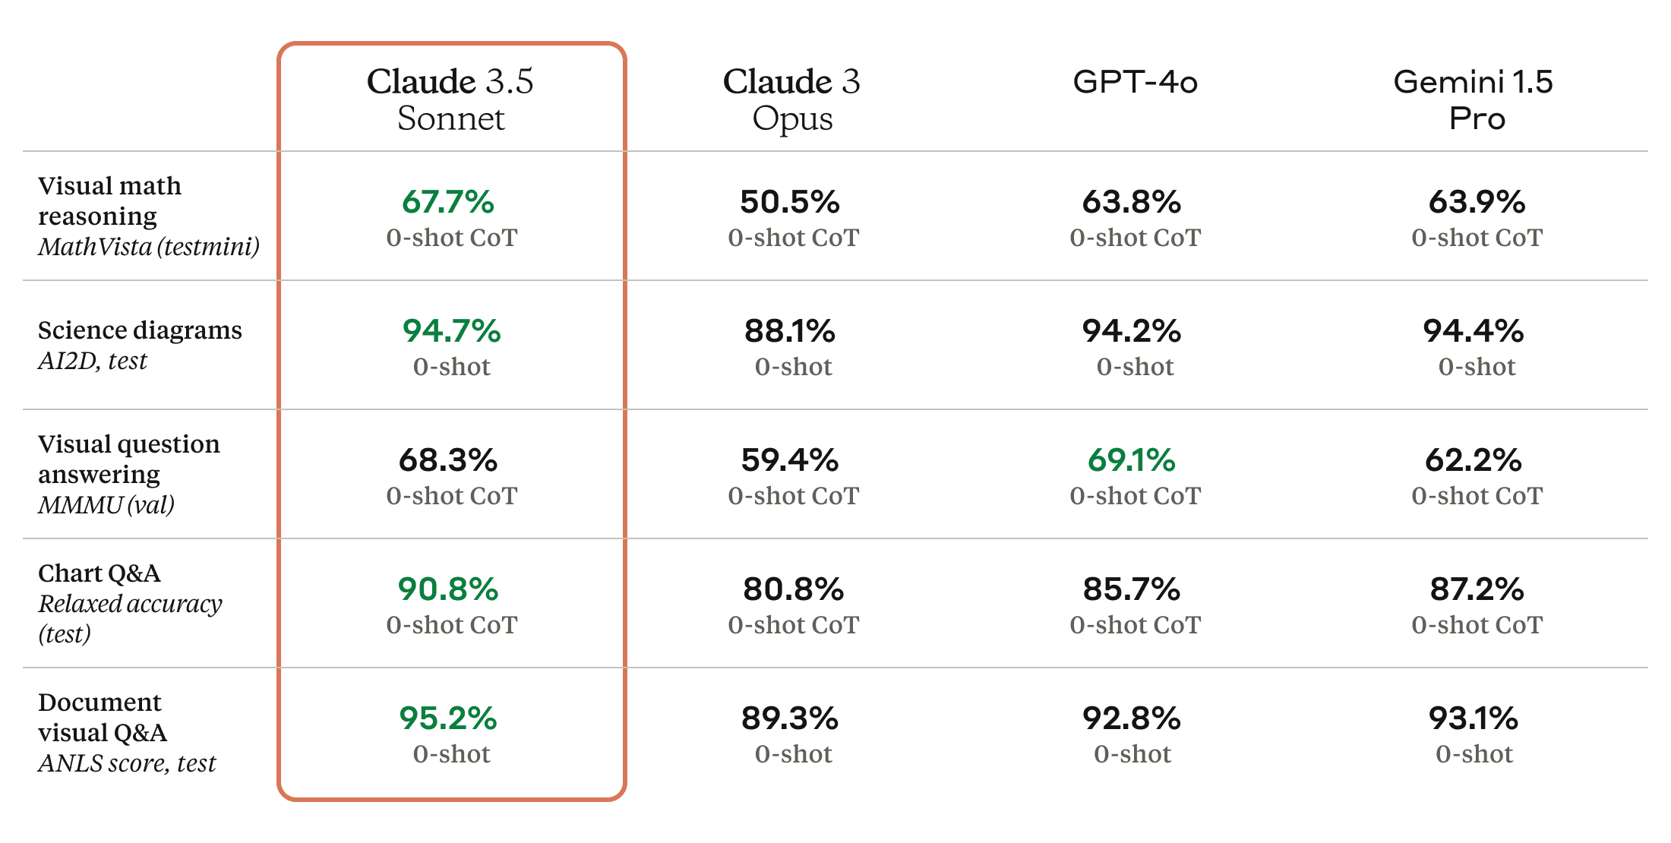
Claude 3.5 Sonnet State-of-the-art vision
Source: https://www.anthropic.com/news/claude-3-5-sonnet

Slide 66

Google Gemini
Largest and most capable AI model
Making AI more helpful for everyone
Source: https://blog.google/technology/ai/google-gemini-ai

Slide 67
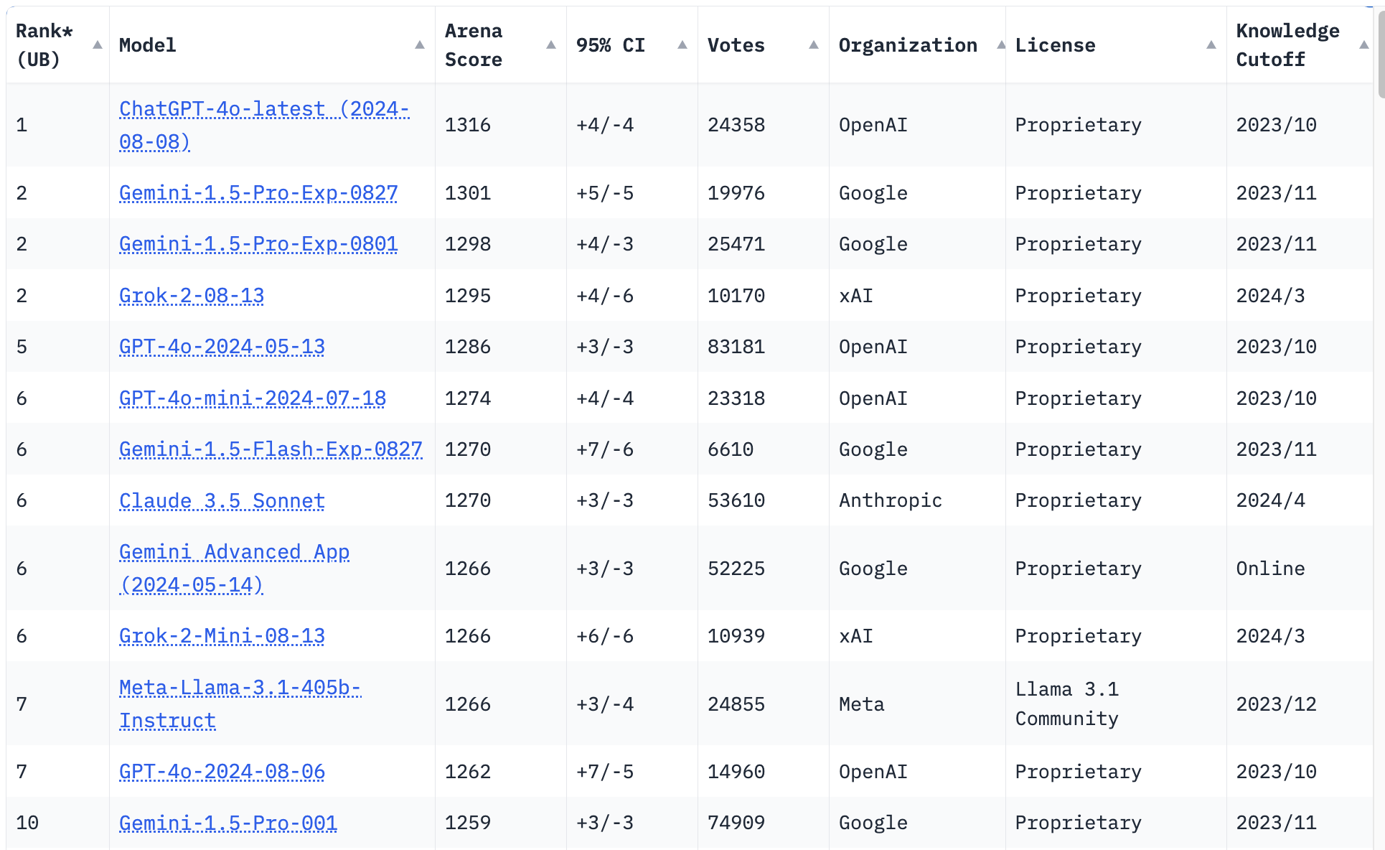
LMSYS Chatbot Arena Leaderboard
GPT-4o
Claude 3.5
https://lmarena.ai/

Slide 68

Perplexity.ai
https://www.perplexity.ai/

Slide 69

Generative AI and LLMs for Sustainability and
ESG Data Analytics

Slide 70

Sustainability and ESG Data Analytics

Slide 71

Generative AI for ESG Rating and Reporting Generation

Slide 72

Teaching
Artificial Intelligence
  Spring 2021, Fall 2022, Fall 2024
Sustainability and ESG Data Analytics
  Spring 2024, Fall 2024
Big Data Analytics
  Fall 2020, Spring 2023, Spring 2024
Software Engineering
  Fall 2020, Fall, 2021, Spring 2022, Spring 2023, Spring 2024
Artificial Intelligence in Finance and Quantitative
  Fall 2021, Fall 2022, Fall 2023
Artificial Intelligence for Text Analytics
  Spring 2022, Fall 2023
Python for Accounting Applications
  Fall 2023, Fall 2024
Foundation of Business Cloud Computing
  Spring 2021, Spring 2022, Spring 2023, Spring 2024
https://web.ntpu.edu.tw/~myday/teaching.htm

Slide 73
Research Projects
Fintech Green Finance for Carbon Market Index, Corporate Finance, and Environmental Policies.
Carbon Emission Sentiment Index with AI Text Analytics
  NTPU, 113-NTPU_ORDA-F-003, 2023/01/01~2024/12/31
Digital Support, Unimpeded Communication: The Development, Support and Promotion of AI-assisted Communication Assistive Devices for Speech Impairment (2/3).
Multimodal Cross-lingual Task-Oriented Dialogue System for Inclusive Communication Support
  NSTC 113-2425-H-305-002-, 3 Years (2023/05/01-2026/04/30) Year 1: 2024/05/01~2025/04/30
Research on speech processing, synthesis, recognition, and sentence construction of people with language disabilities. Multimodal Cross-lingual Task-Oriented Dialogue System
  NTPU, 113-NTPU_ORDA-F-004, 2023/01/01~2025/12/31
Metaverse AI Multimodal Cross-Language Task-Oriented Dialogue System
  ATEC Group, Fintech and Green Finance Center (FGFC, NTPU), NTPU-112A413E01, 3 Years (2023/05/01~2026/04/30)
Generative AI-Driven ESG Report Generation Technology
  Industrial Technology Research Institute (ITRI), Fintech and Green Finance Center (FGFC, NTPU), NTPU-113A513E01, 2024/03/01~2024/12/31
Establishment and Implement of Smart Assistive Technology for Dementia Care and Its Socio-Economic Impacts (3/3). Intelligent, individualized and precise care with smart AT and system integration
  NSTC, 113-2627-M-038-001-, 2024/08/01~2025/07/31
Prospective longitudinal study on peri-implant bone loss associated with peri-implantitis
  USTP (NTPU, TMU), USTP-NTPU-TMU-113-03, 2024/01/01~2024/12/31
https://web.ntpu.edu.tw/~myday/cindex.htm#projects

Slide 74
Summary
This course introduces the fundamental concepts and hands-on practices of Sustainability and ESG Data Analytics.
Topics include
  Introduction Sustainability and ESG Data Analytics
  Environmental, Social, and Governance (ESG) in Net-Zero Digital Transformation
  Data Science for Sustainability and ESG
  Web 3.0 and Big Data Analysis in Fintech, Green Finance, Sustainable Finance
  Task Force on Climate-Related Financial Disclosures (TCFD) and En-Roads Interactive
  ESG Data Gathering, Analysis, and Visualization
  ESG Data Reporting, Corporate Sustainability Reports
  ESG Data Verification
  Energy Star Reporting and Data Disclosure
  Artificial Intelligence of things (AIoT) in ESG and Sustainability Applications
  Generative AI for ESG Rating and Reporting Generation
  Case Study on Sustainability and ESG Data Analytics

Slide 75

Sustainability and ESG Data Analytics
Contact Information
Min-Yuh Day, Ph.D.
Professor
Institute of Information Management, National Taipei University
Tel: 02-86741111 ext. 66873
Office: B8F12
Address: 151, University Rd., San Shia District, New Taipei City, 23741 Taiwan
Email: myday@gm.ntpu.edu.tw
Web: http://web.ntpu.edu.tw/~myday/

