Slide 1








ESG Data Reporting
Corporate Sustainability Reports
ESG Data Verification
Sustainability and ESG Data Analytics
1131ESGDA07
MBA, IM, NTPU (M5265) (Fall 2024)
Wed 2, 3, 4 (9:10-12:00) (B3F17)
Min-Yuh Day, Ph.D.
Professor
Institute of Information Management, National Taipei University
https://web.ntpu.edu.tw/~myday
https://meet.google.com/miy-fbif-max
2024-11-20

Slide 2
Syllabus
Week Date Subject/Topics
1 2024/09/11 Introduction Sustainability and ESG Data Analytics
2 2024/09/18 Environmental, Social, and Governance (ESG) in
Net-Zero Digital Transformation
3 2024/09/25 Data Science for Sustainability and ESG
4 2024/10/02 (Class Canceled due to Typhoon)
5 2024/10/09 (Self-Learning) Web 3.0 and Big Data Analysis in Fintech, Green and Sustainable Finance
6 2024/10/16 Case Study on Sustainability and ESG Data Analytics I

Slide 3
Syllabus
Week Date Subject/Topics
7 2024/10/23 (Self-Learning) Task Force on Climate-Related Financial
Disclosures (TCFD) and En-Roads Interactive;
ESG Data Gathering, Analysis, and Visualization
8 2024/10/30 (Self-Learning)
9 2024/11/06 Self-Learning
10 2024/11/13 Midterm Project Report
11 2024/11/20 ESG Data Reporting; Corporate Sustainability Reports;
ESG Data Verification
12 2024/11/27 Case Study on Sustainability and ESG Data Analytics II

Slide 4
Syllabus
Week Date Subject/Topics
13 2024/12/04 Artificial Intelligence of things (AIoT) in
ESG and Sustainability Applications
14 2024/12/11 Generative AI for ESG Rating and Reporting Generation
15 2024/12/18 Final Project Report I
16 2024/12/25 Final Project Report II

Slide 5
ESG Data Reporting
Corporate Sustainability Reports
ESG Data Verification

Slide 6
Outline
ESG Data Reporting
Corporate Sustainability Reports
ESG Data Verification

Slide 7

Sherry Madera (2024),
Navigating Sustainability Data: How Organizations can use ESG Data to Secure Their Future, Kogan Page
Source: https://www.amazon.com/Navigating-Sustainability-Data-Organizations-Secure/dp/1398612243/

Slide 8
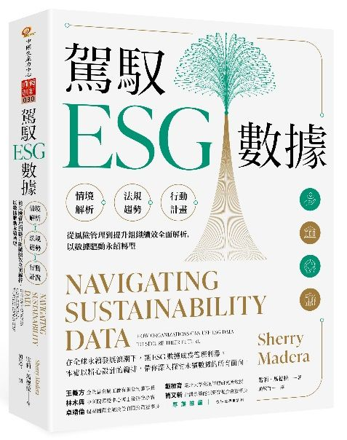
雪莉．馬德拉 (Sherry Madera) (顏敏竹 譯) (2024),
駕馭ESG數據 (Navigating Sustainability Data),
財團法人中國生產力中心
專業推薦：
王義方
（金全益金屬工廠有限公司董事長）
林木興
（中研院環變中心博士後研究學者）
卓靖倫
（揚秦國際企業股份有限公司董事長）
戴敏育
（國立臺北大學資訊管理研究所教授）
簡又新
（台灣永續能源研究基金會董事長）
Source: https://www.eslite.com/product/10012011762682688929002

Slide 9
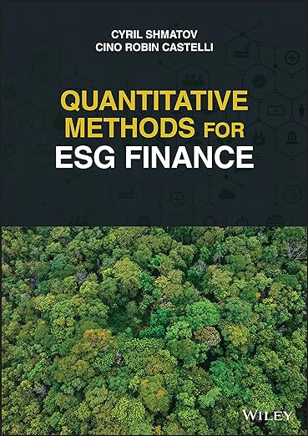
Cino Robin Castelli, Cyril Shmatov (2022),
Quantitative Methods for ESG Finance,
Wiley
Source: https://www.amazon.com/Quantitative-Methods-Finance-Robin-Castelli/dp/1119903807/

Slide 10

Simon Thompson (2023),
Green and Sustainable Finance:
Principles and Practice in Banking, Investment and Insurance,
2nd Edition, Kogan Page.
Source: https://www.amazon.com/Green-Sustainable-Finance-Principles-Investment/dp/1398609242/

Slide 11

Chrissa Pagitsas (2023),
Chief Sustainability Officers At Work:
How CSOs Build Successful Sustainability and ESG Strategies,
Apress.
Source: https://www.amazon.com/Chief-Sustainability-Officers-Work-Successful/dp/1484278658/

Slide 12

Sustainability and ESG Data Analytics

Slide 13
Definition of ESG Reporting
Disclosure of Environmental, Social, and Governance (ESG) factors impacting business operations.

Slide 14
Importance of ESG Reporting
Why ESG Data Reporting Matters
Informed decision-making for investors
Transparency and building trust
Identifying risks and opportunities
Benchmarking against peers

Slide 15
ESG Data Reporting
Key Components
Environmental Metrics:
  Carbon footprint, energy consumption, waste management.
Social Metrics:
  Labor practices, community engagement, diversity and inclusion.
Governance Metrics:
  Board composition, executive compensation, ethical practices.

Slide 16
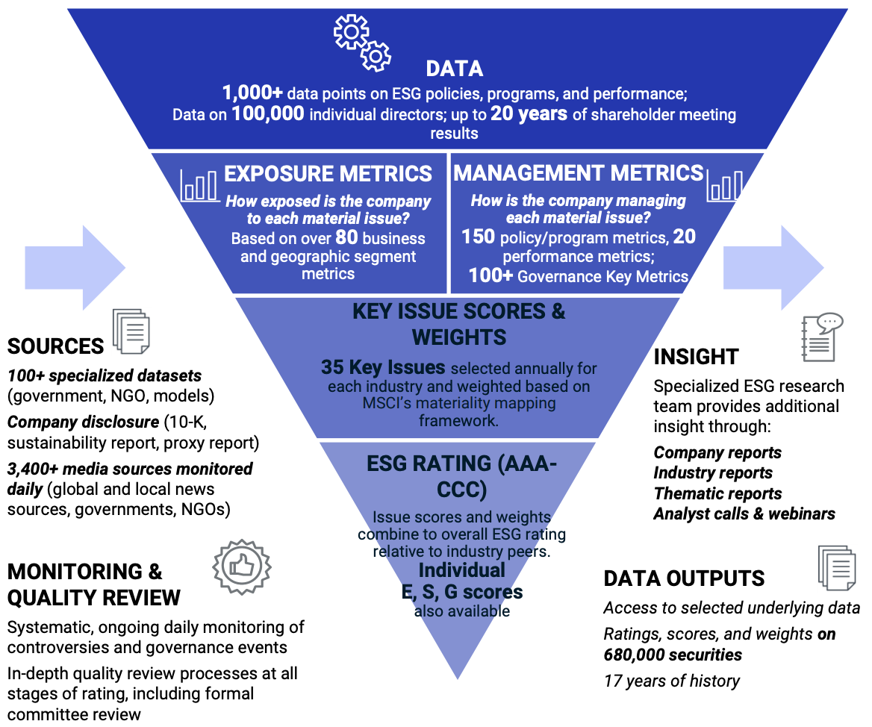
MSCI ESG Rating Framework
Source: https://www.msci.com/documents/1296102/21901542/ESG-Ratings-Methodology-Exec-Summary.pdf

Slide 17
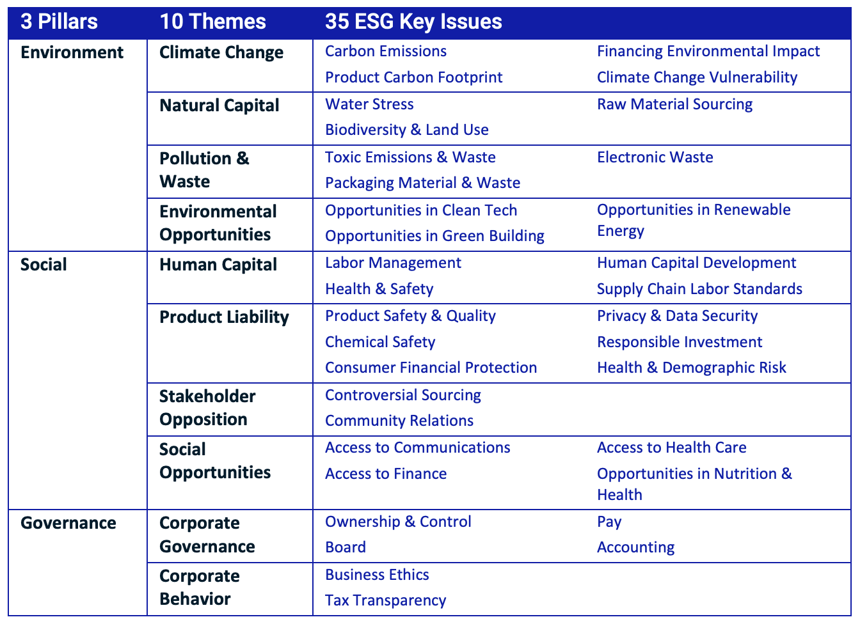
MSCI ESG Key Issue Hierarchy
Source: https://www.msci.com/documents/1296102/21901542/ESG-Ratings-Methodology-Exec-Summary.pdf

Slide 18
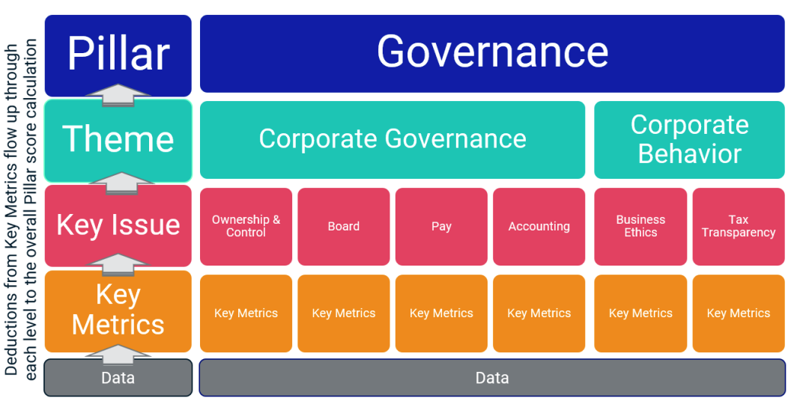
MSCI Governance Model Structure
Source: https://www.msci.com/documents/1296102/21901542/ESG-Ratings-Methodology-Exec-Summary.pdf

Slide 19
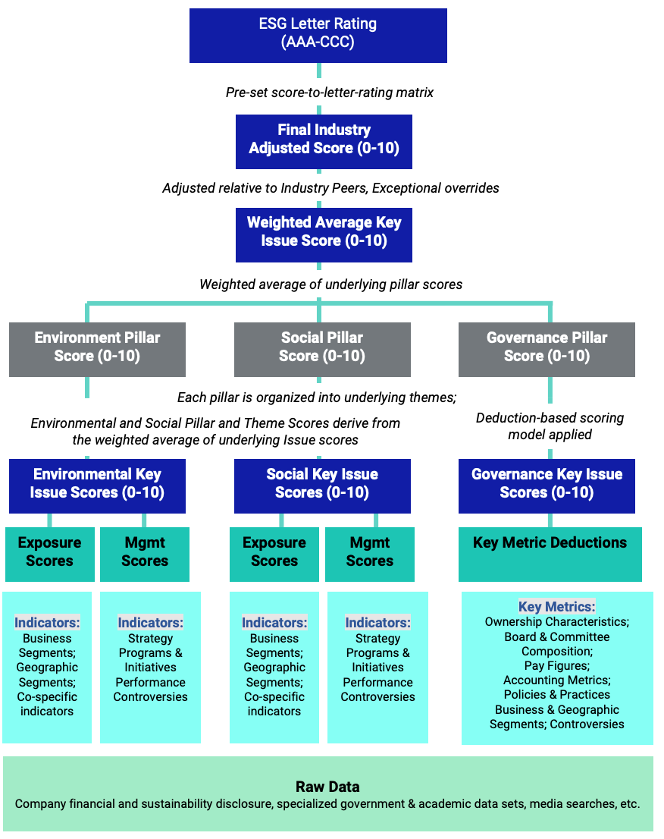
MSCI Hierarchy of ESG Scores
Source: https://www.msci.com/documents/1296102/21901542/ESG-Ratings-Methodology-Exec-Summary.pdf

Slide 20
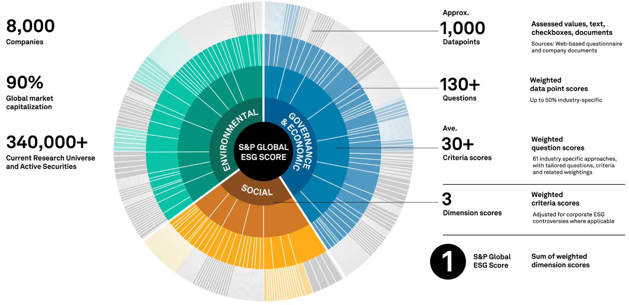
DJSI S&P Global ESG Score
Source: DJSI, S&P Global Corporate Sustainability Assessment (CSA), https://www.spglobal.com/esg/solutions/data-intelligence-esg-scores

Slide 21
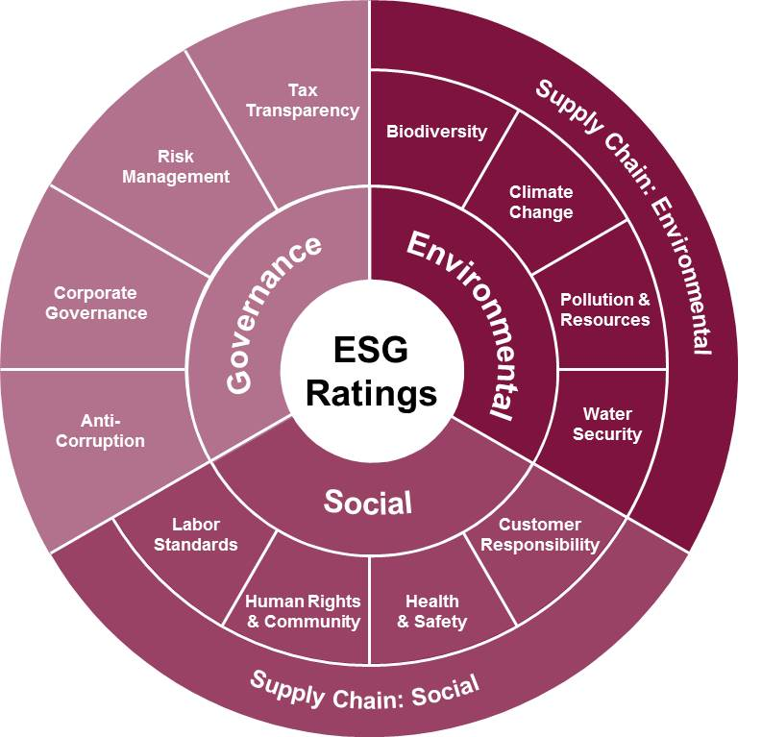
FTSE Russell ESG Ratings
Source: https://www.ftserussell.com/data/sustainability-and-esg-data/esg-ratings

Slide 22
ESG Data Reporting
Reporting Frameworks and Standards
Global Reporting Initiative (GRI):
  Provides a comprehensive framework for sustainability reporting
Sustainability Accounting Standards Board (SASB):
  Focuses on industry-specific standards for disclosing financially material sustainability information
Task Force on Climate-related Financial Disclosures (TCFD):
  Offers recommendations for climate-related financial disclosures

Slide 23

GRI (Global Report Initiative)
https://www.globalreporting.org/

Slide 24
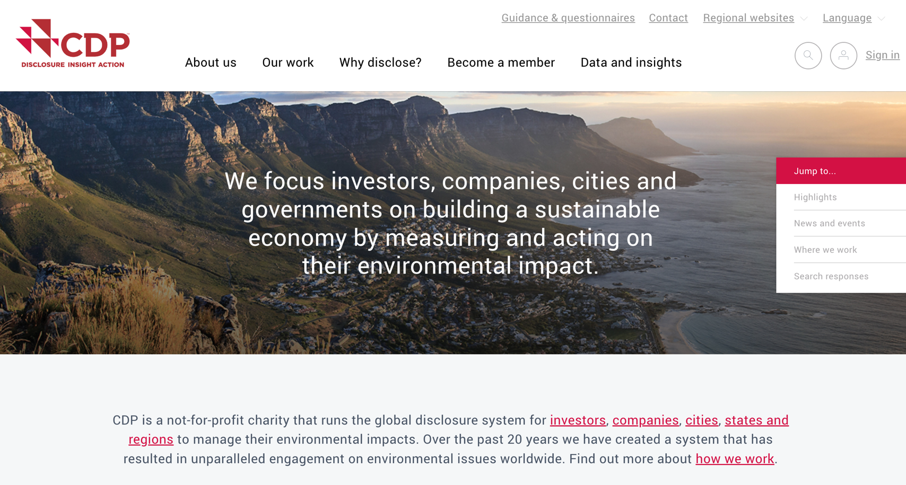
CDP (Carbon Disclosure Project)
https://www.cdp.net/

Slide 25
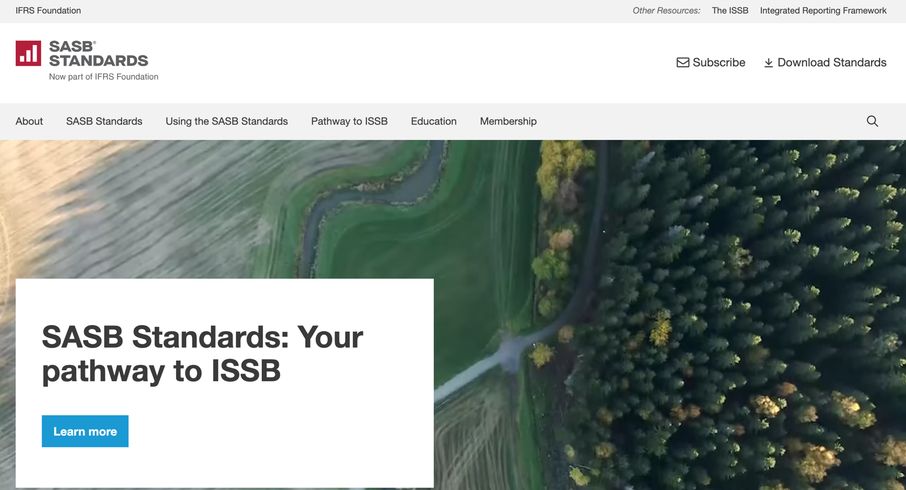
SASB (Sustainability Accounting Standards Board)
https://sasb.org/

Slide 26
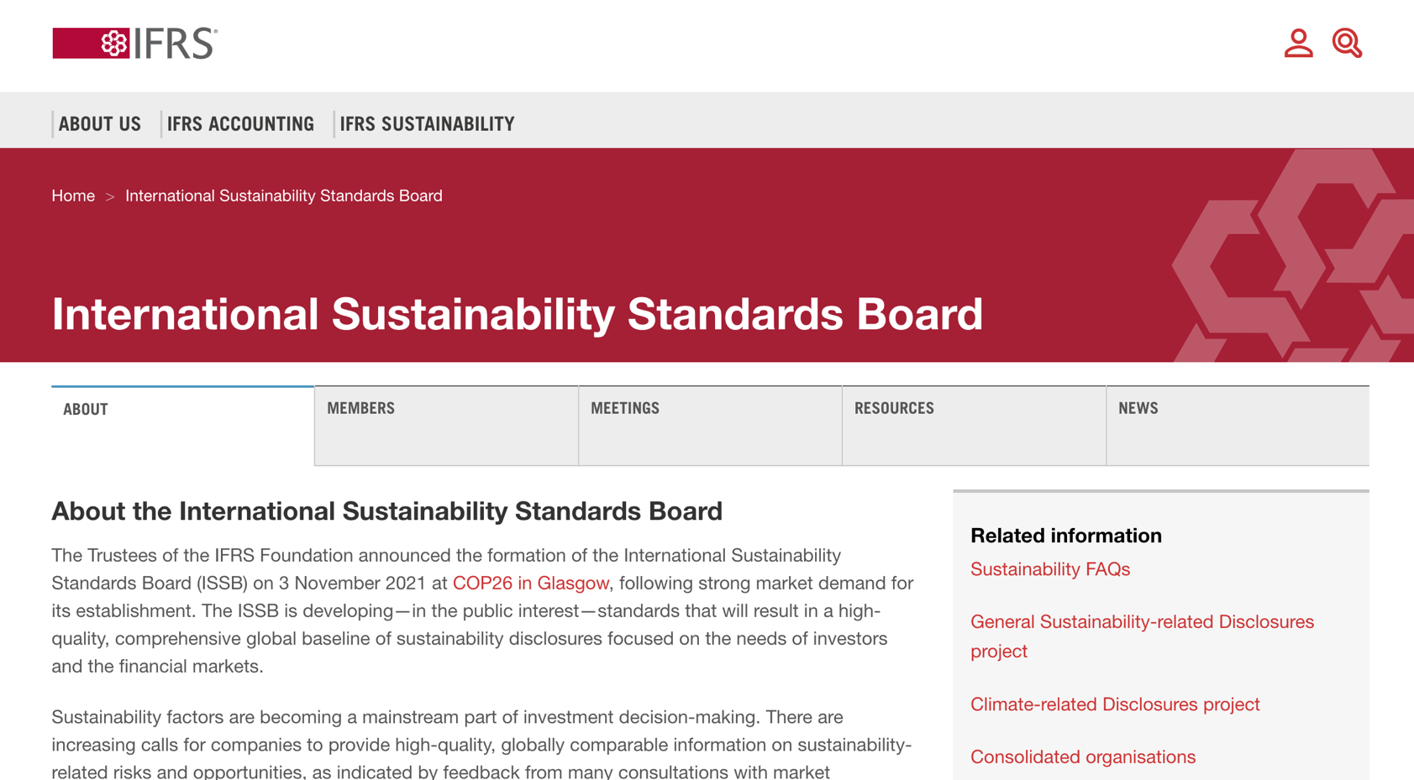
ISSB (International Sustainability Standards Board)
https://www.ifrs.org/groups/international-sustainability-standards-board/

Slide 27
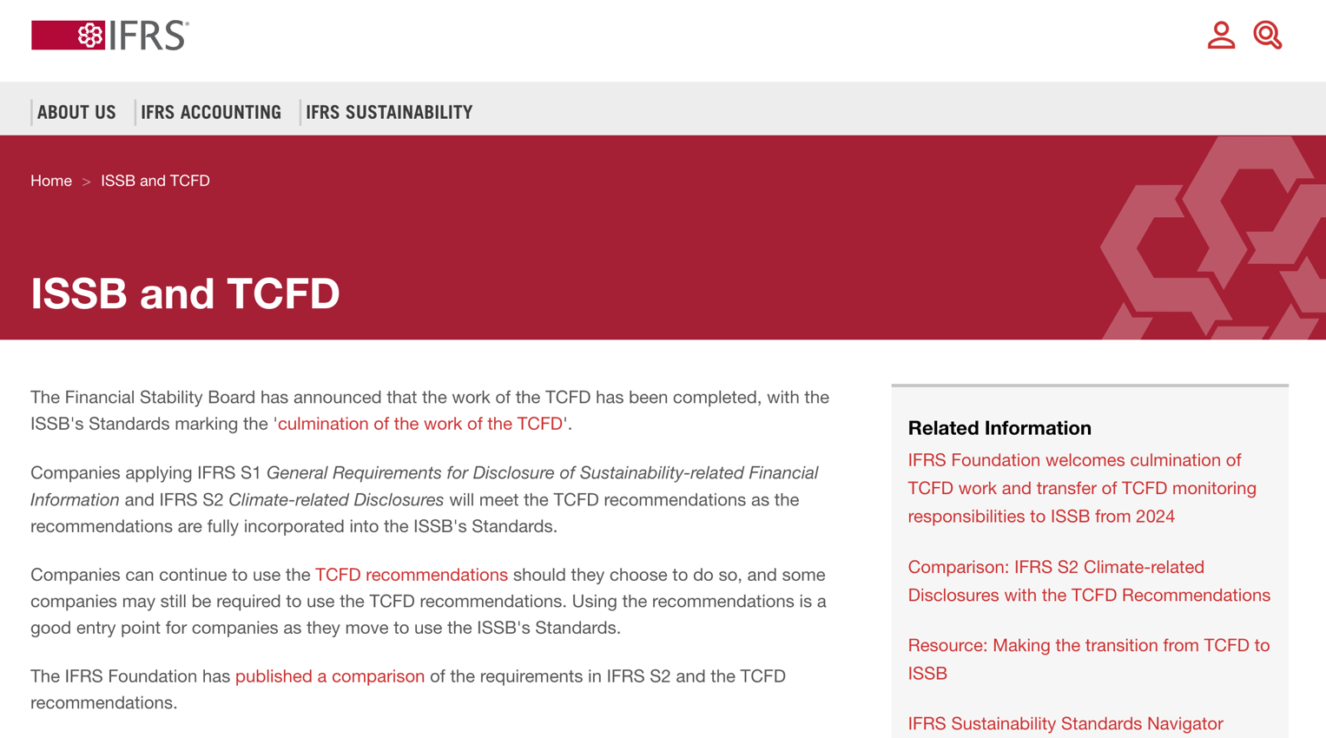
TCFD
(Task Force on Climate-related Financial Disclosures)
https://www.ifrs.org/sustainability/tcfd/
https://www.fsb-tcfd.org/

Slide 28
Corporate Sustainability Reports (CSR)
Purpose and Benefits
Enhancing transparency and accountability
Building trust with stakeholders
Identifying risks and opportunities related to sustainability

Slide 29
Corporate Sustainability Reports (CSR)
Structure and Content
Executive Summary
Materiality Assessment
Performance Indicators and Metrics
Case Studies and Success Stories
Future Goals and Commitments

Slide 30
Corporate Sustainability Reports (CSR)
Best Practices
Align reports with recognized frameworks (e.g., GRI, SASB)
Ensure data accuracy and completeness
Engage stakeholders in the reporting process
Commit to continuous improvement and regular updates

Slide 31
ESG Data Verification
Enhances credibility and reliability of reported data.
Meets regulatory and stakeholder expectations.

Slide 32
ESG Data Verification
Verification Methods
Internal audits and controls
Third-party assurance services
Use of technology and data analytics for validation

Slide 33
ESG Data Verification
Challenges
Ensuring consistency across reporting periods
Addressing data gaps and limitations
Balancing transparency with confidentiality concerns

Slide 34
Essential Python Libraries for
ESG Data Reporting
Pandas
  Data loading, manipulation, cleaning
NumPy
  Numerical calculations
Matplotlib/Seaborn
  Data visualization

Slide 35
Collecting ESG Data
Free repositories
  MSCI ESG Ratings
  Sustainalytics
Paid Providers
  Highlight specialization and more granular data
Company Websites
  Sustainability reports, investor relations

Slide 36
Processing and Analyzing ESG Data
Transforming Data into Insights
Cleaning and preprocessing
  handling missing data
Calculating ESG Scores or metrics
Normalization
  for cross-company comparison

Slide 37
Corporate Sustainability Reports
Why Analyze Sustainability Reports?
The Power of Data-Driven ESG Analysis
Speed and scale compared to manual reading
Track performance trends more precisely
Deeper insights and comparisons
Identify areas for critical evaluation

Slide 38
Python for Sustainability Reports Analysis
BeautifulSoup
  Handle HTML reports
pdfminer.six
  Extract text from PDF reports
Pandas
  Store and manipulate extracted data
Matplotlib/Seaborn
  Data visualization

Slide 39
Corporate Sustainability Reports
Finding Sustainability Data
Company Websites
  Investor relations section,
  dedicated reports page
Sustainability Report Repositories
  GRI, etc.

Slide 40
Extracting Data (HTML)
Scraping Data from Web-Based Reports
Finding the right HTML tags
  (using browser inspection tools)
BeautifulSoup to parse and extract into structured data

Slide 41
Extracting Data (PDF)
Handling PDF-Based Reports
Using pdfminer.six for text conversion
Potential use of regular expressions for cleaning

Slide 42
Analysis with Pandas
Turning Data into Insights
Loading into DataFrames
Cleaning (handling missing values, formats)
Calculating ESG metrics or ratios
Comparing data across years

Slide 43
Visualizing Results
Communicating ESG Performance
Choose charts that align with analysis goals
Clear visuals: labeling, annotations

Slide 44
ESG Data Analysis and Visualization
# ESG Data Analysis and Visualization
import numpy as np
import pandas as pd
import matplotlib.pyplot as plt
from datetime import datetime
import random
# Generate synthetic data
np.random.seed(0)
data = {
  'company': ['Company A', 'Company B', 'Company C', 'Company D', 'Company E'],
  'emissions': np.random.randint(10000, 50000, 5),
  'diversity': np.random.uniform(0.2, 0.9, 5),
  'employee_satisfaction': np.random.uniform(60, 90, 5),
  'waste_type': ['Plastic', 'Organic', 'Electronic', 'Metal', 'Other'],
  'waste_amount': np.random.randint(100, 500, 5)
}
df = pd.DataFrame(data)

Slide 45
ESG Data Analysis and Visualization
# Separate DataFrame for time series and correlation
time_series_data = pd.DataFrame({
  'year': np.repeat(np.arange(2018, 2023), 5),
  'company': np.tile(['Company A', 'Company B', 'Company C', 'Company D', 'Company E'], 5),
  'energy_use': np.random.randint(1000, 5000, 25)
})
# Simulating correlation data with a slight positive trend
diversity = np.linspace(0.2, 0.9, 100)
np.random.shuffle(diversity)
employee_satisfaction = 60 + (diversity - 0.2) * 150
employee_satisfaction += np.random.normal(0, 5, 100)
correlation_data = pd.DataFrame({
  'diversity': diversity,
  'employee_satisfaction': employee_satisfaction
})

Slide 46
ESG Data Analysis and Visualization
# Save DataFrame to CSV
df.to_csv('ESG_Dataset.csv', index=False)
# Calculate statistics for each company
statistics = df.describe()
statistics = statistics.applymap(lambda x: format(x, '.4f'))
print(statistics)
statistics.to_csv('Company_ESG_Statistics.csv')
emissions diversity employee_satisfaction waste_amount
count 5.0000 5.0000 5.0000 5.0000
mean 31447.6000 0.4085 77.1504 345.6000
std 11667.5748 0.1099 7.0841 94.8093
min 12732.0000 0.2397 70.1219 215.0000
25% 30757.0000 0.3909 71.7835 297.0000
50% 31243.0000 0.4083 74.3993 343.0000
75% 40403.0000 0.4691 84.3651 435.0000
max 42103.0000 0.5344 85.0824 438.0000

Slide 47
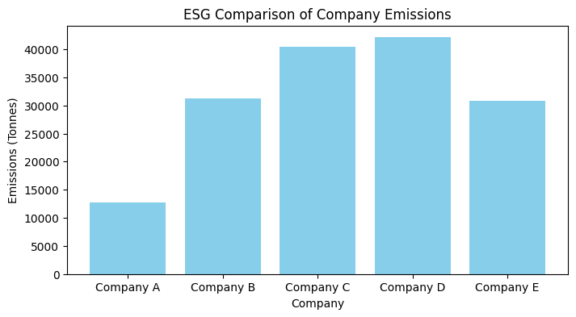
ESG Data Analysis and Visualization
# Create visualizations and save them at 300 dpi
# Bar Chart for Emissions
plt.figure(figsize=(8, 4))
plt.bar(df['company'], df['emissions'], color='skyblue')
plt.xlabel('Company')
plt.ylabel('Emissions (Tonnes)')
plt.title('ESG Comparison of Company Emissions')
plt.show()
plt.savefig('ESG Company_Emissions.jpg', format='jpg', dpi=300)

Slide 48
ESG Data Analysis and Visualization
# Line Chart for Energy Use
plt.figure(figsize=(8, 4))
for company in time_series_data['company'].unique():
  company_data = time_series_data[time_series_data['company'] == company]
  company_data = company_data.sort_values(by='year')
  plt.plot(company_data['year'], company_data['energy_use'], marker='o', linestyle='-', label=company)
plt.xlabel('Year')
plt.ylabel('Energy Use (kWh)')
plt.title("ESG Companies' Energy Use Over Time")
plt.xticks(company_data['year'].unique()) # Ensuring only whole years are marked
plt.legend()
plt.grid(True)
plt.show()

Slide 49
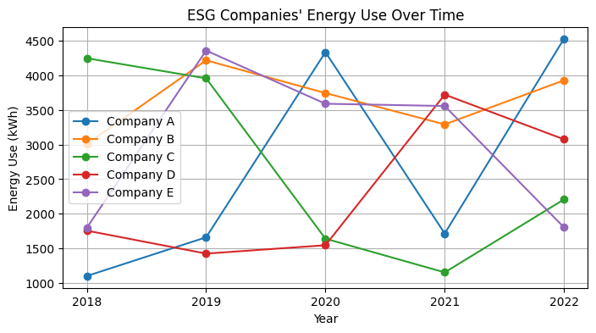
ESG Data Analysis and Visualization

Slide 50
ESG Data Analysis and Visualization
# Scatter Plot for Diversity vs. Satisfaction
plt.figure(figsize=(8, 4))
plt.scatter(correlation_data['diversity'], correlation_data['employee_satisfaction'], alpha=0.7)
plt.xlabel('Board Diversity (Ratio)')
plt.ylabel('Employee Satisfaction (%)')
plt.title('ESG Correlation Between Board Diversity and Employee Satisfaction')
plt.grid(True)
plt.show()
plt.savefig('ESG_Diversity_vs_Satisfaction.jpg', format='jpg', dpi=300)

Slide 51
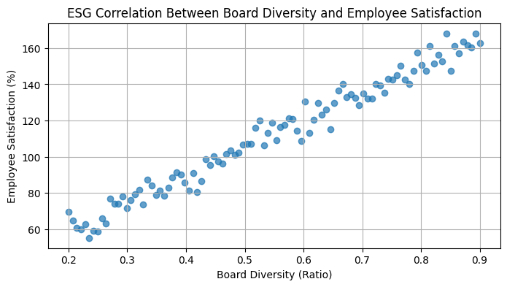
ESG Data Analysis and Visualization

Slide 52
ESG Data Analysis and Visualization
# Pie Chart for Waste Types
plt.figure(figsize=(8, 4))
plt.pie(df['waste_amount'], labels=df['waste_type'], autopct='%1.1f%%', startangle=140)
plt.title('ESG Waste Types')
plt.axis('equal') # Equal aspect ratio ensures that pie is drawn as a circle.
plt.show()
plt.savefig('ESG_Waste_Type_Breakdown.jpg', format='jpg', dpi=300)

Slide 53
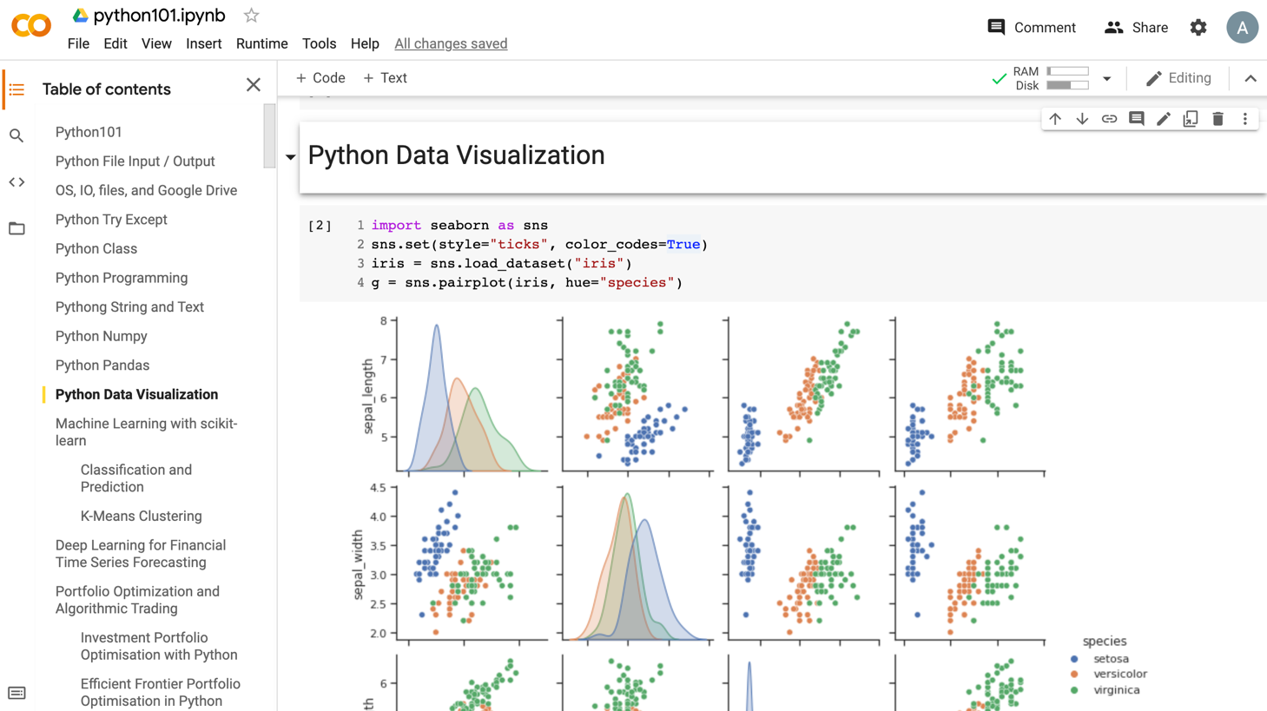
Python in Google Colab (Python101)
https://colab.research.google.com/drive/1FEG6DnGvwfUbeo4zJ1zTunjMqf2RkCrT
https://tinyurl.com/aintpupython101

Slide 54
Summary
ESG Data Reporting
Corporate Sustainability Reports
ESG Data Verification

Slide 55
References
Sherry Madera (2024), Navigating Sustainability Data: How Organizations can use ESG Data to Secure Their Future, Kogan Page
Simon Thompson (2023), Green and Sustainable Finance: Principles and Practice in Banking, Investment and Insurance, 2nd Edition, Kogan Page.
Chrissa Pagitsas (2023), Chief Sustainability Officers At Work: How CSOs Build Successful Sustainability and ESG Strategies, Apress.
Wes McKinney (2022), "Python for Data Analysis: Data Wrangling with pandas, NumPy, and Jupyter", 3rd Edition, O'Reilly Media.
Cino Robin Castelli, Cyril Shmatov (2022), Quantitative Methods for ESG Finance, Wiley
Simon Thompson (2023), Green and Sustainable Finance: Principles and Practice in Banking, Investment and Insurance, 2nd Edition, Kogan Page.
Chrissa Pagitsas (2023), Chief Sustainability Officers At Work: How CSOs Build Successful Sustainability and ESG Strategies, Apress.
Min-Yuh Day (2024), Python 101, https://tinyurl.com/aintpupython101

