Slide 1







Introduction to
Python for Accounting Applications
Python for Accounting Applications
1121PAA01
ACC2, NTPU (U2004) (Fall 2024)
Wed 6, 7, 8, (14:10-17:00) (9:10-12:00) (B3F10)
Min-Yuh Day, Ph.D,
Professor
Institute of Information Management, National Taipei University
https://web.ntpu.edu.tw/~myday
2024-09-11

Slide 2











Min-Yuh Day, Ph.D.
Professor, Information Management, NTPU
Visiting Scholar, IIS, Academia Sinica
Ph.D., Information Management, NTU
Director, Intelligent Financial Innovation Technology, IFIT Lab, IM, NTPU
Director, Fintech and Green Finance Research Center, NTPU
Division Director, Sustainable Development, Sustainability Office, NTPU
Artificial Intelligence, Financial Technology, Big Data Analytics,
Data Mining and Text Mining, Electronic Commerce

Slide 3
Course Syllabus
National Taipei University
Academic Year 113, 1st Semester (Fall 2024)
Course Title: Python for Accounting Applications
Instructor: Min-Yuh Day
Course Class: ACC2, NTPU (3 Credits, Elective)
Details
  EMI Course
  (3 Credits, Elective, One Semester) (U2004)
Time & Place: Wed. 6, 7, 8, 14:10-17:00(B3F17)
Google Meet: https://meet.google.com/ofh-iosa-ehd

Slide 4
Course Objectives
Understand the fundamental concepts of
Python for Accounting Applications.
Equip with Hands-on practices of
Python for Accounting Applications.

Slide 5
Course Outline
This course introduces the fundamental concepts and hands-on practices of
Python for Accounting Applications.
Topics include
  Introduction to Python for Accounting Applications,
  Python Programming and Data Science,
  Foundations of Python Programming,
  Data Structures,
  Control Logic and Loops,
  Functions and Modules,
  Files and Exception Handling,
  Data Analytics and Visualization with Python,
  Obtaining Data From the Web with Python,
  Statistical Analysis with Python,
  Machine Learning with Python,
  Text Analytics with Generative AI and Python,
  Applications of Accounting Data Analytics with Python, and
  Applications of ESG Data Analytics with Python.

Slide 6
Syllabus
Week Date Subject/Topics
1 2024/09/11 Introduction to Python for Accounting Applications
2 2024/09/18 Python Programming and Data Science
3 2024/09/25 Foundations of Python Programming
4 2024/10/02 Data Structures
5 2024/10/09 Control Logic and Loops
6 2024/10/16 Functions and Modules; Files and Exception Handling
7 2024/10/23 Data Analytics and Visualization with Python
8 2024/10/30 Midterm Project Report

Slide 7
Syllabus
Week Date Subject/Topics
9 2024/11/06 Self-Learning
10 2024/11/13 Obtaining Data From the Web with Python
11 2024/11/20 Statistical Analysis with Python
12 2024/11/27 Machine Learning with Python
13 2024/12/04 Text Analytics with Generative AI and Python
14 2024/12/11 Applications of Accounting Data Analytics with Python
15 2024/12/18 Applications of ESG Data Analytics with Python
16 2024/12/25 Final Project Report

Slide 8
Teaching Methods and Activities
Lecture
Discussion
Practicum

Slide 9
Evaluation Methods
Individual Presentation 30 %
Group Presentation 30 %
Case Report 20 %
Class Participation 10 %
Assignment 10 %

Slide 10
Required Texts
Allen B. Downey (2016), Think Python: How to Think Like a Computer Scientist, 2nd Edition, O’Reilly Media

Slide 11
Reference Books
1. Frederick Kaefer and Paul Kaefer (2020), Introduction to Python Programming for Business and Social Science Applications, SAGE Publications
2. Abdullah Karasan (2021), Machine Learning for Financial Risk Management with Python: Algorithms for Modeling Risk, O’Reilly Media
3. Vic Anand, Khrystyna Bochkay, and Roman Chychyla (2020), Using Python for Text Analysis in Accounting Research, Now Publishers
4. Aurélien Géron (2022), Hands-On Machine Learning with Scikit-Learn, Keras, and TensorFlow: Concepts, Tools, and Techniques to Build Intelligent Systems, 3rd Edition, O’Reilly Media.
5. Yves Hilpisch (2018), Python for Finance: Mastering Data-Driven Finance, 2nd Edition, O'Reilly Media.
6. Yves Hilpisch (2020), Artificial Intelligence in Finance: A Python-Based Guide, O’Reilly Media.
7. Numa Dhamani and Maggie Engler (2024), Introduction to Generative AI, Manning
8. Denis Rothman (2024), Transformers for Natural Language Processing and Computer Vision - Third Edition: Explore Generative AI and Large Language Models with Hugging Face, ChatGPT, GPT-4V, and DALL-E 3, 3rd ed. Edition, Packt Publishing
9. Ben Auffarth (2023), Generative AI with LangChain: Build large language model (LLM) apps with Python, ChatGPT and other LLMs, Packt Publishing.

Slide 12
Other References
Python, https://www.python.org/
GRI (Global Report Initiative):
https://www.globalreporting.org/
CDP (Carbon Disclosure Project):
https://www.cdp.net/
SASB (Sustainability Accounting Standards Board):
https://sasb.org/
ISSB (International Sustainability Standards Board):
https://www.ifrs.org/groups/international-sustainability-standards-board/
TCFD (Task Force on Climate-related Financial Disclosures):
https://www.fsb-tcfd.org/

Slide 13

Python Ecosystem for Data Science
Source: https://medium.com/pyfinance/why-python-is-best-choice-for-financial-data-modeling-in-2019-c0d0d1858c45

Slide 14


Python Ecosystem for Data Science
Source:https://duchesnay.github.io/pystatsml/introduction/python_ecosystem.html

Slide 15


The Quant Finance PyData Stack
Source: http://nbviewer.jupyter.org/format/slides/github/quantopian/pyfolio/blob/master/pyfolio/examples/overview_slides.ipynb#/5

Slide 16

Python
Programming

Slide 17

Top Programming Languages
https://spectrum.ieee.org/the-top-programming-languages-2023

Slide 18
Python is an interpreted, object-oriented, high-level programming language with dynamic semantics.
Source: https://www.python.org/doc/essays/blurb/

Slide 19
Numpy
NumPy
Base
N-dimensional array package

Slide 20
Python matplotlib
Source: https://matplotlib.org/

Slide 21
Python Pandas
http://pandas.pydata.org/

Slide 22

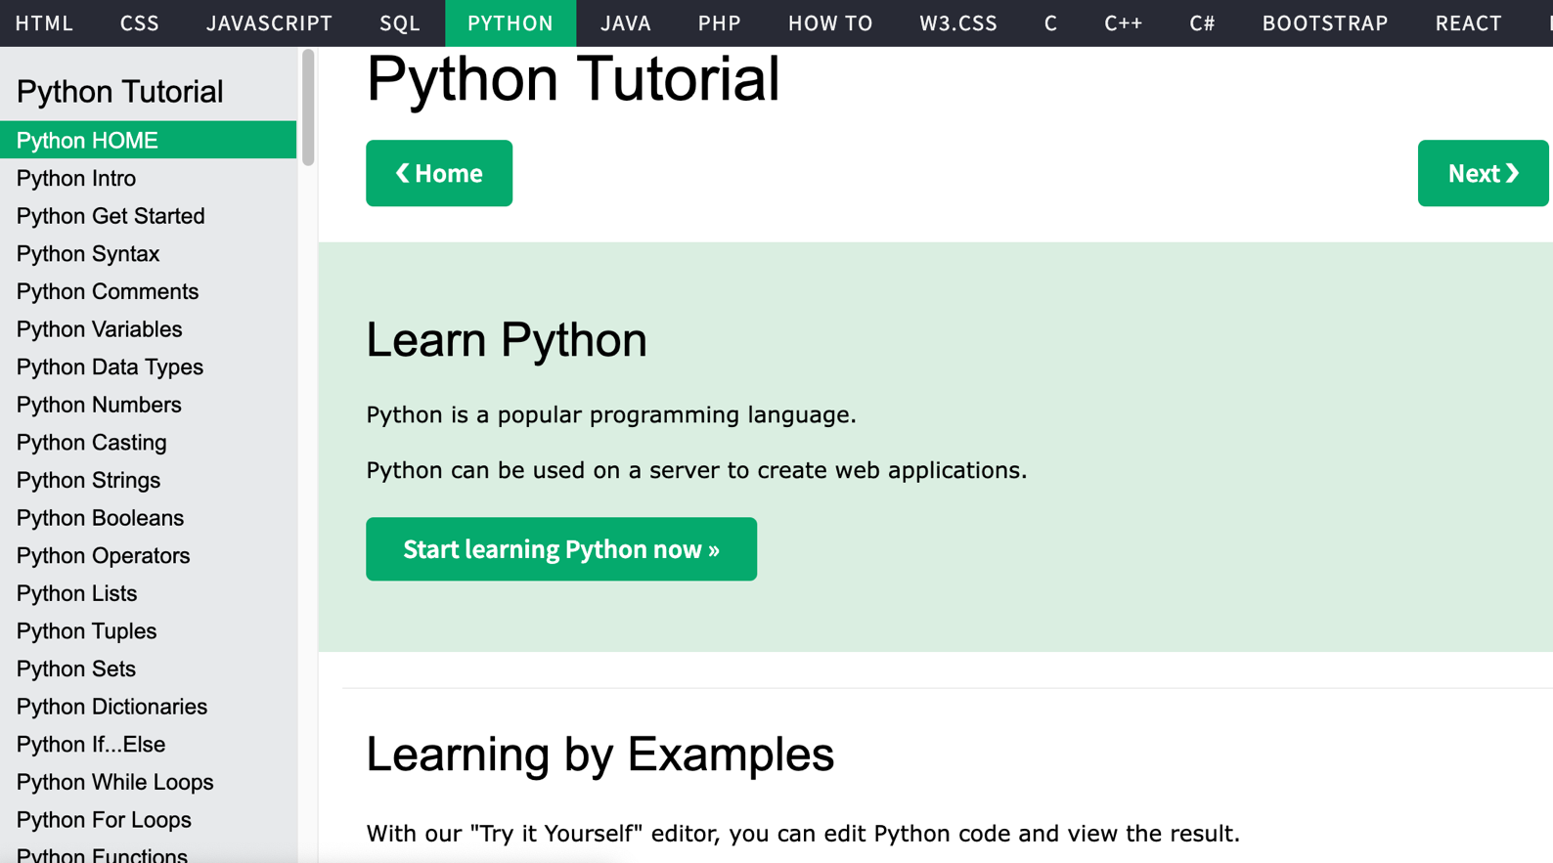
W3Schools Python
https://www.w3schools.com/python/

Slide 23

W3Schools Python: Try Python
https://www.w3schools.com/python/trypython.asp?filename=demo_default

Slide 24

LearnPython.org
https://www.learnpython.org/

Slide 25

Google’s Python Class
https://developers.google.com/edu/python

Slide 26

Google Colab
https://colab.research.google.com/notebooks/welcome.ipynb

Slide 27

Connect Google Colab in Google Drive

Slide 28

Google Colab

Slide 29

Google Colab

Slide 30

Connect Colaboratory to Google Drive

Slide 31

Google Colab

Slide 32

Google Colab

Slide 33

Google Colab

Slide 34

Run Jupyter Notebook
Python3 GPU
Google Colab

Slide 35

Google Colab Python Hello World print('Hello World')

Slide 36

Python in Google Colab (Python101)
https://colab.research.google.com/drive/1FEG6DnGvwfUbeo4zJ1zTunjMqf2RkCrT
https://tinyurl.com/aintpupython101

Slide 37
Anaconda
The Most Popular Python
Data Science Platform
Source: https://www.anaconda.com/

Slide 38


Download Anaconda
https://www.anaconda.com/download

Slide 39
Python
HelloWorld

Slide 40

Anaconda-Navigator
Launchpad

Slide 41

Anaconda Navigator

Slide 42

Jupyter Notebook

Slide 43

Jupyter Notebook
New Python 3

Slide 44

print("hello, world")
Notes:
print("hello, world")

Slide 45
Python
Programming

Slide 46
Foundations of Python Programming
Python Syntax
  Python Comments
Python Variables
Python Data Types
  Python Numbers
  Python Casting
  Python Strings
Python Operators
Python Booleans

Slide 47

Numa Dhamani and Maggie Engler (2024),
Introduction to Generative AI,
Manning
Source: Numa Dhamani and Maggie Engler (2024), Introduction to Generative AI, Manning
https://www.amazon.com/Introduction-Generative-AI-Numa-Dhamani/dp/1633437191/

Slide 48

Denis Rothman (2024),
Transformers for Natural Language Processing and Computer Vision:
Explore Generative AI and Large Language Models with Hugging Face, ChatGPT, GPT-4V, and DALL-E 3,
3rd Edition, Packt Publishing
Source: https://www.amazon.com/Transformers-Natural-Language-Processing-Computer/dp/1805128728

Slide 49
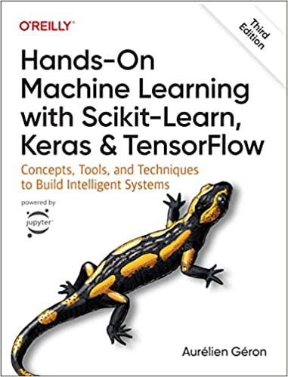
Aurélien Géron (2022),
Hands-On Machine Learning with Scikit-Learn, Keras, and TensorFlow: Concepts, Tools, and Techniques to Build Intelligent Systems,
3rd Edition, O’Reilly Media.
Source: https://www.amazon.com/Hands-Machine-Learning-Scikit-Learn-TensorFlow/dp/1098125975

Slide 50

SASB (Sustainability Accounting Standards Board)
https://sasb.org/

Slide 51

ISSB (International Sustainability Standards Board)
https://www.ifrs.org/groups/international-sustainability-standards-board/

Slide 52
Sustainability and
ESG Data Analytics

Slide 53


















Sustainable Development Goals (SDGs)
Source: https://sdgs.un.org/goals

Slide 54
Evolution of Sustainable Finance Research
Topic
SDGs:
Sustainable Development Goals
SDGs
Innovative Financial Instrument
Impact Investing
ESG: Environmental, Social, and Governance
CSR: Corporate Social Responsibility
Conscious Capitalism
Climate Financing
Carbon Financing
Green Financing
Ethical Investing
Socially Responsible Investing
1986
1995
2005
2015
2020
Source: Kumar, S., Sharma, D., Rao, S., Lim, W. M., & Mangla, S. K. (2022). Past, present, and future of sustainable finance:
Insights from big data analytics through machine learning of scholarly research. Annals of Operations Research, 1-44.

Slide 55
Green Finance and
Sustainable Finance

Slide 56
AI for
Environmental,
Social, and
Governance
(AI4ESG)
Source: Nenad Tomašev, Julien Cornebise, Frank Hutter, Shakir Mohamed, Angela Picciariello, Bec Connelly, Danielle Belgrave et al. (2020)
"AI for social good: unlocking the opportunity for positive impact." Nature Communications 11, no. 1: 1-6.

Slide 57
AI for
Social Good
(AI4SG)
Source: Nenad Tomašev, Julien Cornebise, Frank Hutter, Shakir Mohamed, Angela Picciariello, Bec Connelly, Danielle Belgrave et al. (2020)
"AI for social good: unlocking the opportunity for positive impact." Nature Communications 11, no. 1: 1-6.

Slide 58
Sustainability
SDGs
CSR
ESG

Slide 59

Sustainable Development Goals (SDGs) and 5P
Partnership
Peace
Prosperity
People
Planet
Source: Folke, Carl, Reinette Biggs, Albert V. Norström, Belinda Reyers, and Johan Rockström. "Social-ecological resilience and biosphere-based sustainability science.”Ecology and Society 21, no. 3 (2016).

Slide 60

ESG to 17 SDGs
Source: Henrik Skaug Sætra (2021) "A Framework for Evaluating and Disclosing the ESG Related Impacts of AI with the SDGs." Sustainability 13, no. 15 (2021): 8503.

Slide 61

ESG to 17 SDGs
Source: https://sustainometric.com/esg-to-sdgs-connected-paths-to-a-sustainable-future/

Slide 62
Generative AI for
ESG Applications

Slide 63

AI, ML, DL, Generative AI
Source: Jeong, Cheonsu. "A Study on the Implementation of Generative AI Services Using an Enterprise Data-Based LLM Application Architecture." arXiv preprint arXiv:2309.01105 (2023).

Slide 64

Sustainable Productivity:
Finance ESG
Source: Huang, Ziqi, Yang Shen, Jiayi Li, Marcel Fey, and Christian Brecher (2021). "A survey on AI-driven digital twins in Industry 4.0: Smart manufacturing and advanced robotics." Sensors 21, no. 19: 6340.

Slide 65

Sustainable Resilient Manufacturing
ESG
Source: Huang, Ziqi, Yang Shen, Jiayi Li, Marcel Fey, and Christian Brecher (2021). "A survey on AI-driven digital twins in Industry 4.0: Smart manufacturing and advanced robotics." Sensors 21, no. 19: 6340.

Slide 66
ESG Indexes
MSCI ESG Index
Dow Jones Sustainability Indices (DJSI)
FTSE ESG Index

Slide 67

MSCI ESG Rating Framework
Source: https://www.msci.com/documents/1296102/21901542/ESG-Ratings-Methodology-Exec-Summary.pdf

Slide 68

MSCI ESG Key Issue Hierarchy
Source: https://www.msci.com/documents/1296102/21901542/ESG-Ratings-Methodology-Exec-Summary.pdf

Slide 69

MSCI Governance Model Structure
Source: https://www.msci.com/documents/1296102/21901542/ESG-Ratings-Methodology-Exec-Summary.pdf

Slide 70

MSCI Hierarchy of ESG Scores
Source: https://www.msci.com/documents/1296102/21901542/ESG-Ratings-Methodology-Exec-Summary.pdf

Slide 71

DJSI S&P Global ESG Score
Source: DJSI, S&P Global Corporate Sustainability Assessment (CSA), https://www.spglobal.com/esg/solutions/data-intelligence-esg-scores

Slide 72

FTSE Russell ESG Ratings
Source: https://www.ftserussell.com/data/sustainability-and-esg-data/esg-ratings

Slide 73


Sustainalytics
ESG Risk Ratings
Analyst-based
approach
Sustainalytics’ ESG Risk Ratings measure a company’s exposure to industry-specific material ESG risks and how well a company is managing those risks.
Source: https://www.sustainalytics.com/esg-data

Slide 74

Truvalue
ESG Ranks
TruValue Labs
Machine-based approach
Truvalue Labs applies AI to analyze over 100,000 sources and uncover ESG risks and opportunities hidden in unstructured text.
The ESG Ranks data service produces an overall company rank based on industry percentile leveraging the 26 ESG categories defined by the Sustainability Accounting Standards Board (SASB).
The data feed covers 20,000+ companies with more than 13 years of history.
Source: :https://developer.truvaluelabs.com/data/esg-ranks

Slide 75

Analyst-driven vs. AI-driven ESG
Sustainalytics
Truvalue Labs
Source: Mark Tulay (2020), Man vs. machine: A tale of two sustainability ratings systems, GreenBiz, https://www.greenbiz.com/article/man-vs-machine-tale-two-sustainability-ratings-systems

Slide 76

Analyst based
ESG Research
AI based
ESG Research
Source: https://www.esganalytics.io/insights/how-data-is-accelerating-esg

Slide 77

ESG Analytics: NLP Taxonomy
Source: https://www.esganalytics.io/insights/how-data-is-accelerating-esg

Slide 78

Top
ESG Reporting Software
Environmental, Social and Governance (ESG) Reporting software or Sustainability software helps organizations manage their operational data, evaluate their impact on the environment and provide reporting to perform audits.
Source: https://www.softwarereviews.com/categories/environmental-social-and-governance-reporting

Slide 79
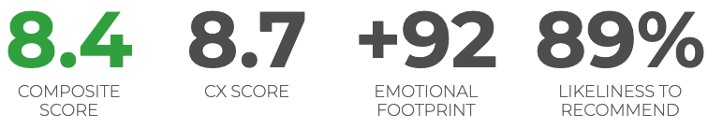
ESG Reporting Software: Workiva ESG
Workiva is a cloud native platform that simplifies the complexities of reporting and compliance.
Workiva ESG is the end-to-end platform that allows you to integrate financial data, nonfinancial data, and XBRL.
Workiva, the platform that streamlines your entire ESG process.
Automate data collection, utilize frameworks, and directly connect to all your ESG reports. in meaningful glossy reports, accurate survey responses, and regulatory filings with integrated XBRL tagging.
Source: https://www.softwarereviews.com/categories/environmental-social-and-governance-reporting

Slide 80

Large Language Models (LLMs)
Source: Hadi, Muhammad Usman, Rizwan Qureshi, Abbas Shah, Muhammad Irfan, Anas Zafar, Muhammad Bilal Shaikh, Naveed Akhtar, Jia Wu, and Seyedali Mirjalili. "Large language models: a comprehensive survey of its applications, challenges, limitations, and future prospects." Authorea Preprints (2023).

Slide 81

Four Paradigms in NLP (LM)
Transfer Learning: Pre-training, Fine-Tuning (FT)
GAI: Pre-train, Prompt, and Predict (Prompting)
Source: Pengfei Liu, Weizhe Yuan, Jinlan Fu, Zhengbao Jiang, Hiroaki Hayashi, and Graham Neubig. (2023) "Pre-train, prompt, and predict: A systematic survey of prompting methods in natural language processing." ACM Computing Surveys 55, no. 9 (2023): 1-35.

Slide 82
Generative AI
Text, Image, Video, Audio Applications

Slide 83
Comparison of Generative AI and Traditional AI
Feature | Generative AI | Traditional AI
Output type | New content | Classification/Prediction
Creativity | High | Low
Interactivity | Usually more natural | Limited

Slide 84
Generative AI
Generative AI: The Art of Creation
Definition: AI systems capable of creating new content
Characteristics: Creativity, interactivity

Slide 85
Popular Generative AI
OpenAI ChatGPT (GPT-4o, GPT-4)
Claude.ai (Claude 3.5)
Google Gemini
Chat.LMSys.org
Perplexity.ai
ChatPDF
Stable Diffusion
Video: D-ID, Synthesia
Audio: Speechify

Slide 86
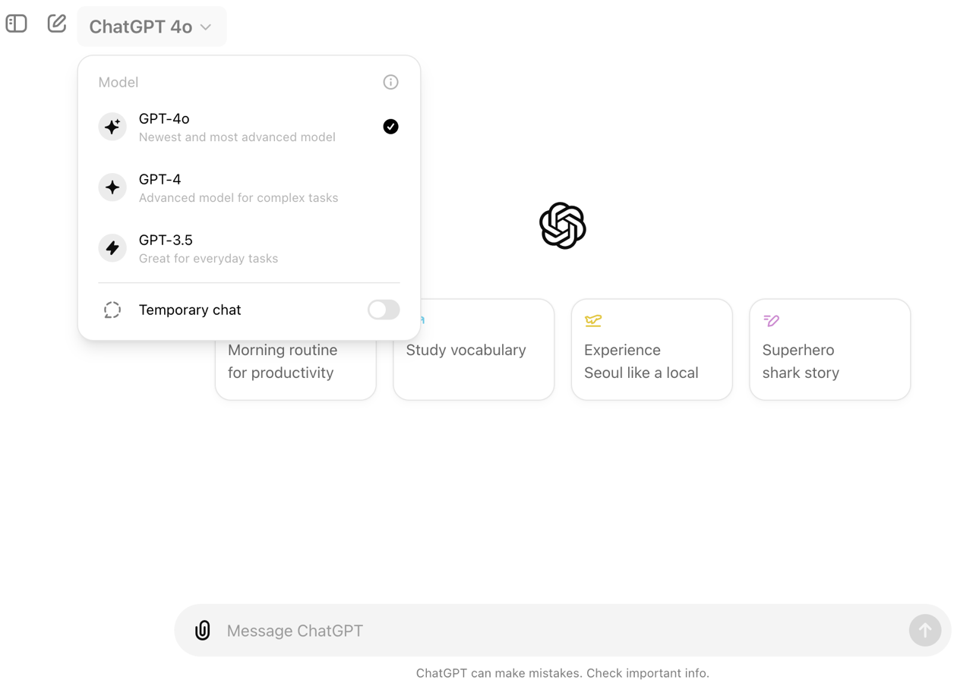
OpenAI ChatGPT (GPT-4o, GPT-4)
https://chat.openai.com/

Slide 87
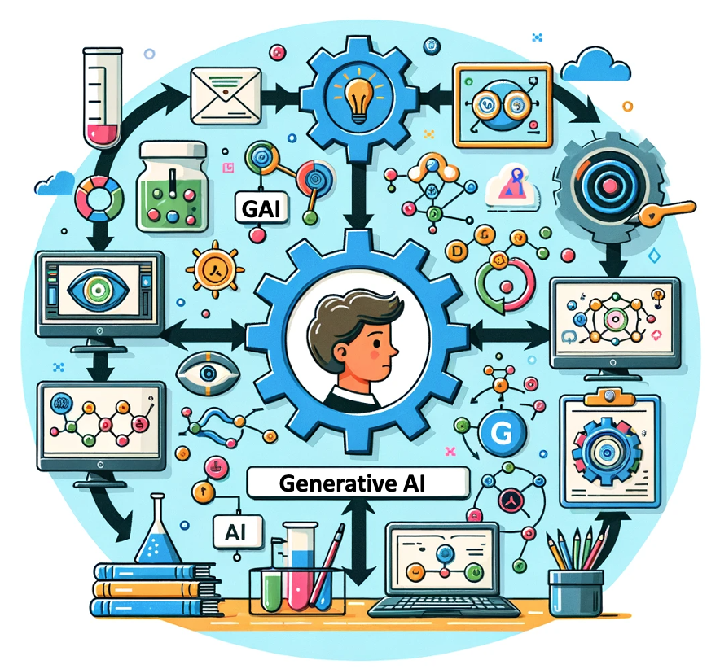
OpenAI ChatGPT (GPT-4) DALL·E 3
Vector graphic of a flowchart depicting the integration of
generative AI in the education process,
from content creation to
virtual experiments,
personalized learning, and innovative learning.
https://chat.openai.com/

Slide 88
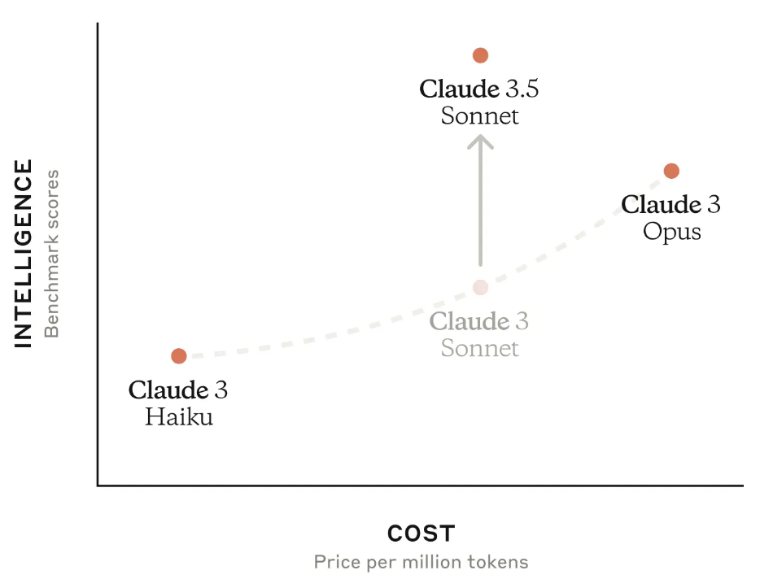
Claude 3.5 Sonnet
Source: https://www.anthropic.com/news/claude-3-5-sonnet

Slide 89
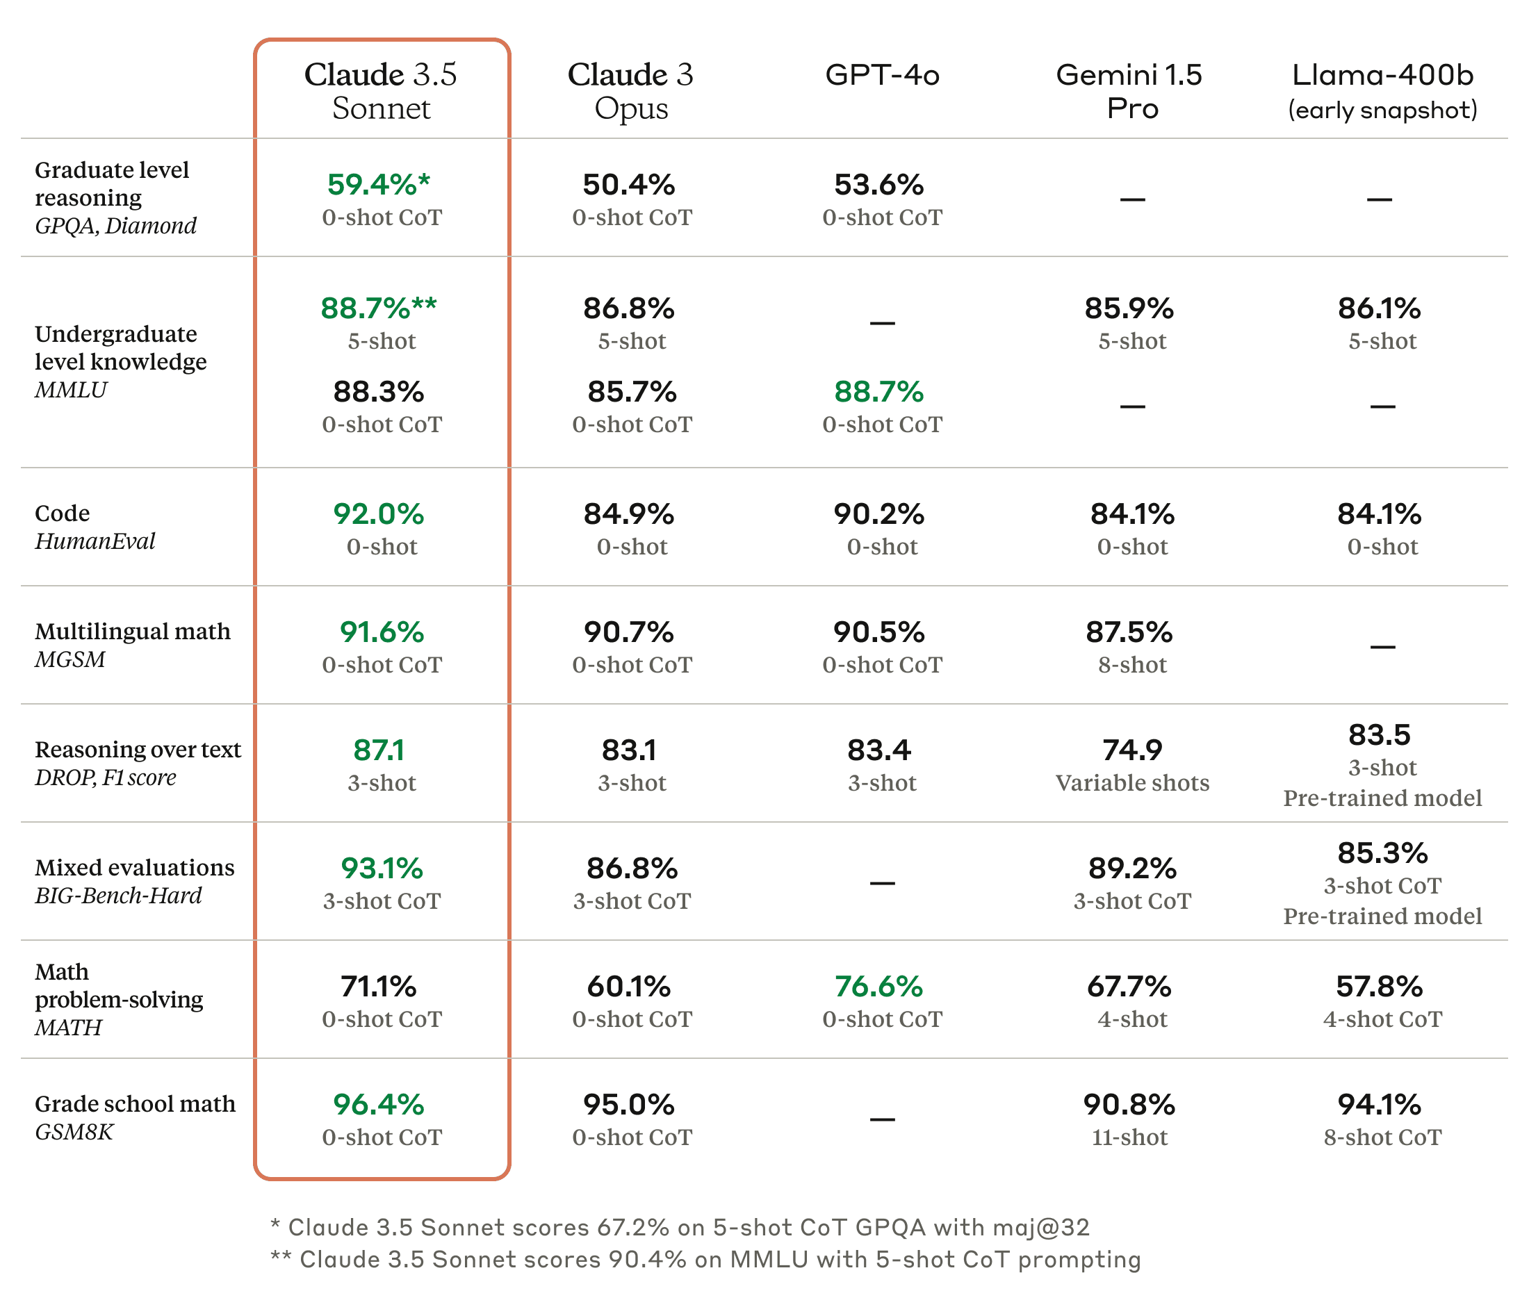
Claude 3.5, GPT-4o, Gemini 1.5 Pro
Source: https://www.anthropic.com/news/claude-3-5-sonnet

Slide 90
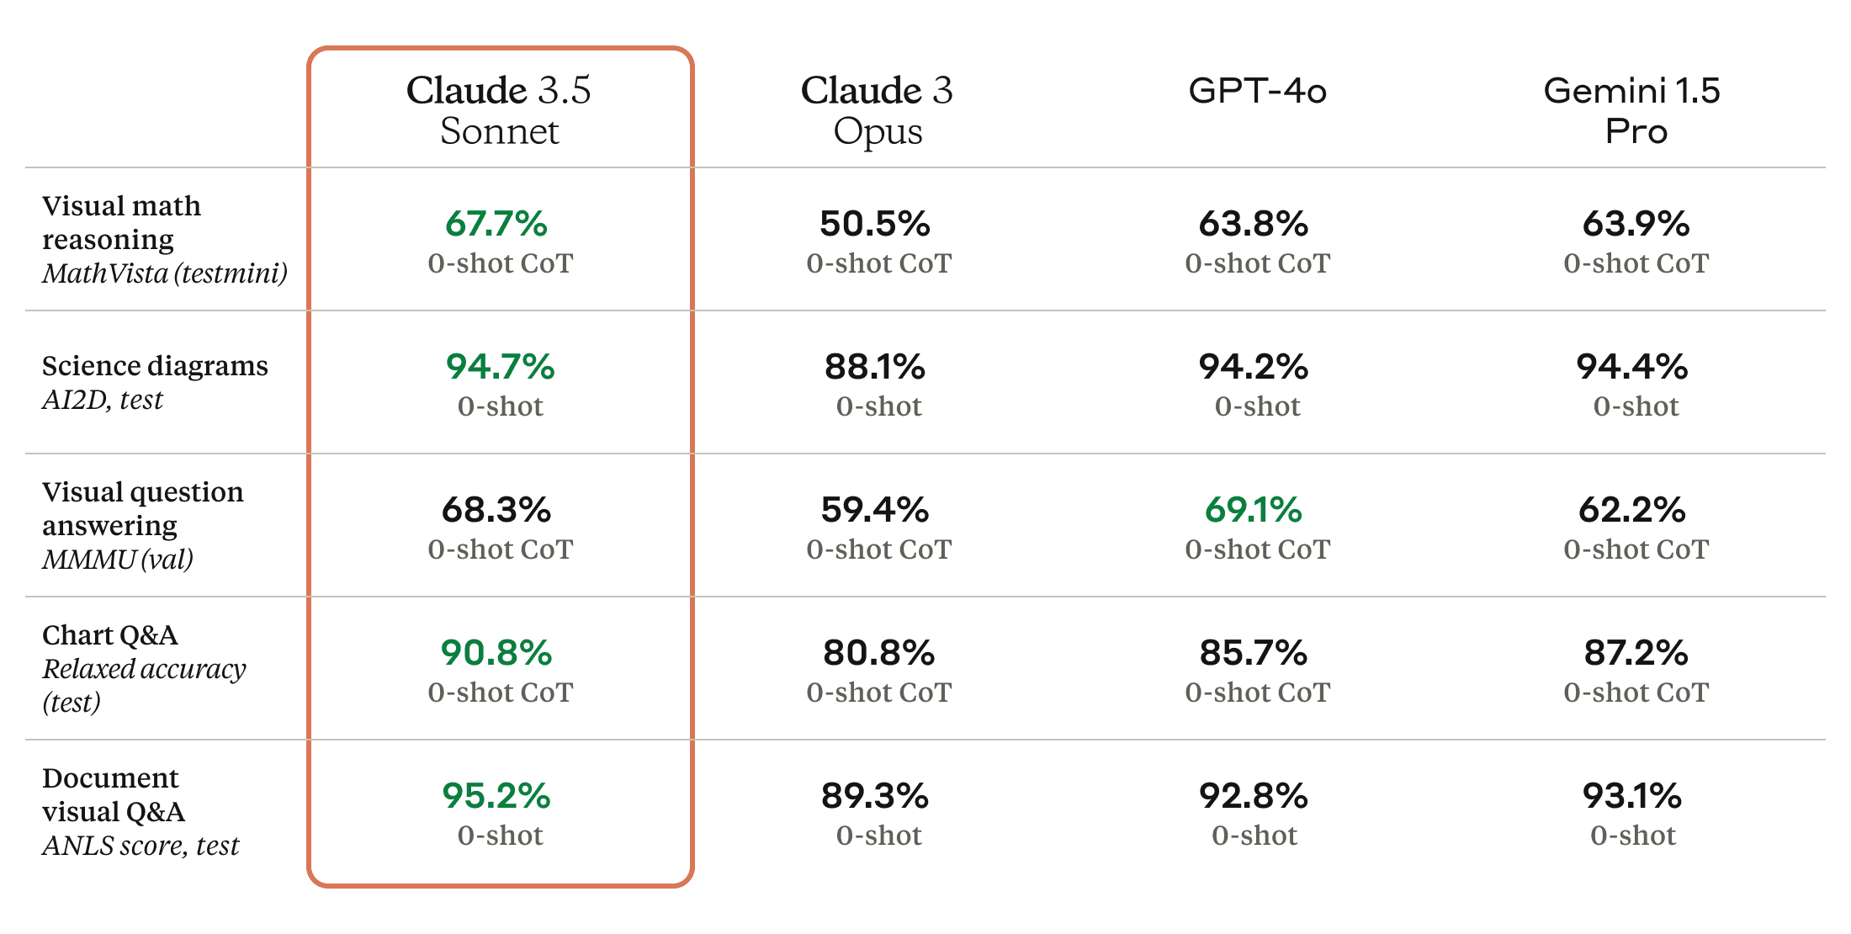
Claude 3.5 Sonnet State-of-the-art vision
Source: https://www.anthropic.com/news/claude-3-5-sonnet

Slide 91
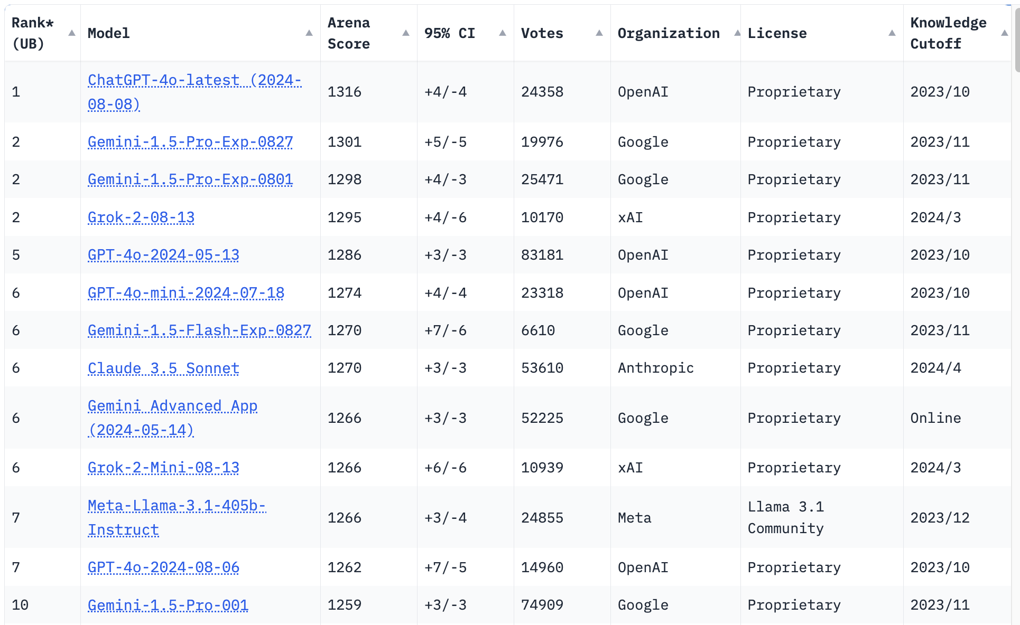
LMSYS Chatbot Arena Leaderboard
GPT-4o
Claude 3.5
https://lmarena.ai/

Slide 92

Perplexity.ai
https://www.perplexity.ai/

Slide 93

Generative AI and LLMs for Sustainability and
ESG Data Analytics

Slide 94

Sustainability and ESG Data Analytics

Slide 95
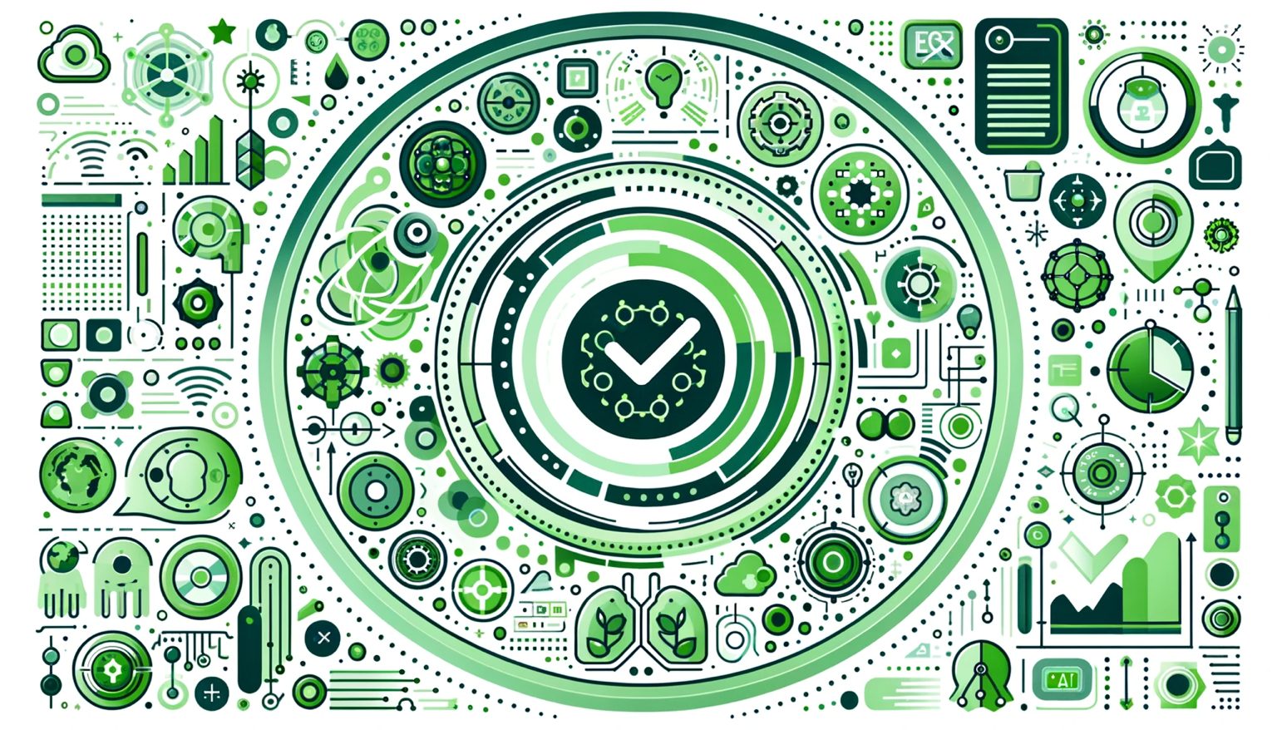
Generative AI for ESG Rating and Reporting Generation

Slide 96
Python in Google Colab (Python101)
https://colab.research.google.com/drive/1FEG6DnGvwfUbeo4zJ1zTunjMqf2RkCrT
https://tinyurl.com/aintpupython101

Slide 97



Teaching
Artificial Intelligence
  Spring 2021, Fall 2022, Fall 2024
Sustainability and ESG Data Analytics
  Spring 2024, Fall 2024
Big Data Analytics
  Fall 2020, Spring 2023, Spring 2024
Software Engineering
  Fall 2020, Fall, 2021, Spring 2022, Spring 2023, Spring 2024
Artificial Intelligence in Finance and Quantitative
  Fall 2021, Fall 2022, Fall 2023
Artificial Intelligence for Text Analytics
  Spring 2022, Fall 2023
Python for Accounting Applications
  Fall 2023, Fall 2024
Foundation of Business Cloud Computing
  Spring 2021, Spring 2022, Spring 2023, Spring 2024
https://web.ntpu.edu.tw/~myday/teaching.htm

Slide 98
Research Projects
Fintech Green Finance for Carbon Market Index, Corporate Finance, and Environmental Policies.
Carbon Emission Sentiment Index with AI Text Analytics
  NTPU, 113-NTPU_ORDA-F-003, 2023/01/01~2024/12/31
Digital Support, Unimpeded Communication: The Development, Support and Promotion of AI-assisted Communication Assistive Devices for Speech Impairment (2/3).
Multimodal Cross-lingual Task-Oriented Dialogue System for Inclusive Communication Support
  NSTC 113-2425-H-305-002-, 3 Years (2023/05/01-2026/04/30) Year 1: 2024/05/01~2025/04/30
Research on speech processing, synthesis, recognition, and sentence construction of people with language disabilities. Multimodal Cross-lingual Task-Oriented Dialogue System
  NTPU, 113-NTPU_ORDA-F-004, 2023/01/01~2025/12/31
Metaverse AI Multimodal Cross-Language Task-Oriented Dialogue System
  ATEC Group, Fintech and Green Finance Center (FGFC, NTPU), NTPU-112A413E01, 3 Years (2023/05/01~2026/04/30)
Generative AI-Driven ESG Report Generation Technology
  Industrial Technology Research Institute (ITRI), Fintech and Green Finance Center (FGFC, NTPU), NTPU-113A513E01, 2024/03/01~2024/12/31
Establishment and Implement of Smart Assistive Technology for Dementia Care and Its Socio-Economic Impacts (3/3). Intelligent, individualized and precise care with smart AT and system integration
  NSTC, 113-2627-M-038-001-, 2024/08/01~2025/07/31
Prospective longitudinal study on peri-implant bone loss associated with peri-implantitis
  USTP (NTPU, TMU), USTP-NTPU-TMU-113-03, 2024/01/01~2024/12/31
https://web.ntpu.edu.tw/~myday/cindex.htm#projects

Slide 99
Summary
This course introduces the fundamental concepts and hands-on practices of
Python for Accounting Applications.
Topics include
  Introduction to Python for Accounting Applications,
  Python Programming and Data Science,
  Foundations of Python Programming,
  Data Structures,
  Control Logic and Loops,
  Functions and Modules,
  Files and Exception Handling,
  Data Analytics and Visualization with Python,
  Obtaining Data From the Web with Python,
  Statistical Analysis with Python,
  Machine Learning with Python,
  Text Analytics with Generative AI and Python,
  Applications of Accounting Data Analytics with Python, and
  Applications of ESG Data Analytics with Python.

Slide 100

Python for Accounting Applications
Contact Information
Min-Yuh Day, Ph.D.
Professor
Institute of Information Management, National Taipei University
Tel: 02-86741111 ext. 66873
Office: B8F12
Address: 151, University Rd., San Shia District, New Taipei City, 23741 Taiwan
Email: myday@gm.ntpu.edu.tw
Web: http://web.ntpu.edu.tw/~myday/

