Slide 1



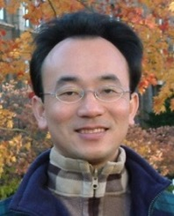



Functions and Modules;
Files and Exception Handling
Python for Accounting Applications
1131PAA05
ACC2, NTPU (U2004) (Fall 2024)
Wed 6, 7, 8, (14:10-17:00) (9:10-12:00) (B3F10)
Min-Yuh Day, Ph.D,
Professor
Institute of Information Management, National Taipei University
https://web.ntpu.edu.tw/~myday
2024-10-16

Slide 2
Syllabus
Week Date Subject/Topics
1 2024/09/11 Introduction to Python for Accounting Applications
2 2024/09/18 Python Programming and Data Science
3 2024/09/25 Foundations of Python Programming
4 2024/10/02 Data Structures
5 2024/10/09 Control Logic and Loops
6 2024/10/16 Functions and Modules; Files and Exception Handling
7 2024/10/23 Data Analytics and Visualization with Python
8 2024/10/30 Midterm Project Report

Slide 3
Syllabus
Week Date Subject/Topics
9 2024/11/06 Self-Learning
10 2024/11/13 Obtaining Data From the Web with Python
11 2024/11/20 Statistical Analysis with Python
12 2024/11/27 Machine Learning with Python
13 2024/12/04 Text Analytics with Generative AI and Python
14 2024/12/11 Applications of Accounting Data Analytics with Python
15 2024/12/18 Applications of ESG Data Analytics with Python
16 2024/12/25 Final Project Report

Slide 4
Outline
Python Functions: def myfunction():
Python Classes/Objects: class MyClass:
Python Modules: import mymodule
Python Files (File Handling): open()
Python Try Except (Exception Handling):
  try: except: else: finally:

Slide 5
Python Functions and Modules
Python Functions
  def myfunction():
Python Classes/Objects
  class MyClass:
Python Modules
  mymodule.py
  import mymodule

Slide 6
Files and Exception Handling
Python Files (File Handling)
  open()
  f = open("myfile.txt")
Python Try Except (Exception Handling)
  try:
  except:
  else:
  finally:

Slide 7

Python
Programming

Slide 8
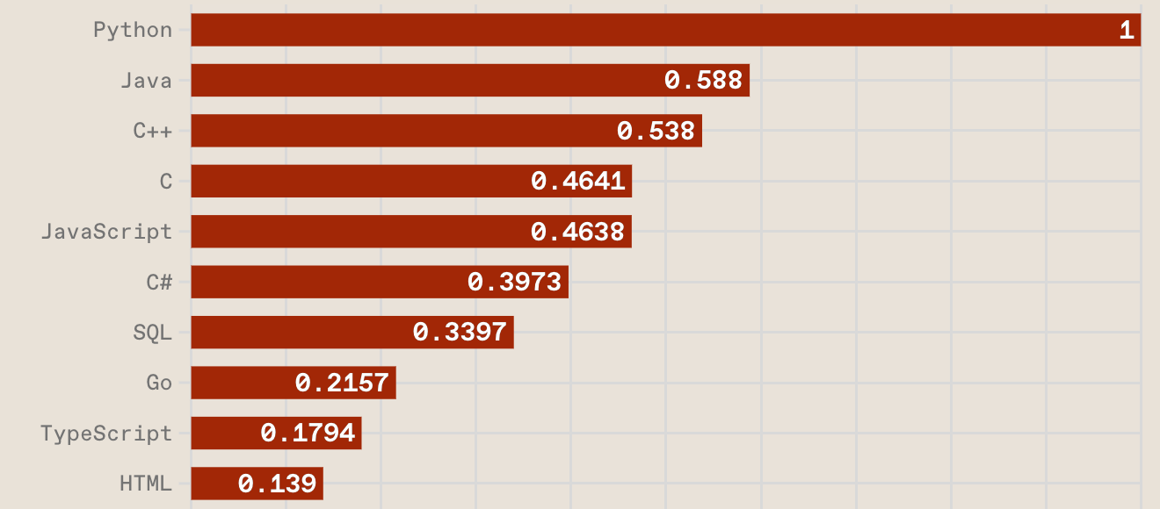
Top Programming Languages
https://spectrum.ieee.org/the-top-programming-languages-2023

Slide 9
Python is an interpreted, object-oriented, high-level programming language with dynamic semantics.
Source: https://www.python.org/doc/essays/blurb/

Slide 10
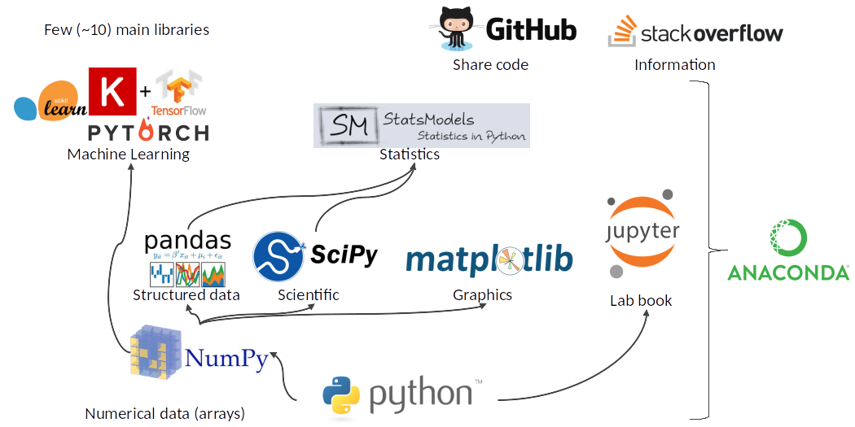
Python Ecosystem for Data Science
Source: https://medium.com/pyfinance/why-python-is-best-choice-for-financial-data-modeling-in-2019-c0d0d1858c45

Slide 11
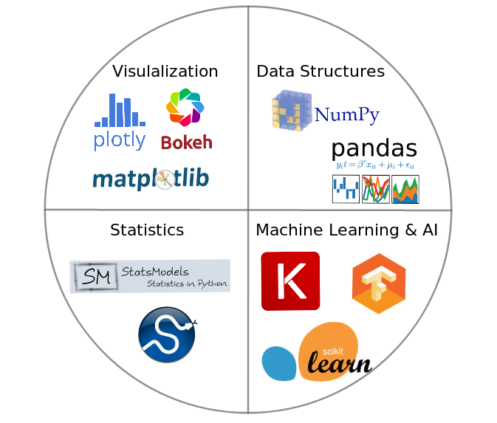

Python Ecosystem for Data Science
Source:https://duchesnay.github.io/pystatsml/introduction/python_ecosystem.html

Slide 12
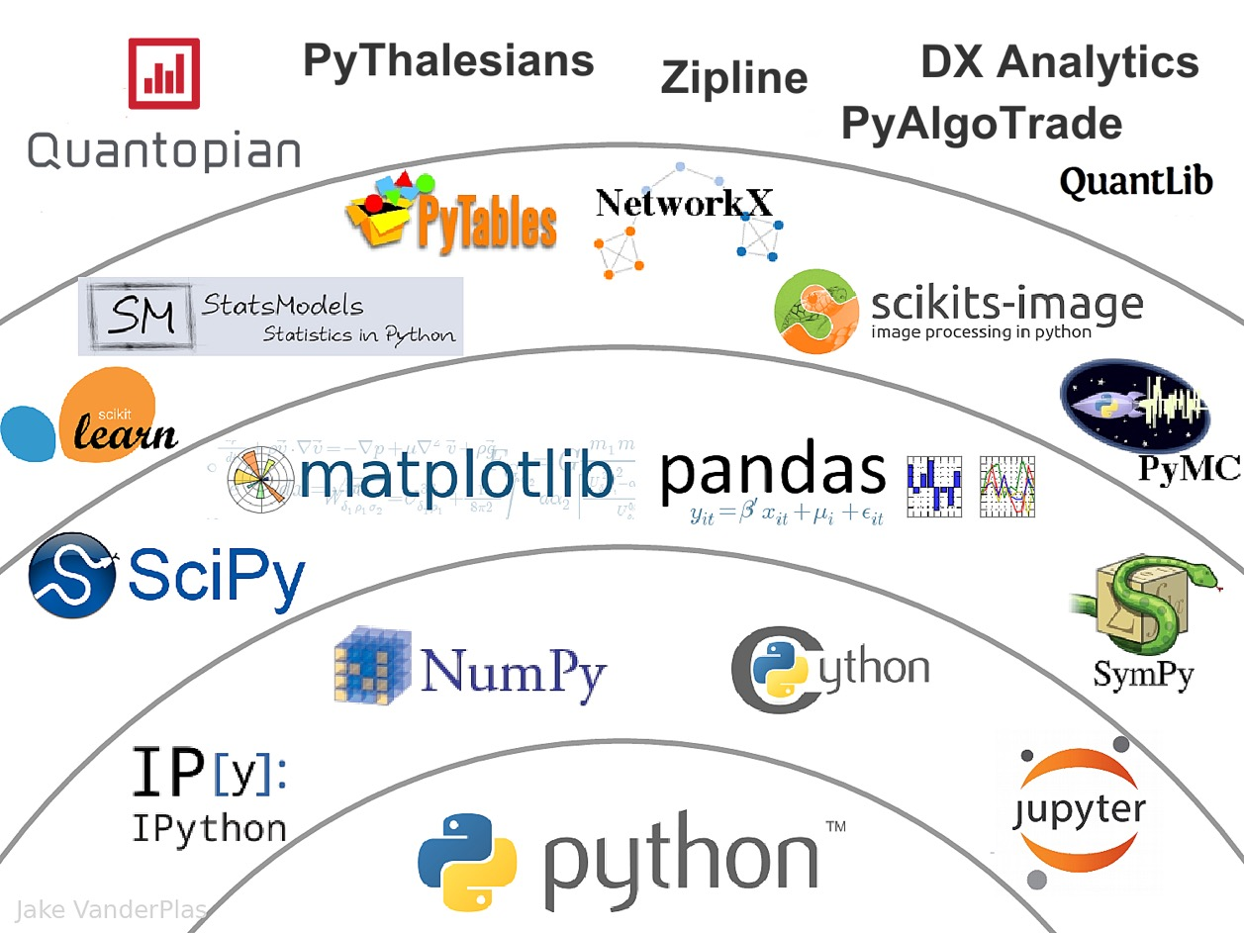

The Quant Finance PyData Stack
Source: http://nbviewer.jupyter.org/format/slides/github/quantopian/pyfolio/blob/master/pyfolio/examples/overview_slides.ipynb#/5

Slide 13
Numpy
NumPy
Base
N-dimensional array package

Slide 14
Python matplotlib
Source: https://matplotlib.org/

Slide 15
Python Pandas
http://pandas.pydata.org/

Slide 16

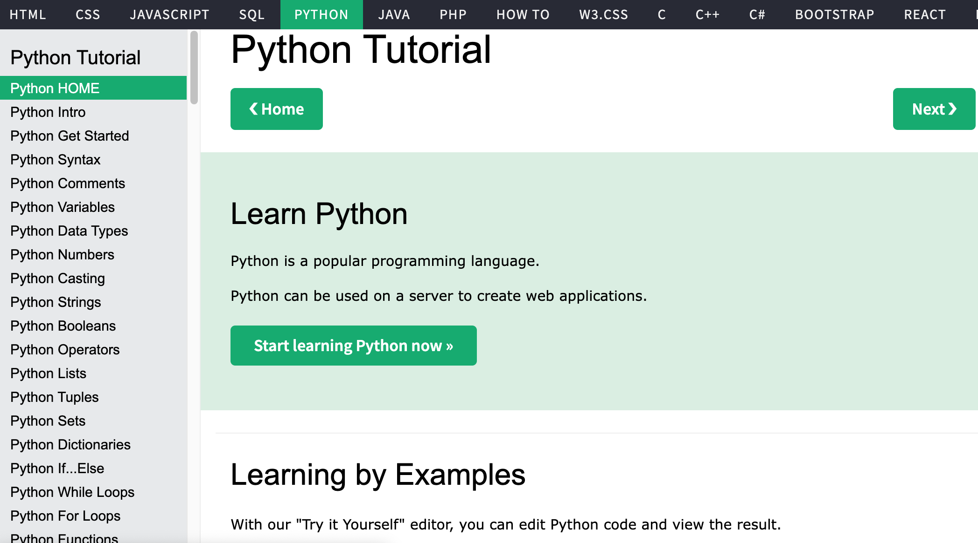
W3Schools Python
https://www.w3schools.com/python/

Slide 17
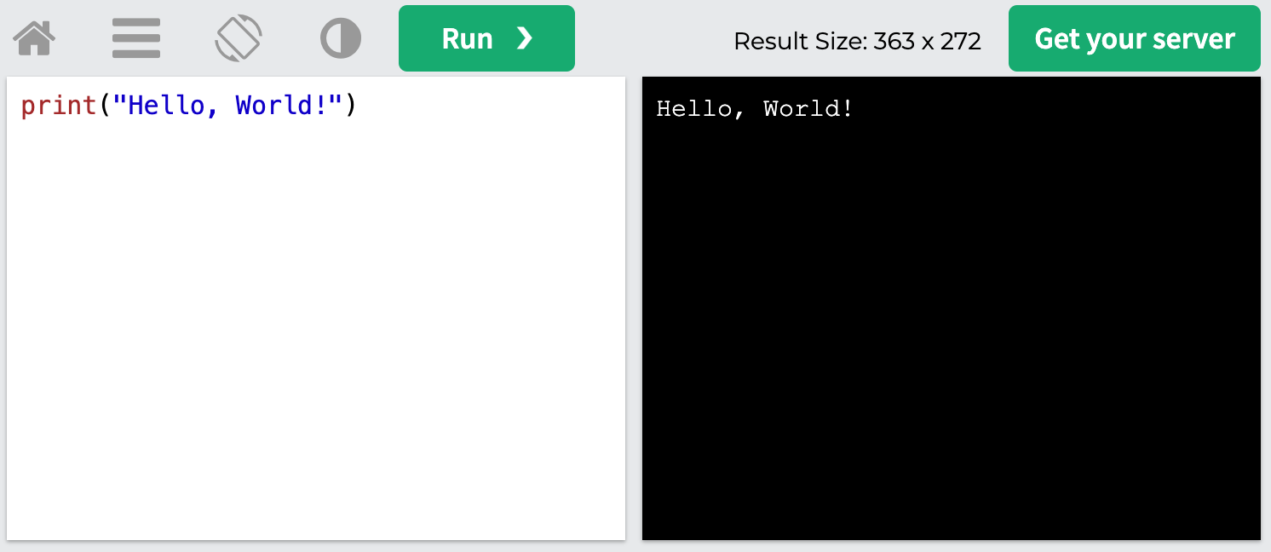
W3Schools Python: Try Python
https://www.w3schools.com/python/trypython.asp?filename=demo_default

Slide 18
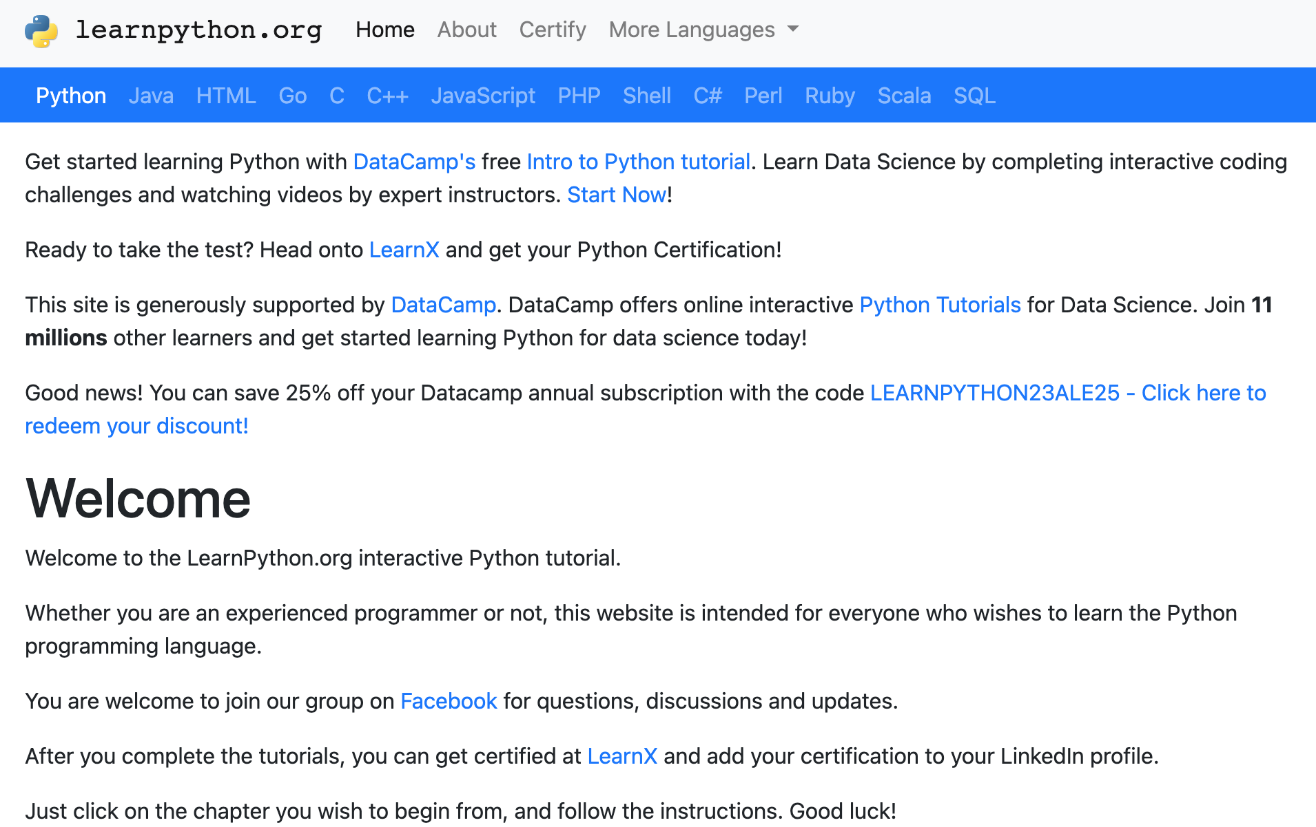
LearnPython.org
https://www.learnpython.org/

Slide 19
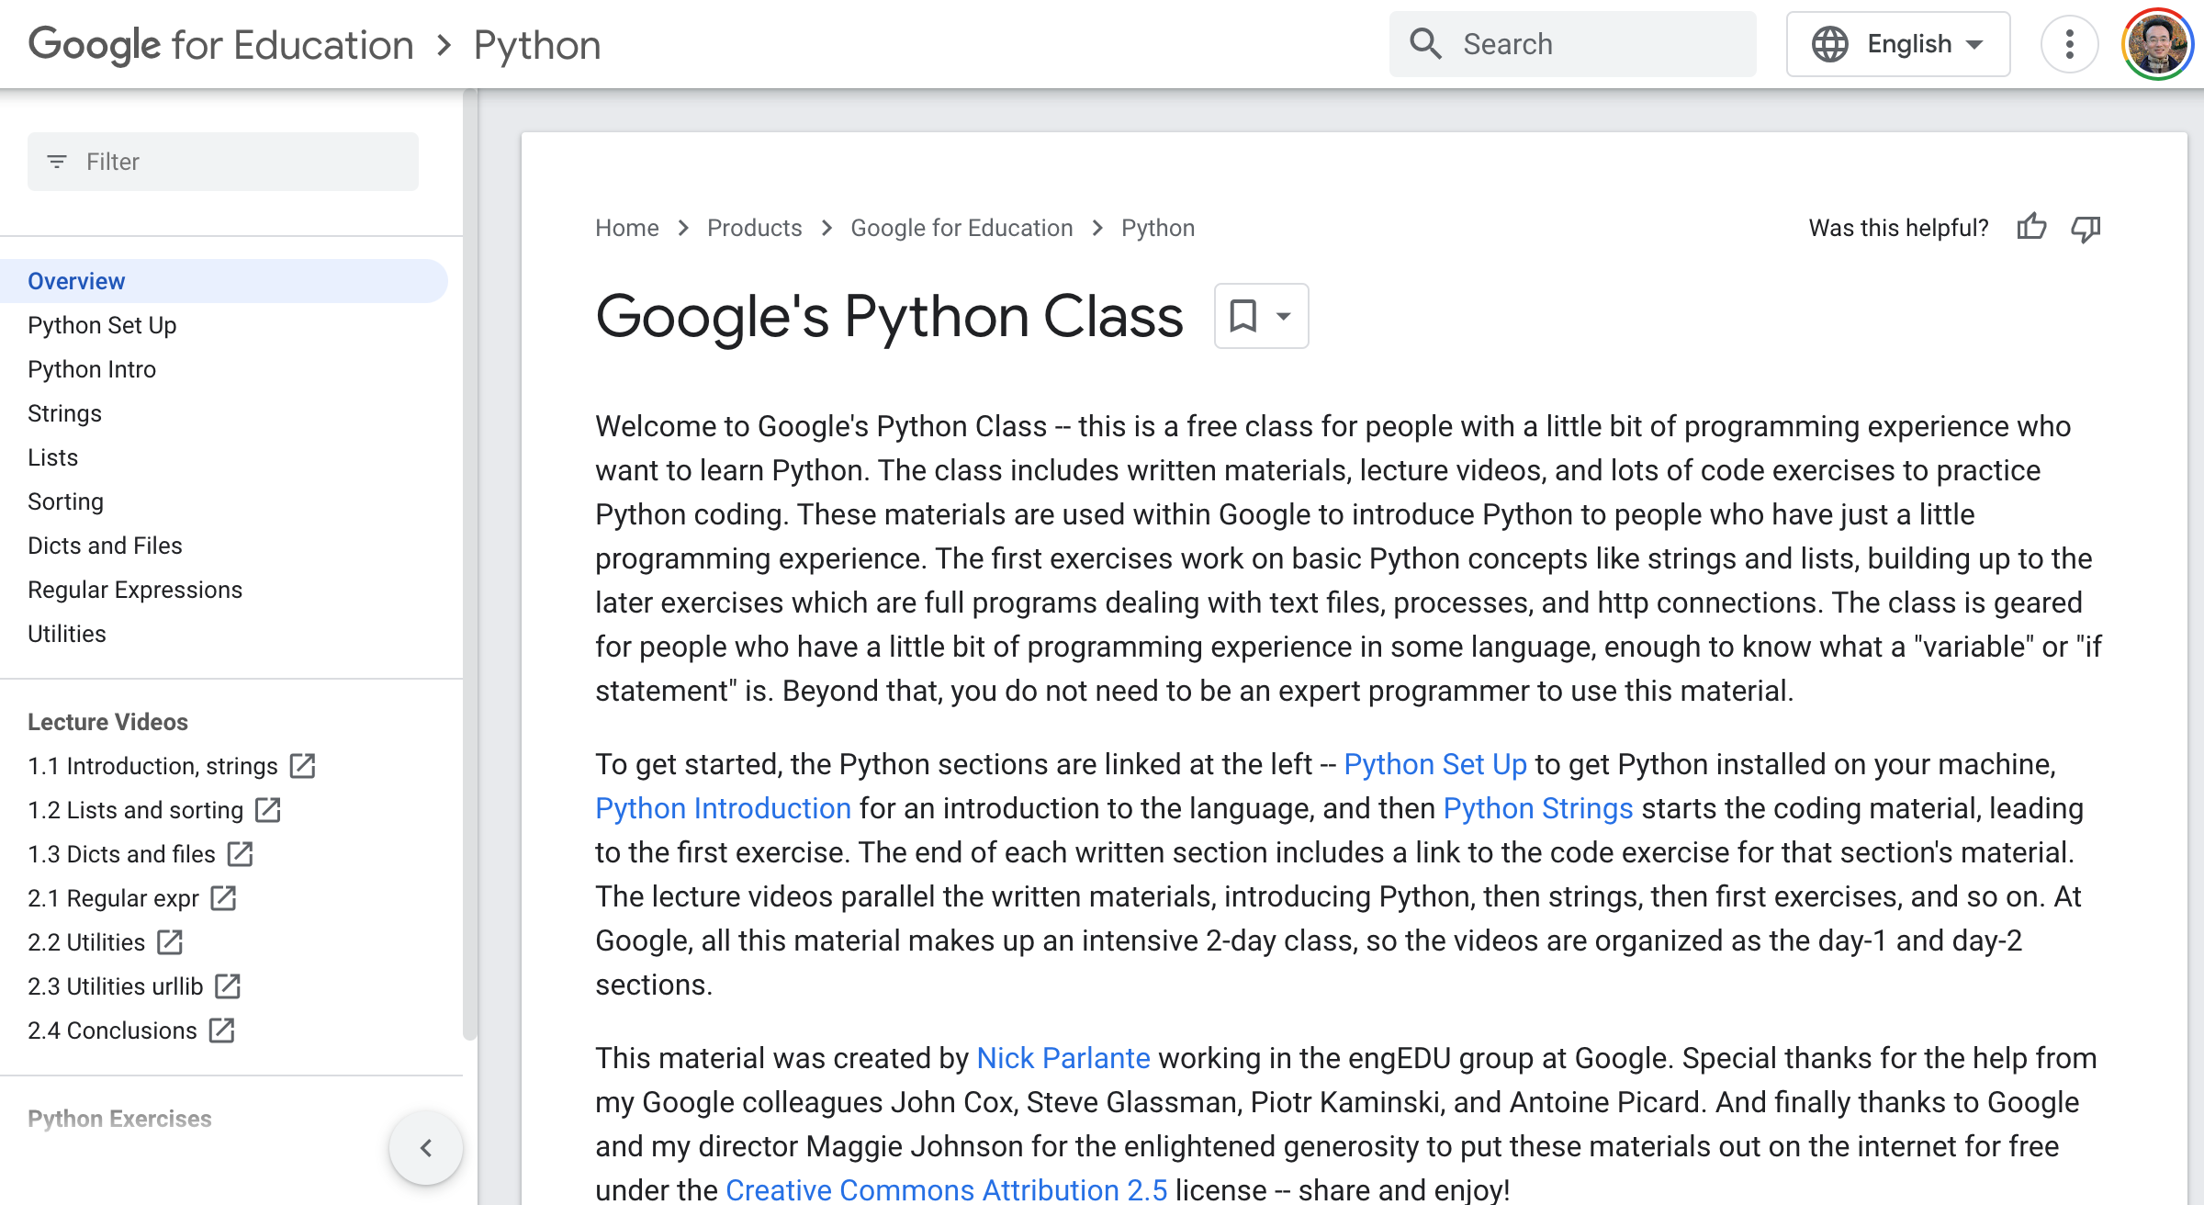
Google’s Python Class
https://developers.google.com/edu/python

Slide 20
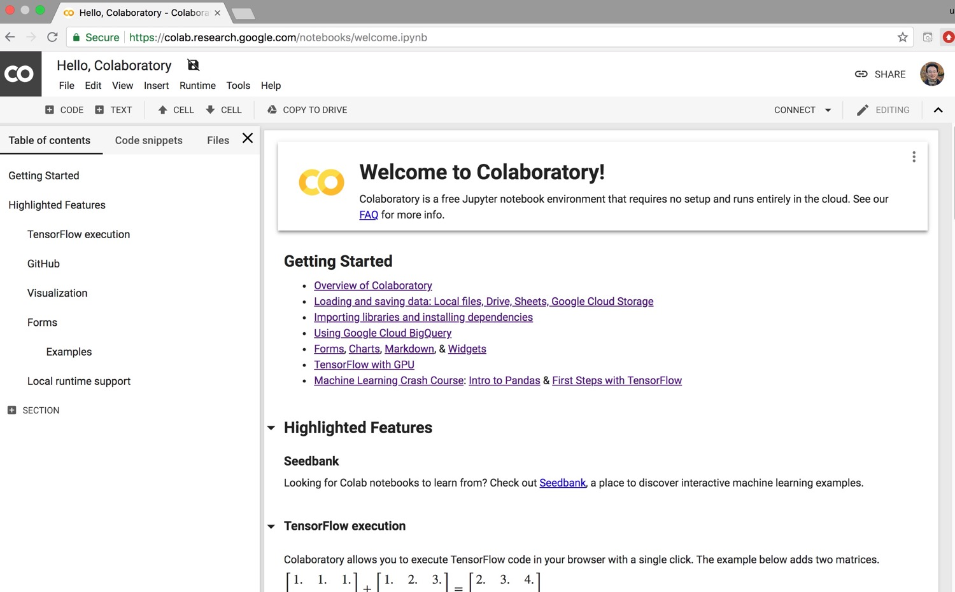
Google Colab
https://colab.research.google.com/notebooks/welcome.ipynb

Slide 21
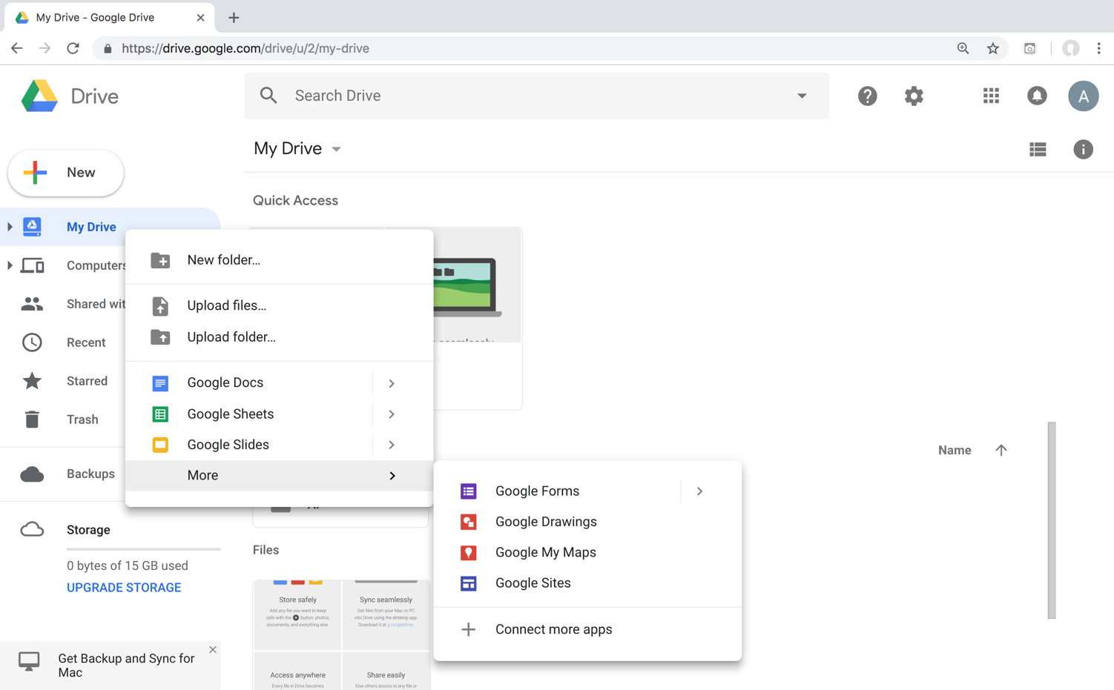
Connect Google Colab in Google Drive

Slide 22
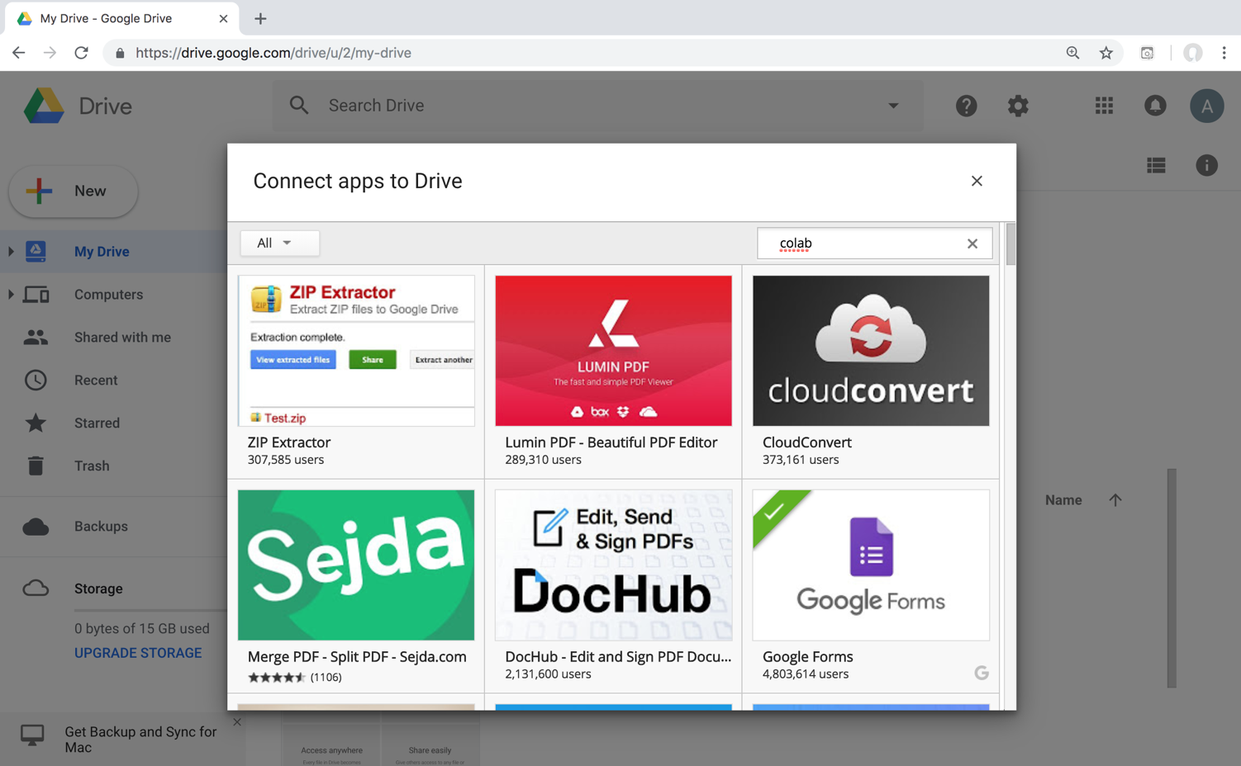
Google Colab

Slide 23
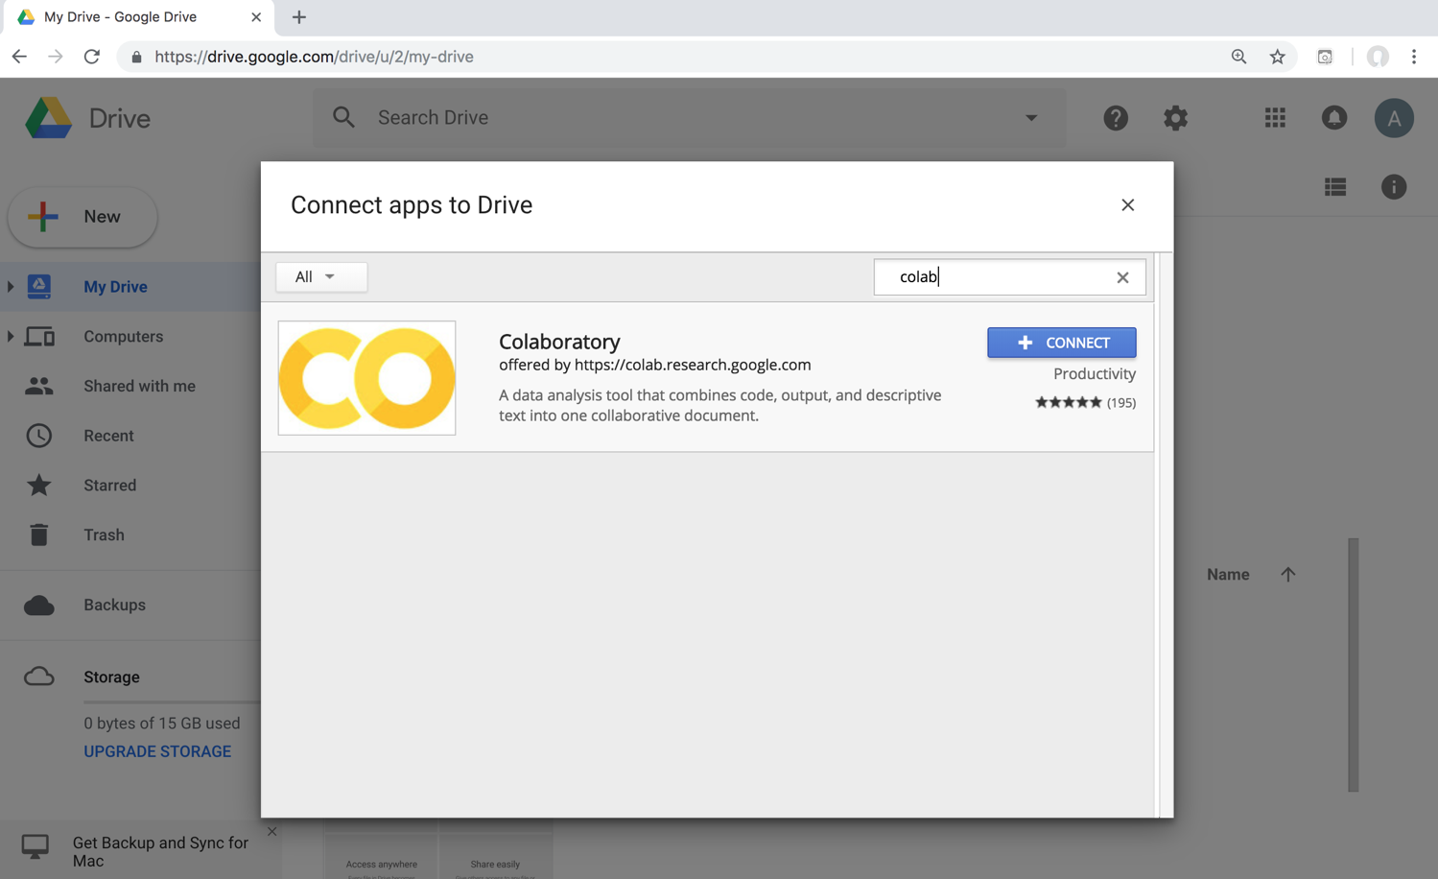
Google Colab

Slide 24
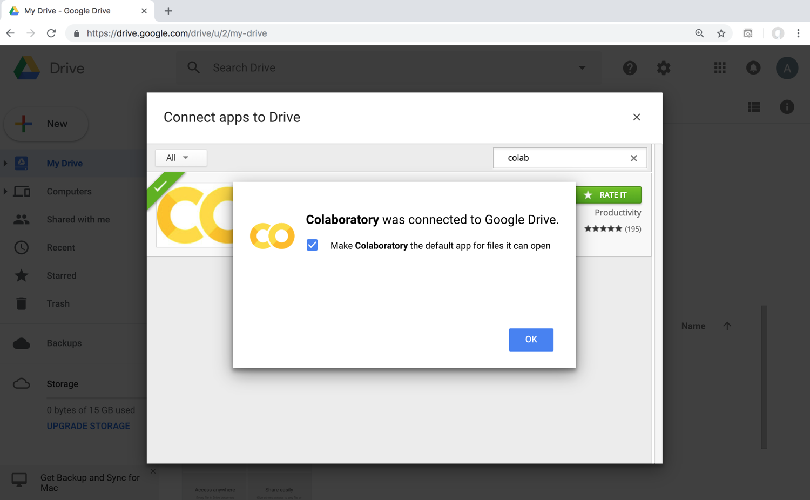
Connect Colaboratory to Google Drive

Slide 25
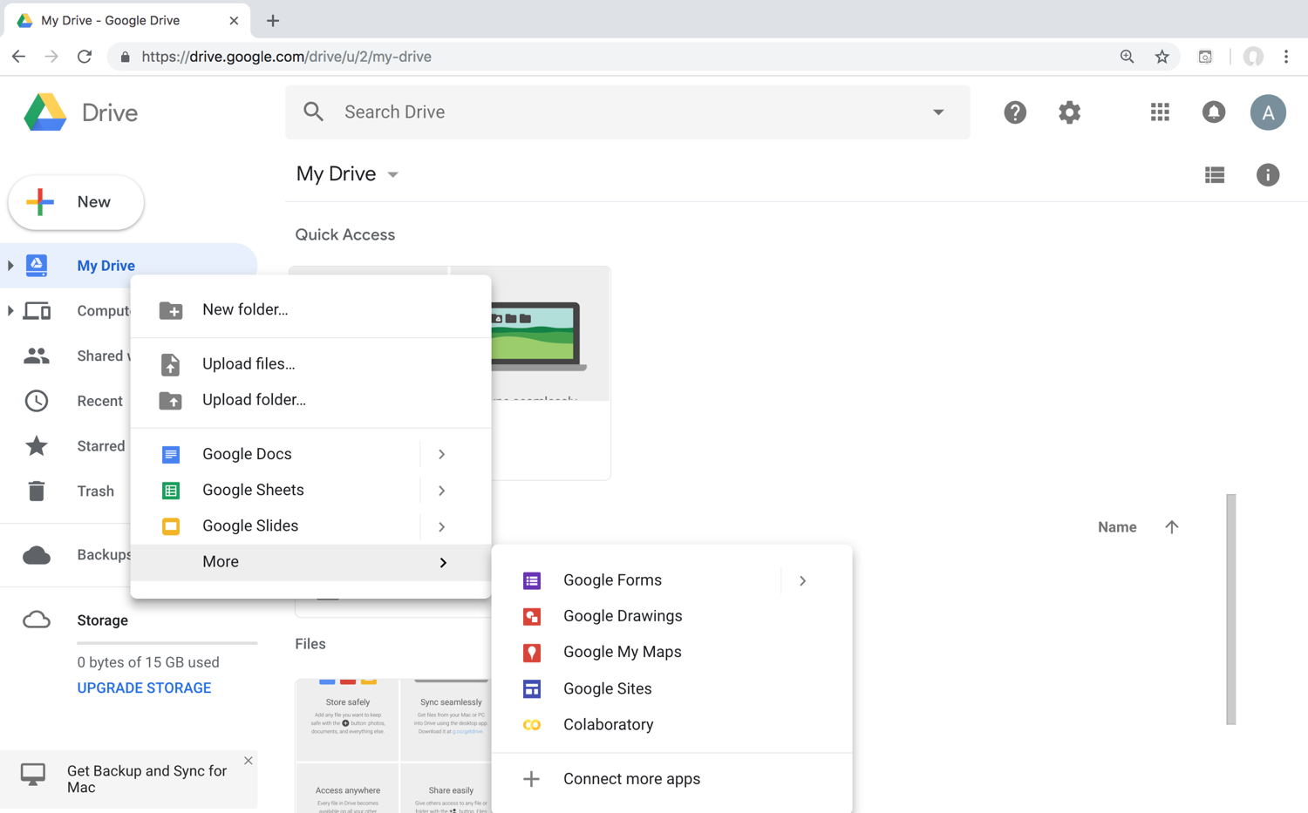
Google Colab

Slide 26
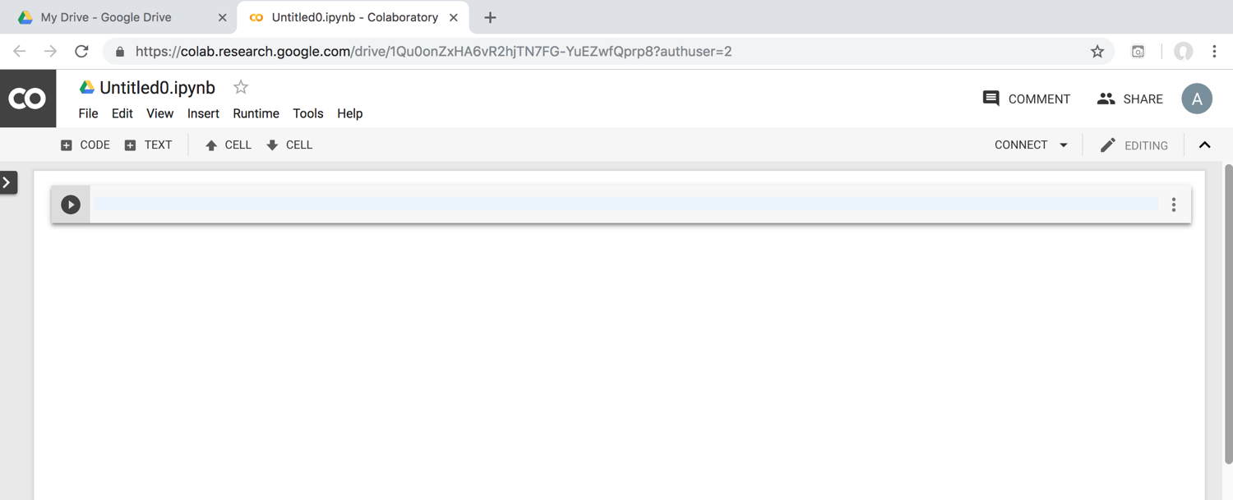
Google Colab

Slide 27
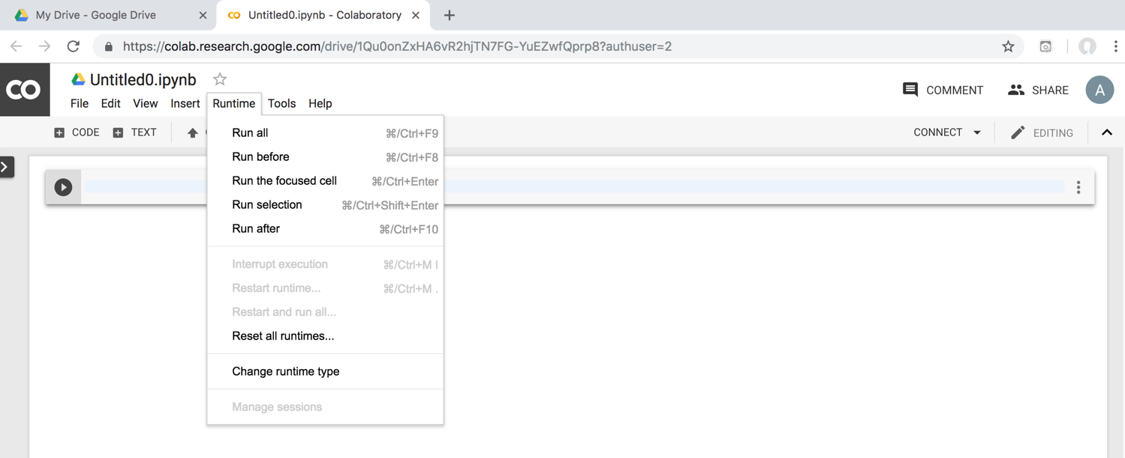
Google Colab

Slide 28
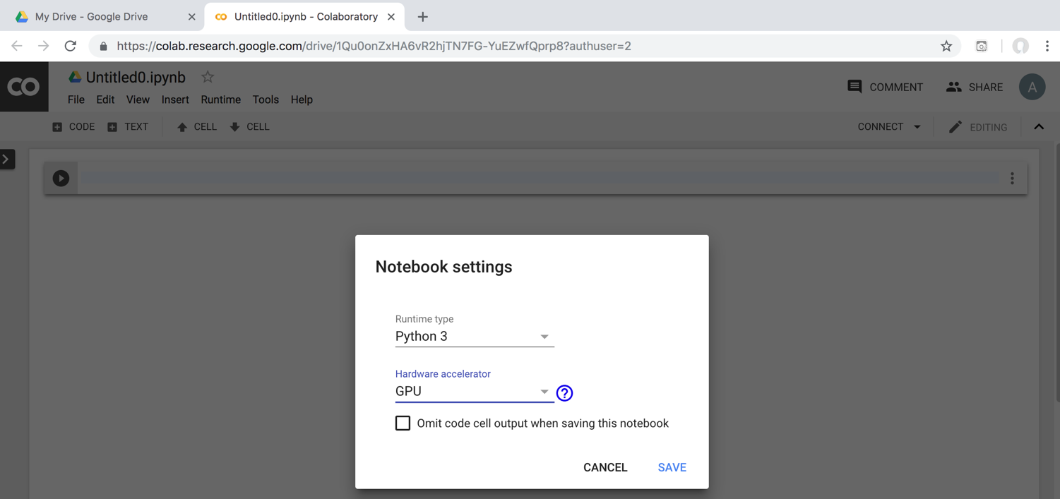
Run Jupyter Notebook
Python3 GPU
Google Colab

Slide 29
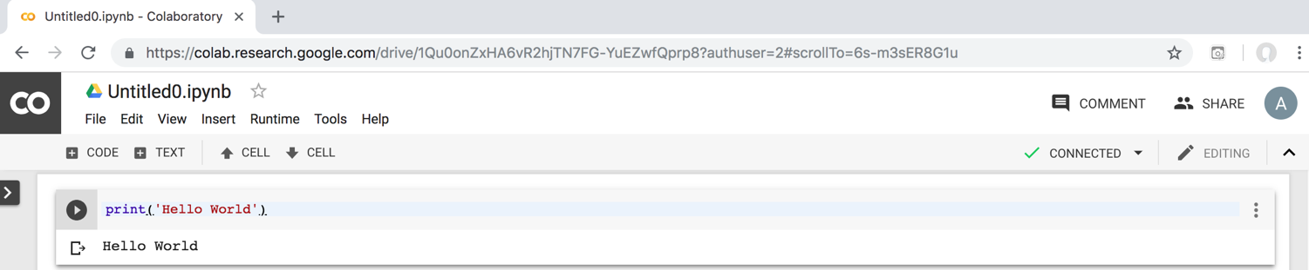
Google Colab Python Hello World print('Hello World')

Slide 30
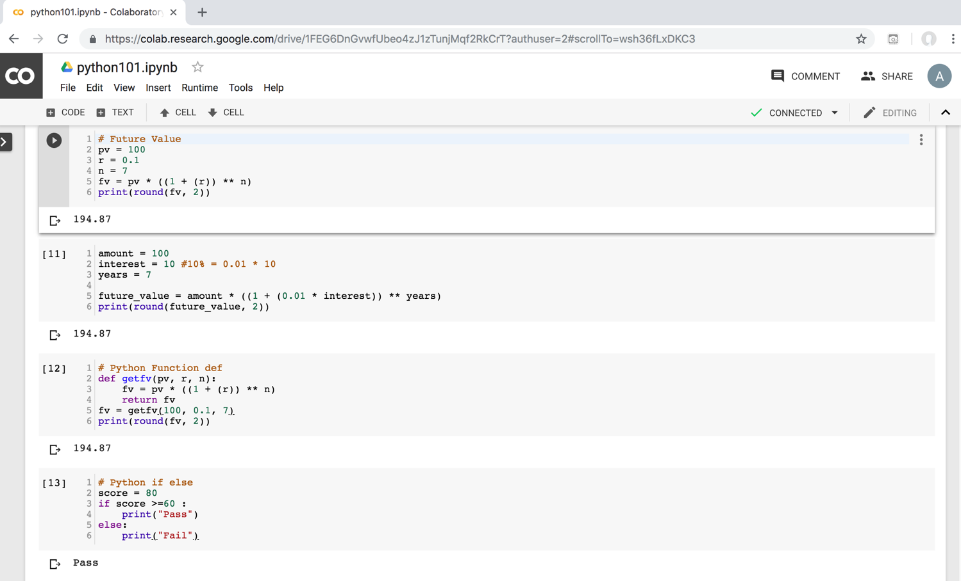
Python in Google Colab (Python101)
https://colab.research.google.com/drive/1FEG6DnGvwfUbeo4zJ1zTunjMqf2RkCrT
https://tinyurl.com/aintpupython101

Slide 31
Anaconda
The Most Popular Python
Data Science Platform
Source: https://www.anaconda.com/

Slide 32


Download Anaconda
https://www.anaconda.com/download

Slide 33
Python
HelloWorld

Slide 34
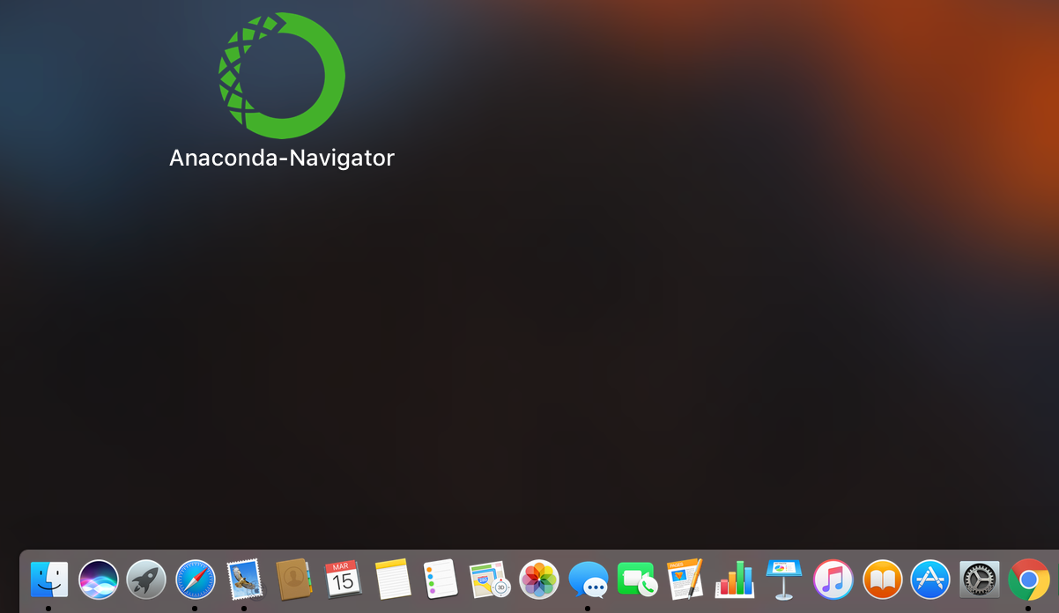
Anaconda-Navigator
Launchpad

Slide 35
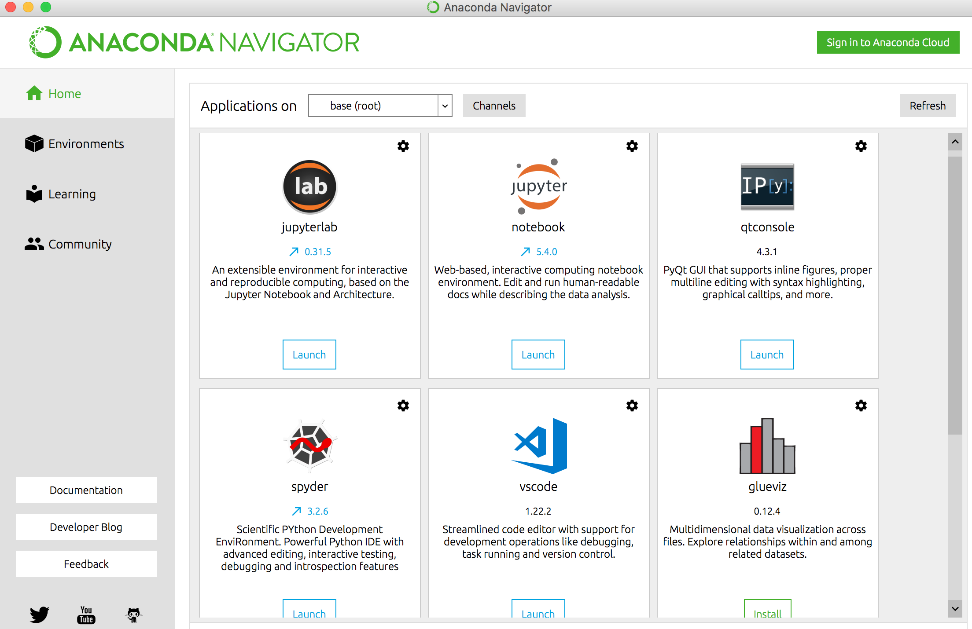
Anaconda Navigator

Slide 36
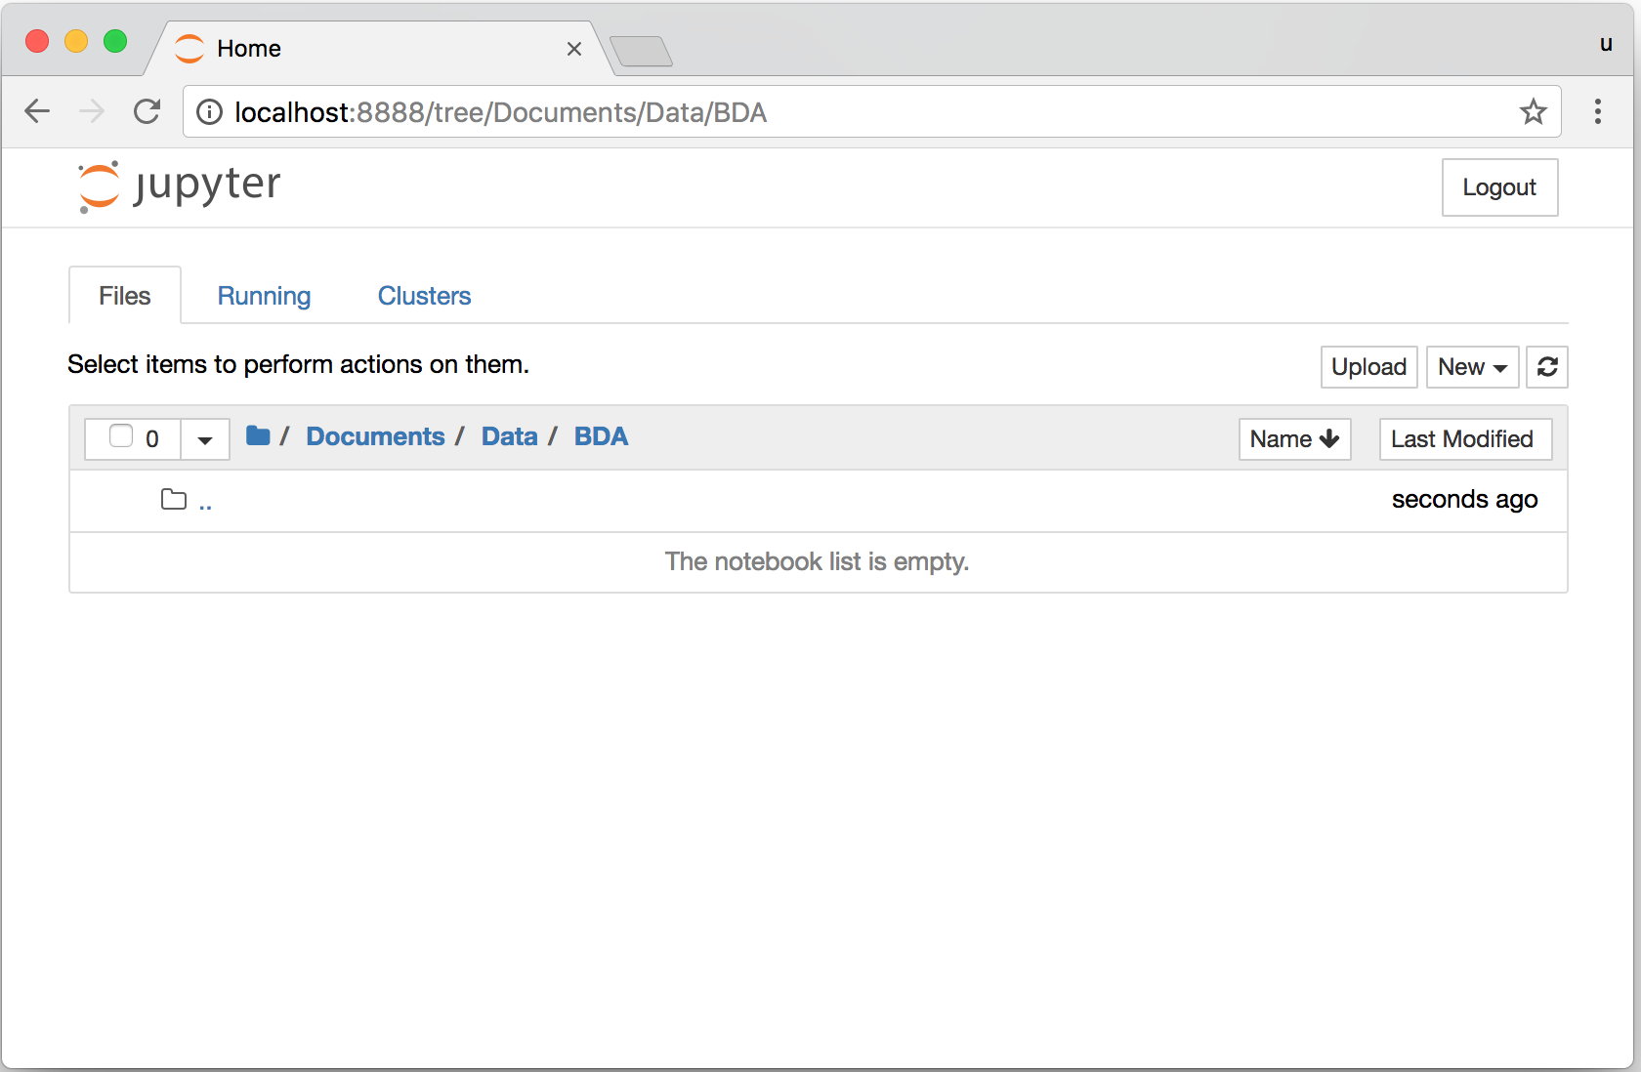
Jupyter Notebook

Slide 37
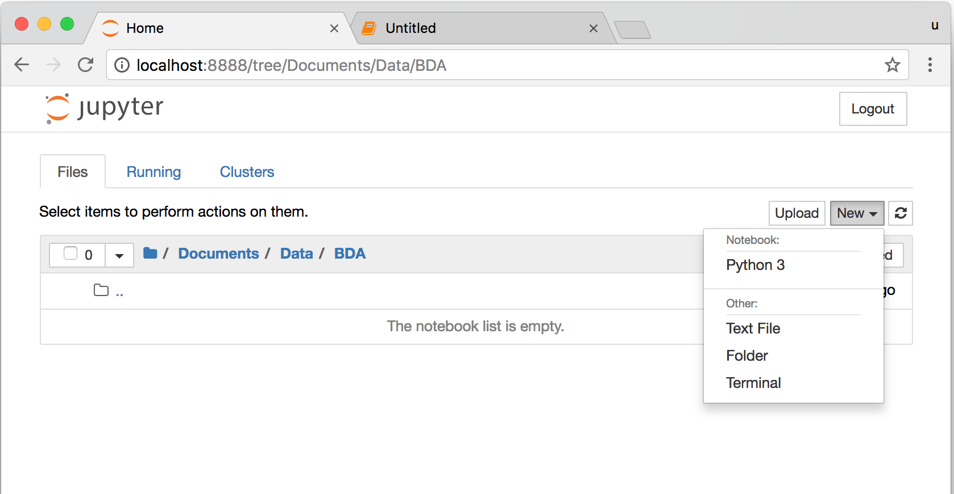
Jupyter Notebook
New Python 3

Slide 38
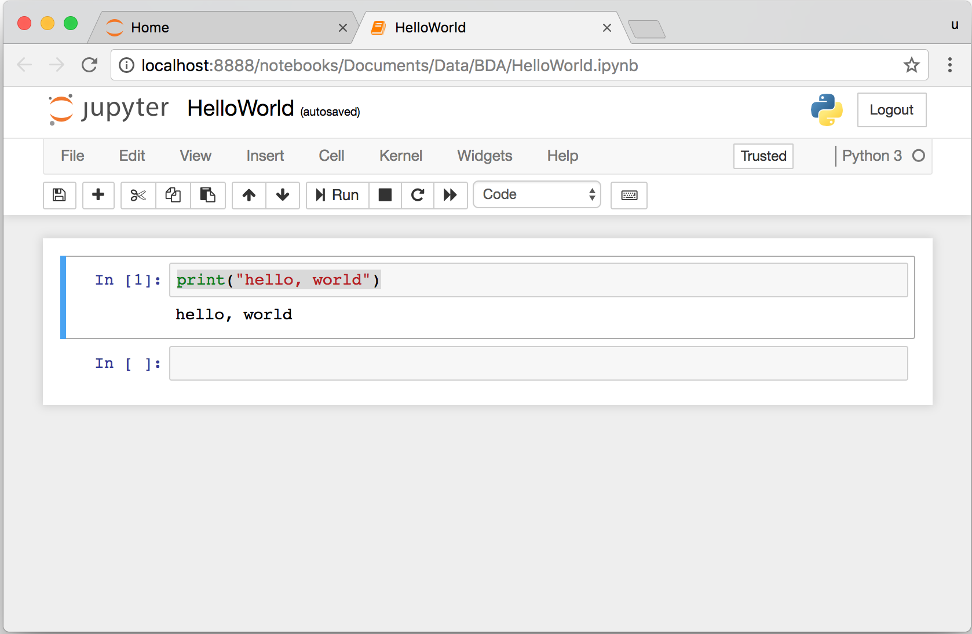
print("hello, world")
Notes:
print("hello, world")

Slide 39

Source: https://www.python.org/community/logos/

Slide 40
Python
Programming

Slide 41
Foundations of Python Programming
Python Syntax
  Python Comments
Python Variables
Python Data Types
  Python Numbers
  Python Casting
  Python Strings
Python Operators
Python Booleans

Slide 42
Python Hello World print("Hello World")
print("Hello World")

Slide 43
Python Syntax
# comment
# comment

Slide 44
Python Syntax
Indentation the spaces at the beginning of a code line
4 spaces
score = 80
if score >=60 :
print("Pass")

Slide 45
Python Variables
# Python Variables
x = 2
price = 2.5
word = 'Hello'
word = 'Hello'
word = "Hello"
word = '''Hello'''

Slide 46
Python Variables
x = 2
y = x + 1

Slide 47
python_version()
# comment
from platform import python_version
print("Python Version:", python_version())
Python Version: 3.10.12

Slide 48
Python Data Types
x = "Hello World" #str
x = 2 #int
x = 2.5 #float
x = 7j #complex

Slide 49
Python Data Types
x = ["apple", "banana", "cherry"] #list
x = ("apple", "banana", "cherry") #tuple
x = range(6) #range
x = {"name" : "Tom", "age" : 20} #dict
x = {"apple", "banana", "cherry"} #set
x = frozenset({"apple", "banana", "cherry"}) #frozenset

Slide 50
Python Data Types
x = True #bool
x = b"Hello" #bytes
x = bytearray(5) #bytearray
x = memoryview(bytes(5)) #memoryview
x = None #NoneType

Slide 51
Python Casting
x = str(3) # x will be '3'
y = int(3) # y will be 3
z = float(3) # z will be 3.0
print(x, type(x))
print(y, type(y))
print(z, type(z))
3 <class 'str’>
3 <class 'int’>
3.0 <class 'float'>

Slide 52
Python Numbers
x = 2 # int
y = 3.4 # float
z = 7j #complex
print(x, type(x))
print(y, type(y))
print(z, type(z))
2 <class 'int’>
3.4 <class 'float’>
7j <class 'complex'>

Slide 53
Python Arithmetic Operators
Operator Name Example
+ Addition 7 + 2 = 9
- Subtraction 7 - 2 = 5
* Multiplication 7 * 2 = 14
/ Division 7 / 2 = 3.5
// Floor division 7 // 2 = 3 (Quotient)
% Modulus 7 % 2 = 1 (Remainder)
** Exponentiation 7 ** 2 = 49

Slide 54
Python Basic Operators
print('7 + 2 =', 7 + 2)
print('7 - 2 =', 7 - 2)
print('7 * 2 =', 7 * 2)
print('7 / 2 =', 7 / 2)
print('7 // 2 =', 7 // 2)
print('7 % 2 =', 7 % 2)
print('7 ** 2 =', 7 ** 2)
7 + 2 = 9
7 - 2 = 5
7 * 2 = 14
7 / 2 = 3.5
7 // 2 = 3
7 % 2 = 1
7 ** 2 = 49

Slide 55
Python Booleans:
True or False
# Python Booleans: True or False
print(3 > 2)
print(3 == 2)
print(3 < 2)

Slide 56
Python BMI Calculator
# BMI Calculator in Python
height_cm = 170
weight_kg = 60
height_m = height_cm/100
BMI = (weight_kg/(height_m**2))
print("Your BMI is: " + str(round(BMI,1)))
Your BMI is: 20.8

Slide 57
Future value of a specified principal amount, rate of interest, and a number of years
Source: https://www.w3resource.com/python-exercises/python-basic-exercise-39.php

Slide 58
How much is your $100 worth after 7 years?
# How much is your $100 worth after 7 years?
fv = 100 * 1.1 ** 7
print('fv = ', round(fv, 2))
# output = 194.87
fv = 194.87

Slide 59
Future Value
# Future Value
pv = 100
r = 0.1
n = 7
fv = pv * ((1 + (r)) ** n)
print(round(fv, 2))
194.87

Slide 60
Future Value
# Future Value
amount = 100
interest = 10 #10% = 0.01 * 10
years = 7
future_value = amount * ((1 + (0.01 * interest)) ** years)
print(round(future_value, 2))
194.87

Slide 61
Python
Data Structures

Slide 62
Python Data Structures
  Python Lists []
  Python Tuples ()
  Python Sets {}
  Python Dictionaries {k:v}

Slide 63
Python Data Structures
fruits = ["apple", "banana", "cherry"] #lists []
colors = ("red", "green", "blue") #tuples ()
animals = {'cat', 'dog'} #sets {}
person = {"name" : "Tom", "age" : 20} #dictionaries {}

Slide 64
Python Data Types
x = ["apple", "banana", "cherry"] #list
x = ("apple", "banana", "cherry") #tuple
x = {"name" : "Tom", "age" : 20} #dict
x = {"apple", "banana", "cherry"} #set

Slide 65
Python Collections
There are four collection data types in the Python programming language
List []
  a collection which is ordered and changeable. Allows duplicate members.
Tuple ()
  a collection which is ordered and unchangeable. Allows duplicate members.
Set {}
  a collection which is unordered, unchangeable, and unindexed. No duplicate members.
Dictionary {k:v}
  a collection which is ordered and changeable. No duplicate members.

Slide 66
Python Dictionaries {k:v}
As of Python version 3.7, dictionaries are ordered.
In Python 3.6 and earlier, dictionaries are unordered.

Slide 67
Lists []
x = [60, 70, 80, 90]
print(len(x))
print(x[0])
print(x[1])
print(x[-1])
4
60
70
90

Slide 68
Lists []
len(): how many items
type(): data type
list() constructor: creating a new list

Slide 69
Python List Methods
Method Description
append() Adds an element at the end of the list
clear() Removes all the elements from the list
copy() Returns a copy of the list
count() Returns the number of elements with the specified value
extend() Add the elements of a list (or any iterable), to the end of the current list
index() Returns the index of the first element with the specified value
insert() Adds an element at the specified position
pop() Removes the element at the specified position
remove() Removes the item with the specified value
reverse() Reverses the order of the list
sort() Sorts the list
https://www.w3schools.com/python/python_lists_methods.asp

Slide 70
Tuples ()
A tuple in Python is a collection that cannot be modified.
A tuple is defined using parenthesis.
x = (10, 20, 30, 40, 50)
print(x[0])
print(x[1])
print(x[2])
print(x[-1])
10
20
30
50
Source: http://pythonprogramminglanguage.com/tuples/

Slide 71
Sets {}
animals = {'cat', 'dog'}
print('cat' in animals)
print('fish' in animals)
animals.add('fish')
print('fish' in animals) print(len(animals))
animals.add('cat’)
print(len(animals))
animals.remove('cat')
print(len(animals))
True
False
True
3
3
2
Source: http://cs231n.github.io/python-numpy-tutorial/

Slide 72
Dictionary {key : value}
Python Dictionary
Key → Value
'EN’ → 'English’
'FR’ → 'French'
k = { 'EN':'English', 'FR':'French' }
print(k['EN'])
English
Source: http://pythonprogramminglanguage.com/dictionary/

Slide 73
Python Data Structures
fruits = ["apple", "banana", "cherry"] #lists []
colors = ("red", "green", "blue") #tuples ()
animals = {'cat', 'dog'} #sets {}
person = {"name" : "Tom", "age" : 20} #dictionaries {}
https://tinyurl.com/aintpupython101

Slide 74
Python
Control Logic and
Loops

Slide 75
Python Control Logic and Loops
  Python if else
    if elif else
    Booleans: True, False
    Operators: ==, !=, >, <, >=, <=, and, or, not
  Python for Loops
    for
  Python while Loops
    While
      break
      continue

Slide 76
Python if...else
  Python if...else
    if elif else
    Booleans: True, False
    Operators: ==, !=, >, <, >=, <=, and, or, not

Slide 77
Python Conditions and If statements
Python supports the usual logical conditions from mathematics:
  Equals: a == b
  Not Equals: a != b
  Less than: a < b
  Less than or equal to: a <= b
  Greater than: a > b
  Greater than or equal to: a >= b

Slide 78
Python Comparison Operators
Operator | Name | Example
== | Equal | x == y
!= | Not equal | x != y
> | Greater than | x > y
< | Less than | x < y
>= | Greater than or equal to | x >= y
<= | Less than or equal to | x <= y
Source: https://www.w3schools.com/python/python_operators.asp

Slide 79
Python Logical Operators
Operator | Description | Example
and | Returns True if both statements are true | x < 5 and x < 10
or | Returns True if one of the statements is true | x < 5 or x < 4
not | Reverse the result, returns False if the result is true | not(x < 5 and x < 10)
Source: https://www.w3schools.com/python/python_operators.asp

Slide 80
Python if
# Python if
score = 80
if score >=60 :
print("Pass")
https://tinyurl.com/aintpupython101

Slide 81
Python if else
# Python if else
score = 80
if score >=60 :
print("Pass")
else:
print("Fail")
https://tinyurl.com/aintpupython101

Slide 82
Python if elif else
score = 95
if score >= 90 :
print("A")
elif score >=60 :
print("Pass")
else:
print("Fail")

Slide 83
Python if elif else
# Python if elif else
score = 90
grade = ""
if score >=90:
grade = "A"
elif score >= 80:
grade = "B"
elif score >= 70:
grade = "C"
elif score >= 60:
grade = "D"
else:
grade = "E"
print(grade)

Slide 84
Python for Loops
for i in range(1,6):
print(i)
1
2
3
4
5
https://tinyurl.com/aintpupython101

Slide 85
Python for loops
# for loops
for i in range(1,10):
for j in range(1,10):
print(i, ' * ' , j , ' = ', i*j)
https://tinyurl.com/aintpupython101

Slide 86
Python while Loops
  while
    break
    continue

Slide 87
Python while loops
# while loops
age = 10
while age < 20:
print(age)
age = age + 1
https://tinyurl.com/aintpupython101

Slide 88
Python
Functions and
Modules

Slide 89
Python Functions and Modules
Python Functions
  def myfunction():
Python Classes/Objects
  class MyClass:
Python Modules
  mymodule.py
  import mymodule

Slide 90
Python
Functions

Slide 91
Python Functions
A function is a block of code which only runs when it is called.
You can pass data, known as parameters, into a function.
A function can return data as a result.
Creating a Function
  In Python a function is defined using the def keyword:

Slide 92
Python Function def
# Python Function def
# indentation for blocks. four spaces
def getfv(pv, r, n):
fv = pv * ((1 + (r)) ** n)
return fv
fv = getfv(100, 0.1, 7)
print(round(fv, 2))
194.87
https://tinyurl.com/aintpupython101

Slide 93
Future value of a specified principal amount, rate of interest, and a number of years
Source: https://www.w3resource.com/python-exercises/python-basic-exercise-39.php

Slide 94
How much is your $100 worth after 7 years?
# How much is your $100 worth after 7 years?
fv = 100 * 1.1 ** 7
print('fv = ', round(fv, 2))
# output = 194.87
fv = 194.87

Slide 95
Future Value
# Future Value
pv = 100
r = 0.1
n = 7
fv = pv * ((1 + (r)) ** n)
print(round(fv, 2))
194.87

Slide 96
Future Value
# Future Value
amount = 100
interest = 10 #10% = 0.01 * 10
years = 7
future_value = amount * ((1 + (0.01 * interest)) ** years)
print(round(future_value, 2))
194.87

Slide 97
Python Function def getfv() define get future value function
# Python Function def
# indentation for blocks. four spaces
def getfv(pv, r, n):
fv = pv * ((1 + (r)) ** n)
return fv
fv = getfv(100, 0.1, 7)
print(round(fv, 2))
194.87
https://tinyurl.com/aintpupython101

Slide 98
Python
Classes/Objects class MyClass:

Slide 99
Python Classes/Objects
Python is an object oriented programming language.
Almost everything in Python is an object, with its properties and methods.
A Class is like an object constructor, or a "blueprint" for creating objects.
Create a Class:
  To create a class, use the keyword class:

Slide 100
Python Classes/Objects class MyClass:
# Python class
class MyClass:
x = 5
c1 = MyClass()
print(c1.x)
https://www.w3schools.com/python/python_classes.asp

Slide 101
Python Classes/Objects
class Person:
def __init__(self, name, age):
self.name = name
self.age = age
p1 = Person("Alan", 20)
print(p1.name)
print(p1.age)
Alan
20
https://tinyurl.com/aintpupython101

Slide 102
Python Classes/Objects
class Person:
def __init__(self, name, age):
self.name = name
self.age = age
def myfunc(self):
print("Hello my name is " + self.name)
p1 = Person("Alan", 20)
p1.myfunc()
https://tinyurl.com/aintpupython101

Slide 103
Python Classes/Objects
class Person:
def __init__(self, name, age):
self.name = name
self.age = age
def myfunc(self):
print("Hello my name is " + self.name)
p1 = Person("Alan", 20)
p1.myfunc()
print(p1.name)
print(p1.age)
Hello my name is Alan
Alan
20
https://tinyurl.com/aintpupython101

Slide 104
Python Classes and Obects
class Vehicle:
name = ""
kind = "car"
color = ""
value = 100.00
def description(self):
desc_str = "%s is a %s %s worth $%.2f." % (self.name, self.color, self.kind, self.value)
return desc_str
https://tinyurl.com/aintpupython101

Slide 105
Python Classes and Objects
car1 = Vehicle()
car1.name = "Fer"
car1.color = "red"
car1.kind = "convertible"
car1.value = 60000.00
car2 = Vehicle()
car2.name = "Jump"
car2.color = "blue"
car2.kind = "van"
car2.value = 10000.00
print(car1.description())
print(car1.name)
print(car2.description())
print(car2.name)
class Vehicle:
name = ""
kind = "car"
color = ""
value = 100.00
def description(self):
desc_str = "%s is a %s %s worth $%.2f." % (self.name, self.color, self.kind, self.value)
return desc_str
Fer is a red convertible worth $60000.00.
Fer
Jump is a blue van worth $10000.00.
Jump
https://www.learnpython.org/en/Classes_and_Objects

Slide 106
Python
Modules

Slide 107
Python Modules
Consider a module to be the same as a code library.
A file containing a set of functions you want to include in your application.
Create a Module
  To create a module just save the code you want in a file with the file extension .py:
Use a Module
  import module

Slide 108
Python Modules
# mymodule.py
def greeting(name):
print("Hello, " + name)
import mymodule
mymodule.greeting("Alan")
mymodule.py
def greeting(name):
print("Hello, " + name)
https://tinyurl.com/aintpupython101

Slide 109
Python File Input / Output
# Python File Input / Output
with open('myfile.txt', 'w') as file:
file.write('Hello World\nThis is Python File Input Output')
with open('myfile.txt', 'r') as file:
text = file.read()
print(text)
Hello World This is Python File Input Output
https://tinyurl.com/aintpupython101

Slide 110
Python File Input / Output
# Python File Input / Output
filename = 'mymodule.py'
with open(filename, 'w') as file:
text = '''def greeting(name):
print("Hello, " + name)
'''
file.write(text)
with open(filename, 'r') as file:
text = file.read()
print(filename)
print(text)
mymodule.py
def greeting(name):
print("Hello, " + name)
https://tinyurl.com/aintpupython101

Slide 111
Python Modules import mymodule
# mymodule.py
def greeting(name):
print("Hello, " + name)
import mymodule
mymodule.greeting("Alan")
Hello, Alan
https://tinyurl.com/aintpupython101

Slide 112
Python main() function
#Python main() function
def main():
print("Hello World!")
if __name__ == "__main__":
main()
https://tinyurl.com/aintpupython101

Slide 113
Files and
Exception Handling

Slide 114
Files and Exception Handling
Python Files (File Handling)
  open()
  f = open("myfile.txt")
Python Try Except (Exception Handling)
  try:
  except:
  else:
  finally:

Slide 115
File Handling
The key function for working with files in Python is the open() function.
The open() function takes two parameters; filename, and mode.
There are four different methods (modes) for opening a file:
  "r" - Read - Default value. Opens a file for reading, error if the file does not exist
  "a" - Append - Opens a file for appending, creates the file if it does not exist
  "w" - Write - Opens a file for writing, creates the file if it does not exist
  "x" - Create - Creates the specified file, returns an error if the file exists

Slide 116
Python Files (File Handling)
f = open("myfile.txt", "w")
f.write("Hello World")
f.close()
f = open("myfile.txt", "r")
text = f.read()
print(text)
f.close()
Hello World
https://tinyurl.com/aintpupython101

Slide 117
Python Files (File Handling)
# Python File Input / Output
with open('myfile.txt', 'w') as file:
file.write('Hello World')
with open('myfile.txt', 'r') as file:
text = file.read()
print(text)
Hello World
https://tinyurl.com/aintpupython101

Slide 118
Python Files
# Python File Input / Output
with open('myfile.txt', 'w') as file:
file.write('Hello World\nPython File IO')
with open('myfile.txt', 'r') as file:
text = file.read()
print(text)
Hello World
Python File IO
https://tinyurl.com/aintpupython101

Slide 119
Python Files
# Python File Input / Output
with open('myfile.txt', 'a+') as file:
file.write('\n' + 'New line')
with open('myfile.txt', 'r') as file:
text = file.read()
print(text)
Hello World
Python File IO
New line
https://tinyurl.com/aintpupython101

Slide 120
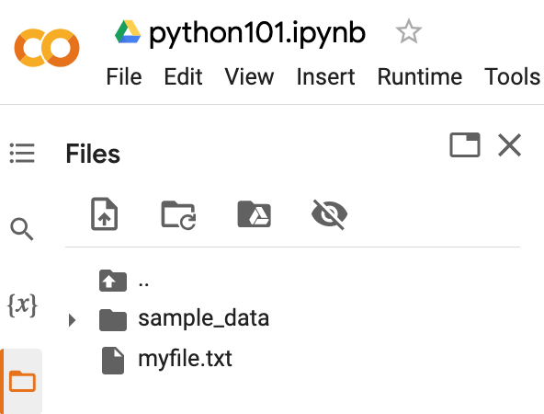
Python Files
# !ls list files
!ls
myfile.txt sample_data
https://tinyurl.com/aintpupython101

Slide 121
Python OS, IO, files, and Google Drive
import os
cwd = os.getcwd()
print(cwd)
/content
https://tinyurl.com/aintpupython101

Slide 122
os.listdir()
os.listdir(cwd)
['.config', 'myfile.txt', 'sample_data']
https://tinyurl.com/aintpupython101

Slide 123
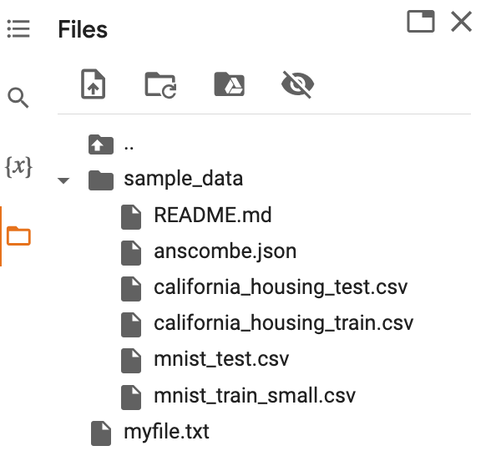
os.path.join()
path = os.path.join(cwd, 'sample_data')
print(path)
os.listdir(path)
/content/sample_data
['README.md', 'anscombe.json', 'mnist_train_small.csv', 'mnist_test.csv', 'california_housing_train.csv', 'california_housing_test.csv']
https://tinyurl.com/aintpupython101

Slide 124
from google.colab import files
from google.colab import files
with open('io_file_myday.txt', 'w') as f:
f.write('Google Colab File Write Text some content Myday')
import time
time.sleep(1) # time sleep 1 second
files.download('io_file_myday.txt')
print('downloaded')
downloaded
https://tinyurl.com/aintpupython101

Slide 125
Python Files
from google.colab import files
uploaded = files.upload()
for fn in uploaded.keys():
print('User uploaded file "{name}" with length {length} bytes'.format(
name=fn, length=len(uploaded[fn])))
User uploaded file "io_file_myday2.txt" with length 47 bytes
https://tinyurl.com/aintpupython101

Slide 126
os.remove()
import os
if os.path.exists("myfile.txt"):
os.remove("myfile.txt")
print("myfile.txt removed")
else:
print("The file does not exist")
myfile.txt removed
https://tinyurl.com/aintpupython101

Slide 127
os.mkdir("myfolder1") os.rmdir("myfolder1")
import os
os.listdir()
os.mkdir("myfolder1")
os.listdir()
os.rmdir("myfolder1")
os.listdir()
https://tinyurl.com/aintpupython101

Slide 128
Python Try Except
The try block lets you test a block of code for errors.
The except block lets you handle the error.
The else block lets you execute code when there is no error.
The finally block lets you execute code, regardless of the result of the try- and except blocks.

Slide 129
Python Try Except (Exception Handling) try: except:
#Python try except
try:
print(x)
except:
print("Exception Error")
https://tinyurl.com/aintpupython101

Slide 130
Python try: except: finally:
#Python try except finally
try:
print("Hello")
except:
print("Exception Error")
finally:
print("Finally process")
Hello
Finally process
https://tinyurl.com/aintpupython101

Slide 131
Python try: except: else:
#Python try except else
try:
print("Hello")
except:
print("Exception Error")
else:
print("No exception")
Hello
No exception
https://tinyurl.com/aintpupython101

Slide 132
Python try: except: else: finally:
try:
print("Hello")
except:
print("Exception Error")
else:
print("No exception")
finally:
print("Finally process")
Hello
No exception
Finally process
https://tinyurl.com/aintpupython101

Slide 133
Python try: except: else: finally:
try:
price = float(input("Enter the price of the stock (e.g. 10):"))
shares = int(input("Enter the number of shares (e.g. 2):"))
total = price * shares
except Exception as e:
print("Exception error:", str(e))
else:
print("The total value of the shares is:", total)
finally:
print("Thank you.")
Enter the price of the stock (e.g. 10):10
Enter the number of shares (e.g. 2):2
The total value of the shares is: 20.0
Thank you.
https://tinyurl.com/aintpupython101

Slide 134
Python try: except: else: finally:
try:
file = open("myfile.txt")
file.write("Python write file")
print("file saved")
except:
print("Exception file Error")
Exception file Error
https://tinyurl.com/aintpupython101

Slide 135
Python try: except: else: finally:
try:
file = open("myfile.txt")
file.write("Python write file")
print("file saved")
except:
print("Exception file Error")
finally:
file.close()
print("Finally process")
Exception file Error
Finally process
https://tinyurl.com/aintpupython101

Slide 136
Python try: except: else: finally:
try:
file = open("myfile.txt", 'w’)
file.write("Python write file")
print("file saved")
except:
print("Exception file Error")
finally:
file.close()
print("Finally process")
file saved
Finally process
https://tinyurl.com/aintpupython101

Slide 137
Summary
Python Functions: def myfunction():
Python Classes/Objects: class MyClass:
Python Modules: import mymodule
Python Files (File Handling): open()
Python Try Except (Exception Handling):
  try: except: else: finally:

Slide 138
References
Wes McKinney (2022), "Python for Data Analysis: Data Wrangling with pandas, NumPy, and Jupyter", 3rd Edition, O'Reilly Media.
Aurélien Géron (2023), Hands-On Machine Learning with Scikit-Learn, Keras, and TensorFlow: Concepts, Tools, and Techniques to Build Intelligent Systems, 3rd Edition, O’Reilly Media.
Steven D'Ascoli (2022), Artificial Intelligence and Deep Learning with Python: Every Line of Code Explained For Readers New to AI and New to Python, Independently published.
Stuart Russell and Peter Norvig (2020), Artificial Intelligence: A Modern Approach, 4th Edition, Pearson.
Denis Rothman (2024), Transformers for Natural Language Processing and Computer Vision - Third Edition: Explore Generative AI and Large Language Models with Hugging Face, ChatGPT, GPT-4V, and DALL-E 3, 3rd ed. Edition, Packt Publishing
Ben Auffarth (2023), Generative AI with LangChain: Build large language model (LLM) apps with Python, ChatGPT and other LLMs, Packt Publishing.
Varun Grover, Roger HL Chiang, Ting-Peng Liang, and Dongsong Zhang (2018), "Creating Strategic Business Value from Big Data Analytics: A Research Framework", Journal of Management Information Systems, 35, no. 2, pp. 388-423.
Junliang Wang, Chuqiao Xu, Jie Zhang, and Ray Zhong (2022). "Big data analytics for intelligent manufacturing systems: A review." Journal of Manufacturing Systems 62 (2022): 738-752.
Ramesh Sharda, Dursun Delen, and Efraim Turban (2017), Business Intelligence, Analytics, and Data Science: A Managerial Perspective, 4th Edition, Pearson
Python Programming, https://pythonprogramming.net/
Python, https://www.python.org/
Python Programming Language, http://pythonprogramminglanguage.com/
Numpy, http://www.numpy.org/
Pandas, http://pandas.pydata.org/
Skikit-learn, http://scikit-learn.org/
W3Schools Python, https://www.w3schools.com/python/
Learn Python, https://www.learnpython.org/
Google’s Python Class, https://developers.google.com/edu/python
Harvard University (2024), CS50x 2024 - Lecture 6 - Python, http://www.youtube.com/watch?v=EHi0RDZ31VA
Min-Yuh Day (2024), Python 101, https://tinyurl.com/aintpupython101

