Slide 1







Obtaining Data From the Web with Python
Statistical Analysis with Python
Python for Accounting Applications
1131PAA07
ACC2, NTPU (U2004) (Fall 2024)
Wed 6, 7, 8, (14:10-17:00) (9:10-12:00) (B3F10)
Min-Yuh Day, Ph.D,
Professor
Institute of Information Management, National Taipei University
https://web.ntpu.edu.tw/~myday
2024-11-20

Slide 2
Syllabus
Week Date Subject/Topics
1 2024/09/11 Introduction to Python for Accounting Applications
2 2024/09/18 Python Programming and Data Science
3 2024/09/25 Foundations of Python Programming
4 2024/10/02 Data Structures
5 2024/10/09 Control Logic and Loops
6 2024/10/16 Functions and Modules; Files and Exception Handling
7 2024/10/23 Data Analytics and Visualization with Python
8 2024/10/30 Midterm Project Report (Self-Learning)

Slide 3
Syllabus
Week Date Subject/Topics
9 2024/11/06 Self-Learning
10 2024/11/13 Midterm Project Report
11 2024/11/20 Obtaining Data From the Web with Python;
Statistical Analysis with Python
12 2024/11/27 Machine Learning with Python
13 2024/12/04 Text Analytics with Generative AI and Python
14 2024/12/11 Applications of Accounting Data Analytics with Python
15 2024/12/18 Applications of ESG Data Analytics with Python
16 2024/12/25 Final Project Report

Slide 4
Obtaining Data From the Web with Python
Statistical Analysis with Python

Slide 5
Outline
Obtaining Data From the Web with Python
  Requests
  BeautifulSoup
  Pandas
Statistical Analysis with Python
  Descriptive Statistics
  Inferential Statistics

Slide 6
Statistical Analysis with Python
  Descriptive Statistics
    df.describe()
    df.mean(), df.std() df.median() df.max() df.min()
    df.skew(), df.kurtosis()
  Inferential Statistics
    import scipy.stats as stats
    t_statistic, p_value = stats.ttest_ind(ga, gb)

Slide 7

Python
Programming

Slide 8

Top Programming Languages
https://spectrum.ieee.org/the-top-programming-languages-2023

Slide 9
Python is an interpreted, object-oriented, high-level programming language with dynamic semantics.
Source: https://www.python.org/doc/essays/blurb/

Slide 10

Python Ecosystem for Data Science
Source: https://medium.com/pyfinance/why-python-is-best-choice-for-financial-data-modeling-in-2019-c0d0d1858c45

Slide 11


Python Ecosystem for Data Science
Source:https://duchesnay.github.io/pystatsml/introduction/python_ecosystem.html

Slide 12


The Quant Finance PyData Stack
Source: http://nbviewer.jupyter.org/format/slides/github/quantopian/pyfolio/blob/master/pyfolio/examples/overview_slides.ipynb#/5

Slide 13
Numpy
NumPy
Base
N-dimensional array package

Slide 14
Python matplotlib
Source: https://matplotlib.org/

Slide 15
Python Pandas
http://pandas.pydata.org/

Slide 16

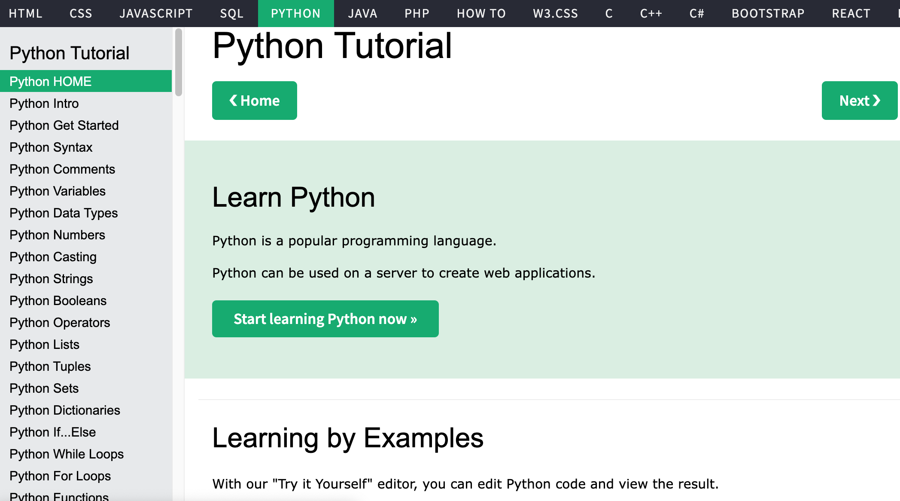
W3Schools Python
https://www.w3schools.com/python/

Slide 17
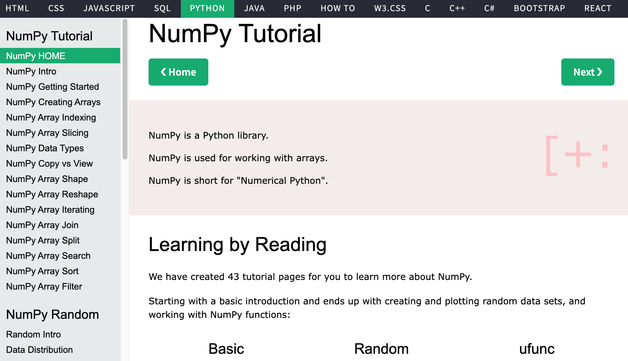
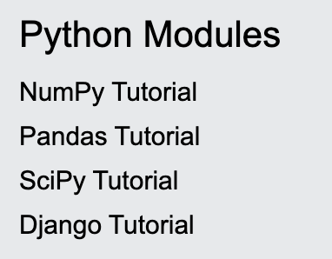
W3Schools Python Numpy
https://www.w3schools.com/python/numpy/default.asp

Slide 18
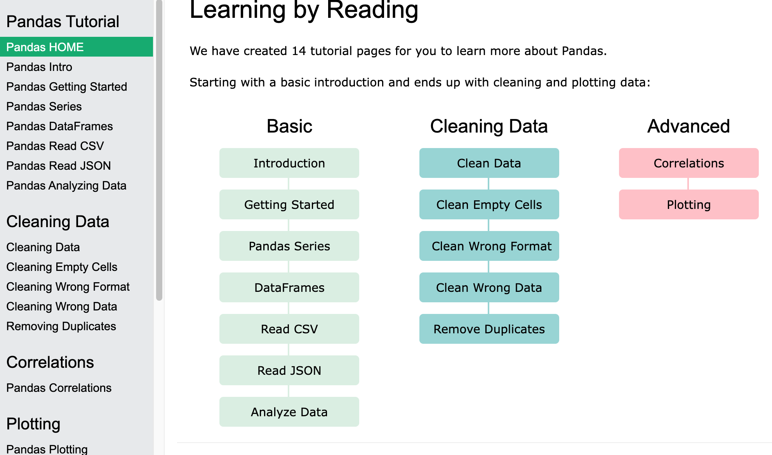
W3Schools Python Pandas
Pandas Tutorial
https://www.w3schools.com/python/pandas/default.asp

Slide 19
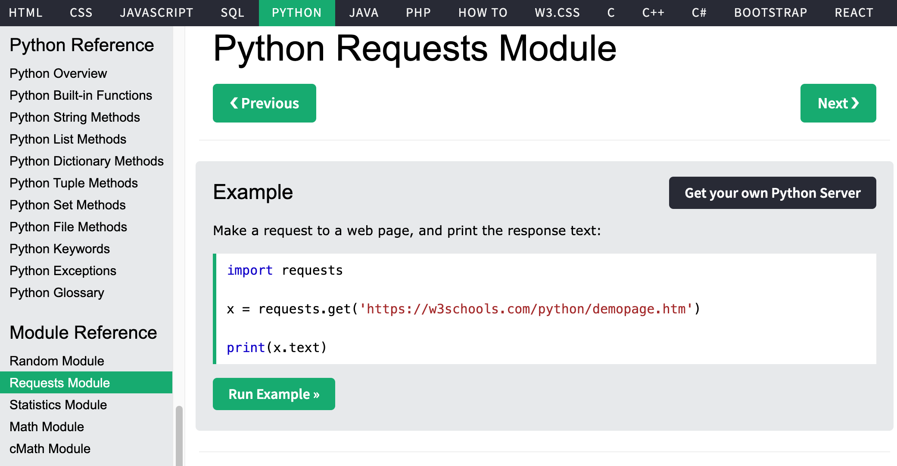
W3Schools Python Requests Module
https://www.w3schools.com/python/

Slide 20

W3Schools Python: Try Python
https://www.w3schools.com/python/trypython.asp?filename=demo_default

Slide 21

LearnPython.org
https://www.learnpython.org/

Slide 22

Google’s Python Class
https://developers.google.com/edu/python

Slide 23

Google Colab
https://colab.research.google.com/notebooks/welcome.ipynb

Slide 24

Connect Google Colab in Google Drive

Slide 25

Google Colab

Slide 26

Google Colab

Slide 27

Connect Colaboratory to Google Drive

Slide 28

Google Colab

Slide 29

Google Colab

Slide 30

Google Colab

Slide 31

Run Jupyter Notebook
Python3 GPU
Google Colab

Slide 32

Google Colab Python Hello World print('Hello World')

Slide 33

Python in Google Colab (Python101)
https://colab.research.google.com/drive/1FEG6DnGvwfUbeo4zJ1zTunjMqf2RkCrT
https://tinyurl.com/aintpupython101

Slide 34
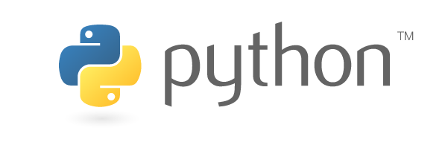
Source: https://www.python.org/community/logos/

Slide 35
Python
Programming

Slide 36
Data Analytics and
Visualization with Python

Slide 37
Data Analytics and Visualization with Python
NumPy
  Numerical Python N-dimensional array
Pandas
  Data Analytics
Matplotlib
  Basic Data Visualization
Seaborn
  Advanced Visualization

Slide 38
W3Schools Python Numpy
https://www.w3schools.com/python/numpy/default.asp

Slide 39
W3Schools Python Pandas
Pandas Tutorial
https://www.w3schools.com/python/pandas/default.asp

Slide 40
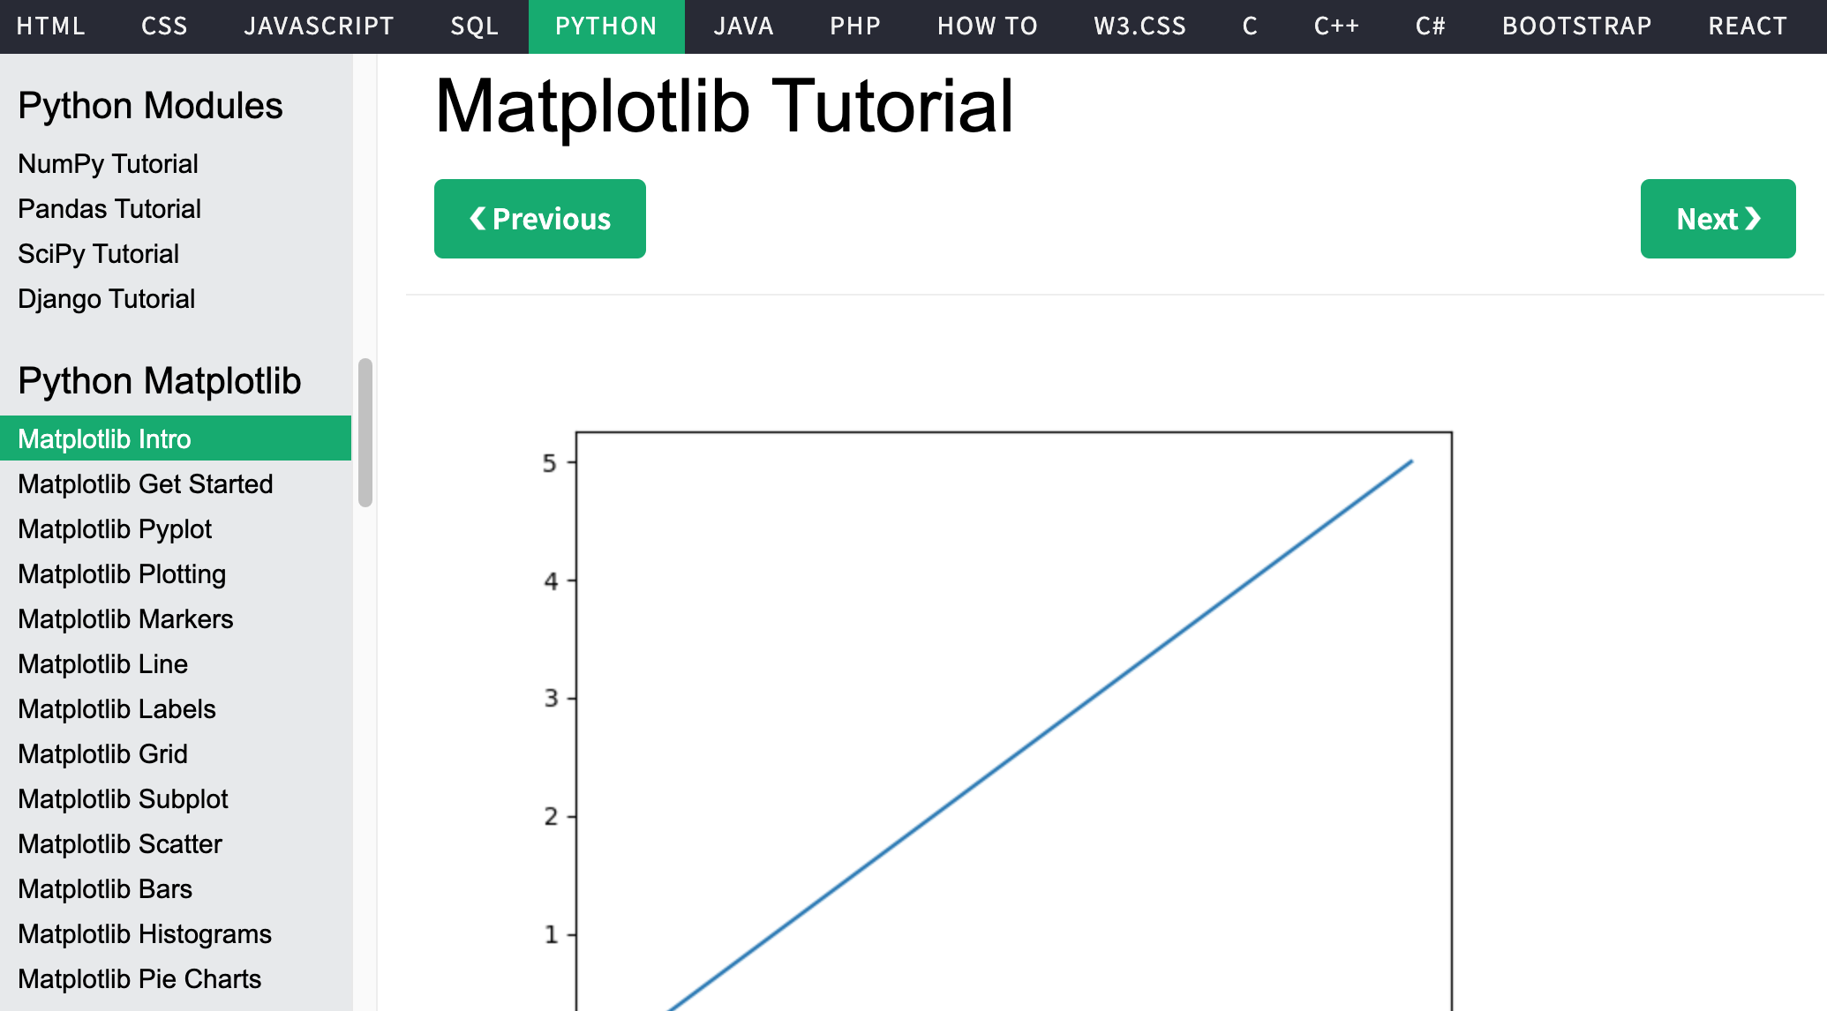
W3Schools Python
https://www.w3schools.com/python/

Slide 41
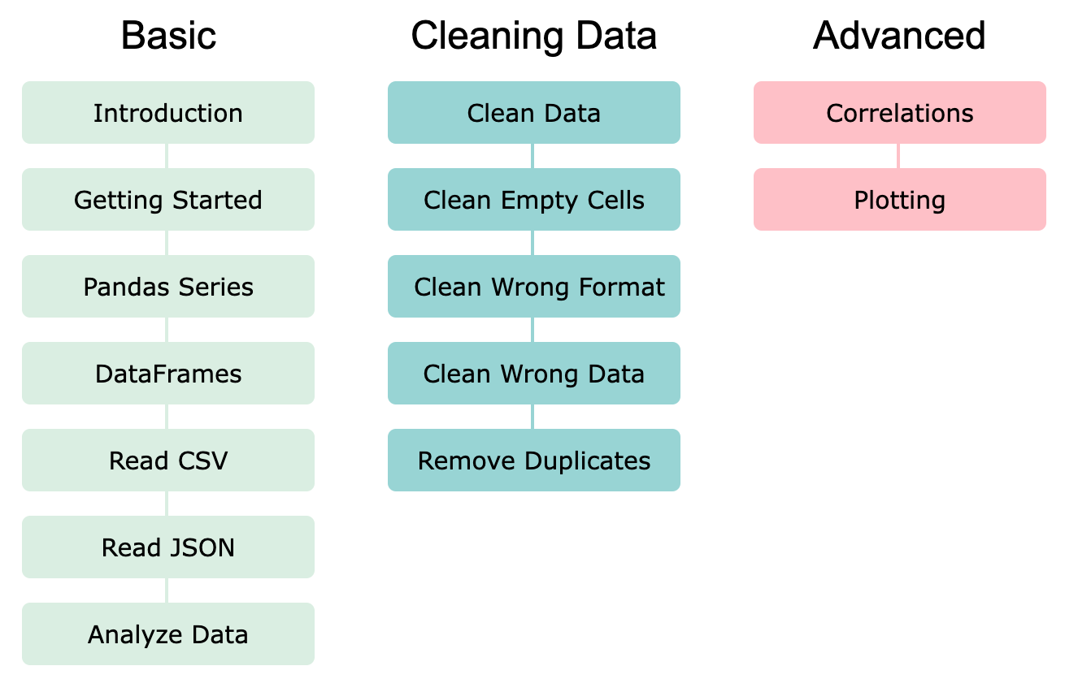
Pandas: Data Analytics and Visualization
https://www.w3schools.com/python/pandas/default.asp

Slide 42
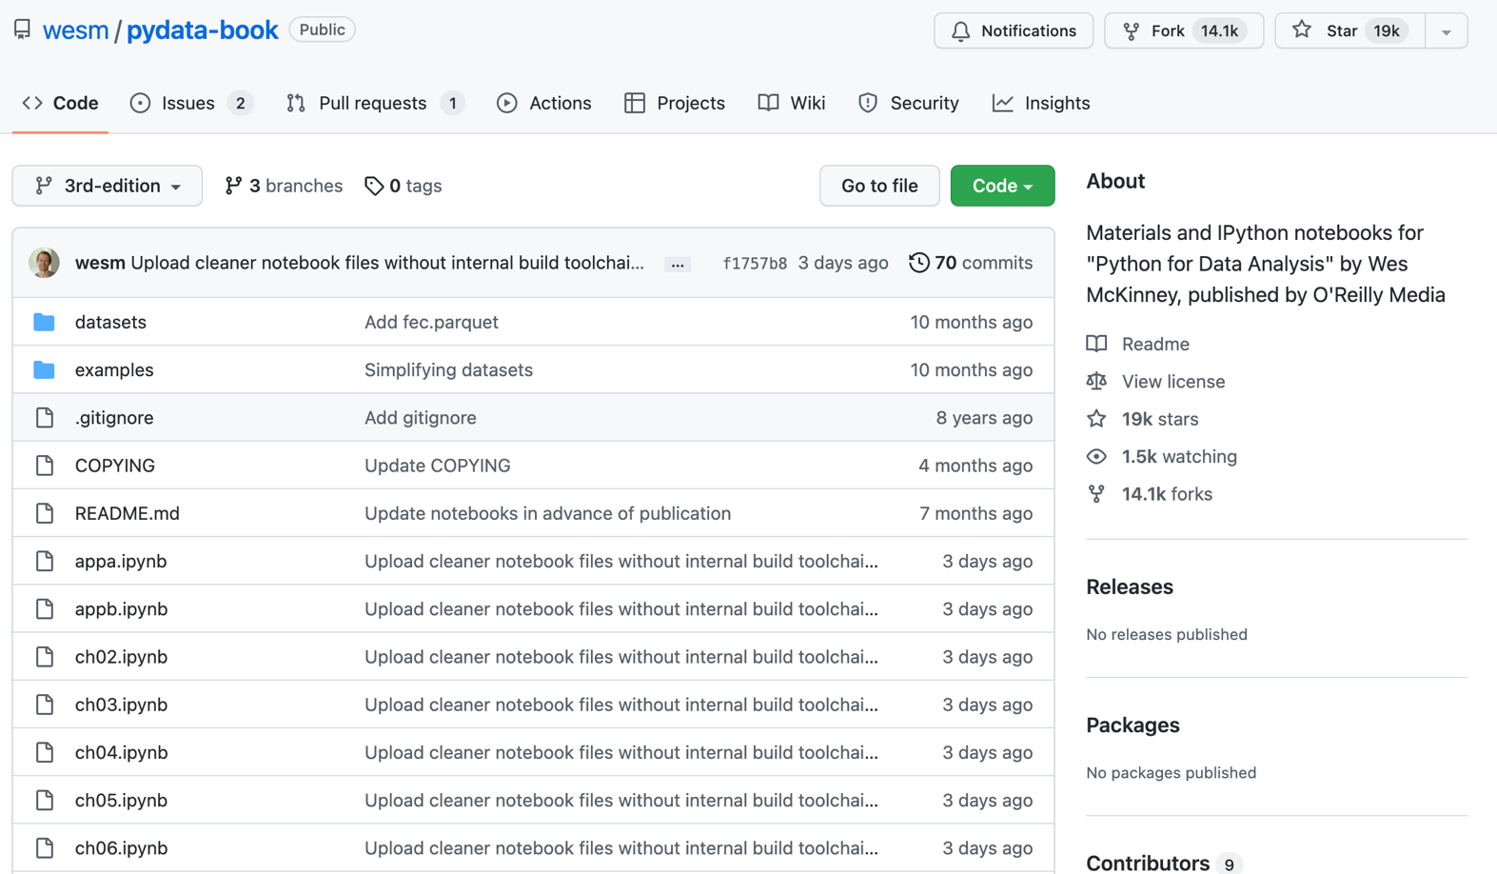
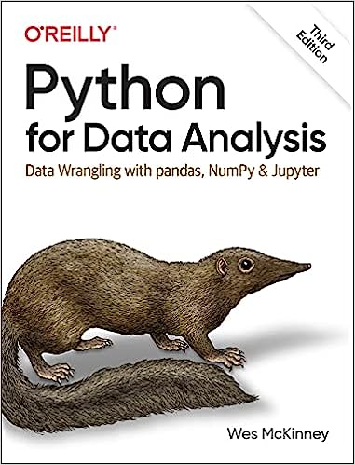
Wes McKinney (2022), "Python for Data Analysis: Data Wrangling with pandas, NumPy, and Jupyter", 3rd Edition, O'Reilly Media.
https://github.com/wesm/pydata-book

Slide 43
Numpy
NumPy
Base
N-dimensional array package

Slide 44
NumPy is the fundamental package for scientific computing with Python.
Source: http://www.numpy.org/

Slide 45
NumPy
NumPy
NumPy provides a
multidimensional array object
to store homogenous or heterogeneous data;
it also provides
optimized functions/methods to operate on this array object.
Source: Yves Hilpisch (2014), Python for Finance: Analyze Big Financial Data, O'Reilly

Slide 46
NumPy ndarray
NumPy
One-dimensional Array
(1-D Array)
0 | 1 |  |  | n-1
1 | 2 | 3 | 4 | 5
Two-dimensional Array
(2-D Array)
 | 0 | 1 |  |  | n-1
0 | 1 | 2 | 3 | 4 | 5
1 | 6 | 7 | 8 | 9 | 10
 | 11 | 12 | 13 | 14 | 15
m-1 | 16 | 17 | 18 | 19 | 20

Slide 47
v = list(range(1, 6)) v
2 * v import numpy as np v = np.arange(1, 6) v
2 * v
NumPy
NumPy
Source: Yves Hilpisch (2014), Python for Finance: Analyze Big Financial Data, O'Reilly
Notes:
# pip3 install numpy
# pip install numpy
# sudo pip3 install numpy
import numpy as np

Slide 48
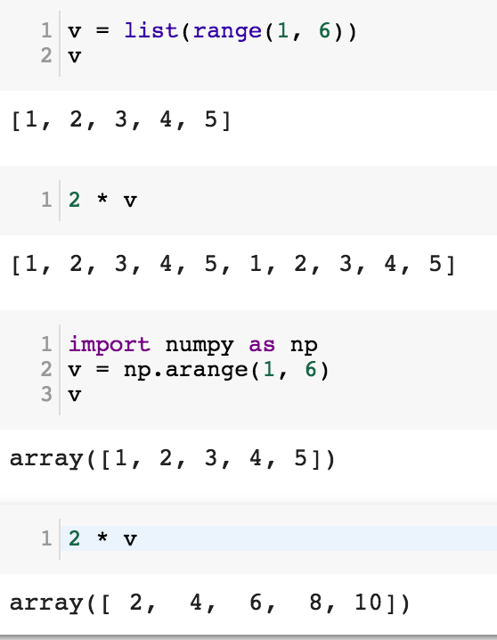
NumPy
Base
N-dimensional array package

Slide 49
Python Data Structures
fruits = ["apple", "banana", "cherry"] #lists []
colors = ("red", "green", "blue") #tuples ()
animals = {'cat', 'dog'} #sets {}
person = {"name" : "Tom", "age" : 20} #dictionaries {}
https://tinyurl.com/aintpupython101

Slide 50
Lists []
x = [60, 70, 80, 90]
print(len(x))
print(x[0])
print(x[1])
print(x[-1])
4
60
70
90

Slide 51
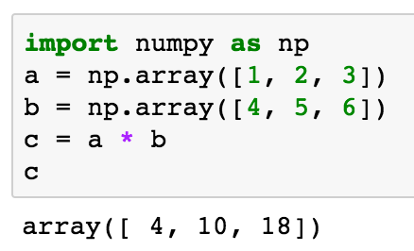
import numpy as np a = np.array([1, 2, 3]) b = np.array([4, 5, 6]) c = a * b c
NumPy Create Array
NumPy
Source: Yves Hilpisch (2014), Python for Finance: Analyze Big Financial Data, O'Reilly

Slide 52
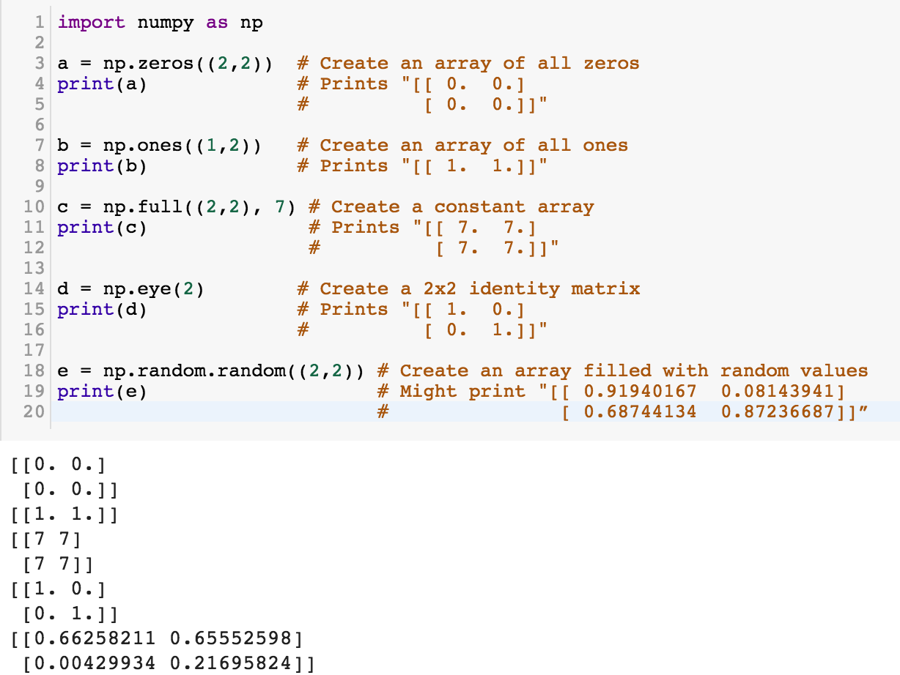
NumPy
NumPy
Source: http://cs231n.github.io/python-numpy-tutorial/
Notes:
import numpy as np
a = np.zeros((2,2)) # Create an array of all zeros
print(a) # Prints "[[ 0. 0.]
# [ 0. 0.]]"
b = np.ones((1,2)) # Create an array of all ones
print(b) # Prints "[[ 1. 1.]]"
c = np.full((2,2), 7) # Create a constant array
print(c) # Prints "[[ 7. 7.]
# [ 7. 7.]]"
d = np.eye(2) # Create a 2x2 identity matrix
print(d) # Prints "[[ 1. 0.]
# [ 0. 1.]]"
e = np.random.random((2,2)) # Create an array filled with random values
print(e) # Might print "[[ 0.91940167 0.08143941]
# [ 0.68744134 0.87236687]]”
Source: http://cs231n.github.io/python-numpy-tutorial/

Slide 53
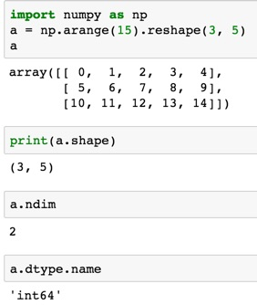
import numpy as np
a = np.arange(15).reshape(3, 5)
a.shape
a.ndim
a.dtype.name
Source: https://docs.scipy.org/doc/numpy-dev/user/quickstart.html
Notes:
Numpy Tutorial
Source: https://docs.scipy.org/doc/numpy-dev/user/quickstart.html
In [1]:
import numpy as np
a = np.arange(15).reshape(3, 5)
a
Out[1]:
array([[ 0, 1, 2, 3, 4],
[ 5, 6, 7, 8, 9],
[10, 11, 12, 13, 14]])
In [2]:
print(a.shape)
(3, 5)
In [3]:
a.ndim
Out[3]:
2
In [4]:
a.dtype.name
Out[4]:
'int64'
In [5]:
a.itemsize
Out[5]:
8
In [6]:
a.size
Out[6]:
15
In [7]:
type(a)
Out[7]:
numpy.ndarray
In [8]:
b = np.array([1, 2, 3])
In [9]:
b
Out[9]:
array([1, 2, 3])
In [10]:
type(b)
Out[10]:
numpy.ndarray

Slide 54
Matrix
Source: https://simple.wikipedia.org/wiki/Matrix_(mathematics)

Slide 55
NumPy ndarray:
Multidimensional Array Object

Slide 56
NumPy ndarray
One-dimensional Array
(1-D Array)
0 | 1 |  |  | n-1
1 | 2 | 3 | 4 | 5
Two-dimensional Array
(2-D Array)
 | 0 | 1 |  |  | n-1
0 | 1 | 2 | 3 | 4 | 5
1 | 6 | 7 | 8 | 9 | 10
 | 11 | 12 | 13 | 14 | 15
m-1 | 16 | 17 | 18 | 19 | 20

Slide 57

import numpy as np a = np.array([1,2,3,4,5])
One-dimensional Array
(1-D Array)
0 | 1 |  |  | n-1
1 | 2 | 3 | 4 | 5

Slide 58
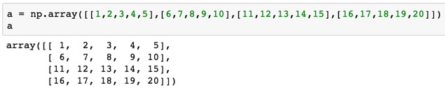
a = np.array([[1,2,3,4,5],[6,7,8,9,10],[11,12,13,14,15],[16,17,18,19,20]])
Two-dimensional Array
(2-D Array)
 | 0 | 1 |  |  | n-1
0 | 1 | 2 | 3 | 4 | 5
1 | 6 | 7 | 8 | 9 | 10
 | 11 | 12 | 13 | 14 | 15
m-1 | 16 | 17 | 18 | 19 | 20

Slide 59
import numpy as np
a = np.array([[0, 1, 2, 3], [10, 11, 12, 13],
[20, 21, 22, 23]])
a
0 | 1 | 2 | 3
10 | 11 | 12 | 13
20 | 21 | 22 | 23
Notes:
import numpy as np
a = np.array([[0, 1, 2, 3], [10, 11, 12, 13],
[20, 21, 22, 23]])
a

Slide 60
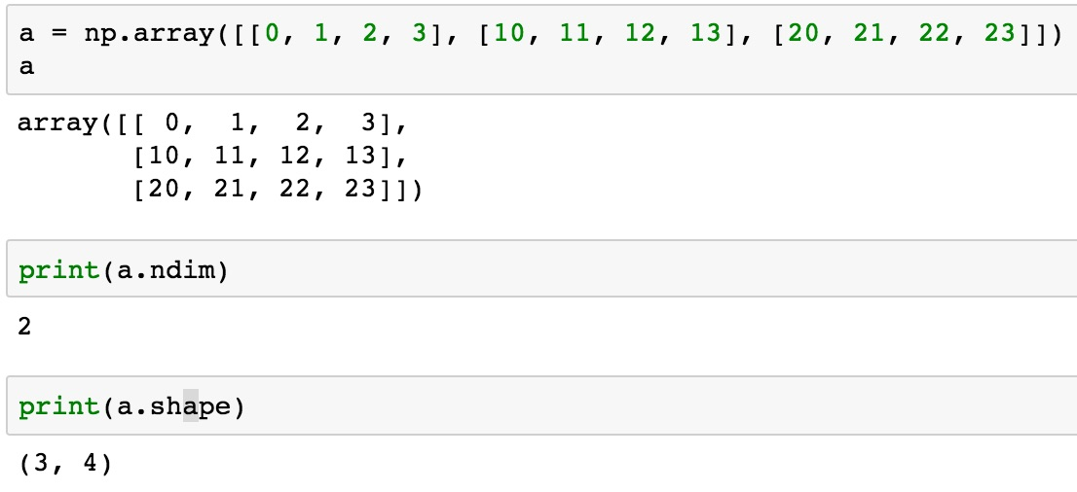
a = np.array([[0, 1, 2, 3], [10, 11, 12, 13], [20, 21, 22, 23]])
0 | 1 | 2 | 3
10 | 11 | 12 | 13
20 | 21 | 22 | 23

Slide 61
NumPy Basics:
Arrays and Vectorized Computation
Source: https://www.safaribooksonline.com/library/view/python-for-data/9781449323592/ch04.html

Slide 62
NumPy Array
Source: https://www.safaribooksonline.com/library/view/python-for-data/9781449323592/ch04.html

Slide 63
Numpy Array
Source: https://www.safaribooksonline.com/library/view/python-for-data/9781449323592/ch04.html

Slide 64

Tensor
3
  a rank 0 tensor; this is a scalar with shape []
[1. ,2., 3.]
  a rank 1 tensor; this is a vector with shape [3]
[[1., 2., 3.], [4., 5., 6.]]
  a rank 2 tensor; a matrix with shape [2, 3]
[[[1., 2., 3.]], [[7., 8., 9.]]]
  a rank 3 tensor with shape [2, 1, 3]
https://www.tensorflow.org/

Slide 65
Scalar
80
Vector
[50 60 70]
Matrix
50 60 70
55 65 75
[50 60 70] [70 80 90]
[55 65 75] [75 85 95]
Tensor

Slide 66

pandas
Python Data Analysis Library providing high-performance, easy-to-use data structures and data analysis tools for the Python programming language.
Source: http://pandas.pydata.org/

Slide 67
pandas: powerful Python data analysis toolkit
Tabular data with
heterogeneously-typed columns,
as in an SQL table or Excel spreadsheet
Ordered and unordered (not necessarily fixed-frequency) time series data.
Arbitrary matrix data (homogeneously typed or heterogeneous) with row and column labels
Any other form of observational / statistical data sets. The data actually need not be labeled at all to be placed into a pandas data structure
Source: http://pandas.pydata.org/pandas-docs/stable/

Slide 68
Series
DataFrame
Primary data structures of pandas
  Series (1-dimensional)
  DataFrame (2-dimensional)
Handle the vast majority of typical use cases in finance, statistics, social science, and many areas of engineering.
Source: http://pandas.pydata.org/pandas-docs/stable/

Slide 69
pandas DataFrame
DataFrame provides everything that R’s data.frame provides and much more.
pandas is built on top of NumPy and is intended to integrate well within a scientific computing environment with many other 3rd party libraries.

Slide 70
pandas
Comparison with SAS
pandas | SAS
DataFrame | data set
column | variable
row | observation
groupby | BY-group
NaN | .
Source: http://pandas.pydata.org/pandas-docs/stable/comparison_with_sas.html

Slide 71
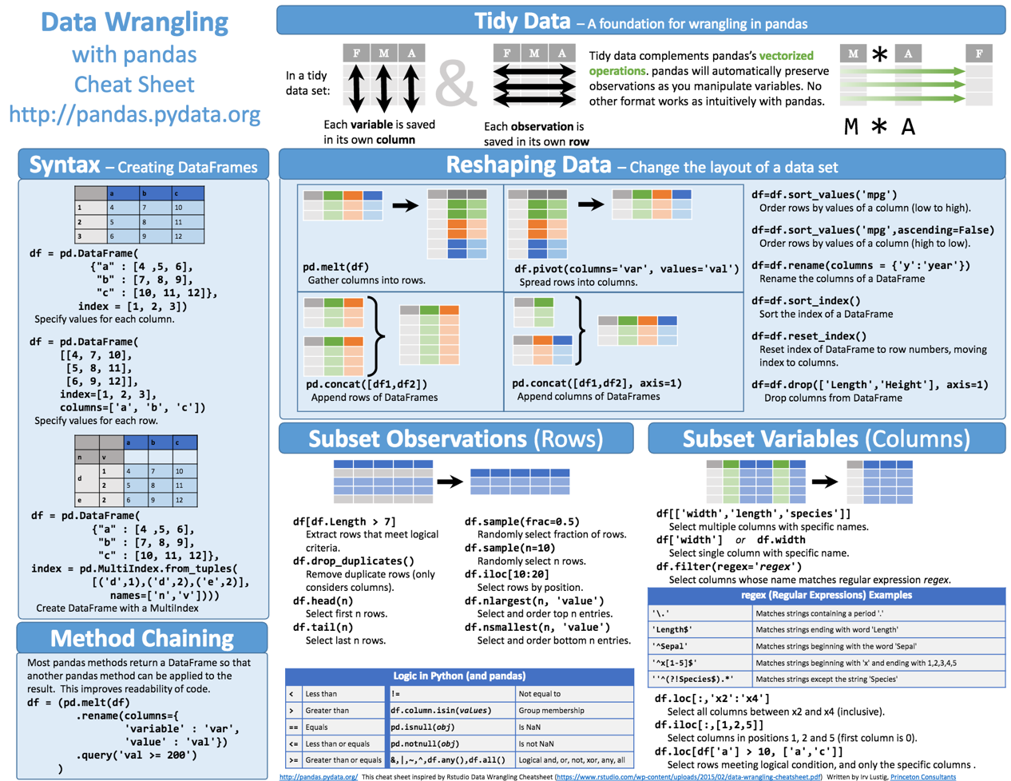
Python Pandas Cheat Sheet
Source: https://github.com/pandas-dev/pandas/blob/master/doc/cheatsheet/Pandas_Cheat_Sheet.pdf

Slide 72
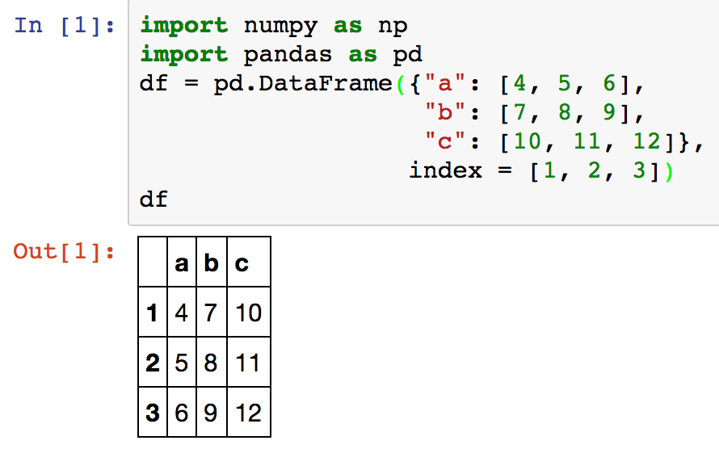
Creating pd.DataFrame
 | a | b | c
1 | 4 | 7 | 10
2 | 5 | 8 | 11
3 | 6 | 9 | 12
import pandas as pd
df = pd.DataFrame({"a": [4, 5, 6],
"b": [7, 8, 9],
"c": [10, 11, 12]},
index = [1, 2, 3])
Source: https://github.com/pandas-dev/pandas/blob/master/doc/cheatsheet/Pandas_Cheat_Sheet.pdf
Notes:
import numpy as np
import pandas as pd
df = pd.DataFrame({"a": [4, 5, 6],
"b": [7, 8, 9],
"c": [10, 11, 12]},
index = [1, 2, 3])
df

Slide 73
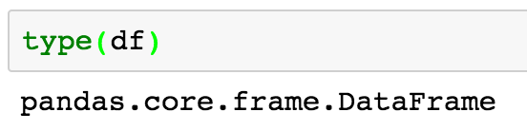
Pandas DataFrame
type(df)

Slide 74
import numpy as np
import pandas as pd
import matplotlib.pyplot as plt
print('pandas imported')
s = pd.Series([1,3,5,np.nan,6,8])
s
dates = pd.date_range('20181001', periods=6)
dates
Source: http://pandas.pydata.org/pandas-docs/stable/10min.html

Slide 75
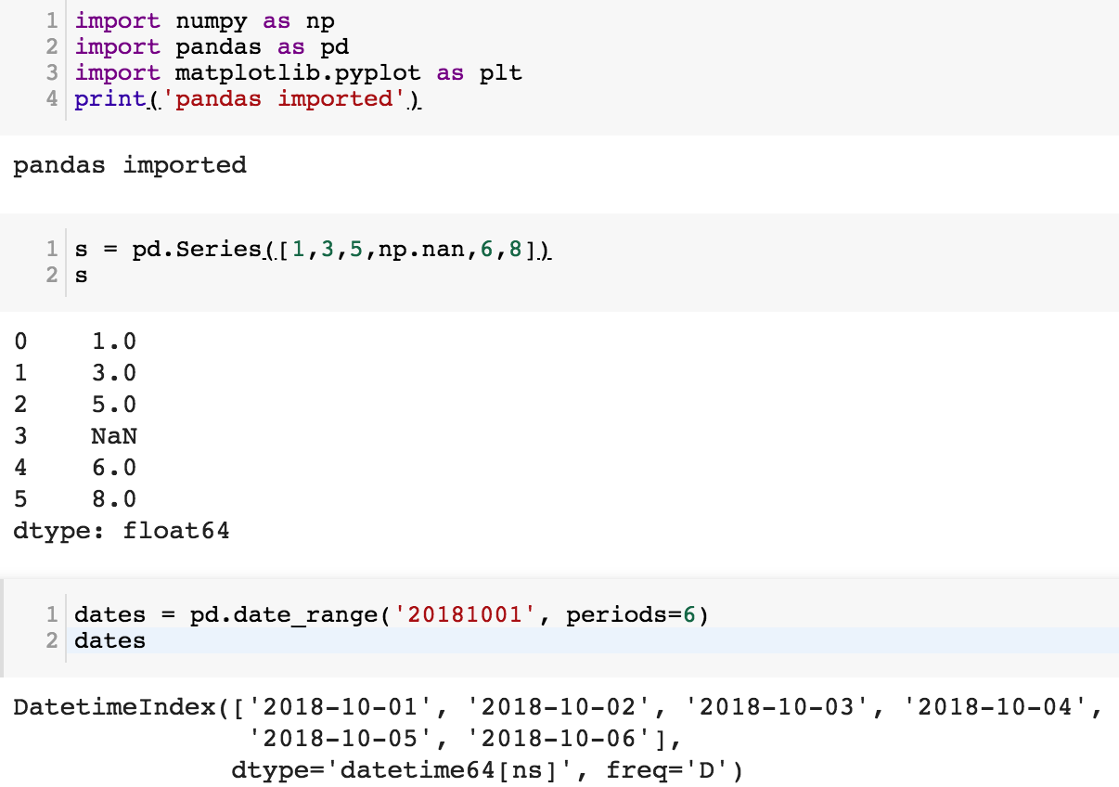

Slide 76
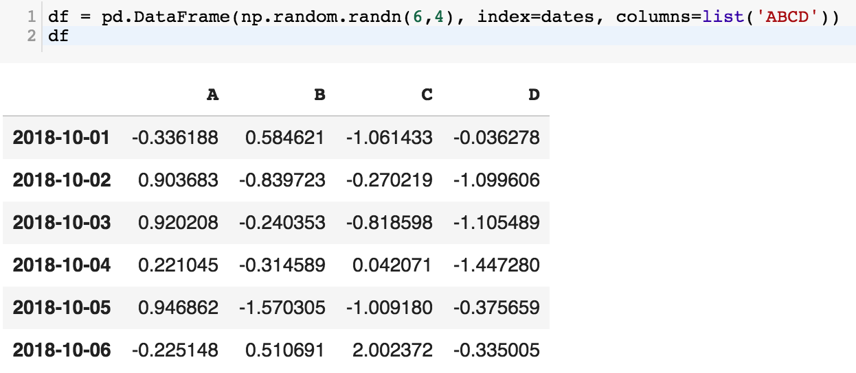
df = pd.DataFrame(np.random.randn(6,4), index=dates, columns=list('ABCD'))
df

Slide 77
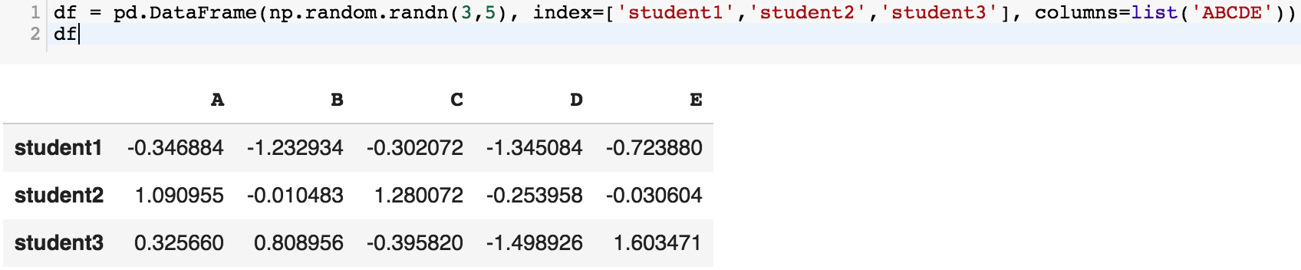
df = pd.DataFrame(np.random.randn(3,5), index=['student1','student2','student3'], columns=list('ABCDE'))
df

Slide 78
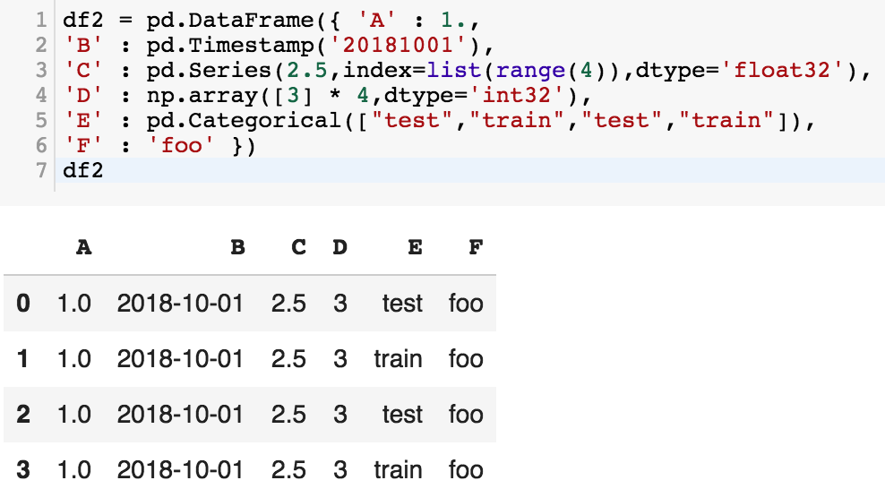
df2 = pd.DataFrame({ 'A' : 1.,
'B' : pd.Timestamp('20181001'),
'C' : pd.Series(2.5,index=list(range(4)),dtype='float32'),
'D' : np.array([3] * 4,dtype='int32'),
'E' : pd.Categorical(["test","train","test","train"]),
'F' : 'foo' })
df2

Slide 79
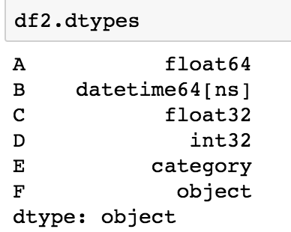
df2.dtypes

Slide 80
Python Accounting Application with Pandas
import pandas as pd
# Create a DataFrame to store transactions
columns = ['Date', 'Description', 'Amount']
ledger = pd.DataFrame(columns=columns)
# Function to add a transaction
def add_transaction(date, description, amount):
global ledger
new_transaction = pd.DataFrame([[date, description, amount]], columns=columns)
ledger = pd.concat([ledger, new_transaction], ignore_index=True)
# Function to view the ledger
def view_ledger():
print(ledger)
# Function to get the current balance
def get_balance():
return ledger['Amount'].sum()
# Adding sample transactions
add_transaction('2023-11-01', 'Income', 1000)
add_transaction('2023-11-02', 'Groceries', -200)
add_transaction('2023-11-03', 'Utilities', -100)
# Viewing the ledger
view_ledger()
# Checking the current balance
print("Current Balance:", get_balance())
Date Description Amount
0 2023-11-01 Income 1000
1 2023-11-02 Groceries -200
2 2023-11-03 Utilities -100
Current Balance: 700
https://tinyurl.com/aintpupython101

Slide 81

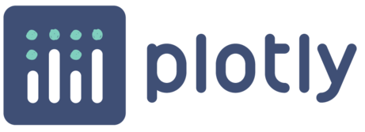




Python Data Analysis and Visualization
Altair

Slide 82
Python Pandas
http://pandas.pydata.org/

Slide 83
Python matplotlib
Source: https://matplotlib.org/

Slide 84
Python seaborn
Source: https://seaborn.pydata.org/

Slide 85
Python plotly
Source: https://plotly.com/python/

Slide 86
Python bokeh
Source: https://bokeh.org/

Slide 87
Python
Altair
Altair
Source: https://altair-viz.github.io/

Slide 88
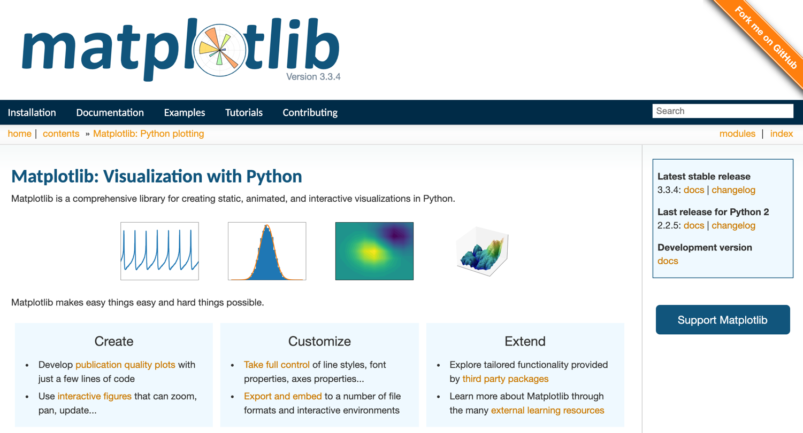
Python matplotlib
https://matplotlib.org/

Slide 89

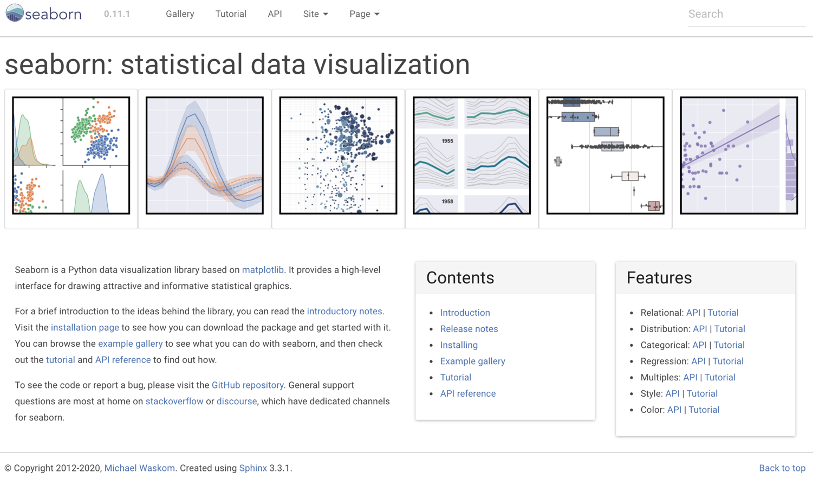
Python Seaborn
https://seaborn.pydata.org/

Slide 90

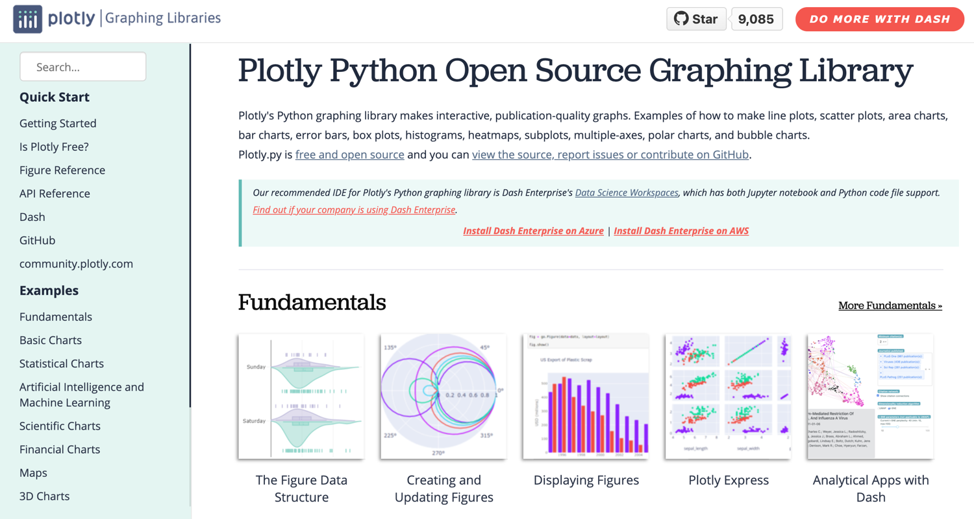
Python Plotly Graphing Library
https://plotly.com/python/

Slide 91
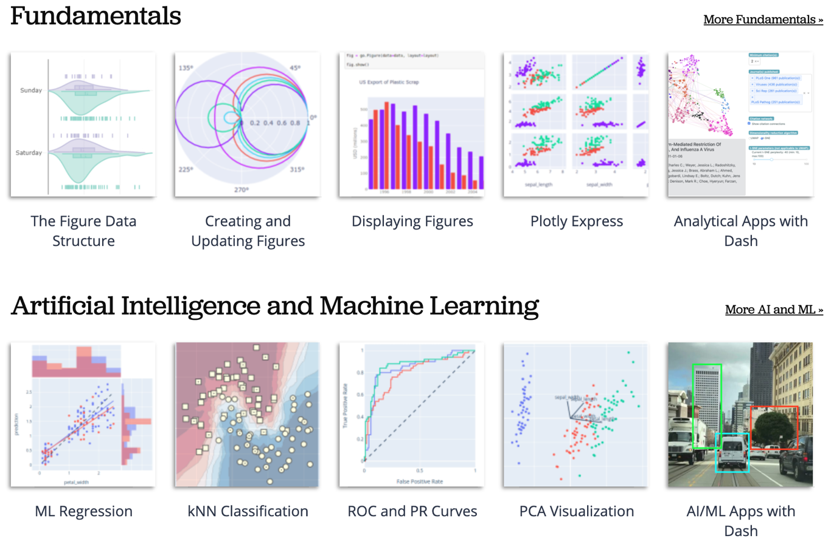
Python Plotly Graphing Library
https://plotly.com/python/

Slide 92
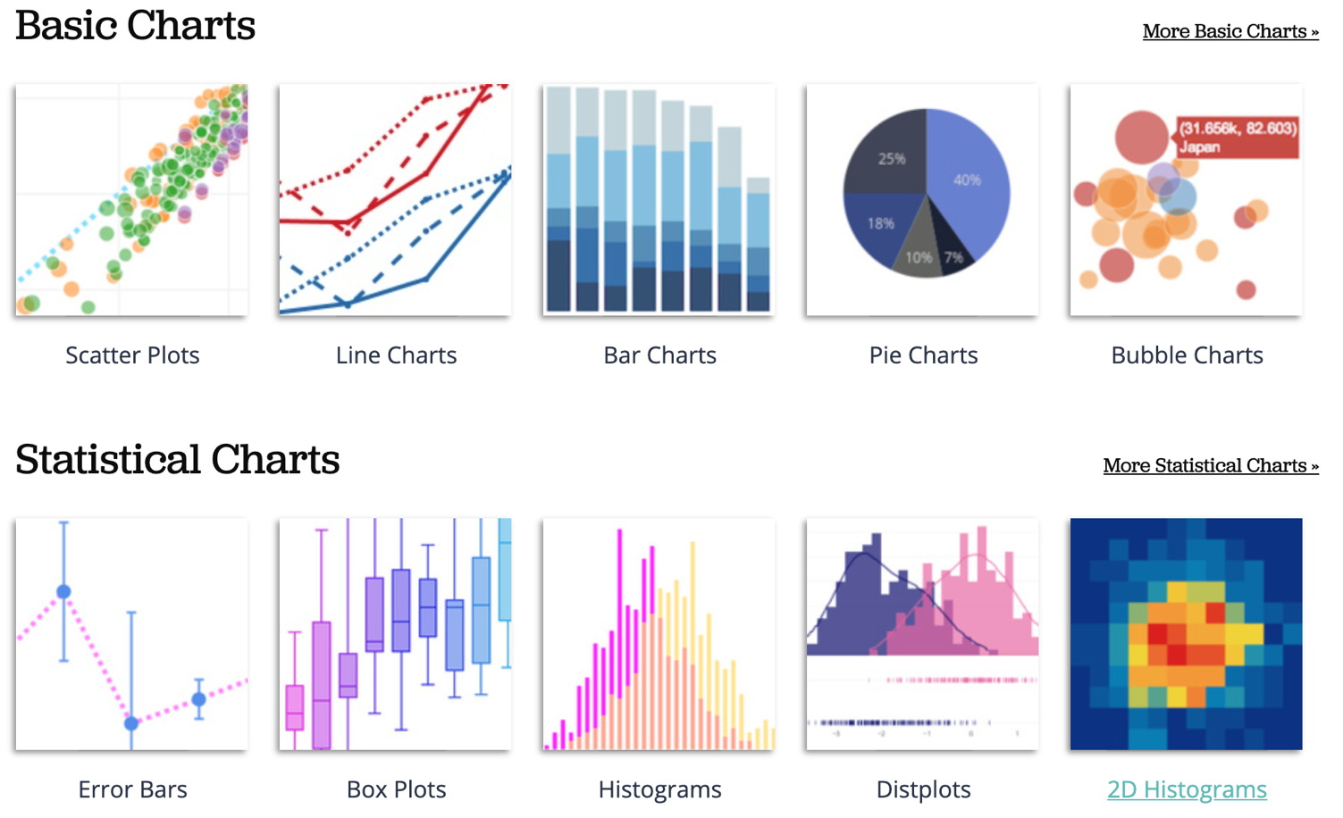
Python Plotly Graphing Library
https://plotly.com/python/

Slide 93
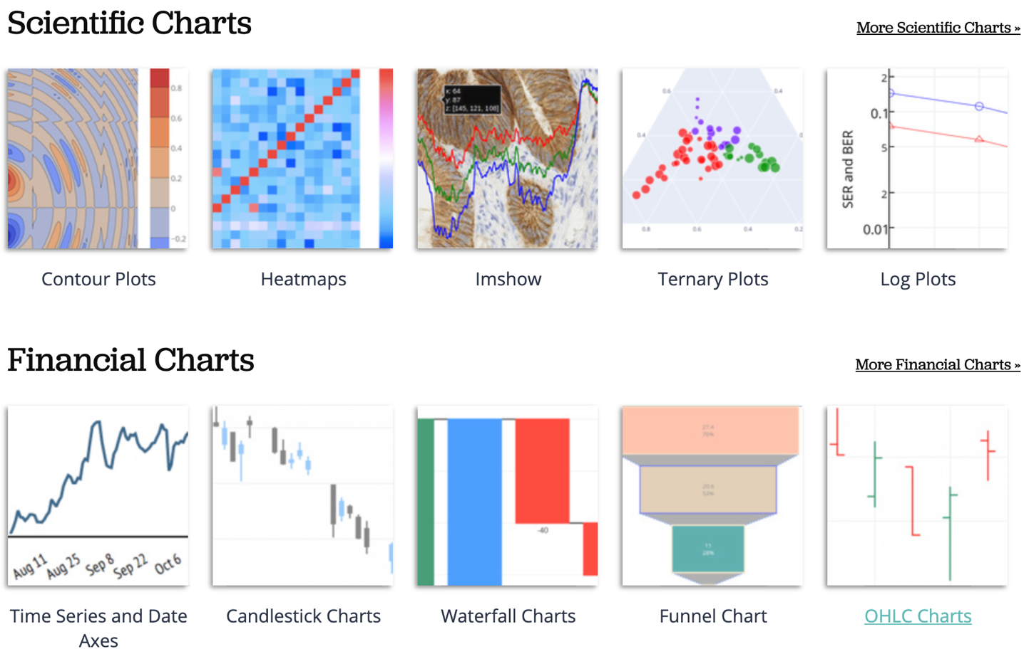
Python Plotly Graphing Library
https://plotly.com/python/

Slide 94
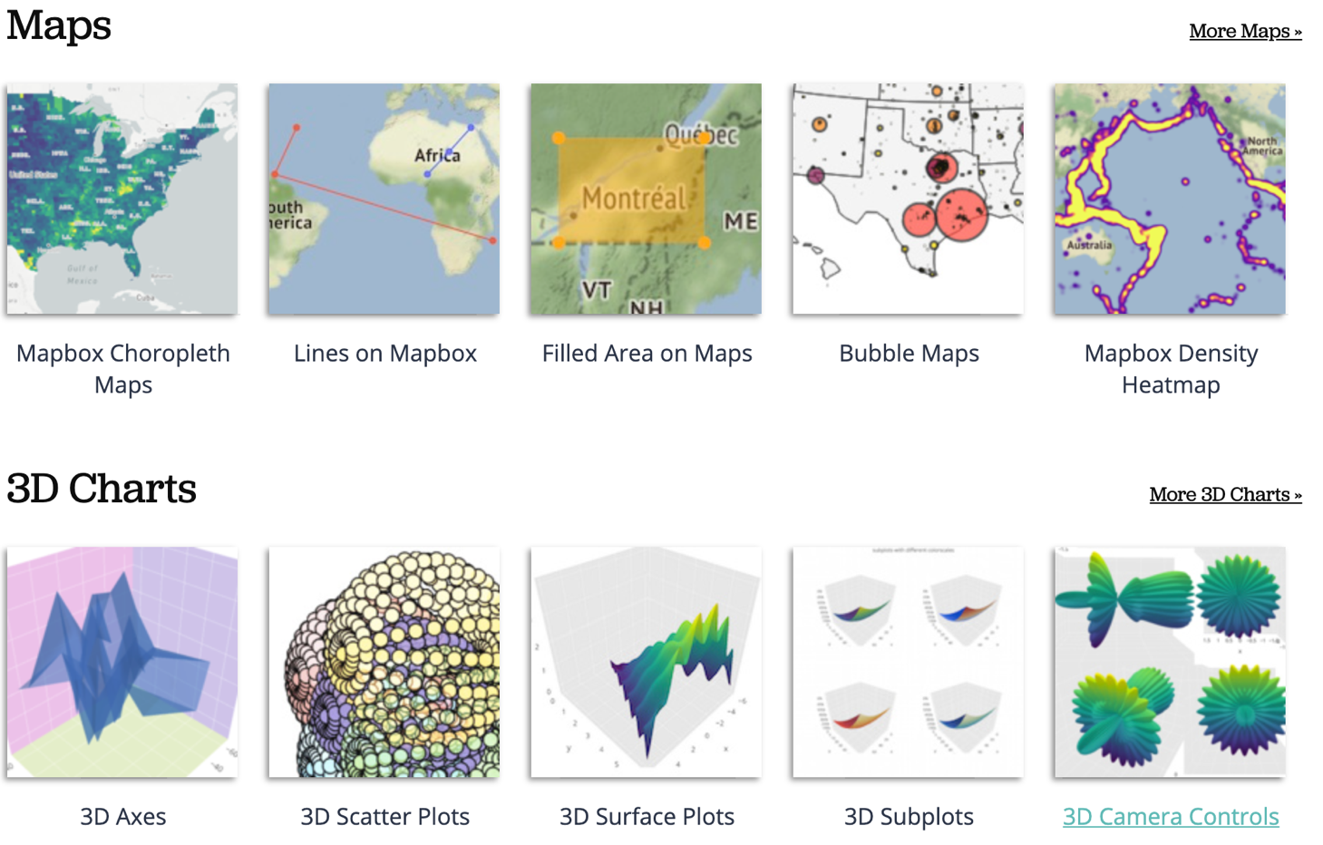
Python Plotly Graphing Library
https://plotly.com/python/

Slide 95
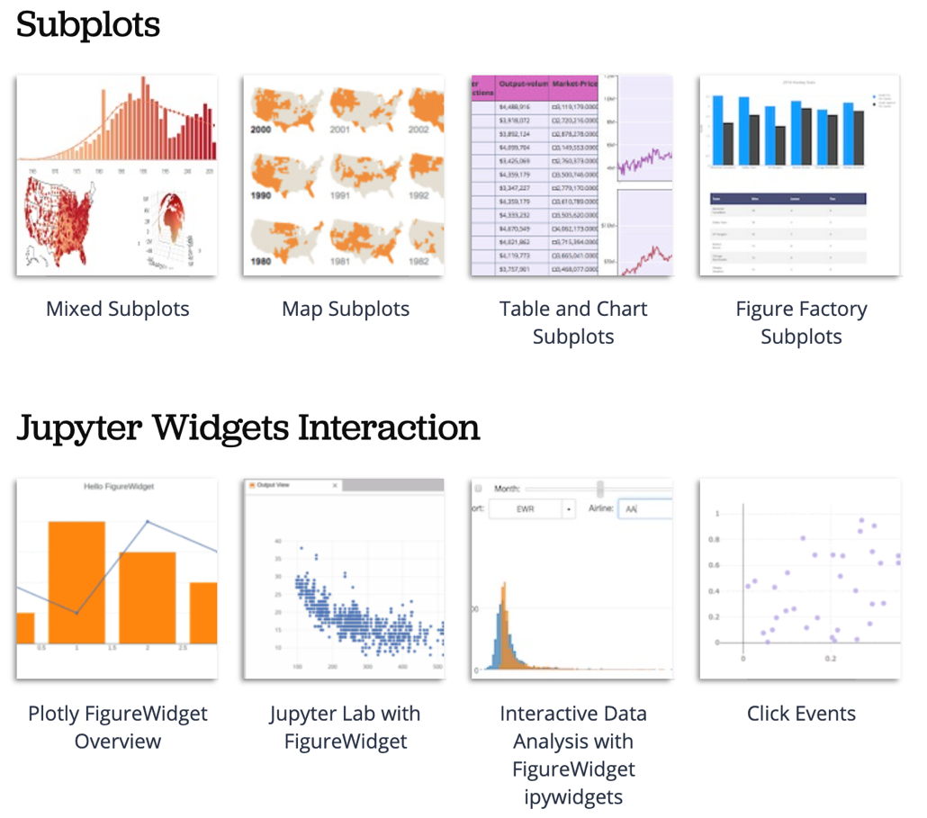
Python Plotly Graphing Library
https://plotly.com/python/

Slide 96
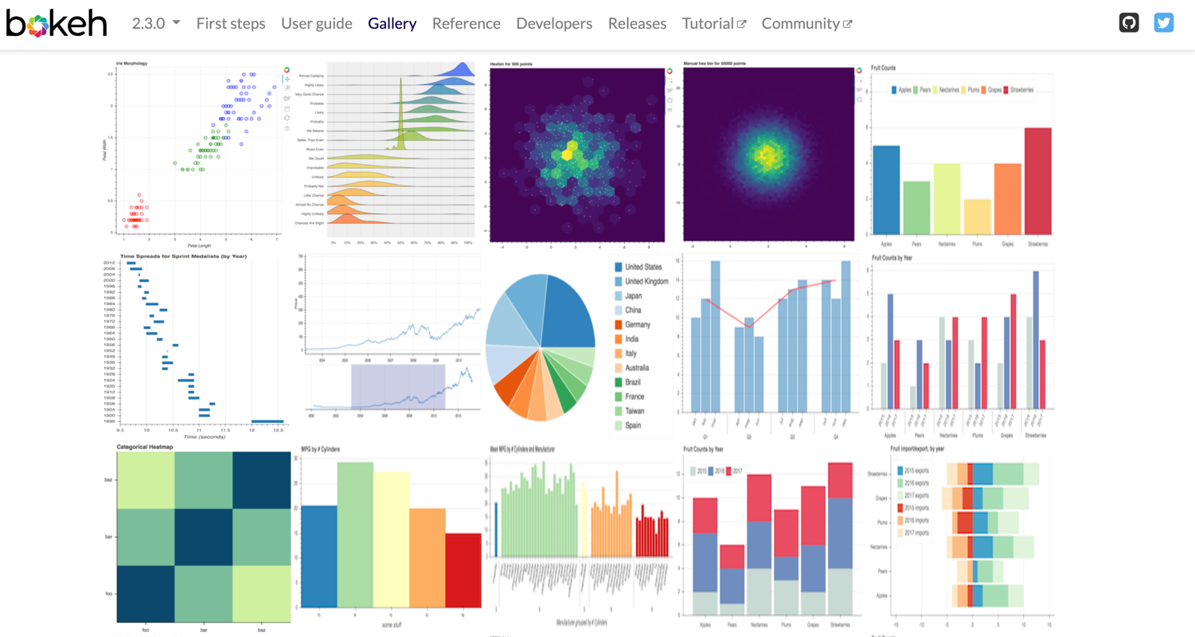
Python Bokeh
https://bokeh.org/

Slide 97
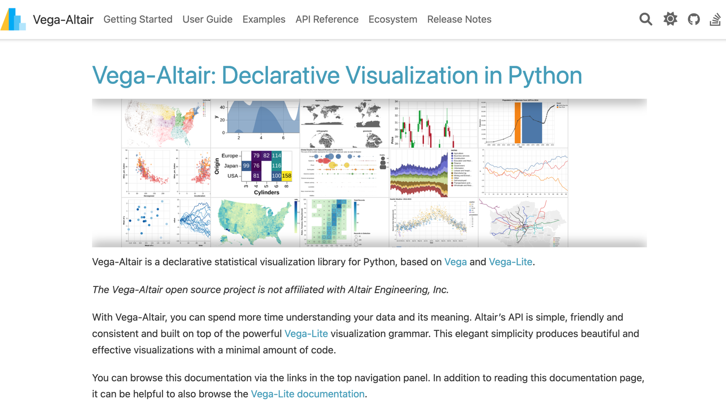
Python Altair
https://altair-viz.github.io/

Slide 98
Iris flower data set
setosa
versicolor
virginica
Source: https://en.wikipedia.org/wiki/Iris_flower_data_set
Source: http://suruchifialoke.com/2016-10-13-machine-learning-tutorial-iris-classification/

Slide 99
Iris Classfication
Source: http://suruchifialoke.com/2016-10-13-machine-learning-tutorial-iris-classification/

Slide 100
iris.data
https://archive.ics.uci.edu/ml/machine-learning-databases/iris/iris.data
5.1,3.5,1.4,0.2,Iris-setosa 4.9,3.0,1.4,0.2,Iris-setosa 4.7,3.2,1.3,0.2,Iris-setosa 4.6,3.1,1.5,0.2,Iris-setosa 5.0,3.6,1.4,0.2,Iris-setosa 5.4,3.9,1.7,0.4,Iris-setosa 4.6,3.4,1.4,0.3,Iris-setosa 5.0,3.4,1.5,0.2,Iris-setosa 4.4,2.9,1.4,0.2,Iris-setosa 4.9,3.1,1.5,0.1,Iris-setosa 5.4,3.7,1.5,0.2,Iris-setosa 4.8,3.4,1.6,0.2,Iris-setosa 4.8,3.0,1.4,0.1,Iris-setosa 4.3,3.0,1.1,0.1,Iris-setosa 5.8,4.0,1.2,0.2,Iris-setosa 5.7,4.4,1.5,0.4,Iris-setosa 5.4,3.9,1.3,0.4,Iris-setosa 5.1,3.5,1.4,0.3,Iris-setosa 5.7,3.8,1.7,0.3,Iris-setosa 5.1,3.8,1.5,0.3,Iris-setosa 5.4,3.4,1.7,0.2,Iris-setosa 5.1,3.7,1.5,0.4,Iris-setosa 4.6,3.6,1.0,0.2,Iris-setosa 5.1,3.3,1.7,0.5,Iris-setosa 4.8,3.4,1.9,0.2,Iris-setosa 5.0,3.0,1.6,0.2,Iris-setosa 5.0,3.4,1.6,0.4,Iris-setosa 5.2,3.5,1.5,0.2,Iris-setosa 5.2,3.4,1.4,0.2,Iris-setosa 4.7,3.2,1.6,0.2,Iris-setosa 4.8,3.1,1.6,0.2,Iris-setosa 5.4,3.4,1.5,0.4,Iris-setosa 5.2,4.1,1.5,0.1,Iris-setosa 5.5,4.2,1.4,0.2,Iris-setosa 4.9,3.1,1.5,0.1,Iris-setosa 5.0,3.2,1.2,0.2,Iris-setosa 5.5,3.5,1.3,0.2,Iris-setosa 4.9,3.1,1.5,0.1,Iris-setosa 4.4,3.0,1.3,0.2,Iris-setosa 5.1,3.4,1.5,0.2,Iris-setosa 5.0,3.5,1.3,0.3,Iris-setosa 4.5,2.3,1.3,0.3,Iris-setosa 4.4,3.2,1.3,0.2,Iris-setosa 5.0,3.5,1.6,0.6,Iris-setosa 5.1,3.8,1.9,0.4,Iris-setosa 4.8,3.0,1.4,0.3,Iris-setosa 5.1,3.8,1.6,0.2,Iris-setosa 4.6,3.2,1.4,0.2,Iris-setosa 5.3,3.7,1.5,0.2,Iris-setosa 5.0,3.3,1.4,0.2,Iris-setosa 7.0,3.2,4.7,1.4,Iris-versicolor 6.4,3.2,4.5,1.5,Iris-versicolor 6.9,3.1,4.9,1.5,Iris-versicolor 5.5,2.3,4.0,1.3,Iris-versicolor 6.5,2.8,4.6,1.5,Iris-versicolor 5.7,2.8,4.5,1.3,Iris-versicolor 6.3,3.3,4.7,1.6,Iris-versicolor 4.9,2.4,3.3,1.0,Iris-versicolor 6.6,2.9,4.6,1.3,Iris-versicolor 5.2,2.7,3.9,1.4,Iris-versicolor 5.0,2.0,3.5,1.0,Iris-versicolor 5.9,3.0,4.2,1.5,Iris-versicolor 6.0,2.2,4.0,1.0,Iris-versicolor 6.1,2.9,4.7,1.4,Iris-versicolor 5.6,2.9,3.6,1.3,Iris-versicolor 6.7,3.1,4.4,1.4,Iris-versicolor 5.6,3.0,4.5,1.5,Iris-versicolor 5.8,2.7,4.1,1.0,Iris-versicolor 6.2,2.2,4.5,1.5,Iris-versicolor 5.6,2.5,3.9,1.1,Iris-versicolor 5.9,3.2,4.8,1.8,Iris-versicolor 6.1,2.8,4.0,1.3,Iris-versicolor 6.3,2.5,4.9,1.5,Iris-versicolor 6.1,2.8,4.7,1.2,Iris-versicolor 6.4,2.9,4.3,1.3,Iris-versicolor 6.6,3.0,4.4,1.4,Iris-versicolor 6.8,2.8,4.8,1.4,Iris-versicolor 6.7,3.0,5.0,1.7,Iris-versicolor 6.0,2.9,4.5,1.5,Iris-versicolor 5.7,2.6,3.5,1.0,Iris-versicolor 5.5,2.4,3.8,1.1,Iris-versicolor 5.5,2.4,3.7,1.0,Iris-versicolor 5.8,2.7,3.9,1.2,Iris-versicolor 6.0,2.7,5.1,1.6,Iris-versicolor 5.4,3.0,4.5,1.5,Iris-versicolor 6.0,3.4,4.5,1.6,Iris-versicolor 6.7,3.1,4.7,1.5,Iris-versicolor 6.3,2.3,4.4,1.3,Iris-versicolor 5.6,3.0,4.1,1.3,Iris-versicolor 5.5,2.5,4.0,1.3,Iris-versicolor 5.5,2.6,4.4,1.2,Iris-versicolor 6.1,3.0,4.6,1.4,Iris-versicolor 5.8,2.6,4.0,1.2,Iris-versicolor 5.0,2.3,3.3,1.0,Iris-versicolor 5.6,2.7,4.2,1.3,Iris-versicolor 5.7,3.0,4.2,1.2,Iris-versicolor 5.7,2.9,4.2,1.3,Iris-versicolor 6.2,2.9,4.3,1.3,Iris-versicolor 5.1,2.5,3.0,1.1,Iris-versicolor 5.7,2.8,4.1,1.3,Iris-versicolor 6.3,3.3,6.0,2.5,Iris-virginica 5.8,2.7,5.1,1.9,Iris-virginica 7.1,3.0,5.9,2.1,Iris-virginica 6.3,2.9,5.6,1.8,Iris-virginica 6.5,3.0,5.8,2.2,Iris-virginica 7.6,3.0,6.6,2.1,Iris-virginica 4.9,2.5,4.5,1.7,Iris-virginica 7.3,2.9,6.3,1.8,Iris-virginica 6.7,2.5,5.8,1.8,Iris-virginica 7.2,3.6,6.1,2.5,Iris-virginica 6.5,3.2,5.1,2.0,Iris-virginica 6.4,2.7,5.3,1.9,Iris-virginica 6.8,3.0,5.5,2.1,Iris-virginica 5.7,2.5,5.0,2.0,Iris-virginica 5.8,2.8,5.1,2.4,Iris-virginica 6.4,3.2,5.3,2.3,Iris-virginica 6.5,3.0,5.5,1.8,Iris-virginica 7.7,3.8,6.7,2.2,Iris-virginica 7.7,2.6,6.9,2.3,Iris-virginica 6.0,2.2,5.0,1.5,Iris-virginica 6.9,3.2,5.7,2.3,Iris-virginica 5.6,2.8,4.9,2.0,Iris-virginica 7.7,2.8,6.7,2.0,Iris-virginica 6.3,2.7,4.9,1.8,Iris-virginica 6.7,3.3,5.7,2.1,Iris-virginica 7.2,3.2,6.0,1.8,Iris-virginica 6.2,2.8,4.8,1.8,Iris-virginica 6.1,3.0,4.9,1.8,Iris-virginica 6.4,2.8,5.6,2.1,Iris-virginica 7.2,3.0,5.8,1.6,Iris-virginica 7.4,2.8,6.1,1.9,Iris-virginica 7.9,3.8,6.4,2.0,Iris-virginica 6.4,2.8,5.6,2.2,Iris-virginica 6.3,2.8,5.1,1.5,Iris-virginica 6.1,2.6,5.6,1.4,Iris-virginica 7.7,3.0,6.1,2.3,Iris-virginica 6.3,3.4,5.6,2.4,Iris-virginica 6.4,3.1,5.5,1.8,Iris-virginica 6.0,3.0,4.8,1.8,Iris-virginica 6.9,3.1,5.4,2.1,Iris-virginica 6.7,3.1,5.6,2.4,Iris-virginica 6.9,3.1,5.1,2.3,Iris-virginica 5.8,2.7,5.1,1.9,Iris-virginica 6.8,3.2,5.9,2.3,Iris-virginica 6.7,3.3,5.7,2.5,Iris-virginica 6.7,3.0,5.2,2.3,Iris-virginica 6.3,2.5,5.0,1.9,Iris-virginica 6.5,3.0,5.2,2.0,Iris-virginica 6.2,3.4,5.4,2.3,Iris-virginica 5.9,3.0,5.1,1.8,Iris-virginica
setosa
virginica
versicolor

Slide 101
Iris Data Visualization
Source: https://seaborn.pydata.org/generated/seaborn.pairplot.html

Slide 102

Data Visualization in Google Colab
https://tinyurl.com/aintpupython101

Slide 103
import seaborn as sns
sns.set(style="ticks", color_codes=True)
iris = sns.load_dataset("iris")
g = sns.pairplot(iris, hue="species")
Source: https://seaborn.pydata.org/generated/seaborn.pairplot.html

Slide 104

import numpy as np
import pandas as pd
%matplotlib inline
import matplotlib.pyplot as plt
import seaborn as sns
from pandas.plotting import scatter_matrix

Slide 105

url = "https://archive.ics.uci.edu/ml/machine-learning-databases/iris/iris.data"
names = ['sepal-length', 'sepal-width', 'petal-length', 'petal-width', 'class']
df = pd.read_csv(url, names=names)
print(df.head(10))

Slide 106

df.tail(10)

Slide 107

df.describe()

Slide 108

print(df.info())
print(df.shape)

Slide 109

df.groupby('class').size()

Slide 110
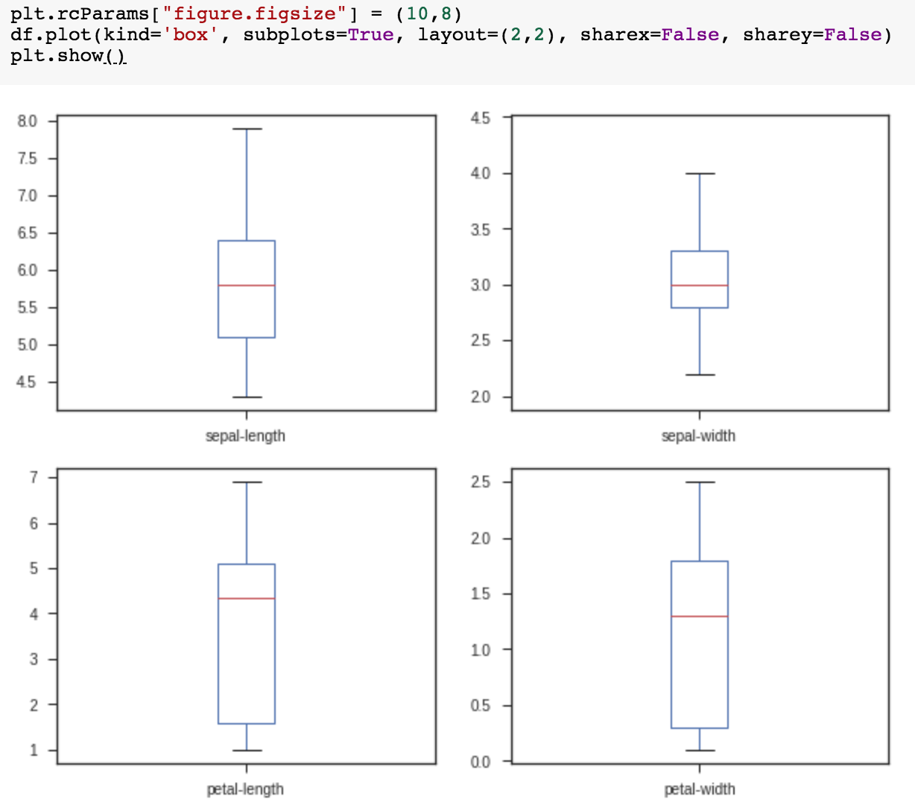
plt.rcParams["figure.figsize"] = (10,8)
df.plot(kind='box', subplots=True, layout=(2,2), sharex=False, sharey=False)
plt.show()

Slide 111

df.hist()
plt.show()

Slide 112

scatter_matrix(df)
plt.show()

Slide 113

sns.pairplot(df, hue="class", size=2)

Slide 114
Obtaining Data
From the Web with Python

Slide 115
W3Schools Python Requests Module
https://www.w3schools.com/python/

Slide 116
Python requests
! pip install requests
import requests
x = requests.get('https://w3schools.com/python/demopage.htm')
print(x.text)
<!DOCTYPE html>
<html>
<body>
<h1>This is a Test Page</h1>
</body>
</html>
https://tinyurl.com/aintpupython101

Slide 117
Requests Methods
Method | Description
delete(url, args) | Sends a DELETE request to the specified url
get(url, params, args) | Sends a GET request to the specified url
head(url, args) | Sends a HEAD request to the specified url
patch(url, data, args) | Sends a PATCH request to the specified url
post(url, data, json, args) | Sends a POST request to the specified url
put(url, data, args) | Sends a PUT request to the specified url
request(method, url, args) | Sends a request of the specified method to the specified url
https://www.w3schools.com/python/module_requests.asp

Slide 118
Statistical Analysis with Python

Slide 119
Statistical Analysis with Python
  Descriptive Statistics
    df.describe()
    df.mean(), df.std() df.median() df.max() df.min()
    df.skew(), df.kurtosis()
  Inferential Statistics
    import scipy.stats as stats
    t_statistic, p_value = stats.ttest_ind(ga, gb)

Slide 120
SciPy: Scientific Python
SciPy is a scientific computation library
that uses NumPy underneath.
SciPy stands for Scientific Python.
SciPy provides more utility functions for
optimization, stats and signal processing.

Slide 121
SciPy Statistical Significance Tests
In statistics, statistical significance means that the result that was produced has a reason behind it, it was not produced randomly, or by chance.
SciPy provides us with a module called scipy.stats, which has functions for performing statistical significance tests.
https://www.w3schools.com/python/scipy/scipy_statistical_significance_tests.php

Slide 122
ESG Score and Financial Performance
How Python can be used to analyze and visualize ESG-related financial data, combining statistical analysis with effective data visualization techniques.
1. Two datasets for high and low ESG score companies are generated, each with normally distributed ESG scores and financial performance metrics.
2. Descriptive statistics provide insights into the central tendency and variability of the data.
3. An inferential t-test is used to determine if there is a statistically significant difference in financial performance between the two groups.
4. Data visualizations, including histograms and box plots, illustrate the distribution of ESG scores and financial performance, helping to visualize the differences between the high and low ESG score companies.

Slide 123
Python Statistical Analysis
import pandas as pd
import numpy as np
import scipy.stats as stats
https://tinyurl.com/aintpupython101

Slide 124
Python Statistical Analysis
#Step 1: Generate Datasets
import pandas as pd
import numpy as np
import scipy.stats as stats
# Seed for reproducibility
np.random.seed(3)
# Number of companies in each group
n_companies = 50
# High ESG Score Companies (ESG scores and financial performance follow a normal distribution)
high_esg_means = {'ESG_Score': 80, 'Financial_Performance': 15}
high_esg_stds = {'ESG_Score': 5, 'Financial_Performance': 5}
high_esg_data = {
'Company': [f'High_ESG_{i}' for i in range(n_companies)],
'ESG_Score': np.random.normal(high_esg_means['ESG_Score'], high_esg_stds['ESG_Score'], n_companies),
'Financial_Performance': np.random.normal(high_esg_means['Financial_Performance'], high_esg_stds['Financial_Performance'], n_companies)
}
high_esg_df = pd.DataFrame(high_esg_data)
print(high_esg_df)
https://tinyurl.com/aintpupython101

Slide 125
Python Statistical Analysis
# Low ESG Score Companies
low_esg_means = {'ESG_Score': 30, 'Financial_Performance': 10}
low_esg_stds = {'ESG_Score': 5, 'Financial_Performance': 5}
low_esg_data = {
'Company': [f'Low_ESG_{i}' for i in range(n_companies)],
'ESG_Score': np.random.normal(low_esg_means['ESG_Score'], low_esg_stds['ESG_Score'], n_companies),
'Financial_Performance': np.random.normal(low_esg_means['Financial_Performance'], low_esg_stds['Financial_Performance'], n_companies)
}
low_esg_df = pd.DataFrame(low_esg_data)
print(low_esg_df)
Company ESG_Score Financial_Performance
0 Low_ESG_0 34.371429 5.688458
1 Low_ESG_1 23.532317 15.358420
2 Low_ESG_2 29.601295 3.895490
3 Low_ESG_3 32.822428 10.298077
4 Low_ESG_4 36.167355 10.012221
https://tinyurl.com/aintpupython101

Slide 126
Python Statistical Analysis
Company ESG_Score Financial_Performance
0 High_ESG_0 88.943142 20.065917
1 High_ESG_1 82.182549 19.263989
2 High_ESG_2 80.482487 20.540937
3 High_ESG_3 70.682536 20.596953
4 High_ESG_4 78.613059 22.437716
5 High_ESG_5 78.226205 9.408497
6 High_ESG_6 79.586293 19.229167
7 High_ESG_7 76.864997 5.695552
8 High_ESG_8 79.780909 11.985574
9 High_ESG_9 77.613910 5.427640
45 High_ESG_45 77.057028 14.452728
46 High_ESG_46 75.630589 18.395358
47 High_ESG_47 80.148569 10.722814
48 High_ESG_48 68.758711 13.498970
49 High_ESG_49 78.661191 25.790747
https://tinyurl.com/aintpupython101

Slide 127
Python Statistical Analysis
Company ESG_Score Financial_Performance
0 Low_ESG_0 34.371429 5.688458
1 Low_ESG_1 23.532317 15.358420
2 Low_ESG_2 29.601295 3.895490
3 Low_ESG_3 32.822428 10.298077
4 Low_ESG_4 36.167355 10.012221
5 Low_ESG_5 30.744932 12.123179
6 Low_ESG_6 27.347089 6.372833
7 Low_ESG_7 26.347367 9.825283
8 Low_ESG_8 33.225310 9.296900
9 Low_ESG_9 31.565302 14.985442
45 Low_ESG_45 33.657329 6.086455
46 Low_ESG_46 32.129834 19.942448
47 Low_ESG_47 29.254931 15.975292
48 Low_ESG_48 34.179220 9.523812
49 Low_ESG_49 32.460595 7.364061
https://tinyurl.com/aintpupython101

Slide 128
Descriptive Statistics
#Step 2: Descriptive Statistics
print("High ESG Companies Statistics:")
print(high_esg_df.describe())
print("\nLow ESG Companies Statistics:")
print(low_esg_df.describe())
https://tinyurl.com/aintpupython101

Slide 129
Descriptive Statistics
high_esg_df.describe()
High ESG Companies Statistics:
ESG_Score Financial_Performance
count 50.000000 50.000000
mean 78.530366 15.383263
std 5.043011 5.529527
min 67.904584 0.421311
25% 75.443427 11.014420
50% 78.222426 15.758906
75% 81.008308 19.438516
max 89.880554 25.790747
Low ESG Companies Statistics:
ESG_Score Financial_Performance
count 50.000000 50.000000
mean 30.145838 9.524720
std 3.909959 4.894234
min 21.279449 -0.151968
25% 27.353736 6.158049
50% 30.541058 9.357192
75% 32.815212 12.202473
max 39.546384 23.380562
https://tinyurl.com/aintpupython101

Slide 130
Inferential Statistics
#Step 3: Inferential Statistics
#Perform a t-test to compare the financial performance between the two groups.
# T-test for Financial Performance
t_stat, p_value = stats.ttest_ind(high_esg_df['Financial_Performance'], low_esg_df['Financial_Performance'])
print(f"T-statistic: {t_stat}, P-value: {p_value}")
T-statistic: 5.609964050849995,
P-value: 1.876011775191166e-07
https://tinyurl.com/aintpupython101

Slide 131
Python Statistical Analysis
#Step 4: Data Visualization
#Visualize the data with histograms and box plots.
#Histograms of ESG Scores
import matplotlib.pyplot as plt
import seaborn as sns
plt.hist(high_esg_df['ESG_Score'], alpha=0.5, label='High ESG', bins=15, density=True)
plt.hist(low_esg_df['ESG_Score'], alpha=0.5, label='Low ESG', bins=15, density=True)
plt.title('ESG Score Distribution')
plt.xlabel('ESG Score')
plt.ylabel('Density')
plt.legend()
plt.show()
https://tinyurl.com/aintpupython101

Slide 132
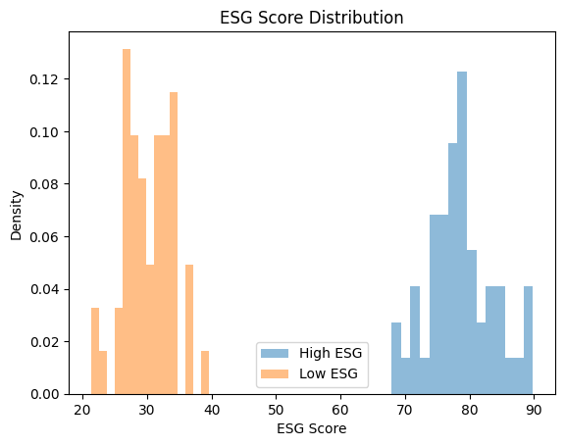
Histograms of ESG Scores
plt.hist(high_esg_df['ESG_Score'], alpha=0.5, label='High ESG', bins=15, density=True)
plt.hist(low_esg_df['ESG_Score'], alpha=0.5, label='Low ESG', bins=15, density=True)
https://tinyurl.com/aintpupython101

Slide 133
Histograms of Financial Performance
#Histograms of Financial Performance
plt.hist(high_esg_df['Financial_Performance'], alpha=0.5, label='High ESG', bins=15, density=True)
plt.hist(low_esg_df['Financial_Performance'], alpha=0.5, label='Low ESG', bins=15, density=True)
plt.title('Financial Performance Distribution')
plt.xlabel('Financial Performance')
plt.ylabel('Density')
plt.legend()
plt.show()
https://tinyurl.com/aintpupython101

Slide 134
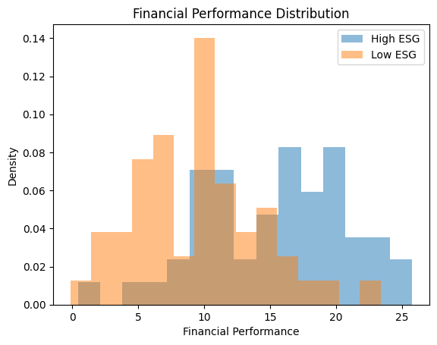
Histograms of Financial Performance
https://tinyurl.com/aintpupython101

Slide 135
Box Plot for Financial Performance
# Box Plot for Financial Performance
sns.boxplot(x='Group', y='Financial_Performance',
data=pd.concat([high_esg_df.assign(Group='High ESG'), low_esg_df.assign(Group='Low ESG')]))
plt.title('Financial Performance Comparison')
plt.xlabel('ESG Group')
plt.ylabel('Financial Performance')
plt.show()
https://tinyurl.com/aintpupython101

Slide 136
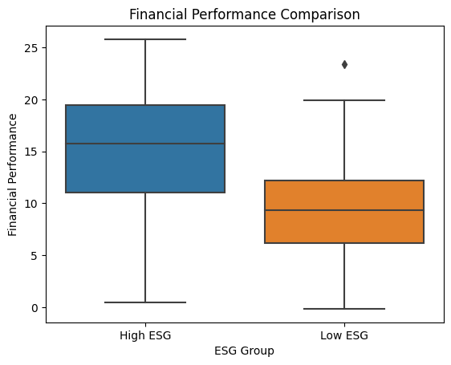
Box Plot for Financial Performance
sns.boxplot(x='Group', y='Financial_Performance',
data=pd.concat([high_esg_df.assign(Group='High ESG'), low_esg_df.assign(Group='Low ESG')]))
https://tinyurl.com/aintpupython101

Slide 137
Python Statistical Analysis
import pandas as pd
from scipy import stats
# Calculate basic statistics for each group with formatting
def basic_statistics(df):
  stats_dict = {
    'Mean': f"{df.mean():.4f}",
    'Std': f"{df.std():.4f}",
    'Median': f"{df.median():.4f}",
    'Max': f"{df.max():.4f}",
    'Min': f"{df.min():.4f}",
    'Skewness': f"{df.skew():.4f}",
    'Kurtosis': f"{df.kurtosis():.4f}"
    }
  return pd.Series(stats_dict)
https://tinyurl.com/aintpupython101

Slide 138
Python Statistical Analysis
high_esg_stats = basic_statistics(high_esg_df['Financial_Performance'])
low_esg_stats = basic_statistics(low_esg_df['Financial_Performance'])
# Perform t-test
t_stat, p_value = stats.ttest_ind(high_esg_df['Financial_Performance'], low_esg_df['Financial_Performance'])
# Determine significance level
def significance(p_value):
  if p_value < 0.001:
  return '***'
  elif p_value < 0.01:
  return '**'
  elif p_value < 0.05:
  return '*'
  else:
  return ''
https://tinyurl.com/aintpupython101

Slide 139
Python Statistical Analysis
# Create table
table_data = {
  'Statistic': ['Mean', 'Std', 'Median', 'Max', 'Min', 'Skewness', 'Kurtosis', 'T-statistic', 'P-value'],
  'High ESG': high_esg_stats.tolist() + [f"{t_stat:.4f}", f"{p_value:.4f}"],
  'Low ESG': low_esg_stats.tolist() + ['', ''],
  'Significance': [''] * 7 + ['', significance(p_value)]
  }
table_df = pd.DataFrame(table_data)
# Printing the table
print(table_df)
https://tinyurl.com/aintpupython101

Slide 140
Python Statistical Analysis
Statistic High ESG Low ESG Significance
0 Mean 15.3833 9.5247
1 Std 5.5295 4.8942
2 Median 15.7589 9.3572
3 Max 25.7907 23.3806
4 Min 0.4213 -0.1520
5 Skewness -0.3003 0.5287
6 Kurtosis -0.2029 0.3327
7 T-statistic 5.6100
8 P-value 0.0000 ***
https://tinyurl.com/aintpupython101

Slide 141
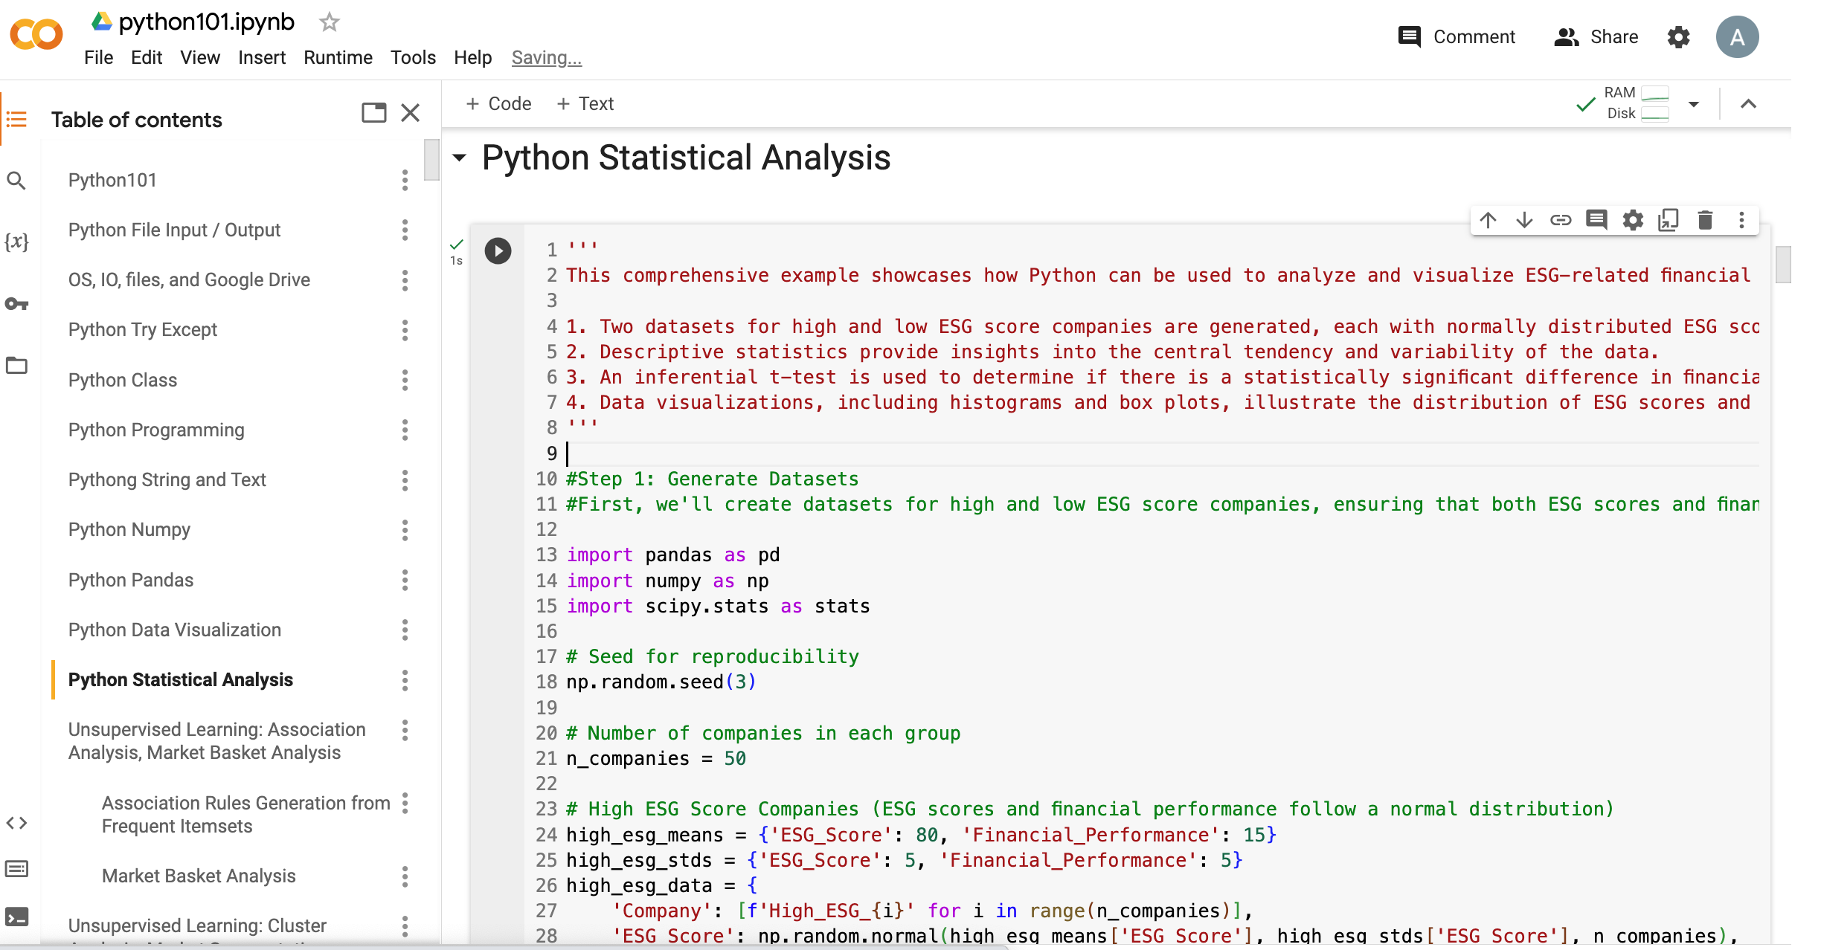
Python Statistical Analysis
https://tinyurl.com/aintpupython101

Slide 142
ESG Indexes
MSCI ESG Index
Dow Jones Sustainability Indices (DJSI)
FTSE ESG Index

Slide 143

MSCI ESG Rating Framework
Source: https://www.msci.com/documents/1296102/21901542/ESG-Ratings-Methodology-Exec-Summary.pdf

Slide 144

MSCI ESG Key Issue Hierarchy
Source: https://www.msci.com/documents/1296102/21901542/ESG-Ratings-Methodology-Exec-Summary.pdf

Slide 145

MSCI Governance Model Structure
Source: https://www.msci.com/documents/1296102/21901542/ESG-Ratings-Methodology-Exec-Summary.pdf

Slide 146

MSCI Hierarchy of ESG Scores
Source: https://www.msci.com/documents/1296102/21901542/ESG-Ratings-Methodology-Exec-Summary.pdf

Slide 147
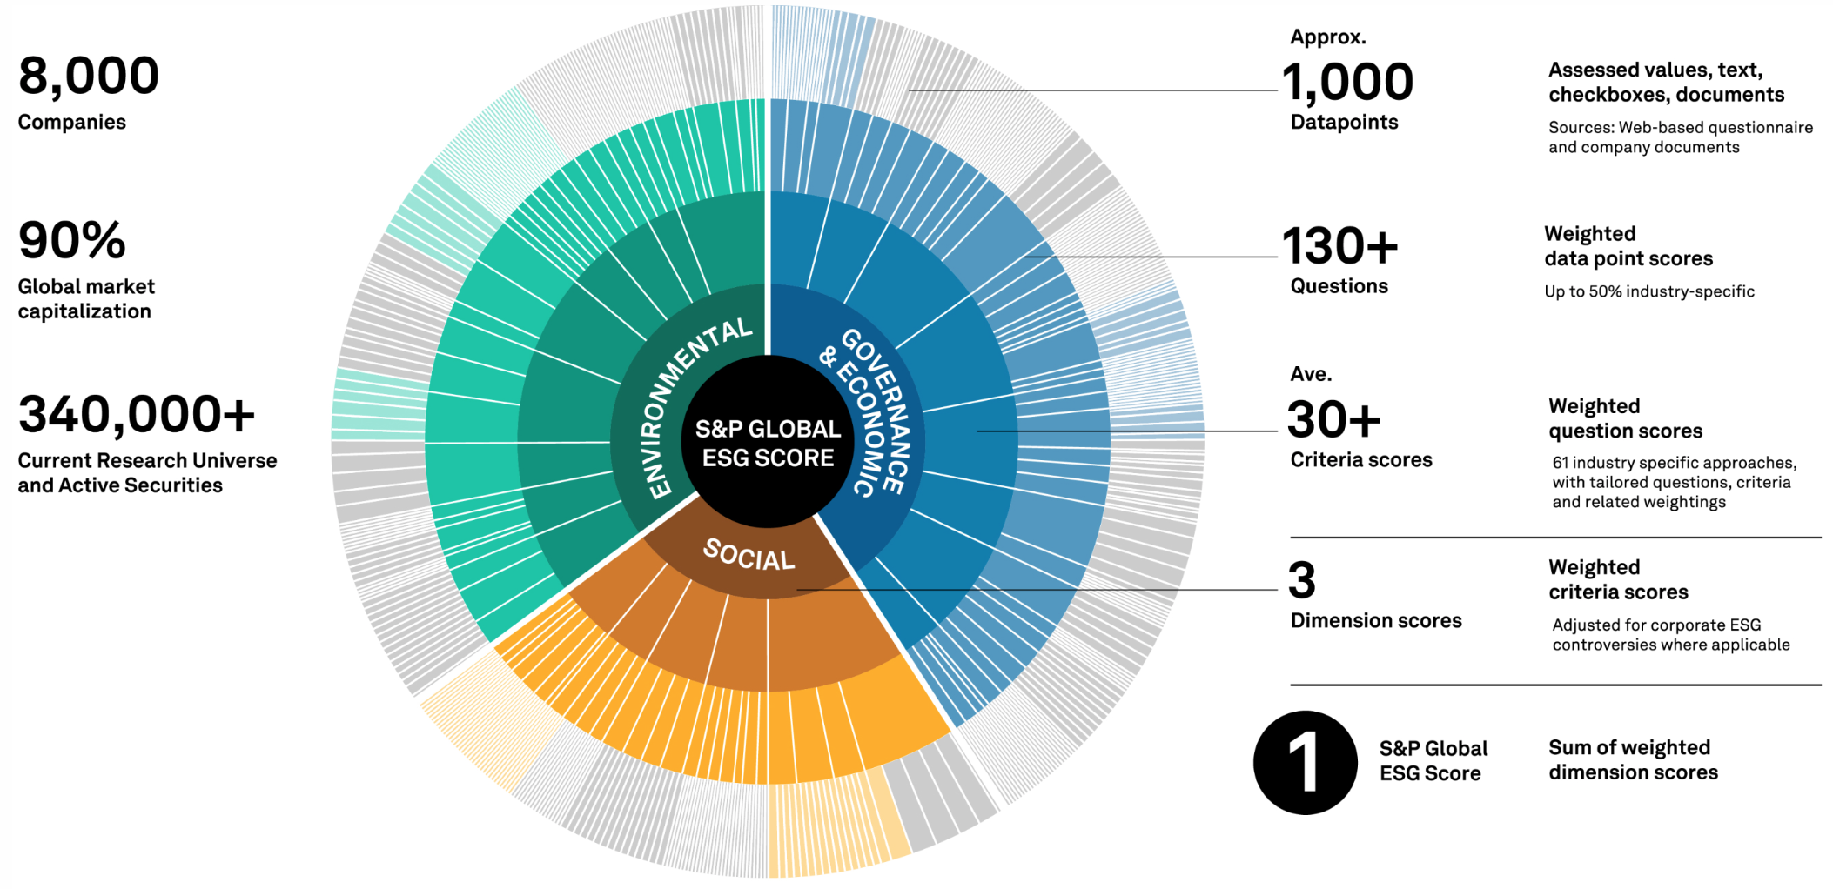
DJSI S&P Global ESG Score
Source: DJSI, S&P Global Corporate Sustainability Assessment (CSA), https://www.spglobal.com/esg/solutions/data-intelligence-esg-scores

Slide 148

FTSE Russell ESG Ratings
Source: https://www.ftserussell.com/data/sustainability-and-esg-data/esg-ratings

Slide 149


Sustainalytics
ESG Risk Ratings
Analyst-based
approach
Sustainalytics’ ESG Risk Ratings measure a company’s exposure to industry-specific material ESG risks and how well a company is managing those risks.
Source: https://www.sustainalytics.com/esg-data

Slide 150

Truvalue
ESG Ranks
TruValue Labs
Machine-based approach
Truvalue Labs applies AI to analyze over 100,000 sources and uncover ESG risks and opportunities hidden in unstructured text.
The ESG Ranks data service produces an overall company rank based on industry percentile leveraging the 26 ESG categories defined by the Sustainability Accounting Standards Board (SASB).
The data feed covers 20,000+ companies with more than 13 years of history.
Source: :https://developer.truvaluelabs.com/data/esg-ranks

Slide 151
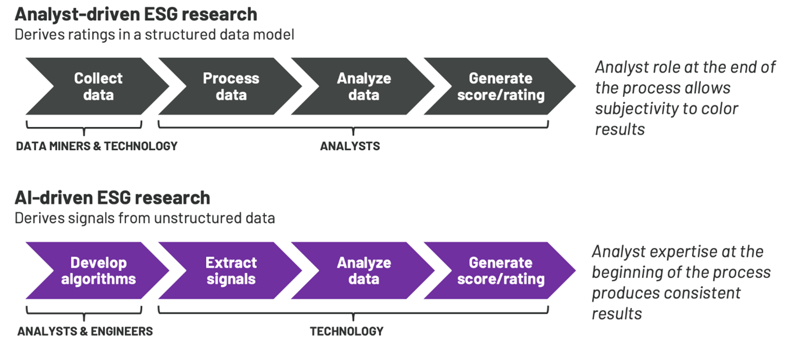
Analyst-driven vs. AI-driven ESG
Sustainalytics
Truvalue Labs
Source: Mark Tulay (2020), Man vs. machine: A tale of two sustainability ratings systems, GreenBiz, https://www.greenbiz.com/article/man-vs-machine-tale-two-sustainability-ratings-systems

Slide 152
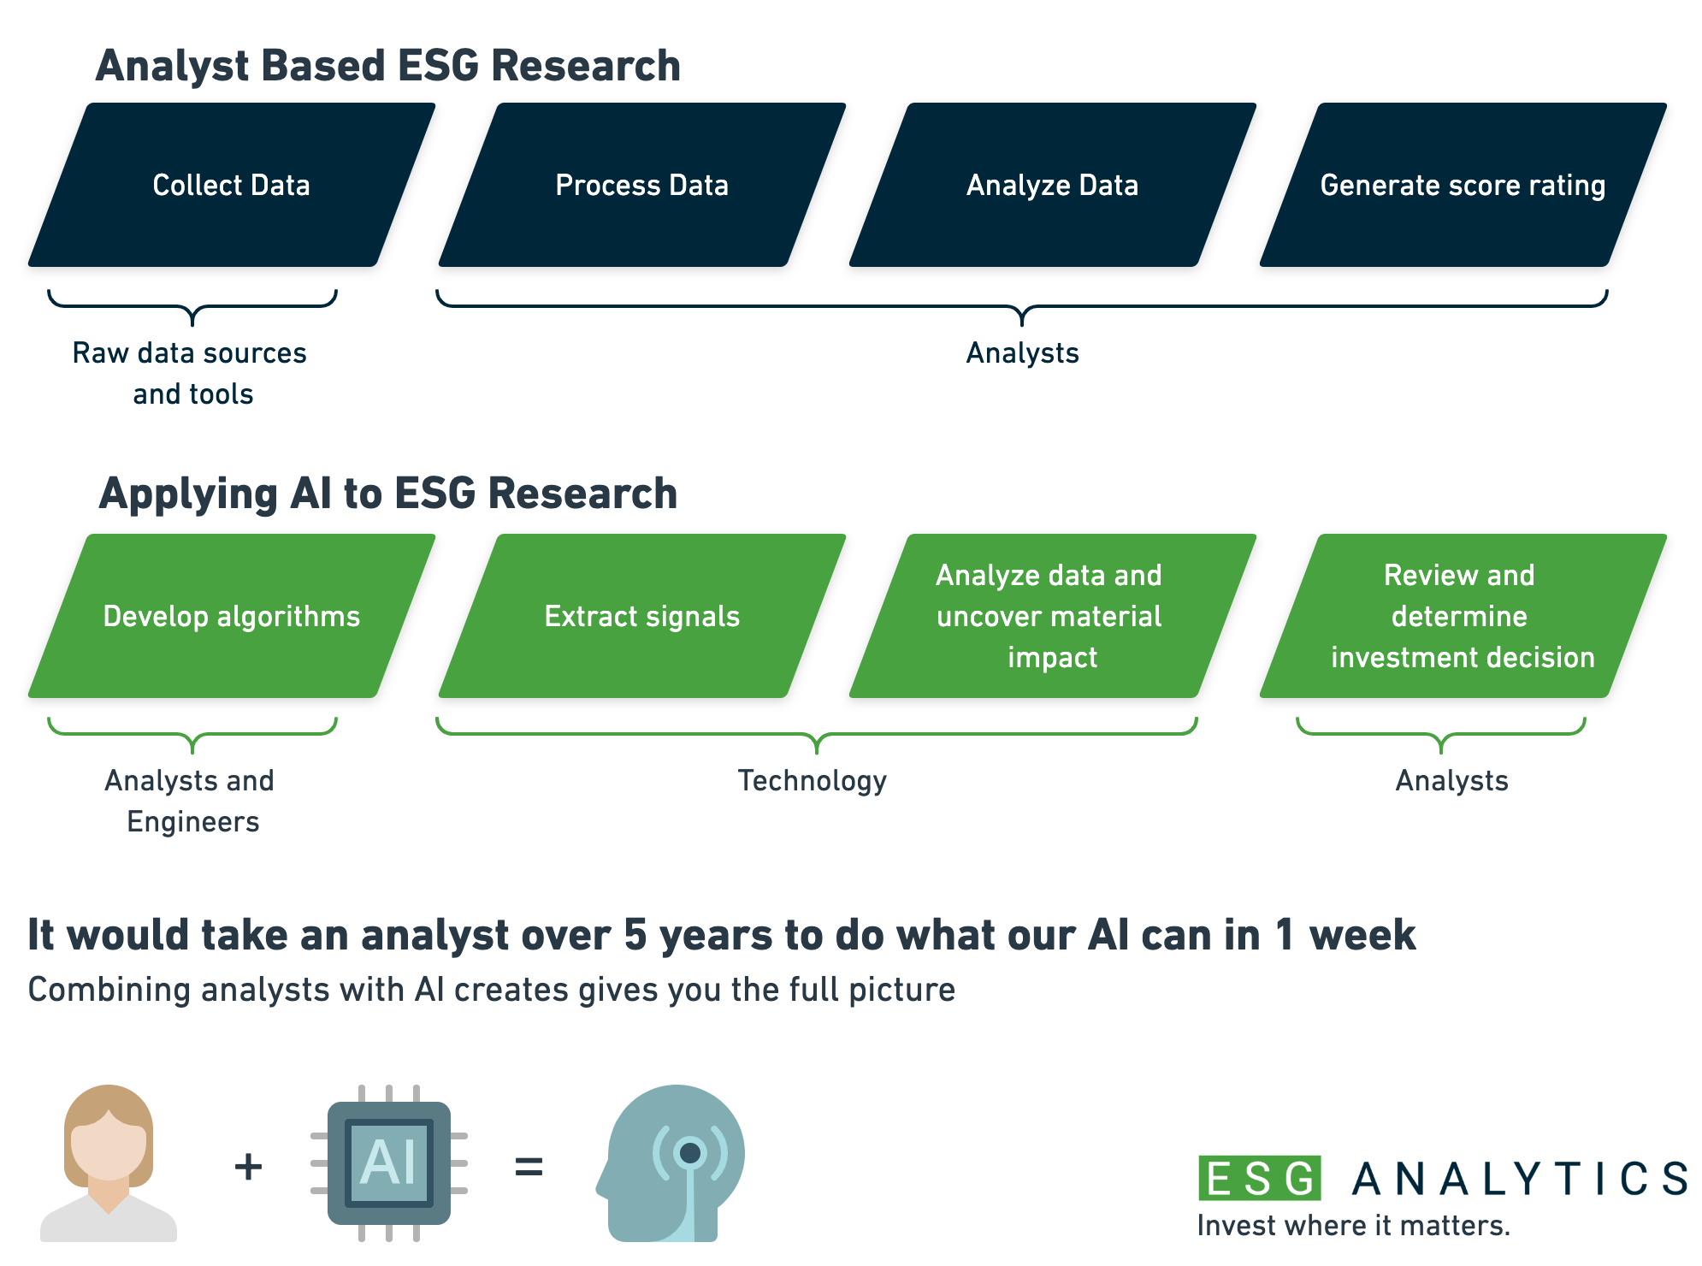
Analyst based
ESG Research
AI based
ESG Research
Source: https://www.esganalytics.io/insights/how-data-is-accelerating-esg

Slide 153

ESG Analytics: NLP Taxonomy
Source: https://www.esganalytics.io/insights/how-data-is-accelerating-esg

Slide 154

Top
ESG Reporting Software
Environmental, Social and Governance (ESG) Reporting software or Sustainability software helps organizations manage their operational data, evaluate their impact on the environment and provide reporting to perform audits.
Source: https://www.softwarereviews.com/categories/environmental-social-and-governance-reporting

Slide 155
Wes McKinney (2022), "Python for Data Analysis: Data Wrangling with pandas, NumPy, and Jupyter", 3rd Edition, O'Reilly Media.
https://github.com/wesm/pydata-book

Slide 156
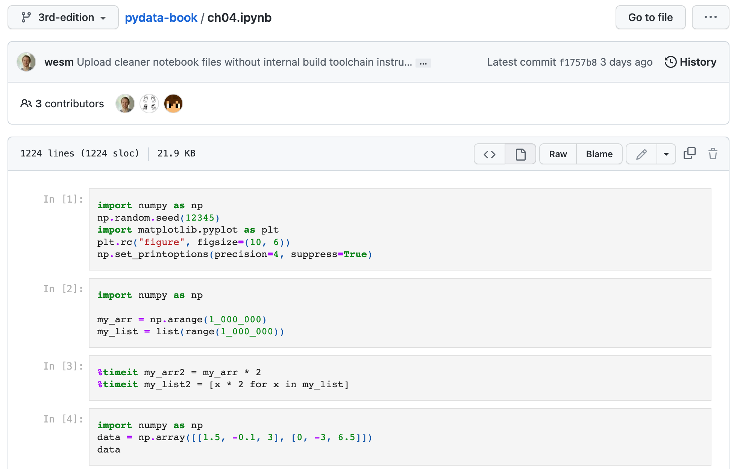
Wes McKinney (2022), "Python for Data Analysis: Data Wrangling with pandas, NumPy, and Jupyter", 3rd Edition, O'Reilly Media.
Source: https://github.com/wesm/pydata-book/blob/3rd-edition/ch04.ipynb

Slide 157
Python in Google Colab (Python101)
https://colab.research.google.com/drive/1FEG6DnGvwfUbeo4zJ1zTunjMqf2RkCrT
https://tinyurl.com/aintpupython101

Slide 158
Python in Google Colab (Python101)
https://colab.research.google.com/drive/1FEG6DnGvwfUbeo4zJ1zTunjMqf2RkCrT
https://tinyurl.com/aintpupython101

Slide 159

Papers with Code
State-of-the-Art (SOTA)
https://paperswithcode.com/sota

Slide 160

Kaggle Datasets for
Data Science

Slide 161
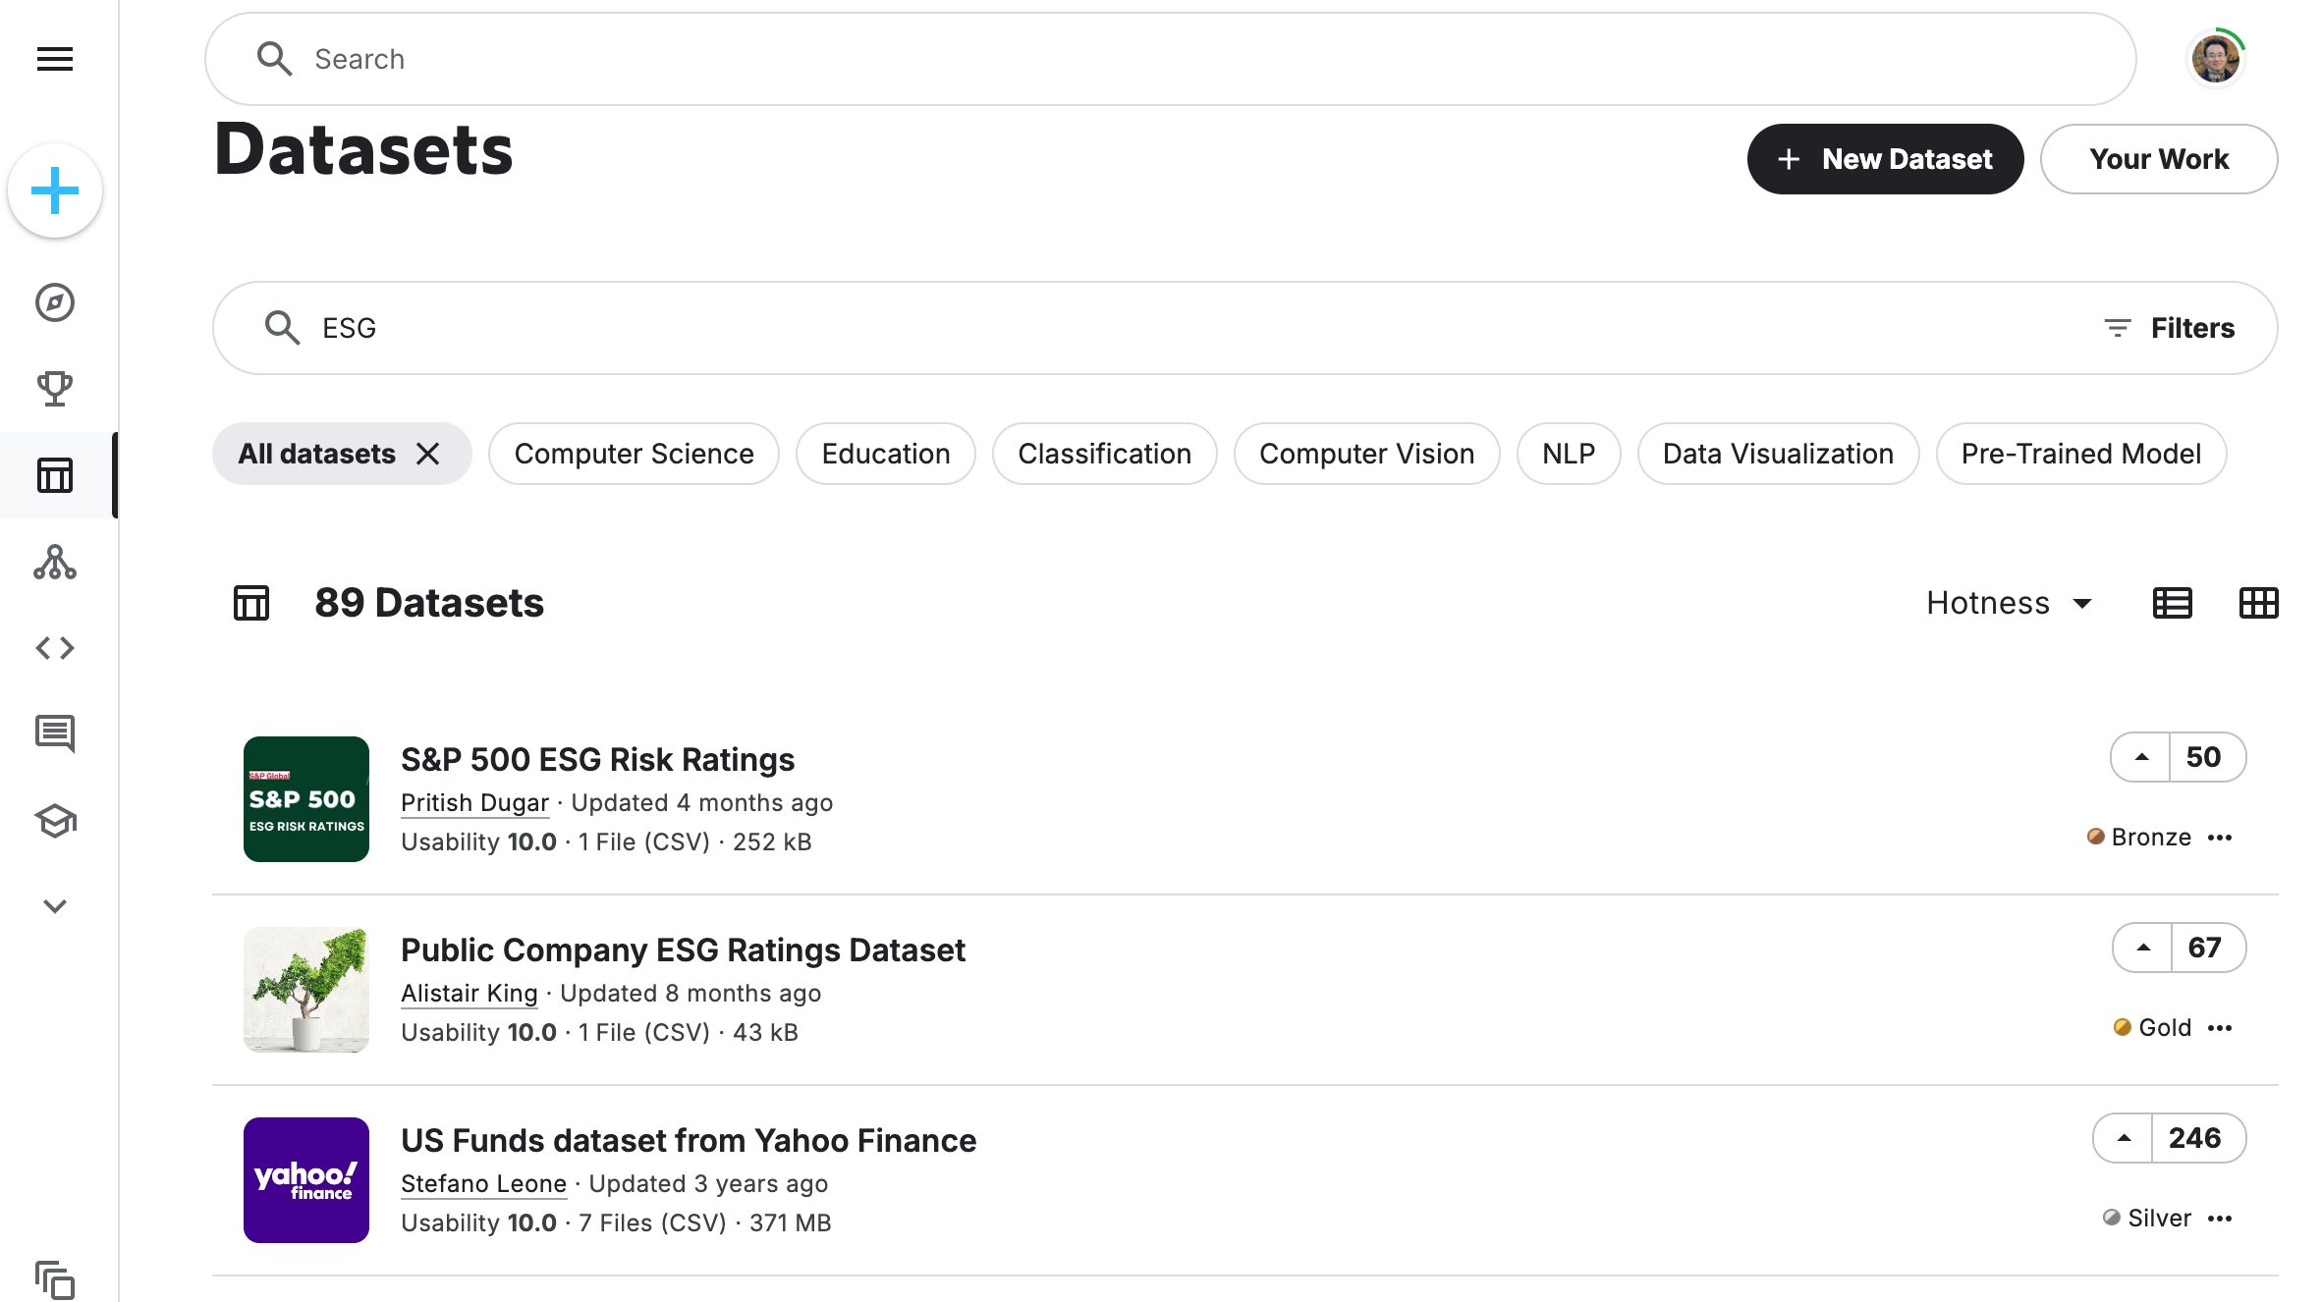
Kaggle Datasets for Machine Learning
Source: https://www.kaggle.com/datasets?search=ESG

Slide 162
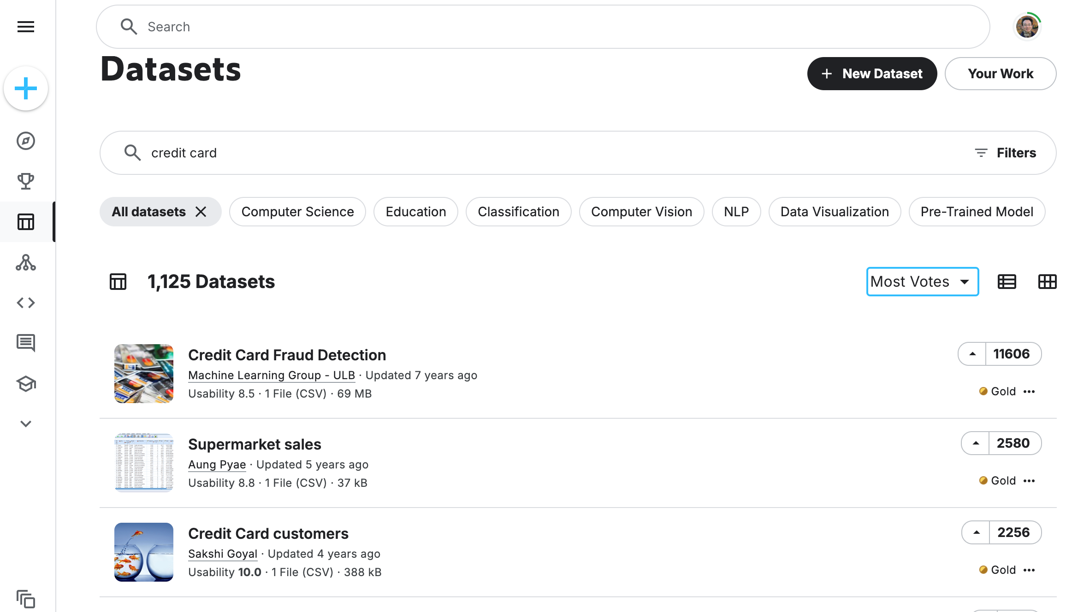
Kaggle Datasets for Machine Learning
Source: https://www.kaggle.com/datasets?search=credit+card&sort=votes

Slide 163
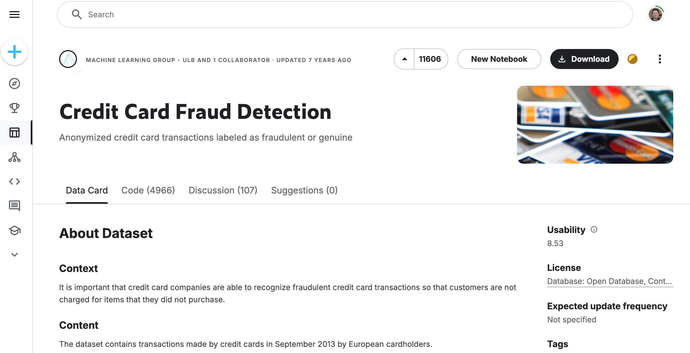
Kaggle Datasets: Credit Card Fraud Detection
Source: https://www.kaggle.com/datasets/mlg-ulb/creditcardfraud

Slide 164
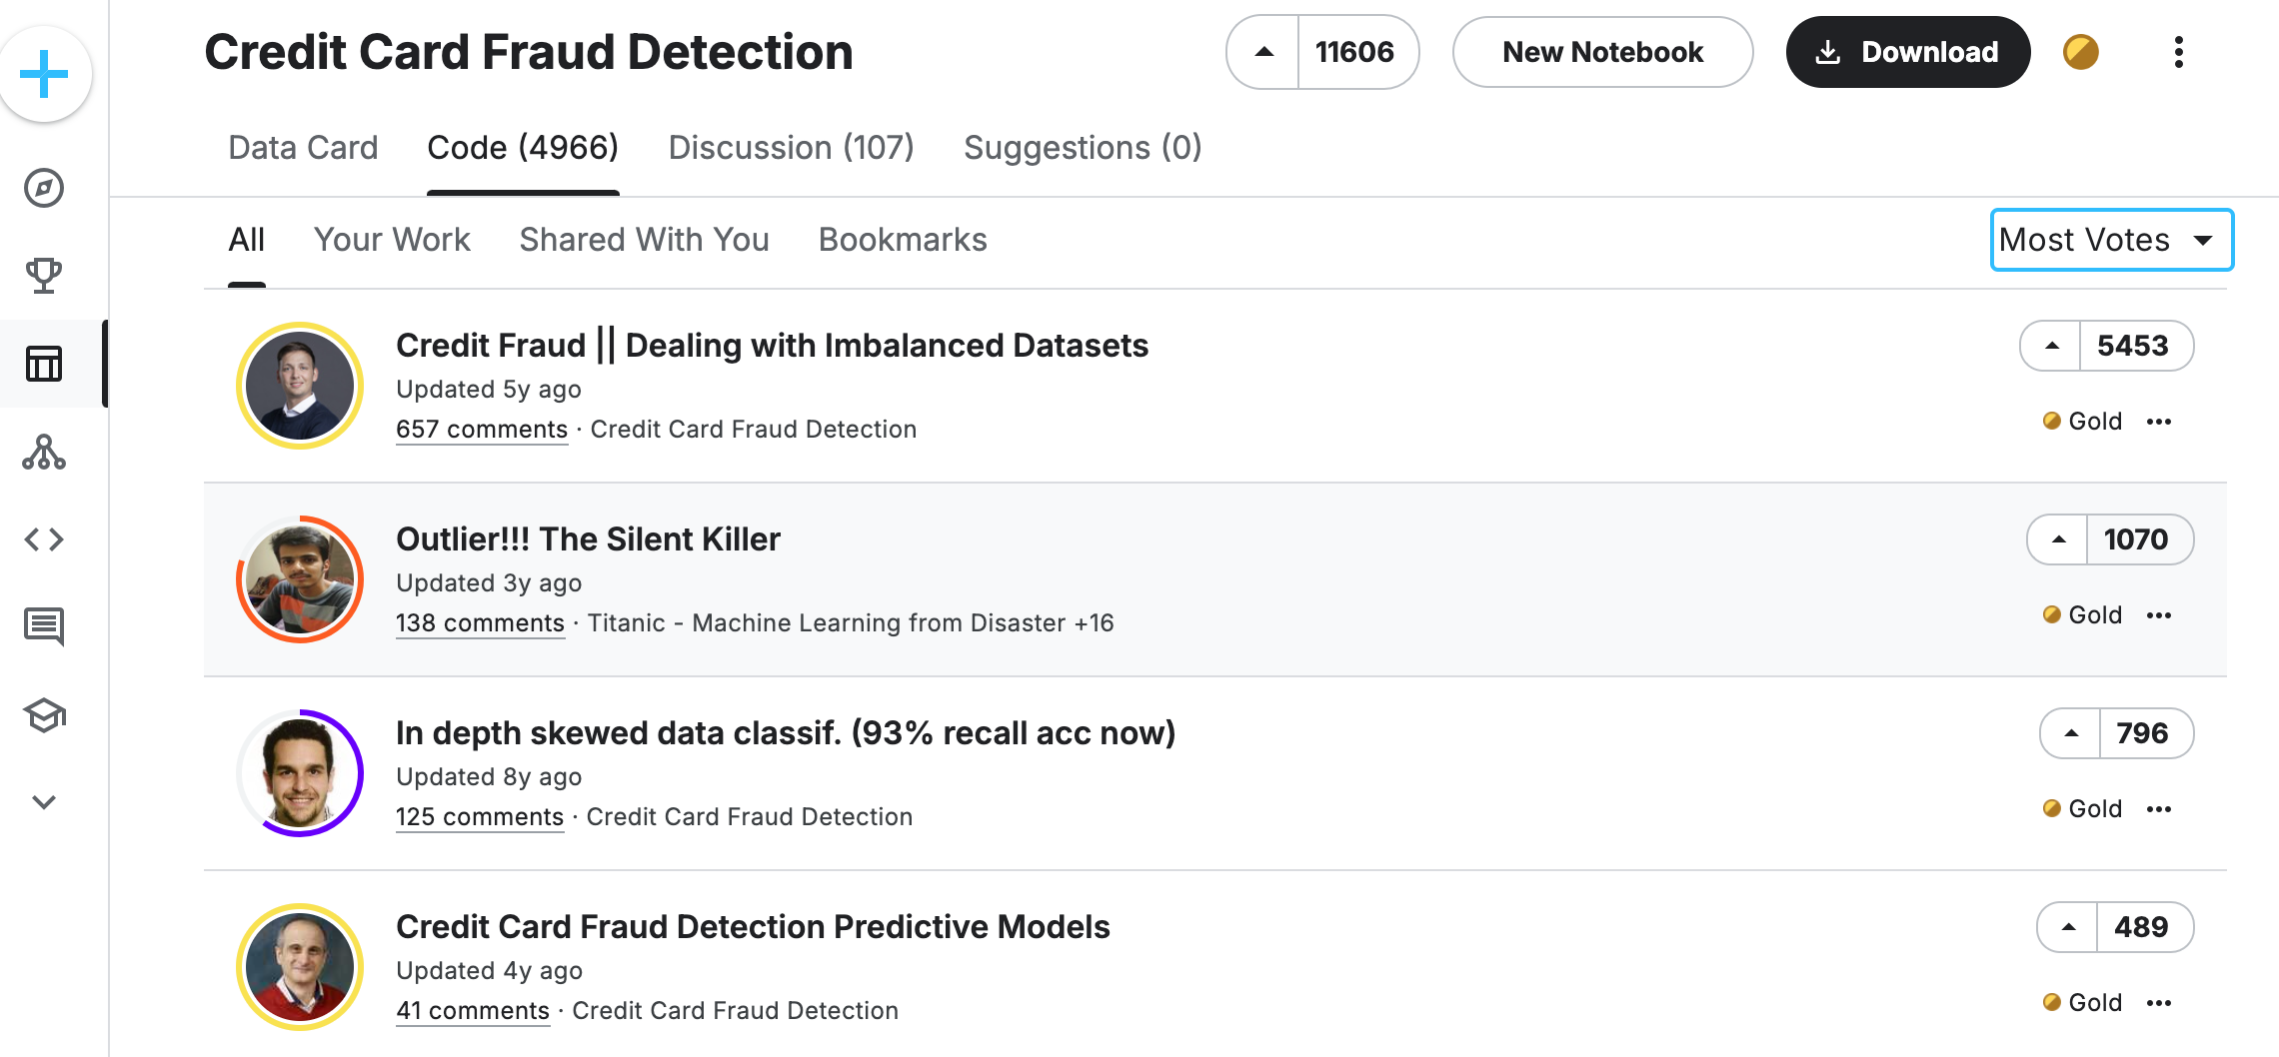
Kaggle Code: Credit Card Fraud Detection
Source: https://www.kaggle.com/datasets/mlg-ulb/creditcardfraud/code?datasetId=310&sortBy=voteCount

Slide 165
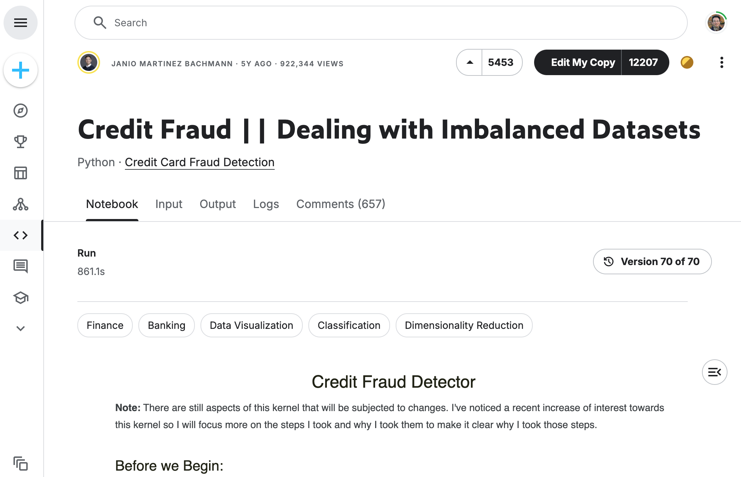
Kaggle Code: Credit Card Fraud Detection
Source: https://www.kaggle.com/code/janiobachmann/credit-fraud-dealing-with-imbalanced-datasets

Slide 166
Summary
Obtaining Data From the Web with Python
  Requests
  BeautifulSoup
  Pandas
Statistical Analysis with Python
  Descriptive Statistics
  Inferential Statistics

Slide 167
References
Wes McKinney (2022), "Python for Data Analysis: Data Wrangling with pandas, NumPy, and Jupyter", 3rd Edition, O'Reilly Media.
Aurélien Géron (2023), Hands-On Machine Learning with Scikit-Learn, Keras, and TensorFlow: Concepts, Tools, and Techniques to Build Intelligent Systems, 3rd Edition, O’Reilly Media.
Steven D'Ascoli (2022), Artificial Intelligence and Deep Learning with Python: Every Line of Code Explained For Readers New to AI and New to Python, Independently published.
Stuart Russell and Peter Norvig (2020), Artificial Intelligence: A Modern Approach, 4th Edition, Pearson.
Denis Rothman (2024), Transformers for Natural Language Processing and Computer Vision - Third Edition: Explore Generative AI and Large Language Models with Hugging Face, ChatGPT, GPT-4V, and DALL-E 3, 3rd ed. Edition, Packt Publishing
Ben Auffarth (2023), Generative AI with LangChain: Build large language model (LLM) apps with Python, ChatGPT and other LLMs, Packt Publishing.
Varun Grover, Roger HL Chiang, Ting-Peng Liang, and Dongsong Zhang (2018), "Creating Strategic Business Value from Big Data Analytics: A Research Framework", Journal of Management Information Systems, 35, no. 2, pp. 388-423.
Junliang Wang, Chuqiao Xu, Jie Zhang, and Ray Zhong (2022). "Big data analytics for intelligent manufacturing systems: A review." Journal of Manufacturing Systems 62 (2022): 738-752.
Ramesh Sharda, Dursun Delen, and Efraim Turban (2017), Business Intelligence, Analytics, and Data Science: A Managerial Perspective, 4th Edition, Pearson
Python Programming, https://pythonprogramming.net/
Python, https://www.python.org/
Python Programming Language, http://pythonprogramminglanguage.com/
Numpy, http://www.numpy.org/
Pandas, http://pandas.pydata.org/
Skikit-learn, http://scikit-learn.org/
W3Schools Python, https://www.w3schools.com/python/
Learn Python, https://www.learnpython.org/
Google’s Python Class, https://developers.google.com/edu/python
Harvard University (2024), CS50x 2024 - Lecture 6 - Python, http://www.youtube.com/watch?v=EHi0RDZ31VA
Min-Yuh Day (2024), Python 101, https://tinyurl.com/aintpupython101

