Slide 1



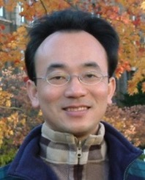



Applications of Accounting
Data Analytics with Python
Python for Accounting Applications
1131PAA11
ACC2, NTPU (U2004) (Fall 2024)
Wed 6, 7, 8, (14:10-17:00) (9:10-12:00) (B3F10)
Min-Yuh Day, Ph.D,
Professor
Institute of Information Management, National Taipei University
https://web.ntpu.edu.tw/~myday
2024-12-11

Slide 2
Syllabus
Week Date Subject/Topics
1 2024/09/11 Introduction to Python for Accounting Applications
2 2024/09/18 Python Programming and Data Science
3 2024/09/25 Foundations of Python Programming
4 2024/10/02 Data Structures
5 2024/10/09 Control Logic and Loops
6 2024/10/16 Functions and Modules; Files and Exception Handling
7 2024/10/23 Data Analytics and Visualization with Python
8 2024/10/30 Midterm Project Report (Self-Learning)

Slide 3
Syllabus
Week Date Subject/Topics
9 2024/11/06 Self-Learning
10 2024/11/13 Midterm Project Report
11 2024/11/20 Obtaining Data From the Web with Python;
Statistical Analysis with Python
12 2024/11/27 Machine Learning with Python
13 2024/12/04 Text Analytics with Generative AI and Python
14 2024/12/11 Applications of Accounting Data Analytics with Python
15 2024/12/18 Applications of ESG Data Analytics with Python
16 2024/12/25 Final Project Report

Slide 4
Applications of Accounting
Data Analytics with Python
https://colab.research.google.com/drive/1IZnqcenbxSlehvPYb3xMqLVF21oWQdj_?usp=sharing

Slide 5
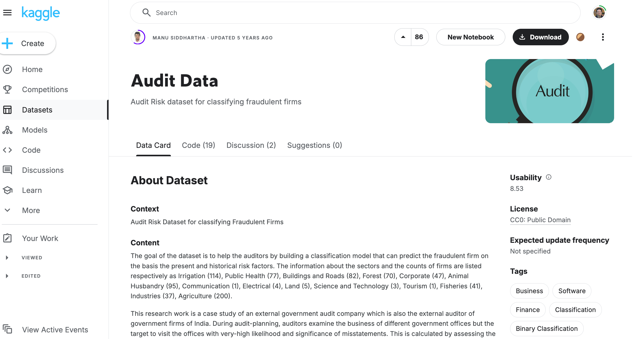
Audit Data Classification https://www.kaggle.com/datasets/sid321axn/audit-data/data

Slide 6
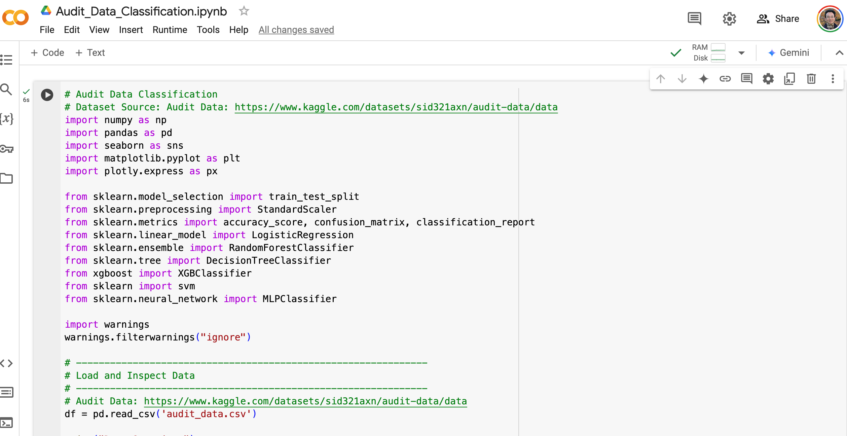
Audit Data Classification https://www.kaggle.com/datasets/sid321axn/audit-data/data
https://colab.research.google.com/drive/1IZnqcenbxSlehvPYb3xMqLVF21oWQdj_?usp=sharing

Slide 7
# Audit Data Classification
import numpy as np
import pandas as pd
import seaborn as sns
import matplotlib.pyplot as plt
import plotly.express as px
from sklearn.model_selection import train_test_split
from sklearn.preprocessing import StandardScaler
from sklearn.metrics import accuracy_score, confusion_matrix, classification_report
from sklearn.linear_model import LogisticRegression
from sklearn.ensemble import RandomForestClassifier
from sklearn.tree import DecisionTreeClassifier
from xgboost import XGBClassifier
from sklearn import svm
from sklearn.neural_network import MLPClassifier
import warnings
warnings.filterwarnings("ignore")
https://tinyurl.com/aintpupython101

Slide 8
# Audit Data: https://www.kaggle.com/datasets/sid321axn/audit-data/data
# Load and Inspect Data
df = pd.read_csv('audit_data.csv')
print("Data Overview:")
print(df.head(), "\n")
print("Missing Values:")
print(df.isnull().sum(), "\n")
# Visualize target distribution
sns.countplot(x="Risk", data=df, palette="coolwarm")
plt.title("Count of Risk Labels")
plt.show()
https://tinyurl.com/aintpupython101

Slide 9
# Data Preprocessing
df_ml = df.copy()
# Fill missing values in 'Money_Value' with the mean
df_ml['Money_Value'] = df_ml['Money_Value'].fillna(df_ml['Money_Value'].mean())
# One-hot encode the 'LOCATION_ID' column
location_dummies = pd.get_dummies(df_ml['LOCATION_ID'], prefix='location')
df_ml = pd.concat([df_ml, location_dummies], axis=1).drop('LOCATION_ID', axis=1)
https://tinyurl.com/aintpupython101

Slide 10
# Separate features and target
y = df_ml['Risk']
X = df_ml.drop('Risk', axis=1)
# Split into train and test sets
X_train, X_test, y_train, y_test = train_test_split(
X, y, train_size=0.7, shuffle=True, random_state=1
)
https://tinyurl.com/aintpupython101

Slide 11
# Standardize the numerical features
scaler = StandardScaler()
scaler.fit(X_train)
X_train = pd.DataFrame(scaler.transform(X_train), index=X_train.index, columns=X_train.columns)
X_test = pd.DataFrame(scaler.transform(X_test), index=X_test.index, columns=X_test.columns)
https://tinyurl.com/aintpupython101

Slide 12
# Utility Functions
def evaluate_model(model, X_test, y_test, model_name="Model"):
"""
Fits a given model to the test data, computes predictions,
and returns accuracy score and confusion matrix.
"""
y_pred = model.predict(X_test)
acc = accuracy_score(y_test, y_pred)
cm = confusion_matrix(y_test, y_pred)
print(f"{model_name} Accuracy: {acc:.4f}")
print(classification_report(y_test, y_pred))
return acc, cm
https://tinyurl.com/aintpupython101

Slide 13
def plot_confusion_matrix(cm, labels=['No Risk', 'Risk'], title="Confusion Matrix"):
"""
Plots a confusion matrix with the given labels.
"""
disp = sns.heatmap(cm, annot=True, fmt='g', cmap='Blues', xticklabels=labels, yticklabels=labels)
plt.title(title)
plt.xlabel("Predicted")
plt.ylabel("Actual")
plt.show()
https://tinyurl.com/aintpupython101

Slide 14
def plot_bar_comparison(df, x_col, y_col, title, x_label, y_label):
"""
Plots a horizontal bar chart for comparison of models based on a specified metric.
"""
fig = px.bar(df, y=y_col, x=x_col, color=y_col, text=x_col, orientation='h', title=title)
fig.update_layout(xaxis_title=x_label, yaxis_title=y_label)
fig.show()
https://tinyurl.com/aintpupython101

Slide 15
# Modeling
models = {
  "Decision Tree": DecisionTreeClassifier(random_state=1),
  "Random Forest": RandomForestClassifier(n_estimators=100, random_state=1),
  "Logistic Regression": LogisticRegression(random_state=1),
  "XGBoost Classifier": XGBClassifier(random_state=1, use_label_encoder=False, eval_metric='mlogloss'),
  "Support Vector Machine": svm.SVC(kernel='linear', random_state=1),
  "Neural Network": MLPClassifier(random_state=1, max_iter=200)
  }
https://tinyurl.com/aintpupython101

Slide 16
results = []
confusion_matrices = {}
# Train, evaluate, and store results
for name, model in models.items():
model.fit(X_train, y_train)
acc, cm = evaluate_model(model, X_test, y_test, model_name=name)
results.append((name, acc))
confusion_matrices[name] = cm
https://tinyurl.com/aintpupython101

Slide 17
# Compare Model Performance
results_df = pd.DataFrame(results, columns=['Model', 'Accuracy'])
results_df['Accuracy'] = results_df['Accuracy'] * 100
results_df = results_df.sort_values(by='Accuracy', ascending=False)
print("\nModel Performance Comparison:")
print(results_df)
https://tinyurl.com/aintpupython101

Slide 18
results_df['Text'] = results_df.apply(lambda row: f"{row['Model']}: {row['Accuracy']:.2f}%", axis=1)
plot_bar_comparison(results_df, x_col="Accuracy", y_col="Model",
title="Model Accuracy Comparison",
x_label="Accuracy (%)", y_label="Model")
https://tinyurl.com/aintpupython101

Slide 19
# Error Analysis (FP, FN, TN)
analysis_data = []
for name, cm in confusion_matrices.items():
TN, FP = cm[0,0], cm[0,1]
FN, TP = cm[1,0], cm[1,1]
analysis_data.append([name, FP, FN, TP])
analysis_df = pd.DataFrame(analysis_data, columns=['Model', 'False Positives', 'False Negative', 'True Negative'])
https://tinyurl.com/aintpupython101

Slide 20
# Visualize False Positives
fp_df = analysis_df[['Model', 'False Positives']].sort_values(by='False Positives', ascending=False)
fp_df['Text'] = fp_df.apply(lambda row: f"{row['Model']}: {row['False Positives']}", axis=1)
plot_bar_comparison(fp_df, x_col='False Positives', y_col='Model',
title="False Positives Comparison",
x_label="False Positives", y_label="Model")
https://tinyurl.com/aintpupython101

Slide 21
# Visualize False Negatives
fn_df = analysis_df[['Model', 'False Negative']].sort_values(by='False Negative', ascending=False)
fn_df['Text'] = fn_df.apply(lambda row: f"{row['Model']}: {row['False Negative']}", axis=1)
plot_bar_comparison(fn_df, x_col='False Negative', y_col='Model',
title="False Negatives Comparison",
x_label="False Negative", y_label="Model")
https://tinyurl.com/aintpupython101

Slide 22
# Visualize True Negatives
tn_df = analysis_df[['Model', 'True Negative']].sort_values(by='True Negative', ascending=False)
tn_df['Text'] = tn_df.apply(lambda row: f"{row['Model']}: {row['True Negative']}", axis=1)
plot_bar_comparison(tn_df, x_col='True Negative', y_col='Model',
title="True Negative (Correct Risk Predictions) Comparison",
x_label="True Negative", y_label="Model")
https://tinyurl.com/aintpupython101

Slide 23
# Feature Importance (From Random Forest)
if 'Random Forest' in models:
  rfc = models['Random Forest']
  importances = rfc.feature_importances_
  indices = np.argsort(importances)[::-1]
  names = [X.columns[i] for i in indices]
  fig = px.bar(x=names, y=importances[indices], title="Feature Importance (Random Forest)")
  fig.update_xaxes(tickangle=90)
  fig.show()
https://tinyurl.com/aintpupython101

Slide 24



NVIDIA Developer Program
NVIDIA
Deep Learning Institute (DLI)
https://developer.nvidia.com/join-nvidia-developer-program
https://learn.nvidia.com/

Slide 25
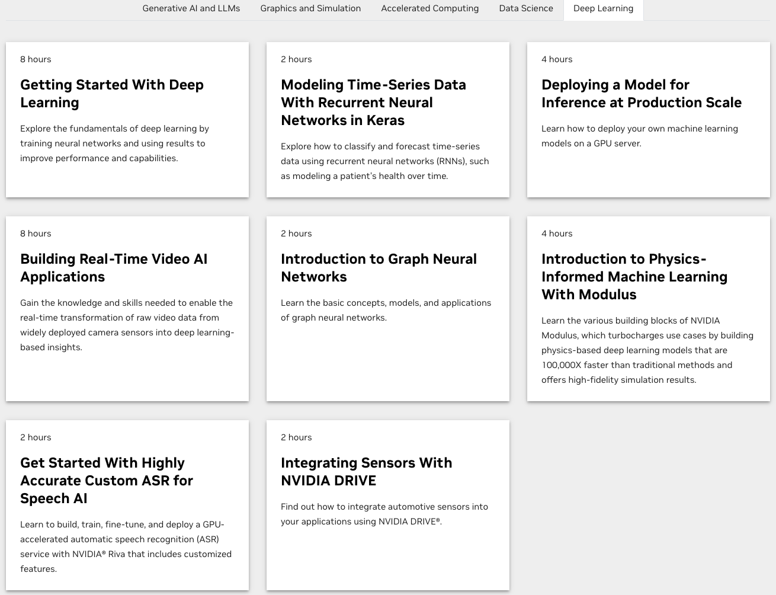
Join the NVIDIA Developer Program take one of the complimentary technical self-paced courses
(worth up to $90)
https://developer.nvidia.com/join-nvidia-developer-program

Slide 26
NVIDIA Deep Learning Institute (DLI)
Self-Paced Course
Generative AI Explained
Free
2 hours
Self-Paced Course
Getting Started With Deep Learning
Certificate available
$90
8 hours
Instructor-Led Workshop
Fundamentals of Deep Learning
Certificate available
$500
8 hours
Self-Paced Course
Introduction to Transformer-Based Natural Language Processing
Certificate available
$30
6 hours
Self-Paced Course
Building RAG Agents With LLMs
Certificate available
Free
8 hours
Instructor-Led Workshop
Building RAG Agents With LLMs
Certificate available
$500
8 hours
Self-Paced Course
Generative AI with Diffusion Models
Certificate available
$90
8 hours
Instructor-Led Workshop
Generative AI with Diffusion Models
Certificate available
$500
8 hours
https://www.nvidia.com/en-us/learn/learning-path/generative-ai-llm/

Slide 27
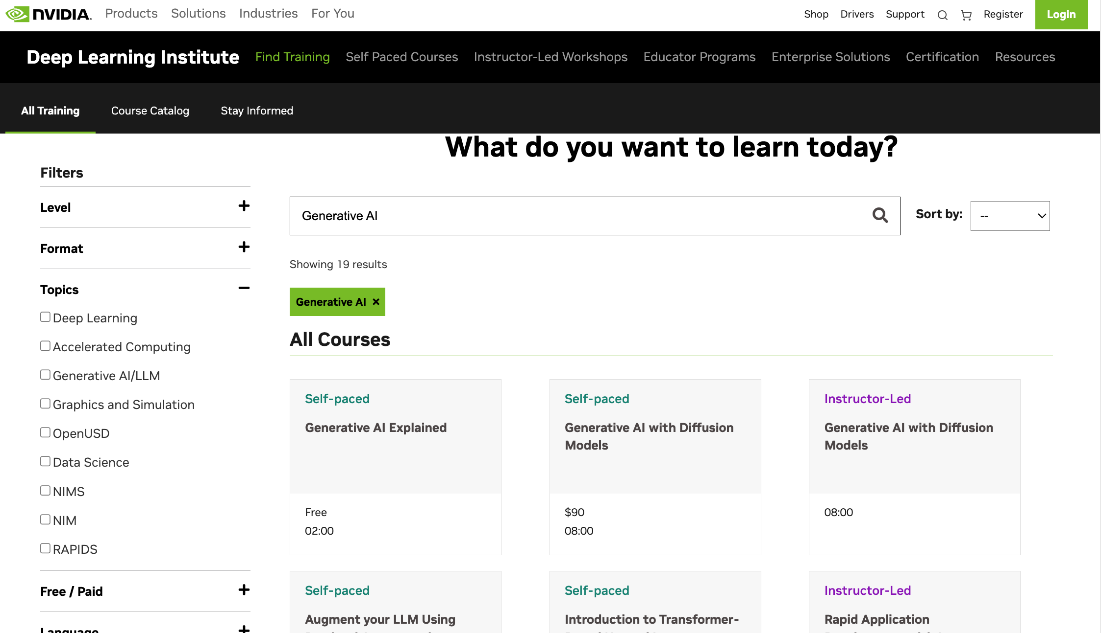
NVIDIA Deep Learning Institute (DLI)
Generative AI
https://learn.nvidia.com/en-us/training/find-training?q=Generative+AI

Slide 28

Generative AI Explained
https://learn.nvidia.com/courses/course-detail?course_id=course-v1:DLI+S-FX-15+V1

Slide 29

Introduction to Transformer-Based
Natural Language Processing
https://learn.nvidia.com/courses/course-detail?course_id=course-v1:DLI+S-FX-08+V1

Slide 30

Building RAG Agents with LLMs
https://learn.nvidia.com/courses/course-detail?course_id=course-v1:DLI+S-FX-15+V1

Slide 31

Generative AI with Diffusion Models
https://learn.nvidia.com/courses/course-detail?course_id=course-v1:DLI+S-FX-14+V1

Slide 32
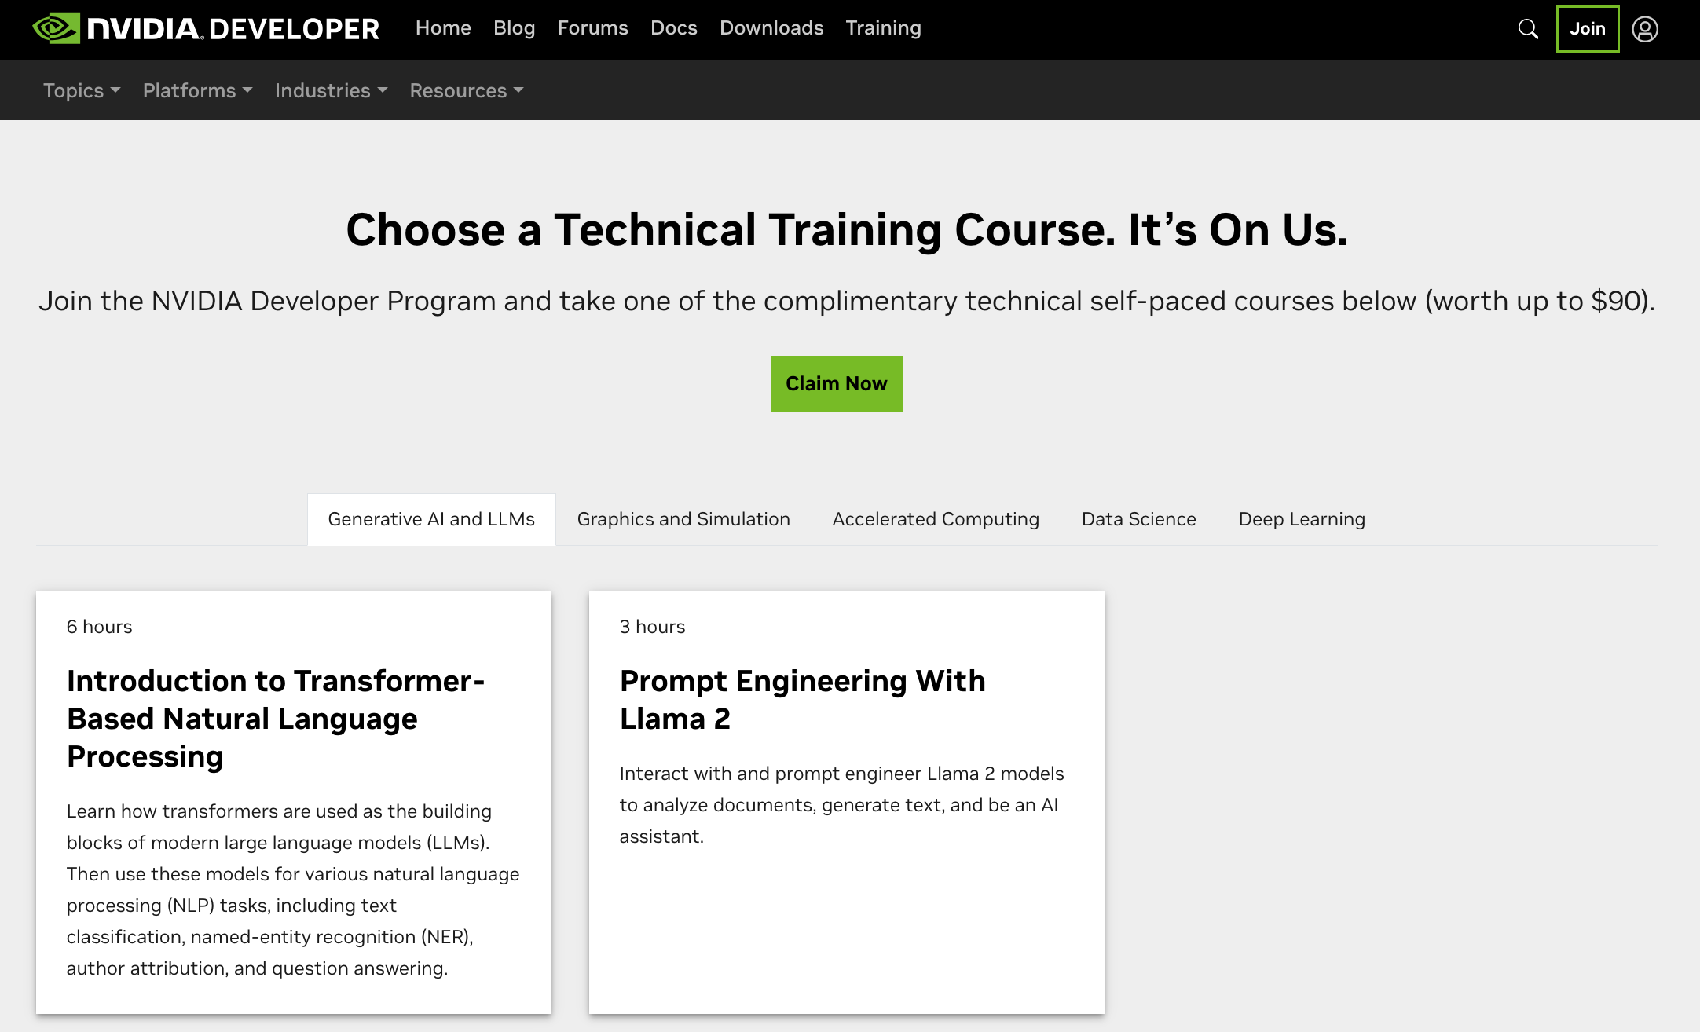
Join the NVIDIA Developer Program take one of the complimentary technical self-paced courses (worth up to $90)
https://developer.nvidia.com/join-nvidia-developer-program

Slide 33
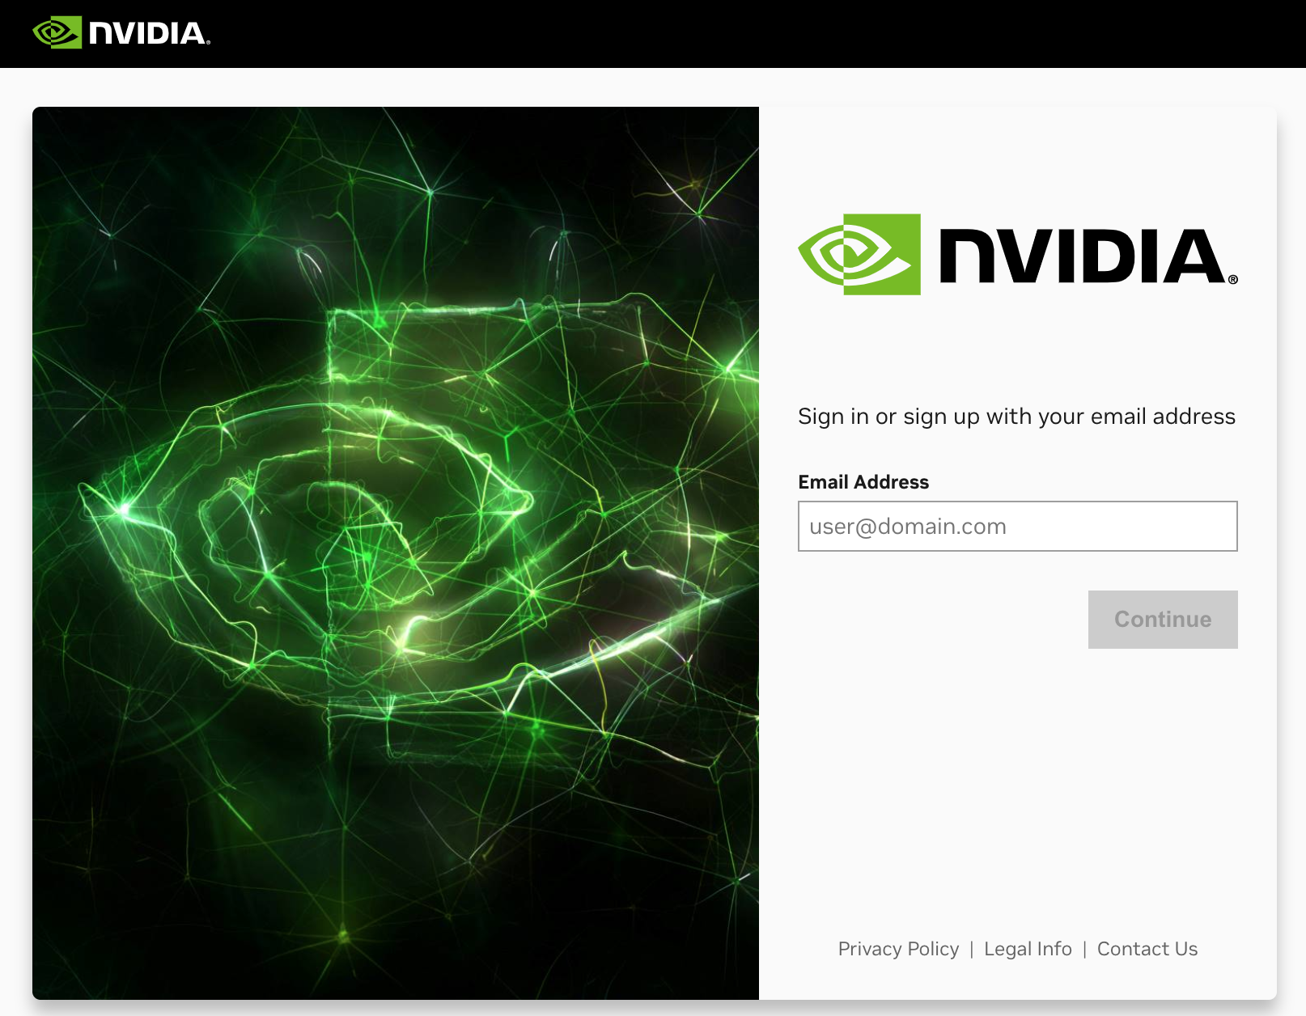
Join the NVIDIA Developer Program take one of the complimentary technical self-paced courses (worth up to $90)
https://developer.nvidia.com/join-nvidia-developer-program

Slide 34
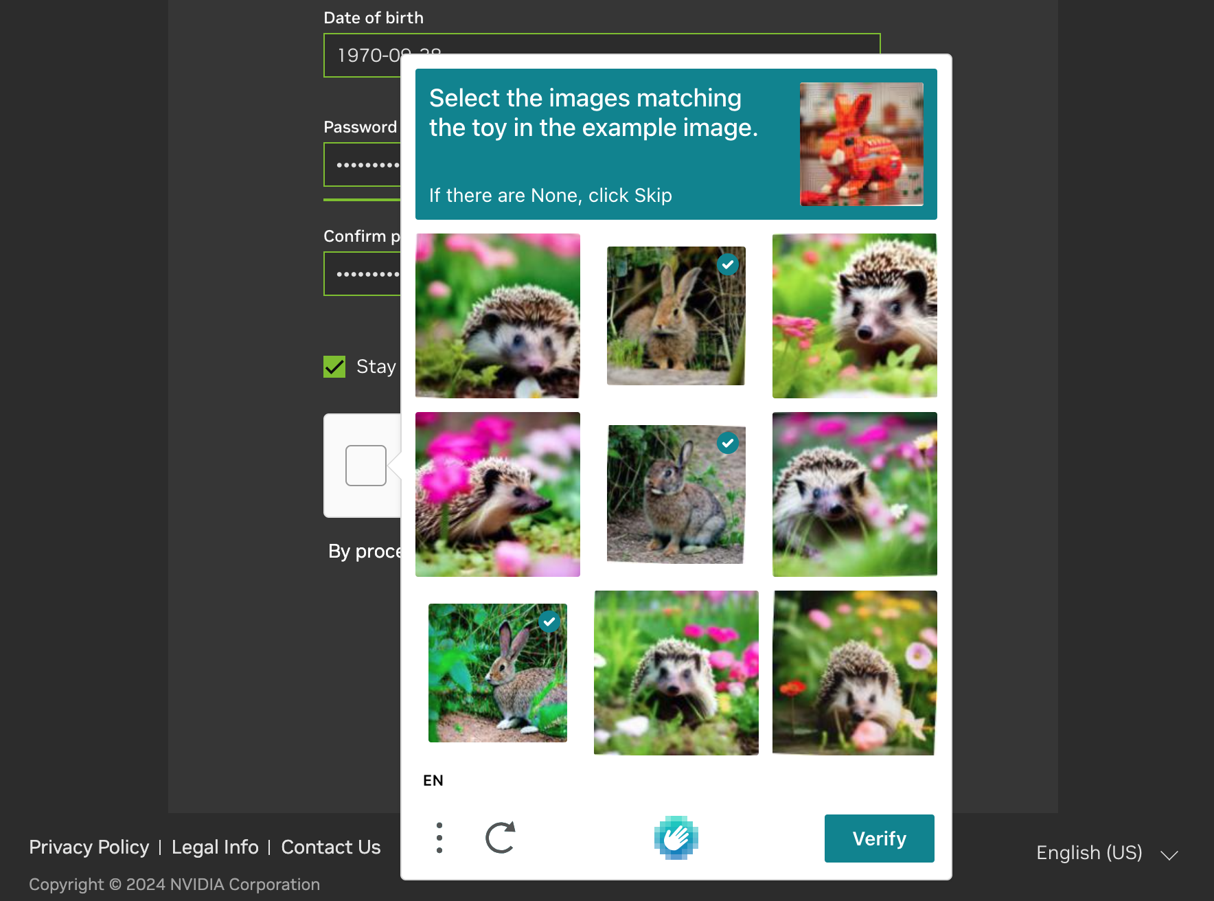
Join the NVIDIA Developer Program take one of the complimentary technical self-paced courses (worth up to $90)
https://developer.nvidia.com/join-nvidia-developer-program

Slide 35
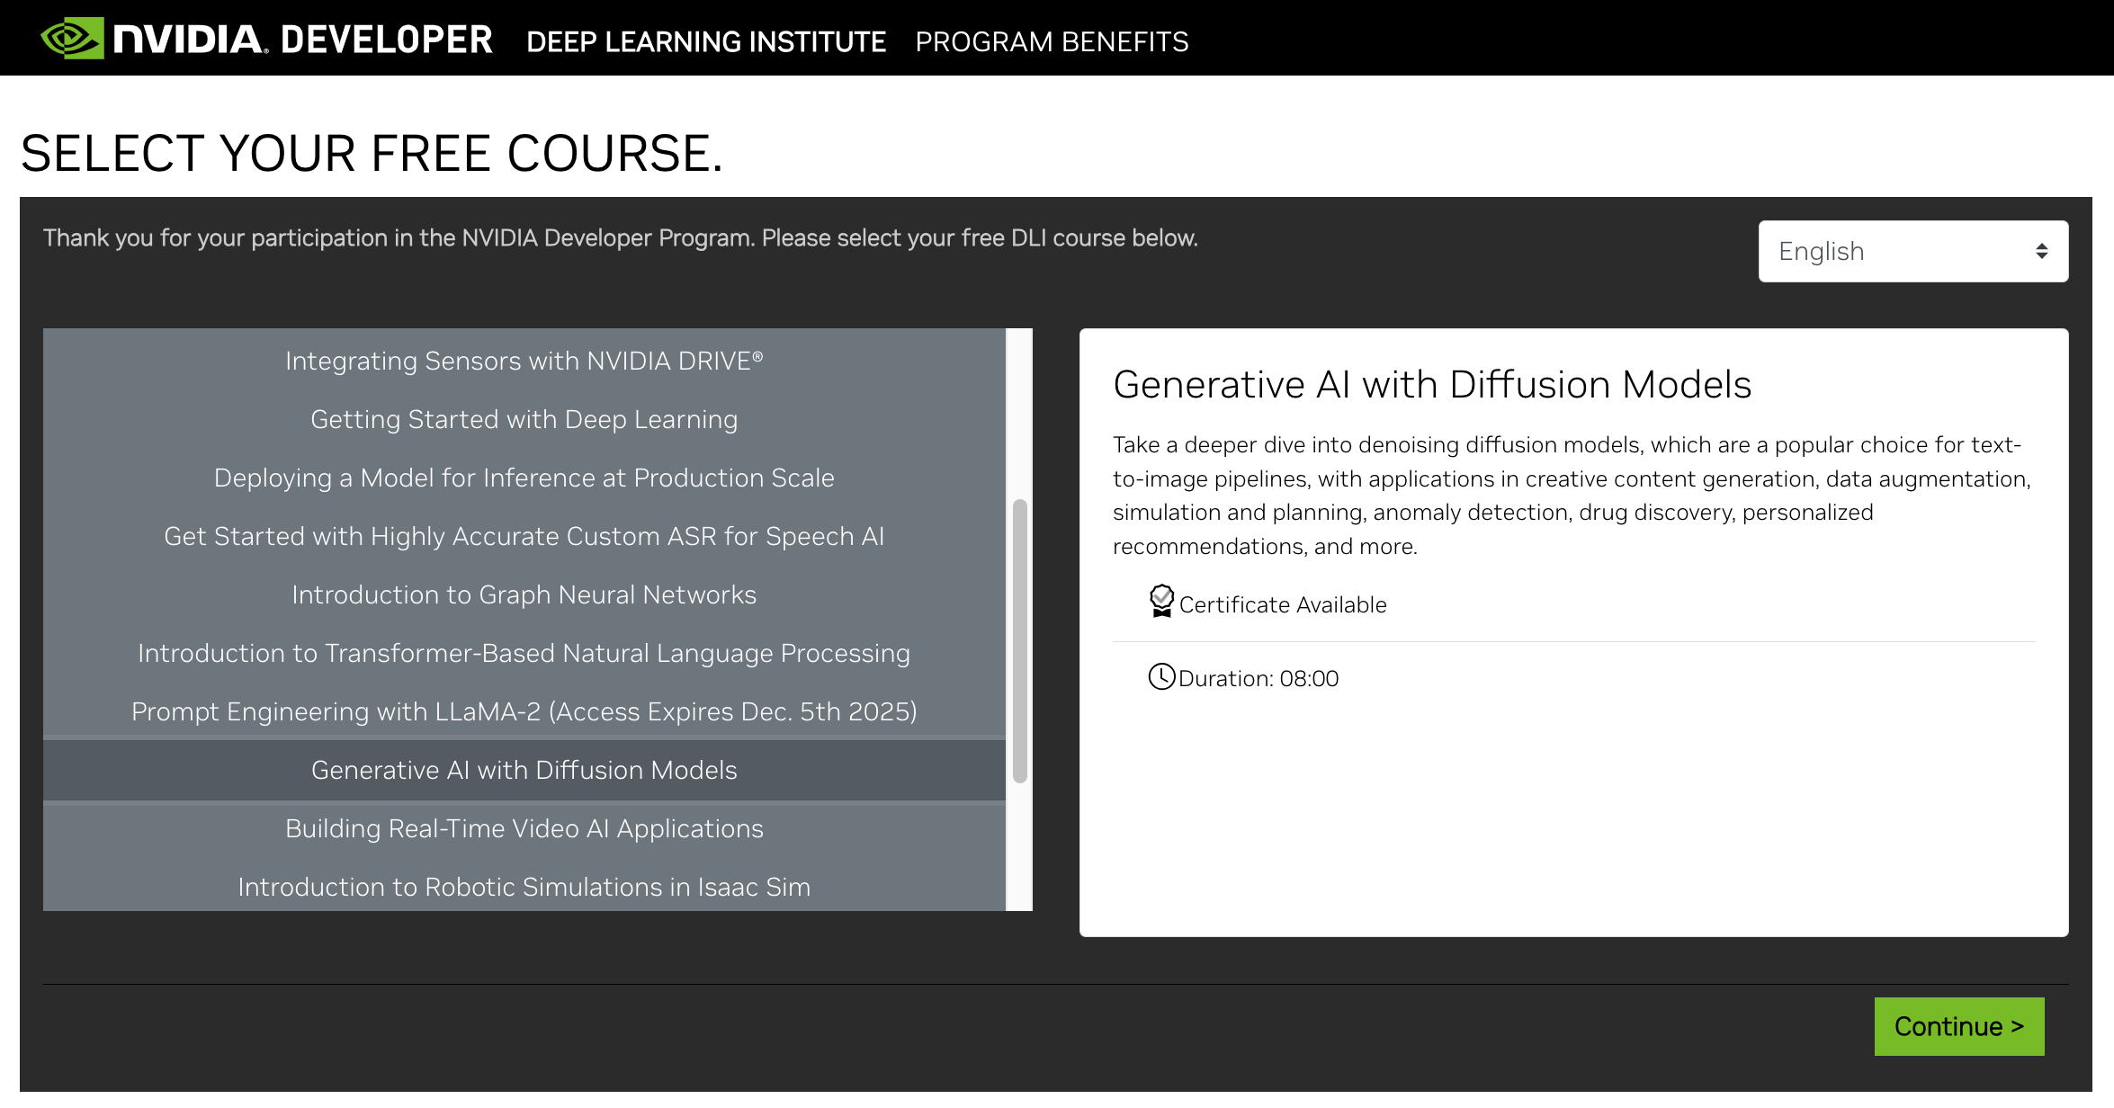
Join the NVIDIA Developer Program take one of the complimentary technical self-paced courses (worth up to $90)
https://developer.nvidia.com/join-nvidia-developer-program

Slide 36
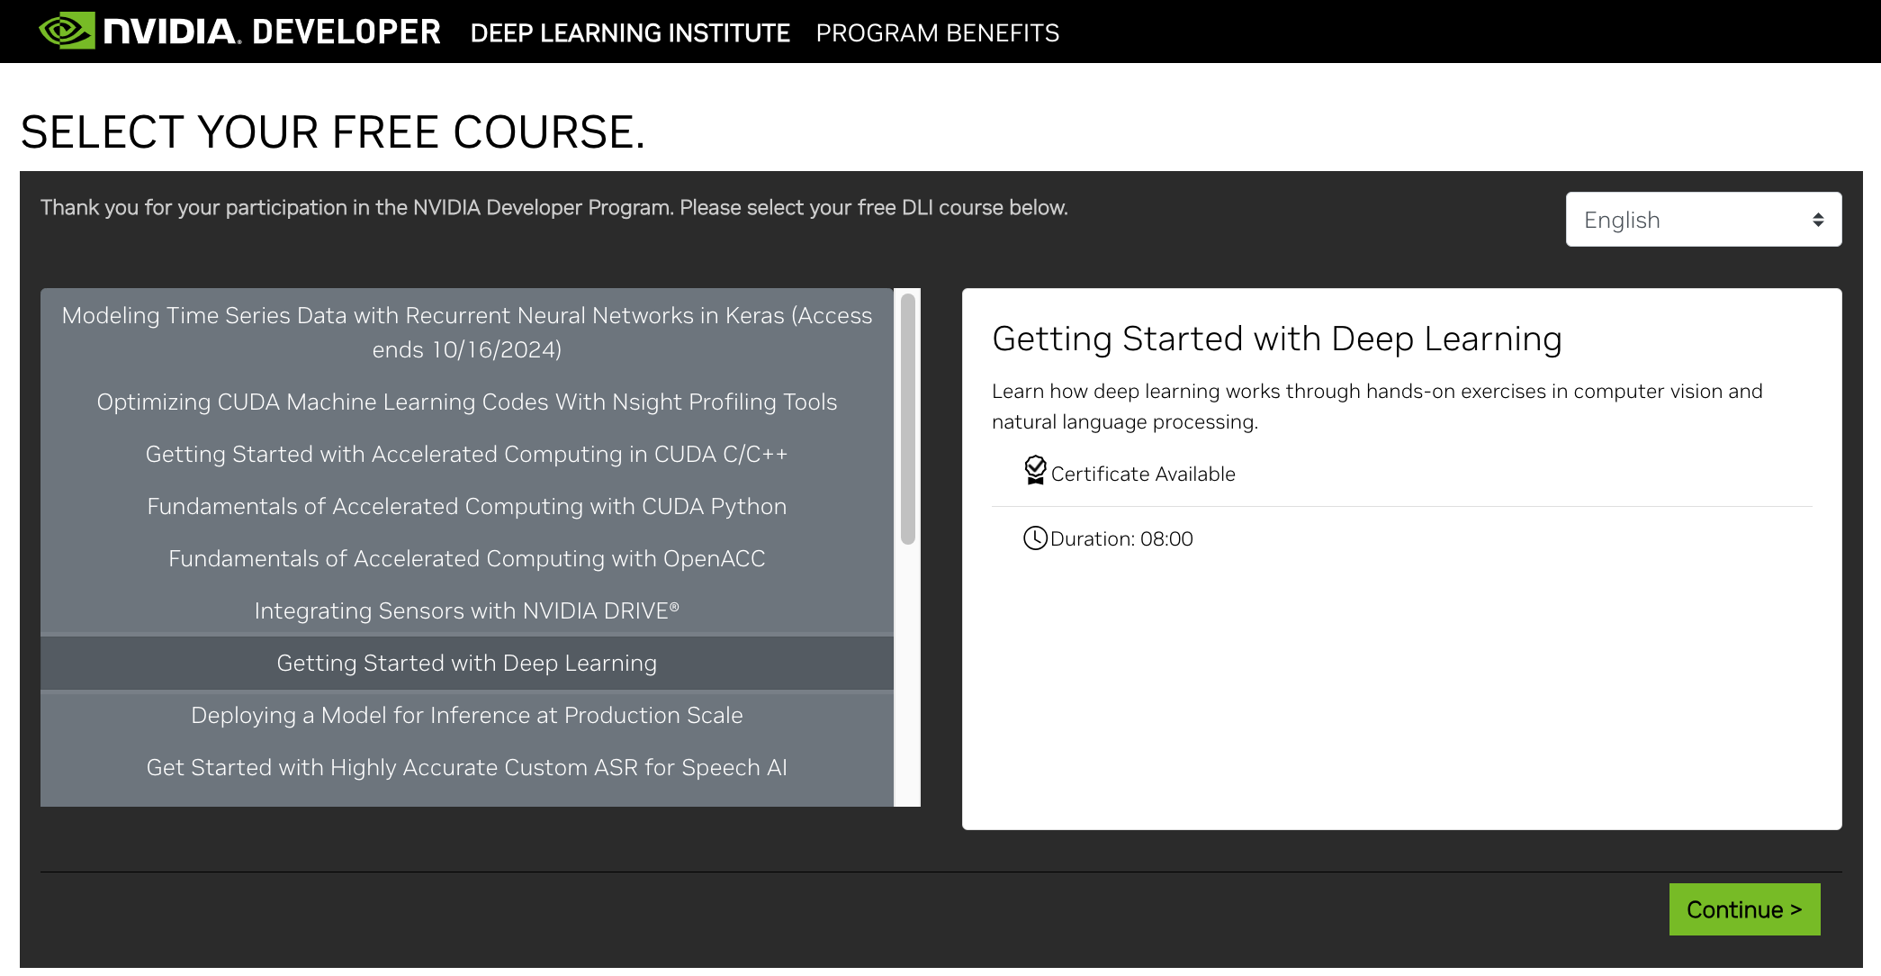
Join the NVIDIA Developer Program take one of the complimentary technical self-paced courses (worth up to $90)
https://developer.nvidia.com/join-nvidia-developer-program

Slide 37
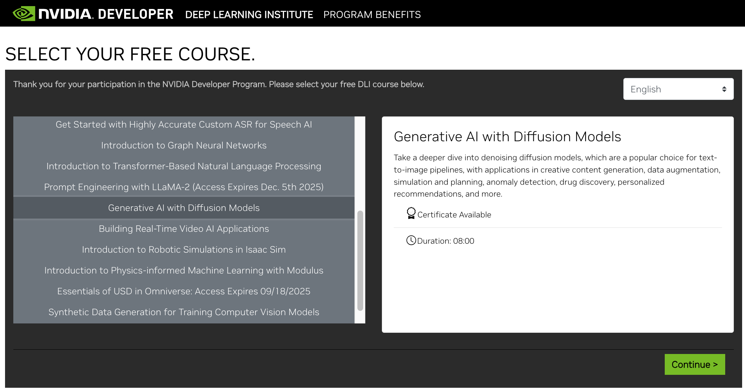
Join the NVIDIA Developer Program take one of the complimentary technical self-paced courses (worth up to $90)
https://developer.nvidia.com/join-nvidia-developer-program

Slide 38
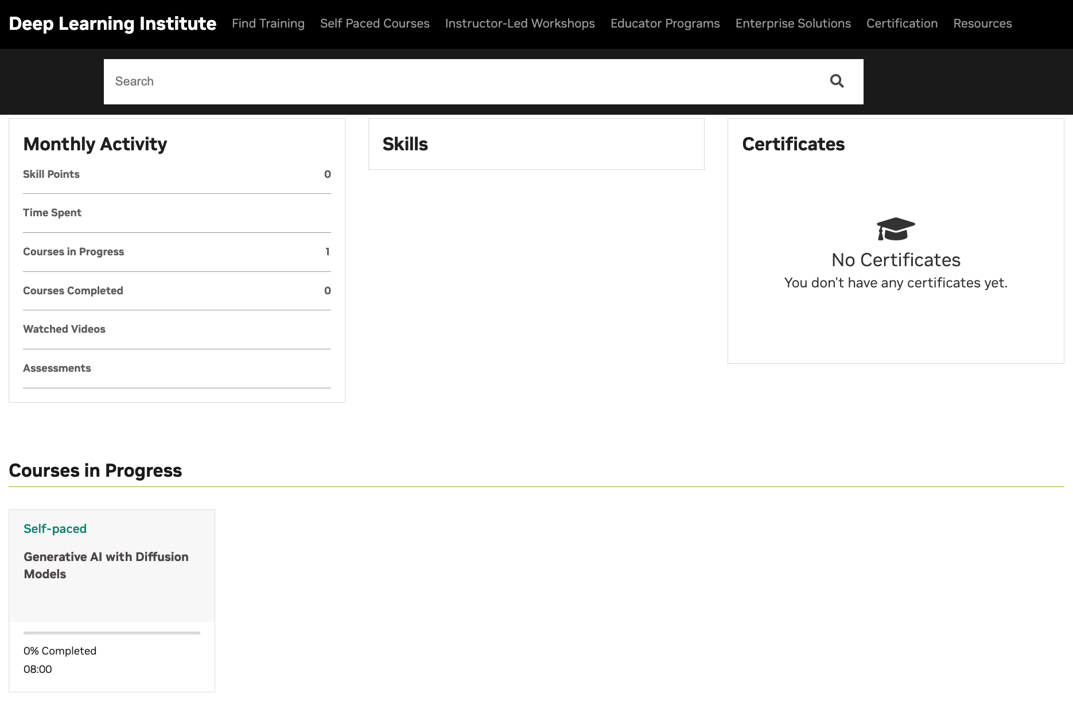
NVIDIA Deep Learning Institute (DLI)
https://learn.nvidia.com/my-learning

Slide 39
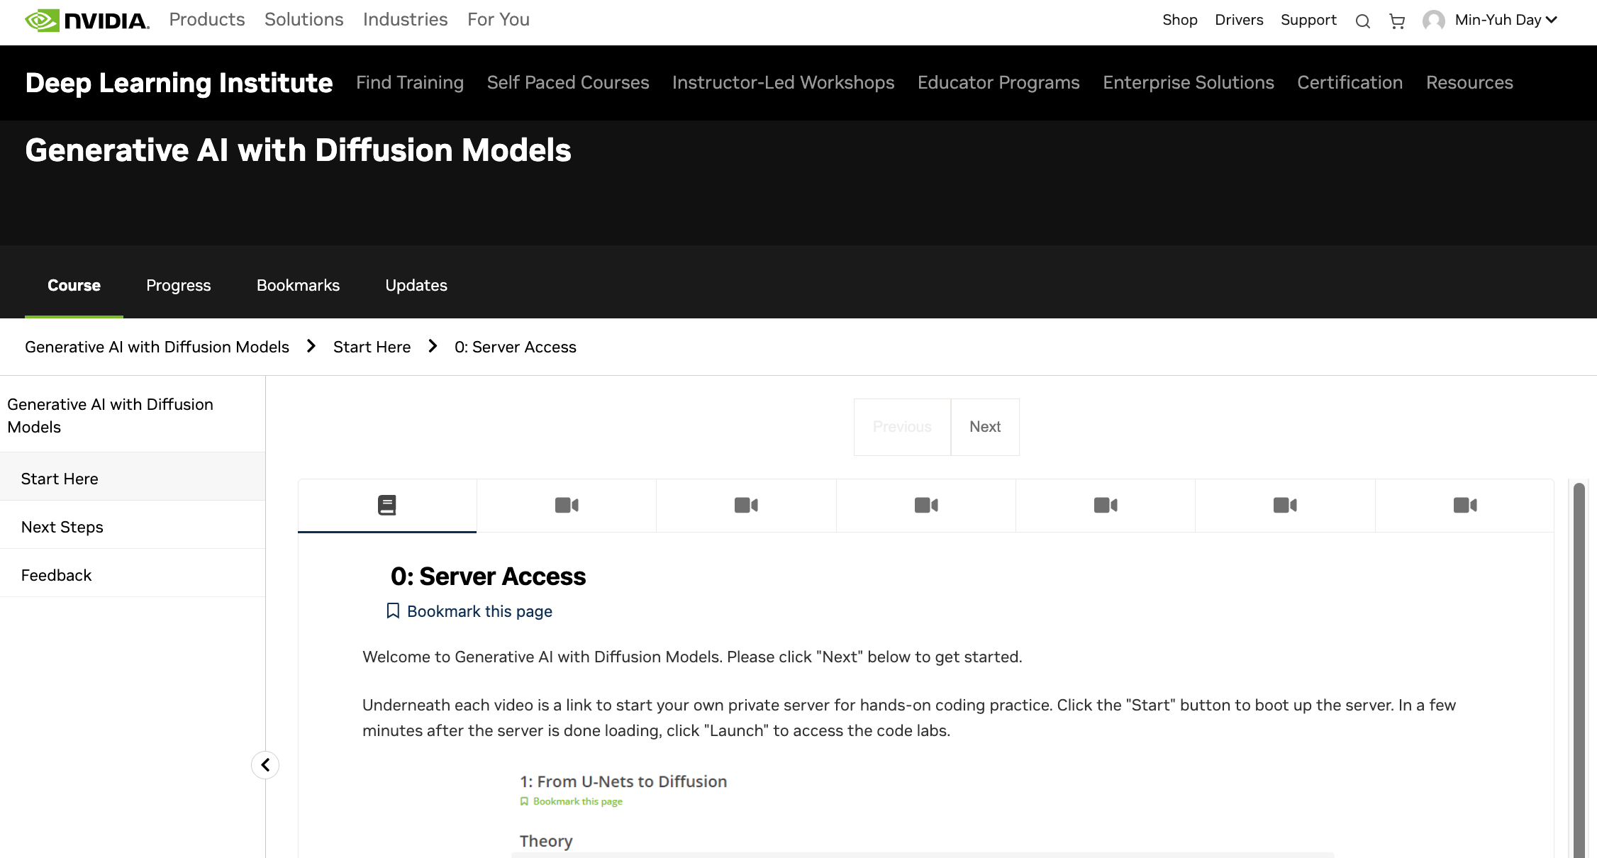
NVIDIA Deep Learning Institute (DLI)
https://learn.nvidia.com/my-learning

Slide 40
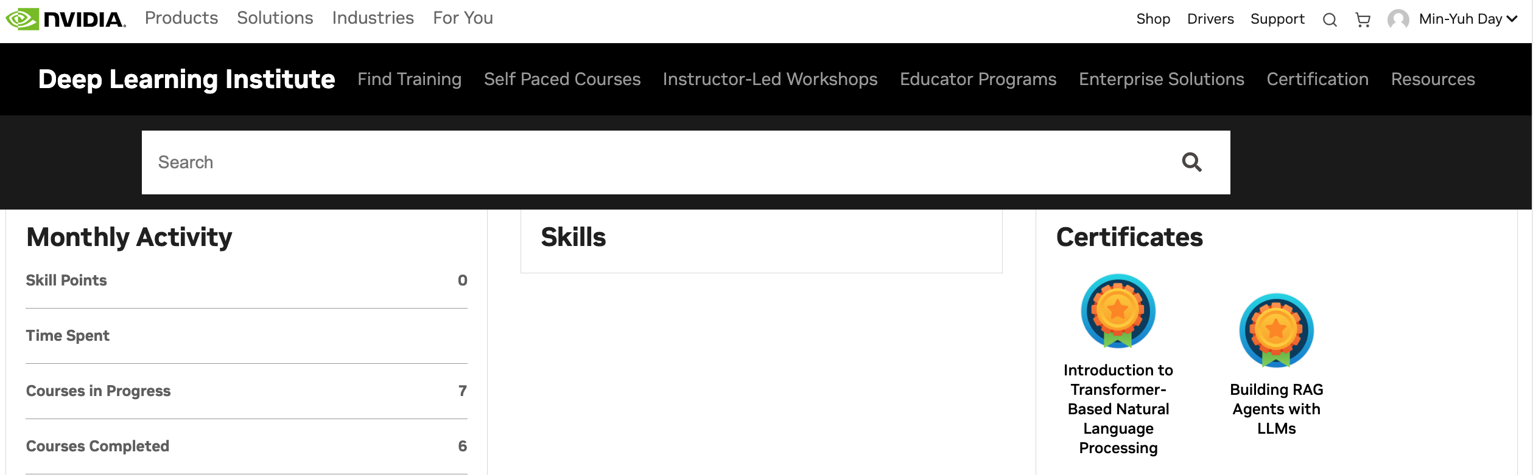
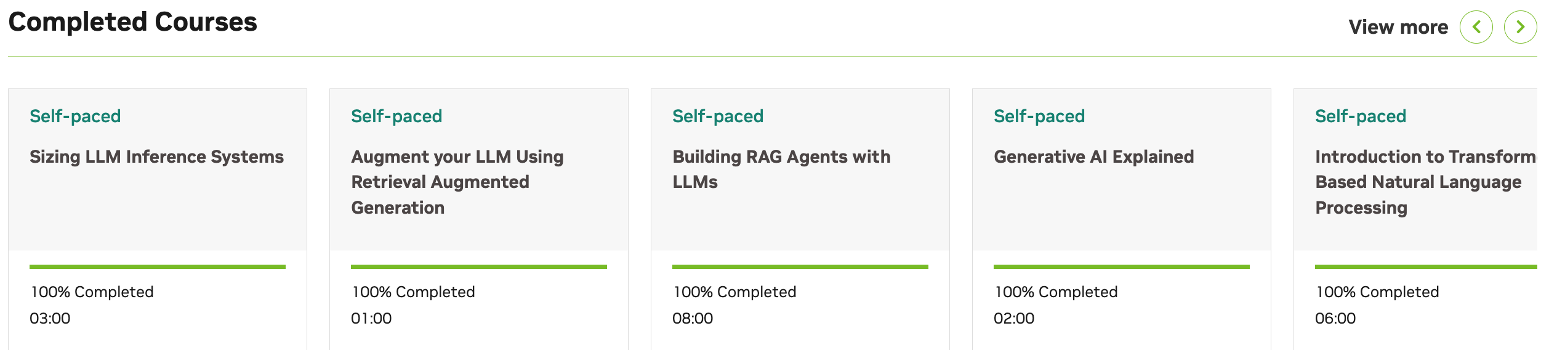
Deep Learning Institute (DLI)
https://learn.nvidia.com/my-learning

Slide 41
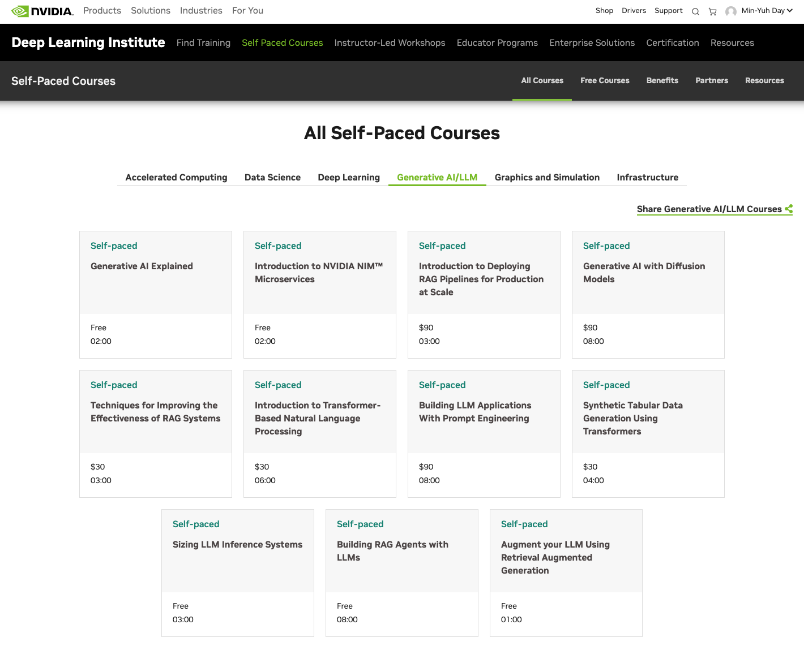
NVIDIA Deep Learning Institute (DLI)
https://learn.nvidia.com/en-us/training/self-paced-courses

Slide 42
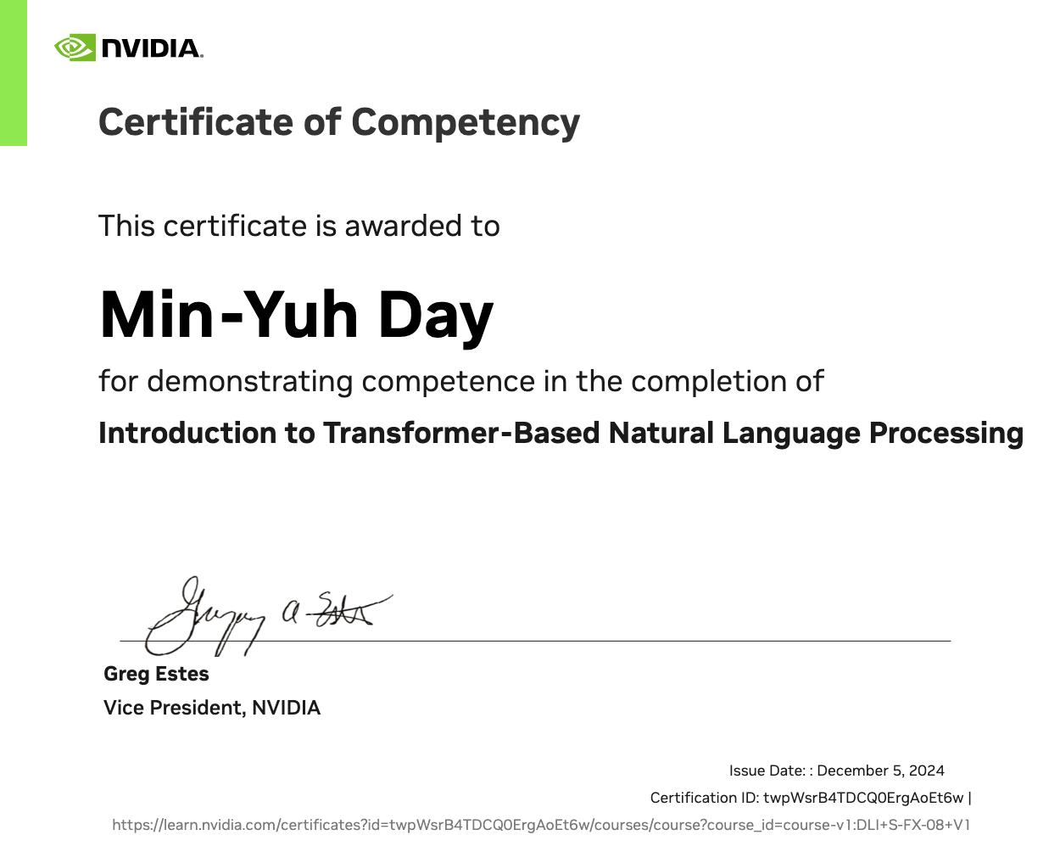
https://learn.nvidia.com/certificates?id=twpWsrB4TDCQ0ErgAoEt6w

Slide 43
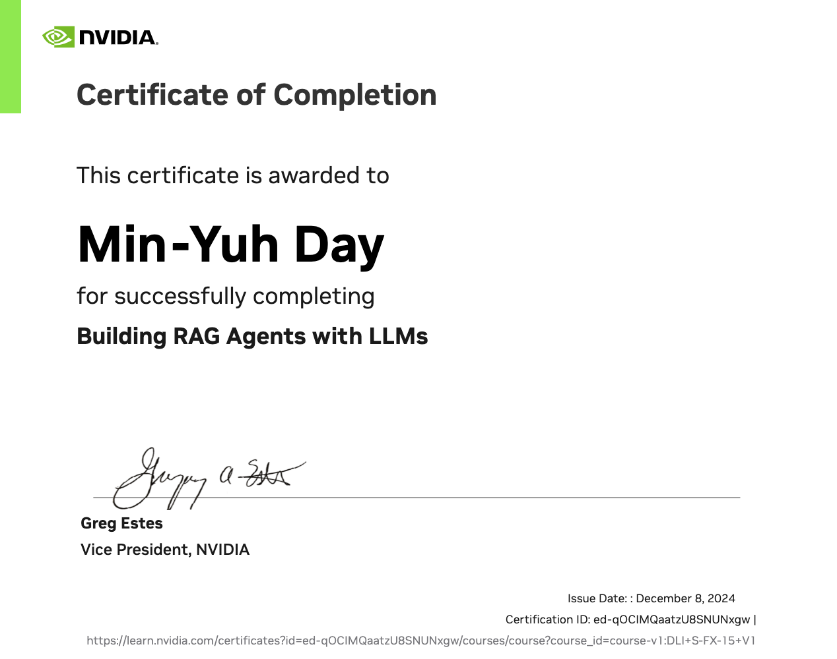
https://learn.nvidia.com/certificates?id=ed-qOCIMQaatzU8SNUNxgw

