Slide 1







Applications of ESG Data Analytics with Python
Python for Accounting Applications
1131PAA11
ACC2, NTPU (U2004) (Fall 2024)
Wed 6, 7, 8, (14:10-17:00) (9:10-12:00) (B3F10)
Min-Yuh Day, Ph.D,
Professor
Institute of Information Management, National Taipei University
https://web.ntpu.edu.tw/~myday
2024-12-18

Slide 2
Syllabus
Week Date Subject/Topics
1 2024/09/11 Introduction to Python for Accounting Applications
2 2024/09/18 Python Programming and Data Science
3 2024/09/25 Foundations of Python Programming
4 2024/10/02 Data Structures
5 2024/10/09 Control Logic and Loops
6 2024/10/16 Functions and Modules; Files and Exception Handling
7 2024/10/23 Data Analytics and Visualization with Python
8 2024/10/30 Midterm Project Report (Self-Learning)

Slide 3
Syllabus
Week Date Subject/Topics
9 2024/11/06 Self-Learning
10 2024/11/13 Midterm Project Report
11 2024/11/20 Obtaining Data From the Web with Python;
Statistical Analysis with Python
12 2024/11/27 Machine Learning with Python
13 2024/12/04 Text Analytics with Generative AI and Python
14 2024/12/11 Applications of Accounting Data Analytics with Python
15 2024/12/18 Applications of ESG Data Analytics with Python
16 2024/12/25 Final Project Report

Slide 4
Applications of
ESG Data Analytics with Python

Slide 5
Outline
Data Science and Sustainability
Data Collection and Analysis for Sustainability
Implementing Data-Driven Sustainability Strategies

Slide 6

Sherry Madera (2024),
Navigating Sustainability Data: How Organizations can use ESG Data to Secure Their Future, Kogan Page
Source: https://www.amazon.com/Navigating-Sustainability-Data-Organizations-Secure/dp/1398612243/

Slide 7
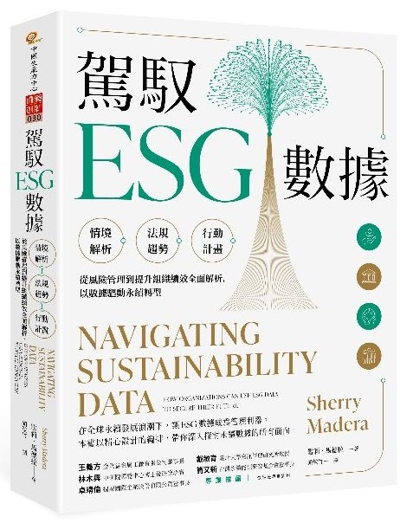
雪莉．馬德拉 (Sherry Madera) (顏敏竹 譯) (2024),
駕馭ESG數據 (Navigating Sustainability Data),
財團法人中國生產力中心
專業推薦：
王義方
（金全益金屬工廠有限公司董事長）
林木興
（中研院環變中心博士後研究學者）
卓靖倫
（揚秦國際企業股份有限公司董事長）
戴敏育
（國立臺北大學資訊管理研究所教授）
簡又新
（台灣永續能源研究基金會董事長）
Source: https://www.eslite.com/product/10012011762682688929002

Slide 8
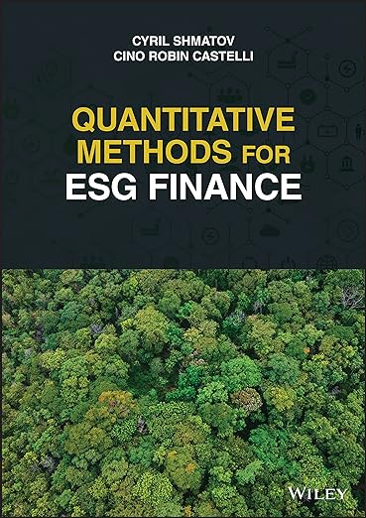
Cino Robin Castelli, Cyril Shmatov (2022),
Quantitative Methods for ESG Finance,
Wiley
Source: https://www.amazon.com/Quantitative-Methods-Finance-Robin-Castelli/dp/1119903807/

Slide 9

Simon Thompson (2023),
Green and Sustainable Finance:
Principles and Practice in Banking, Investment and Insurance,
2nd Edition, Kogan Page.
Source: https://www.amazon.com/Green-Sustainable-Finance-Principles-Investment/dp/1398609242/

Slide 10

Chrissa Pagitsas (2023),
Chief Sustainability Officers At Work:
How CSOs Build Successful Sustainability and ESG Strategies,
Apress.
Source: https://www.amazon.com/Chief-Sustainability-Officers-Work-Successful/dp/1484278658/

Slide 11

Sustainability and ESG Data Analytics

Slide 12
Sustainability and ESG Data Analytics

Slide 13
Data Science for
Sustainability and ESG:
Transforming Decision-Making for a Better Future

Slide 14
Data Science for Sustainability and ESG: Foundations & Frameworks

Slide 15
Data Science for
Sustainability and ESG

Slide 16
Data Science for
Sustainability and ESG
Data Science and Sustainability
Data Collection and Analysis for Sustainability
Implementing Data-Driven Sustainability Strategies

Slide 17
Fundamentals of Data Science
Definition of Data Science:
  Interdisciplinary field using scientific methods, processes, algorithms and systems to
  extract knowledge and insights
  from structured and unstructured data.
Key components:
  Statistics, Machine Learning, Data Engineering

Slide 18
Data Science Process
Business Understanding
Data Understanding
Data Preparation
Modeling
Evaluation
Deployment

Slide 19
Data Science Essential tools
Python
R
SQL
Tableau
Power BI

Slide 20
Sustainability and ESG
Sustainability: Meeting present needs without compromising future generations
ESG: Environmental, Social, and Governance
  Environmental: Climate change, resource depletion, waste, pollution, deforestation
  Social: Human rights, labor standards, workplace safety, community relations
  Governance: Board diversity, executive compensation, ethics, transparency

Slide 21
Sustainability and ESG: Business case
Risk management
Cost savings
Innovation
Brand value
Investor attraction

Slide 22
Intersection of Data Science with Sustainability and ESG
Data-driven decision making for sustainability initiatives
Predictive analytics for environmental impact
Machine learning for optimizing resource usage
Big data analysis for social impact assessment
AI-powered governance risk management

Slide 23
The Interconnectedness of
Data, Sustainability & ESG
Sustainability encompasses environmental, social, and governance concerns.
ESG provides a framework for measuring and reporting sustainability performance.
Data science offers the tools to collect, analyze, and use ESG data for decision-making.

Slide 24
ESG:
Environmental
Social
Governance

Slide 25


















Sustainable Development Goals (SDGs)
Source: https://sdgs.un.org/goals

Slide 26

Sustainable Development Goals (SDGs) and 5P
Partnership
Peace
Prosperity
People
Planet
Source: Folke, Carl, Reinette Biggs, Albert V. Norström, Belinda Reyers, and Johan Rockström. "Social-ecological resilience and biosphere-based sustainability science.”Ecology and Society 21, no. 3 (2016).

Slide 27

ESG to 17 SDGs
Source: Henrik Skaug Sætra (2021) "A Framework for Evaluating and Disclosing the ESG Related Impacts of AI with the SDGs." Sustainability 13, no. 15 (2021): 8503.

Slide 28

ESG to 17 SDGs
Source: https://sustainometric.com/esg-to-sdgs-connected-paths-to-a-sustainable-future/

Slide 29
Data Collection and Analysis for Sustainability

Slide 30
Data Collection and Analysis for Sustainability
Types of sustainability data and collection methods
Data quality, preparation, and analysis techniques
Case studies of data-driven sustainability initiatives

Slide 31
Types of Data Relevant to
Sustainability and ESG
Environmental: GHG emissions, energy usage, water consumption, waste generation
Social: Employee demographics, health and safety incidents, community engagement metrics
Governance: Board composition, executive compensation, ethical violations
Financial: ESG-related investments, sustainable product revenues, carbon pricing

Slide 32
Understanding ESG Data
Quantitative data: Measurable metrics
(e.g., carbon emissions, employee diversity)
Qualitative data: Text-based information
(e.g., policies, news articles)
Structured data: Organized in databases
Unstructured data: Requires processing
(e.g., social media)

Slide 33
Challenges of ESG Data
Lack of standardization:
  Different reporting frameworks and metrics
Reliability:
  Concerns about "greenwashing" and accuracy
Availability:
  Data gaps, especially for smaller companies and certain sectors

Slide 34
Data Collection Methods and Sources
Internal:
  ERP systems, HR databases, facility management systems
External:
  Government databases, NGO reports, industry benchmarks

Slide 35
Data Collection Methods and Sources
IoT and sensor data
  Smart meters, environmental sensors
Satellite and geospatial data
  Land use changes, deforestation monitoring
Social media and web scraping
  Brand sentiment, consumer trends
Surveys and stakeholder engagement
  Employee satisfaction, community feedback

Slide 36
Data Quality and Preparation
Ensuring data accuracy:
  Validation checks, cross-referencing
Data cleaning:
  Handling outliers, formatting inconsistencies
Addressing missing data:
  Imputation techniques, understanding data gaps
Data integration:
  Combining multiple sources, resolving conflicts
Standardization:
  Aligning with industry standards (e.g., GRI, SASB)

Slide 37
Data Analysis Techniques for Sustainability
Descriptive analytics:
  KPI tracking, trend analysis
Diagnostic analytics:
  Root cause analysis of sustainability issues
Predictive analytics:
  Forecasting future sustainability performance
Prescriptive analytics:
  Optimization of resource allocation
Machine learning applications:
  Anomaly detection, pattern recognition in sustainability data

Slide 38

MSCI ESG Rating Framework
Source: https://www.msci.com/documents/1296102/21901542/ESG-Ratings-Methodology-Exec-Summary.pdf

Slide 39

MSCI ESG Key Issue Hierarchy
Source: https://www.msci.com/documents/1296102/21901542/ESG-Ratings-Methodology-Exec-Summary.pdf

Slide 40
Data Preparation & Cleaning:
Preparing ESG Data for Analysis
Handling missing values:
  Imputation, deletion, etc.
Detecting and addressing outliers.
Ensuring data consistency (formatting, units).
Feature engineering:
  Creating new metrics based on raw ESG data.

Slide 41
Exploratory Data Analysis (EDA) & Visualization:
Uncovering Patterns in ESG Data
Exploratory Data Analysis (EDA)
  Using statistical summaries and visualizations.
Identifying trends, correlations, and unusual patterns in ESG data.
Storytelling with data:
  Effective visualizations for ESG insights.

Slide 42
ESG Predictive Modeling:
Forecasting with ESG Data
Regression
  Predicting continuous ESG outcomes (e.g., emissions)
Classification:
  Categorizing companies (e.g., high/low ESG risk)
Time Series:
  Forecasting ESG metrics over time.

Slide 43
Natural Language Processing (NLP) for Sentiment Analysis:
Sentiment Analysis for ESG Insights
Natural Language Processing (NLP):
  Enabling computers to understand human language.
Sentiment analysis:
  Determining the emotional tone of text
  (positive, negative, neutral)
Applications for ESG:
  Tracking public opinion, identifying ESG risks and opportunities.

Slide 44
Analyzing Sustainability Reports
Company sustainability report
Identify which framework was used, key ESG metrics, areas of strength and weakness
  How the company presents its ESG data and
  whether it aligns with the ESG key framework identified

Slide 45
ESG Key Frameworks
Global Reporting Initiative (GRI):
  Comprehensive sustainability standards
Sustainability Accounting Standards Board (SASB):
  Industry-specific metrics
UN Sustainable Development Goals (SDGs):
  Global goals for 2030

Slide 46
Case Studies:
Data-Driven Sustainability Initiatives
Carbon footprint reduction:
  Using ML to optimize logistics routes
Supply chain optimization:
  Predictive analytics for sustainable sourcing
Energy efficiency improvement:
  IoT-driven smart building management
Diversity and inclusion analysis:
  NLP on job descriptions and employee feedback

Slide 47

GRI (Global Report Initiative)
https://www.globalreporting.org/

Slide 48

CDP (Carbon Disclosure Project)
https://www.cdp.net/

Slide 49

SASB (Sustainability Accounting Standards Board)
https://sasb.org/

Slide 50

ISSB (International Sustainability Standards Board)
https://www.ifrs.org/groups/international-sustainability-standards-board/

Slide 51

TCFD
(Task Force on Climate-related Financial Disclosures)
https://www.ifrs.org/sustainability/tcfd/
https://www.fsb-tcfd.org/

Slide 52
Implementing
Data-Driven Sustainability Strategies

Slide 53
Implementing
Data-Driven Sustainability Strategies
Setting science-based targets and integrating metrics into operations
Advanced analytics for sustainability strategy
Overcoming challenges and future trends in data science for sustainability

Slide 54
Setting Science-Based Sustainability Targets
Science-based targets:
  Emissions reduction goals aligned with Paris Agreement
Using historical data and projections to set realistic targets
Aligning with Sustainable Development Goals (SDGs)
Case study:
  Unilever's science-based targets and progress tracking

Slide 55
Integrating Sustainability Metrics into Business Operations
Embedding ESG KPIs in performance management
Developing sustainability scorecards and dashboards
Data-driven decision making for sustainability
Challenges: Data silos, resistance to change
Best practices: Cross-functional teams, executive sponsorship

Slide 56
Advanced Analytics for
Sustainability Strategy
Scenario analysis for climate risk assessment
AI for optimizing energy consumption in real-time
Predictive modeling for supply chain sustainability risks
NLP for analyzing sustainability-related news and social media

Slide 57
Communicating ESG Performance to Stakeholders
Comprehensive sustainability reporting
(GRI, SASB standards)
Data visualization: Infographics, interactive dashboards
Real-time sustainability performance portals
Addressing data privacy in sustainability communication

Slide 58
Overcoming Challenges in
Data-Driven Sustainability
Improving data quality and standardization
Change management strategies for adoption
Ethical data collection and use in sustainability
Staying compliant with evolving ESG regulations

Slide 59
Data-Driven Sustainable Investing:
Building ESG-Conscious Portfolios
ESG investing:
  Considering environmental, social, and governance factors in investment decisions.
Performance of ESG-focused funds vs.
traditional funds.
Building ESG portfolios:
  Screening, index funds, impact investing.

Slide 60
ESG Risk Assessment and Mitigation:
Managing ESG Risks for Resilience
Identifying ESG risks across the supply chain
(environmental impact, labor practices).
Using data to quantify potential
financial consequences of ESG risks.
Developing strategies to mitigate ESG risks.
Integrating ESG risk monitoring into
decision-making for greater resilience.

Slide 61
Driving Corporate Sustainability:
Data-Powered Sustainability Transformations
Setting data-driven ESG targets and tracking progress.
Utilizing dashboards and analytics for real-time ESG insights.
Engaging stakeholders through transparent ESG reporting.

Slide 62
The Future of Data-Driven ESG:
A Sustainable Future Powered by Data
Emerging trends in ESG data and analytics
  e.g., AI for ESG insights
The potential of data to drive progress towards global sustainability goals.
The role of data scientists in shaping ethical and equitable ESG practices.
Be part of the ESG Data Science solution.

Slide 63
Future Trends in Data Science for Sustainability
Blockchain for transparent, sustainable supply chains
Digital twins for environmental impact simulation
Edge computing for real-time sustainability management
Quantum computing for complex climate modeling

Slide 64
Evolution of Sustainable Finance Research
Topic
SDGs:
Sustainable Development Goals
SDGs
Innovative Financial Instrument
Impact Investing
ESG: Environmental, Social, and Governance
CSR: Corporate Social Responsibility
Conscious Capitalism
Climate Financing
Carbon Financing
Green Financing
Ethical Investing
Socially Responsible Investing
1986
1995
2005
2015
2020
Source: Kumar, S., Sharma, D., Rao, S., Lim, W. M., & Mangla, S. K. (2022). Past, present, and future of sustainable finance:
Insights from big data analytics through machine learning of scholarly research. Annals of Operations Research, 1-44.

Slide 65

Generative AI and LLMs for Sustainability and
ESG Data Analytics

Slide 66

Generative AI for ESG Rating and Reporting Generation

Slide 67

Sustainable Productivity:
Finance ESG
Source: Huang, Ziqi, Yang Shen, Jiayi Li, Marcel Fey, and Christian Brecher (2021). "A survey on AI-driven digital twins in Industry 4.0: Smart manufacturing and advanced robotics." Sensors 21, no. 19: 6340.

Slide 68

Sustainable Resilient Manufacturing
ESG
Source: Huang, Ziqi, Yang Shen, Jiayi Li, Marcel Fey, and Christian Brecher (2021). "A survey on AI-driven digital twins in Industry 4.0: Smart manufacturing and advanced robotics." Sensors 21, no. 19: 6340.

Slide 69
ESG Indexes
MSCI ESG Index
Dow Jones Sustainability Indices (DJSI)
FTSE ESG Index

Slide 70
MSCI ESG Rating Framework
Source: https://www.msci.com/documents/1296102/21901542/ESG-Ratings-Methodology-Exec-Summary.pdf

Slide 71
MSCI ESG Key Issue Hierarchy
Source: https://www.msci.com/documents/1296102/21901542/ESG-Ratings-Methodology-Exec-Summary.pdf

Slide 72

MSCI Governance Model Structure
Source: https://www.msci.com/documents/1296102/21901542/ESG-Ratings-Methodology-Exec-Summary.pdf

Slide 73

MSCI Hierarchy of ESG Scores
Source: https://www.msci.com/documents/1296102/21901542/ESG-Ratings-Methodology-Exec-Summary.pdf

Slide 74

DJSI S&P Global ESG Score
Source: DJSI, S&P Global Corporate Sustainability Assessment (CSA), https://www.spglobal.com/esg/solutions/data-intelligence-esg-scores

Slide 75

FTSE Russell ESG Ratings
Source: https://www.ftserussell.com/data/sustainability-and-esg-data/esg-ratings

Slide 76




Sustainalytics
ESG Risk Ratings
Analyst-based
approach
Sustainalytics’ ESG Risk Ratings measure a company’s exposure to industry-specific material ESG risks and how well a company is managing those risks.
Source: https://www.sustainalytics.com/esg-data

Slide 77

Truvalue
ESG Ranks
TruValue Labs
Machine-based approach
Truvalue Labs applies AI to analyze over 100,000 sources and uncover ESG risks and opportunities hidden in unstructured text.
The ESG Ranks data service produces an overall company rank based on industry percentile leveraging the 26 ESG categories defined by the Sustainability Accounting Standards Board (SASB).
The data feed covers 20,000+ companies with more than 13 years of history.
Source: :https://developer.truvaluelabs.com/data/esg-ranks

Slide 78

Analyst-driven vs. AI-driven ESG
Sustainalytics
Truvalue Labs
Source: Mark Tulay (2020), Man vs. machine: A tale of two sustainability ratings systems, GreenBiz, https://www.greenbiz.com/article/man-vs-machine-tale-two-sustainability-ratings-systems

Slide 79

Analyst based
ESG Research
AI based
ESG Research
Source: https://www.esganalytics.io/insights/how-data-is-accelerating-esg

Slide 80

ESG Analytics: NLP Taxonomy
Source: https://www.esganalytics.io/insights/how-data-is-accelerating-esg

Slide 81

Top
ESG Reporting Software
Environmental, Social and Governance (ESG) Reporting software or Sustainability software helps organizations manage their operational data, evaluate their impact on the environment and provide reporting to perform audits.
Source: https://www.softwarereviews.com/categories/environmental-social-and-governance-reporting

Slide 82
ESG Data Analysis and Visualization
# ESG Data Analysis and Visualization
import numpy as np
import pandas as pd
import matplotlib.pyplot as plt
from datetime import datetime
import random
# Generate synthetic data
np.random.seed(0)
data = {
  'company': ['Company A', 'Company B', 'Company C', 'Company D', 'Company E'],
  'emissions': np.random.randint(10000, 50000, 5),
  'diversity': np.random.uniform(0.2, 0.9, 5),
  'employee_satisfaction': np.random.uniform(60, 90, 5),
  'waste_type': ['Plastic', 'Organic', 'Electronic', 'Metal', 'Other'],
  'waste_amount': np.random.randint(100, 500, 5)
}
df = pd.DataFrame(data)

Slide 83
ESG Data Analysis and Visualization
# Separate DataFrame for time series and correlation
time_series_data = pd.DataFrame({
  'year': np.repeat(np.arange(2018, 2023), 5),
  'company': np.tile(['Company A', 'Company B', 'Company C', 'Company D', 'Company E'], 5),
  'energy_use': np.random.randint(1000, 5000, 25)
})
# Simulating correlation data with a slight positive trend
diversity = np.linspace(0.2, 0.9, 100)
np.random.shuffle(diversity)
employee_satisfaction = 60 + (diversity - 0.2) * 150
employee_satisfaction += np.random.normal(0, 5, 100)
correlation_data = pd.DataFrame({
  'diversity': diversity,
  'employee_satisfaction': employee_satisfaction
})

Slide 84
ESG Data Analysis and Visualization
# Save DataFrame to CSV
df.to_csv('ESG_Dataset.csv', index=False)
# Calculate statistics for each company
statistics = df.describe()
statistics = statistics.applymap(lambda x: format(x, '.4f'))
print(statistics)
statistics.to_csv('Company_ESG_Statistics.csv')
emissions diversity employee_satisfaction waste_amount
count 5.0000 5.0000 5.0000 5.0000
mean 31447.6000 0.4085 77.1504 345.6000
std 11667.5748 0.1099 7.0841 94.8093
min 12732.0000 0.2397 70.1219 215.0000
25% 30757.0000 0.3909 71.7835 297.0000
50% 31243.0000 0.4083 74.3993 343.0000
75% 40403.0000 0.4691 84.3651 435.0000
max 42103.0000 0.5344 85.0824 438.0000

Slide 85
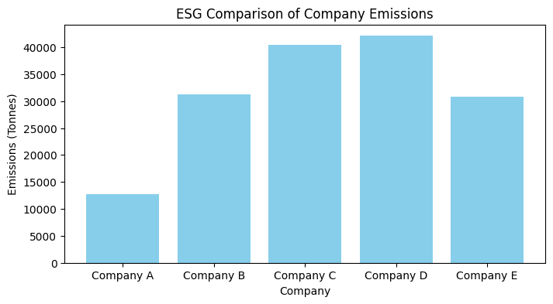
ESG Data Analysis and Visualization
# Create visualizations and save them at 300 dpi
# Bar Chart for Emissions
plt.figure(figsize=(8, 4))
plt.bar(df['company'], df['emissions'], color='skyblue')
plt.xlabel('Company')
plt.ylabel('Emissions (Tonnes)')
plt.title('ESG Comparison of Company Emissions')
plt.show()
plt.savefig('ESG Company_Emissions.jpg', format='jpg', dpi=300)

Slide 86
ESG Data Analysis and Visualization
# Line Chart for Energy Use
plt.figure(figsize=(8, 4))
for company in time_series_data['company'].unique():
  company_data = time_series_data[time_series_data['company'] == company]
  company_data = company_data.sort_values(by='year')
  plt.plot(company_data['year'], company_data['energy_use'], marker='o', linestyle='-', label=company)
plt.xlabel('Year')
plt.ylabel('Energy Use (kWh)')
plt.title("ESG Companies' Energy Use Over Time")
plt.xticks(company_data['year'].unique()) # Ensuring only whole years are marked
plt.legend()
plt.grid(True)
plt.show()

Slide 87
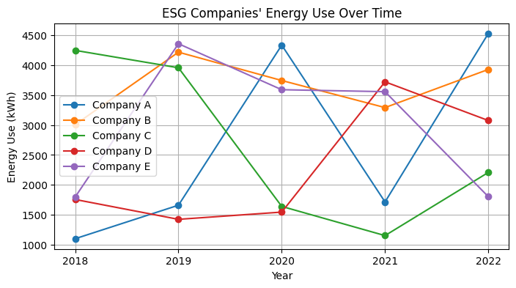
ESG Data Analysis and Visualization

Slide 88
ESG Data Analysis and Visualization
# Scatter Plot for Diversity vs. Satisfaction
plt.figure(figsize=(8, 4))
plt.scatter(correlation_data['diversity'], correlation_data['employee_satisfaction'], alpha=0.7)
plt.xlabel('Board Diversity (Ratio)')
plt.ylabel('Employee Satisfaction (%)')
plt.title('ESG Correlation Between Board Diversity and Employee Satisfaction')
plt.grid(True)
plt.show()
plt.savefig('ESG_Diversity_vs_Satisfaction.jpg', format='jpg', dpi=300)

Slide 89
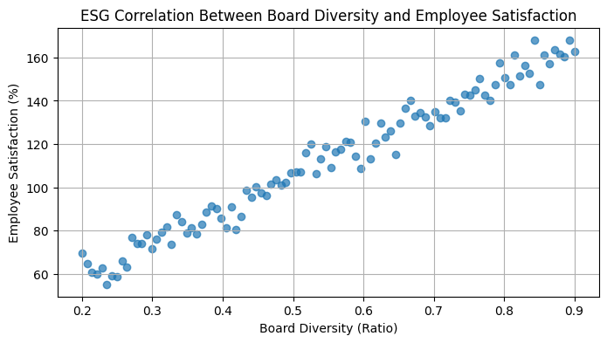
ESG Data Analysis and Visualization

Slide 90
ESG Data Analysis and Visualization
# Pie Chart for Waste Types
plt.figure(figsize=(8, 4))
plt.pie(df['waste_amount'], labels=df['waste_type'], autopct='%1.1f%%', startangle=140)
plt.title('ESG Waste Types')
plt.axis('equal') # Equal aspect ratio ensures that pie is drawn as a circle.
plt.show()
plt.savefig('ESG_Waste_Type_Breakdown.jpg', format='jpg', dpi=300)

Slide 91
Applications of
ESG Data Analytics with Python
https://colab.research.google.com/drive/1IZnqcenbxSlehvPYb3xMqLVF21oWQdj_?usp=sharing

Slide 92
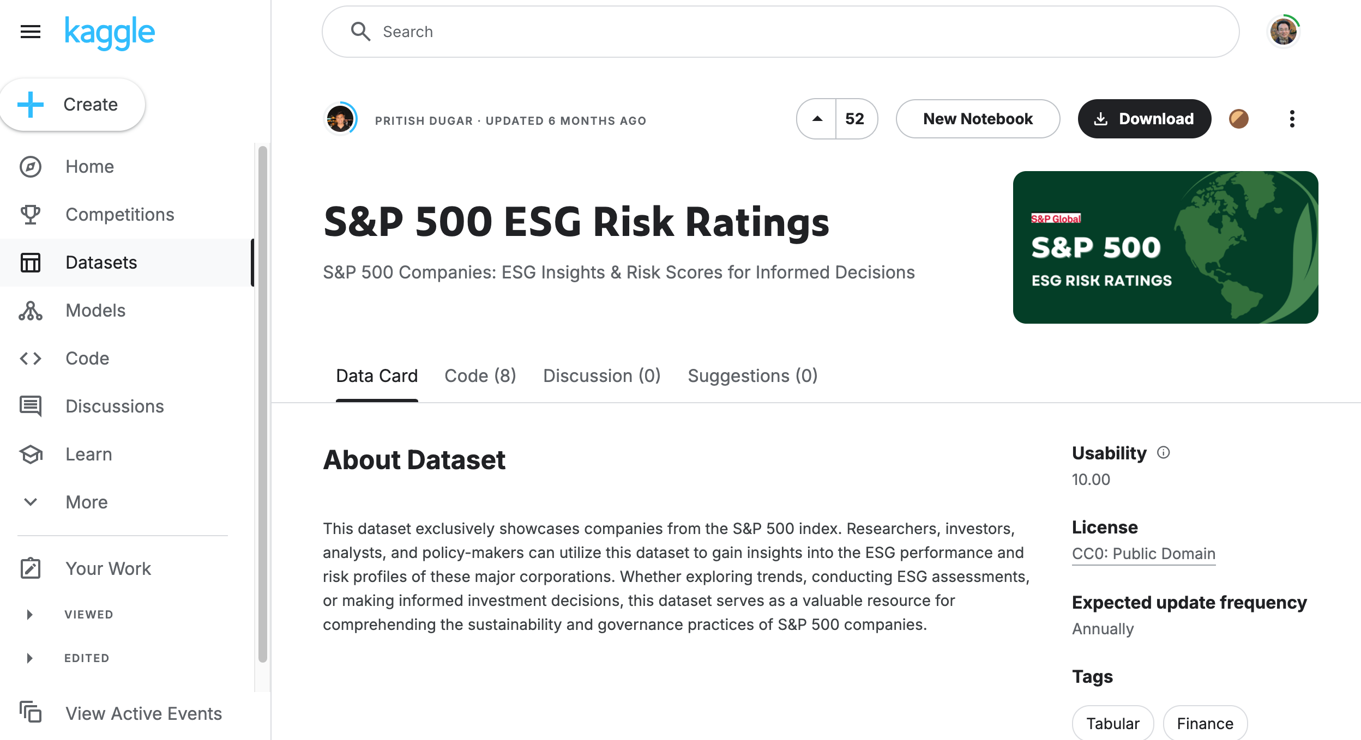
ESG Data Analytics https://www.kaggle.com/datasets/pritish509/s-and-p-500-esg-risk-ratings/data

Slide 93
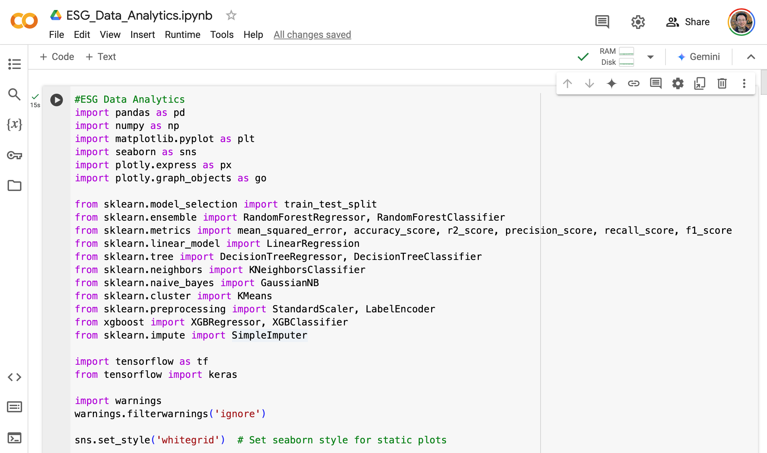
ESG Data Analytics https://www.kaggle.com/datasets/pritish509/s-and-p-500-esg-risk-ratings/data
https://colab.research.google.com/drive/1Kq_Am3t9t_YIDbn5TjAfdyQRY5n3K7sR

Slide 94

Python in Google Colab (Python101)
https://colab.research.google.com/drive/1FEG6DnGvwfUbeo4zJ1zTunjMqf2RkCrT
https://tinyurl.com/aintpupython101

Slide 95
Summary
Data Science and Sustainability
Data Collection and Analysis for Sustainability
Implementing Data-Driven Sustainability Strategies

Slide 96
References
Sherry Madera (2024), Navigating Sustainability Data: How Organizations can use ESG Data to Secure Their Future, Kogan Page
Cino Robin Castelli, Cyril Shmatov (2022), Quantitative Methods for ESG Finance, Wiley
Simon Thompson (2023), Green and Sustainable Finance: Principles and Practice in Banking, Investment and Insurance, 2nd Edition, Kogan Page.
Chrissa Pagitsas (2023), Chief Sustainability Officers At Work: How CSOs Build Successful Sustainability and ESG Strategies, Apress.
Wes McKinney (2022), "Python for Data Analysis: Data Wrangling with pandas, NumPy, and Jupyter", 3rd Edition, O'Reilly Media.
Aurélien Géron (2023), Hands-On Machine Learning with Scikit-Learn, Keras, and TensorFlow: Concepts, Tools, and Techniques to Build Intelligent Systems, 3rd Edition, O’Reilly Media.
Steven D'Ascoli (2022), Artificial Intelligence and Deep Learning with Python: Every Line of Code Explained For Readers New to AI and New to Python, Independently published.
Stuart Russell and Peter Norvig (2020), Artificial Intelligence: A Modern Approach, 4th Edition, Pearson.
Cino Robin Castelli, Cyril Shmatov (2022), Quantitative Methods for ESG Finance, Wiley
Simon Thompson (2023), Green and Sustainable Finance: Principles and Practice in Banking, Investment and Insurance, 2nd Edition, Kogan Page.
Chrissa Pagitsas (2023), Chief Sustainability Officers At Work: How CSOs Build Successful Sustainability and ESG Strategies, Apress.
Yihan Cao, Siyu Li, Yixin Liu, Zhiling Yan, Yutong Dai, Philip S. Yu, and Lichao Sun (2023). "A Comprehensive Survey of AI-Generated Content (AIGC): A History of Generative AI from GAN to ChatGPT." arXiv preprint arXiv:2303.04226.
Min-Yuh Day (2024), Python 101, https://tinyurl.com/aintpupython101

