Slide 1









Deep Learning,
Reinforcement Learning, and Generative AI in Finance
Artificial Intelligence in Finance and Quantitative Analysis
1132AIFQA08
MBA, IM, NTPU (M5147) (Spring 2025)
Tue 5, 6, 7 (13:10-16:00) (B3F17)
Min-Yuh Day, Ph.D,
Professor
Institute of Information Management, National Taipei University
https://web.ntpu.edu.tw/~myday
https://meet.google.com/miy-fbif-max
2025-04-29

Slide 2
Syllabus
Week Date Subject/Topics
1 2025/02/18 Introduction to Artificial Intelligence in Finance and
Quantitative Analysis
2 2025/02/25 AI in FinTech: Metaverse, Web3, DeFi, NFT,
Generative AI for Financial Innovation Applications
3 2025/03/04 Investing Psychology and Behavioral Finance
4 2025/03/11 Event Studies in Finance
5 2025/03/18 Case Study on AI in Finance and Quantitative Analysis I
6 2025/03/25 Finance Theory and Data-Driven Finance

Slide 3
Syllabus
Week Date Subject/Topics
7 2025/04/01 Self-Study
8 2025/04/08 Midterm Project Report
9 2025/04/15 Financial Econometrics and Machine Learning
10 2025/04/22 AI-First Finance
11 2025/04/29 Deep Learning, Reinforcement Learning,
and Generative AI in Finance
12 2025/05/06 Case Study on AI in Finance and Quantitative Analysis II

Slide 4
Syllabus
Week Date Subject/Topics
13 2025/05/13 Industry Practices of AI in Finance and
Quantitative Analysis
14 2025/05/20 Algorithmic Trading; Risk Management;
Trading Bot and Event-Based Backtesting
15 2025/05/27 Final Project Report I
16 2025/06/03 Final Project Report II

Slide 5
Deep Learning in Finance
Reinforcement Learning in Finance
Generative AI in Finance

Slide 6
Outline
Generative AI in Finance
Deep Learning (DL) in Finance
  Dense Neural Networks (DNN)
  Recurrent Neural Networks (RNN)
  Convolutional Neural Networks (CNN)
Reinforcement Learning (RL) in Finance
  Q Learning (QL)
  Improved Finance Environment
  Improved Financial QL Agent
Source: Yves Hilpisch (2020), Artificial Intelligence in Finance: A Python-Based Guide, O’Reilly Media.

Slide 7
Generative AI in Finance

Slide 8
Applications of Generative AI in Finance
Conversational
Finance
Stock Behaviour Predictions
Report Generation
Fraud Detection
Financial Query Resolution
Portfolio Optimisation
Analysis of Financial Documents
Risk Assessment
Synthetic Data Generation
Named Entity
Recognition (NER)
Generating Applicant-Friendly Application Denials
Source: Siva Sai, Keya Arunakar, Vinay Chamola, Amir Hussain, Pranav Bisht, and Sanjeev Kumar (2025). "Generative AI for Finance: Applications, Case Studies and Challenges." Expert Systems 42, no. 3 (2025): e70018.

Slide 9
Applications of Generative AI in Finance
Conversational Finance
Enhances customer service through chatbots
and virtual assistants using NLP,
providing personalised financial advice,
transaction alerts, and payment reminders.
Source: Siva Sai, Keya Arunakar, Vinay Chamola, Amir Hussain, Pranav Bisht, and Sanjeev Kumar (2025). "Generative AI for Finance: Applications, Case Studies and Challenges." Expert Systems 42, no. 3 (2025): e70018.

Slide 10
Applications of Generative AI in Finance
Report Generation
Automatically creates financial reports
like cash flow statements,
income reports, and balance sheets,
saving time and reducing human error.
Source: Siva Sai, Keya Arunakar, Vinay Chamola, Amir Hussain, Pranav Bisht, and Sanjeev Kumar (2025). "Generative AI for Finance: Applications, Case Studies and Challenges." Expert Systems 42, no. 3 (2025): e70018.

Slide 11
Applications of Generative AI in Finance
Financial Query Resolution
Responds to finance-related queries
in real-time using generative models,
offering personalised insights
for customers and analysts.
Source: Siva Sai, Keya Arunakar, Vinay Chamola, Amir Hussain, Pranav Bisht, and Sanjeev Kumar (2025). "Generative AI for Finance: Applications, Case Studies and Challenges." Expert Systems 42, no. 3 (2025): e70018.

Slide 12
Applications of Generative AI in Finance
Analysis of Financial Documents
Applies NLP to automate extraction
and summarization of key information
from lengthy financial reports and filings.
Source: Siva Sai, Keya Arunakar, Vinay Chamola, Amir Hussain, Pranav Bisht, and Sanjeev Kumar (2025). "Generative AI for Finance: Applications, Case Studies and Challenges." Expert Systems 42, no. 3 (2025): e70018.

Slide 13
Applications of Generative AI in Finance
Synthetic Data Generation
Produces artificial financial data
for training models,
ensuring privacy and overcoming
data scarcity
while maintaining data realism.
Source: Siva Sai, Keya Arunakar, Vinay Chamola, Amir Hussain, Pranav Bisht, and Sanjeev Kumar (2025). "Generative AI for Finance: Applications, Case Studies and Challenges." Expert Systems 42, no. 3 (2025): e70018.

Slide 14
Applications of Generative AI in Finance
Generating Applicant-Friendly Application Denials
Provides clear and understandable reasons
for loan or credit application rejections
to improve customer transparency and experience.
Source: Siva Sai, Keya Arunakar, Vinay Chamola, Amir Hussain, Pranav Bisht, and Sanjeev Kumar (2025). "Generative AI for Finance: Applications, Case Studies and Challenges." Expert Systems 42, no. 3 (2025): e70018.

Slide 15
Applications of Generative AI in Finance
Stock Behaviour Predictions
Uses deep learning (especially RNNs)
and NLP to forecast stock price trends
and market behavior
with higher accuracy
than traditional methods.
Source: Siva Sai, Keya Arunakar, Vinay Chamola, Amir Hussain, Pranav Bisht, and Sanjeev Kumar (2025). "Generative AI for Finance: Applications, Case Studies and Challenges." Expert Systems 42, no. 3 (2025): e70018.

Slide 16
Applications of Generative AI in Finance
Fraud Detection
Utilises AI to identify suspicious activities, reducing financial risk
and preventing fraud
by detecting anomalies and
unusual transaction patterns.
Source: Siva Sai, Keya Arunakar, Vinay Chamola, Amir Hussain, Pranav Bisht, and Sanjeev Kumar (2025). "Generative AI for Finance: Applications, Case Studies and Challenges." Expert Systems 42, no. 3 (2025): e70018.

Slide 17
Applications of Generative AI in Finance
Portfolio Optimisation
Helps in personalising asset management
by considering individual risk preferences, expected returns,
and financial goals.
Source: Siva Sai, Keya Arunakar, Vinay Chamola, Amir Hussain, Pranav Bisht, and Sanjeev Kumar (2025). "Generative AI for Finance: Applications, Case Studies and Challenges." Expert Systems 42, no. 3 (2025): e70018.

Slide 18
Applications of Generative AI in Finance
Risk Assessment
Assesses financial risk using
advanced data-driven models
to better inform investment
and credit decisions.
Source: Siva Sai, Keya Arunakar, Vinay Chamola, Amir Hussain, Pranav Bisht, and Sanjeev Kumar (2025). "Generative AI for Finance: Applications, Case Studies and Challenges." Expert Systems 42, no. 3 (2025): e70018.

Slide 19
Applications of Generative AI in Finance
Named Entity Recognition
(NER)
Identifies and classifies
key financial entities
(like company names, stock symbols)
from unstructured text
to assist in data organization and analysis.
Source: Siva Sai, Keya Arunakar, Vinay Chamola, Amir Hussain, Pranav Bisht, and Sanjeev Kumar (2025). "Generative AI for Finance: Applications, Case Studies and Challenges." Expert Systems 42, no. 3 (2025): e70018.

Slide 20
Generative AI for Finance
Aspect | Advantages | Disadvantages
Data Efficiency | Can generate synthetic financial data, reducing the need for large, real datasets. | Synthetic data may not fully capture the complexities of real-world financial data.
Model Complexity | Capable of modelling complex financial systems and patterns. | Complexity makes models hard to interpret, leading to a "black box" issue.
Accuracy | High predictive accuracy for tasks like stock prediction, fraud detection, etc. | High-accuracy models may overfit training data, leading to poor real-world performance.
Adaptability | Can adapt to new financial conditions or types of fraud more quickly. | Adapting models to new events may require expensive re-training.
Anomaly Detection | Excellent at identifying anomalies, which is crucial for fraud detection and risk assessment. | May produce false positives or negatives due to model complexity.
Real-time Analysis | Capable of real-time analysis and decision-making. | Requires heavy computational resources, increasing operational costs.
Operational Costs | Can automate financial tasks, potentially reducing operational costs. | Initial setup and ongoing maintenance can be costly due to high computational requirements.
Ethical Concerns | Can be built with fairness constraints to reduce biased decision-making. | "Black box" models can cause ethical concerns, especially in critical financial decisions.
Source: Siva Sai, Keya Arunakar, Vinay Chamola, Amir Hussain, Pranav Bisht, and Sanjeev Kumar (2025). "Generative AI for Finance: Applications, Case Studies and Challenges." Expert Systems 42, no. 3 (2025): e70018.

Slide 21
Generative AI (GAI) in Fraud Detection
Aspect | Existing Methods | Generative AI (GAI)
Data Requirement | Typically requires large, well-labelled datasets for training. | Can generate synthetic data for training, reducing the need for large datasets.
Model Complexity | May use simpler models that might not capture all complexities. | Complex models capable of understanding complicated patterns in the data.
Training Time | Simpler models, hence training is usually faster. | May require longer training time due to complexity.
Accuracy | Accuracy can vary; may not be as high as GAI in some cases. | High degree of accuracy for recognising fraudulent activity.
Adaptability | May require manual feature engineering to adapt to new fraud types. | Can adapt to new types of fraud by retraining the generative model.
Anomaly Detection | Additional algorithms often necessary for anomaly detection. | Excellent at identifying abnormalities, a key feature in fraud detection.
Real-time Analysis | Real-time capabilities may vary; not always suitable. | Capable of real-time fraud detection due to advanced algorithms.
Computational Requirements | Usually lower computational requirements. | Generally higher due to complexity of models.
Regulatory and Ethical Issues | Easier to interpret and explain, beneficial for legal compliance. | May raise concerns due to the "black box" nature of some generative models.
Source: Siva Sai, Keya Arunakar, Vinay Chamola, Amir Hussain, Pranav Bisht, and Sanjeev Kumar (2025). "Generative AI for Finance: Applications, Case Studies and Challenges." Expert Systems 42, no. 3 (2025): e70018.

Slide 22
Generative AI for Finance
Product | Description | Key Features | Primary Users
Finance GPT (GPT-F) | A finance-optimized language model trained on financial documents, news, and market data. | Financial research, wealth management, personalized recommendations, risk evaluation, fraud detection. | Financial institutions, analysts.
Bloomberg GPT | Domain-specific model tailored for financial text analysis, integrated into Bloomberg Terminal. | Real-time news summarization, predictive analytics, sentiment analysis, named entity recognition. | Analysts, traders, portfolio managers.
SmartSummaries (AlphaSense) | AI-based market intelligence tool that delivers concise financial summaries and insights from large datasets. | Summarizes filings, news, and reports; detects market sentiment; context-based financial content extraction. | Financial professionals, hedge funds.
Index GPT (JPMorgan) | AI-driven investment advisory service under development, using GPT-like technology to recommend securities and funds to customers. | Investment advice, securities analysis, personalized financial information and suggestions. | Retail investors, financial advisors.
Source: Siva Sai, Keya Arunakar, Vinay Chamola, Amir Hussain, Pranav Bisht, and Sanjeev Kumar (2025). "Generative AI for Finance: Applications, Case Studies and Challenges." Expert Systems 42, no. 3 (2025): e70018.

Slide 23
Bloomberg GPT
Aspect | Description
Purpose | Designed to analyse financial news and reports.
Data Sources | Financial news, stock market data, and other Bloomberg services.
Primary Users | Financial analysts, traders, portfolio managers, and journalists.
Key Features | Real-time news summarization, predictive analytics for varying market trends.
Natural Language Capabilities | High-level natural language understanding and generation for complex financial topics.
Integration | Effortlessly integrates with Bloomberg Terminal and its other services.
Customization | Allows users to tailor news feeds and alerts based on individual preferences and portfolios.
Security and Compliance | Follows the privacy and data security laws put in place by the financial industry.
Accessibility | Accessible via Bloomberg Terminal, web interface, and mobile applications.
Cost | Mostly a premium service given the specialised financial focus.
Source: Siva Sai, Keya Arunakar, Vinay Chamola, Amir Hussain, Pranav Bisht, and Sanjeev Kumar (2025). "Generative AI for Finance: Applications, Case Studies and Challenges." Expert Systems 42, no. 3 (2025): e70018.

Slide 24
Deep Learning in Finance
Dense Neural Networks (DNN)
Recurrent Neural Networks (RNN)
Convolutional Neural Networks (CNN)
Source: Yves Hilpisch (2020), Artificial Intelligence in Finance: A Python-Based Guide, O’Reilly Media.

Slide 25
AI, ML, DL
Artificial Intelligence (AI)
Machine Learning (ML)
Supervised
Learning
Unsupervised Learning
Deep Learning (DL)
CNN
RNN LSTM GRU
GAN
Semi-supervised Learning
Reinforcement Learning
Source: https://leonardoaraujosantos.gitbooks.io/artificial-inteligence/content/deep_learning.html

Slide 26
Applications of DL in Financial Economics
Deep learning for financial economics
Deep learning for macroeconomics and monetary economics
Deep learning for agricultural and natural resource economics
Deep learning for industrial organization
Deep learning for urban, rural, regional, real estate, and transportation economics
Deep learning for health, education, and welfare
Deep learning for business administration and microeconomics
Source: Zheng, Yuanhang, Zeshui Xu, and Anran Xiao. "Deep learning in economics: a systematic and critical review." Artificial Intelligence Review (2023): 1-43.

Slide 27
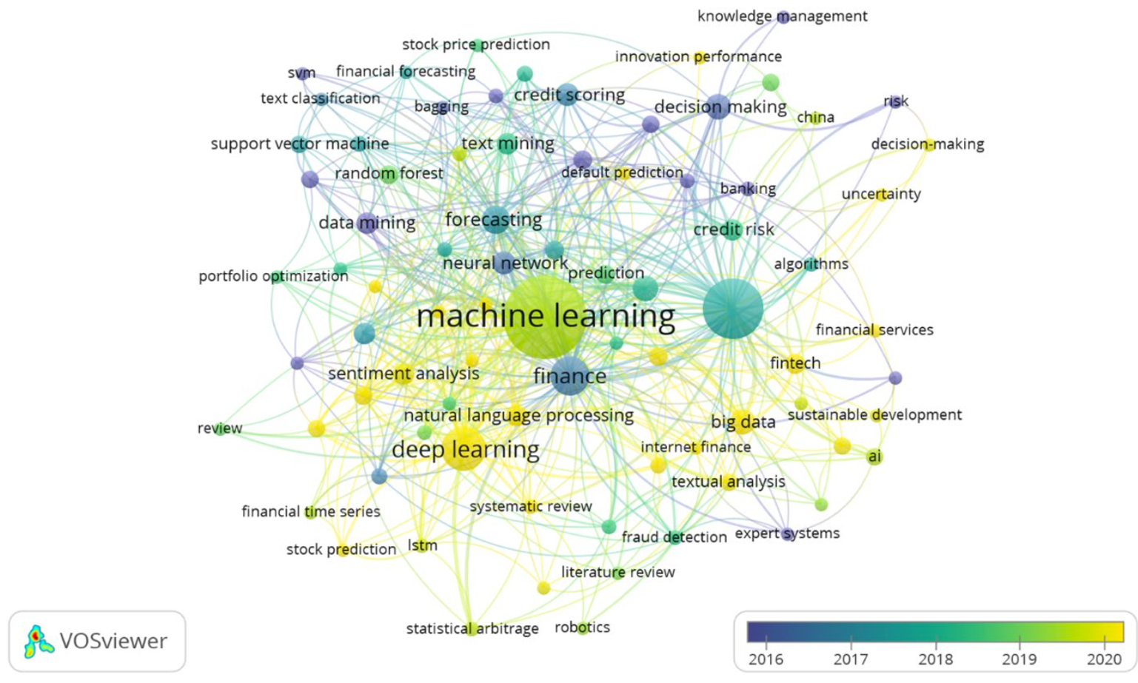
Machine Learning and Deep Learning in Finance
(2016-2022)
Source: Biju, Ajitha Kumari Vijayappan Nair, Ann Susan Thomas, and J. Thasneem. "Examining the research taxonomy of artificial intelligence, deep learning & machine learning in the financial sphere—
a bibliometric analysis." Quality & Quantity (2023): 1-30.

Slide 28
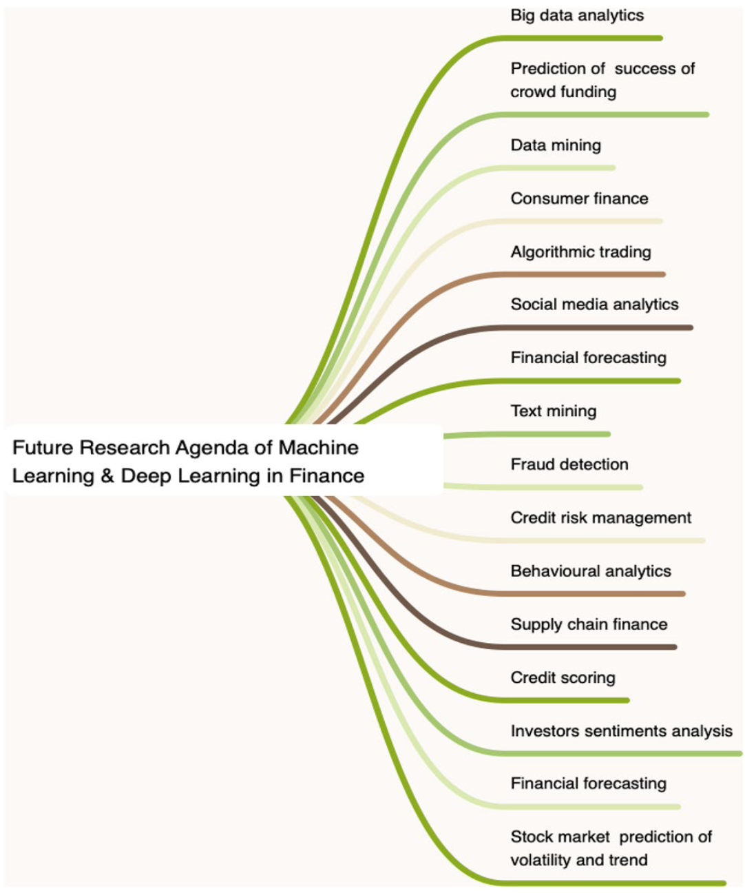
Machine Learning and Deep Learning in Finance
Source: Biju, Ajitha Kumari Vijayappan Nair, Ann Susan Thomas, and J. Thasneem. "Examining the research taxonomy of artificial intelligence, deep learning & machine learning in the financial sphere—
a bibliometric analysis." Quality & Quantity (2023): 1-30.

Slide 29
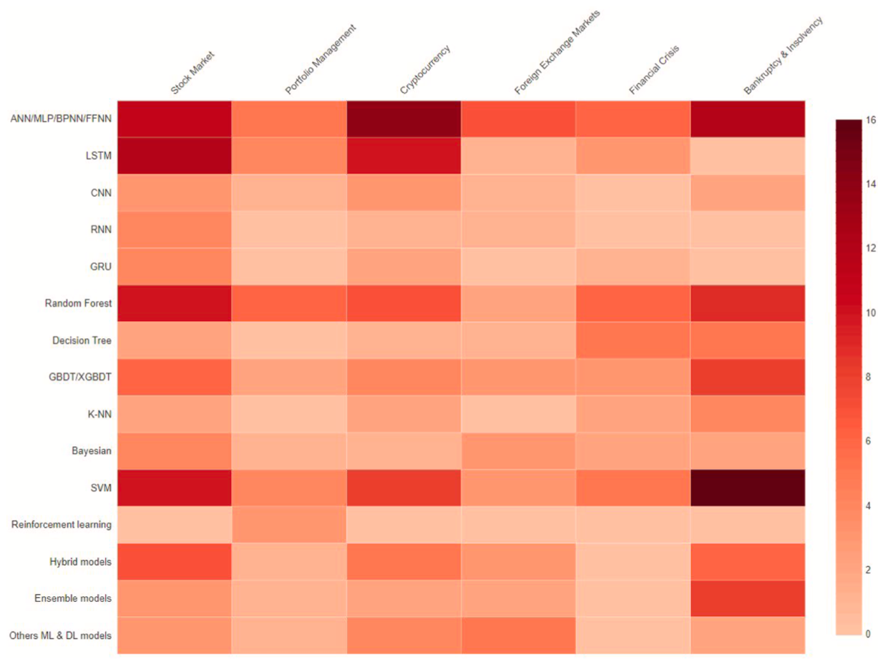
Financial Applications of Machine Learning
Application
– Model
Heatmap
Stock Market
Portfolio Management
Cryptocurrency
Foreign Exchange Market
Financial Crisis
Bankruptcy and Insolvency
Source: Nazareth, Noella, and Yeruva Yenkata Ramana Reddy. "Financial applications of machine learning: a literature review." Expert Systems with Applications (2023): 119640.

Slide 30
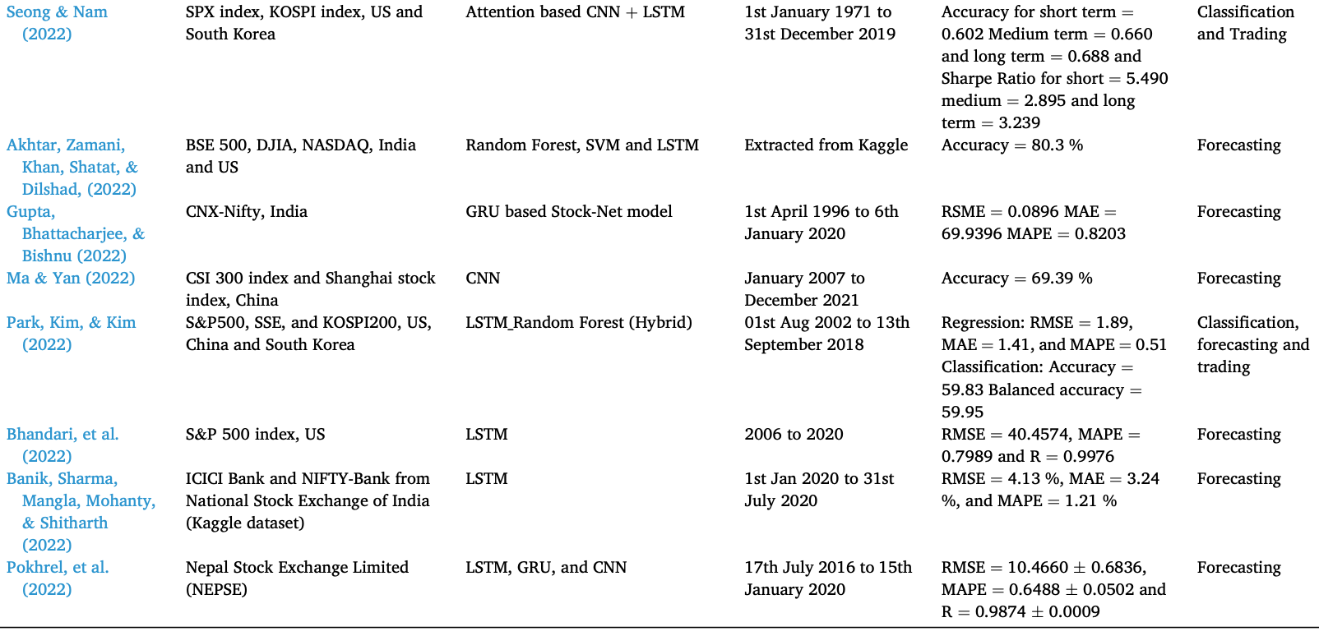
Machine Learning in Stock Market Prediction
Source: Nazareth, Noella, and Yeruva Yenkata Ramana Reddy. "Financial applications of machine learning: a literature review." Expert Systems with Applications (2023): 119640.

Slide 31
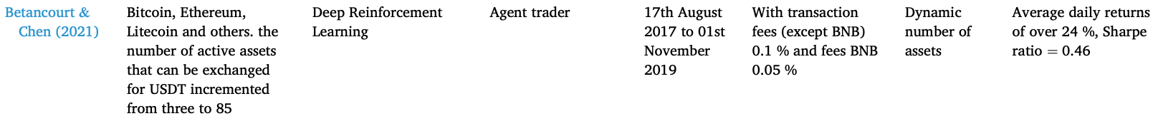
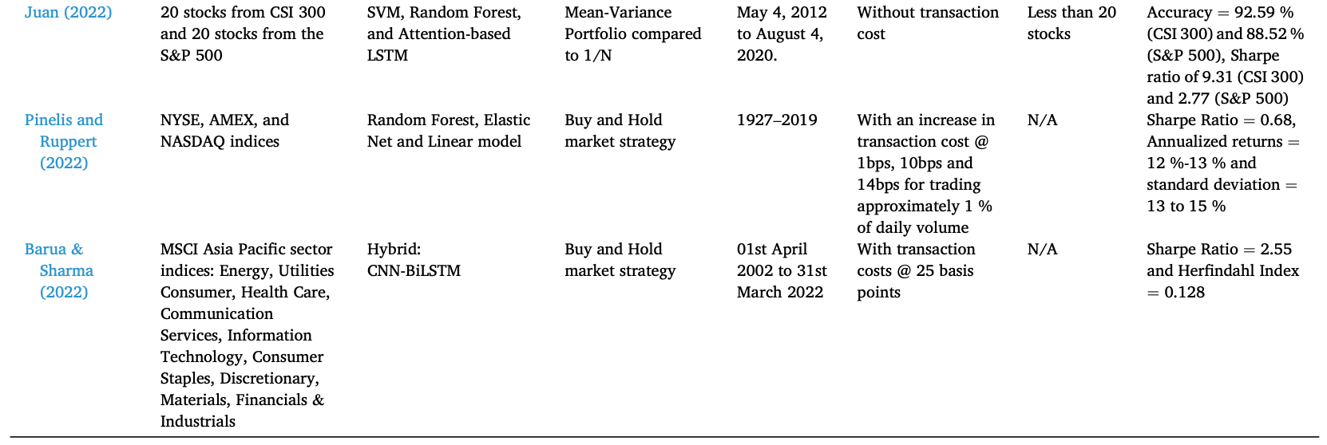
Machine Learning in Portfolio Management
Source: Nazareth, Noella, and Yeruva Yenkata Ramana Reddy. "Financial applications of machine learning: a literature review." Expert Systems with Applications (2023): 119640.

Slide 32
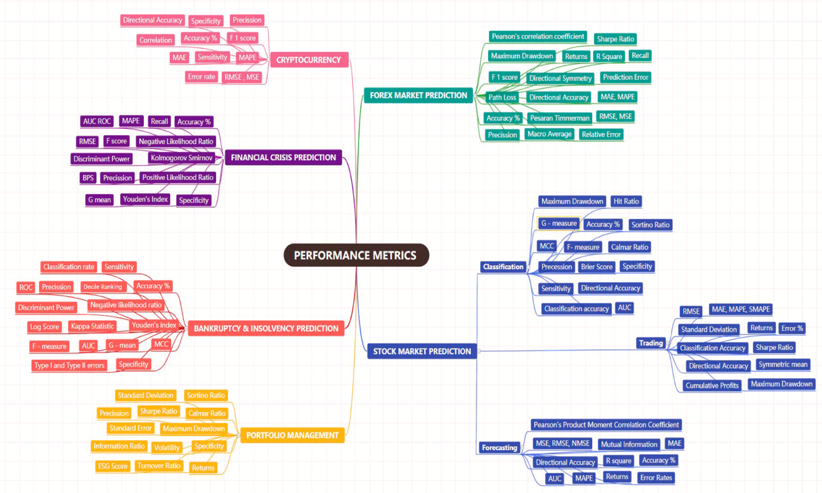
Performance Metrics of Financial Applications of ML
Source: Nazareth, Noella, and Yeruva Yenkata Ramana Reddy. "Financial applications of machine learning: a literature review." Expert Systems with Applications (2023): 119640.

Slide 33
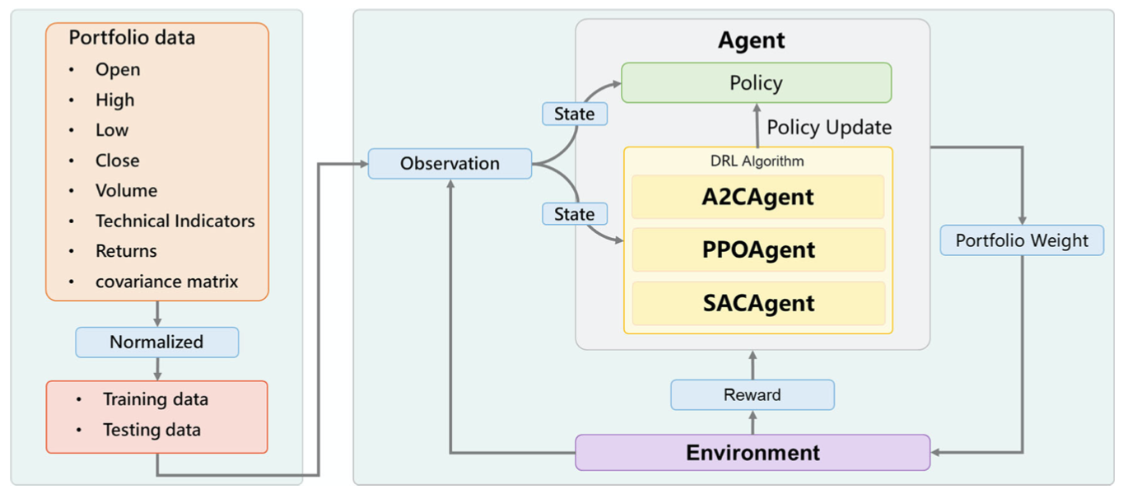
Deep Reinforcement Learning in Portfolio Management for Environmental, Social, and Governance (DRLPMESG)
Day et al. (2023)
Source: Min-Yuh Day, Ching-Ying Yang, and Yensen Ni (2023), "Portfolio dynamic trading strategies using deep reinforcement learning." Soft Computing (2023): 1-16.

Slide 34
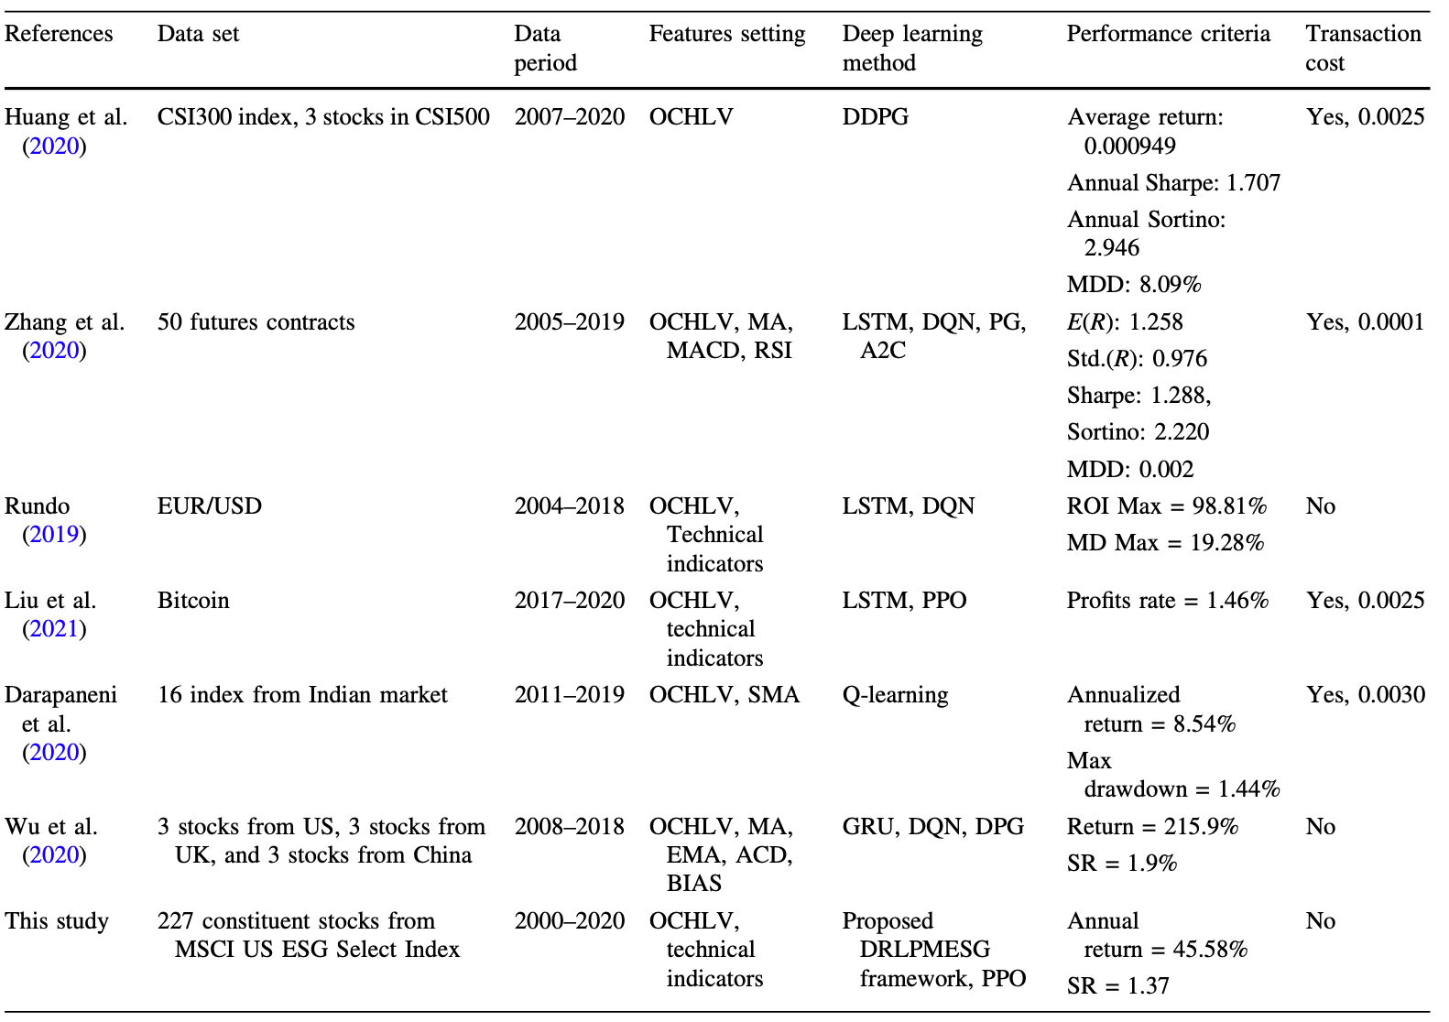
Deep Reinforcement Learning in Portfolio Management
Day et al.
(2023)
Source: Min-Yuh Day, Ching-Ying Yang, and Yensen Ni (2023), "Portfolio dynamic trading strategies using deep reinforcement learning." Soft Computing (2023): 1-16.

Slide 35
Deep learning for financial applications: Topic-Model Heatmap
Source: Ahmet Murat Ozbayoglu, Mehmet Ugur Gudelek, and Omer Berat Sezer (2020). "Deep learning for financial applications: A survey." Applied Soft Computing (2020): 106384.

Slide 36
Deep learning for financial applications: Topic-Feature Heatmap
Source: Ahmet Murat Ozbayoglu, Mehmet Ugur Gudelek, and Omer Berat Sezer (2020). "Deep learning for financial applications: A survey." Applied Soft Computing (2020): 106384.

Slide 37
Deep learning for financial applications: Topic-Dataset Heatmap
Source: Ahmet Murat Ozbayoglu, Mehmet Ugur Gudelek, and Omer Berat Sezer (2020). "Deep learning for financial applications: A survey." Applied Soft Computing (2020): 106384.

Slide 38
Financial time series forecasting with deep learning: Topic-model heatmap
Source: Omer Berat Sezer, Mehmet Ugur Gudelek, and Ahmet Murat Ozbayoglu (2020), "Financial time series forecasting with deep learning:
A systematic literature review: 2005–2019." Applied Soft Computing 90 (2020): 106181.

Slide 39
Deep learning for financial applications:
Algo-trading applications embedded with time series forecasting models
Source: Ahmet Murat Ozbayoglu, Mehmet Ugur Gudelek, and Omer Berat Sezer (2020). "Deep learning for financial applications: A survey." Applied Soft Computing (2020): 106384.

Slide 40
Deep learning for financial applications:
Algo-trading applications embedded with time series forecasting models
Source: Ahmet Murat Ozbayoglu, Mehmet Ugur Gudelek, and Omer Berat Sezer (2020). "Deep learning for financial applications: A survey." Applied Soft Computing (2020): 106384.

Slide 41
Deep learning for financial applications:
Classification (buy–sell signal, or trend detection) based algo-trading models
Source: Ahmet Murat Ozbayoglu, Mehmet Ugur Gudelek, and Omer Berat Sezer (2020). "Deep learning for financial applications: A survey." Applied Soft Computing (2020): 106384.

Slide 42
Deep learning for financial applications:
Stand-alone and/or other algorithmic models
Source: Ahmet Murat Ozbayoglu, Mehmet Ugur Gudelek, and Omer Berat Sezer (2020). "Deep learning for financial applications: A survey." Applied Soft Computing (2020): 106384.

Slide 43
Deep learning for financial applications:
Credit scoring or classification studies
Source: Ahmet Murat Ozbayoglu, Mehmet Ugur Gudelek, and Omer Berat Sezer (2020). "Deep learning for financial applications: A survey." Applied Soft Computing (2020): 106384.

Slide 44
Deep learning for financial applications:
Financial distress, bankruptcy, bank risk, mortgage risk, crisis forecasting studies.
Source: Ahmet Murat Ozbayoglu, Mehmet Ugur Gudelek, and Omer Berat Sezer (2020). "Deep learning for financial applications: A survey." Applied Soft Computing (2020): 106384.

Slide 45
Deep learning for financial applications:
Fraud detection studies
Source: Ahmet Murat Ozbayoglu, Mehmet Ugur Gudelek, and Omer Berat Sezer (2020). "Deep learning for financial applications: A survey." Applied Soft Computing (2020): 106384.

Slide 46
Deep learning for financial applications:
Portfolio management studies
Source: Ahmet Murat Ozbayoglu, Mehmet Ugur Gudelek, and Omer Berat Sezer (2020). "Deep learning for financial applications: A survey." Applied Soft Computing (2020): 106384.

Slide 47
Deep learning for financial applications:
Asset pricing and derivatives market studies
Source: Ahmet Murat Ozbayoglu, Mehmet Ugur Gudelek, and Omer Berat Sezer (2020). "Deep learning for financial applications: A survey." Applied Soft Computing (2020): 106384.

Slide 48
Deep learning for financial applications:
Cryptocurrency and blockchain studies
Source: Ahmet Murat Ozbayoglu, Mehmet Ugur Gudelek, and Omer Berat Sezer (2020). "Deep learning for financial applications: A survey." Applied Soft Computing (2020): 106384.

Slide 49
Deep learning for financial applications:
Financial sentiment studies coupled with text mining for forecasting
Source: Ahmet Murat Ozbayoglu, Mehmet Ugur Gudelek, and Omer Berat Sezer (2020). "Deep learning for financial applications: A survey." Applied Soft Computing (2020): 106384.

Slide 50
Deep learning for financial applications:
Text mining studies without sentiment analysis for forecasting
Source: Ahmet Murat Ozbayoglu, Mehmet Ugur Gudelek, and Omer Berat Sezer (2020). "Deep learning for financial applications: A survey." Applied Soft Computing (2020): 106384.

Slide 51
Deep learning for financial applications:
Text mining studies without sentiment analysis for forecasting
Source: Ahmet Murat Ozbayoglu, Mehmet Ugur Gudelek, and Omer Berat Sezer (2020). "Deep learning for financial applications: A survey." Applied Soft Computing (2020): 106384.

Slide 52
Deep learning for financial applications:
Financial sentiment studies coupled with text mining without forecasting
Source: Ahmet Murat Ozbayoglu, Mehmet Ugur Gudelek, and Omer Berat Sezer (2020). "Deep learning for financial applications: A survey." Applied Soft Computing (2020): 106384.

Slide 53
Deep learning for financial applications:
Other text mining studies
Source: Ahmet Murat Ozbayoglu, Mehmet Ugur Gudelek, and Omer Berat Sezer (2020). "Deep learning for financial applications: A survey." Applied Soft Computing (2020): 106384.

Slide 54
Deep learning for financial applications:
Other financial applications
Source: Ahmet Murat Ozbayoglu, Mehmet Ugur Gudelek, and Omer Berat Sezer (2020). "Deep learning for financial applications: A survey." Applied Soft Computing (2020): 106384.

Slide 55
Stock Market Movement Forecast:
Phases of the stock market modeling
Source: O. Bustos and A. Pomares-Quimbaya (2020), "Stock Market Movement Forecast: A Systematic Review."
Expert Systems with Applications (2020): 113464.

Slide 56
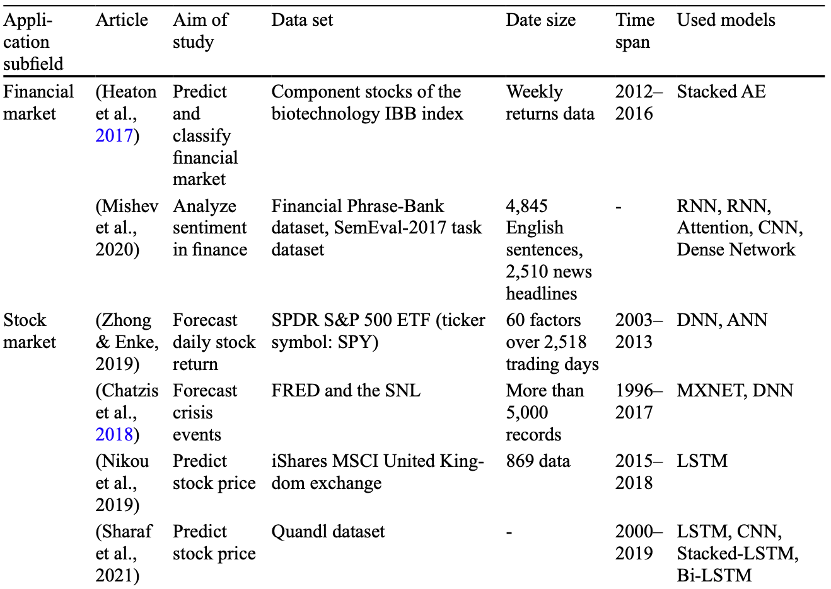
Deep learning for Financial Economics
Source: Zheng, Yuanhang, Zeshui Xu, and Anran Xiao. "Deep learning in economics: a systematic and critical review." Artificial Intelligence Review (2023): 1-43.

Slide 57
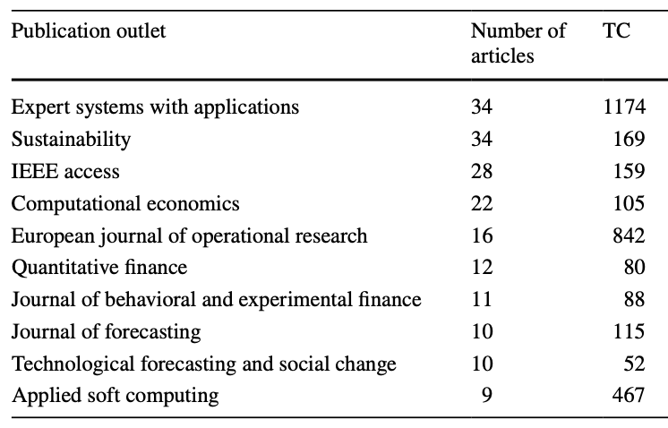
Journal Articles of ML and AI in Finance
Source: Biju, Ajitha Kumari Vijayappan Nair, Ann Susan Thomas, and J. Thasneem. "Examining the research taxonomy of artificial intelligence, deep learning & machine learning in the financial sphere—
a bibliometric analysis." Quality & Quantity (2023): 1-30.

Slide 58
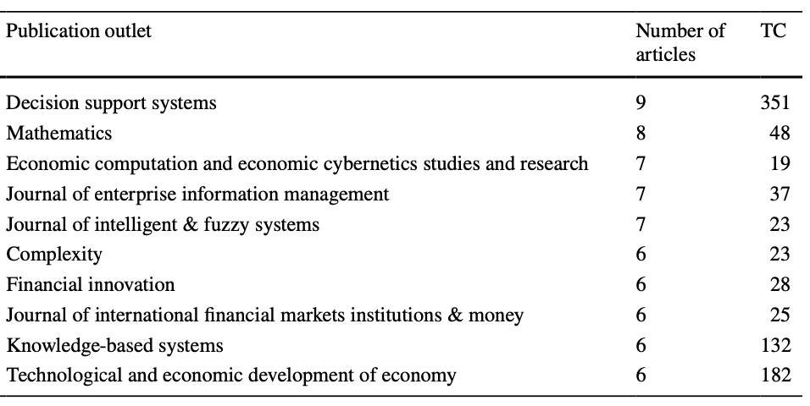
Journal Articles of ML and AI in Finance
Source: Biju, Ajitha Kumari Vijayappan Nair, Ann Susan Thomas, and J. Thasneem. "Examining the research taxonomy of artificial intelligence, deep learning & machine learning in the financial sphere—
a bibliometric analysis." Quality & Quantity (2023): 1-30.

Slide 59
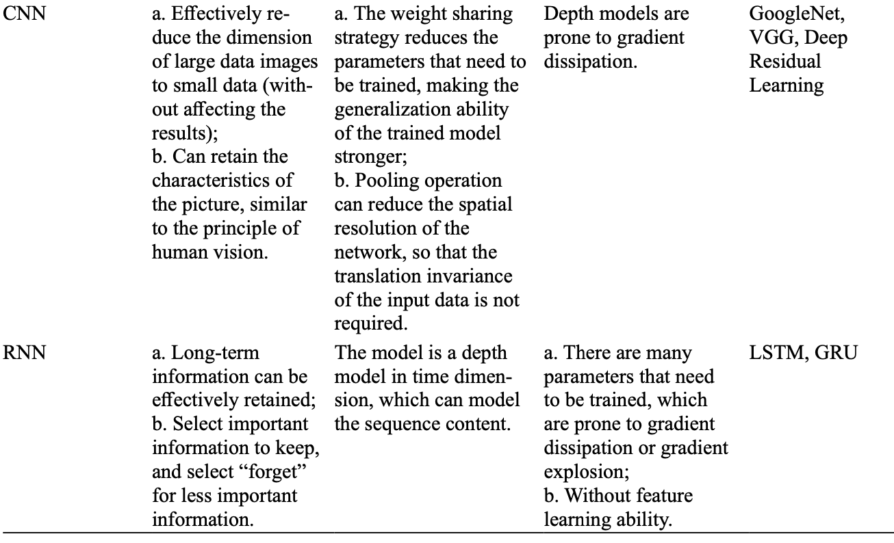
Deep learning: CNN, RNN
Source: Zheng, Yuanhang, Zeshui Xu, and Anran Xiao. "Deep learning in economics: a systematic and critical review." Artificial Intelligence Review (2023): 1-43.

Slide 60
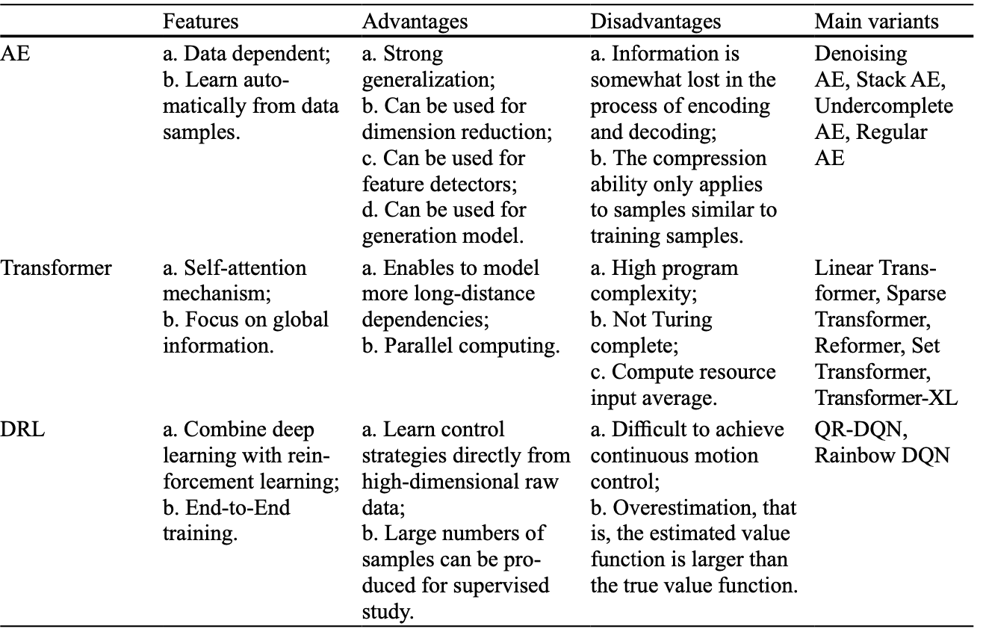
Deep learning: AE, Transformer, DRL
Source: Zheng, Yuanhang, Zeshui Xu, and Anran Xiao. "Deep learning in economics: a systematic and critical review." Artificial Intelligence Review (2023): 1-43.

Slide 61
Deep Learning and
Neural Networks

Slide 62

Tensor
3
  # a rank 0 tensor; this is a scalar with shape []
[1. ,2., 3.]
  # a rank 1 tensor; this is a vector with shape [3]
[[1., 2., 3.], [4., 5., 6.]]
  # a rank 2 tensor; a matrix with shape [2, 3]
[[[1., 2., 3.]], [[7., 8., 9.]]]
  # a rank 3 tensor with shape [2, 1, 3]
https://www.tensorflow.org/

Slide 63
Scalar
80
Vector
[50 60 70]
Matrix
50 60 70
55 65 75
[50 60 70] [70 80 90]
[55 65 75] [75 85 95]
Tensor

Slide 64
Deep Learning Foundations:
Neural Networks

Slide 65
Deep Learning and
Neural Networks
Input Layer
(X)
Hidden Layer
(H)
Output Layer
(Y)
X1
Y
X2

Slide 66
Deep Learning and
Neural Networks
Input Layer
(X)
Hidden Layer
(H)
Output Layer
(Y)

Slide 67
Deep Learning and
Neural Networks
Input Layer
(X)
Hidden Layers
(H)
Output Layer
(Y)
Deep Neural Networks
Deep Learning

Slide 68
The Neuron
x₁
w₁
w₂
x₂
y
…
…
w_{n}
x_{n}
Source: Jeff Dean (2016), Large-Scale Deep Learning For Building Intelligent Computer Systems, WSDM 2016

Slide 69
The Neuron
x₁
w₁
w₂
x₂
y
…
…
w_{n}
x_{n}
Source: Jeff Dean (2016), Large-Scale Deep Learning For Building Intelligent Computer Systems, WSDM 2016

Slide 70
y = max ( 0, -0.21 * x₁ + 0.3 * x₂ + 0.7 * x₃ )
Weights
x₁
-0.21
x₂
0.3
y
Inputs
0.7
x₃
Source: Jeff Dean (2016), Large-Scale Deep Learning For Building Intelligent Computer Systems, WSDM 2016

Slide 71
Neural Networks
Source: https://www.youtube.com/watch?v=bxe2T-V8XRs&index=1&list=PLiaHhY2iBX9hdHaRr6b7XevZtgZRa1PoU

Slide 72
Neural Networks
Input Layer
(X)
Hidden Layer
(H)
Output Layer
(Y)
X1
Y
X2
Source: https://www.youtube.com/watch?v=bxe2T-V8XRs&index=1&list=PLiaHhY2iBX9hdHaRr6b7XevZtgZRa1PoU

Slide 73
Neural Networks
Input Layer
(X)
Hidden Layers
(H)
Output Layer
(Y)
Deep Neural Networks
Deep Learning
Source: https://www.youtube.com/watch?v=bxe2T-V8XRs&index=1&list=PLiaHhY2iBX9hdHaRr6b7XevZtgZRa1PoU

Slide 74
Neural Networks
Input Layer
(X)
Hidden Layer
(H)
Output Layer
(Y)
Neuron
Synapse
Synapse
Neuron
X1
Y
X2
Source: https://www.youtube.com/watch?v=bxe2T-V8XRs&index=1&list=PLiaHhY2iBX9hdHaRr6b7XevZtgZRa1PoU

Slide 75
Neural Networks
Input Layer
(X)
Hidden Layer
(H)
Output Layer
(Y)
Source: https://www.youtube.com/watch?v=P2HPcj8lRJE&list=PLjJh1vlSEYgvGod9wWiydumYl8hOXixNu&index=2

Slide 76
Neural Networks
Input Layer
(X)
Hidden Layer
(H)
Output Layer
(Y)
X1
Y
X2
Source: https://www.youtube.com/watch?v=bxe2T-V8XRs&index=1&list=PLiaHhY2iBX9hdHaRr6b7XevZtgZRa1PoU

Slide 77
Linear function
y = f(x)
y = w₁x + w₀
h_{w}(x) = w₁x + w₀
Source: Stuart Russell and Peter Norvig (2020), Artificial Intelligence: A Modern Approach, 4th Edition, Pearson

Slide 78
Y = W X + b
Source: https://www.youtube.com/watch?v=G8eNWzxOgqE

Slide 79
Output
input
Y = W X + b
Weights
bias
Trained
Source: https://www.youtube.com/watch?v=G8eNWzxOgqE

Slide 80
2.0
1.0
0.1
0.7
0.2
0.1
W X + b = Y
Scores
Probabilities
Source: https://www.youtube.com/watch?v=G8eNWzxOgqE

Slide 81
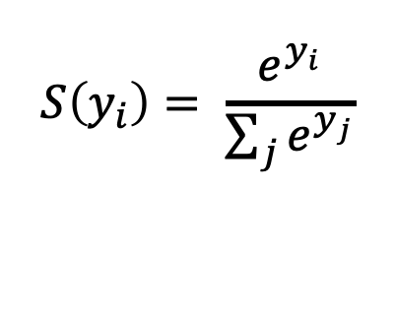
SoftMAX
2.0
1.0
0.1
0.7
0.2
0.1
W X + b = Y
$$S\left(y_{i}\right)= \frac{e^{y_{i}}}{\sum_{j}{e^{y_{j}}}}$$
Logits
Scores
Probabilities
Source: https://www.youtube.com/watch?v=G8eNWzxOgqE

Slide 82
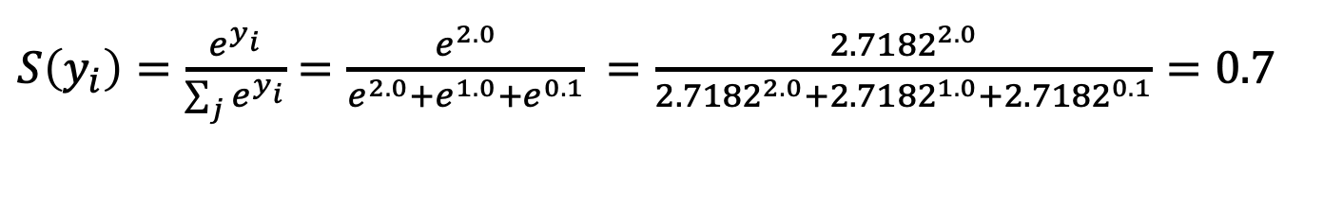
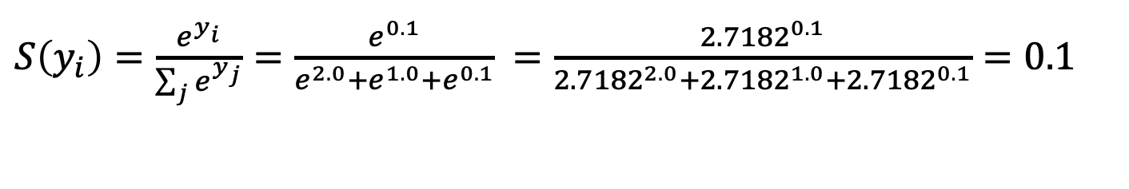
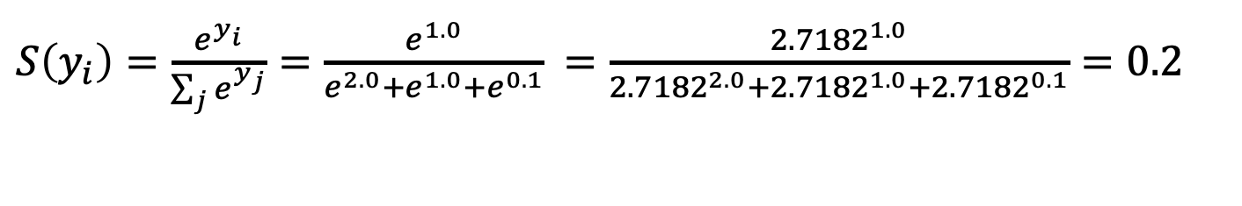
$S\left(y_{i}\right)=\frac{e^{y_{i}}}{\sum_{j}{e^{y_{i}}}}=\frac{e^{2.0}}{e^{2.0}+e^{1.0}+e^{0.1}}$ $=\frac{{2.7182}^{2.0}}{{2.7182}^{2.0}+{2.7182}^{1.0}+{2.7182}^{0.1}}=0.7$
$S\left(y_{i}\right)=\frac{e^{y_{i}}}{\sum_{j}{e^{y_{j}}}}=\frac{e^{1.0}}{e^{2.0}+e^{1.0}+e^{0.1}}$ $=\frac{{2.7182}^{1.0}}{{2.7182}^{2.0}+{2.7182}^{1.0}+{2.7182}^{0.1}}=0.2$
$S\left(y_{i}\right)=\frac{e^{y_{i}}}{\sum_{j}{e^{y_{j}}}}=\frac{e^{0.1}}{e^{2.0}+e^{1.0}+e^{0.1}}$ $=\frac{{2.7182}^{0.1}}{{2.7182}^{2.0}+{2.7182}^{1.0}+{2.7182}^{0.1}}=0.1$
2.0
1.0
0.1
0.7
0.2
0.1
W X + b = Y
$$S\left(y_{i}\right)= \frac{e^{y_{i}}}{\sum_{j}{e^{y_{j}}}}$$
Logits
Scores
Probabilities
Source: https://www.youtube.com/watch?v=G8eNWzxOgqE

Slide 83
Training a Network
=
Minimize the Cost Function
Source: https://www.youtube.com/watch?v=bxe2T-V8XRs&index=1&list=PLiaHhY2iBX9hdHaRr6b7XevZtgZRa1PoU

Slide 84
Training a Network
=
Minimize the Cost Function
Minimize the Loss Function
Source: https://www.youtube.com/watch?v=bxe2T-V8XRs&index=1&list=PLiaHhY2iBX9hdHaRr6b7XevZtgZRa1PoU

Slide 85



Error = Predict Y - Actual Y
Error : Cost : Loss
100
$$y$$
$$\hat{y}$$
75
$$e$$
50
25
Test1
Test2
Test3
Source: https://www.youtube.com/watch?v=bxe2T-V8XRs&index=1&list=PLiaHhY2iBX9hdHaRr6b7XevZtgZRa1PoU

Slide 86
Error = Predict Y - Actual Y
Error : Cost : Loss
100
$$y$$
$$\hat{y}$$
75
$$e$$
50
25
Test1
Test2
Test3
Source: https://www.youtube.com/watch?v=bxe2T-V8XRs&index=1&list=PLiaHhY2iBX9hdHaRr6b7XevZtgZRa1PoU

Slide 87
Error = Predict Y - Actual Y
Error : Cost : Loss
100
$$y$$
$$\hat{y}$$
75
$$e$$
50
25
Test1
Test2
Test3
Source: https://www.youtube.com/watch?v=bxe2T-V8XRs&index=1&list=PLiaHhY2iBX9hdHaRr6b7XevZtgZRa1PoU

Slide 88
Activation Functions

Slide 89
Activation Functions
Sigmoid
TanH
ReLU
(Rectified Linear Unit)
[0, 1]
[-1, 1]
f(x) = max(0, x)
Source: http://cs231n.github.io/neural-networks-1/

Slide 90
Activation Functions
Source: http://adilmoujahid.com/posts/2016/06/introduction-deep-learning-python-caffe/

Slide 91
Loss
Function

Slide 92
Binary Classification: 2 Class
Activation Function:
Sigmoid
Loss Function:
Binary Cross-Entropy

Slide 93
Multiple Classification: 10 Class
Activation Function:
SoftMAX
Loss Function:
Categorical Cross-Entropy

Slide 94
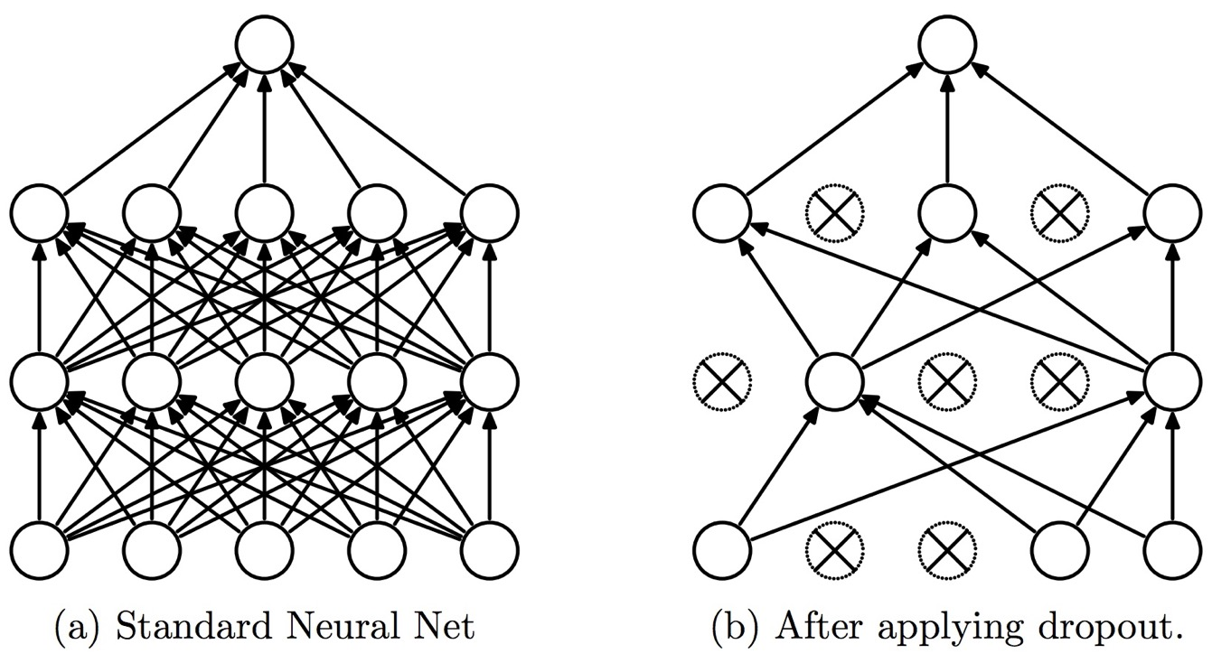
Dropout
Dropout: a simple way to prevent neural networks from overfitting
Source: Srivastava, Nitish, Geoffrey E. Hinton, Alex Krizhevsky, Ilya Sutskever, and Ruslan Salakhutdinov.
"Dropout: a simple way to prevent neural networks from overfitting." Journal of machine learning research 15, no. 1 (2014): 1929-1958.

Slide 95
y = max ( 0, -0.21 * x₁ + 0.3 * x₂ + 0.7 * x₃ )
Weights
x₁
-0.21
x₂
0.3
y
Inputs
0.7
x₃
Source: Jeff Dean (2016), Large-Scale Deep Learning For Building Intelligent Computer Systems, WSDM 2016

Slide 96
Next time:
y = max ( 0, -0.23 * x₁ + 0.31 * x₂ + 0.65 * x₃ )
y = max ( 0, -0.21 * x₁ + 0.3 * x₂ + 0.7 * x₃ )
Weights
-0.23
x₁
-0.21
0.31
x₂
0.3
y
Inputs
0.65
x₃
0.7
Source: Jeff Dean (2016), Large-Scale Deep Learning For Building Intelligent Computer Systems, WSDM 2016

Slide 97
Optimizer:
Stochastic Gradient Descent
(SGD)
J(w)
Initial
weight
Gradient
Global cost
minimum
w

Slide 98
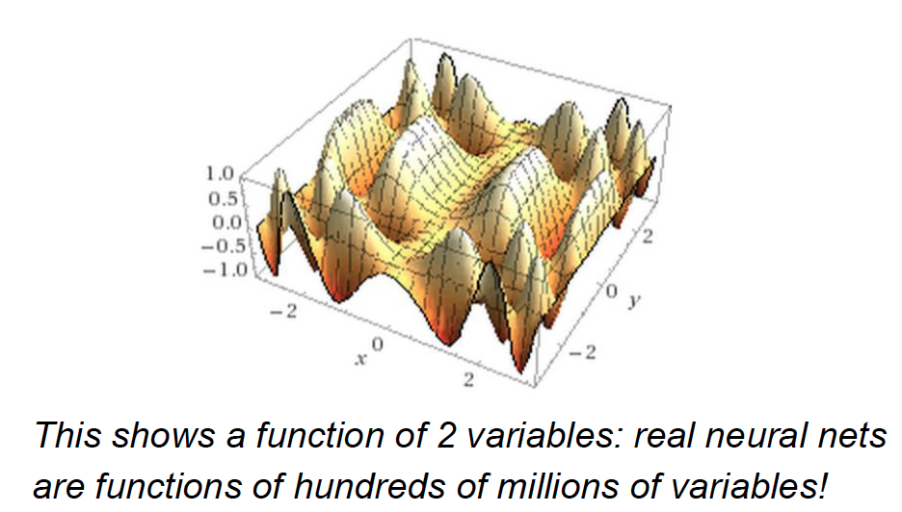
Source: Jeff Dean (2016), Large-Scale Deep Learning For Building Intelligent Computer Systems, WSDM 2016

Slide 99
Convolutional Neural Networks (CNN)

Slide 100
Convolutional Neural Networks
(CNN)
Convolution
Pooling
Fully Connection (FC) (Flattening)

Slide 101
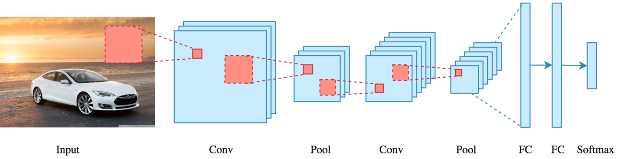
CNN Architecture
Source: Arden Dertat (2017), Applied Deep Learning - Part 4: Convolutional Neural Networks, https://towardsdatascience.com/applied-deep-learning-part-4-convolutional-neural-networks-584bc134c1e2

Slide 102
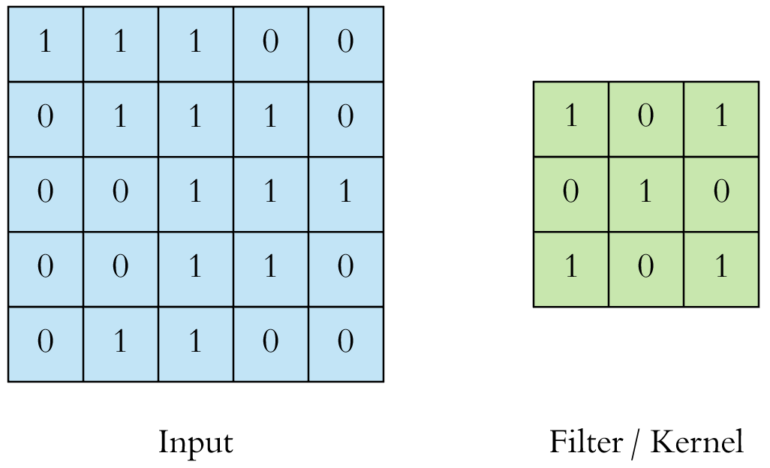
CNN Convolution Layer
Convolution is a mathematical operation to merge two sets of information
3x3 convolution
Source: Arden Dertat (2017), Applied Deep Learning - Part 4: Convolutional Neural Networks, https://towardsdatascience.com/applied-deep-learning-part-4-convolutional-neural-networks-584bc134c1e2

Slide 103
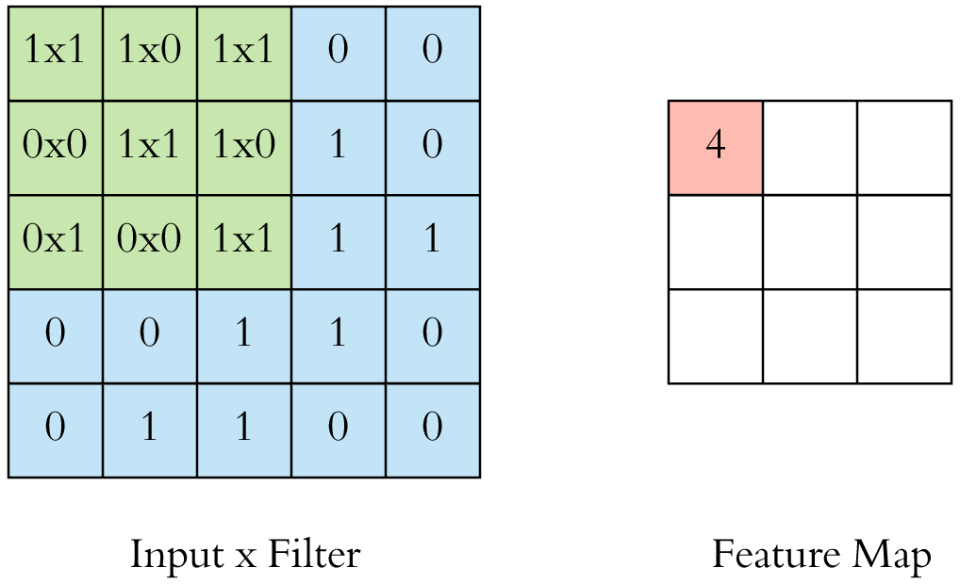
CNN Convolution Layer
Input x Filter --> Feature Map
receptive field: 3x3
Source: Arden Dertat (2017), Applied Deep Learning - Part 4: Convolutional Neural Networks, https://towardsdatascience.com/applied-deep-learning-part-4-convolutional-neural-networks-584bc134c1e2

Slide 104
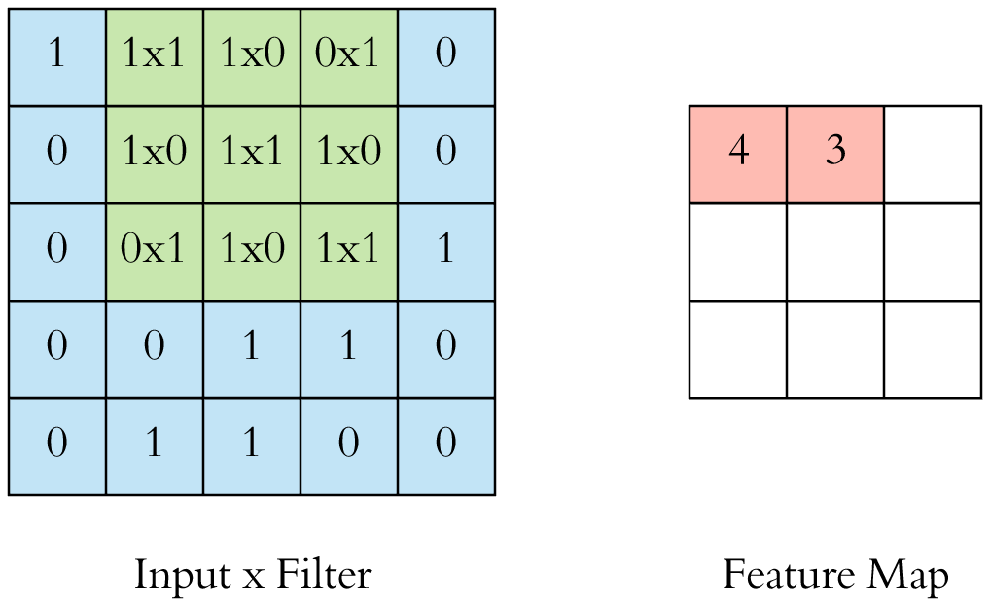
CNN Convolution Layer
Input x Filter --> Feature Map
receptive field: 3x3
Source: Arden Dertat (2017), Applied Deep Learning - Part 4: Convolutional Neural Networks, https://towardsdatascience.com/applied-deep-learning-part-4-convolutional-neural-networks-584bc134c1e2

Slide 105

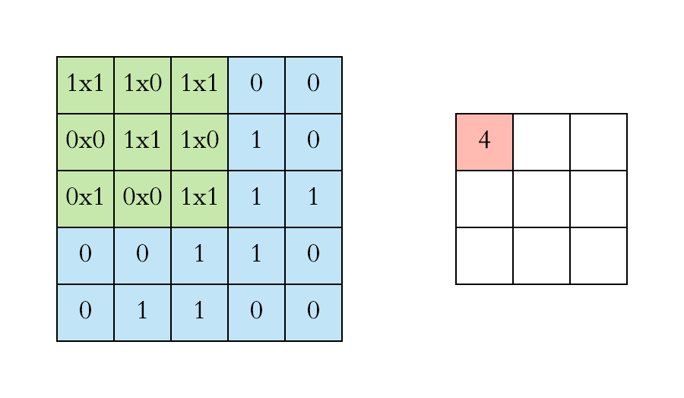
CNN Convolution Layer
Example convolution operation shown in 2D using a 3x3 filter
Source: Arden Dertat (2017), Applied Deep Learning - Part 4: Convolutional Neural Networks, https://towardsdatascience.com/applied-deep-learning-part-4-convolutional-neural-networks-584bc134c1e2

Slide 106
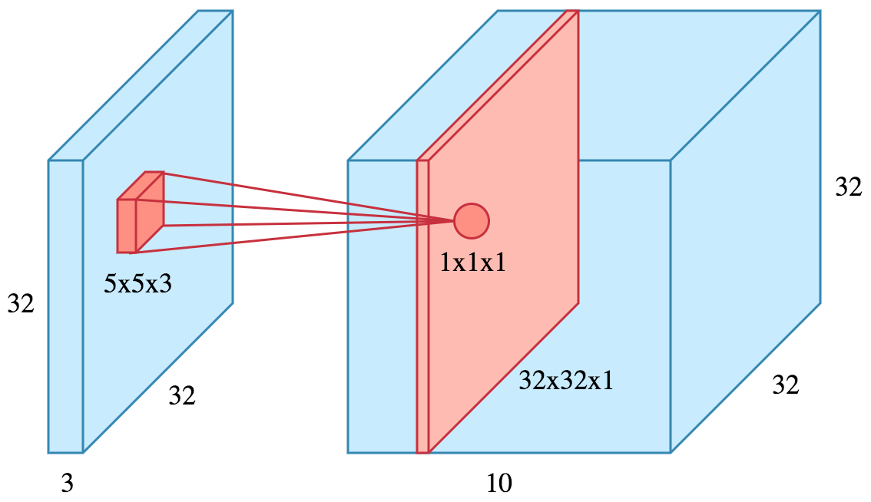
CNN Convolution Layer
10 different filters
10 feature maps of size 32x32x1
final output of the convolution layer:
a volume of size 32x32x10
Source: Arden Dertat (2017), Applied Deep Learning - Part 4: Convolutional Neural Networks, https://towardsdatascience.com/applied-deep-learning-part-4-convolutional-neural-networks-584bc134c1e2

Slide 107
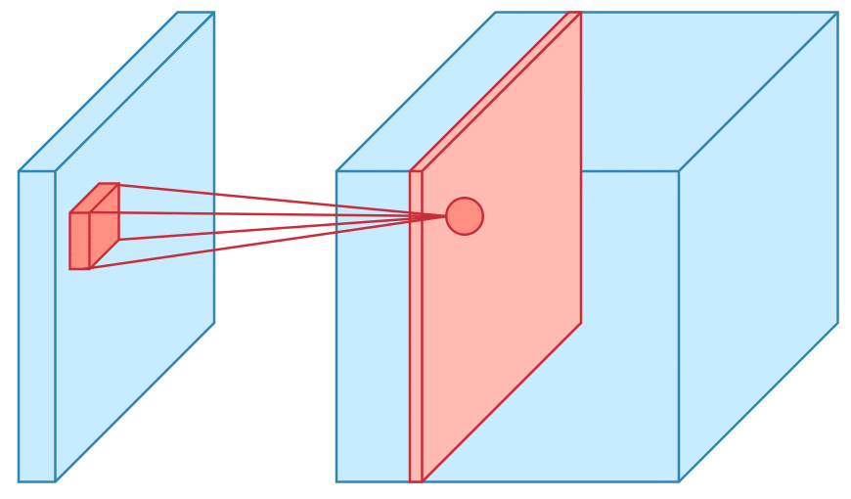
CNN Convolution Layer
Sliding operation at 4 locations
Source: Arden Dertat (2017), Applied Deep Learning - Part 4: Convolutional Neural Networks, https://towardsdatascience.com/applied-deep-learning-part-4-convolutional-neural-networks-584bc134c1e2

Slide 108
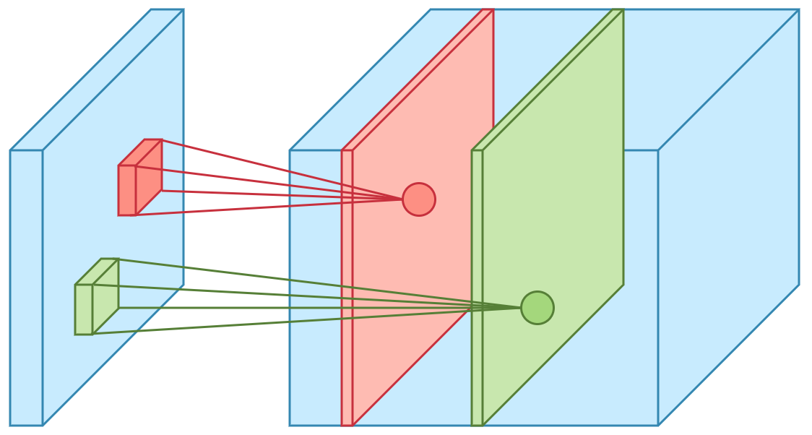
CNN Convolution Layer
two feature maps
Source: Arden Dertat (2017), Applied Deep Learning - Part 4: Convolutional Neural Networks, https://towardsdatascience.com/applied-deep-learning-part-4-convolutional-neural-networks-584bc134c1e2

Slide 109
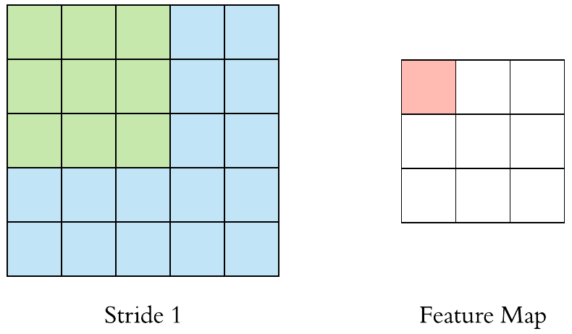
CNN Convolution Layer
Stride specifies how much
we move the convolution filter at each step
Source: Arden Dertat (2017), Applied Deep Learning - Part 4: Convolutional Neural Networks, https://towardsdatascience.com/applied-deep-learning-part-4-convolutional-neural-networks-584bc134c1e2

Slide 110
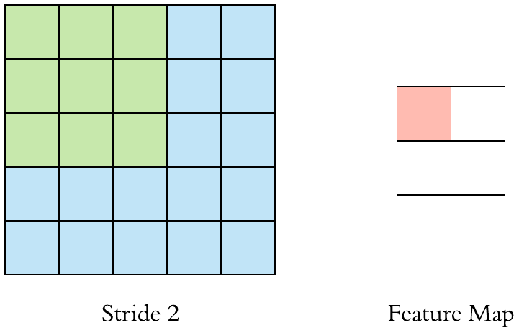
CNN Convolution Layer
Stride specifies how much
we move the convolution filter at each step
Source: Arden Dertat (2017), Applied Deep Learning - Part 4: Convolutional Neural Networks, https://towardsdatascience.com/applied-deep-learning-part-4-convolutional-neural-networks-584bc134c1e2

Slide 111
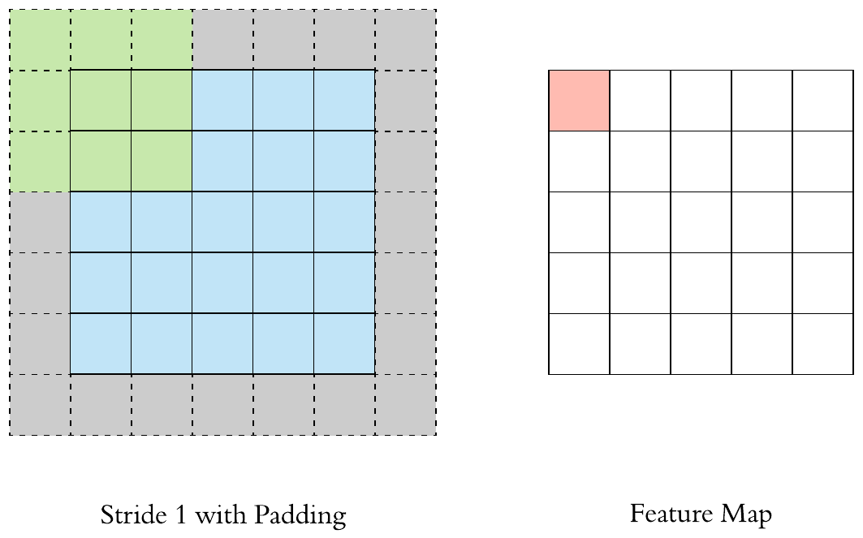
CNN Convolution Layer
Stride 1 with Padding
Source: Arden Dertat (2017), Applied Deep Learning - Part 4: Convolutional Neural Networks, https://towardsdatascience.com/applied-deep-learning-part-4-convolutional-neural-networks-584bc134c1e2

Slide 112
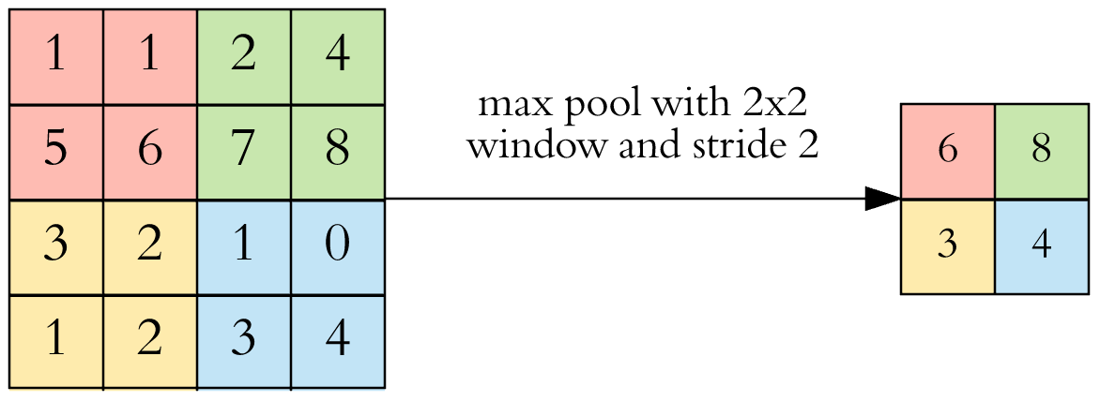
CNN Pooling Layer
Max Pooling
Source: Arden Dertat (2017), Applied Deep Learning - Part 4: Convolutional Neural Networks, https://towardsdatascience.com/applied-deep-learning-part-4-convolutional-neural-networks-584bc134c1e2

Slide 113
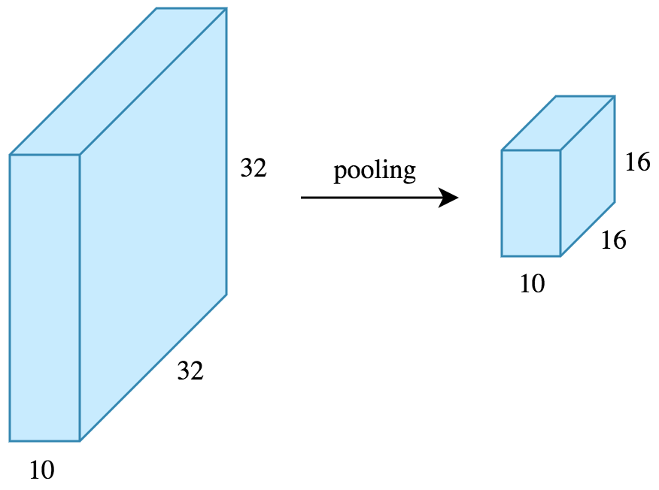
CNN Pooling Layer
Source: Arden Dertat (2017), Applied Deep Learning - Part 4: Convolutional Neural Networks, https://towardsdatascience.com/applied-deep-learning-part-4-convolutional-neural-networks-584bc134c1e2

Slide 114
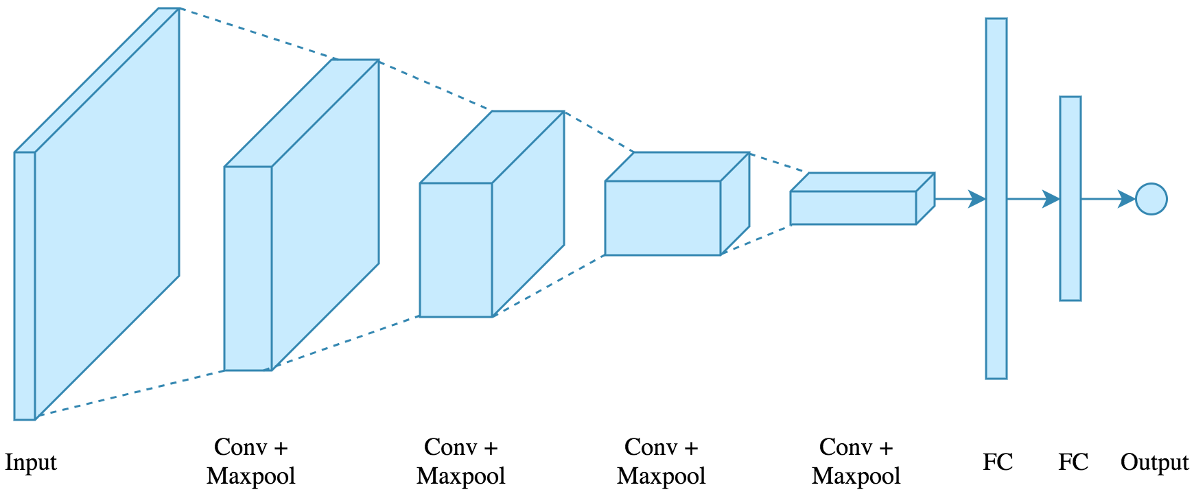
CNN Architecture
4 convolution + pooling layers,
followed by 2 fully connected layers
Source: Arden Dertat (2017), Applied Deep Learning - Part 4: Convolutional Neural Networks, https://towardsdatascience.com/applied-deep-learning-part-4-convolutional-neural-networks-584bc134c1e2

Slide 115
CNN Architecture
4 convolution + pooling layers,
followed by 2 fully connected layers
https://gist.github.com/ardendertat/0fc5515057c47e7386fe04e9334504e3
model = Sequential()
model.add(Conv2D(32, (3, 3), activation='relu', padding='same', name='conv_1',
input_shape=(150, 150, 3)))
model.add(MaxPooling2D((2, 2), name='maxpool_1'))
model.add(Conv2D(64, (3, 3), activation='relu', padding='same', name='conv_2'))
model.add(MaxPooling2D((2, 2), name='maxpool_2'))
model.add(Conv2D(128, (3, 3), activation='relu', padding='same', name='conv_3'))
model.add(MaxPooling2D((2, 2), name='maxpool_3'))
model.add(Conv2D(128, (3, 3), activation='relu', padding='same', name='conv_4'))
model.add(MaxPooling2D((2, 2), name='maxpool_4'))
model.add(Flatten())
model.add(Dropout(0.5))
model.add(Dense(512, activation='relu', name='dense_1'))
model.add(Dense(128, activation='relu', name='dense_2'))
model.add(Dense(1, activation='sigmoid', name='output'))
Source: Arden Dertat (2017), Applied Deep Learning - Part 4: Convolutional Neural Networks, https://towardsdatascience.com/applied-deep-learning-part-4-convolutional-neural-networks-584bc134c1e2

Slide 116
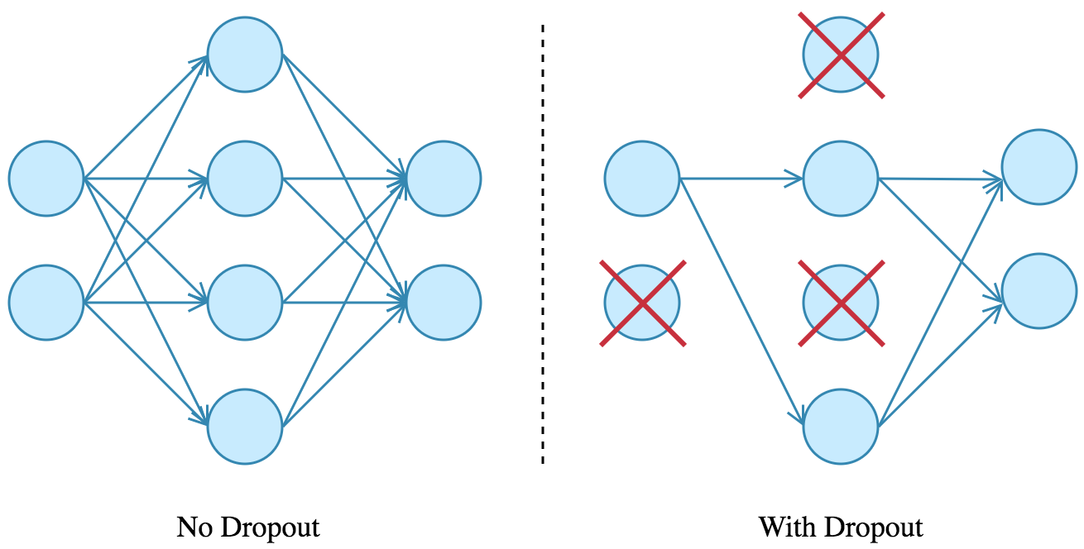
Dropout
Source: Arden Dertat (2017), Applied Deep Learning - Part 4: Convolutional Neural Networks, https://towardsdatascience.com/applied-deep-learning-part-4-convolutional-neural-networks-584bc134c1e2

Slide 117
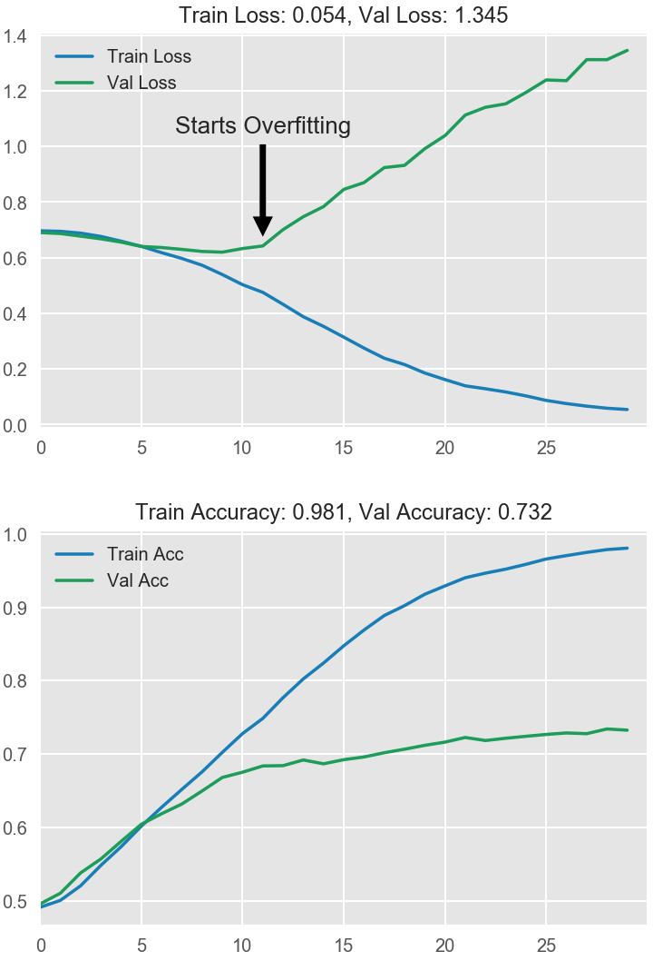
Model Performance
Source: Arden Dertat (2017), Applied Deep Learning - Part 4: Convolutional Neural Networks, https://towardsdatascience.com/applied-deep-learning-part-4-convolutional-neural-networks-584bc134c1e2

Slide 118
Recurrent
Neural Networks (RNN)

Slide 119
Recurrent Neural Networks (RNN)
y_{t-2}
y_{t-1}
y_{t}
y_{t+1}
y_{t+2}
output
h_{t-2}
h_{t-1}
h_{t}
h_{t+1}
h_{t+2}
hidden
X_{t-2}
X_{t-1}
X_{t}
X_{t+1}
X_{t+2}
Input

Slide 120
Recurrent Neural Networks (RNN)
Time Series Forecasting
110
120
130
140
150
y_{t-2}
y_{t-1}
y_{t}
y_{t+1}
y_{t+2}
output
h_{t-2}
h_{t-1}
h_{t}
h_{t+1}
h_{t+2}
hidden
X_{t-2}
X_{t-1}
X_{t}
X_{t+1}
X_{t+2}
Input
100
110
120
130
140

Slide 121
Recurrent Neural Networks (RNN)
y
output
h_{t-2}
h_{t-1}
h_{t}
h_{t+1}
h_{t+2}
hidden
X_{t-2}
X_{t-1}
X_{t}
X_{t+1}
X_{t+2}
Input

Slide 122

Recurrent Neural Networks (RNN)
Sentiment Analysis
y
output
h_{t-2}
h_{t-1}
h_{t}
h_{t+1}
h_{t+2}
hidden
X_{t-2}
X_{t-1}
X_{t}
X_{t+1}
X_{t+2}
Input
This
movie
is
very
good

Slide 123

Recurrent Neural Networks (RNN)
Sentiment Analysis
y
output
h_{t-2}
h_{t-1}
h_{t}
h_{t+1}
h_{t+2}
hidden
X_{t-2}
X_{t-1}
X_{t}
X_{t+1}
X_{t+2}
Input
This
movie
is
very
boring

Slide 124
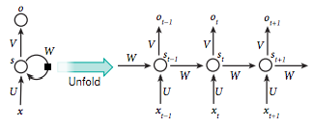
Recurrent Neural Network (RNN)
Source: LeCun, Yann, Yoshua Bengio, and Geoffrey Hinton. "Deep learning." Nature 521, no. 7553 (2015): 436-444.

Slide 125
RNN
Source: Christopher Olah, (2015) Understanding LSTM Networks, http://colah.github.io/posts/2015-08-Understanding-LSTMs/

Slide 126
RNN long-term dependencies
I grew up in France… I speak fluent French.
Source: Christopher Olah, (2015) Understanding LSTM Networks, http://colah.github.io/posts/2015-08-Understanding-LSTMs/

Slide 127
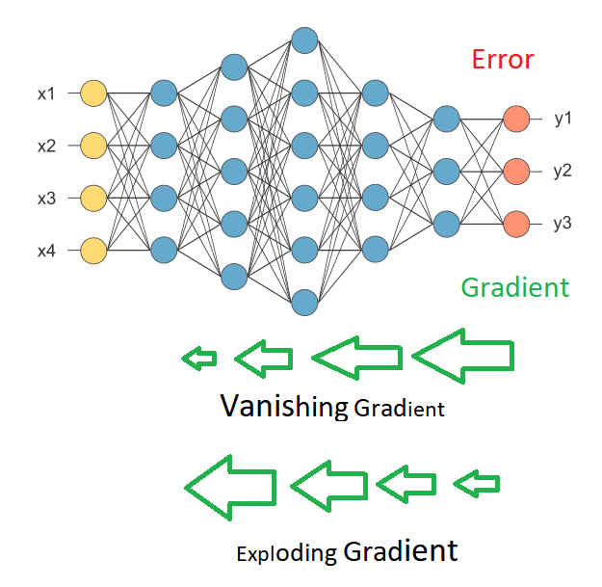
Vanishing Gradient
Exploding Gradient
Source: https://medium.com/deep-math-machine-learning-ai/chapter-10-1-deepnlp-lstm-long-short-term-memory-networks-with-math-21477f8e4235

Slide 128
Recurrent Neural Networks (RNN)
y_{t-2}
y_{t-1}
y_{t}
y_{t+1}
y_{t+2}
output
V
V
V
V
W
W
W
W
h_{t-2}
h_{t-1}
h_{t}
h_{t+1}
h_{t+2}
hidden
U
U
U
U
X_{t-2}
X_{t-1}
X_{t}
X_{t+1}
X_{t+2}
Input

Slide 129
RNN
Vanishing Gradient problem
Exploding Gradient problem
Error
y_{t-2}
y_{t-1}
y_{t}
y_{t+1}
y_{t+2}
output
V
V
V
V
W
W
W
W
h_{t-2}
h_{t-1}
h_{t}
h_{t+1}
h_{t+2}
hidden
U
U
U
U
X_{t-2}
X_{t-1}
X_{t}
X_{t+1}
X_{t+2}
Input
if |W| < 1 (Vanishing)
if |W| > 1 (Exploding)
Source: https://medium.com/deep-math-machine-learning-ai/chapter-10-1-deepnlp-lstm-long-short-term-memory-networks-with-math-21477f8e4235

Slide 130
RNN
Vanishing Gradient problem
Error
y_{t-2}
y_{t-1}
y_{t}
y_{t+1}
y_{t+2}
output
V
V
V
V
0.9
0.9
0.9
0.9
h_{t-2}
h_{t-1}
h_{t}
h_{t+1}
h_{t+2}
hidden
U
U
U
U
X_{t-2}
X_{t-1}
X_{t}
X_{t+1}
X_{t+2}
Input
W = 0.9 < 1 (Vanishing)
Source: https://medium.com/deep-math-machine-learning-ai/chapter-10-1-deepnlp-lstm-long-short-term-memory-networks-with-math-21477f8e4235

Slide 131
RNN
Exploding Gradient problem
Error
y_{t-2}
y_{t-1}
y_{t}
y_{t+1}
y_{t+2}
output
V
V
V
V
1.1
1.1
1.1
1.1
h_{t-2}
h_{t-1}
h_{t}
h_{t+1}
h_{t+2}
hidden
U
U
U
U
X_{t-2}
X_{t-1}
X_{t}
X_{t+1}
X_{t+2}
Input
W = 1.1 > 1 (Exploding)
Source: https://medium.com/deep-math-machine-learning-ai/chapter-10-1-deepnlp-lstm-long-short-term-memory-networks-with-math-21477f8e4235

Slide 132
RNN LSTM
RNN
LSTM
Source: Christopher Olah, (2015) Understanding LSTM Networks, http://colah.github.io/posts/2015-08-Understanding-LSTMs/

Slide 133
Long Short Term Memory
(LSTM)
forget
gate
input
gate
output
gate
Source: Christopher Olah, (2015) Understanding LSTM Networks, http://colah.github.io/posts/2015-08-Understanding-LSTMs/

Slide 134
Gated Recurrent Unit
(GRU)
reset
gate
update
gate
Source: Christopher Olah, (2015) Understanding LSTM Networks, http://colah.github.io/posts/2015-08-Understanding-LSTMs/

Slide 135
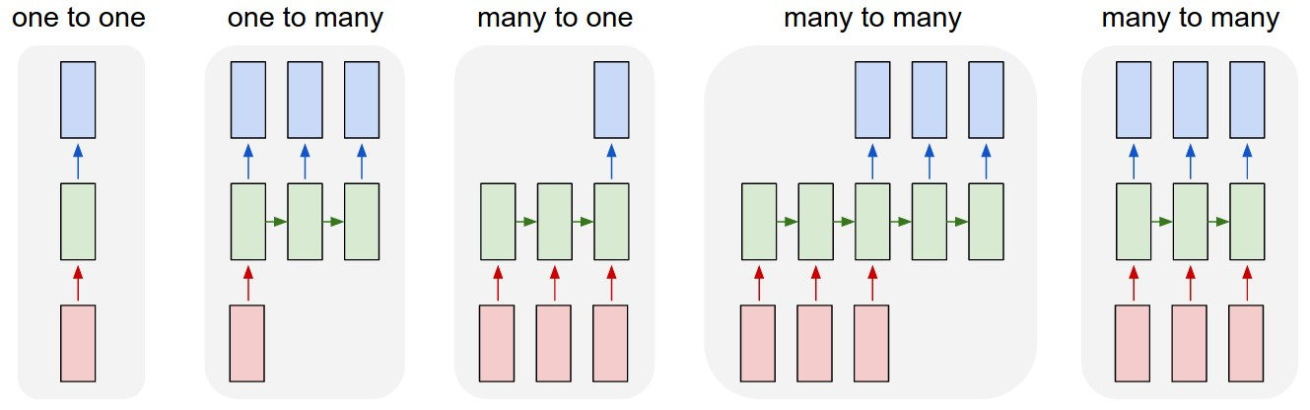
LSTM Recurrent Neural Network
Traditional Neural Network
Music
Generation
Sentiment
Classification
Name
Entity
Recognition
Machine
Translation
Source: https://github.com/Vict0rSch/deep_learning/tree/master/keras/recurrent

Slide 136
Long Short Term Memory (LSTM) for Time Series Forecasting
h_{t-2}
h_{t-1}
h_{t}
h_{t+1}
h_{t+2}
LSTM
LSTM
LSTM
LSTM
LSTM
X_{t-2}
X_{t-1}
X_{t}
X_{t+1}
X_{t+2}

Slide 137
Time Series Data
[100, 110, 120, 130, 140, 150]
Y
X
Y
[100 110 120 130 140] 150
X_{t1}
X_{t2}
X_{t3}
X_{t4}
X_{t5}

Slide 138
Time Series Data
[10, 20, 30, 40, 50, 60, 70, 80, 90]
X
Y
[10 20 30] 40
[20 30 40] 50
[30 40 50] 60
[40 50 60] 70
[50 60 70] 80
[60 70 80] 90

Slide 139
Reinforcement Learning (RL)
Computer Science
Engineering
Machine
Learning
Neuroscience
Optimal
Control
Reward
System
Reinforcement
Learning
Operations
Research
Classical/Operant
Conditioning
Mathematics
Bounded
Rationality
Psychology
Economics
Source: David Silver (2015), Introduction to reinforcement learning, https://www.youtube.com/playlist?list=PLqYmG7hTraZDM-OYHWgPebj2MfCFzFObQ

Slide 140
Branches of Machine Learning (ML)
Reinforcement Learning (RL)
No Labels
No feedback
Find hidden structure
Labeled data
Direct feedback
Predict
Supervised
Learning
Unsupervised
Learning
Machine
Learning
Reinforcement
Learning
Decision process
Reward system
Learn series of actions
Source: David Silver (2015), Introduction to reinforcement learning, https://www.youtube.com/playlist?list=PLqYmG7hTraZDM-OYHWgPebj2MfCFzFObQ

Slide 141
Reinforcement Learning (RL) Taxonomy
Model-Free
Value Function
Actor
Critic
Policy
Model-Based
Policy-Based
Value-Based
Model
Source: David Silver (2015), Introduction to reinforcement learning, https://www.youtube.com/playlist?list=PLqYmG7hTraZDM-OYHWgPebj2MfCFzFObQ

Slide 142
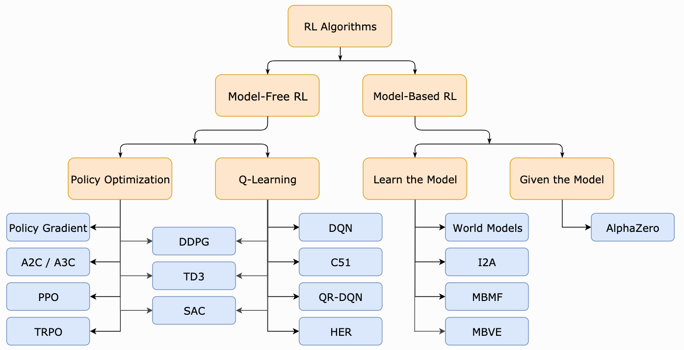
Reinforcement Learning (RL)
A Taxonomy of RL Algorithms
Source: https://spinningup.openai.com/en/latest/spinningup/rl_intro2.html

Slide 143
Reinforcement Learning (DL)
Agent
Environment
Source: Richard S. Sutton & Andrew G. Barto (2018), Reinforcement Learning: An Introduction, 2nd Edition, A Bradford Book.

Slide 144
Reinforcement Learning (DL)
1
2
observation
Agent
action
3
reward
Environment
Source: Richard S. Sutton & Andrew G. Barto (2018), Reinforcement Learning: An Introduction, 2nd Edition, A Bradford Book.

Slide 145
Reinforcement Learning (DL)
1
2
observation
Agent
action
O_{t}
A_{t}
3
reward
R_{t}
Environment
Source: Richard S. Sutton & Andrew G. Barto (2018), Reinforcement Learning: An Introduction, 2nd Edition, A Bradford Book.

Slide 146
Agent and Environment
At each step t the agent:
  Executes action A_{t}
  Receives observation O_{t}
  Receives scalar reward R_{t}
The environment:
  Receives action A_{t}
  Emits observation O_{t+1}
  Emits scalar reward R_{t+1}
t increments at env. step
observation
action
Agent
O_{t}
A_{t}
reward
R_{t}
Environment
Source: David Silver (2015), Introduction to reinforcement learning, https://www.youtube.com/playlist?list=PLqYmG7hTraZDM-OYHWgPebj2MfCFzFObQ

Slide 147
Reinforcement Learning (DL)
The Agent-Environment Interaction in a Markov Decision Process (MDP)
Agent
state
reward
action
S_{t}
R_{t}
A_{t}
R_{t+1}
Environment
S_{t+1}
Source: Richard S. Sutton & Andrew G. Barto (2018), Reinforcement Learning: An Introduction, 2nd Edition, A Bradford Book.

Slide 148
Model-Based RL
value/policy
acting
planning
model
experience
model
learning
Source: Richard S. Sutton & Andrew G. Barto (2018), Reinforcement Learning: An Introduction, 2nd Edition, A Bradford Book.

Slide 149
Model-Free RL
(DQN, A3C)
value/policy
acting
planning
direct
RL
model
experience
model
learning
Source: Richard S. Sutton & Andrew G. Barto (2018), Reinforcement Learning: An Introduction, 2nd Edition, A Bradford Book.

Slide 150
Reinforcement Learning Algorithms
Deep Reinforcement Learning (DRL)
Dynamic Programming
Markov Decision Process (MDP)
Monte Carlo Method
Q-Learning
TD Learning
Partially Observable MDP
(POMDP)
Actor-Critic Methods
Deep Q Network (DQN)
Double DQN
Neural Fitted Q Learning
Deep Recurrent Q Network (DQRN)
A3C
Rainbow
Source: https://amitray.com/deep-learning-past-present-and-future-a-review/

Slide 151
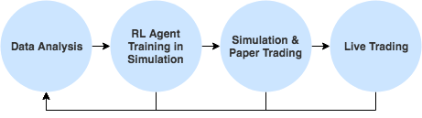
Reinforcement Learning (RL) in Trading Strategies
Source: http://www.wildml.com/2018/02/introduction-to-learning-to-trade-with-reinforcement-learning/

Slide 152
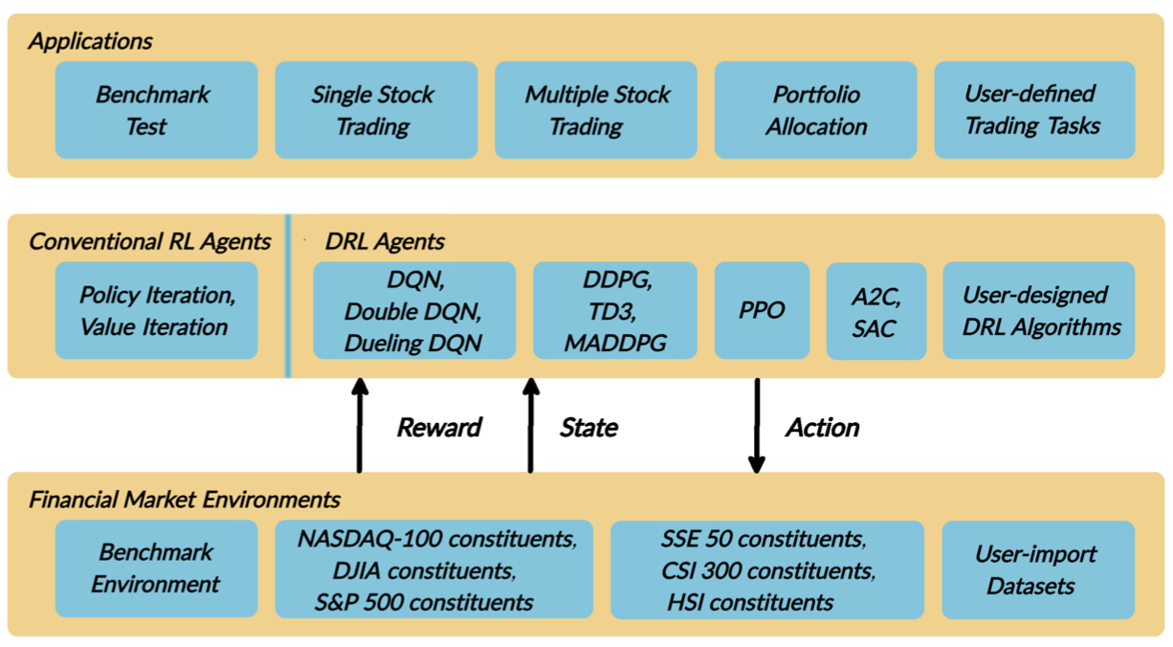
FinRL:
A Deep Reinforcement Learning Library for
Automated Stock Trading in Quantitative Finance
Source: Xiao-Yang Liu, Hongyang Yang, Qian Chen, Runjia Zhang, Liuqing Yang, Bowen Xiao, and Christina Dan Wang (2020). "FinRL: A Deep Reinforcement Learning Library for Automated Stock Trading in Quantitative Finance." arXiv preprint arXiv:2011.09607 (2020).

Slide 153
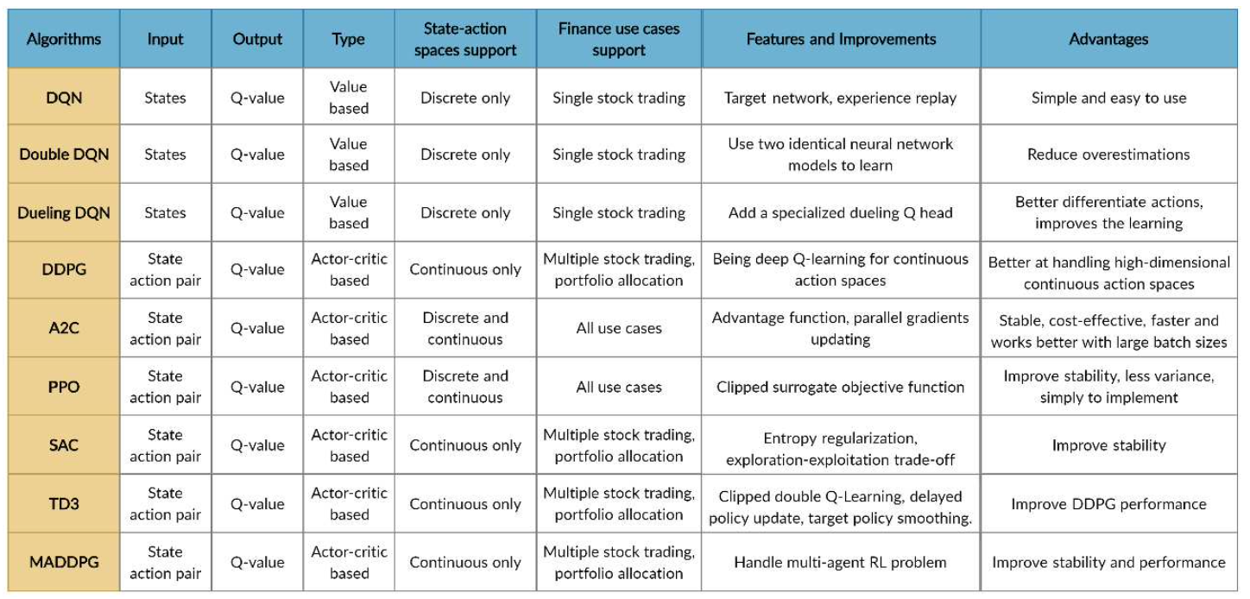
FinRL
Deep Reinforcement Learning Algorithms
Source: Xiao-Yang Liu, Hongyang Yang, Qian Chen, Runjia Zhang, Liuqing Yang, Bowen Xiao, and Christina Dan Wang (2020). "FinRL: A Deep Reinforcement Learning Library for Automated Stock Trading in Quantitative Finance." arXiv preprint arXiv:2011.09607 (2020).

Slide 154
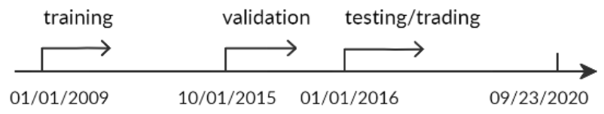
FinRL:
A Deep Reinforcement Learning Library for
Automated Stock Trading in Quantitative Finance
Evaluation of Trading Performance
Training-Validation-Testing Flow
Source: Xiao-Yang Liu, Hongyang Yang, Qian Chen, Runjia Zhang, Liuqing Yang, Bowen Xiao, and Christina Dan Wang (2020). "FinRL: A Deep Reinforcement Learning Library for Automated Stock Trading in Quantitative Finance." arXiv preprint arXiv:2011.09607 (2020).

Slide 155
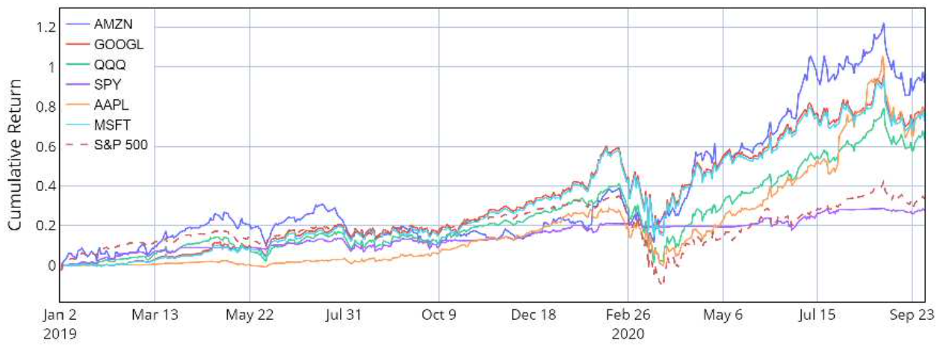
Reinforcement Learning (RL)
FinRL
Performance of single stock trading using Proximal policy optimization (PPO) in the FinRL library
Source: Xiao-Yang Liu, Hongyang Yang, Qian Chen, Runjia Zhang, Liuqing Yang, Bowen Xiao, and Christina Dan Wang (2020). "FinRL: A Deep Reinforcement Learning Library for Automated Stock Trading in Quantitative Finance." arXiv preprint arXiv:2011.09607 (2020).

Slide 156
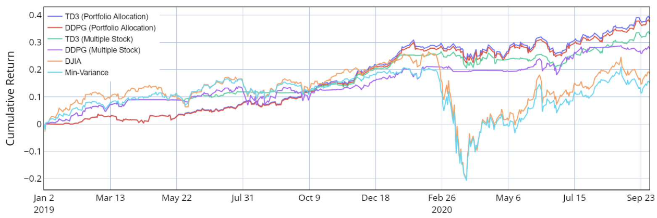
Reinforcement Learning (RL)
FinRL
Performance of multiple stock trading and portfolio allocation using the FinRL library
Source: Xiao-Yang Liu, Hongyang Yang, Qian Chen, Runjia Zhang, Liuqing Yang, Bowen Xiao, and Christina Dan Wang (2020). "FinRL: A Deep Reinforcement Learning Library for Automated Stock Trading in Quantitative Finance." arXiv preprint arXiv:2011.09607 (2020).

Slide 157
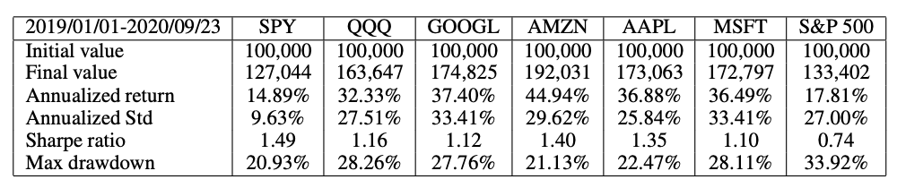
Reinforcement Learning (RL)
FinRL
Performance of single stock trading using Proximal policy optimization (PPO) in the FinRL library
Source: Xiao-Yang Liu, Hongyang Yang, Qian Chen, Runjia Zhang, Liuqing Yang, Bowen Xiao, and Christina Dan Wang (2020). "FinRL: A Deep Reinforcement Learning Library for Automated Stock Trading in Quantitative Finance." arXiv preprint arXiv:2011.09607 (2020).

Slide 158
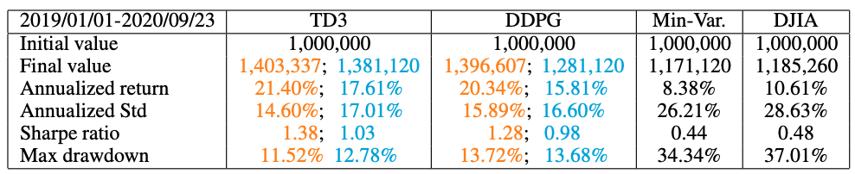
Reinforcement Learning (RL)
FinRL
Performance of multiple stock trading and portfolio allocation over the DJIA constituents stocks using the FinRL library
Source: Xiao-Yang Liu, Hongyang Yang, Qian Chen, Runjia Zhang, Liuqing Yang, Bowen Xiao, and Christina Dan Wang (2020). "FinRL: A Deep Reinforcement Learning Library for Automated Stock Trading in Quantitative Finance." arXiv preprint arXiv:2011.09607 (2020).

Slide 159
Deep Reinforcement Learning Library
OpenAI Gym
Google Dopamine
RLlib
Horizon
FinRL

Slide 160
import os
import numpy as np
import pandas as pd
from pylab import plt, mpl
plt.style.use('seaborn')
mpl.rcParams['savefig.dpi'] = 300
mpl.rcParams['font.family'] = 'serif'
pd.set_option('precision', 4)
np.set_printoptions(suppress=True, precision=4)
os.environ['PYTHONHASHSEED'] = '0'
url = 'http://hilpisch.com/aiif_eikon_id_eur_usd.csv'
symbol = 'EUR_USD'
raw = pd.read_csv(url, index_col=0, parse_dates=True)
raw.head()
Source: Yves Hilpisch (2020), Artificial Intelligence in Finance: A Python-Based Guide, O’Reilly Media.

Slide 161
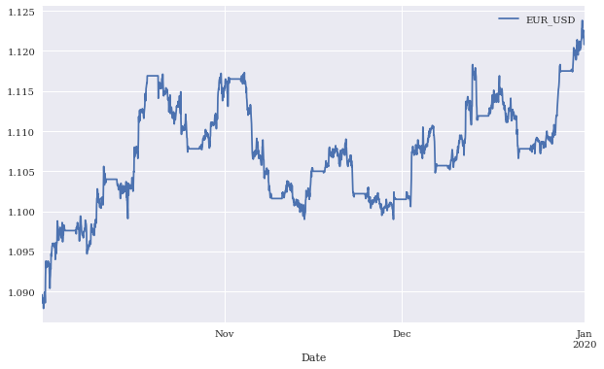
Mid-closing prices for EUR/USD (intraday)
Source: Yves Hilpisch (2020), Artificial Intelligence in Finance: A Python-Based Guide, O’Reilly Media.

Slide 162
optimizer = Adam(lr=0.001)
def create_model(hl=1, hu=128, optimizer=optimizer):
  model = Sequential()
  model.add(Dense(hu, input_dim=len(cols),
  activation='relu'))
  for _ in range(hl):
  model.add(Dense(hu, activation='relu'))
  model.add(Dense(1, activation='sigmoid'))
  model.compile(loss='binary_crossentropy',
              optimizer=optimizer,
              metrics=['accuracy'])
  return model
set_seeds()
model = create_model(hl=1, hu=128)
model.summary()
Source: Yves Hilpisch (2020), Artificial Intelligence in Finance: A Python-Based Guide, O’Reilly Media.

Slide 163
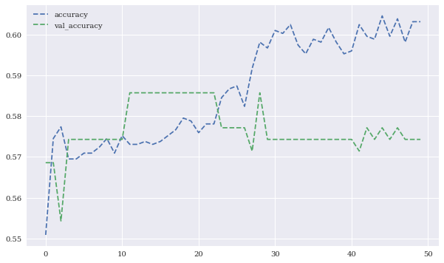
Training and validation accuracy values
Source: Yves Hilpisch (2020), Artificial Intelligence in Finance: A Python-Based Guide, O’Reilly Media.

Slide 164

Training and validation accuracy values (normalized features data)
Source: Yves Hilpisch (2020), Artificial Intelligence in Finance: A Python-Based Guide, O’Reilly Media.

Slide 165

Training and validation accuracy values
(with dropout)
Source: Yves Hilpisch (2020), Artificial Intelligence in Finance: A Python-Based Guide, O’Reilly Media.

Slide 166

Training and validation accuracy values
(with regularization)
Source: Yves Hilpisch (2020), Artificial Intelligence in Finance: A Python-Based Guide, O’Reilly Media.

Slide 167

Training and validation accuracy values
(with dropout and regularization)
Source: Yves Hilpisch (2020), Artificial Intelligence in Finance: A Python-Based Guide, O’Reilly Media.

Slide 168
from keras.models import Sequential
from keras.layers import SimpleRNN, LSTM, Dense
model = Sequential()
model.add(SimpleRNN(100, activation='relu’,
input_shape=(lags, 1)))
model.add(Dense(1, activation='linear'))
model.compile(optimizer='adagrad', loss='mse’,
metrics=['mae'])
model.summary()
model.fit(g, epochs=1000, steps_per_epoch=5, verbose=False)
Source: Yves Hilpisch (2020), Artificial Intelligence in Finance: A Python-Based Guide, O’Reilly Media.

Slide 169

Performance metrics during RNN training
Source: Yves Hilpisch (2020), Artificial Intelligence in Finance: A Python-Based Guide, O’Reilly Media.

Slide 170

Sample sequence data
Source: Yves Hilpisch (2020), Artificial Intelligence in Finance: A Python-Based Guide, O’Reilly Media.

Slide 171

in-sample and out-of-sample predictions of the RNN
Source: Yves Hilpisch (2020), Artificial Intelligence in Finance: A Python-Based Guide, O’Reilly Media.

Slide 172

In-sample prediction for financial price series by the RNN (whole data set)
Source: Yves Hilpisch (2020), Artificial Intelligence in Finance: A Python-Based Guide, O’Reilly Media.

Slide 173

In-sample prediction for financial price series by the RNN (data sub-set)
Source: Yves Hilpisch (2020), Artificial Intelligence in Finance: A Python-Based Guide, O’Reilly Media.

Slide 174

Financial Price Series
data = generate_data()
data.plot()
Source: Yves Hilpisch (2020), Artificial Intelligence in Finance: A Python-Based Guide, O’Reilly Media.

Slide 175

Financial Return Series
data['r'] = np.log(data / data.shift(1))
data['r'].plot()
Source: Yves Hilpisch (2020), Artificial Intelligence in Finance: A Python-Based Guide, O’Reilly Media.

Slide 176

Financial Price and Return Normalization Series
data.dropna(inplace=True)
data = (data - data.mean()) / data.std()
data.plot()
Source: Yves Hilpisch (2020), Artificial Intelligence in Finance: A Python-Based Guide, O’Reilly Media.

Slide 177

In-sample prediction for financial return series by the RNN (data sub-set)
Source: Yves Hilpisch (2020), Artificial Intelligence in Finance: A Python-Based Guide, O’Reilly Media.

Slide 178
model = Sequential()
model.add(Conv1D(filters=96, kernel_size=5,
              activation='relu',
              input_shape=(len(cols), 1)))
model.add(Flatten())
model.add(Dense(10, activation='relu'))
model.add(Dense(1, activation='sigmoid'))
model.compile(optimizer='adam',
            loss='binary_crossentropy',
            metrics=['accuracy'])
model.summary()
model.fit(np.atleast_3d(train[cols]), train['d'],
        epochs=60, batch_size=48, verbose=False,
        validation_split=0.15, shuffle=False)
Source: Yves Hilpisch (2020), Artificial Intelligence in Finance: A Python-Based Guide, O’Reilly Media.

Slide 179

Performance metrics for the training and validation of the CNN
Source: Yves Hilpisch (2020), Artificial Intelligence in Finance: A Python-Based Guide, O’Reilly Media.

Slide 180

Gross performance of passive benchmark investment and CNN strategy
(before/after transaction costs)
Source: Yves Hilpisch (2020), Artificial Intelligence in Finance: A Python-Based Guide, O’Reilly Media.

Slide 181
Reinforcement Learning in Finance
Simple Learning
DNN Learning
Q Learning
Finance Environment
Improved Finance Environment
Improved Financial QL Agent
Source: Yves Hilpisch (2020), Artificial Intelligence in Finance: A Python-Based Guide, O’Reilly Media.

Slide 182

Average total rewards of DQLAgent for CartPole
Source: Yves Hilpisch (2020), Artificial Intelligence in Finance: A Python-Based Guide, O’Reilly Media.

Slide 183

Average total rewards of DQLAgent for Finance
Source: Yves Hilpisch (2020), Artificial Intelligence in Finance: A Python-Based Guide, O’Reilly Media.

Slide 184

Training and validation performance of the FQLAgent per episode
Source: Yves Hilpisch (2020), Artificial Intelligence in Finance: A Python-Based Guide, O’Reilly Media.

Slide 185

Papers with Code: Time Series Analysis
https://paperswithcode.com/area/time-series/time-series

Slide 186

The Quant Finance PyData Stack
Source: http://nbviewer.jupyter.org/format/slides/github/quantopian/pyfolio/blob/master/pyfolio/examples/overview_slides.ipynb#/5

Slide 187

Yves Hilpisch (2020),
Artificial Intelligence in Finance:
A Python-Based Guide,
O’Reilly
Source: https://www.amazon.com/Artificial-Intelligence-Finance-Python-Based-Guide/dp/1492055433

Slide 188

Yves Hilpisch (2020), Artificial Intelligence in Finance: A Python-Based Guide, O’Reilly
https://github.com/yhilpisch/aiif
Source: https://github.com/yhilpisch/aiif

Slide 189

Yves Hilpisch (2020), Artificial Intelligence in Finance: A Python-Based Guide, O’Reilly
https://github.com/yhilpisch/aiif/tree/main/code
Source: https://github.com/yhilpisch/aiif/tree/main/code

Slide 190

Python in Google Colab (Python101)
https://colab.research.google.com/drive/1FEG6DnGvwfUbeo4zJ1zTunjMqf2RkCrT
https://tinyurl.com/aintpupython101

Slide 191

Python in Google Colab (Python101)
https://colab.research.google.com/drive/1FEG6DnGvwfUbeo4zJ1zTunjMqf2RkCrT
AI in Finance
https://tinyurl.com/aintpupython101

Slide 192

Python in Google Colab (Python101)
Data Driven Finance
https://tinyurl.com/aintpupython101

Slide 193

Python in Google Colab (Python101)
Machine Learning
https://tinyurl.com/aintpupython101

Slide 194

Python in Google Colab (Python101)
Efficient Markets
https://tinyurl.com/aintpupython101

Slide 195

Python in Google Colab (Python101)
Deep Learning (DL) in Finance
https://tinyurl.com/aintpupython101

Slide 196

Python in Google Colab (Python101)
https://tinyurl.com/aintpupython101

Slide 197

Python in Google Colab (Python101)
Recurrent Neural Networks (RNN)
https://tinyurl.com/aintpupython101

Slide 198

Python in Google Colab (Python101)
Convolutional Neural Networks (CNN)
https://tinyurl.com/aintpupython101

Slide 199

Python in Google Colab (Python101)
Reinforcement Learning (RL) in Finance
https://tinyurl.com/aintpupython101

Slide 200

Python in Google Colab (Python101)
Improved Financial QL Agent
https://tinyurl.com/aintpupython101

Slide 201
Summary
Generative AI in Finance
Deep Learning (DL) in Finance
  Dense Neural Networks (DNN)
  Recurrent Neural Networks (RNN)
  Convolutional Neural Networks (CNN)
Reinforcement Learning (RL) in Finance
  Q Learning (QL)
  Improved Finance Environment
  Improved Financial QL Agent
Source: Yves Hilpisch (2020), Artificial Intelligence in Finance: A Python-Based Guide, O’Reilly Media.

Slide 202
References
Siva Sai, Keya Arunakar, Vinay Chamola, Amir Hussain, Pranav Bisht, and Sanjeev Kumar (2025). "Generative AI for Finance: Applications, Case Studies and Challenges." Expert Systems 42, no. 3 (2025): e70018.
Yuanhang Zheng, Zeshui Xu, and Anran Xiao (2023). "Deep learning in economics: a systematic and critical review." Artificial Intelligence Review (2023): 1-43.
Ajitha Kumari Vijayappan Nair Biju, Ann Susan Thomas, and J. Thasneem (2023). "Examining the research taxonomy of artificial intelligence, deep learning & machine learning in the financial sphere—a bibliometric analysis." Quality & Quantity (2023): 1-30.
Min-Yuh Day, Ching-Ying Yang, and Yensen Ni (2023), "Portfolio dynamic trading strategies using deep reinforcement learning." Soft Computing (2023): 1-16.
Ahmet Murat Ozbayoglu, Mehmet Ugur Gudelek, and Omer Berat Sezer (2020), "Deep learning for financial applications: A survey." Applied Soft Computing (2020): 106384.
Omer Berat Sezer, Mehmet Ugur Gudelek, and Ahmet Murat Ozbayoglu (2020), "Financial time series forecasting with deep learning: A systematic literature review: 2005–2019." Applied Soft Computing 90 (2020): 106181.
Yves Hilpisch (2020), Artificial Intelligence in Finance: A Python-Based Guide, O’Reilly Media, https://github.com/yhilpisch/aiif .
Aurélien Géron (2022), Hands-On Machine Learning with Scikit-Learn, Keras, and TensorFlow: Concepts, Tools, and Techniques to Build Intelligent Systems, 3rd Edition, O’Reilly Media.
Min-Yuh Day (2025), Python 101, https://tinyurl.com/aintpupython101

