Slide 1








Generative AI for ESG and
Sustainable Development
(生成式 AI 於 ESG 與永續發展)
國立臺北大學 商學院碩士在職專班
企業倫理與永續發展
(Business Ethics and Sustainable Development)
Time: 18:50-21:30, Tuesday, March, 11, 2025
企業倫理與永續發展 (Business Ethics and Sustainable Development)
任課教師：陳宥杉，戴敏育
戴敏育 教授 (Prof. Min-Yuh Day)
國立臺北大學 資訊管理研究所 教授
金融科技暨綠色金融研究中心 主任
永續辦公室 永續發展組 組長
2025-03-11

Slide 2










戴敏育 教授
Prof. Min-Yuh Day
1
University Ambassador
Certified Instructor
Professor, Information Management, NTPU
Director, Intelligent Financial Innovation Technology, IFIT Lab, IM, NTPU
Director, Fintech and Green Finance Center (FGFC), NTPU
Division Director, Sustainable Development, Sustainability Office, NTPU
Visiting Scholar, IIS, Academia Sinica
Ph.D., Information Management, NTU
Publications Co-Chairs, International Conference on Advances in Social Networks Analysis and Mining
(ASONAM 2013- )
Program Co-Chair, IEEE International Workshop on Empirical Methods for Recognizing Inference in TExt
(IEEE EM-RITE 2012- )
Publications Chair, The IEEE International Conference on Information Reuse and Integration for Data Science
(IEEE IRI 2007- )

Slide 3
Outline
1. Generative AI
2. ESG
3. Sustainable Development

Slide 4


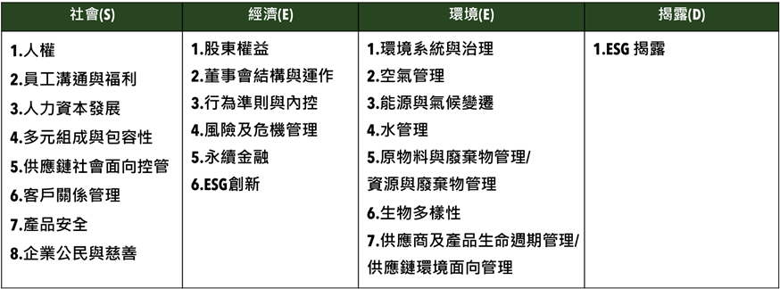
衡量企業永續關鍵指標
臺北大學獨創ESG永續評鑑系統
Source: https://www.aacsb.ntpu.edu.tw/twsvi/view.php?id=Nzc=

Slide 5







台灣永續評鑑
國立臺北大學商學院企業永續發展研究團隊

Slide 6
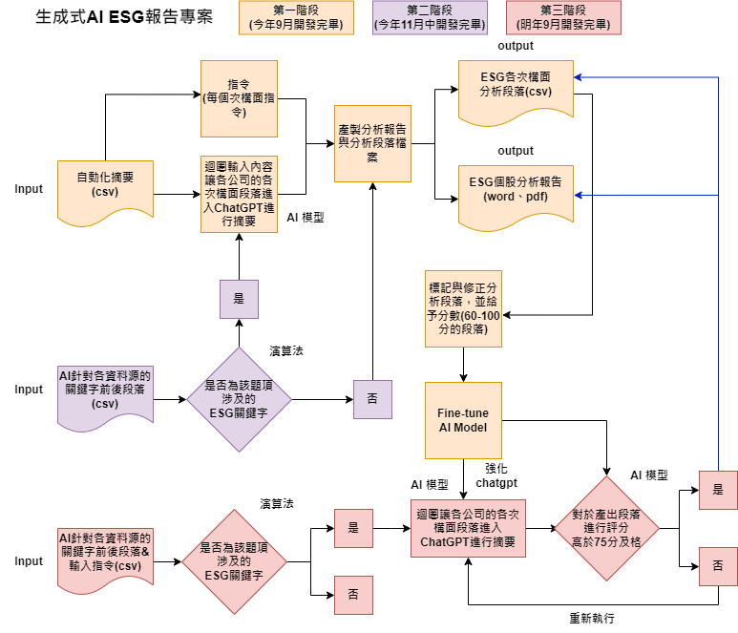
透過 AI SEED 提升評鑑效率
為使評鑑效率提升，與國立臺北大學資管所及資工所合作，開發相關程式，
已有25%題項自動或半自動化，大幅提升評鑑效率，並持續開發機械學習，持續透過AI 輔助評鑑進行。
另也透過AI SEED團隊持續將部分流程自動化，提升評鑑正確性，減少人力出錯可能。
題號 | 題目關鍵字 | 完成度
2-1-15 | 僅分派董監酬勞未分派股利 | 100%
2-2-3 | 獨董達董事席次1/2以上 | 100%
2-2-4 | 至少兩名獨董任期不超過9年 | 100%
2-2-14 | 設提名委員會且半數以上為獨董 | 100%
2-2-30 | 董事長兼任總經理 | 100%
2-2-31 | 1/3以上董事任期超過15年 | 100%
2-3-8 | 破產／面臨下市 | 100%
2-3-15 | 資安長或資訊安全委員會 | 100%
2-4-7 | 無保留意見 | 100%

Slide 7
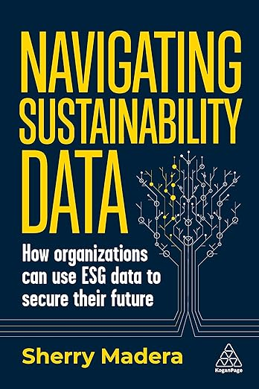
Sherry Madera (2024),
Navigating Sustainability Data: How Organizations can use ESG Data to Secure Their Future, Kogan Page
Source: https://www.amazon.com/Navigating-Sustainability-Data-Organizations-Secure/dp/1398612243/

Slide 8
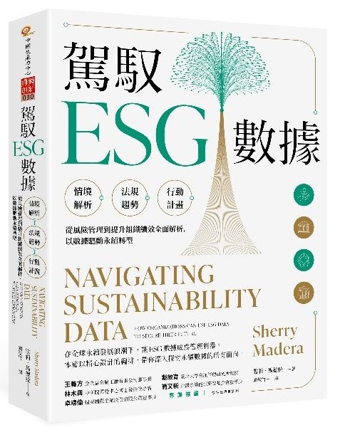
雪莉．馬德拉 (Sherry Madera) (顏敏竹 譯) (2024),
駕馭ESG數據 (Navigating Sustainability Data),
財團法人中國生產力中心
專業推薦：
王義方
（金全益金屬工廠有限公司董事長）
林木興
（中研院環變中心博士後研究學者）
卓靖倫
（揚秦國際企業股份有限公司董事長）
戴敏育
（國立臺北大學資訊管理研究所教授）
簡又新
（台灣永續能源研究基金會董事長）
Source: https://www.eslite.com/product/10012011762682688929002

Slide 9


Generative AI-Driven ESG Report
Generation Technology
Industrial Technology Research Institute (ITRI),
Fintech and Green Finance Center (FGFC, NTPU),
NTPU-113A513E01, 2024/03/01~2024/12/31

Slide 10
Generative AI
Powering
Digital Sustainability Transformation

Slide 11
Generative AI
(Gen AI)
AI Generated Content (AIGC)

Slide 12

Generative AI (Gen AI)
AI Generated Content (AIGC)
Source: Yihan Cao, Siyu Li, Yixin Liu, Zhiling Yan, Yutong Dai, Philip S. Yu, and Lichao Sun (2023). "A Comprehensive Survey of AI-Generated Content (AIGC): A History of Generative AI from GAN to ChatGPT." arXiv preprint arXiv:2303.04226.

Slide 13

AI, ML, DL, Generative AI
Source: Jeong, Cheonsu. "A Study on the Implementation of Generative AI Services Using an Enterprise Data-Based LLM Application Architecture." arXiv preprint arXiv:2309.01105 (2023).

Slide 14
Definition of
Artificial Intelligence (A.I.)

Slide 15
Artificial Intelligence
“… the science and engineering of making intelligent machines”
(John McCarthy, 1955)
Source: https://digitalintelligencetoday.com/artificial-intelligence-defined-useful-list-of-popular-definitions-from-business-and-science/

Slide 16
Artificial Intelligence
“… technology that thinks and acts like humans”
Source: https://digitalintelligencetoday.com/artificial-intelligence-defined-useful-list-of-popular-definitions-from-business-and-science/

Slide 17
Artificial Intelligence
“… intelligence exhibited by machines or software”
Source: https://digitalintelligencetoday.com/artificial-intelligence-defined-useful-list-of-popular-definitions-from-business-and-science/

Slide 18
4 Approaches of AI
2. Thinking Humanly: The Cognitive Modeling Approach | 3. Thinking Rationally: The “Laws of Thought” Approach
1. Acting Humanly: The Turing Test Approach (1950) | 4. Acting Rationally: The Rational Agent Approach
Source: Stuart Russell and Peter Norvig (2020), Artificial Intelligence: A Modern Approach, 4th Edition, Pearson

Slide 19
AI Acting Humanly:
The Turing Test Approach
(Alan Turing, 1950)
Knowledge Representation
Automated Reasoning
Machine Learning (ML)
  Deep Learning (DL)
Computer Vision (Image, Video)
Natural Language Processing (NLP)
Robotics
Source: Stuart Russell and Peter Norvig (2020), Artificial Intelligence: A Modern Approach, 4th Edition, Pearson

Slide 20
AI, ML, DL
Artificial Intelligence (AI)
Machine Learning (ML)
Supervised
Learning
Unsupervised Learning
Deep Learning (DL)
CNN
RNN LSTM GRU
GAN
Semi-supervised Learning
Reinforcement Learning
Source: https://leonardoaraujosantos.gitbooks.io/artificial-inteligence/content/deep_learning.html

Slide 21
Comparison of Generative AI and Traditional AI
Feature | Generative AI | Traditional AI
Output type | New content | Classification/Prediction
Creativity | High | Low
Interactivity | Usually more natural | Limited

Slide 22
Generative AI
Generative AI: The Art of Creation
Definition: AI systems capable of creating new content
Characteristics: Creativity, interactivity

Slide 23
Generative AI and
Large Language Models (LLMs):
Popular Generative AI Applications

Slide 24
Generative AI
Large Language Models (LLMs)
Foundation Models

Slide 25
Spring 2025
Generative AI
Innovative Applications

Slide 26

https://learn.nvidia.com/certificates?id=cCFh1ZWWTvqKTq7dcKkEWw

Slide 27

https://learn.nvidia.com/certificates?id=OVmqY4cSSya0BdMQBWHxzw

Slide 28
NVIDIA Developer Program
NVIDIA
Deep Learning Institute (DLI)
https://developer.nvidia.com/join-nvidia-developer-program
https://learn.nvidia.com/

Slide 29
Get NVIDIA DLI Certificate
Welcome to NVIDIA DLI "Building RAG Agents with LLMs" workshop scheduled for March 11th-25th, 2025 at NTPU.
Step 1. Visit https://learn.nvidia.com/dli-event
Step 2. Enter the event code: NTPU_RAG_AMBASSADOR_MA25
Step 3. Complete the NVIDIA DLI course and review the course datasheet (on March 25, 2025) at https://developer.nvidia.com/dli/getready

Slide 30
Get NVIDIA DLI Certificate
Before the NVIDIA Workshop
Step 1. Join NVIDIA Developer Program (Free)
https://developer.nvidia.com/join-nvidia-developer-program
Step 2. Visit NVIDIA Deep Learning Institute (DLI)
https://learn.nvidia.com/
Step 3. Enroll "Building RAG Agents with LLMs" Self-Paced Course (Free)
https://learn.nvidia.com/courses/course-detail?course_id=course-v1:DLI+S-FX-15+V1

Slide 31
NVIDIA Deep Learning Institute (DLI)
Building RAG Agents with LLMs
workshop
March 11th-25th, 2025 at NTPU
Step 1.
Visit
https://learn.nvidia.com/dli-event
Step 2.
Enter the event code: NTPU_RAG_AMBASSADOR_MA25
Self-Paced Course
Building RAG Agents With LLMs
Certificate available
Free
8 hours
Instructor-Led Workshop
Building RAG Agents With LLMs
Certificate available
$500
8 hours
https://www.nvidia.com/en-us/learn/learning-path/generative-ai-llm/

Slide 32

Get NVIDIA Certificate
https://learn.nvidia.com/certificates?id=ed-qOCIMQaatzU8SNUNxgw

Slide 33

Join the NVIDIA Developer Program take one of the complimentary technical self-paced courses
(worth up to $90)
https://developer.nvidia.com/join-nvidia-developer-program

Slide 34
NVIDIA Deep Learning Institute (DLI)
Self-Paced Course
Generative AI Explained
Free
2 hours
Self-Paced Course
Getting Started With Deep Learning
Certificate available
$90
8 hours
Instructor-Led Workshop
Fundamentals of Deep Learning
Certificate available
$500
8 hours
Self-Paced Course
Introduction to Transformer-Based Natural Language Processing
Certificate available
$30
6 hours
Self-Paced Course
Building RAG Agents With LLMs
Certificate available
Free
8 hours
Instructor-Led Workshop
Building RAG Agents With LLMs
Certificate available
$500
8 hours
Self-Paced Course
Generative AI with Diffusion Models
Certificate available
$90
8 hours
Instructor-Led Workshop
Generative AI with Diffusion Models
Certificate available
$500
8 hours
https://www.nvidia.com/en-us/learn/learning-path/generative-ai-llm/

Slide 35

NVIDIA Deep Learning Institute (DLI)
Generative AI
https://learn.nvidia.com/en-us/training/find-training?q=Generative+AI

Slide 36

Building RAG Agents with LLMs
https://learn.nvidia.com/courses/course-detail?course_id=course-v1:DLI+S-FX-15+V1

Slide 37

Generative AI Explained
https://learn.nvidia.com/courses/course-detail?course_id=course-v1:DLI+S-FX-15+V1

Slide 38

Introduction to Transformer-Based
Natural Language Processing
https://learn.nvidia.com/courses/course-detail?course_id=course-v1:DLI+S-FX-08+V1

Slide 39

Generative AI with Diffusion Models
https://learn.nvidia.com/courses/course-detail?course_id=course-v1:DLI+S-FX-14+V1

Slide 40

Join the NVIDIA Developer Program take one of the complimentary technical self-paced courses (worth up to $90)
https://developer.nvidia.com/join-nvidia-developer-program

Slide 41

Join the NVIDIA Developer Program take one of the complimentary technical self-paced courses (worth up to $90)
https://developer.nvidia.com/join-nvidia-developer-program

Slide 42

Join the NVIDIA Developer Program take one of the complimentary technical self-paced courses (worth up to $90)
https://developer.nvidia.com/join-nvidia-developer-program

Slide 43

Join the NVIDIA Developer Program take one of the complimentary technical self-paced courses (worth up to $90)
https://developer.nvidia.com/join-nvidia-developer-program

Slide 44

Join the NVIDIA Developer Program take one of the complimentary technical self-paced courses (worth up to $90)
https://developer.nvidia.com/join-nvidia-developer-program

Slide 45

Join the NVIDIA Developer Program take one of the complimentary technical self-paced courses (worth up to $90)
https://developer.nvidia.com/join-nvidia-developer-program

Slide 46

NVIDIA Deep Learning Institute (DLI)
https://learn.nvidia.com/my-learning

Slide 47

NVIDIA Deep Learning Institute (DLI)
https://learn.nvidia.com/my-learning

Slide 48


Deep Learning Institute (DLI)
https://learn.nvidia.com/my-learning

Slide 49

https://learn.nvidia.com/certificates?id=ed-qOCIMQaatzU8SNUNxgw

Slide 50

NVIDIA Deep Learning Institute (DLI)
https://learn.nvidia.com/en-us/training/self-paced-courses

Slide 51
Building RAG Agents with LLMs
https://learn.nvidia.com/courses/course-detail?course_id=course-v1:DLI+S-FX-15+V1

Slide 52

Building RAG Agents with LLMs
Source: NVIDIA DLI (2024), Building RAG Agents with LLMs, https://learn.nvidia.com/courses/course-detail?course_id=course-v1:DLI+S-FX-15+V1

Slide 53

Building RAG Agents with LLMs
https://learn.nvidia.com/my-learning

Slide 54

Building RAG Agents with LLMs
https://learn.nvidia.com/courses/course?course_id=course-v1:DLI+S-FX-15+V1

Slide 55

Building RAG Agents with LLMs
https://learn.nvidia.com/courses/course?course_id=course-v1:DLI+S-FX-15+V1

Slide 56

Building RAG Agents with LLMs
https://learn.nvidia.com/courses/course?course_id=course-v1:DLI+S-FX-15+V1

Slide 57

Building RAG Agents with LLMs
https://learn.nvidia.com/courses/course?course_id=course-v1:DLI+S-FX-15+V1

Slide 58

Building RAG Agents with LLMs
https://learn.nvidia.com/courses/course?course_id=course-v1:DLI+S-FX-15+V1

Slide 59

Building RAG Agents with LLMs
https://learn.nvidia.com/courses/course?course_id=course-v1:DLI+S-FX-15+V1

Slide 60

Building RAG Agents with LLMs
https://learn.nvidia.com/courses/course?course_id=course-v1:DLI+S-FX-15+V1

Slide 61

Generative AI (Gen AI)
AI Generated Content (AIGC)
Image Generation
Source: Yihan Cao, Siyu Li, Yixin Liu, Zhiling Yan, Yutong Dai, Philip S. Yu, and Lichao Sun (2023). "A Comprehensive Survey of AI-Generated Content (AIGC): A History of Generative AI from GAN to ChatGPT." arXiv preprint arXiv:2303.04226.

Slide 62

The history of Generative AI in CV, NLP and VL
Source: Yihan Cao, Siyu Li, Yixin Liu, Zhiling Yan, Yutong Dai, Philip S. Yu, and Lichao Sun (2023). "A Comprehensive Survey of AI-Generated Content (AIGC): A History of Generative AI from GAN to ChatGPT." arXiv preprint arXiv:2303.04226.

Slide 63

Categories of Vision Generative Models
Source: Yihan Cao, Siyu Li, Yixin Liu, Zhiling Yan, Yutong Dai, Philip S. Yu, and Lichao Sun (2023). "A Comprehensive Survey of AI-Generated Content (AIGC): A History of Generative AI from GAN to ChatGPT." arXiv preprint arXiv:2303.04226.

Slide 64

The General Structure of
Generative Vision Language
Source: Yihan Cao, Siyu Li, Yixin Liu, Zhiling Yan, Yutong Dai, Philip S. Yu, and Lichao Sun (2023). "A Comprehensive Survey of AI-Generated Content (AIGC): A History of Generative AI from GAN to ChatGPT." arXiv preprint arXiv:2303.04226.

Slide 65
Transformer Models
Transformer
Encoder
Decoder
DistilBERT
BERT
T5
GPT
RoBERTa
BART
GPT-2
CTRL
XLM-R
XLM
M2M-100
GPT-3
ALBERT
BigBird
GPT-Neo
GPT-J
ELECTRA
mT0
BLOOM
BLOOMZ
DeBERTa
ChatGPT
GPT-4
Source: Lewis Tunstall, Leandro von Werra, and Thomas Wolf (2022), Natural Language Processing with Transformers: Building Language Applications with Hugging Face, O'Reilly Media.

Slide 66

The Development of LM-based Dialogue Systems
1) Early Stage (1966 - 2015)
2) The Independent Development of TOD and ODD (2015 - 2019)
3) Fusions of Dialogue Systems (2019 - 2022)
4) LLM-based DS (2022 - Now)
Task-oriented DS (TOD), Open-domain DS (ODD)
Source: Wang, Hongru, Lingzhi Wang, Yiming Du, Liang Chen, Jingyan Zhou, Yufei Wang, and Kam-Fai Wong. "A Survey of the Evolution of Language Model-Based Dialogue Systems." arXiv preprint arXiv:2311.16789 (2023).

Slide 67

Major GenAI LLMs Research Milestones
(2017-2024)
Source: https://github.com/Hannibal046/Awesome-LLM

Slide 68

LLM Capabilities
Source: Minaee, Shervin, Tomas Mikolov, Narjes Nikzad, Meysam Chenaghlu, Richard Socher, Xavier Amatriain, and Jianfeng Gao. (2024) "Large language models: A survey." arXiv preprint arXiv:2402.06196 (2024).

Slide 69
lmarena.ai Chatbot Arena Leaderboard
Rank* (UB) | Rank (StyleCtrl) | Model | Arena Score | 95% CI | Votes | Organization | License
1 | 1 | chocolate (Early Grok-3) | 1403 | +6/-6 | 9992 | xAI | Proprietary
2 | 3 | Gemini-2.0-Flash-Thinking-Exp-01-21 | 1385 | +4/-6 | 15083 | Google | Proprietary
2 | 3 | Gemini-2.0-Pro-Exp-02-05 | 1380 | +5/-6 | 13000 | Google | Proprietary
2 | 1 | ChatGPT-4o-latest (2025-01-29) | 1377 | +5/-5 | 13470 | OpenAI | Proprietary
5 | 3 | DeepSeek-R1 | 1362 | +7/-7 | 6581 | DeepSeek | MIT
5 | 8 | Gemini-2.0-Flash-001 | 1358 | +7/-7 | 10862 | Google | Proprietary
5 | 3 | o1-2024-12-17 | 1352 | +5/-5 | 17248 | OpenAI | Proprietary
8 | 7 | o1-preview | 1335 | +3/-4 | 33169 | OpenAI | Proprietary
8 | 8 | Qwen2.5-Max | 1334 | +5/-5 | 9282 | Alibaba | Proprietary
8 | 7 | o3-mini-high | 1332 | +5/-9 | 5954 | OpenAI | Proprietary
11 | 11 | DeepSeek-V3 | 1318 | +4/-5 | 19461 | DeepSeek | DeepSeek
11 | 13 | Qwen-Plus-0125 | 1311 | +9/-7 | 5112 | Alibaba | Proprietary
11 | 14 | GLM-4-Plus-0111 | 1310 | +6/-9 | 5134 | Zhipu | Proprietary
11 | 13 | Gemini-2.0-Flash-Lite-Preview-02-05 | 1309 | +6/-5 | 10262 | Google | Proprietary
12 | 12 | o3-mini | 1306 | +5/-6 | 12179 | OpenAI | Proprietary
https://huggingface.co/spaces/lmarena-ai/chatbot-arena-leaderboard

Slide 70
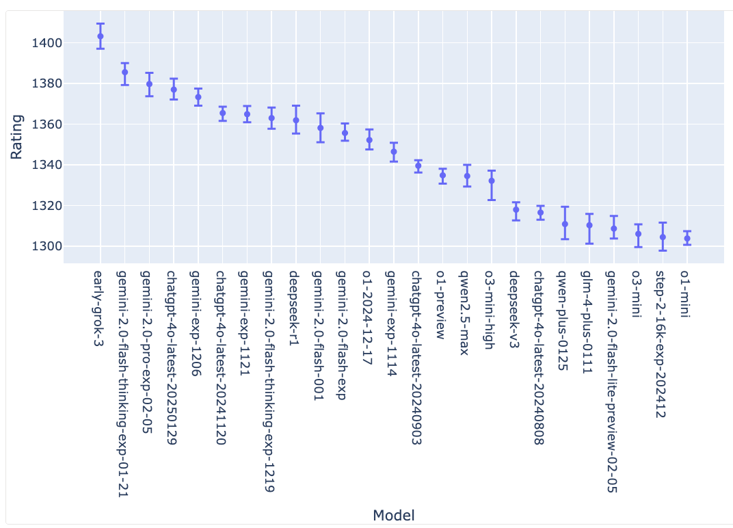
lmarena.ai Chatbot Arena Leaderboard
Confidence Intervals on Model Strength (via Bootstrapping)
https://huggingface.co/spaces/lmarena-ai/chatbot-arena-leaderboard

Slide 71
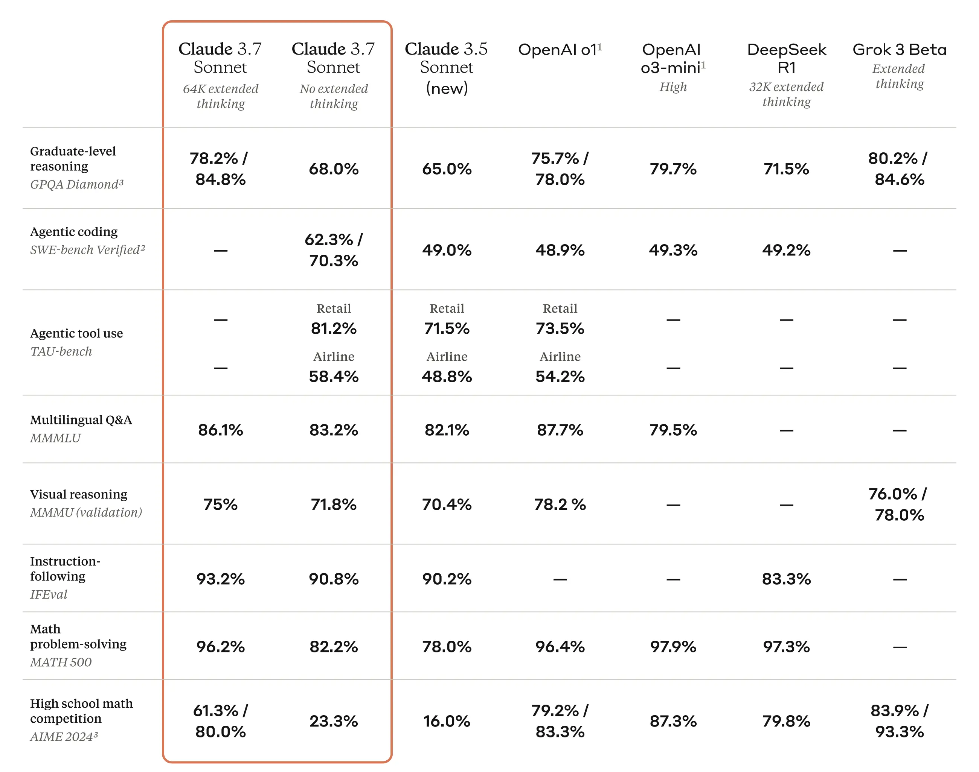
Claude 3.7 Sonnet, Claude 3.5 Sonnet, OpenAI, DeepSeek, and Grok
Source: https://www.anthropic.com/news/claude-3-7-sonnet

Slide 72
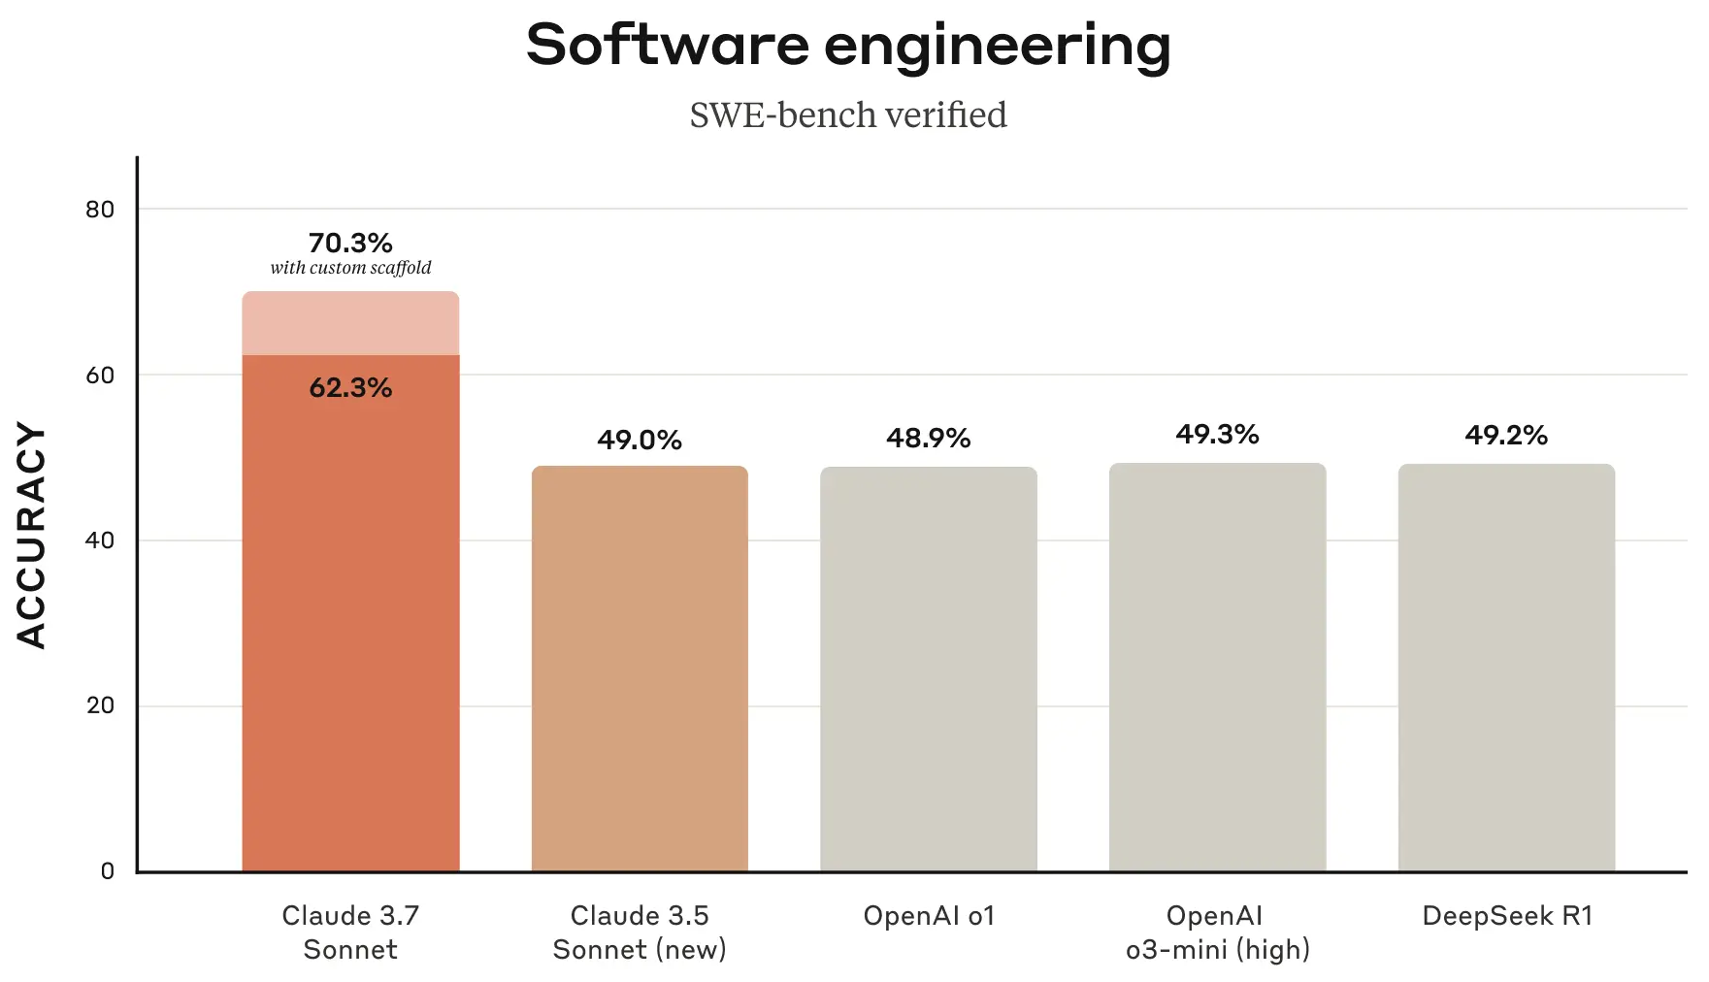
Claude 3.7 Sonnet and Claude Code
Source: https://www.anthropic.com/news/claude-3-7-sonnet

Slide 73

LLM-powered Multimodal Agents
Large Multimodal Agents (LMAs)
2022
2023
2024
Source: Xie, Junlin, Zhihong Chen, Ruifei Zhang, Xiang Wan, and Guanbin Li. "Large Multimodal Agents: A Survey." arXiv preprint arXiv:2402.15116 (2024).

Slide 74

Four Paradigms in NLP (LM)
Transfer Learning: Pre-training, Fine-Tuning (FT)
GAI: Pre-train, Prompt, and Predict (Prompting)
Source: Pengfei Liu, Weizhe Yuan, Jinlan Fu, Zhengbao Jiang, Hiroaki Hayashi, and Graham Neubig. (2023) "Pre-train, prompt, and predict: A systematic survey of prompting methods in natural language processing." ACM Computing Surveys 55, no. 9 (2023): 1-35.

Slide 75

Large Language Models (LLM)
Three typical learning paradigms
Source: Shukang Yin, Chaoyou Fu, Sirui Zhao, Ke Li, Xing Sun, Tong Xu, and Enhong Chen. (2024) "A survey on multimodal large language models." National Science Review (2024): nwae403.

Slide 76
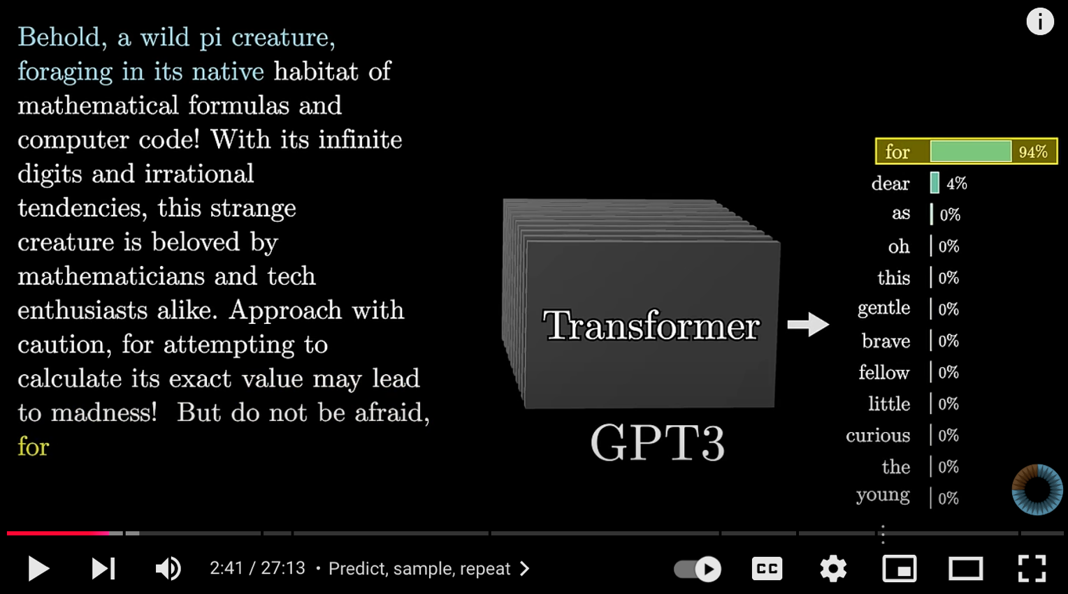
Transformers (how LLMs work)
Source: 3Blue1Brown (2024), Transformers (how LLMs work) explained visually | DL5, https://www.youtube.com/watch?v=wjZofJX0v4M

Slide 77
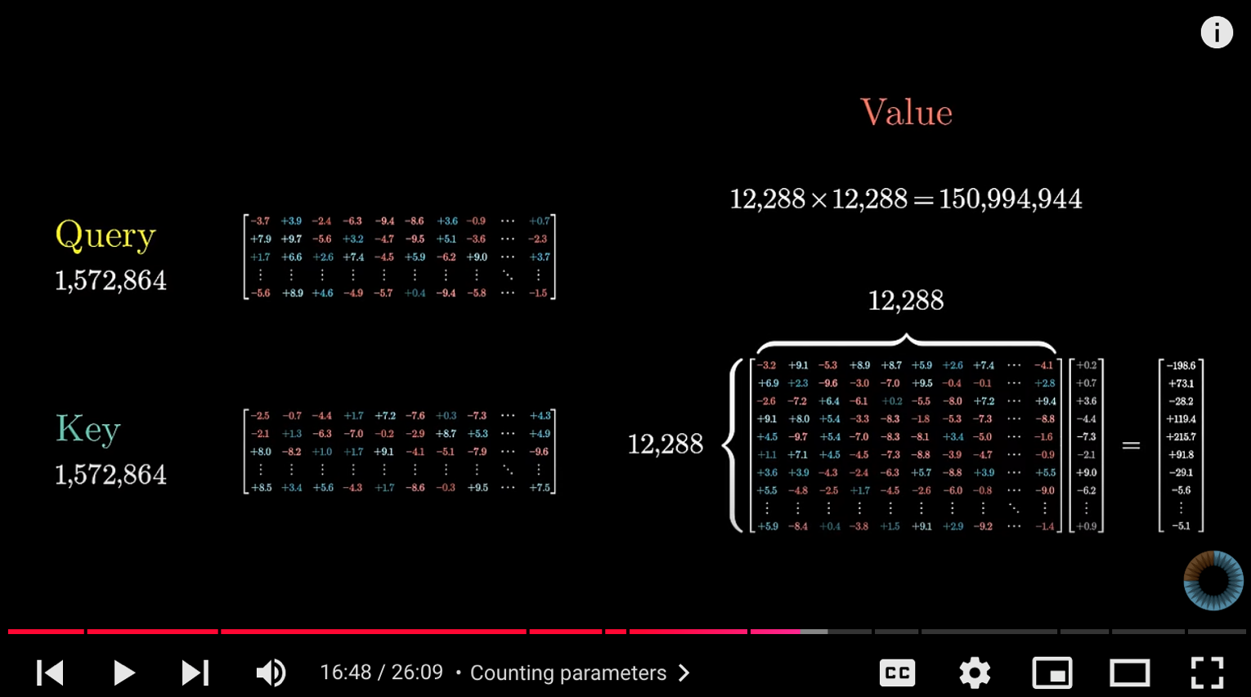
Attention in Transformers
Source: 3Blue1Brown (2024), Attention in transformers, visually explained | DL6, https://www.youtube.com/watch?v=eMlx5fFNoYc

Slide 78
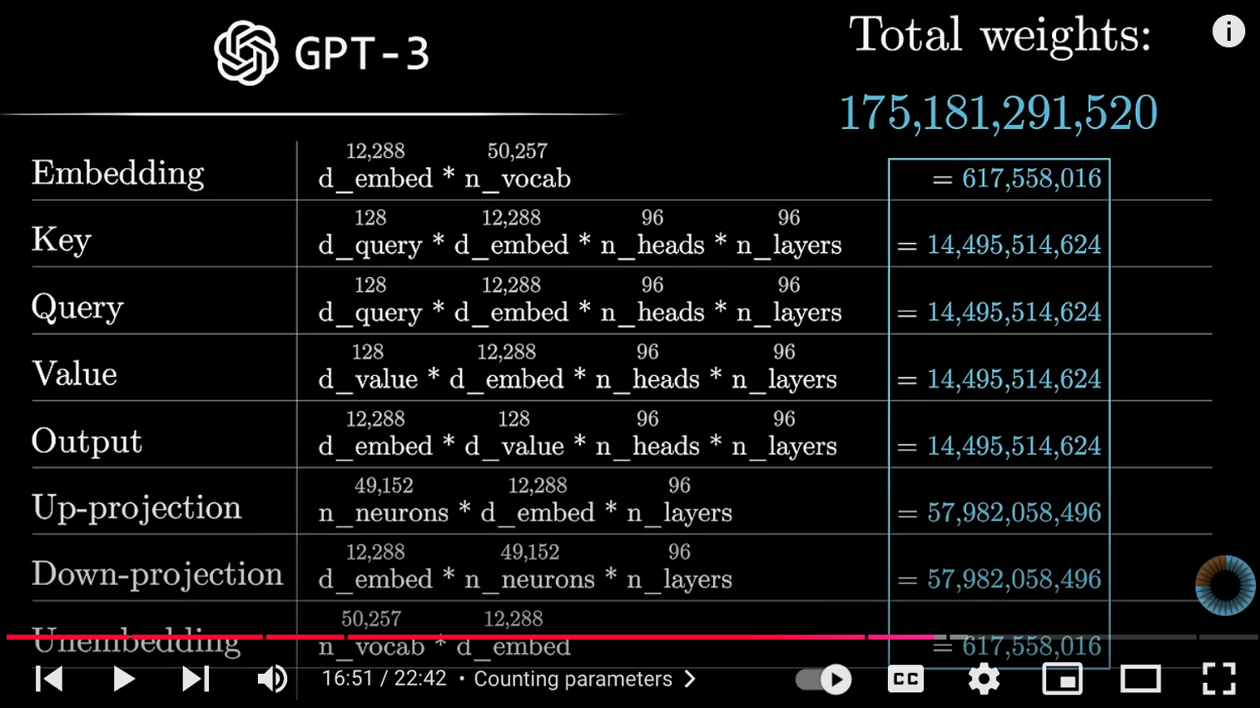
How might LLMs store facts
Source: 3Blue1Brown (2024), How might LLMs store facts | DL7,
https://www.youtube.com/watch?v=9-Jl0dxWQs8

Slide 79
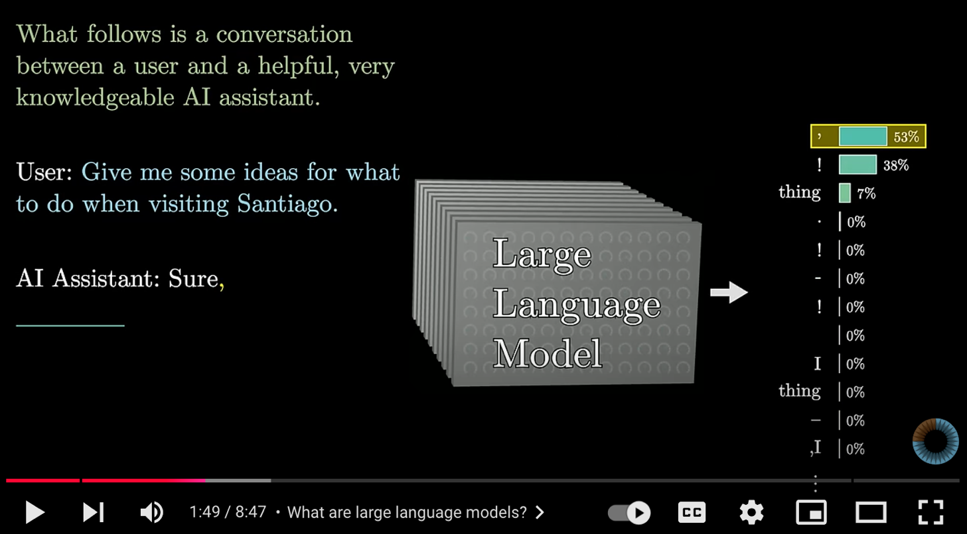
Large Language Models explained briefly
Source: 3Blue1Brown (2024), Large Language Models explained briefly, https://www.youtube.com/watch?v=LPZh9BOjkQs

Slide 80
RAG LLM
Dialogue Systems

Slide 81
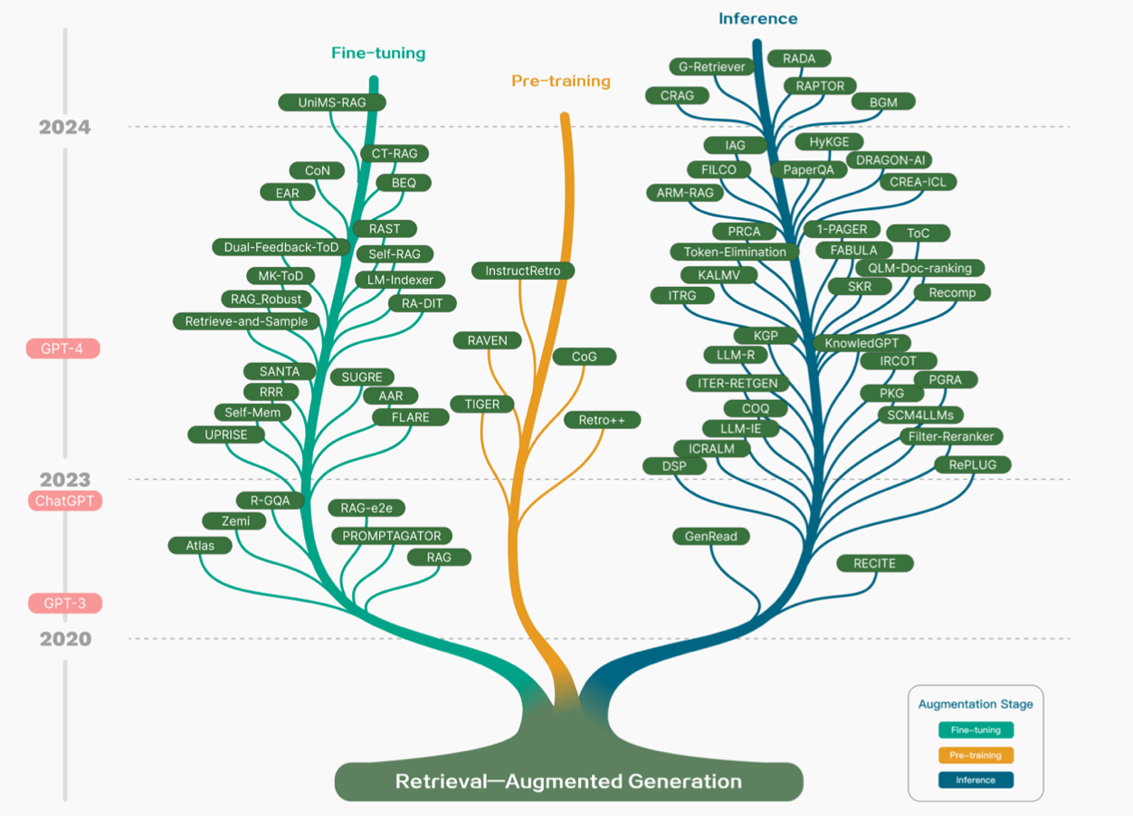
Technology Tree of RAG Research
Retrieval-Augmented Generation (RAG) for Large Language Models (LLMs)
Source: Gao, Y., Xiong, Y., Gao, X., Jia, K., Pan, J., Bi, Y., ... & Wang, H. (2023). Retrieval-augmented generation for large language models: A survey. arXiv preprint arXiv:2312.10997.

Slide 82
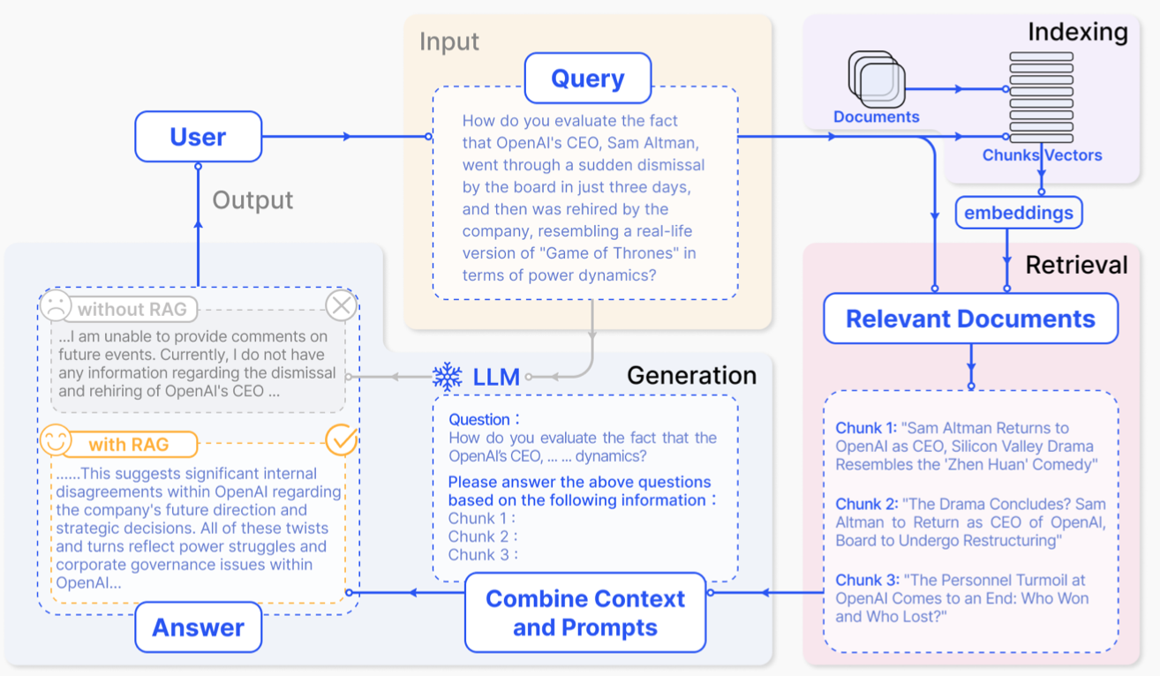
Retrieval-Augmented Generation (RAG) for Large Language Models (LLMs)
Source: Gao, Y., Xiong, Y., Gao, X., Jia, K., Pan, J., Bi, Y., ... & Wang, H. (2023). Retrieval-augmented generation for large language models: A survey. arXiv preprint arXiv:2312.10997.

Slide 83
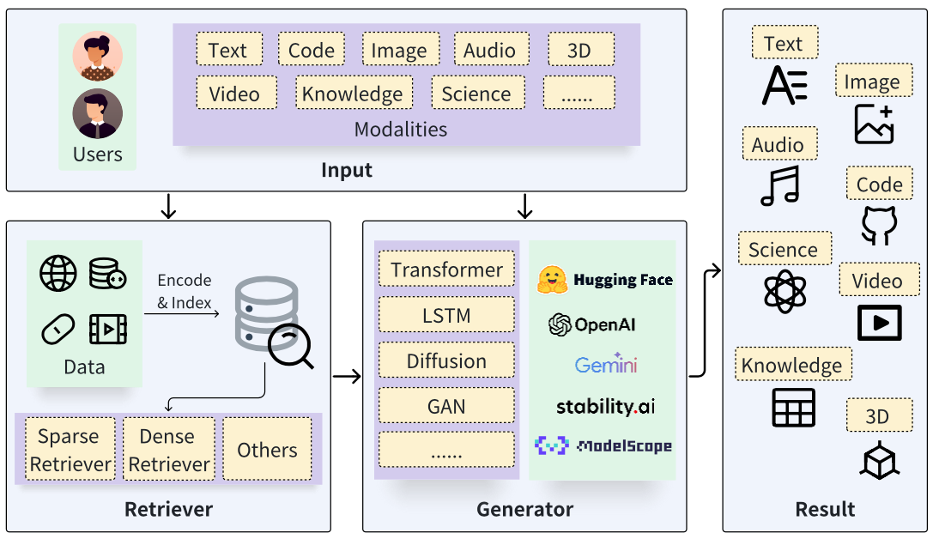
Retrieval-Augmented Generation (RAG) Architecture
Source: Zhao, P., Zhang, H., Yu, Q., Wang, Z., Geng, Y., Fu, F., ... & Cui, B. (2024). Retrieval-augmented generation for ai-generated content: A survey. arXiv preprint arXiv:2402.19473.

Slide 84
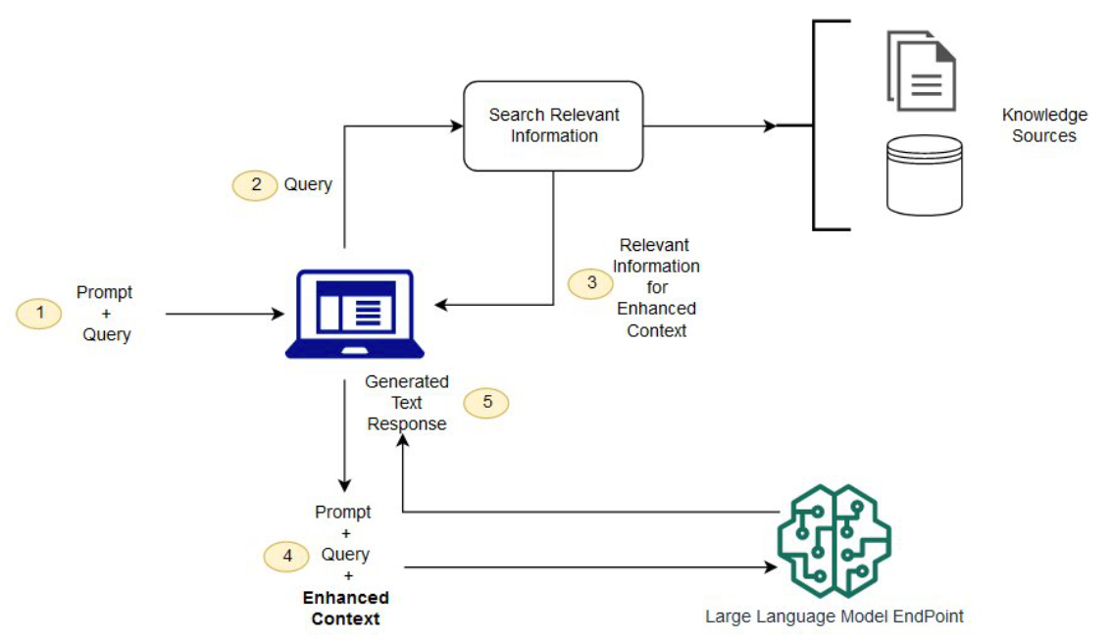
Synthesizing RAG with LLMs for Question Answering Application
Source: Minaee, S., Mikolov, T., Nikzad, N., Chenaghlu, M., Socher, R., Amatriain, X., & Gao, J. (2024). Large language models: A survey. arXiv preprint arXiv:2402.06196.

Slide 85
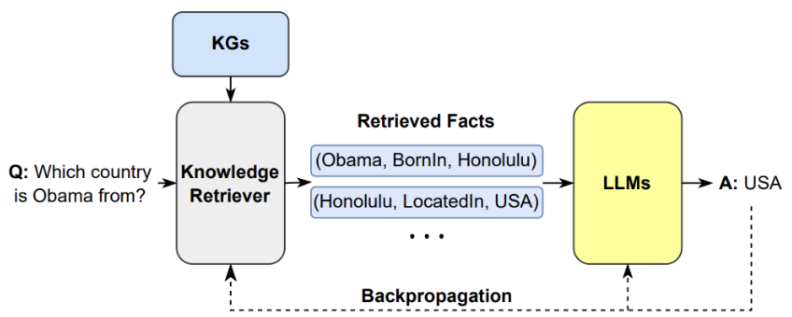
Synthesizing the KG as a Retriever with LLMs
Source: Minaee, S., Mikolov, T., Nikzad, N., Chenaghlu, M., Socher, R., Amatriain, X., & Gao, J. (2024). Large language models: A survey. arXiv preprint arXiv:2402.06196.

Slide 86
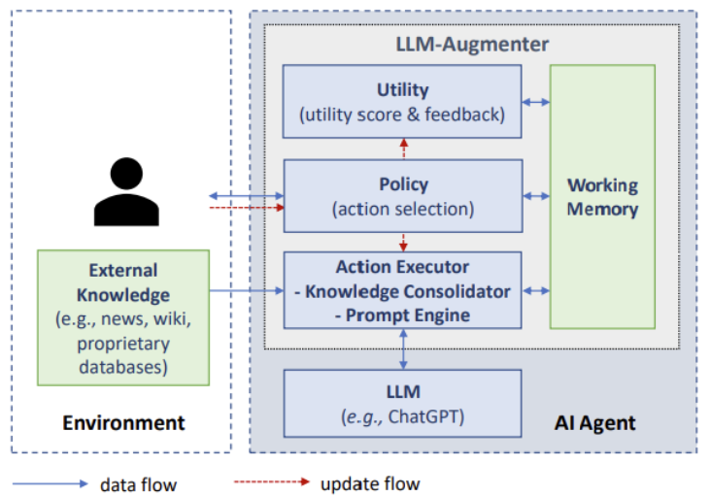
A LLM-based Agent for
Conversational Information Seeking
Source: Minaee, S., Mikolov, T., Nikzad, N., Chenaghlu, M., Socher, R., Amatriain, X., & Gao, J. (2024). Large language models: A survey. arXiv preprint arXiv:2402.06196.

Slide 87
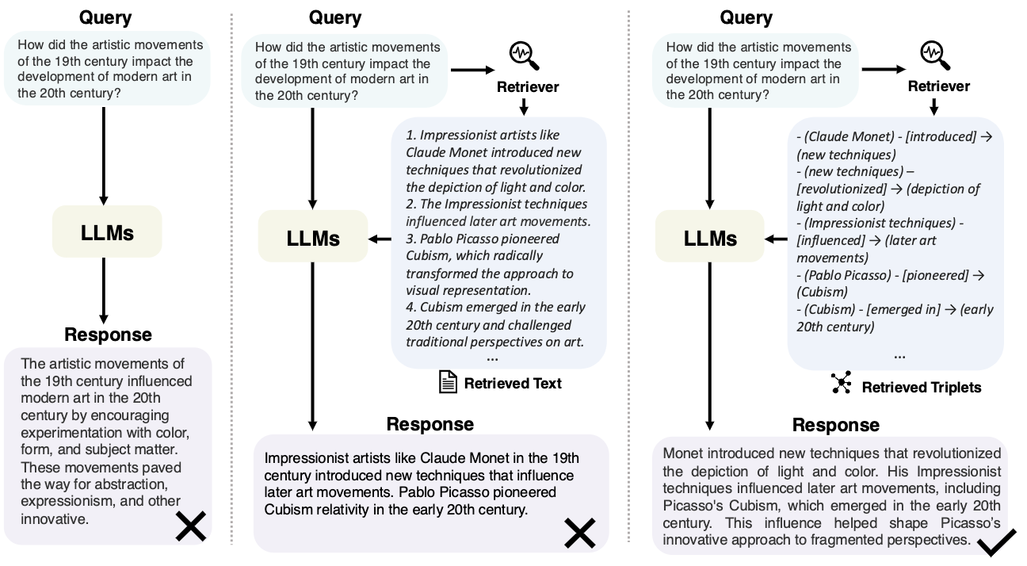
Direct LLM, RAG, and GraphRAG
Source: Peng, B., Zhu, Y., Liu, Y., Bo, X., Shi, H., Hong, C., ... & Tang, S. (2024). Graph retrieval-augmented generation: A survey. arXiv preprint arXiv:2408.08921.

Slide 88
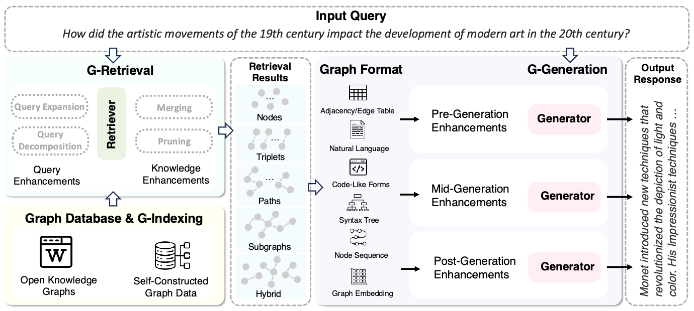
GraphRAG Framework for Question Answering
Source: Peng, B., Zhu, Y., Liu, Y., Bo, X., Shi, H., Hong, C., ... & Tang, S. (2024). Graph retrieval-augmented generation: A survey. arXiv preprint arXiv:2408.08921.

Slide 89
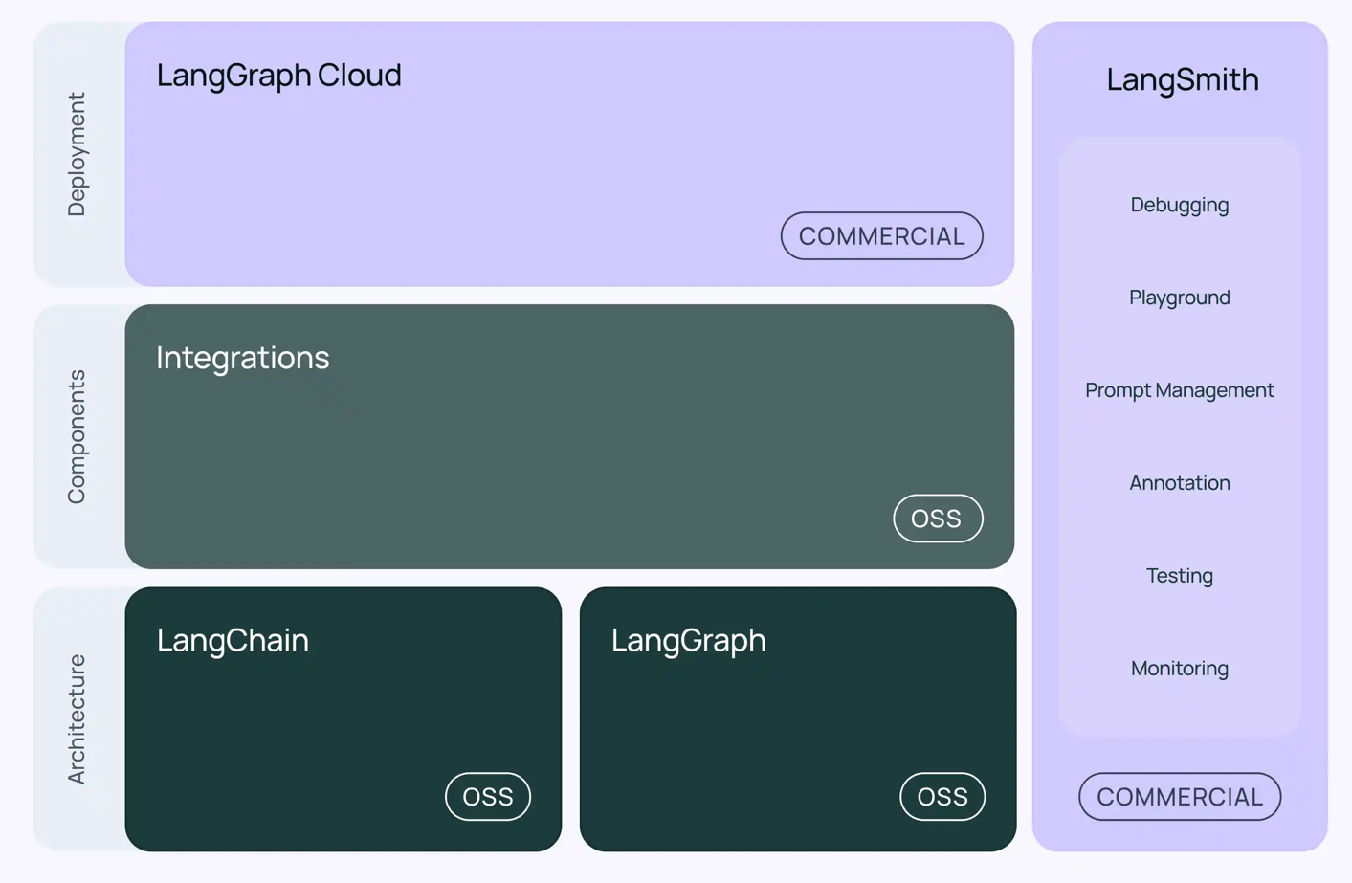
LangChain Architecture
Source: https://www.langchain.com/

Slide 90
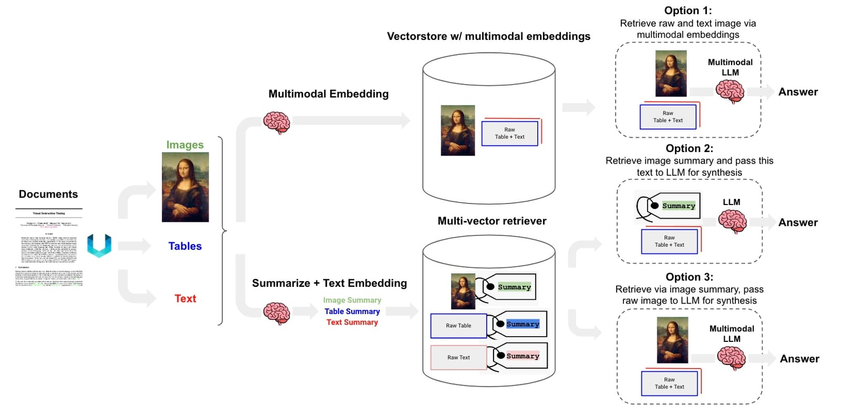
Multimodal LLM RAG
Multi-Vector Retriever for RAG
Source: https://blog.langchain.dev/deconstructing-rag/

Slide 91
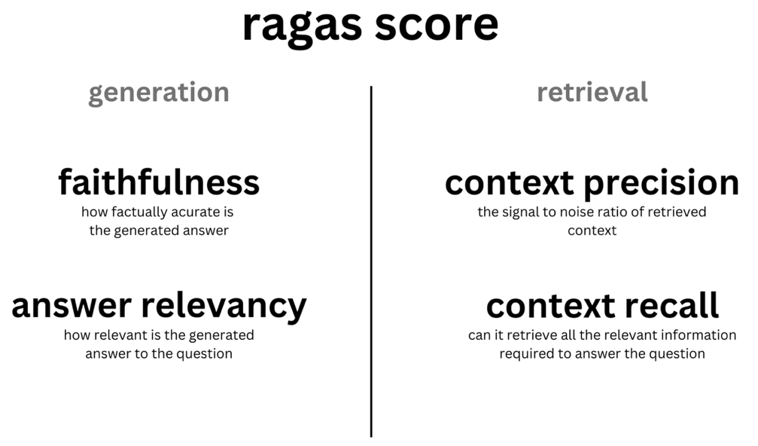
Evaluating RAG with Ragas Metrics
Source: https://blog.langchain.dev/evaluating-rag-pipelines-with-ragas-langsmith/

Slide 92
ESG

Slide 93
ESG:
Environmental
Social
Governance

Slide 94
CSR:
Corporate
Social
Responsibility

Slide 95
Evolution of Sustainable Finance Research
Topic
SDGs:
Sustainable Development Goals
SDGs
Innovative Financial Instrument
Impact Investing
ESG: Environmental, Social, and Governance
CSR: Corporate Social Responsibility
Conscious Capitalism
Climate Financing
Carbon Financing
Green Financing
Ethical Investing
Socially Responsible Investing
1986
1995
2005
2015
2020
Source: Kumar, S., Sharma, D., Rao, S., Lim, W. M., & Mangla, S. K. (2022). Past, present, and future of sustainable finance:
Insights from big data analytics through machine learning of scholarly research. Annals of Operations Research, 1-44.

Slide 96


















Sustainable Development Goals (SDGs)
Source: https://sdgs.un.org/goals

Slide 97

Sustainable Development Goals (SDGs) and 5P
Partnership
Peace
Prosperity
People
Planet
Source: Folke, Carl, Reinette Biggs, Albert V. Norström, Belinda Reyers, and Johan Rockström. "Social-ecological resilience and biosphere-based sustainability science.”Ecology and Society 21, no. 3 (2016).

Slide 98

ESG to 17 SDGs
Source: Henrik Skaug Sætra (2021) "A Framework for Evaluating and Disclosing the ESG Related Impacts of AI with the SDGs." Sustainability 13, no. 15 (2021): 8503.

Slide 99

ESG to 17 SDGs
Source: https://sustainometric.com/esg-to-sdgs-connected-paths-to-a-sustainable-future/

Slide 100
Sustainable Development

Slide 101
Net-Zero Transformation
Ambition
  Aligned to achieving global net zero by no later than 2050 & to limit warming to 1.5°C
Governance
  Accountability driven from the top
Strategy
  Embedded and aligned net zero into company strategy
Enterprise
  Key operating model changes in support of transformation
Supply chains
  Transformed net zero supply chains
Innovation
  Developed innovation and technologies to deliver net zero
Finance
  Financing the net zero transformation
Transparency
  Communicating action
Engagement
  Enhancing the pace and scale of net zero action
Source: https://www.pwc.com/us/en/services/esg/library/building-blocks-for-net-zero-transformation.html

Slide 102
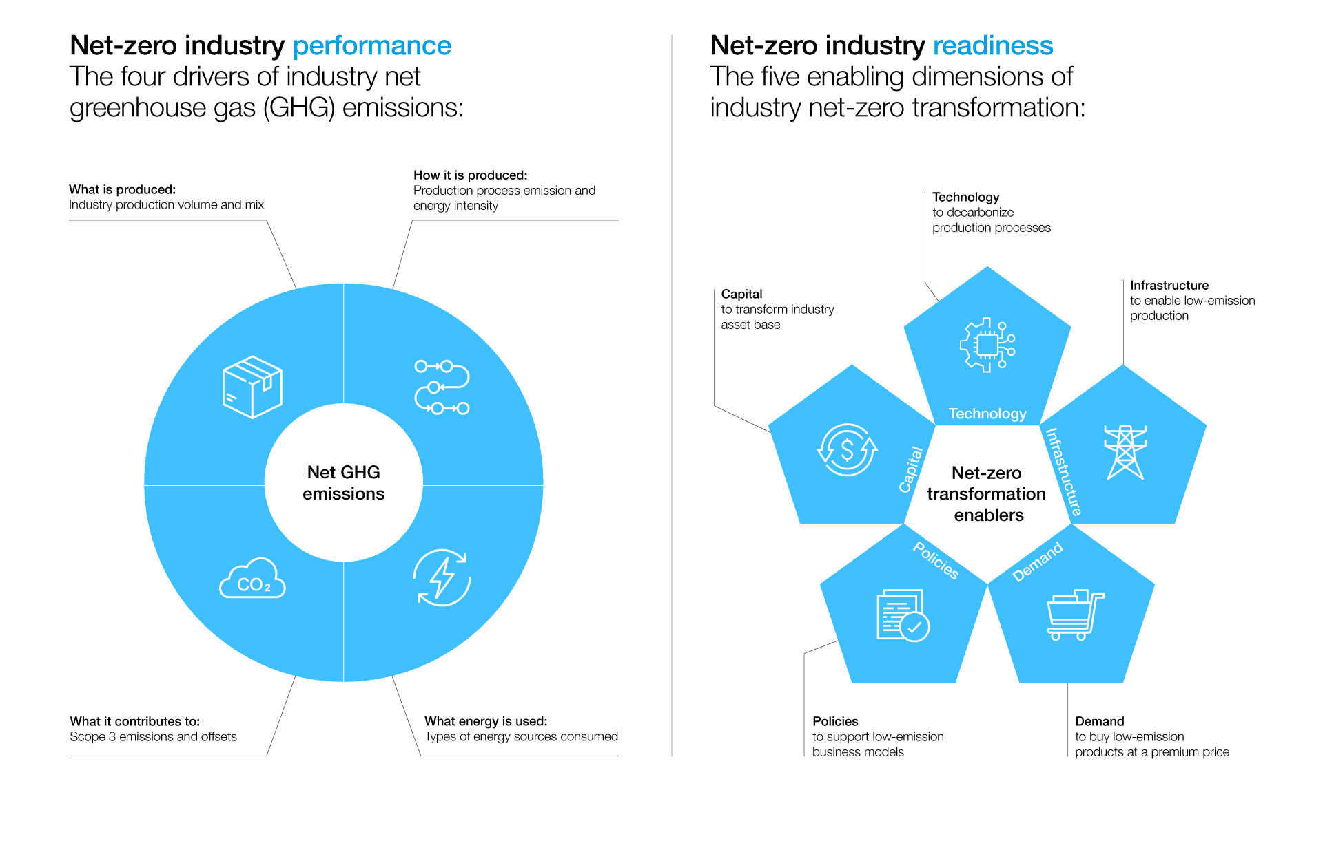
Net-Zero Transformation Enablers
Source: https://www.weforum.org/agenda/2022/07/net-zero-tracker/

Slide 103
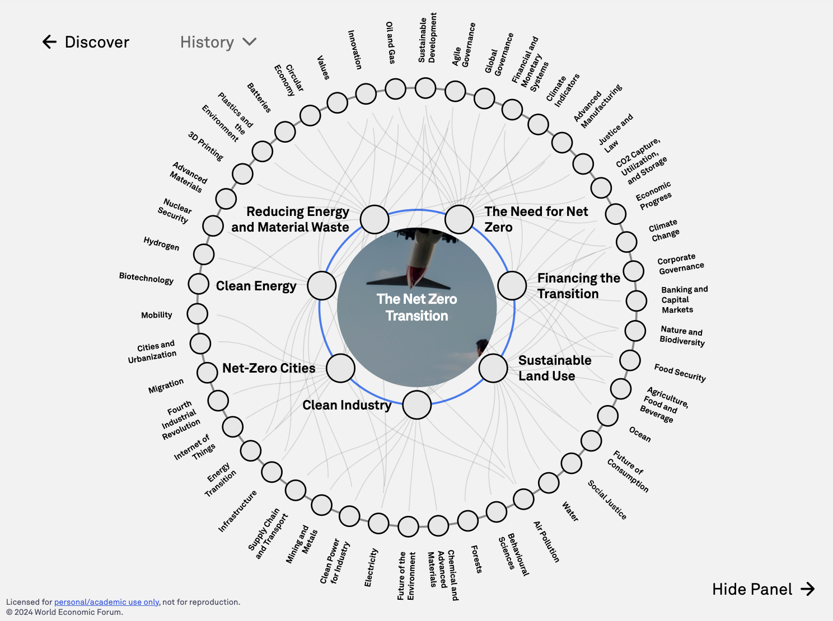
The
Net Zero Transition
Source: https://intelligence.weforum.org/topics/a1G680000004C93EAE

Slide 104
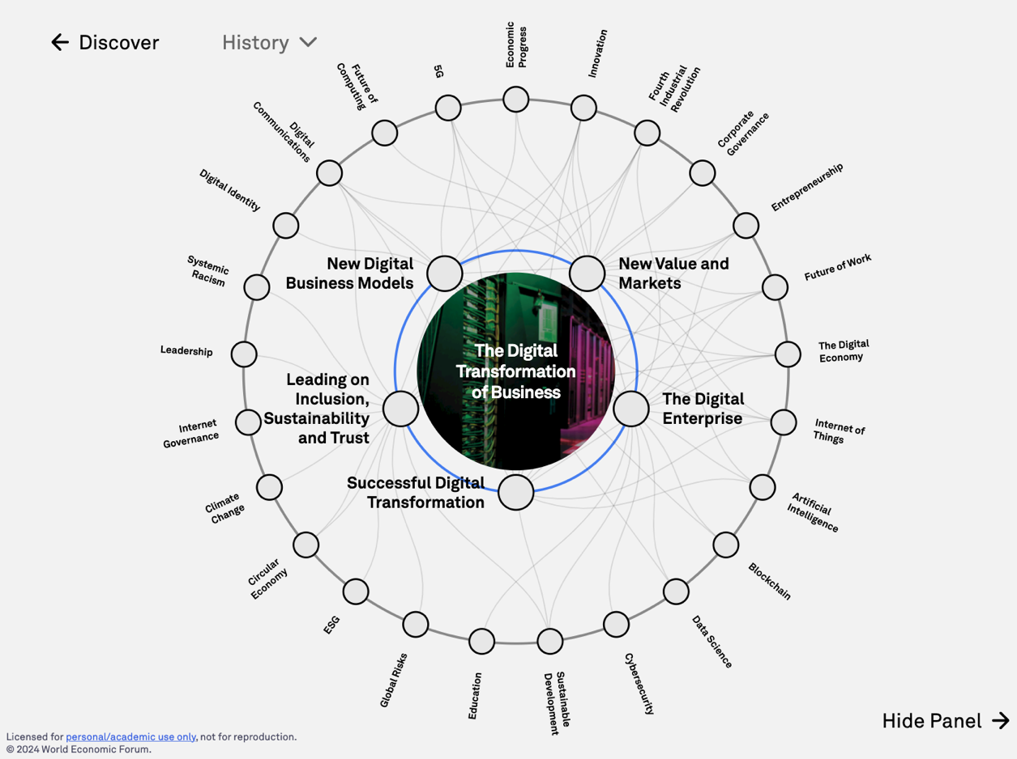
The
Digital Transformation of Business
Source: https://intelligence.weforum.org/topics/a1G0X000006DIDZUA4

Slide 105
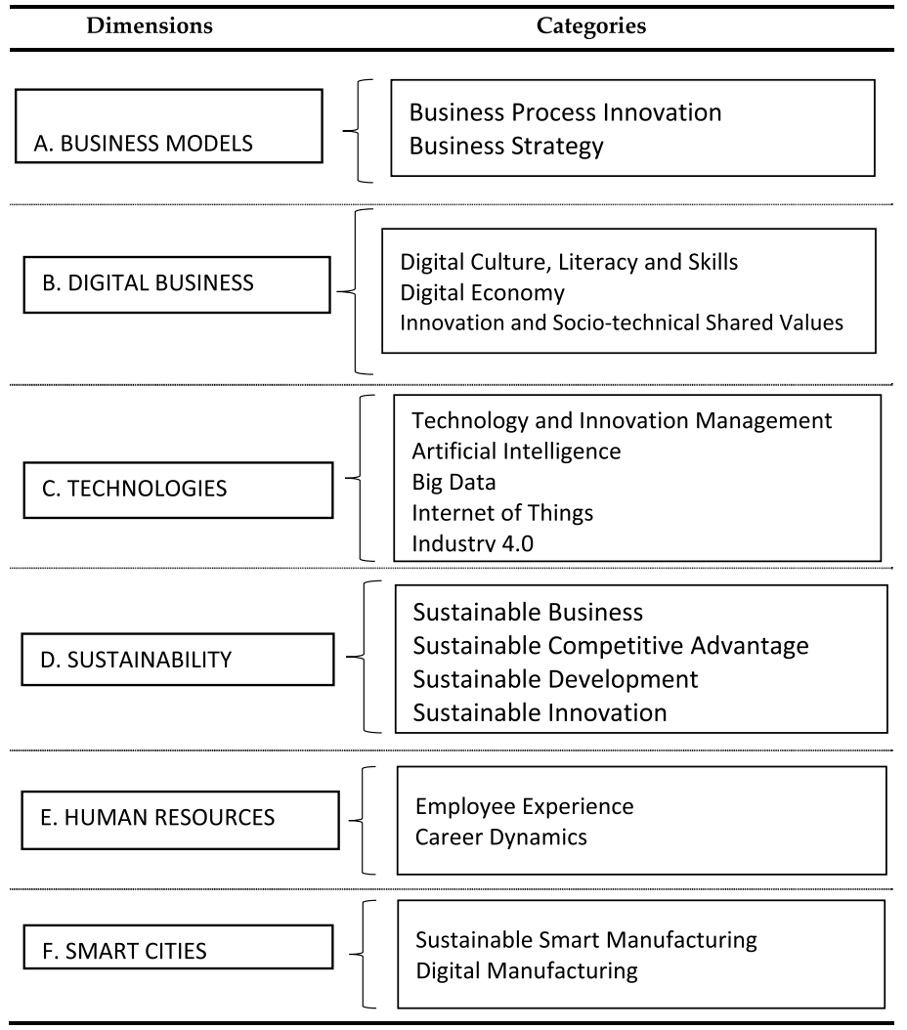
Digital Transformation
Source: Reis, João, and Nuno Melão (2023). "Digital transformation: A meta-review and guidelines for future research." Heliyon (2023).

Slide 106
ESG Challenges and Opportunities
Challenges
  Fragmented and unstructured ESG data.
  Lack of standardization and transparency.
  Timeliness of data availability.
Opportunities
  Rising demand for actionable ESG insights.
  Innovation in sustainable solutions and policies.
  Generative AI as a tool for transformation.

Slide 107

Sustainability and ESG Data Analytics

Slide 108
Generative AI for ESG Data Analytics
Data Integration and Enrichment:
  Synthesizing structured and unstructured ESG data.
Automated Reporting and Insight Generation:
  Tailored ESG reports and insights for stakeholders.
Scenario Modeling and Forecasting:
  Simulating potential risks and opportunities.
Addressing Bias and Ensuring Accountability:
  Transparent, fair, and ethical AI deployment.

Slide 109

Generative AI and LLMs for Sustainability and
ESG Data Analytics

Slide 110
Sustainability Innovation with Generative AI
Sustainable Product Design:
  Eco-friendly designs minimizing waste and energy.
Policy Formulation and Implementation:
  AI-driven simulations for effective policies.
Stakeholder Engagement and Awareness:
  Communicating ESG strategies with compelling AI-driven visuals.

Slide 111
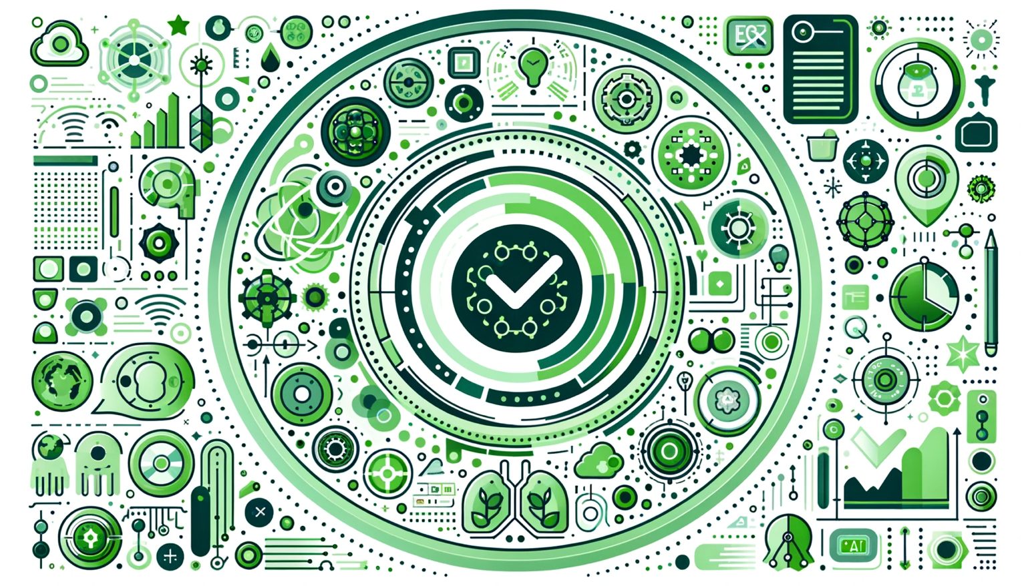
Generative AI for ESG Rating and Reporting Generation

Slide 112
Mapping the ESG Standards Landscape
The most prevalent ESG reporting frameworks
  GRI (Global Report Initiative)
  CDP (Carbon Disclosure Project)
  SASB (Sustainability Accounting Standards Board
  ISSB (International Sustainability Standards Board)
  TCFD (Task Force on Climate-related Financial Disclosures
How companies choose
  Materiality, industry-specific standards, investor alignment

Slide 113

GRI (Global Report Initiative)
https://www.globalreporting.org/

Slide 114

CDP (Carbon Disclosure Project)
https://www.cdp.net/

Slide 115

SASB (Sustainability Accounting Standards Board)
https://sasb.org/

Slide 116

ISSB (International Sustainability Standards Board)
https://www.ifrs.org/groups/international-sustainability-standards-board/

Slide 117

TCFD
(Task Force on Climate-related Financial Disclosures)
https://www.ifrs.org/sustainability/tcfd/
https://www.fsb-tcfd.org/

Slide 118

Sustainable Productivity:
Finance ESG
Source: Huang, Ziqi, Yang Shen, Jiayi Li, Marcel Fey, and Christian Brecher (2021). "A survey on AI-driven digital twins in Industry 4.0: Smart manufacturing and advanced robotics." Sensors 21, no. 19: 6340.

Slide 119

Sustainable Resilient Manufacturing
ESG
Source: Huang, Ziqi, Yang Shen, Jiayi Li, Marcel Fey, and Christian Brecher (2021). "A survey on AI-driven digital twins in Industry 4.0: Smart manufacturing and advanced robotics." Sensors 21, no. 19: 6340.

Slide 120
ESG Indexes
MSCI ESG Index
Dow Jones Sustainability Indices (DJSI)
FTSE ESG Index

Slide 121

MSCI ESG Rating Framework
Source: https://www.msci.com/documents/1296102/21901542/ESG-Ratings-Methodology-Exec-Summary.pdf

Slide 122

MSCI ESG Key Issue Hierarchy
Source: https://www.msci.com/documents/1296102/21901542/ESG-Ratings-Methodology-Exec-Summary.pdf

Slide 123

MSCI Governance Model Structure
Source: https://www.msci.com/documents/1296102/21901542/ESG-Ratings-Methodology-Exec-Summary.pdf

Slide 124

MSCI Hierarchy of ESG Scores
Source: https://www.msci.com/documents/1296102/21901542/ESG-Ratings-Methodology-Exec-Summary.pdf

Slide 125

DJSI S&P Global ESG Score
Source: DJSI, S&P Global Corporate Sustainability Assessment (CSA), https://www.spglobal.com/esg/solutions/data-intelligence-esg-scores

Slide 126

FTSE Russell ESG Ratings
Source: https://www.ftserussell.com/data/sustainability-and-esg-data/esg-ratings

Slide 127


Sustainalytics
ESG Risk Ratings
Analyst-based
approach
Sustainalytics’ ESG Risk Ratings measure a company’s exposure to industry-specific material ESG risks and how well a company is managing those risks.
Source: https://www.sustainalytics.com/esg-data

Slide 128

Truvalue
ESG Ranks
TruValue Labs
Machine-based approach
Truvalue Labs applies AI to analyze over 100,000 sources and uncover ESG risks and opportunities hidden in unstructured text.
The ESG Ranks data service produces an overall company rank based on industry percentile leveraging the 26 ESG categories defined by the Sustainability Accounting Standards Board (SASB).
The data feed covers 20,000+ companies with more than 13 years of history.
Source: :https://developer.truvaluelabs.com/data/esg-ranks

Slide 129

Analyst-driven vs. AI-driven ESG
Sustainalytics
Truvalue Labs
Source: Mark Tulay (2020), Man vs. machine: A tale of two sustainability ratings systems, GreenBiz, https://www.greenbiz.com/article/man-vs-machine-tale-two-sustainability-ratings-systems

Slide 130

Analyst based
ESG Research
AI based
ESG Research
Source: https://www.esganalytics.io/insights/how-data-is-accelerating-esg

Slide 131

ESG Analytics: NLP Taxonomy
Source: https://www.esganalytics.io/insights/how-data-is-accelerating-esg

Slide 132

Top
ESG Reporting Software
Environmental, Social and Governance (ESG) Reporting software or Sustainability software helps organizations manage their operational data, evaluate their impact on the environment and provide reporting to perform audits.
Source: https://www.softwarereviews.com/categories/environmental-social-and-governance-reporting

Slide 133
Future Directions
Integrating blockchain, IoT, and digital twins.
Democratizing AI tools for all stakeholders.
Promoting collaboration among experts and communities.

Slide 134
Conclusion
Generative AI is transforming ESG analytics and sustainability innovation.
Collaboration among researchers, policymakers, and innovators is key.
Generative AI to build a sustainable future.

Slide 135
Summary
1. Generative AI
2. ESG
3. Sustainable Development

Slide 136
References
Stuart Russell and Peter Norvig (2020), Artificial Intelligence: A Modern Approach, 4th Edition, Pearson.
Numa Dhamani and Maggie Engler (2024), Introduction to Generative AI, Manning
Denis Rothman (2024), Transformers for Natural Language Processing and Computer Vision - Third Edition: Explore Generative AI and Large Language Models with Hugging Face, ChatGPT, GPT-4V, and DALL-E 3, 3rd ed. Edition, Packt Publishing
NVIDIA DLI (2024), Building RAG Agents with LLMs, https://learn.nvidia.com/courses/course-detail?course_id=course-v1:DLI+S-FX-15+V1
NVIDIA DLI (2024), Generative AI with Diffusion Models, https://learn.nvidia.com/courses/course-detail?course_id=course-v1:DLI+S-FX-14+V1
Denis Rothman (2024), Transformers for Natural Language Processing and Computer Vision: Explore Generative AI and Large Language Models with Hugging Face, ChatGPT, GPT-4V, and DALL-E 3, 3rd Edition, Packt Publishing
Denis Rothman (2024), RAG-Driven Generative AI: Build custom retrieval augmented generation pipelines with LlamaIndex, Deep Lake, and Pinecone, Packt Publishing
Jay Alammar and Maarten Grootendorst (2024), Hands-On Large Language Models: Language Understanding and Generation, O'Reilly Media
Simon Thompson (2023), Green and Sustainable Finance: Principles and Practice in Banking, Investment and Insurance, 2nd Edition, Kogan Page.
Chrissa Pagitsas (2023), Chief Sustainability Officers At Work: How CSOs Build Successful Sustainability and ESG Strategies, Apress.
Yihan Cao, Siyu Li, Yixin Liu, Zhiling Yan, Yutong Dai, Philip S. Yu, and Lichao Sun (2023). "A Comprehensive Survey of AI-Generated Content (AIGC): A History of Generative AI from GAN to ChatGPT." arXiv preprint arXiv:2303.04226.
Pengfei Liu, Weizhe Yuan, Jinlan Fu, Zhengbao Jiang, Hiroaki Hayashi, and Graham Neubig. (2023) "Pre-train, prompt, and predict: A systematic survey of prompting methods in natural language processing." ACM Computing Surveys 55, no. 9 (2023): 1-35.
Wayne Xin Zhao, Kun Zhou, Junyi Li, Tianyi Tang, Xiaolei Wang, Yupeng Hou, Yingqian Min et al. (2023) "A Survey of Large Language Models." arXiv preprint arXiv:2303.18223.
Touvron, Hugo, Louis Martin, Kevin Stone, Peter Albert, Amjad Almahairi, Yasmine Babaei, Nikolay Bashlykov et al. (2023) "Llama 2: Open Foundation and Fine-Tuned Chat Models." arXiv preprint arXiv:2307.09288 (2023).
Rafailov, R., Sharma, A., Mitchell, E., Ermon, S., Manning, C. D., & Finn, C. (2023). Direct preference optimization: Your language model is secretly a reward model. arXiv preprint arXiv:2305.18290.
Tunstall, Lewis, Edward Beeching, Nathan Lambert, Nazneen Rajani, Kashif Rasul, Younes Belkada, Shengyi Huang et al. "Zephyr: Direct Distillation of LM Alignment." arXiv preprint arXiv:2310.16944 (2023).
Ouyang, L., Wu, J., Jiang, X., Almeida, D., Wainwright, C. L., Mishkin, P., ... & Lowe, R. (2022). Training language models to follow instructions with human feedback. arXiv preprint arXiv:2203.02155.
Gozalo-Brizuela, Roberto, and Eduardo C. Garrido-Merchan (2023). "ChatGPT is not all you need. A State of the Art Review of large Generative AI models." arXiv preprint arXiv:2301.04655 (2023).
Wenliang Dai, Junnan Li, Dongxu Li, Anthony Meng Huat Tiong, Junqi Zhao, Weisheng Wang, Boyang Li, Pascale Fung, and Steven Hoi. (2023) "InstructBLIP: Towards General-purpose Vision-Language Models with Instruction Tuning." arXiv preprint arXiv:2305.06500 (2023).
Shahab Saquib Sohail, Faiza Farhat, Yassine Himeur, Mohammad Nadeem, Dag Øivind Madsen, Yashbir Singh, Shadi Atalla, and Wathiq Mansoor (2023). "The Future of GPT: A Taxonomy of Existing ChatGPT Research, Current Challenges, and Possible Future Directions." Current Challenges, and Possible Future Directions (April 8, 2023) (2023).
Longbing Cao (2022). "Decentralized ai: Edge intelligence and smart blockchain, metaverse, web3, and desci." IEEE Intelligent Systems 37, no. 3: 6-19.
Qinglin Yang, Yetong Zhao, Huawei Huang, Zehui Xiong, Jiawen Kang, and Zibin Zheng (2022). "Fusing blockchain and AI with metaverse: A survey." IEEE Open Journal of the Computer Society 3 : 122-136.
Ouyang, L., Wu, J., Jiang, X., Almeida, D., Wainwright, C. L., Mishkin, P., ... & Lowe, R. (2022). Training language models to follow instructions with human feedback. arXiv preprint arXiv:2203.02155.

Slide 137
Generative AI for ESG and
Sustainable Development
(生成式 AI 於 ESG 與永續發展)
國立臺北大學 商學院碩士在職專班
企業倫理與永續發展
(Business Ethics and Sustainable Development)
Q & A
Time: 18:50-21:30, Tuesday, March, 11, 2025
企業倫理與永續發展 (Business Ethics and Sustainable Development)
任課教師：陳宥杉，戴敏育
戴敏育 教授 (Prof. Min-Yuh Day)
國立臺北大學 資訊管理研究所 教授
金融科技暨綠色金融研究中心 主任
永續辦公室 永續發展組 組長
2025-03-11

