Slide 1








Introduction to Generative AI Innovative Applications
Generative AI Innovative Applications
1132GAIIA01
MBA, IM, NTPU (M6031) (Spring 2025)
Tue 2, 3, 4 (9:10-12:00) (B3F17)
Min-Yuh Day, Ph.D,
Professor
Institute of Information Management, National Taipei University
https://web.ntpu.edu.tw/~myday
https://meet.google.com/paj-zhhj-mya
2025-02-18

Slide 2











Min-Yuh Day, Ph.D.
Professor, Information Management, NTPU
Visiting Scholar, IIS, Academia Sinica
Ph.D., Information Management, NTU
Director, Intelligent Financial Innovation Technology, IFIT Lab, IM, NTPU
Director, Fintech and Green Finance Research Center, NTPU
Division Director, Sustainable Development, Sustainability Office, NTPU
Artificial Intelligence, Generative AI, ESG and Green Financial Technology,
Big Data Analytics, Electronic Commerce, Biomedical Informatics

Slide 3



Spring 2025
Generative AI
Innovative Applications

Slide 4
Course Syllabus
National Taipei University
Academic Year 113, 2nd Semester (Spring 2025)
Course Title: Generative AI Innovative Applications
Instructor: Min-Yuh Day
Course Class: MBA, IM, NTPU (3 Credits, Elective)
Details
  In-Class and Distance Learning EMI Course
  (3 Credits, Elective, One Semester) (M6031)
Time & Place: Tue, 2, 3, 4, (9:10-12:00) (B3F17)
Google Meet: https://meet.google.com/paj-zhhj-mya
https://meet.google.com/paj-zhhj-mya

Slide 5
Course Objectives
Understand the fundamental concepts and research issues of Generative AI Innovative Applications..
Equip with Hands-on practices of Generative AI Innovative Applications..
Conduct information systems research in the context of Generative AI Innovative Applications.

Slide 6
Course Outline
This course introduces the fundamental concepts, research issues, and hands-on practices of Generative AI Innovative Applications.
Topics include:
  Introduction to Generative AI Innovative Applications
  Transformers for Natural Language Processing and Computer Vision
  Large Language Models (LLMs)
  NVIDIA Building RAG Agents with LLMs
  Generative AI for Multimodal Information Generation
  NVIDIA Generative AI with Diffusion Models
  AI Agents and Large Multimodal Agents (LMAs)
  Case Study on Generative AI Innovative Applications

Slide 7
Core Competence
Exploring new knowledge in information technology, system development and application 80 %
Internet marketing planning ability 10 %
Thesis writing and independent research skills 10 %

Slide 8
Four Fundamental Qualities
Professionalism
  Creative thinking and Problem-solving 40 %
  Comprehensive Integration 40 %
Interpersonal Relationship
  Communication and Coordination 10 %
  Teamwork 5 %
Ethics
  Honesty and Integrity 0 %
  Self-Esteem and Self-reflection 0 %
International Vision
  Caring for Diversity 0 %
  Interdisciplinary Vision 5 %

Slide 9
College Learning Goals
Ethics/Corporate Social Responsibility
Global Knowledge/Awareness
Communication
Analytical and Critical Thinking

Slide 10
Department Learning Goals
Information Technologies and
System Development Capabilities
Internet Marketing Management Capabilities
Research capabilities

Slide 11
Syllabus
Week Date Subject/Topics
1 2025/02/18 Introduction to Generative AI Innovative Applications
2 2025/02/25 Transformers for Natural Language Processing and
Computer Vision
3 2025/03/04 Large Language Models (LLMs),
NVIDIA Building RAG Agents with LLMs Part I
4 2025/03/11 Case Study on Generative AI Innovative Applications I
5 2025/03/18 NVIDIA Building RAG Agents with LLMs Part II
6 2025/03/25 NVIDIA Building RAG Agents with LLMs Part III

Slide 12
Syllabus
Week Date Subject/Topics
7 2025/04/01 Self-Learning
8 2025/04/08 Midterm Project Report
9 2025/04/15 Generative AI for Multimodal Information Generation
10 2025/04/22 NVIDIA Generative AI with Diffusion Models Part I
11 2025/04/29 NVIDIA Generative AI with Diffusion Models Part II
12 2025/05/06 Case Study on Generative AI Innovative Applications II

Slide 13
Syllabus
Week Date Subject/Topics
13 2025/05/13 NVIDIA Generative AI with Diffusion Models Part III
14 2025/05/20 AI Agents and Large Multimodal Agents (LMAs)
15 2025/05/27 Final Project Report I
16 2025/06/03 Final Project Report II

Slide 14
Teaching Methods and Activities
Lecture
Discussion
Practicum

Slide 15
Evaluation Methods
Individual Presentation 60 %
Group Presentation 10 %
Case Report 10 %
Class Participation 10 %
Assignment 10 %

Slide 16
Required Texts
Numa Dhamani and Maggie Engler (2024),
Introduction to Generative AI, Manning
Denis Rothman (2024), Transformers for Natural Language Processing and Computer Vision: Explore Generative AI and Large Language Models with Hugging Face, ChatGPT, GPT-4V, and DALL-E 3, 3rd Edition, Packt Publishing

Slide 17
References
NVIDIA DLI (2024), Building RAG Agents with LLMs, https://learn.nvidia.com/courses/course-detail?course_id=course-v1:DLI+S-FX-15+V1
NVIDIA DLI (2024), Generative AI with Diffusion Models, https://learn.nvidia.com/courses/course-detail?course_id=course-v1:DLI+S-FX-14+V1
Denis Rothman (2024), RAG-Driven Generative AI: Build custom retrieval augmented generation pipelines with LlamaIndex, Deep Lake, and Pinecone, Packt Publishing
Alammar and Maarten Grootendorst (2024), Hands-On Large Language Models: Language Understanding and Generation, O'Reilly Media
Ben Auffarth (2023), Generative AI with LangChain: Build large language model (LLM) apps with Python, ChatGPT and other LLMs, Packt Publishing
Chris Fregly, Antje Barth, and Shelbee Eigenbrode (2023), Generative AI on AWS: Building Context-Aware Multimodal Reasoning Applications, O'Reilly Media
David Foster (2023), Generative Deep Learning: Teaching Machines to Paint, Write, Compose, and Play, 2nd Edition, Oreilly & Associates Inc

Slide 18

Numa Dhamani and Maggie Engler (2024),
Introduction to Generative AI,
Manning
Source: Numa Dhamani and Maggie Engler (2024), Introduction to Generative AI, Manning
https://www.amazon.com/Introduction-Generative-AI-Numa-Dhamani/dp/1633437191/

Slide 19

Denis Rothman (2024),
Transformers for Natural Language Processing and Computer Vision:
Explore Generative AI and Large Language Models with Hugging Face, ChatGPT, GPT-4V, and DALL-E 3,
3rd Edition, Packt Publishing
Source: https://www.amazon.com/Transformers-Natural-Language-Processing-Computer/dp/1805128728

Slide 20
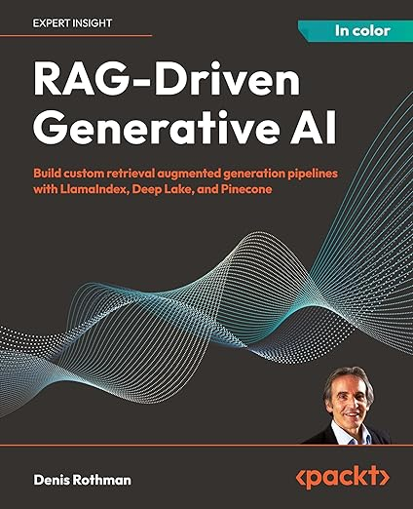
Denis Rothman (2024),
RAG-Driven Generative AI:
Build custom retrieval augmented generation pipelines with LlamaIndex, Deep Lake, and Pinecone, Packt Publishing
Source: https://www.amazon.com/RAG-Driven-Generative-retrieval-generation-LlamaIndex/dp/1836200919/

Slide 21
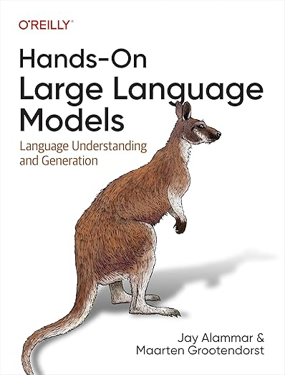
Jay Alammar and Maarten Grootendorst (2024),
Hands-On Large Language Models:
Language Understanding and Generation,
O'Reilly Media
Source: https://www.amazon.com/Hands-Large-Language-Models-Understanding/dp/1098150961/

Slide 22
Jay Alammar and Maarten Grootendorst (2024),
Hands-On Large Language Models:
Language Understanding and Generation,
O'Reilly Media
Chapter 1: Introduction to Language Models
Chapter 2: Tokens and Embeddings
Chapter 3: Looking Inside Transformer LLMs
Chapter 4: Text Classification
Chapter 5: Text Clustering and Topic Modeling
Chapter 6: Prompt Engineering
Chapter 7: Advanced Text Generation Techniques and Tools
Chapter 8: Semantic Search and Retrieval-Augmented Generation
Chapter 9: Multimodal Large Language Models
Chapter 10: Creating Text Embedding Models
Chapter 11: Fine-tuning Representation Models for Classification
Chapter 12: Fine-tuning Generation Models
Source: https://github.com/HandsOnLLM/Hands-On-Large-Language-Models

Slide 23
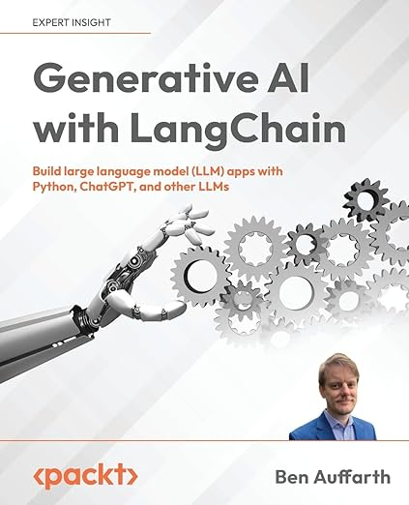
Ben Auffarth (2023),
Generative AI with LangChain:
Build large language model (LLM) apps with Python, ChatGPT and other LLMs,
Packt Publishing.
Source: https://www.amazon.com/Generative-AI-LangChain-language-ChatGPT/dp/1835083463

Slide 24
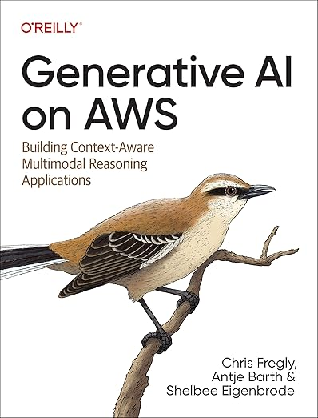
Chris Fregly, Antje Barth, and Shelbee Eigenbrode (2023),
Generative AI on AWS:
Building Context-Aware Multimodal Reasoning Applications,
O'Reilly Media
Source:https://www.amazon.com/Generative-AWS-Context-Aware-Multimodal-Applications/dp/1098159225/

Slide 25
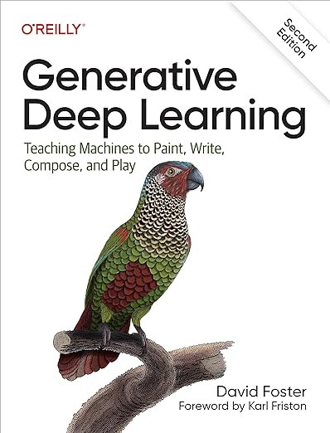
David Foster (2023),
Generative Deep Learning:
Teaching Machines to Paint, Write, Compose, and Play,
2nd Edition, Oreilly & Associates Inc
Source: https://www.amazon.com/Generative-Deep-Learning-Teaching-Machines/dp/1098134184/

Slide 26
Generative AI
Large Language Models (LLMs)
Foundation Models

Slide 27
NVIDIA Developer Program
NVIDIA
Deep Learning Institute (DLI)
https://developer.nvidia.com/join-nvidia-developer-program
https://learn.nvidia.com/

Slide 28

Join the NVIDIA Developer Program take one of the complimentary technical self-paced courses
(worth up to $90)
https://developer.nvidia.com/join-nvidia-developer-program

Slide 29
NVIDIA Deep Learning Institute (DLI)
Self-Paced Course
Generative AI Explained
Free
2 hours
Self-Paced Course
Getting Started With Deep Learning
Certificate available
$90
8 hours
Instructor-Led Workshop
Fundamentals of Deep Learning
Certificate available
$500
8 hours
Self-Paced Course
Introduction to Transformer-Based Natural Language Processing
Certificate available
$30
6 hours
Self-Paced Course
Building RAG Agents With LLMs
Certificate available
Free
8 hours
Instructor-Led Workshop
Building RAG Agents With LLMs
Certificate available
$500
8 hours
Self-Paced Course
Generative AI with Diffusion Models
Certificate available
$90
8 hours
Instructor-Led Workshop
Generative AI with Diffusion Models
Certificate available
$500
8 hours
https://www.nvidia.com/en-us/learn/learning-path/generative-ai-llm/

Slide 30

NVIDIA Deep Learning Institute (DLI)
Generative AI
https://learn.nvidia.com/en-us/training/find-training?q=Generative+AI

Slide 31

Generative AI Explained
https://learn.nvidia.com/courses/course-detail?course_id=course-v1:DLI+S-FX-15+V1

Slide 32

Introduction to Transformer-Based
Natural Language Processing
https://learn.nvidia.com/courses/course-detail?course_id=course-v1:DLI+S-FX-08+V1

Slide 33

Building RAG Agents with LLMs
https://learn.nvidia.com/courses/course-detail?course_id=course-v1:DLI+S-FX-15+V1

Slide 34

Generative AI with Diffusion Models
https://learn.nvidia.com/courses/course-detail?course_id=course-v1:DLI+S-FX-14+V1

Slide 35

Join the NVIDIA Developer Program take one of the complimentary technical self-paced courses (worth up to $90)
https://developer.nvidia.com/join-nvidia-developer-program

Slide 36

Join the NVIDIA Developer Program take one of the complimentary technical self-paced courses (worth up to $90)
https://developer.nvidia.com/join-nvidia-developer-program

Slide 37

Join the NVIDIA Developer Program take one of the complimentary technical self-paced courses (worth up to $90)
https://developer.nvidia.com/join-nvidia-developer-program

Slide 38

Join the NVIDIA Developer Program take one of the complimentary technical self-paced courses (worth up to $90)
https://developer.nvidia.com/join-nvidia-developer-program

Slide 39

Join the NVIDIA Developer Program take one of the complimentary technical self-paced courses (worth up to $90)
https://developer.nvidia.com/join-nvidia-developer-program

Slide 40

Join the NVIDIA Developer Program take one of the complimentary technical self-paced courses (worth up to $90)
https://developer.nvidia.com/join-nvidia-developer-program

Slide 41

NVIDIA Deep Learning Institute (DLI)
https://learn.nvidia.com/my-learning

Slide 42

NVIDIA Deep Learning Institute (DLI)
https://learn.nvidia.com/my-learning

Slide 43
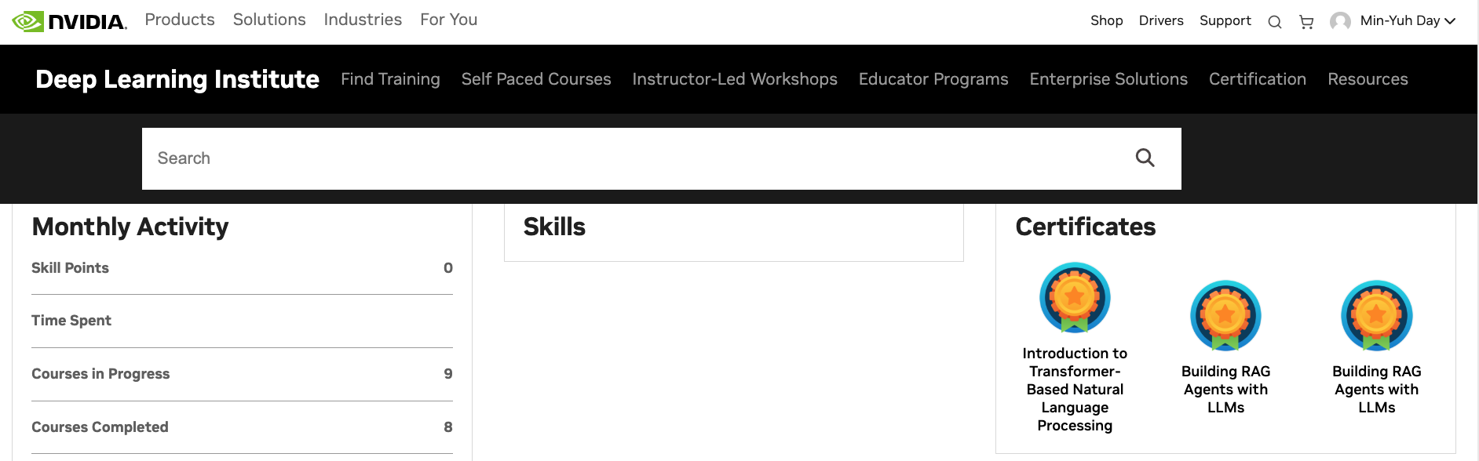

Deep Learning Institute (DLI)
https://learn.nvidia.com/my-learning

Slide 44

NVIDIA Deep Learning Institute (DLI)
https://learn.nvidia.com/en-us/training/self-paced-courses

Slide 45
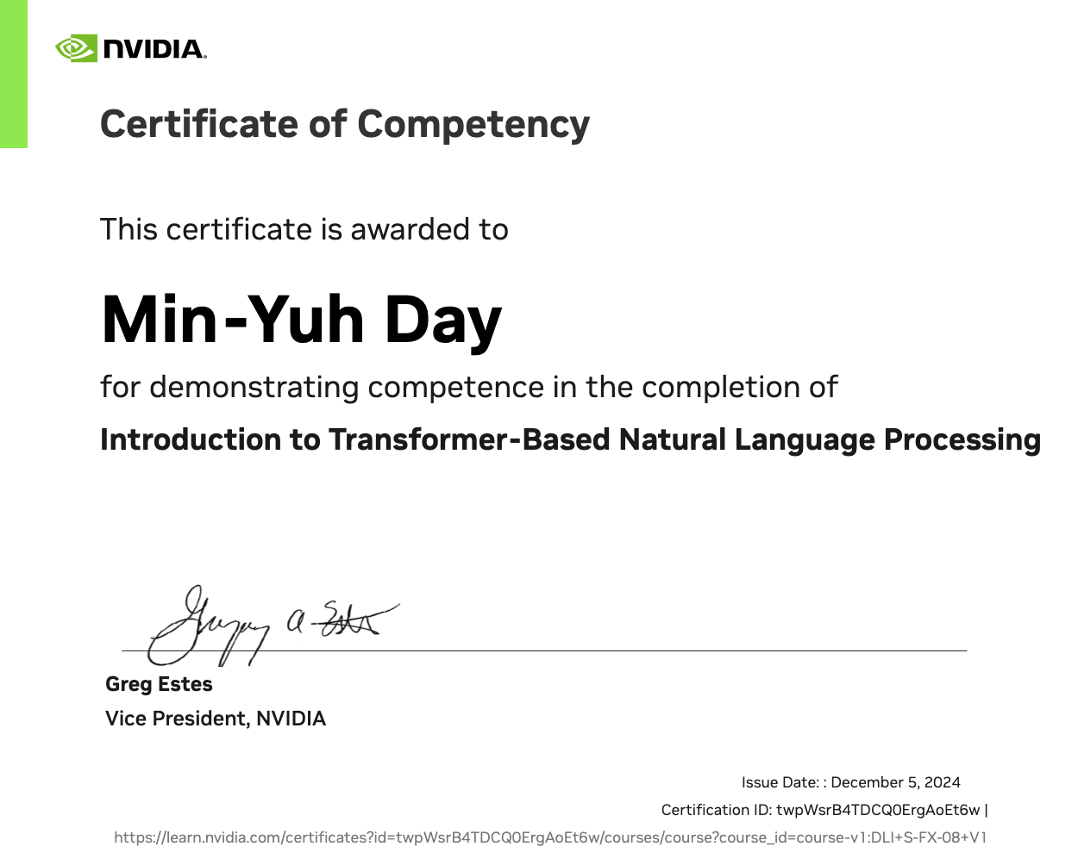
https://learn.nvidia.com/certificates?id=twpWsrB4TDCQ0ErgAoEt6w

Slide 46

https://learn.nvidia.com/certificates?id=ed-qOCIMQaatzU8SNUNxgw

Slide 47
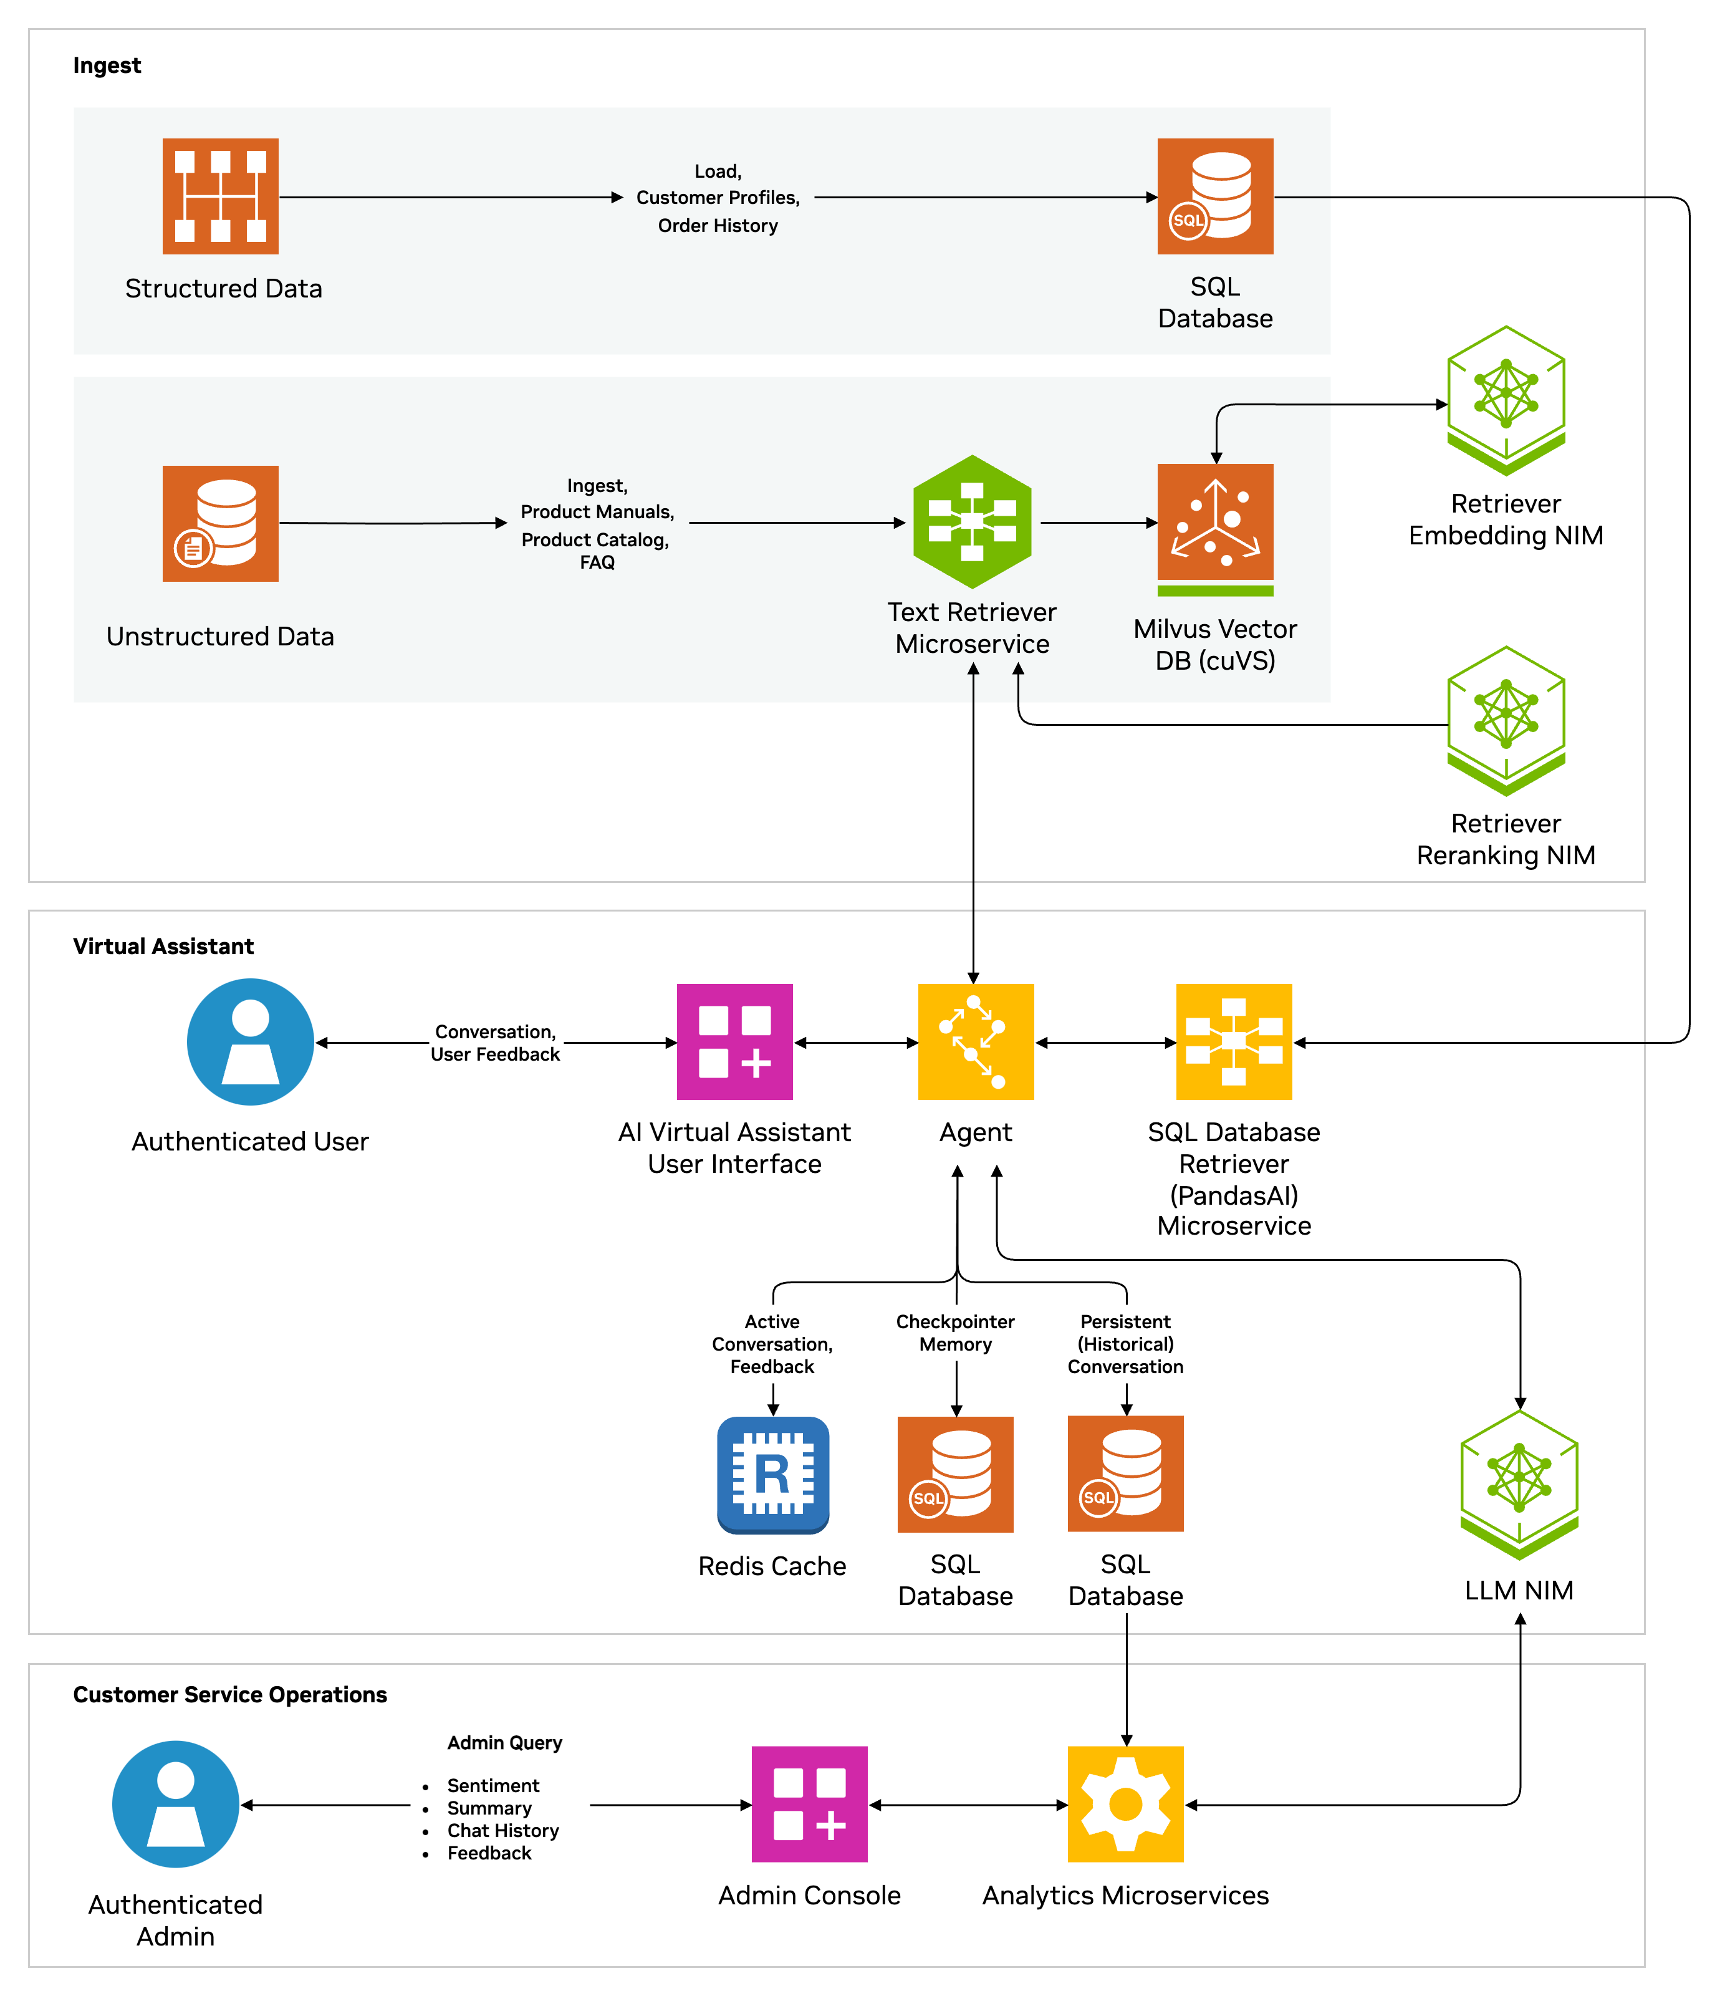
AI Virtual Assistant for Customer Service
AI Virtual Assistant to reduce handling time, boost customer satisfaction
Benefits
Personalized Responses: Handles structured and unstructured customer queries (e.g., order details, spending history).
Multi-Turn Dialogue: Offers context-aware, seamless interactions across multiple questions.
Custom Conversation Style: Adapts text responses to reflect corporate branding and tone.
Sentiment Analysis: Analyzes real-time customer interactions to gauge sentiment and adjust responses.
Multi-Session Support: Allows for multiple user sessions with conversation history and summaries.
Data Privacy: Integrates with on-premises or cloud-hosted knowledge bases to protect sensitive data.
Source: NVIDIA DLI (2024), Introduction to NVIDIA NIM™ Microservices, https://learn.nvidia.com/courses/course-detail?course_id=course-v1:DLI+S-FX-23+V1
Notes:
In today's fast-paced business environment, providing excellent customer service is critical.
Traditional solutions often fall short in delivering responses to complex customer queries in real time, leading to longer resolution times and limited customer satisfaction.
AI-based assistants can revolutionize industries by offering a streamlined process for enterprises to enhance these customer experiences, but integrating AI into existing systems can present challenges such as managing fragmented data sources and mitigating potential data security risks.
NVIDIA's AI virtual assistant NIM Agent Blueprint provides a centralized knowledge base that enables enterprises to improve the operational efficiency of existing solutions or build new customer service-centric systems that integrate seamlessly with internal applications and tools.
It enables organizations to meet unique business needs by delivering meaningful interactions and continuously improving their human-like responses over time.
It goes beyond automating routine tasks by analyzing customer profiles and tailoring responses to their specific requests, all while ensuring alignment with company goals, industry standards, and compliance requirements.
It is built using retrieval-augmented generation (RAG) and enterprise-ready NeMo Retriever and NIM microservices to enable the AI assistant to access proprietary data wherever it resides for highly personalized and compliant interactions.
Additional microservices like Nemotron-4-Hindi 4B Instruct allow for further customization and capabilities like synthetic data generation and model fine-tuning.
Ingestion and Retrieval Pipeline
Retrieval Pipeline ingests and retrieves the most up-to-date, relevant/accurate information in real-time from structured and unstructured data stores
AI Agent
provides personalized, context-aware, multi-turn human-like responses and faster resolution times
summarizes conversations to reduce call times and costs
sentiment analysis for continuous improvement of responses
Customer Service Operations
review chat history, user feedback, sentiment analysis data, and call summaries. This data can be used to generate analytics – such as average call time, time to resolution, and customer satisfaction – and also as user feedback to retrain the LLM models for accuracy improvement.
Scalable multi-session support to handle calls from large numbers of concurrent customers
Secure, compliant data management

Slide 48











Digital Humans for Customer Service
$125B market for digital human economy by 2035
Web Front End
Text Prompt
Audio In
Audio Out
User
Audio
Video
Audio/Video
Streaming
ACE Agent
Text Response
RAG
Application
Benefits
Increases engagement and satisfaction for user-facing applications
Creates a lifelike 3D digital human with accurate skin, hair, animation, and speech
Enables natural conversations with enterprise applications
and data
User Feedback
On Response
Digital Human
AV Out
3D Animation Pipeline
Audio Pipeline
Audio In
Text Response
Omniverse
Renderer
Animation Data
Text
Audio
Animation Graph
Audio2Face
Riva ASR
ElevenLabs TTS
Feedback Data
Source: NVIDIA DLI (2024), Introduction to NVIDIA NIM™ Microservices, https://learn.nvidia.com/courses/course-detail?course_id=course-v1:DLI+S-FX-23+V1
Notes:
When customers need service, they often just want to speak to a helpful person who can quickly resolve their issue, versus searching through knowledge base articles or navigating complex phone trees. Which is why application development teams are looking for ways to increase engagement with customer service applications to drive higher customer satisfaction.
Generative AI powered applications have changed the way customers are assisted by providing a more knowledgeable and responsive chat interface. But a text chat window is not always the best replacement for a knowledgeable and helpful person.
The Digital Humans for Customer Service NIM Blueprint brings enterprise applications to life with a 3D animated digital human interface. With an approachable, human-like interface, customer service applications can provide better user experiences with faster resolutions than traditional customer service options.
This workflow is designed to integrate within your existing generative AI applications built using retrieval-augmented generation (RAG).
Walking through the workflow, audio from the user comes in through the web front end and is processed by an audio/video engine and passed on to the NVIDIA ACE Agent. The Agent uses the audio pipeline to convert audio to text and text to audio as it interacts with the RAG-powered chatbot or copilot using its API. The audio is sent to the 3D animation pipeline to animate the avatar and render its features to be lifelike. As users engage the digital human, they can provide feedback, like thumbs up / thumbs down, on the response, which is fed back into the backend RAG application for improvement.
Source for $125B: https://drive.google.com/file/d/1EAiI03y1SczRiczpXFlVk2_mtDFiKEkC/view?usp=sharingn (Must keep the 2035 year in any reference to this $ projection, per Gartner. Approval from Gartner though this projection is more than 1 year old, stipulates we have to use the 2035 for clarity)

Slide 49








Multimodal PDF Data Extraction for Enterprise RAG
Unlocks Knowledge from trillions of PDFs
Response
Query
User
Front End
NeMo Retriever
Embedding
Vector
Database
NeMo Retriever
Reranking
LLM
User Feedback
On Response
Retrieval Pipeline
Feedback Data
NeMo Retriever
Embedding
Benefits
Unlocks the next level
of indexable enterprise data from text to images and charts
High-accuracy extraction and responses
Enterprise-scale
PDF ingestion
Ingestion Pipeline
Chart Extraction
Charts as Images
VLM
DePlot
Chart Element Detector
CACHED
OCR
PaddleOCR
Text
Pages as Images
Object Detection
YOLOX
Tables as
Images
Text
Documents
PDF Parser
Table Extraction
PaddleOCR
Post-Process Filtering
Chunking/Ingestion
Logic
Text Content and Metadata
Source: NVIDIA DLI (2024), Introduction to NVIDIA NIM™ Microservices, https://learn.nvidia.com/courses/course-detail?course_id=course-v1:DLI+S-FX-23+V1
Notes:
Trillions of PDF files are generated every year, each file likely consisting of multiple pages, filled with various content types, including text, images, charts, and tables. This goldmine of data can only be used as quickly as humans can read and understand it.
But with generative AI and retrieval-augmented generation (RAG) this untapped data can be used to uncover business insights that can help employees work more efficiently resulting in lower costs.
The multimodal PDF data extraction blueprint enables organizations to to accurately extract the knowledge contained in massive volumes of enterprise data, effectively talking to the data, to quickly make your digital human an expert on any topic, in turn enabling your employees to make smarter decisions faster.
Walking through the workflow, PDFs are parsed to separate out the modalities (text, images, charts, tables, plots and other diagrams). NIM microservices are leveraged to accurately extract textual metadata from charts and tables. The extracted information is filtered to avoid duplicate chunks. We leverage the NeMo Retriever embedding NIM to convert the chunks into embeddings and store them in a VectorStore.
When a user submits a query, relevant information is retrieved from the vast repository of ingested documents. NeMo Retriever embedding NIM embeds the user query, which is used to retrieve the most relevant chunks using vector similarity search from the VectorStore.
NeMo Retriever reranking NIM evaluates and reranks the results to ensure the most accurate and useful chunks are used to respond to the query.
With the most pertinent information at hand, the LLM NIM generates a response that is informed, accurate and contextually relevant.

Slide 50
Artificial Intelligence
(AI)

Slide 51

AI, ML, DL, Generative AI
Source: Jeong, Cheonsu. "A Study on the Implementation of Generative AI Services Using an Enterprise Data-Based LLM Application Architecture." arXiv preprint arXiv:2309.01105 (2023).

Slide 52
Generative AI,
Agentic AI,
AI Agent,
RAG LLM for
QA and Dialogue Systems

Slide 53
Chatbot
Dialogue System
Intelligent Agent
Conversational AI

Slide 54

The Development of LM-based Dialogue Systems
1) Early Stage (1966 - 2015)
2) The Independent Development of TOD and ODD (2015 - 2019)
3) Fusions of Dialogue Systems (2019 - 2022)
4) LLM-based DS (2022 - Now)
Task-oriented DS (TOD), Open-domain DS (ODD)
Source: Wang, Hongru, Lingzhi Wang, Yiming Du, Liang Chen, Jingyan Zhou, Yufei Wang, and Kam-Fai Wong. "A Survey of the Evolution of Language Model-Based Dialogue Systems." arXiv preprint arXiv:2311.16789 (2023).

Slide 55
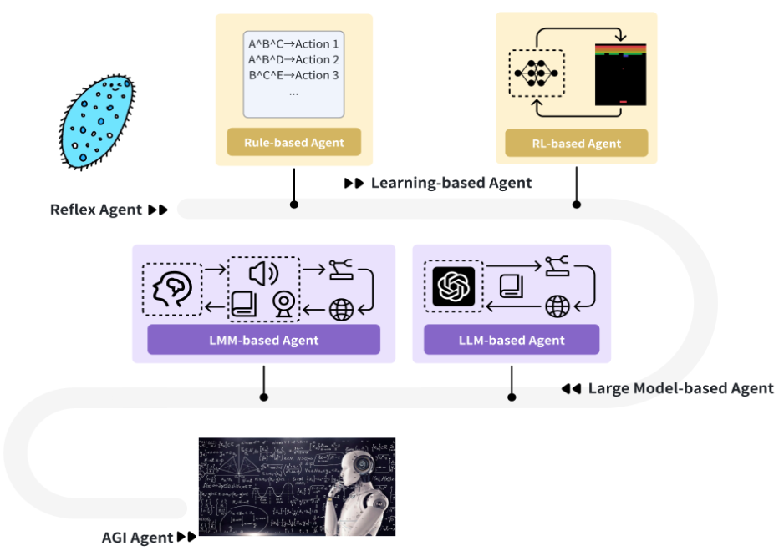
Intelligent Agents Roadmap
Source: Cheng, Yuheng, Ceyao Zhang, Zhengwen Zhang, Xiangrui Meng, Sirui Hong, Wenhao Li, Zihao Wang et al. "Exploring large language model based intelligent agents: Definitions, methods, and prospects." arXiv preprint arXiv:2401.03428 (2024).

Slide 56
AI Agents
Traditional AI Agents
    Simple reflex agents
    Model-based reflex agents
    Goal-based agents
    Utility-based agents
    Learning agents
Evolution of AI Agents
  LLM-based Agents
    Multi-modal agents
    Embodied AI agents in virtual environments
    Collaborative AI agents

Slide 57
Reinforcement Learning (DL)
Agent
Environment
Source: Richard S. Sutton & Andrew G. Barto (2018), Reinforcement Learning: An Introduction, 2nd Edition, A Bradford Book.

Slide 58
Reinforcement Learning (DL)
1
2
observation
Agent
action
3
reward
Environment
Source: Richard S. Sutton & Andrew G. Barto (2018), Reinforcement Learning: An Introduction, 2nd Edition, A Bradford Book.

Slide 59
Reinforcement Learning (DL)
1
2
observation
Agent
action
O_{t}
A_{t}
3
reward
R_{t}
Environment
Source: Richard S. Sutton & Andrew G. Barto (2018), Reinforcement Learning: An Introduction, 2nd Edition, A Bradford Book.

Slide 60

Large Language Model (LLM) based Agents
Source: Xi, Z., Chen, W., Guo, X., He, W., Ding, Y., Hong, B., ... & Gui, T. (2023). The rise and potential of large language model based agents: A survey. arXiv preprint arXiv:2309.07864.

Slide 61

LLM-based Agents
Source: Cheng, Yuheng, Ceyao Zhang, Zhengwen Zhang, Xiangrui Meng, Sirui Hong, Wenhao Li, Zihao Wang et al. "Exploring large language model based intelligent agents: Definitions, methods, and prospects." arXiv preprint arXiv:2401.03428 (2024).

Slide 62

Large Multimodal Agents (LMA)
Source: Xie, J., Chen, Z., Zhang, R., Wan, X., & Li, G. (2024). Large Multimodal Agents: A Survey. ArXiv, abs/2402.15116.

Slide 63

Large Multimodal Agents (LMA)
Source: Xie, J., Chen, Z., Zhang, R., Wan, X., & Li, G. (2024). Large Multimodal Agents: A Survey. ArXiv, abs/2402.15116.

Slide 64
Transformer Models
Transformer
Encoder
Decoder
DistilBERT
BERT
T5
GPT
RoBERTa
BART
GPT-2
CTRL
XLM-R
XLM
M2M-100
GPT-3
ALBERT
BigBird
GPT-Neo
GPT-J
ELECTRA
mT0
BLOOM
BLOOMZ
DeBERTa
ChatGPT
GPT-4
Source: Lewis Tunstall, Leandro von Werra, and Thomas Wolf (2022), Natural Language Processing with Transformers: Building Language Applications with Hugging Face, O'Reilly Media.

Slide 65
The Development of LM-based Dialogue Systems
1) Early Stage (1966 - 2015)
2) The Independent Development of TOD and ODD (2015 - 2019)
3) Fusions of Dialogue Systems (2019 - 2022)
4) LLM-based DS (2022 - Now)
Task-oriented DS (TOD), Open-domain DS (ODD)
Source: Wang, Hongru, Lingzhi Wang, Yiming Du, Liang Chen, Jingyan Zhou, Yufei Wang, and Kam-Fai Wong. "A Survey of the Evolution of Language Model-Based Dialogue Systems." arXiv preprint arXiv:2311.16789 (2023).

Slide 66

Major GenAI LLMs Research Milestones
(2017-2024)
Source: https://github.com/Hannibal046/Awesome-LLM

Slide 67
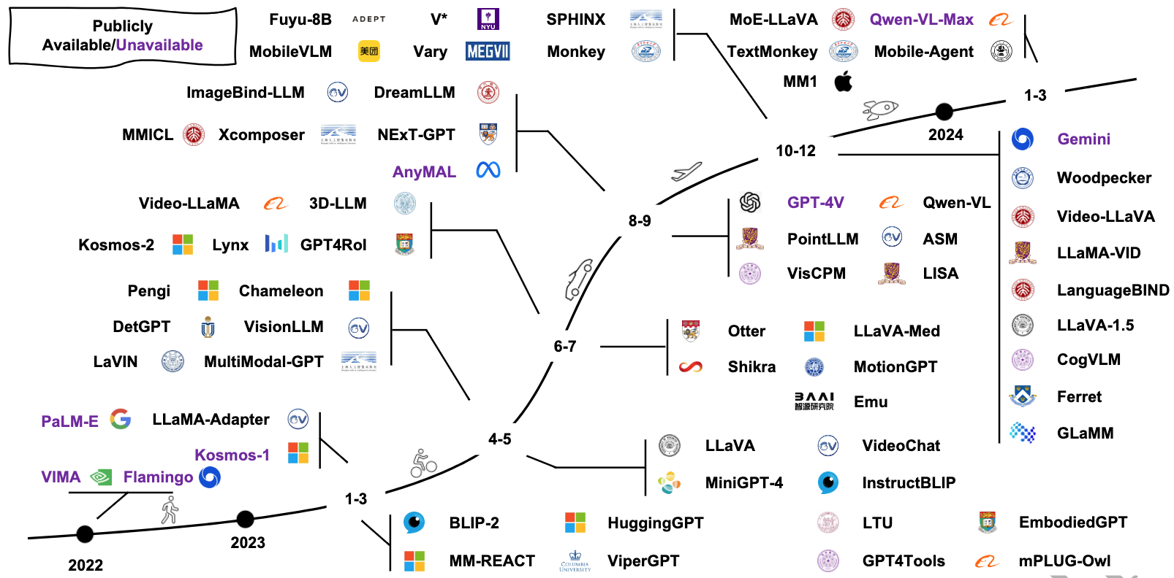
Multimodal Large Language Models (MLLM)
Source: Shukang Yin, Chaoyou Fu, Sirui Zhao, Ke Li, Xing Sun, Tong Xu, and Enhong Chen. (2024) "A survey on multimodal large language models." National Science Review (2024): nwae403.

Slide 68
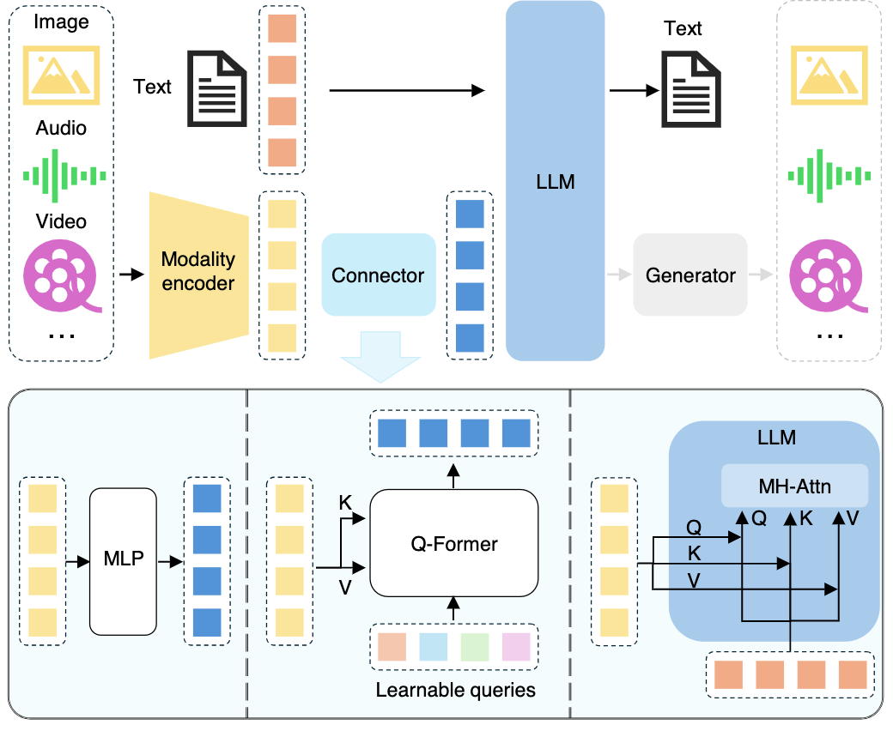
Multimodal Large Language Models (MLLM)
Multimodall LLM
Three types of connectors:
1. projection-based
2. query-based
3. fusion-based connectors
Source: Shukang Yin, Chaoyou Fu, Sirui Zhao, Ke Li, Xing Sun, Tong Xu, and Enhong Chen. (2024) "A survey on multimodal large language models." National Science Review (2024): nwae403.

Slide 69
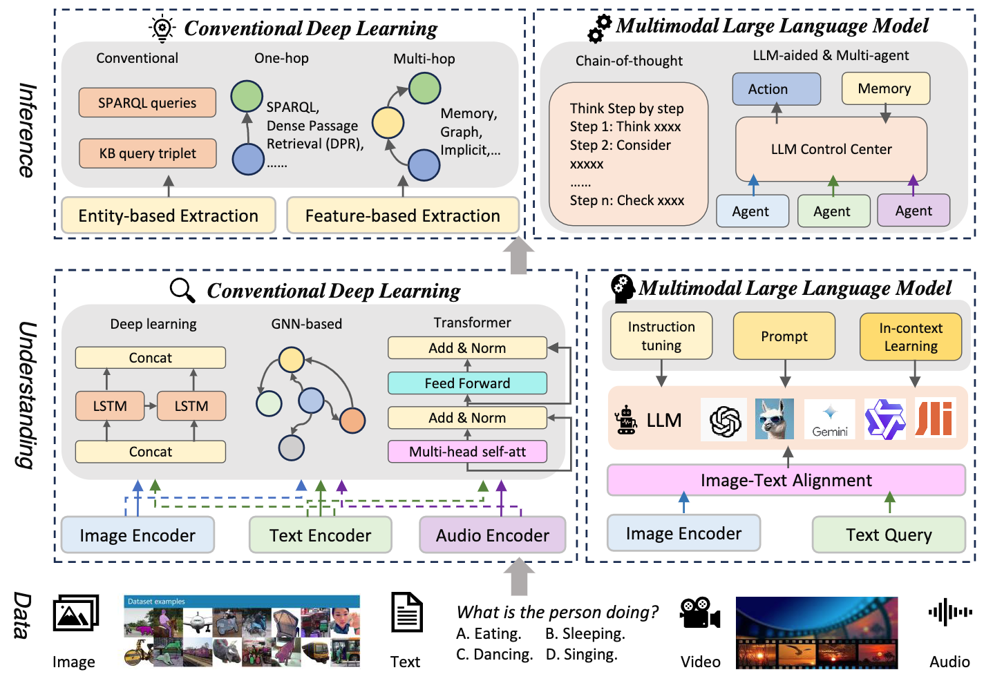
Multimodal Large Language Model (MLLM) for Vision Question Answering
Source: Jiayi Kuang, Jingyou Xie, Haohao Luo, Ronghao Li, Zhe Xu, Xianfeng Cheng, Yinghui Li, Xika Lin, and Ying Shen. (2024) "Natural Language Understanding and Inference with MLLM in Visual Question Answering: A Survey." arXiv preprint arXiv:2411.17558.

Slide 70
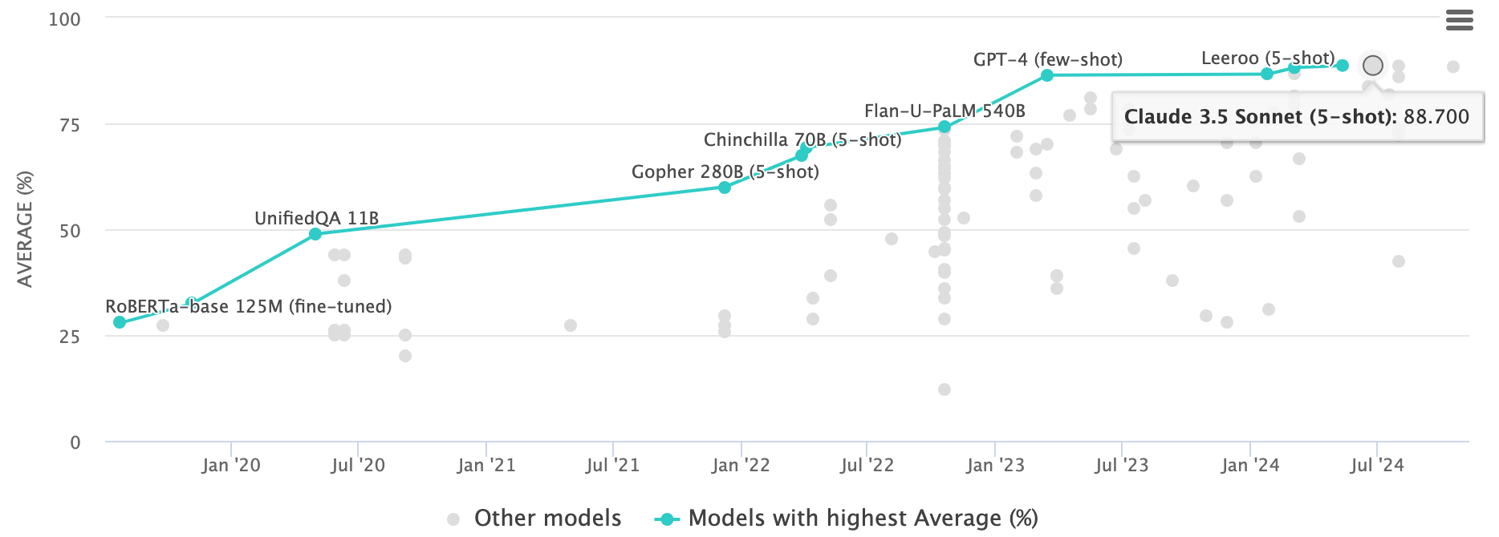
Multi-task Language Understanding on MMLU
GPT-4, Claude 3.5 Sonnet
Massive Multitask Language Understanding (MMLU)
Source: https://paperswithcode.com/sota/multi-task-language-understanding-on-mmlu

Slide 71

LLM Capabilities
Source: Minaee, Shervin, Tomas Mikolov, Narjes Nikzad, Meysam Chenaghlu, Richard Socher, Xavier Amatriain, and Jianfeng Gao. (2024) "Large language models: A survey." arXiv preprint arXiv:2402.06196 (2024).

Slide 72

LLM-powered Multimodal Agents
Large Multimodal Agents (LMAs)
2022
2023
2024
Source: Xie, Junlin, Zhihong Chen, Ruifei Zhang, Xiang Wan, and Guanbin Li. "Large Multimodal Agents: A Survey." arXiv preprint arXiv:2402.15116 (2024).

Slide 73

Four Paradigms in NLP (LM)
Transfer Learning: Pre-training, Fine-Tuning (FT)
GAI: Pre-train, Prompt, and Predict (Prompting)
Source: Pengfei Liu, Weizhe Yuan, Jinlan Fu, Zhengbao Jiang, Hiroaki Hayashi, and Graham Neubig. (2023) "Pre-train, prompt, and predict: A systematic survey of prompting methods in natural language processing." ACM Computing Surveys 55, no. 9 (2023): 1-35.

Slide 74

Large Language Models (LLM)
Three typical learning paradigms
Source: Shukang Yin, Chaoyou Fu, Sirui Zhao, Ke Li, Xing Sun, Tong Xu, and Enhong Chen. (2024) "A survey on multimodal large language models." National Science Review (2024): nwae403.

Slide 75
Popular Generative AI
OpenAI ChatGPT (GPT-o1, GPT-4o, GPT-4)
Claude.ai (Claude 3.5)
Google Gemini
Meta Llama 3.3, Llama 3.2 Vision
Mixtral Pixtral (mistral.ai)
DeepSeek
Chat.LMSys.org (lmarena.ai)
Perplexity.ai
Stable Diffusion
Video: D-ID, Synthesia
Audio: Speechify

Slide 76
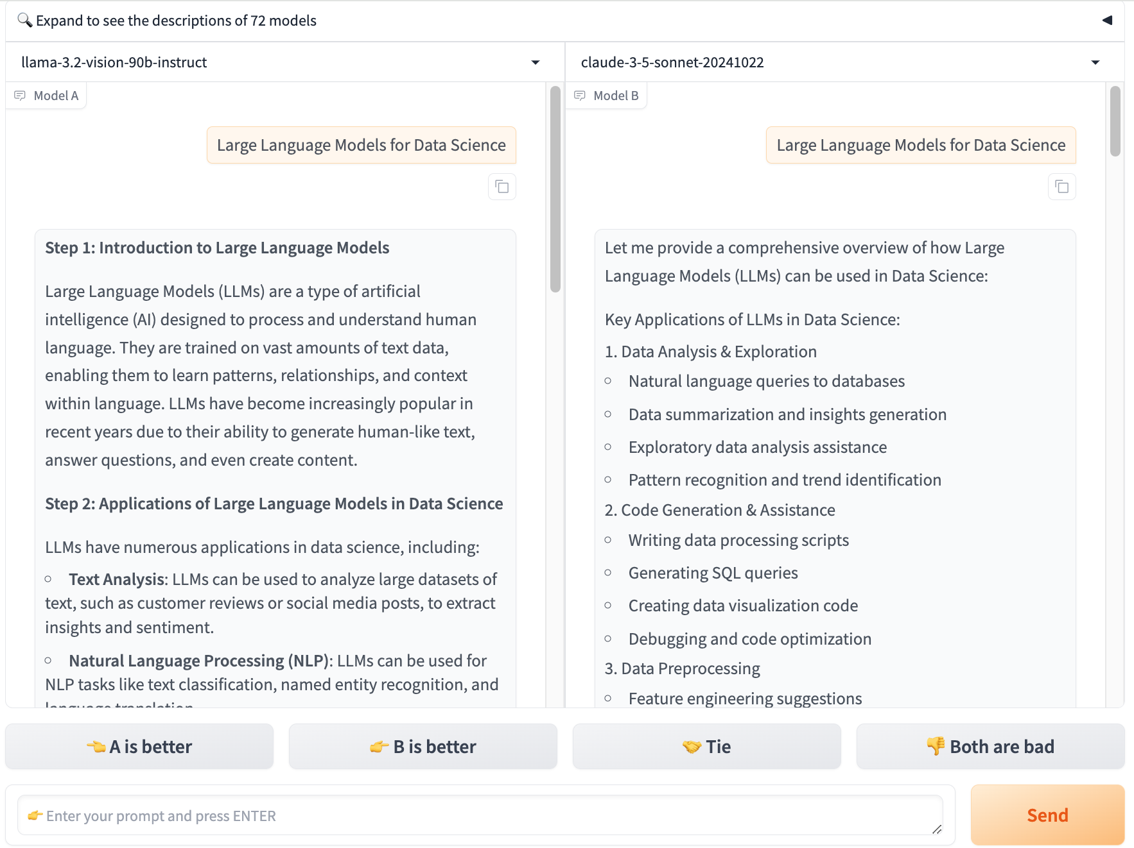
Chat with
Open
Large Language Models:
Chatbot Arena
Large Language Models for Data Science
llama 3.2
claude 3.5 sonnet
https://lmarena.ai/

Slide 77

Perplexity.ai
https://www.perplexity.ai/

Slide 78

Generative AI (Gen AI)
AI Generated Content (AIGC)
Image Generation
Source: Yihan Cao, Siyu Li, Yixin Liu, Zhiling Yan, Yutong Dai, Philip S. Yu, and Lichao Sun (2023). "A Comprehensive Survey of AI-Generated Content (AIGC): A History of Generative AI from GAN to ChatGPT." arXiv preprint arXiv:2303.04226.

Slide 79

Generative AI (Gen AI)
AI Generated Content (AIGC)
Source: Yihan Cao, Siyu Li, Yixin Liu, Zhiling Yan, Yutong Dai, Philip S. Yu, and Lichao Sun (2023). "A Comprehensive Survey of AI-Generated Content (AIGC): A History of Generative AI from GAN to ChatGPT." arXiv preprint arXiv:2303.04226.

Slide 80

The history of Generative AI in CV, NLP and VL
Source: Yihan Cao, Siyu Li, Yixin Liu, Zhiling Yan, Yutong Dai, Philip S. Yu, and Lichao Sun (2023). "A Comprehensive Survey of AI-Generated Content (AIGC): A History of Generative AI from GAN to ChatGPT." arXiv preprint arXiv:2303.04226.

Slide 81
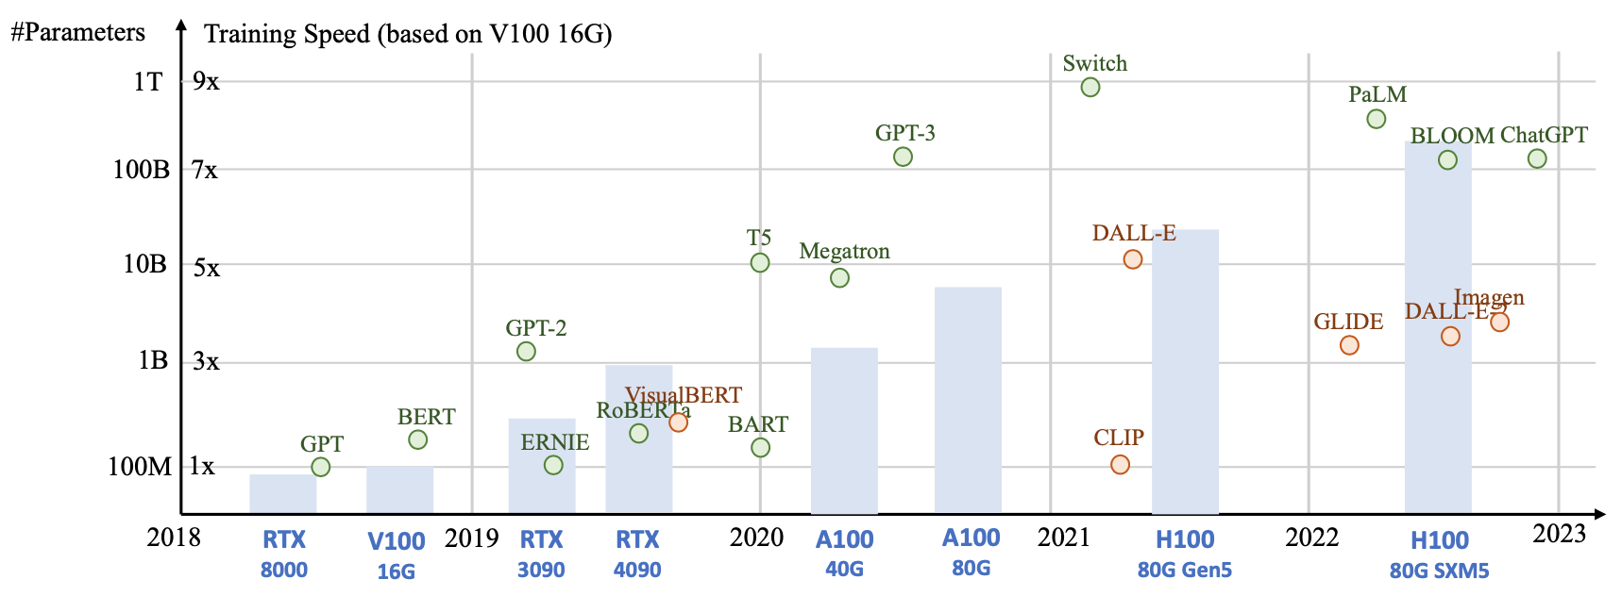
Generative AI
Foundation Models
Source: Yihan Cao, Siyu Li, Yixin Liu, Zhiling Yan, Yutong Dai, Philip S. Yu, and Lichao Sun (2023). "A Comprehensive Survey of AI-Generated Content (AIGC): A History of Generative AI from GAN to ChatGPT." arXiv preprint arXiv:2303.04226.

Slide 82

Categories of Vision Generative Models
Source: Yihan Cao, Siyu Li, Yixin Liu, Zhiling Yan, Yutong Dai, Philip S. Yu, and Lichao Sun (2023). "A Comprehensive Survey of AI-Generated Content (AIGC): A History of Generative AI from GAN to ChatGPT." arXiv preprint arXiv:2303.04226.

Slide 83

The General Structure of
Generative Vision Language
Source: Yihan Cao, Siyu Li, Yixin Liu, Zhiling Yan, Yutong Dai, Philip S. Yu, and Lichao Sun (2023). "A Comprehensive Survey of AI-Generated Content (AIGC): A History of Generative AI from GAN to ChatGPT." arXiv preprint arXiv:2303.04226.

Slide 84
RAG LLM
Dialogue Systems

Slide 85
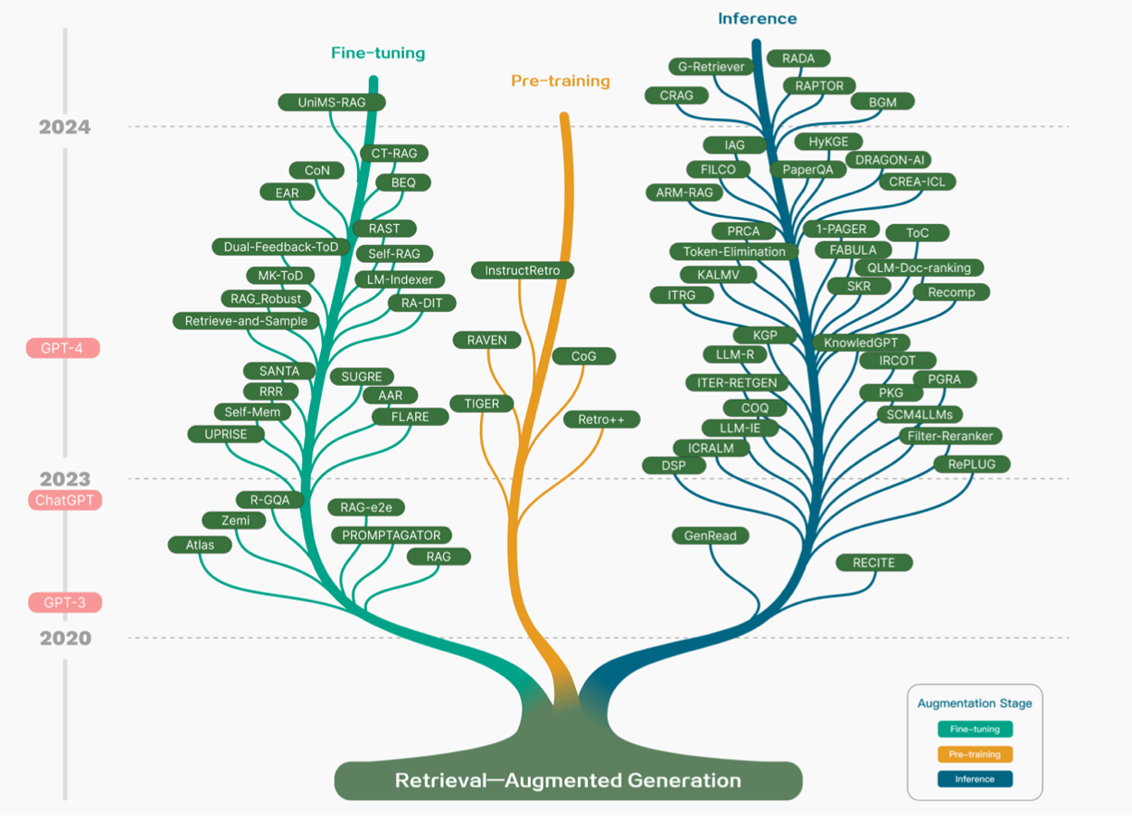
Technology Tree of RAG Research
Retrieval-Augmented Generation (RAG) for Large Language Models (LLMs)
Source: Gao, Y., Xiong, Y., Gao, X., Jia, K., Pan, J., Bi, Y., ... & Wang, H. (2023). Retrieval-augmented generation for large language models: A survey. arXiv preprint arXiv:2312.10997.

Slide 86
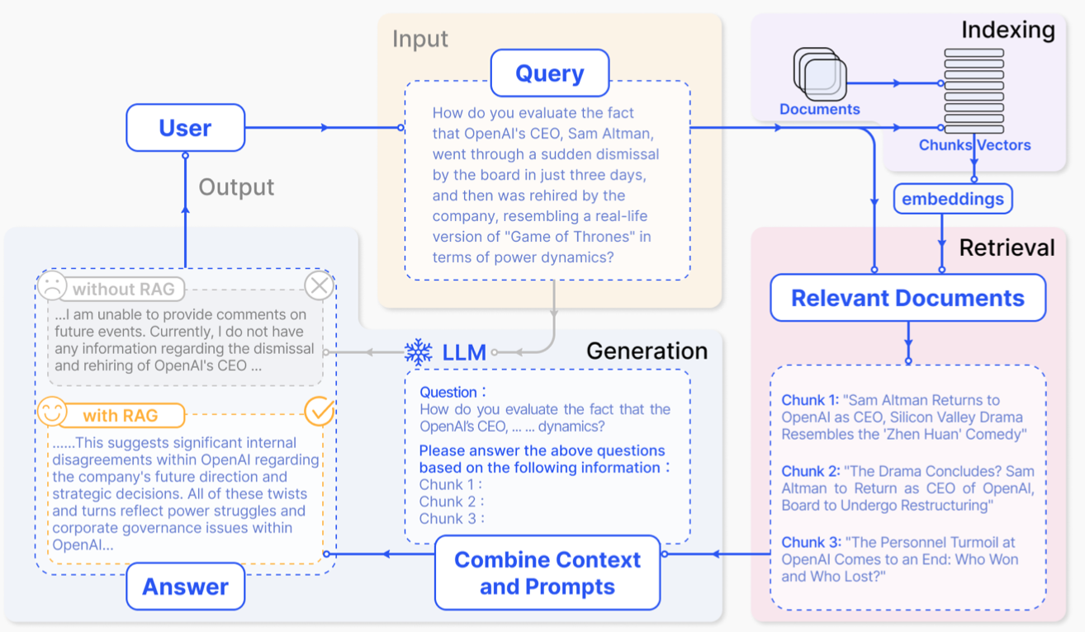
Retrieval-Augmented Generation (RAG) for Large Language Models (LLMs)
Source: Gao, Y., Xiong, Y., Gao, X., Jia, K., Pan, J., Bi, Y., ... & Wang, H. (2023). Retrieval-augmented generation for large language models: A survey. arXiv preprint arXiv:2312.10997.

Slide 87
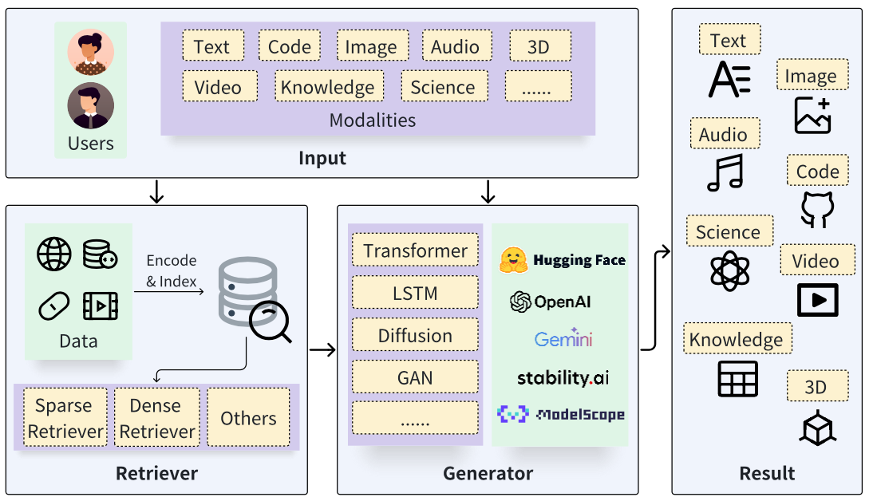
Retrieval-Augmented Generation (RAG) Architecture
Source: Zhao, P., Zhang, H., Yu, Q., Wang, Z., Geng, Y., Fu, F., ... & Cui, B. (2024). Retrieval-augmented generation for ai-generated content: A survey. arXiv preprint arXiv:2402.19473.

Slide 88
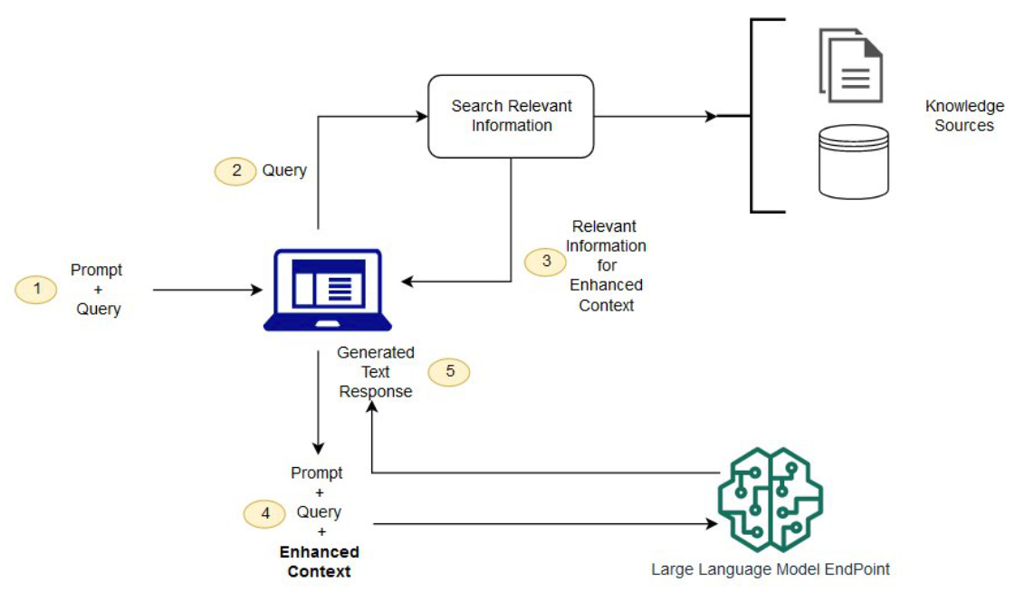
Synthesizing RAG with LLMs for Question Answering Application
Source: Minaee, S., Mikolov, T., Nikzad, N., Chenaghlu, M., Socher, R., Amatriain, X., & Gao, J. (2024). Large language models: A survey. arXiv preprint arXiv:2402.06196.

Slide 89
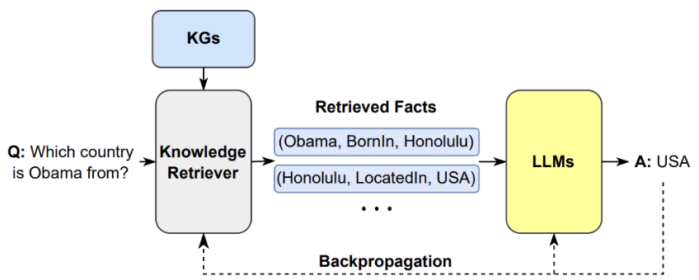
Synthesizing the KG as a Retriever with LLMs
Source: Minaee, S., Mikolov, T., Nikzad, N., Chenaghlu, M., Socher, R., Amatriain, X., & Gao, J. (2024). Large language models: A survey. arXiv preprint arXiv:2402.06196.

Slide 90
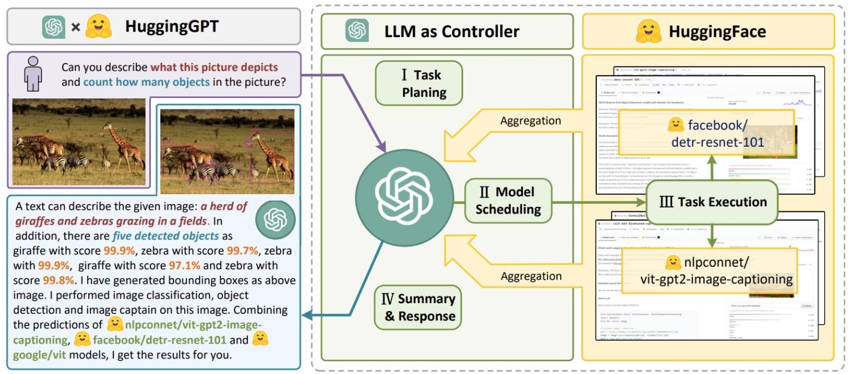
HuggingGPT:
An agent-based approach to use tools and planning
Source: Minaee, S., Mikolov, T., Nikzad, N., Chenaghlu, M., Socher, R., Amatriain, X., & Gao, J. (2024). Large language models: A survey. arXiv preprint arXiv:2402.06196.

Slide 91
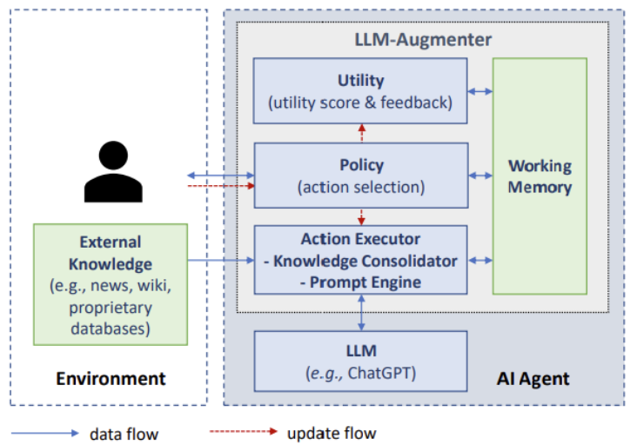
A LLM-based Agent for
Conversational Information Seeking
Source: Minaee, S., Mikolov, T., Nikzad, N., Chenaghlu, M., Socher, R., Amatriain, X., & Gao, J. (2024). Large language models: A survey. arXiv preprint arXiv:2402.06196.

Slide 92
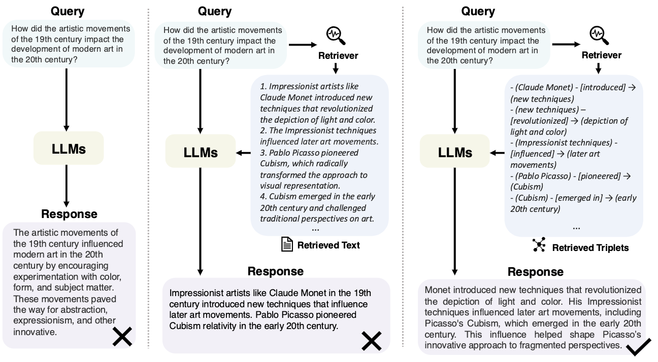
Direct LLM, RAG, and GraphRAG
Source: Peng, B., Zhu, Y., Liu, Y., Bo, X., Shi, H., Hong, C., ... & Tang, S. (2024). Graph retrieval-augmented generation: A survey. arXiv preprint arXiv:2408.08921.

Slide 93
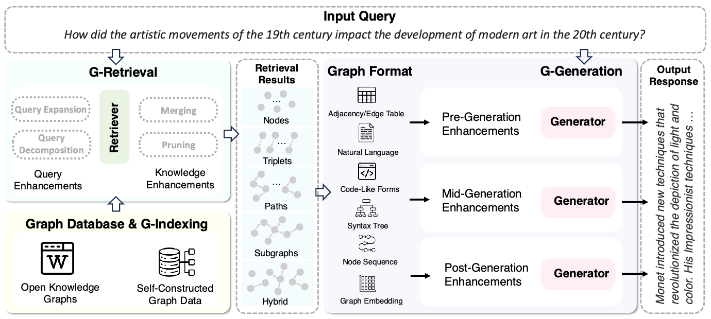
GraphRAG Framework for Question Answering
Source: Peng, B., Zhu, Y., Liu, Y., Bo, X., Shi, H., Hong, C., ... & Tang, S. (2024). Graph retrieval-augmented generation: A survey. arXiv preprint arXiv:2408.08921.

Slide 94
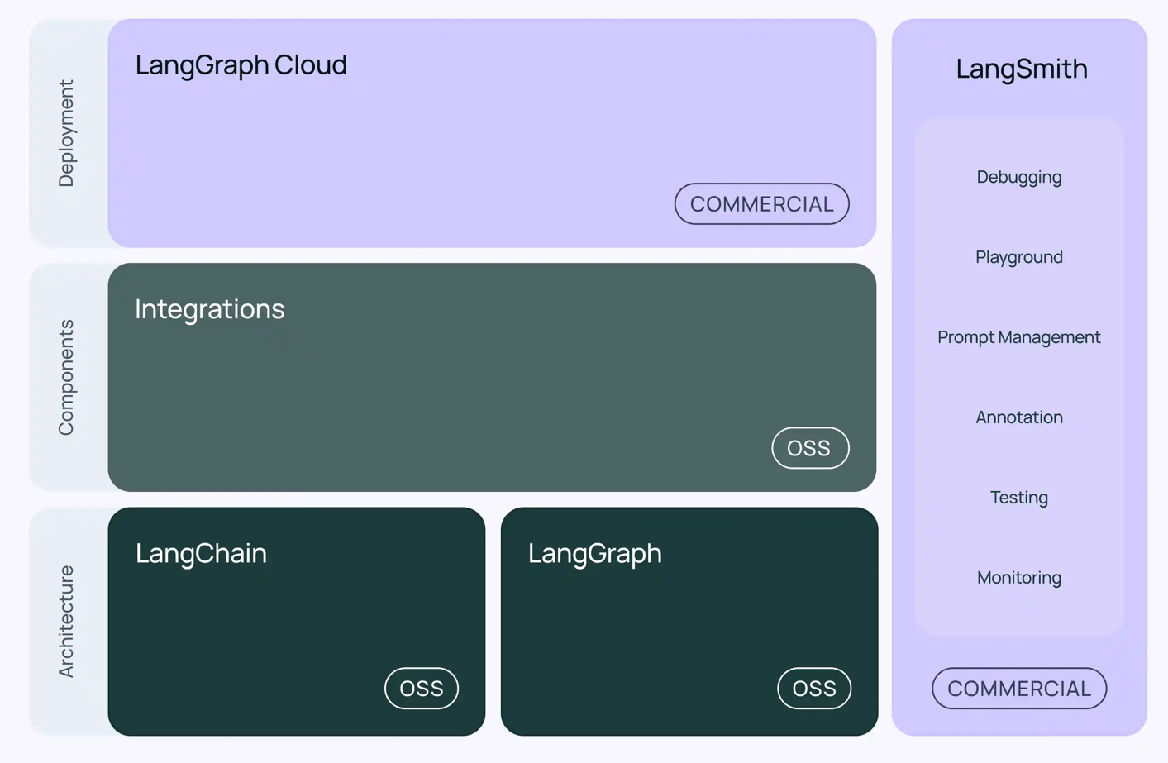
LangChain Architecture
Source: https://www.langchain.com/

Slide 95
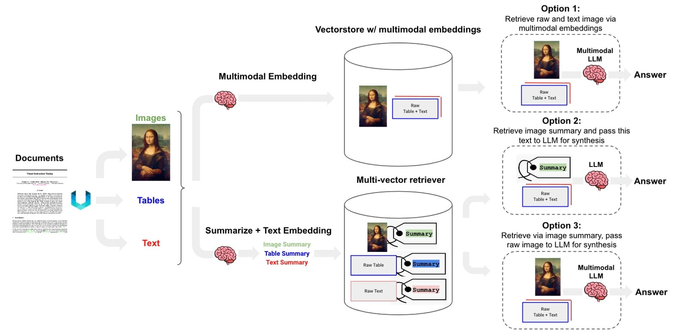
Multimodal LLM RAG
Multi-Vector Retriever for RAG
Source: https://blog.langchain.dev/deconstructing-rag/

Slide 96
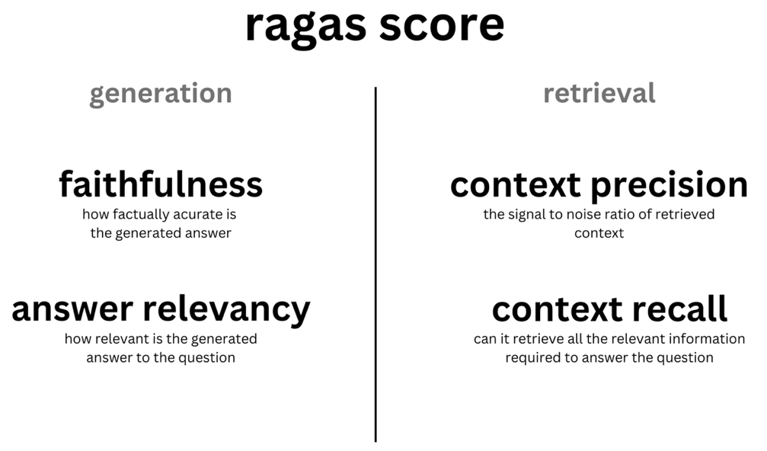
Evaluating RAG with Ragas Metrics
Source: https://blog.langchain.dev/evaluating-rag-pipelines-with-ragas-langsmith/

Slide 97

Teaching
Generative AI Innovative Applications
  Spring 2025
Artificial Intelligence in Finance and Quantitative
  Fall 2021, Fall 2022, Fall 2023, Spring 2025
Software Engineering
  Fall 2020, Fall, 2021, Spring 2022, Spring 2023, Spring 2024, Spring 2025
Artificial Intelligence
  Spring 2021, Fall 2022, Fall 2024
Sustainability and ESG Data Analytics
  Spring 2024, Fall 2024
Big Data Analytics
  Fall 2020, Spring 2023, Spring 2024
Artificial Intelligence for Text Analytics
  Spring 2022, Fall 2023
Python for Accounting Applications
  Fall 2023, Fall 2024
Foundation of Business Cloud Computing
  Spring 2021, Spring 2022, Spring 2023, Spring 2024
https://web.ntpu.edu.tw/~myday/teaching.htm

Slide 98
Research Projects
Digital Support, Unimpeded Communication: The Development, Support and Promotion of AI-assisted Communication Assistive Devices for Speech Impairment (2/3).
Multimodal Cross-lingual Task-Oriented Dialogue System for Inclusive Communication Support
  NSTC 113-2425-H-305-002-, 3 Years (2023/05/01-2026/04/30) Year 1: 2024/05/01~2025/04/30
Research on speech processing, synthesis, recognition, and sentence construction of people with language disabilities. Multimodal Cross-lingual Task-Oriented Dialogue System
  NTPU, 114-NTPU_ORDA-F-004, 2023/01/01~2025/12/31
Development of a Deep Learning for Dental Implant Detection in Panoramic Radiographs,
  USTP-NTPU-TMU-114-02, 2025/01/01~2025/12/31
Metaverse AI Multimodal Cross-Language Task-Oriented Dialogue System
  ATEC Group, Fintech and Green Finance Center (FGFC, NTPU), NTPU-112A413E01, 2 Years (2023/05/01~2025/04/30)
Establishment and Implement of Smart Assistive Technology for Dementia Care and Its Socio-Economic Impacts (3/3). Intelligent, individualized and precise care with smart AT and system integration
  NSTC, 113-2627-M-038-001-, 2024/08/01~2025/07/31
https://web.ntpu.edu.tw/~myday/cindex.htm#projects

Slide 99
Summary
This course introduces the fundamental concepts, research issues, and hands-on practices of Generative AI Innovative Applications.
Topics include:
  Introduction to Generative AI Innovative Applications
  Transformers for Natural Language Processing and Computer Vision
  Large Language Models (LLMs)
  NVIDIA Building RAG Agents with LLMs
  Generative AI for Multimodal Information Generation
  NVIDIA Generative AI with Diffusion Models
  AI Agents and Large Multimodal Agents (LMAs)
  Case Study on Generative AI Innovative Applications

Slide 100

Generative AI
Innovative Applications
Contact Information
Min-Yuh Day, Ph.D.
Professor
Institute of Information Management, National Taipei University
Tel: 02-86741111 ext. 66873
Office: B8F12
Address: 151, University Rd., San Shia District, New Taipei City, 23741 Taiwan
Email: myday@gm.ntpu.edu.tw
Web: http://web.ntpu.edu.tw/~myday/

