Slide 1








Transformers for Natural Language Processing and Computer Vision
Generative AI Innovative Applications
1132GAIIA02
MBA, IM, NTPU (M6031) (Spring 2025)
Tue 2, 3, 4 (9:10-12:00) (B3F17)
Min-Yuh Day, Ph.D,
Professor
Institute of Information Management, National Taipei University
https://web.ntpu.edu.tw/~myday
https://meet.google.com/paj-zhhj-mya
2025-02-25

Slide 2
Syllabus
Week Date Subject/Topics
1 2025/02/18 Introduction to Generative AI Innovative Applications
2 2025/02/25 Transformers for Natural Language Processing and
Computer Vision
3 2025/03/04 Large Language Models (LLMs),
NVIDIA Building RAG Agents with LLMs Part I
4 2025/03/11 Case Study on Generative AI Innovative Applications I
5 2025/03/18 NVIDIA Building RAG Agents with LLMs Part II
6 2025/03/25 NVIDIA Building RAG Agents with LLMs Part III

Slide 3
Syllabus
Week Date Subject/Topics
7 2025/04/01 Self-Learning
8 2025/04/08 Midterm Project Report
9 2025/04/15 Generative AI for Multimodal Information Generation
10 2025/04/22 NVIDIA Generative AI with Diffusion Models Part I
11 2025/04/29 NVIDIA Generative AI with Diffusion Models Part II
12 2025/05/06 Case Study on Generative AI Innovative Applications II

Slide 4
Syllabus
Week Date Subject/Topics
13 2025/05/13 NVIDIA Generative AI with Diffusion Models Part III
14 2025/05/20 AI Agents and Large Multimodal Agents (LMAs)
15 2025/05/27 Final Project Report I
16 2025/06/03 Final Project Report II

Slide 5
Transformers for
Natural Language Processing and Computer Vision

Slide 6

Denis Rothman (2024),
Transformers for Natural Language Processing and Computer Vision:
Explore Generative AI and Large Language Models with Hugging Face, ChatGPT, GPT-4V, and DALL-E 3,
3rd Edition, Packt Publishing
Source: https://www.amazon.com/Transformers-Natural-Language-Processing-Computer/dp/1805128728

Slide 7
Denis Rothman (2024),
Transformers for Natural Language Processing and Computer Vision:
Explore Generative AI and Large Language Models with Hugging Face, ChatGPT, GPT-4V, and DALL-E 3,
3rd Edition, Packt Publishing
What Are Transformers?
Getting Started with the Architecture of the Transformer Model
Emergent vs Downstream Tasks: The Unseen Depths of Transformers
Advancements in Translations with Google Trax, Google Translate, and Gemini
Diving into Fine-Tuning through BERT
Pretraining a Transformer from Scratch through RoBERTa
The Generative AI Revolution with ChatGPT
Fine-Tuning OpenAI GPT Models
Shattering the Black Box with Interpretable Tools
Investigating the Role of Tokenizers in Shaping Transformer Models
Leveraging LLM Embeddings as an Alternative to Fine-Tuning
Toward Syntax-Free Semantic Role Labeling with ChatGPT and GPT-4
Summarization with T5 and ChatGPT
Exploring Cutting-Edge LLMs with Vertex AI and PaLM 2
Guarding the Giants: Mitigating Risks in Large Language Models
Beyond Text: Vision Transformers in the Dawn of Revolutionary AI
Transcending the Image-Text Boundary with Stable Diffusion
Hugging Face AutoTrain: Training Vision Models without Coding
On the Road to Functional AGI with HuggingGPT and its Peers
Beyond Human-Designed Prompts with Generative Ideation
Source: https://github.com/Denis2054/Transformers-for-NLP-and-Computer-Vision-3rd-Edition

Slide 8
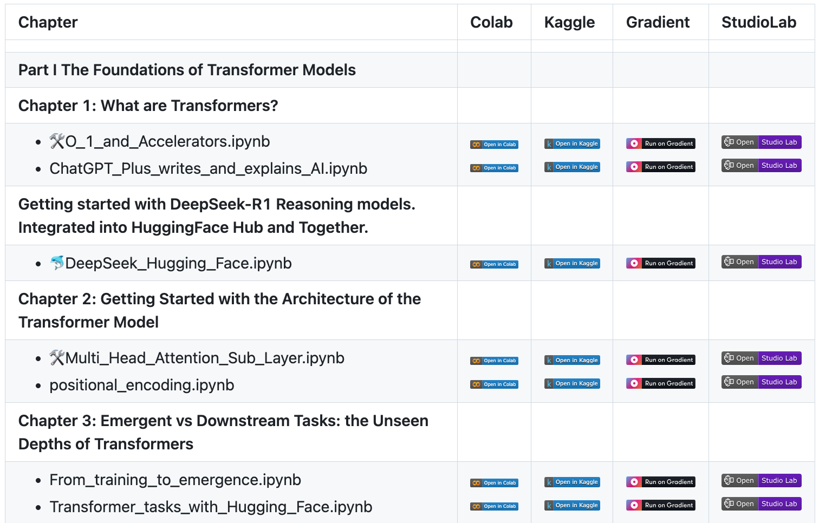
Denis Rothman (2024),
Transformers for Natural Language Processing and Computer Vision:
Explore Generative AI and Large Language Models with Hugging Face, ChatGPT, GPT-4V, and DALL-E 3,
3rd Edition, Packt Publishing
Source: https://github.com/Denis2054/Transformers-for-NLP-and-Computer-Vision-3rd-Edition

Slide 9
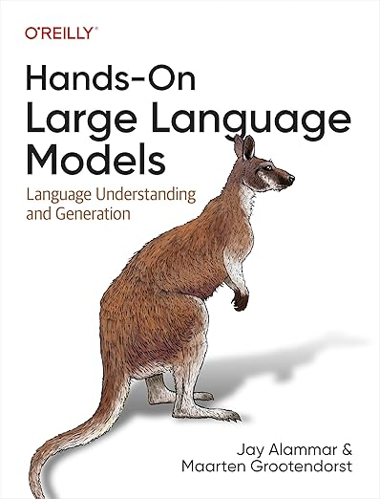
Jay Alammar and Maarten Grootendorst (2024),
Hands-On Large Language Models:
Language Understanding and Generation,
O'Reilly Media
Source: https://www.amazon.com/Hands-Large-Language-Models-Understanding/dp/1098150961/

Slide 10
Jay Alammar and Maarten Grootendorst (2024),
Hands-On Large Language Models:
Language Understanding and Generation,
O'Reilly Media
Chapter 1: Introduction to Language Models
Chapter 2: Tokens and Embeddings
Chapter 3: Looking Inside Transformer LLMs
Chapter 4: Text Classification
Chapter 5: Text Clustering and Topic Modeling
Chapter 6: Prompt Engineering
Chapter 7: Advanced Text Generation Techniques and Tools
Chapter 8: Semantic Search and Retrieval-Augmented Generation
Chapter 9: Multimodal Large Language Models
Chapter 10: Creating Text Embedding Models
Chapter 11: Fine-tuning Representation Models for Classification
Chapter 12: Fine-tuning Generation Models
Source: https://github.com/HandsOnLLM/Hands-On-Large-Language-Models

Slide 11


Generative AI
Large Language Models (LLMs)
Foundation Models

Slide 12
Generative AI
(Gen AI)
AI Generated Content (AIGC)

Slide 13

Generative AI (Gen AI)
AI Generated Content (AIGC)
Source: Yihan Cao, Siyu Li, Yixin Liu, Zhiling Yan, Yutong Dai, Philip S. Yu, and Lichao Sun (2023). "A Comprehensive Survey of AI-Generated Content (AIGC): A History of Generative AI from GAN to ChatGPT." arXiv preprint arXiv:2303.04226.

Slide 14

AI, ML, DL, Generative AI
Source: Jeong, Cheonsu. "A Study on the Implementation of Generative AI Services Using an Enterprise Data-Based LLM Application Architecture." arXiv preprint arXiv:2309.01105 (2023).

Slide 15
lmarena.ai Chatbot Arena Leaderboard
Rank* (UB) | Rank (StyleCtrl) | Model | Arena Score | 95% CI | Votes | Organization | License
1 | 1 | chocolate (Early Grok-3) | 1403 | +6/-6 | 9992 | xAI | Proprietary
2 | 3 | Gemini-2.0-Flash-Thinking-Exp-01-21 | 1385 | +4/-6 | 15083 | Google | Proprietary
2 | 3 | Gemini-2.0-Pro-Exp-02-05 | 1380 | +5/-6 | 13000 | Google | Proprietary
2 | 1 | ChatGPT-4o-latest (2025-01-29) | 1377 | +5/-5 | 13470 | OpenAI | Proprietary
5 | 3 | DeepSeek-R1 | 1362 | +7/-7 | 6581 | DeepSeek | MIT
5 | 8 | Gemini-2.0-Flash-001 | 1358 | +7/-7 | 10862 | Google | Proprietary
5 | 3 | o1-2024-12-17 | 1352 | +5/-5 | 17248 | OpenAI | Proprietary
8 | 7 | o1-preview | 1335 | +3/-4 | 33169 | OpenAI | Proprietary
8 | 8 | Qwen2.5-Max | 1334 | +5/-5 | 9282 | Alibaba | Proprietary
8 | 7 | o3-mini-high | 1332 | +5/-9 | 5954 | OpenAI | Proprietary
11 | 11 | DeepSeek-V3 | 1318 | +4/-5 | 19461 | DeepSeek | DeepSeek
11 | 13 | Qwen-Plus-0125 | 1311 | +9/-7 | 5112 | Alibaba | Proprietary
11 | 14 | GLM-4-Plus-0111 | 1310 | +6/-9 | 5134 | Zhipu | Proprietary
11 | 13 | Gemini-2.0-Flash-Lite-Preview-02-05 | 1309 | +6/-5 | 10262 | Google | Proprietary
12 | 12 | o3-mini | 1306 | +5/-6 | 12179 | OpenAI | Proprietary
https://huggingface.co/spaces/lmarena-ai/chatbot-arena-leaderboard

Slide 16
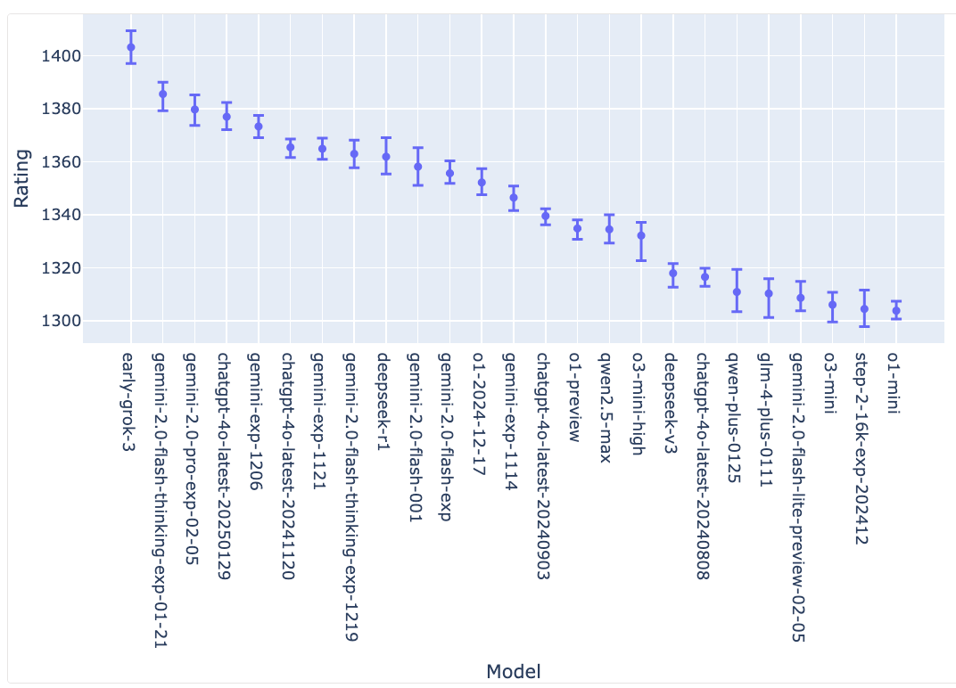
lmarena.ai Chatbot Arena Leaderboard
Confidence Intervals on Model Strength (via Bootstrapping)
https://huggingface.co/spaces/lmarena-ai/chatbot-arena-leaderboard

Slide 17

Transformer (Attention is All You Need)
(Vaswani et al., 2017)
Source: Vaswani, Ashish, Noam Shazeer, Niki Parmar, Jakob Uszkoreit, Llion Jones, Aidan N. Gomez, Łukasz Kaiser, and Illia Polosukhin. "Attention is all you need." In Advances in neural information processing systems, pp. 5998-6008. 2017.

Slide 18
Transformer (Attention is All You Need)
(Vaswani et al., 2017)
A Transformer is a type of deep learning model introduced in the paper "Attention Is All You Need" (Vaswani et al., 2017).
It revolutionized Natural Language Processing (NLP)
by replacing traditional sequence models
like RNNs and LSTMs with a self-attention mechanism that enables highly parallelizable training.
Source: Vaswani, Ashish, Noam Shazeer, Niki Parmar, Jakob Uszkoreit, Llion Jones, Aidan N. Gomez, Łukasz Kaiser, and Illia Polosukhin. "Attention is all you need." In Advances in neural information processing systems, pp. 5998-6008. 2017.

Slide 19
Transformer Models
Transformer
Encoder
Decoder
DistilBERT
BERT
T5
GPT
RoBERTa
BART
GPT-2
CTRL
XLM-R
XLM
M2M-100
GPT-3
ALBERT
BigBird
GPT-Neo
GPT-J
ELECTRA
mT0
BLOOM
BLOOMZ
DeBERTa
ChatGPT
GPT-4
Source: Lewis Tunstall, Leandro von Werra, and Thomas Wolf (2022), Natural Language Processing with Transformers: Building Language Applications with Hugging Face, O'Reilly Media.

Slide 20

BERT: Pre-training of Deep Bidirectional Transformers for Language Understanding
BERT (Bidirectional Encoder Representations from Transformers)
Overall pre-training and fine-tuning procedures for BERT
Source: Devlin, Jacob, Ming-Wei Chang, Kenton Lee, and Kristina Toutanova (2018).
"Bert: Pre-training of deep bidirectional transformers for language understanding." arXiv preprint arXiv:1810.04805.

Slide 21
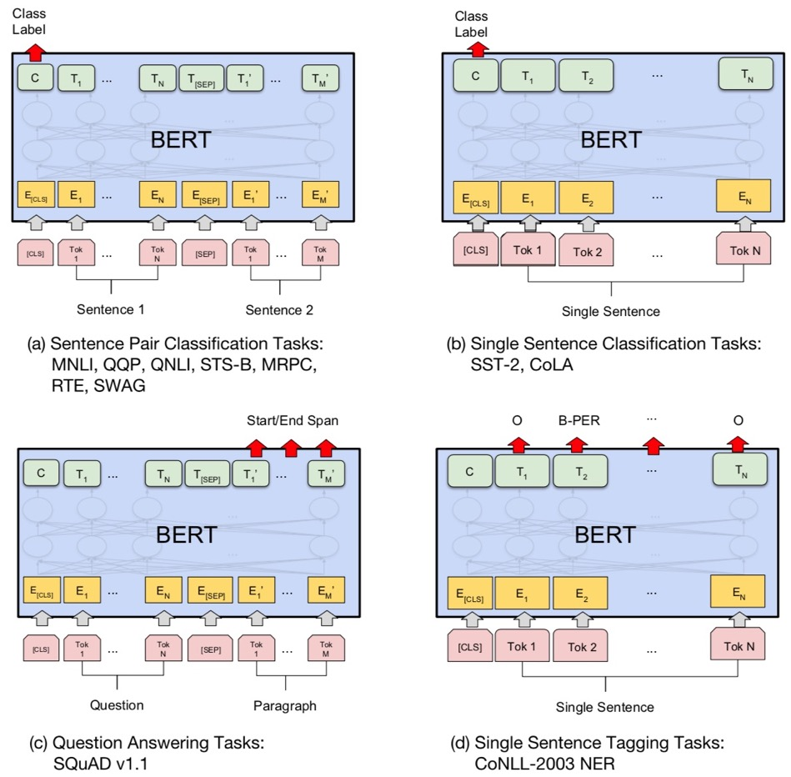
Fine-tuning BERT on Different Tasks
Source: Devlin, Jacob, Ming-Wei Chang, Kenton Lee, and Kristina Toutanova (2018).
"Bert: Pre-training of deep bidirectional transformers for language understanding." arXiv preprint arXiv:1810.04805.

Slide 22
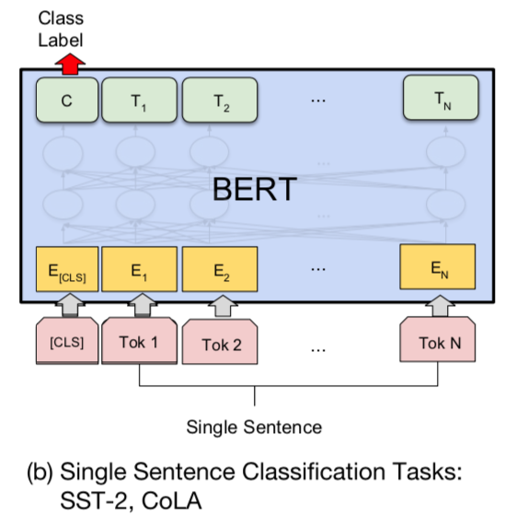
Sentiment Analysis:
Single Sentence Classification
Source: Devlin, Jacob, Ming-Wei Chang, Kenton Lee, and Kristina Toutanova (2018).
"BERT: Pre-training of Deep Bidirectional Transformers for Language Understanding." arXiv preprint arXiv:1810.04805

Slide 23
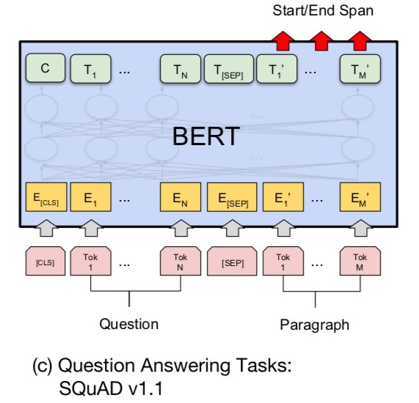
Fine-tuning BERT on
Question Answering (QA)
Source: Devlin, Jacob, Ming-Wei Chang, Kenton Lee, and Kristina Toutanova (2018).
"Bert: Pre-training of deep bidirectional transformers for language understanding." arXiv preprint arXiv:1810.04805.

Slide 24
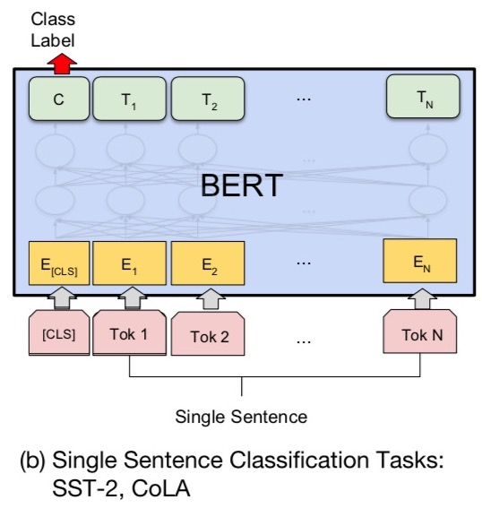
Fine-tuning BERT on Dialogue
Intent Detection (ID; Classification)
Source: Devlin, Jacob, Ming-Wei Chang, Kenton Lee, and Kristina Toutanova (2018).
"Bert: Pre-training of deep bidirectional transformers for language understanding." arXiv preprint arXiv:1810.04805.

Slide 25
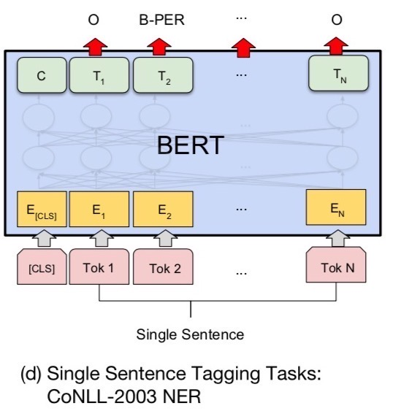
Fine-tuning BERT on Dialogue
Slot Filling (SF)
Source: Devlin, Jacob, Ming-Wei Chang, Kenton Lee, and Kristina Toutanova (2018).
"Bert: Pre-training of deep bidirectional transformers for language understanding." arXiv preprint arXiv:1810.04805.

Slide 26
Key Features of the Transformer Model
Self-Attention Mechanism: Allows the model to weigh the importance of different words in a sentence, regardless of their position.
Positional Encoding: Since Transformers don’t use recurrence (like RNNs), positional encodings are added to input embeddings to retain word order information.
Multi-Head Attention: The model attends to different words simultaneously in multiple ways, capturing various relationships.
Feed-Forward Layers: After attention, the output passes through dense layers for further transformation.
Layer Normalization & Residual Connections: Improve gradient flow and training stability.
Encoder-Decoder Architecture:
  Encoder: Processes input text and converts it into contextual embeddings.
  Decoder: Generates output text, often used in translation or text generation tasks.
Source: Denis Rothman (2024), Transformers for Natural Language Processing and Computer Vision: Explore Generative AI and Large Language Models with Hugging Face, ChatGPT, GPT-4V, and DALL-E 3, 3rd Edition, Packt Publishing

Slide 27
Popular Transformer-Based Models
BERT (Bidirectional Encoder Representations from Transformers)
  Used for tasks like classification and question answering.
GPT (Generative Pre-trained Transformer)
  Generates text based on input prompts.
T5 (Text-To-Text Transfer Transformer)
  Converts all NLP tasks into a text-to-text format.
ViT (Vision Transformer)
  Applies Transformer architecture to computer vision.
Source: Denis Rothman (2024), Transformers for Natural Language Processing and Computer Vision: Explore Generative AI and Large Language Models with Hugging Face, ChatGPT, GPT-4V, and DALL-E 3, 3rd Edition, Packt Publishing

Slide 28
Tokens in NLP (Text Processing)
Aspect | Description
Tokenization | Splitting text into meaningful units (words, subwords, or characters).
Subword Tokens | Methods like Byte Pair Encoding (BPE) and WordPiece break words into reusable subunits (e.g., "unhappiness" → ["un", "happiness"]).
Embeddings | Converts tokens into numerical vectors for processing.
Semantic Role Labeling (SRL) | Identifies sentence structure by assigning roles to tokens (e.g., subject, object).
Special Tokens | [CLS], [SEP]
Source: Denis Rothman (2024), Transformers for Natural Language Processing and Computer Vision: Explore Generative AI and Large Language Models with Hugging Face, ChatGPT, GPT-4V, and DALL-E 3, 3rd Edition, Packt Publishing

Slide 29
Tokens in CV (Image Processing)
Aspect | Description
Patch Tokens | Vision Transformers (ViT) split an image into small patches (e.g., 16x16 pixels), treating them as tokens.
Positional Encoding | Since images lack inherent sequence order like text, positional embeddings help ViTs understand spatial structure.
Midjourney API Tokens | Midjourney’s AI processes text prompts into image tokens, converting descriptions into AI-generated art.
CLIP Tokens | OpenAI’s CLIP model tokenizes both text and images, allowing cross-modal understanding (e.g., “dog” matches a picture of a dog).
Source: Denis Rothman (2024), Transformers for Natural Language Processing and Computer Vision: Explore Generative AI and Large Language Models with Hugging Face, ChatGPT, GPT-4V, and DALL-E 3, 3rd Edition, Packt Publishing

Slide 30
Tokens in NLP vs CV
Feature | NLP Tokens | CV Tokens
Basic Unit | Words, subwords, or characters | Image patches (e.g., 16×16 pixel grids)
Processing | Tokenized using BPE, WordPiece, SentencePiece | Tokenized as patch embeddings
Positional Encoding? | Needed to retain word order | Needed to retain spatial information
Example Models | BERT, GPT, T5, RAG | ViT, DINOv2, CLIP
Use Case | Text-based tasks (chatbots, summarization, RAG) | Vision-based tasks (image classification, AI art generation)
Source: Denis Rothman (2024), Transformers for Natural Language Processing and Computer Vision: Explore Generative AI and Large Language Models with Hugging Face, ChatGPT, GPT-4V, and DALL-E 3, 3rd Edition, Packt Publishing

Slide 31
Attention in NLP (Text Processing)
Aspect | Description
Self-Attention | Each token attends to every other token in a sentence, capturing dependencies across long text sequences.
Scaled Dot-Product Attention | Computes attention scores using query (Q), key (K), and value (V) vectors.
Multi-Head Attention (MHA) | Improves attention by using multiple attention heads that learn different relationships.
Causal Attention (Decoder-Only Models) | Restricts attention to past tokens only, enabling text generation without looking ahead.
Cross-Attention | The decoder attends to encoder outputs in seq-to-seq tasks like translation (e.g., T5, BART).
Retrieval-Augmented Attention | Fetches external knowledge before generating a response (RAG models).
Source: Denis Rothman (2024), Transformers for Natural Language Processing and Computer Vision: Explore Generative AI and Large Language Models with Hugging Face, ChatGPT, GPT-4V, and DALL-E 3, 3rd Edition, Packt Publishing

Slide 32
Attention in CV (Vision Processing)
Aspect | Description
Self-Attention in ViTs | Treats images as a sequence of patches (like words in text) and applies attention to learn spatial relationships.
Multi-Head Attention in ViTs | Similar to NLP, multiple attention heads capture different visual features.
Positional Encoding in Vision | Since images lack inherent order, positional embeddings help maintain spatial structure.
Cross-Attention in Multimodal AI | Used in models like CLIP and Midjourney, where text descriptions attend to visual features.
Attention Maps in Vision | Heatmaps showing which image regions the model focuses on (e.g., for explainability).
Source: Denis Rothman (2024), Transformers for Natural Language Processing and Computer Vision: Explore Generative AI and Large Language Models with Hugging Face, ChatGPT, GPT-4V, and DALL-E 3, 3rd Edition, Packt Publishing

Slide 33
Attention in NLP vs CV
Feature | NLP Attention (Text) | CV Attention (Images)
Input Format | Tokenized text sequences | Image patches
Basic Unit | Words/subwords | Pixels/patches
Role of Attention | Captures long-range dependencies | Learns spatial & contextual relationships
Sequential Processing? | No, operates on full input (parallelizable) | No, processes patches like text
Model Examples | BERT, GPT, T5, RAG | ViT, CLIP, Midjourney
Source: Denis Rothman (2024), Transformers for Natural Language Processing and Computer Vision: Explore Generative AI and Large Language Models with Hugging Face, ChatGPT, GPT-4V, and DALL-E 3, 3rd Edition, Packt Publishing

Slide 34
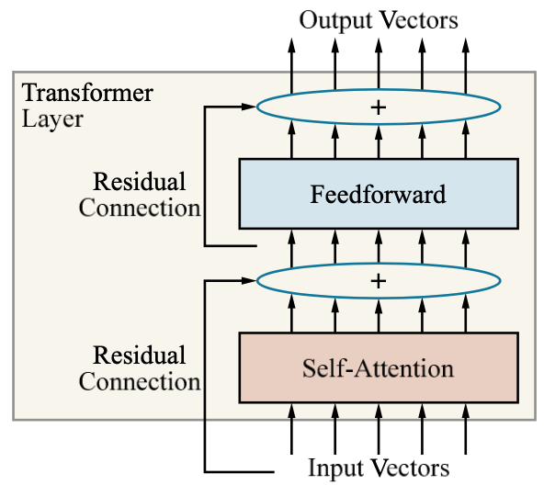
Single-layer Transformer consists of self-attention, a feedforward network, and residual connection
Source: Stuart Russell and Peter Norvig (2020), Artificial Intelligence: A Modern Approach, 4th Edition, Pearson

Slide 35
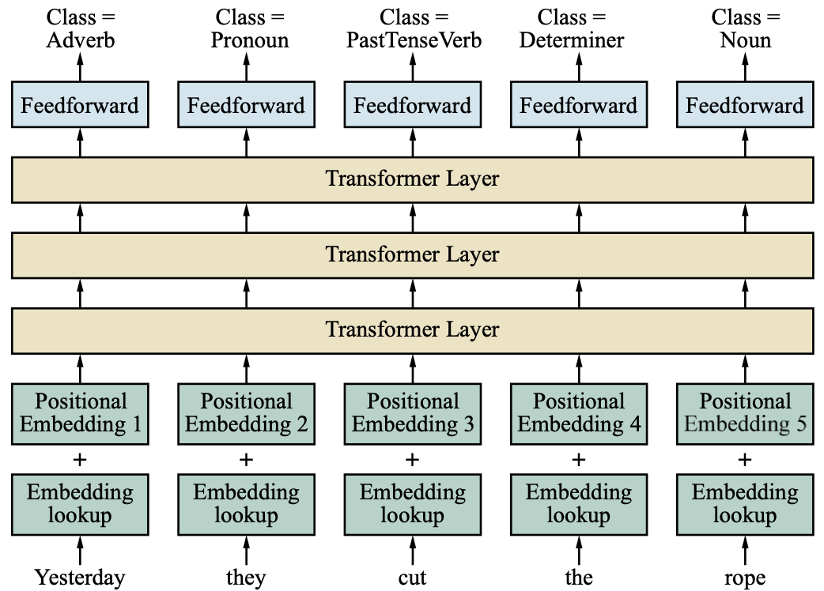
Transformer Architecture for POS Tagging
Source: Stuart Russell and Peter Norvig (2020), Artificial Intelligence: A Modern Approach, 4th Edition, Pearson

Slide 36
Transformer (Attention is All You Need)
(Vaswani et al., 2017)
Source: Vaswani, Ashish, Noam Shazeer, Niki Parmar, Jakob Uszkoreit, Llion Jones, Aidan N. Gomez, Łukasz Kaiser, and Illia Polosukhin. "Attention is all you need." In Advances in neural information processing systems, pp. 5998-6008. 2017.

Slide 37
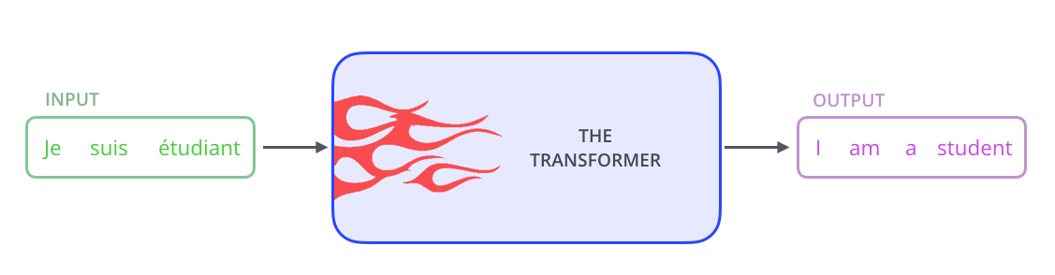
Transformer
Source: Jay Alammar (2019), The Illustrated Transformer, http://jalammar.github.io/illustrated-transformer/

Slide 38
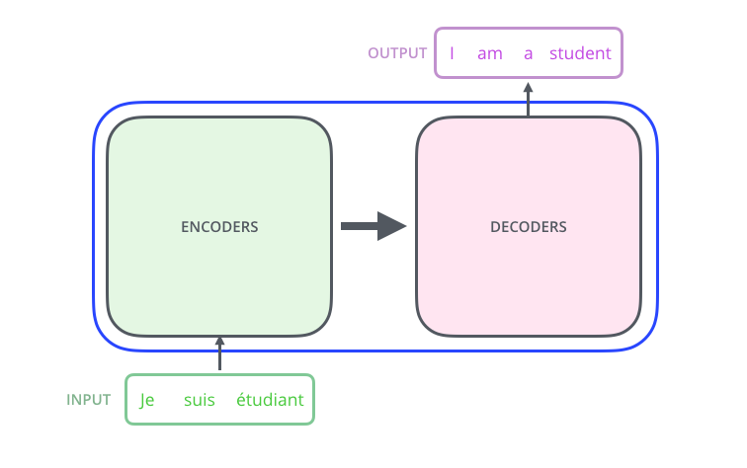
Transformer
Encoder Decoder
Source: Jay Alammar (2019), The Illustrated Transformer, http://jalammar.github.io/illustrated-transformer/

Slide 39
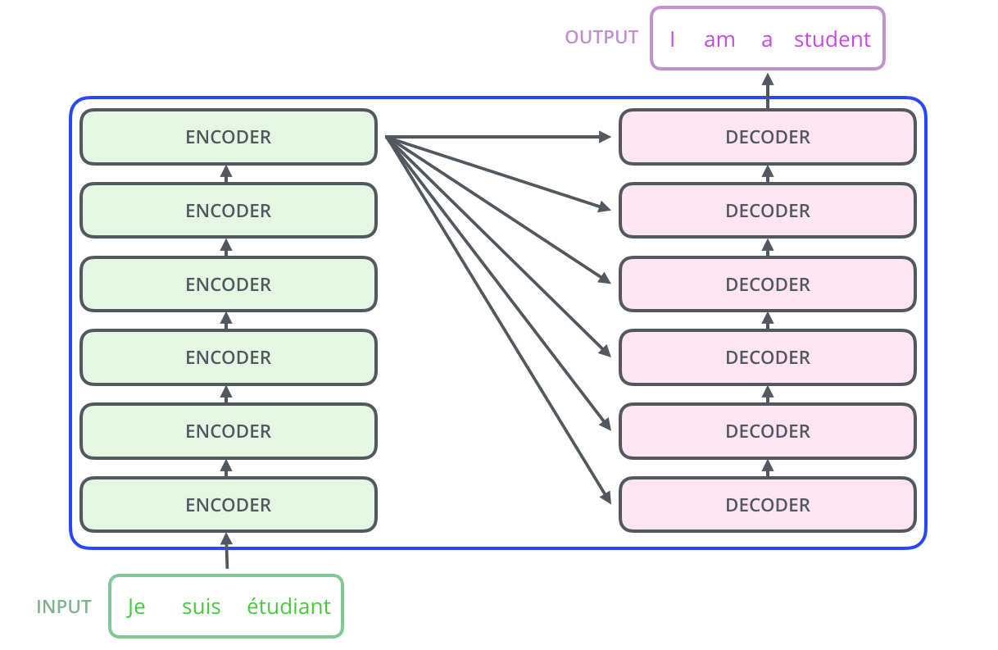
Transformer
Encoder Decoder Stack
Source: Jay Alammar (2019), The Illustrated Transformer, http://jalammar.github.io/illustrated-transformer/

Slide 40
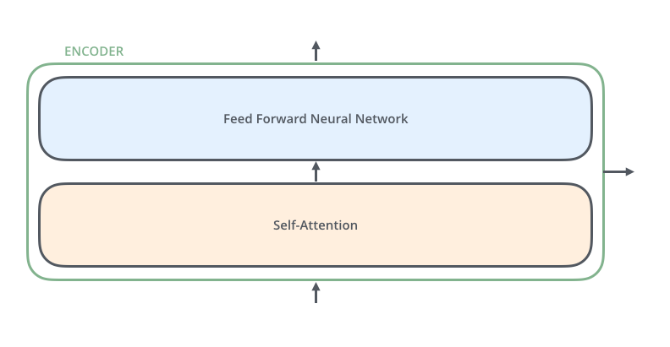
Transformer
Encoder Self-Attention
Source: Jay Alammar (2019), The Illustrated Transformer, http://jalammar.github.io/illustrated-transformer/

Slide 41
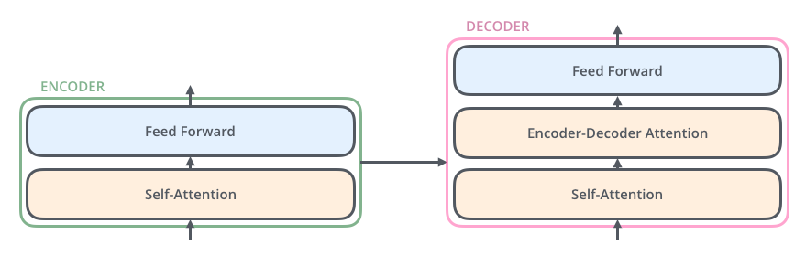
Transformer
Decoder
Source: Jay Alammar (2019), The Illustrated Transformer, http://jalammar.github.io/illustrated-transformer/

Slide 42
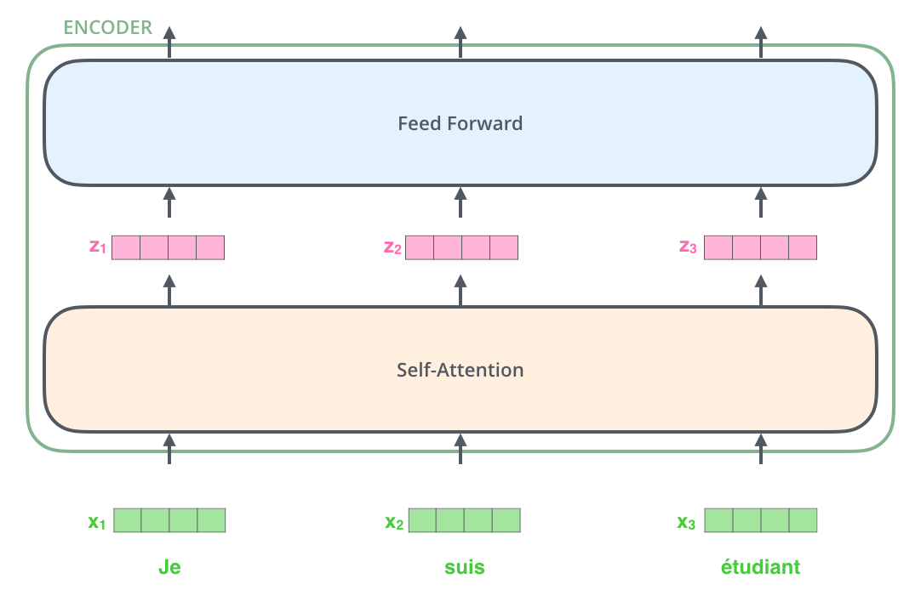
Transformer
Encoder with Tensors
Word Embeddings
Source: Jay Alammar (2019), The Illustrated Transformer, http://jalammar.github.io/illustrated-transformer/

Slide 43
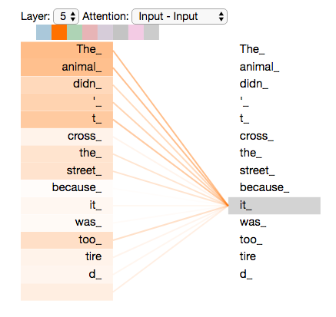
Transformer
Self-Attention Visualization
Source: Jay Alammar (2019), The Illustrated Transformer, http://jalammar.github.io/illustrated-transformer/

Slide 44
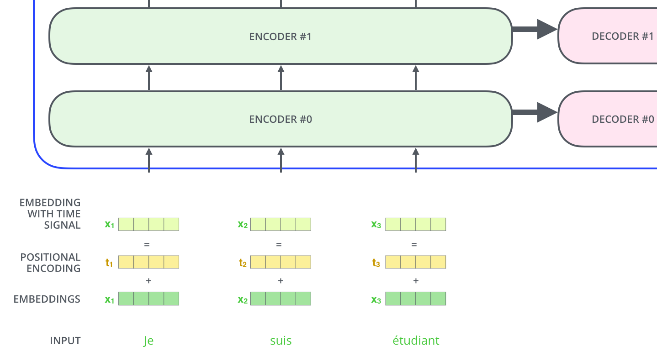
Transformer
Positional Encoding Vectors
Source: Jay Alammar (2019), The Illustrated Transformer, http://jalammar.github.io/illustrated-transformer/

Slide 45
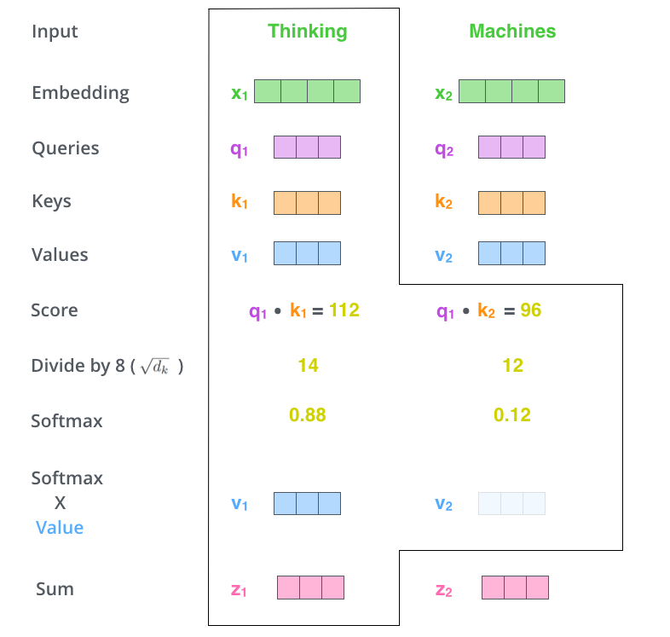
Transformer
Self-Attention Softmax Output
Source: Jay Alammar (2019), The Illustrated Transformer, http://jalammar.github.io/illustrated-transformer/

Slide 46
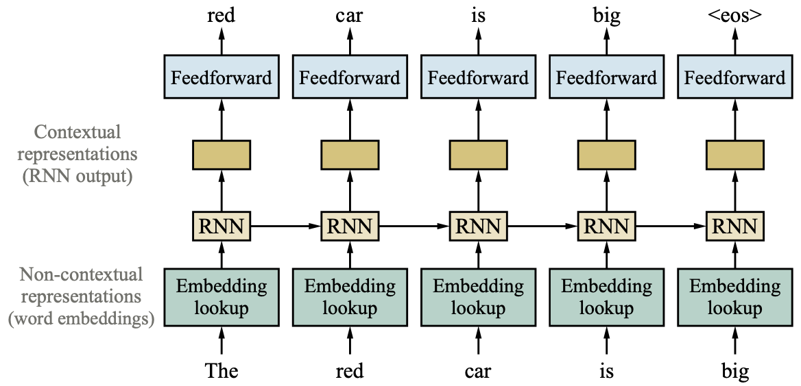
Training Contextual Representations using a left-to-right Language Model
Source: Stuart Russell and Peter Norvig (2020), Artificial Intelligence: A Modern Approach, 4th Edition, Pearson

Slide 47
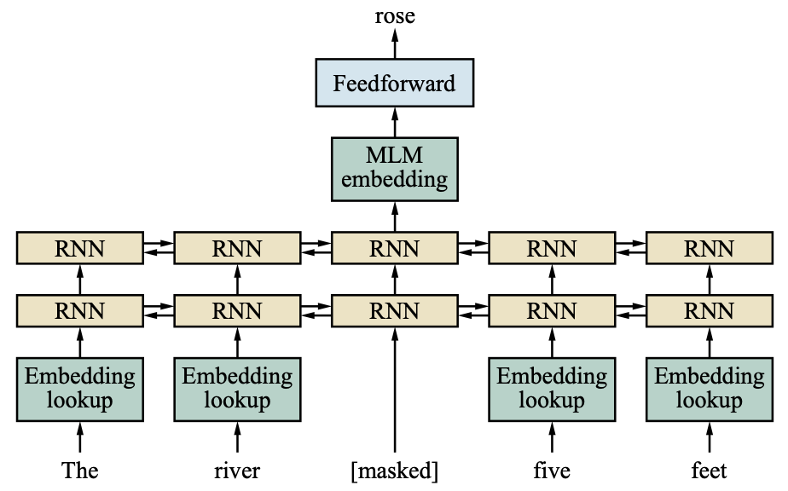
Masked Language Modeling:
Pretrain a Bidirectional Model
Source: Stuart Russell and Peter Norvig (2020), Artificial Intelligence: A Modern Approach, 4th Edition, Pearson

Slide 48
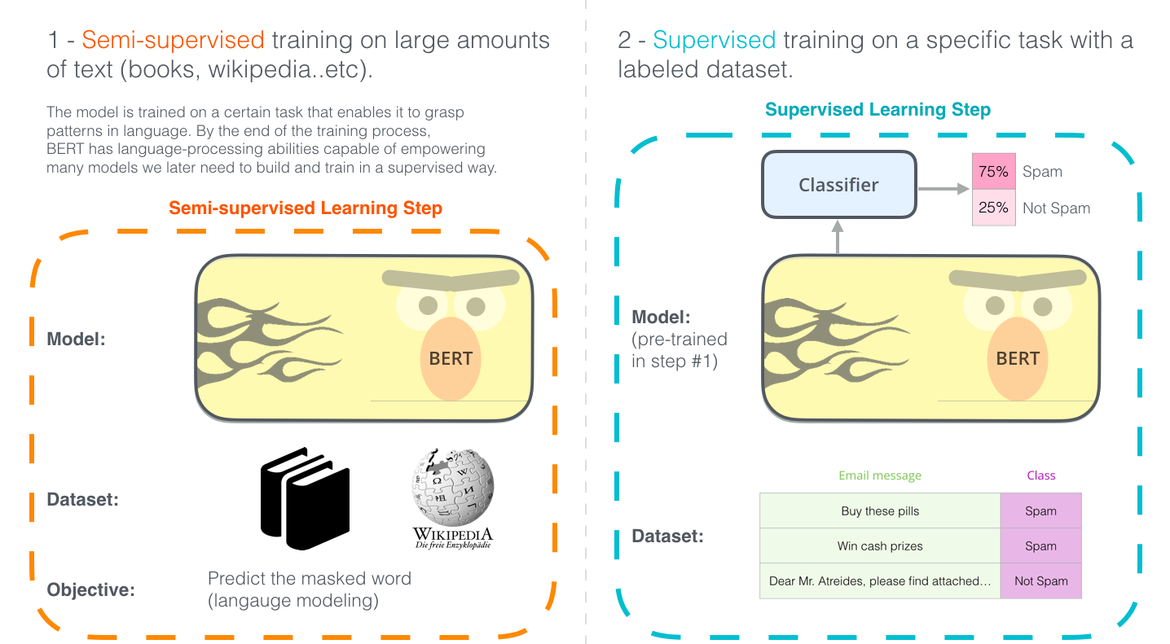
Illustrated BERT
Source: Jay Alammar (2019), The Illustrated BERT, ELMo, and co. (How NLP Cracked Transfer Learning), http://jalammar.github.io/illustrated-bert/

Slide 49
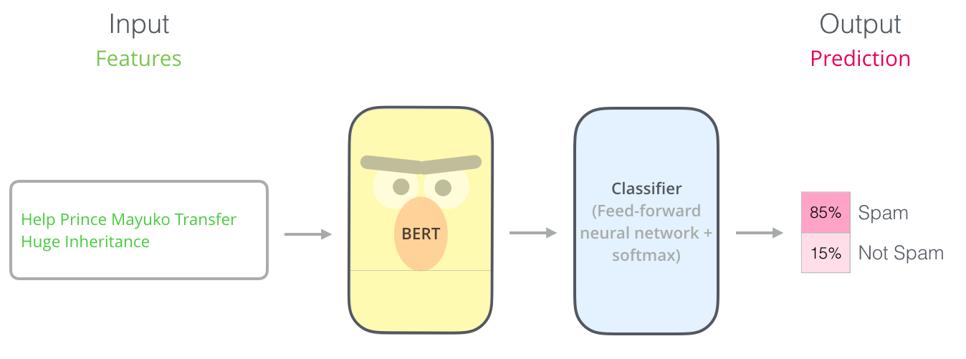
BERT Classification Input Output
Source: Jay Alammar (2019), The Illustrated BERT, ELMo, and co. (How NLP Cracked Transfer Learning), http://jalammar.github.io/illustrated-bert/

Slide 50
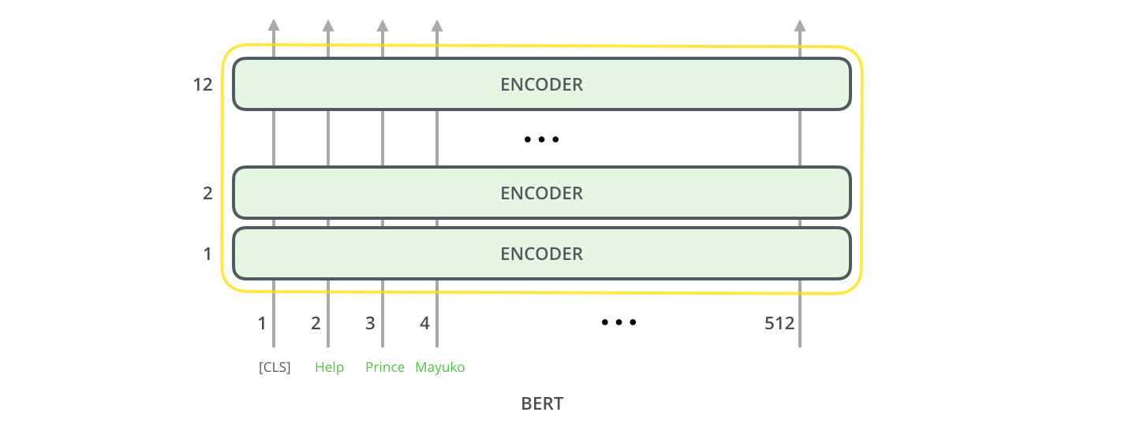
BERT Encoder Input
Source: Jay Alammar (2019), The Illustrated BERT, ELMo, and co. (How NLP Cracked Transfer Learning), http://jalammar.github.io/illustrated-bert/

Slide 51
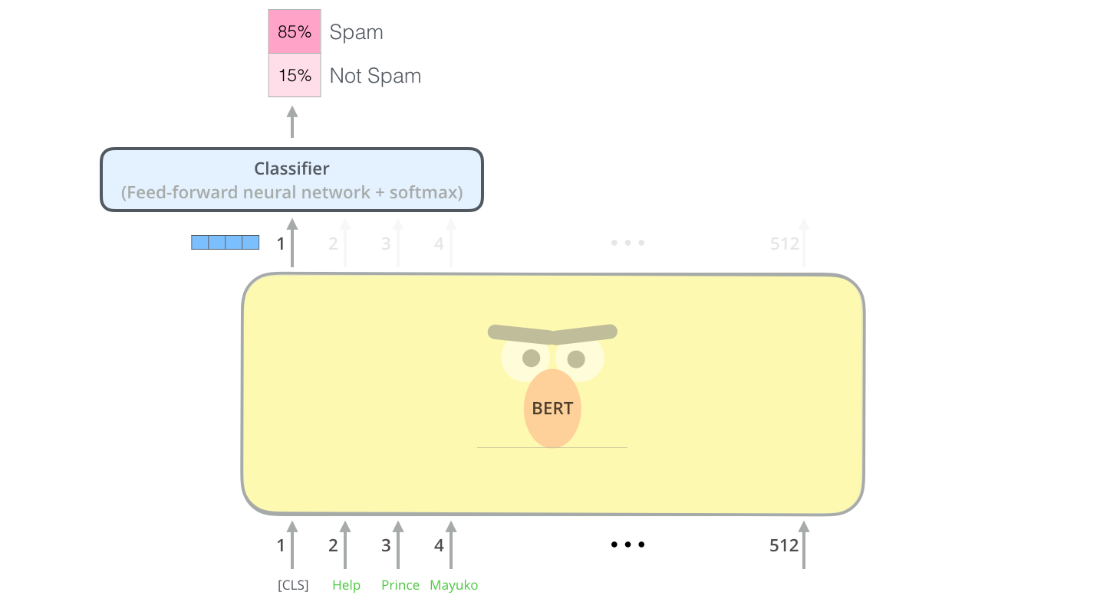
BERT Classifier
Source: Jay Alammar (2019), The Illustrated BERT, ELMo, and co. (How NLP Cracked Transfer Learning), http://jalammar.github.io/illustrated-bert/

Slide 52
Sentiment Analysis:
Single Sentence Classification
Source: Devlin, Jacob, Ming-Wei Chang, Kenton Lee, and Kristina Toutanova (2018).
"BERT: Pre-training of Deep Bidirectional Transformers for Language Understanding." arXiv preprint arXiv:1810.04805

Slide 53
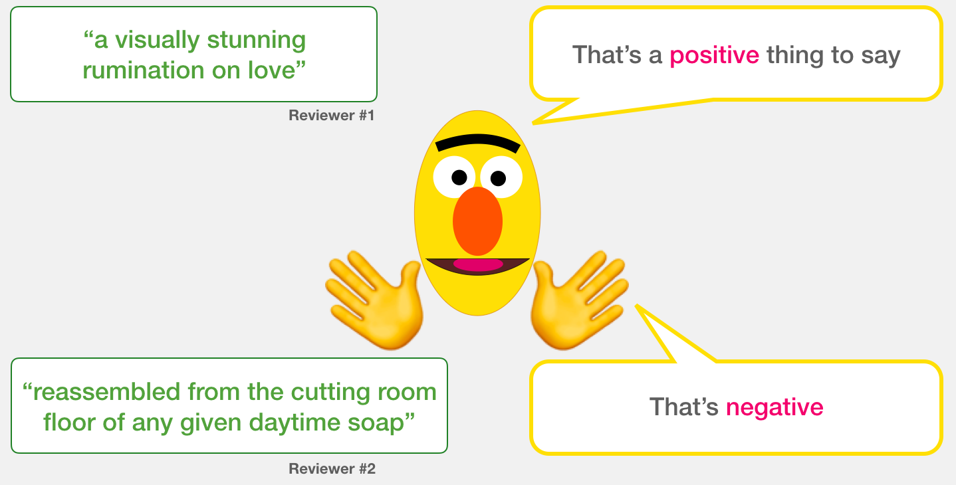
A Visual Guide to
Using BERT for the First Time
(Jay Alammar, 2019)
Source: Jay Alammar (2019), A Visual Guide to Using BERT for the First Time,
http://jalammar.github.io/a-visual-guide-to-using-bert-for-the-first-time/

Slide 54
Sentiment Classification: SST2
Sentences from movie reviews
sentence | label
a stirring , funny and finally transporting re imagining of beauty and the beast and 1930s horror films | 1
apparently reassembled from the cutting room floor of any given daytime soap | 0
they presume their audience won't sit still for a sociology lesson | 0
this is a visually stunning rumination on love , memory , history and the war between art and commerce | 1
jonathan parker 's bartleby should have been the be all end all of the modern office anomie films | 1
Source: Jay Alammar (2019), A Visual Guide to Using BERT for the First Time,
http://jalammar.github.io/a-visual-guide-to-using-bert-for-the-first-time/

Slide 55
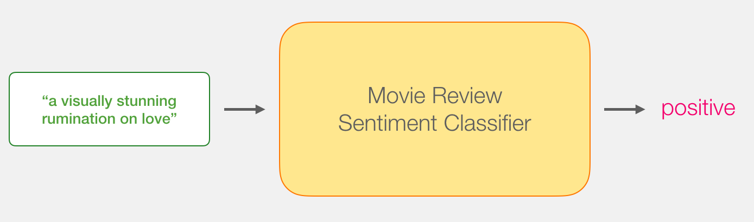
Movie Review Sentiment Classifier
Source: Jay Alammar (2019), A Visual Guide to Using BERT for the First Time,
http://jalammar.github.io/a-visual-guide-to-using-bert-for-the-first-time/

Slide 56
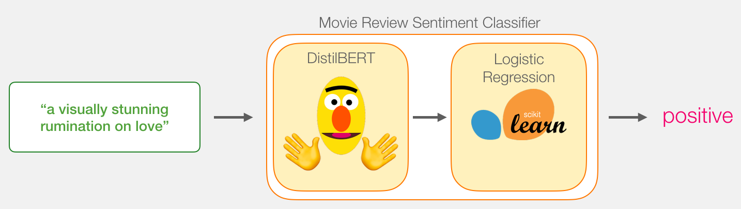
Movie Review Sentiment Classifier
Source: Jay Alammar (2019), A Visual Guide to Using BERT for the First Time,
http://jalammar.github.io/a-visual-guide-to-using-bert-for-the-first-time/

Slide 57
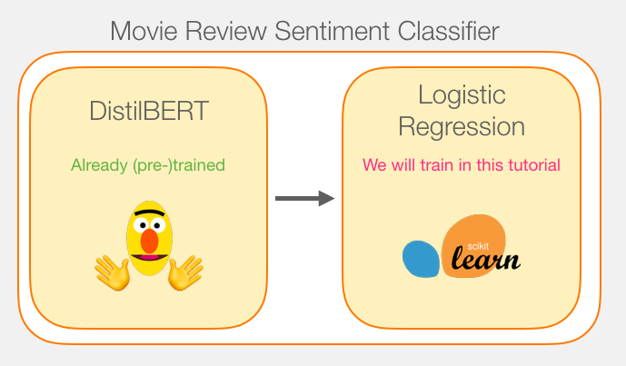
Movie Review Sentiment Classifier
Model Training
Source: Jay Alammar (2019), A Visual Guide to Using BERT for the First Time,
http://jalammar.github.io/a-visual-guide-to-using-bert-for-the-first-time/

Slide 58
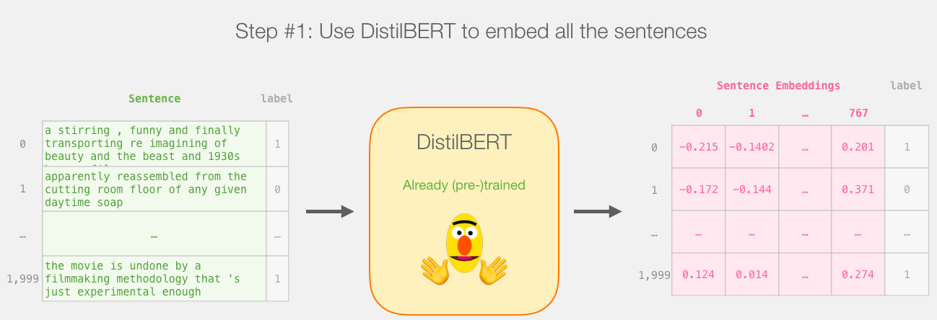
Step # 1 Use distilBERT to Generate Sentence Embeddings
Source: Jay Alammar (2019), A Visual Guide to Using BERT for the First Time,
http://jalammar.github.io/a-visual-guide-to-using-bert-for-the-first-time/

Slide 59
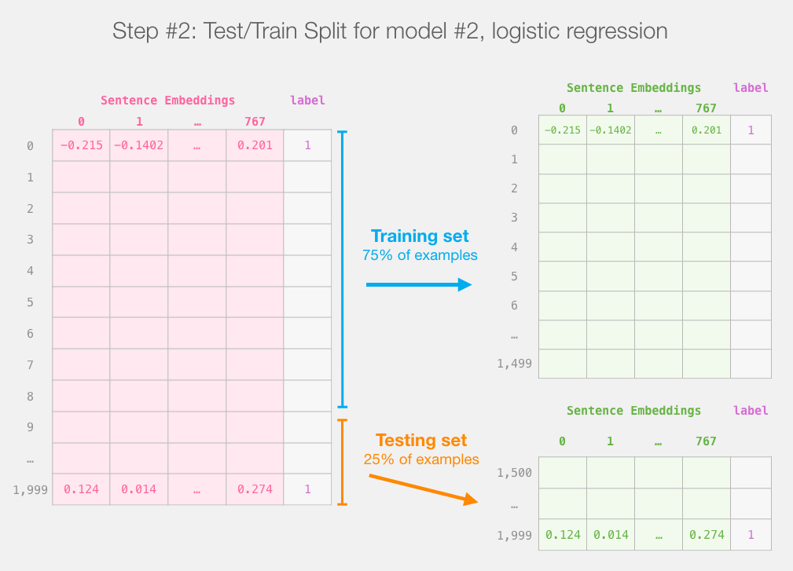
Step #2:Test/Train Split for
Model #2, Logistic Regression
Source: Jay Alammar (2019), A Visual Guide to Using BERT for the First Time,
http://jalammar.github.io/a-visual-guide-to-using-bert-for-the-first-time/

Slide 60
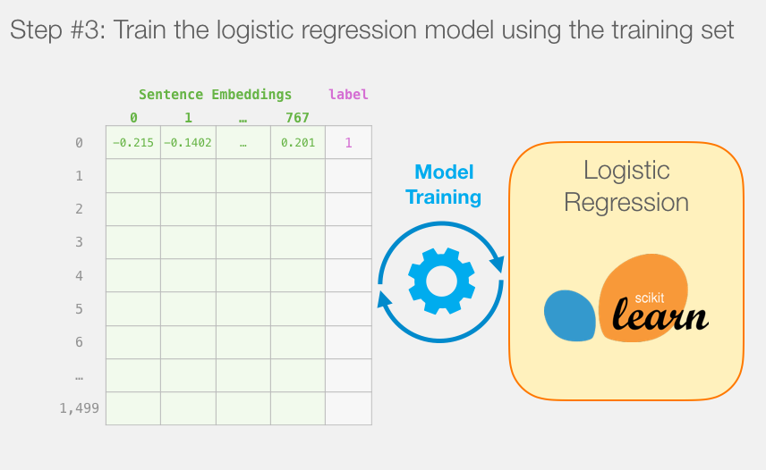
Step #3 Train the logistic regression model using the training set
Source: Jay Alammar (2019), A Visual Guide to Using BERT for the First Time,
http://jalammar.github.io/a-visual-guide-to-using-bert-for-the-first-time/

Slide 61
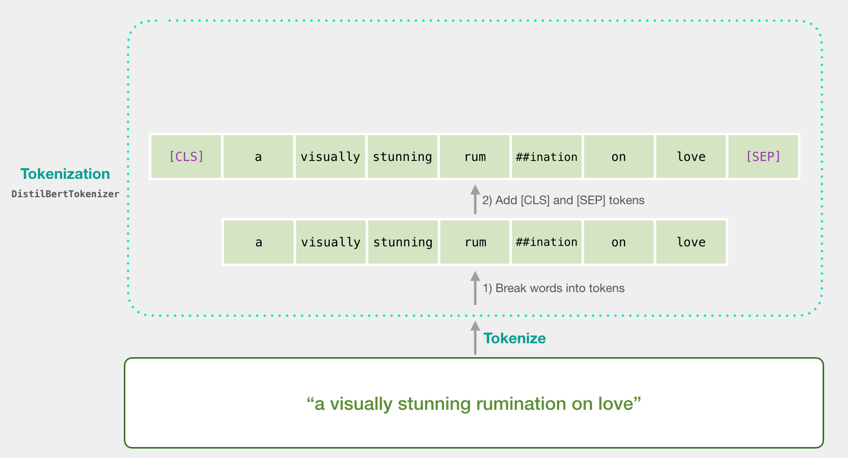
Tokenization
[CLS] a visually stunning rum ##ination on love [SEP]
a visually stunning rumination on love
Source: Jay Alammar (2019), A Visual Guide to Using BERT for the First Time,
http://jalammar.github.io/a-visual-guide-to-using-bert-for-the-first-time/

Slide 62
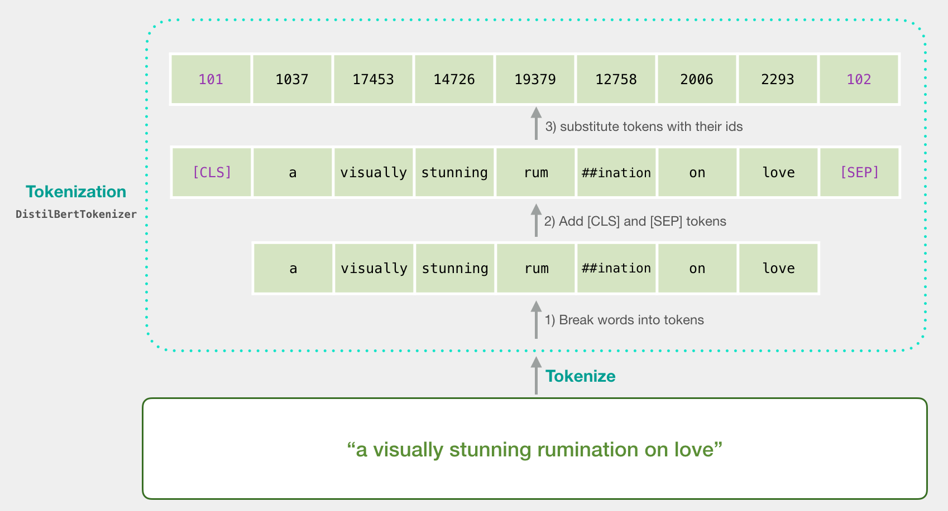
Tokenization
tokenizer.encode("a visually stunning rumination on love", add_special_tokens=True)
Source: Jay Alammar (2019), A Visual Guide to Using BERT for the First Time,
http://jalammar.github.io/a-visual-guide-to-using-bert-for-the-first-time/

Slide 63
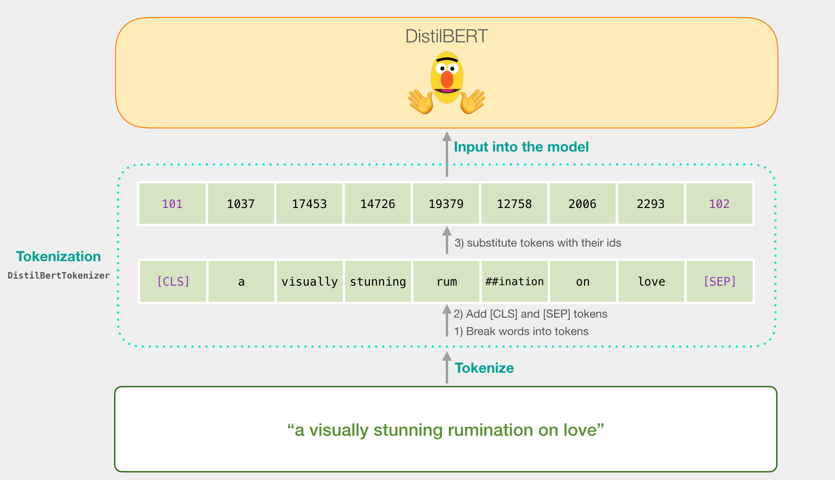
Tokenization for BERT Model
Source: Jay Alammar (2019), A Visual Guide to Using BERT for the First Time,
http://jalammar.github.io/a-visual-guide-to-using-bert-for-the-first-time/

Slide 64
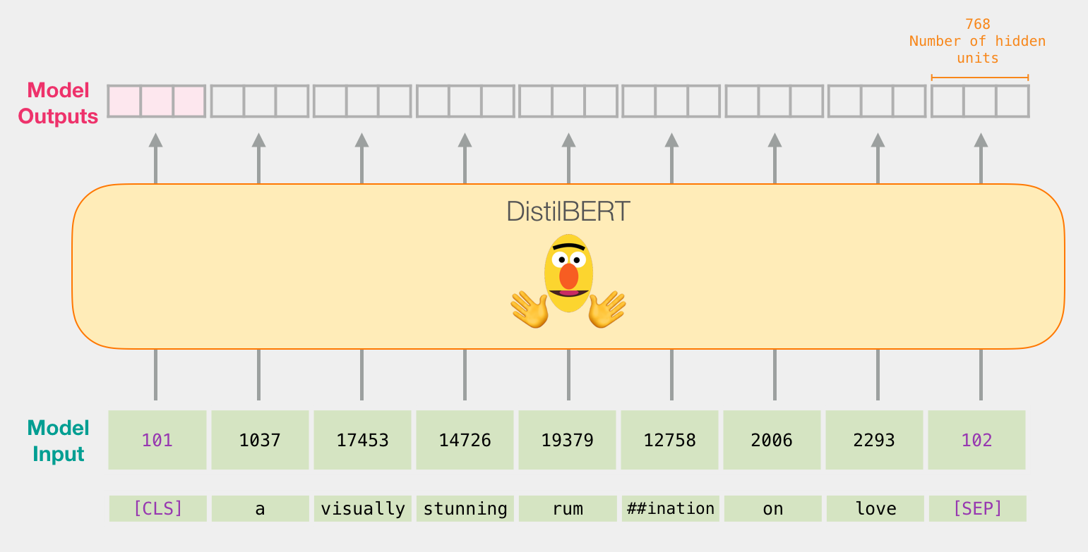
Flowing Through DistilBERT
(768 features)
Source: Jay Alammar (2019), A Visual Guide to Using BERT for the First Time,
http://jalammar.github.io/a-visual-guide-to-using-bert-for-the-first-time/

Slide 65
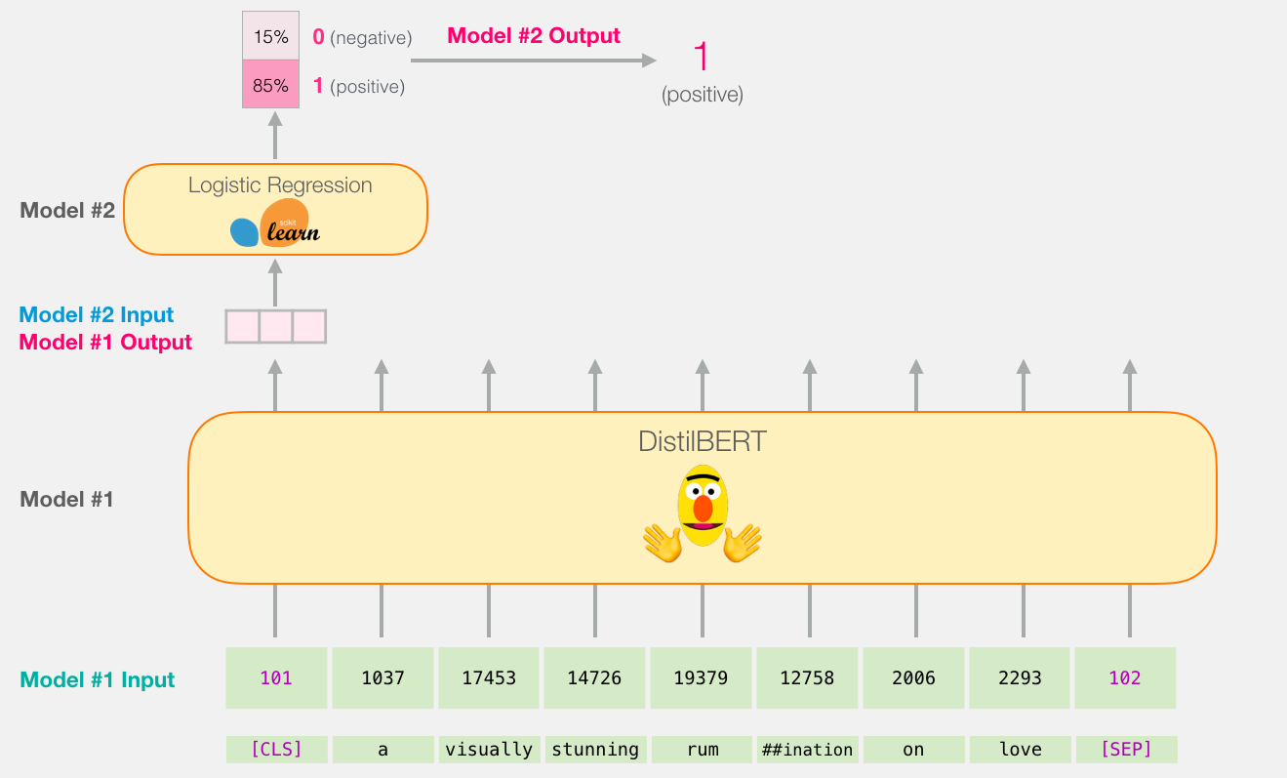
Model #1 Output Class vector as
Model #2 Input
Source: Jay Alammar (2019), A Visual Guide to Using BERT for the First Time,
http://jalammar.github.io/a-visual-guide-to-using-bert-for-the-first-time/

Slide 66
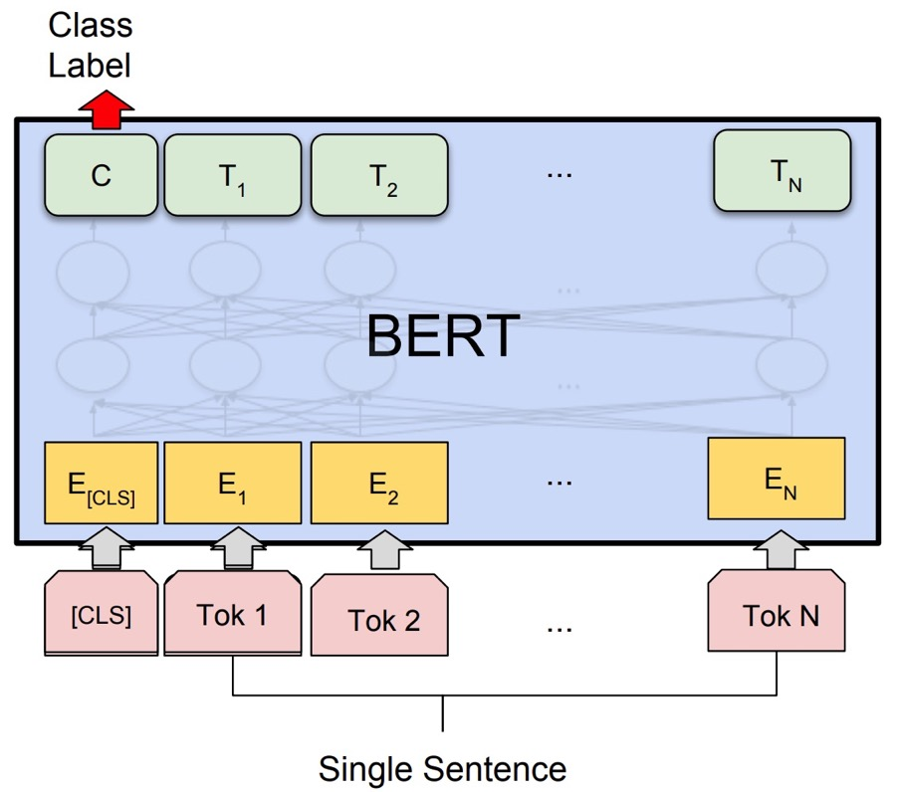
Fine-tuning BERT on
Single Sentence Classification Tasks
Source: Devlin, Jacob, Ming-Wei Chang, Kenton Lee, and Kristina Toutanova (2018).
"Bert: Pre-training of deep bidirectional transformers for language understanding." arXiv preprint arXiv:1810.04805.

Slide 67
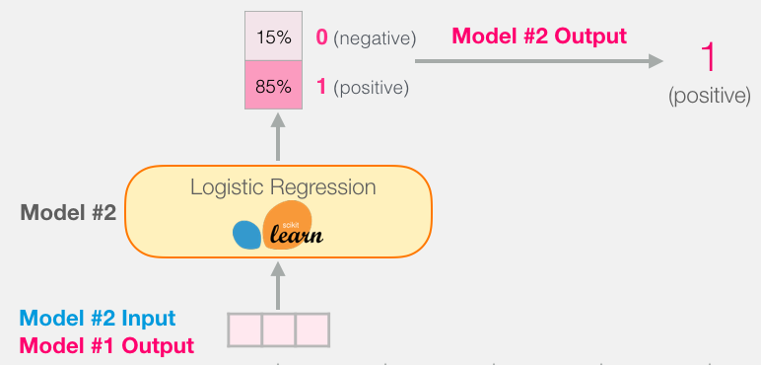
Model #1 Output Class vector as
Model #2 Input
Source: Jay Alammar (2019), A Visual Guide to Using BERT for the First Time,
http://jalammar.github.io/a-visual-guide-to-using-bert-for-the-first-time/

Slide 68
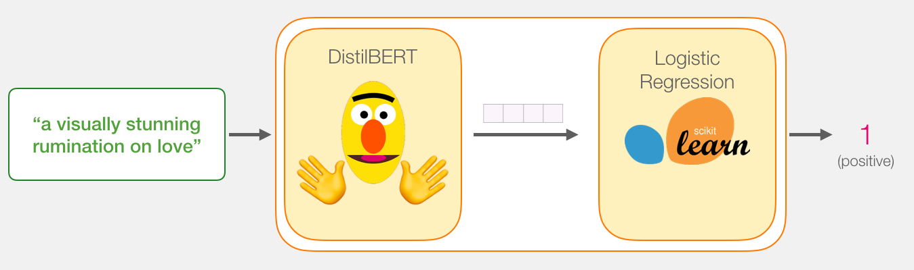
Logistic Regression Model to classify Class vector
Source: Jay Alammar (2019), A Visual Guide to Using BERT for the First Time,
http://jalammar.github.io/a-visual-guide-to-using-bert-for-the-first-time/

Slide 69
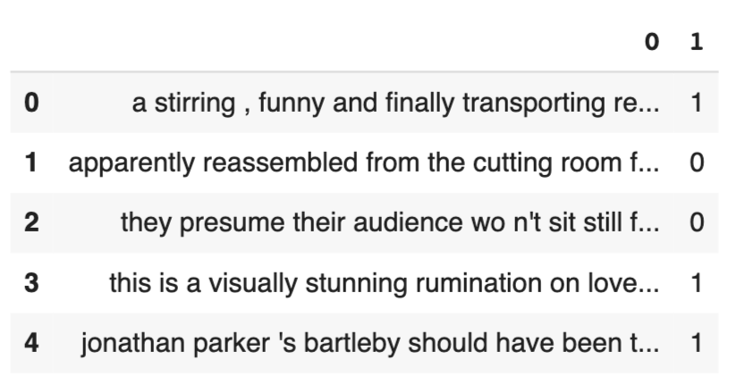
df = pd.read_csv('https://github.com/clairett/pytorch-sentiment-classification/raw/master/data/SST2/train.tsv', delimiter='\t', header=None)
df.head()
Source: Jay Alammar (2019), A Visual Guide to Using BERT for the First Time,
http://jalammar.github.io/a-visual-guide-to-using-bert-for-the-first-time/

Slide 70
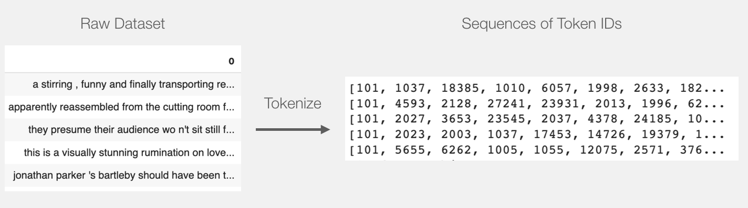
Tokenization
tokenized = df[0].apply((lambda x: tokenizer.encode(x, add_special_tokens=True)))
Source: Jay Alammar (2019), A Visual Guide to Using BERT for the First Time,
http://jalammar.github.io/a-visual-guide-to-using-bert-for-the-first-time/

Slide 71
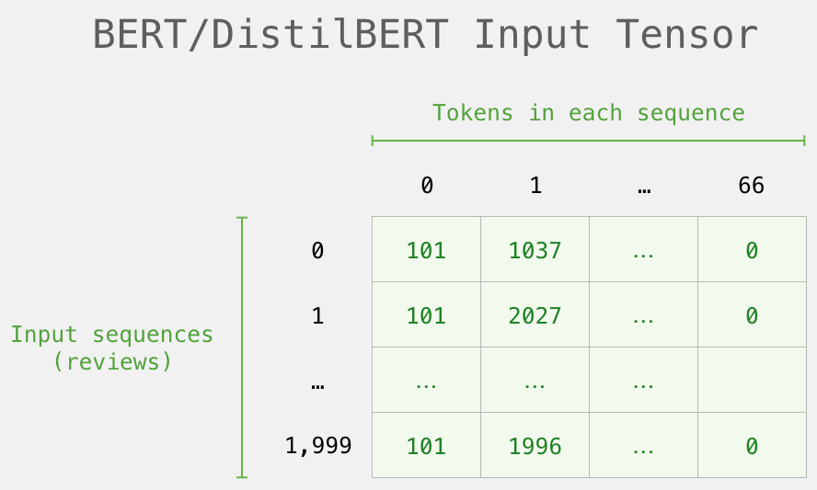
BERT Input Tensor
Source: Jay Alammar (2019), A Visual Guide to Using BERT for the First Time,
http://jalammar.github.io/a-visual-guide-to-using-bert-for-the-first-time/

Slide 72
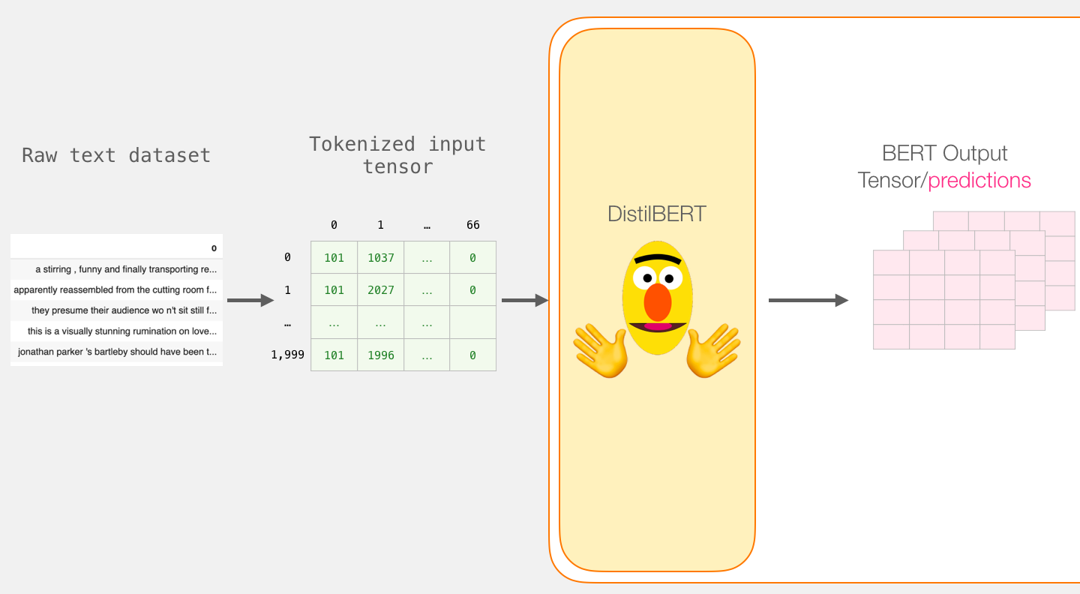
Processing with DistilBERT
input_ids = torch.tensor(np.array(padded))
last_hidden_states = model(input_ids)
Source: Jay Alammar (2019), A Visual Guide to Using BERT for the First Time,
http://jalammar.github.io/a-visual-guide-to-using-bert-for-the-first-time/

Slide 73
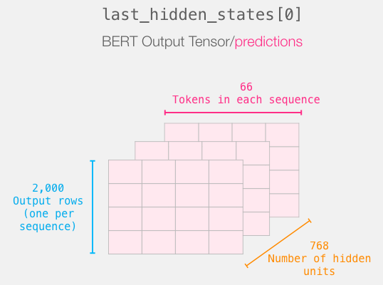
Unpacking the BERT output tensor
Source: Jay Alammar (2019), A Visual Guide to Using BERT for the First Time,
http://jalammar.github.io/a-visual-guide-to-using-bert-for-the-first-time/

Slide 74
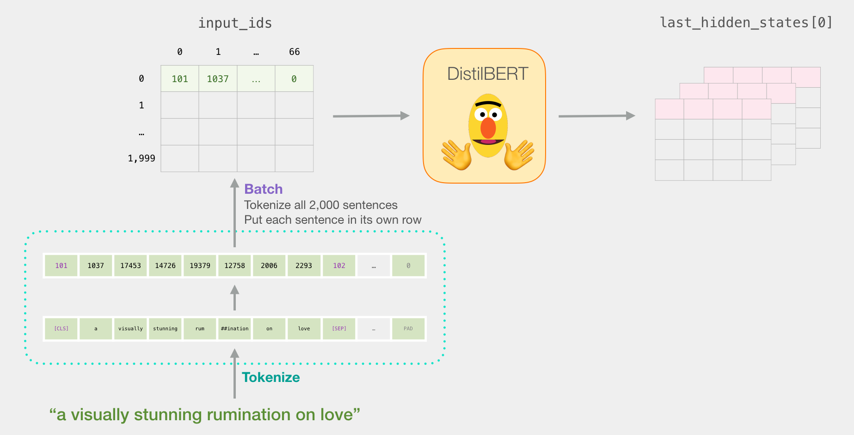
Sentence to last_hidden_state[0]
Source: Jay Alammar (2019), A Visual Guide to Using BERT for the First Time,
http://jalammar.github.io/a-visual-guide-to-using-bert-for-the-first-time/

Slide 75
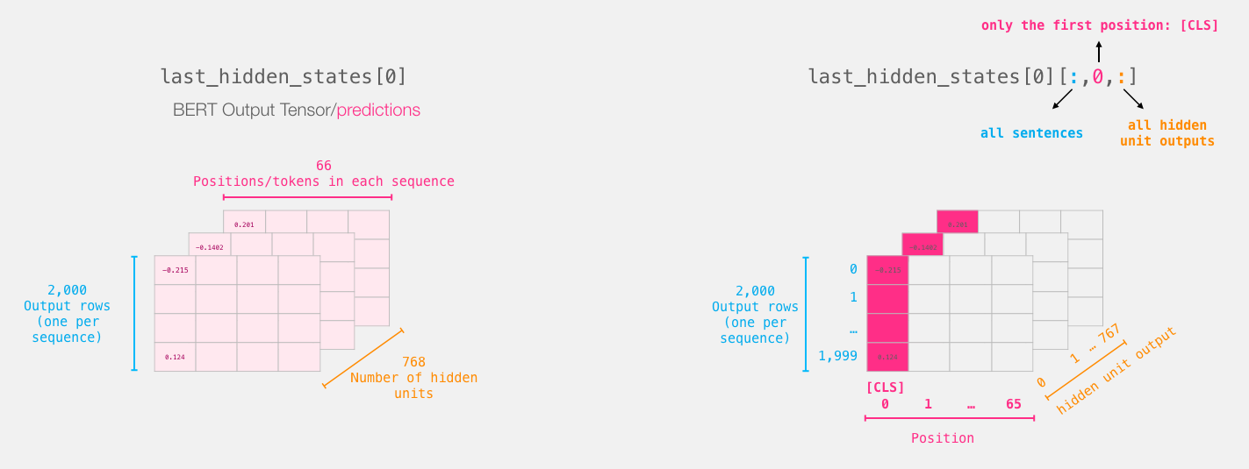
BERT’s output for the [CLS] tokens
# Slice the output for the first position for all the sequences, take all hidden unit outputs
features = last_hidden_states[0][:,0,:].numpy()
Source: Jay Alammar (2019), A Visual Guide to Using BERT for the First Time,
http://jalammar.github.io/a-visual-guide-to-using-bert-for-the-first-time/

Slide 76
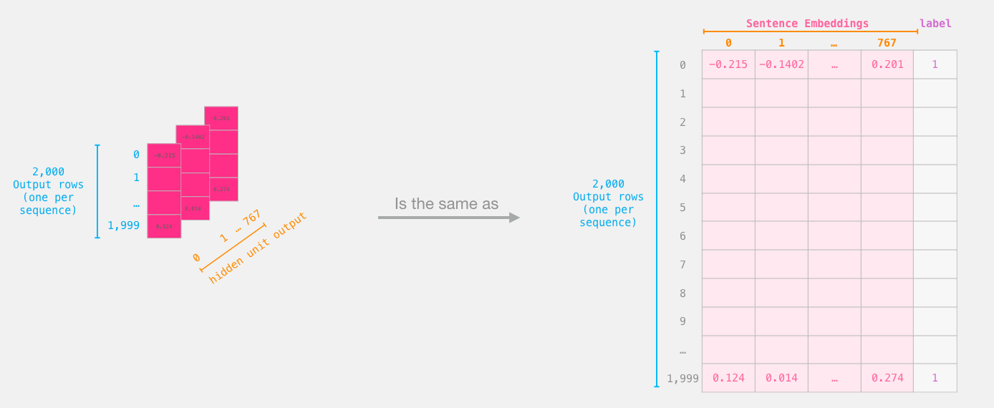
The tensor sliced from BERT's output
Sentence Embeddings
Source: Jay Alammar (2019), A Visual Guide to Using BERT for the First Time,
http://jalammar.github.io/a-visual-guide-to-using-bert-for-the-first-time/

Slide 77
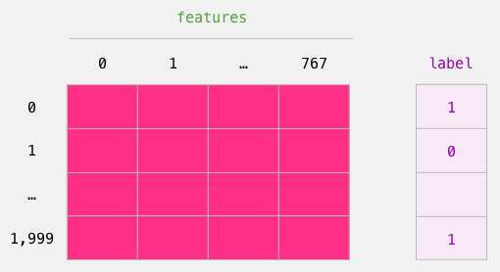
Dataset for Logistic Regression
(768 Features)
The features are the output vectors of BERT for the [CLS] token (position #0)
Source: Jay Alammar (2019), A Visual Guide to Using BERT for the First Time,
http://jalammar.github.io/a-visual-guide-to-using-bert-for-the-first-time/

Slide 78
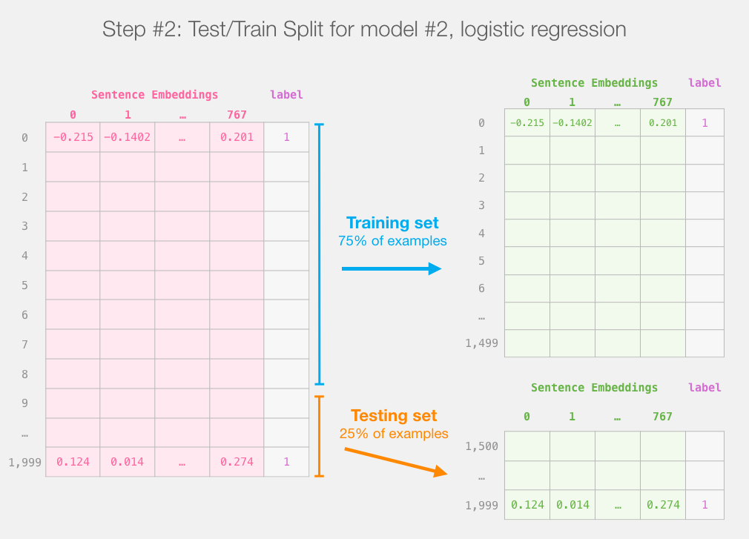
labels = df[1]
train_features, test_features, train_labels, test_labels = train_test_split(features, labels)
Source: Jay Alammar (2019), A Visual Guide to Using BERT for the First Time,
http://jalammar.github.io/a-visual-guide-to-using-bert-for-the-first-time/

Slide 79
Score Benchmarks
Logistic Regression Model on SST-2 Dataset
# Training
lr_clf = LogisticRegression()
lr_clf.fit(train_features, train_labels)
#Testing
lr_clf.score(test_features, test_labels)
# Accuracy: 81%
# Highest accuracy: 96.8%
# Fine-tuned DistilBERT: 90.7%
# Full size BERT model: 94.9%
Source: Jay Alammar (2019), A Visual Guide to Using BERT for the First Time,
http://jalammar.github.io/a-visual-guide-to-using-bert-for-the-first-time/

Slide 80
Sentiment Classification: SST2
Sentences from movie reviews
sentence | label
a stirring , funny and finally transporting re imagining of beauty and the beast and 1930s horror films | 1
apparently reassembled from the cutting room floor of any given daytime soap | 0
they presume their audience won't sit still for a sociology lesson | 0
this is a visually stunning rumination on love , memory , history and the war between art and commerce | 1
jonathan parker 's bartleby should have been the be all end all of the modern office anomie films | 1
Source: Jay Alammar (2019), A Visual Guide to Using BERT for the First Time,
http://jalammar.github.io/a-visual-guide-to-using-bert-for-the-first-time/

Slide 81

A Visual Notebook to
Using BERT for the First Time
https://colab.research.google.com/github/jalammar/jalammar.github.io/blob/master/notebooks/bert/A_Visual_Notebook_to_Using_BERT_for_the_First_Time.ipynb

Slide 82
Artificial Intelligence
(AI)

Slide 83
Definition of
Artificial Intelligence (A.I.)

Slide 84
Artificial Intelligence
“… the science and engineering of making intelligent machines”
(John McCarthy, 1955)
Source: https://digitalintelligencetoday.com/artificial-intelligence-defined-useful-list-of-popular-definitions-from-business-and-science/

Slide 85
Artificial Intelligence
“… technology that thinks and acts like humans”
Source: https://digitalintelligencetoday.com/artificial-intelligence-defined-useful-list-of-popular-definitions-from-business-and-science/

Slide 86
Artificial Intelligence
“… intelligence exhibited by machines or software”
Source: https://digitalintelligencetoday.com/artificial-intelligence-defined-useful-list-of-popular-definitions-from-business-and-science/

Slide 87
4 Approaches of AI
2. Thinking Humanly: The Cognitive Modeling Approach | 3. Thinking Rationally: The “Laws of Thought” Approach
1. Acting Humanly: The Turing Test Approach (1950) | 4. Acting Rationally: The Rational Agent Approach
Source: Stuart Russell and Peter Norvig (2020), Artificial Intelligence: A Modern Approach, 4th Edition, Pearson

Slide 88
AI Acting Humanly:
The Turing Test Approach
(Alan Turing, 1950)
Knowledge Representation
Automated Reasoning
Machine Learning (ML)
  Deep Learning (DL)
Computer Vision (Image, Video)
Natural Language Processing (NLP)
Robotics
Source: Stuart Russell and Peter Norvig (2020), Artificial Intelligence: A Modern Approach, 4th Edition, Pearson

Slide 89
AI, ML, DL
Artificial Intelligence (AI)
Machine Learning (ML)
Supervised
Learning
Unsupervised Learning
Deep Learning (DL)
CNN
RNN LSTM GRU
GAN
Semi-supervised Learning
Reinforcement Learning
Source: https://leonardoaraujosantos.gitbooks.io/artificial-inteligence/content/deep_learning.html

Slide 90
Comparison of Generative AI and Traditional AI
Feature | Generative AI | Traditional AI
Output type | New content | Classification/Prediction
Creativity | High | Low
Interactivity | Usually more natural | Limited

Slide 91
Generative AI
Generative AI: The Art of Creation
Definition: AI systems capable of creating new content
Characteristics: Creativity, interactivity

Slide 92

Neural Network and Deep Learning
Source: 3Blue1Brown (2017), But what *is* a Neural Network? | Chapter 1, deep learning, https://www.youtube.com/watch?v=aircAruvnKk

Slide 93

Gradient Descent how neural networks learn
Source: 3Blue1Brown (2017), Gradient descent, how neural networks learn | Chapter 2, deep learning, https://www.youtube.com/watch?v=IHZwWFHWa-w

Slide 94

Backpropagation
Source: 3Blue1Brown (2017), What is backpropagation really doing? | Chapter 3, deep learning, https://www.youtube.com/watch?v=Ilg3gGewQ5U

Slide 95

Transformers (how LLMs work)
Source: 3Blue1Brown (2024), Transformers (how LLMs work) explained visually | DL5, https://www.youtube.com/watch?v=wjZofJX0v4M

Slide 96

Attention in Transformers
Source: 3Blue1Brown (2024), Attention in transformers, visually explained | DL6, https://www.youtube.com/watch?v=eMlx5fFNoYc

Slide 97

How might LLMs store facts
Source: 3Blue1Brown (2024), How might LLMs store facts | DL7,
https://www.youtube.com/watch?v=9-Jl0dxWQs8

Slide 98

Large Language Models explained briefly
Source: 3Blue1Brown (2024), Large Language Models explained briefly, https://www.youtube.com/watch?v=LPZh9BOjkQs

Slide 99
Generative AI,
Agentic AI,
AI Agent,
RAG LLM for
QA and Dialogue Systems

Slide 100
Chatbot
Dialogue System
Intelligent Agent
Conversational AI

Slide 101

The Development of LM-based Dialogue Systems
1) Early Stage (1966 - 2015)
2) The Independent Development of TOD and ODD (2015 - 2019)
3) Fusions of Dialogue Systems (2019 - 2022)
4) LLM-based DS (2022 - Now)
Task-oriented DS (TOD), Open-domain DS (ODD)
Source: Wang, Hongru, Lingzhi Wang, Yiming Du, Liang Chen, Jingyan Zhou, Yufei Wang, and Kam-Fai Wong. "A Survey of the Evolution of Language Model-Based Dialogue Systems." arXiv preprint arXiv:2311.16789 (2023).

Slide 102

Intelligent Agents Roadmap
Source: Cheng, Yuheng, Ceyao Zhang, Zhengwen Zhang, Xiangrui Meng, Sirui Hong, Wenhao Li, Zihao Wang et al. "Exploring large language model based intelligent agents: Definitions, methods, and prospects." arXiv preprint arXiv:2401.03428 (2024).

Slide 103
AI Agents
Traditional AI Agents
    Simple reflex agents
    Model-based reflex agents
    Goal-based agents
    Utility-based agents
    Learning agents
Evolution of AI Agents
  LLM-based Agents
    Multi-modal agents
    Embodied AI agents in virtual environments
    Collaborative AI agents

Slide 104
Reinforcement Learning (DL)
Agent
Environment
Source: Richard S. Sutton & Andrew G. Barto (2018), Reinforcement Learning: An Introduction, 2nd Edition, A Bradford Book.

Slide 105
Reinforcement Learning (DL)
1
2
observation
Agent
action
3
reward
Environment
Source: Richard S. Sutton & Andrew G. Barto (2018), Reinforcement Learning: An Introduction, 2nd Edition, A Bradford Book.

Slide 106
Reinforcement Learning (DL)
1
2
observation
Agent
action
O_{t}
A_{t}
3
reward
R_{t}
Environment
Source: Richard S. Sutton & Andrew G. Barto (2018), Reinforcement Learning: An Introduction, 2nd Edition, A Bradford Book.

Slide 107

Large Language Model (LLM) based Agents
Source: Xi, Z., Chen, W., Guo, X., He, W., Ding, Y., Hong, B., ... & Gui, T. (2023). The rise and potential of large language model based agents: A survey. arXiv preprint arXiv:2309.07864.

Slide 108

LLM-based Agents
Source: Cheng, Yuheng, Ceyao Zhang, Zhengwen Zhang, Xiangrui Meng, Sirui Hong, Wenhao Li, Zihao Wang et al. "Exploring large language model based intelligent agents: Definitions, methods, and prospects." arXiv preprint arXiv:2401.03428 (2024).

Slide 109

Large Multimodal Agents (LMA)
Source: Xie, J., Chen, Z., Zhang, R., Wan, X., & Li, G. (2024). Large Multimodal Agents: A Survey. ArXiv, abs/2402.15116.

Slide 110

Large Multimodal Agents (LMA)
Source: Xie, J., Chen, Z., Zhang, R., Wan, X., & Li, G. (2024). Large Multimodal Agents: A Survey. ArXiv, abs/2402.15116.

Slide 111
The Development of LM-based Dialogue Systems
1) Early Stage (1966 - 2015)
2) The Independent Development of TOD and ODD (2015 - 2019)
3) Fusions of Dialogue Systems (2019 - 2022)
4) LLM-based DS (2022 - Now)
Task-oriented DS (TOD), Open-domain DS (ODD)
Source: Wang, Hongru, Lingzhi Wang, Yiming Du, Liang Chen, Jingyan Zhou, Yufei Wang, and Kam-Fai Wong. "A Survey of the Evolution of Language Model-Based Dialogue Systems." arXiv preprint arXiv:2311.16789 (2023).

Slide 112

Major GenAI LLMs Research Milestones
(2017-2024)
Source: https://github.com/Hannibal046/Awesome-LLM

Slide 113

Multimodal Large Language Models (MLLM)
Source: Shukang Yin, Chaoyou Fu, Sirui Zhao, Ke Li, Xing Sun, Tong Xu, and Enhong Chen. (2024) "A survey on multimodal large language models." National Science Review (2024): nwae403.

Slide 114

Multimodal Large Language Models (MLLM)
Multimodall LLM
Three types of connectors:
1. projection-based
2. query-based
3. fusion-based connectors
Source: Shukang Yin, Chaoyou Fu, Sirui Zhao, Ke Li, Xing Sun, Tong Xu, and Enhong Chen. (2024) "A survey on multimodal large language models." National Science Review (2024): nwae403.

Slide 115

Multimodal Large Language Model (MLLM) for Vision Question Answering
Source: Jiayi Kuang, Jingyou Xie, Haohao Luo, Ronghao Li, Zhe Xu, Xianfeng Cheng, Yinghui Li, Xika Lin, and Ying Shen. (2024) "Natural Language Understanding and Inference with MLLM in Visual Question Answering: A Survey." arXiv preprint arXiv:2411.17558.

Slide 116

Multi-task Language Understanding on MMLU
GPT-4, Claude 3.5 Sonnet
Massive Multitask Language Understanding (MMLU)
Source: https://paperswithcode.com/sota/multi-task-language-understanding-on-mmlu

Slide 117

LLM Capabilities
Source: Minaee, Shervin, Tomas Mikolov, Narjes Nikzad, Meysam Chenaghlu, Richard Socher, Xavier Amatriain, and Jianfeng Gao. (2024) "Large language models: A survey." arXiv preprint arXiv:2402.06196 (2024).

Slide 118

LLM-powered Multimodal Agents
Large Multimodal Agents (LMAs)
2022
2023
2024
Source: Xie, Junlin, Zhihong Chen, Ruifei Zhang, Xiang Wan, and Guanbin Li. "Large Multimodal Agents: A Survey." arXiv preprint arXiv:2402.15116 (2024).

Slide 119

Four Paradigms in NLP (LM)
Transfer Learning: Pre-training, Fine-Tuning (FT)
GAI: Pre-train, Prompt, and Predict (Prompting)
Source: Pengfei Liu, Weizhe Yuan, Jinlan Fu, Zhengbao Jiang, Hiroaki Hayashi, and Graham Neubig. (2023) "Pre-train, prompt, and predict: A systematic survey of prompting methods in natural language processing." ACM Computing Surveys 55, no. 9 (2023): 1-35.

Slide 120

Large Language Models (LLM)
Three typical learning paradigms
Source: Shukang Yin, Chaoyou Fu, Sirui Zhao, Ke Li, Xing Sun, Tong Xu, and Enhong Chen. (2024) "A survey on multimodal large language models." National Science Review (2024): nwae403.

Slide 121
Popular Generative AI
OpenAI ChatGPT (GPT-o1, GPT-4o, GPT-4)
Claude.ai (Claude 3.5)
Google Gemini
Meta Llama 3.3, Llama 3.2 Vision
Mixtral Pixtral (mistral.ai)
DeepSeek
Chat.LMSys.org (lmarena.ai)
Perplexity.ai
Stable Diffusion
Video: D-ID, Synthesia
Audio: Speechify

Slide 122

Claude 3.5 Sonnet State-of-the-art vision
Source: https://www.anthropic.com/news/3-5-models-and-computer-use

Slide 123

Llama 3.2 90B vision LLMs
Source: https://ai.meta.com/blog/llama-3-2-connect-2024-vision-edge-mobile-devices/

Slide 124

Llama 3.3 70B instruction-tuned
https://www.llama.com/

Slide 125

Mistral Pixtral Large (124B)
Frontier-class multimodal performance
Source: https://mistral.ai/news/pixtral-large/

Slide 126

Mistral Pixtral 12B
Source: Agrawal, Pravesh, Szymon Antoniak, Emma Bou Hanna, Baptiste Bout, Devendra Chaplot, Jessica Chudnovsky, Diogo Costa et al. (2024) "Pixtral 12B." arXiv preprint arXiv:2410.07073.

Slide 127

Large Language Models (LLMs)
Artificial Analysis Quality Index
Source: https://artificialanalysis.ai/

Slide 128

Large Language Models (LLMs)
Quality vs. Price
Source: https://artificialanalysis.ai/

Slide 129

Chat with
Open
Large Language Models:
Chatbot Arena
Large Language Models for Data Science
llama 3.2
claude 3.5 sonnet
https://lmarena.ai/

Slide 130

Perplexity.ai
https://www.perplexity.ai/

Slide 131

Generative AI (Gen AI)
AI Generated Content (AIGC)
Image Generation
Source: Yihan Cao, Siyu Li, Yixin Liu, Zhiling Yan, Yutong Dai, Philip S. Yu, and Lichao Sun (2023). "A Comprehensive Survey of AI-Generated Content (AIGC): A History of Generative AI from GAN to ChatGPT." arXiv preprint arXiv:2303.04226.

Slide 132
Generative AI (Gen AI)
AI Generated Content (AIGC)
Source: Yihan Cao, Siyu Li, Yixin Liu, Zhiling Yan, Yutong Dai, Philip S. Yu, and Lichao Sun (2023). "A Comprehensive Survey of AI-Generated Content (AIGC): A History of Generative AI from GAN to ChatGPT." arXiv preprint arXiv:2303.04226.

Slide 133

The history of Generative AI in CV, NLP and VL
Source: Yihan Cao, Siyu Li, Yixin Liu, Zhiling Yan, Yutong Dai, Philip S. Yu, and Lichao Sun (2023). "A Comprehensive Survey of AI-Generated Content (AIGC): A History of Generative AI from GAN to ChatGPT." arXiv preprint arXiv:2303.04226.

Slide 134

Generative AI
Foundation Models
Source: Yihan Cao, Siyu Li, Yixin Liu, Zhiling Yan, Yutong Dai, Philip S. Yu, and Lichao Sun (2023). "A Comprehensive Survey of AI-Generated Content (AIGC): A History of Generative AI from GAN to ChatGPT." arXiv preprint arXiv:2303.04226.

Slide 135

Categories of Vision Generative Models
Source: Yihan Cao, Siyu Li, Yixin Liu, Zhiling Yan, Yutong Dai, Philip S. Yu, and Lichao Sun (2023). "A Comprehensive Survey of AI-Generated Content (AIGC): A History of Generative AI from GAN to ChatGPT." arXiv preprint arXiv:2303.04226.

Slide 136

The General Structure of
Generative Vision Language
Source: Yihan Cao, Siyu Li, Yixin Liu, Zhiling Yan, Yutong Dai, Philip S. Yu, and Lichao Sun (2023). "A Comprehensive Survey of AI-Generated Content (AIGC): A History of Generative AI from GAN to ChatGPT." arXiv preprint arXiv:2303.04226.

Slide 137
RAG LLM
Dialogue Systems

Slide 138

Technology Tree of RAG Research
Retrieval-Augmented Generation (RAG) for Large Language Models (LLMs)
Source: Gao, Y., Xiong, Y., Gao, X., Jia, K., Pan, J., Bi, Y., ... & Wang, H. (2023). Retrieval-augmented generation for large language models: A survey. arXiv preprint arXiv:2312.10997.

Slide 139

Retrieval-Augmented Generation (RAG) for Large Language Models (LLMs)
Source: Gao, Y., Xiong, Y., Gao, X., Jia, K., Pan, J., Bi, Y., ... & Wang, H. (2023). Retrieval-augmented generation for large language models: A survey. arXiv preprint arXiv:2312.10997.

Slide 140

Retrieval-Augmented Generation (RAG) Architecture
Source: Zhao, P., Zhang, H., Yu, Q., Wang, Z., Geng, Y., Fu, F., ... & Cui, B. (2024). Retrieval-augmented generation for ai-generated content: A survey. arXiv preprint arXiv:2402.19473.

Slide 141

Synthesizing RAG with LLMs for Question Answering Application
Source: Minaee, S., Mikolov, T., Nikzad, N., Chenaghlu, M., Socher, R., Amatriain, X., & Gao, J. (2024). Large language models: A survey. arXiv preprint arXiv:2402.06196.

Slide 142

Synthesizing the KG as a Retriever with LLMs
Source: Minaee, S., Mikolov, T., Nikzad, N., Chenaghlu, M., Socher, R., Amatriain, X., & Gao, J. (2024). Large language models: A survey. arXiv preprint arXiv:2402.06196.

Slide 143

HuggingGPT:
An agent-based approach to use tools and planning
Source: Minaee, S., Mikolov, T., Nikzad, N., Chenaghlu, M., Socher, R., Amatriain, X., & Gao, J. (2024). Large language models: A survey. arXiv preprint arXiv:2402.06196.

Slide 144

A LLM-based Agent for
Conversational Information Seeking
Source: Minaee, S., Mikolov, T., Nikzad, N., Chenaghlu, M., Socher, R., Amatriain, X., & Gao, J. (2024). Large language models: A survey. arXiv preprint arXiv:2402.06196.

Slide 145

Direct LLM, RAG, and GraphRAG
Source: Peng, B., Zhu, Y., Liu, Y., Bo, X., Shi, H., Hong, C., ... & Tang, S. (2024). Graph retrieval-augmented generation: A survey. arXiv preprint arXiv:2408.08921.

Slide 146

GraphRAG Framework for Question Answering
Source: Peng, B., Zhu, Y., Liu, Y., Bo, X., Shi, H., Hong, C., ... & Tang, S. (2024). Graph retrieval-augmented generation: A survey. arXiv preprint arXiv:2408.08921.

Slide 147

LangChain Architecture
Source: https://www.langchain.com/

Slide 148

Multimodal LLM RAG
Multi-Vector Retriever for RAG
Source: https://blog.langchain.dev/deconstructing-rag/

Slide 149

Evaluating RAG with Ragas Metrics
Source: https://blog.langchain.dev/evaluating-rag-pipelines-with-ragas-langsmith/

Slide 150
References
Numa Dhamani and Maggie Engler (2024), Introduction to Generative AI, Manning
Denis Rothman (2024), Transformers for Natural Language Processing and Computer Vision: Explore Generative AI and Large Language Models with Hugging Face, ChatGPT, GPT-4V, and DALL-E 3, 3rd Edition, Packt Publishing
NVIDIA DLI (2024), Building RAG Agents with LLMs, https://learn.nvidia.com/courses/course-detail?course_id=course-v1:DLI+S-FX-15+V1
NVIDIA DLI (2024), Generative AI with Diffusion Models, https://learn.nvidia.com/courses/course-detail?course_id=course-v1:DLI+S-FX-14+V1
Denis Rothman (2024), RAG-Driven Generative AI: Build custom retrieval augmented generation pipelines with LlamaIndex, Deep Lake, and Pinecone, Packt Publishing
Jay Alammar and Maarten Grootendorst (2024), Hands-On Large Language Models: Language Understanding and Generation, O'Reilly Media
Ben Auffarth (2023), Generative AI with LangChain: Build large language model (LLM) apps with Python, ChatGPT and other LLMs, Packt Publishing
Chris Fregly, Antje Barth, and Shelbee Eigenbrode (2023), Generative AI on AWS: Building Context-Aware Multimodal Reasoning Applications, O'Reilly Media
David Foster (2023), Generative Deep Learning: Teaching Machines to Paint, Write, Compose, and Play, 2nd Edition, Oreilly & Associates Inc

