Slide 1








Large Language Models (LLMs),
NVIDIA Building RAG Agents with LLMs
Part I
Generative AI Innovative Applications
1132GAIIA03
MBA, IM, NTPU (M6031) (Spring 2025)
Tue 2, 3, 4 (9:10-12:00) (B3F17)
Min-Yuh Day, Ph.D,
Professor
Institute of Information Management, National Taipei University
https://web.ntpu.edu.tw/~myday
https://meet.google.com/paj-zhhj-mya
2025-03-04

Slide 2
Syllabus
Week Date Subject/Topics
1 2025/02/18 Introduction to Generative AI Innovative Applications
2 2025/02/25 Transformers for Natural Language Processing and
Computer Vision
3 2025/03/04 Large Language Models (LLMs),
NVIDIA Building RAG Agents with LLMs Part I
4 2025/03/11 Case Study on Generative AI Innovative Applications I
5 2025/03/18 NVIDIA Building RAG Agents with LLMs Part II
6 2025/03/25 NVIDIA Building RAG Agents with LLMs Part III

Slide 3
Syllabus
Week Date Subject/Topics
7 2025/04/01 Self-Learning
8 2025/04/08 Midterm Project Report
9 2025/04/15 Generative AI for Multimodal Information Generation
10 2025/04/22 NVIDIA Generative AI with Diffusion Models Part I
11 2025/04/29 NVIDIA Generative AI with Diffusion Models Part II
12 2025/05/06 Case Study on Generative AI Innovative Applications II

Slide 4
Syllabus
Week Date Subject/Topics
13 2025/05/13 NVIDIA Generative AI with Diffusion Models Part III
14 2025/05/20 AI Agents and Large Multimodal Agents (LMAs)
15 2025/05/27 Final Project Report I
16 2025/06/03 Final Project Report II

Slide 5
Large Language Models (LLMs),
NVIDIA Building RAG Agents with LLMs
Part I

Slide 6



Spring 2025
Generative AI
Innovative Applications

Slide 7
Large Language Models (LLMs)

Slide 8

Major GenAI LLMs Research Milestones
(2017-2024)
Source: https://github.com/Hannibal046/Awesome-LLM

Slide 9

LLM Capabilities
Source: Minaee, Shervin, Tomas Mikolov, Narjes Nikzad, Meysam Chenaghlu, Richard Socher, Xavier Amatriain, and Jianfeng Gao. (2024) "Large language models: A survey." arXiv preprint arXiv:2402.06196 (2024).

Slide 10
lmarena.ai Chatbot Arena Leaderboard
Rank* (UB) | Rank (StyleCtrl) | Model | Arena Score | 95% CI | Votes | Organization | License
1 | 1 | chocolate (Early Grok-3) | 1403 | +6/-6 | 9992 | xAI | Proprietary
2 | 3 | Gemini-2.0-Flash-Thinking-Exp-01-21 | 1385 | +4/-6 | 15083 | Google | Proprietary
2 | 3 | Gemini-2.0-Pro-Exp-02-05 | 1380 | +5/-6 | 13000 | Google | Proprietary
2 | 1 | ChatGPT-4o-latest (2025-01-29) | 1377 | +5/-5 | 13470 | OpenAI | Proprietary
5 | 3 | DeepSeek-R1 | 1362 | +7/-7 | 6581 | DeepSeek | MIT
5 | 8 | Gemini-2.0-Flash-001 | 1358 | +7/-7 | 10862 | Google | Proprietary
5 | 3 | o1-2024-12-17 | 1352 | +5/-5 | 17248 | OpenAI | Proprietary
8 | 7 | o1-preview | 1335 | +3/-4 | 33169 | OpenAI | Proprietary
8 | 8 | Qwen2.5-Max | 1334 | +5/-5 | 9282 | Alibaba | Proprietary
8 | 7 | o3-mini-high | 1332 | +5/-9 | 5954 | OpenAI | Proprietary
11 | 11 | DeepSeek-V3 | 1318 | +4/-5 | 19461 | DeepSeek | DeepSeek
11 | 13 | Qwen-Plus-0125 | 1311 | +9/-7 | 5112 | Alibaba | Proprietary
11 | 14 | GLM-4-Plus-0111 | 1310 | +6/-9 | 5134 | Zhipu | Proprietary
11 | 13 | Gemini-2.0-Flash-Lite-Preview-02-05 | 1309 | +6/-5 | 10262 | Google | Proprietary
12 | 12 | o3-mini | 1306 | +5/-6 | 12179 | OpenAI | Proprietary
https://huggingface.co/spaces/lmarena-ai/chatbot-arena-leaderboard

Slide 11
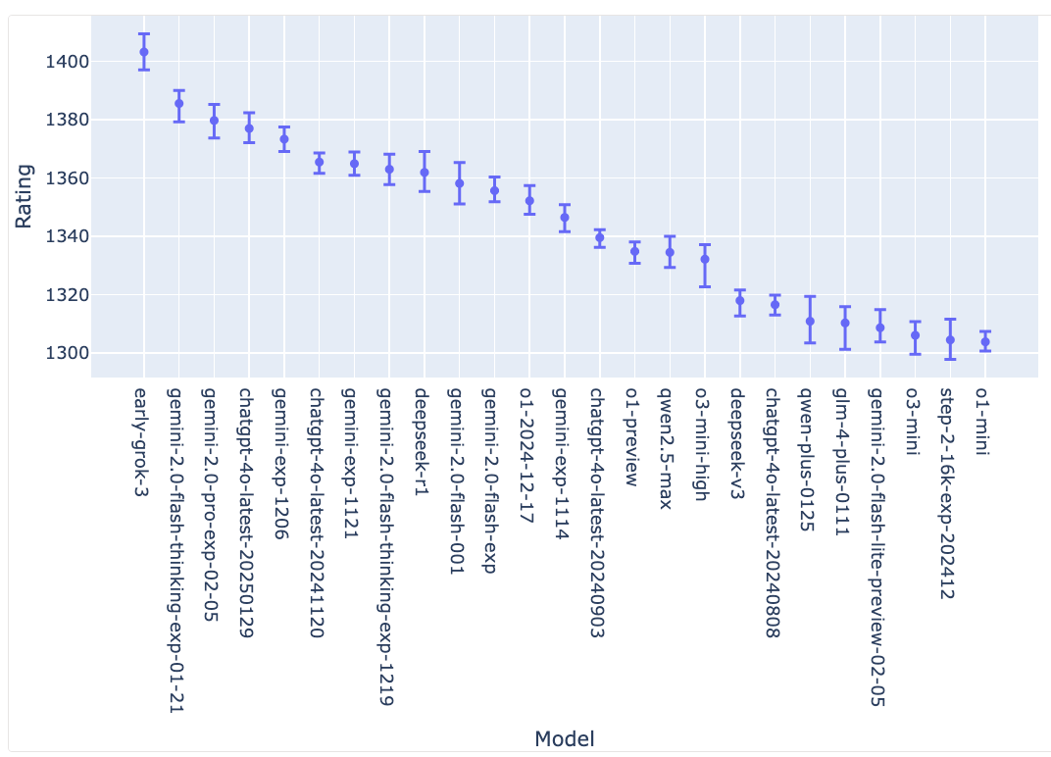
lmarena.ai Chatbot Arena Leaderboard
Confidence Intervals on Model Strength (via Bootstrapping)
https://huggingface.co/spaces/lmarena-ai/chatbot-arena-leaderboard

Slide 12
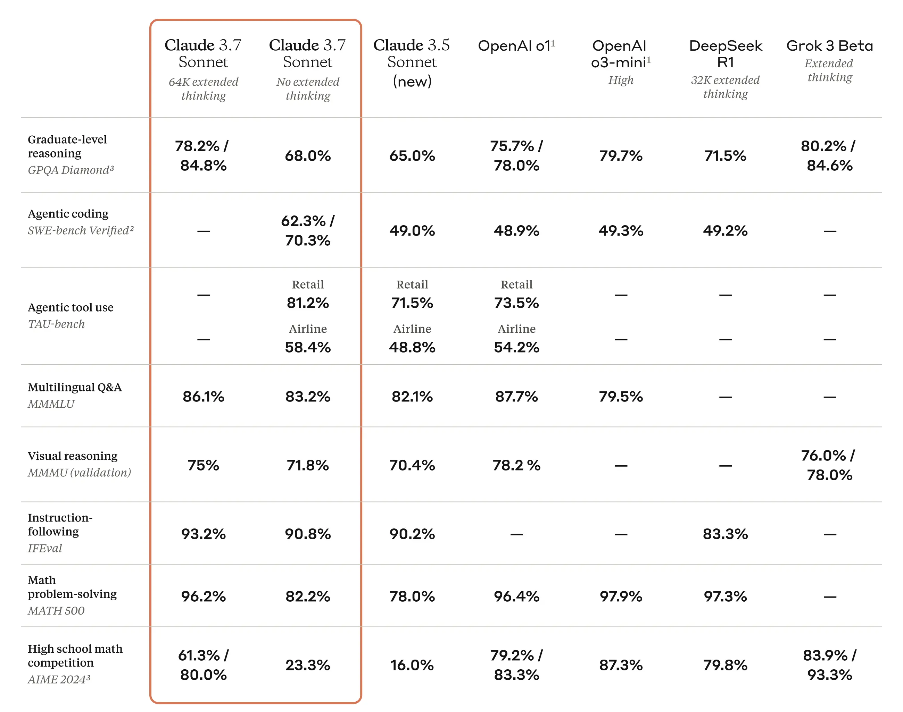
Claude 3.7 Sonnet, Claude 3.5 Sonnet, OpenAI, DeepSeek, and Grok
Source: https://www.anthropic.com/news/claude-3-7-sonnet

Slide 13
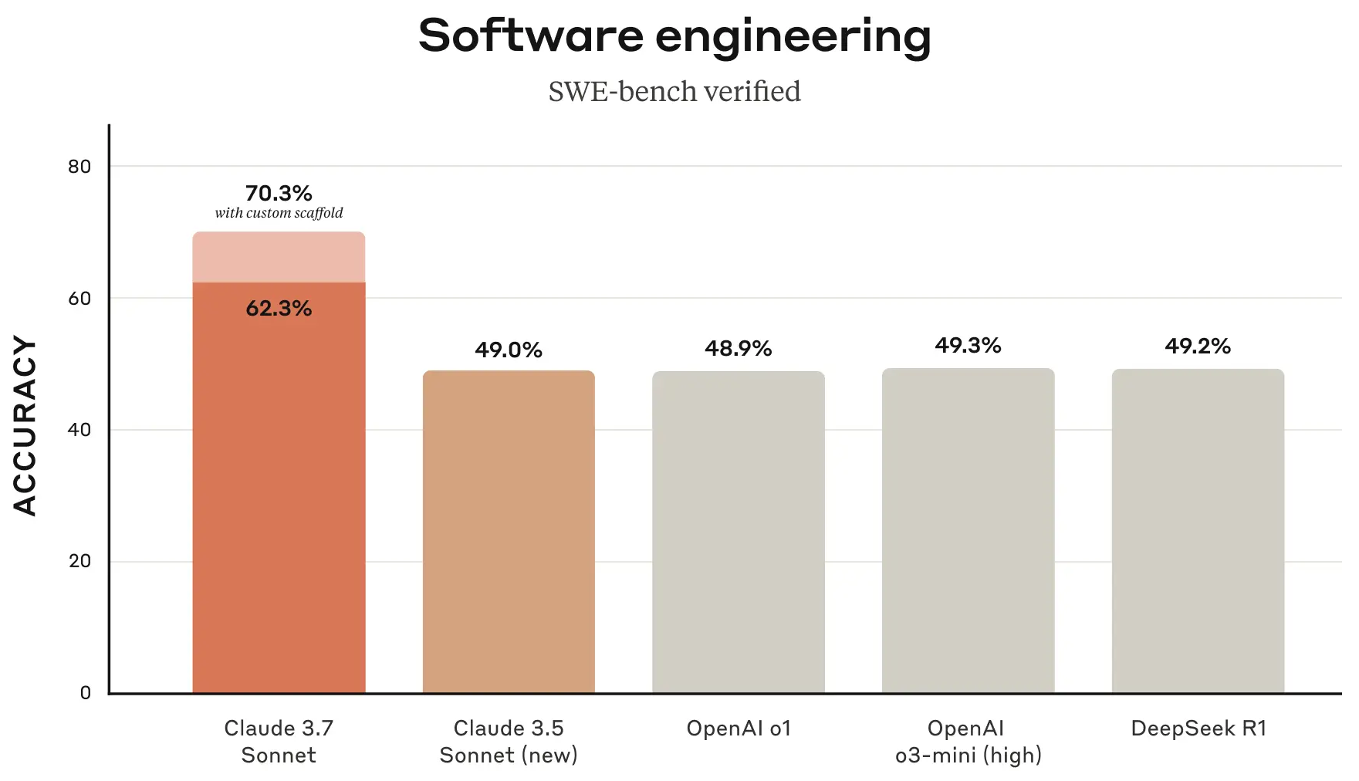
Claude 3.7 Sonnet and Claude Code
Source: https://www.anthropic.com/news/claude-3-7-sonnet

Slide 14

LLM-powered Multimodal Agents
Large Multimodal Agents (LMAs)
2022
2023
2024
Source: Xie, Junlin, Zhihong Chen, Ruifei Zhang, Xiang Wan, and Guanbin Li. "Large Multimodal Agents: A Survey." arXiv preprint arXiv:2402.15116 (2024).

Slide 15

Four Paradigms in NLP (LM)
Transfer Learning: Pre-training, Fine-Tuning (FT)
GAI: Pre-train, Prompt, and Predict (Prompting)
Source: Pengfei Liu, Weizhe Yuan, Jinlan Fu, Zhengbao Jiang, Hiroaki Hayashi, and Graham Neubig. (2023) "Pre-train, prompt, and predict: A systematic survey of prompting methods in natural language processing." ACM Computing Surveys 55, no. 9 (2023): 1-35.

Slide 16

Large Language Models (LLM)
Three typical learning paradigms
Source: Shukang Yin, Chaoyou Fu, Sirui Zhao, Ke Li, Xing Sun, Tong Xu, and Enhong Chen. (2024) "A survey on multimodal large language models." National Science Review (2024): nwae403.

Slide 17
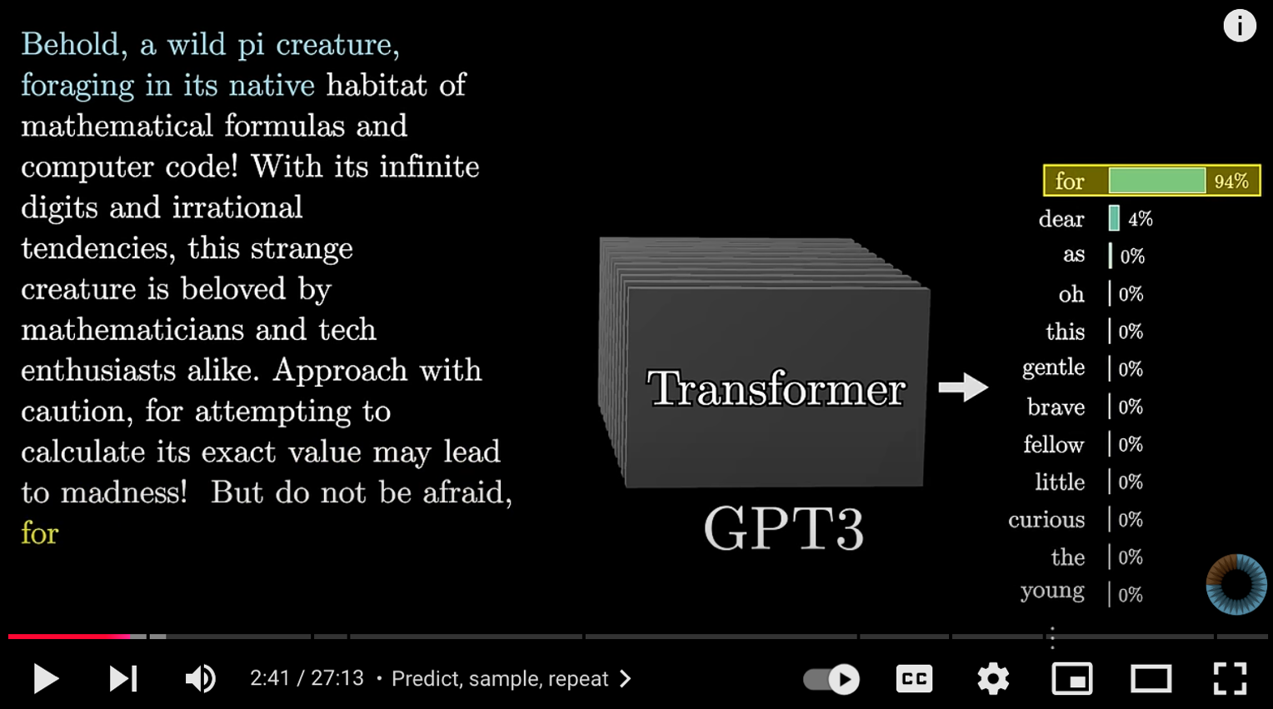
Transformers (how LLMs work)
Source: 3Blue1Brown (2024), Transformers (how LLMs work) explained visually | DL5, https://www.youtube.com/watch?v=wjZofJX0v4M

Slide 18
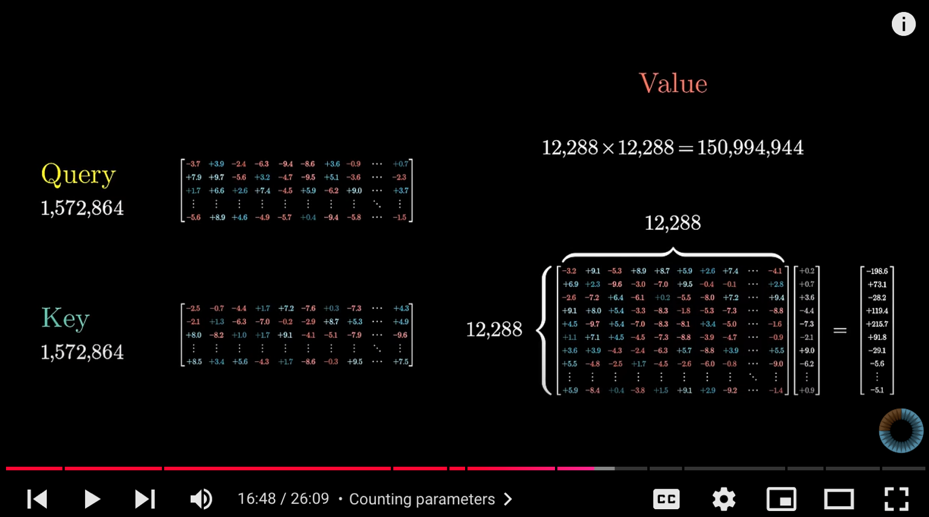
Attention in Transformers
Source: 3Blue1Brown (2024), Attention in transformers, visually explained | DL6, https://www.youtube.com/watch?v=eMlx5fFNoYc

Slide 19
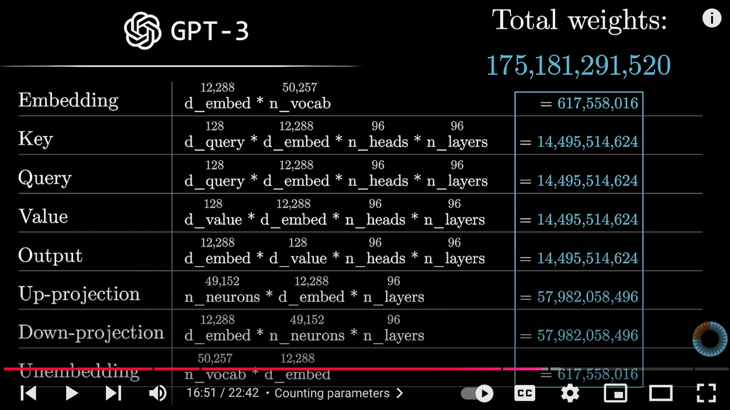
How might LLMs store facts
Source: 3Blue1Brown (2024), How might LLMs store facts | DL7,
https://www.youtube.com/watch?v=9-Jl0dxWQs8

Slide 20
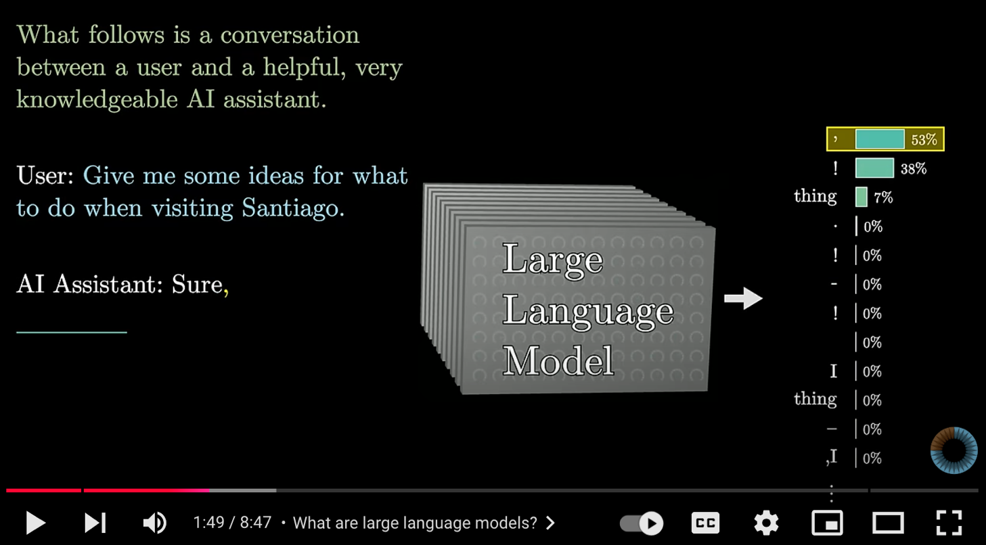
Large Language Models explained briefly
Source: 3Blue1Brown (2024), Large Language Models explained briefly, https://www.youtube.com/watch?v=LPZh9BOjkQs

Slide 21
RAG LLM
Dialogue Systems

Slide 22
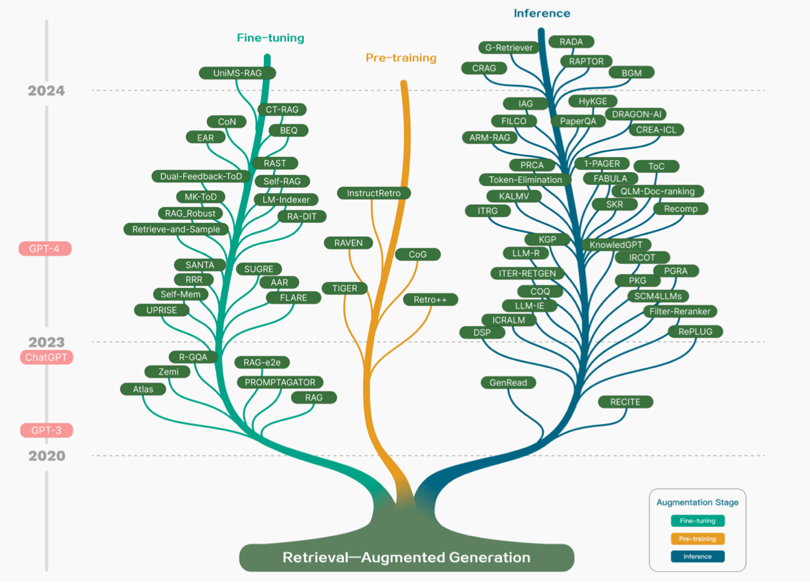
Technology Tree of RAG Research
Retrieval-Augmented Generation (RAG) for Large Language Models (LLMs)
Source: Gao, Y., Xiong, Y., Gao, X., Jia, K., Pan, J., Bi, Y., ... & Wang, H. (2023). Retrieval-augmented generation for large language models: A survey. arXiv preprint arXiv:2312.10997.

Slide 23
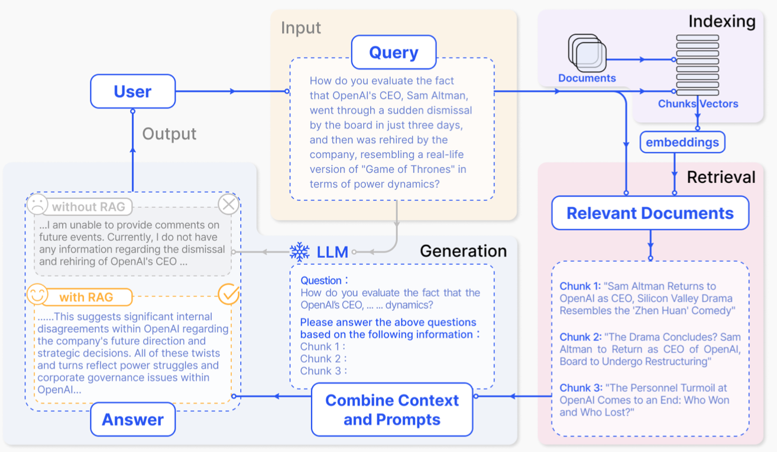
Retrieval-Augmented Generation (RAG) for Large Language Models (LLMs)
Source: Gao, Y., Xiong, Y., Gao, X., Jia, K., Pan, J., Bi, Y., ... & Wang, H. (2023). Retrieval-augmented generation for large language models: A survey. arXiv preprint arXiv:2312.10997.

Slide 24
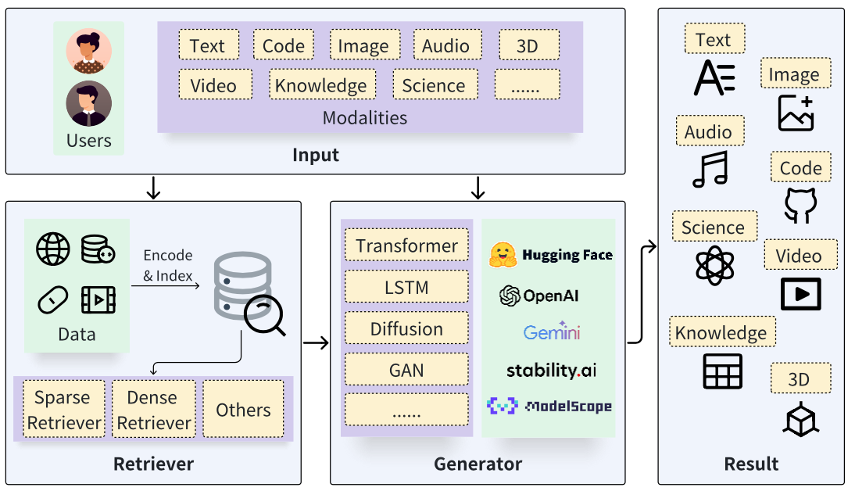
Retrieval-Augmented Generation (RAG) Architecture
Source: Zhao, P., Zhang, H., Yu, Q., Wang, Z., Geng, Y., Fu, F., ... & Cui, B. (2024). Retrieval-augmented generation for ai-generated content: A survey. arXiv preprint arXiv:2402.19473.

Slide 25
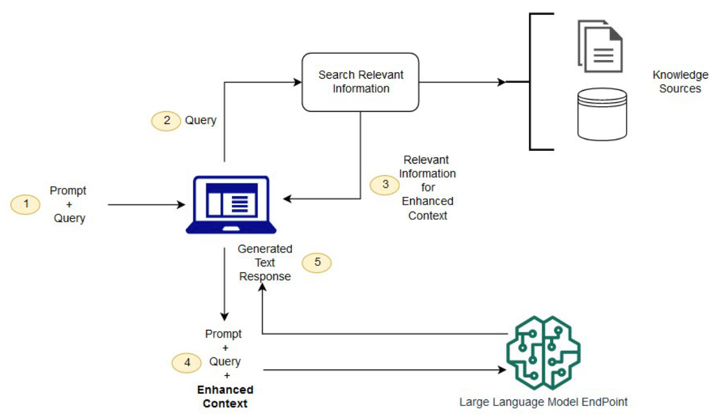
Synthesizing RAG with LLMs for Question Answering Application
Source: Minaee, S., Mikolov, T., Nikzad, N., Chenaghlu, M., Socher, R., Amatriain, X., & Gao, J. (2024). Large language models: A survey. arXiv preprint arXiv:2402.06196.

Slide 26
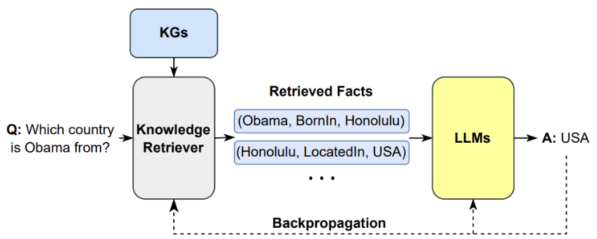
Synthesizing the KG as a Retriever with LLMs
Source: Minaee, S., Mikolov, T., Nikzad, N., Chenaghlu, M., Socher, R., Amatriain, X., & Gao, J. (2024). Large language models: A survey. arXiv preprint arXiv:2402.06196.

Slide 27
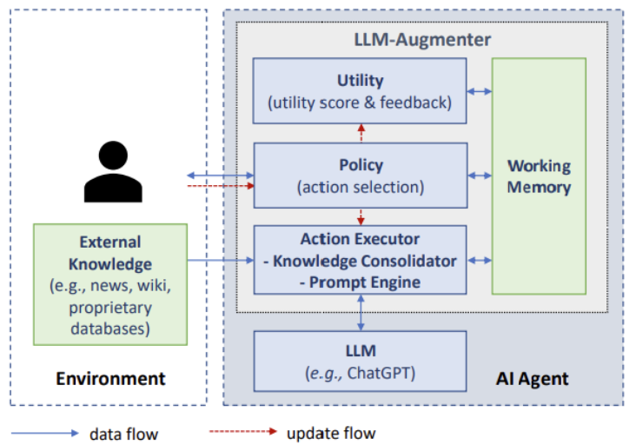
A LLM-based Agent for
Conversational Information Seeking
Source: Minaee, S., Mikolov, T., Nikzad, N., Chenaghlu, M., Socher, R., Amatriain, X., & Gao, J. (2024). Large language models: A survey. arXiv preprint arXiv:2402.06196.

Slide 28
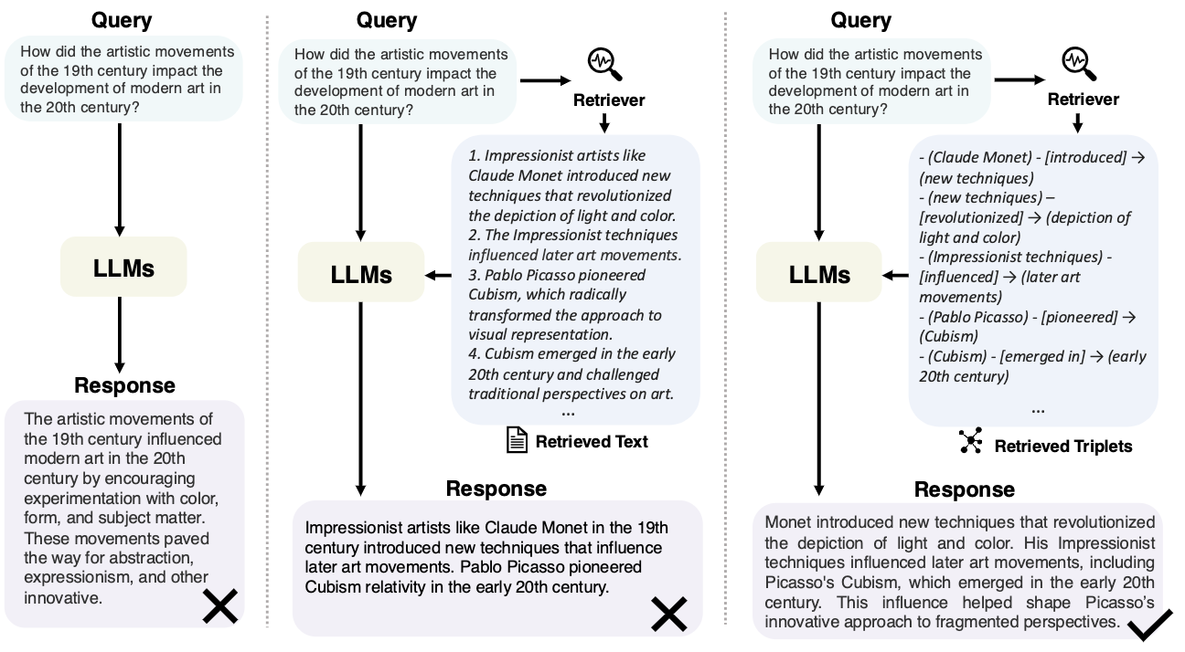
Direct LLM, RAG, and GraphRAG
Source: Peng, B., Zhu, Y., Liu, Y., Bo, X., Shi, H., Hong, C., ... & Tang, S. (2024). Graph retrieval-augmented generation: A survey. arXiv preprint arXiv:2408.08921.

Slide 29
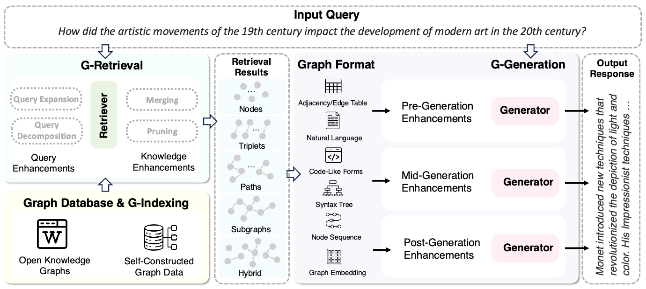
GraphRAG Framework for Question Answering
Source: Peng, B., Zhu, Y., Liu, Y., Bo, X., Shi, H., Hong, C., ... & Tang, S. (2024). Graph retrieval-augmented generation: A survey. arXiv preprint arXiv:2408.08921.

Slide 30
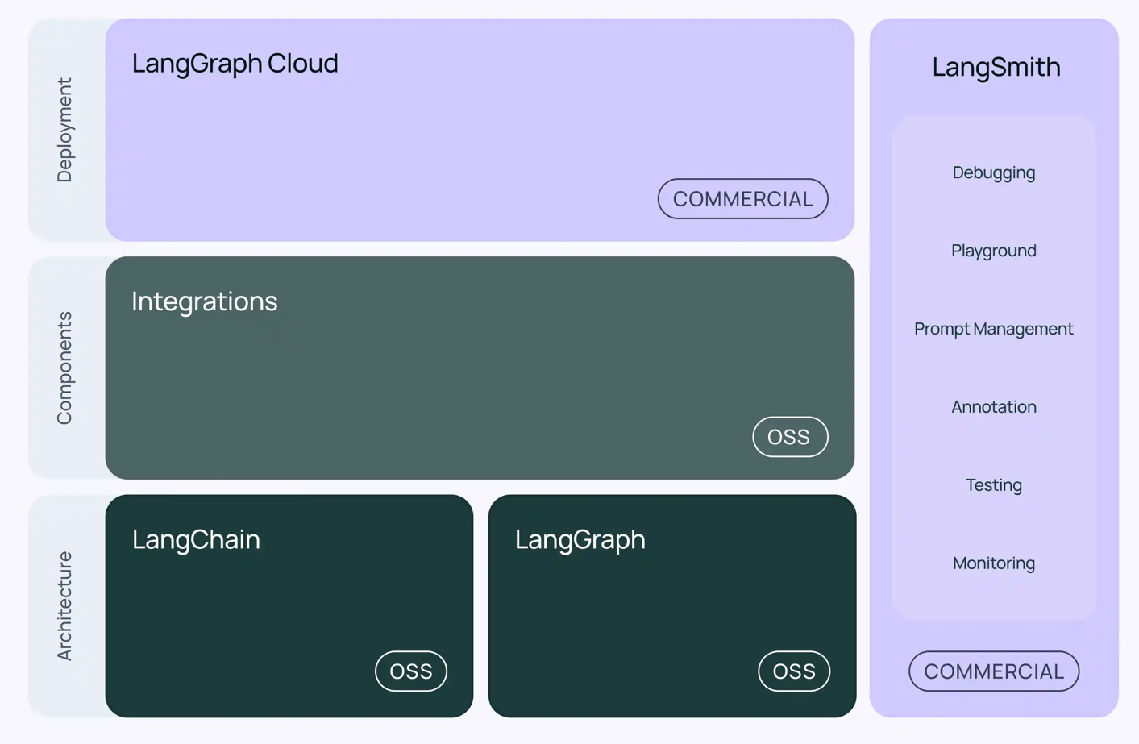
LangChain Architecture
Source: https://www.langchain.com/

Slide 31
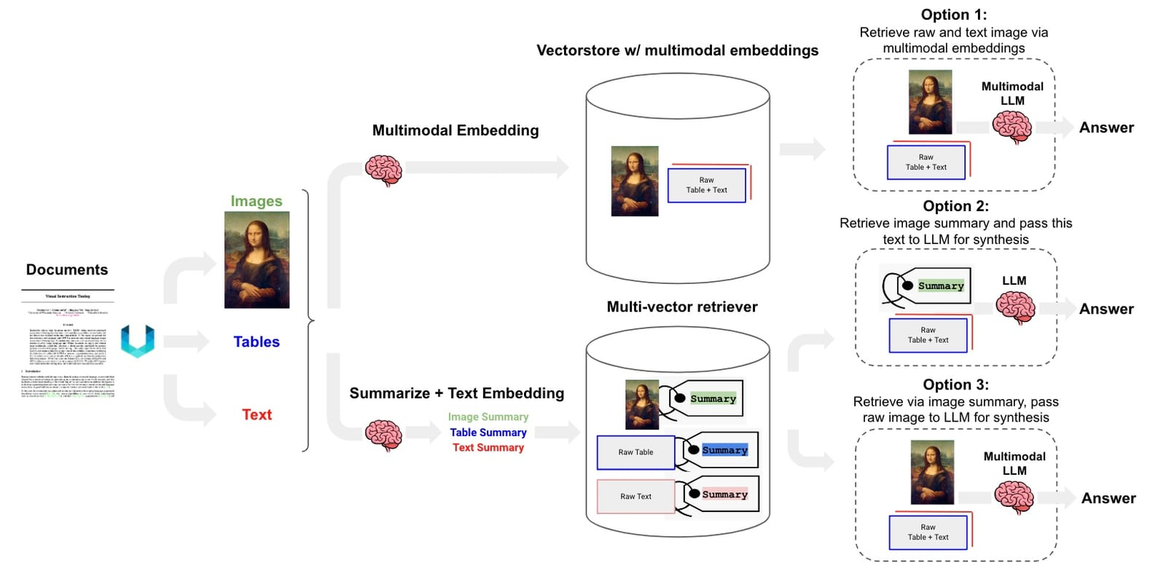
Multimodal LLM RAG
Multi-Vector Retriever for RAG
Source: https://blog.langchain.dev/deconstructing-rag/

Slide 32
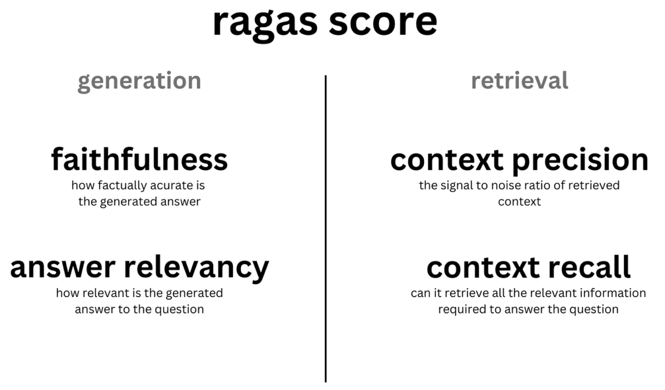
Evaluating RAG with Ragas Metrics
Source: https://blog.langchain.dev/evaluating-rag-pipelines-with-ragas-langsmith/

Slide 33
NVIDIA
Building RAG Agents with LLMs
Part I

Slide 34
NVIDIA Developer Program
NVIDIA
Deep Learning Institute (DLI)
https://developer.nvidia.com/join-nvidia-developer-program
https://learn.nvidia.com/

Slide 35

Join the NVIDIA Developer Program take one of the complimentary technical self-paced courses
(worth up to $90)
https://developer.nvidia.com/join-nvidia-developer-program

Slide 36
NVIDIA Deep Learning Institute (DLI)
Self-Paced Course
Generative AI Explained
Free
2 hours
Self-Paced Course
Getting Started With Deep Learning
Certificate available
$90
8 hours
Instructor-Led Workshop
Fundamentals of Deep Learning
Certificate available
$500
8 hours
Self-Paced Course
Introduction to Transformer-Based Natural Language Processing
Certificate available
$30
6 hours
Self-Paced Course
Building RAG Agents With LLMs
Certificate available
Free
8 hours
Instructor-Led Workshop
Building RAG Agents With LLMs
Certificate available
$500
8 hours
Self-Paced Course
Generative AI with Diffusion Models
Certificate available
$90
8 hours
Instructor-Led Workshop
Generative AI with Diffusion Models
Certificate available
$500
8 hours
https://www.nvidia.com/en-us/learn/learning-path/generative-ai-llm/

Slide 37

NVIDIA Deep Learning Institute (DLI)
Generative AI
https://learn.nvidia.com/en-us/training/find-training?q=Generative+AI

Slide 38

Building RAG Agents with LLMs
https://learn.nvidia.com/courses/course-detail?course_id=course-v1:DLI+S-FX-15+V1

Slide 39

Generative AI Explained
https://learn.nvidia.com/courses/course-detail?course_id=course-v1:DLI+S-FX-15+V1

Slide 40

Introduction to Transformer-Based
Natural Language Processing
https://learn.nvidia.com/courses/course-detail?course_id=course-v1:DLI+S-FX-08+V1

Slide 41

Generative AI with Diffusion Models
https://learn.nvidia.com/courses/course-detail?course_id=course-v1:DLI+S-FX-14+V1

Slide 42

Join the NVIDIA Developer Program take one of the complimentary technical self-paced courses (worth up to $90)
https://developer.nvidia.com/join-nvidia-developer-program

Slide 43

Join the NVIDIA Developer Program take one of the complimentary technical self-paced courses (worth up to $90)
https://developer.nvidia.com/join-nvidia-developer-program

Slide 44

Join the NVIDIA Developer Program take one of the complimentary technical self-paced courses (worth up to $90)
https://developer.nvidia.com/join-nvidia-developer-program

Slide 45

Join the NVIDIA Developer Program take one of the complimentary technical self-paced courses (worth up to $90)
https://developer.nvidia.com/join-nvidia-developer-program

Slide 46

Join the NVIDIA Developer Program take one of the complimentary technical self-paced courses (worth up to $90)
https://developer.nvidia.com/join-nvidia-developer-program

Slide 47

Join the NVIDIA Developer Program take one of the complimentary technical self-paced courses (worth up to $90)
https://developer.nvidia.com/join-nvidia-developer-program

Slide 48

NVIDIA Deep Learning Institute (DLI)
https://learn.nvidia.com/my-learning

Slide 49

NVIDIA Deep Learning Institute (DLI)
https://learn.nvidia.com/my-learning

Slide 50
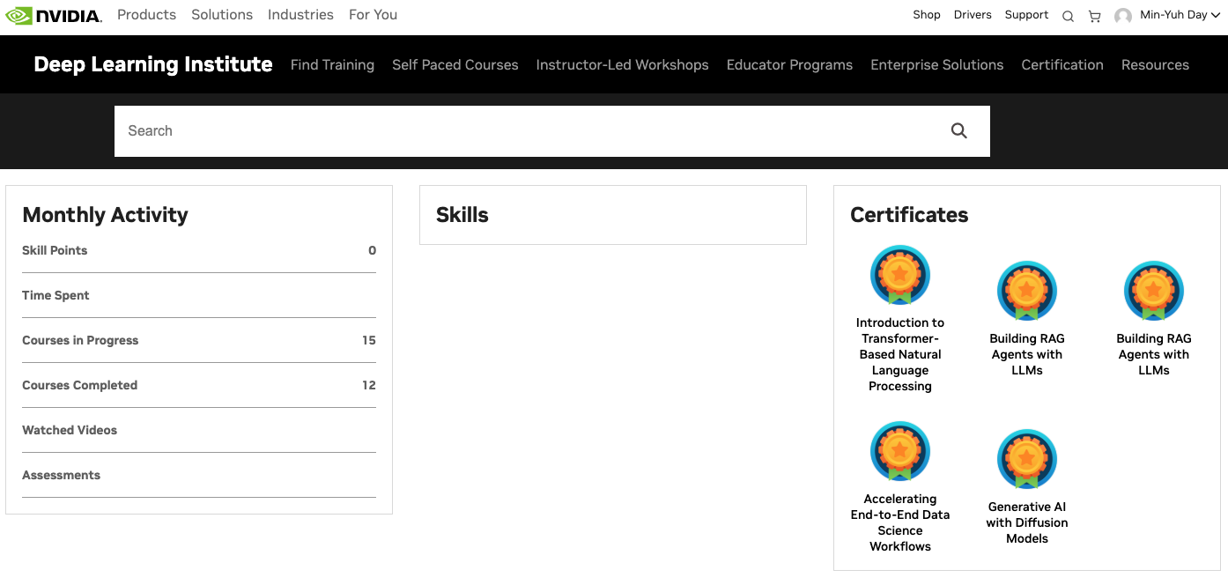

Deep Learning Institute (DLI)
https://learn.nvidia.com/my-learning

Slide 51

NVIDIA Deep Learning Institute (DLI)
https://learn.nvidia.com/en-us/training/self-paced-courses

Slide 52

https://learn.nvidia.com/certificates?id=ed-qOCIMQaatzU8SNUNxgw

Slide 53
Building RAG Agents with LLMs
https://learn.nvidia.com/courses/course-detail?course_id=course-v1:DLI+S-FX-15+V1

Slide 54

Building RAG Agents with LLMs
Source: NVIDIA DLI (2024), Building RAG Agents with LLMs, https://learn.nvidia.com/courses/course-detail?course_id=course-v1:DLI+S-FX-15+V1

Slide 55

Building RAG Agents with LLMs
https://learn.nvidia.com/my-learning

Slide 56

Building RAG Agents with LLMs
https://learn.nvidia.com/courses/course?course_id=course-v1:DLI+S-FX-15+V1

Slide 57

Building RAG Agents with LLMs
https://learn.nvidia.com/courses/course?course_id=course-v1:DLI+S-FX-15+V1

Slide 58

Building RAG Agents with LLMs
https://learn.nvidia.com/courses/course?course_id=course-v1:DLI+S-FX-15+V1

Slide 59

Building RAG Agents with LLMs
https://learn.nvidia.com/courses/course?course_id=course-v1:DLI+S-FX-15+V1

Slide 60

Building RAG Agents with LLMs
https://learn.nvidia.com/courses/course?course_id=course-v1:DLI+S-FX-15+V1

Slide 61

Building RAG Agents with LLMs
https://learn.nvidia.com/courses/course?course_id=course-v1:DLI+S-FX-15+V1

Slide 62

Building RAG Agents with LLMs
https://learn.nvidia.com/courses/course?course_id=course-v1:DLI+S-FX-15+V1

Slide 63
Building RAG Agents with LLMs
Introduction
Source: NVIDIA DLI (2024), Building RAG Agents with LLMs, https://learn.nvidia.com/courses/course-detail?course_id=course-v1:DLI+S-FX-15+V1
Notes:
Welcome to our course on Building RAG Agents with LLMs!
REMIND STUDENTS TO START UP THEIR COURSE ENVIRONMENT!
LLMs: Large Language Models which take in, produce, or otherwise reason with text. We’ll learn to make more complex systems
Course Topics:
Creating chatbot applications capable of dialogue management and retrieval augmented generation.
Built from the ground up using foundation models which can be deployed on your own compute.
Leveraging current best practices from open-source frameworks like LangChain.

Slide 64
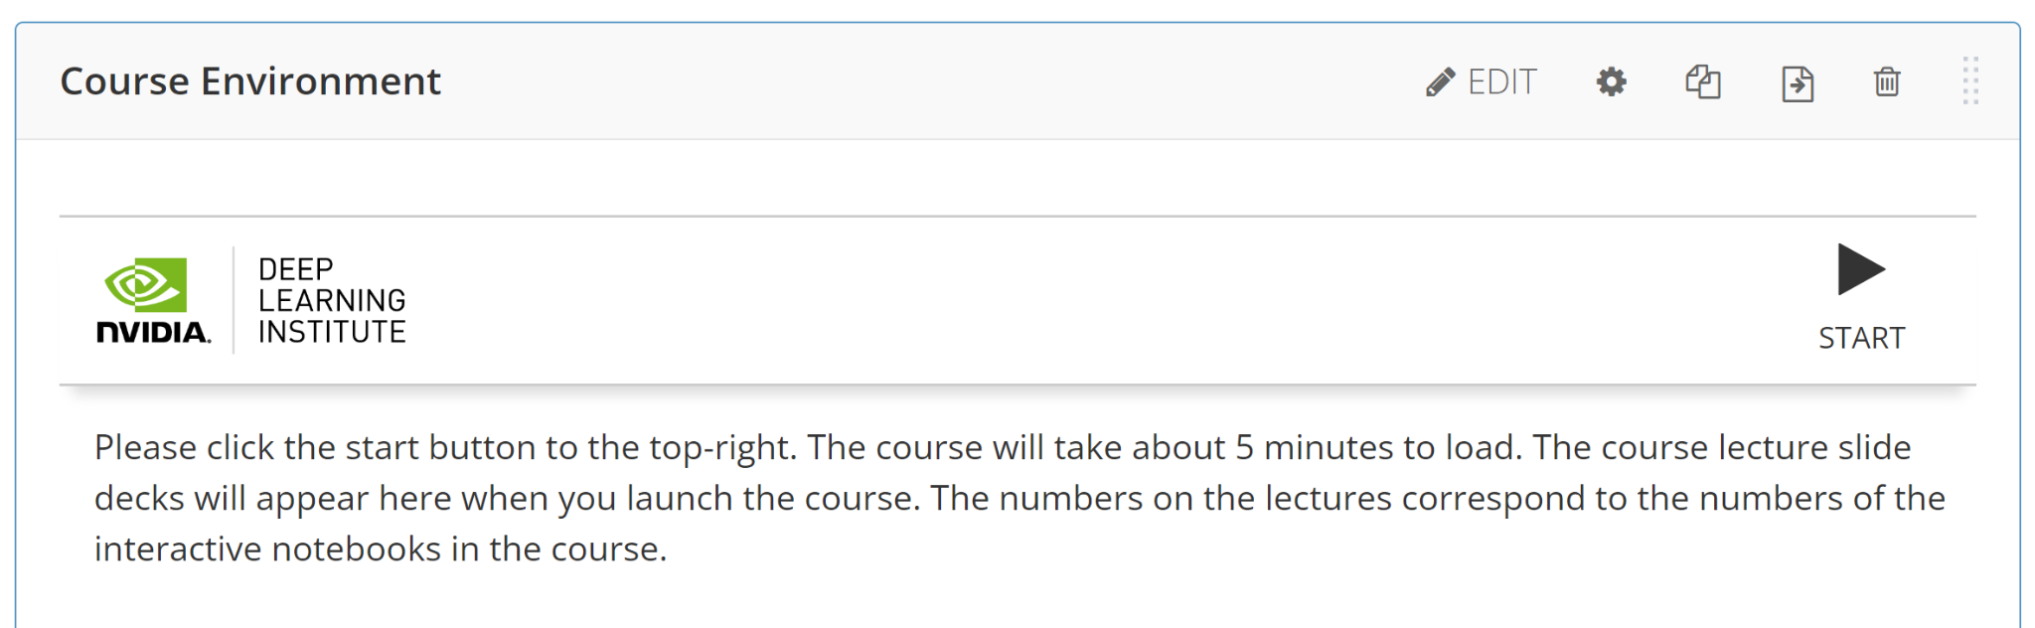
Building RAG Agents with LLMs
Introduction
Source: NVIDIA DLI (2024), Building RAG Agents with LLMs, https://learn.nvidia.com/courses/course-detail?course_id=course-v1:DLI+S-FX-15+V1
Notes:
Welcome to our course on Building RAG Agents with LLMs!
REMIND STUDENTS TO START UP THEIR COURSE ENVIRONMENT!
LLMs: Large Language Models which take in, produce, or otherwise reason with text. We’ll learn to make more complex systems
Course Topics:
Creating chatbot applications capable of dialogue management and retrieval augmented generation.
Built from the ground up using foundation models which can be deployed on your own compute.
Leveraging current best practices from open-source frameworks like LangChain.

Slide 65
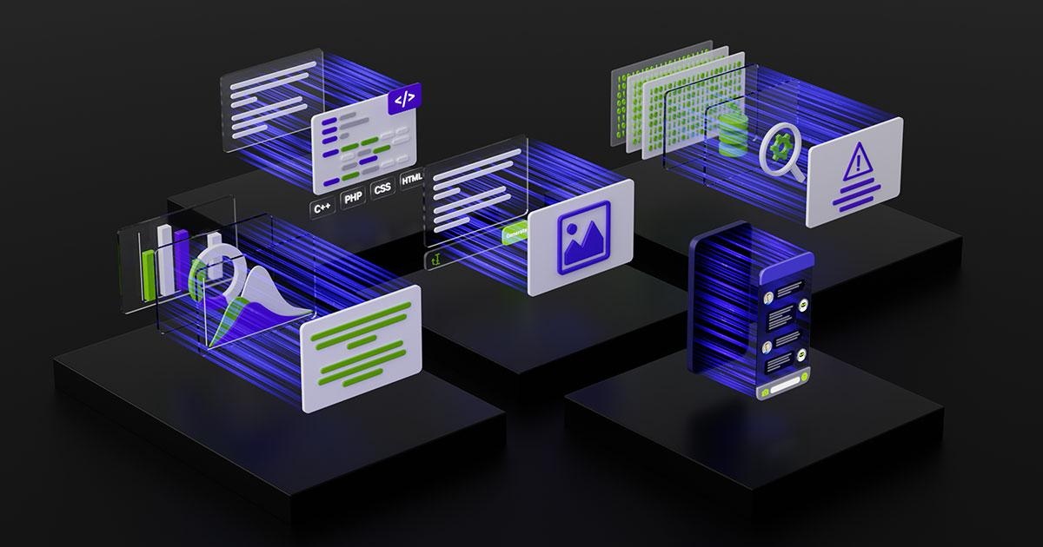
Large Language Models
Backbones for Language Understanding
Backbones for language tasks, including classification and generation.
https://www.nvidia.com/content/dam/en-zz/Solutions/lp/large-language-models-ebook/nvidia-llm-ebook-og.jpg
Source: NVIDIA DLI (2024), Building RAG Agents with LLMs, https://learn.nvidia.com/courses/course-detail?course_id=course-v1:DLI+S-FX-15+V1
Notes:
Welcome to our course on Building RAG Agents with LLMs!
LLMs: Large Language Models which take in, produce, or otherwise reason with text. We’ll learn to make more complex systems

Slide 66
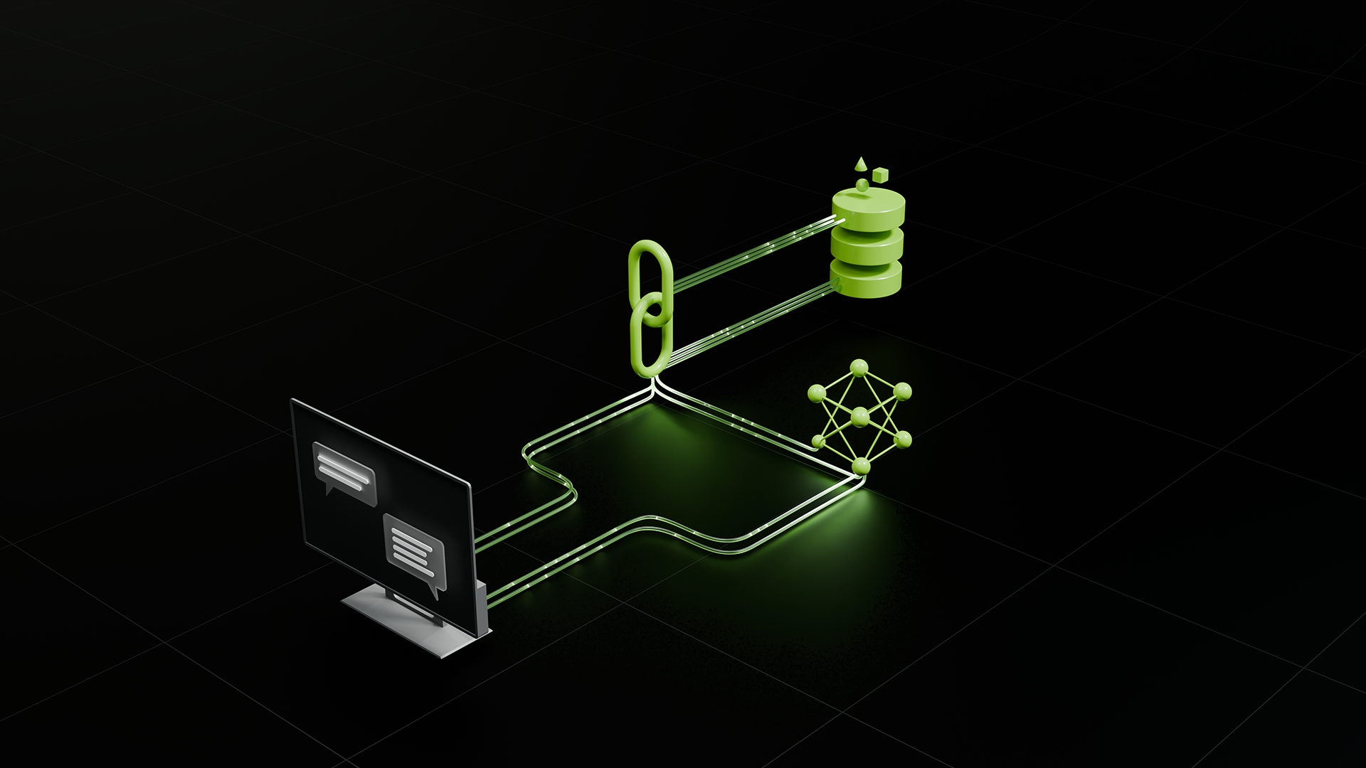
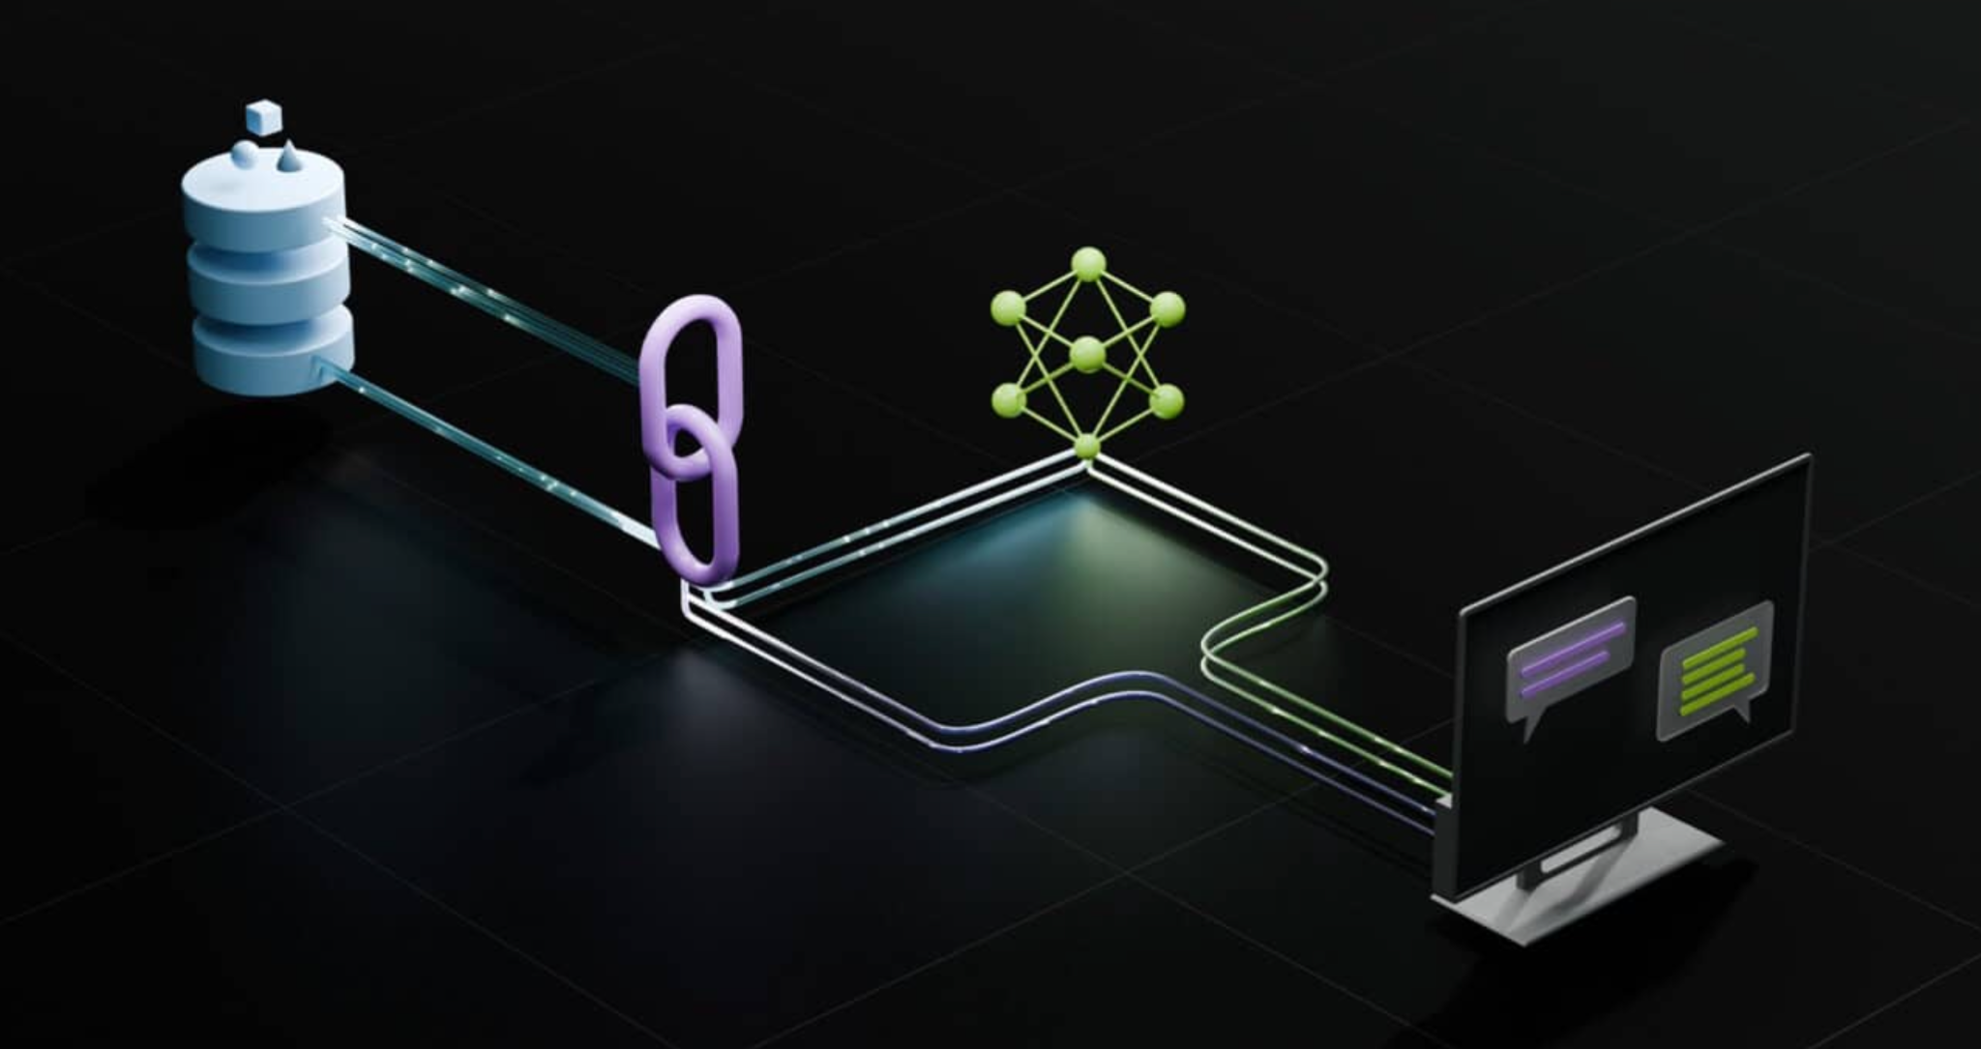
Dialog/Retrieval Agents
LLMs with Context and Control
User Asks Something
Agent Responds
https://www.nvidia.com/content/dam/en-zz/Solutions/lp/large-language-models-ebook/nvidia-llm-ebook-og.jpg
Source: NVIDIA DLI (2024), Building RAG Agents with LLMs, https://learn.nvidia.com/courses/course-detail?course_id=course-v1:DLI+S-FX-15+V1
Notes:
Welcome to our course on Building RAG Agents with LLMs!
Course Topics:
Creating chatbot applications capable of dialogue management and retrieval augmented generation.
Superficial: User sends message, and agent responds. But we want to bring our own data.
To achieve this, we need LLM Orchestration, so combining software practices and LLMs together.
Using this, we can Retrieve and synthesize data from a database or environment…
…create a new input that contains the grounding information (AKA augmenting our LLM’s behavior)…
…and then generating our response, having supplied our LLM with all the necessary info to make the decision.

Slide 67
Dialog/Retrieval Agents
LLMs with Context and Control
LLM Orchestration: Software + LLM helps to route to software and LLMs.
User Asks Something
Agent Responds
https://www.nvidia.com/content/dam/en-zz/Solutions/lp/large-language-models-ebook/nvidia-llm-ebook-og.jpg
Source: NVIDIA DLI (2024), Building RAG Agents with LLMs, https://learn.nvidia.com/courses/course-detail?course_id=course-v1:DLI+S-FX-15+V1
Notes:
Welcome to our course on Building RAG Agents with LLMs!
Course Topics:
Creating chatbot applications capable of dialogue management and retrieval augmented generation.
Superficial: User sends message, and agent responds. But we want to bring our own data.
To achieve this, we need LLM Orchestration, so combining software practices and LLMs together.
Using this, we can Retrieve and synthesize data from a database or environment…
…create a new input that contains the grounding information (AKA augmenting our LLM’s behavior)…
…and then generating our response, having supplied our LLM with all the necessary info to make the decision.

Slide 68
Dialog/Retrieval Agents
LLMs with Context and Control
Retrieval: Tool runs algorithms (database, code execution, semantic search, return a constant value, etc) to provide context
LLM Orchestration: Software + LLM helps to route to software and LLMs.
User Asks Something
Agent Responds
https://www.nvidia.com/content/dam/en-zz/Solutions/lp/large-language-models-ebook/nvidia-llm-ebook-og.jpg
Source: NVIDIA DLI (2024), Building RAG Agents with LLMs, https://learn.nvidia.com/courses/course-detail?course_id=course-v1:DLI+S-FX-15+V1
Notes:
Welcome to our course on Building RAG Agents with LLMs!
Course Topics:
Creating chatbot applications capable of dialogue management and retrieval augmented generation.
Superficial: User sends message, and agent responds. But we want to bring our own data.
To achieve this, we need LLM Orchestration, so combining software practices and LLMs together.
Using this, we can Retrieve and synthesize data from a database or environment…
…create a new input that contains the grounding information (AKA augmenting our LLM’s behavior)…
…and then generating our response, having supplied our LLM with all the necessary info to make the decision.

Slide 69
Dialog/Retrieval Agents
LLMs with Context and Control
Retrieval: Tool runs algorithms (database, code execution, semantic search, return a constant value, etc) to provide context
LLM Orchestration: Software + LLM helps to route to software and LLMs.
Augmented: Based on tool responses, the software pipeline synthesizes some “context”
to feed to LLM w/ question.
User Asks Something
Agent Responds
https://www.nvidia.com/content/dam/en-zz/Solutions/lp/large-language-models-ebook/nvidia-llm-ebook-og.jpg
Source: NVIDIA DLI (2024), Building RAG Agents with LLMs, https://learn.nvidia.com/courses/course-detail?course_id=course-v1:DLI+S-FX-15+V1
Notes:
Welcome to our course on Building RAG Agents with LLMs!
Course Topics:
Creating chatbot applications capable of dialogue management and retrieval augmented generation.
Superficial: User sends message, and agent responds. But we want to bring our own data.
To achieve this, we need LLM Orchestration, so combining software practices and LLMs together.
Using this, we can Retrieve and synthesize data from a database or environment…
…create a new input that contains the grounding information (AKA augmenting our LLM’s behavior)…
…and then generating our response, having supplied our LLM with all the necessary info to make the decision.

Slide 70
Dialog/Retrieval Agents
LLMs with Context and Control
Retrieval: Tool runs algorithms (database, code execution, semantic search, return a constant value, etc) to provide context
LLM Orchestration: Software + LLM helps to route to software and LLMs.
Augmented: Based on tool responses, the software pipeline synthesizes some “context”
to feed to LLM w/ question.
User Asks Something
Generation: Based on question, instructions, and enhanced context, the LLM returns a response.
Agent Responds
https://www.nvidia.com/content/dam/en-zz/Solutions/lp/large-language-models-ebook/nvidia-llm-ebook-og.jpg
Source: NVIDIA DLI (2024), Building RAG Agents with LLMs, https://learn.nvidia.com/courses/course-detail?course_id=course-v1:DLI+S-FX-15+V1
Notes:
Welcome to our course on Building RAG Agents with LLMs!
Course Topics:
Creating chatbot applications capable of dialogue management and retrieval augmented generation.
Superficial: User sends message, and agent responds. But we want to bring our own data.
To achieve this, we need LLM Orchestration, so combining software practices and LLMs together.
Using this, we can Retrieve and synthesize data from a database or environment…
…create a new input that contains the grounding information (AKA augmenting our LLM’s behavior)…
…and then generating our response, having supplied our LLM with all the necessary info to make the decision.
We’ll learn to build these pipelines from the ground up using foundation models which can be deployed on your own compute and at scale.

Slide 71
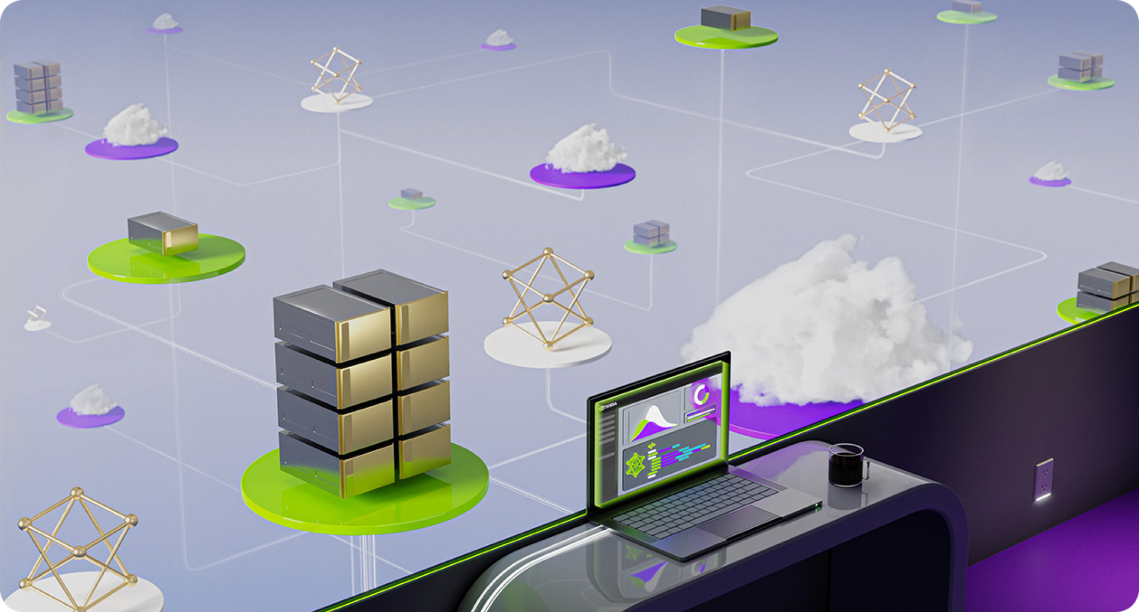
Chat Applications
Full Applications Build with LLMs
https://www.nvidia.com/content/dam/en-zz/Solutions/lp/large-language-models-ebook/nvidia-llm-ebook-og.jpg
Source: NVIDIA DLI (2024), Building RAG Agents with LLMs, https://learn.nvidia.com/courses/course-detail?course_id=course-v1:DLI+S-FX-15+V1
Notes:
Welcome to our course on Building RAG Agents with LLMs!
Course Topics:
Creating chatbot applications capable of dialogue management and retrieval augmented generation.
We’ll learn to build these pipelines from the ground up using foundation models which can be deployed on your own compute and at scale.
Leveraging current best practices from open-source frameworks like LangChain, as well as enterprise-grade microservice options like NVIDIA NIMs.

Slide 72
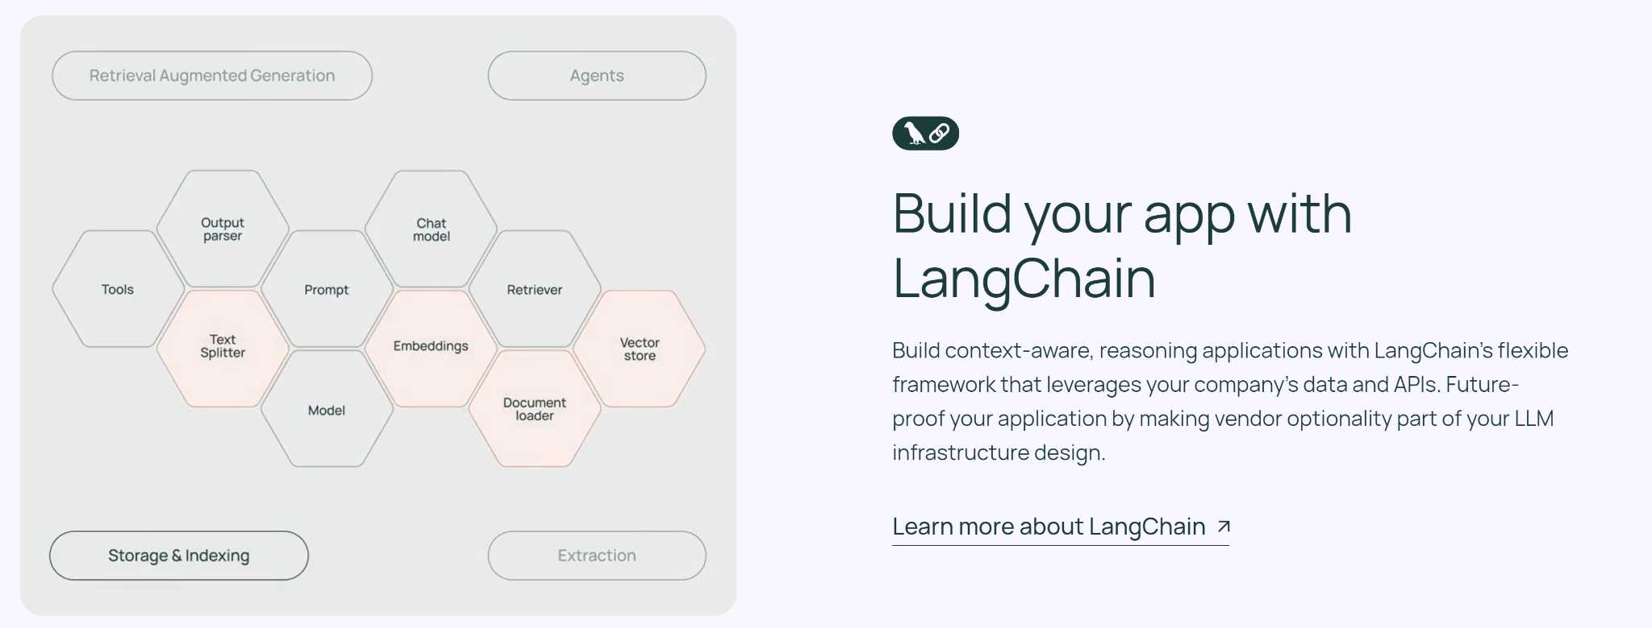
Chat Applications
Full Applications Build with LLMs
Production-Ready APIs That Run Anywhere | NVIDIA
Source: NVIDIA DLI (2024), Building RAG Agents with LLMs, https://learn.nvidia.com/courses/course-detail?course_id=course-v1:DLI+S-FX-15+V1
Notes:
Welcome to our course on Building RAG Agents with LLMs!
Course Topics:
Creating chatbot applications capable of dialogue management and retrieval augmented generation.
We’ll learn to build these pipelines from the ground up using foundation models which can be deployed on your own compute and at scale.
Leveraging current best practices from open-source frameworks like LangChain, as well as enterprise-grade microservice options like NVIDIA NIMs.

Slide 73
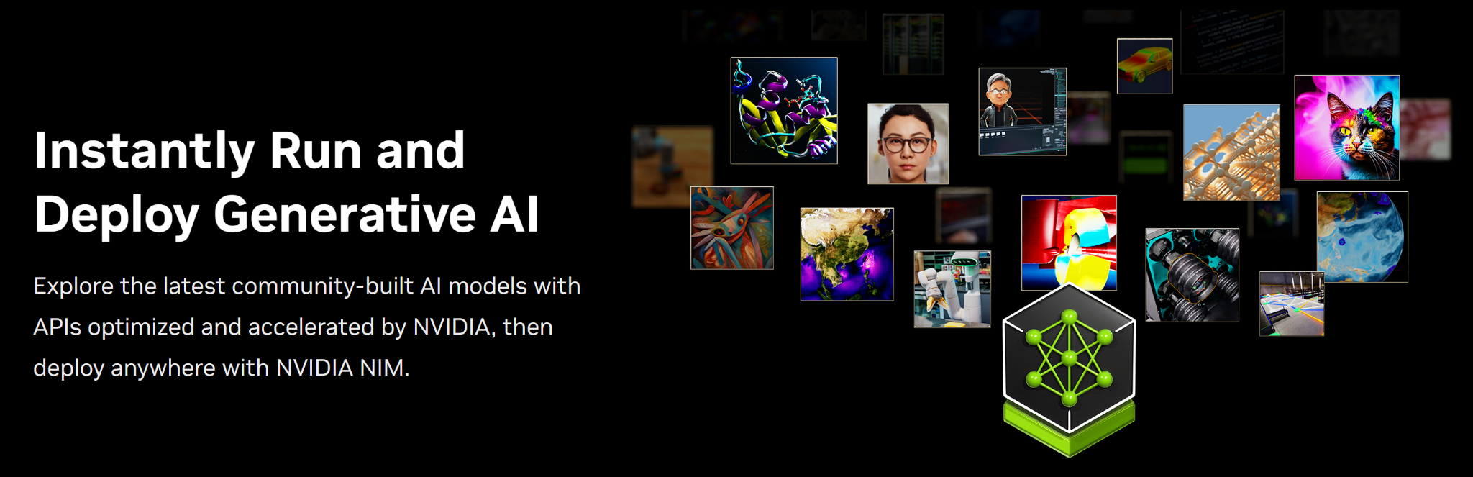
Chat Applications
Full Applications Build with LLMs
Production-Ready APIs That Run Anywhere | NVIDIA
Source: NVIDIA DLI (2024), Building RAG Agents with LLMs, https://learn.nvidia.com/courses/course-detail?course_id=course-v1:DLI+S-FX-15+V1
Notes:
Welcome to our course on Building RAG Agents with LLMs!
Course Topics:
Creating chatbot applications capable of dialogue management and retrieval augmented generation.
We’ll learn to build these pipelines from the ground up using foundation models which can be deployed on your own compute and at scale.
Leveraging current best practices from open-source frameworks like LangChain, as well as enterprise-grade microservice options like NVIDIA NIMs.
(Up Next: Prerequisites)
(After That: Course Objectives/Outline)
(Up Next: Section 1 Title)

Slide 74
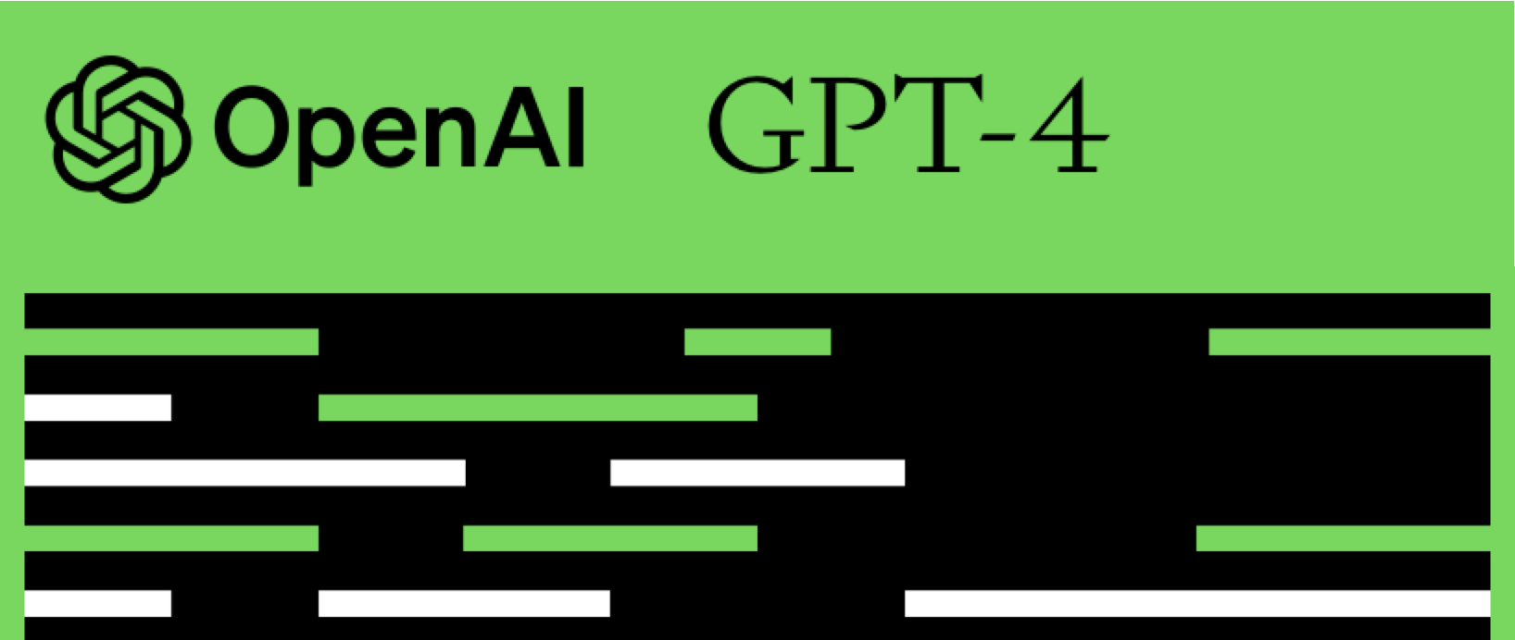
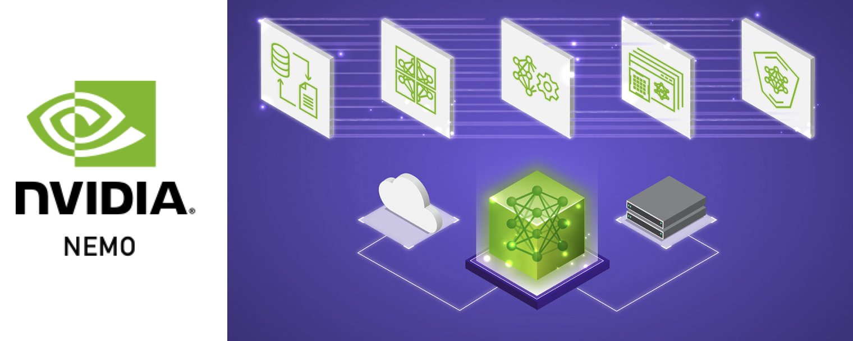
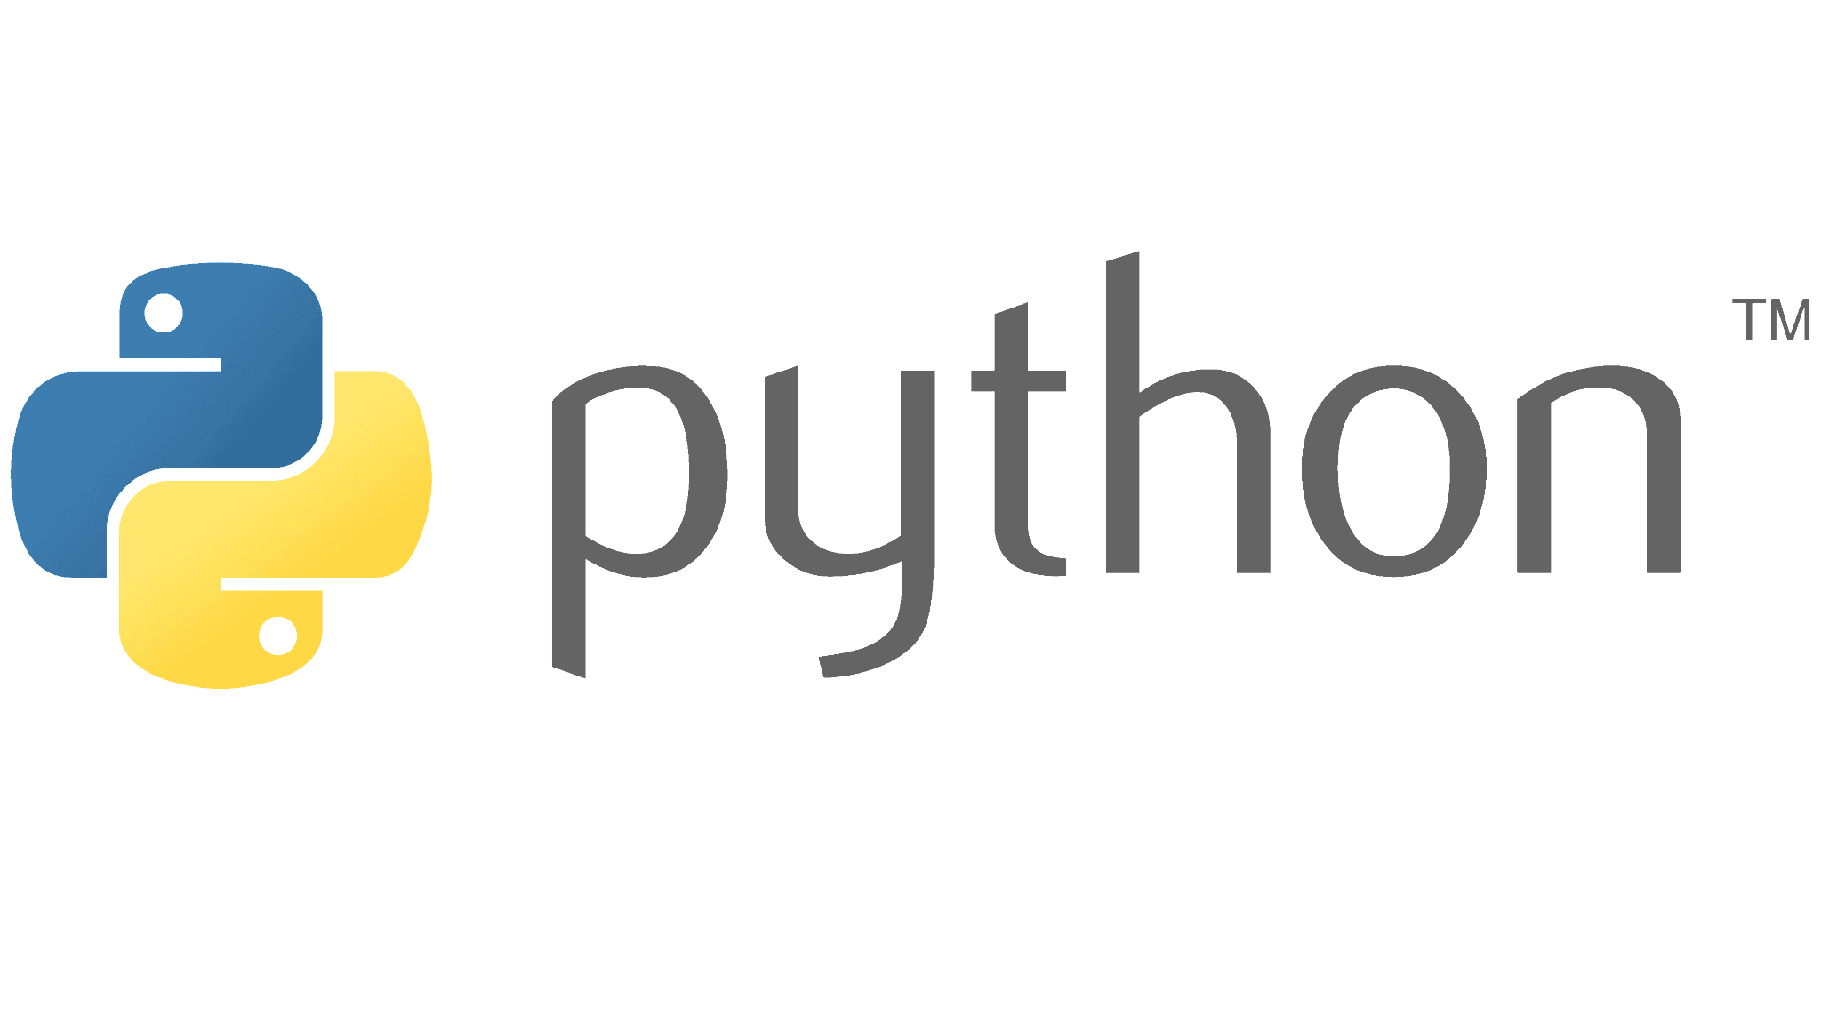
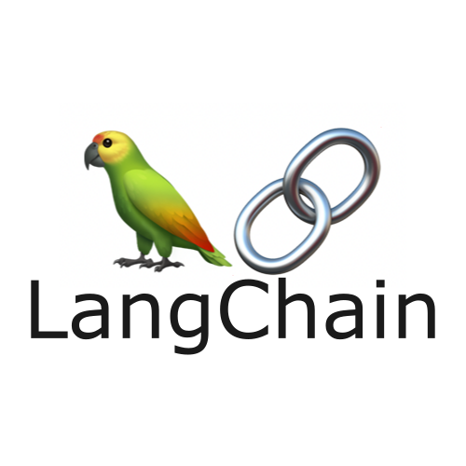
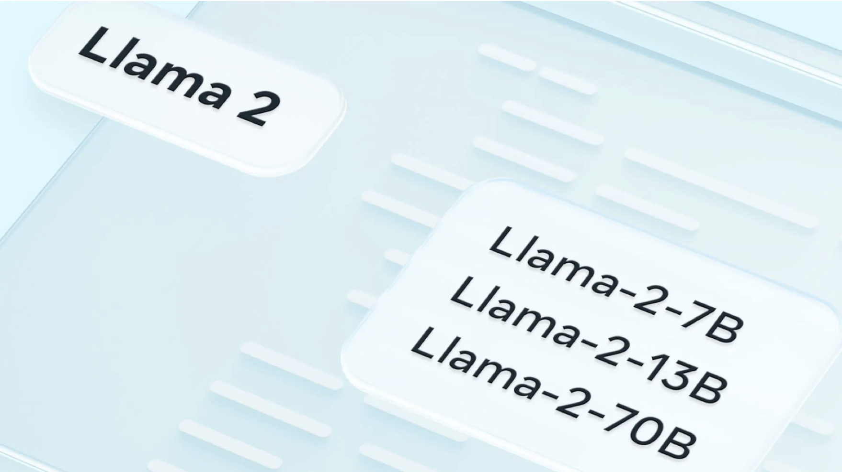
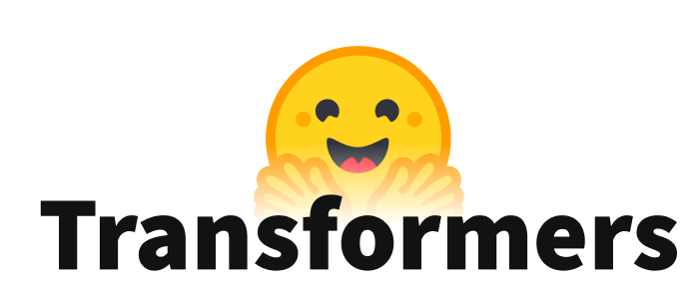
Prerequisites
RAG Agents in Production
Prior LLM/LangChain Exposure
Intermediate Python Experience
Exposure to Web Engineering
Source: NVIDIA DLI (2024), Building RAG Agents with LLMs, https://learn.nvidia.com/courses/course-detail?course_id=course-v1:DLI+S-FX-15+V1
Notes:
(Current: Prerequisites)
(Up Next: Course Objectives/Outline)
(After That: Section 1 Title)

Slide 75
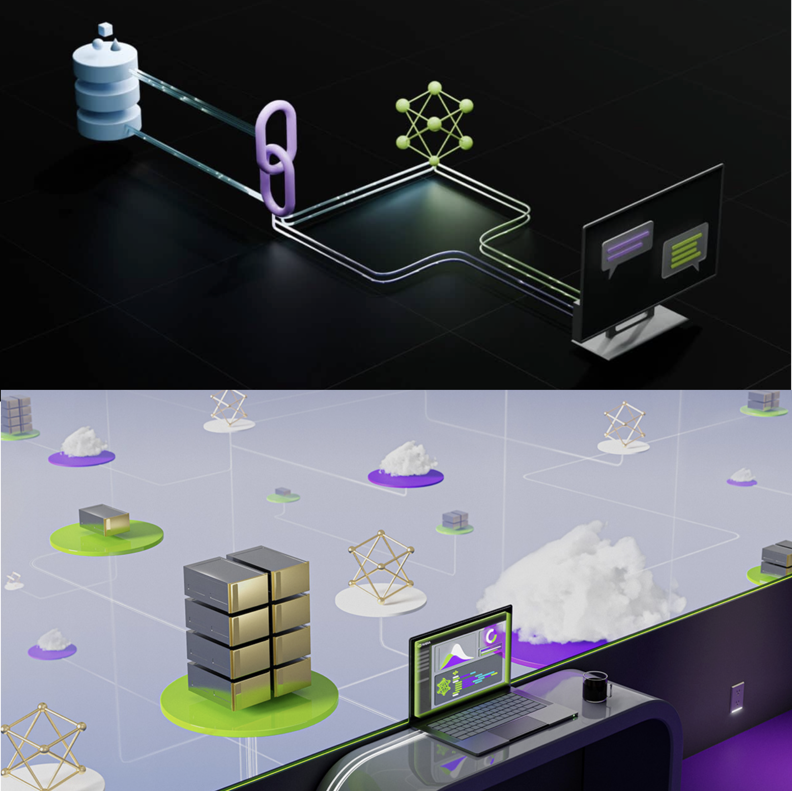
Course Objectives
RAG Agents in Production
Environment
LLM Services
Intro to LangChain (LCEL)
Running State Chains
Document Loading
Embeddings
Document Retrieval
RAG Evaluation
Source: NVIDIA DLI (2024), Building RAG Agents with LLMs, https://learn.nvidia.com/courses/course-detail?course_id=course-v1:DLI+S-FX-15+V1
Notes:
(Previous: Prerequisites)
(Current: Course Objectives/Outline)
(Up Next: Section 1: Your Course Environment)

Slide 76
Course Objectives
RAG Agents in Production
(Starts at 9)
Environment
LLM Services
Intro to LangChain (LCEL)
Running State Chains
  (Lunch)
Document Loading
Embeddings
Document Retrieval
RAG Evaluation
  (Ends at 5, take-home/ask instructor)
Source: NVIDIA DLI (2024), Building RAG Agents with LLMs, https://learn.nvidia.com/courses/course-detail?course_id=course-v1:DLI+S-FX-15+V1
Notes:
(Previous: Prerequisites)
(Current: Course Objectives/Outline)
(Up Next: Section 1: Your Course Environment)

Slide 77
Building RAG Agents with LLMs
Part 1: Your Course Environment
Source: NVIDIA DLI (2024), Building RAG Agents with LLMs, https://learn.nvidia.com/courses/course-detail?course_id=course-v1:DLI+S-FX-15+V1

Slide 78
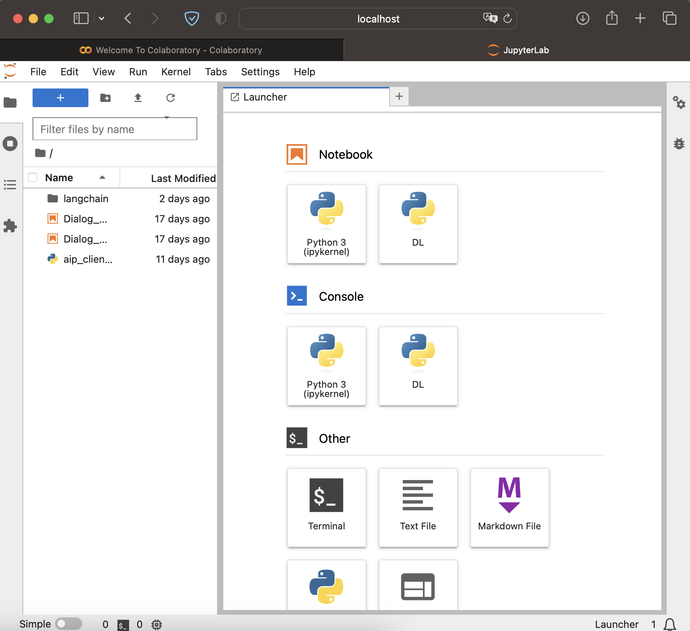
Typical Jupyter Labs Interface
jupyter lab . &; open -a Safari http://localhost:8888/lab
Source: NVIDIA DLI (2024), Building RAG Agents with LLMs, https://learn.nvidia.com/courses/course-detail?course_id=course-v1:DLI+S-FX-15+V1
Notes:
"Once you've launched the course environment, you'll be greeted with the JupyterLab interface.
Can be deployed locally from a system and using your resources. Rely on your hardware and access via your browser.
Can also be launched through a service like Google Colab! Allocates resources for you, and doesn’t rely on your compute!

Slide 79
Typical Jupyter Labs Interface
Your Device
Your Device
Web Browser
Files
Python
OS
C++
Hardware
jupyter lab . &; open -a Safari http://localhost:8888/lab
Source: NVIDIA DLI (2024), Building RAG Agents with LLMs, https://learn.nvidia.com/courses/course-detail?course_id=course-v1:DLI+S-FX-15+V1
Notes:
"Once you've launched the course environment, you'll be greeted with the JupyterLab interface.
Can be deployed locally from your system and using your resources. Rely on your hardware and access via your browser.
(Next slide adds in Jupyter Labs server, which probably stays within your local host scope.)
Can also be launched through a service like Google Colab! Allocates resources for you, and doesn’t rely on your compute!

Slide 80
Typical Jupyter Labs Interface
Your Device
Your Device
Web Browser
:8888
Files
Python
OS
Jupyter Labs
C++
Hardware
jupyter lab . &; open -a Safari http://localhost:8888/lab
Source: NVIDIA DLI (2024), Building RAG Agents with LLMs, https://learn.nvidia.com/courses/course-detail?course_id=course-v1:DLI+S-FX-15+V1
Notes:
"Once you've launched the course environment, you'll be greeted with the JupyterLab interface.
Can be deployed locally from your system and using your resources. Rely on your hardware and access via your browser.
Can also be launched through a service like Google Colab! Allocates resources for you, and doesn’t rely on your compute!

Slide 81
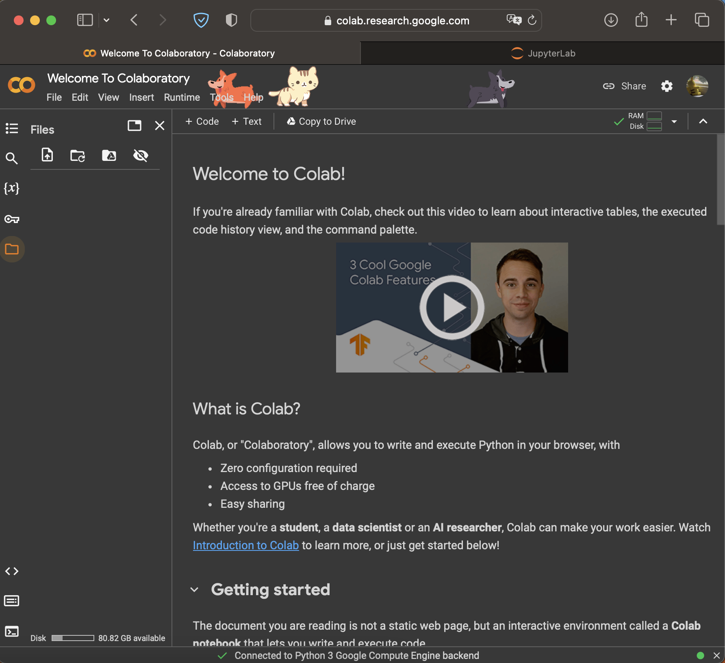
Typical Jupyter Labs Interface
Your Device
Your Device
Web Browser
:8888
Files
Python
OS
Jupyter Labs
C++
Hardware
jupyter lab . &; open -a Safari http://localhost:8888/lab
https://colab.research.google.com
Source: NVIDIA DLI (2024), Building RAG Agents with LLMs, https://learn.nvidia.com/courses/course-detail?course_id=course-v1:DLI+S-FX-15+V1
Notes:
"Once you've launched the course environment, you'll be greeted with the JupyterLab interface.
Can be deployed locally from your system and using your resources. Rely on your hardware and access via your browser.
Can also be launched through a service like Google Colab! Allocates resources for you, and doesn’t rely on your compute!
(Use your computer to coordinate with some allocation system)
(Get yourself access to a GPU-enabled resource from the cloud)

Slide 82
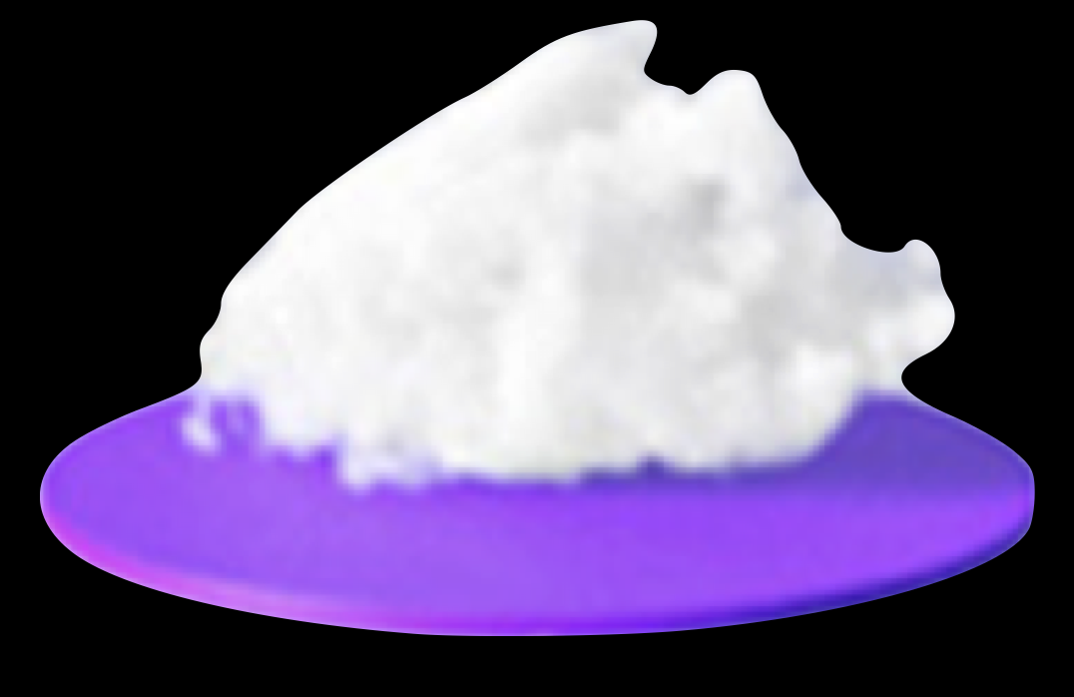
Typical Jupyter Labs Interface
Your Device
Your Device
Web Browser
Your Device
:8888
Web Browser
Files
Python
OS
Jupyter Labs
C++
Hardware
Files
Python
OS
C++
Hardware
jupyter lab . &; open -a Safari http://localhost:8888/lab
https://colab.research.google.com
Source: NVIDIA DLI (2024), Building RAG Agents with LLMs, https://learn.nvidia.com/courses/course-detail?course_id=course-v1:DLI+S-FX-15+V1
Notes:
"Once you've launched the course environment, you'll be greeted with the JupyterLab interface.
Can be deployed locally from your system and using your resources. Rely on your hardware and access via your browser.
Can also be launched through a service like Google Colab! Allocates resources for you, and doesn’t rely on your compute!
(Use your computer to coordinate with some allocation system)
(Get yourself access to a GPU-enabled resource from the cloud)

Slide 83
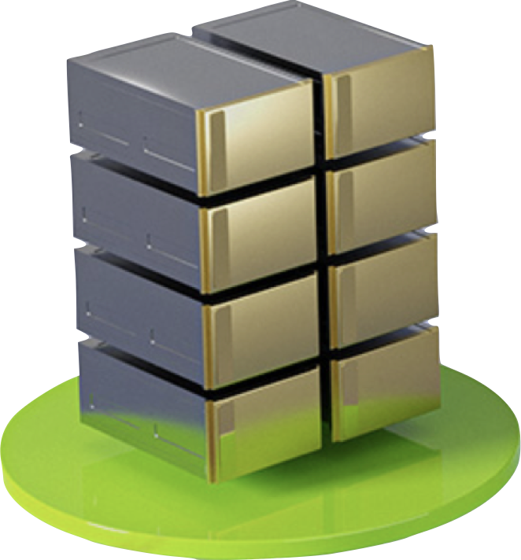
Typical Jupyter Labs Interface
Your Device
Your Device
Web Browser
Your Device
:8888
Web Browser
Files
Python
OS
Jupyter Labs
C++
Hardware
Files
Python
OS
C++
Hardware
jupyter lab . &; open -a Safari http://localhost:8888/lab
https://colab.research.google.com
Source: NVIDIA DLI (2024), Building RAG Agents with LLMs, https://learn.nvidia.com/courses/course-detail?course_id=course-v1:DLI+S-FX-15+V1
Notes:
"Once you've launched the course environment, you'll be greeted with the JupyterLab interface.
Can be deployed locally from your system and using your resources. Rely on your hardware and access via your browser.
Can also be launched through a service like Google Colab! Allocates resources for you, and doesn’t rely on your compute!
(Use your computer to coordinate with some allocation system)
(Get yourself access to a GPU-enabled resource from the cloud)

Slide 84
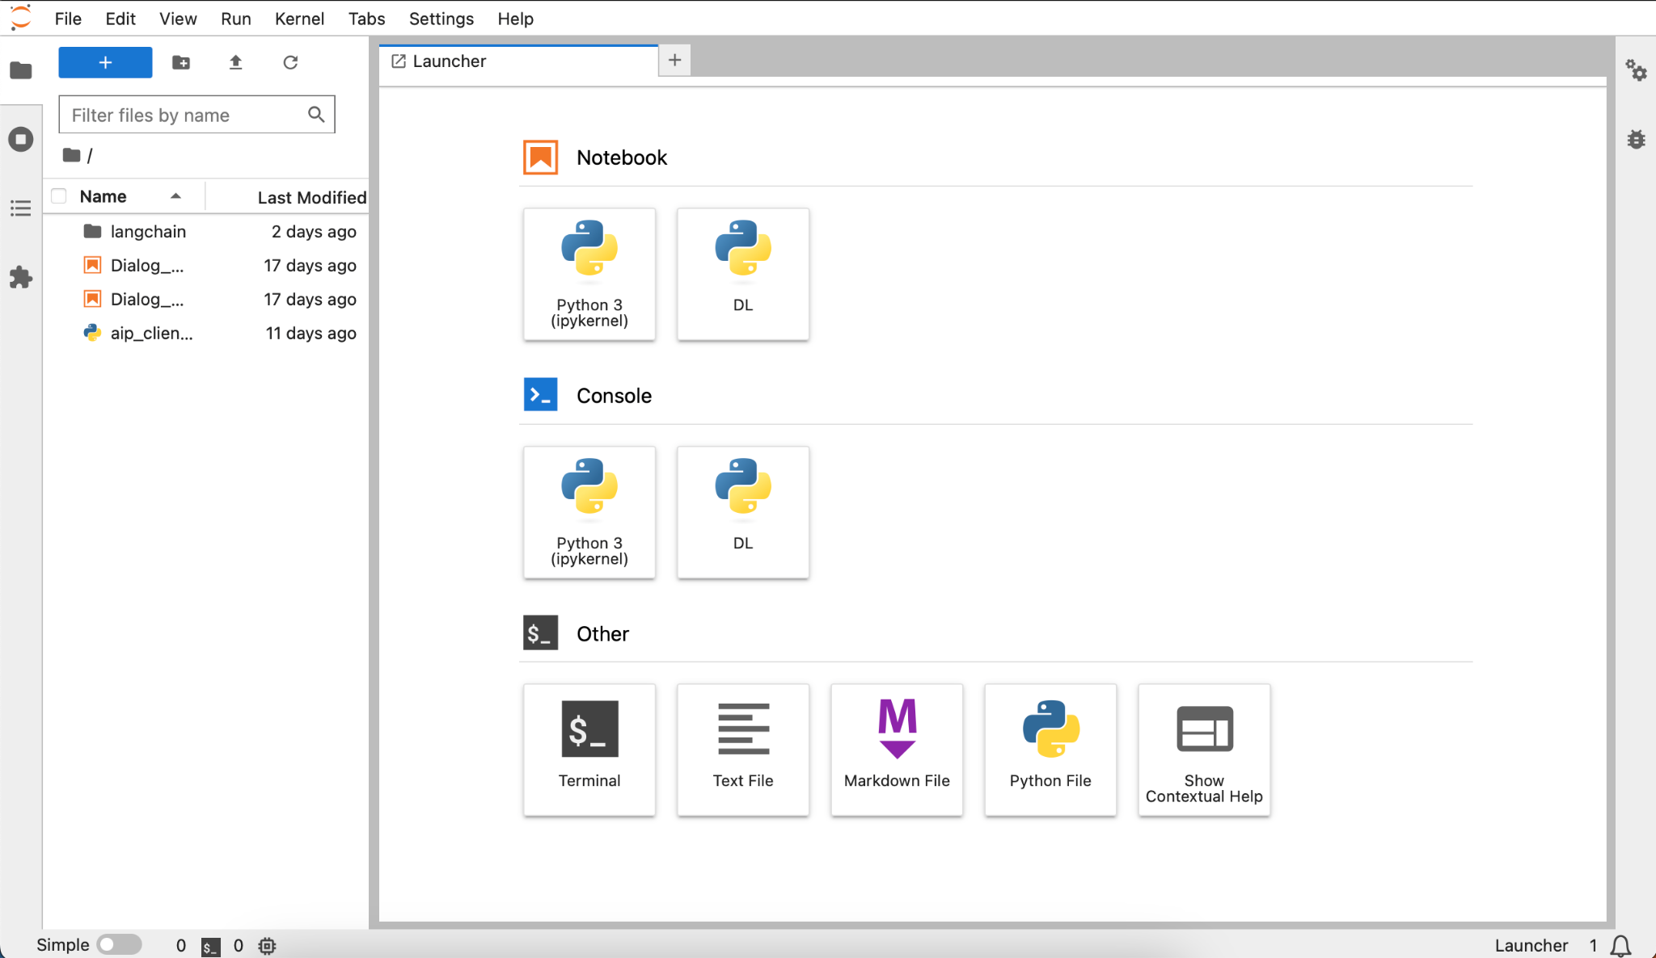
DLI Jupyter Labs Interface
Source: NVIDIA DLI (2024), Building RAG Agents with LLMs, https://learn.nvidia.com/courses/course-detail?course_id=course-v1:DLI+S-FX-15+V1
Notes:
How is this interface actually provided for you?
Compute allocated for you by cloud provider like AWS or Azure. Has some hardware, os, software, etc.
Good to go!!! Except there are other things happening in the background…
Maybe data loader? Maybe proxy server? Metadata tracker? Database connection? Need different software…
Maybe some of the other resources have different requirements? Volume space? Hardware allocation?...
TO HELP SOLVE THIS, WE CAN CONTAINERIZE INTO MICROSERVICES!

Slide 85

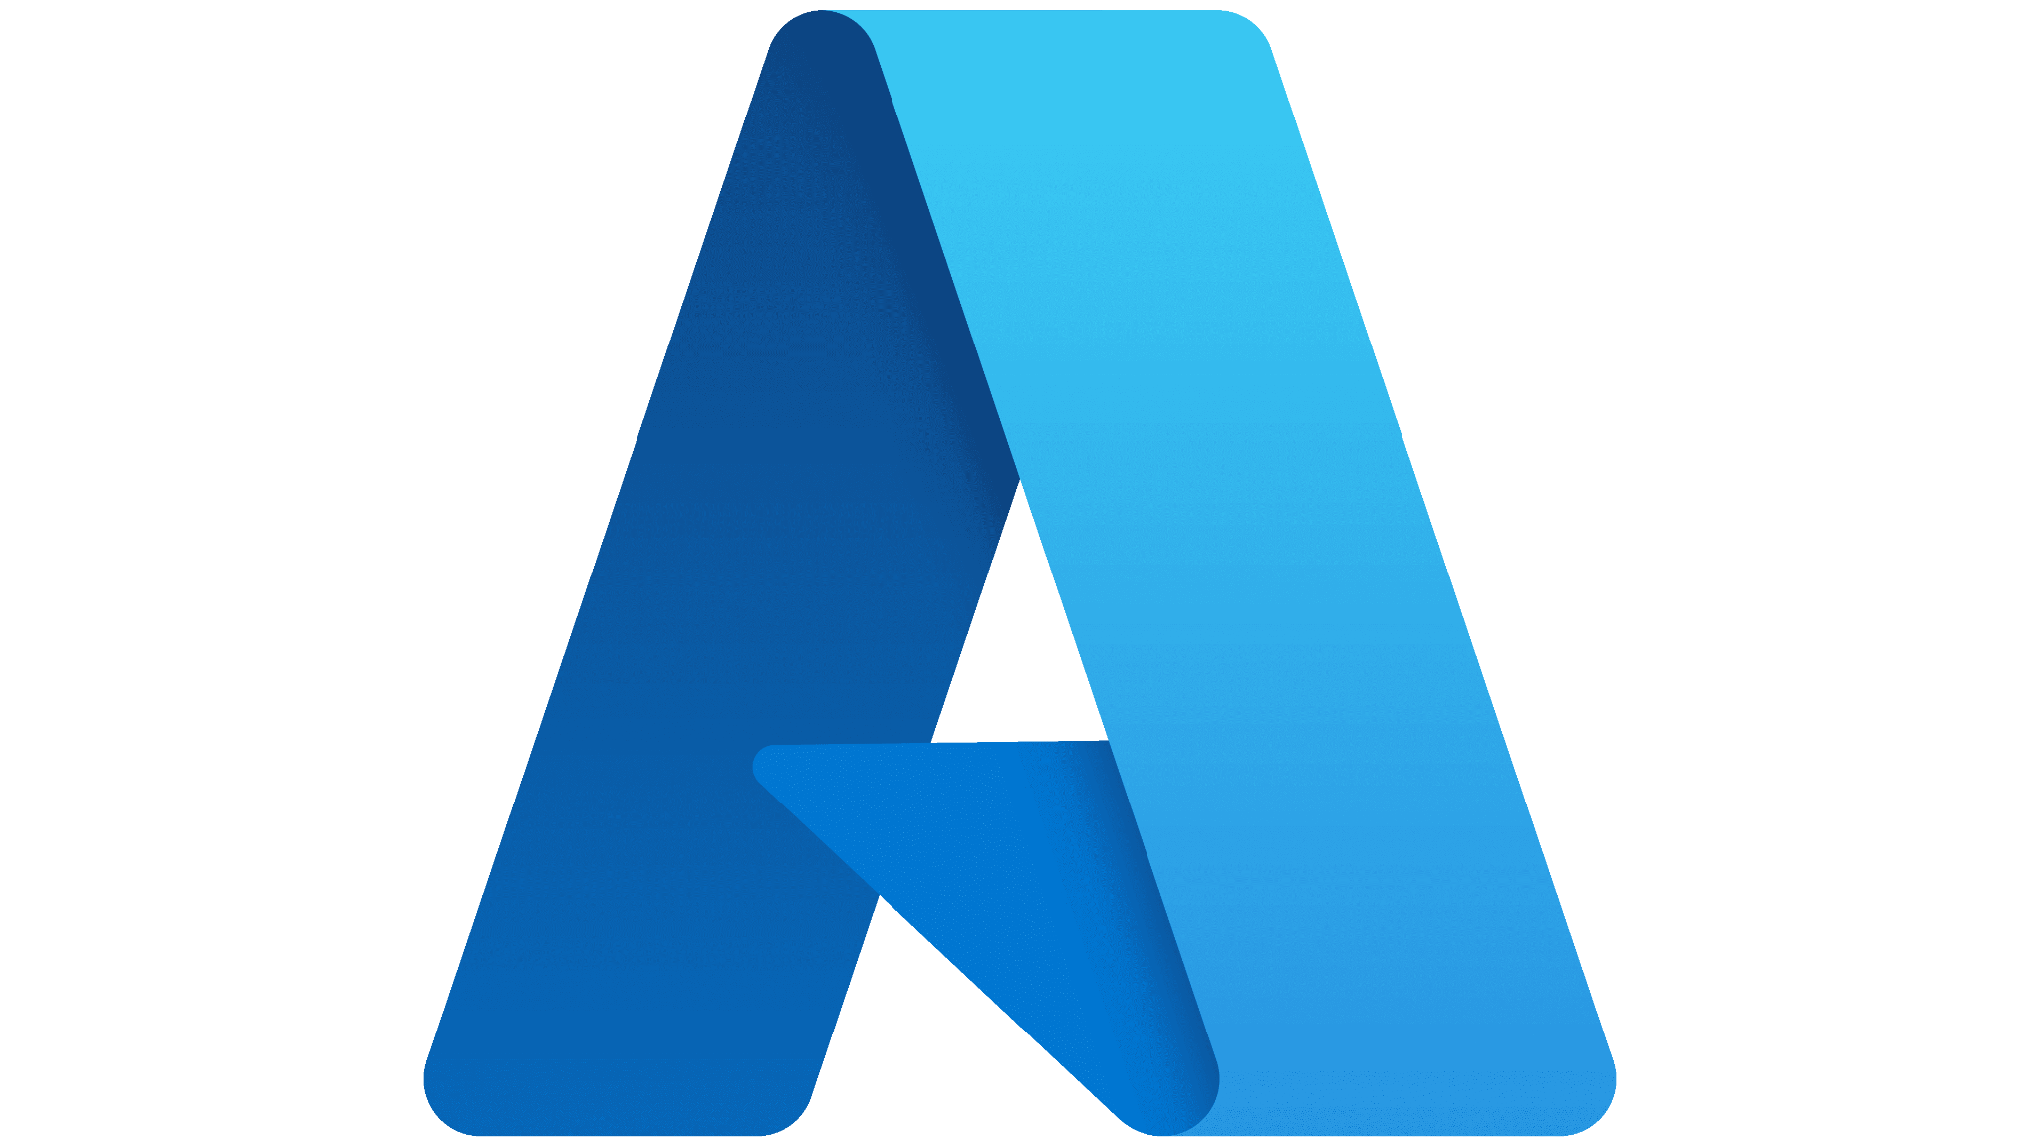
DLI Jupyter Labs Interface
Your Device
Remote Host
Files
Jupyter Labs
Python
OS
C++
Hardware
Your Device
Your Device
Web Browser
Source: NVIDIA DLI (2024), Building RAG Agents with LLMs, https://learn.nvidia.com/courses/course-detail?course_id=course-v1:DLI+S-FX-15+V1
Notes:
How is this interface actually provided for you?
Compute allocated for you by cloud provider like AWS or Azure. Has some hardware, os, software, etc.
Good to go!!! Except there are other things happening in the background…
Maybe data loader? Maybe proxy server? Metadata tracker? Database connection? Need different software…
Maybe some of the other resources have different requirements? Volume space? Hardware allocation?...
TO HELP SOLVE THIS, WE CAN CONTAINERIZE INTO MICROSERVICES!

Slide 86
DLI Jupyter Labs Interface
Your Device
Remote Host
Good to go!
… sort of …
Files
Jupyter Labs
Python
OS
C++
Hardware
Your Device
Your Device
Web Browser
Source: NVIDIA DLI (2024), Building RAG Agents with LLMs, https://learn.nvidia.com/courses/course-detail?course_id=course-v1:DLI+S-FX-15+V1
Notes:
How is this interface actually provided for you?
Compute allocated for you by cloud provider like AWS or Azure. Has some hardware, os, software, etc.
Good to go!!! Except there are other things happening in the background…
Maybe data loader? Maybe proxy server? Metadata tracker? Database connection? Need different software…
Maybe some of the other resources have different requirements? Volume space? Hardware allocation?...
TO HELP SOLVE THIS, WE CAN CONTAINERIZE INTO MICROSERVICES!

Slide 87
DLI Jupyter Labs Interface
Your Device
Remote Host
More Processes?
Python
Data Loader
Scheduler
Proxy Service
Node
Env
Shell
Python
Files
Jupyter Labs
OS
C++
Hardware
Your Device
Your Device
Web Browser
Source: NVIDIA DLI (2024), Building RAG Agents with LLMs, https://learn.nvidia.com/courses/course-detail?course_id=course-v1:DLI+S-FX-15+V1
Notes:
How is this interface actually provided for you?
Compute allocated for you by cloud provider like AWS or Azure. Has some hardware, os, software, etc.
Good to go!!! Except there are other things happening in the background…
Maybe data loader? Maybe proxy server? Metadata tracker? Database connection? Need different software…
Maybe some of the other resources have different requirements? Volume space? Hardware allocation?...
TO HELP SOLVE THIS, WE CAN CONTAINERIZE INTO MICROSERVICES!

Slide 88
DLI Jupyter Labs Interface
Your Device
Remote Host
More Processes?
Python
Data Loader
Scheduler
Proxy Service
Node
Env
Shell
Python
Files
Jupyter Labs
OS
C++
Hardware
Your Device
Your Device
Dividing Resources?
Web Browser
Source: NVIDIA DLI (2024), Building RAG Agents with LLMs, https://learn.nvidia.com/courses/course-detail?course_id=course-v1:DLI+S-FX-15+V1
Notes:
How is this interface actually provided for you?
Compute allocated for you by cloud provider like AWS or Azure. Has some hardware, os, software, etc.
Good to go!!! Except there are other things happening in the background…
Maybe data loader? Maybe proxy server? Metadata tracker? Database connection? Need different software…
Maybe some of the other resources have different requirements? Volume space? Hardware allocation?...
TO HELP SOLVE THIS, WE CAN CONTAINERIZE INTO MICROSERVICES!

Slide 89
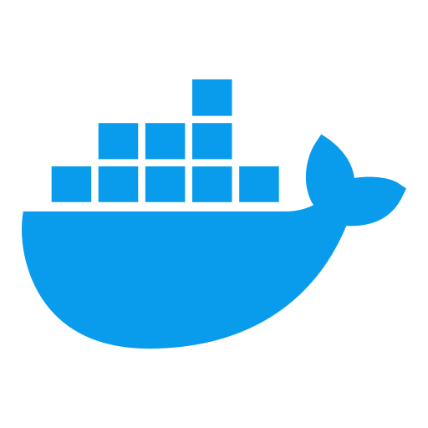
Containerization with Docker
Compartmentalizing Functionality Into Microservices
Your Device
Host
Python
Data Loader
Scheduler
Proxy Service
Node
Env
Shell
Your Device
Python
Files
Host
Jupyter Labs
OS
C++
Hardware
Python
Sh
Volume
:8070
:8888
Volume
Files
:88
Python
OS
Jupyter
GPU/2
C++
Hardware
Source: NVIDIA DLI (2024), Building RAG Agents with LLMs, https://learn.nvidia.com/courses/course-detail?course_id=course-v1:DLI+S-FX-15+V1
Notes:
How is this interface actually provided for you?
Compute allocated for you by cloud provider like AWS or Azure. Has some hardware, os, software, etc.
Good to go!!! Except there are other things happening in the background…
Maybe data loader? Maybe proxy server? Metadata tracker? Database connection? Need different software…
Maybe some of the other resources have different requirements? Volume space? Hardware allocation?...
TO HELP SOLVE THIS, WE CAN CONTAINERIZE INTO MICROSERVICES!
Avoid dependency conflict, allocate resources as necessary, provide connections through server ports!

Slide 90
Microservices Workflow
Your Device
Your Device
Web Browser
Source: NVIDIA DLI (2024), Building RAG Agents with LLMs, https://learn.nvidia.com/courses/course-detail?course_id=course-v1:DLI+S-FX-15+V1
Notes:
What does microservice orchestration look like in practice?
Let’s start with your device, which is telling a service (like DLI?) that you need compute.
DLI will ask AWS/Azure to ALLOCATE RESOURCES for the environment.
Then, DLI will DEFINE the microservices. What they are, how they’re made, what ports they can use. (i.e. docker-compose)
These microservices can then be CONSTRUCTED from a base image. Install packages, move files, download stuff, etc. (i.e. Dockerfile)
Then, perpetual services can be kickstarted in these containers, like servers or endpoints. We now have live microservices!

Slide 91
Microservices Workflow
Your Device
Remote Host
Allocate Resources
Define Services
Construct Containers
Start Processes
Files
Python
OS
C++
Hardware
Your Device
Your Device
Web Browser
Source: NVIDIA DLI (2024), Building RAG Agents with LLMs, https://learn.nvidia.com/courses/course-detail?course_id=course-v1:DLI+S-FX-15+V1
Notes:
What does microservice orchestration look like in practice?
Let’s start with your device, which is telling a service (like DLI?) that you need compute.
DLI will ask AWS/Azure to ALLOCATE RESOURCES for the environment.
Then, DLI will DEFINE the microservices. What they are, how they’re made, what ports they can use. (i.e. docker-compose)
These microservices can then be CONSTRUCTED from a base image. Install packages, move files, download stuff, etc. (i.e. Dockerfile)
Then, perpetual services can be kickstarted in these containers, like servers or endpoints. We now have live microservices!

Slide 92
Microservices Workflow
Your Device
Remote Host
Allocate Resources
Define Services
Construct Containers
Start Processes
Python
Sh
Volume
:8070
:8888
Volume
Files
:88
Python
OS
Jupyter
GPU/2
C++
Hardware
Your Device
Your Device
Web Browser
Source: NVIDIA DLI (2024), Building RAG Agents with LLMs, https://learn.nvidia.com/courses/course-detail?course_id=course-v1:DLI+S-FX-15+V1
Notes:
What does microservice orchestration look like in practice?
Let’s start with your device, which is telling a service (like DLI?) that you need compute.
DLI will ask AWS/Azure to ALLOCATE RESOURCES for the environment.
Then, DLI will DEFINE the microservices. What they are, how they’re made, what ports they can use. (i.e. docker-compose)
These microservices can then be CONSTRUCTED from a base image. Install packages, move files, download stuff, etc. (i.e. Dockerfile)
Then, perpetual services can be kickstarted in these containers, like servers or endpoints. We now have live microservices!

Slide 93
Microservices Workflow
Your Device
Remote Host
Allocate Resources
Define Services
Construct Containers
Start Processes
Database Environment
Data Loader
:8070
:8888
Jupyter Notebook Environment
Files
:88
Python
OS
C++
Hardware
Your Device
Your Device
Web Browser
Source: NVIDIA DLI (2024), Building RAG Agents with LLMs, https://learn.nvidia.com/courses/course-detail?course_id=course-v1:DLI+S-FX-15+V1
Notes:
What does microservice orchestration look like in practice?
Let’s start with your device, which is telling a service (like DLI?) that you need compute.
DLI will ask AWS/Azure to ALLOCATE RESOURCES for the environment.
Then, DLI will DEFINE the microservices. What they are, how they’re made, what ports they can use. (i.e. docker-compose)
These microservices can then be CONSTRUCTED from a base image. Install packages, move files, download stuff, etc. (i.e. Dockerfile)
Then, perpetual services can be kickstarted in these containers, like servers or endpoints. We now have live microservices!

Slide 94
Microservices Workflow
Your Device
Remote Host
Allocate Resources
Define Services
Construct Containers
Start Processes
Database Environment
Data Loader
:8070
:8888
Jupyter Notebook Environment
Files
:88
Python
OS
C++
Hardware
Your Device
Your Device
Web Browser
Source: NVIDIA DLI (2024), Building RAG Agents with LLMs, https://learn.nvidia.com/courses/course-detail?course_id=course-v1:DLI+S-FX-15+V1
Notes:
What does microservice orchestration look like in practice?
Let’s start with your device, which is telling a service (like DLI?) that you need compute.
DLI will ask AWS/Azure to ALLOCATE RESOURCES for the environment.
Then, DLI will DEFINE the microservices. What they are, how they’re made, what ports they can use. (i.e. docker-compose)
These microservices can then be CONSTRUCTED from a base image. Install packages, move files, download stuff, etc. (i.e. Dockerfile)
Then, perpetual services can be kickstarted in these containers, like servers or endpoints. We now have live microservices!
Why bother setting things up this way though?
…

Slide 95
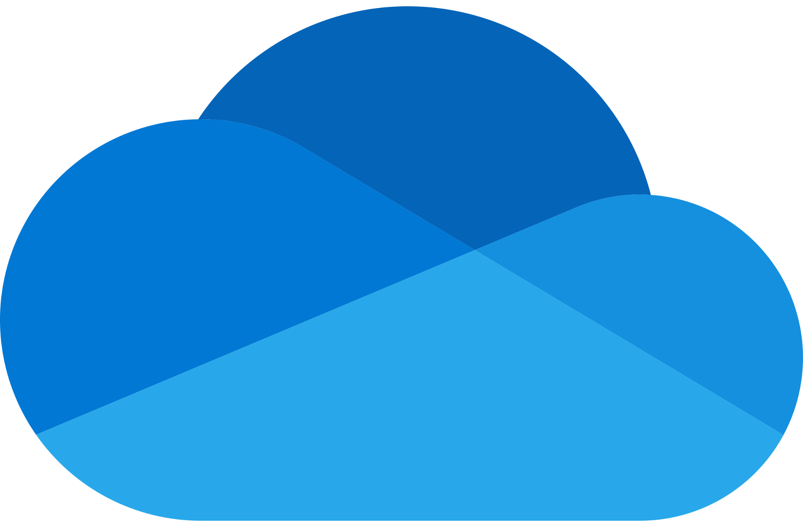
Scaling Containerized Applications
Company
Database
Your Device
GenAI
Service
Arbitrary Host
Database Environment
Data Loader
:8070
:8888
Jupyter Notebook Environment
Files
Python
OS
C++
Hardware
Your Device
Your Device
Web Browser
Your Device
Your Device
Other Devices
Your Device
Other Devices
Your Device
Web Browser
Other Devices
Web Browser
Other Devices
Web Browser
Web Browser
Source: NVIDIA DLI (2024), Building RAG Agents with LLMs, https://learn.nvidia.com/courses/course-detail?course_id=course-v1:DLI+S-FX-15+V1
Notes:
What does microservice orchestration look like in practice?
…
Why bother setting things up this way though?
Turns out, creating services that communicate over ports makes it simple to move stuff around! (next slide shows connections)
You can move services off your device and into the cloud, or can move processes towards edge devices without too much trouble!

Slide 96
Scaling Containerized Applications
Company
Database
Your Device
GenAI
Service
Arbitrary Host
Database Environment
Data Loader
:8070
:8888
Jupyter Notebook Environment
Files
Python
OS
C++
Hardware
Your Device
Your Device
Your Device
Your Device
Your Device
Web Browser
Your Device
Your Device
Other Devices
Your Device
Other Devices
Your Device
Web Browser
Other Devices
Web Browser
Other Devices
Web Browser
Web Browser
Source: NVIDIA DLI (2024), Building RAG Agents with LLMs, https://learn.nvidia.com/courses/course-detail?course_id=course-v1:DLI+S-FX-15+V1
Notes:
What does microservice orchestration look like in practice?
…
Why bother setting things up this way though?
Turns out, creating services that communicate over ports makes it simple to move stuff around! (next slide shows connections)
You can move services off your device and into the cloud, or move processes towards edge devices without too much trouble!
So, let’s get back to our own environment! So far, we know we have our Jupyter Labs interface, but what else?

Slide 97
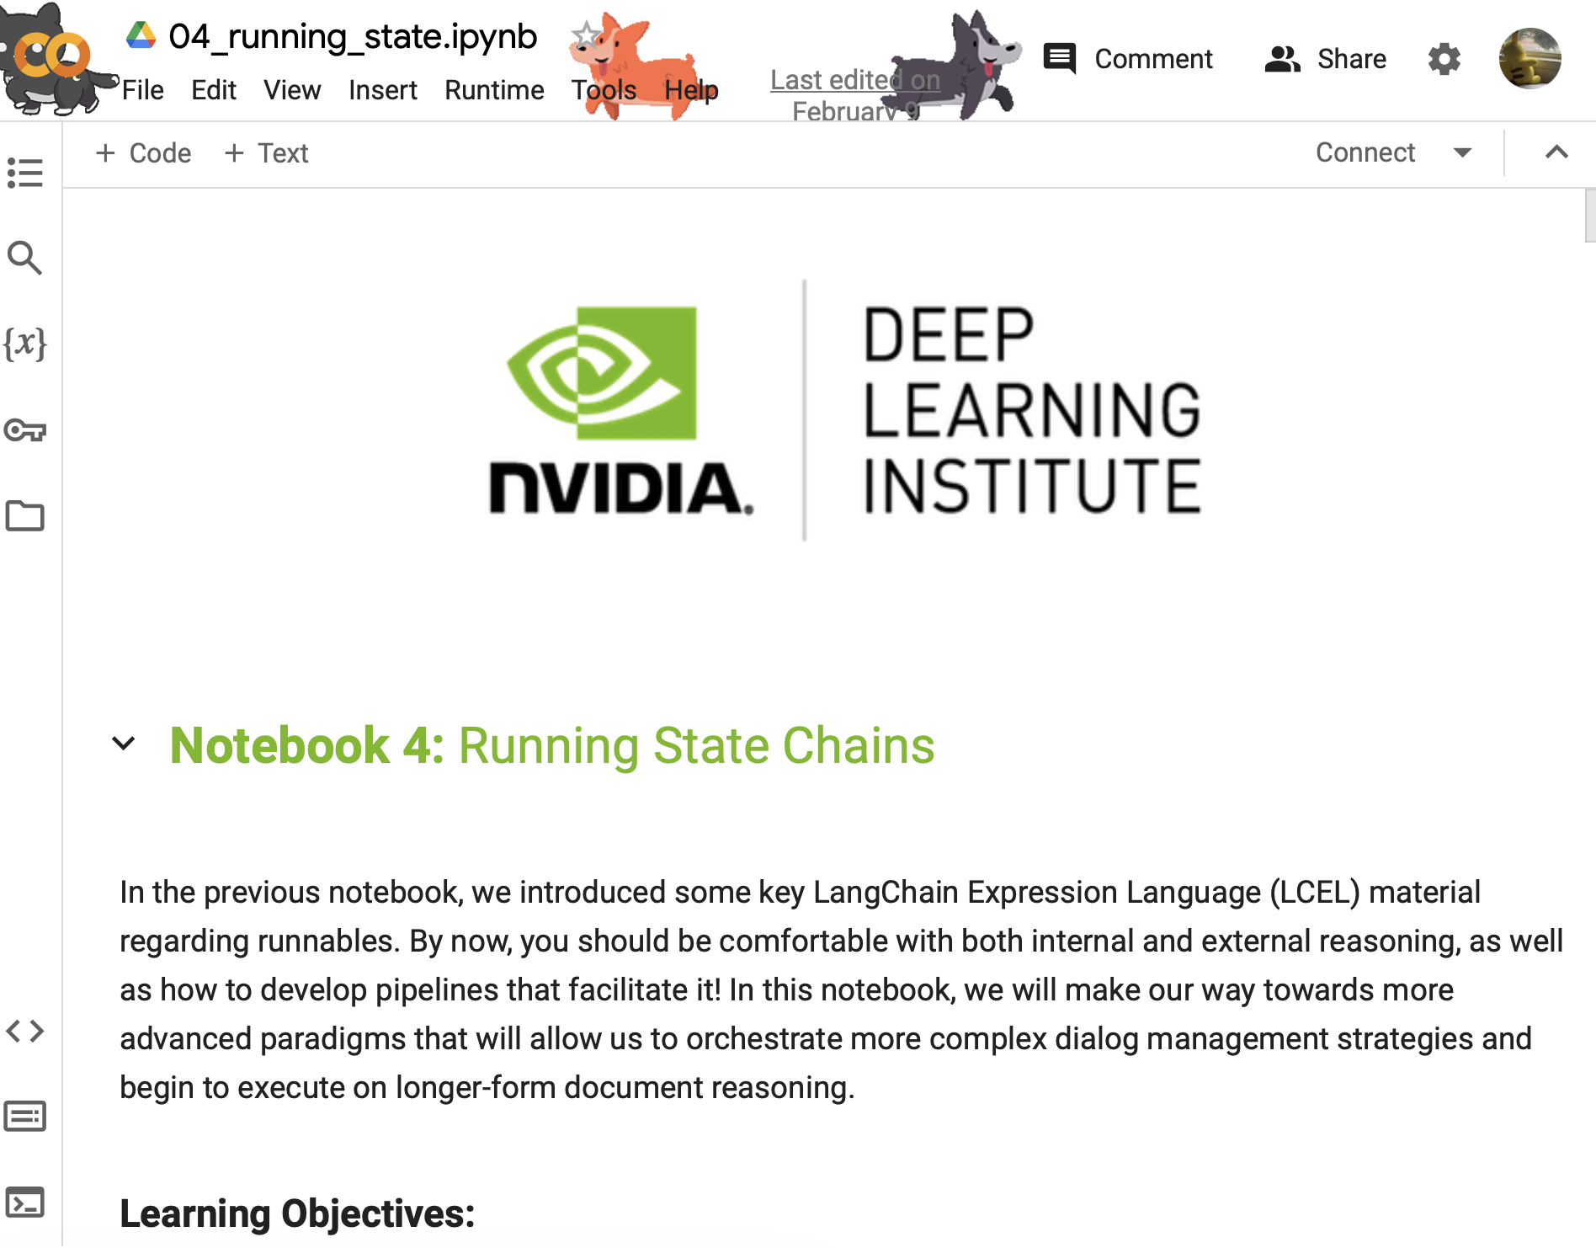
Our Environment
Jupyter Notebooks
Your Device
Remote Host
Docker
Router
Jupyter Notebook Server
:88
Source: NVIDIA DLI (2024), Building RAG Agents with LLMs, https://learn.nvidia.com/courses/course-detail?course_id=course-v1:DLI+S-FX-15+V1
Notes:
What does microservice orchestration look like in practice?
So, let’s get back to our own environment! So far, we know we have our Jupyter Labs interface, but what else?
In the lab, you’ll find out about the frontend microservice, which is already hosted on port 8090.

Slide 98
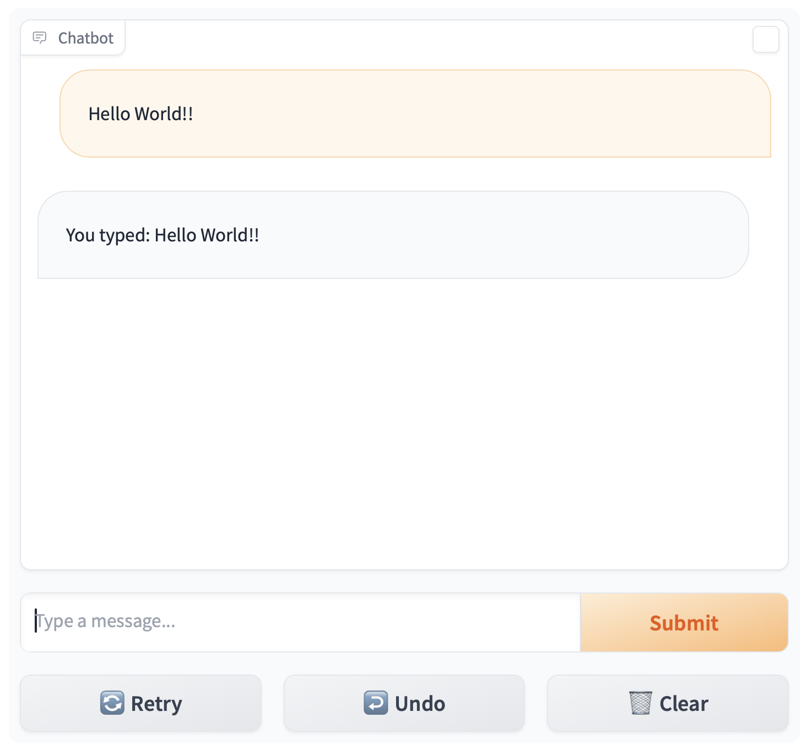
Our Environment
Jupyter Notebooks + Frontend
Your Device
Remote Host
:8090
Frontend
Docker
Router
Jupyter Notebook Server
:88
Source: NVIDIA DLI (2024), Building RAG Agents with LLMs, https://learn.nvidia.com/courses/course-detail?course_id=course-v1:DLI+S-FX-15+V1
Notes:
What does microservice orchestration look like in practice?
So, let’s get back to our own environment! So far, we know we have our Jupyter Labs interface, but what else?
In the lab, you’ll find out about the frontend microservice, which is already hosted on port 8090.
This frontend is hosted in Gradio, an open-source web interface design library well-suited for presenting AI models.

Slide 99
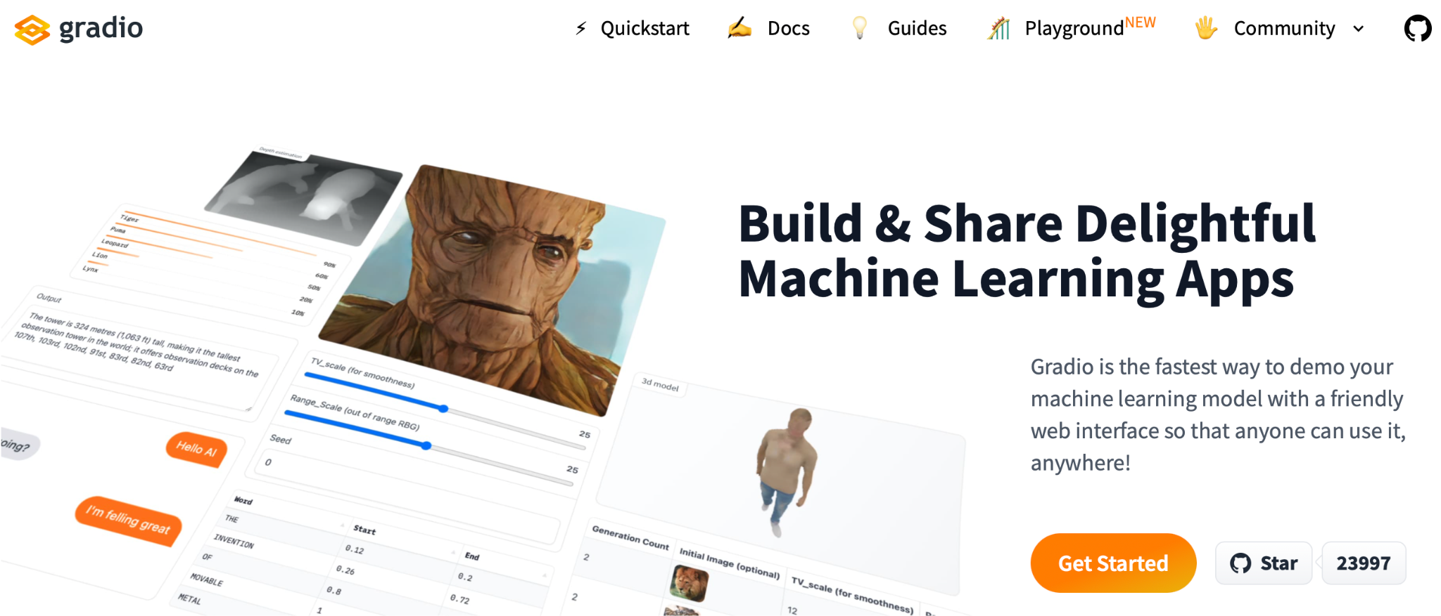
Gradio
Source: NVIDIA DLI (2024), Building RAG Agents with LLMs, https://learn.nvidia.com/courses/course-detail?course_id=course-v1:DLI+S-FX-15+V1
Notes:
What does microservice orchestration look like in practice?
So, let’s get back to our own environment! So far, we know we have our Jupyter Labs interface, but what else?
In the lab, you’ll find out about the frontend microservice, which is already hosted on port 8090.
This frontend is hosted in Gradio, an open-source web interface design library well-suited for presenting AI models.
1. Simple interface: slow_echo is being ran in a loop
2. More involved interface example from huggingface spaces, which anybody can contribute to
3. A more involved interface, which is closer to what is available/running in environment. See ./frontent/server_app.py

Slide 100
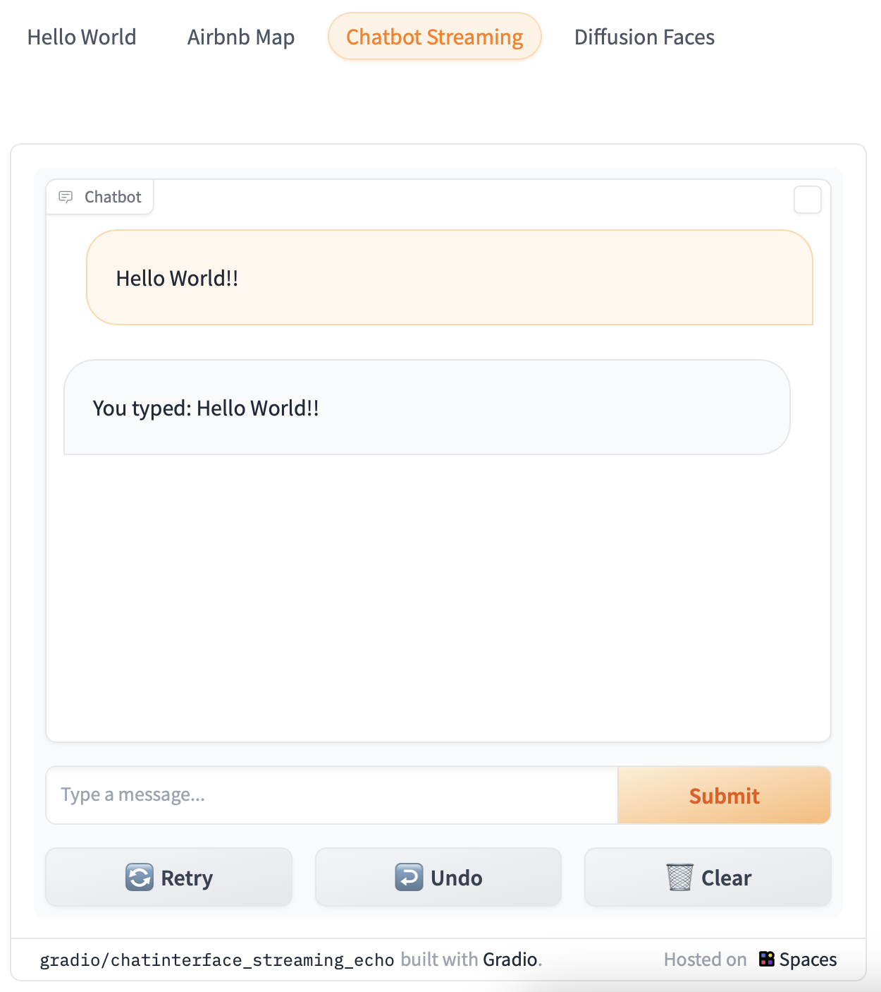
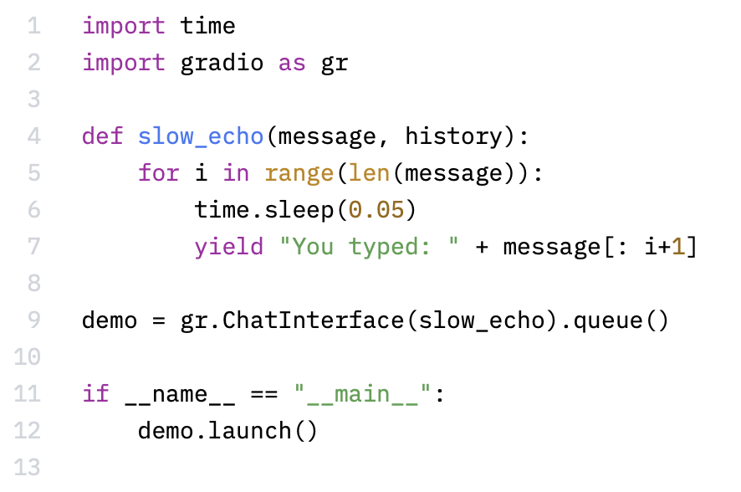
Simple Gradio ChatInterface
https://www.gradio.app/
https://huggingface.co/spaces/gradio/chatinterface_streaming_echo/blob/main/run.py
Source: NVIDIA DLI (2024), Building RAG Agents with LLMs, https://learn.nvidia.com/courses/course-detail?course_id=course-v1:DLI+S-FX-15+V1
Notes:
What does microservice orchestration look like in practice?
So, let’s get back to our own environment! So far, we know we have our Jupyter Labs interface, but what else?
In the lab, you’ll find out about the frontend microservice, which is already hosted on port 8090.
This frontend is hosted in Gradio, an open-source web interface design library well-suited for presenting AI models.
1. Simple interface: slow_echo is being ran in a loop
2. More involved interface example from huggingface spaces, which anybody can contribute to
3. A more involved interface, which is closer to what is available/running in environment. See ./frontent/server_app.py

Slide 101
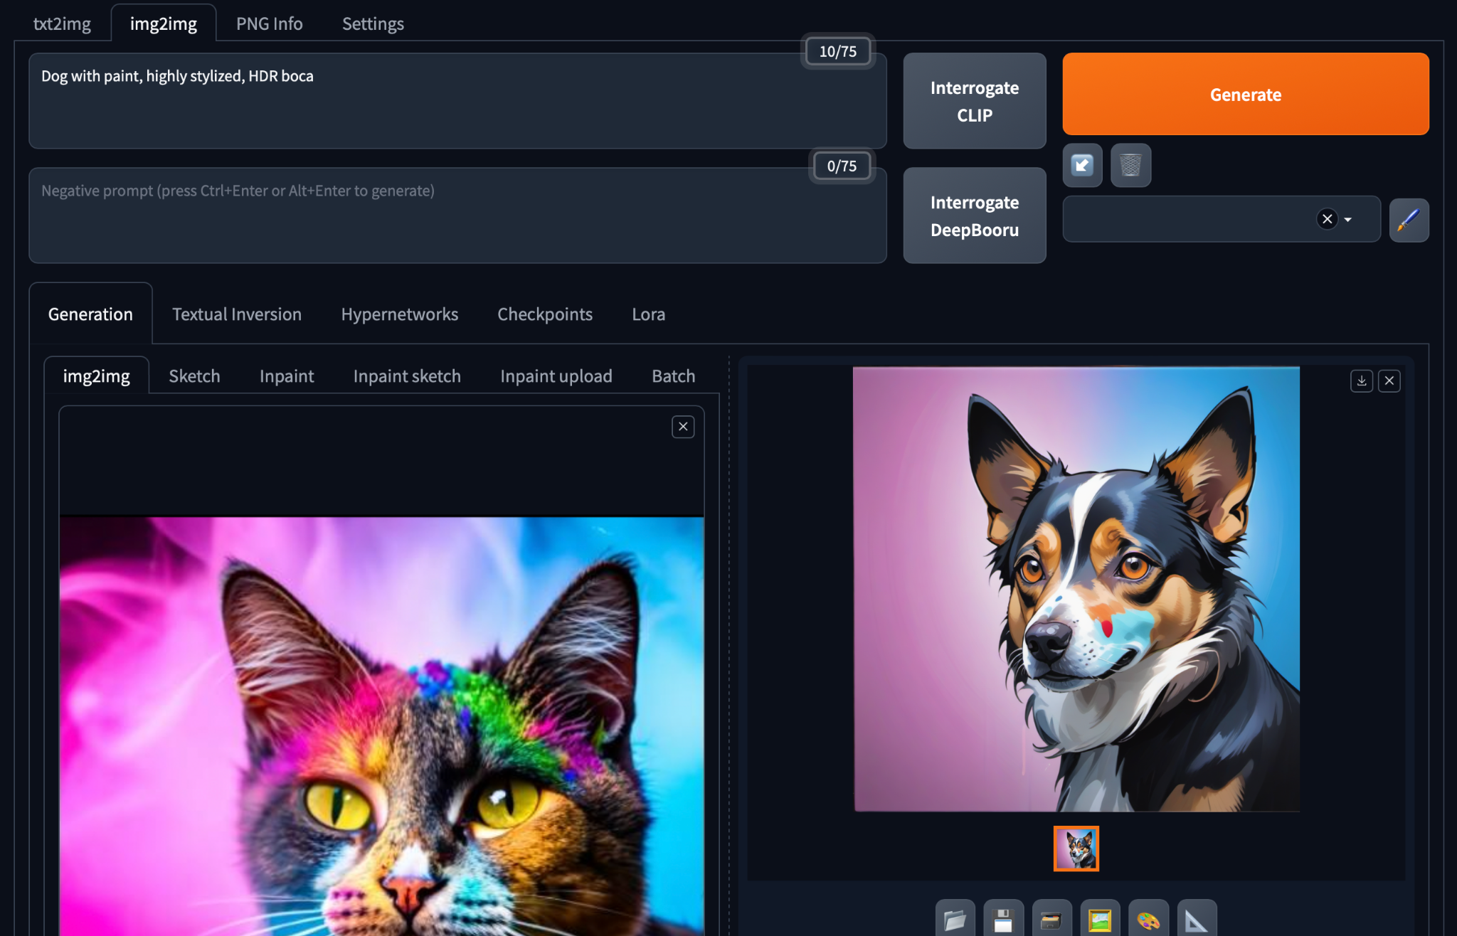
Gradio in HuggingFace Spaces
https://huggingface.co/spaces/camenduru-com/webui
Source: NVIDIA DLI (2024), Building RAG Agents with LLMs, https://learn.nvidia.com/courses/course-detail?course_id=course-v1:DLI+S-FX-15+V1
Notes:
What does microservice orchestration look like in practice?
So, let’s get back to our own environment! So far, we know we have our Jupyter Labs interface, but what else?
In the lab, you’ll find out about the frontend microservice, which is already hosted on port 8090.
This frontend is hosted in Gradio, an open-source web interface design library well-suited for presenting AI models.
1. Simple interface: slow_echo is being ran in a loop
2. More involved interface example from huggingface spaces, which anybody can contribute to
3. A more involved interface, which is closer to what is available/running in environment. See ./frontent/server_app.py

Slide 102
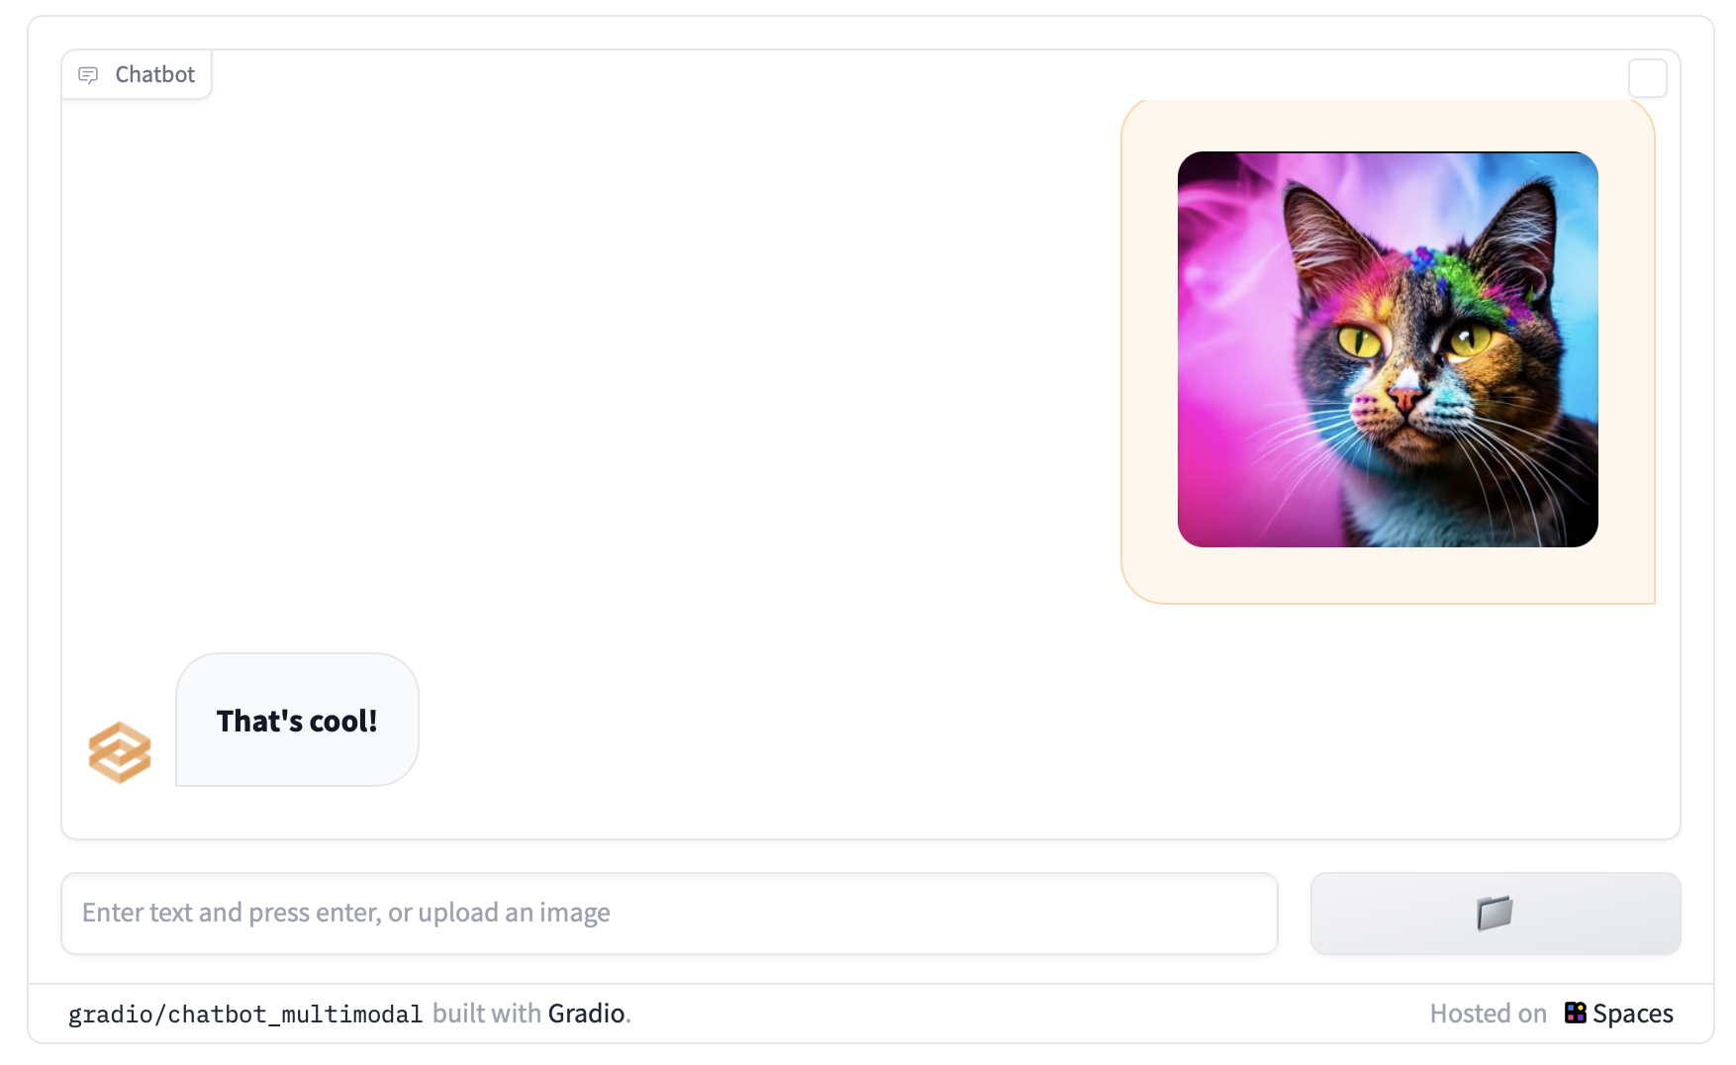
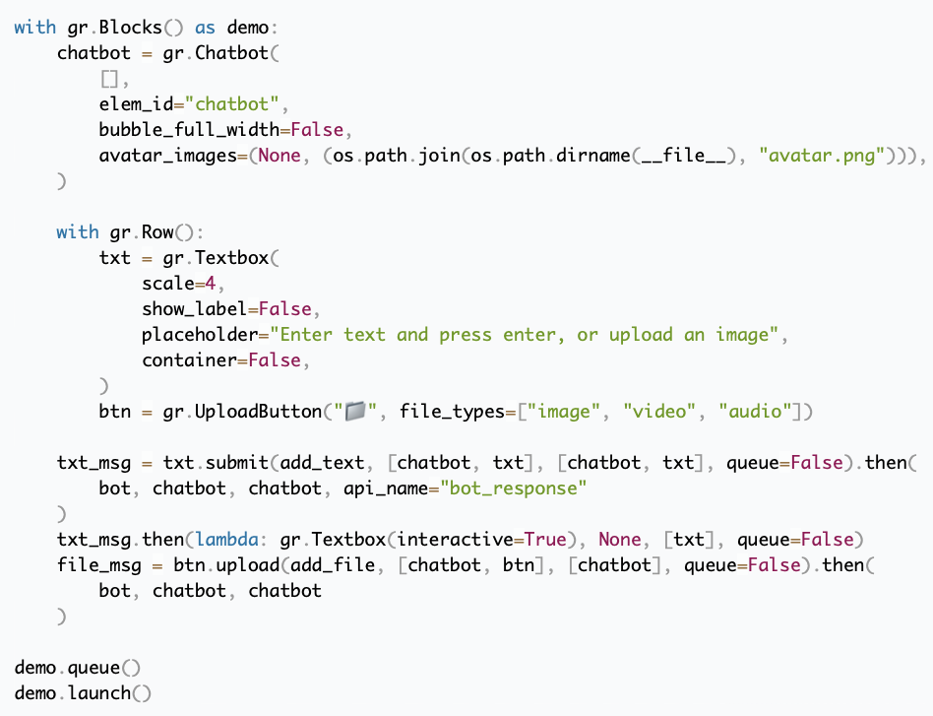
Custom Gradio Block Interface
https://www.gradio.app/guides/creating-a-custom-chatbot-with-blocks
Source: NVIDIA DLI (2024), Building RAG Agents with LLMs, https://learn.nvidia.com/courses/course-detail?course_id=course-v1:DLI+S-FX-15+V1
Notes:
What does microservice orchestration look like in practice?
So, let’s get back to our own environment! So far, we know we have our Jupyter Labs interface, but what else?
In the lab, you’ll find out about the frontend microservice, which is already hosted on port 8090.
This frontend is hosted in Gradio, an open-source web interface design library well-suited for presenting AI models.
1. Simple interface: slow_echo is being ran in a loop
2. More involved interface example from huggingface spaces, which anybody can contribute to
3. A more involved interface, which is closer to what is available/running in environment. See ./frontent/server_app.py

Slide 103
Our Environment
Jupyter Notebooks + Frontend
Your Device
Remote Host
:8090
Frontend
Docker
Router
Jupyter Notebook Server
:88
Source: NVIDIA DLI (2024), Building RAG Agents with LLMs, https://learn.nvidia.com/courses/course-detail?course_id=course-v1:DLI+S-FX-15+V1
Notes:
So that’s it!
Frontend interface already running on port :8090. To see details, check out ./frontend
Jupyter notebook running on port :88. To see details, check out ./composer
(Next Section: We’ll talk about the LLM-serving microservice)
Enjoy the lab!

Slide 104
Building RAG Agents with LLMs
Part 2: LLM Services
Source: NVIDIA DLI (2024), Building RAG Agents with LLMs, https://learn.nvidia.com/courses/course-detail?course_id=course-v1:DLI+S-FX-15+V1

Slide 105
Our Environment
Jupyter Notebooks + Frontend
Your Device
Remote Host
:8090
Frontend
Docker
Router
Jupyter Notebook Server
:88
Source: NVIDIA DLI (2024), Building RAG Agents with LLMs, https://learn.nvidia.com/courses/course-detail?course_id=course-v1:DLI+S-FX-15+V1
Notes:
So we have our environment, and we can use it to run some Python…
but wasn’t the point of this course to learn about chatbots and agents and RAG?
So where’s the LLM?
Well, if we don’t have a microservice for it…
…perhaps we can just pull in an LLM directly into our Jupyter notebook session and go from there!

Slide 106
Dialog/Retrieval Agents
LLMs with Context and Control
Execute with dialog management and information retrieval in production
https://www.nvidia.com/content/dam/en-zz/Solutions/lp/large-language-models-ebook/nvidia-llm-ebook-og.jpg
Source: NVIDIA DLI (2024), Building RAG Agents with LLMs, https://learn.nvidia.com/courses/course-detail?course_id=course-v1:DLI+S-FX-15+V1
Notes:
So we have our environment, and we can use it to run some Python…
but wasn’t the point of this course to learn about chatbots and agents and RAG?
So where’s the LLM?
Well, if we don’t have a microservice for it…
…perhaps we can just pull in an LLM directly into our Jupyter notebook session and go from there!

Slide 107
Dialog/Retrieval Agents
LLMs with Context and Control
Execute with dialog management and information retrieval in production
https://www.nvidia.com/content/dam/en-zz/Solutions/lp/large-language-models-ebook/nvidia-llm-ebook-og.jpg
Source: NVIDIA DLI (2024), Building RAG Agents with LLMs, https://learn.nvidia.com/courses/course-detail?course_id=course-v1:DLI+S-FX-15+V1
Notes:
So we have our environment, and we can use it to run some Python…
but wasn’t the point of this course to learn about chatbots and agents and RAG?
So where’s the LLM?
Well, if we don’t have a microservice for it…
…perhaps we can just pull in an LLM directly into our Jupyter notebook session and go from there!

Slide 108
Standalone Environment LLM
Your Device
Remote Host
Frontend
Docker
Router
Jupyter Notebook Server
Source: NVIDIA DLI (2024), Building RAG Agents with LLMs, https://learn.nvidia.com/courses/course-detail?course_id=course-v1:DLI+S-FX-15+V1
Notes:
So we have our environment, and we can use it to run some Python…
but wasn’t the point of this course to learn about chatbots and agents and RAG?
So where’s the LLM?
Well, if we don’t have a microservice for it…
…perhaps we can just pull in an LLM directly into our Jupyter notebook session and go from there!

Slide 109
Standalone Environment LLM
Your Device
Remote Host
Frontend
Docker
Router
Jupyter Notebook Server
LLM
Source: NVIDIA DLI (2024), Building RAG Agents with LLMs, https://learn.nvidia.com/courses/course-detail?course_id=course-v1:DLI+S-FX-15+V1
Notes:
So we have our environment, and we can use it to run some Python…
but wasn’t the point of this course to learn about chatbots and agents and RAG?
So where’s the LLM?
Well, if we don’t have a microservice for it…
…perhaps we can just pull in an LLM directly into our Jupyter notebook session and go from there!

Slide 110
Standalone Environment LLM
Jupyter Notebook
H200
A100
Jupyter Notebook
A10
4070
<s>[INST]<<SYS>>
{{system_message}}
<</SYS>>
{{instruction}} [/INST] {{primer}}
Jupyter Notebook
<s>[INST]<<SYS>>
You are a code generator.
Please provide Python code
per the instruction.
<</SYS>>
Write a Fibonacci method [/INST] ```python
## Implementation of Fibonacci w/
VRAM-bound
CPU-only
Source: NVIDIA DLI (2024), Building RAG Agents with LLMs, https://learn.nvidia.com/courses/course-detail?course_id=course-v1:DLI+S-FX-15+V1
Notes:
Datacenter Compute Environment: We’d be able to pull in one or more large models and run them without too much compromises.
This kind of environment is great for exclusive access to models for experimentation and fine-tuning, and is also great for running instances perpetually for delivery to many users. Pretty costly on a per-user basis.
Lighter Datacenter/High-End Consumer Environment: We’d probably still be able to pull in some smaller models or maybe one large model to use with some compromises.
Would need to quantize and conserve resources, but can still scale to some users and have some access to the raw models.
Typical Consumer Device: Problematic to run large models without some severe compromises. Can still be done, but limited interfaces.
Good to follow minimum device spec assumption of “I can run stuff in a browser”

Slide 111
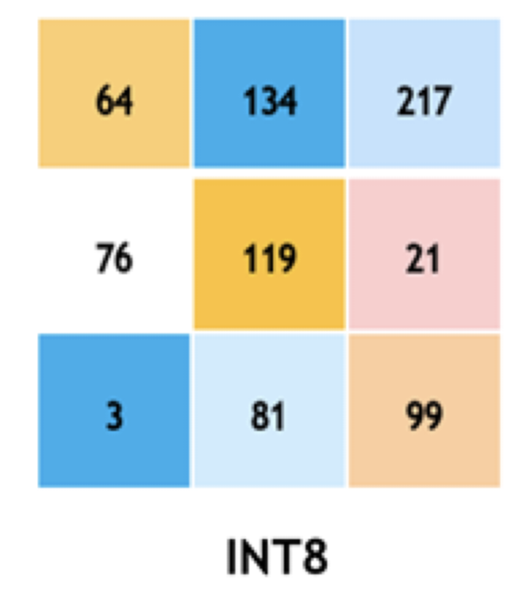

Standalone Environment LLM
Jupyter Notebook
H200
A100
Jupyter Notebook
A10
4070
Jupyter Notebook
VRAM-bound
CPU-only
Source: NVIDIA DLI (2024), Building RAG Agents with LLMs, https://learn.nvidia.com/courses/course-detail?course_id=course-v1:DLI+S-FX-15+V1
Notes:
Datacenter Compute Environment: We’d be able to pull in one or more large models and run them without too much compromises.
This kind of environment is great for exclusive access to models for experimentation and fine-tuning, and is also great for running instances perpetually for delivery to many users. Pretty costly on a per-user basis.
Lighter Datacenter/High-End Consumer Environment: We’d probably still be able to pull in some smaller models or maybe one large model to use with some compromises.
Would need to quantize and conserve resources, but can still scale to some users and have some access to the raw models.
Typical Consumer Device: Problematic to run large models without some severe compromises. Can still be done, but limited interfaces.
Good to follow minimum device spec assumption of “I can run stuff in a browser”

Slide 112
Standalone Environment LLM
Jupyter Notebook
H200
A100
Jupyter Notebook
A10
4070
Jupyter Notebook
VRAM-bound
CPU-only
Source: NVIDIA DLI (2024), Building RAG Agents with LLMs, https://learn.nvidia.com/courses/course-detail?course_id=course-v1:DLI+S-FX-15+V1
Notes:
Datacenter Compute Environment: We’d be able to pull in one or more large models and run them without too much compromises.
This kind of environment is great for exclusive access to models for experimentation and fine-tuning, and is also great for running instances perpetually for delivery to many users. Pretty costly on a per-user basis.
Lighter Datacenter/High-End Consumer Environment: We’d probably still be able to pull in some smaller models or maybe one large model to use with some compromises.
Would need to quantize and conserve resources, but can still scale to some users and have some access to the raw models.
Typical Consumer Device: Problematic to run large models without some severe compromises. Can still be done, but limited interfaces.
Good to follow minimum device spec assumption of “I can run stuff in a browser”
(Next Slide: Typical consumer device is our assumption, so what now?)

Slide 113

Remote LLM Access
<s>[INST]<<SYS>>
{{system_message}}
<</SYS>>
{{instruction}} [/INST] {{primer}}
Your Device
Remote Host
Llama
Frontend
<s>[INST]<<SYS>>
You are a code generator.
Please provide Python code
per the instruction.
<</SYS>>
Write a Fibonacci method [/INST] ```python
## Implementation of Fibonacci w/
Jupyter Notebook
VRAM-bound
CPU-only
Source: NVIDIA DLI (2024), Building RAG Agents with LLMs, https://learn.nvidia.com/courses/course-detail?course_id=course-v1:DLI+S-FX-15+V1
Notes:
Typical Consumer Device: Problematic to run large models without some severe compromises. Can still be done, but limited interfaces.
Good to follow minimum device spec assumption of “I can run stuff in a browser”
That’ll be our assumption, so what can we do?
Luckily, we can interface with large model hosting platforms that can provide the scalable inference services for us!
For now, we can use network requests like GET and POST to communicate to an external platform. Maybe someday these will be hosted by us as well, but for now let’s see what we can bank on from others!

Slide 114
Large Model Hosting Platforms
Your Device
NVIDIA
GPU CLOUD
Remote Host
Frontend
Jupyter Notebook
VRAM-bound
CPU-only
Source: NVIDIA DLI (2024), Building RAG Agents with LLMs, https://learn.nvidia.com/courses/course-detail?course_id=course-v1:DLI+S-FX-15+V1
Notes:
Typical Consumer Device: Problematic to run large models without some severe compromises. Can still be done, but limited interfaces.
Good to follow minimum device spec assumption of “I can run stuff in a browser”
That’ll be our assumption, so what can we do?
Luckily, we can interface with large model hosting platforms that can provide the scalable inference services for us!
We can use network requests like GET and POST to communicate to an external platform.
Maybe someday these will be hosted by you, but for now let’s see what we can work with from others!

Slide 115
Large Model Hosting Platforms
NVIDIA
GPU CLOUD
GPT4/3.5
Integrated Tools/Multimodal Support
Models/Query Router Internal
Path to Local Deployment Less Clear
Publicly Available Models
Models/Query Router Accessible
Path to Local Deployment/Self-Hosting
Pieces to Compose Complex Systems
Source: NVIDIA DLI (2024), Building RAG Agents with LLMs, https://learn.nvidia.com/courses/course-detail?course_id=course-v1:DLI+S-FX-15+V1
Notes:
OpenAI
Has GPT4/ChatGPT/Dalle/etc. Lots of under-the-hood bells and whistles (models/functions that get called automatically).
(NEXT SECTION: multi-slide tangent on how the models are hosted and provided from OpenAI)
(Later) No straightforward path to local deployment, but it is very easy to use! Great for easily making solutions that work.

Slide 116

Query Router Access
GPT4
Dalle-3
Embed
<s>[INST]<<SYS>>
{{system_message}}
<</SYS>>
{{instruction}} [/INST] {{primer}}????
Source: NVIDIA DLI (2024), Building RAG Agents with LLMs, https://learn.nvidia.com/courses/course-detail?course_id=course-v1:DLI+S-FX-15+V1
Notes:
How are these models provided:
Large model providers host models on allocated compute instances where they download the model and let it run perpetually.
From the end user perspective, these large models host endpoints which can be connected to by a variety of users and applications at any given time through a gateway service (more details to come).
Under the hood, these services generally use scaled deployment orchestrators like Kubernetes.

Slide 117
Query Router Access
{
"messages": [{
"content": "...",
"role": "system"
},{
"content": "...",
"role": "user"
}],
"model": ”gpt-4”,
"temperature": 0.2,
"top_p": 0.7,
"max_tokens": 1024,
"stream": True
}
GPT4
/chat/completions
Dalle-3
Facilitate
Monitor
Optimize
Load Balance
Embed
<s>[INST]<<SYS>>
{{system_message}}
<</SYS>>
{{instruction}} [/INST] {{primer}}????
https://kubernetes.io/
Source: NVIDIA DLI (2024), Building RAG Agents with LLMs, https://learn.nvidia.com/courses/course-detail?course_id=course-v1:DLI+S-FX-15+V1
Notes:
How are these models provided:
Large model providers host models on allocated compute instances where they download the model and let it run perpetually.
From the end user perspective, these large models host endpoints which can be connected to by a variety of users and applications at any given time through a gateway service (more details to come).
Under the hood, these services generally use scaled deployment orchestrators like Kubernetes.

Slide 118

Query Router Access
{
"messages": [{
"content": "...",
"role": "system"
},{
"content": "...",
"role": "user"
}],
"model": ”gpt-4”,
"temperature": 0.2,
"top_p": 0.7,
"max_tokens": 1024,
"stream": True
}
GPT4
/chat/completions
Dalle-3
Facilitate
Monitor
Optimize
Load Balance
Embed
<s>[INST]<<SYS>>
{{system_message}}
<</SYS>>
{{instruction}} [/INST] {{primer}}????
https://kubernetes.io/
Source: NVIDIA DLI (2024), Building RAG Agents with LLMs, https://learn.nvidia.com/courses/course-detail?course_id=course-v1:DLI+S-FX-15+V1
Notes:
How are these models provided:
Large model providers host models on allocated compute instances where they download the model and let it run perpetually.
From the end user perspective, these large models host endpoints which can be connected to by a variety of users and applications at any given time through a gateway service (more details to come).
Under the hood, these services generally use scaled deployment orchestrators like Kubernetes.
(UP NEXT: How An OpenAPI-spec gateway server is structured)

Slide 119
Large Model Hosting Platforms - OpenAI
models
completion
chat/completion
embeddings
images/generate
OpenAI Gateway
GPT
(3.5/4)
embed-<>
Dalle-3
Source: NVIDIA DLI (2024), Building RAG Agents with LLMs, https://learn.nvidia.com/courses/course-detail?course_id=course-v1:DLI+S-FX-15+V1
Notes:
More details about the OpenAI gateway, which conforms to the OpenAPI standard.
Slide 1: It’s an abstraction layer over call functions that are deployed to run persistently and auto-scale.
Slide 2: Things like model name, messages, API keys, etc are ingested, gateway handles redirect and handling, and finally returns the response.
Slide 3: Using this interface as a building block, you can build applications on top of this, including custom microservices and end-user applications.

Slide 120
Large Model Hosting Platforms - OpenAI
models
completion
chat/completion
embeddings
images/generate
Messages
Model Name
Settings
API Key
OpenAI Gateway
Responses
GPT
(3.5/4)
embed-<>
Dalle-3
Source: NVIDIA DLI (2024), Building RAG Agents with LLMs, https://learn.nvidia.com/courses/course-detail?course_id=course-v1:DLI+S-FX-15+V1
Notes:
More details about the OpenAI gateway, which conforms to the OpenAPI standard.
Slide 1: It’s an abstraction layer over call functions that are deployed to run persistently and auto-scale.
Slide 2: Things like model name, messages, API keys, etc are ingested, gateway handles redirect and handling, and finally returns the response.
Slide 3: Using this interface as a building block, you can build applications on top of this, including custom microservices and end-user applications.

Slide 121
Large Model Hosting Platforms - OpenAI
End-User Application
Retriever Microservice
models
completion
chat/completion
embeddings
images/generate
Messages
Model Name
Settings
API Key
OpenAI Gateway
Responses
GPT
(3.5/4)
embed-<>
Dalle-3
Server Management
https://developer.nvidia.com/blog/simplifying-ai-inference-in-production-with-triton/
Source: NVIDIA DLI (2024), Building RAG Agents with LLMs, https://learn.nvidia.com/courses/course-detail?course_id=course-v1:DLI+S-FX-15+V1
Notes:
More details about the OpenAI gateway, which conforms to the OpenAPI standard.
Slide 1: It’s an abstraction layer over call functions that are deployed to run persistently and auto-scale.
Slide 2: Things like model name, messages, API keys, etc are ingested, gateway handles redirect and handling, and finally returns the response.
Slide 3: Using this interface as a building block, you can build applications on top of this, including custom microservices and end-user applications.
(Up Next) Limitations of OpenAI service with regard to privacy and cost ownership.

Slide 122
Large Model Hosting Platforms
NVIDIA
GPU CLOUD
GPT4/3.5
Integrated Tools/Multimodal Support
Models/Query Router Internal
Path to Local Deployment Less Clear
Publicly Available Models
Models/Query Router Accessible
Path to Local Deployment/Self-Hosting
Pieces to Compose Complex Systems
Source: NVIDIA DLI (2024), Building RAG Agents with LLMs, https://learn.nvidia.com/courses/course-detail?course_id=course-v1:DLI+S-FX-15+V1
Notes:
Now that we know what large model hosting platforms are, let’s look at some of our options!
OpenAI API
Has GPT4/ChatGPT/etc. Lots of under-the-hood bells and whistles (models/functions that get called automatically).
No straightforward path to local deployment (for cost and scale), cannot guarantee data security.
NVIDIA GPU Cloud
Allows you to access publicly-available models and set up systems that work directly on the optimized deployments. Straightforward path to local deployment, but it’s not quite as automatic as some systems. These are your own deployments, after all!

Slide 123
Large Model Hosting Platforms
NVIDIA
GPU CLOUD
GPT4/3.5
Integrated Tools/Multimodal Support
Models/Query Router Internal
Path to Local Deployment Less Clear
Publicly Available Models
Models/Query Router Accessible
Path to Local Deployment/Self-Hosting
Pieces to Compose Complex Systems
Source: NVIDIA DLI (2024), Building RAG Agents with LLMs, https://learn.nvidia.com/courses/course-detail?course_id=course-v1:DLI+S-FX-15+V1
Notes:
Now that we know what large model hosting platforms are, let’s look at some of our options!
OpenAI API
Has GPT4/ChatGPT/etc. Lots of under-the-hood bells and whistles (models/functions that get called automatically).
No straightforward path to local deployment (for cost and scale), cannot guarantee data security.
NVIDIA GPU Cloud
Allows you to access publicly-available models and set up systems that work directly on the optimized deployments. Straightforward path to local deployment, but it’s not quite as automatic as some systems. These are your own deployments, after all!

Slide 124
Query Router Access
GPT4
Dalle-3
Embed
{
"messages": [{
"content": "...",
"role": "system"
},{
"content": "...",
"role": "user"
}],
"model": ”mixtral”,
"temperature": 0.2,
"top_p": 0.7,
"max_tokens": 1024,
"stream": True
}
<s>[INST]<<SYS>>
{{system_message}}
<</SYS>>
{{instruction}} [/INST] {{primer}}
/chat/completions
Mixtral
SDXL
Facilitate
Monitor
Optimize
Load Balance
{
“context”:{{context}}
“model”:“query”/”doc”
}
E5
https://kubernetes.io/
Source: NVIDIA DLI (2024), Building RAG Agents with LLMs, https://learn.nvidia.com/courses/course-detail?course_id=course-v1:DLI+S-FX-15+V1
Notes:
1. Structured similar to OpenAI, so either service can be used.
2. Full GenAI deployment stack for those interested.
3. State of our environment (jupyter + frontend + service API)

Slide 125

Full Deployment Stack
General Chatbot
Image Generator
Document
Copilot
Custom Server
NIMs
NeMo Retriever
Mixtral
E5
SDXL
VideoGen
RIVA
TensorRT-LLM / vLLM
K8s
Azure
/AWS
Org
Cluster
https://developer.nvidia.com/blog/simplifying-ai-inference-in-production-with-triton/
Source: NVIDIA DLI (2024), Building RAG Agents with LLMs, https://learn.nvidia.com/courses/course-detail?course_id=course-v1:DLI+S-FX-15+V1
Notes:
1. Structured similar to OpenAI, so either service can be used.
2. Full GenAI deployment stack for those interested.
3. State of our environment (jupyter + frontend + service API)

Slide 126
Our Environment
Jupyter Notebooks + Frontend
LLM Client
Your Device
Remote Host
:8090
Frontend
LLMs
Docker
Router
:9000
Jupyter Notebook Server
:88
Source: NVIDIA DLI (2024), Building RAG Agents with LLMs, https://learn.nvidia.com/courses/course-detail?course_id=course-v1:DLI+S-FX-15+V1
Notes:
1. Structured similar to OpenAI, so either service can be used.
2. Full GenAI deployment stack for those interested.
3. State of our environment (jupyter + frontend + service API)
(Next Slide: Talk about the LLM service)

Slide 127

NVIDIA Foundation Model Endpoints
NVIDIA
GPU CLOUD
Source: NVIDIA DLI (2024), Building RAG Agents with LLMs, https://learn.nvidia.com/courses/course-detail?course_id=course-v1:DLI+S-FX-15+V1
Notes:
So what are we going to use to get started with some LLMs quickly?... NVIDIA Foundation Model Endpoints!
1. Free access to publicly-available models which can be deployed on your own infrastructure (i.e. with NIMs)!
2. Picture of Mixtral model hosted in API Catalog. Other options available in environment.
3. Picture of user interface and API specification

Slide 128

NVIDIA Foundation Model Endpoints
NVIDIA
GPU CLOUD
Source: NVIDIA DLI (2024), Building RAG Agents with LLMs, https://learn.nvidia.com/courses/course-detail?course_id=course-v1:DLI+S-FX-15+V1
Notes:
So what are we going to use to get started with some LLMs quickly?... NVIDIA Foundation Model Endpoints!
1. Free access to publicly-available models which can be deployed on your own infrastructure (i.e. with NIMs)!
2. Picture of Mixtral model hosted in API Catalog. Other options available in environment.
3. Picture of user interface and API specification

Slide 129

NVIDIA Foundation Model Endpoints
NVIDIA
GPU CLOUD
Source: NVIDIA DLI (2024), Building RAG Agents with LLMs, https://learn.nvidia.com/courses/course-detail?course_id=course-v1:DLI+S-FX-15+V1
Notes:
So what are we going to use to get started with some LLMs quickly?... NVIDIA Foundation Model Endpoints!
1. Free access to publicly-available models which can be deployed on your own infrastructure (i.e. with NIMs)!
2. Picture of Mixtral model hosted in API Catalog. Other options available in environment.
3. Picture of user interface and API specification. You can make your own apps with it!
(Next: But we need LangChain…)

Slide 130

NVIDIA Foundation Model Endpoints
NVIDIA
GPU CLOUD
Source: NVIDIA DLI (2024), Building RAG Agents with LLMs, https://learn.nvidia.com/courses/course-detail?course_id=course-v1:DLI+S-FX-15+V1
Notes:
So what are we going to use to get started with some LLMs quickly?... NVIDIA Foundation Model Endpoints!
1. Free access to publicly-available models which can be deployed on your own infrastructure (i.e. with NIMs)!
2. Picture of Mixtral model hosted in API Catalog. Other options available in environment.
3. Picture of user interface and API specification. You can make your own apps with it!

Slide 131

From Raw Requests to LangChain Model
Source: NVIDIA DLI (2024), Building RAG Agents with LLMs, https://learn.nvidia.com/courses/course-detail?course_id=course-v1:DLI+S-FX-15+V1
Notes:
For this course, we will use LangChain to orchestrate our large model endpoints into more complex software…
Our new API will need to change just a bit for it to play well. To be discussed in the notebook.
(Sequence) Final walkthrough of abstractions going from scaled deployment API -> to gateway API -> to language wrapper -> to framework wrapper.

Slide 132
From Raw Requests to LangChain Model
> llm(“Hello world”)
ChatMessage(content=”hello”)
> embedder(“Hello”)
[0.4535437, 0.0800435, ...]
<s>[INST]<<SYS>>
{{system_message}}
<</SYS>>
{{instruction}} [/INST] {{primer}}
Query Router
Llama
Mistral
Facilitate
Monitor
Optimize
{
“context”:{{context}}
“model”:“query”/”doc”
}
E5
Source: NVIDIA DLI (2024), Building RAG Agents with LLMs, https://learn.nvidia.com/courses/course-detail?course_id=course-v1:DLI+S-FX-15+V1
Notes:
For this course, we will use LangChain to orchestrate our large model endpoints into more complex software…
Our new API will need to change just a bit for it to play well. To be discussed in the notebook.
(Sequence) Final walkthrough of abstractions going from scaled deployment API -> to gateway API -> to language wrapper -> to framework wrapper.

Slide 133

LLM Interfaces
The Whole Stack
api.nvcf.
nvidia.com
/v2/nvcf
Scaled
Function Deployment Solution
Source: NVIDIA DLI (2024), Building RAG Agents with LLMs, https://learn.nvidia.com/courses/course-detail?course_id=course-v1:DLI+S-FX-15+V1
Notes:
For this course, we will use LangChain to orchestrate our large model endpoints into more complex software…
Our new API will need to change just a bit for it to play well. To be discussed in the notebook.
(Sequence) Final walkthrough of abstractions going from scaled deployment API -> to gateway API -> to language client->...-> to framework connector.

Slide 134
LLM Interfaces
The Whole Stack
health.api.nvidia.com/
ai.api.nvidia.com/
api.nvcf.
nvidia.com
/v2/nvcf
integrate.api.nvidia.com
v1/models
v1/completions
v1/chat/completions
v1/embeddings
Scaled
Function Deployment Solution
api.openai.com
v1/models
v1/completions
v1/chat/completions
v1/embeddings
Source: NVIDIA DLI (2024), Building RAG Agents with LLMs, https://learn.nvidia.com/courses/course-detail?course_id=course-v1:DLI+S-FX-15+V1
Notes:
For this course, we will use LangChain to orchestrate our large model endpoints into more complex software…
Our new API will need to change just a bit for it to play well. To be discussed in the notebook.
(Sequence) Final walkthrough of abstractions going from scaled deployment API -> to gateway API -> to language client->...-> to framework connector.

Slide 135
LLM Interfaces
The Whole Stack
health.api.nvidia.com/
ai.api.nvidia.com/
api.nvcf.
nvidia.com
/v2/nvcf
NVIDIABase
integrate.api.nvidia.com
v1/models
v1/completions
v1/chat/completions
v1/embeddings
Scaled
Function Deployment Solution
api.openai.com
v1/models
v1/completions
v1/chat/completions
v1/embeddings
OpenAI
Source: NVIDIA DLI (2024), Building RAG Agents with LLMs, https://learn.nvidia.com/courses/course-detail?course_id=course-v1:DLI+S-FX-15+V1
Notes:
For this course, we will use LangChain to orchestrate our large model endpoints into more complex software…
Our new API will need to change just a bit for it to play well. To be discussed in the notebook.
(Sequence) Final walkthrough of abstractions going from scaled deployment API -> to gateway API -> to language client->...-> to framework connector.

Slide 136
LLM Interfaces
The Whole Stack
health.api.nvidia.com/
ai.api.nvidia.com/
api.nvcf.
nvidia.com
/v2/nvcf
NVIDIABase
integrate.api.nvidia.com
v1/models
v1/completions
v1/chat/completions
v1/embeddings
Scaled
Function Deployment Solution
api.openai.com
v1/models
v1/completions
v1/chat/completions
v1/embeddings
OpenAI
Source: NVIDIA DLI (2024), Building RAG Agents with LLMs, https://learn.nvidia.com/courses/course-detail?course_id=course-v1:DLI+S-FX-15+V1
Notes:
For this course, we will use LangChain to orchestrate our large model endpoints into more complex software…
Our new API will need to change just a bit for it to play well. To be discussed in the notebook.
(Sequence) Final walkthrough of abstractions going from scaled deployment API -> to gateway API -> to language client->...-> to framework connector.

Slide 137
LLM Interfaces
The Whole Stack
health.api.nvidia.com/
ai.api.nvidia.com/
api.nvcf.
nvidia.com
/v2/nvcf
ChatNVIDIA
NVIDIABase
integrate.api.nvidia.com
v1/models
v1/completions
v1/chat/completions
v1/embeddings
Scaled
Function Deployment Solution
api.openai.com
ChatOpenAI
v1/models
v1/completions
v1/chat/completions
v1/embeddings
OpenAI
Source: NVIDIA DLI (2024), Building RAG Agents with LLMs, https://learn.nvidia.com/courses/course-detail?course_id=course-v1:DLI+S-FX-15+V1
Notes:
For this course, we will use LangChain to orchestrate our large model endpoints into more complex software…
Our new API will need to change just a bit for it to play well. To be discussed in the notebook.
(Sequence) Final walkthrough of abstractions going from scaled deployment API -> to gateway API -> to language client->...-> to framework connector.

Slide 138
References
NVIDIA DLI (2024), Building RAG Agents with LLMs, https://learn.nvidia.com/courses/course-detail?course_id=course-v1:DLI+S-FX-15+V1
NVIDIA DLI (2024), Generative AI with Diffusion Models, https://learn.nvidia.com/courses/course-detail?course_id=course-v1:DLI+S-FX-14+V1
Numa Dhamani and Maggie Engler (2024), Introduction to Generative AI, Manning
Denis Rothman (2024), Transformers for Natural Language Processing and Computer Vision: Explore Generative AI and Large Language Models with Hugging Face, ChatGPT, GPT-4V, and DALL-E 3, 3rd Edition, Packt Publishing
Denis Rothman (2024), RAG-Driven Generative AI: Build custom retrieval augmented generation pipelines with LlamaIndex, Deep Lake, and Pinecone, Packt Publishing
Jay Alammar and Maarten Grootendorst (2024), Hands-On Large Language Models: Language Understanding and Generation, O'Reilly Media
Ben Auffarth (2023), Generative AI with LangChain: Build large language model (LLM) apps with Python, ChatGPT and other LLMs, Packt Publishing
Chris Fregly, Antje Barth, and Shelbee Eigenbrode (2023), Generative AI on AWS: Building Context-Aware Multimodal Reasoning Applications, O'Reilly Media
David Foster (2023), Generative Deep Learning: Teaching Machines to Paint, Write, Compose, and Play, 2nd Edition, Oreilly & Associates Inc

