Slide 1








NVIDIA Building RAG Agents with LLMs
Part II
Generative AI Innovative Applications
1132GAIIA04
MBA, IM, NTPU (M6031) (Spring 2025)
Tue 2, 3, 4 (9:10-12:00) (B3F17)
Min-Yuh Day, Ph.D,
Professor
Institute of Information Management, National Taipei University
https://web.ntpu.edu.tw/~myday
https://meet.google.com/paj-zhhj-mya
2025-03-18

Slide 2
Syllabus
Week Date Subject/Topics
1 2025/02/18 Introduction to Generative AI Innovative Applications
2 2025/02/25 Transformers for Natural Language Processing and
Computer Vision
3 2025/03/04 Large Language Models (LLMs),
NVIDIA Building RAG Agents with LLMs Part I
4 2025/03/11 Case Study on Generative AI Innovative Applications I
5 2025/03/18 NVIDIA Building RAG Agents with LLMs Part II
6 2025/03/25 NVIDIA Building RAG Agents with LLMs Part III

Slide 3
Syllabus
Week Date Subject/Topics
7 2025/04/01 Self-Learning
8 2025/04/08 Midterm Project Report
9 2025/04/15 Generative AI for Multimodal Information Generation
10 2025/04/22 NVIDIA Generative AI with Diffusion Models Part I
11 2025/04/29 NVIDIA Generative AI with Diffusion Models Part II
12 2025/05/06 Case Study on Generative AI Innovative Applications II

Slide 4
Syllabus
Week Date Subject/Topics
13 2025/05/13 NVIDIA Generative AI with Diffusion Models Part III
14 2025/05/20 AI Agents and Large Multimodal Agents (LMAs)
15 2025/05/27 Final Project Report I
16 2025/06/03 Final Project Report II

Slide 5
NVIDIA Building RAG Agents with LLMs
Part II
[0,1,2] [3, 4] [5, 6] [7,8]

Slide 6



Spring 2025
Generative AI
Innovative Applications

Slide 7

https://learn.nvidia.com/certificates?id=cCFh1ZWWTvqKTq7dcKkEWw

Slide 8

https://learn.nvidia.com/certificates?id=OVmqY4cSSya0BdMQBWHxzw

Slide 9

NVIDIA
Certified Instructors
(12 from Taiwan)
https://www.nvidia.com/en-us/training/instructor-directory/search/

Slide 10
NVIDIA Developer Program
NVIDIA
Deep Learning Institute (DLI)
https://developer.nvidia.com/join-nvidia-developer-program
https://learn.nvidia.com/

Slide 11
Get NVIDIA DLI Certificate
Welcome to NVIDIA DLI "Building RAG Agents with LLMs" workshop scheduled for March 11th-25th, 2025 at NTPU.
Step 1. Visit https://learn.nvidia.com/dli-event
Step 2. Enter the event code: NTPU_RAG_AMBASSADOR_MA25
Step 3. Complete the NVIDIA DLI course and review the course datasheet (on March 25, 2025) at https://developer.nvidia.com/dli/getready

Slide 12
Get NVIDIA DLI Certificate
Before the NVIDIA Workshop
Step 1. Join NVIDIA Developer Program (Free)
https://developer.nvidia.com/join-nvidia-developer-program
Step 2. Visit NVIDIA Deep Learning Institute (DLI)
https://learn.nvidia.com/
Step 3. Enroll "Building RAG Agents with LLMs" Self-Paced Course (Free)
https://learn.nvidia.com/courses/course-detail?course_id=course-v1:DLI+S-FX-15+V1

Slide 13
NVIDIA Deep Learning Institute (DLI)
Building RAG Agents with LLMs
workshop
March 11th-25th, 2025 at NTPU
Step 1.
Visit
https://learn.nvidia.com/dli-event
Step 2.
Enter the event code: NTPU_RAG_AMBASSADOR_MA25
Self-Paced Course
Building RAG Agents With LLMs
Certificate available
Free
8 hours
Instructor-Led Workshop
Building RAG Agents With LLMs
Certificate available
$500
8 hours
https://www.nvidia.com/en-us/learn/learning-path/generative-ai-llm/

Slide 14

Get NVIDIA Certificate
https://learn.nvidia.com/certificates?id=ed-qOCIMQaatzU8SNUNxgw

Slide 15

Join the NVIDIA Developer Program take one of the complimentary technical self-paced courses
(worth up to $90)
https://developer.nvidia.com/join-nvidia-developer-program

Slide 16
NVIDIA Deep Learning Institute (DLI)
Self-Paced Course
Generative AI Explained
Free
2 hours
Self-Paced Course
Getting Started With Deep Learning
Certificate available
$90
8 hours
Instructor-Led Workshop
Fundamentals of Deep Learning
Certificate available
$500
8 hours
Self-Paced Course
Introduction to Transformer-Based Natural Language Processing
Certificate available
$30
6 hours
Self-Paced Course
Building RAG Agents With LLMs
Certificate available
Free
8 hours
Instructor-Led Workshop
Building RAG Agents With LLMs
Certificate available
$500
8 hours
Self-Paced Course
Generative AI with Diffusion Models
Certificate available
$90
8 hours
Instructor-Led Workshop
Generative AI with Diffusion Models
Certificate available
$500
8 hours
https://www.nvidia.com/en-us/learn/learning-path/generative-ai-llm/

Slide 17

NVIDIA Deep Learning Institute (DLI)
Generative AI
https://learn.nvidia.com/en-us/training/find-training?q=Generative+AI

Slide 18

Building RAG Agents with LLMs
https://learn.nvidia.com/courses/course-detail?course_id=course-v1:DLI+S-FX-15+V1

Slide 19

Generative AI Explained
https://learn.nvidia.com/courses/course-detail?course_id=course-v1:DLI+S-FX-15+V1

Slide 20

Introduction to Transformer-Based
Natural Language Processing
https://learn.nvidia.com/courses/course-detail?course_id=course-v1:DLI+S-FX-08+V1

Slide 21

Generative AI with Diffusion Models
https://learn.nvidia.com/courses/course-detail?course_id=course-v1:DLI+S-FX-14+V1

Slide 22

Join the NVIDIA Developer Program take one of the complimentary technical self-paced courses (worth up to $90)
https://developer.nvidia.com/join-nvidia-developer-program

Slide 23

Join the NVIDIA Developer Program take one of the complimentary technical self-paced courses (worth up to $90)
https://developer.nvidia.com/join-nvidia-developer-program

Slide 24

Join the NVIDIA Developer Program take one of the complimentary technical self-paced courses (worth up to $90)
https://developer.nvidia.com/join-nvidia-developer-program

Slide 25

Join the NVIDIA Developer Program take one of the complimentary technical self-paced courses (worth up to $90)
https://developer.nvidia.com/join-nvidia-developer-program

Slide 26

Join the NVIDIA Developer Program take one of the complimentary technical self-paced courses (worth up to $90)
https://developer.nvidia.com/join-nvidia-developer-program

Slide 27

Join the NVIDIA Developer Program take one of the complimentary technical self-paced courses (worth up to $90)
https://developer.nvidia.com/join-nvidia-developer-program

Slide 28

NVIDIA Deep Learning Institute (DLI)
https://learn.nvidia.com/my-learning

Slide 29

NVIDIA Deep Learning Institute (DLI)
https://learn.nvidia.com/my-learning

Slide 30

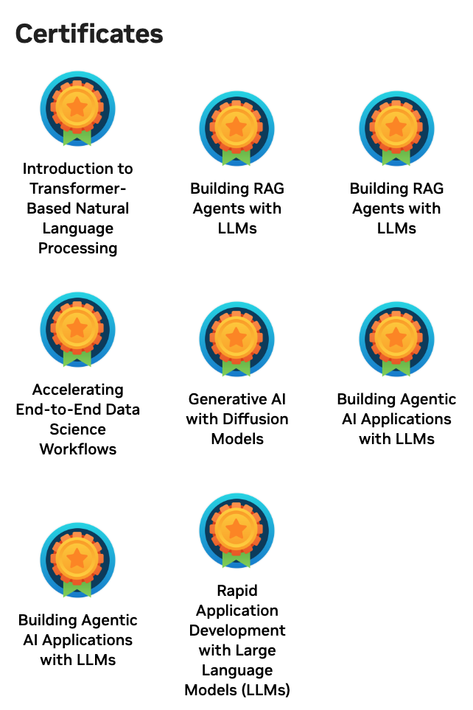

Deep Learning Institute (DLI)
https://learn.nvidia.com/my-learning

Slide 31

https://learn.nvidia.com/certificates?id=ed-qOCIMQaatzU8SNUNxgw

Slide 32

NVIDIA Deep Learning Institute (DLI)
https://learn.nvidia.com/en-us/training/self-paced-courses

Slide 33
Building RAG Agents with LLMs
https://learn.nvidia.com/courses/course-detail?course_id=course-v1:DLI+S-FX-15+V1

Slide 34

Building RAG Agents with LLMs
Source: NVIDIA DLI (2024), Building RAG Agents with LLMs, https://learn.nvidia.com/courses/course-detail?course_id=course-v1:DLI+S-FX-15+V1

Slide 35

Building RAG Agents with LLMs
https://learn.nvidia.com/my-learning

Slide 36

Building RAG Agents with LLMs
https://learn.nvidia.com/courses/course?course_id=course-v1:DLI+S-FX-15+V1

Slide 37

Building RAG Agents with LLMs
https://learn.nvidia.com/courses/course?course_id=course-v1:DLI+S-FX-15+V1

Slide 38

Building RAG Agents with LLMs
https://learn.nvidia.com/courses/course?course_id=course-v1:DLI+S-FX-15+V1

Slide 39

Building RAG Agents with LLMs
https://learn.nvidia.com/courses/course?course_id=course-v1:DLI+S-FX-15+V1

Slide 40

Building RAG Agents with LLMs
https://learn.nvidia.com/courses/course?course_id=course-v1:DLI+S-FX-15+V1

Slide 41

Building RAG Agents with LLMs
https://learn.nvidia.com/courses/course?course_id=course-v1:DLI+S-FX-15+V1

Slide 42

Building RAG Agents with LLMs
https://learn.nvidia.com/courses/course?course_id=course-v1:DLI+S-FX-15+V1

Slide 43
Building RAG Agents with LLMs
Introduction
Source: NVIDIA DLI (2024), Building RAG Agents with LLMs, https://learn.nvidia.com/courses/course-detail?course_id=course-v1:DLI+S-FX-15+V1
Notes:
Welcome to our course on Building RAG Agents with LLMs!
REMIND STUDENTS TO START UP THEIR COURSE ENVIRONMENT!
LLMs: Large Language Models which take in, produce, or otherwise reason with text. We’ll learn to make more complex systems
Course Topics:
Creating chatbot applications capable of dialogue management and retrieval augmented generation.
Built from the ground up using foundation models which can be deployed on your own compute.
Leveraging current best practices from open-source frameworks like LangChain.

Slide 44
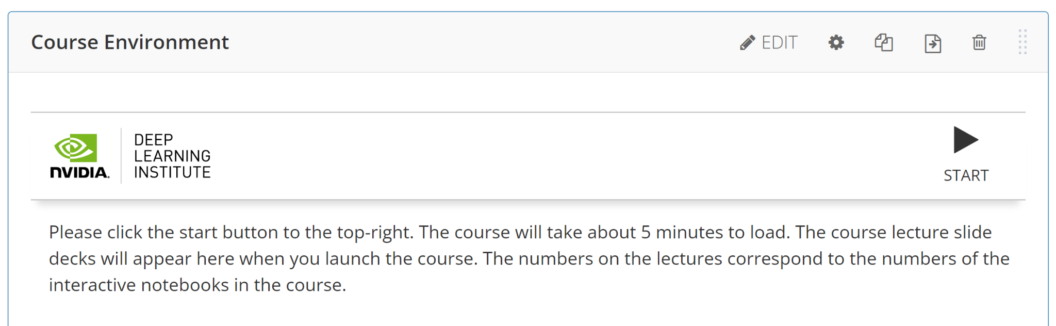
Building RAG Agents with LLMs
Introduction
Source: NVIDIA DLI (2024), Building RAG Agents with LLMs, https://learn.nvidia.com/courses/course-detail?course_id=course-v1:DLI+S-FX-15+V1
Notes:
Welcome to our course on Building RAG Agents with LLMs!
REMIND STUDENTS TO START UP THEIR COURSE ENVIRONMENT!
LLMs: Large Language Models which take in, produce, or otherwise reason with text. We’ll learn to make more complex systems
Course Topics:
Creating chatbot applications capable of dialogue management and retrieval augmented generation.
Built from the ground up using foundation models which can be deployed on your own compute.
Leveraging current best practices from open-source frameworks like LangChain.

Slide 45
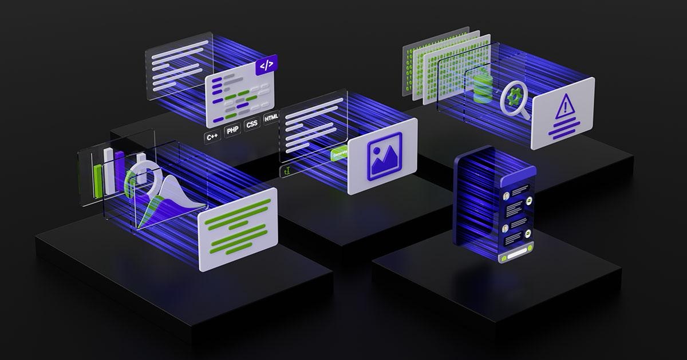
Large Language Models
Backbones for Language Understanding
Backbones for language tasks, including classification and generation.
https://www.nvidia.com/content/dam/en-zz/Solutions/lp/large-language-models-ebook/nvidia-llm-ebook-og.jpg
Source: NVIDIA DLI (2024), Building RAG Agents with LLMs, https://learn.nvidia.com/courses/course-detail?course_id=course-v1:DLI+S-FX-15+V1
Notes:
Welcome to our course on Building RAG Agents with LLMs!
LLMs: Large Language Models which take in, produce, or otherwise reason with text. We’ll learn to make more complex systems

Slide 46
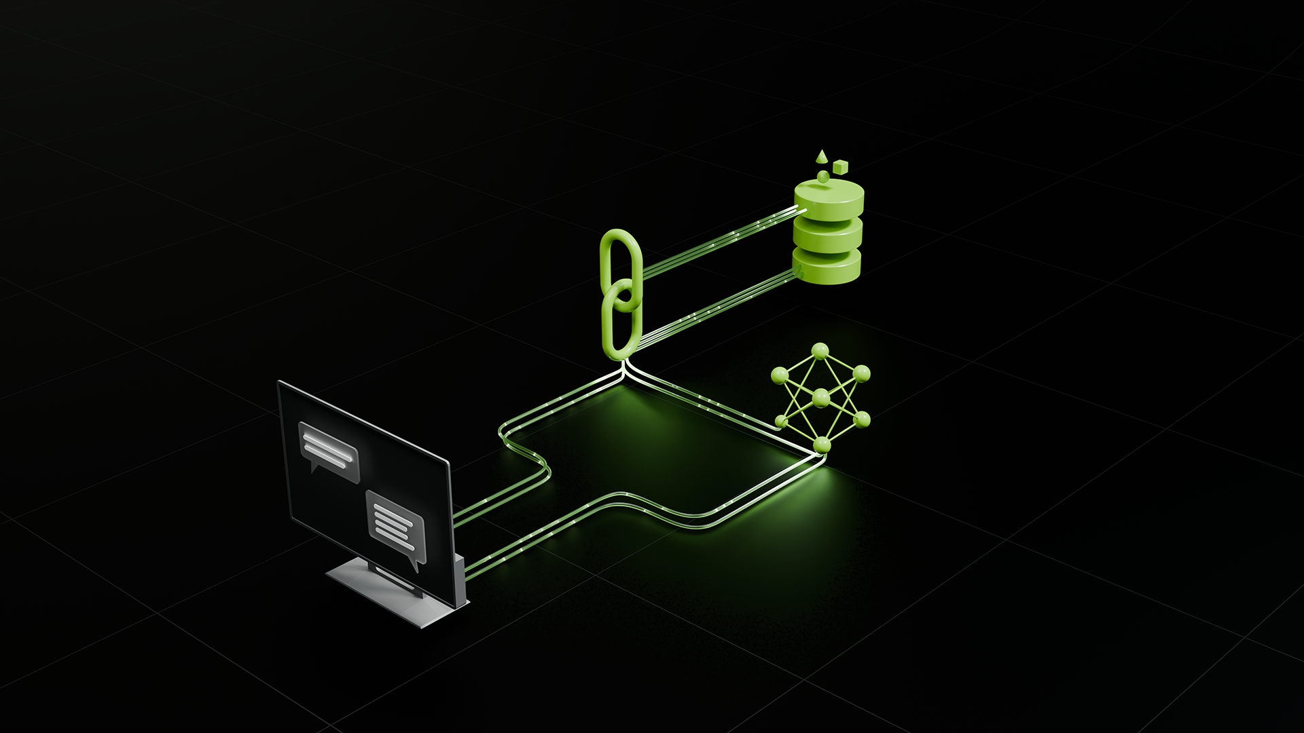
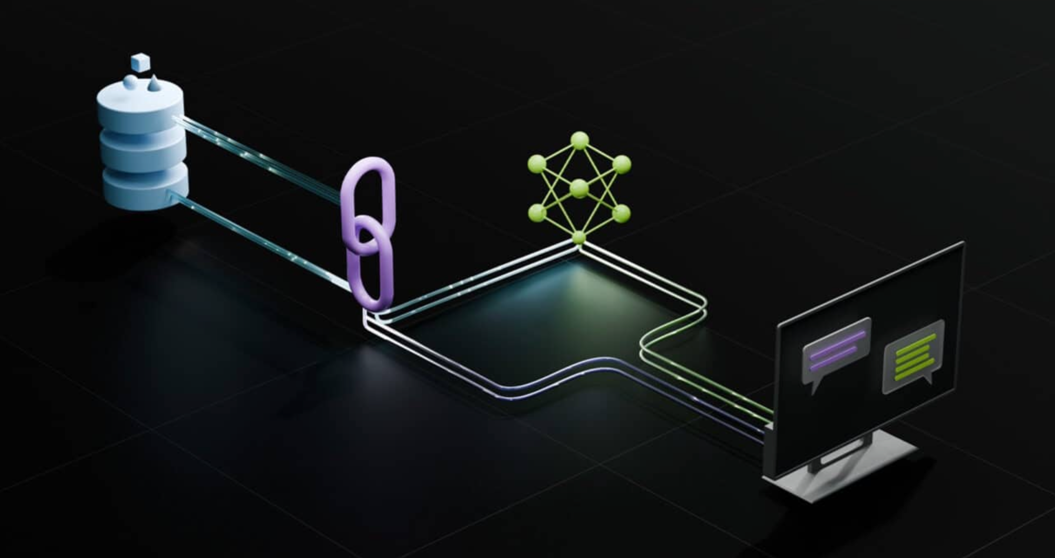
Dialog/Retrieval Agents
LLMs with Context and Control
User Asks Something
Agent Responds
https://www.nvidia.com/content/dam/en-zz/Solutions/lp/large-language-models-ebook/nvidia-llm-ebook-og.jpg
Source: NVIDIA DLI (2024), Building RAG Agents with LLMs, https://learn.nvidia.com/courses/course-detail?course_id=course-v1:DLI+S-FX-15+V1
Notes:
Welcome to our course on Building RAG Agents with LLMs!
Course Topics:
Creating chatbot applications capable of dialogue management and retrieval augmented generation.
Superficial: User sends message, and agent responds. But we want to bring our own data.
To achieve this, we need LLM Orchestration, so combining software practices and LLMs together.
Using this, we can Retrieve and synthesize data from a database or environment…
…create a new input that contains the grounding information (AKA augmenting our LLM’s behavior)…
…and then generating our response, having supplied our LLM with all the necessary info to make the decision.

Slide 47
Dialog/Retrieval Agents
LLMs with Context and Control
LLM Orchestration: Software + LLM helps to route to software and LLMs.
User Asks Something
Agent Responds
https://www.nvidia.com/content/dam/en-zz/Solutions/lp/large-language-models-ebook/nvidia-llm-ebook-og.jpg
Source: NVIDIA DLI (2024), Building RAG Agents with LLMs, https://learn.nvidia.com/courses/course-detail?course_id=course-v1:DLI+S-FX-15+V1
Notes:
Welcome to our course on Building RAG Agents with LLMs!
Course Topics:
Creating chatbot applications capable of dialogue management and retrieval augmented generation.
Superficial: User sends message, and agent responds. But we want to bring our own data.
To achieve this, we need LLM Orchestration, so combining software practices and LLMs together.
Using this, we can Retrieve and synthesize data from a database or environment…
…create a new input that contains the grounding information (AKA augmenting our LLM’s behavior)…
…and then generating our response, having supplied our LLM with all the necessary info to make the decision.

Slide 48
Dialog/Retrieval Agents
LLMs with Context and Control
Retrieval: Tool runs algorithms (database, code execution, semantic search, return a constant value, etc) to provide context
LLM Orchestration: Software + LLM helps to route to software and LLMs.
User Asks Something
Agent Responds
https://www.nvidia.com/content/dam/en-zz/Solutions/lp/large-language-models-ebook/nvidia-llm-ebook-og.jpg
Source: NVIDIA DLI (2024), Building RAG Agents with LLMs, https://learn.nvidia.com/courses/course-detail?course_id=course-v1:DLI+S-FX-15+V1
Notes:
Welcome to our course on Building RAG Agents with LLMs!
Course Topics:
Creating chatbot applications capable of dialogue management and retrieval augmented generation.
Superficial: User sends message, and agent responds. But we want to bring our own data.
To achieve this, we need LLM Orchestration, so combining software practices and LLMs together.
Using this, we can Retrieve and synthesize data from a database or environment…
…create a new input that contains the grounding information (AKA augmenting our LLM’s behavior)…
…and then generating our response, having supplied our LLM with all the necessary info to make the decision.

Slide 49
Dialog/Retrieval Agents
LLMs with Context and Control
Retrieval: Tool runs algorithms (database, code execution, semantic search, return a constant value, etc) to provide context
LLM Orchestration: Software + LLM helps to route to software and LLMs.
Augmented: Based on tool responses, the software pipeline synthesizes some “context”
to feed to LLM w/ question.
User Asks Something
Agent Responds
https://www.nvidia.com/content/dam/en-zz/Solutions/lp/large-language-models-ebook/nvidia-llm-ebook-og.jpg
Source: NVIDIA DLI (2024), Building RAG Agents with LLMs, https://learn.nvidia.com/courses/course-detail?course_id=course-v1:DLI+S-FX-15+V1
Notes:
Welcome to our course on Building RAG Agents with LLMs!
Course Topics:
Creating chatbot applications capable of dialogue management and retrieval augmented generation.
Superficial: User sends message, and agent responds. But we want to bring our own data.
To achieve this, we need LLM Orchestration, so combining software practices and LLMs together.
Using this, we can Retrieve and synthesize data from a database or environment…
…create a new input that contains the grounding information (AKA augmenting our LLM’s behavior)…
…and then generating our response, having supplied our LLM with all the necessary info to make the decision.

Slide 50
Dialog/Retrieval Agents
LLMs with Context and Control
Retrieval: Tool runs algorithms (database, code execution, semantic search, return a constant value, etc) to provide context
LLM Orchestration: Software + LLM helps to route to software and LLMs.
Augmented: Based on tool responses, the software pipeline synthesizes some “context”
to feed to LLM w/ question.
User Asks Something
Generation: Based on question, instructions, and enhanced context, the LLM returns a response.
Agent Responds
https://www.nvidia.com/content/dam/en-zz/Solutions/lp/large-language-models-ebook/nvidia-llm-ebook-og.jpg
Source: NVIDIA DLI (2024), Building RAG Agents with LLMs, https://learn.nvidia.com/courses/course-detail?course_id=course-v1:DLI+S-FX-15+V1
Notes:
Welcome to our course on Building RAG Agents with LLMs!
Course Topics:
Creating chatbot applications capable of dialogue management and retrieval augmented generation.
Superficial: User sends message, and agent responds. But we want to bring our own data.
To achieve this, we need LLM Orchestration, so combining software practices and LLMs together.
Using this, we can Retrieve and synthesize data from a database or environment…
…create a new input that contains the grounding information (AKA augmenting our LLM’s behavior)…
…and then generating our response, having supplied our LLM with all the necessary info to make the decision.
We’ll learn to build these pipelines from the ground up using foundation models which can be deployed on your own compute and at scale.

Slide 51
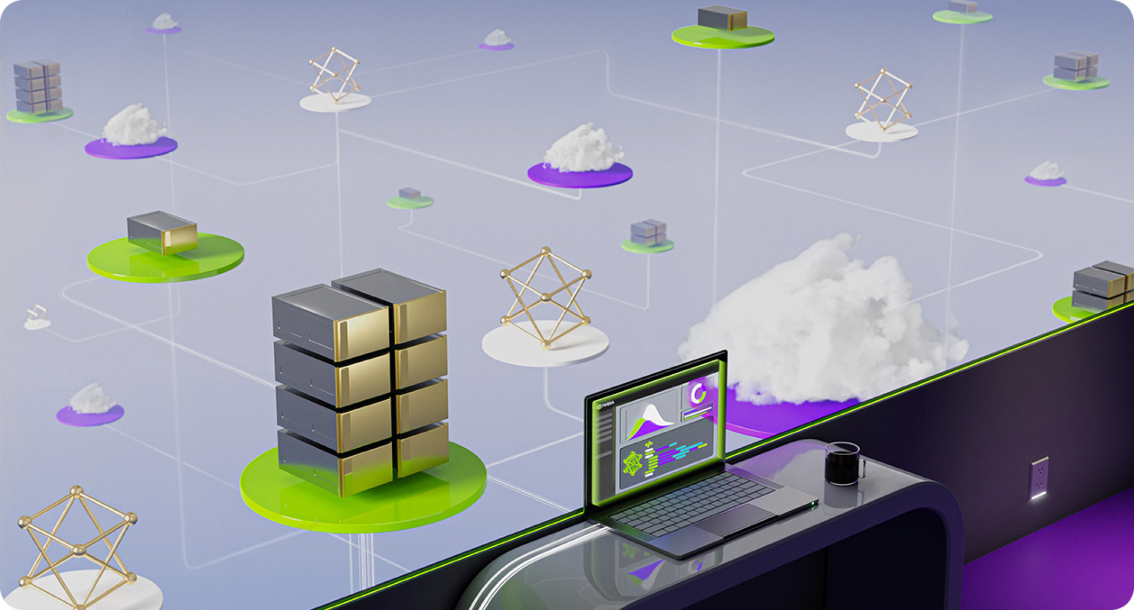
Chat Applications
Full Applications Build with LLMs
https://www.nvidia.com/content/dam/en-zz/Solutions/lp/large-language-models-ebook/nvidia-llm-ebook-og.jpg
Source: NVIDIA DLI (2024), Building RAG Agents with LLMs, https://learn.nvidia.com/courses/course-detail?course_id=course-v1:DLI+S-FX-15+V1
Notes:
Welcome to our course on Building RAG Agents with LLMs!
Course Topics:
Creating chatbot applications capable of dialogue management and retrieval augmented generation.
We’ll learn to build these pipelines from the ground up using foundation models which can be deployed on your own compute and at scale.
Leveraging current best practices from open-source frameworks like LangChain, as well as enterprise-grade microservice options like NVIDIA NIMs.

Slide 52
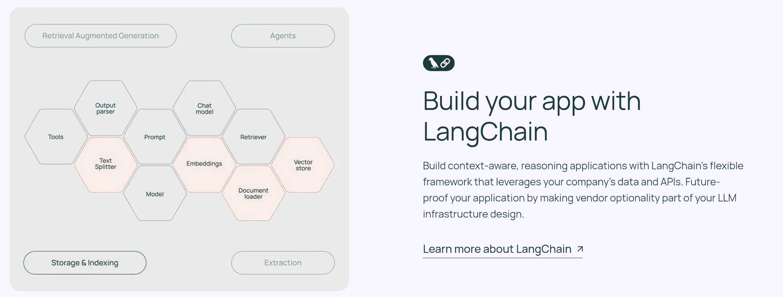
Chat Applications
Full Applications Build with LLMs
Production-Ready APIs That Run Anywhere | NVIDIA
Source: NVIDIA DLI (2024), Building RAG Agents with LLMs, https://learn.nvidia.com/courses/course-detail?course_id=course-v1:DLI+S-FX-15+V1
Notes:
Welcome to our course on Building RAG Agents with LLMs!
Course Topics:
Creating chatbot applications capable of dialogue management and retrieval augmented generation.
We’ll learn to build these pipelines from the ground up using foundation models which can be deployed on your own compute and at scale.
Leveraging current best practices from open-source frameworks like LangChain, as well as enterprise-grade microservice options like NVIDIA NIMs.

Slide 53
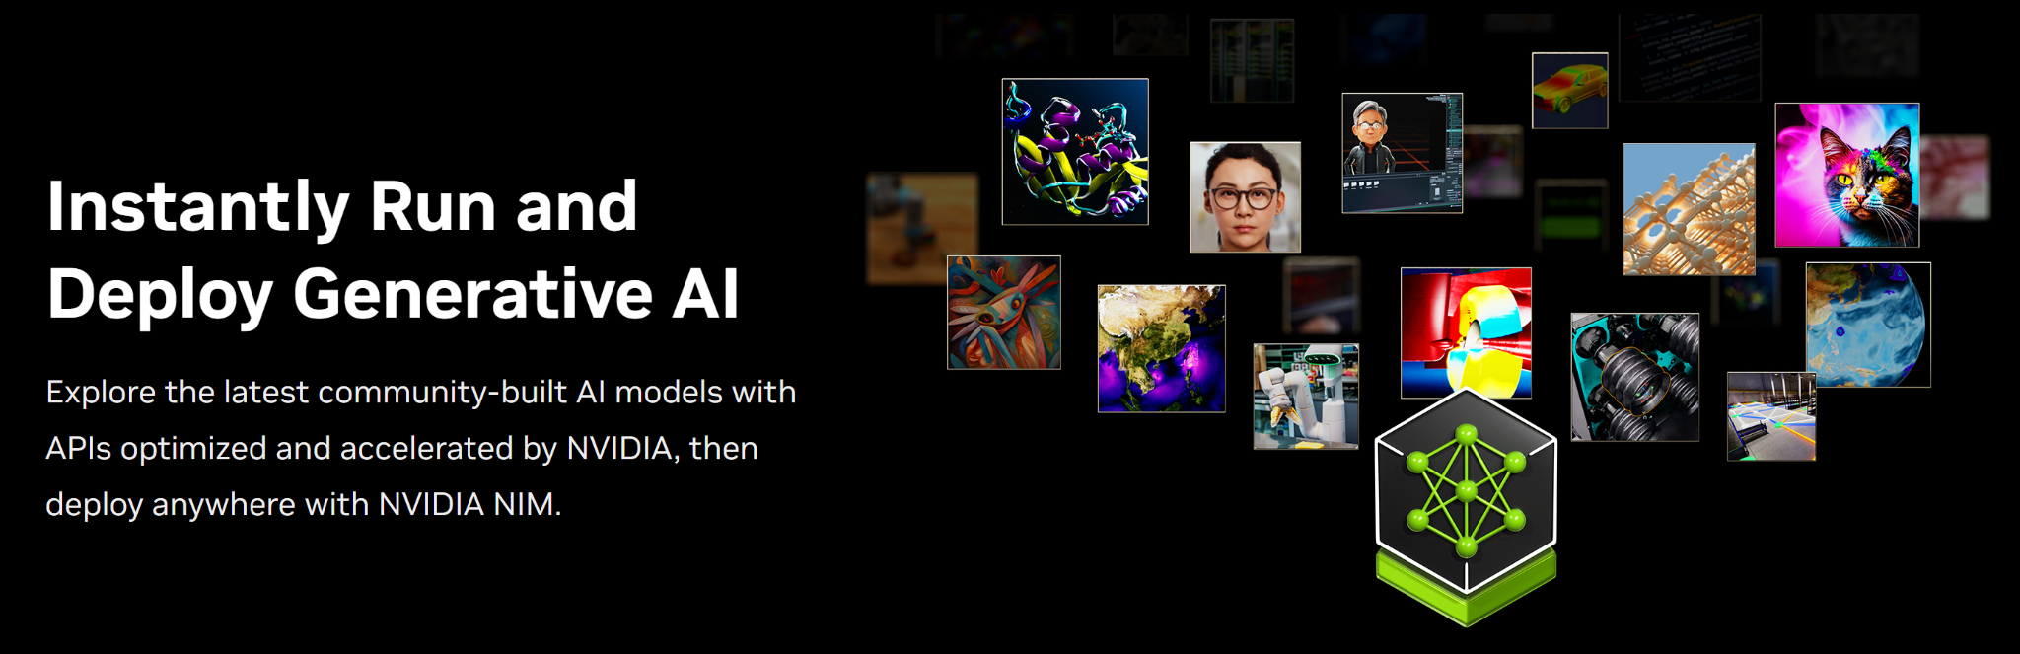
Chat Applications
Full Applications Build with LLMs
Production-Ready APIs That Run Anywhere | NVIDIA
Source: NVIDIA DLI (2024), Building RAG Agents with LLMs, https://learn.nvidia.com/courses/course-detail?course_id=course-v1:DLI+S-FX-15+V1
Notes:
Welcome to our course on Building RAG Agents with LLMs!
Course Topics:
Creating chatbot applications capable of dialogue management and retrieval augmented generation.
We’ll learn to build these pipelines from the ground up using foundation models which can be deployed on your own compute and at scale.
Leveraging current best practices from open-source frameworks like LangChain, as well as enterprise-grade microservice options like NVIDIA NIMs.
(Up Next: Prerequisites)
(After That: Course Objectives/Outline)
(Up Next: Section 1 Title)

Slide 54
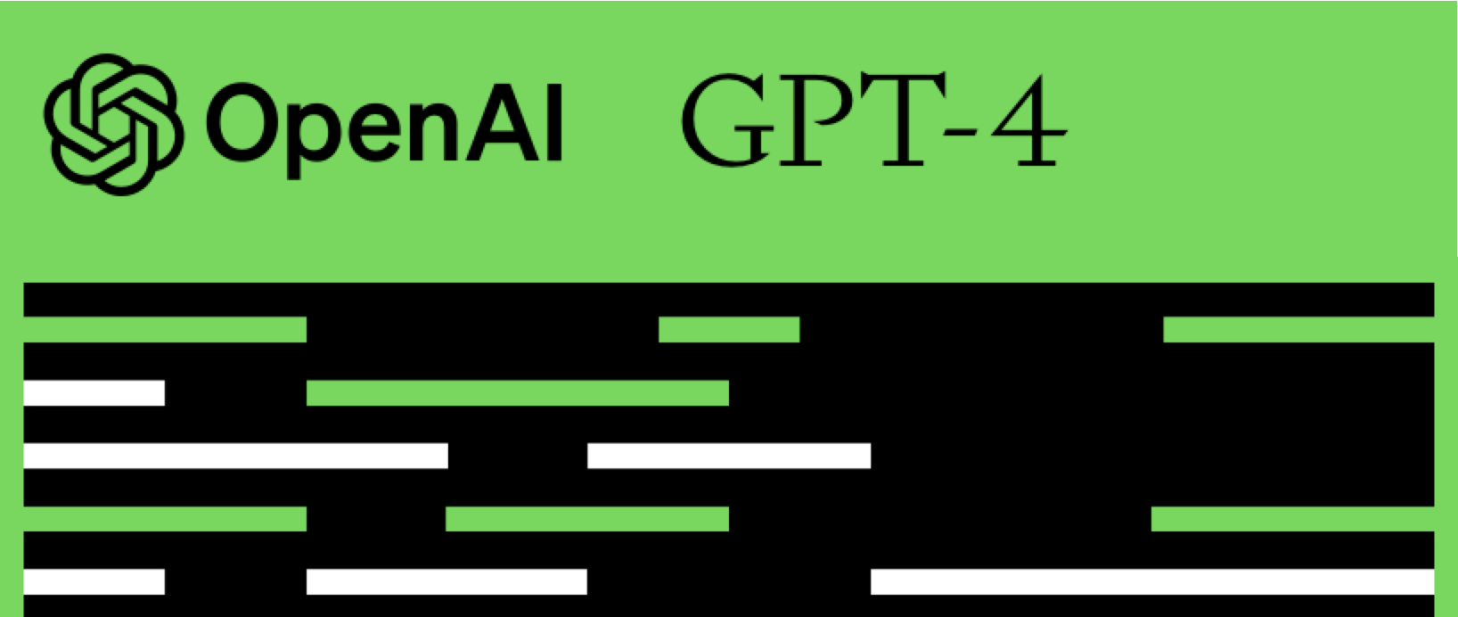
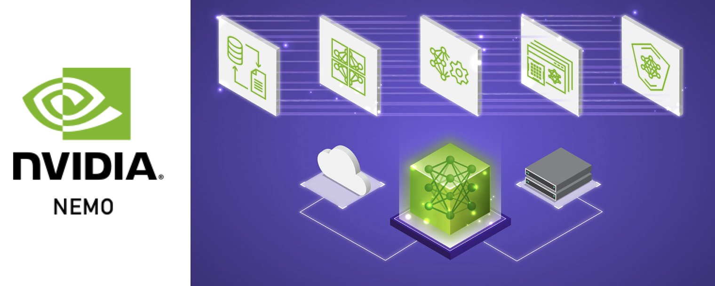
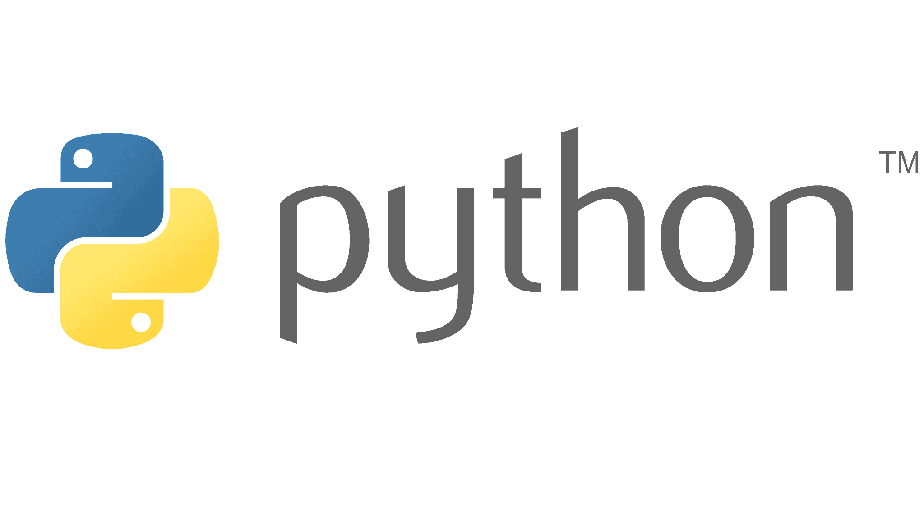
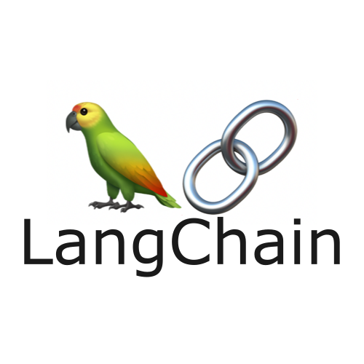
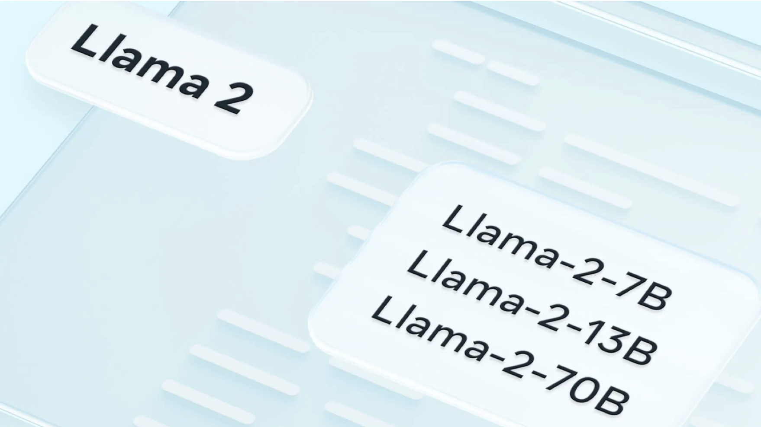
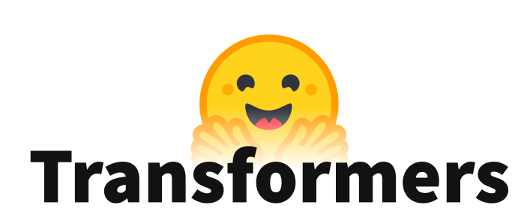
Prerequisites
RAG Agents in Production
Prior LLM/LangChain Exposure
Intermediate Python Experience
Exposure to Web Engineering
Source: NVIDIA DLI (2024), Building RAG Agents with LLMs, https://learn.nvidia.com/courses/course-detail?course_id=course-v1:DLI+S-FX-15+V1
Notes:
(Current: Prerequisites)
(Up Next: Course Objectives/Outline)
(After That: Section 1 Title)

Slide 55
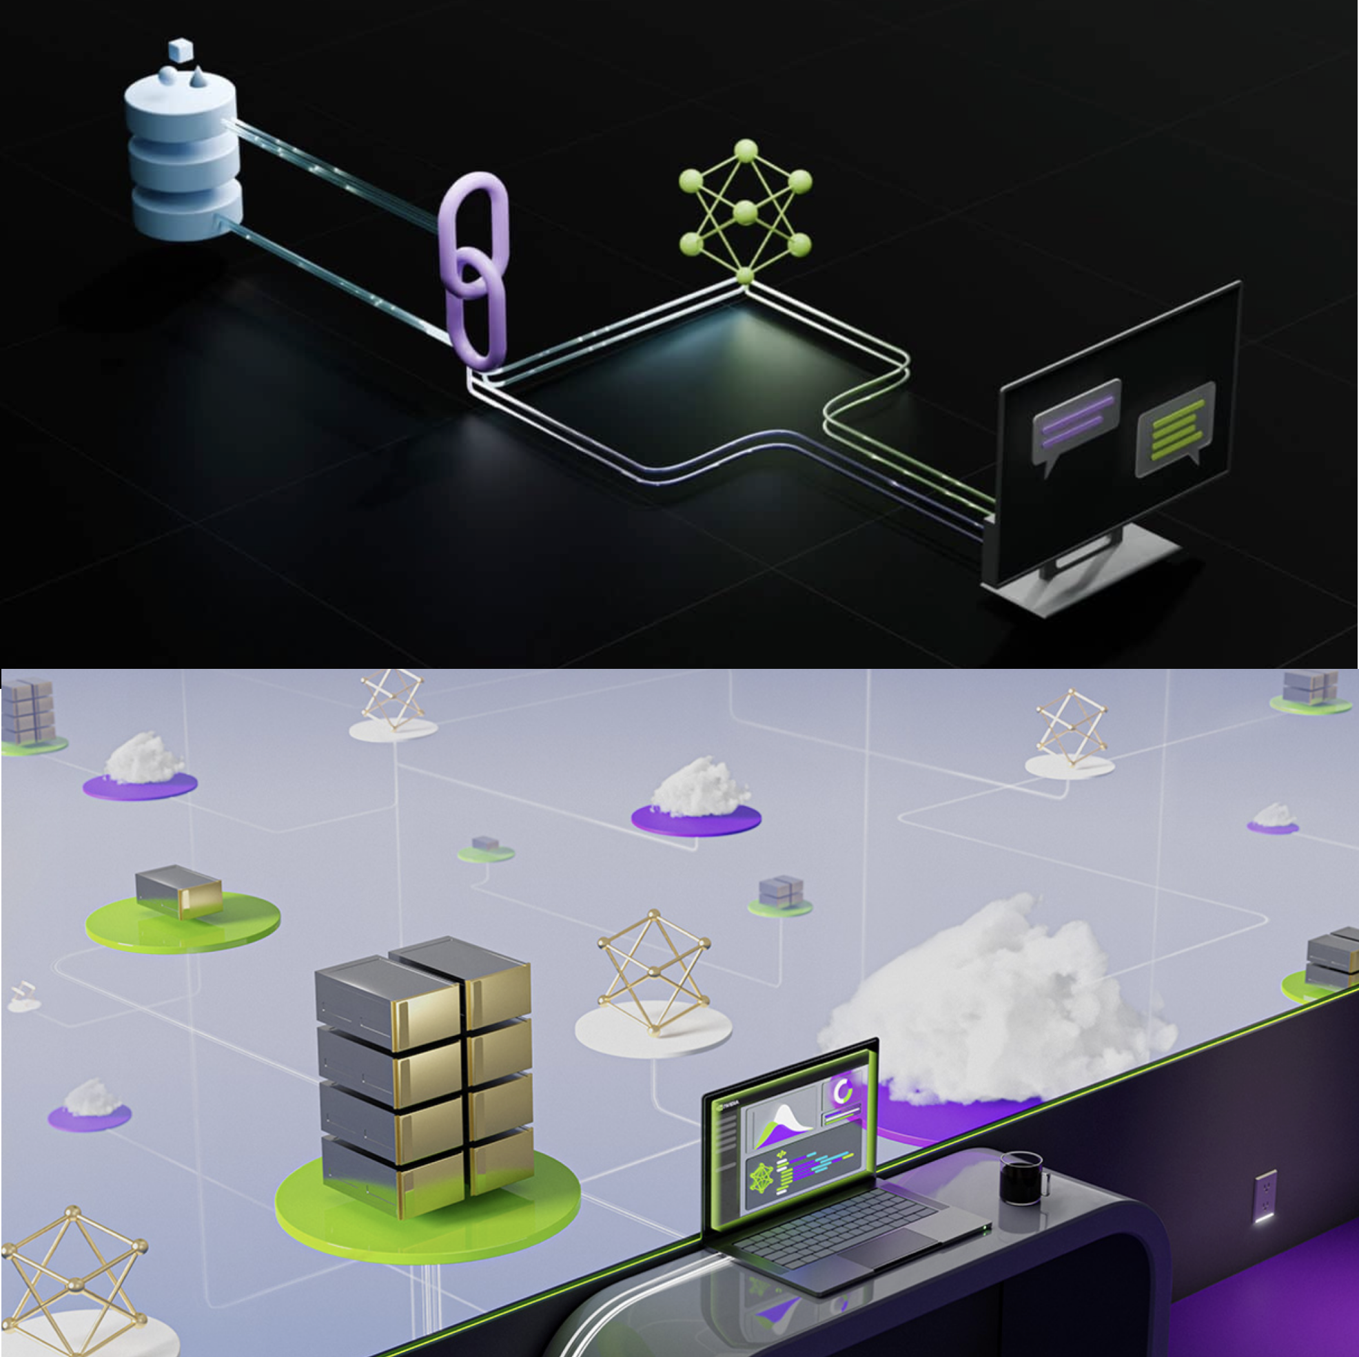
Course Objectives
RAG Agents in Production
Environment
LLM Services
Intro to LangChain (LCEL)
Running State Chains
Document Loading
Embeddings
Document Retrieval
RAG Evaluation
Source: NVIDIA DLI (2024), Building RAG Agents with LLMs, https://learn.nvidia.com/courses/course-detail?course_id=course-v1:DLI+S-FX-15+V1
Notes:
(Previous: Prerequisites)
(Current: Course Objectives/Outline)
(Up Next: Section 1: Your Course Environment)

Slide 56
Course Objectives
RAG Agents in Production
(Starts at 9)
Environment
LLM Services
Intro to LangChain (LCEL)
Running State Chains
  (Lunch)
Document Loading
Embeddings
Document Retrieval
RAG Evaluation
  (Ends at 5, take-home/ask instructor)
Source: NVIDIA DLI (2024), Building RAG Agents with LLMs, https://learn.nvidia.com/courses/course-detail?course_id=course-v1:DLI+S-FX-15+V1
Notes:
(Previous: Prerequisites)
(Current: Course Objectives/Outline)
(Up Next: Section 1: Your Course Environment)

Slide 57
Building RAG Agents with LLMs
Part 1: Your Course Environment
Source: NVIDIA DLI (2024), Building RAG Agents with LLMs, https://learn.nvidia.com/courses/course-detail?course_id=course-v1:DLI+S-FX-15+V1

Slide 58
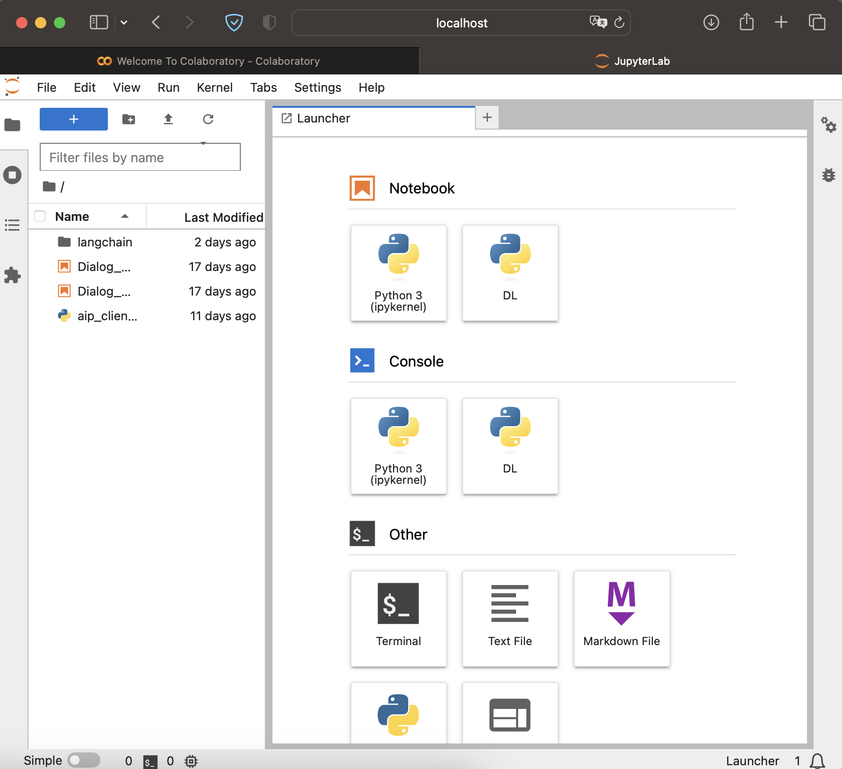
Typical Jupyter Labs Interface
jupyter lab . &; open -a Safari http://localhost:8888/lab
Source: NVIDIA DLI (2024), Building RAG Agents with LLMs, https://learn.nvidia.com/courses/course-detail?course_id=course-v1:DLI+S-FX-15+V1
Notes:
"Once you've launched the course environment, you'll be greeted with the JupyterLab interface.
Can be deployed locally from a system and using your resources. Rely on your hardware and access via your browser.
Can also be launched through a service like Google Colab! Allocates resources for you, and doesn’t rely on your compute!

Slide 59
Typical Jupyter Labs Interface
Your Device
Your Device
Web Browser
Files
Python
OS
C++
Hardware
jupyter lab . &; open -a Safari http://localhost:8888/lab
Source: NVIDIA DLI (2024), Building RAG Agents with LLMs, https://learn.nvidia.com/courses/course-detail?course_id=course-v1:DLI+S-FX-15+V1
Notes:
"Once you've launched the course environment, you'll be greeted with the JupyterLab interface.
Can be deployed locally from your system and using your resources. Rely on your hardware and access via your browser.
(Next slide adds in Jupyter Labs server, which probably stays within your local host scope.)
Can also be launched through a service like Google Colab! Allocates resources for you, and doesn’t rely on your compute!

Slide 60
Typical Jupyter Labs Interface
Your Device
Your Device
Web Browser
:8888
Files
Python
OS
Jupyter Labs
C++
Hardware
jupyter lab . &; open -a Safari http://localhost:8888/lab
Source: NVIDIA DLI (2024), Building RAG Agents with LLMs, https://learn.nvidia.com/courses/course-detail?course_id=course-v1:DLI+S-FX-15+V1
Notes:
"Once you've launched the course environment, you'll be greeted with the JupyterLab interface.
Can be deployed locally from your system and using your resources. Rely on your hardware and access via your browser.
Can also be launched through a service like Google Colab! Allocates resources for you, and doesn’t rely on your compute!

Slide 61
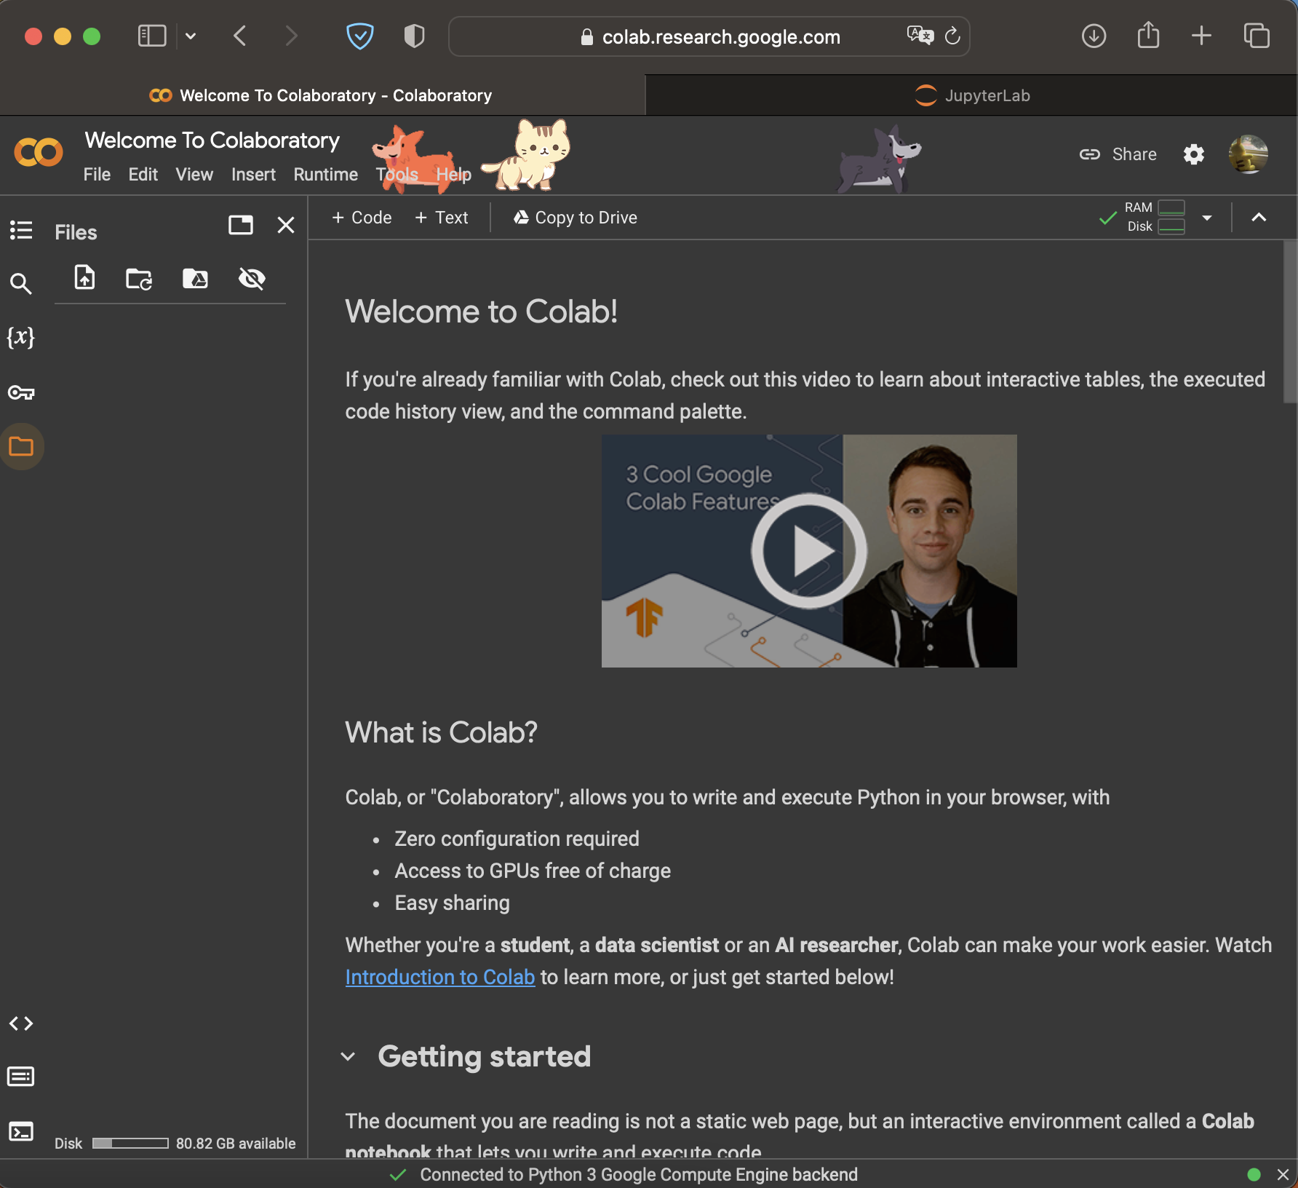
Typical Jupyter Labs Interface
Your Device
Your Device
Web Browser
:8888
Files
Python
OS
Jupyter Labs
C++
Hardware
jupyter lab . &; open -a Safari http://localhost:8888/lab
https://colab.research.google.com
Source: NVIDIA DLI (2024), Building RAG Agents with LLMs, https://learn.nvidia.com/courses/course-detail?course_id=course-v1:DLI+S-FX-15+V1
Notes:
"Once you've launched the course environment, you'll be greeted with the JupyterLab interface.
Can be deployed locally from your system and using your resources. Rely on your hardware and access via your browser.
Can also be launched through a service like Google Colab! Allocates resources for you, and doesn’t rely on your compute!
(Use your computer to coordinate with some allocation system)
(Get yourself access to a GPU-enabled resource from the cloud)

Slide 62
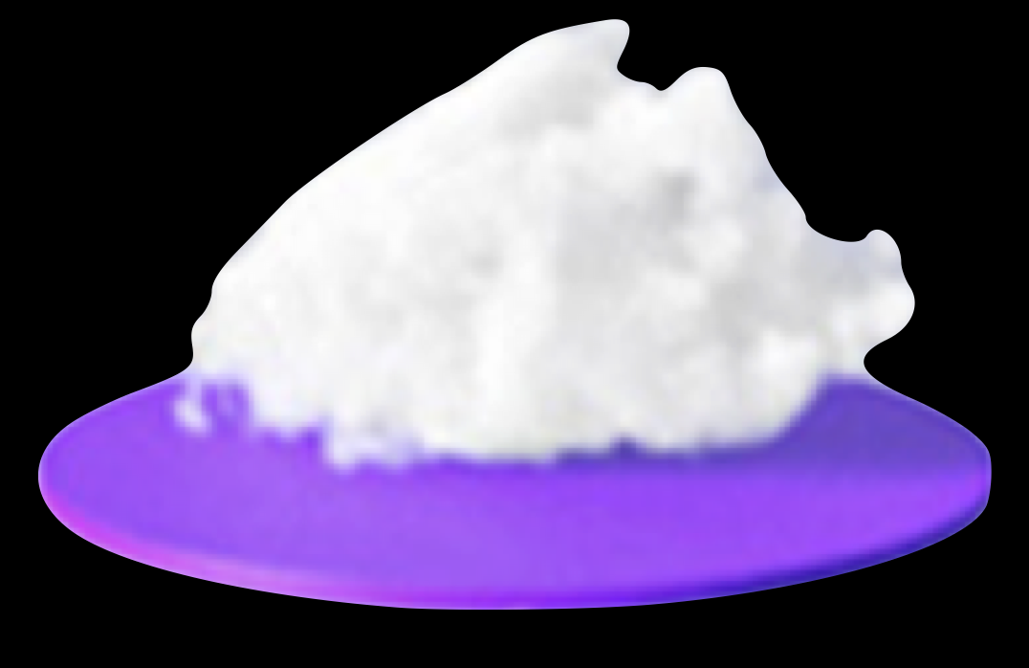
Typical Jupyter Labs Interface
Your Device
Your Device
Web Browser
Your Device
:8888
Web Browser
Files
Python
OS
Jupyter Labs
C++
Hardware
Files
Python
OS
C++
Hardware
jupyter lab . &; open -a Safari http://localhost:8888/lab
https://colab.research.google.com
Source: NVIDIA DLI (2024), Building RAG Agents with LLMs, https://learn.nvidia.com/courses/course-detail?course_id=course-v1:DLI+S-FX-15+V1
Notes:
"Once you've launched the course environment, you'll be greeted with the JupyterLab interface.
Can be deployed locally from your system and using your resources. Rely on your hardware and access via your browser.
Can also be launched through a service like Google Colab! Allocates resources for you, and doesn’t rely on your compute!
(Use your computer to coordinate with some allocation system)
(Get yourself access to a GPU-enabled resource from the cloud)

Slide 63
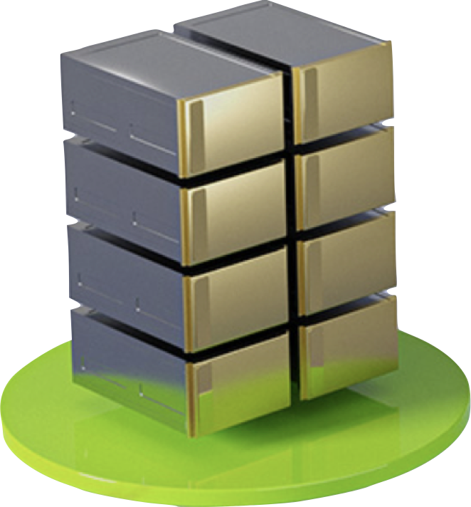
Typical Jupyter Labs Interface
Your Device
Your Device
Web Browser
Your Device
:8888
Web Browser
Files
Python
OS
Jupyter Labs
C++
Hardware
Files
Python
OS
C++
Hardware
jupyter lab . &; open -a Safari http://localhost:8888/lab
https://colab.research.google.com
Source: NVIDIA DLI (2024), Building RAG Agents with LLMs, https://learn.nvidia.com/courses/course-detail?course_id=course-v1:DLI+S-FX-15+V1
Notes:
"Once you've launched the course environment, you'll be greeted with the JupyterLab interface.
Can be deployed locally from your system and using your resources. Rely on your hardware and access via your browser.
Can also be launched through a service like Google Colab! Allocates resources for you, and doesn’t rely on your compute!
(Use your computer to coordinate with some allocation system)
(Get yourself access to a GPU-enabled resource from the cloud)

Slide 64
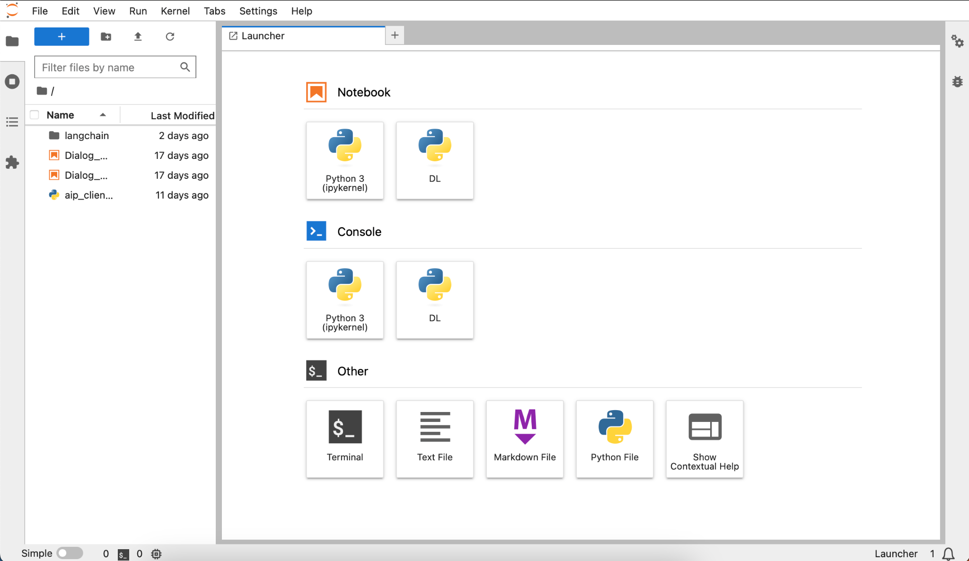
DLI Jupyter Labs Interface
Source: NVIDIA DLI (2024), Building RAG Agents with LLMs, https://learn.nvidia.com/courses/course-detail?course_id=course-v1:DLI+S-FX-15+V1
Notes:
How is this interface actually provided for you?
Compute allocated for you by cloud provider like AWS or Azure. Has some hardware, os, software, etc.
Good to go!!! Except there are other things happening in the background…
Maybe data loader? Maybe proxy server? Metadata tracker? Database connection? Need different software…
Maybe some of the other resources have different requirements? Volume space? Hardware allocation?...
TO HELP SOLVE THIS, WE CAN CONTAINERIZE INTO MICROSERVICES!

Slide 65

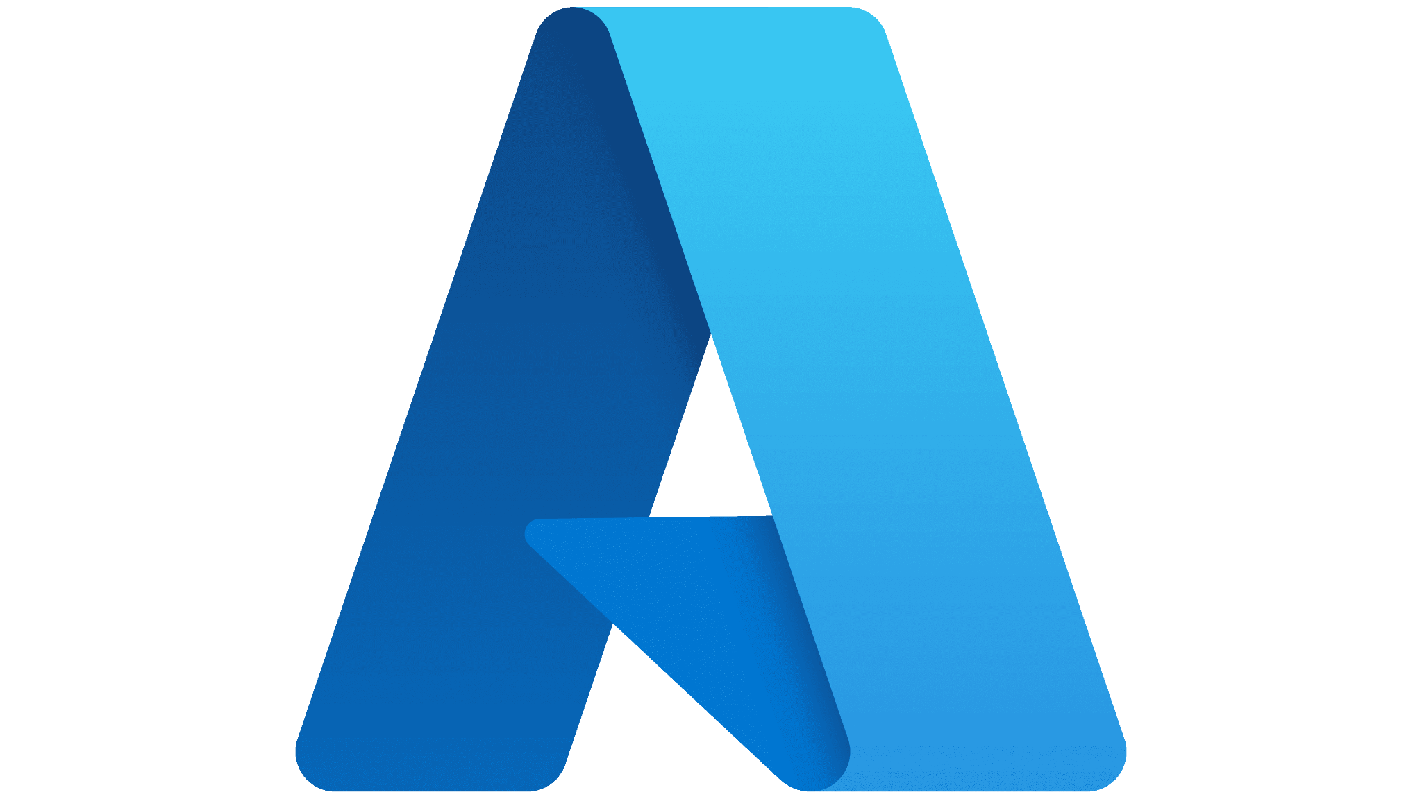
DLI Jupyter Labs Interface
Your Device
Remote Host
Files
Jupyter Labs
Python
OS
C++
Hardware
Your Device
Your Device
Web Browser
Source: NVIDIA DLI (2024), Building RAG Agents with LLMs, https://learn.nvidia.com/courses/course-detail?course_id=course-v1:DLI+S-FX-15+V1
Notes:
How is this interface actually provided for you?
Compute allocated for you by cloud provider like AWS or Azure. Has some hardware, os, software, etc.
Good to go!!! Except there are other things happening in the background…
Maybe data loader? Maybe proxy server? Metadata tracker? Database connection? Need different software…
Maybe some of the other resources have different requirements? Volume space? Hardware allocation?...
TO HELP SOLVE THIS, WE CAN CONTAINERIZE INTO MICROSERVICES!

Slide 66
DLI Jupyter Labs Interface
Your Device
Remote Host
Good to go!
… sort of …
Files
Jupyter Labs
Python
OS
C++
Hardware
Your Device
Your Device
Web Browser
Source: NVIDIA DLI (2024), Building RAG Agents with LLMs, https://learn.nvidia.com/courses/course-detail?course_id=course-v1:DLI+S-FX-15+V1
Notes:
How is this interface actually provided for you?
Compute allocated for you by cloud provider like AWS or Azure. Has some hardware, os, software, etc.
Good to go!!! Except there are other things happening in the background…
Maybe data loader? Maybe proxy server? Metadata tracker? Database connection? Need different software…
Maybe some of the other resources have different requirements? Volume space? Hardware allocation?...
TO HELP SOLVE THIS, WE CAN CONTAINERIZE INTO MICROSERVICES!

Slide 67
DLI Jupyter Labs Interface
Your Device
Remote Host
More Processes?
Python
Data Loader
Scheduler
Proxy Service
Node
Env
Shell
Python
Files
Jupyter Labs
OS
C++
Hardware
Your Device
Your Device
Web Browser
Source: NVIDIA DLI (2024), Building RAG Agents with LLMs, https://learn.nvidia.com/courses/course-detail?course_id=course-v1:DLI+S-FX-15+V1
Notes:
How is this interface actually provided for you?
Compute allocated for you by cloud provider like AWS or Azure. Has some hardware, os, software, etc.
Good to go!!! Except there are other things happening in the background…
Maybe data loader? Maybe proxy server? Metadata tracker? Database connection? Need different software…
Maybe some of the other resources have different requirements? Volume space? Hardware allocation?...
TO HELP SOLVE THIS, WE CAN CONTAINERIZE INTO MICROSERVICES!

Slide 68
DLI Jupyter Labs Interface
Your Device
Remote Host
More Processes?
Python
Data Loader
Scheduler
Proxy Service
Node
Env
Shell
Python
Files
Jupyter Labs
OS
C++
Hardware
Your Device
Your Device
Dividing Resources?
Web Browser
Source: NVIDIA DLI (2024), Building RAG Agents with LLMs, https://learn.nvidia.com/courses/course-detail?course_id=course-v1:DLI+S-FX-15+V1
Notes:
How is this interface actually provided for you?
Compute allocated for you by cloud provider like AWS or Azure. Has some hardware, os, software, etc.
Good to go!!! Except there are other things happening in the background…
Maybe data loader? Maybe proxy server? Metadata tracker? Database connection? Need different software…
Maybe some of the other resources have different requirements? Volume space? Hardware allocation?...
TO HELP SOLVE THIS, WE CAN CONTAINERIZE INTO MICROSERVICES!

Slide 69

Containerization with Docker
Compartmentalizing Functionality Into Microservices
Your Device
Host
Python
Data Loader
Scheduler
Proxy Service
Node
Env
Shell
Your Device
Python
Files
Host
Jupyter Labs
OS
C++
Hardware
Python
Sh
Volume
:8070
:8888
Volume
Files
:88
Python
OS
Jupyter
GPU/2
C++
Hardware
Source: NVIDIA DLI (2024), Building RAG Agents with LLMs, https://learn.nvidia.com/courses/course-detail?course_id=course-v1:DLI+S-FX-15+V1
Notes:
How is this interface actually provided for you?
Compute allocated for you by cloud provider like AWS or Azure. Has some hardware, os, software, etc.
Good to go!!! Except there are other things happening in the background…
Maybe data loader? Maybe proxy server? Metadata tracker? Database connection? Need different software…
Maybe some of the other resources have different requirements? Volume space? Hardware allocation?...
TO HELP SOLVE THIS, WE CAN CONTAINERIZE INTO MICROSERVICES!
Avoid dependency conflict, allocate resources as necessary, provide connections through server ports!

Slide 70
Microservices Workflow
Your Device
Your Device
Web Browser
Source: NVIDIA DLI (2024), Building RAG Agents with LLMs, https://learn.nvidia.com/courses/course-detail?course_id=course-v1:DLI+S-FX-15+V1
Notes:
What does microservice orchestration look like in practice?
Let’s start with your device, which is telling a service (like DLI?) that you need compute.
DLI will ask AWS/Azure to ALLOCATE RESOURCES for the environment.
Then, DLI will DEFINE the microservices. What they are, how they’re made, what ports they can use. (i.e. docker-compose)
These microservices can then be CONSTRUCTED from a base image. Install packages, move files, download stuff, etc. (i.e. Dockerfile)
Then, perpetual services can be kickstarted in these containers, like servers or endpoints. We now have live microservices!

Slide 71
Microservices Workflow
Your Device
Remote Host
Allocate Resources
Define Services
Construct Containers
Start Processes
Files
Python
OS
C++
Hardware
Your Device
Your Device
Web Browser
Source: NVIDIA DLI (2024), Building RAG Agents with LLMs, https://learn.nvidia.com/courses/course-detail?course_id=course-v1:DLI+S-FX-15+V1
Notes:
What does microservice orchestration look like in practice?
Let’s start with your device, which is telling a service (like DLI?) that you need compute.
DLI will ask AWS/Azure to ALLOCATE RESOURCES for the environment.
Then, DLI will DEFINE the microservices. What they are, how they’re made, what ports they can use. (i.e. docker-compose)
These microservices can then be CONSTRUCTED from a base image. Install packages, move files, download stuff, etc. (i.e. Dockerfile)
Then, perpetual services can be kickstarted in these containers, like servers or endpoints. We now have live microservices!

Slide 72
Microservices Workflow
Your Device
Remote Host
Allocate Resources
Define Services
Construct Containers
Start Processes
Python
Sh
Volume
:8070
:8888
Volume
Files
:88
Python
OS
Jupyter
GPU/2
C++
Hardware
Your Device
Your Device
Web Browser
Source: NVIDIA DLI (2024), Building RAG Agents with LLMs, https://learn.nvidia.com/courses/course-detail?course_id=course-v1:DLI+S-FX-15+V1
Notes:
What does microservice orchestration look like in practice?
Let’s start with your device, which is telling a service (like DLI?) that you need compute.
DLI will ask AWS/Azure to ALLOCATE RESOURCES for the environment.
Then, DLI will DEFINE the microservices. What they are, how they’re made, what ports they can use. (i.e. docker-compose)
These microservices can then be CONSTRUCTED from a base image. Install packages, move files, download stuff, etc. (i.e. Dockerfile)
Then, perpetual services can be kickstarted in these containers, like servers or endpoints. We now have live microservices!

Slide 73
Microservices Workflow
Your Device
Remote Host
Allocate Resources
Define Services
Construct Containers
Start Processes
Database Environment
Data Loader
:8070
:8888
Jupyter Notebook Environment
Files
:88
Python
OS
C++
Hardware
Your Device
Your Device
Web Browser
Source: NVIDIA DLI (2024), Building RAG Agents with LLMs, https://learn.nvidia.com/courses/course-detail?course_id=course-v1:DLI+S-FX-15+V1
Notes:
What does microservice orchestration look like in practice?
Let’s start with your device, which is telling a service (like DLI?) that you need compute.
DLI will ask AWS/Azure to ALLOCATE RESOURCES for the environment.
Then, DLI will DEFINE the microservices. What they are, how they’re made, what ports they can use. (i.e. docker-compose)
These microservices can then be CONSTRUCTED from a base image. Install packages, move files, download stuff, etc. (i.e. Dockerfile)
Then, perpetual services can be kickstarted in these containers, like servers or endpoints. We now have live microservices!

Slide 74
Microservices Workflow
Your Device
Remote Host
Allocate Resources
Define Services
Construct Containers
Start Processes
Database Environment
Data Loader
:8070
:8888
Jupyter Notebook Environment
Files
:88
Python
OS
C++
Hardware
Your Device
Your Device
Web Browser
Source: NVIDIA DLI (2024), Building RAG Agents with LLMs, https://learn.nvidia.com/courses/course-detail?course_id=course-v1:DLI+S-FX-15+V1
Notes:
What does microservice orchestration look like in practice?
Let’s start with your device, which is telling a service (like DLI?) that you need compute.
DLI will ask AWS/Azure to ALLOCATE RESOURCES for the environment.
Then, DLI will DEFINE the microservices. What they are, how they’re made, what ports they can use. (i.e. docker-compose)
These microservices can then be CONSTRUCTED from a base image. Install packages, move files, download stuff, etc. (i.e. Dockerfile)
Then, perpetual services can be kickstarted in these containers, like servers or endpoints. We now have live microservices!
Why bother setting things up this way though?
…

Slide 75

Scaling Containerized Applications
Company
Database
Your Device
GenAI
Service
Arbitrary Host
Database Environment
Data Loader
:8070
:8888
Jupyter Notebook Environment
Files
Python
OS
C++
Hardware
Your Device
Your Device
Web Browser
Your Device
Your Device
Other Devices
Your Device
Other Devices
Your Device
Web Browser
Other Devices
Web Browser
Other Devices
Web Browser
Web Browser
Source: NVIDIA DLI (2024), Building RAG Agents with LLMs, https://learn.nvidia.com/courses/course-detail?course_id=course-v1:DLI+S-FX-15+V1
Notes:
What does microservice orchestration look like in practice?
…
Why bother setting things up this way though?
Turns out, creating services that communicate over ports makes it simple to move stuff around! (next slide shows connections)
You can move services off your device and into the cloud, or can move processes towards edge devices without too much trouble!

Slide 76
Scaling Containerized Applications
Company
Database
Your Device
GenAI
Service
Arbitrary Host
Database Environment
Data Loader
:8070
:8888
Jupyter Notebook Environment
Files
Python
OS
C++
Hardware
Your Device
Your Device
Your Device
Your Device
Your Device
Web Browser
Your Device
Your Device
Other Devices
Your Device
Other Devices
Your Device
Web Browser
Other Devices
Web Browser
Other Devices
Web Browser
Web Browser
Source: NVIDIA DLI (2024), Building RAG Agents with LLMs, https://learn.nvidia.com/courses/course-detail?course_id=course-v1:DLI+S-FX-15+V1
Notes:
What does microservice orchestration look like in practice?
…
Why bother setting things up this way though?
Turns out, creating services that communicate over ports makes it simple to move stuff around! (next slide shows connections)
You can move services off your device and into the cloud, or move processes towards edge devices without too much trouble!
So, let’s get back to our own environment! So far, we know we have our Jupyter Labs interface, but what else?

Slide 77
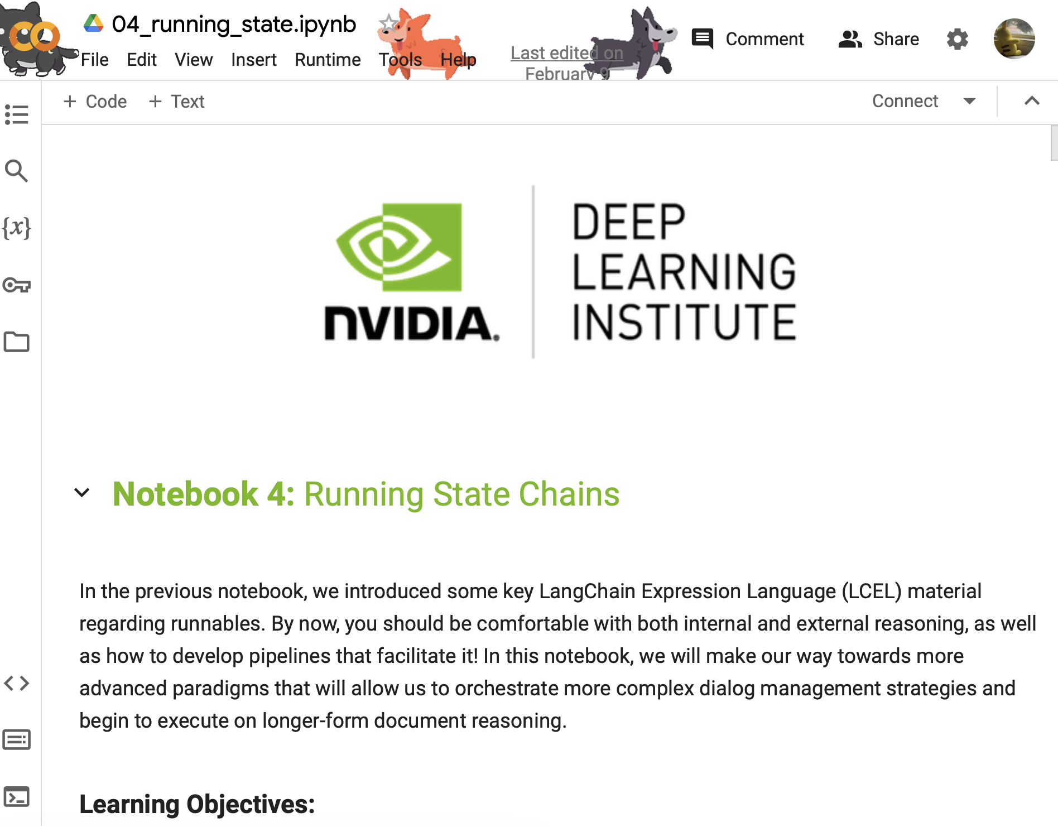
Our Environment
Jupyter Notebooks
Your Device
Remote Host
Docker
Router
Jupyter Notebook Server
:88
Source: NVIDIA DLI (2024), Building RAG Agents with LLMs, https://learn.nvidia.com/courses/course-detail?course_id=course-v1:DLI+S-FX-15+V1
Notes:
What does microservice orchestration look like in practice?
So, let’s get back to our own environment! So far, we know we have our Jupyter Labs interface, but what else?
In the lab, you’ll find out about the frontend microservice, which is already hosted on port 8090.

Slide 78
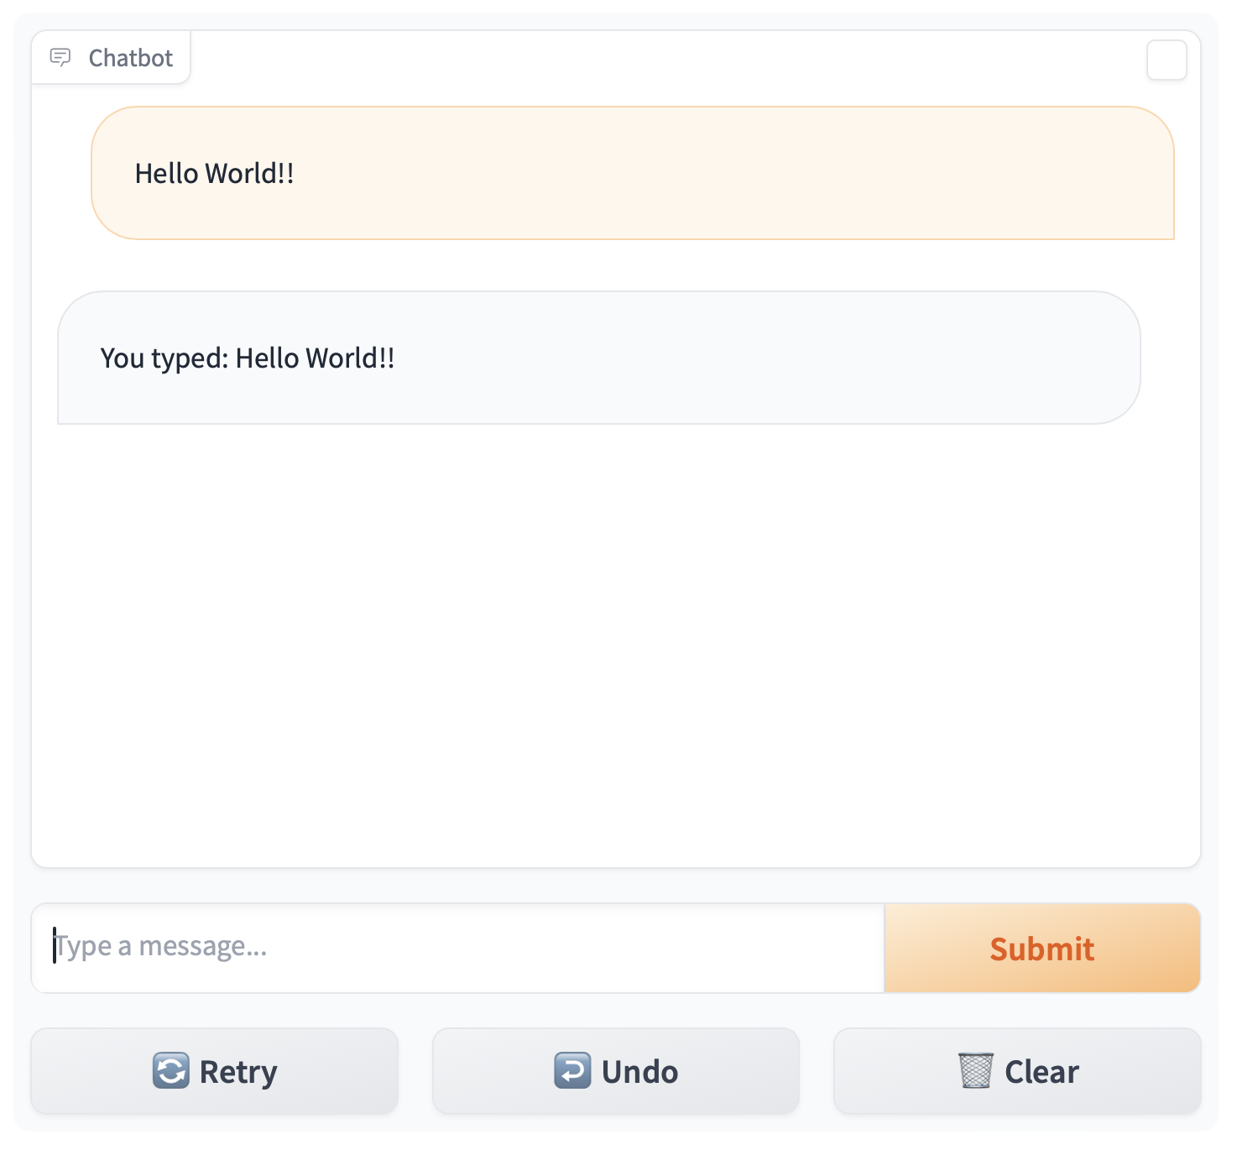
Our Environment
Jupyter Notebooks + Frontend
Your Device
Remote Host
:8090
Frontend
Docker
Router
Jupyter Notebook Server
:88
Source: NVIDIA DLI (2024), Building RAG Agents with LLMs, https://learn.nvidia.com/courses/course-detail?course_id=course-v1:DLI+S-FX-15+V1
Notes:
What does microservice orchestration look like in practice?
So, let’s get back to our own environment! So far, we know we have our Jupyter Labs interface, but what else?
In the lab, you’ll find out about the frontend microservice, which is already hosted on port 8090.
This frontend is hosted in Gradio, an open-source web interface design library well-suited for presenting AI models.

Slide 79
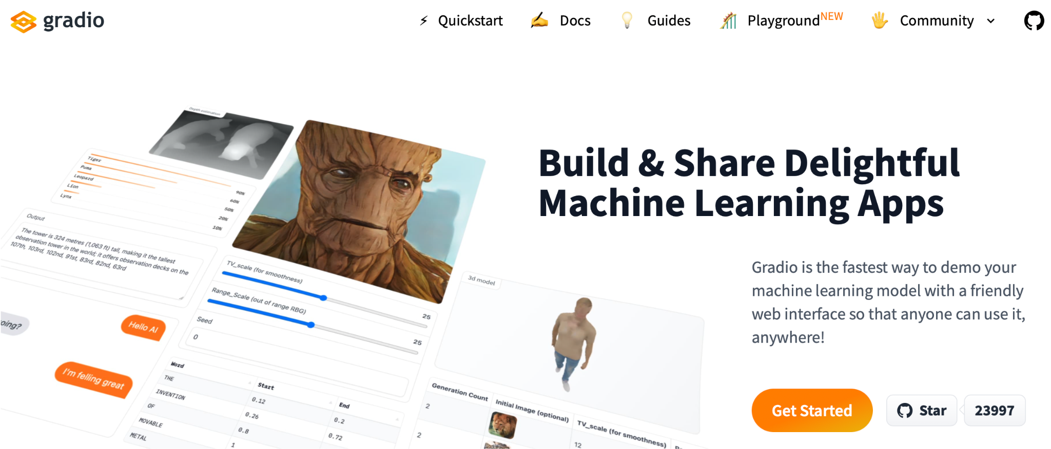
Gradio
Source: NVIDIA DLI (2024), Building RAG Agents with LLMs, https://learn.nvidia.com/courses/course-detail?course_id=course-v1:DLI+S-FX-15+V1
Notes:
What does microservice orchestration look like in practice?
So, let’s get back to our own environment! So far, we know we have our Jupyter Labs interface, but what else?
In the lab, you’ll find out about the frontend microservice, which is already hosted on port 8090.
This frontend is hosted in Gradio, an open-source web interface design library well-suited for presenting AI models.
1. Simple interface: slow_echo is being ran in a loop
2. More involved interface example from huggingface spaces, which anybody can contribute to
3. A more involved interface, which is closer to what is available/running in environment. See ./frontent/server_app.py

Slide 80
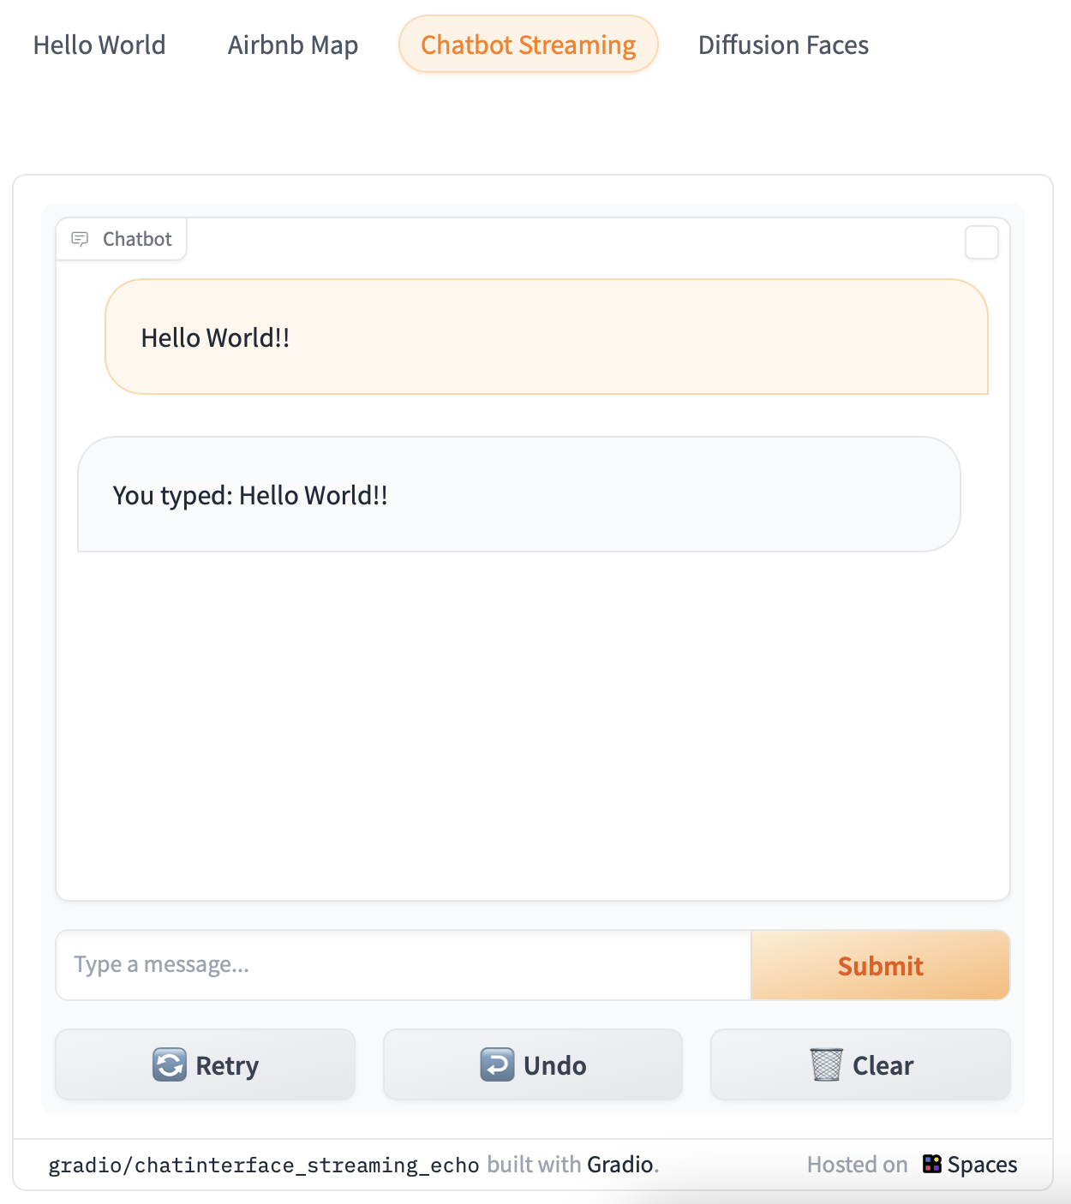
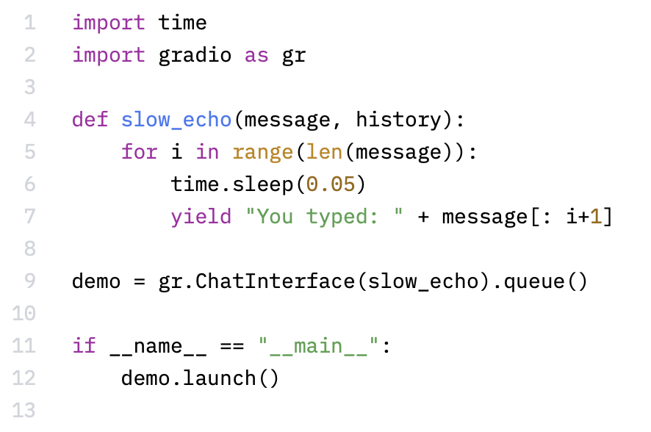
Simple Gradio ChatInterface
https://www.gradio.app/
https://huggingface.co/spaces/gradio/chatinterface_streaming_echo/blob/main/run.py
Source: NVIDIA DLI (2024), Building RAG Agents with LLMs, https://learn.nvidia.com/courses/course-detail?course_id=course-v1:DLI+S-FX-15+V1
Notes:
What does microservice orchestration look like in practice?
So, let’s get back to our own environment! So far, we know we have our Jupyter Labs interface, but what else?
In the lab, you’ll find out about the frontend microservice, which is already hosted on port 8090.
This frontend is hosted in Gradio, an open-source web interface design library well-suited for presenting AI models.
1. Simple interface: slow_echo is being ran in a loop
2. More involved interface example from huggingface spaces, which anybody can contribute to
3. A more involved interface, which is closer to what is available/running in environment. See ./frontent/server_app.py

Slide 81
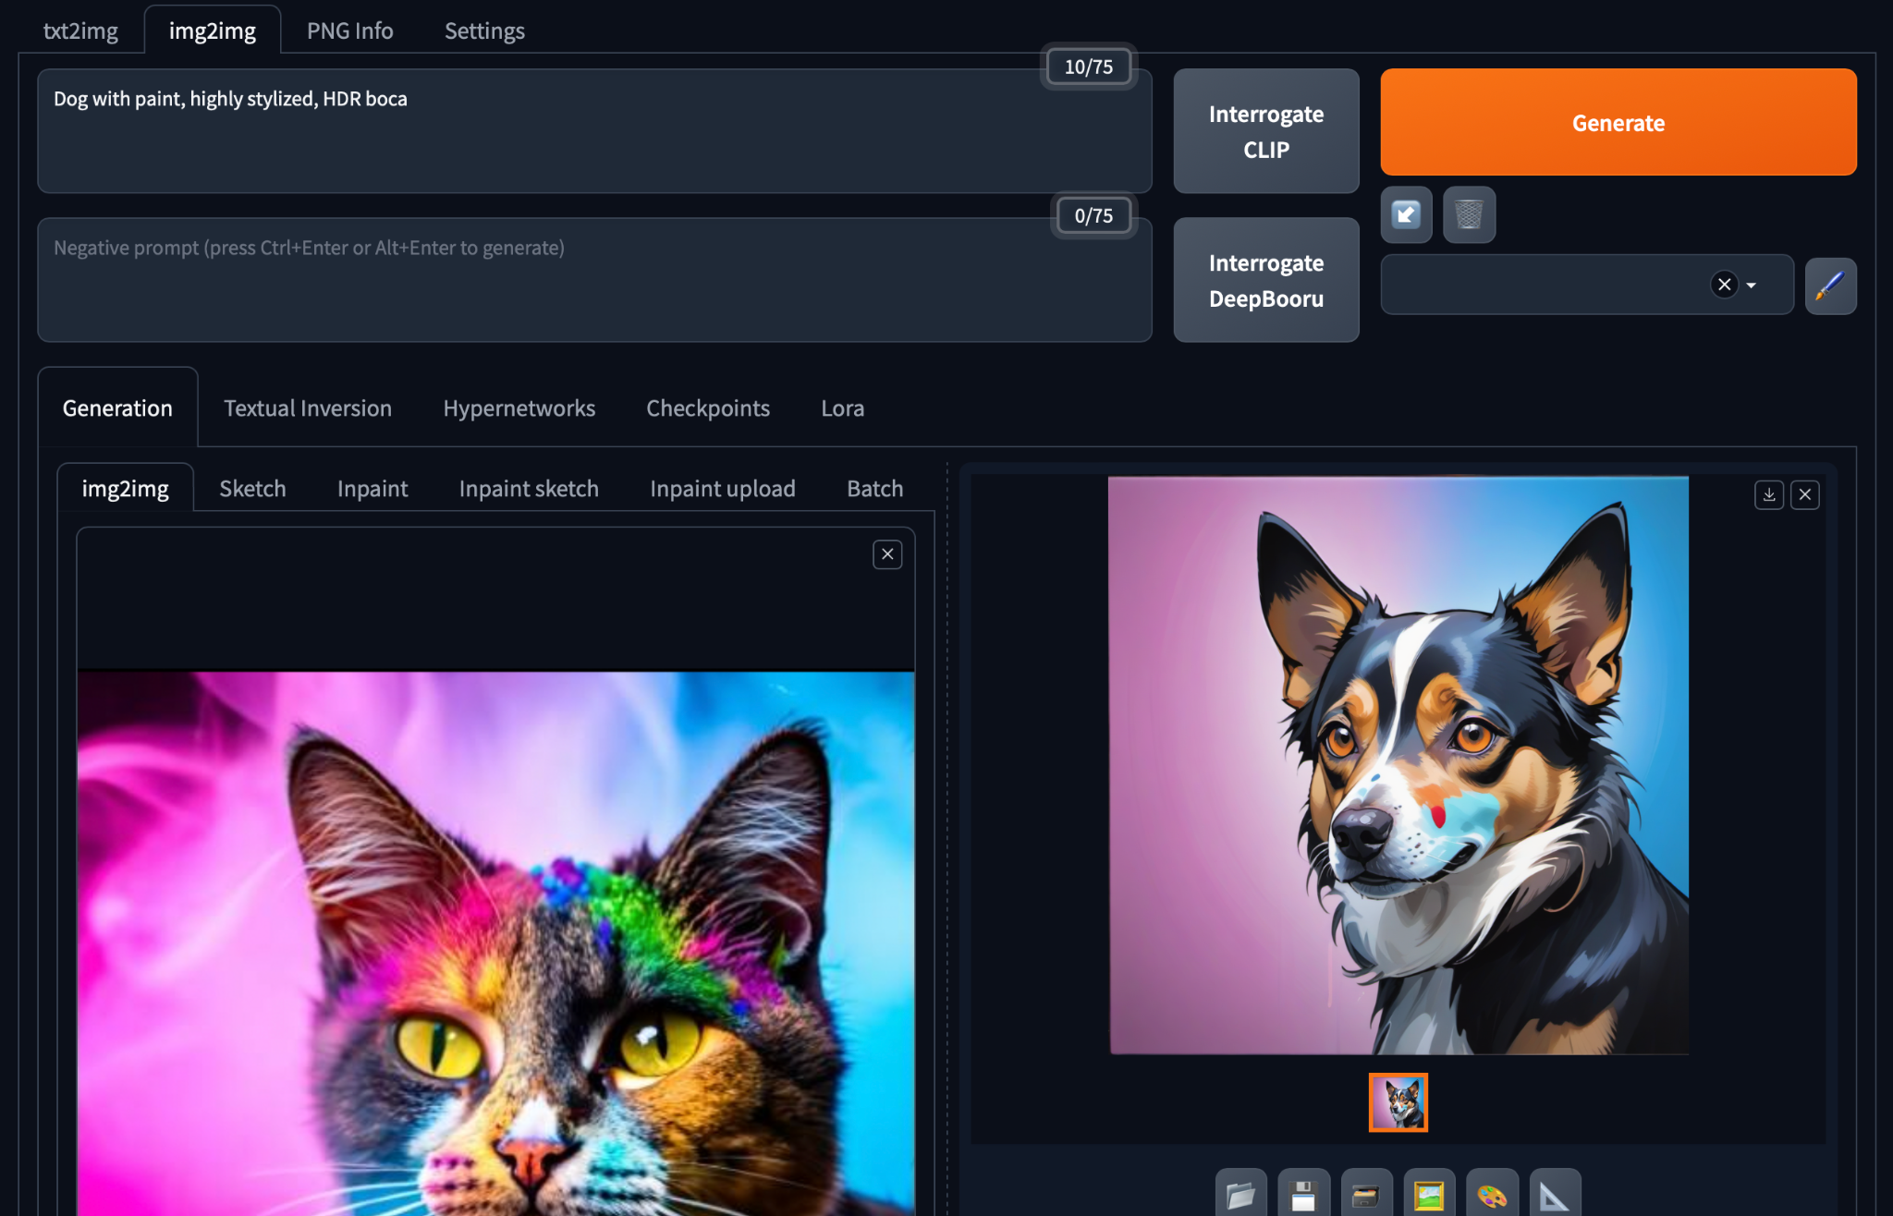
Gradio in HuggingFace Spaces
https://huggingface.co/spaces/camenduru-com/webui
Source: NVIDIA DLI (2024), Building RAG Agents with LLMs, https://learn.nvidia.com/courses/course-detail?course_id=course-v1:DLI+S-FX-15+V1
Notes:
What does microservice orchestration look like in practice?
So, let’s get back to our own environment! So far, we know we have our Jupyter Labs interface, but what else?
In the lab, you’ll find out about the frontend microservice, which is already hosted on port 8090.
This frontend is hosted in Gradio, an open-source web interface design library well-suited for presenting AI models.
1. Simple interface: slow_echo is being ran in a loop
2. More involved interface example from huggingface spaces, which anybody can contribute to
3. A more involved interface, which is closer to what is available/running in environment. See ./frontent/server_app.py

Slide 82
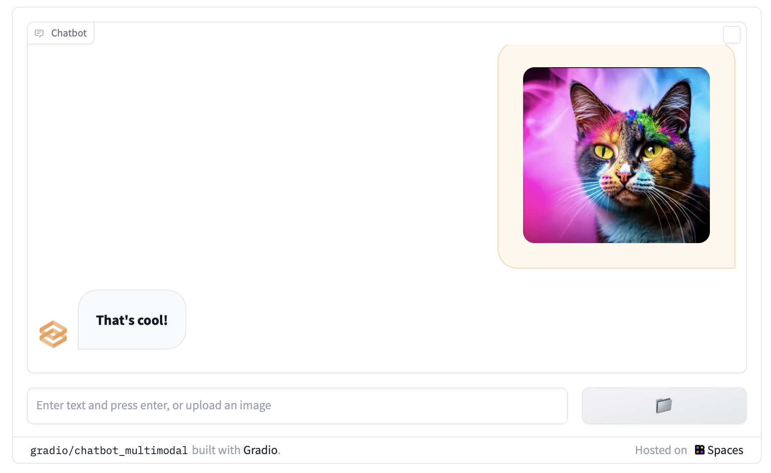
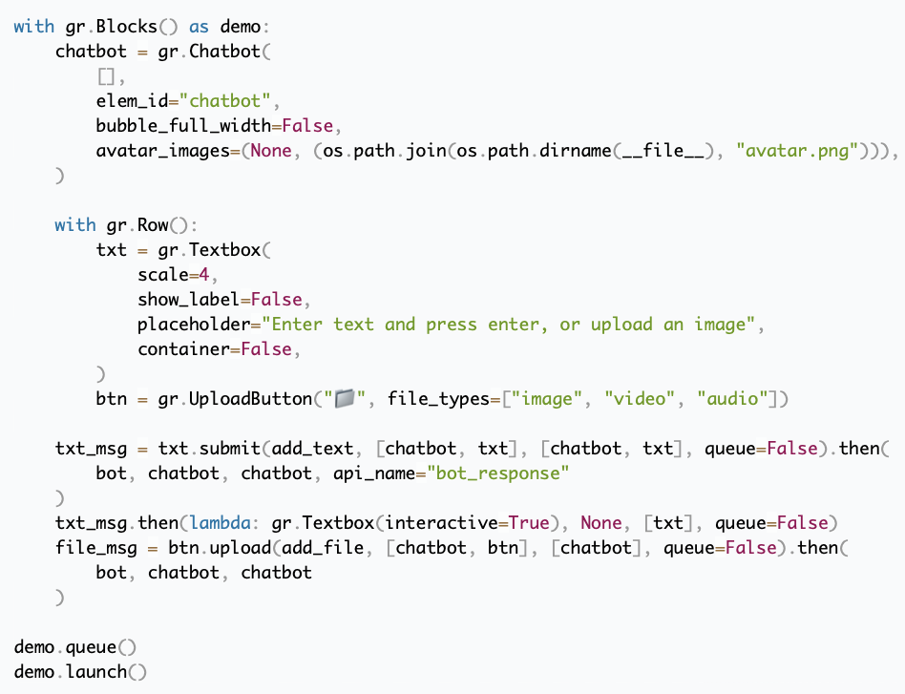
Custom Gradio Block Interface
https://www.gradio.app/guides/creating-a-custom-chatbot-with-blocks
Source: NVIDIA DLI (2024), Building RAG Agents with LLMs, https://learn.nvidia.com/courses/course-detail?course_id=course-v1:DLI+S-FX-15+V1
Notes:
What does microservice orchestration look like in practice?
So, let’s get back to our own environment! So far, we know we have our Jupyter Labs interface, but what else?
In the lab, you’ll find out about the frontend microservice, which is already hosted on port 8090.
This frontend is hosted in Gradio, an open-source web interface design library well-suited for presenting AI models.
1. Simple interface: slow_echo is being ran in a loop
2. More involved interface example from huggingface spaces, which anybody can contribute to
3. A more involved interface, which is closer to what is available/running in environment. See ./frontent/server_app.py

Slide 83
Our Environment
Jupyter Notebooks + Frontend
Your Device
Remote Host
:8090
Frontend
Docker
Router
Jupyter Notebook Server
:88
Source: NVIDIA DLI (2024), Building RAG Agents with LLMs, https://learn.nvidia.com/courses/course-detail?course_id=course-v1:DLI+S-FX-15+V1
Notes:
So that’s it!
Frontend interface already running on port :8090. To see details, check out ./frontend
Jupyter notebook running on port :88. To see details, check out ./composer
(Next Section: We’ll talk about the LLM-serving microservice)
Enjoy the lab!

Slide 84
Building RAG Agents with LLMs
Part 2: LLM Services
Source: NVIDIA DLI (2024), Building RAG Agents with LLMs, https://learn.nvidia.com/courses/course-detail?course_id=course-v1:DLI+S-FX-15+V1

Slide 85
Our Environment
Jupyter Notebooks + Frontend
Your Device
Remote Host
:8090
Frontend
Docker
Router
Jupyter Notebook Server
:88
Source: NVIDIA DLI (2024), Building RAG Agents with LLMs, https://learn.nvidia.com/courses/course-detail?course_id=course-v1:DLI+S-FX-15+V1
Notes:
So we have our environment, and we can use it to run some Python…
but wasn’t the point of this course to learn about chatbots and agents and RAG?
So where’s the LLM?
Well, if we don’t have a microservice for it…
…perhaps we can just pull in an LLM directly into our Jupyter notebook session and go from there!

Slide 86
Dialog/Retrieval Agents
LLMs with Context and Control
Execute with dialog management and information retrieval in production
https://www.nvidia.com/content/dam/en-zz/Solutions/lp/large-language-models-ebook/nvidia-llm-ebook-og.jpg
Source: NVIDIA DLI (2024), Building RAG Agents with LLMs, https://learn.nvidia.com/courses/course-detail?course_id=course-v1:DLI+S-FX-15+V1
Notes:
So we have our environment, and we can use it to run some Python…
but wasn’t the point of this course to learn about chatbots and agents and RAG?
So where’s the LLM?
Well, if we don’t have a microservice for it…
…perhaps we can just pull in an LLM directly into our Jupyter notebook session and go from there!

Slide 87
Dialog/Retrieval Agents
LLMs with Context and Control
Execute with dialog management and information retrieval in production
https://www.nvidia.com/content/dam/en-zz/Solutions/lp/large-language-models-ebook/nvidia-llm-ebook-og.jpg
Source: NVIDIA DLI (2024), Building RAG Agents with LLMs, https://learn.nvidia.com/courses/course-detail?course_id=course-v1:DLI+S-FX-15+V1
Notes:
So we have our environment, and we can use it to run some Python…
but wasn’t the point of this course to learn about chatbots and agents and RAG?
So where’s the LLM?
Well, if we don’t have a microservice for it…
…perhaps we can just pull in an LLM directly into our Jupyter notebook session and go from there!

Slide 88
Standalone Environment LLM
Your Device
Remote Host
Frontend
Docker
Router
Jupyter Notebook Server
Source: NVIDIA DLI (2024), Building RAG Agents with LLMs, https://learn.nvidia.com/courses/course-detail?course_id=course-v1:DLI+S-FX-15+V1
Notes:
So we have our environment, and we can use it to run some Python…
but wasn’t the point of this course to learn about chatbots and agents and RAG?
So where’s the LLM?
Well, if we don’t have a microservice for it…
…perhaps we can just pull in an LLM directly into our Jupyter notebook session and go from there!

Slide 89
Standalone Environment LLM
Your Device
Remote Host
Frontend
Docker
Router
Jupyter Notebook Server
LLM
Source: NVIDIA DLI (2024), Building RAG Agents with LLMs, https://learn.nvidia.com/courses/course-detail?course_id=course-v1:DLI+S-FX-15+V1
Notes:
So we have our environment, and we can use it to run some Python…
but wasn’t the point of this course to learn about chatbots and agents and RAG?
So where’s the LLM?
Well, if we don’t have a microservice for it…
…perhaps we can just pull in an LLM directly into our Jupyter notebook session and go from there!

Slide 90
Standalone Environment LLM
Jupyter Notebook
H200
A100
Jupyter Notebook
A10
4070
<s>[INST]<<SYS>>
{{system_message}}
<</SYS>>
{{instruction}} [/INST] {{primer}}
Jupyter Notebook
<s>[INST]<<SYS>>
You are a code generator.
Please provide Python code
per the instruction.
<</SYS>>
Write a Fibonacci method [/INST] ```python
## Implementation of Fibonacci w/
VRAM-bound
CPU-only
Source: NVIDIA DLI (2024), Building RAG Agents with LLMs, https://learn.nvidia.com/courses/course-detail?course_id=course-v1:DLI+S-FX-15+V1
Notes:
Datacenter Compute Environment: We’d be able to pull in one or more large models and run them without too much compromises.
This kind of environment is great for exclusive access to models for experimentation and fine-tuning, and is also great for running instances perpetually for delivery to many users. Pretty costly on a per-user basis.
Lighter Datacenter/High-End Consumer Environment: We’d probably still be able to pull in some smaller models or maybe one large model to use with some compromises.
Would need to quantize and conserve resources, but can still scale to some users and have some access to the raw models.
Typical Consumer Device: Problematic to run large models without some severe compromises. Can still be done, but limited interfaces.
Good to follow minimum device spec assumption of “I can run stuff in a browser”

Slide 91
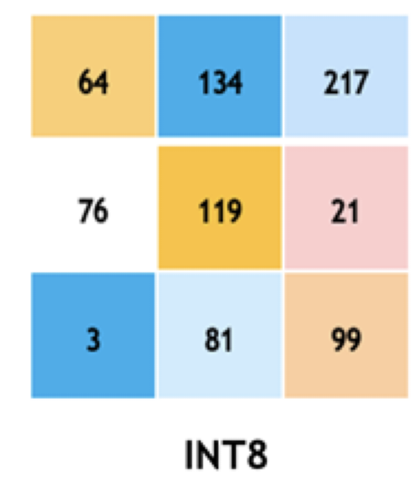
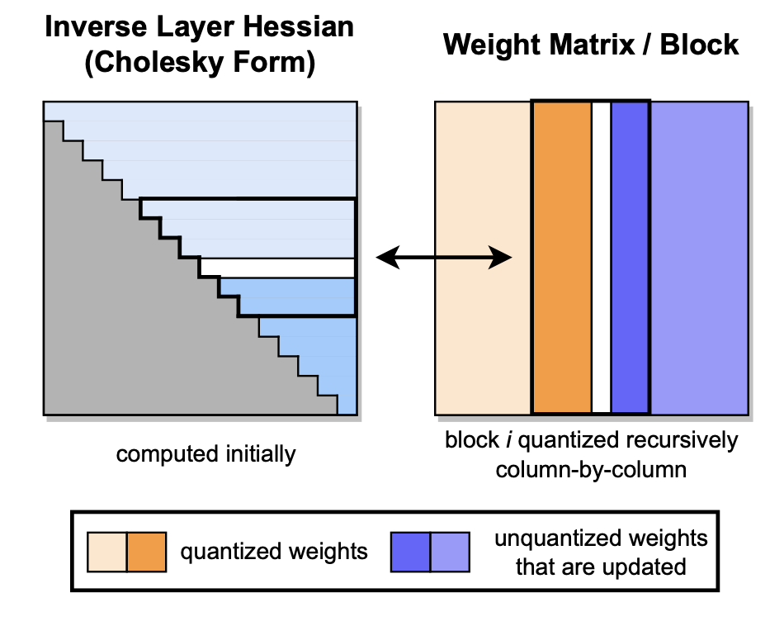
Standalone Environment LLM
Jupyter Notebook
H200
A100
Jupyter Notebook
A10
4070
Jupyter Notebook
VRAM-bound
CPU-only
Source: NVIDIA DLI (2024), Building RAG Agents with LLMs, https://learn.nvidia.com/courses/course-detail?course_id=course-v1:DLI+S-FX-15+V1
Notes:
Datacenter Compute Environment: We’d be able to pull in one or more large models and run them without too much compromises.
This kind of environment is great for exclusive access to models for experimentation and fine-tuning, and is also great for running instances perpetually for delivery to many users. Pretty costly on a per-user basis.
Lighter Datacenter/High-End Consumer Environment: We’d probably still be able to pull in some smaller models or maybe one large model to use with some compromises.
Would need to quantize and conserve resources, but can still scale to some users and have some access to the raw models.
Typical Consumer Device: Problematic to run large models without some severe compromises. Can still be done, but limited interfaces.
Good to follow minimum device spec assumption of “I can run stuff in a browser”

Slide 92
Standalone Environment LLM
Jupyter Notebook
H200
A100
Jupyter Notebook
A10
4070
Jupyter Notebook
VRAM-bound
CPU-only
Source: NVIDIA DLI (2024), Building RAG Agents with LLMs, https://learn.nvidia.com/courses/course-detail?course_id=course-v1:DLI+S-FX-15+V1
Notes:
Datacenter Compute Environment: We’d be able to pull in one or more large models and run them without too much compromises.
This kind of environment is great for exclusive access to models for experimentation and fine-tuning, and is also great for running instances perpetually for delivery to many users. Pretty costly on a per-user basis.
Lighter Datacenter/High-End Consumer Environment: We’d probably still be able to pull in some smaller models or maybe one large model to use with some compromises.
Would need to quantize and conserve resources, but can still scale to some users and have some access to the raw models.
Typical Consumer Device: Problematic to run large models without some severe compromises. Can still be done, but limited interfaces.
Good to follow minimum device spec assumption of “I can run stuff in a browser”
(Next Slide: Typical consumer device is our assumption, so what now?)

Slide 93

Remote LLM Access
<s>[INST]<<SYS>>
{{system_message}}
<</SYS>>
{{instruction}} [/INST] {{primer}}
Your Device
Remote Host
Llama
Frontend
<s>[INST]<<SYS>>
You are a code generator.
Please provide Python code
per the instruction.
<</SYS>>
Write a Fibonacci method [/INST] ```python
## Implementation of Fibonacci w/
Jupyter Notebook
VRAM-bound
CPU-only
Source: NVIDIA DLI (2024), Building RAG Agents with LLMs, https://learn.nvidia.com/courses/course-detail?course_id=course-v1:DLI+S-FX-15+V1
Notes:
Typical Consumer Device: Problematic to run large models without some severe compromises. Can still be done, but limited interfaces.
Good to follow minimum device spec assumption of “I can run stuff in a browser”
That’ll be our assumption, so what can we do?
Luckily, we can interface with large model hosting platforms that can provide the scalable inference services for us!
For now, we can use network requests like GET and POST to communicate to an external platform. Maybe someday these will be hosted by us as well, but for now let’s see what we can bank on from others!

Slide 94
Large Model Hosting Platforms
Your Device
NVIDIA
GPU CLOUD
Remote Host
Frontend
Jupyter Notebook
VRAM-bound
CPU-only
Source: NVIDIA DLI (2024), Building RAG Agents with LLMs, https://learn.nvidia.com/courses/course-detail?course_id=course-v1:DLI+S-FX-15+V1
Notes:
Typical Consumer Device: Problematic to run large models without some severe compromises. Can still be done, but limited interfaces.
Good to follow minimum device spec assumption of “I can run stuff in a browser”
That’ll be our assumption, so what can we do?
Luckily, we can interface with large model hosting platforms that can provide the scalable inference services for us!
We can use network requests like GET and POST to communicate to an external platform.
Maybe someday these will be hosted by you, but for now let’s see what we can work with from others!

Slide 95
Large Model Hosting Platforms
NVIDIA
GPU CLOUD
GPT4/3.5
Integrated Tools/Multimodal Support
Models/Query Router Internal
Path to Local Deployment Less Clear
Publicly Available Models
Models/Query Router Accessible
Path to Local Deployment/Self-Hosting
Pieces to Compose Complex Systems
Source: NVIDIA DLI (2024), Building RAG Agents with LLMs, https://learn.nvidia.com/courses/course-detail?course_id=course-v1:DLI+S-FX-15+V1
Notes:
OpenAI
Has GPT4/ChatGPT/Dalle/etc. Lots of under-the-hood bells and whistles (models/functions that get called automatically).
(NEXT SECTION: multi-slide tangent on how the models are hosted and provided from OpenAI)
(Later) No straightforward path to local deployment, but it is very easy to use! Great for easily making solutions that work.

Slide 96

Query Router Access
GPT4
Dalle-3
Embed
<s>[INST]<<SYS>>
{{system_message}}
<</SYS>>
{{instruction}} [/INST] {{primer}}????
Source: NVIDIA DLI (2024), Building RAG Agents with LLMs, https://learn.nvidia.com/courses/course-detail?course_id=course-v1:DLI+S-FX-15+V1
Notes:
How are these models provided:
Large model providers host models on allocated compute instances where they download the model and let it run perpetually.
From the end user perspective, these large models host endpoints which can be connected to by a variety of users and applications at any given time through a gateway service (more details to come).
Under the hood, these services generally use scaled deployment orchestrators like Kubernetes.

Slide 97
Query Router Access
{
"messages": [{
"content": "...",
"role": "system"
},{
"content": "...",
"role": "user"
}],
"model": ”gpt-4”,
"temperature": 0.2,
"top_p": 0.7,
"max_tokens": 1024,
"stream": True
}
GPT4
/chat/completions
Dalle-3
Facilitate
Monitor
Optimize
Load Balance
Embed
<s>[INST]<<SYS>>
{{system_message}}
<</SYS>>
{{instruction}} [/INST] {{primer}}????
https://kubernetes.io/
Source: NVIDIA DLI (2024), Building RAG Agents with LLMs, https://learn.nvidia.com/courses/course-detail?course_id=course-v1:DLI+S-FX-15+V1
Notes:
How are these models provided:
Large model providers host models on allocated compute instances where they download the model and let it run perpetually.
From the end user perspective, these large models host endpoints which can be connected to by a variety of users and applications at any given time through a gateway service (more details to come).
Under the hood, these services generally use scaled deployment orchestrators like Kubernetes.

Slide 98
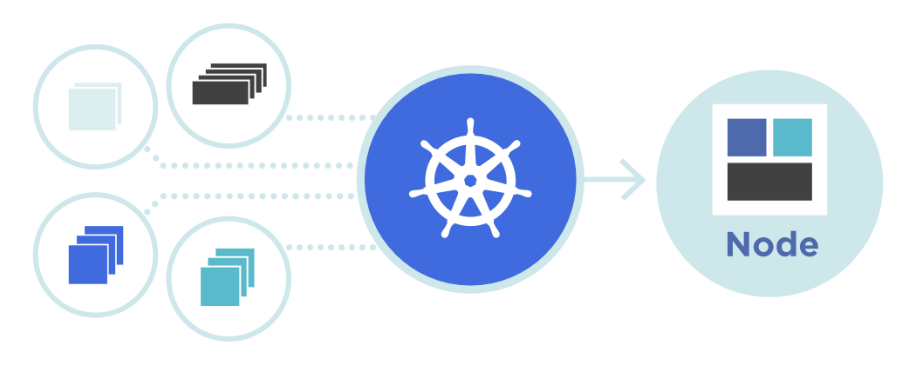
Query Router Access
{
"messages": [{
"content": "...",
"role": "system"
},{
"content": "...",
"role": "user"
}],
"model": ”gpt-4”,
"temperature": 0.2,
"top_p": 0.7,
"max_tokens": 1024,
"stream": True
}
GPT4
/chat/completions
Dalle-3
Facilitate
Monitor
Optimize
Load Balance
Embed
<s>[INST]<<SYS>>
{{system_message}}
<</SYS>>
{{instruction}} [/INST] {{primer}}????
https://kubernetes.io/
Source: NVIDIA DLI (2024), Building RAG Agents with LLMs, https://learn.nvidia.com/courses/course-detail?course_id=course-v1:DLI+S-FX-15+V1
Notes:
How are these models provided:
Large model providers host models on allocated compute instances where they download the model and let it run perpetually.
From the end user perspective, these large models host endpoints which can be connected to by a variety of users and applications at any given time through a gateway service (more details to come).
Under the hood, these services generally use scaled deployment orchestrators like Kubernetes.
(UP NEXT: How An OpenAPI-spec gateway server is structured)

Slide 99
Large Model Hosting Platforms - OpenAI
models
completion
chat/completion
embeddings
images/generate
OpenAI Gateway
GPT
(3.5/4)
embed-<>
Dalle-3
Source: NVIDIA DLI (2024), Building RAG Agents with LLMs, https://learn.nvidia.com/courses/course-detail?course_id=course-v1:DLI+S-FX-15+V1
Notes:
More details about the OpenAI gateway, which conforms to the OpenAPI standard.
Slide 1: It’s an abstraction layer over call functions that are deployed to run persistently and auto-scale.
Slide 2: Things like model name, messages, API keys, etc are ingested, gateway handles redirect and handling, and finally returns the response.
Slide 3: Using this interface as a building block, you can build applications on top of this, including custom microservices and end-user applications.

Slide 100
Large Model Hosting Platforms - OpenAI
models
completion
chat/completion
embeddings
images/generate
Messages
Model Name
Settings
API Key
OpenAI Gateway
Responses
GPT
(3.5/4)
embed-<>
Dalle-3
Source: NVIDIA DLI (2024), Building RAG Agents with LLMs, https://learn.nvidia.com/courses/course-detail?course_id=course-v1:DLI+S-FX-15+V1
Notes:
More details about the OpenAI gateway, which conforms to the OpenAPI standard.
Slide 1: It’s an abstraction layer over call functions that are deployed to run persistently and auto-scale.
Slide 2: Things like model name, messages, API keys, etc are ingested, gateway handles redirect and handling, and finally returns the response.
Slide 3: Using this interface as a building block, you can build applications on top of this, including custom microservices and end-user applications.

Slide 101
Large Model Hosting Platforms - OpenAI
End-User Application
Retriever Microservice
models
completion
chat/completion
embeddings
images/generate
Messages
Model Name
Settings
API Key
OpenAI Gateway
Responses
GPT
(3.5/4)
embed-<>
Dalle-3
Server Management
https://developer.nvidia.com/blog/simplifying-ai-inference-in-production-with-triton/
Source: NVIDIA DLI (2024), Building RAG Agents with LLMs, https://learn.nvidia.com/courses/course-detail?course_id=course-v1:DLI+S-FX-15+V1
Notes:
More details about the OpenAI gateway, which conforms to the OpenAPI standard.
Slide 1: It’s an abstraction layer over call functions that are deployed to run persistently and auto-scale.
Slide 2: Things like model name, messages, API keys, etc are ingested, gateway handles redirect and handling, and finally returns the response.
Slide 3: Using this interface as a building block, you can build applications on top of this, including custom microservices and end-user applications.
(Up Next) Limitations of OpenAI service with regard to privacy and cost ownership.

Slide 102
Large Model Hosting Platforms
NVIDIA
GPU CLOUD
GPT4/3.5
Integrated Tools/Multimodal Support
Models/Query Router Internal
Path to Local Deployment Less Clear
Publicly Available Models
Models/Query Router Accessible
Path to Local Deployment/Self-Hosting
Pieces to Compose Complex Systems
Source: NVIDIA DLI (2024), Building RAG Agents with LLMs, https://learn.nvidia.com/courses/course-detail?course_id=course-v1:DLI+S-FX-15+V1
Notes:
Now that we know what large model hosting platforms are, let’s look at some of our options!
OpenAI API
Has GPT4/ChatGPT/etc. Lots of under-the-hood bells and whistles (models/functions that get called automatically).
No straightforward path to local deployment (for cost and scale), cannot guarantee data security.
NVIDIA GPU Cloud
Allows you to access publicly-available models and set up systems that work directly on the optimized deployments. Straightforward path to local deployment, but it’s not quite as automatic as some systems. These are your own deployments, after all!

Slide 103
Large Model Hosting Platforms
NVIDIA
GPU CLOUD
GPT4/3.5
Integrated Tools/Multimodal Support
Models/Query Router Internal
Path to Local Deployment Less Clear
Publicly Available Models
Models/Query Router Accessible
Path to Local Deployment/Self-Hosting
Pieces to Compose Complex Systems
Source: NVIDIA DLI (2024), Building RAG Agents with LLMs, https://learn.nvidia.com/courses/course-detail?course_id=course-v1:DLI+S-FX-15+V1
Notes:
Now that we know what large model hosting platforms are, let’s look at some of our options!
OpenAI API
Has GPT4/ChatGPT/etc. Lots of under-the-hood bells and whistles (models/functions that get called automatically).
No straightforward path to local deployment (for cost and scale), cannot guarantee data security.
NVIDIA GPU Cloud
Allows you to access publicly-available models and set up systems that work directly on the optimized deployments. Straightforward path to local deployment, but it’s not quite as automatic as some systems. These are your own deployments, after all!

Slide 104
Query Router Access
GPT4
Dalle-3
Embed
{
"messages": [{
"content": "...",
"role": "system"
},{
"content": "...",
"role": "user"
}],
"model": ”mixtral”,
"temperature": 0.2,
"top_p": 0.7,
"max_tokens": 1024,
"stream": True
}
<s>[INST]<<SYS>>
{{system_message}}
<</SYS>>
{{instruction}} [/INST] {{primer}}
/chat/completions
Mixtral
SDXL
Facilitate
Monitor
Optimize
Load Balance
{
“context”:{{context}}
“model”:“query”/”doc”
}
E5
https://kubernetes.io/
Source: NVIDIA DLI (2024), Building RAG Agents with LLMs, https://learn.nvidia.com/courses/course-detail?course_id=course-v1:DLI+S-FX-15+V1
Notes:
1. Structured similar to OpenAI, so either service can be used.
2. Full GenAI deployment stack for those interested.
3. State of our environment (jupyter + frontend + service API)

Slide 105
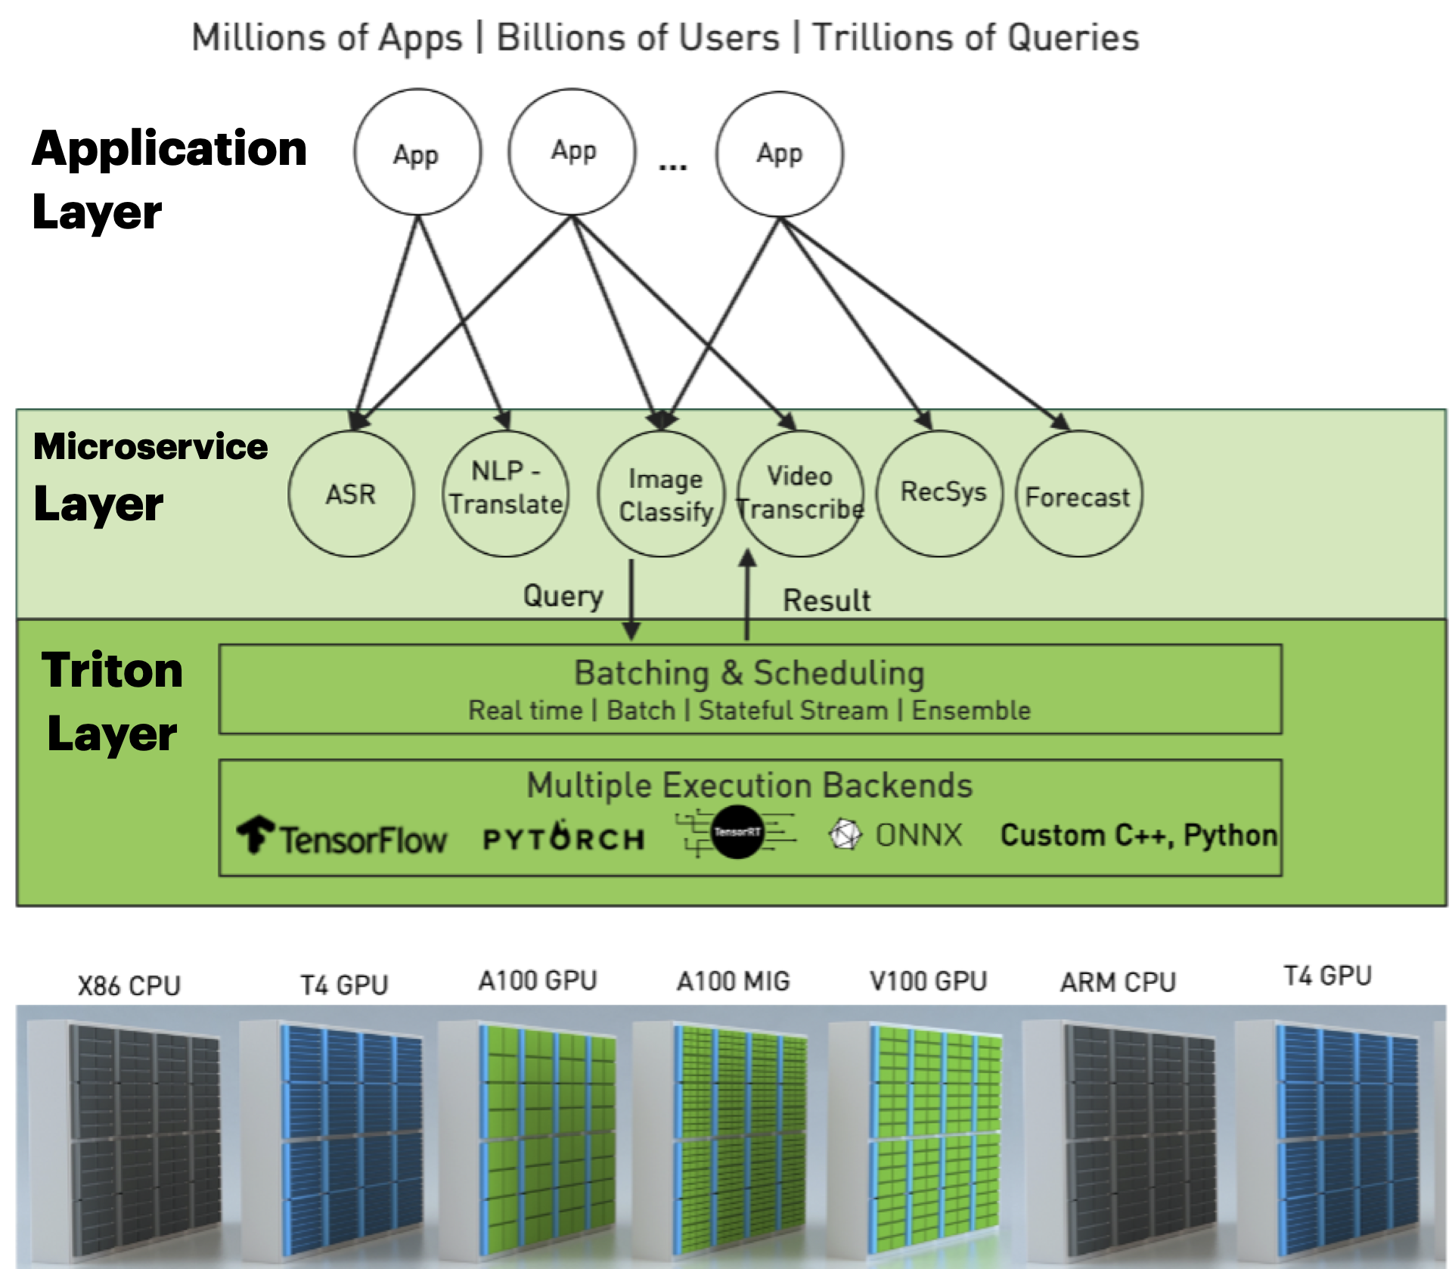
Full Deployment Stack
General Chatbot
Image Generator
Document
Copilot
Custom Server
NIMs
NeMo Retriever
Mixtral
E5
SDXL
VideoGen
RIVA
TensorRT-LLM / vLLM
K8s
Azure
/AWS
Org
Cluster
https://developer.nvidia.com/blog/simplifying-ai-inference-in-production-with-triton/
Source: NVIDIA DLI (2024), Building RAG Agents with LLMs, https://learn.nvidia.com/courses/course-detail?course_id=course-v1:DLI+S-FX-15+V1
Notes:
1. Structured similar to OpenAI, so either service can be used.
2. Full GenAI deployment stack for those interested.
3. State of our environment (jupyter + frontend + service API)

Slide 106
Our Environment
Jupyter Notebooks + Frontend
LLM Client
Your Device
Remote Host
:8090
Frontend
LLMs
Docker
Router
:9000
Jupyter Notebook Server
:88
Source: NVIDIA DLI (2024), Building RAG Agents with LLMs, https://learn.nvidia.com/courses/course-detail?course_id=course-v1:DLI+S-FX-15+V1
Notes:
1. Structured similar to OpenAI, so either service can be used.
2. Full GenAI deployment stack for those interested.
3. State of our environment (jupyter + frontend + service API)
(Next Slide: Talk about the LLM service)

Slide 107
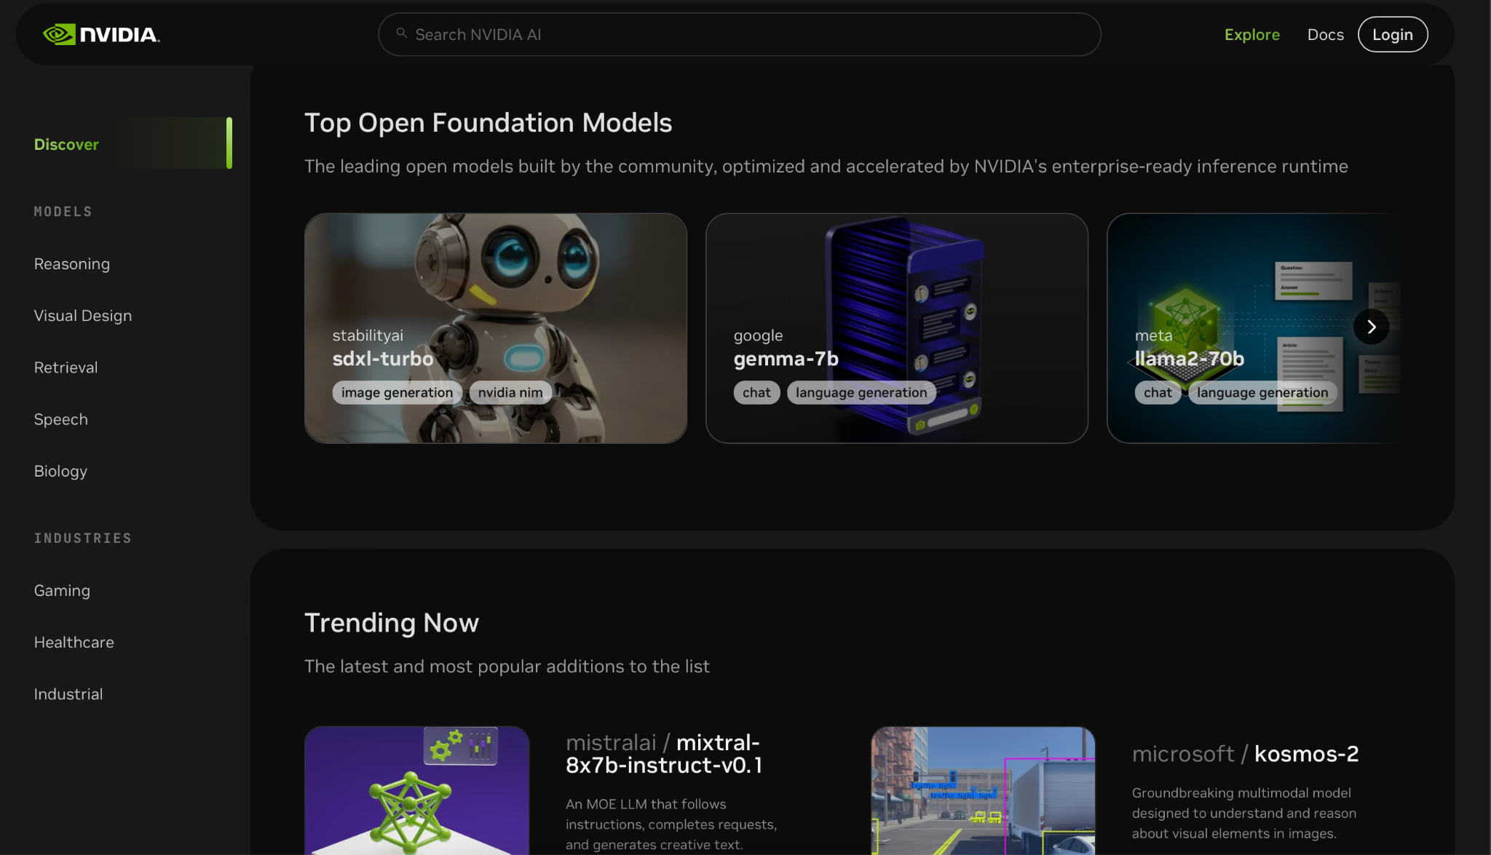
NVIDIA Foundation Model Endpoints
NVIDIA
GPU CLOUD
Source: NVIDIA DLI (2024), Building RAG Agents with LLMs, https://learn.nvidia.com/courses/course-detail?course_id=course-v1:DLI+S-FX-15+V1
Notes:
So what are we going to use to get started with some LLMs quickly?... NVIDIA Foundation Model Endpoints!
1. Free access to publicly-available models which can be deployed on your own infrastructure (i.e. with NIMs)!
2. Picture of Mixtral model hosted in API Catalog. Other options available in environment.
3. Picture of user interface and API specification

Slide 108
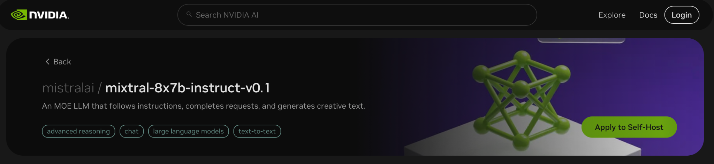
NVIDIA Foundation Model Endpoints
NVIDIA
GPU CLOUD
Source: NVIDIA DLI (2024), Building RAG Agents with LLMs, https://learn.nvidia.com/courses/course-detail?course_id=course-v1:DLI+S-FX-15+V1
Notes:
So what are we going to use to get started with some LLMs quickly?... NVIDIA Foundation Model Endpoints!
1. Free access to publicly-available models which can be deployed on your own infrastructure (i.e. with NIMs)!
2. Picture of Mixtral model hosted in API Catalog. Other options available in environment.
3. Picture of user interface and API specification

Slide 109
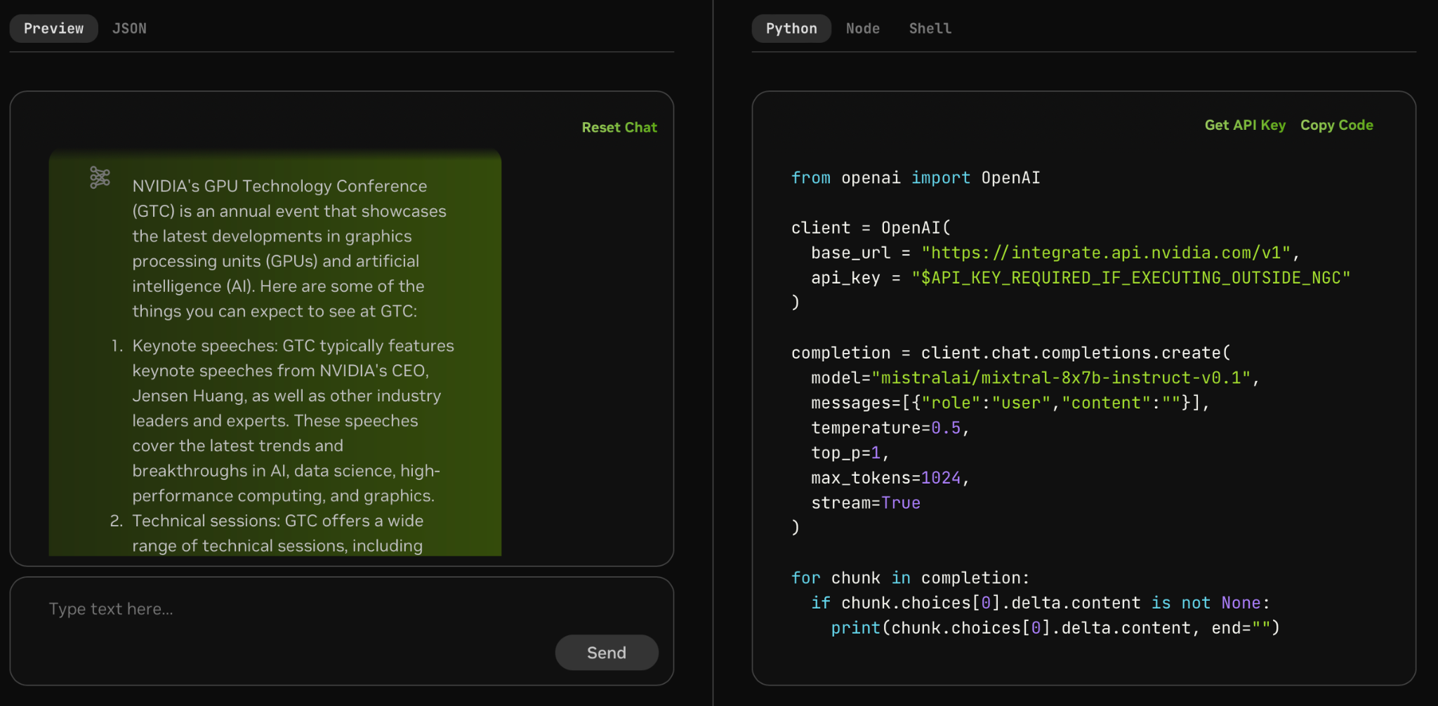
NVIDIA Foundation Model Endpoints
NVIDIA
GPU CLOUD
Source: NVIDIA DLI (2024), Building RAG Agents with LLMs, https://learn.nvidia.com/courses/course-detail?course_id=course-v1:DLI+S-FX-15+V1
Notes:
So what are we going to use to get started with some LLMs quickly?... NVIDIA Foundation Model Endpoints!
1. Free access to publicly-available models which can be deployed on your own infrastructure (i.e. with NIMs)!
2. Picture of Mixtral model hosted in API Catalog. Other options available in environment.
3. Picture of user interface and API specification. You can make your own apps with it!
(Next: But we need LangChain…)

Slide 110
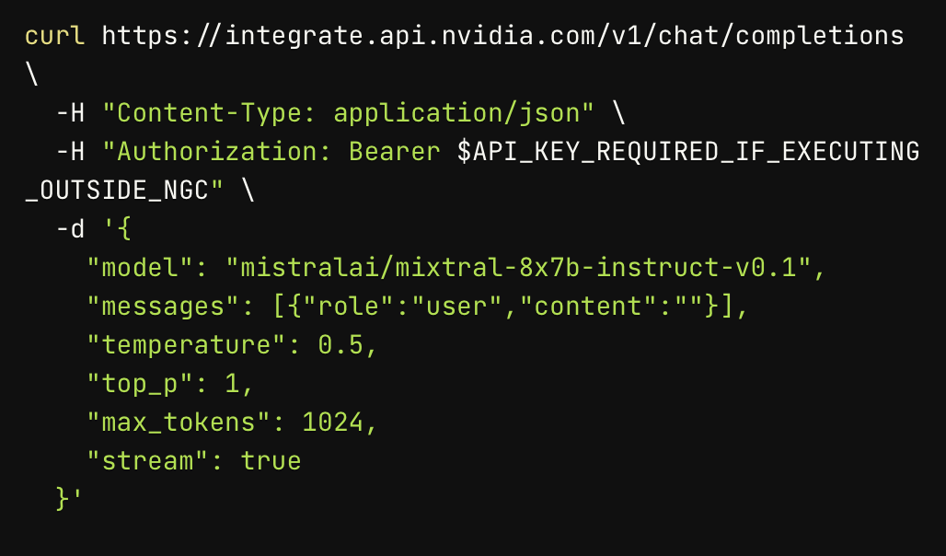
NVIDIA Foundation Model Endpoints
NVIDIA
GPU CLOUD
Source: NVIDIA DLI (2024), Building RAG Agents with LLMs, https://learn.nvidia.com/courses/course-detail?course_id=course-v1:DLI+S-FX-15+V1
Notes:
So what are we going to use to get started with some LLMs quickly?... NVIDIA Foundation Model Endpoints!
1. Free access to publicly-available models which can be deployed on your own infrastructure (i.e. with NIMs)!
2. Picture of Mixtral model hosted in API Catalog. Other options available in environment.
3. Picture of user interface and API specification. You can make your own apps with it!

Slide 111
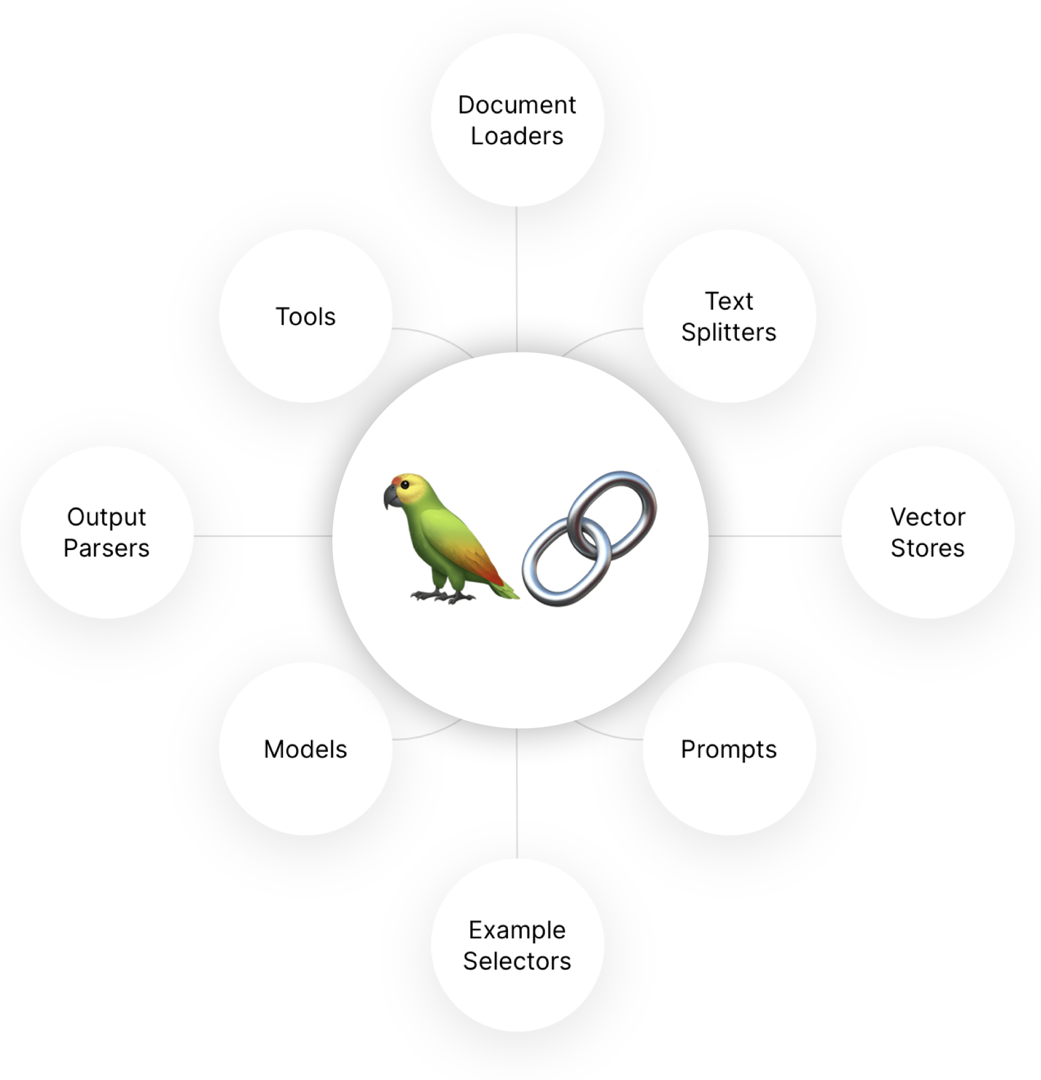
From Raw Requests to LangChain Model
Source: NVIDIA DLI (2024), Building RAG Agents with LLMs, https://learn.nvidia.com/courses/course-detail?course_id=course-v1:DLI+S-FX-15+V1
Notes:
For this course, we will use LangChain to orchestrate our large model endpoints into more complex software…
Our new API will need to change just a bit for it to play well. To be discussed in the notebook.
(Sequence) Final walkthrough of abstractions going from scaled deployment API -> to gateway API -> to language wrapper -> to framework wrapper.

Slide 112
From Raw Requests to LangChain Model
> llm(“Hello world”)
ChatMessage(content=”hello”)
> embedder(“Hello”)
[0.4535437, 0.0800435, ...]
<s>[INST]<<SYS>>
{{system_message}}
<</SYS>>
{{instruction}} [/INST] {{primer}}
Query Router
Llama
Mistral
Facilitate
Monitor
Optimize
{
“context”:{{context}}
“model”:“query”/”doc”
}
E5
Source: NVIDIA DLI (2024), Building RAG Agents with LLMs, https://learn.nvidia.com/courses/course-detail?course_id=course-v1:DLI+S-FX-15+V1
Notes:
For this course, we will use LangChain to orchestrate our large model endpoints into more complex software…
Our new API will need to change just a bit for it to play well. To be discussed in the notebook.
(Sequence) Final walkthrough of abstractions going from scaled deployment API -> to gateway API -> to language wrapper -> to framework wrapper.

Slide 113
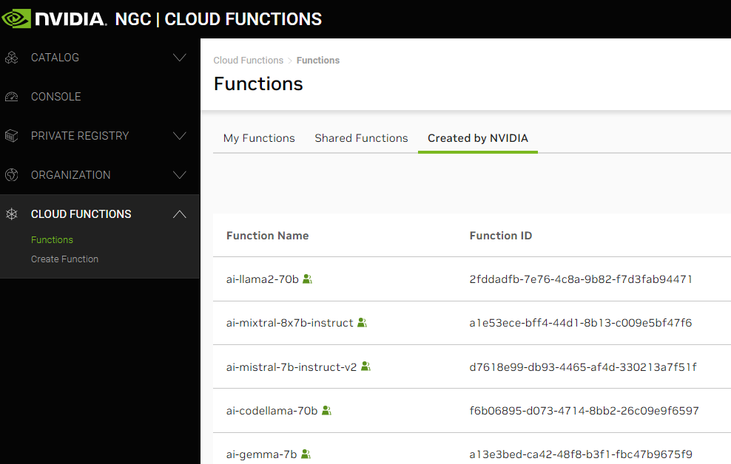
LLM Interfaces
The Whole Stack
api.nvcf.
nvidia.com
/v2/nvcf
Scaled
Function Deployment Solution
Source: NVIDIA DLI (2024), Building RAG Agents with LLMs, https://learn.nvidia.com/courses/course-detail?course_id=course-v1:DLI+S-FX-15+V1
Notes:
For this course, we will use LangChain to orchestrate our large model endpoints into more complex software…
Our new API will need to change just a bit for it to play well. To be discussed in the notebook.
(Sequence) Final walkthrough of abstractions going from scaled deployment API -> to gateway API -> to language client->...-> to framework connector.

Slide 114
LLM Interfaces
The Whole Stack
health.api.nvidia.com/
ai.api.nvidia.com/
api.nvcf.
nvidia.com
/v2/nvcf
integrate.api.nvidia.com
v1/models
v1/completions
v1/chat/completions
v1/embeddings
Scaled
Function Deployment Solution
api.openai.com
v1/models
v1/completions
v1/chat/completions
v1/embeddings
Source: NVIDIA DLI (2024), Building RAG Agents with LLMs, https://learn.nvidia.com/courses/course-detail?course_id=course-v1:DLI+S-FX-15+V1
Notes:
For this course, we will use LangChain to orchestrate our large model endpoints into more complex software…
Our new API will need to change just a bit for it to play well. To be discussed in the notebook.
(Sequence) Final walkthrough of abstractions going from scaled deployment API -> to gateway API -> to language client->...-> to framework connector.

Slide 115
LLM Interfaces
The Whole Stack
health.api.nvidia.com/
ai.api.nvidia.com/
api.nvcf.
nvidia.com
/v2/nvcf
NVIDIABase
integrate.api.nvidia.com
v1/models
v1/completions
v1/chat/completions
v1/embeddings
Scaled
Function Deployment Solution
api.openai.com
v1/models
v1/completions
v1/chat/completions
v1/embeddings
OpenAI
Source: NVIDIA DLI (2024), Building RAG Agents with LLMs, https://learn.nvidia.com/courses/course-detail?course_id=course-v1:DLI+S-FX-15+V1
Notes:
For this course, we will use LangChain to orchestrate our large model endpoints into more complex software…
Our new API will need to change just a bit for it to play well. To be discussed in the notebook.
(Sequence) Final walkthrough of abstractions going from scaled deployment API -> to gateway API -> to language client->...-> to framework connector.

Slide 116
LLM Interfaces
The Whole Stack
health.api.nvidia.com/
ai.api.nvidia.com/
api.nvcf.
nvidia.com
/v2/nvcf
NVIDIABase
integrate.api.nvidia.com
v1/models
v1/completions
v1/chat/completions
v1/embeddings
Scaled
Function Deployment Solution
api.openai.com
v1/models
v1/completions
v1/chat/completions
v1/embeddings
OpenAI
Source: NVIDIA DLI (2024), Building RAG Agents with LLMs, https://learn.nvidia.com/courses/course-detail?course_id=course-v1:DLI+S-FX-15+V1
Notes:
For this course, we will use LangChain to orchestrate our large model endpoints into more complex software…
Our new API will need to change just a bit for it to play well. To be discussed in the notebook.
(Sequence) Final walkthrough of abstractions going from scaled deployment API -> to gateway API -> to language client->...-> to framework connector.

Slide 117
LLM Interfaces
The Whole Stack
health.api.nvidia.com/
ai.api.nvidia.com/
api.nvcf.
nvidia.com
/v2/nvcf
ChatNVIDIA
NVIDIABase
integrate.api.nvidia.com
v1/models
v1/completions
v1/chat/completions
v1/embeddings
Scaled
Function Deployment Solution
api.openai.com
ChatOpenAI
v1/models
v1/completions
v1/chat/completions
v1/embeddings
OpenAI
Source: NVIDIA DLI (2024), Building RAG Agents with LLMs, https://learn.nvidia.com/courses/course-detail?course_id=course-v1:DLI+S-FX-15+V1
Notes:
For this course, we will use LangChain to orchestrate our large model endpoints into more complex software…
Our new API will need to change just a bit for it to play well. To be discussed in the notebook.
(Sequence) Final walkthrough of abstractions going from scaled deployment API -> to gateway API -> to language client->...-> to framework connector.

Slide 118
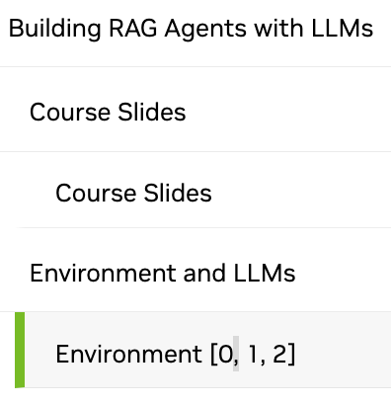
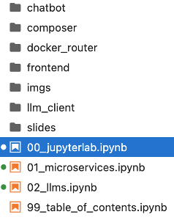
NVIDIA Building RAG Agents with LLMs
Part I
[0, 1, 2]
Source: NVIDIA DLI (2024), Building RAG Agents with LLMs, https://learn.nvidia.com/courses/course-detail?course_id=course-v1:DLI+S-FX-15+V1

Slide 119
NVIDIA Building RAG Agents with LLMs
Part II
[3, 4]

Slide 120
Building RAG Agents with LLMs
Part 3: Intro to LangChain
Source: NVIDIA DLI (2024), Building RAG Agents with LLMs, https://learn.nvidia.com/courses/course-detail?course_id=course-v1:DLI+S-FX-15+V1

Slide 121
LangChain Structure
Source: NVIDIA DLI (2024), Building RAG Agents with LLMs, https://learn.nvidia.com/courses/course-detail?course_id=course-v1:DLI+S-FX-15+V1
Notes:
In the previous section, we saw how we can wrap our endpoints with a LangChain connector interface, and alleged that this will make life a lot easier since LangChain is an LLM orchestration framework. Let’s see what this means in practice!
At minimum, we’d expect our LLM to accept an input and produce an output, so of course our connector can do that.

Slide 122

Chain Building
Just The LLM
Input
LLM
Output
Source: NVIDIA DLI (2024), Building RAG Agents with LLMs, https://learn.nvidia.com/courses/course-detail?course_id=course-v1:DLI+S-FX-15+V1

Slide 123
Chain Building
Just The LLM
Input
LLM
Output
Hey There
AIMessage(“Hello”)
LLM
Source: NVIDIA DLI (2024), Building RAG Agents with LLMs, https://learn.nvidia.com/courses/course-detail?course_id=course-v1:DLI+S-FX-15+V1
Notes:
In the previous section, we saw how we can wrap our endpoints with a LangChain connector interface, and alleged that this will make life a lot easier since LangChain is an LLM orchestration framework. Let’s see what this means in practice!
At minimum, we’d expect our LLM to accept an input and produce an output, so of course our connector can do that.
In addition, we also would want a way to specifying additional components to our inputs. System messages, other components, etc.
In LangChain, specifying this can be done using a paradigm called Runnables, for which you can chain modules of functionality into pipelines.
These are pretty simple to specify manually. All you have to do is define a function that takes in the previous input and produces the next output, and then you can add it to the chain like this.
And then there you go! You now have a chain…
…which you can either invoke for an all-at-once response or stream for a one-token-at-a-time response.

Slide 124
Chain Building
Simple Prompt+LLM Chain
Input
Prompt
LLM
Output
{‘input’ : “Hey There”}
AIMessage(“Hello”)
Hey There
Prompt
Context: {context}
Input: {input}
LLM
Source: NVIDIA DLI (2024), Building RAG Agents with LLMs, https://learn.nvidia.com/courses/course-detail?course_id=course-v1:DLI+S-FX-15+V1
Notes:
In the previous section, we saw how we can wrap our endpoints with a LangChain connector interface, and alleged that this will make life a lot easier since LangChain is an LLM orchestration framework. Let’s see what this means in practice!
At minimum, we’d expect our LLM to accept an input and produce an output, so of course our connector can do that.
In addition, we also would want a way to specifying additional components to our inputs. System messages, other components, etc.
In LangChain, specifying this can be done using a paradigm called Runnables, for which you can chain modules of functionality into pipelines.
These are pretty simple to specify manually. All you have to do is define a function that takes in the previous input and produces the next output, and then you can add it to the chain like this.
And then there you go! You now have a chain…
…which you can either invoke for an all-at-once response or stream for a one-token-at-a-time response.

Slide 125
Chain Building
Simple Prompt+LLM Chain
Input
Prompt
LLM
Output
chain = prompt | chat
chain.invoke(inputs)
{‘input’ : “Hey There”}
AIMessage(“Hello”)
Hey There
Prompt
Context: {context}
Input: {input}
LLM
Source: NVIDIA DLI (2024), Building RAG Agents with LLMs, https://learn.nvidia.com/courses/course-detail?course_id=course-v1:DLI+S-FX-15+V1
Notes:
In the previous section, we saw how we can wrap our endpoints with a LangChain connector interface, and alleged that this will make life a lot easier since LangChain is an LLM orchestration framework. Let’s see what this means in practice!
At minimum, we’d expect our LLM to accept an input and produce an output, so of course our connector can do that.
In addition, we also would want a way to specifying additional components to our inputs. System messages, other components, etc.
In LangChain, specifying this can be done using a paradigm called Runnables, for which you can chain modules of functionality into pipelines.
These are pretty simple to specify manually. All you have to do is define a function that takes in the previous input and produces the next output, and then you can add it to the chain like this.
And then there you go! You now have a chain…
…which you can either invoke for an all-at-once response or stream for a one-token-at-a-time response.

Slide 126
Chain Building
Simple Prompt+LLM Chain
Input
Prompt
LLM
Output
## StrOutputParser()
def get_content(value):
return getattr(value, “content”, value)
| get_content
chain = prompt | chat
chain.invoke(inputs)
{‘input’ : “Hey There”}
AIMessage(“Hello”)
Hey There
Prompt
Context: {context}
Input: {input}
LLM
Source: NVIDIA DLI (2024), Building RAG Agents with LLMs, https://learn.nvidia.com/courses/course-detail?course_id=course-v1:DLI+S-FX-15+V1
Notes:
In the previous section, we saw how we can wrap our endpoints with a LangChain connector interface, and alleged that this will make life a lot easier since LangChain is an LLM orchestration framework. Let’s see what this means in practice!
At minimum, we’d expect our LLM to accept an input and produce an output, so of course our connector can do that.
In addition, we also would want a way to specifying additional components to our inputs. System messages, other components, etc.
In LangChain, specifying this can be done using a paradigm called Runnables, for which you can chain modules of functionality into pipelines.
These are pretty simple to specify manually. All you have to do is define a function that takes in the previous input and produces the next output, and then you can add it to the chain like this.
And then there you go! You now have a chain…
…which you can either invoke for an all-at-once response or stream for a one-token-at-a-time response.

Slide 127
Chain Building
Invoking Runnables
Input
Prompt
LLM
Output
chain = prompt | chat | StrOutputParser()
Source: NVIDIA DLI (2024), Building RAG Agents with LLMs, https://learn.nvidia.com/courses/course-detail?course_id=course-v1:DLI+S-FX-15+V1
Notes:
In the previous section, we saw how we can wrap our endpoints with a LangChain connector interface, and alleged that this will make life a lot easier since LangChain is an LLM orchestration framework. Let’s see what this means in practice!
At minimum, we’d expect our LLM to accept an input and produce an output, so of course our connector can do that.
In addition, we also would want a way to specifying additional components to our inputs. System messages, other components, etc.
In LangChain, specifying this can be done using a paradigm called Runnables, for which you can chain modules of functionality into pipelines.
These are pretty simple to specify manually. All you have to do is define a function that takes in the previous input and produces the next output, and then you can add it to the chain like this.
And then there you go! You now have an end-to-end chain…
…which you can either invoke for an all-at-once response or stream for a one-token-at-a-time response.

Slide 128
Chain Building
Invoking Runnables
Input
Prompt
LLM
Output
chain = prompt | chat | StrOutputParser()
msg = chain.invoke(...)
for token in chain.stream(...)
Source: NVIDIA DLI (2024), Building RAG Agents with LLMs, https://learn.nvidia.com/courses/course-detail?course_id=course-v1:DLI+S-FX-15+V1
Notes:
In the previous section, we saw how we can wrap our endpoints with a LangChain connector interface, and alleged that this will make life a lot easier since LangChain is an LLM orchestration framework. Let’s see what this means in practice!
At minimum, we’d expect our LLM to accept an input and produce an output, so of course our connector can do that.
In addition, we also would want a way to specifying additional components to our inputs. System messages, other components, etc.
In LangChain, specifying this can be done using a paradigm called Runnables, for which you can chain modules of functionality into pipelines.
These are pretty simple to specify manually. All you have to do is define a function that takes in the previous input and produces the next output, and then you can add it to the chain like this.
And then there you go! You now have an end-to-end chain…
…which you can either invoke for an all-at-once response or stream for a one-token-at-a-time response.

Slide 129
Chain Building
Building Information Pipelines
Input
Prompt
LLM
Output
External
Source: NVIDIA DLI (2024), Building RAG Agents with LLMs, https://learn.nvidia.com/courses/course-detail?course_id=course-v1:DLI+S-FX-15+V1
Notes:
As of right now, we have talked about a single chain, which is already a powerful module for generating an LLM “external” response to a user.
Chaining these together, however, allows you to make pipelines that route from one component to another. You can imagine processes like gating, prompt selection, and even programmatic decision making would happen at this layer, and then the user would only end up seeing the final result that comes out from the chat model after all of the internal prompt construction is finished.
In this notebook, you’ll get to explore chaining and more, including LangServe for chain deployment and the aforementioned Gradio framework for making user interfaces.
(Slide showing current notebook environment, including the routes that will be delivered via langserve)

Slide 130

Chain Building
Building Information Pipelines
Input
Prompt
LLM
Output
External
Input
Prompt
LLM
Prompt
LLM
Output
If/Else
Prompt
Database
Internal
Output
Source: NVIDIA DLI (2024), Building RAG Agents with LLMs, https://learn.nvidia.com/courses/course-detail?course_id=course-v1:DLI+S-FX-15+V1
Notes:
As of right now, we have talked about a single chain, which is already a powerful module for generating an LLM “external” response to a user.
Chaining these together, however, allows you to make pipelines that route from one component to another. You can imagine processes like gating, prompt selection, and even programmatic decision making would happen at this layer, and then the user would only end up seeing the final result that comes out from the chat model after all of the internal prompt construction is finished.
In this notebook, you’ll get to explore chaining and more, including LangServe for chain deployment and the aforementioned Gradio framework for making user interfaces.
(Slide showing current notebook environment, including the routes that will be delivered via langserve)

Slide 131
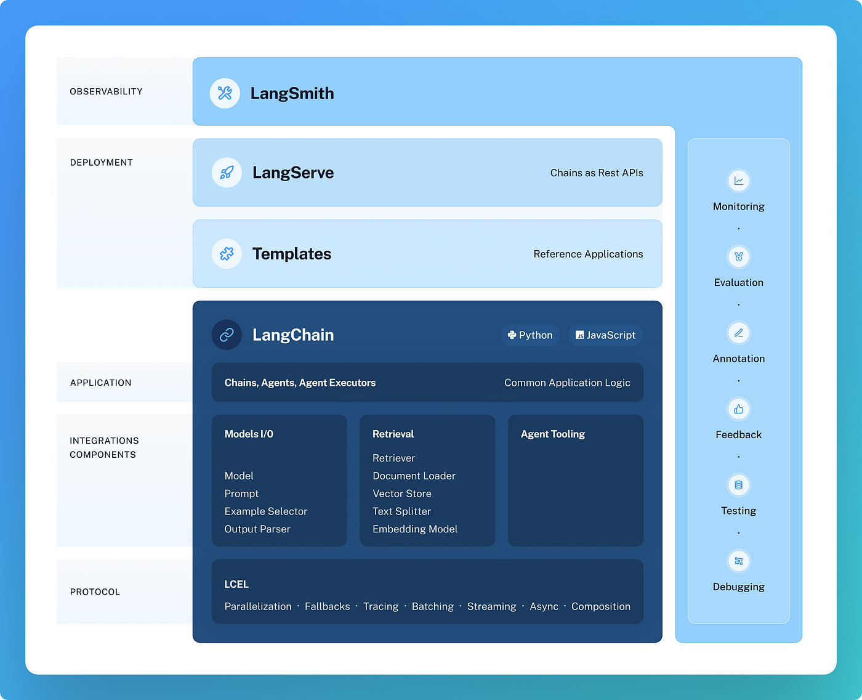
LangChain Extended Ecosystem
https://github.com/langchain-ai/langchain/tree/master
Source: NVIDIA DLI (2024), Building RAG Agents with LLMs, https://learn.nvidia.com/courses/course-detail?course_id=course-v1:DLI+S-FX-15+V1
Notes:
As of right now, we have talked about a single chain, which is already a powerful module for generating an LLM “external” response to a user.
Chaining these together, however, allows you to make pipelines that route from one component to another. You can imagine processes like gating, prompt selection, and even programmatic decision making would happen at this layer, and then the user would only end up seeing the final result that comes out from the chat model after all of the internal prompt construction is finished.
In this notebook, you’ll get to explore chaining and more, including LangServe for chain deployment and the aforementioned Gradio framework for making user interfaces.
(Slide showing current notebook environment, including the routes that will be delivered via langserve)

Slide 132
Our Environment
Jupyter Notebooks + Frontend
LLM Client
Your Device
Remote Host
:8090
Frontend
LLMs
Docker
Router
:9012
:9000
Jupyter Notebook Server
:88
Source: NVIDIA DLI (2024), Building RAG Agents with LLMs, https://learn.nvidia.com/courses/course-detail?course_id=course-v1:DLI+S-FX-15+V1
Notes:
As of right now, we have talked about a single chain, which is already a powerful module for generating an LLM “external” response to a user.
Chaining these together, however, allows you to make pipelines that route from one component to another. You can imagine processes like gating, prompt selection, and even programmatic decision making would happen at this layer, and then the user would only end up seeing the final result that comes out from the chat model after all of the internal prompt construction is finished.
In this notebook, you’ll get to explore chaining and more, including LangServe for chain deployment and the aforementioned Gradio framework for making user interfaces.
(Slide showing current notebook environment, including the routes that will be delivered via langserve)

Slide 133
Building RAG Agents with LLMs
Part 4: Running State Chain
Source: NVIDIA DLI (2024), Building RAG Agents with LLMs, https://learn.nvidia.com/courses/course-detail?course_id=course-v1:DLI+S-FX-15+V1

Slide 134
Chain Building
Recall Our Assumptions
External
Input
Prompt
LLM
Prompt
LLM
Output
What to do?
If/Else
No Lookup
Prompt
Needs Lookup
Off-Topic
Database
Internal
Output
Source: NVIDIA DLI (2024), Building RAG Agents with LLMs, https://learn.nvidia.com/courses/course-detail?course_id=course-v1:DLI+S-FX-15+V1
Notes:
In the previous section, you learned a bit about chaining LLMs to make interesting systems!
Great idea, internal vs external reasoning! Modularity of components. But there are some limitations
Let’s say you have a chain that performs some internal reasoning (i.e. sentence classification) and you wanted to use it for internal reasoning…
Then, you’d be able to just chain the two components together and stream the final result!
But what if you wanted to use both the original input and the classification at the same time?

Slide 135
Chain Building
Towards Running State
Input
Prompt
Classify Sentence
LLM
Topic
inputs = {‘input’ : ‘sentence’}
cls_chain = cls_prompt | llm
topic = cls_chain.invoke(inputs)
Source: NVIDIA DLI (2024), Building RAG Agents with LLMs, https://learn.nvidia.com/courses/course-detail?course_id=course-v1:DLI+S-FX-15+V1
Notes:
In the previous section, you learned a bit about chaining LLMs to make interesting systems!
Great idea, internal vs external reasoning! Modularity of components. But there are some limitations
Let’s say you have a chain that performs some internal reasoning (i.e. sentence classification) and you wanted to use it for internal reasoning…
Then, you’d be able to just chain the two components together and stream the final result!
But what if you wanted to use both the original input and the classification at the same time?

Slide 136
Chain Building
Towards Running State
Input
Prompt
Classify Sentence
LLM
Topic
Prompt
Generate Sentence
LLM
Output
inputs = {‘input’ : ‘sentence’}
cls_chain = cls_prompt | llm
topic = cls_chain.invoke(inputs)
gen_chain = out_prompt | llm
out_chain = cls_chain | gen_chain
for token in out_chain.stream(inputs):
print(token, end=””)
Source: NVIDIA DLI (2024), Building RAG Agents with LLMs, https://learn.nvidia.com/courses/course-detail?course_id=course-v1:DLI+S-FX-15+V1
Notes:
In the previous section, you learned a bit about chaining LLMs to make interesting systems!
Great idea, internal vs external reasoning! Modularity of components. But there are some limitations
Let’s say you have a chain that performs some internal reasoning (i.e. sentence classification) and you wanted to use it for internal reasoning…
Then, you’d be able to just chain the two components together and stream the final result!
But what if you wanted to use both the original input and the classification at the same time?

Slide 137
Chain Building
Towards Running State
Input
Prompt
Classify Sentence
LLM
Prompt
Generate Sentence
LLM
Output
Prompt
Combine Sentences
LLM
Output
Input
inputs = {‘input’ : ‘sentence’}
new_sentence = out_chain.invoke(inputs)
Source: NVIDIA DLI (2024), Building RAG Agents with LLMs, https://learn.nvidia.com/courses/course-detail?course_id=course-v1:DLI+S-FX-15+V1
Notes:
But what if you wanted to use both the original input and the classification at the same time?
One option (previous notebook) was to break the chain and feed in both the output of the first chain and the original input to the second, discrete chain, but then it’s no longer a logical module…
Another way is to use a structure like RunnableAssign which can only mutate and add, not remove, keys!..

Slide 138
Chain Building
Towards Running State
Input
Prompt
Classify Sentence
LLM
Prompt
Generate Sentence
LLM
Output
Prompt
Combine Sentences
LLM
Output
Input
inputs = {‘input’ : ‘sentence’}
new_sentence = out_chain.invoke(inputs)
inputs.update({‘new’ : ‘new_sentence’})
for token in merge_chain.stream(inputs):
print(token, end=””)
Source: NVIDIA DLI (2024), Building RAG Agents with LLMs, https://learn.nvidia.com/courses/course-detail?course_id=course-v1:DLI+S-FX-15+V1
Notes:
But what if you wanted to use both the original input and the classification at the same time?
One option (previous notebook) was to break the chain and feed in both the output of the first chain and the original input to the second, discrete chain, but then it’s no longer a logical module…
Another way is to use a structure like RunnableAssign which can only mutate and add, not remove, keys!..

Slide 139
Chain Building
Towards Running State
Input
Prompt
Classify Sentence
LLM
Prompt
Generate Sentence
LLM
Output
Branch Chain
Prompt
Combine Sentences
LLM
Output
Input
RunnableAssign
Branch Chain
out_chain = RunnableAssign({
new_sentence : cls_chain | gen_chain
}) | merge_chain
Source: NVIDIA DLI (2024), Building RAG Agents with LLMs, https://learn.nvidia.com/courses/course-detail?course_id=course-v1:DLI+S-FX-15+V1
Notes:
But what if you wanted to use both the original input and the classification at the same time?
One option (previous notebook) was to break the chain and feed in both the output of the first chain and the original input to the second, discrete chain, but then it’s no longer a logical module…
Another way is to use a structure like RunnableAssign which can only mutate and add, not remove, keys!..
Using this as a key component, we can start to formalize a useful paradigm to keep history and progress state: The Running State Chain scheme.

Slide 140
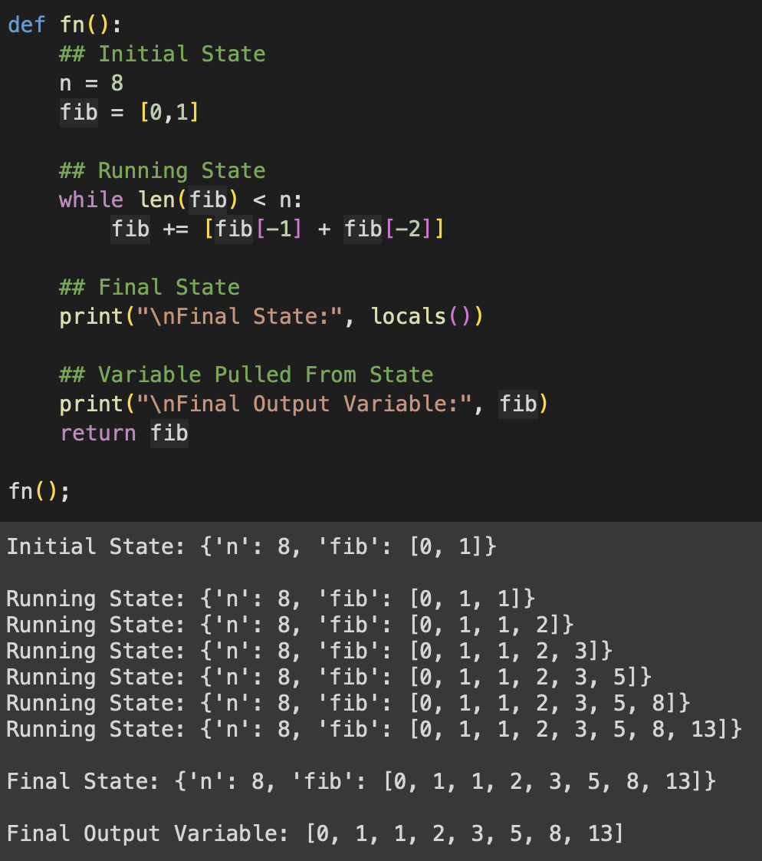
Typical Running State
Regular Fibonacci w/ While Loop
Source: NVIDIA DLI (2024), Building RAG Agents with LLMs, https://learn.nvidia.com/courses/course-detail?course_id=course-v1:DLI+S-FX-15+V1
Notes:
We can start to formalize a useful paradigm to keep history and progress state: The Running State Chain scheme.
What is a Running State?
Just the state of your system at any given time. Take this fibonacci function…
Can we make a chain to perform this state transition for us?

Slide 141
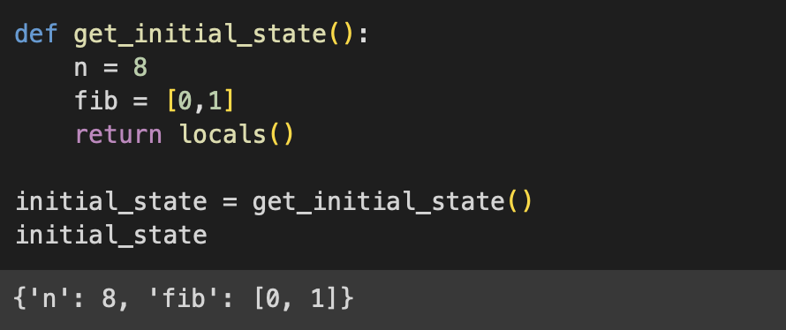
Running State Chain Components
Towards LCEL While Loop
State
n = 8
fib = [0,1]
Source: NVIDIA DLI (2024), Building RAG Agents with LLMs, https://learn.nvidia.com/courses/course-detail?course_id=course-v1:DLI+S-FX-15+V1
Notes:
What is a Running State?
Just the state of your system at any given time. Take this fibonacci function…
Can we make a chain to perform this state transition for us?
Create an initial state
Allow a running state to be any mutation of the initial state (that doesn’t lose values, only adds or overrides)
Allow any modifications to the running state, but assert that the modification happens in a RunnableAssign.
As an example, if you invoke an LLM Chain to generate a value, make sure the other values of the running state stick around.
Lastly, make sure that your running state is updated on each run of the chain by overriding it with the newest output.
And that’s it! Those are the roles for your running state chain! Toss it into a while loop that checks on the running state, and you have looping in LCEL land!
And yes, you can put this into a runnable to make a runnable that invokes a loop! Example of that in the notebook 5.

Slide 142
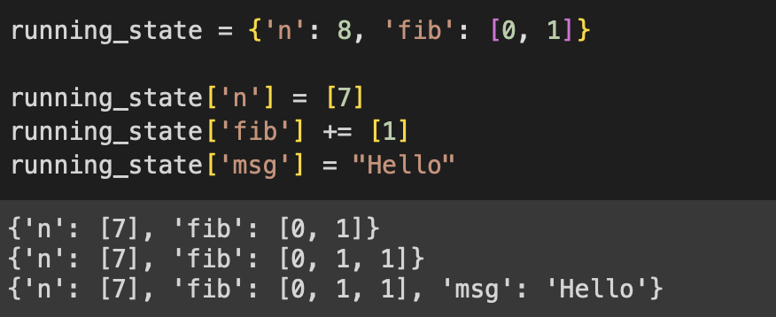
Running State Chain Components
Towards LCEL While Loop
State
n = 8
fib = [0,1]
State
n = 7
fib = [0,1,1]
msg=“Hello”
Source: NVIDIA DLI (2024), Building RAG Agents with LLMs, https://learn.nvidia.com/courses/course-detail?course_id=course-v1:DLI+S-FX-15+V1
Notes:
What is a Running State?
Just the state of your system at any given time. Take this fibonacci function…
Can we make a chain to perform this state transition for us?
Create an initial state
Allow a running state to be any mutation of the initial state (that doesn’t lose values, only adds or overrides)
Allow any modifications to the running state, but assert that the modification happens in a RunnableAssign.
As an example, if you invoke an LLM Chain to generate a value, make sure the other values of the running state stick around.
Lastly, make sure that your running state is updated on each run of the chain by overriding it with the newest output.
And that’s it! Those are the roles for your running state chain! Toss it into a while loop that checks on the running state, and you have looping in LCEL land!
And yes, you can put this into a runnable to make a runnable that invokes a loop! Example of that in the notebook 5.

Slide 143
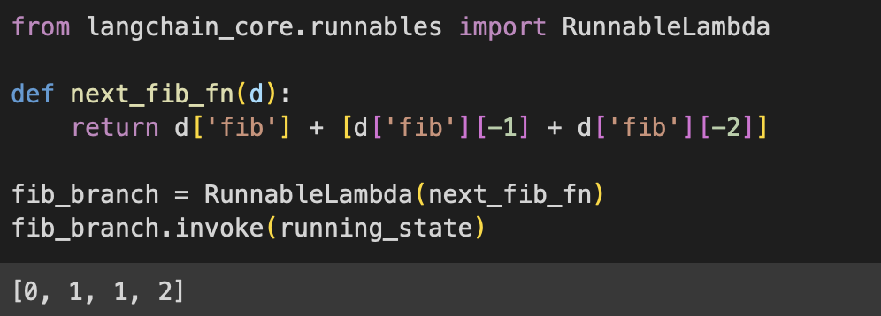
Running State Chain Components
Towards LCEL While Loop
State
n = 8
fib = [0,1,1]
[0,1,1,2]
Source: NVIDIA DLI (2024), Building RAG Agents with LLMs, https://learn.nvidia.com/courses/course-detail?course_id=course-v1:DLI+S-FX-15+V1
Notes:
What is a Running State?
Just the state of your system at any given time. Take this fibonacci function…
Can we make a chain to perform this state transition for us?
Create an initial state
Allow a running state to be any mutation of the initial state (that doesn’t lose values, only adds or overrides)
Allow any modifications to the running state, but assert that the modification happens in a RunnableAssign.
As an example, if you invoke an LLM Chain to generate a value, make sure the other values of the running state stick around.
Lastly, make sure that your running state is updated on each run of the chain by overriding it with the newest output.
And that’s it! Those are the roles for your running state chain! Toss it into a while loop that checks on the running state, and you have looping in LCEL land!
And yes, you can put this into a runnable to make a runnable that invokes a loop! Example of that in the notebook 5.

Slide 144
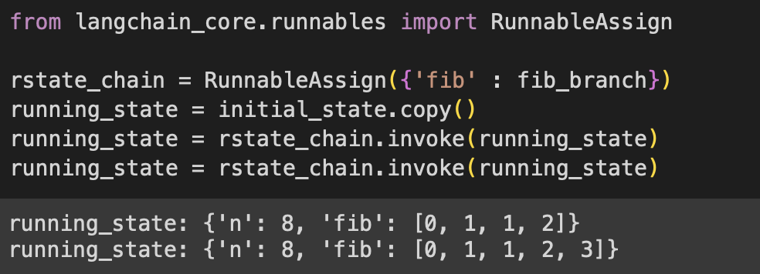
Running State Chain Components
Towards LCEL While Loop
State
n = 8
fib = [0,1,1]
[0,1,1,2]
State
n = 8
fib = [0,1,1,2]
Source: NVIDIA DLI (2024), Building RAG Agents with LLMs, https://learn.nvidia.com/courses/course-detail?course_id=course-v1:DLI+S-FX-15+V1
Notes:
What is a Running State?
Just the state of your system at any given time. Take this fibonacci function…
Can we make a chain to perform this state transition for us?
Create an initial state
Allow a running state to be any mutation of the initial state (that doesn’t lose values, only adds or overrides)
Allow any modifications to the running state, but assert that the modification happens in a RunnableAssign.
As an example, if you invoke an LLM Chain to generate a value, make sure the other values of the running state stick around.
Lastly, make sure that your running state is updated on each run of the chain by overriding it with the newest output.
And that’s it! Those are the roles for your running state chain! Toss it into a while loop that checks on the running state, and you have looping in LCEL land!
And yes, you can put this into a runnable to make a runnable that invokes a loop! Example of that in the notebook 5.

Slide 145
Running State Chain Components
Towards LCEL While Loop
State
n = 8
fib = [0,1,1]
State
n = 8
fib = [0,1,1,2]
State
n = 8
fib =
[0,1,1,2, 3]
Source: NVIDIA DLI (2024), Building RAG Agents with LLMs, https://learn.nvidia.com/courses/course-detail?course_id=course-v1:DLI+S-FX-15+V1
Notes:
What is a Running State?
Just the state of your system at any given time. Take this fibonacci function…
Can we make a chain to perform this state transition for us?
Create an initial state
Allow a running state to be any mutation of the initial state (that doesn’t lose values, only adds or overrides)
Allow any modifications to the running state, but assert that the modification happens in a RunnableAssign.
As an example, if you invoke an LLM Chain to generate a value, make sure the other values of the running state stick around.
Lastly, make sure that your running state is updated on each run of the chain by overriding it with the newest output.
And that’s it! Those are the roles for your running state chain! Toss it into a while loop that checks on the running state, and you have looping in LCEL land!
And yes, you can put this into a runnable to make a runnable that invokes a loop! Example of that in the notebook 5.

Slide 146
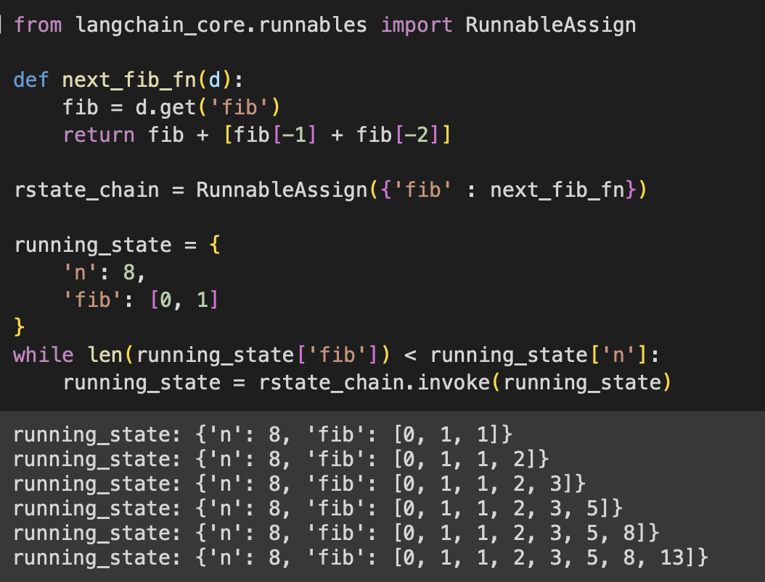
Final Running State Loop
Source: NVIDIA DLI (2024), Building RAG Agents with LLMs, https://learn.nvidia.com/courses/course-detail?course_id=course-v1:DLI+S-FX-15+V1
Notes:
What is a Running State?
Just the state of your system at any given time. Take this fibonacci function…
Can we make a chain to perform this state transition for us?
Create an initial state
Allow a running state to be any mutation of the initial state (that doesn’t lose values, only adds or overrides)
Allow any modifications to the running state, but assert that the modification happens in a RunnableAssign.
As an example, if you invoke an LLM Chain to generate a value, make sure the other values of the running state stick around.
Lastly, make sure that your running state is updated on each run of the chain by overriding it with the newest output.
And that’s it! Those are the roles for your running state chain! Toss it into a while loop that checks on the running state, and you have looping in LCEL land!
And yes, you can put this into a runnable to make a runnable that invokes a loop! Example of that in the notebook 5.
(next slide; side-by-side for comparison)

Slide 147
Typical Running State Loop
Comparing Typical with Running State
Source: NVIDIA DLI (2024), Building RAG Agents with LLMs, https://learn.nvidia.com/courses/course-detail?course_id=course-v1:DLI+S-FX-15+V1
Notes:
What is a Running State?
Just the state of your system at any given time. Take this fibonacci function…
Can we make a chain to perform this state transition for us?
Create an initial state
Allow a running state to be any mutation of the initial state (that doesn’t lose values, only adds or overrides)
Allow any modifications to the running state, but assert that the modification happens in a RunnableAssign.
As an example, if you invoke an LLM Chain to generate a value, make sure the other values of the running state stick around.
Lastly, make sure that your running state is updated on each run of the chain by overriding it with the newest output.
And that’s it! Those are the roles for your running state chain! Toss it into a while loop that checks on the running state, and you have looping in LCEL land!
And yes, you can put this into a runnable to make a runnable that invokes a loop! Example of that in the notebook 5.

Slide 148
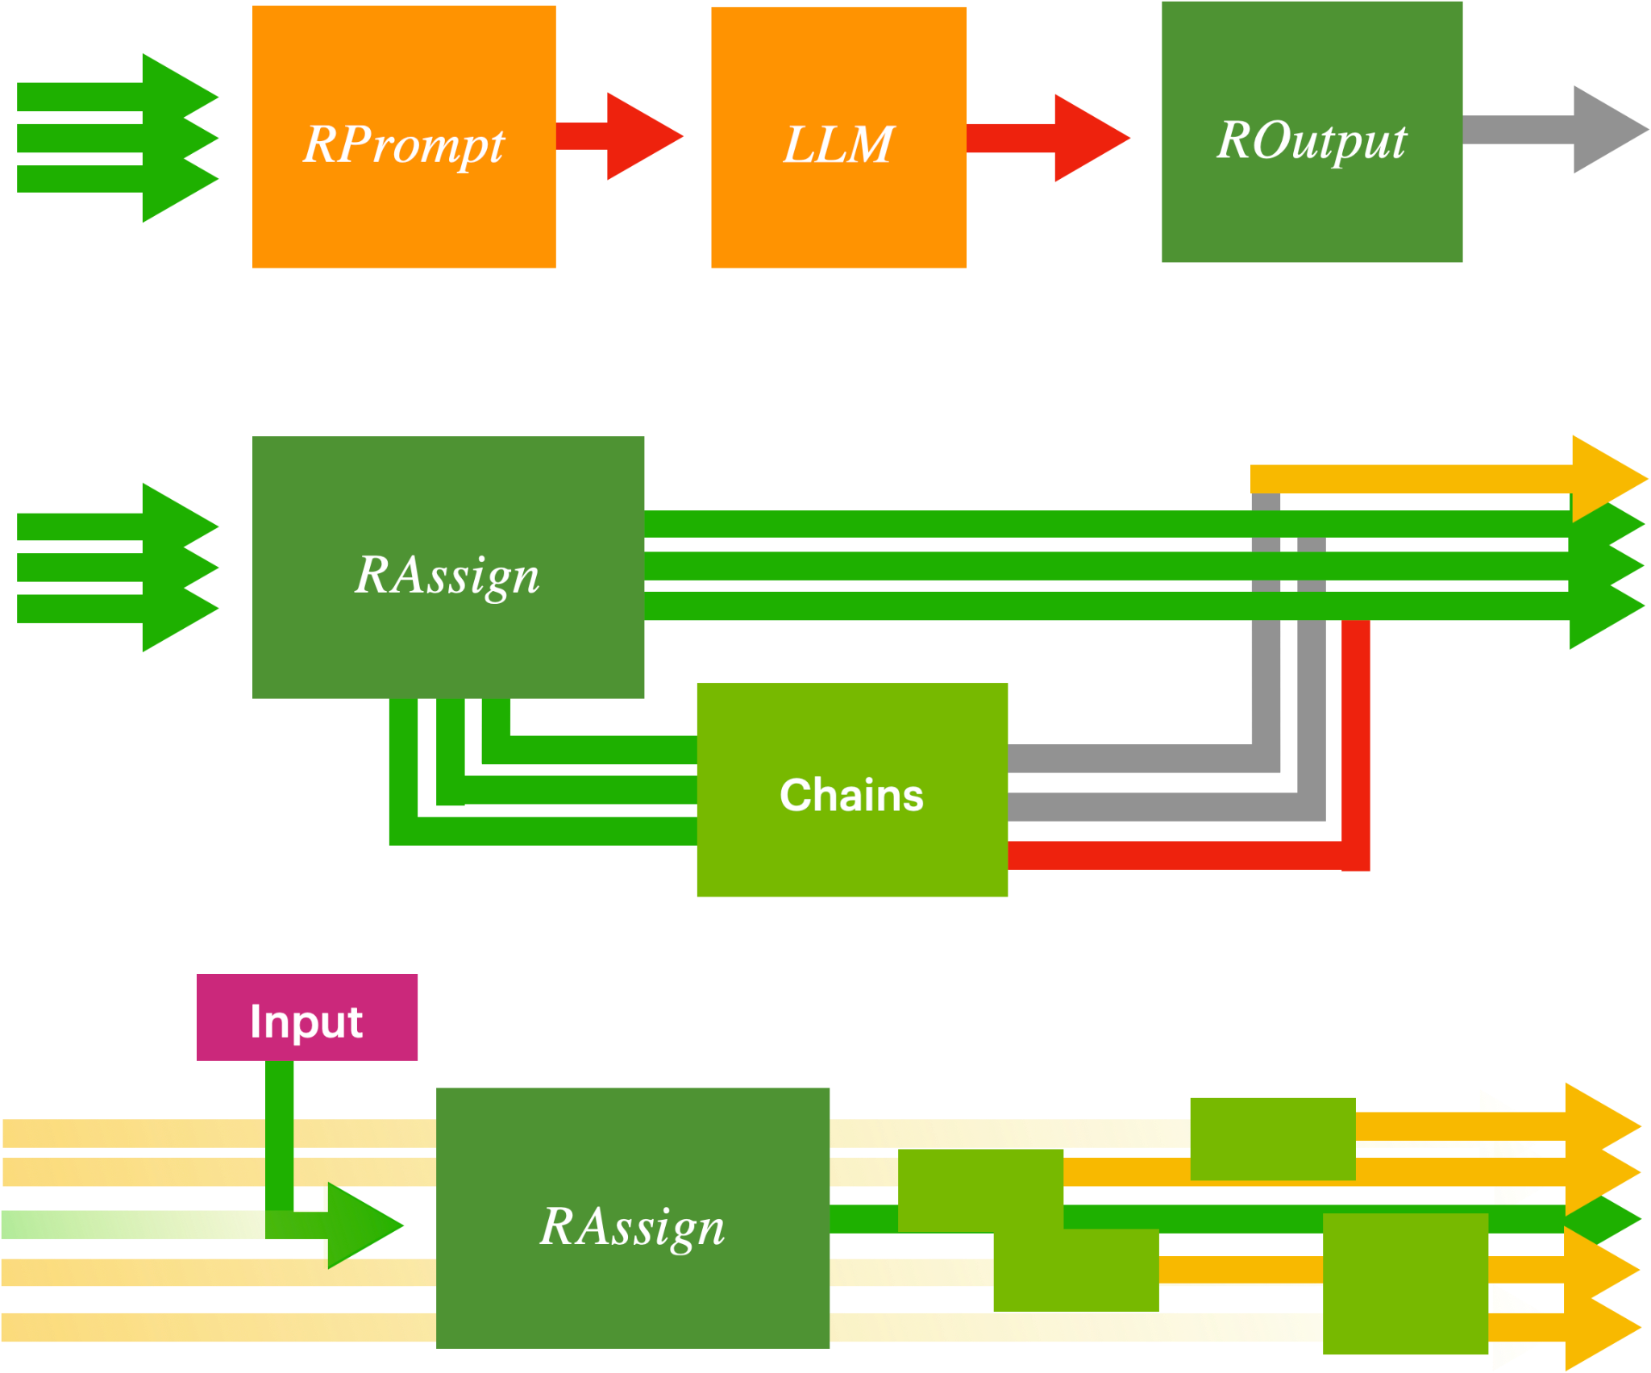
Final Running State Loop
Big Picture
RunnableAssign
RunnableLambda
RunnableBranch
Source: NVIDIA DLI (2024), Building RAG Agents with LLMs, https://learn.nvidia.com/courses/course-detail?course_id=course-v1:DLI+S-FX-15+V1
Notes:
And that’s all you need to know to make looping structures using the LCEL specification!
This can be extremely useful for modularization, since you can just make simple modules that perform complex event loops behind the scenes
In The Upcoming Notebook, we use this to set up a chatbot that can pull a customer’s information from a database!

Slide 149
Airline Chatbot
+Knowledge Base
+Response
Input
Prompt
Update Knowledge
DB Lookup
Prompt
Format
Prompt
Update Knowledge
LLM
LLM
+Customer Info
History
User
Source: NVIDIA DLI (2024), Building RAG Agents with LLMs, https://learn.nvidia.com/courses/course-detail?course_id=course-v1:DLI+S-FX-15+V1
Notes:
In The Upcoming Notebook, we use this to set up a chatbot that can pull a customer’s information from a database!
But it might be useful to formalize a few more components before that…
Unstructured generation: What you’ve been doing. Natural language -> natural language.
Structured Retrieval: Natural language -> commands that query a system (i.e. SQL, python).
Guided Generation: Natural language -> schema enforced by either instruction or sampling (i.e. dictionary/json generation)
Tooling: Natural language -> [(optionally tool selection) + (tool inputs via guided generation) + (tool code)].
Incorporating these paradigms (especially tooling), you’ll will try to make the LLM predict arguments for a data retriever command, and then subsequently populate your LLM context with the retrieved information so that it can help the user.
And then put it into a loop. There we go!

Slide 150
Modern Chain Paradigms
Towards Powerful Running State
Prompt
LLM
Unstructured Generation
Input
Source: NVIDIA DLI (2024), Building RAG Agents with LLMs, https://learn.nvidia.com/courses/course-detail?course_id=course-v1:DLI+S-FX-15+V1
Notes:
In The Upcoming Notebook, we use this to set up a chatbot that can pull a customer’s information from a database!
But it might be useful to formalize a few more components before that…
Unstructured generation: What you’ve been doing. Natural language -> natural language.
Structured Retrieval: Natural language -> commands that query a system (i.e. SQL, python).
Guided Generation: Natural language -> schema enforced by either instruction or sampling (i.e. dictionary/json generation)
Tooling: Natural language -> [(optionally tool selection) + (tool inputs via guided generation) + (tool code)].
Incorporating these paradigms (especially tooling), you’ll will try to make the LLM predict arguments for a data retriever command, and then subsequently populate your LLM context with the retrieved information so that it can help the user.
And then put it into a loop. There we go!

Slide 151
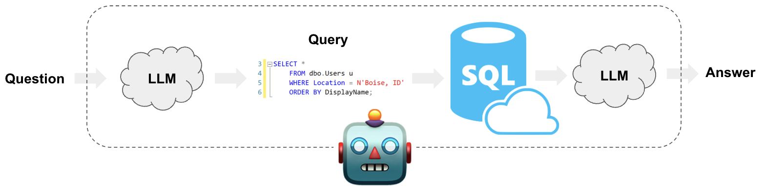
Modern Chain Paradigms
Towards Powerful Running State
Prompt
LLM
Unstructured Generation
Prompt
Code
LLM
Environment
Structured Retrieval
Input
https://python.langchain.com/docs/use_cases/qa_structured/sql
Source: NVIDIA DLI (2024), Building RAG Agents with LLMs, https://learn.nvidia.com/courses/course-detail?course_id=course-v1:DLI+S-FX-15+V1
Notes:
In The Upcoming Notebook, we use this to set up a chatbot that can pull a customer’s information from a database!
But it might be useful to formalize a few more components before that…
Unstructured generation: What you’ve been doing. Natural language -> natural language.
Structured Retrieval: Natural language -> commands that query a system (i.e. SQL, python).
Guided Generation: Natural language -> schema enforced by either instruction or sampling (i.e. dictionary/json generation)
Tooling: Natural language -> [(optionally tool selection) + (tool inputs via guided generation) + (tool code)].
Incorporating these paradigms (especially tooling), you’ll will try to make the LLM predict arguments for a data retriever command, and then subsequently populate your LLM context with the retrieved information so that it can help the user.
And then put it into a loop. There we go!

Slide 152
Modern Chain Paradigms
Towards Powerful Running State
Prompt
LLM
Unstructured Generation
Prompt
Code
LLM
Environment
Structured Retrieval
Input
Prompt
LLM
Grammar
/Schema
Guided Generation
{“first_name” : “unknown”,
“last_name” : “unknown”,
“confirmation” : -1}
Update given new info:
“Sure, my name is Jane Doe!”
{“first_name” : “Jane”,
“last_name” : “Doe”,
“confirmation” : -1}
LLM
Source: NVIDIA DLI (2024), Building RAG Agents with LLMs, https://learn.nvidia.com/courses/course-detail?course_id=course-v1:DLI+S-FX-15+V1
Notes:
In The Upcoming Notebook, we use this to set up a chatbot that can pull a customer’s information from a database!
But it might be useful to formalize a few more components before that…
Unstructured generation: What you’ve been doing. Natural language -> natural language.
Structured Retrieval: Natural language -> commands that query a system (i.e. SQL, python).
Guided Generation: Natural language -> schema enforced by either instruction or sampling (i.e. dictionary/json generation)
Tooling: Natural language -> [(optionally tool selection) + (tool inputs via guided generation) + (tool code)].
Incorporating these paradigms (especially tooling), you’ll will try to make the LLM predict arguments for a data retriever command, and then subsequently populate your LLM context with the retrieved information so that it can help the user.
And then put it into a loop. There we go!

Slide 153
Modern Chain Paradigms
Towards Powerful Running State
Prompt
LLM
Unstructured Generation
Prompt
Code
LLM
Environment
Structured Retrieval
Input
Prompt
LLM
Grammar
/Schema
Guided Generation
Prompt
LLM
Tool Choice
Tool
Tooling
Tool Schema
Source: NVIDIA DLI (2024), Building RAG Agents with LLMs, https://learn.nvidia.com/courses/course-detail?course_id=course-v1:DLI+S-FX-15+V1
Notes:
In The Upcoming Notebook, we use this to set up a chatbot that can pull a customer’s information from a database!
But it might be useful to formalize a few more components before that…
Unstructured generation: What you’ve been doing. Natural language -> natural language.
Structured Retrieval: Natural language -> commands that query a system (i.e. SQL, python).
Guided Generation: Natural language -> schema enforced by either instruction or sampling (i.e. dictionary/json generation)
Tooling: Natural language -> [(optionally tool selection) + (tool inputs via guided generation) + (tool code)].
Incorporating these paradigms (especially tooling), you’ll will try to make the LLM predict arguments for a data retriever command, and then subsequently populate your LLM context with the retrieved information so that it can help the user.
And then put it into a loop. There we go!

Slide 154

Final Objective
Knowledge Base + Running State Chain
{
“first_name” : “unknown”,
“last_name” : “unknown”,
“confirmation” : -1,
...
}
Update given new info:
“Sure, my name is Jane Doe!”
{
“first_name” : “Jane”,
“last_name” : “Doe”,
“confirmation” : -1,
...
}
LLM
Source: NVIDIA DLI (2024), Building RAG Agents with LLMs, https://learn.nvidia.com/courses/course-detail?course_id=course-v1:DLI+S-FX-15+V1
Notes:
In The Upcoming Notebook, we use this to set up a chatbot that can pull a customer’s information from a database!
But it might be useful to formalize a few more components before that…
Unstructured generation: What you’ve been doing. Natural language -> natural language.
Structured Retrieval: Natural language -> commands that query a system (i.e. SQL, python).
Guided Generation: Natural language -> schema enforced by either instruction or sampling (i.e. dictionary/json generation)
Tooling: Natural language -> [(optionally tool selection) + (tool inputs via guided generation) + (tool code)].
Incorporating these paradigms (especially tooling), you’ll will try to make the LLM predict arguments for a data retriever command
Then subsequently populate your LLM context with the retrieved information so that it can help the user…
…making sure to keep the full state of the system intact as the chain progresses.
And then put it into a loop. There we go!

Slide 155
Airline Chatbot
+Knowledge Base
+Response
Input
Prompt
Update Knowledge
DB Lookup
Prompt
Format
Prompt
Update Knowledge
LLM
LLM
+Customer Info
Source: NVIDIA DLI (2024), Building RAG Agents with LLMs, https://learn.nvidia.com/courses/course-detail?course_id=course-v1:DLI+S-FX-15+V1
Notes:
In The Upcoming Notebook, we use this to set up a chatbot that can pull a customer’s information from a database!
But it might be useful to formalize a few more components before that…
Unstructured generation: What you’ve been doing. Natural language -> natural language.
Structured Retrieval: Natural language -> commands that query a system (i.e. SQL, python).
Guided Generation: Natural language -> schema enforced by either instruction or sampling (i.e. dictionary/json generation)
Tooling: Natural language -> [(optionally tool selection) + (tool inputs via guided generation) + (tool code)].
Incorporating these paradigms (especially tooling), you’ll will try to make the LLM predict arguments for a data retriever command
Then subsequently populate your LLM context with the retrieved information so that it can help the user…
…making sure to keep the full state of the system intact as the chain progresses.
And then put it into a loop. There we go!

Slide 156
Airline Chatbot
+Knowledge Base
+Response
Input
Prompt
Update Knowledge
DB Lookup
Prompt
Format
Prompt
Update Knowledge
LLM
LLM
+Customer Info
Source: NVIDIA DLI (2024), Building RAG Agents with LLMs, https://learn.nvidia.com/courses/course-detail?course_id=course-v1:DLI+S-FX-15+V1
Notes:
In The Upcoming Notebook, we use this to set up a chatbot that can pull a customer’s information from a database!
But it might be useful to formalize a few more components before that…
Unstructured generation: What you’ve been doing. Natural language -> natural language.
Structured Retrieval: Natural language -> commands that query a system (i.e. SQL, python).
Guided Generation: Natural language -> schema enforced by either instruction or sampling (i.e. dictionary/json generation)
Tooling: Natural language -> [(optionally tool selection) + (tool inputs via guided generation) + (tool code)].
Incorporating these paradigms (especially tooling), you’ll will try to make the LLM predict arguments for a data retriever command
Then subsequently populate your LLM context with the retrieved information so that it can help the user…
…making sure to keep the full state of the system intact as the chain progresses.
And then put it into a loop. There we go!

Slide 157
Airline Chatbot
+Knowledge Base
+Response
Input
Prompt
Update Knowledge
DB Lookup
Prompt
Format
Prompt
Update Knowledge
LLM
LLM
+Customer Info
History
User
Source: NVIDIA DLI (2024), Building RAG Agents with LLMs, https://learn.nvidia.com/courses/course-detail?course_id=course-v1:DLI+S-FX-15+V1
Notes:
In The Upcoming Notebook, we use this to set up a chatbot that can pull a customer’s information from a database!
But it might be useful to formalize a few more components before that…
Unstructured generation: What you’ve been doing. Natural language -> natural language.
Structured Retrieval: Natural language -> commands that query a system (i.e. SQL, python).
Guided Generation: Natural language -> schema enforced by either instruction or sampling (i.e. dictionary/json generation)
Tooling: Natural language -> [(optionally tool selection) + (tool inputs via guided generation) + (tool code)].
Incorporating these paradigms (especially tooling), you’ll will try to make the LLM predict arguments for a data retriever command
Then subsequently populate your LLM context with the retrieved information so that it can help the user…
…making sure to keep the full state of the system intact as the chain progresses.
And then put it into a loop. There we go!
Good luck with the notebook!!

Slide 158


NVIDIA Building RAG Agents with LLMs
Part II
[3, 4]
Source: NVIDIA DLI (2024), Building RAG Agents with LLMs, https://learn.nvidia.com/courses/course-detail?course_id=course-v1:DLI+S-FX-15+V1

Slide 159
NVIDIA Building RAG Agents with LLMs
Part II
[5, 6]

Slide 160
Building RAG Agents with LLMs
Part 5: Working with Documents
Source: NVIDIA DLI (2024), Building RAG Agents with LLMs, https://learn.nvidia.com/courses/course-detail?course_id=course-v1:DLI+S-FX-15+V1
Notes:
KEY TRANSITION:
Previously: We’ve formalized how to make custom pathways and manage chain logic.
NOW: Now let’s learn how we can work with documents using these approaches.

Slide 161
Modern Chain Paradigms
Towards Powerful Running State
Prompt
LLM
Unstructured Generation
Prompt
Code
LLM
Environment
Structured Retrieval
Input
Prompt
LLM
Grammar
/Schema
Guided Generation
Prompt
LLM
Tool Choice
Tool
Tooling
Tool Schema
Source: NVIDIA DLI (2024), Building RAG Agents with LLMs, https://learn.nvidia.com/courses/course-detail?course_id=course-v1:DLI+S-FX-15+V1
Notes:
At this point, we’ve gone into detail about some heavier orchestration topics. Many ideas about how we could modify the running state to achieve what we want!
So does that mean we’re ready to handle document reasoning?

Slide 162


Document Reasoning
Sure, I can answer by referring this blog post!
Prompt
Context Question
LLM
https://developer.nvidia.com/blog/
Source: NVIDIA DLI (2024), Building RAG Agents with LLMs, https://learn.nvidia.com/courses/course-detail?course_id=course-v1:DLI+S-FX-15+V1
Notes:
Reasoning about documents is great!
Why not feed documents into an LLM as context?
Use Case: Feed documents by default as a consistent context. Corporate knowledge base?
Use Case: Allow users to upload their own documents and use the data as context. Productivity tool?
Problem: How do we feed a document into our LLM?
Solution: Make connectors to convert to information-dense plaintext.
Problem: But what about for longer-form inputs? Can our LLM handle it? Can it still follow instructions? (Probably not)

Slide 163
Document Reasoning
Company
Database
Sure, I can answer by referring this blog post!
Prompt
Context Question
LLM
Source: NVIDIA DLI (2024), Building RAG Agents with LLMs, https://learn.nvidia.com/courses/course-detail?course_id=course-v1:DLI+S-FX-15+V1
Notes:
Reasoning about documents is great!
Why not feed documents into an LLM as context?
Use Case: Feed documents by default as a consistent context. Corporate knowledge base?
Use Case: Allow users to upload their own documents and use the data as context. Productivity tool?
Problem: How do we feed a document into our LLM?
Solution: Make connectors to convert to information-dense plaintext.
Problem: But what about for longer-form inputs? Can our LLM handle it? Can it still follow instructions? (Probably not)

Slide 164
Document Reasoning
Company
Database
Sure, I can answer by referring this blog post!
Prompt
Context Question
LLM
Local files
Your Device
Source: NVIDIA DLI (2024), Building RAG Agents with LLMs, https://learn.nvidia.com/courses/course-detail?course_id=course-v1:DLI+S-FX-15+V1
Notes:
Reasoning about documents is great!
Why not feed documents into an LLM as context?
Use Case: Feed documents by default as a consistent context. Corporate knowledge base?
Use Case: Allow users to upload their own documents and use the data as context. Productivity tool?
Problem: How do we feed a document into our LLM?
Solution: Make connectors to convert to information-dense plaintext.
Problem: But what about for longer-form inputs? Can our LLM handle it? Can it still follow instructions? (Probably not)

Slide 165

Document Reasoning
Company
Database
Sure, I can answer by referring this blog post!
Prompt
Context Question
LLM
Local files
Your Device
https://js.langchain.com/docs/use_cases/question_answering/
Source: NVIDIA DLI (2024), Building RAG Agents with LLMs, https://learn.nvidia.com/courses/course-detail?course_id=course-v1:DLI+S-FX-15+V1
Notes:
Reasoning about documents is great!
Why not feed documents into an LLM as context?
Use Case: Feed documents by default as a consistent context. Corporate knowledge base?
Use Case: Allow users to upload their own documents and use the data as context. Productivity tool?
Problem: How do we feed a document into our LLM?
Solution: Make connectors to convert to information-dense plaintext.
Problem: But what about for longer-form inputs? Can our LLM handle it? Can it still follow instructions? (Probably not)

Slide 166

Document Reasoning
Company
Database
Prompt
Context……………………………………………………………………………………………………………………………………………………………………………………………………………………………………………………………………………………………………………………………………………………………………………………………Question
I forgot the instructions, but I can still say things
LLM
Local files
Your Device
https://js.langchain.com/docs/use_cases/question_answering/
https://d2l.ai/
Source: NVIDIA DLI (2024), Building RAG Agents with LLMs, https://learn.nvidia.com/courses/course-detail?course_id=course-v1:DLI+S-FX-15+V1
Notes:
Reasoning about documents is great!
Why not feed documents into an LLM as context?
Use Case: Feed documents by default as a consistent context. Corporate knowledge base?
Use Case: Allow users to upload their own documents and use the data as context. Productivity tool?
Problem: How do we feed a document into our LLM?
Solution: Make connectors to convert to information-dense plaintext.
Problem: But what about for longer-form inputs? Can our LLM handle it? Can it still follow instructions? (Probably not)

Slide 167


Chunking
https://arxiv.org/pdf/2307.09288.pdf
Source: NVIDIA DLI (2024), Building RAG Agents with LLMs, https://learn.nvidia.com/courses/course-detail?course_id=course-v1:DLI+S-FX-15+V1
Notes:
Problem: But what about for longer-form inputs? Can our LLM handle it? Can it still follow instructions? (Probably not)
Strategies:
Chunking: Dividing long documents into smaller pieces. Then, a subset (several? one?) can be fed to an LLM as context.
Stuffing: If you have smaller documents, you can feed multiple into your context, but you’ll soon run out of room…
Map Reduce: We could just try to make all of the chunks smaller? Maybe a same “give the main idea” chain or a “coerce into smaller chunks” chain? Just a single uniform
Refinement: We could also iterate through the chunks and try to get a cumulative summary, synthesis, etc.
Knowledge Graph: Create multiple refinements and you can create logical groupings and organize them into a hierarchy.
Example of traversing the hierarchy

Slide 168
Document Stuffing
Prompt
(DOCS 1-4)
Use Them Please
Question
Oh yes, the intro tells me everything! You see…
LLM
https://arxiv.org/pdf/2307.09288.pdf
Source: NVIDIA DLI (2024), Building RAG Agents with LLMs, https://learn.nvidia.com/courses/course-detail?course_id=course-v1:DLI+S-FX-15+V1
Notes:
Problem: But what about for longer-form inputs? Can our LLM handle it? Can it still follow instructions? (Probably not)
Strategies:
Chunking: Dividing long documents into smaller pieces. Then, a subset (several? one?) can be fed to an LLM as context.
Stuffing: If you have smaller documents, you can feed multiple into your context, but you’ll soon run out of room…
Map Reduce: We could just try to make all of the chunks smaller? Maybe a same “give the main idea” chain or a “coerce into smaller chunks” chain? Just a single uniform
Refinement: We could also iterate through the chunks and try to get a cumulative summary, synthesis, etc.
Knowledge Graph: Create multiple refinements and you can create logical groupings and organize them into a hierarchy.
Example of traversing the hierarchy

Slide 169
Map Reduce Chain
Smaller Chunk
Prompt
Useful Info
LLM
Smaller Chunk
Smaller Chunk
⠇
https://arxiv.org/pdf/2307.09288.pdf
Source: NVIDIA DLI (2024), Building RAG Agents with LLMs, https://learn.nvidia.com/courses/course-detail?course_id=course-v1:DLI+S-FX-15+V1
Notes:
Problem: But what about for longer-form inputs? Can our LLM handle it? Can it still follow instructions? (Probably not)
Strategies:
Chunking: Dividing long documents into smaller pieces. Then, a subset (several? one?) can be fed to an LLM as context.
Stuffing: If you have smaller documents, you can feed multiple into your context, but you’ll soon run out of room…
Map Reduce: We could just try to make all of the chunks smaller? Maybe a same “give the main idea” chain or a “coerce into smaller chunks” chain? Just a single uniform operation.
Refinement: We could also iterate through the chunks and try to get a cumulative summary, synthesis, etc.
Knowledge Graph: Create multiple refinements and you can create logical groupings and organize them into a hierarchy.
Example of traversing the hierarchy

Slide 170
Refinement Chain
Top 10 Chunks
for doc in docs:
yield doc
Prompt
Useful Info
LLM
Summary
Main Ideas
https://arxiv.org/pdf/2307.09288.pdf
Source: NVIDIA DLI (2024), Building RAG Agents with LLMs, https://learn.nvidia.com/courses/course-detail?course_id=course-v1:DLI+S-FX-15+V1
Notes:
Problem: But what about for longer-form inputs? Can our LLM handle it? Can it still follow instructions? (Probably not)
Strategies:
Chunking: Dividing long documents into smaller pieces. Then, a subset (several? one?) can be fed to an LLM as context.
Stuffing: If you have smaller documents, you can feed multiple into your context, but you’ll soon run out of room…
Map Reduce: We could just try to make all of the chunks smaller? Maybe a same “give the main idea” chain or a “coerce into smaller chunks” chain? Just a single uniform
Refinement: We could also iterate through the chunks and try to get a cumulative summary, synthesis, etc.
Knowledge Graph: Create multiple refinements and you can create logical groupings and organize them into a hierarchy.
Example of traversing the hierarchy

Slide 171
Knowledge Graph Construction
Abstraction Main Ideas
Prompt
Useful Constructs
LLM
Abstractions
for doc in docs:
yield doc
Prompt
Chapter Logic
LLM
Chapters
Per-Chapter Main Ideas
Prompt
Character Information
LLM
Names
Identity Key Points
https://blog.langchain.dev/using-a-knowledge-graph-to-implement-a-devops-rag-application/
Source: NVIDIA DLI (2024), Building RAG Agents with LLMs, https://learn.nvidia.com/courses/course-detail?course_id=course-v1:DLI+S-FX-15+V1
Notes:
Problem: But what about for longer-form inputs? Can our LLM handle it? Can it still follow instructions? (Probably not)
Strategies:
Chunking: Dividing long documents into smaller pieces. Then, a subset (several? one?) can be fed to an LLM as context.
Stuffing: If you have smaller documents, you can feed multiple into your context, but you’ll soon run out of room…
Map Reduce: We could just try to make all of the chunks smaller? Maybe a same “give the main idea” chain or a “coerce into smaller chunks” chain? Just a single uniform
Refinement: We could also iterate through the chunks and try to get a cumulative summary, synthesis, etc.
Knowledge Graph: Create multiple refinements and you can create logical groupings and organize them into a hierarchy.
Example of traversing the hierarchy

Slide 172
Knowledge Graph Traversal
Abstraction Main Ideas
How does Flying work according to your book?
Abstractions
Prompt
Find Info
LLM
Chapters
Per-Chapter Main Ideas
Prompt
Use Info
LLM
Names
Sure! From the chapter on Birds, I can tell you…
Identity Key Points
https://blog.langchain.dev/using-a-knowledge-graph-to-implement-a-devops-rag-application/
Source: NVIDIA DLI (2024), Building RAG Agents with LLMs, https://learn.nvidia.com/courses/course-detail?course_id=course-v1:DLI+S-FX-15+V1
Notes:
Problem: But what about for longer-form inputs? Can our LLM handle it? Can it still follow instructions? (Probably not)
Strategies:
Chunking: Dividing long documents into smaller pieces. Then, a subset (several? one?) can be fed to an LLM as context.
Stuffing: If you have smaller documents, you can feed multiple into your context, but you’ll soon run out of room…
Map Reduce: We could just try to make all of the chunks smaller? Maybe a same “give the main idea” chain or a “coerce into smaller chunks” chain? Just a single uniform
Refinement: We could also iterate through the chunks and try to get a cumulative summary, synthesis, etc.
Knowledge Graph: Create multiple refinements and you can create logical groupings and organize them into a hierarchy.
Example of traversing the hierarchy via agent actions

Slide 173
Refinement Chain
Your Assignment
Top 10 Chunks
for doc in docs:
yield doc
Prompt
Useful Info
LLM
Summary
Main Ideas
https://arxiv.org/pdf/2307.09288.pdf
Source: NVIDIA DLI (2024), Building RAG Agents with LLMs, https://learn.nvidia.com/courses/course-detail?course_id=course-v1:DLI+S-FX-15+V1
Notes:
Anyways, those are all things you can do, so what will you be doing? In the notebook, we’ll focus more on refinement, since it’s a great entryway into long-form document processing.
We’ll try to implement a running chain that packages up a while loop to generate a running summary of a longer-form document.
(Tangent Slide) Of note, LangGraph is a first-class-supported framework to abstract the while loop and running state enforcement behind a graph-like structure.
We won’t go into it here, but it is very well-liked for multi-agent workflows and for being somewhat standardizing.
In this notebook, you’ll be implementing the enforcement and while loop manually, so you’ll already understand what’s going on behind the scenes in LangGraph when you get around to it!
Author Note: In the near future, it may not be necessary to do refinement on most documents. But it will be required for human-intuitive knowledge graph construction over larger datasets. Like in the previous slide.

Slide 174
Refinement Chain
Your Assignment
RunnableLambda
for doc in docs:
yield doc
Prompt
Useful Info
LLM
Summary
https://arxiv.org/pdf/2307.09288.pdf
Source: NVIDIA DLI (2024), Building RAG Agents with LLMs, https://learn.nvidia.com/courses/course-detail?course_id=course-v1:DLI+S-FX-15+V1
Notes:
Anyways, those are all things you can do, so what will you be doing? In the notebook, we’ll focus more on refinement, since it’s a great entryway into long-form document processing.
We’ll try to implement a running chain that packages up a while loop to generate a running summary of a longer-form document.
(Tangent Slide) Of note, LangGraph is a first-class-supported framework to abstract the while loop and running state enforcement behind a graph-like structure.
We won’t go into it here, but it is very well-liked for multi-agent workflows and for being somewhat standardizing.
In this notebook, you’ll be implementing the enforcement and while loop manually, so you’ll already understand what’s going on behind the scenes in LangGraph when you get around to it!
Author Note: In the near future, it may not be necessary to do refinement on most documents. But it will be required for human-intuitive knowledge graph construction over larger datasets. Like in the previous slide.

Slide 175


Optional Tangent: LangGraph
https://python.langchain.com/docs/langgraph/
https://blog.langchain.dev/langgraph-multi-agent-workflows/
Source: NVIDIA DLI (2024), Building RAG Agents with LLMs, https://learn.nvidia.com/courses/course-detail?course_id=course-v1:DLI+S-FX-15+V1
Notes:
Anyways, those are all things you can do, so what will you be doing? In the notebook, we’ll focus more on refinement, since it’s a great entryway into long-form document processing.
We’ll try to implement a running chain that packages up a while loop to generate a running summary of a longer-form document.
(Tangent Slide) Of note, LangGraph is a popular framework to abstract the while loop and running state enforcement behind a graph-like structure.
We won’t go into it here, but it is very well-liked for multi-agent workflows and for being somewhat standardizing.
In this notebook, you’ll be implementing the enforcement and while loop manually, so you’ll already understand what’s going on behind the scenes in LangGraph when you get around to it!
Author Note: In the near future, it may not be necessary to do refinement on most documents. But it will be required for human-intuitive knowledge graph construction over larger datasets. Like in the previous slide.

Slide 176
Refinement Chain
Your Assignment
RunnableLambda
for doc in docs:
yield doc
Prompt
Useful Info
LLM
Summary
https://arxiv.org/pdf/2307.09288.pdf
Source: NVIDIA DLI (2024), Building RAG Agents with LLMs, https://learn.nvidia.com/courses/course-detail?course_id=course-v1:DLI+S-FX-15+V1
Notes:
Anyways, those are all things you can do, so what will you be doing? In the notebook, we’ll focus more on refinement, since it’s a great entryway into long-form document processing.
We’ll try to implement a running chain that packages up a while loop to generate a running summary of a longer-form document.
(Tangent Slide) Of note, LangGraph is a first-class-supported framework to abstract the while loop and running state enforcement behind a graph-like structure.
We won’t go into it here, but it is very well-liked for multi-agent workflows and for being somewhat standardizing.
In this notebook, you’ll be implementing the enforcement and while loop manually, so you’ll already understand what’s going on behind the scenes in LangGraph when you get around to it!
Good Luck!
Author Note: In the near future, it may not be necessary to do refinement on most documents. But it will be required for human-intuitive knowledge graph construction over larger datasets. Like in the previous slide.

Slide 177
Building RAG Agents with LLMs
Part 6: Embedding Model for Retrieval
Source: NVIDIA DLI (2024), Building RAG Agents with LLMs, https://learn.nvidia.com/courses/course-detail?course_id=course-v1:DLI+S-FX-15+V1
Notes:
Coming up:
Last time, we learned a good bit about document intake and a little bit about using LLMs to navigate a hierarchy.
PROBLEMS:
This requires a lot of inference steps and can run into errors.
This requires a lot of preprocessing with strong various assumptions about what is important.
What we want:
A relatively simple pipeline where we ask our agent something, it pulls in “relevant” material from a database, and it uses it!
Solution: What if we didn’t need to use an expensive autoregressive model to retrieve our documents?
Back To Basics:
Recall that transformers come in several default configurations (encoders and decoders)
So why don’t we use encoders to encode our documents, and retrieve using embedding similarity?

Slide 178
Knowledge Graph Traversal
Abstraction Main Ideas
How does Flying work according to your book?
Abstractions
Prompt
Find Info
LLM
Chapters
Per-Chapter Main Ideas
Prompt
Use Info
LLM
Names
Sure! From the chapter on Birds, I can tell you…
Identity Key Points
https://blog.langchain.dev/using-a-knowledge-graph-to-implement-a-devops-rag-application/
Source: NVIDIA DLI (2024), Building RAG Agents with LLMs, https://learn.nvidia.com/courses/course-detail?course_id=course-v1:DLI+S-FX-15+V1
Notes:
Last time, we learned a good bit about document intake and a little bit about using LLMs to navigate a hierarchy.
PROBLEMS:
This requires a lot of inference steps and can run into errors.
This requires a lot of preprocessing with strong various assumptions about what is important.
What we want:
A relatively simple pipeline where we ask our agent something, it pulls in “relevant” material from a database, and it uses it!
Solution: What if we didn’t need to use an expensive autoregressive model to retrieve our documents?
Back To Basics:
Recall that transformers come in several default configurations (encoders and decoders)
So why don’t we use encoders to encode our documents, and retrieve using embedding similarity?

Slide 179
Modern Chain Paradigms
Towards Powerful Running State
Prompt
LLM
Unstructured Generation
Prompt
Code
LLM
Environment
Structured Retrieval
Input
Prompt
LLM
???
Unstructured Retrieval
Unstructured Retrieval
Source: NVIDIA DLI (2024), Building RAG Agents with LLMs, https://learn.nvidia.com/courses/course-detail?course_id=course-v1:DLI+S-FX-15+V1
Notes:
Last time, we learned a good bit about document intake and a little bit about using LLMs to navigate a hierarchy.
PROBLEMS:
This requires a lot of inference steps and can run into errors.
This requires a lot of preprocessing with strong various assumptions about what is important.
What we want:
A relatively simple pipeline where we ask our agent something, it pulls in “relevant” material from a database, and it uses it!
Solution: What if we didn’t need to use an expensive autoregressive model to retrieve our documents?
Back To Basics:
Recall that transformers come in several default configurations (encoders and decoders)
So why don’t we use encoders to encode our documents, and retrieve using embedding similarity?

Slide 180
Modern Chain Paradigms
Towards Powerful Running State
Prompt
LLM
Unstructured Generation
Prompt
Code
LLM
Environment
Structured Retrieval
Input
Prompt
LLM
Vector
Database
Unstructured Retrieval
Unstructured Retrieval
Source: NVIDIA DLI (2024), Building RAG Agents with LLMs, https://learn.nvidia.com/courses/course-detail?course_id=course-v1:DLI+S-FX-15+V1
Notes:
Last time, we learned a good bit about document intake and a little bit about using LLMs to navigate a hierarchy.
PROBLEMS:
This requires a lot of inference steps and can run into errors.
This requires a lot of preprocessing with strong various assumptions about what is important.
What we want:
A relatively simple pipeline where we ask our agent something, it pulls in “relevant” material from a database, and it uses it!
Solution: What if we didn’t need to use an expensive autoregressive model to retrieve our documents? Why not use an embedding model?
Back To Basics:
Recall that transformers come in several default configurations (encoders and decoders)
So why don’t we use encoders to encode our documents, and retrieve using embedding similarity?

Slide 181

Retrieval-Augmented Generation
Pulling in Information from a Database
https://www.nvidia.com/en-us/training/instructor-led-workshops/rapid-application-development-using-large-language-models/
https://cs.stanford.edu/~myasu/blog/racm3/
Source: NVIDIA DLI (2024), Building RAG Agents with LLMs, https://learn.nvidia.com/courses/course-detail?course_id=course-v1:DLI+S-FX-15+V1
Notes:
Feel free to introduce RAG early if you want.

Slide 182

Transformer Architecture
Primary Backbone of LLMs
Element-Wise Feed-Forward
Element-Wise Feed-Forward
Sequence Attention Interface
Sequence Attention Interface
Element-Wise Feed-Forward
Element-Wise Feed-Forward
https://arxiv.org/pdf/1706.03762.pdf
Source: NVIDIA DLI (2024), Building RAG Agents with LLMs, https://learn.nvidia.com/courses/course-detail?course_id=course-v1:DLI+S-FX-15+V1
Notes:
What we want:
A relatively simple pipeline where we ask our agent something, it pulls in “relevant” material from a database, and it uses it!
Solution: What if we didn’t need to use an expensive autoregressive model to retrieve our documents?
Back To Basics:
Recall that transformers come in several default configurations (encoders for embedding and decoders for autoregression).
Decoders are the structures used in autoregressive generation. They have unidirectional reasoning and are expected to work well for long-form generation, so they also need to be quite powerful.
Encoders are the structures used in embedding passages with bidirectional reasoning. They don’t need to have good autoregressive (long-horizon with accumulating error) generation, so they can be smaller and faster.
So why don’t we use encoders to encode our documents, and retrieve using embedding similarity?

Slide 183

Transformer Architecture
Autoregressing vs Embedding Flavors
Source: NVIDIA DLI (2024), Building RAG Agents with LLMs, https://learn.nvidia.com/courses/course-detail?course_id=course-v1:DLI+S-FX-15+V1
Notes:
What we want:
A relatively simple pipeline where we ask our agent something, it pulls in “relevant” material from a database, and it uses it!
Solution: What if we didn’t need to use an expensive autoregressive model to retrieve our documents?
Back To Basics:
Recall that transformers come in several default configurations (encoders for embedding and decoders for autoregression).
Decoders are the structures used in autoregressive generation. They have unidirectional reasoning and are expected to work well for long-form generation, so they also need to be quite powerful.
Encoders are the structures used in embedding passages with bidirectional reasoning. They don’t need to have good autoregressive (long-horizon with accumulating error) generation, so they can be smaller and faster.
So why don’t we use encoders to encode our documents, and retrieve using embedding similarity?

Slide 184

Transformer Architecture
Autoregressing vs Embedding Flavors
Source: NVIDIA DLI (2024), Building RAG Agents with LLMs, https://learn.nvidia.com/courses/course-detail?course_id=course-v1:DLI+S-FX-15+V1
Notes:
What we want:
A relatively simple pipeline where we ask our agent something, it pulls in “relevant” material from a database, and it uses it!
Solution: What if we didn’t need to use an expensive autoregressive model to retrieve our documents?
Back To Basics:
Recall that transformers come in several default configurations (encoders for embedding and decoders for autoregression).
Decoders are the structures used in autoregressive generation. They have unidirectional reasoning and are expected to work well for long-form generation, so they also need to be quite powerful.
Encoders are the structures used in embedding passages with bidirectional reasoning. They don’t need to have good autoregressive (long-horizon with accumulating error) generation, so they can be smaller and faster.
So why don’t we use encoders to encode our documents, and retrieve using embedding similarity?

Slide 185


Retrieval QA Embedding
Asymmetric Query/Document Model
https://catalog.ngc.nvidia.com/orgs/nvidia/teams/ai-foundation/models/nvolve-29k/api
Source: NVIDIA DLI (2024), Building RAG Agents with LLMs, https://learn.nvidia.com/courses/course-detail?course_id=course-v1:DLI+S-FX-15+V1
Notes:
So why don’t we use encoders to encode our documents, and retrieve using embedding similarity?
We have models just for that, which can accept passages and generate useful vector embeddings.
Given a selection of passages that you want to consider (i.e. example phrases, document pool, etc)...
…Use a use-case-specific embedding model to encode them into vectors…
…and the embeddings should capture semantic properties which can be reasoned about.

Slide 186
Embedding and Comparing
Querying for Semantically Similar Entries
High-performance computing.
Happy Holidays!
DLSS Gaming Statistics
Any cool video games lately?
Biological vision structure
What’s with GPUs these days?
Mitochondria, powerhouse
https://developer.nvidia.com/blog/accelerating-vector-search-using-gpu-powered-indexes-with-rapids-raft/
Source: NVIDIA DLI (2024), Building RAG Agents with LLMs, https://learn.nvidia.com/courses/course-detail?course_id=course-v1:DLI+S-FX-15+V1
Notes:
So why don’t we use encoders to encode our documents, and retrieve using embedding similarity?
We have models just for that, which can accept passages and generate useful vector embeddings.
Given a selection of passages that you want to consider (i.e. example phrases, document pool, etc)...
…Use a use-case-specific embedding model to encode them into vectors…
…and the embeddings should capture semantic properties which can be reasoned about.

Slide 187

Embedding and Comparing
Querying for Semantically Similar Entries
High-performance computing.
Happy Holidays!
DLSS Gaming Statistics
Any cool video games lately?
Biological vision structure
What’s with GPUs these days?
Mitochondria, powerhouse
https://developer.nvidia.com/blog/accelerating-vector-search-using-gpu-powered-indexes-with-rapids-raft/
Source: NVIDIA DLI (2024), Building RAG Agents with LLMs, https://learn.nvidia.com/courses/course-detail?course_id=course-v1:DLI+S-FX-15+V1
Notes:
So why don’t we use encoders to encode our documents, and retrieve using embedding similarity?
We have models just for that, which can accept passages and generate useful vector embeddings.
Given a selection of passages that you want to consider (i.e. example phrases, document pool, etc)...
…Use a use-case-specific embedding model to encode them into vectors…
…and the embeddings should capture semantic properties which can be reasoned about.

Slide 188

Embedding and Comparing
Querying for Semantically Similar Entries
High-performance computing.
Happy Holidays!
DLSS Gaming Statistics
Any cool video games lately?
Biological vision structure
What’s with GPUs these days?
Mitochondria, powerhouse
https://developer.nvidia.com/blog/accelerating-vector-search-using-gpu-powered-indexes-with-rapids-raft/
Source: NVIDIA DLI (2024), Building RAG Agents with LLMs, https://learn.nvidia.com/courses/course-detail?course_id=course-v1:DLI+S-FX-15+V1
Notes:
So why don’t we use encoders to encode our documents, and retrieve using embedding similarity?
We have models just for that, which can accept passages and generate useful vector embeddings.
Given a selection of passages that you want to consider (i.e. example phrases, document pool, etc)...
…Use a use-case-specific embedding model to encode them into vectors…
…and the embeddings should capture semantic properties which can be reasoned about.

Slide 189



Embedding Spaces
Learned Semantically Dense Values
https://queenscompsci.wordpress.com/2018/03/04/interpolation-in-the-latent-space-of-variational-autoencoders/
https://en.wikipedia.org/wiki/T-distributed_stochastic_neighbor_embedding
https://ichko.github.io/visualizing-vae-with-efemarai
Source: NVIDIA DLI (2024), Building RAG Agents with LLMs, https://learn.nvidia.com/courses/course-detail?course_id=course-v1:DLI+S-FX-15+V1
Notes:
Optional Slide: Feel free to nerd out about embedding space theory if you’re interested. Slide can be used to connect to MNIST/DL Fundamentals.

Slide 190
Language Embedding Schemes
Bi-Encoder versus Cross-Encoder
Embedding
Reranker
Bi-Encoder
Cross-Encoder
Cosine-Similarity
u
v
Classifier
Encoder
Encoder
Encoder
Passage 1
Passage 2
Passage 1
Passage 2
https://www.sbert.net/examples/applications/cross-encoder/README.html
Source: NVIDIA DLI (2024), Building RAG Agents with LLMs, https://learn.nvidia.com/courses/course-detail?course_id=course-v1:DLI+S-FX-15+V1
Notes:
Embedding Model flavors of interest:
Bi-encoder formulations rely on cosine similarity (same or different encoders used to produce synergized vectors). Deep learning part doesn’t reason about both inputs, but vectors can be pre-computed.
Cross-Encoder formulations take two (or more) passages and produce a classification through an end-to-end deep learning pipeline. Scale worse (since you can’t pre-compute vectors) but allows encoder to reason about both passages at the same time. Powerful, but use sparingly.
Useful for re-ranking (classifying priority among multiple documents)
(next, symmetric vs asymmetric/generalized definitions)

Slide 191

Language Embedding Schemes
Symmetric versus Asymmetric
Symmetric
Asymmetric/Generalized
Cosine-Similarity
u
v
Encoder 1
Encoder 1
Passage 1
Passage 2
https://www.sbert.net/examples/applications/cross-encoder/README.html
https://cs.stanford.edu/~myasu/blog/racm3/
Source: NVIDIA DLI (2024), Building RAG Agents with LLMs, https://learn.nvidia.com/courses/course-detail?course_id=course-v1:DLI+S-FX-15+V1
Notes:
Embedding Model flavors of interest:
Symmetric means all the inputs are embedded using the same embedding strategy.
Asymmetric means there are different embedding models/strategies depending on the input type.
i.e. “query” vs “document” pathway
In general, the only requirement is that the output of the different embedding strategies is synergized such that things that you need to be similar end up being similar! Exactly how CLIP works, which is an

Slide 192
Language Embedding Schemes
Generalized Definition
https://cs.stanford.edu/~myasu/blog/racm3/
Source: NVIDIA DLI (2024), Building RAG Agents with LLMs, https://learn.nvidia.com/courses/course-detail?course_id=course-v1:DLI+S-FX-15+V1
Notes:
Embedding Model flavors of interest:
Symmetric means all the inputs are embedded using the same embedding strategy.
Asymmetric means there are different embedding models/strategies depending on the input type.
i.e. “query” vs “document” pathway
In general, the only requirement is that the output of the different embedding strategies is synergized such that things that you need to be similar end up being similar! Exactly how CLIP works, which is an image encoder and a text encoder that are synergized to output the same embedding for image-caption pairs.

Slide 193
Embedding and Comparing
Querying for Semantically Similar Entries
High-performance computing.
Happy Holidays!
DLSS Gaming Statistics
Any cool video games lately?
Biological vision structure
What’s with GPUs these days?
Mitochondria, powerhouse
https://developer.nvidia.com/blog/accelerating-vector-search-using-gpu-powered-indexes-with-rapids-raft/
Source: NVIDIA DLI (2024), Building RAG Agents with LLMs, https://learn.nvidia.com/courses/course-detail?course_id=course-v1:DLI+S-FX-15+V1
Notes:
For the purposes of this notebook, understanding the embedding model’s properties should be good enough! Namely:
It can embed natural language into a semantic space
The semantic space can be reasoned with to find similarities (or differences, or just properties).
Author’s Notes: Depending on the audience, you may want to walk through notebook 06 yourself and just have students do 64_guardrails by themselves after presenting the next section. Your call.

Slide 194
Building RAG Agents with LLMs
Part 6.4: Guardrails
Source: NVIDIA DLI (2024), Building RAG Agents with LLMs, https://learn.nvidia.com/courses/course-detail?course_id=course-v1:DLI+S-FX-15+V1

Slide 195
Embedding and Comparing
Querying for Semantically Similar Entries
High-performance computing.
Happy Holidays!
DLSS Gaming Statistics
Any cool video games lately?
Biological vision structure
What’s with GPUs these days?
Mitochondria, powerhouse
https://developer.nvidia.com/blog/accelerating-vector-search-using-gpu-powered-indexes-with-rapids-raft/
Source: NVIDIA DLI (2024), Building RAG Agents with LLMs, https://learn.nvidia.com/courses/course-detail?course_id=course-v1:DLI+S-FX-15+V1
Notes:
In the previous section, you got familiar with the code syntax and prior assumptions of embedding models.
For part 6.4, you’ll get the opportunity to put this API to the test using to implement an “input guardrail”
One of several types of guardrails (output guardrails and topic guardrails also quite common).
Some simple ones rely on raw prompt engineering or zero-shot classification with generative models, you but can actually do it pretty easily by creating a classifier off of a known-useful embedding model.

Slide 196
Semantic Guardrails
Illegal Topics
Irrelevant Questions
Prompt
Answer Please Question
How’s the weather?
No. I shouldn’t answer that
Classifier
Branch
LLM
Prompt
Don’t Answer question
Tell me about GPUs
What’s an LLM Service
What’s a good game with RTX?
Source: NVIDIA DLI (2024), Building RAG Agents with LLMs, https://learn.nvidia.com/courses/course-detail?course_id=course-v1:DLI+S-FX-15+V1
Notes:
In the previous section, you got familiar with the code syntax and prior assumptions of embedding models.
For part 6.4, you’ll get the opportunity to put this API to the test using to implement an “input guardrail”
One of several types of guardrails (output guardrails and topic guardrails also quite common).
Some simple ones rely on raw prompt engineering or zero-shot classification with generative models, you but can actually do it pretty easily by creating a classifier off of a known-useful embedding model.
How will this be done?
Given a curated set of good and bad example inputs…
… embed all of them to generate semantically-dense vectors…
… and train a classifier to go from embedding to classification (using supervised machine learning/deep learning)
If the embeddings are good for general reasoning, this is usually easy enough to do with classical logistic regression or a shallow network.

Slide 197
Embedding Classification
Classifying with embeddings
Illegal Topics
Irrelevant Questions
Tell me about GPUs
What’s an LLM Service
What’s a good game with RTX?
https://developer.nvidia.com/blog/accelerating-vector-search-using-gpu-powered-indexes-with-rapids-raft/
Source: NVIDIA DLI (2024), Building RAG Agents with LLMs, https://learn.nvidia.com/courses/course-detail?course_id=course-v1:DLI+S-FX-15+V1
Notes:
For part 6.4, you’ll get the opportunity to put this API to the test using to implement an “input guardrail”
How will this be done?
Given a curated set of good and bad example inputs…
… embed all of them to generate semantically-dense vectors…
… and train a classifier to go from embedding to classification (using supervised machine learning/deep learning)
If the embeddings are good for general reasoning, this is usually easy enough to do with classical logistic regression or a shallow network.

Slide 198

Embedding Classification
Classifying with embeddings
Illegal Topics
Irrelevant Questions
Tell me about GPUs
What’s an LLM Service
What’s a good game with RTX?
https://developer.nvidia.com/blog/accelerating-vector-search-using-gpu-powered-indexes-with-rapids-raft/
Source: NVIDIA DLI (2024), Building RAG Agents with LLMs, https://learn.nvidia.com/courses/course-detail?course_id=course-v1:DLI+S-FX-15+V1
Notes:
For part 6.4, you’ll get the opportunity to put this API to the test using to implement an “input guardrail”
How will this be done?
Given a curated set of good and bad example inputs…
… embed all of them to generate semantically-dense vectors…
… and train a classifier to go from embedding to classification (using supervised machine learning/deep learning)
If the embeddings are good for general reasoning, this is usually easy enough to do with classical logistic regression or a shallow network.

Slide 199

Embedding Classification
Classifying with embeddings
Illegal Topics
Classification Head
Irrelevant Questions
0 or 1?
Tell me about GPUs
What’s an LLM Service
What’s a good game with RTX?
https://developer.nvidia.com/blog/accelerating-vector-search-using-gpu-powered-indexes-with-rapids-raft/
Source: NVIDIA DLI (2024), Building RAG Agents with LLMs, https://learn.nvidia.com/courses/course-detail?course_id=course-v1:DLI+S-FX-15+V1
Notes:
For part 6.4, you’ll get the opportunity to put this API to the test using to implement an “input guardrail”
How will this be done?
Given a curated set of good and bad example inputs…
… embed all of them to generate semantically-dense vectors…
… and train a classifier to go from embedding to classification (using using supervised machine learning/deep learning)
If the embeddings are good for general reasoning, this is usually easy enough to do with classical logistic regression or a shallow network.
And that’s it! You have a classifier branch!

Slide 200
Semantic Guardrails
Illegal Topics
Irrelevant Questions
Prompt
Answer Please Question
How’s the weather?
No. I shouldn’t answer that
Classifier
Branch
LLM
Prompt
Don’t Answer question
Tell me about GPUs
What’s an LLM Service
What’s a good game with RTX?
Source: NVIDIA DLI (2024), Building RAG Agents with LLMs, https://learn.nvidia.com/courses/course-detail?course_id=course-v1:DLI+S-FX-15+V1
Notes:
For part 6.4, you’ll get the opportunity to put this API to the test using to implement an “input guardrail”
How will this be done? Given a curated set of good and bad example inputs, embed all of them to generate semantically-dense vectors, and train a classifier to go from embedding to classification.
And that’s it! You have a classifier branch!
You could use this as a hard gating mechanism to stop or route the dialog, or the value could be injected directly into a prompt to request special kind of logic from your LLM. It can also be used to aggregate statistics and move conversations accordingly.
In our case, we will use it to route between two kinds of prompts; one that tries to help, and another that tries to NOT help and explain why.
Good luck! In the next section, we will be using a similar logic for document retrieval and will implement RAG from scratch.

Slide 201


NVIDIA Building RAG Agents with LLMs
Part II
[5, 6]
Source: NVIDIA DLI (2024), Building RAG Agents with LLMs, https://learn.nvidia.com/courses/course-detail?course_id=course-v1:DLI+S-FX-15+V1

Slide 202
References
NVIDIA DLI (2024), Building RAG Agents with LLMs,
https://learn.nvidia.com/courses/course-detail?course_id=course-v1:DLI+S-FX-15+V1
NVIDIA DLI (2024), Generative AI with Diffusion Models, https://learn.nvidia.com/courses/course-detail?course_id=course-v1:DLI+S-FX-14+V1

