Slide 1








Generative AI for
Multimodal Information Generation
Generative AI Innovative Applications
1132GAIIA06
MBA, IM, NTPU (M6031) (Spring 2025)
Tue 2, 3, 4 (9:10-12:00) (B3F17)
Min-Yuh Day, Ph.D,
Professor
Institute of Information Management, National Taipei University
https://web.ntpu.edu.tw/~myday
https://meet.google.com/paj-zhhj-mya
2025-04-15

Slide 2
Syllabus
Week Date Subject/Topics
1 2025/02/18 Introduction to Generative AI Innovative Applications
2 2025/02/25 Transformers for Natural Language Processing and
Computer Vision
3 2025/03/04 Large Language Models (LLMs),
NVIDIA Building RAG Agents with LLMs Part I
4 2025/03/11 Case Study on Generative AI Innovative Applications I
5 2025/03/18 NVIDIA Building RAG Agents with LLMs Part II
6 2025/03/25 NVIDIA Building RAG Agents with LLMs Part III

Slide 3
Syllabus
Week Date Subject/Topics
7 2025/04/01 Self-Learning
8 2025/04/08 Midterm Project Report
9 2025/04/15 Generative AI for Multimodal Information Generation
10 2025/04/22 NVIDIA Generative AI with Diffusion Models Part I
11 2025/04/29 NVIDIA Generative AI with Diffusion Models Part II
12 2025/05/06 Case Study on Generative AI Innovative Applications II

Slide 4
Syllabus
Week Date Subject/Topics
13 2025/05/13 NVIDIA Generative AI with Diffusion Models Part III
14 2025/05/20 AI Agents and Large Multimodal Agents (LMAs)
15 2025/05/27 Final Project Report I
16 2025/06/03 Final Project Report II

Slide 5
Generative AI for
Multimodal Information Generation

Slide 6
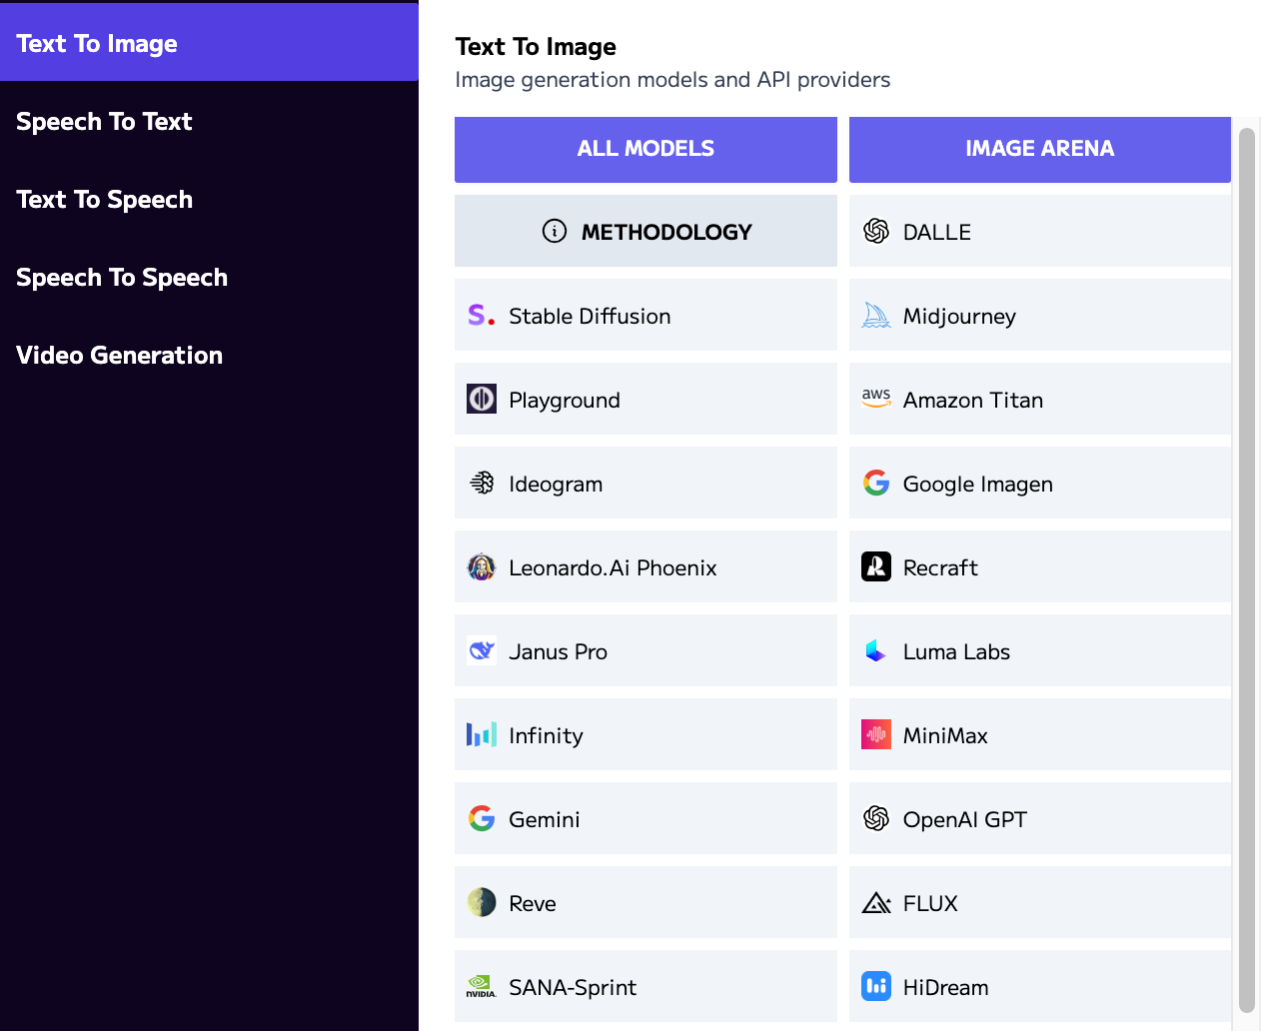
Language
Models
Text
Image
Speech
Video
Models
https://artificialanalysis.ai/

Slide 7

Generative AI (Gen AI)
AI Generated Content (AIGC)
Image Generation
Source: Yihan Cao, Siyu Li, Yixin Liu, Zhiling Yan, Yutong Dai, Philip S. Yu, and Lichao Sun (2023). "A Comprehensive Survey of AI-Generated Content (AIGC): A History of Generative AI from GAN to ChatGPT." arXiv preprint arXiv:2303.04226.

Slide 8

Generative AI (Gen AI)
AI Generated Content (AIGC)
Source: Yihan Cao, Siyu Li, Yixin Liu, Zhiling Yan, Yutong Dai, Philip S. Yu, and Lichao Sun (2023). "A Comprehensive Survey of AI-Generated Content (AIGC): A History of Generative AI from GAN to ChatGPT." arXiv preprint arXiv:2303.04226.

Slide 9
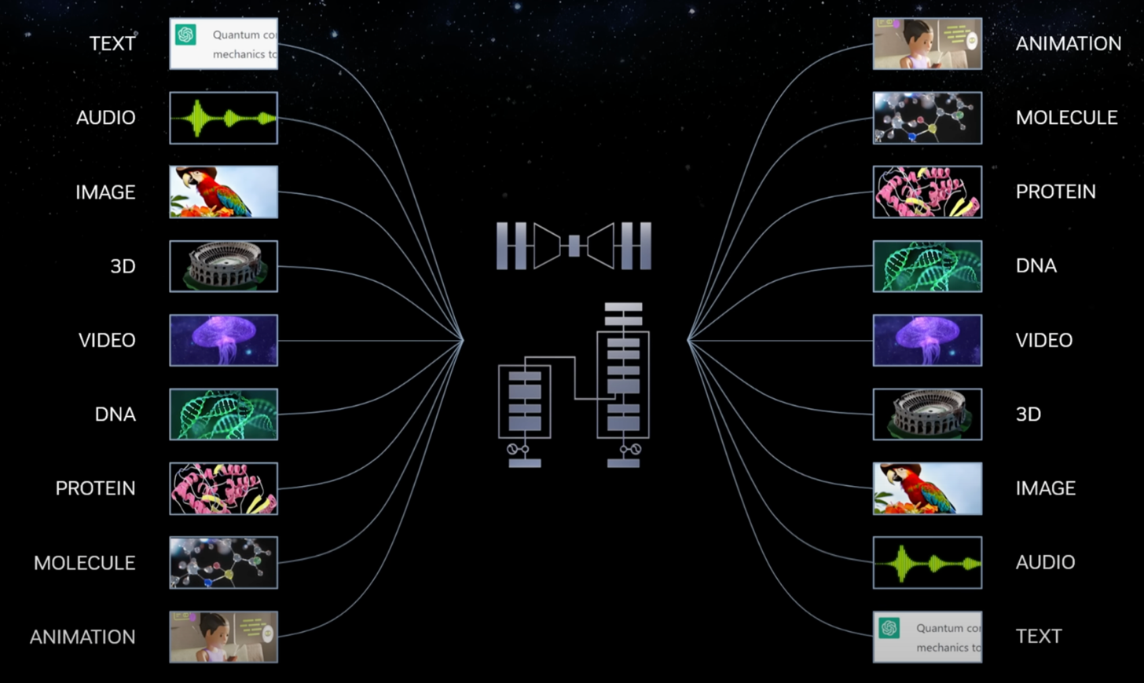
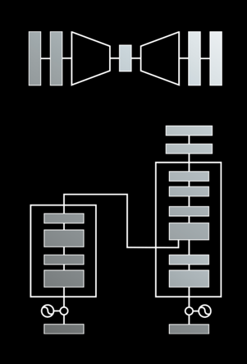
Modular Modalities
Where Can The Transformer Fit?
Notes:
At the beginning, we mentioned that natural language isn't just for reasoning with language in isolation—it's useful to incorporate other modalities like images, audio, 3D video, DNA, protein molecules, etc.
We've been working with text input and text output, but what about these other things? Before diving into each individually, let's discuss what we mean by 'different modalities.'"

Slide 10

The history of Generative AI in CV, NLP and VL
Source: Yihan Cao, Siyu Li, Yixin Liu, Zhiling Yan, Yutong Dai, Philip S. Yu, and Lichao Sun (2023). "A Comprehensive Survey of AI-Generated Content (AIGC): A History of Generative AI from GAN to ChatGPT." arXiv preprint arXiv:2303.04226.

Slide 11
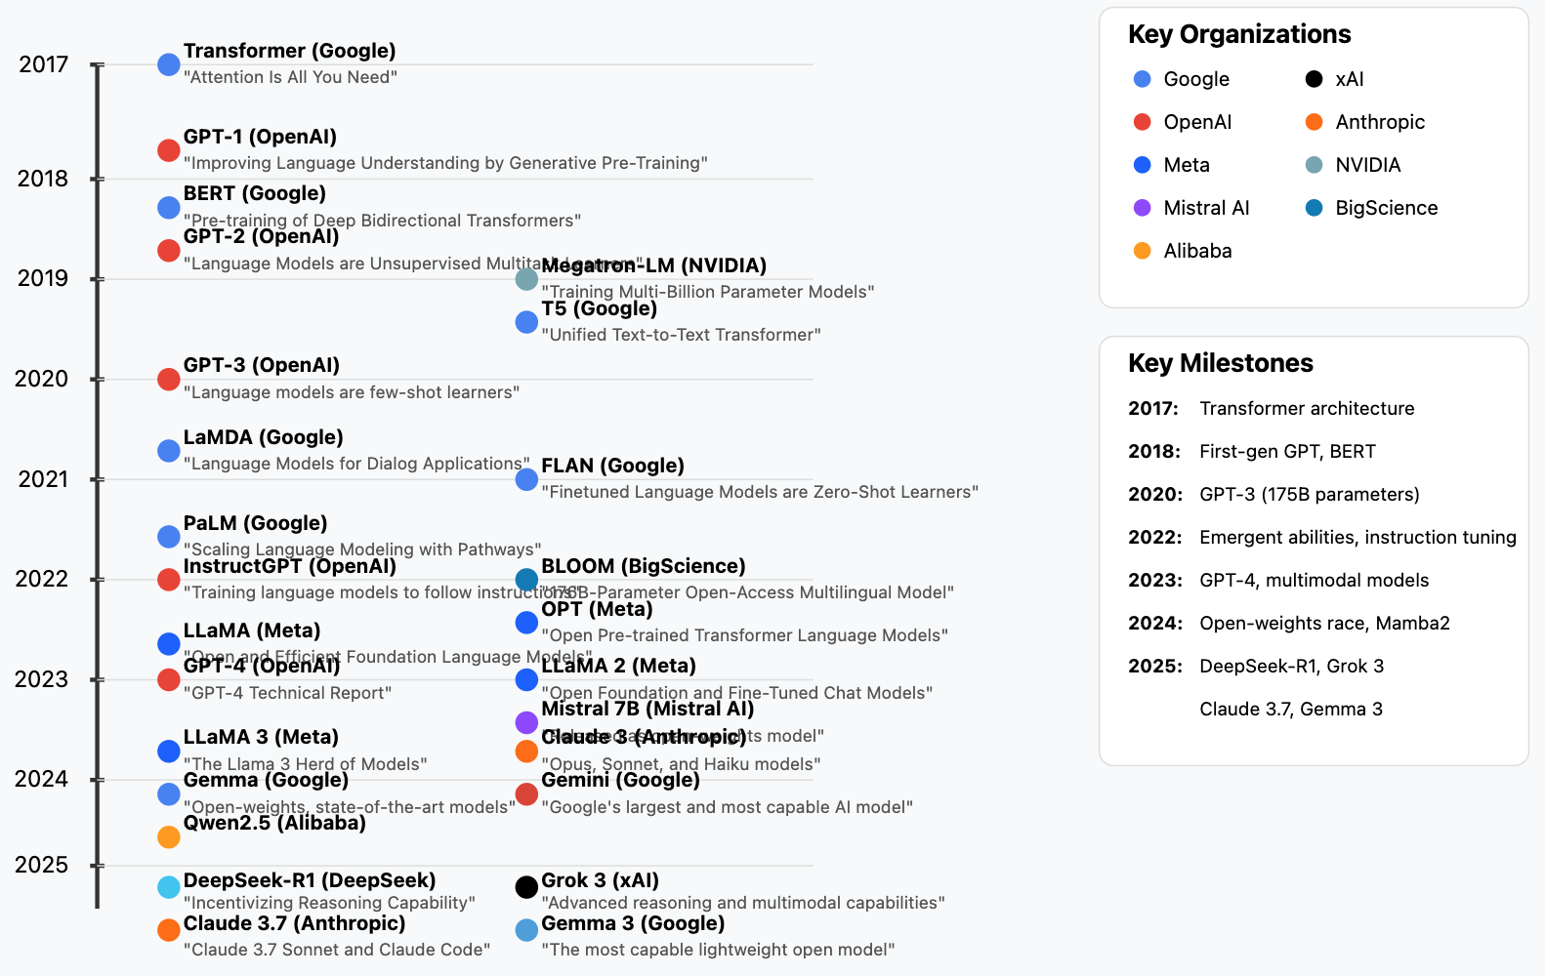
Generative AI LLMs (2017-2025)
Source: https://github.com/Hannibal046/Awesome-LLM

Slide 12
Generative AI, Agentic AI, Physical AI
Physical AI
Self-driving cars
General robotics
Agentic AI
Coding assistants
Customer service
Patient care
Generative AI
Digital marketing
Content creation
Perception AI
Speech recognition
Deep recommender systems
Medical imaging
2012 AlexNet
Deep learning breakthrough
Source: NVIDIA (2025), GTC March 2025 Keynote with NVIDIA CEO Jensen Huang, https://www.youtube.com/watch?v=_waPvOwL9Z8

Slide 13

Categories of Vision Generative Models
Source: Yihan Cao, Siyu Li, Yixin Liu, Zhiling Yan, Yutong Dai, Philip S. Yu, and Lichao Sun (2023). "A Comprehensive Survey of AI-Generated Content (AIGC): A History of Generative AI from GAN to ChatGPT." arXiv preprint arXiv:2303.04226.

Slide 14

The General Structure of
Generative Vision Language
Source: Yihan Cao, Siyu Li, Yixin Liu, Zhiling Yan, Yutong Dai, Philip S. Yu, and Lichao Sun (2023). "A Comprehensive Survey of AI-Generated Content (AIGC): A History of Generative AI from GAN to ChatGPT." arXiv preprint arXiv:2303.04226.

Slide 15

LLM-powered Multimodal Agents
Large Multimodal Agents (LMAs)
2022
2023
2024
Source: Xie, Junlin, Zhihong Chen, Ruifei Zhang, Xiang Wan, and Guanbin Li. "Large Multimodal Agents: A Survey." arXiv preprint arXiv:2402.15116 (2024).

Slide 16



Large Language Model (LLM) based Agents
Source: Xi, Z., Chen, W., Guo, X., He, W., Ding, Y., Hong, B., ... & Gui, T. (2023). The rise and potential of large language model based agents: A survey. arXiv preprint arXiv:2309.07864.

Slide 17

LLM-based Agents
Source: Cheng, Yuheng, Ceyao Zhang, Zhengwen Zhang, Xiangrui Meng, Sirui Hong, Wenhao Li, Zihao Wang et al. "Exploring large language model based intelligent agents: Definitions, methods, and prospects." arXiv preprint arXiv:2401.03428 (2024).

Slide 18

Large Multimodal Agents (LMA)
Source: Xie, J., Chen, Z., Zhang, R., Wan, X., & Li, G. (2024). Large Multimodal Agents: A Survey. ArXiv, abs/2402.15116.

Slide 19

Large Multimodal Agents (LMA)
Source: Xie, J., Chen, Z., Zhang, R., Wan, X., & Li, G. (2024). Large Multimodal Agents: A Survey. ArXiv, abs/2402.15116.

Slide 20
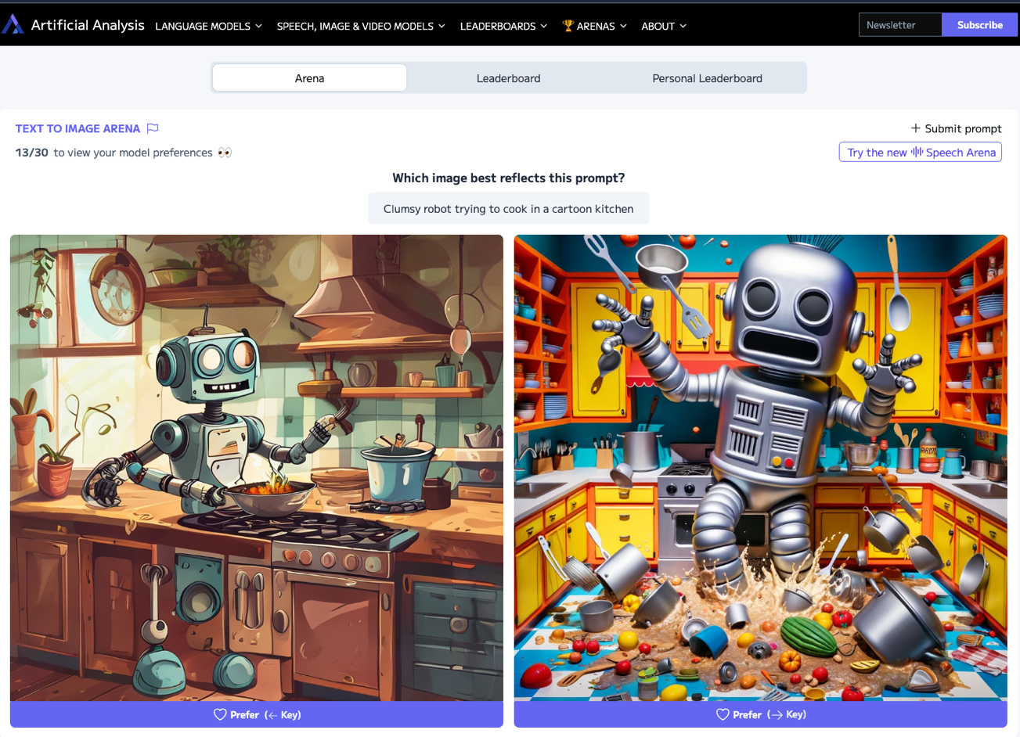
Artificial Analysis Text to Image Arena
Source: https://artificialanalysis.ai/text-to-image/arena

Slide 21
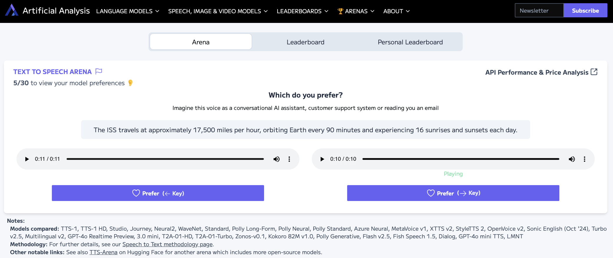
Artificial Analysis Text to Speech Arena
Source: https://artificialanalysis.ai/text-to-speech/arena

Slide 22
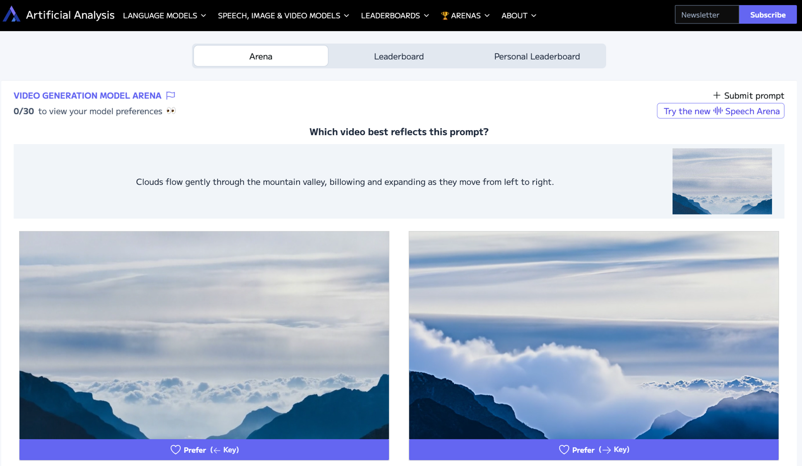
Artificial Analysis Video Generation Model Arena
Source: https://artificialanalysis.ai/text-to-video/arena

Slide 23
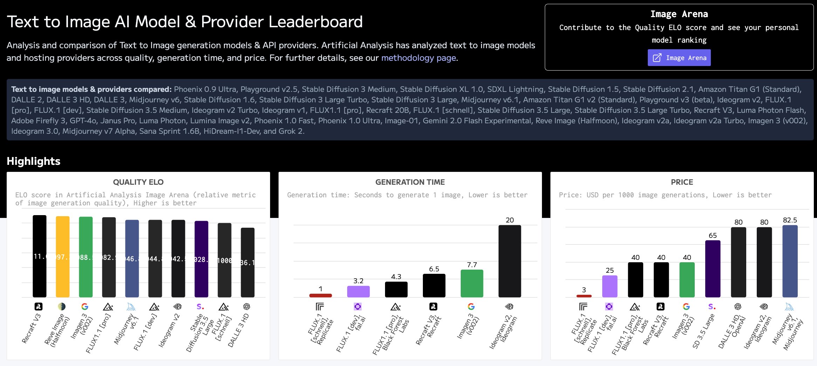
Artificial Analysis Text to Image Leaderboard
Source: https://artificialanalysis.ai/text-to-image

Slide 24
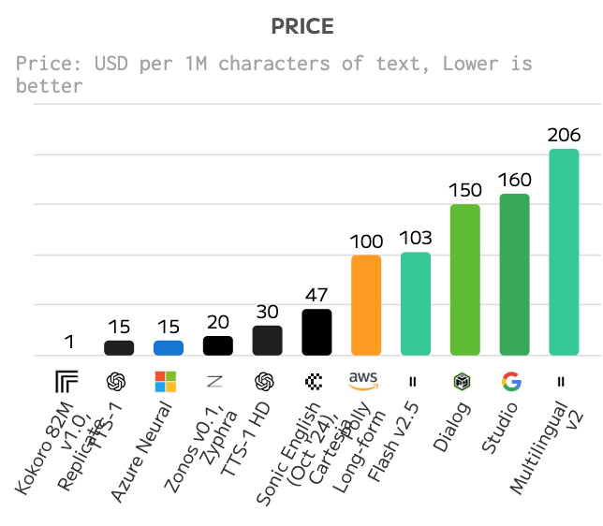
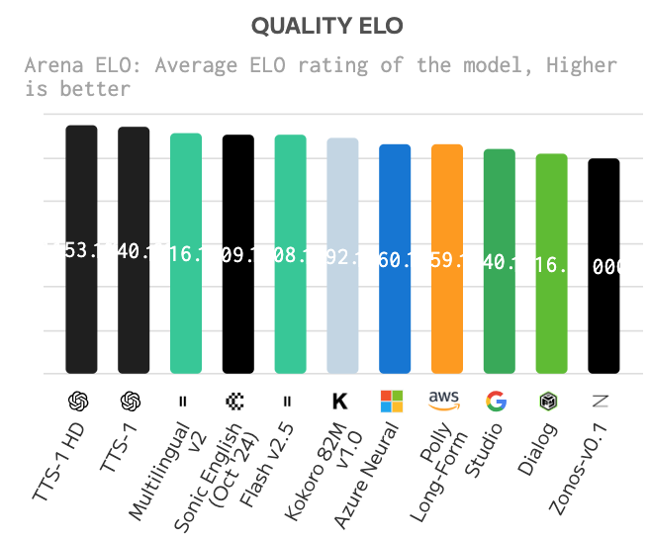
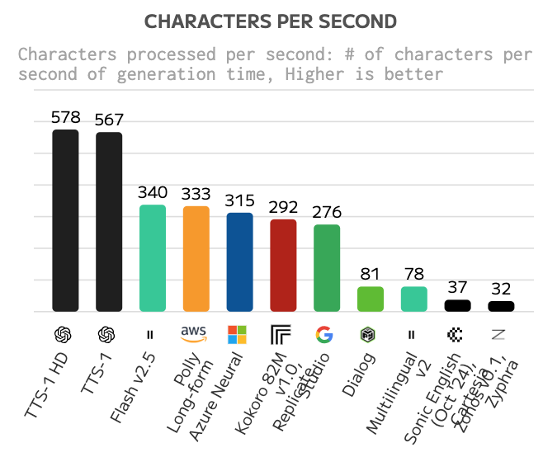
Text to Speech (TTS) AI Model & Provider Leaderboard
Text to speech models & providers compared: TTS-1, TTS-1 HD, Studio, Journey, Neural2, WaveNet, Standard, Polly Long-Form, Polly Neural, Polly Standard, Azure Neural, MetaVoice v1, XTTS v2, StyleTTS 2, OpenVoice v2, Sonic English (Oct '24), 3.0 mini, Turbo v2.5, Multilingual v2, T2A-01-HD, T2A-01-Turbo, Zonos-v0.1, Kokoro 82M v1.0, Polly Generative, Flash v2.5, Dialog, Murf Speech Gen 2, and Step TTS Mini.
Source: https://artificialanalysis.ai/text-to-speech

Slide 25
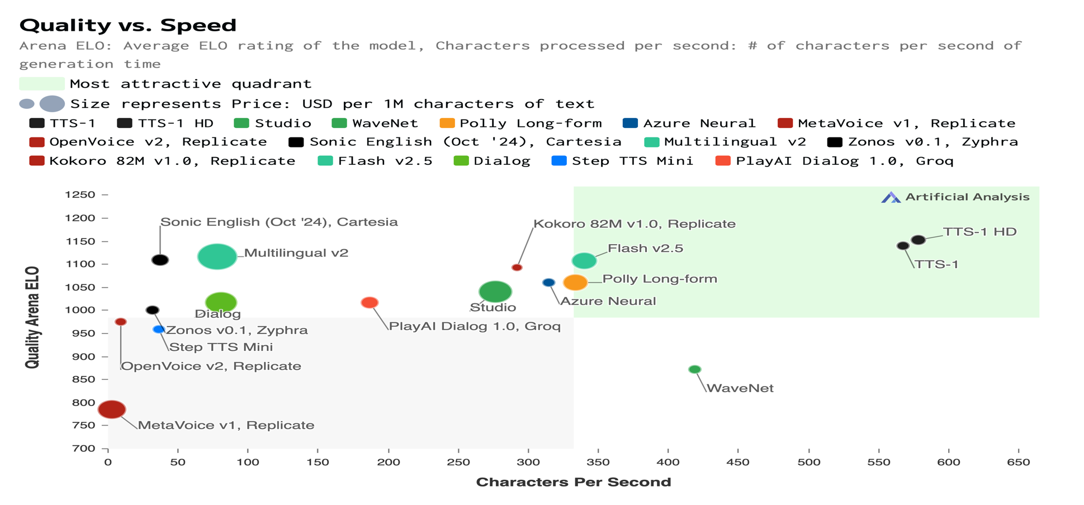
Text to Speech (TTS) AI Model & Provider Leaderboard
Source: https://artificialanalysis.ai/text-to-speech

Slide 26
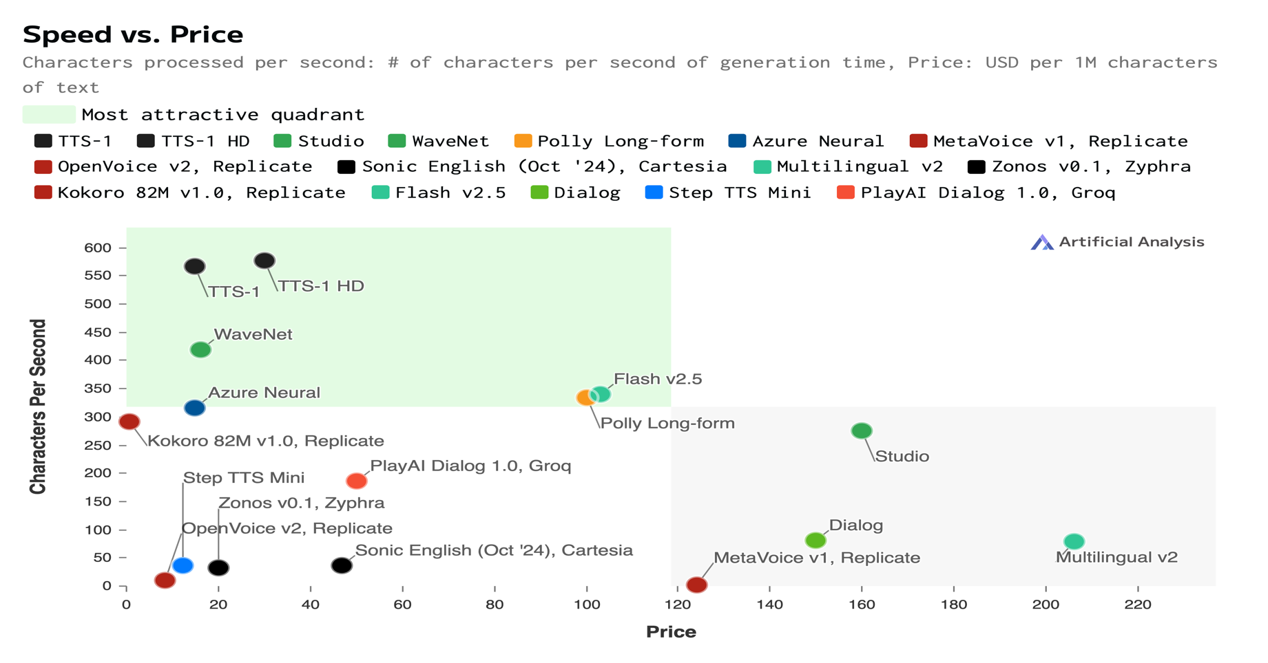
Text to Speech (TTS) AI Model & Provider Leaderboard
Source: https://artificialanalysis.ai/text-to-speech

Slide 27
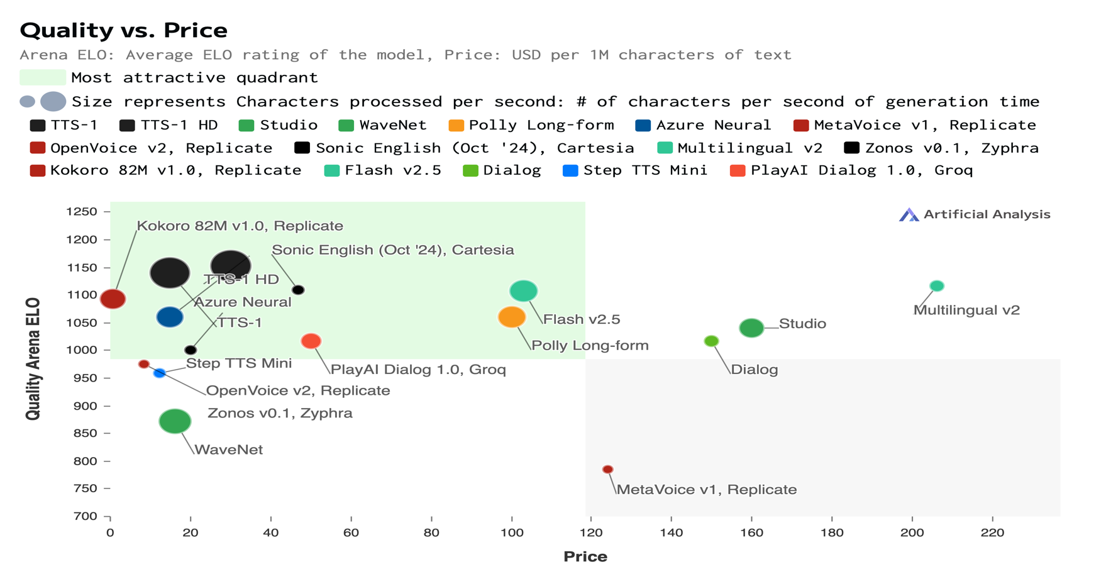
Text to Speech (TTS) AI Model & Provider Leaderboard
Source: https://artificialanalysis.ai/text-to-speech

Slide 28
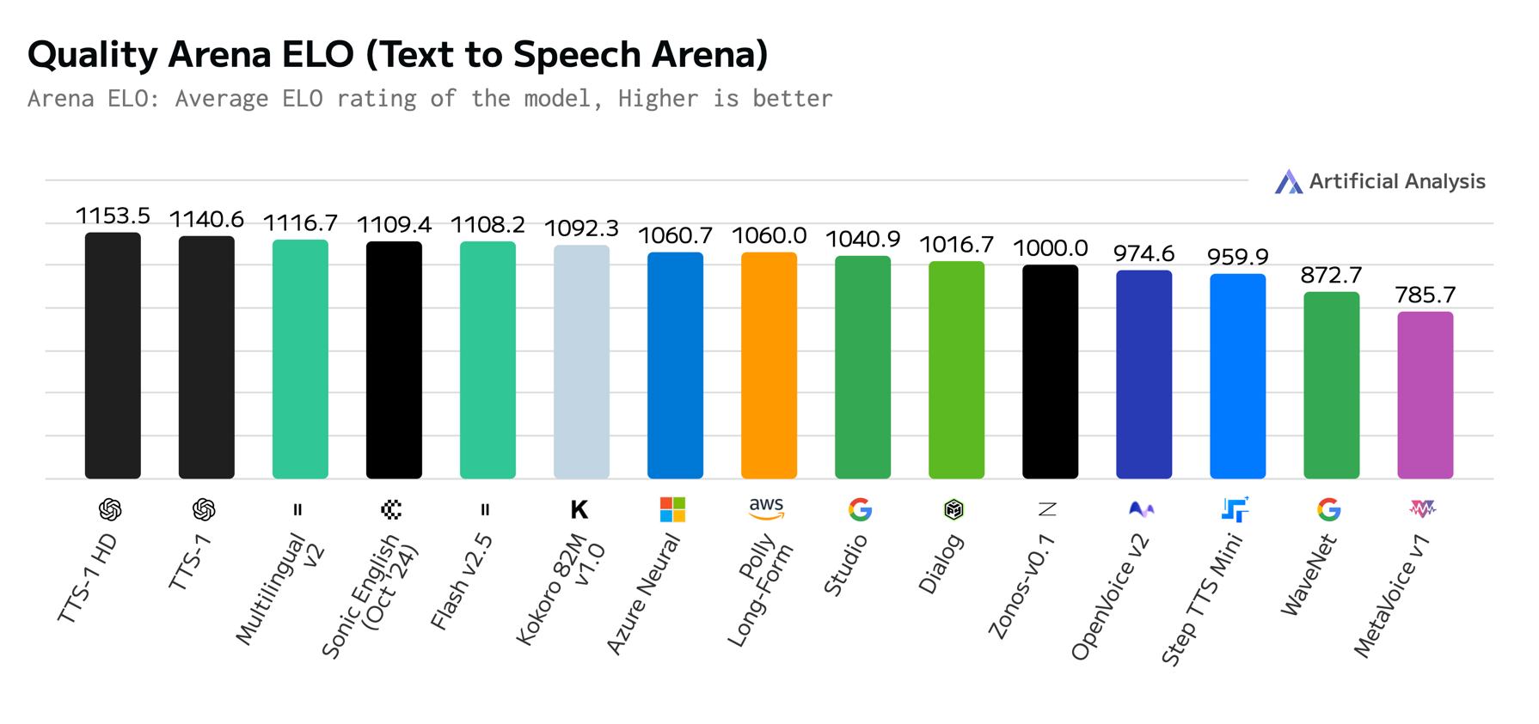
Text to Speech (TTS) AI Model & Provider Leaderboard
Source: https://artificialanalysis.ai/text-to-speech

Slide 29
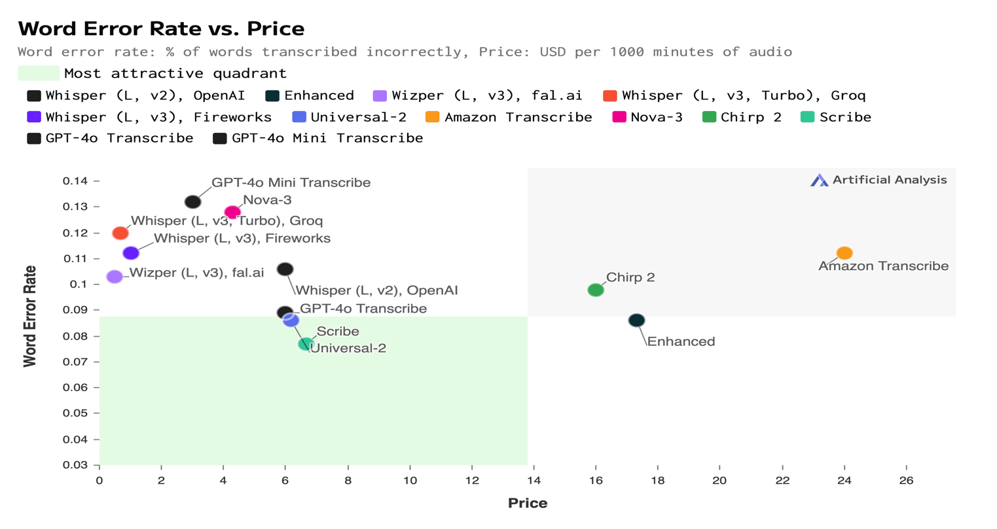
Speech to Text (STT) AI Model & Provider Leaderboard
Speech-to-text models & providers compared: Whisper (L, v2), OpenAI, Universal-1, Standard, Whisper (L, v2), Azure, Enhanced, Nano, Wizper (L, v3), fal.ai, Incredibly Fast Whisper, Replicate, Nova-2, Whisper (L, v2), Replicate, Whisper (L, v3), Replicate, Base, WhisperX, Replicate, Whisper (L v2), Deepgram, Gladia, Whisper (L, v3), Groq, Distil-Whisper, Groq, Whisper (L, v3), fal.ai, Whisper (L, v3), Deepinfra, Whisper (L, v3, Turbo), Groq, Whisper (L, v3), Fireworks, Whisper (L, v3, Turbo), Fireworks, Universal-2, Amazon Transcribe, Fish Speech to Text, Nova-3, Chirp, Chirp 2, Scribe, GPT-4o Transcribe, and GPT-4o Mini Transcribe.
Source: https://artificialanalysis.ai/speech-to-text

Slide 30
Speech to Text (STT) AI Model & Provider Leaderboard
Speech-to-text models & providers compared: Whisper (L, v2), OpenAI, Universal-1, Standard, Whisper (L, v2), Azure, Enhanced, Nano, Wizper (L, v3), fal.ai, Incredibly Fast Whisper, Replicate, Nova-2, Whisper (L, v2), Replicate, Whisper (L, v3), Replicate, Base, WhisperX, Replicate, Whisper (L v2), Deepgram, Gladia, Whisper (L, v3), Groq, Distil-Whisper, Groq, Whisper (L, v3), fal.ai, Whisper (L, v3), Deepinfra, Whisper (L, v3, Turbo), Groq, Whisper (L, v3), Fireworks, Whisper (L, v3, Turbo), Fireworks, Universal-2, Amazon Transcribe, Fish Speech to Text, Nova-3, Chirp, Chirp 2, Scribe, GPT-4o Transcribe, and GPT-4o Mini Transcribe.
Source: https://artificialanalysis.ai/speech-to-text

Slide 31
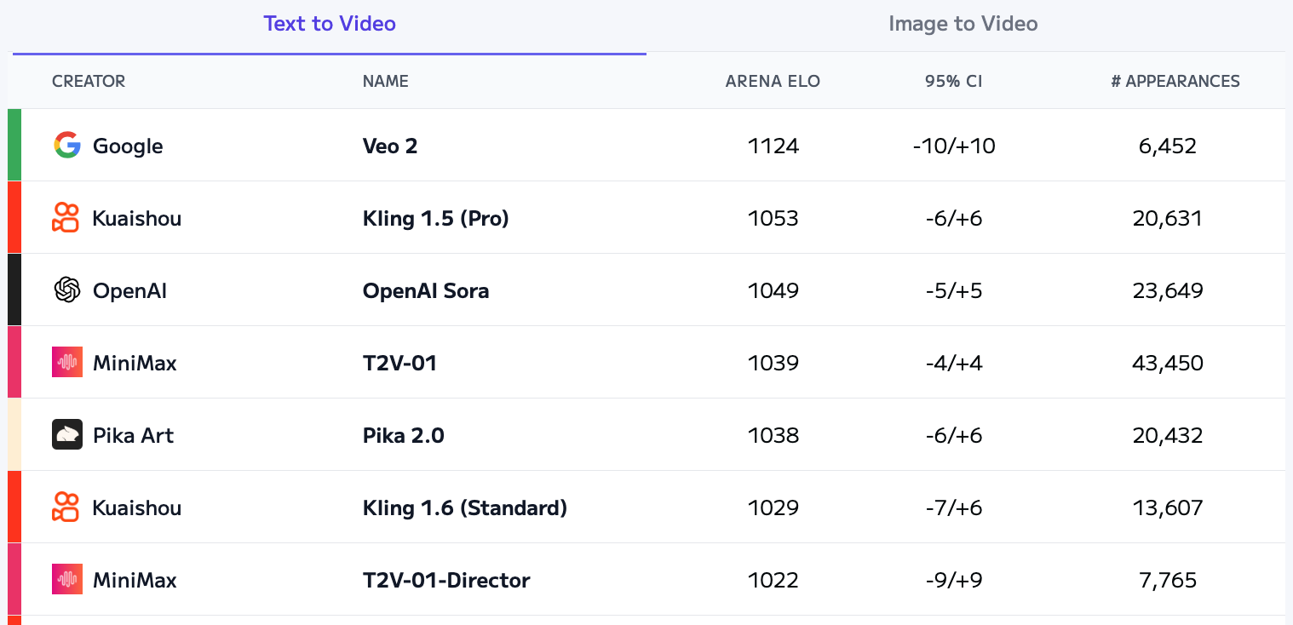
Artificial Analysis Text to Video Leaderboard
Source: https://artificialanalysis.ai/text-to-video/arena?tab=Leaderboard&leaderboard_tab=t2v

Slide 32
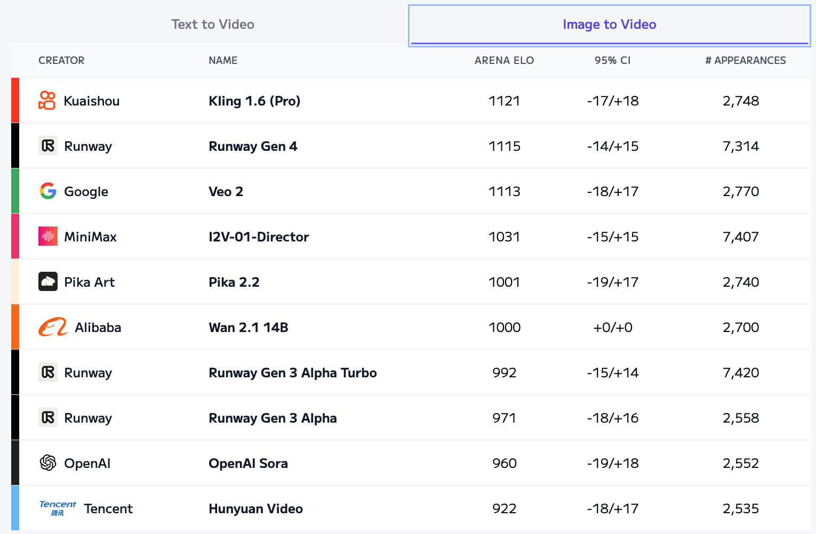
Artificial Analysis Image to Video Leaderboard
Source: https://artificialanalysis.ai/text-to-video/arena?tab=Leaderboard&leaderboard_tab=t2v

Slide 33

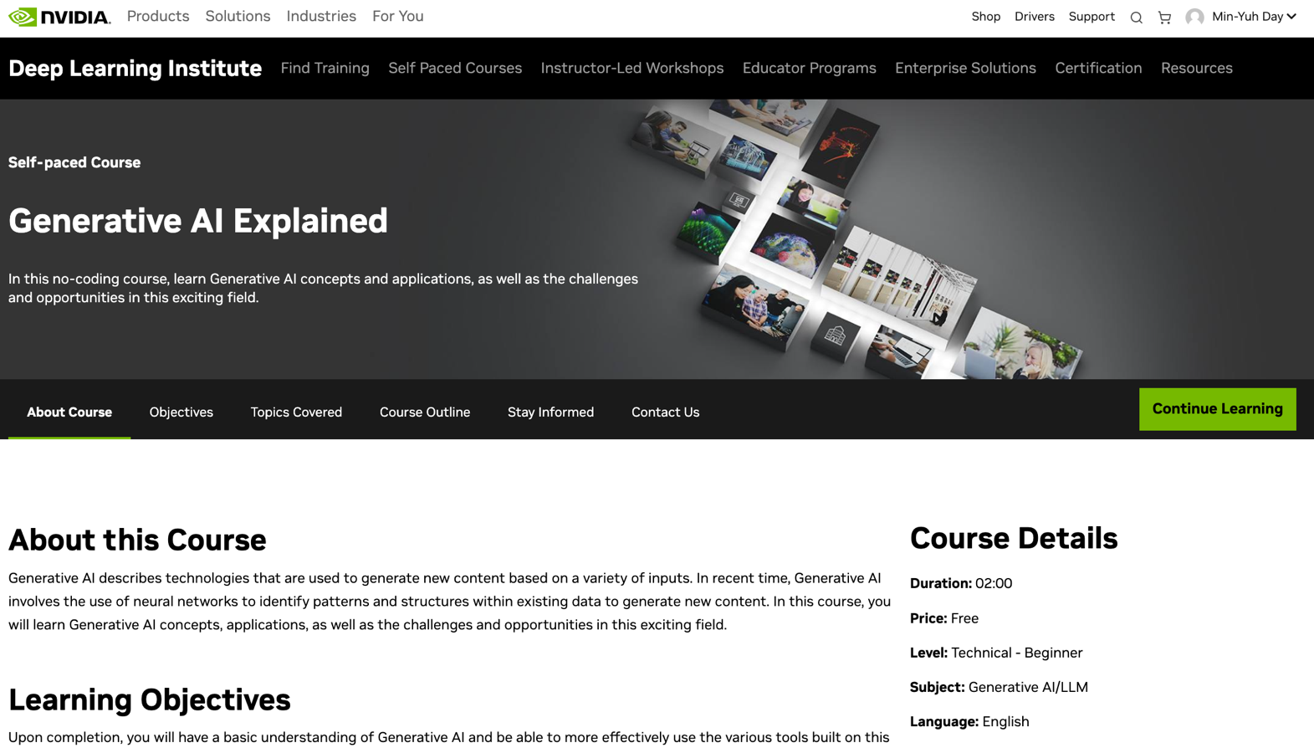
Generative AI Explained
https://learn.nvidia.com/courses/course-detail?course_id=course-v1:DLI+S-FX-15+V1

Slide 34
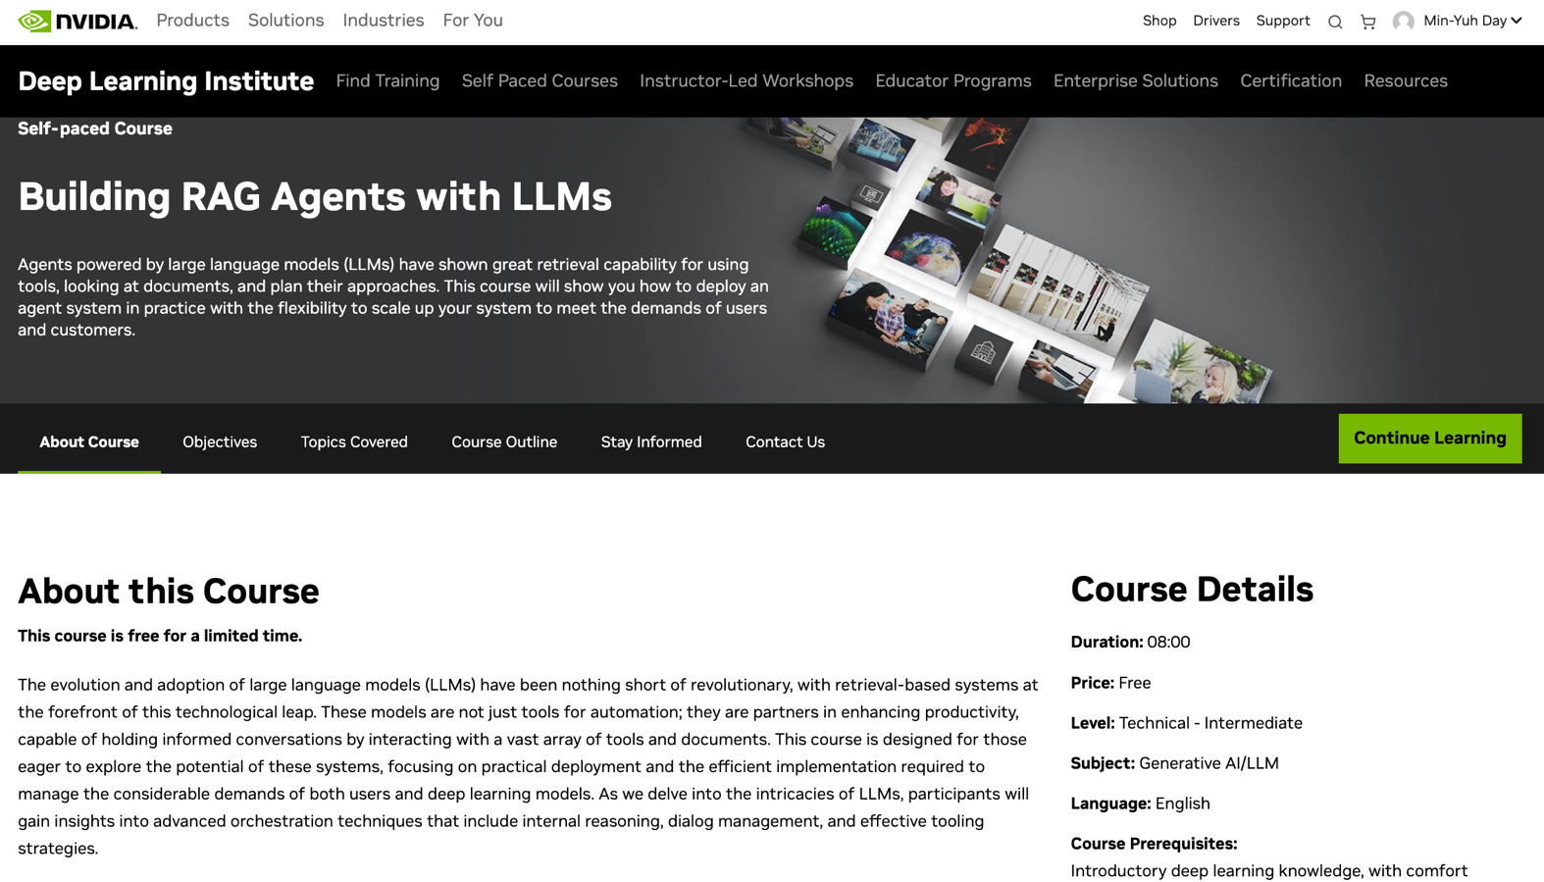
Building RAG Agents with LLMs
https://learn.nvidia.com/courses/course-detail?course_id=course-v1:DLI+S-FX-15+V1

Slide 35
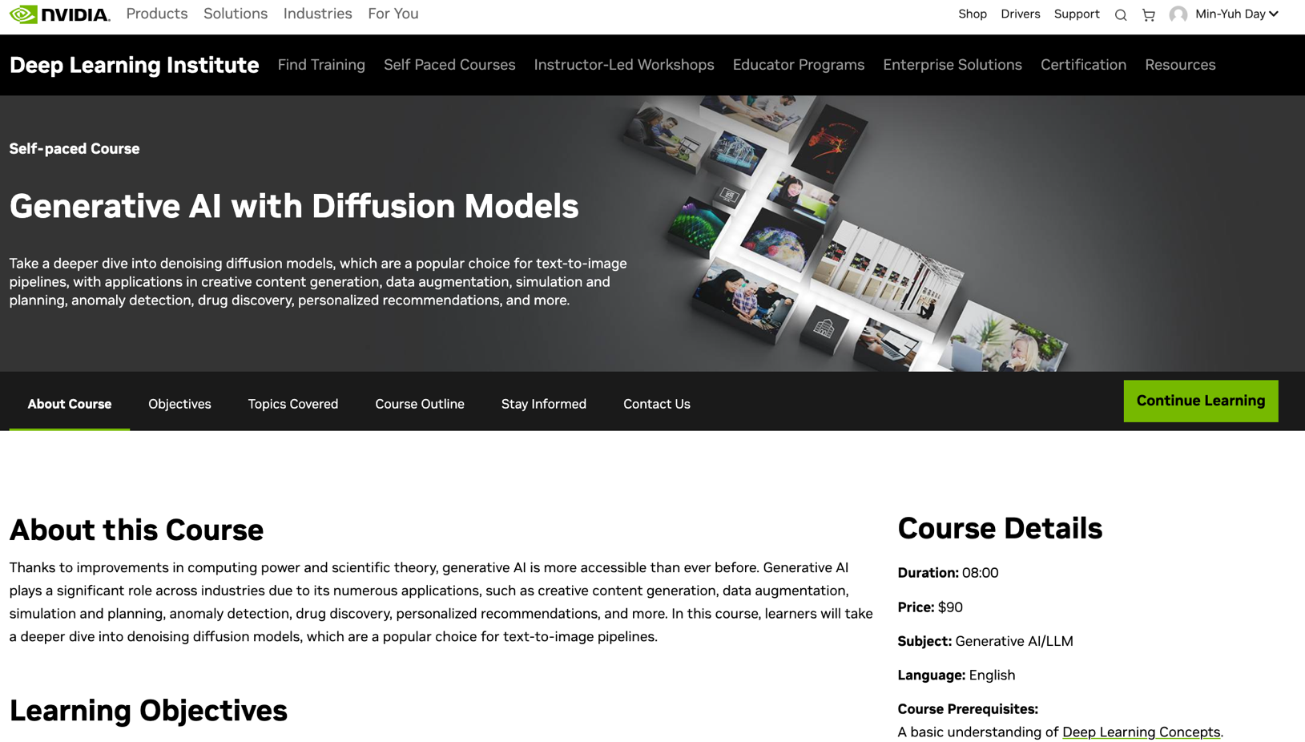
Generative AI with Diffusion Models
https://learn.nvidia.com/courses/course-detail?course_id=course-v1:DLI+S-FX-14+V1

Slide 36
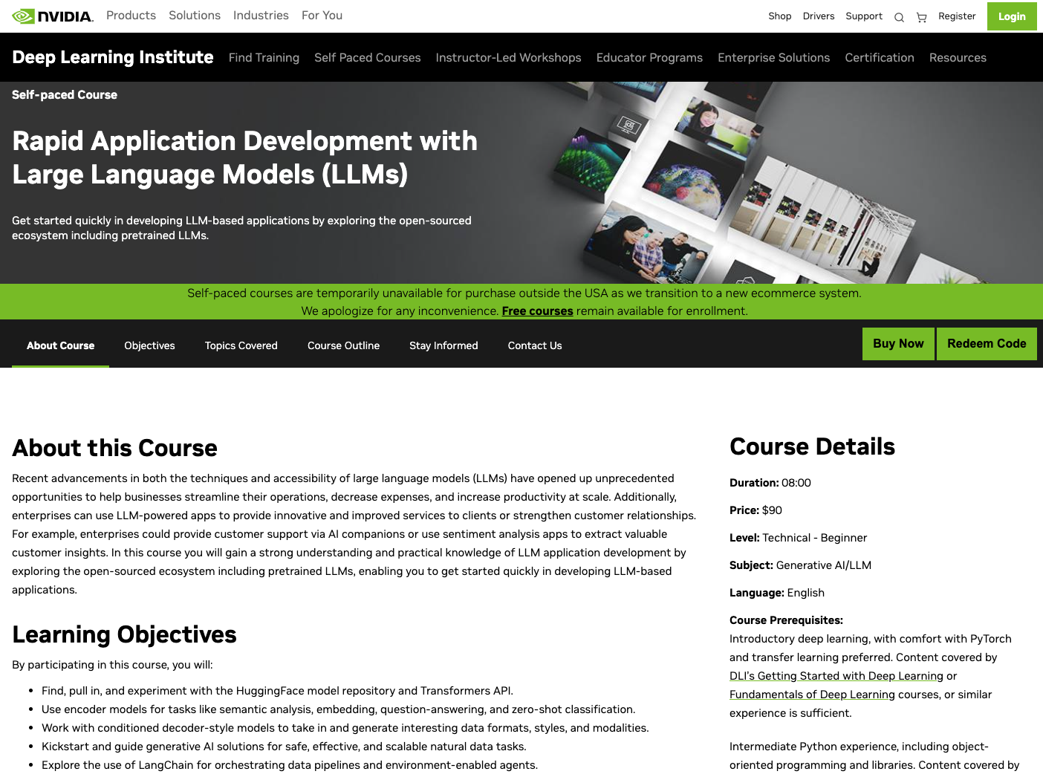
Rapid Application Development with Large Language Models (LLMs)
https://learn.nvidia.com/courses/course-detail?course_id=course-v1:DLI+S-FX-26+V1

Slide 37
Rapid Application Development
using Large Language Models
Source: NVIDIA DLI (2025), Rapid Application Development with Large Language Models (LLMs), https://learn.nvidia.com/courses/course-detail?course_id=course-v1:DLI+S-FX-26+V1

Slide 38
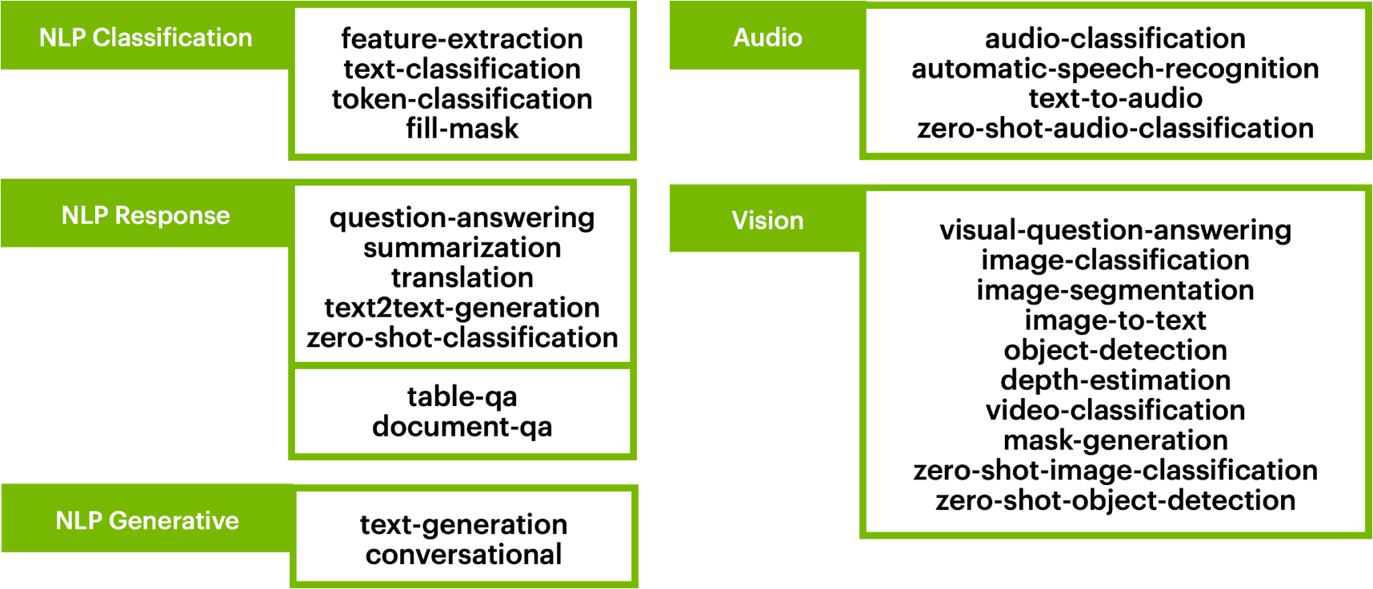
HF Pipeline Options
Automatic End-to-End Pipelines
Source: NVIDIA DLI (2025), Rapid Application Development with Large Language Models (LLMs), https://learn.nvidia.com/courses/course-detail?course_id=course-v1:DLI+S-FX-26+V1

Slide 39
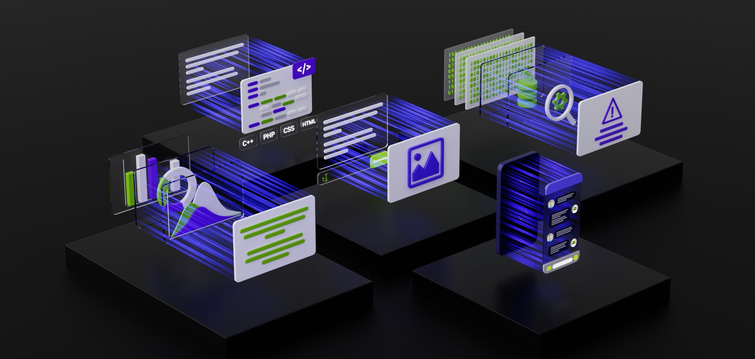
Large Language Models
Backbones for Language Understanding
Backbones for language tasks, including classification and generation.
Source: NVIDIA DLI (2025), Rapid Application Development with Large Language Models (LLMs), https://learn.nvidia.com/courses/course-detail?course_id=course-v1:DLI+S-FX-26+V1

Slide 40
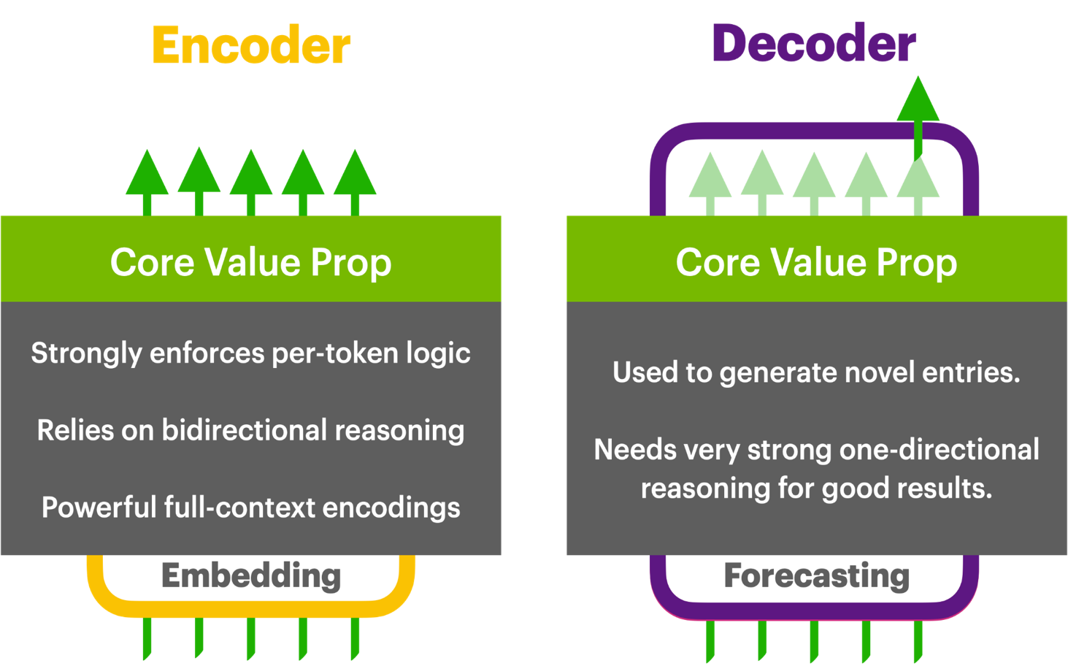
Encoders vs Decoders
Both Options Have Pros and Cons
Source: NVIDIA DLI (2025), Rapid Application Development with Large Language Models (LLMs), https://learn.nvidia.com/courses/course-detail?course_id=course-v1:DLI+S-FX-26+V1

Slide 41
Modular Modalities
Where Can The Transformer Fit?
Source: NVIDIA DLI (2025), Rapid Application Development with Large Language Models (LLMs), https://learn.nvidia.com/courses/course-detail?course_id=course-v1:DLI+S-FX-26+V1
Notes:
At the beginning, we mentioned that natural language isn't just for reasoning with language in isolation—it's useful to incorporate other modalities like images, audio, 3D video, DNA, protein molecules, etc.
We've been working with text input and text output, but what about these other things? Before diving into each individually, let's discuss what we mean by 'different modalities.'"

Slide 42
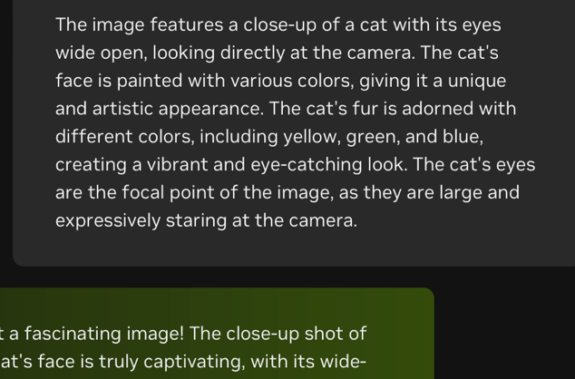

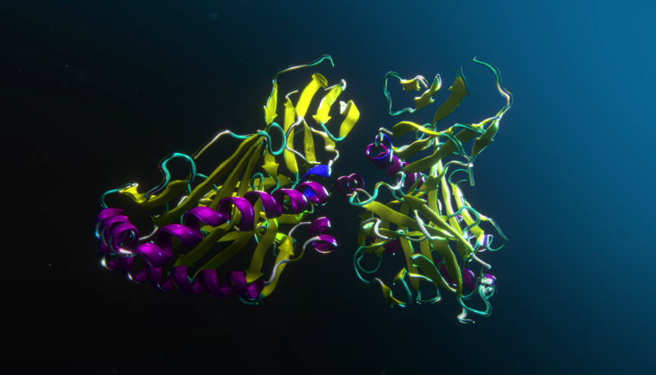
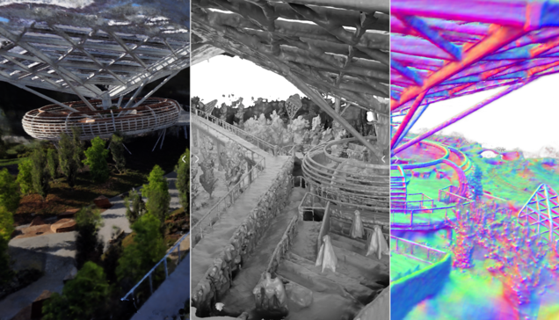
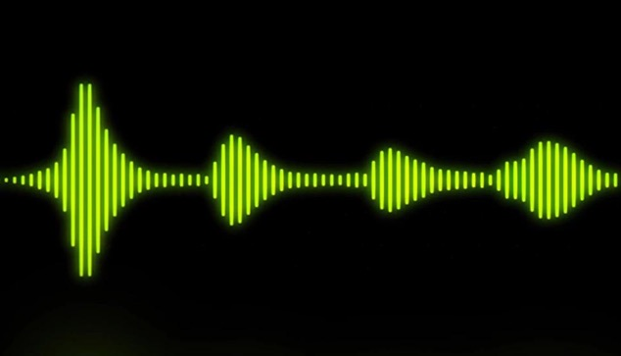
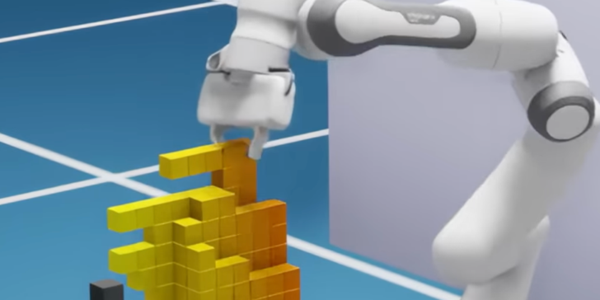
Information Modalities
Core Component of Generative AI
Source: NVIDIA DLI (2025), Rapid Application Development with Large Language Models (LLMs), https://learn.nvidia.com/courses/course-detail?course_id=course-v1:DLI+S-FX-26+V1
Notes:
An information modality is data in a particular format. You're familiar with classes, images, and text.
We've reasoned with images as two-dimensional grids of pixels with spatial locality—hence why convolutional networks are common.
For natural language, while you could use convolutional neural networks, people often prefer transformers for their attention mechanisms.
Other modalities exist, and as far as processing is concerned, these are just different data distributions with different modeling assumptions. But let’s define them a bit more rigorously…

Slide 43




What Makes Modalities Different?
Core Component of Generative AI
Data communicated in different ways | Data that follows different distributions
Data produced/ingested in different ways | Data that is structurally different to model
Broad
Narrow
Surface
Technical
Source: NVIDIA DLI (2025), Rapid Application Development with Large Language Models (LLMs), https://learn.nvidia.com/courses/course-detail?course_id=course-v1:DLI+S-FX-26+V1
Notes:
Modalities can be communicated in different ways—different file types, sensory types, etc.
Whether they're explicit files processed differently by an operating system or data frequencies processed internally by humans through senses like sight, hearing, touch—they're different.
That's the surface-level definition. Technically, all this data is just data. We can think of modalities as different data distributions—maybe Gaussian, Poisson, or the distribution of images or employee data.”
But we also have a narrower technical definition when motivating architectures. When we think about images or natural language, we consider how to understand the data—what structure does it elicit, and how do we process it effectively?
For images, we used convolutional neural networks to extract features, then dense layers to reason about them. For language, we use encoder-decoder structures.
Depending on the data's structure and important intuitions, we choose different models. This can define a different modality or data distribution, radically changing our approach to processing the domain."

Slide 44
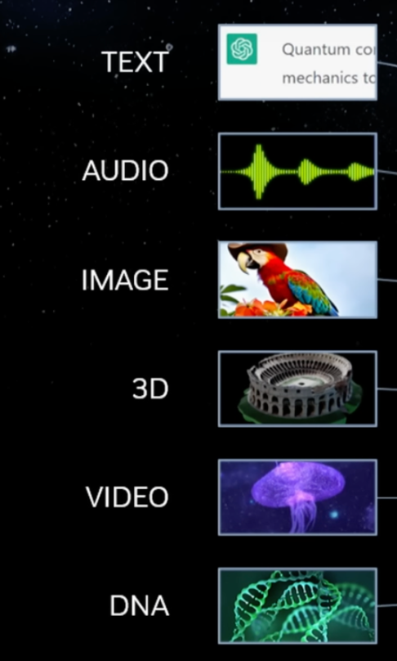
Multimodal Connections
Core Components of Generative AI
Sequence of Letters
Sequence of Classes
Sequence of Frequencies
Sequence of Images
Image of Objects
Grid of Pixels
3D Field
Collection of Faces
Volume of Values
Sequence of Images
Sequence of Classes
Source: NVIDIA DLI (2025), Rapid Application Development with Large Language Models (LLMs), https://learn.nvidia.com/courses/course-detail?course_id=course-v1:DLI+S-FX-26+V1
Notes:
So all this data—text, audio, images, 3D, etc.— may be modeled differently depending on how it's captured and represented.
Text can be modeled as a sequence of letters or classes—that's an engineering decision that works well.
Audio—is it a sequence of frequencies? Frequencies can be considered as vectors; maybe we can model it as images if we window it.
For images, we've thought of grids of pixels with spatial locality, but perhaps there are other ways—chunking into patches, for example.
3D data can be modeled as volumes, point clouds, or collections of faces (meshes).
Video is a sequence of images—but should we model it that way? Maybe as sequences of windows or 3D blocks.
DNA is also a sequence of classes with a limited vocabulary—it can be modeled similarly.
So, how do we link these modalities together?"

Slide 45
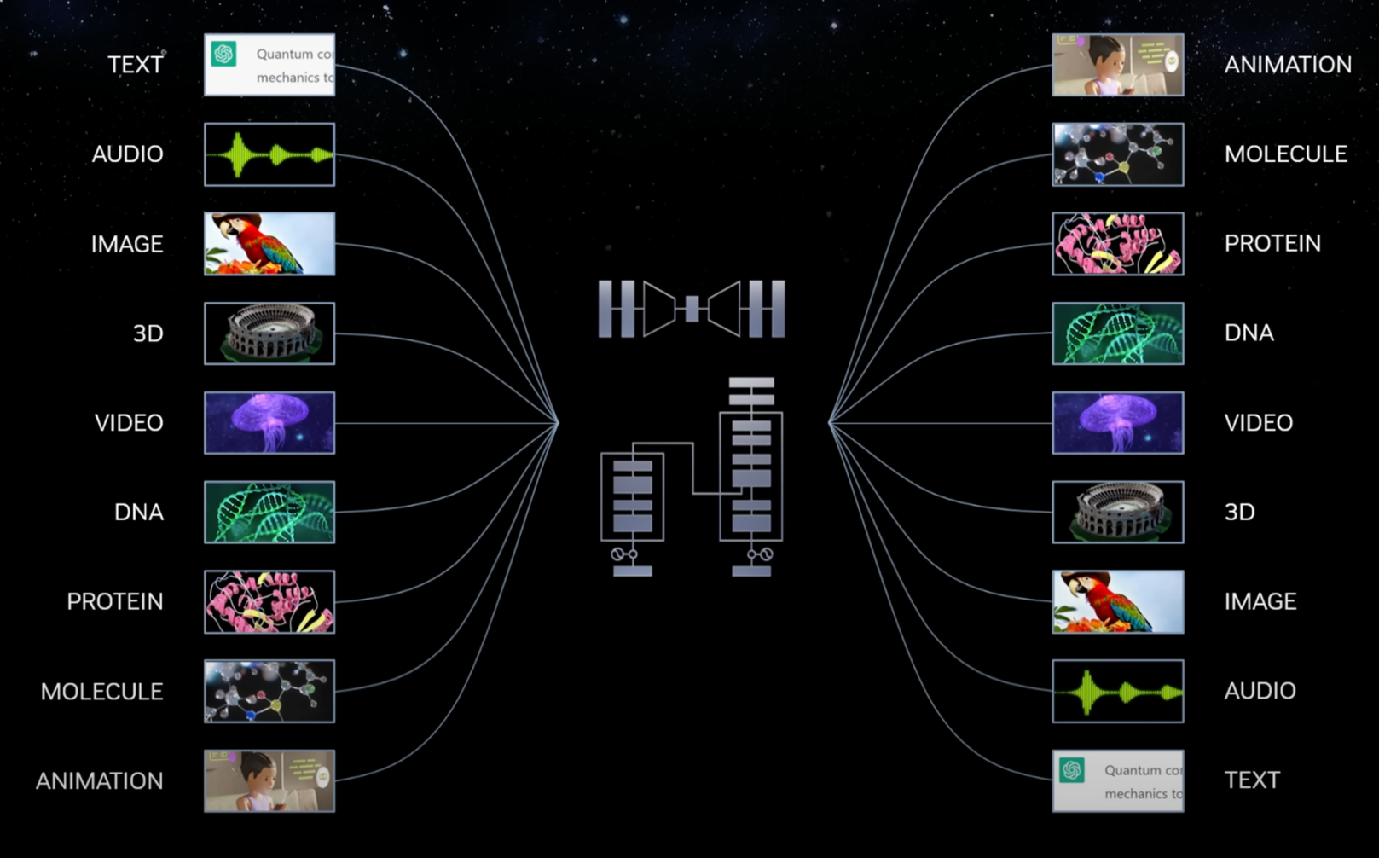
Multimodal Connections
Core Components of Generative AI
Source: NVIDIA DLI (2025), Rapid Application Development with Large Language Models (LLMs), https://learn.nvidia.com/courses/course-detail?course_id=course-v1:DLI+S-FX-26+V1
Notes:
At an architectural level, we can link modalities by encoding them through intuitive architectures and combining them if their dimensionalities align. We've seen in previous notebooks that we can pass from natural language representations into latent sequences repeatedly. Is it possible to combine information from one sequence with another?
Mathematically, yes—if we have vectors of lengths N and M, we can perform operations on them.
So, if we can encode multiple modalities in a way that they can be connected mathematically, or adjust their structures to align, that works.
In practice, creating multimodal connections involves modeling different input pathways, different decoder or output pathways, and linking them together."

Slide 46
Multimodal Connections
Core Components of Generative AI
Sequence of Classes
Grid of Pixels
Volume of Values
Sequence of Images
Volume of Values
Sequence of Classes
Source: NVIDIA DLI (2025), Rapid Application Development with Large Language Models (LLMs), https://learn.nvidia.com/courses/course-detail?course_id=course-v1:DLI+S-FX-26+V1
Notes:
At an architectural level, we can link modalities by encoding them through intuitive architectures and combining them if their dimensionalities align. We've seen in previous notebooks that we can pass from natural language representations into latent sequences repeatedly. Is it possible to combine information from one sequence with another?
Mathematically, yes—if we have vectors of lengths N and M, we can perform operations on them.
So, if we can encode multiple modalities in a way that they can be connected mathematically, or adjust their structures to align, that works.
In practice, creating multimodal connections involves modeling different input pathways, different decoder or output pathways, and linking them together."

Slide 47
Multimodal Connections
Core Components of Generative AI
Sequence of Letters
Sequence of Classes
Sequence of Frequencies
Sequence of Images
Image of Objects
Grid of Pixels
3D Field
Collection of Faces
Volume of Values
Sequence of Images
Sequence of Classes
Source: NVIDIA DLI (2025), Rapid Application Development with Large Language Models (LLMs), https://learn.nvidia.com/courses/course-detail?course_id=course-v1:DLI+S-FX-26+V1
Notes:
Now that we understand we have these components and can link them, let's focus on the ones we'll discuss in the course and notebooks: audio and images, in addition to text.
Text, as a sequence of letters or classes, makes sense.
Audio has similar assumptions—it's a sequence of frequencies.
Images are also relatively easy to reason about as sequences but will present more issues when we discuss generation.
Other modalities like 3D, video, DNA, robotics—you can explore on your own, but they also involve modeling assumptions and architectures suited to process that data efficiently.

Slide 48
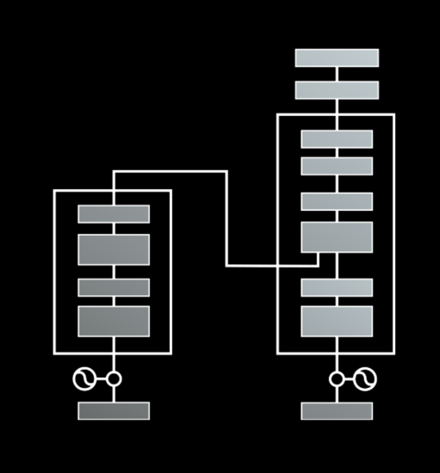
Transformer Benefits
Seq
What Are They Good For
Misconception:
Transformers are only good for language
Recall:
Language Text = Ordered Sequence of Classes
Resolution:
Transformers are good for ordered sequences
Seq
Seq
Source: NVIDIA DLI (2025), Rapid Application Development with Large Language Models (LLMs), https://learn.nvidia.com/courses/course-detail?course_id=course-v1:DLI+S-FX-26+V1
Notes:
Reiterating the value proposition of transformers—they're great for text because text is an ordered sequence of classes. So, if we can think of data as a sequence and reason about it as a sequence, transformers might be a good fit.
Moving to audio, people use transformers a lot for reasoning with audio and speech because audio is a sequence over time—a time series of frequencies. You sample audio over time, getting frequency samples at each timestep. You can normalize them to mel-frequency spectrograms, but you’re inherently reasoning with a time series. So, transformers can be applied here.
"What about images? We've learned that convolution is great for encoding images. Can we use transformers? Yes—Vision Transformers (ViTs) take an image, split it into patches, and reason about the embeddings of patches. This provides benefits, allowing us to synergize with existing transformer architectures. ViTs are still used today for image processing."

Slide 49

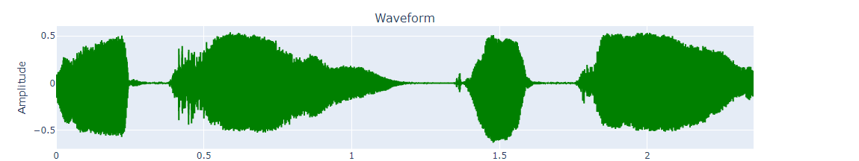
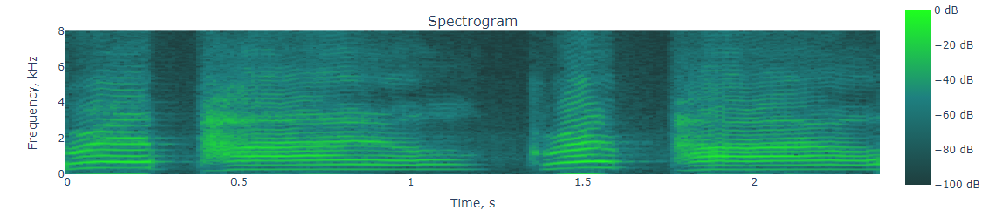
Speech-Guided
Encoders
Audio-In Systems
Speech Data Explorer | NeMo Framework User Guide
Source: NVIDIA DLI (2025), Rapid Application Development with Large Language Models (LLMs), https://learn.nvidia.com/courses/course-detail?course_id=course-v1:DLI+S-FX-26+V1
Notes:
Reiterating the value proposition of transformers—they're great for text because text is an ordered sequence of classes. So, if we can think of data as a sequence and reason about it as a sequence, transformers might be a good fit.
Moving to audio, people use transformers a lot for reasoning with audio and speech because audio is a sequence over time—a time series of frequencies. You sample audio over time, getting frequency samples at each timestep. You can normalize them to mel-frequency spectrograms, but you’re inherently reasoning with a time series. So, transformers can be applied here.
"What about images? We've learned that convolution is great for encoding images. Can we use transformers? Yes—Vision Transformers (ViTs) take an image, split it into patches, and reason about the embeddings of patches. This provides benefits, allowing us to synergize with existing transformer architectures. ViTs are still used today for image processing.

Slide 50
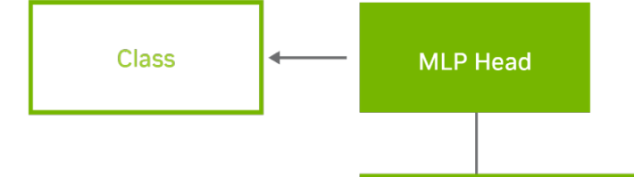
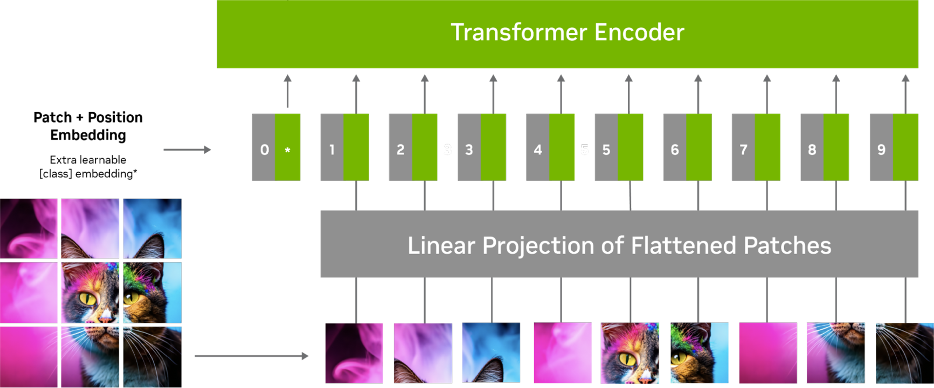
Image-Guided
Encoders
Improve Accuracy and Robustness of Vision AI Apps with Vision Transformers and NVIDIA TAO | NVIDIA Blog
Source: NVIDIA DLI (2025), Rapid Application Development with Large Language Models (LLMs), https://learn.nvidia.com/courses/course-detail?course_id=course-v1:DLI+S-FX-26+V1
Notes:
Reiterating the value proposition of transformers—they're great for text because text is an ordered sequence of classes. So, if we can think of data as a sequence and reason about it as a sequence, transformers might be a good fit.
Moving to audio, people use transformers a lot for reasoning with audio and speech because audio is a sequence over time—a time series of frequencies. You sample audio over time, getting frequency samples at each timestep. You can normalize them to mel-frequency spectrograms, but you’re inherently reasoning with a time series. So, transformers can be applied here.
"What about images? We've learned that convolution is great for encoding images. Can we use transformers? Yes—Vision Transformers (ViTs) take an image, split it into patches, and reason about the embeddings of patches. This provides benefits, allowing us to synergize with existing transformer architectures. ViTs are still used today for image processing.

Slide 51
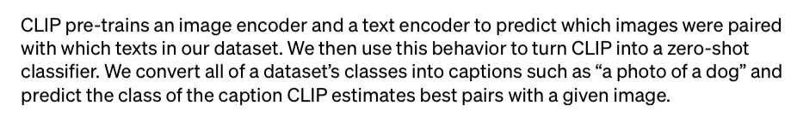
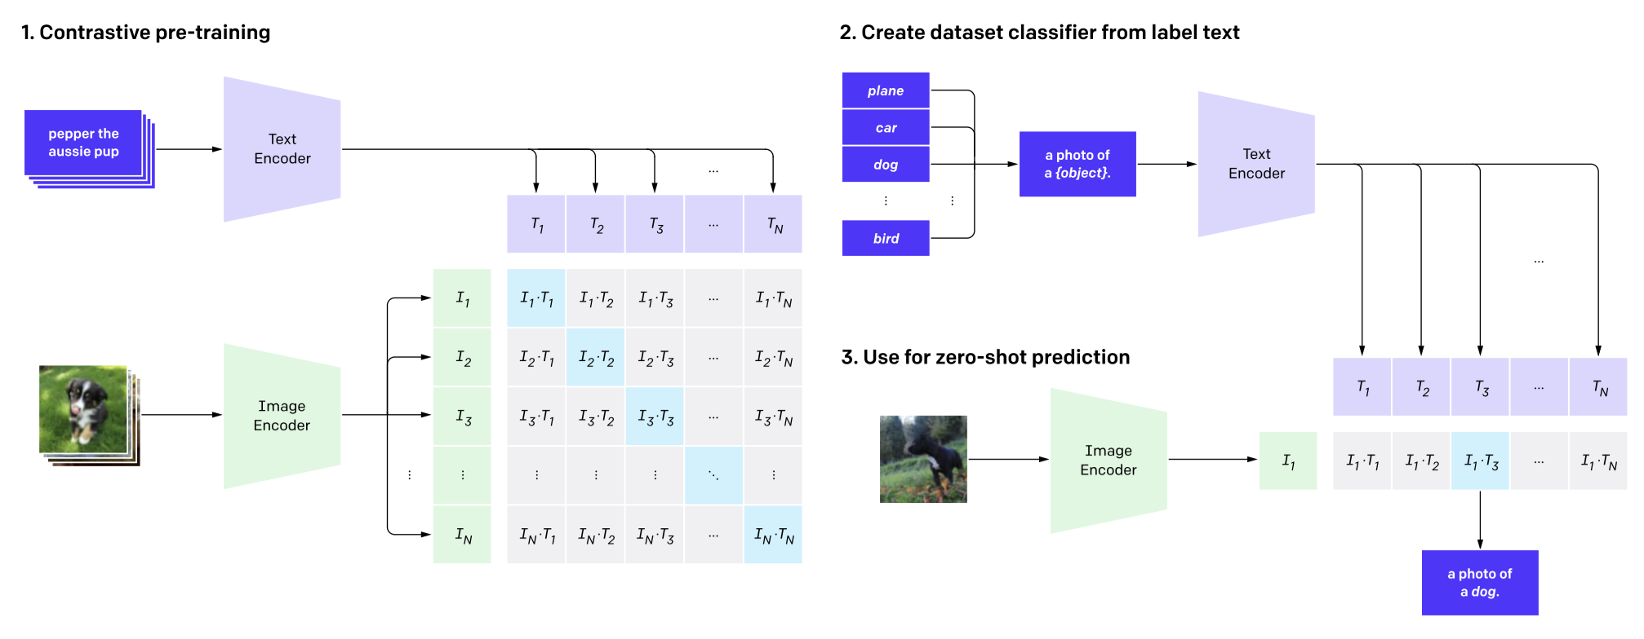
Synergizing Encoders
Resolving Modality Gaps via Similarity
CLIP: Connecting text and images | OpenAI
Source: NVIDIA DLI (2025), Rapid Application Development with Large Language Models (LLMs), https://learn.nvidia.com/courses/course-detail?course_id=course-v1:DLI+S-FX-26+V1
Notes:
Given that we can create different encoders based on the transformer architecture, can we get use out of them without an explicit decoder?
Yes—Contrastive Language-Image Pre-training (CLIP) shows this. CLIP uses multiple encoders for different modalities and synergizes their outputs.
When we have a pair of an image and a caption, we train the network to produce embeddings that are close together. This synergizes a text encoder and an image encoder.
You'll see this in the notebook—the embeddings become useful representations for images and text, allowing for tasks like retrieval or swapping between images and text in analysis.

Slide 52
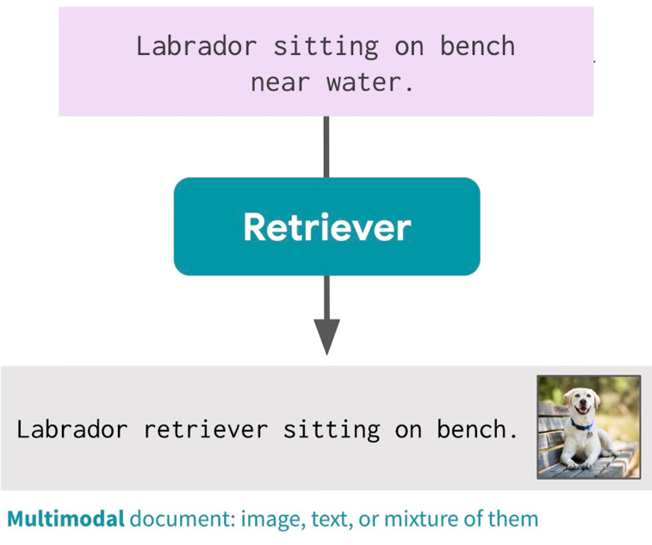
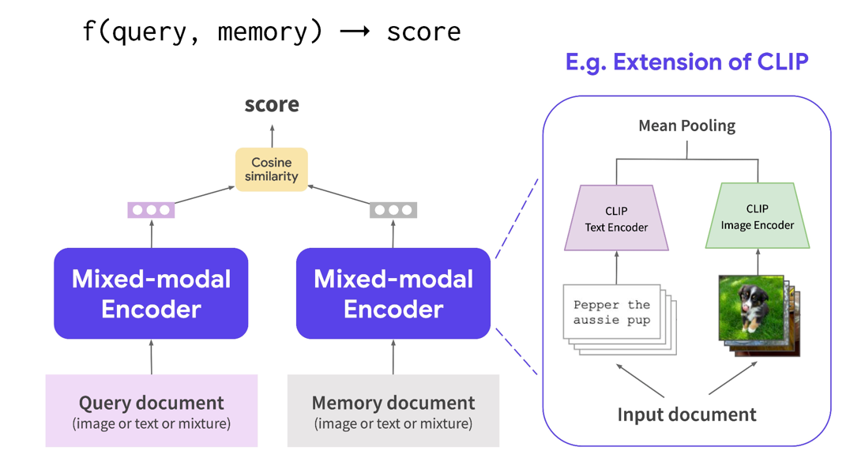
Multimodal Retrievers
Resolving Modality Gaps via Similarity
RA-CM3: Retrieval-Augmented Multimodal Modeling (2023)
Source: NVIDIA DLI (2025), Rapid Application Development with Large Language Models (LLMs), https://learn.nvidia.com/courses/course-detail?course_id=course-v1:DLI+S-FX-26+V1
Notes:
Going further into retrieval, synergized encoders are useful even within natural language.
If you have two types of text or documents, you can use encoders to retrieve what's relevant, similar, or useful in a context. This is common in retrieval-augmented generation.
For example, with a query 'Labrador sitting on bench near water,' if you have synergized image and text encoders, you can embed the query and retrieve images from a pool that match.
Similarly, with text documents, you can use different encoders to retrieve longer passages or summaries.

Slide 53
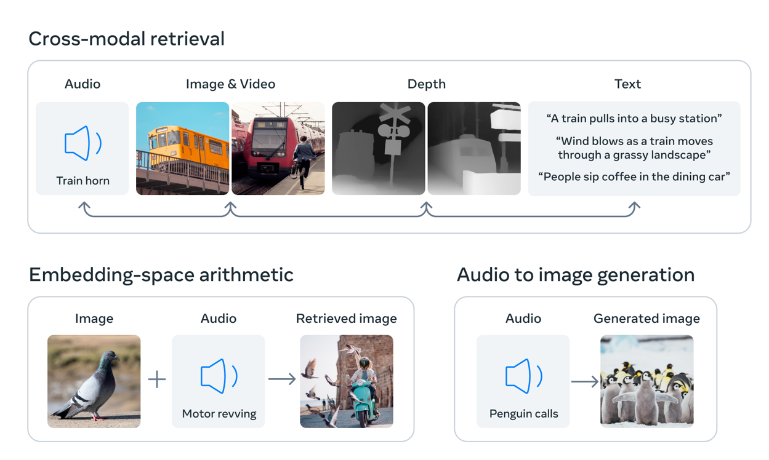
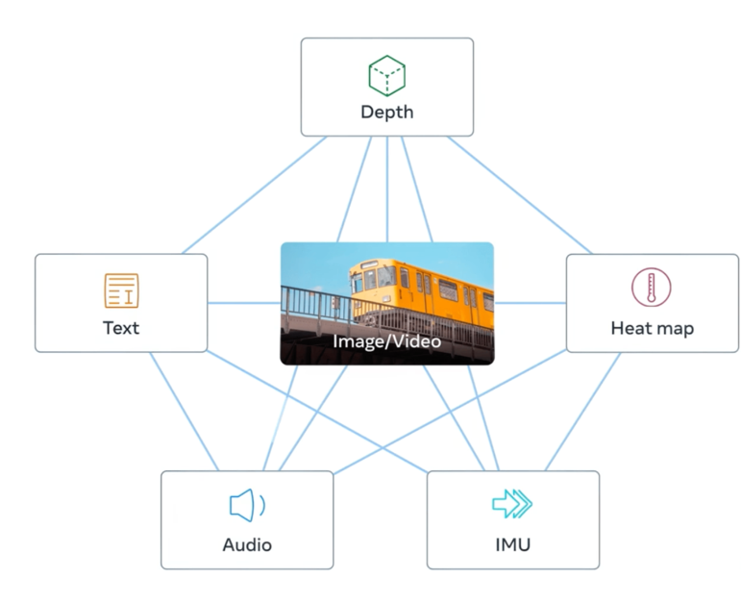

Synergizing Encoders
By aligning six modalities’ embedding into a common space, ImageBind enables cross-modal retrieval of different types of content that aren’t observed together, the addition of embeddings from different modalities to naturally compose their semantics, and audio-to-image generation by using our audio embeddings with a pretrained DALLE-2 decoder to work with CLIP text embeddings.
Resolving Modality Gaps via Similarity
ImageBind: Holistic AI learning across six modalities (2023)
Source: NVIDIA DLI (2025), Rapid Application Development with Large Language Models (LLMs), https://learn.nvidia.com/courses/course-detail?course_id=course-v1:DLI+S-FX-26+V1
Notes:
This idea of synergizing encoders can be pushed to extremes.
The ImageBind research from Meta trained encoders mapping various modalities (depth, heatmaps, IMUs, audio, text) into a joint embedding space.
They could swap out modalities, generate new data, retrieve from pools, and explore emergent properties.

Slide 54
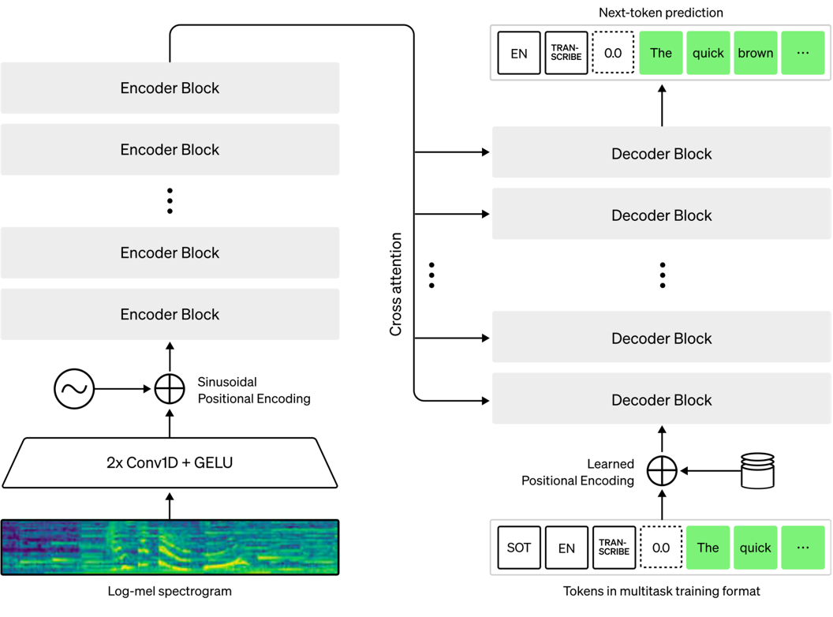
Speech-Guided
Text Generation
Text
Audio-In, Text-Out
Audio
Text
Introducing Whisper | OpenAI
Source: NVIDIA DLI (2025), Rapid Application Development with Large Language Models (LLMs), https://learn.nvidia.com/courses/course-detail?course_id=course-v1:DLI+S-FX-26+V1
Notes:
Let's step back to not only taking in interesting modalities but also creating interesting information.
Is speech-guided text generation possible? Yes—if we have transformer components for ingesting audio and creating text, we can combine them in a classic encoder-decoder architecture. This makes sense due to the clear modality gap: input audio, output text. Encoder-decoder architectures work well here—OpenAI's Whisper model is an example, using encoder plus decoder with cross-attention. You'll get to play with that in the notebook.
Similarly, for image-guided text generation, we can take an image encoder and combine it with a text decoder using cross-attention. This works well in practice, and you can experiment with it. More recently, people have been training decoder-only models for the same objective.

Slide 55
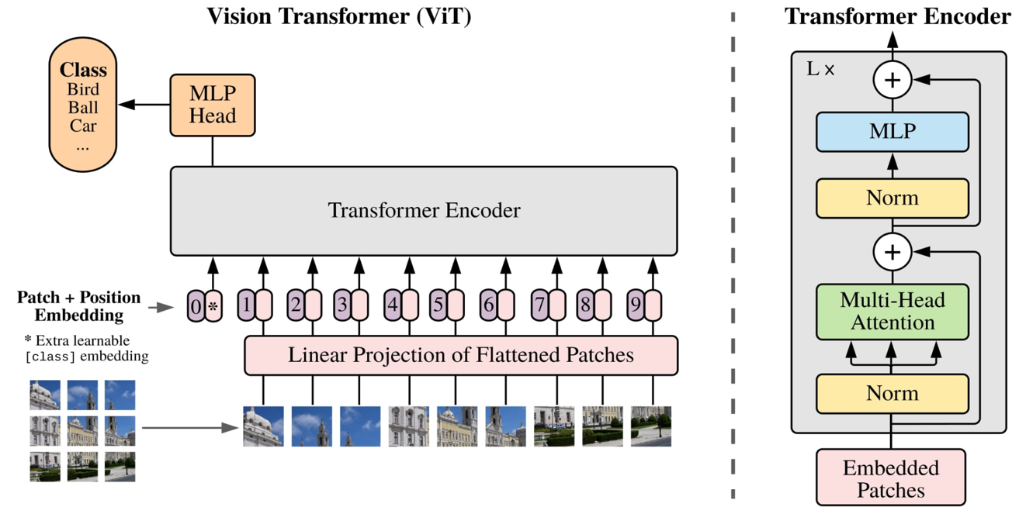
Image-Guided
Text Generation
Text
Image-In, Text-Out
Image
Text
An Image is Worth 16x16 Words: Transformers for Image Recognition at Scale (2021)
Source: NVIDIA DLI (2025), Rapid Application Development with Large Language Models (LLMs), https://learn.nvidia.com/courses/course-detail?course_id=course-v1:DLI+S-FX-26+V1
Notes:
Let's step back to not only taking in interesting modalities but also creating interesting information.
Is speech-guided text generation possible? Yes—if we have transformer components for ingesting audio and creating text, we can combine them in a classic encoder-decoder architecture. This makes sense due to the clear modality gap: input audio, output text. Encoder-decoder architectures work well here—OpenAI's Whisper model is an example, using encoder plus decoder with cross-attention. You'll get to play with that in the notebook.
Similarly, for image-guided text generation, we can take an image encoder and combine it with a text decoder using cross-attention. This works well in practice, and you can experiment with it. More recently, people have been training decoder-only models for the same objective.

Slide 56
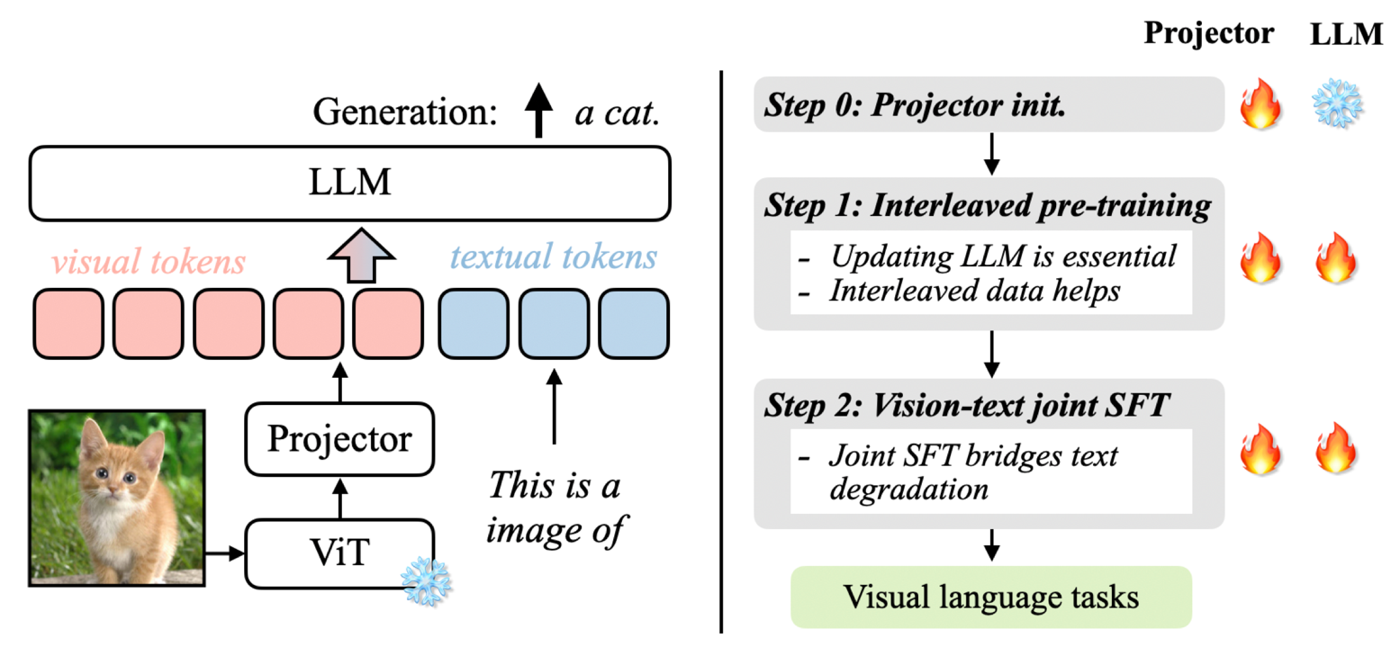
Multi-Image Guided
Text Generation
Image- Systems
VILA: On Pre-training for Visual Language Models
Source: NVIDIA DLI (2025), Rapid Application Development with Large Language Models (LLMs), https://learn.nvidia.com/courses/course-detail?course_id=course-v1:DLI+S-FX-26+V1
Notes:
Similarly, for image-guided text generation, we can take an image encoder and combine it with a text decoder using cross-attention. This works well in practice, and you can experiment with it.
More recently, people have been training decoder-only models for the same objective.
If you look into models like LLaVA, VILA, or InstructBLIP, you'll notice that models taking both text and images often put them through the same input pathway. There's a text decoder running, and you can input natural language or train an auxiliary layer to embed images into the same input space as text. This allows for rich and even multi-image prompts. Of course, this requires different training formulations, but there's no reason you can't use a one-size-fits-all decoder taking in both text and images, as long as images are projected appropriately (e.g., using a ViT).

Slide 57
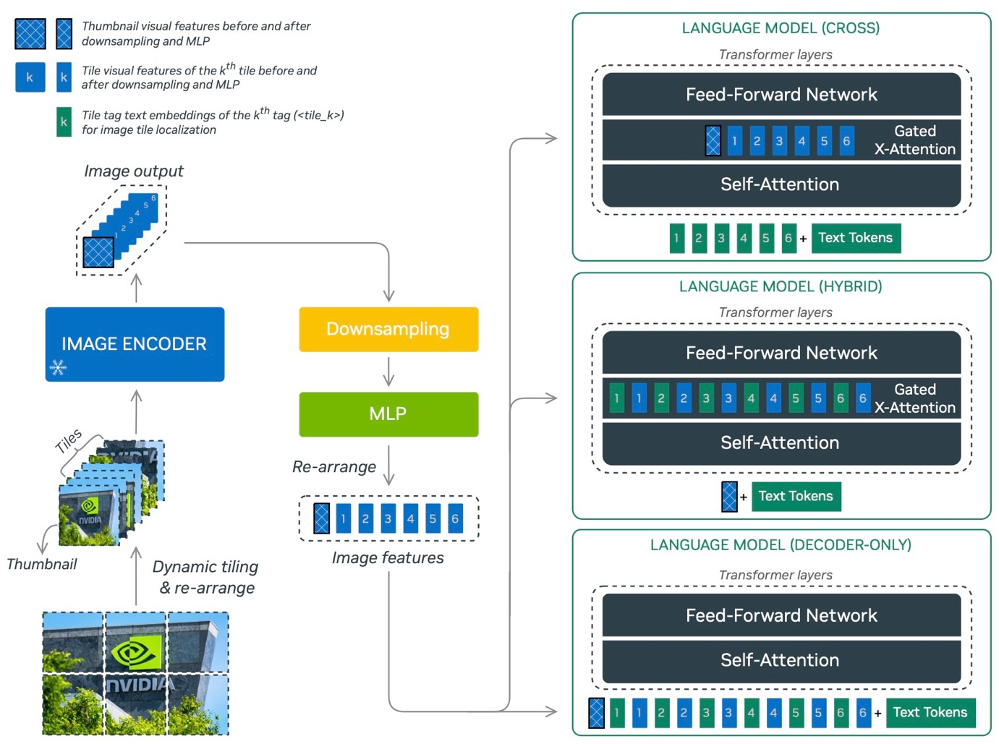
NVLM: Open Frontier-Class Multimodal LLMS (2024)
Source: NVIDIA DLI (2025), Rapid Application Development with Large Language Models (LLMs), https://learn.nvidia.com/courses/course-detail?course_id=course-v1:DLI+S-FX-26+V1
Notes:
We've solidified that both encoder-decoder and decoder-only models can be used for multimodality. Models like NVLM exemplify this with three architectures for the same task of visual-language modeling: cross-attention-based, hybrid, and decoder-only schemes. Encoding is processed at the beginning, and inputs of images and text are fed through the same pathway.
This validates that encoder-decoder vs. decoder-only is up to you, with pros and cons for each."

Slide 58
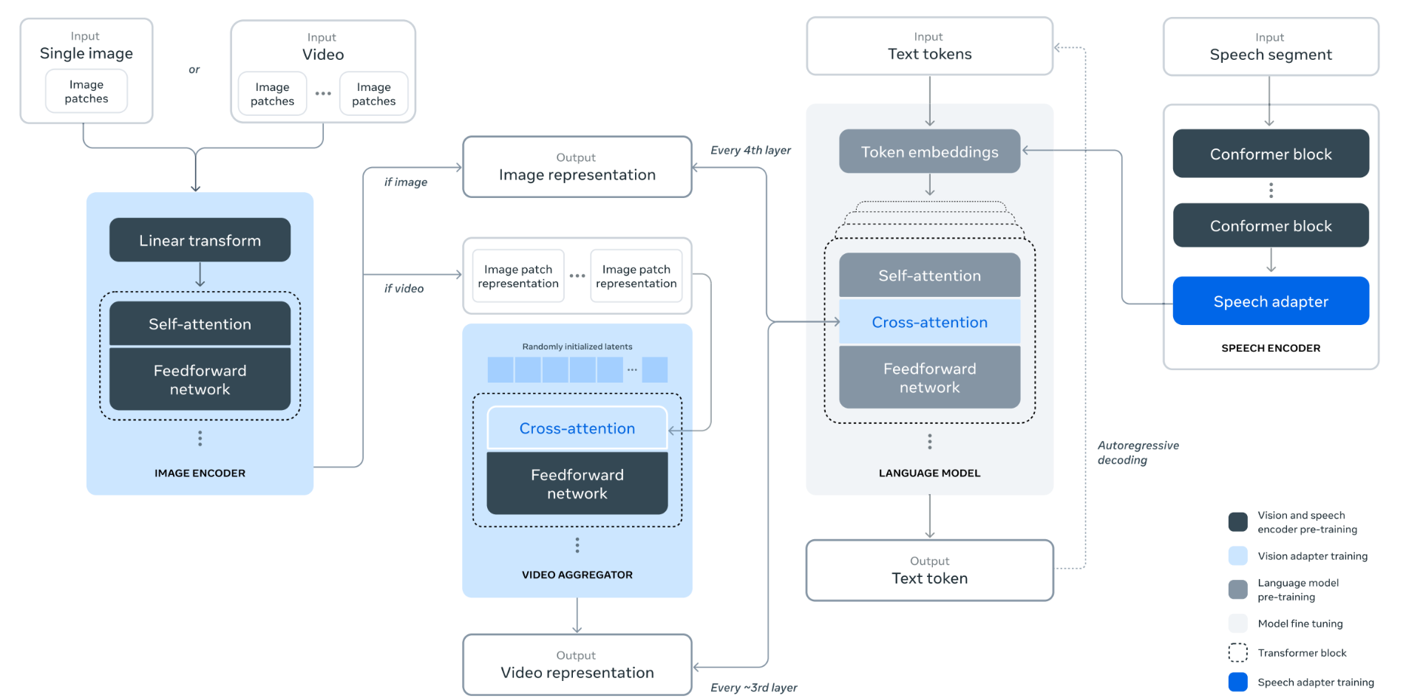
Introducing Llama 3.1: Our most capable models to date | Meta (2024)
Source: NVIDIA DLI (2025), Rapid Application Development with Large Language Models (LLMs), https://learn.nvidia.com/courses/course-detail?course_id=course-v1:DLI+S-FX-26+V1
Notes:
Going further, people have been experimenting with creating complex pathways with arbitrary numbers of encoders and decoders to build the systems they want. This can be prohibitively expensive if starting from scratch due to the need to synergize components. But if you have the resources, you can create custom pipelines for video, image, speech, etc., and combine them. Most people benefit from these architectures' emergence. Conceptually, when reading papers, this is what's happening—experimenting with different modalities, input representations, and combining them into shared fused architectures.

Slide 59
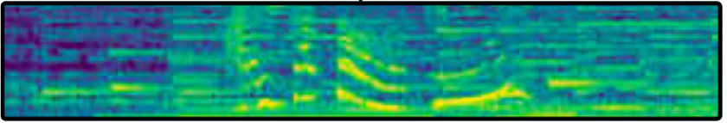

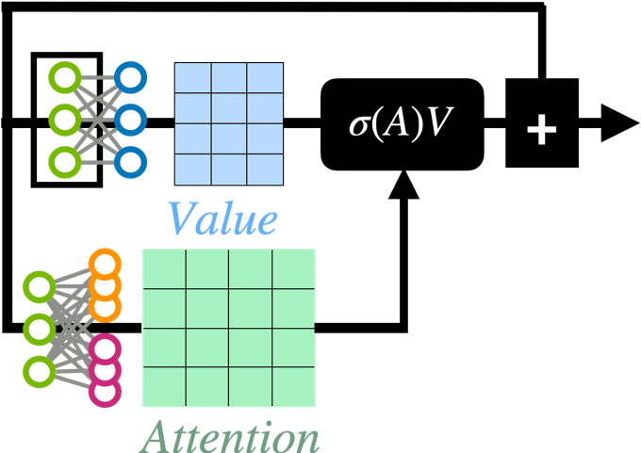

Core Transformer Benefits
When Does It Shine
Delivers Semantically-Dense Embeddings
Easy to reuse. Easy to transfer
Sequence logic and token logic
Enforce Attention-Oriented Logic
Lightweight supervisory interface
Doubles as interpretable “I care about X”
Synergize Semantically-Dense Embeddings
Link two modalities for powerful results
Good for zero-shot and training enforcement
Transformer Interpretability Beyond Attention Visualization (2021)
Source: NVIDIA DLI (2025), Rapid Application Development with Large Language Models (LLMs), https://learn.nvidia.com/courses/course-detail?course_id=course-v1:DLI+S-FX-26+V1
Notes:
To wrap up this multimodal encoding discussion, what are the core benefits of transformers? It's not just language modeling—it's sequence modeling. If we're good at modeling sequences, we can model audio and image ingestion as well. We can combine them, use fusion formulations, and train mappings from one latent representation to another.
That's what you saw with decoder-only language modeling where there's an image encoder at the beginning mapping to the decoder's input. Lots of good stuff going on.

Slide 60

Image Generation?
Can Transformers Generate Images?
Source: NVIDIA DLI (2025), Rapid Application Development with Large Language Models (LLMs), https://learn.nvidia.com/courses/course-detail?course_id=course-v1:DLI+S-FX-26+V1
Notes:
It looks like transformers can reason with a lot of data… so does that mean they can generate images? Unfortunately, sort of, but not really.
That's why, when we looked at diagrams connecting modalities, there wasn't just the transformer—there was another structure, like an autoencoder or a U-Net, which we'll discuss. Generating images isn't the transformer's strong suit on its own.
This is partly because we don't model images as sequences when generating them. Generating images as sequences is problematic—you miss high-frequency, pixel-level information. What's your sequence resolution—one pixel? Autoregressive image generation is inefficient."

Slide 61



Image Generation?
Can Transformers Generate Images?
Source: NVIDIA DLI (2025), Rapid Application Development with Large Language Models (LLMs), https://learn.nvidia.com/courses/course-detail?course_id=course-v1:DLI+S-FX-26+V1
Notes:
It looks like transformers can reason with a lot of data… so does that mean they can generate images? Unfortunately, sort of, but not really.
That's why, when we looked at diagrams connecting modalities, there wasn't just the transformer—there was another structure, like an autoencoder or a U-Net, which we'll discuss. Generating images isn't the transformer's strong suit on its own.
This is partly because we don't model images as sequences when generating them. Generating images as sequences is problematic—you miss high-frequency, pixel-level information. What's your sequence resolution—one pixel? Autoregressive image generation is inefficient."

Slide 62



Image Generation?
Can Transformers Generate Images?
Can Transformers Generate Images?
VAE in 3D | Differentiable Blog (2020)
Denoising Diffusion Implicit Models | Keras (2022)
Source: NVIDIA DLI (2025), Rapid Application Development with Large Language Models (LLMs), https://learn.nvidia.com/courses/course-detail?course_id=course-v1:DLI+S-FX-26+V1
Notes:
It looks like transformers can reason with a lot of data… so does that mean they can generate images? Unfortunately, sort of, but not really.
That's why, when we looked at diagrams connecting modalities, there wasn't just the transformer—there was another structure, like an autoencoder or a U-Net, which we'll discuss. Generating images isn't the transformer's strong suit on its own.
This is partly because we don't model images as sequences when generating them. Generating images as sequences is problematic—you miss high-frequency, pixel-level information. What's your sequence resolution—one pixel? Autoregressive image generation is inefficient."

Slide 63






Making An Autoencoder
Decoding Your Encoding
Latents
Source: NVIDIA DLI (2025), Rapid Application Development with Large Language Models (LLMs), https://learn.nvidia.com/courses/course-detail?course_id=course-v1:DLI+S-FX-26+V1
Notes:
So, what do we do instead?
We often use bottlenecking architectures where we go down in encoding and up in decoding.
Transpose convolutions can add details, maintaining spatial locality, allowing the decoder to learn how to add pixel information. This is useful for denoising or super-resolution.
U-Nets are similar to autoencoders but include skip connections between encoder and decoder layers, allowing information at different resolutions to be communicated as the decoder progresses."

Slide 64



Making A U-Net
Restyle An Image
U-Net: Convolutional Networks for Biomedical Image Segmentation (2015)
Source: NVIDIA DLI (2025), Rapid Application Development with Large Language Models (LLMs), https://learn.nvidia.com/courses/course-detail?course_id=course-v1:DLI+S-FX-26+V1
Notes:
So, what do we do instead?
We often use bottlenecking architectures where we go down in encoding and up in decoding.
Transpose convolutions can add details, maintaining spatial locality, allowing the decoder to learn how to add pixel information. This is useful for denoising or super-resolution.
U-Nets are similar to autoencoders but include skip connections between encoder and decoder layers, allowing information at different resolutions to be communicated as the decoder progresses."

Slide 65


Making A Denoiser
Data by Noising, Train/Inferending by Denoising
Noising (Algorithmic)
Denoising (Learned)
Denoising Diffusion Probabilistic Models (2020)
Source: NVIDIA DLI (2025), Rapid Application Development with Large Language Models (LLMs), https://learn.nvidia.com/courses/course-detail?course_id=course-v1:DLI+S-FX-26+V1
Notes:
Another strategy is denoising or diffusion. Instead of going from implicit representations to explicit output suddenly, we progress the representation in a natural space, like image space or compressed image space. We go from noise to slightly less noise progressively until we get a clear image. This allows details to be added progressively, enforcing spatial locality and refining high-precision information. It's an all-in-one approach for modeling complex, high-frequency details progressively.

Slide 66


Policy Networks
Where Direct, Autoregression, or Diffusion Can Work
[Spatial] Delta Prediction From Previous Position/Delta
[Sequential] Prediction From Previous Position(s)
[Diffusion] Progression of points into final structured alignment
Diffusion Policy: Visuomotor Policy Learning via Action Diffusion (2024)
Source: NVIDIA DLI (2025), Rapid Application Development with Large Language Models (LLMs), https://learn.nvidia.com/courses/course-detail?course_id=course-v1:DLI+S-FX-26+V1
Notes:
Considering that we have diffusion, autoregression, and other methods, there are situations where all are viable. For example, policy networks in robotics predict what a robot should do at a given time.
You can model the entire trajectory directly, which works but is restrictive. Alternatively, you can model it progressively, predicting the next action step by step. This can be autoregressive. In some cases, diffusion is used to initialize possible paths and progressively denoise them into the final pathway. Despite treating it less like a sequence problem, this works fine.

Slide 67
Helping Image Generation?
Can Transformers HELP Generate Images?
Source: NVIDIA DLI (2025), Rapid Application Development with Large Language Models (LLMs), https://learn.nvidia.com/courses/course-detail?course_id=course-v1:DLI+S-FX-26+V1
Notes:
That was a deep dive, but hopefully you're still with us.
We’ve confirmed that transformers might not be ideal for generating complex images.
But, can transformers help generate images? The answer is very much yes.

Slide 68





Image Generation?
Can Transformers Help Generate Images?
Can Transformers Help Generate Images?
High-Resolution Image Synthesis with Latent Diffusion Models
Source: NVIDIA DLI (2025), Rapid Application Development with Large Language Models (LLMs), https://learn.nvidia.com/courses/course-detail?course_id=course-v1:DLI+S-FX-26+V1
Notes:
This is the architecture for a common image-generating model called Stable Diffusion.
As you can see, we can guide the denoising process with textual information or other representations using attention mechanisms. We inject context into the generation, impacting the output.
There's also an additional encoder-decoder on the far left, converting raw pixel space into a smaller representation before denoising. It's engineering, but it follows the logic of giving enough information, simplifying representations, modeling important aspects, and with proper training, it works."

Slide 69

Synergized Multi-Domain Encoders
Image-In Systems
X-VILA: Cross-Modality Alignment for Large Language Model (2024)
Source: NVIDIA DLI (2025), Rapid Application Development with Large Language Models (LLMs), https://learn.nvidia.com/courses/course-detail?course_id=course-v1:DLI+S-FX-26+V1
Notes:
Pushing this further, models like X-VILA have multiple embedding and encoding strategies optimized for various modalities, creating a visual embedding highway.
Representations communicate with each other, and as long as we have something like a language model and the highway connecting information without decimating structure, we can learn effective relationships.
We can have diffusion-guided image decoding, video decoding, audio decoding, language generation—all happening with shared representations synergized together in an end-to-end deep learning pipeline."

Slide 70
Modular Modalities
Where Can The Transformer Fit?
Source: NVIDIA DLI (2025), Rapid Application Development with Large Language Models (LLMs), https://learn.nvidia.com/courses/course-detail?course_id=course-v1:DLI+S-FX-26+V1

Slide 71
References
Numa Dhamani and Maggie Engler (2024), Introduction to Generative AI, Manning
Denis Rothman (2024), Transformers for Natural Language Processing and Computer Vision: Explore Generative AI and Large Language Models with Hugging Face, ChatGPT, GPT-4V, and DALL-E 3, 3rd Edition, Packt Publishing
NVIDIA DLI (2025), Rapid Application Development with Large Language Models (LLMs), https://learn.nvidia.com/courses/course-detail?course_id=course-v1:DLI+S-FX-26+V1
NVIDIA DLI (2024), Building RAG Agents with LLMs, https://learn.nvidia.com/courses/course-detail?course_id=course-v1:DLI+S-FX-15+V1
NVIDIA DLI (2024), Generative AI with Diffusion Models, https://learn.nvidia.com/courses/course-detail?course_id=course-v1:DLI+S-FX-14+V1

