Slide 1









NVIDIA Generative AI with Diffusion Models
Part I
Generative AI Innovative Applications
1132GAIIA07
MBA, IM, NTPU (M6031) (Spring 2025)
Tue 2, 3, 4 (9:10-12:00) (B3F17)
Min-Yuh Day, Ph.D,
Professor
Institute of Information Management, National Taipei University
https://web.ntpu.edu.tw/~myday
https://meet.google.com/paj-zhhj-mya
2025-04-22

Slide 2
Syllabus
Week Date Subject/Topics
1 2025/02/18 Introduction to Generative AI Innovative Applications
2 2025/02/25 Transformers for Natural Language Processing and
Computer Vision
3 2025/03/04 Large Language Models (LLMs),
NVIDIA Building RAG Agents with LLMs Part I
4 2025/03/11 Case Study on Generative AI Innovative Applications I
5 2025/03/18 NVIDIA Building RAG Agents with LLMs Part II
6 2025/03/25 NVIDIA Building RAG Agents with LLMs Part III

Slide 3
Syllabus
Week Date Subject/Topics
7 2025/04/01 Self-Learning
8 2025/04/08 Midterm Project Report
9 2025/04/15 Generative AI for Multimodal Information Generation
10 2025/04/22 NVIDIA Generative AI with Diffusion Models Part I
11 2025/04/29 NVIDIA Generative AI with Diffusion Models Part II
12 2025/05/06 Case Study on Generative AI Innovative Applications II

Slide 4
Syllabus
Week Date Subject/Topics
13 2025/05/13 NVIDIA DLI and NVIDIA-Certified Associate (NCA)
Generative AI LLMs Certification [Invited Talk]
14 2025/05/20 NVIDIA Generative AI with Diffusion Models Part III
AI Agents and Large Multimodal Agents (LMAs)
15 2025/05/27 Final Project Report I
16 2025/06/03 Final Project Report II

Slide 5
NVIDIA
Generative AI with
Diffusion Models
Part I
[0,1,2] [3, 4] [5, 6]

Slide 6
Generative AI with Diffusion Models
Part 1: From U-Nets to Diffusion
Part 2: Denoising Diffusion Probabilistic Models
Part 3: Optimizations
Part 4: Classifier-Free Diffusion Guidance (CFG)
Part 5: CLIP (Contrastive Language-Image Pre-Training)
Part 6: Wrap-up & Assessment
https://learn.nvidia.com/courses/course-detail?course_id=course-v1:DLI+S-FX-14+V1

Slide 7
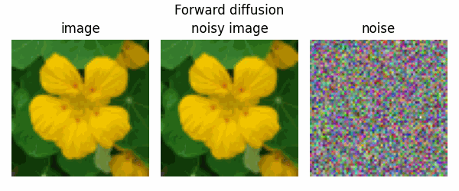
Diffusion Models
diffusion models are trained to denoise noisy images,
and can generate images by iteratively denoising pure noise.
Source: https://keras.io/examples/generative/ddim/

Slide 8
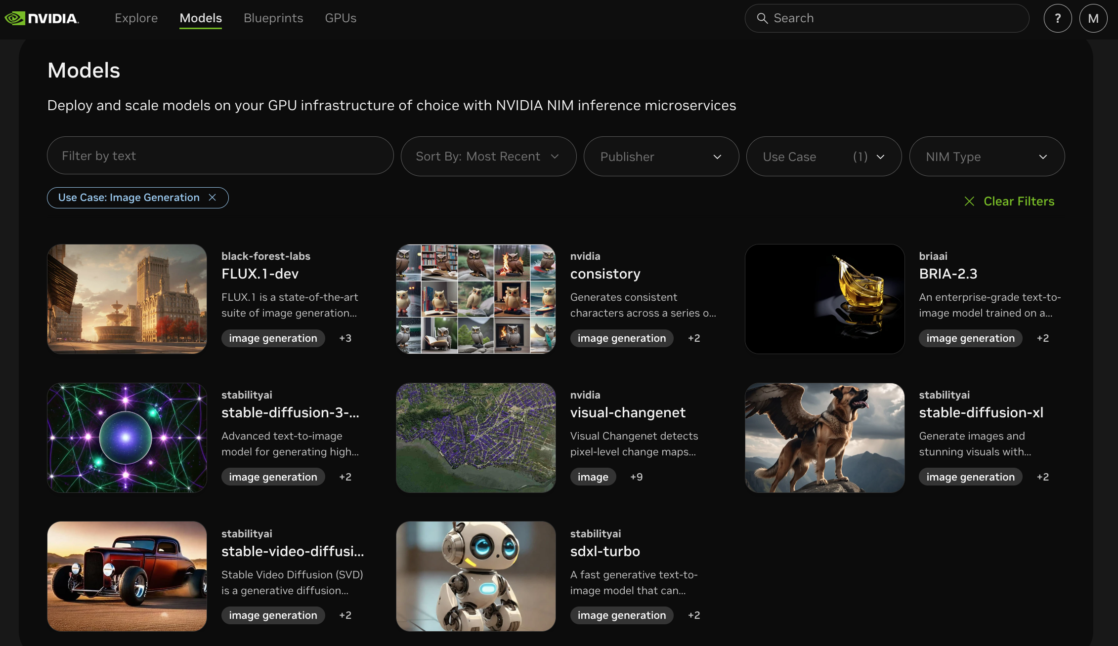
build.nvidia.com Models: Image Generation
https://build.nvidia.com/models?filters=usecase%3Ausecase_image_gen

Slide 9
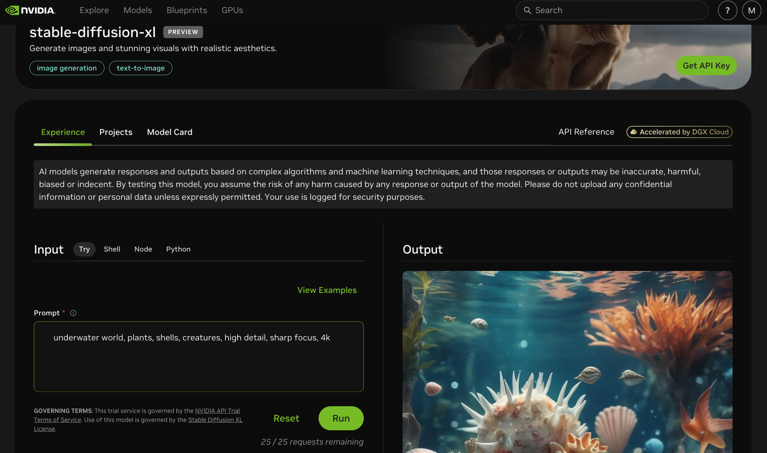
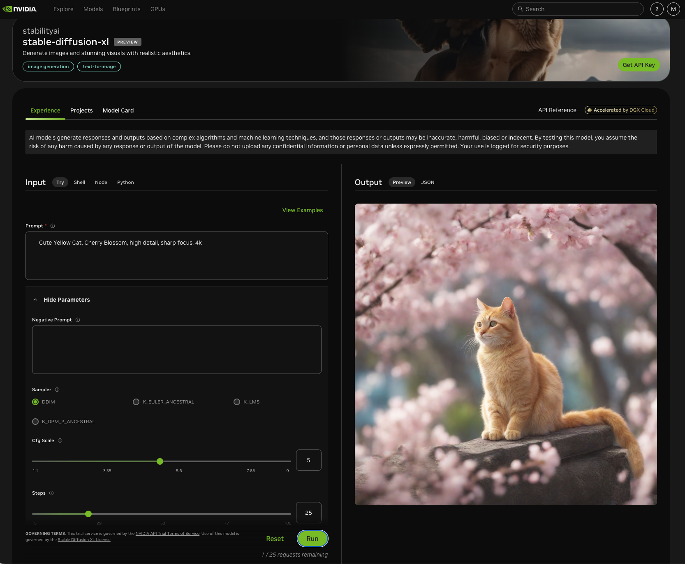
build.nvidia.com stabilityai/stable-diffusion-xl
https://build.nvidia.com/stabilityai/stable-diffusion-xl

Slide 10
build.nvidia.com stabilityai/stable-diffusion-xl
Input
Prompt
Cute Yellow Cat, Cherry Blossom, high detail, sharp focus, 4k
https://build.nvidia.com/stabilityai/stable-diffusion-xl

Slide 11


Spring 2025
Generative AI
Innovative Applications

Slide 12

https://learn.nvidia.com/certificates?id=cCFh1ZWWTvqKTq7dcKkEWw

Slide 13

https://learn.nvidia.com/certificates?id=OVmqY4cSSya0BdMQBWHxzw

Slide 14

https://learn.nvidia.com/certificates?id=ed-qOCIMQaatzU8SNUNxgw

Slide 15

https://learn.nvidia.com/certificates?id=q3oo-oBhTQKtyCCote2E-Q

Slide 16

NVIDIA
Certified Instructors
(12 from Taiwan)
https://www.nvidia.com/en-us/training/instructor-directory/search/

Slide 17
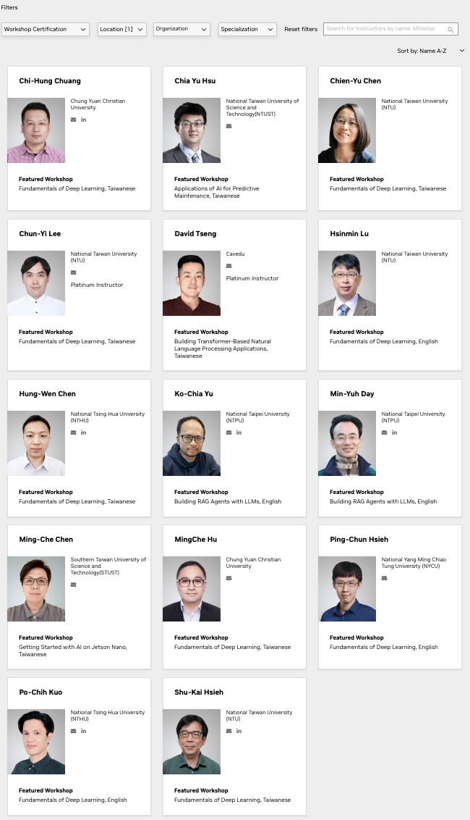
NVIDIA
Certified Instructors
(14 from Taiwan)
(2 from NTPU)(April 2025)
https://www.nvidia.com/en-us/training/instructor-directory/search/

Slide 18
NVIDIA Developer Program
NVIDIA
Deep Learning Institute (DLI)
https://developer.nvidia.com/join-nvidia-developer-program
https://learn.nvidia.com/

Slide 19
Get NVIDIA DLI Certificate
Step 1. Join NVIDIA Developer Program (Free)
https://developer.nvidia.com/join-nvidia-developer-program
Step 2. Visit NVIDIA Deep Learning Institute (DLI)
https://learn.nvidia.com/
Step 3. Enroll "Generative AI with Diffusion Models"
Self-Paced Course ($90)
https://learn.nvidia.com/courses/course-detail?course_id=course-v1:DLI+S-FX-14+V1

Slide 20

Join the NVIDIA Developer Program take one of the complimentary technical self-paced courses
(worth up to $90)
https://developer.nvidia.com/join-nvidia-developer-program

Slide 21
NVIDIA Deep Learning Institute (DLI)
Self-Paced Course
Generative AI Explained
Free
2 hours
Self-Paced Course
Getting Started With Deep Learning
Certificate available
$90
8 hours
Instructor-Led Workshop
Fundamentals of Deep Learning
Certificate available
$500
8 hours
Self-Paced Course
Introduction to Transformer-Based Natural Language Processing
Certificate available
$30
6 hours
Self-Paced Course
Building RAG Agents With LLMs
Certificate available
Free
8 hours
Instructor-Led Workshop
Building RAG Agents With LLMs
Certificate available
$500
8 hours
Self-Paced Course
Generative AI with Diffusion Models
Certificate available
$90
8 hours
Instructor-Led Workshop
Generative AI with Diffusion Models
Certificate available
$500
8 hours
https://www.nvidia.com/en-us/learn/learning-path/generative-ai-llm/

Slide 22

NVIDIA Deep Learning Institute (DLI)
Generative AI
https://learn.nvidia.com/en-us/training/find-training?q=Generative+AI

Slide 23

Generative AI with Diffusion Models
https://learn.nvidia.com/courses/course-detail?course_id=course-v1:DLI+S-FX-14+V1

Slide 24

Building RAG Agents with LLMs
https://learn.nvidia.com/courses/course-detail?course_id=course-v1:DLI+S-FX-15+V1

Slide 25

Generative AI Explained
https://learn.nvidia.com/courses/course-detail?course_id=course-v1:DLI+S-FX-15+V1

Slide 26

Introduction to Transformer-Based
Natural Language Processing
https://learn.nvidia.com/courses/course-detail?course_id=course-v1:DLI+S-FX-08+V1

Slide 27

Join the NVIDIA Developer Program take one of the complimentary technical self-paced courses (worth up to $90)
https://developer.nvidia.com/join-nvidia-developer-program

Slide 28

Join the NVIDIA Developer Program take one of the complimentary technical self-paced courses (worth up to $90)
https://developer.nvidia.com/join-nvidia-developer-program

Slide 29

Join the NVIDIA Developer Program take one of the complimentary technical self-paced courses (worth up to $90)
https://developer.nvidia.com/join-nvidia-developer-program

Slide 30

Join the NVIDIA Developer Program take one of the complimentary technical self-paced courses (worth up to $90)
https://developer.nvidia.com/join-nvidia-developer-program

Slide 31

Join the NVIDIA Developer Program take one of the complimentary technical self-paced courses (worth up to $90)
https://developer.nvidia.com/join-nvidia-developer-program

Slide 32

NVIDIA Deep Learning Institute (DLI)
https://learn.nvidia.com/my-learning

Slide 33

NVIDIA Deep Learning Institute (DLI)
https://learn.nvidia.com/my-learning

Slide 34
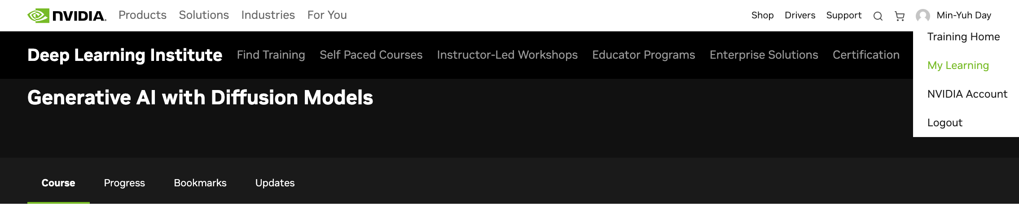
NVIDIA Deep Learning Institute (DLI)
https://learn.nvidia.com/my-learning

Slide 35

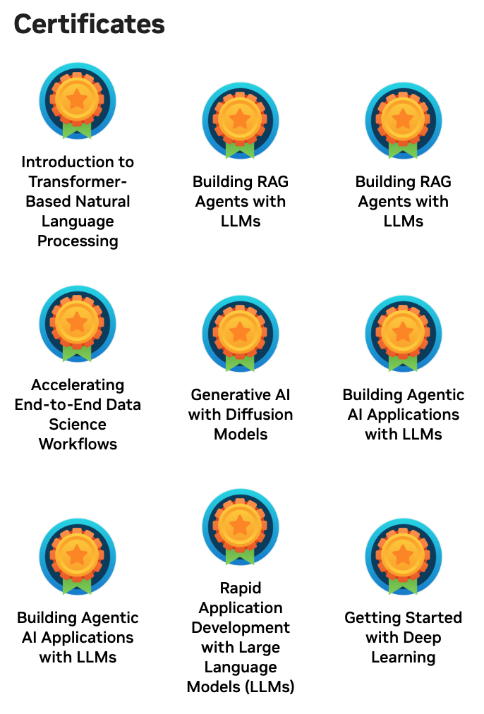
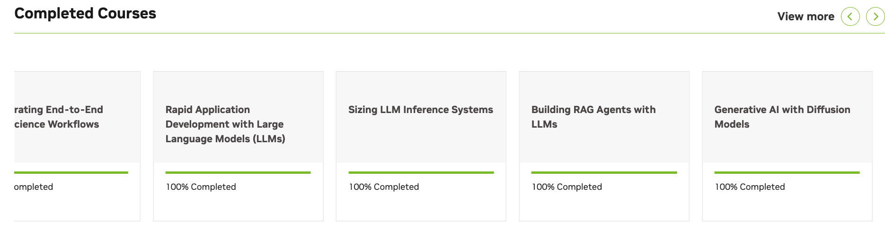
Deep Learning Institute (DLI)
https://learn.nvidia.com/my-learning

Slide 36
https://learn.nvidia.com/certificates?id=q3oo-oBhTQKtyCCote2E-Q

Slide 37
https://learn.nvidia.com/certificates?id=ed-qOCIMQaatzU8SNUNxgw

Slide 38

NVIDIA Deep Learning Institute (DLI)
https://learn.nvidia.com/en-us/training/self-paced-courses

Slide 39
Generative AI with Diffusion Models
https://learn.nvidia.com/courses/course-detail?course_id=course-v1:DLI+S-FX-14+V1

Slide 40
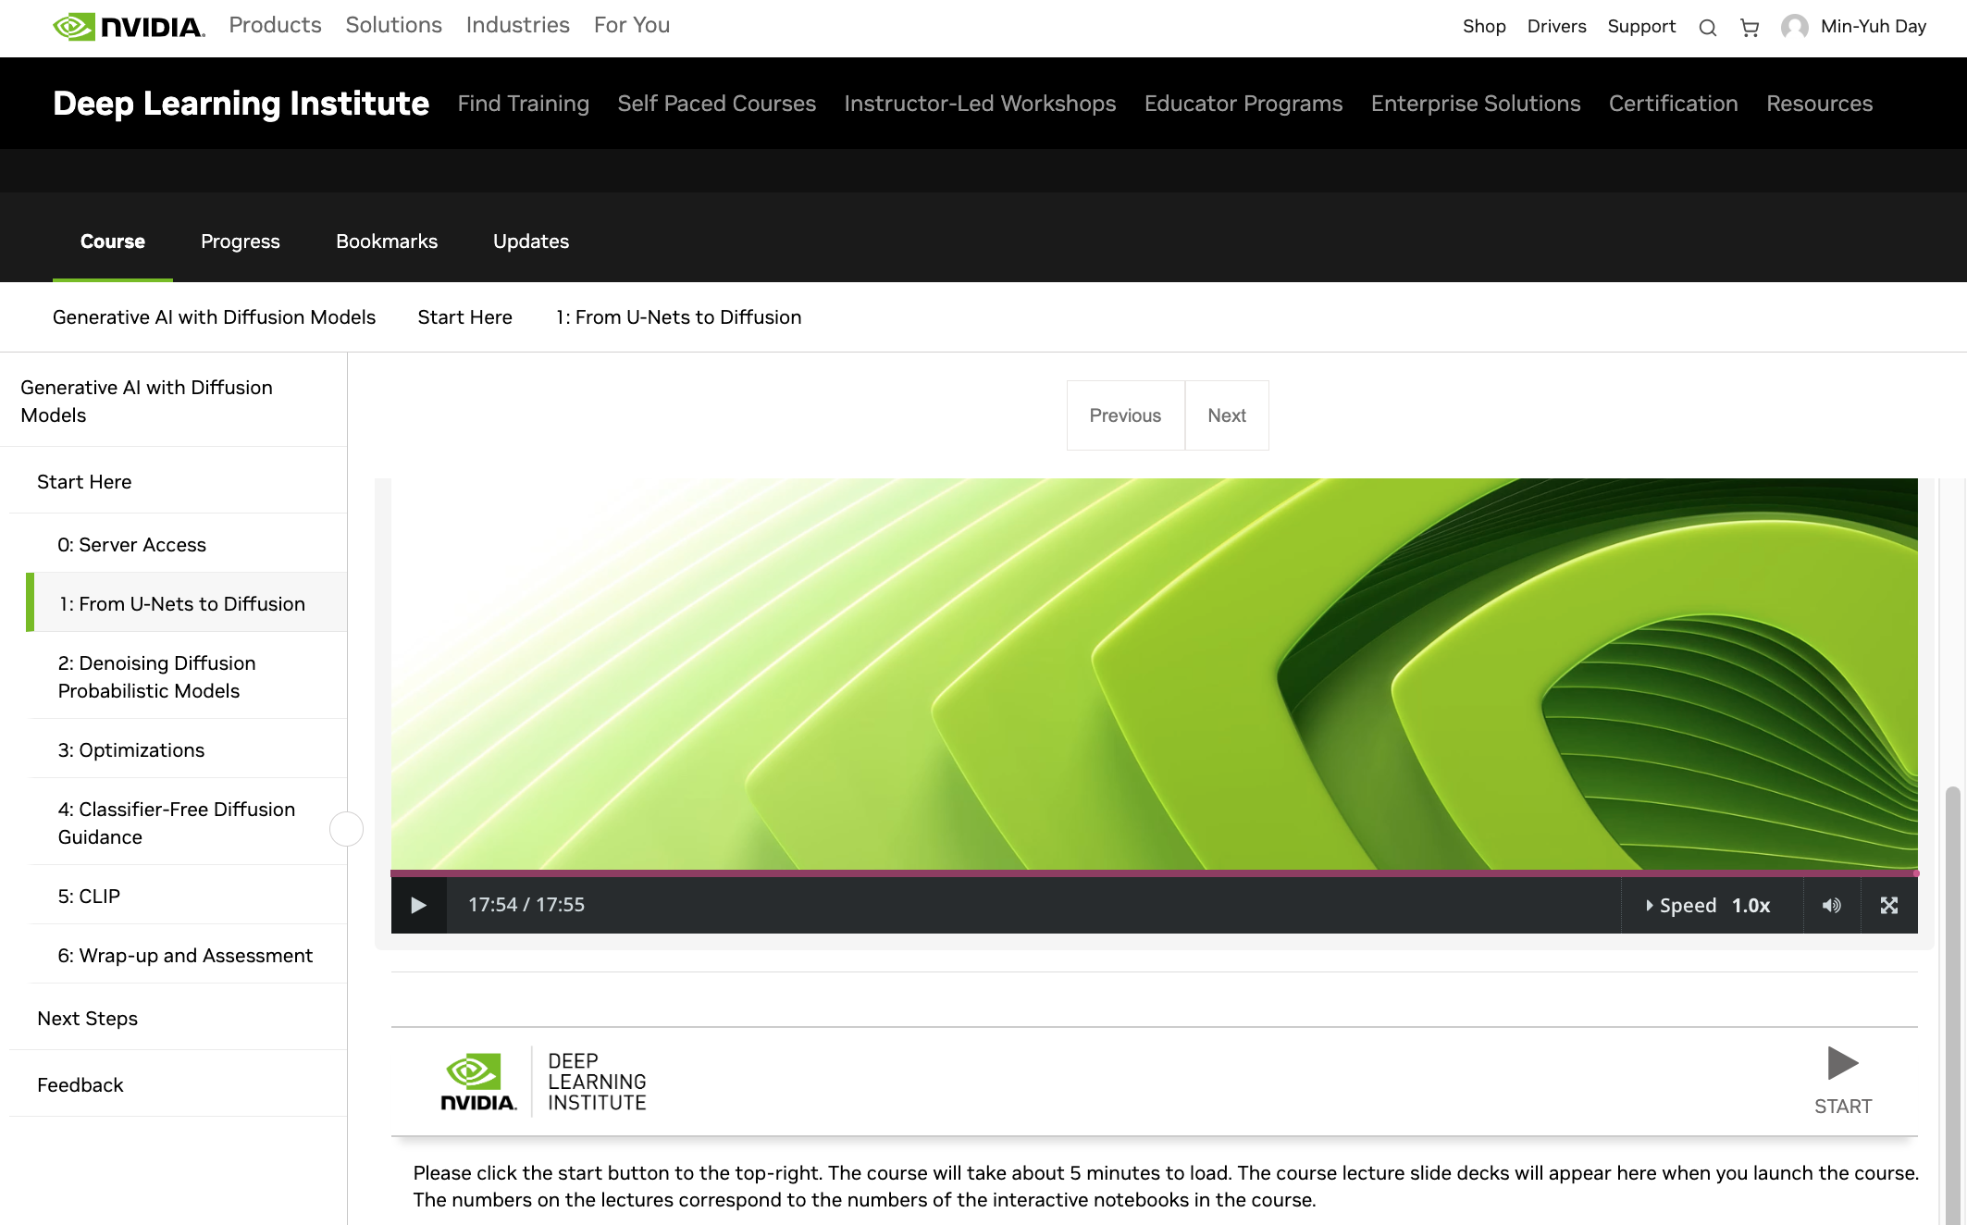
Generative AI with Diffusion Models
1: From U-Nets to Diffusion
https://learn.nvidia.com/courses/course-detail?course_id=course-v1:DLI+S-FX-14+V1

Slide 41
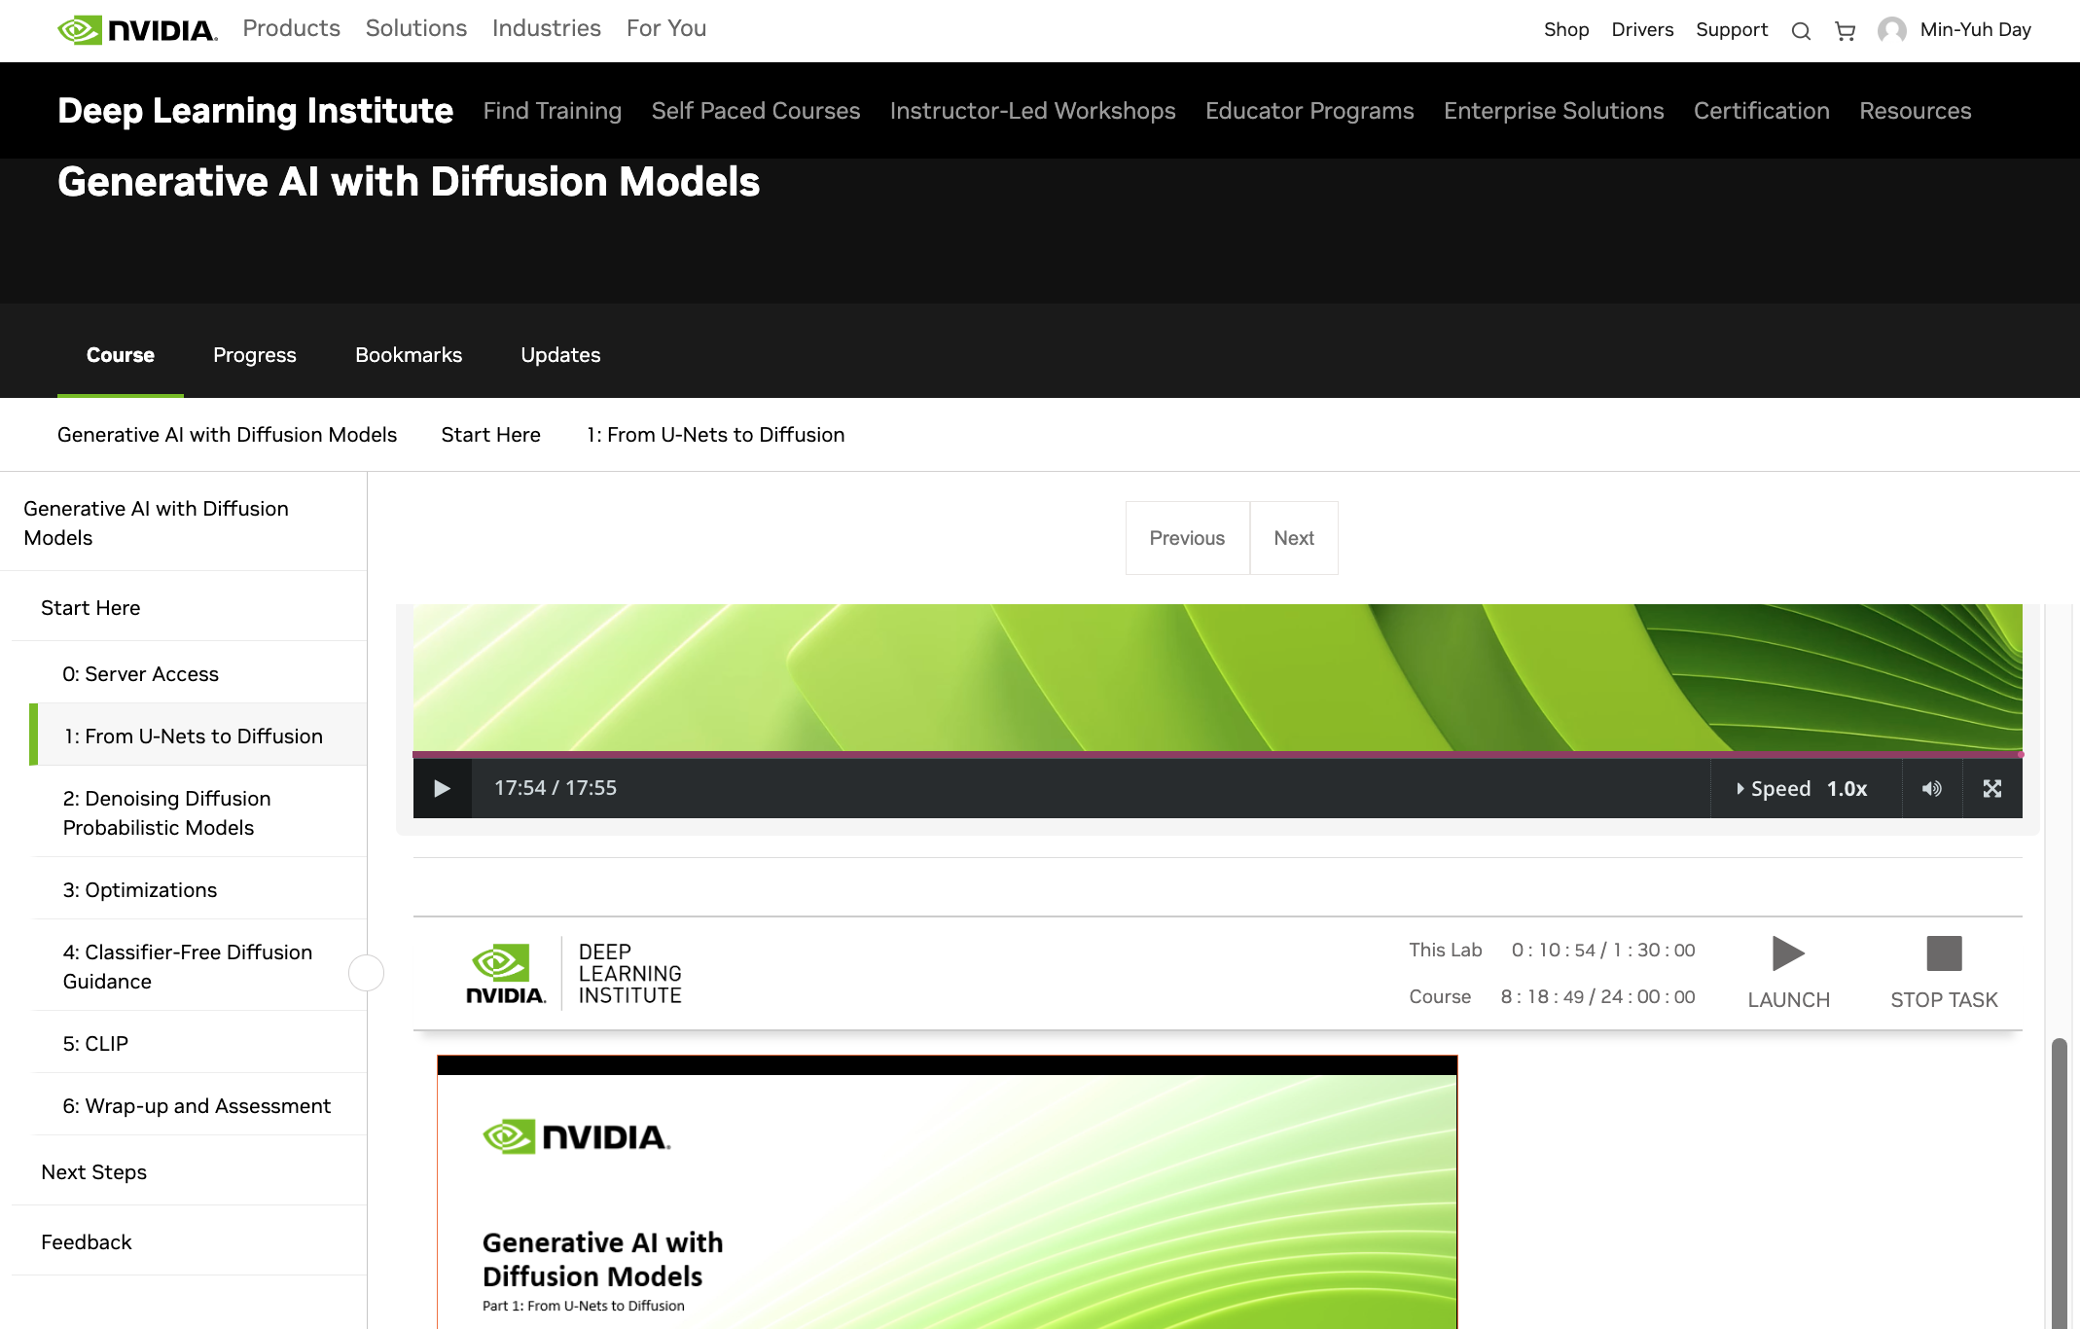
Generative AI with Diffusion Models
1: From U-Nets to Diffusion
https://learn.nvidia.com/courses/course-detail?course_id=course-v1:DLI+S-FX-14+V1

Slide 42
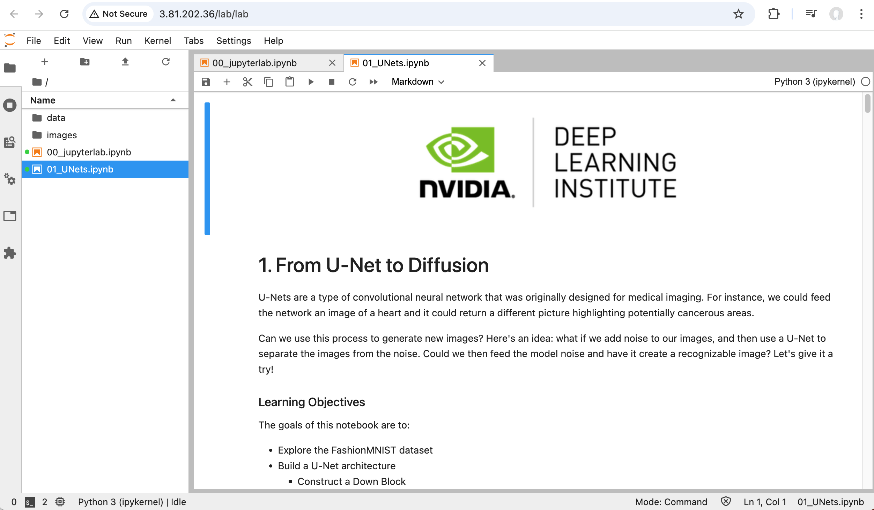
Generative AI with Diffusion Models
01_UNets.ipynb
1: From U-Nets to Diffusion
https://learn.nvidia.com/courses/course-detail?course_id=course-v1:DLI+S-FX-14+V1

Slide 43
Generative AI with
Diffusion Models
Part 1: From U-Nets to Diffusion
Source: NVIDIA DLI (2024), Generative AI with Diffusion Models, https://learn.nvidia.com/courses/course-detail?course_id=course-v1:DLI+S-FX-14+V1
43
Notes:
Hi there, and welcome to Generative AI with Diffusion Models.

Slide 44
Agenda
• | Part 1: From U-Nets to Diffusion
• | Part 2: Denoising Diffusion Probabilistic Models
• | Part 3: Optimizations
• | Part 4: Classifier Free Diffusion
• | Part 5: CLIP
• | Part 6: Wrap-up & Assessment
Source: NVIDIA DLI (2024), Generative AI with Diffusion Models, https://learn.nvidia.com/courses/course-detail?course_id=course-v1:DLI+S-FX-14+V1
44
Notes:
Today, we’ll start with the U-Net architecture and eventually work our way towards creating a full text-to-image pipeline.

Slide 45

Prerequisites
Basic familiarity with convolutional neural networks (CNNs)
Basic familiarity with a deep learning framework such as:
  PyTorch
  TensorFlow
Source: NVIDIA DLI (2024), Generative AI with Diffusion Models, https://learn.nvidia.com/courses/course-detail?course_id=course-v1:DLI+S-FX-14+V1
45
Notes:
If you are familiar with how convolutional neural networks are built, then you have what it takes to complete this course. We will be using PyTorch. If you come from a TensorFlow background, we have provided links to the relevant PyTorch documentation to help you get up to speed quickly.

Slide 46
A Brief History of Generative AI
Source: NVIDIA DLI (2024), Generative AI with Diffusion Models, https://learn.nvidia.com/courses/course-detail?course_id=course-v1:DLI+S-FX-14+V1
46
Notes:
To begin, let’s go over a brief history of Generative AI.

Slide 47
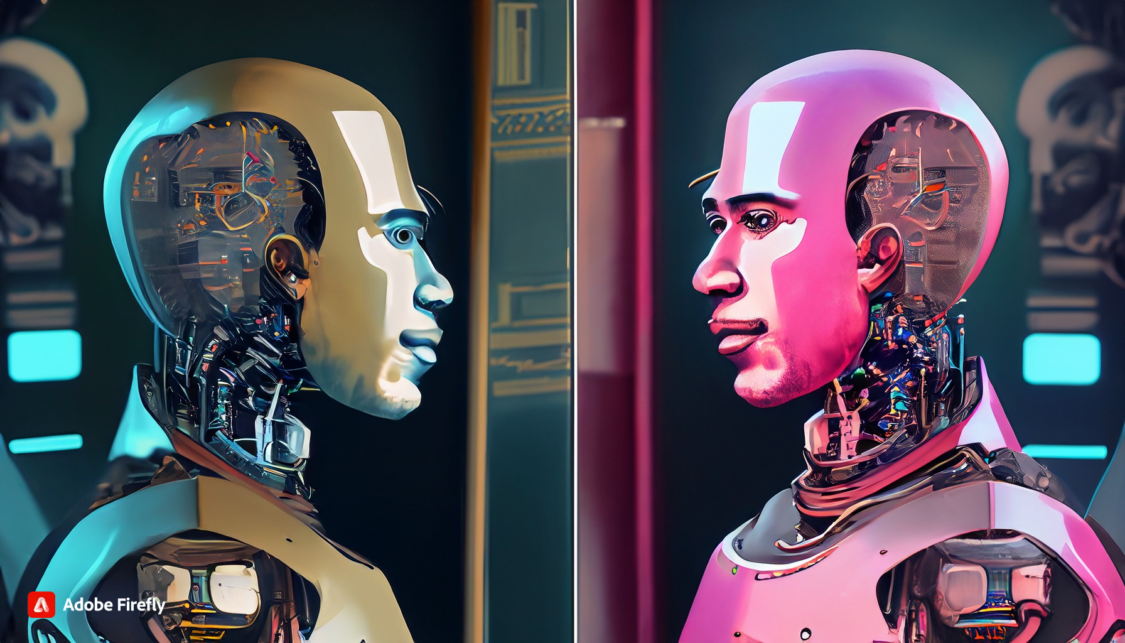
The Imitation Game
A.K.A The Turing Test
A robot looks in a mirror and the reflection is human, cyberpunk
Source: NVIDIA DLI (2024), Generative AI with Diffusion Models, https://learn.nvidia.com/courses/course-detail?course_id=course-v1:DLI+S-FX-14+V1
47
Notes:
Throughout this course, we will be showcasing images generated by Adobe Firefly. Beside each image that was generated, we provide the prompt used to create it.
In the 1950’s Alan Turing proposed a question, “Can machines think?” Since the definition of consciousness is difficult to define, he then proposed a test: could a machine imitate a human well enough that a human did not know it was a machine? He called this test, the Imitation Game.

Slide 48
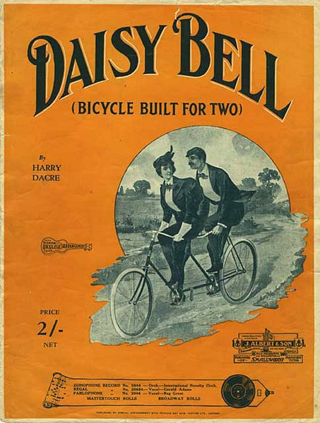
IBM 704
The First Singing Computer
Source: NVIDIA DLI (2024), Generative AI with Diffusion Models, https://learn.nvidia.com/courses/course-detail?course_id=course-v1:DLI+S-FX-14+V1
48
Notes:
About ten years later in 1961, researchers were attempting to emulate various instruments with electronic sound. Of these instruments, the human voice was one of the most difficult to replicate. The IBM 704 is considered the first machine to synthesize human singing. If you’re a fan of sci-fi and wonder why computers often sing about daisies, that’s because the first song sung by a computer is “Daisy Bell”.

Slide 49
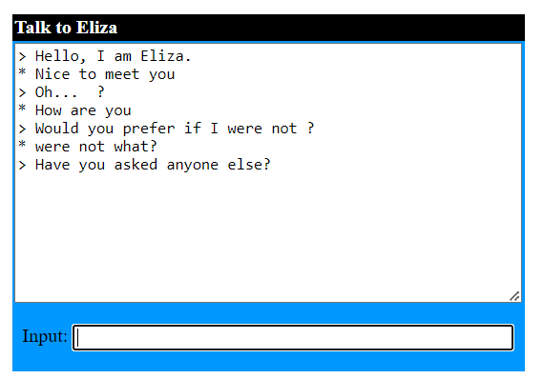
Eliza
The First Gen AI Chatbot?
Source: NVIDIA DLI (2024), Generative AI with Diffusion Models, https://learn.nvidia.com/courses/course-detail?course_id=course-v1:DLI+S-FX-14+V1
49
Notes:
Around the same time, Eliza was created to replicate the questioning of a psychologist to help people talk through their problems. It was considered one of the first great successes of natural language processing. Eliza was created by Joseph Weizenbaum , and the JavaScript version here was created by Michael Wallace and George Dunlop
If you downloaded the slides, a link to Eliza is in the instructor notes. The image here is my own conversation with Eliza.
https://psych.fullerton.edu/mbirnbaum/psych101/eliza.htm

Slide 50
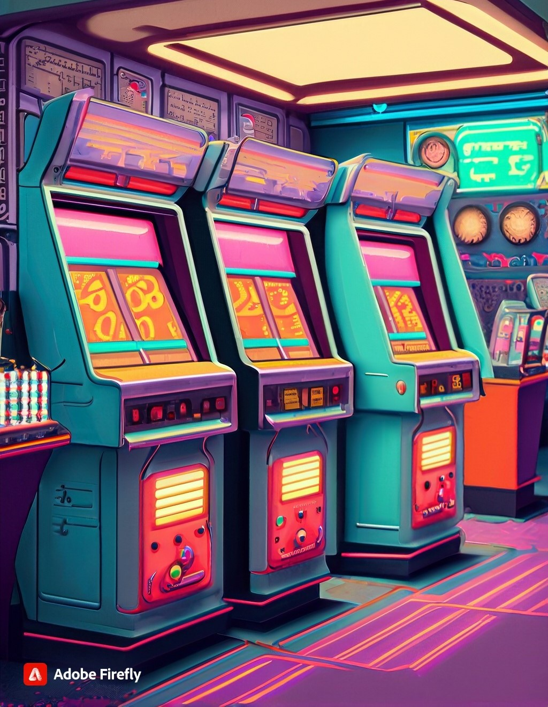
Generative AI of the 70’s, 80’s and 90s?
Electronic music
Video games graphics
Video game AI
Computer animation
Instant messaging chatbots
An 80’s arcade with lots of machines
Source: NVIDIA DLI (2024), Generative AI with Diffusion Models, https://learn.nvidia.com/courses/course-detail?course_id=course-v1:DLI+S-FX-14+V1
50
Notes:
After Eliza’s era, the generative AI field was considered dormant for many years. However, many advancements in computer technology gave rise to the AI we have today. It became easier to digitally create and store music. Videogames were a playground to test how a computer could respond to human input. Computer graphics helped speed up hand animation or gave some films a sci-fi feel. When instant messaging became a thing, smarter and smarter chatbots were developed.
Even though computers weren’t thinking in the way that Turing suggested, people increasingly interacted with computers.
What were some of your favorite technological advancements that paved the way for what we have now?

Slide 51
The Rise of Neural Networks
Source: NVIDIA DLI (2024), Generative AI with Diffusion Models, https://learn.nvidia.com/courses/course-detail?course_id=course-v1:DLI+S-FX-14+V1
51
Notes:
With the rise of Neural Networks in the past decade, we’ve seen an explosion of Generative AI applications.

Slide 52
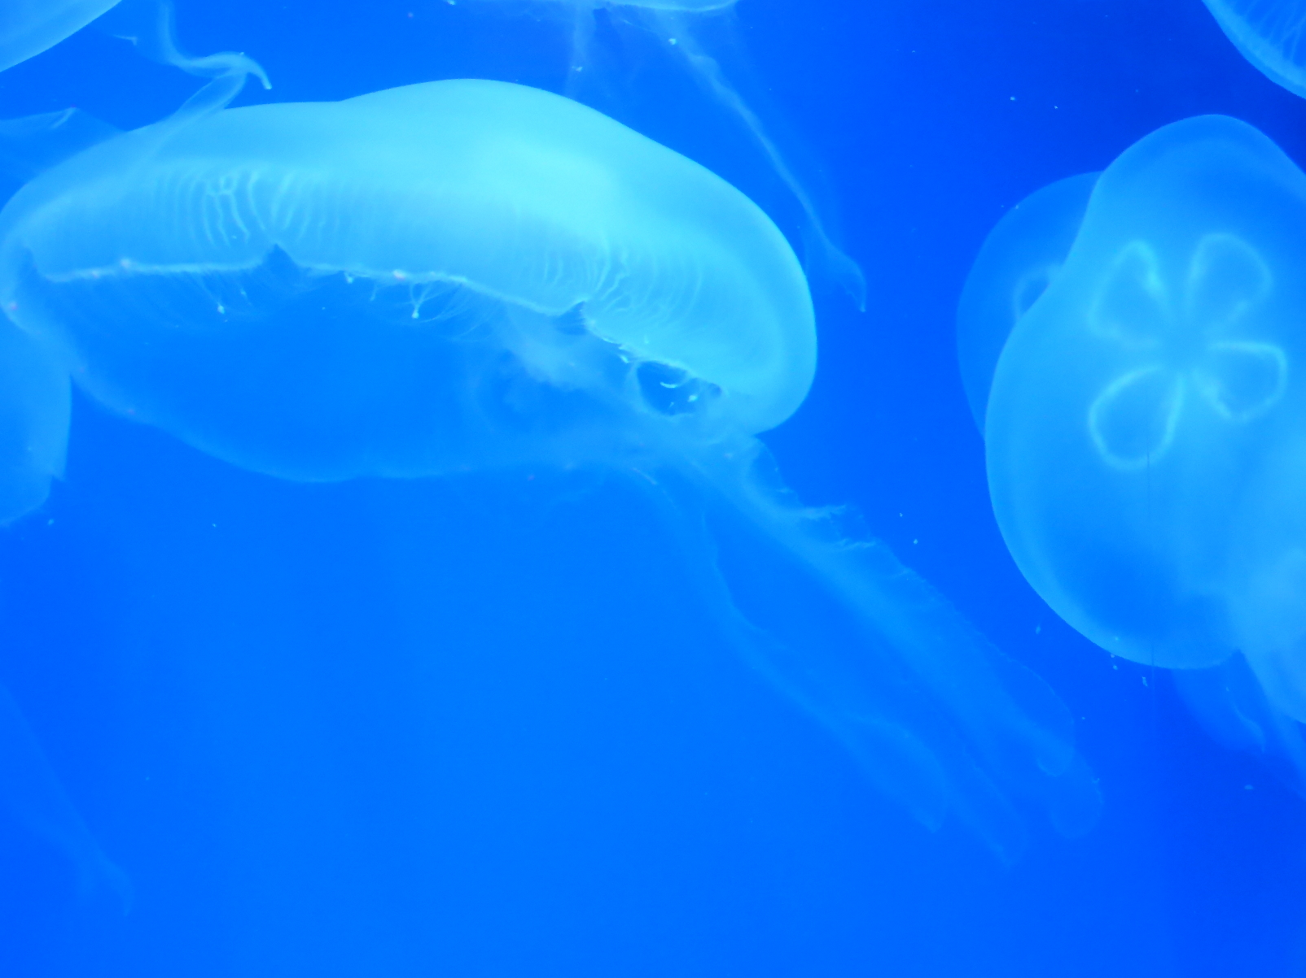
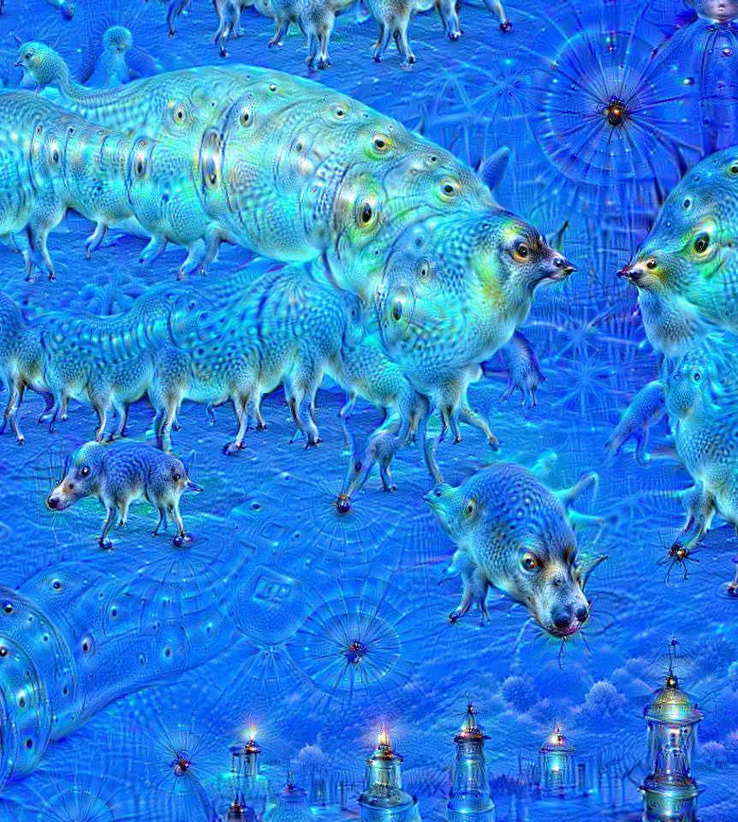
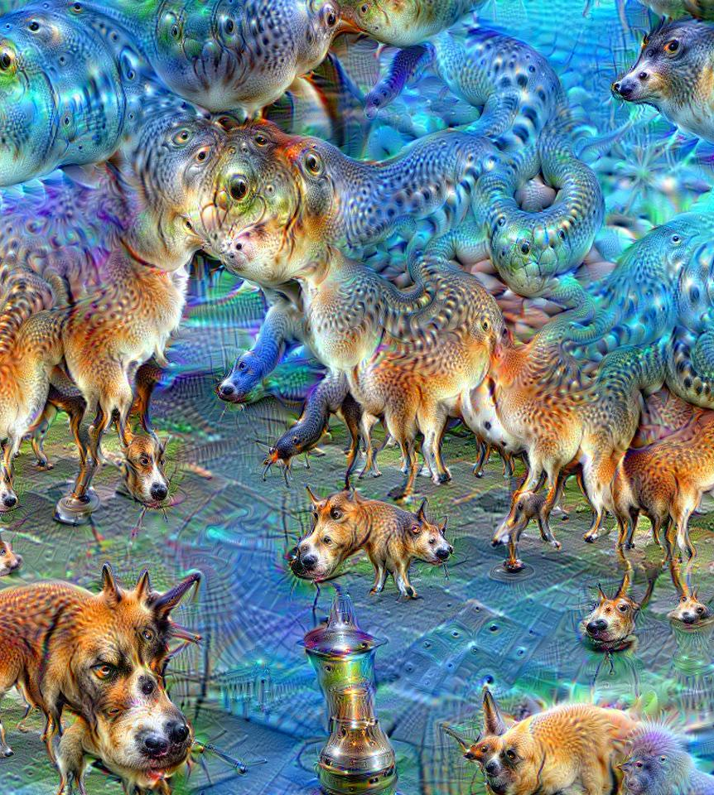
Deep Dreaming
Images by Martin Thoma
Original
10 Iterations
50 Iterations
Source: NVIDIA DLI (2024), Generative AI with Diffusion Models, https://learn.nvidia.com/courses/course-detail?course_id=course-v1:DLI+S-FX-14+V1
52
Notes:
One of the first neural network applications to create AI art was “Deep Dreaming”. A Google engineer by the name of Alexander Mordvintsev realized he could run ImageNet “backwards” on an image to exaggerate features that ImageNet learned to classify. Because at the time, ImageNet was trained with many dog and animal photos, it tended to exaggerate dogs and animals.
This is similar to the psychology phenomenon Pareidolia. Or if you’re a gamer, the Tetris Effect.
https://en.wikipedia.org/wiki/DeepDream#/media/File:Aurelia-aurita-3_(cropped).jpg
https://en.wikipedia.org/wiki/DeepDream#/media/File:Aurelia-aurita-3-0009.jpg
https://en.wikipedia.org/wiki/DeepDream#/media/File:Aurelia-aurita-3-0049.jpg

Slide 53
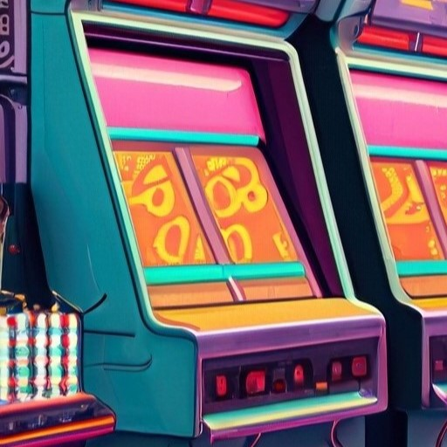
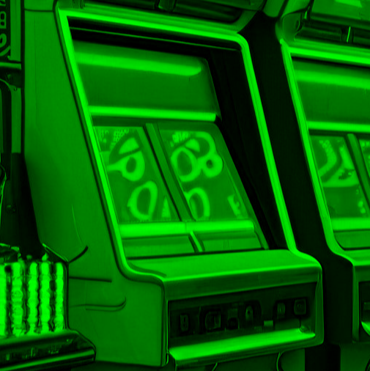
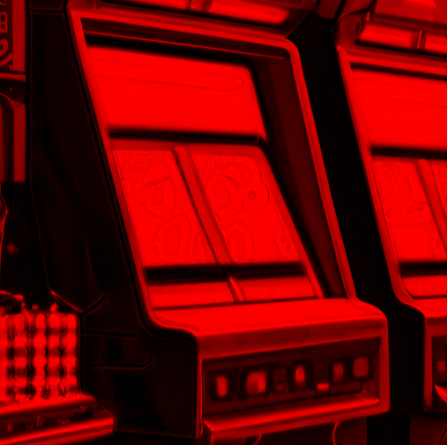
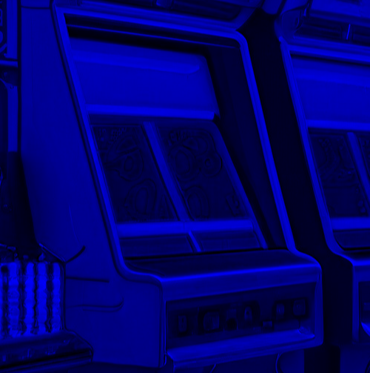
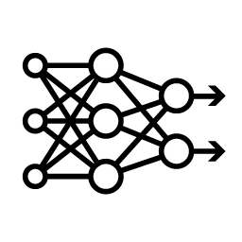


GANs
Generative Adversarial Networks
Discrimination Network
[0.1, -.2, … 0.9]
Real
Feature Map
CNN
Down
Block
CNN
Down
Block
Feature Map
Fake
DNN
Flatten
Convolution
Normalization
Activation Function
Pooling
Source: NVIDIA DLI (2024), Generative AI with Diffusion Models, https://learn.nvidia.com/courses/course-detail?course_id=course-v1:DLI+S-FX-14+V1
53
Notes:
Soon after Deep Dreaming, the GAN architecture was invented by Ian Goodfellow and colleagues.
Here’s the idea: we’re going to create two neural networks. We’ll call the first network the “Discriminator”. The Discriminator is a typical convolutional neural network that has one job: it’s trying to figure out if the image fed into it is a real photo, or a generated one. We’ll call the output of each convolution block a “Feature Map”. This is a result of the input image after it has been convolved and pooled.
If we feed it our generated arcade cabinet to the discriminator, it will flag a fake.

Slide 54
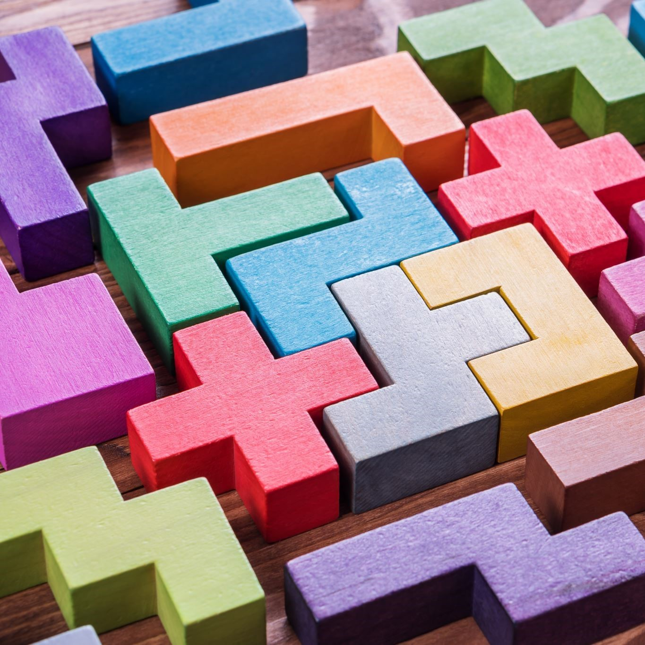
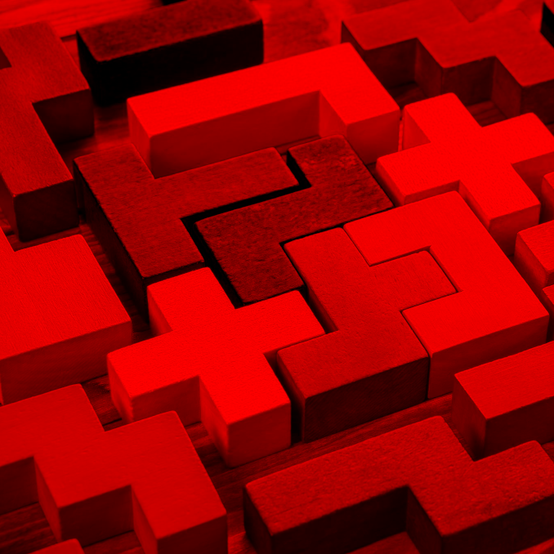
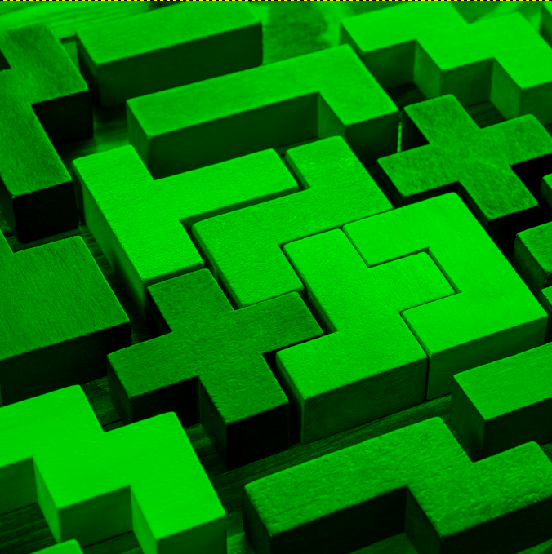
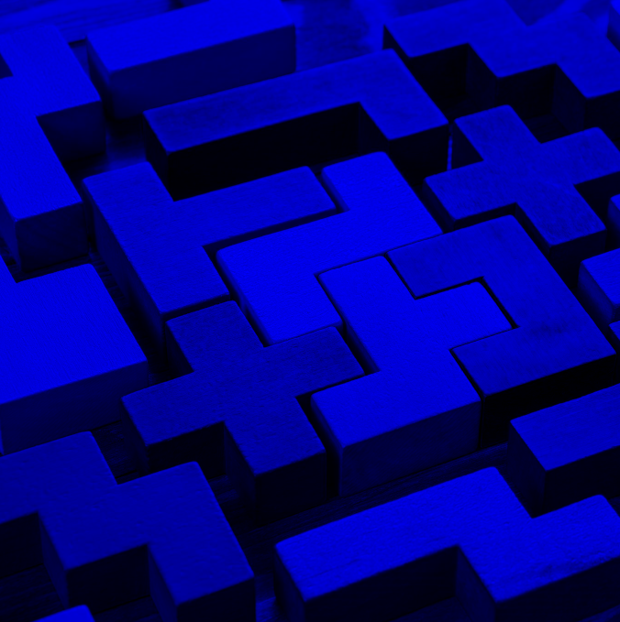
GANs
Generative Adversarial Networks
Discrimination Network
[0.1, -.2, … 0.9]
Real
Feature Map
CNN
Down
Block
CNN
Down
Block
Feature Map
Fake
DNN
Flatten
Source: NVIDIA DLI (2024), Generative AI with Diffusion Models, https://learn.nvidia.com/courses/course-detail?course_id=course-v1:DLI+S-FX-14+V1
54
Notes:
If we feed it this stock photo of pentominoes, it will flag as real.

Slide 55
GANs
Generative Adversarial Networks
Discrimination Network
[0.1, -.2, … 0.9]
Real
Feature Map
CNN
Down
Block
CNN
Down
Block
Feature Map
Fake
DNN
Flatten
Generation Network
[0.2, -.8, … -0.1]
Feature Map
Add to Discriminator Dataset
CT
Up
Block
Feature Map
CT
Up
Block
Noise Vector
Source: NVIDIA DLI (2024), Generative AI with Diffusion Models, https://learn.nvidia.com/courses/course-detail?course_id=course-v1:DLI+S-FX-14+V1
55
Notes:
The other network is the “Generator” network. It will create the fake images that the discriminator is trained on.

Slide 56
GANs
Generative Adversarial Networks
Normalization
Activation Function
Convolution
Normalization
Activation Function
Conv T
Generation Network
[0.2, -.8, … -0.1]
Feature Map
Add to Discriminator Dataset
CT
Up
Block
Feature Map
CT
Up
Block
Noise Vector
Source: NVIDIA DLI (2024), Generative AI with Diffusion Models, https://learn.nvidia.com/courses/course-detail?course_id=course-v1:DLI+S-FX-14+V1
56
Notes:
The generator architecture is similar to a convolutional neural network in reverse. It does this by doing using transposed convolution. Unlike pooling which is used to reduce the height and width of a feature map, transposed convolution expands the height and width.

Slide 57
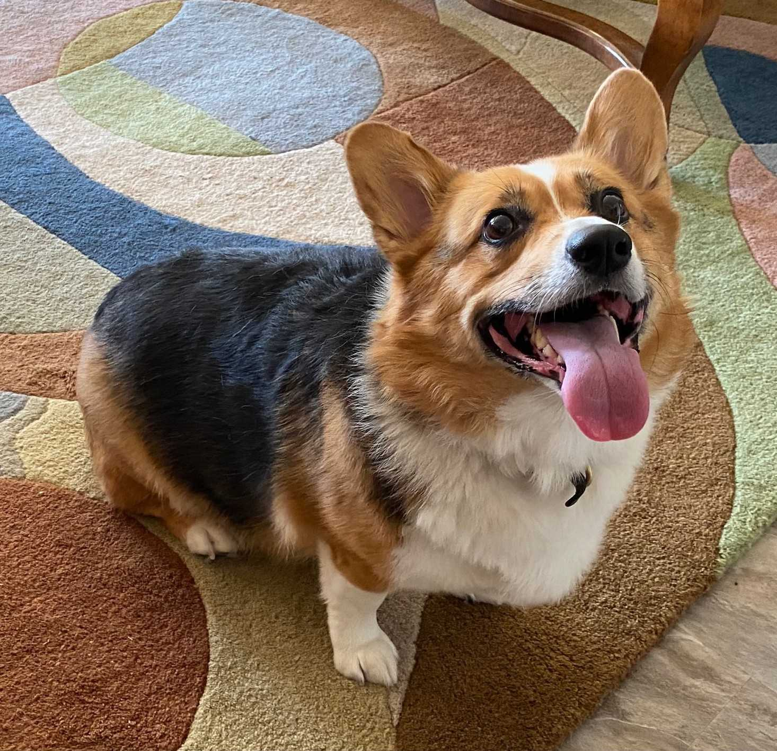

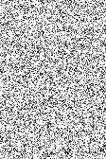
GANs
Generative Adversarial Networks
Real
Discriminator
Real Images
Fake
Generator
Noise
Fake Images
Source: NVIDIA DLI (2024), Generative AI with Diffusion Models, https://learn.nvidia.com/courses/course-detail?course_id=course-v1:DLI+S-FX-14+V1
57
Notes:
The loss function for the generator is based on how well it “fooled” the discriminator. And the loss function for the discriminator is based on how well it avoided being fooled. Hence the phrase “adversarial”.

Slide 58

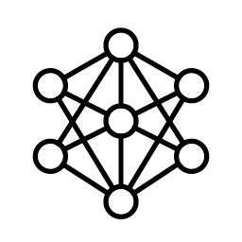
Image Segmentation
Not Corgi
Corgi
Source: NVIDIA DLI (2024), Generative AI with Diffusion Models, https://learn.nvidia.com/courses/course-detail?course_id=course-v1:DLI+S-FX-14+V1
58
Notes:
Around the same time GANs were invented, Image Segmentation was developed for medical purposes. Could we train a neural network to detect anomalies in x-rays or ultrasounds? In more recent times, image segmentation is used with autonomous vehicles to help cars categorize pedestrians, other vehicles, or street signs. The example above is a picture of a dog, and we’ve segmented the image to separate the dog from the background.

Slide 59
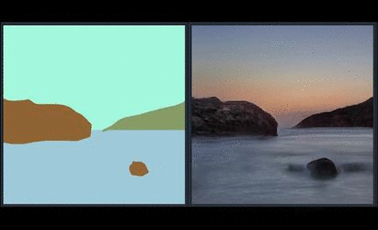
Image Segmentation + GANs
NVIDIA Spade
Source: NVIDIA DLI (2024), Generative AI with Diffusion Models, https://learn.nvidia.com/courses/course-detail?course_id=course-v1:DLI+S-FX-14+V1
59
Notes:
If we combine the two techniques together, we can train a model to create images from segmentation maps. This is NVIDIA Spade, a precursor to NVIDIA Canvas, which is available in Omniverse.
https://github.com/NVlabs/SPADE

Slide 60
U-Nets
Source: NVIDIA DLI (2024), Generative AI with Diffusion Models, https://learn.nvidia.com/courses/course-detail?course_id=course-v1:DLI+S-FX-14+V1
60
Notes:
Now that we’ve gone through history, let’s highly the star of today’s show: the U-Net.

Slide 61
GANs
Generative Adversarial Networks
Discrimination Network
[0.1, -.2, … 0.9]
Real
Feature Map
CNN
Down
Block
CNN
Down
Block
Feature Map
Fake
DNN
Flatten
Generation Network
[0.2, -.8, … -0.1]
Feature Map
Add to Discriminator Dataset
CT
Up
Block
Feature Map
CT
Up
Block
Noise Vector
Source: NVIDIA DLI (2024), Generative AI with Diffusion Models, https://learn.nvidia.com/courses/course-detail?course_id=course-v1:DLI+S-FX-14+V1
61
Notes:
So what if we want to make an image based on another image? How could we do that?
We could take our GAN architecture here and …

Slide 62
GANs U-Nets
The U shaped Autoencoder
Encoder
[0.1, -.2, … 0.9]
Feature Map
CNN
Down
Block
CNN
Down
Block
Feature Map
DNN
Latent Vector
Decoder
[0.2, -.8, … -0.1]
Feature Map
CT
Up
Block
Feature Map
CT
Up
Block
Latent Vector
Source: NVIDIA DLI (2024), Generative AI with Diffusion Models, https://learn.nvidia.com/courses/course-detail?course_id=course-v1:DLI+S-FX-14+V1
62
Notes:
Connect the output of the discriminator directly into the generator.
This would make an image autoencoder. The discriminator becomes the encoder and the discriminator becomes the decoder.

Slide 63
U-Nets
The U shaped Autoencoder
Feature Map
(Down0)
Down0
Copy
Feature Map
(Up2)
128 px
128 px
128 px
128 px
128 px
128 px
128 px
128 px
1 ch
50 ch
2 x 50 ch
3 ch
Feature Map
(Down1)
Down1 Copy
Feature Map
(Up1)
64 px
64 px
64 px
64 px
100 ch
2 x100 ch
Feature Map
(Down2)
32 px
Latent Vector
Down2 Copy
Feature Map
(Up0)
32 px
200 ch
32 px
2 x 200 ch
400 ch
32 px
200 x 32 x 32
204,800 features
Source: NVIDIA DLI (2024), Generative AI with Diffusion Models, https://learn.nvidia.com/courses/course-detail?course_id=course-v1:DLI+S-FX-14+V1
63
Notes:
The U-Net has a special architecture for an image autoencoder. After each convolution, we will have a feature map. On the encoder side, we will take each feature map after pooling, and create a copy. On the decoder side, we’ll stack each copy with the corresponding feature map. These stacked feature maps will be inputs into a transposed convolution layer.

Slide 64
Transposed Convolution
Source: NVIDIA DLI (2024), Generative AI with Diffusion Models, https://learn.nvidia.com/courses/course-detail?course_id=course-v1:DLI+S-FX-14+V1
64
Notes:
We have mentioned Transposed Convolution a few times, so let’s see what it’s doing on a technical level.

Slide 65
Transposed Convolution
Convolution Review
Kernel
Image
Output
1 | 0 | 1
0 | 1 | 0
1 | 0 | 1
.25 | .25
.25 | .25
Source: NVIDIA DLI (2024), Generative AI with Diffusion Models, https://learn.nvidia.com/courses/course-detail?course_id=course-v1:DLI+S-FX-14+V1
65
Notes:
First, let’s review convolution. We have an image and a Kernel.

Slide 66
Transposed Convolution
Convolution Review
Kernel
Image
Output
1 • .25 | 0 • .25 | 1
0 • .25 | 1 • .25 | 0
1 | 0 | 1
.25 | .25
.25 | .25
.5
Source: NVIDIA DLI (2024), Generative AI with Diffusion Models, https://learn.nvidia.com/courses/course-detail?course_id=course-v1:DLI+S-FX-14+V1
66
Notes:
And we can convolve the image by sliding the kernel along the image and multiplying the kernel values with the respective image values.

Slide 67
Transposed Convolution
Convolution Review
Kernel
Image
Output
1 | 0 • .25 | 1 • .25
0 | 1 • .25 | 0 • .25
1 | 0 | 1
.25 | .25
.25 | .25
.5 | .5
Source: NVIDIA DLI (2024), Generative AI with Diffusion Models, https://learn.nvidia.com/courses/course-detail?course_id=course-v1:DLI+S-FX-14+V1
67

Slide 68
Transposed Convolution
Convolution Review
Kernel
Image
Output
1 | 0 | 1
0 • .25 | 1 • .25 | 0
1 • .25 | 0 • .25 | 1
.25 | .25
.25 | .25
.5 | .5
.5
Source: NVIDIA DLI (2024), Generative AI with Diffusion Models, https://learn.nvidia.com/courses/course-detail?course_id=course-v1:DLI+S-FX-14+V1
68

Slide 69
Transposed Convolution
Convolution Review
Kernel
Image
Output
1 | 0 | 1
0 | 1 • .25 | 0 • .25
1 | 0 • .25 | 1 • .25
.25 | .25
.25 | .25
.5 | .5
.5 | .5
Source: NVIDIA DLI (2024), Generative AI with Diffusion Models, https://learn.nvidia.com/courses/course-detail?course_id=course-v1:DLI+S-FX-14+V1
69

Slide 70
Transposed Convolution
Image Upscaling
Kernel
Image
Output
.25 | .25
.25 | .25
1 | 0 | 1
0 | 1 | 0
1 | 0 | 1
Source: NVIDIA DLI (2024), Generative AI with Diffusion Models, https://learn.nvidia.com/courses/course-detail?course_id=course-v1:DLI+S-FX-14+V1
70
Notes:
Transposed convolution is still convolution, but we’re going to be using the convolution parameters in an opposite way.
For example, with regular convolution, when we say stride is equal to 2, we move our convolution window across the image two spaces at a time instead of 1.
With transposed convolution…

Slide 71
Transposed Convolution
Image Upscaling
Kernel
Image
Output
Stride = 2
1 | 0 | 0 | 0 | 1
0 | 0 | 0 | 0 | 0
0 | 0 | 1 | 0 | 0
0 | 0 | 0 | 0 | 0
1 | 0 | 0 | 0 | 1
.25 | .25
.25 | .25
Source: NVIDIA DLI (2024), Generative AI with Diffusion Models, https://learn.nvidia.com/courses/course-detail?course_id=course-v1:DLI+S-FX-14+V1
71
Notes:
We expand the image by adding rows and columns.

Slide 72
Transposed Convolution
Image Upscaling
Kernel
Image
Output
Stride = 2
1 • .25 | 0 • .25 | 0 | 0 | 1
0 • .25 | 0 • .25 | 0 | 0 | 0
0 | 0 | 1 | 0 | 0
0 | 0 | 0 | 0 | 0
1 | 0 | 0 | 0 | 1
.25
.25 | .25
.25 | .25
Source: NVIDIA DLI (2024), Generative AI with Diffusion Models, https://learn.nvidia.com/courses/course-detail?course_id=course-v1:DLI+S-FX-14+V1
72
Notes:
After adding these new rows and columns, we perform convolution as normal.

Slide 73
Transposed Convolution
Image Upscaling
Kernel
Image
Output
Stride = 2
1 | 0 • .25 | 0 • .25 | 0 | 1
0 | 0 • .25 | 0 • .25 | 0 | 0
0 | 0 | 1 | 0 | 0
0 | 0 | 0 | 0 | 0
1 | 0 | 0 | 0 | 1
.25 | 0
.25 | .25
.25 | .25
Source: NVIDIA DLI (2024), Generative AI with Diffusion Models, https://learn.nvidia.com/courses/course-detail?course_id=course-v1:DLI+S-FX-14+V1
73

Slide 74
Transposed Convolution
Image Upscaling
Kernel
Image
Output
Stride = 2
1 | 0 | 0 | 0 | 1
0 | 0 | 0 | 0 | 0
0 | 0 | 1 | 0 | 0
0 | 0 | 0 | 0 | 0
1 | 0 | 0 | 0 | 1
.25 | 0 | 0 | .25
0 | .25 | .25 | 0
0 | .25 | .25 | 0
.25 | 0 | 0 | .25
.25 | .25
.25 | .25
Source: NVIDIA DLI (2024), Generative AI with Diffusion Models, https://learn.nvidia.com/courses/course-detail?course_id=course-v1:DLI+S-FX-14+V1
74

Slide 75
Transposed Convolution
Stride
Image
Image
Stride = 2
Stride = 3
1 | 0 | 0 | 0 | 0 | 0 | 1
0 | 0 | 0 | 0 | 0 | 0 | 0
0 | 0 | 0 | 0 | 0 | 0 | 0
0 | 0 | 0 | 1 | 0 | 0 | 0
0 | 0 | 0 | 0 | 0 | 0 | 0
0 | 0 | 0 | 0 | 0 | 0 | 0
1 | 0 | 0 | 0 | 0 | 0 | 1
1 | 0 | 0 | 0 | 1
0 | 0 | 0 | 0 | 0
0 | 0 | 1 | 0 | 0
0 | 0 | 0 | 0 | 0
1 | 0 | 0 | 0 | 1
Source: NVIDIA DLI (2024), Generative AI with Diffusion Models, https://learn.nvidia.com/courses/course-detail?course_id=course-v1:DLI+S-FX-14+V1
75
Notes:
The stride now defines how many rows and columns we will add. With a stride of 2, we’ll add 1 row of zeros in between each image row. With a stride of 3, we’ll add 2 rows of zeros in between each image row.

Slide 76
Transposed Convolution
Padding
Image
Image
Stride = 3
Padding = 0
Stride = 3
Padding = 2
1 | 0 | 0 | 0 | 0 | 0 | 1
0 | 0 | 0 | 0 | 0 | 0 | 0
0 | 0 | 0 | 0 | 0 | 0 | 0
0 | 0 | 0 | 1 | 0 | 0 | 0
0 | 0 | 0 | 0 | 0 | 0 | 0
0 | 0 | 0 | 0 | 0 | 0 | 0
1 | 0 | 0 | 0 | 0 | 0 | 1
 |  | 0 | 0 | 0
 |  | 0 | 1 | 0
 |  | 0 | 0 | 0
Source: NVIDIA DLI (2024), Generative AI with Diffusion Models, https://learn.nvidia.com/courses/course-detail?course_id=course-v1:DLI+S-FX-14+V1
76
Notes:
In regular convolution, padding adds rows and columns around the perimeter of the input image. Any idea what padding will do here?

Slide 77
Transposed Convolution
Padding
Image
Image
Stride = 3
Padding = 0
Stride = 3
Padding = 2
1 | 0 | 0 | 0 | 0 | 0 | 1
0 | 0 | 0 | 0 | 0 | 0 | 0
0 | 0 | 0 | 0 | 0 | 0 | 0
0 | 0 | 0 | 1 | 0 | 0 | 0
0 | 0 | 0 | 0 | 0 | 0 | 0
0 | 0 | 0 | 0 | 0 | 0 | 0
1 | 0 | 0 | 0 | 0 | 0 | 1
0 | 0 | 0
0 | 1 | 0
0 | 0 | 0
Source: NVIDIA DLI (2024), Generative AI with Diffusion Models, https://learn.nvidia.com/courses/course-detail?course_id=course-v1:DLI+S-FX-14+V1
77
Notes:
With Transposed Convolution, padding removes rows and columns along the perimeter. The order of operations matters. Padding applies after expansion with stride.

Slide 78
Transposed Convolution
Out Padding
Image
Image
Image
Out Padding = 0
Out Padding = 1
Out Padding = 2
1 | 0 | 1
0 | 1 | 0
1 | 0 | 1
1 | 0 | 1 | 0
0 | 1 | 0 | 0
1 | 0 | 1 | 0
0 | 0 | 0 | 0
1 | 0 | 1 | 0 | 0
0 | 1 | 0 | 0 | 0
1 | 0 | 1 | 0 | 0
0 | 0 | 0 | 0 | 0
0 | 0 | 0 | 0 | 0
Source: NVIDIA DLI (2024), Generative AI with Diffusion Models, https://learn.nvidia.com/courses/course-detail?course_id=course-v1:DLI+S-FX-14+V1
78
Notes:
Because of the image stacking in the decoder, U-Nets are particular about dimensions. The Out Padding parameter was added to give more control over the size of the output feature map.
By the way, when used with padding, output padding brings back the dropped rows and columns by padding.
Pytorch limits out_padding such that it must be smaller the stride size.

Slide 79
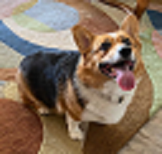

Image Resizing
Upsampling
64 px
128 px
192 px
64 px
128 px
192 px
Source: NVIDIA DLI (2024), Generative AI with Diffusion Models, https://learn.nvidia.com/courses/course-detail?course_id=course-v1:DLI+S-FX-14+V1
79
Notes:
Another alternative is to rescale the feature map and convolve on that. If you look through code repositories featuring U-Nets, you’ll often find both rescaling and transposed convolution.

Slide 80
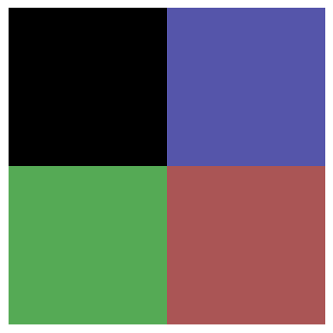
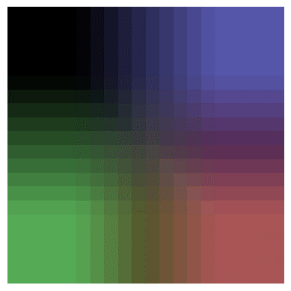
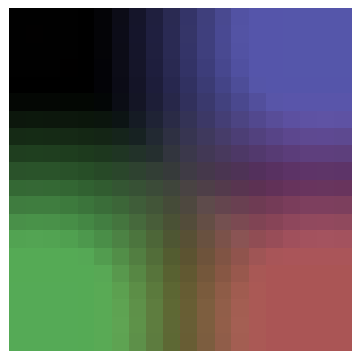
Image Resizing
Upsampling
Nearest
Bilinear
Bicubic
Source: NVIDIA DLI (2024), Generative AI with Diffusion Models, https://learn.nvidia.com/courses/course-detail?course_id=course-v1:DLI+S-FX-14+V1
80
Notes:
The original image is 2x2. Let’s try scaling up to an image 10x bigger (so 20x20).
This is the effect of different scaling options. Nearest will copy the pixel values. Bilinear and Bicubic use different formulas to interpolate between the pixel values. Notice how bilinear is more square and bicubic is more round?

Slide 81
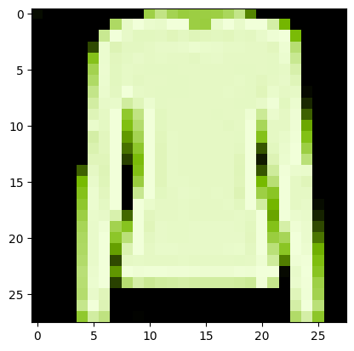
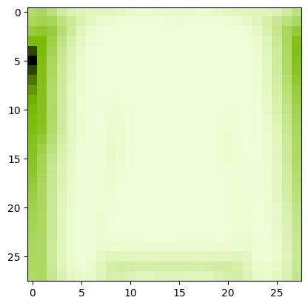
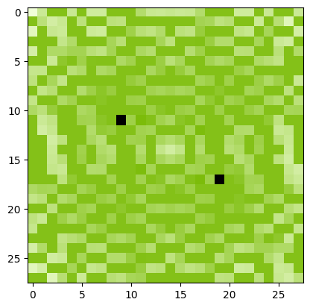
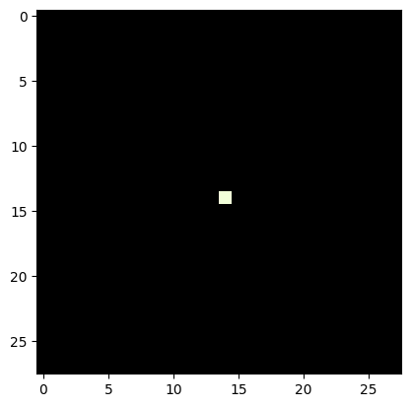
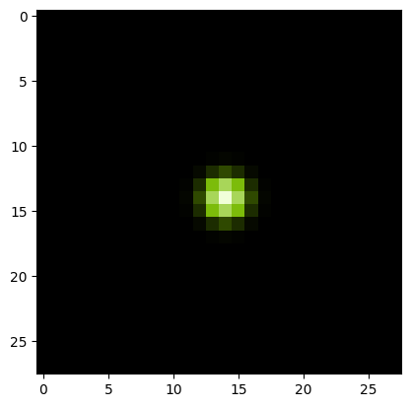
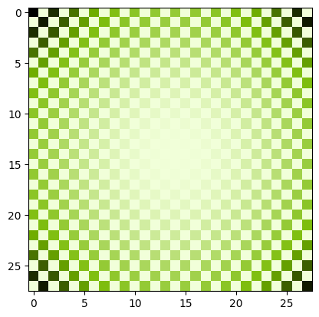
Deconvolution?
Same as Transposed Convolution?
Image
Convolved Image
FFT Convolved
Deconvolved Convolved Image
Point
Point Spread Function
FFT Point Spread Function
Source: NVIDIA DLI (2024), Generative AI with Diffusion Models, https://learn.nvidia.com/courses/course-detail?course_id=course-v1:DLI+S-FX-14+V1
81
Notes:
Sometimes, people refer to transposed convolutional layers as deconvolution layers, but if you talk to an old school computer vision expert, deconvolution means something entirely different to them.
The goal of deconvolution is to undo a previous convolution. In this case, our convolution kernel is called he point spread function. We can take the fast Fourier Transform (FFT) of both the convolved image and the point spread function. We’ll then divide the transformed convolved image by the transformed point spread function. Take the reverse Fourier transform and tada! We have an approximation of the original image.
We don’t use Fourier Transforms much with computer vision neural networks, but it is a handy trick to know when working with audio.

Slide 82
Lab
Source: NVIDIA DLI (2024), Generative AI with Diffusion Models, https://learn.nvidia.com/courses/course-detail?course_id=course-v1:DLI+S-FX-14+V1
82
Notes:
Ok, time for an experiment.

Slide 83
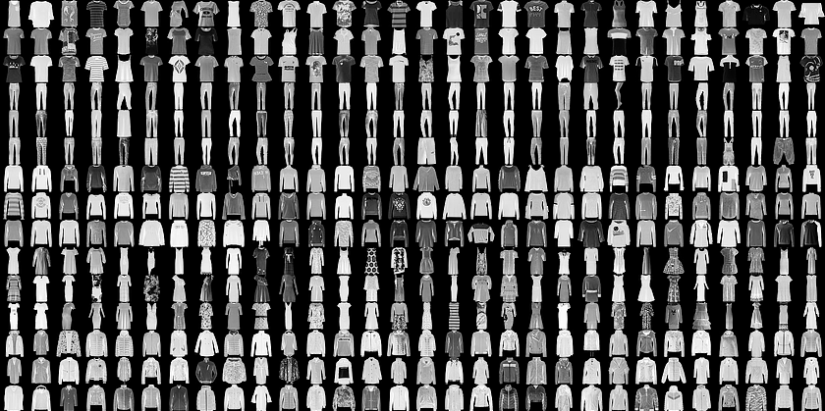
FashionMNIST
Convolutional Neural Network “Hello World”
Source: NVIDIA DLI (2024), Generative AI with Diffusion Models, https://learn.nvidia.com/courses/course-detail?course_id=course-v1:DLI+S-FX-14+V1
83
Notes:
For this experiment, we’ll be using FashionMNIST. This dataset is a bunch of small black and white images that fall into ten categories of clothing.

Slide 84
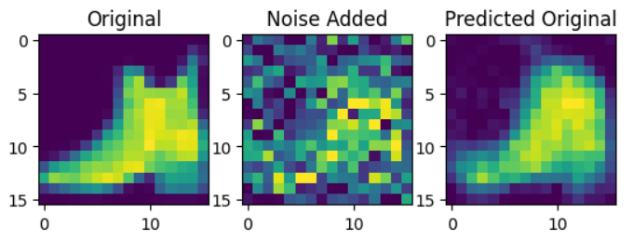
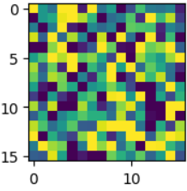

Hypothesis: Generate an image from Noise
Random Noise
Source: NVIDIA DLI (2024), Generative AI with Diffusion Models, https://learn.nvidia.com/courses/course-detail?course_id=course-v1:DLI+S-FX-14+V1
84
Notes:
We’re going to add random noise to our images, and train a neural network to remove that noise. We will be using the normal distribution to sample our noise. If you are unfamiliar with this distribution, please see the appendix for this section.
If we then give the model purely random noise, as in, it is not added to any image, what would the model generate? We’re going to find out!

Slide 85
The Experiment
Feature Map
(Down0)
Down0
Copy
Feature Map
(Up2)
16 px
16 px
16 px
16 px
16 px
16 px
16 px
16 px
1 ch
16 ch
2 x 16 ch
1 ch
Feature Map
(Down1)
Down1 Copy
Feature Map
(Up1)
8 px
8 px
8 px
8 px
32 ch
2 x 32 ch
Feature Map
(Down2)
4 px
Latent Vector
Down2 Copy
Feature Map
(Up0)
4 px
64 ch
4 px
2 x 64 ch
128 ch
4 px
64 x 32 x 32
1024 features
Source: NVIDIA DLI (2024), Generative AI with Diffusion Models, https://learn.nvidia.com/courses/course-detail?course_id=course-v1:DLI+S-FX-14+V1
85
Notes:
As mentioned before U-Nets are picky about their dimensions. So we’ve listed the dimensions of each feature map as it moves the U-Net we’ll be building.

Slide 86
Let’s get started!
1: From U-Nets to Diffusion
Source: NVIDIA DLI (2024), Generative AI with Diffusion Models, https://learn.nvidia.com/courses/course-detail?course_id=course-v1:DLI+S-FX-14+V1
86
Notes:
Ready to get building? Let’s get started!

Slide 87
Appendix:
The Normal Distribution
Source: NVIDIA DLI (2024), Generative AI with Diffusion Models, https://learn.nvidia.com/courses/course-detail?course_id=course-v1:DLI+S-FX-14+V1
87
Notes:
If you’re not familiar with the normal distribution, that’s ok! Let me share with you a secret my math teachers passed on to me. Don’t worry so much about how a formula was derived. Focus instead on why it was created. Then it will be easier to remember when and how to use it.
So let’s dive into how the normal distribution was created. I’m not sure if this story is true, but it’s amusing and makes sense, so I’m going to tell it anyway.

Slide 88
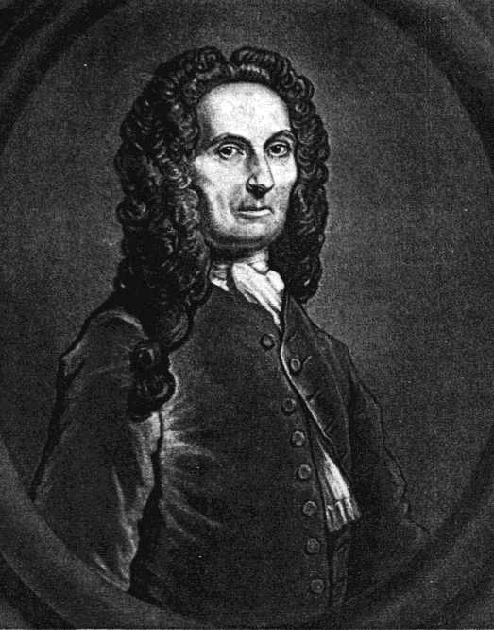

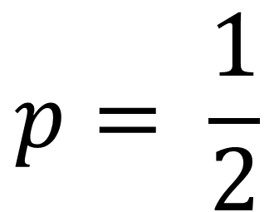
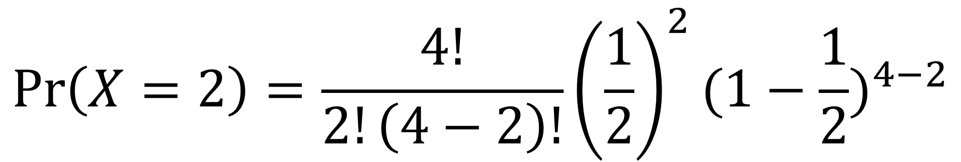
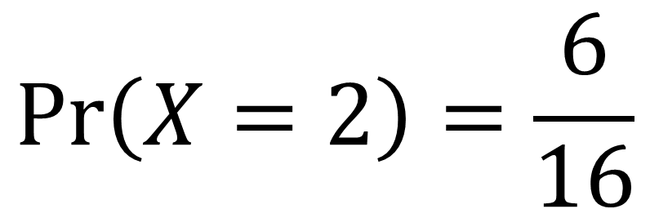
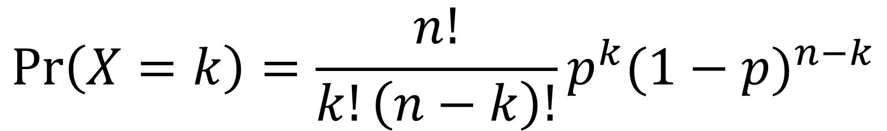
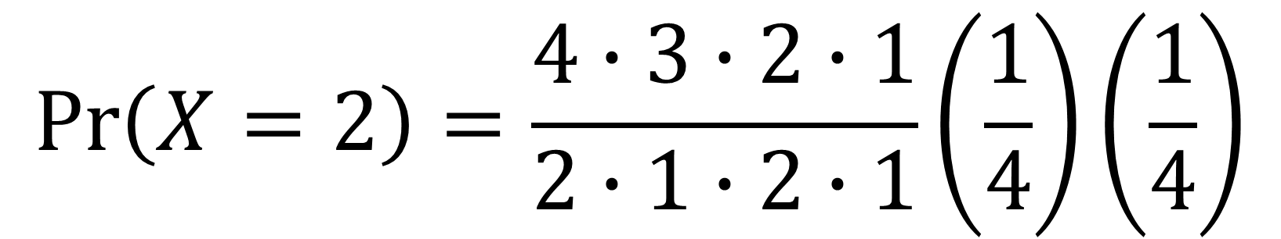



De Moivre
From Coin Flips to Bells
$$p= \frac{1}{2}$$
$$\operatorname{Pr}\left(X=k\right)=\left({n \atop k}\right)p^{k}{(1−p)}^{n−k}$$
$$n=4$$
$$\operatorname{Pr}\left(X=k\right)=\frac{n!}{k!\left(n−k\right)!}p^{k}{(1−p)}^{n−k}$$
$$k=2$$
$$\operatorname{Pr}\left(X=2\right)=\frac{4!}{2!\left(4−2\right)!}{\left(\frac{1}{2}\right)}^{2}{(1−\frac{1}{2})}^{4−2}$$
$$\operatorname{Pr}\left(X=2\right)=\frac{4∙3∙2∙1}{2∙1∙2∙1}\left(\frac{1}{4}\right)\left(\frac{1}{4}\right)$$
$$\operatorname{Pr}\left(X=2\right)=\frac{6}{16}$$
A weighted coin flipping through the air like a cartoon
Source: NVIDIA DLI (2024), Generative AI with Diffusion Models, https://learn.nvidia.com/courses/course-detail?course_id=course-v1:DLI+S-FX-14+V1
88
Notes:
De Moivre was a famous French mathematician in the late 1700’s. Gamblers found out of his mathematical prowess and kept asking him to calculate what are the chances they would get at least x heads in y coin flips.
This is a doable, but tedious calculation. Let’s say we flip 4 coins (n) and want to find out the chance we get 2 heads (k). The chance we get heads (p) is ½.
We can plug in these numbers…
And get a 6 out of 16 chance, or 37.5% chance.
But if we want to find the chance to flip at least 2 heads, we also must calculate the chance for 3 heads, and the chance for 4 heads.

Slide 89




De Moivre
From Coin Flips to Bells
Source: NVIDIA DLI (2024), Generative AI with Diffusion Models, https://learn.nvidia.com/courses/course-detail?course_id=course-v1:DLI+S-FX-14+V1
89
Notes:
This was in the 1700’s so de Moivre was doing these calculations by hand. No computers and no calculators. The process is a little annoying with a small number of coin flips, extremely annoying with large number of coin flips.
As de Moivre was working on this, he noticed when n gets large, the probability distribution takes on a bell shape. He thought if he could create an approximation, he wouldn’t have to keep doing this annoying calculation.

Slide 90




De Moivre
From Coin Flips to Bells
$$\operatorname{Pr}\left(X=k\right)=\left({n \atop k}\right)p^{k}{(1−p)}^{n−k}$$
$$\operatorname{Pr}\left(X=k\right)=\frac{n!}{k!\left(n−k\right)!}p^{k}{(1−p)}^{n−k}$$
$$n!≈ {\sqrt{2π}\left(\frac{n}{e}\right)}^{n}$$
$$\left({n \atop k}\right)p^{k}q^{n−k}≃\frac{1}{\sqrt{2πnpq}}e^{−\frac{{\left(k−np\right)}^{2}}{2npq}}$$
$N\left(x;μ,σ^{2}\right)=\frac{1}{σ\sqrt{2π}}e^{−\frac{1}{2}{\left(\frac{x−μ}{σ}\right)}^{2}}$
A weighted coin flipping through the air like a cartoon
Source: NVIDIA DLI (2024), Generative AI with Diffusion Models, https://learn.nvidia.com/courses/course-detail?course_id=course-v1:DLI+S-FX-14+V1
90
Notes:
The mathematician James Stirling knew that de Moivre was working on this and sent a letter. He discovered when n! is sufficiently large, it can be approximated with this equation.
De Moivre took that equation and derived this one. After a few other mathematicians added their input and…
The normal curve was born!
(q in this context is 1 – p. Another shorthand for tedious hand-written math)
The normal curve was modified to have two important parameters. $μ$ (mu, sounds like mew the Pokémon) is the model mean, or as it’s also called, the average. It is the center of the normal curve. Notice where $μ$ is, there is n times p in the previous equation? The number of coin flips times the probability of landing heads would give you the average number of heads for n coin flips. This relatively small term in this large equation is responsible for centering the entire distribution.
On the other hand, $σ$ (sigma) is the standard deviation and represents the spread of the distribution, or how much it is stretched or squished horizontally. Comparing it to the previous equation sigma represents $\sqrt{npq}$, but only conceptually. De Moivre was looking for a solution for a finite number of coin flips. We can think of the normal curve as an infinite number of coin flips!

Slide 91





De Moivre
From Coin Flips to Bells
$N\left(x;μ,σ^{2}\right)=\frac{1}{σ\sqrt{2π}}e^{−\frac{1}{2}{\left(\frac{x−μ}{σ}\right)}^{2}}$
$μ=mean, a.k.a. average$
$$σ=standard devaition, a.k.a. spread$$
$$z=\frac{x −μ}{σ}$$
Source: NVIDIA DLI (2024), Generative AI with Diffusion Models, https://learn.nvidia.com/courses/course-detail?course_id=course-v1:DLI+S-FX-14+V1
91
Notes:
So what would that mean?
Instead of calculating the probability, it calculates the probability density. If we flip an infinite number of coins, the chance to flip exactly 10 coins is 0. But, we can use this to calculate the chance of flipping at least 10 heads. Back in the day, people would calculate this using the integral, but it became so useful, the results were precalculated into a table of values, so you don’t need calculus to use this. These days the computer takes care of everything.
The bands highlighted in the picture are a famous set of bands. 68% of data samples from a normal distribution will within 1 standard deviation of the mean. So, when we sample our noisy pixels, 63.7% of them are going to have a value between -1 and 1. 95% of pixel values will be between -2 and 2. And 97.7% of the pixel values will be between -3 and 3.
When something is “normalized” using the normal distribution, that means it is fit to what’s called a “standard normal distribution”. That’s when the mean is 0 and the standard deviation is 1. The z score is a transformation of a variable to its corresponding standard normal distribution equivalent. For many images, the default pixel range is between 0 to 255 or 0 to 1. In the lab, we will convert the pixel values to -1 to 1 so it aligns with the noise we will be generating using the standard normal distribution.
In the lab, for each of our pixel values in our image, we will be selecting values based on this standard normal distribution, and this will be key to the theory behind diffusion models.

Slide 92
Generative AI with Diffusion Models
1: From U-Nets to Diffusion
https://learn.nvidia.com/courses/course-detail?course_id=course-v1:DLI+S-FX-14+V1

Slide 93
Generative AI with Diffusion Models
01_UNets.ipynb
1: From U-Nets to Diffusion
https://learn.nvidia.com/courses/course-detail?course_id=course-v1:DLI+S-FX-14+V1

Slide 94
Generative AI with
Diffusion Models
Part 2: Denoising Diffusion Probabilistic Models
Source: NVIDIA DLI (2024), Generative AI with Diffusion Models, https://learn.nvidia.com/courses/course-detail?course_id=course-v1:DLI+S-FX-14+V1
94

Slide 95
Agenda
• | Part 1: From U-Nets to Diffusion
• | Part 2: Denoising Diffusion Probabilistic Models
• | Part 3: Optimizations
• | Part 4: Classifier-Free Diffusion Guidance
• | Part 5: CLIP
• | Part 6: Wrap-up & Assessment
Source: NVIDIA DLI (2024), Generative AI with Diffusion Models, https://learn.nvidia.com/courses/course-detail?course_id=course-v1:DLI+S-FX-14+V1
95
Notes:
In the previous lab, we tried using a U-Net to generate a recognizable image from noise. The model tried its best, but it wasn’t quite able to make something recognizable. We’re going to try a slightly different strategy.

Slide 96
Diffusion Inspiration
Source: NVIDIA DLI (2024), Generative AI with Diffusion Models, https://learn.nvidia.com/courses/course-detail?course_id=course-v1:DLI+S-FX-14+V1
96
Notes:
Diffusion models are inspired from the real-life physical phenomenon of diffusion.

Slide 97


Thermodynamic Origins
Green food coloring dissolving in a glass of water
Source: NVIDIA DLI (2024), Generative AI with Diffusion Models, https://learn.nvidia.com/courses/course-detail?course_id=course-v1:DLI+S-FX-14+V1
97
Notes:
Have you ever added a drop of food coloring to a glass of water? The color starts out concentrated and then expands and fades until eventually, there is an even mix throughout the glass. Researchers at Stanford and Berkely attempted to model this phenomenon with a neural network.
https://arxiv.org/pdf/1503.03585.pdf

Slide 98





Thermodynamic Origins
t = 25
t = 75
t = 150
Source: NVIDIA DLI (2024), Generative AI with Diffusion Models, https://learn.nvidia.com/courses/course-detail?course_id=course-v1:DLI+S-FX-14+V1
98
Notes:
Here’s how we might model the drop of food coloring. Let’s say we measure timesteps with the variable t. When t is small, the particles are clumped together. The clump expands as t increases. We could create a neural network to predict the movement of each particle between each timestep.

Slide 99
Denoising Diffusion
Probabilistic Models
Source: NVIDIA DLI (2024), Generative AI with Diffusion Models, https://learn.nvidia.com/courses/course-detail?course_id=course-v1:DLI+S-FX-14+V1
99
Notes:
But that’s not what we’re actually going to do. We’re going to do something that’s hopefully a little more simple.
If I had to pick a theme for today, it’s that the mathematics of Diffusion can seem complex, but in practice, we’re finding that simpler approaches often give better results. So it’s ok if the math seems a little overwhelming at first. Play around with the code in the labs, see what the results are, and the intention behind these math equations will become more clear.

Slide 100


Getting Lost in the Noise
Source: NVIDIA DLI (2024), Generative AI with Diffusion Models, https://learn.nvidia.com/courses/course-detail?course_id=course-v1:DLI+S-FX-14+V1
100
Notes:
Instead of tracking the movement of particles, we’re going to be adding noise to our fashionMNIST images. In the previous lab, we only added noise to the images once. This time, we’re going to add noise over multiple timesteps. Even though it’s only going to be a little noise each time, eventually the image will look like pure noise.
https://arxiv.org/pdf/2006.11239.pdf

Slide 101
Forward Diffusion
Source: NVIDIA DLI (2024), Generative AI with Diffusion Models, https://learn.nvidia.com/courses/course-detail?course_id=course-v1:DLI+S-FX-14+V1
101
Notes:
We’re going to call the process of adding noise to our image the forward diffusion process.

Slide 102












Getting Lost in the Noise
Forward Diffusion
t = 0
t = 1
t = 2
t = 3
t = 4
t = 5
t = 6
t = 7
t = 8
t = 9
t = 10
$N\left(x;μ,σ^{2}\right)=\frac{1}{σ\sqrt{2π}}e^{−\frac{1}{2}{\left(\frac{x−μ}{σ}\right)}^{2}}$
Source: NVIDIA DLI (2024), Generative AI with Diffusion Models, https://learn.nvidia.com/courses/course-detail?course_id=course-v1:DLI+S-FX-14+V1
102
Notes:
To generate the noise, each color channel for each pixel will have a random value selected by a normal distribution like in the previous lab.

Slide 103















Getting Lost in the Noise
Forward Diffusion
$$q\left(\left.x_{1}\right|x_{0}\right)$$
$$q\left(\left.x_{2}\right|x_{1}\right)$$
$$q\left(\left.x_{3}\right|x_{2}\right)$$
$$q\left(\left.x_{4}\right|x_{3}\right)$$
$$q\left(\left.x_{5}\right|x_{4}\right)$$
$$q\left(\left.x_{6}\right|x_{5}\right)$$
$$q\left(\left.x_{7}\right|x_{6}\right)$$
$$q\left(\left.x_{8}\right|x_{7}\right)$$
$$q\left(\left.x_{9}\right|x_{8}\right)$$
$$q\left(\left.x_{10}\right|x_{9}\right)$$
t = 0
t = 1
t = 2
t = 3
t = 4
t = 5
t = 6
t = 7
t = 8
t = 9
t = 10
$$β$$
$$= \left[0.0001, 0.0023, 0.0045, 0.0067, …, 0.0200\right]$$
t = 0
t = 1
t = 3
t = 4
t = 10
$$T$$
$$=10$$
Total number of timesteps
$$α$$
$$= 1−β$$
Convenient shorthand
Source: NVIDIA DLI (2024), Generative AI with Diffusion Models, https://learn.nvidia.com/courses/course-detail?course_id=course-v1:DLI+S-FX-14+V1
103
Notes:
We’re going to call the probability distribution we use to generate a noisy image at each timestep “q”. Given an image x_t, all the possible pixel values for x_t+1 will follow a normal distribution.
How much noise we add at each timestep is called the “Beta schedule” or “Variance Schedule”.
The “variance schedule” is something we decide. There is an art to it. We should add just enough for the model to tell that a change occurred. If we add to much at once, the model will have a harder time seeing a path to a recognizable destination, just like in the previous lab.
A popular “variance schedule” is to start with a small amount of noise at the beginning so the model can better generate detail, and then add larger amounts of noise later.

Slide 104


Getting Lost in the Noise
Forward Diffusion
t = 0
t = 1
t = 2
t = 3
t = 4
t = 5
t = 6
t = 7
t = 8
t = 9
t = 10
$$q\left(x_{t} | x_{t−1}\right)=N(x_{t};\sqrt{1−β_{t}}⋅x_{t−1},β_{t}⋅I)$$
Code:
Step 1:
  noise = torch.randn_like(x_t)
  x_t = torch.sqrt(1 - B[t]) * x_t + torch.sqrt(B[t]) * noise
  Generate noise from a standard normal distribution
  Multiply result by $\sqrt{β_{t}}$
Step 2:
  Multiply image at previous step by $\sqrt{1−β_{t}}$
  Add it to the result from step 1
Source: NVIDIA DLI (2024), Generative AI with Diffusion Models, https://learn.nvidia.com/courses/course-detail?course_id=course-v1:DLI+S-FX-14+V1
104
Notes:
Here is the q probability distribution. The mu or average of the distribution will be the square root of 1 – Beta t multiplied by the corresponding pixel value of the various timestep. The variance, which is the standard deviation, will be Beta t. Hence the name, Variance Schedule.
The code looks less intense than the math equations. We’ll use the same function we used in the previous lab to generate noise by sampling from a standard normal distribution. Then, we’ll multiply the result of that by the square root of Beta t. Then we’ll multiply the value of each pixel in the image we want to modify by the square root of one minus Beta t. Finally, we add the modified image and the generated noise to create a new noisier image for the next timestep.
https://arxiv.org/pdf/1503.03585.pdf

Slide 105
Reverse Diffusion
Source: NVIDIA DLI (2024), Generative AI with Diffusion Models, https://learn.nvidia.com/courses/course-detail?course_id=course-v1:DLI+S-FX-14+V1
105

Slide 106











Getting Lost in the Noise
Reverse Diffusion
$$q\left(\left.x_{1}\right|x_{0}\right)$$
$$q\left(\left.x_{2}\right|x_{1}\right)$$
$$q\left(\left.x_{3}\right|x_{2}\right)$$
$$q\left(\left.x_{4}\right|x_{3}\right)$$
$$q\left(\left.x_{5}\right|x_{4}\right)$$
$$q\left(\left.x_{6}\right|x_{5}\right)$$
$$q\left(\left.x_{7}\right|x_{6}\right)$$
$$q\left(\left.x_{8}\right|x_{7}\right)$$
$$q\left(\left.x_{9}\right|x_{8}\right)$$
$$q\left(\left.x_{10}\right|x_{9}\right)$$
t = 0
t = 1
t = 2
t = 3
t = 4
t = 5
t = 6
t = 7
t = 8
t = 9
t = 10
$$p\left(\left.x_{0}\right|x_{1}\right)$$
$$p\left(\left.x_{1}\right|x_{2}\right)$$
$$p\left(\left.x_{2}\right|x_{3}\right)$$
$$p\left(\left.x_{3}\right|x_{4}\right)$$
$$p\left(\left.x_{4}\right|x_{5}\right)$$
$$p\left(\left.x_{5}\right|x_{6}\right)$$
$$p\left(\left.x_{6}\right|x_{7}\right)$$
$$p\left(\left.x_{7}\right|x_{8}\right)$$
$$p\left(\left.x_{8}\right|x_{9}\right)$$
$$p\left(\left.x_{9}\right|x_{10}\right)$$
$$p\left(x_{t−1} | x_{t}\right)=N(x_{t−1};μ_{θ}\left(x_{t},t\right),Σ_{θ}\left(x_{t},t\right))$$
Difficult to calculate
Approximate average used to create $x_{t}$
Source: NVIDIA DLI (2024), Generative AI with Diffusion Models, https://learn.nvidia.com/courses/course-detail?course_id=course-v1:DLI+S-FX-14+V1
106
Notes:
Ok, so now we have a way to add noise to our images, but we’ll need to be able to remove noise if we want to generate images. Let’s call this hypothetical distribution p.
There are practically infinite ways noise can be added at timestep t. ut represents what the average image would be at timestep t-1. $Σ_{θ}$ represents some model of noise at the previous timestep. The trouble is… it’s challenging to know what that model is exactly. This is what our neural network will attempt to emulate.

Slide 107

Getting Lost in the Noise
Reverse Diffusion
t = 0
t = 1
t = 2
t = 3
t = 4
t = 5
t = 6
t = 7
t = 8
t = 9
t = 10
Can generate “evidence” of $p$ using $q$
Source: NVIDIA DLI (2024), Generative AI with Diffusion Models, https://learn.nvidia.com/courses/course-detail?course_id=course-v1:DLI+S-FX-14+V1
107
Notes:
We may not know what this p distribution is, but we know it exists. Whenever we use the q distribution to add noise to an image at time t to create a noisy image at time t+1, the image at time t is a sample of the p distribution. We will call the original image at time t “evidence” that p exists.

Slide 108

Getting Lost in the Noise
Reverse Diffusion
$$q\left(\left.x_{1}\right|x_{0}\right)$$
$$q\left(\left.x_{2}\right|x_{1}\right)$$
$$q\left(\left.x_{3}\right|x_{2}\right)$$
$$q\left(\left.x_{4}\right|x_{3}\right)$$
$$q\left(\left.x_{5}\right|x_{4}\right)$$
$$q\left(\left.x_{6}\right|x_{5}\right)$$
$$q\left(\left.x_{7}\right|x_{6}\right)$$
$$q\left(\left.x_{8}\right|x_{7}\right)$$
$$q\left(\left.x_{9}\right|x_{8}\right)$$
$$q\left(\left.x_{10}\right|x_{9}\right)$$
t = 0
t = 1
t = 2
t = 3
t = 4
t = 5
t = 6
t = 7
t = 8
t = 9
t = 10
$$p\left(\left.x_{0}\right|x_{1}\right)$$
$$p\left(\left.x_{1}\right|x_{2}\right)$$
$$p\left(\left.x_{2}\right|x_{3}\right)$$
$$p\left(\left.x_{3}\right|x_{4}\right)$$
$$p\left(\left.x_{4}\right|x_{5}\right)$$
$$p\left(\left.x_{5}\right|x_{6}\right)$$
$$p\left(\left.x_{6}\right|x_{7}\right)$$
$$p\left(\left.x_{7}\right|x_{8}\right)$$
$$p\left(\left.x_{8}\right|x_{9}\right)$$
$$p\left(\left.x_{9}\right|x_{10}\right)$$
$$p\left(x_{t−1} | x_{t}\right)=N(x_{t−1};μ_{θ}\left(x_{t},t\right),Σ_{θ}\left(x_{t},t\right))$$
$$\tilde{β_{t}}= \frac{1−{\overline{α}}_{t−1}}{1−{\overline{α}}_{t}}β_{t}$$
$$q\left(x_{t−1} | x_{t},x_{0}\right)=N(x_{t−1};\tilde{μ}\left(x_{t},x_{0}\right),\tilde{β_{t}}⋅I)$$
Use Bayes' Rule and …
Source: NVIDIA DLI (2024), Generative AI with Diffusion Models, https://learn.nvidia.com/courses/course-detail?course_id=course-v1:DLI+S-FX-14+V1
108
Notes:
What we can do, is try to reverse the q distribution. Since we know exactly what this distribution, we can create an estimate for x_t-1 from x_t and x_0. IF you’re curious to how we arrived at this equation here, Lilian Weng has an excellent blog post on the derivation of the math.
Using Bayer’s Rule and some other mathematical tricks …
https://lilianweng.github.io/posts/2021-07-11-diffusion-models/#forward-diffusion-process

Slide 109


Getting Lost in the Noise
Reverse Diffusion
$$q\left(\left.x_{1}\right|x_{0}\right)$$
$$q\left(\left.x_{2}\right|x_{1}\right)$$
$$q\left(\left.x_{3}\right|x_{2}\right)$$
$$q\left(\left.x_{4}\right|x_{3}\right)$$
$$q\left(\left.x_{5}\right|x_{4}\right)$$
$$q\left(\left.x_{6}\right|x_{5}\right)$$
$$q\left(\left.x_{7}\right|x_{6}\right)$$
$$q\left(\left.x_{8}\right|x_{7}\right)$$
$$q\left(\left.x_{9}\right|x_{8}\right)$$
$$q\left(\left.x_{10}\right|x_{9}\right)$$
t = 0
t = 1
t = 2
t = 3
t = 4
t = 5
t = 6
t = 7
t = 8
t = 9
t = 10
$$p\left(\left.x_{0}\right|x_{1}\right)$$
$$p\left(\left.x_{1}\right|x_{2}\right)$$
$$p\left(\left.x_{2}\right|x_{3}\right)$$
$$p\left(\left.x_{3}\right|x_{4}\right)$$
$$p\left(\left.x_{4}\right|x_{5}\right)$$
$$p\left(\left.x_{5}\right|x_{6}\right)$$
$$p\left(\left.x_{6}\right|x_{7}\right)$$
$$p\left(\left.x_{7}\right|x_{8}\right)$$
$$p\left(\left.x_{8}\right|x_{9}\right)$$
$$p\left(\left.x_{9}\right|x_{10}\right)$$
$$p\left(x_{t−1} | x_{t}\right)=N(x_{t−1};μ_{θ}\left(x_{t},t\right),Σ_{θ}\left(x_{t},t\right))$$
$$q\left(x_{t−1} | x_{t},x_{0}\right)=N(x_{t−1};\tilde{μ}\left(x_{t},x_{0}\right),\tilde{β_{t}}⋅I)$$
$$\tilde{μ_{t}}=\frac{1}{\sqrt{α_{t}}}\left(x_{t}−\frac{1−α_{t}}{\sqrt{1−α_{t}}}ε_{t}\right)$$
The noise added at time $t$
This is what the neural network will estimate
Source: NVIDIA DLI (2024), Generative AI with Diffusion Models, https://learn.nvidia.com/courses/course-detail?course_id=course-v1:DLI+S-FX-14+V1
109
Notes:
We can create an estimate for what the average image at timestep t would look like. We know our neural network is decent at recognizing added noise, which is $ε_{t}$ in this equation. We will use our network to predict the noise, plug in our values of alpha, and this will help us predict what an image at the previous timestep could look like.
Then, we can start from pure noise, and use this function repeatedly to generate an unseen image!

Slide 110
Model Training
Source: NVIDIA DLI (2024), Generative AI with Diffusion Models, https://learn.nvidia.com/courses/course-detail?course_id=course-v1:DLI+S-FX-14+V1
110
Notes:
Congratulations if you got this far. That was the most intense mathematics will be doing today. It’s all downhill from here.
Now that we know the theory, let’s see how this changes our neural network.

Slide 111









Model Training
Training Data
Noisy image at time $t$
Noise added at time $t$
$$q\left(x_{t} | x_{0}\right)=N(x_{t};\sqrt{{\overline{α}}_{t}}⋅x_{0}, \left(1−{\overline{α}}_{t}\right)⋅I)$$
“Skip ahead” function
$t=5$
$t=25$
$t=100$
Source: NVIDIA DLI (2024), Generative AI with Diffusion Models, https://learn.nvidia.com/courses/course-detail?course_id=course-v1:DLI+S-FX-14+V1
111
Notes:
Given a noisy at time t, our model will predict what noise was added to it between t-1 and t.
Thanks to some handy properties of the normal function, we don’t have to generate a noisy image at each timestep to do this. We can use the power of recursion to predict what a noisy image at time t would like like straight from the original clean image at t = 0/

Slide 112


Model Training
ELBO Loss
Noisy image at time $t$
Noise added at time $t$
$$ELBO∶= 𝔼_{z\sim q_{φ}}\left[log\frac{p_{φ}\left(x, z\right)}{q\left(z|x\right)}\right]$$
$$MSE= \frac{1}{n}{\sum_{i=1}^{n}{\left(y_{i}−{\hat{y}}_{i}\right)}}^{2}$$
Source: NVIDIA DLI (2024), Generative AI with Diffusion Models, https://learn.nvidia.com/courses/course-detail?course_id=course-v1:DLI+S-FX-14+V1
112
Notes:
Ok, ready for some more intense math?
Just kidding, we’re going to be using good ol’ fashioned mean squared error for the loss function. The loss function was originally using ELBO loss which stands for:
Evidence based
Lower Bound
Of the Log Likelihood
The likelihood is when we create a function to calculate the probability or probability density for fixed events in terms of model parameters. Let’s use an example. Let’s say I want to know what the chances are that I flip 10 heads. I could create a function to calculate that probability based on the number of coin flips, n. If the coin is weighted, I could make it a multivariate function and also base it on the probability a coin will land on heads, p.
Depending on what kind of event we’re creating this function for, it can be very challenging to create such a function, so Jensen’s inequality is used to say, “the probability is at least this.” (Johan Jensen, not NVIDIA’s Jensen).
The evidence is our evidence that p exists: each image used to generate a new noisy image.
If this is too much at once, do not worry about it. It turns out, like many things in life, a simpler approach is better in practice.

Slide 113
Model Architecture
Source: NVIDIA DLI (2024), Generative AI with Diffusion Models, https://learn.nvidia.com/courses/course-detail?course_id=course-v1:DLI+S-FX-14+V1
113
Notes:
Now that we have our loss function, let’s see how the model architecture changes.

Slide 114
The U-Net Architecture
Previous Lab
Feature Map
(Down0)
Down0
Copy
Feature Map
(Up2)
16 px
16 px
16 px
16 px
16 px
16 px
16 px
16 px
1 ch
16 ch
2 x 16 ch
1 ch
Feature Map
(Down1)
Down1 Copy
Feature Map
(Up1)
8 px
8 px
8 px
8 px
32 ch
2 x 32 ch
Feature Map
(Down2)
4 px
Latent Vector
Down2 Copy
Feature Map
(Up0)
4 px
64 ch
4 px
2 x 64 ch
128 ch
4 px
64 x 32 x 32
1024 features
Source: NVIDIA DLI (2024), Generative AI with Diffusion Models, https://learn.nvidia.com/courses/course-detail?course_id=course-v1:DLI+S-FX-14+V1
114
Notes:
This is what we used in the previous lab. It’s actually very similar to what we will be doing in the next lab. Let’s get rid of the dimensions to better see the connections and update the input and output.

Slide 115
The U-Net Architecture
Next Lab
Feature Map
(Down0)
Down0
Copy
Feature Map
(Up2)
Feature Map
(Down1)
Down1 Copy
Feature Map
(Up1)
Feature Map
(Down2)
Down2 Copy
Feature Map
(Up0)
Latent Vector
Source: NVIDIA DLI (2024), Generative AI with Diffusion Models, https://learn.nvidia.com/courses/course-detail?course_id=course-v1:DLI+S-FX-14+V1
115
Notes:
Ok, one more step. Here, the architecture is the same as before, so we need to add…

Slide 116
It’s About Time
Adding Time
Time
Time Embed 2
Feature Map
(Down0)
Down0
Copy
Feature Map
(Up2)
Time Embed 1
Feature Map
(Down1)
Down1 Copy
Feature Map
(Up1)
Feature Map
(Down2)
Down2 Copy
Feature Map
(Up0)
Latent Vector
Source: NVIDIA DLI (2024), Generative AI with Diffusion Models, https://learn.nvidia.com/courses/course-detail?course_id=course-v1:DLI+S-FX-14+V1
116
Notes:
This. This is a time embedding. Since the variance schedule changes over time, the model will perform better if it know which timestep it is removing the noise for. We’re going to be adding this embedding straight into our feature maps. Let’s take a moment to break down what that means.

Slide 117






It’s About Time
Broadcasting
1 | 0 | 1
0 | 1 | 0
1 | 0 | 1
$5$
$+$
$=$
1 | 0 | 1
0 | 1 | 0
1 | 0 | 1
$5$
$0$ or $1$
$$3 x 3$$
Dimensions
Source: NVIDIA DLI (2024), Generative AI with Diffusion Models, https://learn.nvidia.com/courses/course-detail?course_id=course-v1:DLI+S-FX-14+V1
117
Notes:
What happens when we add 5 to a matrix?
Sorry, trick question. That’s not actually possible. A scalar only has one dimension. A matrix has multiple.

Slide 118






It’s About Time
Broadcasting
1 | 0 | 1
0 | 1 | 0
1 | 0 | 1
Each dimension of 1 will repeat its element to align with destination
[[$5]]$
$+$
$$1 x 1$$
5 | 5 | 5
5 | 5 | 5
5 | 5 | 5
1 | 0 | 1
0 | 1 | 0
1 | 0 | 1
6 | 5 | 6
5 | 6 | 5
6 | 5 | 6
$+$
$=$
$$3 x 3$$
$$3 x 3$$
$$3 x 3$$
Source: NVIDIA DLI (2024), Generative AI with Diffusion Models, https://learn.nvidia.com/courses/course-detail?course_id=course-v1:DLI+S-FX-14+V1
118
Notes:
What we can do is turn our 5 into a 1 by 1 matrix. Many matrix libraries will interpret this to mean we would like to broadcast the 5 so we can add it to the matrix. For each dimension of 1, that dimension will be repeat to fit the destination matrix. So, our 1 by 1 matrix containing 5 will become a 3 by 3 matrix of 5s.

Slide 119

It’s About Time
Broadcasting
1
2
3
1 | 0 | 1
0 | 1 | 0
1 | 0 | 1
Each dimension of 1 will repeat its element to align with destination
$+$
$$3 x 1$$
1 | 1 | 1
2 | 2 | 2
3 | 3 | 3
1 | 0 | 1
0 | 1 | 0
1 | 0 | 1
2 | 1 | 2
2 | 3 | 2
4 | 3 | 4
$+$
$=$
$$3 x 3$$
$$3 x 3$$
$$3 x 3$$
Source: NVIDIA DLI (2024), Generative AI with Diffusion Models, https://learn.nvidia.com/courses/course-detail?course_id=course-v1:DLI+S-FX-14+V1
119
Notes:
Let’s look at a more complicated example. Our time embedding is a vector, meaning it’s a matrix where all but one dimensions have a size of 1. In this case, we have a 3 by 1 vector. We can add it to our 3 by 3 matrix because each respective dimension is either the same size or 1. So, the 3 by 1 vector becomes a 3 by 3 matrix by repeating the vector values 3 times.

Slide 120
Let’s get started!
2: Denoising Diffusion Probabilistic Models
Source: NVIDIA DLI (2024), Generative AI with Diffusion Models, https://learn.nvidia.com/courses/course-detail?course_id=course-v1:DLI+S-FX-14+V1
120
Notes:
It takes some practice to get used to it, so let’s start practicing!

Slide 121

Generative AI with Diffusion Models
2: Denoising Diffusion Probabilistic Models
https://learn.nvidia.com/courses/course-detail?course_id=course-v1:DLI+S-FX-14+V1

Slide 122

Generative AI with Diffusion Models
2: Denoising Diffusion Probabilistic Models
https://learn.nvidia.com/courses/course-detail?course_id=course-v1:DLI+S-FX-14+V1

Slide 123

Generative AI with Diffusion Models
2: Denoising Diffusion Probabilistic Models
https://learn.nvidia.com/courses/course-detail?course_id=course-v1:DLI+S-FX-14+V1

Slide 124

Generative AI with Diffusion Models
02_Diffusion_Models.ipynb
2: Denoising Diffusion Probabilistic Models
https://learn.nvidia.com/courses/course-detail?course_id=course-v1:DLI+S-FX-14+V1

Slide 125

Generative AI with Diffusion Models
6: Wrap-up and Assessment
https://learn.nvidia.com/courses/course-detail?course_id=course-v1:DLI+S-FX-14+V1

Slide 126

NVIDIA Generative AI with Diffusion Models
Source: NVIDIA DLI (2024), Generative AI with Diffusion Models, https://learn.nvidia.com/courses/course-detail?course_id=course-v1:DLI+S-FX-14+V1

Slide 127

NVIDIA Generative AI with Diffusion Models
Source: NVIDIA DLI (2024), Generative AI with Diffusion Models, https://learn.nvidia.com/courses/course-detail?course_id=course-v1:DLI+S-FX-14+V1

Slide 128

NVIDIA Generative AI with Diffusion Models
Source: NVIDIA DLI (2024), Generative AI with Diffusion Models, https://learn.nvidia.com/courses/course-detail?course_id=course-v1:DLI+S-FX-14+V1

Slide 129

NVIDIA Generative AI with Diffusion Models
Source: NVIDIA DLI (2024), Generative AI with Diffusion Models, https://learn.nvidia.com/courses/course-detail?course_id=course-v1:DLI+S-FX-14+V1

Slide 130

NVIDIA Generative AI with Diffusion Models
Source: NVIDIA DLI (2024), Generative AI with Diffusion Models, https://learn.nvidia.com/courses/course-detail?course_id=course-v1:DLI+S-FX-14+V1

Slide 131

NVIDIA Generative AI with Diffusion Models
Source: NVIDIA DLI (2024), Generative AI with Diffusion Models, https://learn.nvidia.com/courses/course-detail?course_id=course-v1:DLI+S-FX-14+V1

Slide 132

NVIDIA Generative AI with Diffusion Models
Source: NVIDIA DLI (2024), Generative AI with Diffusion Models, https://learn.nvidia.com/courses/course-detail?course_id=course-v1:DLI+S-FX-14+V1

Slide 133
https://learn.nvidia.com/certificates?id=q3oo-oBhTQKtyCCote2E-Q

Slide 134
References
NVIDIA DLI (2024), Building RAG Agents with LLMs,
https://learn.nvidia.com/courses/course-detail?course_id=course-v1:DLI+S-FX-15+V1
NVIDIA DLI (2024), Generative AI with Diffusion Models, https://learn.nvidia.com/courses/course-detail?course_id=course-v1:DLI+S-FX-14+V1

