Slide 1









NVIDIA Generative AI with Diffusion Models
Part III
AI Agents and Large Multimodal Agents (LMAs)
Generative AI Innovative Applications
1132GAIIA09
MBA, IM, NTPU (M6031) (Spring 2025)
Tue 2, 3, 4 (9:10-12:00) (B3F17)
University Ambassador
Certified Instructor
Min-Yuh Day, Ph.D,
Professor
Institute of Information Management, National Taipei University
https://web.ntpu.edu.tw/~myday
https://meet.google.com/paj-zhhj-mya
2025-05-20

Slide 2
Syllabus
Week Date Subject/Topics
1 2025/02/18 Introduction to Generative AI Innovative Applications
2 2025/02/25 Transformers for Natural Language Processing and
Computer Vision
3 2025/03/04 Large Language Models (LLMs),
NVIDIA Building RAG Agents with LLMs Part I
4 2025/03/11 Case Study on Generative AI Innovative Applications I
5 2025/03/18 NVIDIA Building RAG Agents with LLMs Part II
6 2025/03/25 NVIDIA Building RAG Agents with LLMs Part III

Slide 3
Syllabus
Week Date Subject/Topics
7 2025/04/01 Self-Learning
8 2025/04/08 Midterm Project Report
9 2025/04/15 Generative AI for Multimodal Information Generation
10 2025/04/22 NVIDIA Generative AI with Diffusion Models Part I
11 2025/04/29 NVIDIA Generative AI with Diffusion Models Part II
12 2025/05/06 Case Study on Generative AI Innovative Applications II

Slide 4
Syllabus
Week Date Subject/Topics
13 2025/05/13 NVIDIA DLI and NVIDIA-Certified Associate (NCA)
Generative AI LLMs Certification [Invited Talk]
14 2025/05/20 NVIDIA Generative AI with Diffusion Models Part III
AI Agents and Large Multimodal Agents (LMAs)
15 2025/05/27 Final Project Report I
16 2025/06/03 Final Project Report II

Slide 5
AI Agents and
Large Multimodal Agents (LMAs)

Slide 6
NVIDIA
Generative AI with
Diffusion Models
Part III
[0,1,2] [3, 4] [5, 6]

Slide 7
Generative AI with Diffusion Models
Part 1: From U-Nets to Diffusion
Part 2: Denoising Diffusion Probabilistic Models
Part 3: Optimizations
Part 4: Classifier-Free Diffusion Guidance (CFG)
Part 5: CLIP (Contrastive Language-Image Pre-Training)
Part 6: Wrap-up & Assessment
https://learn.nvidia.com/courses/course-detail?course_id=course-v1:DLI+S-FX-14+V1

Slide 8
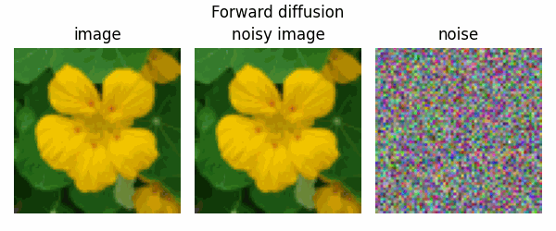
Diffusion Models
diffusion models are trained to denoise noisy images,
and can generate images by iteratively denoising pure noise.
Source: https://keras.io/examples/generative/ddim/

Slide 9
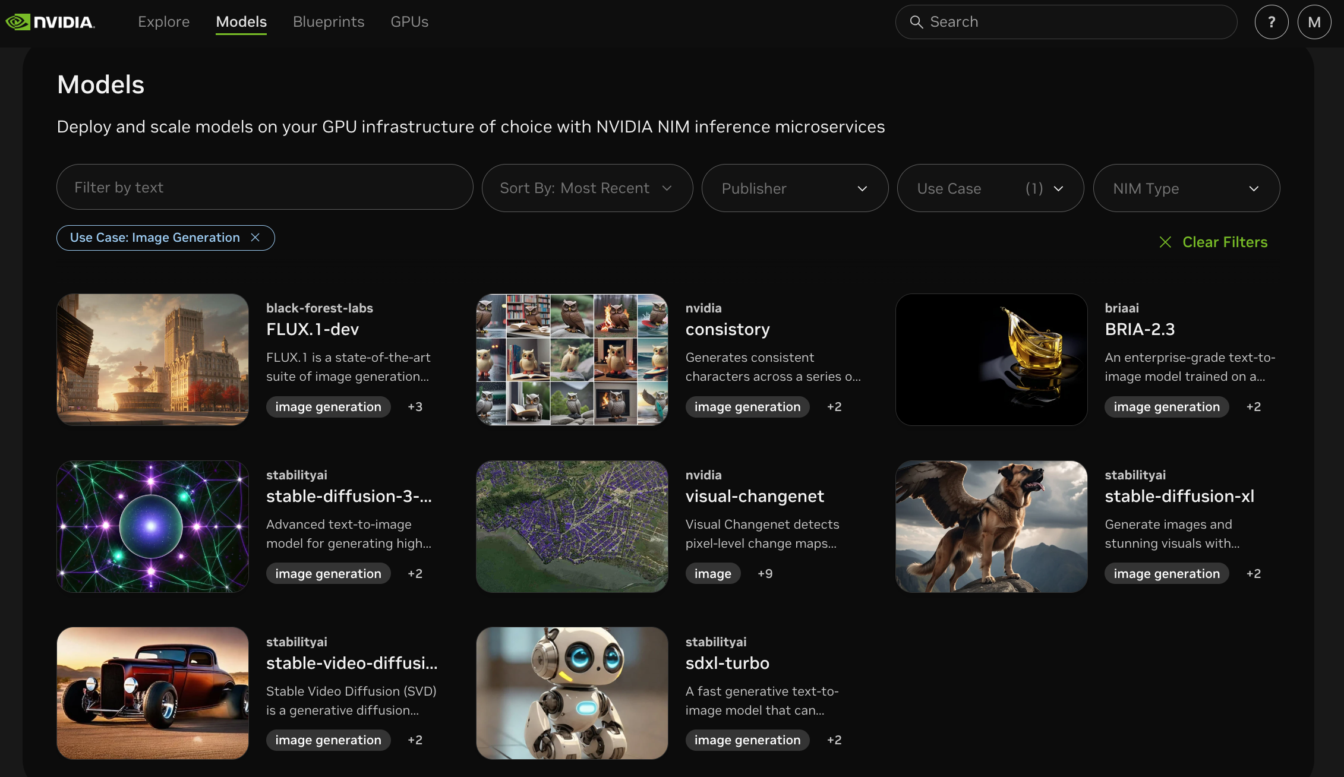
build.nvidia.com Models: Image Generation
https://build.nvidia.com/models?filters=usecase%3Ausecase_image_gen

Slide 10
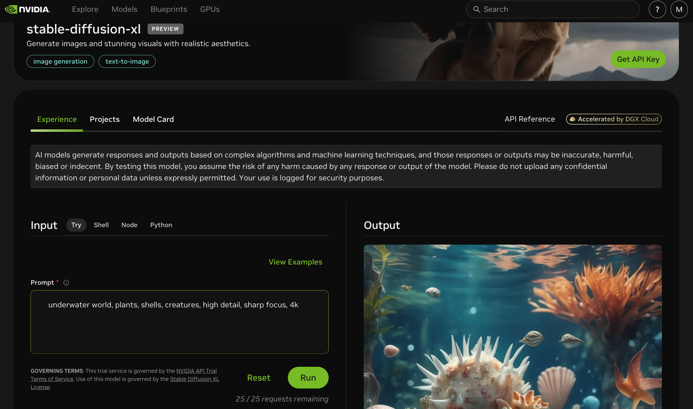
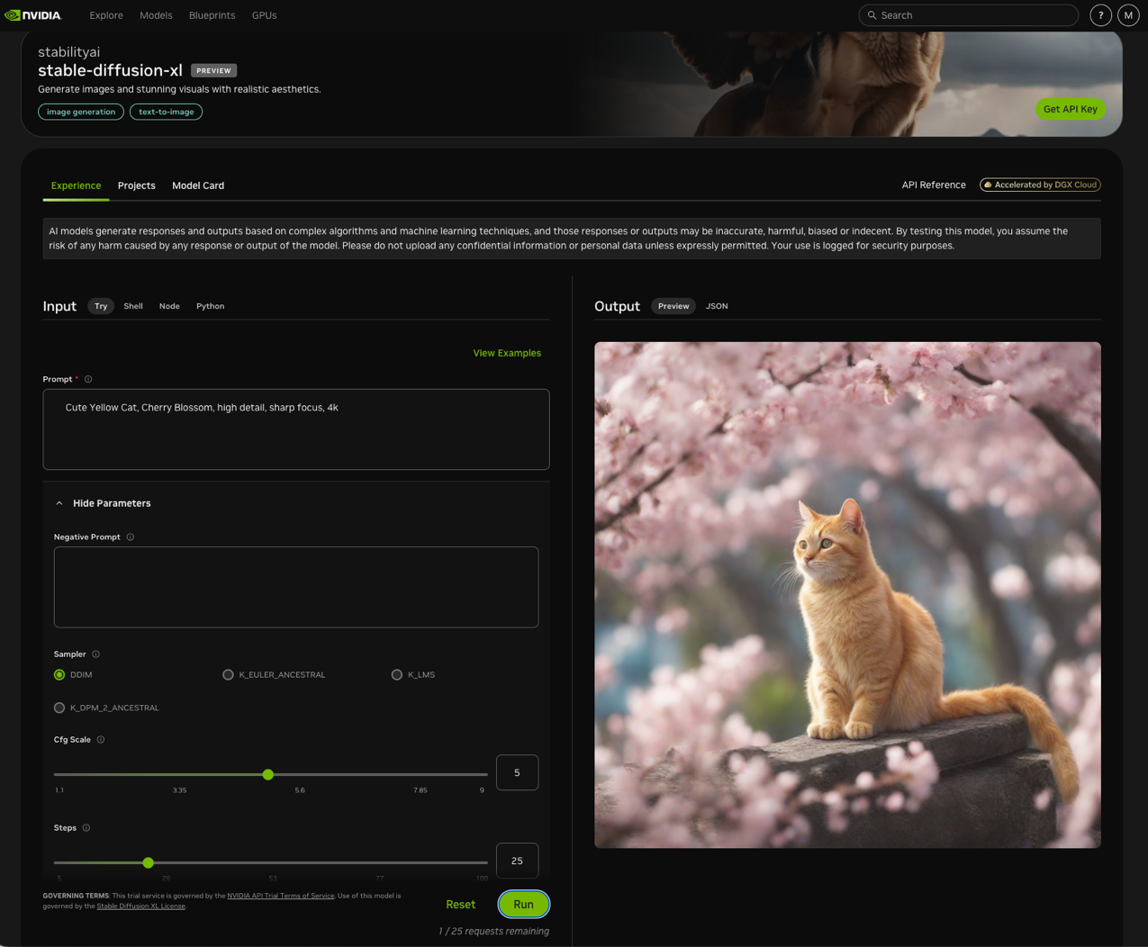
build.nvidia.com stabilityai/stable-diffusion-xl
https://build.nvidia.com/stabilityai/stable-diffusion-xl

Slide 11

build.nvidia.com stabilityai/stable-diffusion-xl
Input
Prompt
Cute Yellow Cat, Cherry Blossom, high detail, sharp focus, 4k
https://build.nvidia.com/stabilityai/stable-diffusion-xl

Slide 12


Spring 2025
Generative AI
Innovative Applications

Slide 13

https://learn.nvidia.com/certificates?id=cCFh1ZWWTvqKTq7dcKkEWw

Slide 14

https://learn.nvidia.com/certificates?id=OVmqY4cSSya0BdMQBWHxzw

Slide 15

https://learn.nvidia.com/certificates?id=ed-qOCIMQaatzU8SNUNxgw

Slide 16

https://learn.nvidia.com/certificates?id=q3oo-oBhTQKtyCCote2E-Q

Slide 17

NVIDIA
Certified Instructors
(12 from Taiwan)
https://www.nvidia.com/en-us/training/instructor-directory/search/

Slide 18
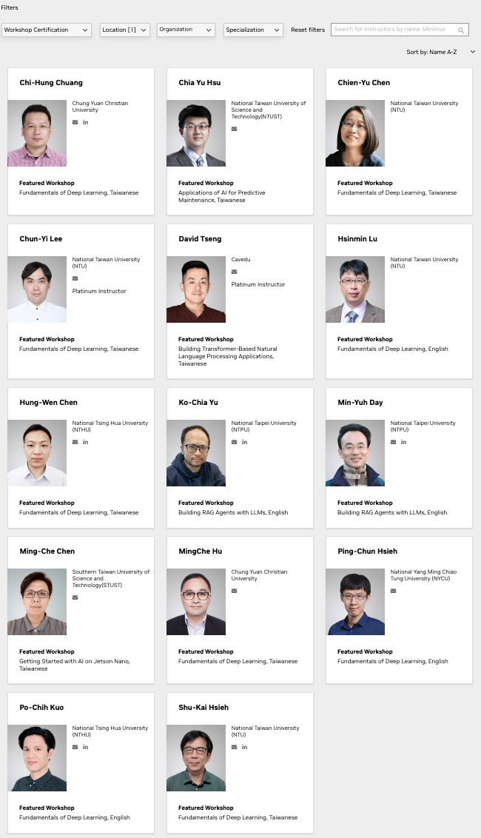
NVIDIA
Certified Instructors
(14 from Taiwan)
(2 from NTPU)(April 2025)
https://www.nvidia.com/en-us/training/instructor-directory/search/

Slide 19
NVIDIA Developer Program
NVIDIA
Deep Learning Institute (DLI)
https://developer.nvidia.com/join-nvidia-developer-program
https://learn.nvidia.com/

Slide 20
Get NVIDIA DLI Certificate
Step 1. Join NVIDIA Developer Program (Free)
https://developer.nvidia.com/join-nvidia-developer-program
Step 2. Visit NVIDIA Deep Learning Institute (DLI)
https://learn.nvidia.com/
Step 3. Enroll "Generative AI with Diffusion Models"
Self-Paced Course ($90)
https://learn.nvidia.com/courses/course-detail?course_id=course-v1:DLI+S-FX-14+V1

Slide 21

Join the NVIDIA Developer Program take one of the complimentary technical self-paced courses
(worth up to $90)
https://developer.nvidia.com/join-nvidia-developer-program

Slide 22
NVIDIA Deep Learning Institute (DLI)
Self-Paced Course
Generative AI Explained
Free
2 hours
Self-Paced Course
Getting Started With Deep Learning
Certificate available
$90
8 hours
Instructor-Led Workshop
Fundamentals of Deep Learning
Certificate available
$500
8 hours
Self-Paced Course
Introduction to Transformer-Based Natural Language Processing
Certificate available
$30
6 hours
Self-Paced Course
Building RAG Agents With LLMs
Certificate available
Free
8 hours
Instructor-Led Workshop
Building RAG Agents With LLMs
Certificate available
$500
8 hours
Self-Paced Course
Generative AI with Diffusion Models
Certificate available
$90
8 hours
Instructor-Led Workshop
Generative AI with Diffusion Models
Certificate available
$500
8 hours
https://www.nvidia.com/en-us/learn/learning-path/generative-ai-llm/

Slide 23

NVIDIA Deep Learning Institute (DLI)
Generative AI
https://learn.nvidia.com/en-us/training/find-training?q=Generative+AI

Slide 24

Generative AI with Diffusion Models
https://learn.nvidia.com/courses/course-detail?course_id=course-v1:DLI+S-FX-14+V1

Slide 25

Building RAG Agents with LLMs
https://learn.nvidia.com/courses/course-detail?course_id=course-v1:DLI+S-FX-15+V1

Slide 26

Generative AI Explained
https://learn.nvidia.com/courses/course-detail?course_id=course-v1:DLI+S-FX-15+V1

Slide 27

Introduction to Transformer-Based
Natural Language Processing
https://learn.nvidia.com/courses/course-detail?course_id=course-v1:DLI+S-FX-08+V1

Slide 28

Join the NVIDIA Developer Program take one of the complimentary technical self-paced courses (worth up to $90)
https://developer.nvidia.com/join-nvidia-developer-program

Slide 29

Join the NVIDIA Developer Program take one of the complimentary technical self-paced courses (worth up to $90)
https://developer.nvidia.com/join-nvidia-developer-program

Slide 30

Join the NVIDIA Developer Program take one of the complimentary technical self-paced courses (worth up to $90)
https://developer.nvidia.com/join-nvidia-developer-program

Slide 31

Join the NVIDIA Developer Program take one of the complimentary technical self-paced courses (worth up to $90)
https://developer.nvidia.com/join-nvidia-developer-program

Slide 32

Join the NVIDIA Developer Program take one of the complimentary technical self-paced courses (worth up to $90)
https://developer.nvidia.com/join-nvidia-developer-program

Slide 33

NVIDIA Deep Learning Institute (DLI)
https://learn.nvidia.com/my-learning

Slide 34

NVIDIA Deep Learning Institute (DLI)
https://learn.nvidia.com/my-learning

Slide 35
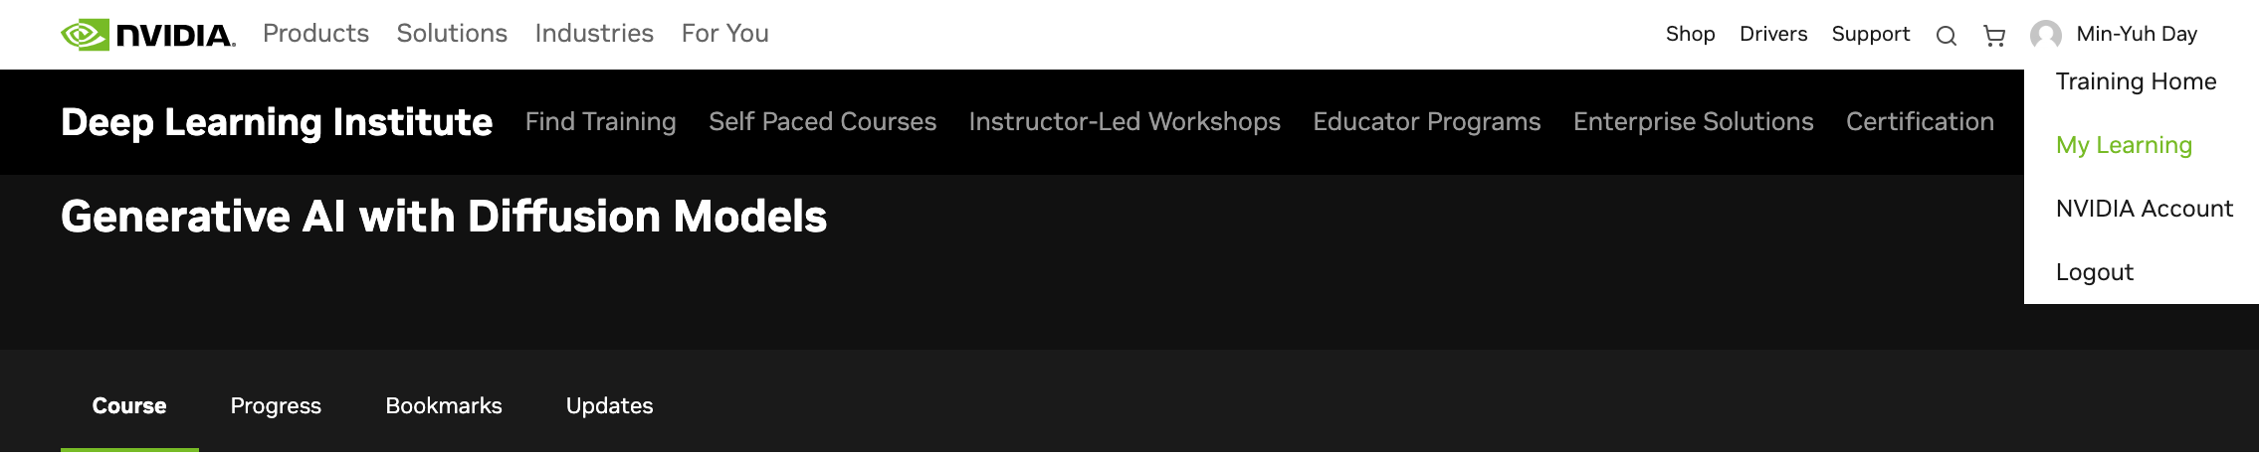
NVIDIA Deep Learning Institute (DLI)
https://learn.nvidia.com/my-learning

Slide 36

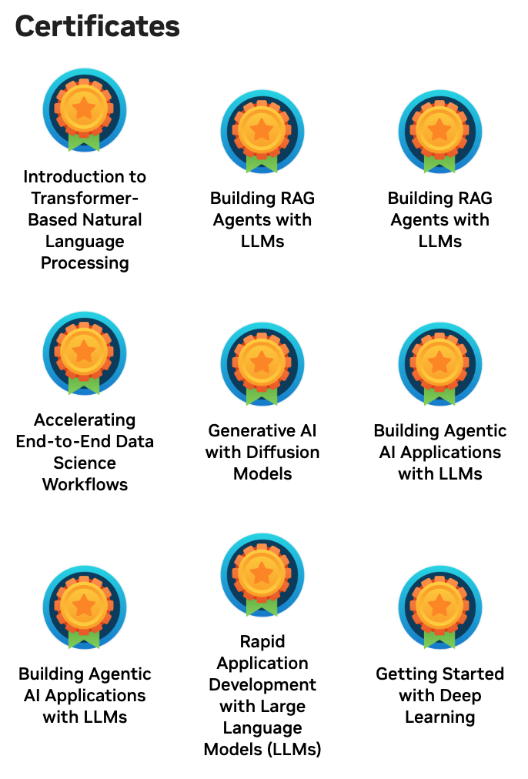
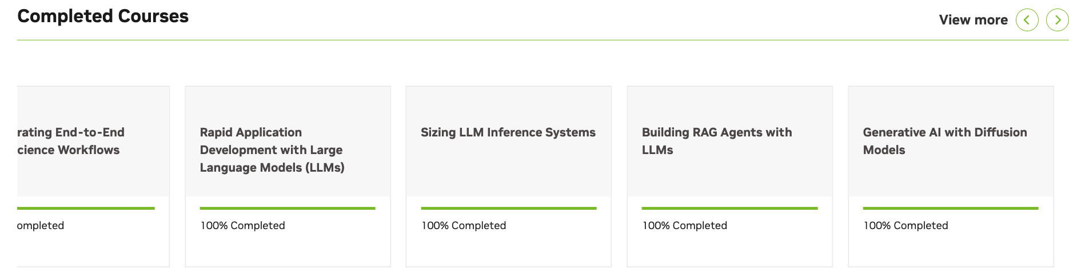
Deep Learning Institute (DLI)
https://learn.nvidia.com/my-learning

Slide 37
https://learn.nvidia.com/certificates?id=q3oo-oBhTQKtyCCote2E-Q

Slide 38
https://learn.nvidia.com/certificates?id=ed-qOCIMQaatzU8SNUNxgw

Slide 39

NVIDIA Deep Learning Institute (DLI)
https://learn.nvidia.com/en-us/training/self-paced-courses

Slide 40
Generative AI with Diffusion Models
https://learn.nvidia.com/courses/course-detail?course_id=course-v1:DLI+S-FX-14+V1

Slide 41
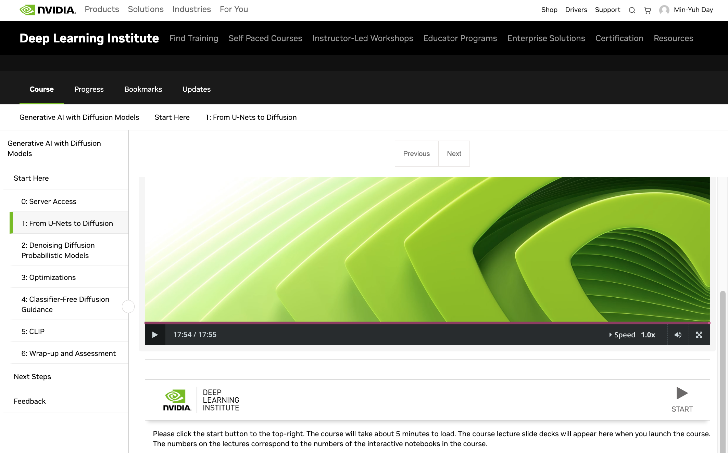
Generative AI with Diffusion Models
1: From U-Nets to Diffusion
https://learn.nvidia.com/courses/course-detail?course_id=course-v1:DLI+S-FX-14+V1

Slide 42
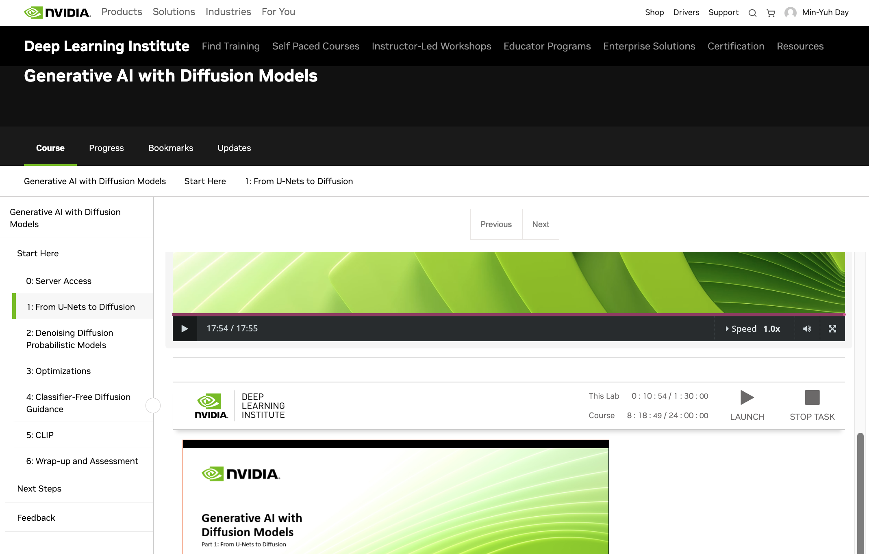
Generative AI with Diffusion Models
1: From U-Nets to Diffusion
https://learn.nvidia.com/courses/course-detail?course_id=course-v1:DLI+S-FX-14+V1

Slide 43
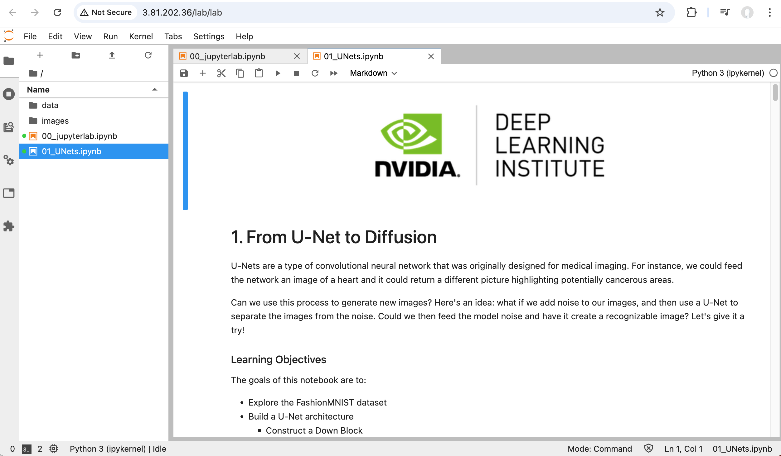
Generative AI with Diffusion Models
01_UNets.ipynb
1: From U-Nets to Diffusion
https://learn.nvidia.com/courses/course-detail?course_id=course-v1:DLI+S-FX-14+V1

Slide 44
Generative AI with
Diffusion Models
Part 1: From U-Nets to Diffusion
Source: NVIDIA DLI (2024), Generative AI with Diffusion Models, https://learn.nvidia.com/courses/course-detail?course_id=course-v1:DLI+S-FX-14+V1
44
Notes:
Hi there, and welcome to Generative AI with Diffusion Models.

Slide 45
Agenda
• | Part 1: From U-Nets to Diffusion
• | Part 2: Denoising Diffusion Probabilistic Models
• | Part 3: Optimizations
• | Part 4: Classifier Free Diffusion
• | Part 5: CLIP
• | Part 6: Wrap-up & Assessment
Source: NVIDIA DLI (2024), Generative AI with Diffusion Models, https://learn.nvidia.com/courses/course-detail?course_id=course-v1:DLI+S-FX-14+V1
45
Notes:
Today, we’ll start with the U-Net architecture and eventually work our way towards creating a full text-to-image pipeline.

Slide 46

Prerequisites
Basic familiarity with convolutional neural networks (CNNs)
Basic familiarity with a deep learning framework such as:
  PyTorch
  TensorFlow
Source: NVIDIA DLI (2024), Generative AI with Diffusion Models, https://learn.nvidia.com/courses/course-detail?course_id=course-v1:DLI+S-FX-14+V1
46
Notes:
If you are familiar with how convolutional neural networks are built, then you have what it takes to complete this course. We will be using PyTorch. If you come from a TensorFlow background, we have provided links to the relevant PyTorch documentation to help you get up to speed quickly.

Slide 47
A Brief History of Generative AI
Source: NVIDIA DLI (2024), Generative AI with Diffusion Models, https://learn.nvidia.com/courses/course-detail?course_id=course-v1:DLI+S-FX-14+V1
47
Notes:
To begin, let’s go over a brief history of Generative AI.

Slide 48
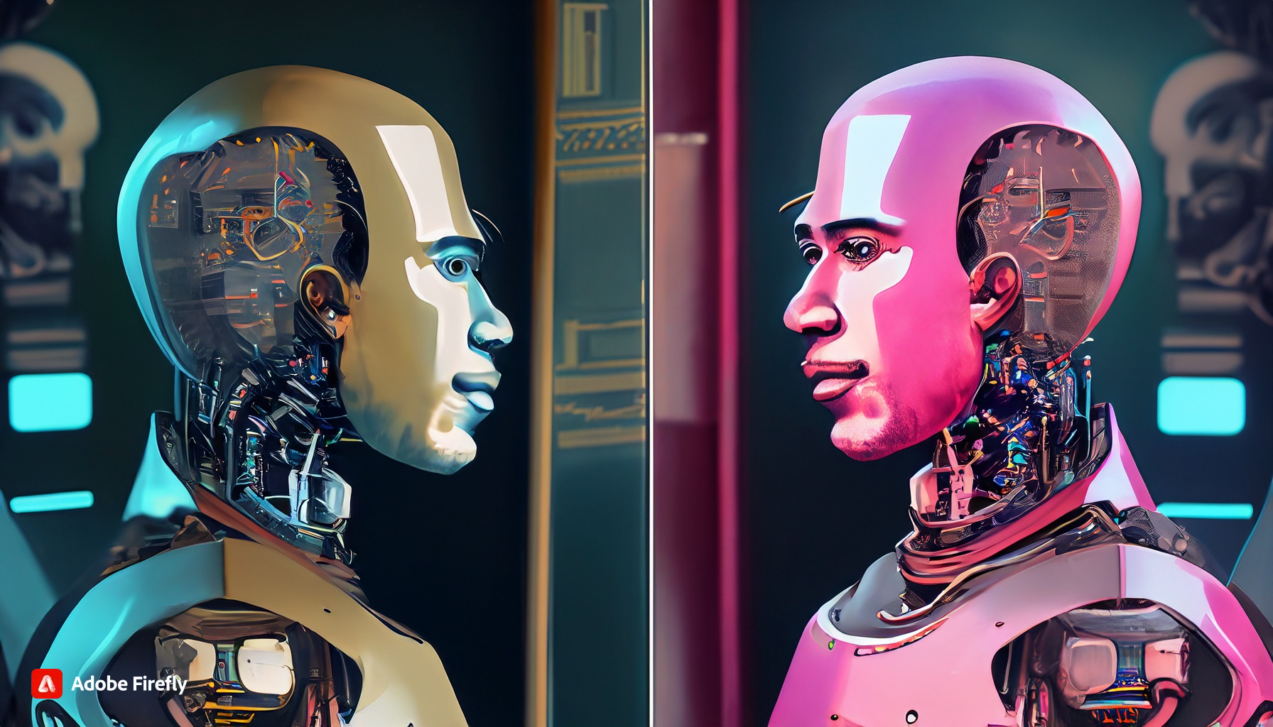
The Imitation Game
A.K.A The Turing Test
A robot looks in a mirror and the reflection is human, cyberpunk
Source: NVIDIA DLI (2024), Generative AI with Diffusion Models, https://learn.nvidia.com/courses/course-detail?course_id=course-v1:DLI+S-FX-14+V1
48
Notes:
Throughout this course, we will be showcasing images generated by Adobe Firefly. Beside each image that was generated, we provide the prompt used to create it.
In the 1950’s Alan Turing proposed a question, “Can machines think?” Since the definition of consciousness is difficult to define, he then proposed a test: could a machine imitate a human well enough that a human did not know it was a machine? He called this test, the Imitation Game.

Slide 49
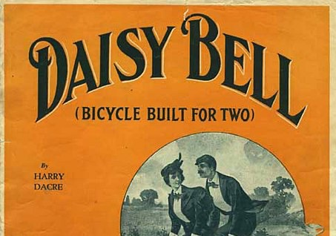
IBM 704
The First Singing Computer
Source: NVIDIA DLI (2024), Generative AI with Diffusion Models, https://learn.nvidia.com/courses/course-detail?course_id=course-v1:DLI+S-FX-14+V1
49
Notes:
About ten years later in 1961, researchers were attempting to emulate various instruments with electronic sound. Of these instruments, the human voice was one of the most difficult to replicate. The IBM 704 is considered the first machine to synthesize human singing. If you’re a fan of sci-fi and wonder why computers often sing about daisies, that’s because the first song sung by a computer is “Daisy Bell”.

Slide 50
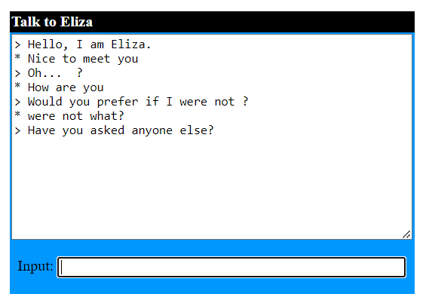
Eliza
The First Gen AI Chatbot?
Source: NVIDIA DLI (2024), Generative AI with Diffusion Models, https://learn.nvidia.com/courses/course-detail?course_id=course-v1:DLI+S-FX-14+V1
50
Notes:
Around the same time, Eliza was created to replicate the questioning of a psychologist to help people talk through their problems. It was considered one of the first great successes of natural language processing. Eliza was created by Joseph Weizenbaum , and the JavaScript version here was created by Michael Wallace and George Dunlop
If you downloaded the slides, a link to Eliza is in the instructor notes. The image here is my own conversation with Eliza.
https://psych.fullerton.edu/mbirnbaum/psych101/eliza.htm

Slide 51

Generative AI of the 70’s, 80’s and 90s?
Electronic music
Video games graphics
Video game AI
Computer animation
Instant messaging chatbots
An 80’s arcade with lots of machines
Source: NVIDIA DLI (2024), Generative AI with Diffusion Models, https://learn.nvidia.com/courses/course-detail?course_id=course-v1:DLI+S-FX-14+V1
51
Notes:
After Eliza’s era, the generative AI field was considered dormant for many years. However, many advancements in computer technology gave rise to the AI we have today. It became easier to digitally create and store music. Videogames were a playground to test how a computer could respond to human input. Computer graphics helped speed up hand animation or gave some films a sci-fi feel. When instant messaging became a thing, smarter and smarter chatbots were developed.
Even though computers weren’t thinking in the way that Turing suggested, people increasingly interacted with computers.
What were some of your favorite technological advancements that paved the way for what we have now?

Slide 52
The Rise of Neural Networks
Source: NVIDIA DLI (2024), Generative AI with Diffusion Models, https://learn.nvidia.com/courses/course-detail?course_id=course-v1:DLI+S-FX-14+V1
52
Notes:
With the rise of Neural Networks in the past decade, we’ve seen an explosion of Generative AI applications.

Slide 53
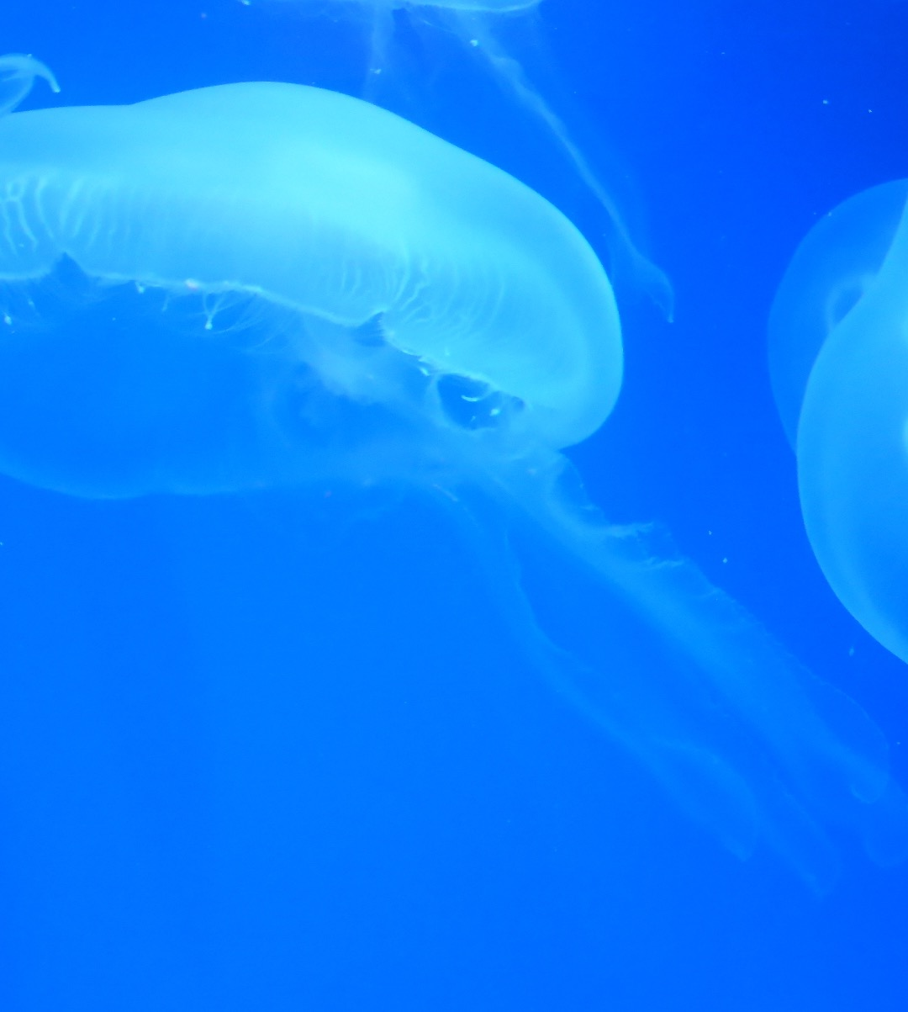
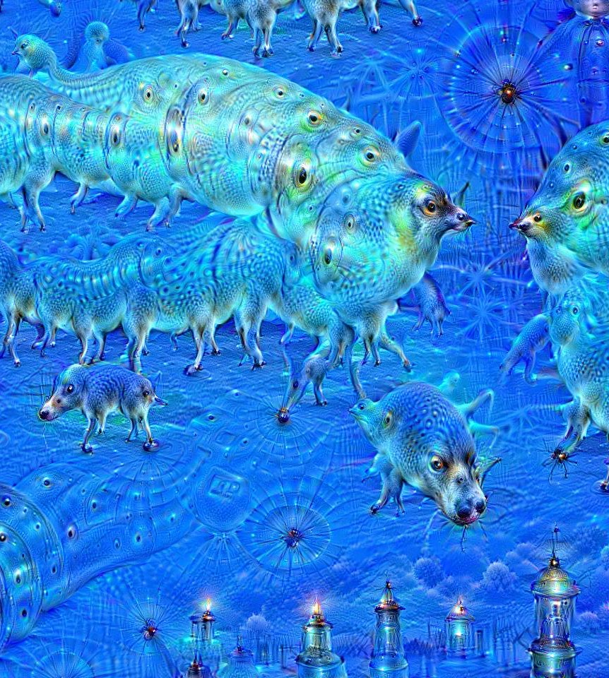
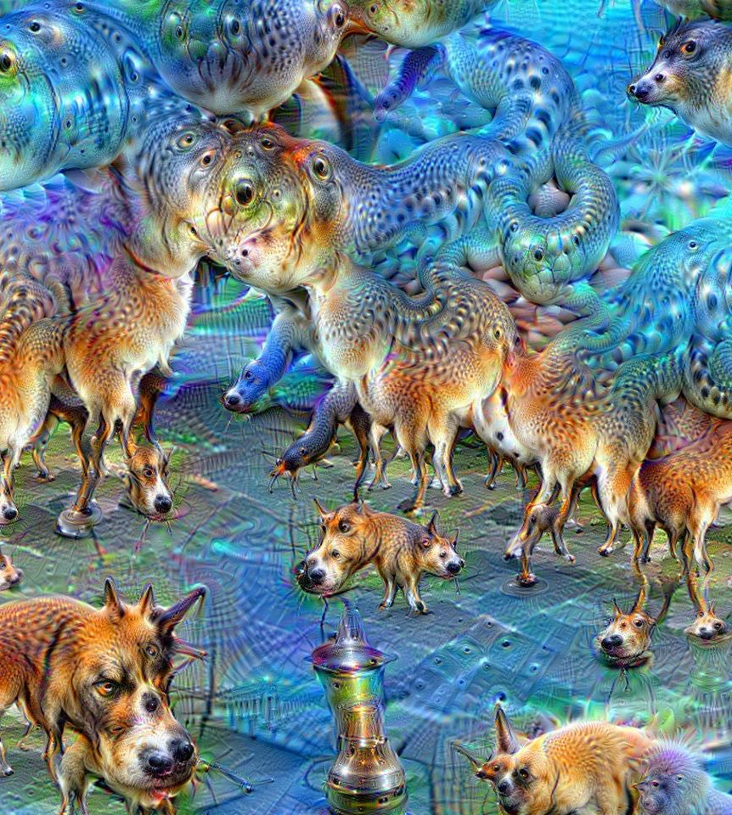
Deep Dreaming
Images by Martin Thoma
Original
10 Iterations
50 Iterations
Source: NVIDIA DLI (2024), Generative AI with Diffusion Models, https://learn.nvidia.com/courses/course-detail?course_id=course-v1:DLI+S-FX-14+V1
53
Notes:
One of the first neural network applications to create AI art was “Deep Dreaming”. A Google engineer by the name of Alexander Mordvintsev realized he could run ImageNet “backwards” on an image to exaggerate features that ImageNet learned to classify. Because at the time, ImageNet was trained with many dog and animal photos, it tended to exaggerate dogs and animals.
This is similar to the psychology phenomenon Pareidolia. Or if you’re a gamer, the Tetris Effect.
https://en.wikipedia.org/wiki/DeepDream#/media/File:Aurelia-aurita-3_(cropped).jpg
https://en.wikipedia.org/wiki/DeepDream#/media/File:Aurelia-aurita-3-0009.jpg
https://en.wikipedia.org/wiki/DeepDream#/media/File:Aurelia-aurita-3-0049.jpg

Slide 54
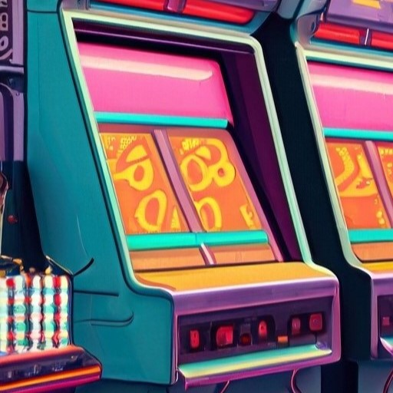
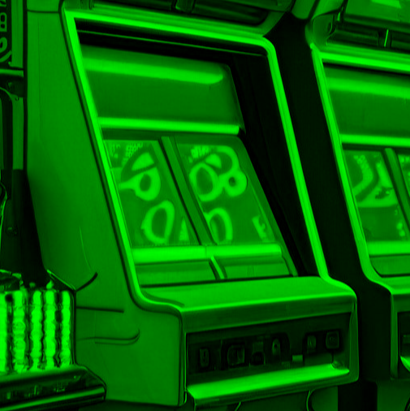
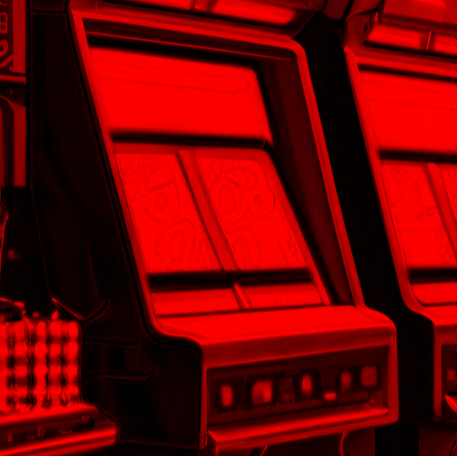
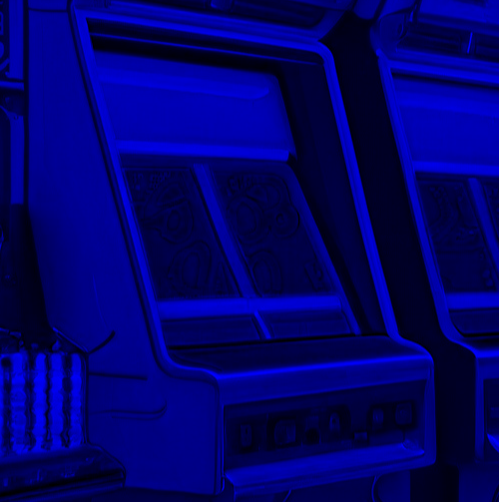
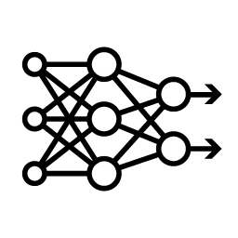


GANs
Generative Adversarial Networks
Discrimination Network
[0.1, -.2, … 0.9]
Real
Feature Map
CNN
Down
Block
CNN
Down
Block
Feature Map
Fake
DNN
Flatten
Convolution
Normalization
Activation Function
Pooling
Source: NVIDIA DLI (2024), Generative AI with Diffusion Models, https://learn.nvidia.com/courses/course-detail?course_id=course-v1:DLI+S-FX-14+V1
54
Notes:
Soon after Deep Dreaming, the GAN architecture was invented by Ian Goodfellow and colleagues.
Here’s the idea: we’re going to create two neural networks. We’ll call the first network the “Discriminator”. The Discriminator is a typical convolutional neural network that has one job: it’s trying to figure out if the image fed into it is a real photo, or a generated one. We’ll call the output of each convolution block a “Feature Map”. This is a result of the input image after it has been convolved and pooled.
If we feed it our generated arcade cabinet to the discriminator, it will flag a fake.

Slide 55
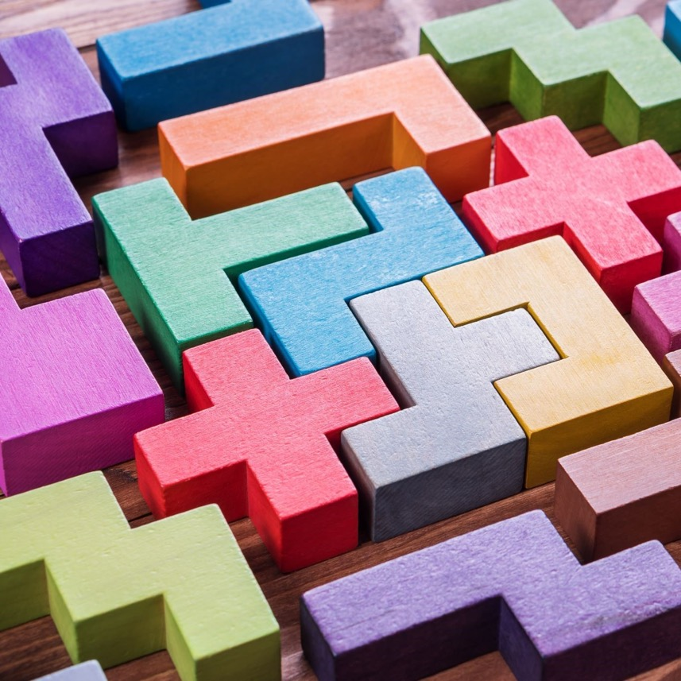
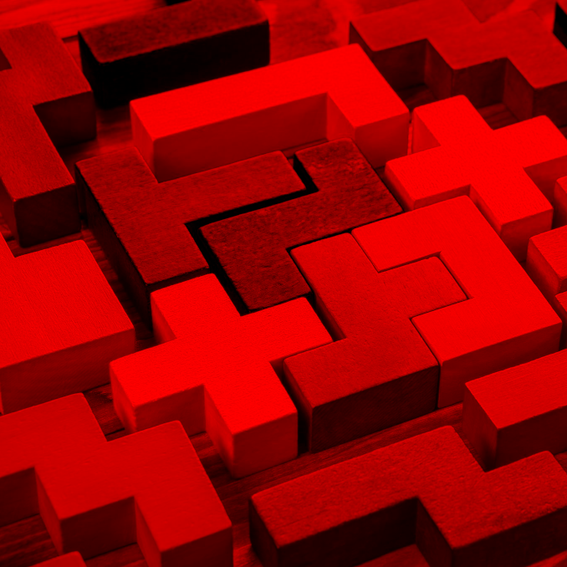
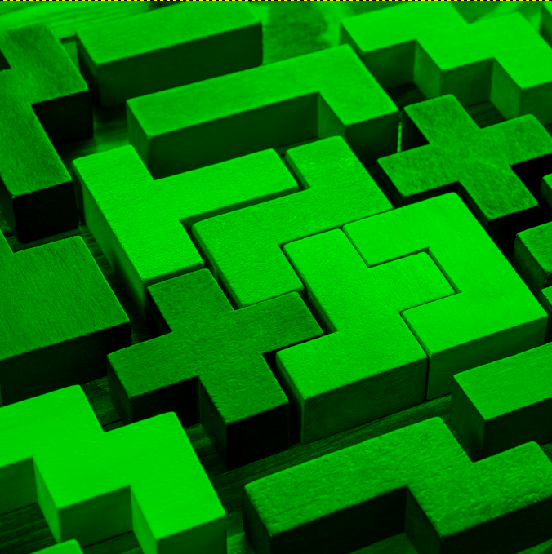
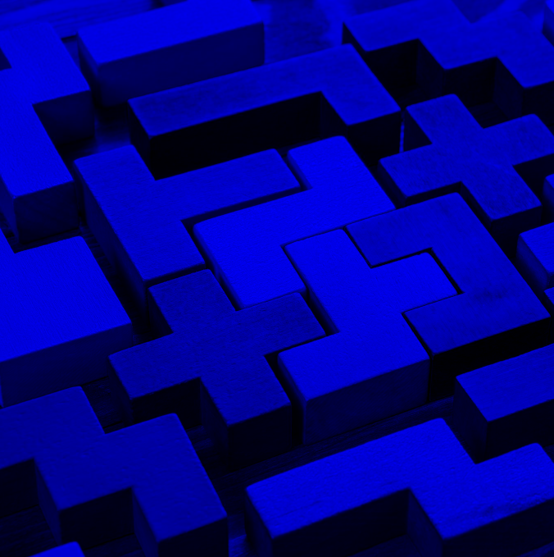
GANs
Generative Adversarial Networks
Discrimination Network
[0.1, -.2, … 0.9]
Real
Feature Map
CNN
Down
Block
CNN
Down
Block
Feature Map
Fake
DNN
Flatten
Source: NVIDIA DLI (2024), Generative AI with Diffusion Models, https://learn.nvidia.com/courses/course-detail?course_id=course-v1:DLI+S-FX-14+V1
55
Notes:
If we feed it this stock photo of pentominoes, it will flag as real.

Slide 56
GANs
Generative Adversarial Networks
Discrimination Network
[0.1, -.2, … 0.9]
Real
Feature Map
CNN
Down
Block
CNN
Down
Block
Feature Map
Fake
DNN
Flatten
Generation Network
[0.2, -.8, … -0.1]
Feature Map
Add to Discriminator Dataset
CT
Up
Block
Feature Map
CT
Up
Block
Noise Vector
Source: NVIDIA DLI (2024), Generative AI with Diffusion Models, https://learn.nvidia.com/courses/course-detail?course_id=course-v1:DLI+S-FX-14+V1
56
Notes:
The other network is the “Generator” network. It will create the fake images that the discriminator is trained on.

Slide 57
GANs
Generative Adversarial Networks
Normalization
Activation Function
Convolution
Normalization
Activation Function
Conv T
Generation Network
[0.2, -.8, … -0.1]
Feature Map
Add to Discriminator Dataset
CT
Up
Block
Feature Map
CT
Up
Block
Noise Vector
Source: NVIDIA DLI (2024), Generative AI with Diffusion Models, https://learn.nvidia.com/courses/course-detail?course_id=course-v1:DLI+S-FX-14+V1
57
Notes:
The generator architecture is similar to a convolutional neural network in reverse. It does this by doing using transposed convolution. Unlike pooling which is used to reduce the height and width of a feature map, transposed convolution expands the height and width.

Slide 58
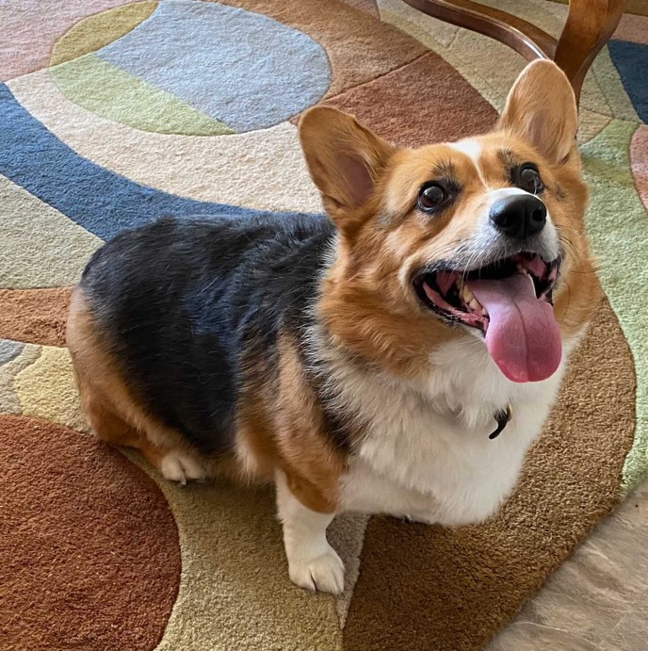
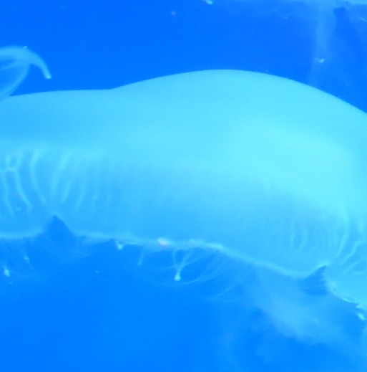
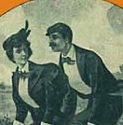

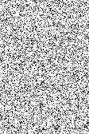
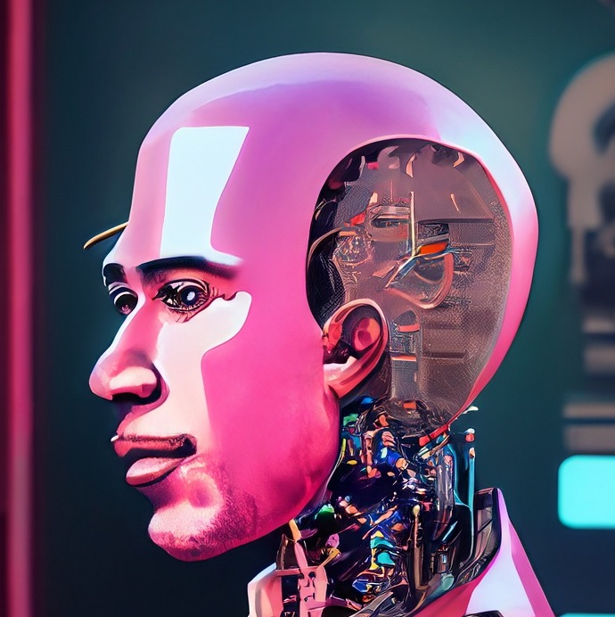
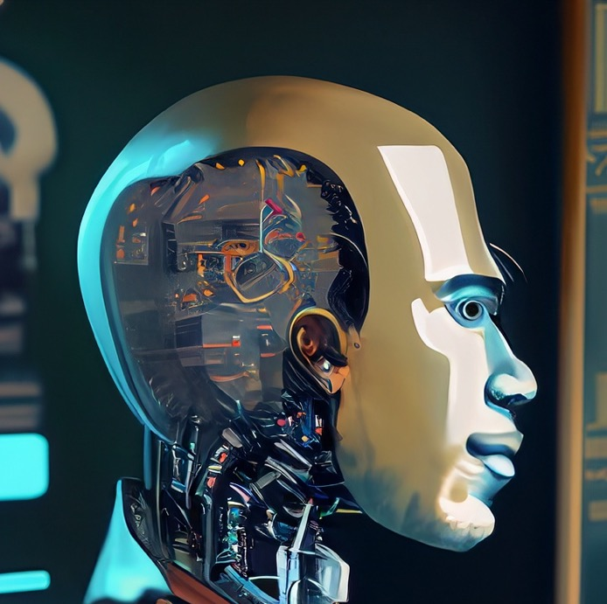
GANs
Generative Adversarial Networks
Real
Discriminator
Real Images
Fake
Generator
Noise
Fake Images
Source: NVIDIA DLI (2024), Generative AI with Diffusion Models, https://learn.nvidia.com/courses/course-detail?course_id=course-v1:DLI+S-FX-14+V1
58
Notes:
The loss function for the generator is based on how well it “fooled” the discriminator. And the loss function for the discriminator is based on how well it avoided being fooled. Hence the phrase “adversarial”.

Slide 59
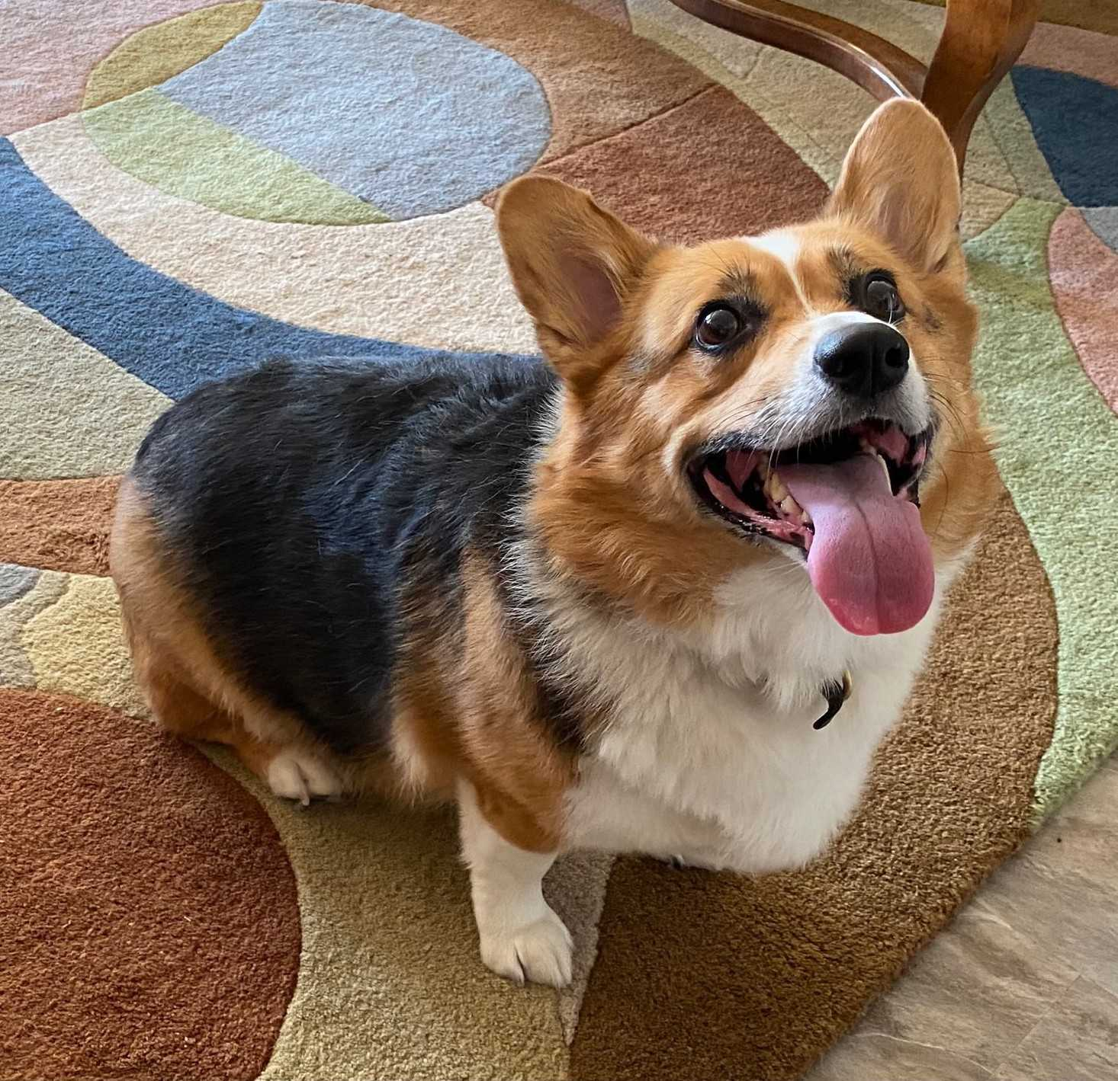

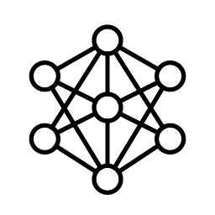
Image Segmentation
Not Corgi
Corgi
Source: NVIDIA DLI (2024), Generative AI with Diffusion Models, https://learn.nvidia.com/courses/course-detail?course_id=course-v1:DLI+S-FX-14+V1
59
Notes:
Around the same time GANs were invented, Image Segmentation was developed for medical purposes. Could we train a neural network to detect anomalies in x-rays or ultrasounds? In more recent times, image segmentation is used with autonomous vehicles to help cars categorize pedestrians, other vehicles, or street signs. The example above is a picture of a dog, and we’ve segmented the image to separate the dog from the background.

Slide 60
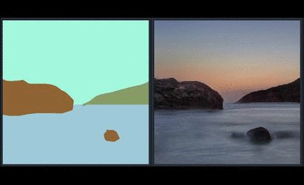
Image Segmentation + GANs
NVIDIA Spade
Source: NVIDIA DLI (2024), Generative AI with Diffusion Models, https://learn.nvidia.com/courses/course-detail?course_id=course-v1:DLI+S-FX-14+V1
60
Notes:
If we combine the two techniques together, we can train a model to create images from segmentation maps. This is NVIDIA Spade, a precursor to NVIDIA Canvas, which is available in Omniverse.
https://github.com/NVlabs/SPADE

Slide 61
U-Nets
Source: NVIDIA DLI (2024), Generative AI with Diffusion Models, https://learn.nvidia.com/courses/course-detail?course_id=course-v1:DLI+S-FX-14+V1
61
Notes:
Now that we’ve gone through history, let’s highly the star of today’s show: the U-Net.

Slide 62
GANs
Generative Adversarial Networks
Discrimination Network
[0.1, -.2, … 0.9]
Real
Feature Map
CNN
Down
Block
CNN
Down
Block
Feature Map
Fake
DNN
Flatten
Generation Network
[0.2, -.8, … -0.1]
Feature Map
Add to Discriminator Dataset
CT
Up
Block
Feature Map
CT
Up
Block
Noise Vector
Source: NVIDIA DLI (2024), Generative AI with Diffusion Models, https://learn.nvidia.com/courses/course-detail?course_id=course-v1:DLI+S-FX-14+V1
62
Notes:
So what if we want to make an image based on another image? How could we do that?
We could take our GAN architecture here and …

Slide 63
GANs U-Nets
The U shaped Autoencoder
Encoder
[0.1, -.2, … 0.9]
Feature Map
CNN
Down
Block
CNN
Down
Block
Feature Map
DNN
Latent Vector
Decoder
[0.2, -.8, … -0.1]
Feature Map
CT
Up
Block
Feature Map
CT
Up
Block
Latent Vector
Source: NVIDIA DLI (2024), Generative AI with Diffusion Models, https://learn.nvidia.com/courses/course-detail?course_id=course-v1:DLI+S-FX-14+V1
63
Notes:
Connect the output of the discriminator directly into the generator.
This would make an image autoencoder. The discriminator becomes the encoder and the discriminator becomes the decoder.

Slide 64


U-Nets
The U shaped Autoencoder
Feature Map
(Down0)
Down0
Copy
Feature Map
(Up2)
128 px
128 px
128 px
128 px
128 px
128 px
128 px
128 px
1 ch
50 ch
2 x 50 ch
3 ch
Feature Map
(Down1)
Down1 Copy
Feature Map
(Up1)
64 px
64 px
64 px
64 px
100 ch
2 x100 ch
Feature Map
(Down2)
32 px
Latent Vector
Down2 Copy
Feature Map
(Up0)
32 px
200 ch
32 px
2 x 200 ch
400 ch
32 px
200 x 32 x 32
204,800 features
Source: NVIDIA DLI (2024), Generative AI with Diffusion Models, https://learn.nvidia.com/courses/course-detail?course_id=course-v1:DLI+S-FX-14+V1
64
Notes:
The U-Net has a special architecture for an image autoencoder. After each convolution, we will have a feature map. On the encoder side, we will take each feature map after pooling, and create a copy. On the decoder side, we’ll stack each copy with the corresponding feature map. These stacked feature maps will be inputs into a transposed convolution layer.

Slide 65
Transposed Convolution
Source: NVIDIA DLI (2024), Generative AI with Diffusion Models, https://learn.nvidia.com/courses/course-detail?course_id=course-v1:DLI+S-FX-14+V1
65
Notes:
We have mentioned Transposed Convolution a few times, so let’s see what it’s doing on a technical level.

Slide 66
Transposed Convolution
Convolution Review
Kernel
Image
Output
1 | 0 | 1
0 | 1 | 0
1 | 0 | 1
.25 | .25
.25 | .25
Source: NVIDIA DLI (2024), Generative AI with Diffusion Models, https://learn.nvidia.com/courses/course-detail?course_id=course-v1:DLI+S-FX-14+V1
66
Notes:
First, let’s review convolution. We have an image and a Kernel.

Slide 67
Transposed Convolution
Convolution Review
Kernel
Image
Output
1 • .25 | 0 • .25 | 1
0 • .25 | 1 • .25 | 0
1 | 0 | 1
.25 | .25
.25 | .25
.5
Source: NVIDIA DLI (2024), Generative AI with Diffusion Models, https://learn.nvidia.com/courses/course-detail?course_id=course-v1:DLI+S-FX-14+V1
67
Notes:
And we can convolve the image by sliding the kernel along the image and multiplying the kernel values with the respective image values.

Slide 68
Transposed Convolution
Convolution Review
Kernel
Image
Output
1 | 0 • .25 | 1 • .25
0 | 1 • .25 | 0 • .25
1 | 0 | 1
.25 | .25
.25 | .25
.5 | .5
Source: NVIDIA DLI (2024), Generative AI with Diffusion Models, https://learn.nvidia.com/courses/course-detail?course_id=course-v1:DLI+S-FX-14+V1
68

Slide 69
Transposed Convolution
Convolution Review
Kernel
Image
Output
1 | 0 | 1
0 • .25 | 1 • .25 | 0
1 • .25 | 0 • .25 | 1
.25 | .25
.25 | .25
.5 | .5
.5
Source: NVIDIA DLI (2024), Generative AI with Diffusion Models, https://learn.nvidia.com/courses/course-detail?course_id=course-v1:DLI+S-FX-14+V1
69

Slide 70
Transposed Convolution
Convolution Review
Kernel
Image
Output
1 | 0 | 1
0 | 1 • .25 | 0 • .25
1 | 0 • .25 | 1 • .25
.25 | .25
.25 | .25
.5 | .5
.5 | .5
Source: NVIDIA DLI (2024), Generative AI with Diffusion Models, https://learn.nvidia.com/courses/course-detail?course_id=course-v1:DLI+S-FX-14+V1
70

Slide 71
Transposed Convolution
Image Upscaling
Kernel
Image
Output
.25 | .25
.25 | .25
1 | 0 | 1
0 | 1 | 0
1 | 0 | 1
Source: NVIDIA DLI (2024), Generative AI with Diffusion Models, https://learn.nvidia.com/courses/course-detail?course_id=course-v1:DLI+S-FX-14+V1
71
Notes:
Transposed convolution is still convolution, but we’re going to be using the convolution parameters in an opposite way.
For example, with regular convolution, when we say stride is equal to 2, we move our convolution window across the image two spaces at a time instead of 1.
With transposed convolution…

Slide 72
Transposed Convolution
Image Upscaling
Kernel
Image
Output
Stride = 2
1 | 0 | 0 | 0 | 1
0 | 0 | 0 | 0 | 0
0 | 0 | 1 | 0 | 0
0 | 0 | 0 | 0 | 0
1 | 0 | 0 | 0 | 1
.25 | .25
.25 | .25
Source: NVIDIA DLI (2024), Generative AI with Diffusion Models, https://learn.nvidia.com/courses/course-detail?course_id=course-v1:DLI+S-FX-14+V1
72
Notes:
We expand the image by adding rows and columns.

Slide 73
Transposed Convolution
Image Upscaling
Kernel
Image
Output
Stride = 2
1 • .25 | 0 • .25 | 0 | 0 | 1
0 • .25 | 0 • .25 | 0 | 0 | 0
0 | 0 | 1 | 0 | 0
0 | 0 | 0 | 0 | 0
1 | 0 | 0 | 0 | 1
.25
.25 | .25
.25 | .25
Source: NVIDIA DLI (2024), Generative AI with Diffusion Models, https://learn.nvidia.com/courses/course-detail?course_id=course-v1:DLI+S-FX-14+V1
73
Notes:
After adding these new rows and columns, we perform convolution as normal.

Slide 74
Transposed Convolution
Image Upscaling
Kernel
Image
Output
Stride = 2
1 | 0 • .25 | 0 • .25 | 0 | 1
0 | 0 • .25 | 0 • .25 | 0 | 0
0 | 0 | 1 | 0 | 0
0 | 0 | 0 | 0 | 0
1 | 0 | 0 | 0 | 1
.25 | 0
.25 | .25
.25 | .25
Source: NVIDIA DLI (2024), Generative AI with Diffusion Models, https://learn.nvidia.com/courses/course-detail?course_id=course-v1:DLI+S-FX-14+V1
74

Slide 75
Transposed Convolution
Image Upscaling
Kernel
Image
Output
Stride = 2
1 | 0 | 0 | 0 | 1
0 | 0 | 0 | 0 | 0
0 | 0 | 1 | 0 | 0
0 | 0 | 0 | 0 | 0
1 | 0 | 0 | 0 | 1
.25 | 0 | 0 | .25
0 | .25 | .25 | 0
0 | .25 | .25 | 0
.25 | 0 | 0 | .25
.25 | .25
.25 | .25
Source: NVIDIA DLI (2024), Generative AI with Diffusion Models, https://learn.nvidia.com/courses/course-detail?course_id=course-v1:DLI+S-FX-14+V1
75

Slide 76
Transposed Convolution
Stride
Image
Image
Stride = 2
Stride = 3
1 | 0 | 0 | 0 | 0 | 0 | 1
0 | 0 | 0 | 0 | 0 | 0 | 0
0 | 0 | 0 | 0 | 0 | 0 | 0
0 | 0 | 0 | 1 | 0 | 0 | 0
0 | 0 | 0 | 0 | 0 | 0 | 0
0 | 0 | 0 | 0 | 0 | 0 | 0
1 | 0 | 0 | 0 | 0 | 0 | 1
1 | 0 | 0 | 0 | 1
0 | 0 | 0 | 0 | 0
0 | 0 | 1 | 0 | 0
0 | 0 | 0 | 0 | 0
1 | 0 | 0 | 0 | 1
Source: NVIDIA DLI (2024), Generative AI with Diffusion Models, https://learn.nvidia.com/courses/course-detail?course_id=course-v1:DLI+S-FX-14+V1
76
Notes:
The stride now defines how many rows and columns we will add. With a stride of 2, we’ll add 1 row of zeros in between each image row. With a stride of 3, we’ll add 2 rows of zeros in between each image row.

Slide 77
Transposed Convolution
Padding
Image
Image
Stride = 3
Padding = 0
Stride = 3
Padding = 2
1 | 0 | 0 | 0 | 0 | 0 | 1
0 | 0 | 0 | 0 | 0 | 0 | 0
0 | 0 | 0 | 0 | 0 | 0 | 0
0 | 0 | 0 | 1 | 0 | 0 | 0
0 | 0 | 0 | 0 | 0 | 0 | 0
0 | 0 | 0 | 0 | 0 | 0 | 0
1 | 0 | 0 | 0 | 0 | 0 | 1
 |  | 0 | 0 | 0
 |  | 0 | 1 | 0
 |  | 0 | 0 | 0
Source: NVIDIA DLI (2024), Generative AI with Diffusion Models, https://learn.nvidia.com/courses/course-detail?course_id=course-v1:DLI+S-FX-14+V1
77
Notes:
In regular convolution, padding adds rows and columns around the perimeter of the input image. Any idea what padding will do here?

Slide 78
Transposed Convolution
Padding
Image
Image
Stride = 3
Padding = 0
Stride = 3
Padding = 2
1 | 0 | 0 | 0 | 0 | 0 | 1
0 | 0 | 0 | 0 | 0 | 0 | 0
0 | 0 | 0 | 0 | 0 | 0 | 0
0 | 0 | 0 | 1 | 0 | 0 | 0
0 | 0 | 0 | 0 | 0 | 0 | 0
0 | 0 | 0 | 0 | 0 | 0 | 0
1 | 0 | 0 | 0 | 0 | 0 | 1
0 | 0 | 0
0 | 1 | 0
0 | 0 | 0
Source: NVIDIA DLI (2024), Generative AI with Diffusion Models, https://learn.nvidia.com/courses/course-detail?course_id=course-v1:DLI+S-FX-14+V1
78
Notes:
With Transposed Convolution, padding removes rows and columns along the perimeter. The order of operations matters. Padding applies after expansion with stride.

Slide 79
Transposed Convolution
Out Padding
Image
Image
Image
Out Padding = 0
Out Padding = 1
Out Padding = 2
1 | 0 | 1
0 | 1 | 0
1 | 0 | 1
1 | 0 | 1 | 0
0 | 1 | 0 | 0
1 | 0 | 1 | 0
0 | 0 | 0 | 0
1 | 0 | 1 | 0 | 0
0 | 1 | 0 | 0 | 0
1 | 0 | 1 | 0 | 0
0 | 0 | 0 | 0 | 0
0 | 0 | 0 | 0 | 0
Source: NVIDIA DLI (2024), Generative AI with Diffusion Models, https://learn.nvidia.com/courses/course-detail?course_id=course-v1:DLI+S-FX-14+V1
79
Notes:
Because of the image stacking in the decoder, U-Nets are particular about dimensions. The Out Padding parameter was added to give more control over the size of the output feature map.
By the way, when used with padding, output padding brings back the dropped rows and columns by padding.
Pytorch limits out_padding such that it must be smaller the stride size.

Slide 80
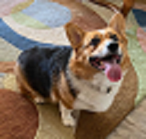

Image Resizing
Upsampling
64 px
128 px
192 px
64 px
128 px
192 px
Source: NVIDIA DLI (2024), Generative AI with Diffusion Models, https://learn.nvidia.com/courses/course-detail?course_id=course-v1:DLI+S-FX-14+V1
80
Notes:
Another alternative is to rescale the feature map and convolve on that. If you look through code repositories featuring U-Nets, you’ll often find both rescaling and transposed convolution.

Slide 81
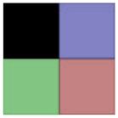
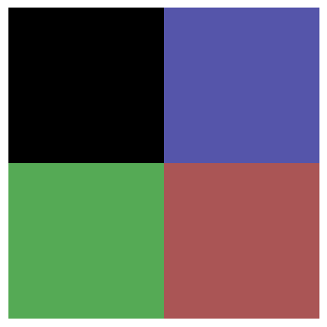
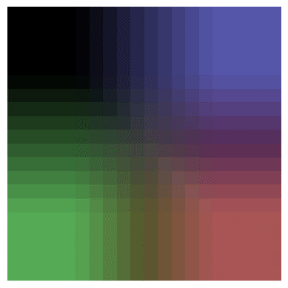
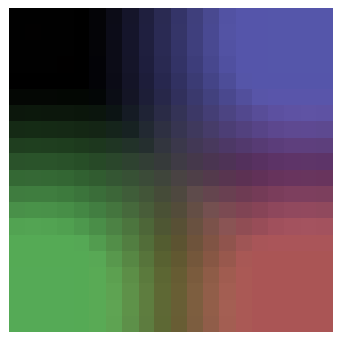
Image Resizing
Upsampling
Nearest
Bilinear
Bicubic
Source: NVIDIA DLI (2024), Generative AI with Diffusion Models, https://learn.nvidia.com/courses/course-detail?course_id=course-v1:DLI+S-FX-14+V1
81
Notes:
The original image is 2x2. Let’s try scaling up to an image 10x bigger (so 20x20).
This is the effect of different scaling options. Nearest will copy the pixel values. Bilinear and Bicubic use different formulas to interpolate between the pixel values. Notice how bilinear is more square and bicubic is more round?

Slide 82
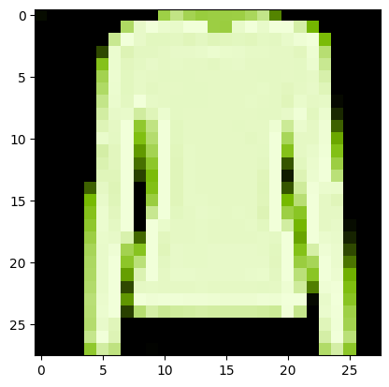
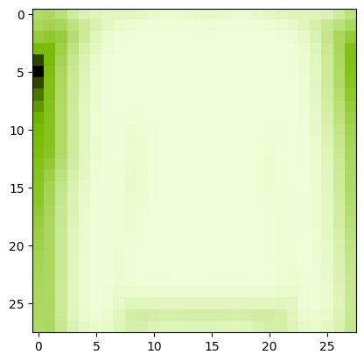
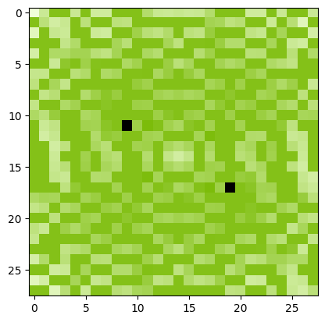
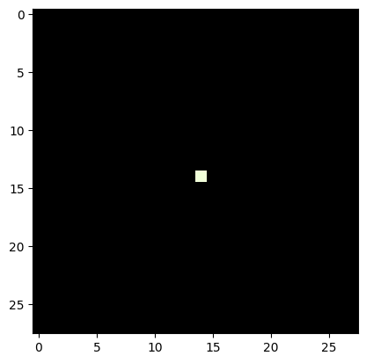
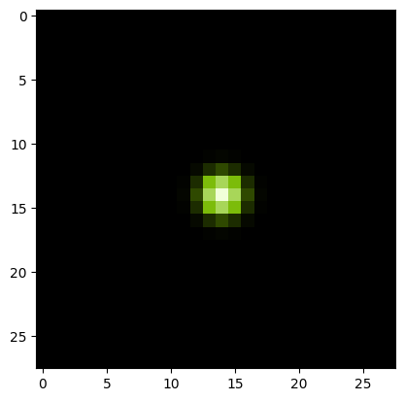
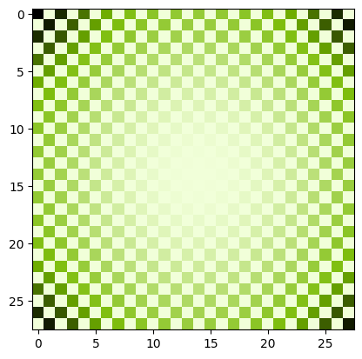
Deconvolution?
Same as Transposed Convolution?
Image
Convolved Image
FFT Convolved
Deconvolved Convolved Image
Point
Point Spread Function
FFT Point Spread Function
Source: NVIDIA DLI (2024), Generative AI with Diffusion Models, https://learn.nvidia.com/courses/course-detail?course_id=course-v1:DLI+S-FX-14+V1
82
Notes:
Sometimes, people refer to transposed convolutional layers as deconvolution layers, but if you talk to an old school computer vision expert, deconvolution means something entirely different to them.
The goal of deconvolution is to undo a previous convolution. In this case, our convolution kernel is called he point spread function. We can take the fast Fourier Transform (FFT) of both the convolved image and the point spread function. We’ll then divide the transformed convolved image by the transformed point spread function. Take the reverse Fourier transform and tada! We have an approximation of the original image.
We don’t use Fourier Transforms much with computer vision neural networks, but it is a handy trick to know when working with audio.

Slide 83
Lab
Source: NVIDIA DLI (2024), Generative AI with Diffusion Models, https://learn.nvidia.com/courses/course-detail?course_id=course-v1:DLI+S-FX-14+V1
83
Notes:
Ok, time for an experiment.

Slide 84
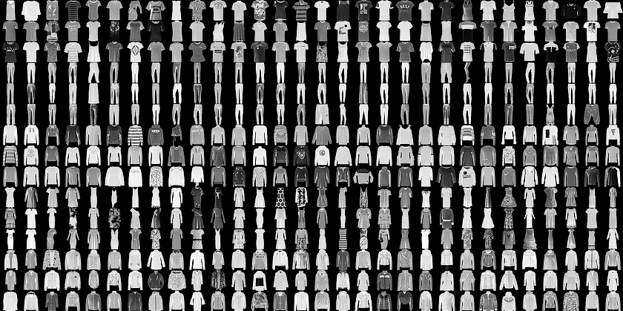
FashionMNIST
Convolutional Neural Network “Hello World”
Source: NVIDIA DLI (2024), Generative AI with Diffusion Models, https://learn.nvidia.com/courses/course-detail?course_id=course-v1:DLI+S-FX-14+V1
84
Notes:
For this experiment, we’ll be using FashionMNIST. This dataset is a bunch of small black and white images that fall into ten categories of clothing.

Slide 85
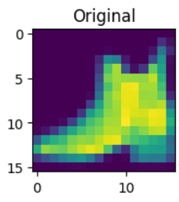
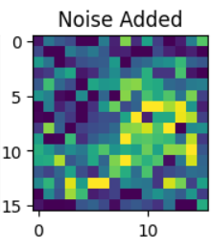
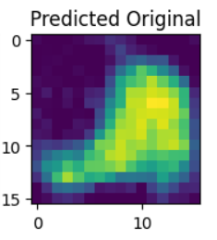


Hypothesis: Generate an image from Noise
Random Noise
Source: NVIDIA DLI (2024), Generative AI with Diffusion Models, https://learn.nvidia.com/courses/course-detail?course_id=course-v1:DLI+S-FX-14+V1
85
Notes:
We’re going to add random noise to our images, and train a neural network to remove that noise. We will be using the normal distribution to sample our noise. If you are unfamiliar with this distribution, please see the appendix for this section.
If we then give the model purely random noise, as in, it is not added to any image, what would the model generate? We’re going to find out!

Slide 86


The Experiment
Feature Map
(Down0)
Down0
Copy
Feature Map
(Up2)
16 px
16 px
16 px
16 px
16 px
16 px
16 px
16 px
1 ch
16 ch
2 x 16 ch
1 ch
Feature Map
(Down1)
Down1 Copy
Feature Map
(Up1)
8 px
8 px
8 px
8 px
32 ch
2 x 32 ch
Feature Map
(Down2)
4 px
Latent Vector
Down2 Copy
Feature Map
(Up0)
4 px
64 ch
4 px
2 x 64 ch
128 ch
4 px
64 x 32 x 32
1024 features
Source: NVIDIA DLI (2024), Generative AI with Diffusion Models, https://learn.nvidia.com/courses/course-detail?course_id=course-v1:DLI+S-FX-14+V1
86
Notes:
As mentioned before U-Nets are picky about their dimensions. So we’ve listed the dimensions of each feature map as it moves the U-Net we’ll be building.

Slide 87
Let’s get started!
1: From U-Nets to Diffusion
Source: NVIDIA DLI (2024), Generative AI with Diffusion Models, https://learn.nvidia.com/courses/course-detail?course_id=course-v1:DLI+S-FX-14+V1
87
Notes:
Ready to get building? Let’s get started!

Slide 88
Appendix:
The Normal Distribution
Source: NVIDIA DLI (2024), Generative AI with Diffusion Models, https://learn.nvidia.com/courses/course-detail?course_id=course-v1:DLI+S-FX-14+V1
88
Notes:
If you’re not familiar with the normal distribution, that’s ok! Let me share with you a secret my math teachers passed on to me. Don’t worry so much about how a formula was derived. Focus instead on why it was created. Then it will be easier to remember when and how to use it.
So let’s dive into how the normal distribution was created. I’m not sure if this story is true, but it’s amusing and makes sense, so I’m going to tell it anyway.

Slide 89










De Moivre
From Coin Flips to Bells
$$p= \frac{1}{2}$$
$$\operatorname{Pr}\left(X=k\right)=\left({n \atop k}\right)p^{k}{(1−p)}^{n−k}$$
$$n=4$$
$$\operatorname{Pr}\left(X=k\right)=\frac{n!}{k!\left(n−k\right)!}p^{k}{(1−p)}^{n−k}$$
$$k=2$$
$$\operatorname{Pr}\left(X=2\right)=\frac{4!}{2!\left(4−2\right)!}{\left(\frac{1}{2}\right)}^{2}{(1−\frac{1}{2})}^{4−2}$$
$$\operatorname{Pr}\left(X=2\right)=\frac{4∙3∙2∙1}{2∙1∙2∙1}\left(\frac{1}{4}\right)\left(\frac{1}{4}\right)$$
$$\operatorname{Pr}\left(X=2\right)=\frac{6}{16}$$
A weighted coin flipping through the air like a cartoon
Source: NVIDIA DLI (2024), Generative AI with Diffusion Models, https://learn.nvidia.com/courses/course-detail?course_id=course-v1:DLI+S-FX-14+V1
89
Notes:
De Moivre was a famous French mathematician in the late 1700’s. Gamblers found out of his mathematical prowess and kept asking him to calculate what are the chances they would get at least x heads in y coin flips.
This is a doable, but tedious calculation. Let’s say we flip 4 coins (n) and want to find out the chance we get 2 heads (k). The chance we get heads (p) is ½.
We can plug in these numbers…
And get a 6 out of 16 chance, or 37.5% chance.
But if we want to find the chance to flip at least 2 heads, we also must calculate the chance for 3 heads, and the chance for 4 heads.

Slide 90




De Moivre
From Coin Flips to Bells
Source: NVIDIA DLI (2024), Generative AI with Diffusion Models, https://learn.nvidia.com/courses/course-detail?course_id=course-v1:DLI+S-FX-14+V1
90
Notes:
This was in the 1700’s so de Moivre was doing these calculations by hand. No computers and no calculators. The process is a little annoying with a small number of coin flips, extremely annoying with large number of coin flips.
As de Moivre was working on this, he noticed when n gets large, the probability distribution takes on a bell shape. He thought if he could create an approximation, he wouldn’t have to keep doing this annoying calculation.

Slide 91




De Moivre
From Coin Flips to Bells
$$\operatorname{Pr}\left(X=k\right)=\left({n \atop k}\right)p^{k}{(1−p)}^{n−k}$$
$$\operatorname{Pr}\left(X=k\right)=\frac{n!}{k!\left(n−k\right)!}p^{k}{(1−p)}^{n−k}$$
$$n!≈ {\sqrt{2π}\left(\frac{n}{e}\right)}^{n}$$
$$\left({n \atop k}\right)p^{k}q^{n−k}≃\frac{1}{\sqrt{2πnpq}}e^{−\frac{{\left(k−np\right)}^{2}}{2npq}}$$
$N\left(x;μ,σ^{2}\right)=\frac{1}{σ\sqrt{2π}}e^{−\frac{1}{2}{\left(\frac{x−μ}{σ}\right)}^{2}}$
A weighted coin flipping through the air like a cartoon
Source: NVIDIA DLI (2024), Generative AI with Diffusion Models, https://learn.nvidia.com/courses/course-detail?course_id=course-v1:DLI+S-FX-14+V1
91
Notes:
The mathematician James Stirling knew that de Moivre was working on this and sent a letter. He discovered when n! is sufficiently large, it can be approximated with this equation.
De Moivre took that equation and derived this one. After a few other mathematicians added their input and…
The normal curve was born!
(q in this context is 1 – p. Another shorthand for tedious hand-written math)
The normal curve was modified to have two important parameters. $μ$ (mu, sounds like mew the Pokémon) is the model mean, or as it’s also called, the average. It is the center of the normal curve. Notice where $μ$ is, there is n times p in the previous equation? The number of coin flips times the probability of landing heads would give you the average number of heads for n coin flips. This relatively small term in this large equation is responsible for centering the entire distribution.
On the other hand, $σ$ (sigma) is the standard deviation and represents the spread of the distribution, or how much it is stretched or squished horizontally. Comparing it to the previous equation sigma represents $\sqrt{npq}$, but only conceptually. De Moivre was looking for a solution for a finite number of coin flips. We can think of the normal curve as an infinite number of coin flips!

Slide 92





De Moivre
From Coin Flips to Bells
$N\left(x;μ,σ^{2}\right)=\frac{1}{σ\sqrt{2π}}e^{−\frac{1}{2}{\left(\frac{x−μ}{σ}\right)}^{2}}$
$μ=mean, a.k.a. average$
$$σ=standard devaition, a.k.a. spread$$
$$z=\frac{x −μ}{σ}$$
Source: NVIDIA DLI (2024), Generative AI with Diffusion Models, https://learn.nvidia.com/courses/course-detail?course_id=course-v1:DLI+S-FX-14+V1
92
Notes:
So what would that mean?
Instead of calculating the probability, it calculates the probability density. If we flip an infinite number of coins, the chance to flip exactly 10 coins is 0. But, we can use this to calculate the chance of flipping at least 10 heads. Back in the day, people would calculate this using the integral, but it became so useful, the results were precalculated into a table of values, so you don’t need calculus to use this. These days the computer takes care of everything.
The bands highlighted in the picture are a famous set of bands. 68% of data samples from a normal distribution will within 1 standard deviation of the mean. So, when we sample our noisy pixels, 63.7% of them are going to have a value between -1 and 1. 95% of pixel values will be between -2 and 2. And 97.7% of the pixel values will be between -3 and 3.
When something is “normalized” using the normal distribution, that means it is fit to what’s called a “standard normal distribution”. That’s when the mean is 0 and the standard deviation is 1. The z score is a transformation of a variable to its corresponding standard normal distribution equivalent. For many images, the default pixel range is between 0 to 255 or 0 to 1. In the lab, we will convert the pixel values to -1 to 1 so it aligns with the noise we will be generating using the standard normal distribution.
In the lab, for each of our pixel values in our image, we will be selecting values based on this standard normal distribution, and this will be key to the theory behind diffusion models.

Slide 93
Generative AI with Diffusion Models
1: From U-Nets to Diffusion
https://learn.nvidia.com/courses/course-detail?course_id=course-v1:DLI+S-FX-14+V1

Slide 94
Generative AI with Diffusion Models
01_UNets.ipynb
1: From U-Nets to Diffusion
https://learn.nvidia.com/courses/course-detail?course_id=course-v1:DLI+S-FX-14+V1

Slide 95
Generative AI with
Diffusion Models
Part 2: Denoising Diffusion Probabilistic Models
Source: NVIDIA DLI (2024), Generative AI with Diffusion Models, https://learn.nvidia.com/courses/course-detail?course_id=course-v1:DLI+S-FX-14+V1
95

Slide 96
Agenda
• | Part 1: From U-Nets to Diffusion
• | Part 2: Denoising Diffusion Probabilistic Models
• | Part 3: Optimizations
• | Part 4: Classifier-Free Diffusion Guidance
• | Part 5: CLIP
• | Part 6: Wrap-up & Assessment
Source: NVIDIA DLI (2024), Generative AI with Diffusion Models, https://learn.nvidia.com/courses/course-detail?course_id=course-v1:DLI+S-FX-14+V1
96
Notes:
In the previous lab, we tried using a U-Net to generate a recognizable image from noise. The model tried its best, but it wasn’t quite able to make something recognizable. We’re going to try a slightly different strategy.

Slide 97
Diffusion Inspiration
Source: NVIDIA DLI (2024), Generative AI with Diffusion Models, https://learn.nvidia.com/courses/course-detail?course_id=course-v1:DLI+S-FX-14+V1
97
Notes:
Diffusion models are inspired from the real-life physical phenomenon of diffusion.

Slide 98


Thermodynamic Origins
Green food coloring dissolving in a glass of water
Source: NVIDIA DLI (2024), Generative AI with Diffusion Models, https://learn.nvidia.com/courses/course-detail?course_id=course-v1:DLI+S-FX-14+V1
98
Notes:
Have you ever added a drop of food coloring to a glass of water? The color starts out concentrated and then expands and fades until eventually, there is an even mix throughout the glass. Researchers at Stanford and Berkely attempted to model this phenomenon with a neural network.
https://arxiv.org/pdf/1503.03585.pdf

Slide 99





Thermodynamic Origins
t = 25
t = 75
t = 150
Source: NVIDIA DLI (2024), Generative AI with Diffusion Models, https://learn.nvidia.com/courses/course-detail?course_id=course-v1:DLI+S-FX-14+V1
99
Notes:
Here’s how we might model the drop of food coloring. Let’s say we measure timesteps with the variable t. When t is small, the particles are clumped together. The clump expands as t increases. We could create a neural network to predict the movement of each particle between each timestep.

Slide 100
Denoising Diffusion
Probabilistic Models
Source: NVIDIA DLI (2024), Generative AI with Diffusion Models, https://learn.nvidia.com/courses/course-detail?course_id=course-v1:DLI+S-FX-14+V1
100
Notes:
But that’s not what we’re actually going to do. We’re going to do something that’s hopefully a little more simple.
If I had to pick a theme for today, it’s that the mathematics of Diffusion can seem complex, but in practice, we’re finding that simpler approaches often give better results. So it’s ok if the math seems a little overwhelming at first. Play around with the code in the labs, see what the results are, and the intention behind these math equations will become more clear.

Slide 101


Getting Lost in the Noise
Source: NVIDIA DLI (2024), Generative AI with Diffusion Models, https://learn.nvidia.com/courses/course-detail?course_id=course-v1:DLI+S-FX-14+V1
101
Notes:
Instead of tracking the movement of particles, we’re going to be adding noise to our fashionMNIST images. In the previous lab, we only added noise to the images once. This time, we’re going to add noise over multiple timesteps. Even though it’s only going to be a little noise each time, eventually the image will look like pure noise.
https://arxiv.org/pdf/2006.11239.pdf

Slide 102
Forward Diffusion
Source: NVIDIA DLI (2024), Generative AI with Diffusion Models, https://learn.nvidia.com/courses/course-detail?course_id=course-v1:DLI+S-FX-14+V1
102
Notes:
We’re going to call the process of adding noise to our image the forward diffusion process.

Slide 103












Getting Lost in the Noise
Forward Diffusion
t = 0
t = 1
t = 2
t = 3
t = 4
t = 5
t = 6
t = 7
t = 8
t = 9
t = 10
$N\left(x;μ,σ^{2}\right)=\frac{1}{σ\sqrt{2π}}e^{−\frac{1}{2}{\left(\frac{x−μ}{σ}\right)}^{2}}$
Source: NVIDIA DLI (2024), Generative AI with Diffusion Models, https://learn.nvidia.com/courses/course-detail?course_id=course-v1:DLI+S-FX-14+V1
103
Notes:
To generate the noise, each color channel for each pixel will have a random value selected by a normal distribution like in the previous lab.

Slide 104















Getting Lost in the Noise
Forward Diffusion
$$q\left(\left.x_{1}\right|x_{0}\right)$$
$$q\left(\left.x_{2}\right|x_{1}\right)$$
$$q\left(\left.x_{3}\right|x_{2}\right)$$
$$q\left(\left.x_{4}\right|x_{3}\right)$$
$$q\left(\left.x_{5}\right|x_{4}\right)$$
$$q\left(\left.x_{6}\right|x_{5}\right)$$
$$q\left(\left.x_{7}\right|x_{6}\right)$$
$$q\left(\left.x_{8}\right|x_{7}\right)$$
$$q\left(\left.x_{9}\right|x_{8}\right)$$
$$q\left(\left.x_{10}\right|x_{9}\right)$$
t = 0
t = 1
t = 2
t = 3
t = 4
t = 5
t = 6
t = 7
t = 8
t = 9
t = 10
$$β$$
$$= \left[0.0001, 0.0023, 0.0045, 0.0067, …, 0.0200\right]$$
t = 0
t = 1
t = 3
t = 4
t = 10
$$T$$
$$=10$$
Total number of timesteps
$$α$$
$$= 1−β$$
Convenient shorthand
Source: NVIDIA DLI (2024), Generative AI with Diffusion Models, https://learn.nvidia.com/courses/course-detail?course_id=course-v1:DLI+S-FX-14+V1
104
Notes:
We’re going to call the probability distribution we use to generate a noisy image at each timestep “q”. Given an image x_t, all the possible pixel values for x_t+1 will follow a normal distribution.
How much noise we add at each timestep is called the “Beta schedule” or “Variance Schedule”.
The “variance schedule” is something we decide. There is an art to it. We should add just enough for the model to tell that a change occurred. If we add to much at once, the model will have a harder time seeing a path to a recognizable destination, just like in the previous lab.
A popular “variance schedule” is to start with a small amount of noise at the beginning so the model can better generate detail, and then add larger amounts of noise later.

Slide 105


Getting Lost in the Noise
Forward Diffusion
t = 0
t = 1
t = 2
t = 3
t = 4
t = 5
t = 6
t = 7
t = 8
t = 9
t = 10
$$q\left(x_{t} | x_{t−1}\right)=N(x_{t};\sqrt{1−β_{t}}⋅x_{t−1},β_{t}⋅I)$$
Code:
Step 1:
  noise = torch.randn_like(x_t)
  x_t = torch.sqrt(1 - B[t]) * x_t + torch.sqrt(B[t]) * noise
  Generate noise from a standard normal distribution
  Multiply result by $\sqrt{β_{t}}$
Step 2:
  Multiply image at previous step by $\sqrt{1−β_{t}}$
  Add it to the result from step 1
Source: NVIDIA DLI (2024), Generative AI with Diffusion Models, https://learn.nvidia.com/courses/course-detail?course_id=course-v1:DLI+S-FX-14+V1
105
Notes:
Here is the q probability distribution. The mu or average of the distribution will be the square root of 1 – Beta t multiplied by the corresponding pixel value of the various timestep. The variance, which is the standard deviation, will be Beta t. Hence the name, Variance Schedule.
The code looks less intense than the math equations. We’ll use the same function we used in the previous lab to generate noise by sampling from a standard normal distribution. Then, we’ll multiply the result of that by the square root of Beta t. Then we’ll multiply the value of each pixel in the image we want to modify by the square root of one minus Beta t. Finally, we add the modified image and the generated noise to create a new noisier image for the next timestep.
https://arxiv.org/pdf/1503.03585.pdf

Slide 106
Reverse Diffusion
Source: NVIDIA DLI (2024), Generative AI with Diffusion Models, https://learn.nvidia.com/courses/course-detail?course_id=course-v1:DLI+S-FX-14+V1
106

Slide 107











Getting Lost in the Noise
Reverse Diffusion
$$q\left(\left.x_{1}\right|x_{0}\right)$$
$$q\left(\left.x_{2}\right|x_{1}\right)$$
$$q\left(\left.x_{3}\right|x_{2}\right)$$
$$q\left(\left.x_{4}\right|x_{3}\right)$$
$$q\left(\left.x_{5}\right|x_{4}\right)$$
$$q\left(\left.x_{6}\right|x_{5}\right)$$
$$q\left(\left.x_{7}\right|x_{6}\right)$$
$$q\left(\left.x_{8}\right|x_{7}\right)$$
$$q\left(\left.x_{9}\right|x_{8}\right)$$
$$q\left(\left.x_{10}\right|x_{9}\right)$$
t = 0
t = 1
t = 2
t = 3
t = 4
t = 5
t = 6
t = 7
t = 8
t = 9
t = 10
$$p\left(\left.x_{0}\right|x_{1}\right)$$
$$p\left(\left.x_{1}\right|x_{2}\right)$$
$$p\left(\left.x_{2}\right|x_{3}\right)$$
$$p\left(\left.x_{3}\right|x_{4}\right)$$
$$p\left(\left.x_{4}\right|x_{5}\right)$$
$$p\left(\left.x_{5}\right|x_{6}\right)$$
$$p\left(\left.x_{6}\right|x_{7}\right)$$
$$p\left(\left.x_{7}\right|x_{8}\right)$$
$$p\left(\left.x_{8}\right|x_{9}\right)$$
$$p\left(\left.x_{9}\right|x_{10}\right)$$
$$p\left(x_{t−1} | x_{t}\right)=N(x_{t−1};μ_{θ}\left(x_{t},t\right),Σ_{θ}\left(x_{t},t\right))$$
Difficult to calculate
Approximate average used to create $x_{t}$
Source: NVIDIA DLI (2024), Generative AI with Diffusion Models, https://learn.nvidia.com/courses/course-detail?course_id=course-v1:DLI+S-FX-14+V1
107
Notes:
Ok, so now we have a way to add noise to our images, but we’ll need to be able to remove noise if we want to generate images. Let’s call this hypothetical distribution p.
There are practically infinite ways noise can be added at timestep t. ut represents what the average image would be at timestep t-1. $Σ_{θ}$ represents some model of noise at the previous timestep. The trouble is… it’s challenging to know what that model is exactly. This is what our neural network will attempt to emulate.

Slide 108

Getting Lost in the Noise
Reverse Diffusion
t = 0
t = 1
t = 2
t = 3
t = 4
t = 5
t = 6
t = 7
t = 8
t = 9
t = 10
Can generate “evidence” of $p$ using $q$
Source: NVIDIA DLI (2024), Generative AI with Diffusion Models, https://learn.nvidia.com/courses/course-detail?course_id=course-v1:DLI+S-FX-14+V1
108
Notes:
We may not know what this p distribution is, but we know it exists. Whenever we use the q distribution to add noise to an image at time t to create a noisy image at time t+1, the image at time t is a sample of the p distribution. We will call the original image at time t “evidence” that p exists.

Slide 109

Getting Lost in the Noise
Reverse Diffusion
$$q\left(\left.x_{1}\right|x_{0}\right)$$
$$q\left(\left.x_{2}\right|x_{1}\right)$$
$$q\left(\left.x_{3}\right|x_{2}\right)$$
$$q\left(\left.x_{4}\right|x_{3}\right)$$
$$q\left(\left.x_{5}\right|x_{4}\right)$$
$$q\left(\left.x_{6}\right|x_{5}\right)$$
$$q\left(\left.x_{7}\right|x_{6}\right)$$
$$q\left(\left.x_{8}\right|x_{7}\right)$$
$$q\left(\left.x_{9}\right|x_{8}\right)$$
$$q\left(\left.x_{10}\right|x_{9}\right)$$
t = 0
t = 1
t = 2
t = 3
t = 4
t = 5
t = 6
t = 7
t = 8
t = 9
t = 10
$$p\left(\left.x_{0}\right|x_{1}\right)$$
$$p\left(\left.x_{1}\right|x_{2}\right)$$
$$p\left(\left.x_{2}\right|x_{3}\right)$$
$$p\left(\left.x_{3}\right|x_{4}\right)$$
$$p\left(\left.x_{4}\right|x_{5}\right)$$
$$p\left(\left.x_{5}\right|x_{6}\right)$$
$$p\left(\left.x_{6}\right|x_{7}\right)$$
$$p\left(\left.x_{7}\right|x_{8}\right)$$
$$p\left(\left.x_{8}\right|x_{9}\right)$$
$$p\left(\left.x_{9}\right|x_{10}\right)$$
$$p\left(x_{t−1} | x_{t}\right)=N(x_{t−1};μ_{θ}\left(x_{t},t\right),Σ_{θ}\left(x_{t},t\right))$$
$$\tilde{β_{t}}= \frac{1−{\overline{α}}_{t−1}}{1−{\overline{α}}_{t}}β_{t}$$
$$q\left(x_{t−1} | x_{t},x_{0}\right)=N(x_{t−1};\tilde{μ}\left(x_{t},x_{0}\right),\tilde{β_{t}}⋅I)$$
Use Bayes' Rule and …
Source: NVIDIA DLI (2024), Generative AI with Diffusion Models, https://learn.nvidia.com/courses/course-detail?course_id=course-v1:DLI+S-FX-14+V1
109
Notes:
What we can do, is try to reverse the q distribution. Since we know exactly what this distribution, we can create an estimate for x_t-1 from x_t and x_0. IF you’re curious to how we arrived at this equation here, Lilian Weng has an excellent blog post on the derivation of the math.
Using Bayer’s Rule and some other mathematical tricks …
https://lilianweng.github.io/posts/2021-07-11-diffusion-models/#forward-diffusion-process

Slide 110


Getting Lost in the Noise
Reverse Diffusion
$$q\left(\left.x_{1}\right|x_{0}\right)$$
$$q\left(\left.x_{2}\right|x_{1}\right)$$
$$q\left(\left.x_{3}\right|x_{2}\right)$$
$$q\left(\left.x_{4}\right|x_{3}\right)$$
$$q\left(\left.x_{5}\right|x_{4}\right)$$
$$q\left(\left.x_{6}\right|x_{5}\right)$$
$$q\left(\left.x_{7}\right|x_{6}\right)$$
$$q\left(\left.x_{8}\right|x_{7}\right)$$
$$q\left(\left.x_{9}\right|x_{8}\right)$$
$$q\left(\left.x_{10}\right|x_{9}\right)$$
t = 0
t = 1
t = 2
t = 3
t = 4
t = 5
t = 6
t = 7
t = 8
t = 9
t = 10
$$p\left(\left.x_{0}\right|x_{1}\right)$$
$$p\left(\left.x_{1}\right|x_{2}\right)$$
$$p\left(\left.x_{2}\right|x_{3}\right)$$
$$p\left(\left.x_{3}\right|x_{4}\right)$$
$$p\left(\left.x_{4}\right|x_{5}\right)$$
$$p\left(\left.x_{5}\right|x_{6}\right)$$
$$p\left(\left.x_{6}\right|x_{7}\right)$$
$$p\left(\left.x_{7}\right|x_{8}\right)$$
$$p\left(\left.x_{8}\right|x_{9}\right)$$
$$p\left(\left.x_{9}\right|x_{10}\right)$$
$$p\left(x_{t−1} | x_{t}\right)=N(x_{t−1};μ_{θ}\left(x_{t},t\right),Σ_{θ}\left(x_{t},t\right))$$
$$q\left(x_{t−1} | x_{t},x_{0}\right)=N(x_{t−1};\tilde{μ}\left(x_{t},x_{0}\right),\tilde{β_{t}}⋅I)$$
$$\tilde{μ_{t}}=\frac{1}{\sqrt{α_{t}}}\left(x_{t}−\frac{1−α_{t}}{\sqrt{1−α_{t}}}ε_{t}\right)$$
The noise added at time $t$
This is what the neural network will estimate
Source: NVIDIA DLI (2024), Generative AI with Diffusion Models, https://learn.nvidia.com/courses/course-detail?course_id=course-v1:DLI+S-FX-14+V1
110
Notes:
We can create an estimate for what the average image at timestep t would look like. We know our neural network is decent at recognizing added noise, which is $ε_{t}$ in this equation. We will use our network to predict the noise, plug in our values of alpha, and this will help us predict what an image at the previous timestep could look like.
Then, we can start from pure noise, and use this function repeatedly to generate an unseen image!

Slide 111
Model Training
Source: NVIDIA DLI (2024), Generative AI with Diffusion Models, https://learn.nvidia.com/courses/course-detail?course_id=course-v1:DLI+S-FX-14+V1
111
Notes:
Congratulations if you got this far. That was the most intense mathematics will be doing today. It’s all downhill from here.
Now that we know the theory, let’s see how this changes our neural network.

Slide 112










Model Training
Training Data
Noisy image at time $t$
Noise added at time $t$
$$q\left(x_{t} | x_{0}\right)=N(x_{t};\sqrt{{\overline{α}}_{t}}⋅x_{0}, \left(1−{\overline{α}}_{t}\right)⋅I)$$
“Skip ahead” function
$t=5$
$t=25$
$t=100$
Source: NVIDIA DLI (2024), Generative AI with Diffusion Models, https://learn.nvidia.com/courses/course-detail?course_id=course-v1:DLI+S-FX-14+V1
112
Notes:
Given a noisy at time t, our model will predict what noise was added to it between t-1 and t.
Thanks to some handy properties of the normal function, we don’t have to generate a noisy image at each timestep to do this. We can use the power of recursion to predict what a noisy image at time t would like like straight from the original clean image at t = 0/

Slide 113


Model Training
ELBO Loss
Noisy image at time $t$
Noise added at time $t$
$$ELBO∶= 𝔼_{z\sim q_{φ}}\left[log\frac{p_{φ}\left(x, z\right)}{q\left(z|x\right)}\right]$$
$$MSE= \frac{1}{n}{\sum_{i=1}^{n}{\left(y_{i}−{\hat{y}}_{i}\right)}}^{2}$$
Source: NVIDIA DLI (2024), Generative AI with Diffusion Models, https://learn.nvidia.com/courses/course-detail?course_id=course-v1:DLI+S-FX-14+V1
113
Notes:
Ok, ready for some more intense math?
Just kidding, we’re going to be using good ol’ fashioned mean squared error for the loss function. The loss function was originally using ELBO loss which stands for:
Evidence based
Lower Bound
Of the Log Likelihood
The likelihood is when we create a function to calculate the probability or probability density for fixed events in terms of model parameters. Let’s use an example. Let’s say I want to know what the chances are that I flip 10 heads. I could create a function to calculate that probability based on the number of coin flips, n. If the coin is weighted, I could make it a multivariate function and also base it on the probability a coin will land on heads, p.
Depending on what kind of event we’re creating this function for, it can be very challenging to create such a function, so Jensen’s inequality is used to say, “the probability is at least this.” (Johan Jensen, not NVIDIA’s Jensen).
The evidence is our evidence that p exists: each image used to generate a new noisy image.
If this is too much at once, do not worry about it. It turns out, like many things in life, a simpler approach is better in practice.

Slide 114
Model Architecture
Source: NVIDIA DLI (2024), Generative AI with Diffusion Models, https://learn.nvidia.com/courses/course-detail?course_id=course-v1:DLI+S-FX-14+V1
114
Notes:
Now that we have our loss function, let’s see how the model architecture changes.

Slide 115
The U-Net Architecture
Previous Lab
Feature Map
(Down0)
Down0
Copy
Feature Map
(Up2)
16 px
16 px
16 px
16 px
16 px
16 px
16 px
16 px
1 ch
16 ch
2 x 16 ch
1 ch
Feature Map
(Down1)
Down1 Copy
Feature Map
(Up1)
8 px
8 px
8 px
8 px
32 ch
2 x 32 ch
Feature Map
(Down2)
4 px
Latent Vector
Down2 Copy
Feature Map
(Up0)
4 px
64 ch
4 px
2 x 64 ch
128 ch
4 px
64 x 32 x 32
1024 features
Source: NVIDIA DLI (2024), Generative AI with Diffusion Models, https://learn.nvidia.com/courses/course-detail?course_id=course-v1:DLI+S-FX-14+V1
115
Notes:
This is what we used in the previous lab. It’s actually very similar to what we will be doing in the next lab. Let’s get rid of the dimensions to better see the connections and update the input and output.

Slide 116


The U-Net Architecture
Next Lab
Feature Map
(Down0)
Down0
Copy
Feature Map
(Up2)
Feature Map
(Down1)
Down1 Copy
Feature Map
(Up1)
Feature Map
(Down2)
Down2 Copy
Feature Map
(Up0)
Latent Vector
Source: NVIDIA DLI (2024), Generative AI with Diffusion Models, https://learn.nvidia.com/courses/course-detail?course_id=course-v1:DLI+S-FX-14+V1
116
Notes:
Ok, one more step. Here, the architecture is the same as before, so we need to add…

Slide 117
It’s About Time
Adding Time
Time
Time Embed 2
Feature Map
(Down0)
Down0
Copy
Feature Map
(Up2)
Time Embed 1
Feature Map
(Down1)
Down1 Copy
Feature Map
(Up1)
Feature Map
(Down2)
Down2 Copy
Feature Map
(Up0)
Latent Vector
Source: NVIDIA DLI (2024), Generative AI with Diffusion Models, https://learn.nvidia.com/courses/course-detail?course_id=course-v1:DLI+S-FX-14+V1
117
Notes:
This. This is a time embedding. Since the variance schedule changes over time, the model will perform better if it know which timestep it is removing the noise for. We’re going to be adding this embedding straight into our feature maps. Let’s take a moment to break down what that means.

Slide 118






It’s About Time
Broadcasting
1 | 0 | 1
0 | 1 | 0
1 | 0 | 1
$5$
$+$
$=$
1 | 0 | 1
0 | 1 | 0
1 | 0 | 1
$5$
$0$ or $1$
$$3 x 3$$
Dimensions
Source: NVIDIA DLI (2024), Generative AI with Diffusion Models, https://learn.nvidia.com/courses/course-detail?course_id=course-v1:DLI+S-FX-14+V1
118
Notes:
What happens when we add 5 to a matrix?
Sorry, trick question. That’s not actually possible. A scalar only has one dimension. A matrix has multiple.

Slide 119






It’s About Time
Broadcasting
1 | 0 | 1
0 | 1 | 0
1 | 0 | 1
Each dimension of 1 will repeat its element to align with destination
[[$5]]$
$+$
$$1 x 1$$
5 | 5 | 5
5 | 5 | 5
5 | 5 | 5
1 | 0 | 1
0 | 1 | 0
1 | 0 | 1
6 | 5 | 6
5 | 6 | 5
6 | 5 | 6
$+$
$=$
$$3 x 3$$
$$3 x 3$$
$$3 x 3$$
Source: NVIDIA DLI (2024), Generative AI with Diffusion Models, https://learn.nvidia.com/courses/course-detail?course_id=course-v1:DLI+S-FX-14+V1
119
Notes:
What we can do is turn our 5 into a 1 by 1 matrix. Many matrix libraries will interpret this to mean we would like to broadcast the 5 so we can add it to the matrix. For each dimension of 1, that dimension will be repeat to fit the destination matrix. So, our 1 by 1 matrix containing 5 will become a 3 by 3 matrix of 5s.

Slide 120

It’s About Time
Broadcasting
1
2
3
1 | 0 | 1
0 | 1 | 0
1 | 0 | 1
Each dimension of 1 will repeat its element to align with destination
$+$
$$3 x 1$$
1 | 1 | 1
2 | 2 | 2
3 | 3 | 3
1 | 0 | 1
0 | 1 | 0
1 | 0 | 1
2 | 1 | 2
2 | 3 | 2
4 | 3 | 4
$+$
$=$
$$3 x 3$$
$$3 x 3$$
$$3 x 3$$
Source: NVIDIA DLI (2024), Generative AI with Diffusion Models, https://learn.nvidia.com/courses/course-detail?course_id=course-v1:DLI+S-FX-14+V1
120
Notes:
Let’s look at a more complicated example. Our time embedding is a vector, meaning it’s a matrix where all but one dimensions have a size of 1. In this case, we have a 3 by 1 vector. We can add it to our 3 by 3 matrix because each respective dimension is either the same size or 1. So, the 3 by 1 vector becomes a 3 by 3 matrix by repeating the vector values 3 times.

Slide 121
Let’s get started!
2: Denoising Diffusion Probabilistic Models
Source: NVIDIA DLI (2024), Generative AI with Diffusion Models, https://learn.nvidia.com/courses/course-detail?course_id=course-v1:DLI+S-FX-14+V1
121
Notes:
It takes some practice to get used to it, so let’s start practicing!

Slide 122

Generative AI with Diffusion Models
2: Denoising Diffusion Probabilistic Models
https://learn.nvidia.com/courses/course-detail?course_id=course-v1:DLI+S-FX-14+V1

Slide 123

Generative AI with Diffusion Models
2: Denoising Diffusion Probabilistic Models
https://learn.nvidia.com/courses/course-detail?course_id=course-v1:DLI+S-FX-14+V1

Slide 124

Generative AI with Diffusion Models
2: Denoising Diffusion Probabilistic Models
https://learn.nvidia.com/courses/course-detail?course_id=course-v1:DLI+S-FX-14+V1

Slide 125

Generative AI with Diffusion Models
02_Diffusion_Models.ipynb
2: Denoising Diffusion Probabilistic Models
https://learn.nvidia.com/courses/course-detail?course_id=course-v1:DLI+S-FX-14+V1

Slide 126
NVIDIA
Generative AI with
Diffusion Models
Part II
[0,1,2] [3, 4] [5, 6]

Slide 127
Generative AI with Diffusion Models
Part 1: From U-Nets to Diffusion
Part 2: Denoising Diffusion Probabilistic Models
Part 3: Optimizations
Part 4: Classifier-Free Diffusion Guidance (CFG)
Part 5: CLIP (Contrastive Language-Image Pre-Training)
Part 6: Wrap-up & Assessment
https://learn.nvidia.com/courses/course-detail?course_id=course-v1:DLI+S-FX-14+V1

Slide 128
Generative AI with Diffusion Models
Part 3: Optimizations
Technique | Key Benefit
Group Normalization | Stable training
Gaussian Error Linear Unit (GELU) Activation | Smoother learning
Rearrange Pooling | Smooth upsampling
Sinusoidal Position Embeddings (Sine Wave) | Better timestep understanding
Deeper Networks | Finer image generation
Source: NVIDIA DLI (2024), Generative AI with Diffusion Models, https://learn.nvidia.com/courses/course-detail?course_id=course-v1:DLI+S-FX-14+V1

Slide 129

Sinusoidal Position Embeddings for Diffusion Model
Sine and Cosine Waves to Represent Time as a Sequence
Source: https://en.m.wikipedia.org/wiki/File:Circle_cos_sin.gif

Slide 130

Sinusoidal Position Embeddings for Diffusion Model
Sine and Cosine Waves to Represent Time as a Sequence
Source: https://www.mathsisfun.com/algebra/trig-sin-cos-tan-graphs.html

Slide 131

Generative AI with Diffusion Models
3: Optimizations
START
https://learn.nvidia.com/courses/course-detail?course_id=course-v1:DLI+S-FX-14+V1

Slide 132
Generative AI with
Diffusion Models
Part 3: Optimizations
Source: NVIDIA DLI (2024), Generative AI with Diffusion Models, https://learn.nvidia.com/courses/course-detail?course_id=course-v1:DLI+S-FX-14+V1
132

Slide 133
Agenda
• | Part 1: From U-Nets to Diffusion
• | Part 2: Denoising Diffusion Probabilistic Models
• | Part 3: Optimizations
• | Part 4: Classifier-Free Diffusion Guidance
• | Part 5: CLIP
• | Part 6: Wrap-up & Assessment
Source: NVIDIA DLI (2024), Generative AI with Diffusion Models, https://learn.nvidia.com/courses/course-detail?course_id=course-v1:DLI+S-FX-14+V1
133
Notes:
Our models are starting to make something recognizable, but they’re not quite there. In this section, we will look at various techniques to improve our model performance.

Slide 134
The Checkerboard Problem
Source: NVIDIA DLI (2024), Generative AI with Diffusion Models, https://learn.nvidia.com/courses/course-detail?course_id=course-v1:DLI+S-FX-14+V1
134
Notes:
To begin, let’s talk about the checkerboard problem.

Slide 135


The Checkerboard Problem
Shoe?
Shirt?
Source: NVIDIA DLI (2024), Generative AI with Diffusion Models, https://learn.nvidia.com/courses/course-detail?course_id=course-v1:DLI+S-FX-14+V1
135
Notes:
We might be able to make out what the model is trying to go for, but it has this sort of cross-stitch problem. This phenomenon is called the checkerboard problem.

Slide 136

The Checkerboard Problem
The Impact of Stride
Stride = 2
Kernel Size = 3
A cozy green plaid blanket, fairy tale drawing
Source: NVIDIA DLI (2024), Generative AI with Diffusion Models, https://learn.nvidia.com/courses/course-detail?course_id=course-v1:DLI+S-FX-14+V1
136
Notes:
Here’s the theory to what’s happening during transposed convolution. If the kernel size is larger than the stride…
We can end up using a pixel value for calculation multiple times, resulting in this cozy blanket pattern.

Slide 137
The Checkerboard Problem
The Impact of Stride
Stride = 2
Kernel Size = 2
Source: NVIDIA DLI (2024), Generative AI with Diffusion Models, https://learn.nvidia.com/courses/course-detail?course_id=course-v1:DLI+S-FX-14+V1
137
Notes:
Even if the kernel and stride are not overlapping, the kernel can still output a pattern if it has trouble learning. In the next few slides, we will go over some model optimizations to help get a better output.

Slide 138
Group Normalization
Source: NVIDIA DLI (2024), Generative AI with Diffusion Models, https://learn.nvidia.com/courses/course-detail?course_id=course-v1:DLI+S-FX-14+V1
138
Notes:
One technique is called group normalization.

Slide 139
Group Normalization
Batch Normalization Review
H, W
C
N
Source: NVIDIA DLI (2024), Generative AI with Diffusion Models, https://learn.nvidia.com/courses/course-detail?course_id=course-v1:DLI+S-FX-14+V1
139
Notes:
Let’s say we have a batch of images. We could represent all the pixel values for every image with this cube here. To make things easier to visualize, we’ll combine the width and height into one dimension.

Slide 140
Group Normalization
Batch Normalization Review
H, W
C
N
Batch Normalization
Source: NVIDIA DLI (2024), Generative AI with Diffusion Models, https://learn.nvidia.com/courses/course-detail?course_id=course-v1:DLI+S-FX-14+V1
140
Notes:
The goal of batch normalization is to convert the output of each neuron across a batch into a z-score, hence the word “normalization”. With convolutional neural networks, a kernel is equivalent to a neuron, so if the output of each neuron creates a channel, the outputs across the channel is normalized.
In practice, it is found that small batch sizes are effective, so the impact of batch normalization is minimized.

Slide 141
Group Normalization
Types of Group Normalization
H, W
H, W
C
C
N
N
Batch Normalization
Group Normalization
Source: NVIDIA DLI (2024), Generative AI with Diffusion Models, https://learn.nvidia.com/courses/course-detail?course_id=course-v1:DLI+S-FX-14+V1
141
Notes:
With group normalization, we will normalize the output of each sample image across a group of channels. Each image in the batch does not influence each other.

Slide 142
Group Normalization
Types of Group Normalization
H, W
H, W
H, W
C
C
C
N
N
N
Instance Normalization
Group Normalization
Layer Normalization
Group Size = 1
Group Size = 2
Group Size = All
Source: NVIDIA DLI (2024), Generative AI with Diffusion Models, https://learn.nvidia.com/courses/course-detail?course_id=course-v1:DLI+S-FX-14+V1
142
Notes:
When group size is 1, Group Normalization is equivalent to Instance Normalization. When group size equals the number of channels, Group Normalization is equal to Layer Normalization

Slide 143


Group Normalization
Types of Group Normalization
H, W
H, W
C
C
N
N
Group Normalization
Group Normalization
Group Size = 2
Group Size = 3
Source: NVIDIA DLI (2024), Generative AI with Diffusion Models, https://learn.nvidia.com/courses/course-detail?course_id=course-v1:DLI+S-FX-14+V1
143
Notes:
The channels should be divisible by the group size. If not, there will be leftover channels that cannot be grouped.

Slide 144
Gaussian Error Linear Unit
(GELU)
Source: NVIDIA DLI (2024), Generative AI with Diffusion Models, https://learn.nvidia.com/courses/course-detail?course_id=course-v1:DLI+S-FX-14+V1
144

Slide 145


GELU
Gaussian Error Linear Unit
Source: NVIDIA DLI (2024), Generative AI with Diffusion Models, https://learn.nvidia.com/courses/course-detail?course_id=course-v1:DLI+S-FX-14+V1
145
Notes:
When the constant term (b) in a ReLU gets too negative, all of the outputs are zero. Then the ReLU neuron is “dead” because its output is always zero, and the derivative of a flat line is zero.
GELU tries to fix this by creating a smoother function. When the sum of the inputs is largely negative, GELU will still have a small derivative.
The examples in our notebooks probably will not have any dead neurons, but we will get some practice with GELU anyway.

Slide 146
Rearrange Pooling
Source: NVIDIA DLI (2024), Generative AI with Diffusion Models, https://learn.nvidia.com/courses/course-detail?course_id=course-v1:DLI+S-FX-14+V1
146

Slide 147
Pooling
Max Pooling Review
Image
Pooled Image
1 | 8 | 6 | 7
5 | 3 | 0 | 9
0 | 5 | 6 | 1
9 | 3 | 7 | 8
8 | 9
9 | 8
Information lost
Source: NVIDIA DLI (2024), Generative AI with Diffusion Models, https://learn.nvidia.com/courses/course-detail?course_id=course-v1:DLI+S-FX-14+V1
147
Notes:
Max Pooling is an effective technique for reducing the size of our feature map, but it also drops a lot of information. What if some of that information is useful? Can we somehow let the neural network decide what information is useful?

Slide 148
Einops
Better Dimension Manipulation
Rearrange(
"c (h p1) (w p2) -> (c p1 p2) h w", p1=2, p2=2
)
1
2
3
4
Cut image into strips and stack
5
6
7
8
9
10
11
12
13
14
15
16
Einops: Einstein Operations
Flexible and powerful tensor operations for readable and reliable code.
Supports numpy, pytorch, tensorflow, jax, and others.
Source: NVIDIA DLI (2024), Generative AI with Diffusion Models, https://learn.nvidia.com/courses/course-detail?course_id=course-v1:DLI+S-FX-14+V1
148
Notes:
What if instead of pooling the information, we stack the cells in such a way that it can be processed by a convolution kernel? Enter the Einops library. The goal of Einops is to provide tools that have more control over rearranging our feature maps.
Here’s an example to the right. p1 and p2 define the parts we would like to split our dimension. In this case, we’re requesting every other column get cut into strips and stacked along the channel dimension.
Then, cut every other row into strips and stack those along the channel dimension.
We can use parenthesis to identify which part variable should affect which dimension.

Slide 149


Einops
Better Dimension Manipulation
Rearrange(
"c (h p1) (w p2) -> (c p1 p2) h w", p1=2, p2=2
)
6
6
5
5
12
2
4
14
1
3
11
13
10
10
$1/2$ Height
Cut image into strips and stack
9
11
4 x new Channels
$1/2$ Width
Source: NVIDIA DLI (2024), Generative AI with Diffusion Models, https://learn.nvidia.com/courses/course-detail?course_id=course-v1:DLI+S-FX-14+V1
149
Notes:
This will halve the width and height of our feature map, but in turn, quadruple the number of kernels. Then we can use our convolution kernels as normal.

Slide 150
Einops
Order Matters
Rearrange(
"c (h p1) w -> (c p1) h w", p1=2
)
Rearrange(
"c (p1 h) w -> (c p1) h w", p1=2
)
Source: NVIDIA DLI (2024), Generative AI with Diffusion Models, https://learn.nvidia.com/courses/course-detail?course_id=course-v1:DLI+S-FX-14+V1
150
Notes:
By the way, the order is important here. If we put the part variable p1 after the height dimension h, it lets einops know that every p1th row should be grouped.
On the other hand, if we put p1 before h, it tells einops group the first p1 rows, then the next p1 rows, and so on.

Slide 151
Sinusoidal Position Embeddings
Source: NVIDIA DLI (2024), Generative AI with Diffusion Models, https://learn.nvidia.com/courses/course-detail?course_id=course-v1:DLI+S-FX-14+V1
151

Slide 152
Time as a Sequence
How to Represent Time as Discrete Steps?
t
0 | 1 | 2 | 3 | 4 | 5 | 6 | 7 | 8 | 9 | …
As a one-hot encoding?
0 | 0 | 0 | 0 | 0 | 0 | 0 | 1 | 0 | 0 | …
t = 7
0 | 0 | 0 | 0 | 0 | 0 | 0 | 0 | 1 | 1 | …
0 | 0 | 0 | 0 | 1 | 1 | 1 | 1 | 0 | 0 | …
0 | 0 | 1 | 1 | 0 | 0 | 1 | 1 | 0 | 0 | …
0 | 1 | 0 | 1 | 0 | 1 | 0 | 1 | 0 | 1 | …
As binary?
Source: NVIDIA DLI (2024), Generative AI with Diffusion Models, https://learn.nvidia.com/courses/course-detail?course_id=course-v1:DLI+S-FX-14+V1
152
Notes:
Currently, time is being passed into the model as a single float. In the real world, time is continuous, but with diffusion, time passes with more discrete timesteps. If we do not make it clear to the model that time is a sequence, it may learn to think that it can interpolate between the steps. For example, it might think that the amount of noise added at timestep 2 would be the average between timestep 1 and timestep 3.
That’s not always true, is it?
So we might consider treating time as a category. We could one-hot encode each timestep.
This would help the model better see time as discrete, but we also loose something valuable. We lose the ability to add timesteps. If we add 2 + 4 it should give us 6. If we one hot encode t, we can no longer do this.
How about we convert our time to binary?
This is getting closer. There is one weird property of representing time in this way. If we add 0001 to 0111, we get 1000. In terms of binary, that’s a small change. But to our model, all 4 digits changed. It will think “Must be a big change!” Maybe we can find a smoother way to express these values.

Slide 153



Time as a Sequence
As a Unit Circle?
1, 0
$$\frac{−\sqrt{2}}{2},\frac{\sqrt{2}}{2}$$
$$cos\left(θ\right), sin\left(θ\right)$$
$$θ$$
-1, 0
1, 0
0, -1
Source: NVIDIA DLI (2024), Generative AI with Diffusion Models, https://learn.nvidia.com/courses/course-detail?course_id=course-v1:DLI+S-FX-14+V1
153
Notes:
Know what’s smooth? The edge of a circle. What if we put our time on a clock? We can use time as the angle of the hand of the clock. We can use this to get two numbers: the sine of the angle and the cosine of that angle.

Slide 154
Time as a Sequence
As Unit Circles?
12
11
t = 3
10
9
Source: NVIDIA DLI (2024), Generative AI with Diffusion Models, https://learn.nvidia.com/courses/course-detail?course_id=course-v1:DLI+S-FX-14+V1
154
Notes:
Let’s say we have a good ole 12 hour clock. With that, we can get 24 values: the sine and cosine for each hour on the clock.
But why settle for one clock? Why not multiple clocks? If we use multiple clocks that count up to a different number of hours, we can represent many values with these clocks. For example, if we only use a 12 hour clock, 3 o’clock would look the same as 15 o’clock…

Slide 155

Time as a Sequence
As Unit Circles?
12
11
t = 15
10
9
A bunch of abstract clocks with different numbers on them
Source: NVIDIA DLI (2024), Generative AI with Diffusion Models, https://learn.nvidia.com/courses/course-detail?course_id=course-v1:DLI+S-FX-14+V1
155
Notes:
But if we have an 10 hour clock, 3 o’clock would be 120 degrees, and 15 o'clock would be 180 degrees. The 12 hour clock and the 10 hour clock would only line up every 60 hours. With a few clocks, we can represent many timesteps!
If you would like to learn more about how this system came about, please check out the blog post by Jonathan Kernes linked in the presentation notes:
https://towardsdatascience.com/master-positional-encoding-part-i-63c05d90a0c3

Slide 156
Deeper Networks
Source: NVIDIA DLI (2024), Generative AI with Diffusion Models, https://learn.nvidia.com/courses/course-detail?course_id=course-v1:DLI+S-FX-14+V1
156

Slide 157
The U-Net Architecture
Adding Time
Time
Time Embed 2
Missing in previous labs
Feature Map
(Down0)
Down0
Copy
Feature Map
(Up2)
Time Embed 1
Feature Map
(Down1)
Down1 Copy
Feature Map
(Up1)
Feature Map
(Down2)
Down2 Copy
Feature Map
(Up0)
Latent Vector
Source: NVIDIA DLI (2024), Generative AI with Diffusion Models, https://learn.nvidia.com/courses/course-detail?course_id=course-v1:DLI+S-FX-14+V1
157
Notes:
It’s time for me to come clean. Remember this diagram? Well, the lab does not perfectly replicate it. I purposely left out the top-level skip connection. Adding this back in will dramatically improve the pattern caused by the checkerboard problem.

Slide 158
Adding Depth
Normalization
Activation Function
Convolution
Normalization
Activation Function
Conv T
CT
Up
Block
Source: NVIDIA DLI (2024), Generative AI with Diffusion Models, https://learn.nvidia.com/courses/course-detail?course_id=course-v1:DLI+S-FX-14+V1
158
Notes:
In general, adding more depth helps fight the checkerboard model. This is what our convolution blocks look like so far…

Slide 159
Adding Depth
Normalization
Activation Function
Convolution
Normalization
Activation Function
Convolution
Normalization
Activation Function
Convolution
Normalization
Activation Function
Convolution
Normalization
Activation Function
Conv T
CT
Up
Block
Source: NVIDIA DLI (2024), Generative AI with Diffusion Models, https://learn.nvidia.com/courses/course-detail?course_id=course-v1:DLI+S-FX-14+V1
159
Notes:
And this is what we’ll change it to. We’ll add two more convolution layers per up block.

Slide 160
Let’s get started!
3: Optimizations
Source: NVIDIA DLI (2024), Generative AI with Diffusion Models, https://learn.nvidia.com/courses/course-detail?course_id=course-v1:DLI+S-FX-14+V1
160
Notes:
Ready for the model to create something recognizable? Let’s get started!

Slide 161
Generative AI with Diffusion Models
3: Optimizations
START
https://learn.nvidia.com/courses/course-detail?course_id=course-v1:DLI+S-FX-14+V1

Slide 162

Generative AI with Diffusion Models
03_Optimizations.ipynb
3: Optimizations
https://learn.nvidia.com/courses/course-detail?course_id=course-v1:DLI+S-FX-14+V1

Slide 163
Generative AI with Diffusion Models
Part 1: From U-Nets to Diffusion
Part 2: Denoising Diffusion Probabilistic Models
Part 3: Optimizations
Part 4: Classifier-Free Diffusion Guidance (CFG)
Part 5: CLIP (Contrastive Language-Image Pre-Training)
Part 6: Wrap-up & Assessment
https://learn.nvidia.com/courses/course-detail?course_id=course-v1:DLI+S-FX-14+V1

Slide 164

Classifier-Free Diffusion Guidance (CFG)
CFG Scale (Condition)
Low CFG
More Freedom
High CFG
Less Freedom
Better Quality
Medium CFG
Math Prompt
0
1
2
3
4
7
10
15
20
30
Source: https://blogs.novita.ai/understanding-cfg-scale-in-stable-diffusion/

Slide 165

Classifier-Free Diffusion Guidance (CFG)
CFG and Steps
Source: SiliconThaumaturgy (2023), Stable Diffusion Deep Dive - CFG - Don't Accidentally Fry Your Images, https://www.youtube.com/watch?v=kuhO9zAzetk

Slide 166
Generative AI with
Diffusion Models
Part 4: Classifier-Free Diffusion Guidance
Source: NVIDIA DLI (2024), Generative AI with Diffusion Models, https://learn.nvidia.com/courses/course-detail?course_id=course-v1:DLI+S-FX-14+V1
166

Slide 167
Agenda
• | Part 1: From U-Nets to Diffusion
• | Part 2: Denoising Diffusion Probabilistic Models
• | Part 3: Optimizations
• | Part 4: Classifier-Free Diffusion Guidance
• | Part 5: CLIP
• | Part 6: Wrap-up & Assessment
Source: NVIDIA DLI (2024), Generative AI with Diffusion Models, https://learn.nvidia.com/courses/course-detail?course_id=course-v1:DLI+S-FX-14+V1
167
Notes:
Thus far, we have generated purely random images. We haven’t been able to tell the model what it should generate.

Slide 168
Adding Context
Source: NVIDIA DLI (2024), Generative AI with Diffusion Models, https://learn.nvidia.com/courses/course-detail?course_id=course-v1:DLI+S-FX-14+V1
168
Notes:
So in this section, we’re going to learn how to add context.

Slide 169

Adding Context
Shirt sleeve?
Shoe heel?
Source: NVIDIA DLI (2024), Generative AI with Diffusion Models, https://learn.nvidia.com/courses/course-detail?course_id=course-v1:DLI+S-FX-14+V1
169
Notes:
Our models are now able to generate something recognizable, but since we are not giving it any categorical information, it doesn’t know how to tell the difference between a shoe and a shirt.

Slide 170
Adding Context
Time
Position Embed
Time Embed 2
Feature Map
(Down0)
Down0
Copy
Feature Map
(Up2)
Time Embed 1
Feature Map
(Down1)
Down1 Copy
Feature Map
(Up1)
Feature Map
(Down2)
Down2 Copy
Feature Map
(Up0)
Latent Vector
Source: NVIDIA DLI (2024), Generative AI with Diffusion Models, https://learn.nvidia.com/courses/course-detail?course_id=course-v1:DLI+S-FX-14+V1
170
Notes:
So, we’re going to make a tiny change to our model. This is what we had before

Slide 171
Adding Context
Time
Position Embed
Time Embed 2
Feature Map
(Down0)
Down0
Copy
Feature Map
(Up2)
Time Embed 1
Context Embed 2
Feature Map
(Down1)
Down1 Copy
Feature Map
(Up1)
Context Embed 1
Feature Map
(Down2)
Down2 Copy
Feature Map
(Up0)
Latent Vector
Context
up2 = self.up2(c_emb2 * up1 + t_emb2, down1)
Source: NVIDIA DLI (2024), Generative AI with Diffusion Models, https://learn.nvidia.com/courses/course-detail?course_id=course-v1:DLI+S-FX-14+V1
171
Notes:
And this is how we will add context. We will one-hot encode our clothing class, and then create an embedding. Unlike time which gets added into the feature map, the context will be multiplied. This is a technique to keep our model sizes smaller. The theory is, multiplication and addition are different enough operations the model will have an easier time learning how to treat the embeddings separately.

Slide 172
Classifier-Free Diffusion Guidance
Source: NVIDIA DLI (2024), Generative AI with Diffusion Models, https://learn.nvidia.com/courses/course-detail?course_id=course-v1:DLI+S-FX-14+V1
172
Notes:
That’s it for model updates, but it’s not the only thing we will do to add context. We will also guide our context during diffusion.

Slide 173
Make a Classifier Model?
Diffusion Model
Classifier Model
“Shoe”
Source: NVIDIA DLI (2024), Generative AI with Diffusion Models, https://learn.nvidia.com/courses/course-detail?course_id=course-v1:DLI+S-FX-14+V1
173
Notes:
Here’s the dilemma. Even though we’ve added classifier information into the model, it’s not included in the loss function. Because of this, the classifier input will have a weak influence on the result.
Researchers thought about how to make this influence stronger? What if we made a classifier model, like a typical convolutional neural network? The classifier could guess what the category is, and how correct it was would be added to the loss function of the diffusion model.
This technique works, but researchers have since found a better way.

Slide 174

Classifier-Free Diffusion Guidance
Source: NVIDIA DLI (2024), Generative AI with Diffusion Models, https://learn.nvidia.com/courses/course-detail?course_id=course-v1:DLI+S-FX-14+V1
174
Notes:
Jonathan Ho and Tim Salimans from the Google Brain team created a way to add contextual guidance without the need for a classifier model. Hence the name “Classifier-Free Diffusion Guidance”. Here’s how it works.
https://arxiv.org/pdf/2207.12598.pdf

Slide 175

Classifier Free Diffusion Guidance
Bernoulli Masks
“sneaker”
one-hot encoding
0 | 0 | 0 | 0 | 0 | 0 | 0 | 1 | 0 | 0
Bernoulli mask
1 | 1 | 0 | 1 | 0 | 1 | 1 | 1 | 1 | 1
p = .9
0 | 0 | 0 | 0 | 0 | 0 | 0 | 1 | 0 | 0
$1 −p$ chance class will be dropped
A weighted coin flipping through the air like a cartoon
Source: NVIDIA DLI (2024), Generative AI with Diffusion Models, https://learn.nvidia.com/courses/course-detail?course_id=course-v1:DLI+S-FX-14+V1
175
Notes:
We’re going to make an interesting change to how we change our model. We’ll still one-hot encode our clothing categories. However, we’re going to randomly drop values from that encoding.
We will use the Bernoulli distribution to do this. The Bernoulli distribution is much like flipping a weighted coin. Let’s say our coin has a 90% chance of landing heads. We’re going to take each category value represented in our one-hot encoding and flip our weighted coin. If it’s tails, we’ll set that encoding value to zero.
If you’re thinking “that seems like extra work. Why not flip only one coin for our one-hot encoding?”
And to that I say, “I like the way you think, and I will explain why later.”

Slide 176








Classifier Free Diffusion Guidance
Weighted Reverse Diffusion
$${\tilde{ε}}_{θ}\left(z_{λ},c\right)= \left(1+w\right)ε_{θ}\left(z_{λ},c\right)−wε_{θ}\left(z_{λ}\right)$$
Keep Context
$$t=1$$
$$1+w$$
$$−w$$
Drop Context
Source: NVIDIA DLI (2024), Generative AI with Diffusion Models, https://learn.nvidia.com/courses/course-detail?course_id=course-v1:DLI+S-FX-14+V1
176
Notes:
Another question could be, “Why would we drop the context encoding at all?”
Good question! We’re going to do something pretty clever. When we are generating our images by removing noise, we are going to predict two kinds of added noise. The first set of noise, we will keep the context information. The second set of noise, we will drop all context information.
Let’s call the first noise the context noise and the second noise the average noise. We will subtract the average noise from the context noise by weighting them both with w. Here, I’ve set w equal to 1. Do you see the difference? I sure don’t. It’s very subtle.

Slide 177






Classifier Free Diffusion Guidance
Weighted Reverse Diffusion
$$\left(1+w\right)ε_{θ}\left(z_{λ},c\right)−wε_{θ}\left(z_{λ}\right)$$
$$w$$
$$−w$$
w = 0
w = 1
w = 10
No context feature exaggeration
Some context feature exaggeration
Huge context feature exaggeration
Source: NVIDIA DLI (2024), Generative AI with Diffusion Models, https://learn.nvidia.com/courses/course-detail?course_id=course-v1:DLI+S-FX-14+V1
177
Notes:
Let’s see what the new noise looks like if change 1 + w to only w for the context noise. When w is 0, nothing happens. Negative 0 is still 0, and 0 + 0 is zero.
When w is 1, we can start to see the difference, and when w is 10, it’s clear something is going on. The goal is to exaggerate the noise associated with the context by subtracting away what the “average case” would be, and we can use w to increase that exaggeration.

Slide 178




Classifier Free Diffusion Guidance
Weighted Reverse Diffusion
$$\left(1+w\right)ε_{θ}\left(z_{λ},c\right)−wε_{θ}\left(z_{λ}\right)$$
$$1+w$$
$$−w$$
w = 0
w = 1
w = 10
No context feature exaggeration
Some context feature exaggeration
Huge context feature exaggeration
Source: NVIDIA DLI (2024), Generative AI with Diffusion Models, https://learn.nvidia.com/courses/course-detail?course_id=course-v1:DLI+S-FX-14+V1
178
Notes:
This is what new noise looks like when we add that 1 back into the context noise. If we flip between the two slides, it’s easier to see the impact of w.

Slide 179

Classifier Free Diffusion Guidance
Weighted Reverse Diffusion
w = -2.0
w = -1.0
w = -0.5
w = 0.0
w = 0.5
w = 1.0
w = 2.0
Source: NVIDIA DLI (2024), Generative AI with Diffusion Models, https://learn.nvidia.com/courses/course-detail?course_id=course-v1:DLI+S-FX-14+V1
179
Notes:
Here’s how different values of w impact the generation results. From left to right, we’re asking the model to generate a t-shirt, trousers, a pullover sweater, a dress, a coat, a sandal, a shirt, a sneaker, a bag, and an ankle boot. When w is largely positive, the images will be strongly tied to their category, but there will be less diversity in the generated images. When w is zero, it will still be influenced by the category because the context noise is weighted by 1 + w. When w is -.5, the categorical influence is very weak. It’s common to see the model generate images from other categories. When w is strongly negative, we’re saying “generate anything but this category”.

Slide 180
Modified TF Flowers
Source: NVIDIA DLI (2024), Generative AI with Diffusion Models, https://learn.nvidia.com/courses/course-detail?course_id=course-v1:DLI+S-FX-14+V1
180
Notes:
Once we’ve added classifier-free guidance, we will have completely mastered FashionMNIST! Time to up the challenge. Let’s mo

Slide 181


Modified TF Flowers
Modified for Image Generation
Photo by _e.t
Source: NVIDIA DLI (2024), Generative AI with Diffusion Models, https://learn.nvidia.com/courses/course-detail?course_id=course-v1:DLI+S-FX-14+V1
181
Notes:
Why are we calling it Modified TF Flowers? We’ve cropped the photos to focus on the flower. If there was too much else going on in the image, our models would need much longer to conceptually understand the difference between a daisy, a sunflower, and a rose.
Images where it was difficult to see the flower were dropped, and images with people or insects were also removed. We also dropped images of dandelions and tulips for the sake of time.
It will take much longer to generate the color images, up to fifteen minutes. We will be sampling the results along the way, and we hope it is fun to watch the model learn!

Slide 182
Let’s get started!
4: Classifier-Free Diffusion Guidance
(CFG)
Source: NVIDIA DLI (2024), Generative AI with Diffusion Models, https://learn.nvidia.com/courses/course-detail?course_id=course-v1:DLI+S-FX-14+V1
182
Notes:
Ready to give it a try? Let’s get started!

Slide 183

Generative AI with Diffusion Models
4: Classifier-Free Diffusion Guidance
(CFG)
START
https://learn.nvidia.com/courses/course-detail?course_id=course-v1:DLI+S-FX-14+V1

Slide 184

Generative AI with Diffusion Models
04_Classifier_Free_Diffusion.ipynb
4: Classifier-Free Diffusion Guidance
(CFG)
https://learn.nvidia.com/courses/course-detail?course_id=course-v1:DLI+S-FX-14+V1

Slide 185
NVIDIA
Generative AI with
Diffusion Models
Part III
[0,1,2] [3, 4] [5, 6]

Slide 186
Generative AI with Diffusion Models
Part 1: From U-Nets to Diffusion
Part 2: Denoising Diffusion Probabilistic Models
Part 3: Optimizations
Part 4: Classifier-Free Diffusion Guidance (CFG)
Part 5: CLIP (Contrastive Language-Image Pre-Training)
Part 6: Wrap-up & Assessment
https://learn.nvidia.com/courses/course-detail?course_id=course-v1:DLI+S-FX-14+V1

Slide 187

CLIP (Contrastive Language-Image Pre-Training) Learning Transferable Visual Models From Natural Language Supervision
Source: Radford, Alec, Jong Wook Kim, Chris Hallacy, Aditya Ramesh, Gabriel Goh, Sandhini Agarwal, Girish Sastry et al. (2021) "Learning transferable visual models from natural language supervision." In International Conference on Machine Learning, pp. 8748-8763. PMLR.

Slide 188


CLIP
(Contrastive Language-Image Pre-Training)
https://learn.nvidia.com/courses/course-detail?course_id=course-v1:DLI+S-FX-14+V1

Slide 189
Agenda
• | Part 1: From U-Nets to Diffusion
• | Part 2: Denoising Diffusion Probabilistic Models
• | Part 3: Optimizations
• | Part 4: Classifier-Free Diffusion Guidance
• | Part 5: CLIP
• | Part 6: Wrap-up & Assessment
Notes:
We’ve made a ton of great progress today, but we have one more hands-lab left. We’re going to learn how to turn generate images from text!

Slide 190
Contrastive Language-Image
Pre-Training (CLIP)
Notes:
We will be using a pre-trained model called CLIP in order to make this happen.

Slide 191

Matching Text to Image
Is it Possible?
[0.8, -0.6, 0.7]
“A bunch of different marbles”
Notes:
Here is the goal of CLIP.
Let’s say we have an image and a corresponding description of that image. Can we create a model such that it produces the same vector embedding for both the text and the image?

Slide 192
Cosine Similarity
[0.0, 1.0]
“A bunch of different marbles”
[1.0, 1.0]
Notes:
To see why this would be useful, let’s say this model gives our image an embedding of 0, 1. And, it gives the text an embedding of 1, 1.

Slide 193







Cosine Similarity
[0.0, 1.0]
[1.0, 1.0]
“A bunch of different marbles”
$$cos\left({90}^{°}\right)=0$$
$$cos\left({270}^{°}\right)=0$$
$${45}^{°}$$
$$cos\left(0^{°}\right)=1$$
$$cos\left({180}^{°}\right)=−1$$
$$cos\left({45}^{°}\right)=\frac{\sqrt{2}}{2}$$
Notes:
We can check if the image is aligned with the text by using the cosine similarity. We can plot the vectors, find the angle between them, and use the cosine of the angle to see how well these vectors align.
Cosine of 0 is 1. That’s perfect! When the vectors are completely aligned, we get a value of 1. On the other hand, Cosign of 180 degrees is -1. This is also fine, we have an easy way to tell if vectors are opposites. Relatedly, cosine of 90 and 270 degrees is 0. The 0 here can be deceptive. It means there is no relationship, which is not the same as an opposite relationship.
This is great and all, but how are we going to calculate the angle between the vectors? Without a trusty protractor, we’d have to draw some extra lines and use SOHCAHTOA… that’s kind of a mess. There’s an easier way with the computer.

Slide 194
Dot Product
[0.0, 1.0]
[1.0, 1.0]
[0.0, 1.0]
[1.0, 1.0]
“A bunch of different marbles”
Notes:
First, we’re going to snap each vector to the unit circle. The vertical vector already has a length of 1, so we don’t have to do anything. For the other vector, we divide each component (in this case x and y), by the length or magnitude of the vector. We can use the good ole Pythagorean theorem to get the length. Thankfully, most matrix libraries like NumPy and PyTorch have this function built-in.

Slide 195




Dot Product
A
[0.0, 1.0]
B
[0.0, 1.0]
[1.0, 1.0]
$$\frac{\sqrt{2}}{2},\frac{\sqrt{2}}{2}$$
“A bunch of different marbles”
 | A | B | A x B
x | 0 | $$\frac{\sqrt{2}}{2}$$ | 0
y | 1 | $$\frac{\sqrt{2}}{2}$$ | $$\frac{\sqrt{2}}{2}$$
$$cos\left({45}^{°}\right)=$$
$$\frac{\sqrt{2}}{2}$$
Notes:
Nice, everything is aligned. Let’s call the vertical line A and the other B.
We can multiply both of the x values together, and both of the y values together. Add them up, and what do we get? Square root of two over two. The same as cosine of 45 degrees. Mathemagical!

Slide 196

CLIP Training
Cosine similarity between encoding for “A happy corgi” and encoding for each image
A happy corgi
A leather jacket
Cosine similarity between encoding for the NVIDIA logo and encoding for each text
A green spiral
A bunch of different marbles
Notes:
CLIP uses the cosine similarity to train its neural network. Let’s say we have a batch of images with descriptions. During CLIP’s training, it will calculate the cosine similarity for each combination of image and text in the batch.

Slide 197
CLIP Training
A happy corgi
Minimize
A leather jacket
A green spiral
Minimize
A bunch of different marbles
Maximize
Notes:
The diagonal is the “correct” answer, so the loss function uses cross entropy to maximize the values along the diagonal. Everything else is the “wrong” answer, so the loss function will minimize those.

Slide 198
An Experiment
Notes:
With that in mind, let’s do an experiment.

Slide 199
If CLIP is a pretrained model, do we need text labels to make a text-to-image model?
Notes:
If CLIP is a pretrained model, do we need text labels to make a text-to-image model? We’re going to find out!

Slide 200
The Final Model
Time
Position Embed
Time Embed 2
Same as before
Feature Map
(Down0)
Down0
Copy
Feature Map
(Up2)
Time Embed 1
Context Embed 2
Feature Map
(Down1)
Down1 Copy
Feature Map
(Up1)
Context Embed 1
Feature Map
(Down2)
Down2 Copy
Feature Map
(Up0)
Latent Vector
Context
Notes:
The good news is, there are not changes to our neural network.

Slide 201
From Class to Context
“sneaker”
one-hot encoding
0 | 0 | 0 | 0 | 0 | 0 | 0 | 1 | 0 | 0
Bernoulli mask
1 | 1 | 0 | 1 | 0 | 1 | 1 | 1 | 1 | 1
p = .9
0 | 0 | 0 | 0 | 0 | 0 | 0 | 1 | 0 | 0
Notes:
We will make a slight change in our categorical one-hot encoding. Instead of using this to train the model, we will be using…

Slide 202
From Class to Context
“a snazzy sneaker”
512
features
CLIP Encoding
0.01 | -0.31 | 0.23 | -0.43 | 0.00 | 0.11 | 0.06 | -0.53 | … | -0.17
Bernoulli mask
1 | 1 | 0 | 1 | 0 | 1 | 1 | 1 | … | 1
p = .9
0.01 | -0.31 | 0 | -0.43 | 0 | 0.11 | 0.06 | -0.53 | … | -0.17
Notes:
A CLIP encoding. We will still use the Bernoulli function to train the model to handle an average case with no context.

Slide 203

From Class to Context
“a snazzy sneaker”
512
features
CLIP Encoding
0.01 | -0.31 | 0.23 | -0.43 | 0.00 | 0.11 | 0.06 | -0.53 | … | -0.17
Bernoulli mask
1 | 1 | 0 | 1 | 0 | 1 | 1 | 1 | … | 1
p = .9
0.01 | -0.31 | 0 | -0.43 | 0 | 0.11 | 0.06 | -0.53 | … | -0.17
$1 −p$ chance feature will be dropped
Notes:
Each of CLIP’s 512 features would have a chance of being dropped.

Slide 204
Experimenting with CLIP
Training
[-0.13, …, 0.00]
CLIP
Prediction
“A bunch of different marbles”
[-0.17, …, -0.11]
CLIP
Notes:
We will use the CLIP encodings of our images to train the model. Then, during prediction, we will give it a text encoding. What do you think will happen?

Slide 205
Let’s get started!
5: CLIP (Contrastive Language-Image Pre-Training)
Notes:
Ready to find out? Let’s get started!

Slide 206

Generative AI with Diffusion Models
5: CLIP (Contrastive Language-Image Pre-Training)
START
https://learn.nvidia.com/courses/course-detail?course_id=course-v1:DLI+S-FX-14+V1

Slide 207

Generative AI with Diffusion Models
05_CLIP.ipynb
5: CLIP (Contrastive Language-Image Pre-Training)
https://learn.nvidia.com/courses/course-detail?course_id=course-v1:DLI+S-FX-14+V1

Slide 208
Generative AI with Diffusion Models
Part 1: From U-Nets to Diffusion
Part 2: Denoising Diffusion Probabilistic Models
Part 3: Optimizations
Part 4: Classifier-Free Diffusion Guidance (CFG)
Part 5: CLIP (Contrastive Language-Image Pre-Training)
Part 6: Wrap-up & Assessment
https://learn.nvidia.com/courses/course-detail?course_id=course-v1:DLI+S-FX-14+V1

Slide 209
Generative AI with
Diffusion Models
Part 6: Wrap-up & Assessment

Slide 210
Agenda
• | Part 1: From U-Nets to Diffusion
• | Part 2: Denoising Diffusion Probabilistic Models
• | Part 3: Optimizations
• | Part 4: Classifier-Free Diffusion Guidance
• | Part 5: CLIP
• | Part 6: Wrap-up & Assessment
Notes:
Congratulations! We are now through all the hands-on practice labs and are ready for the assessment. Before we end the course let’s talk about how we can enhance what we’ve learned today in order to create state-of-the-art models.

Slide 211
Variational Autoencoders (VAE)
Notes:
Earlier, we talked about GANs, and this course focused on Diffusion Models. Variational Autoencoders are another type of popular generative AI architecture.

Slide 212
U-Net
Time
Position Embed
Time Embed 2
Feature Map
(Down0)
Down0
Copy
Feature Map
(Up2)
Time Embed 1
Context Embed 2
Feature Map
(Down1)
Down1 Copy
Feature Map
(Up1)
Context Embed 1
Feature Map
(Down2)
Down2 Copy
Feature Map
(Up0)
Latent Vector
Context
Notes:
Variational Autoencoders, or VAEs, use a neural network that is similar to a Diffusion Model. This is where we ended the diffusion course…

Slide 213




Variational Autoencoder
Feature Map
(Down0)
Encoder
Decoder
Feature Map
(Up2)
Context Embed 2
Feature Map
(Down1)
Feature Map
(Up1)
Context Embed 1
Feature Map
(Down2)
Feature Map
(Up0)
$μ$ Vector
Context
$z$ Vector
$σ$ Vector
Notes:
And this is what a VAE looks like. Looks cleaner and simpler, huh? If you were able to follow along with today’s class, you will have no problem picking up VAEs.
Like other kinds of Autoencoders, the model is split between an encoder and a decoder. Here’s what’s clever about this architecture. Like a U-Net, the bottom of the model flattens the feature map into a vector. However, VAEs have two vectors on the encoder side, and one vector on the decoder side. If we assume our latent vector follows a normal distribution, the encoder learns how to represent each value in the vector as a mean and a standard deviation.
Then when we decode the latent vector, we use the mean and standard deviation to calculate a z score. Conceptually, the model is learns how to represent image features as deviations from the feature average.

Slide 214







Variational Autoencoder
$$1.5$$
$$z_{2}$$
FashionMNIST
2 Latent Variables
$$−1.5$$
$$−1.5$$
$$z_{1}$$
$$1.5$$
Notes:
If we decide to represent our images with two latent variables, we can graph the result by plotting a range of different z scores. Here, we’ve trained a VAE on FashionMNIST. We can see how the model assigns different image features to the different values of z1 and z2. It’s amusing to see how a picture of a shirt is only a few steps away from a picture of pants.

Slide 215

Variational Autoencoder
Modified TF Flowers
20 Latent Variables
16 Random Images
Notes:
The architecture for VAEs is clean and efficient compared to Diffusion models, but they do have a catch. Variational Autoencoders tend to produce blurry images. The theory is this is because the model is learning to represent image feature averages.

Slide 216
State of the Art Models
Notes:
We’ve now covered many of the basic components of Generative AI models. Let’s see where we can go from here?

Slide 217




State of the Art Models
All of them are used
Diffusion
VAE
CLIP
GAN
Notes:
Here are four of the model architectures we learned today. Which one do you think is used by state of the art models?
Sorry, it’s a trick question. State of the art models use a combination of all of these.

Slide 218



Latent Diffusion
VAE
Diffusion
Encode Image
Latent Diffusion
Decode Image
Notes:
Let’s look at one example of a popular State-of-the-art model: latent diffusion. We could make a VAE that learns how to generate an image based on a segmented image. Then, instead of using diffusion to denoise an image, we can denoise a latent vector. Trippy to think about, isn’t it?

Slide 219
Tiled Upsampling
Transposed Convolution Review
Kernel
Image
Output
.25 | 0 | 0 | .25
0 | .25 | .25 | 0
0 | .25 | .25 | 0
.25 | 0 | 0 | .25
.25 | .25
.25 | .25
1 | 0 | 1
0 | 1 | 0
1 | 0 | 1
Notes:
Here’s another popular combination of models. As we saw, diffusion takes a while to generate even relatively small images. What if we keep the images produced by diffusion small, and then created another model just to upsample the image?
Here we have a typical convolution kernel.

Slide 220
Tiled Upsampling
Convolving with a Neural Network
Kernel?
Image
Output
? | ? | ? | ?
? | ? | ? | ?
? | ? | ? | ?
? | ? | ? | ?
1 | 0 | 1
0 | 1 | 0
1 | 0 | 1
Notes:
We could replace the convolution kernel with another neural network, with values that change based on what is in the convolution window. Some models create another diffusion model purely for upsampling. Others use a VAE.

Slide 221
Tiled Upsampling
Convolving with a Neural Network
Kernel?
Image
Output
Notes:
Remember at the beginning of the course when we talked about upsampling, and the results with traditional techniques were blurry? Neural networks are great at producing nice sharp images.

Slide 222
Trustworthy AI
Notes:
On the subject of state-of-the-art models, let’s talk about Trustworthy AI.

Slide 223




Foundations of Trustworthiness
Laws & Regulations
An AI model complies with relevant laws, regulations, and standards for the region and industry where it is deployed
Accountability
Responsibility
Accountability means being answerable for the impact of an AI on the societal system that uses it and being thoughtful about how it might be misused
Certification
Trustworthy AI Principles
Responsibility can be legal or moral. Legal responsibility requires a violation of a law or regulation. Moral responsibility occurs from an action or an intentional failure to act.
An AI model has been certified as fit for purpose as required by the region or industry where it is deployed
Notes:
Trustworthy AI sits at the intersection of many factors.
Accountability and Responsibility are two semi-external factors that developers have some control over.
Laws & Regulations and certifications are external factors that developers have no control over, but influence how models should be developed.
Accountability means being answerable for the impact of an AI on the societal system that uses it and being thoughtful about how it might be misused
Responsibility can be legal or moral. Legal responsibility requires a violation of a law or regulation. Moral responsibility occurs from an action or an intentional failure to act.
As for Laws & Regulations, an AI model must comply with relevant laws, regulations, and standards for the region and industry where it is deployed
And for Certification, n AI model has to be certified as fit for purpose as required by the region or industry where it is deployed

Slide 224

Check the License
Many code repositories and datasets have a license file which describe the use limitations such as:
Whether the asset can be used for commercial purposes
How the authors would like to be recognized or attributed
Notes:
It is certainly challenging navigation the legal landscape. For every dataset or model that DLI uses, the first thing we look for is the license file. These files will often explicitly state if the asset can be used commercially or non-commercially, and how the author wishes to be recognized.

Slide 225



Trustworthy AI Tools
Notes:
The Content Authenticity Initiative, or CAI, is making tools for content creators to share their work while getting recognized. If you see a picture like this online…

Slide 226

Trustworthy AI Tools
Notes:
You can hover your mouse over the content credentials logo to see who created the content and how.

Slide 227

All content generated with Adobe Firefly
is clearly labeled and can be inspected
Notes:
If you generate an image with Adobe Firefly, it automatically includes content credentials that can be inspected.

Slide 228

Notes:
We’ve included a link to this resource in the instructor notes. Try generating an image with Adobe Firefly and uploading it here.
https://contentcredentials.org/verify

Slide 229

The Verify inspection tool allows us see
the provenance of a digital file
Notes:
For images created from multiple sources, this view will show the file history and how it has changed.

Slide 230

Notes:
For instance, these snowy pyramids were created by combining multiple photos. The Content Credentials tool can display that history in a tree.

Slide 231

The Content Credentials pin will appear next to content online, indicating that provenance information is present.
Notes:
Anywhere you see this logo, check it out to see the story behind the content.

Slide 232
Adobe Firefly
Notes:
One of the reasons we chose to highlight Adobe Firefly throughout this course is because they have worked extensively to be fair to content creators in this new generative AI world. Adobe Firefly was trained on Adobe’s own licensed stock images, other works in the public domain, moderated generative AI content, and work that is openly licensed by the rightsholder.

Slide 233

Adobe Firefly
https://firefly.adobe.com/
Notes:
And all that hard work has paid off! I had a blast using Firefly to make this course. If you create an account with Adobe, you can try the same tool for free.

Slide 234

Prompt Engineering
State-of-the-art Models
Better understanding the vocabulary the model was trained
will make it easier to influence the results.
“Portrait of a happy canine with a 17mm lens”
“Portrait of a happy canine with a 300mm lens”
Notes:
Like any other generative AI model, it takes a little practice to get the most out of it. Firefly images already look great with basic prompts, but being more descriptive adds more control. Take these wonderful canines for example. If I specify what kind of camera lens the photo was taken with, there will be a slight change in the output.

Slide 235
Good Luck!
6: Wrap-up and Assessment
Notes:
That’s all folks, now its your time to shine! Good luck on the assessment. If you made it this far, you can reach the end!

Slide 236

Generative AI with Diffusion Models
6: Wrap-up and Assessment
https://learn.nvidia.com/courses/course-detail?course_id=course-v1:DLI+S-FX-14+V1

Slide 237

NVIDIA Generative AI with Diffusion Models
06_Assessment.ipynb
6: Wrap-up and
Assessment
Source: NVIDIA DLI (2024), Generative AI with Diffusion Models, https://learn.nvidia.com/courses/course-detail?course_id=course-v1:DLI+S-FX-14+V1

Slide 238

NVIDIA Generative AI with Diffusion Models
06_Assessment.ipynb
https://tinyurl.com/nvdligaidms
6: Wrap-up and
Assessment
Source: NVIDIA DLI (2024), Generative AI with Diffusion Models, https://learn.nvidia.com/courses/course-detail?course_id=course-v1:DLI+S-FX-14+V1

Slide 239

NVIDIA Generative AI with Diffusion Models
6: Wrap-up and
Assessment
Source: NVIDIA DLI (2024), Generative AI with Diffusion Models, https://learn.nvidia.com/courses/course-detail?course_id=course-v1:DLI+S-FX-14+V1

Slide 240

NVIDIA Generative AI with Diffusion Models
Source: NVIDIA DLI (2024), Generative AI with Diffusion Models, https://learn.nvidia.com/courses/course-detail?course_id=course-v1:DLI+S-FX-14+V1

Slide 241

NVIDIA Generative AI with Diffusion Models
Source: NVIDIA DLI (2024), Generative AI with Diffusion Models, https://learn.nvidia.com/courses/course-detail?course_id=course-v1:DLI+S-FX-14+V1

Slide 242

NVIDIA Generative AI with Diffusion Models
Source: NVIDIA DLI (2024), Generative AI with Diffusion Models, https://learn.nvidia.com/courses/course-detail?course_id=course-v1:DLI+S-FX-14+V1

Slide 243

NVIDIA Generative AI with Diffusion Models
Source: NVIDIA DLI (2024), Generative AI with Diffusion Models, https://learn.nvidia.com/courses/course-detail?course_id=course-v1:DLI+S-FX-14+V1

Slide 244

NVIDIA Generative AI with Diffusion Models
Source: NVIDIA DLI (2024), Generative AI with Diffusion Models, https://learn.nvidia.com/courses/course-detail?course_id=course-v1:DLI+S-FX-14+V1

Slide 245

NVIDIA Generative AI with Diffusion Models
Source: NVIDIA DLI (2024), Generative AI with Diffusion Models, https://learn.nvidia.com/courses/course-detail?course_id=course-v1:DLI+S-FX-14+V1

Slide 246

NVIDIA Generative AI with Diffusion Models
https://tinyurl.com/nvdligaidms
06_Assessment.ipynb
6: Wrap-up and Assessment
Source: NVIDIA DLI (2024), Generative AI with Diffusion Models, https://learn.nvidia.com/courses/course-detail?course_id=course-v1:DLI+S-FX-14+V1

Slide 247
https://learn.nvidia.com/certificates?id=q3oo-oBhTQKtyCCote2E-Q

Slide 248
AI Agents and
Large Multimodal Agents (LMAs)

Slide 249
Generative AI, Agentic AI, Physical AI
Physical AI
Self-driving cars
General robotics
Agentic AI
Coding assistants
Customer service
Patient care
Generative AI
Digital marketing
Content creation
Perception AI
Speech recognition
Deep recommender systems
Medical imaging
2012 AlexNet
Deep learning breakthrough
Source: NVIDIA (2025), GTC March 2025 Keynote with NVIDIA CEO Jensen Huang, https://www.youtube.com/watch?v=_waPvOwL9Z8

Slide 250

Generative AI LLMs (2017-2025)
Source: https://github.com/Hannibal046/Awesome-LLM

Slide 251

From Generative AI to Agentic AI
Source: Schneider, Johannes. "Generative to Agentic AI: Survey, Conceptualization, and Challenges." arXiv preprint arXiv:2504.18875 (2025).

Slide 252

LLM-powered Multimodal Agents
Large Multimodal Agents (LMAs)
2022
2023
2024
Source: Xie, Junlin, Zhihong Chen, Ruifei Zhang, Xiang Wan, and Guanbin Li. "Large Multimodal Agents: A Survey." arXiv preprint arXiv:2402.15116 (2024).

Slide 253

Large Language Model (LLM) based Agents
Source: Xi, Z., Chen, W., Guo, X., He, W., Ding, Y., Hong, B., ... & Gui, T. (2023). The rise and potential of large language model based agents: A survey. arXiv preprint arXiv:2309.07864.

Slide 254

LLM-based Agents
Source: Cheng, Yuheng, Ceyao Zhang, Zhengwen Zhang, Xiangrui Meng, Sirui Hong, Wenhao Li, Zihao Wang et al. "Exploring large language model based intelligent agents: Definitions, methods, and prospects." arXiv preprint arXiv:2401.03428 (2024).

Slide 255

Large Multimodal Agents (LMA)
Source: Xie, J., Chen, Z., Zhang, R., Wan, X., & Li, G. (2024). Large Multimodal Agents: A Survey. ArXiv, abs/2402.15116.

Slide 256

Large Multimodal Agents (LMA)
Source: Xie, J., Chen, Z., Zhang, R., Wan, X., & Li, G. (2024). Large Multimodal Agents: A Survey. ArXiv, abs/2402.15116.

Slide 257
Agentic AI Cloud Architecture
Microservices and Serverless Architecture
Containers (Docker, Kubernetes)
Serverless platforms (AWS Lambda, Google Cloud Functions)
APIs and Tooling Integration via MCP
Agents access tools (e.g., databases, APIs, CRMs, payment gateways)
using Model Context Protocol (MCP)
Enhances tool-using behavior of LLM agents
Tools and Frameworks
LangChain, AutoGen, CrewAI: for orchestrating LLM agents
Anthropic’s MCP, Google’s A2A: communication protocols
Vector DBs (Pinecone, Weaviate): for agent memory

Slide 258

Agent2Agent Protocol (A2A)
An open protocol enabling Agent-to-Agent interoperability, bridging the gap between opaque agentic systems
Source: https://google.github.io/A2A/

Slide 259

A2A Demo Web App
Agents talking to other agents over A2A
Source: https://github.com/google/A2A/blob/main/demo/README.md

Slide 260

A2A
(Agent2Agent Protocol) for agent-agent collaboration
MCP
(Model Context Protocol) for tools and resources
Source: https://google.github.io/A2A/

Slide 261

Google A2A (Agent2Agent Protocol)
Seamless Agent Collaboration
Simplifies Enterprise
Agent Integration
Supports Key
Enterprise Requirements
Source: https://google.github.io/A2A/

Slide 262

MCP (Model Context Protocol)
MCP is a open protocol that standardizes how applications provide context to LLMs.
MCP: USB-C port for AI applications.
Source: https://modelcontextprotocol.io/introduction

Slide 263
MCP and A2A
MCP (Model Context Protocol) for tools and resources
  Connect agents to tools, APIs, and resources with structured inputs/outputs.
  Google ADK supports MCP tools. Enabling wide range of MCP servers to be used with agents.
A2A (Agent2Agent Protocol) for agent-agent collaboration
  Dynamic, multimodal communication between different agents without sharing memory, resources, and tools
  Open standard driven by community.
  Samples available using Google ADK, LangGraph, Crew.AI
Source: https://google.github.io/A2A/

Slide 264

Agentic applications require both A2A and MCP
A2A allows agents to connect with other agents and collaborate in teams.
MCP provides agents with access to tools
Source: https://blog.dailydoseofds.com/p/a-visual-guide-to-agent2agent-a2a

Slide 265

MCP and A2A Protocol for AI Agents
Source: https://blog.dailydoseofds.com/p/a-visual-guide-to-agent2agent-a2a

Slide 266

Agentic AI System with Microservices Architecture

Slide 267

MCP (Model Context Protocol)

Slide 268

A2A (Agent2Agent Protocol)

Slide 269
References
NVIDIA DLI (2024), Building RAG Agents with LLMs,
https://learn.nvidia.com/courses/course-detail?course_id=course-v1:DLI+S-FX-15+V1
NVIDIA DLI (2024), Generative AI with Diffusion Models, https://learn.nvidia.com/courses/course-detail?course_id=course-v1:DLI+S-FX-14+V1

