Slide 1


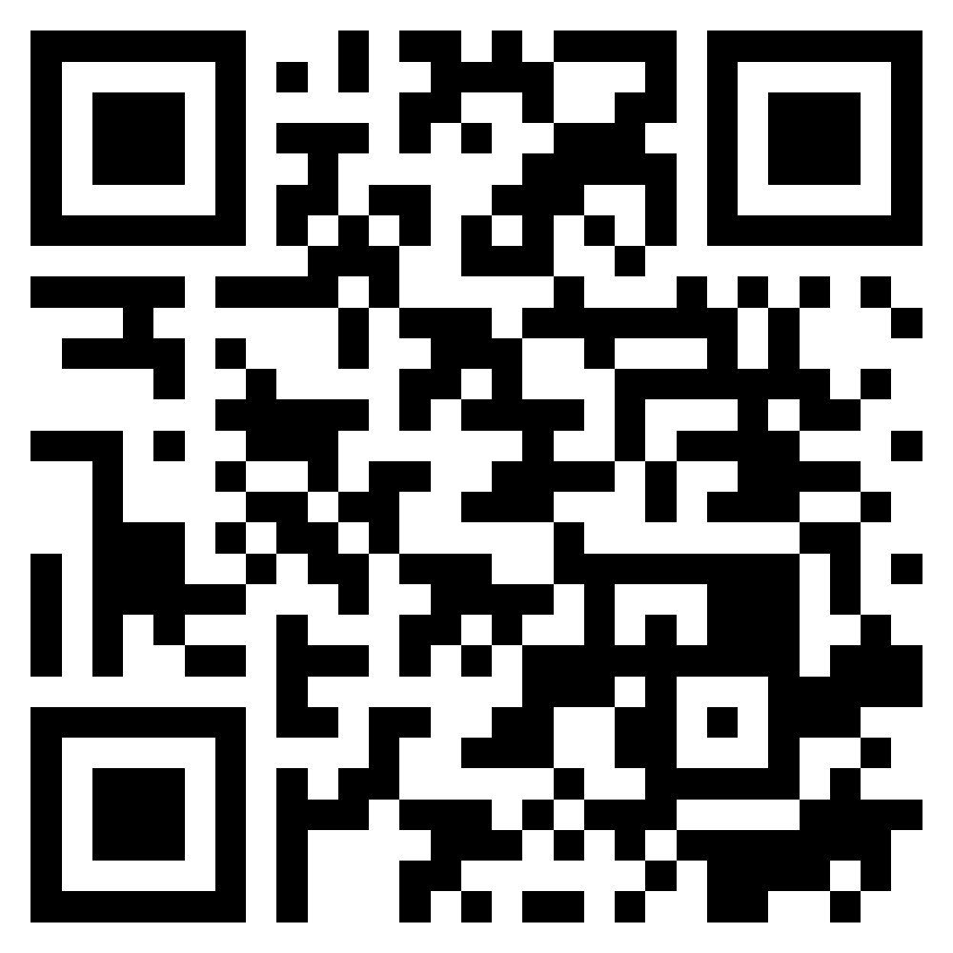
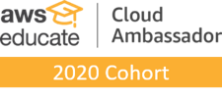


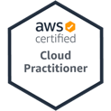
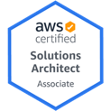
Software Engineering
Cloud Computing and
Cloud Software Architecture
1132SE07
MBA, IM, NTPU (M5010) (Spring 2025)
Wed 2, 3, 4 (9:10-12:00) (B3F17)
Min-Yuh Day, Ph.D,
Professor
Institute of Information Management, National Taipei University
https://web.ntpu.edu.tw/~myday
https://meet.google.com/ish-gzmy-pmo
2025-04-23

Slide 2
Syllabus
Week Date Subject/Topics
1 2025/02/19 Introduction to Software Engineering
2 2025/02/26 Software Products and Project Management:
Software product management and prototyping with
Generative AI
3 2025/03/05 Agile Software Engineering:
Agile methods, Scrum, and Extreme Programming
4 2025/03/12 Case Study on Software Engineering I
5 2025/03/19 Features, Scenarios, and Stories
6 2025/03/26 Software Architecture:
Architectural design, System decomposition, and
Distribution architecture

Slide 3
Syllabus
Week Date Subject/Topics
7 2025/04/02 Make-up holiday for NTPU Sports Day (No Classes)
8 2025/04/09 Midterm Project Report
9 2025/04/16 Cloud-Based Software: Virtualization and containers,
Everything as a service, Software as a service
10 2025/04/23 Cloud Computing and Cloud Software Architecture
11 2025/04/30 Case Study on Software Engineering II
12 2025/05/07 Microservices Architecture, RESTful services,
Service deployment

Slide 4
Syllabus
Week Date Subject/Topics
13 2025/05/14 Industry Practices of Software Engineering
14 2025/05/21 Security and Privacy; Reliable Programming;
Testing: Functional testing, Test automation,
Test-driven development, and Code reviews;
DevOps and Code Management:
Code management and DevOps automation
15 2025/05/28 Final Project Report I
16 2025/06/04 Final Project Report II

Slide 5
Cloud Computing and
Cloud Software Architecture

Slide 6
Software Engineering and
Project Management
Analyze
Requirements
definition
Design
System and Software design
Build
Implementation and
unit testing
Test
Integration
and
system testing
Deliver
Operation
and maintenance
Project Management

Slide 7
Information Management (MIS)
Information Systems
Organizations
Technology
Information
Systems
Management

Slide 8
Fundamental MIS Concepts
Business
Challenges
Management
Organization
Information
System
Business
Solutions
Technology

Slide 9
Project-based software engineering
CUSTOMER
Problem
generates
helps-with
Requirements
implemented-by
Software
1
CUSTOMER and
DEVELOPER
DEVELOPER

Slide 10
Product software engineering
DEVELOPER
Opportunity
1
inspires
realizes
Product features
implemented-by
Software
DEVELOPER
DEVELOPER

Slide 11
Software execution models
Stand-alone execution
Hybrid execution
Software as a service
User’s computer
User’s computer
User’s computer
User interface
Product functionality
User data
User interface
Partial functionality
User data
User interface
(browser or app)
Product updates
Additional functionality
User data backups
Product updates
Product functionality
User data
Vendor’s servers
Vendor’s servers
Vendor’s servers

Slide 12
Product management concerns
Business
needs
Product manager
Technology
constraints
Customer
experience

Slide 13
Technical interactions of product managers
Product
vision management
Product
backlog management
User stories
and
scenarios
Product manager
Acceptance
testing
Customer
testing
User
interface
design

Slide 14
Software Development Life Cycle (SDLC)
The waterfall model
Requirements
definition
System and Software design
Implementation and unit testing
Integration and system testing
Operation and maintenance

Slide 15
Plan-based and Agile development
Plan-based development
Requirements
engineering
Requirements
specification
Design and implementation
Requirements change requests
Agile development
Requirements
engineering
Design and implementation

Slide 16
The Continuum of Life Cycles
High
Incremental
Agile
Frequency of Delivery
Predictive
Iterative
Low
Low
High
Degree of Change

Slide 17
Predictive Life Cycle
Analyze
Design
Build
Test
Deliver

Slide 18
Iterative Life Cycle
Prototype
Refine
Analyze
Analyze
Design
Build
Test
Deliver

Slide 19
A Life Cycle of
Varying-Sized Increments
Analyze
Design
Build
Test
Deliver
Analyze
Design
Build
Test
Deliver
Analyze
Design
Build
Test
Deliver

Slide 20
Iteration-Based and Flow-Based Agile Life Cycles
Iteration-Based Agile
Requirements
Analysis
Design
Build
Test
Requirements
Analysis
Design
Build
Test
Requirements
Analysis
Design
Build
Test
Requirements
Analysis
Design
Build
Test
Repeat
as needed
…
Requirements
Analysis
Design
Build
Test
Requirements
Analysis
Design
Build
Test
Flow-Based Agile
Requirements
Analysis
Design
Build
Test
the number of features in the WIP limit
Requirements
Analysis
Design
Build
Test
the number of features in the WIP limit
Requirements
Analysis
Design
Build
Test
the number of features in the WIP limit
Repeat
as needed
…
Requirements
Analysis
Design
Build
Test
the number of features in the WIP limit
Requirements
Analysis
Design
Build
Test
the number of features in the WIP limit

Slide 21
From personas to features
1
Personas
A way of representing users
inspire
Natural language descriptions of a user interacting with a software product
2
Scenarios
are-developed-into
3
inspire
Stories
Natural language descriptions of something that is needed or wanted by users
4
Features
define
Fragments of product functionality

Slide 22
Multi-tier client-server architecture
Client 1
Client 2
Web
Server
Application
Server
Database
Server
Client 3
Client …

Slide 23
Service-oriented Architecture
Client 1
S1
S2
Client 2
S3
Web
Server
Service
gateway
S4
Client 3
S5
Client …
S6
Services

Slide 24
VM
Container
Virtual
web server
Virtual
mail server
User 1
Container 1
User 2
Container 2
Server
software
Server
software
Application
software
Application
software
Guest
OS
Guest
OS
Server
software
Server
software
Hypervisor
Container manager
Host OS
Host OS
Server Hardware
Server Hardware

Slide 25
Everything as a service
Photo
editing
Software as a service
(SaaS)
Logistics
management
Cloud management
Monitoring
Platform as a service
(PaaS)
Database
Software
development
Storage Network
Infrastructure as a service
(IaaS)
Computing Virtualization
Cloud data center

Slide 26
Software as a service
Software customers
Software
provider
Software services
Cloud Infrastructure
Cloud
provider

Slide 27
Microservices architecture – key design questions
What are the microservices that make up the system?
How should data be distributed and shared?
How should microservices communicate with each other?
Microservices architecture
design
How should the microservices in the system be coordinated?
How should service failure be detected, reported and managed?

Slide 28
Types of security threat
An attacker attempts to deny access to the system for legitimate users
An attacker attempts to damage the system or its data
Availability
threats
Integrity
threats
SOFTWARE PRODUCT
PROGRAM
Distributed denial of service (DDoS) attack
Virus
DATA
Ransomware
Data theft
Confidentiality
threats
An attacker tries to gain access to private information held by the system

Slide 29
Software product quality attributes
Reliability
Availability
1
2
Software product quality attributes
Security
Resilience
7
3
Usability
Maintainability
6
4
Responsiveness
5

Slide 30
A refactoring process
1
2
Start
Identify code
‘smell’
Identify refactoring strategy
4
3
Run automated code tests
Make small
improvement until strategy completed

Slide 31
Functional testing
Start
1
Unit
Testing
4
2
Release
Testing
Feature
Testing
3
System
Testing

Slide 32
Test-driven development (TDD)
Start
1
Identify new
functionality
2
Identify partial implementation
of functionality
3
Write code stub
that will fail test
Functionality
complete
Functionality
incomplete
4
Run all
automated test
7
Refactor code
if required
5
Implement code that should cause failing test to pass
Test failure
6
Run all
automated test
All tests pass

Slide 33
DevOps
Development
Deployment
Support
Multi-skilled DevOps team

Slide 34
Code management and DevOps
DevOps automation
Continuous
integration
Continuous
deployment
Continuous
delivery
Infrastructure
as code
Code management system
Branching and merging
Recover
version
information
Code
repository
Save and
retrieve
versions
Transfer code to/from developer’s filestore
DevOps measurement
Data
collection
Data
analysis
Report
generation

Slide 35
Cloud Computing and
Cloud Software Architecture

Slide 36
Cloud Software Architecture for Agentic AI

Slide 37
Cloud Software Architecture for Agentic AI
Microservices and Serverless Architecture
Containers (Docker, Kubernetes)
Serverless platforms (AWS Lambda, Google Cloud Functions)
APIs and Tooling Integration via MCP
Agents access tools (e.g., databases, APIs, CRMs, payment gateways)
using Model Context Protocol (MCP)
Enhances tool-using behavior of LLM agents
Tools and Frameworks
LangChain, AutoGen, CrewAI: for orchestrating LLM agents
Anthropic’s MCP, Google’s A2A: communication protocols
Vector DBs (Pinecone, Weaviate): for agent memory

Slide 38
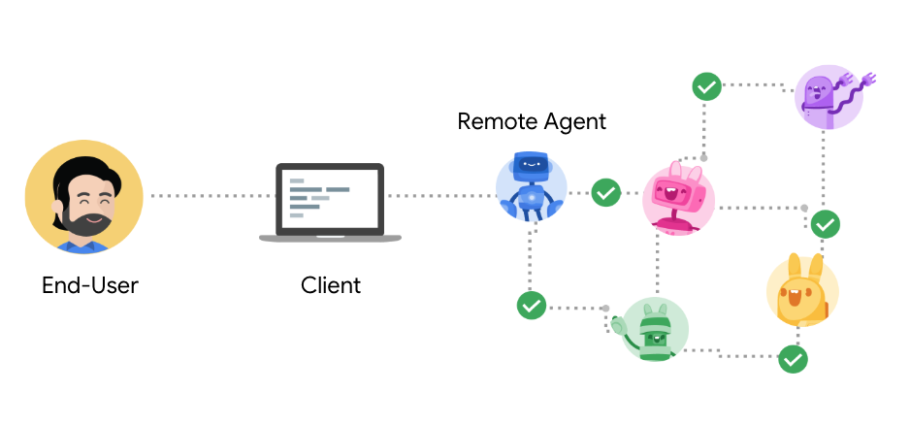
Agent2Agent Protocol (A2A)
An open protocol enabling Agent-to-Agent interoperability, bridging the gap between opaque agentic systems
Source: https://google.github.io/A2A/

Slide 39
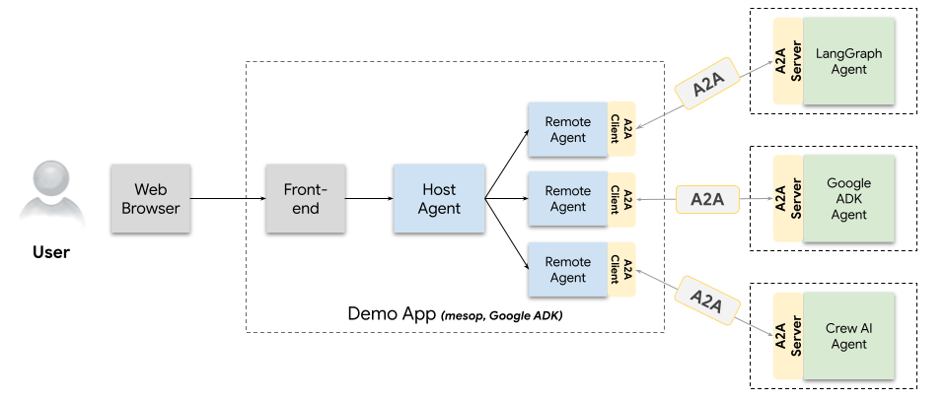
A2A Demo Web App
Agents talking to other agents over A2A
Source: https://github.com/google/A2A/blob/main/demo/README.md

Slide 40
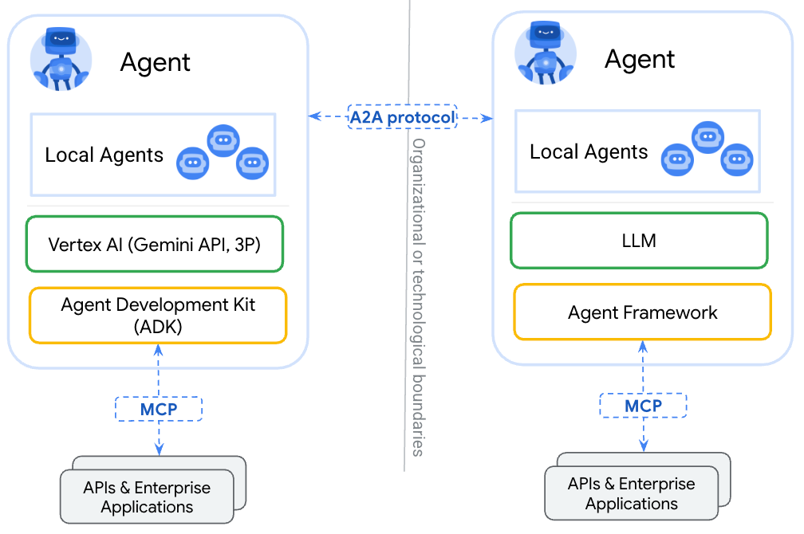
A2A
(Agent2Agent Protocol) for agent-agent collaboration
MCP
(Model Context Protocol) for tools and resources
Source: https://google.github.io/A2A/

Slide 41
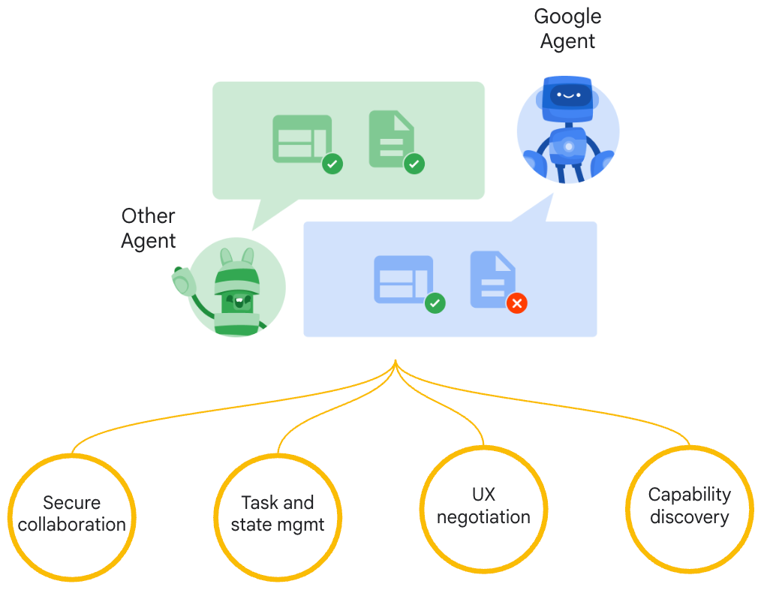
Google A2A (Agent2Agent Protocol)
Seamless Agent Collaboration
Simplifies Enterprise
Agent Integration
Supports Key
Enterprise Requirements
Source: https://google.github.io/A2A/

Slide 42
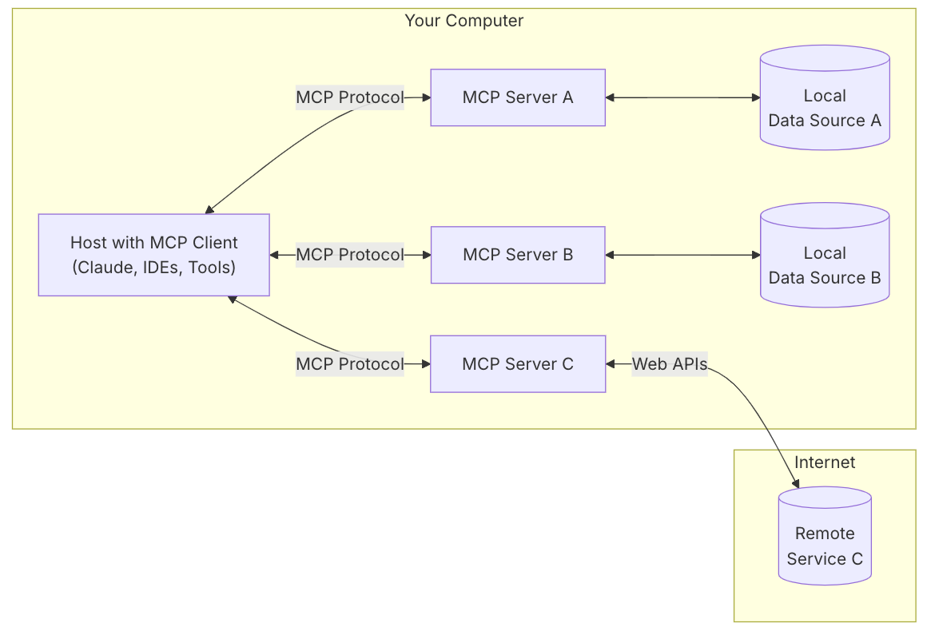
MCP (Model Context Protocol)
MCP is a open protocol that standardizes how applications provide context to LLMs.
MCP: USB-C port for AI applications.
Source: https://modelcontextprotocol.io/introduction

Slide 43
MCP and A2A
MCP (Model Context Protocol) for tools and resources
  Connect agents to tools, APIs, and resources with structured inputs/outputs.
  Google ADK supports MCP tools. Enabling wide range of MCP servers to be used with agents.
A2A (Agent2Agent Protocol) for agent-agent collaboration
  Dynamic, multimodal communication between different agents without sharing memory, resources, and tools
  Open standard driven by community.
  Samples available using Google ADK, LangGraph, Crew.AI
Source: https://google.github.io/A2A/

Slide 44
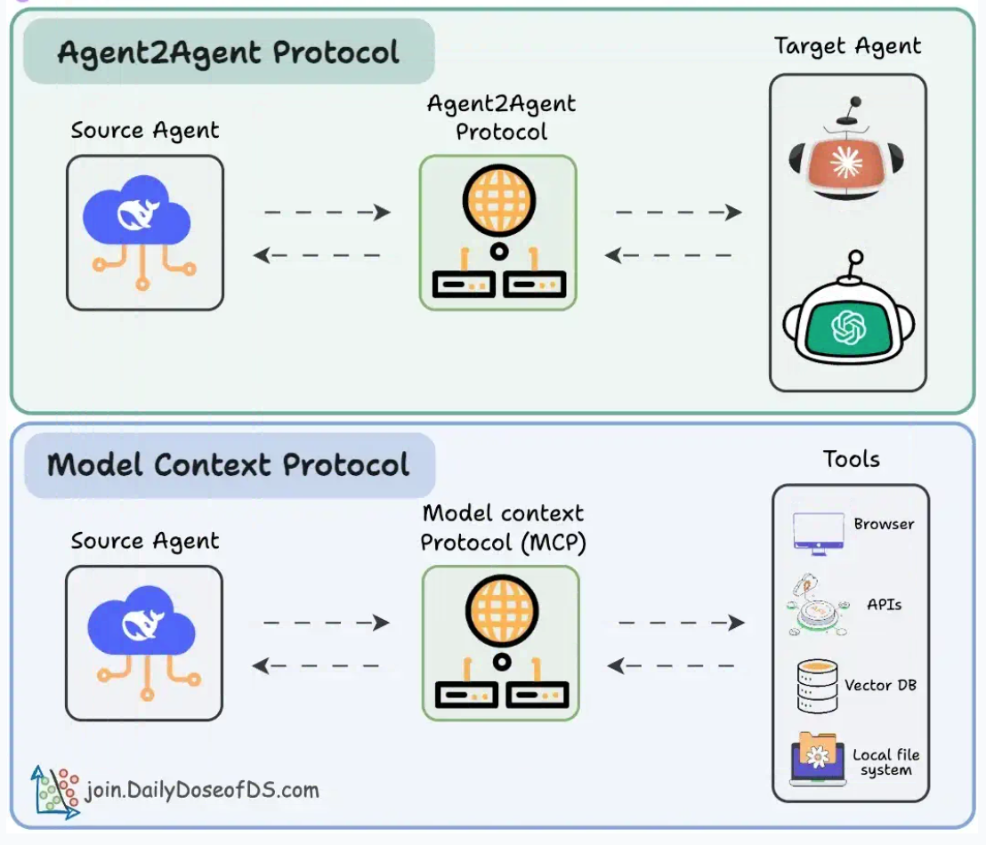
Agentic applications require both A2A and MCP
A2A allows agents to connect with other agents and collaborate in teams.
MCP provides agents with access to tools
Source: https://blog.dailydoseofds.com/p/a-visual-guide-to-agent2agent-a2a

Slide 45
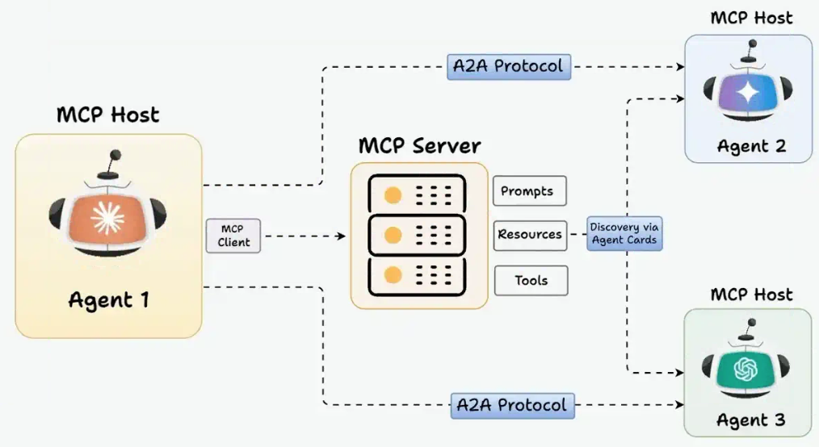
MCP and A2A Protocol for AI Agents
Source: https://blog.dailydoseofds.com/p/a-visual-guide-to-agent2agent-a2a

Slide 46

Web Application with
AWS Core Services

Slide 47
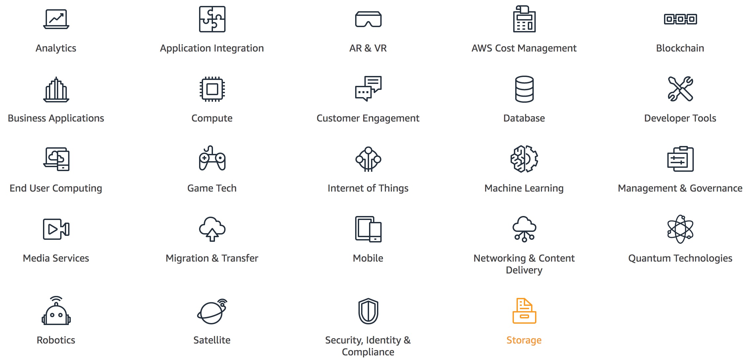
AWS Products and Services
Source: https://aws.amazon.com/

Slide 48
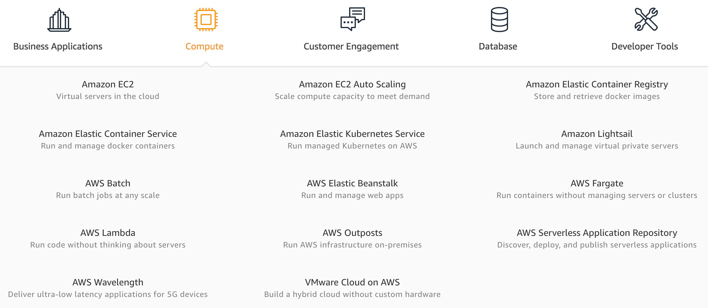
AWS Compute
Source: https://aws.amazon.com/

Slide 49
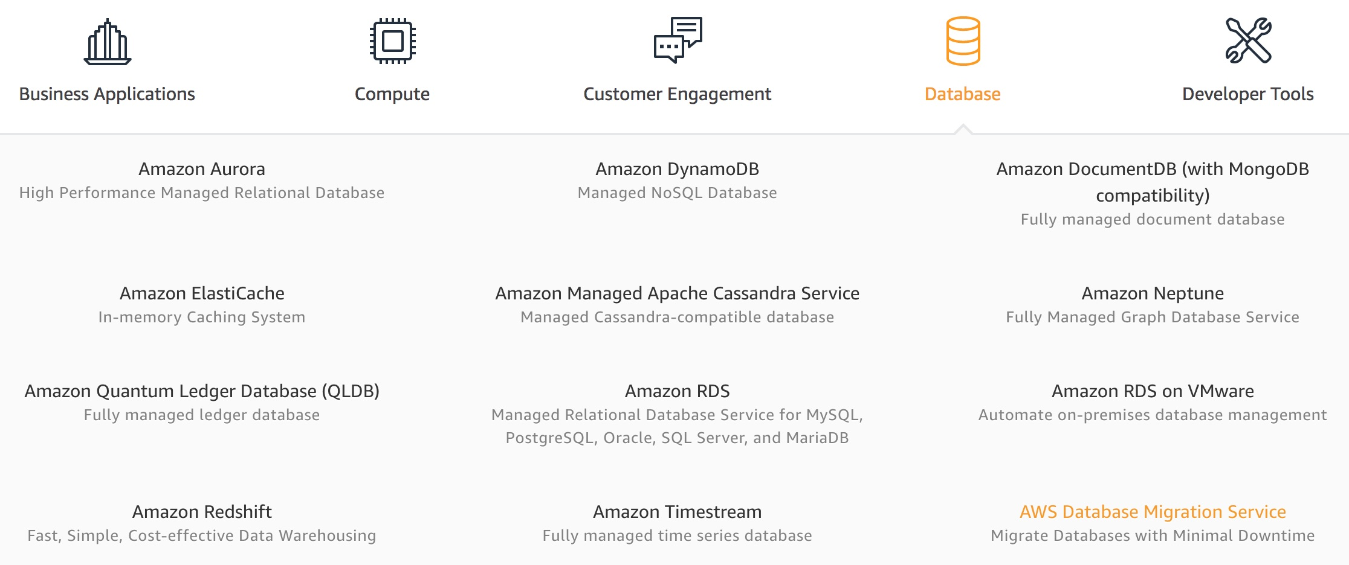
AWS Database
Source: https://aws.amazon.com/

Slide 50
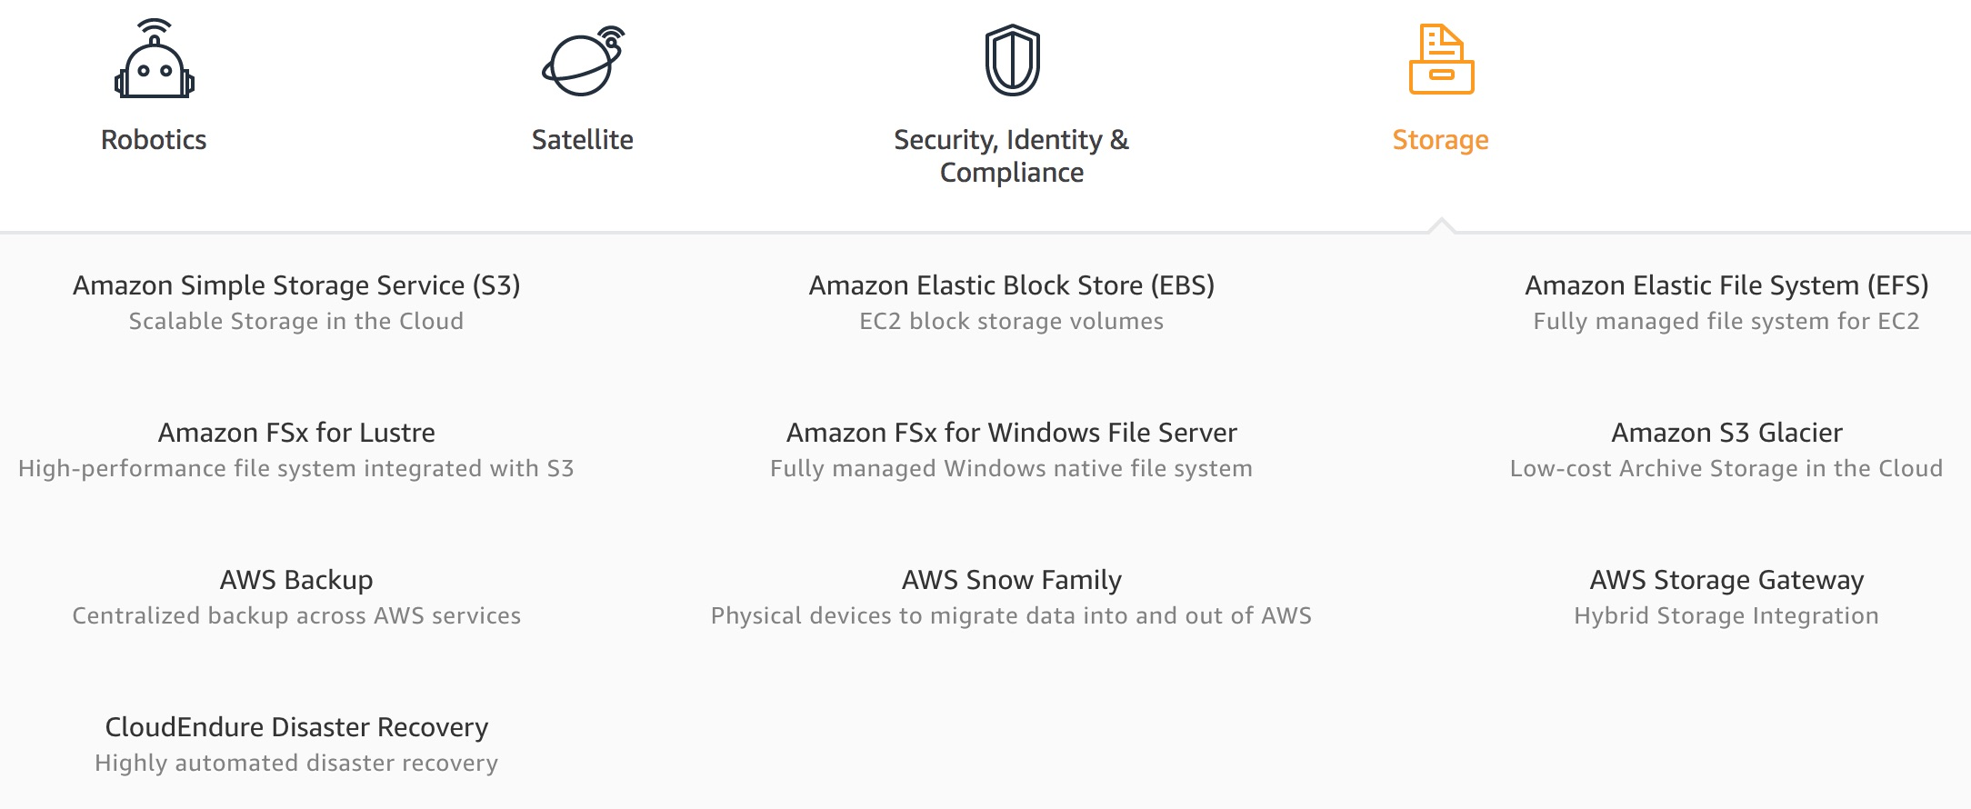
AWS Storage
Source: https://aws.amazon.com/

Slide 51
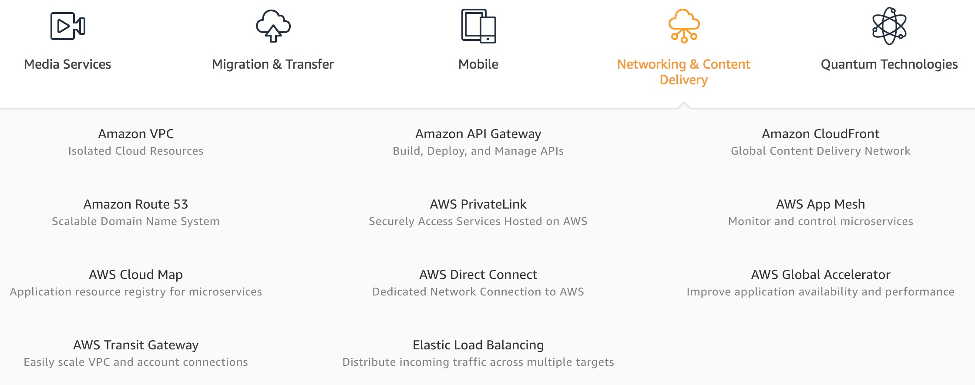
AWS Networking & Content Dilivery
Source: https://aws.amazon.com/

Slide 52
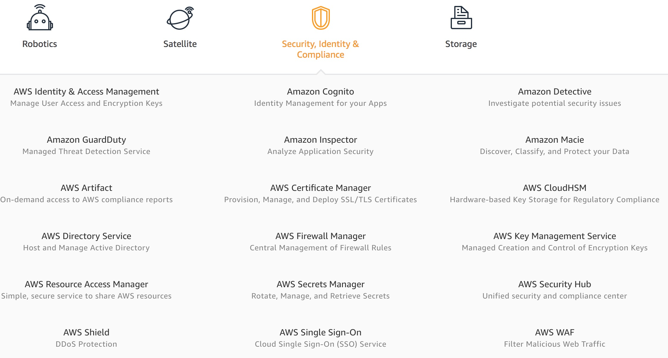
AWS Security, Identity & Compliance
Source: https://aws.amazon.com/

Slide 53
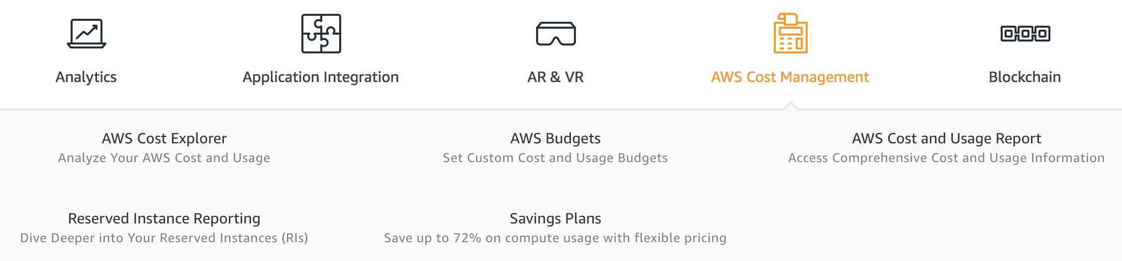
AWS Cost Management
Source: https://aws.amazon.com/

Slide 54
AWS Services
Amazon EC2
  Virtual servers in the cloud
Amazon Simple Storage Service (S3)
  Scalable storage in the cloud
Amazon Aurora
  High performance managed relational database
Amazon DynamoDB
  Managed NoSQL database
Amazon RDS
  Managed relational database service for MySQL, PostgreSQL, Oracle, SQL Server, and MariaDB
Source: https://aws.amazon.com/

Slide 55
AWS Services
AWS Lambda
  Run code without thinking about servers
AWS Elastic Beanstalk
  Run and manage web apps
Amazon VPC
  Isolated cloud resources
Amazon Lightsail
  Launch and manage virtual private servers
Amazon SageMaker
  Build, train, and deploy machine learning models at scale
Source: https://aws.amazon.com/

Slide 56
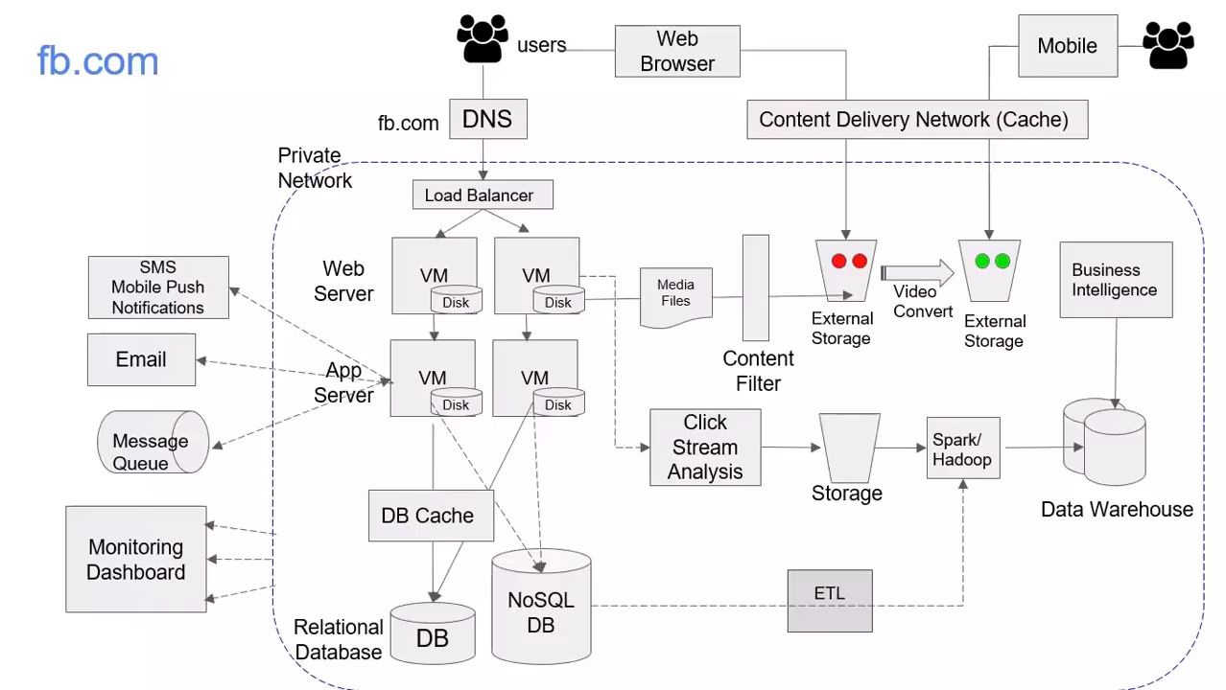
Source: AWS Training Center (2019), Introduction to AWS Services, https://youtu.be/Z3SYDTMP3ME

Slide 57
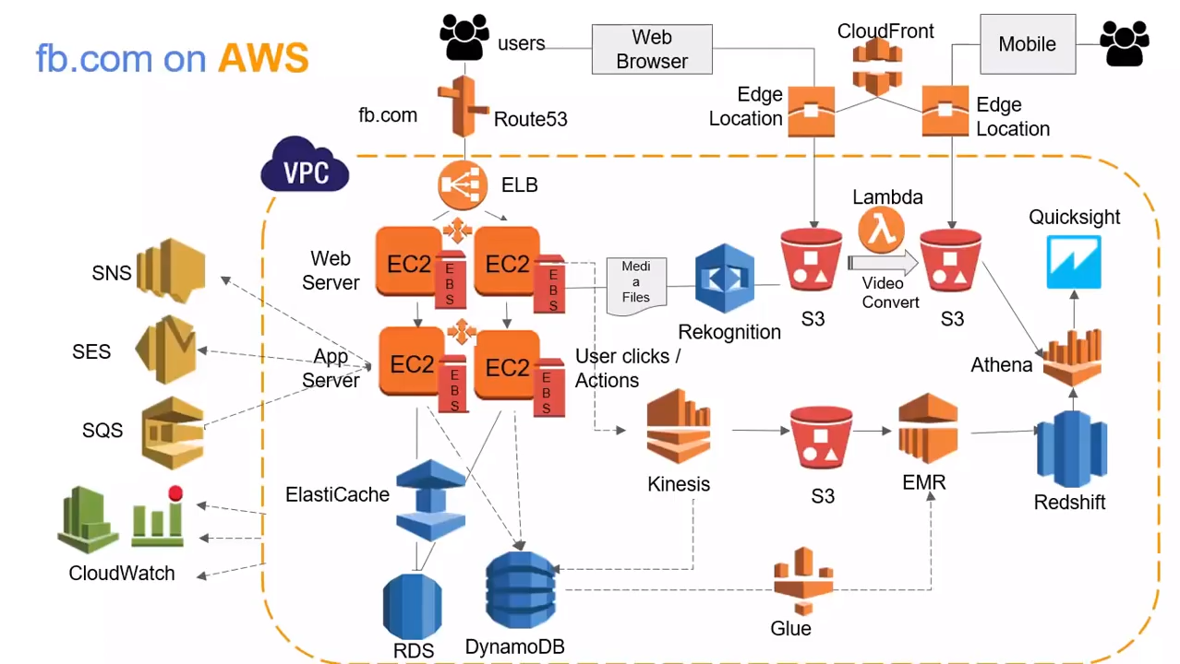
Source: AWS Training Center (2019), Introduction to AWS Services, https://youtu.be/Z3SYDTMP3ME

Slide 58
Source: AWS Training Center (2019), Introduction to AWS Services, https://youtu.be/Z3SYDTMP3ME

Slide 59
Source: AWS Training Center (2019), Introduction to AWS Services, https://youtu.be/Z3SYDTMP3ME

Slide 60
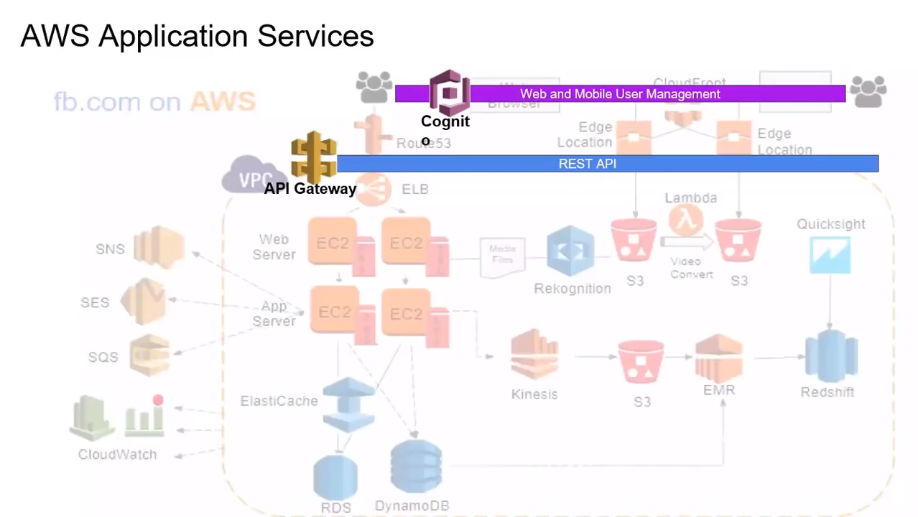
Source: AWS Training Center (2019), Introduction to AWS Services, https://youtu.be/Z3SYDTMP3ME

Slide 61
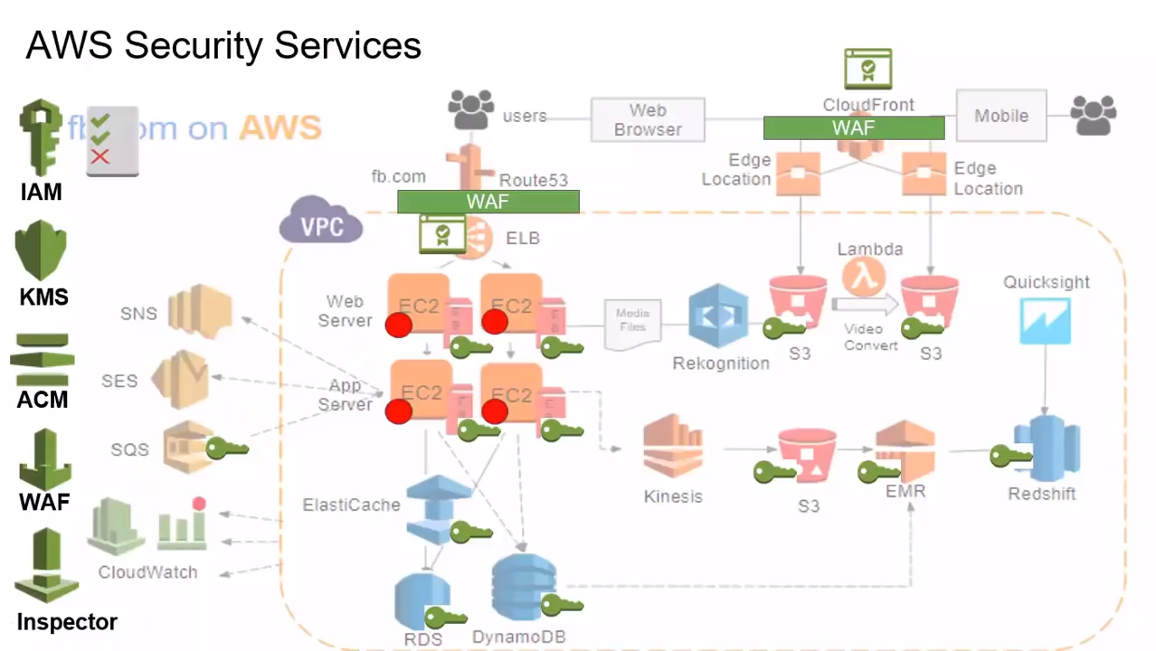
Source: AWS Training Center (2019), Introduction to AWS Services, https://youtu.be/Z3SYDTMP3ME

Slide 62
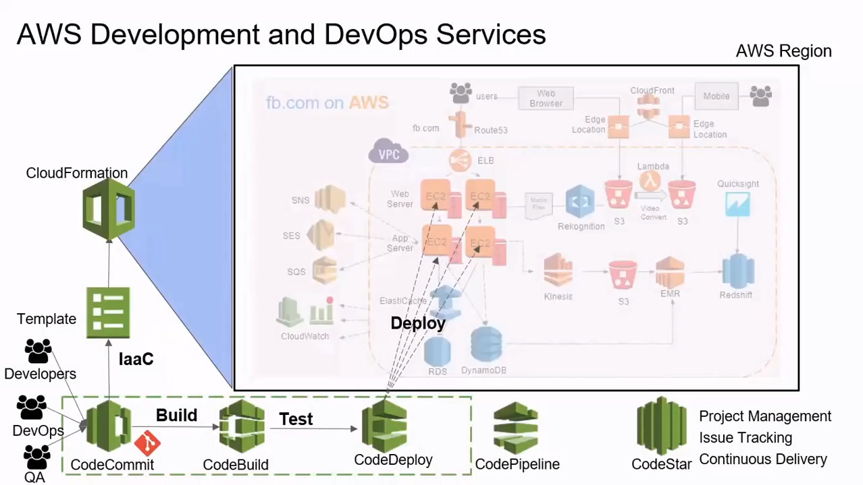
Source: AWS Training Center (2019), Introduction to AWS Services, https://youtu.be/Z3SYDTMP3ME

Slide 63
AWS
Serverless Architecture

Slide 64
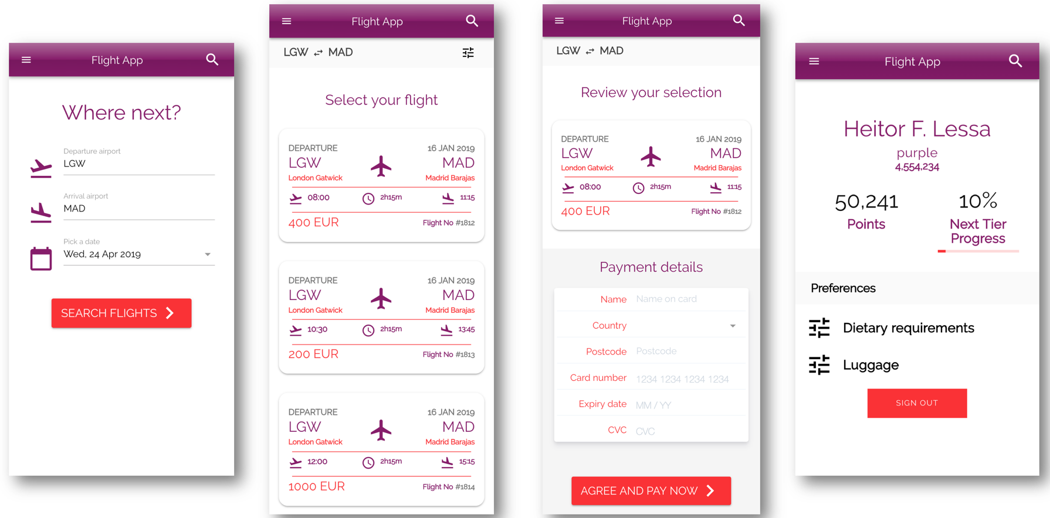
AWS Serverless Airline Booking
Source: https://github.com/aws-samples/aws-serverless-airline-booking

Slide 65
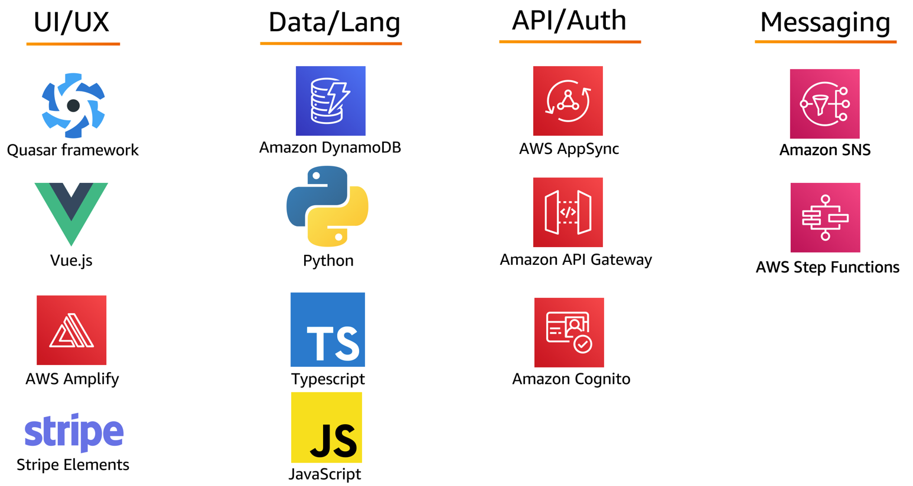
AWS Serverless Airline Booking
Stack
Source: https://github.com/aws-samples/aws-serverless-airline-booking

Slide 66
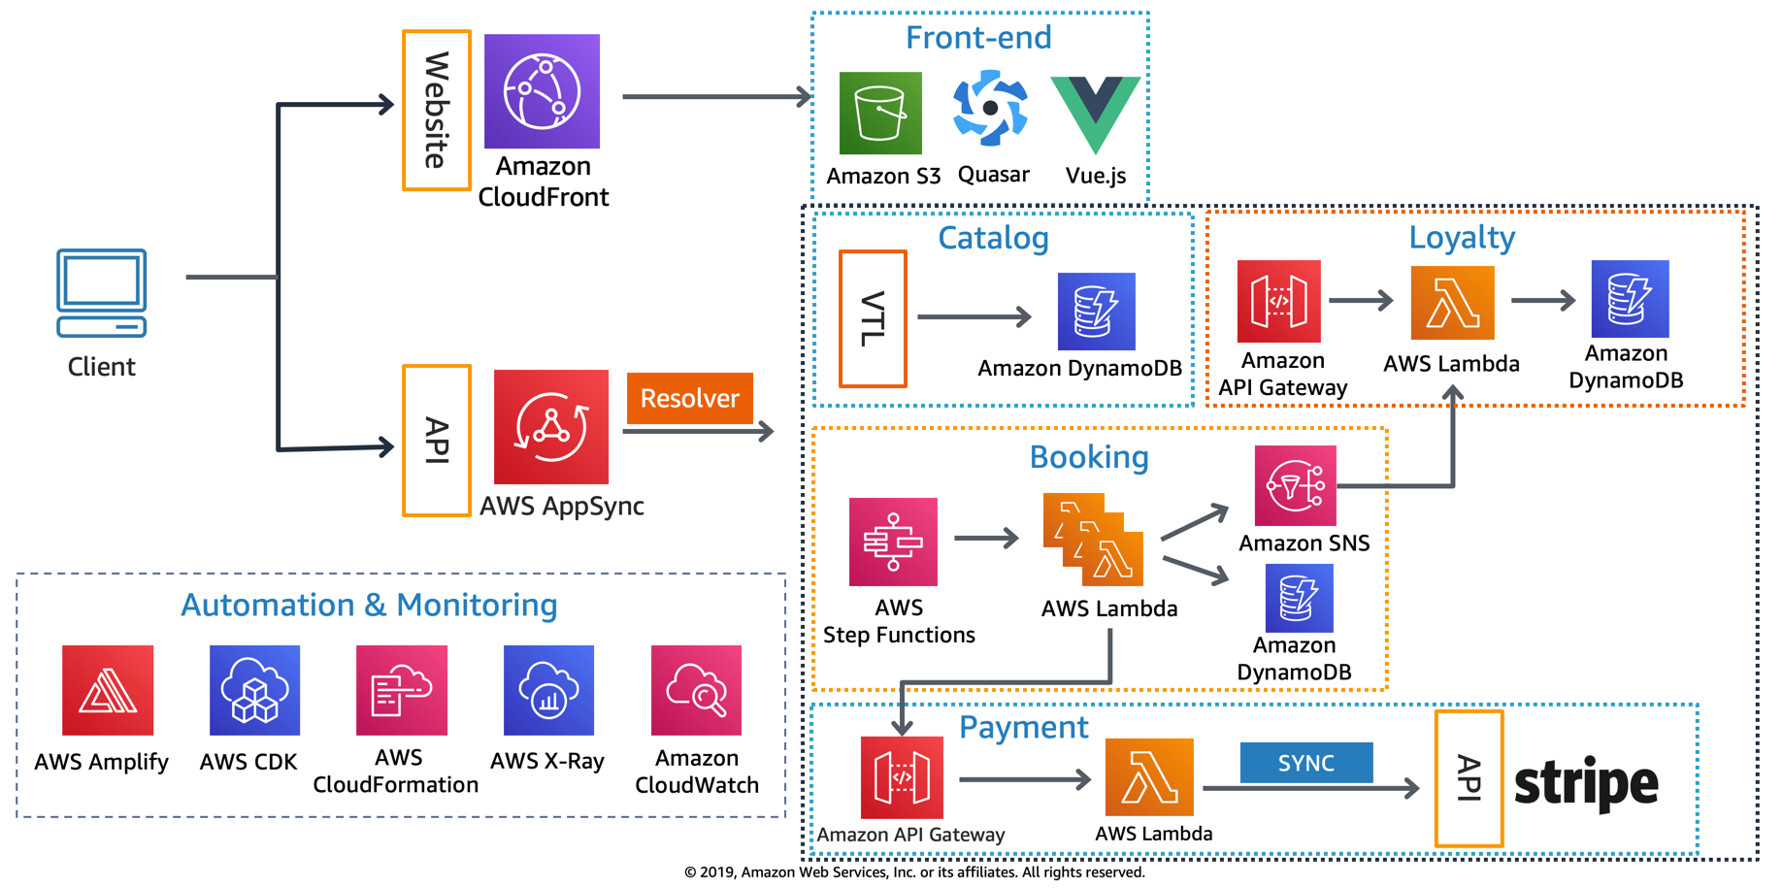
AWS Serverless Airline Booking
High level infrastructure architecture
Source: https://github.com/aws-samples/aws-serverless-airline-booking

Slide 67
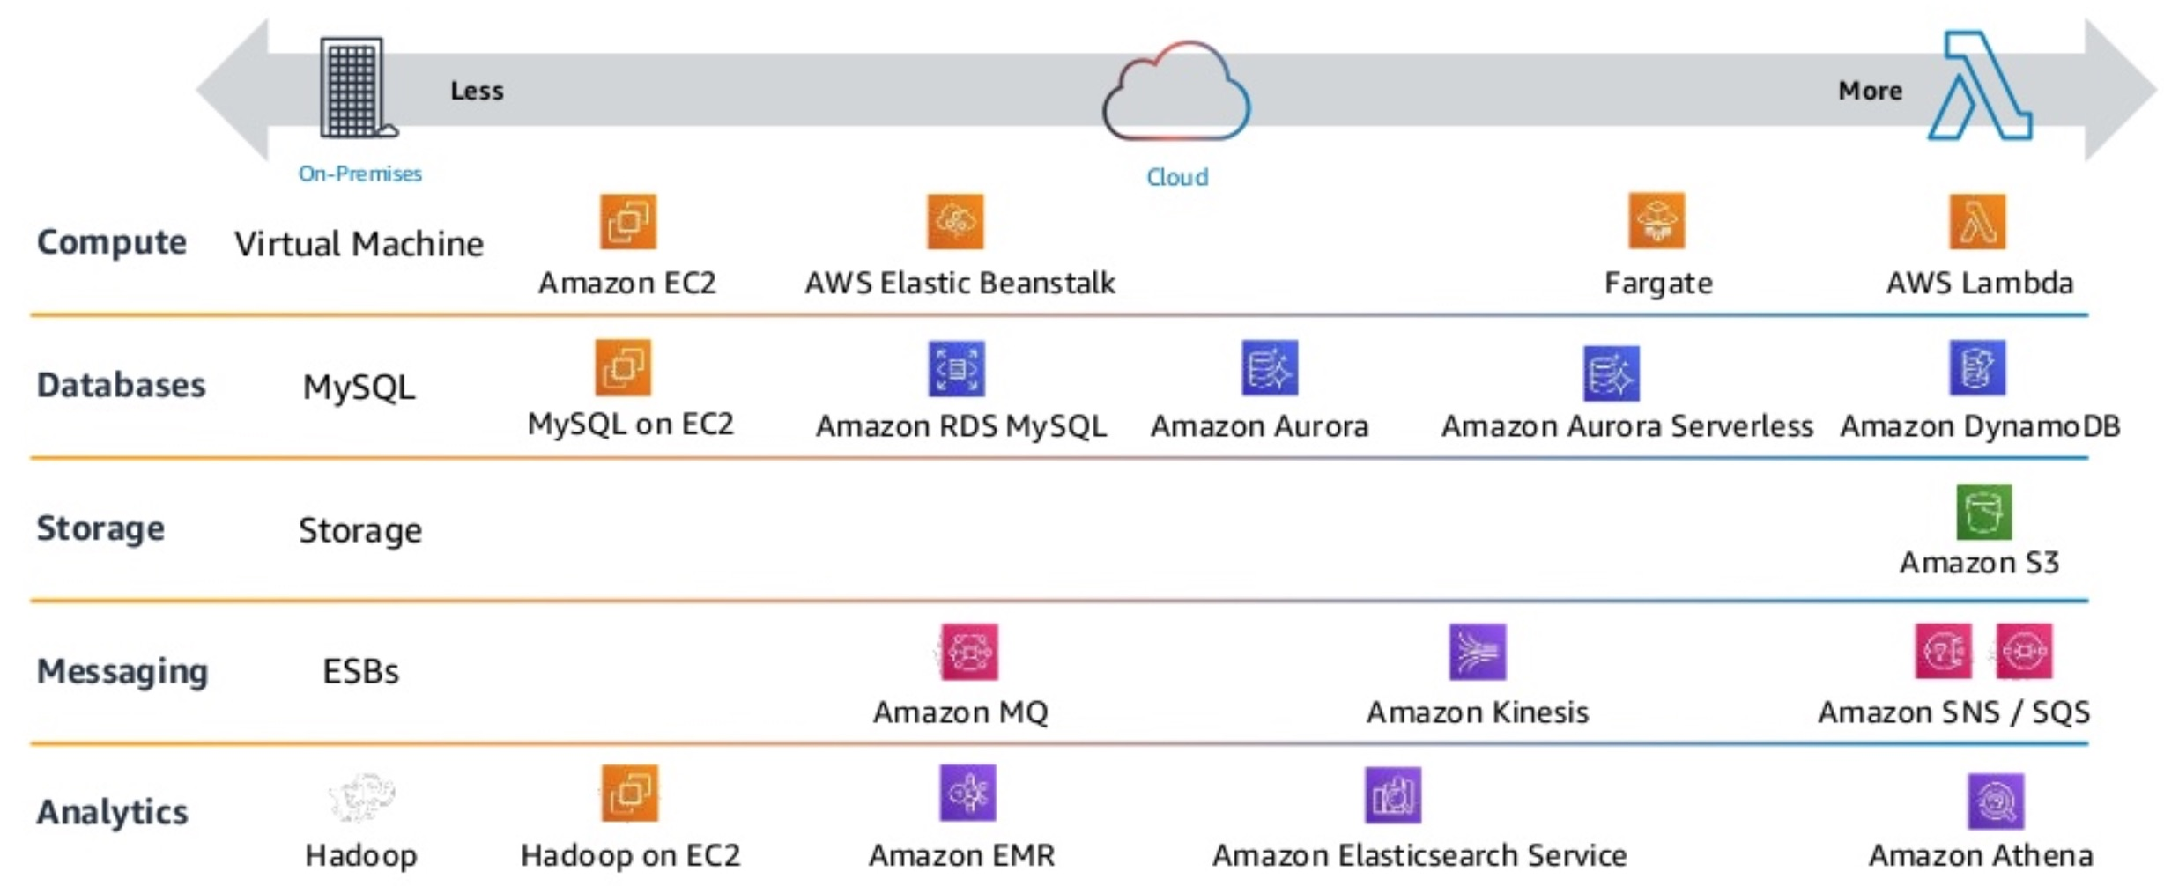
AWS Serverless Architecture
AWS Operational Responsibility Models
Source: Heitor Lessa (2019), How to build a full stack serverless airline ticketing web app, https://www.youtube.com/watch?v=MyoOeHTp2pg

Slide 68
Build a
Serverless
Web Application

Slide 69
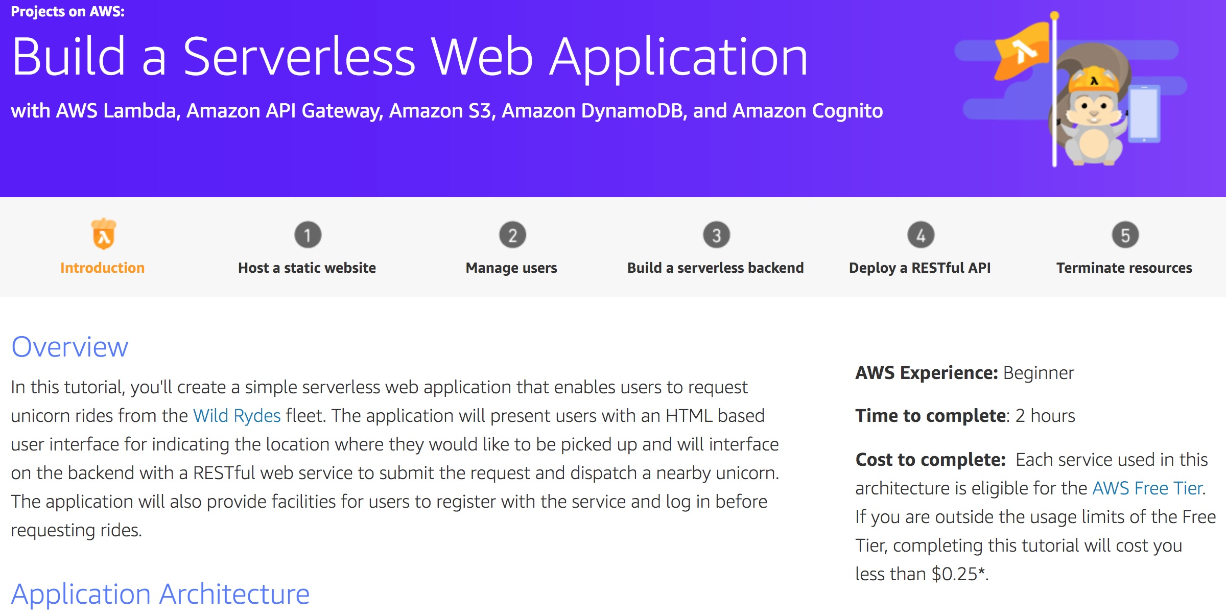
Build a Serverless Web Application
Source: https://aws.amazon.com/getting-started/projects/build-serverless-web-app-lambda-apigateway-s3-dynamodb-cognito/

Slide 70
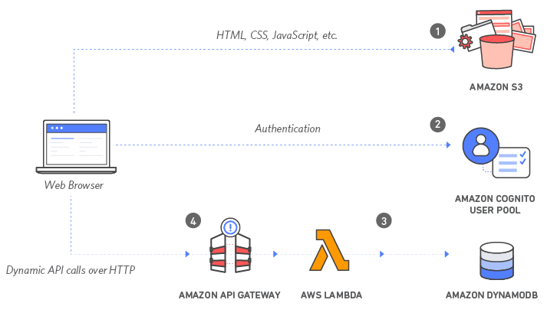
Build a Serverless Web Application with Amazon S3, AWS Lambda, Amazon API Gateway,
Amazon DynamoDB, and Amazon Cognito
Source: https://aws.amazon.com/getting-started/projects/build-serverless-web-app-lambda-apigateway-s3-dynamodb-cognito/

Slide 71
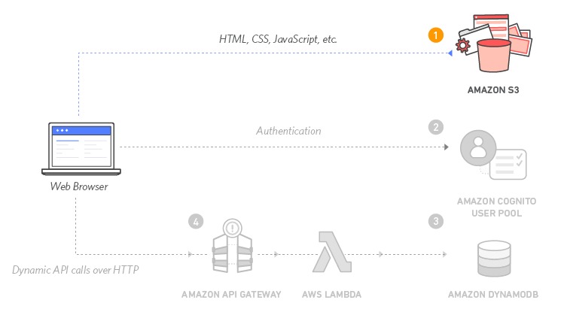
Build a Serverless Web Application with Amazon S3, AWS Lambda, Amazon API Gateway,
Amazon DynamoDB, and Amazon Cognito
1
Source: https://aws.amazon.com/getting-started/projects/build-serverless-web-app-lambda-apigateway-s3-dynamodb-cognito/

Slide 72
Build a Serverless Web Application with Amazon S3, AWS Lambda, Amazon API Gateway,
Amazon DynamoDB, and Amazon Cognito
1
Static Web Hosting
Amazon S3 hosts static web resources including HTML, CSS, JavaScript, and image files which are loaded in the user's browser.
Source: https://aws.amazon.com/getting-started/projects/build-serverless-web-app-lambda-apigateway-s3-dynamodb-cognito/

Slide 73
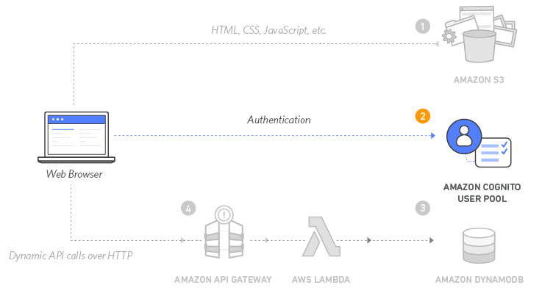
Build a Serverless Web Application with Amazon S3, AWS Lambda, Amazon API Gateway,
Amazon DynamoDB, and Amazon Cognito
2
Source: https://aws.amazon.com/getting-started/projects/build-serverless-web-app-lambda-apigateway-s3-dynamodb-cognito/

Slide 74
Build a Serverless Web Application with Amazon S3, AWS Lambda, Amazon API Gateway,
Amazon DynamoDB, and Amazon Cognito
2
User Management
Amazon Cognito provides
user management and authentication functions to secure the backend API.
Source: https://aws.amazon.com/getting-started/projects/build-serverless-web-app-lambda-apigateway-s3-dynamodb-cognito/

Slide 75
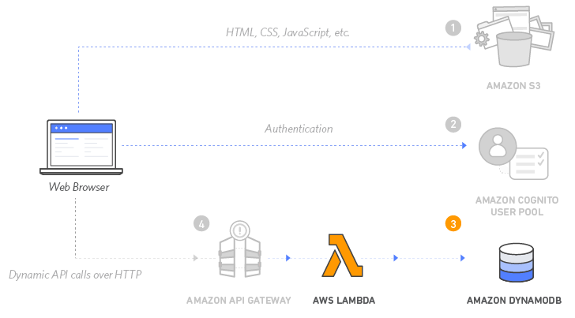
Build a Serverless Web Application with Amazon S3, AWS Lambda, Amazon API Gateway,
Amazon DynamoDB, and Amazon Cognito
3
Source: https://aws.amazon.com/getting-started/projects/build-serverless-web-app-lambda-apigateway-s3-dynamodb-cognito/

Slide 76
Build a Serverless Web Application with Amazon S3, AWS Lambda, Amazon API Gateway,
Amazon DynamoDB, and Amazon Cognito
3
Serverless Backend
Amazon DynamoDB provides a persistence layer where data can be stored by the API's Lambda function.
Source: https://aws.amazon.com/getting-started/projects/build-serverless-web-app-lambda-apigateway-s3-dynamodb-cognito/

Slide 77
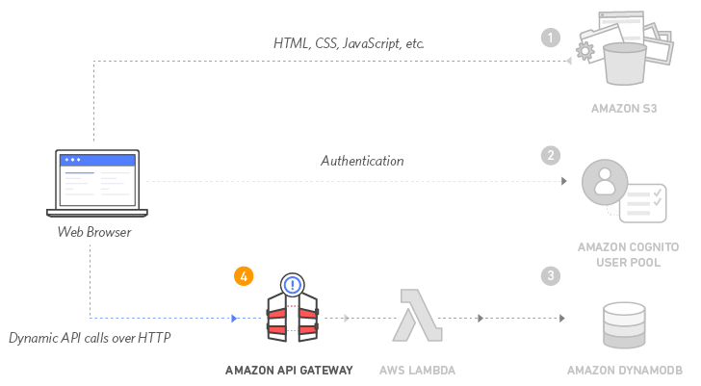
Build a Serverless Web Application with Amazon S3, AWS Lambda, Amazon API Gateway,
Amazon DynamoDB, and Amazon Cognito
4
Source: https://aws.amazon.com/getting-started/projects/build-serverless-web-app-lambda-apigateway-s3-dynamodb-cognito/

Slide 78
Build a Serverless Web Application with Amazon S3, AWS Lambda, Amazon API Gateway,
Amazon DynamoDB, and Amazon Cognito
4
RESTful API
JavaScript executed in the browser sends and receives data from a public backend API built using Lambda and API Gateway.
Source: https://aws.amazon.com/getting-started/projects/build-serverless-web-app-lambda-apigateway-s3-dynamodb-cognito/

Slide 79
Build a Serverless Web Application with Amazon S3, AWS Lambda, Amazon API Gateway,
Amazon DynamoDB, and Amazon Cognito
5
Terminate resources
Resource Cleanup
You will terminate an Amazon S3 bucket, an Amazon Cognito User Pool, an AWS Lambda function, an IAM role, a DynamoDB table, a REST API, and a CloudWatch Log.
It is a best practice to delete resources you are no longer using to avoid unwanted charges.
Source: https://aws.amazon.com/getting-started/projects/build-serverless-web-app-lambda-apigateway-s3-dynamodb-cognito/

Slide 80
References
Ian Sommerville (2019), Engineering Software Products: An Introduction to Modern Software Engineering, Pearson.
Ian Sommerville (2015), Software Engineering, 10th Edition, Pearson.
Titus Winters, Tom Manshreck, and Hyrum Wright (2020), Software Engineering at Google: Lessons Learned from Programming Over Time, O'Reilly Media.
Project Management Institute (2021), A Guide to the Project Management Body of Knowledge (PMBOK Guide) – Seventh Edition and The Standard for Project Management, PMI.
Project Management Institute (2017), A Guide to the Project Management Body of Knowledge (PMBOK Guide), Sixth Edition, Project Management Institute.
Project Management Institute (2017), Agile Practice Guide, Project Management Institute.

