Slide 1









Introduction to
Artificial Intelligence
Artificial Intelligence
1141AI01
MBA, IM, NTPU (M5276) (Fall 2025)
Tue 2, 3, 4 (9:10-12:00) (B3F17)
University Ambassador
Certified Instructor
Min-Yuh Day, Ph.D,
Professor and Director
Institute of Information Management, National Taipei University
https://web.ntpu.edu.tw/~myday
https://meet.google.com/paj-zhhj-mya
2025-09-09

Slide 2











Prof. Min-Yuh Day
University Ambassador
Certified Instructor
Director, Information Management, NTPU
Director, Intelligent Financial Innovation Technology, IFIT Lab, IM, NTPU
Director, Fintech and Green Finance Center (FGFC), NTPU
Division Director, Sustainable Development, Sustainability Office, NTPU
Visiting Scholar, IIS, Academia Sinica
Ph.D., Information Management, NTU
Artificial Intelligence, Agentic AI, ESG and Green Financial Technology,
Big Data Analytics, Electronic Commerce

Slide 3
Course Syllabus
National Taipei University
Academic Year 114, 1st Semester (Fall 2025)
Course Title: Artificial Intelligence
Instructor: Min-Yuh Day
Course Class: MBA, IM, NTPU (3 Credits, Elective)
Details
  In-Class and Distance Learning EMI Course
  (3 Credits, Elective, One Semester) (M5276)
Time & Place: Tue, 2, 3, 4, (9:10-12:00) (B3F17)
Google Meet: https://meet.google.com/paj-zhhj-mya
https://meet.google.com/paj-zhhj-mya

Slide 4
Course Objectives
Understand the fundamental concepts and research issues of Artificial Intelligence.
Equip with Hands-on practices of Artificial Intelligence.
Conduct information systems research in the context of Artificial Intelligence.

Slide 5
Course Outline
This course introduces the fundamental concepts, research issues, and hands-on practices of Artificial Intelligence.
Topics include:
  Introduction to Artificial Intelligence
  Artificial Intelligence and Intelligent Agents; Problem Solving
  Knowledge, Reasoning and Knowledge Representation
  Uncertain Knowledge and Reasoning
  Machine Learning: Supervised and Unsupervised Learning
  The Theory of Learning and Ensemble Learning
  NVIDIA Fundamentals of Deep Learning
  Natural Language Processing
  Computer Vision and Robotics
  Generative AI, Agentic AI, and Physical AI
  Philosophy and Ethics of AI and the Future of AI
  Case Study on AI

Slide 6
Core Competence
Exploring new knowledge in information technology, system development and application 80 %
Internet marketing planning ability 10 %
Thesis writing and independent research skills 10 %

Slide 7
Four Fundamental Qualities
Professionalism
  Creative thinking and Problem-solving 40 %
  Comprehensive Integration 40 %
Interpersonal Relationship
  Communication and Coordination 10 %
  Teamwork 5 %
Ethics
  Honesty and Integrity 0 %
  Self-Esteem and Self-reflection 0 %
International Vision
  Caring for Diversity 0 %
  Interdisciplinary Vision 5 %

Slide 8
College Learning Goals
Ethics/Corporate Social Responsibility
Global Knowledge/Awareness
Communication
Analytical and Critical Thinking

Slide 9
Department Learning Goals
Information Technologies and
System Development Capabilities
Internet Marketing Management Capabilities
Research capabilities

Slide 10
Syllabus
Week Date Subject/Topics
1 2025/09/09 Introduction to Artificial Intelligence
2 2025/09/16 Artificial Intelligence and Intelligent Agents;
Problem Solving
3 2025/09/23 Knowledge, Reasoning and Knowledge Representation;
Uncertain Knowledge and Reasoning
4 2025/09/30 Case Study on Artificial Intelligence I
5 2025/10/07 Machine Learning: Supervised and Unsupervised Learning;
The Theory of Learning and Ensemble Learning

Slide 11
Syllabus
Week Date Subject/Topics
6 2025/10/14 NVIDIA Fundamentals of Deep Learning I:
Deep Learning; Neural Networks
7 2025/10/21 NVIDIA Fundamentals of Deep Learning II:
Convolutional Neural Networks;
Data Augmentation and Deployment
8 2025/10/28 Self-Learning
9 2025/11/04 Midterm Project Report
10 2025/11/11 NVIDIA Fundamentals of Deep Learning III:
Pre-trained Models; Natural Language Processing

Slide 12
Syllabus
Week Date Subject/Topics
11 2025/11/18 Case Study on Artificial Intelligence II
12 2025/11/25 Computer Vision and Robotics
13 2025/12/02 Generative AI, Agentic AI, and Physical AI
14 2025/12/09 Philosophy and Ethics of AI and the Future of AI
15 2025/12/16 Final Project Report I
16 2025/12/23 Final Project Report II

Slide 13
Teaching Methods and Activities
Lecture
Discussion
Practicum

Slide 14
Evaluation Methods
Individual Presentation 60 %
Group Presentation 10 %
Case Report 10 %
Class Participation 10 %
Assignment 10 %

Slide 15

Required Texts
Stuart Russell and Peter Norvig (2020),
Artificial Intelligence: A Modern Approach,
4th Edition, Pearson.
https://www.amazon.com/Artificial-Intelligence-A-Modern-Approach/dp/0134610997/

Slide 16
Reference Books
Thomas R. Caldwell (2025), The Agentic AI Bible: The Complete and Up-to-Date Guide to Design, Build, and Scale Goal-Driven, LLM-Powered Agents that Think, Execute and Evolve, Independently published
Numa Dhamani and Maggie Engler (2024), Introduction to Generative AI, Manning
Denis Rothman (2024), Transformers for Natural Language Processing and Computer Vision - Third Edition: Explore Generative AI and Large Language Models with Hugging Face, ChatGPT, GPT-4V, and DALL-E 3, 3rd ed. Edition, Packt Publishing
Ben Auffarth (2023), Generative AI with LangChain: Build large language model (LLM) apps with Python, ChatGPT and other LLMs, Packt Publishing.
Aurélien Géron (2022), Hands-On Machine Learning with Scikit-Learn, Keras, and TensorFlow: Concepts, Tools, and Techniques to Build Intelligent Systems, 3rd Edition, O’Reilly Media.
Steven D'Ascoli (2022), Artificial Intelligence and Deep Learning with Python: Every Line of Code Explained For Readers New to AI and New to Python, Independently published.
Nithin Buduma, Nikhil Buduma, Joe Papa (2022), Fundamentals of Deep Learning: Designing Next-Generation Machine Intelligence Algorithms, 2nd Edition, ‎O'Reilly Media.

Slide 17
Stuart Russell and Peter Norvig (2020),
Artificial Intelligence: A Modern Approach,
4th Edition, Pearson
Source: Stuart Russell and Peter Norvig (2020), Artificial Intelligence: A Modern Approach, 4th Edition, Pearson
https://www.amazon.com/Artificial-Intelligence-A-Modern-Approach/dp/0134610997/

Slide 18
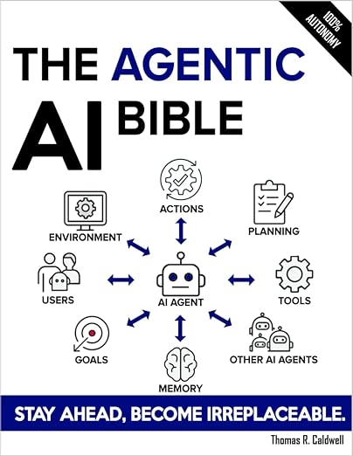
Thomas R. Caldwell (2025),
The Agentic AI Bible:
The Complete and Up-to-Date Guide to Design, Build, and Scale Goal-Driven,
LLM-Powered Agents that Think, Execute and Evolve,
Independently published
Source: https://www.amazon.com/Agentic-Bible-Up-Date-Goal-Driven/dp/B0FL21R86Q

Slide 19

Numa Dhamani and Maggie Engler (2024),
Introduction to Generative AI,
Manning
Source: Numa Dhamani and Maggie Engler (2024), Introduction to Generative AI, Manning
https://www.amazon.com/Introduction-Generative-AI-Numa-Dhamani/dp/1633437191/

Slide 20

Denis Rothman (2024),
Transformers for Natural Language Processing and Computer Vision:
Explore Generative AI and Large Language Models with Hugging Face, ChatGPT, GPT-4V, and DALL-E 3,
3rd Edition, Packt Publishing
Source: https://www.amazon.com/Transformers-Natural-Language-Processing-Computer/dp/1805128728

Slide 21
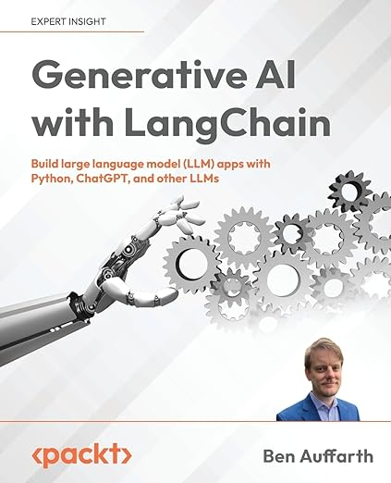
Ben Auffarth (2023),
Generative AI with LangChain:
Build large language model (LLM) apps with Python, ChatGPT and other LLMs,
Packt Publishing.
Source: https://www.amazon.com/Generative-AI-LangChain-language-ChatGPT/dp/1835083463

Slide 22

Aurélien Géron (2022),
Hands-On Machine Learning with Scikit-Learn, Keras, and TensorFlow: Concepts, Tools, and Techniques to Build Intelligent Systems,
3rd Edition, O’Reilly Media
https://github.com/ageron/handson-ml3
Source: https://www.amazon.com/Hands-Machine-Learning-Scikit-Learn-TensorFlow/dp/1098125975

Slide 23
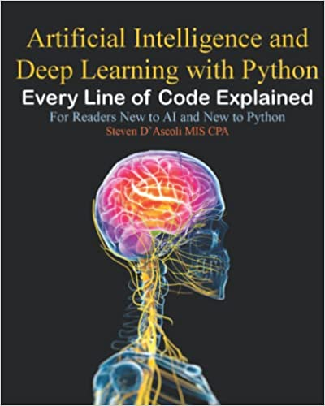
Steven D'Ascoli (2022),
Artificial Intelligence and Deep Learning with Python:
Every Line of Code Explained For Readers New to AI and New to Python,
Independently published.
Source: https://www.amazon.com/Artificial-Intelligence-Deep-Learning-Python/dp/B09QNZBZMN/

Slide 24
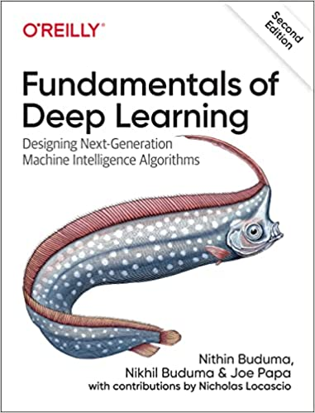
Nithin Buduma, Nikhil Buduma, Joe Papa (2022),
Fundamentals of Deep Learning:
Designing Next-Generation Machine Intelligence Algorithms,
2nd Edition, ‎O'Reilly Media.
Source: https://www.amazon.com/Fundamentals-Deep-Learning-Next-Generation-Intelligence/dp/149208218X/

Slide 25


NVIDIA Developer Program
NVIDIA
Deep Learning Institute (DLI)
https://developer.nvidia.com/join-nvidia-developer-program
https://learn.nvidia.com/

Slide 26
Artificial Intelligence
(AI)

Slide 27

AI, ML, DL, Generative AI
Source: Jeong, Cheonsu. "A Study on the Implementation of Generative AI Services Using an Enterprise Data-Based LLM Application Architecture." arXiv preprint arXiv:2309.01105 (2023).

Slide 28
Generative AI, Agentic AI, Physical AI
Physical AI
Self-driving cars
General robotics
Agentic AI
Coding assistants
Customer service
Patient care
Generative AI
Digital marketing
Content creation
Perception AI
Speech recognition
Deep recommender systems
Medical imaging
2012 AlexNet
Deep learning breakthrough
Source: NVIDIA (2025), GTC March 2025 Keynote with NVIDIA CEO Jensen Huang, https://www.youtube.com/watch?v=_waPvOwL9Z8

Slide 29
Generative AI
Computing
Generative AI
Data
Algorithms

Slide 30

From Generative AI to Agentic AI
Source: Schneider, Johannes. "Generative to Agentic AI: Survey, Conceptualization, and Challenges." arXiv preprint arXiv:2504.18875 (2025).

Slide 31

Generative AI (Gen AI)
AI Generated Content (AIGC)
Source: Yihan Cao, Siyu Li, Yixin Liu, Zhiling Yan, Yutong Dai, Philip S. Yu, and Lichao Sun (2023). "A Comprehensive Survey of AI-Generated Content (AIGC): A History of Generative AI from GAN to ChatGPT." arXiv preprint arXiv:2303.04226.

Slide 32
AI, Big Data, Cloud Computing
Evolution of Decision Support, Business Intelligence, and Analytics
AI
AI
Cloud Computing
Big Data
DM
BI
Source: Ramesh Sharda, Dursun Delen, and Efraim Turban (2017),
Business Intelligence, Analytics, and Data Science: A Managerial Perspective, 4th Edition, Pearson

Slide 33
The Rise of AI
Source: DHL (2018), Artificial Intelligence in Logistics,
http://www.globalhha.com/doclib/data/upload/doc_con/5e50c53c5bf67.pdf/

Slide 34

The Development of LM-based Dialogue Systems
1) Early Stage (1966 - 2015)
2) The Independent Development of TOD and ODD (2015 - 2019)
3) Fusions of Dialogue Systems (2019 - 2022)
4) LLM-based DS (2022 - Now)
Task-oriented DS (TOD), Open-domain DS (ODD)
Source: Wang, Hongru, Lingzhi Wang, Yiming Du, Liang Chen, Jingyan Zhou, Yufei Wang, and Kam-Fai Wong. "A Survey of the Evolution of Language Model-Based Dialogue Systems." arXiv preprint arXiv:2311.16789 (2023).

Slide 35
Definition of
Artificial Intelligence (A.I.)

Slide 36
Artificial Intelligence
“… the science and engineering of making intelligent machines”
(John McCarthy, 1955)
Source: https://digitalintelligencetoday.com/artificial-intelligence-defined-useful-list-of-popular-definitions-from-business-and-science/

Slide 37
Artificial Intelligence
“… technology that thinks and acts like humans”
Source: https://digitalintelligencetoday.com/artificial-intelligence-defined-useful-list-of-popular-definitions-from-business-and-science/

Slide 38
Artificial Intelligence
“… intelligence exhibited by machines or software”
Source: https://digitalintelligencetoday.com/artificial-intelligence-defined-useful-list-of-popular-definitions-from-business-and-science/

Slide 39
4 Approaches of AI
Thinking Humanly | Thinking Rationally
Acting Humanly | Acting Rationally
Source: Stuart Russell and Peter Norvig (2020), Artificial Intelligence: A Modern Approach, 4th Edition, Pearson

Slide 40
4 Approaches of AI
2. Thinking Humanly: The Cognitive Modeling Approach | 3. Thinking Rationally: The “Laws of Thought” Approach
1. Acting Humanly: The Turing Test Approach (1950) | 4. Acting Rationally: The Rational Agent Approach
Source: Stuart Russell and Peter Norvig (2020), Artificial Intelligence: A Modern Approach, 4th Edition, Pearson

Slide 41
AI Acting Humanly:
The Turing Test Approach
(Alan Turing, 1950)
Knowledge Representation
Automated Reasoning
Machine Learning (ML)
  Deep Learning (DL)
Computer Vision (Image, Video)
Natural Language Processing (NLP)
Robotics
Source: Stuart Russell and Peter Norvig (2020), Artificial Intelligence: A Modern Approach, 4th Edition, Pearson

Slide 42
Artificial Intelligence:
A Modern Approach
Artificial Intelligence
Problem Solving
Knowledge and Reasoning
Uncertain Knowledge and Reasoning
Machine Learning
Communicating, Perceiving, and Acting
Philosophy and Ethics of AI
Source: Stuart Russell and Peter Norvig (2020), Artificial Intelligence: A Modern Approach, 4th Edition, Pearson

Slide 43
Artificial Intelligence:
Intelligent Agents
Source: Stuart Russell and Peter Norvig (2020), Artificial Intelligence: A Modern Approach, 4th Edition, Pearson

Slide 44
Artificial Intelligence:
2. Problem Solving
Solving Problems by Searching
Search in Complex Environments
Adversarial Search and Games
Constraint Satisfaction Problems
Source: Stuart Russell and Peter Norvig (2020), Artificial Intelligence: A Modern Approach, 4th Edition, Pearson

Slide 45
Artificial Intelligence:
3. Knowledge and Reasoning
Logical Agents
First-Order Logic
Inference in First-Order Logic
Knowledge Representation
Automated Planning
Source: Stuart Russell and Peter Norvig (2020), Artificial Intelligence: A Modern Approach, 4th Edition, Pearson

Slide 46
Artificial Intelligence:
4. Uncertain Knowledge and Reasoning
Quantifying Uncertainty
Probabilistic Reasoning
Probabilistic Reasoning over Time
Probabilistic Programming
Making Simple Decisions
Making Complex Decisions
Multiagent Decision Making
Source: Stuart Russell and Peter Norvig (2020), Artificial Intelligence: A Modern Approach, 4th Edition, Pearson

Slide 47
Artificial Intelligence:
5. Machine Learning
Learning from Examples
Learning Probabilistic Models
Deep Learning
Reinforcement Learning
Source: Stuart Russell and Peter Norvig (2020), Artificial Intelligence: A Modern Approach, 4th Edition, Pearson

Slide 48
Artificial Intelligence:
6. Communicating, Perceiving, and Acting
Natural Language Processing
Deep Learning for Natural Language Processing
Computer Vision
Robotics
Source: Stuart Russell and Peter Norvig (2020), Artificial Intelligence: A Modern Approach, 4th Edition, Pearson

Slide 49
Artificial Intelligence:
Philosophy and Ethics of AI
The Future of AI
Source: Stuart Russell and Peter Norvig (2020), Artificial Intelligence: A Modern Approach, 4th Edition, Pearson

Slide 50
Artificial Intelligence
Machine Learning & Deep Learning
Source: https://blogs.nvidia.com/blog/2016/07/29/whats-difference-artificial-intelligence-machine-learning-deep-learning-ai/

Slide 51
AI, ML, DL
Artificial Intelligence (AI)
Machine Learning (ML)
Supervised
Learning
Unsupervised Learning
Deep Learning (DL)
CNN
RNN LSTM GRU
GAN
Semi-supervised Learning
Reinforcement Learning
Source: https://leonardoaraujosantos.gitbooks.io/artificial-inteligence/content/deep_learning.html

Slide 52
3 Machine Learning Algorithms
Source: Enrico Galimberti, http://blogs.teradata.com/data-points/tree-machine-learning-algorithms/

Slide 53
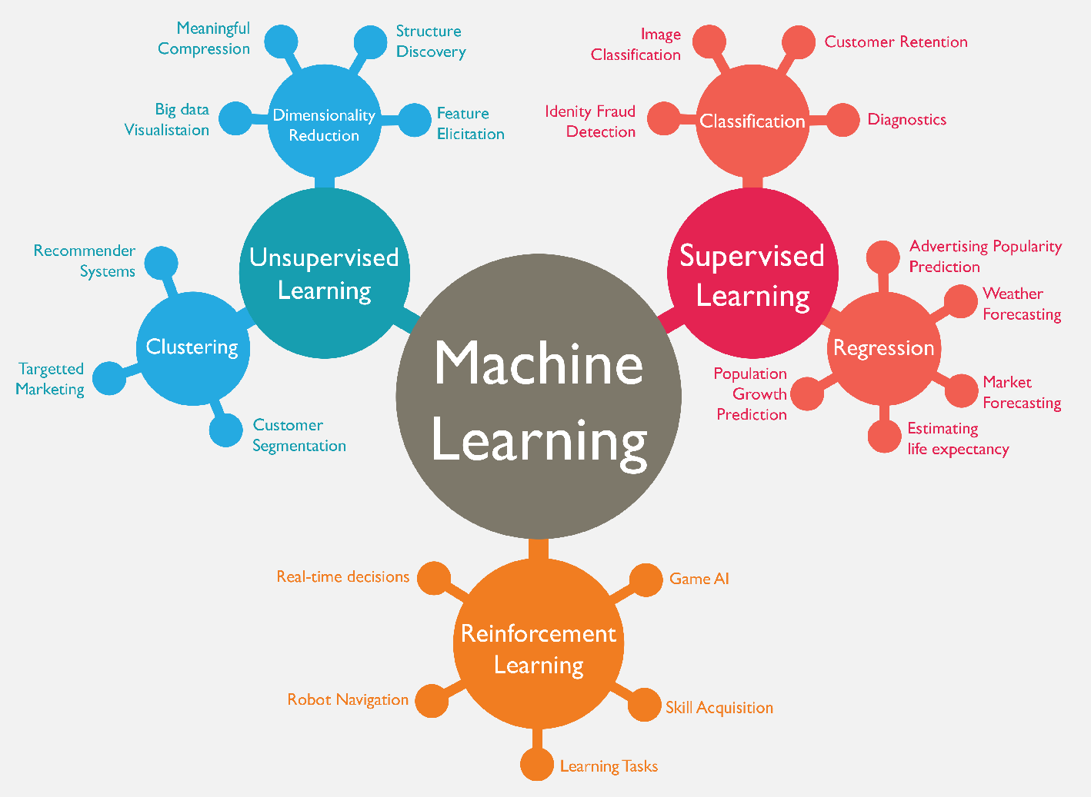
Machine Learning (ML)
Source: https://www.mactores.com/services/aws-big-data-machine-learning-cognitive-services/

Slide 54
Machine Learning (ML) / Deep Learning (DL)
Decision Tree Classifiers
Support Vector Machine (SVM)
Supervised Learning
Neural Network (NN)
Linear Classifiers
Deep Learning (DL)
Machine Learning
(ML)
Rule-based Classifiers
Naïve Bayes
(NB)
Unsupervised Learning
Probabilistic Classifiers
Bayesian Network (BN)
Maximum Entropy (ME)
Reinforcement Learning
Source: Jesus Serrano-Guerrero, Jose A. Olivas, Francisco P. Romero, and Enrique Herrera-Viedma (2015),
"Sentiment analysis: A review and comparative analysis of web services," Information Sciences, 311, pp. 18-38.

Slide 55
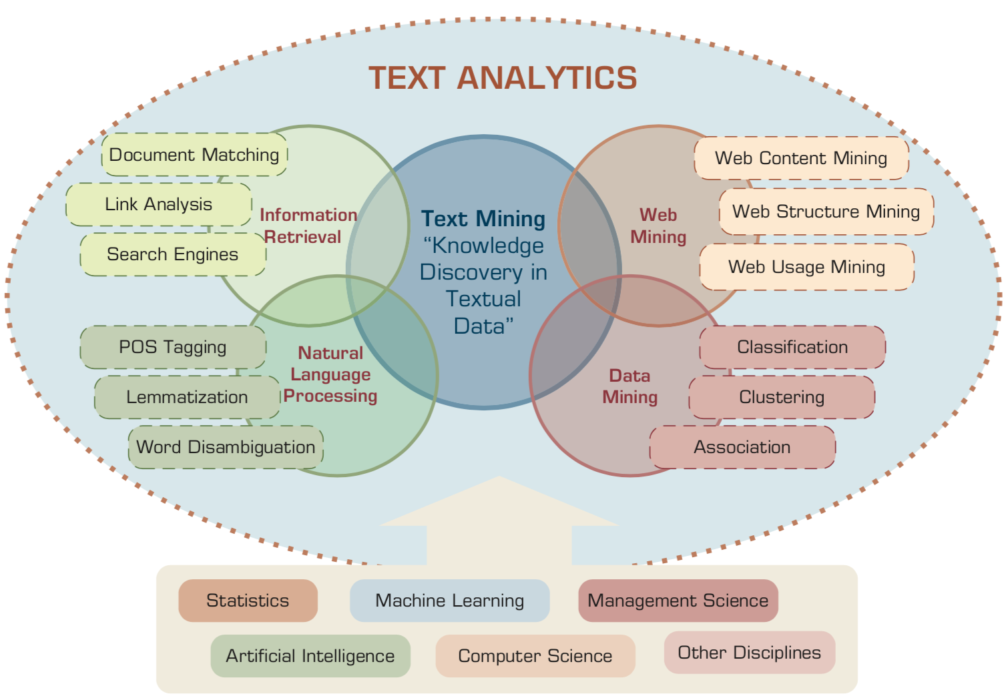
AI for Text Analytics
Source: Ramesh Sharda, Dursun Delen, and Efraim Turban (2017), Business Intelligence, Analytics, and Data Science: A Managerial Perspective, 4th Edition, Pearson

Slide 56
Transformer Models
Transformer
Encoder
Decoder
DistilBERT
BERT
T5
GPT
RoBERTa
BART
GPT-2
CTRL
XLM-R
XLM
M2M-100
GPT-3
ALBERT
BigBird
GPT-Neo
GPT-J
ELECTRA
mT0
BLOOM
BLOOMZ
DeBERTa
ChatGPT
GPT-4
Source: Lewis Tunstall, Leandro von Werra, and Thomas Wolf (2022), Natural Language Processing with Transformers: Building Language Applications with Hugging Face, O'Reilly Media.

Slide 57

Large Language Models (LLMs)
Source: Hadi, Muhammad Usman, Rizwan Qureshi, Abbas Shah, Muhammad Irfan, Anas Zafar, Muhammad Bilal Shaikh, Naveed Akhtar, Jia Wu, and Seyedali Mirjalili. "Large language models: a comprehensive survey of its applications, challenges, limitations, and future prospects." Authorea Preprints (2023).

Slide 58

Four Paradigms in NLP (LM)
Transfer Learning: Pre-training, Fine-Tuning (FT)
GAI: Pre-train, Prompt, and Predict (Prompting)
Source: Pengfei Liu, Weizhe Yuan, Jinlan Fu, Zhengbao Jiang, Hiroaki Hayashi, and Graham Neubig. (2023) "Pre-train, prompt, and predict: A systematic survey of prompting methods in natural language processing." ACM Computing Surveys 55, no. 9 (2023): 1-35.

Slide 59
Generative AI
Text, Image, Video, Audio Applications

Slide 60
Comparison of Generative AI and Traditional AI
Feature | Generative AI | Traditional AI
Output type | New content | Classification/Prediction
Creativity | High | Low
Interactivity | Usually more natural | Limited

Slide 61
Generative AI
Generative AI: The Art of Creation
Definition: AI systems capable of creating new content
Characteristics: Creativity, interactivity

Slide 62
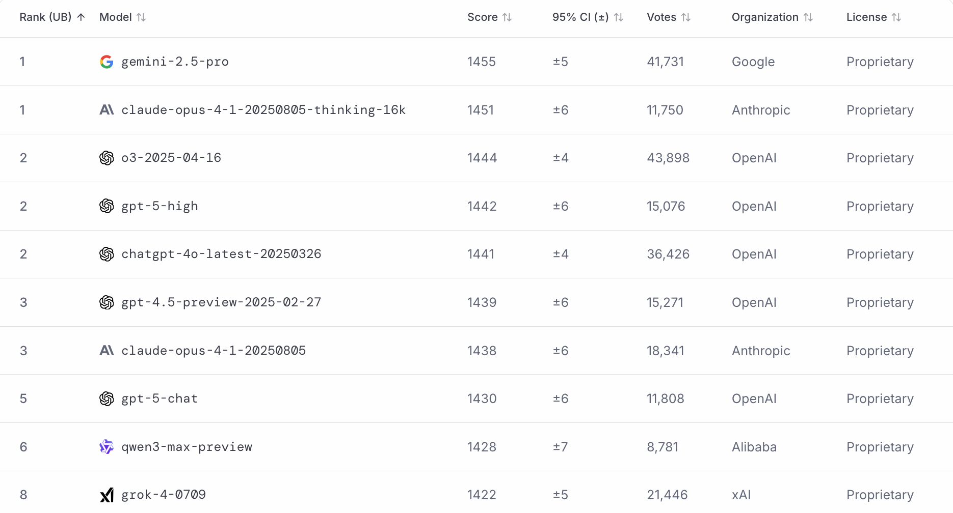
LMArena Leaderboard
https://lmarena.ai/

Slide 63
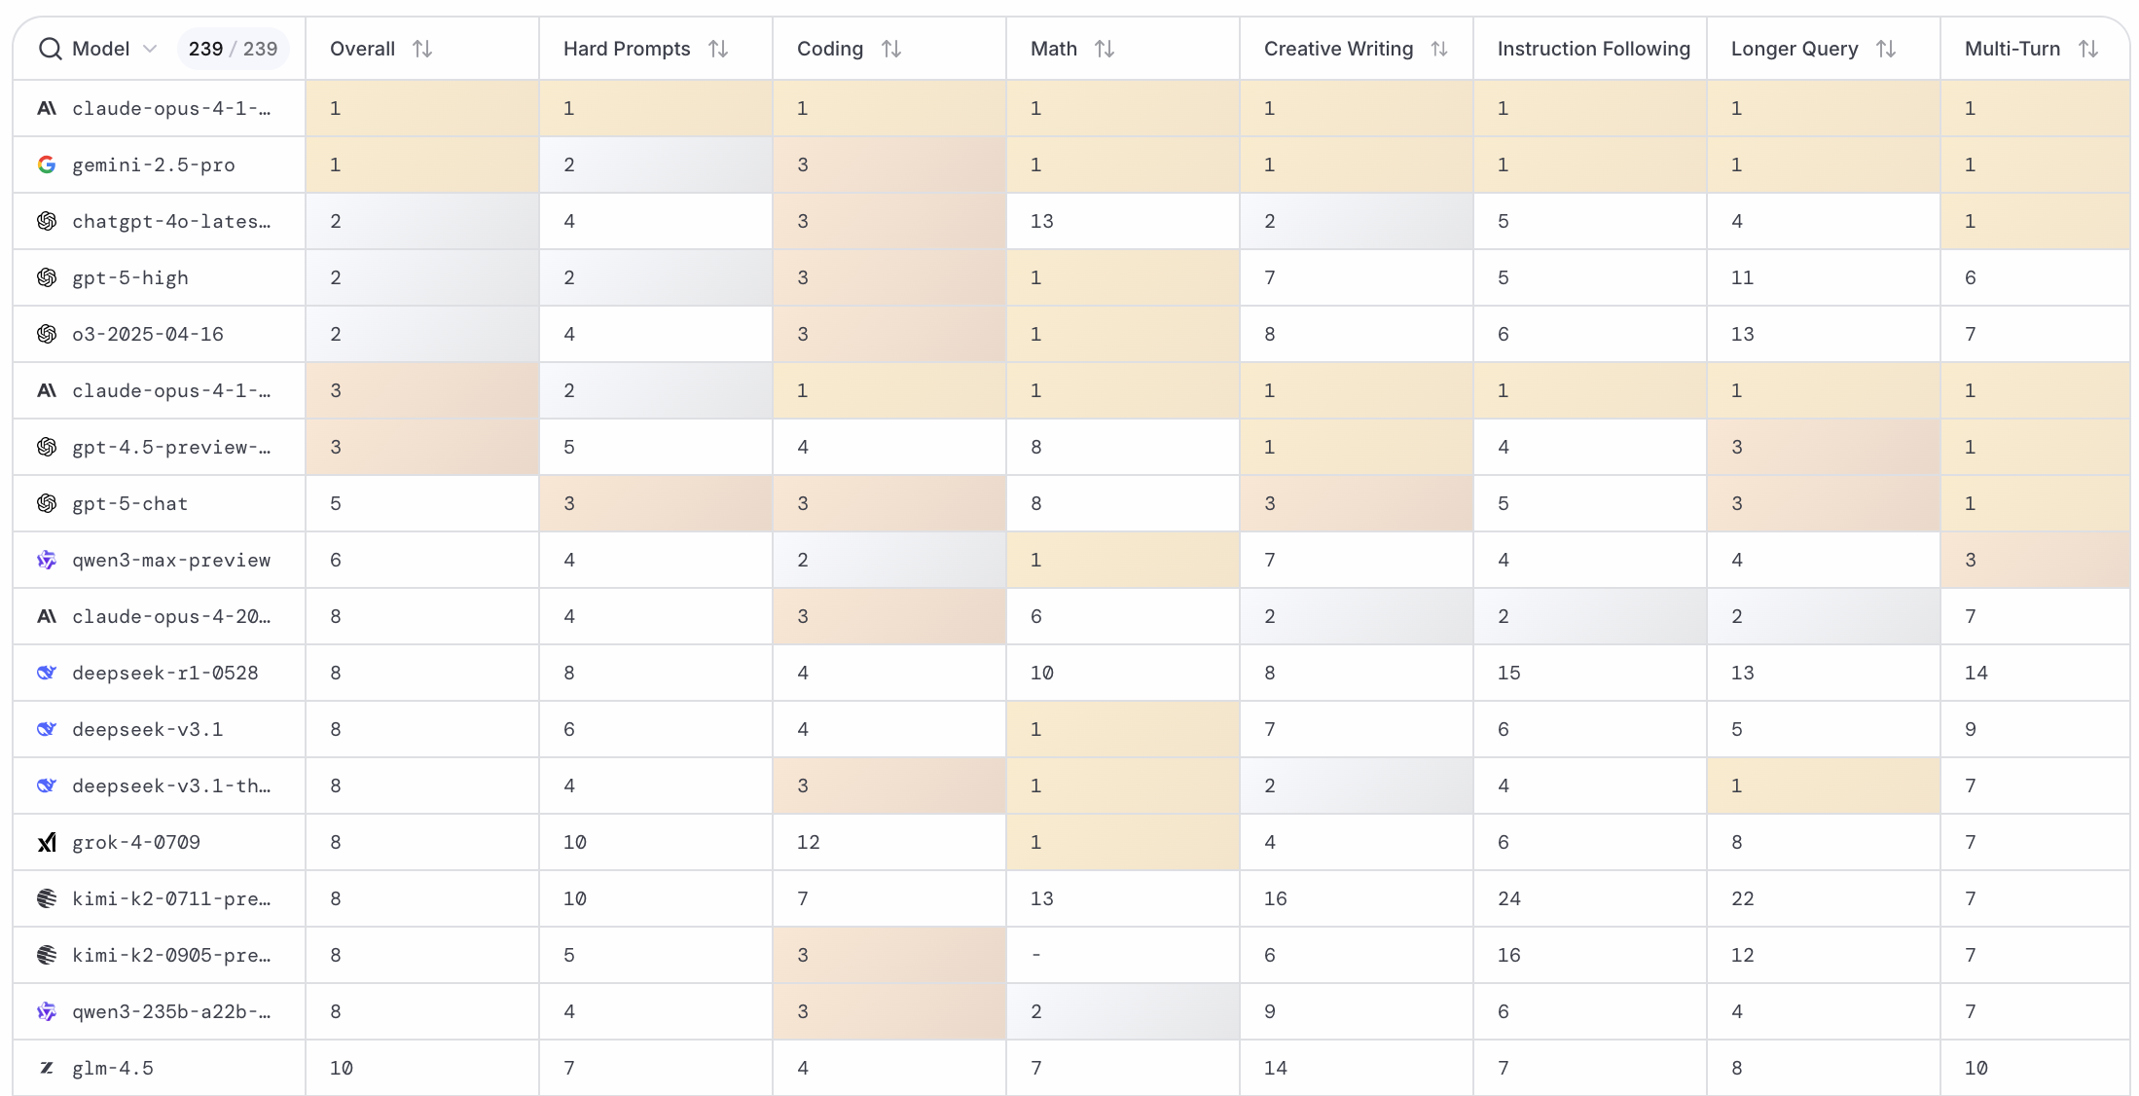
LMArena Leaderboard
https://huggingface.co/spaces/lmarena-ai/lmarena-leaderboard

Slide 64
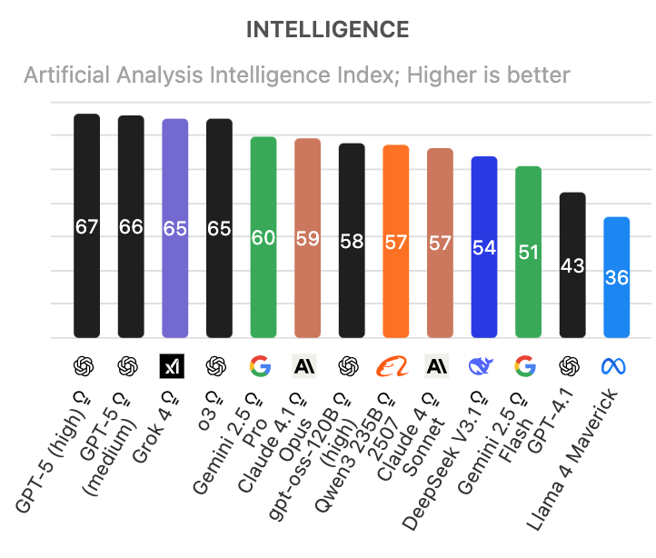
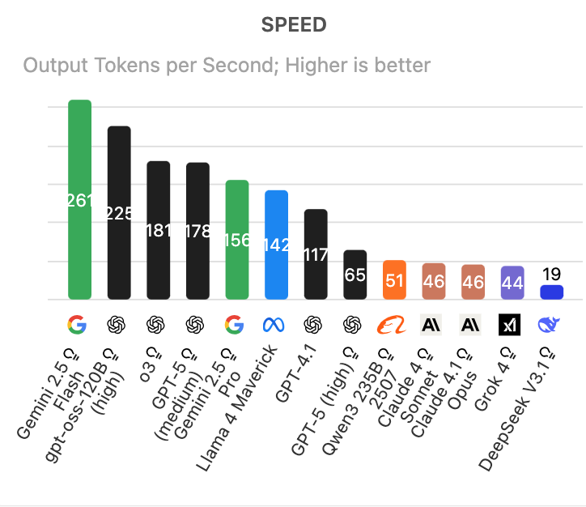
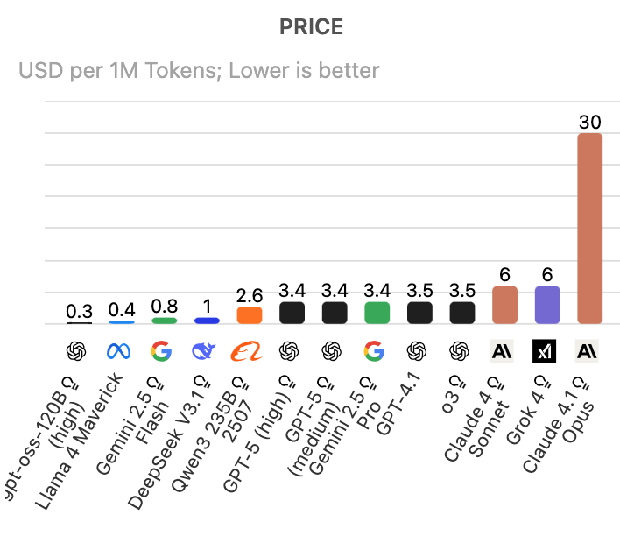
Artificial Analysis Intelligence Index
Intelligence, Speed, Price
Source: https://artificialanalysis.ai/

Slide 65
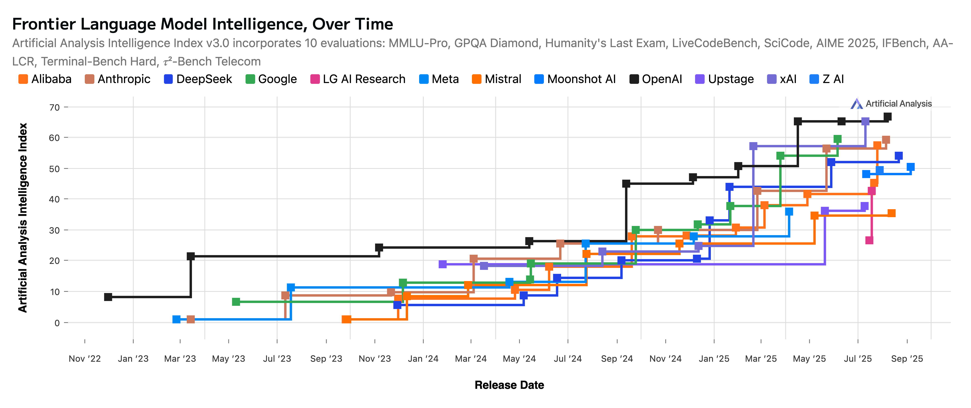
Artificial Analysis Intelligence Index
2022-2025
Source: https://artificialanalysis.ai/

Slide 66
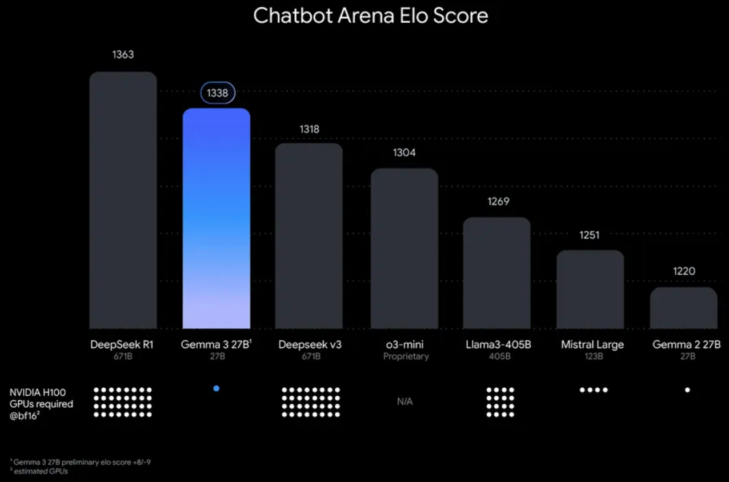
Google Gemma 3 27B
The most capable model you can run on a single GPU or TPU
Source: https://blog.google/technology/developers/gemma-3/

Slide 67
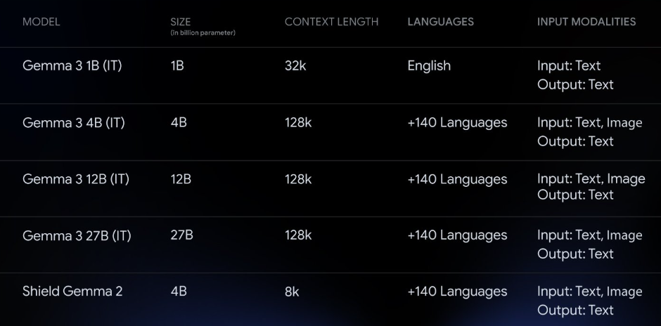
Google Gemma 3 Multimodality
(vision-language input and text outputs)
Source: https://developers.googleblog.com/en/introducing-gemma3/

Slide 68
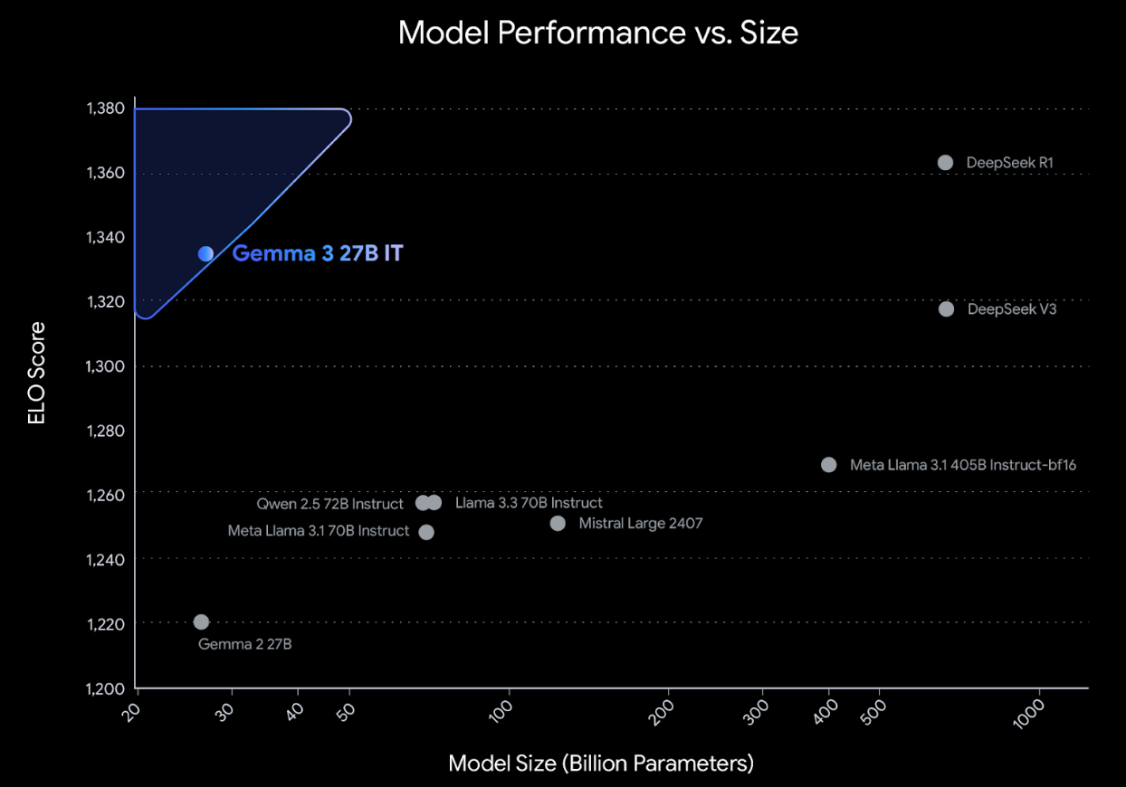
Google Gemma 3: Pre-training and Post-training
(distillation, reinforcement learning, and model merging)
Source: https://developers.googleblog.com/en/introducing-gemma3/

Slide 69
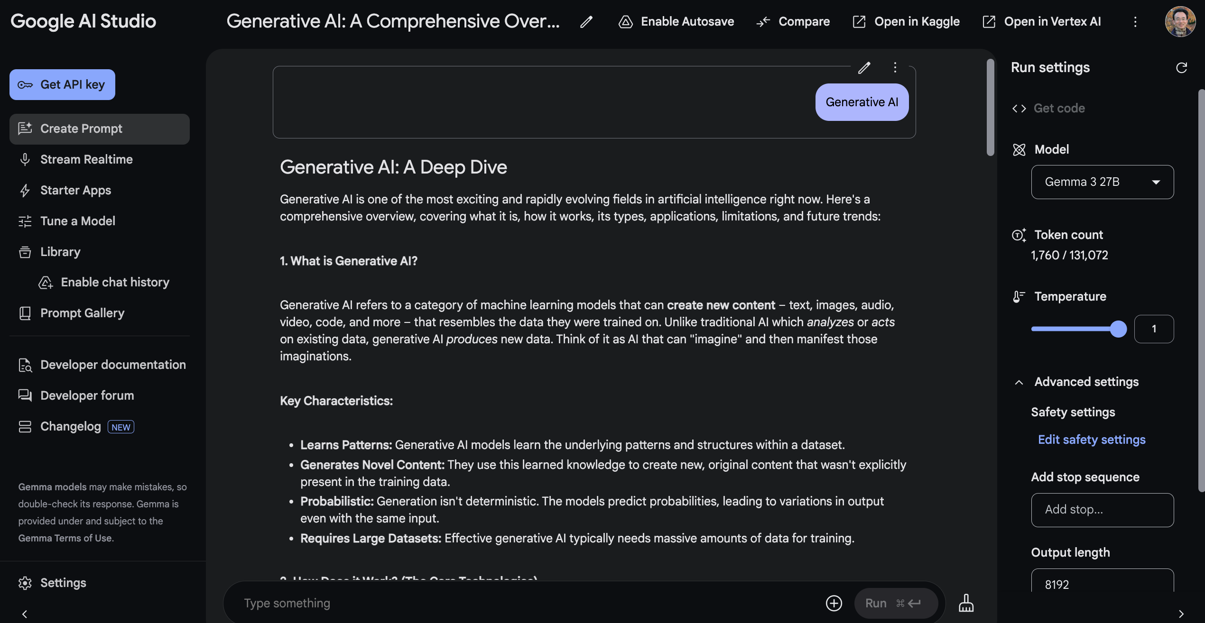
Google AI Studio (Gemma 3 27B)
Source: https://aistudio.google.com/

Slide 70
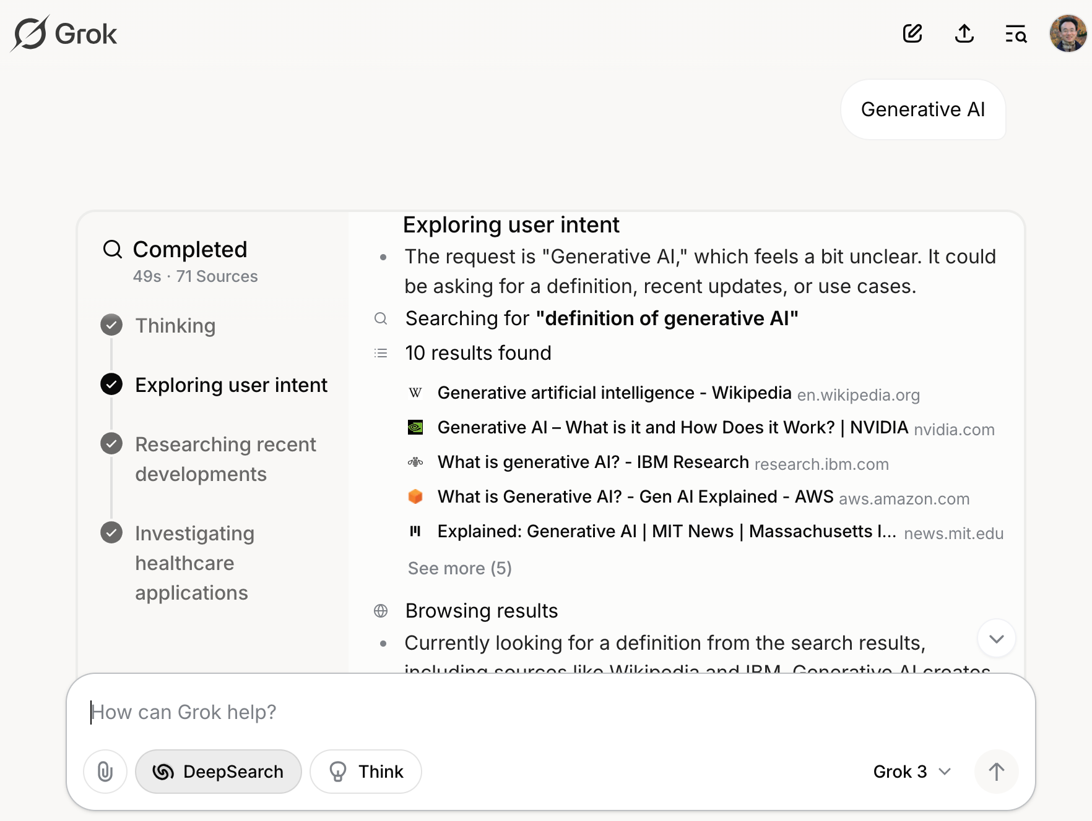
Grok 3 Deep Search
Source: https://grok.com/chat

Slide 71

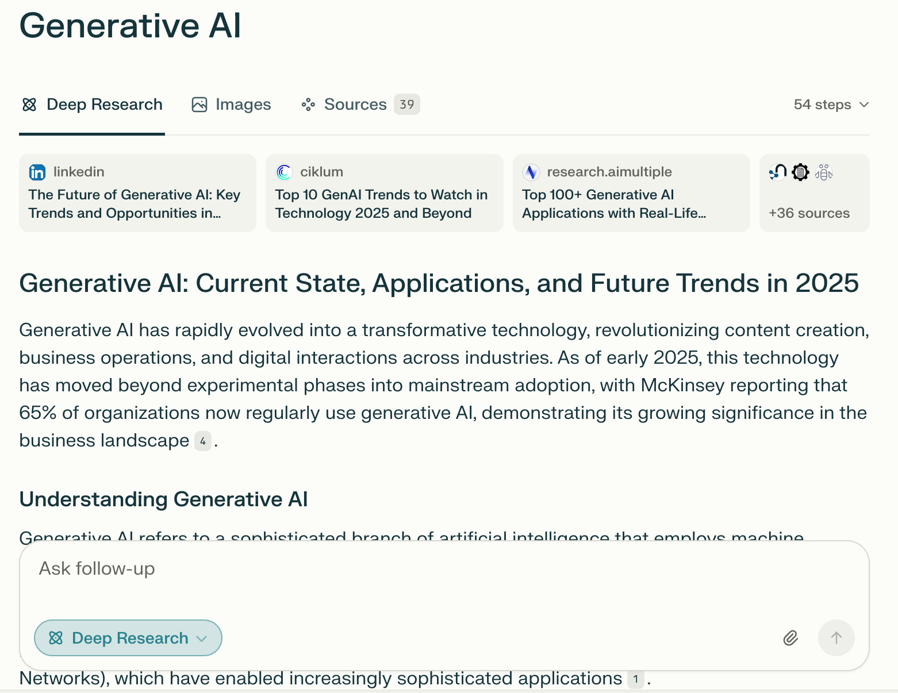
Perplexity.ai Deep Research
Source: https://www.perplexity.ai/

Slide 72
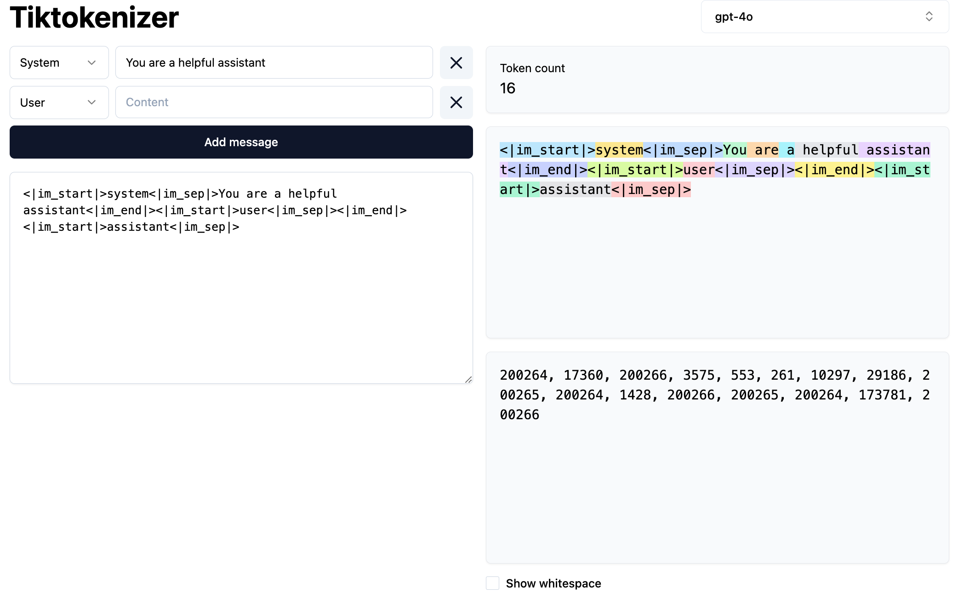
Token
https://tiktokenizer.vercel.app/

Slide 73
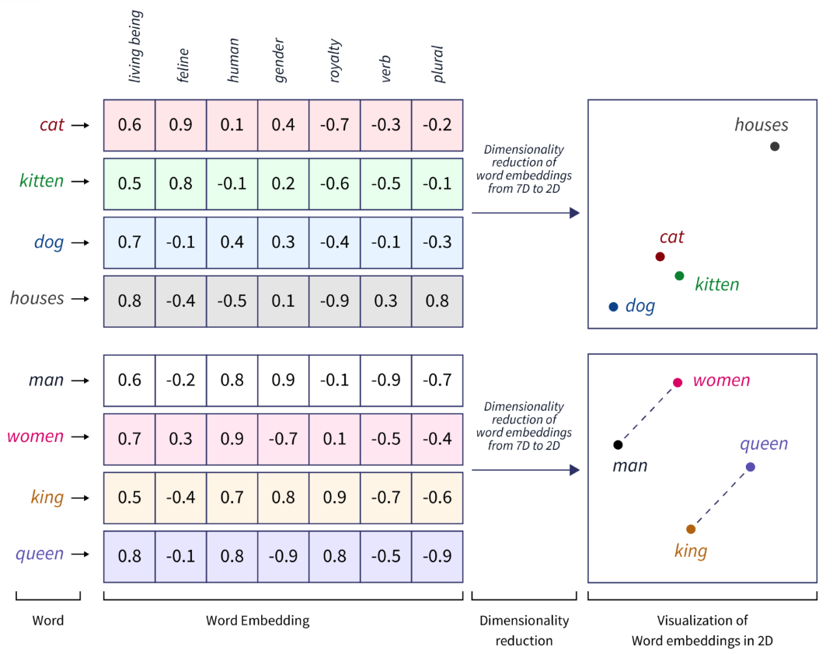
Word Embeddings
Source: https://www.scaler.com/topics/tensorflow/tensorflow-word-embeddings/

Slide 74

Transformer (Attention is All You Need)
(Vaswani et al., 2017)
Source: Vaswani, Ashish, Noam Shazeer, Niki Parmar, Jakob Uszkoreit, Llion Jones, Aidan N. Gomez, Łukasz Kaiser, and Illia Polosukhin. "Attention is all you need." In Advances in neural information processing systems, pp. 5998-6008. 2017.

Slide 75

BERT: Pre-training of Deep Bidirectional Transformers for Language Understanding
BERT (Bidirectional Encoder Representations from Transformers)
Overall pre-training and fine-tuning procedures for BERT
Source: Devlin, Jacob, Ming-Wei Chang, Kenton Lee, and Kristina Toutanova (2018).
"Bert: Pre-training of deep bidirectional transformers for language understanding." arXiv preprint arXiv:1810.04805.

Slide 76
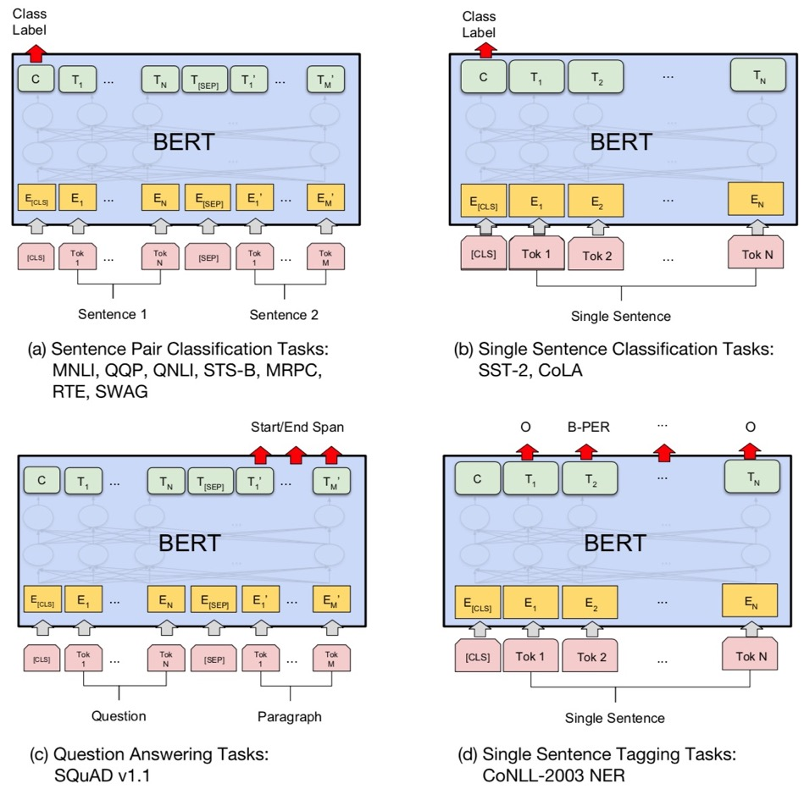
Fine-tuning BERT on Different Tasks
Source: Devlin, Jacob, Ming-Wei Chang, Kenton Lee, and Kristina Toutanova (2018).
"Bert: Pre-training of deep bidirectional transformers for language understanding." arXiv preprint arXiv:1810.04805.

Slide 77
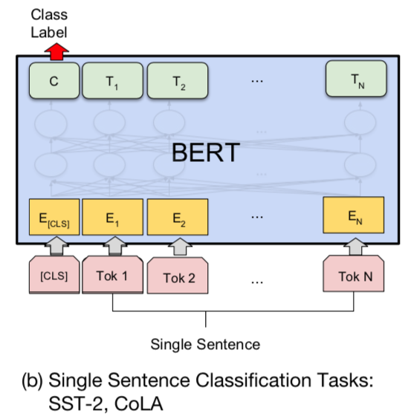
Sentiment Analysis:
Single Sentence Classification
Source: Devlin, Jacob, Ming-Wei Chang, Kenton Lee, and Kristina Toutanova (2018).
"BERT: Pre-training of Deep Bidirectional Transformers for Language Understanding." arXiv preprint arXiv:1810.04805

Slide 78
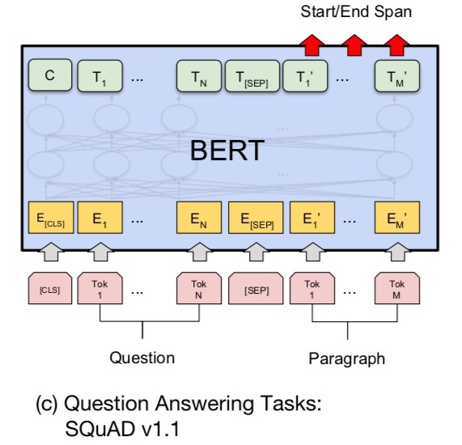
Fine-tuning BERT on
Question Answering (QA)
Source: Devlin, Jacob, Ming-Wei Chang, Kenton Lee, and Kristina Toutanova (2018).
"Bert: Pre-training of deep bidirectional transformers for language understanding." arXiv preprint arXiv:1810.04805.

Slide 79
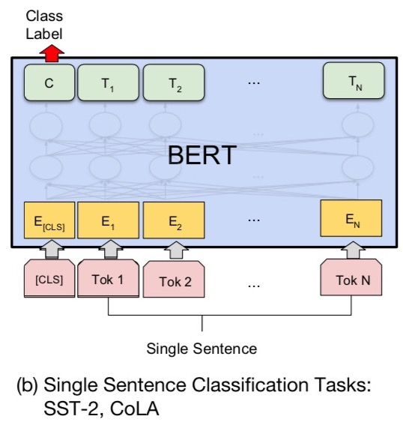
Fine-tuning BERT on Dialogue
Intent Detection (ID; Classification)
Source: Devlin, Jacob, Ming-Wei Chang, Kenton Lee, and Kristina Toutanova (2018).
"Bert: Pre-training of deep bidirectional transformers for language understanding." arXiv preprint arXiv:1810.04805.

Slide 80
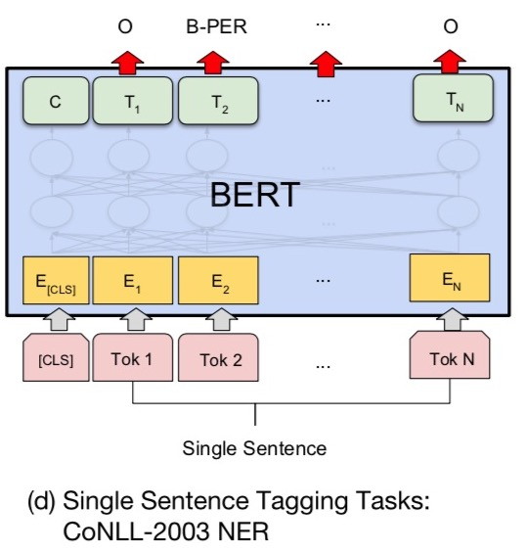
Fine-tuning BERT on Dialogue
Slot Filling (SF)
Source: Devlin, Jacob, Ming-Wei Chang, Kenton Lee, and Kristina Toutanova (2018).
"Bert: Pre-training of deep bidirectional transformers for language understanding." arXiv preprint arXiv:1810.04805.

Slide 81
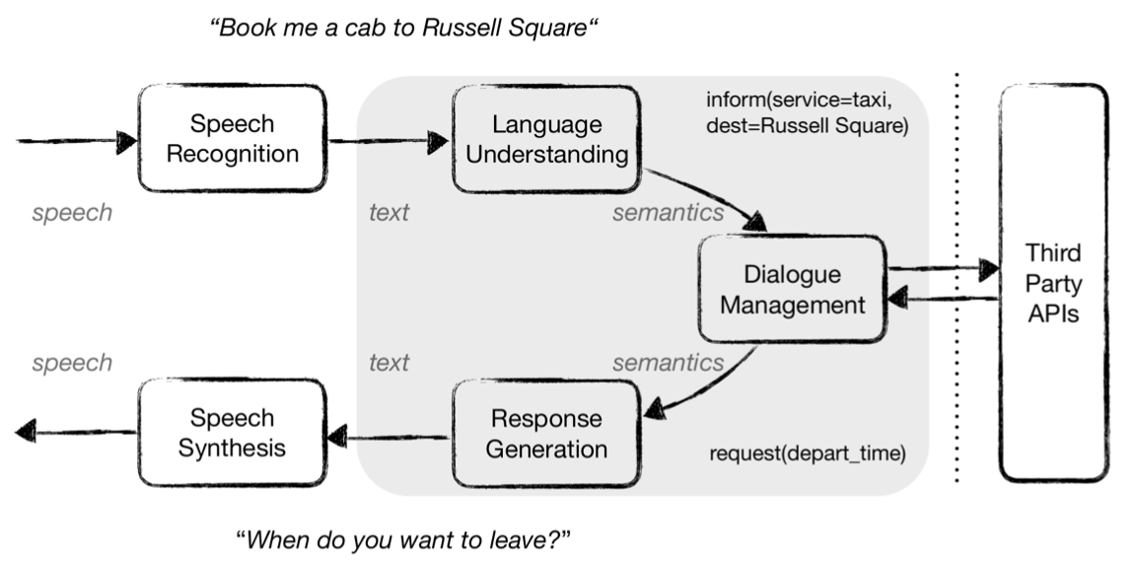
Task-Oriented Dialogue (ToD) System
Speech, Text, NLP
Source: Razumovskaia, Evgeniia, Goran Glavas, Olga Majewska, Edoardo M. Ponti, Anna Korhonen, and Ivan Vulic.
"Crossing the conversational chasm: A primer on natural language processing for multilingual task-oriented dialogue systems." Journal of Artificial Intelligence Research 74 (2022): 1351-1402.

Slide 82
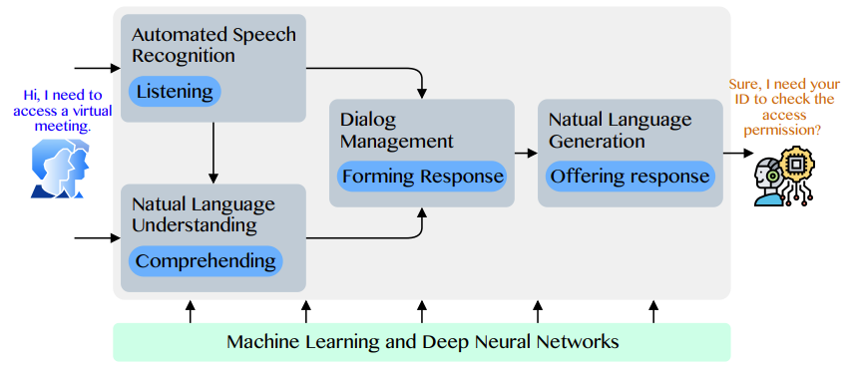
Conversational AI to deliver contextual and personal experience to users
Source: Huynh-The, Thien, Quoc-Viet Pham, Xuan-Qui Pham, Thanh Thi Nguyen, Zhu Han, and Dong-Seong Kim (2022).
"Artificial Intelligence for the Metaverse: A Survey." arXiv preprint arXiv:2202.10336.

Slide 83
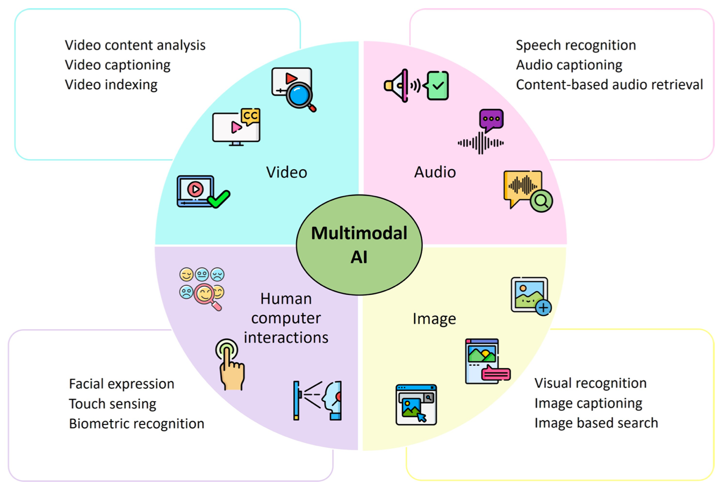
Technological Integration for Multimodal AI
Source: Sohail, Shahab Saquib, Faiza Farhat, Yassine Himeur, Mohammad Nadeem, Dag Øivind Madsen, Yashbir Singh, Shadi Atalla, and Wathiq Mansoor. "The Future of GPT: A Taxonomy of Existing ChatGPT Research, Current Challenges, and Possible Future Directions." Current Challenges, and Possible Future Directions (April 8, 2023) (2023).

Slide 84

Large Language Model (LLM) based Agents
Source: Xi, Z., Chen, W., Guo, X., He, W., Ding, Y., Hong, B., ... & Gui, T. (2023). The rise and potential of large language model based agents: A survey. arXiv preprint arXiv:2309.07864.

Slide 85

Large Multimodal Agents (LMA)
Source: Xie, J., Chen, Z., Zhang, R., Wan, X., & Li, G. (2024). Large Multimodal Agents: A Survey. ArXiv, abs/2402.15116.

Slide 86

Large Multimodal Agents (LMA)
Source: Xie, J., Chen, Z., Zhang, R., Wan, X., & Li, G. (2024). Large Multimodal Agents: A Survey. ArXiv, abs/2402.15116.

Slide 87
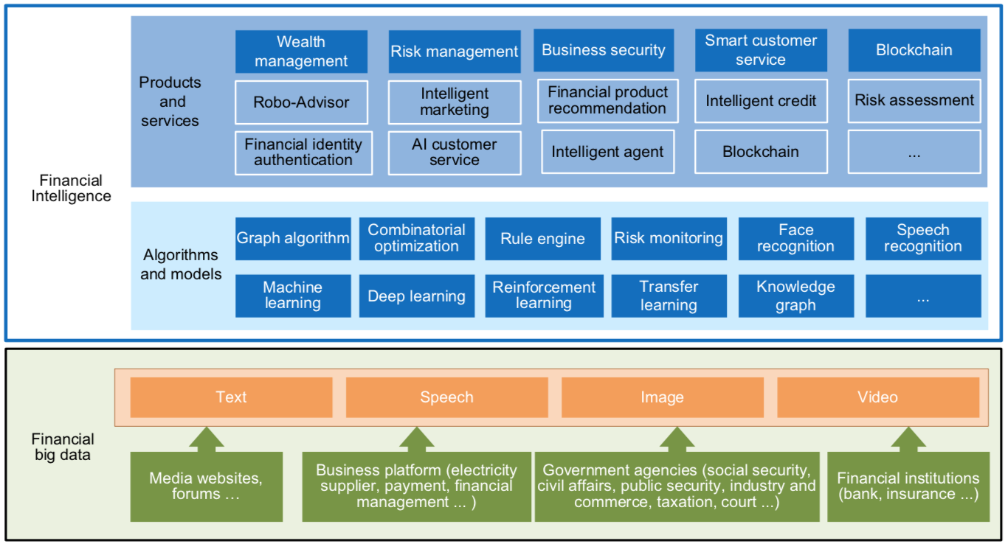
FinBrain: when Finance meets AI 2.0
(Zheng et al., 2019)
Source: Xiao-lin Zheng, Meng-ying Zhu, Qi-bing Li, Chao-chao Chen, and Yan-chao Tan (2019), "Finbrain: When finance meets AI 2.0." Frontiers of Information Technology & Electronic Engineering 20, no. 7, pp. 914-924

Slide 88
Technology-driven
Financial Industry Development
Development stage | Driving technology | Main landscape | Inclusive finance | Relationship between technology and finance
Fintech 1.0 (financial IT) | Computer | Credit card, ATM, and CRMS | Low | Technology as a tool
Fintech 2.0 (Internet finance) | Mobile Internet | Marketplace lending, third-party payment, crowdfunding, and Internet insurance | Medium | Technology-driven change
Fintech 3.0 (financial intelligence) | AI, Big Data, Cloud Computing, Blockchain | Intelligent finance | High | Deep fusion
Source: Xiao-lin Zheng, Meng-ying Zhu, Qi-bing Li, Chao-chao Chen, and Yan-chao Tan (2019), "Finbrain: When finance meets AI 2.0." Frontiers of Information Technology & Electronic Engineering 20, no. 7, pp. 914-924

Slide 89
Deep learning for financial applications:
A survey
Applied Soft Computing (2020)
Source:
Ahmet Murat Ozbayoglu, Mehmet Ugur Gudelek, and Omer Berat Sezer (2020). "Deep learning for financial applications: A survey."
Applied Soft Computing (2020): 106384.

Slide 90
Financial time series forecasting with deep learning:
A systematic literature review:
2005–2019
Applied Soft Computing (2020)
Source:
Omer Berat Sezer, Mehmet Ugur Gudelek, and Ahmet Murat Ozbayoglu (2020), "Financial time series forecasting with deep learning: A systematic literature review: 2005–2019." Applied Soft Computing 90 (2020): 106181.

Slide 91
Deep learning for financial applications: Topic-Model Heatmap
Source: Ahmet Murat Ozbayoglu, Mehmet Ugur Gudelek, and Omer Berat Sezer (2020). "Deep learning for financial applications: A survey." Applied Soft Computing (2020): 106384.

Slide 92
Deep learning for financial applications: Topic-Feature Heatmap
Source: Ahmet Murat Ozbayoglu, Mehmet Ugur Gudelek, and Omer Berat Sezer (2020). "Deep learning for financial applications: A survey." Applied Soft Computing (2020): 106384.

Slide 93
Deep learning for financial applications: Topic-Dataset Heatmap
Source: Ahmet Murat Ozbayoglu, Mehmet Ugur Gudelek, and Omer Berat Sezer (2020). "Deep learning for financial applications: A survey." Applied Soft Computing (2020): 106384.

Slide 94
Financial time series forecasting with deep learning: Topic-model heatmap
Source: Omer Berat Sezer, Mehmet Ugur Gudelek, and Ahmet Murat Ozbayoglu (2020), "Financial time series forecasting with deep learning:
A systematic literature review: 2005–2019." Applied Soft Computing 90 (2020): 106181.

Slide 95
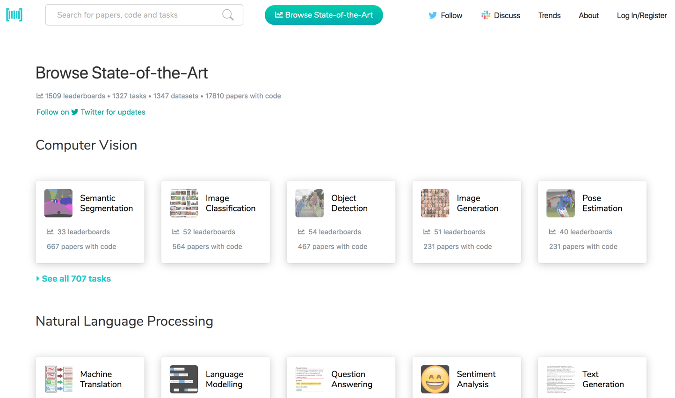
Papers with Code
State-of-the-Art (SOTA)
https://paperswithcode.com/sota

Slide 96

Python in Google Colab (Python101)
https://colab.research.google.com/drive/1FEG6DnGvwfUbeo4zJ1zTunjMqf2RkCrT
https://tinyurl.com/aintpupython101

Slide 97

Teaching
Artificial Intelligence
  Spring 2021, Fall 2022, Fall 2024, Fall 2025
Sustainability and ESG Data Analytics
  Spring 2024, Fall 2024, Fall 2025
Software Engineering
  Fall 2020, Fall, 2021, Spring 2022, Spring 2023, Spring 2024, Spring 2025
Generative AI Innovative Applications
  Spring 2025
Artificial Intelligence in Finance and Quantitative
  Fall 2021, Fall 2022, Fall 2023, Spring 2025
Big Data Analytics
  Fall 2020, Spring 2023, Spring 2024
Artificial Intelligence for Text Analytics
  Spring 2022, Fall 2023
Python for Accounting Applications
  Fall 2023, Fall 2024, ,Fall 2025
Foundation of Business Cloud Computing
  Spring 2021, Spring 2022, Spring 2023, Spring 2024
https://web.ntpu.edu.tw/~myday/teaching.htm

Slide 98
Research Projects
Generative AI Multi-Agent Systems with LLM-Based RAG for ESG Reporting Automation
  NSTC (E4104), NSTC 114-2221-E-305-002-, 2025/08/01~2026/07/31
Innovative Agentic AI Technology for Autonomous ESG Report Generation
  Industrial Technology Research Institute (ITRI), Fintech and Green Finance Center (FGFC, NTPU), NTPU-114A513E01, 2025/03/01~2025/12/31
Digital Support, Unimpeded Communication: The Development, Support and Promotion of AI-assisted Communication Assistive Devices for Speech Impairment(3/3), Sub-project 3: Multimodal Cross-lingual Task-Oriented Dialogue System for Inclusive Communication Support,
  NSTC (HZZ22), NSTC 114-2425-H-305-003-, 3 Years (2023/05/01-2026/04/30) Year 3: 2025/05/01~2026/04/30
Research on speech processing, synthesis, recognition, and sentence construction of people with language disabilities, Sub-project 3: Multimodal Cross-lingual Task-Oriented Dialogue System
  NTPU, 114-NTPU_ORDA-F-004, 3 Years (2023/01/01-2025/12/31) Year 3: 2025/01/01~2025/12/31
Development of a Deep Learning for Dental Implant Detection in Panoramic Radiographs,
  University System of Taipei Joint Research Program (NTPU, TMU), USTP-NTPU-TMU-114-02, 2025/01/01~2025/12/31
https://web.ntpu.edu.tw/~myday/cindex.htm#projects

Slide 99
Summary
This course introduces the fundamental concepts, research issues, and hands-on practices of Artificial Intelligence.
Topics include:
  Introduction to Artificial Intelligence
  Artificial Intelligence and Intelligent Agents; Problem Solving
  Knowledge, Reasoning and Knowledge Representation
  Uncertain Knowledge and Reasoning
  Machine Learning: Supervised and Unsupervised Learning
  The Theory of Learning and Ensemble Learning
  NVIDIA Fundamentals of Deep Learning
  Natural Language Processing
  Computer Vision and Robotics
  Generative AI, Agentic AI, and Physical AI
  Philosophy and Ethics of AI and the Future of AI
  Case Study on AI

Slide 100

Artificial Intelligence
Contact Information
University Ambassador
Certified Instructor
Min-Yuh Day, Ph.D.
Professor and Director
Institute of Information Management, National Taipei University
Tel: 02-86741111 ext. 66873
Office: B8F12
Address: 151, University Rd., San Shia District, New Taipei City, 23741 Taiwan
Email: myday@gm.ntpu.edu.tw
Web: http://web.ntpu.edu.tw/~myday/

