Slide 1









Knowledge, Reasoning and
Knowledge Representation;
Uncertain Knowledge and Reasoning
Artificial Intelligence
1141AI03
MBA, IM, NTPU (M5276) (Fall 2025)
Tue 2, 3, 4 (9:10-12:00) (B3F17)
University Ambassador
Certified Instructor
Min-Yuh Day, Ph.D,
Professor and Director
Institute of Information Management, National Taipei University
https://web.ntpu.edu.tw/~myday
https://meet.google.com/paj-zhhj-mya
2025-09-23

Slide 2
Syllabus
Week Date Subject/Topics
1 2025/09/09 Introduction to Artificial Intelligence
2 2025/09/16 Artificial Intelligence and Intelligent Agents;
Problem Solving
3 2025/09/23 Knowledge, Reasoning and Knowledge Representation;
Uncertain Knowledge and Reasoning
4 2025/09/30 Case Study on Artificial Intelligence I
5 2025/10/07 Machine Learning: Supervised and Unsupervised Learning;
The Theory of Learning and Ensemble Learning

Slide 3
Syllabus
Week Date Subject/Topics
6 2025/10/14 NVIDIA Fundamentals of Deep Learning I:
Deep Learning; Neural Networks
7 2025/10/21 NVIDIA Fundamentals of Deep Learning II:
Convolutional Neural Networks;
Data Augmentation and Deployment
8 2025/10/28 Self-Learning
9 2025/11/04 Midterm Project Report
10 2025/11/11 NVIDIA Fundamentals of Deep Learning III:
Pre-trained Models; Natural Language Processing

Slide 4
Syllabus
Week Date Subject/Topics
11 2025/11/18 Case Study on Artificial Intelligence II
12 2025/11/25 Computer Vision and Robotics
13 2025/12/02 Generative AI, Agentic AI, and Physical AI
14 2025/12/09 Philosophy and Ethics of AI and the Future of AI
15 2025/12/16 Final Project Report I
16 2025/12/23 Final Project Report II

Slide 5
Knowledge, Reasoning and
Knowledge Representation
Uncertain Knowledge and Reasoning

Slide 6
Outline
Knowledge and Reasoning
  Logical Agents
  First-Order Logic
  Inference in First-Order Logic
  Knowledge Representation
  Knowledge Graph (KG)
Uncertain Knowledge and Reasoning
  Quantifying Uncertainty
  Probabilistic Reasoning
  Making Complex Decisions

Slide 7

Stuart Russell and Peter Norvig (2020),
Artificial Intelligence: A Modern Approach,
4th Edition, Pearson
Source: Stuart Russell and Peter Norvig (2020), Artificial Intelligence: A Modern Approach, 4th Edition, Pearson
https://www.amazon.com/Artificial-Intelligence-A-Modern-Approach/dp/0134610997/

Slide 8
Artificial Intelligence:
A Modern Approach
Artificial Intelligence
Problem Solving
Knowledge and Reasoning
Uncertain Knowledge and Reasoning
Machine Learning
Communicating, Perceiving, and Acting
Philosophy and Ethics of AI
Source: Stuart Russell and Peter Norvig (2020), Artificial Intelligence: A Modern Approach, 4th Edition, Pearson

Slide 9
Artificial Intelligence:
Knowledge and Reasoning
Source: Stuart Russell and Peter Norvig (2020), Artificial Intelligence: A Modern Approach, 4th Edition, Pearson

Slide 10
Artificial Intelligence:
3. Knowledge and Reasoning
Logical Agents
First-Order Logic
Inference in First-Order Logic
Knowledge Representation
Automated Planning
Source: Stuart Russell and Peter Norvig (2020), Artificial Intelligence: A Modern Approach, 4th Edition, Pearson

Slide 11
Intelligent Agents
Source: Stuart Russell and Peter Norvig (2020), Artificial Intelligence: A Modern Approach, 4th Edition, Pearson

Slide 12
4 Approaches of AI
2. Thinking Humanly: The Cognitive Modeling Approach | 3. Thinking Rationally: The “Laws of Thought” Approach
1. Acting Humanly: The Turing Test Approach (1950) | 4. Acting Rationally: The Rational Agent Approach
Source: Stuart Russell and Peter Norvig (2020), Artificial Intelligence: A Modern Approach, 4th Edition, Pearson

Slide 13
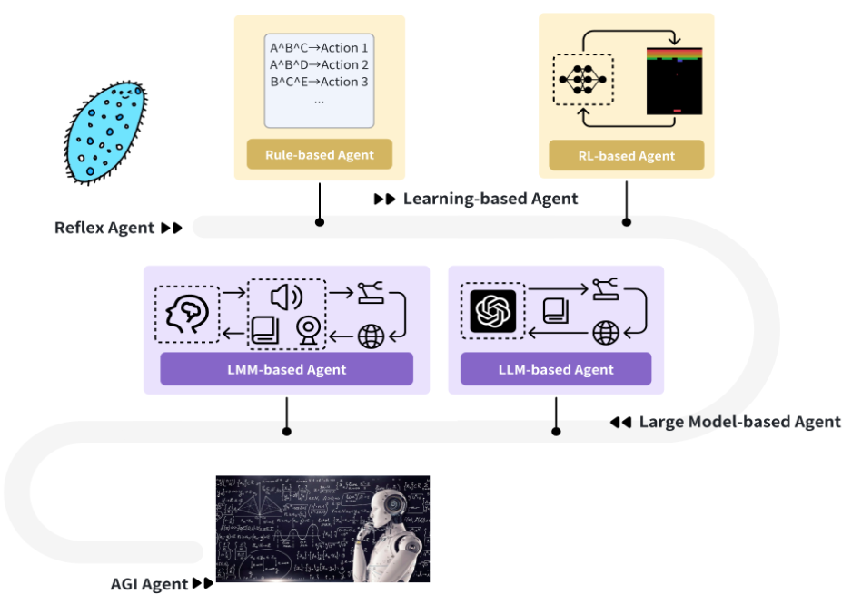
Intelligent Agents Roadmap
Source: Cheng, Yuheng, Ceyao Zhang, Zhengwen Zhang, Xiangrui Meng, Sirui Hong, Wenhao Li, Zihao Wang et al. "Exploring large language model based intelligent agents: Definitions, methods, and prospects." arXiv preprint arXiv:2401.03428 (2024).

Slide 14
AI Agents
Traditional AI Agents
    Simple reflex agents
    Model-based reflex agents
    Goal-based agents
    Utility-based agents
    Learning agents
Evolution of AI Agents
  LLM-based Agents
    Multi-modal agents
    Embodied AI agents in virtual environments
    Collaborative AI agents

Slide 15
Agents interact with environments through sensors and actuators
Source: Stuart Russell and Peter Norvig (2020), Artificial Intelligence: A Modern Approach, 4th Edition, Pearson

Slide 16
AI Agents
Definition: An AI agent is an entity that perceives its environment and takes actions to achieve goals
Components:
  Sensors: Perceive the environment
  Actuators: Act upon the environment
  Decision-making mechanism: Process inputs and decide on actions
Source: Stuart Russell and Peter Norvig (2020), Artificial Intelligence: A Modern Approach, 4th Edition, Pearson

Slide 17
Reinforcement Learning (DL)
Agent
Environment
Source: Richard S. Sutton & Andrew G. Barto (2018), Reinforcement Learning: An Introduction, 2nd Edition, A Bradford Book.

Slide 18
Reinforcement Learning (DL)
1
2
observation
Agent
action
3
reward
Environment
Source: Richard S. Sutton & Andrew G. Barto (2018), Reinforcement Learning: An Introduction, 2nd Edition, A Bradford Book.

Slide 19
Reinforcement Learning (DL)
1
2
observation
Agent
action
O_{t}
A_{t}
3
reward
R_{t}
Environment
Source: Richard S. Sutton & Andrew G. Barto (2018), Reinforcement Learning: An Introduction, 2nd Edition, A Bradford Book.

Slide 20

Large Language Model (LLM) based Agents
Source: Xi, Z., Chen, W., Guo, X., He, W., Ding, Y., Hong, B., ... & Gui, T. (2023). The rise and potential of large language model based agents: A survey. arXiv preprint arXiv:2309.07864.

Slide 21
LLM-based Agents
Definition: AI agents that use Large Language Models as their core decision-making mechanism
Key Features:
  Natural language interface
  Vast knowledge base
  Ability to understand context and nuance
  Generalize to new tasks with minimal additional training

Slide 22

LLM-based Agents
Source: Cheng, Yuheng, Ceyao Zhang, Zhengwen Zhang, Xiangrui Meng, Sirui Hong, Wenhao Li, Zihao Wang et al. "Exploring large language model based intelligent agents: Definitions, methods, and prospects." arXiv preprint arXiv:2401.03428 (2024).

Slide 23

Large Multimodal Agents (LMA)
Source: Xie, J., Chen, Z., Zhang, R., Wan, X., & Li, G. (2024). Large Multimodal Agents: A Survey. ArXiv, abs/2402.15116.

Slide 24

Large Multimodal Agents (LMA)
Source: Xie, J., Chen, Z., Zhang, R., Wan, X., & Li, G. (2024). Large Multimodal Agents: A Survey. ArXiv, abs/2402.15116.

Slide 25
Logical Agents
Source: Stuart Russell and Peter Norvig (2020), Artificial Intelligence: A Modern Approach, 4th Edition, Pearson

Slide 26
Logical Agents
Knowledge-based Agents
KB Agents
Source: Stuart Russell and Peter Norvig (2020), Artificial Intelligence: A Modern Approach, 4th Edition, Pearson

Slide 27
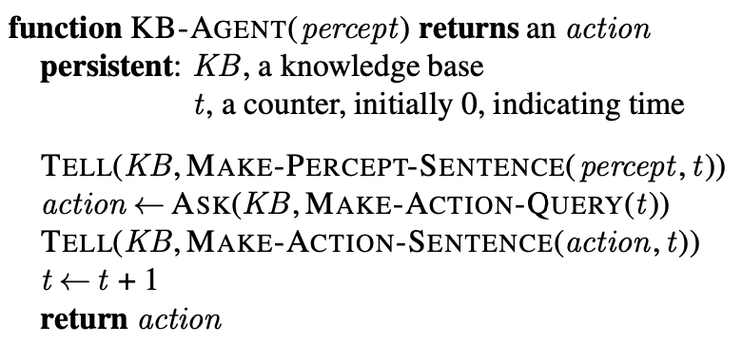
Knowledge-based Agent
(KB Agent)
Source: Stuart Russell and Peter Norvig (2020), Artificial Intelligence: A Modern Approach, 4th Edition, Pearson

Slide 28
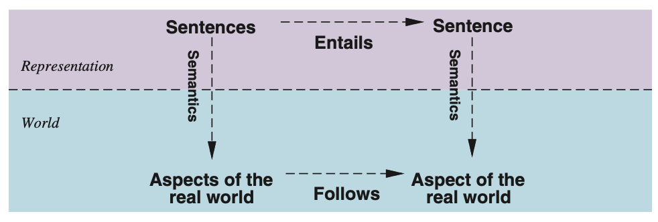
Sentences are physical configurations of the agent
Reasoning is a process of
constructing new physical configurations from old ones
Logical reasoning should ensure that the new configurations represent aspects of the world that actually follow from the aspects that the old configurations represent.
Source: Stuart Russell and Peter Norvig (2020), Artificial Intelligence: A Modern Approach, 4th Edition, Pearson

Slide 29
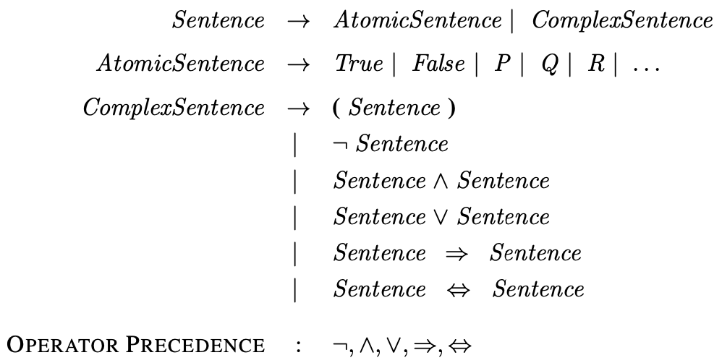
A BNF (Backus–Naur Form) grammar of sentences in propositional logic
Source: Stuart Russell and Peter Norvig (2020), Artificial Intelligence: A Modern Approach, 4th Edition, Pearson

Slide 30
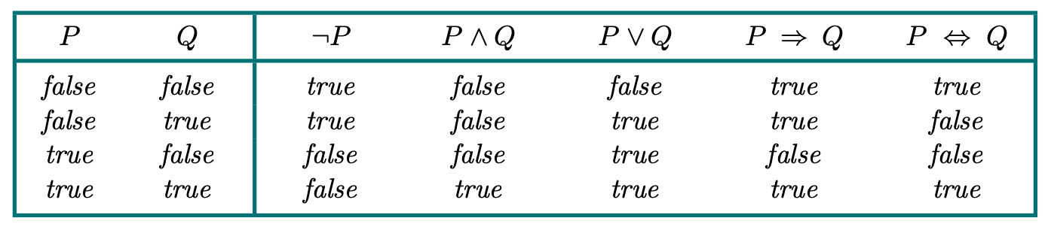
Truth Tables (TT) for the Five Logical Connectives
Source: Stuart Russell and Peter Norvig (2020), Artificial Intelligence: A Modern Approach, 4th Edition, Pearson

Slide 31
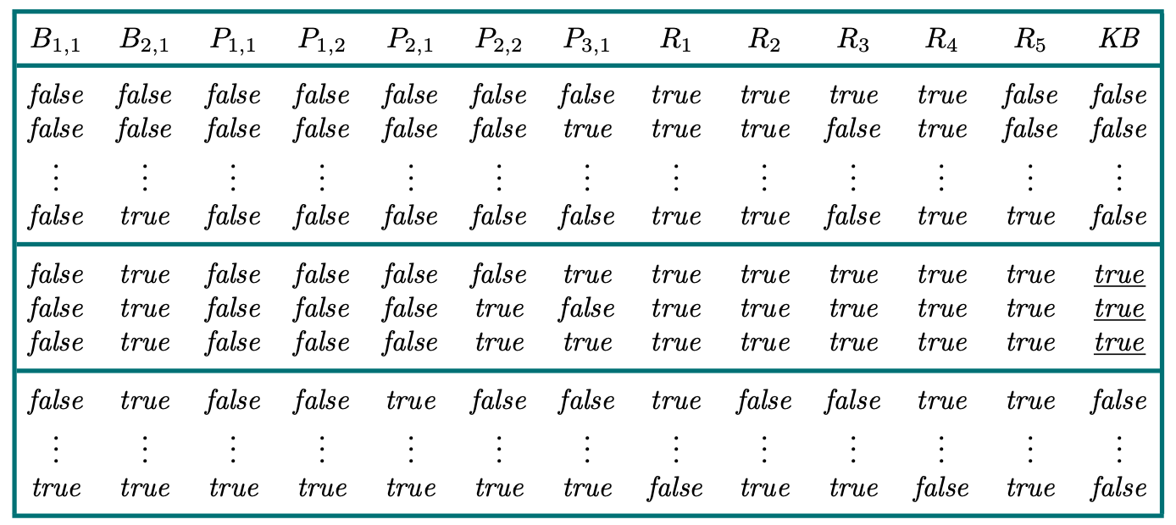
A Truth Table constructed for the knowledge base given in the text
Source: Stuart Russell and Peter Norvig (2020), Artificial Intelligence: A Modern Approach, 4th Edition, Pearson

Slide 32
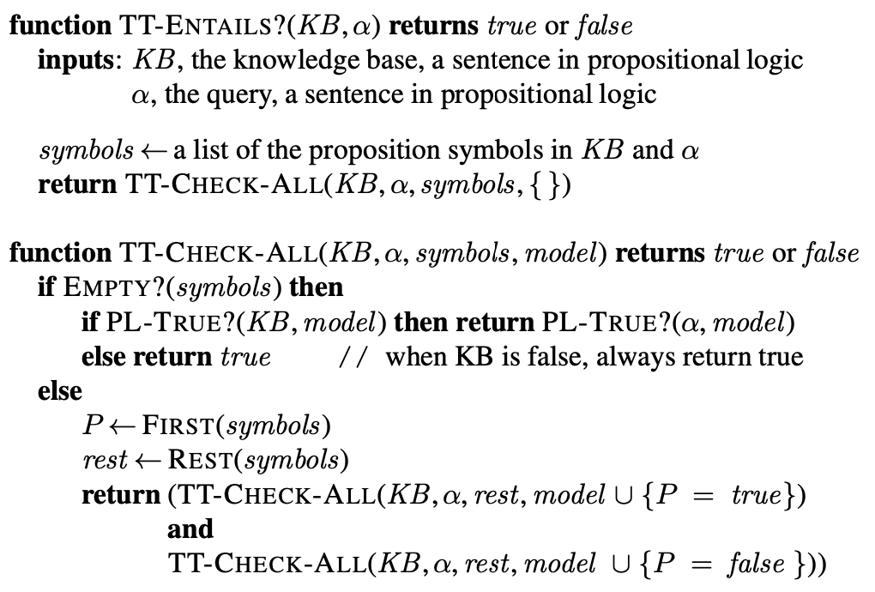
A Truth-Table (TT) enumeration algorithm for deciding propositional entailment
Source: Stuart Russell and Peter Norvig (2020), Artificial Intelligence: A Modern Approach, 4th Edition, Pearson

Slide 33
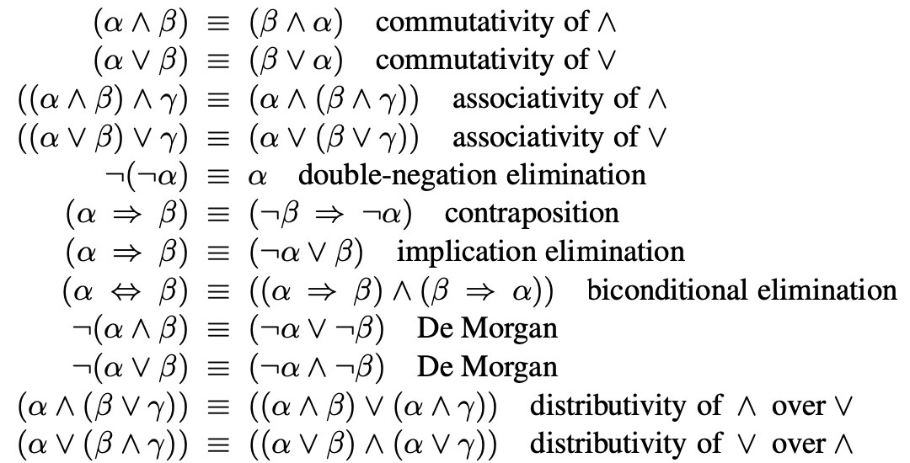
Standard Logical Equivalences
The symbols α, β, and γ stand for
arbitrary sentences of propositional logic.
Source: Stuart Russell and Peter Norvig (2020), Artificial Intelligence: A Modern Approach, 4th Edition, Pearson

Slide 34
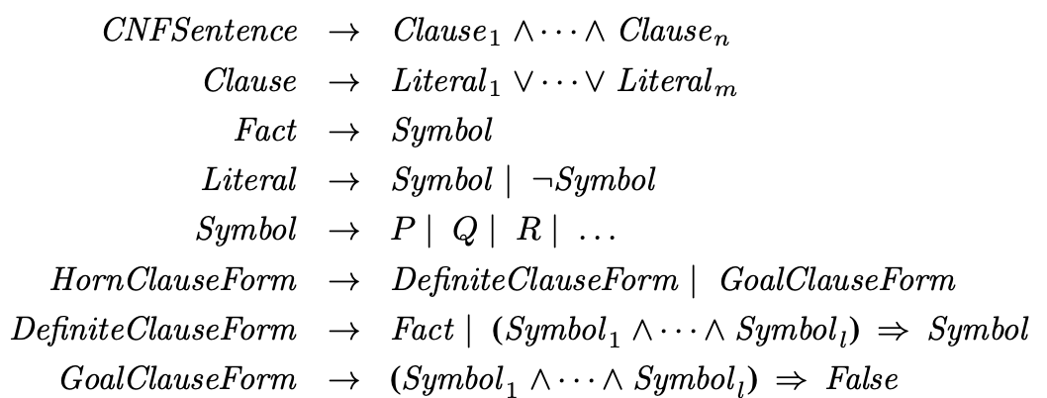
A grammar for
Conjunctive Normal Form (CNF),
Horn clauses, and definite clauses
Source: Stuart Russell and Peter Norvig (2020), Artificial Intelligence: A Modern Approach, 4th Edition, Pearson

Slide 35
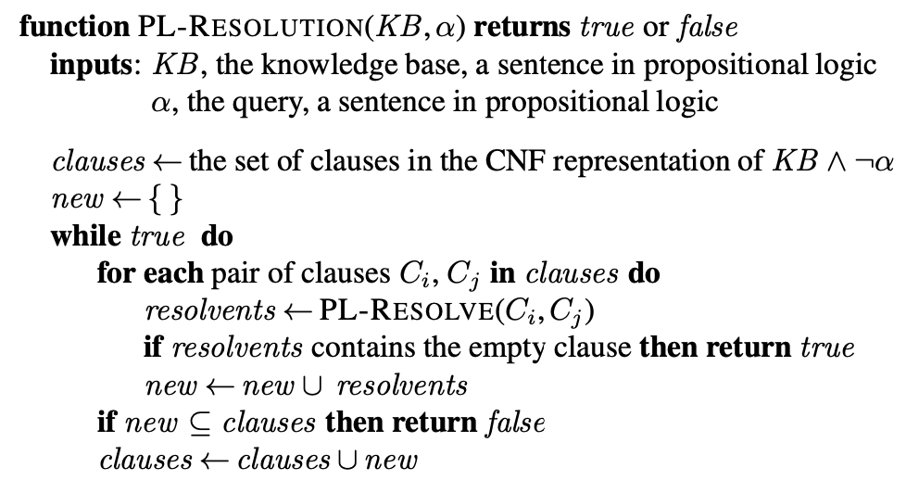
A simple resolution algorithm for propositional logic
Source: Stuart Russell and Peter Norvig (2020), Artificial Intelligence: A Modern Approach, 4th Edition, Pearson

Slide 36
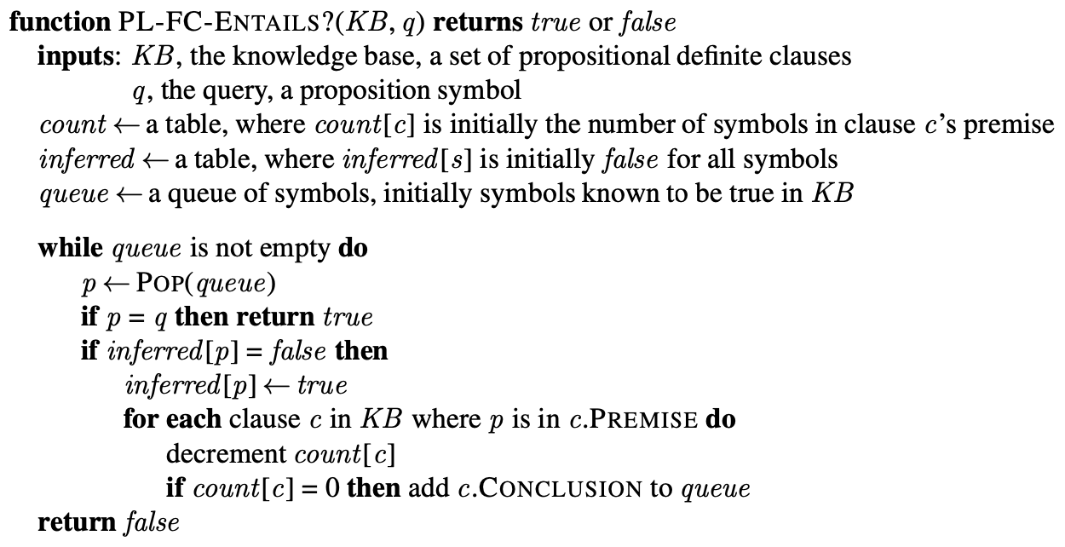
The forward-chaining algorithm for propositional logic
Source: Stuart Russell and Peter Norvig (2020), Artificial Intelligence: A Modern Approach, 4th Edition, Pearson

Slide 37
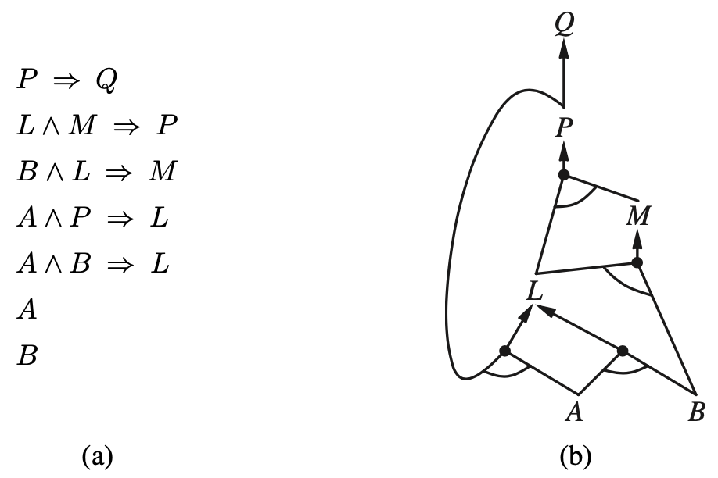
A set of Horn clauses
The corresponding AND–OR graph
Source: Stuart Russell and Peter Norvig (2020), Artificial Intelligence: A Modern Approach, 4th Edition, Pearson

Slide 38
First-Order Logic
Source: Stuart Russell and Peter Norvig (2020), Artificial Intelligence: A Modern Approach, 4th Edition, Pearson

Slide 39
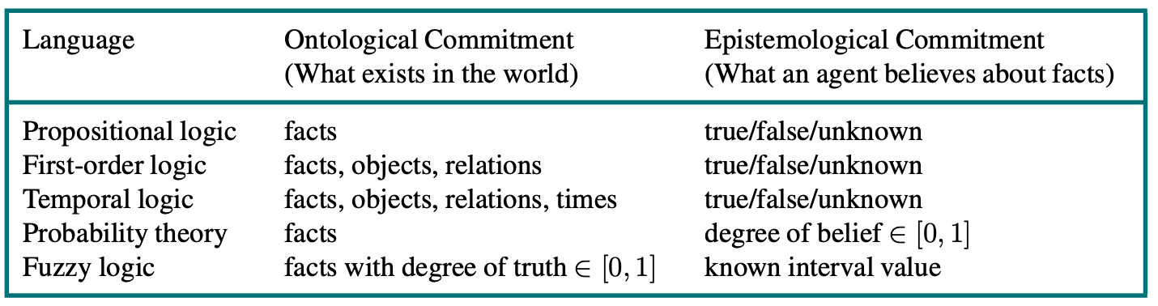
Formal languages and their ontological and epistemological commitments
Source: Stuart Russell and Peter Norvig (2020), Artificial Intelligence: A Modern Approach, 4th Edition, Pearson

Slide 40
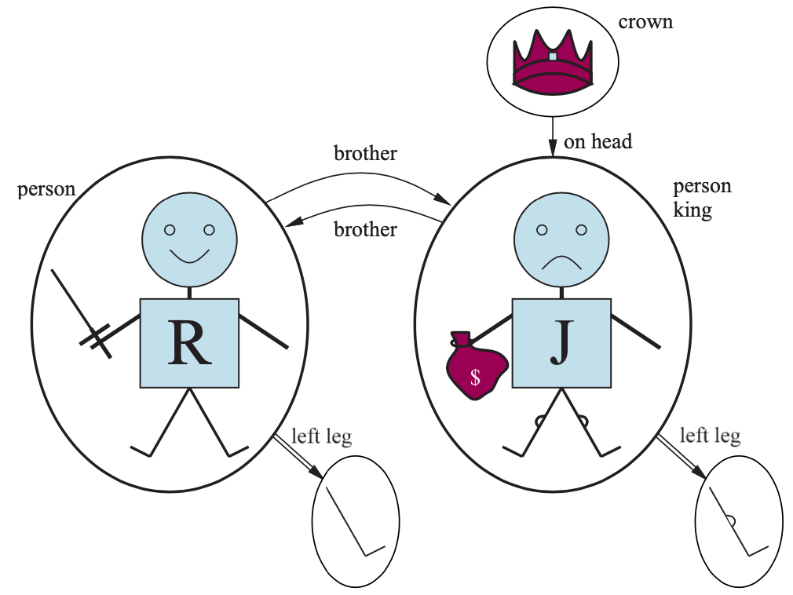
A model containing five objects two binary relations (brother and on-head), three unary relations (person, king, and crown), and one unary function (left-leg).
Source: Stuart Russell and Peter Norvig (2020), Artificial Intelligence: A Modern Approach, 4th Edition, Pearson

Slide 41
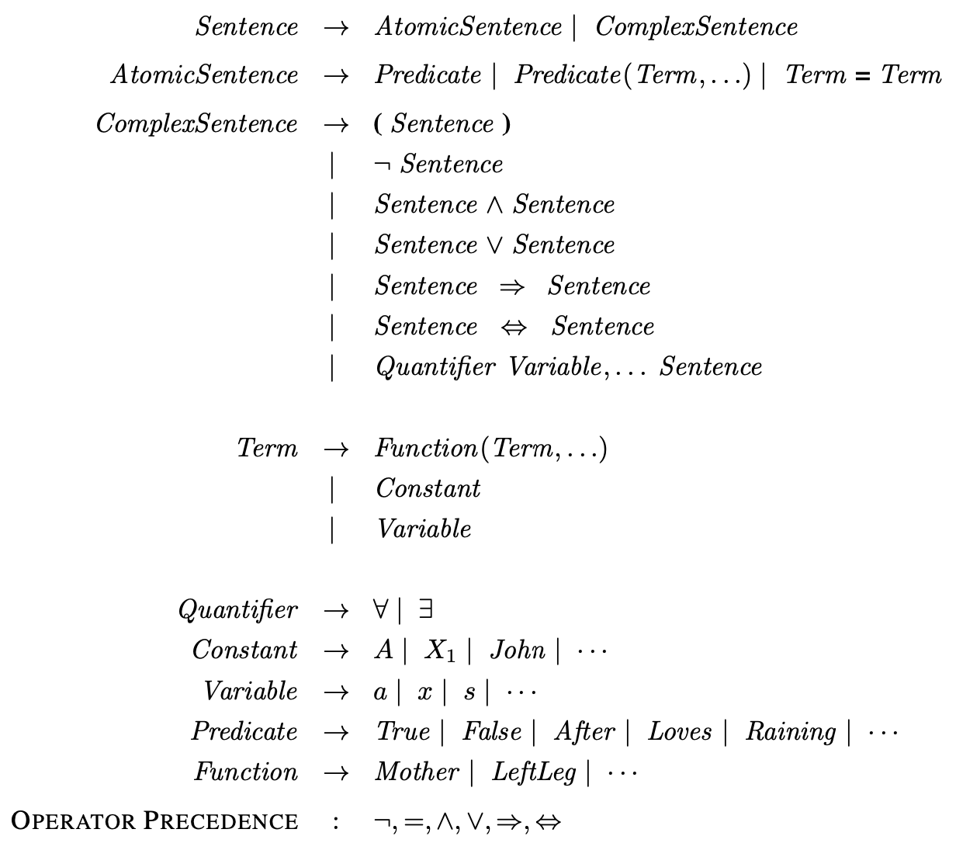
The syntax of first-order logic with equality
Source: Stuart Russell and Peter Norvig (2020), Artificial Intelligence: A Modern Approach, 4th Edition, Pearson

Slide 42
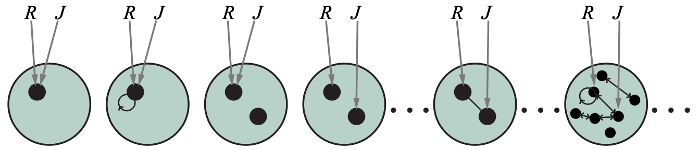
Some members of the set of all models for a language with two constant symbols, R and J, and one binary relation symbol
Source: Stuart Russell and Peter Norvig (2020), Artificial Intelligence: A Modern Approach, 4th Edition, Pearson

Slide 43
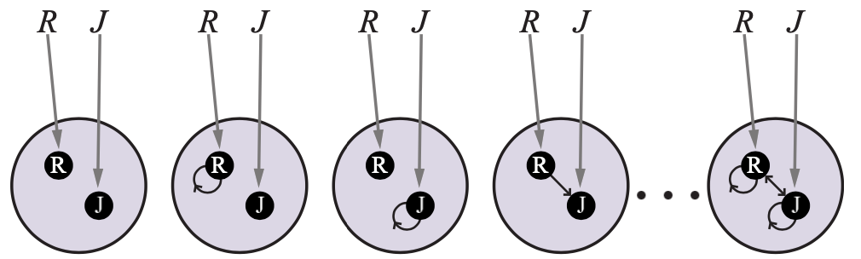
Some members of the set of all models for a language with two constant symbols, R and J, and one binary relation symbol, under database semantics
Source: Stuart Russell and Peter Norvig (2020), Artificial Intelligence: A Modern Approach, 4th Edition, Pearson

Slide 44
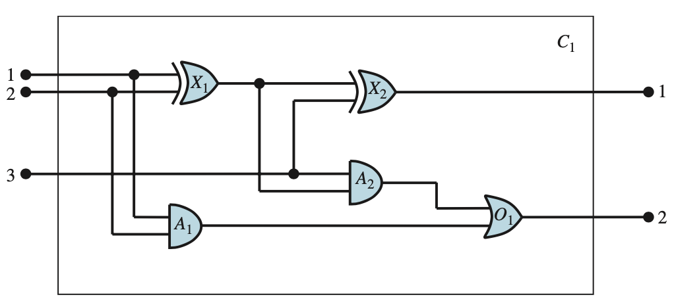
A digital circuit C1, purporting to be a one-bit full adder.
Source: Stuart Russell and Peter Norvig (2020), Artificial Intelligence: A Modern Approach, 4th Edition, Pearson

Slide 45
Inference in
First-Order Logic
Source: Stuart Russell and Peter Norvig (2020), Artificial Intelligence: A Modern Approach, 4th Edition, Pearson

Slide 46
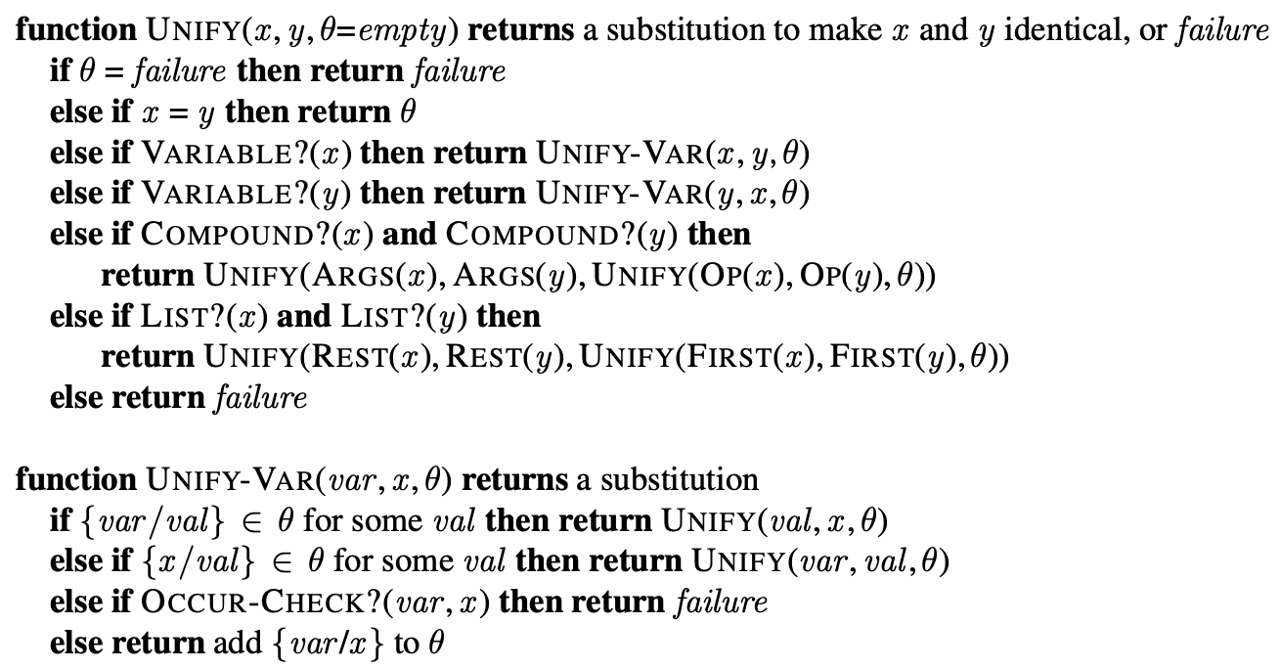
The unification algorithm
Source: Stuart Russell and Peter Norvig (2020), Artificial Intelligence: A Modern Approach, 4th Edition, Pearson

Slide 47
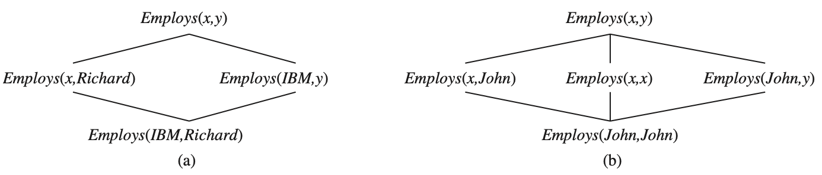
The subsumption lattice whose lowest node is Employs
(IBM , Richard )
The subsumption lattice for the sentence Employs (John, John )
Source: Stuart Russell and Peter Norvig (2020), Artificial Intelligence: A Modern Approach, 4th Edition, Pearson

Slide 48
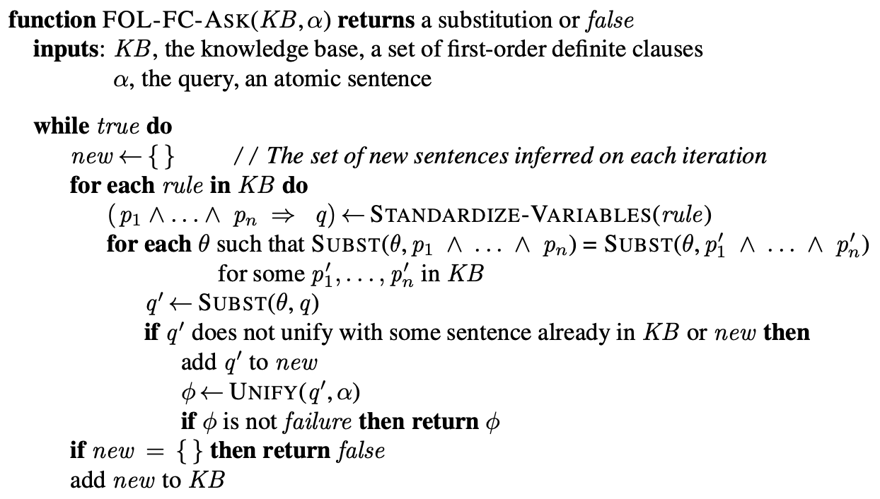
A conceptually straightforward, but inefficient, forward-chaining algorithm
Source: Stuart Russell and Peter Norvig (2020), Artificial Intelligence: A Modern Approach, 4th Edition, Pearson

Slide 49
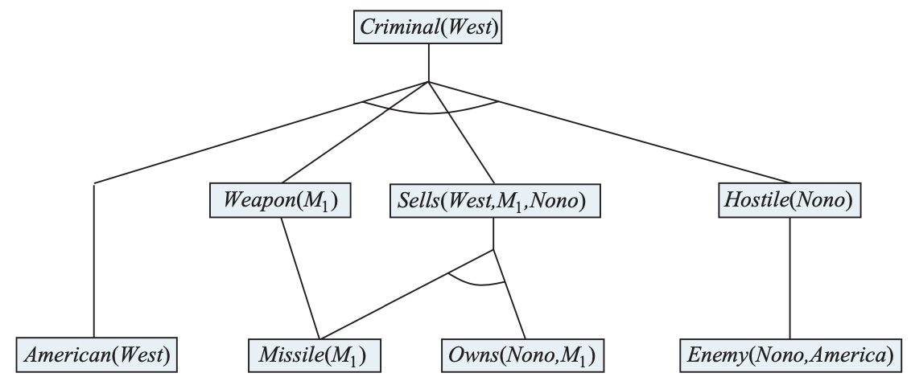
The proof tree generated by forward chaining on the crime example
Source: Stuart Russell and Peter Norvig (2020), Artificial Intelligence: A Modern Approach, 4th Edition, Pearson

Slide 50
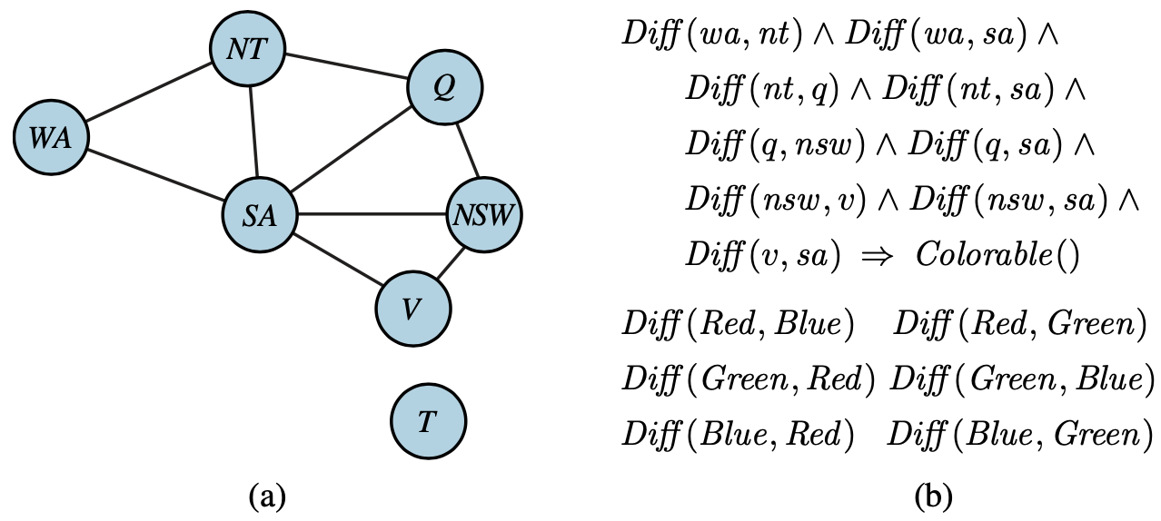
Constraint graph for coloring the map of Australia
Source: Stuart Russell and Peter Norvig (2020), Artificial Intelligence: A Modern Approach, 4th Edition, Pearson

Slide 51
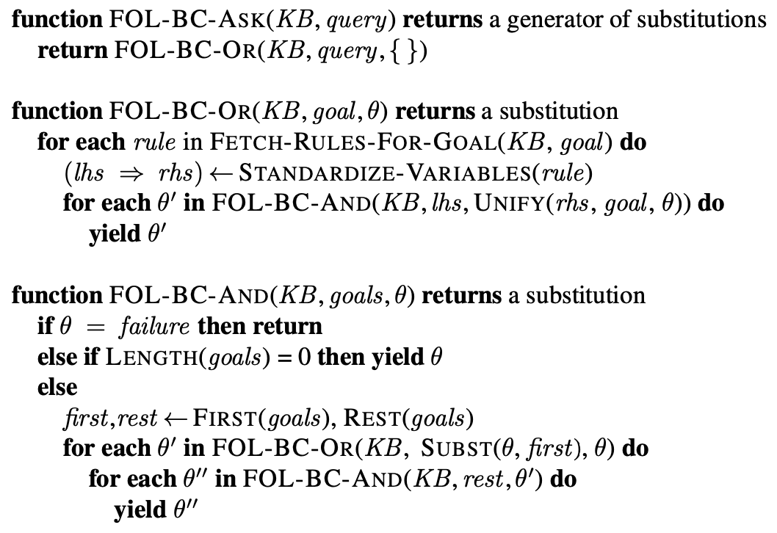
A simple backward-chaining algorithm for first-order knowledge bases
Source: Stuart Russell and Peter Norvig (2020), Artificial Intelligence: A Modern Approach, 4th Edition, Pearson

Slide 52
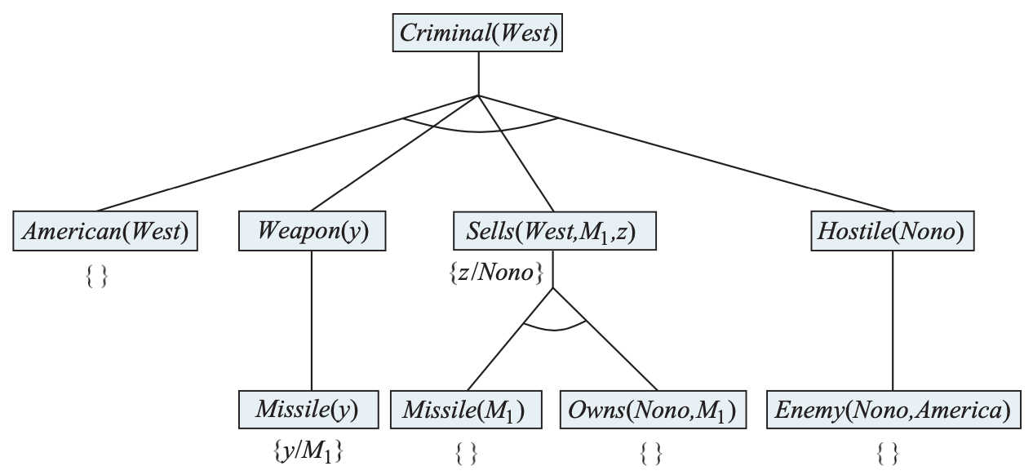
Proof tree constructed by backward chaining t o prove that West is a criminal
Source: Stuart Russell and Peter Norvig (2020), Artificial Intelligence: A Modern Approach, 4th Edition, Pearson

Slide 53
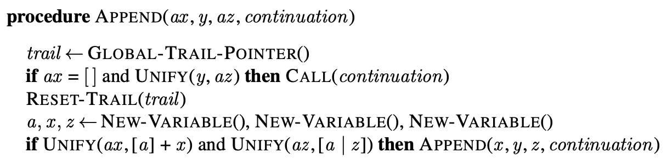
Pseudocode representing the result of compiling the Append predicate
Source: Stuart Russell and Peter Norvig (2020), Artificial Intelligence: A Modern Approach, 4th Edition, Pearson

Slide 54
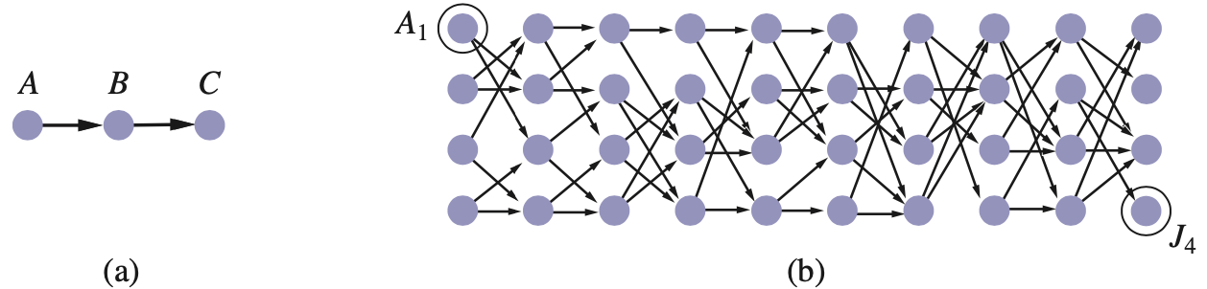
Finding a path from A to C can lead Prolog into an infinite loop.
Source: Stuart Russell and Peter Norvig (2020), Artificial Intelligence: A Modern Approach, 4th Edition, Pearson

Slide 55
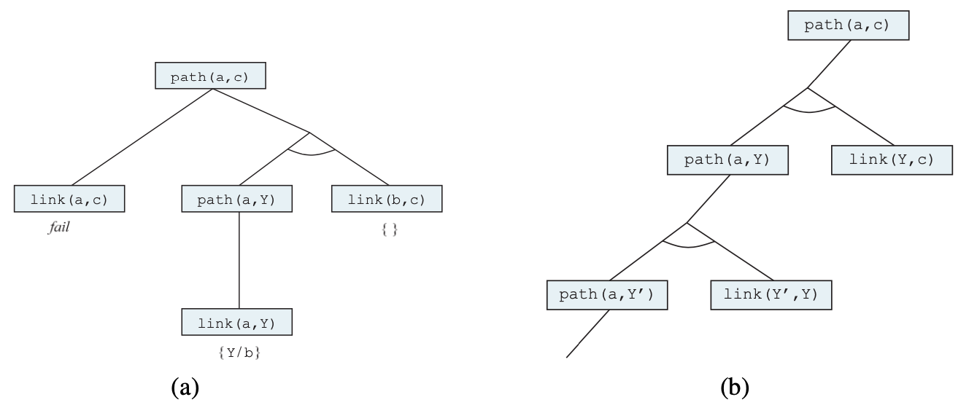
Proof that a path exists from A to C.
Infinite proof tree generated
when the clauses are
in the “wrong” order
Source: Stuart Russell and Peter Norvig (2020), Artificial Intelligence: A Modern Approach, 4th Edition, Pearson

Slide 56
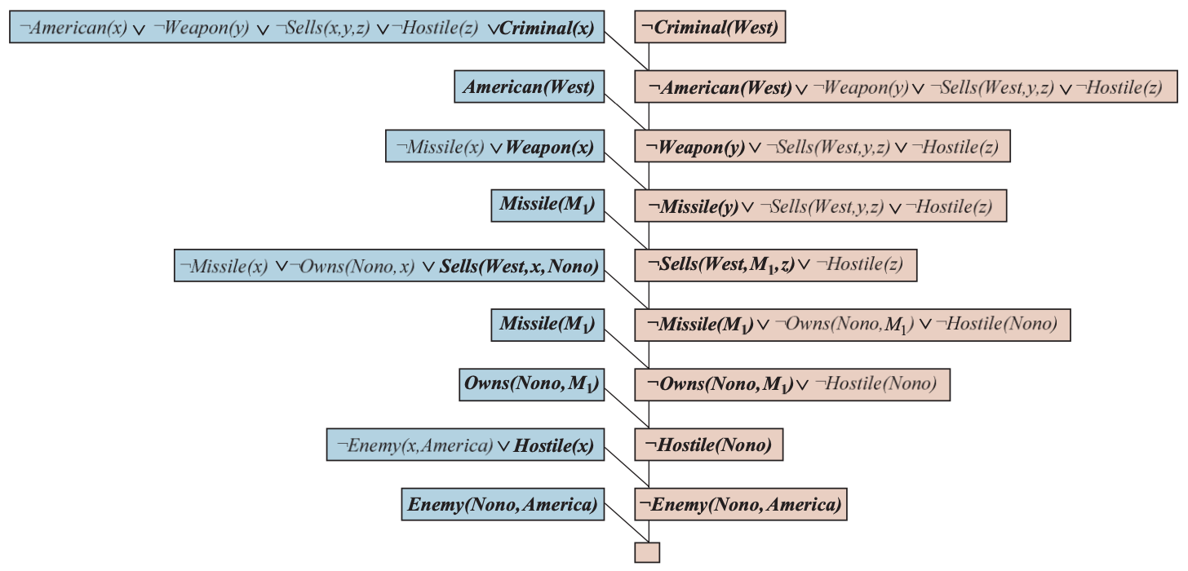
A resolution proof that
West is a criminal
Source: Stuart Russell and Peter Norvig (2020), Artificial Intelligence: A Modern Approach, 4th Edition, Pearson

Slide 57
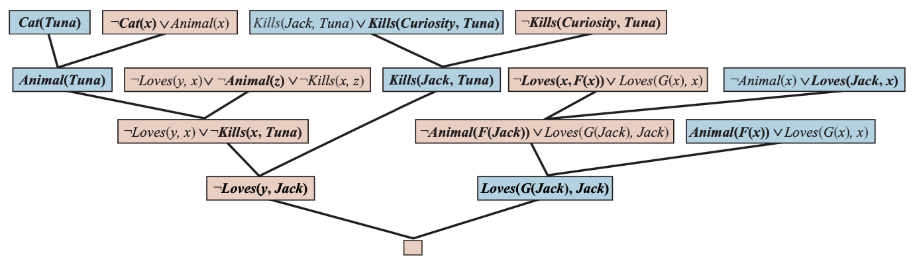
A resolution proof that
Curiosity killed the cat
Source: Stuart Russell and Peter Norvig (2020), Artificial Intelligence: A Modern Approach, 4th Edition, Pearson

Slide 58
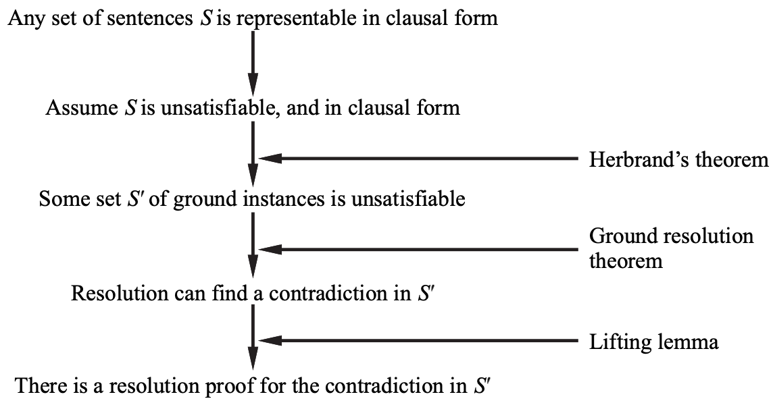
Structure of a completeness proof for resolution
Source: Stuart Russell and Peter Norvig (2020), Artificial Intelligence: A Modern Approach, 4th Edition, Pearson

Slide 59
Knowledge Representation
Source: Stuart Russell and Peter Norvig (2020), Artificial Intelligence: A Modern Approach, 4th Edition, Pearson

Slide 60
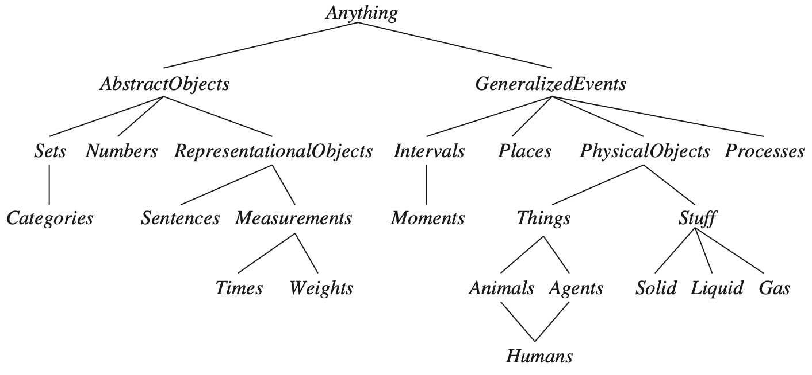
The Upper Ontology of the World
Source: Stuart Russell and Peter Norvig (2020), Artificial Intelligence: A Modern Approach, 4th Edition, Pearson

Slide 61
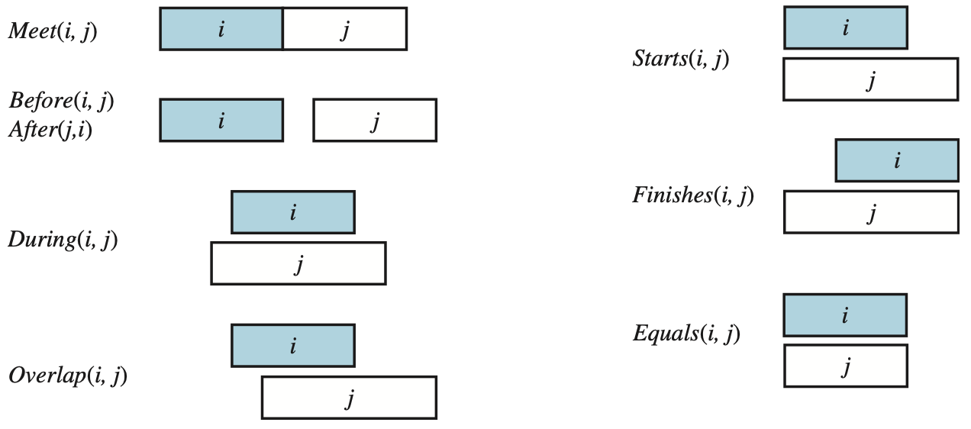
Predicates on time intervals
Source: Stuart Russell and Peter Norvig (2020), Artificial Intelligence: A Modern Approach, 4th Edition, Pearson

Slide 62
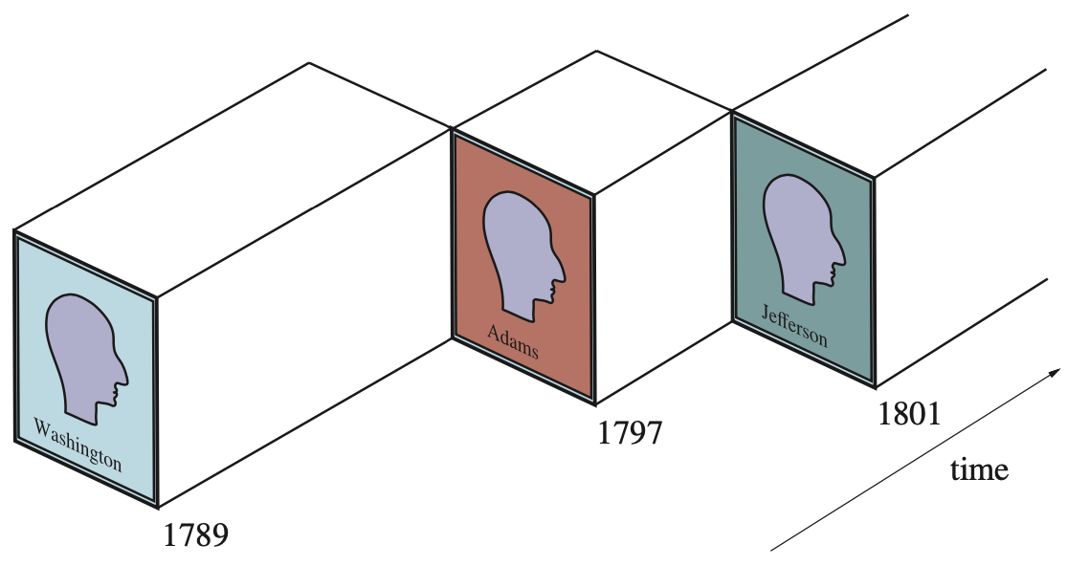
A schematic view of the object President (USA) for the early years
Source: Stuart Russell and Peter Norvig (2020), Artificial Intelligence: A Modern Approach, 4th Edition, Pearson

Slide 63
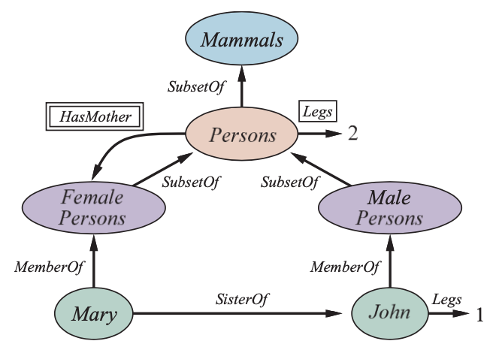
A semantic network with four objects (John, Mary, 1, and 2) and four categories Relations are denoted by labeled links
Source: Stuart Russell and Peter Norvig (2020), Artificial Intelligence: A Modern Approach, 4th Edition, Pearson

Slide 64
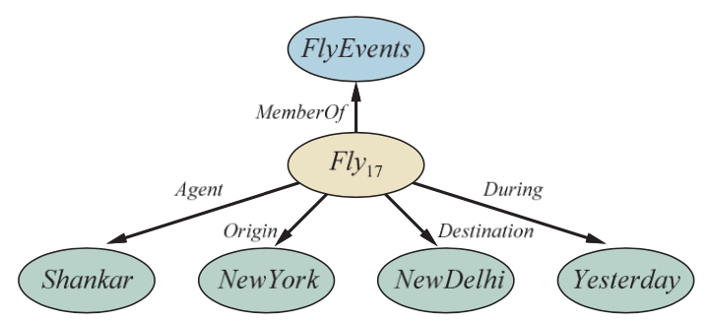
Semantic network
Representation of the logical assertion
Fly (Shankar, NewYork, NewDelhi, Yesterday)
Source: Stuart Russell and Peter Norvig (2020), Artificial Intelligence: A Modern Approach, 4th Edition, Pearson

Slide 65
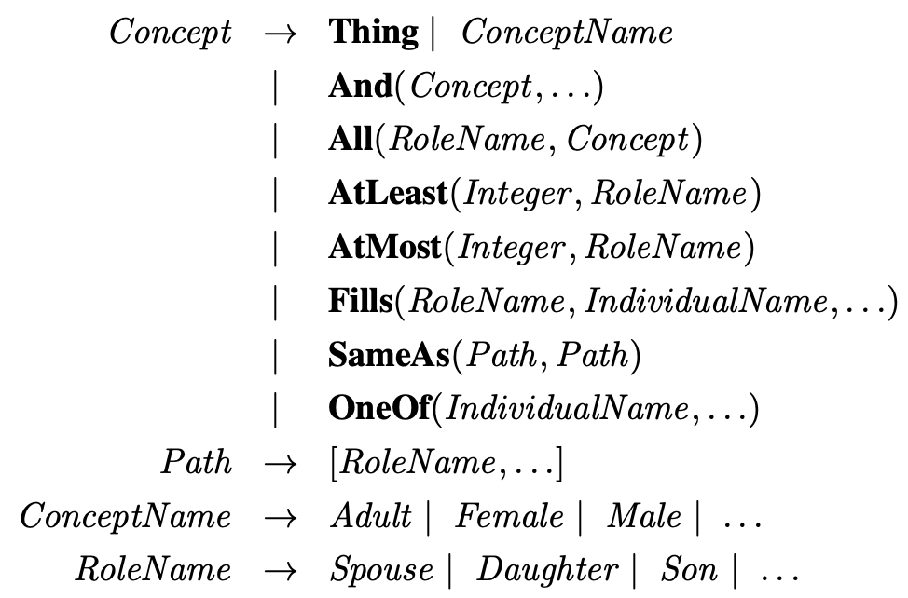
The syntax of descriptions in a subset of the CLASSIC language.
Source: Stuart Russell and Peter Norvig (2020), Artificial Intelligence: A Modern Approach, 4th Edition, Pearson

Slide 66
Knowledge Graph (KG)
Source: Stuart Russell and Peter Norvig (2020), Artificial Intelligence: A Modern Approach, 4th Edition, Pearson

Slide 67
Knowledge Graph (KG)
Knowledge Graph (KG)
  A knowledge graph is a multi-relational graph composed of
  entities and relations, which are regarded as
  nodes and different types of edges, respectively (Ji et al., 2021).
  Represents knowledge as concepts (entities) and
  their relationships (Facts)
  Triple of facts
    SPO: (subject, predicate, object)
    HRT: (head, relation, tail)
Common Knowledge Graph: DBpedia, YAGO, Wikidata

Slide 68
Knowledge Graph, Facts, Triple, Embedding
G
  Knowledge graph
F
  Set of facts
(h, r, t)
  Triple of head, relation, and tail
(h, r, t)
  Embedding of head, relation, and tail
Source: Ji, S., Pan, S., Cambria, E., Marttinen, P., & Philip, S. Y. (2021). A survey on knowledge graphs: Representation, acquisition, and applications.
IEEE Transactions on Neural Networks and Learning Systems.

Slide 69
Knowledge Representation
Factual Triple and Knowledge Graph
Albert Einstein, winner of the 1921 Nobel prize in physics
The Nobel Prize in Physics 1921 was awarded to Albert Einstein "for his services to Theoretical Physics, and especially for his discovery of the law of the photoelectric effect.”
Triple
(Albert Einstein, WinnerOf, Nobel Prize in Physics)
Knowledge Graph
Albert
Einstein
WinnerOf
Nobel Prize
in Physics

Slide 70
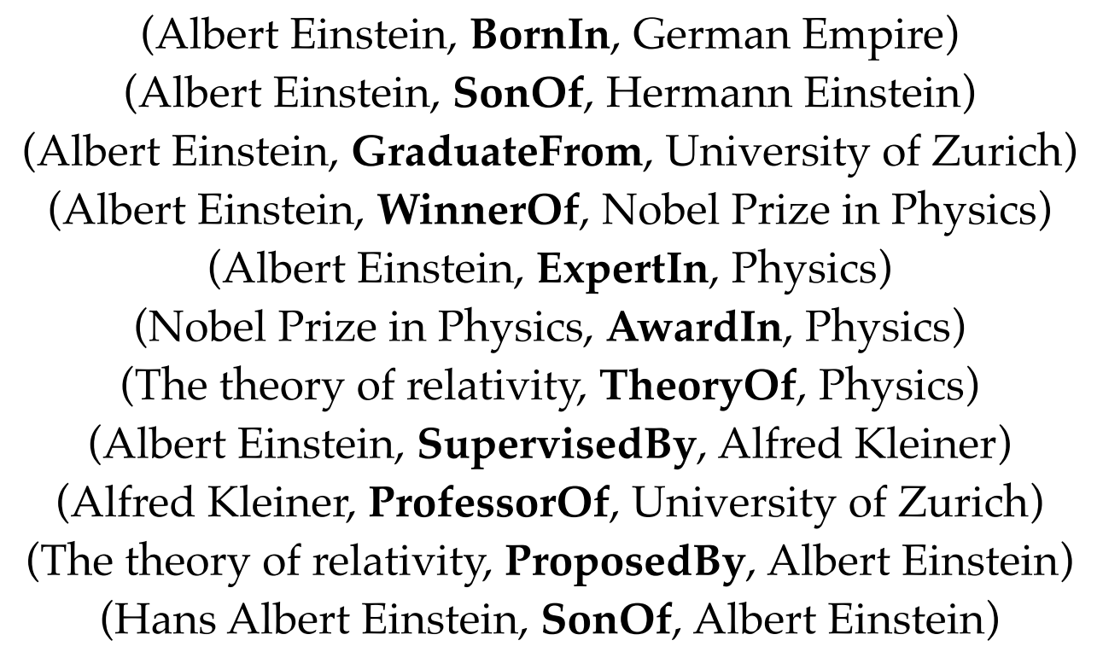
Factual Triples in Knowledge Base
(h, r, t)
Source: Ji, S., Pan, S., Cambria, E., Marttinen, P., & Philip, S. Y. (2021). A survey on knowledge graphs: Representation, acquisition, and applications.
IEEE Transactions on Neural Networks and Learning Systems.

Slide 71
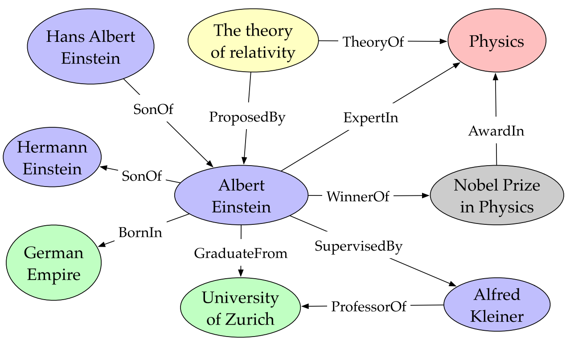
Entities and Relations in Knowledge Graph
(Albert Einstein, WinnerOf, Nobel Prize in Physics)
Source: Ji, S., Pan, S., Cambria, E., Marttinen, P., & Philip, S. Y. (2021). A survey on knowledge graphs: Representation, acquisition, and applications.
IEEE Transactions on Neural Networks and Learning Systems.

Slide 72

knowledge base and knowledge graph
Factual triples in knowledge base
Entities and relations in knowledge graph
(Albert Einstein, WinnerOf, Nobel Prize in Physics)
Source: Ji, S., Pan, S., Cambria, E., Marttinen, P., & Philip, S. Y. (2021). A survey on knowledge graphs: Representation, acquisition, and applications.
IEEE Transactions on Neural Networks and Learning Systems.

Slide 73
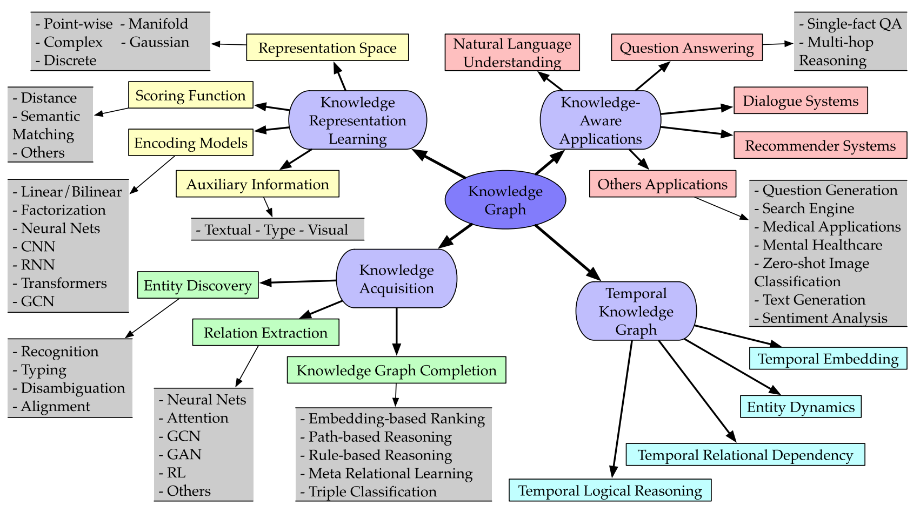
Categorization of Research on Knowledge Graphs
Source: Ji, S., Pan, S., Cambria, E., Marttinen, P., & Philip, S. Y. (2021). A survey on knowledge graphs: Representation, acquisition, and applications.
IEEE Transactions on Neural Networks and Learning Systems.

Slide 74
Knowledge Graph Completion (KGC) Datasets
Knowledge Graph Completion (KGC) Dataset | #Entity | #Relation | #Train | #Valid | #Test | Reference
WN18RR | 40,943 | 11 | 86,835 | 3,034 | 3,134 | Toutanova & Chen (2015); Zhang et al. (2020)
FB15k-237 | 14,541 | 237 | 272,115 | 17,535 | 20,466 | Dettmers et al. (2018); Zhang et al. (2020)
YAGO3-10 | 123,182 | 37 | 1,079,040 | 5,000 | 5,000 | Mahdisoltani et al. (2015); Zhang et al. (2020)

Slide 75
Domain-Specific Knowledge Graph
Domain-Specific Knowledge Graph
  PubMed Knowledge Graph (PKG)
    Extracting biological entities from 29 million PubMed abstracts
  Lynx: Legal Knowledge Graph for Multilingual Compliance Services
    Legal Knowledge Graph (LKG) integrates and links heterogeneous compliance data sources including legislation, case law, standards and other private contracts.

Slide 76
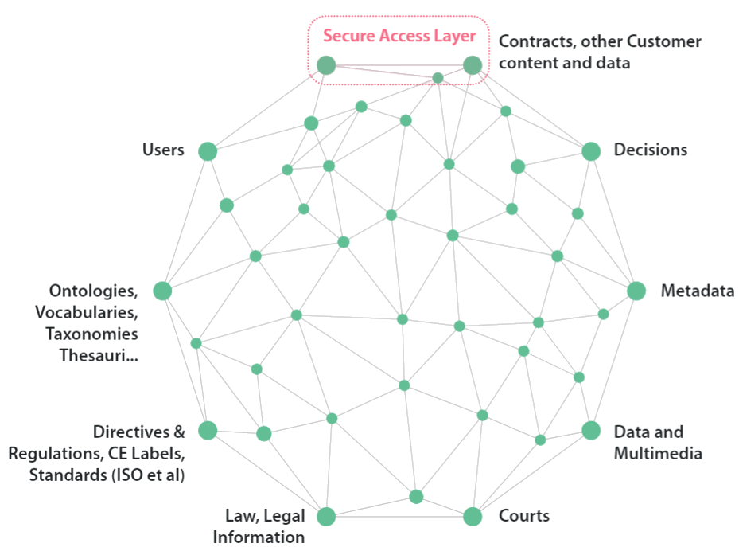
Lynx: Legal Knowledge Graph for
Multilingual Compliance Services
Source: Lynx Legal Knowledge Graph (LKG), https://lynx-project.eu/

Slide 77
Automated Planning
Source: Stuart Russell and Peter Norvig (2020), Artificial Intelligence: A Modern Approach, 4th Edition, Pearson

Slide 78
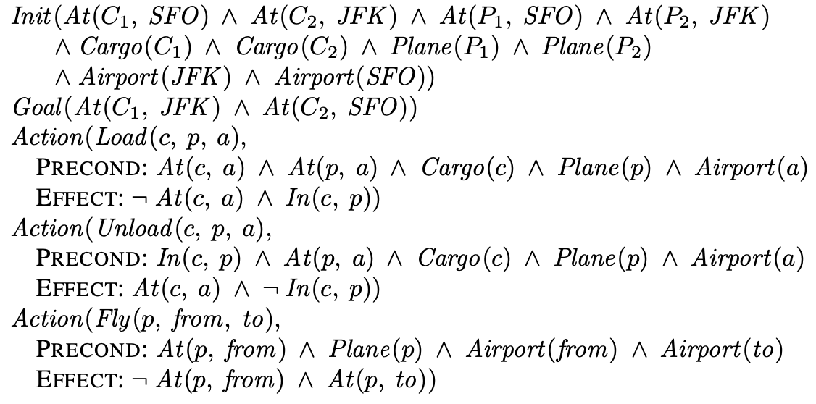
A PDDL description of an air cargo transportation planning problem
Source: Stuart Russell and Peter Norvig (2020), Artificial Intelligence: A Modern Approach, 4th Edition, Pearson

Slide 79
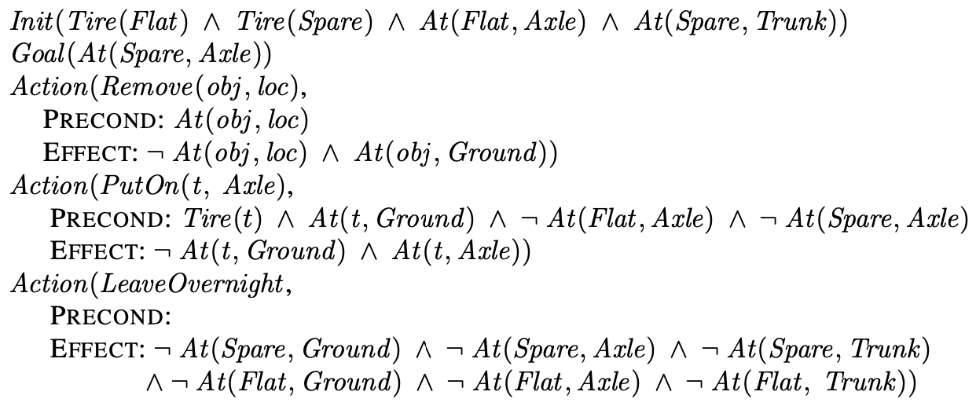
The simple spare tire problem
Source: Stuart Russell and Peter Norvig (2020), Artificial Intelligence: A Modern Approach, 4th Edition, Pearson

Slide 80
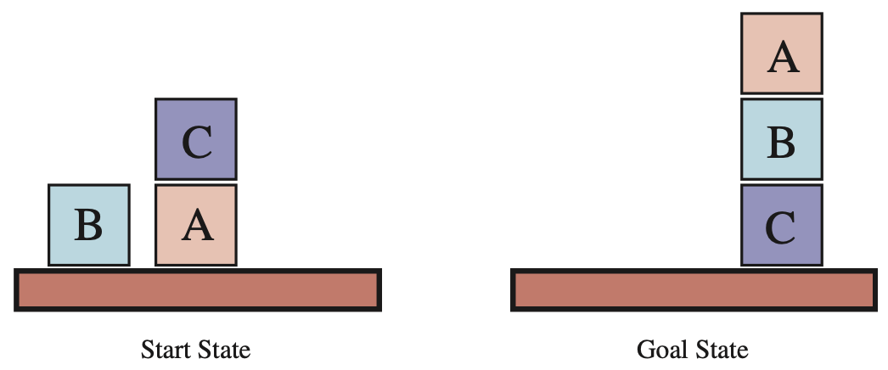
Diagram of the blocks-world problem
Source: Stuart Russell and Peter Norvig (2020), Artificial Intelligence: A Modern Approach, 4th Edition, Pearson

Slide 81
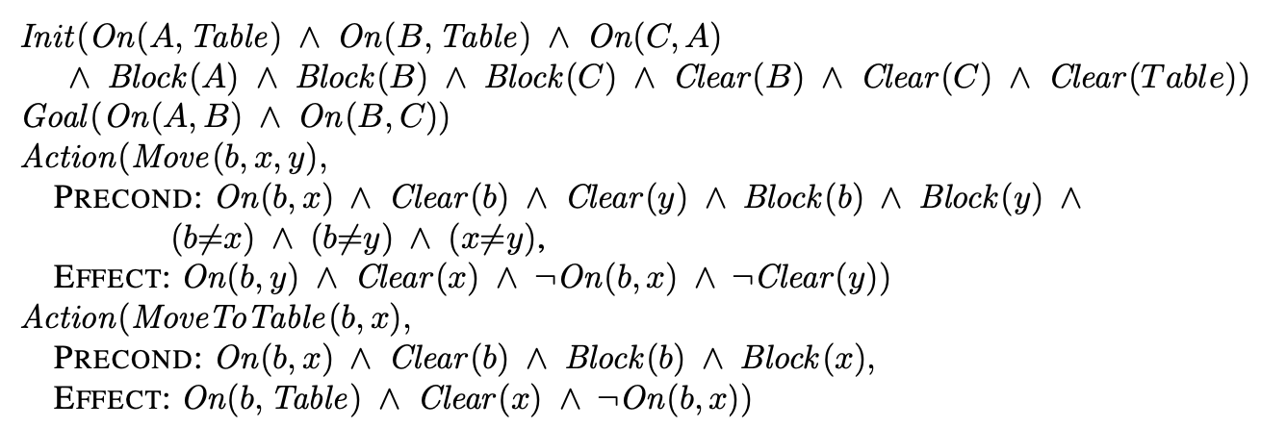
A planning problem in the blocks world: building a three-block tower
Source: Stuart Russell and Peter Norvig (2020), Artificial Intelligence: A Modern Approach, 4th Edition, Pearson

Slide 82
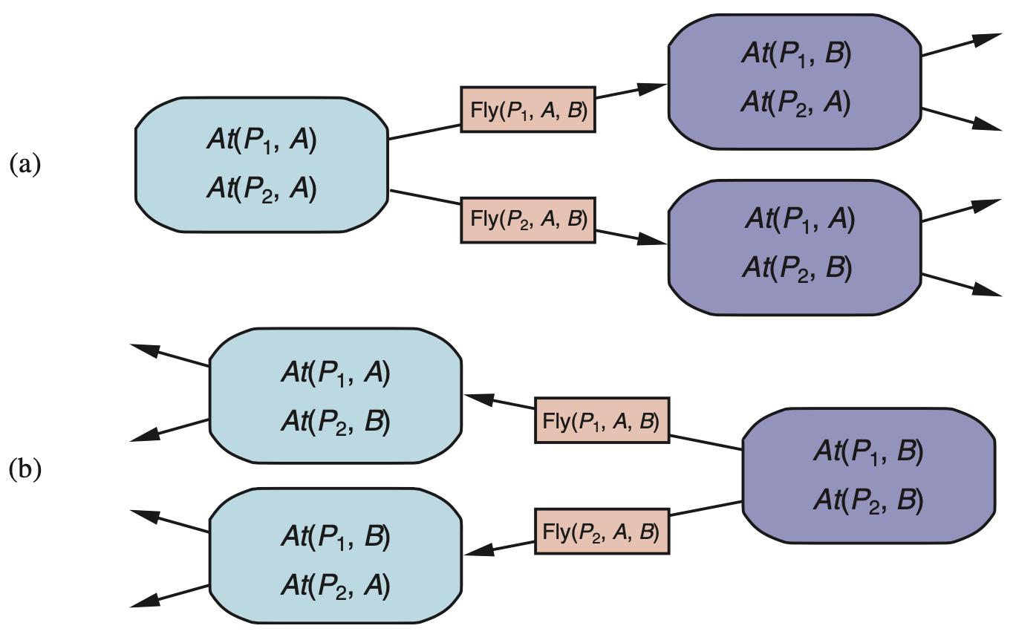
Two approaches to searching for a plan (a) Forward (progression) search
(b) Backward (regression) search
Source: Stuart Russell and Peter Norvig (2020), Artificial Intelligence: A Modern Approach, 4th Edition, Pearson

Slide 83
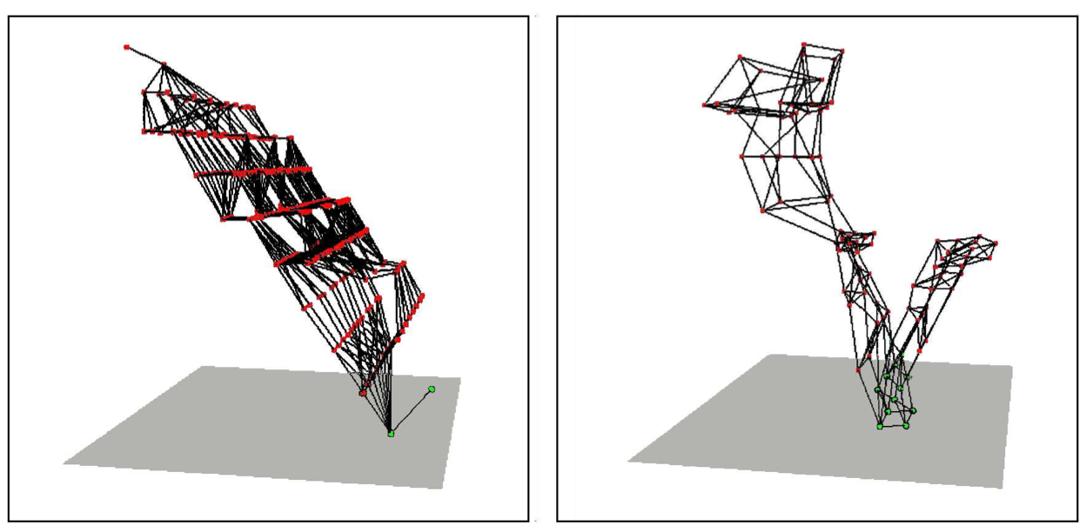
Two state spaces from planning problems with the ignore-delete-lists heuristic
Source: Stuart Russell and Peter Norvig (2020), Artificial Intelligence: A Modern Approach, 4th Edition, Pearson

Slide 84
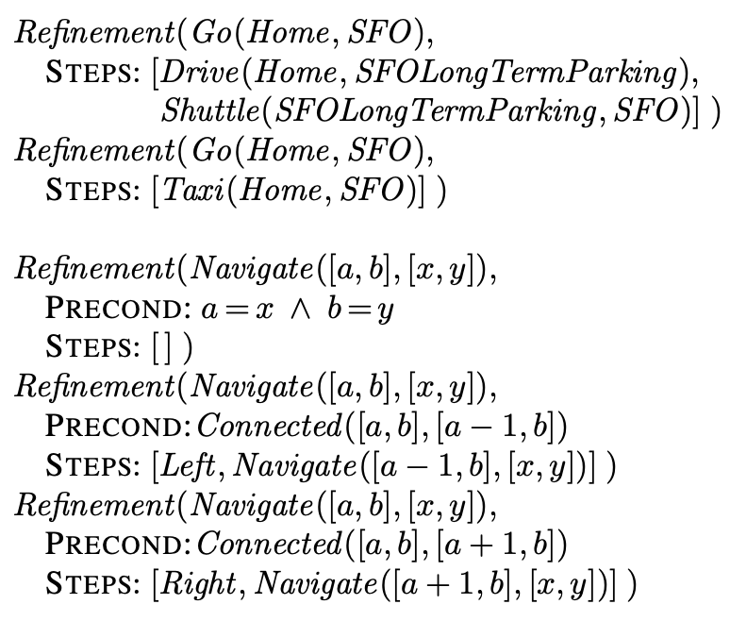
Definitions of possible refinements for two high-level actions
Source: Stuart Russell and Peter Norvig (2020), Artificial Intelligence: A Modern Approach, 4th Edition, Pearson

Slide 85
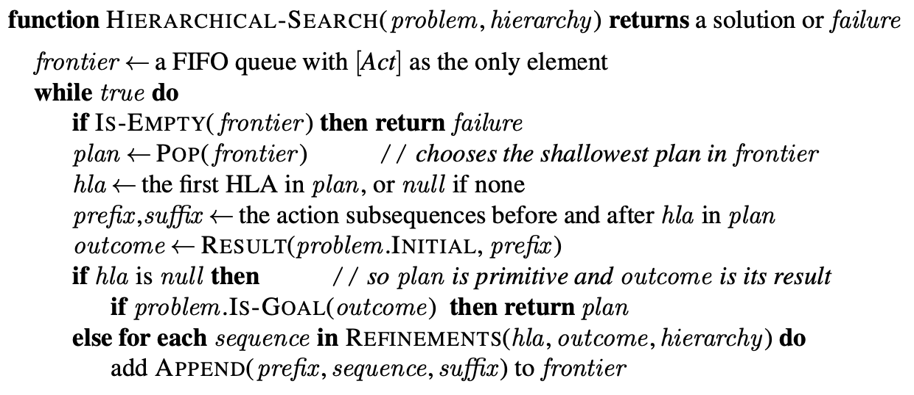
A breadth-first implementation of hierarchical forward planning search
Source: Stuart Russell and Peter Norvig (2020), Artificial Intelligence: A Modern Approach, 4th Edition, Pearson

Slide 86
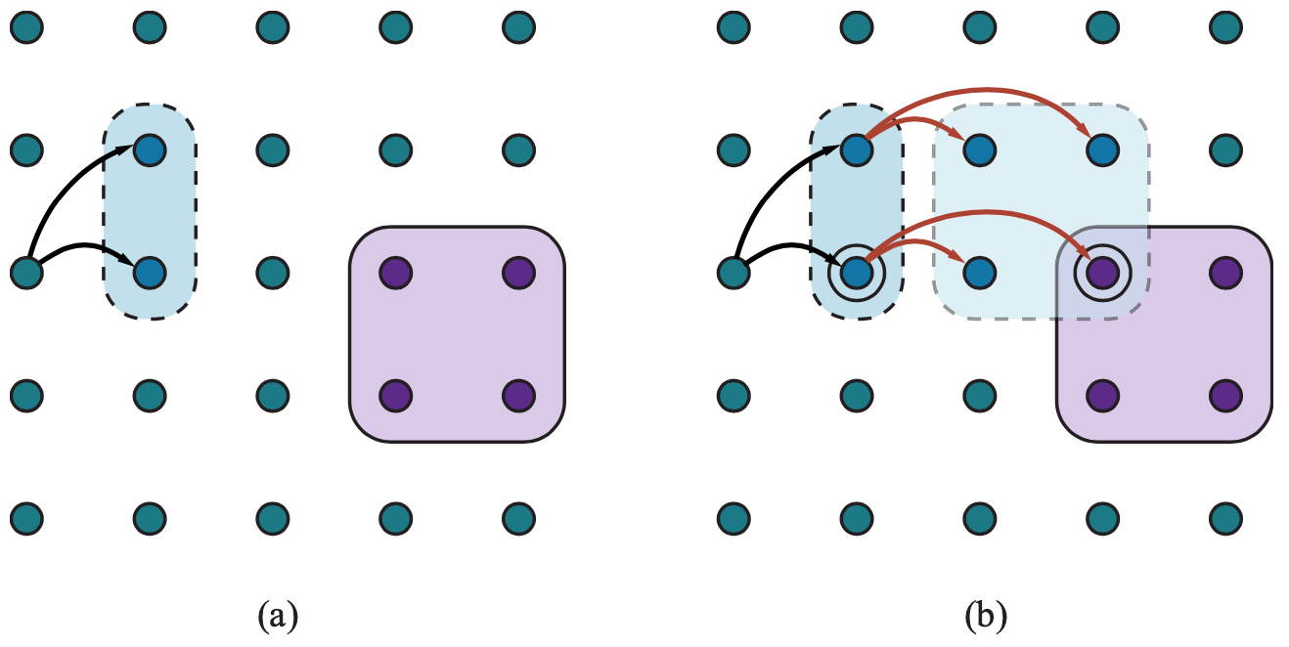
Schematic examples of reachable sets
Source: Stuart Russell and Peter Norvig (2020), Artificial Intelligence: A Modern Approach, 4th Edition, Pearson

Slide 87

Goal achievement for high-level plans with approximate descriptions
Source: Stuart Russell and Peter Norvig (2020), Artificial Intelligence: A Modern Approach, 4th Edition, Pearson

Slide 88

A hierarchical planning algorithm
Source: Stuart Russell and Peter Norvig (2020), Artificial Intelligence: A Modern Approach, 4th Edition, Pearson

Slide 89

A hierarchical planning algorithm
Decompose solution
Source: Stuart Russell and Peter Norvig (2020), Artificial Intelligence: A Modern Approach, 4th Edition, Pearson

Slide 90

At first, the sequence “whole plan” is expected to get the agent from S to G
Source: Stuart Russell and Peter Norvig (2020), Artificial Intelligence: A Modern Approach, 4th Edition, Pearson

Slide 91

A job-shop scheduling problem for assembling two cars, with resource constraints
Source: Stuart Russell and Peter Norvig (2020), Artificial Intelligence: A Modern Approach, 4th Edition, Pearson

Slide 92

A representation of the temporal constraints for the job-shop scheduling problem
Source: Stuart Russell and Peter Norvig (2020), Artificial Intelligence: A Modern Approach, 4th Edition, Pearson

Slide 93

A solution to the job-shop scheduling problem
Source: Stuart Russell and Peter Norvig (2020), Artificial Intelligence: A Modern Approach, 4th Edition, Pearson

Slide 94
Artificial Intelligence:
Uncertain Knowledge and Reasoning
Source: Stuart Russell and Peter Norvig (2020), Artificial Intelligence: A Modern Approach, 4th Edition, Pearson

Slide 95
Artificial Intelligence:
4. Uncertain Knowledge and Reasoning
Quantifying Uncertainty
Probabilistic Reasoning
Probabilistic Reasoning over Time
Probabilistic Programming
Making Simple Decisions
Making Complex Decisions
Multiagent Decision Making
Source: Stuart Russell and Peter Norvig (2020), Artificial Intelligence: A Modern Approach, 4th Edition, Pearson

Slide 96
Quantifying Uncertainty
Source: Stuart Russell and Peter Norvig (2020), Artificial Intelligence: A Modern Approach, 4th Edition, Pearson

Slide 97

DT-Agent
A Decision-Theoretic Agent that Selects Rational Actions
Source: Stuart Russell and Peter Norvig (2020), Artificial Intelligence: A Modern Approach, 4th Edition, Pearson

Slide 98

Agent 1 has inconsistent beliefs
Source: Stuart Russell and Peter Norvig (2020), Artificial Intelligence: A Modern Approach, 4th Edition, Pearson

Slide 99

A full joint distribution for the Toothache, Cavity, Catch world
Source: Stuart Russell and Peter Norvig (2020), Artificial Intelligence: A Modern Approach, 4th Edition, Pearson

Slide 100

Weather and Dental problems are independent
Source: Stuart Russell and Peter Norvig (2020), Artificial Intelligence: A Modern Approach, 4th Edition, Pearson

Slide 101
Coin flips are independent
Source: Stuart Russell and Peter Norvig (2020), Artificial Intelligence: A Modern Approach, 4th Edition, Pearson

Slide 102
Probabilistic Reasoning
Source: Stuart Russell and Peter Norvig (2020), Artificial Intelligence: A Modern Approach, 4th Edition, Pearson

Slide 103

A Simple Bayesian Network
Weather is independent to the other three variables.
Toothache and Catch are conditionally independent, given Cavity.
Source: Stuart Russell and Peter Norvig (2020), Artificial Intelligence: A Modern Approach, 4th Edition, Pearson

Slide 104

A Typical Bayesian Network
Topology and the Conditional Probability Tables (CPTs)
Source: Stuart Russell and Peter Norvig (2020), Artificial Intelligence: A Modern Approach, 4th Edition, Pearson

Slide 105

Conditional Probability Table for P(Fever |Cold, Flu, Malaria)
Source: Stuart Russell and Peter Norvig (2020), Artificial Intelligence: A Modern Approach, 4th Edition, Pearson

Slide 106

A Simple Network with discrete variables (Subsidy and Buys) and continuous variables (Harvest and Cost )
Source: Stuart Russell and Peter Norvig (2020), Artificial Intelligence: A Modern Approach, 4th Edition, Pearson

Slide 107

Probability distribution over Cost as a function of Harvest size
distribution P (Cost | Harvest ),
obtained by summing over the two subsidy cases.
Source: Stuart Russell and Peter Norvig (2020), Artificial Intelligence: A Modern Approach, 4th Edition, Pearson

Slide 108

A normal (Gaussian) distribution for the cost threshold
Expit and Probit models for the probability of buys given cost
Source: Stuart Russell and Peter Norvig (2020), Artificial Intelligence: A Modern Approach, 4th Edition, Pearson

Slide 109

A Bayesian Network for evaluating car insurance applications
Source: Stuart Russell and Peter Norvig (2020), Artificial Intelligence: A Modern Approach, 4th Edition, Pearson

Slide 110

The structure of the expression
Source: Stuart Russell and Peter Norvig (2020), Artificial Intelligence: A Modern Approach, 4th Edition, Pearson

Slide 111

The Enumeration Algorithm for Exact Inference in Bayes Nets
Source: Stuart Russell and Peter Norvig (2020), Artificial Intelligence: A Modern Approach, 4th Edition, Pearson

Slide 112

Pointwise Multiplication f(X,Y) × g(Y,Z) = h(X,Y,Z)
Source: Stuart Russell and Peter Norvig (2020), Artificial Intelligence: A Modern Approach, 4th Edition, Pearson

Slide 113

The Variable Elimination Algorithm for Exact Inference in Bayes Nets
Source: Stuart Russell and Peter Norvig (2020), Artificial Intelligence: A Modern Approach, 4th Edition, Pearson

Slide 114

Bayes Net Encoding of the 3-CNF (Conjunctive Normal Form) Sentence
(W ∨X ∨Y) ∧ (¬W ∨Y ∨Z) ∧ (X ∨Y ∨¬Z)
Source: Stuart Russell and Peter Norvig (2020), Artificial Intelligence: A Modern Approach, 4th Edition, Pearson

Slide 115

Multiply Connected Network
(b) A clustered equivalent
Source: Stuart Russell and Peter Norvig (2020), Artificial Intelligence: A Modern Approach, 4th Edition, Pearson

Slide 116

A Sampling Algorithm that generates events from a Bayesian network
Source: Stuart Russell and Peter Norvig (2020), Artificial Intelligence: A Modern Approach, 4th Edition, Pearson

Slide 117

The Rejection-Sampling Algorithm for answering queries given evidence in a Bayesian network
Source: Stuart Russell and Peter Norvig (2020), Artificial Intelligence: A Modern Approach, 4th Edition, Pearson

Slide 118

The Likelihood-Weighting Algorithm for inference in Bayesian networks
Source: Stuart Russell and Peter Norvig (2020), Artificial Intelligence: A Modern Approach, 4th Edition, Pearson

Slide 119

Performance of rejection sampling and likelihood weighting on the insurance network
Source: Stuart Russell and Peter Norvig (2020), Artificial Intelligence: A Modern Approach, 4th Edition, Pearson

Slide 120

The Gibbs Sampling Algorithm for approximate inference in Bayes nets
Source: Stuart Russell and Peter Norvig (2020), Artificial Intelligence: A Modern Approach, 4th Edition, Pearson

Slide 121

The States and Transition Probabilities of the Markov Chain for the query P(Rain | Sprinkler = true, WetGrass = true)
Transition Probabilities
when the CPT for Rain constrains it
to have the same value as Cloudy
Source: Stuart Russell and Peter Norvig (2020), Artificial Intelligence: A Modern Approach, 4th Edition, Pearson

Slide 122

Performance of Gibbs sampling compared to likelihood weighting on the car insurance network
for the standard query on PropertyCost
for the case where the output variables
are observed and Age is the query variable
Source: Stuart Russell and Peter Norvig (2020), Artificial Intelligence: A Modern Approach, 4th Edition, Pearson

Slide 123

A Causal Bayesian Network representing cause-effect relations among five variables
The network after performing the action
“turn Sprinkler on.”
Source: Stuart Russell and Peter Norvig (2020), Artificial Intelligence: A Modern Approach, 4th Edition, Pearson

Slide 124
Probabilistic Reasoning over Time
Source: Stuart Russell and Peter Norvig (2020), Artificial Intelligence: A Modern Approach, 4th Edition, Pearson

Slide 125

Bayesian network structure corresponding to a First-order Markov Process with state defined by the variables Xt.
A Second-order Markov Process
Source: Stuart Russell and Peter Norvig (2020), Artificial Intelligence: A Modern Approach, 4th Edition, Pearson

Slide 126

Bayesian Network Structure and Conditional Distributions describing the umbrella world
Source: Stuart Russell and Peter Norvig (2020), Artificial Intelligence: A Modern Approach, 4th Edition, Pearson

Slide 127

Smoothing computes P(X_{k} | e_{1:t}) the posterior distribution of the state at some past time k given a complete sequence of observations from 1 to t.
Source: Stuart Russell and Peter Norvig (2020), Artificial Intelligence: A Modern Approach, 4th Edition, Pearson

Slide 128

The Forward–Backward Algorithm for Smoothing
Source: Stuart Russell and Peter Norvig (2020), Artificial Intelligence: A Modern Approach, 4th Edition, Pearson

Slide 129

Possible state sequences for Rain _{t} can be viewed as paths through a graph of the possible states at each time step
Operation of the Viterbi algorithm
for the umbrella observation sequence [true, true, false, true, true]
Source: Stuart Russell and Peter Norvig (2020), Artificial Intelligence: A Modern Approach, 4th Edition, Pearson

Slide 130

Algorithm for Smoothing with a Fixed Time Lag of d Step
Source: Stuart Russell and Peter Norvig (2020), Artificial Intelligence: A Modern Approach, 4th Edition, Pearson

Slide 131

Specification of the prior, transition model, and sensor model for the umbrella DBN
Source: Stuart Russell and Peter Norvig (2020), Artificial Intelligence: A Modern Approach, 4th Edition, Pearson

Slide 132

A DBN fragment the sensor status variable required for modeling persistent failure of the battery sensor
Source: Stuart Russell and Peter Norvig (2020), Artificial Intelligence: A Modern Approach, 4th Edition, Pearson

Slide 133

Unrolling a
Dynamic Bayesian Network
Source: Stuart Russell and Peter Norvig (2020), Artificial Intelligence: A Modern Approach, 4th Edition, Pearson

Slide 134

The Particle Filtering Algorithm
Source: Stuart Russell and Peter Norvig (2020), Artificial Intelligence: A Modern Approach, 4th Edition, Pearson

Slide 135

The Particle Filtering Update Cycle for the Umbrella DBN
Source: Stuart Russell and Peter Norvig (2020), Artificial Intelligence: A Modern Approach, 4th Edition, Pearson

Slide 136

A Dynamic Bayes Net for simultaneous localization and mapping in the stochastic-dirt vacuum world
Source: Stuart Russell and Peter Norvig (2020), Artificial Intelligence: A Modern Approach, 4th Edition, Pearson

Slide 137
Probabilistic Programming
Source: Stuart Russell and Peter Norvig (2020), Artificial Intelligence: A Modern Approach, 4th Edition, Pearson

Slide 138

Possible Worlds for a language with two constant symbols, R and J
Source: Stuart Russell and Peter Norvig (2020), Artificial Intelligence: A Modern Approach, 4th Edition, Pearson

Slide 139

Bayes Net for a Single customer C1 recommending a single book B1. Honest(C1) is Boolean
Bayes net with two customers and two books
Source: Stuart Russell and Peter Norvig (2020), Artificial Intelligence: A Modern Approach, 4th Edition, Pearson

Slide 140

Bayes Net for the book recommendation when Author(B2) is unknown
Source: Stuart Russell and Peter Norvig (2020), Artificial Intelligence: A Modern Approach, 4th Edition, Pearson

Slide 141

One particular world for the book recommendation OUPM
Source: Stuart Russell and Peter Norvig (2020), Artificial Intelligence: A Modern Approach, 4th Edition, Pearson

Slide 142

An OUPM for
Citation Information Extraction
Source: Stuart Russell and Peter Norvig (2020), Artificial Intelligence: A Modern Approach, 4th Edition, Pearson

Slide 143
Making
Simple
Decisions
Source: Stuart Russell and Peter Norvig (2020), Artificial Intelligence: A Modern Approach, 4th Edition, Pearson

Slide 144

Nontransitive preferences A ≻ B ≻ C ≻ A can result in irrational behavior: a cycle of exchanges each costing one cent
The decomposability axiom
Source: Stuart Russell and Peter Norvig (2020), Artificial Intelligence: A Modern Approach, 4th Edition, Pearson

Slide 145

The Utility of Money
Source: Stuart Russell and Peter Norvig (2020), Artificial Intelligence: A Modern Approach, 4th Edition, Pearson

Slide 146

Unjustified optimism caused by choosing the best of k options
Source: Stuart Russell and Peter Norvig (2020), Artificial Intelligence: A Modern Approach, 4th Edition, Pearson

Slide 147

Strict dominance
(a) Deterministic (b) Uncertain
Source: Stuart Russell and Peter Norvig (2020), Artificial Intelligence: A Modern Approach, 4th Edition, Pearson

Slide 148

Stochastic dominance
Cumulative distributions for the
frugality of S1 and S2.
Source: Stuart Russell and Peter Norvig (2020), Artificial Intelligence: A Modern Approach, 4th Edition, Pearson

Slide 149

A decision network for the airport-siting problem
Source: Stuart Russell and Peter Norvig (2020), Artificial Intelligence: A Modern Approach, 4th Edition, Pearson

Slide 150

A simplified representation of the airport-siting problem
Source: Stuart Russell and Peter Norvig (2020), Artificial Intelligence: A Modern Approach, 4th Edition, Pearson

Slide 151
Making
Complex Decisions
Source: Stuart Russell and Peter Norvig (2020), Artificial Intelligence: A Modern Approach, 4th Edition, Pearson

Slide 152

A dynamic decision network for a mobile robot with state variables for battery level, charging status, location, and velocity, and action variables for the left and right wheel motors and for charging.
Source: Stuart Russell and Peter Norvig (2020), Artificial Intelligence: A Modern Approach, 4th Edition, Pearson

Slide 153

The game of Tetris
The DDN for the Tetris MDP
Source: Stuart Russell and Peter Norvig (2020), Artificial Intelligence: A Modern Approach, 4th Edition, Pearson

Slide 154

The Value Iteration Algorithm for calculating utilities of states
Source: Stuart Russell and Peter Norvig (2020), Artificial Intelligence: A Modern Approach, 4th Edition, Pearson

Slide 155
Stuart Russell and Peter Norvig (2020),
Artificial Intelligence: A Modern Approach,
4th Edition, Pearson
Source: Stuart Russell and Peter Norvig (2020), Artificial Intelligence: A Modern Approach, 4th Edition, Pearson
https://www.amazon.com/Artificial-Intelligence-A-Modern-Approach/dp/0134610997/

Slide 156
Artificial Intelligence: A Modern Approach (AIMA)
Artificial Intelligence: A Modern Approach (AIMA)
  http://aima.cs.berkeley.edu/
AIMA Python
  http://aima.cs.berkeley.edu/python/readme.html
  https://github.com/aimacode/aima-python
Logic, KB Agent
  http://aima.cs.berkeley.edu/python/logic.html
Probability Models (DTAgent)
  http://aima.cs.berkeley.edu/python/probability.html
Markov Decision Processes (MDP)
  http://aima.cs.berkeley.edu/python/mdp.html
Source: Stuart Russell and Peter Norvig (2020), Artificial Intelligence: A Modern Approach, 4th Edition, Pearson

Slide 157

Artificial Intelligence: A Modern Approach (AIMA)
http://aima.cs.berkeley.edu/

Slide 158

AIMA Code
https://github.com/aimacode

Slide 159

AIMA Python
https://github.com/aimacode/aima-python

Slide 160

Papers with Code
State-of-the-Art (SOTA)
https://paperswithcode.com/sota

Slide 161

Python in Google Colab (Python101)
https://colab.research.google.com/drive/1FEG6DnGvwfUbeo4zJ1zTunjMqf2RkCrT
https://tinyurl.com/aintpupython101

Slide 162
Summary
Knowledge and Reasoning
  Logical Agents
  First-Order Logic
  Inference in First-Order Logic
  Knowledge Representation
  Knowledge Graph (KG)
Uncertain Knowledge and Reasoning
  Quantifying Uncertainty
  Probabilistic Reasoning
  Making Complex Decisions

Slide 163
References
Stuart Russell and Peter Norvig (2020), Artificial Intelligence: A Modern Approach, 4th Edition, Pearson.
Numa Dhamani and Maggie Engler (2024), Introduction to Generative AI, Manning
Denis Rothman (2024), Transformers for Natural Language Processing and Computer Vision - Third Edition: Explore Generative AI and Large Language Models with Hugging Face, ChatGPT, GPT-4V, and DALL-E 3, 3rd ed. Edition, Packt Publishing
Thomas R. Caldwell (2025), The Agentic AI Bible: The Complete and Up-to-Date Guide to Design, Build, and Scale Goal-Driven, LLM-Powered Agents that Think, Execute and Evolve, Independently published
Ben Auffarth (2023), Generative AI with LangChain: Build large language model (LLM) apps with Python, ChatGPT and other LLMs, Packt Publishing.
Aurélien Géron (2022), Hands-On Machine Learning with Scikit-Learn, Keras, and TensorFlow: Concepts, Tools, and Techniques to Build Intelligent Systems, 3rd Edition, O’Reilly Media.
Steven D'Ascoli (2022), Artificial Intelligence and Deep Learning with Python: Every Line of Code Explained For Readers New to AI and New to Python, Independently published.
Nithin Buduma, Nikhil Buduma, Joe Papa (2022), Fundamentals of Deep Learning: Designing Next-Generation Machine Intelligence Algorithms, 2nd Edition, ‎O'Reilly Media.
Aske Plaat, Annie Wong, Suzan Verberne, Joost Broekens, Niki van Stein, and Thomas Back. (2024) "Reasoning with Large Language Models, a Survey." arXiv preprint arXiv:2407.11511.
Madaan, Aman, Niket Tandon, Prakhar Gupta, Skyler Hallinan, Luyu Gao, Sarah Wiegreffe, Uri Alon et al. (2024) "Self-refine: Iterative refinement with self-feedback." Advances in Neural Information Processing Systems 36.

