Slide 1









Machine Learning:
Supervised and Unsupervised Learning;
The Theory of Learning and Ensemble Learning
Artificial Intelligence
1141AI04
MBA, IM, NTPU (M5276) (Fall 2025)
Tue 2, 3, 4 (9:10-12:00) (B3F17)
University Ambassador
Certified Instructor
Min-Yuh Day, Ph.D,
Professor and Director
Institute of Information Management, National Taipei University
https://web.ntpu.edu.tw/~myday
https://meet.google.com/paj-zhhj-mya
2025-10-07

Slide 2
Syllabus
Week Date Subject/Topics
1 2025/09/09 Introduction to Artificial Intelligence
2 2025/09/16 Artificial Intelligence and Intelligent Agents;
Problem Solving
3 2025/09/23 Knowledge, Reasoning and Knowledge Representation;
Uncertain Knowledge and Reasoning
4 2025/09/30 Case Study on Artificial Intelligence I
5 2025/10/07 Machine Learning: Supervised and Unsupervised Learning;
The Theory of Learning and Ensemble Learning

Slide 3
Syllabus
Week Date Subject/Topics
6 2025/10/14 NVIDIA Fundamentals of Deep Learning I:
Deep Learning; Neural Networks
7 2025/10/21 NVIDIA Fundamentals of Deep Learning II:
Convolutional Neural Networks;
Data Augmentation and Deployment
8 2025/10/28 Self-Learning
9 2025/11/04 Midterm Project Report
10 2025/11/11 NVIDIA Fundamentals of Deep Learning III:
Pre-trained Models; Natural Language Processing

Slide 4
Syllabus
Week Date Subject/Topics
11 2025/11/18 Case Study on Artificial Intelligence II
12 2025/11/25 Computer Vision and Robotics
13 2025/12/02 Generative AI, Agentic AI, and Physical AI
14 2025/12/09 Philosophy and Ethics of AI and the Future of AI
15 2025/12/16 Final Project Report I
16 2025/12/23 Final Project Report II

Slide 5
Machine Learning:
Supervised and Unsupervised Learning;
The Theory of Learning and Ensemble Learning

Slide 6
Outline
Machine Learning
  Supervised Learning
  Unsupervised Learning
The Theory of Learning
  Computational Learning Theory
  Probably Approximately Correct (PAC) Learning
Ensemble Learning
  Bagging: Random Forests (RF)
  Boosting: Gradient Boosting, XGBoost, LightGBM, CatBoost
  Stacking
  Online learning
Meta Learning: Learning to Learn

Slide 7

Stuart Russell and Peter Norvig (2020),
Artificial Intelligence: A Modern Approach,
4th Edition, Pearson
Source: Stuart Russell and Peter Norvig (2020), Artificial Intelligence: A Modern Approach, 4th Edition, Pearson
https://www.amazon.com/Artificial-Intelligence-A-Modern-Approach/dp/0134610997/

Slide 8
Artificial Intelligence:
A Modern Approach
Artificial Intelligence
Problem Solving
Knowledge and Reasoning
Uncertain Knowledge and Reasoning
Machine Learning
Communicating, Perceiving, and Acting
Philosophy and Ethics of AI
Source: Stuart Russell and Peter Norvig (2020), Artificial Intelligence: A Modern Approach, 4th Edition, Pearson

Slide 9
Artificial Intelligence:
Machine Learning
Source: Stuart Russell and Peter Norvig (2020), Artificial Intelligence: A Modern Approach, 4th Edition, Pearson

Slide 10
Artificial Intelligence:
5. Machine Learning
Learning from Examples
Learning Probabilistic Models
Deep Learning
Reinforcement Learning
Source: Stuart Russell and Peter Norvig (2020), Artificial Intelligence: A Modern Approach, 4th Edition, Pearson

Slide 11

Aurélien Géron (2022),
Hands-On Machine Learning with Scikit-Learn, Keras, and TensorFlow: Concepts, Tools, and Techniques to Build Intelligent Systems,
3rd Edition, O’Reilly Media
https://github.com/ageron/handson-ml3
Source: https://www.amazon.com/Hands-Machine-Learning-Scikit-Learn-TensorFlow/dp/1098125975

Slide 12
Hands-On Machine Learning with
Scikit-Learn, Keras, and TensorFlow
Notebooks
The Machine Learning landscape
End-to-end Machine Learning project
Classification
Training Models
Support Vector Machines
Decision Trees
Ensemble Learning and Random Forests
Dimensionality Reduction
Unsupervised Learning Techniques
Artificial Neural Nets with Keras
Training Deep Neural Networks
Custom Models and Training with TensorFlow
Loading and Preprocessing Data
Deep Computer Vision Using Convolutional Neural Networks
Processing Sequences Using RNNs and CNNs
Natural Language Processing with RNNs and Attention
Autoencoders, GANs, and Diffusion Models
Reinforcement Learning
Training and Deploying TensorFlow Models at Scale
https://github.com/ageron/handson-ml3

Slide 13
Reinforcement Learning (DL)
Agent
Environment
Source: Richard S. Sutton & Andrew G. Barto (2018), Reinforcement Learning: An Introduction, 2nd Edition, A Bradford Book.

Slide 14
Reinforcement Learning (DL)
1
2
observation
Agent
action
3
reward
Environment
Source: Richard S. Sutton & Andrew G. Barto (2018), Reinforcement Learning: An Introduction, 2nd Edition, A Bradford Book.

Slide 15
Reinforcement Learning (DL)
1
2
observation
Agent
action
O_{t}
A_{t}
3
reward
R_{t}
Environment
Source: Richard S. Sutton & Andrew G. Barto (2018), Reinforcement Learning: An Introduction, 2nd Edition, A Bradford Book.

Slide 16
Agents interact with environments through sensors and actuators
Source: Stuart Russell and Peter Norvig (2020), Artificial Intelligence: A Modern Approach, 4th Edition, Pearson

Slide 17
Machine Learning
Supervised Learning (Classification)
Learning from Examples
y = f(x)
x
y

Slide 18
Machine Learning
Supervised Learning (Classification)
Learning from Examples
y = f(x)
x
y
input
Output
label

Slide 19
Iris flower data set
setosa
versicolor
virginica
Source: https://en.wikipedia.org/wiki/Iris_flower_data_set
Source: http://suruchifialoke.com/2016-10-13-machine-learning-tutorial-iris-classification/

Slide 20
Iris Classfication
Source: http://suruchifialoke.com/2016-10-13-machine-learning-tutorial-iris-classification/

Slide 21
iris.data
https://archive.ics.uci.edu/ml/machine-learning-databases/iris/iris.data
5.1,3.5,1.4,0.2,Iris-setosa 4.9,3.0,1.4,0.2,Iris-setosa 4.7,3.2,1.3,0.2,Iris-setosa 4.6,3.1,1.5,0.2,Iris-setosa 5.0,3.6,1.4,0.2,Iris-setosa 5.4,3.9,1.7,0.4,Iris-setosa 4.6,3.4,1.4,0.3,Iris-setosa 5.0,3.4,1.5,0.2,Iris-setosa 4.4,2.9,1.4,0.2,Iris-setosa 4.9,3.1,1.5,0.1,Iris-setosa 5.4,3.7,1.5,0.2,Iris-setosa 4.8,3.4,1.6,0.2,Iris-setosa 4.8,3.0,1.4,0.1,Iris-setosa 4.3,3.0,1.1,0.1,Iris-setosa 5.8,4.0,1.2,0.2,Iris-setosa 5.7,4.4,1.5,0.4,Iris-setosa 5.4,3.9,1.3,0.4,Iris-setosa 5.1,3.5,1.4,0.3,Iris-setosa 5.7,3.8,1.7,0.3,Iris-setosa 5.1,3.8,1.5,0.3,Iris-setosa 5.4,3.4,1.7,0.2,Iris-setosa 5.1,3.7,1.5,0.4,Iris-setosa 4.6,3.6,1.0,0.2,Iris-setosa 5.1,3.3,1.7,0.5,Iris-setosa 4.8,3.4,1.9,0.2,Iris-setosa 5.0,3.0,1.6,0.2,Iris-setosa 5.0,3.4,1.6,0.4,Iris-setosa 5.2,3.5,1.5,0.2,Iris-setosa 5.2,3.4,1.4,0.2,Iris-setosa 4.7,3.2,1.6,0.2,Iris-setosa 4.8,3.1,1.6,0.2,Iris-setosa 5.4,3.4,1.5,0.4,Iris-setosa 5.2,4.1,1.5,0.1,Iris-setosa 5.5,4.2,1.4,0.2,Iris-setosa 4.9,3.1,1.5,0.1,Iris-setosa 5.0,3.2,1.2,0.2,Iris-setosa 5.5,3.5,1.3,0.2,Iris-setosa 4.9,3.1,1.5,0.1,Iris-setosa 4.4,3.0,1.3,0.2,Iris-setosa 5.1,3.4,1.5,0.2,Iris-setosa 5.0,3.5,1.3,0.3,Iris-setosa 4.5,2.3,1.3,0.3,Iris-setosa 4.4,3.2,1.3,0.2,Iris-setosa 5.0,3.5,1.6,0.6,Iris-setosa 5.1,3.8,1.9,0.4,Iris-setosa 4.8,3.0,1.4,0.3,Iris-setosa 5.1,3.8,1.6,0.2,Iris-setosa 4.6,3.2,1.4,0.2,Iris-setosa 5.3,3.7,1.5,0.2,Iris-setosa 5.0,3.3,1.4,0.2,Iris-setosa 7.0,3.2,4.7,1.4,Iris-versicolor 6.4,3.2,4.5,1.5,Iris-versicolor 6.9,3.1,4.9,1.5,Iris-versicolor 5.5,2.3,4.0,1.3,Iris-versicolor 6.5,2.8,4.6,1.5,Iris-versicolor 5.7,2.8,4.5,1.3,Iris-versicolor 6.3,3.3,4.7,1.6,Iris-versicolor 4.9,2.4,3.3,1.0,Iris-versicolor 6.6,2.9,4.6,1.3,Iris-versicolor 5.2,2.7,3.9,1.4,Iris-versicolor 5.0,2.0,3.5,1.0,Iris-versicolor 5.9,3.0,4.2,1.5,Iris-versicolor 6.0,2.2,4.0,1.0,Iris-versicolor 6.1,2.9,4.7,1.4,Iris-versicolor 5.6,2.9,3.6,1.3,Iris-versicolor 6.7,3.1,4.4,1.4,Iris-versicolor 5.6,3.0,4.5,1.5,Iris-versicolor 5.8,2.7,4.1,1.0,Iris-versicolor 6.2,2.2,4.5,1.5,Iris-versicolor 5.6,2.5,3.9,1.1,Iris-versicolor 5.9,3.2,4.8,1.8,Iris-versicolor 6.1,2.8,4.0,1.3,Iris-versicolor 6.3,2.5,4.9,1.5,Iris-versicolor 6.1,2.8,4.7,1.2,Iris-versicolor 6.4,2.9,4.3,1.3,Iris-versicolor 6.6,3.0,4.4,1.4,Iris-versicolor 6.8,2.8,4.8,1.4,Iris-versicolor 6.7,3.0,5.0,1.7,Iris-versicolor 6.0,2.9,4.5,1.5,Iris-versicolor 5.7,2.6,3.5,1.0,Iris-versicolor 5.5,2.4,3.8,1.1,Iris-versicolor 5.5,2.4,3.7,1.0,Iris-versicolor 5.8,2.7,3.9,1.2,Iris-versicolor 6.0,2.7,5.1,1.6,Iris-versicolor 5.4,3.0,4.5,1.5,Iris-versicolor 6.0,3.4,4.5,1.6,Iris-versicolor 6.7,3.1,4.7,1.5,Iris-versicolor 6.3,2.3,4.4,1.3,Iris-versicolor 5.6,3.0,4.1,1.3,Iris-versicolor 5.5,2.5,4.0,1.3,Iris-versicolor 5.5,2.6,4.4,1.2,Iris-versicolor 6.1,3.0,4.6,1.4,Iris-versicolor 5.8,2.6,4.0,1.2,Iris-versicolor 5.0,2.3,3.3,1.0,Iris-versicolor 5.6,2.7,4.2,1.3,Iris-versicolor 5.7,3.0,4.2,1.2,Iris-versicolor 5.7,2.9,4.2,1.3,Iris-versicolor 6.2,2.9,4.3,1.3,Iris-versicolor 5.1,2.5,3.0,1.1,Iris-versicolor 5.7,2.8,4.1,1.3,Iris-versicolor 6.3,3.3,6.0,2.5,Iris-virginica 5.8,2.7,5.1,1.9,Iris-virginica 7.1,3.0,5.9,2.1,Iris-virginica 6.3,2.9,5.6,1.8,Iris-virginica 6.5,3.0,5.8,2.2,Iris-virginica 7.6,3.0,6.6,2.1,Iris-virginica 4.9,2.5,4.5,1.7,Iris-virginica 7.3,2.9,6.3,1.8,Iris-virginica 6.7,2.5,5.8,1.8,Iris-virginica 7.2,3.6,6.1,2.5,Iris-virginica 6.5,3.2,5.1,2.0,Iris-virginica 6.4,2.7,5.3,1.9,Iris-virginica 6.8,3.0,5.5,2.1,Iris-virginica 5.7,2.5,5.0,2.0,Iris-virginica 5.8,2.8,5.1,2.4,Iris-virginica 6.4,3.2,5.3,2.3,Iris-virginica 6.5,3.0,5.5,1.8,Iris-virginica 7.7,3.8,6.7,2.2,Iris-virginica 7.7,2.6,6.9,2.3,Iris-virginica 6.0,2.2,5.0,1.5,Iris-virginica 6.9,3.2,5.7,2.3,Iris-virginica 5.6,2.8,4.9,2.0,Iris-virginica 7.7,2.8,6.7,2.0,Iris-virginica 6.3,2.7,4.9,1.8,Iris-virginica 6.7,3.3,5.7,2.1,Iris-virginica 7.2,3.2,6.0,1.8,Iris-virginica 6.2,2.8,4.8,1.8,Iris-virginica 6.1,3.0,4.9,1.8,Iris-virginica 6.4,2.8,5.6,2.1,Iris-virginica 7.2,3.0,5.8,1.6,Iris-virginica 7.4,2.8,6.1,1.9,Iris-virginica 7.9,3.8,6.4,2.0,Iris-virginica 6.4,2.8,5.6,2.2,Iris-virginica 6.3,2.8,5.1,1.5,Iris-virginica 6.1,2.6,5.6,1.4,Iris-virginica 7.7,3.0,6.1,2.3,Iris-virginica 6.3,3.4,5.6,2.4,Iris-virginica 6.4,3.1,5.5,1.8,Iris-virginica 6.0,3.0,4.8,1.8,Iris-virginica 6.9,3.1,5.4,2.1,Iris-virginica 6.7,3.1,5.6,2.4,Iris-virginica 6.9,3.1,5.1,2.3,Iris-virginica 5.8,2.7,5.1,1.9,Iris-virginica 6.8,3.2,5.9,2.3,Iris-virginica 6.7,3.3,5.7,2.5,Iris-virginica 6.7,3.0,5.2,2.3,Iris-virginica 6.3,2.5,5.0,1.9,Iris-virginica 6.5,3.0,5.2,2.0,Iris-virginica 6.2,3.4,5.4,2.3,Iris-virginica 5.9,3.0,5.1,1.8,Iris-virginica
setosa
virginica
versicolor

Slide 22
Machine Learning
Supervised Learning (Classification)
Learning from Examples
y = f(x)
5.1,3.5,1.4,0.2,Iris-setosa 4.9,3.0,1.4,0.2,Iris-setosa 4.7,3.2,1.3,0.2,Iris-setosa 7.0,3.2,4.7,1.4,Iris-versicolor 6.4,3.2,4.5,1.5,Iris-versicolor 6.9,3.1,4.9,1.5,Iris-versicolor 6.3,3.3,6.0,2.5,Iris-virginica 5.8,2.7,5.1,1.9,Iris-virginica 7.1,3.0,5.9,2.1,Iris-virginica

Slide 23
Machine Learning
Supervised Learning (Classification)
Learning from Examples
y = f(x)
Example
5.1,3.5,1.4,0.2,Iris-setosa 4.9,3.0,1.4,0.2,Iris-setosa 4.7,3.2,1.3,0.2,Iris-setosa 7.0,3.2,4.7,1.4,Iris-versicolor 6.4,3.2,4.5,1.5,Iris-versicolor 6.9,3.1,4.9,1.5,Iris-versicolor 6.3,3.3,6.0,2.5,Iris-virginica 5.8,2.7,5.1,1.9,Iris-virginica 7.1,3.0,5.9,2.1,Iris-virginica

Slide 24
Machine Learning
Supervised Learning (Classification)
Learning from Examples
y = f(x)
Example
5.1,3.5,1.4,0.2,Iris-setosa 4.9,3.0,1.4,0.2,Iris-setosa 4.7,3.2,1.3,0.2,Iris-setosa 7.0,3.2,4.7,1.4,Iris-versicolor 6.4,3.2,4.5,1.5,Iris-versicolor 6.9,3.1,4.9,1.5,Iris-versicolor 6.3,3.3,6.0,2.5,Iris-virginica 5.8,2.7,5.1,1.9,Iris-virginica 7.1,3.0,5.9,2.1,Iris-virginica
y
x

Slide 25
Artificial Intelligence
Machine Learning & Deep Learning
Source: https://blogs.nvidia.com/blog/2016/07/29/whats-difference-artificial-intelligence-machine-learning-deep-learning-ai/

Slide 26
AI, ML, DL
Artificial Intelligence (AI)
Machine Learning (ML)
Supervised
Learning
Unsupervised Learning
Deep Learning (DL)
CNN
RNN LSTM GRU
GAN
Semi-supervised Learning
Reinforcement Learning
Source: https://leonardoaraujosantos.gitbooks.io/artificial-inteligence/content/deep_learning.html

Slide 27
3 Machine Learning Algorithms
Source: Enrico Galimberti, http://blogs.teradata.com/data-points/tree-machine-learning-algorithms/

Slide 28

Machine Learning (ML)
Source: https://www.mactores.com/services/aws-big-data-machine-learning-cognitive-services/

Slide 29
Machine Learning (ML) / Deep Learning (DL)
Decision Tree Classifiers
Support Vector Machine (SVM)
Supervised Learning
Neural Network (NN)
Linear Classifiers
Deep Learning (DL)
Machine Learning
(ML)
Rule-based Classifiers
Naïve Bayes
(NB)
Unsupervised Learning
Probabilistic Classifiers
Bayesian Network (BN)
Maximum Entropy (ME)
Reinforcement Learning
Source: Jesus Serrano-Guerrero, Jose A. Olivas, Francisco P. Romero, and Enrique Herrera-Viedma (2015),
"Sentiment analysis: A review and comparative analysis of web services," Information Sciences, 311, pp. 18-38.

Slide 30
Machine Learning Models
Deep Learning
Kernel
Association rules
Ensemble
Decision tree
Dimensionality reduction
Clustering
Regression Analysis
Bayesian
Instance based
Source: Sunila Gollapudi (2016), Practical Machine Learning, Packt Publishing

Slide 31
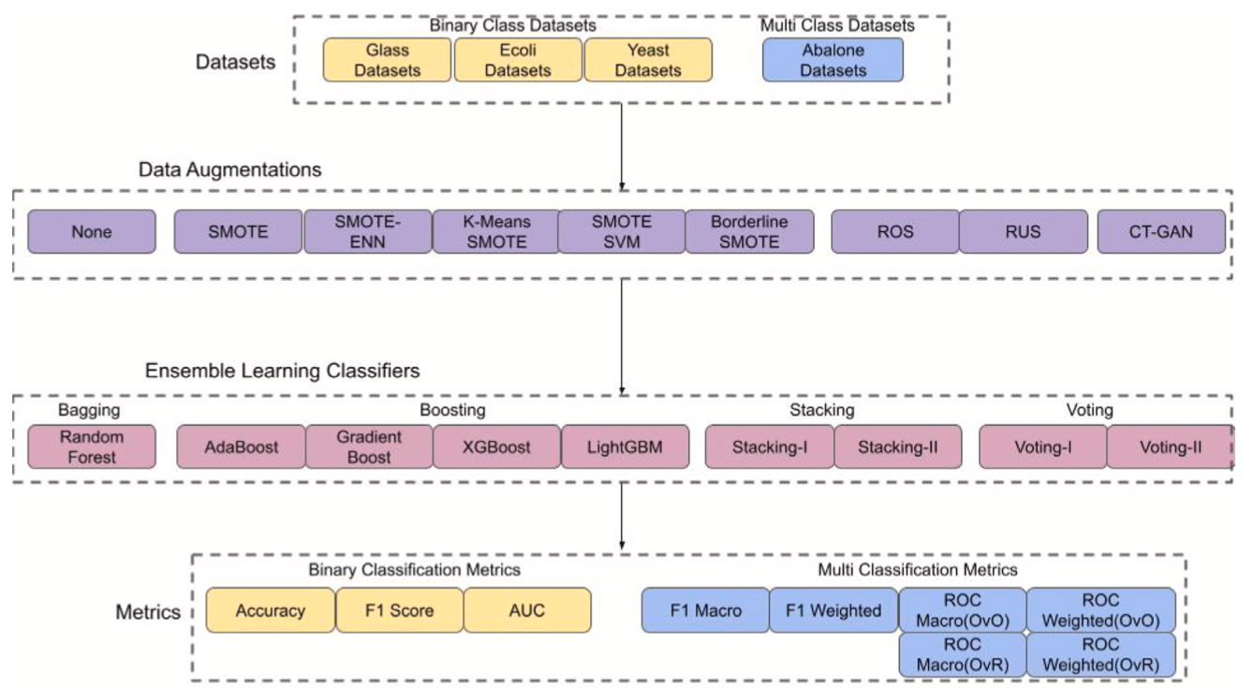
Ensemble Learning and Data Augmentations (DA)
Source: Khan, A. A., Chaudhari, O., & Chandra, R. (2023). A review of ensemble learning and data augmentation models for class imbalanced problems: combination, implementation and evaluation. Expert Systems with Applications, 122778.

Slide 32
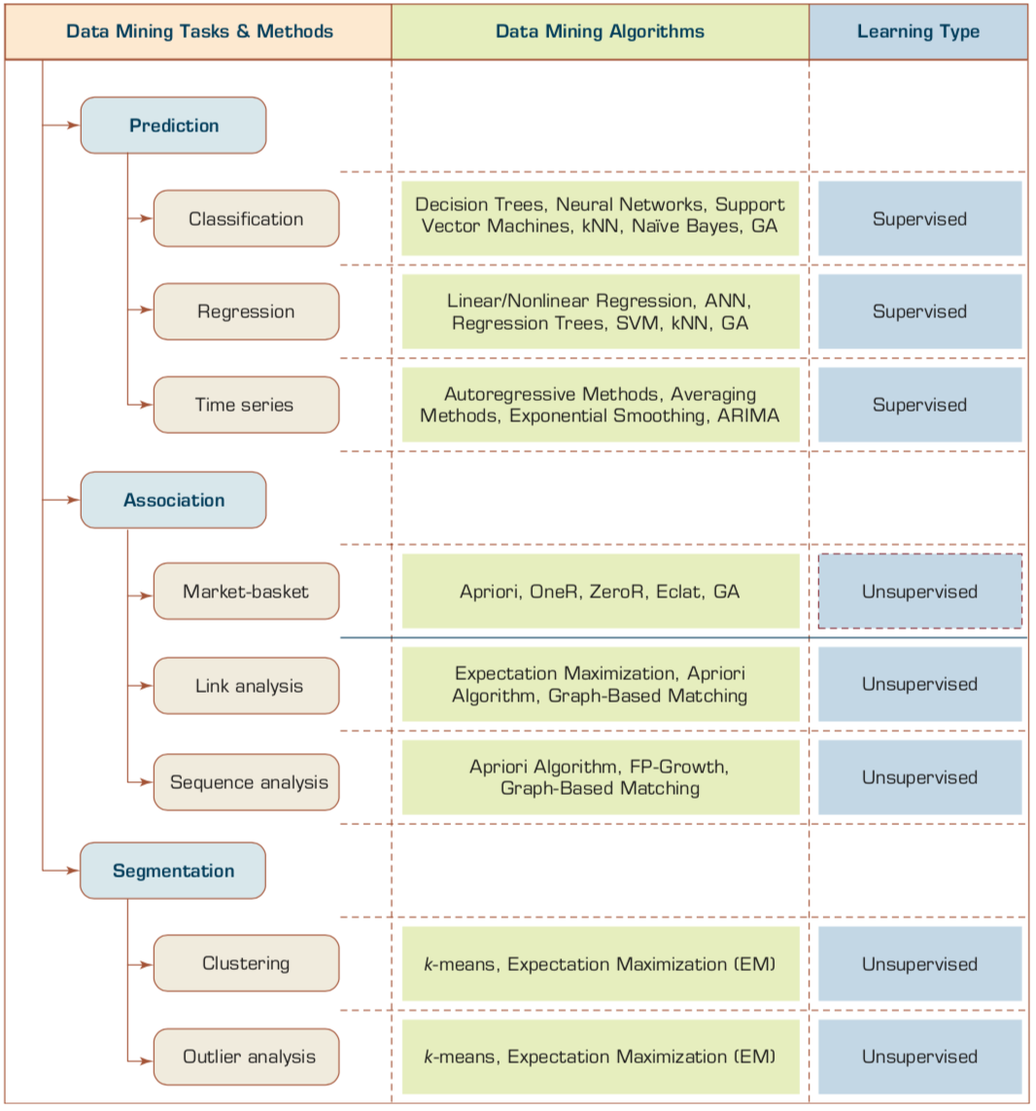
Machine Learning: Data Mining Tasks & Methods
Source: Ramesh Sharda, Dursun Delen, and Efraim Turban (2017), Business Intelligence, Analytics, and Data Science: A Managerial Perspective, 4th Edition, Pearson

Slide 33
Data Mining Methods
Supervised Learning
  Classification
    Class Label Prediction
  Regression
    Numeric Value Prediction
Unsupervised Learning
  Clustering
  Association
Source: Ramesh Sharda, Dursun Delen, and Efraim Turban (2017), Business Intelligence, Analytics, and Data Science: A Managerial Perspective, 4th Edition, Pearson

Slide 34
Scikit-Learn
Machine Learning in Python

Slide 35
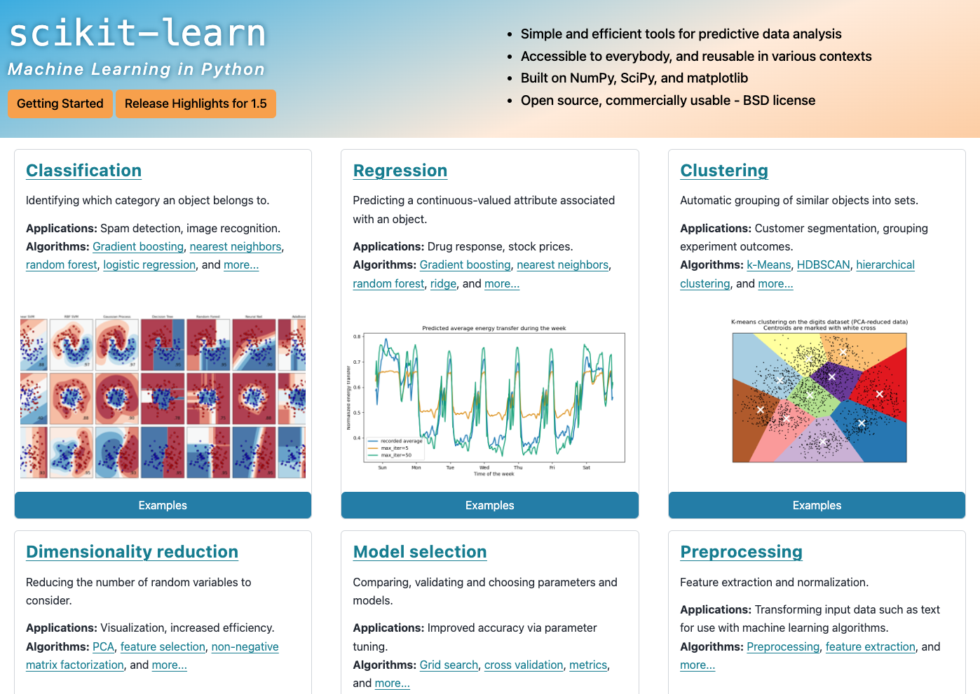
Scikit-Learn
Source: http://scikit-learn.org/

Slide 36
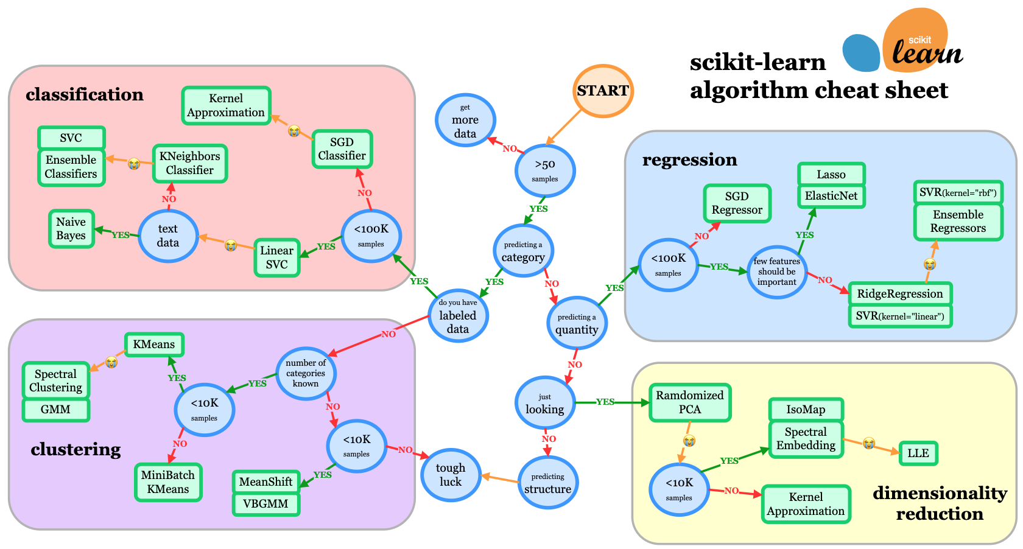
Scikit-Learn Machine Learning Map
Source: http://scikit-learn.org/stable/tutorial/machine_learning_map/index.html

Slide 37
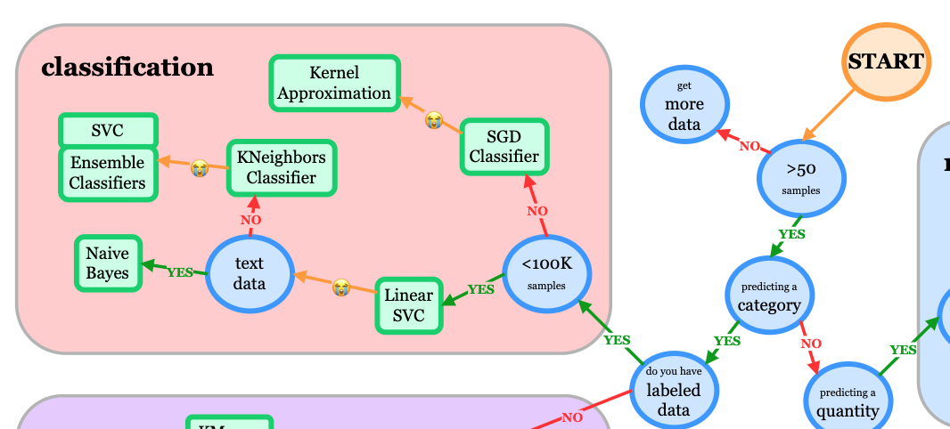
Scikit-Learn Machine Learning Map
Source: http://scikit-learn.org/stable/tutorial/machine_learning_map/index.html

Slide 38
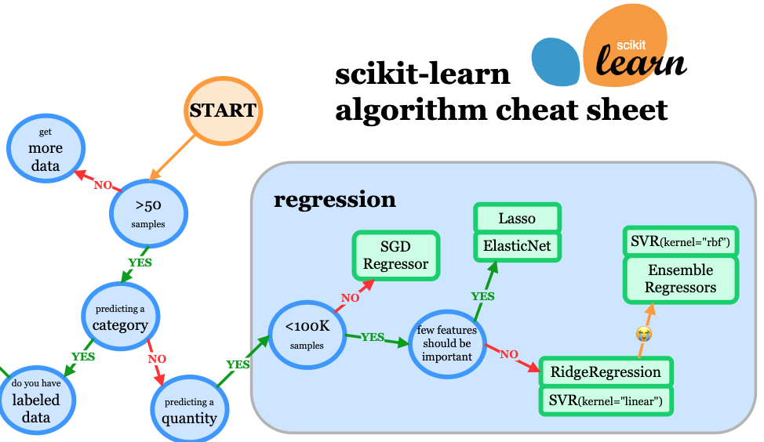
Scikit-Learn Machine Learning Map
Source: http://scikit-learn.org/stable/tutorial/machine_learning_map/index.html

Slide 39
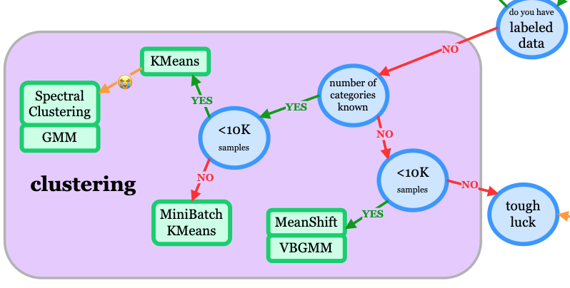
Scikit-Learn Machine Learning Map
Source: http://scikit-learn.org/stable/tutorial/machine_learning_map/index.html

Slide 40
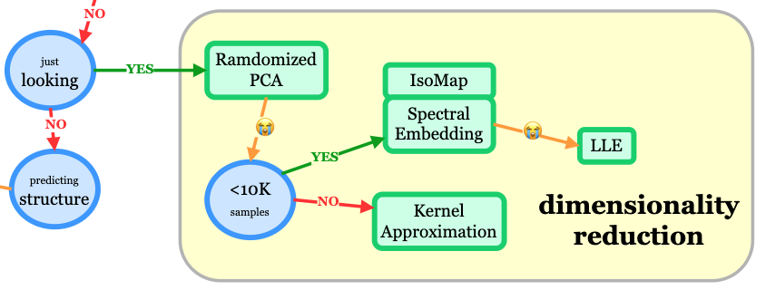
Scikit-Learn Machine Learning Map
Source: http://scikit-learn.org/stable/tutorial/machine_learning_map/index.html

Slide 41
Iris flower data set
setosa
versicolor
virginica
Source: https://en.wikipedia.org/wiki/Iris_flower_data_set
Source: http://suruchifialoke.com/2016-10-13-machine-learning-tutorial-iris-classification/

Slide 42
Iris Classfication
Source: http://suruchifialoke.com/2016-10-13-machine-learning-tutorial-iris-classification/

Slide 43
iris.data
https://archive.ics.uci.edu/ml/machine-learning-databases/iris/iris.data
5.1,3.5,1.4,0.2,Iris-setosa 4.9,3.0,1.4,0.2,Iris-setosa 4.7,3.2,1.3,0.2,Iris-setosa 4.6,3.1,1.5,0.2,Iris-setosa 5.0,3.6,1.4,0.2,Iris-setosa 5.4,3.9,1.7,0.4,Iris-setosa 4.6,3.4,1.4,0.3,Iris-setosa 5.0,3.4,1.5,0.2,Iris-setosa 4.4,2.9,1.4,0.2,Iris-setosa 4.9,3.1,1.5,0.1,Iris-setosa 5.4,3.7,1.5,0.2,Iris-setosa 4.8,3.4,1.6,0.2,Iris-setosa 4.8,3.0,1.4,0.1,Iris-setosa 4.3,3.0,1.1,0.1,Iris-setosa 5.8,4.0,1.2,0.2,Iris-setosa 5.7,4.4,1.5,0.4,Iris-setosa 5.4,3.9,1.3,0.4,Iris-setosa 5.1,3.5,1.4,0.3,Iris-setosa 5.7,3.8,1.7,0.3,Iris-setosa 5.1,3.8,1.5,0.3,Iris-setosa 5.4,3.4,1.7,0.2,Iris-setosa 5.1,3.7,1.5,0.4,Iris-setosa 4.6,3.6,1.0,0.2,Iris-setosa 5.1,3.3,1.7,0.5,Iris-setosa 4.8,3.4,1.9,0.2,Iris-setosa 5.0,3.0,1.6,0.2,Iris-setosa 5.0,3.4,1.6,0.4,Iris-setosa 5.2,3.5,1.5,0.2,Iris-setosa 5.2,3.4,1.4,0.2,Iris-setosa 4.7,3.2,1.6,0.2,Iris-setosa 4.8,3.1,1.6,0.2,Iris-setosa 5.4,3.4,1.5,0.4,Iris-setosa 5.2,4.1,1.5,0.1,Iris-setosa 5.5,4.2,1.4,0.2,Iris-setosa 4.9,3.1,1.5,0.1,Iris-setosa 5.0,3.2,1.2,0.2,Iris-setosa 5.5,3.5,1.3,0.2,Iris-setosa 4.9,3.1,1.5,0.1,Iris-setosa 4.4,3.0,1.3,0.2,Iris-setosa 5.1,3.4,1.5,0.2,Iris-setosa 5.0,3.5,1.3,0.3,Iris-setosa 4.5,2.3,1.3,0.3,Iris-setosa 4.4,3.2,1.3,0.2,Iris-setosa 5.0,3.5,1.6,0.6,Iris-setosa 5.1,3.8,1.9,0.4,Iris-setosa 4.8,3.0,1.4,0.3,Iris-setosa 5.1,3.8,1.6,0.2,Iris-setosa 4.6,3.2,1.4,0.2,Iris-setosa 5.3,3.7,1.5,0.2,Iris-setosa 5.0,3.3,1.4,0.2,Iris-setosa 7.0,3.2,4.7,1.4,Iris-versicolor 6.4,3.2,4.5,1.5,Iris-versicolor 6.9,3.1,4.9,1.5,Iris-versicolor 5.5,2.3,4.0,1.3,Iris-versicolor 6.5,2.8,4.6,1.5,Iris-versicolor 5.7,2.8,4.5,1.3,Iris-versicolor 6.3,3.3,4.7,1.6,Iris-versicolor 4.9,2.4,3.3,1.0,Iris-versicolor 6.6,2.9,4.6,1.3,Iris-versicolor 5.2,2.7,3.9,1.4,Iris-versicolor 5.0,2.0,3.5,1.0,Iris-versicolor 5.9,3.0,4.2,1.5,Iris-versicolor 6.0,2.2,4.0,1.0,Iris-versicolor 6.1,2.9,4.7,1.4,Iris-versicolor 5.6,2.9,3.6,1.3,Iris-versicolor 6.7,3.1,4.4,1.4,Iris-versicolor 5.6,3.0,4.5,1.5,Iris-versicolor 5.8,2.7,4.1,1.0,Iris-versicolor 6.2,2.2,4.5,1.5,Iris-versicolor 5.6,2.5,3.9,1.1,Iris-versicolor 5.9,3.2,4.8,1.8,Iris-versicolor 6.1,2.8,4.0,1.3,Iris-versicolor 6.3,2.5,4.9,1.5,Iris-versicolor 6.1,2.8,4.7,1.2,Iris-versicolor 6.4,2.9,4.3,1.3,Iris-versicolor 6.6,3.0,4.4,1.4,Iris-versicolor 6.8,2.8,4.8,1.4,Iris-versicolor 6.7,3.0,5.0,1.7,Iris-versicolor 6.0,2.9,4.5,1.5,Iris-versicolor 5.7,2.6,3.5,1.0,Iris-versicolor 5.5,2.4,3.8,1.1,Iris-versicolor 5.5,2.4,3.7,1.0,Iris-versicolor 5.8,2.7,3.9,1.2,Iris-versicolor 6.0,2.7,5.1,1.6,Iris-versicolor 5.4,3.0,4.5,1.5,Iris-versicolor 6.0,3.4,4.5,1.6,Iris-versicolor 6.7,3.1,4.7,1.5,Iris-versicolor 6.3,2.3,4.4,1.3,Iris-versicolor 5.6,3.0,4.1,1.3,Iris-versicolor 5.5,2.5,4.0,1.3,Iris-versicolor 5.5,2.6,4.4,1.2,Iris-versicolor 6.1,3.0,4.6,1.4,Iris-versicolor 5.8,2.6,4.0,1.2,Iris-versicolor 5.0,2.3,3.3,1.0,Iris-versicolor 5.6,2.7,4.2,1.3,Iris-versicolor 5.7,3.0,4.2,1.2,Iris-versicolor 5.7,2.9,4.2,1.3,Iris-versicolor 6.2,2.9,4.3,1.3,Iris-versicolor 5.1,2.5,3.0,1.1,Iris-versicolor 5.7,2.8,4.1,1.3,Iris-versicolor 6.3,3.3,6.0,2.5,Iris-virginica 5.8,2.7,5.1,1.9,Iris-virginica 7.1,3.0,5.9,2.1,Iris-virginica 6.3,2.9,5.6,1.8,Iris-virginica 6.5,3.0,5.8,2.2,Iris-virginica 7.6,3.0,6.6,2.1,Iris-virginica 4.9,2.5,4.5,1.7,Iris-virginica 7.3,2.9,6.3,1.8,Iris-virginica 6.7,2.5,5.8,1.8,Iris-virginica 7.2,3.6,6.1,2.5,Iris-virginica 6.5,3.2,5.1,2.0,Iris-virginica 6.4,2.7,5.3,1.9,Iris-virginica 6.8,3.0,5.5,2.1,Iris-virginica 5.7,2.5,5.0,2.0,Iris-virginica 5.8,2.8,5.1,2.4,Iris-virginica 6.4,3.2,5.3,2.3,Iris-virginica 6.5,3.0,5.5,1.8,Iris-virginica 7.7,3.8,6.7,2.2,Iris-virginica 7.7,2.6,6.9,2.3,Iris-virginica 6.0,2.2,5.0,1.5,Iris-virginica 6.9,3.2,5.7,2.3,Iris-virginica 5.6,2.8,4.9,2.0,Iris-virginica 7.7,2.8,6.7,2.0,Iris-virginica 6.3,2.7,4.9,1.8,Iris-virginica 6.7,3.3,5.7,2.1,Iris-virginica 7.2,3.2,6.0,1.8,Iris-virginica 6.2,2.8,4.8,1.8,Iris-virginica 6.1,3.0,4.9,1.8,Iris-virginica 6.4,2.8,5.6,2.1,Iris-virginica 7.2,3.0,5.8,1.6,Iris-virginica 7.4,2.8,6.1,1.9,Iris-virginica 7.9,3.8,6.4,2.0,Iris-virginica 6.4,2.8,5.6,2.2,Iris-virginica 6.3,2.8,5.1,1.5,Iris-virginica 6.1,2.6,5.6,1.4,Iris-virginica 7.7,3.0,6.1,2.3,Iris-virginica 6.3,3.4,5.6,2.4,Iris-virginica 6.4,3.1,5.5,1.8,Iris-virginica 6.0,3.0,4.8,1.8,Iris-virginica 6.9,3.1,5.4,2.1,Iris-virginica 6.7,3.1,5.6,2.4,Iris-virginica 6.9,3.1,5.1,2.3,Iris-virginica 5.8,2.7,5.1,1.9,Iris-virginica 6.8,3.2,5.9,2.3,Iris-virginica 6.7,3.3,5.7,2.5,Iris-virginica 6.7,3.0,5.2,2.3,Iris-virginica 6.3,2.5,5.0,1.9,Iris-virginica 6.5,3.0,5.2,2.0,Iris-virginica 6.2,3.4,5.4,2.3,Iris-virginica 5.9,3.0,5.1,1.8,Iris-virginica
setosa
virginica
versicolor

Slide 44
Machine Learning
Supervised Learning (Classification)
Learning from Examples
5.1,3.5,1.4,0.2,Iris-setosa 4.9,3.0,1.4,0.2,Iris-setosa 4.7,3.2,1.3,0.2,Iris-setosa 7.0,3.2,4.7,1.4,Iris-versicolor 6.4,3.2,4.5,1.5,Iris-versicolor 6.9,3.1,4.9,1.5,Iris-versicolor 6.3,3.3,6.0,2.5,Iris-virginica 5.8,2.7,5.1,1.9,Iris-virginica 7.1,3.0,5.9,2.1,Iris-virginica

Slide 45
Machine Learning
Supervised Learning (Classification)
Learning from Examples
y = f(x)
5.1,3.5,1.4,0.2,Iris-setosa 4.9,3.0,1.4,0.2,Iris-setosa 4.7,3.2,1.3,0.2,Iris-setosa 7.0,3.2,4.7,1.4,Iris-versicolor 6.4,3.2,4.5,1.5,Iris-versicolor 6.9,3.1,4.9,1.5,Iris-versicolor 6.3,3.3,6.0,2.5,Iris-virginica 5.8,2.7,5.1,1.9,Iris-virginica 7.1,3.0,5.9,2.1,Iris-virginica
y
x

Slide 46
Machine Learning
Supervised Learning (Classification)
Learning from Examples
y = f(x)
x
y

Slide 47
Iris Data Visualization
Source: https://seaborn.pydata.org/generated/seaborn.pairplot.html

Slide 48
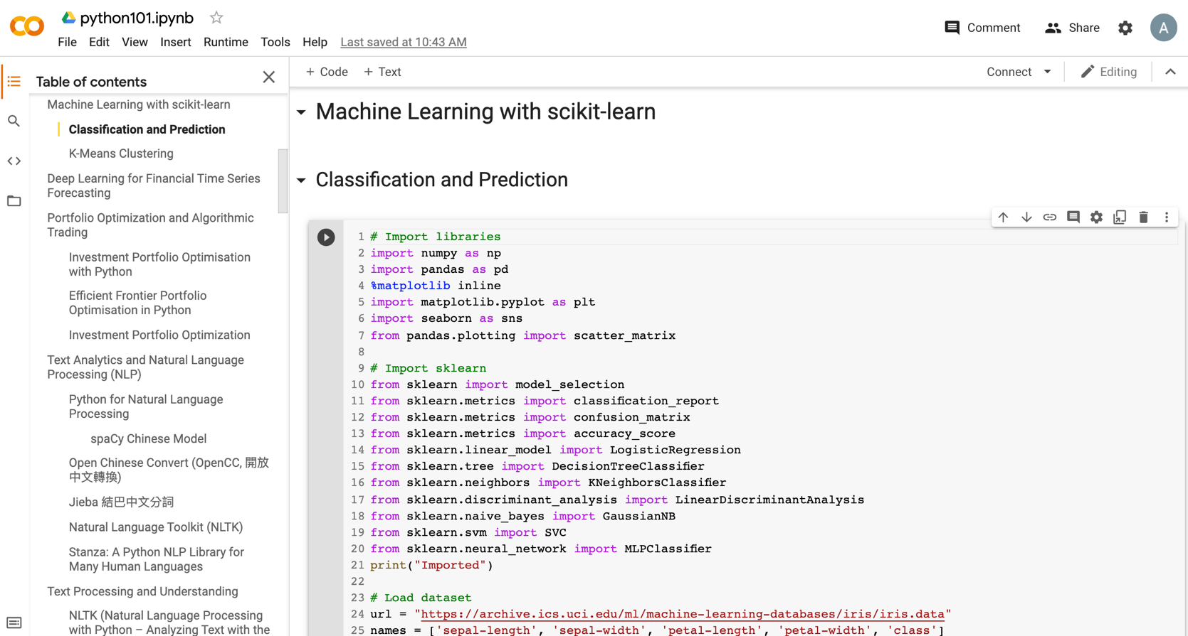
Python in Google Colab (Python101)
https://colab.research.google.com/drive/1FEG6DnGvwfUbeo4zJ1zTunjMqf2RkCrT
https://tinyurl.com/aintpupython101

Slide 49
import seaborn as sns
sns.set(style="ticks", color_codes=True)
iris = sns.load_dataset("iris")
g = sns.pairplot(iris, hue="species")
Source: https://seaborn.pydata.org/generated/seaborn.pairplot.html

Slide 50

import numpy as np
import pandas as pd
%matplotlib inline
import matplotlib.pyplot as plt
import seaborn as sns
from pandas.plotting import scatter_matrix

Slide 51

url = "https://archive.ics.uci.edu/ml/machine-learning-databases/iris/iris.data"
names = ['sepal-length', 'sepal-width', 'petal-length', 'petal-width', 'class']
df = pd.read_csv(url, names=names)
print(df.head(10))

Slide 52

df.tail(10)

Slide 53

df.describe()

Slide 54

print(df.info())
print(df.shape)

Slide 55

df.groupby('class').size()

Slide 56
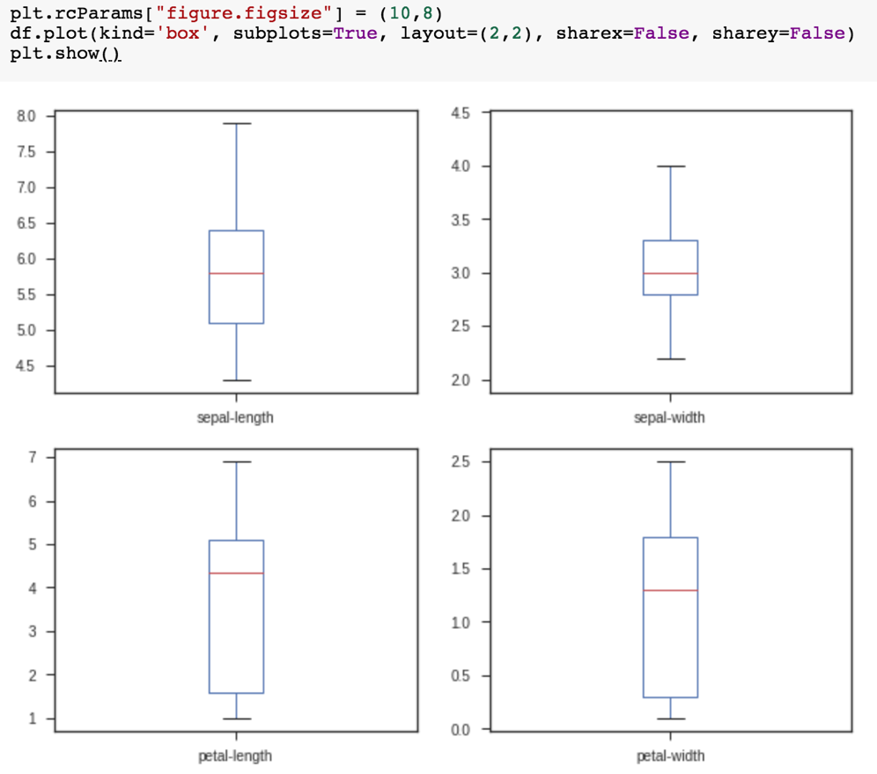
plt.rcParams["figure.figsize"] = (10,8)
df.plot(kind='box', subplots=True, layout=(2,2), sharex=False, sharey=False)
plt.show()

Slide 57

df.hist()
plt.show()

Slide 58

scatter_matrix(df)
plt.show()

Slide 59

sns.pairplot(df, hue="class", size=2)

Slide 60
Machine Learning:
Supervised Learning:
Classification and
Prediction

Slide 61
Machine Learning: Data Mining Tasks & Methods
Prediction
Classification
Supervised Learning:
Classification
and
Prediction
Source: Ramesh Sharda, Dursun Delen, and Efraim Turban (2017), Business Intelligence, Analytics, and Data Science: A Managerial Perspective, 4th Edition, Pearson

Slide 62

Machine Learning: Supervised Learning
Classification and Prediction
https://tinyurl.com/aintpupython101

Slide 63
# Import sklearn
from sklearn import model_selection
from sklearn.metrics import classification_report
from sklearn.metrics import confusion_matrix
from sklearn.metrics import accuracy_score
from sklearn.linear_model import LogisticRegression
from sklearn.tree import DecisionTreeClassifier
from sklearn.neighbors import KNeighborsClassifier
from sklearn.discriminant_analysis import LinearDiscriminantAnalysis
from sklearn.naive_bayes import GaussianNB
from sklearn.svm import SVC
from sklearn.neural_network import MLPClassifier
print("Imported")
https://tinyurl.com/aintpupython101

Slide 64
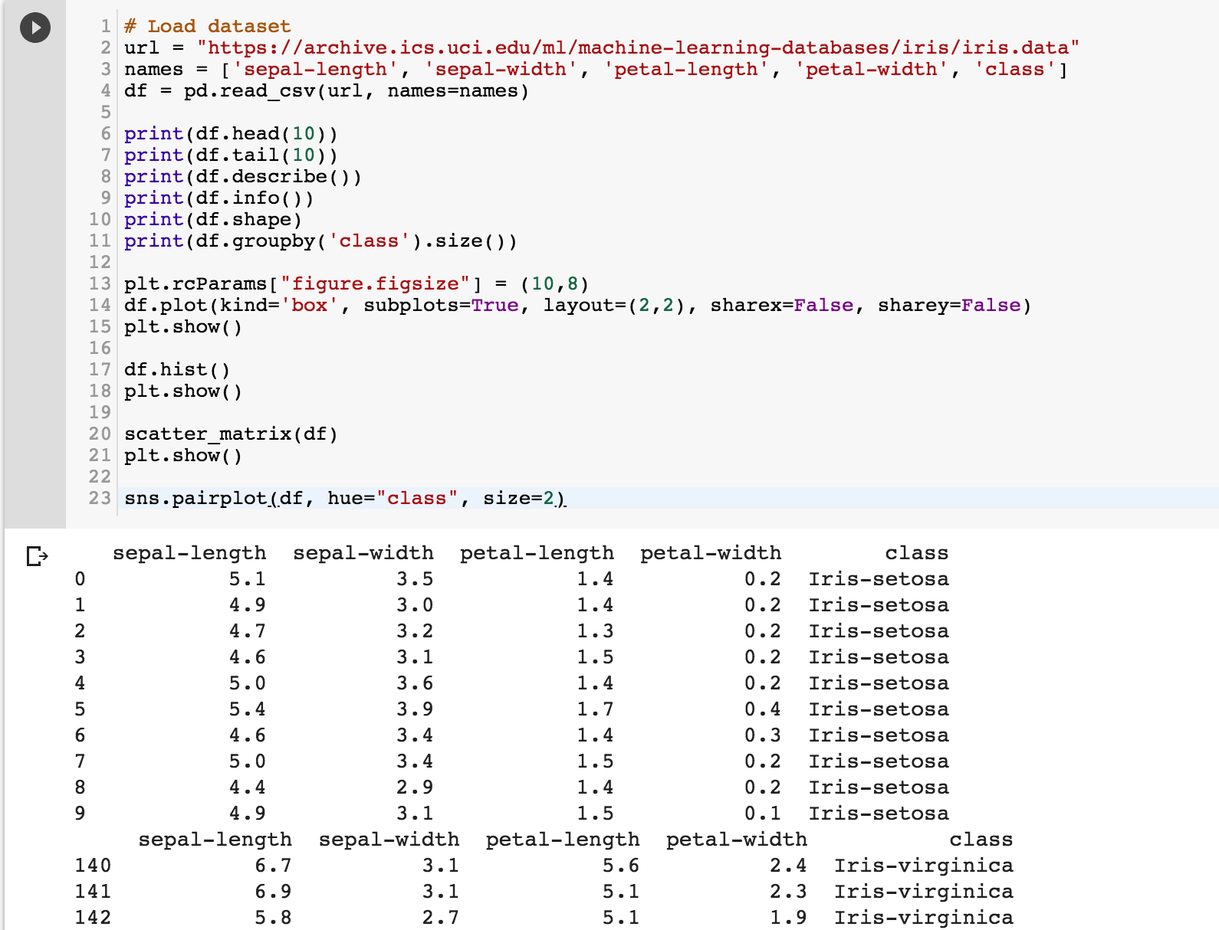
https://tinyurl.com/aintpupython101

Slide 65
https://tinyurl.com/aintpupython101

Slide 66
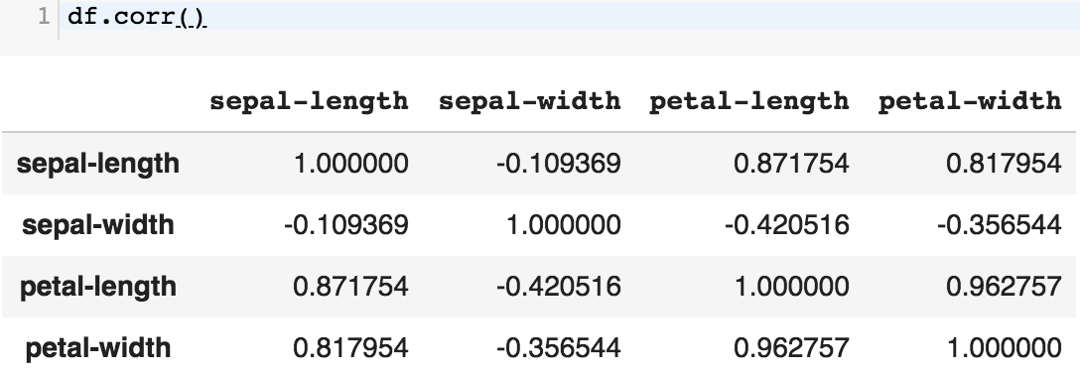
df.corr()
https://tinyurl.com/aintpupython101

Slide 67
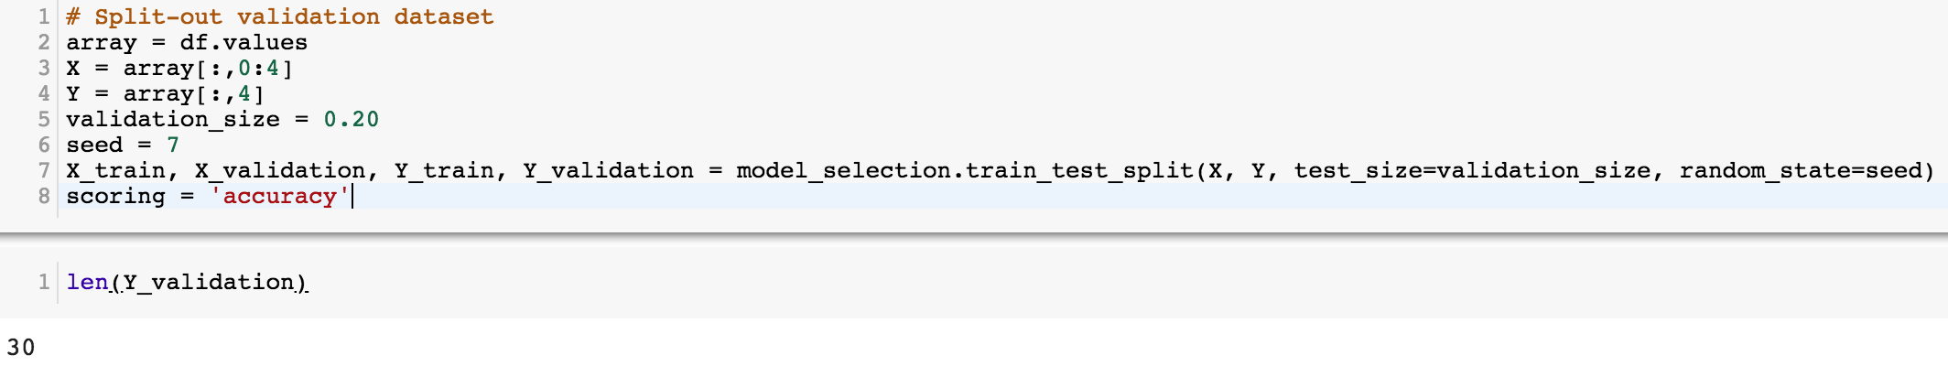
# Split-out validation dataset
array = df.values
X = array[:,0:4]
Y = array[:,4]
validation_size = 0.20
seed = 7
X_train, X_validation, Y_train, Y_validation = model_selection.train_test_split(X, Y, test_size=validation_size, random_state=seed)
scoring = 'accuracy'
https://tinyurl.com/aintpupython101

Slide 68
# Models
models = []
models.append(('LR', LogisticRegression()))
models.append(('LDA', LinearDiscriminantAnalysis()))
models.append(('KNN', KNeighborsClassifier()))
models.append(('DT', DecisionTreeClassifier()))
models.append(('NB', GaussianNB()))
models.append(('SVM', SVC()))
https://tinyurl.com/aintpupython101

Slide 69
# evaluate each model in turn
results = []
names = []
for name, model in models:
kfold = model_selection.KFold(n_splits=10, random_state=seed)
cv_results = model_selection.cross_val_score(model, X_train, Y_train, cv=kfold, scoring=scoring)
results.append(cv_results)
names.append(name)
msg = "%s: %.4f (%.4f)" % (name, cv_results.mean(), cv_results.std())
print(msg)
https://tinyurl.com/aintpupython101

Slide 70
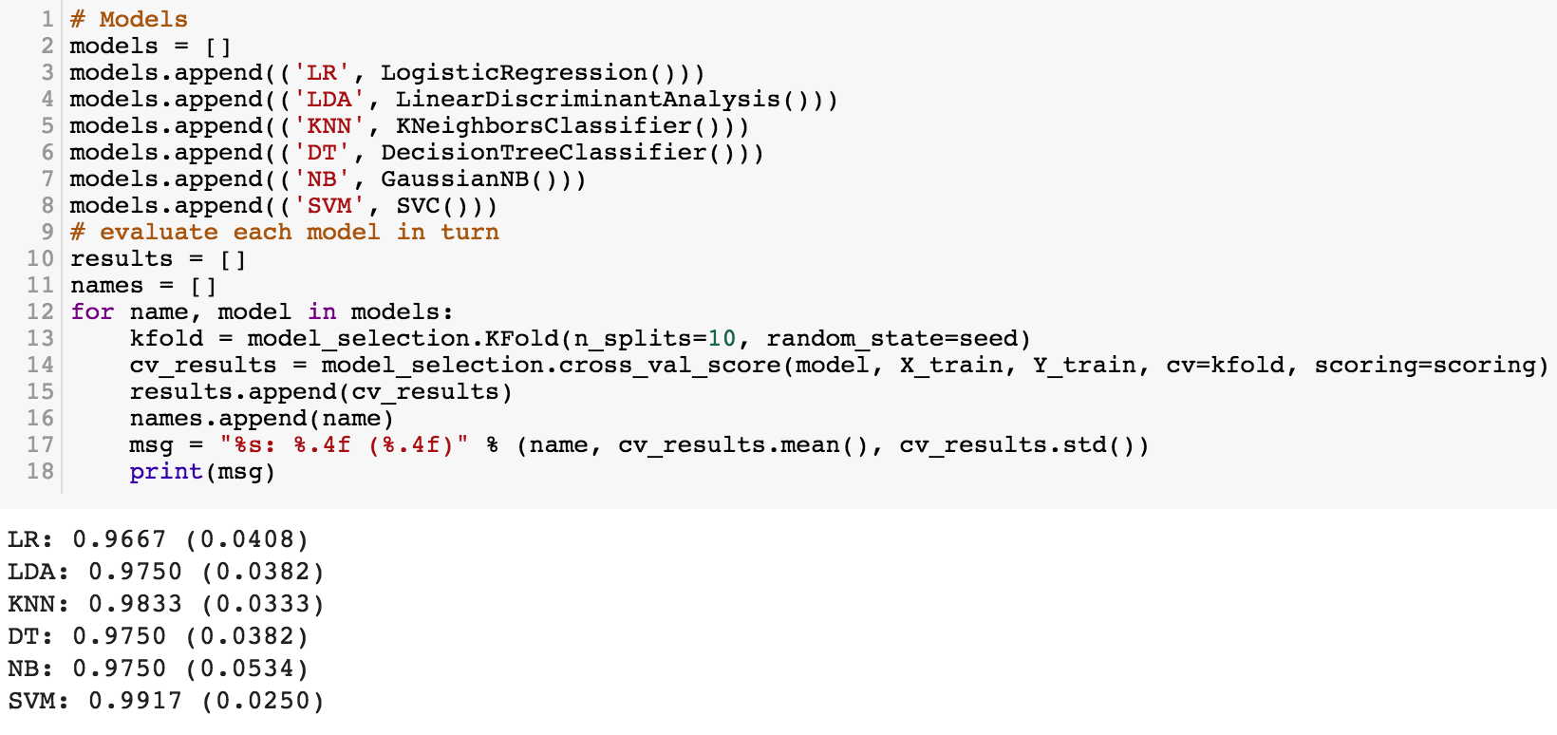
https://tinyurl.com/aintpupython101

Slide 71
# Make predictions on validation dataset
model = KNeighborsClassifier()
model.fit(X_train, Y_train)
predictions = model.predict(X_validation)
print("%.4f" % accuracy_score(Y_validation, predictions))
print(confusion_matrix(Y_validation, predictions))
print(classification_report(Y_validation, predictions))
print(model)
https://tinyurl.com/aintpupython101

Slide 72
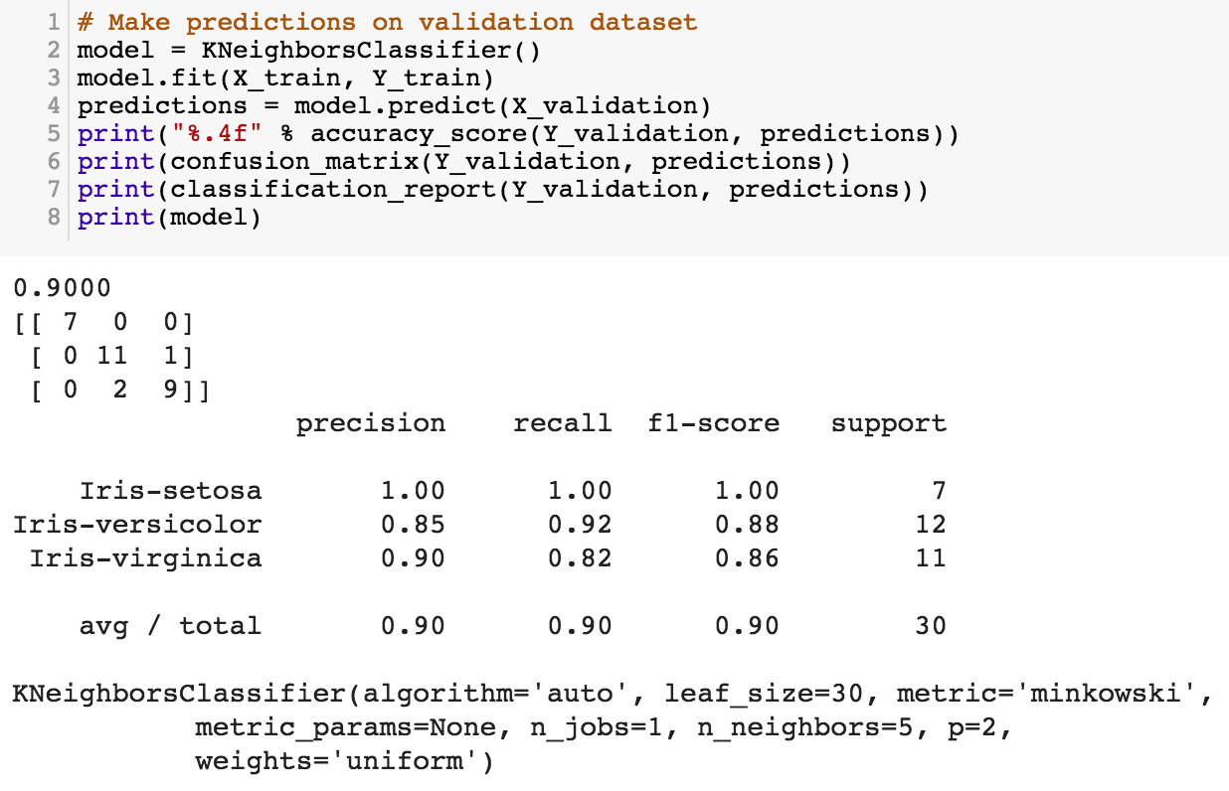
https://tinyurl.com/aintpupython101

Slide 73
# Make predictions on validation dataset
model = SVC()
model.fit(X_train, Y_train)
predictions = model.predict(X_validation)
print("%.4f" % accuracy_score(Y_validation, predictions))
print(confusion_matrix(Y_validation, predictions))
print(classification_report(Y_validation, predictions))
print(model)
https://tinyurl.com/aintpupython101

Slide 74
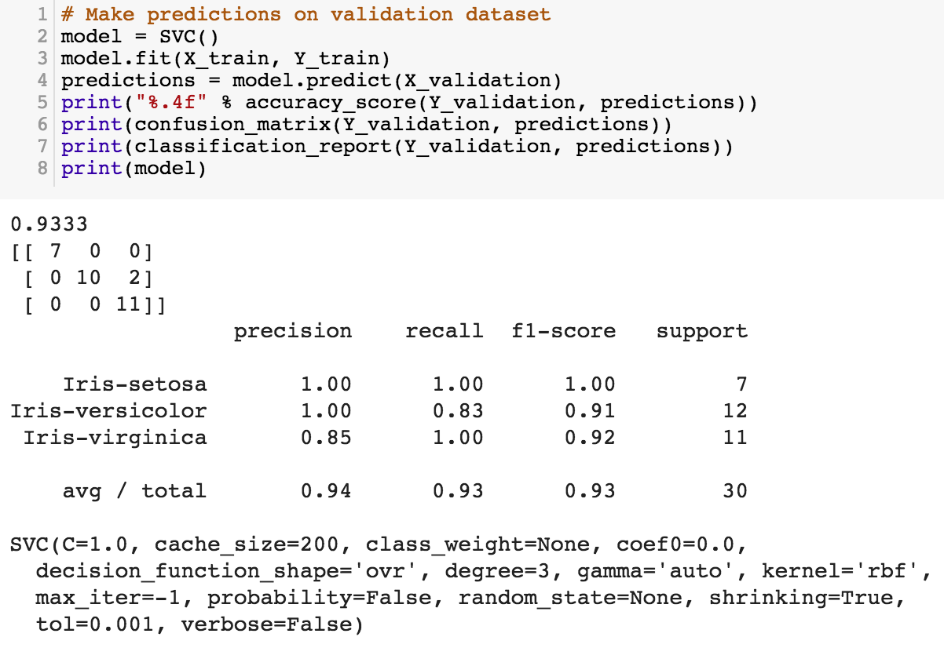
model = SVC()
model.fit(X_train, Y_train)
predictions = model.predict(X_validation)
https://tinyurl.com/aintpupython101

Slide 75
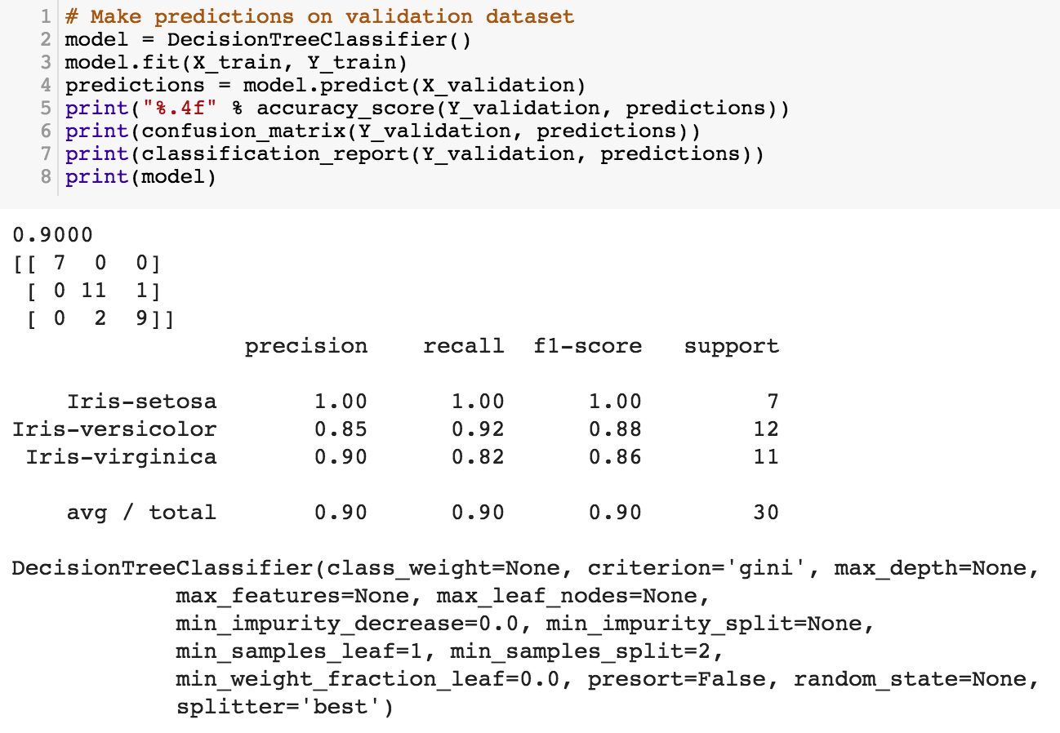
https://tinyurl.com/aintpupython101

Slide 76
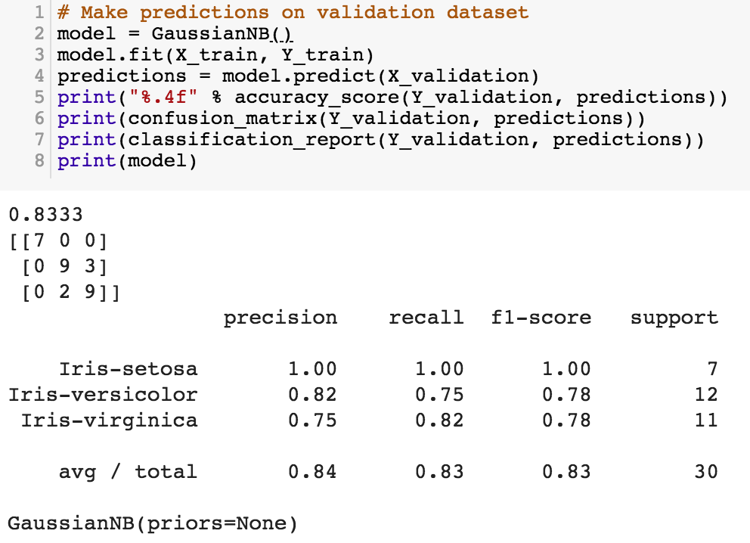
https://tinyurl.com/aintpupython101

Slide 77
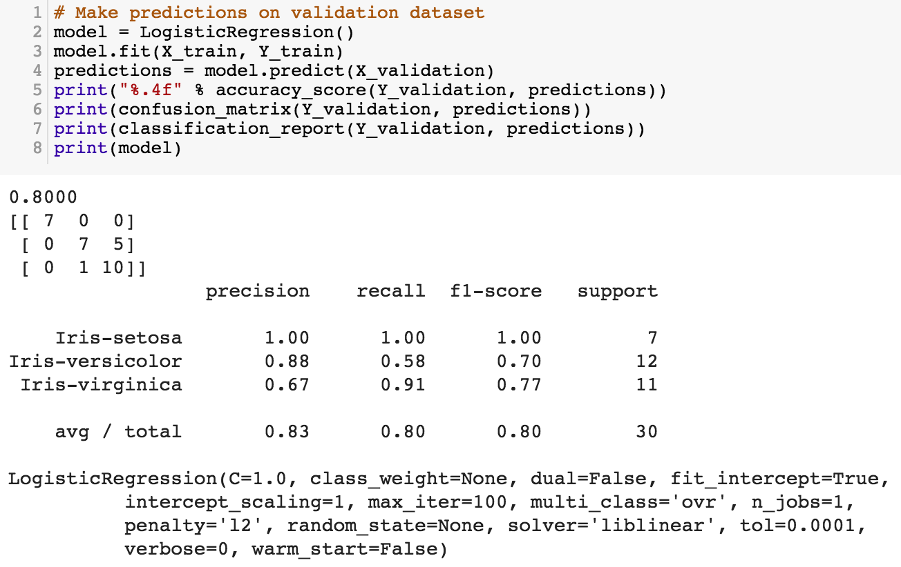
https://tinyurl.com/aintpupython101

Slide 78
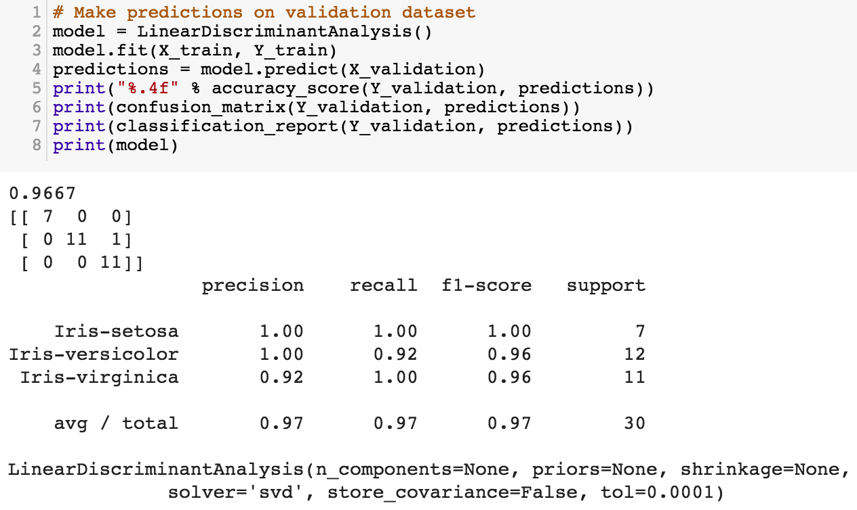
https://tinyurl.com/aintpupython101

Slide 79
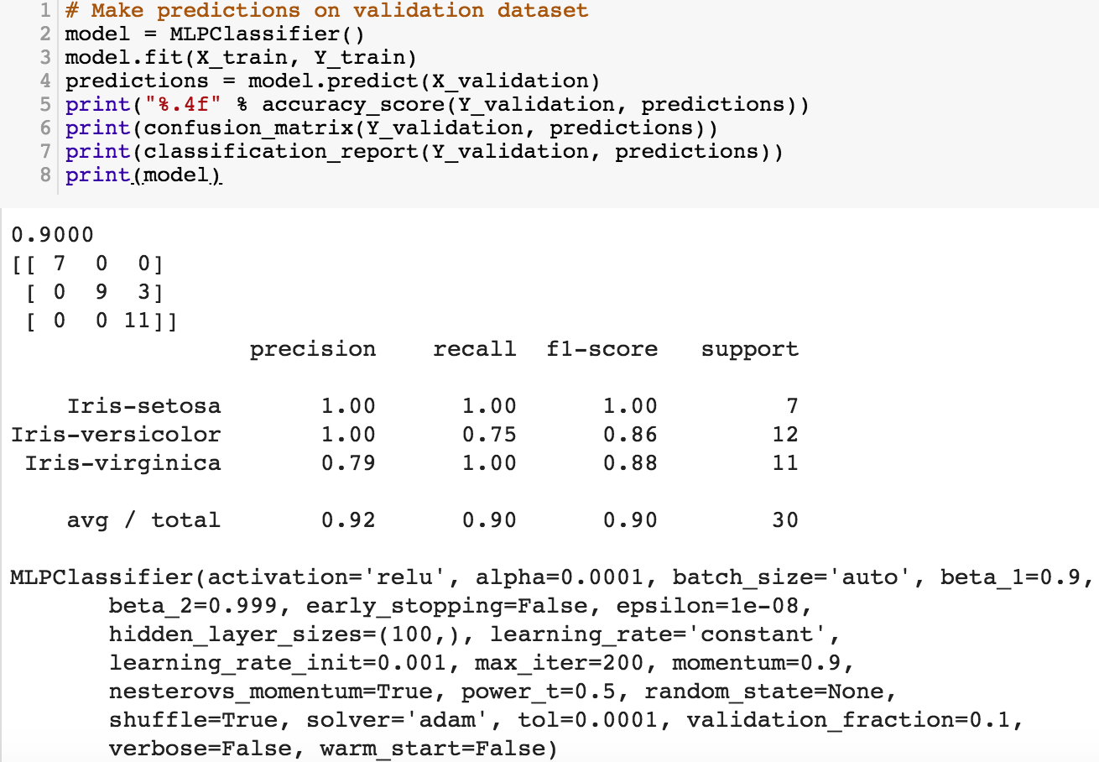
https://tinyurl.com/aintpupython101

Slide 80
Evaluation
(Accuracy of Classification Model)

Slide 81
Assessing the Classification Model
Predictive accuracy
  Hit rate
Speed
  Model building; predicting
Robustness
Scalability
Interpretability
  Transparency, explainability
Source: Ramesh Sharda, Dursun Delen, and Efraim Turban (2017), Business Intelligence, Analytics, and Data Science: A Managerial Perspective, 4th Edition, Pearson

Slide 82
Accuracy
Precision
Validity
Reliability

Slide 84
Accuracy vs. Precision
A
B
High Accuracy
High Precision
Low Accuracy
High Precision
C
D
High Accuracy
Low Precision
Low Accuracy
Low Precision

Slide 85
Accuracy vs. Precision
A
B
High Accuracy
High Precision
Low Accuracy
High Precision
High Validity
High Reliability
Low Validity
High Reliability
C
D
High Accuracy
Low Precision
Low Accuracy
Low Precision
High Validity
Low Reliability
Low Validity
Low Reliability

Slide 86
Accuracy vs. Precision
A
B
High Accuracy
High Precision
Low Accuracy
High Precision
High Validity
High Reliability
Low Validity
High Reliability
C
D
High Accuracy
Low Precision
Low Accuracy
Low Precision
High Validity
Low Reliability
Low Validity
Low Reliability

Slide 87
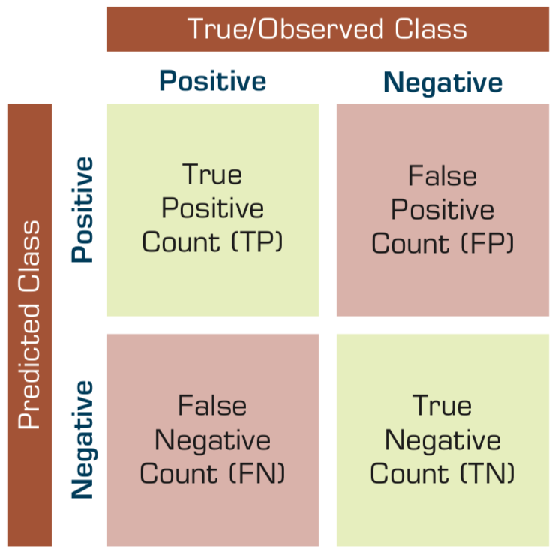
Confusion Matrix for Tabulation of Two-Class Classification Results
Source: Ramesh Sharda, Dursun Delen, and Efraim Turban (2017), Business Intelligence, Analytics, and Data Science: A Managerial Perspective, 4th Edition, Pearson

Slide 88
Sensitivity
Specificity
=True Positive Rate
=True Negative Rate

Slide 89

Estimation Methodologies for Classification
Simple split (or holdout or test sample estimation)
  Split the data into 2 mutually exclusive sets
  training (~70%) and testing (30%)
  For ANN, the data is split into three sub-sets
  (training [~60%], validation [~20%], testing [~20%])
Source: Ramesh Sharda, Dursun Delen, and Efraim Turban (2017), Business Intelligence, Analytics, and Data Science: A Managerial Perspective, 4th Edition, Pearson

Slide 90

k-Fold Cross-Validation
Source: Ramesh Sharda, Dursun Delen, and Efraim Turban (2017), Business Intelligence, Analytics, and Data Science: A Managerial Perspective, 4th Edition, Pearson

Slide 91
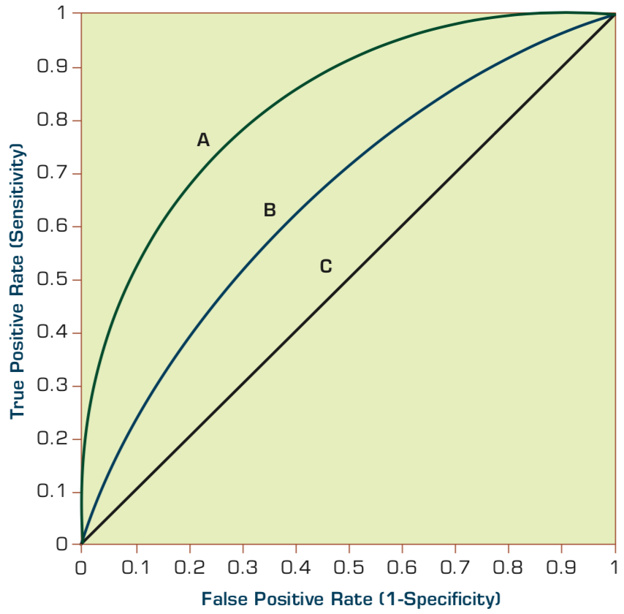
Estimation Methodologies for Classification
Area under the ROC curve
Source: Ramesh Sharda, Dursun Delen, and Efraim Turban (2017), Business Intelligence, Analytics, and Data Science: A Managerial Perspective, 4th Edition, Pearson

Slide 92
True Class
(actual value)
Positive
Negative
total
True
Positive
(TP)
False
Positive
(FP)
Positive
P’
Predictive Class
(prediction outcome)
False
Negative
(FN)
True
Negative
(TN)
Negative
N’
total
P
N
Source: http://en.wikipedia.org/wiki/Receiver_operating_characteristic

Slide 93
True Class
(actual value)
Positive
Negative
total
True
Positive
(TP)
False
Positive
(FP)
Positive
P’
Predictive Class
(prediction outcome)
False
Negative
(FN)
True
Negative
(TN)
Negative
N’
total
P
N
Sensitivity
= True Positive Rate
= Recall
= Hit rate
= TP / (TP + FN)
Source: http://en.wikipedia.org/wiki/Receiver_operating_characteristic

Slide 94
True Class
(actual value)
Positive
Negative
total
True
Positive
(TP)
False
Positive
(FP)
Positive
P’
Predictive Class
(prediction outcome)
False
Negative
(FN)
True
Negative
(TN)
Negative
N’
total
P
N
Specificity
= True Negative Rate
= TN / N
= TN / (TN+ FP)
Source: http://en.wikipedia.org/wiki/Receiver_operating_characteristic

Slide 95
True Class
(actual value)
Precision
= Positive Predictive Value (PPV)
Positive
Negative
total
True
Positive
(TP)
False
Positive
(FP)
Positive
P’
Recall
= True Positive Rate (TPR)
= Sensitivity
= Hit Rate
Predictive Class
(prediction outcome)
False
Negative
(FN)
True
Negative
(TN)
Negative
N’
total
P
N
F1 score (F-score)(F-measure)
is the harmonic mean of precision and recall
= 2TP / (P + P’)
= 2TP / (2TP + FP + FN)
Source: http://en.wikipedia.org/wiki/Receiver_operating_characteristic

Slide 96
A
63
(TP)
28
(FP)
Recall
= True Positive Rate (TPR)
= Sensitivity
= Hit Rate
= TP / (TP + FN)
Specificity
= True Negative Rate
= TN / N
= TN / (TN + FP)
91
37
(FN)
72
(TN)
109
100
100
200
TPR = 0.63
FPR = 0.28
PPV = 0.69
=63/(63+28)
=63/91
Precision
= Positive Predictive Value (PPV)
F1 = 0.66
= 2*(0.63*0.69)/(0.63+0.69)
= (2 * 63) /(100 + 91)
= (0.63 + 0.69) / 2 =1.32 / 2 =0.66
F1 score (F-score)
(F-measure)
is the harmonic mean of precision and recall
= 2TP / (P + P’)
= 2TP / (2TP + FP + FN)
ACC = 0.68
= (63 + 72) / 200
= 135/200 = 67.5
Source: http://en.wikipedia.org/wiki/Receiver_operating_characteristic

Slide 97
A
B
63
(TP)
28
(FP)
77
(TP)
77
(FP)
91
154
37
(FN)
72
(TN)
109
23
(FN)
23
(TN)
46
100
100
200
100
100
200
TPR = 0.63
TPR = 0.77
FPR = 0.77
PPV = 0.50
F1 = 0.61
ACC = 0.50
FPR = 0.28
PPV = 0.69
=63/(63+28)
=63/91
F1 = 0.66
= 2*(0.63*0.69)/(0.63+0.69)
= (2 * 63) /(100 + 91)
= (0.63 + 0.69) / 2 =1.32 / 2 =0.66
Recall
= True Positive Rate (TPR)
= Sensitivity
= Hit Rate
ACC = 0.68
= (63 + 72) / 200
= 135/200 = 67.5
Precision
= Positive Predictive Value (PPV)
Source: http://en.wikipedia.org/wiki/Receiver_operating_characteristic

Slide 98
C
C’
24
(TP)
88
(FP)
76
(TP)
12
(FP)
112
88
76
(FN)
12
(TN)
88
24
(FN)
88
(TN)
112
100
100
200
100
100
200
TPR = 0.24
FPR = 0.88
PPV = 0.21
F1 = 0.22
ACC = 0.18
TPR = 0.76
FPR = 0.12
PPV = 0.86
F1 = 0.81
ACC = 0.82
Recall
= True Positive Rate (TPR)
= Sensitivity
= Hit Rate
Precision
= Positive Predictive Value (PPV)
Source: http://en.wikipedia.org/wiki/Receiver_operating_characteristic

Slide 99
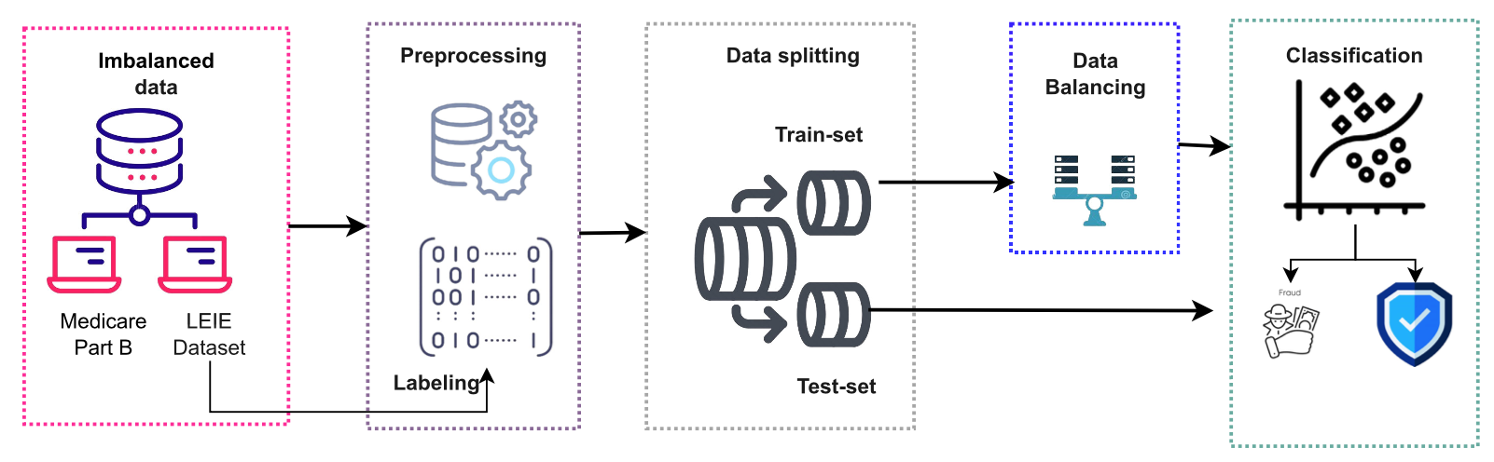
Enhancing Medicare Fraud Detection Through Machine Learning: Addressing Class Imbalance With SMOTE-ENN
Architecture for healthcare fraud detection based on SMOTE-ENN
Synthetic Minority Over-sampling technique with Edited Nearest Neighbors (SMOTE-ENN)
Source: Bounab, R., Zarour, K., Guelib, B., & Khlifa, N. (2024). Enhancing Medicare Fraud Detection Through Machine Learning: Addressing Class Imbalance With SMOTE-ENN. IEEE Access

Slide 100
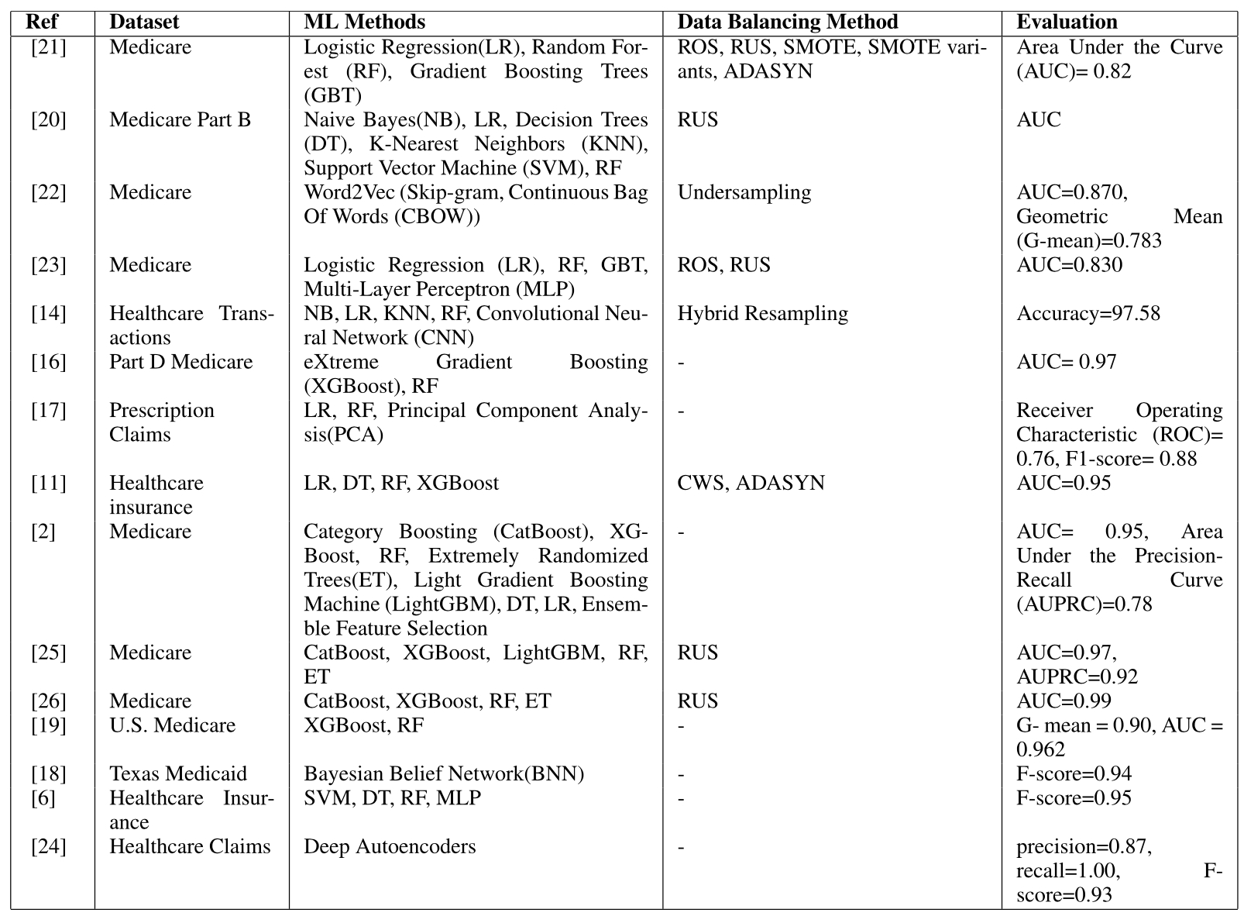
Medicare Fraud Detection Through Machine Learning: Addressing Class Imbalance
Source: Bounab, R., Zarour, K., Guelib, B., & Khlifa, N. (2024). Enhancing Medicare Fraud Detection Through Machine Learning: Addressing Class Imbalance With SMOTE-ENN. IEEE Access

Slide 101
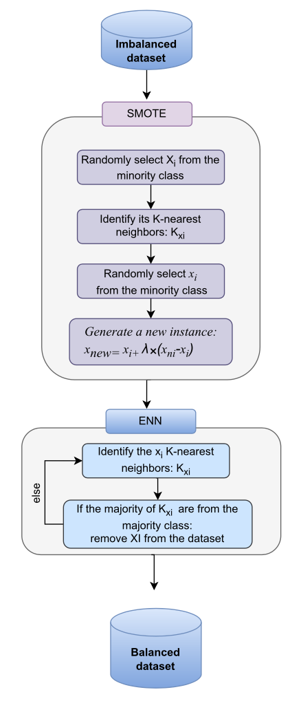
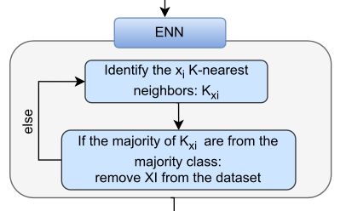
Enhancing Medicare Fraud Detection Through Machine Learning: Addressing Class Imbalance With SMOTE-ENN
SMOTE-ENN process
Synthetic Minority Over-sampling technique with Edited Nearest Neighbors (SMOTE-ENN)
Source: Bounab, R., Zarour, K., Guelib, B., & Khlifa, N. (2024). Enhancing Medicare Fraud Detection Through Machine Learning: Addressing Class Imbalance With SMOTE-ENN. IEEE Access

Slide 102
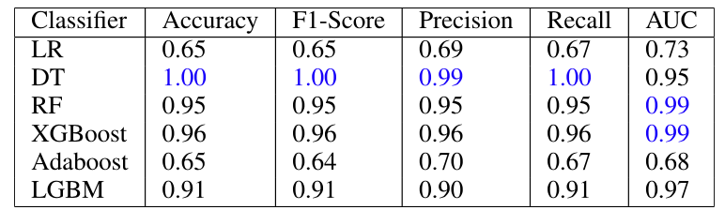
Enhancing Medicare Fraud Detection Through Machine Learning: Addressing Class Imbalance With SMOTE-ENN
Synthetic Minority Over-sampling technique with Edited Nearest Neighbors (SMOTE-ENN)
Classification results using SMOTE-ENN and cross-validation
Source: Bounab, R., Zarour, K., Guelib, B., & Khlifa, N. (2024). Enhancing Medicare Fraud Detection Through Machine Learning: Addressing Class Imbalance With SMOTE-ENN. IEEE Access

Slide 103
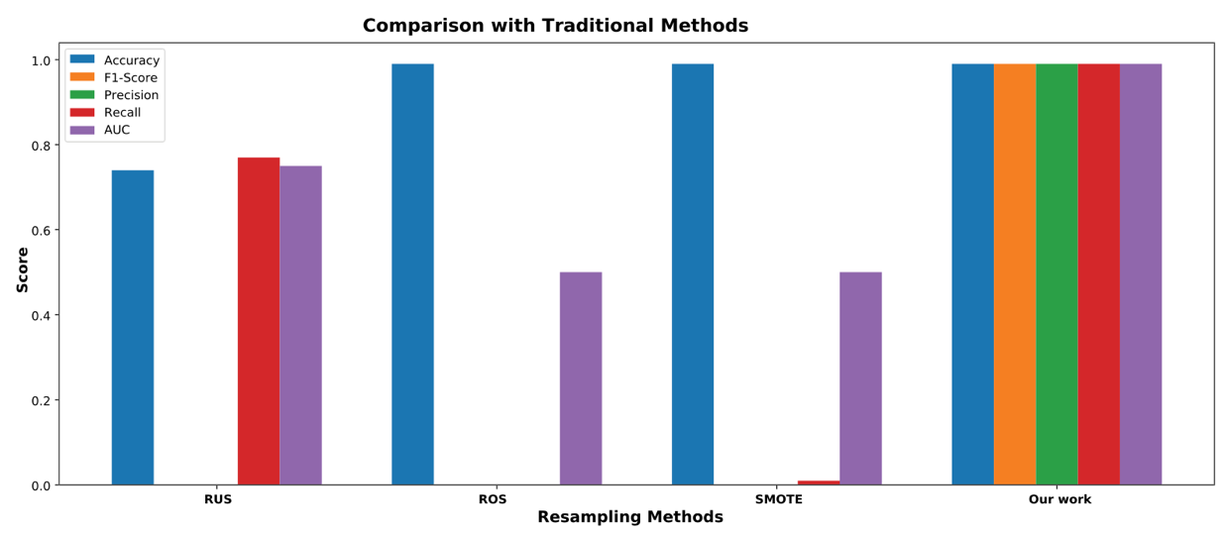
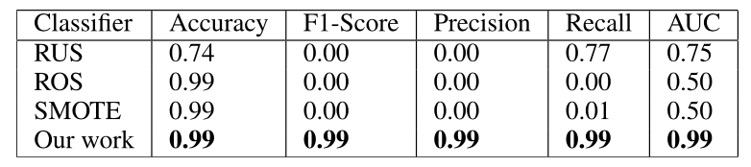
Enhancing Medicare Fraud Detection Through Machine Learning: Addressing Class Imbalance With SMOTE-ENN
SMOTE-ENN
SMOTE-ENN
Source: Bounab, R., Zarour, K., Guelib, B., & Khlifa, N. (2024). Enhancing Medicare Fraud Detection Through Machine Learning: Addressing Class Imbalance With SMOTE-ENN. IEEE Access

Slide 104
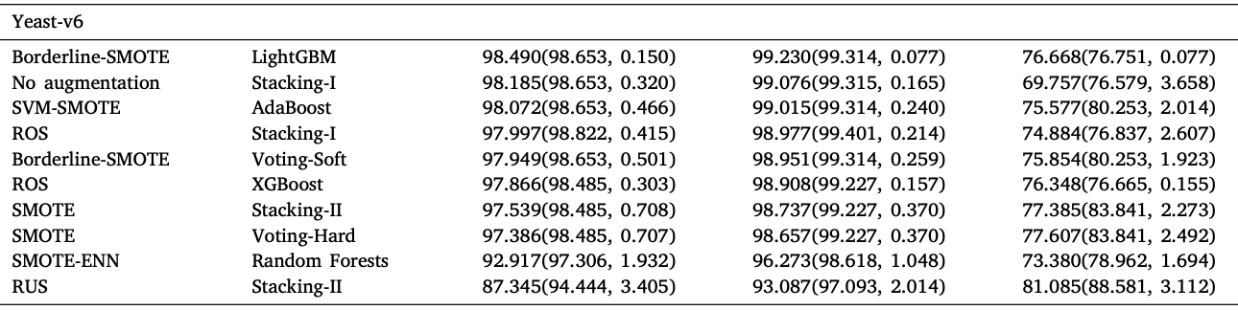
ML Evaluation of Imbalanced Dataset:
Ensemble Learning and Data Augmentations (DA)
Source: Khan, A. A., Chaudhari, O., & Chandra, R. (2023). A review of ensemble learning and data augmentation models for class imbalanced problems: combination, implementation and evaluation. Expert Systems with Applications, 122778.

Slide 105
Machine Learning:
Unsupervised Learning:
Cluster Analysis,
Market Segmentation

Slide 106
Machine Learning: Data Mining Tasks & Methods
Unsupervised Learning:
Cluster Analysis,
Market Segmentation
Segmentation
Source: Ramesh Sharda, Dursun Delen, and Efraim Turban (2017), Business Intelligence, Analytics, and Data Science: A Managerial Perspective, 4th Edition, Pearson

Slide 107
Example of Cluster Analysis
Point | P | P(x,y)
p01 | a | (3, 4)
p02 | b | (3, 6)
p03 | c | (3, 8)
p04 | d | (4, 5)
p05 | e | (4, 7)
p06 | f | (5, 1)
p07 | g | (5, 5)
p08 | h | (7, 3)
p09 | i | (7, 5)
p10 | j | (8, 5)

Slide 108
K-Means Clustering
Point | P | P(x,y) | m1 distance | m2 distance | Cluster
p01 | a | (3, 4) | 1.95 | 3.78 | Cluster1
p02 | b | (3, 6) | 0.69 | 4.51 | Cluster1
p03 | c | (3, 8) | 2.27 | 5.86 | Cluster1
p04 | d | (4, 5) | 0.89 | 3.13 | Cluster1
p05 | e | (4, 7) | 1.22 | 4.45 | Cluster1
p06 | f | (5, 1) | 5.01 | 3.05 | Cluster2
p07 | g | (5, 5) | 1.57 | 2.30 | Cluster1
p08 | h | (7, 3) | 4.37 | 0.56 | Cluster2
p09 | i | (7, 5) | 3.43 | 1.52 | Cluster2
p10 | j | (8, 5) | 4.41 | 1.95 | Cluster2
 | m1 | (3.67, 5.83)
 | m2 | (6.75, 3.50)

Slide 109
Cluster Analysis

Slide 110
Cluster Analysis
Used for automatic identification of
natural groupings of things
Part of the machine-learning family
Employ unsupervised learning
Learns the clusters of things from past data, then assigns new instances
There is not an output variable
Also known as segmentation
Source: Turban et al. (2011), Decision Support and Business Intelligence Systems

Slide 111
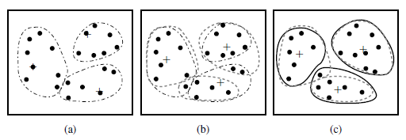
Cluster Analysis
Clustering of a set of objects based on the k-means method.
(The mean of each cluster is marked by a “+”.)
Source: Han & Kamber (2006)

Slide 112
Cluster Analysis
Clustering results may be used to
  Identify natural groupings of customers
  Identify rules for assigning new cases to classes for targeting/diagnostic purposes
  Provide characterization, definition, labeling of populations
  Decrease the size and complexity of problems
  for other data mining methods
  Identify outliers in a specific domain
  (e.g., rare-event detection)
Source: Turban et al. (2011), Decision Support and Business Intelligence Systems

Slide 113
k-Means Clustering Algorithm
k : pre-determined number of clusters
Algorithm (Step 0: determine value of k)
Step 1: Randomly generate k random points as initial cluster centers
Step 2: Assign each point to the nearest cluster center
Step 3: Re-compute the new cluster centers
Repetition step: Repeat steps 2 and 3 until some convergence criterion is met (usually that the assignment of points to clusters becomes stable)
Source: Turban et al. (2011), Decision Support and Business Intelligence Systems

Slide 114
Cluster Analysis for Data Mining - k-Means Clustering Algorithm
Source: Turban et al. (2011), Decision Support and Business Intelligence Systems

Slide 115
Similarity
Distance

Slide 116
Similarity and Dissimilarity Between Objects
Distances are normally used to measure the similarity or dissimilarity between two data objects
Some popular ones include: Minkowski distance:
  where i = (x_{i1}, x_{i2}, …, x_{ip}) and j = (x_{j1}, x_{j2}, …, x_{jp}) are two p-dimensional data objects, and q is a positive integer
If q = 1, d is Manhattan distance
Source: Han & Kamber (2006)

Slide 117
Similarity and Dissimilarity Between Objects (Cont.)
If q = 2, d is Euclidean distance:
  Properties
    d(i,j) ≥ 0
    d(i,i) = 0
    d(i,j) = d(j,i)
    d(i,j) ≤ d(i,k) + d(k,j)
Also, one can use weighted distance, parametric Pearson product moment correlation, or other disimilarity measures
Source: Han & Kamber (2006)

Slide 118
Euclidean distance vs
Manhattan distance
Distance of two point x₁ = (1, 2) and x₂ (3, 5)
Euclidean distance:
= ((3-1)² + (5-2)² )^{1/2}
= (2² + 3²)^{1/2}
= (4 + 9)^{1/2}
= (13)^{1/2}
= 3.61
5
x₂ (3, 5)
4
3
3.61
3
2
2
x₁ = (1, 2)
1
Manhattan distance:
= (3-1) + (5-2)
= 2 + 3
= 5
1
2
3

Slide 119
The K-Means Clustering Method
Example
10
10
9
9
8
8
7
7
6
6
5
5
4
Assign each objects to most similar center
Update the cluster means
4
3
3
2
2
1
1
0
0
0
1
2
3
4
5
6
7
8
9
10
0
1
2
3
4
5
6
7
8
9
10
reassign
reassign
K=2
Arbitrarily choose K object as initial cluster center
Update the cluster means
Source: Han & Kamber (2006)

Slide 120
K-Means Clustering

Slide 121
Example of Cluster Analysis
Point | P | P(x,y)
p01 | a | (3, 4)
p02 | b | (3, 6)
p03 | c | (3, 8)
p04 | d | (4, 5)
p05 | e | (4, 7)
p06 | f | (5, 1)
p07 | g | (5, 5)
p08 | h | (7, 3)
p09 | i | (7, 5)
p10 | j | (8, 5)

Slide 122
K-Means Clustering
Step by Step
Point | P | P(x,y)
p01 | a | (3, 4)
p02 | b | (3, 6)
p03 | c | (3, 8)
p04 | d | (4, 5)
p05 | e | (4, 7)
p06 | f | (5, 1)
p07 | g | (5, 5)
p08 | h | (7, 3)
p09 | i | (7, 5)
p10 | j | (8, 5)

Slide 123
K-Means Clustering
Step 1: K=2, Arbitrarily choose K object as initial cluster center
Point | P | P(x,y)
p01 | a | (3, 4)
p02 | b | (3, 6)
p03 | c | (3, 8)
p04 | d | (4, 5)
p05 | e | (4, 7)
p06 | f | (5, 1)
p07 | g | (5, 5)
p08 | h | (7, 3)
p09 | i | (7, 5)
p10 | j | (8, 5)
Initial | m1 | (3, 4)
Initial | m2 | (8, 5)
M₂ = (8, 5)
m₁ = (3, 4)

Slide 124
Step 2: Compute seed points as the centroids of the clusters of the current partition
Step 3: Assign each objects to most similar center
Point | P | P(x,y) | m1 distance | m2 distance | Cluster
p01 | a | (3, 4) | 0.00 | 5.10 | Cluster1
p02 | b | (3, 6) | 2.00 | 5.10 | Cluster1
p03 | c | (3, 8) | 4.00 | 5.83 | Cluster1
p04 | d | (4, 5) | 1.41 | 4.00 | Cluster1
p05 | e | (4, 7) | 3.16 | 4.47 | Cluster1
p06 | f | (5, 1) | 3.61 | 5.00 | Cluster1
p07 | g | (5, 5) | 2.24 | 3.00 | Cluster1
p08 | h | (7, 3) | 4.12 | 2.24 | Cluster2
p09 | i | (7, 5) | 4.12 | 1.00 | Cluster2
p10 | j | (8, 5) | 5.10 | 0.00 | Cluster2
Initial | m1 | (3, 4)
Initial | m2 | (8, 5)
M₂ = (8, 5)
m₁ = (3, 4)
K-Means Clustering

Slide 125
Step 2: Compute seed points as the centroids of the clusters of the current partition
Step 3: Assign each objects to most similar center
Point | P | P(x,y) | m1 distance | m2 distance | Cluster
p01 | a | (3, 4) | 0.00 | 5.10 | Cluster1
p02 | b | (3, 6) | 2.00 | 5.10 | Cluster1
p03 | c | (3, 8) | 4.00 | 5.83 | Cluster1
p04 | d | (4, 5) | 1.41 | 4.00 | Cluster1
p05 | e | (4, 7) | 3.16 | 4.47 | Cluster1
p06 | f | (5, 1) | 3.61 | 5.00 | Cluster1
p07 | g | (5, 5) | 2.24 | 3.00 | Cluster1
p08 | h | (7, 3) | 4.12 | 2.24 | Cluster2
p09 | i | (7, 5) | 4.12 | 1.00 | Cluster2
p10 | j | (8, 5) | 5.10 | 0.00 | Cluster2
Initial | m1 | (3, 4)
Initial | m2 | (8, 5)
M₂ = (8, 5)
Euclidean distance b(3,6) ←→m2(8,5)
= ((8-3)² + (5-6)² )^{1/2}
= (5² + (-1)²)^{1/2}
= (25 + 1)^{1/2}
= (26)^{1/2}
= 5.10
m₁ = (3, 4)
Euclidean distance b(3,6) ←→m1(3,4)
= ((3-3)² + (4-6)² )^{1/2}
= (0² + (-2)²)^{1/2}
= (0 + 4)^{1/2}
= (4)^{1/2}
= 2.00
K-Means Clustering

Slide 126
Step 4: Update the cluster means,
Repeat Step 2, 3,
stop when no more new assignment
Point | P | P(x,y) | m1 distance | m2 distance | Cluster
p01 | a | (3, 4) | 1.43 | 4.34 | Cluster1
p02 | b | (3, 6) | 1.22 | 4.64 | Cluster1
p03 | c | (3, 8) | 2.99 | 5.68 | Cluster1
p04 | d | (4, 5) | 0.20 | 3.40 | Cluster1
p05 | e | (4, 7) | 1.87 | 4.27 | Cluster1
p06 | f | (5, 1) | 4.29 | 4.06 | Cluster2
p07 | g | (5, 5) | 1.15 | 2.42 | Cluster1
p08 | h | (7, 3) | 3.80 | 1.37 | Cluster2
p09 | i | (7, 5) | 3.14 | 0.75 | Cluster2
p10 | j | (8, 5) | 4.14 | 0.95 | Cluster2
 | m1 | (3.86, 5.14)
 | m2 | (7.33, 4.33)
m₁ = (3.86, 5.14)
M₂ = (7.33, 4.33)
K-Means Clustering

Slide 127
Step 4: Update the cluster means,
Repeat Step 2, 3,
stop when no more new assignment
Point | P | P(x,y) | m1 distance | m2 distance | Cluster
p01 | a | (3, 4) | 1.95 | 3.78 | Cluster1
p02 | b | (3, 6) | 0.69 | 4.51 | Cluster1
p03 | c | (3, 8) | 2.27 | 5.86 | Cluster1
p04 | d | (4, 5) | 0.89 | 3.13 | Cluster1
p05 | e | (4, 7) | 1.22 | 4.45 | Cluster1
p06 | f | (5, 1) | 5.01 | 3.05 | Cluster2
p07 | g | (5, 5) | 1.57 | 2.30 | Cluster1
p08 | h | (7, 3) | 4.37 | 0.56 | Cluster2
p09 | i | (7, 5) | 3.43 | 1.52 | Cluster2
p10 | j | (8, 5) | 4.41 | 1.95 | Cluster2
 | m1 | (3.67, 5.83)
 | m2 | (6.75, 3.50)
m₁ = (3.67, 5.83)
M₂ = (6.75., 3.50)
K-Means Clustering

Slide 128
stop when no more new assignment
Point | P | P(x,y) | m1 distance | m2 distance | Cluster
p01 | a | (3, 4) | 1.95 | 3.78 | Cluster1
p02 | b | (3, 6) | 0.69 | 4.51 | Cluster1
p03 | c | (3, 8) | 2.27 | 5.86 | Cluster1
p04 | d | (4, 5) | 0.89 | 3.13 | Cluster1
p05 | e | (4, 7) | 1.22 | 4.45 | Cluster1
p06 | f | (5, 1) | 5.01 | 3.05 | Cluster2
p07 | g | (5, 5) | 1.57 | 2.30 | Cluster1
p08 | h | (7, 3) | 4.37 | 0.56 | Cluster2
p09 | i | (7, 5) | 3.43 | 1.52 | Cluster2
p10 | j | (8, 5) | 4.41 | 1.95 | Cluster2
 | m1 | (3.67, 5.83)
 | m2 | (6.75, 3.50)
K-Means Clustering

Slide 129
K-Means Clustering (K=2, two clusters)
stop when no more new assignment
Point | P | P(x,y) | m1 distance | m2 distance | Cluster
p01 | a | (3, 4) | 1.95 | 3.78 | Cluster1
p02 | b | (3, 6) | 0.69 | 4.51 | Cluster1
p03 | c | (3, 8) | 2.27 | 5.86 | Cluster1
p04 | d | (4, 5) | 0.89 | 3.13 | Cluster1
p05 | e | (4, 7) | 1.22 | 4.45 | Cluster1
p06 | f | (5, 1) | 5.01 | 3.05 | Cluster2
p07 | g | (5, 5) | 1.57 | 2.30 | Cluster1
p08 | h | (7, 3) | 4.37 | 0.56 | Cluster2
p09 | i | (7, 5) | 3.43 | 1.52 | Cluster2
p10 | j | (8, 5) | 4.41 | 1.95 | Cluster2
 | m1 | (3.67, 5.83)
 | m2 | (6.75, 3.50)
K-Means Clustering

Slide 130
K-Means Clustering
Point | P | P(x,y) | m1 distance | m2 distance | Cluster
p01 | a | (3, 4) | 1.95 | 3.78 | Cluster1
p02 | b | (3, 6) | 0.69 | 4.51 | Cluster1
p03 | c | (3, 8) | 2.27 | 5.86 | Cluster1
p04 | d | (4, 5) | 0.89 | 3.13 | Cluster1
p05 | e | (4, 7) | 1.22 | 4.45 | Cluster1
p06 | f | (5, 1) | 5.01 | 3.05 | Cluster2
p07 | g | (5, 5) | 1.57 | 2.30 | Cluster1
p08 | h | (7, 3) | 4.37 | 0.56 | Cluster2
p09 | i | (7, 5) | 3.43 | 1.52 | Cluster2
p10 | j | (8, 5) | 4.41 | 1.95 | Cluster2
 | m1 | (3.67, 5.83)
 | m2 | (6.75, 3.50)

Slide 131
Machine Learning:
Unsupervised Learning:
Cluster Analysis
K-Means Clustering

Slide 132
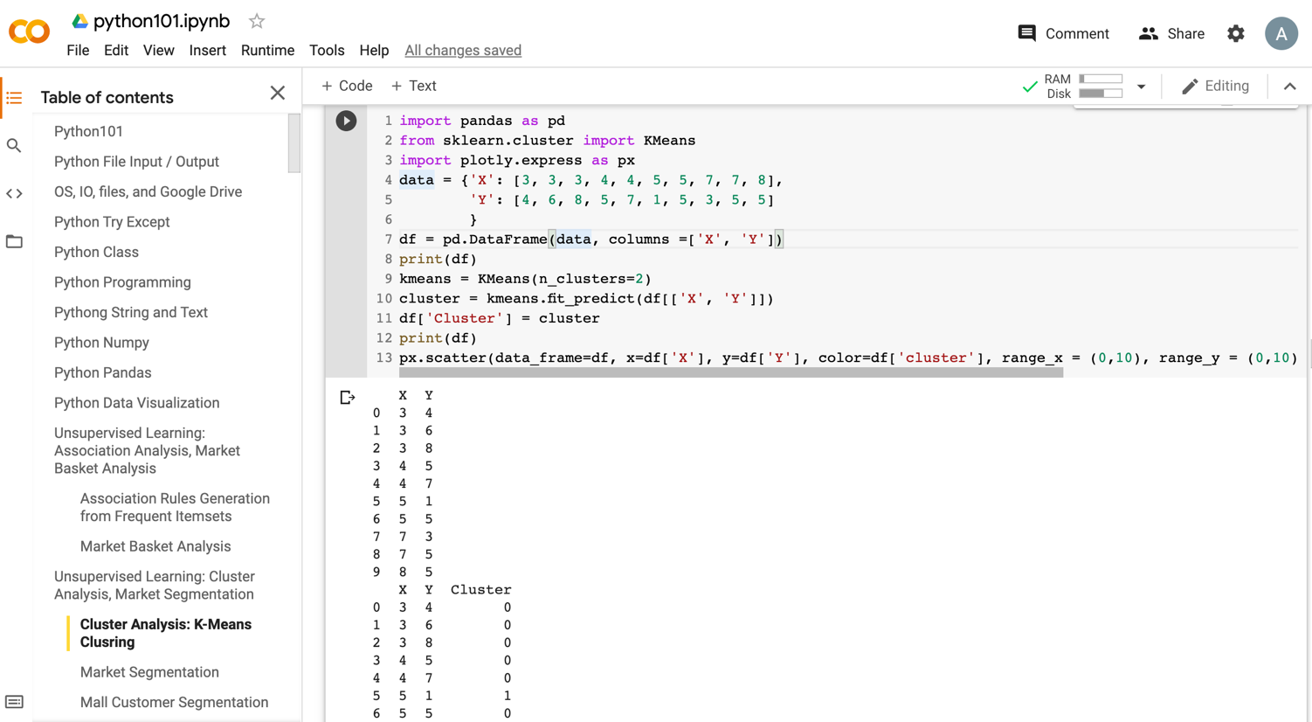
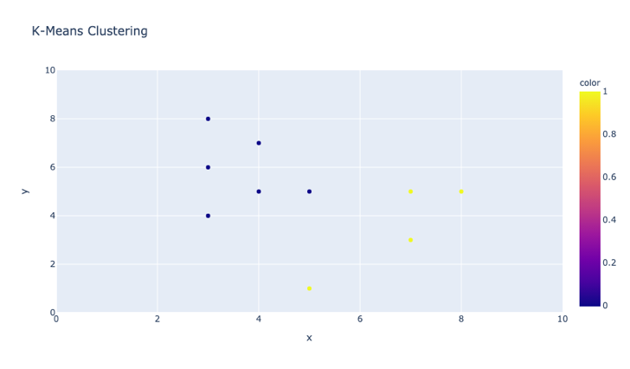
Python in Google Colab (Python101)
https://colab.research.google.com/drive/1FEG6DnGvwfUbeo4zJ1zTunjMqf2RkCrT
https://tinyurl.com/aintpupython101

Slide 133
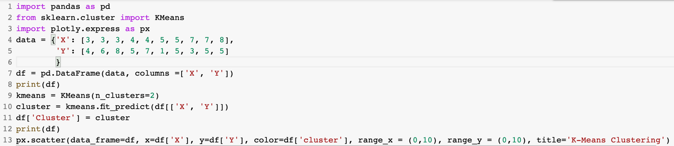
from sklearn.cluster import KMeans
kmeans = KMeans(n_clusters=2)
cluster = kmeans.fit_predict(df[['X', 'Y']])
https://tinyurl.com/aintpupython101

Slide 134
from sklearn.cluster import KMeans
kmeans = KMeans(n_clusters=2)
cluster = kmeans.fit_predict(df[['X', 'Y']])
import pandas as pd
from sklearn.cluster import KMeans
import plotly.express as px
data = {'X': [3, 3, 3, 4, 4, 5, 5, 7, 7, 8],
'Y': [4, 6, 8, 5, 7, 1, 5, 3, 5, 5]
}
df = pd.DataFrame(data, columns =['X', 'Y'])
print(df)
kmeans = KMeans(n_clusters=2)
cluster = kmeans.fit_predict(df[['X', 'Y']])
df['Cluster'] = cluster
print(df)
px.scatter(data_frame=df, x=df['X'], y=df['Y'], color=df['cluster'], range_x = (0,10), range_y = (0,10), title='K-Means Clustering')
https://tinyurl.com/aintpupython101

Slide 135
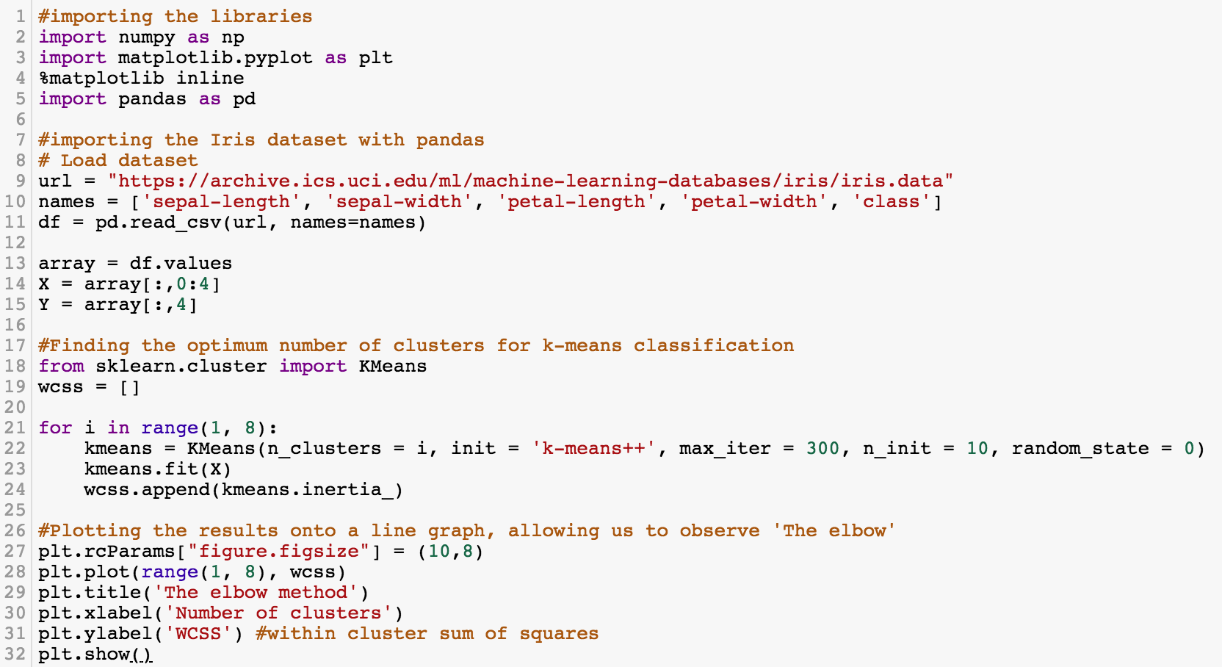
K-Means Clustering
https://tinyurl.com/aintpupython101

Slide 136
#importing the libraries
import numpy as np
import matplotlib.pyplot as plt
%matplotlib inline
import pandas as pd
#importing the Iris dataset with pandas
# Load dataset
url = "https://archive.ics.uci.edu/ml/machine-learning-databases/iris/iris.data"
names = ['sepal-length', 'sepal-width', 'petal-length', 'petal-width', 'class']
df = pd.read_csv(url, names=names)
array = df.values
X = array[:,0:4]
Y = array[:,4]
https://tinyurl.com/aintpupython101

Slide 137
#Finding the optimum number of clusters for k-means classification
from sklearn.cluster import KMeans
wcss = []
for i in range(1, 8):
kmeans = KMeans(n_clusters = i, init = 'k-means++', max_iter = 300, n_init = 10, random_state = 0)
kmeans.fit(X)
wcss.append(kmeans.inertia_)
#Plotting the results onto a line graph, allowing us to observe 'The elbow'
plt.rcParams["figure.figsize"] = (10,8)
plt.plot(range(1, 8), wcss)
plt.title('The elbow method')
plt.xlabel('Number of clusters')
plt.ylabel('WCSS') #within cluster sum of squares
plt.show()
https://tinyurl.com/aintpupython101

Slide 138
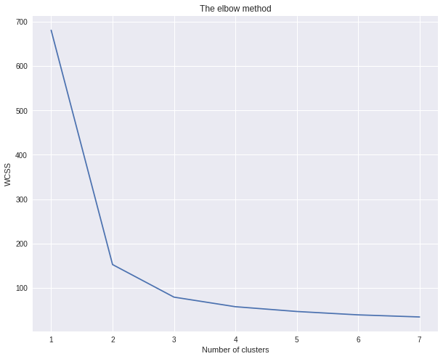
K-Means Clustering
The elbow method (k=3)
https://tinyurl.com/aintpupython101

Slide 139
kmeans = KMeans(n_clusters = 3, init = 'k-means++', max_iter = 300, n_init = 10, random_state = 0)
y_kmeans = kmeans.fit_predict(X)
https://tinyurl.com/aintpupython101

Slide 140
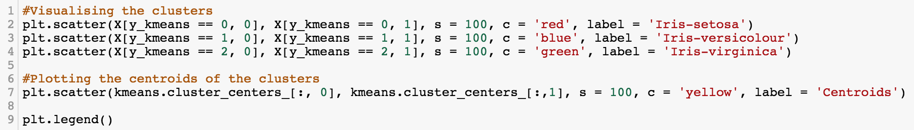
#Visualising the clusters
plt.scatter(X[y_kmeans == 0, 0], X[y_kmeans == 0, 1], s = 100, c = 'red', label = 'Iris-setosa')
plt.scatter(X[y_kmeans == 1, 0], X[y_kmeans == 1, 1], s = 100, c = 'blue', label = 'Iris-versicolour')
plt.scatter(X[y_kmeans == 2, 0], X[y_kmeans == 2, 1], s = 100, c = 'green', label = 'Iris-virginica')
#Plotting the centroids of the clusters
plt.scatter(kmeans.cluster_centers_[:, 0], kmeans.cluster_centers_[:,1], s = 100, c = 'yellow', label = 'Centroids')
plt.legend()
https://tinyurl.com/aintpupython101

Slide 141
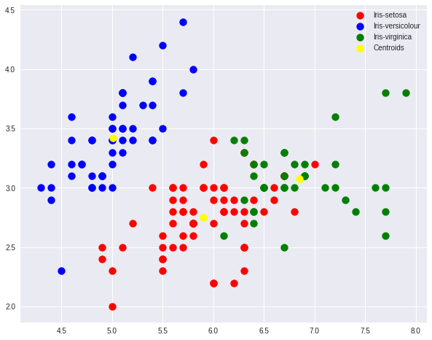
K-Means Clustering
https://tinyurl.com/aintpupython101

Slide 142
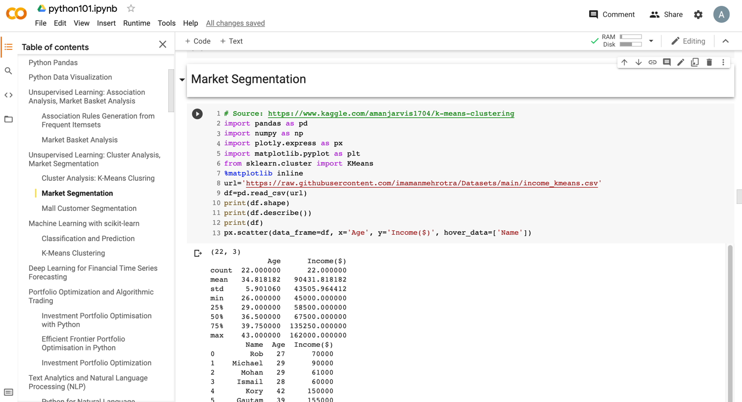
Market Segmentation
https://tinyurl.com/aintpupython101

Slide 143
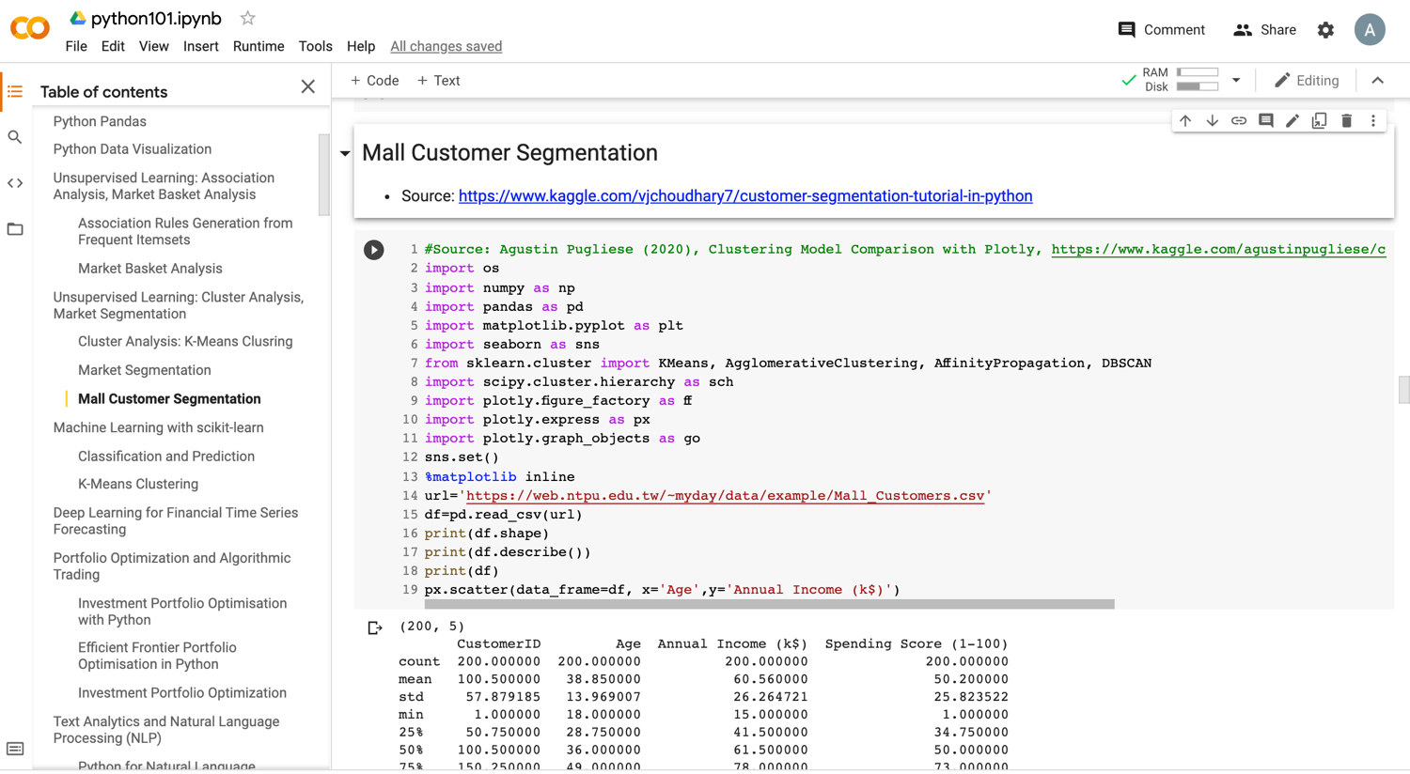
Mall Customer Segmentation
https://tinyurl.com/aintpupython101

Slide 144
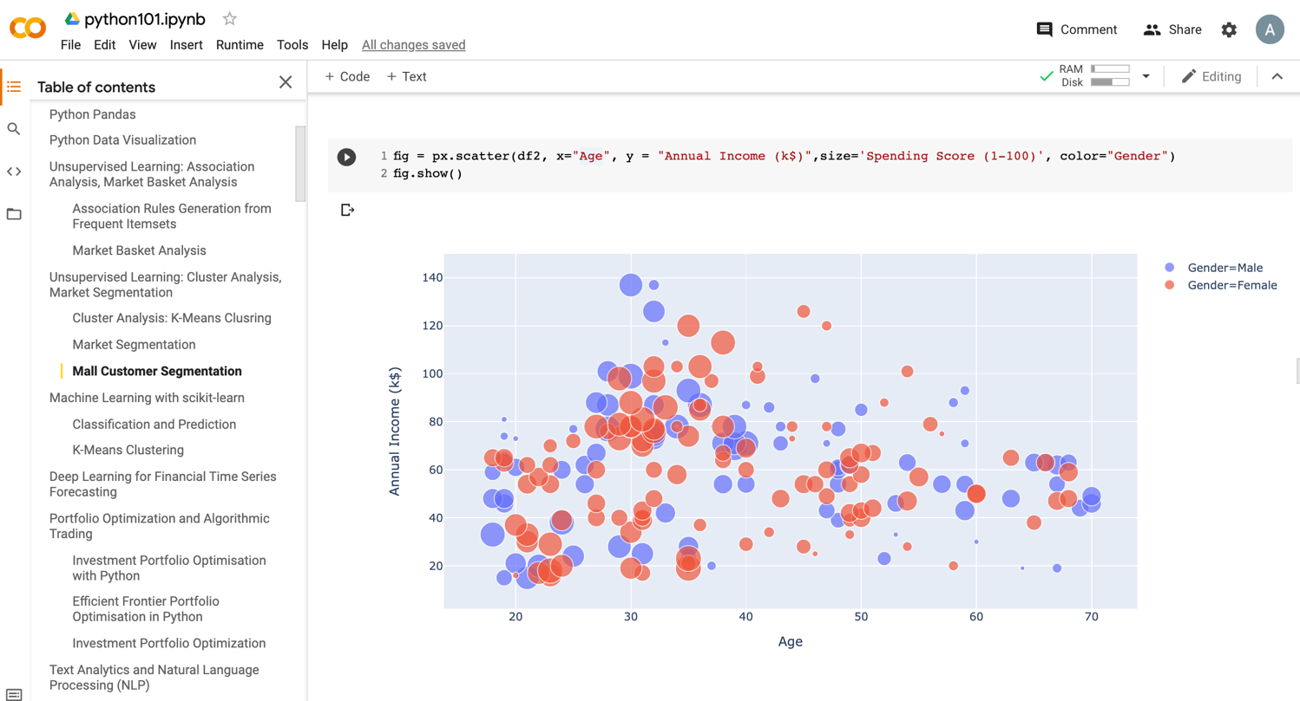
Mall Customer Segmentation
https://tinyurl.com/aintpupython101

Slide 145
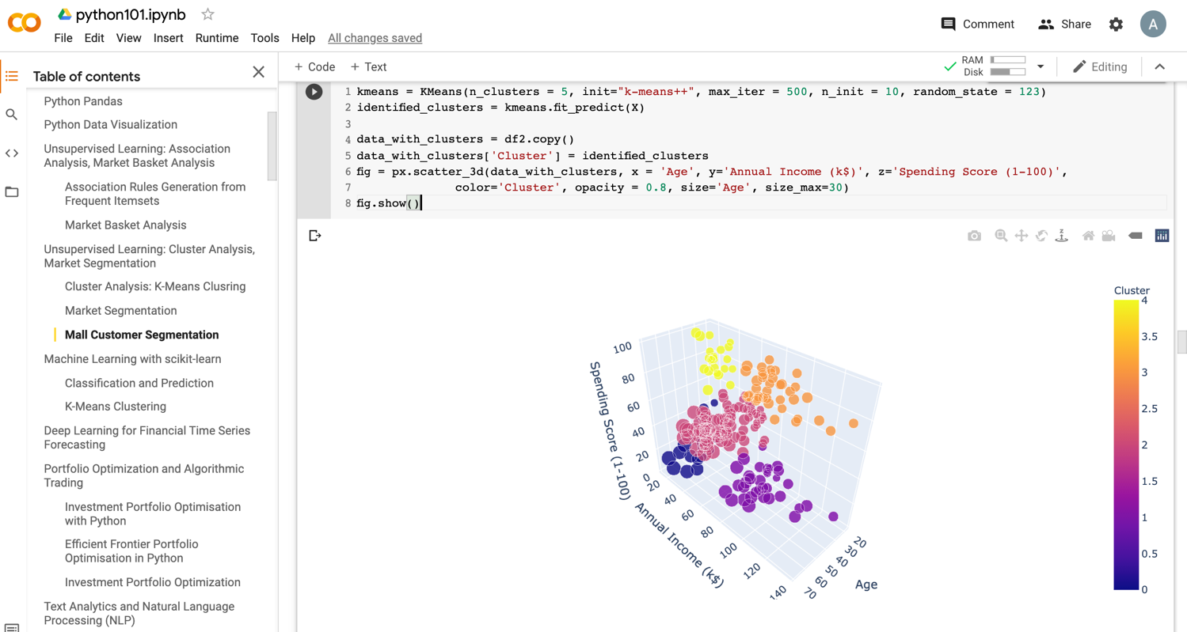
Mall Customer Segmentation
https://tinyurl.com/aintpupython101

Slide 146
Machine Learning:
Unsupervised Learning:
Association Analysis, Market Basket Analysis

Slide 147
Machine Learning: Data Mining Tasks & Methods
Unsupervised Learning:
Association Analysis
Market-basket
Association
Source: Ramesh Sharda, Dursun Delen, and Efraim Turban (2017), Business Intelligence, Analytics, and Data Science: A Managerial Perspective, 4th Edition, Pearson

Slide 148
Transaction Database
Transaction ID | Items bought
T01 | A, B, D
T02 | A, C, D
T03 | B, C, D, E
T04 | A, B, D
T05 | A, B, C, E
T06 | A, C
T07 | B, C, D
T08 | B, D
T09 | A, C, E
T10 | B, D

Slide 149
Association Analysis

Slide 150
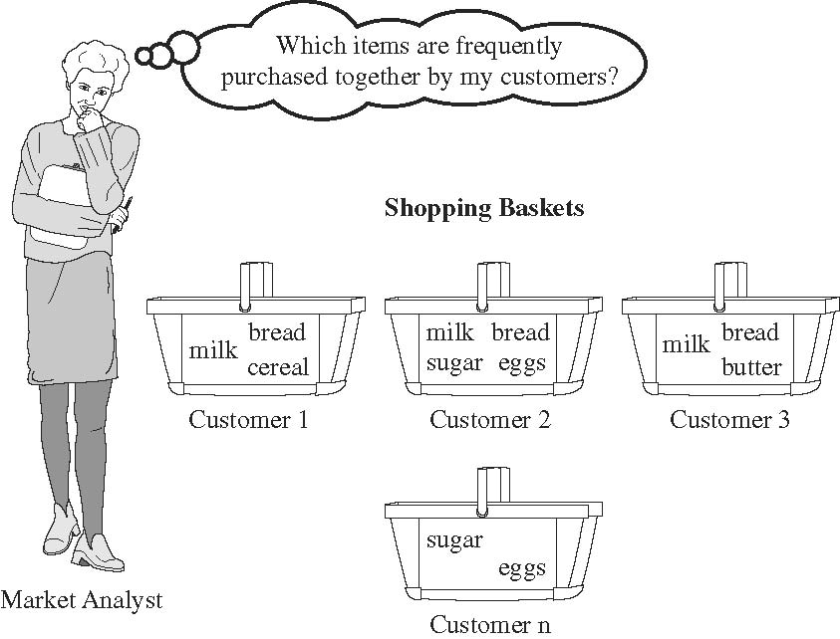
Market Basket Analysis
Source: Han & Kamber (2006)

Slide 151
Python mlxtend Association Rules
# !pip install mlxtend
import pandas as pd
from mlxtend.preprocessing import TransactionEncoder
from mlxtend.frequent_patterns import apriori
from mlxtend.frequent_patterns import association_rules
dataset = [['A', 'B', 'D’],
['A', 'C', 'D'],
['B', 'C', 'D', 'E'],
['A', 'B', 'D’],
['A', 'B', 'C', 'E’],
['A', 'C’],
['B', 'C', 'D’],
['B', 'D’],
['A', 'C', 'E'],
['B', 'D']]
te = TransactionEncoder()
te_ary = te.fit(dataset).transform(dataset)
df = pd.DataFrame(te_ary, columns=te.columns_)
frequent_itemsets = apriori(df, min_support=0.2, use_colnames=True)
association_rules(frequent_itemsets, metric="confidence", min_threshold=0.8)
https://tinyurl.com/aintpupython101

Slide 152
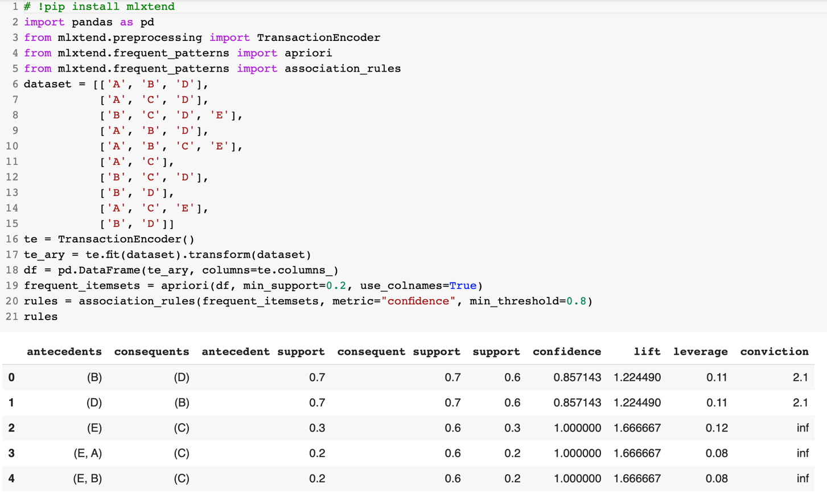
Python mlxtend Association Rules
https://tinyurl.com/aintpupython101

Slide 153
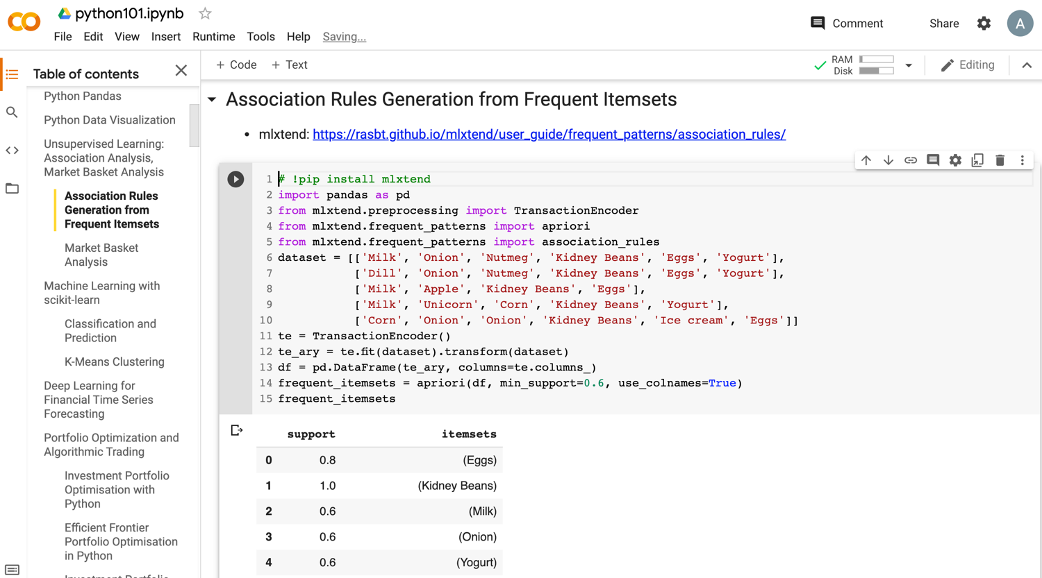
Python in Google Colab (Python101)
https://colab.research.google.com/drive/1FEG6DnGvwfUbeo4zJ1zTunjMqf2RkCrT
https://tinyurl.com/aintpupython101

Slide 154
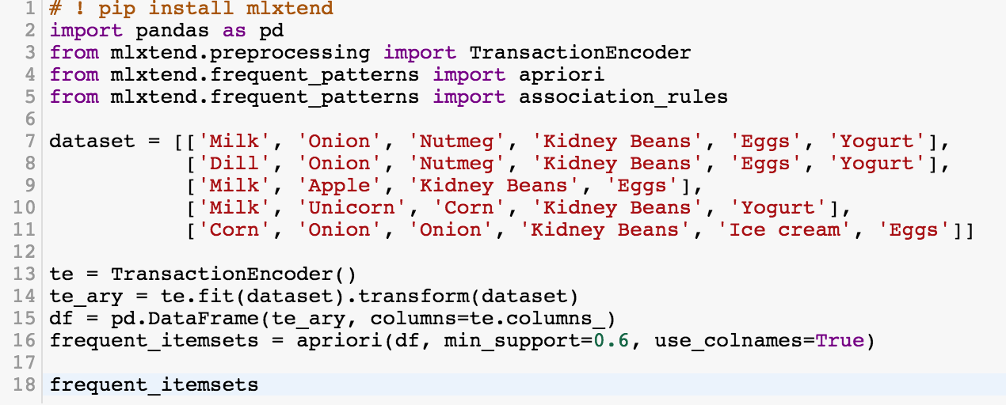
# ! pip install mlxtend
from mlxtend.frequent_patterns import apriori
from mlxtend.frequent_patterns import association_rules
frequent_itemsets = apriori(df, min_support=0.6, use_colnames=True)
https://tinyurl.com/aintpupython101

Slide 155
# ! pip install mlxtend
import pandas as pd
from mlxtend.preprocessing import TransactionEncoder
from mlxtend.frequent_patterns import apriori
from mlxtend.frequent_patterns import association_rules
dataset = [['Milk', 'Onion', 'Nutmeg', 'Kidney Beans', 'Eggs', 'Yogurt'],
['Dill', 'Onion', 'Nutmeg', 'Kidney Beans', 'Eggs', 'Yogurt'],
['Milk', 'Apple', 'Kidney Beans', 'Eggs'],
['Milk', 'Unicorn', 'Corn', 'Kidney Beans', 'Yogurt'],
['Corn', 'Onion', 'Onion', 'Kidney Beans', 'Ice cream', 'Eggs']]
te = TransactionEncoder()
te_ary = te.fit(dataset).transform(dataset)
df = pd.DataFrame(te_ary, columns=te.columns_)
frequent_itemsets = apriori(df, min_support=0.6, use_colnames=True)
frequent_itemsets
https://tinyurl.com/aintpupython101

Slide 156
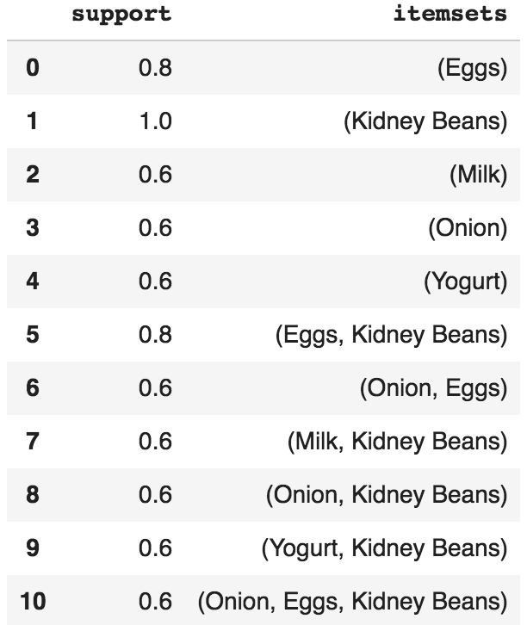
frequent_itemsets = apriori(df, min_support=0.6, use_colnames=True)
https://tinyurl.com/aintpupython101

Slide 157
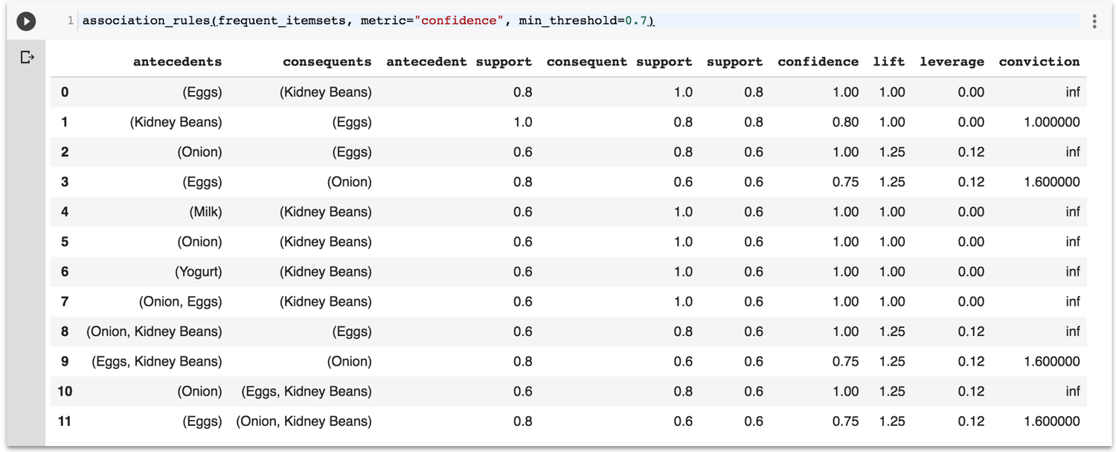
association_rules(frequent_itemsets, metric="confidence", min_threshold=0.7)
https://tinyurl.com/aintpupython101

Slide 158
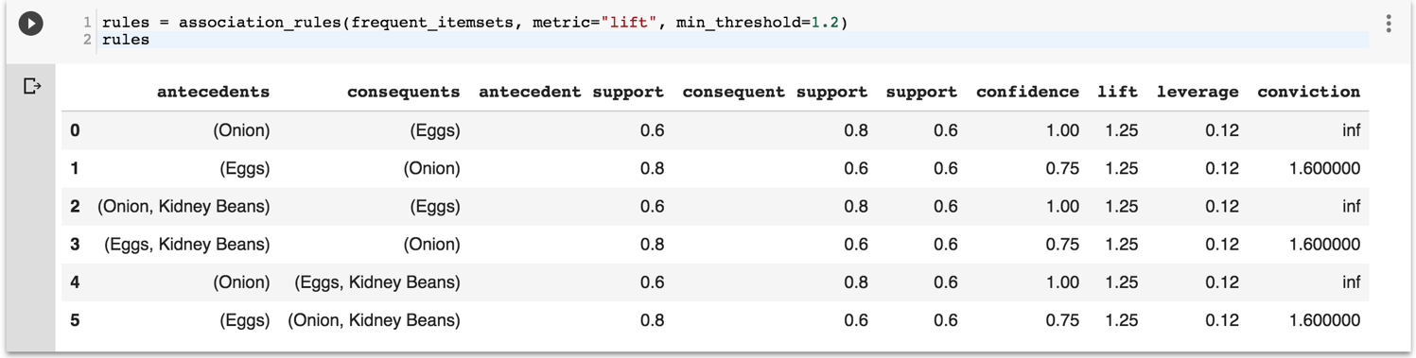
rules = association_rules(frequent_itemsets, metric="lift", min_threshold=1.2)
rules
https://tinyurl.com/aintpupython101

Slide 159

rules["antecedent_len"] = rules["antecedents"].apply(lambda x: len(x))
rules
https://tinyurl.com/aintpupython101

Slide 160

rules[ (rules['antecedent_len'] >= 2) &
(rules['confidence'] > 0.75) &
(rules['lift'] > 1.2) ]
https://tinyurl.com/aintpupython101

Slide 161

rules[rules['antecedents'] == {'Eggs', 'Kidney Beans’}]
https://tinyurl.com/aintpupython101

Slide 162
The
Theory of Learning

Slide 163
The Theory of Learning
Computational Learning Theory
  Probably Approximately Correct (PAC) Learning
  Vapnik-Chervonenkis (VC) Dimension
  Bias-Variance Trade-off
Overfitting and Underfitting
  Avoid overfitting:
  Regularization, Cross-Validation
Source: Stuart Russell and Peter Norvig (2020), Artificial Intelligence: A Modern Approach, 4th Edition, Pearson

Slide 164
What is Learning in Machine Learning?
Learning involves finding patterns from data to make predictions.
Performance is measured through generalization to unseen data.
Three paradigms of learning:
  Supervised Learning (e.g., classification, regression)
  Unsupervised Learning (e.g., clustering, dimensionality reduction)
  Reinforcement Learning (e.g., learning through rewards)
Source: Stuart Russell and Peter Norvig (2020), Artificial Intelligence: A Modern Approach, 4th Edition, Pearson

Slide 165
The Theory of Learning
How can we be sure that our learned hypothesis will predict well for previously unseen inputs?
  How do we know that the hypothesis h is close to the target function f
  if we don’t know what is?
How many examples do we need to get a good h?
What hypothesis space should we use?
If the hypothesis space is very complex,
can we even find the best h or do we have to settle for a local maximum?
How complex should h be?
How do we avoid overfitting?
Source: Stuart Russell and Peter Norvig (2020), Artificial Intelligence: A Modern Approach, 4th Edition, Pearson

Slide 166
Computational Learning Theory
Intersection of AI, statistics, and
theoretical computer science.
Any hypothesis that is seriously wrong will almost certainly be “found out” with high probability after a small number of examples.
Source: Stuart Russell and Peter Norvig (2020), Artificial Intelligence: A Modern Approach, 4th Edition, Pearson

Slide 167
Probably Approximately Correct (PAC) Learning
Any hypothesis that is consistent with a sufficiently large set of training examples is unlikely to be seriously wrong.
PAC learning algorithm:
  Any learning algorithm that returns hypotheses that are probably approximately correct.
Source: Stuart Russell and Peter Norvig (2020), Artificial Intelligence: A Modern Approach, 4th Edition, Pearson

Slide 168
Probably Approximately Correct (PAC) Learning
PAC Learning provides a way to understand generalization
Key Components:
  Error threshold (ε)
  Confidence level (1 - δ)
Example: Linear models are PAC-learnable with enough data
Source: Stuart Russell and Peter Norvig (2020), Artificial Intelligence: A Modern Approach, 4th Edition, Pearson

Slide 169
Linear function
y = f(x)
y = w₁x + w₀
h_{w}(x) = w₁x + w₀
Source: Stuart Russell and Peter Norvig (2020), Artificial Intelligence: A Modern Approach, 4th Edition, Pearson

Slide 170

Linear Regression Weight Space
h_{w}(x) = w₁x + w₀
w* = argmin_{w} Loss(h_{w})
y = 0.232 x + 246
Loss function for Weights (w₁, w₀)
Source: Stuart Russell and Peter Norvig (2020), Artificial Intelligence: A Modern Approach, 4th Edition, Pearson

Slide 171
Vapnik-Chervonenkis (VC) Dimension
VC Dimension measures a model's capacity to fit various patterns
Higher VC Dimension
Higher model complexity
Balancing model complexity helps improve generalization
Source: Stuart Russell and Peter Norvig (2020), Artificial Intelligence: A Modern Approach, 4th Edition, Pearson

Slide 172
Bias-Variance Trade-off
Bias: Error due to simple models
(e.g., linear models)
Variance: Error from models too sensitive to noise (e.g., deep trees)
Bias-Variance Trade-off:
  Low bias-high variance: Risk of overfitting
  High bias-low variance: Risk of underfitting
Selecting the right model balances bias and variance
Source: Stuart Russell and Peter Norvig (2020), Artificial Intelligence: A Modern Approach, 4th Edition, Pearson

Slide 173

Overfitting vs. Underfitting
Overfitting
Underfitting
Good Balance

Slide 175
Bias vs. Variance
Low Bias
Low Variance
High Bias
Low Variance
Low
Variance
Low Bias
High Variance
High Bias
High Variance
High
Variance
Low Bias
High Bias

Slide 176
Bias vs. Variance
Truth
Low Bias
Low Variance
High Bias
Low Variance
Low
Variance
Underfitting
Low Bias
High Variance
High Bias
High Variance
High
Variance
Overfitting
Low Bias
High Bias

Slide 177
Bias vs. Variance
A
B
Low Bias
Low Variance
High Bias
Low Variance
Low
Variance
High Accuracy
High Precision
Low Accuracy
High Precision
C
D
Low Bias
High Variance
High Bias
High Variance
High
Variance
High Accuracy
Low Precision
Low Accuracy
Low Precision
Low Bias
High Bias

Slide 178
Accuracy vs. Precision
A
B
High Accuracy
High Precision
Low Accuracy
High Precision
High Validity
High Reliability
Low Validity
High Reliability
C
D
High Accuracy
Low Precision
Low Accuracy
Low Precision
High Validity
Low Reliability
Low Validity
Low Reliability

Slide 179
Accuracy (Validity) vs. Precision (Reliability)
A
B
High Accuracy
High Precision
Low Accuracy
High Precision
High Validity
High Reliability
Low Validity
High Reliability
C
D
High Accuracy
Low Precision
Low Accuracy
Low Precision
High Validity
Low Reliability
Low Validity
Low Reliability

Slide 180
Learning Theory
PAC Learning:
  Focuses on generalization
VC Dimension:
  Measures model capacity and impacts generalization
Bias-Variance Trade-off:
  Helps in model selection and tuning
Source: Stuart Russell and Peter Norvig (2020), Artificial Intelligence: A Modern Approach, 4th Edition, Pearson

Slide 181
Ensemble Learning

Slide 182
Ensemble Learning
Select a collection, or ensemble,
of hypotheses, h₁, h₂, …, h_{n}
, and combine their predictions
by averaging, voting, or
by another level of machine learning.
Source: Stuart Russell and Peter Norvig (2020), Artificial Intelligence: A Modern Approach, 4th Edition, Pearson

Slide 183

Ensemble Models
Heterogeneous Ensemble
Source: Ramesh Sharda, Dursun Delen, and Efraim Turban (2017), Business Intelligence, Analytics, and Data Science: A Managerial Perspective, 4th Edition, Pearson

Slide 184
Ensemble Learning:
Bagging, Boosting, Stacking, Voting
Ensemble
Learning
Bagging
Boosting
Stacking
Voting

Slide 185
Ensemble Learning
Base model
  individual hypotheses
  h₁, h₂, …, h_{n}
Ensemble model
  hypotheses combination
Source: Stuart Russell and Peter Norvig (2020), Artificial Intelligence: A Modern Approach, 4th Edition, Pearson

Slide 186
Why Ensemble Learning
Reduce bias
Reduce variance
Source: Stuart Russell and Peter Norvig (2020), Artificial Intelligence: A Modern Approach, 4th Edition, Pearson

Slide 187
Ensemble Learning
Bagging
  Random Forests (RF)
Boosting
  Gradient Boosting, XGBoost, LightGBM, CatBoost
Stacking
Online learning
Source: Stuart Russell and Peter Norvig (2020), Artificial Intelligence: A Modern Approach, 4th Edition, Pearson

Slide 188
Ensemble Learning:
Bagging (Bootstrap Aggregation)
Weak
Learner 1
Prediction
Subset 1
Input
(x)
Training
Set
Weak
Learner 2
Prediction
Aggregation
Subset 2
...
...
...
Weak
Learner m
Prediction
Subset m
Bootstrap
Samples
Parallel

Slide 189
Ensemble Learning:
Boosting
Weak
Learner 1
False
Prediction
Subset 1
Input
(x)
Training
Set
Weak
Learner 2
False
Prediction
Subset 2
...
...
...
Weak
Learner m
Overall Prediction
Subset m
Sequential

Slide 190
Ensemble Learning:
Stacking
Model 1
Input
(x)
Training
Set
New
Training
Dataset
Meta
Model
Model 2
Final
Prediction
Model 3

Slide 191
Ensemble Learning:
Voting
Model 1
Input
(x)
Training
Set
Voting
Model 2
Final
Prediction
Model 3

Slide 192
Ensemble Learning: Bagging
Bagging
  Generate distinct training sets by sampling with replacement from the original training set.
Classification:
  Plurality Vote (Majority Vote)
Regression:
  Average
Source: Stuart Russell and Peter Norvig (2020), Artificial Intelligence: A Modern Approach, 4th Edition, Pearson

Slide 193
Ensemble Learning: Random forests
Random forest model is a form of decision tree bagging in which we take extra steps to make the ensemble of trees more diverse, to reduce variance.
The key idea is to randomly vary the attribute choices (rather than the training examples)
Source: Stuart Russell and Peter Norvig (2020), Artificial Intelligence: A Modern Approach, 4th Edition, Pearson

Slide 194
Ensemble Learning: Random forests
Extremely randomized trees (ExtraTrees)
  Use randomness in selecting the split point value
  for each selected attribute, we randomly sample several candidate values from a uniform distribution over the attribute’s range
Source: Stuart Russell and Peter Norvig (2020), Artificial Intelligence: A Modern Approach, 4th Edition, Pearson

Slide 195
Ensemble Learning: Boosting
Boosting
  The most popular ensemble method
Weighted training set
Source: Stuart Russell and Peter Norvig (2020), Artificial Intelligence: A Modern Approach, 4th Edition, Pearson

Slide 196

Ensemble Learning: Boosting
Source: Stuart Russell and Peter Norvig (2020), Artificial Intelligence: A Modern Approach, 4th Edition, Pearson

Slide 197
Ensemble Learning:
Gradient boosting
Gradient boosting
  Gradient boosting is a form of boosting using gradient descent
Gradient boosting machines (GBM)
Gradient boosted regression trees (GBRT)
Popular method for regression and classification of factored tabular data
Source: Stuart Russell and Peter Norvig (2020), Artificial Intelligence: A Modern Approach, 4th Edition, Pearson

Slide 198
Ensemble Learning: Stacking
Staking
  Stacked generalization combines multiple base models from different model classes trained on the same data.
Bagging
  Combines multiple base models of the same model class trained on different data.
Source: Stuart Russell and Peter Norvig (2020), Artificial Intelligence: A Modern Approach, 4th Edition, Pearson

Slide 199
Ensemble Learning:
Online learning
Online learning
  Data are not i.i.d.
  (independent and identically distributed)
  An agent receives an input x_{i} from nature, predicts the corresponding y_{i} and then is told the correct answer.
Source: Stuart Russell and Peter Norvig (2020), Artificial Intelligence: A Modern Approach, 4th Edition, Pearson

Slide 200
Ensemble Learning and Data Augmentations (DA)
Source: Khan, A. A., Chaudhari, O., & Chandra, R. (2023). A review of ensemble learning and data augmentation models for class imbalanced problems: combination, implementation and evaluation. Expert Systems with Applications, 122778.

Slide 201
ML Evaluation of Imbalanced Dataset:
Ensemble Learning and Data Augmentations (DA)
Source: Khan, A. A., Chaudhari, O., & Chandra, R. (2023). A review of ensemble learning and data augmentation models for class imbalanced problems: combination, implementation and evaluation. Expert Systems with Applications, 122778.

Slide 202

Kaggle Datasets for Machine Learning
Source: https://www.kaggle.com/datasets?search=ESG

Slide 203

Kaggle Datasets for Machine Learning
Source: https://www.kaggle.com/datasets?search=credit+card&sort=votes

Slide 204

Kaggle Datasets: Credit Card Fraud Detection
Source: https://www.kaggle.com/datasets/mlg-ulb/creditcardfraud

Slide 205

Kaggle Code: Credit Card Fraud Detection
Source: https://www.kaggle.com/datasets/mlg-ulb/creditcardfraud/code?datasetId=310&sortBy=voteCount

Slide 206

Kaggle Code: Credit Card Fraud Detection
Source: https://www.kaggle.com/code/janiobachmann/credit-fraud-dealing-with-imbalanced-datasets

Slide 207
Meta Learning:
Learning to Learn

Slide 208
Deep Learning
Transfer Learning
Few-Shot Learning
Meta Learning

Slide 209
Deep Learning, Transfer Learning,
Few-Shot Learning, Meta Learning
Deep Learning
  Transfer Learning
    Pre-training, Fine-Tuning (FT)
Meta Learning: Learning to Learn
Few-Shot Learning (FSL)
One-Shot Learning (1SL)
Zero-Shot Learning (0SL)(ZSL)

Slide 210

Machine Learning, Deep Learning, Meta Learning
Source: Luo, Shuai, Yujie Li, Pengxiang Gao, Yichuan Wang, and Seiichi Serikawa. "Meta-seg: A survey of meta-learning for image segmentation." Pattern Recognition (2022): 108586.

Slide 211

Machine Learning, Deep Learning, Meta Learning
Source: Feng, Yong, Jinglong Chen, Jingsong Xie, Tianci Zhang, Haixin Lv, and Tongyang Pan. "Meta-learning as a promising approach for few-shot cross-domain fault diagnosis: Algorithms, applications, and prospects." Knowledge-Based Systems 235 (2022): 107646.

Slide 212

Few-Shot Learning (FSL) and Meta Learning
Machine learning from few training examples
Source: Parnami, Archit, and Minwoo Lee. "Learning from Few Examples: A Summary of Approaches to Few-Shot Learning." arXiv preprint arXiv:2203.04291 (2022).

Slide 213

Meta Learning, Transfer Learning,
Ensemble Learning, Continual Learning,
Multi-Task Learning
Source: Luo, Shuai, Yujie Li, Pengxiang Gao, Yichuan Wang, and Seiichi Serikawa. "Meta-seg: A survey of meta-learning for image segmentation." Pattern Recognition (2022): 108586.

Slide 214

Meta-Learning and Few-shot Learning
Notations and Terms
Optimization-based
Meta-learning
Metric-based
Meta-learning
Source: Parnami, Archit, and Minwoo Lee. "Learning from Few Examples: A Summary of Approaches to Few-Shot Learning." arXiv preprint arXiv:2203.04291 (2022).

Slide 215

Meta-Learning Symbols
Source: Parnami, Archit, and Minwoo Lee. "Learning from Few Examples: A Summary of Approaches to Few-Shot Learning." arXiv preprint arXiv:2203.04291 (2022).

Slide 216

Meta-Learning Example Setup
Source: Parnami, Archit, and Minwoo Lee. "Learning from Few Examples: A Summary of Approaches to Few-Shot Learning." arXiv preprint arXiv:2203.04291 (2022).

Slide 217

Few-Shot Learning (FSL)
Solving the FSL problem by meta-learning
Source: Yaqing Wang, Quanming Yao, James T. Kwok, and Lionel M. Ni (2020). "Generalizing from a few examples: A survey on few-shot learning." ACM computing surveys (csur) 53, no. 3 (2020): 1-34.

Slide 218

Few-Shot Learning (FSL)
Meta-learning
Each task mimics the few-shot scenario, and can be completely non-overlapping.
Support sets are used to train; query sets are used to evaluate the model
Source: Yao Ge, Yuting Guo, Yuan-Chi Yang, Mohammed Ali Al-Garadi, and Abeed Sarker (2022). "Few-shot learning for medical text: A systematic review." arXiv preprint arXiv:2204.14081 (2022).

Slide 219

Meta-Task Learning (MTL)
Transfer Learning Strategy for Meta-Learning
Source: Parnami, Archit, and Minwoo Lee. "Learning from Few Examples: A Summary of Approaches to Few-Shot Learning." arXiv preprint arXiv:2203.04291 (2022).

Slide 220

Meta Learning
The task construction of cross-domain transfer and domain generalization
Source: Lee, Hung-yi, Shang-Wen Li, and Ngoc Thang Vu. "Meta Learning for Natural Language Processing: A Survey." arXiv preprint arXiv:2205.01500 (2022).

Slide 221

Transfer Learning, Fine-tuning, Few-shot learning
Unsupervised Data Augmentation
(UDA)
Uncertainty-aware Self-Training
(UST)
Source: Lewis Tunstall, Leandro von Werra, and Thomas Wolf (2022), Natural Language Processing with Transformers: Building Language Applications with Hugging Face, O'Reilly Media.

Slide 222
Transfer Learning
Pre-training
Fine-Tuning
Transfer Learning

Slide 223

BERT: Pre-training of Deep Bidirectional Transformers for Language Understanding
BERT (Bidirectional Encoder Representations from Transformers)
Overall pre-training and fine-tuning procedures for BERT
Source: Devlin, Jacob, Ming-Wei Chang, Kenton Lee, and Kristina Toutanova (2018).
"Bert: Pre-training of deep bidirectional transformers for language understanding." arXiv preprint arXiv:1810.04805.

Slide 224

Meta Learning
Source: TMa, Yao, Shilin Zhao, Weixiao Wang, Yaoman Li, and Irwin King. "Multimodality in meta-learning: A comprehensive survey." Knowledge-Based Systems (2022): 108976.

Slide 225

Meta Learning
Source: TMa, Yao, Shilin Zhao, Weixiao Wang, Yaoman Li, and Irwin King. "Multimodality in meta-learning: A comprehensive survey." Knowledge-Based Systems (2022): 108976.

Slide 226

Meta-learning Approaches
Source: Parnami, Archit, and Minwoo Lee. "Learning from Few Examples: A Summary of Approaches to Few-Shot Learning." arXiv preprint arXiv:2203.04291 (2022).

Slide 227

Meta Learning: Learning to Learn
Source: Tian, Yingjie, Xiaoxi Zhao, and Wei Huang. "Meta-learning approaches for learning-to-learn in deep learning: A survey." Neurocomputing 494 (2022): 203-223.

Slide 228

Metric-based Meta-learning
M-Way K-Shot Task (4-way-1-shot classification task)
Source: Parnami, Archit, and Minwoo Lee. "Learning from Few Examples: A Summary of Approaches to Few-Shot Learning." arXiv preprint arXiv:2203.04291 (2022).

Slide 229

Metric-based Meta-Learning Methods
Source: Parnami, Archit, and Minwoo Lee. "Learning from Few Examples: A Summary of Approaches to Few-Shot Learning." arXiv preprint arXiv:2203.04291 (2022).

Slide 230

Convolutional Siamese Network
Source: Parnami, Archit, and Minwoo Lee. "Learning from Few Examples: A Summary of Approaches to Few-Shot Learning." arXiv preprint arXiv:2203.04291 (2022).

Slide 231

Meta Learning: Matching Networks
Source: Parnami, Archit, and Minwoo Lee. "Learning from Few Examples: A Summary of Approaches to Few-Shot Learning." arXiv preprint arXiv:2203.04291 (2022).

Slide 232

Few-shot Prototypes v_{c} are computed as the mean of embedded support examples for each class
Source: Parnami, Archit, and Minwoo Lee. "Learning from Few Examples: A Summary of Approaches to Few-Shot Learning." arXiv preprint arXiv:2203.04291 (2022).

Slide 233

Meta Learning: Relation Network
Source: Parnami, Archit, and Minwoo Lee. "Learning from Few Examples: A Summary of Approaches to Few-Shot Learning." arXiv preprint arXiv:2203.04291 (2022).

Slide 234

Meta Learning: Category Traversal Module (CTM)
Source: Parnami, Archit, and Minwoo Lee. "Learning from Few Examples: A Summary of Approaches to Few-Shot Learning." arXiv preprint arXiv:2203.04291 (2022).

Slide 235

Optimization-based Meta-Learning Methods
Source: Parnami, Archit, and Minwoo Lee. "Learning from Few Examples: A Summary of Approaches to Few-Shot Learning." arXiv preprint arXiv:2203.04291 (2022).

Slide 236

Computational Graph for the Forward Pass of the Meta-learner
Source: Parnami, Archit, and Minwoo Lee. "Learning from Few Examples: A Summary of Approaches to Few-Shot Learning." arXiv preprint arXiv:2203.04291 (2022).

Slide 237

Model-Agnostic Meta-Learning (MAML)
Hierarchically Structured Meta-Learning (HSML)
Source: Parnami, Archit, and Minwoo Lee. "Learning from Few Examples: A Summary of Approaches to Few-Shot Learning." arXiv preprint arXiv:2203.04291 (2022).

Slide 238

Latent Embedding Optimization (LEO)
Source: Parnami, Archit, and Minwoo Lee. "Learning from Few Examples: A Summary of Approaches to Few-Shot Learning." arXiv preprint arXiv:2203.04291 (2022).

Slide 239

Overall Architecture of Meta Networks
Source: Tian, Yingjie, Xiaoxi Zhao, and Wei Huang. "Meta-learning approaches for learning-to-learn in deep learning: A survey." Neurocomputing 494 (2022): 203-223.

Slide 240
ULMFiT: 3 Steps
Transfer Learning in NLP
Wikitet
103
IMDB
IMDB
Language
Model
Language
Model
Classifier
1. Pretraining
2. Domain adaptation
3. Fine-tuning
Source: Lewis Tunstall, Leandro von Werra, and Thomas Wolf (2022), Natural Language Processing with Transformers: Building Language Applications with Hugging Face, O'Reilly Media.

Slide 241
A typical pipeline for training transformer models with the Datasets, Tokenizers, and Transformers libraries
Datasets
Tokenizers
Transformers
Datasets
Load and
process datasets
Tokenize
input texts
Load models,
train and infer
Load metrics
evaluate models
Source: Lewis Tunstall, Leandro von Werra, and Thomas Wolf (2022), Natural Language Processing with Transformers: Building Language Applications with Hugging Face, O'Reilly Media.
https://github.com/nlp-with-transformers/notebooks

Slide 242
Few-Shot Learning (FSL)
Typical Scenarios
Acting as a test bed for learning like human
Learning for rare cases
Reducing data gathering effort and computational cost
Source: Yaqing Wang, Quanming Yao, James T. Kwok, and Lionel M. Ni (2020). "Generalizing from a few examples: A survey on few-shot learning." ACM computing surveys (csur) 53, no. 3 (2020): 1-34.

Slide 243
Few-Shot Learning (FSL)
Few-Shot Learning (FSL) is a sub-area in machine learning.
Machine Learning Definition
  A computer program is said to learn from experience E with respect to some classes of task T and performance measure P if its performance can improve with E on T measured by P.
    Example: Image classification task (T ), a machine learning program can improve its classification accuracy (P) through E obtained by training on a large number of labeled images (e.g., the ImageNet data set).
Source: Yaqing Wang, Quanming Yao, James T. Kwok, and Lionel M. Ni (2020). "Generalizing from a few examples: A survey on few-shot learning." ACM computing surveys (csur) 53, no. 3 (2020): 1-34.

Slide 244

Machine Learning
Source: Yaqing Wang, Quanming Yao, James T. Kwok, and Lionel M. Ni (2020). "Generalizing from a few examples: A survey on few-shot learning." ACM computing surveys (csur) 53, no. 3 (2020): 1-34.

Slide 245
Few-Shot Learning (FSL)
Few-shot Learning (FSL) is a type of machine learning problems (specified by E, T, and P),
where E contains only a limited number of examples with supervised information for the target T.
  Existing FSL problems are mainly supervised learning problems.
  Few-shot classification learns classifiers given only
  a few labeled examples of each class.
    image classification
    sentiment classification from short text
    object recognition
Source: Yaqing Wang, Quanming Yao, James T. Kwok, and Lionel M. Ni (2020). "Generalizing from a few examples: A survey on few-shot learning." ACM computing surveys (csur) 53, no. 3 (2020): 1-34.

Slide 246
Few-Shot Learning (FSL)
Few-shot classification learns a classifier h,
which predicts label y_{i} for each input x_{i}.
Usually, one considers the N-way-K-shot classification,
in which D_{train} contains I = KN examples
from N classes each with K examples
Source: Yaqing Wang, Quanming Yao, James T. Kwok, and Lionel M. Ni (2020). "Generalizing from a few examples: A survey on few-shot learning." ACM computing surveys (csur) 53, no. 3 (2020): 1-34.

Slide 247
Few-Shot Learning (FSL)
Few-Shot Learning (FSL)
  K = 10 ~ 100 examples
One-Shot Learning (1SL)
  K = 1 example
Zero-Shot Learning (0SL)(ZSL)
  K = 0

Slide 248

Few-Shot Learning (FSL)
Source: Yaqing Wang, Quanming Yao, James T. Kwok, and Lionel M. Ni (2020). "Generalizing from a few examples: A survey on few-shot learning." ACM computing surveys (csur) 53, no. 3 (2020): 1-34.

Slide 249

Few-Shot Learning (FSL)
Comparison of learning with sufficient and few training samples
Source: Yaqing Wang, Quanming Yao, James T. Kwok, and Lionel M. Ni (2020). "Generalizing from a few examples: A survey on few-shot learning." ACM computing surveys (csur) 53, no. 3 (2020): 1-34.

Slide 250

Few-Shot Learning (FSL)
Different perspectives on how FSL methods solve the few-shot problem
Source: Yaqing Wang, Quanming Yao, James T. Kwok, and Lionel M. Ni (2020). "Generalizing from a few examples: A survey on few-shot learning." ACM computing surveys (csur) 53, no. 3 (2020): 1-34.

Slide 251

Few-Shot Learning (FSL)
A taxonomy of FSL methods
Source: Yaqing Wang, Quanming Yao, James T. Kwok, and Lionel M. Ni (2020). "Generalizing from a few examples: A survey on few-shot learning." ACM computing surveys (csur) 53, no. 3 (2020): 1-34.

Slide 252

Few-Shot Learning (FSL)
Source: Yaqing Wang, Quanming Yao, James T. Kwok, and Lionel M. Ni (2020). "Generalizing from a few examples: A survey on few-shot learning." ACM computing surveys (csur) 53, no. 3 (2020): 1-34.

Slide 253

Few-Shot Learning (FSL)
Source: Yaqing Wang, Quanming Yao, James T. Kwok, and Lionel M. Ni (2020). "Generalizing from a few examples: A survey on few-shot learning." ACM computing surveys (csur) 53, no. 3 (2020): 1-34.

Slide 254

Few-Shot Learning (FSL)
Source: Yaqing Wang, Quanming Yao, James T. Kwok, and Lionel M. Ni (2020). "Generalizing from a few examples: A survey on few-shot learning." ACM computing surveys (csur) 53, no. 3 (2020): 1-34.

Slide 255

Few-Shot Learning (FSL)
Solving the FSL problem by data augmentation
Source: Yaqing Wang, Quanming Yao, James T. Kwok, and Lionel M. Ni (2020). "Generalizing from a few examples: A survey on few-shot learning." ACM computing surveys (csur) 53, no. 3 (2020): 1-34.

Slide 256

Few-Shot Learning (FSL)
Characteristics for FSL Methods Focusing on the Data Perspective
Source: Yaqing Wang, Quanming Yao, James T. Kwok, and Lionel M. Ni (2020). "Generalizing from a few examples: A survey on few-shot learning." ACM computing surveys (csur) 53, no. 3 (2020): 1-34.

Slide 257

Few-Shot Learning (FSL)
Characteristics for FSL Methods Focusing on the Model Perspective
Source: Yaqing Wang, Quanming Yao, James T. Kwok, and Lionel M. Ni (2020). "Generalizing from a few examples: A survey on few-shot learning." ACM computing surveys (csur) 53, no. 3 (2020): 1-34.

Slide 258

Few-Shot Learning (FSL)
Solving the FSL problem by multitask learning with parameter sharing
Source: Yaqing Wang, Quanming Yao, James T. Kwok, and Lionel M. Ni (2020). "Generalizing from a few examples: A survey on few-shot learning." ACM computing surveys (csur) 53, no. 3 (2020): 1-34.

Slide 259

Few-Shot Learning (FSL)
Solving the FSL problem by multitask learning with parameter tying
Source: Yaqing Wang, Quanming Yao, James T. Kwok, and Lionel M. Ni (2020). "Generalizing from a few examples: A survey on few-shot learning." ACM computing surveys (csur) 53, no. 3 (2020): 1-34.

Slide 260

Few-Shot Learning (FSL)
Characteristics of Embedding Learning Methods
Source: Yaqing Wang, Quanming Yao, James T. Kwok, and Lionel M. Ni (2020). "Generalizing from a few examples: A survey on few-shot learning." ACM computing surveys (csur) 53, no. 3 (2020): 1-34.

Slide 261

Few-Shot Learning (FSL)
Solving the FSL problem by task-invariant embedding model
Source: Yaqing Wang, Quanming Yao, James T. Kwok, and Lionel M. Ni (2020). "Generalizing from a few examples: A survey on few-shot learning." ACM computing surveys (csur) 53, no. 3 (2020): 1-34.

Slide 262

Few-Shot Learning (FSL)
Solving the FSL problem by hybrid embedding model
Source: Yaqing Wang, Quanming Yao, James T. Kwok, and Lionel M. Ni (2020). "Generalizing from a few examples: A survey on few-shot learning." ACM computing surveys (csur) 53, no. 3 (2020): 1-34.

Slide 263

Few-Shot Learning (FSL)
Solving the FSL problem by learning with external memory
Source: Yaqing Wang, Quanming Yao, James T. Kwok, and Lionel M. Ni (2020). "Generalizing from a few examples: A survey on few-shot learning." ACM computing surveys (csur) 53, no. 3 (2020): 1-34.

Slide 264

Few-Shot Learning (FSL)
Characteristics of FSL Methods
Based on Learning with External Memory
Source: Yaqing Wang, Quanming Yao, James T. Kwok, and Lionel M. Ni (2020). "Generalizing from a few examples: A survey on few-shot learning." ACM computing surveys (csur) 53, no. 3 (2020): 1-34.

Slide 265

Few-Shot Learning (FSL)
Solving the FSL problem by generative modeling
Source: Yaqing Wang, Quanming Yao, James T. Kwok, and Lionel M. Ni (2020). "Generalizing from a few examples: A survey on few-shot learning." ACM computing surveys (csur) 53, no. 3 (2020): 1-34.

Slide 266

Few-Shot Learning (FSL)
Solving the FSL problem by fine-tuning existing parameter θ₀ by regularization
Source: Yaqing Wang, Quanming Yao, James T. Kwok, and Lionel M. Ni (2020). "Generalizing from a few examples: A survey on few-shot learning." ACM computing surveys (csur) 53, no. 3 (2020): 1-34.

Slide 267

Few-Shot Learning (FSL)
Characteristics for FSL Methods
Focusing on the Algorithm Perspective
Source: Yaqing Wang, Quanming Yao, James T. Kwok, and Lionel M. Ni (2020). "Generalizing from a few examples: A survey on few-shot learning." ACM computing surveys (csur) 53, no. 3 (2020): 1-34.

Slide 268
Few-Shot Learning (FSL)
Solving the FSL problem by meta-learning
Source: Yaqing Wang, Quanming Yao, James T. Kwok, and Lionel M. Ni (2020). "Generalizing from a few examples: A survey on few-shot learning." ACM computing surveys (csur) 53, no. 3 (2020): 1-34.

Slide 269
Few-Shot Learning (FSL)
Meta-learning
Each task mimics the few-shot scenario, and can be completely non-overlapping.
Support sets are used to train; query sets are used to evaluate the model
Source: Yao Ge, Yuting Guo, Yuan-Chi Yang, Mohammed Ali Al-Garadi, and Abeed Sarker (2022). "Few-shot learning for medical text: A systematic review." arXiv preprint arXiv:2204.14081 (2022).

Slide 270

Few-Shot Learning (FSL)
Matching networks
Source: Yao Ge, Yuting Guo, Yuan-Chi Yang, Mohammed Ali Al-Garadi, and Abeed Sarker (2022). "Few-shot learning for medical text: A systematic review." arXiv preprint arXiv:2204.14081 (2022).

Slide 271

Few-Shot Learning (FSL)
Prototypical network
Source: Yao Ge, Yuting Guo, Yuan-Chi Yang, Mohammed Ali Al-Garadi, and Abeed Sarker (2022). "Few-shot learning for medical text: A systematic review." arXiv preprint arXiv:2204.14081 (2022).

Slide 272

Few-Shot Learning (FSL) for medical text
Source: Yao Ge, Yuting Guo, Yuan-Chi Yang, Mohammed Ali Al-Garadi, and Abeed Sarker (2022). "Few-shot learning for medical text: A systematic review." arXiv preprint arXiv:2204.14081 (2022).

Slide 273

Few-Shot Learning (FSL) for medical text
Source: Yao Ge, Yuting Guo, Yuan-Chi Yang, Mohammed Ali Al-Garadi, and Abeed Sarker (2022). "Few-shot learning for medical text: A systematic review." arXiv preprint arXiv:2204.14081 (2022).

Slide 274

Multimodal Few-Shot Learning with
Frozen Language Models
Curated samples with about five seeds required to get past well-known language model failure modes of either repeating text for the prompt or emitting text that does not pertain to the image.
These samples demonstrate the ability to generate open-ended outputs that adapt to both images and text, and to make use of facts that it has learned during language-only pre-training.
Source: Maria Tsimpoukelli, Jacob L. Menick, Serkan Cabi, S. M. Eslami, Oriol Vinyals, and Felix Hill (2021). "Multimodal few-shot learning with frozen language models."
Advances in Neural Information Processing Systems 34 (2021): 200-212.

Slide 275

Multimodal Few-Shot Learning with
Frozen Language Models
Gradients through a frozen language model’s self attention layers are used to train the vision encoder.
Source: Maria Tsimpoukelli, Jacob L. Menick, Serkan Cabi, S. M. Eslami, Oriol Vinyals, and Felix Hill (2021). "Multimodal few-shot learning with frozen language models."
Advances in Neural Information Processing Systems 34 (2021): 200-212.

Slide 276

Multimodal Few-Shot Learning with
Frozen Language Models
Inference-Time interface for Frozen. The figure demonstrates how we can support (a) visual question answering,
(b) outside-knowledge question answering and (c) few-shot image classification via in-context learning.
Source: Maria Tsimpoukelli, Jacob L. Menick, Serkan Cabi, S. M. Eslami, Oriol Vinyals, and Felix Hill (2021). "Multimodal few-shot learning with frozen language models."
Advances in Neural Information Processing Systems 34 (2021): 200-212.

Slide 277

Multimodal Few-Shot Learning with
Frozen Language Models
Examples of (a) the Open-Ended miniImageNet evaluation (b) the Fast VQA evaluation.
Source: Maria Tsimpoukelli, Jacob L. Menick, Serkan Cabi, S. M. Eslami, Oriol Vinyals, and Felix Hill (2021). "Multimodal few-shot learning with frozen language models."
Advances in Neural Information Processing Systems 34 (2021): 200-212.

Slide 278

Machine Learning: Ensemble Learning
Random Forest
https://tinyurl.com/aintpupython101

Slide 279

Machine Learning: Supervised Learning
Classification and Prediction
https://tinyurl.com/aintpupython101

Slide 280
Hands-On Machine Learning with
Scikit-Learn, Keras, and TensorFlow
Notebooks
The Machine Learning landscape
End-to-end Machine Learning project
Classification
Training Models
Support Vector Machines
Decision Trees
Ensemble Learning and Random Forests
Dimensionality Reduction
Unsupervised Learning Techniques
Artificial Neural Nets with Keras
Training Deep Neural Networks
Custom Models and Training with TensorFlow
Loading and Preprocessing Data
Deep Computer Vision Using Convolutional Neural Networks
Processing Sequences Using RNNs and CNNs
Natural Language Processing with RNNs and Attention
Autoencoders, GANs, and Diffusion Models
Reinforcement Learning
Training and Deploying TensorFlow Models at Scale
https://github.com/ageron/handson-ml3

Slide 281
Python in Google Colab (Python101)
https://colab.research.google.com/drive/1FEG6DnGvwfUbeo4zJ1zTunjMqf2RkCrT
https://tinyurl.com/aintpupython101

Slide 282
Summary
The Theory of Learning
  Computational Learning Theory
  Probably Approximately Correct (PAC) Learning
Ensemble Learning
  Bagging: Random Forests (RF)
  Boosting: Gradient Boosting, XGBoost, LightGBM, CatBoost
  Stacking
  Online learning
Meta Learning: Learning to Learn

Slide 283
References
Stuart Russell and Peter Norvig (2020), Artificial Intelligence: A Modern Approach, 4th Edition, Pearson.
Numa Dhamani and Maggie Engler (2024), Introduction to Generative AI, Manning
Denis Rothman (2024), Transformers for Natural Language Processing and Computer Vision - Third Edition: Explore Generative AI and Large Language Models with Hugging Face, ChatGPT, GPT-4V, and DALL-E 3, 3rd ed. Edition, Packt Publishing
Thomas R. Caldwell (2025), The Agentic AI Bible: The Complete and Up-to-Date Guide to Design, Build, and Scale Goal-Driven, LLM-Powered Agents that Think, Execute and Evolve, Independently published
Ben Auffarth (2023), Generative AI with LangChain: Build large language model (LLM) apps with Python, ChatGPT and other LLMs, Packt Publishing.
Aurélien Géron (2022), Hands-On Machine Learning with Scikit-Learn, Keras, and TensorFlow: Concepts, Tools, and Techniques to Build Intelligent Systems, 3rd Edition, O’Reilly Media.
Steven D'Ascoli (2022), Artificial Intelligence and Deep Learning with Python: Every Line of Code Explained For Readers New to AI and New to Python, Independently published.
Nithin Buduma, Nikhil Buduma, Joe Papa (2022), Fundamentals of Deep Learning: Designing Next-Generation Machine Intelligence Algorithms, 2nd Edition, ‎O'Reilly Media.
Aske Plaat, Annie Wong, Suzan Verberne, Joost Broekens, Niki van Stein, and Thomas Back. (2024) "Reasoning with Large Language Models, a Survey." arXiv preprint arXiv:2407.11511.
Madaan, Aman, Niket Tandon, Prakhar Gupta, Skyler Hallinan, Luyu Gao, Sarah Wiegreffe, Uri Alon et al. (2024) "Self-refine: Iterative refinement with self-feedback." Advances in Neural Information Processing Systems 36.

