Slide 1









NVIDIA Fundamentals of Deep Learning II:
Convolutional Neural Networks;
Data Augmentation and Deployment
Artificial Intelligence
1141AI06
MBA, IM, NTPU (M5276) (Fall 2025)
Tue 2, 3, 4 (9:10-12:00) (B3F17)
University Ambassador
Certified Instructor
Min-Yuh Day, Ph.D,
Professor and Director
Institute of Information Management, National Taipei University
https://web.ntpu.edu.tw/~myday
https://meet.google.com/paj-zhhj-mya
2025-10-21

Slide 2
Syllabus
Week Date Subject/Topics
1 2025/09/09 Introduction to Artificial Intelligence
2 2025/09/16 Artificial Intelligence and Intelligent Agents;
Problem Solving
3 2025/09/23 Knowledge, Reasoning and Knowledge Representation;
Uncertain Knowledge and Reasoning
4 2025/09/30 Case Study on Artificial Intelligence I
5 2025/10/07 Machine Learning: Supervised and Unsupervised Learning;
The Theory of Learning and Ensemble Learning

Slide 3
Syllabus
Week Date Subject/Topics
6 2025/10/14 NVIDIA Fundamentals of Deep Learning I:
Deep Learning; Neural Networks
7 2025/10/21 NVIDIA Fundamentals of Deep Learning II:
Convolutional Neural Networks;
Data Augmentation and Deployment
8 2025/10/28 Self-Learning
9 2025/11/04 Midterm Project Report
10 2025/11/11 NVIDIA Fundamentals of Deep Learning III:
Pre-trained Models; Natural Language Processing

Slide 4
Syllabus
Week Date Subject/Topics
11 2025/11/18 Case Study on Artificial Intelligence II
12 2025/11/25 Computer Vision and Robotics
13 2025/12/02 Generative AI, Agentic AI, and Physical AI
14 2025/12/09 Philosophy and Ethics of AI and the Future of AI
15 2025/12/16 Final Project Report I
16 2025/12/23 Final Project Report II

Slide 5
NVIDIA Getting Started with Deep Learning
1: An Introduction to Deep Learning
2: The Theory Behind Neural Networks
3: Convolutional Neural Networks
4: Data Augmentation and Deployment
5: Pre-trained Models
6: Natural Language Processing
7: Wrap-up and Assessment
Source: NVIDIA DLI (2025), Getting Started with Deep Learning, https://learn.nvidia.com/courses/course-detail?course_id=course-v1:DLI+S-FX-01+V1

Slide 6


Fall 2025
Deep Learning

Slide 7
Spring 2025
Generative AI
Innovative Applications

Slide 8

https://learn.nvidia.com/certificates?id=cCFh1ZWWTvqKTq7dcKkEWw

Slide 9

https://learn.nvidia.com/certificates?id=OVmqY4cSSya0BdMQBWHxzw

Slide 10
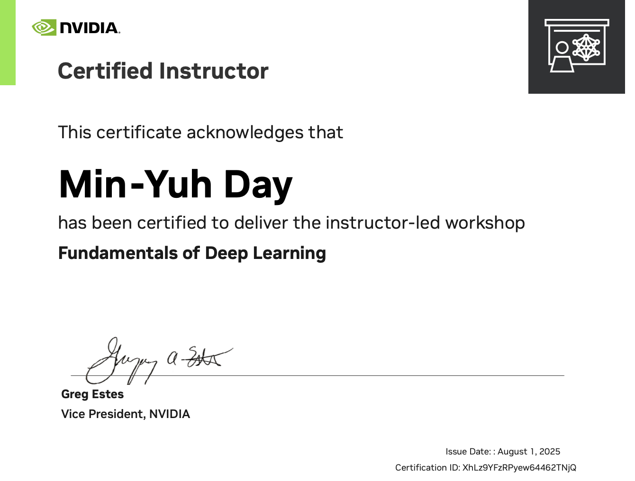
https://learn.nvidia.com/certificates?id=ny50l3TXT5W8Q_6kENkIaQ

Slide 11

https://learn.nvidia.com/certificates?id=XhLz9YFzRPyew64462TNjQ

Slide 12

NVIDIA
Certified Instructors
(12 from Taiwan)
https://www.nvidia.com/en-us/training/instructor-directory/search/

Slide 13

NVIDIA
Certified Instructors
(14 from Taiwan)
(2 from NTPU)(April 2025)
https://www.nvidia.com/en-us/training/instructor-directory/search/

Slide 14
NVIDIA Developer Program
NVIDIA
Deep Learning Institute (DLI)
https://developer.nvidia.com/join-nvidia-developer-program
https://learn.nvidia.com/

Slide 15
Get NVIDIA DLI Certificate
Before the NVIDIA Workshop
Step 1. Join NVIDIA Developer Program (Free)
https://developer.nvidia.com/join-nvidia-developer-program
Step 2. Visit NVIDIA Deep Learning Institute (DLI)
https://learn.nvidia.com/
Step 3. Enroll "Building RAG Agents with LLMs" Self-Paced Course (Free)
https://learn.nvidia.com/courses/course-detail?course_id=course-v1:DLI+S-FX-15+V1

Slide 16
Get NVIDIA DLI Certificate
Welcome to NVIDIA DLI "Building RAG Agents with LLMs" workshop.
Step 1. Visit https://learn.nvidia.com/dli-event
Step 2. Enter the event code: NTPU_RAG_AMBASSADOR_OC25
Step 3. Complete the NVIDIA DLI course and review the course datasheet at https://developer.nvidia.com/dli/getready

Slide 17
NVIDIA Deep Learning Institute (DLI)
Building RAG Agents with LLMs
workshop
Step 1.
Visit
https://learn.nvidia.com/dli-event
Step 2.
Enter the event code: NTPU_RAG_AMBASSADOR_OC25
Self-Paced Course
Building RAG Agents With LLMs
Certificate available
Free
8 hours
Instructor-Led Workshop
Building RAG Agents With LLMs
Certificate available
$500
8 hours
https://www.nvidia.com/en-us/learn/learning-path/generative-ai-llm/

Slide 18

Get NVIDIA Certificate
https://learn.nvidia.com/certificates?id=ed-qOCIMQaatzU8SNUNxgw

Slide 19

Join the NVIDIA Developer Program take one of the complimentary technical self-paced courses
(worth up to $90)
https://developer.nvidia.com/join-nvidia-developer-program

Slide 20
NVIDIA Deep Learning Institute (DLI)
Self-Paced Course
Generative AI Explained
Free
2 hours
Self-Paced Course
Getting Started With Deep Learning
Certificate available
$90
8 hours
Instructor-Led Workshop
Fundamentals of Deep Learning
Certificate available
$500
8 hours
Self-Paced Course
Introduction to Transformer-Based Natural Language Processing
Certificate available
$30
6 hours
Self-Paced Course
Building RAG Agents With LLMs
Certificate available
Free
8 hours
Instructor-Led Workshop
Building RAG Agents With LLMs
Certificate available
$500
8 hours
Self-Paced Course
Generative AI with Diffusion Models
Certificate available
$90
8 hours
Instructor-Led Workshop
Generative AI with Diffusion Models
Certificate available
$500
8 hours
https://www.nvidia.com/en-us/learn/learning-path/generative-ai-llm/

Slide 21
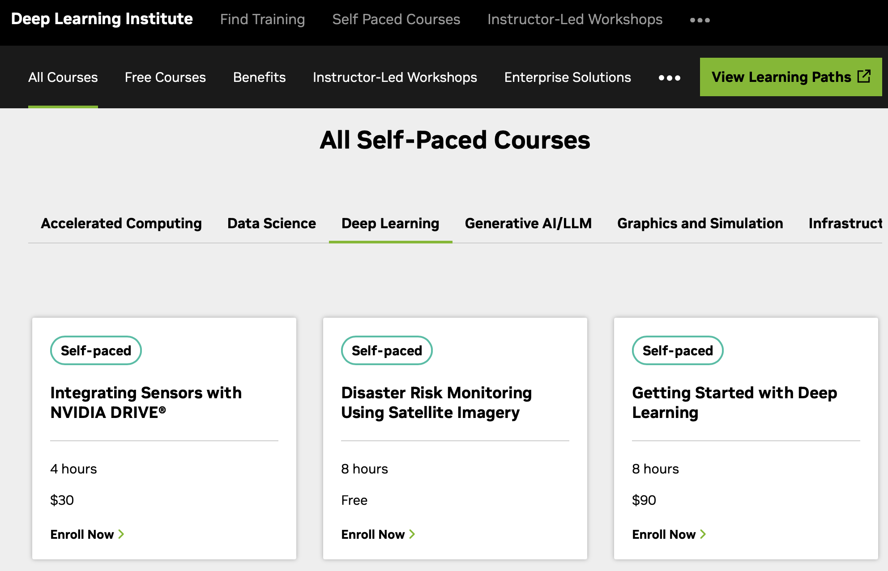
NVIDIA Getting Started with Deep Learning
Source: NVIDIA DLI (2025), Getting Started with Deep Learning, https://learn.nvidia.com/courses/course-detail?course_id=course-v1:DLI+S-FX-01+V1

Slide 22

NVIDIA Getting Started with Deep Learning
Source: NVIDIA DLI (2025), Getting Started with Deep Learning, https://learn.nvidia.com/courses/course-detail?course_id=course-v1:DLI+S-FX-01+V1

Slide 23

NVIDIA Deep Learning Institute (DLI)
Generative AI
https://learn.nvidia.com/en-us/training/find-training?q=Generative+AI

Slide 24

Building RAG Agents with LLMs
https://learn.nvidia.com/courses/course-detail?course_id=course-v1:DLI+S-FX-15+V1

Slide 25

Generative AI Explained
https://learn.nvidia.com/courses/course-detail?course_id=course-v1:DLI+S-FX-15+V1

Slide 26

Introduction to Transformer-Based
Natural Language Processing
https://learn.nvidia.com/courses/course-detail?course_id=course-v1:DLI+S-FX-08+V1

Slide 27

Generative AI with Diffusion Models
https://learn.nvidia.com/courses/course-detail?course_id=course-v1:DLI+S-FX-14+V1

Slide 28

Join the NVIDIA Developer Program take one of the complimentary technical self-paced courses (worth up to $90)
https://developer.nvidia.com/join-nvidia-developer-program

Slide 29

Join the NVIDIA Developer Program take one of the complimentary technical self-paced courses (worth up to $90)
https://developer.nvidia.com/join-nvidia-developer-program

Slide 30

Join the NVIDIA Developer Program take one of the complimentary technical self-paced courses (worth up to $90)
https://developer.nvidia.com/join-nvidia-developer-program

Slide 31

Join the NVIDIA Developer Program take one of the complimentary technical self-paced courses (worth up to $90)
https://developer.nvidia.com/join-nvidia-developer-program

Slide 32

Join the NVIDIA Developer Program take one of the complimentary technical self-paced courses (worth up to $90)
https://developer.nvidia.com/join-nvidia-developer-program

Slide 33

Join the NVIDIA Developer Program take one of the complimentary technical self-paced courses (worth up to $90)
https://developer.nvidia.com/join-nvidia-developer-program

Slide 34

NVIDIA Deep Learning Institute (DLI)
https://learn.nvidia.com/my-learning

Slide 35

NVIDIA Deep Learning Institute (DLI)
https://learn.nvidia.com/my-learning

Slide 36

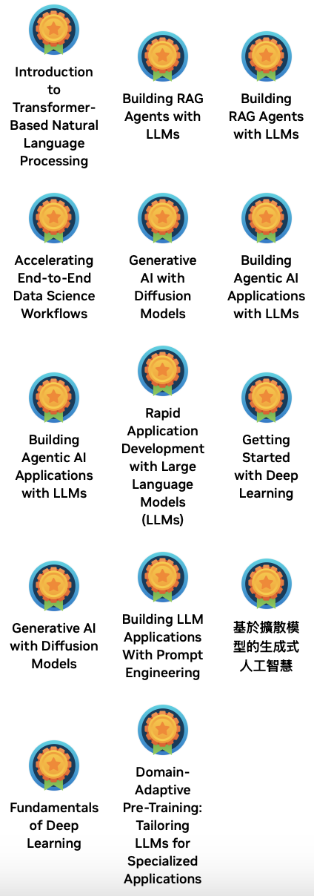

Deep Learning Institute (DLI)
https://learn.nvidia.com/my-learning

Slide 37

https://learn.nvidia.com/certificates?id=ed-qOCIMQaatzU8SNUNxgw

Slide 38

NVIDIA Deep Learning Institute (DLI)
https://learn.nvidia.com/en-us/training/self-paced-courses

Slide 39
Building RAG Agents with LLMs
https://learn.nvidia.com/courses/course-detail?course_id=course-v1:DLI+S-FX-15+V1

Slide 40

Building RAG Agents with LLMs
Source: NVIDIA DLI (2024), Building RAG Agents with LLMs, https://learn.nvidia.com/courses/course-detail?course_id=course-v1:DLI+S-FX-15+V1

Slide 41

Building RAG Agents with LLMs
https://learn.nvidia.com/my-learning

Slide 42

Building RAG Agents with LLMs
https://learn.nvidia.com/courses/course?course_id=course-v1:DLI+S-FX-15+V1

Slide 43

Building RAG Agents with LLMs
https://learn.nvidia.com/courses/course?course_id=course-v1:DLI+S-FX-15+V1

Slide 44

Building RAG Agents with LLMs
https://learn.nvidia.com/courses/course?course_id=course-v1:DLI+S-FX-15+V1

Slide 45

Building RAG Agents with LLMs
https://learn.nvidia.com/courses/course?course_id=course-v1:DLI+S-FX-15+V1

Slide 46

Building RAG Agents with LLMs
https://learn.nvidia.com/courses/course?course_id=course-v1:DLI+S-FX-15+V1

Slide 47

Building RAG Agents with LLMs
https://learn.nvidia.com/courses/course?course_id=course-v1:DLI+S-FX-15+V1

Slide 48

Building RAG Agents with LLMs
https://learn.nvidia.com/courses/course?course_id=course-v1:DLI+S-FX-15+V1

Slide 49
NVIDIA
Fundamentals of Deep Learning

Slide 50
NVIDIA Getting Started with Deep Learning
Learn how deep learning works through hands-on exercises in computer vision and natural language processing.
Learning Objectives
  Learn the fundamental techniques and tools required to train a deep learning model
  Gain experience with common deep learning data types and model architectures
  Enhance datasets through data augmentation to improve model accuracy
  Leverage transfer learning between models to achieve efficient results with less data and computation
  Build confidence to take on your own project with a modern deep learning framework
Source: NVIDIA DLI (2025), Getting Started with Deep Learning, https://learn.nvidia.com/courses/course-detail?course_id=course-v1:DLI+S-FX-01+V1

Slide 51
NVIDIA Getting Started with Deep Learning
1: An Introduction to Deep Learning
2: The Theory Behind Neural Networks
3: Convolutional Neural Networks
4: Data Augmentation and Deployment
5: Pre-trained Models
6: Natural Language Processing
7: Wrap-up and Assessment
Source: NVIDIA DLI (2025), Getting Started with Deep Learning, https://learn.nvidia.com/courses/course-detail?course_id=course-v1:DLI+S-FX-01+V1

Slide 52
NVIDIA Getting Started with Deep Learning
Source: NVIDIA DLI (2025), Getting Started with Deep Learning, https://learn.nvidia.com/courses/course-detail?course_id=course-v1:DLI+S-FX-01+V1

Slide 53
NVIDIA Getting Started with Deep Learning
Source: NVIDIA DLI (2025), Getting Started with Deep Learning, https://learn.nvidia.com/courses/course-detail?course_id=course-v1:DLI+S-FX-01+V1

Slide 54
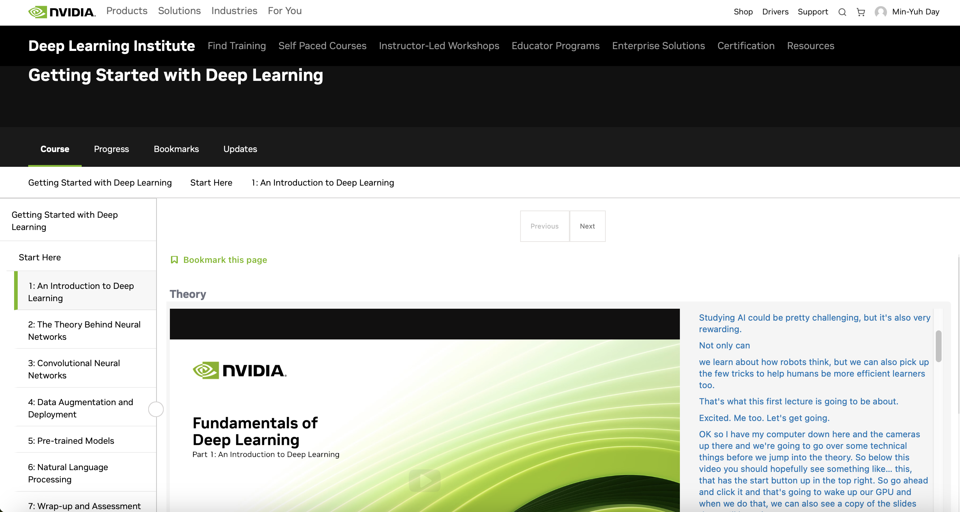
NVIDIA Getting Started with Deep Learning
Source: NVIDIA DLI (2025), Getting Started with Deep Learning, https://learn.nvidia.com/courses/course-detail?course_id=course-v1:DLI+S-FX-01+V1

Slide 55
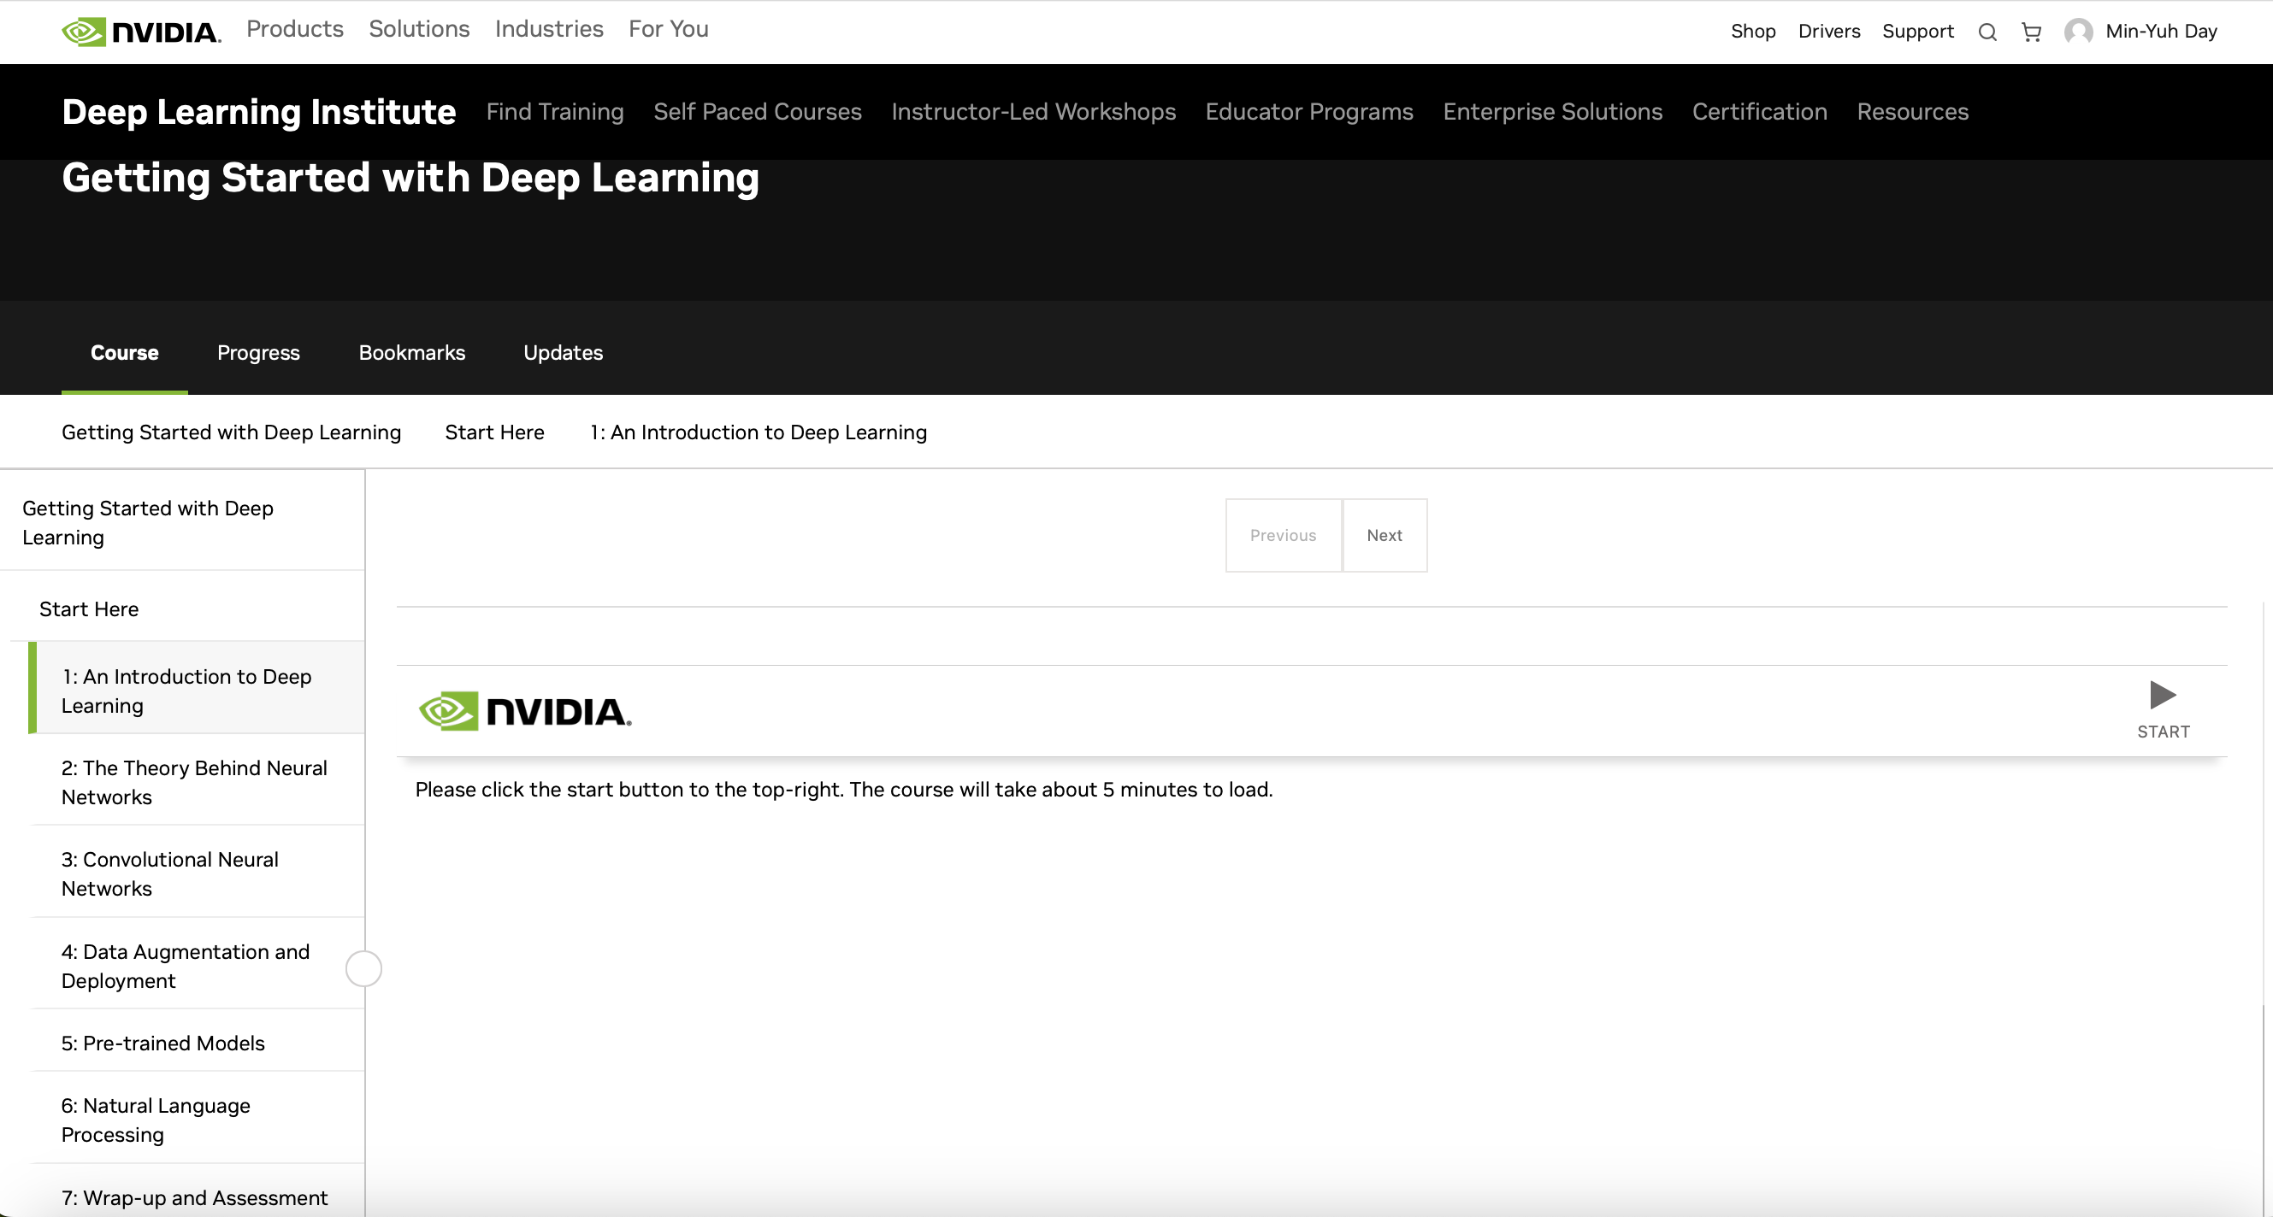
NVIDIA Getting Started with Deep Learning
Source: NVIDIA DLI (2025), Getting Started with Deep Learning, https://learn.nvidia.com/courses/course-detail?course_id=course-v1:DLI+S-FX-01+V1

Slide 56
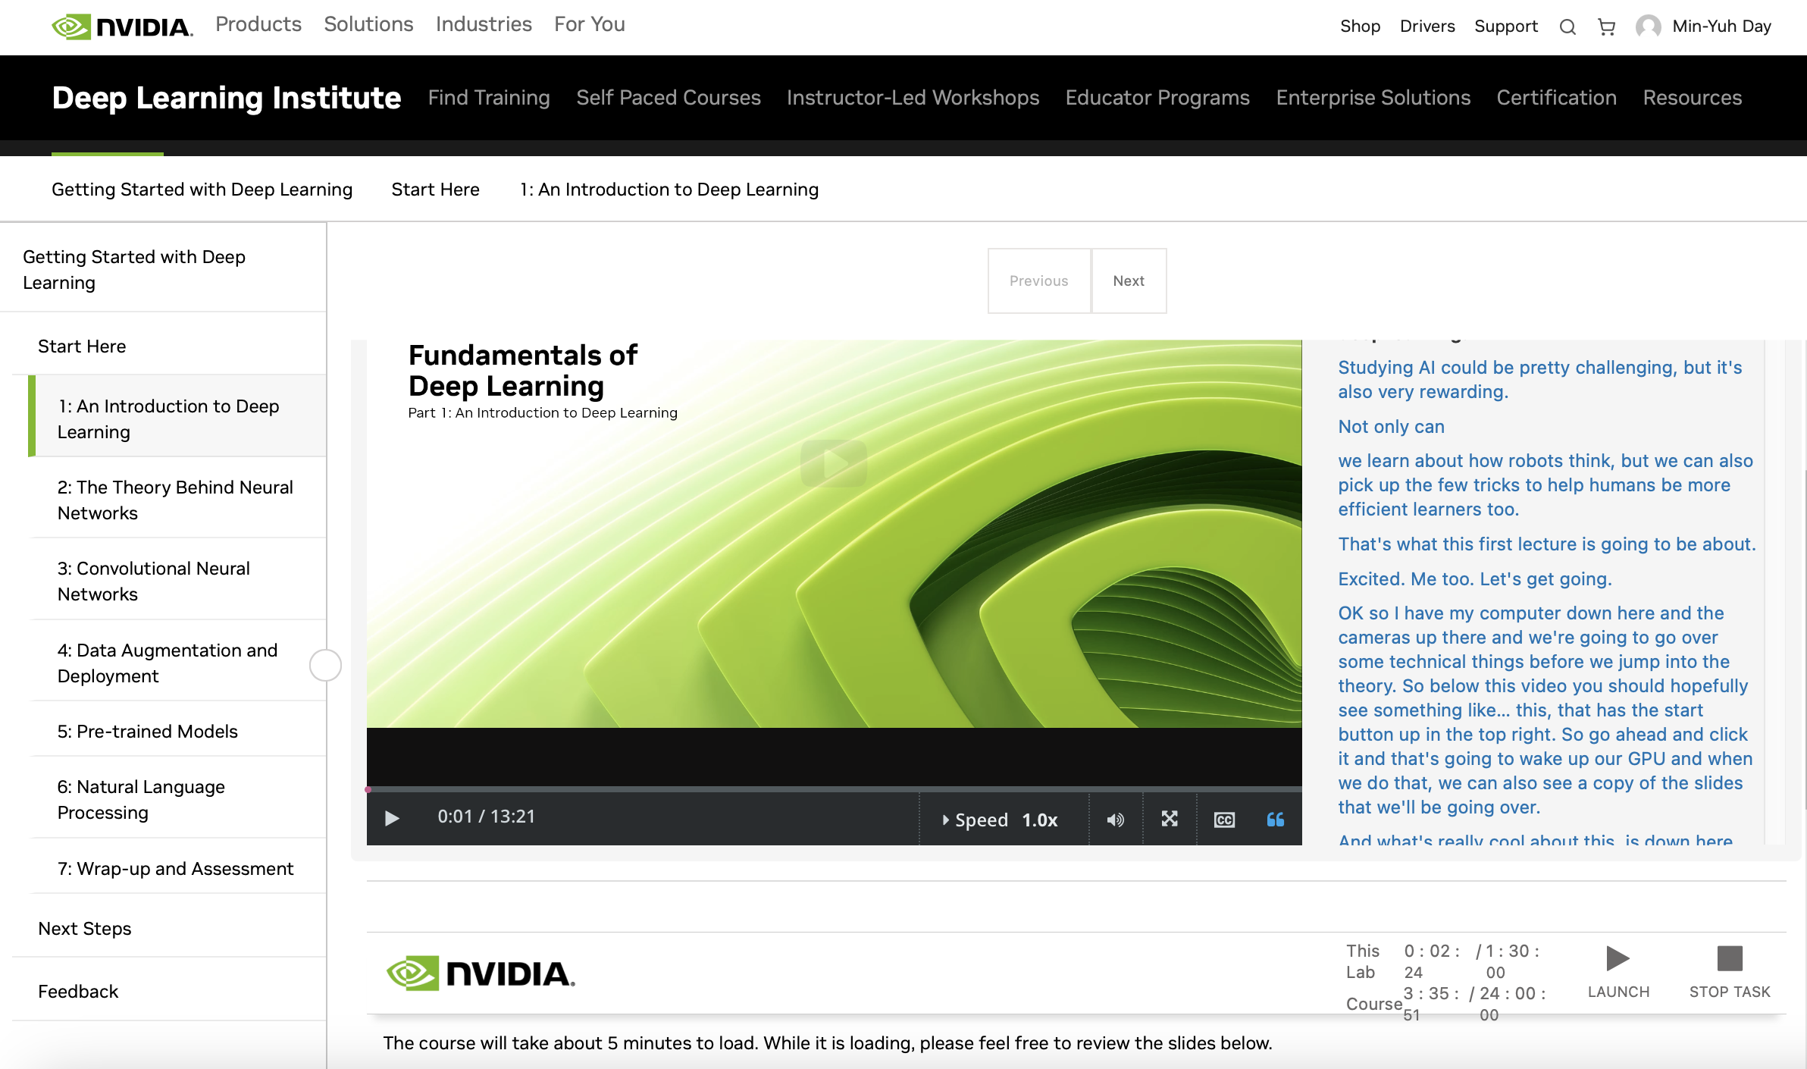
NVIDIA Getting Started with Deep Learning
Source: NVIDIA DLI (2025), Getting Started with Deep Learning, https://learn.nvidia.com/courses/course-detail?course_id=course-v1:DLI+S-FX-01+V1

Slide 57
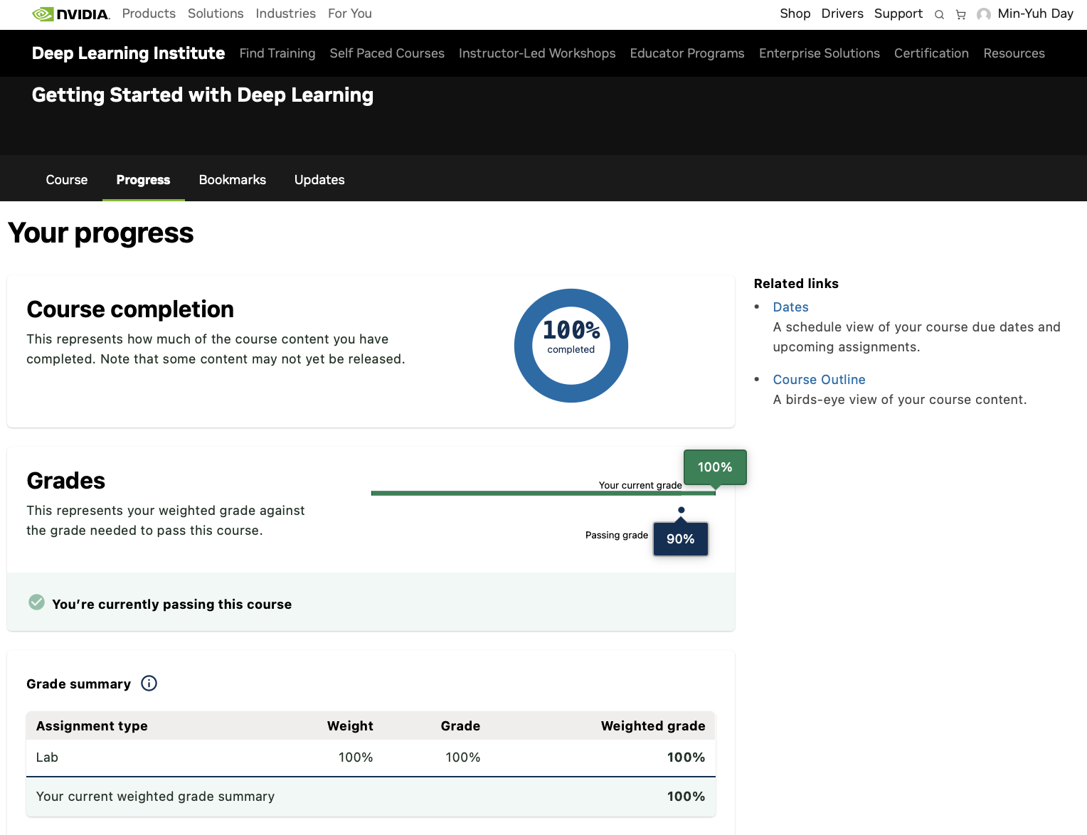
NVIDIA Getting Started with Deep Learning
Source: NVIDIA DLI (2025), Getting Started with Deep Learning, https://learn.nvidia.com/courses/course-detail?course_id=course-v1:DLI+S-FX-01+V1

Slide 58
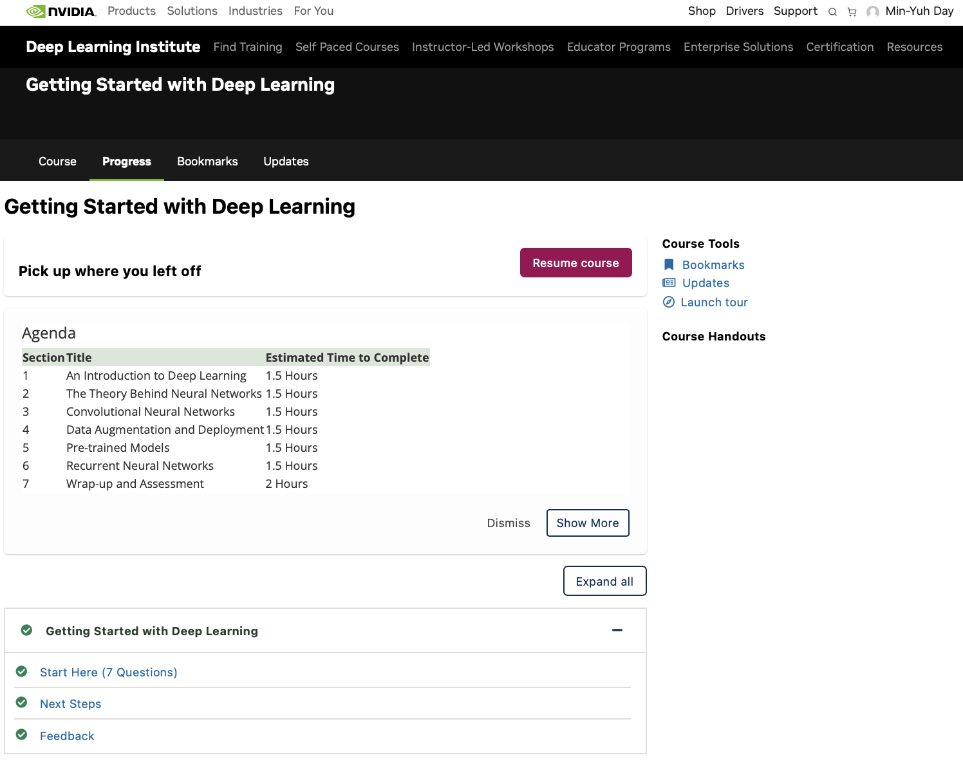
NVIDIA Getting Started with Deep Learning
Source: NVIDIA DLI (2025), Getting Started with Deep Learning, https://learn.nvidia.com/courses/course-detail?course_id=course-v1:DLI+S-FX-01+V1

Slide 59
NVIDIA Getting Started with Deep Learning
Section | Title | Estimated Time to Complete
1 | An Introduction to Deep Learning | 1.5 Hours
2 | The Theory Behind Neural Networks | 1.5 Hours
3 | Convolutional Neural Networks | 1.5 Hours
4 | Data Augmentation and Deployment | 1.5 Hours
5 | Pre-trained Models | 1.5 Hours
6 | Recurrent Neural Networks | 1.5 Hours
7 | Wrap-up and Assessment | 2 Hours
Source: NVIDIA DLI (2025), Getting Started with Deep Learning, https://learn.nvidia.com/courses/course-detail?course_id=course-v1:DLI+S-FX-01+V1

Slide 60

NVIDIA Getting Started with Deep Learning
Source: NVIDIA DLI (2025), Getting Started with Deep Learning, https://learn.nvidia.com/courses/course-detail?course_id=course-v1:DLI+S-FX-01+V1

Slide 61

NVIDIA Getting Started with Deep Learning
Source: NVIDIA DLI (2025), Getting Started with Deep Learning, https://learn.nvidia.com/courses/course-detail?course_id=course-v1:DLI+S-FX-01+V1

Slide 62
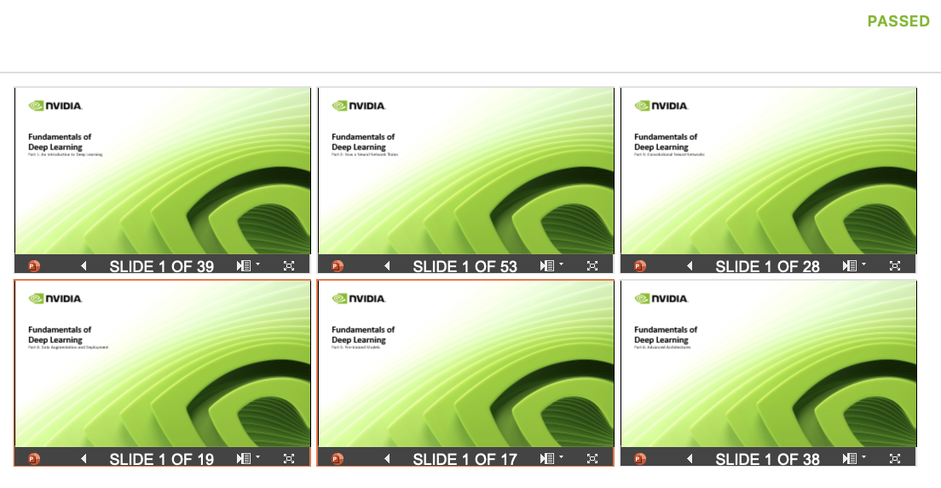
NVIDIA Getting Started with Deep Learning
Source: NVIDIA DLI (2025), Getting Started with Deep Learning, https://learn.nvidia.com/courses/course-detail?course_id=course-v1:DLI+S-FX-01+V1

Slide 63
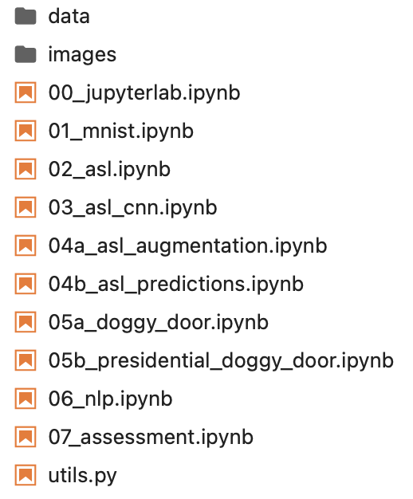
NVIDIA Getting Started with Deep Learning
Source: NVIDIA DLI (2025), Getting Started with Deep Learning, https://learn.nvidia.com/courses/course-detail?course_id=course-v1:DLI+S-FX-01+V1

Slide 64
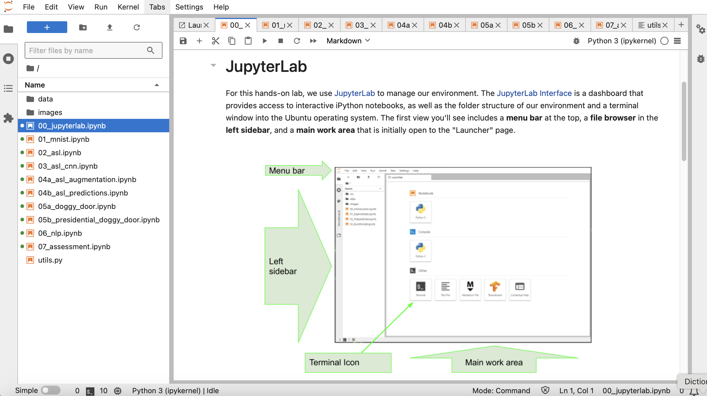
NVIDIA Getting Started with Deep Learning
Source: NVIDIA DLI (2025), Getting Started with Deep Learning, https://learn.nvidia.com/courses/course-detail?course_id=course-v1:DLI+S-FX-01+V1

Slide 65
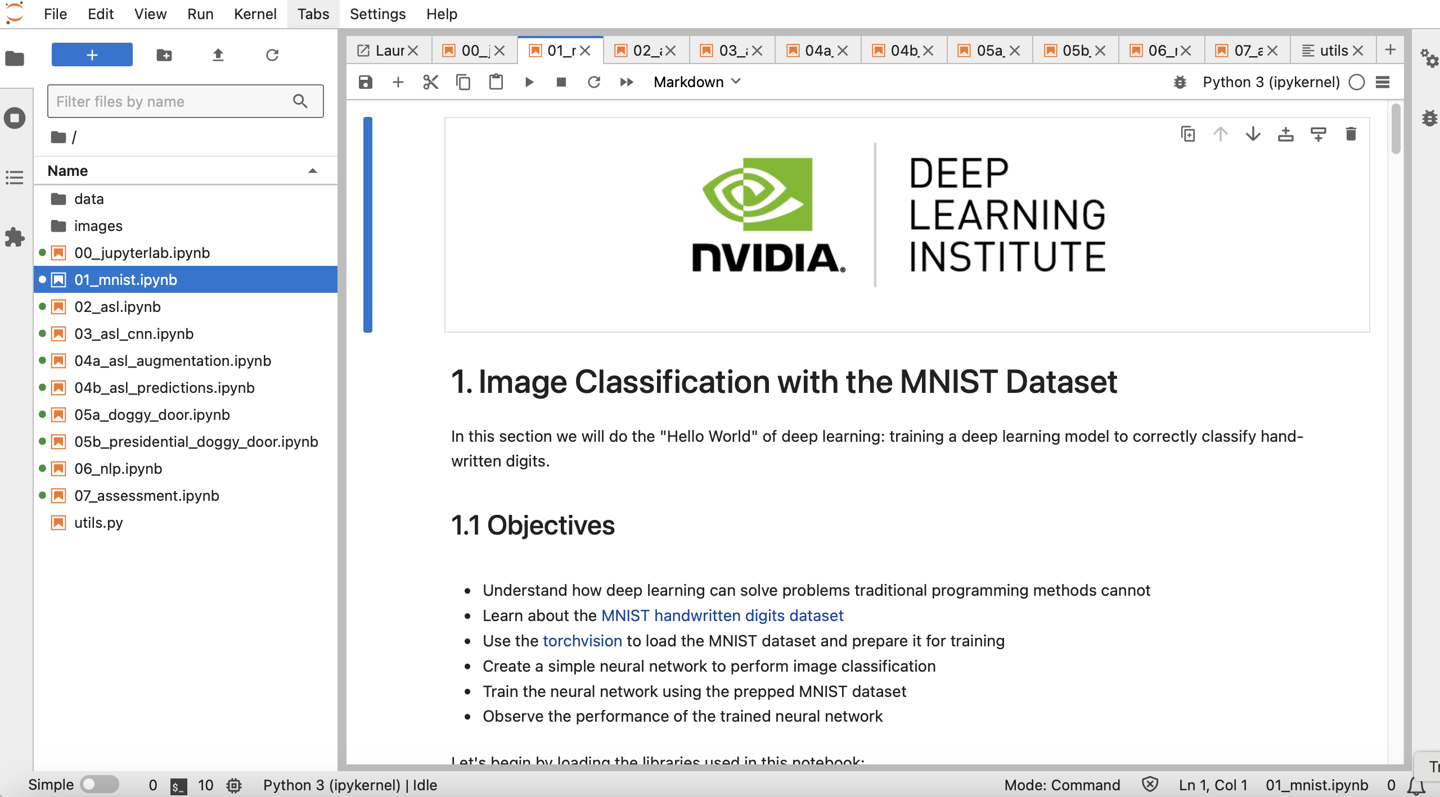
NVIDIA Getting Started with Deep Learning
Source: NVIDIA DLI (2025), Getting Started with Deep Learning, https://learn.nvidia.com/courses/course-detail?course_id=course-v1:DLI+S-FX-01+V1

Slide 66
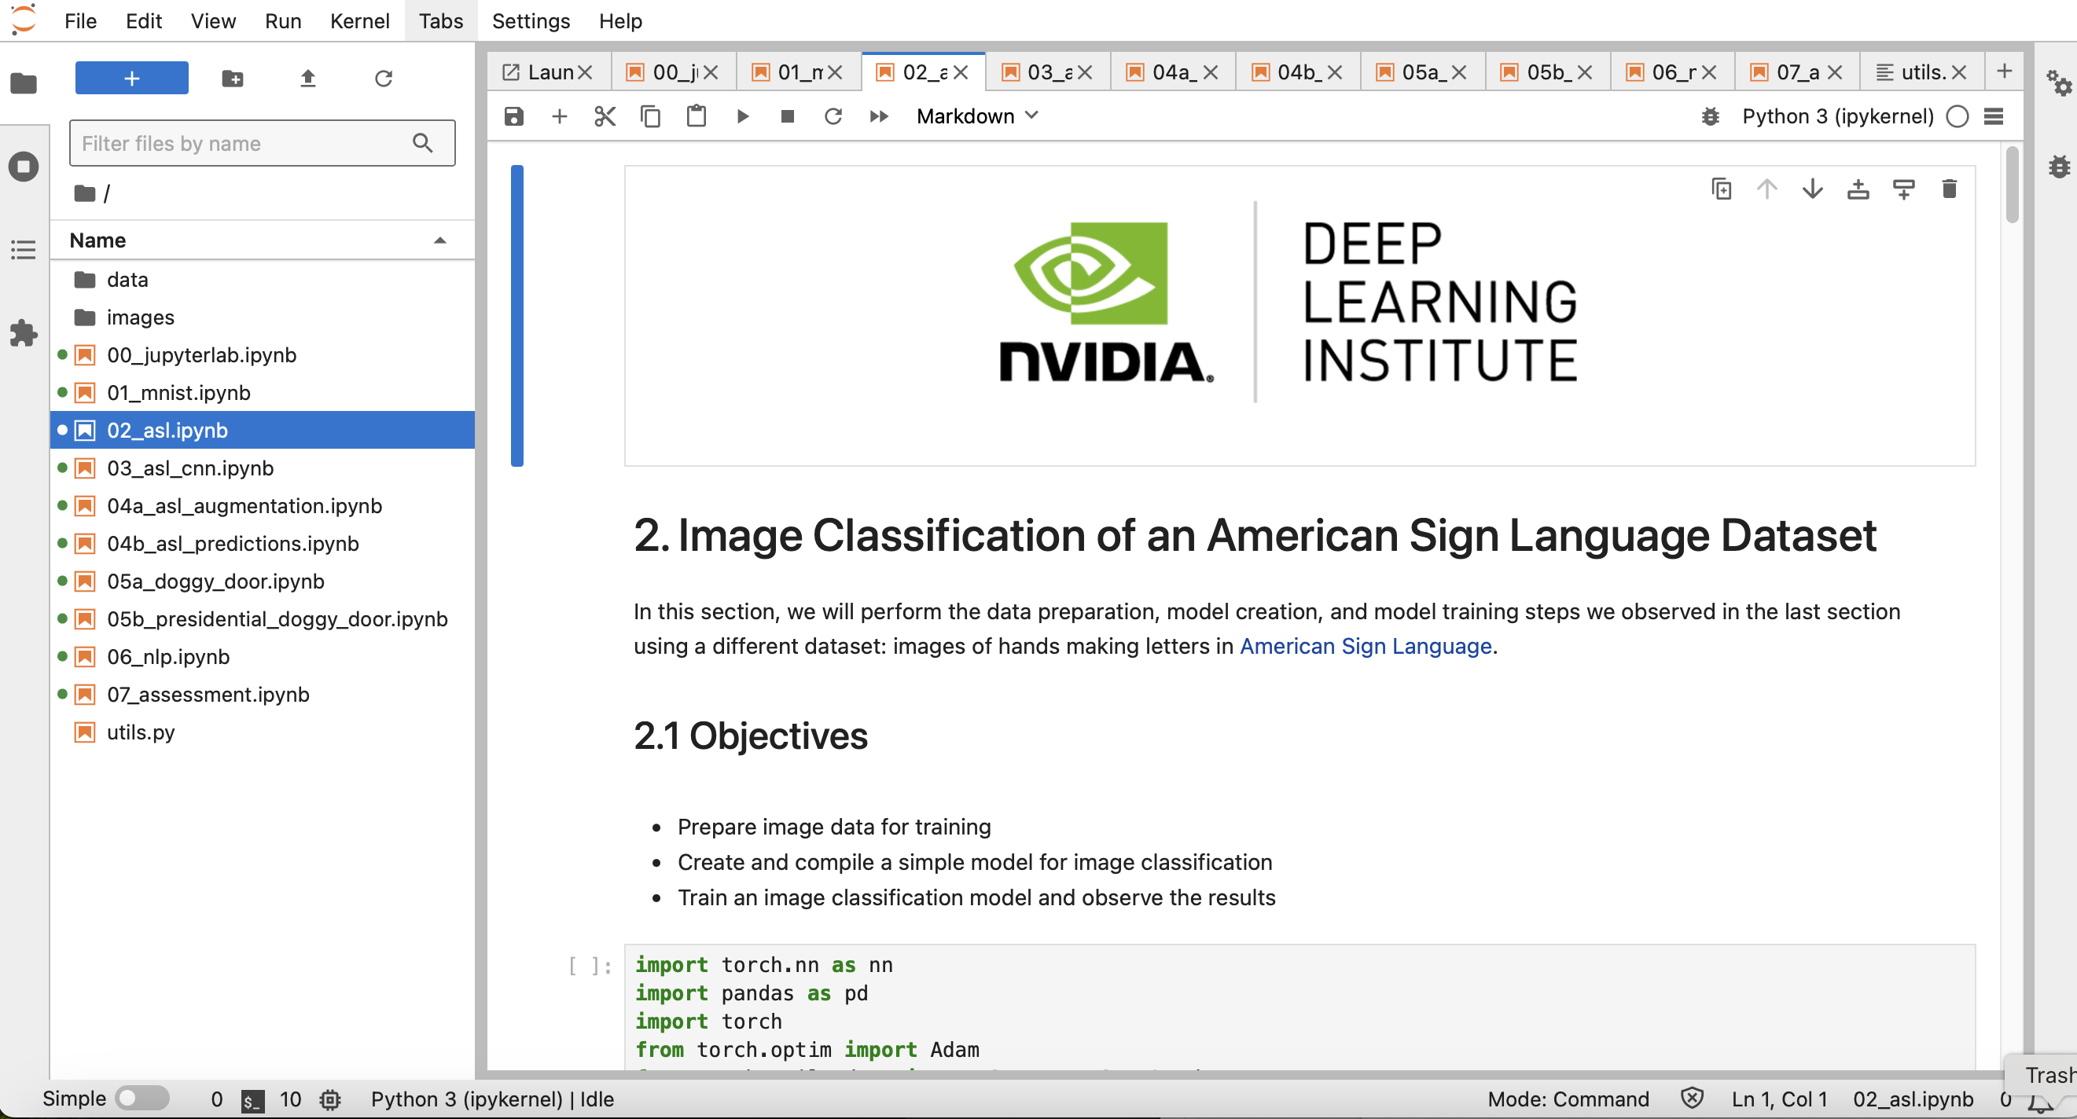
NVIDIA Getting Started with Deep Learning
Source: NVIDIA DLI (2025), Getting Started with Deep Learning, https://learn.nvidia.com/courses/course-detail?course_id=course-v1:DLI+S-FX-01+V1

Slide 67
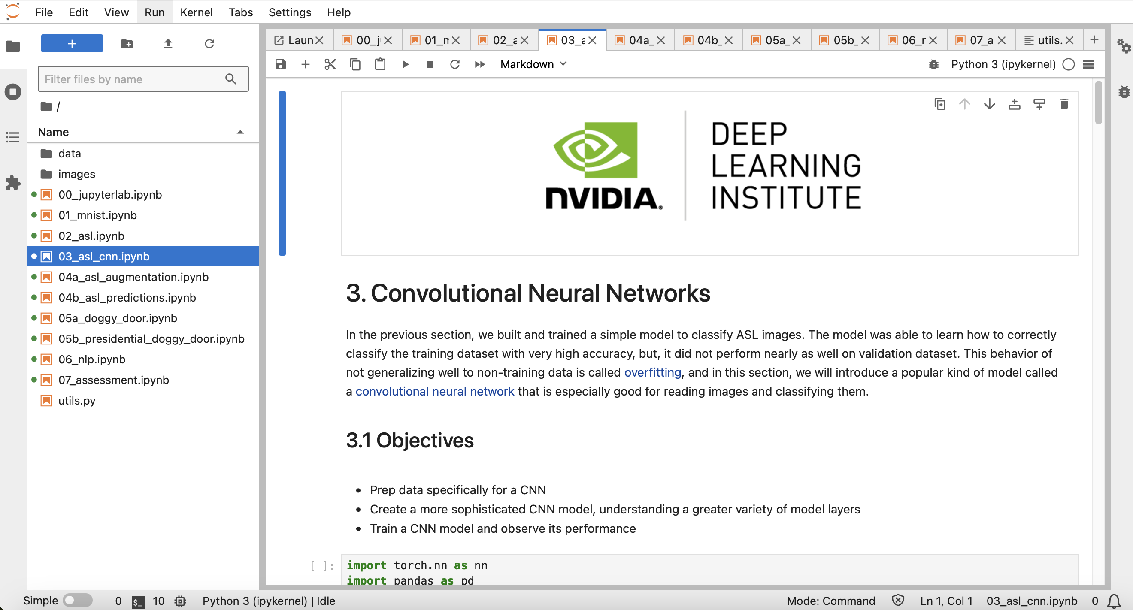
NVIDIA Getting Started with Deep Learning
Source: NVIDIA DLI (2025), Getting Started with Deep Learning, https://learn.nvidia.com/courses/course-detail?course_id=course-v1:DLI+S-FX-01+V1

Slide 68
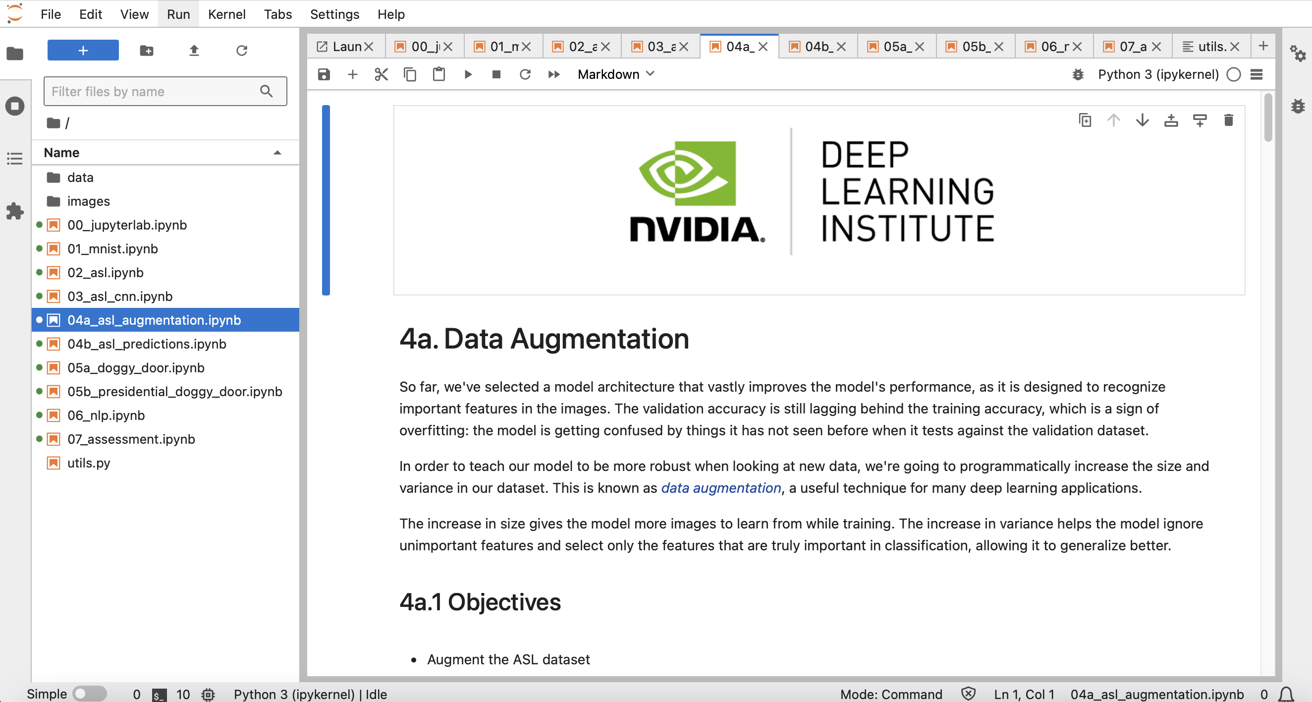
NVIDIA Getting Started with Deep Learning
Source: NVIDIA DLI (2025), Getting Started with Deep Learning, https://learn.nvidia.com/courses/course-detail?course_id=course-v1:DLI+S-FX-01+V1

Slide 69
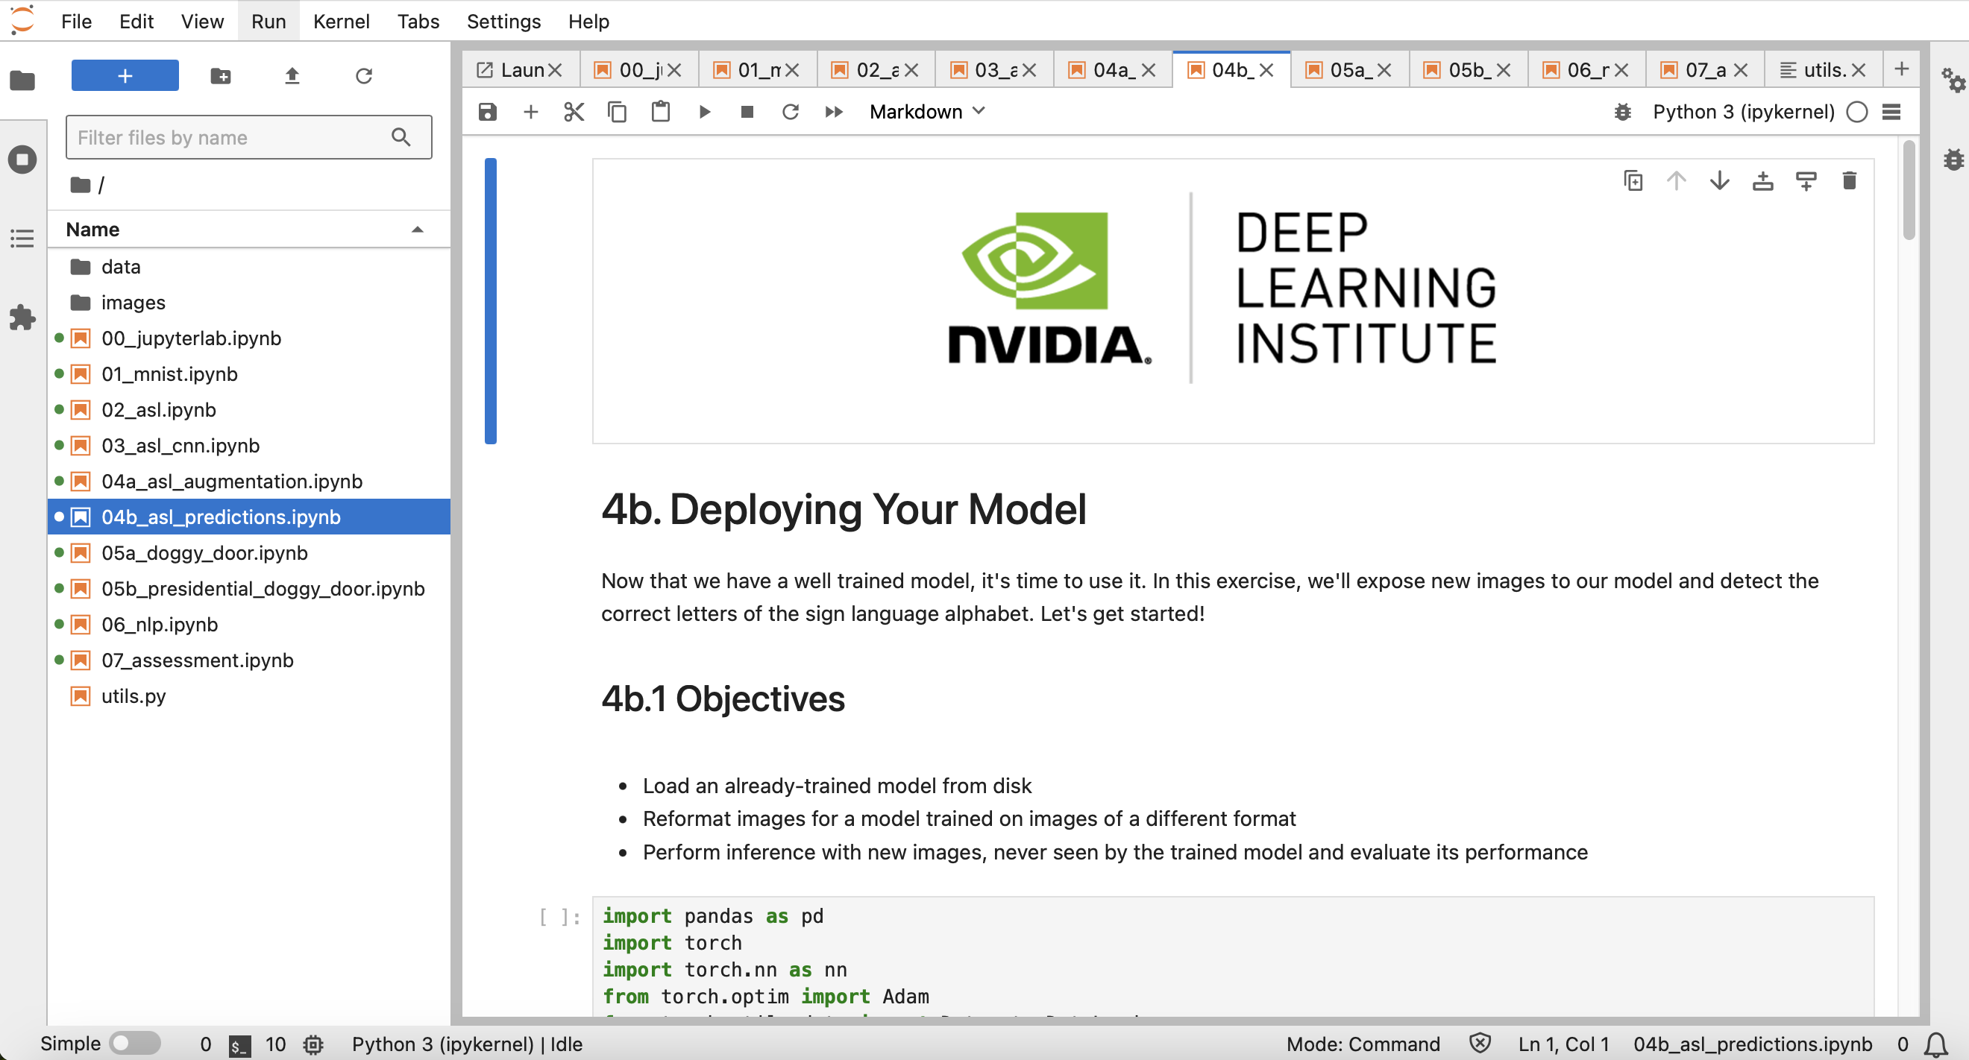
NVIDIA Getting Started with Deep Learning
Source: NVIDIA DLI (2025), Getting Started with Deep Learning, https://learn.nvidia.com/courses/course-detail?course_id=course-v1:DLI+S-FX-01+V1

Slide 70
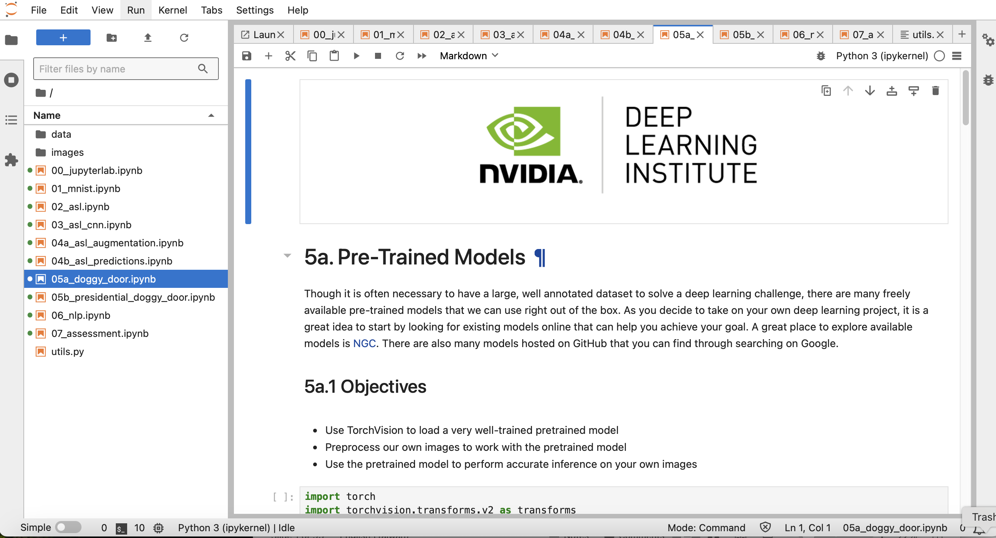
NVIDIA Getting Started with Deep Learning
Source: NVIDIA DLI (2025), Getting Started with Deep Learning, https://learn.nvidia.com/courses/course-detail?course_id=course-v1:DLI+S-FX-01+V1

Slide 71
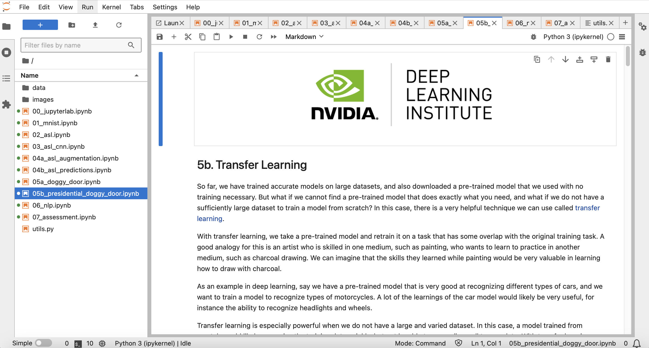
NVIDIA Getting Started with Deep Learning
Source: NVIDIA DLI (2025), Getting Started with Deep Learning, https://learn.nvidia.com/courses/course-detail?course_id=course-v1:DLI+S-FX-01+V1

Slide 72
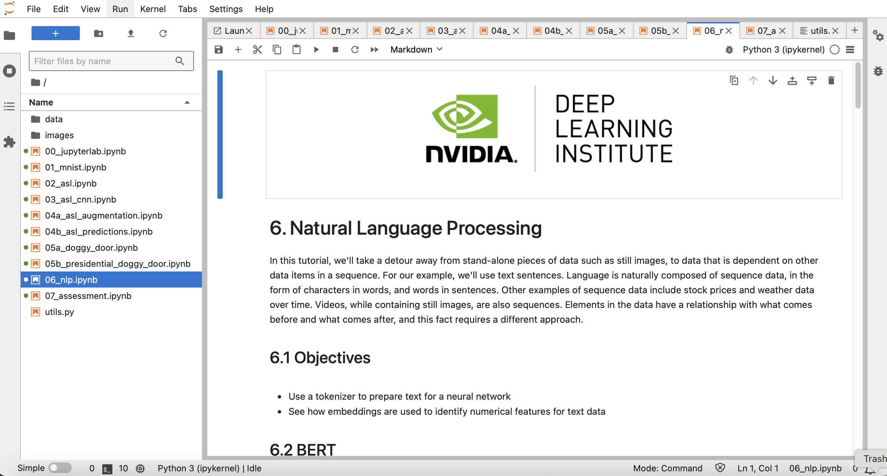
NVIDIA Getting Started with Deep Learning
Source: NVIDIA DLI (2025), Getting Started with Deep Learning, https://learn.nvidia.com/courses/course-detail?course_id=course-v1:DLI+S-FX-01+V1

Slide 73
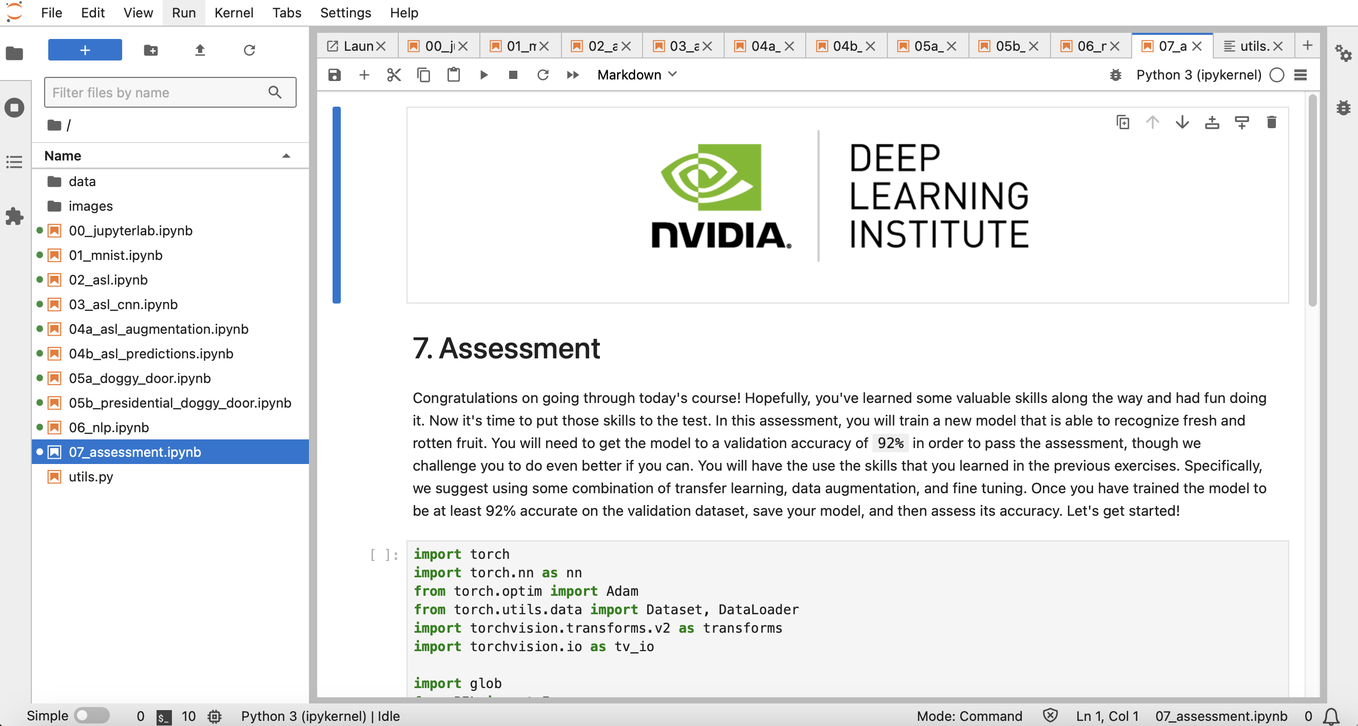
NVIDIA Getting Started with Deep Learning
Source: NVIDIA DLI (2025), Getting Started with Deep Learning, https://learn.nvidia.com/courses/course-detail?course_id=course-v1:DLI+S-FX-01+V1

Slide 74
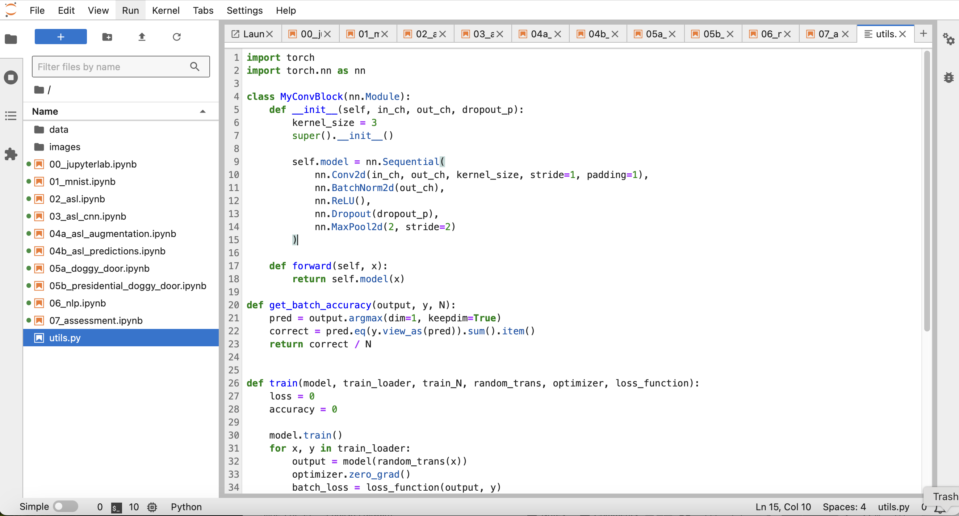
NVIDIA Getting Started with Deep Learning
Source: NVIDIA DLI (2025), Getting Started with Deep Learning, https://learn.nvidia.com/courses/course-detail?course_id=course-v1:DLI+S-FX-01+V1

Slide 75
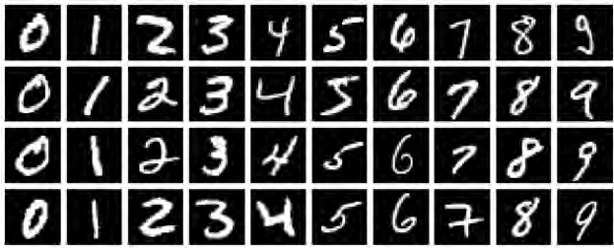
NVIDIA Getting Started with Deep Learning
MNIST Handwritten Digits
Source: NVIDIA DLI (2025), Getting Started with Deep Learning, https://learn.nvidia.com/courses/course-detail?course_id=course-v1:DLI+S-FX-01+V1

Slide 76
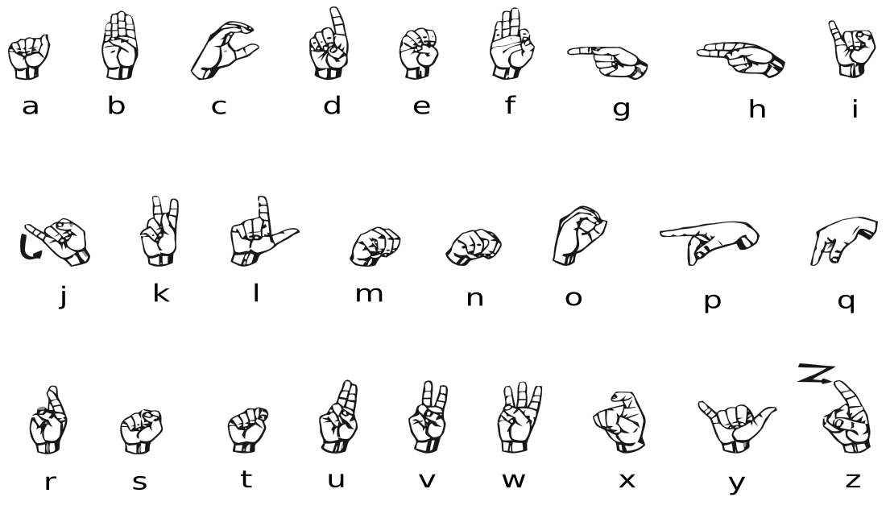


NVIDIA Getting Started with Deep Learning
American Sign Language (ASL) Alphabet
Source: NVIDIA DLI (2025), Getting Started with Deep Learning, https://learn.nvidia.com/courses/course-detail?course_id=course-v1:DLI+S-FX-01+V1

Slide 77
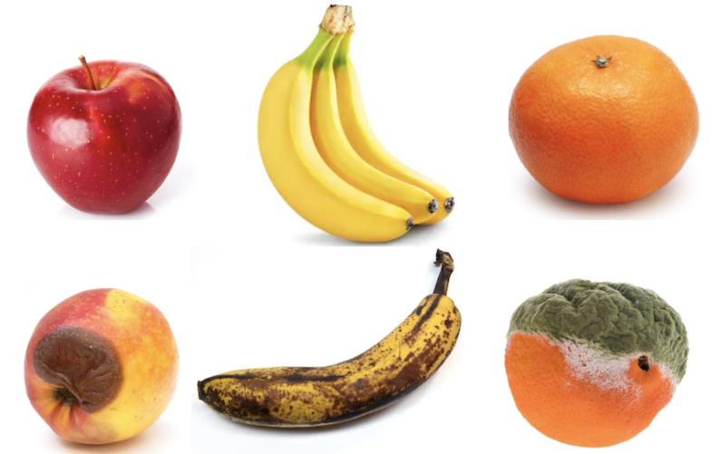
NVIDIA Getting Started with Deep Learning
Fruits fresh and rotten for classification
Kaggle Datasets: https://www.kaggle.com/datasets/sriramr/fruits-fresh-and-rotten-for-classification
Source: NVIDIA DLI (2025), Getting Started with Deep Learning, https://learn.nvidia.com/courses/course-detail?course_id=course-v1:DLI+S-FX-01+V1

Slide 78
Fundamentals of
Deep Learning
Part 1: An Introduction to Deep Learning
Source: NVIDIA DLI (2025), Getting Started with Deep Learning, https://learn.nvidia.com/courses/course-detail?course_id=course-v1:DLI+S-FX-01+V1
78
78

Slide 79
Fundamentals of
Deep Learning
Agenda
• | Part 1: An Introduction to Deep Learning
• | Part 2: How a Neural Network Trains
• | Part 3: Convolutional Neural Networks
• | Part 4: Data Augmentation and Deployment
• | Part 5: Pre-Trained Models
• | Part 6: Advanced Architectures
Source: NVIDIA DLI (2025), Getting Started with Deep Learning, https://learn.nvidia.com/courses/course-detail?course_id=course-v1:DLI+S-FX-01+V1
79
79

Slide 80
The Goals of This Course
Get you up and on your feet quickly
Build a foundation to tackle a deep learning project right away
We won’t cover the whole field, but we’ll get a great head start
Foundation from which to read articles, follow tutorials, take further classes
Source: NVIDIA DLI (2025), Getting Started with Deep Learning, https://learn.nvidia.com/courses/course-detail?course_id=course-v1:DLI+S-FX-01+V1
80
80
Notes:
We want to get you up and on your feet quickly, and give you the tools and theory necessary to jump into the field and tackle your own problems right away
We won’t be able to cover the whole field of deep learning, but we’ll give you a valuable set of skills and a solid understanding of how to practice deep learning today
The goal is also to prepare you to dive deeper into your learning, allowing you a foundation for reading articles, following tutorials, or taking further deep learning classes

Slide 81


Human Vs Machine Learning
Relaxed Alertness
Human | Machine
Rest and Digest | Training
Fight-or-flight | Prediction
Source: NVIDIA DLI (2025), Getting Started with Deep Learning, https://learn.nvidia.com/courses/course-detail?course_id=course-v1:DLI+S-FX-01+V1
81
Notes:
The technical term for learning while having fun is called “Relaxed alertness”. Our brains effectively have a gate between when we’re executing versus when we’re learning, much like how neural nets and machine learning models have “training” and “prediction” phases.
When we’re stressed out, our “Fight-or-flight” systems kick in which helps us be top performers, but that doesn’t leave a lot of resources for learning, which is a high energy process. When we’re relaxed, sure, we might not be “in the zone”, but if we’re intrigued, this is the best state for our brains to act as sponges.
https://tomprof.stanford.edu/posting/1508
One thing that’s fascinating about AI is that because it’s designed to mimic the way that humans learn, we’re going to see in action effective learning strategies. The Artificial Intelligences that we’ll be building don’t have things like “ego” or “fear of failure”, and that’s one reason why their effective learners.
At the same time there are (thankfully) many areas of learning where humans still outperform our ai counterparts. The people who capture our human ability to learn in a mathematical way are the ones who make the biggest discoveries in artificial intelligence. By working together with our robot brethren, we can learn just as much about ourselves.

Slide 82
History of AI
Source: NVIDIA DLI (2025), Getting Started with Deep Learning, https://learn.nvidia.com/courses/course-detail?course_id=course-v1:DLI+S-FX-01+V1
82
Notes:
Deep learning is a subset of a wider field called Artificial Intelligence. We won’t try to teach you about the whole field, but let’s start with a bit of history.

Slide 83
Beginning of Artificial Intelligence
Computers are made in part to complete human tasks
Early on, generalized intelligence looked possible
Turned out to be harder than expected
Source: NVIDIA DLI (2025), Getting Started with Deep Learning, https://learn.nvidia.com/courses/course-detail?course_id=course-v1:DLI+S-FX-01+V1
83
Notes:
Humans have been trying to teach computers to perform tasks since their invention. It’s sort of the purpose of a computer, to do something at the level, or beyond what a human can do
Early in the days of computers, many people were convinced that they would achieve human level intelligence within a few decades
It turned out that generalized human intelligence was beyond the grasp of computers at that time (although today, we’re starting to see systems that look a whole lot like human intelligence)

Slide 84
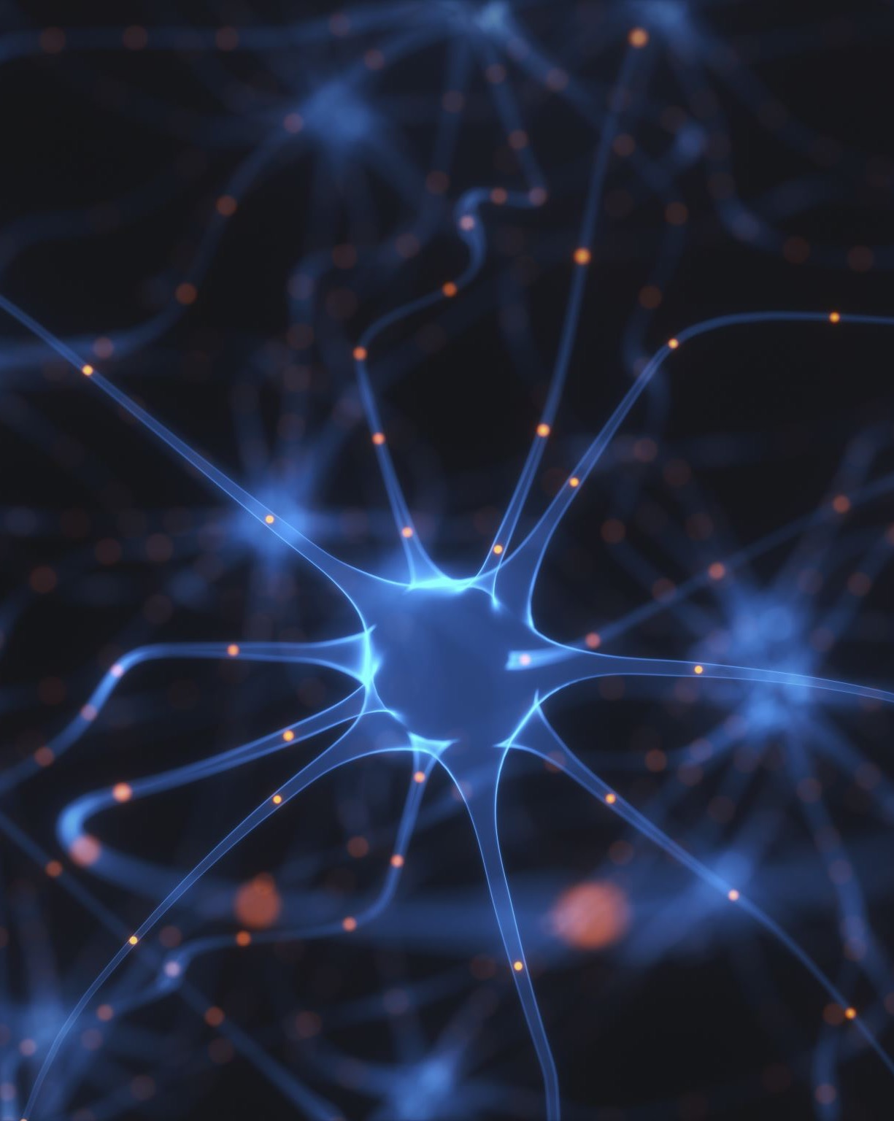
Early Neural Networks
Inspired by biology
Created in the 1950’s
Outclassed by Von Neumann Architecture
Source: NVIDIA DLI (2025), Getting Started with Deep Learning, https://learn.nvidia.com/courses/course-detail?course_id=course-v1:DLI+S-FX-01+V1
84
Notes:
It wasn’t long after the invention of the computer that people started experimenting with artificial neural networks, inspired by the structure and function of human brains
There was some success with using these networks to perform tasks such as reading handwritten digits and playing backgammon, but it did not appear that this would be the major path forward. A major factor was the computational resources at the time. As we’ll see in the hands-on labs, these networks take time to train. Imagine how long it would take to train forty years ago!
These early neural networks were outperformed by something called the Von Neumann Architecture, which is the basis for modern CPUs
https://www.cs.cornell.edu/boom/2001sp/Tsinteris/gammon.htm
https://cs.stanford.edu/people/eroberts/courses/soco/projects/neural-networks/History/history1.html
https://www.computerscience.gcse.guru/theory/von-neumann-architecture

Slide 85
Expert Systems
Highly complex
Programmed by hundreds of engineers
Rigorous programming of many rules
Source: NVIDIA DLI (2025), Getting Started with Deep Learning, https://learn.nvidia.com/courses/course-detail?course_id=course-v1:DLI+S-FX-01+V1
85
Notes:
Instead, intelligence in computers was achieved through the building of expert systems.
https://hbr.org/1988/03/putting-expert-systems-to-work
These were highly complex systems that took hundreds to thousands of engineers to build, where the computer was taught to complete tasks by the rigorous programming of many rules
These systems where meant to mimic that of a human Subject Matter Expert, hence the name.
https://www.britannica.com/technology/expert-system
An example would be a stock trading robot that traded based on user defined limits, or a machine to give medical diagnosis given a list of symptoms.

Slide 86



Expert Systems - Limitations
What are these three images?
Source: NVIDIA DLI (2025), Getting Started with Deep Learning, https://learn.nvidia.com/courses/course-detail?course_id=course-v1:DLI+S-FX-01+V1
86
Notes:
However these systems had limitations. Most importantly, rules for these systems had to be understood, defined, and programmed by humans. The computer could only do as much as a human engineer was able to understand and turn directly into code.
For some well-defined tasks (ex, creating a system to route customers to sales representatives based on region and vertical) this was fine. But for some tasks that are simple to humans, it was extremely difficult to build rules that a computer could follow
As an example, take a moment to answer in your head what these are pictures of (cat, car, ocean)
For most humans this is quite a simple task. But how would you teach a newborn child, let alone a computer to do what you just did?

Slide 87

How Do Children Learn?
Expose them to lots of data
Give them the “correct answer”
They will pick up the important patterns on their own
Source: NVIDIA DLI (2025), Getting Started with Deep Learning, https://learn.nvidia.com/courses/course-detail?course_id=course-v1:DLI+S-FX-01+V1
87
Notes:
With children, we expose them to lots of data, and help them learn by supplying the correct answer. A very popular learning technique is “Trail and Error”, where students make a prediction on what is the correct answer, and if they’re wrong, adjust their approach. It turns out that deep learning is very much like this.

Slide 88
The Deep Learning Revolution
Source: NVIDIA DLI (2025), Getting Started with Deep Learning, https://learn.nvidia.com/courses/course-detail?course_id=course-v1:DLI+S-FX-01+V1
88
Notes:
So there was a period through the nineties and early 2000’s where powerful AI appeared to many to be a pipe dream
Neural networks were being used for some tasks, but fantastic results were not being achieved.
Two major things came together to spawn the era of deep learning that we’re in today

Slide 89

Data
Networks need a lot of information to learn from
The digital era and the internet has supplied that data
Source: NVIDIA DLI (2025), Getting Started with Deep Learning, https://learn.nvidia.com/courses/course-detail?course_id=course-v1:DLI+S-FX-01+V1
89
Notes:
The first is data. In order for a neural network to learn to understand a task, it needs to be exposed to a lot of different data. In order for a neural network to understand what a cat is, it needs to be exposed to a lot of pictures of cats, as well as a lot of pictures of things that are not cats.
The era of the internet has supplied mountains of data for networks to learn on.

Slide 90

Computing Power
Need a way for our artificial “brain” to
observe lots of data within a practical amount of time.
Source: NVIDIA DLI (2025), Getting Started with Deep Learning, https://learn.nvidia.com/courses/course-detail?course_id=course-v1:DLI+S-FX-01+V1
90
Notes:
The other major factor in the onset of modern deep learning was processing power.
If we’re effectively training an artificial brain, let’s think about our own for a second. How many gigabytes of information do we observe in a given second? What’s the “frame rate” of life? What is the resolution of the human eye?
https://www.discovery.com/science/mexapixels-in-human-eye#:~:text=According%20to%20scientist%20and%20photographer,what%20does%20this%20mean%2C%20really%3F
While modern day AI is impressive, we humans process significantly more data in a second than an AI. One way machines can try to catch up to us humans is with higher computing power.

Slide 91

The Importance of the GPU
A Rendered Image
A Neural Network
Source: NVIDIA DLI (2025), Getting Started with Deep Learning, https://learn.nvidia.com/courses/course-detail?course_id=course-v1:DLI+S-FX-01+V1
91
Notes:
Left: A computer rendering of a marble: https://www.youtube.com/watch?v=H0_NZDSqR3Y&t=31s
Right: An abstraction of a neural network
It turns out that under the hood, neural networks are matrix multiplication machines. What other types of problems requires many matrix multiplications? Computer graphics! With computer graphics objects are represented as many tiny triangles working together to give the illusion of something more. With animation, simulation, and gaming, these tiny triangles are often transformed and rotated, requiring matrix manipulation.
Since neural networks and graphics are both built on top of the same fundamental mathematical problem, it’s no surprise that the hardware for one can effectively be used for the other.
An especially important invention in tackling this training was the parallel processor. The math required to train a neural network is not especially complex, but calculations must be performed (millions, billions, trillions?) of times, ideally at the same time.
Your average CPU might have 4, maybe 8 cores that allow parallel processing
However, a modern GPU, originally built for the purpose of computing the mathematics of graphics, are parallel processing juggernauts
The GPU that you will be using in this course today has (x thousand cores). These processors are incredibly well suited for deep learning, and NVIDIA is building its GPUs to be specifically architected for training.

Slide 92
What is Deep Learning?
Source: NVIDIA DLI (2025), Getting Started with Deep Learning, https://learn.nvidia.com/courses/course-detail?course_id=course-v1:DLI+S-FX-01+V1
92
Notes:
So what is Deep Learning and what makes it special?

Slide 93
Deep learning flips traditional programming on its head
Source: NVIDIA DLI (2025), Getting Started with Deep Learning, https://learn.nvidia.com/courses/course-detail?course_id=course-v1:DLI+S-FX-01+V1
93
Notes:
With deep learning, you flip the programming paradigm on its head

Slide 94
Traditional Programming
Building a Classifier
Define a set of rules for classification
Program those rules into the computer
Feed it examples, and the program uses the rules to classify
Source: NVIDIA DLI (2025), Getting Started with Deep Learning, https://learn.nvidia.com/courses/course-detail?course_id=course-v1:DLI+S-FX-01+V1
94
Notes:
For example, normally to build a classifier, you come up with a set of rules, and program those rules
Then when you want classify things, you give it a piece of data, and the rules are used to select a category

Slide 95
Machine Learning
Building a Classifier
Show model the examples with the answer of how to classify
Model takes guesses, we tell it if it’s right or not
Model learns to correctly categorize as it’s training. The system learns the rules on its own
Source: NVIDIA DLI (2025), Getting Started with Deep Learning, https://learn.nvidia.com/courses/course-detail?course_id=course-v1:DLI+S-FX-01+V1
95
Notes:
With deep learning, we first need a list of variables: inputs and their corresponding outputs. We don’t need to know the relationship between the inputs and the outputs, but the more accurate we can observe their values, the better. We’ll call this list of examples the dataset.
We then train a model by showing it the dataset and the correct outputs
The model keeps taking guesses, and finds out if it was right or not
It slowly learns to correctly categorize over the course of training
The fundamental difference is that instead of humans needing to identify and program the rules, a deep learning algorithm will learn them on its own

Slide 96
This is a Fundamental Shift
Source: NVIDIA DLI (2025), Getting Started with Deep Learning, https://learn.nvidia.com/courses/course-detail?course_id=course-v1:DLI+S-FX-01+V1
96
Notes:
This is a fundamental shift in the way we can build software systems

Slide 97
When to Choose Deep Learning
Classic Programming
Deep Learning
If rules are clear and straightforward, often better to program it
If rules are nuanced, complex, difficult to discern, use deep learning
Source: NVIDIA DLI (2025), Getting Started with Deep Learning, https://learn.nvidia.com/courses/course-detail?course_id=course-v1:DLI+S-FX-01+V1
97
Notes:
Deep learning is not always the right choice. If the decisions that need to be made to produce a result are very clear, it’s likely that it should just be programmed in the traditional way
However, if the rules are nuanced or complex, and humans would have a hard time describing them, let alone programming them, deep learning is a great choice

Slide 98
Deep Learning Compared to Other AI
Depth and complexity of networks
Up to billions of parameters (and growing)
Many layers in a model
Important for learning complex rules
Source: NVIDIA DLI (2025), Getting Started with Deep Learning, https://learn.nvidia.com/courses/course-detail?course_id=course-v1:DLI+S-FX-01+V1
98
Notes:
One thing that separates Deep Learning from traditional machine learning is the depth and complexity of the networks that are used. For especially complicated tasks such as natural language understanding (used for translations, text generation, other) networks can have billions of parameters.
The deep in deep learning refers to the many layers in a model that learn the important rules necessary for completing a task. These are often called hidden layers.
https://arxiv.org/ftp/arxiv/papers/1901/1901.06032.pdf

Slide 99
How Deep Learning is Transforming the World
Source: NVIDIA DLI (2025), Getting Started with Deep Learning, https://learn.nvidia.com/courses/course-detail?course_id=course-v1:DLI+S-FX-01+V1
99
Notes:
Deep learning has only been a major factor in the last decade or so, but it has had huge impacts on many industries

Slide 100
Computer Vision
Object Detection
Self-Driving Cars
Robotics and Manufacturing
Source: NVIDIA DLI (2025), Getting Started with Deep Learning, https://learn.nvidia.com/courses/course-detail?course_id=course-v1:DLI+S-FX-01+V1
100
Notes:
The field of Computer Vision has been around long before the field of Deep Learning, but because there are now more and more tagged high quality images available, Deep Learning is having a large influence.
The goal of computer vision is to teach machines to see and perceive images the way that humans do. Thanks to the complexity of our eyes, not to mention the processing our brains do with these images, this is no easy task!

Slide 101
Natural Language Processing
Real-time translation
Voice recognition
Virtual assistants
Source: NVIDIA DLI (2025), Getting Started with Deep Learning, https://learn.nvidia.com/courses/course-detail?course_id=course-v1:DLI+S-FX-01+V1
101
Notes:
Natural language processing, which we’ll also touch on in this course has helped make huge shifts, for example in highly accurate, real time language translation, as well as voice recognition and virtual assistants

Slide 102
Recommender Systems
Content curation
Targeted advertising
Shopping
Source: NVIDIA DLI (2025), Getting Started with Deep Learning, https://learn.nvidia.com/courses/course-detail?course_id=course-v1:DLI+S-FX-01+V1
102
Notes:
Recommender systems based on deep learning fuel the internet with content curated feeds such as facebook, music like spotify, video like youtube and netflix, as well as targeted online advertising and shopping recommendations (Amazon)

Slide 103
Reinforcement Learning
AlphaGo beats world champion in GO
AI bots beat professional videogamers
Stock Trading Robots
Source: NVIDIA DLI (2025), Getting Started with Deep Learning, https://learn.nvidia.com/courses/course-detail?course_id=course-v1:DLI+S-FX-01+V1
103
Notes:
Reinforcement learning has achieved incredible results in matching human expert performance, such as the AI alpha-go, which beat the world champion in what is considered one of the most difficult and complex games in the world. AI bots are now also taking on world experts in complex videogames such as Starcraft and DOTA
The list goes on, and we’ll talk about some exciting models and advancements later in the course

Slide 104
Overview of the Course
Source: NVIDIA DLI (2025), Getting Started with Deep Learning, https://learn.nvidia.com/courses/course-detail?course_id=course-v1:DLI+S-FX-01+V1
104

Slide 105

Hands on Exercises
Get comfortable with the process of deep learning
Exposure to different models and datatypes
Get a jump-start to tackle your own projects
Source: NVIDIA DLI (2025), Getting Started with Deep Learning, https://learn.nvidia.com/courses/course-detail?course_id=course-v1:DLI+S-FX-01+V1
105
Notes:
The course is split up into a series of exercises to get you comfortable with deep learning
We’re going to be exposing you to some different models, as well as different datatypes
With only a day, we can’t expose you to everything, but the goal is to give you a significant jump-start, so that you’ll be able to have a foundation to pursue your own projects moving forward

Slide 106
Structure of the Course
“Hello World” of Deep Learning
Train a more complicated model
New architectures and techniques to improve performance
Pre-trained models
Transfer learning
Source: NVIDIA DLI (2025), Getting Started with Deep Learning, https://learn.nvidia.com/courses/course-detail?course_id=course-v1:DLI+S-FX-01+V1
106
Notes:
Here’s the structure of the course:
- Train your first model (computer vision)
- Train a more complicated model
- Introduce new architectures and techniques to improve model performance and accuracy
- Using your trained model to make new predictions
- Using state-of-the art pre-trained models to solve a deep learning challenge
- Transfer the learning of one model to another to solve difficult deep learning challenges
- Train a language model to gain exposure to new types of data and architectures
- Appendices:
- Play around with cool models from around the web
- Learn to set up a deep learning environment to tackle your own projects

Slide 107
Platform of the Course
GPU powered cloud server
JupyterLab platform
Jupyter notebooks for interactive coding
Source: NVIDIA DLI (2025), Getting Started with Deep Learning, https://learn.nvidia.com/courses/course-detail?course_id=course-v1:DLI+S-FX-01+V1
107
Notes:
In this course you will be connected to a server that contains a very powerful GPU.
Deep learning training is possible to run on a CPU, but due to the computational complexity of the training, it is extremely beneficial to have the massive parallel processing that GPUs provide. Without it, you would be waiting around a lot, and we could not fit this course into a single day.
You will be connected to this powerful server through a software platform called JupyterLab. Jupyter lab is a platform that among other things runs jupyter notebooks. In these notebooks you’ll be able to run and edit Python code to accomplish the goals of the exercises

Slide 108




Software of This Course
Major deep learning platforms:
  TensorFlow + Keras (Google)
  PyTorch (Meta)
  MXNet (Apache)
We’ll be using PyTorch
Good idea to gain exposure to others moving forward
Source: NVIDIA DLI (2025), Getting Started with Deep Learning, https://learn.nvidia.com/courses/course-detail?course_id=course-v1:DLI+S-FX-01+V1
108
Notes:
There are a few big players in the deep learning space when it comes to frameworks
The three most commonly used are Tensorflow + Keras (google), Pytorch (facebook), and MXNet (apache)
They are all great choices, and neither of them is a clear winner
In this course we’ll be using PyTorch, but as you continue your deep learning journey, we recommend that you gain some exposure to the others as well

Slide 109
First Exercise:
Classify Handwritten Digits
Source: NVIDIA DLI (2025), Getting Started with Deep Learning, https://learn.nvidia.com/courses/course-detail?course_id=course-v1:DLI+S-FX-01+V1
109

Slide 110
Hello Neural Networks
Train a network to correctly classify handwritten digits
Historically important and difficult task for computers
Try learning like a Neural Network
Get exposed to the example, and try to figure out the rules to how it works
Source: NVIDIA DLI (2025), Getting Started with Deep Learning, https://learn.nvidia.com/courses/course-detail?course_id=course-v1:DLI+S-FX-01+V1
110
Notes:
Before we get too much into theory and the specifics of deep learning, we’re going to act like an AI and play with a neural network right away. See if you can figure out how we went about constructing the model. Feel free to experiment and alter the code. You can always restart the GPU instance in order to get a fresh start if your curiosity gets a little too crazy.
You’ll start by teaching a model to understand and categorize hand-written digits
Recognizing handwriting is a historically important task in the history of AI, and one that is especially well suited to deep learning
You’ll be working on a dataset called MNIST, which contains 70,000 images of handwritten digits
You might feel that there’s a lot of information to absorb in this first exercise, but be patient with yourself, and don’t worry if it’s not all perfectly clear right away. You’ll be exposed to the steps of training several times over the course, and will gain an understanding through practice
The main goal is just to give you a sense of what training looks like, and we’ll fill in some of the details as we move on

Slide 111
NVIDIA Getting Started with Deep Learning
Source: NVIDIA DLI (2025), Getting Started with Deep Learning, https://learn.nvidia.com/courses/course-detail?course_id=course-v1:DLI+S-FX-01+V1

Slide 112
NVIDIA Getting Started with Deep Learning
Source: NVIDIA DLI (2025), Getting Started with Deep Learning, https://learn.nvidia.com/courses/course-detail?course_id=course-v1:DLI+S-FX-01+V1

Slide 113
NVIDIA Getting Started with Deep Learning
MNIST Handwritten Digits
Source: NVIDIA DLI (2025), Getting Started with Deep Learning, https://learn.nvidia.com/courses/course-detail?course_id=course-v1:DLI+S-FX-01+V1

Slide 114
Fundamentals of
Deep Learning
Part 2: How a Neural Network Trains
Source: NVIDIA DLI (2025), Getting Started with Deep Learning, https://learn.nvidia.com/courses/course-detail?course_id=course-v1:DLI+S-FX-01+V1
114

Slide 115
Fundamentals of
Deep Learning
Agenda
• | Part 1: An Introduction to Deep Learning
• | Part 2: How a Neural Network Trains
• | Part 3: Convolutional Neural Networks
• | Part 4: Data Augmentation and Deployment
• | Part 5: Pre-Trained Models
• | Part 6: Advanced Architectures
Source: NVIDIA DLI (2025), Getting Started with Deep Learning, https://learn.nvidia.com/courses/course-detail?course_id=course-v1:DLI+S-FX-01+V1
115

Slide 116
Recap of the Exercise
What just happened?
Edited our data (reshaped, normalized, to categorical)
Created our model
Compiled our model
Trained the model on our data
Loaded and visualized our data
Source: NVIDIA DLI (2025), Getting Started with Deep Learning, https://learn.nvidia.com/courses/course-detail?course_id=course-v1:DLI+S-FX-01+V1
116
Notes:
Okay, so what just happened? Let’s go over it step by step
We loaded and visualized our data
We edited our data to get it into the right shape, as well as normalizing the values between 0-1
We also edited our “answers” to be in a categorical form, instead of a number, as our model will better train with that type of answer
We then created our model, compiled our model, and trained our model on the data

Slide 117

Data Preparation
Input as an Array
28
[0,0,0,24,75,184,185,78,32,55,0,0,0…]
28
Source: NVIDIA DLI (2025), Getting Started with Deep Learning, https://learn.nvidia.com/courses/course-detail?course_id=course-v1:DLI+S-FX-01+V1
117
Notes:
Let’s start with our data. We received each 28x28 pixel image as an array of 784 integers.
We then normalized that data (make it between 0-1) by dividing it by 255 (the max value for a pixel)

Slide 118
Data Preparation
Targets as Categories
0
[1,0,0,0,0,0,0,0,0,0]
1
[0,1,0,0,0,0,0,0,0,0]
2
[0,0,1,0,0,0,0,0,0,0]
3
[0,0,0,1,0,0,0,0,0,0]
.
.
.
Source: NVIDIA DLI (2025), Getting Started with Deep Learning, https://learn.nvidia.com/courses/course-detail?course_id=course-v1:DLI+S-FX-01+V1
118
Notes:
We then took our ”answers” (or targets), which were in the format of an integer between 0-9 and made it categorical, representing it as an array of 0s with 1 at the index of the correct digit.

Slide 119
An Untrained Model
[ 0, 0, …, 0]
(784,)
… … …
(512,)
Layer
Size
… … …
(512,)
(10,)
Source: NVIDIA DLI (2025), Getting Started with Deep Learning, https://learn.nvidia.com/courses/course-detail?course_id=course-v1:DLI+S-FX-01+V1
119
Notes:
Let’s next talk about our model (show picture of model)
We can’t fully represent it in a slide, because it has many connections
Remember that there are 784 inputs, two layers of 512 neurons (or nodes), and an output layer of 10 neurons (one for each digit)
Every neuron in each layer is connected to every neuron in the next layer. In PyTorch, this is called a Linear layer, and in Keras, the same layer is called a “Dense” layer.
This means there are a lot of connections (784x512 + 512x512 + 512x10)
Looking at this, can anyone guess the approximate magnitude?
668,672 connections
(Each neuron also has a bias term, but we’ll get to that in a bit)
That’s a whole lot for a network for 4 layers
That can store a whole lot of information. Think about a megabyte of info (1 million bytes) and the fact that a megabyte is about 500 pages of text.
So if each neuron has a connection between the other, how do we store information?
We store it in the “weights” between two neurons
This is the analogous to the strength of connection between the neurons of our brain (although with some differences in the mechanisms)
So how do we update those weights?

Slide 120
A Simpler Model
Source: NVIDIA DLI (2025), Getting Started with Deep Learning, https://learn.nvidia.com/courses/course-detail?course_id=course-v1:DLI+S-FX-01+V1
120
Notes:
In order to understand how this network came about, let’s looks at the simplest possible model.

Slide 121
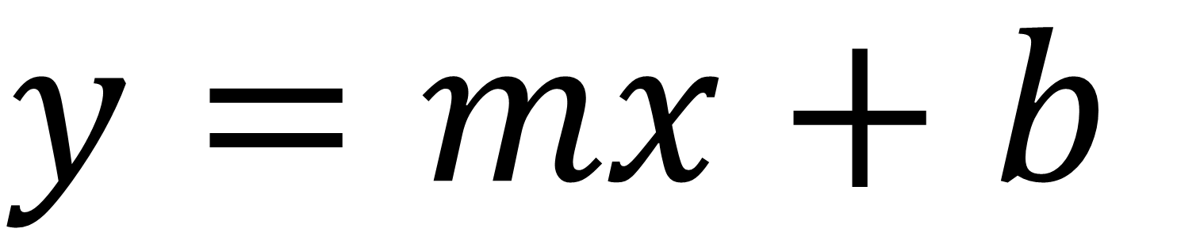
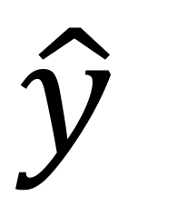
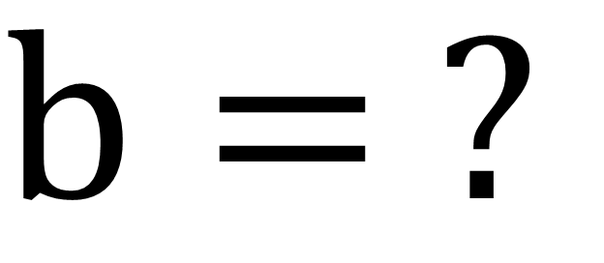
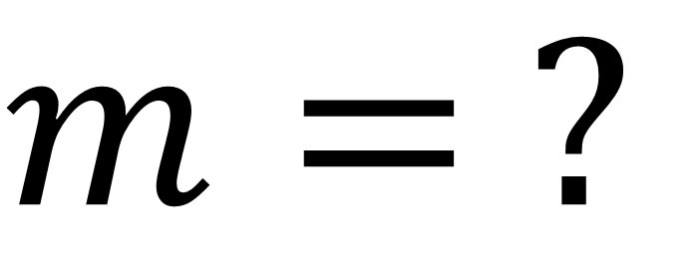
A Simpler Model
$$y=mx+b$$
x | y
1 | 3
2 | 5
m•x
$$m= ?$$
$$b= ?$$
$$\hat{y}$$
Source: NVIDIA DLI (2025), Getting Started with Deep Learning, https://learn.nvidia.com/courses/course-detail?course_id=course-v1:DLI+S-FX-01+V1
121
Notes:
Each of the circles on the slide before is a neuron. The earliest use case of this neuron was to build a regression line, good ol’ y = mx + b. Regression is when we use a continues input to predict a continuous output, like using how many seconds a pot of water has been sitting on the stove to predict the temperature of the water.
For each variable coming into our neuron, we’re going to find a slope (m), or “weight” for it. The “b”, or y-intercept, from y = mx + b is stored with the neuron.

Slide 122
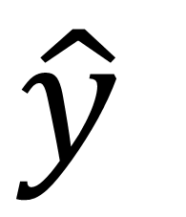
A Simpler Model
$$y=mx+b$$
x | y
1 | 3
2 | 5
m•x
$$m= ?$$
$$b= ?$$
$$\hat{y}$$
Source: NVIDIA DLI (2025), Getting Started with Deep Learning, https://learn.nvidia.com/courses/course-detail?course_id=course-v1:DLI+S-FX-01+V1
122
Notes:
Our goal here is to find a line that can go through these points. That way, we can use that line to make predictions.

Slide 123
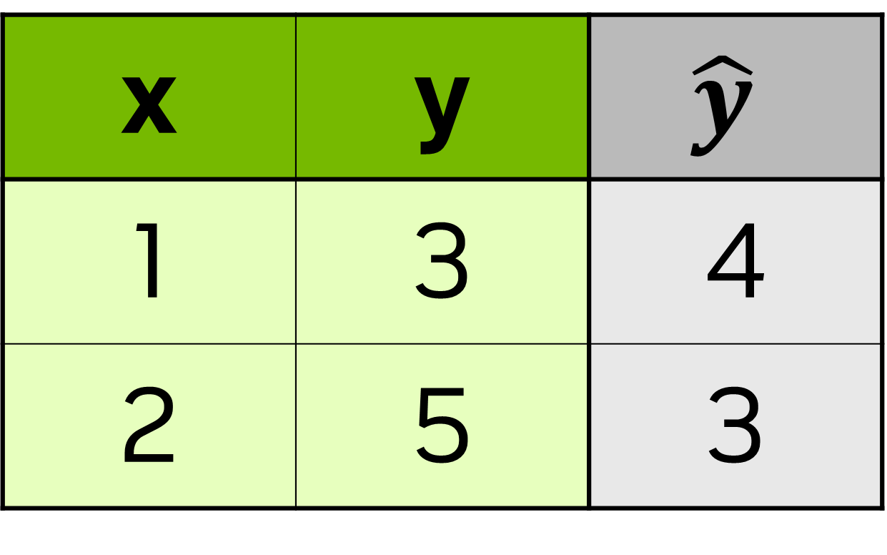
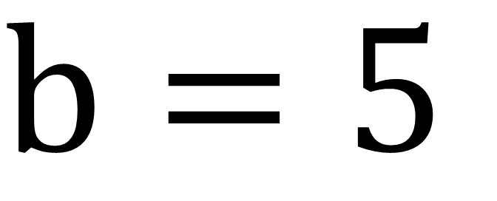
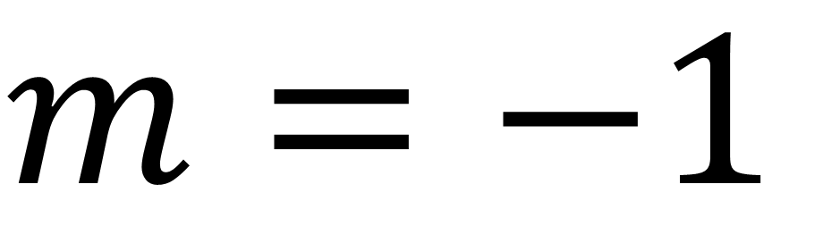
A Simpler Model
$$y=mx+b$$
x | y | $$\hat{y}$$
1 | 3 | 4
2 | 5 | 3
Start Random
m•x
$$m=−1$$
$$b=5$$
$$\hat{y}$$
Source: NVIDIA DLI (2025), Getting Started with Deep Learning, https://learn.nvidia.com/courses/course-detail?course_id=course-v1:DLI+S-FX-01+V1
123
Notes:
Some of you that have taken statistics before probably know of a more deterministic way to get m and b. (We can verify through algebra m = 2 and b = 1). We’re going to do a more trial and error approach. We’re going to pick a random value to start (usually between -1 and 1, but we’re going to pick -1 for m and 5 for b to make things easier to visualize)
The y hat here (the one with the little hat), is going to be our estimate of the true value, y. Most of the time, our guess is going to be a bit off, so how do we correct it?

Slide 124
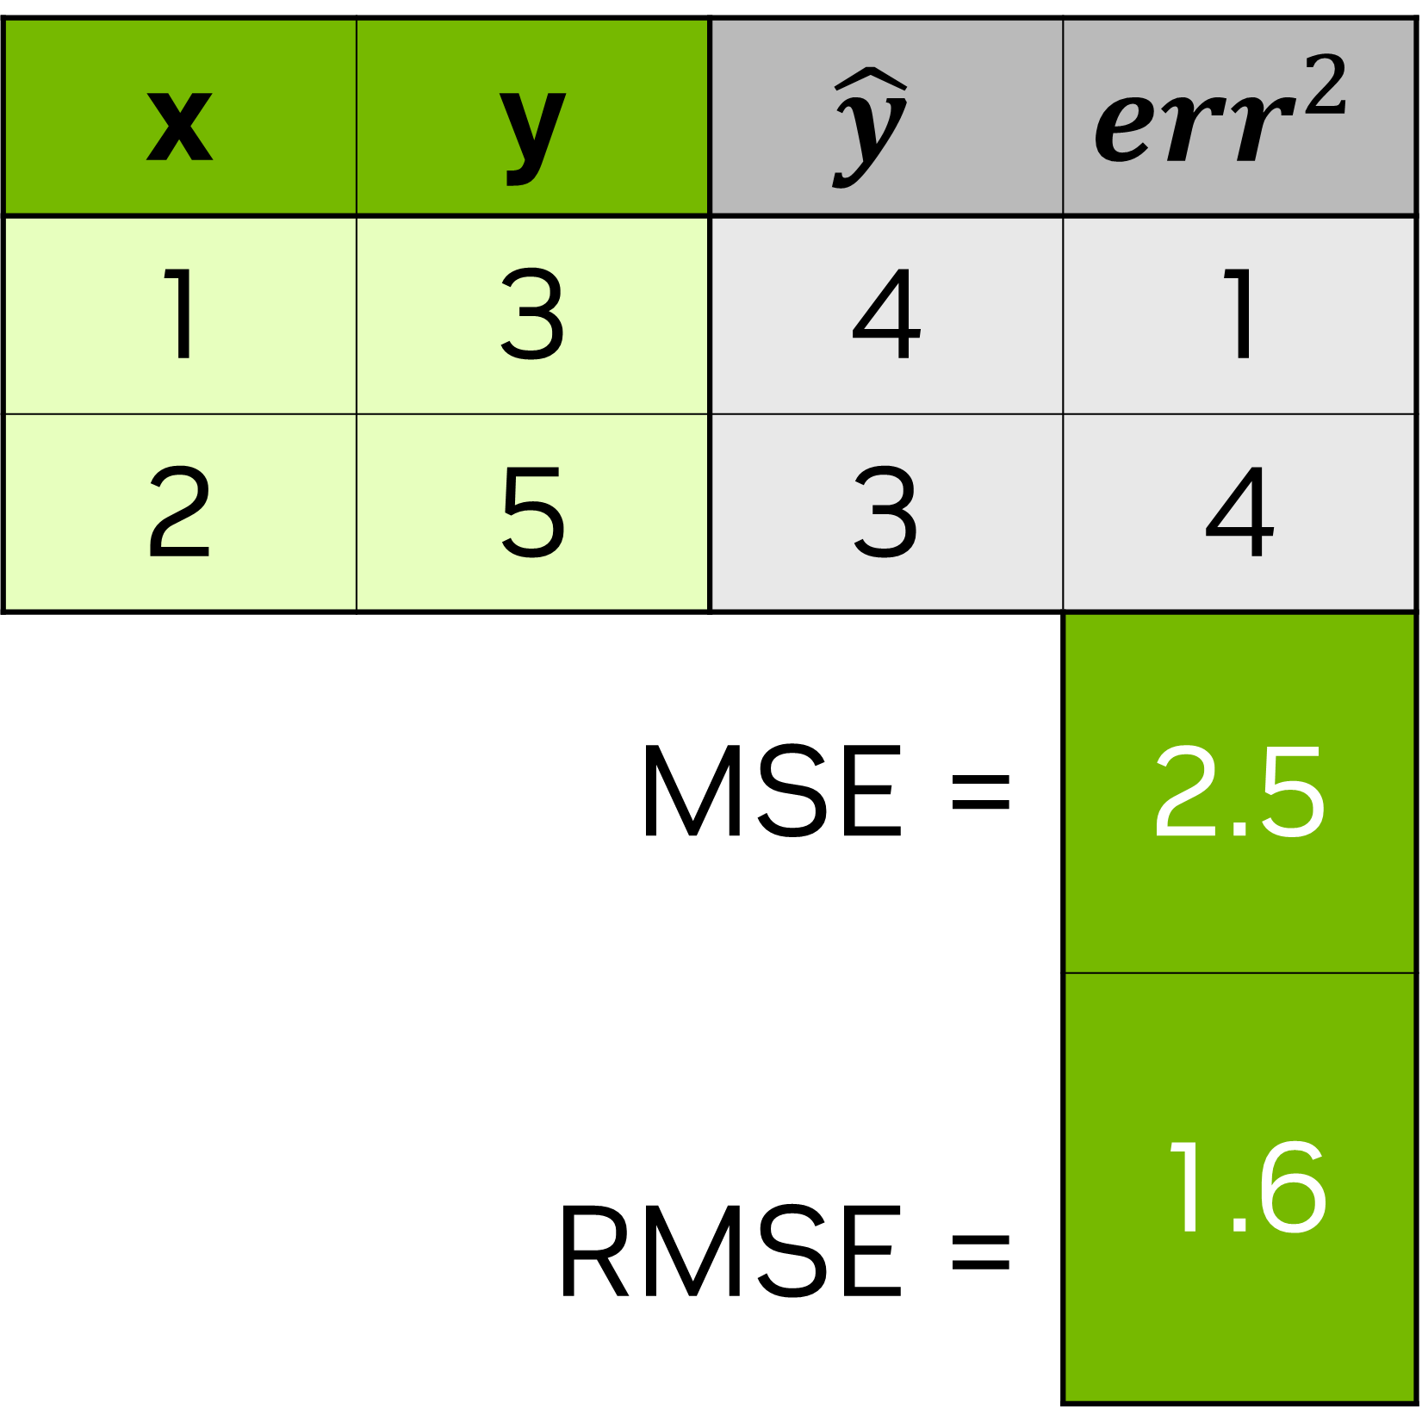
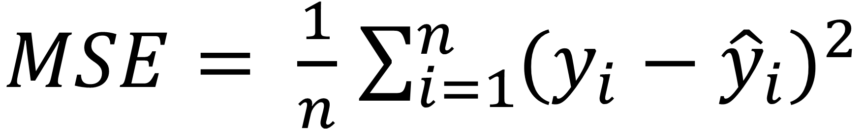
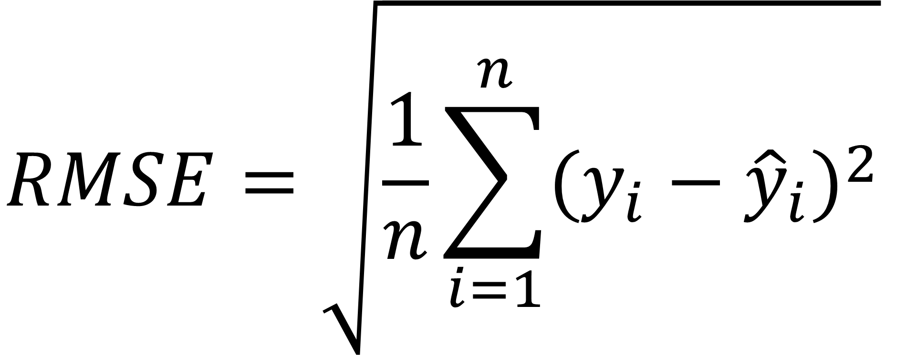
A Simpler Model
$$y=mx+b$$
x | y | $$\hat{y}$$ | $${err}^{2}$$
1 | 3 | 4 | 1
2 | 5 | 3 | 4
MSE = |  |  | 2.5
RMSE = |  |  | 1.6
$MSE= \frac{1}{n}$ $\sum_{i=1}^{n}{{(y_{i}−{\hat{y}}_{i})}^{2}}$
$$RMSE=\sqrt{\frac{1}{n}\sum_{i=1}^{n}{{(y_{i}−{\hat{y}}_{i})}^{2}}}$$
Source: NVIDIA DLI (2025), Getting Started with Deep Learning, https://learn.nvidia.com/courses/course-detail?course_id=course-v1:DLI+S-FX-01+V1
124
Notes:
Traditional regression lines are built on the concept of least squared error, meaning, we’re going to take the difference of each estimate from the true value and square it. This keeps our error positive so when we figure out our total error, they don’t cancel each other out. It also strongly punishes bad guesses.

Slide 125
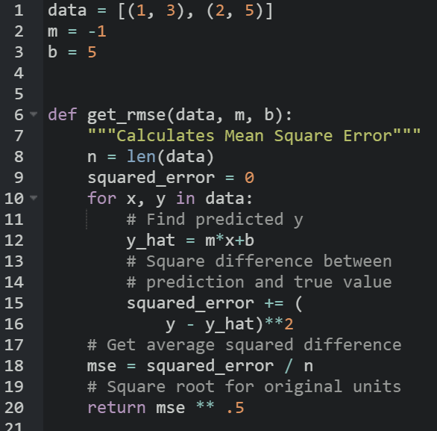
A Simpler Model
$$y=mx+b$$
x | y | $$\hat{y}$$ | $${err}^{2}$$
1 | 3 | 4 | 1
2 | 5 | 3 | 4
MSE = |  |  | 2.5
RMSE = |  |  | 1.6
Source: NVIDIA DLI (2025), Getting Started with Deep Learning, https://learn.nvidia.com/courses/course-detail?course_id=course-v1:DLI+S-FX-01+V1
125
Notes:
So if it’s been a while since seeing some of these math symbols, no problem, we can code our RMSE like this. For each of our points, we’ll figure out what the difference is between y and mx+b. Then we’ll square that difference, and then take the average of all squared differences.
https://black.now.sh/
Code:
data = [(1, 3), (2, 5)]
m = -1
b = 5
def get_rmse(data, m, b):
"""Calculates Mean Square Error"""
n = len(data)
squared_error = 0
for x, y in data:
# Find predicted y
y_hat = m*x+b
# Square difference between
# prediction and true value
squared_error += (
y - y_hat)**2
# Get average squared difference
mse = squared_error / n
# Square root for original units
return mse ** .5

Slide 126
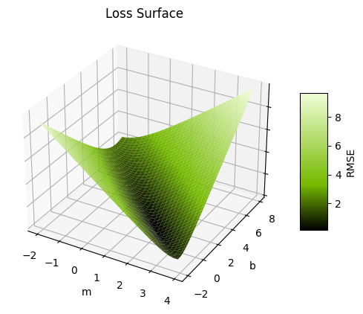
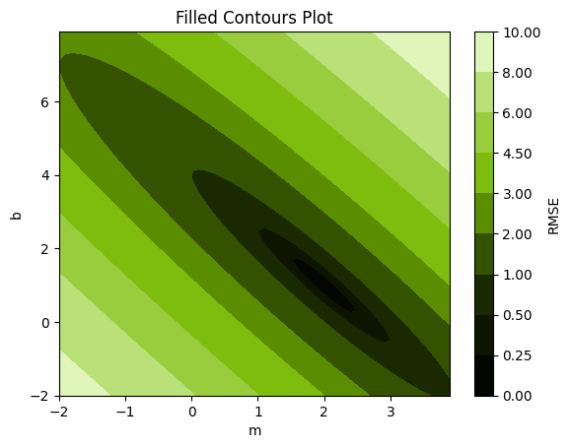
The Loss Curve
16
0
MSE
Source: NVIDIA DLI (2025), Getting Started with Deep Learning, https://learn.nvidia.com/courses/course-detail?course_id=course-v1:DLI+S-FX-01+V1
126
Notes:
Ok, phew, that was a lot of math. Let’s graph out our m and our b in relation to our mean squared error. On the left, we have a surface plot of our loss function. That’s the error function we choose to evaluate our model, which in our case is MSE. It’s a little hard to read, so on the right, we’ve plotted the contours. With that, we can see that it’s actually a kind of parabolic ellipse that bottoms out at b=1 and m=2.

Slide 127

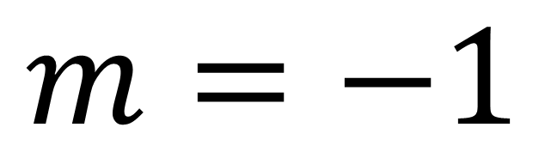
The Loss Curve
Current
Target
$$m=−1$$
$$b=5$$
Source: NVIDIA DLI (2025), Getting Started with Deep Learning, https://learn.nvidia.com/courses/course-detail?course_id=course-v1:DLI+S-FX-01+V1
127
Notes:
So if this is our guessed line, we can see where our current position is on the curve. Our goal is to find the minimum error, and since it’s a toy example, we know that the minimum is 0. For us humans, it’s easy to see that the bottom is around m = 2 and b = 1, but for the computer, it’s not so easy to see that. (The computer can’t visualize this loss curve without some help, we gave it a grid of x,y points, and told it to graph that area). Turns out, the computer isn’t the best at calculus, so we’re going to help it cheat.
We have two leavers to help us move: m and b. We can change b, our intercept, or m, our slope. Let’s start with b, our intercept. If we subtract one…

Slide 128

The Loss Curve
Old
Current
Target
$$m=−1$$
$$b=4$$
Source: NVIDIA DLI (2025), Getting Started with Deep Learning, https://learn.nvidia.com/courses/course-detail?course_id=course-v1:DLI+S-FX-01+V1
128
Notes:
Cool, our line hits one of the points now, but it’s missing the other one. Let’s increase the slope by one…

Slide 129

The Loss Curve
Current
Target
$$m=0$$
$$b=4$$
Source: NVIDIA DLI (2025), Getting Started with Deep Learning, https://learn.nvidia.com/courses/course-detail?course_id=course-v1:DLI+S-FX-01+V1
129
Notes:
Darn it, now we’re missing both points, but the MSE did decrease from 2.5 to one.

Slide 130
The Loss Curve
The Gradient
Which direction loss decreases the most
$λ$: The learning rate
𝝀: The learning rate
How far to travel
Epoch
A model update with the full dataset
Batch
A sample of the full dataset
Step
An update to the weight parameters
Target
Source: NVIDIA DLI (2025), Getting Started with Deep Learning, https://learn.nvidia.com/courses/course-detail?course_id=course-v1:DLI+S-FX-01+V1
130
Notes:
The computer doesn’t have our “human eyeball” ability to guesstimate what it should change in order to get to the bottom of this bowl, so what it’s going to do is given the current point that it’s at, it’s going to calculate the gradient, which is a fancy word to describe a multivariate slope. It’s going to figure out in which direction is the loss decreasing the most, which is going to be some ratio of b to m.
Once we have a direction, we need to figure out how far to travel with it. The gradient is going to change depending on our current position, so we don’t want to make to big of a step because we can accidentally move further away from our target. We also don’t want to be too small because that means it can take a long time to get to our goal, and life it too short to wait for a model to finish training. The amount we travel is something we decide, and it is a parameter called learning rate.
Now that we’re in a new position, we repeat the process: find the new gradient and take another step. There’s a few ways to measure our progress. There are Epochs, which is another way to say to full dataset. It used to be that people calculated the gradient using the full dataset, but nowadays, people see that it’s more efficient to use a sample or batch from the dataset. In either case, a step is when we take either the full dataset or a batch, calculate the gradient, and update our parameters with the gradient and learning rate.

Slide 131
The Loss Curve
The Gradient
Which direction loss decreases the most
$λ$: The learning rate
𝝀: The learning rate
How far to travel
Epoch
A model update with the full dataset
Batch
A sample of the full dataset
Step
An update to the weight parameters
Target
Source: NVIDIA DLI (2025), Getting Started with Deep Learning, https://learn.nvidia.com/courses/course-detail?course_id=course-v1:DLI+S-FX-01+V1
131
Notes:
After a few steps, this is what our journey will look like. This process to find the minimum loss is called gradient descent.

Slide 132
Optimizers
Loss – Momentum Optimizer
Adam
Adagrad
RMSprop
SGD
Source: NVIDIA DLI (2025), Getting Started with Deep Learning, https://learn.nvidia.com/courses/course-detail?course_id=course-v1:DLI+S-FX-01+V1
132
Notes:
Thankfully, a lot of research has been done on the best way to define the learning rate, and machine learning frameworks have a few tools that will automatically adjust the learning rate.
For instance, a popular one is Adam (Adaptive momentum) which is kind of like thinking of our loss curve as a mountain and our position as a marble. If we drop a marble on top of a mountain, it will pick up speed, jumping over trenches (local minima) before hopefully landing at a lower minima.

Slide 133
From Neuron to Network
Source: NVIDIA DLI (2025), Getting Started with Deep Learning, https://learn.nvidia.com/courses/course-detail?course_id=course-v1:DLI+S-FX-01+V1
133

Slide 134
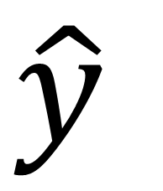
Building a Network
  Scales to more inputs
w₁
w₂
$$\hat{y}$$
Source: NVIDIA DLI (2025), Getting Started with Deep Learning, https://learn.nvidia.com/courses/course-detail?course_id=course-v1:DLI+S-FX-01+V1
134
Notes:
Now that we have the core concept down, we can start building up our network. Instead of having a singular x input with a slope (m), we’re going to have multiple x inputs (x1, x2, x3…) and find each of them a weight. Our previous math stays mostly the same, we just need to find the gradient for the new variable like we did before.

Slide 135
Building a Network
x₁
x₂
w₂
w₃
w₄
  Scales to more inputs
  Can chain neurons
w₁
w₅
w₆
$$\hat{y}$$
Source: NVIDIA DLI (2025), Getting Started with Deep Learning, https://learn.nvidia.com/courses/course-detail?course_id=course-v1:DLI+S-FX-01+V1
135
Notes:
We can also take the output of one neuron and feed it into another, and as long as we don’t make a loop, we can connect the same output to multiple inputs. Badum! With this we officially have a deep learning network. When we calculate our new weights from gradient descent, we can use the error calculated in a later neuron as part of the error for the previous neuron it’s connected to.
Most frameworks automate this part for us, so we’re not going to go much into the math, but here’s a great self paced animation that dives deeper into how it works: https://developers-dot-devsite-v2-prod.appspot.com/machine-learning/crash-course/backprop-scroll

Slide 136

Building a Network
x₁
x₂
w₂
w₃
w₄
  Scales to more inputs
  Can chain neurons
  If all regressions are linear, then output will also be a linear regression
w₁
w₅
w₆
$$\hat{y}$$
Source: NVIDIA DLI (2025), Getting Started with Deep Learning, https://learn.nvidia.com/courses/course-detail?course_id=course-v1:DLI+S-FX-01+V1
136
Notes:
There is one mathematical “gotcha” we should keep an eye out for and that’s our “activation function”. Right now, we’re just doing a linear sum, so we get a line in 2D and a plane in 3D. This is a bit of a waste on a neural network since the only output we’ll get from adding lines together is another line, and it would be nice to be able to capture complex shapes.

Slide 137
Activation Functions
Source: NVIDIA DLI (2025), Getting Started with Deep Learning, https://learn.nvidia.com/courses/course-detail?course_id=course-v1:DLI+S-FX-01+V1
137

Slide 138
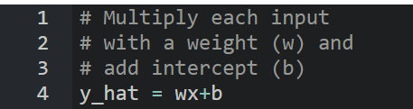
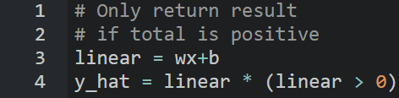
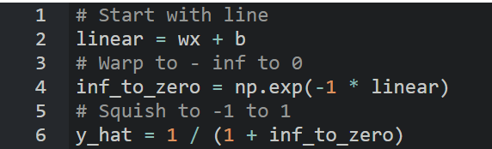
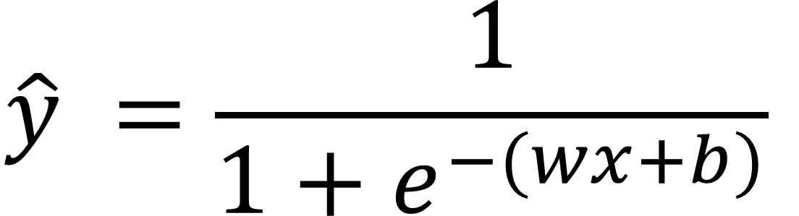
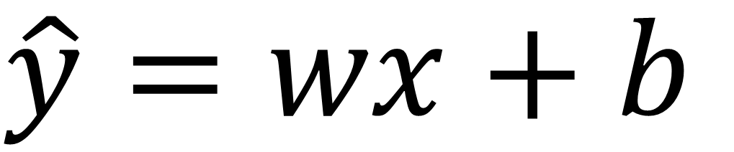
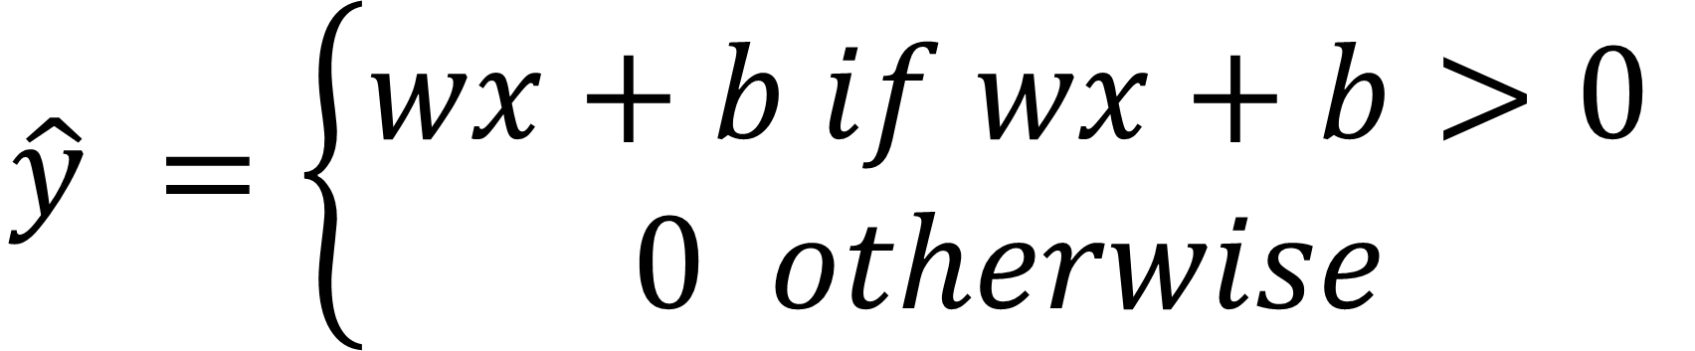
Activation Functions
Linear
ReLU
Sigmoid
$$\hat{y}=wx+b$$
$$\hat{y} =\left\{\begin{aligned}wx+b if wx+b>0 \\ 0 otherwise\end{aligned}\right.$$
$$\hat{y} =\frac{1}{1+e^{−(wx+b)}}$$
Source: NVIDIA DLI (2025), Getting Started with Deep Learning, https://learn.nvidia.com/courses/course-detail?course_id=course-v1:DLI+S-FX-01+V1
138
Notes:
For graphs, w = 1 and b = 0
Here’s the strategy: computers like equations of a line because they’re quick to compute and it’s easy for us to give it the rules on how to differentiate them.
One easy way to add non-linearity is to feed our equation of a line into another non-linear function. One of the most popular ones is ReLU, the Rectified Linear Unit. That’s just a fancy way of saying whenever the output of our line is negative, we’re going to set it to 0. Because the output of our neuron gets assigned a weight if it’s fed into another neuron, there’s a chance the output can become negative.
Another important activation function is Sigmoid. It manipulates our line so we get this S shape that goes from 0 to 1. This is great, because then we can use our neurons to assign probabilities to predictions.
Code:
# Multiply each input
# with a weight (w) and
# add intercept (b)
y_hat = wx+b
# Only return result
# if total is positive
y_hat = wx+b
y_hat = y_hat * (y_hat > 0)
# Start with line
linear = wx + b
# Warp to -inf to 0
inf_to_zero = np.exp(-1 * linear)
# Squish to -1 to 1
y_hat = 1 / (1 + inf_to_zero)

Slide 139






Activation Functions
Linear
ReLU
Sigmoid
Source: NVIDIA DLI (2025), Getting Started with Deep Learning, https://learn.nvidia.com/courses/course-detail?course_id=course-v1:DLI+S-FX-01+V1
139
Notes:
All of these graphs start with linear($y=\sum_{i=1}^{n}{w_{i}x_{i}}+b$), and then squeezes the plane/line through the activation function.
For graphs w1 = 1, w2 = 1, and b = 0
In actuality, we’re likely to have more than one input into our neuron, and this is what shape these activation functions give our neurons in three-dimensional space. Linear is just a plane, like a sheet of paper. ReLU is like a wedge. Sigmoid is like a surf wave.

Slide 140






Activation Functions
x₁
w₁
w₂
w₃
w₄
$$\hat{y}$$
Source: NVIDIA DLI (2025), Getting Started with Deep Learning, https://learn.nvidia.com/courses/course-detail?course_id=course-v1:DLI+S-FX-01+V1
140
Notes:
Here’s how an understanding of all this math is going to help. Let’s say we have a one input one output dataset that we suspect is a summation of two waves. We can use a Sinusoidal activation function in our first layer, and a linear activation in our last layer so we can add the two.
Given enough data, our neural network will figure out the parameters of each of these sub-components for us. Having a general understanding of the shape of the data and the relationship between the variables can help us build more efficient models for our data, saving time, computation, and ultimately, money.

Slide 141
Overfitting
Source: NVIDIA DLI (2025), Getting Started with Deep Learning, https://learn.nvidia.com/courses/course-detail?course_id=course-v1:DLI+S-FX-01+V1
141
Notes:
So if we can make these complicated shapes with more layers and neurons, why not make a super big neural network to solve every problem?

Slide 142

Overfitting
Why not have a super large neural network?
Source: NVIDIA DLI (2025), Getting Started with Deep Learning, https://learn.nvidia.com/courses/course-detail?course_id=course-v1:DLI+S-FX-01+V1
142
Notes:
Can anyone think of what the pitfalls would be from having too big of a model.
We could be wasting a lot of computational resources, and it can also take longer to train, but there’s another problem we should be aware of too.

Slide 143
Overfitting
Which Trendline is Better?
MSE = .0000
MSE = .0113
Source: NVIDIA DLI (2025), Getting Started with Deep Learning, https://learn.nvidia.com/courses/course-detail?course_id=course-v1:DLI+S-FX-01+V1
143
Notes:
The problem goes back to classical statistics, but it still plagues neural networks. Let’s say we’ve gone out, collected some data, and created two models. Which on of these is better?
Going by the RMSE, it’s the one on the left.
But what if we go out at get a new sample of data?

Slide 144
Overfitting
Which Trendline is Better?
MSE = .0308
MSE = .0062
Source: NVIDIA DLI (2025), Getting Started with Deep Learning, https://learn.nvidia.com/courses/course-detail?course_id=course-v1:DLI+S-FX-01+V1
144
Notes:
It turns out, our simpler model does a better job generalizing to new data. Not all problems can be so simple, and it’s the job of a Data Scientist to be able to determine the correct complexity for the model given

Slide 145
Training vs Validation Data
Avoid memorization
Training data
Core dataset for the model to learn on
Validation data
New data for model to see if it truly understands (can generalize)
Overfitting
When model performs well on the training data, but not the validation data (evidence of memorization)
Ideally the accuracy and loss should be similar between both datasets
Source: NVIDIA DLI (2025), Getting Started with Deep Learning, https://learn.nvidia.com/courses/course-detail?course_id=course-v1:DLI+S-FX-01+V1
145
Notes:
Remember when we had two separate pools of data (training and validation)?
So that we can be sure the network is not just “memorizing” the data that it’s learning on
We need to make sure that when it sees new and different images, that it is accurate as well
If the model performs well on training data, but not on new data, we call this over-fitting

Slide 146
From Regression to Classification
Source: NVIDIA DLI (2025), Getting Started with Deep Learning, https://learn.nvidia.com/courses/course-detail?course_id=course-v1:DLI+S-FX-01+V1
146
Notes:
We just went over many parts of a neural network. Let’s see how it applies to the last lab.

Slide 147
An MNIST Model
[ 0, 0, …, 0]
(784,)
… … …
(512,)
Layer
Size
… … …
(512,)
(10,)
Source: NVIDIA DLI (2025), Getting Started with Deep Learning, https://learn.nvidia.com/courses/course-detail?course_id=course-v1:DLI+S-FX-01+V1
147
Notes:
This was the visualization of the model in the previous lab. Can you name some of the components that we just learned on this diagram? Any details missing?

Slide 148
An MNIST Model
During Prediction
[ 0, 0, …, 0]
(784,)
ReLU
… … …
(512,)
Layer
Size
ReLU
… … …
(512,)
Linear
(10,)
Source: NVIDIA DLI (2025), Getting Started with Deep Learning, https://learn.nvidia.com/courses/course-detail?course_id=course-v1:DLI+S-FX-01+V1
148
Notes:
Here’s a more detailed version of the diagram, now including activation functions. We use ReLu in our hidden layer to add efficient nonlinearity, but why use linear at the end? The neuron with the highest value has the strongest prediction, but how does an output neuron develop that confidence?

Slide 149
An MNIST Model
During Training
[ 0, 0, …, 0]
(784,)
ReLU
… … …
(512,)
Layer
Size
ReLU
… … …
(512,)
Softmax
(10,)
Source: NVIDIA DLI (2025), Getting Started with Deep Learning, https://learn.nvidia.com/courses/course-detail?course_id=course-v1:DLI+S-FX-01+V1
149
Notes:
When we use a “Cross Entropy” loss function, which converts the output of our linear layer into a Softmax layer. A Softmax layer is the same as feeding each neuron through a sigmoid activation function to get a probability, then we normalize the probabilities so they all add up to 100%.

Slide 150
RMSE For Probabilities?
Source: NVIDIA DLI (2025), Getting Started with Deep Learning, https://learn.nvidia.com/courses/course-detail?course_id=course-v1:DLI+S-FX-01+V1
150
Notes:
Let’s say we have a group of points that are categorized by color. How would we use an RMSE line to predict whether a new data point is going to be red or blue?

Slide 151
RMSE For Probabilities?
Source: NVIDIA DLI (2025), Getting Started with Deep Learning, https://learn.nvidia.com/courses/course-detail?course_id=course-v1:DLI+S-FX-01+V1
151
Notes:
This time, we want to find a line that best separates the data. The error function that we use to calculate our gradient descent is called the loss function or cost function. RMSE and MSE are one kinds of loss. We could try to assign numbers to these colors and use RMSE, but there’s a better way.

Slide 152
Cross Entropy
Source: NVIDIA DLI (2025), Getting Started with Deep Learning, https://learn.nvidia.com/courses/course-detail?course_id=course-v1:DLI+S-FX-01+V1
152
Notes:
The most popular way to approach this problem is with categorical cross entropy. Before we dive into the math, let’s talk about the logic. We’re going to assign a probability to each point whether it is red or blue. We can almost think of this probability as our confidence it is in a particular class.
Cross entropy was designed like this: If we are 100% confident that a point is blue, and we’re right, perfect, we have 0 loss. However, if we’re wrong, we should be punished for our hubris and receive infinite loss! This works in the reverse case as well. If we assign a point a 0% chance of blue, that is we’re absolutely certain it is red, and it is not blue, we get no loss. However, if it is blue, we’ll have infinite loss.

Slide 153
Cross Entropy
$$Loss=−\left((t\left(x\right)∙log⁡(p\left(x\right))+\left(1−t\left(x\right)\right)∙\log\left(1−p(x)\right)\right)$$
$$t\left(x\right)=target (0 if False, 1 if True)$$
$$p\left(x\right)=probability prediction of point x$$
Source: NVIDIA DLI (2025), Getting Started with Deep Learning, https://learn.nvidia.com/courses/course-detail?course_id=course-v1:DLI+S-FX-01+V1
153
Notes:
Here’s the full mathematical formula for Binary Cross Entropy, meaning we only have two classes. The logarithms are used to get our near infinite loss. It might seem like a lot, but there’s a little trick. The left half cancels to 0 when the target is false, and the right half cancels to 0 when the target is true.

Slide 154

Cross Entropy
Source: NVIDIA DLI (2025), Getting Started with Deep Learning, https://learn.nvidia.com/courses/course-detail?course_id=course-v1:DLI+S-FX-01+V1
154
Notes:
And here’s the code version, for all you programmers out there. This is the same math as the slide before, but in code form.
y_hat is our prediction that a point is blue, and y_actual is whether a point was actually blue or not. The logarithms are what will push our code to infinity as log(0) is negative infinity
.
Code:
def cross_entropy(y_hat, y_actual):
"""Infinite error for misplaced confidence."""
loss = log(y_hat) if y_actual else log(1-y_hat)
return -1*loss

Slide 155
Bringing it Together
Source: NVIDIA DLI (2025), Getting Started with Deep Learning, https://learn.nvidia.com/courses/course-detail?course_id=course-v1:DLI+S-FX-01+V1
155
Notes:
Ok, now that we know the major mechanics, let’s talk about the next lab.

Slide 156
The Next Exercise
The American Sign Language Alphabet
Source: NVIDIA DLI (2025), Getting Started with Deep Learning, https://learn.nvidia.com/courses/course-detail?course_id=course-v1:DLI+S-FX-01+V1
156
Notes:
We’re going to try this again with a different dataset:
The American Sign Language Alphabet
Same shape (28x28 pixels) as last time
Same shape (28x28 pixels) in grayscale
Skipping J and Z because they require movement

Slide 157
Let’s go!
Source: NVIDIA DLI (2025), Getting Started with Deep Learning, https://learn.nvidia.com/courses/course-detail?course_id=course-v1:DLI+S-FX-01+V1
157
Notes:
Let’s get to it!

Slide 158
Appendix:
Gradient Descent
Helping the Computer Cheat Calculus
Source: NVIDIA DLI (2025), Getting Started with Deep Learning, https://learn.nvidia.com/courses/course-detail?course_id=course-v1:DLI+S-FX-01+V1
158
Notes:
Let’s get to it!

Slide 159






Learning from Error
$MSE= \frac{1}{n}\sum_{i=1}^{n}{{(y−\hat{y})}^{2}}=\frac{1}{n}$ $\sum_{i=1}^{n}{{(y−(mx+b))}^{2}}$
$$MSE= \frac{1}{2}{((3 −(m\left(1\right)+b))}^{2} + {(5 −(m\left(2\right)+b))}^{2})$$
$$\frac{∂MSE}{∂m}=5m+3b−13$$
$$\frac{∂MSE}{∂b}=3m+2b−8$$
$$m=−1$$
$$\frac{∂MSE}{∂m}=−3$$
$$\frac{∂MSE}{∂b}=−1$$
$$b=5$$
Source: NVIDIA DLI (2025), Getting Started with Deep Learning, https://learn.nvidia.com/courses/course-detail?course_id=course-v1:DLI+S-FX-01+V1
159
Notes:
We know how to calculate MSE given a model. What can we do with that information?
We’re going to take a page from our calculus textbook and minimize the error.
Now, if we want to find the true minimum, we can plug in the values for all of our points and do some multivariate calculus to find m and b, but it turns out that computers are bad at calculus, so we’re going to help the computer cheat a little.
Here, we’ve taken our MSE and expanded it to include our two xy datapoints (1,3) and (2,5)
So it turns out that while computers have a tough time finding the global minimum of a function, they’re pretty decent at calculating the slope of a function given an input. If that function is multidimensional, (as in, more than one input) then that slope is called the gradient.
There are many ways a computer can go about getting the gradient as described in this quora answer: https://www.quora.com/How-does-TensorFlow-calculate-gradients#:~:text=There%20are%20a%20few%20different,another%20to%20approximate%20the%20derivative.
One easy way is to just take two really really close points and calculate the gradient between them. By calculating the gradient, we’re calculating the slope for each parameter we want to learn, and once the slope is 0 for all variables, then we have found a local minimum.

Slide 160
The Loss Curve
Current
Target
Source: NVIDIA DLI (2025), Getting Started with Deep Learning, https://learn.nvidia.com/courses/course-detail?course_id=course-v1:DLI+S-FX-01+V1
160
Notes:
We’re going to use the gradient we calculated earlier to guide our estimate to the goal.

Slide 161


The Loss Curve
$$\frac{∂MSE}{∂m}=−3$$
$$\frac{∂MSE}{∂b}=−1$$
Target
Source: NVIDIA DLI (2025), Getting Started with Deep Learning, https://learn.nvidia.com/courses/course-detail?course_id=course-v1:DLI+S-FX-01+V1
161
Notes:
Because both of them are negative, that means we need to increase them in order to get closer to 0. Hmm, the gradient gives us the right direction, but the magnitude is too big.

Slide 162


The Loss Curve
$$\frac{∂MSE}{∂m}=−3$$
$$\frac{∂MSE}{∂b}=−1$$
$$m :=m −λ \frac{∂MSE}{∂m}$$
Target
$$b ≔b −λ \frac{∂MSE}{∂b}$$
Source: NVIDIA DLI (2025), Getting Started with Deep Learning, https://learn.nvidia.com/courses/course-detail?course_id=course-v1:DLI+S-FX-01+V1
162
Notes:
Let’s introduce a new parameter called the learning rate (represented by lamba λ) which will allow us to scale our changes to our parameters. Data scientists define this on their own, but thankfully, there’s been enough research on the topic that machine learning libraries have their own built in strategies.

Slide 163

The Loss Curve
$$\frac{∂MSE}{∂m}=−3$$
$$\frac{∂MSE}{∂b}=−1$$
$$m :=m −λ \frac{∂MSE}{∂m}$$
$$λ=2$$
Target
$$b ≔b −λ \frac{∂MSE}{∂b}$$
Source: NVIDIA DLI (2025), Getting Started with Deep Learning, https://learn.nvidia.com/courses/course-detail?course_id=course-v1:DLI+S-FX-01+V1
163
Notes:
If we make the learning rate too big, we’re going to get farther away from our goal.

Slide 164

The Loss Curve
$$\frac{∂MSE}{∂m}=−3$$
$$\frac{∂MSE}{∂b}=−1$$
$$m :=m −λ \frac{∂MSE}{∂m}$$
$$λ=.1$$
Target
$$b ≔b −λ \frac{∂MSE}{∂b}$$
Source: NVIDIA DLI (2025), Getting Started with Deep Learning, https://learn.nvidia.com/courses/course-detail?course_id=course-v1:DLI+S-FX-01+V1
164
Notes:
If we make it too small, it’s going to take forever to get there. Also, once we train on more complicated problems, we can get trapped in a local minimum.

Slide 165



The Loss Curve
$$λ=.1$$
$m≔−1+3 λ=−0.7$
$$b ≔5+ λ=5.1$$
Target
Source: NVIDIA DLI (2025), Getting Started with Deep Learning, https://learn.nvidia.com/courses/course-detail?course_id=course-v1:DLI+S-FX-01+V1
165
Notes:
For now, let’s stick with a learning rate of .1. Ok, step in the right direction, but not close enough. No problem, we’ll just repeat the process over and over gain, taking our new values of b and m and finding the gradient for them.

Slide 166
NVIDIA Getting Started with Deep Learning
Source: NVIDIA DLI (2025), Getting Started with Deep Learning, https://learn.nvidia.com/courses/course-detail?course_id=course-v1:DLI+S-FX-01+V1

Slide 167
NVIDIA Getting Started with Deep Learning
American Sign Language (ASL) Alphabet
Source: NVIDIA DLI (2025), Getting Started with Deep Learning, https://learn.nvidia.com/courses/course-detail?course_id=course-v1:DLI+S-FX-01+V1

Slide 168
NVIDIA Getting Started with Deep Learning
1: An Introduction to Deep Learning
2: The Theory Behind Neural Networks
3: Convolutional Neural Networks
4: Data Augmentation and Deployment
5: Pre-trained Models
6: Natural Language Processing
7: Wrap-up and Assessment
Source: NVIDIA DLI (2025), Getting Started with Deep Learning, https://learn.nvidia.com/courses/course-detail?course_id=course-v1:DLI+S-FX-01+V1

Slide 169
Fundamentals of
Deep Learning
Part 3: Convolutional Neural Networks
Source: NVIDIA DLI (2025), Getting Started with Deep Learning, https://learn.nvidia.com/courses/course-detail?course_id=course-v1:DLI+S-FX-01+V1
169
Notes:
Welcome to convolutional neural networks. Whether you’re following our beginners series or are jumping straight into this lesson, welcome! Today we’re going to talk about how computers learn to see.

Slide 170
Fundamentals of
Deep Learning
Agenda
• | Part 1: An Introduction to Deep Learning
• | Part 2: How a Neural Network Trains
• | Part 3: Convolutional Neural Networks
• | Part 4: Data Augmentation and Deployment
• | Part 5: Pre-Trained Models
• | Part 6: Advanced Architectures
Source: NVIDIA DLI (2025), Getting Started with Deep Learning, https://learn.nvidia.com/courses/course-detail?course_id=course-v1:DLI+S-FX-01+V1
170

Slide 171
Recap of the exercise
Trained a dense neural network model
Training accuracy was high
Validation accuracy was low
Evidence of overfitting
Source: NVIDIA DLI (2025), Getting Started with Deep Learning, https://learn.nvidia.com/courses/course-detail?course_id=course-v1:DLI+S-FX-01+V1
171
Notes:
We found that our model was able to attain high accuracy with the training data, but not with the testing/validation data. We’re passing our image in as one long string of pixels. Why might that not be such a good idea? There is important information contained in how pixels are organized around each other. When we flatten the picture into a single array, we lose that information

Slide 172
Kernels and Convolution
Source: NVIDIA DLI (2025), Getting Started with Deep Learning, https://learn.nvidia.com/courses/course-detail?course_id=course-v1:DLI+S-FX-01+V1
172
Notes:
It’s time to upgrade our model to one that’s designed for pulling spatial information out of an image

Slide 173







Kernels and Convolution
Blur
Sharpen
Brighten
Darken
Original Image
Source: NVIDIA DLI (2025), Getting Started with Deep Learning, https://learn.nvidia.com/courses/course-detail?course_id=course-v1:DLI+S-FX-01+V1
173
Notes:
Before we get into neural networks, lets talk about how Computer Vision experts used to approach this type of problem. If you played with Photoshop, MS Paint, or GIMP a lot as a kid making .gifs or memes or stilly pictures: good news! Understanding how computers represent and manipulate photos is a great foundation for modern day computer vision.
For example, let’s look at the blur, sharpen, brighten and darken tools. In a drawing program, the area around where we click that manipulates our image is called the kernel. Convolution is when our kernel is multiplied with our image, and that is what’s happening when we select these tools and drag it across our image. To be technical, convolution is when we apply one function to another function, but we can think of our base image as a function of color, and our kernel as a function of pixels.

Slide 174
Kernels and Convolution
Blur
.06 | .13 | .06
.13 | .25 | .13
.06 | .13 | .06
Sharpen
0 | -1 | 0
-1 | 5 | -1
0 | -1 | 0
Brighten
0 | 0 | 0
0 | 1.5 | 0
0 | 0 | 0
Darken
0 | 0 | 0
0 | 0.5 | 0
0 | 0 | 0
Original Image
Source: NVIDIA DLI (2025), Getting Started with Deep Learning, https://learn.nvidia.com/courses/course-detail?course_id=course-v1:DLI+S-FX-01+V1
174
Notes:
The kernel is just a small matrix, blurring is a weighted averaging of the numbers that represent the pixels. Sharpen brightens the pixel in the center of it, but subtracts the pixels directly adjacent to it. Brighten makes the center pixel’s color values bigger (if 255 is white) or smaller (if 0 is white). Darken does the opposite. Let’s take a look at a smaller image and break it down.

Slide 175


Kernels and Convolution
Blur Kernel
Original Image
Convolved Image
1 | 0 | 1 | 1 | 0 | 1
0 | 1 | 0 | 0 | 1 | 0
0 | 1 | 1 | 1 | 1 | 0
0 | 1 | 1 | 1 | 1 | 0
1 | 0 | 1 | 1 | 0 | 1
1 | 1 | 0 | 0 | 1 | 1
.06 | .13 | .06
.13 | .25 | .13
.06 | .13 | .06
$$∗$$
$$=$$
Source: NVIDIA DLI (2025), Getting Started with Deep Learning, https://learn.nvidia.com/courses/course-detail?course_id=course-v1:DLI+S-FX-01+V1
175
Notes:
Ok, we have a picture of a heart. Not obvious? Sorry, only had 6 x 6 pixels to work with.
We’re going to step through a convolution. The fancy star in the center is the convolution operator. The resulting image is going to be 4 x 4. It’ll be more obvious in a bit.

Slide 176
Kernels and Convolution
Blur Kernel
Original Image
Convolved Image
1 | 0 | 1 | 1 | 0 | 1
0 | 1 | 0 | 0 | 1 | 0
0 | 1 | 1 | 1 | 1 | 0
0 | 1 | 1 | 1 | 1 | 0
1 | 0 | 1 | 1 | 0 | 1
1 | 1 | 0 | 0 | 1 | 1
.06 | .13 | .06
.13 | .25 | .13
.06 | .13 | .06
$$∗$$
$$=$$
Source: NVIDIA DLI (2025), Getting Started with Deep Learning, https://learn.nvidia.com/courses/course-detail?course_id=course-v1:DLI+S-FX-01+V1
176
Notes:
Let’s start in the top left corner. We call the section that we’re about to convolve, the red box here, the window. Notice how it has the same shape as our kernel.

Slide 177
Kernels and Convolution
Blur Kernel
Original Image
Convolved Image
1 | 0 | 1 | 1 | 0 | 1
0 | 1 | 0 | 0 | 1 | 0
0 | 1 | 1 | 1 | 1 | 0
0 | 1 | 1 | 1 | 1 | 0
1 | 0 | 1 | 1 | 0 | 1
1 | 1 | 0 | 0 | 1 | 1
Multiply
.06 | .13 | .06
.13 | .25 | .13
.06 | .13 | .06
$$∗$$
$$=$$
Source: NVIDIA DLI (2025), Getting Started with Deep Learning, https://learn.nvidia.com/courses/course-detail?course_id=course-v1:DLI+S-FX-01+V1
177
Notes:
We’re going to take our kernel and multiply each cell in the kernel with the respective cell in the window.

Slide 178
Kernels and Convolution
Blur Kernel
Original Image
Convolved Image
1 | 0 | 1 | 1 | 0 | 1
0 | 1 | 0 | 0 | 1 | 0
0 | 1 | 1 | 1 | 1 | 0
0 | 1 | 1 | 1 | 1 | 0
1 | 0 | 1 | 1 | 0 | 1
1 | 1 | 0 | 0 | 1 | 1
.06 | 0 | .06
0 | .25 | 0
0 | .13 | .06
.56
Total
.06 | .13 | .06
.13 | .25 | .13
.06 | .13 | .06
$$∗$$
$$=$$
Source: NVIDIA DLI (2025), Getting Started with Deep Learning, https://learn.nvidia.com/courses/course-detail?course_id=course-v1:DLI+S-FX-01+V1
178
Notes:
We’re then going to total the results of that multiplication

Slide 179
Kernels and Convolution
Blur Kernel
Original Image
Convolved Image
1 | 0 | 1 | 1 | 0 | 1
0 | 1 | 0 | 0 | 1 | 0
0 | 1 | 1 | 1 | 1 | 0
0 | 1 | 1 | 1 | 1 | 0
1 | 0 | 1 | 1 | 0 | 1
1 | 1 | 0 | 0 | 1 | 1
0 | .13 | .06
.13 | 0 | 0
.06 | .13 | .06
.56 | .57
.06 | .13 | .06
.13 | .25 | .13
.06 | .13 | .06
$$∗$$
$$=$$
Source: NVIDIA DLI (2025), Getting Started with Deep Learning, https://learn.nvidia.com/courses/course-detail?course_id=course-v1:DLI+S-FX-01+V1
179
Notes:
Next, we move or window over by 1…

Slide 180

Kernels and Convolution
Blur Kernel
Original Image
Convolved Image
1 | 0 | 1 | 1 | 0 | 1
0 | 1 | 0 | 0 | 1 | 0
0 | 1 | 1 | 1 | 1 | 0
0 | 1 | 1 | 1 | 1 | 0
1 | 0 | 1 | 1 | 0 | 1
1 | 1 | 0 | 0 | 1 | 1
.56 | .57 | .57 | .56
.7 | .82 | .82 | .7
.69 | .95 | .95 | .69
.64 | .69 | .69 | .64
.06 | .13 | .06
.13 | .25 | .13
.06 | .13 | .06
$$∗$$
$$=$$
Source: NVIDIA DLI (2025), Getting Started with Deep Learning, https://learn.nvidia.com/courses/course-detail?course_id=course-v1:DLI+S-FX-01+V1
180
Notes:
.. and we repeat the process until we’ve calculated the convolution for the whole image.
https://mathworld.wolfram.com/Convolution.html

Slide 181
Stride
Stride 1
1 | 0 | 1 | 1 | 0 | 1
0 | 1 | 0 | 0 | 1 | 0
0 | 1 | 1 | 1 | 1 | 0
.56 | .57 | .57 | .56
Stride 2
1 | 0 | 1 | 1 | 0 | 1
0 | 1 | 0 | 0 | 1 | 0
0 | 1 | 1 | 1 | 1 | 0
.56 | .57
Stride 3
1 | 0 | 1 | 1 | 0 | 1
0 | 1 | 0 | 0 | 1 | 0
0 | 1 | 1 | 1 | 1 | 0
.56 | .56
Source: NVIDIA DLI (2025), Getting Started with Deep Learning, https://learn.nvidia.com/courses/course-detail?course_id=course-v1:DLI+S-FX-01+V1
181
Notes:
There are a few parameters we can play with for convolution. One is stride, which is by how many cells should we move our window by when doing convolution. Let’s chop our heart in half to see what we mean. Oh no, broken heart!
Let’s assume we had the same kernel as before.
With a stride of 2, we skip starting convolution at every other column and every other row. When we do this, we also generate less data, which has pros and cons. The good is that means we have less data to analyze, but if we increase our stride too much, we might miss important information.
The other thing to look for is with a stride of 2, we don’t have enough columns to do a convolution for the right side our image.

Slide 182
Padding
Original Image
Zero Padding
0 | 0 | 0 | 0 | 0 | 0 | 0 | 0
0 | 1 | 0 | 1 | 1 | 0 | 1 | 0
0 | 0 | 1 | 0 | 0 | 1 | 0 | 0
0 | 0 | 1 | 1 | 1 | 1 | 0 | 0
0 | 0 | 1 | 1 | 1 | 1 | 0 | 0
0 | 1 | 0 | 1 | 1 | 0 | 1 | 0
0 | 1 | 1 | 0 | 0 | 1 | 1 | 0
0 | 0 | 0 | 0 | 0 | 0 | 0 | 0
1 | 0 | 1 | 1 | 0 | 1
0 | 1 | 0 | 0 | 1 | 0
0 | 1 | 1 | 1 | 1 | 0
0 | 1 | 1 | 1 | 1 | 0
1 | 0 | 1 | 1 | 0 | 1
1 | 1 | 0 | 0 | 1 | 1
Source: NVIDIA DLI (2025), Getting Started with Deep Learning, https://learn.nvidia.com/courses/course-detail?course_id=course-v1:DLI+S-FX-01+V1
182
Notes:
If we want enough data to make sure all pixels are used in convolution, or if we want the resulting image to be the same size as our input image, we can do something called padding. A quick and easy way to do this is called “zero” padding, where we add a border of zeros around our image. This can be sufficient in many cases, but in some where the image is small, it can have an impact on the convolution.
https://setosa.io/ev/image-kernels/
https://glassboxmedicine.com/2019/04/13/a-short-history-of-convolutional-neural-networks/

Slide 183
Padding
Original Image
Mirror Padding
1 | 1 | 0 | 1 | 1 | 0 | 1 | 1
1 | 1 | 0 | 1 | 1 | 0 | 1 | 1
0 | 0 | 1 | 0 | 0 | 1 | 0 | 0
0 | 0 | 1 | 1 | 1 | 1 | 0 | 0
0 | 0 | 1 | 1 | 1 | 1 | 0 | 0
1 | 1 | 0 | 1 | 1 | 0 | 1 | 1
1 | 1 | 1 | 0 | 0 | 1 | 1 | 1
1 | 1 | 1 | 0 | 0 | 1 | 1 | 1
1 | 0 | 1 | 1 | 0 | 1
0 | 1 | 0 | 0 | 1 | 0
0 | 1 | 1 | 1 | 1 | 0
0 | 1 | 1 | 1 | 1 | 0
1 | 0 | 1 | 1 | 0 | 1
1 | 1 | 0 | 0 | 1 | 1
Source: NVIDIA DLI (2025), Getting Started with Deep Learning, https://learn.nvidia.com/courses/course-detail?course_id=course-v1:DLI+S-FX-01+V1
183
Notes:
There are many other types of padding too. Many frameworks have “mirror padding” that instead duplicates the top and bottom rows, and the left and right columns.

Slide 184
Kernels and
Neural Networks
Source: NVIDIA DLI (2025), Getting Started with Deep Learning, https://learn.nvidia.com/courses/course-detail?course_id=course-v1:DLI+S-FX-01+V1
184
Notes:
So how does this apply to neural networks?

Slide 185
Kernels and Neural Networks
Kernel
w₁ | w₂ | w₃
w₄ | w₅ | w₆
w₇ | w₈ | w₉
Source: NVIDIA DLI (2025), Getting Started with Deep Learning, https://learn.nvidia.com/courses/course-detail?course_id=course-v1:DLI+S-FX-01+V1
185
Notes:
So before neural networks, computer vision researchers would play around with the numbers within a kernel to see if it can be used to find any interesting features in images. So far, we’ve only used 3 x 3 kernels, but they can be any size, and researchers would try to do things like make a kernel that returned a high value if it convolved a cat ear. So, you could have a cat ear kernel, a cat nose kernel, a cat eye kernel, and if you ran all those through an image and found matches, you might guess there was a cat!
But as neural networks got more and more powerful, people made the connection that, woah. Kernels are these devices that multiply weights to an input, and then adds the results together. What else does that?

Slide 186

Kernels and Neural Networks
Kernel
Neuron
x₁
x₂
w₁ | w₂ | w₃
w₄ | w₅ | w₆
w₇ | w₈ | w₉
w₂
w₃
w₁
w₄
w₅
w₆
$$\hat{y}$$
Source: NVIDIA DLI (2025), Getting Started with Deep Learning, https://learn.nvidia.com/courses/course-detail?course_id=course-v1:DLI+S-FX-01+V1
186
Notes:
Oh yeah, neurons do that too! That’s exactly what Convolutional Neural Networks are. They map the inputs of a neuron to a kernel with trainable weights.
Interesting history: https://glassboxmedicine.com/2019/04/13/a-short-history-of-convolutional-neural-networks/
How backpropagation works for CNNs: https://www.jefkine.com/general/2016/09/05/backpropagation-in-convolutional-neural-networks/

Slide 187











Kernels and Neural Networks
… …
… …
(2, 28, 28)
Stacked Images
(2, 28, 28)
Stacked Images
(2, 1, 3, 3)
Kernels
(2, 2, 3, 3)
Kernels
(512)
Linear
(512)
Linear
(1, 28, 28)
Image Input
(1568)
Flattened Image
Vector
(10)
Output Prediction
Source: NVIDIA DLI (2025), Getting Started with Deep Learning, https://learn.nvidia.com/courses/course-detail?course_id=course-v1:DLI+S-FX-01+V1
187
Notes:
This is our new neural network architecture. This is a bit smaller than what we’ll do in the lab, but the structure is similar. First, we have our input image. We’re going to start with a variable number of convolutional layers (in this case 2 3x3x1 greyscale filters). We can have as many as we want, and each one of them is going to produce a new image by trying to extract interesting features out of the original image.
We’re then going to stack these images on top of each other, so we end up with a three-dimensional image, but not 3d in the way that humans perceive it. We can then send this new image through a new set of filters. When convolving, even though we’re technically doing a 2D convolution because we’re in black and white, we’re actually convolving a 3D object that is our window size by the number of stacked images. Because we have two stacked images, our kernels are digesting a 3x3x2 slice of the stacked images. In the picture above, we have 2 3x3x2 filters.
When we’re done convolving, we’ll flatten everything out, and feed the results through our neural net as normal.
It used to be that data scientists would toy around with the kernel sizes more, and that’s still useful in some cases, but empirically, sticking with 3x3 works well. Let’s go back to computer vision theory to understand why.
Great stack overflow on how to visualize kernels: https://stackoverflow.com/questions/43305891/how-to-correctly-get-layer-weights-from-conv2d-in-keras
Another stack overflow on the dimensions of the kernels: https://stackoverflow.com/questions/46480699/why-are-my-keras-conv2d-kernels-3-dimensional#:~:text=I%20understand%20the%20mechanics%20of,kernels%20of%20size(7x7x8).
A more advanced topic, but here we’re doing conventional convolution, but there are many ways to do it.
An article diving into the different types: https://towardsdatascience.com/a-comprehensive-introduction-to-different-types-of-convolutions-in-deep-learning-669281e58215
An article explaining the math: http://d2l.ai/chapter_convolutional-neural-networks/channels.html

Slide 188



Finding Edges
Vertical Edges
Original Image
Horizontal Edges
1 | 0 | -1
2 | 0 | -2
1 | 0 | -1
0 | 0 | 0
0 | 1 | 0
0 | 0 | 0
1 | 2 | 1
0 | 0 | 0
-1 | -2 | -1
Source: NVIDIA DLI (2025), Getting Started with Deep Learning, https://learn.nvidia.com/courses/course-detail?course_id=course-v1:DLI+S-FX-01+V1
188
Notes:
So when researchers first came up with these kernels before neural networks, they also realized that you can use them to essentially calculate the derivative of these images. What in the world does that mean? Well there is a special class of kernels that can pick up edges, places where the change in color of an image is changing rapidly. For instance, the kernel on the left picks ups vertical edges and the kernel on the right picks up horizontal edges
(notice how the horizontal lines are gone in the left? That’s because if there’s a horizontal line, there’s no horizontal change).
By combining the information from both the horizontal and vertical changes, bam! We now have a direction of change for each point. (Ever thought of where the term “Color Gradient” comes from?)
We can do some cool things with this information, like be able to identify any circles in our image (like our marble from earlier), but rather than figure out the fancy math for this ourselves, we’ll let the neural network do it.
Here’s a great demo website showing these concepts in action: https://setosa.io/ev/image-kernels/

Slide 189

Neural Network Perception
Input
Convolution
Convolution
Convolution
Convolution
Linear
Linear
Output
Edges
Textures
Objects
Source: NVIDIA DLI (2025), Getting Started with Deep Learning, https://learn.nvidia.com/courses/course-detail?course_id=course-v1:DLI+S-FX-01+V1
189
Notes:
So if we’re willing to get weird for a second, the way artificial neural work is very similar to how our own brains processes images. Both our brain and the artificial brain will take the edge detectors and feed the results into the next layer which will detect intersections between edges and will be good at detecting textures and patterns. Those feed into the next layer and next layer, becoming more and more developed until entire objects can be recognized.
Here is the result of using four layers of three neurons each on our ASL dataset. Nothing too fancy here because our images are small …

Slide 190


Neural Network Perception
Source: NVIDIA DLI (2025), Getting Started with Deep Learning, https://learn.nvidia.com/courses/course-detail?course_id=course-v1:DLI+S-FX-01+V1
190
Notes:
… so I also ran our marble through https://deepdreamgenerator.com/, which is built using a much larger network on plenty of high-resolution photos of many types of objects. It will enhance the patterns or objects it’s able to detect. Any interpretation here is trying to mind read an artificial intelligence, which is as unscientific as it sounds, but I can almost make out a cartoon dog. Google’s inception network was originally trained on a lot of dog photos, so the tools to visualize the intermediate layers ended up displaying many dream-like dog photos.
https://towardsdatascience.com/how-to-visualize-convolutional-features-in-40-lines-of-code-70b7d87b0030

Slide 191
Other Layers in the Model
Source: NVIDIA DLI (2025), Getting Started with Deep Learning, https://learn.nvidia.com/courses/course-detail?course_id=course-v1:DLI+S-FX-01+V1
191
Notes:
We’re almost ready for the next lab, there’s just a few more tricks to help us out.

Slide 192
Max Pooling
110 | 256 | 153 | 67
12 | 89 | 88 | 43
10 | 15 | 50 | 55
23 | 9 | 49 | 23
256 | 153
23 | 55
Source: NVIDIA DLI (2025), Getting Started with Deep Learning, https://learn.nvidia.com/courses/course-detail?course_id=course-v1:DLI+S-FX-01+V1
192
Notes:
Pooling is where we look at all the values in our window and do a simple statistical computation. The most common one is Max Pooling where we take the largest value in the window and discard the rest. This trick is especially useful when working with large images because it’s a way to shrink images down to a smaller size, and smaller images mean less computation, which is quicker and cheaper.

Slide 193
Dropout
rate = 0
rate = .2
rate = .4
Source: NVIDIA DLI (2025), Getting Started with Deep Learning, https://learn.nvidia.com/courses/course-detail?course_id=course-v1:DLI+S-FX-01+V1
193
Notes:
Dropout is another interesting tool which in a way, reflects ensemble learning. During training, we’re going to randomly shutoff neurons at a rate we specify, meaning, it’s unable to learn for that step of training. This prevents overfitting be eliminating overreliance on any particular input or neuron. Just be careful not to set the rate to 1! Then all the neurons will be shut off, and the model won’t be able to learn.
During validation or prediction, all the neurons are then turned back on.
https://www.tensorflow.org/api_docs/python/tf/nn/dropout

Slide 194
Whole Architecture
Input
Convolution
Max Pooling
Convolution
Dropout
Max Pooling
Convolution
Max Pooling
Linear
Linear
Output
Source: NVIDIA DLI (2025), Getting Started with Deep Learning, https://learn.nvidia.com/courses/course-detail?course_id=course-v1:DLI+S-FX-01+V1
194
Notes:
Ok, so here’s the network we’ll be using in the next lab!
We’re also going to do something called batch normalization, where we normalize the amount weights change between layers during training. Batch normalization was made to prevent something called internal covariate shift, but turns out, there is debate on if it solves that problem. Even so, empirically it seems to help with object detection networks.
https://blog.paperspace.com/busting-the-myths-about-batch-normalization/
https://papers.nips.cc/paper/7515-how-does-batch-normalization-help-optimization.pdf
So this is what we’ll do in the next lab:
Shape the data correctly
Create the CNN model
Train as before

Slide 195
Let’s go!
Source: NVIDIA DLI (2025), Getting Started with Deep Learning, https://learn.nvidia.com/courses/course-detail?course_id=course-v1:DLI+S-FX-01+V1
195
Notes:
Let’s get to it!

Slide 196
NVIDIA Getting Started with Deep Learning
Source: NVIDIA DLI (2025), Getting Started with Deep Learning, https://learn.nvidia.com/courses/course-detail?course_id=course-v1:DLI+S-FX-01+V1

Slide 197

CNN
n_classes = 24
kernel_size = 3
flattened_img_size = 75 * 3 * 3
model = nn.Sequential(
        # First convolution
        nn.Conv2d(IMG_CHS, 25, kernel_size, stride=1, padding=1), # 25 x 28 x 28
        nn.BatchNorm2d(25),
        nn.ReLU(),
        nn.MaxPool2d(2, stride=2), # 25 x 14 x 14
        # Second convolution
        nn.Conv2d(25, 50, kernel_size, stride=1, padding=1), # 50 x 14 x 14
        nn.BatchNorm2d(50),
        nn.ReLU(),
        nn.Dropout(.2),
        nn.MaxPool2d(2, stride=2), # 50 x 7 x 7
        # Third convolution
        nn.Conv2d(50, 75, kernel_size, stride=1, padding=1), # 75 x 7 x 7
        nn.BatchNorm2d(75),
        nn.ReLU(),
        nn.MaxPool2d(2, stride=2), # 75 x 3 x 3
        # Flatten to Dense
        nn.Flatten(),
        nn.Linear(flattened_img_size, 512),
        nn.Dropout(.3),
        nn.ReLU(),
        nn.Linear(512, n_classes)
)
Source: NVIDIA DLI (2025), Getting Started with Deep Learning, https://learn.nvidia.com/courses/course-detail?course_id=course-v1:DLI+S-FX-01+V1

Slide 198
Fundamentals of
Deep Learning
Part 4: Data Augmentation and Deployment
Source: NVIDIA DLI (2025), Getting Started with Deep Learning, https://learn.nvidia.com/courses/course-detail?course_id=course-v1:DLI+S-FX-01+V1
198

Slide 199
Fundamentals of
Deep Learning
Agenda
• | Part 1: An Introduction to Deep Learning
• | Part 2: How a Neural Network Trains
• | Part 3: Convolutional Neural Networks
• | Part 4: Data Augmentation and Deployment
• | Part 5: Pre-Trained Models
• | Part 6: Advanced Architectures
Source: NVIDIA DLI (2025), Getting Started with Deep Learning, https://learn.nvidia.com/courses/course-detail?course_id=course-v1:DLI+S-FX-01+V1
199

Slide 200
Recap of the Exercise
Analysis
CNN increased validation accuracy
Still seeing training accuracy higher than validation
Source: NVIDIA DLI (2025), Getting Started with Deep Learning, https://learn.nvidia.com/courses/course-detail?course_id=course-v1:DLI+S-FX-01+V1
200
Notes:
Looks like our models are getting better. When we used a Convolutional Neural Network, our validation accuracy improved, which is great, but it still looks our training accuracy is higher than our validation accuracy. It looks like we’re still overfitting a bit.

Slide 201



Recap of the Exercise
Analysis
Solution
CNN increased validation accuracy
Still seeing training accuracy higher than validation
Clean data provides better examples
Dataset variety helps the model generalize
Source: NVIDIA DLI (2025), Getting Started with Deep Learning, https://learn.nvidia.com/courses/course-detail?course_id=course-v1:DLI+S-FX-01+V1
201
Notes:
Sometimes it’s not the model, but the data. There are lots of sayings around this: “Garbage in, garbage out”, “You can’t make a silk purse out of a sow’s ear”. Just like us humans, neural networks learn from example, and if the examples aren’t that great, the model won’t learn either.
The other thing to consider is to have enough varied examples. For example, let’s consider what it takes to teach a kid what a dog is. There a many different kinds of dogs, not just different breeds, but even within a breed there are many variations. Size, coloring, hair length, the size of the snout, the length of a tail…
If I was an alien that came from a different planet, I might be surprised to learn that a chihuahua and a great dane were from the same species!
At the same time, we should also be providing many different examples of what a dog isn’t. Coyotes, foxes and jackals are all closely related, but are technically not domesticated dogs. If we only proved one or two examples of what a dog is and what a dog isn’t, our model won’t be able to generalize its definition of a dog.

Slide 202
Data Augmentation
Source: NVIDIA DLI (2025), Getting Started with Deep Learning, https://learn.nvidia.com/courses/course-detail?course_id=course-v1:DLI+S-FX-01+V1
202

Slide 203

Data Augmentation
Source: NVIDIA DLI (2025), Getting Started with Deep Learning, https://learn.nvidia.com/courses/course-detail?course_id=course-v1:DLI+S-FX-01+V1
203
Notes:
One neat property about working with a computer vision machine learning model is that if we’re careful, we can augment out data to provide more examples. If you’ve ever spent time altering photos digitally, we’re going to be using a lot of the same tools found in Photoshop or Gimp to expand our datasets.
For instance, even though I’ve changed the hue (color representation) in our marble photo, we can still tell that it’s a marble. Many machine learning frameworks already have tools in them to alter photos. We’re going to go over a few the tricks available to us.
As always, these aren’t tricks that will work in every situation. Depending on what we’re training our model to do, we might end up confusing it instead. Let’s say we’re making a model to identify flowers. Color would likely be critical information, so changing the color like I did above would end up being unhelpful.

Slide 204

Image Flipping
Horizontal Flip
Vertical Flip
Source: NVIDIA DLI (2025), Getting Started with Deep Learning, https://learn.nvidia.com/courses/course-detail?course_id=course-v1:DLI+S-FX-01+V1
204
Notes:
Let’s start with image flipping. In this case, we can imagine our photo is printed on a sheet of paper, and we’re just flipping that sheet of paper over.
Fair warning though flipping an image dataset might not always be appropriate. Fun fact: with a few exceptions, most words in American Sign Language can be mirrored depending on whether you’re right handed or left handed. https://www.handspeak.com/learn/index.php?id=98, so horizontal flipping is appropriate for our dataset. One the other hand, vertical flipping probably is not effective since people aren’t usually upside down when signing.
We can also think of our mnist dataset. If we both vertically and horizontally flip our sixes, they’ll look like nines, unnecessarily confusing our model.

Slide 205

Rotation
90⁰
45⁰
135⁰
0⁰
180⁰
315⁰
225⁰
270⁰
Source: NVIDIA DLI (2025), Getting Started with Deep Learning, https://learn.nvidia.com/courses/course-detail?course_id=course-v1:DLI+S-FX-01+V1
205
Notes:
A related one is rotation. We can still imagine our piece of paper, but now we’re rotating it. Is this one appropriate for American Sign Language?
Within reason. Just checking with my own posture, it’ pretty difficult to get into the exact same position 100% of the time, but we also might expect that signing at a 90 degree angle would be pretty out of place.

Slide 206





Zooming
Source: NVIDIA DLI (2025), Getting Started with Deep Learning, https://learn.nvidia.com/courses/course-detail?course_id=course-v1:DLI+S-FX-01+V1
206
Notes:
In fact, with many of these tools, it’s easy to go too far. Let’s take a look at zooming. If we think of our sheet of paper analogy, we can imagine we’re bringing the sheet closer to our faces.
Here we have our marble, and we’re zooming in on it more and more from left to right, top to bottom. For the first two or three, yeah, we can still tell that it’s a marble, but especially at the fourth one, we’re starting to lose too much information to be able to properly recognize it.
We usually only zoom into our pictures, because if we zoom out, we’ll need some sort of padding around the edges to keep our picture the same number of pixels.

Slide 207





Width And Height
Shifting
Source: NVIDIA DLI (2025), Getting Started with Deep Learning, https://learn.nvidia.com/courses/course-detail?course_id=course-v1:DLI+S-FX-01+V1
207
Notes:
When we zoom in however, we can keep track of the pixels outside our field of view in order to do some shifting. Another word for this is translate. We’re just going to move our image left or right (horizontal) and up or down (vertical).
In the center here, we’ve zoomed in on our marble. Each of the surrounding pictures has the same zoom, but has been shifted either up, right, down, or left.

Slide 208

Homography
Source: NVIDIA DLI (2025), Getting Started with Deep Learning, https://learn.nvidia.com/courses/course-detail?course_id=course-v1:DLI+S-FX-01+V1
208
Notes:
All of these ways where we can warp an image in a physical dimension has an underlying concept called a homography. I’ve linked to an OpenCV article that explains the math behind it more, but here’s the quick version. We can imagine we have a camera and an image, and depending on our camera’s position and our image’s position, we can project our image in three dimensional space. We can do all this with some matrix multiplication, pretty neat!
https://docs.opencv.org/master/d9/dab/tutorial_homography.html

Slide 209





Brightness
Source: NVIDIA DLI (2025), Getting Started with Deep Learning, https://learn.nvidia.com/courses/course-detail?course_id=course-v1:DLI+S-FX-01+V1
209
Notes:
There are other things besides physically moving our image. We can adjust the pixel values as well. Here we have some examples of brightness. This is a great one to consider for real world images because unless the photos are professionally shot, it’s unlikely that lighting will stay consistent.
Just don’t go too crazy with the brightness adjuster. If it’s too dark or too bright, we won’t be able to see the image!

Slide 210
Channel
Shifting
Source: NVIDIA DLI (2025), Getting Started with Deep Learning, https://learn.nvidia.com/courses/course-detail?course_id=course-v1:DLI+S-FX-01+V1
210
Notes:
Up until now, we’ve been working with greyscale images, but soon, we’ll be working with color. Colored images are 3d objects, the 3rd dimension now representing different color channels like Red, Green, and Blue (RGB). Each of these different channels has their own independent value, so for instance, if the red channel is 255, green is 0 and blue is 0, then the pixel will be red. Red 125, green 0, and blue 255 results in a purplish color. There are non-color channels too like alpha in RGBA, which represents transparency.
Channel shifting takes the pixels in each of these channels and adds or subtracts a random amount.

Slide 211
Model Deployment
Source: NVIDIA DLI (2025), Getting Started with Deep Learning, https://learn.nvidia.com/courses/course-detail?course_id=course-v1:DLI+S-FX-01+V1
211
Notes:
So a closing thought before we move on to the next section. How many pictures did we get out of our original marble image? (By my count, it’s 39, including the cropped ones). This is an extremely powerful way to get more data. Pro tip: randomly sample the images coming out of our random image generator. If the images can’t be interpreted by human eyes, chances are the computer will have a tough time too.
Ok, one last thought before moving to the lab, and that’s model deployment.

Slide 212
Model Deployment
… …
… …
(2, 28, 28)
Stacked Images
(2, 28, 28)
Stacked Images
(2, 1, 3, 3)
Kernels
(2, 2, 3, 3)
Kernels
(512)
Linear
(512)
Linear
(1, 28, 28)
Image Input
(1568)
Flattened Image
Vector
(10)
Output Prediction
Source: NVIDIA DLI (2025), Getting Started with Deep Learning, https://learn.nvidia.com/courses/course-detail?course_id=course-v1:DLI+S-FX-01+V1
212
Notes:
Our model expects a particular input dimension, but it’s very possible that when we deploy our model for use in production (the real world), the format of the data we get from users is different then the format we trained on.

Slide 213
Model Deployment
Training Batch Input
Convolution
Max Pooling
…
Source: NVIDIA DLI (2025), Getting Started with Deep Learning, https://learn.nvidia.com/courses/course-detail?course_id=course-v1:DLI+S-FX-01+V1
213
Notes:
Also, Keras models typically assume training batches, meaning it learns on more than one image at a time.

Slide 214

Model Deployment
(3, 220, 155)
(1, 220, 155)
(1, 1, 220, 155)
(3, 287, 433)
Resize
Greyscale
“Batch”
Source: NVIDIA DLI (2025), Getting Started with Deep Learning, https://learn.nvidia.com/courses/course-detail?course_id=course-v1:DLI+S-FX-01+V1
214
Notes:
If the data we want to predict on a single image that has a different shape than our model expects, no problem. We can resize the image, to get the correct width and height. If our image is in color, and our model was trained on grey-scale, there are tools to do the conversion. Another way is to take the average between the red, green and blue channels. A popular method for converting RGB images into grayscale in image processing is to use the luminance, which combines all three color channels into a single representative value.
Finally, to turn it from a single image into a batch, we can add a new axis along the first dimension. That’s just a fancy way of saying we’re going to put a new pair of brackets on the outside of our image.

Slide 215
Let’s Try It Out!
Source: NVIDIA DLI (2025), Getting Started with Deep Learning, https://learn.nvidia.com/courses/course-detail?course_id=course-v1:DLI+S-FX-01+V1
215

Slide 216
NVIDIA Getting Started with Deep Learning
Source: NVIDIA DLI (2025), Getting Started with Deep Learning, https://learn.nvidia.com/courses/course-detail?course_id=course-v1:DLI+S-FX-01+V1

Slide 217
NVIDIA Getting Started with Deep Learning
Source: NVIDIA DLI (2025), Getting Started with Deep Learning, https://learn.nvidia.com/courses/course-detail?course_id=course-v1:DLI+S-FX-01+V1

Slide 218
References
NVIDIA DLI (2025), Getting Started with Deep Learning, https://learn.nvidia.com/courses/course-detail?course_id=course-v1:DLI+S-FX-01+V1
NVIDIA DLI (2025), Building RAG Agents with LLMs,
https://learn.nvidia.com/courses/course-detail?course_id=course-v1:DLI+S-FX-15+V1
NVIDIA DLI (2025), Generative AI with Diffusion Models, https://learn.nvidia.com/courses/course-detail?course_id=course-v1:DLI+S-FX-14+V1

