Slide 1









NVIDIA Fundamentals of Deep Learning III:
Pre-trained Models;
Natural Language Processing
Artificial Intelligence
1141AI07
MBA, IM, NTPU (M5276) (Fall 2025)
Tue 2, 3, 4 (9:10-12:00) (B3F17)
University Ambassador
Certified Instructor
Min-Yuh Day, Ph.D,
Professor and Director
Institute of Information Management, National Taipei University
https://web.ntpu.edu.tw/~myday
https://meet.google.com/paj-zhhj-mya
2025-11-11

Slide 2
Syllabus
Week Date Subject/Topics
1 2025/09/09 Introduction to Artificial Intelligence
2 2025/09/16 Artificial Intelligence and Intelligent Agents;
Problem Solving
3 2025/09/23 Knowledge, Reasoning and Knowledge Representation;
Uncertain Knowledge and Reasoning
4 2025/09/30 Case Study on Artificial Intelligence I
5 2025/10/07 Machine Learning: Supervised and Unsupervised Learning;
The Theory of Learning and Ensemble Learning

Slide 3
Syllabus
Week Date Subject/Topics
6 2025/10/14 NVIDIA Fundamentals of Deep Learning I:
Deep Learning; Neural Networks
7 2025/10/21 NVIDIA Fundamentals of Deep Learning II:
Convolutional Neural Networks;
Data Augmentation and Deployment
8 2025/10/28 Self-Learning
9 2025/11/04 Midterm Project Report
10 2025/11/11 NVIDIA Fundamentals of Deep Learning III:
Pre-trained Models; Natural Language Processing

Slide 4
Syllabus
Week Date Subject/Topics
11 2025/11/18 Case Study on Artificial Intelligence II
12 2025/11/25 Computer Vision and Robotics
13 2025/12/02 Generative AI, Agentic AI, and Physical AI
14 2025/12/09 Philosophy and Ethics of AI and the Future of AI
15 2025/12/16 Final Project Report I
16 2025/12/23 Final Project Report II

Slide 5
NVIDIA Getting Started with Deep Learning
1: An Introduction to Deep Learning
2: The Theory Behind Neural Networks
3: Convolutional Neural Networks
4: Data Augmentation and Deployment
5: Pre-trained Models
6: Natural Language Processing
7: Wrap-up and Assessment
Source: NVIDIA DLI (2025), Getting Started with Deep Learning, https://learn.nvidia.com/courses/course-detail?course_id=course-v1:DLI+S-FX-01+V1

Slide 6


Fall 2025
Deep Learning

Slide 7
Spring 2025
Generative AI
Innovative Applications

Slide 8

https://learn.nvidia.com/certificates?id=cCFh1ZWWTvqKTq7dcKkEWw

Slide 9

https://learn.nvidia.com/certificates?id=OVmqY4cSSya0BdMQBWHxzw

Slide 10
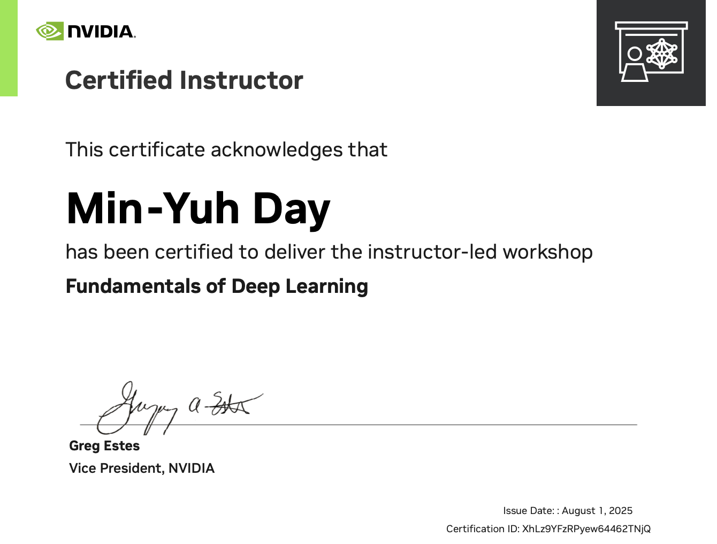
https://learn.nvidia.com/certificates?id=ny50l3TXT5W8Q_6kENkIaQ

Slide 11

https://learn.nvidia.com/certificates?id=XhLz9YFzRPyew64462TNjQ

Slide 12

NVIDIA
Certified Instructors
(12 from Taiwan)
https://www.nvidia.com/en-us/training/instructor-directory/search/

Slide 13

NVIDIA
Certified Instructors
(14 from Taiwan)
(2 from NTPU)(April 2025)
https://www.nvidia.com/en-us/training/instructor-directory/search/

Slide 14
NVIDIA Developer Program
NVIDIA
Deep Learning Institute (DLI)
https://developer.nvidia.com/join-nvidia-developer-program
https://learn.nvidia.com/

Slide 15
Get NVIDIA DLI Certificate
Before the NVIDIA Workshop
Step 1. Join NVIDIA Developer Program (Free)
https://developer.nvidia.com/join-nvidia-developer-program
Step 2. Visit NVIDIA Deep Learning Institute (DLI)
https://learn.nvidia.com/
Step 3. Enroll "Building RAG Agents with LLMs" Self-Paced Course (Free)
https://learn.nvidia.com/courses/course-detail?course_id=course-v1:DLI+S-FX-15+V1

Slide 16
Get NVIDIA DLI Certificate
Welcome to NVIDIA DLI "Building RAG Agents with LLMs" workshop.
Step 1. Visit https://learn.nvidia.com/dli-event
Step 2. Enter the event code: NTPU_RAG_AMBASSADOR_OC25
Step 3. Complete the NVIDIA DLI course and review the course datasheet at https://developer.nvidia.com/dli/getready

Slide 17
NVIDIA Deep Learning Institute (DLI)
Building RAG Agents with LLMs
workshop
Step 1.
Visit
https://learn.nvidia.com/dli-event
Step 2.
Enter the event code: NTPU_RAG_AMBASSADOR_OC25
Self-Paced Course
Building RAG Agents With LLMs
Certificate available
Free
8 hours
Instructor-Led Workshop
Building RAG Agents With LLMs
Certificate available
$500
8 hours
https://www.nvidia.com/en-us/learn/learning-path/generative-ai-llm/

Slide 18

Get NVIDIA Certificate
https://learn.nvidia.com/certificates?id=ed-qOCIMQaatzU8SNUNxgw

Slide 19

Join the NVIDIA Developer Program take one of the complimentary technical self-paced courses
(worth up to $90)
https://developer.nvidia.com/join-nvidia-developer-program

Slide 20
NVIDIA Deep Learning Institute (DLI)
Self-Paced Course
Generative AI Explained
Free
2 hours
Self-Paced Course
Getting Started With Deep Learning
Certificate available
$90
8 hours
Instructor-Led Workshop
Fundamentals of Deep Learning
Certificate available
$500
8 hours
Self-Paced Course
Introduction to Transformer-Based Natural Language Processing
Certificate available
$30
6 hours
Self-Paced Course
Building RAG Agents With LLMs
Certificate available
Free
8 hours
Instructor-Led Workshop
Building RAG Agents With LLMs
Certificate available
$500
8 hours
Self-Paced Course
Generative AI with Diffusion Models
Certificate available
$90
8 hours
Instructor-Led Workshop
Generative AI with Diffusion Models
Certificate available
$500
8 hours
https://www.nvidia.com/en-us/learn/learning-path/generative-ai-llm/

Slide 21
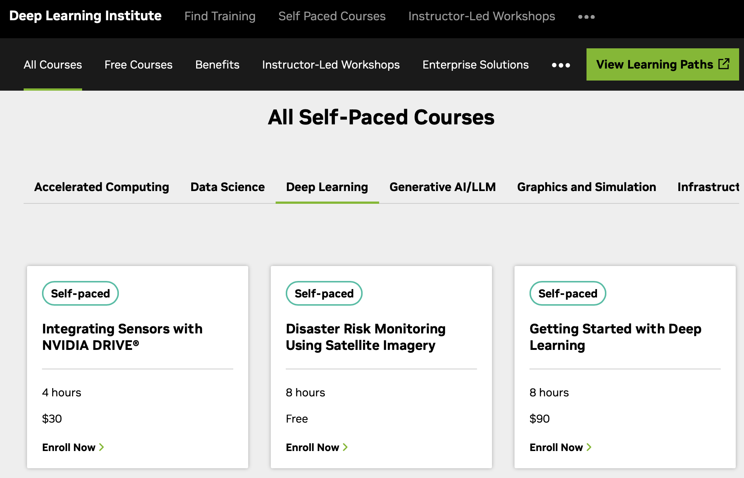
NVIDIA Getting Started with Deep Learning
Source: NVIDIA DLI (2025), Getting Started with Deep Learning, https://learn.nvidia.com/courses/course-detail?course_id=course-v1:DLI+S-FX-01+V1

Slide 22

NVIDIA Getting Started with Deep Learning
Source: NVIDIA DLI (2025), Getting Started with Deep Learning, https://learn.nvidia.com/courses/course-detail?course_id=course-v1:DLI+S-FX-01+V1

Slide 23

NVIDIA Deep Learning Institute (DLI)
Generative AI
https://learn.nvidia.com/en-us/training/find-training?q=Generative+AI

Slide 24

Building RAG Agents with LLMs
https://learn.nvidia.com/courses/course-detail?course_id=course-v1:DLI+S-FX-15+V1

Slide 25

Generative AI Explained
https://learn.nvidia.com/courses/course-detail?course_id=course-v1:DLI+S-FX-15+V1

Slide 26

Introduction to Transformer-Based
Natural Language Processing
https://learn.nvidia.com/courses/course-detail?course_id=course-v1:DLI+S-FX-08+V1

Slide 27

Generative AI with Diffusion Models
https://learn.nvidia.com/courses/course-detail?course_id=course-v1:DLI+S-FX-14+V1

Slide 28

Join the NVIDIA Developer Program take one of the complimentary technical self-paced courses (worth up to $90)
https://developer.nvidia.com/join-nvidia-developer-program

Slide 29

Join the NVIDIA Developer Program take one of the complimentary technical self-paced courses (worth up to $90)
https://developer.nvidia.com/join-nvidia-developer-program

Slide 30

Join the NVIDIA Developer Program take one of the complimentary technical self-paced courses (worth up to $90)
https://developer.nvidia.com/join-nvidia-developer-program

Slide 31

Join the NVIDIA Developer Program take one of the complimentary technical self-paced courses (worth up to $90)
https://developer.nvidia.com/join-nvidia-developer-program

Slide 32

Join the NVIDIA Developer Program take one of the complimentary technical self-paced courses (worth up to $90)
https://developer.nvidia.com/join-nvidia-developer-program

Slide 33

Join the NVIDIA Developer Program take one of the complimentary technical self-paced courses (worth up to $90)
https://developer.nvidia.com/join-nvidia-developer-program

Slide 34

NVIDIA Deep Learning Institute (DLI)
https://learn.nvidia.com/my-learning

Slide 35

NVIDIA Deep Learning Institute (DLI)
https://learn.nvidia.com/my-learning

Slide 36

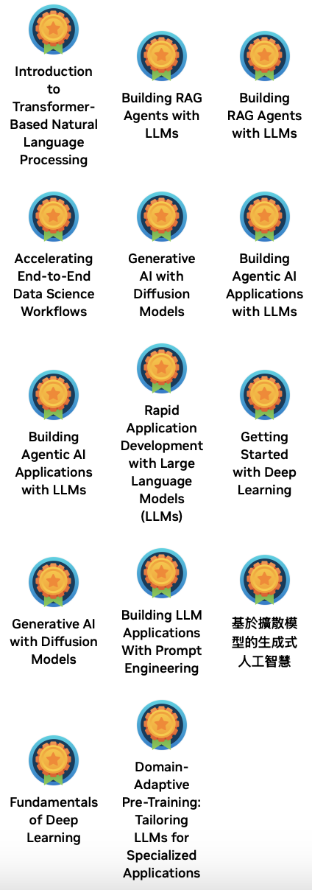

Deep Learning Institute (DLI)
https://learn.nvidia.com/my-learning

Slide 37

https://learn.nvidia.com/certificates?id=ed-qOCIMQaatzU8SNUNxgw

Slide 38

NVIDIA Deep Learning Institute (DLI)
https://learn.nvidia.com/en-us/training/self-paced-courses

Slide 39
Building RAG Agents with LLMs
https://learn.nvidia.com/courses/course-detail?course_id=course-v1:DLI+S-FX-15+V1

Slide 40

Building RAG Agents with LLMs
Source: NVIDIA DLI (2024), Building RAG Agents with LLMs, https://learn.nvidia.com/courses/course-detail?course_id=course-v1:DLI+S-FX-15+V1

Slide 41

Building RAG Agents with LLMs
https://learn.nvidia.com/my-learning

Slide 42

Building RAG Agents with LLMs
https://learn.nvidia.com/courses/course?course_id=course-v1:DLI+S-FX-15+V1

Slide 43

Building RAG Agents with LLMs
https://learn.nvidia.com/courses/course?course_id=course-v1:DLI+S-FX-15+V1

Slide 44

Building RAG Agents with LLMs
https://learn.nvidia.com/courses/course?course_id=course-v1:DLI+S-FX-15+V1

Slide 45

Building RAG Agents with LLMs
https://learn.nvidia.com/courses/course?course_id=course-v1:DLI+S-FX-15+V1

Slide 46

Building RAG Agents with LLMs
https://learn.nvidia.com/courses/course?course_id=course-v1:DLI+S-FX-15+V1

Slide 47

Building RAG Agents with LLMs
https://learn.nvidia.com/courses/course?course_id=course-v1:DLI+S-FX-15+V1

Slide 48

Building RAG Agents with LLMs
https://learn.nvidia.com/courses/course?course_id=course-v1:DLI+S-FX-15+V1

Slide 49
NVIDIA
Fundamentals of Deep Learning

Slide 50
NVIDIA Deep Learning Institute (DLI)
Fundamentals of Deep Learning
Workshop
Step 1.
Visit
https://learn.nvidia.com/dli-event
Step 2.
Enter the event code: NTPU_FDL_AMBASSADOR_DE25
Self-Paced Course
Getting Started With Deep Learning
Certificate available
$90
8 hours
Instructor-Led Workshop
Fundamentals of Deep Learning
Certificate available
$500
8 hours
https://www.nvidia.com/en-us/learn/learning-path/generative-ai-llm/

Slide 51
Get NVIDIA DLI Certificate
Fundamentals of Deep Learning
Welcome to NVIDIA DLI "Fundamentals of Deep Learning" workshop.
Step 1. Visit https://learn.nvidia.com/dli-event
Step 2. Enter the event code: NTPU_FDL_AMBASSADOR_DE25
Step 3. Complete the NVIDIA DLI course and review the course datasheet at https://developer.nvidia.com/dli/getready

Slide 52
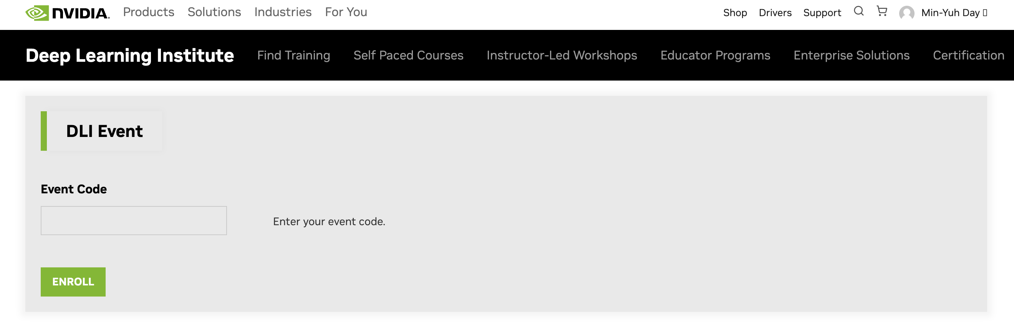
Get NVIDIA DLI Certificate
Fundamentals of Deep Learning
Workshop
Welcome to NVIDIA DLI
" Fundamentals of Deep Learning"
workshop.
Step 1. Visit https://learn.nvidia.com/dli-event
Step 2. Enter the event code: NTPU_FDL_AMBASSADOR_DE25
NTPU_FDL_AMBASSADOR_DE25
https://learn.nvidia.com/dli-event

Slide 53
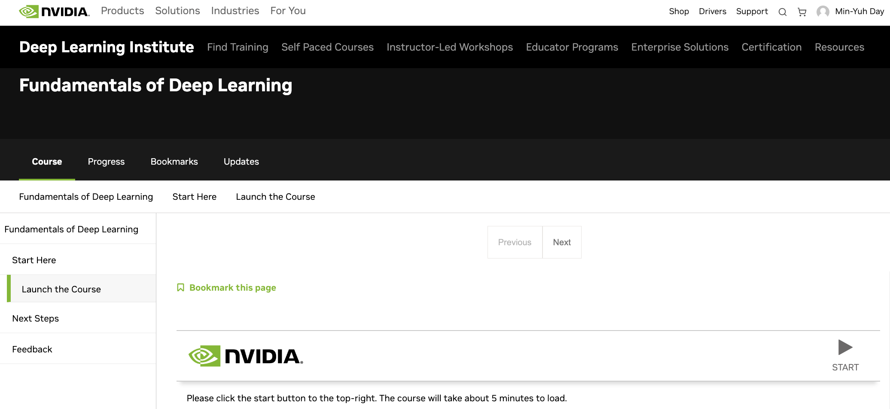
NVIDIA Fundamentals of Deep Learning
Workshop
Source: NVIDIA DLI (2025), Getting Started with Deep Learning, https://learn.nvidia.com/courses/course?course_id=course-v1:DLI+C-FX-01+V3

Slide 54
NVIDIA Deep Learning Institute (DLI)
Building RAG Agents with LLMs
Workshop
Step 1.
Visit
https://learn.nvidia.com/dli-event
Step 2.
Enter the event code: NTPU_RAG_AMBASSADOR_DE25
Self-Paced Course
Building RAG Agents With LLMs
Certificate available
Free
8 hours
Instructor-Led Workshop
Building RAG Agents With LLMs
Certificate available
$500
8 hours
https://www.nvidia.com/en-us/learn/learning-path/generative-ai-llm/

Slide 55
Get NVIDIA DLI Certificate
Building RAG Agents with LLMs
Workshop
Welcome to NVIDIA DLI
" Building RAG Agents with LLMs "
workshop.
Step 1. Visit https://learn.nvidia.com/dli-event
Step 2. Enter the event code: NTPU_RAG_AMBASSADOR_DE25
NTPU_RAG_AMBASSADOR_DE25
https://learn.nvidia.com/dli-event

Slide 56
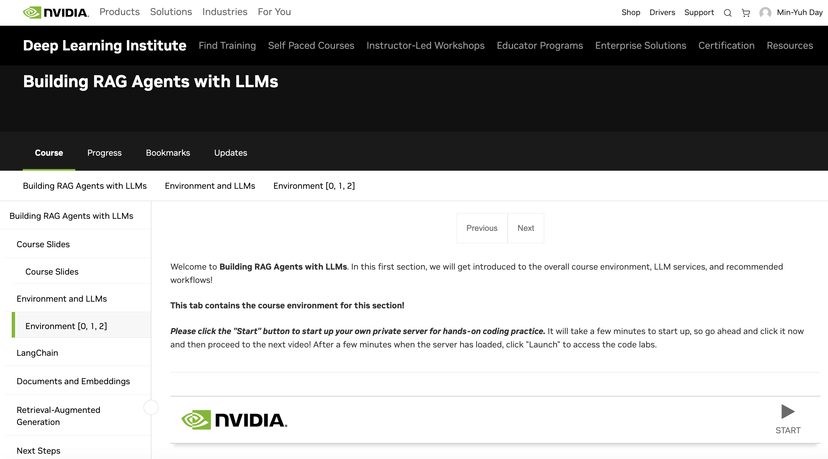
Building RAG Agents with LLMs
Workshop
https://learn.nvidia.com/courses/course?course_id=course-v1:DLI+C-FX-15+V1

Slide 57
NVIDIA Getting Started with Deep Learning
Learn how deep learning works through hands-on exercises in computer vision and natural language processing.
Learning Objectives
  Learn the fundamental techniques and tools required to train a deep learning model
  Gain experience with common deep learning data types and model architectures
  Enhance datasets through data augmentation to improve model accuracy
  Leverage transfer learning between models to achieve efficient results with less data and computation
  Build confidence to take on your own project with a modern deep learning framework
Source: NVIDIA DLI (2025), Getting Started with Deep Learning, https://learn.nvidia.com/courses/course-detail?course_id=course-v1:DLI+S-FX-01+V1

Slide 58
NVIDIA Getting Started with Deep Learning
1: An Introduction to Deep Learning
2: The Theory Behind Neural Networks
3: Convolutional Neural Networks
4: Data Augmentation and Deployment
5: Pre-trained Models
6: Natural Language Processing
7: Wrap-up and Assessment
Source: NVIDIA DLI (2025), Getting Started with Deep Learning, https://learn.nvidia.com/courses/course-detail?course_id=course-v1:DLI+S-FX-01+V1

Slide 59
NVIDIA Getting Started with Deep Learning
Source: NVIDIA DLI (2025), Getting Started with Deep Learning, https://learn.nvidia.com/courses/course-detail?course_id=course-v1:DLI+S-FX-01+V1

Slide 60
NVIDIA Getting Started with Deep Learning
Source: NVIDIA DLI (2025), Getting Started with Deep Learning, https://learn.nvidia.com/courses/course-detail?course_id=course-v1:DLI+S-FX-01+V1

Slide 61
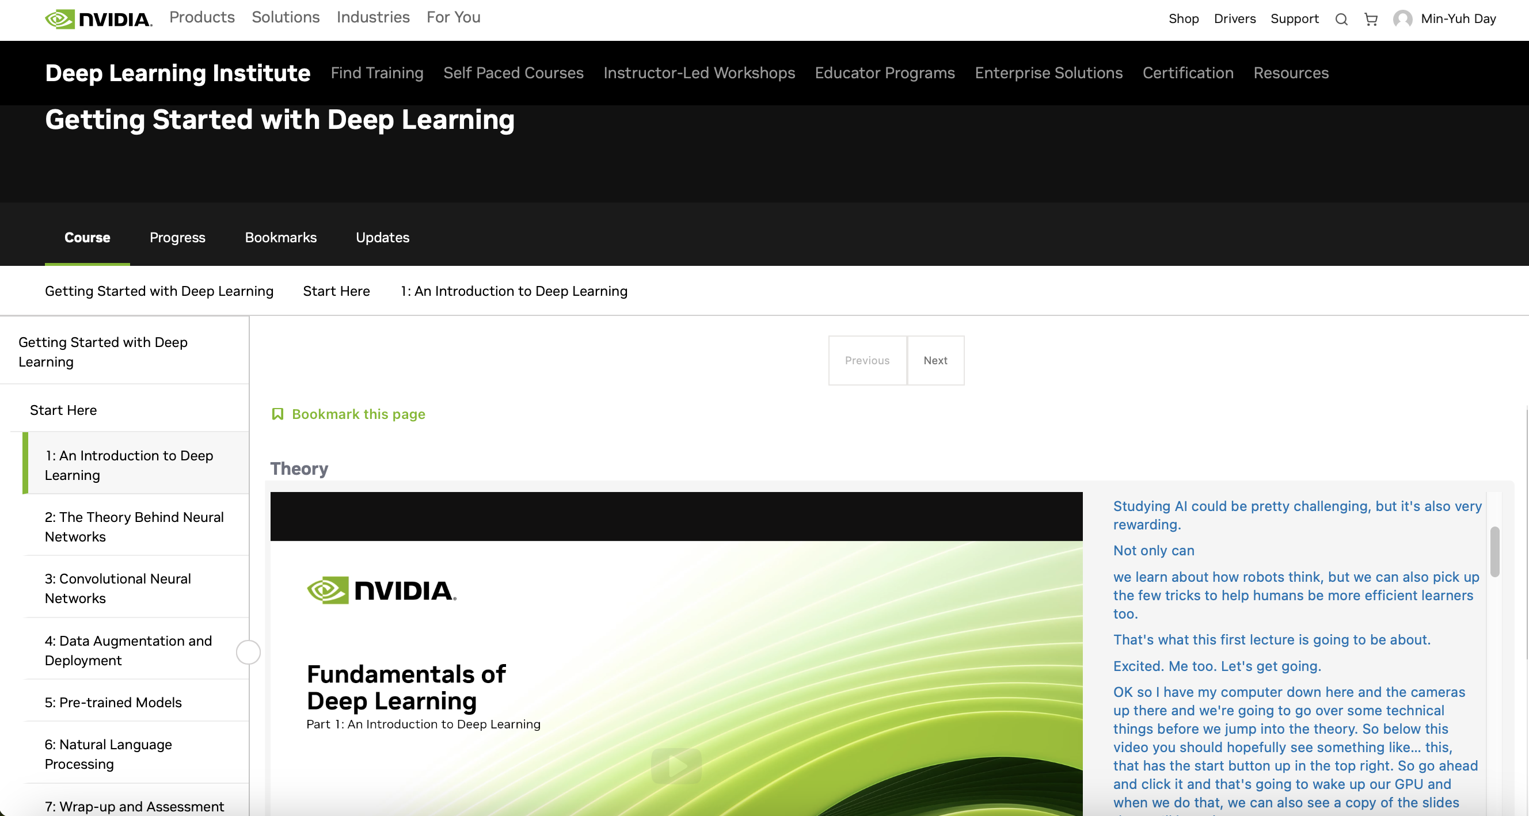
NVIDIA Getting Started with Deep Learning
Source: NVIDIA DLI (2025), Getting Started with Deep Learning, https://learn.nvidia.com/courses/course-detail?course_id=course-v1:DLI+S-FX-01+V1

Slide 62
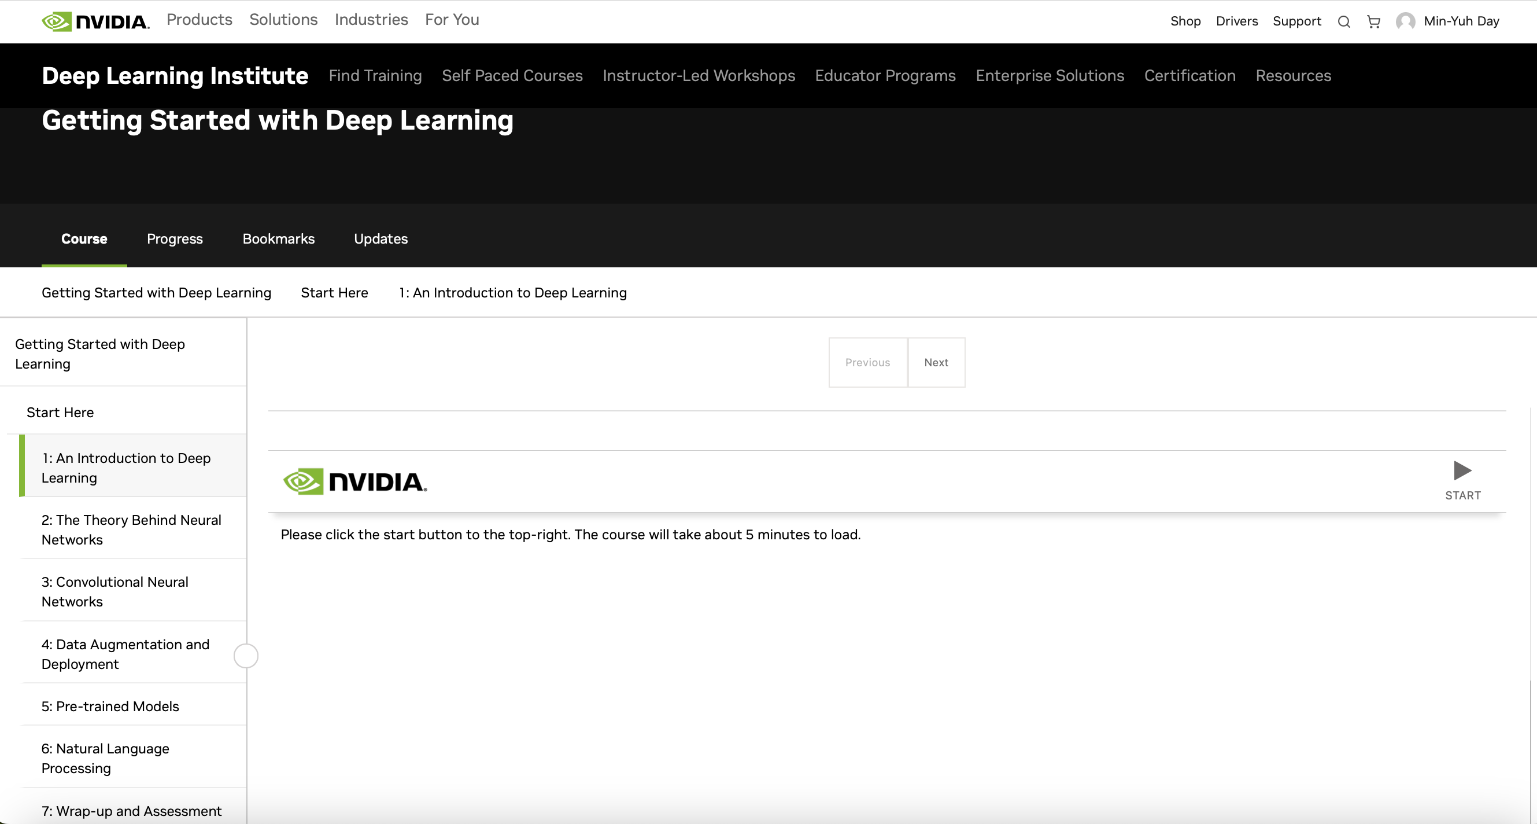
NVIDIA Getting Started with Deep Learning
Source: NVIDIA DLI (2025), Getting Started with Deep Learning, https://learn.nvidia.com/courses/course-detail?course_id=course-v1:DLI+S-FX-01+V1

Slide 63
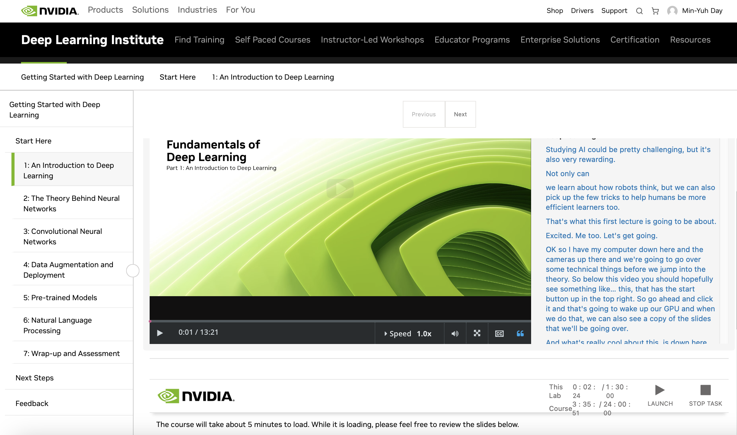
NVIDIA Getting Started with Deep Learning
Source: NVIDIA DLI (2025), Getting Started with Deep Learning, https://learn.nvidia.com/courses/course-detail?course_id=course-v1:DLI+S-FX-01+V1

Slide 64
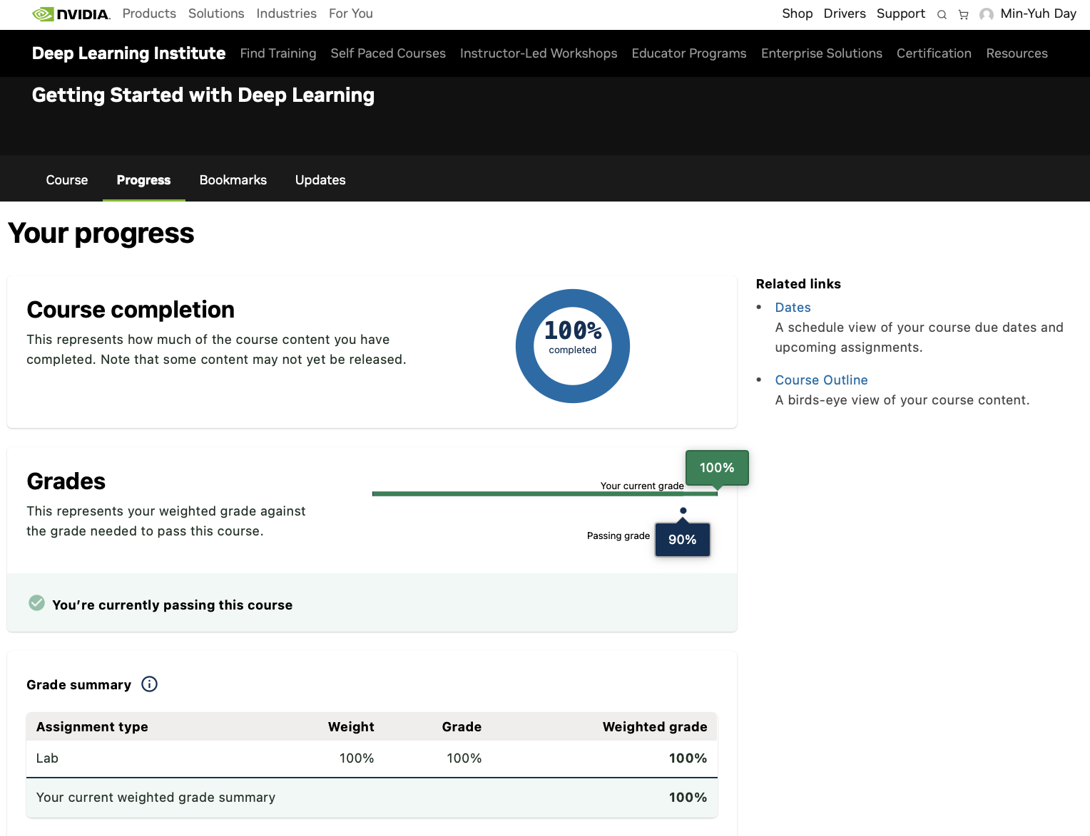
NVIDIA Getting Started with Deep Learning
Source: NVIDIA DLI (2025), Getting Started with Deep Learning, https://learn.nvidia.com/courses/course-detail?course_id=course-v1:DLI+S-FX-01+V1

Slide 65
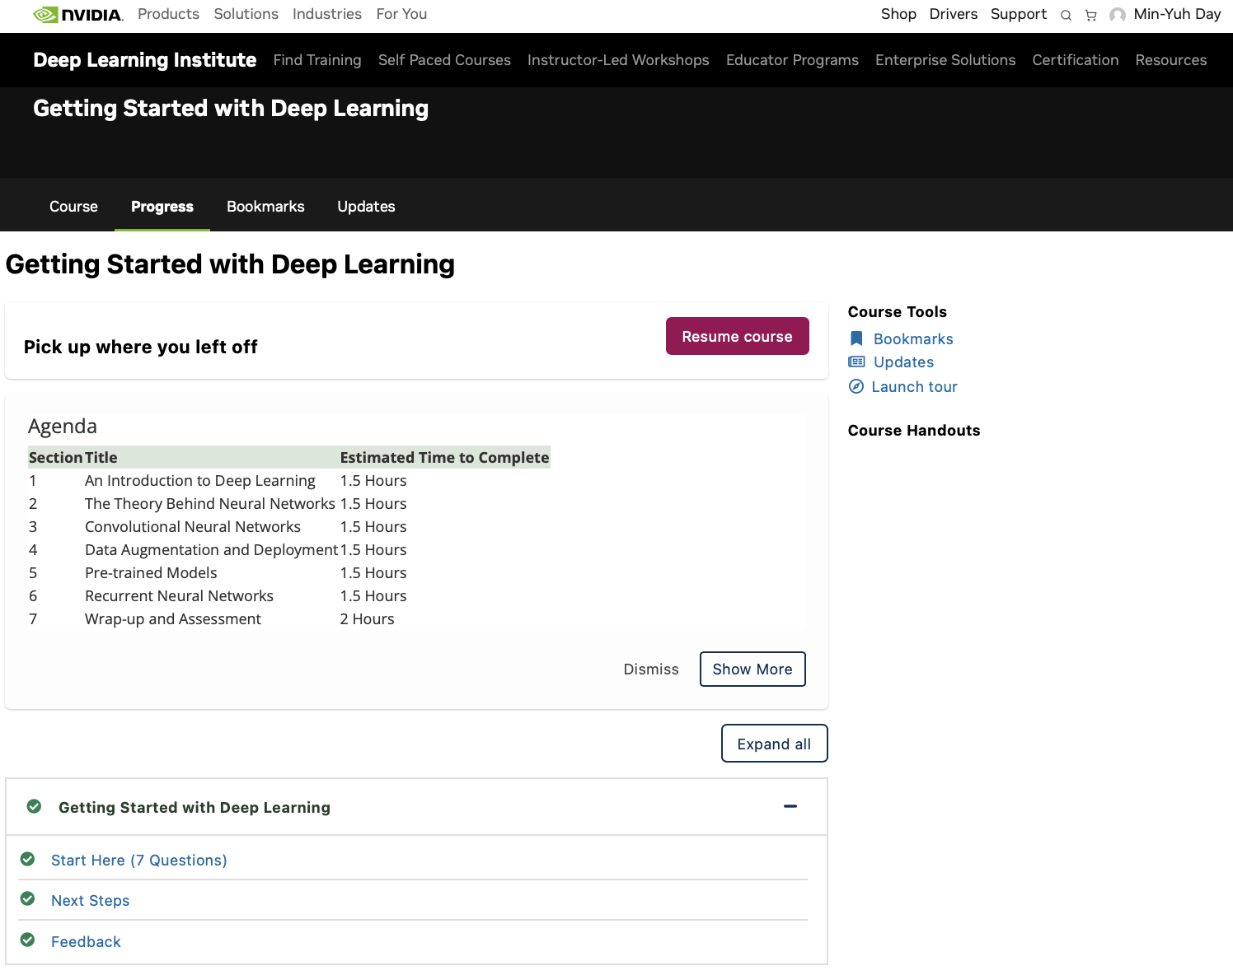
NVIDIA Getting Started with Deep Learning
Source: NVIDIA DLI (2025), Getting Started with Deep Learning, https://learn.nvidia.com/courses/course-detail?course_id=course-v1:DLI+S-FX-01+V1

Slide 66
NVIDIA Getting Started with Deep Learning
Section | Title | Estimated Time to Complete
1 | An Introduction to Deep Learning | 1.5 Hours
2 | The Theory Behind Neural Networks | 1.5 Hours
3 | Convolutional Neural Networks | 1.5 Hours
4 | Data Augmentation and Deployment | 1.5 Hours
5 | Pre-trained Models | 1.5 Hours
6 | Recurrent Neural Networks | 1.5 Hours
7 | Wrap-up and Assessment | 2 Hours
Source: NVIDIA DLI (2025), Getting Started with Deep Learning, https://learn.nvidia.com/courses/course-detail?course_id=course-v1:DLI+S-FX-01+V1

Slide 67

NVIDIA Getting Started with Deep Learning
Source: NVIDIA DLI (2025), Getting Started with Deep Learning, https://learn.nvidia.com/courses/course-detail?course_id=course-v1:DLI+S-FX-01+V1

Slide 68

NVIDIA Getting Started with Deep Learning
Source: NVIDIA DLI (2025), Getting Started with Deep Learning, https://learn.nvidia.com/courses/course-detail?course_id=course-v1:DLI+S-FX-01+V1

Slide 69
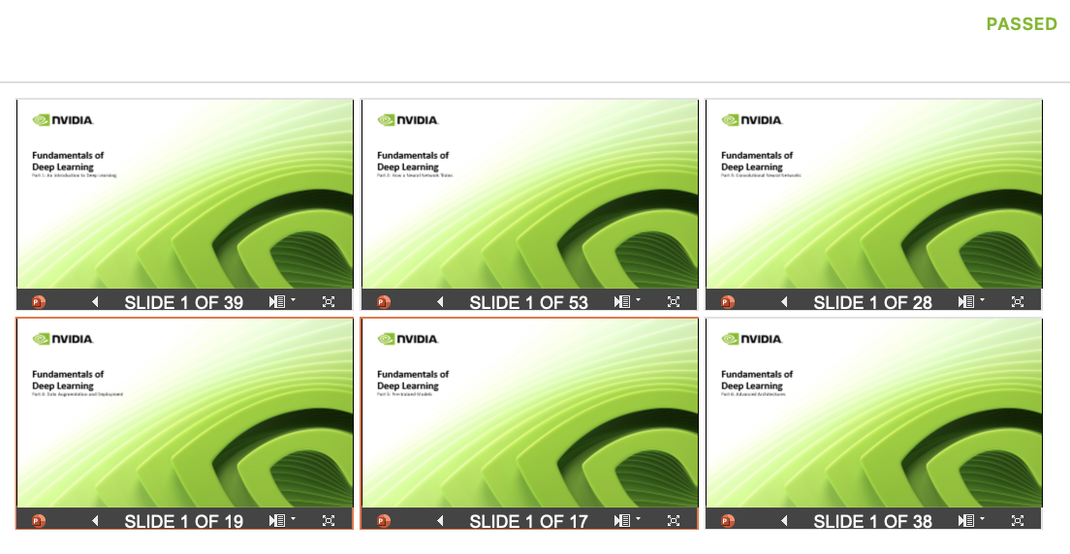
NVIDIA Getting Started with Deep Learning
Source: NVIDIA DLI (2025), Getting Started with Deep Learning, https://learn.nvidia.com/courses/course-detail?course_id=course-v1:DLI+S-FX-01+V1

Slide 70
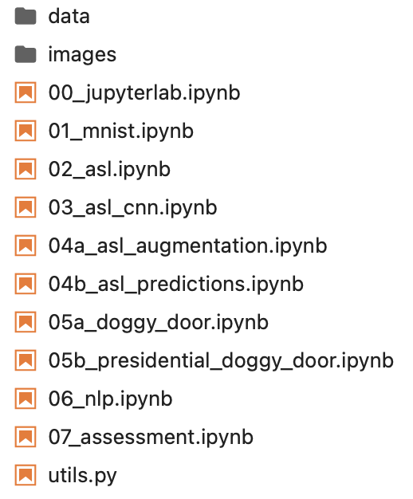
NVIDIA Getting Started with Deep Learning
Source: NVIDIA DLI (2025), Getting Started with Deep Learning, https://learn.nvidia.com/courses/course-detail?course_id=course-v1:DLI+S-FX-01+V1

Slide 71
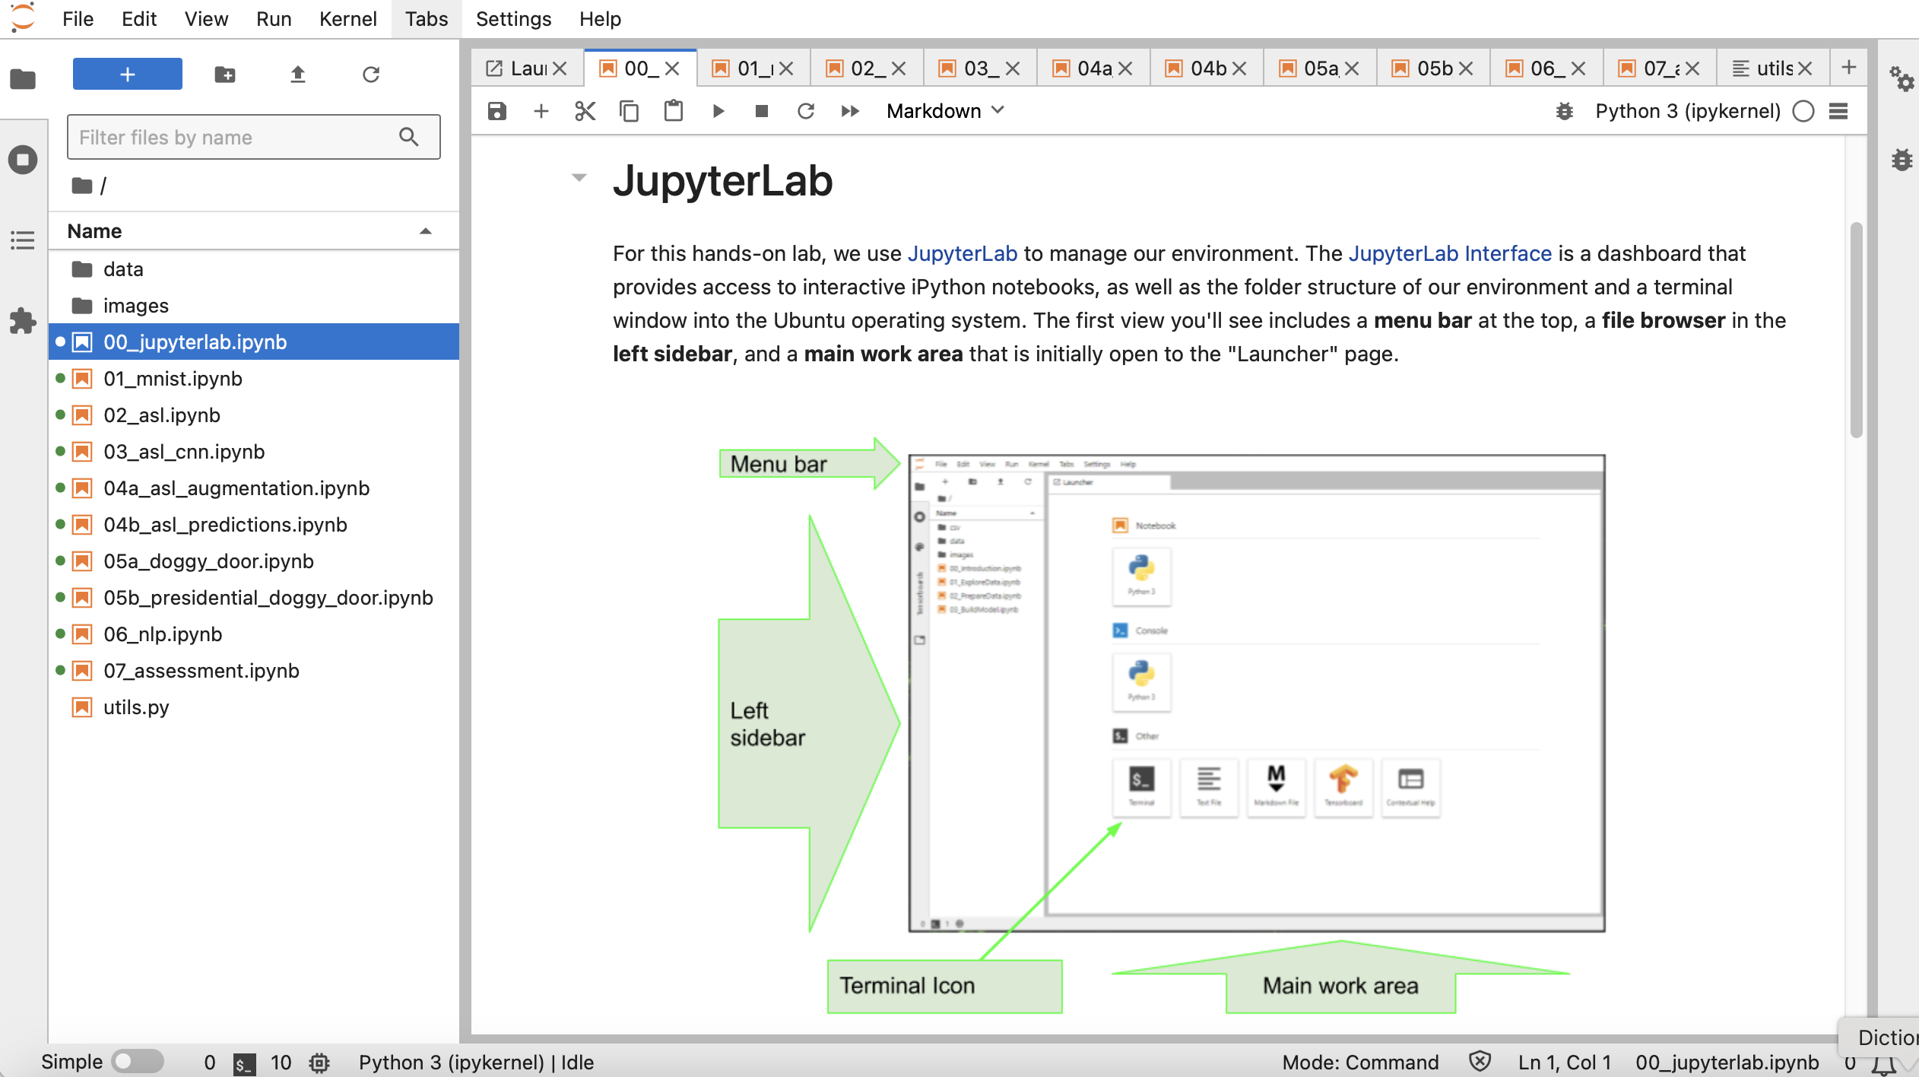
NVIDIA Getting Started with Deep Learning
Source: NVIDIA DLI (2025), Getting Started with Deep Learning, https://learn.nvidia.com/courses/course-detail?course_id=course-v1:DLI+S-FX-01+V1

Slide 72
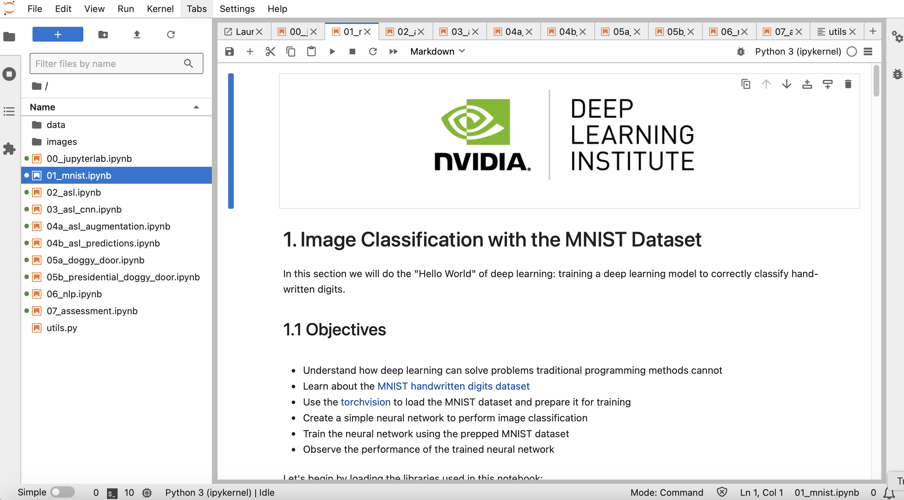
NVIDIA Getting Started with Deep Learning
Source: NVIDIA DLI (2025), Getting Started with Deep Learning, https://learn.nvidia.com/courses/course-detail?course_id=course-v1:DLI+S-FX-01+V1

Slide 73
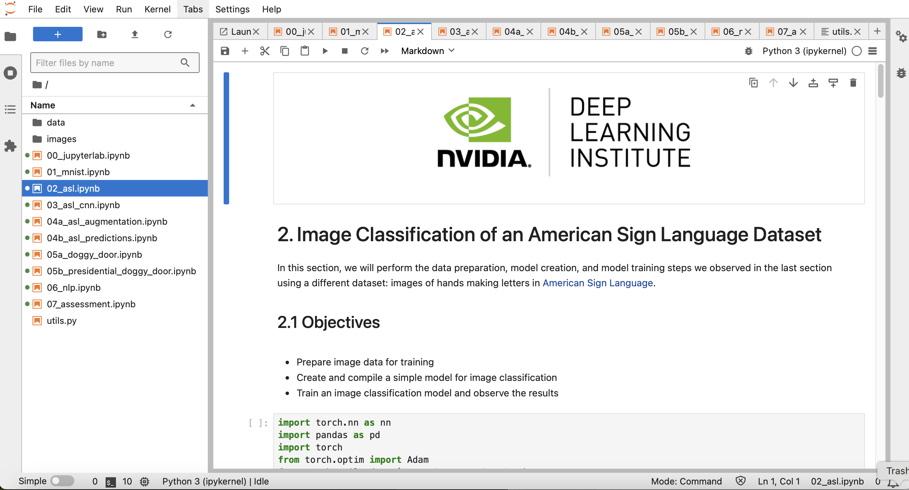
NVIDIA Getting Started with Deep Learning
Source: NVIDIA DLI (2025), Getting Started with Deep Learning, https://learn.nvidia.com/courses/course-detail?course_id=course-v1:DLI+S-FX-01+V1

Slide 74
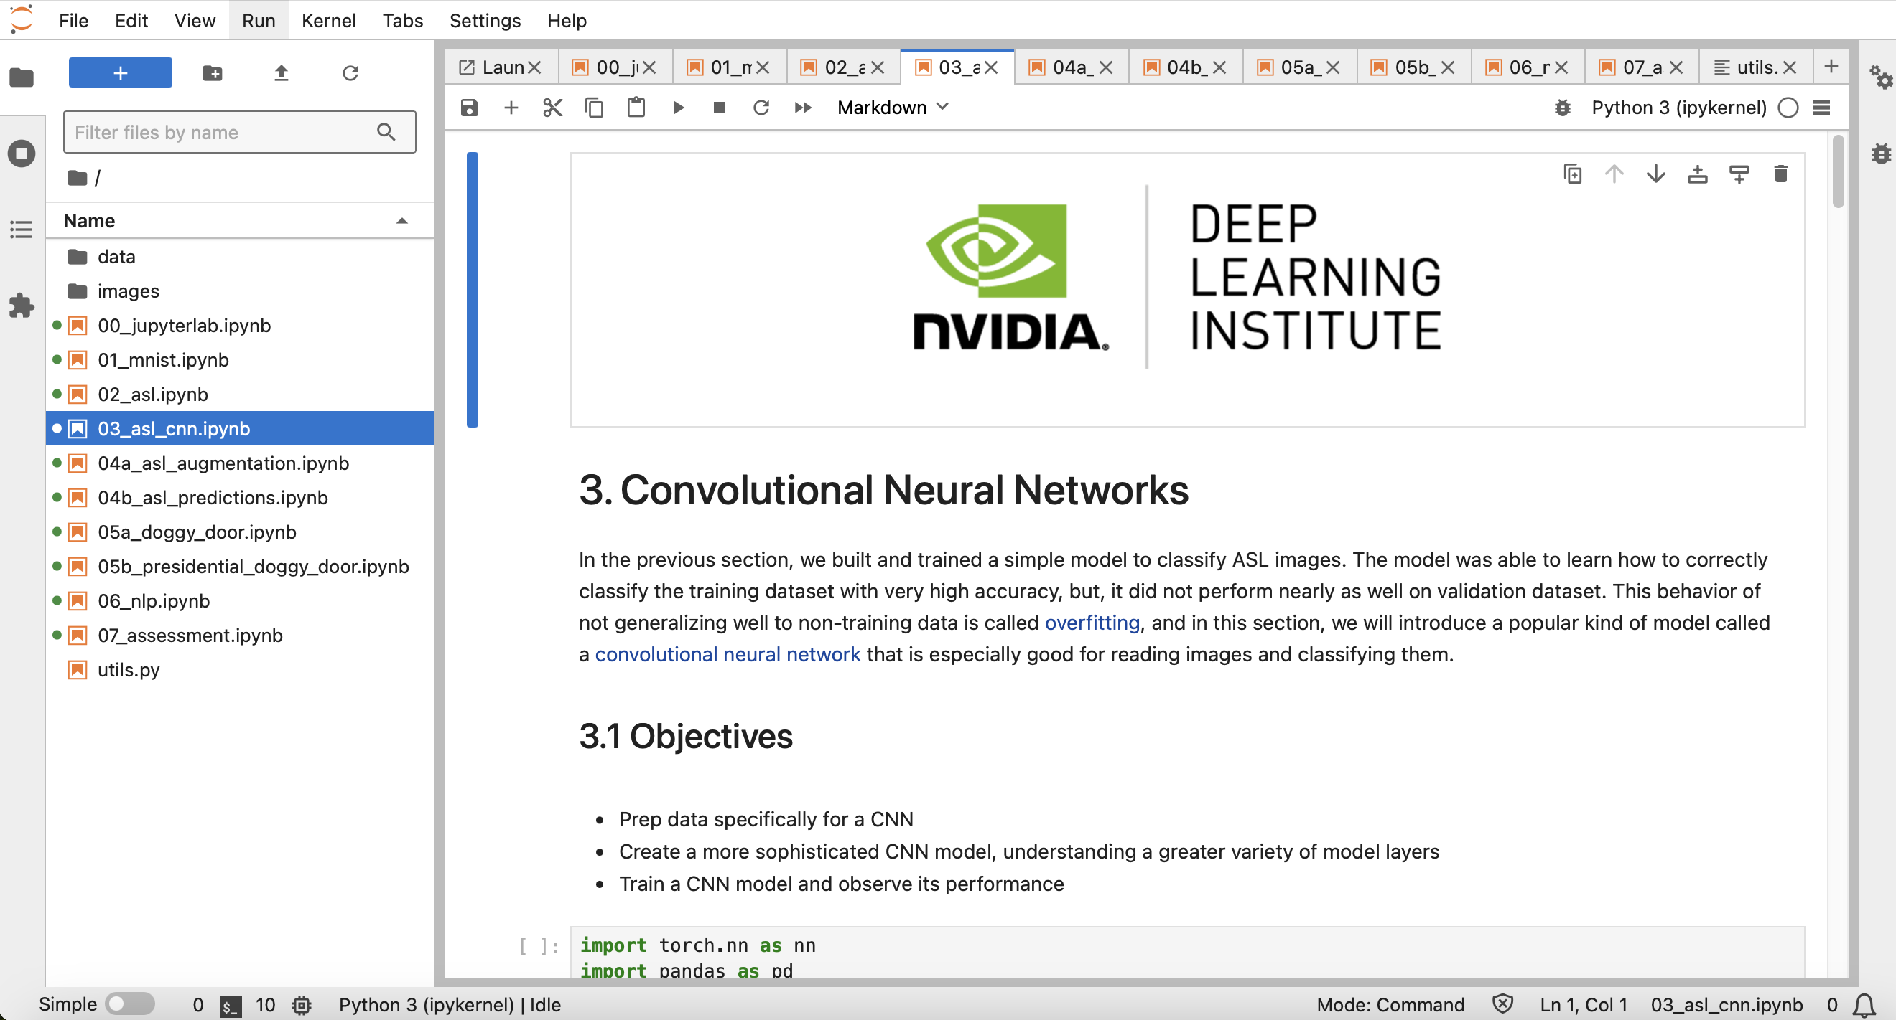
NVIDIA Getting Started with Deep Learning
Source: NVIDIA DLI (2025), Getting Started with Deep Learning, https://learn.nvidia.com/courses/course-detail?course_id=course-v1:DLI+S-FX-01+V1

Slide 75
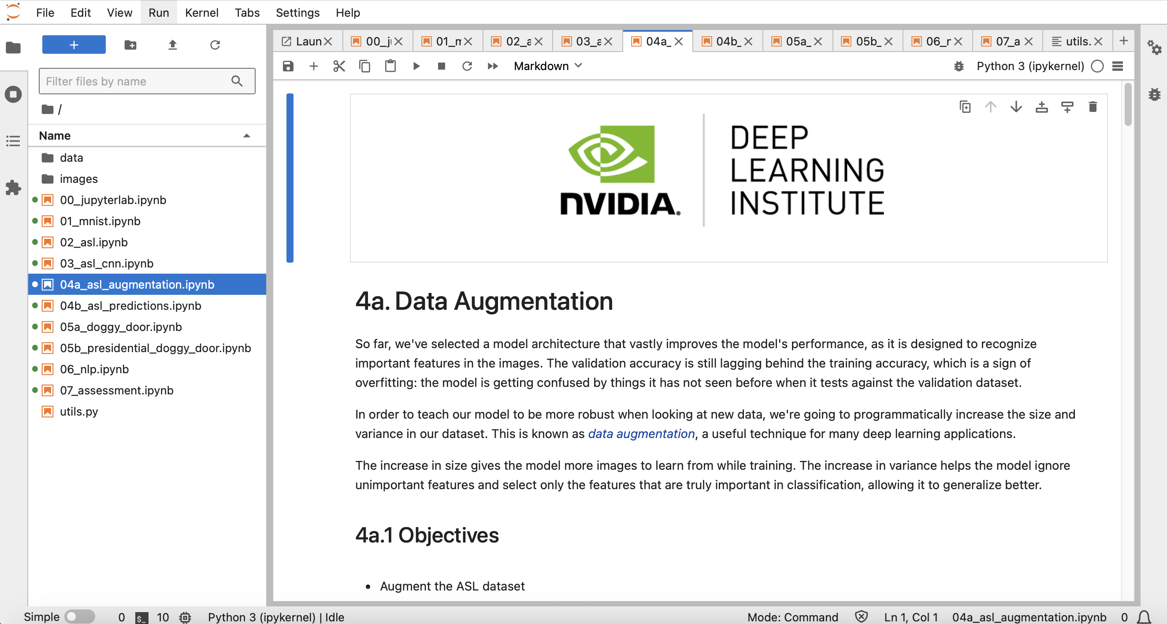
NVIDIA Getting Started with Deep Learning
Source: NVIDIA DLI (2025), Getting Started with Deep Learning, https://learn.nvidia.com/courses/course-detail?course_id=course-v1:DLI+S-FX-01+V1

Slide 76
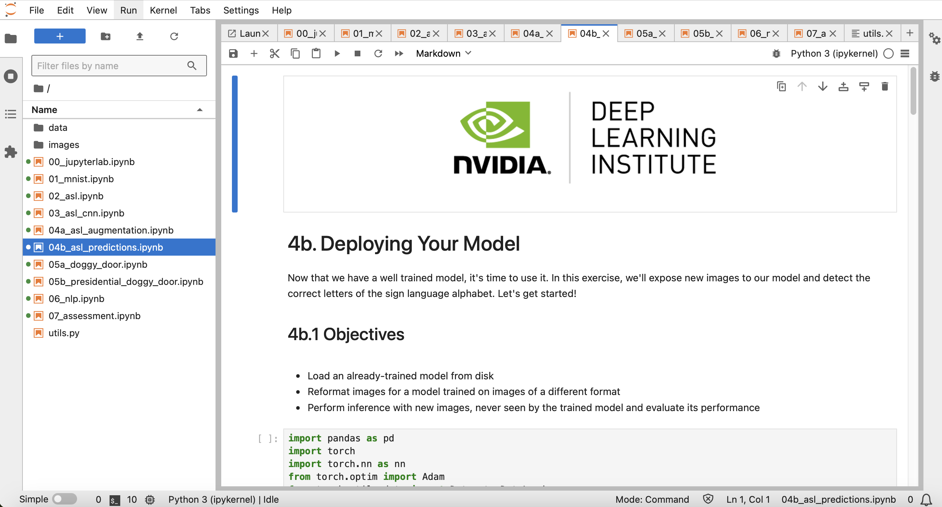
NVIDIA Getting Started with Deep Learning
Source: NVIDIA DLI (2025), Getting Started with Deep Learning, https://learn.nvidia.com/courses/course-detail?course_id=course-v1:DLI+S-FX-01+V1

Slide 77
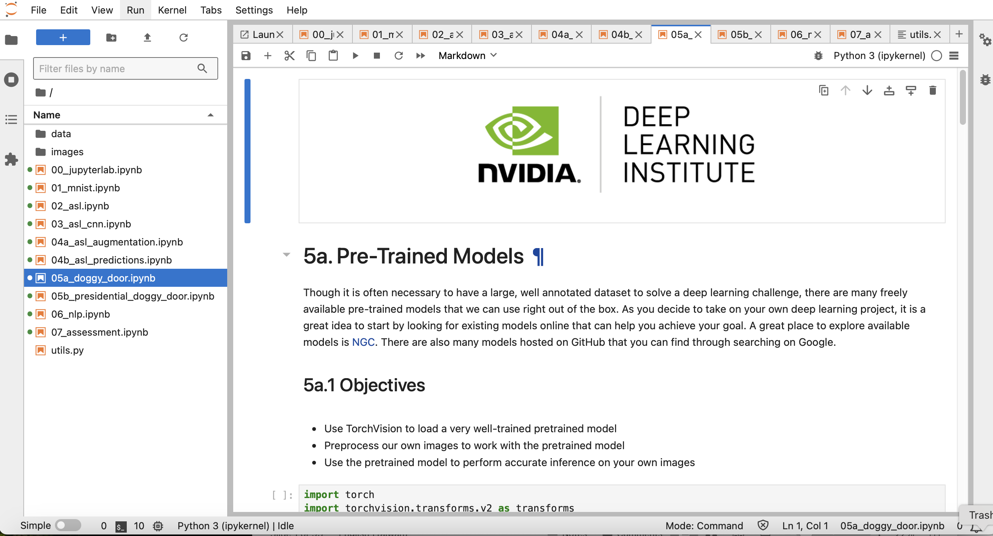
NVIDIA Getting Started with Deep Learning
Source: NVIDIA DLI (2025), Getting Started with Deep Learning, https://learn.nvidia.com/courses/course-detail?course_id=course-v1:DLI+S-FX-01+V1

Slide 78
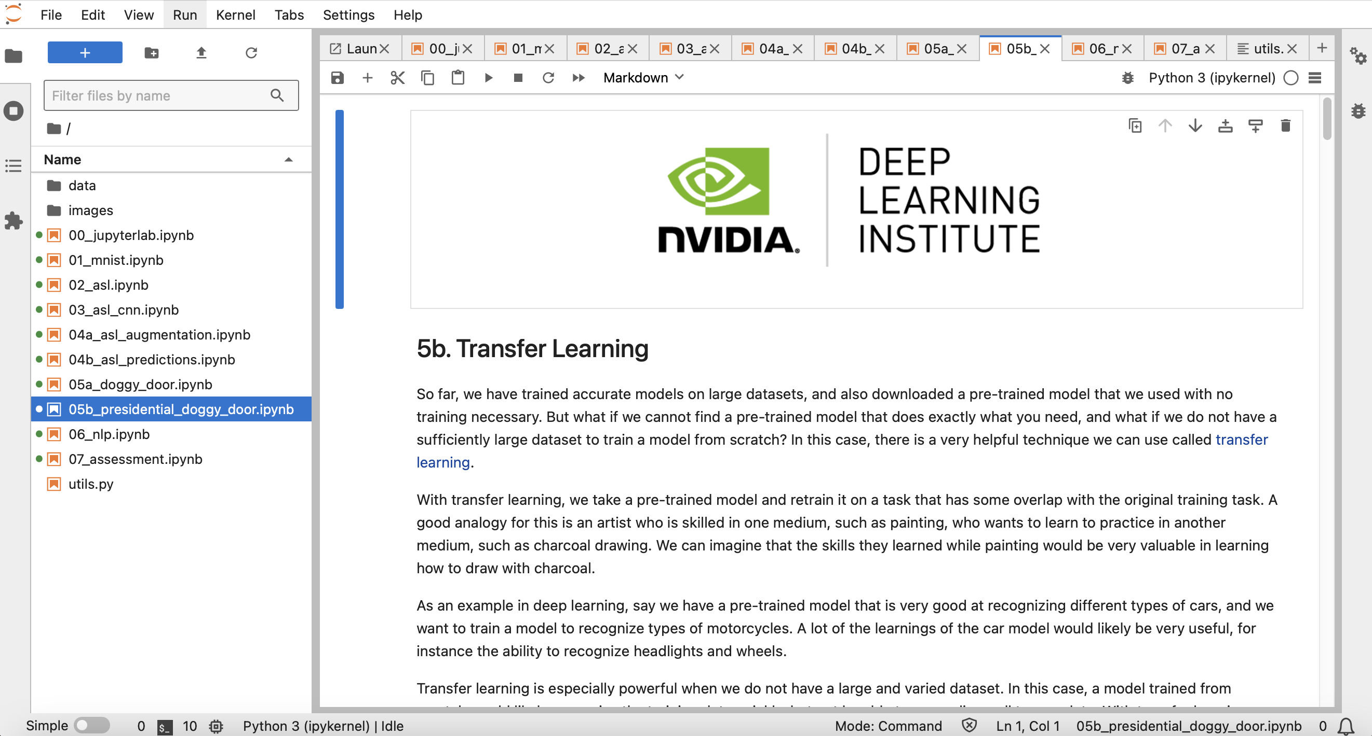
NVIDIA Getting Started with Deep Learning
Source: NVIDIA DLI (2025), Getting Started with Deep Learning, https://learn.nvidia.com/courses/course-detail?course_id=course-v1:DLI+S-FX-01+V1

Slide 79
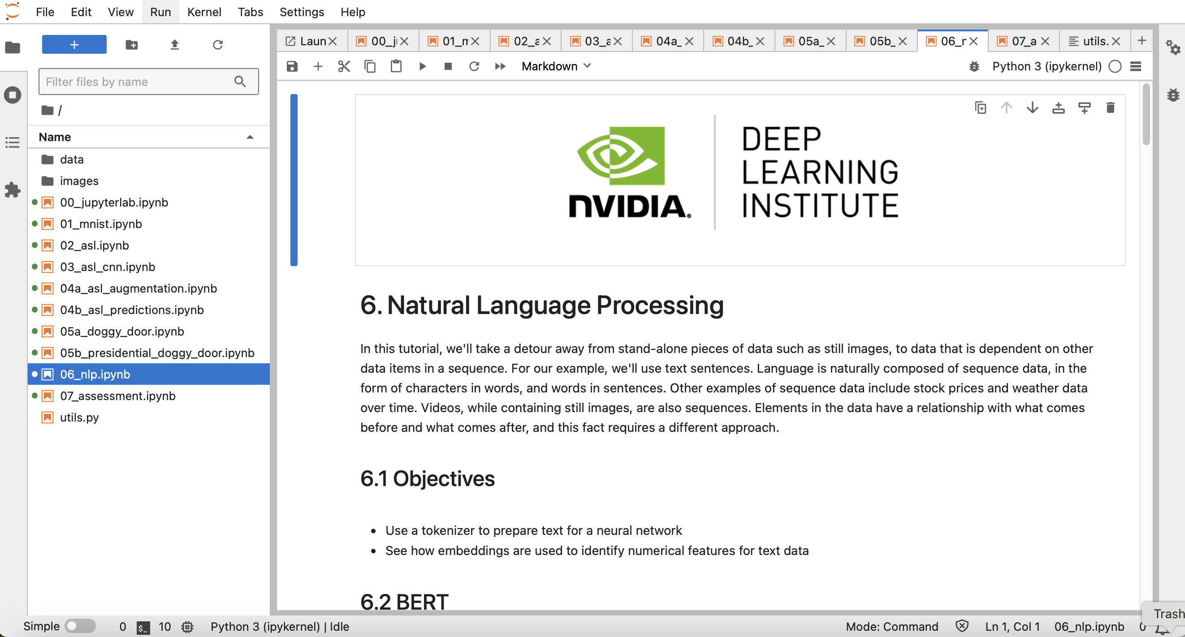
NVIDIA Getting Started with Deep Learning
Source: NVIDIA DLI (2025), Getting Started with Deep Learning, https://learn.nvidia.com/courses/course-detail?course_id=course-v1:DLI+S-FX-01+V1

Slide 80
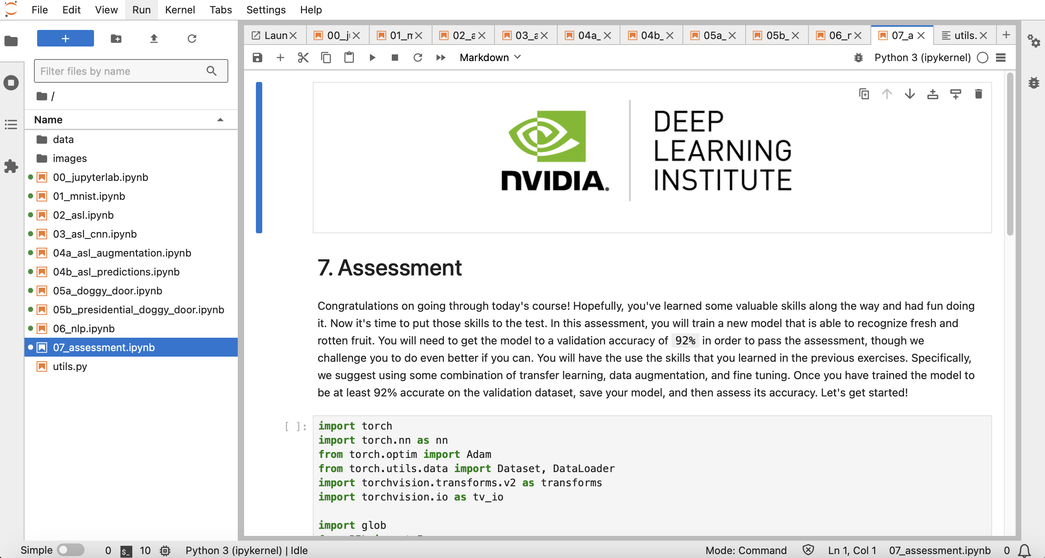
NVIDIA Getting Started with Deep Learning
Source: NVIDIA DLI (2025), Getting Started with Deep Learning, https://learn.nvidia.com/courses/course-detail?course_id=course-v1:DLI+S-FX-01+V1

Slide 81
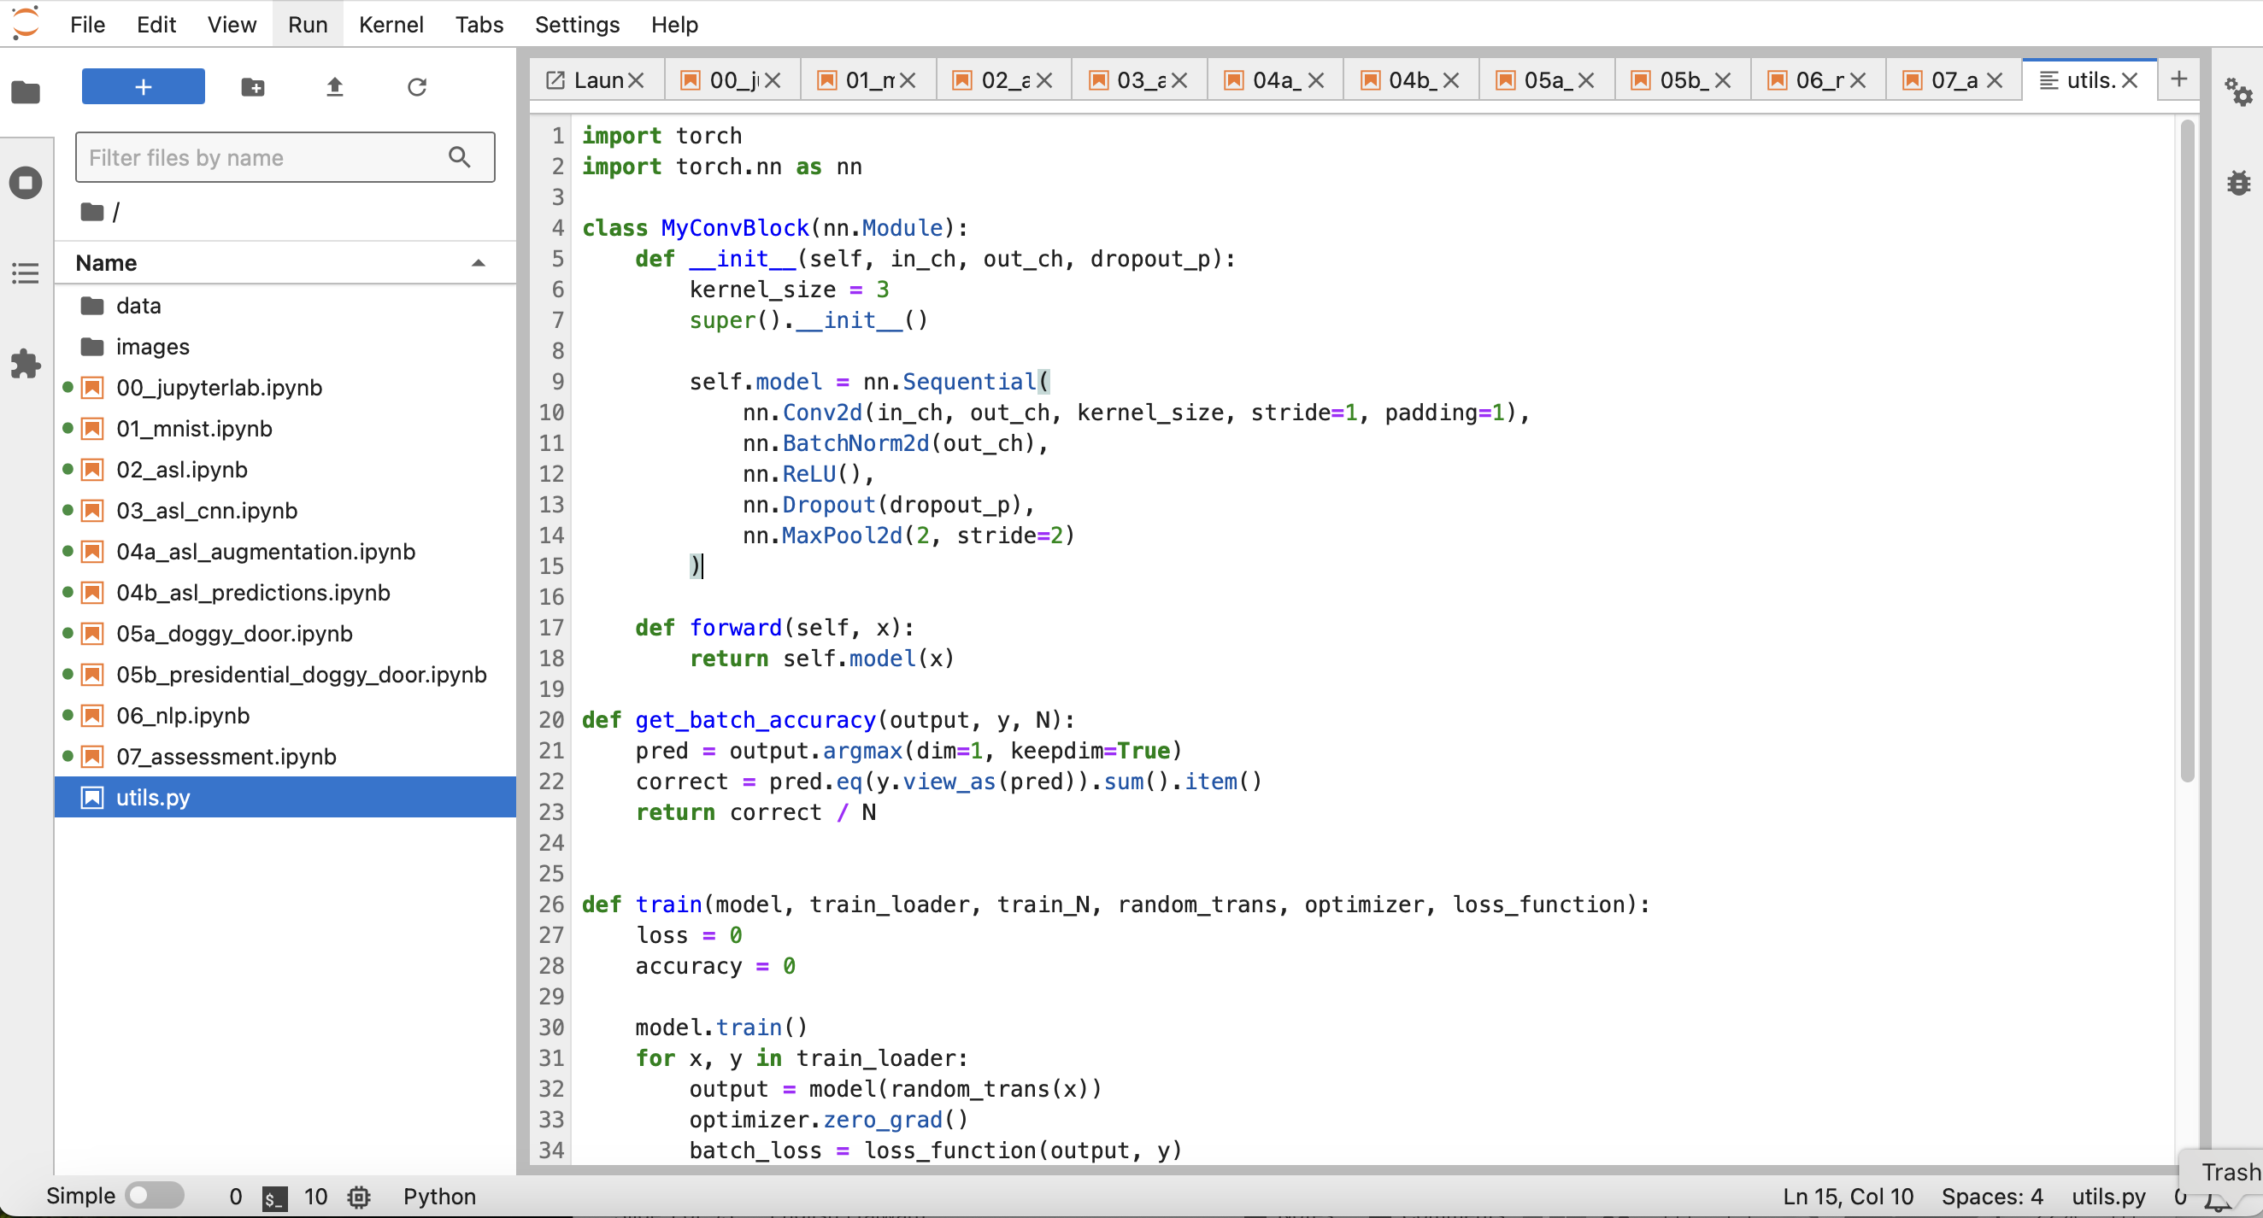
NVIDIA Getting Started with Deep Learning
Source: NVIDIA DLI (2025), Getting Started with Deep Learning, https://learn.nvidia.com/courses/course-detail?course_id=course-v1:DLI+S-FX-01+V1

Slide 82
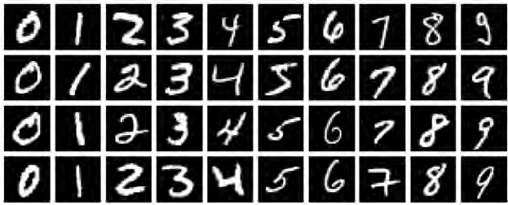
NVIDIA Getting Started with Deep Learning
MNIST Handwritten Digits
Source: NVIDIA DLI (2025), Getting Started with Deep Learning, https://learn.nvidia.com/courses/course-detail?course_id=course-v1:DLI+S-FX-01+V1

Slide 83
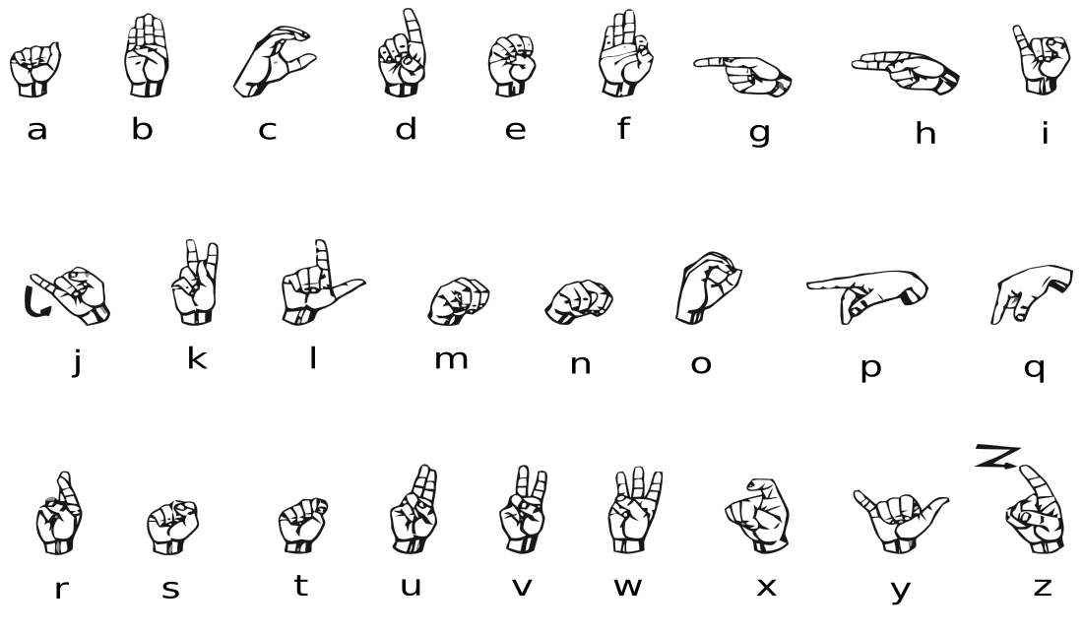


NVIDIA Getting Started with Deep Learning
American Sign Language (ASL) Alphabet
Source: NVIDIA DLI (2025), Getting Started with Deep Learning, https://learn.nvidia.com/courses/course-detail?course_id=course-v1:DLI+S-FX-01+V1

Slide 84
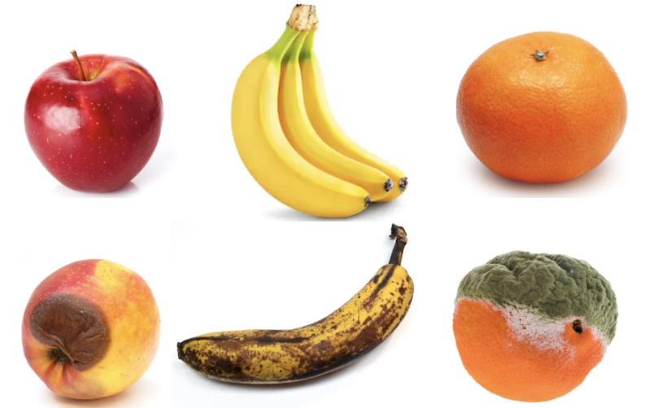
NVIDIA Getting Started with Deep Learning
Fruits fresh and rotten for classification
Kaggle Datasets: https://www.kaggle.com/datasets/sriramr/fruits-fresh-and-rotten-for-classification
Source: NVIDIA DLI (2025), Getting Started with Deep Learning, https://learn.nvidia.com/courses/course-detail?course_id=course-v1:DLI+S-FX-01+V1

Slide 85
Fundamentals of
Deep Learning
Part 1: An Introduction to Deep Learning
Source: NVIDIA DLI (2025), Getting Started with Deep Learning, https://learn.nvidia.com/courses/course-detail?course_id=course-v1:DLI+S-FX-01+V1
85
85

Slide 86
Fundamentals of
Deep Learning
Agenda
• | Part 1: An Introduction to Deep Learning
• | Part 2: How a Neural Network Trains
• | Part 3: Convolutional Neural Networks
• | Part 4: Data Augmentation and Deployment
• | Part 5: Pre-Trained Models
• | Part 6: Advanced Architectures
Source: NVIDIA DLI (2025), Getting Started with Deep Learning, https://learn.nvidia.com/courses/course-detail?course_id=course-v1:DLI+S-FX-01+V1
86
86

Slide 87
The Goals of This Course
Get you up and on your feet quickly
Build a foundation to tackle a deep learning project right away
We won’t cover the whole field, but we’ll get a great head start
Foundation from which to read articles, follow tutorials, take further classes
Source: NVIDIA DLI (2025), Getting Started with Deep Learning, https://learn.nvidia.com/courses/course-detail?course_id=course-v1:DLI+S-FX-01+V1
87
87
Notes:
We want to get you up and on your feet quickly, and give you the tools and theory necessary to jump into the field and tackle your own problems right away
We won’t be able to cover the whole field of deep learning, but we’ll give you a valuable set of skills and a solid understanding of how to practice deep learning today
The goal is also to prepare you to dive deeper into your learning, allowing you a foundation for reading articles, following tutorials, or taking further deep learning classes

Slide 88


Human Vs Machine Learning
Relaxed Alertness
Human | Machine
Rest and Digest | Training
Fight-or-flight | Prediction
Source: NVIDIA DLI (2025), Getting Started with Deep Learning, https://learn.nvidia.com/courses/course-detail?course_id=course-v1:DLI+S-FX-01+V1
88
Notes:
The technical term for learning while having fun is called “Relaxed alertness”. Our brains effectively have a gate between when we’re executing versus when we’re learning, much like how neural nets and machine learning models have “training” and “prediction” phases.
When we’re stressed out, our “Fight-or-flight” systems kick in which helps us be top performers, but that doesn’t leave a lot of resources for learning, which is a high energy process. When we’re relaxed, sure, we might not be “in the zone”, but if we’re intrigued, this is the best state for our brains to act as sponges.
https://tomprof.stanford.edu/posting/1508
One thing that’s fascinating about AI is that because it’s designed to mimic the way that humans learn, we’re going to see in action effective learning strategies. The Artificial Intelligences that we’ll be building don’t have things like “ego” or “fear of failure”, and that’s one reason why their effective learners.
At the same time there are (thankfully) many areas of learning where humans still outperform our ai counterparts. The people who capture our human ability to learn in a mathematical way are the ones who make the biggest discoveries in artificial intelligence. By working together with our robot brethren, we can learn just as much about ourselves.

Slide 89
History of AI
Source: NVIDIA DLI (2025), Getting Started with Deep Learning, https://learn.nvidia.com/courses/course-detail?course_id=course-v1:DLI+S-FX-01+V1
89
Notes:
Deep learning is a subset of a wider field called Artificial Intelligence. We won’t try to teach you about the whole field, but let’s start with a bit of history.

Slide 90
Beginning of Artificial Intelligence
Computers are made in part to complete human tasks
Early on, generalized intelligence looked possible
Turned out to be harder than expected
Source: NVIDIA DLI (2025), Getting Started with Deep Learning, https://learn.nvidia.com/courses/course-detail?course_id=course-v1:DLI+S-FX-01+V1
90
Notes:
Humans have been trying to teach computers to perform tasks since their invention. It’s sort of the purpose of a computer, to do something at the level, or beyond what a human can do
Early in the days of computers, many people were convinced that they would achieve human level intelligence within a few decades
It turned out that generalized human intelligence was beyond the grasp of computers at that time (although today, we’re starting to see systems that look a whole lot like human intelligence)

Slide 91
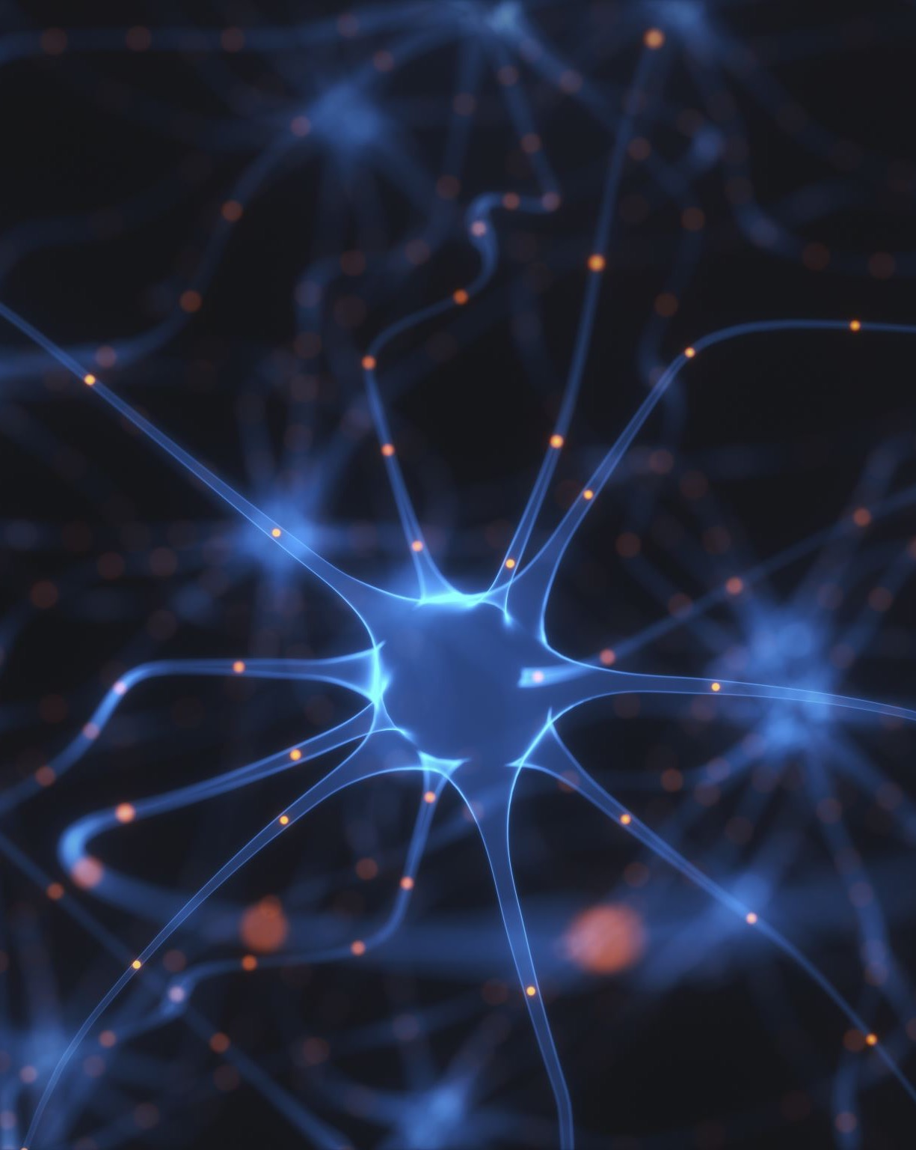
Early Neural Networks
Inspired by biology
Created in the 1950’s
Outclassed by Von Neumann Architecture
Source: NVIDIA DLI (2025), Getting Started with Deep Learning, https://learn.nvidia.com/courses/course-detail?course_id=course-v1:DLI+S-FX-01+V1
91
Notes:
It wasn’t long after the invention of the computer that people started experimenting with artificial neural networks, inspired by the structure and function of human brains
There was some success with using these networks to perform tasks such as reading handwritten digits and playing backgammon, but it did not appear that this would be the major path forward. A major factor was the computational resources at the time. As we’ll see in the hands-on labs, these networks take time to train. Imagine how long it would take to train forty years ago!
These early neural networks were outperformed by something called the Von Neumann Architecture, which is the basis for modern CPUs
https://www.cs.cornell.edu/boom/2001sp/Tsinteris/gammon.htm
https://cs.stanford.edu/people/eroberts/courses/soco/projects/neural-networks/History/history1.html
https://www.computerscience.gcse.guru/theory/von-neumann-architecture

Slide 92
Expert Systems
Highly complex
Programmed by hundreds of engineers
Rigorous programming of many rules
Source: NVIDIA DLI (2025), Getting Started with Deep Learning, https://learn.nvidia.com/courses/course-detail?course_id=course-v1:DLI+S-FX-01+V1
92
Notes:
Instead, intelligence in computers was achieved through the building of expert systems.
https://hbr.org/1988/03/putting-expert-systems-to-work
These were highly complex systems that took hundreds to thousands of engineers to build, where the computer was taught to complete tasks by the rigorous programming of many rules
These systems where meant to mimic that of a human Subject Matter Expert, hence the name.
https://www.britannica.com/technology/expert-system
An example would be a stock trading robot that traded based on user defined limits, or a machine to give medical diagnosis given a list of symptoms.

Slide 93



Expert Systems - Limitations
What are these three images?
Source: NVIDIA DLI (2025), Getting Started with Deep Learning, https://learn.nvidia.com/courses/course-detail?course_id=course-v1:DLI+S-FX-01+V1
93
Notes:
However these systems had limitations. Most importantly, rules for these systems had to be understood, defined, and programmed by humans. The computer could only do as much as a human engineer was able to understand and turn directly into code.
For some well-defined tasks (ex, creating a system to route customers to sales representatives based on region and vertical) this was fine. But for some tasks that are simple to humans, it was extremely difficult to build rules that a computer could follow
As an example, take a moment to answer in your head what these are pictures of (cat, car, ocean)
For most humans this is quite a simple task. But how would you teach a newborn child, let alone a computer to do what you just did?

Slide 94

How Do Children Learn?
Expose them to lots of data
Give them the “correct answer”
They will pick up the important patterns on their own
Source: NVIDIA DLI (2025), Getting Started with Deep Learning, https://learn.nvidia.com/courses/course-detail?course_id=course-v1:DLI+S-FX-01+V1
94
Notes:
With children, we expose them to lots of data, and help them learn by supplying the correct answer. A very popular learning technique is “Trail and Error”, where students make a prediction on what is the correct answer, and if they’re wrong, adjust their approach. It turns out that deep learning is very much like this.

Slide 95
The Deep Learning Revolution
Source: NVIDIA DLI (2025), Getting Started with Deep Learning, https://learn.nvidia.com/courses/course-detail?course_id=course-v1:DLI+S-FX-01+V1
95
Notes:
So there was a period through the nineties and early 2000’s where powerful AI appeared to many to be a pipe dream
Neural networks were being used for some tasks, but fantastic results were not being achieved.
Two major things came together to spawn the era of deep learning that we’re in today

Slide 96

Data
Networks need a lot of information to learn from
The digital era and the internet has supplied that data
Source: NVIDIA DLI (2025), Getting Started with Deep Learning, https://learn.nvidia.com/courses/course-detail?course_id=course-v1:DLI+S-FX-01+V1
96
Notes:
The first is data. In order for a neural network to learn to understand a task, it needs to be exposed to a lot of different data. In order for a neural network to understand what a cat is, it needs to be exposed to a lot of pictures of cats, as well as a lot of pictures of things that are not cats.
The era of the internet has supplied mountains of data for networks to learn on.

Slide 97

Computing Power
Need a way for our artificial “brain” to
observe lots of data within a practical amount of time.
Source: NVIDIA DLI (2025), Getting Started with Deep Learning, https://learn.nvidia.com/courses/course-detail?course_id=course-v1:DLI+S-FX-01+V1
97
Notes:
The other major factor in the onset of modern deep learning was processing power.
If we’re effectively training an artificial brain, let’s think about our own for a second. How many gigabytes of information do we observe in a given second? What’s the “frame rate” of life? What is the resolution of the human eye?
https://www.discovery.com/science/mexapixels-in-human-eye#:~:text=According%20to%20scientist%20and%20photographer,what%20does%20this%20mean%2C%20really%3F
While modern day AI is impressive, we humans process significantly more data in a second than an AI. One way machines can try to catch up to us humans is with higher computing power.

Slide 98

The Importance of the GPU
A Rendered Image
A Neural Network
Source: NVIDIA DLI (2025), Getting Started with Deep Learning, https://learn.nvidia.com/courses/course-detail?course_id=course-v1:DLI+S-FX-01+V1
98
Notes:
Left: A computer rendering of a marble: https://www.youtube.com/watch?v=H0_NZDSqR3Y&t=31s
Right: An abstraction of a neural network
It turns out that under the hood, neural networks are matrix multiplication machines. What other types of problems requires many matrix multiplications? Computer graphics! With computer graphics objects are represented as many tiny triangles working together to give the illusion of something more. With animation, simulation, and gaming, these tiny triangles are often transformed and rotated, requiring matrix manipulation.
Since neural networks and graphics are both built on top of the same fundamental mathematical problem, it’s no surprise that the hardware for one can effectively be used for the other.
An especially important invention in tackling this training was the parallel processor. The math required to train a neural network is not especially complex, but calculations must be performed (millions, billions, trillions?) of times, ideally at the same time.
Your average CPU might have 4, maybe 8 cores that allow parallel processing
However, a modern GPU, originally built for the purpose of computing the mathematics of graphics, are parallel processing juggernauts
The GPU that you will be using in this course today has (x thousand cores). These processors are incredibly well suited for deep learning, and NVIDIA is building its GPUs to be specifically architected for training.

Slide 99
What is Deep Learning?
Source: NVIDIA DLI (2025), Getting Started with Deep Learning, https://learn.nvidia.com/courses/course-detail?course_id=course-v1:DLI+S-FX-01+V1
99
Notes:
So what is Deep Learning and what makes it special?

Slide 100
Deep learning flips traditional programming on its head
Source: NVIDIA DLI (2025), Getting Started with Deep Learning, https://learn.nvidia.com/courses/course-detail?course_id=course-v1:DLI+S-FX-01+V1
100
Notes:
With deep learning, you flip the programming paradigm on its head

Slide 101
Traditional Programming
Building a Classifier
Define a set of rules for classification
Program those rules into the computer
Feed it examples, and the program uses the rules to classify
Source: NVIDIA DLI (2025), Getting Started with Deep Learning, https://learn.nvidia.com/courses/course-detail?course_id=course-v1:DLI+S-FX-01+V1
101
Notes:
For example, normally to build a classifier, you come up with a set of rules, and program those rules
Then when you want classify things, you give it a piece of data, and the rules are used to select a category

Slide 102
Machine Learning
Building a Classifier
Show model the examples with the answer of how to classify
Model takes guesses, we tell it if it’s right or not
Model learns to correctly categorize as it’s training. The system learns the rules on its own
Source: NVIDIA DLI (2025), Getting Started with Deep Learning, https://learn.nvidia.com/courses/course-detail?course_id=course-v1:DLI+S-FX-01+V1
102
Notes:
With deep learning, we first need a list of variables: inputs and their corresponding outputs. We don’t need to know the relationship between the inputs and the outputs, but the more accurate we can observe their values, the better. We’ll call this list of examples the dataset.
We then train a model by showing it the dataset and the correct outputs
The model keeps taking guesses, and finds out if it was right or not
It slowly learns to correctly categorize over the course of training
The fundamental difference is that instead of humans needing to identify and program the rules, a deep learning algorithm will learn them on its own

Slide 103
This is a Fundamental Shift
Source: NVIDIA DLI (2025), Getting Started with Deep Learning, https://learn.nvidia.com/courses/course-detail?course_id=course-v1:DLI+S-FX-01+V1
103
Notes:
This is a fundamental shift in the way we can build software systems

Slide 104
When to Choose Deep Learning
Classic Programming
Deep Learning
If rules are clear and straightforward, often better to program it
If rules are nuanced, complex, difficult to discern, use deep learning
Source: NVIDIA DLI (2025), Getting Started with Deep Learning, https://learn.nvidia.com/courses/course-detail?course_id=course-v1:DLI+S-FX-01+V1
104
Notes:
Deep learning is not always the right choice. If the decisions that need to be made to produce a result are very clear, it’s likely that it should just be programmed in the traditional way
However, if the rules are nuanced or complex, and humans would have a hard time describing them, let alone programming them, deep learning is a great choice

Slide 105
Deep Learning Compared to Other AI
Depth and complexity of networks
Up to billions of parameters (and growing)
Many layers in a model
Important for learning complex rules
Source: NVIDIA DLI (2025), Getting Started with Deep Learning, https://learn.nvidia.com/courses/course-detail?course_id=course-v1:DLI+S-FX-01+V1
105
Notes:
One thing that separates Deep Learning from traditional machine learning is the depth and complexity of the networks that are used. For especially complicated tasks such as natural language understanding (used for translations, text generation, other) networks can have billions of parameters.
The deep in deep learning refers to the many layers in a model that learn the important rules necessary for completing a task. These are often called hidden layers.
https://arxiv.org/ftp/arxiv/papers/1901/1901.06032.pdf

Slide 106
How Deep Learning is Transforming the World
Source: NVIDIA DLI (2025), Getting Started with Deep Learning, https://learn.nvidia.com/courses/course-detail?course_id=course-v1:DLI+S-FX-01+V1
106
Notes:
Deep learning has only been a major factor in the last decade or so, but it has had huge impacts on many industries

Slide 107
Computer Vision
Object Detection
Self-Driving Cars
Robotics and Manufacturing
Source: NVIDIA DLI (2025), Getting Started with Deep Learning, https://learn.nvidia.com/courses/course-detail?course_id=course-v1:DLI+S-FX-01+V1
107
Notes:
The field of Computer Vision has been around long before the field of Deep Learning, but because there are now more and more tagged high quality images available, Deep Learning is having a large influence.
The goal of computer vision is to teach machines to see and perceive images the way that humans do. Thanks to the complexity of our eyes, not to mention the processing our brains do with these images, this is no easy task!

Slide 108
Natural Language Processing
Real-time translation
Voice recognition
Virtual assistants
Source: NVIDIA DLI (2025), Getting Started with Deep Learning, https://learn.nvidia.com/courses/course-detail?course_id=course-v1:DLI+S-FX-01+V1
108
Notes:
Natural language processing, which we’ll also touch on in this course has helped make huge shifts, for example in highly accurate, real time language translation, as well as voice recognition and virtual assistants

Slide 109
Recommender Systems
Content curation
Targeted advertising
Shopping
Source: NVIDIA DLI (2025), Getting Started with Deep Learning, https://learn.nvidia.com/courses/course-detail?course_id=course-v1:DLI+S-FX-01+V1
109
Notes:
Recommender systems based on deep learning fuel the internet with content curated feeds such as facebook, music like spotify, video like youtube and netflix, as well as targeted online advertising and shopping recommendations (Amazon)

Slide 110
Reinforcement Learning
AlphaGo beats world champion in GO
AI bots beat professional videogamers
Stock Trading Robots
Source: NVIDIA DLI (2025), Getting Started with Deep Learning, https://learn.nvidia.com/courses/course-detail?course_id=course-v1:DLI+S-FX-01+V1
110
Notes:
Reinforcement learning has achieved incredible results in matching human expert performance, such as the AI alpha-go, which beat the world champion in what is considered one of the most difficult and complex games in the world. AI bots are now also taking on world experts in complex videogames such as Starcraft and DOTA
The list goes on, and we’ll talk about some exciting models and advancements later in the course

Slide 111
Overview of the Course
Source: NVIDIA DLI (2025), Getting Started with Deep Learning, https://learn.nvidia.com/courses/course-detail?course_id=course-v1:DLI+S-FX-01+V1
111

Slide 112

Hands on Exercises
Get comfortable with the process of deep learning
Exposure to different models and datatypes
Get a jump-start to tackle your own projects
Source: NVIDIA DLI (2025), Getting Started with Deep Learning, https://learn.nvidia.com/courses/course-detail?course_id=course-v1:DLI+S-FX-01+V1
112
Notes:
The course is split up into a series of exercises to get you comfortable with deep learning
We’re going to be exposing you to some different models, as well as different datatypes
With only a day, we can’t expose you to everything, but the goal is to give you a significant jump-start, so that you’ll be able to have a foundation to pursue your own projects moving forward

Slide 113
Structure of the Course
“Hello World” of Deep Learning
Train a more complicated model
New architectures and techniques to improve performance
Pre-trained models
Transfer learning
Source: NVIDIA DLI (2025), Getting Started with Deep Learning, https://learn.nvidia.com/courses/course-detail?course_id=course-v1:DLI+S-FX-01+V1
113
Notes:
Here’s the structure of the course:
- Train your first model (computer vision)
- Train a more complicated model
- Introduce new architectures and techniques to improve model performance and accuracy
- Using your trained model to make new predictions
- Using state-of-the art pre-trained models to solve a deep learning challenge
- Transfer the learning of one model to another to solve difficult deep learning challenges
- Train a language model to gain exposure to new types of data and architectures
- Appendices:
- Play around with cool models from around the web
- Learn to set up a deep learning environment to tackle your own projects

Slide 114
Platform of the Course
GPU powered cloud server
JupyterLab platform
Jupyter notebooks for interactive coding
Source: NVIDIA DLI (2025), Getting Started with Deep Learning, https://learn.nvidia.com/courses/course-detail?course_id=course-v1:DLI+S-FX-01+V1
114
Notes:
In this course you will be connected to a server that contains a very powerful GPU.
Deep learning training is possible to run on a CPU, but due to the computational complexity of the training, it is extremely beneficial to have the massive parallel processing that GPUs provide. Without it, you would be waiting around a lot, and we could not fit this course into a single day.
You will be connected to this powerful server through a software platform called JupyterLab. Jupyter lab is a platform that among other things runs jupyter notebooks. In these notebooks you’ll be able to run and edit Python code to accomplish the goals of the exercises

Slide 115




Software of This Course
Major deep learning platforms:
  TensorFlow + Keras (Google)
  PyTorch (Meta)
  MXNet (Apache)
We’ll be using PyTorch
Good idea to gain exposure to others moving forward
Source: NVIDIA DLI (2025), Getting Started with Deep Learning, https://learn.nvidia.com/courses/course-detail?course_id=course-v1:DLI+S-FX-01+V1
115
Notes:
There are a few big players in the deep learning space when it comes to frameworks
The three most commonly used are Tensorflow + Keras (google), Pytorch (facebook), and MXNet (apache)
They are all great choices, and neither of them is a clear winner
In this course we’ll be using PyTorch, but as you continue your deep learning journey, we recommend that you gain some exposure to the others as well

Slide 116
First Exercise:
Classify Handwritten Digits
Source: NVIDIA DLI (2025), Getting Started with Deep Learning, https://learn.nvidia.com/courses/course-detail?course_id=course-v1:DLI+S-FX-01+V1
116

Slide 117
Hello Neural Networks
Train a network to correctly classify handwritten digits
Historically important and difficult task for computers
Try learning like a Neural Network
Get exposed to the example, and try to figure out the rules to how it works
Source: NVIDIA DLI (2025), Getting Started with Deep Learning, https://learn.nvidia.com/courses/course-detail?course_id=course-v1:DLI+S-FX-01+V1
117
Notes:
Before we get too much into theory and the specifics of deep learning, we’re going to act like an AI and play with a neural network right away. See if you can figure out how we went about constructing the model. Feel free to experiment and alter the code. You can always restart the GPU instance in order to get a fresh start if your curiosity gets a little too crazy.
You’ll start by teaching a model to understand and categorize hand-written digits
Recognizing handwriting is a historically important task in the history of AI, and one that is especially well suited to deep learning
You’ll be working on a dataset called MNIST, which contains 70,000 images of handwritten digits
You might feel that there’s a lot of information to absorb in this first exercise, but be patient with yourself, and don’t worry if it’s not all perfectly clear right away. You’ll be exposed to the steps of training several times over the course, and will gain an understanding through practice
The main goal is just to give you a sense of what training looks like, and we’ll fill in some of the details as we move on

Slide 118
NVIDIA Getting Started with Deep Learning
Source: NVIDIA DLI (2025), Getting Started with Deep Learning, https://learn.nvidia.com/courses/course-detail?course_id=course-v1:DLI+S-FX-01+V1

Slide 119
NVIDIA Getting Started with Deep Learning
Source: NVIDIA DLI (2025), Getting Started with Deep Learning, https://learn.nvidia.com/courses/course-detail?course_id=course-v1:DLI+S-FX-01+V1

Slide 120
NVIDIA Getting Started with Deep Learning
MNIST Handwritten Digits
Source: NVIDIA DLI (2025), Getting Started with Deep Learning, https://learn.nvidia.com/courses/course-detail?course_id=course-v1:DLI+S-FX-01+V1

Slide 121
Fundamentals of
Deep Learning
Part 2: How a Neural Network Trains
Source: NVIDIA DLI (2025), Getting Started with Deep Learning, https://learn.nvidia.com/courses/course-detail?course_id=course-v1:DLI+S-FX-01+V1
121

Slide 122
Fundamentals of
Deep Learning
Agenda
• | Part 1: An Introduction to Deep Learning
• | Part 2: How a Neural Network Trains
• | Part 3: Convolutional Neural Networks
• | Part 4: Data Augmentation and Deployment
• | Part 5: Pre-Trained Models
• | Part 6: Advanced Architectures
Source: NVIDIA DLI (2025), Getting Started with Deep Learning, https://learn.nvidia.com/courses/course-detail?course_id=course-v1:DLI+S-FX-01+V1
122

Slide 123
Recap of the Exercise
What just happened?
Edited our data (reshaped, normalized, to categorical)
Created our model
Compiled our model
Trained the model on our data
Loaded and visualized our data
Source: NVIDIA DLI (2025), Getting Started with Deep Learning, https://learn.nvidia.com/courses/course-detail?course_id=course-v1:DLI+S-FX-01+V1
123
Notes:
Okay, so what just happened? Let’s go over it step by step
We loaded and visualized our data
We edited our data to get it into the right shape, as well as normalizing the values between 0-1
We also edited our “answers” to be in a categorical form, instead of a number, as our model will better train with that type of answer
We then created our model, compiled our model, and trained our model on the data

Slide 124

Data Preparation
Input as an Array
28
[0,0,0,24,75,184,185,78,32,55,0,0,0…]
28
Source: NVIDIA DLI (2025), Getting Started with Deep Learning, https://learn.nvidia.com/courses/course-detail?course_id=course-v1:DLI+S-FX-01+V1
124
Notes:
Let’s start with our data. We received each 28x28 pixel image as an array of 784 integers.
We then normalized that data (make it between 0-1) by dividing it by 255 (the max value for a pixel)

Slide 125
Data Preparation
Targets as Categories
0
[1,0,0,0,0,0,0,0,0,0]
1
[0,1,0,0,0,0,0,0,0,0]
2
[0,0,1,0,0,0,0,0,0,0]
3
[0,0,0,1,0,0,0,0,0,0]
.
.
.
Source: NVIDIA DLI (2025), Getting Started with Deep Learning, https://learn.nvidia.com/courses/course-detail?course_id=course-v1:DLI+S-FX-01+V1
125
Notes:
We then took our ”answers” (or targets), which were in the format of an integer between 0-9 and made it categorical, representing it as an array of 0s with 1 at the index of the correct digit.

Slide 126
An Untrained Model
[ 0, 0, …, 0]
(784,)
… … …
(512,)
Layer
Size
… … …
(512,)
(10,)
Source: NVIDIA DLI (2025), Getting Started with Deep Learning, https://learn.nvidia.com/courses/course-detail?course_id=course-v1:DLI+S-FX-01+V1
126
Notes:
Let’s next talk about our model (show picture of model)
We can’t fully represent it in a slide, because it has many connections
Remember that there are 784 inputs, two layers of 512 neurons (or nodes), and an output layer of 10 neurons (one for each digit)
Every neuron in each layer is connected to every neuron in the next layer. In PyTorch, this is called a Linear layer, and in Keras, the same layer is called a “Dense” layer.
This means there are a lot of connections (784x512 + 512x512 + 512x10)
Looking at this, can anyone guess the approximate magnitude?
668,672 connections
(Each neuron also has a bias term, but we’ll get to that in a bit)
That’s a whole lot for a network for 4 layers
That can store a whole lot of information. Think about a megabyte of info (1 million bytes) and the fact that a megabyte is about 500 pages of text.
So if each neuron has a connection between the other, how do we store information?
We store it in the “weights” between two neurons
This is the analogous to the strength of connection between the neurons of our brain (although with some differences in the mechanisms)
So how do we update those weights?

Slide 127
A Simpler Model
Source: NVIDIA DLI (2025), Getting Started with Deep Learning, https://learn.nvidia.com/courses/course-detail?course_id=course-v1:DLI+S-FX-01+V1
127
Notes:
In order to understand how this network came about, let’s looks at the simplest possible model.

Slide 128
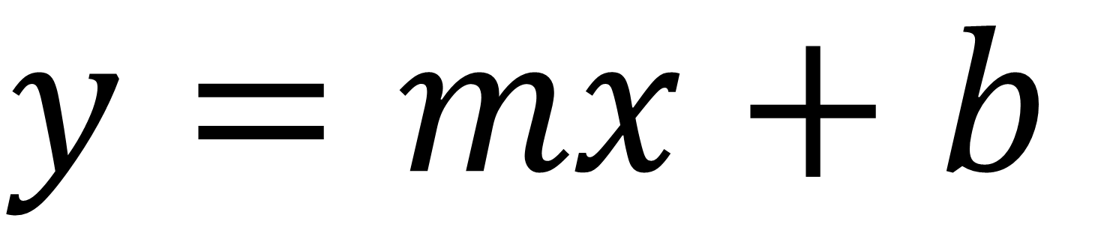
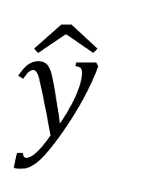
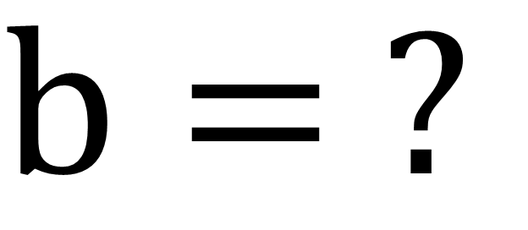
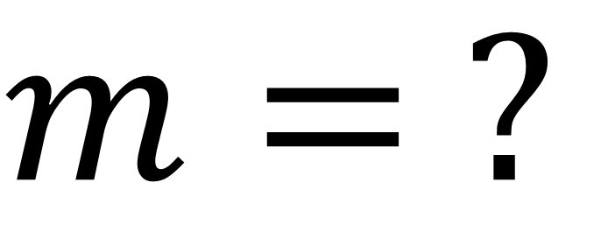
A Simpler Model
$$y=mx+b$$
x | y
1 | 3
2 | 5
m•x
$$m= ?$$
$$b= ?$$
$$\hat{y}$$
Source: NVIDIA DLI (2025), Getting Started with Deep Learning, https://learn.nvidia.com/courses/course-detail?course_id=course-v1:DLI+S-FX-01+V1
128
Notes:
Each of the circles on the slide before is a neuron. The earliest use case of this neuron was to build a regression line, good ol’ y = mx + b. Regression is when we use a continues input to predict a continuous output, like using how many seconds a pot of water has been sitting on the stove to predict the temperature of the water.
For each variable coming into our neuron, we’re going to find a slope (m), or “weight” for it. The “b”, or y-intercept, from y = mx + b is stored with the neuron.

Slide 129
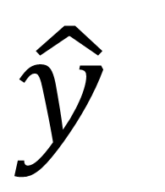
A Simpler Model
$$y=mx+b$$
x | y
1 | 3
2 | 5
m•x
$$m= ?$$
$$b= ?$$
$$\hat{y}$$
Source: NVIDIA DLI (2025), Getting Started with Deep Learning, https://learn.nvidia.com/courses/course-detail?course_id=course-v1:DLI+S-FX-01+V1
129
Notes:
Our goal here is to find a line that can go through these points. That way, we can use that line to make predictions.

Slide 130
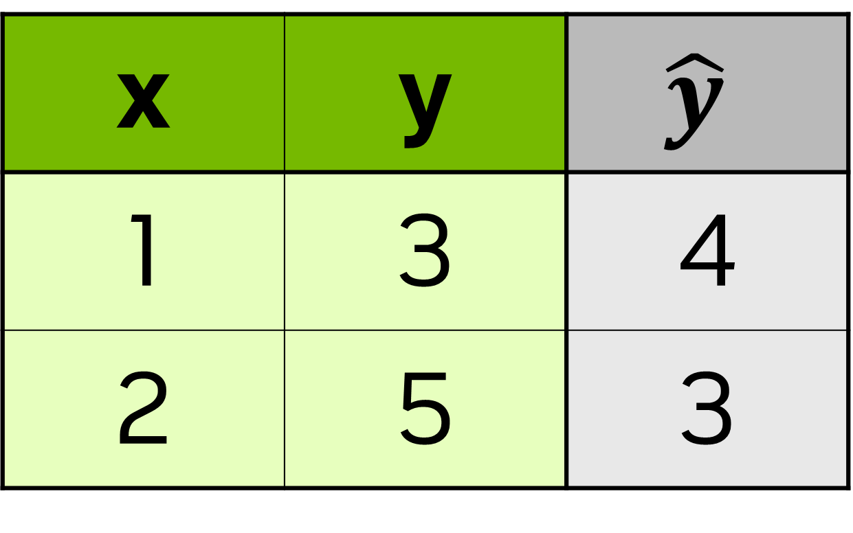
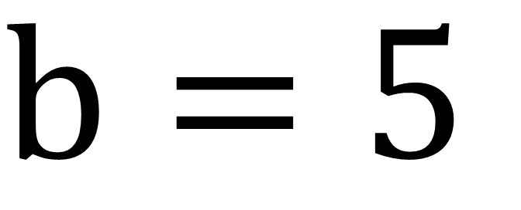
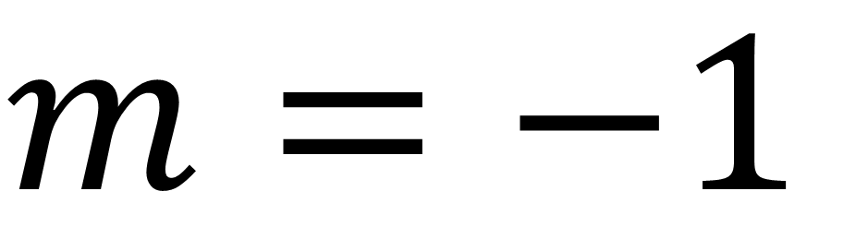
A Simpler Model
$$y=mx+b$$
x | y | $$\hat{y}$$
1 | 3 | 4
2 | 5 | 3
Start Random
m•x
$$m=−1$$
$$b=5$$
$$\hat{y}$$
Source: NVIDIA DLI (2025), Getting Started with Deep Learning, https://learn.nvidia.com/courses/course-detail?course_id=course-v1:DLI+S-FX-01+V1
130
Notes:
Some of you that have taken statistics before probably know of a more deterministic way to get m and b. (We can verify through algebra m = 2 and b = 1). We’re going to do a more trial and error approach. We’re going to pick a random value to start (usually between -1 and 1, but we’re going to pick -1 for m and 5 for b to make things easier to visualize)
The y hat here (the one with the little hat), is going to be our estimate of the true value, y. Most of the time, our guess is going to be a bit off, so how do we correct it?

Slide 131
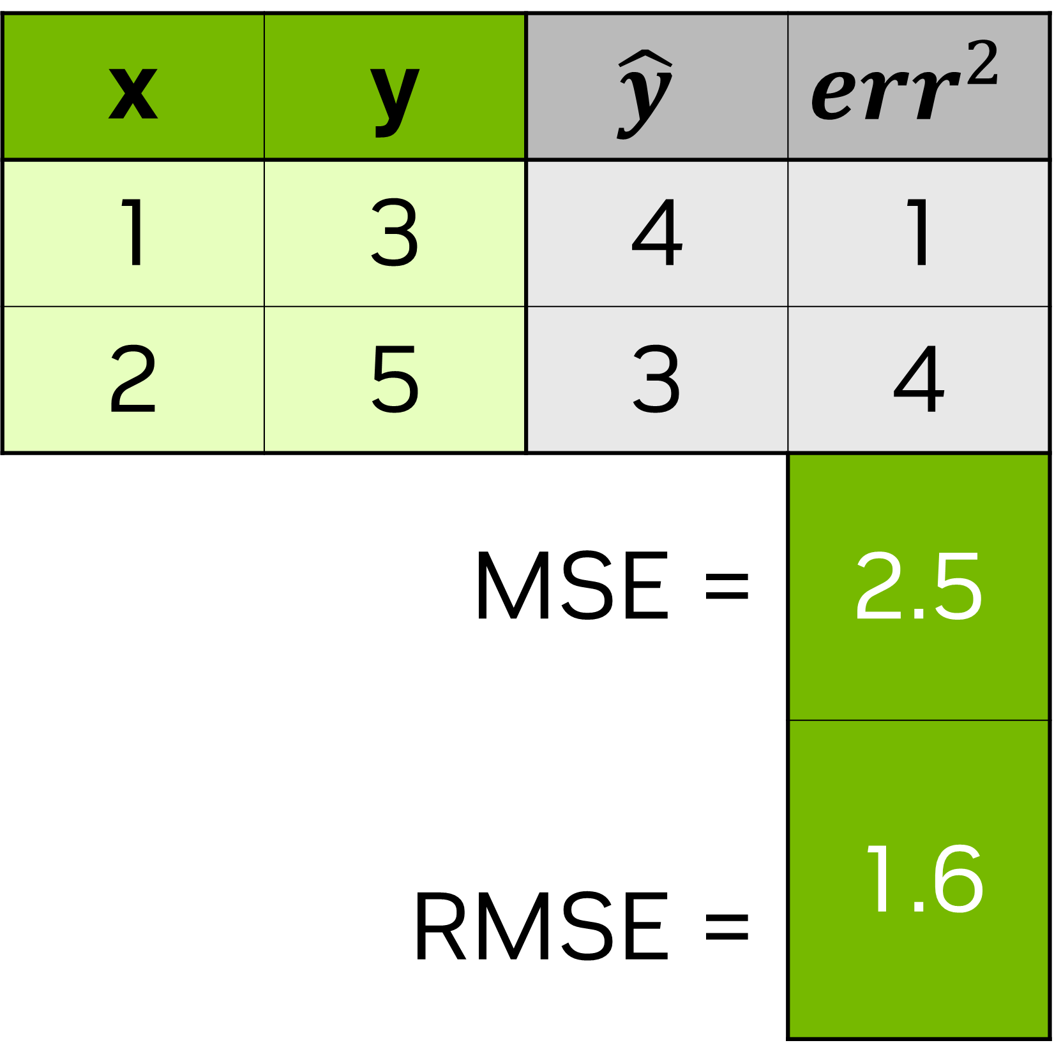
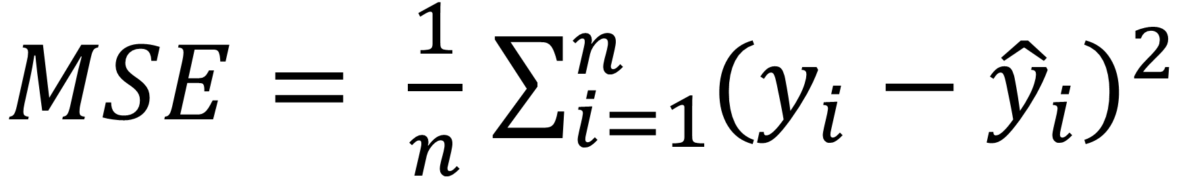
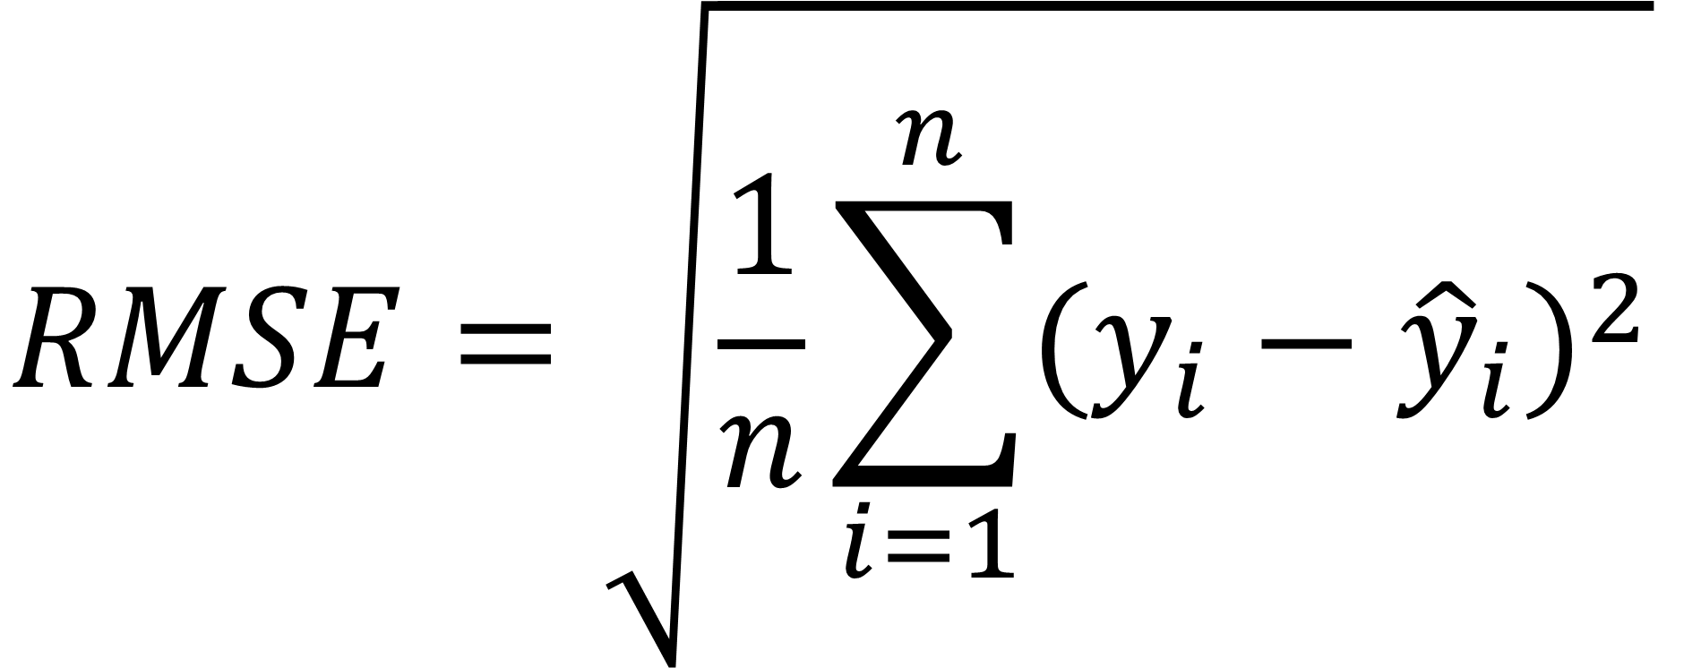
A Simpler Model
$$y=mx+b$$
x | y | $$\hat{y}$$ | $${err}^{2}$$
1 | 3 | 4 | 1
2 | 5 | 3 | 4
MSE = |  |  | 2.5
RMSE = |  |  | 1.6
$MSE= \frac{1}{n}$ $\sum_{i=1}^{n}{{(y_{i}−{\hat{y}}_{i})}^{2}}$
$$RMSE=\sqrt{\frac{1}{n}\sum_{i=1}^{n}{{(y_{i}−{\hat{y}}_{i})}^{2}}}$$
Source: NVIDIA DLI (2025), Getting Started with Deep Learning, https://learn.nvidia.com/courses/course-detail?course_id=course-v1:DLI+S-FX-01+V1
131
Notes:
Traditional regression lines are built on the concept of least squared error, meaning, we’re going to take the difference of each estimate from the true value and square it. This keeps our error positive so when we figure out our total error, they don’t cancel each other out. It also strongly punishes bad guesses.

Slide 132
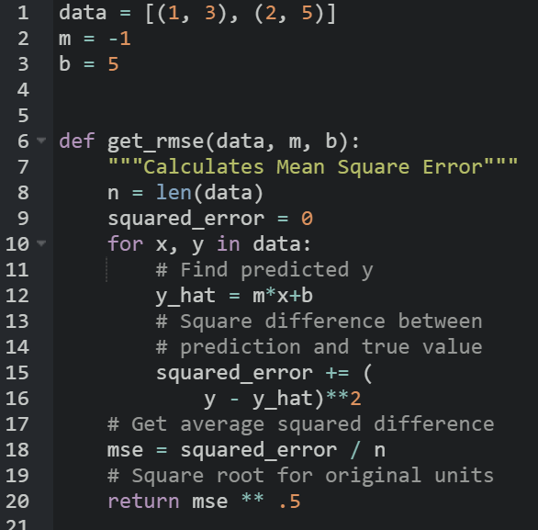
A Simpler Model
$$y=mx+b$$
x | y | $$\hat{y}$$ | $${err}^{2}$$
1 | 3 | 4 | 1
2 | 5 | 3 | 4
MSE = |  |  | 2.5
RMSE = |  |  | 1.6
Source: NVIDIA DLI (2025), Getting Started with Deep Learning, https://learn.nvidia.com/courses/course-detail?course_id=course-v1:DLI+S-FX-01+V1
132
Notes:
So if it’s been a while since seeing some of these math symbols, no problem, we can code our RMSE like this. For each of our points, we’ll figure out what the difference is between y and mx+b. Then we’ll square that difference, and then take the average of all squared differences.
https://black.now.sh/
Code:
data = [(1, 3), (2, 5)]
m = -1
b = 5
def get_rmse(data, m, b):
"""Calculates Mean Square Error"""
n = len(data)
squared_error = 0
for x, y in data:
# Find predicted y
y_hat = m*x+b
# Square difference between
# prediction and true value
squared_error += (
y - y_hat)**2
# Get average squared difference
mse = squared_error / n
# Square root for original units
return mse ** .5

Slide 133
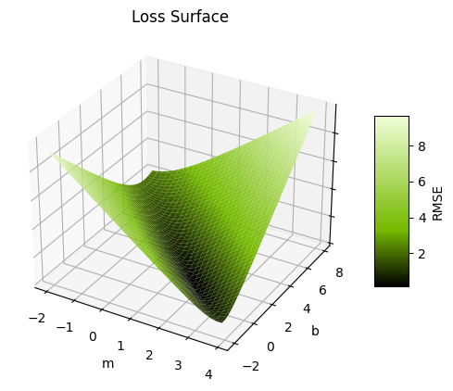
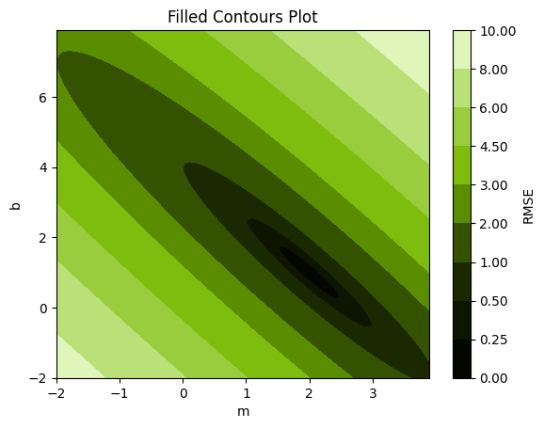
The Loss Curve
16
0
MSE
Source: NVIDIA DLI (2025), Getting Started with Deep Learning, https://learn.nvidia.com/courses/course-detail?course_id=course-v1:DLI+S-FX-01+V1
133
Notes:
Ok, phew, that was a lot of math. Let’s graph out our m and our b in relation to our mean squared error. On the left, we have a surface plot of our loss function. That’s the error function we choose to evaluate our model, which in our case is MSE. It’s a little hard to read, so on the right, we’ve plotted the contours. With that, we can see that it’s actually a kind of parabolic ellipse that bottoms out at b=1 and m=2.

Slide 134

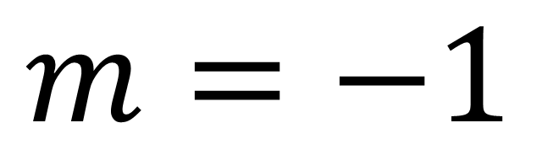
The Loss Curve
Current
Target
$$m=−1$$
$$b=5$$
Source: NVIDIA DLI (2025), Getting Started with Deep Learning, https://learn.nvidia.com/courses/course-detail?course_id=course-v1:DLI+S-FX-01+V1
134
Notes:
So if this is our guessed line, we can see where our current position is on the curve. Our goal is to find the minimum error, and since it’s a toy example, we know that the minimum is 0. For us humans, it’s easy to see that the bottom is around m = 2 and b = 1, but for the computer, it’s not so easy to see that. (The computer can’t visualize this loss curve without some help, we gave it a grid of x,y points, and told it to graph that area). Turns out, the computer isn’t the best at calculus, so we’re going to help it cheat.
We have two leavers to help us move: m and b. We can change b, our intercept, or m, our slope. Let’s start with b, our intercept. If we subtract one…

Slide 135

The Loss Curve
Old
Current
Target
$$m=−1$$
$$b=4$$
Source: NVIDIA DLI (2025), Getting Started with Deep Learning, https://learn.nvidia.com/courses/course-detail?course_id=course-v1:DLI+S-FX-01+V1
135
Notes:
Cool, our line hits one of the points now, but it’s missing the other one. Let’s increase the slope by one…

Slide 136

The Loss Curve
Current
Target
$$m=0$$
$$b=4$$
Source: NVIDIA DLI (2025), Getting Started with Deep Learning, https://learn.nvidia.com/courses/course-detail?course_id=course-v1:DLI+S-FX-01+V1
136
Notes:
Darn it, now we’re missing both points, but the MSE did decrease from 2.5 to one.

Slide 137
The Loss Curve
The Gradient
Which direction loss decreases the most
$λ$: The learning rate
𝝀: The learning rate
How far to travel
Epoch
A model update with the full dataset
Batch
A sample of the full dataset
Step
An update to the weight parameters
Target
Source: NVIDIA DLI (2025), Getting Started with Deep Learning, https://learn.nvidia.com/courses/course-detail?course_id=course-v1:DLI+S-FX-01+V1
137
Notes:
The computer doesn’t have our “human eyeball” ability to guesstimate what it should change in order to get to the bottom of this bowl, so what it’s going to do is given the current point that it’s at, it’s going to calculate the gradient, which is a fancy word to describe a multivariate slope. It’s going to figure out in which direction is the loss decreasing the most, which is going to be some ratio of b to m.
Once we have a direction, we need to figure out how far to travel with it. The gradient is going to change depending on our current position, so we don’t want to make to big of a step because we can accidentally move further away from our target. We also don’t want to be too small because that means it can take a long time to get to our goal, and life it too short to wait for a model to finish training. The amount we travel is something we decide, and it is a parameter called learning rate.
Now that we’re in a new position, we repeat the process: find the new gradient and take another step. There’s a few ways to measure our progress. There are Epochs, which is another way to say to full dataset. It used to be that people calculated the gradient using the full dataset, but nowadays, people see that it’s more efficient to use a sample or batch from the dataset. In either case, a step is when we take either the full dataset or a batch, calculate the gradient, and update our parameters with the gradient and learning rate.

Slide 138
The Loss Curve
The Gradient
Which direction loss decreases the most
$λ$: The learning rate
𝝀: The learning rate
How far to travel
Epoch
A model update with the full dataset
Batch
A sample of the full dataset
Step
An update to the weight parameters
Target
Source: NVIDIA DLI (2025), Getting Started with Deep Learning, https://learn.nvidia.com/courses/course-detail?course_id=course-v1:DLI+S-FX-01+V1
138
Notes:
After a few steps, this is what our journey will look like. This process to find the minimum loss is called gradient descent.

Slide 139
Optimizers
Loss – Momentum Optimizer
Adam
Adagrad
RMSprop
SGD
Source: NVIDIA DLI (2025), Getting Started with Deep Learning, https://learn.nvidia.com/courses/course-detail?course_id=course-v1:DLI+S-FX-01+V1
139
Notes:
Thankfully, a lot of research has been done on the best way to define the learning rate, and machine learning frameworks have a few tools that will automatically adjust the learning rate.
For instance, a popular one is Adam (Adaptive momentum) which is kind of like thinking of our loss curve as a mountain and our position as a marble. If we drop a marble on top of a mountain, it will pick up speed, jumping over trenches (local minima) before hopefully landing at a lower minima.

Slide 140
From Neuron to Network
Source: NVIDIA DLI (2025), Getting Started with Deep Learning, https://learn.nvidia.com/courses/course-detail?course_id=course-v1:DLI+S-FX-01+V1
140

Slide 141
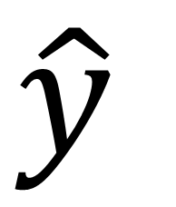
Building a Network
  Scales to more inputs
w₁
w₂
$$\hat{y}$$
Source: NVIDIA DLI (2025), Getting Started with Deep Learning, https://learn.nvidia.com/courses/course-detail?course_id=course-v1:DLI+S-FX-01+V1
141
Notes:
Now that we have the core concept down, we can start building up our network. Instead of having a singular x input with a slope (m), we’re going to have multiple x inputs (x1, x2, x3…) and find each of them a weight. Our previous math stays mostly the same, we just need to find the gradient for the new variable like we did before.

Slide 142
Building a Network
x₁
x₂
w₂
w₃
w₄
  Scales to more inputs
  Can chain neurons
w₁
w₅
w₆
$$\hat{y}$$
Source: NVIDIA DLI (2025), Getting Started with Deep Learning, https://learn.nvidia.com/courses/course-detail?course_id=course-v1:DLI+S-FX-01+V1
142
Notes:
We can also take the output of one neuron and feed it into another, and as long as we don’t make a loop, we can connect the same output to multiple inputs. Badum! With this we officially have a deep learning network. When we calculate our new weights from gradient descent, we can use the error calculated in a later neuron as part of the error for the previous neuron it’s connected to.
Most frameworks automate this part for us, so we’re not going to go much into the math, but here’s a great self paced animation that dives deeper into how it works: https://developers-dot-devsite-v2-prod.appspot.com/machine-learning/crash-course/backprop-scroll

Slide 143

Building a Network
x₁
x₂
w₂
w₃
w₄
  Scales to more inputs
  Can chain neurons
  If all regressions are linear, then output will also be a linear regression
w₁
w₅
w₆
$$\hat{y}$$
Source: NVIDIA DLI (2025), Getting Started with Deep Learning, https://learn.nvidia.com/courses/course-detail?course_id=course-v1:DLI+S-FX-01+V1
143
Notes:
There is one mathematical “gotcha” we should keep an eye out for and that’s our “activation function”. Right now, we’re just doing a linear sum, so we get a line in 2D and a plane in 3D. This is a bit of a waste on a neural network since the only output we’ll get from adding lines together is another line, and it would be nice to be able to capture complex shapes.

Slide 144
Activation Functions
Source: NVIDIA DLI (2025), Getting Started with Deep Learning, https://learn.nvidia.com/courses/course-detail?course_id=course-v1:DLI+S-FX-01+V1
144

Slide 145
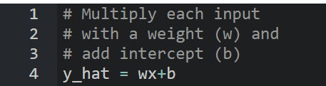
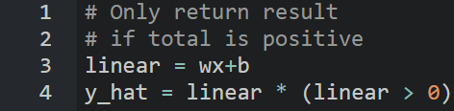
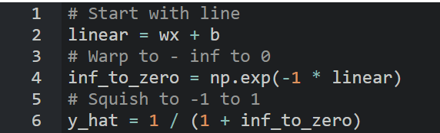



Activation Functions
Linear
ReLU
Sigmoid
$$\hat{y}=wx+b$$
$$\hat{y} =\left\{\begin{aligned}wx+b if wx+b>0 \\ 0 otherwise\end{aligned}\right.$$
$$\hat{y} =\frac{1}{1+e^{−(wx+b)}}$$
Source: NVIDIA DLI (2025), Getting Started with Deep Learning, https://learn.nvidia.com/courses/course-detail?course_id=course-v1:DLI+S-FX-01+V1
145
Notes:
For graphs, w = 1 and b = 0
Here’s the strategy: computers like equations of a line because they’re quick to compute and it’s easy for us to give it the rules on how to differentiate them.
One easy way to add non-linearity is to feed our equation of a line into another non-linear function. One of the most popular ones is ReLU, the Rectified Linear Unit. That’s just a fancy way of saying whenever the output of our line is negative, we’re going to set it to 0. Because the output of our neuron gets assigned a weight if it’s fed into another neuron, there’s a chance the output can become negative.
Another important activation function is Sigmoid. It manipulates our line so we get this S shape that goes from 0 to 1. This is great, because then we can use our neurons to assign probabilities to predictions.
Code:
# Multiply each input
# with a weight (w) and
# add intercept (b)
y_hat = wx+b
# Only return result
# if total is positive
y_hat = wx+b
y_hat = y_hat * (y_hat > 0)
# Start with line
linear = wx + b
# Warp to -inf to 0
inf_to_zero = np.exp(-1 * linear)
# Squish to -1 to 1
y_hat = 1 / (1 + inf_to_zero)

Slide 146






Activation Functions
Linear
ReLU
Sigmoid
Source: NVIDIA DLI (2025), Getting Started with Deep Learning, https://learn.nvidia.com/courses/course-detail?course_id=course-v1:DLI+S-FX-01+V1
146
Notes:
All of these graphs start with linear($y=\sum_{i=1}^{n}{w_{i}x_{i}}+b$), and then squeezes the plane/line through the activation function.
For graphs w1 = 1, w2 = 1, and b = 0
In actuality, we’re likely to have more than one input into our neuron, and this is what shape these activation functions give our neurons in three-dimensional space. Linear is just a plane, like a sheet of paper. ReLU is like a wedge. Sigmoid is like a surf wave.

Slide 147






Activation Functions
x₁
w₁
w₂
w₃
w₄
$$\hat{y}$$
Source: NVIDIA DLI (2025), Getting Started with Deep Learning, https://learn.nvidia.com/courses/course-detail?course_id=course-v1:DLI+S-FX-01+V1
147
Notes:
Here’s how an understanding of all this math is going to help. Let’s say we have a one input one output dataset that we suspect is a summation of two waves. We can use a Sinusoidal activation function in our first layer, and a linear activation in our last layer so we can add the two.
Given enough data, our neural network will figure out the parameters of each of these sub-components for us. Having a general understanding of the shape of the data and the relationship between the variables can help us build more efficient models for our data, saving time, computation, and ultimately, money.

Slide 148
Overfitting
Source: NVIDIA DLI (2025), Getting Started with Deep Learning, https://learn.nvidia.com/courses/course-detail?course_id=course-v1:DLI+S-FX-01+V1
148
Notes:
So if we can make these complicated shapes with more layers and neurons, why not make a super big neural network to solve every problem?

Slide 149

Overfitting
Why not have a super large neural network?
Source: NVIDIA DLI (2025), Getting Started with Deep Learning, https://learn.nvidia.com/courses/course-detail?course_id=course-v1:DLI+S-FX-01+V1
149
Notes:
Can anyone think of what the pitfalls would be from having too big of a model.
We could be wasting a lot of computational resources, and it can also take longer to train, but there’s another problem we should be aware of too.

Slide 150
Overfitting
Which Trendline is Better?
MSE = .0000
MSE = .0113
Source: NVIDIA DLI (2025), Getting Started with Deep Learning, https://learn.nvidia.com/courses/course-detail?course_id=course-v1:DLI+S-FX-01+V1
150
Notes:
The problem goes back to classical statistics, but it still plagues neural networks. Let’s say we’ve gone out, collected some data, and created two models. Which on of these is better?
Going by the RMSE, it’s the one on the left.
But what if we go out at get a new sample of data?

Slide 151
Overfitting
Which Trendline is Better?
MSE = .0308
MSE = .0062
Source: NVIDIA DLI (2025), Getting Started with Deep Learning, https://learn.nvidia.com/courses/course-detail?course_id=course-v1:DLI+S-FX-01+V1
151
Notes:
It turns out, our simpler model does a better job generalizing to new data. Not all problems can be so simple, and it’s the job of a Data Scientist to be able to determine the correct complexity for the model given

Slide 152
Training vs Validation Data
Avoid memorization
Training data
Core dataset for the model to learn on
Validation data
New data for model to see if it truly understands (can generalize)
Overfitting
When model performs well on the training data, but not the validation data (evidence of memorization)
Ideally the accuracy and loss should be similar between both datasets
Source: NVIDIA DLI (2025), Getting Started with Deep Learning, https://learn.nvidia.com/courses/course-detail?course_id=course-v1:DLI+S-FX-01+V1
152
Notes:
Remember when we had two separate pools of data (training and validation)?
So that we can be sure the network is not just “memorizing” the data that it’s learning on
We need to make sure that when it sees new and different images, that it is accurate as well
If the model performs well on training data, but not on new data, we call this over-fitting

Slide 153
From Regression to Classification
Source: NVIDIA DLI (2025), Getting Started with Deep Learning, https://learn.nvidia.com/courses/course-detail?course_id=course-v1:DLI+S-FX-01+V1
153
Notes:
We just went over many parts of a neural network. Let’s see how it applies to the last lab.

Slide 154
An MNIST Model
[ 0, 0, …, 0]
(784,)
… … …
(512,)
Layer
Size
… … …
(512,)
(10,)
Source: NVIDIA DLI (2025), Getting Started with Deep Learning, https://learn.nvidia.com/courses/course-detail?course_id=course-v1:DLI+S-FX-01+V1
154
Notes:
This was the visualization of the model in the previous lab. Can you name some of the components that we just learned on this diagram? Any details missing?

Slide 155
An MNIST Model
During Prediction
[ 0, 0, …, 0]
(784,)
ReLU
… … …
(512,)
Layer
Size
ReLU
… … …
(512,)
Linear
(10,)
Source: NVIDIA DLI (2025), Getting Started with Deep Learning, https://learn.nvidia.com/courses/course-detail?course_id=course-v1:DLI+S-FX-01+V1
155
Notes:
Here’s a more detailed version of the diagram, now including activation functions. We use ReLu in our hidden layer to add efficient nonlinearity, but why use linear at the end? The neuron with the highest value has the strongest prediction, but how does an output neuron develop that confidence?

Slide 156
An MNIST Model
During Training
[ 0, 0, …, 0]
(784,)
ReLU
… … …
(512,)
Layer
Size
ReLU
… … …
(512,)
Softmax
(10,)
Source: NVIDIA DLI (2025), Getting Started with Deep Learning, https://learn.nvidia.com/courses/course-detail?course_id=course-v1:DLI+S-FX-01+V1
156
Notes:
When we use a “Cross Entropy” loss function, which converts the output of our linear layer into a Softmax layer. A Softmax layer is the same as feeding each neuron through a sigmoid activation function to get a probability, then we normalize the probabilities so they all add up to 100%.

Slide 157
RMSE For Probabilities?
Source: NVIDIA DLI (2025), Getting Started with Deep Learning, https://learn.nvidia.com/courses/course-detail?course_id=course-v1:DLI+S-FX-01+V1
157
Notes:
Let’s say we have a group of points that are categorized by color. How would we use an RMSE line to predict whether a new data point is going to be red or blue?

Slide 158
RMSE For Probabilities?
Source: NVIDIA DLI (2025), Getting Started with Deep Learning, https://learn.nvidia.com/courses/course-detail?course_id=course-v1:DLI+S-FX-01+V1
158
Notes:
This time, we want to find a line that best separates the data. The error function that we use to calculate our gradient descent is called the loss function or cost function. RMSE and MSE are one kinds of loss. We could try to assign numbers to these colors and use RMSE, but there’s a better way.

Slide 159
Cross Entropy
Source: NVIDIA DLI (2025), Getting Started with Deep Learning, https://learn.nvidia.com/courses/course-detail?course_id=course-v1:DLI+S-FX-01+V1
159
Notes:
The most popular way to approach this problem is with categorical cross entropy. Before we dive into the math, let’s talk about the logic. We’re going to assign a probability to each point whether it is red or blue. We can almost think of this probability as our confidence it is in a particular class.
Cross entropy was designed like this: If we are 100% confident that a point is blue, and we’re right, perfect, we have 0 loss. However, if we’re wrong, we should be punished for our hubris and receive infinite loss! This works in the reverse case as well. If we assign a point a 0% chance of blue, that is we’re absolutely certain it is red, and it is not blue, we get no loss. However, if it is blue, we’ll have infinite loss.

Slide 160
Cross Entropy
$$Loss=−\left((t\left(x\right)∙log⁡(p\left(x\right))+\left(1−t\left(x\right)\right)∙\log\left(1−p(x)\right)\right)$$
$$t\left(x\right)=target (0 if False, 1 if True)$$
$$p\left(x\right)=probability prediction of point x$$
Source: NVIDIA DLI (2025), Getting Started with Deep Learning, https://learn.nvidia.com/courses/course-detail?course_id=course-v1:DLI+S-FX-01+V1
160
Notes:
Here’s the full mathematical formula for Binary Cross Entropy, meaning we only have two classes. The logarithms are used to get our near infinite loss. It might seem like a lot, but there’s a little trick. The left half cancels to 0 when the target is false, and the right half cancels to 0 when the target is true.

Slide 161

Cross Entropy
Source: NVIDIA DLI (2025), Getting Started with Deep Learning, https://learn.nvidia.com/courses/course-detail?course_id=course-v1:DLI+S-FX-01+V1
161
Notes:
And here’s the code version, for all you programmers out there. This is the same math as the slide before, but in code form.
y_hat is our prediction that a point is blue, and y_actual is whether a point was actually blue or not. The logarithms are what will push our code to infinity as log(0) is negative infinity
.
Code:
def cross_entropy(y_hat, y_actual):
"""Infinite error for misplaced confidence."""
loss = log(y_hat) if y_actual else log(1-y_hat)
return -1*loss

Slide 162
Bringing it Together
Source: NVIDIA DLI (2025), Getting Started with Deep Learning, https://learn.nvidia.com/courses/course-detail?course_id=course-v1:DLI+S-FX-01+V1
162
Notes:
Ok, now that we know the major mechanics, let’s talk about the next lab.

Slide 163
The Next Exercise
The American Sign Language Alphabet
Source: NVIDIA DLI (2025), Getting Started with Deep Learning, https://learn.nvidia.com/courses/course-detail?course_id=course-v1:DLI+S-FX-01+V1
163
Notes:
We’re going to try this again with a different dataset:
The American Sign Language Alphabet
Same shape (28x28 pixels) as last time
Same shape (28x28 pixels) in grayscale
Skipping J and Z because they require movement

Slide 164
Let’s go!
Source: NVIDIA DLI (2025), Getting Started with Deep Learning, https://learn.nvidia.com/courses/course-detail?course_id=course-v1:DLI+S-FX-01+V1
164
Notes:
Let’s get to it!

Slide 165
Appendix:
Gradient Descent
Helping the Computer Cheat Calculus
Source: NVIDIA DLI (2025), Getting Started with Deep Learning, https://learn.nvidia.com/courses/course-detail?course_id=course-v1:DLI+S-FX-01+V1
165
Notes:
Let’s get to it!

Slide 166






Learning from Error
$MSE= \frac{1}{n}\sum_{i=1}^{n}{{(y−\hat{y})}^{2}}=\frac{1}{n}$ $\sum_{i=1}^{n}{{(y−(mx+b))}^{2}}$
$$MSE= \frac{1}{2}{((3 −(m\left(1\right)+b))}^{2} + {(5 −(m\left(2\right)+b))}^{2})$$
$$\frac{∂MSE}{∂m}=5m+3b−13$$
$$\frac{∂MSE}{∂b}=3m+2b−8$$
$$m=−1$$
$$\frac{∂MSE}{∂m}=−3$$
$$\frac{∂MSE}{∂b}=−1$$
$$b=5$$
Source: NVIDIA DLI (2025), Getting Started with Deep Learning, https://learn.nvidia.com/courses/course-detail?course_id=course-v1:DLI+S-FX-01+V1
166
Notes:
We know how to calculate MSE given a model. What can we do with that information?
We’re going to take a page from our calculus textbook and minimize the error.
Now, if we want to find the true minimum, we can plug in the values for all of our points and do some multivariate calculus to find m and b, but it turns out that computers are bad at calculus, so we’re going to help the computer cheat a little.
Here, we’ve taken our MSE and expanded it to include our two xy datapoints (1,3) and (2,5)
So it turns out that while computers have a tough time finding the global minimum of a function, they’re pretty decent at calculating the slope of a function given an input. If that function is multidimensional, (as in, more than one input) then that slope is called the gradient.
There are many ways a computer can go about getting the gradient as described in this quora answer: https://www.quora.com/How-does-TensorFlow-calculate-gradients#:~:text=There%20are%20a%20few%20different,another%20to%20approximate%20the%20derivative.
One easy way is to just take two really really close points and calculate the gradient between them. By calculating the gradient, we’re calculating the slope for each parameter we want to learn, and once the slope is 0 for all variables, then we have found a local minimum.

Slide 167
The Loss Curve
Current
Target
Source: NVIDIA DLI (2025), Getting Started with Deep Learning, https://learn.nvidia.com/courses/course-detail?course_id=course-v1:DLI+S-FX-01+V1
167
Notes:
We’re going to use the gradient we calculated earlier to guide our estimate to the goal.

Slide 168


The Loss Curve
$$\frac{∂MSE}{∂m}=−3$$
$$\frac{∂MSE}{∂b}=−1$$
Target
Source: NVIDIA DLI (2025), Getting Started with Deep Learning, https://learn.nvidia.com/courses/course-detail?course_id=course-v1:DLI+S-FX-01+V1
168
Notes:
Because both of them are negative, that means we need to increase them in order to get closer to 0. Hmm, the gradient gives us the right direction, but the magnitude is too big.

Slide 169


The Loss Curve
$$\frac{∂MSE}{∂m}=−3$$
$$\frac{∂MSE}{∂b}=−1$$
$$m :=m −λ \frac{∂MSE}{∂m}$$
Target
$$b ≔b −λ \frac{∂MSE}{∂b}$$
Source: NVIDIA DLI (2025), Getting Started with Deep Learning, https://learn.nvidia.com/courses/course-detail?course_id=course-v1:DLI+S-FX-01+V1
169
Notes:
Let’s introduce a new parameter called the learning rate (represented by lamba λ) which will allow us to scale our changes to our parameters. Data scientists define this on their own, but thankfully, there’s been enough research on the topic that machine learning libraries have their own built in strategies.

Slide 170

The Loss Curve
$$\frac{∂MSE}{∂m}=−3$$
$$\frac{∂MSE}{∂b}=−1$$
$$m :=m −λ \frac{∂MSE}{∂m}$$
$$λ=2$$
Target
$$b ≔b −λ \frac{∂MSE}{∂b}$$
Source: NVIDIA DLI (2025), Getting Started with Deep Learning, https://learn.nvidia.com/courses/course-detail?course_id=course-v1:DLI+S-FX-01+V1
170
Notes:
If we make the learning rate too big, we’re going to get farther away from our goal.

Slide 171

The Loss Curve
$$\frac{∂MSE}{∂m}=−3$$
$$\frac{∂MSE}{∂b}=−1$$
$$m :=m −λ \frac{∂MSE}{∂m}$$
$$λ=.1$$
Target
$$b ≔b −λ \frac{∂MSE}{∂b}$$
Source: NVIDIA DLI (2025), Getting Started with Deep Learning, https://learn.nvidia.com/courses/course-detail?course_id=course-v1:DLI+S-FX-01+V1
171
Notes:
If we make it too small, it’s going to take forever to get there. Also, once we train on more complicated problems, we can get trapped in a local minimum.

Slide 172



The Loss Curve
$$λ=.1$$
$m≔−1+3 λ=−0.7$
$$b ≔5+ λ=5.1$$
Target
Source: NVIDIA DLI (2025), Getting Started with Deep Learning, https://learn.nvidia.com/courses/course-detail?course_id=course-v1:DLI+S-FX-01+V1
172
Notes:
For now, let’s stick with a learning rate of .1. Ok, step in the right direction, but not close enough. No problem, we’ll just repeat the process over and over gain, taking our new values of b and m and finding the gradient for them.

Slide 173
NVIDIA Getting Started with Deep Learning
Source: NVIDIA DLI (2025), Getting Started with Deep Learning, https://learn.nvidia.com/courses/course-detail?course_id=course-v1:DLI+S-FX-01+V1

Slide 174
NVIDIA Getting Started with Deep Learning
American Sign Language (ASL) Alphabet
Source: NVIDIA DLI (2025), Getting Started with Deep Learning, https://learn.nvidia.com/courses/course-detail?course_id=course-v1:DLI+S-FX-01+V1

Slide 175
NVIDIA Getting Started with Deep Learning
1: An Introduction to Deep Learning
2: The Theory Behind Neural Networks
3: Convolutional Neural Networks
4: Data Augmentation and Deployment
5: Pre-trained Models
6: Natural Language Processing
7: Wrap-up and Assessment
Source: NVIDIA DLI (2025), Getting Started with Deep Learning, https://learn.nvidia.com/courses/course-detail?course_id=course-v1:DLI+S-FX-01+V1

Slide 176
Fundamentals of
Deep Learning
Part 3: Convolutional Neural Networks
Source: NVIDIA DLI (2025), Getting Started with Deep Learning, https://learn.nvidia.com/courses/course-detail?course_id=course-v1:DLI+S-FX-01+V1
176
Notes:
Welcome to convolutional neural networks. Whether you’re following our beginners series or are jumping straight into this lesson, welcome! Today we’re going to talk about how computers learn to see.

Slide 177
Fundamentals of
Deep Learning
Agenda
• | Part 1: An Introduction to Deep Learning
• | Part 2: How a Neural Network Trains
• | Part 3: Convolutional Neural Networks
• | Part 4: Data Augmentation and Deployment
• | Part 5: Pre-Trained Models
• | Part 6: Advanced Architectures
Source: NVIDIA DLI (2025), Getting Started with Deep Learning, https://learn.nvidia.com/courses/course-detail?course_id=course-v1:DLI+S-FX-01+V1
177

Slide 178
Recap of the exercise
Trained a dense neural network model
Training accuracy was high
Validation accuracy was low
Evidence of overfitting
Source: NVIDIA DLI (2025), Getting Started with Deep Learning, https://learn.nvidia.com/courses/course-detail?course_id=course-v1:DLI+S-FX-01+V1
178
Notes:
We found that our model was able to attain high accuracy with the training data, but not with the testing/validation data. We’re passing our image in as one long string of pixels. Why might that not be such a good idea? There is important information contained in how pixels are organized around each other. When we flatten the picture into a single array, we lose that information

Slide 179
Kernels and Convolution
Source: NVIDIA DLI (2025), Getting Started with Deep Learning, https://learn.nvidia.com/courses/course-detail?course_id=course-v1:DLI+S-FX-01+V1
179
Notes:
It’s time to upgrade our model to one that’s designed for pulling spatial information out of an image

Slide 180







Kernels and Convolution
Blur
Sharpen
Brighten
Darken
Original Image
Source: NVIDIA DLI (2025), Getting Started with Deep Learning, https://learn.nvidia.com/courses/course-detail?course_id=course-v1:DLI+S-FX-01+V1
180
Notes:
Before we get into neural networks, lets talk about how Computer Vision experts used to approach this type of problem. If you played with Photoshop, MS Paint, or GIMP a lot as a kid making .gifs or memes or stilly pictures: good news! Understanding how computers represent and manipulate photos is a great foundation for modern day computer vision.
For example, let’s look at the blur, sharpen, brighten and darken tools. In a drawing program, the area around where we click that manipulates our image is called the kernel. Convolution is when our kernel is multiplied with our image, and that is what’s happening when we select these tools and drag it across our image. To be technical, convolution is when we apply one function to another function, but we can think of our base image as a function of color, and our kernel as a function of pixels.

Slide 181
Kernels and Convolution
Blur
.06 | .13 | .06
.13 | .25 | .13
.06 | .13 | .06
Sharpen
0 | -1 | 0
-1 | 5 | -1
0 | -1 | 0
Brighten
0 | 0 | 0
0 | 1.5 | 0
0 | 0 | 0
Darken
0 | 0 | 0
0 | 0.5 | 0
0 | 0 | 0
Original Image
Source: NVIDIA DLI (2025), Getting Started with Deep Learning, https://learn.nvidia.com/courses/course-detail?course_id=course-v1:DLI+S-FX-01+V1
181
Notes:
The kernel is just a small matrix, blurring is a weighted averaging of the numbers that represent the pixels. Sharpen brightens the pixel in the center of it, but subtracts the pixels directly adjacent to it. Brighten makes the center pixel’s color values bigger (if 255 is white) or smaller (if 0 is white). Darken does the opposite. Let’s take a look at a smaller image and break it down.

Slide 182


Kernels and Convolution
Blur Kernel
Original Image
Convolved Image
1 | 0 | 1 | 1 | 0 | 1
0 | 1 | 0 | 0 | 1 | 0
0 | 1 | 1 | 1 | 1 | 0
0 | 1 | 1 | 1 | 1 | 0
1 | 0 | 1 | 1 | 0 | 1
1 | 1 | 0 | 0 | 1 | 1
.06 | .13 | .06
.13 | .25 | .13
.06 | .13 | .06
$$∗$$
$$=$$
Source: NVIDIA DLI (2025), Getting Started with Deep Learning, https://learn.nvidia.com/courses/course-detail?course_id=course-v1:DLI+S-FX-01+V1
182
Notes:
Ok, we have a picture of a heart. Not obvious? Sorry, only had 6 x 6 pixels to work with.
We’re going to step through a convolution. The fancy star in the center is the convolution operator. The resulting image is going to be 4 x 4. It’ll be more obvious in a bit.

Slide 183
Kernels and Convolution
Blur Kernel
Original Image
Convolved Image
1 | 0 | 1 | 1 | 0 | 1
0 | 1 | 0 | 0 | 1 | 0
0 | 1 | 1 | 1 | 1 | 0
0 | 1 | 1 | 1 | 1 | 0
1 | 0 | 1 | 1 | 0 | 1
1 | 1 | 0 | 0 | 1 | 1
.06 | .13 | .06
.13 | .25 | .13
.06 | .13 | .06
$$∗$$
$$=$$
Source: NVIDIA DLI (2025), Getting Started with Deep Learning, https://learn.nvidia.com/courses/course-detail?course_id=course-v1:DLI+S-FX-01+V1
183
Notes:
Let’s start in the top left corner. We call the section that we’re about to convolve, the red box here, the window. Notice how it has the same shape as our kernel.

Slide 184
Kernels and Convolution
Blur Kernel
Original Image
Convolved Image
1 | 0 | 1 | 1 | 0 | 1
0 | 1 | 0 | 0 | 1 | 0
0 | 1 | 1 | 1 | 1 | 0
0 | 1 | 1 | 1 | 1 | 0
1 | 0 | 1 | 1 | 0 | 1
1 | 1 | 0 | 0 | 1 | 1
Multiply
.06 | .13 | .06
.13 | .25 | .13
.06 | .13 | .06
$$∗$$
$$=$$
Source: NVIDIA DLI (2025), Getting Started with Deep Learning, https://learn.nvidia.com/courses/course-detail?course_id=course-v1:DLI+S-FX-01+V1
184
Notes:
We’re going to take our kernel and multiply each cell in the kernel with the respective cell in the window.

Slide 185
Kernels and Convolution
Blur Kernel
Original Image
Convolved Image
1 | 0 | 1 | 1 | 0 | 1
0 | 1 | 0 | 0 | 1 | 0
0 | 1 | 1 | 1 | 1 | 0
0 | 1 | 1 | 1 | 1 | 0
1 | 0 | 1 | 1 | 0 | 1
1 | 1 | 0 | 0 | 1 | 1
.06 | 0 | .06
0 | .25 | 0
0 | .13 | .06
.56
Total
.06 | .13 | .06
.13 | .25 | .13
.06 | .13 | .06
$$∗$$
$$=$$
Source: NVIDIA DLI (2025), Getting Started with Deep Learning, https://learn.nvidia.com/courses/course-detail?course_id=course-v1:DLI+S-FX-01+V1
185
Notes:
We’re then going to total the results of that multiplication

Slide 186
Kernels and Convolution
Blur Kernel
Original Image
Convolved Image
1 | 0 | 1 | 1 | 0 | 1
0 | 1 | 0 | 0 | 1 | 0
0 | 1 | 1 | 1 | 1 | 0
0 | 1 | 1 | 1 | 1 | 0
1 | 0 | 1 | 1 | 0 | 1
1 | 1 | 0 | 0 | 1 | 1
0 | .13 | .06
.13 | 0 | 0
.06 | .13 | .06
.56 | .57
.06 | .13 | .06
.13 | .25 | .13
.06 | .13 | .06
$$∗$$
$$=$$
Source: NVIDIA DLI (2025), Getting Started with Deep Learning, https://learn.nvidia.com/courses/course-detail?course_id=course-v1:DLI+S-FX-01+V1
186
Notes:
Next, we move or window over by 1…

Slide 187

Kernels and Convolution
Blur Kernel
Original Image
Convolved Image
1 | 0 | 1 | 1 | 0 | 1
0 | 1 | 0 | 0 | 1 | 0
0 | 1 | 1 | 1 | 1 | 0
0 | 1 | 1 | 1 | 1 | 0
1 | 0 | 1 | 1 | 0 | 1
1 | 1 | 0 | 0 | 1 | 1
.56 | .57 | .57 | .56
.7 | .82 | .82 | .7
.69 | .95 | .95 | .69
.64 | .69 | .69 | .64
.06 | .13 | .06
.13 | .25 | .13
.06 | .13 | .06
$$∗$$
$$=$$
Source: NVIDIA DLI (2025), Getting Started with Deep Learning, https://learn.nvidia.com/courses/course-detail?course_id=course-v1:DLI+S-FX-01+V1
187
Notes:
.. and we repeat the process until we’ve calculated the convolution for the whole image.
https://mathworld.wolfram.com/Convolution.html

Slide 188
Stride
Stride 1
1 | 0 | 1 | 1 | 0 | 1
0 | 1 | 0 | 0 | 1 | 0
0 | 1 | 1 | 1 | 1 | 0
.56 | .57 | .57 | .56
Stride 2
1 | 0 | 1 | 1 | 0 | 1
0 | 1 | 0 | 0 | 1 | 0
0 | 1 | 1 | 1 | 1 | 0
.56 | .57
Stride 3
1 | 0 | 1 | 1 | 0 | 1
0 | 1 | 0 | 0 | 1 | 0
0 | 1 | 1 | 1 | 1 | 0
.56 | .56
Source: NVIDIA DLI (2025), Getting Started with Deep Learning, https://learn.nvidia.com/courses/course-detail?course_id=course-v1:DLI+S-FX-01+V1
188
Notes:
There are a few parameters we can play with for convolution. One is stride, which is by how many cells should we move our window by when doing convolution. Let’s chop our heart in half to see what we mean. Oh no, broken heart!
Let’s assume we had the same kernel as before.
With a stride of 2, we skip starting convolution at every other column and every other row. When we do this, we also generate less data, which has pros and cons. The good is that means we have less data to analyze, but if we increase our stride too much, we might miss important information.
The other thing to look for is with a stride of 2, we don’t have enough columns to do a convolution for the right side our image.

Slide 189
Padding
Original Image
Zero Padding
0 | 0 | 0 | 0 | 0 | 0 | 0 | 0
0 | 1 | 0 | 1 | 1 | 0 | 1 | 0
0 | 0 | 1 | 0 | 0 | 1 | 0 | 0
0 | 0 | 1 | 1 | 1 | 1 | 0 | 0
0 | 0 | 1 | 1 | 1 | 1 | 0 | 0
0 | 1 | 0 | 1 | 1 | 0 | 1 | 0
0 | 1 | 1 | 0 | 0 | 1 | 1 | 0
0 | 0 | 0 | 0 | 0 | 0 | 0 | 0
1 | 0 | 1 | 1 | 0 | 1
0 | 1 | 0 | 0 | 1 | 0
0 | 1 | 1 | 1 | 1 | 0
0 | 1 | 1 | 1 | 1 | 0
1 | 0 | 1 | 1 | 0 | 1
1 | 1 | 0 | 0 | 1 | 1
Source: NVIDIA DLI (2025), Getting Started with Deep Learning, https://learn.nvidia.com/courses/course-detail?course_id=course-v1:DLI+S-FX-01+V1
189
Notes:
If we want enough data to make sure all pixels are used in convolution, or if we want the resulting image to be the same size as our input image, we can do something called padding. A quick and easy way to do this is called “zero” padding, where we add a border of zeros around our image. This can be sufficient in many cases, but in some where the image is small, it can have an impact on the convolution.
https://setosa.io/ev/image-kernels/
https://glassboxmedicine.com/2019/04/13/a-short-history-of-convolutional-neural-networks/

Slide 190
Padding
Original Image
Mirror Padding
1 | 1 | 0 | 1 | 1 | 0 | 1 | 1
1 | 1 | 0 | 1 | 1 | 0 | 1 | 1
0 | 0 | 1 | 0 | 0 | 1 | 0 | 0
0 | 0 | 1 | 1 | 1 | 1 | 0 | 0
0 | 0 | 1 | 1 | 1 | 1 | 0 | 0
1 | 1 | 0 | 1 | 1 | 0 | 1 | 1
1 | 1 | 1 | 0 | 0 | 1 | 1 | 1
1 | 1 | 1 | 0 | 0 | 1 | 1 | 1
1 | 0 | 1 | 1 | 0 | 1
0 | 1 | 0 | 0 | 1 | 0
0 | 1 | 1 | 1 | 1 | 0
0 | 1 | 1 | 1 | 1 | 0
1 | 0 | 1 | 1 | 0 | 1
1 | 1 | 0 | 0 | 1 | 1
Source: NVIDIA DLI (2025), Getting Started with Deep Learning, https://learn.nvidia.com/courses/course-detail?course_id=course-v1:DLI+S-FX-01+V1
190
Notes:
There are many other types of padding too. Many frameworks have “mirror padding” that instead duplicates the top and bottom rows, and the left and right columns.

Slide 191
Kernels and
Neural Networks
Source: NVIDIA DLI (2025), Getting Started with Deep Learning, https://learn.nvidia.com/courses/course-detail?course_id=course-v1:DLI+S-FX-01+V1
191
Notes:
So how does this apply to neural networks?

Slide 192
Kernels and Neural Networks
Kernel
w₁ | w₂ | w₃
w₄ | w₅ | w₆
w₇ | w₈ | w₉
Source: NVIDIA DLI (2025), Getting Started with Deep Learning, https://learn.nvidia.com/courses/course-detail?course_id=course-v1:DLI+S-FX-01+V1
192
Notes:
So before neural networks, computer vision researchers would play around with the numbers within a kernel to see if it can be used to find any interesting features in images. So far, we’ve only used 3 x 3 kernels, but they can be any size, and researchers would try to do things like make a kernel that returned a high value if it convolved a cat ear. So, you could have a cat ear kernel, a cat nose kernel, a cat eye kernel, and if you ran all those through an image and found matches, you might guess there was a cat!
But as neural networks got more and more powerful, people made the connection that, woah. Kernels are these devices that multiply weights to an input, and then adds the results together. What else does that?

Slide 193

Kernels and Neural Networks
Kernel
Neuron
x₁
x₂
w₁ | w₂ | w₃
w₄ | w₅ | w₆
w₇ | w₈ | w₉
w₂
w₃
w₁
w₄
w₅
w₆
$$\hat{y}$$
Source: NVIDIA DLI (2025), Getting Started with Deep Learning, https://learn.nvidia.com/courses/course-detail?course_id=course-v1:DLI+S-FX-01+V1
193
Notes:
Oh yeah, neurons do that too! That’s exactly what Convolutional Neural Networks are. They map the inputs of a neuron to a kernel with trainable weights.
Interesting history: https://glassboxmedicine.com/2019/04/13/a-short-history-of-convolutional-neural-networks/
How backpropagation works for CNNs: https://www.jefkine.com/general/2016/09/05/backpropagation-in-convolutional-neural-networks/

Slide 194











Kernels and Neural Networks
… …
… …
(2, 28, 28)
Stacked Images
(2, 28, 28)
Stacked Images
(2, 1, 3, 3)
Kernels
(2, 2, 3, 3)
Kernels
(512)
Linear
(512)
Linear
(1, 28, 28)
Image Input
(1568)
Flattened Image
Vector
(10)
Output Prediction
Source: NVIDIA DLI (2025), Getting Started with Deep Learning, https://learn.nvidia.com/courses/course-detail?course_id=course-v1:DLI+S-FX-01+V1
194
Notes:
This is our new neural network architecture. This is a bit smaller than what we’ll do in the lab, but the structure is similar. First, we have our input image. We’re going to start with a variable number of convolutional layers (in this case 2 3x3x1 greyscale filters). We can have as many as we want, and each one of them is going to produce a new image by trying to extract interesting features out of the original image.
We’re then going to stack these images on top of each other, so we end up with a three-dimensional image, but not 3d in the way that humans perceive it. We can then send this new image through a new set of filters. When convolving, even though we’re technically doing a 2D convolution because we’re in black and white, we’re actually convolving a 3D object that is our window size by the number of stacked images. Because we have two stacked images, our kernels are digesting a 3x3x2 slice of the stacked images. In the picture above, we have 2 3x3x2 filters.
When we’re done convolving, we’ll flatten everything out, and feed the results through our neural net as normal.
It used to be that data scientists would toy around with the kernel sizes more, and that’s still useful in some cases, but empirically, sticking with 3x3 works well. Let’s go back to computer vision theory to understand why.
Great stack overflow on how to visualize kernels: https://stackoverflow.com/questions/43305891/how-to-correctly-get-layer-weights-from-conv2d-in-keras
Another stack overflow on the dimensions of the kernels: https://stackoverflow.com/questions/46480699/why-are-my-keras-conv2d-kernels-3-dimensional#:~:text=I%20understand%20the%20mechanics%20of,kernels%20of%20size(7x7x8).
A more advanced topic, but here we’re doing conventional convolution, but there are many ways to do it.
An article diving into the different types: https://towardsdatascience.com/a-comprehensive-introduction-to-different-types-of-convolutions-in-deep-learning-669281e58215
An article explaining the math: http://d2l.ai/chapter_convolutional-neural-networks/channels.html

Slide 195



Finding Edges
Vertical Edges
Original Image
Horizontal Edges
1 | 0 | -1
2 | 0 | -2
1 | 0 | -1
0 | 0 | 0
0 | 1 | 0
0 | 0 | 0
1 | 2 | 1
0 | 0 | 0
-1 | -2 | -1
Source: NVIDIA DLI (2025), Getting Started with Deep Learning, https://learn.nvidia.com/courses/course-detail?course_id=course-v1:DLI+S-FX-01+V1
195
Notes:
So when researchers first came up with these kernels before neural networks, they also realized that you can use them to essentially calculate the derivative of these images. What in the world does that mean? Well there is a special class of kernels that can pick up edges, places where the change in color of an image is changing rapidly. For instance, the kernel on the left picks ups vertical edges and the kernel on the right picks up horizontal edges
(notice how the horizontal lines are gone in the left? That’s because if there’s a horizontal line, there’s no horizontal change).
By combining the information from both the horizontal and vertical changes, bam! We now have a direction of change for each point. (Ever thought of where the term “Color Gradient” comes from?)
We can do some cool things with this information, like be able to identify any circles in our image (like our marble from earlier), but rather than figure out the fancy math for this ourselves, we’ll let the neural network do it.
Here’s a great demo website showing these concepts in action: https://setosa.io/ev/image-kernels/

Slide 196

Neural Network Perception
Input
Convolution
Convolution
Convolution
Convolution
Linear
Linear
Output
Edges
Textures
Objects
Source: NVIDIA DLI (2025), Getting Started with Deep Learning, https://learn.nvidia.com/courses/course-detail?course_id=course-v1:DLI+S-FX-01+V1
196
Notes:
So if we’re willing to get weird for a second, the way artificial neural work is very similar to how our own brains processes images. Both our brain and the artificial brain will take the edge detectors and feed the results into the next layer which will detect intersections between edges and will be good at detecting textures and patterns. Those feed into the next layer and next layer, becoming more and more developed until entire objects can be recognized.
Here is the result of using four layers of three neurons each on our ASL dataset. Nothing too fancy here because our images are small …

Slide 197


Neural Network Perception
Source: NVIDIA DLI (2025), Getting Started with Deep Learning, https://learn.nvidia.com/courses/course-detail?course_id=course-v1:DLI+S-FX-01+V1
197
Notes:
… so I also ran our marble through https://deepdreamgenerator.com/, which is built using a much larger network on plenty of high-resolution photos of many types of objects. It will enhance the patterns or objects it’s able to detect. Any interpretation here is trying to mind read an artificial intelligence, which is as unscientific as it sounds, but I can almost make out a cartoon dog. Google’s inception network was originally trained on a lot of dog photos, so the tools to visualize the intermediate layers ended up displaying many dream-like dog photos.
https://towardsdatascience.com/how-to-visualize-convolutional-features-in-40-lines-of-code-70b7d87b0030

Slide 198
Other Layers in the Model
Source: NVIDIA DLI (2025), Getting Started with Deep Learning, https://learn.nvidia.com/courses/course-detail?course_id=course-v1:DLI+S-FX-01+V1
198
Notes:
We’re almost ready for the next lab, there’s just a few more tricks to help us out.

Slide 199
Max Pooling
110 | 256 | 153 | 67
12 | 89 | 88 | 43
10 | 15 | 50 | 55
23 | 9 | 49 | 23
256 | 153
23 | 55
Source: NVIDIA DLI (2025), Getting Started with Deep Learning, https://learn.nvidia.com/courses/course-detail?course_id=course-v1:DLI+S-FX-01+V1
199
Notes:
Pooling is where we look at all the values in our window and do a simple statistical computation. The most common one is Max Pooling where we take the largest value in the window and discard the rest. This trick is especially useful when working with large images because it’s a way to shrink images down to a smaller size, and smaller images mean less computation, which is quicker and cheaper.

Slide 200
Dropout
rate = 0
rate = .2
rate = .4
Source: NVIDIA DLI (2025), Getting Started with Deep Learning, https://learn.nvidia.com/courses/course-detail?course_id=course-v1:DLI+S-FX-01+V1
200
Notes:
Dropout is another interesting tool which in a way, reflects ensemble learning. During training, we’re going to randomly shutoff neurons at a rate we specify, meaning, it’s unable to learn for that step of training. This prevents overfitting be eliminating overreliance on any particular input or neuron. Just be careful not to set the rate to 1! Then all the neurons will be shut off, and the model won’t be able to learn.
During validation or prediction, all the neurons are then turned back on.
https://www.tensorflow.org/api_docs/python/tf/nn/dropout

Slide 201
Whole Architecture
Input
Convolution
Max Pooling
Convolution
Dropout
Max Pooling
Convolution
Max Pooling
Linear
Linear
Output
Source: NVIDIA DLI (2025), Getting Started with Deep Learning, https://learn.nvidia.com/courses/course-detail?course_id=course-v1:DLI+S-FX-01+V1
201
Notes:
Ok, so here’s the network we’ll be using in the next lab!
We’re also going to do something called batch normalization, where we normalize the amount weights change between layers during training. Batch normalization was made to prevent something called internal covariate shift, but turns out, there is debate on if it solves that problem. Even so, empirically it seems to help with object detection networks.
https://blog.paperspace.com/busting-the-myths-about-batch-normalization/
https://papers.nips.cc/paper/7515-how-does-batch-normalization-help-optimization.pdf
So this is what we’ll do in the next lab:
Shape the data correctly
Create the CNN model
Train as before

Slide 202
Let’s go!
Source: NVIDIA DLI (2025), Getting Started with Deep Learning, https://learn.nvidia.com/courses/course-detail?course_id=course-v1:DLI+S-FX-01+V1
202
Notes:
Let’s get to it!

Slide 203
NVIDIA Getting Started with Deep Learning
Source: NVIDIA DLI (2025), Getting Started with Deep Learning, https://learn.nvidia.com/courses/course-detail?course_id=course-v1:DLI+S-FX-01+V1

Slide 204

CNN
n_classes = 24
kernel_size = 3
flattened_img_size = 75 * 3 * 3
model = nn.Sequential(
        # First convolution
        nn.Conv2d(IMG_CHS, 25, kernel_size, stride=1, padding=1), # 25 x 28 x 28
        nn.BatchNorm2d(25),
        nn.ReLU(),
        nn.MaxPool2d(2, stride=2), # 25 x 14 x 14
        # Second convolution
        nn.Conv2d(25, 50, kernel_size, stride=1, padding=1), # 50 x 14 x 14
        nn.BatchNorm2d(50),
        nn.ReLU(),
        nn.Dropout(.2),
        nn.MaxPool2d(2, stride=2), # 50 x 7 x 7
        # Third convolution
        nn.Conv2d(50, 75, kernel_size, stride=1, padding=1), # 75 x 7 x 7
        nn.BatchNorm2d(75),
        nn.ReLU(),
        nn.MaxPool2d(2, stride=2), # 75 x 3 x 3
        # Flatten to Dense
        nn.Flatten(),
        nn.Linear(flattened_img_size, 512),
        nn.Dropout(.3),
        nn.ReLU(),
        nn.Linear(512, n_classes)
)
Source: NVIDIA DLI (2025), Getting Started with Deep Learning, https://learn.nvidia.com/courses/course-detail?course_id=course-v1:DLI+S-FX-01+V1

Slide 205
Fundamentals of
Deep Learning
Part 4: Data Augmentation and Deployment
Source: NVIDIA DLI (2025), Getting Started with Deep Learning, https://learn.nvidia.com/courses/course-detail?course_id=course-v1:DLI+S-FX-01+V1
205

Slide 206
Fundamentals of
Deep Learning
Agenda
• | Part 1: An Introduction to Deep Learning
• | Part 2: How a Neural Network Trains
• | Part 3: Convolutional Neural Networks
• | Part 4: Data Augmentation and Deployment
• | Part 5: Pre-Trained Models
• | Part 6: Advanced Architectures
Source: NVIDIA DLI (2025), Getting Started with Deep Learning, https://learn.nvidia.com/courses/course-detail?course_id=course-v1:DLI+S-FX-01+V1
206

Slide 207
Recap of the Exercise
Analysis
CNN increased validation accuracy
Still seeing training accuracy higher than validation
Source: NVIDIA DLI (2025), Getting Started with Deep Learning, https://learn.nvidia.com/courses/course-detail?course_id=course-v1:DLI+S-FX-01+V1
207
Notes:
Looks like our models are getting better. When we used a Convolutional Neural Network, our validation accuracy improved, which is great, but it still looks our training accuracy is higher than our validation accuracy. It looks like we’re still overfitting a bit.

Slide 208



Recap of the Exercise
Analysis
Solution
CNN increased validation accuracy
Still seeing training accuracy higher than validation
Clean data provides better examples
Dataset variety helps the model generalize
Source: NVIDIA DLI (2025), Getting Started with Deep Learning, https://learn.nvidia.com/courses/course-detail?course_id=course-v1:DLI+S-FX-01+V1
208
Notes:
Sometimes it’s not the model, but the data. There are lots of sayings around this: “Garbage in, garbage out”, “You can’t make a silk purse out of a sow’s ear”. Just like us humans, neural networks learn from example, and if the examples aren’t that great, the model won’t learn either.
The other thing to consider is to have enough varied examples. For example, let’s consider what it takes to teach a kid what a dog is. There a many different kinds of dogs, not just different breeds, but even within a breed there are many variations. Size, coloring, hair length, the size of the snout, the length of a tail…
If I was an alien that came from a different planet, I might be surprised to learn that a chihuahua and a great dane were from the same species!
At the same time, we should also be providing many different examples of what a dog isn’t. Coyotes, foxes and jackals are all closely related, but are technically not domesticated dogs. If we only proved one or two examples of what a dog is and what a dog isn’t, our model won’t be able to generalize its definition of a dog.

Slide 209
Data Augmentation
Source: NVIDIA DLI (2025), Getting Started with Deep Learning, https://learn.nvidia.com/courses/course-detail?course_id=course-v1:DLI+S-FX-01+V1
209

Slide 210

Data Augmentation
Source: NVIDIA DLI (2025), Getting Started with Deep Learning, https://learn.nvidia.com/courses/course-detail?course_id=course-v1:DLI+S-FX-01+V1
210
Notes:
One neat property about working with a computer vision machine learning model is that if we’re careful, we can augment out data to provide more examples. If you’ve ever spent time altering photos digitally, we’re going to be using a lot of the same tools found in Photoshop or Gimp to expand our datasets.
For instance, even though I’ve changed the hue (color representation) in our marble photo, we can still tell that it’s a marble. Many machine learning frameworks already have tools in them to alter photos. We’re going to go over a few the tricks available to us.
As always, these aren’t tricks that will work in every situation. Depending on what we’re training our model to do, we might end up confusing it instead. Let’s say we’re making a model to identify flowers. Color would likely be critical information, so changing the color like I did above would end up being unhelpful.

Slide 211

Image Flipping
Horizontal Flip
Vertical Flip
Source: NVIDIA DLI (2025), Getting Started with Deep Learning, https://learn.nvidia.com/courses/course-detail?course_id=course-v1:DLI+S-FX-01+V1
211
Notes:
Let’s start with image flipping. In this case, we can imagine our photo is printed on a sheet of paper, and we’re just flipping that sheet of paper over.
Fair warning though flipping an image dataset might not always be appropriate. Fun fact: with a few exceptions, most words in American Sign Language can be mirrored depending on whether you’re right handed or left handed. https://www.handspeak.com/learn/index.php?id=98, so horizontal flipping is appropriate for our dataset. One the other hand, vertical flipping probably is not effective since people aren’t usually upside down when signing.
We can also think of our mnist dataset. If we both vertically and horizontally flip our sixes, they’ll look like nines, unnecessarily confusing our model.

Slide 212

Rotation
90⁰
45⁰
135⁰
0⁰
180⁰
315⁰
225⁰
270⁰
Source: NVIDIA DLI (2025), Getting Started with Deep Learning, https://learn.nvidia.com/courses/course-detail?course_id=course-v1:DLI+S-FX-01+V1
212
Notes:
A related one is rotation. We can still imagine our piece of paper, but now we’re rotating it. Is this one appropriate for American Sign Language?
Within reason. Just checking with my own posture, it’ pretty difficult to get into the exact same position 100% of the time, but we also might expect that signing at a 90 degree angle would be pretty out of place.

Slide 213





Zooming
Source: NVIDIA DLI (2025), Getting Started with Deep Learning, https://learn.nvidia.com/courses/course-detail?course_id=course-v1:DLI+S-FX-01+V1
213
Notes:
In fact, with many of these tools, it’s easy to go too far. Let’s take a look at zooming. If we think of our sheet of paper analogy, we can imagine we’re bringing the sheet closer to our faces.
Here we have our marble, and we’re zooming in on it more and more from left to right, top to bottom. For the first two or three, yeah, we can still tell that it’s a marble, but especially at the fourth one, we’re starting to lose too much information to be able to properly recognize it.
We usually only zoom into our pictures, because if we zoom out, we’ll need some sort of padding around the edges to keep our picture the same number of pixels.

Slide 214





Width And Height
Shifting
Source: NVIDIA DLI (2025), Getting Started with Deep Learning, https://learn.nvidia.com/courses/course-detail?course_id=course-v1:DLI+S-FX-01+V1
214
Notes:
When we zoom in however, we can keep track of the pixels outside our field of view in order to do some shifting. Another word for this is translate. We’re just going to move our image left or right (horizontal) and up or down (vertical).
In the center here, we’ve zoomed in on our marble. Each of the surrounding pictures has the same zoom, but has been shifted either up, right, down, or left.

Slide 215

Homography
Source: NVIDIA DLI (2025), Getting Started with Deep Learning, https://learn.nvidia.com/courses/course-detail?course_id=course-v1:DLI+S-FX-01+V1
215
Notes:
All of these ways where we can warp an image in a physical dimension has an underlying concept called a homography. I’ve linked to an OpenCV article that explains the math behind it more, but here’s the quick version. We can imagine we have a camera and an image, and depending on our camera’s position and our image’s position, we can project our image in three dimensional space. We can do all this with some matrix multiplication, pretty neat!
https://docs.opencv.org/master/d9/dab/tutorial_homography.html

Slide 216





Brightness
Source: NVIDIA DLI (2025), Getting Started with Deep Learning, https://learn.nvidia.com/courses/course-detail?course_id=course-v1:DLI+S-FX-01+V1
216
Notes:
There are other things besides physically moving our image. We can adjust the pixel values as well. Here we have some examples of brightness. This is a great one to consider for real world images because unless the photos are professionally shot, it’s unlikely that lighting will stay consistent.
Just don’t go too crazy with the brightness adjuster. If it’s too dark or too bright, we won’t be able to see the image!

Slide 217
Channel
Shifting
Source: NVIDIA DLI (2025), Getting Started with Deep Learning, https://learn.nvidia.com/courses/course-detail?course_id=course-v1:DLI+S-FX-01+V1
217
Notes:
Up until now, we’ve been working with greyscale images, but soon, we’ll be working with color. Colored images are 3d objects, the 3rd dimension now representing different color channels like Red, Green, and Blue (RGB). Each of these different channels has their own independent value, so for instance, if the red channel is 255, green is 0 and blue is 0, then the pixel will be red. Red 125, green 0, and blue 255 results in a purplish color. There are non-color channels too like alpha in RGBA, which represents transparency.
Channel shifting takes the pixels in each of these channels and adds or subtracts a random amount.

Slide 218
Model Deployment
Source: NVIDIA DLI (2025), Getting Started with Deep Learning, https://learn.nvidia.com/courses/course-detail?course_id=course-v1:DLI+S-FX-01+V1
218
Notes:
So a closing thought before we move on to the next section. How many pictures did we get out of our original marble image? (By my count, it’s 39, including the cropped ones). This is an extremely powerful way to get more data. Pro tip: randomly sample the images coming out of our random image generator. If the images can’t be interpreted by human eyes, chances are the computer will have a tough time too.
Ok, one last thought before moving to the lab, and that’s model deployment.

Slide 219
Model Deployment
… …
… …
(2, 28, 28)
Stacked Images
(2, 28, 28)
Stacked Images
(2, 1, 3, 3)
Kernels
(2, 2, 3, 3)
Kernels
(512)
Linear
(512)
Linear
(1, 28, 28)
Image Input
(1568)
Flattened Image
Vector
(10)
Output Prediction
Source: NVIDIA DLI (2025), Getting Started with Deep Learning, https://learn.nvidia.com/courses/course-detail?course_id=course-v1:DLI+S-FX-01+V1
219
Notes:
Our model expects a particular input dimension, but it’s very possible that when we deploy our model for use in production (the real world), the format of the data we get from users is different then the format we trained on.

Slide 220
Model Deployment
Training Batch Input
Convolution
Max Pooling
…
Source: NVIDIA DLI (2025), Getting Started with Deep Learning, https://learn.nvidia.com/courses/course-detail?course_id=course-v1:DLI+S-FX-01+V1
220
Notes:
Also, Keras models typically assume training batches, meaning it learns on more than one image at a time.

Slide 221

Model Deployment
(3, 220, 155)
(1, 220, 155)
(1, 1, 220, 155)
(3, 287, 433)
Resize
Greyscale
“Batch”
Source: NVIDIA DLI (2025), Getting Started with Deep Learning, https://learn.nvidia.com/courses/course-detail?course_id=course-v1:DLI+S-FX-01+V1
221
Notes:
If the data we want to predict on a single image that has a different shape than our model expects, no problem. We can resize the image, to get the correct width and height. If our image is in color, and our model was trained on grey-scale, there are tools to do the conversion. Another way is to take the average between the red, green and blue channels. A popular method for converting RGB images into grayscale in image processing is to use the luminance, which combines all three color channels into a single representative value.
Finally, to turn it from a single image into a batch, we can add a new axis along the first dimension. That’s just a fancy way of saying we’re going to put a new pair of brackets on the outside of our image.

Slide 222
Let’s Try It Out!
Source: NVIDIA DLI (2025), Getting Started with Deep Learning, https://learn.nvidia.com/courses/course-detail?course_id=course-v1:DLI+S-FX-01+V1
222

Slide 223
NVIDIA Getting Started with Deep Learning
Source: NVIDIA DLI (2025), Getting Started with Deep Learning, https://learn.nvidia.com/courses/course-detail?course_id=course-v1:DLI+S-FX-01+V1

Slide 224
NVIDIA Getting Started with Deep Learning
Source: NVIDIA DLI (2025), Getting Started with Deep Learning, https://learn.nvidia.com/courses/course-detail?course_id=course-v1:DLI+S-FX-01+V1

Slide 225
NVIDIA Getting Started with Deep Learning
1: An Introduction to Deep Learning
2: The Theory Behind Neural Networks
3: Convolutional Neural Networks
4: Data Augmentation and Deployment
5: Pre-trained Models
6: Natural Language Processing
7: Wrap-up and Assessment
Source: NVIDIA DLI (2025), Getting Started with Deep Learning, https://learn.nvidia.com/courses/course-detail?course_id=course-v1:DLI+S-FX-01+V1

Slide 226
Fundamentals of
Deep Learning
Part 5: Pre-trained Models
Source: NVIDIA DLI (2025), Getting Started with Deep Learning, https://learn.nvidia.com/courses/course-detail?course_id=course-v1:DLI+S-FX-01+V1
226

Slide 227
Fundamentals of
Deep Learning
Agenda
• | Part 1: An Introduction to Deep Learning
• | Part 2: How a Neural Network Trains
• | Part 3: Convolutional Neural Networks
• | Part 4: Data Augmentation and Deployment
• | Part 5: Pre-Trained Models
• | Part 6: Advanced Architectures
Source: NVIDIA DLI (2025), Getting Started with Deep Learning, https://learn.nvidia.com/courses/course-detail?course_id=course-v1:DLI+S-FX-01+V1
227

Slide 228
Review So Far
Source: NVIDIA DLI (2025), Getting Started with Deep Learning, https://learn.nvidia.com/courses/course-detail?course_id=course-v1:DLI+S-FX-01+V1
228
Notes:
Let’s take a moment to go over a few of the concepts we’ve learned so far.

Slide 229

Review So Far
Learning Rate
Number of Layers
Neurons per Layer
Activation Functions
Dropout
Data
Source: NVIDIA DLI (2025), Getting Started with Deep Learning, https://learn.nvidia.com/courses/course-detail?course_id=course-v1:DLI+S-FX-01+V1
229
Notes:
Question: What are all of these, and what do they do?
Answer:
The learning rate is the amount we change our parameters (weights) during gradient descent
The number of layers is the depth to our neural network
The number of neurons is the width of a neural network layer
The activation function is how we transform the output of a neuron
Dropout randomly turns off neurons during training to prevent overfitting
Data is the examples we train our model on. If the data isn’t clean or varied enough, the model won’t be able to generalize to real world situations.
It’s a lot of work designing a machine learning model!

Slide 230
Pre-Trained Models
Source: NVIDIA DLI (2025), Getting Started with Deep Learning, https://learn.nvidia.com/courses/course-detail?course_id=course-v1:DLI+S-FX-01+V1
230
Notes:
Wouldn’t it be great if we didn’t have to do all that work?

Slide 231



Pre-Trained Models
PYTORCH
HUB
Source: NVIDIA DLI (2025), Getting Started with Deep Learning, https://learn.nvidia.com/courses/course-detail?course_id=course-v1:DLI+S-FX-01+V1
231
Notes:
The great news is that more and more teams and researchers are making their models readily available. Not only are there websites like NVIDIA’s GPU Cloud where you can download ready to go models, but TensorFlow and PyTorch have modules within their framework to load a model into python given the model’s URL on either the TensorFlow Hub or PyTorch Hub websites. Keras itself comes with models prepackaged.
Even better news? All of these models are free!

Slide 232

Pre-Trained Models
IM GENET
Source: NVIDIA DLI (2025), Getting Started with Deep Learning, https://learn.nvidia.com/courses/course-detail?course_id=course-v1:DLI+S-FX-01+V1
232
Notes:
The model we’ll be experimenting with is called VGG16 which was proposed in an appropriately titled paper, “Very Deep Convolutional Networks for Large-Scale Image Recognition”. It was a winning architecture for the 2014 ImageNet challenge. ImageNet is a database of millions of photos that have been labeled for thousands of categories including animals, food, trees, sports and people. Recently these object detection models perform better than humans, having over a 95% accuracy
VGG16 paper: https://arxiv.org/abs/1409.1556
ImageNet: http://www.image-net.org/
ImageNet tree traversal: http://imagenet.stanford.edu/synset?wnid=n03769722

Slide 233




The Next Challenge
An Automated Doggy Door
Source: NVIDIA DLI (2025), Getting Started with Deep Learning, https://learn.nvidia.com/courses/course-detail?course_id=course-v1:DLI+S-FX-01+V1
233
Notes:
What better use for this model to make an automated doggy door? We no longer need to get up in the middle of the night to let our pets out!
Since ImageNet has many pictures of animals, we’re going to use it to recognize our canine friends and to keep all other critters out.

Slide 234
Transfer Learning
Source: NVIDIA DLI (2025), Getting Started with Deep Learning, https://learn.nvidia.com/courses/course-detail?course_id=course-v1:DLI+S-FX-01+V1
234
Notes:
After you complete the doggy door, we're going to take on another challenge using an approach called transfer learning.

Slide 235

The Challenge After
An Automated Presidential Doggy Door
Source: NVIDIA DLI (2025), Getting Started with Deep Learning, https://learn.nvidia.com/courses/course-detail?course_id=course-v1:DLI+S-FX-01+V1
235
Notes:
Good news everyone! The United States Secret Service has learned of our great machine learning skills and has contracted us to make a Doggy Door for the White House. To help us, they’ve given us a few pictures of Bo, the Portuguese Water Dog that served as “First Dog” from 2009 – 2017.
We need to make sure this door only recognizes Bo, and not any other dogs trying to sneak into the White House.

Slide 236

Transfer Learning
Source: NVIDIA DLI (2025), Getting Started with Deep Learning, https://learn.nvidia.com/courses/course-detail?course_id=course-v1:DLI+S-FX-01+V1
236
Notes:
The trouble is, we can’t use our pretrained model because it can only recognize dogs in general. VGG16 can’t tell the difference between Bo and other kinds of dogs.
But if a model can already tell what a dog is, wouldn’t it be great to use that as a starting point? It turns out, we can! We just have to do a little brain surgery to make it happen.

Slide 237

Transfer Learning
… …
… …
(2, 28, 28)
Stacked Images
(2, 28, 28)
Stacked Images
(2, 1, 3, 3)
Kernels
(2, 2, 3, 3)
Kernels
(512)
Linear
(512)
Linear
(1, 28, 28)
Image Input
(1568)
Flattened Image
Vector
(10)
Output Prediction
Source: NVIDIA DLI (2025), Getting Started with Deep Learning, https://learn.nvidia.com/courses/course-detail?course_id=course-v1:DLI+S-FX-01+V1
237
Notes:
Thankfully, the surgery we’re doing on our machine learning models is a lot easier than actual brain surgery. We’ll take a pretrained model and essentially cut the end off of it. We’ll use the top layers of the old model, and then build out our own new layers on the bottom.
Technically, we can slice and dice these layers any way that we want, but there is a practical reason for using the top of the old model instead of the bottom.

Slide 238
Transfer Learning
Input
Convolution
Max Pooling
Convolution
Dropout
Max Pooling
Convolution
Max Pooling
Linear
Linear
Output
More Generalized
More Specialized
Source: NVIDIA DLI (2025), Getting Started with Deep Learning, https://learn.nvidia.com/courses/course-detail?course_id=course-v1:DLI+S-FX-01+V1
238
Notes:
As we move from the beginning of our model to the end (from left to right in this case), our models go from more generalized to more specific. Remember how we talked about how the top of the convolutional model picks up edges, and each layer builds on the last to build more complicated shapes?
The more layers in the model, the more specialized those shapes are going to be based on the data it’s trained on. These earlier patterns are more generalizable, so when it comes to transfer learning, it tends to be more useful to copy the building blocks found in the earlier layers.

Slide 239

Transfer Learning
Freezing the Model?
Source: NVIDIA DLI (2025), Getting Started with Deep Learning, https://learn.nvidia.com/courses/course-detail?course_id=course-v1:DLI+S-FX-01+V1
239
Notes:
Another thing we should consider is whether or not we want to freeze the weights from the old model we’re building off of. Freezing is another way to say we’re going to prevent the weights from updating during training, or to make them untrainable.
Making the weights of the old model trainable can help specialize the new model for the new dataset coming in, but be warned! If the old model is large like the VGG16 model, the high number of weights will easily result in overfitting if our new dataset is too small.
This would also be a good time to talk about data bias. Data bias is when a subset of our data is overrepresented. For instance, if we’re making a model to determine the manufacturer of a car, and we mostly have trucks in our dataset, our model will have a hard time identifying vans, sports cars, and sedans. If our dataset is biased, our resulting model will be too. This has come up frequently with discussion on the ethical use of artificial intelligence. If models are only trained on one ethnic group than it can result in some embarrassing predictions in the underrepresented groups.
This is something to think about when using transfer learning, as our new model can pick up biases of the old one.

Slide 240



Transfer Learning
Source: NVIDIA DLI (2025), Getting Started with Deep Learning, https://learn.nvidia.com/courses/course-detail?course_id=course-v1:DLI+S-FX-01+V1
240
Notes:
To end on a fun note, transfer learning is a great opportunity to do something called dreaming. We talked about it briefly earlier when we first went over CNNs. This is done by feeding an image through layers in a neural network, but instead of doing gradient descent, we’re going to maximize our loss through gradient ascent. The goal is to exaggerate the patterns that the model sees in our image.
Here, Bo has been fed through the first three convolutional layers from the InceptionV3 model, and what we’re seeing here are the gradients. We can see as it progresses, the layers slowly start picking up more and more detail.
Unfortunately, the full breakdown of the mechanisms would take more time than we have, but we’ve linked the tutorial on how to do it if you’re up for the challenge!
https://www.tensorflow.org/tutorials/generative/deepdream

Slide 241
Let’s Get Started!
Source: NVIDIA DLI (2025), Getting Started with Deep Learning, https://learn.nvidia.com/courses/course-detail?course_id=course-v1:DLI+S-FX-01+V1
241
Notes:
First things first, though. Let’s make our doggy door and our presidential doggy door.

Slide 242
NVIDIA Getting Started with Deep Learning
Source: NVIDIA DLI (2025), Getting Started with Deep Learning, https://learn.nvidia.com/courses/course-detail?course_id=course-v1:DLI+S-FX-01+V1

Slide 243
NVIDIA Getting Started with Deep Learning
Source: NVIDIA DLI (2025), Getting Started with Deep Learning, https://learn.nvidia.com/courses/course-detail?course_id=course-v1:DLI+S-FX-01+V1

Slide 244
Fundamentals of
Deep Learning
Part 6: Advanced Architectures
Source: NVIDIA DLI (2025), Getting Started with Deep Learning, https://learn.nvidia.com/courses/course-detail?course_id=course-v1:DLI+S-FX-01+V1
244

Slide 245
Fundamentals of
Deep Learning
Agenda
• | Part 1: An Introduction to Deep Learning
• | Part 2: How a Neural Network Trains
• | Part 3: Convolutional Neural Networks
• | Part 4: Data Augmentation and Deployment
• | Part 5: Pre-Trained Models
• | Part 6: Advanced Architectures
Source: NVIDIA DLI (2025), Getting Started with Deep Learning, https://learn.nvidia.com/courses/course-detail?course_id=course-v1:DLI+S-FX-01+V1
245

Slide 246
Moving Forward
Source: NVIDIA DLI (2025), Getting Started with Deep Learning, https://learn.nvidia.com/courses/course-detail?course_id=course-v1:DLI+S-FX-01+V1
246
Notes:
Now that we’ve mastered the basics of neural networks, we’re going to do a brief survey of some more advanced neural network architectures.

Slide 247
Fields of AI
Natural Language Processing
Linguistics
Reinforcement Learning
Game Theory
Psychology
Anomaly Detection
Security
Medicine
Computer Vision
Optometry
Source: NVIDIA DLI (2025), Getting Started with Deep Learning, https://learn.nvidia.com/courses/course-detail?course_id=course-v1:DLI+S-FX-01+V1
247
Notes:
Ultimately, the goal of artificial intelligence is to solve problems, as well as or better than humans. The more we try to find practical uses of artificial intelligence, the better we should understand how humans think and operate.

Slide 248
Fields of AI
Natural Language Processing
Linguistics
Reinforcement Learning
Game Theory
Psychology
Anomaly Detection
Security
Medicine
Computer Vision
Optometry
Source: NVIDIA DLI (2025), Getting Started with Deep Learning, https://learn.nvidia.com/courses/course-detail?course_id=course-v1:DLI+S-FX-01+V1
248
Notes:
For example, for most of today, we talked about how AI is used in the field of Computer Vision. But we’ve only scratched the surface of the research in that field. Many of the breakthroughs in computer vision have to do with a better understanding of our own human hardware.
Ever wonder why computers have three color channels for red, green and blue? It’s not a coincidence that those colors are chosen. In human eyes, we have specialized cells called photoreceptors, and there are photoreceptors with the function of picking up red, green, and blue light. So when the RGB data structure for computers was proposed, it was very much done with humans in mind.

Slide 249
Fields of AI
Natural Language Processing
Linguistics
Reinforcement Learning
Game Theory
Psychology
Anomaly Detection
Security
Medicine
Computer Vision
Optometry
Source: NVIDIA DLI (2025), Getting Started with Deep Learning, https://learn.nvidia.com/courses/course-detail?course_id=course-v1:DLI+S-FX-01+V1
249
Notes:
Let’s switch gears a little bit and try our hand at Natural Language Processing, where the goal is to make an intelligence that can perceive and generate language in the way that humans do. There are a lot of interesting mechanisms in place here. To start, for a computer to perceive anything at all, it must be represented as a number. How are we going to do that? And the order in which we choose our words is also important. How are we going to capture sentence structure?
With that in mind, it’s incredible to think that humans have the ability to communicate with each other through language. Turing test time! Are these instructor notes written by a human or by a machine? We look forward to seeing your response in the course feedback : )

Slide 250
Natural Language Processing
Source: NVIDIA DLI (2025), Getting Started with Deep Learning, https://learn.nvidia.com/courses/course-detail?course_id=course-v1:DLI+S-FX-01+V1
250
Notes:
Just like with Computer Vision, we’re only going to be able to scratch the surface of Natural Language Processing. Even so, we’re going to learn a few interesting tricks to help us get started.

Slide 251
From Words to Numbers
Dictionary
“A dog barked at a cat.”
A
An
And
At
Ate
Bark
Barked
Cat
Cats
Dog
Dogs
Eat
[1, 10, 7, 4, 1, 8]
Source: NVIDIA DLI (2025), Getting Started with Deep Learning, https://learn.nvidia.com/courses/course-detail?course_id=course-v1:DLI+S-FX-01+V1
251
Notes:
Let’s say we’re going to make a tool to help with writer’s block. Given the first few words of a sentence, we want our model to fill in the rest of the sentence.
The first thing we need to figure out is how are we going to represent our words as numbers? When people were first approaching this problem, one solution they came up with was to make their own dictionary. We’ll take every unique word and assign it a number, and we’ll call this list of words our dictionary. We can then run our sentence through our dictionary to get the number assigned to each word. A function that does this is called a tokenizer.

Slide 252
From Words to Numbers
Inputs
Outputs
Dictionary
A
A
An
An
And
And
At
At
A
An
And
At
Ate
Bark
Barked
Cat
Cats
Dog
Dogs
Eat
Ate
Ate
Bark
Bark
Barked
Barked
Cat
Cat
Cats
Cats
Dog
Dog
Dogs
Dogs
Eat
Eat
Source: NVIDIA DLI (2025), Getting Started with Deep Learning, https://learn.nvidia.com/courses/course-detail?course_id=course-v1:DLI+S-FX-01+V1
252
Notes:
We’ll start simple and create a model that takes one word as an input and tries to predict the next word as an output. Given our dictionary, we might predict the word to come after “dog” would be “ate” or “barked”. How would we set up our model to do this?
Even though we’ve assigned each word a number, it’s still a categorical variable. To treat it as such, we’ll assign each word to an input neuron.

Slide 253
From Words to Numbers
Inputs
Outputs
Dictionary
0
0%
0
0%
0
10%
0
5%
A
An
And
At
Ate
Bark
Barked
Cat
Cats
Dog
Dogs
Eat
0
35%
0
0%
0
50%
0
0%
0
0%
1
0%
0
0%
0
0%
Source: NVIDIA DLI (2025), Getting Started with Deep Learning, https://learn.nvidia.com/courses/course-detail?course_id=course-v1:DLI+S-FX-01+V1
253
Notes:
From the computer’s perspective, it will assign the input word a 1 and all other inputs a 0. This is called one-hot encoding because we’re giving one value a one (the hot) and everything else is cold (the zeros). For the outputs, it will assign a percentage chance that the output word will follow the input word.

Slide 254





From Words to Numbers
Big
Bigger Dictionary
Giraffe
(.9, .9)
Llama
(-.9, .1)
A
An
And
At
Ate
Bark
Barked
Cat
Cats
Dog
Dogs
Eat
Eaten
A
An
And
At
Ate
Bark
Barked
Cat
Cats
Dog
Dogs
Eat
Eaten
A
An
And
At
Ate
Bark
Barked
Cat
Cats
Dog
Dogs
Eat
Eaten
A
An
And
At
Ate
Bark
Barked
Cat
Cats
Dog
Dogs
Eat
Eaten
A
An
And
At
Ate
Bark
Barked
Cat
Cats
Dog
Dogs
Eat
Eaten
A
An
And
At
Ate
Bark
Barked
Cat
Cats
Dog
Dogs
Eat
Eaten
…
…
…
…
Domestic
Wild
Falcon
(.15, -.4)
Kitty
(-.75, -.8)
Puffin
(.85, -.65)
Small
Source: NVIDIA DLI (2025), Getting Started with Deep Learning, https://learn.nvidia.com/courses/course-detail?course_id=course-v1:DLI+S-FX-01+V1
254
Notes:
That works well if we have a small dictionary size, but what if we have millions of words? That would result in us having millions of weights! One trick to handle this situation is to make something called an embedding. Let’s say we have a dictionary of animals, and we want to represent them with two numbers. We might take two ways we can describe these animals like how domestic/wild they are and how big/small they are. We’ll assign an animal that’s totally domestic a -1 on the domestic/wild scale and assign an animal that’s totally wild a +1 on the domestic/wild scale.
This is called an embedding because we’re taking something that’s higher dimensional (all of our animals as categories) and mapping them in a smaller dimensional space. We’re using two descriptors here, so it’s a 2-dimensional embedding. If we used three descriptors like domestic/wild, big/small, and prey/predator, that would be a 3-dimensional embedding.
A long time ago, a group of linguists tried to do this exercise where they assigned values to word descriptors. Today, we can use neural networks.

Slide 255
From Words to Numbers
Inputs
Technically an Embedding
Outputs
Bigger Dictionary
A
A
An
An
And
And
A
An
And
At
Ate
Bark
Barked
Cat
Cats
Dog
Dogs
Eat
Eaten
A
An
And
At
Ate
Bark
Barked
Cat
Cats
Dog
Dogs
Eat
Eaten
A
An
And
At
Ate
Bark
Barked
Cat
Cats
Dog
Dogs
Eat
Eaten
A
An
And
At
Ate
Bark
Barked
Cat
Cats
Dog
Dogs
Eat
Eaten
A
An
And
At
Ate
Bark
Barked
Cat
Cats
Dog
Dogs
Eat
Eaten
A
An
And
At
Ate
Bark
Barked
Cat
Cats
Dog
Dogs
Eat
Eaten
…
…
…
…
At
At
Ate
Ate
Bark
Bark
Barked
Barked
Cat
Cat
Cats
Cats
Dog
Dog
Dogs
Dogs
Eat
Eat
Source: NVIDIA DLI (2025), Getting Started with Deep Learning, https://learn.nvidia.com/courses/course-detail?course_id=course-v1:DLI+S-FX-01+V1
255
Notes:
Whenever we go from higher dimensional space down to lower dimensional space in our neural network, that’s technically an embedding. In other words, whenever we go from more neurons to less neurons, we’re creating an embedding. The number of neurons in the lower dimension is the embedding size.
These days, people often use transfer learning for word embeddings. This follows the results of recent research. In the lab today, we’ll be creating our own to see how it’s done.

Slide 256
Attention
Source: NVIDIA DLI (2025), Getting Started with Deep Learning, https://learn.nvidia.com/courses/course-detail?course_id=course-v1:DLI+S-FX-01+V1
256
Notes:
Cool, so we now know how to map our words to numbers. Let’s look at how Large Language Models, or LLMs, use these embeddings to generate text.

Slide 257

Sentence Prediction
I am the very model of a modern Major-Gineral,
I've information vegetable, animal, and mineral,
...
I'm very good at integral and differential calculus;
I know the scientific names of beings animalculous:
In short, in matters vegetable, animal, and mineral,
I am the very model of a modern Major-Gineral.
~ Major-General Stanley
Source: NVIDIA DLI (2025), Getting Started with Deep Learning, https://learn.nvidia.com/courses/course-detail?course_id=course-v1:DLI+S-FX-01+V1
257
Notes:
It used to be that neural networks could only predict one word at a time, but they since become more sophisticated. For example, let’s look at these lyrics sung by Major-General Stanley in Pirates of Penzance. Based on the text, can you guess what’s missing from the green box?

Slide 258
Sentence Prediction
I am the very model of a modern Major-Gineral,
I've information vegetable, animal, and mineral,
...
I'm very good at integral and differential calculus;
I know the scientific names of beings animalculous:
In short, in matters vegetable, animal, and mineral,
I am the very model of a modern Major-Gineral.
~ Major-General Stanley
Source: NVIDIA DLI (2025), Getting Started with Deep Learning, https://learn.nvidia.com/courses/course-detail?course_id=course-v1:DLI+S-FX-01+V1
258
Notes:
The information is right in the first sentence. This is a long and rambling song. How would a neural network remember this information?

Slide 259
Attention
I
am
the
very
model
5 x 3
5 x 3
Q
K
Query
Key
Source: NVIDIA DLI (2025), Getting Started with Deep Learning, https://learn.nvidia.com/courses/course-detail?course_id=course-v1:DLI+S-FX-01+V1
259
Notes:
Let’s say we have two neural networks designed to give us an embedding for a tokenized word. The key here is the output embeddings should be the same size. In this case, let’s say each embedding model outputs three numbers for a given input. To keep our ducks in a row, let’s call one embedding the Query and the other the Key.

Slide 260
Attention
I
am
the
very
model
5 x 3
5 x 3
Q
K
Query
Key
Source: NVIDIA DLI (2025), Getting Started with Deep Learning, https://learn.nvidia.com/courses/course-detail?course_id=course-v1:DLI+S-FX-01+V1
260
Notes:
Then for each word, we would get 2 3 number embeddings. In this case, we have 5 words, so we would have 2 5 by 3 matrices.

Slide 261
Attention
5 x 3
3 x 5
Source: NVIDIA DLI (2025), Getting Started with Deep Learning, https://learn.nvidia.com/courses/course-detail?course_id=course-v1:DLI+S-FX-01+V1
261
Notes:
If we take the transpose of one of the matrices…

Slide 262
Attention
Attention
5 x 3
3 x 5
5 x 5
Source: NVIDIA DLI (2025), Getting Started with Deep Learning, https://learn.nvidia.com/courses/course-detail?course_id=course-v1:DLI+S-FX-01+V1
262
Notes:
We can multiply them together. This is called the attention matrix, because it represents how each word in our sequence is related to each other.

Slide 263
Attention
 | I | Understand | Equations | Both | Simple | and | Quadraical
I
Understand
Equations
Both
Simple
And
Quadratical
Source: NVIDIA DLI (2025), Getting Started with Deep Learning, https://learn.nvidia.com/courses/course-detail?course_id=course-v1:DLI+S-FX-01+V1
263
Notes:
An attention matrix might look something like this. The more a word influences another word, the higher their intersection value would be.

Slide 264
Attention
I
am
the
very
model
5 x 3
5 x 3
5 x 3
Q
K
V
Query
Key
Value
Source: NVIDIA DLI (2025), Getting Started with Deep Learning, https://learn.nvidia.com/courses/course-detail?course_id=course-v1:DLI+S-FX-01+V1
264
Notes:
5 by 5 is an awkward shape to work with if we want to create another encoding based on this attention relationship, so let’s make another 5 by 3 matrix called the Value matrix

Slide 265

Attention
$$Z=softmax\left(\frac{Q×K^{T}}{\sqrt{d_{k}}}\right)V$$
I
am
the
very
model
5 x 3
5 x 3
5 x 3
5 x 3
Q
K
V
Z
Query
Key
Value
Attention Score
Source: NVIDIA DLI (2025), Getting Started with Deep Learning, https://learn.nvidia.com/courses/course-detail?course_id=course-v1:DLI+S-FX-01+V1
265
Notes:
By multiplying everything together, we get what’s called the attentions score. We can use this attention score in a variety of natural language processing challenges.

Slide 266



Transformers
Source: NVIDIA DLI (2025), Getting Started with Deep Learning, https://learn.nvidia.com/courses/course-detail?course_id=course-v1:DLI+S-FX-01+V1
266
Notes:
Large language models use the attention mechanism in a neural network architecture called a Transformer. One of the first famous models to use this architecture is BERT, which stands for Bidirectional Encoder Representations from Transformers.
https://arxiv.org/pdf/1706.03762

Slide 267

BERT
Source: NVIDIA DLI (2025), Getting Started with Deep Learning, https://learn.nvidia.com/courses/course-detail?course_id=course-v1:DLI+S-FX-01+V1
267
Notes:
We will use BERT in the lab to see how it uses embeddings and attention to predict sentences.
BERT is not the only famous model to use attention. Llama 2 and GPT also use attention transformers. I’ve included links in the notes if you’d like to dive deeper into how it works.
https://deepgram.com/learn/visualizing-and-explaining-transformer-models-from-the-ground-up
https://medium.com/analytics-vidhya/understanding-attention-in-transformers-models-57bada0cce3e
https://arxiv.org/pdf/1706.03762
https://arxiv.org/pdf/1810.04805

Slide 268
NVIDIA Getting Started with Deep Learning
Source: NVIDIA DLI (2025), Getting Started with Deep Learning, https://learn.nvidia.com/courses/course-detail?course_id=course-v1:DLI+S-FX-01+V1

Slide 269
Other Architectures
Source: NVIDIA DLI (2025), Getting Started with Deep Learning, https://learn.nvidia.com/courses/course-detail?course_id=course-v1:DLI+S-FX-01+V1
269
Notes:
We’re getting close to the end of the class, so before we go, let’s go over how we can take our new skills further.

Slide 270
Autoencoders
Inputs
Outputs
Source: NVIDIA DLI (2025), Getting Started with Deep Learning, https://learn.nvidia.com/courses/course-detail?course_id=course-v1:DLI+S-FX-01+V1
270
Notes:
Autoencoders are a great next step after mastering embeddings as they’re closely related. Like embeddings, one of the goals is to take higher dimensional data and be able to represent it in a lower dimensional space. Here’s our strategy: we’re going to make a model that’s a mirror image of itself with a low number of neurons in the center. Then, we’re going to take our input and also use it as our output when training.
As an example, in the above, we’ve taken a flattened image, and we’ll train this model to output the same flattened image as what was inputted.

Slide 271
Autoencoders
Inputs
Outputs
Source: NVIDIA DLI (2025), Getting Started with Deep Learning, https://learn.nvidia.com/courses/course-detail?course_id=course-v1:DLI+S-FX-01+V1
271
Notes:
Why would we go through this complicated process if we’re just going to get the same thing as what we entered? Check out this magic. After we train the model, we’re going to cut it right after the middle…

Slide 272
Autoencoders
-.3
-.3
.6
.6
Encoder
Decoder
Source: NVIDIA DLI (2025), Getting Started with Deep Learning, https://learn.nvidia.com/courses/course-detail?course_id=course-v1:DLI+S-FX-01+V1
272
Notes:
And we’ll get an encoder and decoder. There are a couple of great uses for this. If our model is accurate, we can store large amounts of data with only a few numbers, and we can restore the original data if and when we ever need the raw data format.
The other use for this is for something called anomaly detection, which is useful in security, fault detection, and medicine. If we train an accurate autoencoder on lots of data, but there are some datapoints for which the output is significantly different than the input, then we might consider that an anomaly that we need to pay more attention to.

Slide 273

Variational Autoencoder
Source: NVIDIA DLI (2025), Getting Started with Deep Learning, https://learn.nvidia.com/courses/course-detail?course_id=course-v1:DLI+S-FX-01+V1
273
Notes:
Not long after the invention of the autoencoder came Variational Autoencoders, which we can use as Generative AI for images. We could train an autoencoder on images so that we can use the decoder to generate images.

Slide 274

Diffusion Models
Source: NVIDIA DLI (2025), Getting Started with Deep Learning, https://learn.nvidia.com/courses/course-detail?course_id=course-v1:DLI+S-FX-01+V1
274
Notes:
Similar to variational autoencoders, but much more complicated, are diffusion models. Diffusion Models work by taking a noisy image and slowly subtracting small amounts of noise at a time until an image is formed. It’s the neural network equivalent of an inkblot test.
Diffusion Models are the bases for many famous image generation tools like Adobe Firefly, Stable Diffusion, and DALL E.

Slide 275



Reinforcement Learning
Agent
Environment
Source: NVIDIA DLI (2025), Getting Started with Deep Learning, https://learn.nvidia.com/courses/course-detail?course_id=course-v1:DLI+S-FX-01+V1
275
Notes:
The last architecture we’re going to talk about is Reinforcement Learning. Well, it’s less of an architecture and more of a clever way to use the machine learning models we learned how to make today. Reinforcement Learning comes from an idea from Psychology called delayed rewards: the idea that we can put off a reward now for a better reward later.
On the left here, I have a picture of my sister’s corgi trying very hard not to eat the treat on her nose. If you have a pet at home, you might recognize that it’s especially hard to teach them concepts that require a bit of time delay. This is something that humans are surprisingly good at.
In Reinforcement Learning, there are two systems at play: there’s the agent, or the intelligence that is trying to learn a skill, and there’s the environment that the agent needs to react to. People who work with Reinforcement Learning are both Data Scientists and Game Designers. Our neural network lives in the agent, where it will predict the best action to take given information about the environment. The environment can change given what the agent does, and that’s where being a Game Designer comes in. It’s quite tricky designing an environment that’s reflective of real-world conditions.
The neural networks in the agent are only a part of what we need to build the agent. We also need to give it memory so it can learn from past actions and a sense of curiosity so that it’s willing to try new things for the sake of learning.
Remember way way back to the beginning of this course when we talked about how humans learn versus how artificial intelligence learns? Much of that insight comes from Reinforcement Learning. The field is known for having applications in robotics and finance, but it’s also a great topic just to have a better appreciation for how humans learn. It takes time and patience to be able to learn a new skill, and those who are a little fearless and are willing to make mistakes in order to learn will have an easier time mastering a subject. Reinforcement Learning shows that our failures are as much a powerful teaching tool as our successes. So genuinely, congrats on making it through the class today. If it was easy for you, that’s great! But if it was hard, that’s fine too. By taking on the challenge, there is a bigger opportunity to learn.

Slide 276
Next Steps
Source: NVIDIA DLI (2025), Getting Started with Deep Learning, https://learn.nvidia.com/courses/course-detail?course_id=course-v1:DLI+S-FX-01+V1
276
Notes:
The next lab is the last one, so if you’re interested, we’d like to share how to set up the same coding environment we used in class so you can use it for your own projects.

Slide 277


ENABLING PORTABILITY WITH NGC CONTAINERS
NGC Deep Learning Containers
Extensive
Diverse range of workloads and industry specific use cases
Optimized
DL containers updated monthly
Packed with latest features and superior performance
Secure & Reliable
Scanned for vulnerabilities and crypto
Tested on workstations, servers, & cloud instances
Scalable
Supports multi-GPU & multi-node systems
Designed for Enterprise & HPC
Supports Docker, Singularity & other runtimes
Run Anywhere
Bare metal, VMs, Kubernetes
x86, ARM, POWER
Multi-cloud, on-prem, hybrid, edge
Riva
Learn more about NGC Containers
Source: NVIDIA DLI (2025), Getting Started with Deep Learning, https://learn.nvidia.com/courses/course-detail?course_id=course-v1:DLI+S-FX-01+V1
277
Notes:
Docker is a useful tool for packaging software stacks for use on other machines. These packages are called containers. They’re very similar to virtual machines, but the difference is that they use the host machine’s operating system and hardware instead of using simulated hardware.
NGC is an online platform that hosts Containers and other AI resources that are free to download.

Slide 278

Next Steps for This Class
Step 1
Sign up for NGC
https://docs.nvidia.com/dgx/ngc-registry-for-dgx-user-guide/index.html
Step 2
Visit NGC Catalog
https://catalog.ngc.nvidia.com/orgs/nvidia/containers/pytorch
Step 3
Pull and Run Container
Visit localhost:8888 to check out a JupyterLab environment
Source: NVIDIA DLI (2025), Getting Started with Deep Learning, https://learn.nvidia.com/courses/course-detail?course_id=course-v1:DLI+S-FX-01+V1
278
Notes:
If you know how to use Docker and have a machine that supports CUDA 10.0, 10.1, or 10.2, you can easily recreate the environment for this class. We’re not going to go over Docker Setup as that is going to be unique to each person’s machine. Once docker is set up, it’s easy to use. “docker run” will run the container, the contents of which can be accessed both through the command line and through the browser if it has ports exposed.
For DLI, we’ve prepared follow up material for the class in a Docker Container. It creates a JupyterLab environment just like the one we’ve used in the class so you can get it set up locally on your own machine. More detailed instructions on how to get this container up and running are provided in the links above, so please check it out.

Slide 279
Closing Thoughts
Source: NVIDIA DLI (2025), Getting Started with Deep Learning, https://learn.nvidia.com/courses/course-detail?course_id=course-v1:DLI+S-FX-01+V1
279
Notes:
Before we end lecture, let’s do a quick thought experiment in order to appreciate computer intelligence a little more.

Slide 280

Copying Rocket Science
Source: NVIDIA DLI (2025), Getting Started with Deep Learning, https://learn.nvidia.com/courses/course-detail?course_id=course-v1:DLI+S-FX-01+V1
280
Notes:
Let’s say there’s a person locked away in a room where people slip equations related to Rocket Science under the door. The person in the room doesn’t know anything about Rocket Science, but they have a list of instructions to follow depending on the symbols on the paper slipped to them. The locked person follows the instructions and returns the solutions on a piece of paper back under the door. The locked person acts like a computer, following a list of instructions with an output, and the people outside the room, none the wiser, believe that the locked person is a Rocket Scientist.
My question to you is, where does mimicry end and understanding begin? When humans first learn how to do math, it’s done by copying, such as memorizing our times tables. We can debate all day on where that line is drawn but the point is this:
The greatest breakthroughs in AI are from people who not only understand computers, but can mathematically express how humans think. See if you can define “understanding” in a way that a computer can interpret, and you will help it grow from mimicry to understanding.
https://plato.stanford.edu/entries/chinese-room/

Slide 281
Let’s get Started!
Source: NVIDIA DLI (2025), Getting Started with Deep Learning, https://learn.nvidia.com/courses/course-detail?course_id=course-v1:DLI+S-FX-01+V1
281
Notes:
That’s all for now. Thank you for joining us.
Alright, last lab! Best of luck!

Slide 282
NVIDIA Getting Started with Deep Learning
https://tinyurl.com/nvdlifdls
Source: NVIDIA DLI (2025), Getting Started with Deep Learning, https://learn.nvidia.com/courses/course-detail?course_id=course-v1:DLI+S-FX-01+V1

Slide 283
NVIDIA Getting Started with Deep Learning
Fruits fresh and rotten for classification
Kaggle Datasets: https://www.kaggle.com/datasets/sriramr/fruits-fresh-and-rotten-for-classification
Source: NVIDIA DLI (2025), Getting Started with Deep Learning, https://learn.nvidia.com/courses/course-detail?course_id=course-v1:DLI+S-FX-01+V1

Slide 284
References
NVIDIA DLI (2025), Getting Started with Deep Learning, https://learn.nvidia.com/courses/course-detail?course_id=course-v1:DLI+S-FX-01+V1
NVIDIA DLI (2025), Building RAG Agents with LLMs,
https://learn.nvidia.com/courses/course-detail?course_id=course-v1:DLI+S-FX-15+V1
NVIDIA DLI (2025), Generative AI with Diffusion Models, https://learn.nvidia.com/courses/course-detail?course_id=course-v1:DLI+S-FX-14+V1

