Slide 1









Computer Vision and Robotics
Artificial Intelligence
1141AI08
MBA, IM, NTPU (M5276) (Fall 2025)
Tue 2, 3, 4 (9:10-12:00) (B3F17)
University Ambassador
Certified Instructor
Min-Yuh Day, Ph.D,
Professor and Director
Institute of Information Management, National Taipei University
https://web.ntpu.edu.tw/~myday
https://meet.google.com/paj-zhhj-mya
2025-11-25

Slide 2
Syllabus
Week Date Subject/Topics
1 2025/09/09 Introduction to Artificial Intelligence
2 2025/09/16 Artificial Intelligence and Intelligent Agents;
Problem Solving
3 2025/09/23 Knowledge, Reasoning and Knowledge Representation;
Uncertain Knowledge and Reasoning
4 2025/09/30 Case Study on Artificial Intelligence I
5 2025/10/07 Machine Learning: Supervised and Unsupervised Learning;
The Theory of Learning and Ensemble Learning

Slide 3
Syllabus
Week Date Subject/Topics
6 2025/10/14 NVIDIA Fundamentals of Deep Learning I:
Deep Learning; Neural Networks
7 2025/10/21 NVIDIA Fundamentals of Deep Learning II:
Convolutional Neural Networks;
Data Augmentation and Deployment
8 2025/10/28 Self-Learning
9 2025/11/04 Midterm Project Report
10 2025/11/11 NVIDIA Fundamentals of Deep Learning III:
Pre-trained Models; Natural Language Processing

Slide 4
Syllabus
Week Date Subject/Topics
11 2025/11/18 Case Study on Artificial Intelligence II
12 2025/11/25 Computer Vision and Robotics
13 2025/12/02 Generative AI, Agentic AI, and Physical AI
14 2025/12/09 Philosophy and Ethics of AI and the Future of AI
15 2025/12/16 Final Project Report I
16 2025/12/23 Final Project Report II

Slide 5
Computer Vision and
Robotics

Slide 6
Outline
Computer Vision
  Classifying Images
  Detecting Objects
  The 3D World
Robotics
  Robotic Perception
  Planning and Control
  Planning Uncertain Movements
  Reinforcement Learning in Robotics

Slide 7

Stuart Russell and Peter Norvig (2020),
Artificial Intelligence: A Modern Approach,
4th Edition, Pearson
Source: Stuart Russell and Peter Norvig (2020), Artificial Intelligence: A Modern Approach, 4th Edition, Pearson
https://www.amazon.com/Artificial-Intelligence-A-Modern-Approach/dp/0134610997/

Slide 8
Artificial Intelligence:
A Modern Approach
Artificial Intelligence
Problem Solving
Knowledge and Reasoning
Uncertain Knowledge and Reasoning
Machine Learning
Communicating, Perceiving, and Acting
Philosophy and Ethics of AI
Source: Stuart Russell and Peter Norvig (2020), Artificial Intelligence: A Modern Approach, 4th Edition, Pearson

Slide 9
Artificial Intelligence:
Communicating, perceiving, and acting
Source: Stuart Russell and Peter Norvig (2020), Artificial Intelligence: A Modern Approach, 4th Edition, Pearson

Slide 10
Artificial Intelligence:
6. Communicating, Perceiving, and Acting
Natural Language Processing
Deep Learning for Natural Language Processing
Computer Vision
Robotics
Source: Stuart Russell and Peter Norvig (2020), Artificial Intelligence: A Modern Approach, 4th Edition, Pearson

Slide 11
Artificial Intelligence:
Computer Vision
Image Formation
Simple Image Features
Classifying Images
Detecting Objects
The 3D World
Using Computer Vision
Source: Stuart Russell and Peter Norvig (2020), Artificial Intelligence: A Modern Approach, 4th Edition, Pearson

Slide 12
Artificial Intelligence:
Robotics
Robots
Robotic Perception
Planning and Control
Planning Uncertain Movements
Reinforcement Learning in Robotics
Humans and Robots
Source: Stuart Russell and Peter Norvig (2020), Artificial Intelligence: A Modern Approach, 4th Edition, Pearson

Slide 13
Reinforcement Learning (DL)
Agent
Environment
Source: Richard S. Sutton & Andrew G. Barto (2018), Reinforcement Learning: An Introduction, 2nd Edition, A Bradford Book.

Slide 14
Reinforcement Learning (DL)
1
2
observation
Agent
action
3
reward
Environment
Source: Richard S. Sutton & Andrew G. Barto (2018), Reinforcement Learning: An Introduction, 2nd Edition, A Bradford Book.

Slide 15
Reinforcement Learning (DL)
1
2
observation
Agent
action
O_{t}
A_{t}
3
reward
R_{t}
Environment
Source: Richard S. Sutton & Andrew G. Barto (2018), Reinforcement Learning: An Introduction, 2nd Edition, A Bradford Book.

Slide 16
Agents interact with environments through sensors and actuators
Source: Stuart Russell and Peter Norvig (2020), Artificial Intelligence: A Modern Approach, 4th Edition, Pearson

Slide 17
AI Acting Humanly:
The Turing Test Approach
(Alan Turing, 1950)
Knowledge Representation
Automated Reasoning
Machine Learning (ML)
  Deep Learning (DL)
Computer Vision (Image, Video)
Natural Language Processing (NLP)
Robotics
Source: Stuart Russell and Peter Norvig (2020), Artificial Intelligence: A Modern Approach, 4th Edition, Pearson

Slide 18
Artificial Intelligence:
Communicating, Perceiving, and Acting
Computer vision and speech recognition
  to perceive the world
Robotics
  to manipulate objects and move about

Slide 19
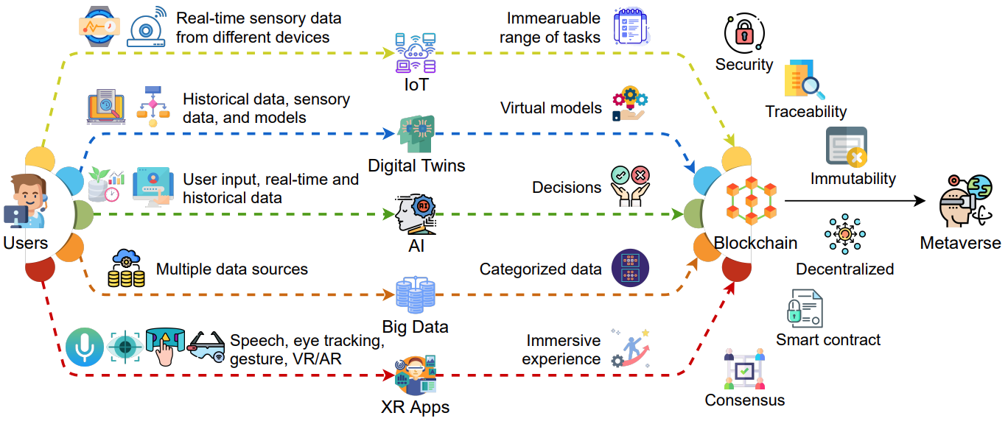
Key Enabling Technologies of the Metaverse
Source: Gadekallu, Thippa Reddy, Thien Huynh-The, Weizheng Wang, Gokul Yenduri, Pasika Ranaweera, Quoc-Viet Pham, Daniel Benevides da Costa, and Madhusanka Liyanage (2022).
"Blockchain for the Metaverse: A Review." arXiv preprint arXiv:2203.09738..

Slide 20
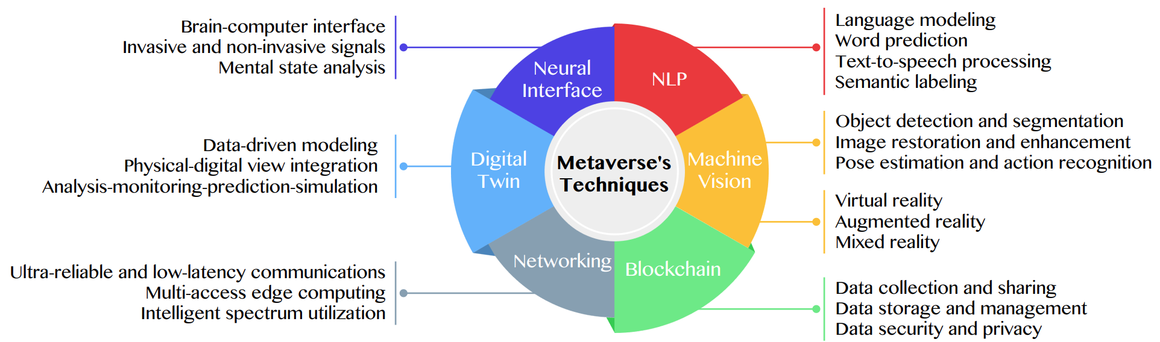
Primary Technical Aspects in the Metaverse
AI with ML algorithms and DL architectures is advancing the user experience in the virtual world
Source: Huynh-The, Thien, Quoc-Viet Pham, Xuan-Qui Pham, Thanh Thi Nguyen, Zhu Han, and Dong-Seong Kim (2022).
"Artificial Intelligence for the Metaverse: A Survey." arXiv preprint arXiv:2202.10336.

Slide 21
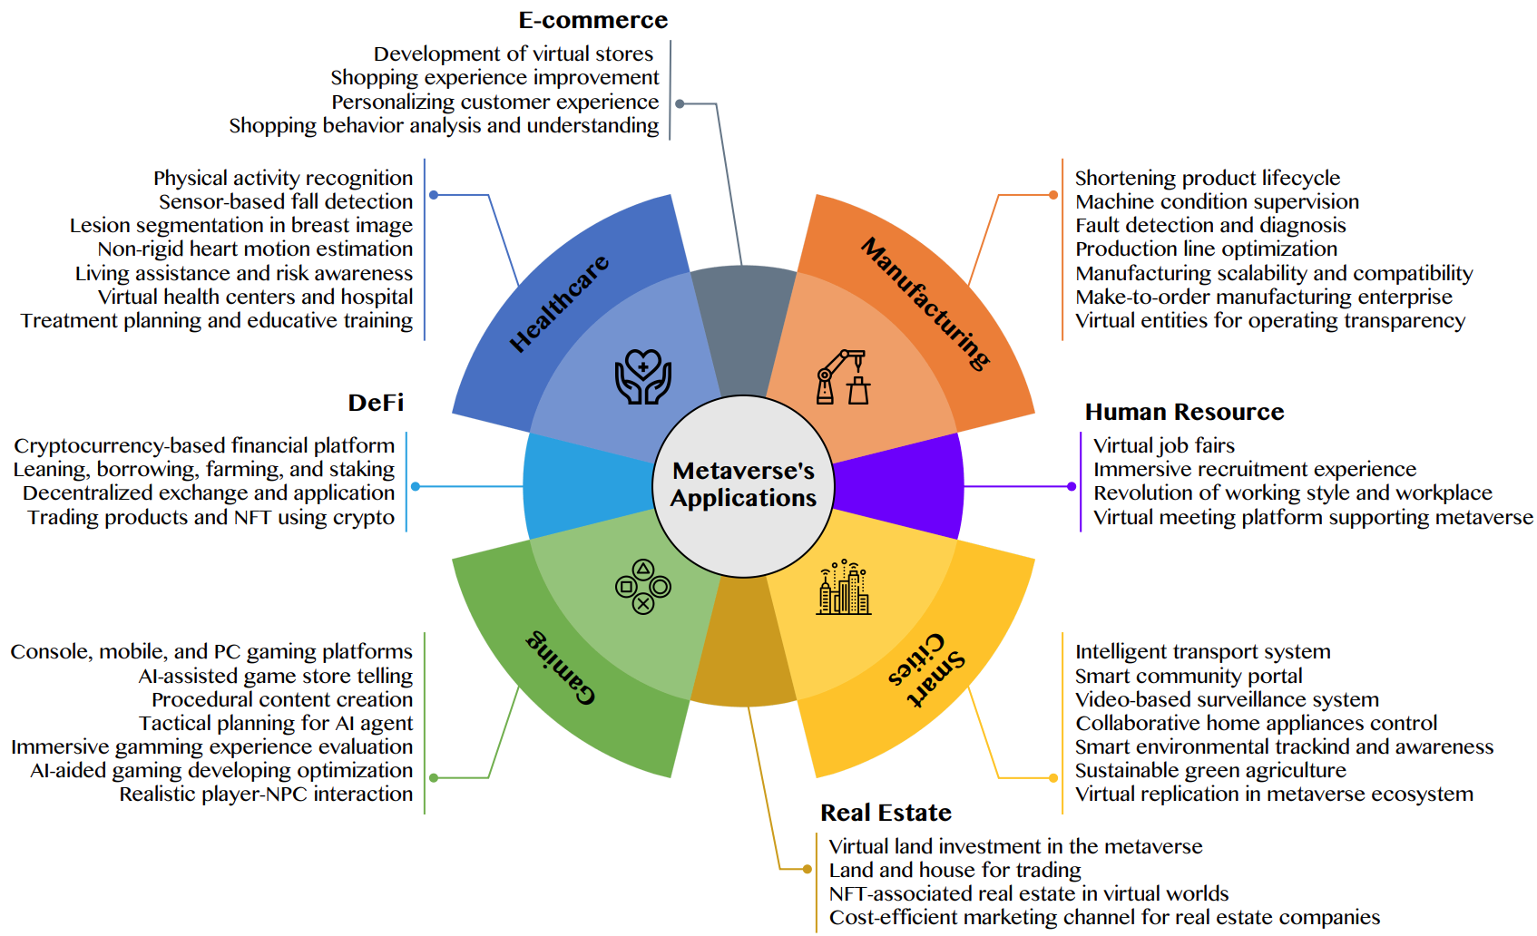
AI for the Metaverse in the Application Aspects healthcare, manufacturing, smart cities, gaming
E-commerce, human resources, real estate, and DeFi
Source: Huynh-The, Thien, Quoc-Viet Pham, Xuan-Qui Pham, Thanh Thi Nguyen, Zhu Han, and Dong-Seong Kim (2022).
"Artificial Intelligence for the Metaverse: A Survey." arXiv preprint arXiv:2202.10336.

Slide 22
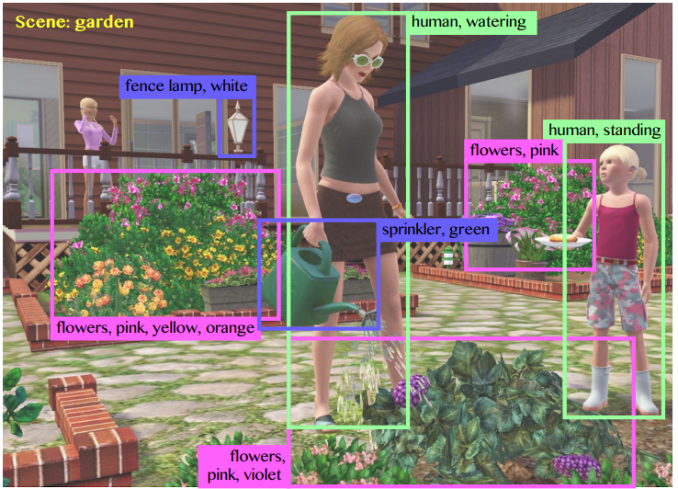
Computer Vision in the Metaverse with scene understanding, object detection, and human action/activity recognition
Source: Huynh-The, Thien, Quoc-Viet Pham, Xuan-Qui Pham, Thanh Thi Nguyen, Zhu Han, and Dong-Seong Kim (2022).
"Artificial Intelligence for the Metaverse: A Survey." arXiv preprint arXiv:2202.10336.

Slide 23
Computer Vision

Slide 24
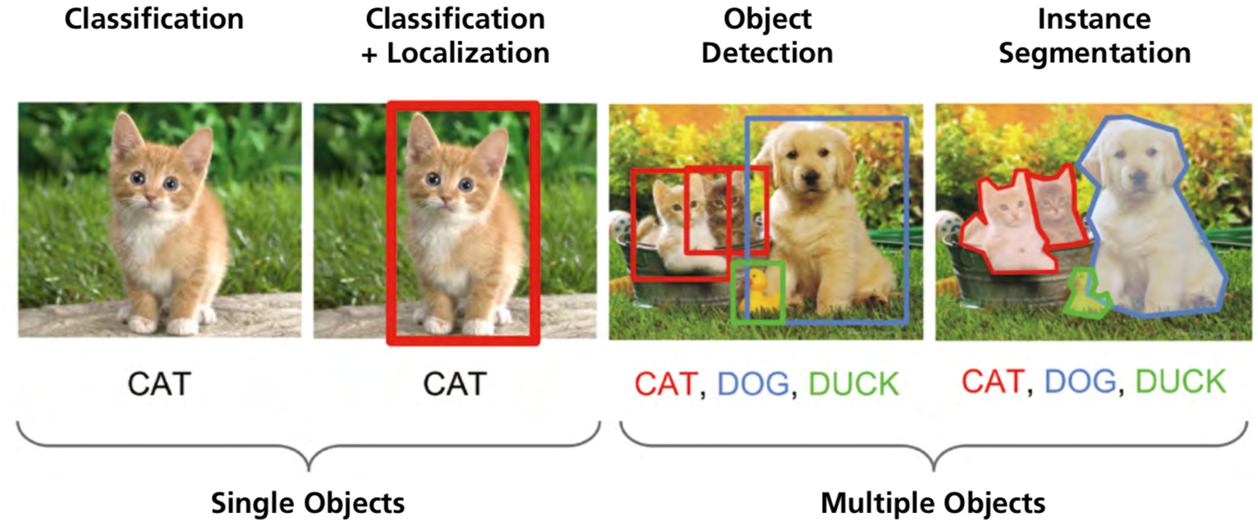
Computer Vision:
Image Classification, Object Detection,
Object Instance Segmentation
Source: DHL (2018), Artificial Intelligence in Logistics,
http://www.globalhha.com/doclib/data/upload/doc_con/5e50c53c5bf67.pdf/

Slide 25
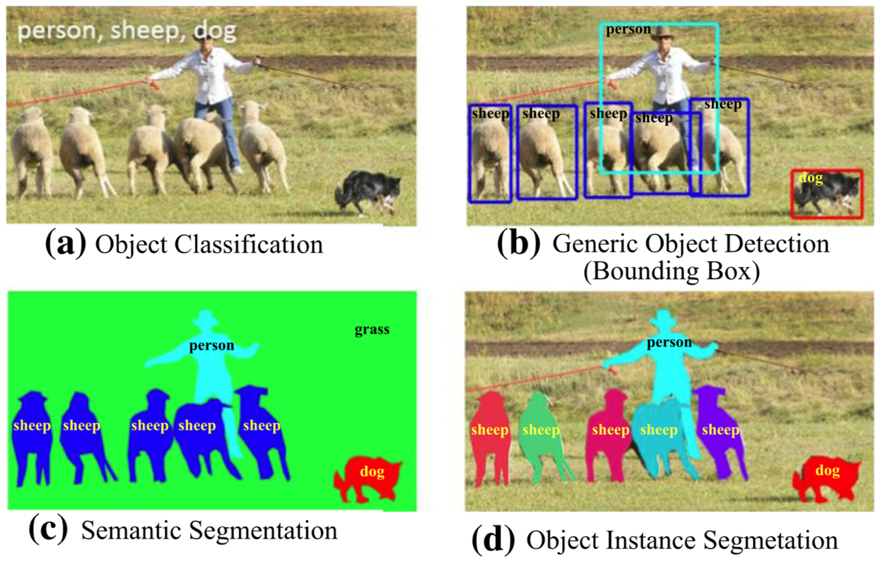
Computer Vision: Object Detection
Source: Li Liu, Wanli Ouyang, Xiaogang Wang, Paul Fieguth, Jie Chen, Xinwang Liu, and Matti Pietikäinen. "Deep learning for generic object detection: A survey." International journal of computer vision 128, no. 2 (2020): 261-318.

Slide 26
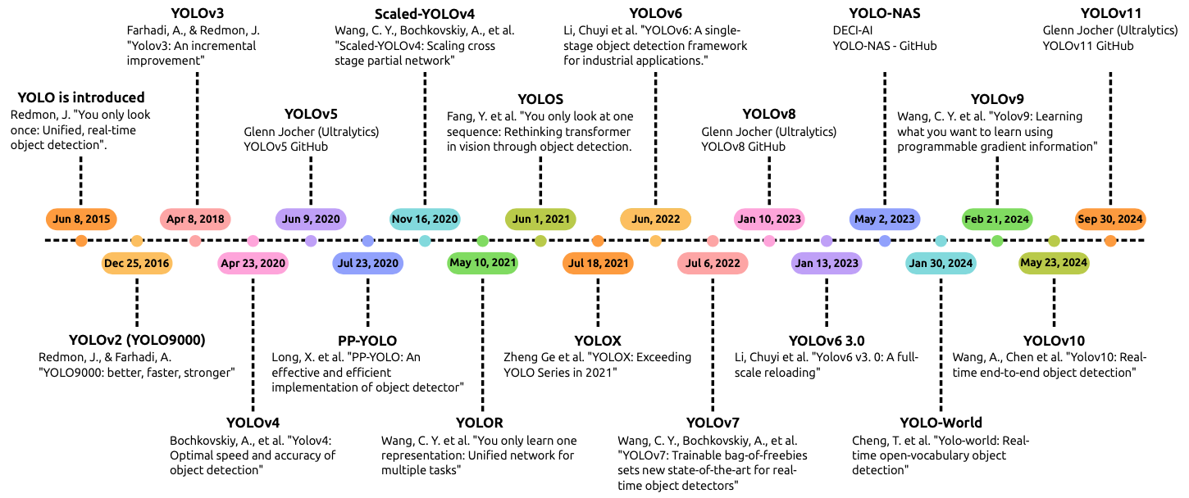
Evolution of YOLO Algorithms
(YOLOv7, YOLOv8, YOLOv9, YOLOv10, YOLOv11)
Source: Nidhal Jegham, Chan Young Koh, Marwan Abdelatti, and Abdeltawab Hendawi. (2024) "Evaluating the Evolution of YOLO (You Only Look Once) Models: A Comprehensive Benchmark Study of YOLO11 and Its Predecessors." arXiv preprint arXiv:2411.00201.

Slide 27
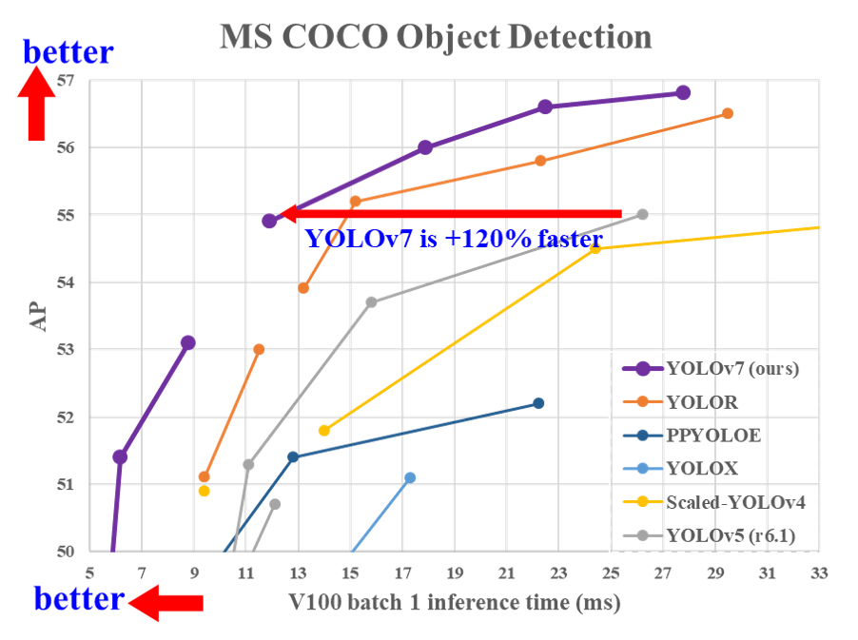
YOLOv7:
Trainable bag-of-freebies sets new state-of-the-art for real-time object detectors
Source: Wang, Chien-Yao, Alexey Bochkovskiy, and Hong-Yuan Mark Liao.
"YOLOv7: Trainable bag-of-freebies sets new state-of-the-art for real-time object detectors." arXiv preprint arXiv:2207.02696 (2022).

Slide 28
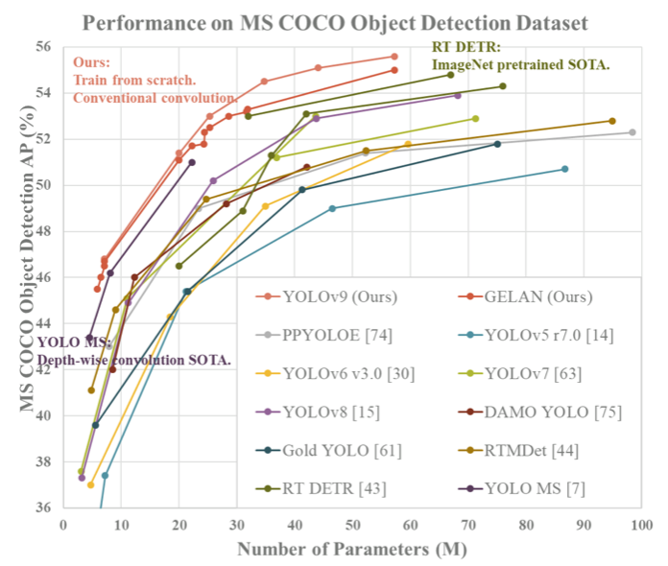
YOLOv9:
Learning what you want to learn using programmable gradient information
Source: Chien-Yao Wang, I-Hau Yeh, and Hong-Yuan Mark Liao. (2025)
"Yolov9: Learning what you want to learn using programmable gradient information." In European Conference on Computer Vision, pp. 1-21. Springer, Cham.

Slide 29
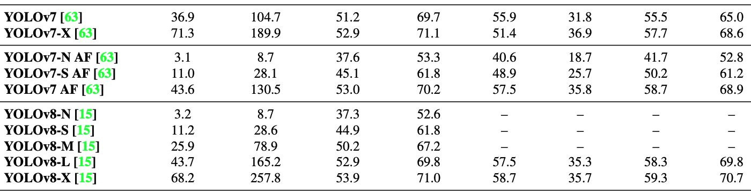
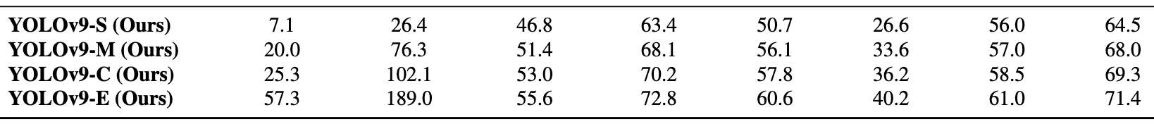
YOLOv9:
Comparison of state-of-the-art real-time object detectors
Source: Chien-Yao Wang, I-Hau Yeh, and Hong-Yuan Mark Liao. (2025)
"Yolov9: Learning what you want to learn using programmable gradient information." In European Conference on Computer Vision, pp. 1-21. Springer, Cham.

Slide 30
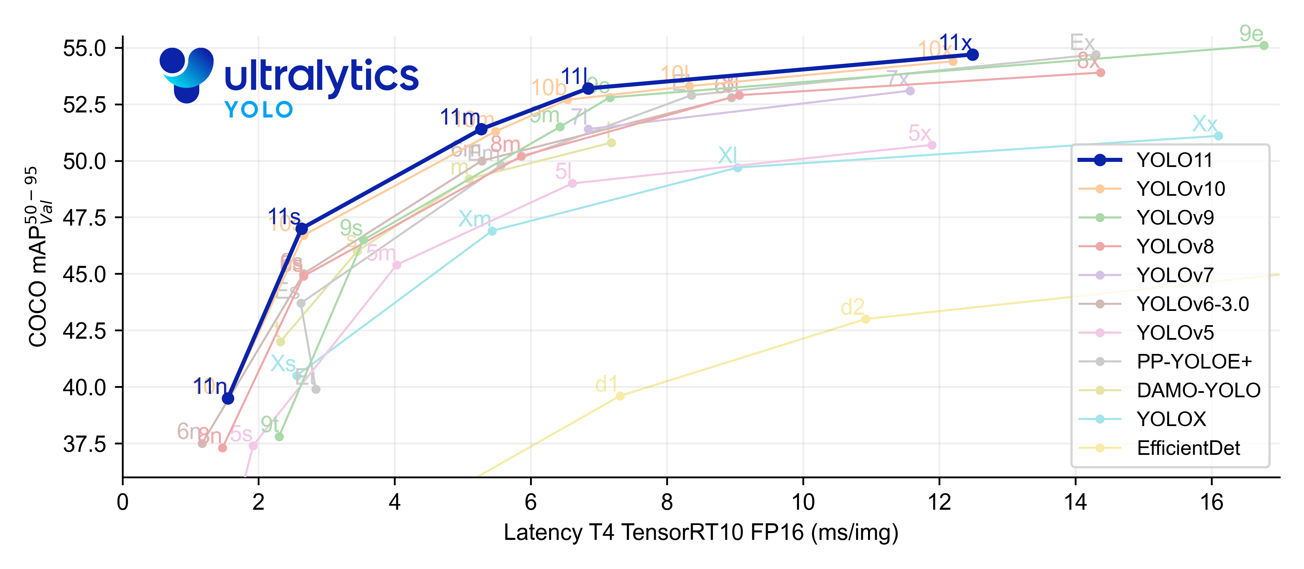
Ultralytics YOLO11
Source: https://docs.ultralytics.com/models/yolo11/

Slide 31
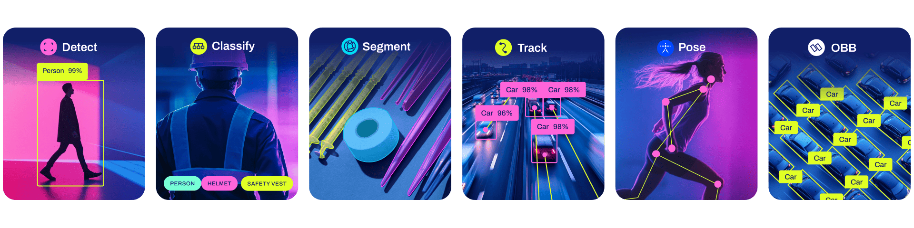
Ultralytics YOLO11 for Computer Vision
YOLO11 can train, val, predict and export models for the most common tasks in vision AI: Detect, Segment, Classify and Pose.
https://colab.research.google.com/github/ultralytics/ultralytics/blob/main/examples/tutorial.ipynb

Slide 32
YOLO11 Supported Tasks and Modes
Model | Filenames | Task
YOLO11 | yolo11n.pt yolo11s.pt yolo11m.pt yolo11l.pt yolo11x.pt | Detection
YOLO11-seg | yolo11n-seg.pt yolo11s-seg.pt yolo11m-seg.pt yolo11l-seg.pt yolo11x-seg.pt | Instance Segmentation
YOLO11-pose | yolo11n-pose.pt yolo11s-pose.pt yolo11m-pose.pt yolo11l-pose.pt yolo11x-pose.pt | Pose/Keypoints
YOLO11-obb | yolo11n-obb.pt yolo11s-obb.pt yolo11m-obb.pt yolo11l-obb.pt yolo11x-obb.pt | Oriented Detection
YOLO11-cls | yolo11n-cls.pt yolo11s-cls.pt yolo11m-cls.pt yolo11l-cls.pt yolo11x-cls.pt | Classification
Source: https://docs.ultralytics.com/models/yolo11/

Slide 33
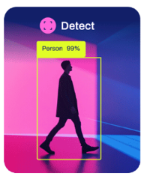
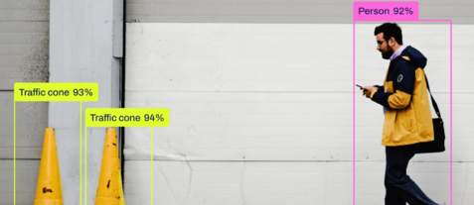
YOLO11 Performance
Detection (COCO)
Object detection: identifying the location and class of objects in an image or video stream (80 pre-trained classes)
Model | size ^{(pixels)} | mAP^{val} ⁵⁰⁻⁹⁵ | Speed ^{CPU ONNX} ^{(ms)} | Speed ^{T4 TensorRT10} ^{(ms)} | params ^{(M)} | FLOPs ^{(B)}
YOLO11n | 640 | 39.5 | 56.1 ± 0.8 | 1.5 ± 0.0 | 2.6 | 6.5
YOLO11s | 640 | 47.0 | 90.0 ± 1.2 | 2.5 ± 0.0 | 9.4 | 21.5
YOLO11m | 640 | 51.5 | 183.2 ± 2.0 | 4.7 ± 0.1 | 20.1 | 68.0
YOLO11l | 640 | 53.4 | 238.6 ± 1.4 | 6.2 ± 0.1 | 25.3 | 86.9
YOLO11x | 640 | 54.7 | 462.8 ± 6.7 | 11.3 ± 0.2 | 56.9 | 194.9
Source: https://docs.ultralytics.com/models/yolo11/

Slide 34
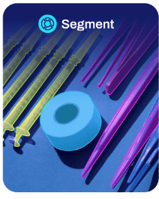
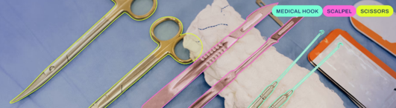
YOLO11 Performance
Segmentation (COCO)
80 pre-trained classes
Model | size ^{(pixels)} | mAP^{box} ⁵⁰⁻⁹⁵ | mAP^{mask} ⁵⁰⁻⁹⁵ | Speed ^{CPU ONNX} ^{(ms)} | Speed ^{T4 TensorRT10} ^{(ms)} | params ^{(M)} | FLOPs ^{(B)}
YOLO11n-seg | 640 | 38.9 | 32.0 | 65.9 ± 1.1 | 1.8 ± 0.0 | 2.9 | 10.4
YOLO11s-seg | 640 | 46.6 | 37.8 | 117.6 ± 4.9 | 2.9 ± 0.0 | 10.1 | 35.5
YOLO11m-seg | 640 | 51.5 | 41.5 | 281.6 ± 1.2 | 6.3 ± 0.1 | 22.4 | 123.3
YOLO11l-seg | 640 | 53.4 | 42.9 | 344.2 ± 3.2 | 7.8 ± 0.2 | 27.6 | 142.2
YOLO11x-seg | 640 | 54.7 | 43.8 | 664.5 ± 3.2 | 15.8 ± 0.7 | 62.1 | 319.0
Source: https://docs.ultralytics.com/models/yolo11/

Slide 35

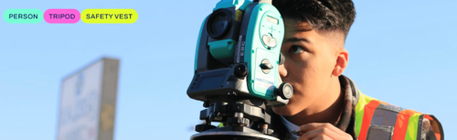
YOLO11 Performance
Classification (ImageNet)
1000 pre-trained classes
Model | size ^{(pixels)} | acc ^{top1} | acc ^{top5} | Speed ^{CPU ONNX} ^{(ms)} | Speed ^{T4 TensorRT10} ^{(ms)} | params ^{(M)} | FLOPs ^{(B) at 640}
YOLO11n-cls | 224 | 70.0 | 89.4 | 5.0 ± 0.3 | 1.1 ± 0.0 | 1.6 | 3.3
YOLO11s-cls | 224 | 75.4 | 92.7 | 7.9 ± 0.2 | 1.3 ± 0.0 | 5.5 | 12.1
YOLO11m-cls | 224 | 77.3 | 93.9 | 17.2 ± 0.4 | 2.0 ± 0.0 | 10.4 | 39.3
YOLO11l-cls | 224 | 78.3 | 94.3 | 23.2 ± 0.3 | 2.8 ± 0.0 | 12.9 | 49.4
YOLO11x-cls | 224 | 79.5 | 94.9 | 41.4 ± 0.9 | 3.8 ± 0.0 | 28.4 | 110.4
Source: https://docs.ultralytics.com/models/yolo11/

Slide 36
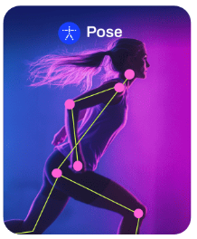
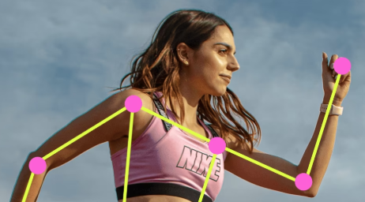
YOLO11 Performance
Pose / Keypoint (COCO)
1 pre-trained class: 'person'
Model | size ^{(pixels)} | mAP^{pose} ⁵⁰⁻⁹⁵ | mAP^{pose} ⁵⁰ | Speed ^{CPU ONNX} ^{(ms)} | Speed ^{T4 TensorRT10} ^{(ms)} | params ^{(M)} | FLOPs ^{(B)}
YOLO11n-pose | 640 | 50.0 | 81.0 | 52.4 ± 0.5 | 1.7 ± 0.0 | 2.9 | 7.6
YOLO11s-pose | 640 | 58.9 | 86.3 | 90.5 ± 0.6 | 2.6 ± 0.0 | 9.9 | 23.2
YOLO11m-pose | 640 | 64.9 | 89.4 | 187.3 ± 0.8 | 4.9 ± 0.1 | 20.9 | 71.7
YOLO11l-pose | 640 | 66.1 | 89.9 | 247.7 ± 1.1 | 6.4 ± 0.1 | 26.2 | 90.7
YOLO11x-pose | 640 | 69.5 | 91.1 | 488.0 ± 13.9 | 12.1 ± 0.2 | 58.8 | 203.3
Source: https://docs.ultralytics.com/models/yolo11/

Slide 37
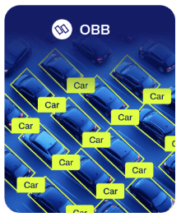
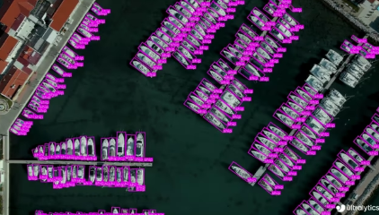
YOLO11 Performance
OBB (DOTAv1)
Oriented Bounding Boxes Object Detection
15 pre-trained classes
Model | size ^{(pixels)} | mAP^{test} ⁵⁰ | Speed ^{CPU ONNX} ^{(ms)} | Speed ^{T4 TensorRT10} ^{(ms)} | params ^{(M)} | FLOPs ^{(B)}
YOLO11n-obb | 1024 | 78.4 | 117.6 ± 0.8 | 4.4 ± 0.0 | 2.7 | 17.2
YOLO11s-obb | 1024 | 79.5 | 219.4 ± 4.0 | 5.1 ± 0.0 | 9.7 | 57.5
YOLO11m-obb | 1024 | 80.9 | 562.8 ± 2.9 | 10.1 ± 0.4 | 20.9 | 183.5
YOLO11l-obb | 1024 | 81.0 | 712.5 ± 5.0 | 13.5 ± 0.6 | 26.2 | 232.0
YOLO11x-obb | 1024 | 81.3 | 1408.6 ± 7.7 | 28.6 ± 1.0 | 58.8 | 520.2
Source: https://docs.ultralytics.com/models/yolo11/

Slide 38
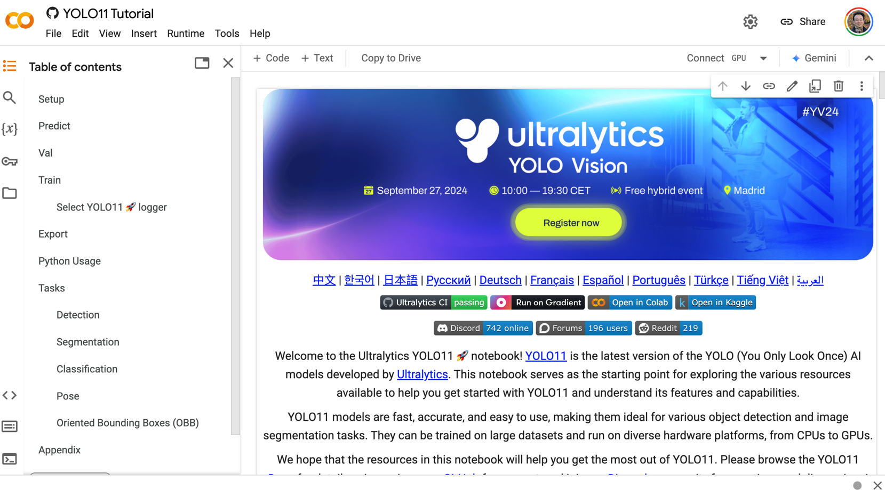
Ultralytics YOLO11 Tutorial
https://colab.research.google.com/github/ultralytics/ultralytics/blob/main/examples/tutorial.ipynb

Slide 39
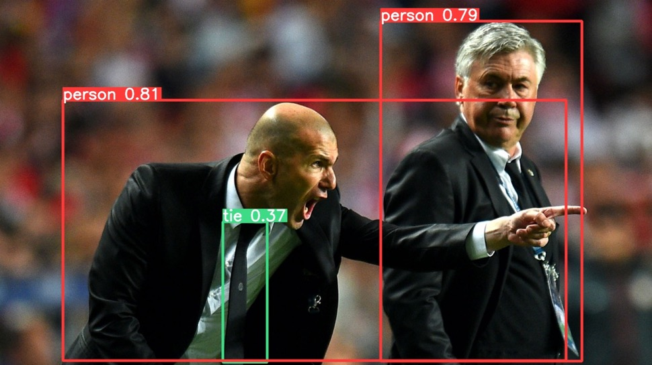
YOLO11 Tutorial (1. Predict)
%pip install ultralytics
import ultralytics
ultralytics.checks()
# Run inference on an image with YOLO11n
!yolo predict model=yolo11n.pt source='https://ultralytics.com/images/zidane.jpg'
https://colab.research.google.com/github/ultralytics/ultralytics/blob/main/examples/tutorial.ipynb

Slide 40
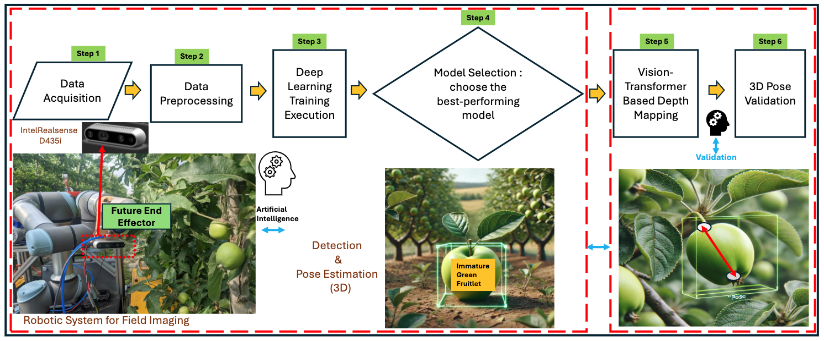
Robotic System with Computer Vision
Precise pose estimation of immature green fruitlets
Source: Sapkota, Ranjan, and Manoj Karkee. "Yolo11 and vision transformers based 3d pose estimation of immature green fruits in commercial apple orchards for robotic thinning." arXiv preprint arXiv:2410.19846 (2024)..

Slide 41
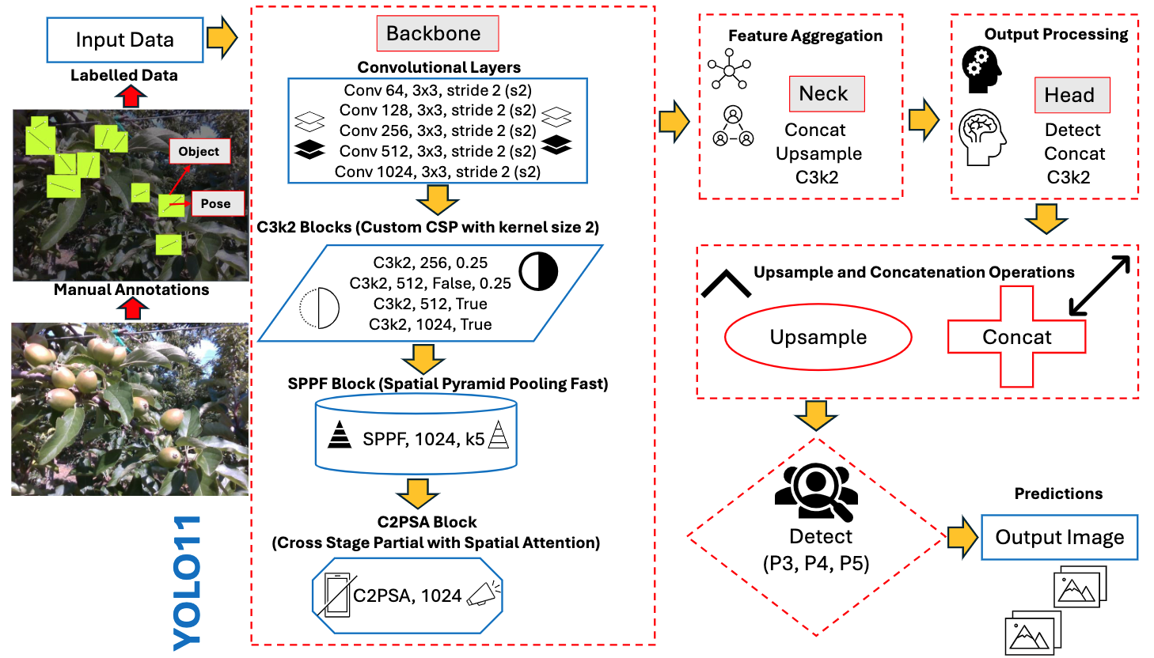
YOLO11 Architecture Diagram for immature green fruit detection and pose estimation
Source: Sapkota, Ranjan, and Manoj Karkee. "Yolo11 and vision transformers based 3d pose estimation of immature green fruits in commercial apple orchards for robotic thinning." arXiv preprint arXiv:2410.19846 (2024)..

Slide 42
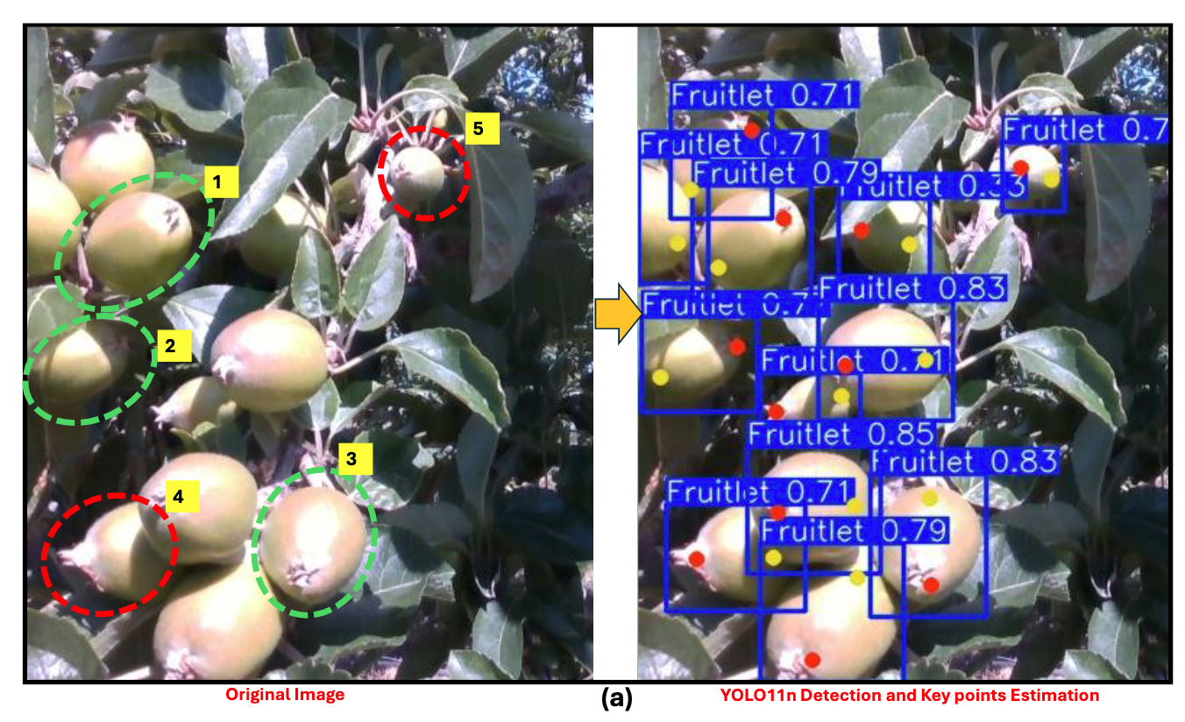
YOLO11n Detection and Pose Estimation capabilities in a commercial orchard
Source: Sapkota, Ranjan, and Manoj Karkee. "Yolo11 and vision transformers based 3d pose estimation of immature green fruits in commercial apple orchards for robotic thinning." arXiv preprint arXiv:2410.19846 (2024)..

Slide 43
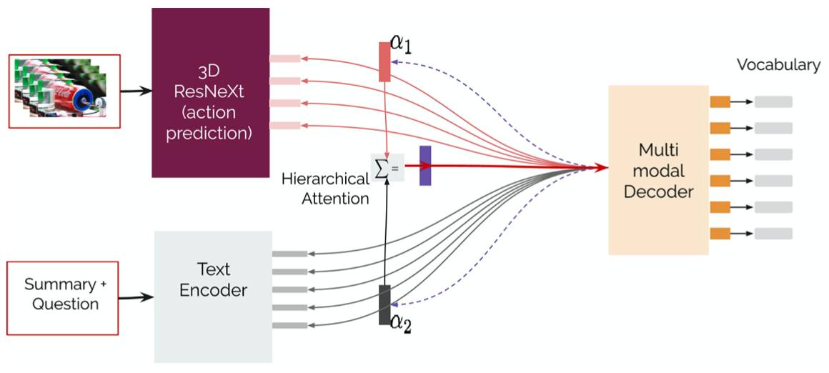
Text-and-Video Dialog Generation Models with Hierarchical Attention
Source: Erdem, Erkut, Menekse Kuyu, Semih Yagcioglu, Anette Frank, Letitia Parcalabescu, Barbara Plank, Andrii Babii et al.
"Neural Natural Language Generation: A Survey on Multilinguality, Multimodality, Controllability and Learning." Journal of Artificial Intelligence Research 73 (2022): 1131-1207.

Slide 44
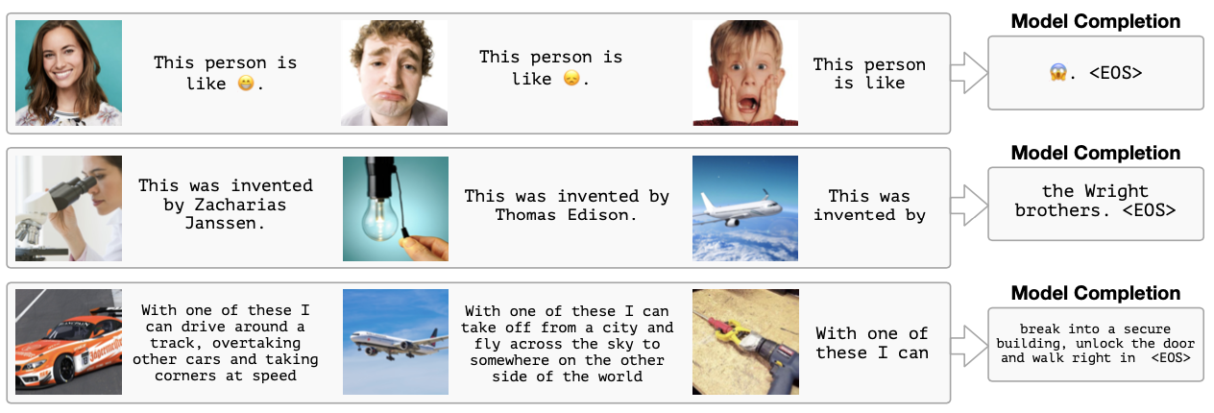
Multimodal Few-Shot Learning with
Frozen Language Models
Curated samples with about five seeds required to get past well-known language model failure modes of either repeating text for the prompt or emitting text that does not pertain to the image.
These samples demonstrate the ability to generate open-ended outputs that adapt to both images and text, and to make use of facts that it has learned during language-only pre-training.
Source: Maria Tsimpoukelli, Jacob L. Menick, Serkan Cabi, S. M. Eslami, Oriol Vinyals, and Felix Hill (2021). "Multimodal few-shot learning with frozen language models."
Advances in Neural Information Processing Systems 34 (2021): 200-212.

Slide 45
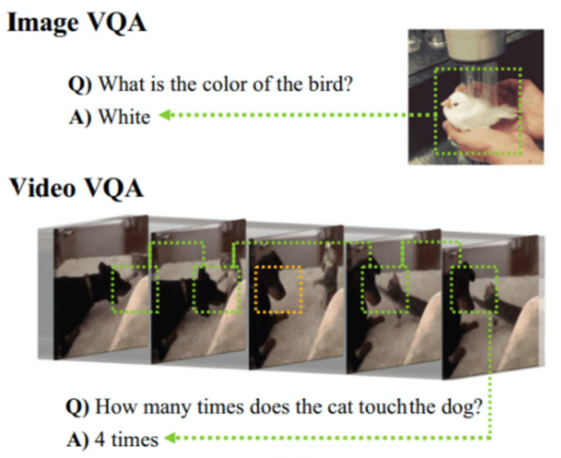
Video Question Answering (VQA)
Source: Bayoudh, Khaled, Raja Knani, Fayçal Hamdaoui, and Abdellatif Mtibaa (2022).
"A survey on deep multimodal learning for computer vision: advances, trends, applications, and datasets." The Visual Computer 38, no. 8: 2939-2970.

Slide 46
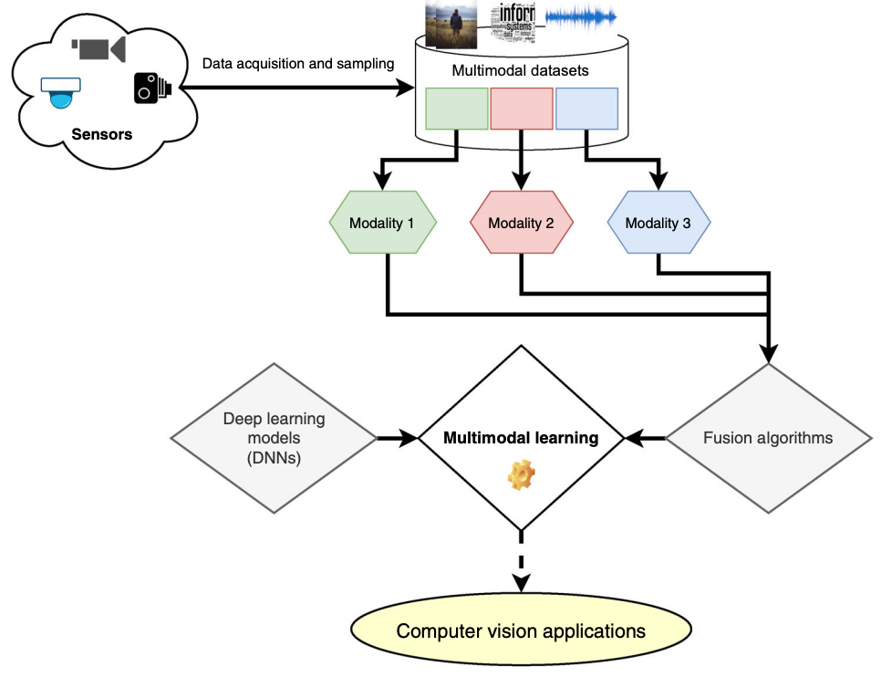
Multimodal Pipeline that includes three different modalities (Image, Text. Audio)
Source: Bayoudh, Khaled, Raja Knani, Fayçal Hamdaoui, and Abdellatif Mtibaa (2022).
"A survey on deep multimodal learning for computer vision: advances, trends, applications, and datasets." The Visual Computer 38, no. 8: 2939-2970.

Slide 47
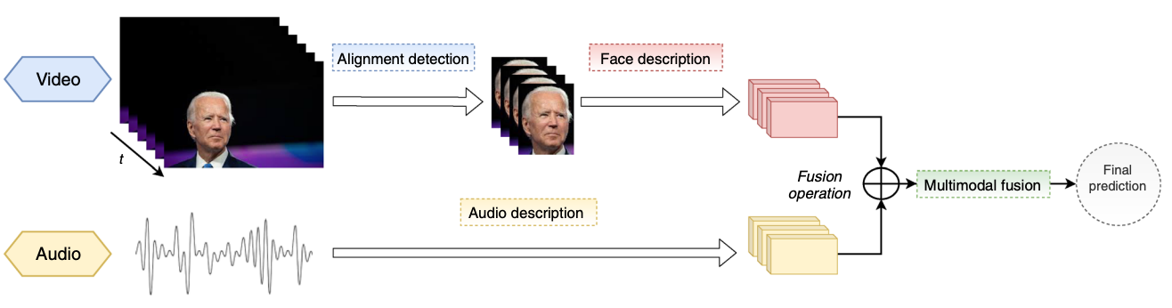
Video and Audio Multimodal Fusion
Source: Bayoudh, Khaled, Raja Knani, Fayçal Hamdaoui, and Abdellatif Mtibaa (2022).
"A survey on deep multimodal learning for computer vision: advances, trends, applications, and datasets." The Visual Computer 38, no. 8: 2939-2970.

Slide 48
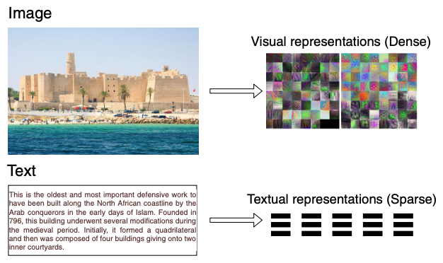
Visual and Textual Representation
Source: Bayoudh, Khaled, Raja Knani, Fayçal Hamdaoui, and Abdellatif Mtibaa (2022).
"A survey on deep multimodal learning for computer vision: advances, trends, applications, and datasets." The Visual Computer 38, no. 8: 2939-2970.

Slide 49
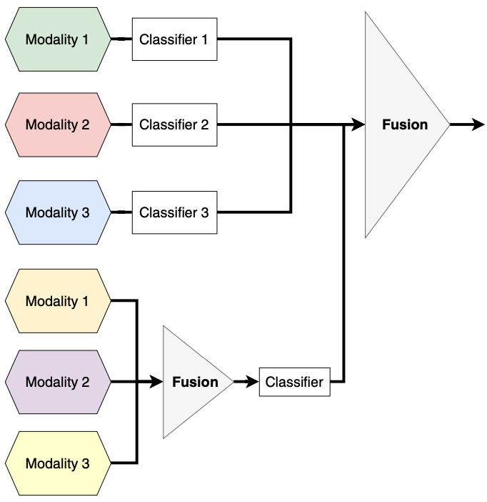
Hybrid Multimodal Data Fusion
Text
Audio
Image
Text
Speech
Video
Source: Bayoudh, Khaled, Raja Knani, Fayçal Hamdaoui, and Abdellatif Mtibaa (2022).
"A survey on deep multimodal learning for computer vision: advances, trends, applications, and datasets." The Visual Computer 38, no. 8: 2939-2970.

Slide 50
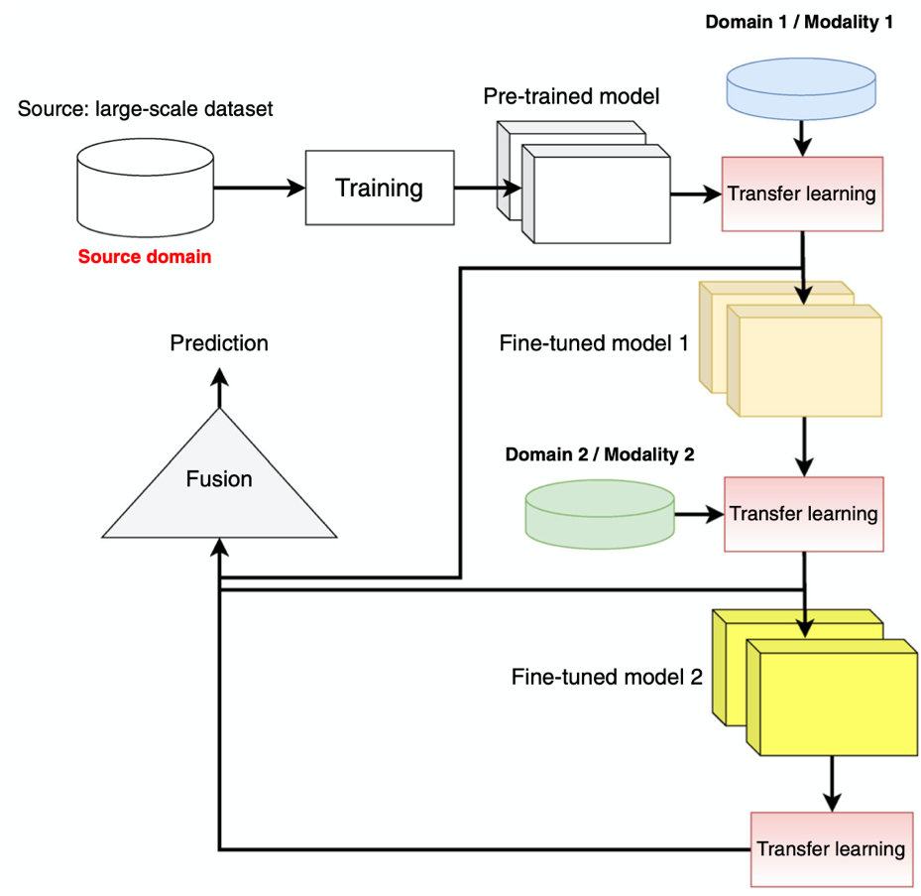
Multimodal Transfer Learning
Source: Bayoudh, Khaled, Raja Knani, Fayçal Hamdaoui, and Abdellatif Mtibaa (2022).
"A survey on deep multimodal learning for computer vision: advances, trends, applications, and datasets." The Visual Computer 38, no. 8: 2939-2970.

Slide 51
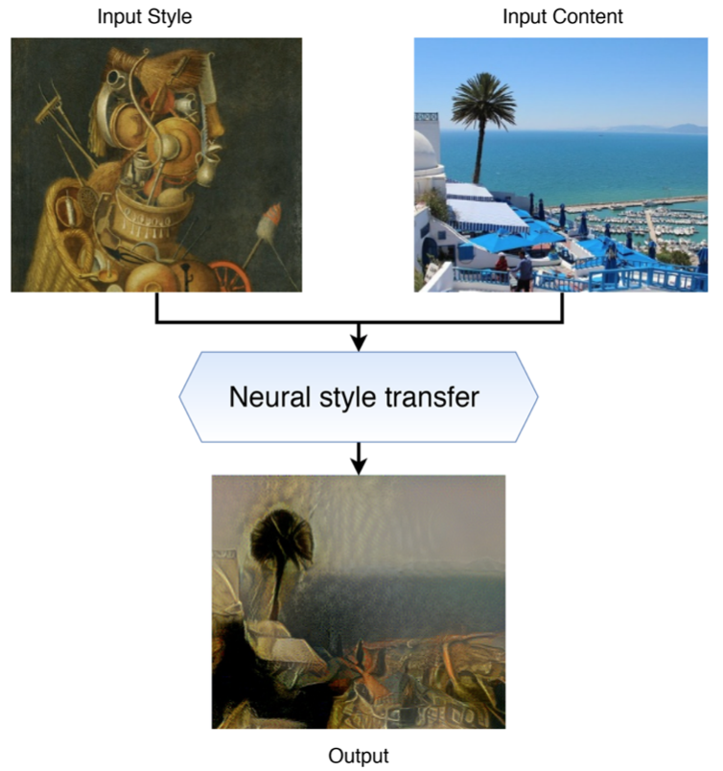
Neural Style Transfer (NST)
Source: Bayoudh, Khaled, Raja Knani, Fayçal Hamdaoui, and Abdellatif Mtibaa (2022).
"A survey on deep multimodal learning for computer vision: advances, trends, applications, and datasets." The Visual Computer 38, no. 8: 2939-2970.

Slide 52
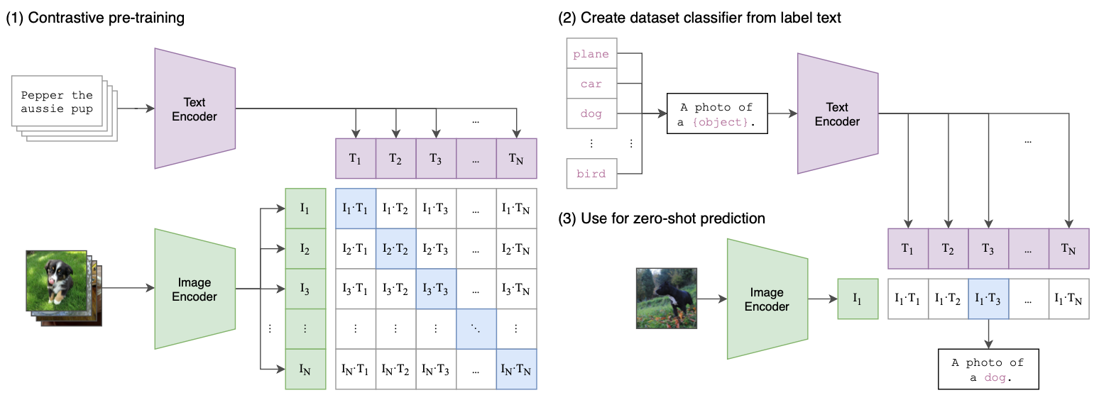
CLIP: Learning Transferable Visual Models From Natural Language Supervision
Source: Radford, Alec, Jong Wook Kim, Chris Hallacy, Aditya Ramesh, Gabriel Goh, Sandhini Agarwal, Girish Sastry et al. (2021) "Learning transferable visual models from natural language supervision." In International Conference on Machine Learning, pp. 8748-8763. PMLR.

Slide 53
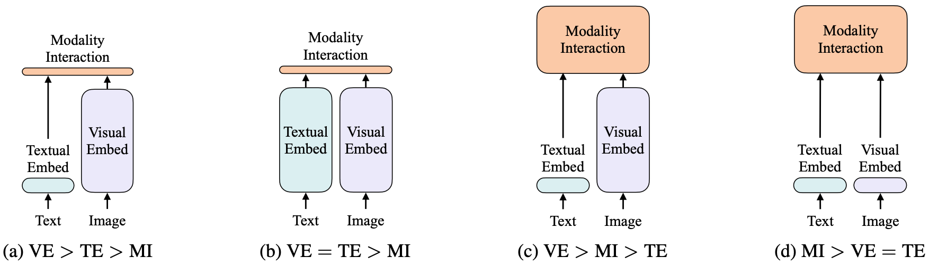
ViLT: Vision-and-Language Transformer Without Convolution or Region Supervision
Source: Kim, Wonjae, Bokyung Son, and Ildoo Kim (2021). "Vilt: Vision-and-language transformer without convolution or region supervision."
In International Conference on Machine Learning, pp. 5583-5594. PMLR.

Slide 54
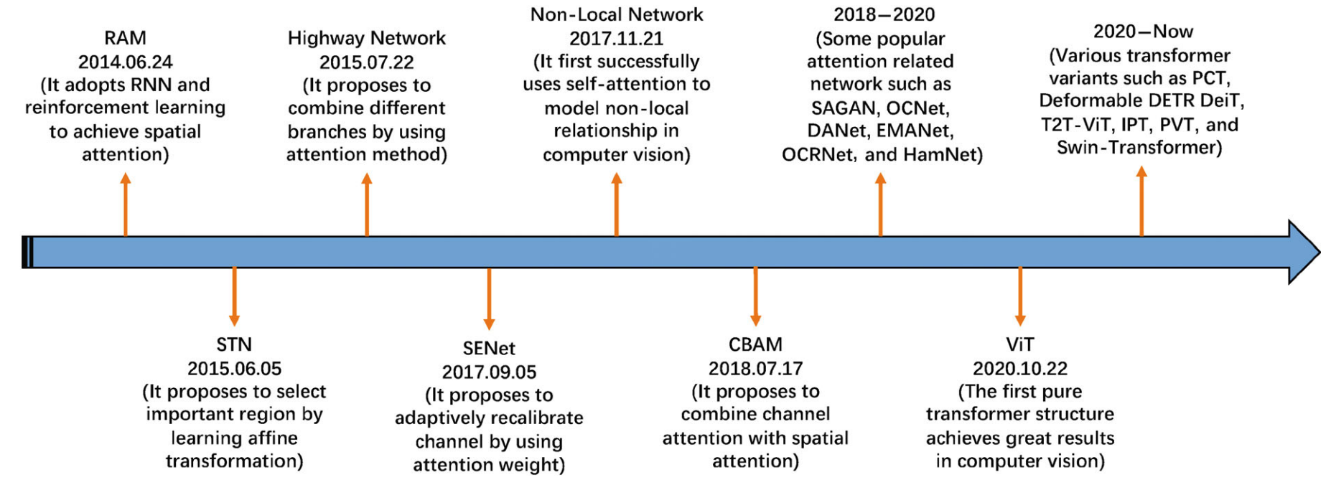
Attention Mechanisms in Computer Vision:
A survey
Source: Guo, Meng-Hao, Tian-Xing Xu, Jiang-Jiang Liu, Zheng-Ning Liu, Peng-Tao Jiang, Tai-Jiang Mu, Song-Hai Zhang, Ralph R. Martin, Ming-Ming Cheng, and Shi-Min Hu. (2022)
"Attention mechanisms in computer vision: A survey." Computational Visual Media ,:1-38.

Slide 55
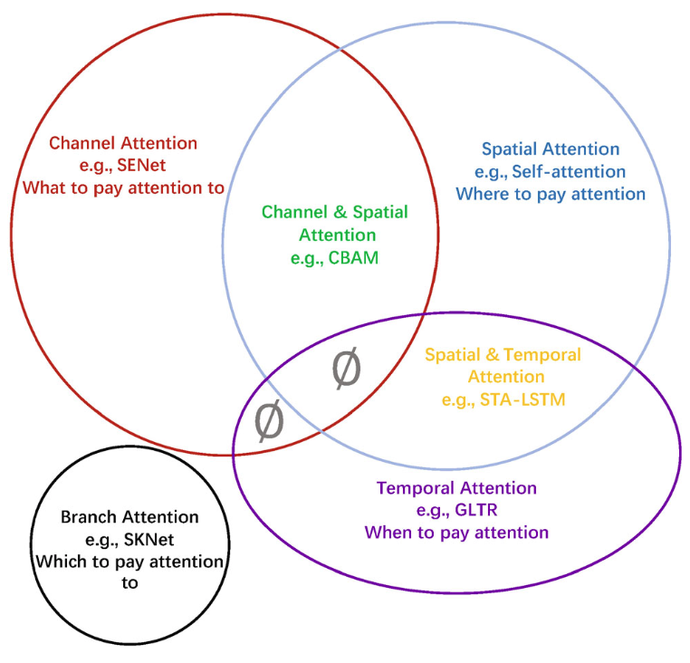
Attention Mechanisms in Computer Vision: Data domain
Source: Guo, Meng-Hao, Tian-Xing Xu, Jiang-Jiang Liu, Zheng-Ning Liu, Peng-Tao Jiang, Tai-Jiang Mu, Song-Hai Zhang, Ralph R. Martin, Ming-Ming Cheng, and Shi-Min Hu. (2022)
"Attention mechanisms in computer vision: A survey." Computational Visual Media ,:1-38.

Slide 56
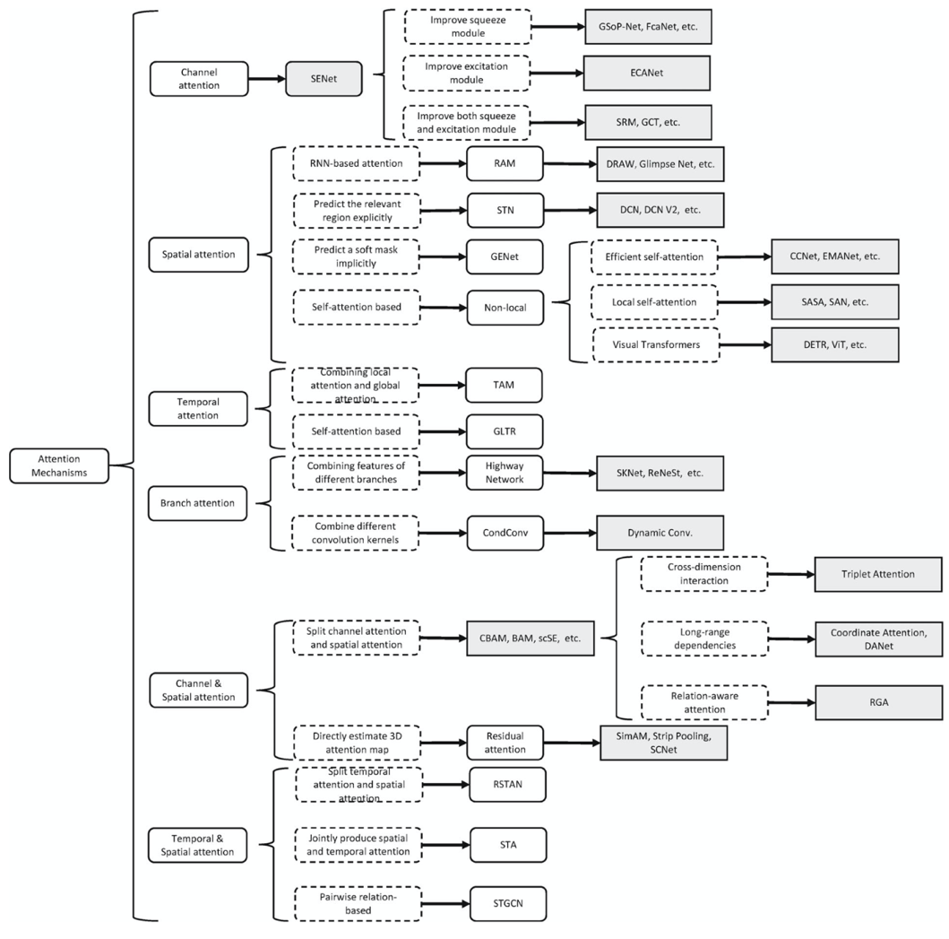
Attention Mechanisms in Computer Vision:
Developmental context of visual attention
Source: Guo, Meng-Hao, Tian-Xing Xu, Jiang-Jiang Liu, Zheng-Ning Liu, Peng-Tao Jiang, Tai-Jiang Mu, Song-Hai Zhang, Ralph R. Martin, Ming-Ming Cheng, and Shi-Min Hu. (2022)
"Attention mechanisms in computer vision: A survey." Computational Visual Media ,:1-38.

Slide 57
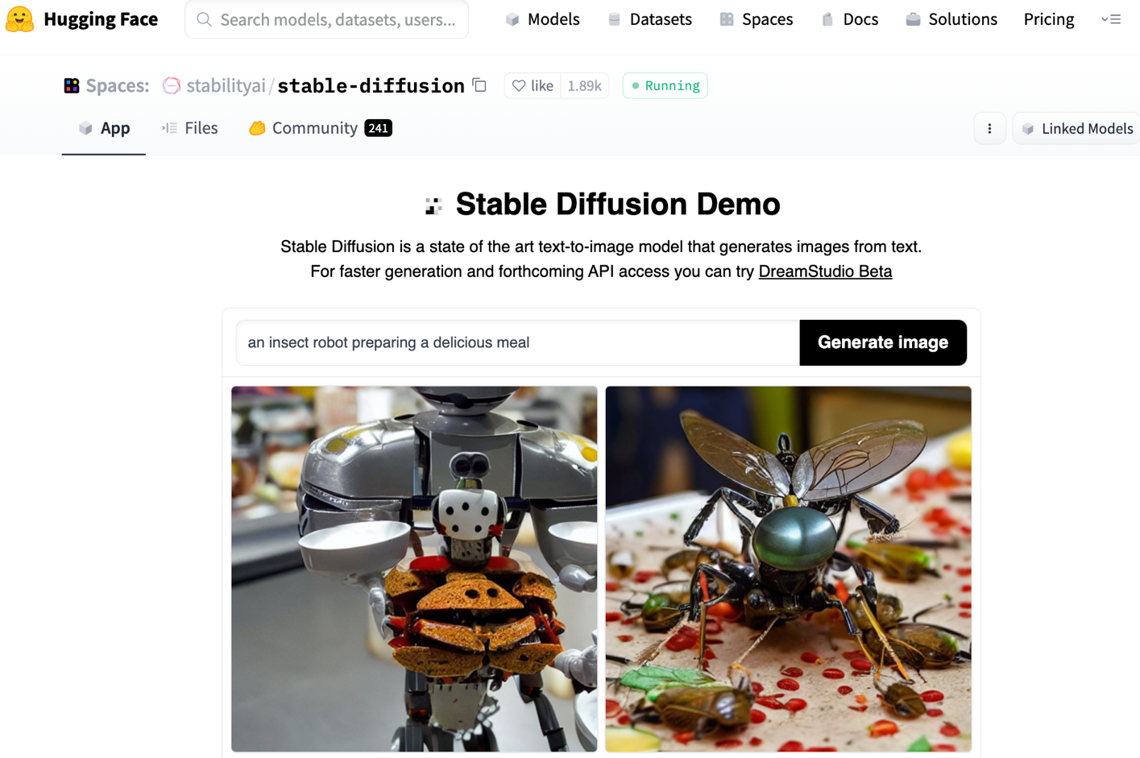
Stable Diffusion
https://huggingface.co/spaces/stabilityai/stable-diffusion

Slide 58
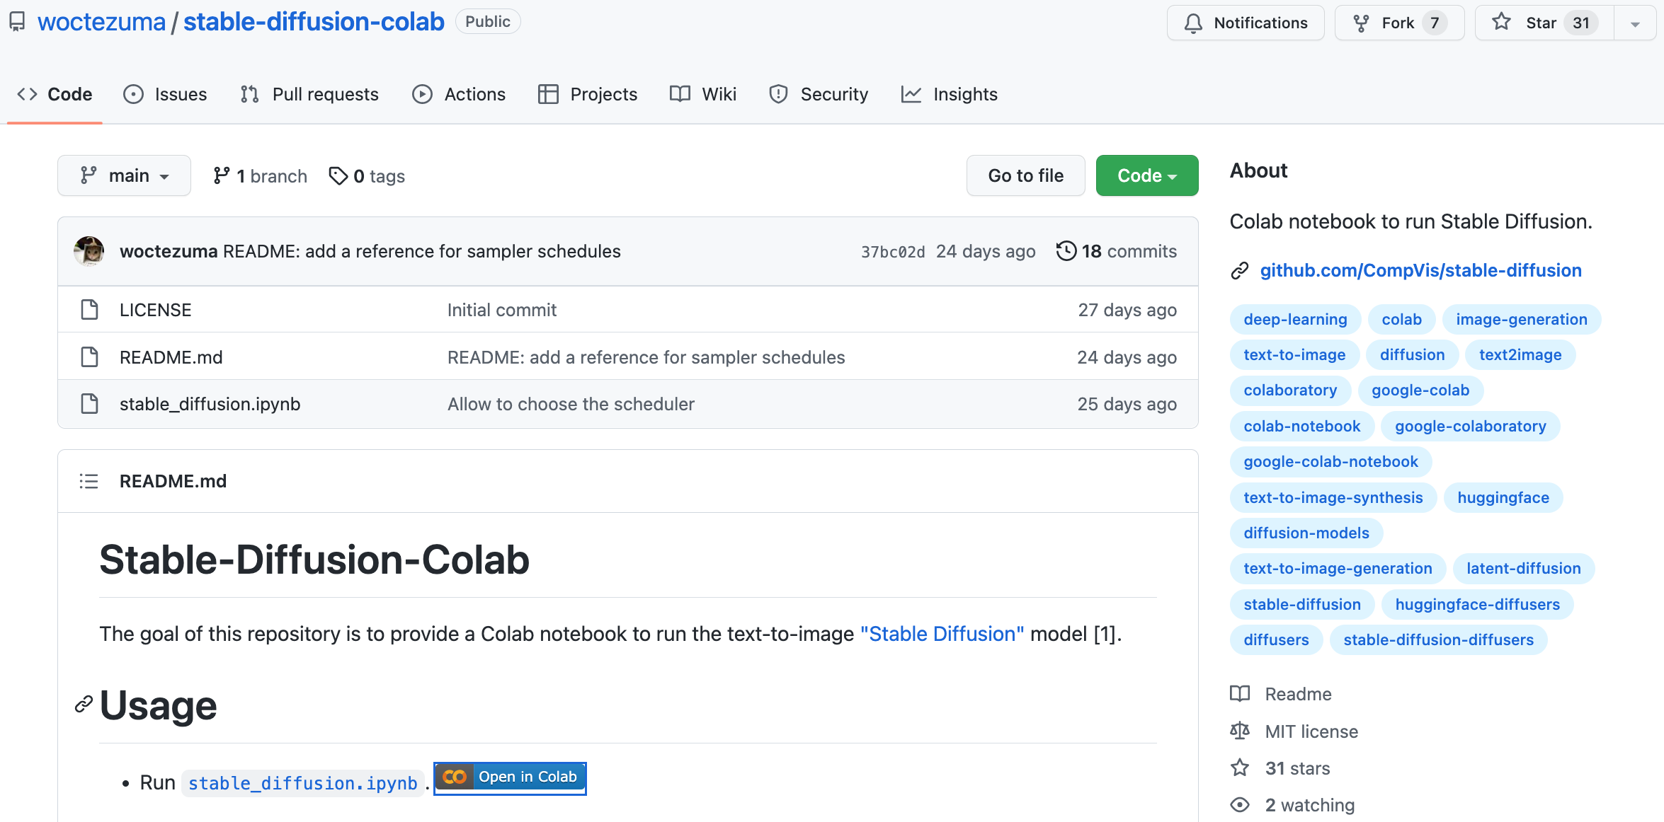
Stable Diffusion Colab
https://github.com/woctezuma/stable-diffusion-colab

Slide 59
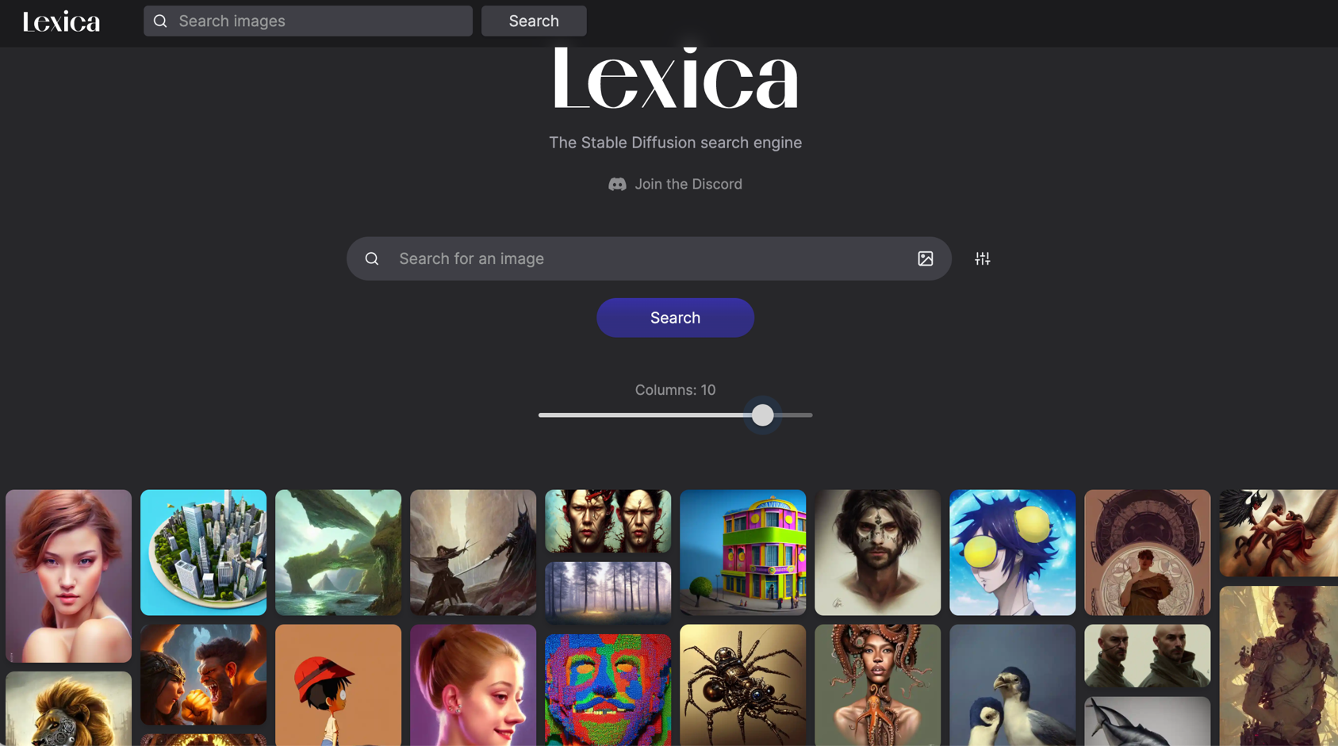
Lexica Art: Search Stable Diffusion images and prompts
https://lexica.art/

Slide 60

Tom Lawry (2020),
AI in Health:
A Leader’s Guide to Winning in the New Age of Intelligent Health Systems,
HIMSS Publishing
Source: Tom Lawry (2020), AI in Health: A Leader’s Guide to Winning in the New Age of Intelligent Health Systems, HIMSS Publishing
https://www.amazon.com/Health-HIMSS-Book-Tom-Lawry/dp/0367333716/

Slide 61
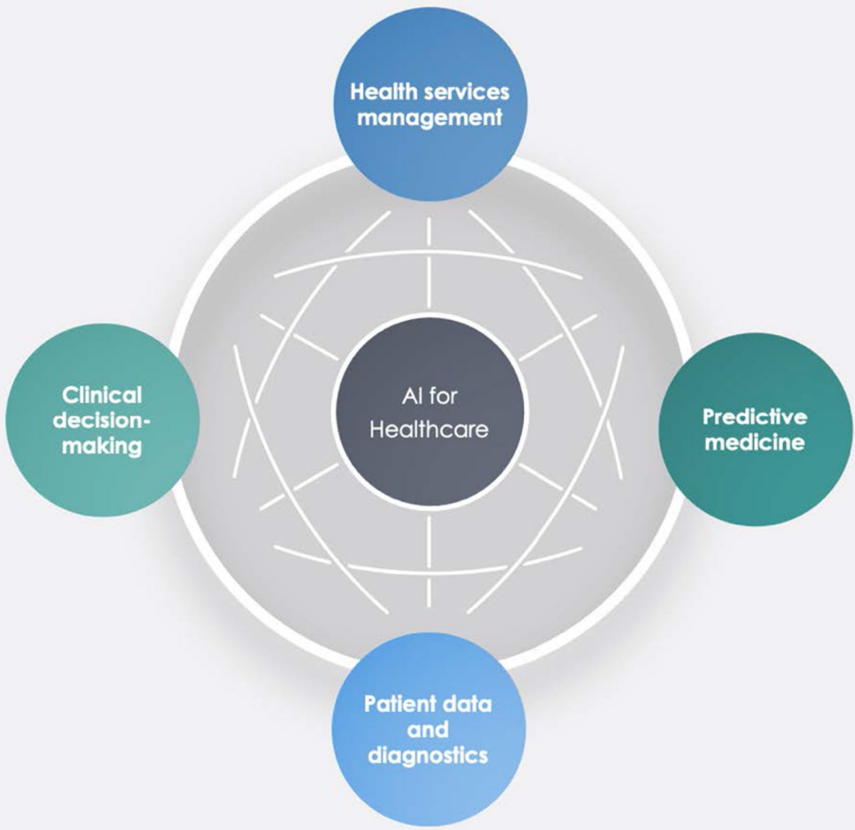
AI in Healthcare
Source: Secinaro, Silvana, Davide Calandra, Aurelio Secinaro, Vivek Muthurangu, and Paolo Biancone. "The role of artificial intelligence in healthcare: a structured literature review." BMC Medical Informatics and Decision Making 21, no. 1 (2021): 1-23.

Slide 62
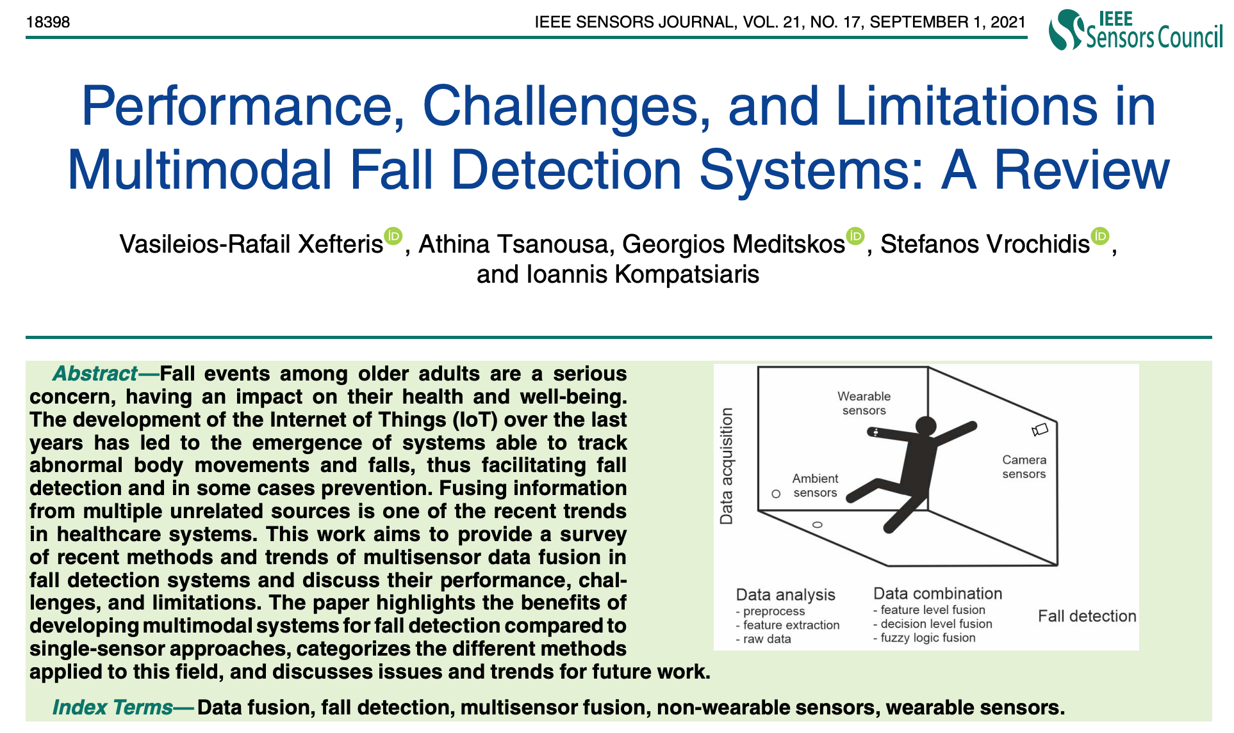
Multimodal Fall Detection
Ambient Assisted Living (AAL)
Source: Xefteris, Vasileios-Rafail, Athina Tsanousa, Georgios Meditskos, Stefanos Vrochidis, and Ioannis Kompatsiaris. "Performance, challenges, and limitations in multimodal fall detection systems: a review." IEEE Sensors Journal (2021).

Slide 63
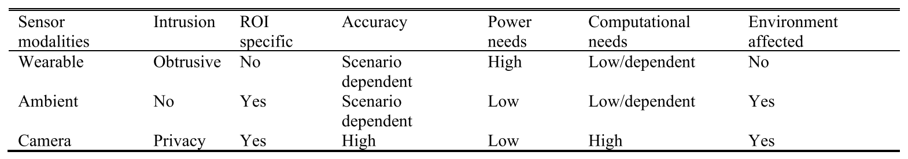
Multimodal Fall Detection
Ambient Assisted Living (AAL)
Source: Xefteris, Vasileios-Rafail, Athina Tsanousa, Georgios Meditskos, Stefanos Vrochidis, and Ioannis Kompatsiaris. "Performance, challenges, and limitations in multimodal fall detection systems: a review." IEEE Sensors Journal (2021).

Slide 64
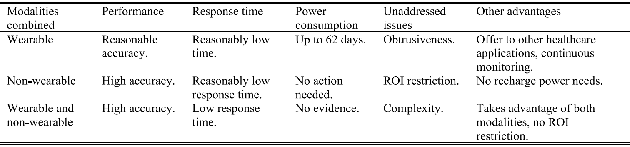
Challenges of Multimodal Fall Detection
Source: Xefteris, Vasileios-Rafail, Athina Tsanousa, Georgios Meditskos, Stefanos Vrochidis, and Ioannis Kompatsiaris. "Performance, challenges, and limitations in multimodal fall detection systems: a review." IEEE Sensors Journal (2021).

Slide 65
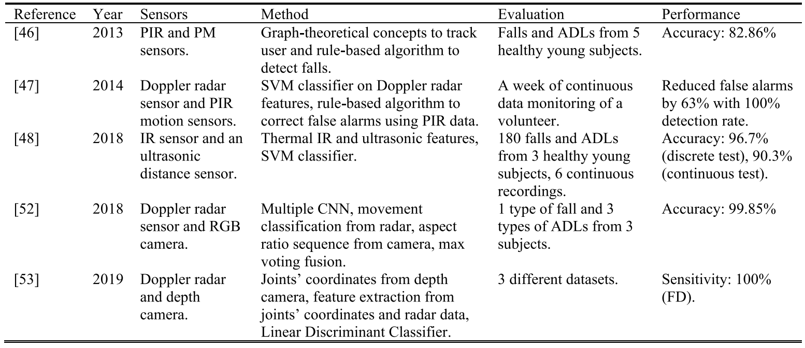
Fall Detection
Non-Wearable Sensors Fusion
Source: Xefteris, Vasileios-Rafail, Athina Tsanousa, Georgios Meditskos, Stefanos Vrochidis, and Ioannis Kompatsiaris. "Performance, challenges, and limitations in multimodal fall detection systems: a review." IEEE Sensors Journal (2021).

Slide 66
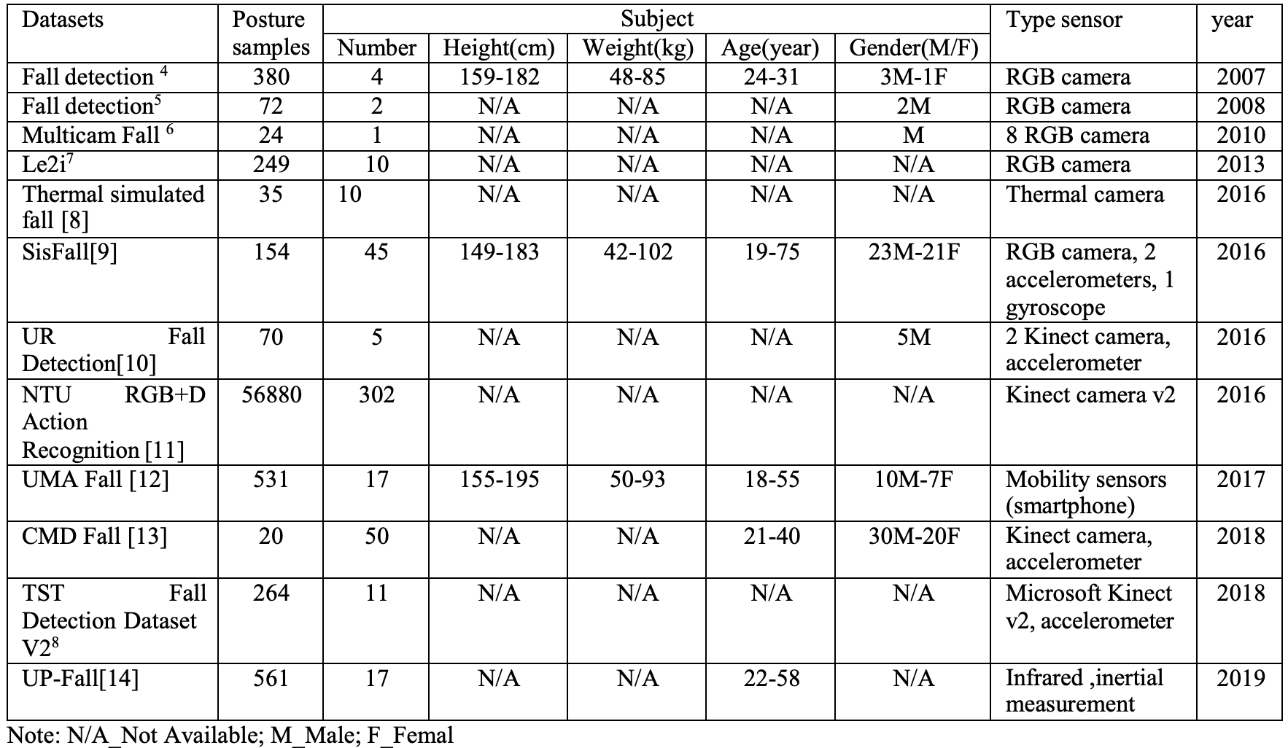
Fall Detection Datasets
Source: Oumaima, Guendoul, Ait Abdelali Hamd, Tabii Youness, Oulad Haj Thami Rachid, and Bourja Omar.
"Vision-based fall detection and prevention for the elderly people: A review & ongoing research." In 2021 Fifth International Conference On Intelligent Computing in Data Sciences (ICDS), pp. 1-6. IEEE, 2021.

Slide 67

Human Action Recognition
(HAR)
Source: Sun, Zehua, Qiuhong Ke, Hossein Rahmani, Mohammed Bennamoun, Gang Wang, and Jun Liu. "Human action recognition from various data modalities: A review." IEEE transactions on pattern analysis and machine intelligence (2022).

Slide 68

Human Action Recognition (HAR)
Modality
Source: Sun, Zehua, Qiuhong Ke, Hossein Rahmani, Mohammed Bennamoun, Gang Wang, and Jun Liu. "Human action recognition from various data modalities: A review." IEEE transactions on pattern analysis and machine intelligence (2022).

Slide 69

Human Action Recognition (HAR)
Modality
Source: Sun, Zehua, Qiuhong Ke, Hossein Rahmani, Mohammed Bennamoun, Gang Wang, and Jun Liu. "Human action recognition from various data modalities: A review." IEEE transactions on pattern analysis and machine intelligence (2022).

Slide 70

Fall Detection
Source: https://www.ankecare.com/article/1929-2022-05-09-08-29-47

Slide 71

BlazePose:
On-device Real-time Body Pose tracking
BlazePose 33 Keypoint topology
0. Nose
1. Left eye inner
2. Left eye
3. Left eye outer
4. Right eye inner
5. Right eye
6. Right eye outer
7. Left ear
8. Right ear
9. Mouth left
10. Mouth right
11. Left shoulder
12. Right shoulder
13. Left elbow
14. Right elbow
15. Left wrist
16. Right wrist
17. Left pinky #1 knuckle
18. Right pinky #1 knuckle
19. Left index #1 knuckle
20. Right index #1 knuckle
21. Left thumb #2 knuckle
22. Right thumb #2 knuckle
23. Left hip
24. Right hip
25. Left knee
26. Right knee
27. Left ankle
28. Right ankle
29. Left heel
30. Right heel
31. Left foot index
32. Right foot index
SourceBazarevsky, Valentin, Ivan Grishchenko, Karthik Raveendran, Tyler Zhu, Fan Zhang, and Matthias Grundmann.
"Blazepose: On-device real-time body pose tracking." arXiv preprint arXiv:2006.10204 (2020).

Slide 72

BlazePose results on yoga and fitness poses
SourceBazarevsky, Valentin, Ivan Grishchenko, Karthik Raveendran, Tyler Zhu, Fan Zhang, and Matthias Grundmann.
"Blazepose: On-device real-time body pose tracking." arXiv preprint arXiv:2006.10204 (2020).

Slide 73

OpenPose vs. BlazePose
Source: Alsawadi, Motasem S., El-Sayed M. El-Kenawy, and Miguel Rio. "Using BlazePose on Spatial Temporal Graph Convolutional Networks for Action Recognition." Computers, Materials and Continua 74, no. 1 (2022): 19-36.

Slide 74


AnyFace: Free-style Text-to-Face Synthesis and Manipulation
Source: Sun, Jianxin, Qiyao Deng, Qi Li, Muyi Sun, Min Ren, and Zhenan Sun. (2022)
"AnyFace: Free-style Text-to-Face Synthesis and Manipulation." In Proceedings of the IEEE/CVF Conference on Computer Vision and Pattern Recognition, pp. 18687-18696.

Slide 75

AnyFace: Free-style Text-to-Face Synthesis and Manipulation
Source: Sun, Jianxin, Qiyao Deng, Qi Li, Muyi Sun, Min Ren, and Zhenan Sun. (2022)
"AnyFace: Free-style Text-to-Face Synthesis and Manipulation." In Proceedings of the IEEE/CVF Conference on Computer Vision and Pattern Recognition, pp. 18687-18696.

Slide 76

AnyFace: Free-style Text-to-Face Synthesis and Manipulation
Source: Sun, Jianxin, Qiyao Deng, Qi Li, Muyi Sun, Min Ren, and Zhenan Sun. (2022)
"AnyFace: Free-style Text-to-Face Synthesis and Manipulation." In Proceedings of the IEEE/CVF Conference on Computer Vision and Pattern Recognition, pp. 18687-18696.

Slide 77

AnyFace: Free-style Text-to-Face Synthesis and Manipulation
Source: Sun, Jianxin, Qiyao Deng, Qi Li, Muyi Sun, Min Ren, and Zhenan Sun. (2022)
"AnyFace: Free-style Text-to-Face Synthesis and Manipulation." In Proceedings of the IEEE/CVF Conference on Computer Vision and Pattern Recognition, pp. 18687-18696.

Slide 78

AnyFace: Free-style Text-to-Face Synthesis and Manipulation
Text-guided
Face Manipulation
Source: Sun, Jianxin, Qiyao Deng, Qi Li, Muyi Sun, Min Ren, and Zhenan Sun. (2022)
"AnyFace: Free-style Text-to-Face Synthesis and Manipulation." In Proceedings of the IEEE/CVF Conference on Computer Vision and Pattern Recognition, pp. 18687-18696.

Slide 79

Papers with Code
State-of-the-Art (SOTA)
https://paperswithcode.com/sota

Slide 80
Papers with Code
State-of-the-Art (SOTA)
Computer Vision
• 3425 benchmarks
• 1088 tasks
• 2320 datasets
• 29741 papers with code
https://paperswithcode.com/area/computer-vision

Slide 81


Computer Vision: State-of-the-Art (SOTA)
https://paperswithcode.com/area/computer-vision

Slide 82
Computer Vision: State-of-the-Art (SOTA)
https://paperswithcode.com/area/computer-vision

Slide 83


Computer Vision: State-of-the-Art (SOTA)
https://paperswithcode.com/area/computer-vision

Slide 84

Computer Vision: Video
State-of-the-Art (SOTA)
https://paperswithcode.com/area/computer-vision/video

Slide 85
Robotics

Slide 86
Artificial Intelligence:
Robotics
Agents are endowed with
sensors and physical effectors
with which to move about and
make mischief in the real world.
Source: Stuart Russell and Peter Norvig (2020), Artificial Intelligence: A Modern Approach, 4th Edition, Pearson

Slide 87

Embodied Robots
Source: Yang Liu, Weixing Chen, Yongjie Bai, Xiaodan Liang, Guanbin Li, Wen Gao, and Liang Lin. (2024) "Aligning cyber space with physical world: A comprehensive survey on embodied ai." arXiv preprint arXiv:2407.06886.

Slide 88

Gemini Robotics:
Bringing AI into the Physical World
Source: Gemini Robotics Team, Saminda Abeyruwan, Joshua Ainslie, Jean-Baptiste Alayrac, Montserrat Gonzalez Arenas, Travis Armstrong, Ashwin Balakrishna et al.(2025)
"Gemini robotics: Bringing ai into the physical world." arXiv preprint arXiv:2503.20020 (2025).

Slide 89

Gemini Robotics Models:
Architecture, Input and Output
Source: Gemini Robotics Team, Saminda Abeyruwan, Joshua Ainslie, Jean-Baptiste Alayrac, Montserrat Gonzalez Arenas, Travis Armstrong, Ashwin Balakrishna et al.(2025)
"Gemini robotics: Bringing ai into the physical world." arXiv preprint arXiv:2503.20020 (2025).

Slide 90

World Foundation Model Platform for Physical AI
Source: Agarwal, Niket, Arslan Ali, Maciej Bala, Yogesh Balaji, Erik Barker, Tiffany Cai, Prithvijit Chattopadhyay et al. "Cosmos world foundation model platform for physical ai."
arXiv preprint arXiv:2501.03575 (2025).

Slide 91

NVIDIA Cosmos
World Foundation Model Platform for Physical AI
Source: Agarwal, Niket, Arslan Ali, Maciej Bala, Yogesh Balaji, Erik Barker, Tiffany Cai, Prithvijit Chattopadhyay et al. "Cosmos world foundation model platform for physical ai."
arXiv preprint arXiv:2501.03575 (2025)., https://research.nvidia.com/labs/dir/cosmos-predict1/

Slide 92

Foundation Models in Robotics
Source: Firoozi, Roya, Johnathan Tucker, Stephen Tian, Anirudha Majumdar, Jiankai Sun, Weiyu Liu, Yuke Zhu et al. "Foundation models in robotics: Applications, challenges, and the future.
" The International Journal of Robotics Research 44, no. 5 (2025): 701-739.

Slide 93

Robotics and Embodied AI
Source: Yang Liu, Weixing Chen, Yongjie Bai, Xiaodan Liang, Guanbin Li, Wen Gao, and Liang Lin. (2024) "Aligning cyber space with physical world: A comprehensive survey on embodied ai." arXiv preprint arXiv:2407.06886.

Slide 94
Embodied AI and Disembodied AI
Source: Yang Liu, Weixing Chen, Yongjie Bai, Xiaodan Liang, Guanbin Li, Wen Gao, and Liang Lin. (2024) "Aligning cyber space with physical world: A comprehensive survey on embodied ai." arXiv preprint arXiv:2407.06886.

Slide 95

Framework of the Embodied Agent based on MLMs and WMs
Source: Yang Liu, Weixing Chen, Yongjie Bai, Xiaodan Liang, Guanbin Li, Wen Gao, and Liang Lin. (2024) "Aligning cyber space with physical world: A comprehensive survey on embodied ai." arXiv preprint arXiv:2407.06886.

Slide 96

Embodied AI
Source: Yang Liu, Weixing Chen, Yongjie Bai, Xiaodan Liang, Guanbin Li, Wen Gao, and Liang Lin. (2024) "Aligning cyber space with physical world: A comprehensive survey on embodied ai." arXiv preprint arXiv:2407.06886.

Slide 97

Embodied Agents
MLM: Multimodal Language Model, which directly perceive the world and control the embodiment
VLM: Visual-Language Model with the outer policy models
LLM + VLM: LLM-based agent that perceives the world utilizing the VLM, and LLM
means the Large-Language Model with visual context and outer policy models.
Source: Yang Liu, Weixing Chen, Yongjie Bai, Xiaodan Liang, Guanbin Li, Wen Gao, and Liang Lin. (2024) "Aligning cyber space with physical world: A comprehensive survey on embodied ai." arXiv preprint arXiv:2407.06886.

Slide 98

Boston Dynamics: Spot
Automate sensing and inspection, capture limitless data, and explore without boundaries.
Source: https://www.bostondynamics.com/spot

Slide 99

Boston Dynamics: Atlas
The world’s most dynamic humanoid robot
Atlas is a research platform designed to push the limits of whole-body mobility
Source: https://www.bostondynamics.com/atlas

Slide 100

Boston Dynamics: Atlas Goes Hands On
Atlas uses a machine learning (ML) vision model to detect and localize the environment fixtures and individual bins.
The robot uses a specialized grasping policy and continuously estimates the state of manipulated objects to achieve the task.
Source: https://bostondynamics.com/video/atlas-goes-hands-on/

Slide 101

Boston Dynamics: Atlas
https://www.youtube.com/watch?v=fRj34o4hN4I

Slide 102

Humanoid Robot: Sophia
https://www.youtube.com/watch?v=S5t6K9iwcdw

Slide 103

Can a robot pass a university entrance exam?
Noriko Arai at TED2017
https://www.ted.com/talks/noriko_arai_can_a_robot_pass_a_university_entrance_exam
https://www.youtube.com/watch?v=XQZjkPyJ8KU

Slide 104
Robots
Robots are physical agents that perform tasks by manipulating the physical world.
  To do so, they are equipped with effectors such as legs, wheels, joints, and grippers.
Effectors are designed to assert physical forces on the environment.
Source: Stuart Russell and Peter Norvig (2020), Artificial Intelligence: A Modern Approach, 4th Edition, Pearson

Slide 105
Robots and Effectors
When they do this, a few things may happen:
  the robot’s state might change
  the state of the environment might change
  the state of the people around the robot might change
Source: Stuart Russell and Peter Norvig (2020), Artificial Intelligence: A Modern Approach, 4th Edition, Pearson

Slide 106
Robots
The most common types of robots are manipulators (robot arms) and mobile robots.
They have sensors for perceiving the world and actuators that produce motion, which then affects the world via effectors.
Source: Stuart Russell and Peter Norvig (2020), Artificial Intelligence: A Modern Approach, 4th Edition, Pearson

Slide 107
Robotics Problem
The general robotics problem involves
  stochasticity
  (which can be handled by MDPs)
  partial observability
  (which can be handled by POMDPs)
  acting with and around other agents
  (which can be handled with game theory)
Source: Stuart Russell and Peter Norvig (2020), Artificial Intelligence: A Modern Approach, 4th Edition, Pearson

Slide 108
Robotic Perception
We typically separate
perception (estimation) from
action (motion generation).
Perception in robotics involves
computer vision
to recognize the surroundings
through cameras,
but also localization and mapping.
Source: Stuart Russell and Peter Norvig (2020), Artificial Intelligence: A Modern Approach, 4th Edition, Pearson

Slide 109
Robotic Perception
Robotic perception concerns itself with estimating decision-relevant quantities from sensor data.
  To do so, we need an internal representation and a method for updating this internal representation over time.
Source: Stuart Russell and Peter Norvig (2020), Artificial Intelligence: A Modern Approach, 4th Edition, Pearson

Slide 110

Robot Perception can be viewed as temporal inference from sequences of actions and measurements
Dynamic Decision network
Source: Stuart Russell and Peter Norvig (2020), Artificial Intelligence: A Modern Approach, 4th Edition, Pearson

Slide 111
Probabilistic Filtering Algorithms
Probabilistic filtering algorithms such as particle filters and Kalman filters are useful for robot perception.
  These techniques maintain the belief state, a posterior distribution over state variables.
Source: Stuart Russell and Peter Norvig (2020), Artificial Intelligence: A Modern Approach, 4th Edition, Pearson

Slide 112
Configuration Spaces
For generating motion, we use configuration spaces, where a point specifies everything we need to know to locate every body point on the robot.
  For instance, for a robot arm with two joints, a configuration consists of the two joint angles.
Source: Stuart Russell and Peter Norvig (2020), Artificial Intelligence: A Modern Approach, 4th Edition, Pearson

Slide 113
Motion Generation
We typically decouple the motion generation problem into
  motion planning, concerned with producing a plan, and
  trajectory tracking control, concerned with producing a policy for control inputs (actuator commands) that results in executing the plan.
Source: Stuart Russell and Peter Norvig (2020), Artificial Intelligence: A Modern Approach, 4th Edition, Pearson

Slide 114
Motion Planning
Motion planning can be solved via graph search
  using cell decomposition
  using randomized motion planning algorithms, which sample milestones in the continuous configuration space
  using trajectory optimization, which can iteratively push a straight-line path out of collision by leveraging a signed distance field.
Source: Stuart Russell and Peter Norvig (2020), Artificial Intelligence: A Modern Approach, 4th Edition, Pearson

Slide 115
Planning and Control
Optimal control unites
motion planning and trajectory tracking by computing an
optimal trajectory directly
over control inputs.
Source: Stuart Russell and Peter Norvig (2020), Artificial Intelligence: A Modern Approach, 4th Edition, Pearson

Slide 116
Planning Uncertain Movements
Planning under uncertainty unites perception and action by
  online replanning (such as model predictive control) and
  information gathering actions that aid perception.
Source: Stuart Russell and Peter Norvig (2020), Artificial Intelligence: A Modern Approach, 4th Edition, Pearson

Slide 117
Reinforcement learning in robotics
Reinforcement learning is applied in robotics, with techniques striving to reduce the required number of interactions with the real world.
Such techniques tend to exploit models, be it estimating models and using them to plan, or training policies that are robust with respect to different possible model parameters.
Source: Stuart Russell and Peter Norvig (2020), Artificial Intelligence: A Modern Approach, 4th Edition, Pearson

Slide 118
Humans and Robots
Interaction with humans requires the ability to coordinate the robot’s actions with theirs, which can be formulated as a game.
We usually decompose the solution into prediction, in which we use the person’s ongoing actions to estimate what they will do in the future, and action, in which we use the predictions to compute the optimal motion for the robot.
Source: Stuart Russell and Peter Norvig (2020), Artificial Intelligence: A Modern Approach, 4th Edition, Pearson

Slide 119
Humans and Robots
Helping humans also requires the ability to learn or infer what they want.
Robots can approach this by learning the desired cost function they should optimize from human input, such as demonstrations, corrections, or instruction in natural language.
Alternatively, robots can imitate human behavior, and use reinforcement learning to help tackle the challenge of generalization to new states.
Source: Stuart Russell and Peter Norvig (2020), Artificial Intelligence: A Modern Approach, 4th Edition, Pearson

Slide 120

Papers with Code
State-of-the-Art (SOTA)
https://paperswithcode.com/sota

Slide 121

Hands-On Machine Learning with
Scikit-Learn, Keras, and TensorFlow
Notebooks
The Machine Learning landscape
End-to-end Machine Learning project
Classification
Training Models
Support Vector Machines
Decision Trees
Ensemble Learning and Random Forests
Dimensionality Reduction
Unsupervised Learning Techniques
Artificial Neural Nets with Keras
Training Deep Neural Networks
Custom Models and Training with TensorFlow
Loading and Preprocessing Data
Deep Computer Vision Using Convolutional Neural Networks
Processing Sequences Using RNNs and CNNs
Natural Language Processing with RNNs and Attention
Autoencoders, GANs, and Diffusion Models
Reinforcement Learning
Training and Deploying TensorFlow Models at Scale
https://github.com/ageron/handson-ml3

Slide 122
Summary
Computer Vision
  Classifying Images
  Detecting Objects
  The 3D World
Robotics
  Robotic Perception
  Planning and Control
  Planning Uncertain Movements
  Reinforcement Learning in Robotics

Slide 123
References
Stuart Russell and Peter Norvig (2020), Artificial Intelligence: A Modern Approach, 4th Edition, Pearson.
Denis Rothman (2024), Transformers for Natural Language Processing and Computer Vision - Third Edition: Explore Generative AI and Large Language Models with Hugging Face, ChatGPT, GPT-4V, and DALL-E 3, 3rd ed. Edition, Packt Publishing
Aurélien Géron (2022), Hands-On Machine Learning with Scikit-Learn, Keras, and TensorFlow: Concepts, Tools, and Techniques to Build Intelligent Systems, 3rd Edition, O’Reilly Media.
Steven D'Ascoli (2022), Artificial Intelligence and Deep Learning with Python: Every Line of Code Explained For Readers New to AI and New to Python, Independently published.
Chien-Yao Wang, Alexey Bochkovskiy, and Hong-Yuan Mark Liao. (2022) "YOLOv7: Trainable bag-of-freebies sets new state-of-the-art for real-time object detectors." arXiv preprint arXiv:2207.02696.
Chien-Yao Wang, I-Hau Yeh, and Hong-Yuan Mark Liao. (2025) "Yolov9: Learning what you want to learn using programmable gradient information." In European Conference on Computer Vision, pp. 1-21. Springer, Cham.
Nidhal Jegham, Chan Young Koh, Marwan Abdelatti, and Abdeltawab Hendawi. (2024) "Evaluating the Evolution of YOLO (You Only Look Once) Models: A Comprehensive Benchmark Study of YOLO11 and Its Predecessors." arXiv preprint arXiv:2411.00201.
Ranjan Sapkota, and Manoj Karkee. (2024) "Yolo11 and vision transformers based 3d pose estimation of immature green fruits in commercial apple orchards for robotic thinning." arXiv preprint arXiv:2410.19846.
Yang Liu, Weixing Chen, Yongjie Bai, Xiaodan Liang, Guanbin Li, Wen Gao, and Liang Lin. (2024) "Aligning cyber space with physical world: A comprehensive survey on embodied ai." arXiv preprint arXiv:2407.06886.
Alec Radford, Jong Wook Kim, Chris Hallacy, Aditya Ramesh, Gabriel Goh, Sandhini Agarwal, Girish Sastry et al. (2021) "Learning transferable visual models from natural language supervision." In International Conference on Machine Learning, pp. 8748-8763. PMLR.
Wonjae Kim, Bokyung Son, and Ildoo Kim. (2021) "Vilt: Vision-and-language transformer without convolution or region supervision." In International Conference on Machine Learning, pp. 5583-5594. PMLR.
Meng-Hao Guo, Tian-Xing Xu, Jiang-Jiang Liu, Zheng-Ning Liu, Peng-Tao Jiang, Tai-Jiang Mu, Song-Hai Zhang, Ralph R. Martin, Ming-Ming Cheng, and Shi-Min Hu. (2022) "Attention mechanisms in computer vision: A survey." Computational Visual Media ,:1-38.
Valentin Bazarevsky, Ivan Grishchenko, Karthik Raveendran, Tyler Zhu, Fan Zhang, and Matthias Grundmann.(2020) "Blazepose: On-device real-time body pose tracking." arXiv preprint arXiv:2006.10204.
Gemini Robotics Team, Saminda Abeyruwan, Joshua Ainslie, Jean-Baptiste Alayrac, Montserrat Gonzalez Arenas, Travis Armstrong, Ashwin Balakrishna et al.(2025) "Gemini robotics: Bringing ai into the physical world." arXiv preprint arXiv:2503.20020 (2025).
Niket Agarwal, Arslan Ali, Maciej Bala, Yogesh Balaji, Erik Barker, Tiffany Cai, Prithvijit Chattopadhyay et al. (2025) "Cosmos world foundation model platform for physical ai." arXiv preprint arXiv:2501.03575 (2025).
Roya Firoozi, Johnathan Tucker, Stephen Tian, Anirudha Majumdar, Jiankai Sun, Weiyu Liu, Yuke Zhu et al. (2025) "Foundation models in robotics: Applications, challenges, and the future." The International Journal of Robotics Research 44, no. 5 (2025): 701-739.
Min-Yuh Day (2025), Python 101, https://tinyurl.com/aintpupython101

