Slide 1









Generative AI, Agentic AI, and Physical AI
Artificial Intelligence
1141AI09
MBA, IM, NTPU (M5276) (Fall 2025)
Tue 2, 3, 4 (9:10-12:00) (B3F17)
University Ambassador
Certified Instructor
Min-Yuh Day, Ph.D,
Professor and Director
Institute of Information Management, National Taipei University
https://web.ntpu.edu.tw/~myday
https://meet.google.com/paj-zhhj-mya
2025-12-02

Slide 2
Syllabus
Week Date Subject/Topics
1 2025/09/09 Introduction to Artificial Intelligence
2 2025/09/16 Artificial Intelligence and Intelligent Agents;
Problem Solving
3 2025/09/23 Knowledge, Reasoning and Knowledge Representation;
Uncertain Knowledge and Reasoning
4 2025/09/30 Case Study on Artificial Intelligence I
5 2025/10/07 Machine Learning: Supervised and Unsupervised Learning;
The Theory of Learning and Ensemble Learning

Slide 3
Syllabus
Week Date Subject/Topics
6 2025/10/14 NVIDIA Fundamentals of Deep Learning I:
Deep Learning; Neural Networks
7 2025/10/21 NVIDIA Fundamentals of Deep Learning II:
Convolutional Neural Networks;
Data Augmentation and Deployment
8 2025/10/28 Self-Learning
9 2025/11/04 Midterm Project Report
10 2025/11/11 NVIDIA Fundamentals of Deep Learning III:
Pre-trained Models; Natural Language Processing

Slide 4
Syllabus
Week Date Subject/Topics
11 2025/11/18 Case Study on Artificial Intelligence II
12 2025/11/25 Computer Vision and Robotics
13 2025/12/02 Generative AI, Agentic AI, and Physical AI
14 2025/12/09 Philosophy and Ethics of AI and the Future of AI
15 2025/12/16 Final Project Report I
16 2025/12/23 Final Project Report II

Slide 5
Generative AI, Agentic AI, and Physical AI

Slide 6
Outline
Generative AI
Agentic AI
Physical AI (Robotics)

Slide 7
Generative AI, Agentic AI, Physical AI
Physical AI
Self-driving cars
General robotics
Agentic AI
Coding assistants
Customer service
Patient care
Generative AI
Digital marketing
Content creation
Perception AI
Speech recognition
Deep recommender systems
Medical imaging
2012 AlexNet
Deep learning breakthrough
Source: NVIDIA (2025), GTC March 2025 Keynote with NVIDIA CEO Jensen Huang, https://www.youtube.com/watch?v=_waPvOwL9Z8

Slide 8
Generative AI, Agentic AI, Physical AI
New Economic
Paradigm Shift:
From Creation
to Execution
Physical AI
(Actuation)
Real-world
Interaction & Execution
Autonomous
Synergy
Generative AI
(Creation)
Content & Idea
Synthesis
Agentic AI
(Orchestration)
Workflow &
Decision
Automation

Slide 9

Stuart Russell and Peter Norvig (2020),
Artificial Intelligence: A Modern Approach,
4th Edition, Pearson
Source: Stuart Russell and Peter Norvig (2020), Artificial Intelligence: A Modern Approach, 4th Edition, Pearson
https://www.amazon.com/Artificial-Intelligence-A-Modern-Approach/dp/0134610997/

Slide 10
Artificial Intelligence:
A Modern Approach
Artificial Intelligence
Problem Solving
Knowledge and Reasoning
Uncertain Knowledge and Reasoning
Machine Learning
Communicating, Perceiving, and Acting
Philosophy and Ethics of AI
Source: Stuart Russell and Peter Norvig (2020), Artificial Intelligence: A Modern Approach, 4th Edition, Pearson

Slide 11
Artificial Intelligence:
Communicating, perceiving, and acting
Source: Stuart Russell and Peter Norvig (2020), Artificial Intelligence: A Modern Approach, 4th Edition, Pearson

Slide 12
Artificial Intelligence:
6. Communicating, Perceiving, and Acting
Natural Language Processing
Deep Learning for Natural Language Processing
Computer Vision
Robotics
Source: Stuart Russell and Peter Norvig (2020), Artificial Intelligence: A Modern Approach, 4th Edition, Pearson

Slide 13
Reinforcement Learning (DL)
Agent
Environment
Source: Richard S. Sutton & Andrew G. Barto (2018), Reinforcement Learning: An Introduction, 2nd Edition, A Bradford Book.

Slide 14
Reinforcement Learning (DL)
1
2
observation
Agent
action
3
reward
Environment
Source: Richard S. Sutton & Andrew G. Barto (2018), Reinforcement Learning: An Introduction, 2nd Edition, A Bradford Book.

Slide 15
Reinforcement Learning (DL)
1
2
observation
Agent
action
O_{t}
A_{t}
3
reward
R_{t}
Environment
Source: Richard S. Sutton & Andrew G. Barto (2018), Reinforcement Learning: An Introduction, 2nd Edition, A Bradford Book.

Slide 16
Agents interact with environments through sensors and actuators
Source: Stuart Russell and Peter Norvig (2020), Artificial Intelligence: A Modern Approach, 4th Edition, Pearson

Slide 17
AI Acting Humanly:
The Turing Test Approach
(Alan Turing, 1950)
Knowledge Representation
Automated Reasoning
Machine Learning (ML)
  Deep Learning (DL)
Computer Vision (Image, Video)
Natural Language Processing (NLP)
Robotics
Source: Stuart Russell and Peter Norvig (2020), Artificial Intelligence: A Modern Approach, 4th Edition, Pearson

Slide 18
4 Approaches of AI
2. Thinking Humanly: The Cognitive Modeling Approach | 3. Thinking Rationally: The “Laws of Thought” Approach
1. Acting Humanly: The Turing Test Approach (1950) | 4. Acting Rationally: The Rational Agent Approach
Source: Stuart Russell and Peter Norvig (2020), Artificial Intelligence: A Modern Approach, 4th Edition, Pearson

Slide 19
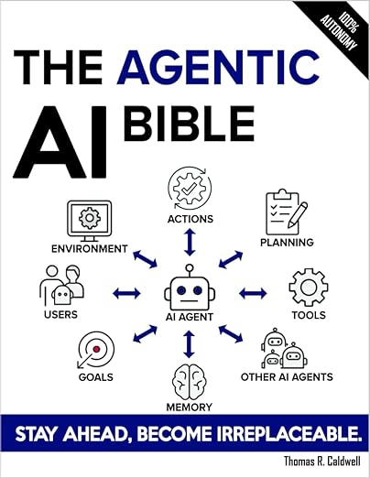
Thomas R. Caldwell (2025),
The Agentic AI Bible:
The Complete and Up-to-Date Guide to Design, Build, and Scale Goal-Driven,
LLM-Powered Agents that Think, Execute and Evolve,
Independently published
Source: https://www.amazon.com/Agentic-Bible-Up-Date-Goal-Driven/dp/B0FL21R86Q

Slide 20


Generative AI-Driven ESG Report
Generation Technology
Industrial Technology Research Institute (ITRI),
Fintech and Green Finance Center (FGFC, NTPU),
NTPU-113A513E01, 2024/03/01~2024/12/31

Slide 21
Innovative Agentic AI Technology for Autonomous ESG Report Generation
Industrial Technology Research Institute (ITRI),
Fintech and Green Finance Center (FGFC, NTPU),
NTPU-114A513E01, 2025/03/01~2025/12/31

Slide 22

AI, ML, DL, Generative AI
Source: Jeong, Cheonsu. "A Study on the Implementation of Generative AI Services Using an Enterprise Data-Based LLM Application Architecture." arXiv preprint arXiv:2309.01105 (2023).

Slide 23
Generative AI
Computing
Generative AI
Data
Algorithms

Slide 24

From Generative AI to Agentic AI
Source: Schneider, Johannes. "Generative to Agentic AI: Survey, Conceptualization, and Challenges." arXiv preprint arXiv:2504.18875 (2025).

Slide 25
Generative AI
Text, Image, Video, Audio Applications

Slide 26

Generative AI (Gen AI)
AI Generated Content (AIGC)
Source: Yihan Cao, Siyu Li, Yixin Liu, Zhiling Yan, Yutong Dai, Philip S. Yu, and Lichao Sun (2023). "A Comprehensive Survey of AI-Generated Content (AIGC): A History of Generative AI from GAN to ChatGPT." arXiv preprint arXiv:2303.04226.

Slide 27
Generative AI (Gen AI)
AI Generated Content (AIGC)
Source: Yihan Cao, Siyu Li, Yixin Liu, Zhiling Yan, Yutong Dai, Philip S. Yu, and Lichao Sun (2023). "A Comprehensive Survey of AI-Generated Content (AIGC): A History of Generative AI from GAN to ChatGPT." arXiv preprint arXiv:2303.04226.

Slide 28
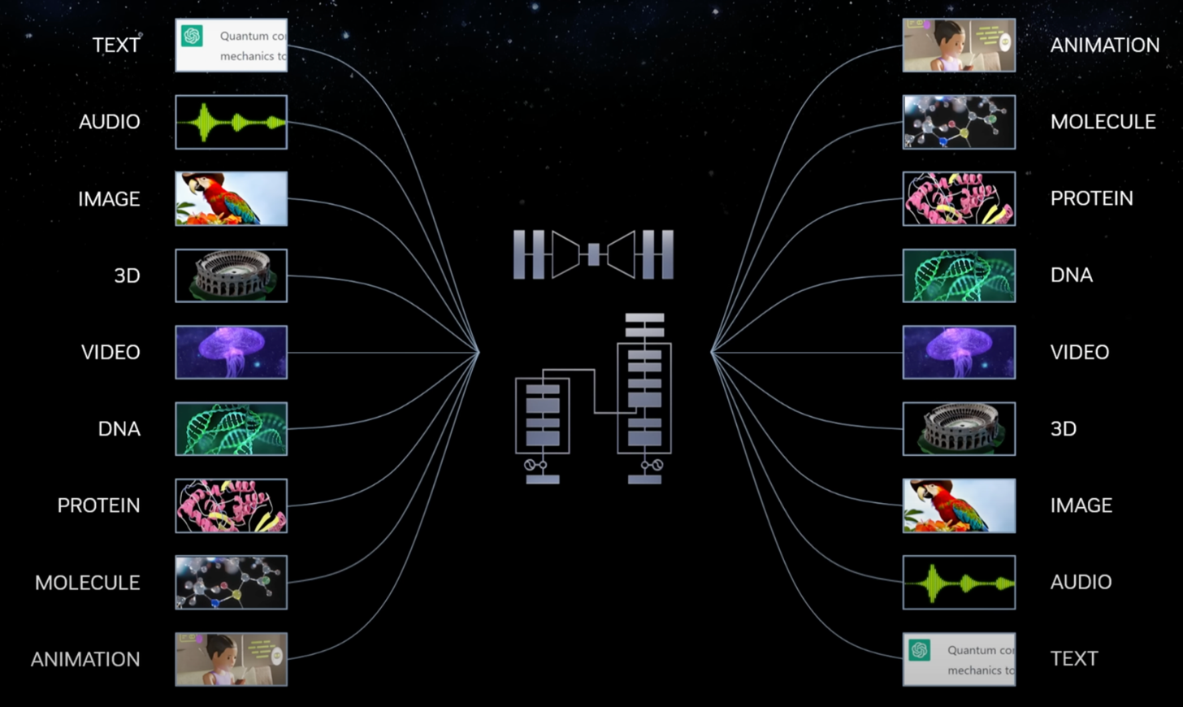
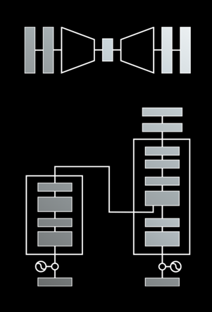
Modular Modalities
Where Can The Transformer Fit?
Source: NVIDIA DLI (2025), Rapid Application Development with Large Language Models (LLMs), https://learn.nvidia.com/courses/course-detail?course_id=course-v1:DLI+S-FX-26+V1

Slide 29

The history of Generative AI in CV, NLP and VL
Source: Yihan Cao, Siyu Li, Yixin Liu, Zhiling Yan, Yutong Dai, Philip S. Yu, and Lichao Sun (2023). "A Comprehensive Survey of AI-Generated Content (AIGC): A History of Generative AI from GAN to ChatGPT." arXiv preprint arXiv:2303.04226.

Slide 30

Categories of Vision Generative Models
Source: Yihan Cao, Siyu Li, Yixin Liu, Zhiling Yan, Yutong Dai, Philip S. Yu, and Lichao Sun (2023). "A Comprehensive Survey of AI-Generated Content (AIGC): A History of Generative AI from GAN to ChatGPT." arXiv preprint arXiv:2303.04226.

Slide 31

The General Structure of
Generative Vision Language
Source: Yihan Cao, Siyu Li, Yixin Liu, Zhiling Yan, Yutong Dai, Philip S. Yu, and Lichao Sun (2023). "A Comprehensive Survey of AI-Generated Content (AIGC): A History of Generative AI from GAN to ChatGPT." arXiv preprint arXiv:2303.04226.

Slide 32
Transformer Models
Transformer
Encoder
Decoder
DistilBERT
BERT
T5
GPT
RoBERTa
BART
GPT-2
CTRL
XLM-R
XLM
M2M-100
GPT-3
ALBERT
BigBird
GPT-Neo
GPT-J
ELECTRA
mT0
BLOOM
BLOOMZ
DeBERTa
ChatGPT
GPT-4
Source: Lewis Tunstall, Leandro von Werra, and Thomas Wolf (2022), Natural Language Processing with Transformers: Building Language Applications with Hugging Face, O'Reilly Media.

Slide 33

Large Language Models (LLMs)
Source: Hadi, Muhammad Usman, Rizwan Qureshi, Abbas Shah, Muhammad Irfan, Anas Zafar, Muhammad Bilal Shaikh, Naveed Akhtar, Jia Wu, and Seyedali Mirjalili. "Large language models: a comprehensive survey of its applications, challenges, limitations, and future prospects." Authorea Preprints (2023).

Slide 34

Four Paradigms in NLP (LM)
Transfer Learning: Pre-training, Fine-Tuning (FT)
GAI: Pre-train, Prompt, and Predict (Prompting)
Source: Pengfei Liu, Weizhe Yuan, Jinlan Fu, Zhengbao Jiang, Hiroaki Hayashi, and Graham Neubig. (2023) "Pre-train, prompt, and predict: A systematic survey of prompting methods in natural language processing." ACM Computing Surveys 55, no. 9 (2023): 1-35.

Slide 35
Comparison of Generative AI and Traditional AI
Feature | Generative AI | Traditional AI
Output type | New content | Classification/Prediction
Creativity | High | Low
Interactivity | Usually more natural | Limited

Slide 36
Generative AI
Text, Image, Video, Audio Applications

Slide 37

The Development of LM-based Dialogue Systems
1) Early Stage (1966 - 2015)
2) The Independent Development of TOD and ODD (2015 - 2019)
3) Fusions of Dialogue Systems (2019 - 2022)
4) LLM-based DS (2022 - Now)
Task-oriented DS (TOD), Open-domain DS (ODD)
Source: Wang, Hongru, Lingzhi Wang, Yiming Du, Liang Chen, Jingyan Zhou, Yufei Wang, and Kam-Fai Wong. "A Survey of the Evolution of Language Model-Based Dialogue Systems." arXiv preprint arXiv:2311.16789 (2023).

Slide 38
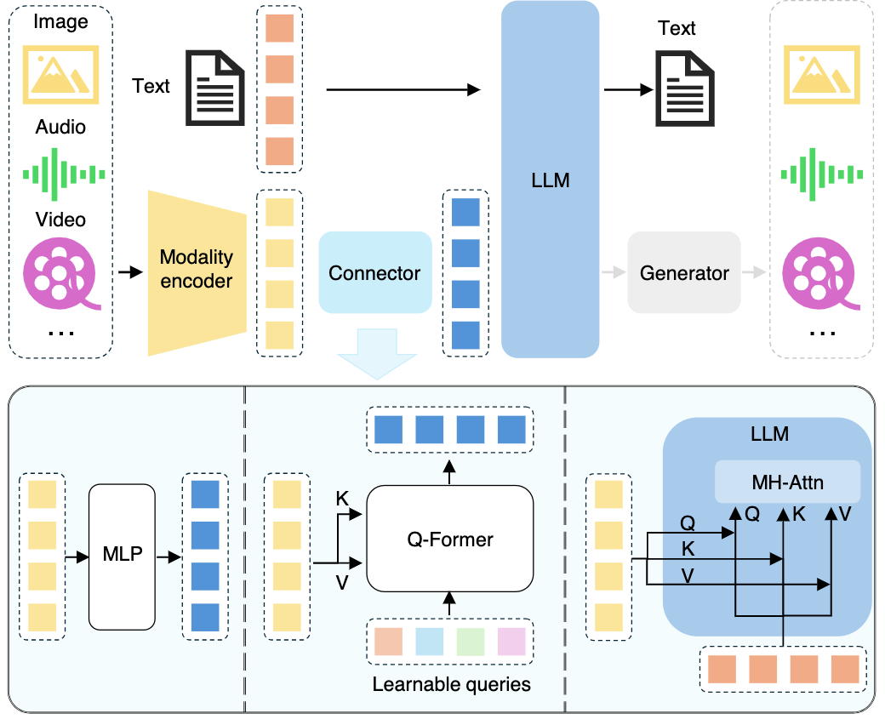
Multimodal Large Language Models (MLLM)
Multimodall LLM
Three types of connectors:
1. projection-based
2. query-based
3. fusion-based connectors
Source: Shukang Yin, Chaoyou Fu, Sirui Zhao, Ke Li, Xing Sun, Tong Xu, and Enhong Chen. (2024) "A survey on multimodal large language models." National Science Review (2024): nwae403.

Slide 39
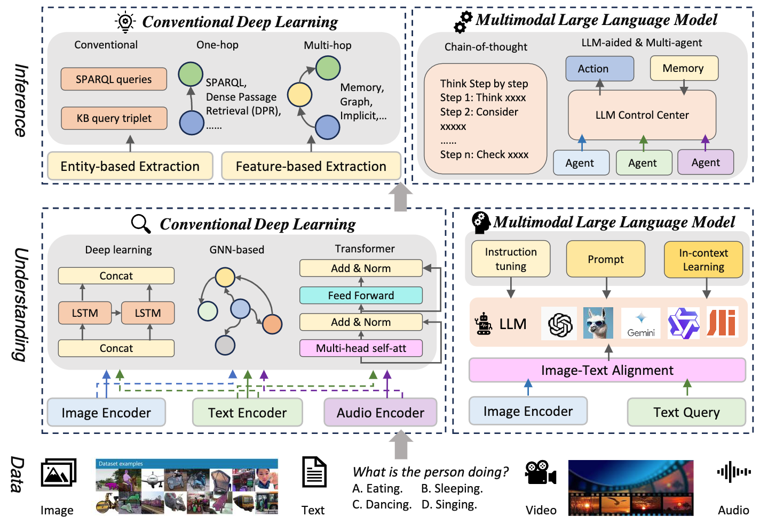
Multimodal Large Language Model (MLLM) for Vision Question Answering
Source: Jiayi Kuang, Jingyou Xie, Haohao Luo, Ronghao Li, Zhe Xu, Xianfeng Cheng, Yinghui Li, Xika Lin, and Ying Shen. (2024) "Natural Language Understanding and Inference with MLLM in Visual Question Answering: A Survey." arXiv preprint arXiv:2411.17558.

Slide 40

Large Language Models (LLM)
Three typical learning paradigms
Source: Shukang Yin, Chaoyou Fu, Sirui Zhao, Ke Li, Xing Sun, Tong Xu, and Enhong Chen. (2024) "A survey on multimodal large language models." National Science Review (2024): nwae403.

Slide 41
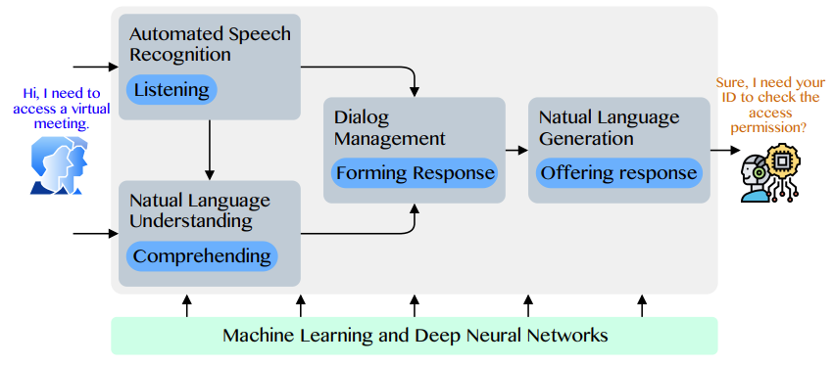
Conversational AI to deliver contextual and personal experience to users
Source: Huynh-The, Thien, Quoc-Viet Pham, Xuan-Qui Pham, Thanh Thi Nguyen, Zhu Han, and Dong-Seong Kim (2022).
"Artificial Intelligence for the Metaverse: A Survey." arXiv preprint arXiv:2202.10336.

Slide 42
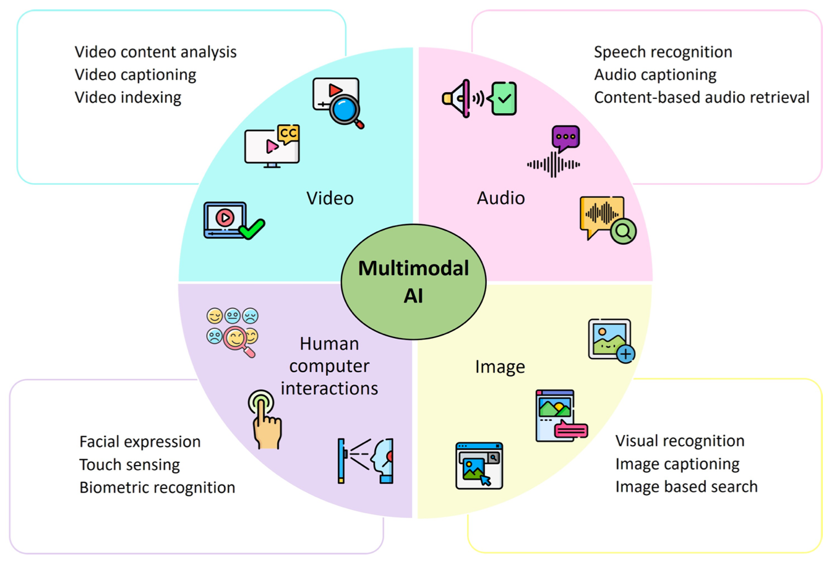
Technological Integration for Multimodal AI
Source: Sohail, Shahab Saquib, Faiza Farhat, Yassine Himeur, Mohammad Nadeem, Dag Øivind Madsen, Yashbir Singh, Shadi Atalla, and Wathiq Mansoor. "The Future of GPT: A Taxonomy of Existing ChatGPT Research, Current Challenges, and Possible Future Directions." Current Challenges, and Possible Future Directions (April 8, 2023) (2023).

Slide 43
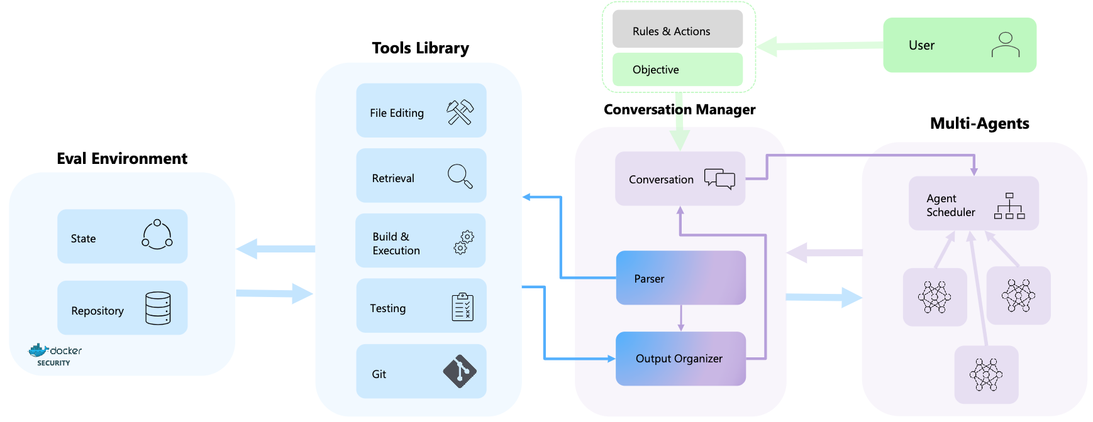
AutoDev: Automated AI-Driven Development

Slide 44
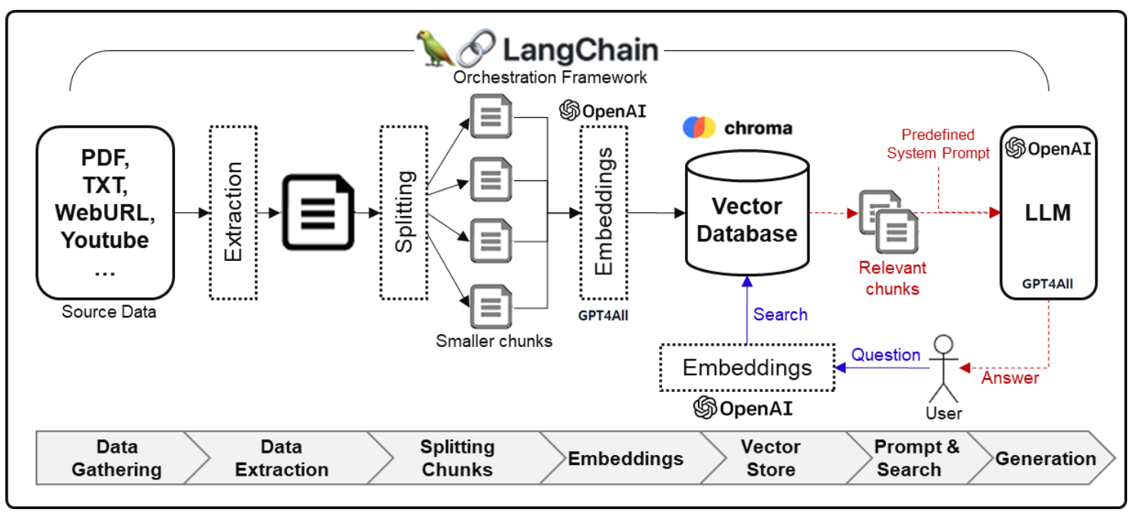
Framework for Implementing Generative AI Services using RAG Model
Source: Jeong, Cheonsu. "A Study on the Implementation of Generative AI Services Using an Enterprise Data-Based LLM Application Architecture." arXiv preprint arXiv:2309.01105 (2023).

Slide 45
Agentic AI

Slide 46
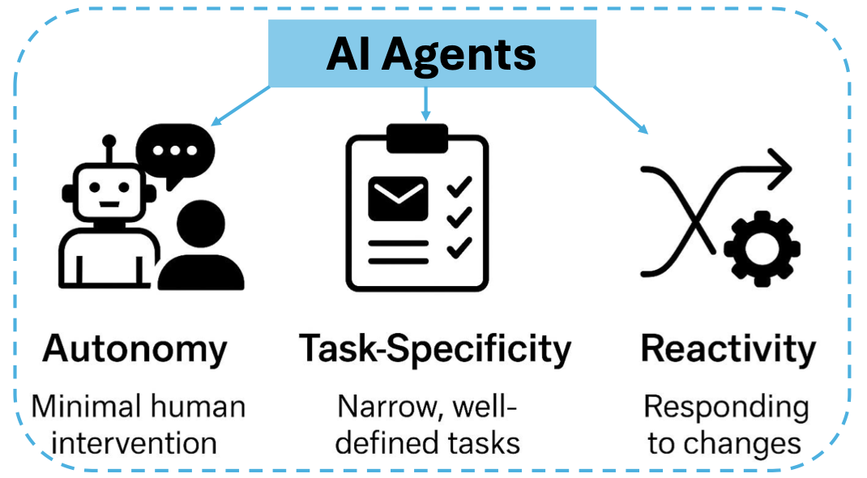
AI Agents
Source: Ranjan Sapkota, Konstantinos I. Roumeliotis, and Manoj Karkee. (2025) "Ai agents vs. agentic ai: A conceptual taxonomy, applications and challenges." arXiv preprint arXiv:2505.10468 (2025).

Slide 47
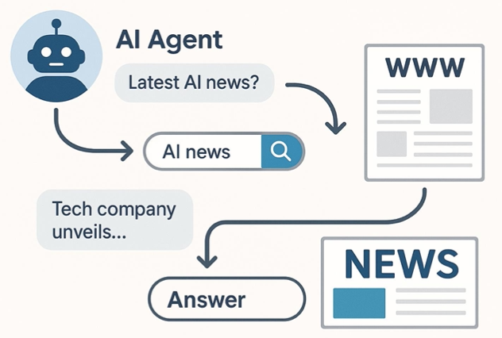
AI Agents
Source: Ranjan Sapkota, Konstantinos I. Roumeliotis, and Manoj Karkee. (2025) "Ai agents vs. agentic ai: A conceptual taxonomy, applications and challenges." arXiv preprint arXiv:2505.10468 (2025).

Slide 48
Comparison of Generative AI and Traditional AI
Feature | Generative AI | Traditional AI
Output type | New content | Classification/Prediction
Creativity | High | Low
Interactivity | Usually more natural | Limited

Slide 49
AI Agent / Agentic AI, Generative AI, Traditional AI
Feature | AI Agent / Agentic AI | Generative AI | Traditional AI
Core Concept | To autonomously perceive its environment, make decisions, and take actions to achieve specific goals. | To create new, original content (text, images, code, etc.) that resembles its training data. | To execute specific tasks based on pre-programmed rules or statistical patterns.
Primary Function | Action & Goal Achievement. Executes a series of tasks to complete an objective (e.g., "Book me a flight to Taipei next Tuesday."). | Creation & Synthesis. Creates novel outputs in response to a prompt (e.g., "Write a poem about rain."). | Classification & Prediction. Answers questions with a known range of outcomes (e.g., "Is this spam?").
Decision Making | Based on a continuous loop: Perceive -> Plan -> Act. It reasons about its goal, breaks it down, and executes steps. | Based on probabilistic patterns learned from massive, unstructured datasets. It predicts the next most likely word, pixel, or note. | Based on explicitly programmed logic (if-then rules) or learned patterns from structured data.
Key Characteristic | Autonomous & Goal-Oriented. Proactively takes steps and can adapt its plan based on new information. | Creative & Probabilistic. Can produce a wide variety of unique outputs from the same prompt. | Deterministic & Logic-Based. Given the same input, it will almost always produce the same output.

Slide 50
AI Agent / Agentic AI, Generative AI, Traditional AI
Feature | AI Agent / Agentic AI | Generative AI | Traditional AI
Interaction Model | Proactive & Interactive. Actively observes its environment (digital or physical) and takes actions to change it. | Responsive. Engages in a dialogue or responds to a user's prompt to generate content. | Reactive. Responds to a direct input or query. It doesn't act on its own.
Example Technologies | Architectural frameworks like ReAct (Reason + Act), and systems that combine LLMs with tools and memory. | Large Language Models (LLMs) like GPT-4, Diffusion Models (for images), Generative Adversarial Networks (GANs). | Expert systems, decision trees, linear regression, traditional machine learning (ML) models.
Common Use Cases | Self-driving cars, autonomous trading bots, smart assistants that manage calendars, customer service agents that process refunds. | ChatGPT, Google Gemini, Midjourney (image generation), Copilot (code generation), music composition. | Spam filters, chess engines, recommendation systems (e.g., Netflix), credit scoring, medical diagnosis from scans.
Relationship to Others | An architecture or system that often uses Generative AI to reason and Traditional AI for specific sub-tasks to accomplish a goal. | Can serve as the "brain" or reasoning engine for an AI Agent, enabling it to understand, plan, and generate actions. | The foundation for modern AI. Its techniques can be components within larger AI systems.

Slide 51
AI Agents vs Agentic AI
Feature | AI Agents | Agentic AI
Definition | Autonomous software programs that perform specific tasks. | Systems of multiple AI agents collaborating to achieve complex goals.
Autonomy Level | High autonomy within specific tasks. | Broad level of autonomy with the ability to manage multi-step, complex tasks and systems.
Task Complexity | Typically handle single, specific tasks. | Handle complex, multi-step tasks requiring coordination.
Collaboration | Operate independently. | Involve multi-agent information sharing, collaboration and cooperation.
Learning and Adaptation | Learn and adapt within their specific domain. | Learn and adapt across a wider range of tasks and environments.
Applications | Customer service chatbots, virtual assistants, automated workflows. | Supply chain management, business process optimization, virtual project managers.
Source: Ranjan Sapkota, Konstantinos I. Roumeliotis, and Manoj Karkee. (2025) "Ai agents vs. agentic ai: A conceptual taxonomy, applications and challenges." arXiv preprint arXiv:2505.10468 (2025).

Slide 52
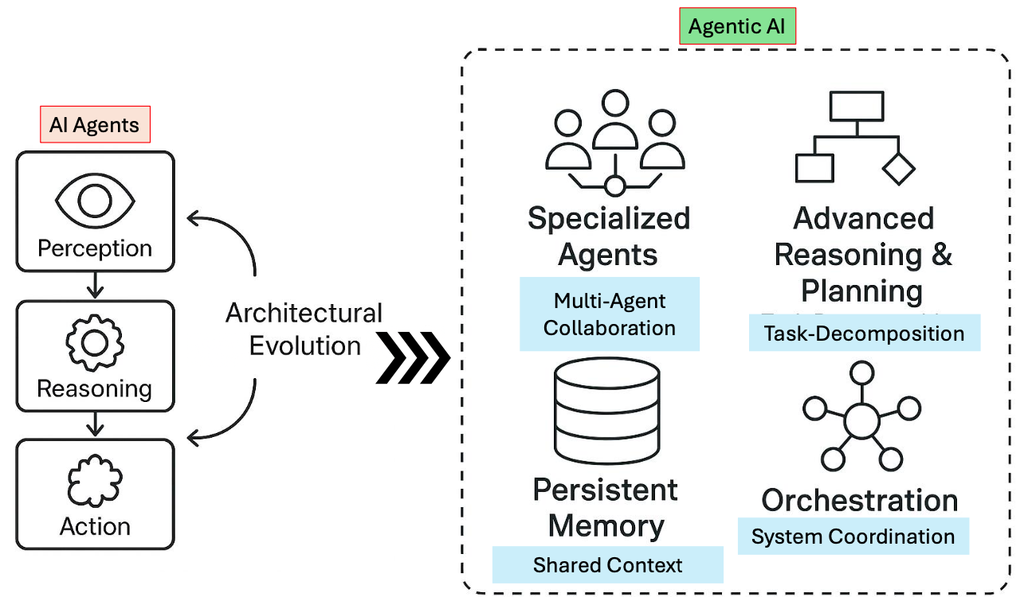
AI Agents vs Agentic AI
Source: Ranjan Sapkota, Konstantinos I. Roumeliotis, and Manoj Karkee. (2025) "Ai agents vs. agentic ai: A conceptual taxonomy, applications and challenges." arXiv preprint arXiv:2505.10468 (2025).

Slide 53
AI Agents and
Large Multimodal Agents (LMAs)

Slide 54
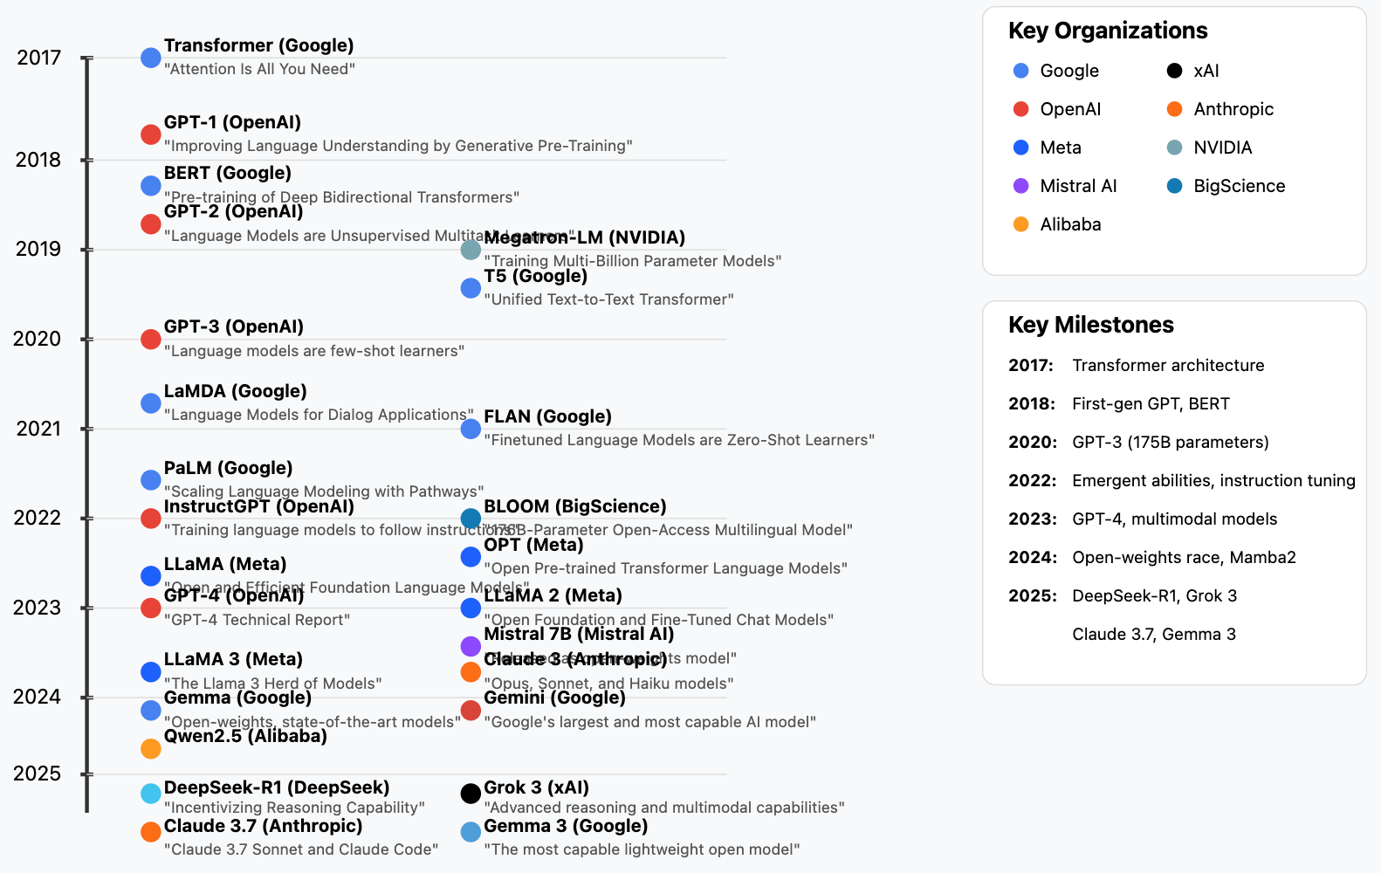
Generative AI LLMs (2017-2025)
Source: https://github.com/Hannibal046/Awesome-LLM

Slide 55

LLM-powered Multimodal Agents
Large Multimodal Agents (LMAs)
2022
2023
2024
Source: Xie, Junlin, Zhihong Chen, Ruifei Zhang, Xiang Wan, and Guanbin Li. "Large Multimodal Agents: A Survey." arXiv preprint arXiv:2402.15116 (2024).

Slide 56

Large Language Model (LLM) based Agents
Source: Xi, Z., Chen, W., Guo, X., He, W., Ding, Y., Hong, B., ... & Gui, T. (2023). The rise and potential of large language model based agents: A survey. arXiv preprint arXiv:2309.07864.

Slide 57
LLM-based Agents
Definition: AI agents that use Large Language Models as their core decision-making mechanism
Key Features:
  Natural language interface
  Vast knowledge base
  Ability to understand context and nuance
  Generalize to new tasks with minimal additional training

Slide 58

LLM-based Agents
Source: Cheng, Yuheng, Ceyao Zhang, Zhengwen Zhang, Xiangrui Meng, Sirui Hong, Wenhao Li, Zihao Wang et al. "Exploring large language model based intelligent agents: Definitions, methods, and prospects." arXiv preprint arXiv:2401.03428 (2024).

Slide 59

Large Multimodal Agents (LMA)
Source: Xie, J., Chen, Z., Zhang, R., Wan, X., & Li, G. (2024). Large Multimodal Agents: A Survey. ArXiv, abs/2402.15116.

Slide 60

Large Multimodal Agents (LMA)
Source: Xie, J., Chen, Z., Zhang, R., Wan, X., & Li, G. (2024). Large Multimodal Agents: A Survey. ArXiv, abs/2402.15116.

Slide 61
Agentic AI Cloud Architecture
Microservices and Serverless Architecture
Containers (Docker, Kubernetes)
Serverless platforms (AWS Lambda, Google Cloud Functions)
APIs and Tooling Integration via MCP
Agents access tools (e.g., databases, APIs, CRMs, payment gateways)
using Model Context Protocol (MCP)
Enhances tool-using behavior of LLM agents
Tools and Frameworks
LangChain, AutoGen, CrewAI: for orchestrating LLM agents
Anthropic’s MCP, Google’s A2A: communication protocols
Vector DBs (Pinecone, Weaviate): for agent memory

Slide 62
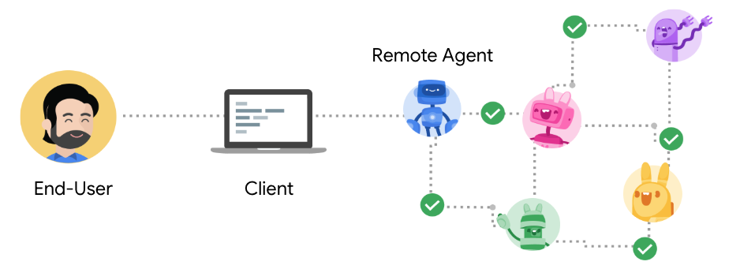
Agent2Agent Protocol (A2A)
An open protocol enabling Agent-to-Agent interoperability, bridging the gap between opaque agentic systems
Source: https://google.github.io/A2A/

Slide 63
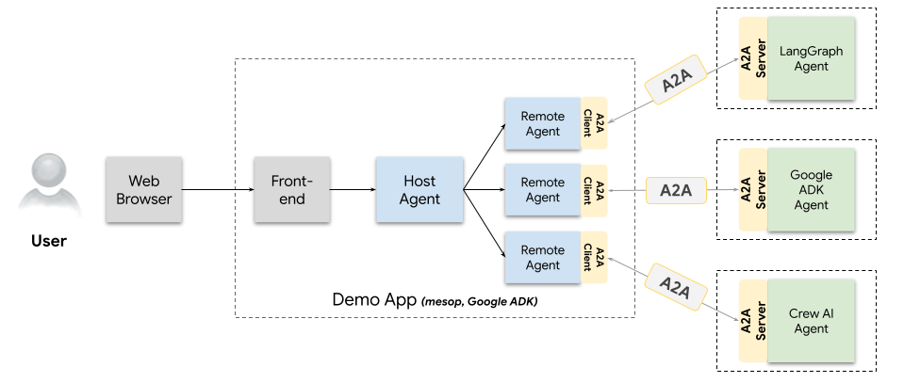
A2A Demo Web App
Agents talking to other agents over A2A
Source: https://github.com/google/A2A/blob/main/demo/README.md

Slide 64
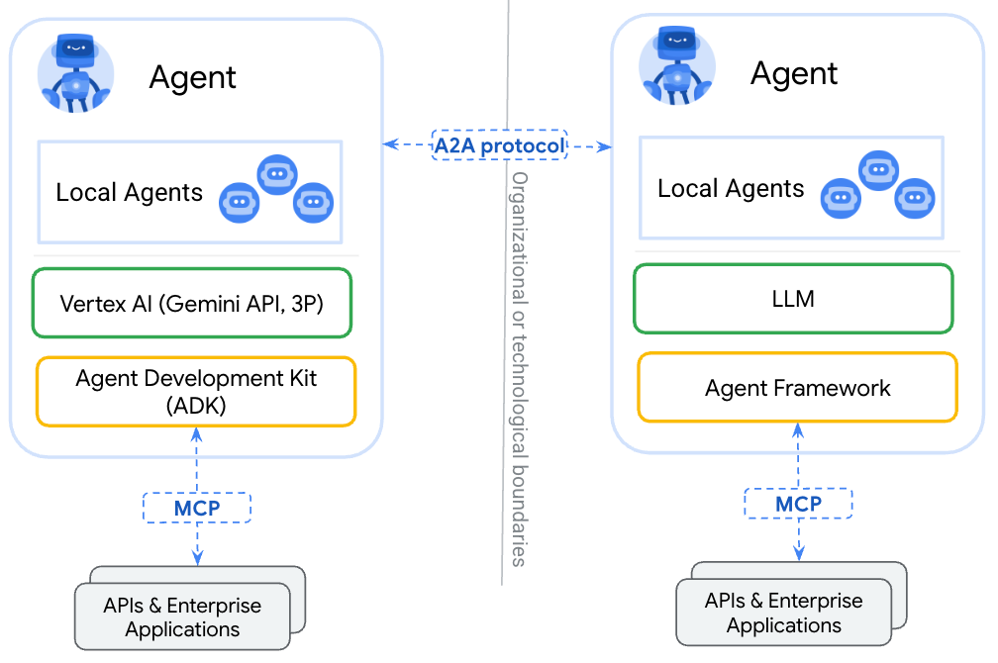
A2A
(Agent2Agent Protocol) for agent-agent collaboration
MCP
(Model Context Protocol) for tools and resources
Source: https://google.github.io/A2A/

Slide 65
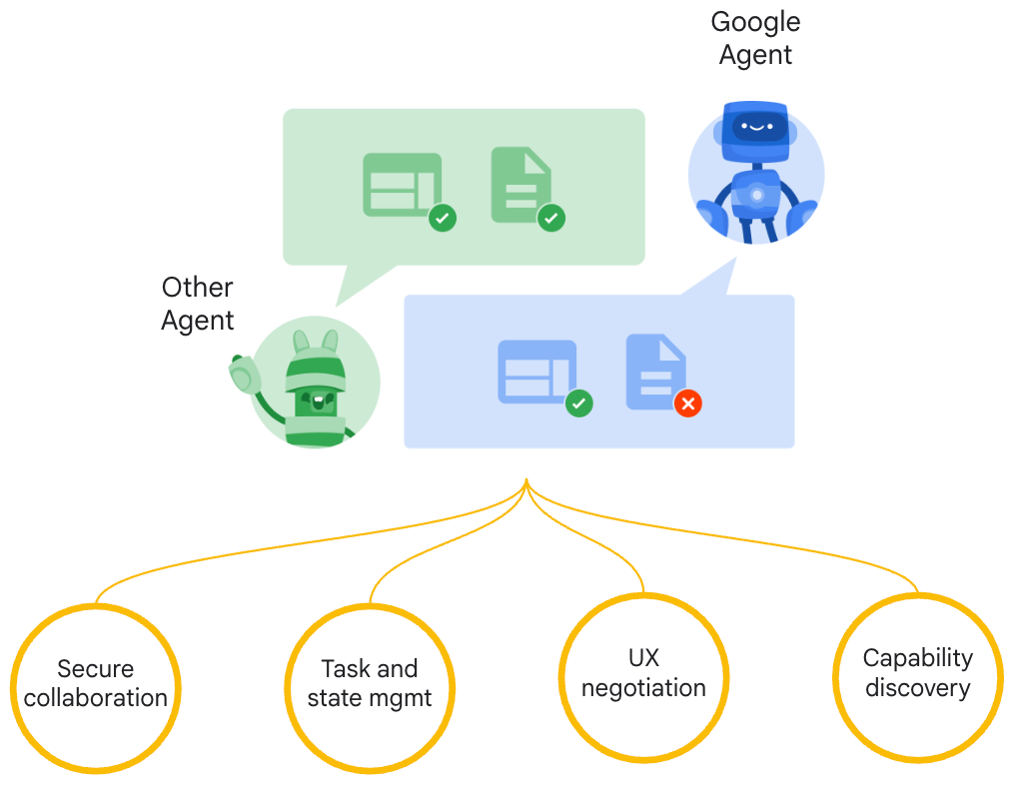
Google A2A (Agent2Agent Protocol)
Seamless Agent Collaboration
Simplifies Enterprise
Agent Integration
Supports Key
Enterprise Requirements
Source: https://google.github.io/A2A/

Slide 66
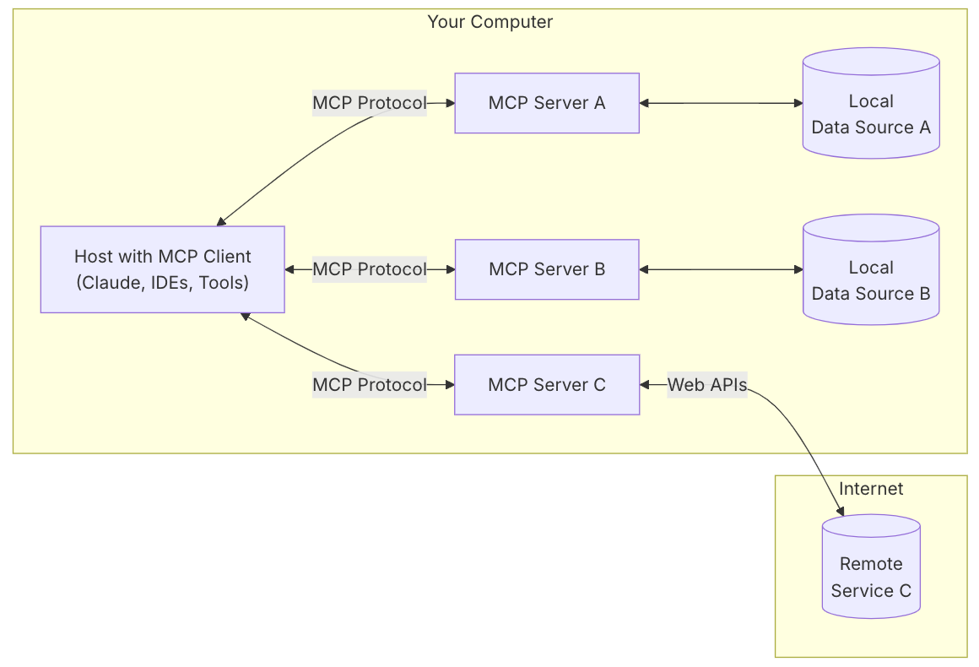
MCP (Model Context Protocol)
MCP is a open protocol that standardizes how applications provide context to LLMs.
MCP: USB-C port for AI applications.
Source: https://modelcontextprotocol.io/introduction

Slide 67
MCP and A2A
MCP (Model Context Protocol) for tools and resources
  Connect agents to tools, APIs, and resources with structured inputs/outputs.
  Google ADK supports MCP tools. Enabling wide range of MCP servers to be used with agents.
A2A (Agent2Agent Protocol) for agent-agent collaboration
  Dynamic, multimodal communication between different agents without sharing memory, resources, and tools
  Open standard driven by community.
  Samples available using Google ADK, LangGraph, Crew.AI
Source: https://google.github.io/A2A/

Slide 68
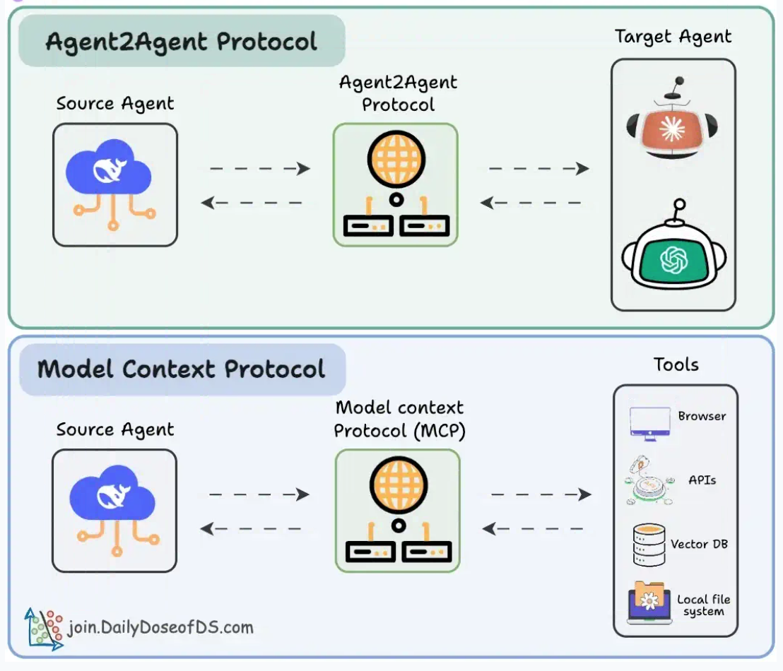
Agentic applications require both A2A and MCP
A2A allows agents to connect with other agents and collaborate in teams.
MCP provides agents with access to tools
Source: https://blog.dailydoseofds.com/p/a-visual-guide-to-agent2agent-a2a

Slide 69
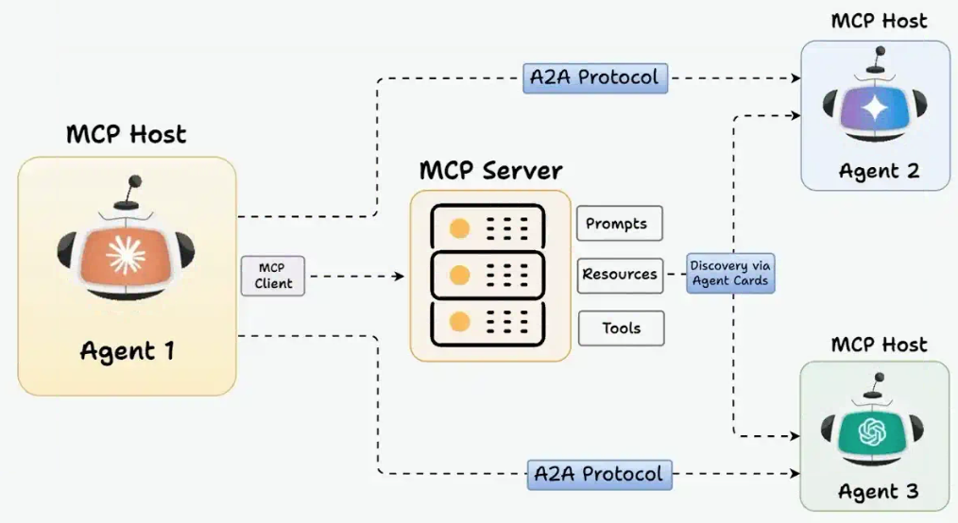
MCP and A2A Protocol for AI Agents
Source: https://blog.dailydoseofds.com/p/a-visual-guide-to-agent2agent-a2a

Slide 70
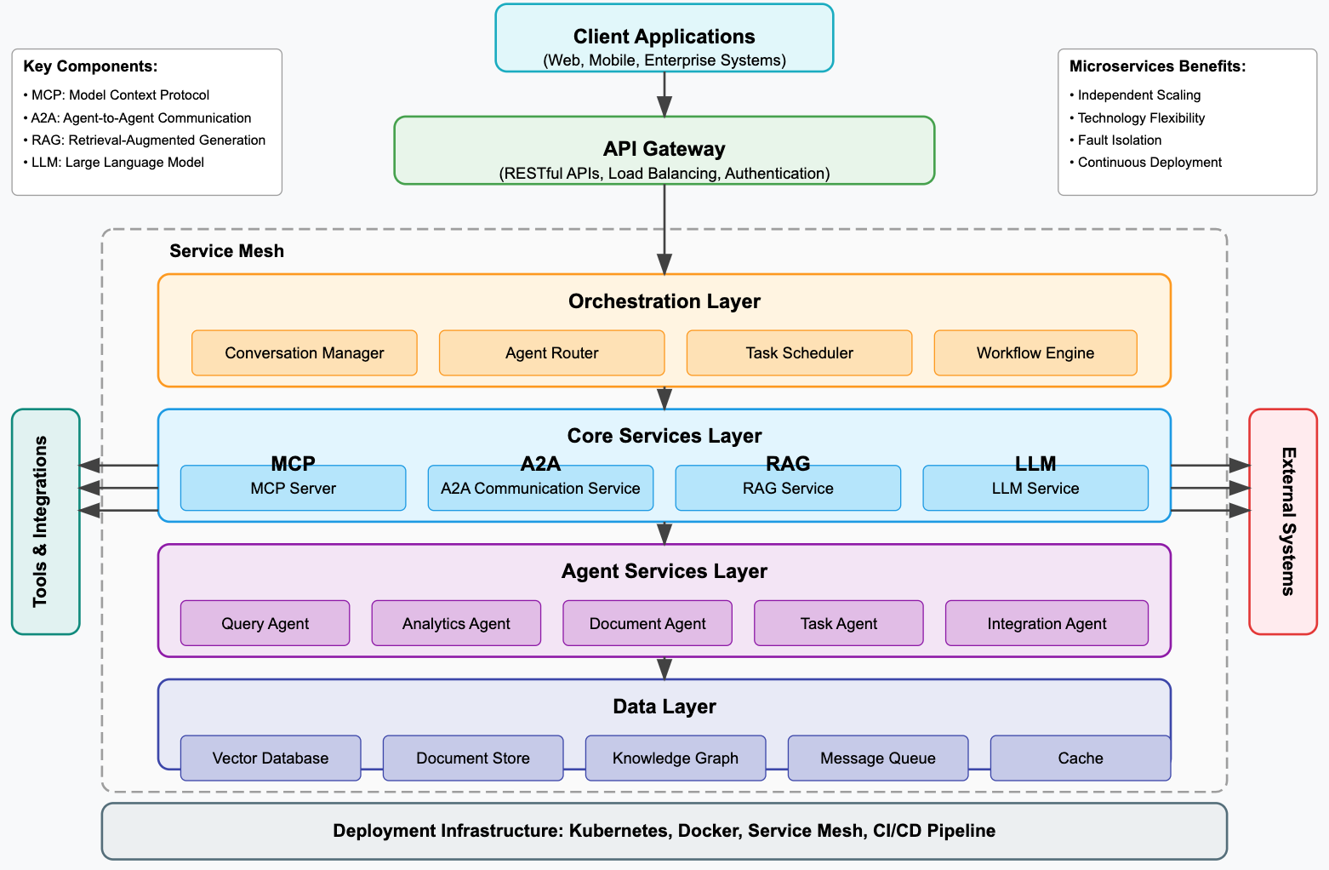
Agentic AI System with Microservices Architecture

Slide 71
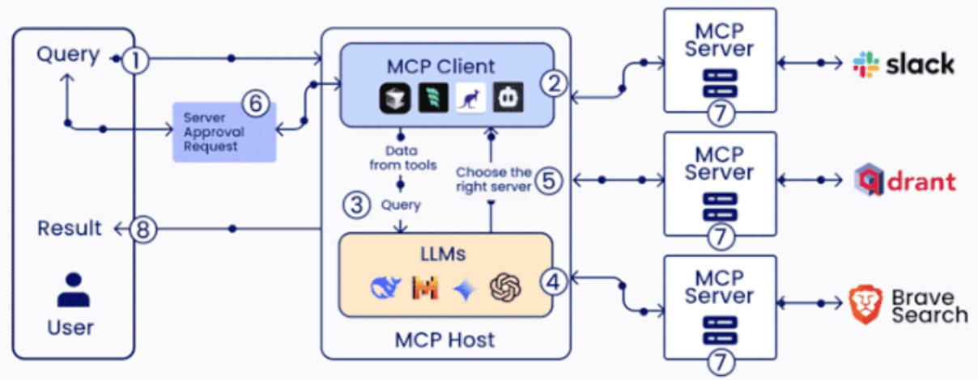
MCP (Model Context Protocol)

Slide 72
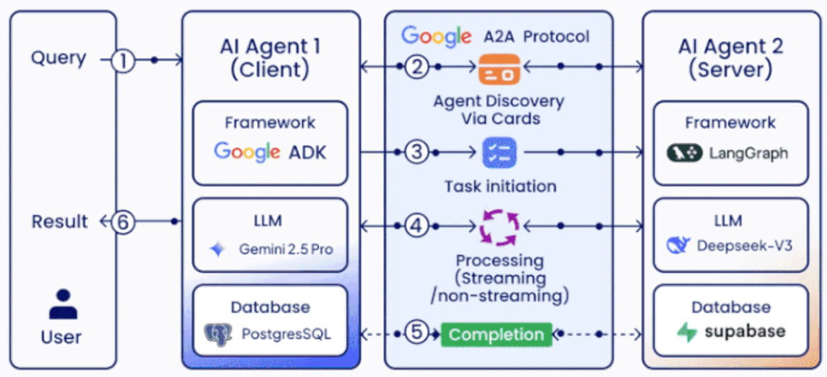
A2A (Agent2Agent Protocol)

Slide 73
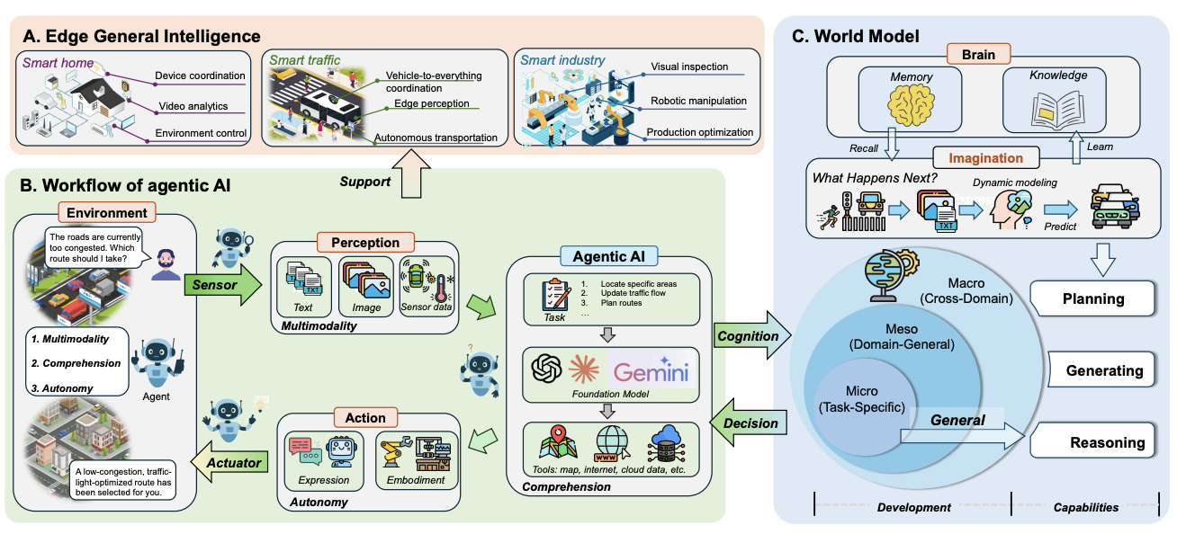
Agentic AI and World Model for
Edge General Intelligence
Source: Changyuan Zhao, Guangyuan Liu, Ruichen Zhang, Yinqiu Liu, Jiacheng Wang, Jiawen Kang, Dusit Niyato et al (2025),
"Edge general intelligence through world models and agentic AI: Fundamentals, solutions, and challenges." arXiv preprint arXiv:2508.09561.

Slide 74
Physical AI
(Robotics)

Slide 75
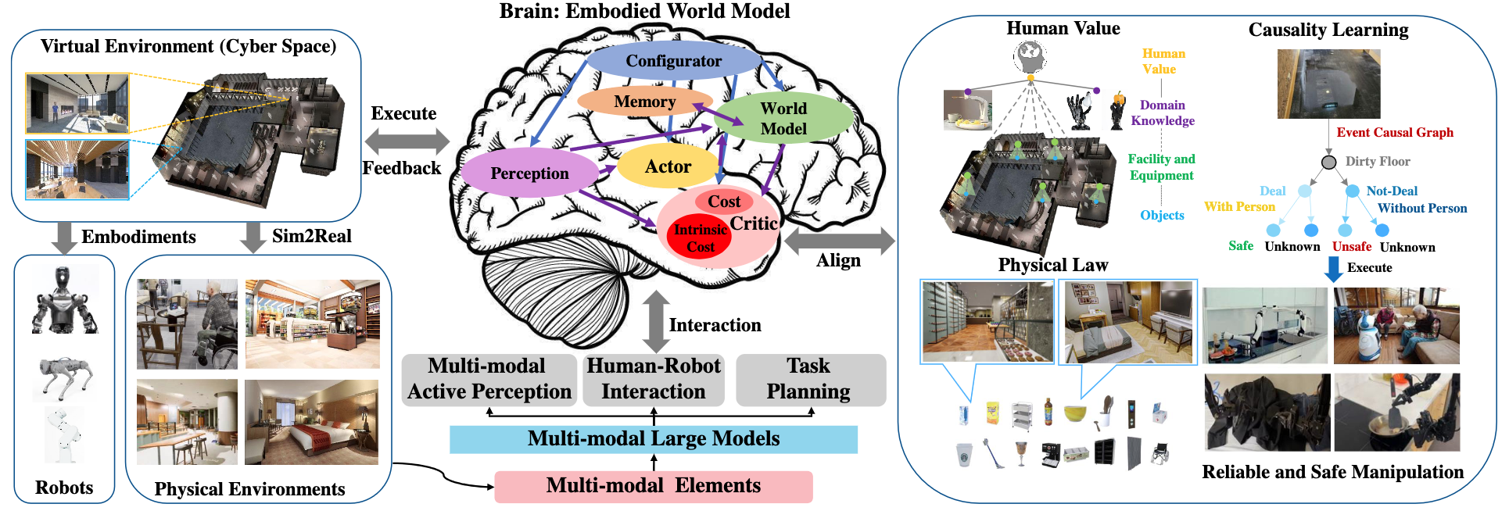
Framework of the Embodied Agent based on MLMs and WMs
Source: Yang Liu, Weixing Chen, Yongjie Bai, Xiaodan Liang, Guanbin Li, Wen Gao, and Liang Lin. (2024) "Aligning cyber space with physical world: A comprehensive survey on embodied ai." arXiv preprint arXiv:2407.06886.

Slide 76
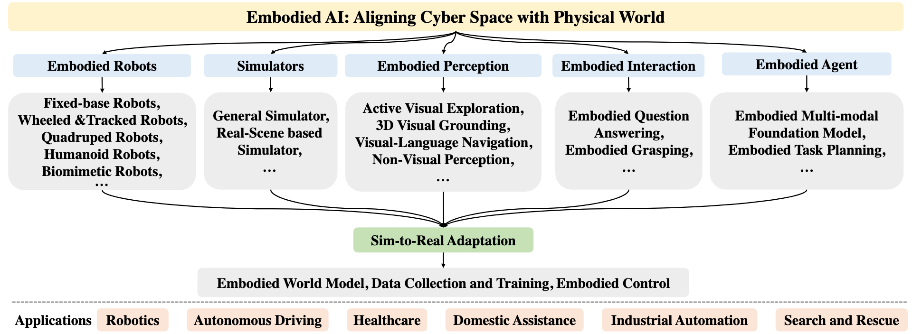
Embodied AI
Source: Yang Liu, Weixing Chen, Yongjie Bai, Xiaodan Liang, Guanbin Li, Wen Gao, and Liang Lin. (2024) "Aligning cyber space with physical world: A comprehensive survey on embodied ai." arXiv preprint arXiv:2407.06886.

Slide 77
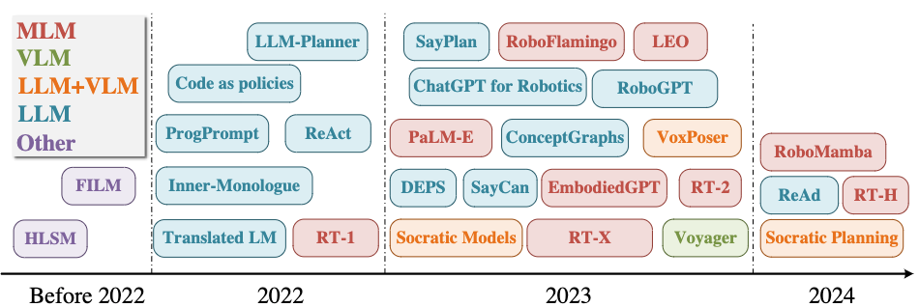
Embodied Agents
MLM: Multimodal Language Model, which directly perceive the world and control the embodiment
VLM: Visual-Language Model with the outer policy models
LLM + VLM: LLM-based agent that perceives the world utilizing the VLM, and LLM
means the Large-Language Model with visual context and outer policy models.
Source: Yang Liu, Weixing Chen, Yongjie Bai, Xiaodan Liang, Guanbin Li, Wen Gao, and Liang Lin. (2024) "Aligning cyber space with physical world: A comprehensive survey on embodied ai." arXiv preprint arXiv:2407.06886.

Slide 78
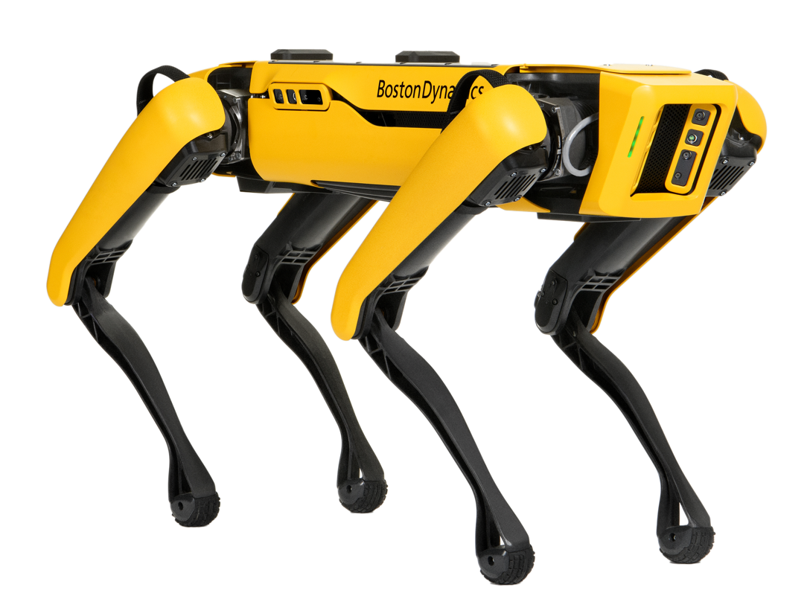
Boston Dynamics: Spot
Automate sensing and inspection, capture limitless data, and explore without boundaries.
Source: https://www.bostondynamics.com/spot

Slide 79
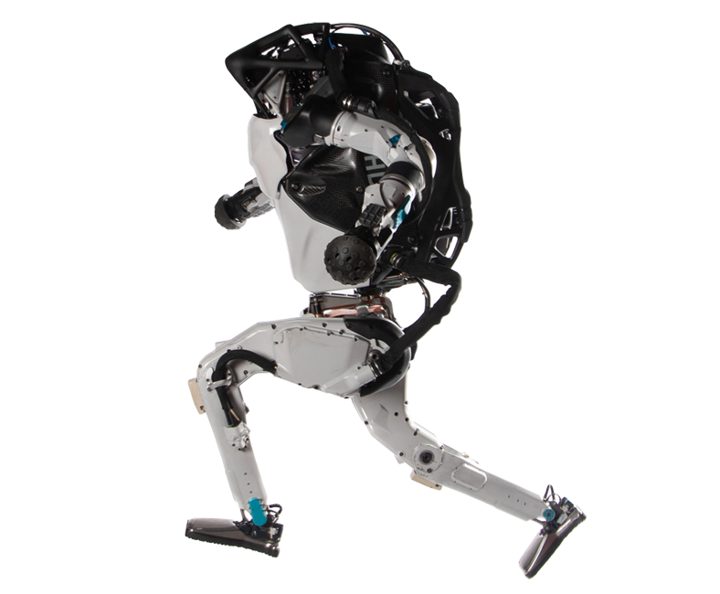
Boston Dynamics: Atlas
The world’s most dynamic humanoid robot
Atlas is a research platform designed to push the limits of whole-body mobility
Source: https://www.bostondynamics.com/atlas

Slide 80
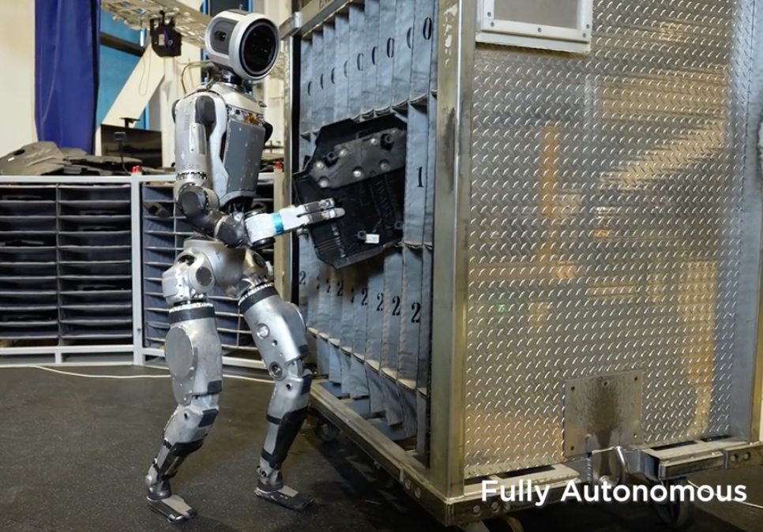
Boston Dynamics: Atlas Goes Hands On
Atlas uses a machine learning (ML) vision model to detect and localize the environment fixtures and individual bins.
The robot uses a specialized grasping policy and continuously estimates the state of manipulated objects to achieve the task.
Source: https://bostondynamics.com/video/atlas-goes-hands-on/

Slide 81
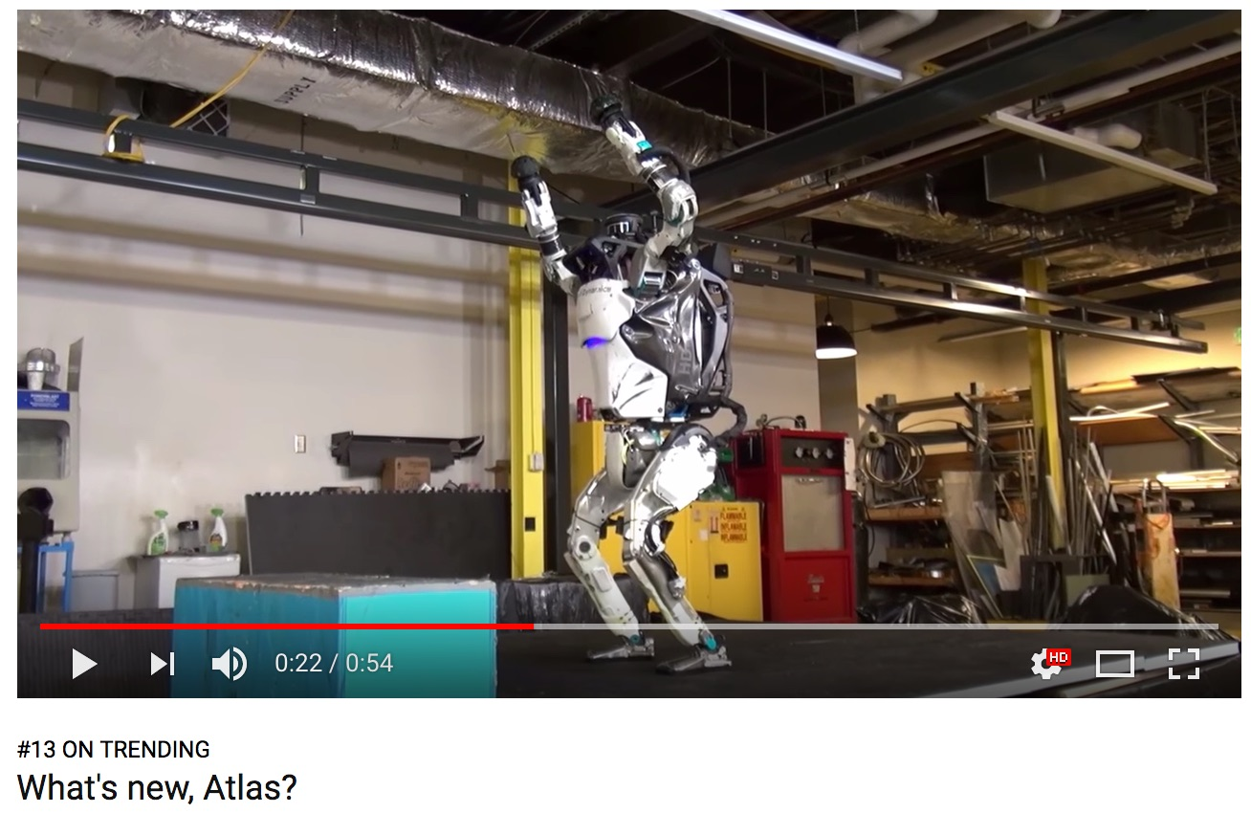
Boston Dynamics: Atlas
https://www.youtube.com/watch?v=fRj34o4hN4I

Slide 82
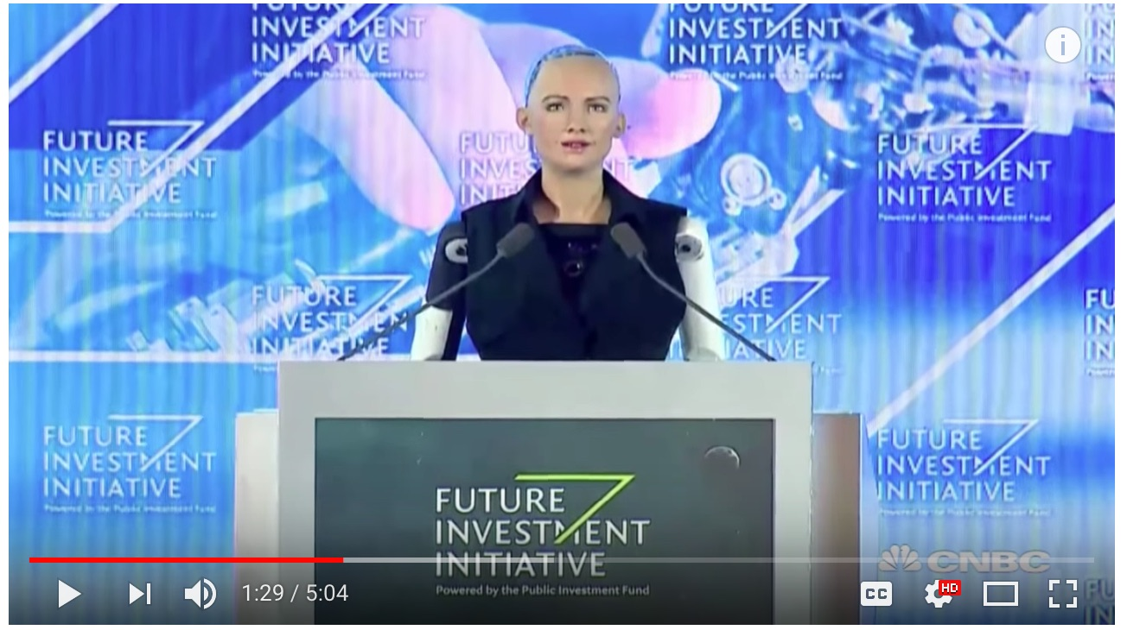
Humanoid Robot: Sophia
https://www.youtube.com/watch?v=S5t6K9iwcdw

Slide 83

Can a robot pass a university entrance exam?
Noriko Arai at TED2017
https://www.ted.com/talks/noriko_arai_can_a_robot_pass_a_university_entrance_exam
https://www.youtube.com/watch?v=XQZjkPyJ8KU

Slide 84
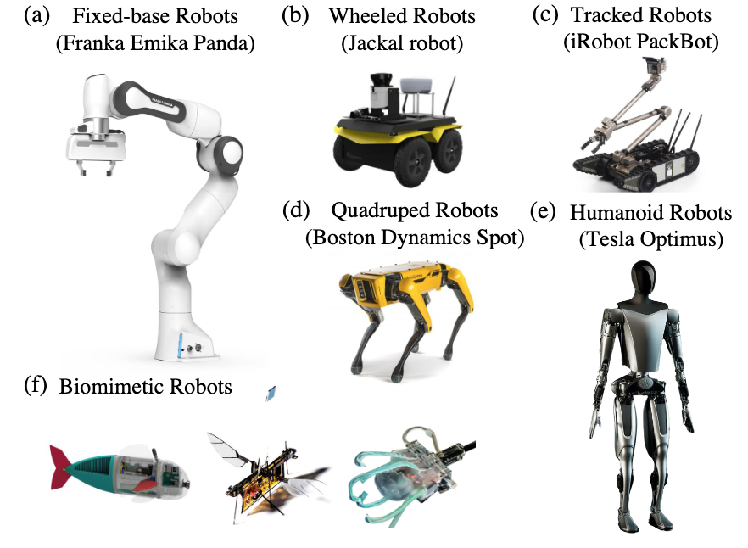
Embodied Robots
Source: Yang Liu, Weixing Chen, Yongjie Bai, Xiaodan Liang, Guanbin Li, Wen Gao, and Liang Lin. (2024) "Aligning cyber space with physical world: A comprehensive survey on embodied ai." arXiv preprint arXiv:2407.06886.

Slide 85
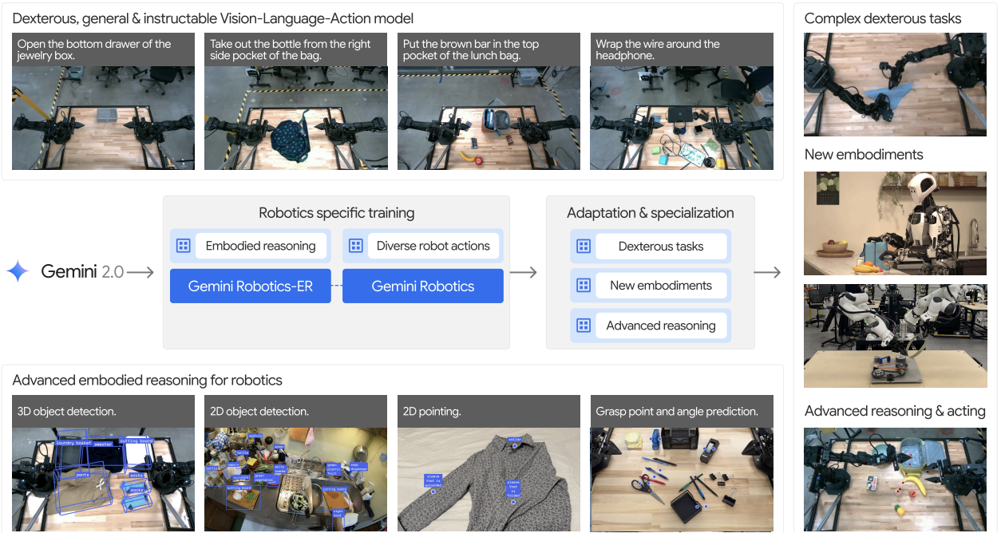
Gemini Robotics:
Bringing AI into the Physical World
Source: Gemini Robotics Team, Saminda Abeyruwan, Joshua Ainslie, Jean-Baptiste Alayrac, Montserrat Gonzalez Arenas, Travis Armstrong, Ashwin Balakrishna et al.(2025)
"Gemini robotics: Bringing ai into the physical world." arXiv preprint arXiv:2503.20020 (2025).

Slide 86
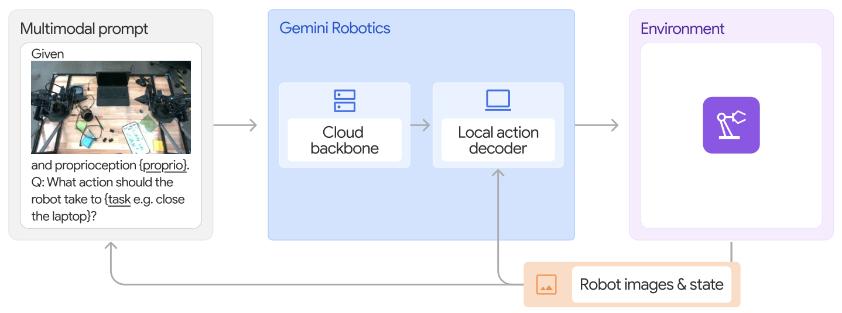
Gemini Robotics Models:
Architecture, Input and Output
Source: Gemini Robotics Team, Saminda Abeyruwan, Joshua Ainslie, Jean-Baptiste Alayrac, Montserrat Gonzalez Arenas, Travis Armstrong, Ashwin Balakrishna et al.(2025)
"Gemini robotics: Bringing ai into the physical world." arXiv preprint arXiv:2503.20020 (2025).

Slide 87
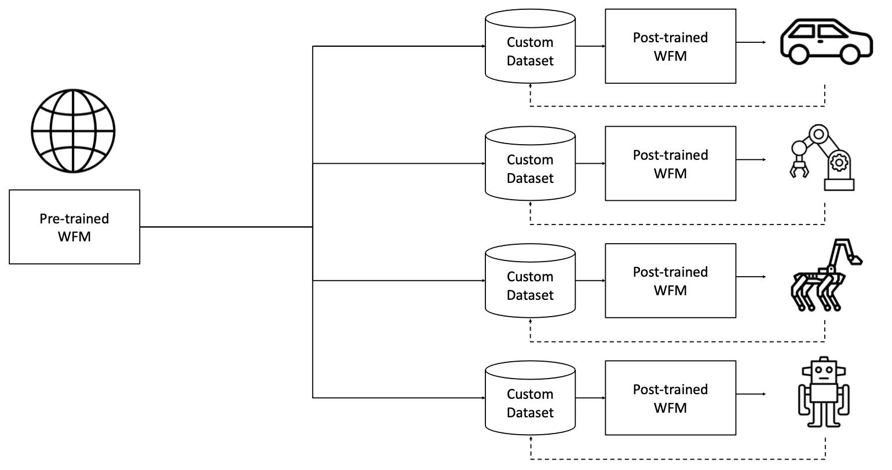
World Foundation Model Platform for Physical AI
Source: Agarwal, Niket, Arslan Ali, Maciej Bala, Yogesh Balaji, Erik Barker, Tiffany Cai, Prithvijit Chattopadhyay et al. "Cosmos world foundation model platform for physical ai."
arXiv preprint arXiv:2501.03575 (2025).

Slide 88
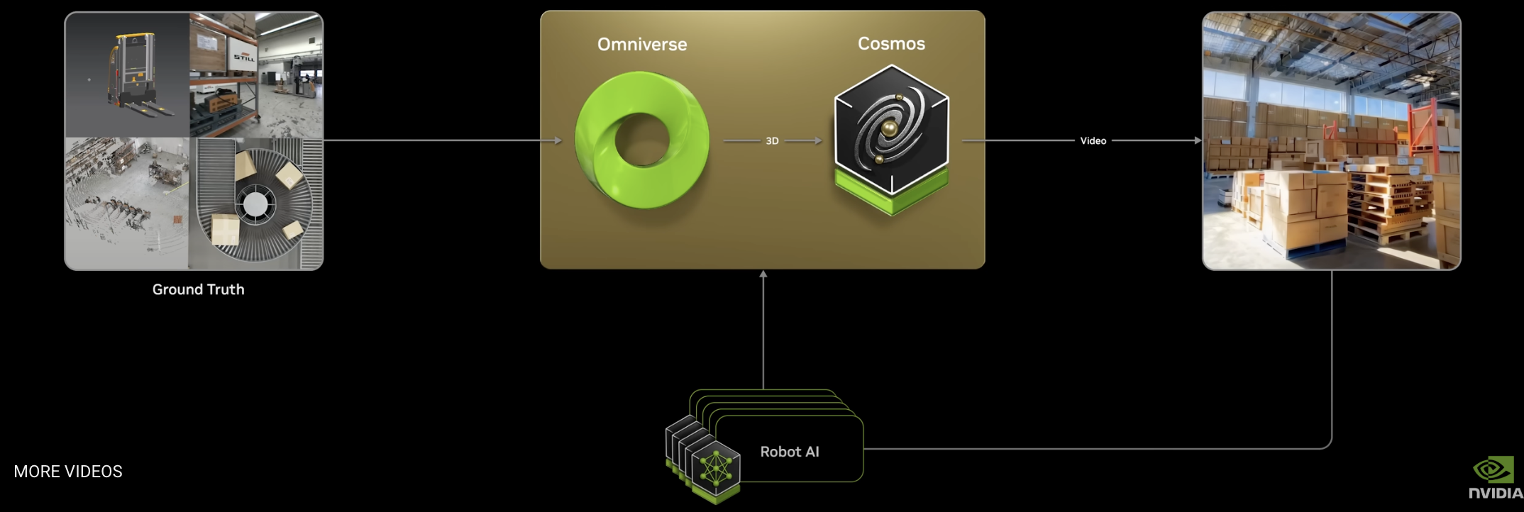
NVIDIA Cosmos
World Foundation Model Platform for Physical AI
Source: Agarwal, Niket, Arslan Ali, Maciej Bala, Yogesh Balaji, Erik Barker, Tiffany Cai, Prithvijit Chattopadhyay et al. "Cosmos world foundation model platform for physical ai."
arXiv preprint arXiv:2501.03575 (2025)., https://research.nvidia.com/labs/dir/cosmos-predict1/

Slide 89
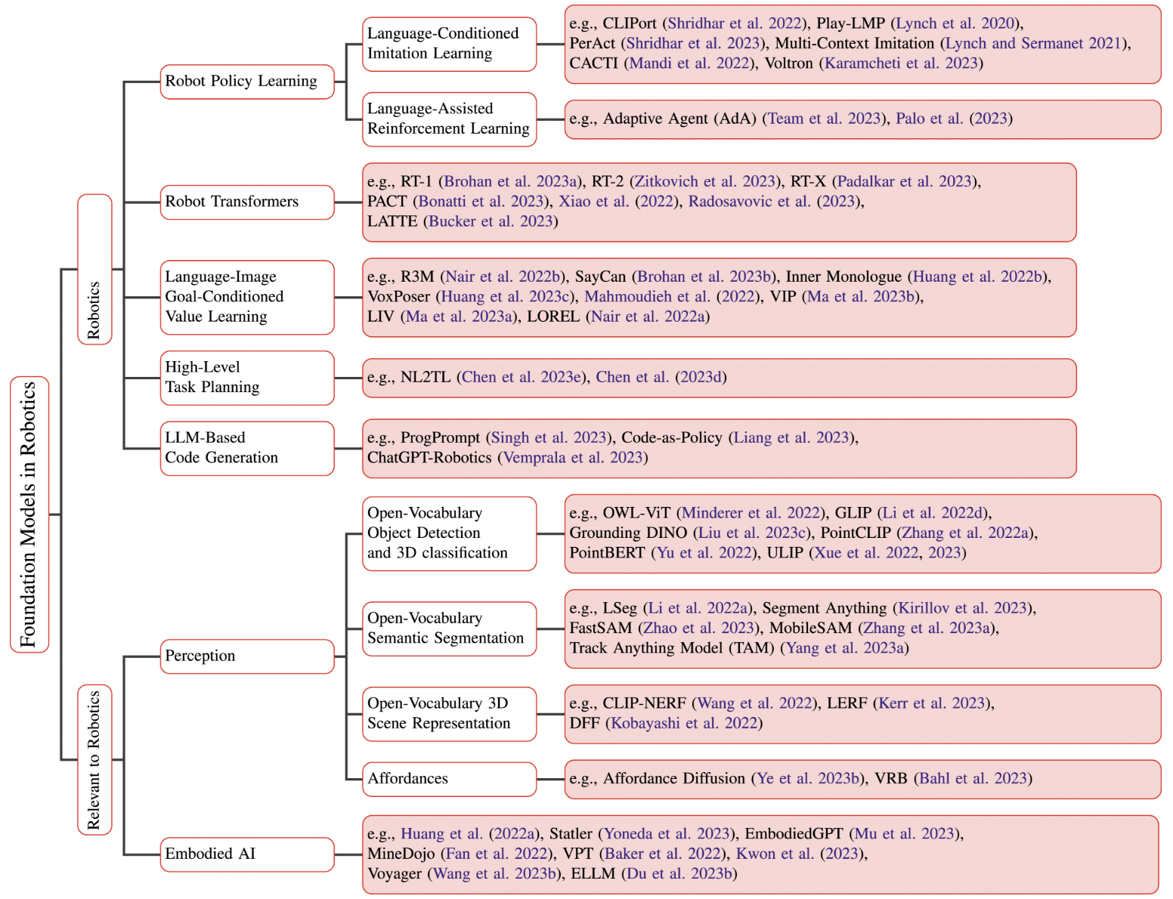
Foundation Models in Robotics
Source: Firoozi, Roya, Johnathan Tucker, Stephen Tian, Anirudha Majumdar, Jiankai Sun, Weiyu Liu, Yuke Zhu et al. "Foundation models in robotics: Applications, challenges, and the future.
" The International Journal of Robotics Research 44, no. 5 (2025): 701-739.

Slide 90
Vision Language Action (VLA)
Models for Robotics

Slide 91
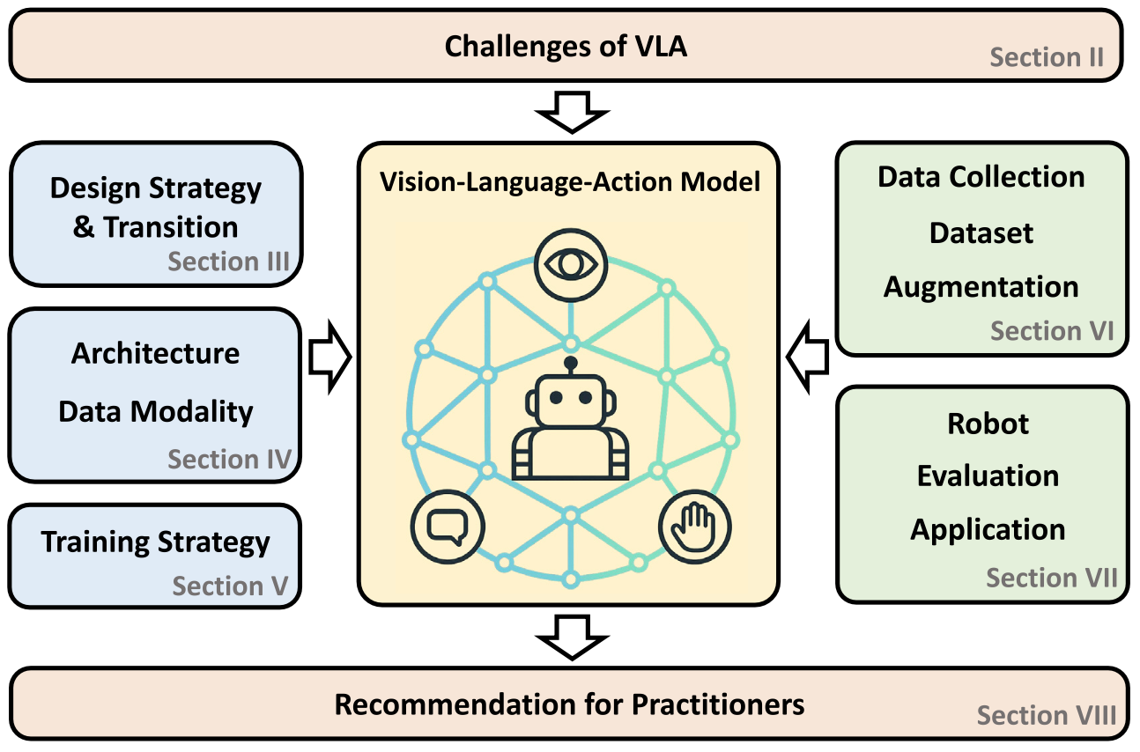
Vision-Language-Action (VLA) Models for Robotics
Source: Kento Kawaharazuka, Jihoon Oh, Jun Yamada, Ingmar Posner, and Yuke Zhu. (2025) "Vision-language-action models for robotics: A review towards real-world applications." IEEE Access (2025).

Slide 92
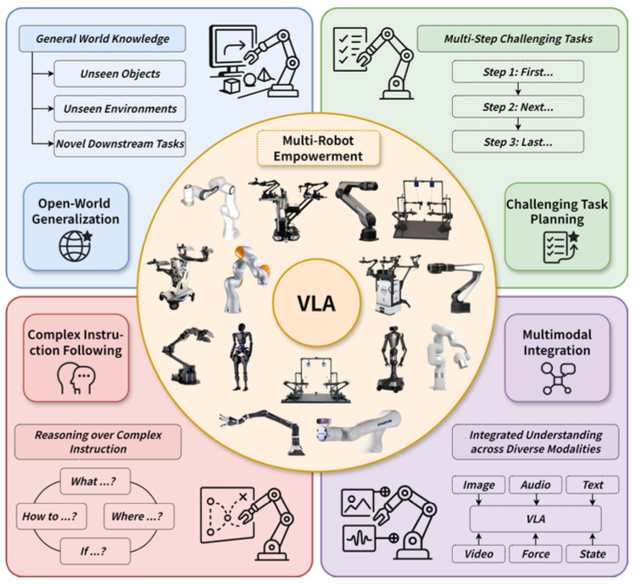
Large VLM-based Vision-Language-Action Models for Robotic Manipulation
Source: Rui Shao, Wei Li, Lingsen Zhang, Renshan Zhang, Zhiyang Liu, Ran Chen, and Liqiang Nie. (2025) "Large vlm-based vision-language-action models for robotic manipulation: A survey."
arXiv preprint arXiv:2508.13073 (2025).

Slide 93
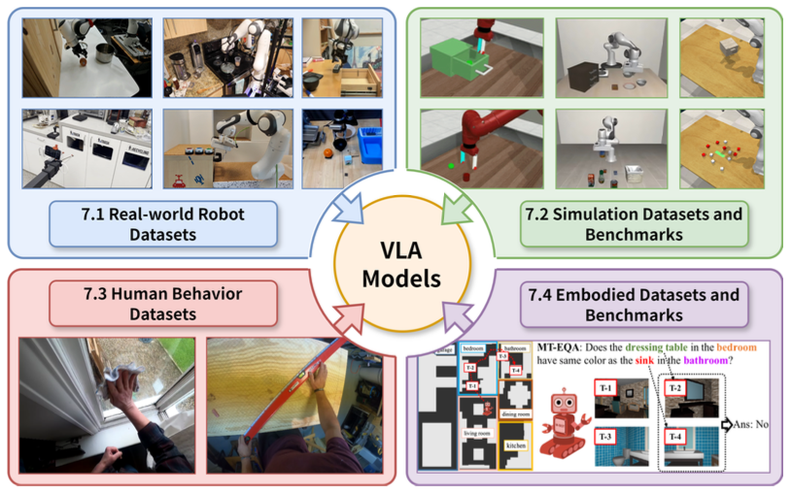
Large VLM-based Vision-Language-Action Models for Robotic Manipulation
Source: Rui Shao, Wei Li, Lingsen Zhang, Renshan Zhang, Zhiyang Liu, Ran Chen, and Liqiang Nie. (2025) "Large vlm-based vision-language-action models for robotic manipulation: A survey."
arXiv preprint arXiv:2508.13073 (2025).

Slide 94
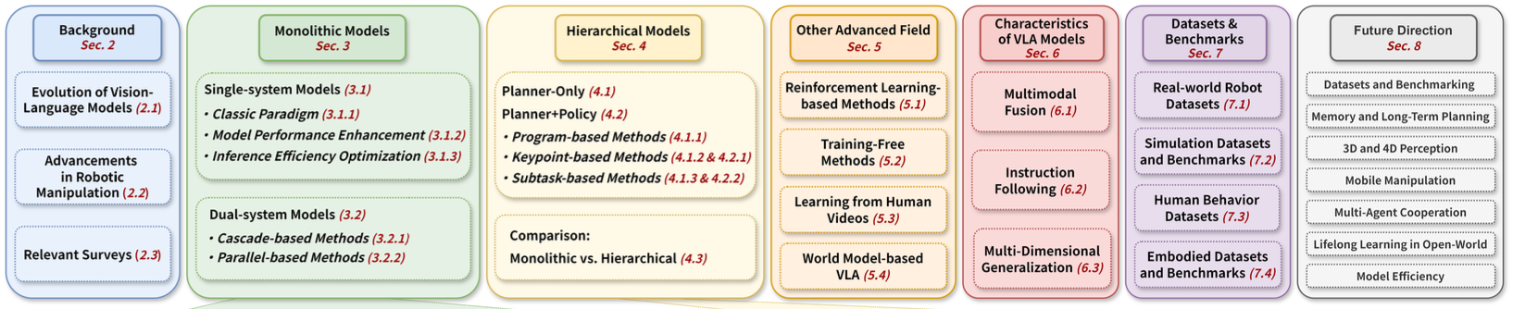
Large VLM-based Vision-Language-Action Models for Robotic Manipulation
Source: Rui Shao, Wei Li, Lingsen Zhang, Renshan Zhang, Zhiyang Liu, Ran Chen, and Liqiang Nie. (2025) "Large vlm-based vision-language-action models for robotic manipulation: A survey."
arXiv preprint arXiv:2508.13073 (2025).

Slide 95
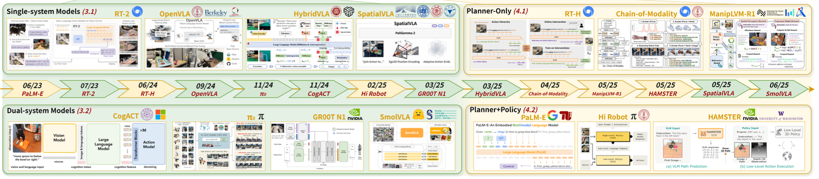
Large VLM-based Vision-Language-Action Models for Robotic Manipulation (Timeline)
Monolithic models and Hierarchical Models
Source: Rui Shao, Wei Li, Lingsen Zhang, Renshan Zhang, Zhiyang Liu, Ran Chen, and Liqiang Nie. (2025) "Large vlm-based vision-language-action models for robotic manipulation: A survey."
arXiv preprint arXiv:2508.13073 (2025).

Slide 96
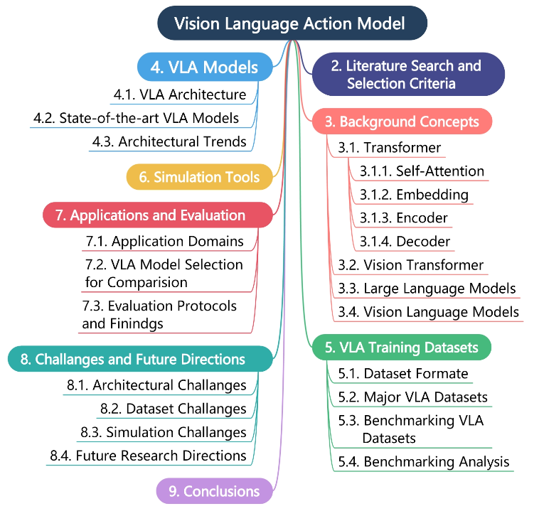
Vision Language Action Models in Robotic Manipulation
Source: Muhayy Ud Din, Waseem Akram, Lyes Saad Saoud, Jan Rosell, and Irfan Hussain. (2025) "Vision language action models in robotic manipulation: A systematic review." arXiv preprint arXiv:2507.10672 (2025).

Slide 97
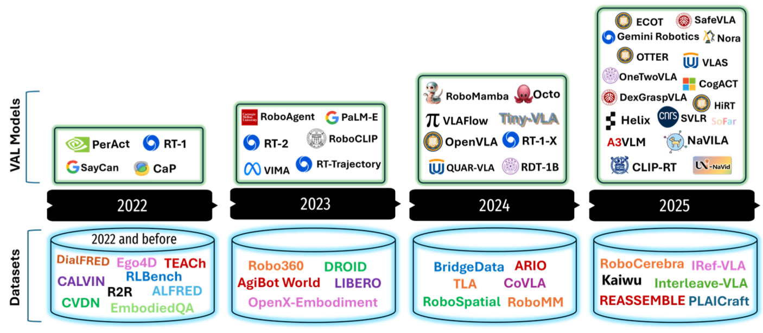
Vision Language Action (VLA) Models, Datasets
Contributing institutions: Academic (e.g., CMU, CNRS, UC, Peking Uni)
Industrial Labs (e.g., Google, NVIDIA, Microsoft)
VLA Models
Datasets
Source: Muhayy Ud Din, Waseem Akram, Lyes Saad Saoud, Jan Rosell, and Irfan Hussain. (2025) "Vision language action models in robotic manipulation: A systematic review." arXiv preprint arXiv:2507.10672 (2025).

Slide 98
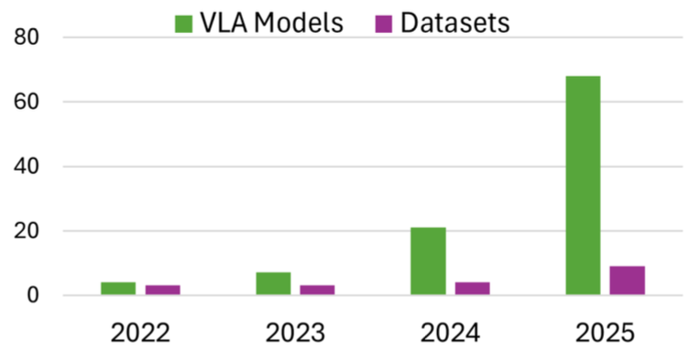
VLA Models and Foundational VLA Datasets
Source: Muhayy Ud Din, Waseem Akram, Lyes Saad Saoud, Jan Rosell, and Irfan Hussain. (2025) "Vision language action models in robotic manipulation: A systematic review." arXiv preprint arXiv:2507.10672 (2025).

Slide 99
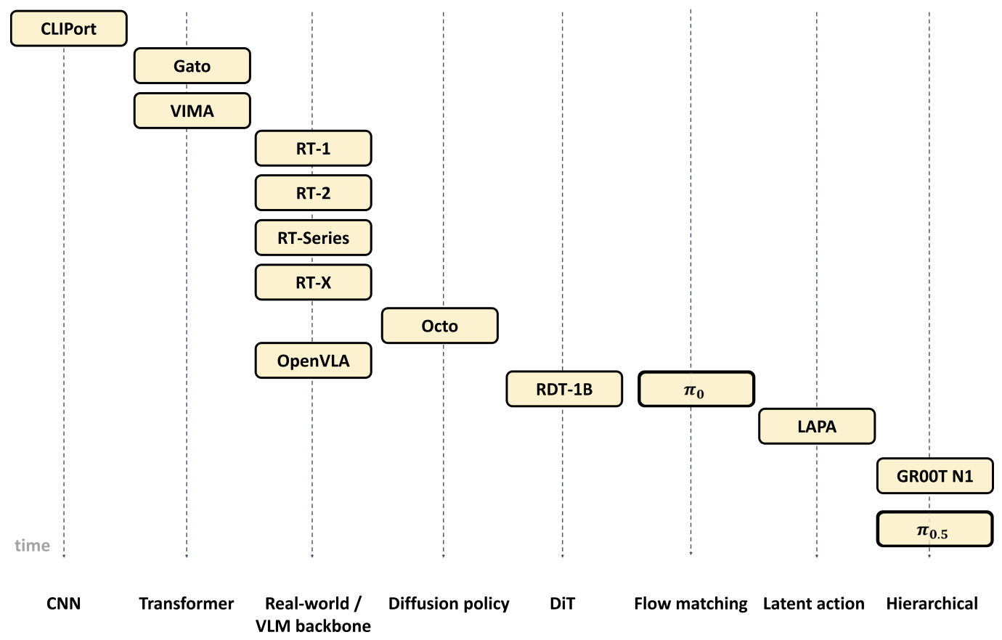
Timeline of Vision-Language-Action (VLA) Models
Source: Kento Kawaharazuka, Jihoon Oh, Jun Yamada, Ingmar Posner, and Yuke Zhu. (2025) "Vision-language-action models for robotics: A review towards real-world applications." IEEE Access (2025).

Slide 100
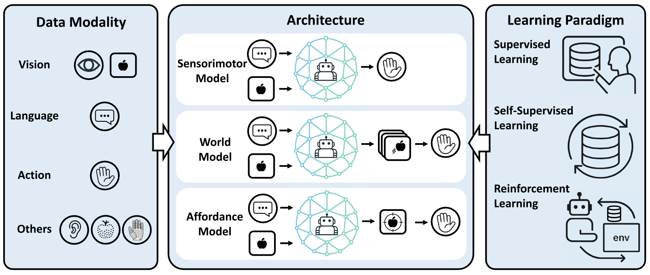
VLA Model Components and Training Paradigms
Source: Kento Kawaharazuka, Jihoon Oh, Jun Yamada, Ingmar Posner, and Yuke Zhu. (2025) "Vision-language-action models for robotics: A review towards real-world applications." IEEE Access (2025).

Slide 101
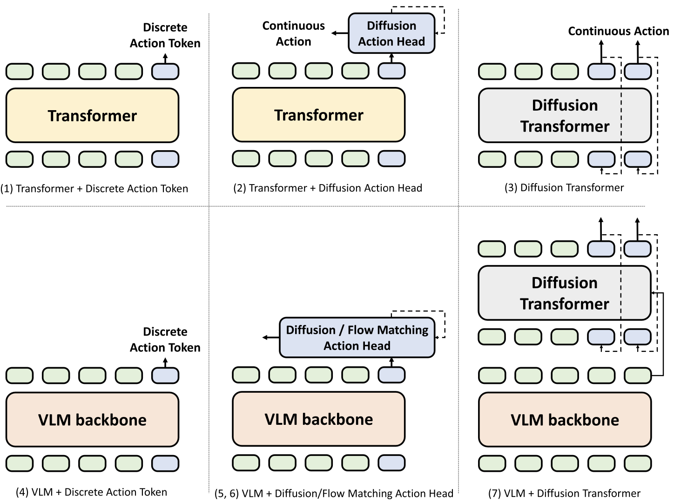
Architecture of Sensorimotor Models for VLA
Source: Kento Kawaharazuka, Jihoon Oh, Jun Yamada, Ingmar Posner, and Yuke Zhu. (2025) "Vision-language-action models for robotics: A review towards real-world applications." IEEE Access (2025).

Slide 102
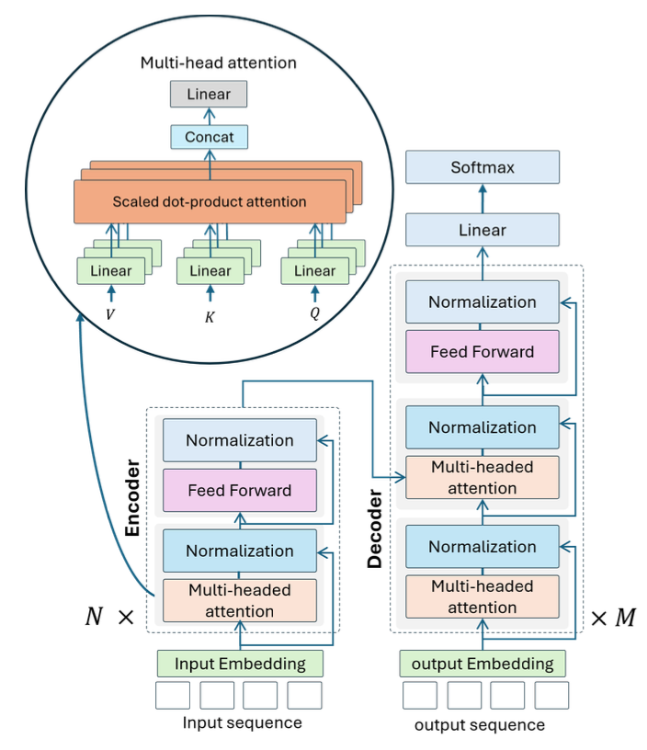
Transformer Architecture:
Encoder-decoder structure and the internal mechanism of multi-head attention
Source: Muhayy Ud Din, Waseem Akram, Lyes Saad Saoud, Jan Rosell, and Irfan Hussain. (2025) "Vision language action models in robotic manipulation: A systematic review." arXiv preprint arXiv:2507.10672 (2025).

Slide 103

Architecture of the ViT
Source: Muhayy Ud Din, Waseem Akram, Lyes Saad Saoud, Jan Rosell, and Irfan Hussain. (2025) "Vision language action models in robotic manipulation: A systematic review." arXiv preprint arXiv:2507.10672 (2025).

Slide 104

Architecture of VLM for Image Captioning and Semantic Understanding
Source: Muhayy Ud Din, Waseem Akram, Lyes Saad Saoud, Jan Rosell, and Irfan Hussain. (2025) "Vision language action models in robotic manipulation: A systematic review." arXiv preprint arXiv:2507.10672 (2025).

Slide 105

Architecture of a VLA System for Robotic Manipulation
Source: Muhayy Ud Din, Waseem Akram, Lyes Saad Saoud, Jan Rosell, and Irfan Hussain. (2025) "Vision language action models in robotic manipulation: A systematic review." arXiv preprint arXiv:2507.10672 (2025).

Slide 106

Design Patterns for Incorporating
World Models in VLA
Source: Kento Kawaharazuka, Jihoon Oh, Jun Yamada, Ingmar Posner, and Yuke Zhu. (2025) "Vision-language-action models for robotics: A review towards real-world applications." IEEE Access (2025).

Slide 107

Design Patterns for Incorporating
Affordance-based Models in VLA
Source: Kento Kawaharazuka, Jihoon Oh, Jun Yamada, Ingmar Posner, and Yuke Zhu. (2025) "Vision-language-action models for robotics: A review towards real-world applications." IEEE Access (2025).

Slide 108

Integrating RL with VLA Models
Source: Kento Kawaharazuka, Jihoon Oh, Jun Yamada, Ingmar Posner, and Yuke Zhu. (2025) "Vision-language-action models for robotics: A review towards real-world applications." IEEE Access (2025).

Slide 109

Robots Used in VLA Research
Source: Kento Kawaharazuka, Jihoon Oh, Jun Yamada, Ingmar Posner, and Yuke Zhu. (2025) "Vision-language-action models for robotics: A review towards real-world applications." IEEE Access (2025).

Slide 110

Vision Language Action (VLA) Components
Source: Muhayy Ud Din, Waseem Akram, Lyes Saad Saoud, Jan Rosell, and Irfan Hussain. (2025) "Vision language action models in robotic manipulation: A systematic review." arXiv preprint arXiv:2507.10672 (2025).

Slide 111

Large VLM-based Vision-Language-Action Models Monolithic VLA Models
Source: Rui Shao, Wei Li, Lingsen Zhang, Renshan Zhang, Zhiyang Liu, Ran Chen, and Liqiang Nie. (2025) "Large vlm-based vision-language-action models for robotic manipulation: A survey."
arXiv preprint arXiv:2508.13073 (2025).

Slide 112

Large VLM-based Vision-Language-Action Models Hierarchical VLA Models
Source: Rui Shao, Wei Li, Lingsen Zhang, Renshan Zhang, Zhiyang Liu, Ran Chen, and Liqiang Nie. (2025) "Large vlm-based vision-language-action models for robotic manipulation: A survey."
arXiv preprint arXiv:2508.13073 (2025).

Slide 113

Large VLM-based Vision-Language-Action Models
Paradigms in Monolithic Single-system Models
Source: Rui Shao, Wei Li, Lingsen Zhang, Renshan Zhang, Zhiyang Liu, Ran Chen, and Liqiang Nie. (2025) "Large vlm-based vision-language-action models for robotic manipulation: A survey."
arXiv preprint arXiv:2508.13073 (2025).

Slide 114

Large VLM-based Vision-Language-Action Models
Paradigms in Monolithic Dual-system Models
Source: Rui Shao, Wei Li, Lingsen Zhang, Renshan Zhang, Zhiyang Liu, Ran Chen, and Liqiang Nie. (2025) "Large vlm-based vision-language-action models for robotic manipulation: A survey."
arXiv preprint arXiv:2508.13073 (2025).

Slide 115

Large VLM-based Vision-Language-Action Models Hierarchical Models
Source: Rui Shao, Wei Li, Lingsen Zhang, Renshan Zhang, Zhiyang Liu, Ran Chen, and Liqiang Nie. (2025) "Large vlm-based vision-language-action models for robotic manipulation: A survey."
arXiv preprint arXiv:2508.13073 (2025).

Slide 116

Schematic of the Unified VLA Training Data Format
Source: Muhayy Ud Din, Waseem Akram, Lyes Saad Saoud, Jan Rosell, and Irfan Hussain. (2025) "Vision language action models in robotic manipulation: A systematic review." arXiv preprint arXiv:2507.10672 (2025).

Slide 117

Benchmarking VLA Datasets by Task Complexity and Modality Richness
Source: Muhayy Ud Din, Waseem Akram, Lyes Saad Saoud, Jan Rosell, and Irfan Hussain. (2025) "Vision language action models in robotic manipulation: A systematic review." arXiv preprint arXiv:2507.10672 (2025).

Slide 118
Real-World Robot Datasets for VLA Research
Name | Episodes | Skill | Task | Modality | Embodiment | Collection
QT-Opt | 580K | 1 (Pick) | NA | RGB | KUKA LBR iiwa | Learned
MT-Opt | 800K | 2 | 12 | RGB, L | 7 robots | Scripted, Learned
RoboNet | 162K | NA | NA | RGB | 7 robots | Scripted
BridgeData | 7.2K | 4 | 71 | RGB, L | WidowX 250 | Teleop
BridgeData V2 | 60.1K | 13 | NA | RGB-D, L | WidowX 250 | Teleop
BC-Z | 26.0K | 3 | 100 | RGB, L | Google EDR | Teleop
Language Table | 413K | 1 (Push) | NA | RGB, L | xArm | Teleop
RH20T | 110K | 42 | 147 | RGB-D, L, F, A | 4 robots | Teleop
RT-1 | 130K | 12 | 700+ | RGB, L | Google EDR | Teleop
OXE | 1.4M | 527 | 160,266 | RGB-D, L | 22 robots | Mixed
DROID | 76K | 86 | NA | RGB-D, L | Franka | Teleop
FuSe | 27K | 2 | 3 | RGB, L, T, A | WidowX 250 | Teleop
RoboMIND | 107K | 38 | 479 | RGB-D, L | 4 robots | Teleop
AgiBot World | 94K | 87 | 217 | RGB-D, L | AgiBot G1 | Teleop
Source: Kento Kawaharazuka, Jihoon Oh, Jun Yamada, Ingmar Posner, and Yuke Zhu. (2025) "Vision-language-action models for robotics: A review towards real-world applications." IEEE Access (2025).

Slide 119
Benchmarks for Vision-Language-Action Evaluation
Simulation Environments: Navigation (Nav), Manipulation (Manip), and Whole-Body Control (WBC)
Name | Task | Scenes / Objects | Observation | Physics | Built Upon | Description
robosuite | Manip | NA / 10 | RGB-D, S | MuJoCo | NA | Modular framework, 11 tasks
robomimic | Manip | NA / NA | RGB | MuJoCo | robosuite | Offline learning, 8 tasks
RoboCasa | Manip | 120 / 2.5K | RGB | MuJoCo | robosuite | 100 kitchen tasks, photorealistic
LIBERO | Manip | NA / NA | RGB | MuJoCo | robosuite | 130 tasks in 4 task suites
Meta-World | Manip | 1 / 80 | Pose | MuJoCo | NA | 50 Manip tasks for Meta-RL
LeVERB-Bench | Nav, WBC | 4 / NA | RGB | PhysX | Isaac Sim | Humanoid control
Source: Kento Kawaharazuka, Jihoon Oh, Jun Yamada, Ingmar Posner, and Yuke Zhu. (2025) "Vision-language-action models for robotics: A review towards real-world applications." IEEE Access (2025).

Slide 120
Benchmarks for Vision-Language-Action Evaluation
Simulation Environments: Navigation (Nav), Manipulation (Manip), and Whole-Body Control (WBC)
Name | Task | Scenes / Objects | Observation | Physics | Built Upon | Description
ManiSkill | Manip | NA / 162 | RGB-D, PC, S | PhysX | SAPIEN | 4 tasks, 36K demos
ManiSkill 2 | Manip | NA / 2.1K | RGB-D, PC | PhysX | ManiSkill | Extended task diversity
ManiSkill 3 | Nav, Manip, WBC | NA / NA | RGB-D, PC, S | PhysX | ManiSkill 2 | GPU-parallelized simulation
ManiSkill-HAB | Manip | 105 / 92 | RGB-D | PhysX | ManiSkill 3, Habitat 2.0 | HAB tasks from Habitat 2.0
RoboTwin | Manip | NA / 731 | RGB-D | PhysX | SAPIEN | Dual-arm tasks
Ravens | Manip | NA / NA | RGB-D | PyBullet | NA | 10 tabletop tasks
VIMA-BENCH | Manip | NA / 29 | RGB, S | PyBullet | Ravens | 17 multimodal prompt tasks
LoHoRavens | Manip | 1 / 3 | RGB-D | PyBullet | Ravens | Long-horizon planning
CALVIN | Manip | 4 / 7 | RGB-D | PyBullet | NA | Long-horizon lang-cond tasks
Source: Kento Kawaharazuka, Jihoon Oh, Jun Yamada, Ingmar Posner, and Yuke Zhu. (2025) "Vision-language-action models for robotics: A review towards real-world applications." IEEE Access (2025).

Slide 121
Benchmarks for Vision-Language-Action Evaluation
Simulation Environments: Navigation (Nav), Manipulation (Manip), and Whole-Body Control (WBC)
Name | Task | Scenes / Objects | Observation | Physics | Built Upon | Description
Habitat | Nav | 185 / NA | RGB-D, S | Bullet | NA | Fast, Nav only
Habitat 2.0 | Nav, Manip | 105 / 92 | RGB-D | Bullet | Habitat | Mobile manipulation (HAB)
Habitat 3.0 | Nav, Manip | 211 / 18K | RGB-D | Bullet | Habitat 2.0 | Human avatars support
RLBench | Manip | 1 / 28 | RGB-D, S | PyBullet | V-REP | Tiered task difficulty
THE COLOSSEUM | Manip | 1 / 107 | RGB-D | PyBullet | RLBench | 20 tasks, 14 env variations
AI2-THOR | Nav, Manip | NA / 118 | RGB-D, S | Unity | NA | Object states, task planning
CHORES | Nav | 191K / 40K | RGB | Unity | AI2-THOR | Shortest-path planning
SIMPLER | Manip | 4 / 17 | RGB | PhysX | SAPIEN, Isaac Sim | Real-to-sim evaluation
RoboArena | Manip | NA / NA | RGB | Real | NA | Distributed real-world evaluation
Source: Kento Kawaharazuka, Jihoon Oh, Jun Yamada, Ingmar Posner, and Yuke Zhu. (2025) "Vision-language-action models for robotics: A review towards real-world applications." IEEE Access (2025).

Slide 122
Summary
Generative AI
Agentic AI
Physical AI (Robotics)

Slide 123
References
Stuart Russell and Peter Norvig (2020), Artificial Intelligence: A Modern Approach, 4th Edition, Pearson.
Denis Rothman (2024), Transformers for Natural Language Processing and Computer Vision - Third Edition: Explore Generative AI and Large Language Models with Hugging Face, ChatGPT, GPT-4V, and DALL-E 3, 3rd ed. Edition, Packt Publishing
Aurélien Géron (2022), Hands-On Machine Learning with Scikit-Learn, Keras, and TensorFlow: Concepts, Tools, and Techniques to Build Intelligent Systems, 3rd Edition, O’Reilly Media.
Steven D'Ascoli (2022), Artificial Intelligence and Deep Learning with Python: Every Line of Code Explained For Readers New to AI and New to Python, Independently published.
Chien-Yao Wang, Alexey Bochkovskiy, and Hong-Yuan Mark Liao. (2022) "YOLOv7: Trainable bag-of-freebies sets new state-of-the-art for real-time object detectors." arXiv preprint arXiv:2207.02696.
Chien-Yao Wang, I-Hau Yeh, and Hong-Yuan Mark Liao. (2025) "Yolov9: Learning what you want to learn using programmable gradient information." In European Conference on Computer Vision, pp. 1-21. Springer, Cham.
Nidhal Jegham, Chan Young Koh, Marwan Abdelatti, and Abdeltawab Hendawi. (2024) "Evaluating the Evolution of YOLO (You Only Look Once) Models: A Comprehensive Benchmark Study of YOLO11 and Its Predecessors." arXiv preprint arXiv:2411.00201.
Ranjan Sapkota, and Manoj Karkee. (2024) "Yolo11 and vision transformers based 3d pose estimation of immature green fruits in commercial apple orchards for robotic thinning." arXiv preprint arXiv:2410.19846.
Yang Liu, Weixing Chen, Yongjie Bai, Xiaodan Liang, Guanbin Li, Wen Gao, and Liang Lin. (2024) "Aligning cyber space with physical world: A comprehensive survey on embodied ai." arXiv preprint arXiv:2407.06886.
Alec Radford, Jong Wook Kim, Chris Hallacy, Aditya Ramesh, Gabriel Goh, Sandhini Agarwal, Girish Sastry et al. (2021) "Learning transferable visual models from natural language supervision." In International Conference on Machine Learning, pp. 8748-8763. PMLR.
Wonjae Kim, Bokyung Son, and Ildoo Kim. (2021) "Vilt: Vision-and-language transformer without convolution or region supervision." In International Conference on Machine Learning, pp. 5583-5594. PMLR.
Meng-Hao Guo, Tian-Xing Xu, Jiang-Jiang Liu, Zheng-Ning Liu, Peng-Tao Jiang, Tai-Jiang Mu, Song-Hai Zhang, Ralph R. Martin, Ming-Ming Cheng, and Shi-Min Hu. (2022) "Attention mechanisms in computer vision: A survey." Computational Visual Media ,:1-38.
Valentin Bazarevsky, Ivan Grishchenko, Karthik Raveendran, Tyler Zhu, Fan Zhang, and Matthias Grundmann.(2020) "Blazepose: On-device real-time body pose tracking." arXiv preprint arXiv:2006.10204.
Gemini Robotics Team, Saminda Abeyruwan, Joshua Ainslie, Jean-Baptiste Alayrac, Montserrat Gonzalez Arenas, Travis Armstrong, Ashwin Balakrishna et al.(2025) "Gemini robotics: Bringing ai into the physical world." arXiv preprint arXiv:2503.20020 (2025).
Niket Agarwal, Arslan Ali, Maciej Bala, Yogesh Balaji, Erik Barker, Tiffany Cai, Prithvijit Chattopadhyay et al. (2025) "Cosmos world foundation model platform for physical ai." arXiv preprint arXiv:2501.03575 (2025).
Roya Firoozi, Johnathan Tucker, Stephen Tian, Anirudha Majumdar, Jiankai Sun, Weiyu Liu, Yuke Zhu et al. (2025) "Foundation models in robotics: Applications, challenges, and the future." The International Journal of Robotics Research 44, no. 5 (2025): 701-739.
Kento Kawaharazuka, Jihoon Oh, Jun Yamada, Ingmar Posner, and Yuke Zhu. (2025) "Vision-language-action models for robotics: A review towards real-world applications." IEEE Access (2025).
Muhayy Ud Din, Waseem Akram, Lyes Saad Saoud, Jan Rosell, and Irfan Hussain. (2025) "Vision language action models in robotic manipulation: A systematic review." arXiv preprint arXiv:2507.10672 (2025)
Rui Shao, Wei Li, Lingsen Zhang, Renshan Zhang, Zhiyang Liu, Ran Chen, and Liqiang Nie. (2025) "Large vlm-based vision-language-action models for robotic manipulation: A survey." arXiv preprint arXiv:2508.13073 (2025)..
Min-Yuh Day (2025), Python 101, https://tinyurl.com/aintpupython101

