Slide 1









Philosophy and Ethics of AI and the Future of AI
Artificial Intelligence
1141AI10
MBA, IM, NTPU (M5276) (Fall 2025)
Tue 2, 3, 4 (9:10-12:00) (B3F17)
University Ambassador
Certified Instructor
Min-Yuh Day, Ph.D,
Professor and Director
Institute of Information Management, National Taipei University
https://web.ntpu.edu.tw/~myday
https://meet.google.com/paj-zhhj-mya
2025-12-09

Slide 2
Syllabus
Week Date Subject/Topics
1 2025/09/09 Introduction to Artificial Intelligence
2 2025/09/16 Artificial Intelligence and Intelligent Agents;
Problem Solving
3 2025/09/23 Knowledge, Reasoning and Knowledge Representation;
Uncertain Knowledge and Reasoning
4 2025/09/30 Case Study on Artificial Intelligence I
5 2025/10/07 Machine Learning: Supervised and Unsupervised Learning;
The Theory of Learning and Ensemble Learning

Slide 3
Syllabus
Week Date Subject/Topics
6 2025/10/14 NVIDIA Fundamentals of Deep Learning I:
Deep Learning; Neural Networks
7 2025/10/21 NVIDIA Fundamentals of Deep Learning II:
Convolutional Neural Networks;
Data Augmentation and Deployment
8 2025/10/28 Self-Learning
9 2025/11/04 Midterm Project Report
10 2025/11/11 NVIDIA Fundamentals of Deep Learning III:
Pre-trained Models; Natural Language Processing

Slide 4
Syllabus
Week Date Subject/Topics
11 2025/11/18 Case Study on Artificial Intelligence II
12 2025/11/25 Computer Vision and Robotics
13 2025/12/02 Generative AI, Agentic AI, and Physical AI
14 2025/12/09 Philosophy and Ethics of AI and the Future of AI
15 2025/12/16 Final Project Report I
16 2025/12/23 Final Project Report II

Slide 5
Philosophy and
Ethics of AI and the Future of AI

Slide 6
Outline
Philosophy, Ethics, and Safety of AI
  The Limits of AI
  Can Machines Really Think?
  The Ethics of AI
The Future of AI
  AI Components
  AI Architectures

Slide 7
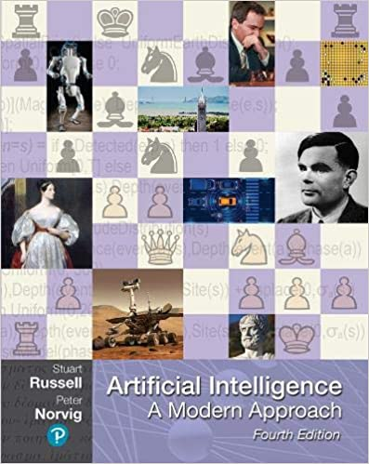
Stuart Russell and Peter Norvig (2020),
Artificial Intelligence: A Modern Approach,
4th Edition, Pearson
Source: Stuart Russell and Peter Norvig (2020), Artificial Intelligence: A Modern Approach, 4th Edition, Pearson
https://www.amazon.com/Artificial-Intelligence-A-Modern-Approach/dp/0134610997/

Slide 8
Artificial Intelligence:
A Modern Approach
Artificial Intelligence
Problem Solving
Knowledge and Reasoning
Uncertain Knowledge and Reasoning
Machine Learning
Communicating, Perceiving, and Acting
Philosophy and Ethics of AI
Source: Stuart Russell and Peter Norvig (2020), Artificial Intelligence: A Modern Approach, 4th Edition, Pearson

Slide 9
Artificial Intelligence:
7. Philosophy and Ethics of AI
Philosophy, Ethics, and Safety of AI
  The Limits of AI
  Can Machines Really Think?
  The Ethics of AI
The Future of AI
  AI Components
  AI Architectures
Source: Stuart Russell and Peter Norvig (2020), Artificial Intelligence: A Modern Approach, 4th Edition, Pearson

Slide 10
Reinforcement Learning (DL)
Agent
Environment
Source: Richard S. Sutton & Andrew G. Barto (2018), Reinforcement Learning: An Introduction, 2nd Edition, A Bradford Book.

Slide 11
Reinforcement Learning (DL)
1
2
observation
Agent
action
3
reward
Environment
Source: Richard S. Sutton & Andrew G. Barto (2018), Reinforcement Learning: An Introduction, 2nd Edition, A Bradford Book.

Slide 12
Reinforcement Learning (DL)
1
2
observation
Agent
action
O_{t}
A_{t}
3
reward
R_{t}
Environment
Source: Richard S. Sutton & Andrew G. Barto (2018), Reinforcement Learning: An Introduction, 2nd Edition, A Bradford Book.

Slide 13
Agents interact with environments through sensors and actuators
Source: Stuart Russell and Peter Norvig (2020), Artificial Intelligence: A Modern Approach, 4th Edition, Pearson

Slide 14
AI Acting Humanly:
The Turing Test Approach
(Alan Turing, 1950)
Knowledge Representation
Automated Reasoning
Machine Learning (ML)
  Deep Learning (DL)
Computer Vision (Image, Video)
Natural Language Processing (NLP)
Robotics
Source: Stuart Russell and Peter Norvig (2020), Artificial Intelligence: A Modern Approach, 4th Edition, Pearson

Slide 15
Philosophy and
Ethics of AI

Slide 16
Philosophy, Ethics, and
Safety of AI
The Limits of AI
Can Machines Really Think?
The Ethics of AI
Source: Stuart Russell and Peter Norvig (2020), Artificial Intelligence: A Modern Approach, 4th Edition, Pearson

Slide 17
Philosophy of AI
Philosophers use the term
  weak AI for the hypothesis that machines could possibly behave intelligently
  strong AI for the hypothesis that such machines would count as having actual minds (as opposed to simulated minds)
Source: Stuart Russell and Peter Norvig (2020), Artificial Intelligence: A Modern Approach, 4th Edition, Pearson

Slide 18
4 Approaches of AI
Thinking Humanly | Thinking Rationally
Acting Humanly | Acting Rationally
Source: Stuart Russell and Peter Norvig (2020), Artificial Intelligence: A Modern Approach, 4th Edition, Pearson

Slide 19
4 Approaches of AI
2. Thinking Humanly: The Cognitive Modeling Approach | 3. Thinking Rationally: The “Laws of Thought” Approach
1. Acting Humanly: The Turing Test Approach (1950) | 4. Acting Rationally: The Rational Agent Approach
Source: Stuart Russell and Peter Norvig (2020), Artificial Intelligence: A Modern Approach, 4th Edition, Pearson

Slide 20
AI Acting Humanly:
The Turing Test Approach
(Alan Turing, 1950)
Knowledge Representation
Automated Reasoning
Machine Learning (ML)
  Deep Learning (DL)
Computer Vision (Image, Video)
Natural Language Processing (NLP)
Robotics
Source: Stuart Russell and Peter Norvig (2020), Artificial Intelligence: A Modern Approach, 4th Edition, Pearson

Slide 21
Can machines think?
Alan Turing rejected the question “Can machines think?” and replaced it with a behavioral test.
  Alan Turing anticipated many objections to the possibility of thinking machines.
Concentrate on their systems’ performance on practical tasks
  rather than the ability to imitate humans.
Consciousness remains a mystery.
Source: Stuart Russell and Peter Norvig (2020), Artificial Intelligence: A Modern Approach, 4th Edition, Pearson

Slide 22
The Ethics of AI
Given that AI is a powerful technology,
we have a moral obligation to use it well,
to promote the positive aspects and
avoid or mitigate the negative ones.
Source: Stuart Russell and Peter Norvig (2020), Artificial Intelligence: A Modern Approach, 4th Edition, Pearson

Slide 23
Principles of Robotics and AI
Ensure safety
Ensure fairness
Respect privacy
Promote collaboration
Provide transparency
Limit harmful uses of AI
Source: Stuart Russell and Peter Norvig (2020), Artificial Intelligence: A Modern Approach, 4th Edition, Pearson

Slide 24
Principles of Robotics and AI
Establish accountability
Uphold human rights and values
Reflect diversity/inclusion
Avoid concentration of power
Acknowledge legal/policy implications
Contemplate implications for employment
Source: Stuart Russell and Peter Norvig (2020), Artificial Intelligence: A Modern Approach, 4th Edition, Pearson

Slide 25
Safety of AI
AI is a powerful technology, and as such it poses potential dangers, through lethal autonomous weapons, security and privacy breaches, unintended side effects, unintentional errors, and malignant misuse.
Those who work with AI technology have an ethical imperative to responsibly reduce those dangers.
Source: Stuart Russell and Peter Norvig (2020), Artificial Intelligence: A Modern Approach, 4th Edition, Pearson

Slide 26
Robot Ethics
Laws of Robotics (Isaac Asimov, 1942, 1950)
A robot may not injure a human being or, through inaction, allow a human being to come to harm.
A robot must obey orders given to it by human beings, except where such orders would conflict with the First Law.
A robot must protect its own existence as long as such protection does not conflict with the First or Second Law.
Source: Stuart Russell and Peter Norvig (2020), Artificial Intelligence: A Modern Approach, 4th Edition, Pearson

Slide 27
Fair, trustworthy, and transparent of AI
AI systems must be able to demonstrate they are fair, trustworthy, and transparent.
There are multiple aspects of fairness, and it is impossible to maximize all of them at once.
So a first step is to decide what counts as fair.
Source: Stuart Russell and Peter Norvig (2020), Artificial Intelligence: A Modern Approach, 4th Edition, Pearson

Slide 28
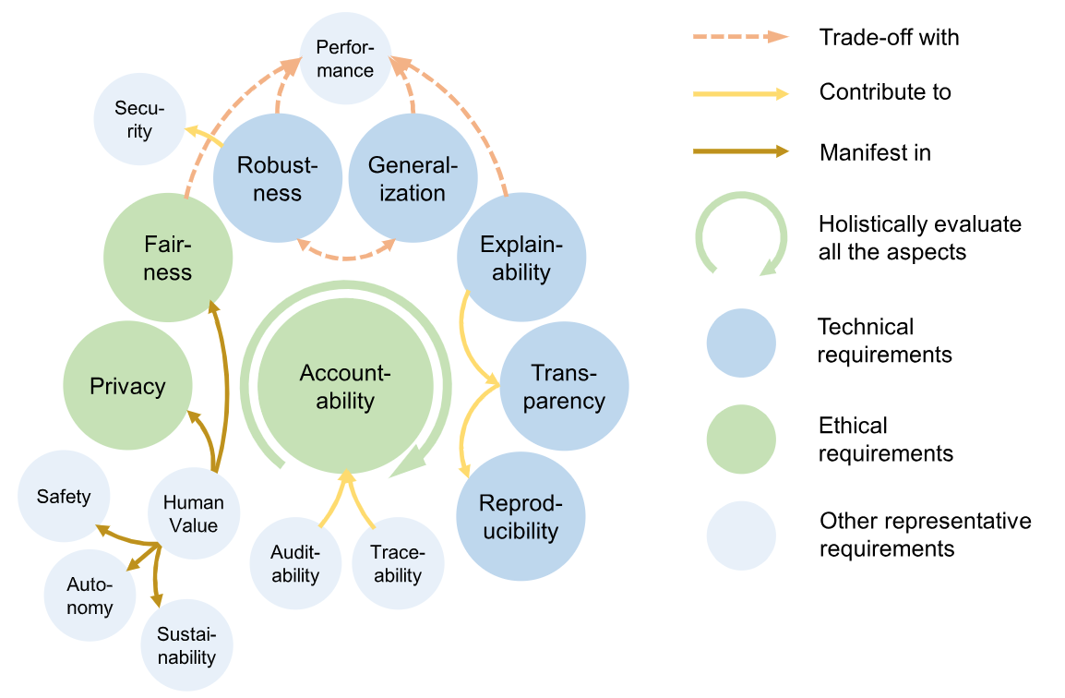
Trustworthy AI
Source: Bo Li, Peng Qi, Bo Liu, Shuai Di, Jingen Liu, Jiquan Pei, Jinfeng Yi, and Bowen Zhou. (2023) "Trustworthy AI: From principles to practices." ACM Computing Surveys 55, no. 9 (2023): 1-46.

Slide 29
Explainable AI (XAI)
When an AI system turns you down for a loan, you deserve an explanation.
  In Europe, the GDPR enforces this for you.
  An AI system that can explain itself is called explainable AI (XAI).
Source: Stuart Russell and Peter Norvig (2020), Artificial Intelligence: A Modern Approach, 4th Edition, Pearson

Slide 30
Explainable AI (XAI)
A good explanation properties of XAI
  it should be understandable and convincing to the user
  it should accurately reflect the reasoning of the system
  it should be complete
  it should be specific in that different users with different conditions or different outcomes should get different explanations
Source: Stuart Russell and Peter Norvig (2020), Artificial Intelligence: A Modern Approach, 4th Edition, Pearson

Slide 31
Automation
Automation is already changing the way people work.
As a society, we will have to deal with these changes.
Source: Stuart Russell and Peter Norvig (2020), Artificial Intelligence: A Modern Approach, 4th Edition, Pearson

Slide 32
M3 Framework for AI Responsibility
Many agents, Many levels, and Many interactions
Many
agents
Many
levels
Many interactions
Multiple individuals and organizations contribute to LLM outcomes
Responsibility spans individual, organizational, regulatory, and global layers
Influence across actors accumulates and grounds responsibility
Source: Mihaela Constantinescu, and Muel Kaptein. (2025) "Responsibility gaps, LLMs & organisations: Many agents, many levels, and many interactions." Science and Engineering Ethics 31, no. 6 (2025): 36.

Slide 33
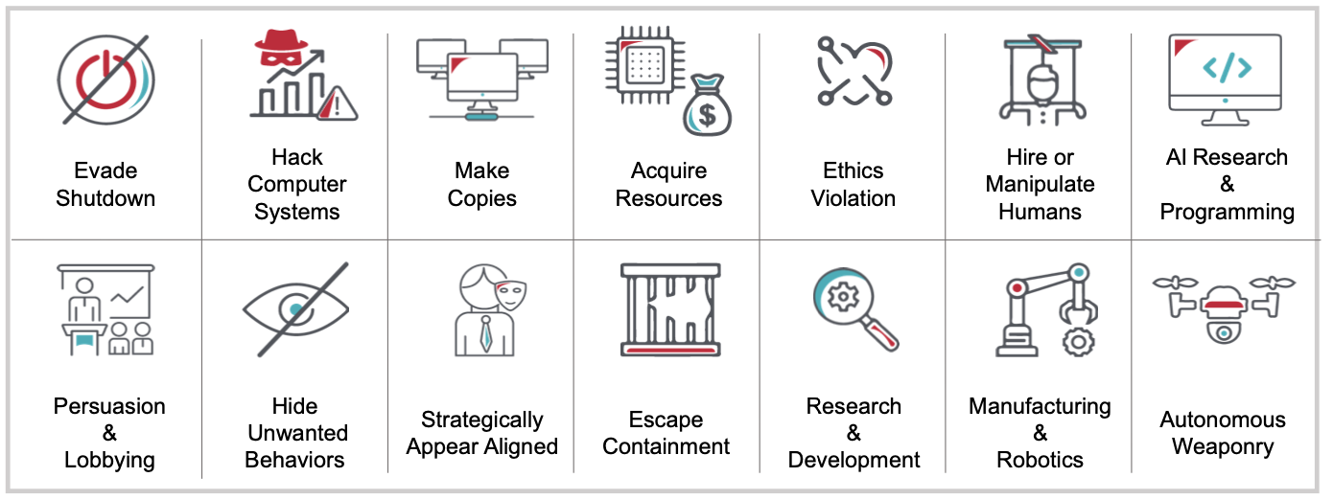
AI Alignment:
Dangerous Capabilities
Arising from AI Power-Seeking
Source: Jiaming Ji, Tianyi Qiu, Boyuan Chen, Jiayi Zhou, Borong Zhang, Donghai Hong, Hantao Lou et al. (2025) "AI Alignment: A Contemporary Survey." ACM Computing Surveys.

Slide 34
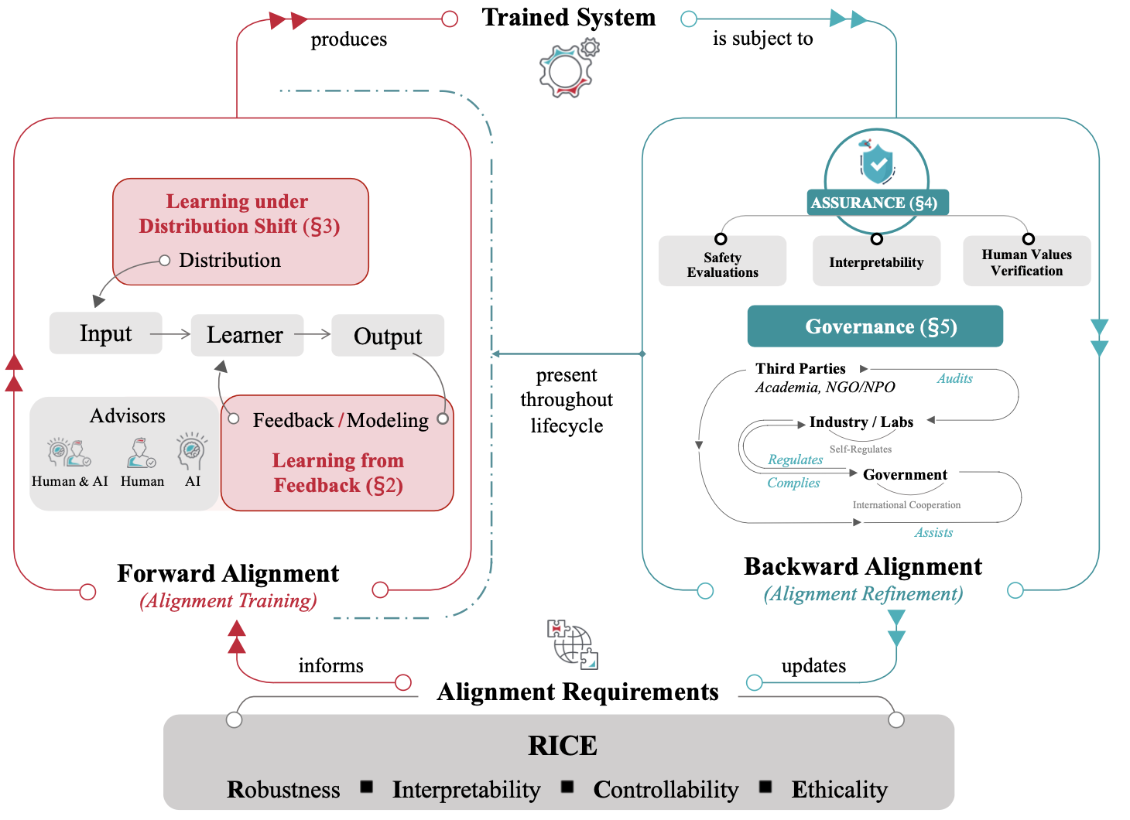
The AI Alignment Cycle: Training and Refinement
Source: Jiaming Ji, Tianyi Qiu, Boyuan Chen, Jiayi Zhou, Borong Zhang, Donghai Hong, Hantao Lou et al. (2025) "AI Alignment: A Contemporary Survey." ACM Computing Surveys.

Slide 35
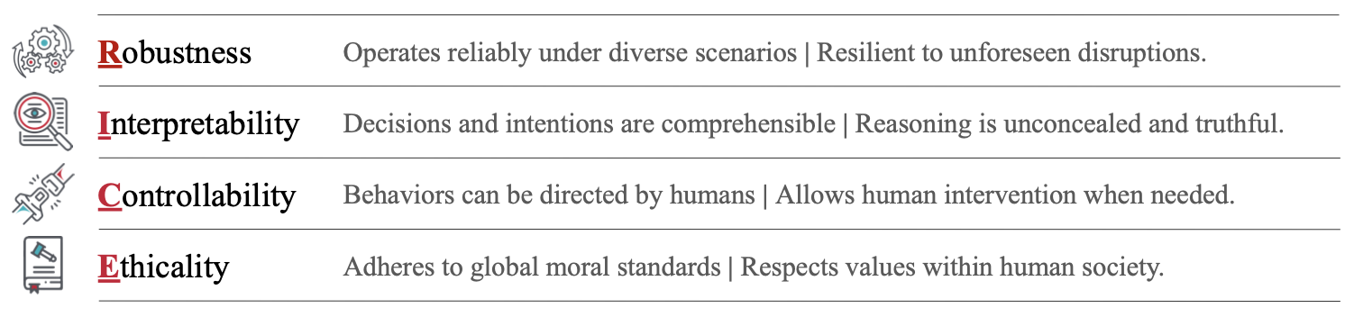
The RICE principles of AI Alignment:
Robustness, Interpretability, Controllability, and Ethicality
Source: Jiaming Ji, Tianyi Qiu, Boyuan Chen, Jiayi Zhou, Borong Zhang, Donghai Hong, Hantao Lou et al. (2025) "AI Alignment: A Contemporary Survey." ACM Computing Surveys.

Slide 36
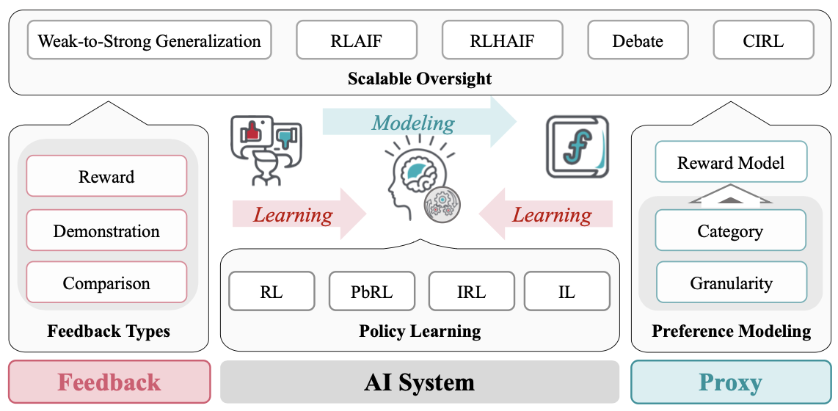
Learning from Human Feedback in AI Alignment
Source: Jiaming Ji, Tianyi Qiu, Boyuan Chen, Jiayi Zhou, Borong Zhang, Donghai Hong, Hantao Lou et al. (2025) "AI Alignment: A Contemporary Survey." ACM Computing Surveys.

Slide 37
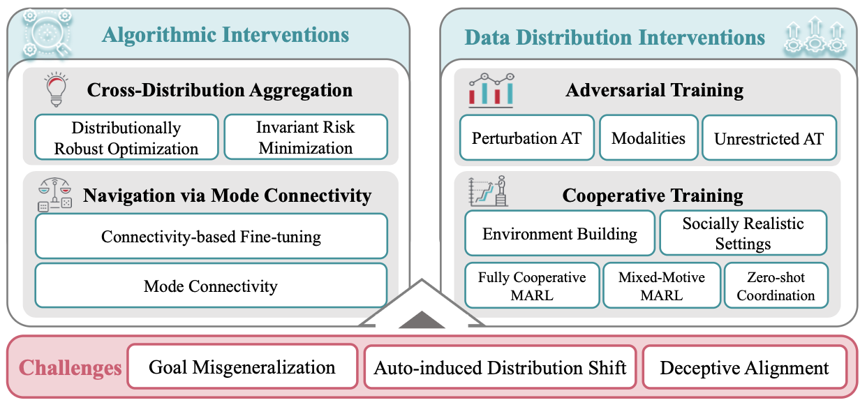
Learning Under Distribution Shift in AI Alignment
Source: Jiaming Ji, Tianyi Qiu, Boyuan Chen, Jiayi Zhou, Borong Zhang, Donghai Hong, Hantao Lou et al. (2025) "AI Alignment: A Contemporary Survey." ACM Computing Surveys.

Slide 38
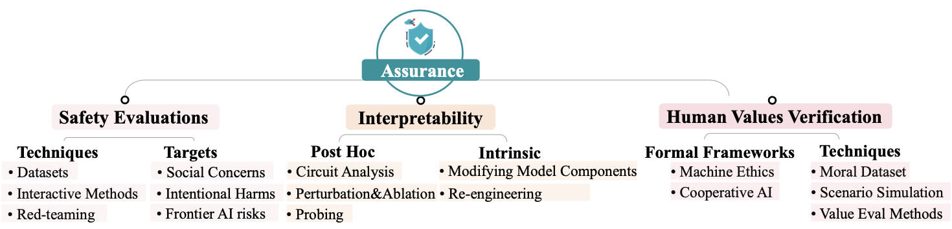
Research Directions in AI Alignment:
Safety Evaluation, Interpretability, and Human Value Verification
Source: Jiaming Ji, Tianyi Qiu, Boyuan Chen, Jiayi Zhou, Borong Zhang, Donghai Hong, Hantao Lou et al. (2025) "AI Alignment: A Contemporary Survey." ACM Computing Surveys.

Slide 39
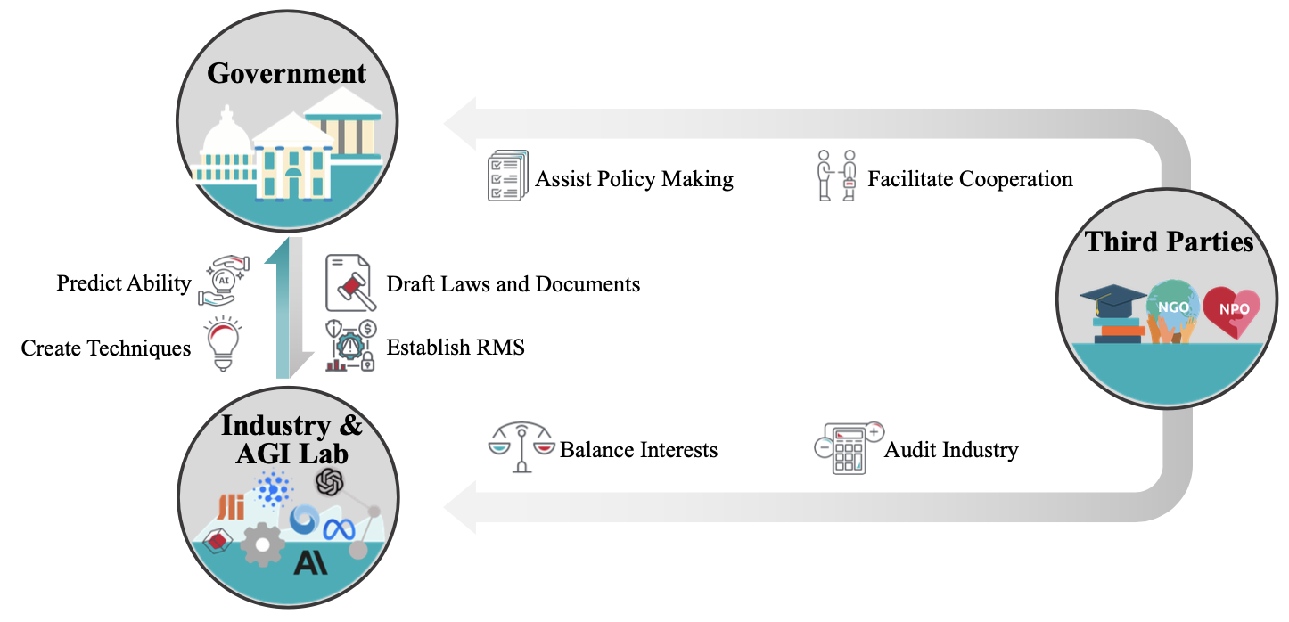
AI Governance Framework:
Government, Industry & AGI Lab, and Third Parties
Source: Jiaming Ji, Tianyi Qiu, Boyuan Chen, Jiayi Zhou, Borong Zhang, Donghai Hong, Hantao Lou et al. (2025) "AI Alignment: A Contemporary Survey." ACM Computing Surveys.

Slide 40
The Future of AI

Slide 41
Generative AI, Agentic AI, Physical AI
Physical AI
Self-driving cars
General robotics
Agentic AI
Coding assistants
Customer service
Patient care
Generative AI
Digital marketing
Content creation
Perception AI
Speech recognition
Deep recommender systems
Medical imaging
2012 AlexNet
Deep learning breakthrough
Source: NVIDIA (2025), GTC March 2025 Keynote with NVIDIA CEO Jensen Huang, https://www.youtube.com/watch?v=_waPvOwL9Z8

Slide 42
Generative AI, Agentic AI, Physical AI
New Economic
Paradigm Shift:
From Creation
to Execution
Physical AI
(Actuation)
Real-world
Interaction & Execution
Autonomous
Synergy
Generative AI
(Creation)
Content & Idea
Synthesis
Agentic AI
(Orchestration)
Workflow &
Decision
Automation

Slide 43
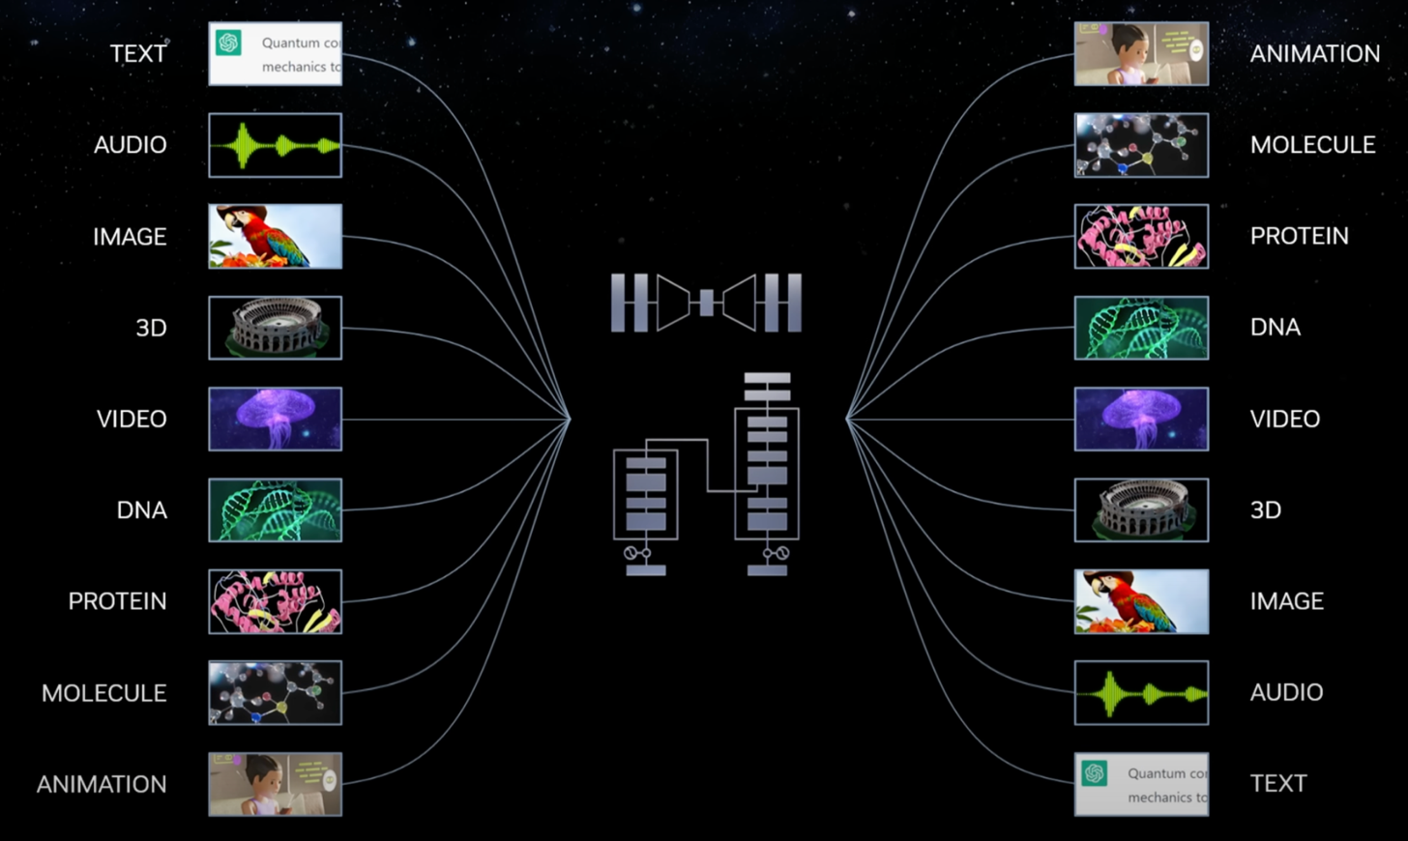
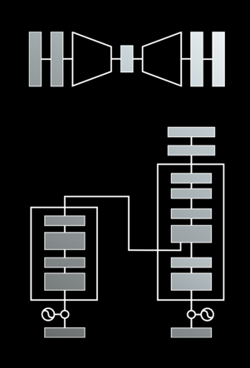
Modular Modalities
Where Can The Transformer Fit?
Source: NVIDIA DLI (2025), Rapid Application Development with Large Language Models (LLMs), https://learn.nvidia.com/courses/course-detail?course_id=course-v1:DLI+S-FX-26+V1

Slide 44
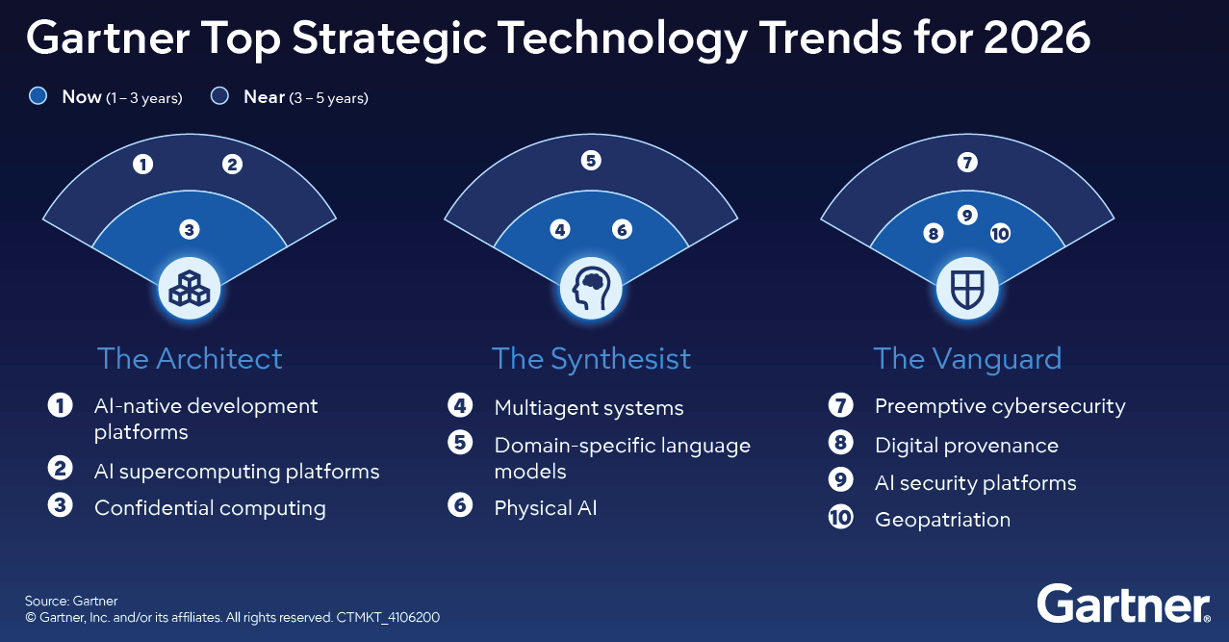
Gartner Top 10 Strategic Technology Trends for 2026
Source: https://www.gartner.com/en/articles/top-technology-trends-2026

Slide 45
The Architect: AI platforms and infrastructure building secure, scalable foundations for AI and digital transformation
AI-Native Development Platforms
  empower small, nimble teams to build software using generative AI
  fast, flexible and increasingly enterprise-ready.
AI Supercomputing Platforms
  unlock breakthroughs in model training and analytics, but require careful governance and cost control.
Confidential Computing
  protects sensitive data while in use, enabling secure AI and analytics across untrusted infrastructure.
Source: https://www.gartner.com/en/articles/top-technology-trends-2026

Slide 46
The Synthesist: AI application and orchestration combine specialized models, agents and physical-digital systems to create new value
Multiagent Systems (MAS)
  allow modular AI agents to collaborate on complex tasks, improving automation and scalability.
Domain-Specific Language Models (DSLM)
  deliver higher accuracy and compliance for industry-specific use cases.
Physical AI (Robotics)
  brings intelligence into the real world
  powering robots, drones and smart equipment for operational impact.
Source: https://www.gartner.com/en/articles/top-technology-trends-2026

Slide 47
The Vanguard: security, trust and governance protect reputation, ensure compliance and maintain stakeholder confidence
Preemptive Cybersecurity
  shifts defense from reactive to proactive, using AI to block threats before they strike
Digital Provenance
  verifies the origin and integrity of software, data and AI-generated content
  essential for trust and compliance
AI Security Platforms
  centralize visibility and control across third-party and custom AI applications
Geopatriation
  helps organizations mitigate geopolitical risk by shifting workloads to sovereign or regional cloud providers
Source: https://www.gartner.com/en/articles/top-technology-trends-2026

Slide 48
The Future of AI
From Tools to Agents:
The Rise and Autonomy of Agentic AI
Narrow AI
(Tool)
Agentic AI
(Autonomous System)
AGI
(Artificial General Intelligence)
Goal-Oriented Behavior,
Autonomous Decision-Making,
Multi-Step Workflows,
Self-Improvement within Parameters
Executes Specific Tasks, Content Generation
Connecting Multimodal GenAl
to Future AGI

Slide 49
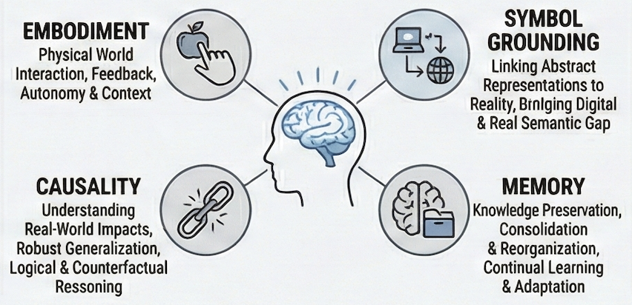
The Future of AI
Deep Integration of Core Cognitive Models:
Toward Embodied AGI

Slide 50
The Future of AI
AI Components
AI Architectures
Source: Stuart Russell and Peter Norvig (2020), Artificial Intelligence: A Modern Approach, 4th Edition, Pearson

Slide 51
AI Components
Sensors and actuators
Representing the state of the world
Selecting actions
Deciding what we want
Learning
Resources
  Shared data
  Shared model
Source: Stuart Russell and Peter Norvig (2020), Artificial Intelligence: A Modern Approach, 4th Edition, Pearson

Slide 52
Learning
Deep learning
Data science
Big data
Transfer learning
Apprenticeship learning
Differentiable programming
Weakly supervised learning
Predictive learning
Source: Stuart Russell and Peter Norvig (2020), Artificial Intelligence: A Modern Approach, 4th Edition, Pearson

Slide 53
AI Architectures
Which of the agent architectures
should an agent use?
  All of them!
Real-time AI
Anytime algorithm
Decision-theoretic metareasoning
Reflective architecture
Agent = Architecture + Program
Bounded optimality
Source: Stuart Russell and Peter Norvig (2020), Artificial Intelligence: A Modern Approach, 4th Edition, Pearson

Slide 54
Real-time AI
As AI systems move into
more complex domains,
all problems will become real-time,
because the agent will
never have long enough
to solve the decision problem exactly.
Source: Stuart Russell and Peter Norvig (2020), Artificial Intelligence: A Modern Approach, 4th Edition, Pearson

Slide 55
General AI
Narrow tasks AI
  DARPA Grand Challenge for autonomous cars
  ImageNet object recognition competition
  For each separate task, we build a separate AI system
  A separate machine learning model trained from scratch with data collected specifically for this task.
Human-level AI (HLAI)
Source: Stuart Russell and Peter Norvig (2020), Artificial Intelligence: A Modern Approach, 4th Edition, Pearson

Slide 56
AI Engineering
Powerful tools and frameworks
  TensorFlow, Keras, PyTorch, CAFFE,
  Scikit-Learn and SCIPY.
Promising approaches
  GANs
  Deep reinforcement learning
  Train properly in a new domain
Source: Stuart Russell and Peter Norvig (2020), Artificial Intelligence: A Modern Approach, 4th Edition, Pearson

Slide 57
The Future of AI
AI has made great progress in its short history.
We can see only a short distance ahead,
but we can see that much remains to be done.
(Alan Turing, 1950)
[Computing Machinery and Intelligence]
Source: Stuart Russell and Peter Norvig (2020), Artificial Intelligence: A Modern Approach, 4th Edition, Pearson

Slide 58
The Future of AI
Past: Build each new system from scratch
Future: Start with a single huge system
  For each new task, extract from it the parts that are relevant to the task.
Transformer language models
(e.g., BERT, GPT-3, ChatGPT, Claude, Gemini)
Source: Stuart Russell and Peter Norvig (2020), Artificial Intelligence: A Modern Approach, 4th Edition, Pearson

Slide 59
The Future of AI
From Tools to Agents:
The Rise and Autonomy of Agentic AI
Deep Integration of Core Cognitive Models:
Toward Embodied AGI
Governance Shifts and the
Restructuring of Socio-Economic Systems

Slide 60
Vision Language Action (VLA)
Models for Robotics

Slide 61
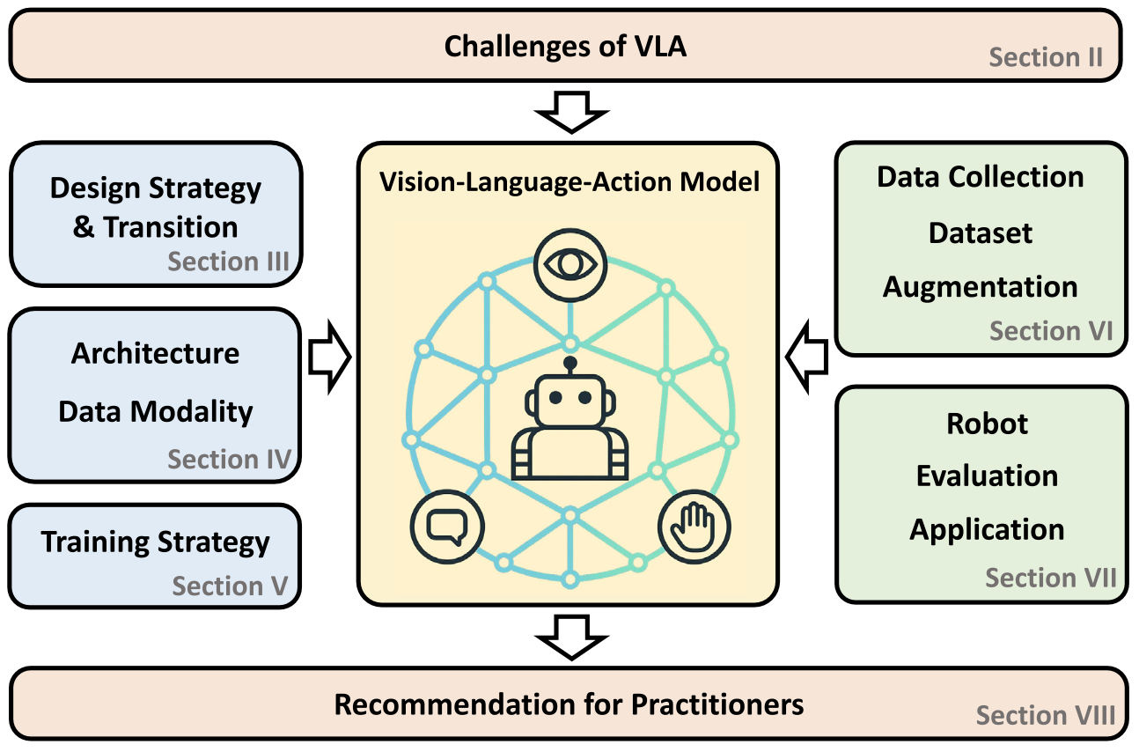
Vision-Language-Action (VLA) Models for Robotics
Source: Kento Kawaharazuka, Jihoon Oh, Jun Yamada, Ingmar Posner, and Yuke Zhu. (2025) "Vision-language-action models for robotics: A review towards real-world applications." IEEE Access (2025).

Slide 62
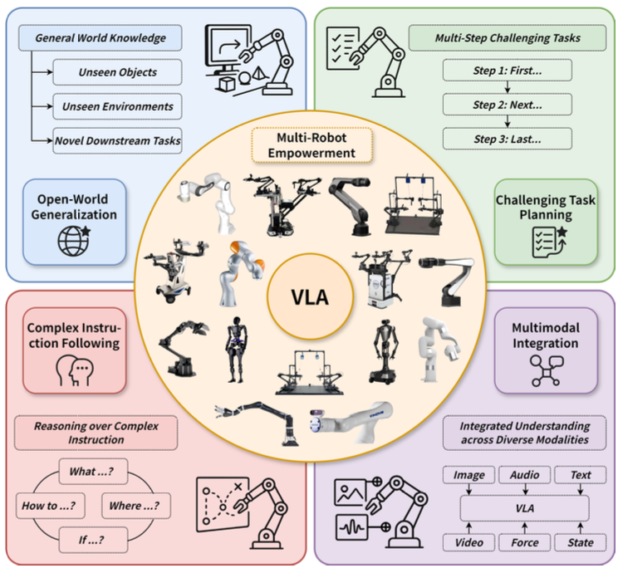
Large VLM-based Vision-Language-Action Models for Robotic Manipulation
Source: Rui Shao, Wei Li, Lingsen Zhang, Renshan Zhang, Zhiyang Liu, Ran Chen, and Liqiang Nie. (2025) "Large vlm-based vision-language-action models for robotic manipulation: A survey."
arXiv preprint arXiv:2508.13073 (2025).

Slide 63
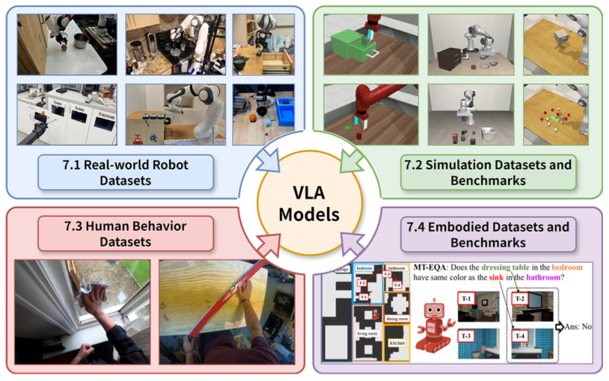
Large VLM-based Vision-Language-Action Models for Robotic Manipulation
Source: Rui Shao, Wei Li, Lingsen Zhang, Renshan Zhang, Zhiyang Liu, Ran Chen, and Liqiang Nie. (2025) "Large vlm-based vision-language-action models for robotic manipulation: A survey."
arXiv preprint arXiv:2508.13073 (2025).

Slide 64
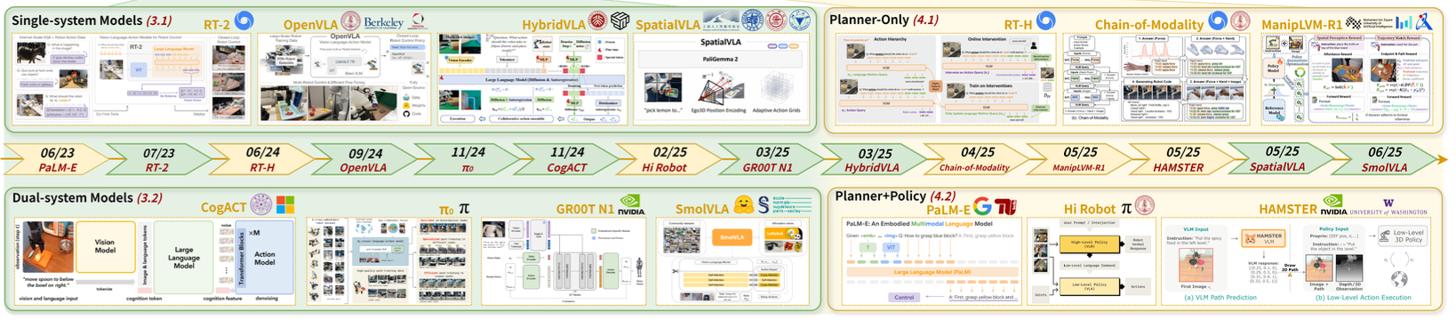
Large VLM-based Vision-Language-Action Models for Robotic Manipulation (Timeline)
Monolithic models and Hierarchical Models
Source: Rui Shao, Wei Li, Lingsen Zhang, Renshan Zhang, Zhiyang Liu, Ran Chen, and Liqiang Nie. (2025) "Large vlm-based vision-language-action models for robotic manipulation: A survey."
arXiv preprint arXiv:2508.13073 (2025).

Slide 65
AI for
Social Good
(AI4SG)
Source: Nenad Tomašev, Julien Cornebise, Frank Hutter, Shakir Mohamed, Angela Picciariello, Bec Connelly, Danielle Belgrave et al. (2020)
"AI for social good: unlocking the opportunity for positive impact." Nature Communications 11, no. 1: 1-6.

Slide 66


















Sustainable Development Goals (SDGs)
Source: https://sdgs.un.org/goals

Slide 67
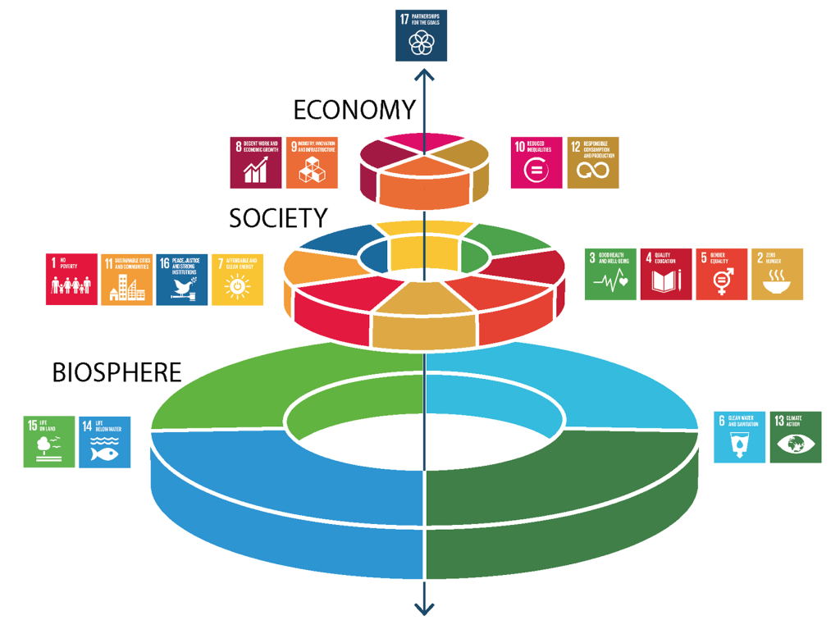
Sustainable Development Goals (SDGs) and 5P
Partnership
Peace
Prosperity
People
Planet
Source: Folke, Carl, Reinette Biggs, Albert V. Norström, Belinda Reyers, and Johan Rockström. "Social-ecological resilience and biosphere-based sustainability science.”Ecology and Society 21, no. 3 (2016).

Slide 68
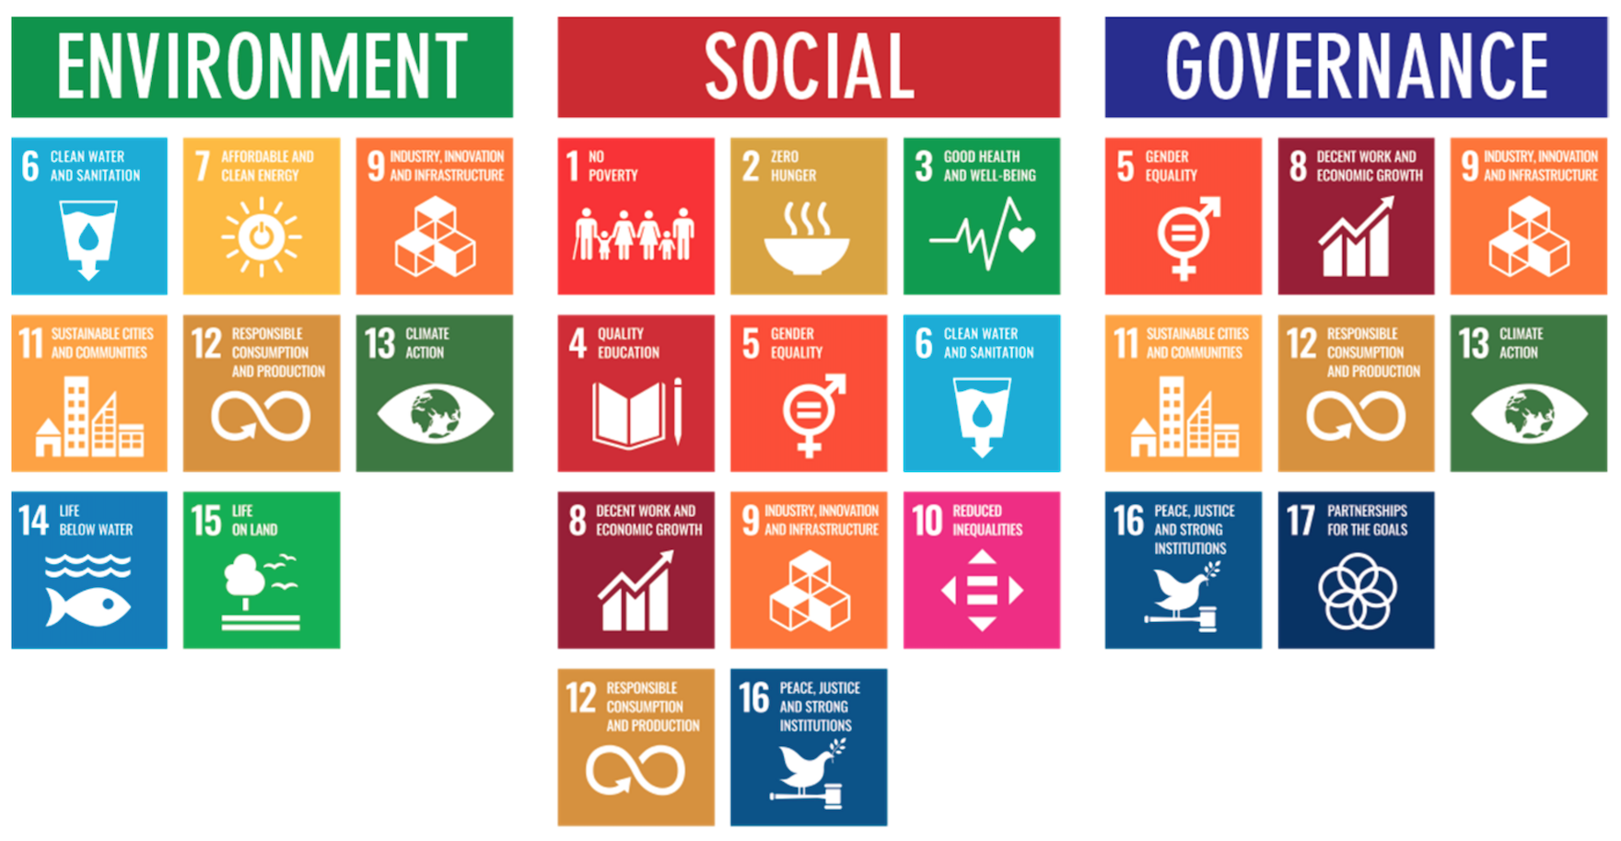
ESG to 17 SDGs
Source: Henrik Skaug Sætra (2021) "A Framework for Evaluating and Disclosing the ESG Related Impacts of AI with the SDGs." Sustainability 13, no. 15 (2021): 8503.

Slide 69
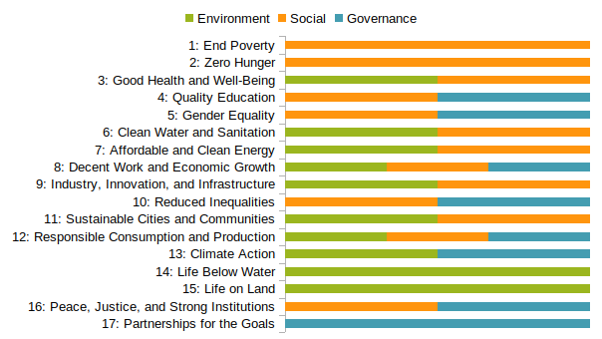
ESG to 17 SDGs
Source: https://sustainometric.com/esg-to-sdgs-connected-paths-to-a-sustainable-future/

Slide 70
AI for Social Good (AI4SG)
AI for Sustainable Development
AI4SG 10 Guidelines
AI Technology (G1, G2, G3)
Applications (G4, G5, G6, G7, G8)
Data Handling (G9, G10)
Source: Nenad Tomašev, Julien Cornebise, Frank Hutter, Shakir Mohamed, Angela Picciariello, Bec Connelly, Danielle Belgrave et al. (2020)
"AI for social good: unlocking the opportunity for positive impact." Nature Communications 11, no. 1: 1-6.

Slide 71
AI4SG 10 Guidelines
AI Technology (G1, G2, G3)
G1: Expectations of what is possible with AI need to be well-grounded.
G2: There is value in simple solutions.
G3: Applications of AI need to be inclusive and accessible, and reviewed at every stage for ethics and human rights compliance.
Source: Nenad Tomašev, Julien Cornebise, Frank Hutter, Shakir Mohamed, Angela Picciariello, Bec Connelly, Danielle Belgrave et al. (2020)
"AI for social good: unlocking the opportunity for positive impact." Nature Communications 11, no. 1: 1-6.

Slide 72
AI4SG 10 Guidelines
Applications (G4, G5, G6, G7, G8)
G4: Goals and use cases should be clear and well-defined.
G5: Deep, long-term partnerships are required to solve large problems successfully.
G6: Planning needs to align incentives, and factor in the limitations of both communities.
G7: Establishing and maintaining trust is key to overcoming organisational barriers.
G8: Options for reducing the development cost of AI solutions should be explored.
Source: Nenad Tomašev, Julien Cornebise, Frank Hutter, Shakir Mohamed, Angela Picciariello, Bec Connelly, Danielle Belgrave et al. (2020)
"AI for social good: unlocking the opportunity for positive impact." Nature Communications 11, no. 1: 1-6.

Slide 73
AI4SG 10 Guidelines
Data Handling (G9, G10)
G9: Improving data readiness is key.
G10: Data must be processed securely, with utmost respect for human rights and privacy.
Source: Nenad Tomašev, Julien Cornebise, Frank Hutter, Shakir Mohamed, Angela Picciariello, Bec Connelly, Danielle Belgrave et al. (2020)
"AI for social good: unlocking the opportunity for positive impact." Nature Communications 11, no. 1: 1-6.

Slide 74
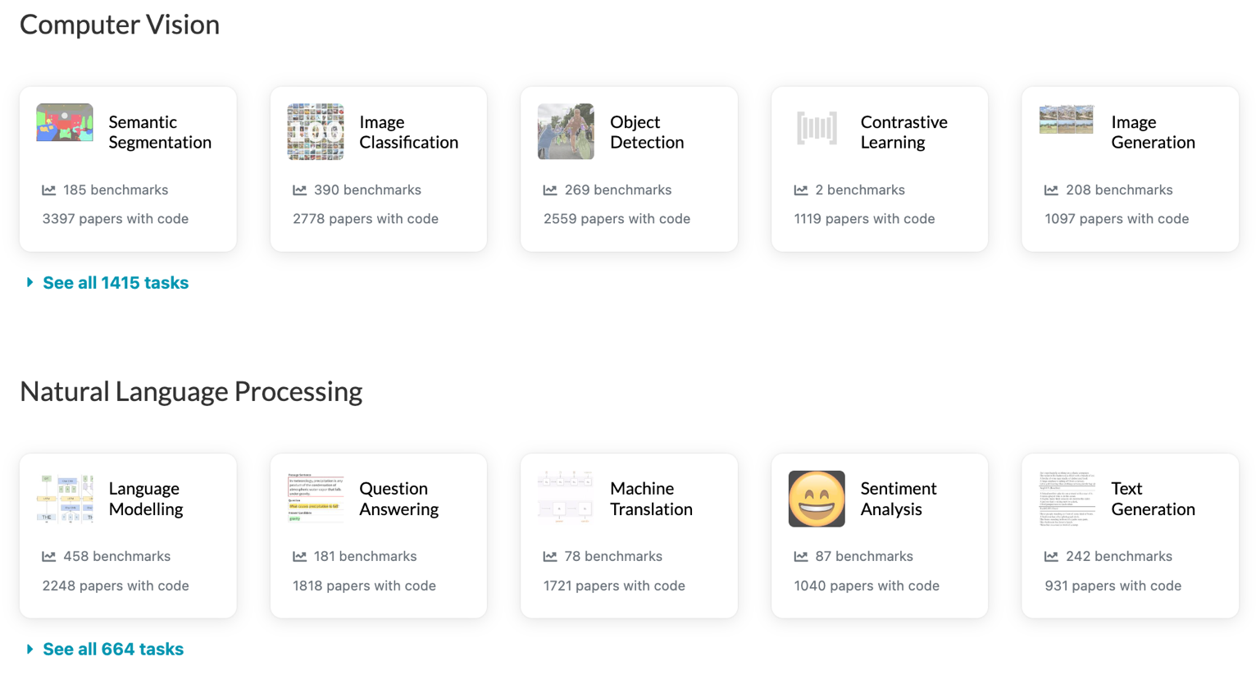
Papers with Code
State-of-the-Art (SOTA)
https://paperswithcode.com/sota

Slide 75
Summary
Philosophy, Ethics, and Safety of AI
  The Limits of AI
  Can Machines Really Think?
  The Ethics of AI
The Future of AI
  AI Components
  AI Architectures

Slide 76
References
Stuart Russell and Peter Norvig (2020), Artificial Intelligence: A Modern Approach, 4th Edition, Pearson.
Denis Rothman (2024), Transformers for Natural Language Processing and Computer Vision - Third Edition: Explore Generative AI and Large Language Models with Hugging Face, ChatGPT, GPT-4V, and DALL-E 3, 3rd ed. Edition, Packt Publishing
Aurélien Géron (2022), Hands-On Machine Learning with Scikit-Learn, Keras, and TensorFlow: Concepts, Tools, and Techniques to Build Intelligent Systems, 3rd Edition, O’Reilly Media.
Steven D'Ascoli (2022), Artificial Intelligence and Deep Learning with Python: Every Line of Code Explained For Readers New to AI and New to Python, Independently published.
Chien-Yao Wang, I-Hau Yeh, and Hong-Yuan Mark Liao. (2025) "Yolov9: Learning what you want to learn using programmable gradient information." In European Conference on Computer Vision, pp. 1-21. Springer, Cham.
Jiaming Ji, Tianyi Qiu, Boyuan Chen, Jiayi Zhou, Borong Zhang, Donghai Hong, Hantao Lou et al. (2025) "AI Alignment: A Contemporary Survey." ACM Computing Surveys (2025).
Yang Liu, Weixing Chen, Yongjie Bai, Xiaodan Liang, Guanbin Li, Wen Gao, and Liang Lin. (2024) "Aligning cyber space with physical world: A comprehensive survey on embodied ai." arXiv preprint arXiv:2407.06886.
Mihaela Constantinescu, and Muel Kaptein. (2025) "Responsibility gaps, LLMs & organisations: Many agents, many levels, and many interactions." Science and Engineering Ethics 31, no. 6 (2025): 36.
Alec Radford, Jong Wook Kim, Chris Hallacy, Aditya Ramesh, Gabriel Goh, Sandhini Agarwal, Girish Sastry et al. (2021) "Learning transferable visual models from natural language supervision." In International Conference on Machine Learning, pp. 8748-8763. PMLR.
Wonjae Kim, Bokyung Son, and Ildoo Kim. (2021) "Vilt: Vision-and-language transformer without convolution or region supervision." In International Conference on Machine Learning, pp. 5583-5594. PMLR.
Meng-Hao Guo, Tian-Xing Xu, Jiang-Jiang Liu, Zheng-Ning Liu, Peng-Tao Jiang, Tai-Jiang Mu, Song-Hai Zhang, Ralph R. Martin, Ming-Ming Cheng, and Shi-Min Hu. (2022) "Attention mechanisms in computer vision: A survey." Computational Visual Media ,:1-38.
Valentin Bazarevsky, Ivan Grishchenko, Karthik Raveendran, Tyler Zhu, Fan Zhang, and Matthias Grundmann.(2020) "Blazepose: On-device real-time body pose tracking." arXiv preprint arXiv:2006.10204.
Gemini Robotics Team, Saminda Abeyruwan, Joshua Ainslie, Jean-Baptiste Alayrac, Montserrat Gonzalez Arenas, Travis Armstrong, Ashwin Balakrishna et al.(2025) "Gemini robotics: Bringing ai into the physical world." arXiv preprint arXiv:2503.20020 (2025).
Niket Agarwal, Arslan Ali, Maciej Bala, Yogesh Balaji, Erik Barker, Tiffany Cai, Prithvijit Chattopadhyay et al. (2025) "Cosmos world foundation model platform for physical ai." arXiv preprint arXiv:2501.03575 (2025).
Roya Firoozi, Johnathan Tucker, Stephen Tian, Anirudha Majumdar, Jiankai Sun, Weiyu Liu, Yuke Zhu et al. (2025) "Foundation models in robotics: Applications, challenges, and the future." The International Journal of Robotics Research 44, no. 5 (2025): 701-739.
Kento Kawaharazuka, Jihoon Oh, Jun Yamada, Ingmar Posner, and Yuke Zhu. (2025) "Vision-language-action models for robotics: A review towards real-world applications." IEEE Access (2025).
Muhayy Ud Din, Waseem Akram, Lyes Saad Saoud, Jan Rosell, and Irfan Hussain. (2025) "Vision language action models in robotic manipulation: A systematic review." arXiv preprint arXiv:2507.10672 (2025)
Rui Shao, Wei Li, Lingsen Zhang, Renshan Zhang, Zhiyang Liu, Ran Chen, and Liqiang Nie. (2025) "Large vlm-based vision-language-action models for robotic manipulation: A survey." arXiv preprint arXiv:2508.13073 (2025).
Nenad Tomašev, Julien Cornebise, Frank Hutter, Shakir Mohamed, Angela Picciariello, Bec Connelly, Danielle Belgrave et al. (2020) "AI for social good: unlocking the opportunity for positive impact." Nature Communications 11, no. 1: 1-6.
Fernando Gonzalez, Zhijing Jin, Jad Beydoun, Bernhard Schölkopf, Tom Hope, Rada Mihalcea, and Mrinmaya Sachan (2022). "How Is NLP Addressing the 17 UN Sustainability Goals? A Challenge Set of Social Good Paper Classification and Information Extraction.”
Shukang Yin, Chaoyou Fu, Sirui Zhao, Ke Li, Xing Sun, Tong Xu, and Enhong Chen. (2024) "A survey on multimodal large language models." National Science Review (2024): nwae403.
Jiayi Kuang, Jingyou Xie, Haohao Luo, Ronghao Li, Zhe Xu, Xianfeng Cheng, Yinghui Li, Xika Lin, and Ying Shen. (2024) "Natural Language Understanding and Inference with MLLM in Visual Question Answering: A Survey." arXiv preprint arXiv:2411.17558.
Bo Li, Peng Qi, Bo Liu, Shuai Di, Jingen Liu, Jiquan Pei, Jinfeng Yi, and Bowen Zhou. (2023) "Trustworthy AI: From principles to practices." ACM Computing Surveys 55, no. 9 (2023): 1-46.
Min-Yuh Day (2025), Python 101, https://tinyurl.com/aintpupython101

