Slide 1









Introduction to
Sustainability and ESG Data Analytics
Sustainability and ESG Data Analytics
1141ESGDA01
MBA, IM, NTPU (M5265) (Fall 2025)
Wed 2, 3, 4 (9:10-12:00) (B3F17)
University Ambassador
Certified Instructor
Min-Yuh Day, Ph.D,
Professor and Director
Institute of Information Management, National Taipei University
https://web.ntpu.edu.tw/~myday
https://meet.google.com/miy-fbif-max
2025-09-10

Slide 2











Prof. Min-Yuh Day
University Ambassador
Certified Instructor
Director, Information Management, NTPU
Director, Intelligent Financial Innovation Technology, IFIT Lab, IM, NTPU
Director, Fintech and Green Finance Center (FGFC), NTPU
Division Director, Sustainable Development, Sustainability Office, NTPU
Visiting Scholar, IIS, Academia Sinica
Ph.D., Information Management, NTU
Artificial Intelligence, Agentic AI, ESG and Green Financial Technology,
Big Data Analytics, Electronic Commerce

Slide 3
Course Syllabus
National Taipei University
Academic Year 114, 1st Semester (Fall 2025)
Course Title: Sustainability and ESG Data Analytics
Instructor: Min-Yuh Day
Course Class: MBA, IM, NTPU (3 Credits, Elective)
Details
  In-Class and Distance Learning EMI Course
  (3 Credits, Elective, One Semester) (M5265)
Time & Place: Wed, 2, 3, 4, (9:10-12:00) (B3F17)
Google Meet: https://meet.google.com/miy-fbif-max
https://meet.google.com/miy-fbif-max

Slide 4


Course Objectives
Understand the fundamental concepts of sustainability and ESG data analytics.
Equip with Hands-on practices of sustainability and ESG data analytics.
Integrate innovative thinking of big data analysis to enhance the operational model of sustainable development.
In the context of sustainability, use data analysis to formulate responses to sustainable issues and cultivate students' ability to extract management-relevant data analysis skills from the data.

Slide 5
The Course Includes
Sustainable Development Goals (SDGs)
SDG4｜Quality Education
SDG7｜Affordable and Clean Energy
SDG8｜Decent Work and Economic Growth
SDG9｜Industry, Innovation and Infrastructure
SDG11｜Sustainable Cities and Communities
SDG12｜Responsible Consumption and Production
SDG13｜Climate Action
SDG17｜Partnerships for the Goals

Slide 6
Course Outline
This course introduces the fundamental concepts and hands-on practices of Sustainability and ESG Data Analytics.
Topics include
  Introduction Sustainability and ESG Data Analytics
  Environmental, Social, and Governance (ESG) in Net-Zero Digital Transformation
  Data Science for Sustainability and ESG
  Web 3.0 and Big Data Analysis in Fintech, Green Finance, Sustainable Finance
  ESG Data Gathering, Analysis, and Visualization
  NVIDIA Building RAG Agents with LLMs
  Artificial Intelligence of things (AIoT) in ESG and Sustainability Applications
  Generative AI for ESG Rating and Reporting Generation
  Case Study on Sustainability and ESG Data Analytics

Slide 7
Core Competence
Exploring new knowledge in information technology, system development and application 80 %
Internet marketing planning ability 10 %
Thesis writing and independent research skills 10 %

Slide 8
Four Fundamental Qualities
Professionalism
  Creative thinking and Problem-solving 40 %
  Comprehensive Integration 40 %
Interpersonal Relationship
  Communication and Coordination 10 %
  Teamwork 5 %
Ethics
  Honesty and Integrity 0 %
  Self-Esteem and Self-reflection 0 %
International Vision
  Caring for Diversity 0 %
  Interdisciplinary Vision 5 %

Slide 9
College Learning Goals
Ethics/Corporate Social Responsibility
Global Knowledge/Awareness
Communication
Analytical and Critical Thinking

Slide 10
Department Learning Goals
Information Technologies and
System Development Capabilities
Internet Marketing Management Capabilities
Research capabilities

Slide 11
Syllabus
Week Date Subject/Topics
1 2025/09/10 Introduction Sustainability and ESG Data Analytics
2 2025/09/17 Environmental, Social, and Governance (ESG) in
Net-Zero Digital Transformation
3 2025/09/24 Data Science for Sustainability and ESG
4 2025/10/01 Case Study on Sustainability and ESG Data Analytics I
5 2025/10/08 Web 3.0 and Big Data Analysis in Fintech, Green and
Sustainable Finance
6 2025/10/15 ESG Data Gathering, Analysis, and Visualization

Slide 12
Syllabus
Week Date Subject/Topics
7 2025/10/22 NVIDIA Building RAG Agents with LLMs Part I:
LLM Services and AI Foundation Models
8 2025/10/29 Self-Learning
9 2025/11/05 Midterm Project Report
10 2025/11/12 NVIDIA Building RAG Agents with LLMs Part II:
Document Loading, Chunking, and Embeddings
11 2025/11/19 NVIDIA Building RAG Agents with LLMs Part III:
Retrieval-Augmented Generation with
Vector Stores and RAG Evaluation

Slide 13
Syllabus
Week Date Subject/Topics
12 2025/11/26 Case Study on Sustainability and ESG Data Analytics II
13 2025/12/03 Artificial Intelligence of things (AIoT) in ESG and
Sustainability Applications
14 2025/12/10 Generative AI for ESG Rating and Reporting Generation
15 2025/12/17 Final Project Report I
16 2025/12/24 Final Project Report II

Slide 14
Course and Teaching Features
Combine Web3.0 to introduce basic concepts of big data analysis, research topics, and practical operations.
Provide theories and tools for data integration and communication planning.
Apply to analyze data from various domains and present analysis results through data visualization.
Expected Social Impact:
Learn from data analysis, cultivating the ability to analyze responses when facing sustainable issues and risks.
Train talents who possess basic concepts of big data analysis, research topics, practical operations, and practical abilities in sustainable data analysis.

Slide 15
Innovative Teaching Strategies
USR (University Social Responsibility) Local Connection and Collaboration
Group Learning
Problem-Based Learning (PBL)
Thematic Teaching
Learning by Thinking Teaching Method

Slide 16
Evaluation Methods
Individual Presentation 60 %
Group Presentation 10 %
Case Report 10 %
Class Participation 10 %
Assignment 10 %

Slide 17
Required Texts
Cino Robin Castelli, Cyril Shmatov (2022),
Quantitative Methods for ESG Finance, Wiley

Slide 18
Reference Books
Simon Thompson (2023), Green and Sustainable Finance: Principles and Practice in Banking, Investment and Insurance, 2nd Edition, Kogan Page.
Chrissa Pagitsas (2023), Chief Sustainability Officers At Work: How CSOs Build Successful Sustainability and ESG Strategies, Apress.
Hariom Tatsat, Sahil Puri, Brad Lookabaugh (2020), Machine Learning and Data Science Blueprints for Finance: From Building Trading Strategies to Robo-Advisors Using Python, O'Reilly Media
Aurélien Géron (2022), Hands-On Machine Learning with Scikit-Learn, Keras, and TensorFlow: Concepts, Tools, and Techniques to Build Intelligent Systems, 3rd Edition, O’Reilly Media.
Numa Dhamani and Maggie Engler (2024), Introduction to Generative AI, Manning.
Denis Rothman (2024), Transformers for Natural Language Processing and Computer Vision - Third Edition: Explore Generative AI and Large Language Models with Hugging Face, ChatGPT, GPT-4V, and DALL-E 3, 3rd ed. Edition, Packt Publishing.
Thomas R. Caldwell (2025), The Agentic AI Bible: The Complete and Up-to-Date Guide to Design, Build, and Scale Goal-Driven, LLM-Powered Agents that Think, Execute and Evolve, Independently published.

Slide 19
Other References
GRI (Global Report Initiative):
https://www.globalreporting.org/
CDP (Carbon Disclosure Project):
https://www.cdp.net/
SASB (Sustainability Accounting Standards Board):
https://sasb.org/
ISSB (International Sustainability Standards Board):
https://www.ifrs.org/groups/international-sustainability-standards-board/
TCFD (Task Force on Climate-related Financial Disclosures):
https://www.fsb-tcfd.org/
Research Papers

Slide 20
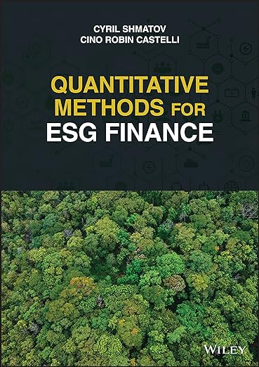
Cino Robin Castelli, Cyril Shmatov (2022),
Quantitative Methods for ESG Finance,
Wiley
Source: https://www.amazon.com/Quantitative-Methods-Finance-Robin-Castelli/dp/1119903807/

Slide 21
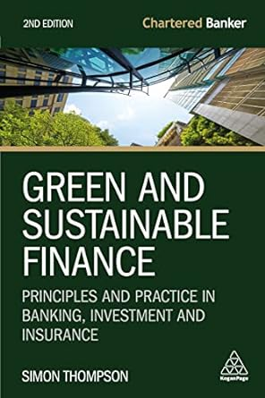
Simon Thompson (2023),
Green and Sustainable Finance:
Principles and Practice in Banking, Investment and Insurance,
2nd Edition, Kogan Page.
Source: https://www.amazon.com/Green-Sustainable-Finance-Principles-Investment/dp/1398609242/

Slide 22
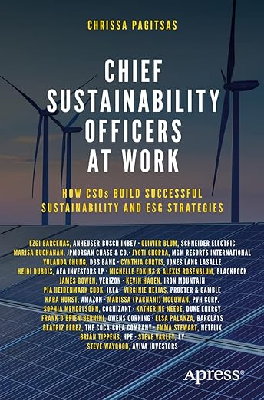
Chrissa Pagitsas (2023),
Chief Sustainability Officers At Work:
How CSOs Build Successful Sustainability and ESG Strategies,
Apress.
Source: https://www.amazon.com/Chief-Sustainability-Officers-Work-Successful/dp/1484278658/

Slide 23
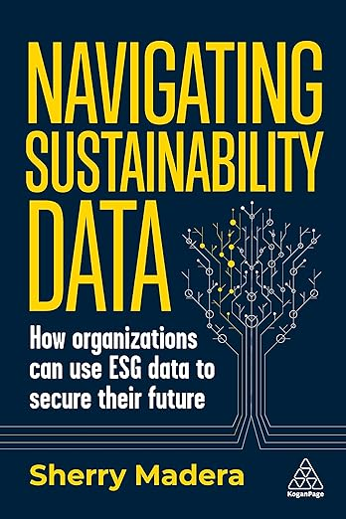
Sherry Madera (2024),
Navigating Sustainability Data: How Organizations can use ESG Data to Secure Their Future, Kogan Page
Source: https://www.amazon.com/Navigating-Sustainability-Data-Organizations-Secure/dp/1398612243/

Slide 24
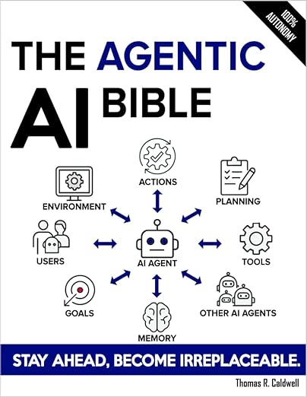
Thomas R. Caldwell (2025),
The Agentic AI Bible:
The Complete and Up-to-Date Guide to Design, Build, and Scale Goal-Driven,
LLM-Powered Agents that Think, Execute and Evolve,
Independently published
Source: https://www.amazon.com/Agentic-Bible-Up-Date-Goal-Driven/dp/B0FL21R86Q

Slide 25

Numa Dhamani and Maggie Engler (2024),
Introduction to Generative AI,
Manning
Source: Numa Dhamani and Maggie Engler (2024), Introduction to Generative AI, Manning
https://www.amazon.com/Introduction-Generative-AI-Numa-Dhamani/dp/1633437191/

Slide 26

Denis Rothman (2024),
Transformers for Natural Language Processing and Computer Vision:
Explore Generative AI and Large Language Models with Hugging Face, ChatGPT, GPT-4V, and DALL-E 3,
3rd Edition, Packt Publishing
Source: https://www.amazon.com/Transformers-Natural-Language-Processing-Computer/dp/1805128728

Slide 27
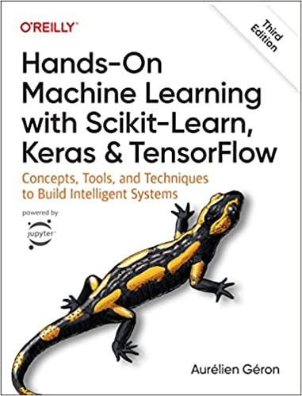
Aurélien Géron (2022),
Hands-On Machine Learning with Scikit-Learn, Keras, and TensorFlow: Concepts, Tools, and Techniques to Build Intelligent Systems,
3rd Edition, O’Reilly Media.
Source: https://www.amazon.com/Hands-Machine-Learning-Scikit-Learn-TensorFlow/dp/1098125975

Slide 28

GRI (Global Report Initiative)
https://www.globalreporting.org/

Slide 29

CDP (Carbon Disclosure Project)
https://www.cdp.net/

Slide 30

SASB (Sustainability Accounting Standards Board)
https://sasb.org/

Slide 31

ISSB (International Sustainability Standards Board)
https://www.ifrs.org/groups/international-sustainability-standards-board/

Slide 32

TCFD
(Task Force on Climate-related Financial Disclosures)
https://www.ifrs.org/sustainability/tcfd/
https://www.fsb-tcfd.org/

Slide 33
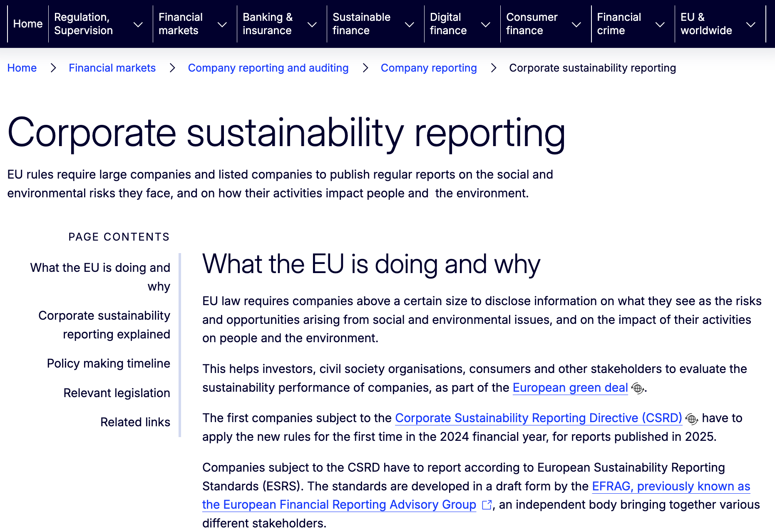
CSRD
(Corporate Sustainability Reporting Directive)
https://www.ifrs.org/sustainability/tcfd/
https://finance.ec.europa.eu/capital-markets-union-and-financial-markets/company-reporting-and-auditing/company-reporting/corporate-sustainability-reporting_en

Slide 34


NVIDIA Developer Program
NVIDIA
Deep Learning Institute (DLI)
https://developer.nvidia.com/join-nvidia-developer-program
https://learn.nvidia.com/

Slide 35
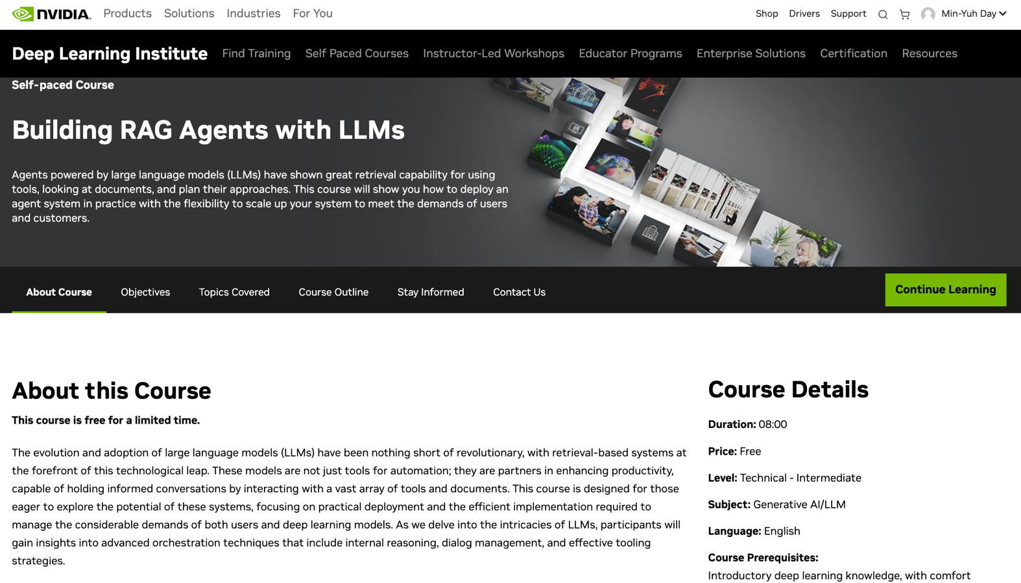
Building RAG Agents with LLMs
https://learn.nvidia.com/courses/course-detail?course_id=course-v1:DLI+S-FX-15+V1

Slide 36
Sustainability and
ESG Data Analytics

Slide 37


















Sustainable Development Goals (SDGs)
Source: https://sdgs.un.org/goals

Slide 38
Evolution of Sustainable Finance Research
Topic
SDGs:
Sustainable Development Goals
SDGs
Innovative Financial Instrument
Impact Investing
ESG: Environmental, Social, and Governance
CSR: Corporate Social Responsibility
Conscious Capitalism
Climate Financing
Carbon Financing
Green Financing
Ethical Investing
Socially Responsible Investing
1986
1995
2005
2015
2020
Source: Kumar, S., Sharma, D., Rao, S., Lim, W. M., & Mangla, S. K. (2022). Past, present, and future of sustainable finance:
Insights from big data analytics through machine learning of scholarly research. Annals of Operations Research, 1-44.

Slide 39

Sustainable Development Goals (SDGs) and 5P
Partnership
Peace
Prosperity
People
Planet
Source: Folke, Carl, Reinette Biggs, Albert V. Norström, Belinda Reyers, and Johan Rockström. "Social-ecological resilience and biosphere-based sustainability science.”Ecology and Society 21, no. 3 (2016).

Slide 40

ESG to 17 SDGs
Source: Henrik Skaug Sætra (2021) "A Framework for Evaluating and Disclosing the ESG Related Impacts of AI with the SDGs." Sustainability 13, no. 15 (2021): 8503.

Slide 41

ESG to 17 SDGs
Source: https://sustainometric.com/esg-to-sdgs-connected-paths-to-a-sustainable-future/

Slide 42
Agentic AI for
ESG Applications

Slide 43

AI, ML, DL, Generative AI
Source: Jeong, Cheonsu. "A Study on the Implementation of Generative AI Services Using an Enterprise Data-Based LLM Application Architecture." arXiv preprint arXiv:2309.01105 (2023).

Slide 44
Generative AI, Agentic AI, Physical AI
Physical AI
Self-driving cars
General robotics
Agentic AI
Coding assistants
Customer service
Patient care
Generative AI
Digital marketing
Content creation
Perception AI
Speech recognition
Deep recommender systems
Medical imaging
2012 AlexNet
Deep learning breakthrough
Source: NVIDIA (2025), GTC March 2025 Keynote with NVIDIA CEO Jensen Huang, https://www.youtube.com/watch?v=_waPvOwL9Z8

Slide 45
Generative AI
Computing
Generative AI
Data
Algorithms

Slide 46

From Generative AI to Agentic AI
Source: Schneider, Johannes. "Generative to Agentic AI: Survey, Conceptualization, and Challenges." arXiv preprint arXiv:2504.18875 (2025).

Slide 47
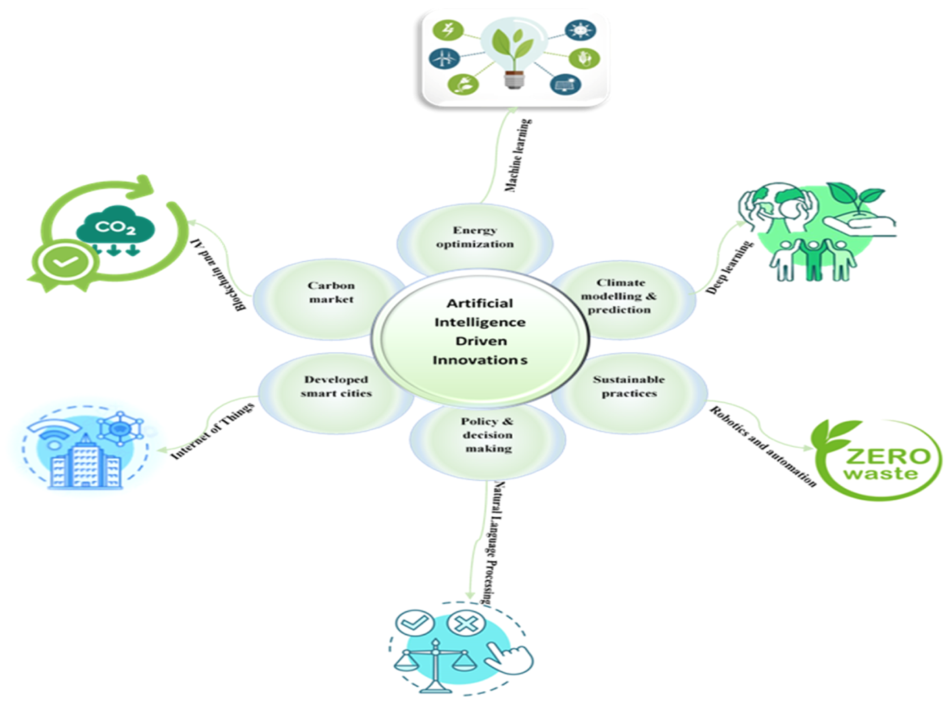
AI Innovations for Net-Zero Transformation
Source: Olawade, D. B., Wada, O. Z., David-Olawade, A. C., Fapohunda, O., Ige, A. O., & Ling, J. (2024). Artificial intelligence potential for net zero sustainability: Current evidence and prospects. Next Sustainability, 4, 100041.

Slide 48
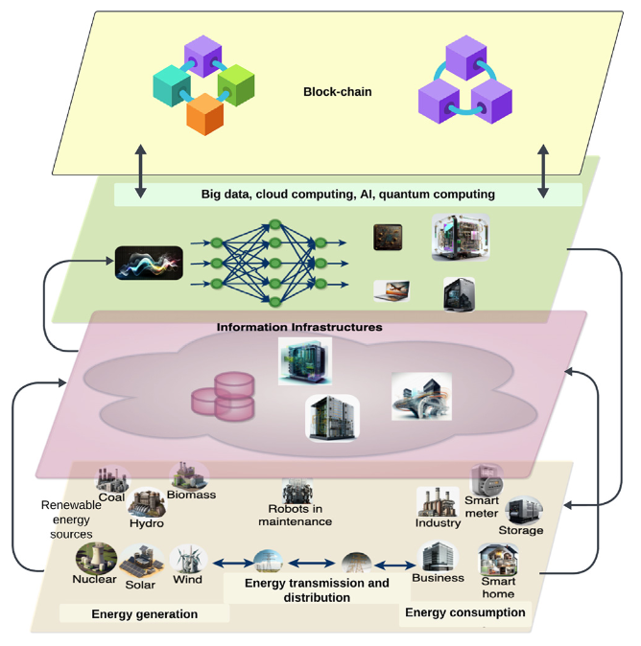
AI Technology for Net-Zero Energy Transition
Source: Ferdaus, M. M., Dam, T., Anavatti, S., & Das, S. (2024). Digital technologies for a net-zero energy future: A comprehensive review. Renewable and Sustainable Energy Reviews, 202, 114681.

Slide 49
Net-Zero Transformation
Ambition
  Aligned to achieving global net zero by no later than 2050 & to limit warming to 1.5°C
Governance
  Accountability driven from the top
Strategy
  Embedded and aligned net zero into company strategy
Enterprise
  Key operating model changes in support of transformation
Supply chains
  Transformed net zero supply chains
Innovation
  Developed innovation and technologies to deliver net zero
Finance
  Financing the net zero transformation
Transparency
  Communicating action
Engagement
  Enhancing the pace and scale of net zero action
Source: https://www.pwc.com/us/en/services/esg/library/building-blocks-for-net-zero-transformation.html

Slide 50

Sustainable Productivity:
Finance ESG
Source: Huang, Ziqi, Yang Shen, Jiayi Li, Marcel Fey, and Christian Brecher (2021). "A survey on AI-driven digital twins in Industry 4.0: Smart manufacturing and advanced robotics." Sensors 21, no. 19: 6340.

Slide 51

Sustainable Resilient Manufacturing
ESG
Source: Huang, Ziqi, Yang Shen, Jiayi Li, Marcel Fey, and Christian Brecher (2021). "A survey on AI-driven digital twins in Industry 4.0: Smart manufacturing and advanced robotics." Sensors 21, no. 19: 6340.

Slide 52
ESG Indexes
MSCI ESG Index
Dow Jones Sustainability Indices (DJSI)
FTSE ESG Index

Slide 53

MSCI ESG Rating Framework
Source: https://www.msci.com/documents/1296102/21901542/ESG-Ratings-Methodology-Exec-Summary.pdf

Slide 54

MSCI ESG Key Issue Hierarchy
Source: https://www.msci.com/documents/1296102/21901542/ESG-Ratings-Methodology-Exec-Summary.pdf

Slide 55

MSCI Governance Model Structure
Source: https://www.msci.com/documents/1296102/21901542/ESG-Ratings-Methodology-Exec-Summary.pdf

Slide 56

MSCI Hierarchy of ESG Scores
Source: https://www.msci.com/documents/1296102/21901542/ESG-Ratings-Methodology-Exec-Summary.pdf

Slide 57

DJSI S&P Global ESG Score
Source: DJSI, S&P Global Corporate Sustainability Assessment (CSA), https://www.spglobal.com/esg/solutions/data-intelligence-esg-scores

Slide 58

FTSE Russell ESG Ratings
Source: https://www.ftserussell.com/data/sustainability-and-esg-data/esg-ratings

Slide 59


Sustainalytics
ESG Risk Ratings
Analyst-based
approach
Sustainalytics’ ESG Risk Ratings measure a company’s exposure to industry-specific material ESG risks and how well a company is managing those risks.
Source: https://www.sustainalytics.com/esg-data

Slide 60

Truvalue
ESG Ranks
TruValue Labs
Machine-based approach
Truvalue Labs applies AI to analyze over 100,000 sources and uncover ESG risks and opportunities hidden in unstructured text.
The ESG Ranks data service produces an overall company rank based on industry percentile leveraging the 26 ESG categories defined by the Sustainability Accounting Standards Board (SASB).
The data feed covers 20,000+ companies with more than 13 years of history.
Source: :https://developer.truvaluelabs.com/data/esg-ranks

Slide 61

Analyst-driven vs. AI-driven ESG
Sustainalytics
Truvalue Labs
Source: Mark Tulay (2020), Man vs. machine: A tale of two sustainability ratings systems, GreenBiz, https://www.greenbiz.com/article/man-vs-machine-tale-two-sustainability-ratings-systems

Slide 62

Analyst based
ESG Research
AI based
ESG Research
Source: https://www.esganalytics.io/insights/how-data-is-accelerating-esg

Slide 63

ESG Analytics: NLP Taxonomy
Source: https://www.esganalytics.io/insights/how-data-is-accelerating-esg

Slide 64

Top
ESG Reporting Software
Environmental, Social and Governance (ESG) Reporting software or Sustainability software helps organizations manage their operational data, evaluate their impact on the environment and provide reporting to perform audits.
Source: https://www.softwarereviews.com/categories/environmental-social-and-governance-reporting

Slide 65

Four Paradigms in NLP (LM)
Transfer Learning: Pre-training, Fine-Tuning (FT)
GAI: Pre-train, Prompt, and Predict (Prompting)
Source: Pengfei Liu, Weizhe Yuan, Jinlan Fu, Zhengbao Jiang, Hiroaki Hayashi, and Graham Neubig. (2023) "Pre-train, prompt, and predict: A systematic survey of prompting methods in natural language processing." ACM Computing Surveys 55, no. 9 (2023): 1-35.

Slide 66
Comparison of Generative AI and Traditional AI
Feature | Generative AI | Traditional AI
Output type | New content | Classification/Prediction
Creativity | High | Low
Interactivity | Usually more natural | Limited

Slide 67
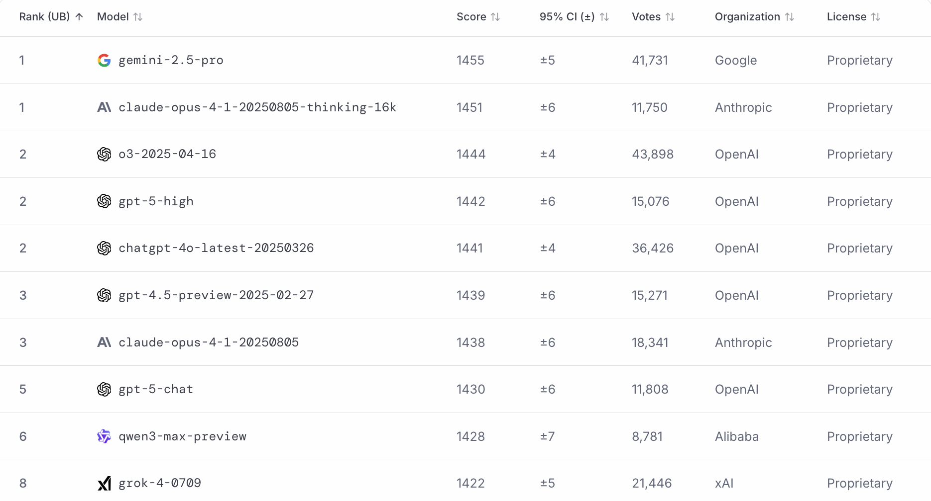
LMArena Leaderboard
https://lmarena.ai/

Slide 68
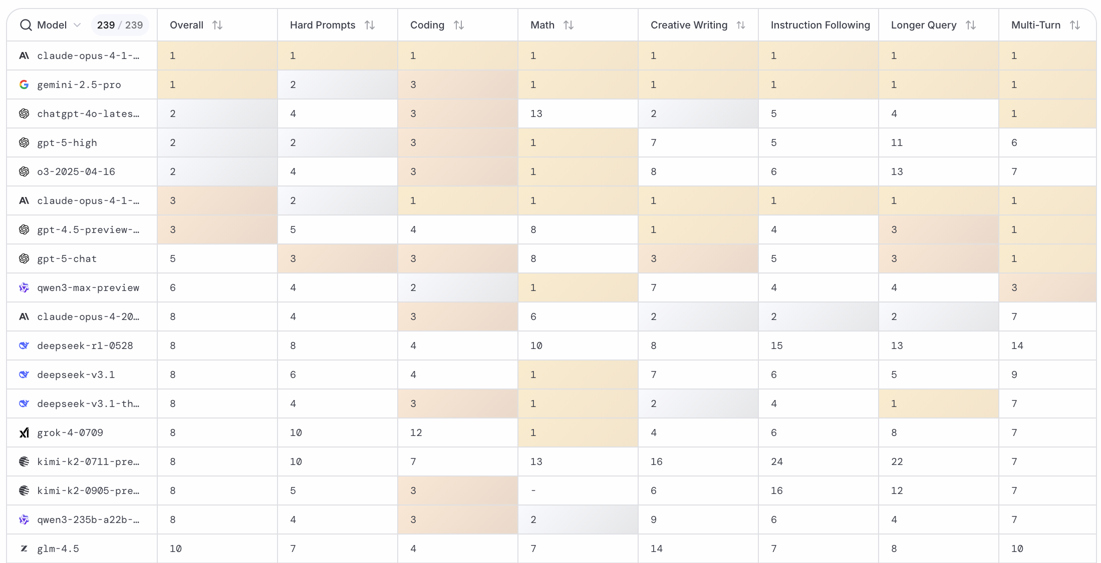
LMArena Leaderboard
https://huggingface.co/spaces/lmarena-ai/lmarena-leaderboard

Slide 69
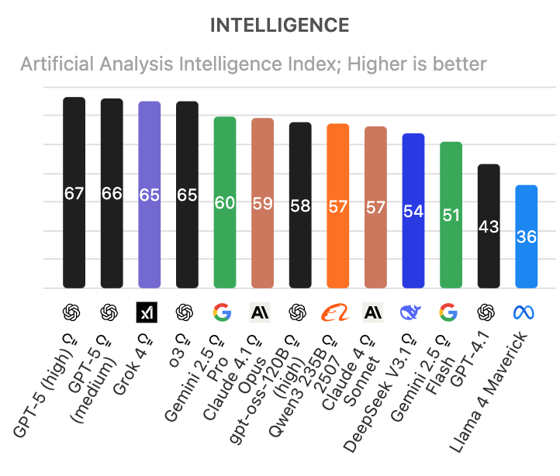
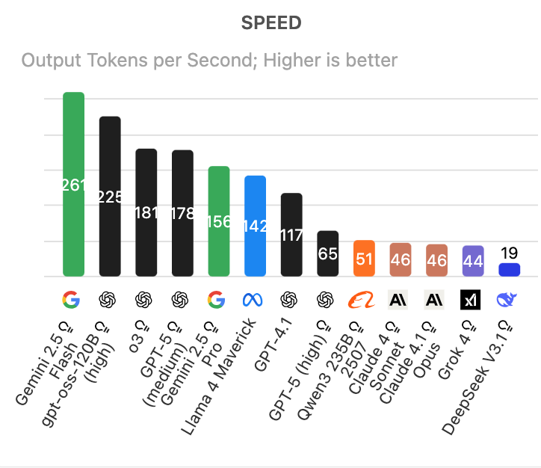
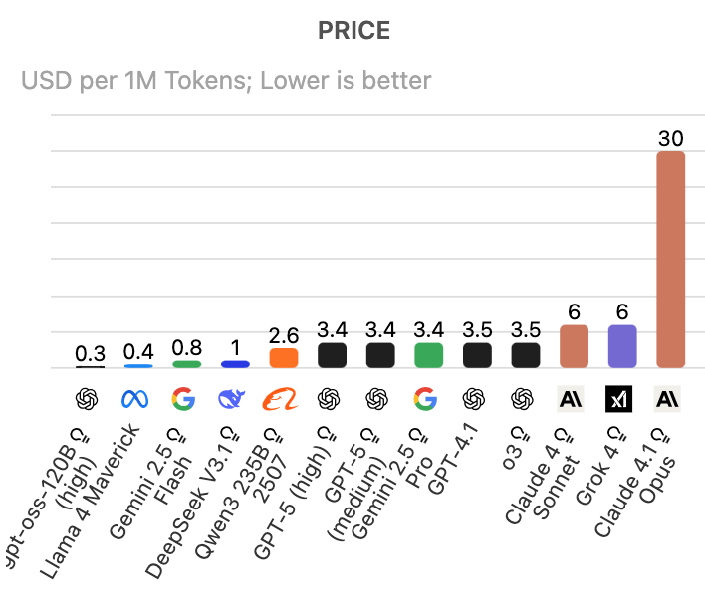
Artificial Analysis Intelligence Index
Intelligence, Speed, Price
Source: https://artificialanalysis.ai/

Slide 70
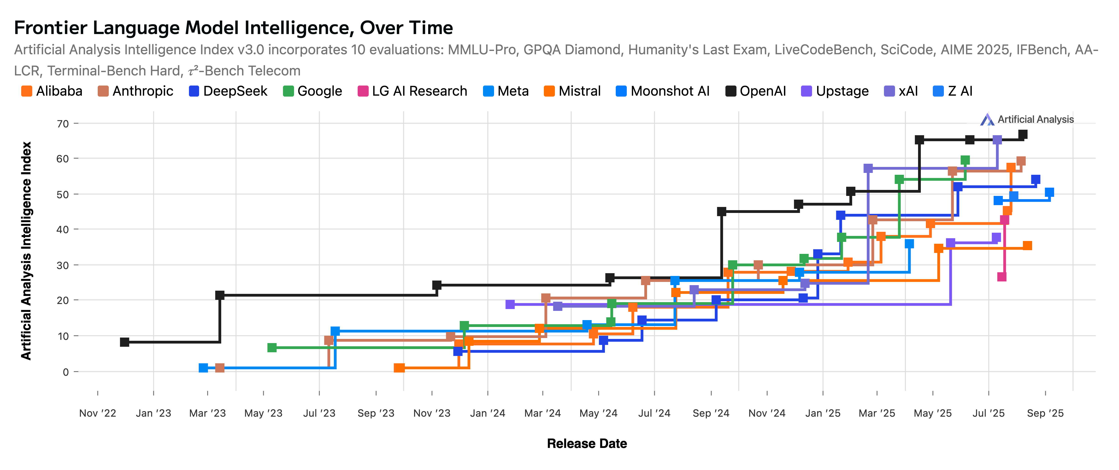
Artificial Analysis Intelligence Index
2022-2025
Source: https://artificialanalysis.ai/

Slide 71
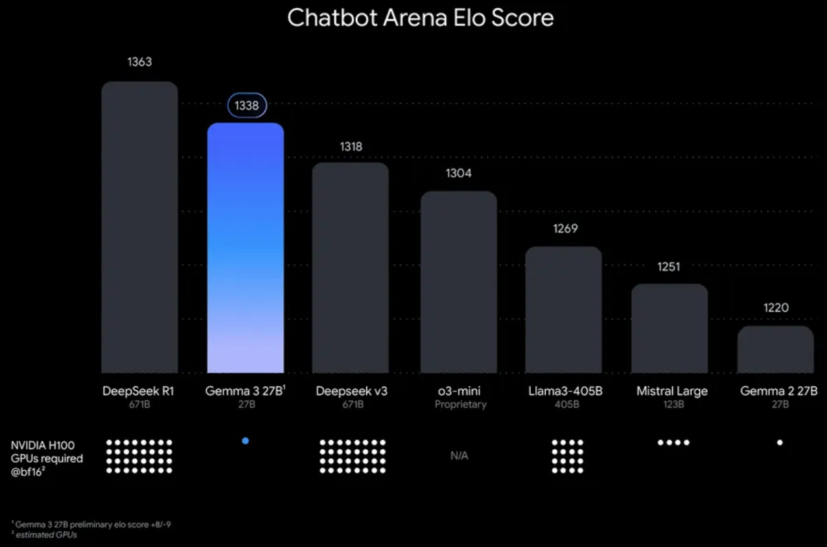
Google Gemma 3 27B
The most capable model you can run on a single GPU or TPU
Source: https://blog.google/technology/developers/gemma-3/

Slide 72
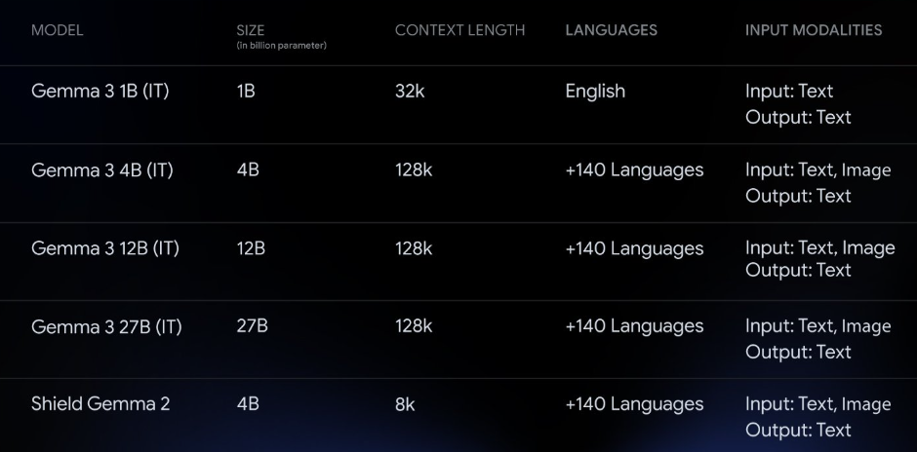
Google Gemma 3 Multimodality
(vision-language input and text outputs)
Source: https://developers.googleblog.com/en/introducing-gemma3/

Slide 73
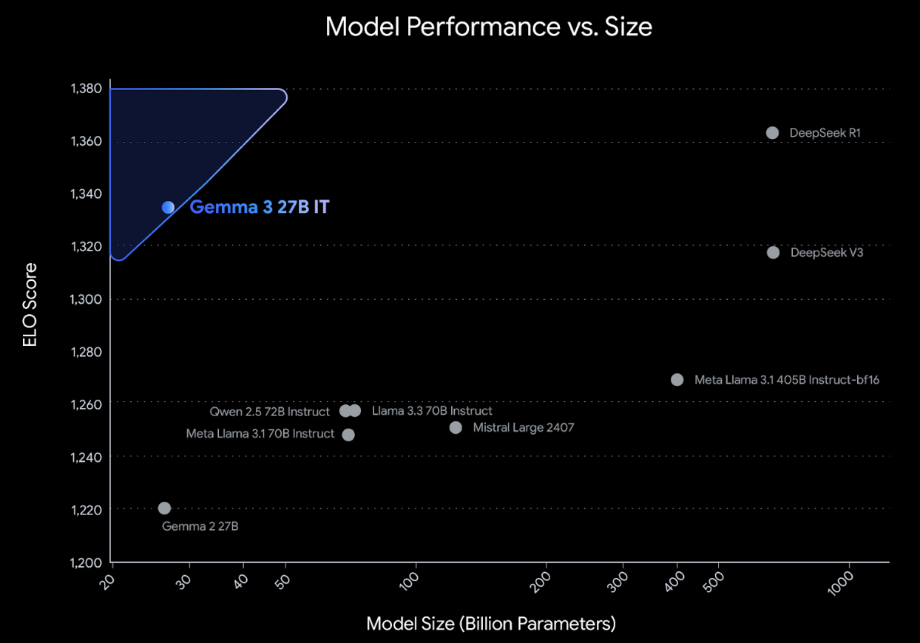
Google Gemma 3: Pre-training and Post-training
(distillation, reinforcement learning, and model merging)
Source: https://developers.googleblog.com/en/introducing-gemma3/

Slide 74
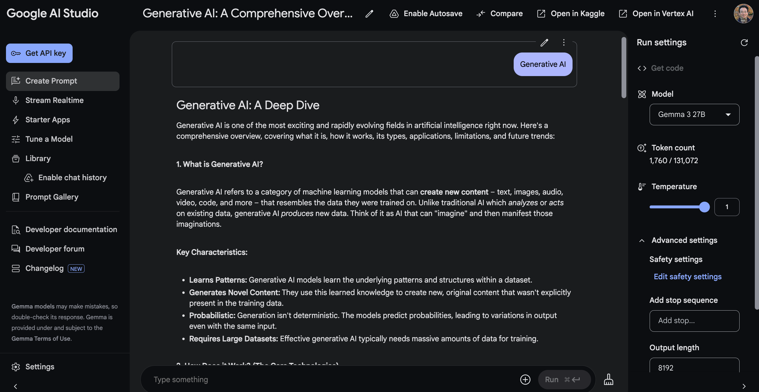
Google AI Studio (Gemma 3 27B)
Source: https://aistudio.google.com/

Slide 75
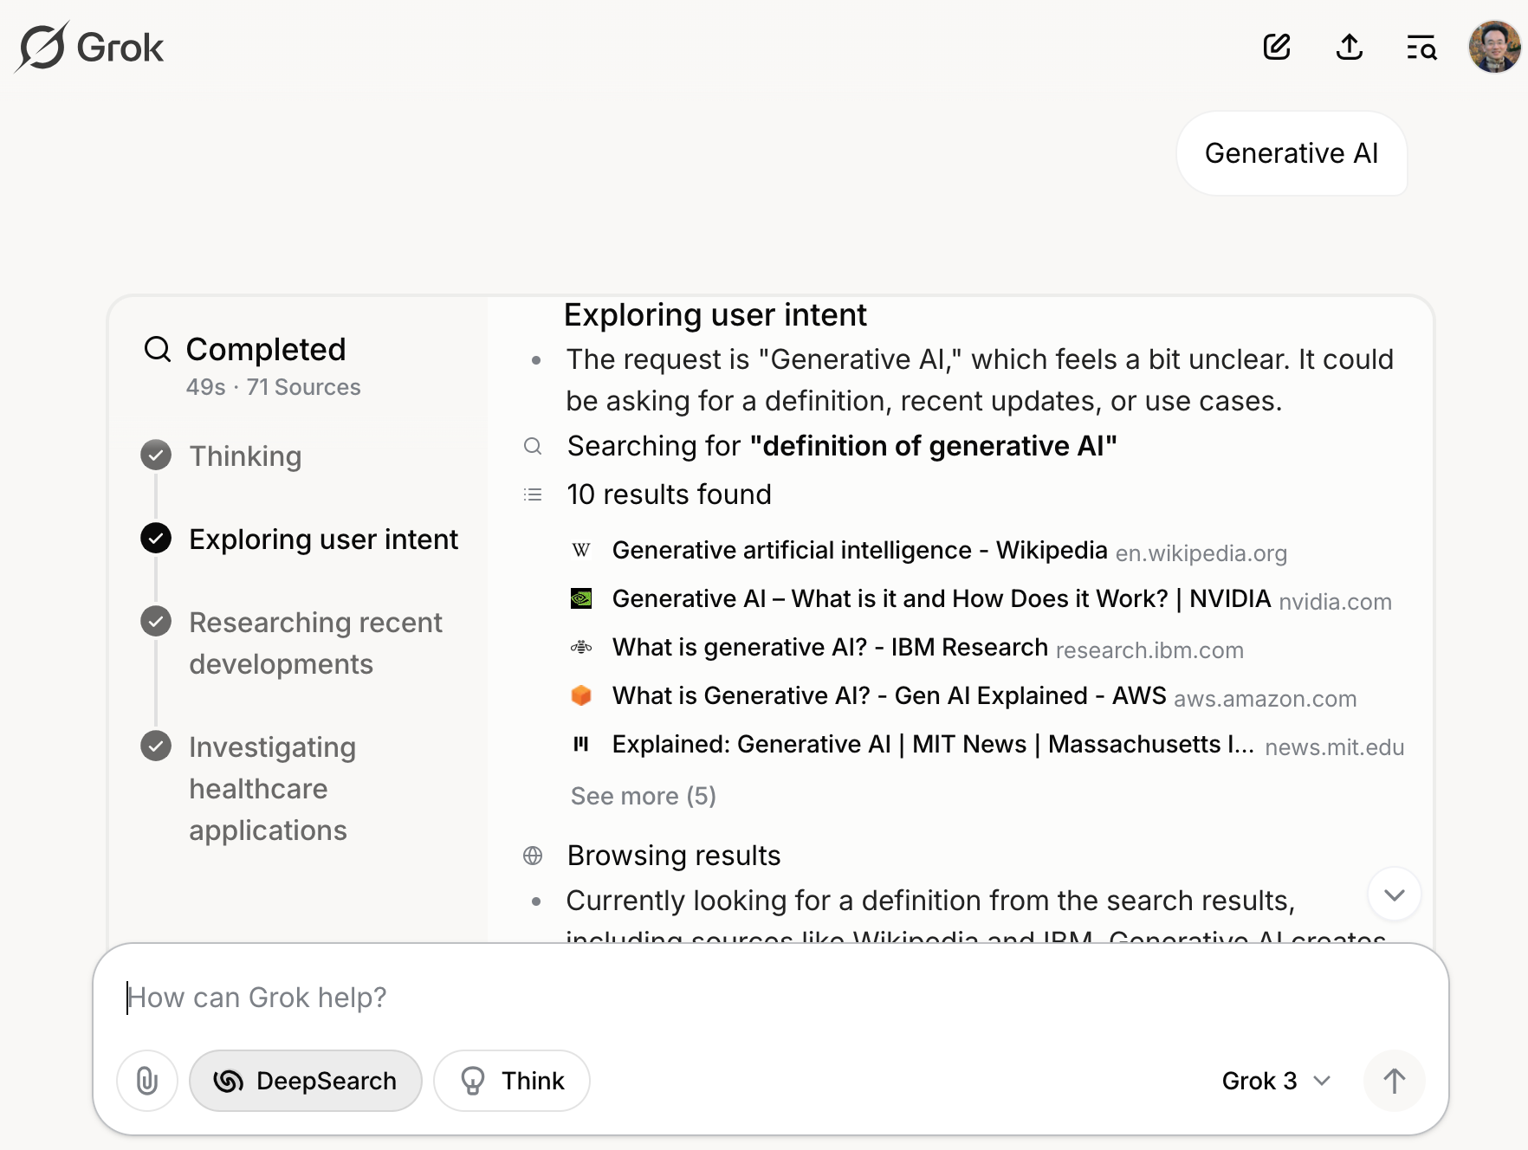
Grok 3 Deep Search
Source: https://grok.com/chat

Slide 76

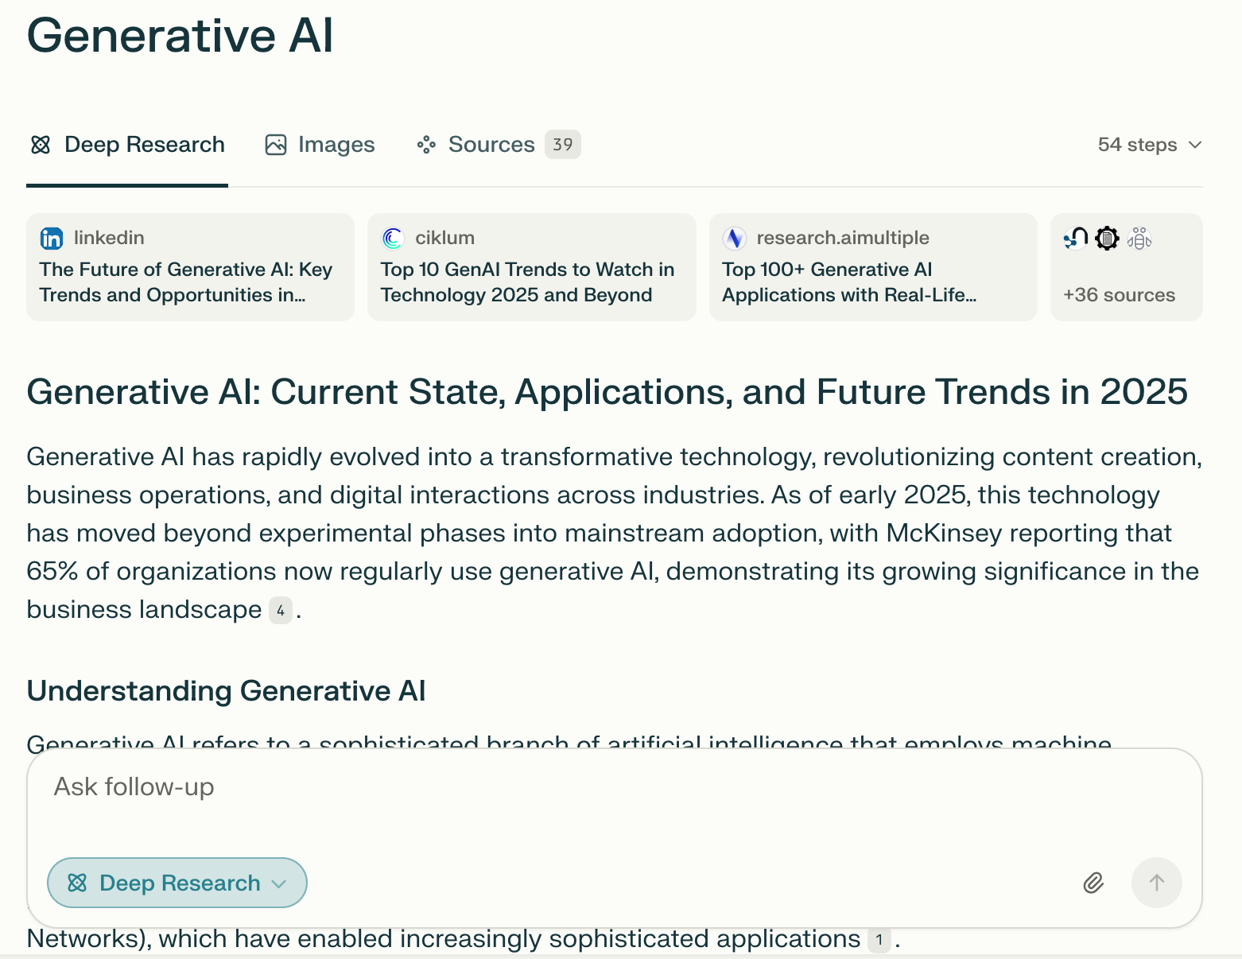
Perplexity.ai Deep Research
Source: https://www.perplexity.ai/

Slide 77
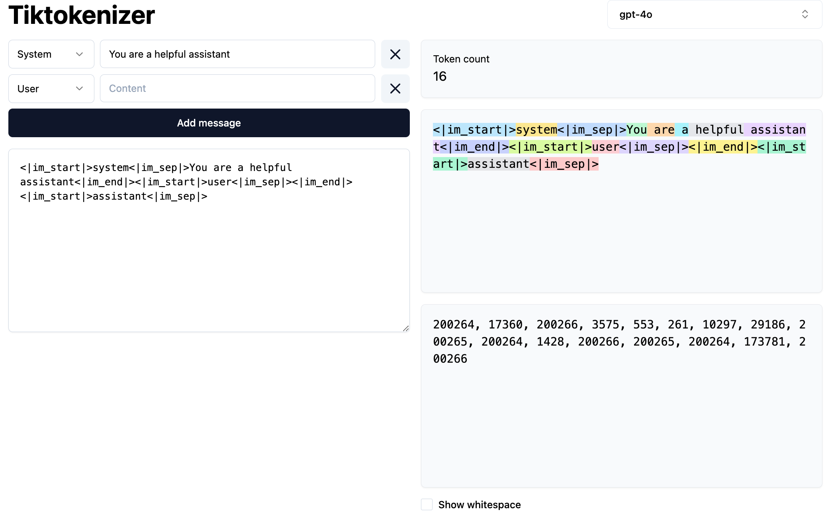
Token
https://tiktokenizer.vercel.app/

Slide 78
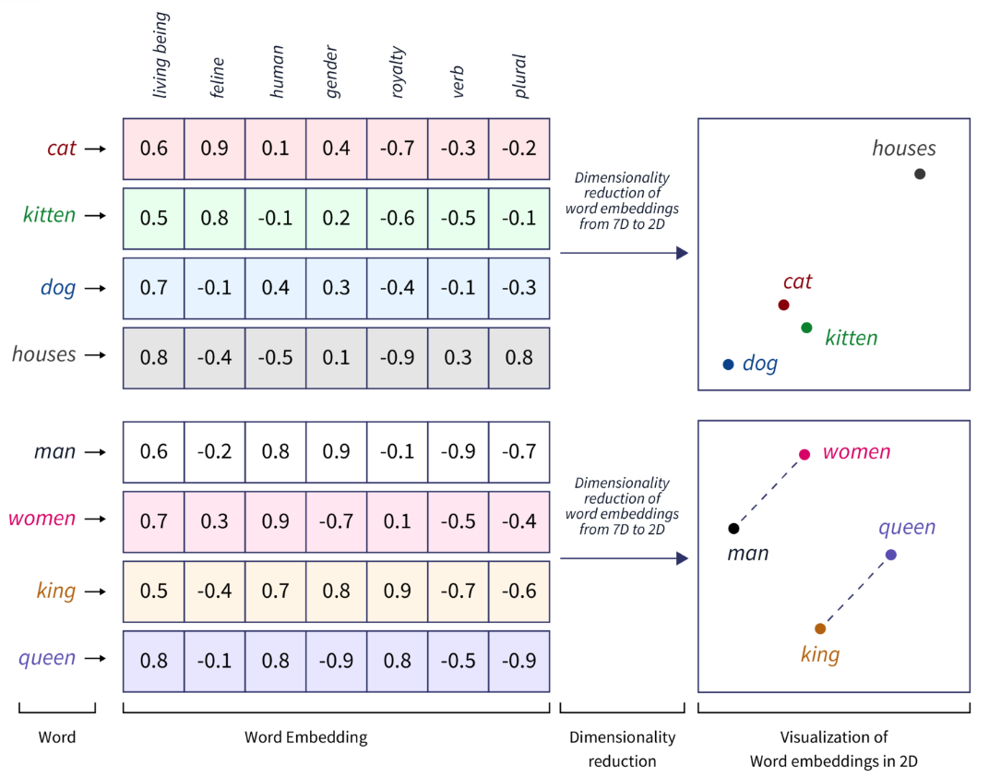
Word Embeddings
Source: https://www.scaler.com/topics/tensorflow/tensorflow-word-embeddings/

Slide 79

Transformer (Attention is All You Need)
(Vaswani et al., 2017)
Source: Vaswani, Ashish, Noam Shazeer, Niki Parmar, Jakob Uszkoreit, Llion Jones, Aidan N. Gomez, Łukasz Kaiser, and Illia Polosukhin. "Attention is all you need." In Advances in neural information processing systems, pp. 5998-6008. 2017.

Slide 80

Estimation Methodologies for
Machine Learning Classification Tasks
Simple split (or holdout or test sample estimation)
  Split the data into 2 mutually exclusive sets
  training (~70%) and testing (30%)
  For ANN, the data is split into three sub-sets
  (training [~60%], validation [~20%], testing [~20%])
Source: Ramesh Sharda, Dursun Delen, and Efraim Turban (2017), Business Intelligence, Analytics, and Data Science: A Managerial Perspective, 4th Edition, Pearson

Slide 81

k-Fold Cross-Validation:
Machine Learning Data Splitting and Model Assessment
Source: Ramesh Sharda, Dursun Delen, and Efraim Turban (2017), Business Intelligence, Analytics, and Data Science: A Managerial Perspective, 4th Edition, Pearson

Slide 82

Generative AI and LLMs for Sustainability and
ESG Data Analytics

Slide 83

Sustainability and ESG Data Analytics

Slide 84

Generative AI for ESG Rating and Reporting Generation

Slide 85

Teaching
Artificial Intelligence
  Spring 2021, Fall 2022, Fall 2024, Fall 2025
Sustainability and ESG Data Analytics
  Spring 2024, Fall 2024, Fall 2025
Software Engineering
  Fall 2020, Fall, 2021, Spring 2022, Spring 2023, Spring 2024, Spring 2025
Generative AI Innovative Applications
  Spring 2025
Artificial Intelligence in Finance and Quantitative
  Fall 2021, Fall 2022, Fall 2023, Spring 2025
Big Data Analytics
  Fall 2020, Spring 2023, Spring 2024
Artificial Intelligence for Text Analytics
  Spring 2022, Fall 2023
Python for Accounting Applications
  Fall 2023, Fall 2024, ,Fall 2025
Foundation of Business Cloud Computing
  Spring 2021, Spring 2022, Spring 2023, Spring 2024
https://web.ntpu.edu.tw/~myday/teaching.htm

Slide 86
Research Projects
Generative AI Multi-Agent Systems with LLM-Based RAG for ESG Reporting Automation
  NSTC (E4104), NSTC 114-2221-E-305-002-, 2025/08/01~2026/07/31
Innovative Agentic AI Technology for Autonomous ESG Report Generation
  Industrial Technology Research Institute (ITRI), Fintech and Green Finance Center (FGFC, NTPU), NTPU-114A513E01, 2025/03/01~2025/12/31
Digital Support, Unimpeded Communication: The Development, Support and Promotion of AI-assisted Communication Assistive Devices for Speech Impairment(3/3), Sub-project 3: Multimodal Cross-lingual Task-Oriented Dialogue System for Inclusive Communication Support,
  NSTC (HZZ22), NSTC 114-2425-H-305-003-, 3 Years (2023/05/01-2026/04/30) Year 3: 2025/05/01~2026/04/30
Research on speech processing, synthesis, recognition, and sentence construction of people with language disabilities, Sub-project 3: Multimodal Cross-lingual Task-Oriented Dialogue System
  NTPU, 114-NTPU_ORDA-F-004, 3 Years (2023/01/01-2025/12/31) Year 3: 2025/01/01~2025/12/31
Development of a Deep Learning for Dental Implant Detection in Panoramic Radiographs,
  University System of Taipei Joint Research Program (NTPU, TMU), USTP-NTPU-TMU-114-02, 2025/01/01~2025/12/31
https://web.ntpu.edu.tw/~myday/cindex.htm#projects

Slide 87
Summary
This course introduces the fundamental concepts and hands-on practices of Sustainability and ESG Data Analytics.
Topics include
  Introduction Sustainability and ESG Data Analytics
  Environmental, Social, and Governance (ESG) in Net-Zero Digital Transformation
  Data Science for Sustainability and ESG
  Web 3.0 and Big Data Analysis in Fintech, Green Finance, Sustainable Finance
  ESG Data Gathering, Analysis, and Visualization
  NVIDIA Building RAG Agents with LLMs
  Artificial Intelligence of things (AIoT) in ESG and Sustainability Applications
  Generative AI for ESG Rating and Reporting Generation
  Case Study on Sustainability and ESG Data Analytics

Slide 88

Sustainability and ESG Data Analytics
Contact Information
University Ambassador
Certified Instructor
Min-Yuh Day, Ph.D.
Professor and Director
Institute of Information Management, National Taipei University
Tel: 02-86741111 ext. 66873
Office: B8F12
Address: 151, University Rd., San Shia District, New Taipei City, 23741 Taiwan
Email: myday@gm.ntpu.edu.tw
Web: http://web.ntpu.edu.tw/~myday/

