Slide 1









Environmental, Social, and Governance (ESG) in Net-Zero Digital Transformation
Sustainability and ESG Data Analytics
1141ESGDA02
MBA, IM, NTPU (M5265) (Fall 2025)
Wed 2, 3, 4 (9:10-12:00) (B3F17)
University Ambassador
Certified Instructor
Min-Yuh Day, Ph.D,
Professor and Director
Institute of Information Management, National Taipei University
https://web.ntpu.edu.tw/~myday
https://meet.google.com/miy-fbif-max
2025-09-17

Slide 2
Syllabus
Week Date Subject/Topics
1 2025/09/10 Introduction Sustainability and ESG Data Analytics
2 2025/09/17 Environmental, Social, and Governance (ESG) in
Net-Zero Digital Transformation
3 2025/09/24 Data Science for Sustainability and ESG
4 2025/10/01 Case Study on Sustainability and ESG Data Analytics I
5 2025/10/08 Web 3.0 and Big Data Analysis in Fintech, Green and
Sustainable Finance
6 2025/10/15 ESG Data Gathering, Analysis, and Visualization

Slide 3
Syllabus
Week Date Subject/Topics
7 2025/10/22 NVIDIA Building RAG Agents with LLMs Part I:
LLM Services and AI Foundation Models
8 2025/10/29 Self-Learning
9 2025/11/05 Midterm Project Report
10 2025/11/12 NVIDIA Building RAG Agents with LLMs Part II:
Document Loading, Chunking, and Embeddings
11 2025/11/19 NVIDIA Building RAG Agents with LLMs Part III:
Retrieval-Augmented Generation with
Vector Stores and RAG Evaluation

Slide 4
Syllabus
Week Date Subject/Topics
12 2025/11/26 Case Study on Sustainability and ESG Data Analytics II
13 2025/12/03 Artificial Intelligence of things (AIoT) in ESG and
Sustainability Applications
14 2025/12/10 Generative AI for ESG Rating and Reporting Generation
15 2025/12/17 Final Project Report I
16 2025/12/24 Final Project Report II

Slide 5
Environmental, Social, and
Governance (ESG) in Net-Zero Digital Transformation

Slide 6
Outline
Environmental, Social, and Governance (ESG)
Net-Zero Digital Transformation
  Net-Zero Transformation
  Digital Transformation
Source: Dipanjan Sarkar (2019), Text Analytics with Python: A Practitioner’s Guide to Natural Language Processing, Second Edition. APress.

Slide 7

Sustainability and ESG Data Analytics

Slide 8
ESG:
Environmental
Social
Governance

Slide 9
CSR:
Corporate
Social
Responsibility

Slide 10

ESG in Net-Zero Digital Transformation: Foundations and Frameworks
Environmental, Social, and Governance (ESG)
Net-Zero Transformation
Digital Transformation
Opportunities and responsibilities

Slide 11

Tech for Good –
Your Solutions!
Challenge:
Most innovative tech solution
to an environmental OR
social problem

Slide 12
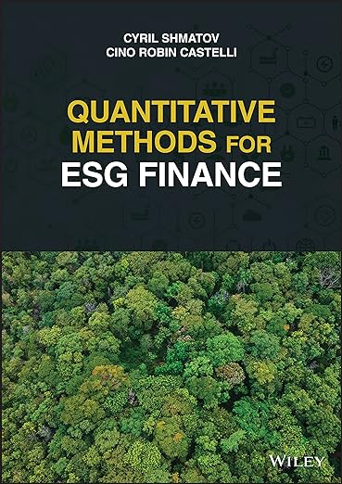
Cino Robin Castelli, Cyril Shmatov (2022),
Quantitative Methods for ESG Finance,
Wiley
Source: https://www.amazon.com/Quantitative-Methods-Finance-Robin-Castelli/dp/1119903807/

Slide 13
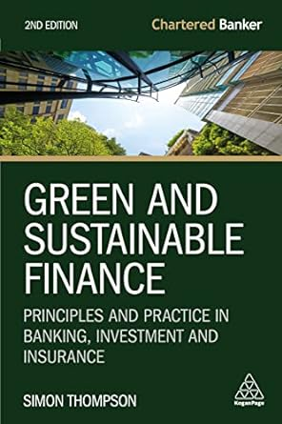
Simon Thompson (2023),
Green and Sustainable Finance:
Principles and Practice in Banking, Investment and Insurance,
2nd Edition, Kogan Page.
Source: https://www.amazon.com/Green-Sustainable-Finance-Principles-Investment/dp/1398609242/

Slide 14

Chrissa Pagitsas (2023),
Chief Sustainability Officers At Work:
How CSOs Build Successful Sustainability and ESG Strategies,
Apress.
Source: https://www.amazon.com/Chief-Sustainability-Officers-Work-Successful/dp/1484278658/

Slide 15

Sherry Madera (2024),
Navigating Sustainability Data: How Organizations can use ESG Data to Secure Their Future, Kogan Page
Source: https://www.amazon.com/Navigating-Sustainability-Data-Organizations-Secure/dp/1398612243/

Slide 16
ESG and Net-Zero: The Essentials
Environmental
  Climate impact, resource use, pollution, biodiversity
Social
  Labor practices, human rights, community impact, diversity & inclusion
Governance
  Transparency, ethics, board structure, risk management
Net-Zero
  Balancing emissions produced with emissions removed globally

Slide 17
Net-Zero Transformation
Ambition
  Aligned to achieving global net zero by no later than 2050 & to limit warming to 1.5°C
Governance
  Accountability driven from the top
Strategy
  Embedded and aligned net zero into company strategy
Enterprise
  Key operating model changes in support of transformation
Supply chains
  Transformed net zero supply chains
Innovation
  Developed innovation and technologies to deliver net zero
Finance
  Financing the net zero transformation
Transparency
  Communicating action
Engagement
  Enhancing the pace and scale of net zero action
Source: https://www.pwc.com/us/en/services/esg/library/building-blocks-for-net-zero-transformation.html

Slide 18
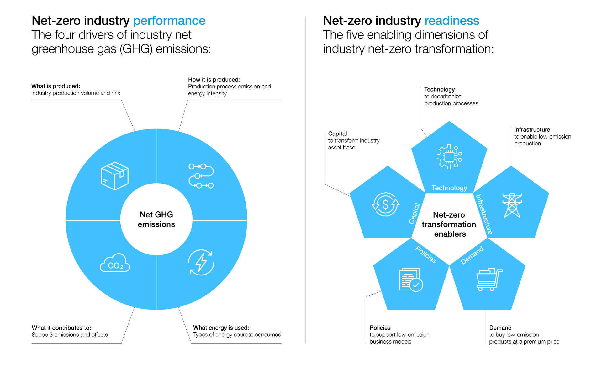
Net-Zero Transformation Enablers
Source: https://www.weforum.org/agenda/2022/07/net-zero-tracker/

Slide 19
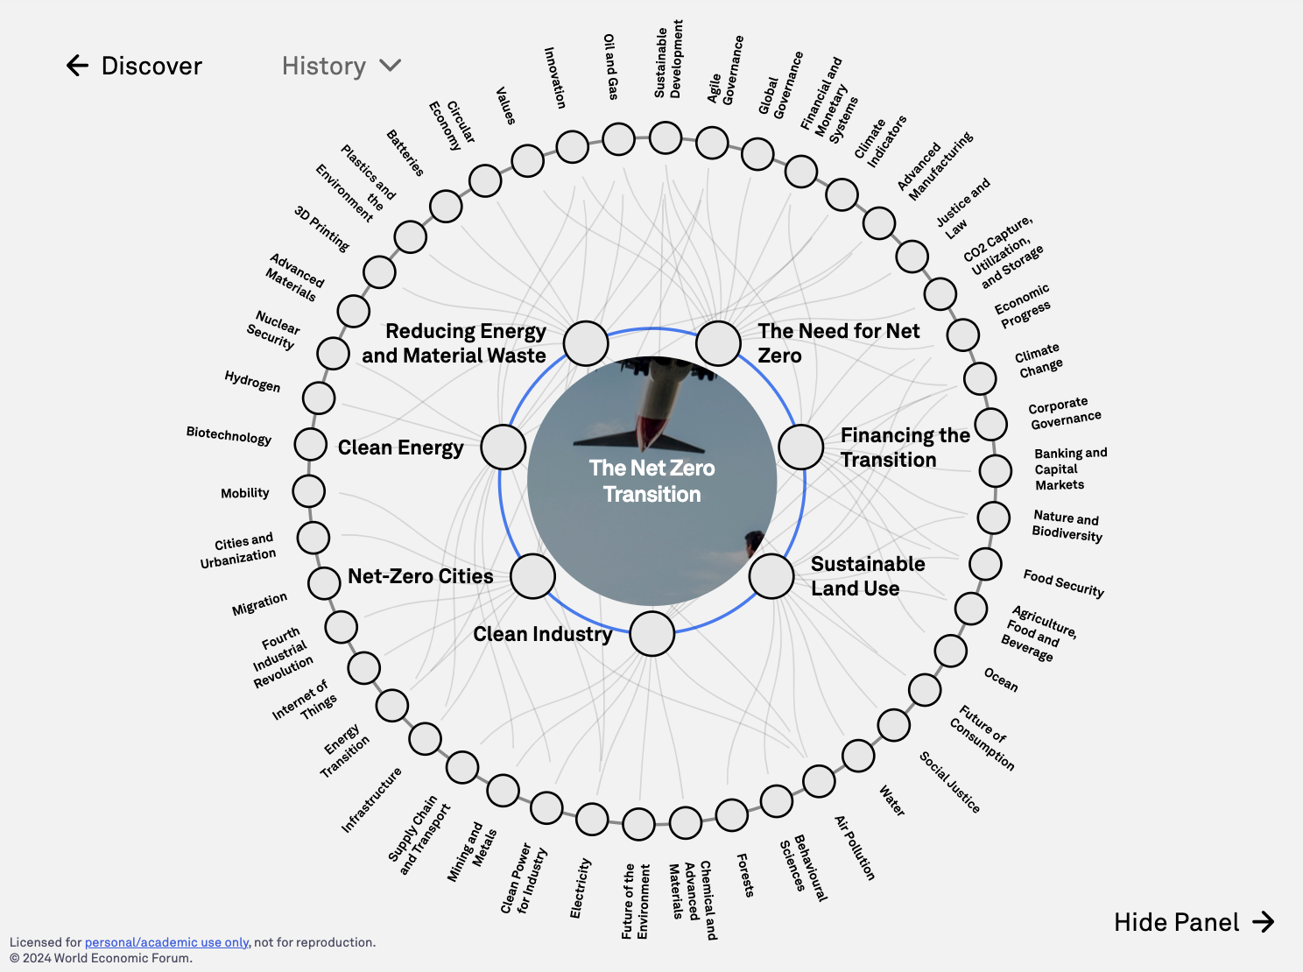
The
Net Zero Transition
Source: https://intelligence.weforum.org/topics/a1G680000004C93EAE

Slide 20
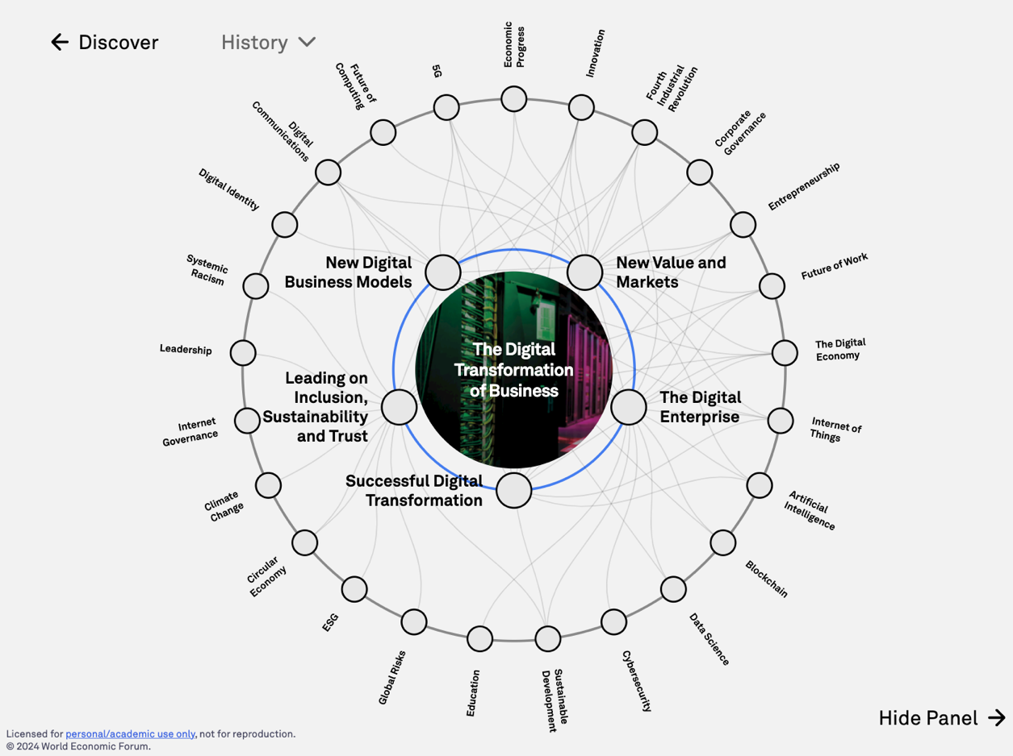
The
Digital Transformation of Business
Source: https://intelligence.weforum.org/topics/a1G0X000006DIDZUA4

Slide 21
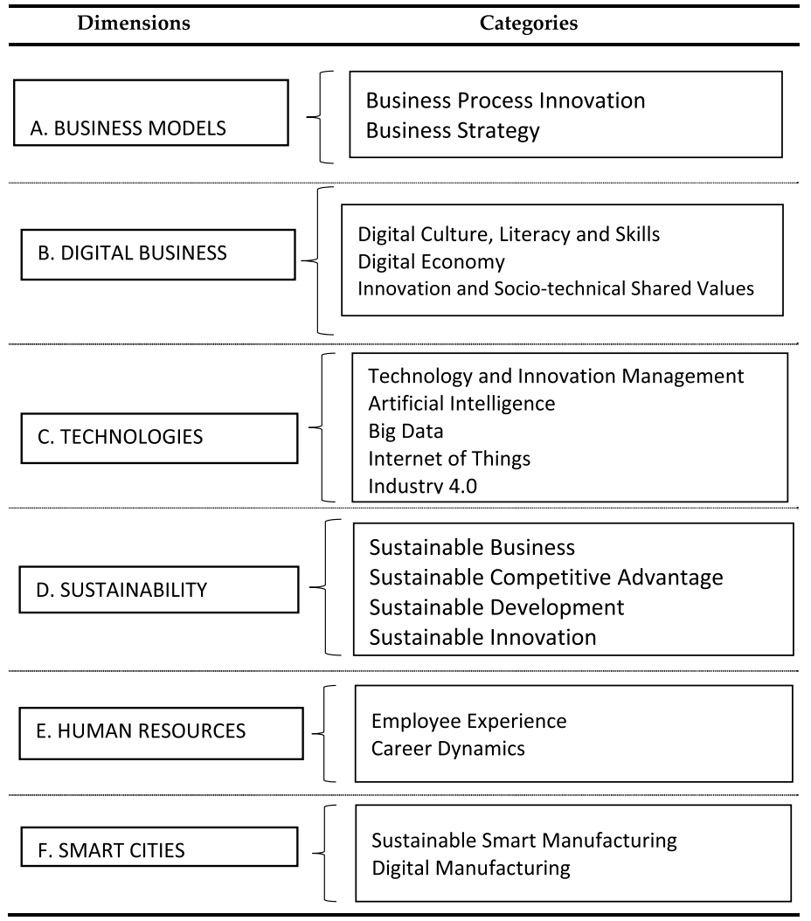
Digital Transformation
Source: Reis, João, and Nuno Melão (2023). "Digital transformation: A meta-review and guidelines for future research." Heliyon (2023).

Slide 22
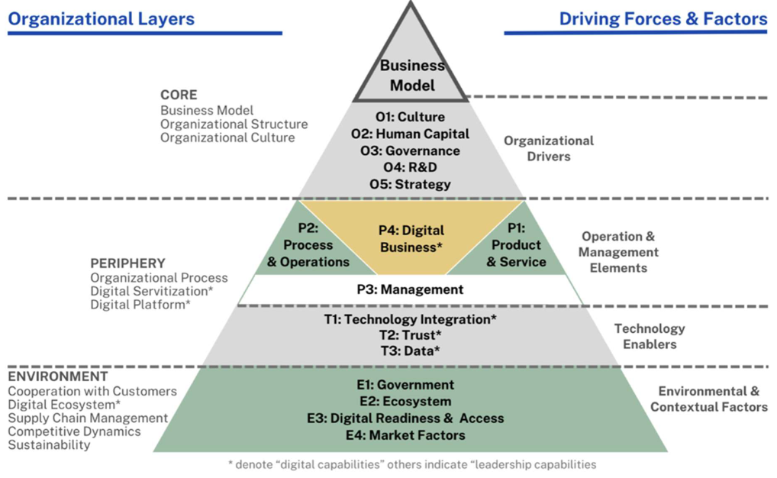
Digital Transformation Framework
Source: Tangwaragorn, P., Chareonruk, N., Viriyasitavat, W., Tangmanee, C., Kanawattanachai, P., Hoonsopon, D., ... & Rhuwadhana, P. (2024).
Analyzing Key Drivers of Digital Transformation: A Review and Framework. Journal of Industrial Information Integration, 100680.

Slide 23
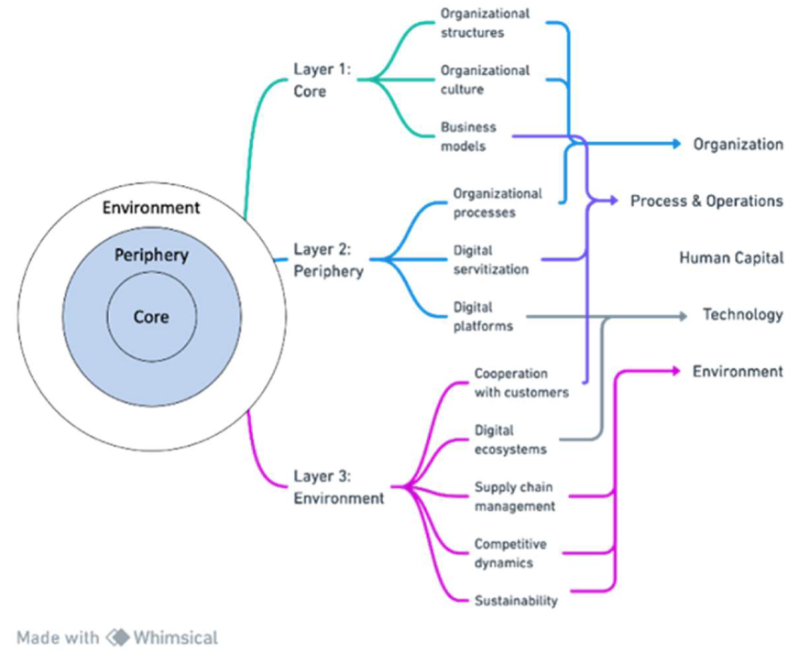
Digital Transformation: Theoretical and practical dimensions
Source: Tangwaragorn, P., Chareonruk, N., Viriyasitavat, W., Tangmanee, C., Kanawattanachai, P., Hoonsopon, D., ... & Rhuwadhana, P. (2024).
Analyzing Key Drivers of Digital Transformation: A Review and Framework. Journal of Industrial Information Integration, 100680.

Slide 24
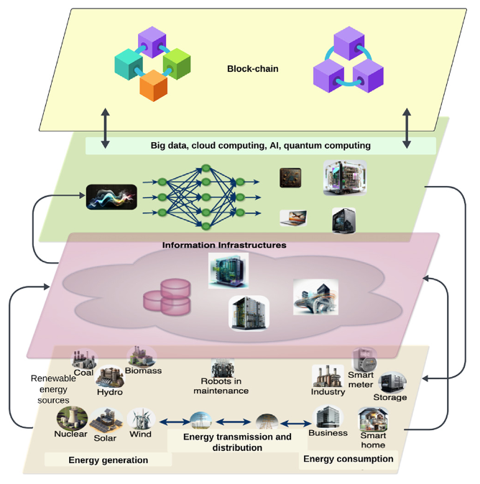
AI Technology for Net-Zero Energy Transition
Source: Ferdaus, M. M., Dam, T., Anavatti, S., & Das, S. (2024). Digital technologies for a net-zero energy future: A comprehensive review. Renewable and Sustainable Energy Reviews, 202, 114681.

Slide 25
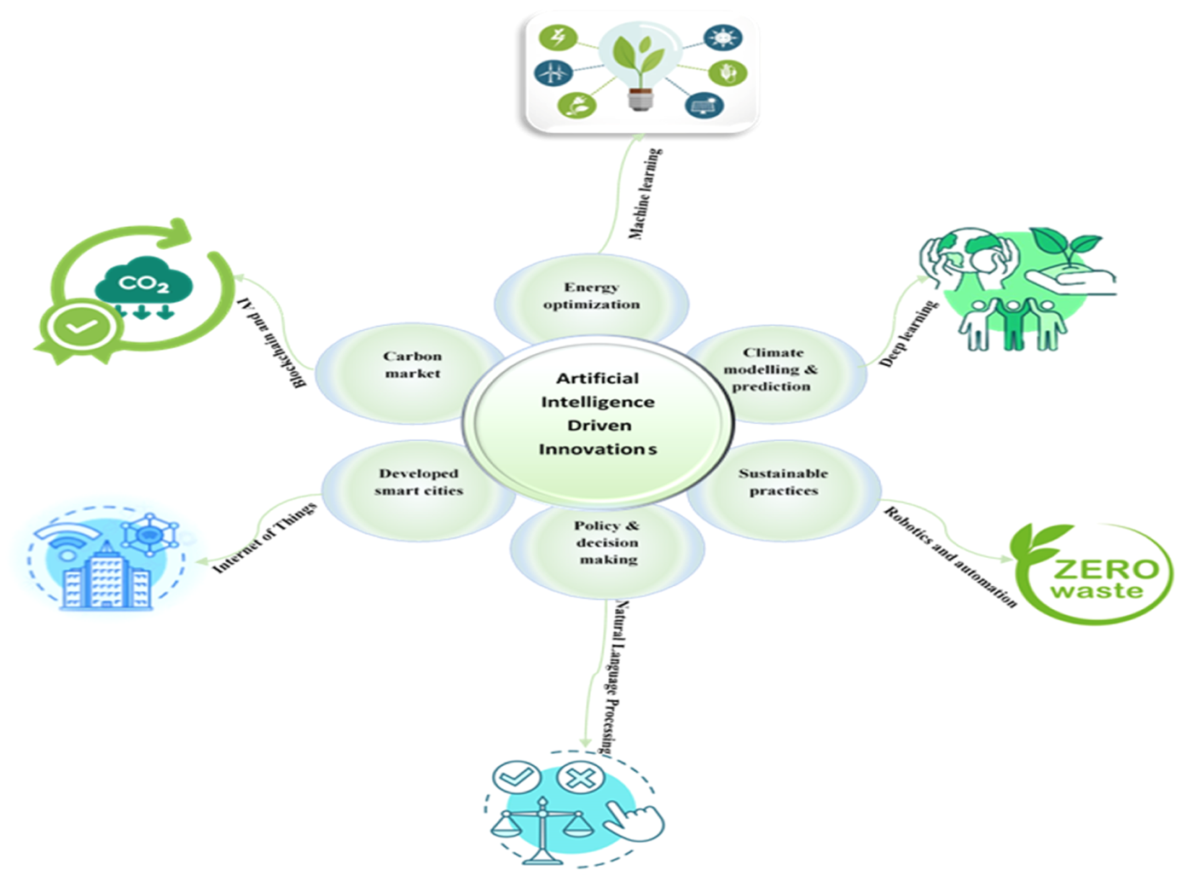
AI Innovations for Net-Zero Transformation
Source: Olawade, D. B., Wada, O. Z., David-Olawade, A. C., Fapohunda, O., Ige, A. O., & Ling, J. (2024). Artificial intelligence potential for net zero sustainability: Current evidence and prospects. Next Sustainability, 4, 100041.

Slide 26
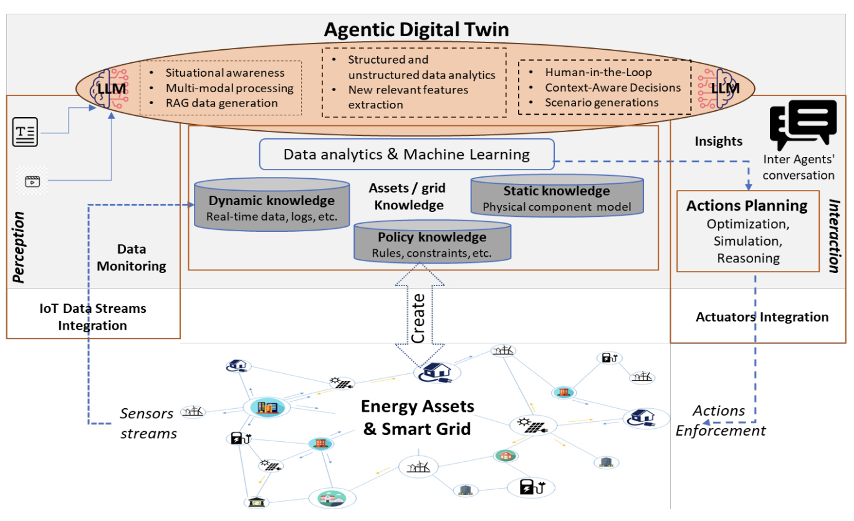
AI for Energy Systems and Agentic Digital Twins
Source: Antonesi, Gabriel, Tudor Cioara, Ionut Anghel, Vasilis Michalakopoulos, Elissaios Sarmas, and Liana Toderean. "From Transformers to Large Language Models: A systematic review of AI applications in the energy sector towards Agentic Digital Twins." arXiv preprint arXiv:2506.06359 (2025).

Slide 27
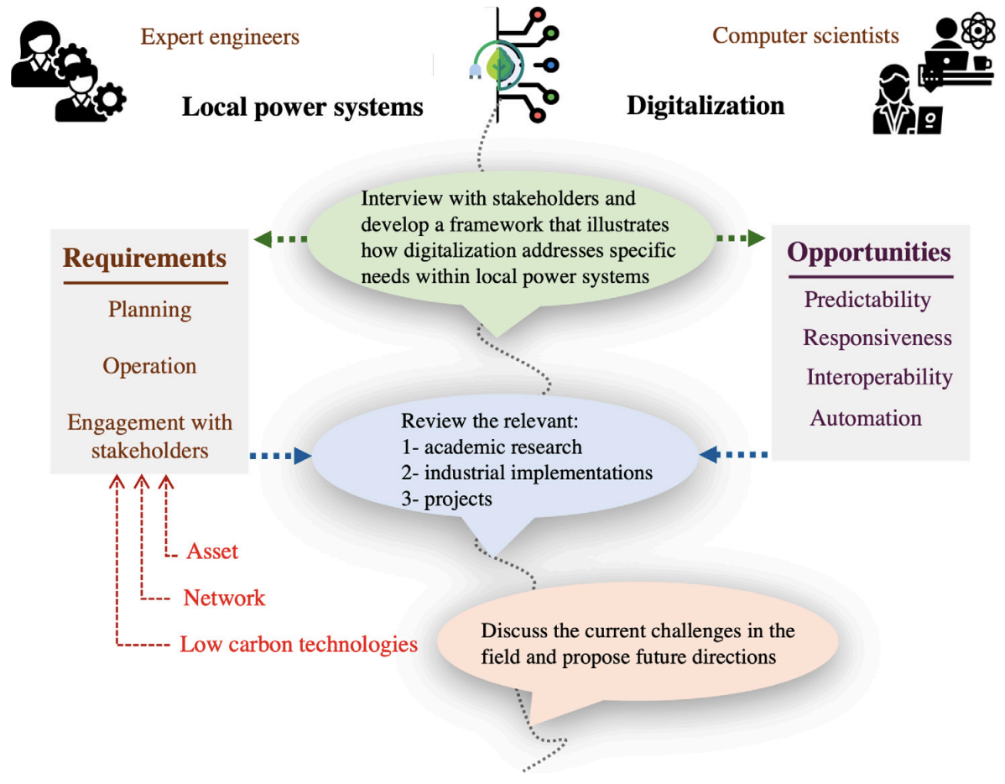
Local Power System Digitalization
Transition to Net-Zero
Source: Azizi, Elnaz, Weiqi Hua, Bruce Stephen, David CH Wallom, and Malcolm Mcculloch. "Digitalization opportunities to enable local power system transition to net-zero." Energy for Sustainable Development 84 (2025): 101596.

Slide 28
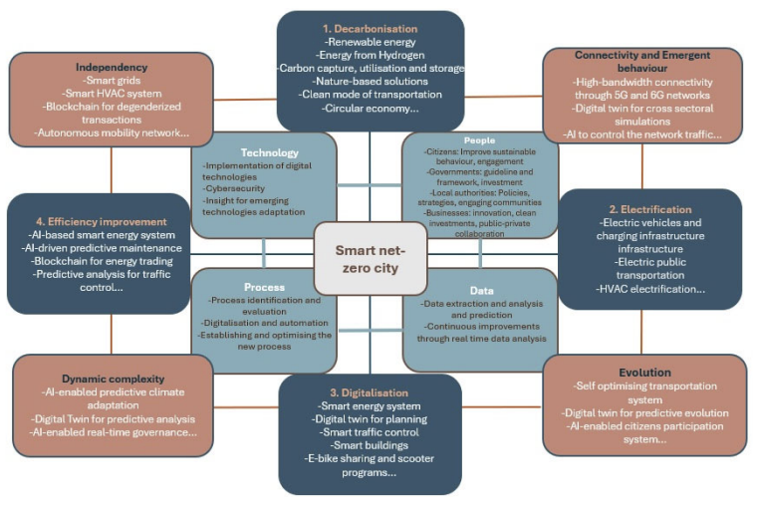
Digital Transformation for Smart Net-Zero Cities
(Technology, People, Data, and Process)
Source: Jouzdani, Farzaneh Mohammadi, Vahid Javidroozi, Hanifa Shah, and Monica Mateo Garcia. "A Systemic Digital Transformation for Smart Net-Zero Cities: A State-of-the-Art Review." J 8, no. 1 (2025): 11.

Slide 29


















Sustainable Development Goals (SDGs)
Source: https://sdgs.un.org/goals

Slide 30
Evolution of Sustainable Finance Research
Topic
SDGs:
Sustainable Development Goals
SDGs
Innovative Financial Instrument
Impact Investing
ESG: Environmental, Social, and Governance
CSR: Corporate Social Responsibility
Conscious Capitalism
Climate Financing
Carbon Financing
Green Financing
Ethical Investing
Socially Responsible Investing
1986
1995
2005
2015
2020
Source: Kumar, S., Sharma, D., Rao, S., Lim, W. M., & Mangla, S. K. (2022). Past, present, and future of sustainable finance:
Insights from big data analytics through machine learning of scholarly research. Annals of Operations Research, 1-44.

Slide 31

Sustainable Development Goals (SDGs) and 5P
Partnership
Peace
Prosperity
People
Planet
Source: Folke, Carl, Reinette Biggs, Albert V. Norström, Belinda Reyers, and Johan Rockström. "Social-ecological resilience and biosphere-based sustainability science.”Ecology and Society 21, no. 3 (2016).

Slide 32

ESG to 17 SDGs
Source: Henrik Skaug Sætra (2021) "A Framework for Evaluating and Disclosing the ESG Related Impacts of AI with the SDGs." Sustainability 13, no. 15 (2021): 8503.

Slide 33

ESG to 17 SDGs
Source: https://sustainometric.com/esg-to-sdgs-connected-paths-to-a-sustainable-future/

Slide 34
Where ESG Meets – It's All Connected
Environmental Justice
  Underserved communities disproportionately impacted by pollution, climate hazards
Responsible Tech Supply Chains
  Resource extraction, e-waste, labor rights across the tech lifecycle
Inclusive Product Design
  Accessibility, addressing digital divides, social impacts of technology.

Slide 35
Digital Transformation: Enabler and Challenge
Enabler
  Data-driven decision-making, efficiency gains, new business models, collaboration
  AI optimizing renewable energy
Challenge
  Energy consumption, e-waste, planned obsolescence, AI ethics
  AI servers representing increased energy use

Slide 36
Mapping the ESG Standards Landscape
The most prevalent ESG reporting frameworks
  GRI (Global Report Initiative)
  CDP (Carbon Disclosure Project)
  SASB (Sustainability Accounting Standards Board
  ISSB (International Sustainability Standards Board)
  TCFD (Task Force on Climate-related Financial Disclosures
How companies choose
  Materiality, industry-specific standards, investor alignment

Slide 37

GRI (Global Report Initiative)
https://www.globalreporting.org/

Slide 38

CDP (Carbon Disclosure Project)
https://www.cdp.net/

Slide 39

SASB (Sustainability Accounting Standards Board)
https://sasb.org/

Slide 40

ISSB (International Sustainability Standards Board)
https://www.ifrs.org/groups/international-sustainability-standards-board/

Slide 41

TCFD
(Task Force on Climate-related Financial Disclosures)
https://www.ifrs.org/sustainability/tcfd/
https://www.fsb-tcfd.org/

Slide 42
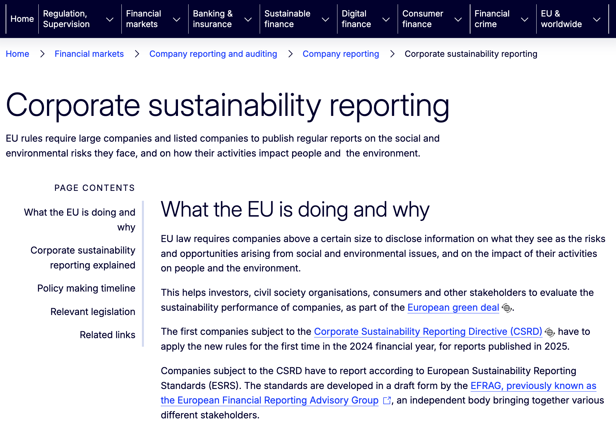
CSRD
(Corporate Sustainability Reporting Directive)
https://www.ifrs.org/sustainability/tcfd/
https://finance.ec.europa.eu/capital-markets-union-and-financial-markets/company-reporting-and-auditing/company-reporting/corporate-sustainability-reporting_en

Slide 43

The Human Impact of ESG Choices
Digital Initiatives
This isn't abstract,
it's about improving lives
Positive potential
when ESG is prioritized

Slide 44
Agentic AI for
ESG Applications

Slide 45

AI, ML, DL, Generative AI
Source: Jeong, Cheonsu. "A Study on the Implementation of Generative AI Services Using an Enterprise Data-Based LLM Application Architecture." arXiv preprint arXiv:2309.01105 (2023).

Slide 46
Generative AI, Agentic AI, Physical AI
Physical AI
Self-driving cars
General robotics
Agentic AI
Coding assistants
Customer service
Patient care
Generative AI
Digital marketing
Content creation
Perception AI
Speech recognition
Deep recommender systems
Medical imaging
2012 AlexNet
Deep learning breakthrough
Source: NVIDIA (2025), GTC March 2025 Keynote with NVIDIA CEO Jensen Huang, https://www.youtube.com/watch?v=_waPvOwL9Z8

Slide 47
Generative AI
Computing
Generative AI
Data
Algorithms

Slide 48

From Generative AI to Agentic AI
Source: Schneider, Johannes. "Generative to Agentic AI: Survey, Conceptualization, and Challenges." arXiv preprint arXiv:2504.18875 (2025).

Slide 49
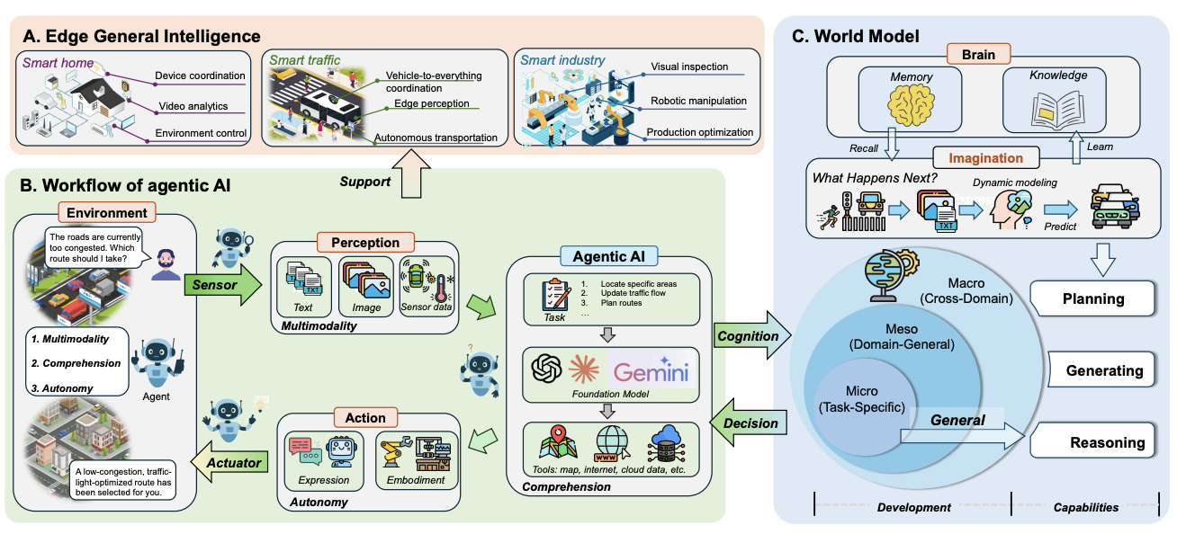
Agentic AI and World Model for
Edge General Intelligence
Source: Changyuan Zhao, Guangyuan Liu, Ruichen Zhang, Yinqiu Liu, Jiacheng Wang, Jiawen Kang, Dusit Niyato et al (2025),
"Edge general intelligence through world models and agentic AI: Fundamentals, solutions, and challenges." arXiv preprint arXiv:2508.09561.

Slide 50
AI Innovations for Net-Zero Transformation
Source: Olawade, D. B., Wada, O. Z., David-Olawade, A. C., Fapohunda, O., Ige, A. O., & Ling, J. (2024). Artificial intelligence potential for net zero sustainability: Current evidence and prospects. Next Sustainability, 4, 100041.

Slide 51
AI Technology for Net-Zero Energy Transition
Source: Ferdaus, M. M., Dam, T., Anavatti, S., & Das, S. (2024). Digital technologies for a net-zero energy future: A comprehensive review. Renewable and Sustainable Energy Reviews, 202, 114681.

Slide 52
Net-Zero Transformation
Ambition
  Aligned to achieving global net zero by no later than 2050 & to limit warming to 1.5°C
Governance
  Accountability driven from the top
Strategy
  Embedded and aligned net zero into company strategy
Enterprise
  Key operating model changes in support of transformation
Supply chains
  Transformed net zero supply chains
Innovation
  Developed innovation and technologies to deliver net zero
Finance
  Financing the net zero transformation
Transparency
  Communicating action
Engagement
  Enhancing the pace and scale of net zero action
Source: https://www.pwc.com/us/en/services/esg/library/building-blocks-for-net-zero-transformation.html

Slide 53

Sustainable Productivity:
Finance ESG
Source: Huang, Ziqi, Yang Shen, Jiayi Li, Marcel Fey, and Christian Brecher (2021). "A survey on AI-driven digital twins in Industry 4.0: Smart manufacturing and advanced robotics." Sensors 21, no. 19: 6340.

Slide 54

Sustainable Resilient Manufacturing
ESG
Source: Huang, Ziqi, Yang Shen, Jiayi Li, Marcel Fey, and Christian Brecher (2021). "A survey on AI-driven digital twins in Industry 4.0: Smart manufacturing and advanced robotics." Sensors 21, no. 19: 6340.

Slide 55
ESG Indexes
MSCI ESG Index
Dow Jones Sustainability Indices (DJSI)
FTSE ESG Index

Slide 56

MSCI ESG Rating Framework
Source: https://www.msci.com/documents/1296102/21901542/ESG-Ratings-Methodology-Exec-Summary.pdf

Slide 57

MSCI ESG Key Issue Hierarchy
Source: https://www.msci.com/documents/1296102/21901542/ESG-Ratings-Methodology-Exec-Summary.pdf

Slide 58

MSCI Governance Model Structure
Source: https://www.msci.com/documents/1296102/21901542/ESG-Ratings-Methodology-Exec-Summary.pdf

Slide 59

MSCI Hierarchy of ESG Scores
Source: https://www.msci.com/documents/1296102/21901542/ESG-Ratings-Methodology-Exec-Summary.pdf

Slide 60

DJSI S&P Global ESG Score
Source: DJSI, S&P Global Corporate Sustainability Assessment (CSA), https://www.spglobal.com/esg/solutions/data-intelligence-esg-scores

Slide 61

FTSE Russell ESG Ratings
Source: https://www.ftserussell.com/data/sustainability-and-esg-data/esg-ratings

Slide 62


Sustainalytics
ESG Risk Ratings
Analyst-based
approach
Sustainalytics’ ESG Risk Ratings measure a company’s exposure to industry-specific material ESG risks and how well a company is managing those risks.
Source: https://www.sustainalytics.com/esg-data

Slide 63

Truvalue
ESG Ranks
TruValue Labs
Machine-based approach
Truvalue Labs applies AI to analyze over 100,000 sources and uncover ESG risks and opportunities hidden in unstructured text.
The ESG Ranks data service produces an overall company rank based on industry percentile leveraging the 26 ESG categories defined by the Sustainability Accounting Standards Board (SASB).
The data feed covers 20,000+ companies with more than 13 years of history.
Source: :https://developer.truvaluelabs.com/data/esg-ranks

Slide 64

Analyst-driven vs. AI-driven ESG
Sustainalytics
Truvalue Labs
Source: Mark Tulay (2020), Man vs. machine: A tale of two sustainability ratings systems, GreenBiz, https://www.greenbiz.com/article/man-vs-machine-tale-two-sustainability-ratings-systems

Slide 65

Analyst based
ESG Research
AI based
ESG Research
Source: https://www.esganalytics.io/insights/how-data-is-accelerating-esg

Slide 66

ESG Analytics: NLP Taxonomy
Source: https://www.esganalytics.io/insights/how-data-is-accelerating-esg

Slide 67

Top
ESG Reporting Software
Environmental, Social and Governance (ESG) Reporting software or Sustainability software helps organizations manage their operational data, evaluate their impact on the environment and provide reporting to perform audits.
Source: https://www.softwarereviews.com/categories/environmental-social-and-governance-reporting

Slide 68

Four Paradigms in NLP (LM)
Transfer Learning: Pre-training, Fine-Tuning (FT)
GAI: Pre-train, Prompt, and Predict (Prompting)
Source: Pengfei Liu, Weizhe Yuan, Jinlan Fu, Zhengbao Jiang, Hiroaki Hayashi, and Graham Neubig. (2023) "Pre-train, prompt, and predict: A systematic survey of prompting methods in natural language processing." ACM Computing Surveys 55, no. 9 (2023): 1-35.

Slide 69
Comparison of Generative AI and Traditional AI
Feature | Generative AI | Traditional AI
Output type | New content | Classification/Prediction
Creativity | High | Low
Interactivity | Usually more natural | Limited

Slide 70

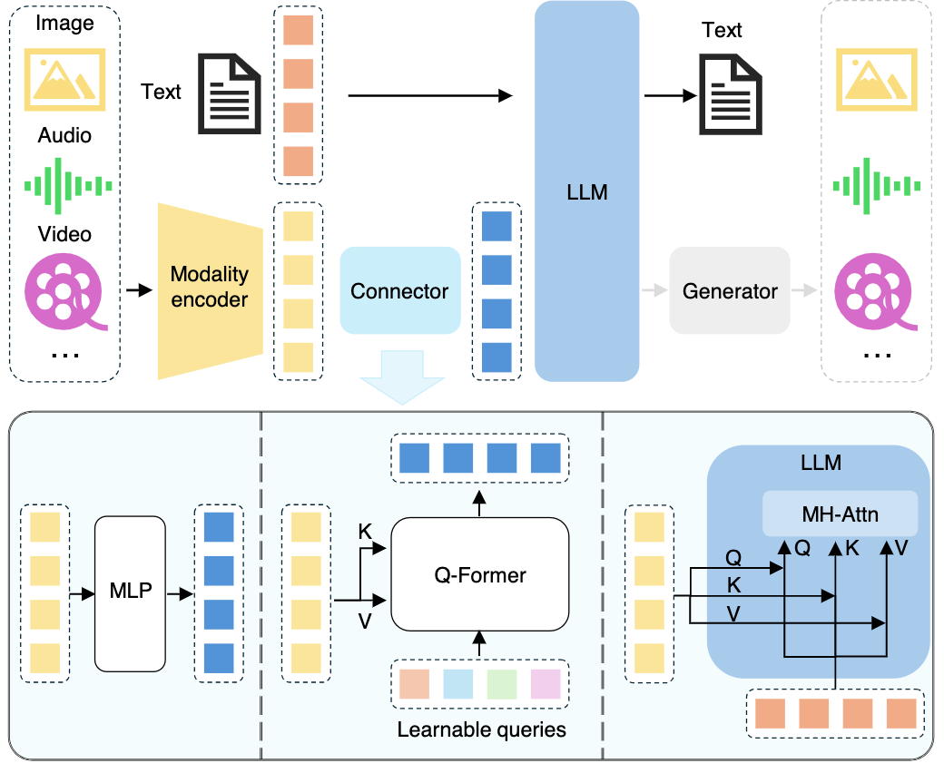

Multimodal Large Language Models (MLLM)
Multimodall LLM
Three types of connectors:
1. projection-based
2. query-based
3. fusion-based connectors
Source: Shukang Yin, Chaoyou Fu, Sirui Zhao, Ke Li, Xing Sun, Tong Xu, and Enhong Chen. (2024) "A survey on multimodal large language models." National Science Review (2024): nwae403.

Slide 71
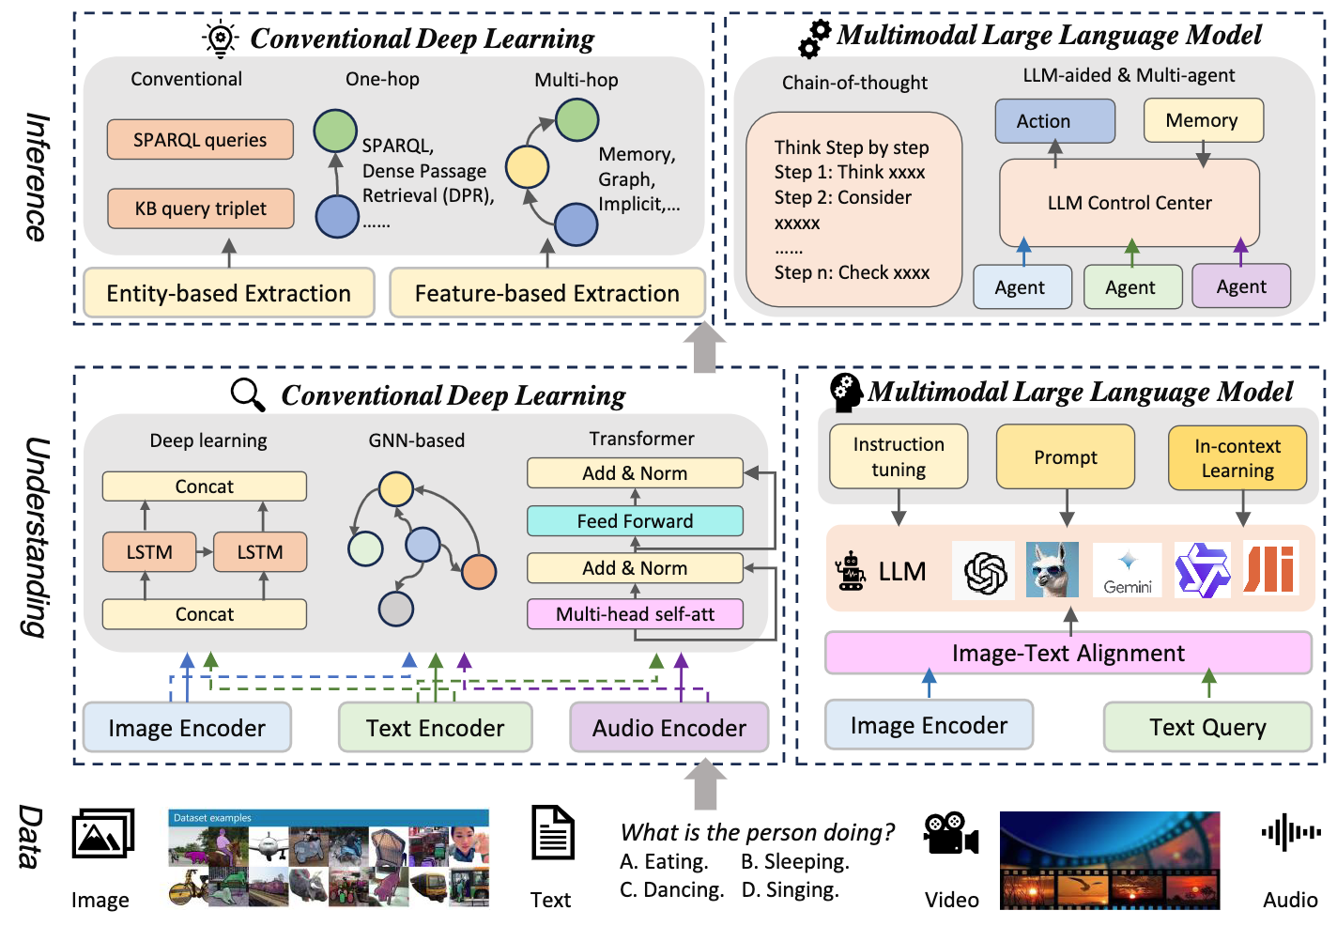
Multimodal Large Language Model (MLLM) for Vision Question Answering
Source: Jiayi Kuang, Jingyou Xie, Haohao Luo, Ronghao Li, Zhe Xu, Xianfeng Cheng, Yinghui Li, Xika Lin, and Ying Shen. (2024) "Natural Language Understanding and Inference with MLLM in Visual Question Answering: A Survey." arXiv preprint arXiv:2411.17558.

Slide 72

Large Language Models (LLM)
Three typical learning paradigms
Source: Shukang Yin, Chaoyou Fu, Sirui Zhao, Ke Li, Xing Sun, Tong Xu, and Enhong Chen. (2024) "A survey on multimodal large language models." National Science Review (2024): nwae403.

Slide 73
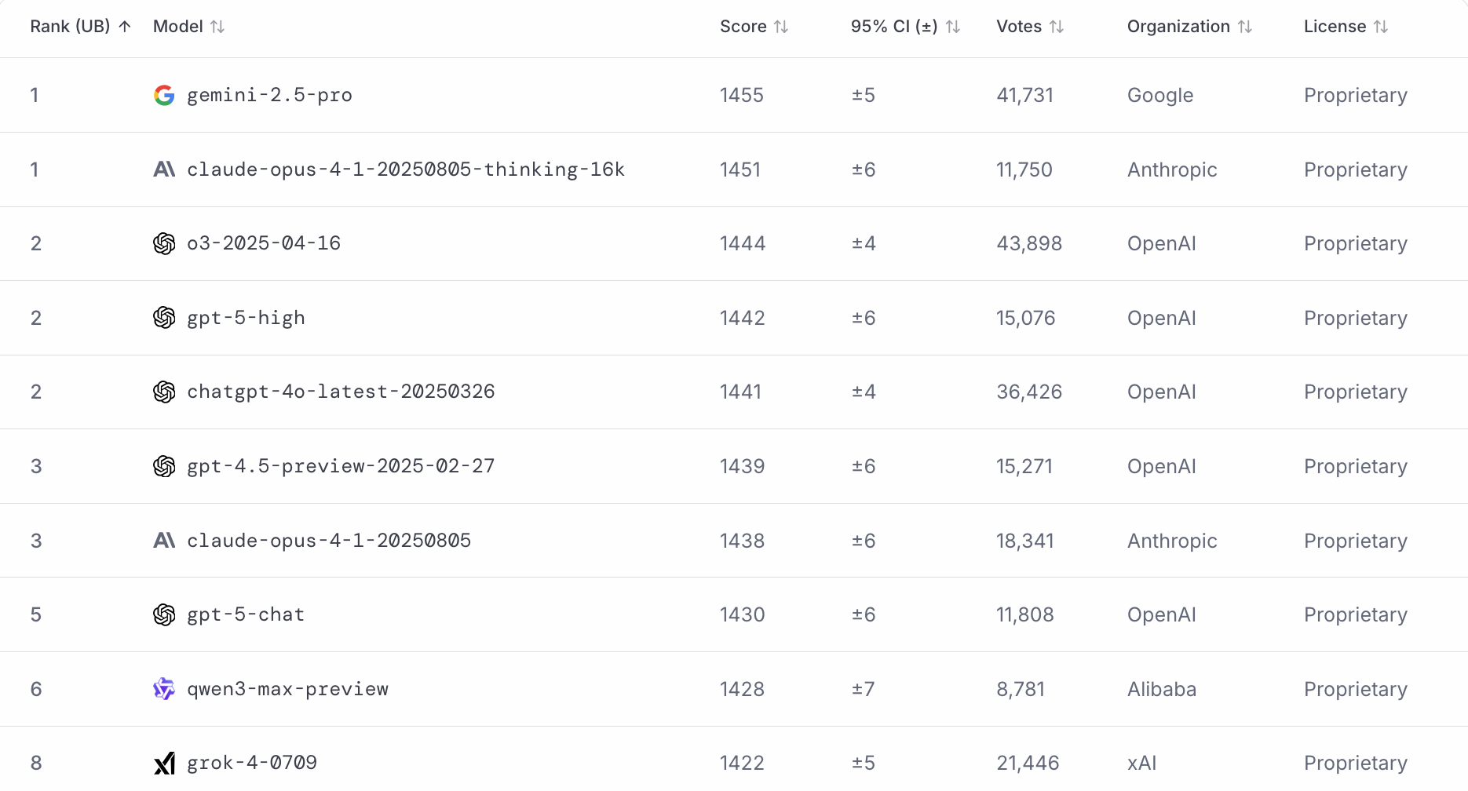
LMArena Leaderboard
https://lmarena.ai/

Slide 74
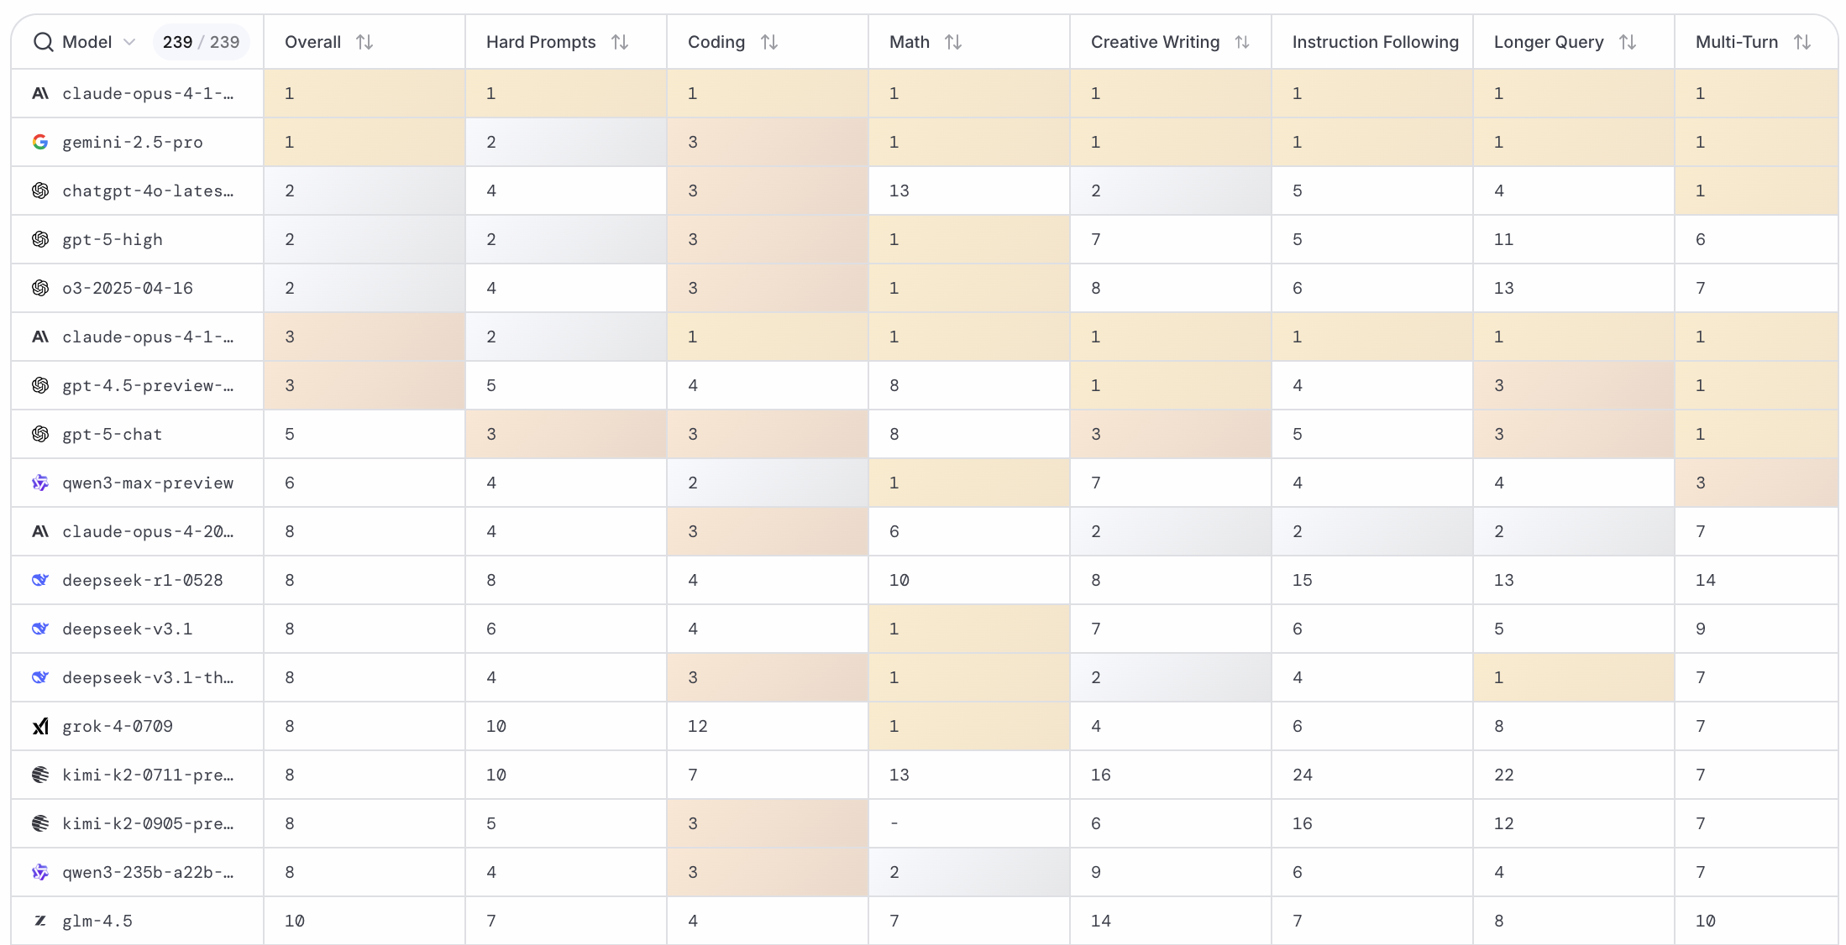
LMArena Leaderboard
https://huggingface.co/spaces/lmarena-ai/lmarena-leaderboard

Slide 75
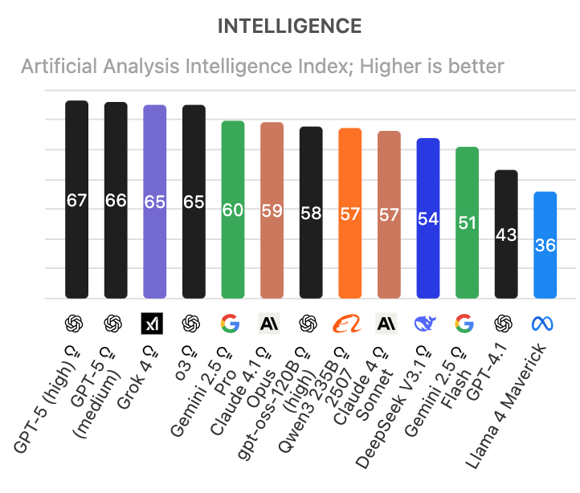
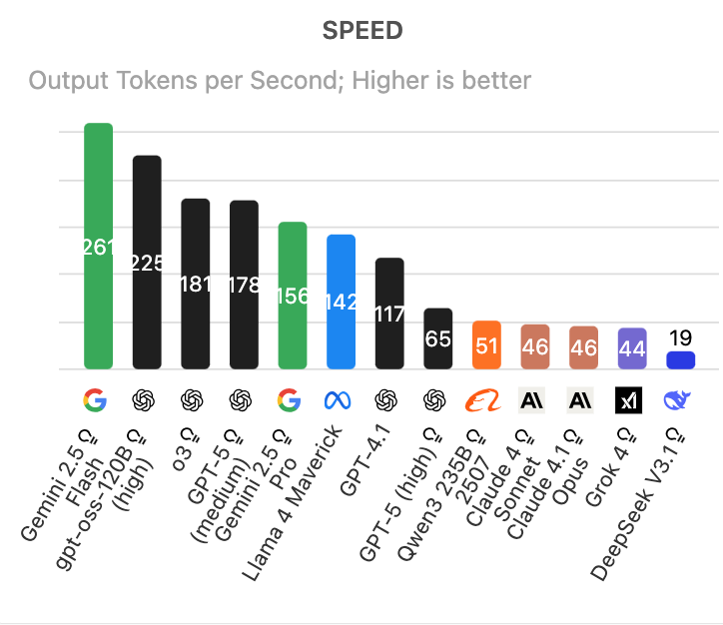
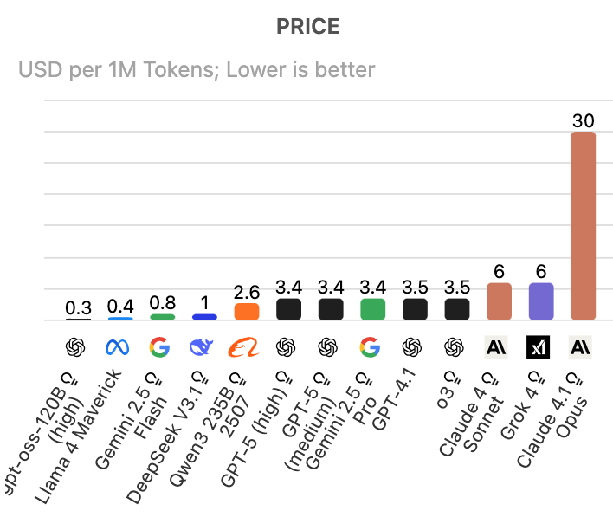
Artificial Analysis Intelligence Index
Intelligence, Speed, Price
Source: https://artificialanalysis.ai/

Slide 76
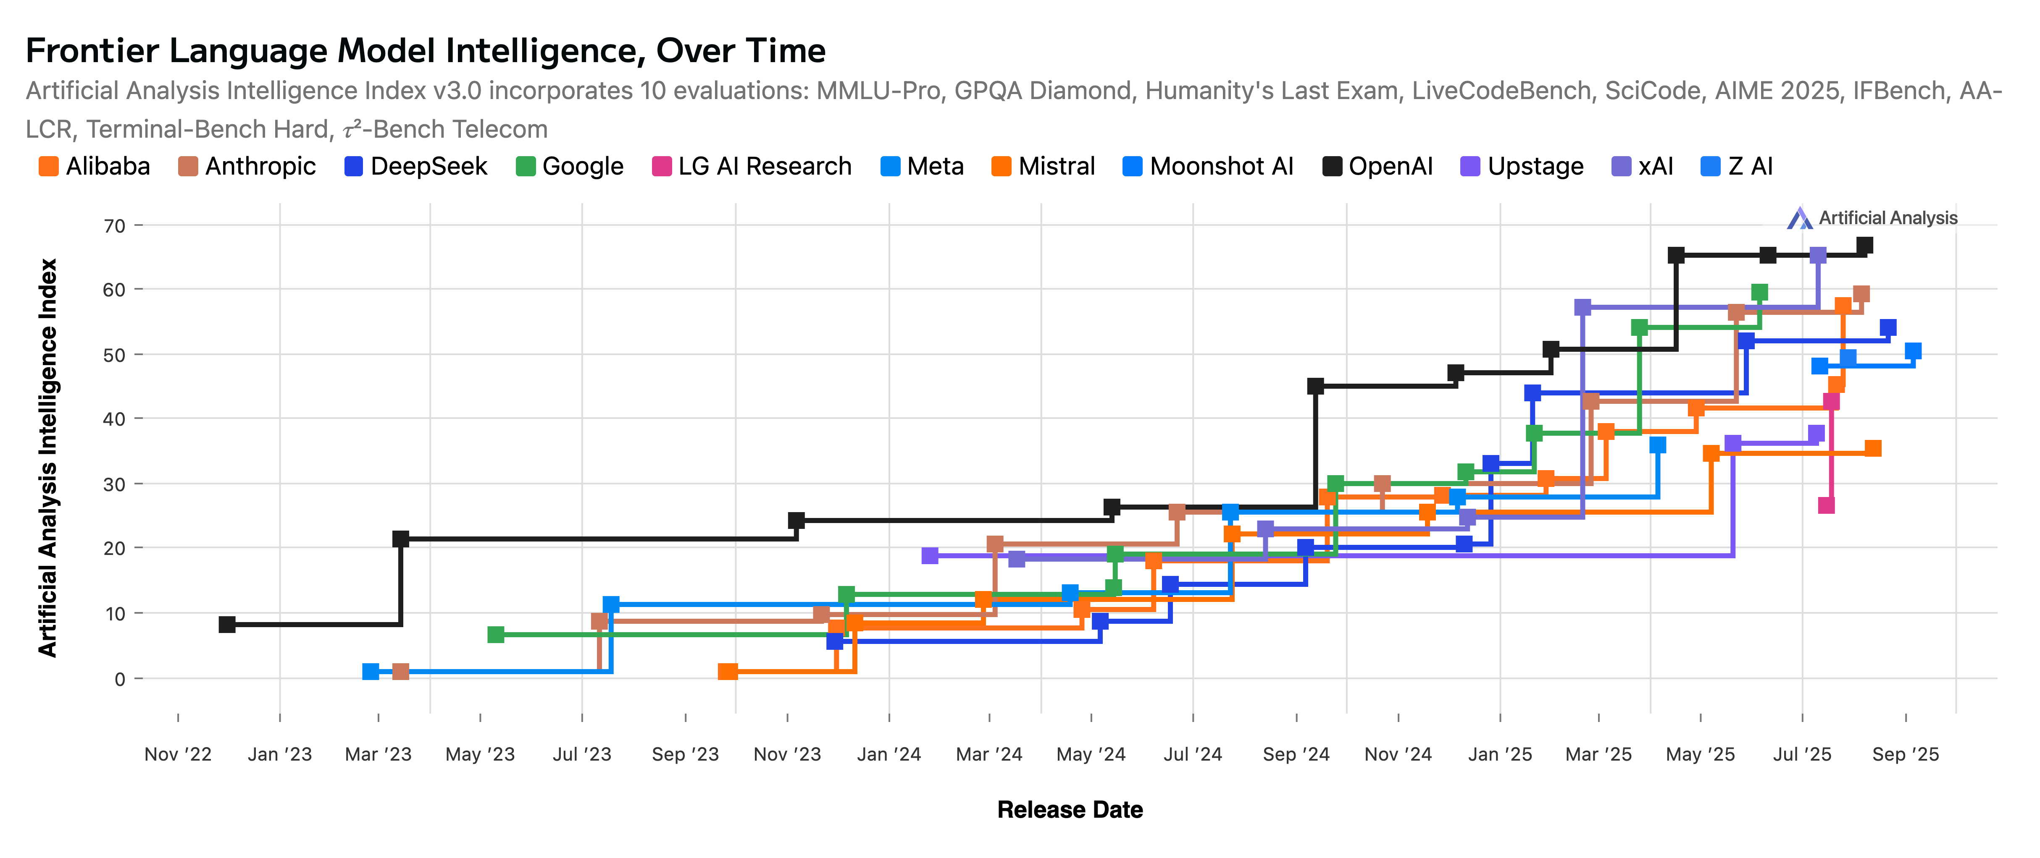
Artificial Analysis Intelligence Index
2022-2025
Source: https://artificialanalysis.ai/

Slide 77
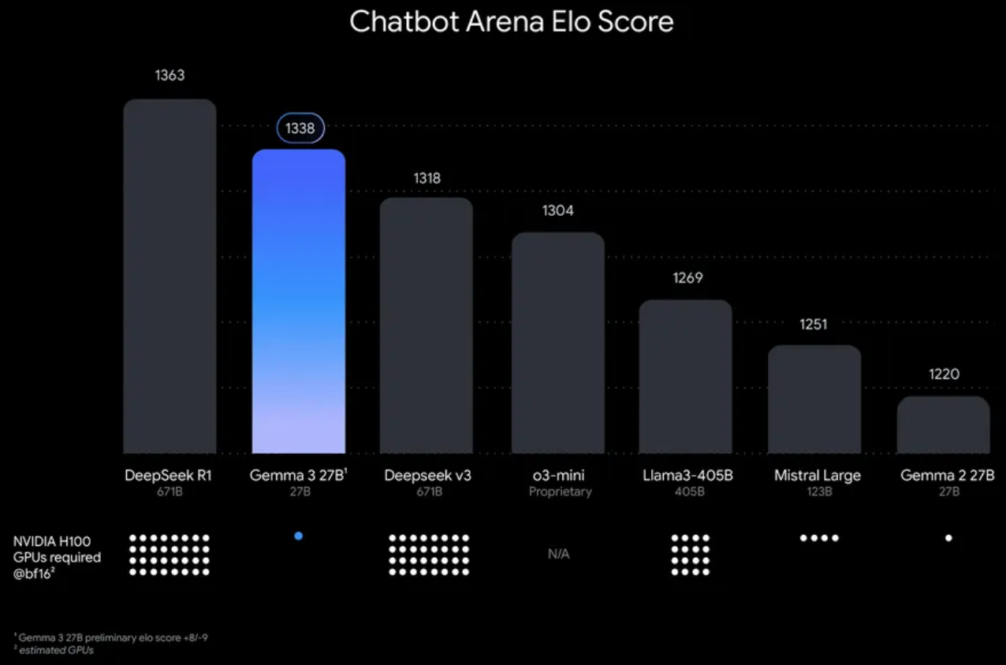
Google Gemma 3 27B
The most capable model you can run on a single GPU or TPU
Source: https://blog.google/technology/developers/gemma-3/

Slide 78
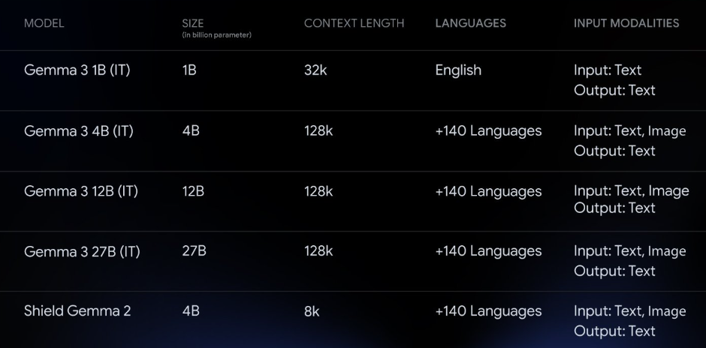
Google Gemma 3 Multimodality
(vision-language input and text outputs)
Source: https://developers.googleblog.com/en/introducing-gemma3/

Slide 79
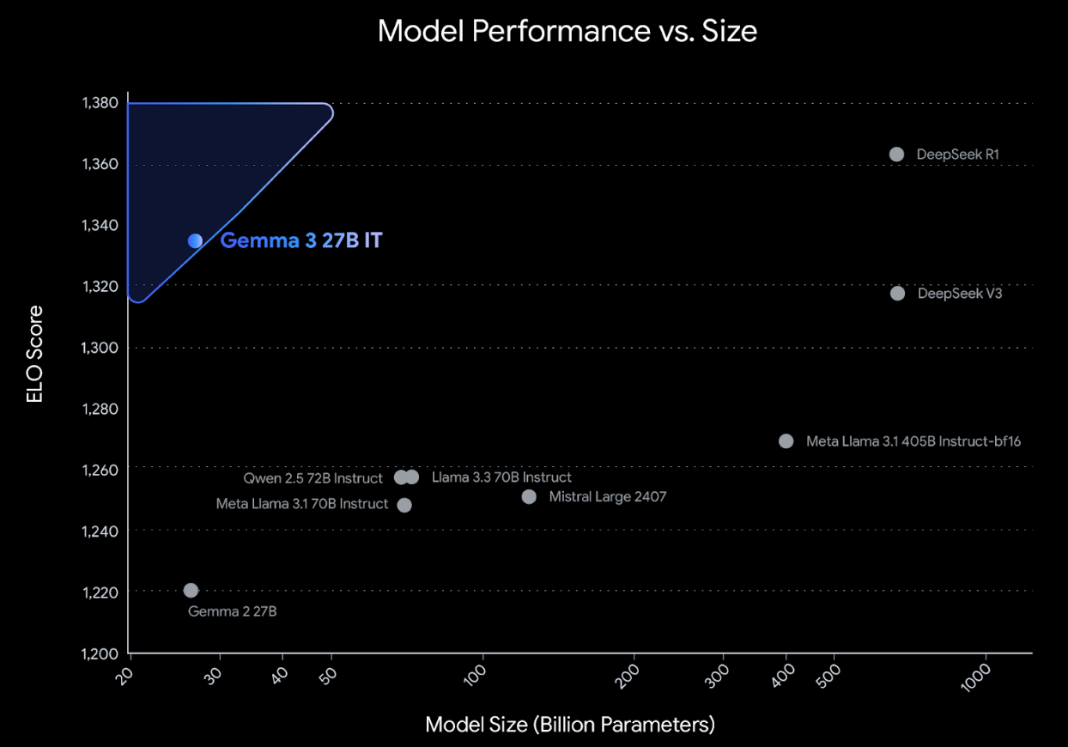
Google Gemma 3: Pre-training and Post-training
(distillation, reinforcement learning, and model merging)
Source: https://developers.googleblog.com/en/introducing-gemma3/

Slide 80
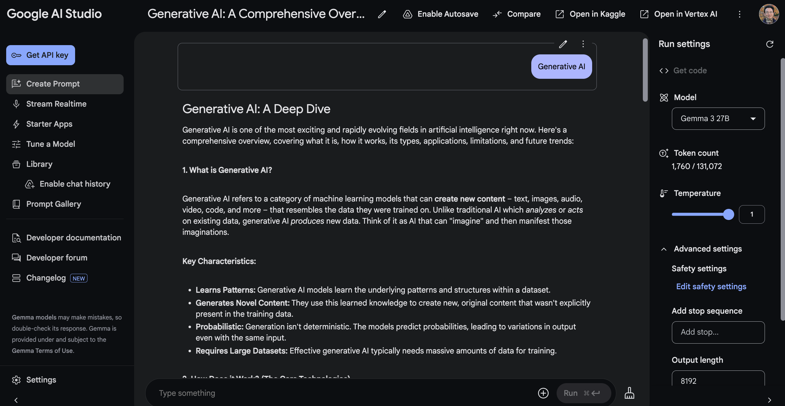
Google AI Studio (Gemma 3 27B)
Source: https://aistudio.google.com/

Slide 81
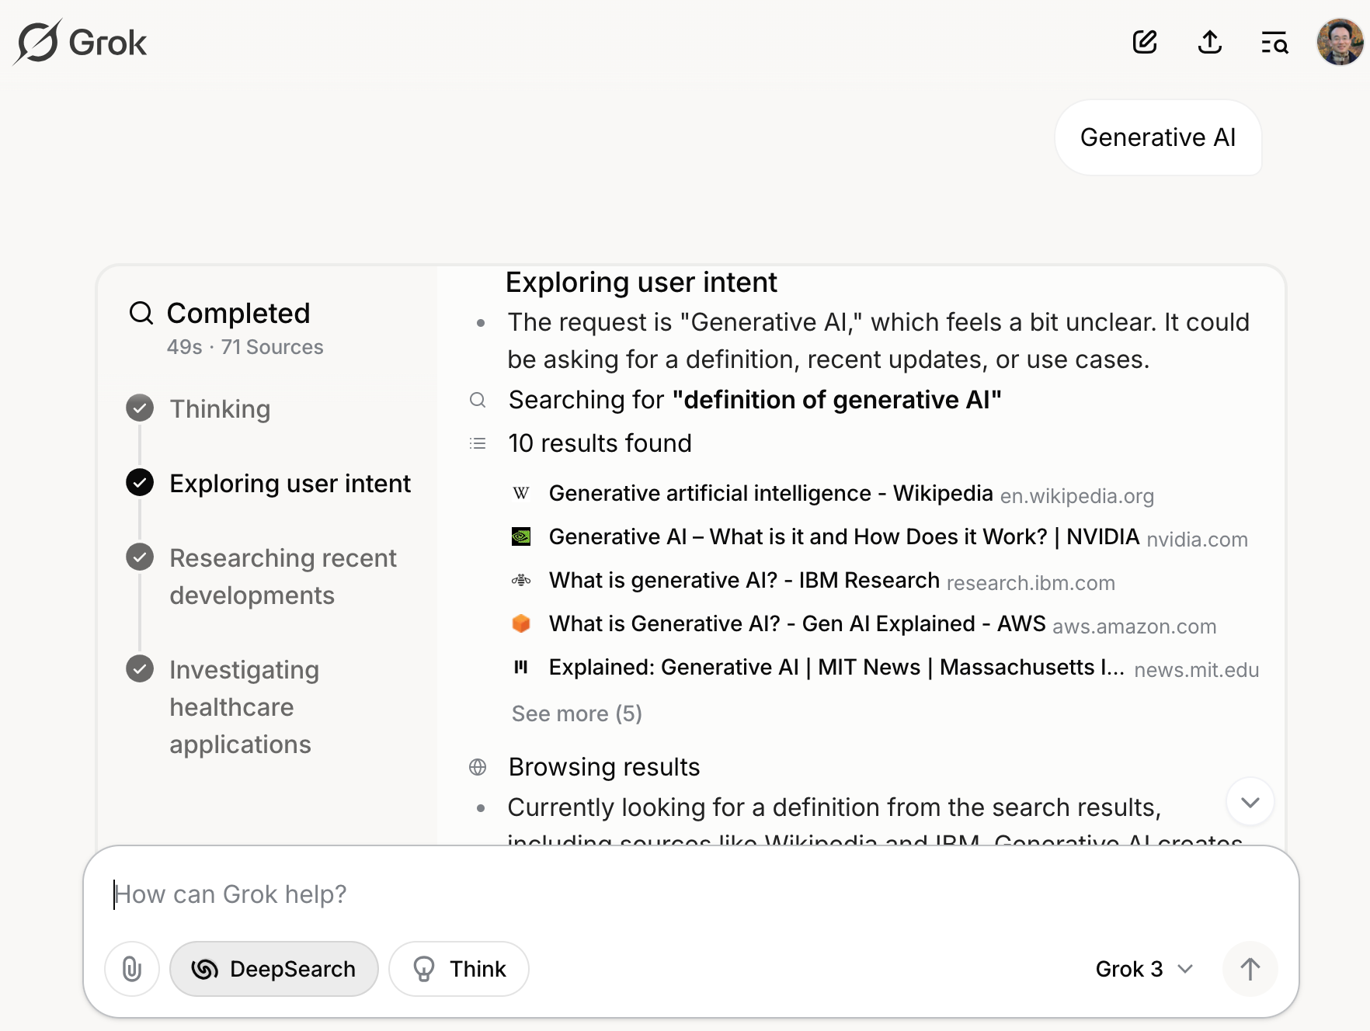
Grok 3 Deep Search
Source: https://grok.com/chat

Slide 82

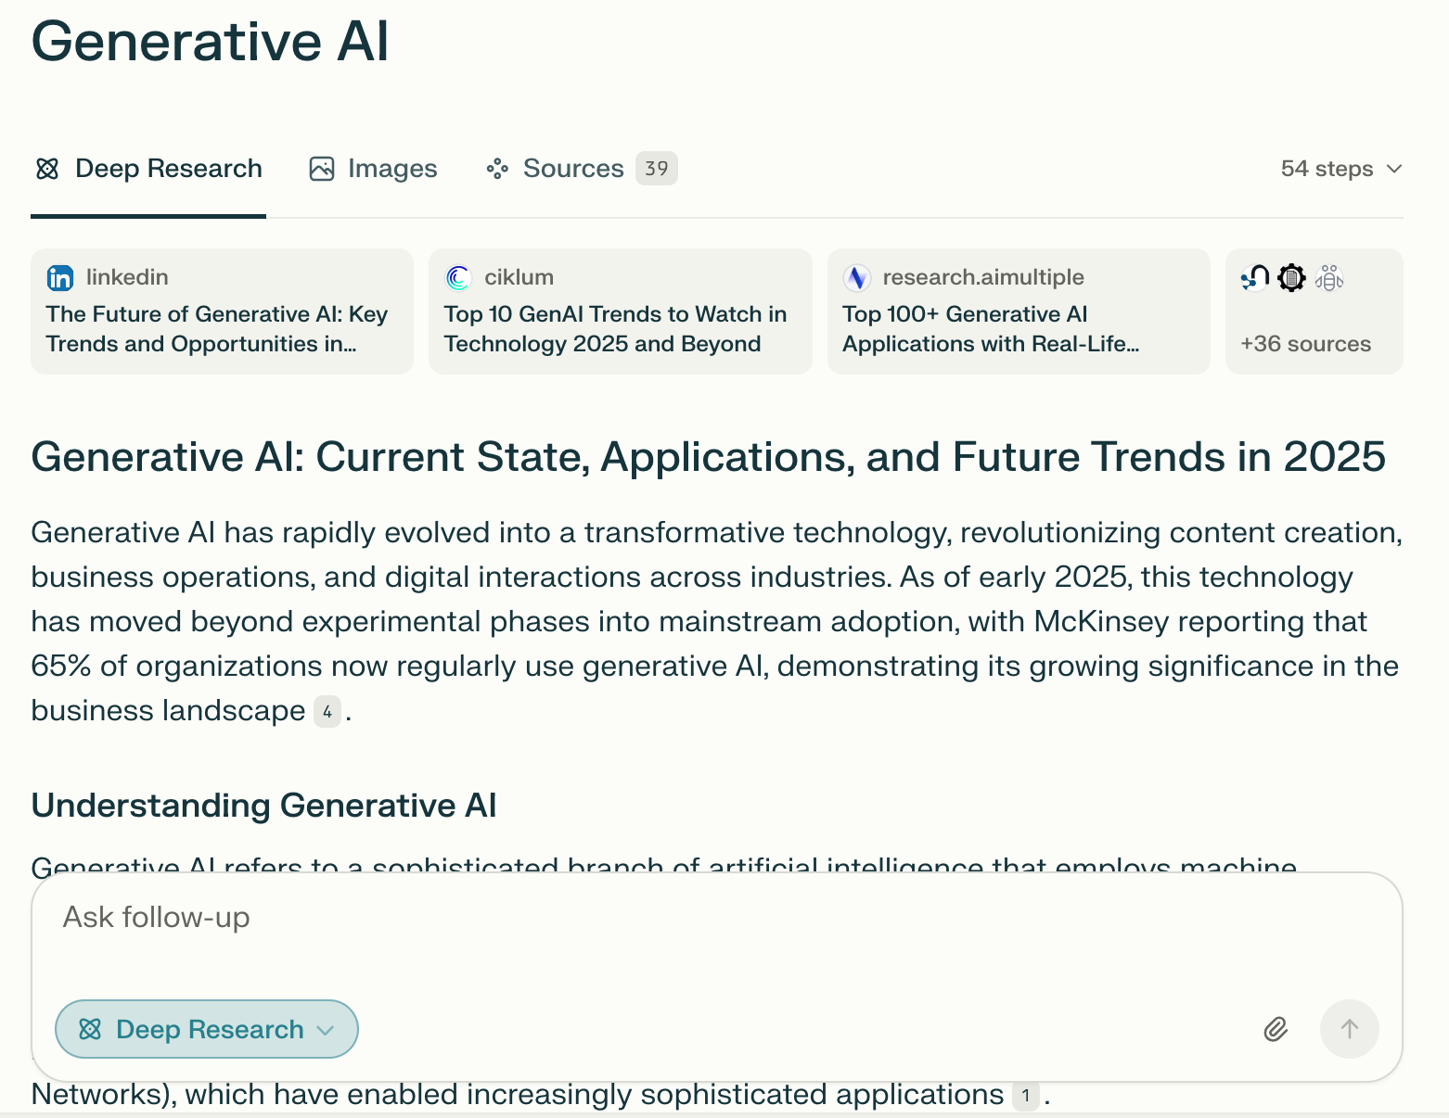
Perplexity.ai Deep Research
Source: https://www.perplexity.ai/

Slide 83
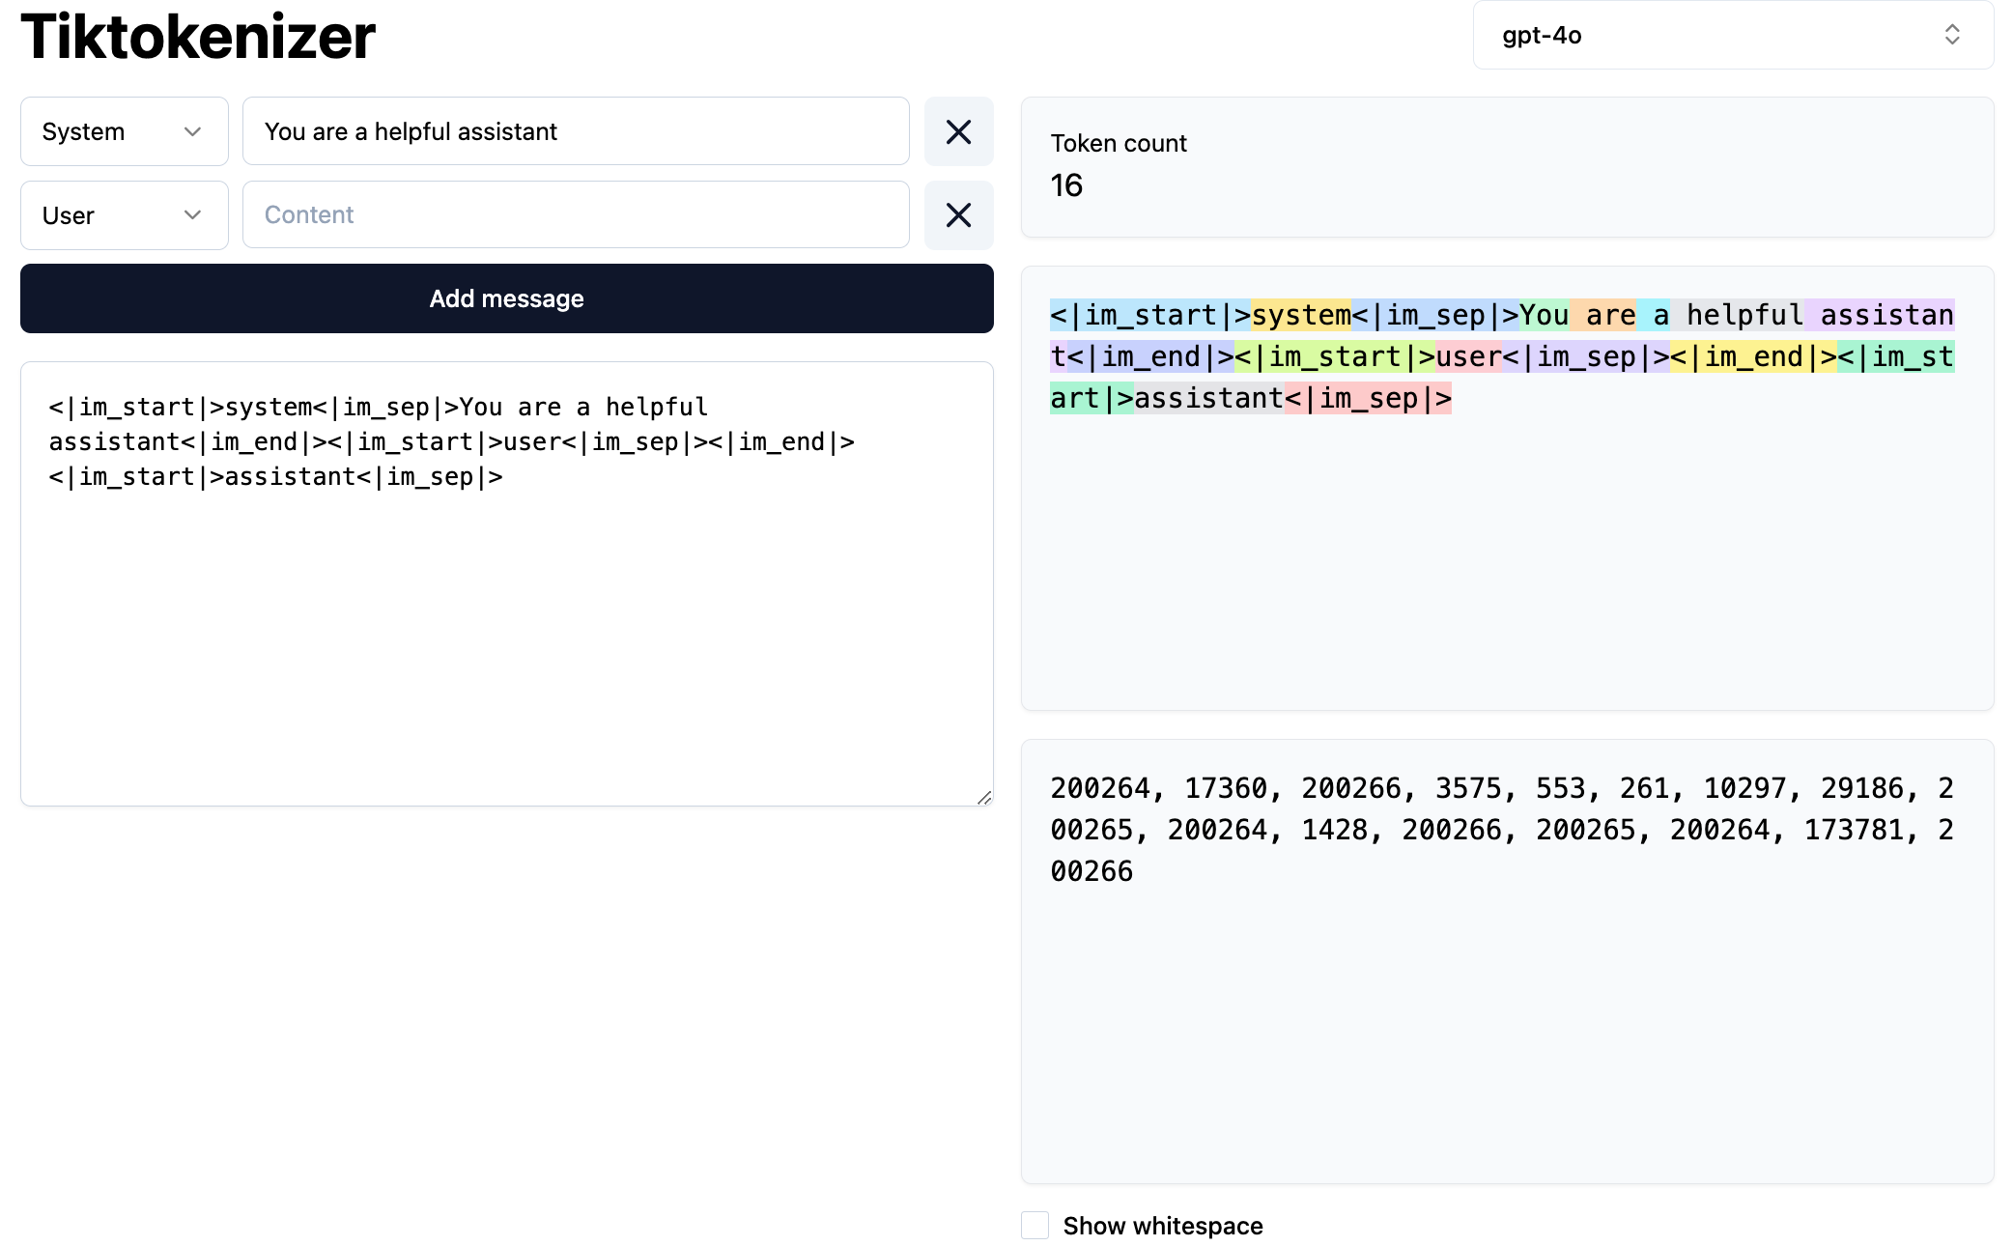
Token
https://tiktokenizer.vercel.app/

Slide 84
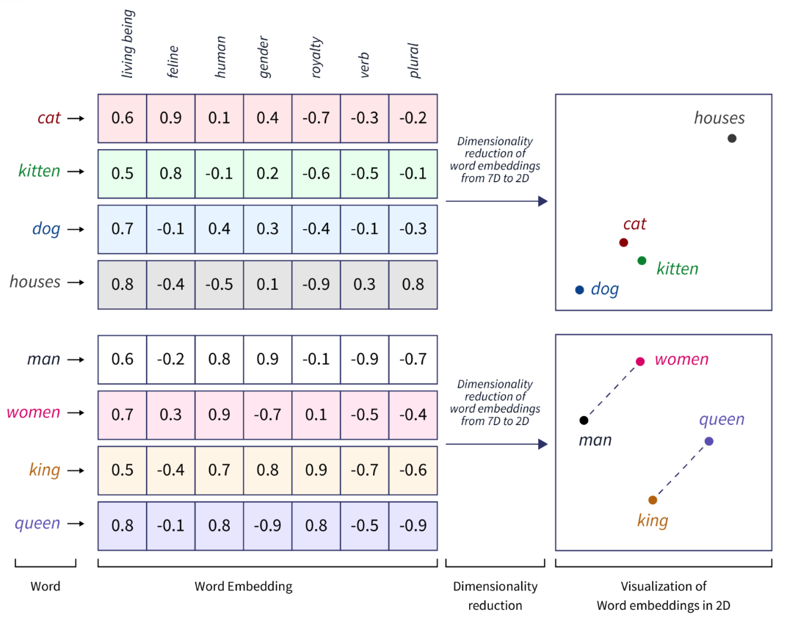
Word Embeddings
Source: https://www.scaler.com/topics/tensorflow/tensorflow-word-embeddings/

Slide 85

Transformer (Attention is All You Need)
(Vaswani et al., 2017)
Source: Vaswani, Ashish, Noam Shazeer, Niki Parmar, Jakob Uszkoreit, Llion Jones, Aidan N. Gomez, Łukasz Kaiser, and Illia Polosukhin. "Attention is all you need." In Advances in neural information processing systems, pp. 5998-6008. 2017.

Slide 86

Estimation Methodologies for
Machine Learning Classification Tasks
Simple split (or holdout or test sample estimation)
  Split the data into 2 mutually exclusive sets
  training (~70%) and testing (30%)
  For ANN, the data is split into three sub-sets
  (training [~60%], validation [~20%], testing [~20%])
Source: Ramesh Sharda, Dursun Delen, and Efraim Turban (2017), Business Intelligence, Analytics, and Data Science: A Managerial Perspective, 4th Edition, Pearson

Slide 87

k-Fold Cross-Validation:
Machine Learning Data Splitting and Model Assessment
Source: Ramesh Sharda, Dursun Delen, and Efraim Turban (2017), Business Intelligence, Analytics, and Data Science: A Managerial Perspective, 4th Edition, Pearson

Slide 88
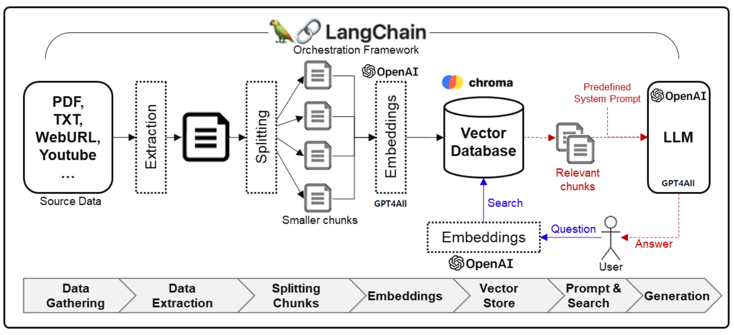
Framework for Implementing Generative AI Services using RAG Model
Source: Jeong, Cheonsu. "A Study on the Implementation of Generative AI Services Using an Enterprise Data-Based LLM Application Architecture." arXiv preprint arXiv:2309.01105 (2023).

Slide 89

Large Language Model (LLM) based Agents
Source: Xi, Z., Chen, W., Guo, X., He, W., Ding, Y., Hong, B., ... & Gui, T. (2023). The rise and potential of large language model based agents: A survey. arXiv preprint arXiv:2309.07864.

Slide 90

LLM-based Agents
Source: Cheng, Yuheng, Ceyao Zhang, Zhengwen Zhang, Xiangrui Meng, Sirui Hong, Wenhao Li, Zihao Wang et al. "Exploring large language model based intelligent agents: Definitions, methods, and prospects." arXiv preprint arXiv:2401.03428 (2024).

Slide 91

Large Multimodal Agents (LMA)
Source: Xie, J., Chen, Z., Zhang, R., Wan, X., & Li, G. (2024). Large Multimodal Agents: A Survey. ArXiv, abs/2402.15116.

Slide 92

Large Multimodal Agents (LMA)
Source: Xie, J., Chen, Z., Zhang, R., Wan, X., & Li, G. (2024). Large Multimodal Agents: A Survey. ArXiv, abs/2402.15116.

Slide 93

Generative AI and LLMs for Sustainability and
ESG Data Analytics

Slide 94
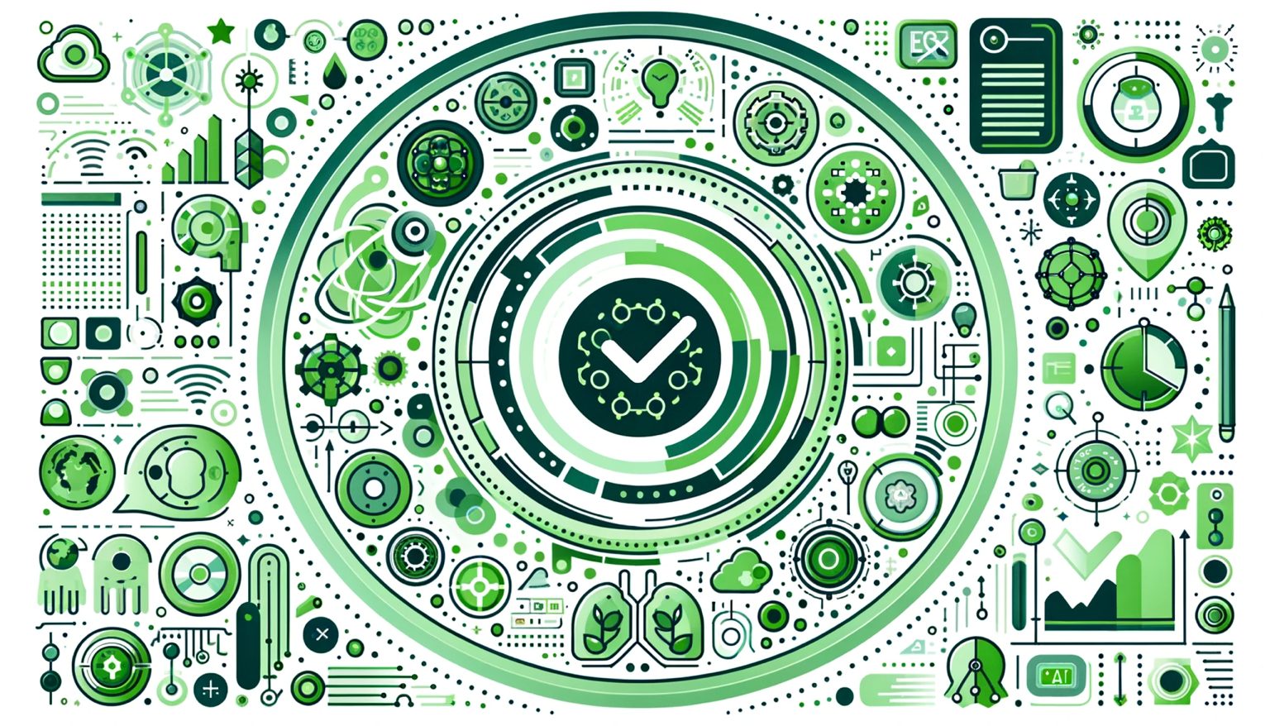
Generative AI for ESG Rating and Reporting Generation

Slide 95
Summary
Environmental, Social, and Governance (ESG)
Net-Zero Digital Transformation
  Net-Zero Transformation
  Digital Transformation
Source: Dipanjan Sarkar (2019), Text Analytics with Python: A Practitioner’s Guide to Natural Language Processing, Second Edition. APress.

Slide 96
References
Cino Robin Castelli, Cyril Shmatov (2022), Quantitative Methods for ESG Finance, Wiley
Simon Thompson (2023), Green and Sustainable Finance: Principles and Practice in Banking, Investment and Insurance, 2nd Edition, Kogan Page.
Chrissa Pagitsas (2023), Chief Sustainability Officers At Work: How CSOs Build Successful Sustainability and ESG Strategies, Apress.
Numa Dhamani and Maggie Engler (2024), Introduction to Generative AI, Manning.
Denis Rothman (2024), Transformers for Natural Language Processing and Computer Vision - Third Edition: Explore Generative AI and Large Language Models with Hugging Face, ChatGPT, GPT-4V, and DALL-E 3, 3rd ed. Edition, Packt Publishing.
Thomas R. Caldwell (2025), The Agentic AI Bible: The Complete and Up-to-Date Guide to Design, Build, and Scale Goal-Driven, LLM-Powered Agents that Think, Execute and Evolve, Independently published.
GRI (Global Report Initiative):
https://www.globalreporting.org/
CDP (Carbon Disclosure Project):
https://www.cdp.net/
SASB (Sustainability Accounting Standards Board):
https://sasb.org/
ISSB (International Sustainability Standards Board):
https://www.ifrs.org/groups/international-sustainability-standards-board/
TCFD (Task Force on Climate-related Financial Disclosures):
https://www.fsb-tcfd.org/
Min-Yuh Day (2025), Python 101, https://tinyurl.com/aintpupython101

