Slide 1









Data Science for Sustainability and ESG
Sustainability and ESG Data Analytics
1141ESGDA03
MBA, IM, NTPU (M5265) (Fall 2025)
Wed 2, 3, 4 (9:10-12:00) (B3F17)
University Ambassador
Certified Instructor
Min-Yuh Day, Ph.D,
Professor and Director
Institute of Information Management, National Taipei University
https://web.ntpu.edu.tw/~myday
https://meet.google.com/miy-fbif-max
2025-09-24

Slide 2
Syllabus
Week Date Subject/Topics
1 2025/09/10 Introduction Sustainability and ESG Data Analytics
2 2025/09/17 Environmental, Social, and Governance (ESG) in
Net-Zero Digital Transformation
3 2025/09/24 Data Science for Sustainability and ESG
4 2025/10/01 Case Study on Sustainability and ESG Data Analytics I
5 2025/10/08 Web 3.0 and Big Data Analysis in Fintech, Green and
Sustainable Finance
6 2025/10/15 ESG Data Gathering, Analysis, and Visualization

Slide 3
Syllabus
Week Date Subject/Topics
7 2025/10/22 NVIDIA Building RAG Agents with LLMs Part I:
LLM Services and AI Foundation Models
8 2025/10/29 Self-Learning
9 2025/11/05 Midterm Project Report
10 2025/11/12 NVIDIA Building RAG Agents with LLMs Part II:
Document Loading, Chunking, and Embeddings
11 2025/11/19 NVIDIA Building RAG Agents with LLMs Part III:
Retrieval-Augmented Generation with
Vector Stores and RAG Evaluation

Slide 4
Syllabus
Week Date Subject/Topics
12 2025/11/26 Case Study on Sustainability and ESG Data Analytics II
13 2025/12/03 Artificial Intelligence of things (AIoT) in ESG and
Sustainability Applications
14 2025/12/10 Generative AI for ESG Rating and Reporting Generation
15 2025/12/17 Final Project Report I
16 2025/12/24 Final Project Report II

Slide 5
Data Science for
Sustainability and ESG

Slide 6
Outline
Data Science and Sustainability
Data Collection and Analysis for Sustainability
Implementing Data-Driven Sustainability Strategies
ESG Data Science Foundation with Python

Slide 7
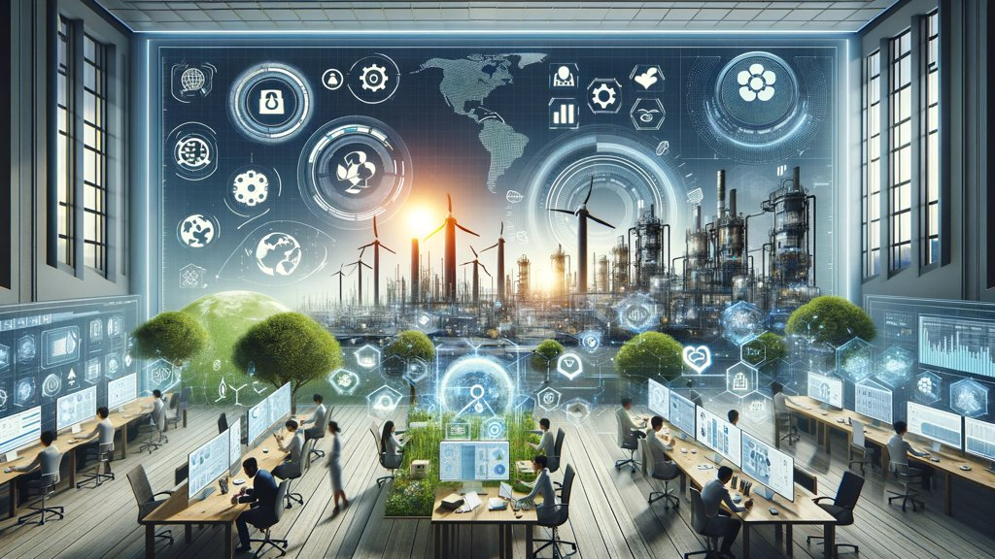
Sustainability and ESG Data Analytics

Slide 8
Data Science for
Sustainability and ESG:
Transforming Decision-Making for a Better Future

Slide 9
Data Science for Sustainability and ESG: Foundations & Frameworks

Slide 10
Data Science for
Sustainability and ESG

Slide 11
Data Science for
Sustainability and ESG
Data Science and Sustainability
Data Collection and Analysis for Sustainability
Implementing Data-Driven Sustainability Strategies

Slide 12
Fundamentals of Data Science
Definition of Data Science:
  Interdisciplinary field using scientific methods, processes, algorithms and systems to
  extract knowledge and insights
  from structured and unstructured data.
Key components:
  Statistics, Machine Learning, Data Engineering

Slide 13
Data Science Process
Business Understanding
Data Understanding
Data Preparation
Modeling
Evaluation
Deployment

Slide 14
Data Science Essential tools
Python
R
SQL
Tableau
Power BI

Slide 15
Sustainability and ESG
Sustainability: Meeting present needs without compromising future generations
ESG: Environmental, Social, and Governance
  Environmental: Climate change, resource depletion, waste, pollution, deforestation
  Social: Human rights, labor standards, workplace safety, community relations
  Governance: Board diversity, executive compensation, ethics, transparency

Slide 16
Sustainability and ESG: Business case
Risk management
Cost savings
Innovation
Brand value
Investor attraction

Slide 17
Intersection of Data Science with Sustainability and ESG
Data-driven decision making for sustainability initiatives
Predictive analytics for environmental impact
Machine learning for optimizing resource usage
Big data analysis for social impact assessment
AI-powered governance risk management

Slide 18
The Interconnectedness of
Data, Sustainability & ESG
Sustainability encompasses environmental, social, and governance concerns.
ESG provides a framework for measuring and reporting sustainability performance.
Data science offers the tools to collect, analyze, and use ESG data for decision-making.

Slide 19
ESG:
Environmental
Social
Governance

Slide 20


















Sustainable Development Goals (SDGs)
Source: https://sdgs.un.org/goals

Slide 21

Sustainable Development Goals (SDGs) and 5P
Partnership
Peace
Prosperity
People
Planet
Source: Folke, Carl, Reinette Biggs, Albert V. Norström, Belinda Reyers, and Johan Rockström. "Social-ecological resilience and biosphere-based sustainability science.”Ecology and Society 21, no. 3 (2016).

Slide 22

ESG to 17 SDGs
Source: Henrik Skaug Sætra (2021) "A Framework for Evaluating and Disclosing the ESG Related Impacts of AI with the SDGs." Sustainability 13, no. 15 (2021): 8503.

Slide 23

ESG to 17 SDGs
Source: https://sustainometric.com/esg-to-sdgs-connected-paths-to-a-sustainable-future/

Slide 24
Data Collection and Analysis for Sustainability

Slide 25
Data Collection and Analysis for Sustainability
Types of sustainability data and collection methods
Data quality, preparation, and analysis techniques
Case studies of data-driven sustainability initiatives

Slide 26
Types of Data Relevant to
Sustainability and ESG
Environmental: GHG emissions, energy usage, water consumption, waste generation
Social: Employee demographics, health and safety incidents, community engagement metrics
Governance: Board composition, executive compensation, ethical violations
Financial: ESG-related investments, sustainable product revenues, carbon pricing

Slide 27
Understanding ESG Data
Quantitative data: Measurable metrics
(e.g., carbon emissions, employee diversity)
Qualitative data: Text-based information
(e.g., policies, news articles)
Structured data: Organized in databases
Unstructured data: Requires processing
(e.g., social media)

Slide 28
Challenges of ESG Data
Lack of standardization:
  Different reporting frameworks and metrics
Reliability:
  Concerns about "greenwashing" and accuracy
Availability:
  Data gaps, especially for smaller companies and certain sectors

Slide 29
Data Collection Methods and Sources
Internal:
  ERP systems, HR databases, facility management systems
External:
  Government databases, NGO reports, industry benchmarks

Slide 30
Data Collection Methods and Sources
IoT and sensor data
  Smart meters, environmental sensors
Satellite and geospatial data
  Land use changes, deforestation monitoring
Social media and web scraping
  Brand sentiment, consumer trends
Surveys and stakeholder engagement
  Employee satisfaction, community feedback

Slide 31
Data Quality and Preparation
Ensuring data accuracy:
  Validation checks, cross-referencing
Data cleaning:
  Handling outliers, formatting inconsistencies
Addressing missing data:
  Imputation techniques, understanding data gaps
Data integration:
  Combining multiple sources, resolving conflicts
Standardization:
  Aligning with industry standards (e.g., GRI, SASB)

Slide 32
Data Analysis Techniques for Sustainability
Descriptive analytics:
  KPI tracking, trend analysis
Diagnostic analytics:
  Root cause analysis of sustainability issues
Predictive analytics:
  Forecasting future sustainability performance
Prescriptive analytics:
  Optimization of resource allocation
Machine learning applications:
  Anomaly detection, pattern recognition in sustainability data

Slide 33

MSCI ESG Rating Framework
Source: https://www.msci.com/documents/1296102/21901542/ESG-Ratings-Methodology-Exec-Summary.pdf

Slide 34

MSCI ESG Key Issue Hierarchy
Source: https://www.msci.com/documents/1296102/21901542/ESG-Ratings-Methodology-Exec-Summary.pdf

Slide 35
Data Preparation & Cleaning:
Preparing ESG Data for Analysis
Handling missing values:
  Imputation, deletion, etc.
Detecting and addressing outliers.
Ensuring data consistency (formatting, units).
Feature engineering:
  Creating new metrics based on raw ESG data.

Slide 36
Exploratory Data Analysis (EDA) & Visualization:
Uncovering Patterns in ESG Data
Exploratory Data Analysis (EDA)
  Using statistical summaries and visualizations.
Identifying trends, correlations, and unusual patterns in ESG data.
Storytelling with data:
  Effective visualizations for ESG insights.

Slide 37
ESG Predictive Modeling:
Forecasting with ESG Data
Regression
  Predicting continuous ESG outcomes (e.g., emissions)
Classification:
  Categorizing companies (e.g., high/low ESG risk)
Time Series:
  Forecasting ESG metrics over time.

Slide 38
Natural Language Processing (NLP) for Sentiment Analysis:
Sentiment Analysis for ESG Insights
Natural Language Processing (NLP):
  Enabling computers to understand human language.
Sentiment analysis:
  Determining the emotional tone of text
  (positive, negative, neutral)
Applications for ESG:
  Tracking public opinion, identifying ESG risks and opportunities.

Slide 39
Analyzing Sustainability Reports
Company sustainability report
Identify which framework was used, key ESG metrics, areas of strength and weakness
  How the company presents its ESG data and
  whether it aligns with the ESG key framework identified

Slide 40
ESG Key Frameworks
Global Reporting Initiative (GRI):
  Comprehensive sustainability standards
Sustainability Accounting Standards Board (SASB):
  Industry-specific metrics
UN Sustainable Development Goals (SDGs):
  Global goals for 2030

Slide 41
Case Studies:
Data-Driven Sustainability Initiatives
Carbon footprint reduction:
  Using ML to optimize logistics routes
Supply chain optimization:
  Predictive analytics for sustainable sourcing
Energy efficiency improvement:
  IoT-driven smart building management
Diversity and inclusion analysis:
  NLP on job descriptions and employee feedback

Slide 42

GRI (Global Report Initiative)
https://www.globalreporting.org/

Slide 43

CDP (Carbon Disclosure Project)
https://www.cdp.net/

Slide 44

SASB (Sustainability Accounting Standards Board)
https://sasb.org/

Slide 45

ISSB (International Sustainability Standards Board)
https://www.ifrs.org/groups/international-sustainability-standards-board/

Slide 46

TCFD
(Task Force on Climate-related Financial Disclosures)
https://www.ifrs.org/sustainability/tcfd/
https://www.fsb-tcfd.org/

Slide 47
Implementing
Data-Driven Sustainability Strategies

Slide 48
Implementing
Data-Driven Sustainability Strategies
Setting science-based targets and integrating metrics into operations
Advanced analytics for sustainability strategy
Overcoming challenges and future trends in data science for sustainability

Slide 49
Setting Science-Based Sustainability Targets
Science-based targets:
  Emissions reduction goals aligned with Paris Agreement
Using historical data and projections to set realistic targets
Aligning with Sustainable Development Goals (SDGs)
Case study:
  Unilever's science-based targets and progress tracking

Slide 50
Integrating Sustainability Metrics into Business Operations
Embedding ESG KPIs in performance management
Developing sustainability scorecards and dashboards
Data-driven decision making for sustainability
Challenges: Data silos, resistance to change
Best practices: Cross-functional teams, executive sponsorship

Slide 51
Advanced Analytics for
Sustainability Strategy
Scenario analysis for climate risk assessment
AI for optimizing energy consumption in real-time
Predictive modeling for supply chain sustainability risks
NLP for analyzing sustainability-related news and social media

Slide 52
Communicating ESG Performance to Stakeholders
Comprehensive sustainability reporting
(GRI, SASB standards)
Data visualization: Infographics, interactive dashboards
Real-time sustainability performance portals
Addressing data privacy in sustainability communication

Slide 53
Overcoming Challenges in
Data-Driven Sustainability
Improving data quality and standardization
Change management strategies for adoption
Ethical data collection and use in sustainability
Staying compliant with evolving ESG regulations

Slide 54
Data-Driven Sustainable Investing:
Building ESG-Conscious Portfolios
ESG investing:
  Considering environmental, social, and governance factors in investment decisions.
Performance of ESG-focused funds vs.
traditional funds.
Building ESG portfolios:
  Screening, index funds, impact investing.

Slide 55
ESG Risk Assessment and Mitigation:
Managing ESG Risks for Resilience
Identifying ESG risks across the supply chain
(environmental impact, labor practices).
Using data to quantify potential
financial consequences of ESG risks.
Developing strategies to mitigate ESG risks.
Integrating ESG risk monitoring into
decision-making for greater resilience.

Slide 56
Driving Corporate Sustainability:
Data-Powered Sustainability Transformations
Setting data-driven ESG targets and tracking progress.
Utilizing dashboards and analytics for real-time ESG insights.
Engaging stakeholders through transparent ESG reporting.

Slide 57
The Future of Data-Driven ESG:
A Sustainable Future Powered by Data
Emerging trends in ESG data and analytics
  e.g., AI for ESG insights
The potential of data to drive progress towards global sustainability goals.
The role of data scientists in shaping ethical and equitable ESG practices.
Be part of the ESG Data Science solution.

Slide 58
Future Trends in Data Science for Sustainability
Blockchain for transparent, sustainable supply chains
Digital twins for environmental impact simulation
Edge computing for real-time sustainability management
Quantum computing for complex climate modeling

Slide 59
Evolution of Sustainable Finance Research
Topic
SDGs:
Sustainable Development Goals
SDGs
Innovative Financial Instrument
Impact Investing
ESG: Environmental, Social, and Governance
CSR: Corporate Social Responsibility
Conscious Capitalism
Climate Financing
Carbon Financing
Green Financing
Ethical Investing
Socially Responsible Investing
1986
1995
2005
2015
2020
Source: Kumar, S., Sharma, D., Rao, S., Lim, W. M., & Mangla, S. K. (2022). Past, present, and future of sustainable finance:
Insights from big data analytics through machine learning of scholarly research. Annals of Operations Research, 1-44.

Slide 60

Generative AI and LLMs for Sustainability and
ESG Data Analytics

Slide 61

Generative AI for ESG Rating and Reporting Generation

Slide 62
ESG Data Science Foundation with Python

Slide 63

Python Ecosystem for Data Science
Source: https://medium.com/pyfinance/why-python-is-best-choice-for-financial-data-modeling-in-2019-c0d0d1858c45

Slide 64


Python Ecosystem for Data Science
Source:https://duchesnay.github.io/pystatsml/introduction/python_ecosystem.html

Slide 65

Python
Programming

Slide 66

Top Programming Languages
https://spectrum.ieee.org/the-top-programming-languages-2023

Slide 67
Python is an interpreted, object-oriented, high-level programming language with dynamic semantics.
Source: https://www.python.org/doc/essays/blurb/

Slide 68
Numpy
NumPy
Base
N-dimensional array package

Slide 69
Python matplotlib
Source: https://matplotlib.org/

Slide 70
Python Pandas
http://pandas.pydata.org/

Slide 71

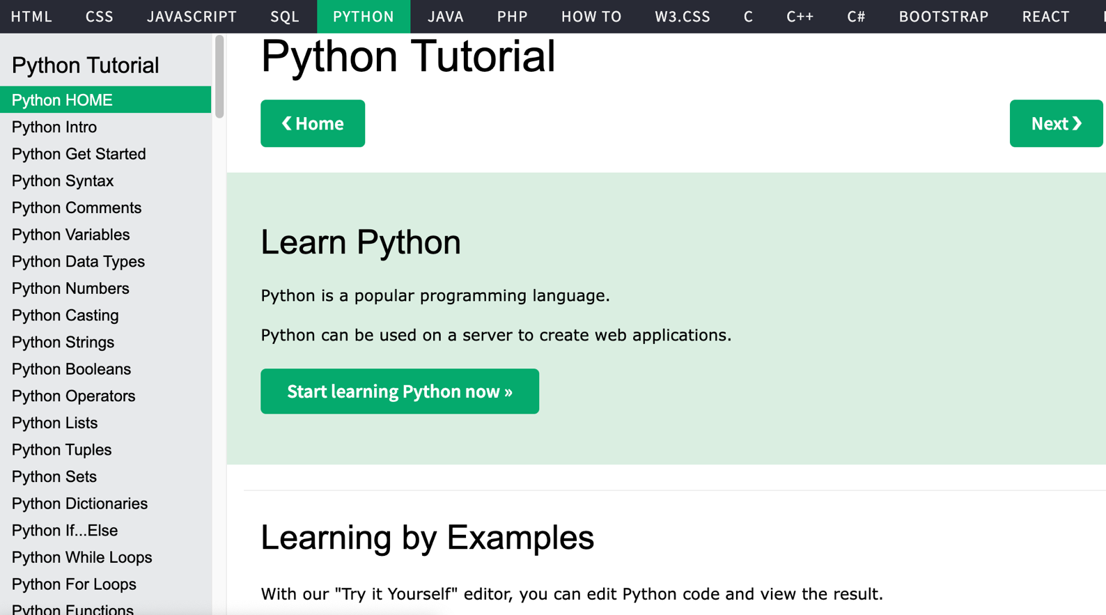
W3Schools Python
https://www.w3schools.com/python/

Slide 72

W3Schools Python: Try Python
https://www.w3schools.com/python/trypython.asp?filename=demo_default

Slide 73

LearnPython.org
https://www.learnpython.org/

Slide 74

Google’s Python Class
https://developers.google.com/edu/python

Slide 75

Google Colab
https://colab.research.google.com/notebooks/welcome.ipynb

Slide 76

Connect Google Colab in Google Drive

Slide 77

Google Colab

Slide 78

Google Colab

Slide 79

Connect Colaboratory to Google Drive

Slide 80

Google Colab

Slide 81

Google Colab

Slide 82

Google Colab

Slide 83

Run Jupyter Notebook
Python3 GPU
Google Colab

Slide 84

Google Colab Python Hello World print('Hello World')

Slide 85

Python in Google Colab (Python101)
https://colab.research.google.com/drive/1FEG6DnGvwfUbeo4zJ1zTunjMqf2RkCrT
https://tinyurl.com/aintpupython101

Slide 86
Anaconda
The Most Popular Python
Data Science Platform
Source: https://www.anaconda.com/

Slide 87


Download Anaconda
https://www.anaconda.com/download

Slide 88
Python
HelloWorld

Slide 89

Anaconda-Navigator
Launchpad

Slide 90

Anaconda Navigator

Slide 91

Jupyter Notebook

Slide 92
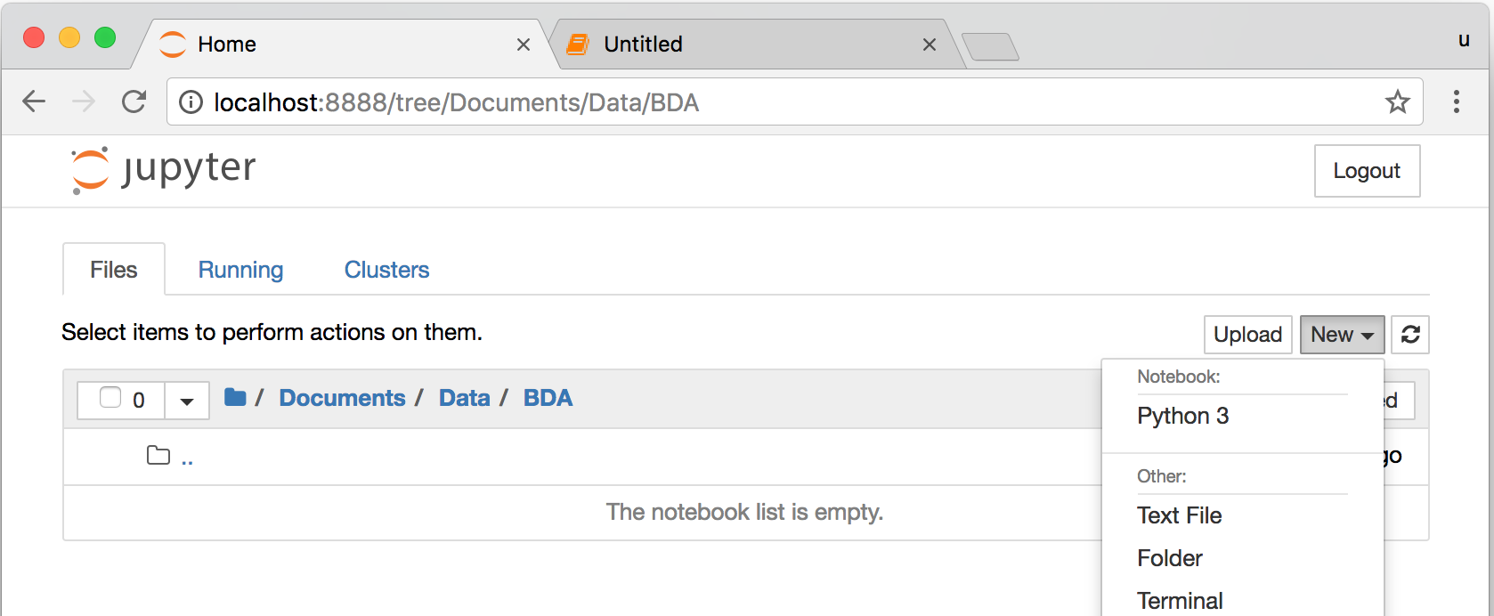
Jupyter Notebook
New Python 3

Slide 93

print("hello, world")
Notes:
print("hello, world")

Slide 94
Python
Programming

Slide 95
Foundations of Python Programming
Python Syntax
  Python Comments
Python Variables
Python Data Types
  Python Numbers
  Python Casting
  Python Strings
Python Operators
Python Booleans

Slide 96
Python Hello World print("Hello World")
print("Hello World")

Slide 97
Python Syntax
# comment
# comment

Slide 98
Python Syntax
Indentation the spaces at the beginning of a code line
4 spaces
score = 80
if score >=60 :
print("Pass")

Slide 99
Python Variables
# Python Variables
x = 2
price = 2.5
word = 'Hello'
word = 'Hello'
word = "Hello"
word = '''Hello'''

Slide 100
Python Variables
x = 2
y = x + 1

Slide 101
python_version()
# comment
from platform import python_version
print("Python Version:", python_version())
Python Version: 3.10.12

Slide 102
Python Data Types
x = "Hello World" #str
x = 2 #int
x = 2.5 #float
x = 7j #complex

Slide 103
Python Data Types
x = ["apple", "banana", "cherry"] #list
x = ("apple", "banana", "cherry") #tuple
x = range(6) #range
x = {"name" : "Tom", "age" : 20} #dict
x = {"apple", "banana", "cherry"} #set
x = frozenset({"apple", "banana", "cherry"}) #frozenset

Slide 104
Python Data Types
x = True #bool
x = b"Hello" #bytes
x = bytearray(5) #bytearray
x = memoryview(bytes(5)) #memoryview
x = None #NoneType

Slide 105
Python Casting
x = str(3) # x will be '3'
y = int(3) # y will be 3
z = float(3) # z will be 3.0
print(x, type(x))
print(y, type(y))
print(z, type(z))
3 <class 'str’>
3 <class 'int’>
3.0 <class 'float'>

Slide 106
Python Numbers
x = 2 # int
y = 3.4 # float
z = 7j #complex
print(x, type(x))
print(y, type(y))
print(z, type(z))
2 <class 'int’>
3.4 <class 'float’>
7j <class 'complex'>

Slide 107
Python Arithmetic Operators
Operator Name Example
+ Addition 7 + 2 = 9
- Subtraction 7 - 2 = 5
* Multiplication 7 * 2 = 14
/ Division 7 / 2 = 3.5
// Floor division 7 // 2 = 3 (Quotient)
% Modulus 7 % 2 = 1 (Remainder)
** Exponentiation 7 ** 2 = 49

Slide 108
Python Basic Operators
print('7 + 2 =', 7 + 2)
print('7 - 2 =', 7 - 2)
print('7 * 2 =', 7 * 2)
print('7 / 2 =', 7 / 2)
print('7 // 2 =', 7 // 2)
print('7 % 2 =', 7 % 2)
print('7 ** 2 =', 7 ** 2)
7 + 2 = 9
7 - 2 = 5
7 * 2 = 14
7 / 2 = 3.5
7 // 2 = 3
7 % 2 = 1
7 ** 2 = 49

Slide 109
Python Booleans:
True or False
# Python Booleans: True or False
print(3 > 2)
print(3 == 2)
print(3 < 2)
True
False
False

Slide 110
Python BMI Calculator
# BMI Calculator in Python
height_cm = 170
weight_kg = 60
height_m = height_cm/100
BMI = (weight_kg/(height_m**2))
print("Your BMI is: " + str(round(BMI,1)))
Your BMI is: 20.8

Slide 111
Future value of a specified principal amount, rate of interest, and a number of years
Source: https://www.w3resource.com/python-exercises/python-basic-exercise-39.php

Slide 112
How much is your $100 worth after 7 years?
# How much is your $100 worth after 7 years?
fv = 100 * 1.1 ** 7
print('fv = ', round(fv, 2))
# output = 194.87
fv = 194.87

Slide 113
Future Value
# Future Value
pv = 100
r = 0.1
n = 7
fv = pv * ((1 + (r)) ** n)
print(round(fv, 2))
194.87

Slide 114
Future Value
# Future Value
amount = 100
interest = 10 #10% = 0.01 * 10
years = 7
future_value = amount * ((1 + (0.01 * interest)) ** years)
print(round(future_value, 2))
194.87

Slide 115
Python
Data Structures

Slide 116
Python Data Structures
  Python Lists []
  Python Tuples ()
  Python Sets {}
  Python Dictionaries {k:v}

Slide 117
Python Data Structures
fruits = ["apple", "banana", "cherry"] #lists []
colors = ("red", "green", "blue") #tuples ()
animals = {'cat', 'dog'} #sets {}
person = {"name" : "Tom", "age" : 20} #dictionaries {}

Slide 118
Python Data Types
x = ["apple", "banana", "cherry"] #list
x = ("apple", "banana", "cherry") #tuple
x = {"name" : "Tom", "age" : 20} #dict
x = {"apple", "banana", "cherry"} #set

Slide 119
Python Collections
There are four collection data types in the Python programming language
List []
  a collection which is ordered and changeable. Allows duplicate members.
Tuple ()
  a collection which is ordered and unchangeable. Allows duplicate members.
Set {}
  a collection which is unordered, unchangeable, and unindexed. No duplicate members.
Dictionary {k:v}
  a collection which is ordered and changeable. No duplicate members.

Slide 120
Python Dictionaries {k:v}
As of Python version 3.7, dictionaries are ordered.
In Python 3.6 and earlier, dictionaries are unordered.

Slide 121
Lists []
x = [60, 70, 80, 90]
print(len(x))
print(x[0])
print(x[1])
print(x[-1])
4
60
70
90

Slide 122
Lists []
len(): how many items
type(): data type
list() constructor: creating a new list

Slide 123
Python List Methods
Method Description
append() Adds an element at the end of the list
clear() Removes all the elements from the list
copy() Returns a copy of the list
count() Returns the number of elements with the specified value
extend() Add the elements of a list (or any iterable), to the end of the current list
index() Returns the index of the first element with the specified value
insert() Adds an element at the specified position
pop() Removes the element at the specified position
remove() Removes the item with the specified value
reverse() Reverses the order of the list
sort() Sorts the list
https://www.w3schools.com/python/python_lists_methods.asp

Slide 124
Tuples ()
A tuple in Python is a collection that cannot be modified.
A tuple is defined using parenthesis.
x = (10, 20, 30, 40, 50)
print(x[0])
print(x[1])
print(x[2])
print(x[-1])
10
20
30
50
Source: http://pythonprogramminglanguage.com/tuples/

Slide 125
Sets {}
animals = {'cat', 'dog'}
print('cat' in animals)
print('fish' in animals)
animals.add('fish')
print('fish' in animals) print(len(animals))
animals.add('cat’)
print(len(animals))
animals.remove('cat')
print(len(animals))
True
False
True
3
3
2
Source: http://cs231n.github.io/python-numpy-tutorial/

Slide 126
Dictionary {key : value}
Python Dictionary
Key → Value
'EN’ → 'English’
'FR’ → 'French'
k = { 'EN':'English', 'FR':'French' }
print(k['EN'])
English
Source: http://pythonprogramminglanguage.com/dictionary/

Slide 127
Python Data Structures
fruits = ["apple", "banana", "cherry"] #lists []
colors = ("red", "green", "blue") #tuples ()
animals = {'cat', 'dog'} #sets {}
person = {"name" : "Tom", "age" : 20} #dictionaries {}
https://tinyurl.com/aintpupython101

Slide 128
Python
Control Logic and
Loops

Slide 129
Python Control Logic and Loops
  Python if else
    if elif else
    Booleans: True, False
    Operators: ==, !=, >, <, >=, <=, and, or, not
  Python for Loops
    for
  Python while Loops
    While
      break
      continue

Slide 130
Python if...else
  Python if...else
    if elif else
    Booleans: True, False
    Operators: ==, !=, >, <, >=, <=, and, or, not

Slide 131
Python Conditions and If statements
Python supports the usual logical conditions from mathematics:
  Equals: a == b
  Not Equals: a != b
  Less than: a < b
  Less than or equal to: a <= b
  Greater than: a > b
  Greater than or equal to: a >= b

Slide 132
Python Comparison Operators
Operator | Name | Example
== | Equal | x == y
!= | Not equal | x != y
> | Greater than | x > y
< | Less than | x < y
>= | Greater than or equal to | x >= y
<= | Less than or equal to | x <= y
Source: https://www.w3schools.com/python/python_operators.asp

Slide 133
Python Logical Operators
Operator | Description | Example
and | Returns True if both statements are true | x < 5 and x < 10
or | Returns True if one of the statements is true | x < 5 or x < 4
not | Reverse the result, returns False if the result is true | not(x < 5 and x < 10)
Source: https://www.w3schools.com/python/python_operators.asp

Slide 134
Python if
# Python if
score = 80
if score >=60 :
print("Pass")
https://tinyurl.com/aintpupython101

Slide 135
Python if else
# Python if else
score = 80
if score >=60 :
print("Pass")
else:
print("Fail")
https://tinyurl.com/aintpupython101

Slide 136
Python if elif else
score = 95
if score >= 90 :
print("A")
elif score >=60 :
print("Pass")
else:
print("Fail")

Slide 137
Python if elif else
# Python if elif else
score = 90
grade = ""
if score >=90:
grade = "A"
elif score >= 80:
grade = "B"
elif score >= 70:
grade = "C"
elif score >= 60:
grade = "D"
else:
grade = "E"
print(grade)

Slide 138
Python for Loops
for i in range(1,6):
print(i)
1
2
3
4
5
https://tinyurl.com/aintpupython101

Slide 139
Python for loops
# for loops
for i in range(1,10):
for j in range(1,10):
print(i, ' * ' , j , ' = ', i*j)
https://tinyurl.com/aintpupython101

Slide 140
Python while Loops
  while
    break
    continue

Slide 141
Python while loops
# while loops
age = 10
while age < 20:
print(age)
age = age + 1
https://tinyurl.com/aintpupython101

Slide 142
Python
Functions,
Classes, and
Modules

Slide 143
Python Functions, Classes, Modules
Python Functions
  def myfunction():
Python Classes/Objects
  class MyClass:
Python Modules
  mymodule.py
  import mymodule

Slide 144
Python
Functions

Slide 145
Python Functions
A function is a block of code which only runs when it is called.
You can pass data, known as parameters, into a function.
A function can return data as a result.
Creating a Function
  In Python a function is defined using the def keyword:

Slide 146
Python Function def
# Python Function def
# indentation for blocks. four spaces
def getfv(pv, r, n):
fv = pv * ((1 + (r)) ** n)
return fv
fv = getfv(100, 0.1, 7)
print(round(fv, 2))
194.87
https://tinyurl.com/aintpupython101

Slide 147
Future value of a specified principal amount, rate of interest, and a number of years
Source: https://www.w3resource.com/python-exercises/python-basic-exercise-39.php

Slide 148
How much is your $100 worth after 7 years?
# How much is your $100 worth after 7 years?
fv = 100 * 1.1 ** 7
print('fv = ', round(fv, 2))
# output = 194.87
fv = 194.87

Slide 149
Future Value
# Future Value
pv = 100
r = 0.1
n = 7
fv = pv * ((1 + (r)) ** n)
print(round(fv, 2))
194.87

Slide 150
Future Value
# Future Value
amount = 100
interest = 10 #10% = 0.01 * 10
years = 7
future_value = amount * ((1 + (0.01 * interest)) ** years)
print(round(future_value, 2))
194.87

Slide 151
Python Function def getfv() define get future value function
# Python Function def
# indentation for blocks. four spaces
def getfv(pv, r, n):
fv = pv * ((1 + (r)) ** n)
return fv
fv = getfv(100, 0.1, 7)
print(round(fv, 2))
194.87
https://tinyurl.com/aintpupython101

Slide 152
Python
Classes/Objects class MyClass:

Slide 153
Python Classes/Objects
Python is an object oriented programming language.
Almost everything in Python is an object, with its properties and methods.
A Class is like an object constructor, or a "blueprint" for creating objects.
Create a Class:
  To create a class, use the keyword class:

Slide 154
Python Classes/Objects class MyClass:
# Python class
class MyClass:
x = 5
c1 = MyClass()
print(c1.x)
https://www.w3schools.com/python/python_classes.asp

Slide 155
Python Classes/Objects
class Person:
def __init__(self, name, age):
self.name = name
self.age = age
p1 = Person("Alan", 20)
print(p1.name)
print(p1.age)
Alan
20
https://tinyurl.com/aintpupython101

Slide 156
Python Classes/Objects
class Person:
def __init__(self, name, age):
self.name = name
self.age = age
def myfunc(self):
print("Hello my name is " + self.name)
p1 = Person("Alan", 20)
p1.myfunc()
https://tinyurl.com/aintpupython101

Slide 157
Python Classes/Objects
class Person:
def __init__(self, name, age):
self.name = name
self.age = age
def myfunc(self):
print("Hello my name is " + self.name)
p1 = Person("Alan", 20)
p1.myfunc()
print(p1.name)
print(p1.age)
Hello my name is Alan
Alan
20
https://tinyurl.com/aintpupython101

Slide 158
Python Classes and Obects
class Vehicle:
name = ""
kind = "car"
color = ""
value = 100.00
def description(self):
desc_str = "%s is a %s %s worth $%.2f." % (self.name, self.color, self.kind, self.value)
return desc_str
https://tinyurl.com/aintpupython101

Slide 159
Python Classes and Objects
car1 = Vehicle()
car1.name = "Fer"
car1.color = "red"
car1.kind = "convertible"
car1.value = 60000.00
car2 = Vehicle()
car2.name = "Jump"
car2.color = "blue"
car2.kind = "van"
car2.value = 10000.00
print(car1.description())
print(car1.name)
print(car2.description())
print(car2.name)
class Vehicle:
name = ""
kind = "car"
color = ""
value = 100.00
def description(self):
desc_str = "%s is a %s %s worth $%.2f." % (self.name, self.color, self.kind, self.value)
return desc_str
Fer is a red convertible worth $60000.00.
Fer
Jump is a blue van worth $10000.00.
Jump
https://www.learnpython.org/en/Classes_and_Objects

Slide 160
Python
Modules

Slide 161
Python Modules
Consider a module to be the same as a code library.
A file containing a set of functions you want to include in your application.
Create a Module
  To create a module just save the code you want in a file with the file extension .py:
Use a Module
  import module

Slide 162
Python Modules
# mymodule.py
def greeting(name):
print("Hello, " + name)
import mymodule
mymodule.greeting("Alan")
mymodule.py
def greeting(name):
print("Hello, " + name)
https://tinyurl.com/aintpupython101

Slide 163
Python File Input / Output
# Python File Input / Output
with open('myfile.txt', 'w') as file:
file.write('Hello World\nThis is Python File Input Output')
with open('myfile.txt', 'r') as file:
text = file.read()
print(text)
Hello World This is Python File Input Output
https://tinyurl.com/aintpupython101

Slide 164
Python File Input / Output
# Python File Input / Output
filename = 'mymodule.py'
with open(filename, 'w') as file:
text = '''def greeting(name):
print("Hello, " + name)
'''
file.write(text)
with open(filename, 'r') as file:
text = file.read()
print(filename)
print(text)
mymodule.py
def greeting(name):
print("Hello, " + name)
https://tinyurl.com/aintpupython101

Slide 165
Python Modules import mymodule
# mymodule.py
def greeting(name):
print("Hello, " + name)
import mymodule
mymodule.greeting("Alan")
Hello, Alan
https://tinyurl.com/aintpupython101

Slide 166
Python main() function
#Python main() function
def main():
print("Hello World!")
if __name__ == "__main__":
main()
https://tinyurl.com/aintpupython101

Slide 167
Files and
Exception Handling

Slide 168
Files and Exception Handling
Python Files (File Handling)
  open()
  f = open("myfile.txt")
Python Try Except (Exception Handling)
  try:
  except:
  else:
  finally:

Slide 169
File Handling
The key function for working with files in Python is the open() function.
The open() function takes two parameters; filename, and mode.
There are four different methods (modes) for opening a file:
  "r" - Read - Default value. Opens a file for reading, error if the file does not exist
  "a" - Append - Opens a file for appending, creates the file if it does not exist
  "w" - Write - Opens a file for writing, creates the file if it does not exist
  "x" - Create - Creates the specified file, returns an error if the file exists

Slide 170
Python Files (File Handling)
f = open("myfile.txt", "w")
f.write("Hello World")
f.close()
f = open("myfile.txt", "r")
text = f.read()
print(text)
f.close()
Hello World
https://tinyurl.com/aintpupython101

Slide 171
Python Files (File Handling)
# Python File Input / Output
with open('myfile.txt', 'w') as file:
file.write('Hello World')
with open('myfile.txt', 'r') as file:
text = file.read()
print(text)
Hello World
https://tinyurl.com/aintpupython101

Slide 172
Python Files
# Python File Input / Output
with open('myfile.txt', 'w') as file:
file.write('Hello World\nPython File IO')
with open('myfile.txt', 'r') as file:
text = file.read()
print(text)
Hello World
Python File IO
https://tinyurl.com/aintpupython101

Slide 173
Python Files
# Python File Input / Output
with open('myfile.txt', 'a+') as file:
file.write('\n' + 'New line')
with open('myfile.txt', 'r') as file:
text = file.read()
print(text)
Hello World
Python File IO
New line
https://tinyurl.com/aintpupython101

Slide 174
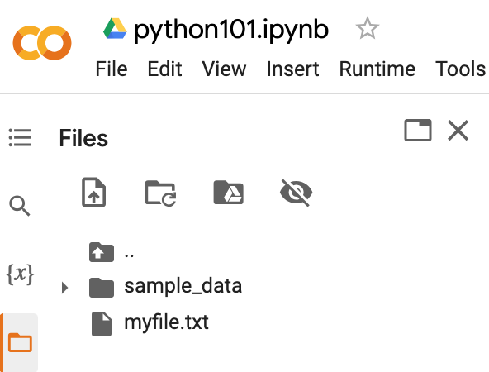
Python Files
# !ls list files
!ls
myfile.txt sample_data
https://tinyurl.com/aintpupython101

Slide 175
Python OS, IO, files, and Google Drive
import os
cwd = os.getcwd()
print(cwd)
/content
https://tinyurl.com/aintpupython101

Slide 176
os.listdir()
os.listdir(cwd)
['.config', 'myfile.txt', 'sample_data']
https://tinyurl.com/aintpupython101

Slide 177
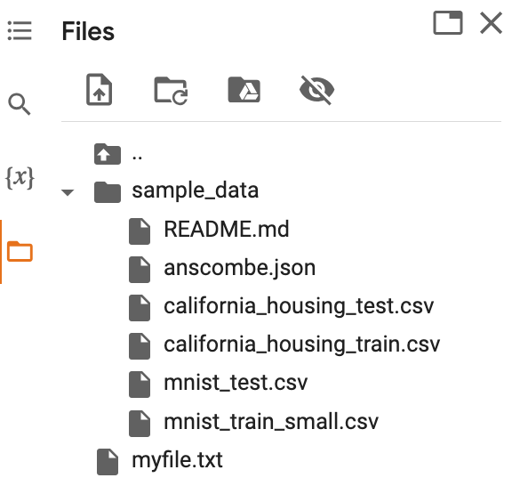
os.path.join()
path = os.path.join(cwd, 'sample_data')
print(path)
os.listdir(path)
/content/sample_data
['README.md', 'anscombe.json', 'mnist_train_small.csv', 'mnist_test.csv', 'california_housing_train.csv', 'california_housing_test.csv']
https://tinyurl.com/aintpupython101

Slide 178
from google.colab import files
from google.colab import files
with open('io_file_myday.txt', 'w') as f:
f.write('Google Colab File Write Text some content Myday')
import time
time.sleep(1) # time sleep 1 second
files.download('io_file_myday.txt')
print('downloaded')
downloaded
https://tinyurl.com/aintpupython101

Slide 179
Python Files
from google.colab import files
uploaded = files.upload()
for fn in uploaded.keys():
print('User uploaded file "{name}" with length {length} bytes'.format(
name=fn, length=len(uploaded[fn])))
User uploaded file "io_file_myday2.txt" with length 47 bytes
https://tinyurl.com/aintpupython101

Slide 180
os.remove()
import os
if os.path.exists("myfile.txt"):
os.remove("myfile.txt")
print("myfile.txt removed")
else:
print("The file does not exist")
myfile.txt removed
https://tinyurl.com/aintpupython101

Slide 181
os.mkdir("myfolder1") os.rmdir("myfolder1")
import os
os.listdir()
os.mkdir("myfolder1")
os.listdir()
os.rmdir("myfolder1")
os.listdir()
https://tinyurl.com/aintpupython101

Slide 182
Python Try Except
The try block lets you test a block of code for errors.
The except block lets you handle the error.
The else block lets you execute code when there is no error.
The finally block lets you execute code, regardless of the result of the try- and except blocks.

Slide 183
Python Try Except (Exception Handling) try: except:
#Python try except
try:
print(x)
except:
print("Exception Error")
https://tinyurl.com/aintpupython101

Slide 184
Python try: except: finally:
#Python try except finally
try:
print("Hello")
except:
print("Exception Error")
finally:
print("Finally process")
Hello
Finally process
https://tinyurl.com/aintpupython101

Slide 185
Python try: except: else:
#Python try except else
try:
print("Hello")
except:
print("Exception Error")
else:
print("No exception")
Hello
No exception
https://tinyurl.com/aintpupython101

Slide 186
Python try: except: else: finally:
try:
print("Hello")
except:
print("Exception Error")
else:
print("No exception")
finally:
print("Finally process")
Hello
No exception
Finally process
https://tinyurl.com/aintpupython101

Slide 187
Python try: except: else: finally:
try:
price = float(input("Enter the price of the stock (e.g. 10):"))
shares = int(input("Enter the number of shares (e.g. 2):"))
total = price * shares
except Exception as e:
print("Exception error:", str(e))
else:
print("The total value of the shares is:", total)
finally:
print("Thank you.")
Enter the price of the stock (e.g. 10):10
Enter the number of shares (e.g. 2):2
The total value of the shares is: 20.0
Thank you.
https://tinyurl.com/aintpupython101

Slide 188
Python try: except: else: finally:
try:
file = open("myfile.txt")
file.write("Python write file")
print("file saved")
except:
print("Exception file Error")
Exception file Error
https://tinyurl.com/aintpupython101

Slide 189
Python try: except: else: finally:
try:
file = open("myfile.txt")
file.write("Python write file")
print("file saved")
except:
print("Exception file Error")
finally:
file.close()
print("Finally process")
Exception file Error
Finally process
https://tinyurl.com/aintpupython101

Slide 190
Python try: except: else: finally:
try:
file = open("myfile.txt", 'w’)
file.write("Python write file")
print("file saved")
except:
print("Exception file Error")
finally:
file.close()
print("Finally process")
file saved
Finally process
https://tinyurl.com/aintpupython101

Slide 191
Data Analytics and
Visualization with Python

Slide 192
Data Analytics and Visualization with Python
NumPy
  Numerical Python N-dimensional array
Pandas
  Data Analytics
Matplotlib
  Basic Data Visualization
Seaborn
  Advanced Visualization

Slide 193
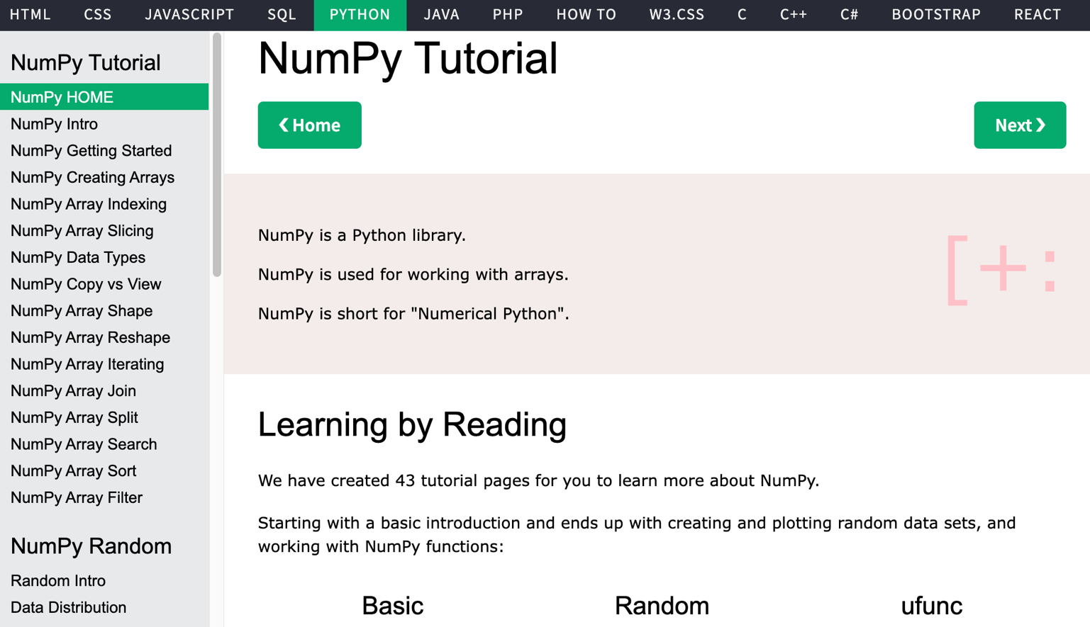
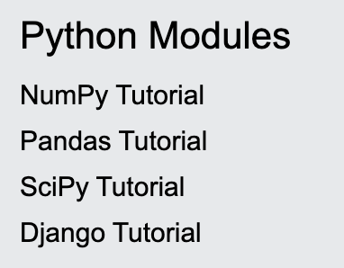
W3Schools Python Numpy
https://www.w3schools.com/python/numpy/default.asp

Slide 194
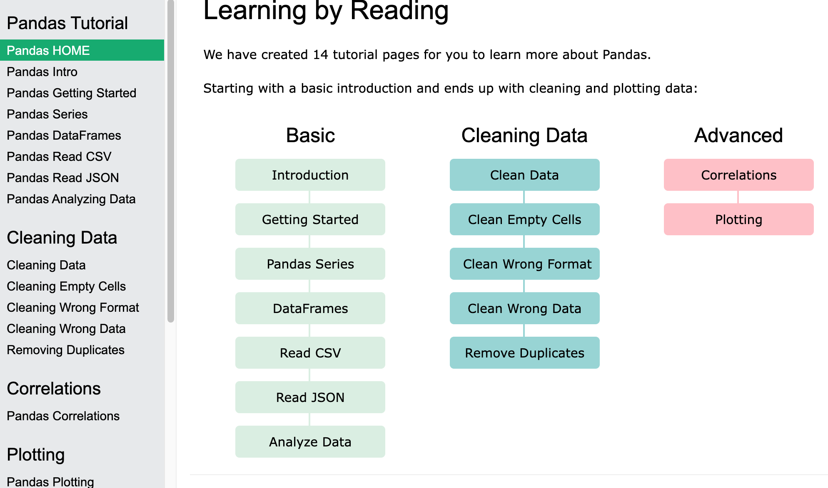
W3Schools Python Pandas
Pandas Tutorial
https://www.w3schools.com/python/pandas/default.asp

Slide 195
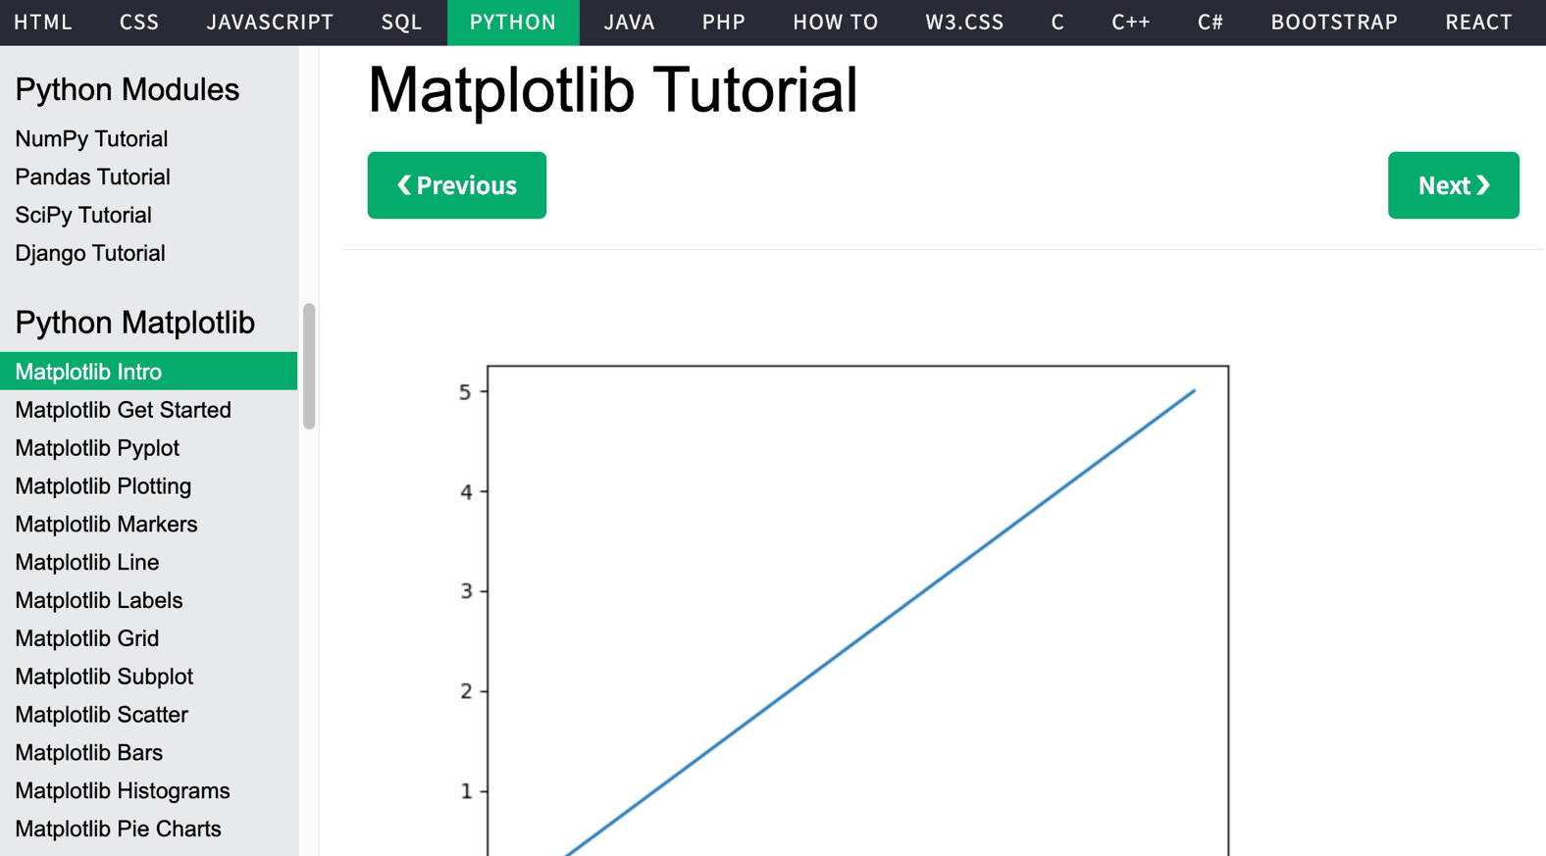
W3Schools Python
https://www.w3schools.com/python/

Slide 196
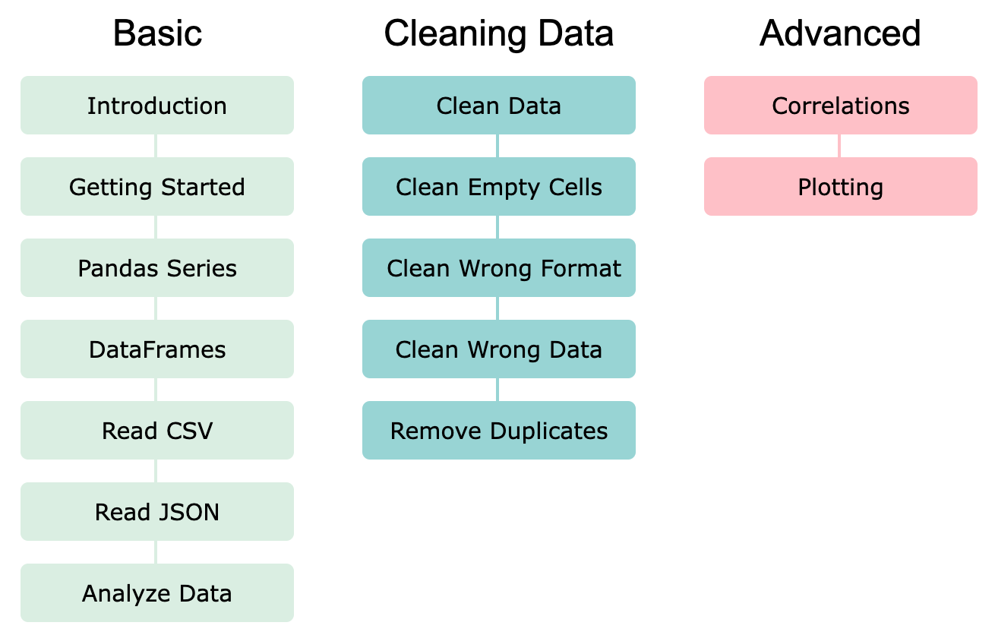
Pandas: Data Analytics and Visualization
https://www.w3schools.com/python/pandas/default.asp

Slide 197
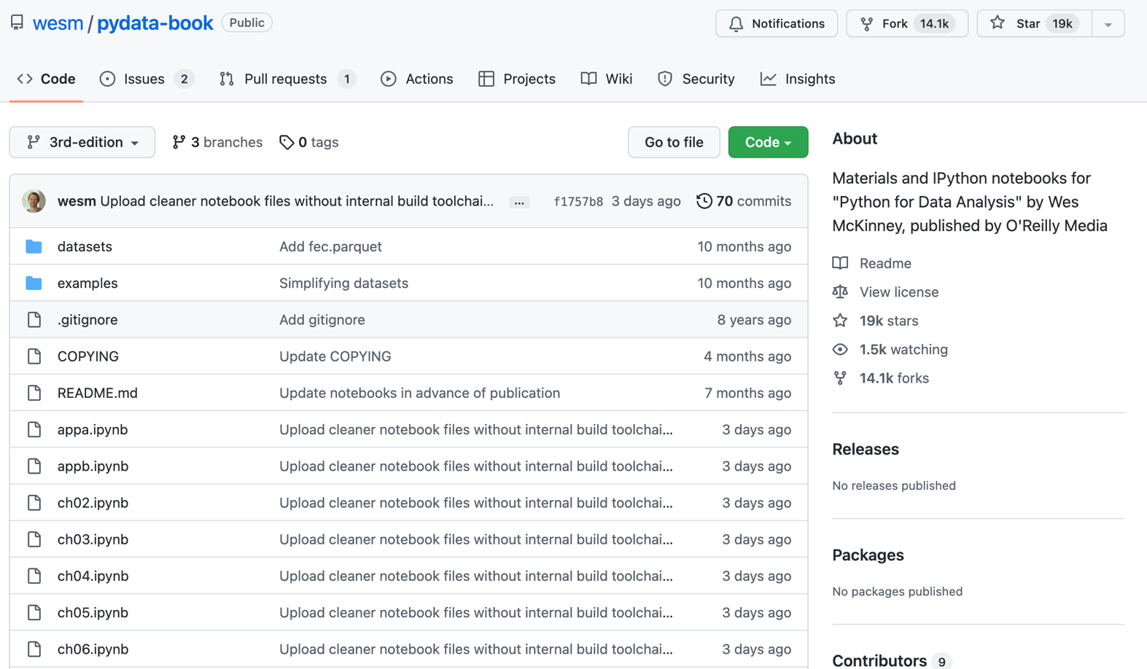
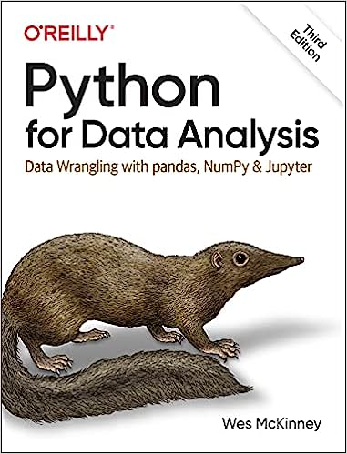
Wes McKinney (2022), "Python for Data Analysis: Data Wrangling with pandas, NumPy, and Jupyter", 3rd Edition, O'Reilly Media.
https://github.com/wesm/pydata-book

Slide 198
Numpy
NumPy
Base
N-dimensional array package

Slide 199
NumPy is the fundamental package for scientific computing with Python.
Source: http://www.numpy.org/

Slide 200
NumPy
NumPy
NumPy provides a
multidimensional array object
to store homogenous or heterogeneous data;
it also provides
optimized functions/methods to operate on this array object.
Source: Yves Hilpisch (2014), Python for Finance: Analyze Big Financial Data, O'Reilly

Slide 201
NumPy ndarray
NumPy
One-dimensional Array
(1-D Array)
0 | 1 |  |  | n-1
1 | 2 | 3 | 4 | 5
Two-dimensional Array
(2-D Array)
 | 0 | 1 |  |  | n-1
0 | 1 | 2 | 3 | 4 | 5
1 | 6 | 7 | 8 | 9 | 10
 | 11 | 12 | 13 | 14 | 15
m-1 | 16 | 17 | 18 | 19 | 20

Slide 202
v = list(range(1, 6)) v
2 * v import numpy as np v = np.arange(1, 6) v
2 * v
NumPy
NumPy
Source: Yves Hilpisch (2014), Python for Finance: Analyze Big Financial Data, O'Reilly
Notes:
# pip3 install numpy
# pip install numpy
# sudo pip3 install numpy
import numpy as np

Slide 203
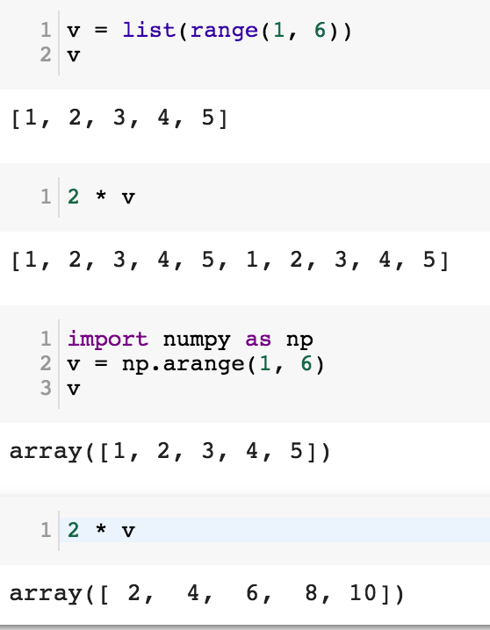
NumPy
Base
N-dimensional array package

Slide 204
Python Data Structures
fruits = ["apple", "banana", "cherry"] #lists []
colors = ("red", "green", "blue") #tuples ()
animals = {'cat', 'dog'} #sets {}
person = {"name" : "Tom", "age" : 20} #dictionaries {}
https://tinyurl.com/aintpupython101

Slide 205
Lists []
x = [60, 70, 80, 90]
print(len(x))
print(x[0])
print(x[1])
print(x[-1])
4
60
70
90

Slide 206
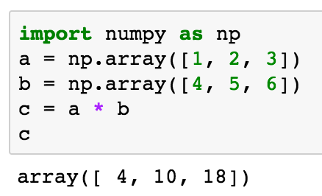
import numpy as np a = np.array([1, 2, 3]) b = np.array([4, 5, 6]) c = a * b c
NumPy Create Array
NumPy
Source: Yves Hilpisch (2014), Python for Finance: Analyze Big Financial Data, O'Reilly

Slide 207
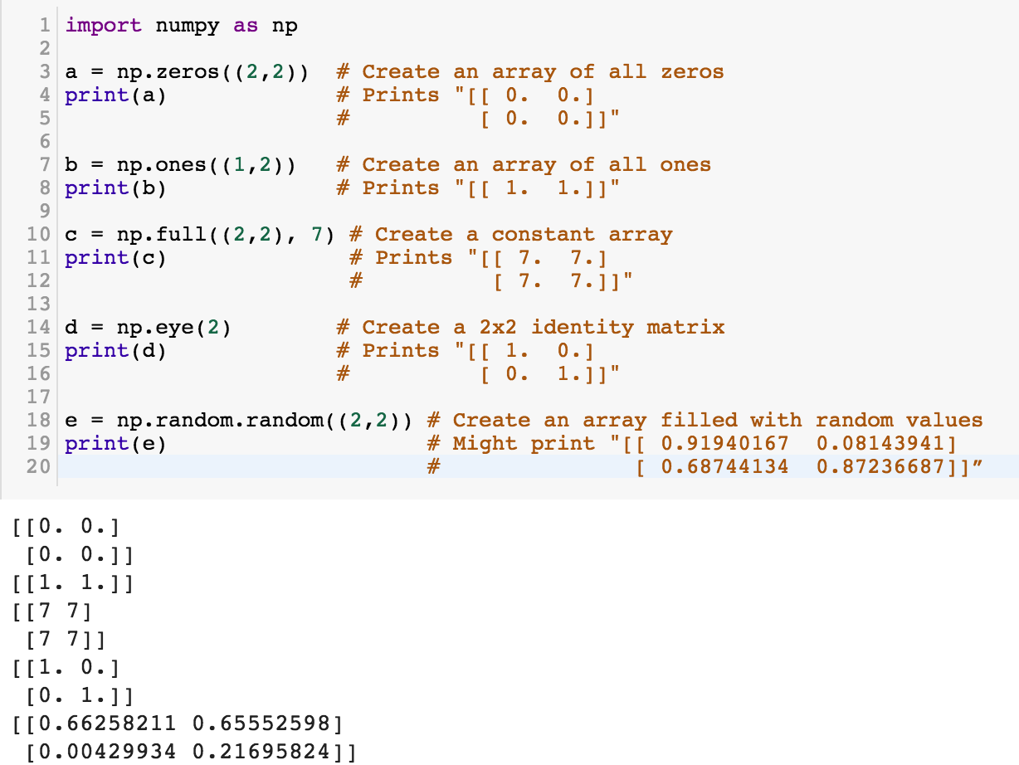
NumPy
NumPy
Source: http://cs231n.github.io/python-numpy-tutorial/
Notes:
import numpy as np
a = np.zeros((2,2)) # Create an array of all zeros
print(a) # Prints "[[ 0. 0.]
# [ 0. 0.]]"
b = np.ones((1,2)) # Create an array of all ones
print(b) # Prints "[[ 1. 1.]]"
c = np.full((2,2), 7) # Create a constant array
print(c) # Prints "[[ 7. 7.]
# [ 7. 7.]]"
d = np.eye(2) # Create a 2x2 identity matrix
print(d) # Prints "[[ 1. 0.]
# [ 0. 1.]]"
e = np.random.random((2,2)) # Create an array filled with random values
print(e) # Might print "[[ 0.91940167 0.08143941]
# [ 0.68744134 0.87236687]]”
Source: http://cs231n.github.io/python-numpy-tutorial/

Slide 208
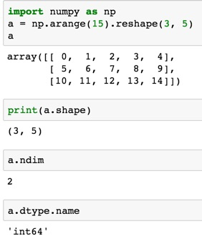
import numpy as np
a = np.arange(15).reshape(3, 5)
a.shape
a.ndim
a.dtype.name
Source: https://docs.scipy.org/doc/numpy-dev/user/quickstart.html
Notes:
Numpy Tutorial
Source: https://docs.scipy.org/doc/numpy-dev/user/quickstart.html
In [1]:
import numpy as np
a = np.arange(15).reshape(3, 5)
a
Out[1]:
array([[ 0, 1, 2, 3, 4],
[ 5, 6, 7, 8, 9],
[10, 11, 12, 13, 14]])
In [2]:
print(a.shape)
(3, 5)
In [3]:
a.ndim
Out[3]:
2
In [4]:
a.dtype.name
Out[4]:
'int64'
In [5]:
a.itemsize
Out[5]:
8
In [6]:
a.size
Out[6]:
15
In [7]:
type(a)
Out[7]:
numpy.ndarray
In [8]:
b = np.array([1, 2, 3])
In [9]:
b
Out[9]:
array([1, 2, 3])
In [10]:
type(b)
Out[10]:
numpy.ndarray

Slide 209
Matrix
Source: https://simple.wikipedia.org/wiki/Matrix_(mathematics)

Slide 210
NumPy ndarray:
Multidimensional Array Object

Slide 211
NumPy ndarray
One-dimensional Array
(1-D Array)
0 | 1 |  |  | n-1
1 | 2 | 3 | 4 | 5
Two-dimensional Array
(2-D Array)
 | 0 | 1 |  |  | n-1
0 | 1 | 2 | 3 | 4 | 5
1 | 6 | 7 | 8 | 9 | 10
 | 11 | 12 | 13 | 14 | 15
m-1 | 16 | 17 | 18 | 19 | 20

Slide 212

import numpy as np a = np.array([1,2,3,4,5])
One-dimensional Array
(1-D Array)
0 | 1 |  |  | n-1
1 | 2 | 3 | 4 | 5

Slide 213
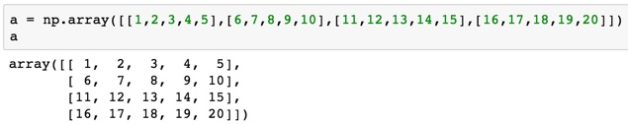
a = np.array([[1,2,3,4,5],[6,7,8,9,10],[11,12,13,14,15],[16,17,18,19,20]])
Two-dimensional Array
(2-D Array)
 | 0 | 1 |  |  | n-1
0 | 1 | 2 | 3 | 4 | 5
1 | 6 | 7 | 8 | 9 | 10
 | 11 | 12 | 13 | 14 | 15
m-1 | 16 | 17 | 18 | 19 | 20

Slide 214
import numpy as np
a = np.array([[0, 1, 2, 3], [10, 11, 12, 13],
[20, 21, 22, 23]])
a
0 | 1 | 2 | 3
10 | 11 | 12 | 13
20 | 21 | 22 | 23
Notes:
import numpy as np
a = np.array([[0, 1, 2, 3], [10, 11, 12, 13],
[20, 21, 22, 23]])
a

Slide 215
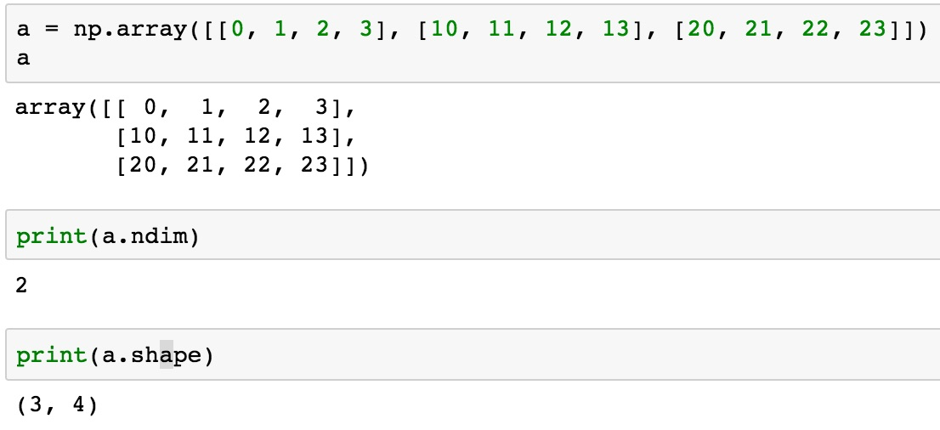
a = np.array([[0, 1, 2, 3], [10, 11, 12, 13], [20, 21, 22, 23]])
0 | 1 | 2 | 3
10 | 11 | 12 | 13
20 | 21 | 22 | 23

Slide 216
NumPy Basics:
Arrays and Vectorized Computation
Source: https://www.safaribooksonline.com/library/view/python-for-data/9781449323592/ch04.html

Slide 217
NumPy Array
Source: https://www.safaribooksonline.com/library/view/python-for-data/9781449323592/ch04.html

Slide 218
Numpy Array
Source: https://www.safaribooksonline.com/library/view/python-for-data/9781449323592/ch04.html

Slide 219

Tensor
3
  a rank 0 tensor; this is a scalar with shape []
[1. ,2., 3.]
  a rank 1 tensor; this is a vector with shape [3]
[[1., 2., 3.], [4., 5., 6.]]
  a rank 2 tensor; a matrix with shape [2, 3]
[[[1., 2., 3.]], [[7., 8., 9.]]]
  a rank 3 tensor with shape [2, 1, 3]
https://www.tensorflow.org/

Slide 220
Scalar
80
Vector
[50 60 70]
Matrix
50 60 70
55 65 75
[50 60 70] [70 80 90]
[55 65 75] [75 85 95]
Tensor

Slide 221

pandas
Python Data Analysis Library providing high-performance, easy-to-use data structures and data analysis tools for the Python programming language.
Source: http://pandas.pydata.org/

Slide 222
pandas: powerful Python data analysis toolkit
Tabular data with
heterogeneously-typed columns,
as in an SQL table or Excel spreadsheet
Ordered and unordered (not necessarily fixed-frequency) time series data.
Arbitrary matrix data (homogeneously typed or heterogeneous) with row and column labels
Any other form of observational / statistical data sets. The data actually need not be labeled at all to be placed into a pandas data structure
Source: http://pandas.pydata.org/pandas-docs/stable/

Slide 223
Series
DataFrame
Primary data structures of pandas
  Series (1-dimensional)
  DataFrame (2-dimensional)
Handle the vast majority of typical use cases in finance, statistics, social science, and many areas of engineering.
Source: http://pandas.pydata.org/pandas-docs/stable/

Slide 224
pandas DataFrame
DataFrame provides everything that R’s data.frame provides and much more.
pandas is built on top of NumPy and is intended to integrate well within a scientific computing environment with many other 3rd party libraries.

Slide 225
pandas
Comparison with SAS
pandas | SAS
DataFrame | data set
column | variable
row | observation
groupby | BY-group
NaN | .
Source: http://pandas.pydata.org/pandas-docs/stable/comparison_with_sas.html

Slide 226
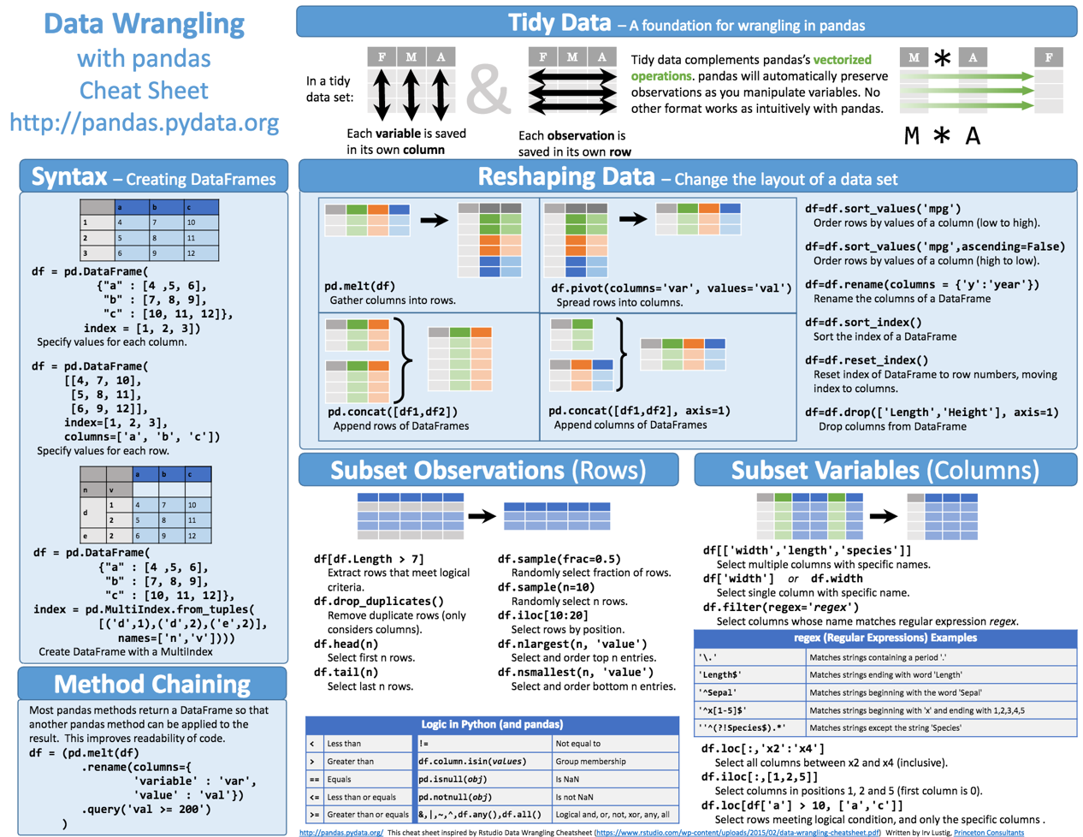
Python Pandas Cheat Sheet
Source: https://github.com/pandas-dev/pandas/blob/master/doc/cheatsheet/Pandas_Cheat_Sheet.pdf

Slide 227
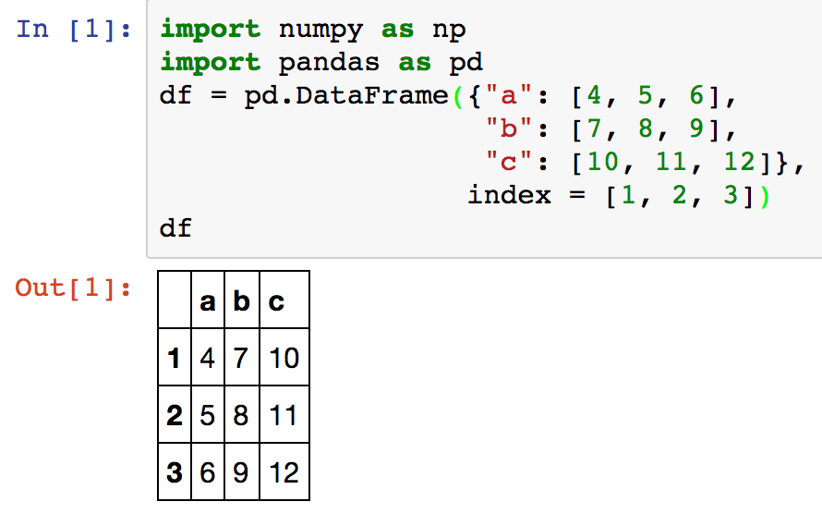
Creating pd.DataFrame
 | a | b | c
1 | 4 | 7 | 10
2 | 5 | 8 | 11
3 | 6 | 9 | 12
import pandas as pd
df = pd.DataFrame({"a": [4, 5, 6],
"b": [7, 8, 9],
"c": [10, 11, 12]},
index = [1, 2, 3])
Source: https://github.com/pandas-dev/pandas/blob/master/doc/cheatsheet/Pandas_Cheat_Sheet.pdf
Notes:
import numpy as np
import pandas as pd
df = pd.DataFrame({"a": [4, 5, 6],
"b": [7, 8, 9],
"c": [10, 11, 12]},
index = [1, 2, 3])
df

Slide 228
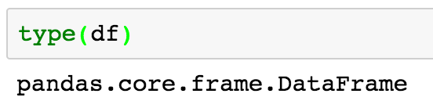
Pandas DataFrame
type(df)

Slide 229
import numpy as np
import pandas as pd
import matplotlib.pyplot as plt
print('pandas imported')
s = pd.Series([1,3,5,np.nan,6,8])
s
dates = pd.date_range('20181001', periods=6)
dates
Source: http://pandas.pydata.org/pandas-docs/stable/10min.html

Slide 230
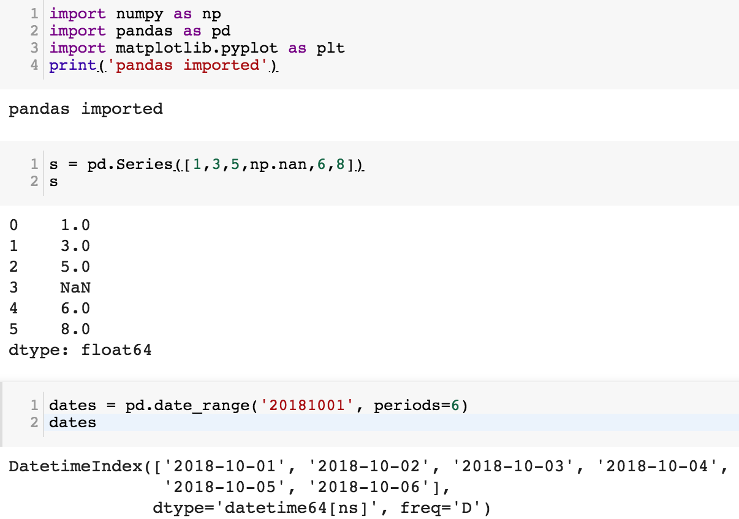

Slide 231
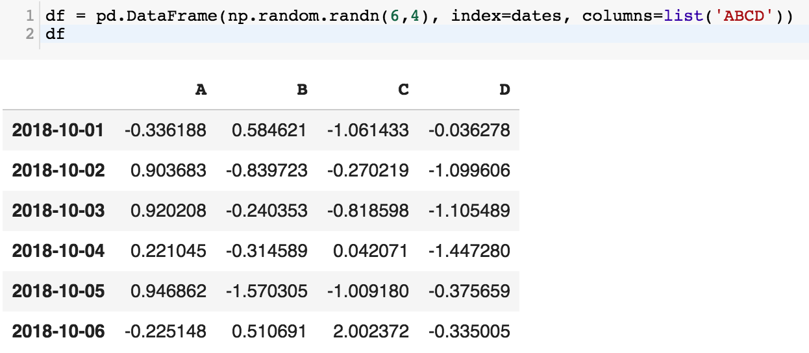
df = pd.DataFrame(np.random.randn(6,4), index=dates, columns=list('ABCD'))
df

Slide 232
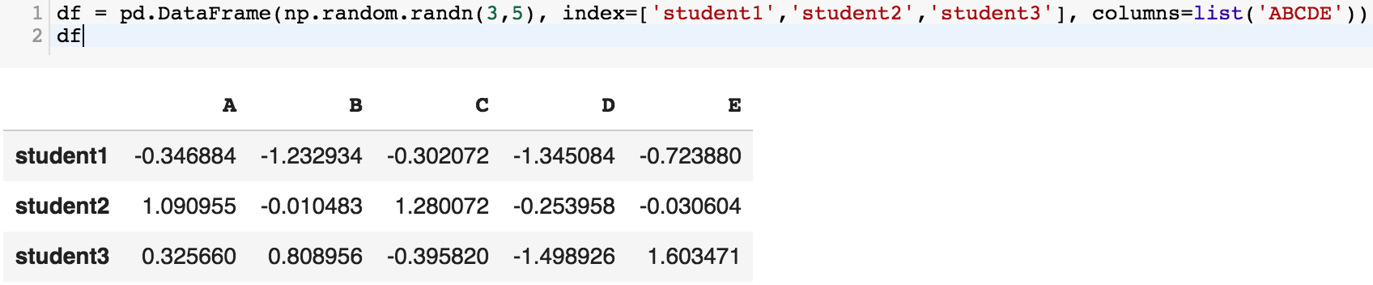
df = pd.DataFrame(np.random.randn(3,5), index=['student1','student2','student3'], columns=list('ABCDE'))
df

Slide 233
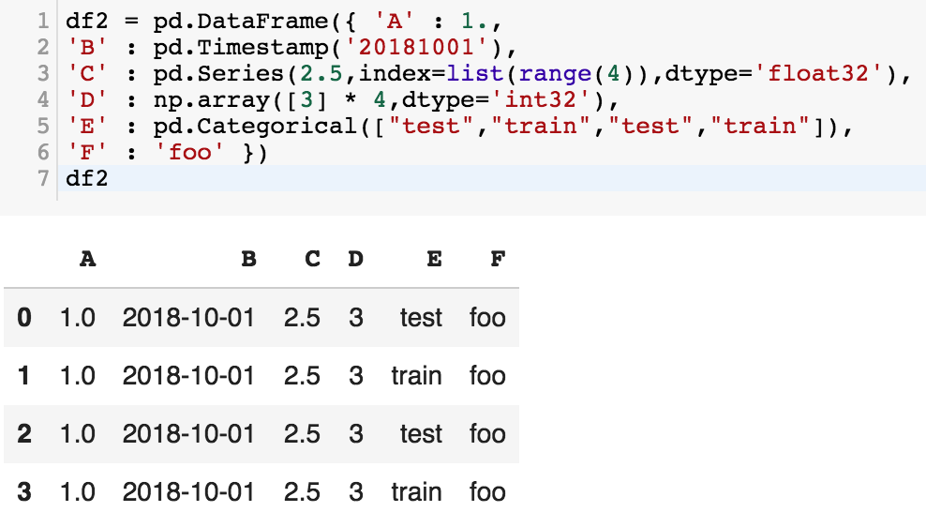
df2 = pd.DataFrame({ 'A' : 1.,
'B' : pd.Timestamp('20181001'),
'C' : pd.Series(2.5,index=list(range(4)),dtype='float32'),
'D' : np.array([3] * 4,dtype='int32'),
'E' : pd.Categorical(["test","train","test","train"]),
'F' : 'foo' })
df2

Slide 234
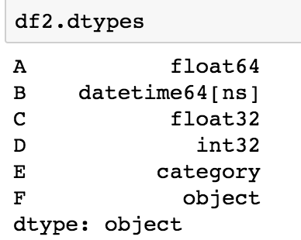
df2.dtypes

Slide 235





Python Data Analysis and Visualization

Slide 236
Python Pandas
http://pandas.pydata.org/

Slide 237
Python matplotlib
Source: https://matplotlib.org/

Slide 238
Python seaborn
Source: https://seaborn.pydata.org/

Slide 239
Python plotly
Source: https://plotly.com/python/

Slide 240
Python bokeh
Source: https://bokeh.org/

Slide 241
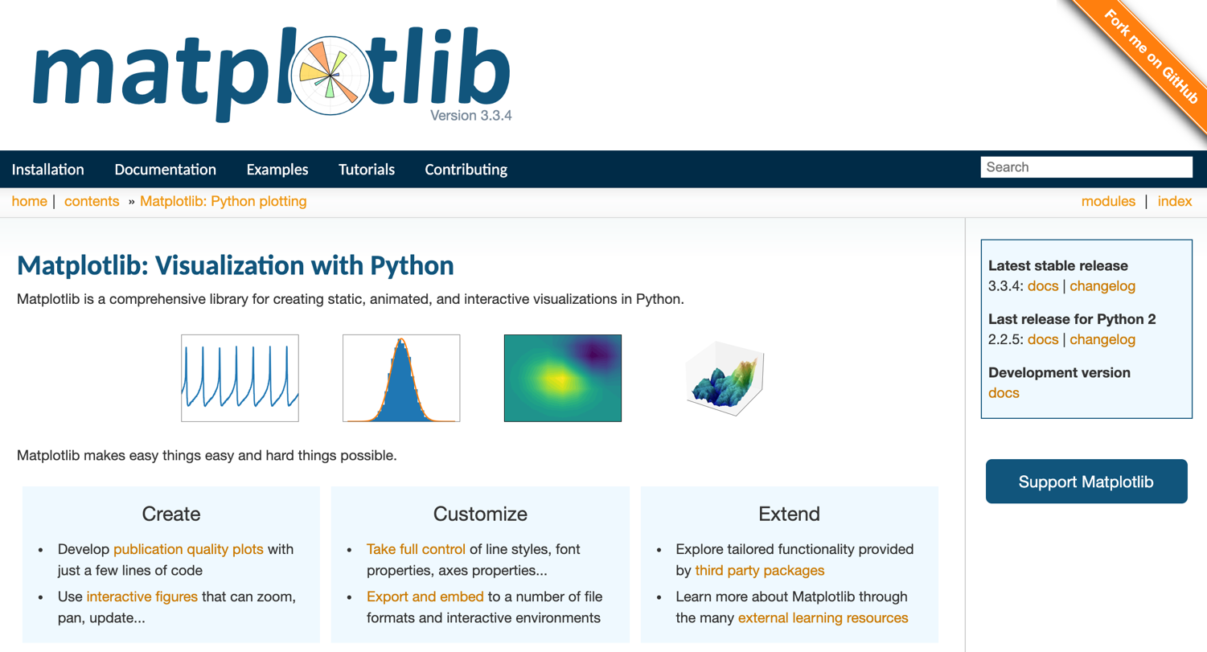
Python matplotlib
https://matplotlib.org/

Slide 242

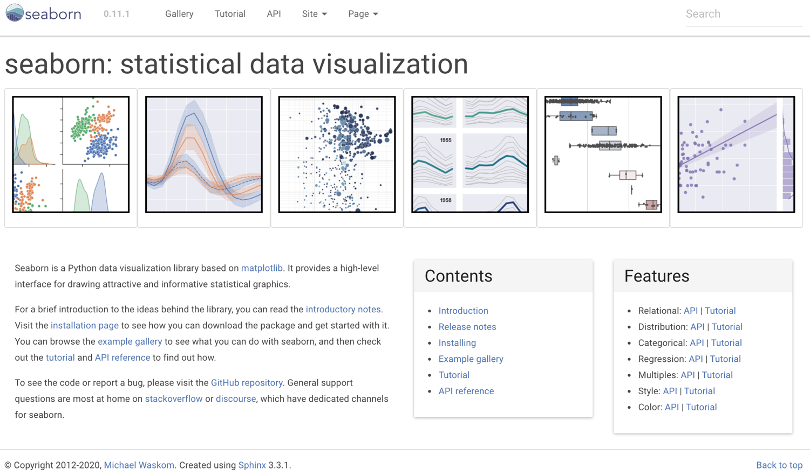
Python Seaborn
https://seaborn.pydata.org/

Slide 243

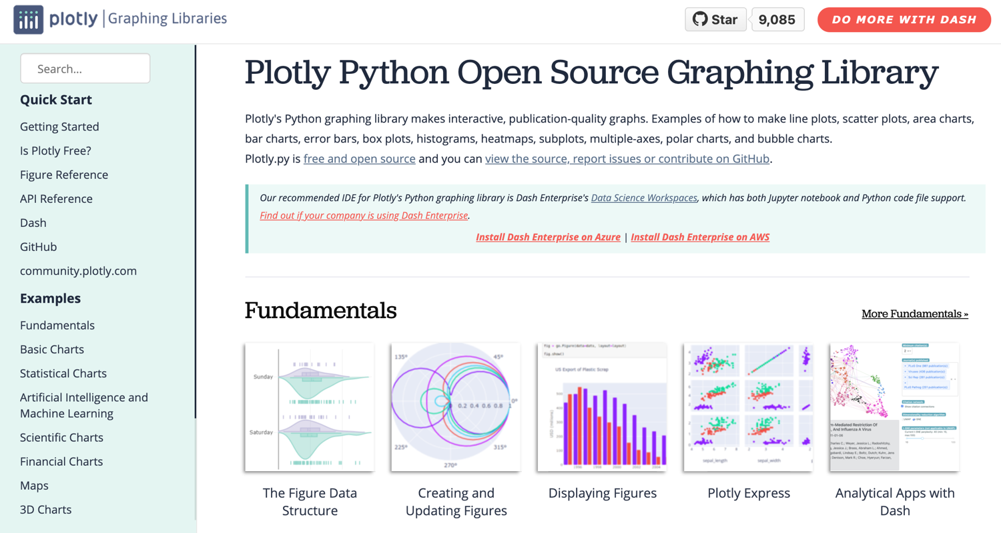
Python Plotly Graphing Library
https://plotly.com/python/

Slide 244
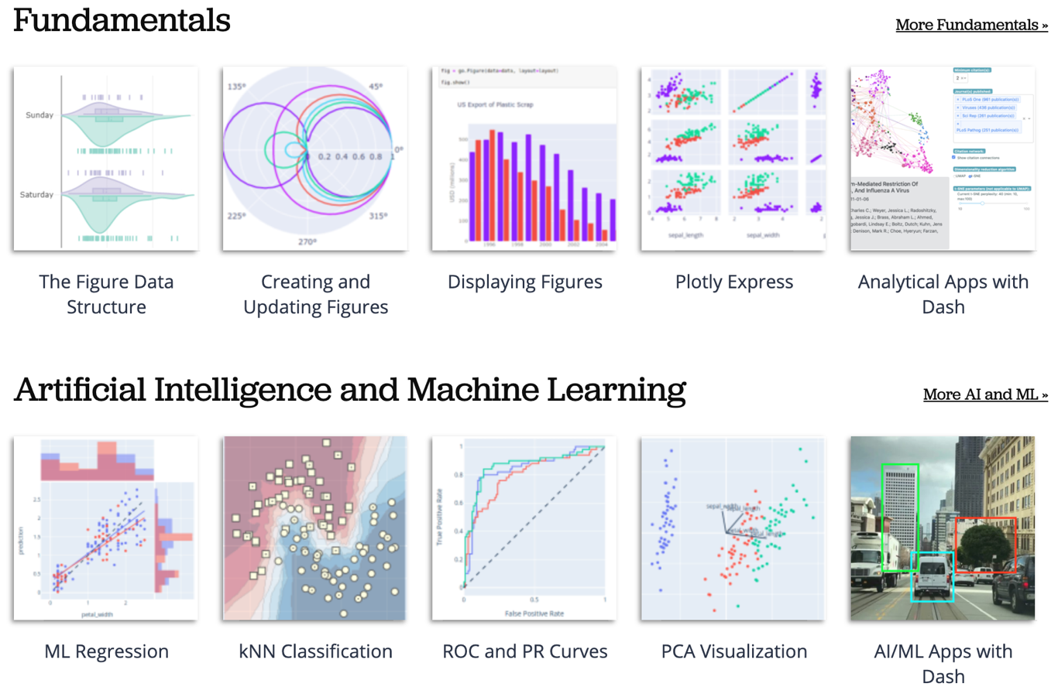
Python Plotly Graphing Library
https://plotly.com/python/

Slide 245
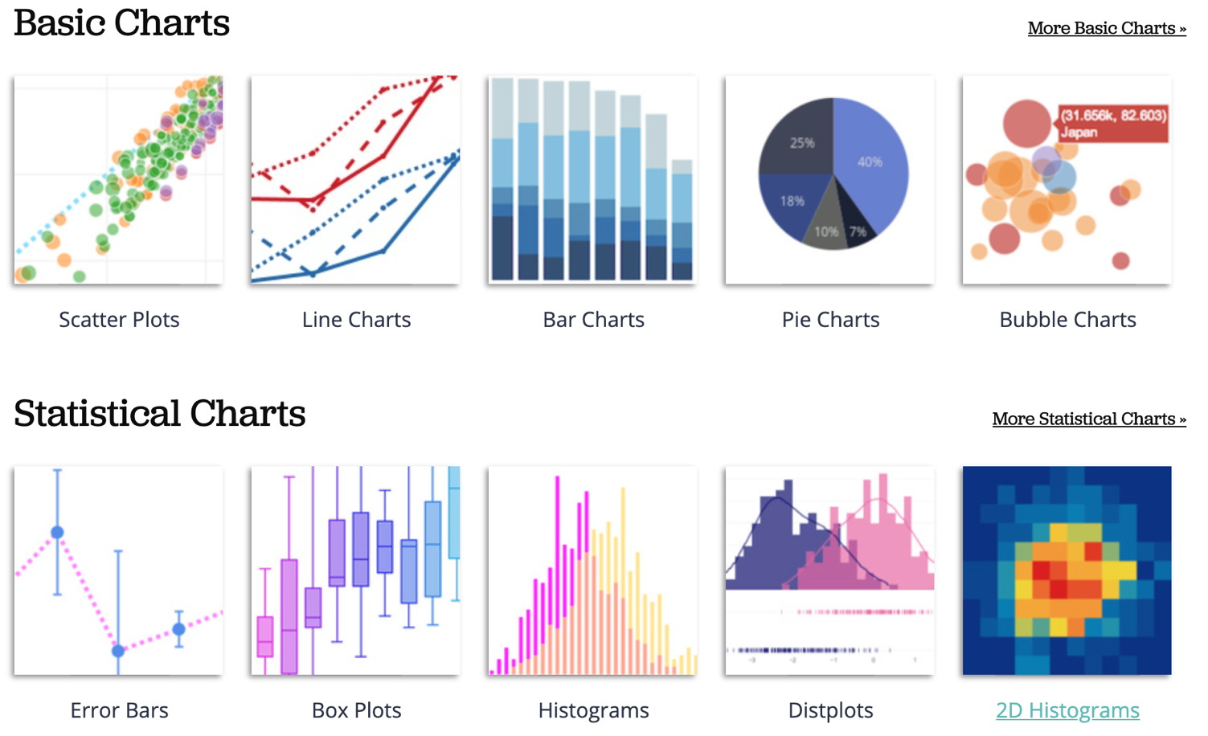
Python Plotly Graphing Library
https://plotly.com/python/

Slide 246
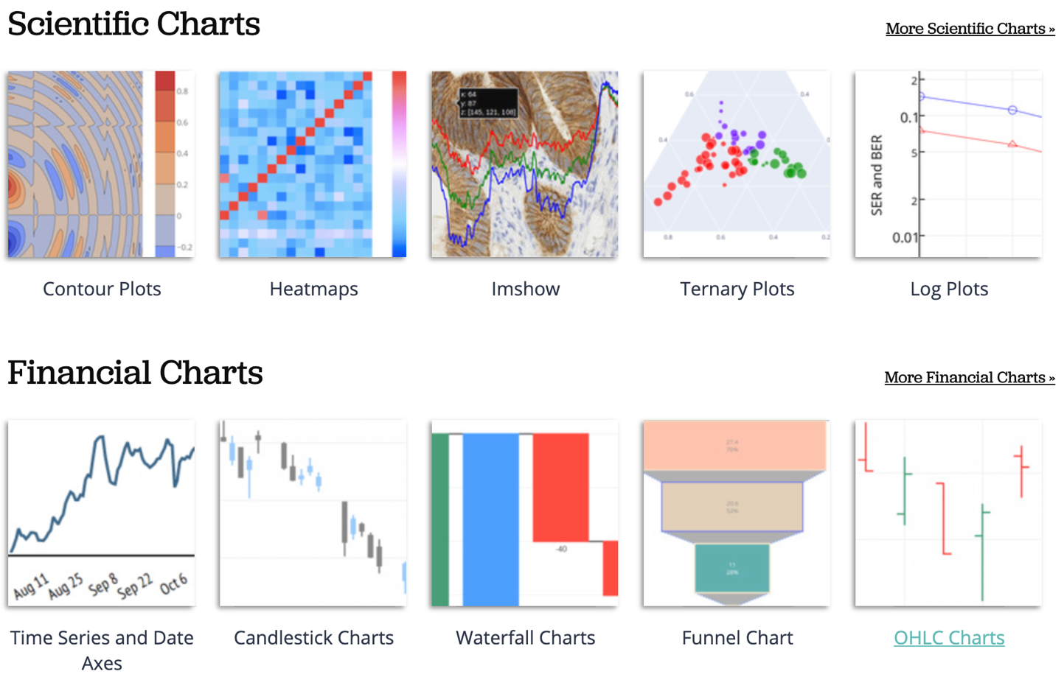
Python Plotly Graphing Library
https://plotly.com/python/

Slide 247
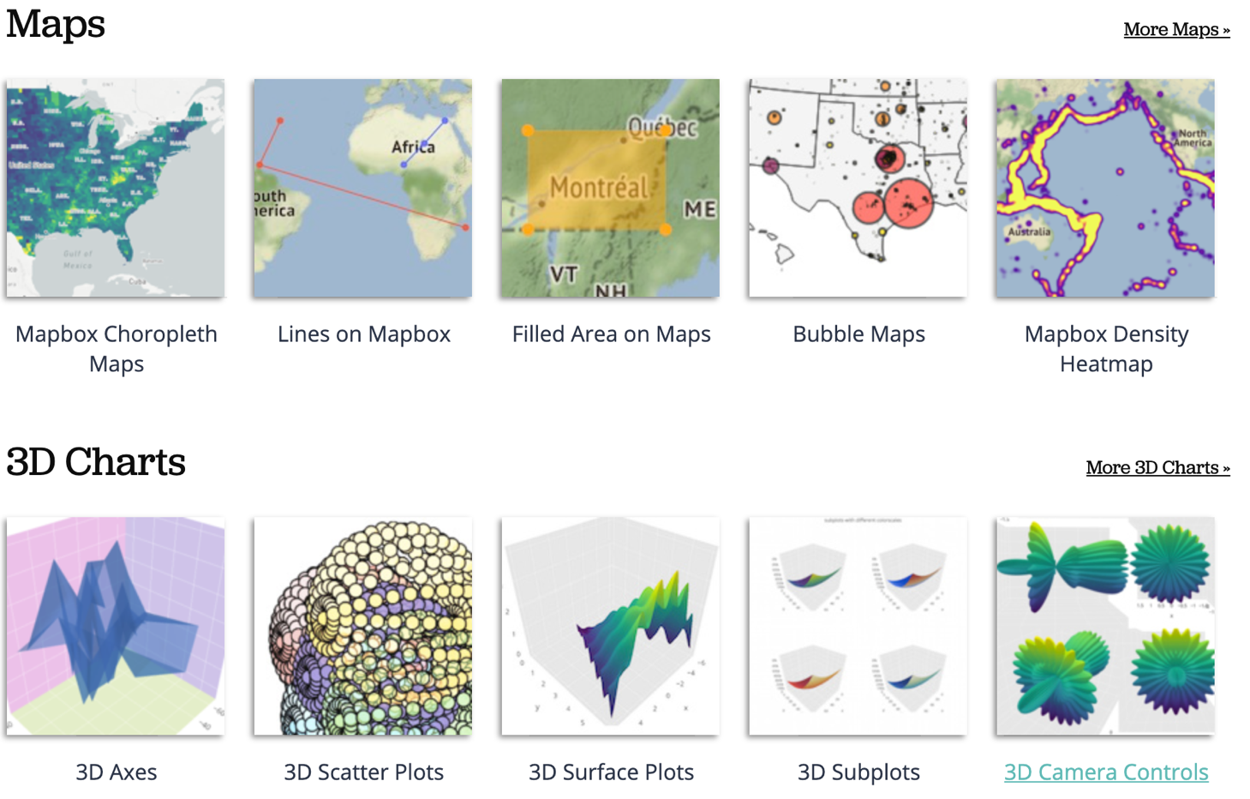
Python Plotly Graphing Library
https://plotly.com/python/

Slide 248
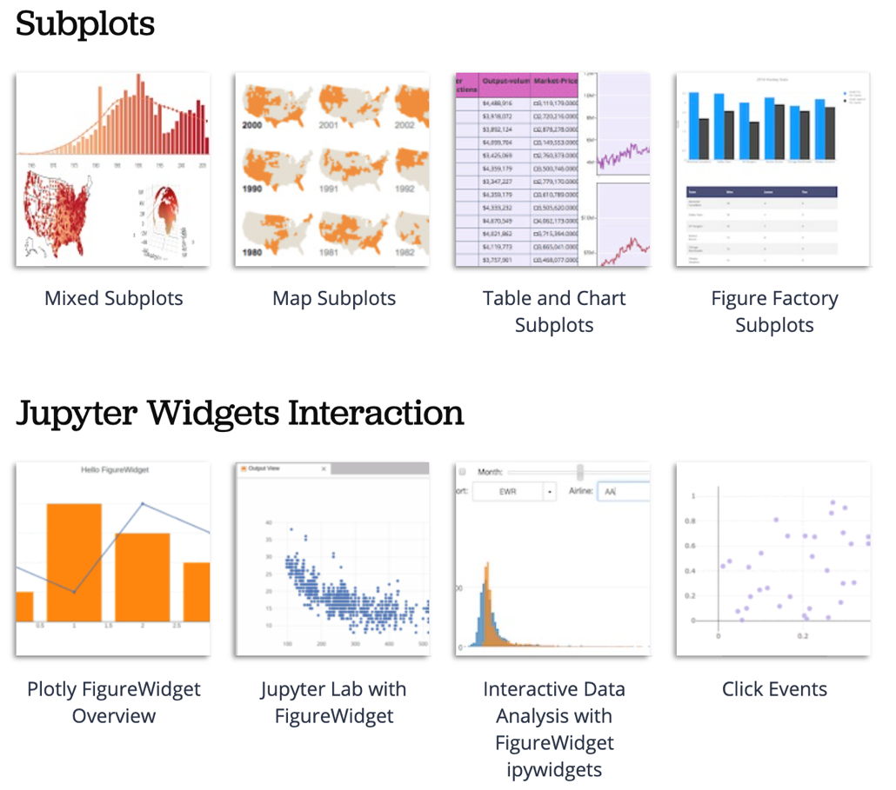
Python Plotly Graphing Library
https://plotly.com/python/

Slide 249
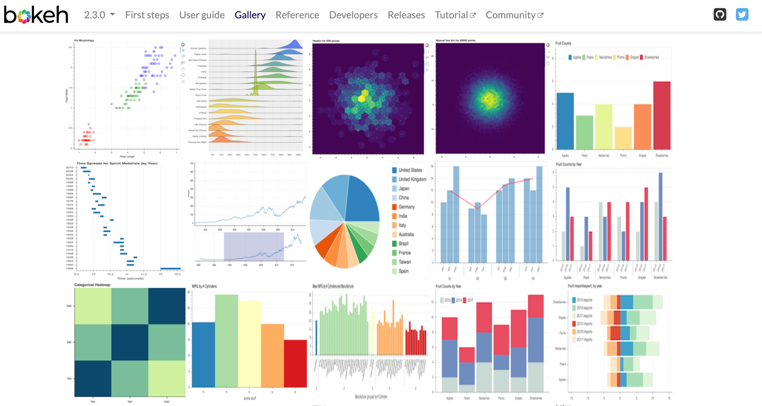
Python Bokeh
https://bokeh.org/

Slide 250
Iris flower data set
setosa
versicolor
virginica
Source: https://en.wikipedia.org/wiki/Iris_flower_data_set
Source: http://suruchifialoke.com/2016-10-13-machine-learning-tutorial-iris-classification/

Slide 251
Iris Classfication
Source: http://suruchifialoke.com/2016-10-13-machine-learning-tutorial-iris-classification/

Slide 252
iris.data
https://archive.ics.uci.edu/ml/machine-learning-databases/iris/iris.data
5.1,3.5,1.4,0.2,Iris-setosa 4.9,3.0,1.4,0.2,Iris-setosa 4.7,3.2,1.3,0.2,Iris-setosa 4.6,3.1,1.5,0.2,Iris-setosa 5.0,3.6,1.4,0.2,Iris-setosa 5.4,3.9,1.7,0.4,Iris-setosa 4.6,3.4,1.4,0.3,Iris-setosa 5.0,3.4,1.5,0.2,Iris-setosa 4.4,2.9,1.4,0.2,Iris-setosa 4.9,3.1,1.5,0.1,Iris-setosa 5.4,3.7,1.5,0.2,Iris-setosa 4.8,3.4,1.6,0.2,Iris-setosa 4.8,3.0,1.4,0.1,Iris-setosa 4.3,3.0,1.1,0.1,Iris-setosa 5.8,4.0,1.2,0.2,Iris-setosa 5.7,4.4,1.5,0.4,Iris-setosa 5.4,3.9,1.3,0.4,Iris-setosa 5.1,3.5,1.4,0.3,Iris-setosa 5.7,3.8,1.7,0.3,Iris-setosa 5.1,3.8,1.5,0.3,Iris-setosa 5.4,3.4,1.7,0.2,Iris-setosa 5.1,3.7,1.5,0.4,Iris-setosa 4.6,3.6,1.0,0.2,Iris-setosa 5.1,3.3,1.7,0.5,Iris-setosa 4.8,3.4,1.9,0.2,Iris-setosa 5.0,3.0,1.6,0.2,Iris-setosa 5.0,3.4,1.6,0.4,Iris-setosa 5.2,3.5,1.5,0.2,Iris-setosa 5.2,3.4,1.4,0.2,Iris-setosa 4.7,3.2,1.6,0.2,Iris-setosa 4.8,3.1,1.6,0.2,Iris-setosa 5.4,3.4,1.5,0.4,Iris-setosa 5.2,4.1,1.5,0.1,Iris-setosa 5.5,4.2,1.4,0.2,Iris-setosa 4.9,3.1,1.5,0.1,Iris-setosa 5.0,3.2,1.2,0.2,Iris-setosa 5.5,3.5,1.3,0.2,Iris-setosa 4.9,3.1,1.5,0.1,Iris-setosa 4.4,3.0,1.3,0.2,Iris-setosa 5.1,3.4,1.5,0.2,Iris-setosa 5.0,3.5,1.3,0.3,Iris-setosa 4.5,2.3,1.3,0.3,Iris-setosa 4.4,3.2,1.3,0.2,Iris-setosa 5.0,3.5,1.6,0.6,Iris-setosa 5.1,3.8,1.9,0.4,Iris-setosa 4.8,3.0,1.4,0.3,Iris-setosa 5.1,3.8,1.6,0.2,Iris-setosa 4.6,3.2,1.4,0.2,Iris-setosa 5.3,3.7,1.5,0.2,Iris-setosa 5.0,3.3,1.4,0.2,Iris-setosa 7.0,3.2,4.7,1.4,Iris-versicolor 6.4,3.2,4.5,1.5,Iris-versicolor 6.9,3.1,4.9,1.5,Iris-versicolor 5.5,2.3,4.0,1.3,Iris-versicolor 6.5,2.8,4.6,1.5,Iris-versicolor 5.7,2.8,4.5,1.3,Iris-versicolor 6.3,3.3,4.7,1.6,Iris-versicolor 4.9,2.4,3.3,1.0,Iris-versicolor 6.6,2.9,4.6,1.3,Iris-versicolor 5.2,2.7,3.9,1.4,Iris-versicolor 5.0,2.0,3.5,1.0,Iris-versicolor 5.9,3.0,4.2,1.5,Iris-versicolor 6.0,2.2,4.0,1.0,Iris-versicolor 6.1,2.9,4.7,1.4,Iris-versicolor 5.6,2.9,3.6,1.3,Iris-versicolor 6.7,3.1,4.4,1.4,Iris-versicolor 5.6,3.0,4.5,1.5,Iris-versicolor 5.8,2.7,4.1,1.0,Iris-versicolor 6.2,2.2,4.5,1.5,Iris-versicolor 5.6,2.5,3.9,1.1,Iris-versicolor 5.9,3.2,4.8,1.8,Iris-versicolor 6.1,2.8,4.0,1.3,Iris-versicolor 6.3,2.5,4.9,1.5,Iris-versicolor 6.1,2.8,4.7,1.2,Iris-versicolor 6.4,2.9,4.3,1.3,Iris-versicolor 6.6,3.0,4.4,1.4,Iris-versicolor 6.8,2.8,4.8,1.4,Iris-versicolor 6.7,3.0,5.0,1.7,Iris-versicolor 6.0,2.9,4.5,1.5,Iris-versicolor 5.7,2.6,3.5,1.0,Iris-versicolor 5.5,2.4,3.8,1.1,Iris-versicolor 5.5,2.4,3.7,1.0,Iris-versicolor 5.8,2.7,3.9,1.2,Iris-versicolor 6.0,2.7,5.1,1.6,Iris-versicolor 5.4,3.0,4.5,1.5,Iris-versicolor 6.0,3.4,4.5,1.6,Iris-versicolor 6.7,3.1,4.7,1.5,Iris-versicolor 6.3,2.3,4.4,1.3,Iris-versicolor 5.6,3.0,4.1,1.3,Iris-versicolor 5.5,2.5,4.0,1.3,Iris-versicolor 5.5,2.6,4.4,1.2,Iris-versicolor 6.1,3.0,4.6,1.4,Iris-versicolor 5.8,2.6,4.0,1.2,Iris-versicolor 5.0,2.3,3.3,1.0,Iris-versicolor 5.6,2.7,4.2,1.3,Iris-versicolor 5.7,3.0,4.2,1.2,Iris-versicolor 5.7,2.9,4.2,1.3,Iris-versicolor 6.2,2.9,4.3,1.3,Iris-versicolor 5.1,2.5,3.0,1.1,Iris-versicolor 5.7,2.8,4.1,1.3,Iris-versicolor 6.3,3.3,6.0,2.5,Iris-virginica 5.8,2.7,5.1,1.9,Iris-virginica 7.1,3.0,5.9,2.1,Iris-virginica 6.3,2.9,5.6,1.8,Iris-virginica 6.5,3.0,5.8,2.2,Iris-virginica 7.6,3.0,6.6,2.1,Iris-virginica 4.9,2.5,4.5,1.7,Iris-virginica 7.3,2.9,6.3,1.8,Iris-virginica 6.7,2.5,5.8,1.8,Iris-virginica 7.2,3.6,6.1,2.5,Iris-virginica 6.5,3.2,5.1,2.0,Iris-virginica 6.4,2.7,5.3,1.9,Iris-virginica 6.8,3.0,5.5,2.1,Iris-virginica 5.7,2.5,5.0,2.0,Iris-virginica 5.8,2.8,5.1,2.4,Iris-virginica 6.4,3.2,5.3,2.3,Iris-virginica 6.5,3.0,5.5,1.8,Iris-virginica 7.7,3.8,6.7,2.2,Iris-virginica 7.7,2.6,6.9,2.3,Iris-virginica 6.0,2.2,5.0,1.5,Iris-virginica 6.9,3.2,5.7,2.3,Iris-virginica 5.6,2.8,4.9,2.0,Iris-virginica 7.7,2.8,6.7,2.0,Iris-virginica 6.3,2.7,4.9,1.8,Iris-virginica 6.7,3.3,5.7,2.1,Iris-virginica 7.2,3.2,6.0,1.8,Iris-virginica 6.2,2.8,4.8,1.8,Iris-virginica 6.1,3.0,4.9,1.8,Iris-virginica 6.4,2.8,5.6,2.1,Iris-virginica 7.2,3.0,5.8,1.6,Iris-virginica 7.4,2.8,6.1,1.9,Iris-virginica 7.9,3.8,6.4,2.0,Iris-virginica 6.4,2.8,5.6,2.2,Iris-virginica 6.3,2.8,5.1,1.5,Iris-virginica 6.1,2.6,5.6,1.4,Iris-virginica 7.7,3.0,6.1,2.3,Iris-virginica 6.3,3.4,5.6,2.4,Iris-virginica 6.4,3.1,5.5,1.8,Iris-virginica 6.0,3.0,4.8,1.8,Iris-virginica 6.9,3.1,5.4,2.1,Iris-virginica 6.7,3.1,5.6,2.4,Iris-virginica 6.9,3.1,5.1,2.3,Iris-virginica 5.8,2.7,5.1,1.9,Iris-virginica 6.8,3.2,5.9,2.3,Iris-virginica 6.7,3.3,5.7,2.5,Iris-virginica 6.7,3.0,5.2,2.3,Iris-virginica 6.3,2.5,5.0,1.9,Iris-virginica 6.5,3.0,5.2,2.0,Iris-virginica 6.2,3.4,5.4,2.3,Iris-virginica 5.9,3.0,5.1,1.8,Iris-virginica
setosa
virginica
versicolor

Slide 253
Iris Data Visualization
Source: https://seaborn.pydata.org/generated/seaborn.pairplot.html

Slide 254

Data Visualization in Google Colab
https://tinyurl.com/aintpupython101

Slide 255
import seaborn as sns
sns.set(style="ticks", color_codes=True)
iris = sns.load_dataset("iris")
g = sns.pairplot(iris, hue="species")
Source: https://seaborn.pydata.org/generated/seaborn.pairplot.html

Slide 256

import numpy as np
import pandas as pd
%matplotlib inline
import matplotlib.pyplot as plt
import seaborn as sns
from pandas.plotting import scatter_matrix

Slide 257

url = "https://archive.ics.uci.edu/ml/machine-learning-databases/iris/iris.data"
names = ['sepal-length', 'sepal-width', 'petal-length', 'petal-width', 'class']
df = pd.read_csv(url, names=names)
print(df.head(10))

Slide 258

df.tail(10)

Slide 259

df.describe()

Slide 260

print(df.info())
print(df.shape)

Slide 261

df.groupby('class').size()

Slide 262
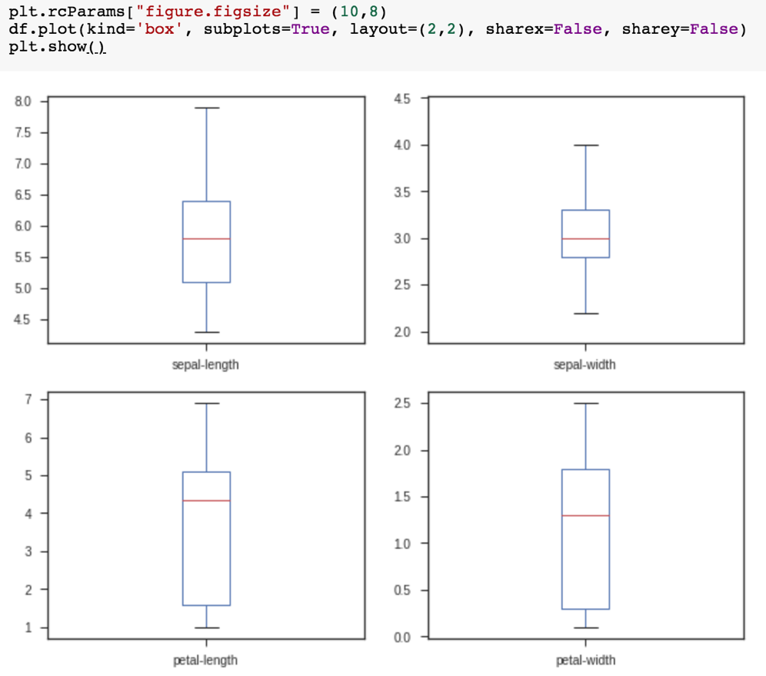
plt.rcParams["figure.figsize"] = (10,8)
df.plot(kind='box', subplots=True, layout=(2,2), sharex=False, sharey=False)
plt.show()

Slide 263

df.hist()
plt.show()

Slide 264

scatter_matrix(df)
plt.show()

Slide 265

sns.pairplot(df, hue="class", size=2)

Slide 266
Wes McKinney (2022), "Python for Data Analysis: Data Wrangling with pandas, NumPy, and Jupyter", 3rd Edition, O'Reilly Media.
https://github.com/wesm/pydata-book

Slide 267
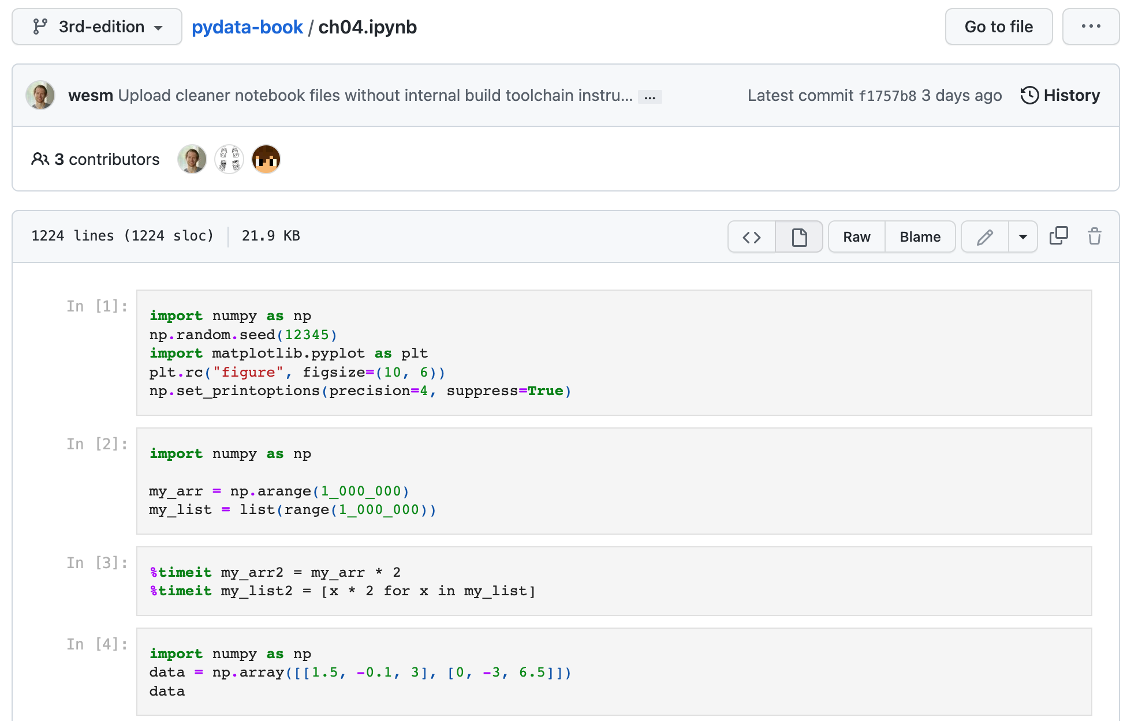
Wes McKinney (2022), "Python for Data Analysis: Data Wrangling with pandas, NumPy, and Jupyter", 3rd Edition, O'Reilly Media.
Source: https://github.com/wesm/pydata-book/blob/3rd-edition/ch04.ipynb

Slide 268
Python in Google Colab (Python101)
https://colab.research.google.com/drive/1FEG6DnGvwfUbeo4zJ1zTunjMqf2RkCrT
https://tinyurl.com/aintpupython101

Slide 269
Python in Google Colab (Python101)
https://colab.research.google.com/drive/1FEG6DnGvwfUbeo4zJ1zTunjMqf2RkCrT
https://tinyurl.com/aintpupython101

Slide 270

Papers with Code
State-of-the-Art (SOTA)
https://paperswithcode.com/sota

Slide 271
Summary
Data Science and Sustainability
Data Collection and Analysis for Sustainability
Implementing Data-Driven Sustainability Strategies
ESG Data Science Foundation with Python
Source: Dipanjan Sarkar (2019), Text Analytics with Python: A Practitioner’s Guide to Natural Language Processing, Second Edition. APress.

Slide 272
References
Cino Robin Castelli, Cyril Shmatov (2022), Quantitative Methods for ESG Finance, Wiley
Simon Thompson (2023), Green and Sustainable Finance: Principles and Practice in Banking, Investment and Insurance, 2nd Edition, Kogan Page.
Chrissa Pagitsas (2023), Chief Sustainability Officers At Work: How CSOs Build Successful Sustainability and ESG Strategies, Apress.
Wes McKinney (2022), "Python for Data Analysis: Data Wrangling with pandas, NumPy, and Jupyter", 3rd Edition, O'Reilly Media.
Aurélien Géron (2023), Hands-On Machine Learning with Scikit-Learn, Keras, and TensorFlow: Concepts, Tools, and Techniques to Build Intelligent Systems, 3rd Edition, O’Reilly Media.
Steven D'Ascoli (2022), Artificial Intelligence and Deep Learning with Python: Every Line of Code Explained For Readers New to AI and New to Python, Independently published.
Denis Rothman (2024), Transformers for Natural Language Processing and Computer Vision - Third Edition: Explore Generative AI and Large Language Models with Hugging Face, ChatGPT, GPT-4V, and DALL-E 3, 3rd ed. Edition, Packt Publishing.
Thomas R. Caldwell (2025), The Agentic AI Bible: The Complete and Up-to-Date Guide to Design, Build, and Scale Goal-Driven, LLM-Powered Agents that Think, Execute and Evolve, Independently published.
Python Programming, https://pythonprogramming.net/
Python, https://www.python.org/
Python Programming Language, http://pythonprogramminglanguage.com/
Numpy, http://www.numpy.org/
Pandas, http://pandas.pydata.org/
Skikit-learn, http://scikit-learn.org/
W3Schools Python, https://www.w3schools.com/python/
Learn Python, https://www.learnpython.org/
Google’s Python Class, https://developers.google.com/edu/python
Min-Yuh Day (2025), Python 101, https://tinyurl.com/aintpupython101

