Slide 1


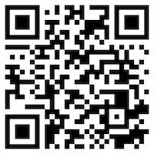






Web 3.0 and Big Data Analysis in Fintech, Green and Sustainable Finance
Sustainability and ESG Data Analytics
1141ESGDA04
MBA, IM, NTPU (M5265) (Fall 2025)
Wed 2, 3, 4 (9:10-12:00) (B3F17)
University Ambassador
Certified Instructor
Min-Yuh Day, Ph.D,
Professor and Director
Institute of Information Management, National Taipei University
https://web.ntpu.edu.tw/~myday
https://meet.google.com/miy-fbif-max
2025-10-08

Slide 2
Syllabus
Week Date Subject/Topics
1 2025/09/10 Introduction Sustainability and ESG Data Analytics
2 2025/09/17 Environmental, Social, and Governance (ESG) in
Net-Zero Digital Transformation
3 2025/09/24 Data Science for Sustainability and ESG
4 2025/10/01 Case Study on Sustainability and ESG Data Analytics I
5 2025/10/08 Web 3.0 and Big Data Analysis in Fintech, Green and
Sustainable Finance
6 2025/10/15 ESG Data Gathering, Analysis, and Visualization

Slide 3
Syllabus
Week Date Subject/Topics
7 2025/10/22 NVIDIA Building RAG Agents with LLMs Part I:
LLM Services and AI Foundation Models
8 2025/10/29 Self-Learning
9 2025/11/05 Midterm Project Report
10 2025/11/12 NVIDIA Building RAG Agents with LLMs Part II:
Document Loading, Chunking, and Embeddings
11 2025/11/19 NVIDIA Building RAG Agents with LLMs Part III:
Retrieval-Augmented Generation with
Vector Stores and RAG Evaluation

Slide 4
Syllabus
Week Date Subject/Topics
12 2025/11/26 Case Study on Sustainability and ESG Data Analytics II
13 2025/12/03 Artificial Intelligence of things (AIoT) in ESG and
Sustainability Applications
14 2025/12/10 Generative AI for ESG Rating and Reporting Generation
15 2025/12/17 Final Project Report I
16 2025/12/24 Final Project Report II

Slide 5
Web 3.0 and
Big Data Analysis in
Fintech, Green and Sustainable Finance

Slide 6
Outline
Web 3.0
Big Data Analysis
Fintech
Green and Sustainable Finance

Slide 7
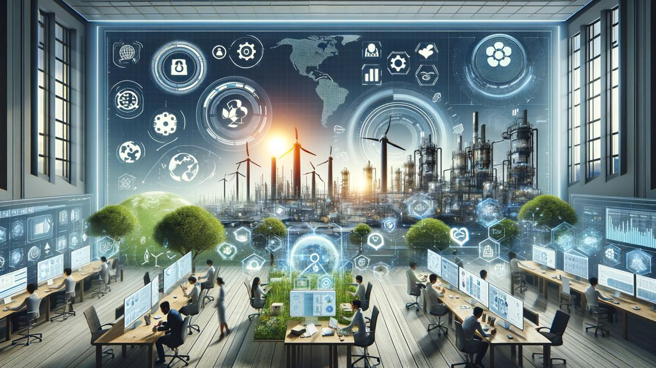
Sustainability and ESG Data Analytics

Slide 8
FinTech ABCD
AI
Block Chain
Cloud Computing
Big Data

Slide 9
Decentralized Finance (DeFi)
Block Chain Financial Technology
Block Chain & Bitcoin
(BTC)
Smart Contract & Ethereum
(ETH)
Decentralized Application
(DApp)

Slide 10
Artificial Intelligence
(AI)

Slide 11
AI, Big Data, Cloud Computing
Evolution of Decision Support, Business Intelligence, and Analytics
AI
AI
Cloud Computing
Big Data
DM
BI
Source: Ramesh Sharda, Dursun Delen, and Efraim Turban (2017),
Business Intelligence, Analytics, and Data Science: A Managerial Perspective, 4th Edition, Pearson

Slide 12
AI, ML, DL
Artificial Intelligence (AI)
Machine Learning (ML)
Supervised
Learning
Unsupervised Learning
Deep Learning (DL)
CNN
RNN LSTM GRU
GAN
Semi-supervised Learning
Reinforcement Learning
Source: https://leonardoaraujosantos.gitbooks.io/artificial-inteligence/content/deep_learning.html

Slide 13
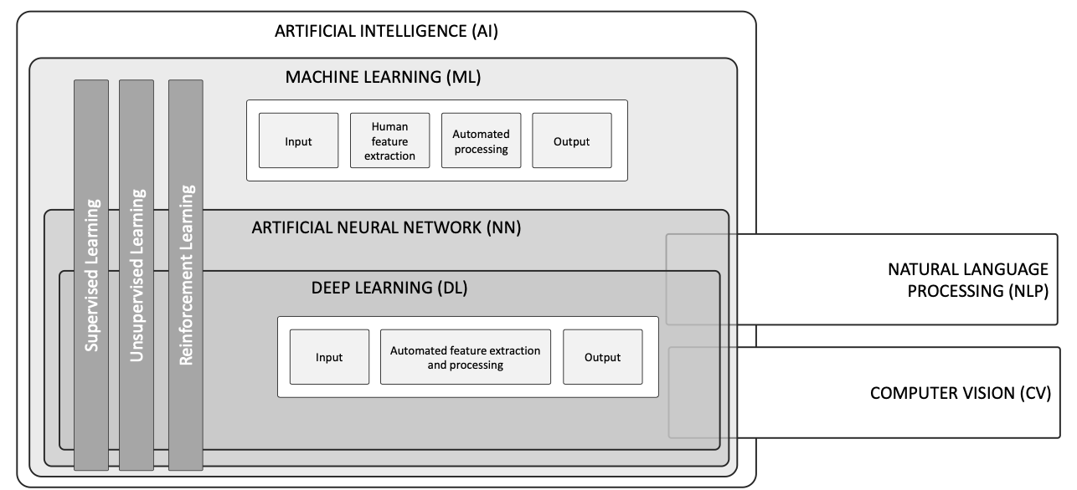
AI, ML, NN, DL
Source: Schoormann, T., Strobel, G., Möller, F., Petrik, D., & Zschech, P. (2023).
Artificial Intelligence for Sustainability—A Systematic Review of Information Systems Literature. Communications of the Association for Information Systems, 52(1), 8.

Slide 14
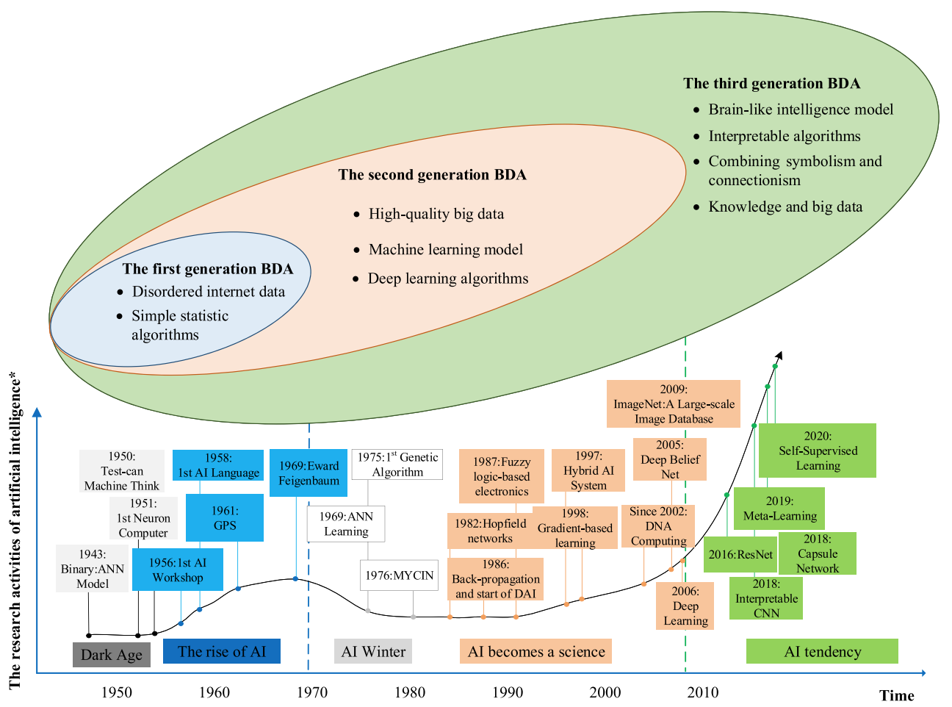
AI and Big Data Analytics (BDA)
Source: Wang, Junliang, Chuqiao Xu, Jie Zhang, and Ray Zhong (2022). "Big data analytics for intelligent manufacturing systems: A review." Journal of Manufacturing Systems 62 (2022): 738-752.

Slide 15
Web 3.0

Slide 16
Web3
Metaverse
DeFi
NFT

Slide 17
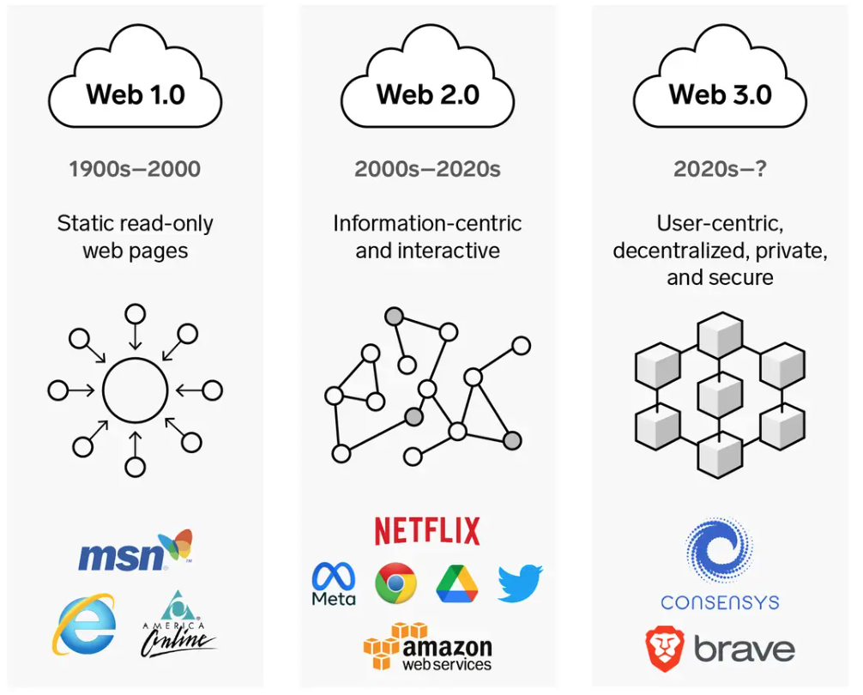
Web3: Decentralized Web
Internet Evolution
1990
2000
2020
Source: https://www.businessinsider.com/personal-finance/what-is-web3

Slide 18
Web 3.0: Key Features of the Web Evolution
The Evolution of Web | Web 1.0 (1980s–) | Web 2.0 (2000s–) | Web 3.0 (2020s–)
Entrance | Browser | App | Wallet
Back-end computing center | Server | Clouds | Peer-to-peer network, blockchain
Interactive mode | Read-only | Read & write | Read & write & own
Economic model | Advertising economy | Platform economy, advertising economy | Ownership/creator economics
Network form | Centralized | Centralized | Decentralized
Data/content publisher | Web portals | PGC, UGC | PGC, UGC, DAO, AIGC
Data/content ownership | Institution | Company and platform | Individuals and organizations, portable
Digital identity system | Username & password | Platform-based identity | Decentralized digital identity
Source: Meng Shen, Zhehui Tan, Dusit Niyato, Yuzhi Liu, Jiawen Kang, Zehui Xiong, Liehuang Zhu, Wei Wang, and Xuemin Shen (2024).
"Artificial intelligence for web 3.0: A comprehensive survey." ACM Computing Surveys 56, no. 10 (2024): 1-39..

Slide 19
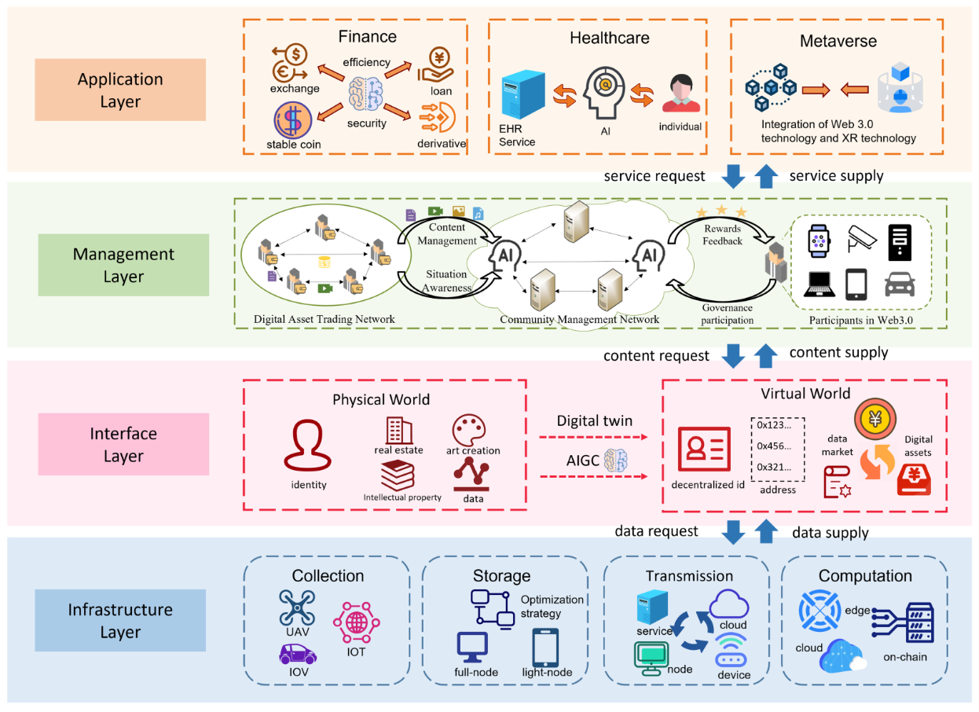
Web 3.0 Architecture
Source: Meng Shen, Zhehui Tan, Dusit Niyato, Yuzhi Liu, Jiawen Kang, Zehui Xiong, Liehuang Zhu, Wei Wang, and Xuemin Shen (2024).
"Artificial intelligence for web 3.0: A comprehensive survey." ACM Computing Surveys 56, no. 10 (2024): 1-39..

Slide 20
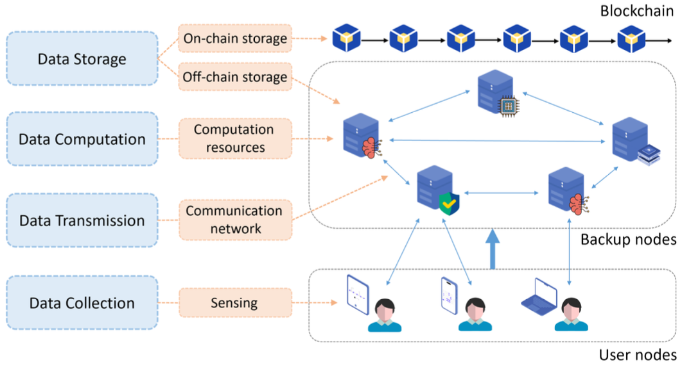
Web 3.0 Infrastructure Layer
Source: Meng Shen, Zhehui Tan, Dusit Niyato, Yuzhi Liu, Jiawen Kang, Zehui Xiong, Liehuang Zhu, Wei Wang, and Xuemin Shen (2024).
"Artificial intelligence for web 3.0: A comprehensive survey." ACM Computing Surveys 56, no. 10 (2024): 1-39..

Slide 21
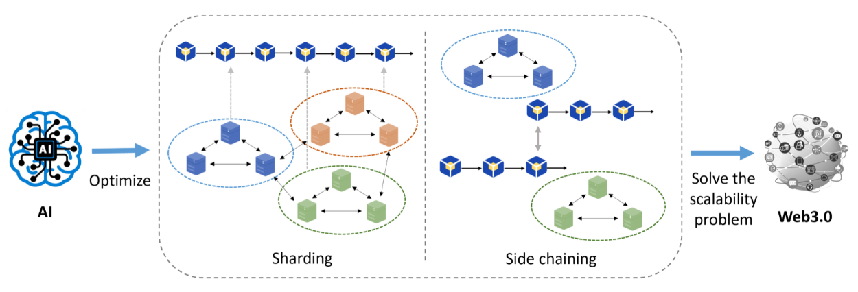
Artificial Intelligence for Web 3.0
Source: Meng Shen, Zhehui Tan, Dusit Niyato, Yuzhi Liu, Jiawen Kang, Zehui Xiong, Liehuang Zhu, Wei Wang, and Xuemin Shen (2024).
"Artificial intelligence for web 3.0: A comprehensive survey." ACM Computing Surveys 56, no. 10 (2024): 1-39..

Slide 22
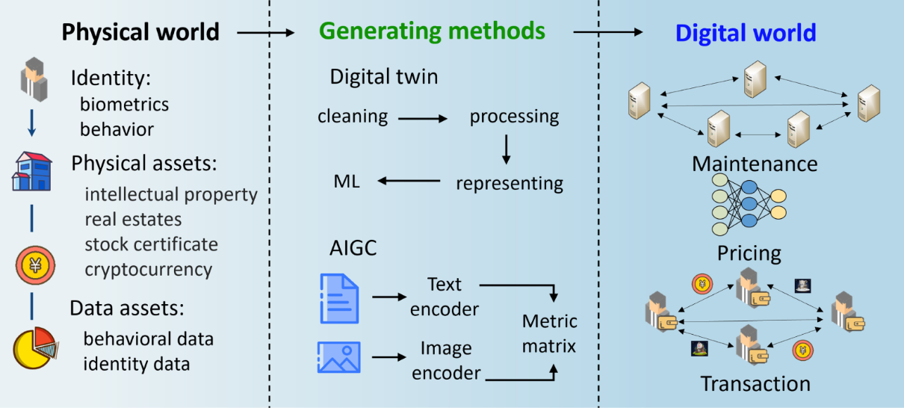
Physical World to the Digital World in the Interface Layer of Web 3.0
Source: Meng Shen, Zhehui Tan, Dusit Niyato, Yuzhi Liu, Jiawen Kang, Zehui Xiong, Liehuang Zhu, Wei Wang, and Xuemin Shen (2024).
"Artificial intelligence for web 3.0: A comprehensive survey." ACM Computing Surveys 56, no. 10 (2024): 1-39..

Slide 23
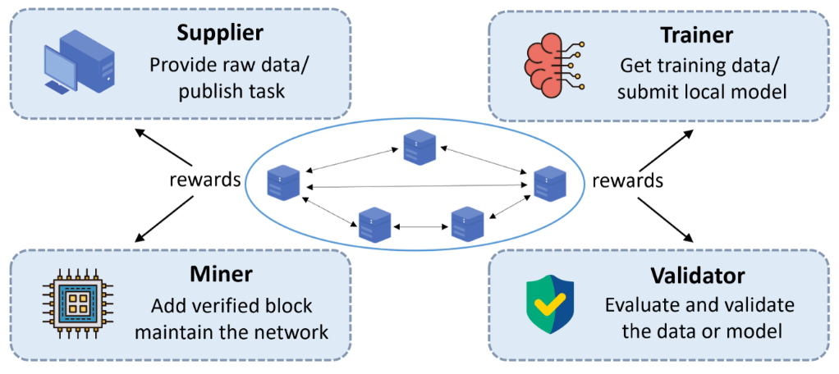
AI-assisted Incentive Mechanism Structure in the Management Layer of Web 3.0
Source: Meng Shen, Zhehui Tan, Dusit Niyato, Yuzhi Liu, Jiawen Kang, Zehui Xiong, Liehuang Zhu, Wei Wang, and Xuemin Shen (2024).
"Artificial intelligence for web 3.0: A comprehensive survey." ACM Computing Surveys 56, no. 10 (2024): 1-39..

Slide 24
Research on AI-based Applications in Web 3.0
Subject | Ref. | AI Methods | Solutions | Web 3.0 tasks
Finance | [62] | DL | AI-based systematic modular framework | Detecting smart contract vulnerabilities
Finance | [63] | LSTM | Applying short- and long-term memory model | Learning vulnerabilities in sequence
Finance | [64] | GNNs | Using graph neural networks for detection | Smart contract vulnerability analysis
Metaverse | [67] | DRL | Visual deep learning | Novel virtual environment establishment
Metaverse | [68] | FL | Federated-learning-based mobile edge computing | Proving computational efficiency of AR applications
Metaverse | [147] | RL | Training virtual characters to move participants | Precomputing avatar behavior
Metaverse | [148] | CNNs | Overlay food segmentation image inferred by CNNs | Improving the presence of users eating in metaverse
Healthcare | [65] | ANN | AI enabled and blockchain driven | Medical healthcare system for COVID-19
Healthcare | [149] | DCNNs | An intermediate fusion framework | Physical activity recognition
Source: Meng Shen, Zhehui Tan, Dusit Niyato, Yuzhi Liu, Jiawen Kang, Zehui Xiong, Liehuang Zhu, Wei Wang, and Xuemin Shen (2024).
"Artificial intelligence for web 3.0: A comprehensive survey." ACM Computing Surveys 56, no. 10 (2024): 1-39..

Slide 25
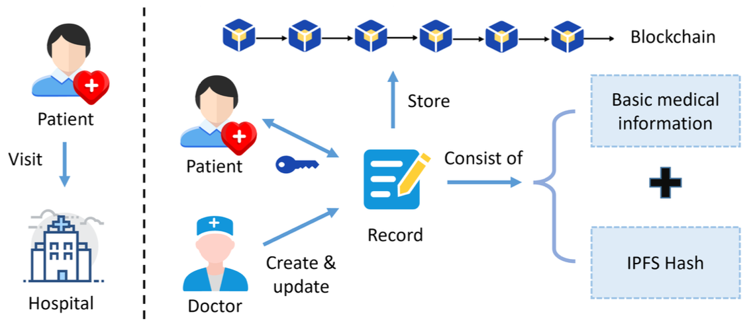
The Framework of EHR Management System based on Blockchain
Source: Meng Shen, Zhehui Tan, Dusit Niyato, Yuzhi Liu, Jiawen Kang, Zehui Xiong, Liehuang Zhu, Wei Wang, and Xuemin Shen (2024).
"Artificial intelligence for web 3.0: A comprehensive survey." ACM Computing Surveys 56, no. 10 (2024): 1-39..

Slide 26
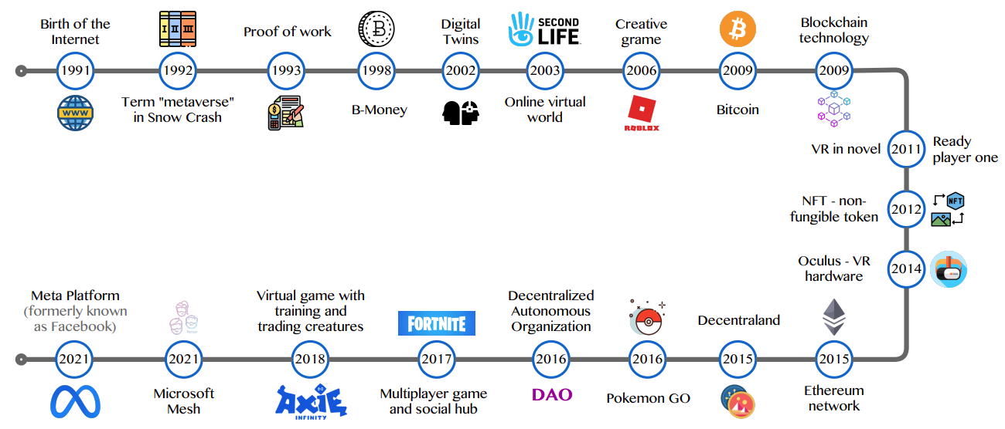
Metaverse Development from 1991 to 2021
Source: Huynh-The, Thien, Quoc-Viet Pham, Xuan-Qui Pham, Thanh Thi Nguyen, Zhu Han, and Dong-Seong Kim (2022).
"Artificial Intelligence for the Metaverse: A Survey." arXiv preprint arXiv:2202.10336.

Slide 27
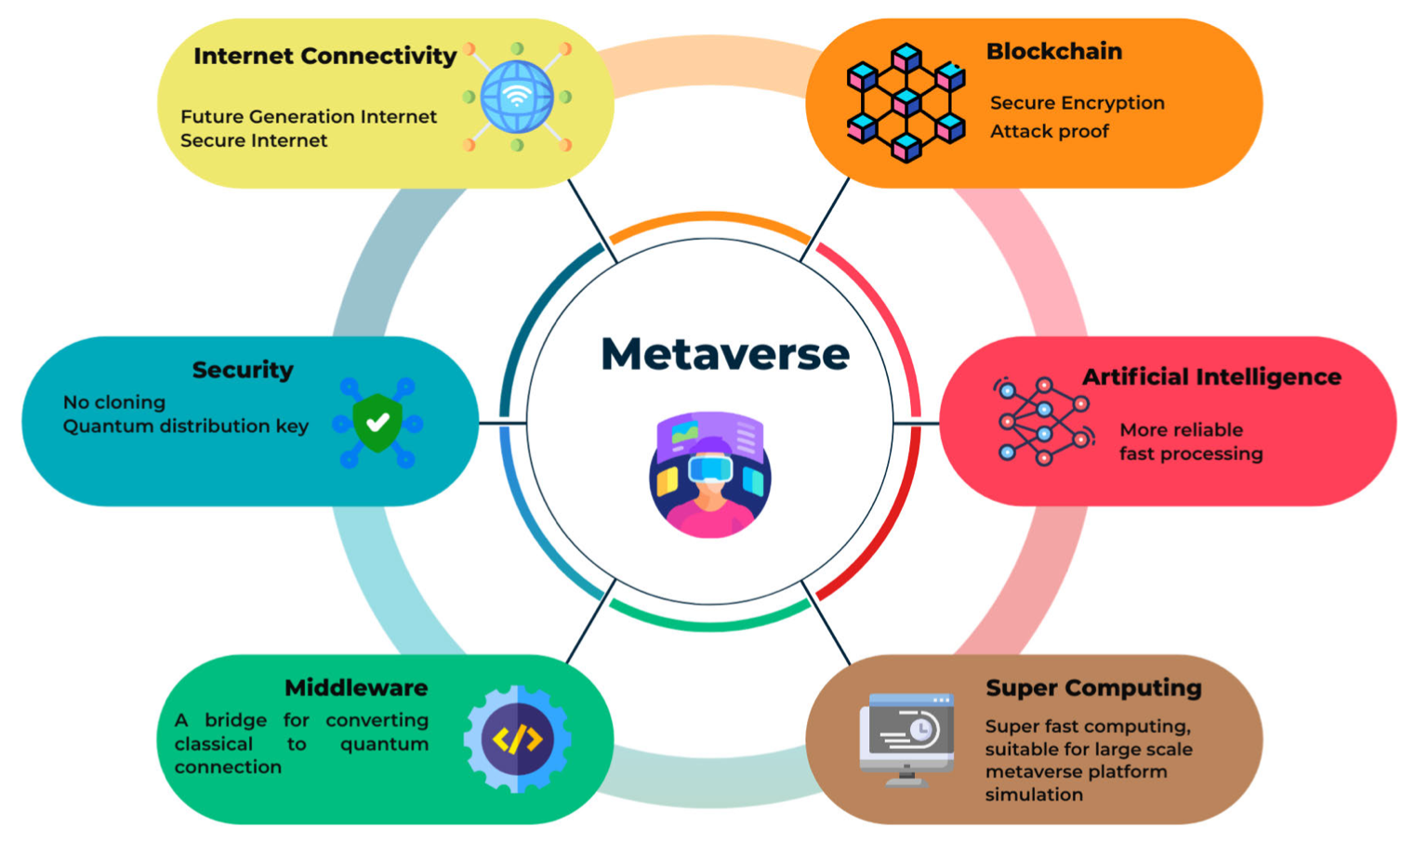
Quantum Computing in the Metaverse
Source: Tuli, Esmot Ara, Jae-Min Lee, and Dong-Seong Kim (2024). "Integration of Quantum Technologies into Metaverse: Applications, Potentials, and Challenges." IEEE Access 12 (2024): 29995-30019.

Slide 28
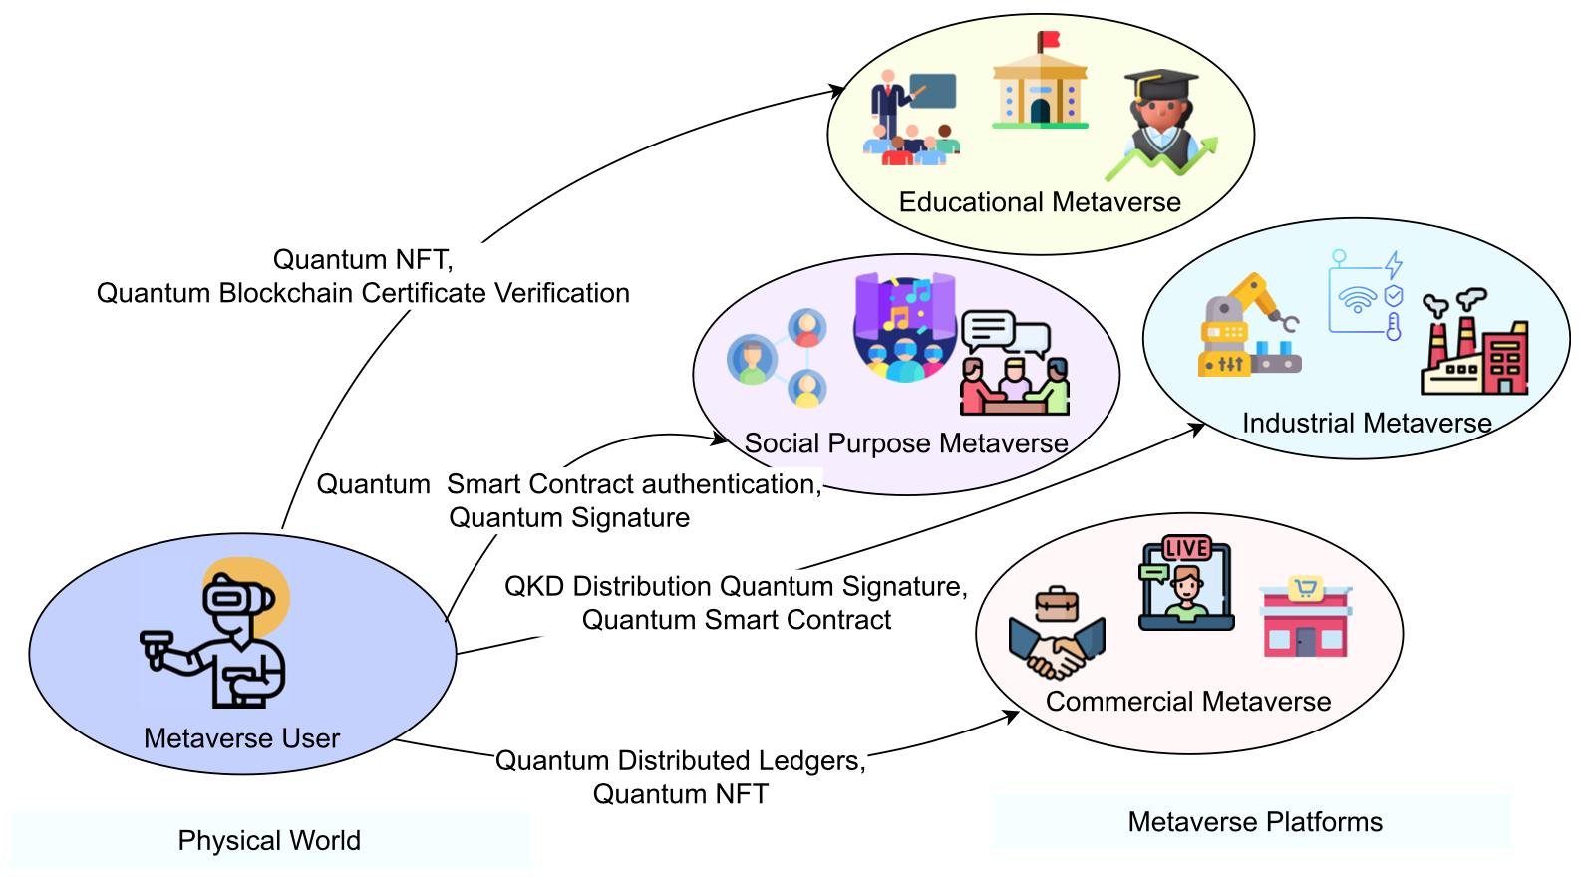
Quantum Blockchain: Bridging between the real world and metaverse
Source: Tuli, Esmot Ara, Jae-Min Lee, and Dong-Seong Kim (2024). "Integration of Quantum Technologies into Metaverse: Applications, Potentials, and Challenges." IEEE Access 12 (2024): 29995-30019.

Slide 29
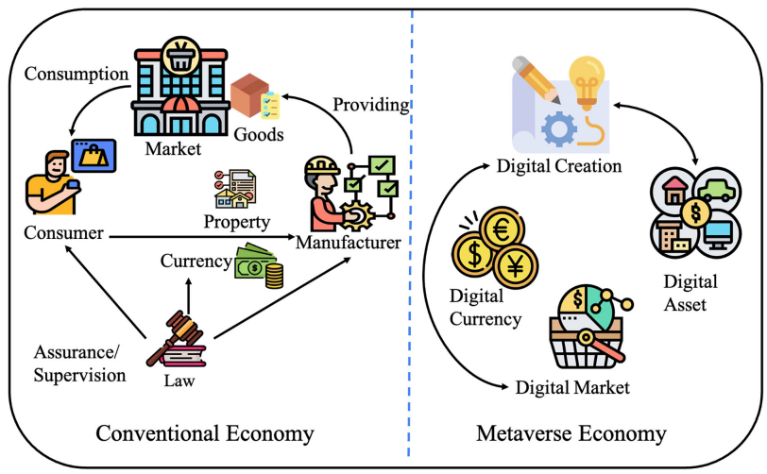
Metaverse Economy
Source: Yang, Qinglin, Yetong Zhao, Huawei Huang, Zehui Xiong, Jiawen Kang, and Zibin Zheng (2022).
"Fusing blockchain and AI with metaverse: A survey." IEEE Open Journal of the Computer Society 3 : 122-136.

Slide 30
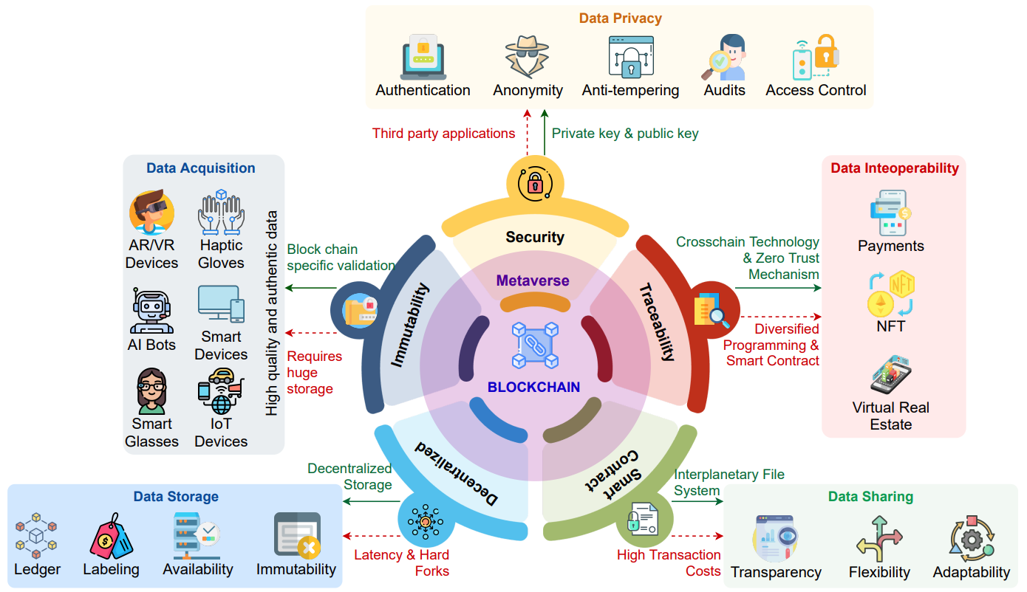
Blockchain in the Metaverse
Source: Gadekallu, Thippa Reddy, Thien Huynh-The, Weizheng Wang, Gokul Yenduri, Pasika Ranaweera, Quoc-Viet Pham, Daniel Benevides da Costa, and Madhusanka Liyanage (2022).
"Blockchain for the Metaverse: A Review." arXiv preprint arXiv:2203.09738..

Slide 31
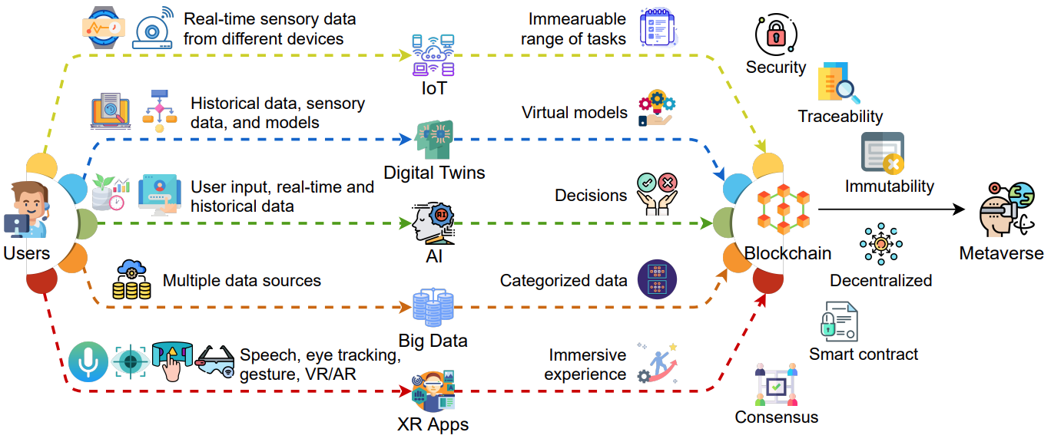
Blockchain for Key Enabling Technologies of the Metaverse
Source: Gadekallu, Thippa Reddy, Thien Huynh-The, Weizheng Wang, Gokul Yenduri, Pasika Ranaweera, Quoc-Viet Pham, Daniel Benevides da Costa, and Madhusanka Liyanage (2022).
"Blockchain for the Metaverse: A Review." arXiv preprint arXiv:2203.09738..

Slide 32
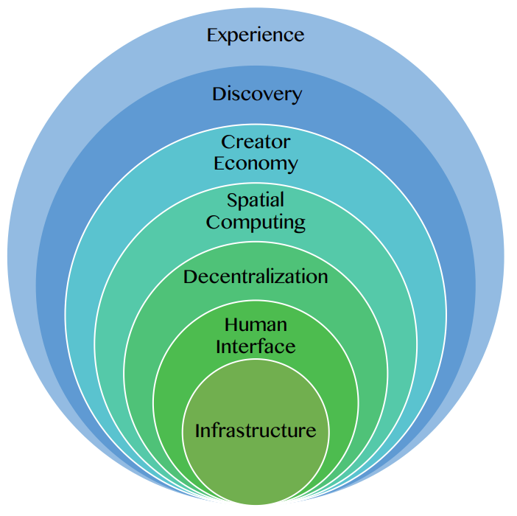
Seven Layers of a Metaverse Platform
Source: Huynh-The, Thien, Quoc-Viet Pham, Xuan-Qui Pham, Thanh Thi Nguyen, Zhu Han, and Dong-Seong Kim (2022).
"Artificial Intelligence for the Metaverse: A Survey." arXiv preprint arXiv:2202.10336.

Slide 33
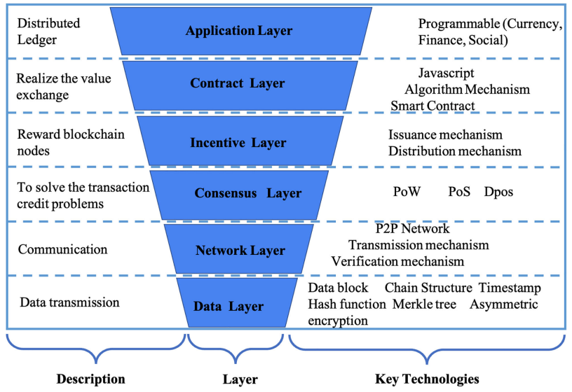
Layered Architecture of Blockchain
Source: Yang, Qinglin, Yetong Zhao, Huawei Huang, Zehui Xiong, Jiawen Kang, and Zibin Zheng (2022).
"Fusing blockchain and AI with metaverse: A survey." IEEE Open Journal of the Computer Society 3 : 122-136.

Slide 34
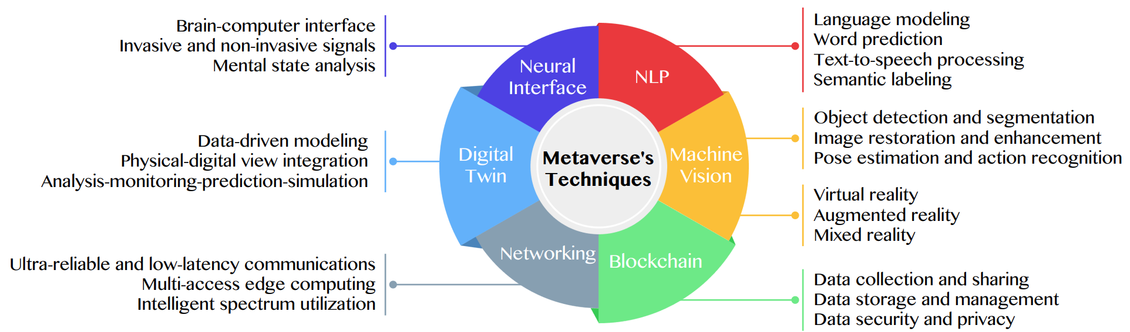
Primary Technical Aspects in the Metaverse
AI with ML algorithms and DL architectures is advancing the user experience in the virtual world
Source: Huynh-The, Thien, Quoc-Viet Pham, Xuan-Qui Pham, Thanh Thi Nguyen, Zhu Han, and Dong-Seong Kim (2022).
"Artificial Intelligence for the Metaverse: A Survey." arXiv preprint arXiv:2202.10336.

Slide 35
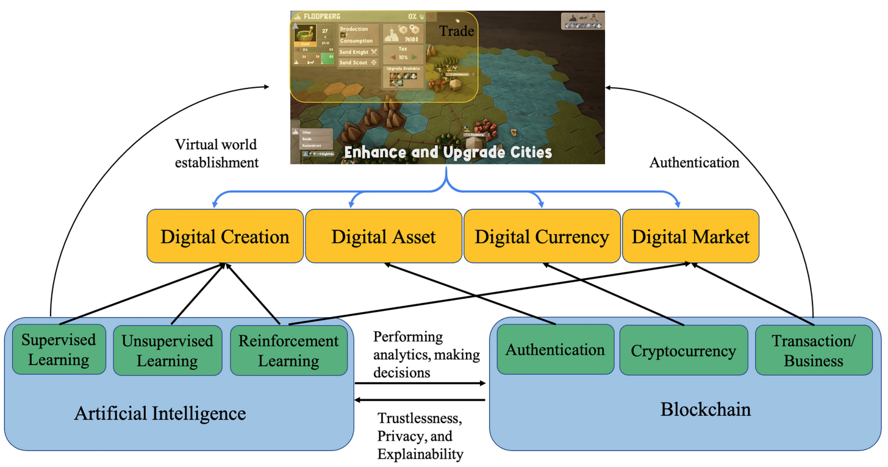
Fusion of AI and Blockchain in Metaverse
Source: Yang, Qinglin, Yetong Zhao, Huawei Huang, Zehui Xiong, Jiawen Kang, and Zibin Zheng (2022).
"Fusing blockchain and AI with metaverse: A survey." IEEE Open Journal of the Computer Society 3 : 122-136.

Slide 36
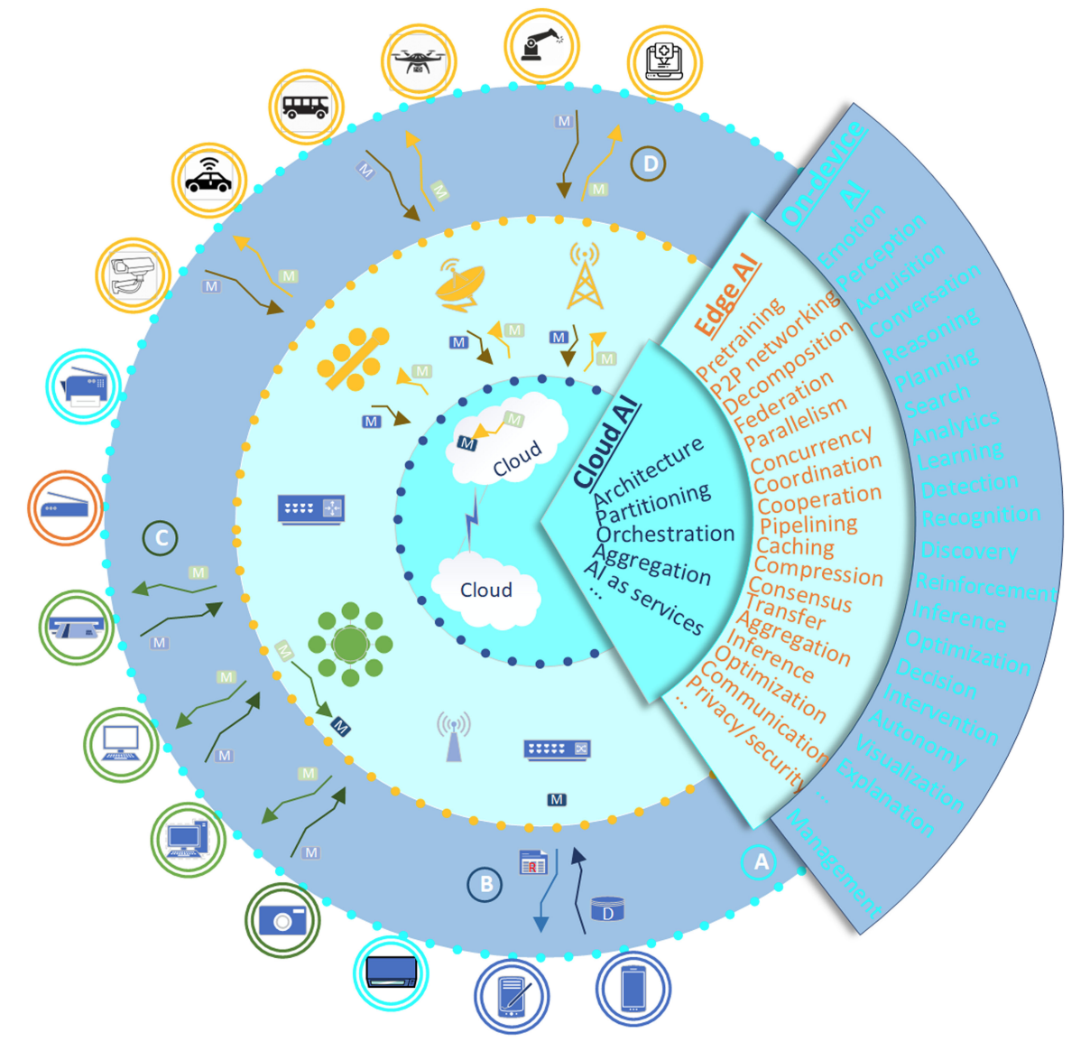
DeAI:
Synthesizing On-device AI, Edge AI, and Cloud AI
Source: Cao, Longbing (2022). "Decentralized ai: Edge intelligence and smart blockchain, metaverse, web3, and desci." IEEE Intelligent Systems 37, no. 3: 6-19.

Slide 37
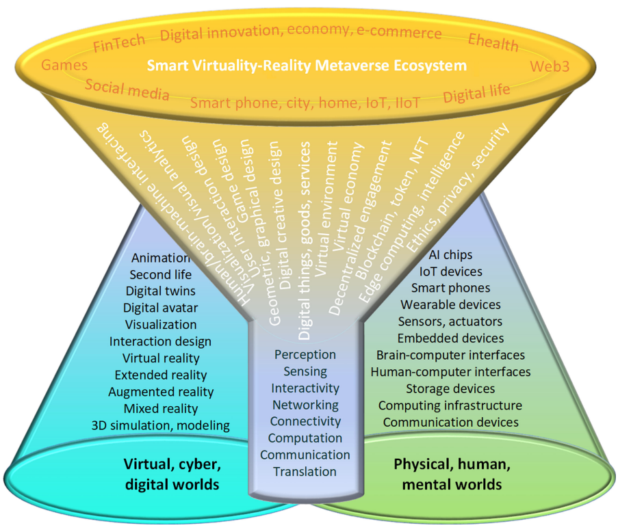
Smart Virtuality-Reality Metaverse Ecosystem: Metasynthesizing DeAI, Metaverse, Blockchain, Web3
Source: Cao, Longbing (2022). "Decentralized ai: Edge intelligence and smart blockchain, metaverse, web3, and desci." IEEE Intelligent Systems 37, no. 3: 6-19.

Slide 38
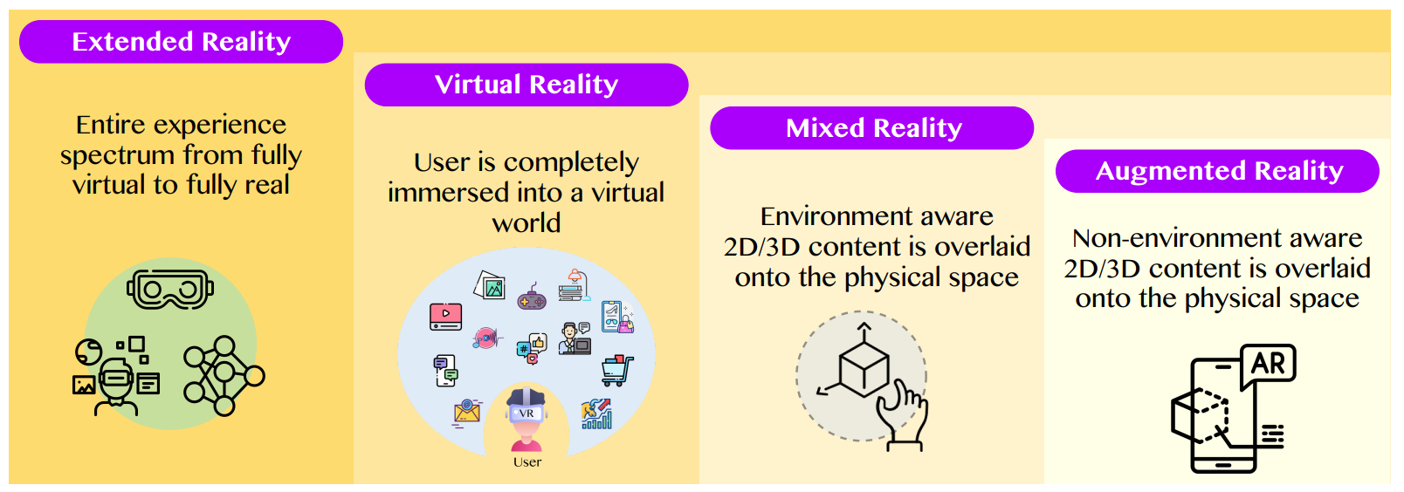
The difference between AR, MR, and VR under the umbrella of XR
XR
VR
MR
AR
Source: Huynh-The, Thien, Quoc-Viet Pham, Xuan-Qui Pham, Thanh Thi Nguyen, Zhu Han, and Dong-Seong Kim (2022).
"Artificial Intelligence for the Metaverse: A Survey." arXiv preprint arXiv:2202.10336.

Slide 39
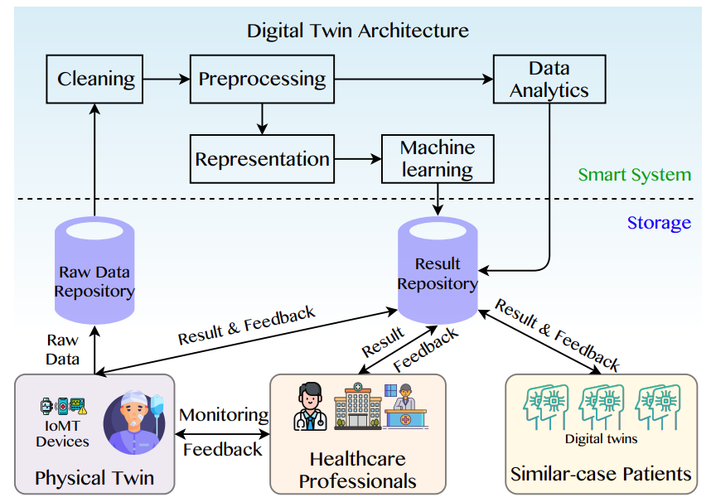
A Data-Driven Digital Twin Architecture for intelligent healthcare systems using ML to process raw data of IoMedicalThings devices
Source: Huynh-The, Thien, Quoc-Viet Pham, Xuan-Qui Pham, Thanh Thi Nguyen, Zhu Han, and Dong-Seong Kim (2022).
"Artificial Intelligence for the Metaverse: A Survey." arXiv preprint arXiv:2202.10336.

Slide 40
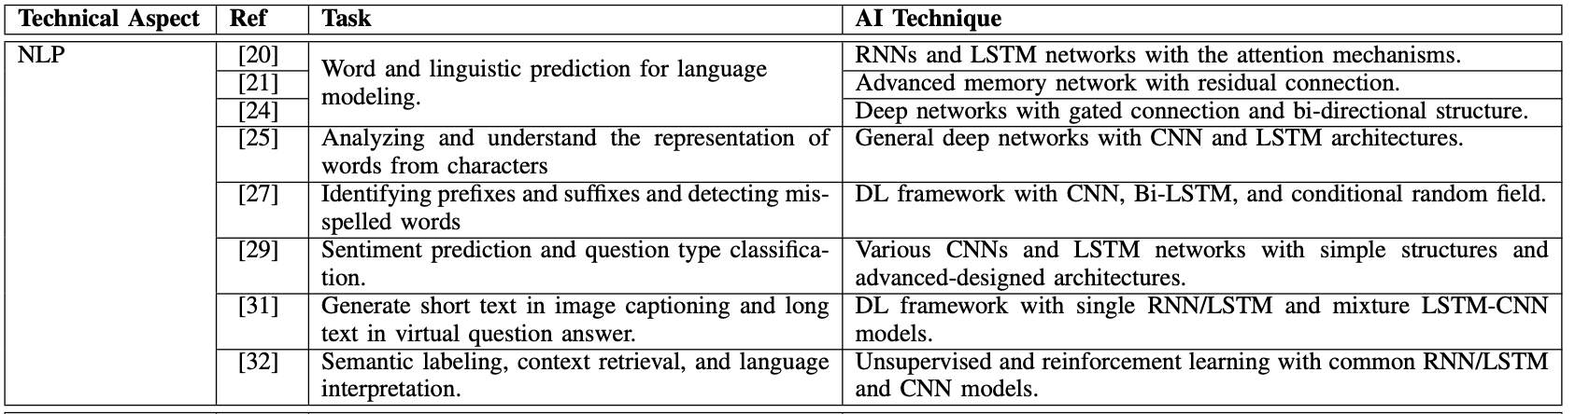
AI for the Metaverse
Source: Huynh-The, Thien, Quoc-Viet Pham, Xuan-Qui Pham, Thanh Thi Nguyen, Zhu Han, and Dong-Seong Kim (2022).
"Artificial Intelligence for the Metaverse: A Survey." arXiv preprint arXiv:2202.10336.

Slide 41
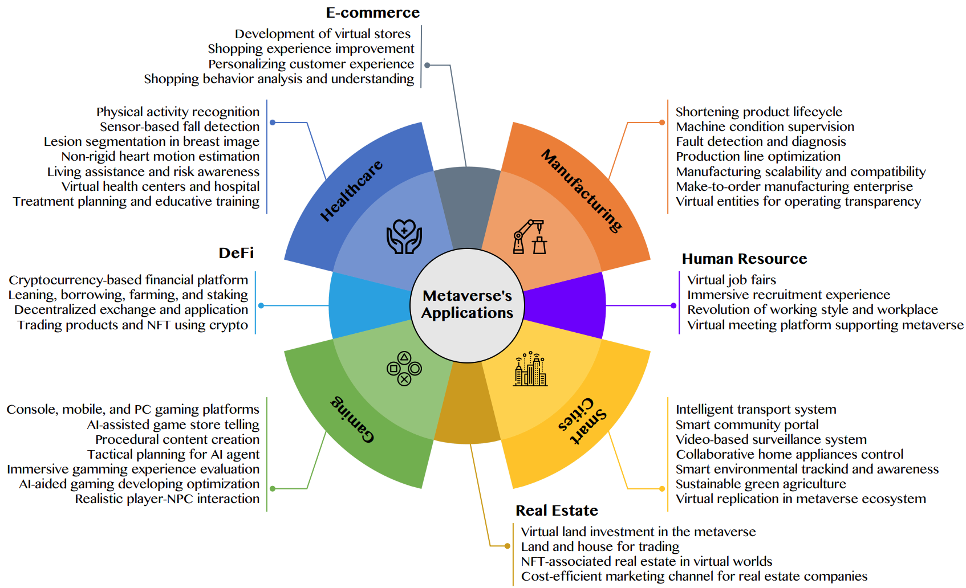
AI for the Metaverse in the Application Aspects healthcare, manufacturing, smart cities, gaming
E-commerce, human resources, real estate, and DeFi
Source: Huynh-The, Thien, Quoc-Viet Pham, Xuan-Qui Pham, Thanh Thi Nguyen, Zhu Han, and Dong-Seong Kim (2022).
"Artificial Intelligence for the Metaverse: A Survey." arXiv preprint arXiv:2202.10336.

Slide 42
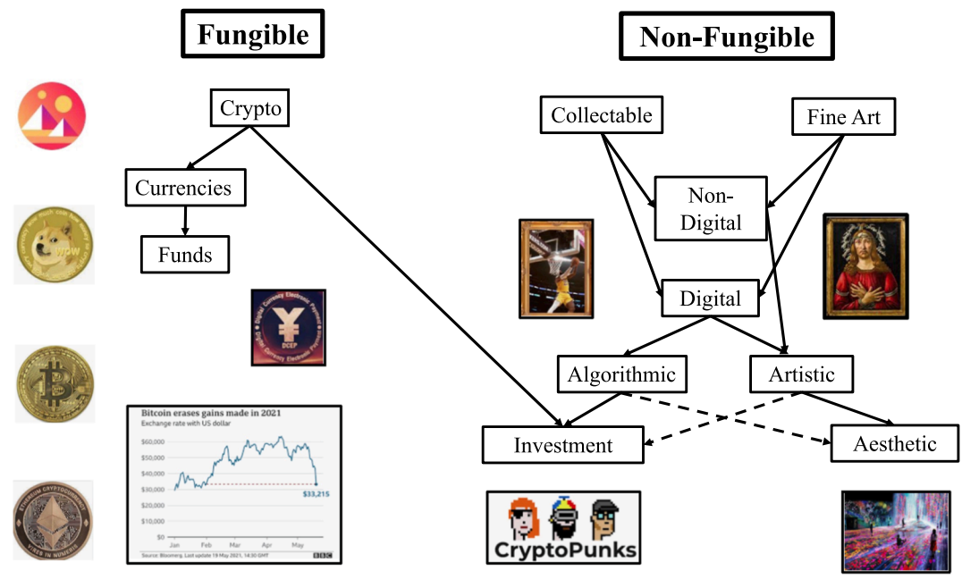
Blockchain-Registered:
Crypto, Collectables, and Art.
Source: Belk, Russell, Mariam Humayun, and Myriam Brouard. (2022)
"Money, possessions, and ownership in the Metaverse: NFTs, cryptocurrencies, Web3 and Wild Markets." Journal of Business Research 153: 198-205.

Slide 43
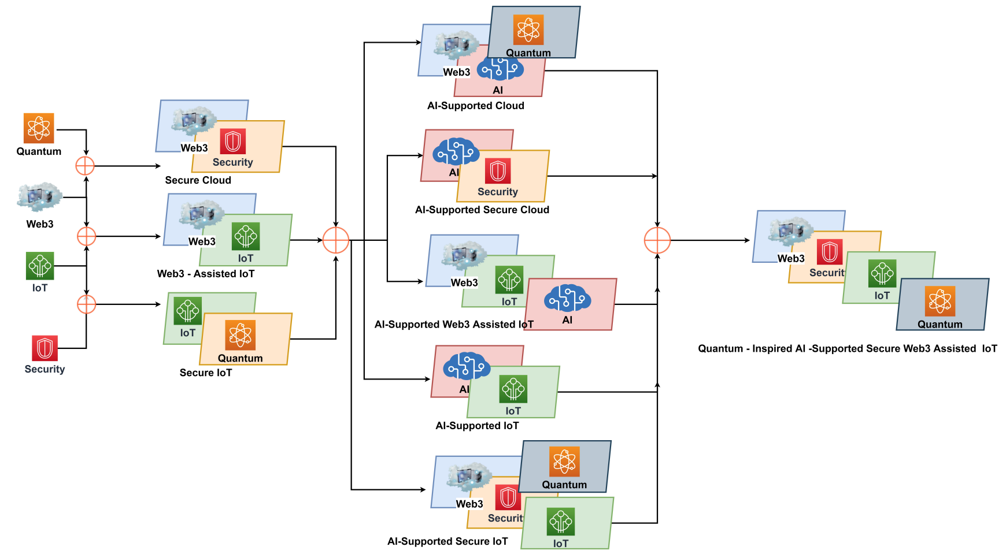
Combination of Web3 with other Technologies
Source: Sheridan, Dan, James Harris, Frank Wear, Jerry Cowell Jr, Easton Wong, and Abbas Yazdinejad. (2022)
"Web3 Challenges and Opportunities for the Market." arXiv preprint arXiv:2209.02446.

Slide 44
FinTech

Slide 45
Financial Technology
FinTech
“providing
financial services
by making use of software and
modern technology”
Source: https://www.fintechweekly.com/fintech-definition

Slide 46
Financial Technology

Slide 47
Financial Services

Slide 48
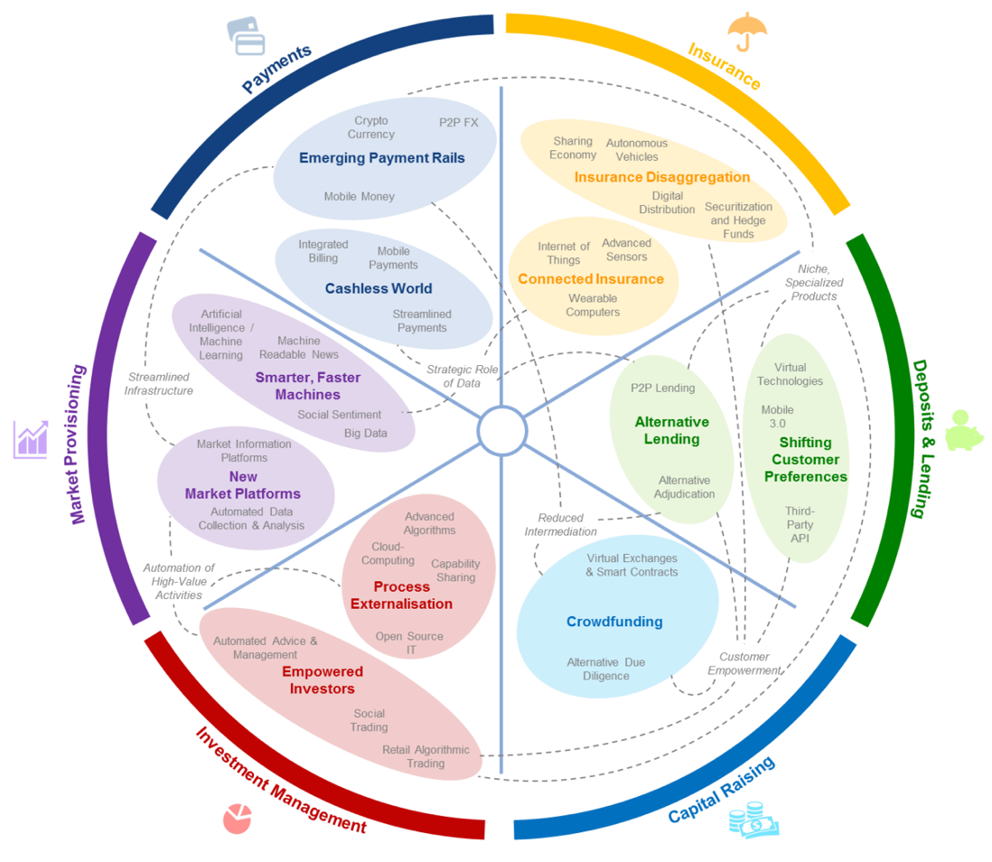
FinTech: Financial Services Innovation
Source: http://www3.weforum.org/docs/WEF_The_future__of_financial_services.pdf

Slide 49
FinTech:
Financial Services Innovation
1. Payments
2. Insurance
3. Deposits & Lending
4. Capital Raising
5. Investment Management
6. Market Provisioning
Source: http://www3.weforum.org/docs/WEF_The_future__of_financial_services.pdf

Slide 50
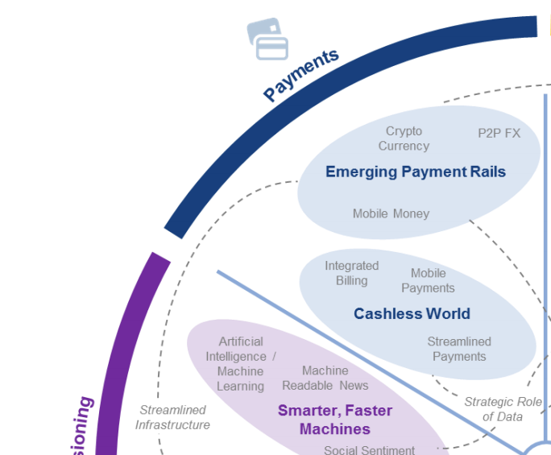
FinTech: Payment
1
Source: http://www3.weforum.org/docs/WEF_The_future__of_financial_services.pdf

Slide 51
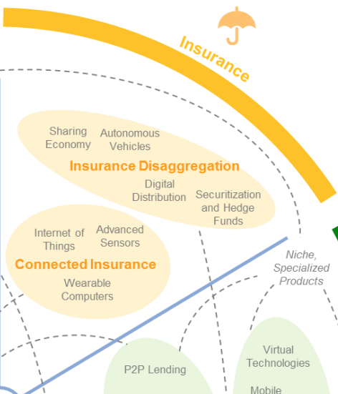
FinTech: Insurance
2
Source: http://www3.weforum.org/docs/WEF_The_future__of_financial_services.pdf

Slide 52
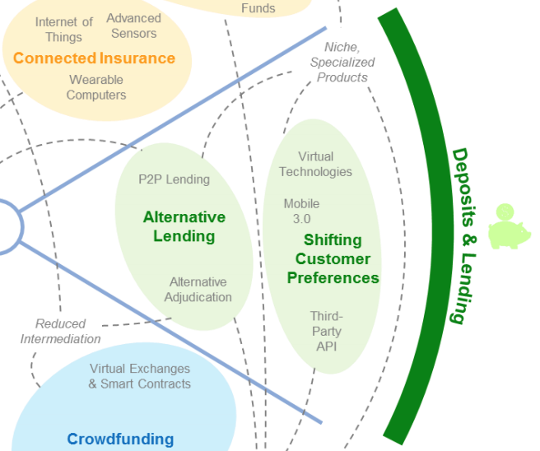
FinTech: Deposits & Lending
3
Source: http://www3.weforum.org/docs/WEF_The_future__of_financial_services.pdf

Slide 53
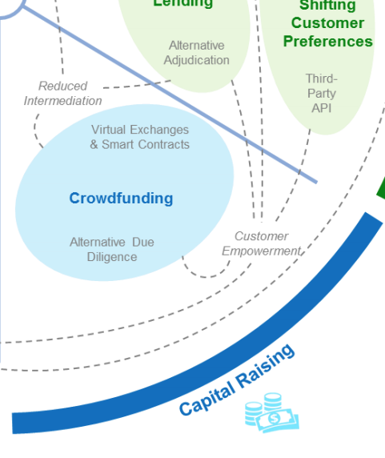
FinTech: Capital Raising
4
Source: http://www3.weforum.org/docs/WEF_The_future__of_financial_services.pdf

Slide 54
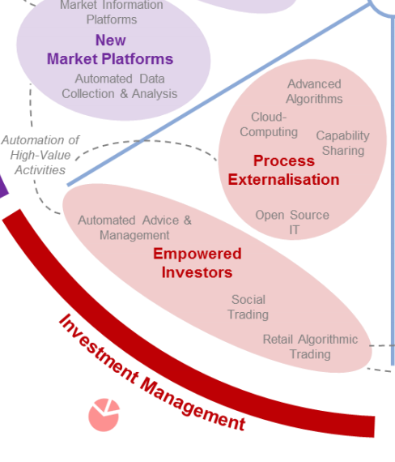
FinTech: Investment Management
5
Source: http://www3.weforum.org/docs/WEF_The_future__of_financial_services.pdf

Slide 55
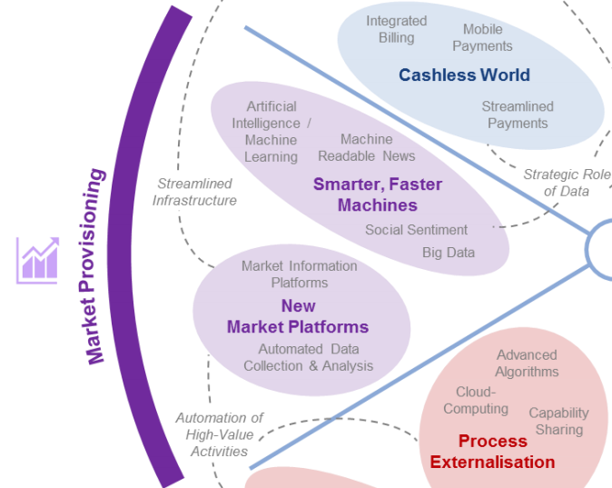
FinTech: Market Provisioning
6
Source: http://www3.weforum.org/docs/WEF_The_future__of_financial_services.pdf

Slide 56
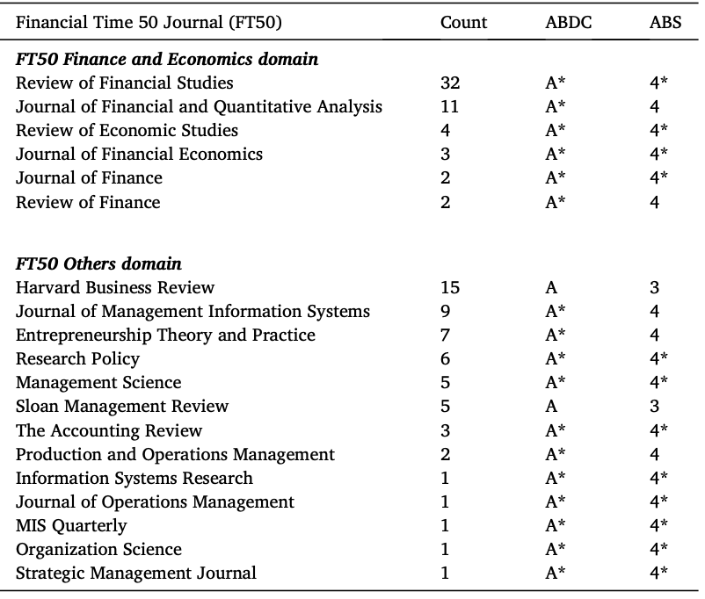
FinTech Research Published in Elite Journals
Source: Morshadul Hasan, Ariful Hoque, Mohammad Zoynul Abedin, and Dominic Gasbarro (2024).
"FinTech and sustainable development: A systematic thematic analysis using human-and machine-generated processing." International Review of Financial Analysis 95 (2024): 103473.

Slide 57
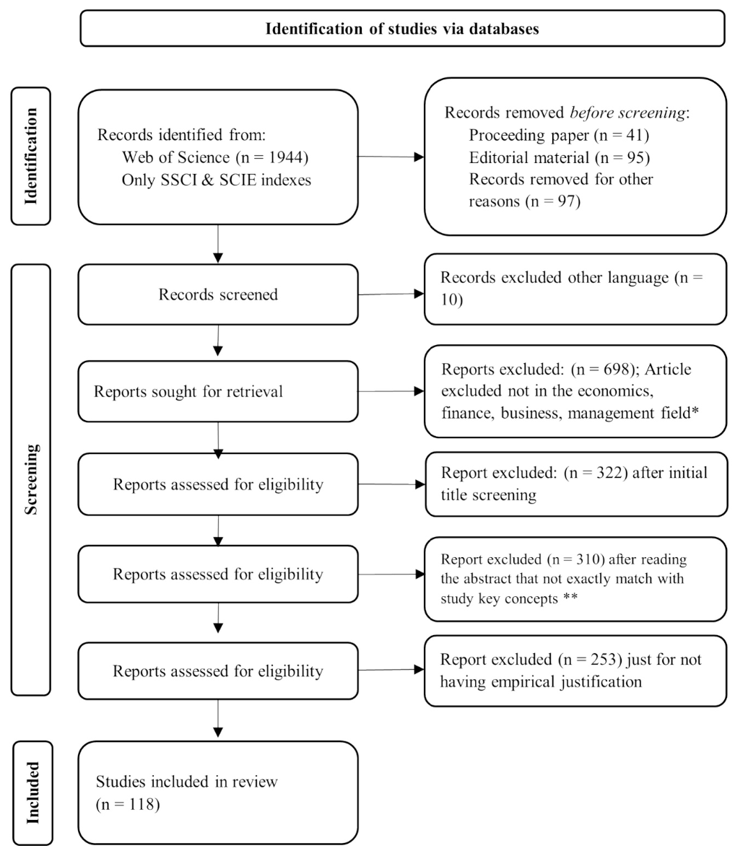
PRISMA of FinTech and Sustainable Development
Source: Morshadul Hasan, Ariful Hoque, Mohammad Zoynul Abedin, and Dominic Gasbarro (2024).
"FinTech and sustainable development: A systematic thematic analysis using human-and machine-generated processing." International Review of Financial Analysis 95 (2024): 103473.

Slide 58
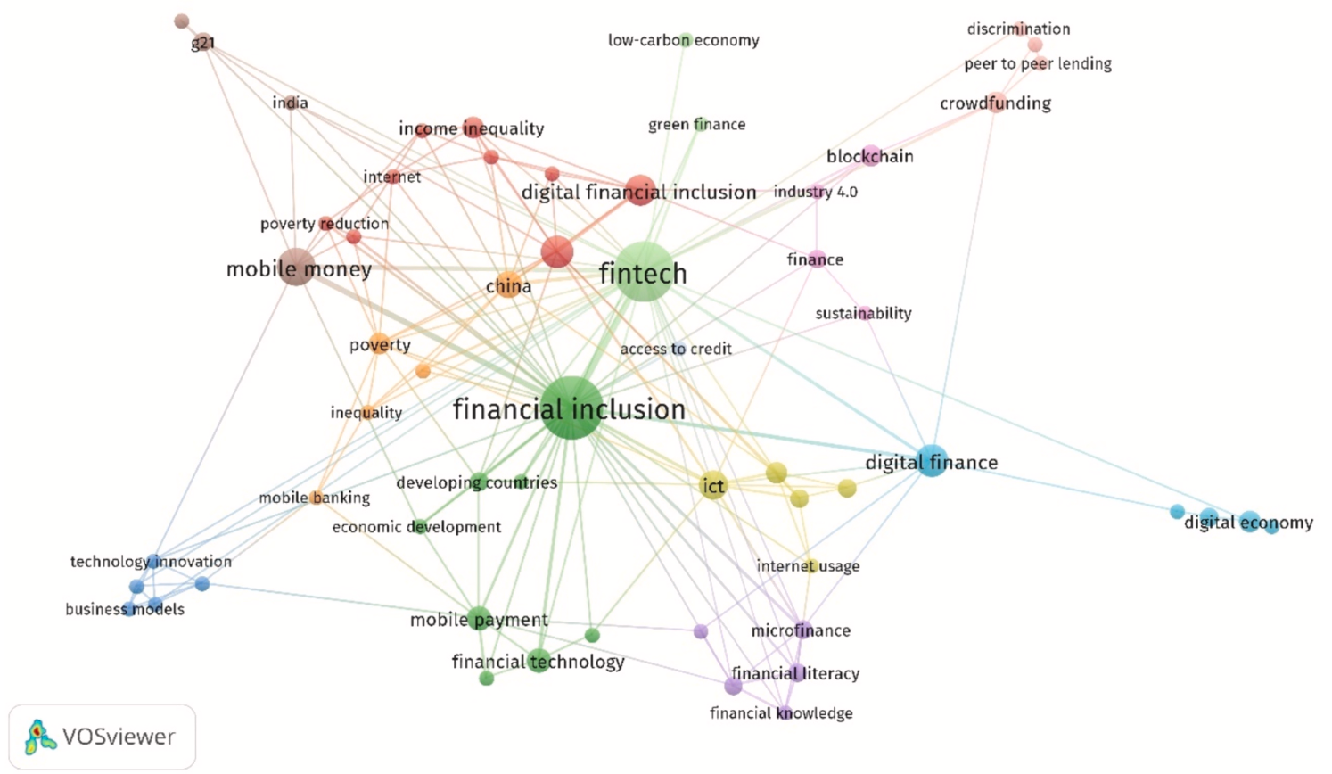
FinTech and Sustainable Development
(clustering and co-occurrence networking)
Source: Morshadul Hasan, Ariful Hoque, Mohammad Zoynul Abedin, and Dominic Gasbarro (2024).
"FinTech and sustainable development: A systematic thematic analysis using human-and machine-generated processing." International Review of Financial Analysis 95 (2024): 103473.

Slide 59
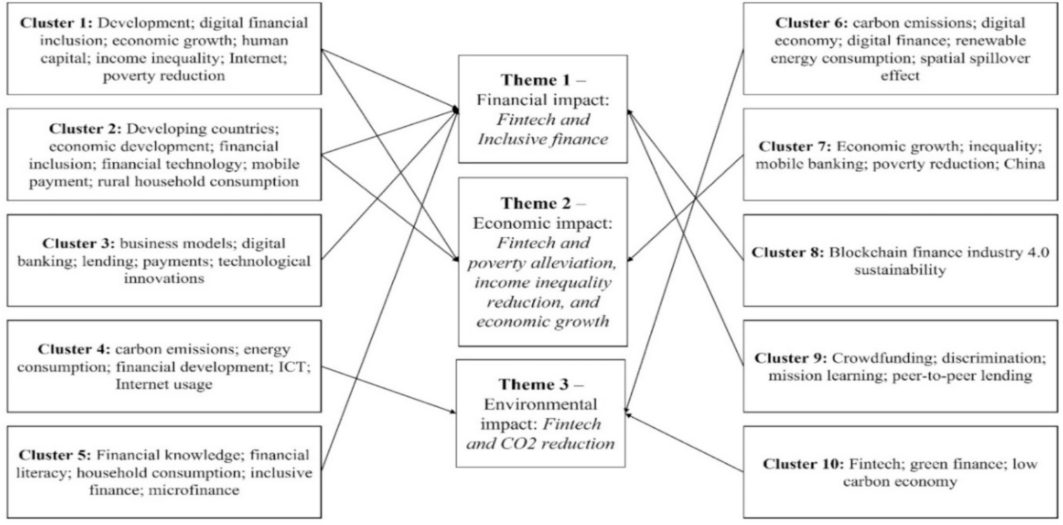
FinTech and Sustainable Development
(Human specified themes and machine clustering)
Source: Morshadul Hasan, Ariful Hoque, Mohammad Zoynul Abedin, and Dominic Gasbarro (2024).
"FinTech and sustainable development: A systematic thematic analysis using human-and machine-generated processing." International Review of Financial Analysis 95 (2024): 103473.

Slide 60
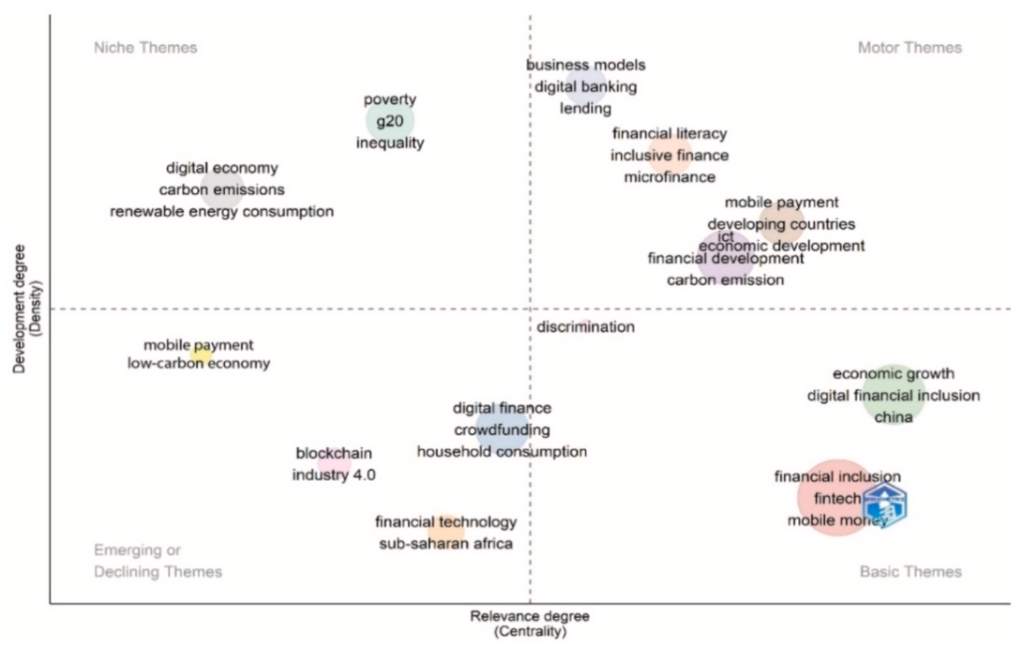
FinTech and Sustainable Development
(Thematic mapping)
Source: Morshadul Hasan, Ariful Hoque, Mohammad Zoynul Abedin, and Dominic Gasbarro (2024).
"FinTech and sustainable development: A systematic thematic analysis using human-and machine-generated processing." International Review of Financial Analysis 95 (2024): 103473.

Slide 61
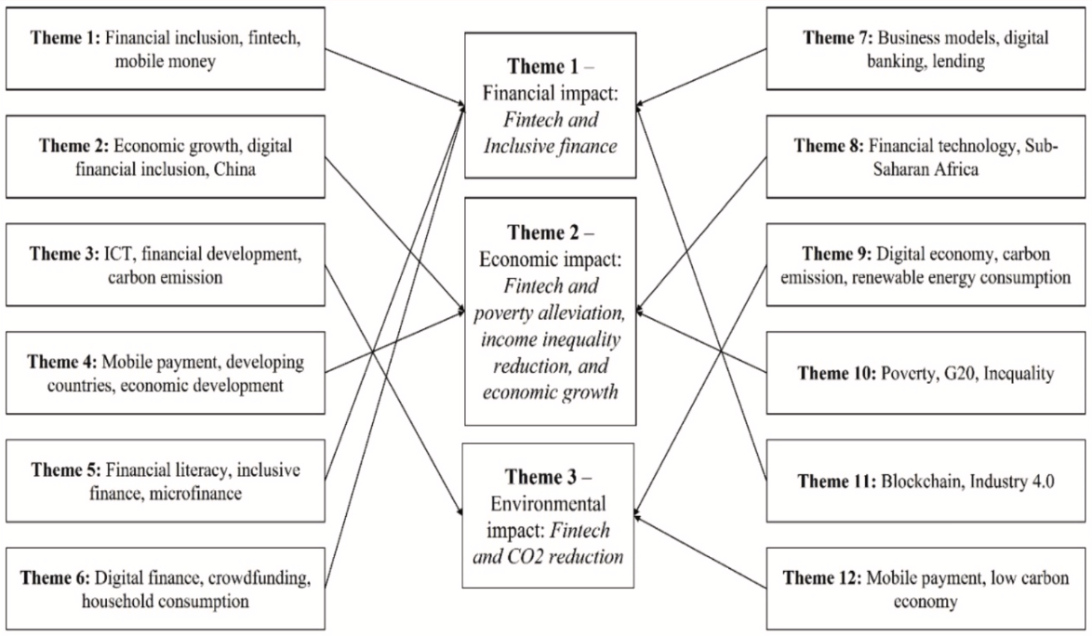
FinTech and Sustainable Development
(Thematic mapping)
Source: Morshadul Hasan, Ariful Hoque, Mohammad Zoynul Abedin, and Dominic Gasbarro (2024).
"FinTech and sustainable development: A systematic thematic analysis using human-and machine-generated processing." International Review of Financial Analysis 95 (2024): 103473.

Slide 62
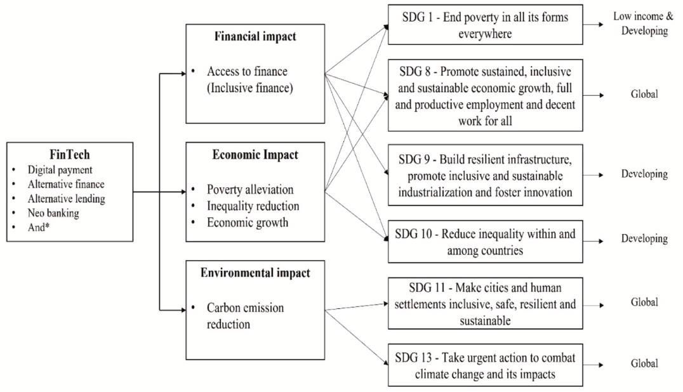
FinTech and SDGs
Source: Morshadul Hasan, Ariful Hoque, Mohammad Zoynul Abedin, and Dominic Gasbarro (2024).
"FinTech and sustainable development: A systematic thematic analysis using human-and machine-generated processing." International Review of Financial Analysis 95 (2024): 103473.

Slide 63
FinTech Products and Services
AI-based financial applications
Big data-based technologically innovative financial products
Blockchain-enhanced emissions-trading systems
Financial innovations (innovative patents)
Mobile payment, mobile savings
Alternative finance (crowdfunding and P2P lending)
Consumer lending, student microlending
Online lending through community-based organizations
Source: Morshadul Hasan, Ariful Hoque, Mohammad Zoynul Abedin, and Dominic Gasbarro (2024).
"FinTech and sustainable development: A systematic thematic analysis using human-and machine-generated processing." International Review of Financial Analysis 95 (2024): 103473.

Slide 64
FinTech and Sustainable Development
Dimension 1: Financial Impact
  FinTech → Inclusive Finance → Sustainable Development
  Focus: Access to finance, financial inclusion, innovative financial services
Dimension 2: Economic Impact
  FinTech → Economy Boosting → Sustainable Development
  Focus: Poverty alleviation, income inequality reduction, economic growth
Dimension 3: Environmental Impact
  FinTech → Environment Quality → Sustainable Development
  Focus: CO2 emissions reduction, green finance, renewable energy
Source: Morshadul Hasan, Ariful Hoque, Mohammad Zoynul Abedin, and Dominic Gasbarro (2024).
"FinTech and sustainable development: A systematic thematic analysis using human-and machine-generated processing." International Review of Financial Analysis 95 (2024): 103473.

Slide 65
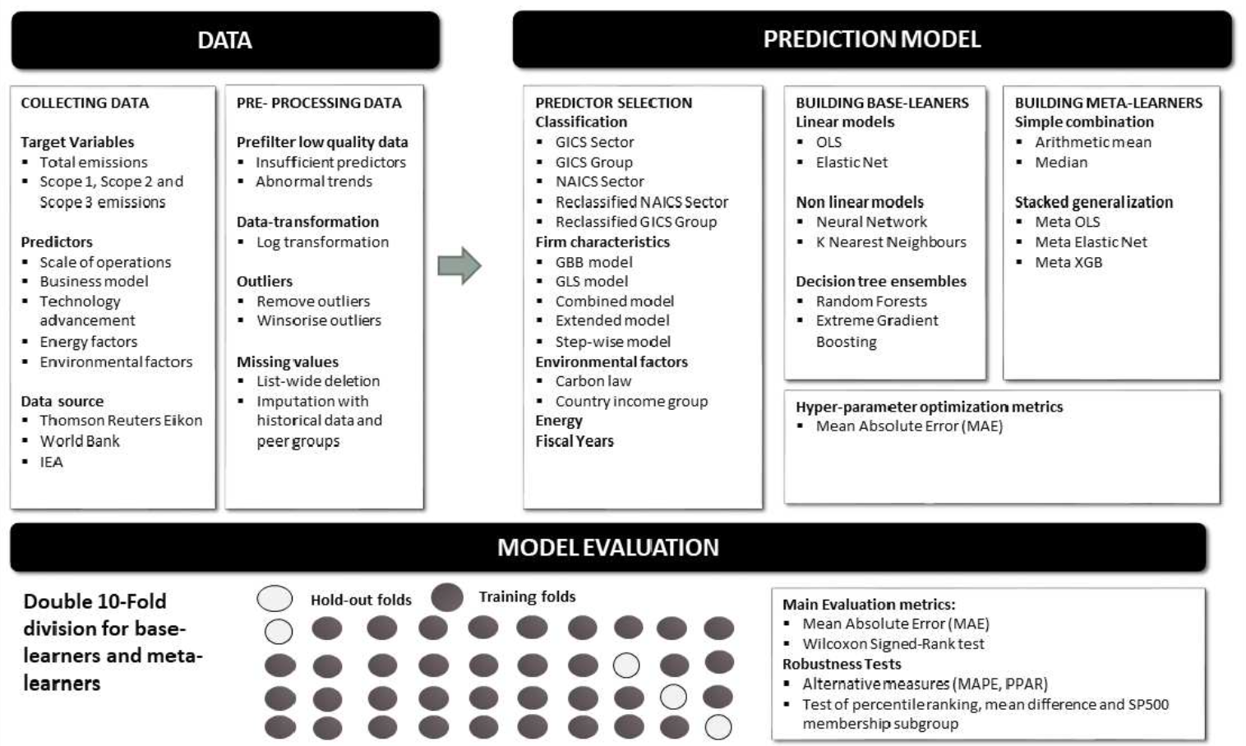
Modelling Strategy to Forecast Carbon Emissions with AI
Source: Brière, M., Keip, M., & Le Berthe, T. (2022). Artificial Intelligence for Sustainable Finance: Why it May Help. Available at SSRN 4252329.
Notes:
Modelling strategy to forecast carbon emisisons with Machine Learning methods
This figure illustrates the modelling framework that is used to train and evaluate the proposed machine learning approach. Block: Data shows the sample selection and data pre-processing process. Block: Prediction Model implements (1) Predictor Selection, where the optimal set of predictors from the listed alternative choices is selected based on OLS regression. (2): Build Base-Learners, where three groups of base-learners are tested, namely linear models, non-linear models, and decision ensembles, and (3) Building Meta-Learners, where predictions are combined using a simple combination or stacked generalization. Finally, block: Model Evaluation: describes the model evaluation with mean absolute error and a set of robustness tests via double-K fold validation.
Source: Nguyen, Diaz-Rainez and Kuruppuarachchi (2021)

Slide 66
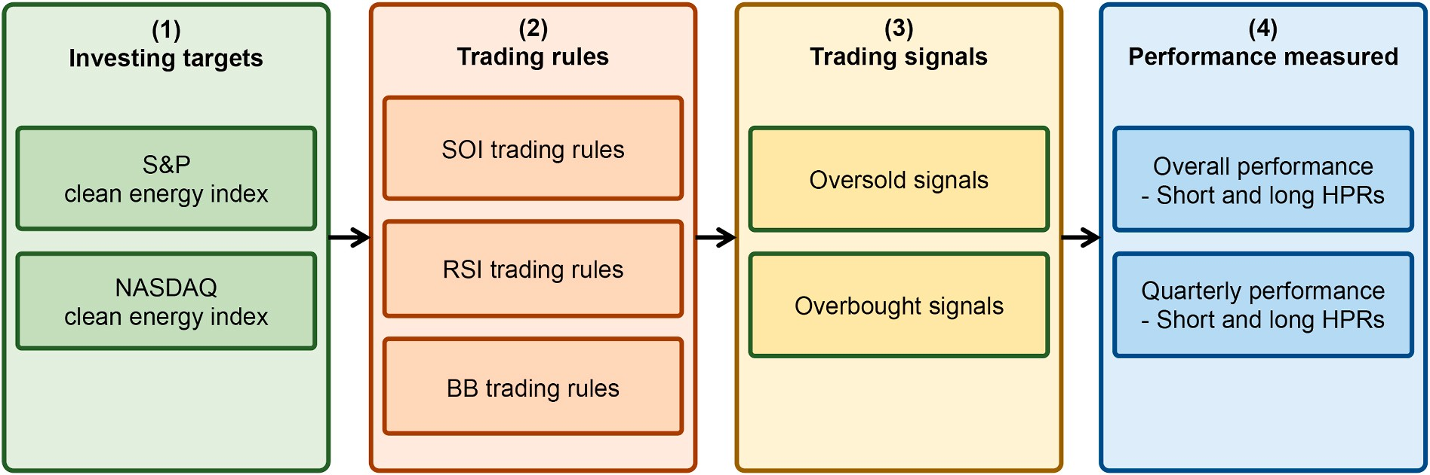
Research Framework
Do clean energy indices outperform using contrarian strategies
Source, Min-Yuh Day and Yensen Ni (2023), "Do clean energy indices outperform using contrarian strategies based on contrarian trading rules?", Energy, Volume 272, 1 June 2023, 127113.

Slide 67
Artificial Intelligence for Sustainable Finance
Why AI may help sustainable finance?
  Brière, M., Keip, M., & Le Berthe, T. (2022). Artificial Intelligence for Sustainable Finance: Why it May Help. Available at SSRN 4252329.
How does artificial intelligence boost sustainable development?
  Schoormann, T., Strobel, G., Möller, F., Petrik, D., & Zschech, P. (2023). Artificial Intelligence for Sustainability—A Systematic Review of Information Systems Literature. Communications of the Association for Information Systems, 52(1), 8.
Does sustainability generate better financial performance?
  Atz, U., Van Holt, T., Liu, Z. Z., & Bruno, C. C. (2023). Does sustainability generate better financial performance? review, meta-analysis, and propositions. Journal of Sustainable Finance & Investment, 13(1), 802-825.
What are the major research topics in AI for Sustainable finance?
  Kumar, S., Sharma, D., Rao, S., Lim, W. M., & Mangla, S. K. (2022). Past, present, and future of sustainable finance: Insights from big data analytics through machine learning of scholarly research. Annals of Operations Research, 1-44.

Slide 68
Decentralized Finance
(DeFi)
Block Chain FinTech

Slide 69
Decentralized Finance (DeFi)
A global, open alternative to the current financial system.
Products that let you borrow, save, invest, trade, and more.
Based on open-source technology that anyone can program with.
Source: https://ethereum.org/en/defi/

Slide 70
Traditional Finance
Centralized Finance (CeFi)
Some people aren't granted access to set up a bank account or use financial services.
Lack of access to financial services can prevent people from being employable.
Financial services can block you from getting paid.
A hidden charge of financial services is your personal data.
Governments and centralized institutions can close down markets at will.
Trading hours often limited to business hours of specific time zone.
Money transfers can take days due to internal human processes.
There's a premium to financial services because intermediary institutions need their cut.
Source: https://ethereum.org/en/defi/

Slide 71
DeFi vs. CeFi
Decentralized Finance (DeFi) | Traditional Finance (Centralized Finance; CeFi)
You hold your money. | Your money is held by companies.
You control where your money goes and how it's spent. | You have to trust companies not to mismanage your money, like lend to risky borrowers.
Transfers of funds happen in minutes. | Payments can take days due to manual processes.
Transaction activity is pseudonymous. | Financial activity is tightly coupled with your identity.
DeFi is open to anyone. | You must apply to use financial services.
The markets are always open. | Markets close because employees need breaks.
It's built on transparency – anyone can look at a product's data and inspect how the system works. | Financial institutions are closed books: you can't ask to see their loan history, a record of their managed assets, and so on.
Source: https://ethereum.org/en/defi/

Slide 72
(DeFi)
Decentralized Applications (Dapps)
Ethereum-powered tools and services
Dapps are a growing movement of applications that use Ethereum to disrupt business models or invent new ones
Source: https://ethereum.org/en/defi/

Slide 73
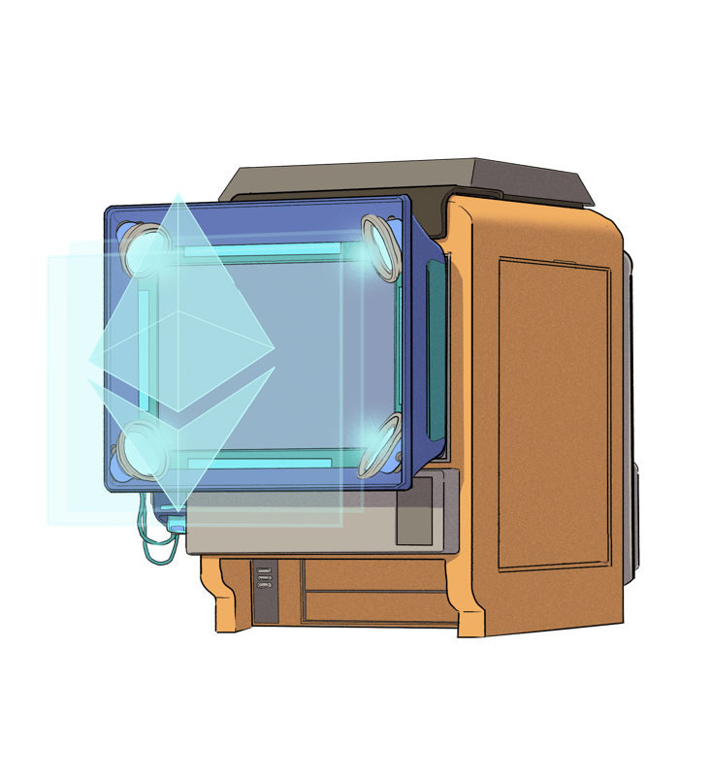
The Internet of Assets
Ethereum isn't just for
digital money.
Anything you can own can be represented,
traded and
put to use as
non-fungible tokens (NFTs).
Source: https://ethereum.org/en/defi/

Slide 74
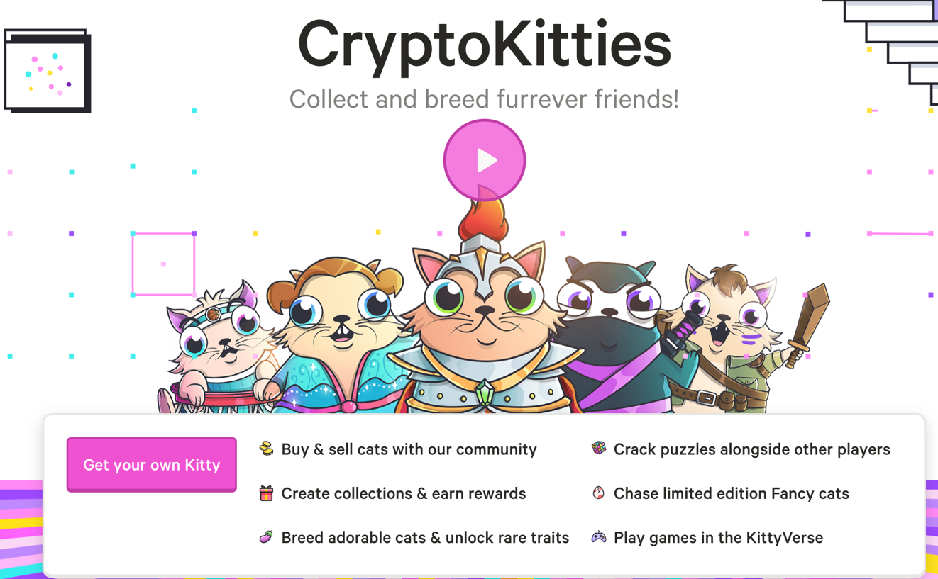
Non-Fungible Tokens (NFT)
CryptoKitties
https://www.cryptokitties.co/
Source: Matt Fortnow and QuHarrison Terry (2021), The NFT Handbook - How to Create, Sell and Buy Non-Fungible Tokens, Wiley

Slide 75
Financial Stability Challenges
Crypto Ecosystem
Operational, cyber, and governance risks
Integrity (market and AML/CFT)
(Anti–Money Laundering / Combating the Financing of Terrorism)
Data availability / reliability
Challenges from cross-boarder activites
Stablecoins
How stable are stablecoins?
Domestic and global regulatory and supervisory
approaches
Macro-Financial
Cryptoization, capital flows, and restrictions
Monetary policy transmission
Bank disintermediation
Source: Parma Bains, Mohamed Diaby, Dimitris Drakopoulos, Julia Faltermeier, Federico Grinberg, Evan Papageorgiou, Dmitri Petrov, Patrick Schneider, and Nobu Sugimoto (2021),
The Crypto Ecosystem and Financial Stability Challenges, International Monetary Fund, October 2021

Slide 76
Financial Services

Slide 77
Technology
Innovation

Slide 78
FinTech Innovation
FinTech high-level classification
Lending
Payments
Robo Advisors
Analytics
Others
Profile
Advice
Re-Balance
Indexing
Source: Paolo Sironi (2016), “FinTech Innovation: From Robo-Advisors to Goal Based Investing and Gamification”, Wiley.

Slide 79
Technology-driven
Financial Industry Development

Slide 80
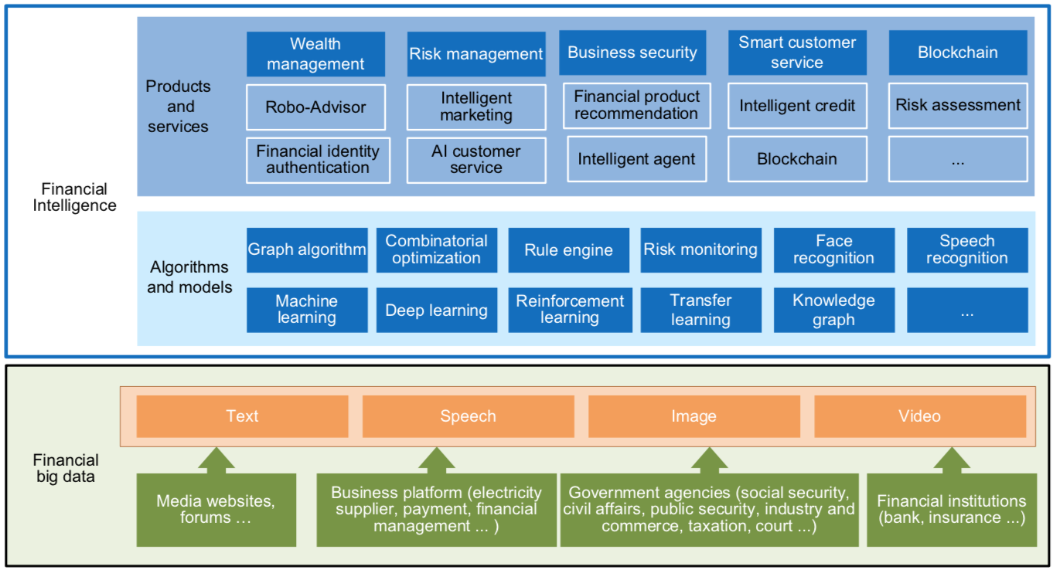
FinBrain: when Finance meets AI 2.0
(Zheng et al., 2019)
Source: Xiao-lin Zheng, Meng-ying Zhu, Qi-bing Li, Chao-chao Chen, and Yan-chao Tan (2019), "Finbrain: When finance meets AI 2.0." Frontiers of Information Technology & Electronic Engineering 20, no. 7, pp. 914-924

Slide 81
AI 2.0
a new generation of AI
based on the
novel information environment of
major changes and
the development of
new goals.
Yunhe Pan (2016), "Heading toward artificial intelligence 2.0." Engineering 2, no. 4, 409-413.

Slide 82
Technology-driven
Financial Industry Development
Development stage | Driving technology | Main landscape | Inclusive finance | Relationship between technology and finance
Fintech 1.0 (financial IT) | Computer | Credit card, ATM, and CRMS | Low | Technology as a tool
Fintech 2.0 (Internet finance) | Mobile Internet | Marketplace lending, third-party payment, crowdfunding, and Internet insurance | Medium | Technology-driven change
Fintech 3.0 (financial intelligence) | AI, Big Data, Cloud Computing, Blockchain | Intelligent finance | High | Deep fusion
Source: Xiao-lin Zheng, Meng-ying Zhu, Qi-bing Li, Chao-chao Chen, and Yan-chao Tan (2019), "Finbrain: When finance meets AI 2.0." Frontiers of Information Technology & Electronic Engineering 20, no. 7, pp. 914-924

Slide 83
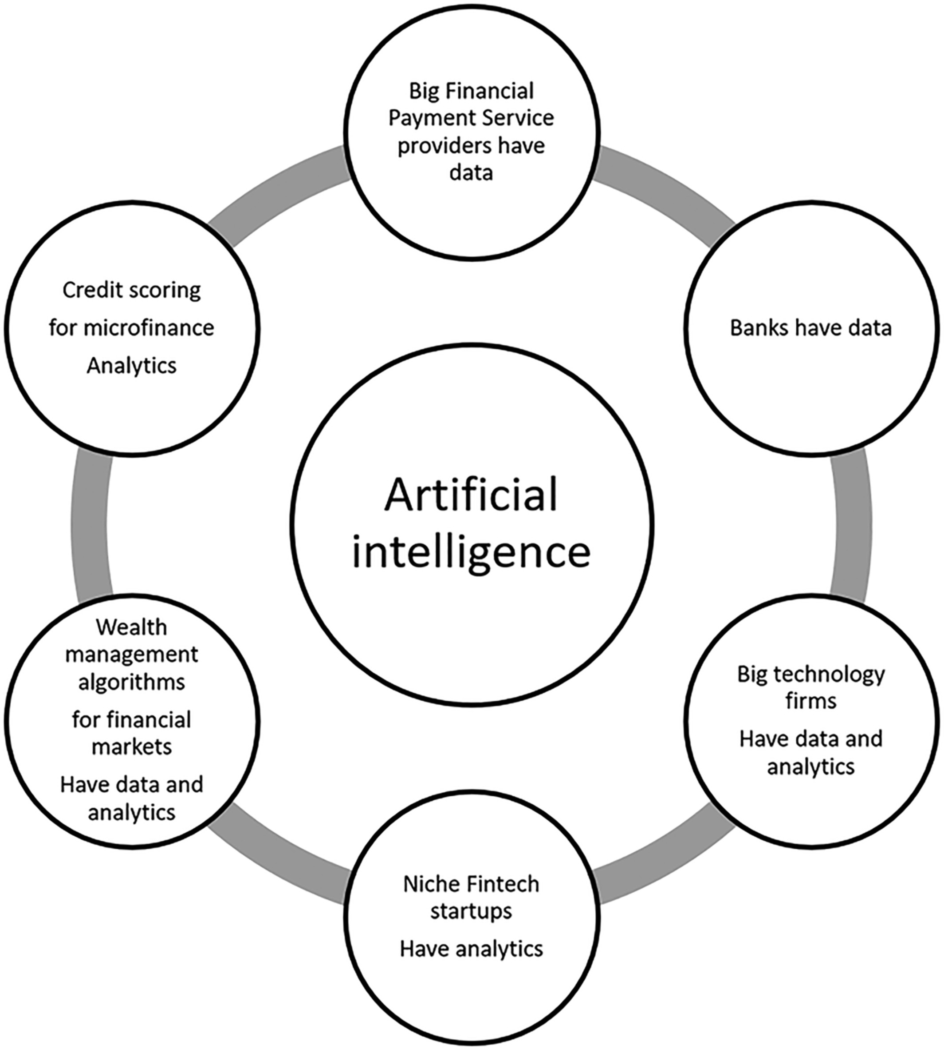
Artificial Intelligence in the Financial Markets
Source: Ashta, Arvind, and Heinz Herrmann (2021). "Artificial intelligence and fintech: An overview of opportunities and risks for banking, investments, and microfinance." Strategic Change 30, no. 3 (2021): 211-222.

Slide 84
Green Finance and
Sustainable Finance

Slide 85
Evolution of Sustainable Finance Research
Topic
SDGs:
Sustainable Development Goals
SDGs
Innovative Financial Instrument
Impact Investing
ESG: Environmental, Social, and Governance
CSR: Corporate Social Responsibility
Conscious Capitalism
Climate Financing
Carbon Financing
Green Financing
Ethical Investing
Socially Responsible Investing
1986
1995
2005
2015
2020
Source: Kumar, S., Sharma, D., Rao, S., Lim, W. M., & Mangla, S. K. (2022). Past, present, and future of sustainable finance:
Insights from big data analytics through machine learning of scholarly research. Annals of Operations Research, 1-44.

Slide 86
AI for
Environmental,
Social, and
Governance
(AI4ESG)
Source: Nenad Tomašev, Julien Cornebise, Frank Hutter, Shakir Mohamed, Angela Picciariello, Bec Connelly, Danielle Belgrave et al. (2020)
"AI for social good: unlocking the opportunity for positive impact." Nature Communications 11, no. 1: 1-6.

Slide 87
Sustainability
SDGs
CSR
ESG

Slide 88














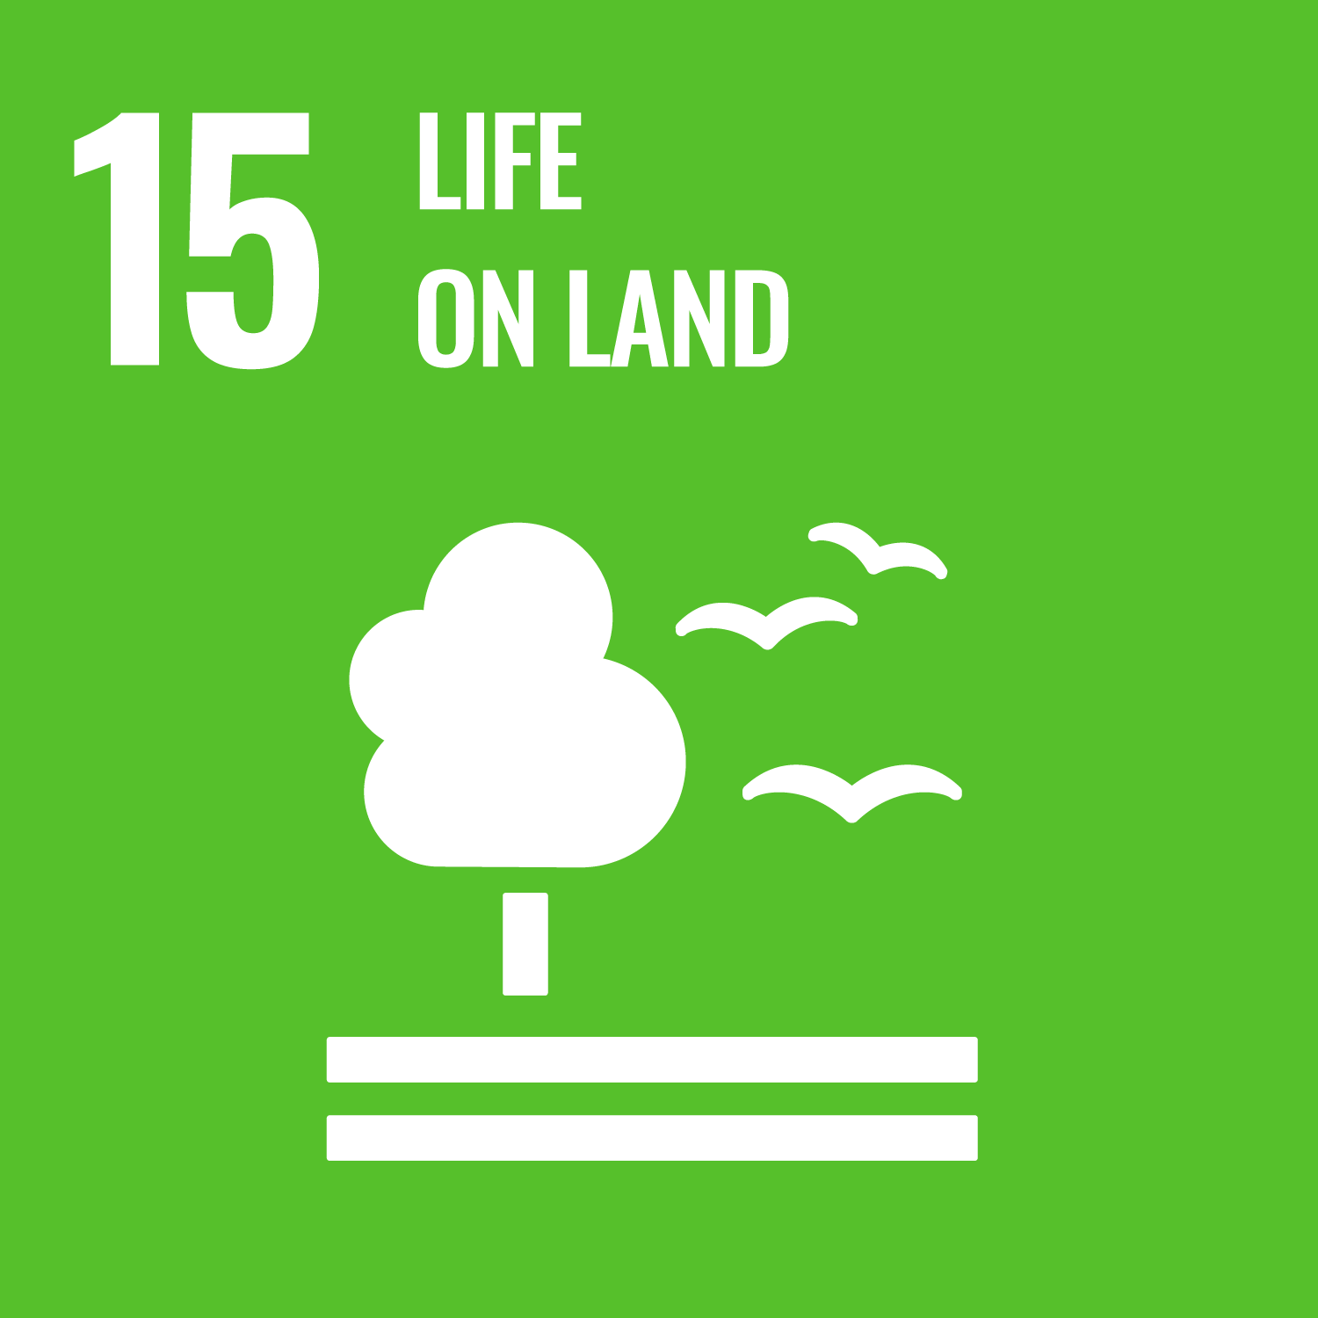



Sustainable Development Goals (SDGs)
Source: https://sdgs.un.org/goals

Slide 89

Sustainable Development Goals (SDGs) and 5P
Partnership
Peace
Prosperity
People
Planet
Source: Folke, Carl, Reinette Biggs, Albert V. Norström, Belinda Reyers, and Johan Rockström. "Social-ecological resilience and biosphere-based sustainability science.”Ecology and Society 21, no. 3 (2016).

Slide 90
Green Finance
Generic term implying use or diversion of financial resources to deploy and support projects with long term positive impact on the environment
Source: Bhattacharyya, Rupsha. "Green finance for energy transition, climate action and sustainable development: overview of concepts, applications, implementation and challenges." Green Finance 4, no. 1 (2022): 1-35.

Slide 91
Sustainable Finance
Finances deployed in support of projects that ensure just, sustainable and inclusive growth or attainment of one or more sustainable development goals
Source: Bhattacharyya, Rupsha. "Green finance for energy transition, climate action and sustainable development: overview of concepts, applications, implementation and challenges." Green Finance 4, no. 1 (2022): 1-35.

Slide 92
Carbon Finance
  Financial instruments
  based on
  economic value of carbon emissions
  which an organization cannot avoid but which
  it offsets by funding other compensatory projects that contribute to carbon emissions reduction
Source: Bhattacharyya, Rupsha. "Green finance for energy transition, climate action and sustainable development: overview of concepts, applications, implementation and challenges." Green Finance 4, no. 1 (2022): 1-35.

Slide 93
Climate Finance
  Finances deployed
  in support of low carbon and
  climate resilient projects
  that help in climate change mitigation and adaptation efforts,
  particularly in the
  energy and infrastructure sectors
Source: Bhattacharyya, Rupsha. "Green finance for energy transition, climate action and sustainable development: overview of concepts, applications, implementation and challenges." Green Finance 4, no. 1 (2022): 1-35.

Slide 94
ESG Investing
  Investments considering the broad range of
  environmental (e.g. climate change,
  pollution biodiversity loss),
  social (e.g. working conditions, human rights, salary or compensation structures)
  and governance (e.g. board composition, diversity and inclusion, taxes)
  characteristics of the projects or companies being invested in; ethical and business sustainability considerations are
  integral part of financing
Source: Bhattacharyya, Rupsha. "Green finance for energy transition, climate action and sustainable development: overview of concepts, applications, implementation and challenges." Green Finance 4, no. 1 (2022): 1-35.

Slide 95
Impact Investing
  Investing in projects
  that solve a social or environmental problem;
  the focus is on the positive impact
  rather than the
  means used to produce that impact
Source: Bhattacharyya, Rupsha. "Green finance for energy transition, climate action and sustainable development: overview of concepts, applications, implementation and challenges." Green Finance 4, no. 1 (2022): 1-35.

Slide 96

Dynamic Trends of Green Finance and Energy Policy
Source: Wang, Moran, Xuerong Li, and Shouyang Wang. (2021) "Discovering research trends and opportunities of green finance and energy policy: A data-driven scientometric analysis." Energy Policy 154 (2021): 112295.

Slide 97

AI and Sustainability Development Goals (SDGs)
Source: Schoormann, T., Strobel, G., Möller, F., Petrik, D., & Zschech, P. (2023).
Artificial Intelligence for Sustainability—A Systematic Review of Information Systems Literature. Communications of the Association for Information Systems, 52(1), 8.

Slide 98

AI for Sustainability
Source: Schoormann, T., Strobel, G., Möller, F., Petrik, D., & Zschech, P. (2023).
Artificial Intelligence for Sustainability—A Systematic Review of Information Systems Literature. Communications of the Association for Information Systems, 52(1), 8.

Slide 99
Financial Technology (Fintech) Categories
Banking Infrastructure
Business Lending
Consumer and Commercial Banking
Consumer Lending
Consumer Payments
Crowdfunding
Equity Financing
Financial Research and Data
Financial Transaction Security
Institutional Investing
International Money Transfer
Payments Backend and Infrastructure
Personal Finance
Point of Sale Payments
Retail Investing
Small and Medium Business Tools
Source: http://www.venturescanner.com/financial-technology

Slide 100
Summary
Web 3.0
Big Data Analysis
Fintech
Green and Sustainable Finance

Slide 101
References
Thorsten Schoormann, Gero Strobel, Frederik Möller, Dimitri Petrik, and Patrick Zschech (2023). "Artificial Intelligence for Sustainability—A Systematic Review of Information Systems Literature." Communications of the Association for Information Systems 52, no. 1 (2023): 8.
Morshadul Hasan, Ariful Hoque, Mohammad Zoynul Abedin, and Dominic Gasbarro (2024). "FinTech and sustainable development: A systematic thematic analysis using human-and machine-generated processing." International Review of Financial Analysis 95 (2024): 103473.
Esmot Ara Tuli, Jae-Min Lee, and Dong-Seong Kim (2024). "Integration of Quantum Technologies into Metaverse: Applications, Potentials, and Challenges." IEEE Access 12 (2024): 29995-30019.
Longbing Cao (2022). "Decentralized ai: Edge intelligence and smart blockchain, metaverse, web3, and desci." IEEE Intelligent Systems 37, no. 3: 6-19.
Qinglin Yang, Yetong Zhao, Huawei Huang, Zehui Xiong, Jiawen Kang, and Zibin Zheng (2022). "Fusing blockchain and AI with metaverse: A survey." IEEE Open Journal of the Computer Society 3 : 122-136.
Russell Belk, Mariam Humayun, and Myriam Brouard (2022). "Money, possessions, and ownership in the Metaverse: NFTs, cryptocurrencies, Web3 and Wild Markets." Journal of Business Research 153: 198-205.
Thien Huynh-The, Quoc-Viet Pham, Xuan-Qui Pham, Thanh Thi Nguyen, Zhu Han, and Dong-Seong Kim (2022). "Artificial Intelligence for the Metaverse: A Survey." arXiv preprint arXiv:2202.10336.
Min-Yuh Day and Yensen Ni (2023), "Do clean energy indices outperform using contrarian strategies based on contrarian trading rules?", Energy, Volume 272, 1 June 2023, 127113.
Thippa Reddy Gadekallu, Thien Huynh-The, Weizheng Wang, Gokul Yenduri, Pasika Ranaweera, Quoc-Viet Pham, Daniel Benevides da Costa, and Madhusanka Liyanage (2022). "Blockchain for the Metaverse: A Review." arXiv preprint arXiv:2203.09738.
Dan Sheridan, James Harris, Frank Wear, Jerry Cowell Jr, Easton Wong, and Abbas Yazdinejad (2022). "Web3 Challenges and Opportunities for the Market." arXiv preprint arXiv:2209.02446.
Simon Thompson (2023), Green and Sustainable Finance: Principles and Practice in Banking, Investment and Insurance, 2nd Edition, Kogan Page.
Chrissa Pagitsas (2023), Chief Sustainability Officers At Work: How CSOs Build Successful Sustainability and ESG Strategies, Apress.
Aurélien Géron (2023), Hands-On Machine Learning with Scikit-Learn, Keras, and TensorFlow: Concepts, Tools, and Techniques to Build Intelligent Systems, 3rd Edition, O’Reilly Media.
Denis Rothman (2024), Transformers for Natural Language Processing and Computer Vision - Third Edition: Explore Generative AI and Large Language Models with Hugging Face, ChatGPT, GPT-4V, and DALL-E 3, 3rd ed. Edition, Packt Publishing.
Thomas R. Caldwell (2025), The Agentic AI Bible: The Complete and Up-to-Date Guide to Design, Build, and Scale Goal-Driven, LLM-Powered Agents that Think, Execute and Evolve, Independently published.
Paolo Sironi (2016), FinTech Innovation: From Robo-Advisors to Goal Based Investing and Gamification, Wiley.
Campbell R. Harvey, Ashwin Ramachandran, Joey Santoro, Fred Ehrsam (2021), DeFi and the Future of Finance, Wiley
Matt Fortnow and QuHarrison Terry (2021), The NFT Handbook - How to Create, Sell and Buy Non-Fungible Tokens, Wiley
Parma Bains, Mohamed Diaby, Dimitris Drakopoulos, Julia Faltermeier, Federico Grinberg, Evan Papageorgiou, Dmitri Petrov, Patrick Schneider, and Nobu Sugimoto (2021),
The Crypto Ecosystem and Financial Stability Challenges, International Monetary Fund, October 2021
Ramesh Sharda, Dursun Delen, and Efraim Turban (2017), “Business Intelligence, Analytics, and Data Science: A Managerial Perspective”, 4th Edition, Pearson
Frederic S. Mishkin (2015), “The Economics of Money, Banking and Financial Markets”, 11th Edition, Pearson
Susanne Chishti and Janos Barberis (2016), “The FINTECH Book: The Financial Technology Handbook for Investors, Entrepreneurs and Visionaries”, Wiley.
Paolo Sironi (2016), “FinTech Innovation: From Robo-Advisors to Goal Based Investing and Gamification”, Wiley.
Brett King (2014), “Breaking Banks: The Innovators, Rogues, and Strategists Rebooting Banking”, Wiley.
Brett King (2012), “Bank 3.0: Why banking is no longer somewhere you go, but something you do”, John Wiley & Sons
Gopalakrishnan, Shanti, and Fariborz Damanpour (1997). "A review of innovation research in economics, sociology and technology management." Omega 25, no. 1 : 15-28.
Pichlak, Magdalena (2016). "The innovation adoption process: A multidimensional approach." Journal of Management and Organization 22, no. 4 : 476.
Everett M. Rogers (2003), “Diffusion of Innovations”, Free Press, 5th Edition

