Slide 1









ESG Data Gathering, Analysis, and Visualization
Sustainability and ESG Data Analytics
1141ESGDA05
MBA, IM, NTPU (M5265) (Fall 2025)
Wed 2, 3, 4 (9:10-12:00) (B3F17)
University Ambassador
Certified Instructor
Min-Yuh Day, Ph.D,
Professor and Director
Institute of Information Management, National Taipei University
https://web.ntpu.edu.tw/~myday
https://meet.google.com/miy-fbif-max
2025-10-15

Slide 2
Syllabus
Week Date Subject/Topics
1 2025/09/10 Introduction Sustainability and ESG Data Analytics
2 2025/09/17 Environmental, Social, and Governance (ESG) in
Net-Zero Digital Transformation
3 2025/09/24 Data Science for Sustainability and ESG
4 2025/10/01 Case Study on Sustainability and ESG Data Analytics I
5 2025/10/08 Web 3.0 and Big Data Analysis in Fintech, Green and
Sustainable Finance
6 2025/10/15 ESG Data Gathering, Analysis, and Visualization

Slide 3
Syllabus
Week Date Subject/Topics
7 2025/10/22 NVIDIA Building RAG Agents with LLMs Part I:
LLM Services and AI Foundation Models
8 2025/10/29 Self-Learning
9 2025/11/05 Midterm Project Report
10 2025/11/12 NVIDIA Building RAG Agents with LLMs Part II:
Document Loading, Chunking, and Embeddings
11 2025/11/19 NVIDIA Building RAG Agents with LLMs Part III:
Retrieval-Augmented Generation with
Vector Stores and RAG Evaluation

Slide 4
Syllabus
Week Date Subject/Topics
12 2025/11/26 Case Study on Sustainability and ESG Data Analytics II
13 2025/12/03 Artificial Intelligence of things (AIoT) in ESG and
Sustainability Applications
14 2025/12/10 Generative AI for ESG Rating and Reporting Generation
15 2025/12/17 Final Project Report I
16 2025/12/24 Final Project Report II

Slide 5
ESG Data Gathering,
Analysis, and Visualization

Slide 6
Outline
ESG Data Gathering
ESG Data Analysis
ESG Data Visualization

Slide 7
ESG Data Challenge: Bridging the Gap
Traditional: Manual & Siloed
AI: Automated & Centralized
Spreadsheets
API & System Integrations
Emails & PDFs
Centralized Data Platform
Departmental Silos
AI-Powered Analytics
Inconsistent, Slow Reporting
Auditable, Real-Time Insights

Slide 8
ESG Data Gathering
Fundamentals of ESG Data
  Defining ESG
  Types of ESG Data
  Key ESG Data Sources
    ESG rating providers (MSCI, Sustainalytics, Bloomberg)
    Corporate sustainability reports
    Government databases
    Non-profit and research organizations

Slide 9
ESG Data Gathering
Real-World Example
  Analyzing carbon emissions data of a multinational company over time (data source: company reports, CDP)
Python Integration
  Python Pandas
    Loading and manipulating tabular ESG data
  Data Cleaning and Preprocessing
    Handling missing values, outliers, and data normalization

Slide 10
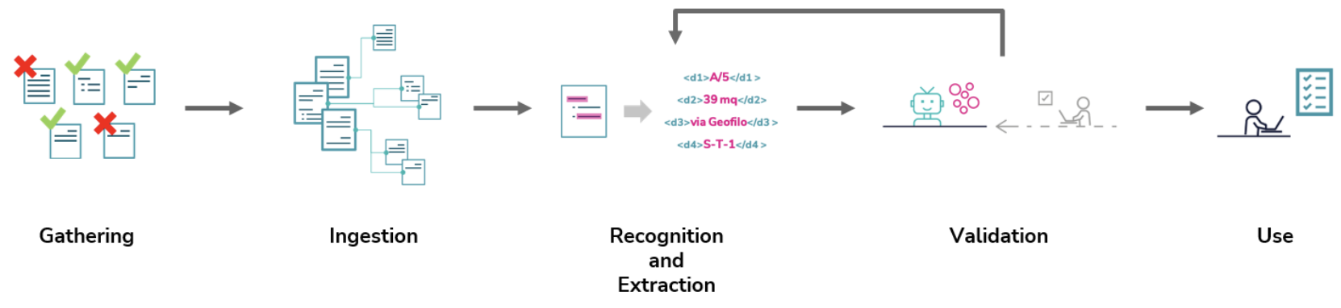
ESG Data Collection Process
Source: Visalli, Francesco, Antonio Patrizio, Antonio Lanza, Prospero Papaleo, Anupam Nautiyal, Mariella Pupo, Umberto Scilinguo, Ermelinda Oro, and Massimo Ruffolo. "ESG Data Collection with Adaptive AI." In ICEIS (1), pp. 468-475. 2023.

Slide 11
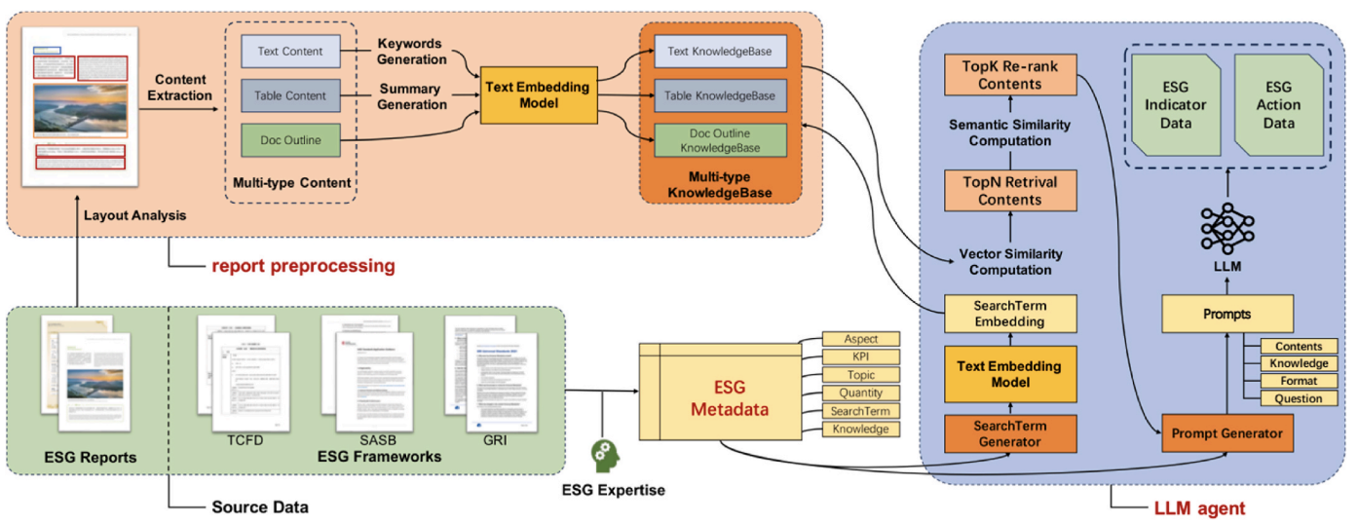
ESGReveal:
An LLM-based approach for extracting structured data from ESG reports
The three-module design (ESG Metadata module, Report Preprocessing module, and LLM Agent module)
Source: Yi Zou, Mengying Shi, Zhongjie Chen, Zhu Deng, ZongXiong Lei, Zihan Zeng, Shiming Yang, Hongxiang Tong, Lei Xiao, and Wenwen Zhou. (2025)
"ESGReveal: An LLM-based approach for extracting structured data from ESG reports." Journal of Cleaner Production 489 (2025): 144572.

Slide 12
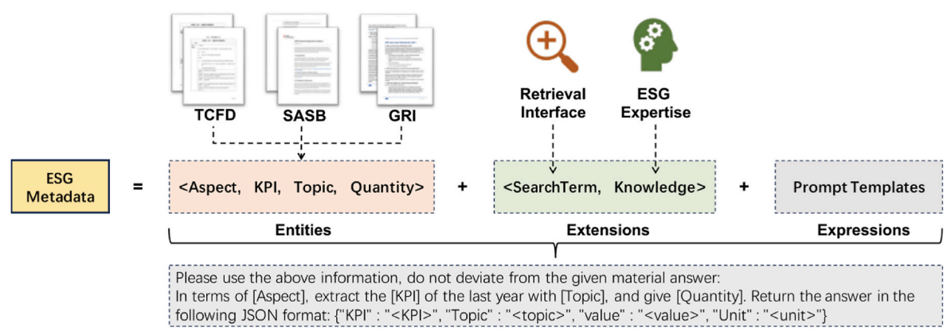
ESGReveal ESG Metadata Module:
Entities, Extensions, and Expressions
Source: Yi Zou, Mengying Shi, Zhongjie Chen, Zhu Deng, ZongXiong Lei, Zihan Zeng, Shiming Yang, Hongxiang Tong, Lei Xiao, and Wenwen Zhou. (2025)
"ESGReveal: An LLM-based approach for extracting structured data from ESG reports." Journal of Cleaner Production 489 (2025): 144572.

Slide 13
ESGReveal ESG Metadata:
An example of the main contents of one KPI
Aspect | KPI | Topic | Quantity | Search Term | Knowledge
A1. Emissions | Total waste produced (in tonnes) and, where appropriate, intensity (e.g., per unit of production volume, per facility) | [Non-hazardous Waste, Hazardous Waste] | [Absolute Values] | Construction waste, building rubbish, soil, rubble, organic waste, recyclable fertilizer, paper, plastic bottles, wood, household garbage | Hazardous waste typically includes the following categories: toxic chemical waste, electronic waste, hazardous gas waste, dangerous waste.
Source: Yi Zou, Mengying Shi, Zhongjie Chen, Zhu Deng, ZongXiong Lei, Zihan Zeng, Shiming Yang, Hongxiang Tong, Lei Xiao, and Wenwen Zhou. (2025)
"ESGReveal: An LLM-based approach for extracting structured data from ESG reports." Journal of Cleaner Production 489 (2025): 144572.

Slide 14
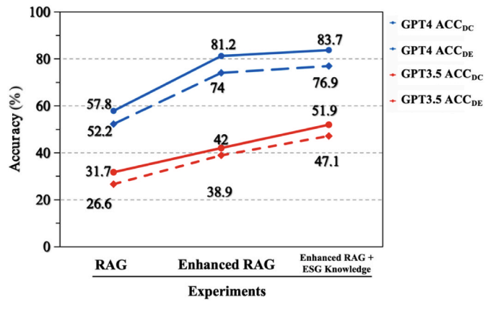
Ablation study on ESGReveal performance of data extraction accuracy (AccDE) and disclosure coverage accuracy (AccDC) by integrating different modules
Source: Yi Zou, Mengying Shi, Zhongjie Chen, Zhu Deng, ZongXiong Lei, Zihan Zeng, Shiming Yang, Hongxiang Tong, Lei Xiao, and Wenwen Zhou. (2025)
"ESGReveal: An LLM-based approach for extracting structured data from ESG reports." Journal of Cleaner Production 489 (2025): 144572.

Slide 15
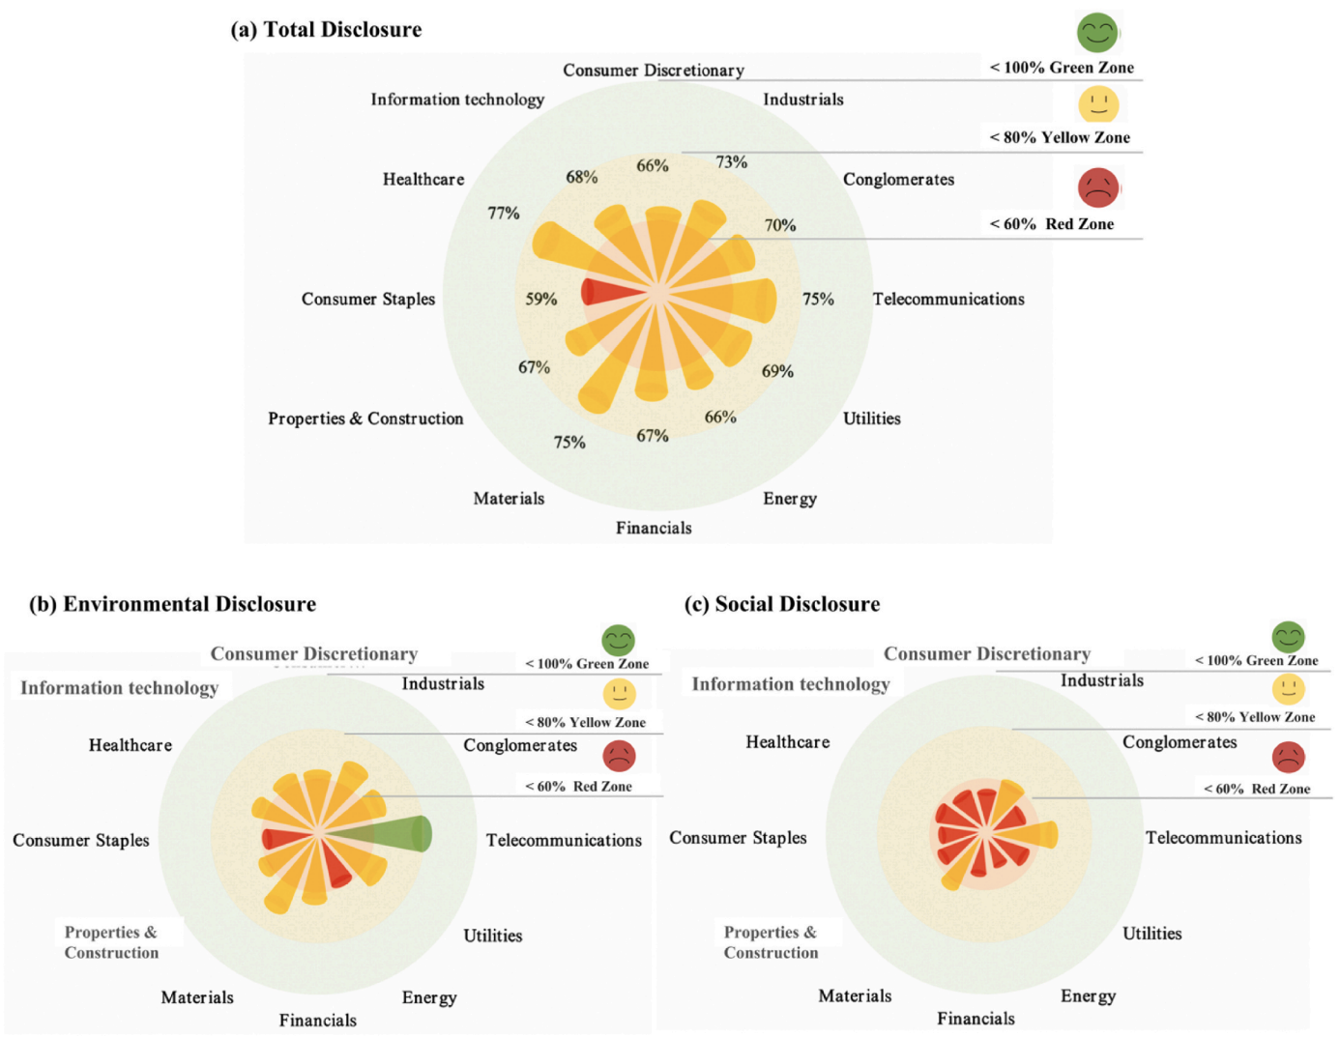
ESGReveal Disclosure levels by sector:
(a) overall,
(b) environmental issues
(c) social issues.
Source: Yi Zou, Mengying Shi, Zhongjie Chen, Zhu Deng, ZongXiong Lei, Zihan Zeng, Shiming Yang, Hongxiang Tong, Lei Xiao, and Wenwen Zhou. (2025)
"ESGReveal: An LLM-based approach for extracting structured data from ESG reports." Journal of Cleaner Production 489 (2025): 144572.

Slide 16
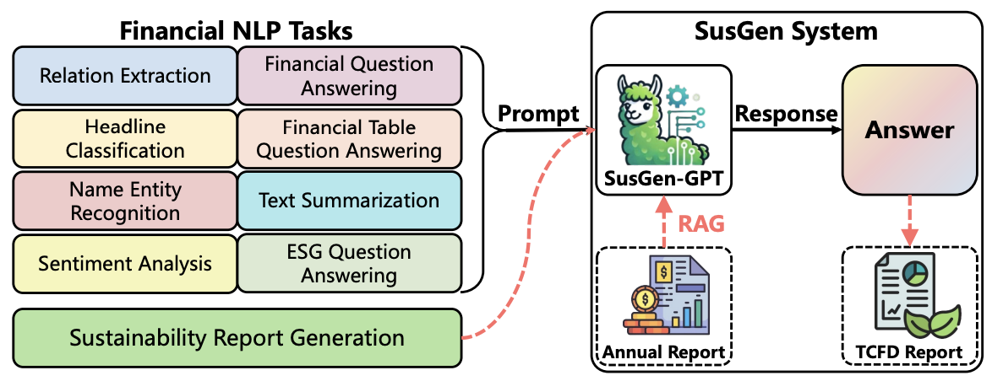
SusGen-GPT:
A Data-Centric LLM for Financial NLP and Sustainability Report Generation
Source: Qilong Wu, Xiaoneng Xiang, Hejia Huang, Xuan Wang, Yeo Wei Jie, Ranjan Satapathy, and Bharadwaj Veeravalli. (2024)
"SusGen-GPT: a data-centric LLM for financial NLP and sustainability report generation." arXiv preprint arXiv:2412.10906 (2024).

Slide 17

Analyst-driven vs. AI-driven ESG
Sustainalytics
Truvalue Labs
Source: Mark Tulay (2020), Man vs. machine: A tale of two sustainability ratings systems, GreenBiz, https://www.greenbiz.com/article/man-vs-machine-tale-two-sustainability-ratings-systems

Slide 18

Analyst based
ESG Research
AI based
ESG Research
Source: https://www.esganalytics.io/insights/how-data-is-accelerating-esg

Slide 19
ESG Data Analysis
ESG Metrics and Frameworks
  Popular frameworks (GRI, SASB, TCFD)
  Calculating key ESG ratios
    (e.g., debt-to-equity,
    employee turnover rate,
    energy efficiency metrics)
Statistical Analysis of ESG Data
Time Series Analysis

Slide 20
ESG Data Analysis
Real-World Example
  Examining the correlation between gender diversity on corporate boards and profitability
    (data source: Bloomberg, MSCI)
Python Integration
  Statistical Libraries
    Using SciPy and NumPy for calculations
  Time Series Analysis
    Utilizing Pandas for date/time manipulation and analysis

Slide 21

Python Ecosystem for Data Science
Source: https://medium.com/pyfinance/why-python-is-best-choice-for-financial-data-modeling-in-2019-c0d0d1858c45

Slide 22

ESG Analytics: NLP Taxonomy
Source: https://www.esganalytics.io/insights/how-data-is-accelerating-esg

Slide 23
ESG Data Visualization
Principles of Effective Data Visualization
ESG Dashboards
Interactive Visualizations
Real-World Example: Visualizing a company's ESG performance against industry benchmarks using a dashboard.

Slide 24
ESG Data Visualization
Real-World Example
  Visualizing a company's ESG performance against industry benchmarks using a dashboard.
Python Integration
  Visualization Libraries
    Matplotlib, Seaborn, or Plotly
  Dashboarding Tools
    Streamlit or Dash for creating simple interactive dashboards

Slide 25
Fundamentals of ESG Data
ESG Data Gathering, Analysis, and Visualization: Practical Techniques and Python Applications
What ESG data is
  where to find it
  its importance in the world of sustainability

Slide 26
Environmental, Social, and Governance
(ESG)
It's a framework used to evaluate the sustainability and ethical impact of companies and investments.
Environmental
  company's interaction with the natural world.
Social
  company's relationships with people – its workers, customers, and communities.
Governance
  how a company is led and managed.

Slide 27
Defining ESG
E – Environmental
  carbon emissions, pollution, resource use, biodiversity impact.
S – Social
  Labor practices, human rights, diversity & inclusion, community impact.
G – Governance
  Board structure, executive compensation, ethics, transparency, anti-corruption.

Slide 28
Importance of ESG
Growing investor demand
  Investors are increasingly looking for companies aligned with their values on sustainability.
Risk mitigation
  Strong ESG performance can help companies avoid potential scandals and reputational damage.
Long-term value creation
  ESG factors are linked to better resource management, innovation, and improved financial performance over time.

Slide 29
Types of ESG Data
Qualitative
  Narrative information, such as policies, statements, news articles
Quantitative
  Numerical data, like emissions figures, employee demographics, board compensation
Structured
  Data that fits neatly into tables and databases
Unstructured
  Data like news articles, social media posts, or company reports that need further processing

Slide 30
Key ESG Data Sources
ESG Rating Providers
  Companies specializing in ESG assessments and data
Corporate Sustainability Reports
  Company-issued reports on their ESG activities
Government Databases
  Public data on environmental metrics, labor statistics, etc.
Non-profit & Research Orgs
  Issue-specific data on topics like human rights or climate change

Slide 31

MSCI ESG Rating Framework
Source: https://www.msci.com/documents/1296102/21901542/ESG-Ratings-Methodology-Exec-Summary.pdf

Slide 32

MSCI ESG Key Issue Hierarchy
Source: https://www.msci.com/documents/1296102/21901542/ESG-Ratings-Methodology-Exec-Summary.pdf

Slide 33

MSCI Governance Model Structure
Source: https://www.msci.com/documents/1296102/21901542/ESG-Ratings-Methodology-Exec-Summary.pdf

Slide 34

MSCI Hierarchy of ESG Scores
Source: https://www.msci.com/documents/1296102/21901542/ESG-Ratings-Methodology-Exec-Summary.pdf

Slide 35

DJSI S&P Global ESG Score
Source: DJSI, S&P Global Corporate Sustainability Assessment (CSA), https://www.spglobal.com/esg/solutions/data-intelligence-esg-scores

Slide 36

FTSE Russell ESG Ratings
Source: https://www.ftserussell.com/data/sustainability-and-esg-data/esg-ratings

Slide 37
ESG Data Analysis
ESG Metrics and Frameworks
Key ESG Ratios
Statistical Analysis of ESG Data
Time Series Analysis

Slide 38
ESG Metrics and Frameworks
Metrics:
  Specific ESG measures
  (e.g., carbon intensity, employee satisfaction, percentage of independent directors).
Frameworks:
  Standards for reporting and interpreting ESG data
  (GRI, SASB, TCFD).

Slide 39
Key ESG Ratios
Financial Ratios with an ESG Twist
Debt-to-equity
  Indicates financial risk, but also potential social or environmental liabilities.
Employee turnover rate
  Measure of employee satisfaction and human capital management.
Energy efficiency metrics
  Energy use per unit of output (shows resource optimization)

Slide 40
Statistical Analysis of ESG Data
Numbers Tell a Story
Descriptive statistics
  Summarize data (mean, median, standard deviation)
Correlation
  Measures the association between two ESG variables
Regression
  Models the relationship between ESG factors and financial performance

Slide 41
Time Series Analysis
The Power of Tracking Over Time
Detecting trends
  Are a company's emissions decreasing?
  Is board diversity improving?
Identifying patterns
  Understanding seasonal or cyclical fluctuations in ESG data.

Slide 42
Real-World Example
Gender Diversity and Profitability: A Correlation?
Data Source:
  Bloomberg, MSCI
Metrics:
  Percentage of women on boards,
  Return on Equity (or similar profitability metric)

Slide 43
Python: Your ESG Analysis Toolbox
SciPy & NumPy
  Powerful libraries for calculations and statistical analysis
Pandas
  Ideal for working with time series data and tabular ESG data

Slide 44


Python Ecosystem for Data Science
Source:https://duchesnay.github.io/pystatsml/introduction/python_ecosystem.html

Slide 45
ESG Data Visualization
Principles of Effective Data Visualization
Chart Types for ESG
Storytelling with Data
ESG Dashboards

Slide 46
Data Analytics and
Visualization with Python

Slide 47
Data Analytics and Visualization with Python
NumPy
  Numerical Python N-dimensional array
Pandas
  Data Analytics
Matplotlib
  Basic Data Visualization
Seaborn
  Advanced Visualization

Slide 48





Python Data Analysis and Visualization

Slide 49
Principles of Effective Data Visualization
Visualizing ESG: Clarity and Impact
Clarity
  Choose chart types that clearly communicate the message
Simplicity
  Avoid visual clutter, highlight key takeaways
Aesthetics
  Use color and design purposefully

Slide 50
Chart Types for ESG
Bar Charts
  Comparing values across categories
  (emissions of different companies)
Line Charts
  Showing change over time
  (a company's energy use over years)
Scatter Plots
  Examining correlations
  (diversity vs. employee satisfaction)
Pie Charts
  Part-to-whole relationships
  (breakdown of waste types)

Slide 51
Storytelling with Data
More Than Just Numbers
Narrative
  Frame your visualizations with context and key takeaways
Annotations
  Use text labels and callouts directly on charts to highlight insights
Visual Hierarchy
  Guide the viewer's eye to the most important information

Slide 52
ESG Dashboards
Your ESG Mission Control
Key Metrics
  Track the most important indicators in one place
Comparisons
  Visualize performance against targets and benchmarks
Interactivity
  Allow users to filter data by time, company, or metric

Slide 53
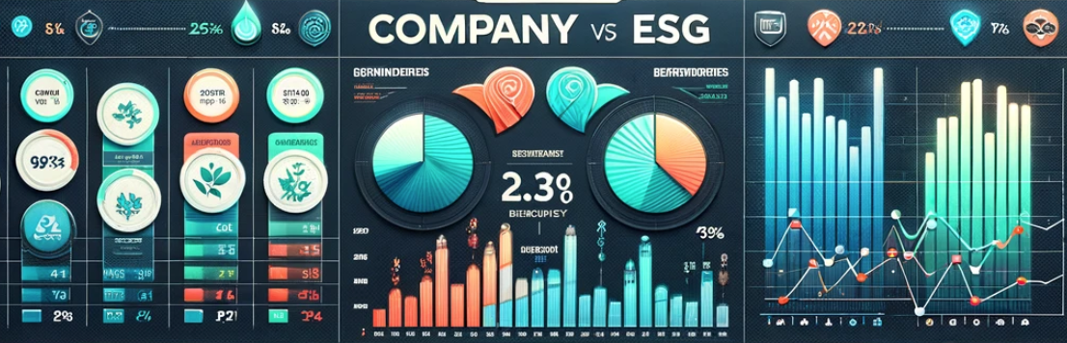
ESG Data Visualization
Company vs. Industry
An ESG Dashboard

Slide 54
Python: Your Visualization Powerhouse
Matplotlib & Seaborn
  Foundational libraries for static plots
Plotly
  For highly interactive visualizations
Streamlit or Dash
  Tools for creating dashboard web applications

Slide 55
ESG Data Analysis and Visualization
# ESG Data Analysis and Visualization
import numpy as np
import pandas as pd
import matplotlib.pyplot as plt
from datetime import datetime
import random
# Generate synthetic data
np.random.seed(0)
data = {
  'company': ['Company A', 'Company B', 'Company C', 'Company D', 'Company E'],
  'emissions': np.random.randint(10000, 50000, 5),
  'diversity': np.random.uniform(0.2, 0.9, 5),
  'employee_satisfaction': np.random.uniform(60, 90, 5),
  'waste_type': ['Plastic', 'Organic', 'Electronic', 'Metal', 'Other'],
  'waste_amount': np.random.randint(100, 500, 5)
}
df = pd.DataFrame(data)

Slide 56
ESG Data Analysis and Visualization
# Separate DataFrame for time series and correlation
time_series_data = pd.DataFrame({
  'year': np.repeat(np.arange(2018, 2023), 5),
  'company': np.tile(['Company A', 'Company B', 'Company C', 'Company D', 'Company E'], 5),
  'energy_use': np.random.randint(1000, 5000, 25)
})
# Simulating correlation data with a slight positive trend
diversity = np.linspace(0.2, 0.9, 100)
np.random.shuffle(diversity)
employee_satisfaction = 60 + (diversity - 0.2) * 150
employee_satisfaction += np.random.normal(0, 5, 100)
correlation_data = pd.DataFrame({
  'diversity': diversity,
  'employee_satisfaction': employee_satisfaction
})

Slide 57
ESG Data Analysis and Visualization
# Save DataFrame to CSV
df.to_csv('ESG_Dataset.csv', index=False)
# Calculate statistics for each company
statistics = df.describe()
statistics = statistics.applymap(lambda x: format(x, '.4f'))
print(statistics)
statistics.to_csv('Company_ESG_Statistics.csv')
emissions diversity employee_satisfaction waste_amount
count 5.0000 5.0000 5.0000 5.0000
mean 31447.6000 0.4085 77.1504 345.6000
std 11667.5748 0.1099 7.0841 94.8093
min 12732.0000 0.2397 70.1219 215.0000
25% 30757.0000 0.3909 71.7835 297.0000
50% 31243.0000 0.4083 74.3993 343.0000
75% 40403.0000 0.4691 84.3651 435.0000
max 42103.0000 0.5344 85.0824 438.0000

Slide 58
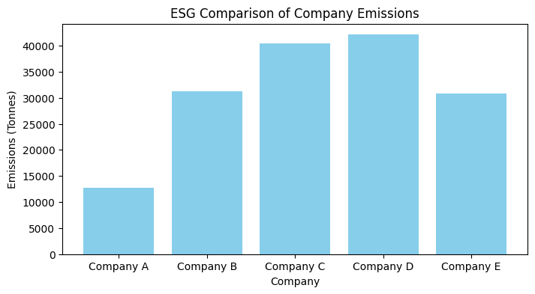
ESG Data Analysis and Visualization
# Create visualizations and save them at 300 dpi
# Bar Chart for Emissions
plt.figure(figsize=(8, 4))
plt.bar(df['company'], df['emissions'], color='skyblue')
plt.xlabel('Company')
plt.ylabel('Emissions (Tonnes)')
plt.title('ESG Comparison of Company Emissions')
plt.show()
plt.savefig('ESG Company_Emissions.jpg', format='jpg', dpi=300)

Slide 59
ESG Data Analysis and Visualization
# Line Chart for Energy Use
plt.figure(figsize=(8, 4))
for company in time_series_data['company'].unique():
  company_data = time_series_data[time_series_data['company'] == company]
  company_data = company_data.sort_values(by='year')
  plt.plot(company_data['year'], company_data['energy_use'], marker='o', linestyle='-', label=company)
plt.xlabel('Year')
plt.ylabel('Energy Use (kWh)')
plt.title("ESG Companies' Energy Use Over Time")
plt.xticks(company_data['year'].unique()) # Ensuring only whole years are marked
plt.legend()
plt.grid(True)
plt.show()

Slide 60
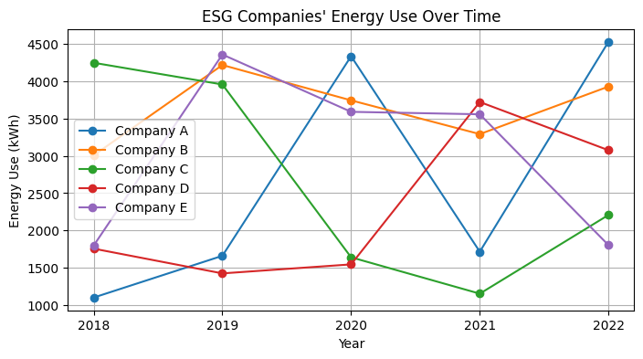
ESG Data Analysis and Visualization

Slide 61
ESG Data Analysis and Visualization
# Scatter Plot for Diversity vs. Satisfaction
plt.figure(figsize=(8, 4))
plt.scatter(correlation_data['diversity'], correlation_data['employee_satisfaction'], alpha=0.7)
plt.xlabel('Board Diversity (Ratio)')
plt.ylabel('Employee Satisfaction (%)')
plt.title('ESG Correlation Between Board Diversity and Employee Satisfaction')
plt.grid(True)
plt.show()
plt.savefig('ESG_Diversity_vs_Satisfaction.jpg', format='jpg', dpi=300)

Slide 62
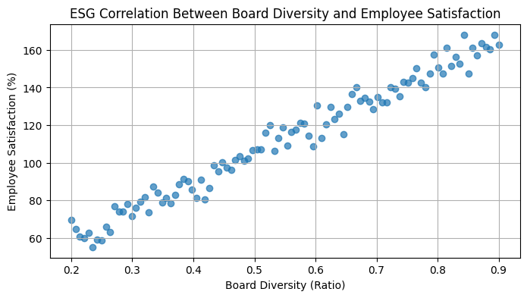
ESG Data Analysis and Visualization

Slide 63
ESG Data Analysis and Visualization
# Pie Chart for Waste Types
plt.figure(figsize=(8, 4))
plt.pie(df['waste_amount'], labels=df['waste_type'], autopct='%1.1f%%', startangle=140)
plt.title('ESG Waste Types')
plt.axis('equal') # Equal aspect ratio ensures that pie is drawn as a circle.
plt.show()
plt.savefig('ESG_Waste_Type_Breakdown.jpg', format='jpg', dpi=300)

Slide 64
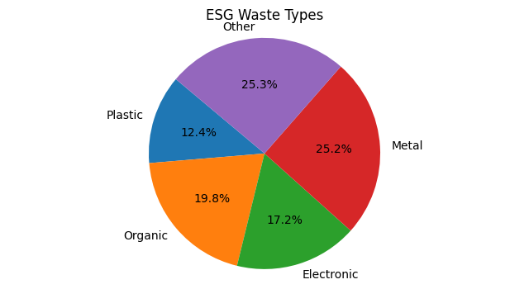
ESG Data Analysis and Visualization

Slide 65
Python Pandas
http://pandas.pydata.org/

Slide 66
Python matplotlib
Source: https://matplotlib.org/

Slide 67
Python seaborn
Source: https://seaborn.pydata.org/

Slide 68
Python plotly
Source: https://plotly.com/python/

Slide 69
Python bokeh
Source: https://bokeh.org/

Slide 70
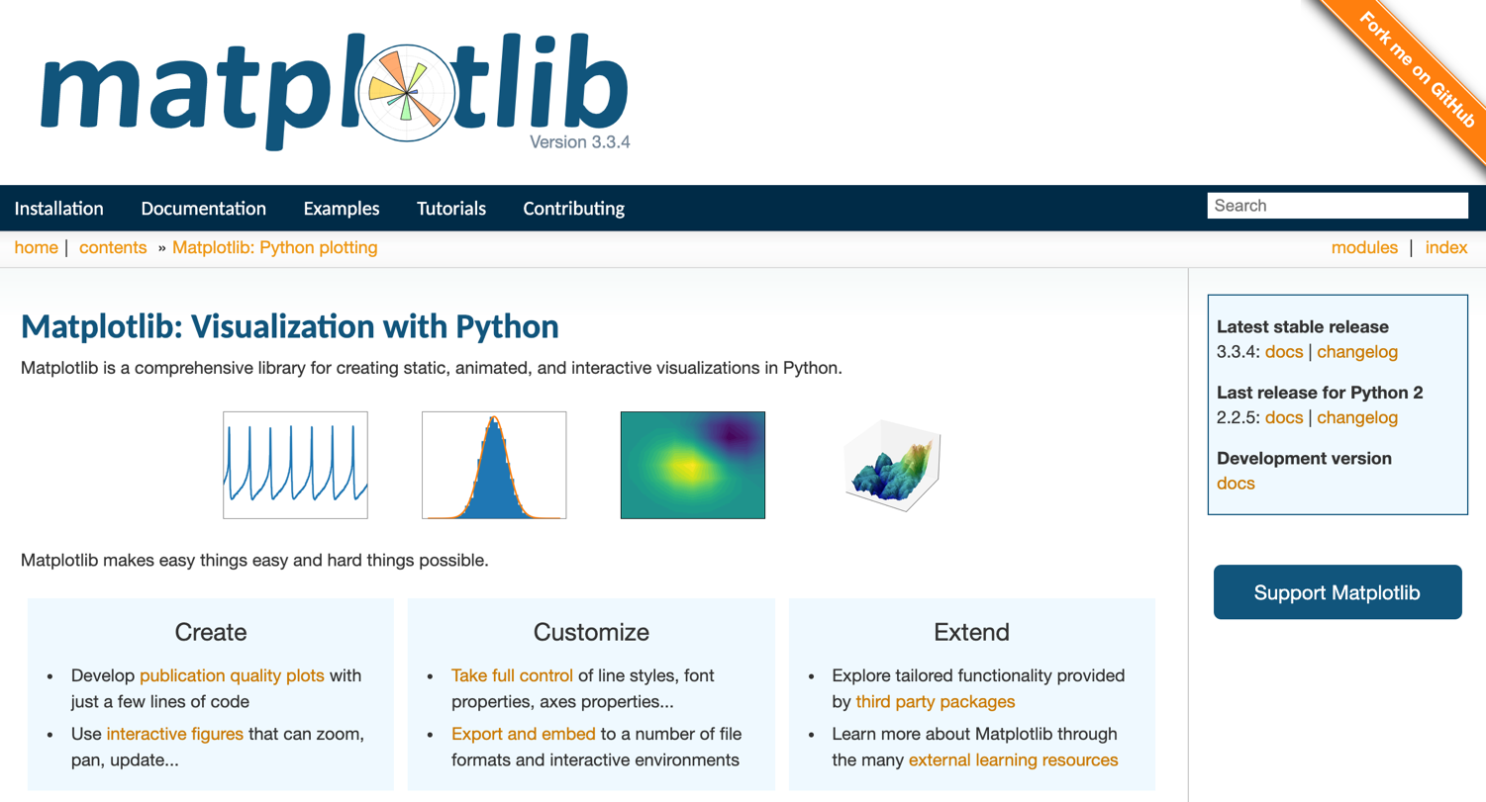
Python matplotlib
https://matplotlib.org/

Slide 71

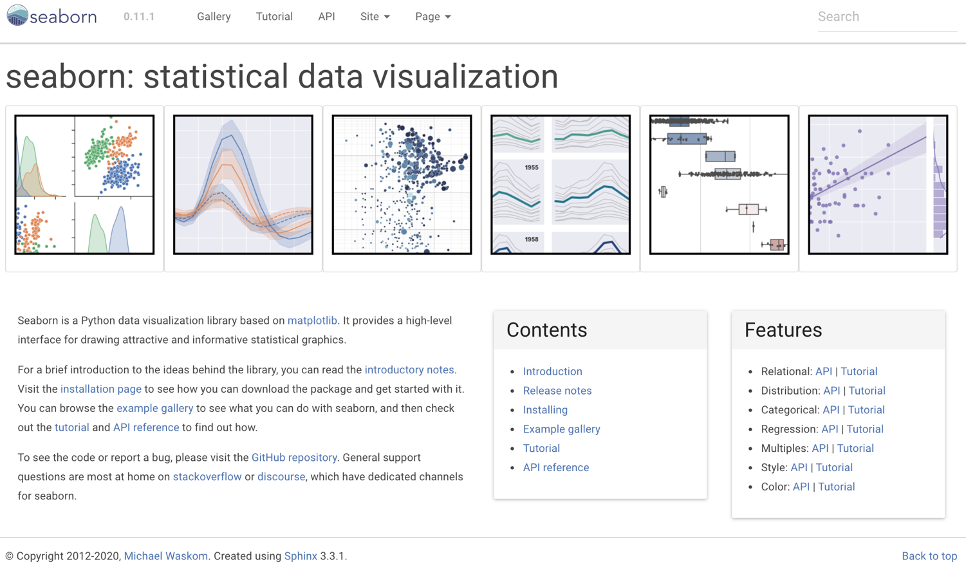
Python Seaborn
https://seaborn.pydata.org/

Slide 72

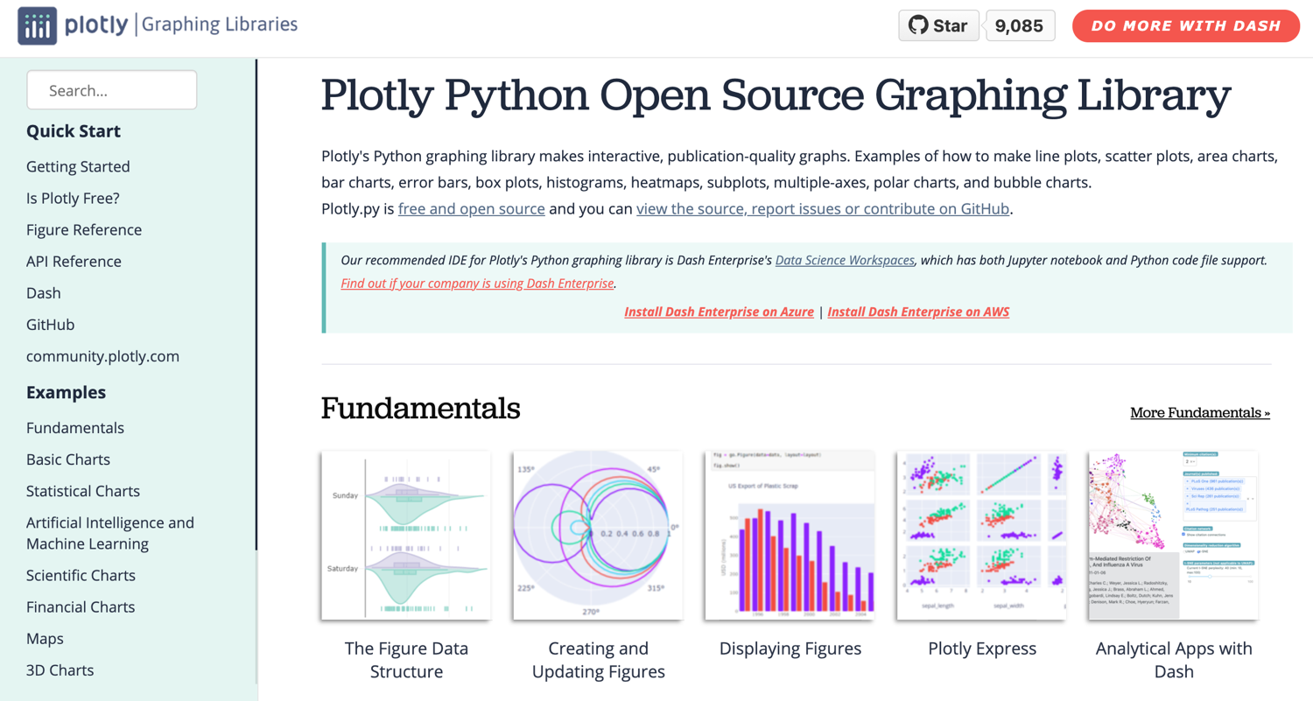
Python Plotly Graphing Library
https://plotly.com/python/

Slide 73
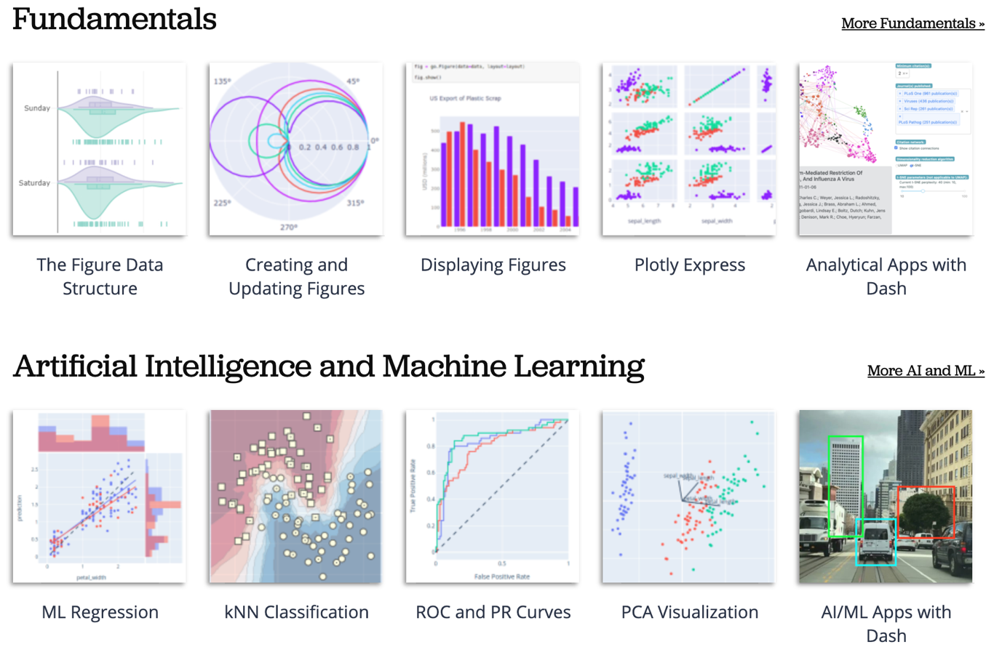
Python Plotly Graphing Library
https://plotly.com/python/

Slide 74
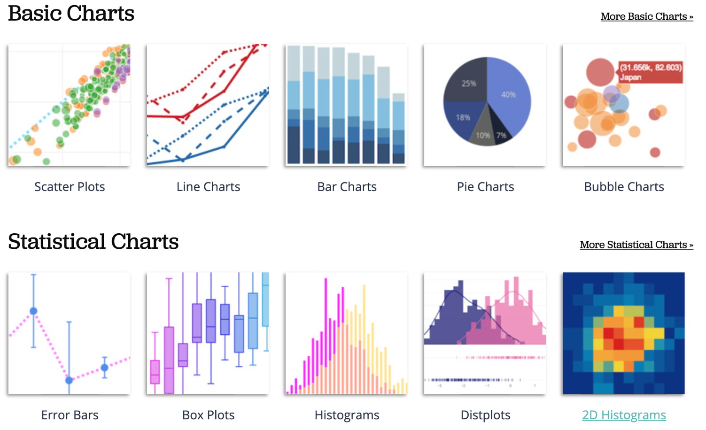
Python Plotly Graphing Library
https://plotly.com/python/

Slide 75
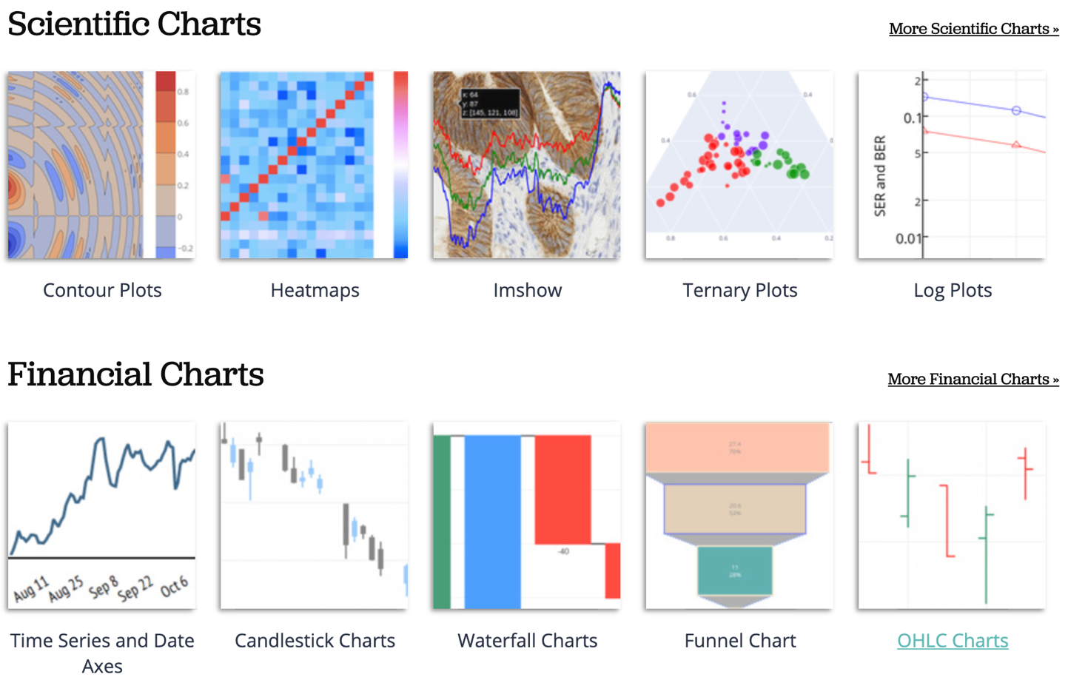
Python Plotly Graphing Library
https://plotly.com/python/

Slide 76
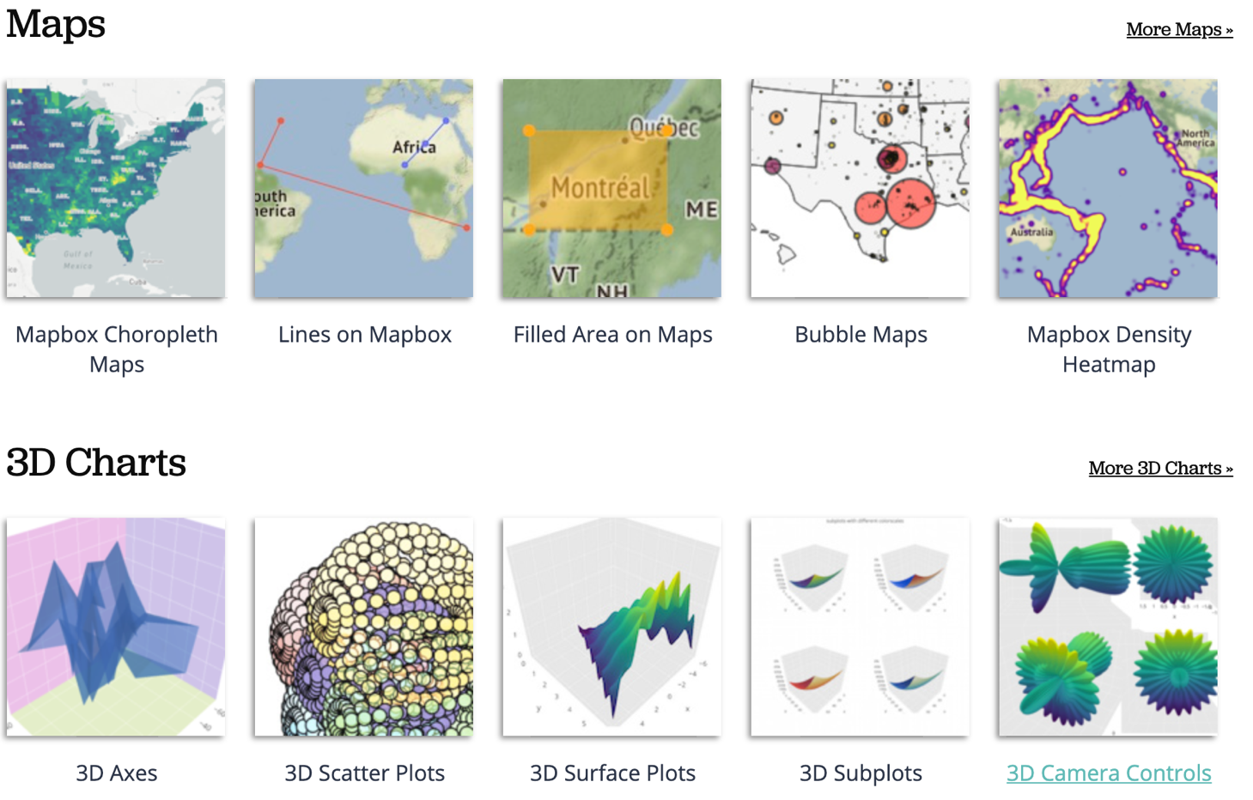
Python Plotly Graphing Library
https://plotly.com/python/

Slide 77
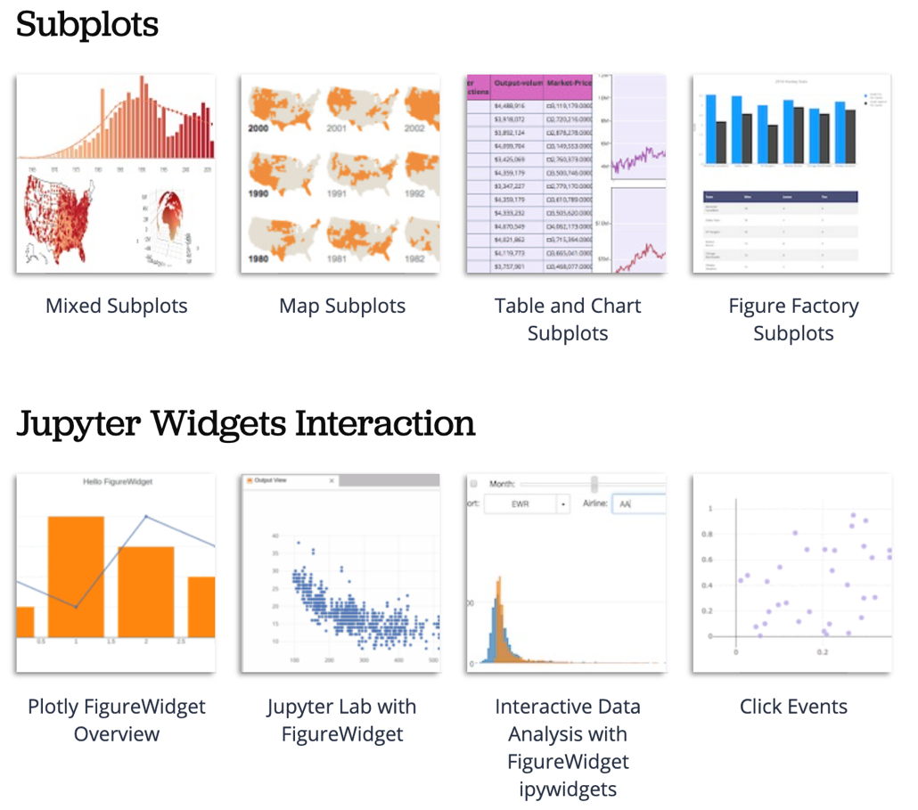
Python Plotly Graphing Library
https://plotly.com/python/

Slide 78
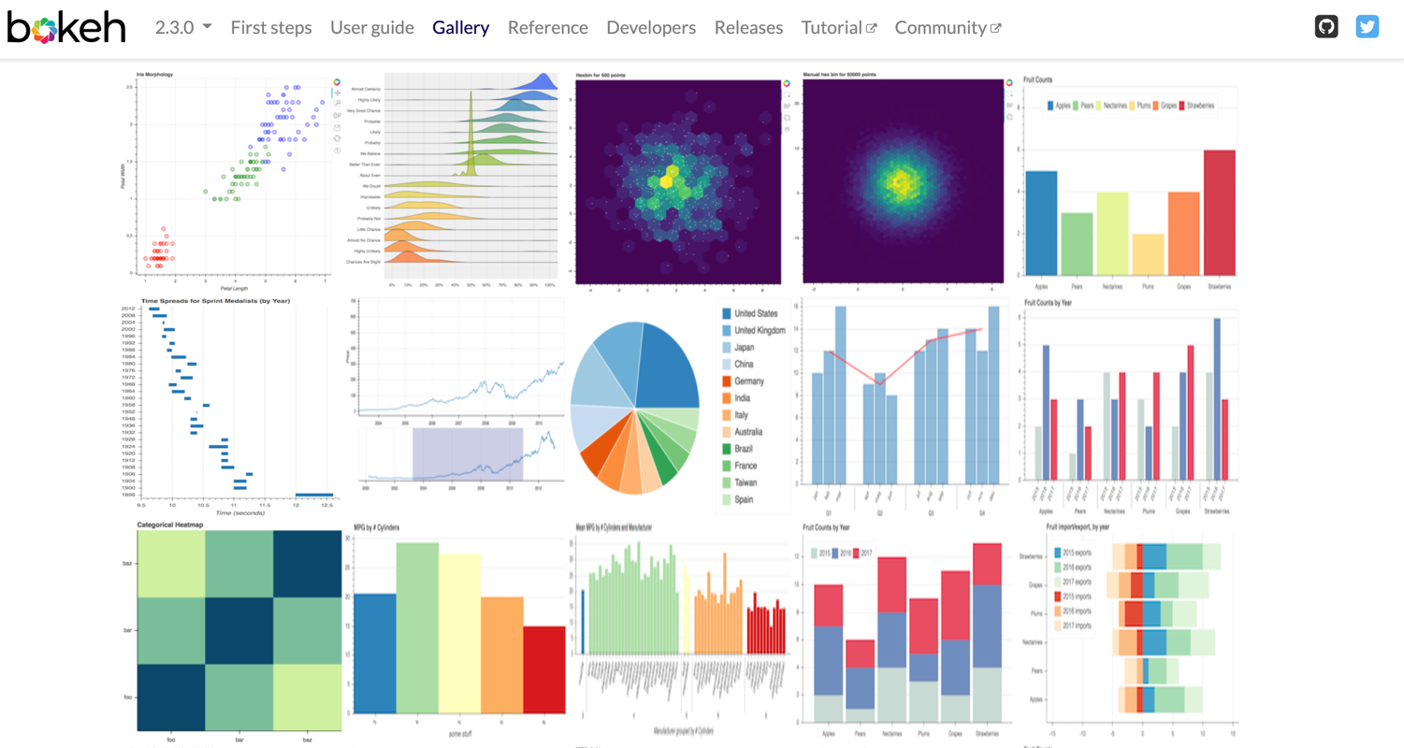
Python Bokeh
https://bokeh.org/

Slide 79

Python in Google Colab (Python101)
https://colab.research.google.com/drive/1FEG6DnGvwfUbeo4zJ1zTunjMqf2RkCrT
https://tinyurl.com/aintpupython101

Slide 80
Summary
ESG Data Gathering
ESG Data Analysis
ESG Data Visualization

Slide 81
References
Yi Zou, Mengying Shi, Zhongjie Chen, Zhu Deng, ZongXiong Lei, Zihan Zeng, Shiming Yang, Hongxiang Tong, Lei Xiao, and Wenwen Zhou. (2025) "ESGReveal: An LLM-based approach for extracting structured data from ESG reports." Journal of Cleaner Production 489 (2025): 144572.
Sherry Madera (2024), Navigating Sustainability Data: How Organizations can use ESG Data to Secure Their Future, Kogan Page
Simon Thompson (2023), Green and Sustainable Finance: Principles and Practice in Banking, Investment and Insurance, 2nd Edition, Kogan Page.
Chrissa Pagitsas (2023), Chief Sustainability Officers At Work: How CSOs Build Successful Sustainability and ESG Strategies, Apress.
Wes McKinney (2022), "Python for Data Analysis: Data Wrangling with pandas, NumPy, and Jupyter", 3rd Edition, O'Reilly Media.
Cino Robin Castelli, Cyril Shmatov (2022), Quantitative Methods for ESG Finance, Wiley
Simon Thompson (2023), Green and Sustainable Finance: Principles and Practice in Banking, Investment and Insurance, 2nd Edition, Kogan Page.
Chrissa Pagitsas (2023), Chief Sustainability Officers At Work: How CSOs Build Successful Sustainability and ESG Strategies, Apress.
Thomas R. Caldwell (2025), The Agentic AI Bible: The Complete and Up-to-Date Guide to Design, Build, and Scale Goal-Driven, LLM-Powered Agents that Think, Execute and Evolve, Independently published.
Min-Yuh Day (2025), Python 101, https://tinyurl.com/aintpupython101

