Slide 1









NVIDIA Building RAG Agents with LLMs Part I: LLM Services and AI Foundation Models
Sustainability and ESG Data Analytics
1141ESGDA06
MBA, IM, NTPU (M5265) (Fall 2025)
Wed 2, 3, 4 (9:10-12:00) (B3F17)
University Ambassador
Certified Instructor
Min-Yuh Day, Ph.D,
Professor and Director
Institute of Information Management, National Taipei University
https://web.ntpu.edu.tw/~myday
https://meet.google.com/miy-fbif-max
2025-10-22

Slide 2
Syllabus
Week Date Subject/Topics
1 2025/09/10 Introduction Sustainability and ESG Data Analytics
2 2025/09/17 Environmental, Social, and Governance (ESG) in
Net-Zero Digital Transformation
3 2025/09/24 Data Science for Sustainability and ESG
4 2025/10/01 Case Study on Sustainability and ESG Data Analytics I
5 2025/10/08 Web 3.0 and Big Data Analysis in Fintech, Green and
Sustainable Finance
6 2025/10/15 ESG Data Gathering, Analysis, and Visualization

Slide 3
Syllabus
Week Date Subject/Topics
7 2025/10/22 NVIDIA Building RAG Agents with LLMs Part I:
LLM Services and AI Foundation Models
8 2025/10/29 Self-Learning
9 2025/11/05 Midterm Project Report
10 2025/11/12 NVIDIA Building RAG Agents with LLMs Part II:
Document Loading, Chunking, and Embeddings
11 2025/11/19 NVIDIA Building RAG Agents with LLMs Part III:
Retrieval-Augmented Generation with
Vector Stores and RAG Evaluation

Slide 4
Syllabus
Week Date Subject/Topics
12 2025/11/26 Case Study on Sustainability and ESG Data Analytics II
13 2025/12/03 Artificial Intelligence of things (AIoT) in ESG and
Sustainability Applications
14 2025/12/10 Generative AI for ESG Rating and Reporting Generation
15 2025/12/17 Final Project Report I
16 2025/12/24 Final Project Report II

Slide 5
NVIDIA
Building RAG Agents with LLMs
Part 1: Your Course Environment
Part 2: LLM Services
Part 3: Intro to LangChain
Part 4: Running State Chain
Part 5: Working with Documents
Part 6: Embedding Model for Retrieval
Part 7: Document Retrieval with Vector Databases
Part 8: RAG Evaluation

Slide 6
NVIDIA
Building RAG Agents with LLMs
[0,1,2] [3, 4] [5, 6] [7,8]

Slide 7
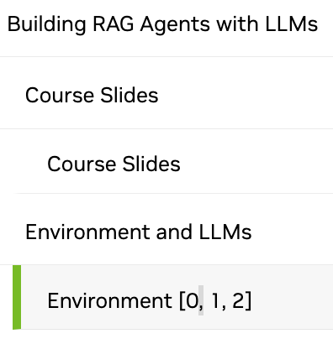
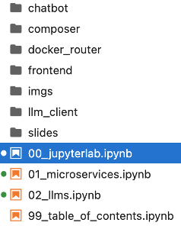
NVIDIA Building RAG Agents with LLMs
[0, 1, 2]
Source: NVIDIA DLI (2024), Building RAG Agents with LLMs, https://learn.nvidia.com/courses/course-detail?course_id=course-v1:DLI+S-FX-15+V1

Slide 8


Spring 2025
Generative AI
Innovative Applications

Slide 9

https://learn.nvidia.com/certificates?id=cCFh1ZWWTvqKTq7dcKkEWw

Slide 10

https://learn.nvidia.com/certificates?id=OVmqY4cSSya0BdMQBWHxzw

Slide 11
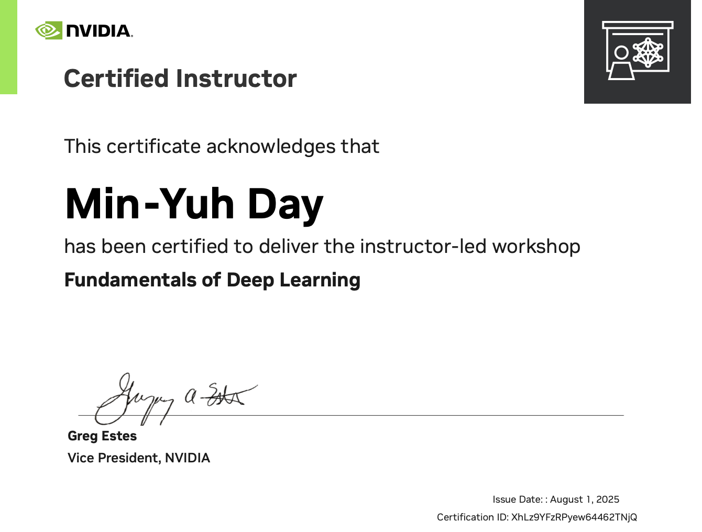
https://learn.nvidia.com/certificates?id=ny50l3TXT5W8Q_6kENkIaQ

Slide 12

https://learn.nvidia.com/certificates?id=ed-qOCIMQaatzU8SNUNxgw

Slide 13

https://learn.nvidia.com/certificates?id=q3oo-oBhTQKtyCCote2E-Q

Slide 14

https://learn.nvidia.com/certificates?id=XhLz9YFzRPyew64462TNjQ

Slide 15

NVIDIA
Certified Instructors
(12 from Taiwan)
https://www.nvidia.com/en-us/training/instructor-directory/search/

Slide 16
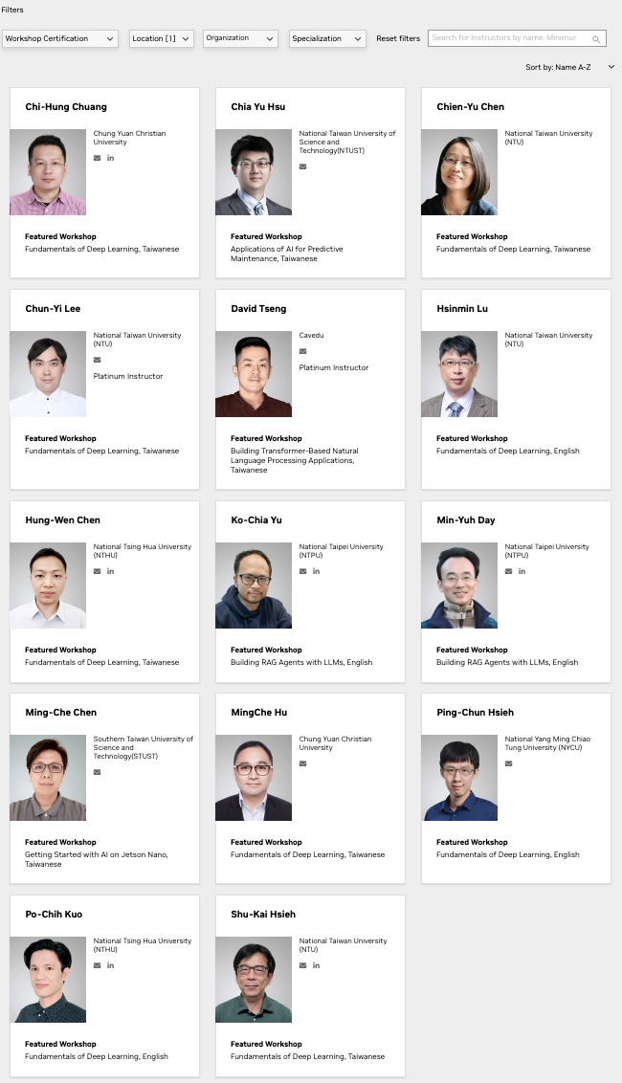
NVIDIA
Certified Instructors
(14 from Taiwan)
(2 from NTPU)(April 2025)
https://www.nvidia.com/en-us/training/instructor-directory/search/

Slide 17
NVIDIA Developer Program
NVIDIA
Deep Learning Institute (DLI)
https://developer.nvidia.com/join-nvidia-developer-program
https://learn.nvidia.com/

Slide 18
Get NVIDIA DLI Certificate
Before the NVIDIA Workshop
Step 1. Join NVIDIA Developer Program (Free)
https://developer.nvidia.com/join-nvidia-developer-program
Step 2. Visit NVIDIA Deep Learning Institute (DLI)
https://learn.nvidia.com/
Step 3. Enroll "Building RAG Agents with LLMs" Self-Paced Course (Free)
https://learn.nvidia.com/courses/course-detail?course_id=course-v1:DLI+S-FX-15+V1

Slide 19
Get NVIDIA DLI Certificate
Welcome to NVIDIA DLI "Building RAG Agents with LLMs" workshop.
Step 1. Visit https://learn.nvidia.com/dli-event
Step 2. Enter the event code: NTPU_RAG_AMBASSADOR_OC25
Step 3. Complete the NVIDIA DLI course and review the course datasheet at https://developer.nvidia.com/dli/getready

Slide 20
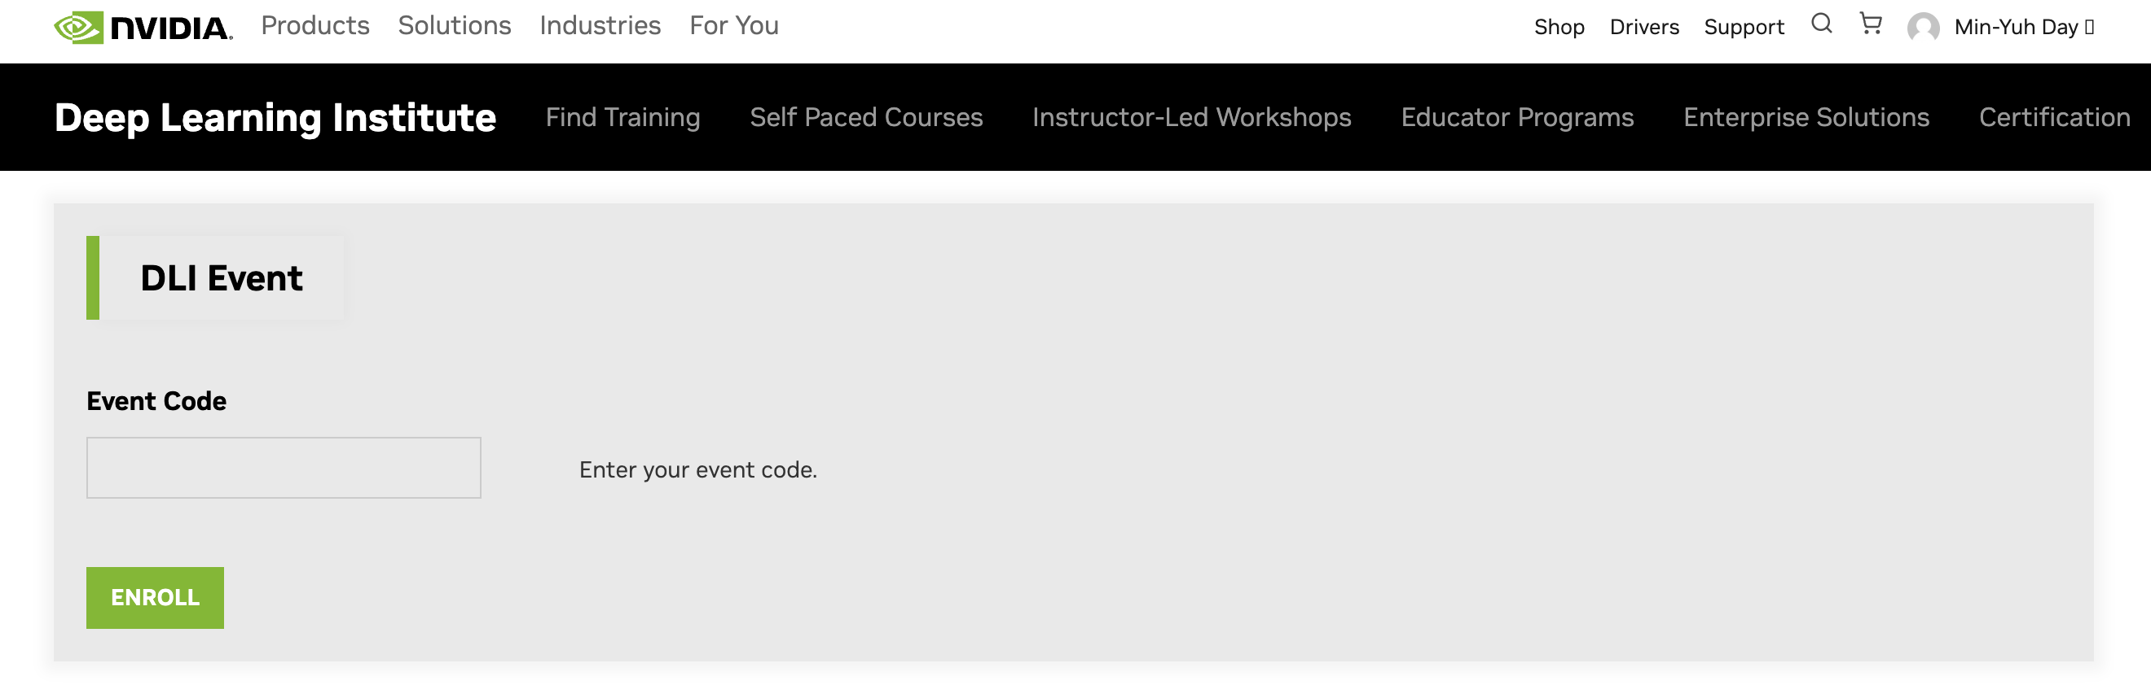
Get NVIDIA DLI Certificate
Workshop
Welcome to NVIDIA DLI
" Building RAG Agents with LLMs "
workshop.
Step 1. Visit https://learn.nvidia.com/dli-event
Step 2. Enter the event code: NTPU_RAG_AMBASSADOR_OC25
NTPU_RAG_AMBASSADOR_OC25
https://learn.nvidia.com/dli-event

Slide 21
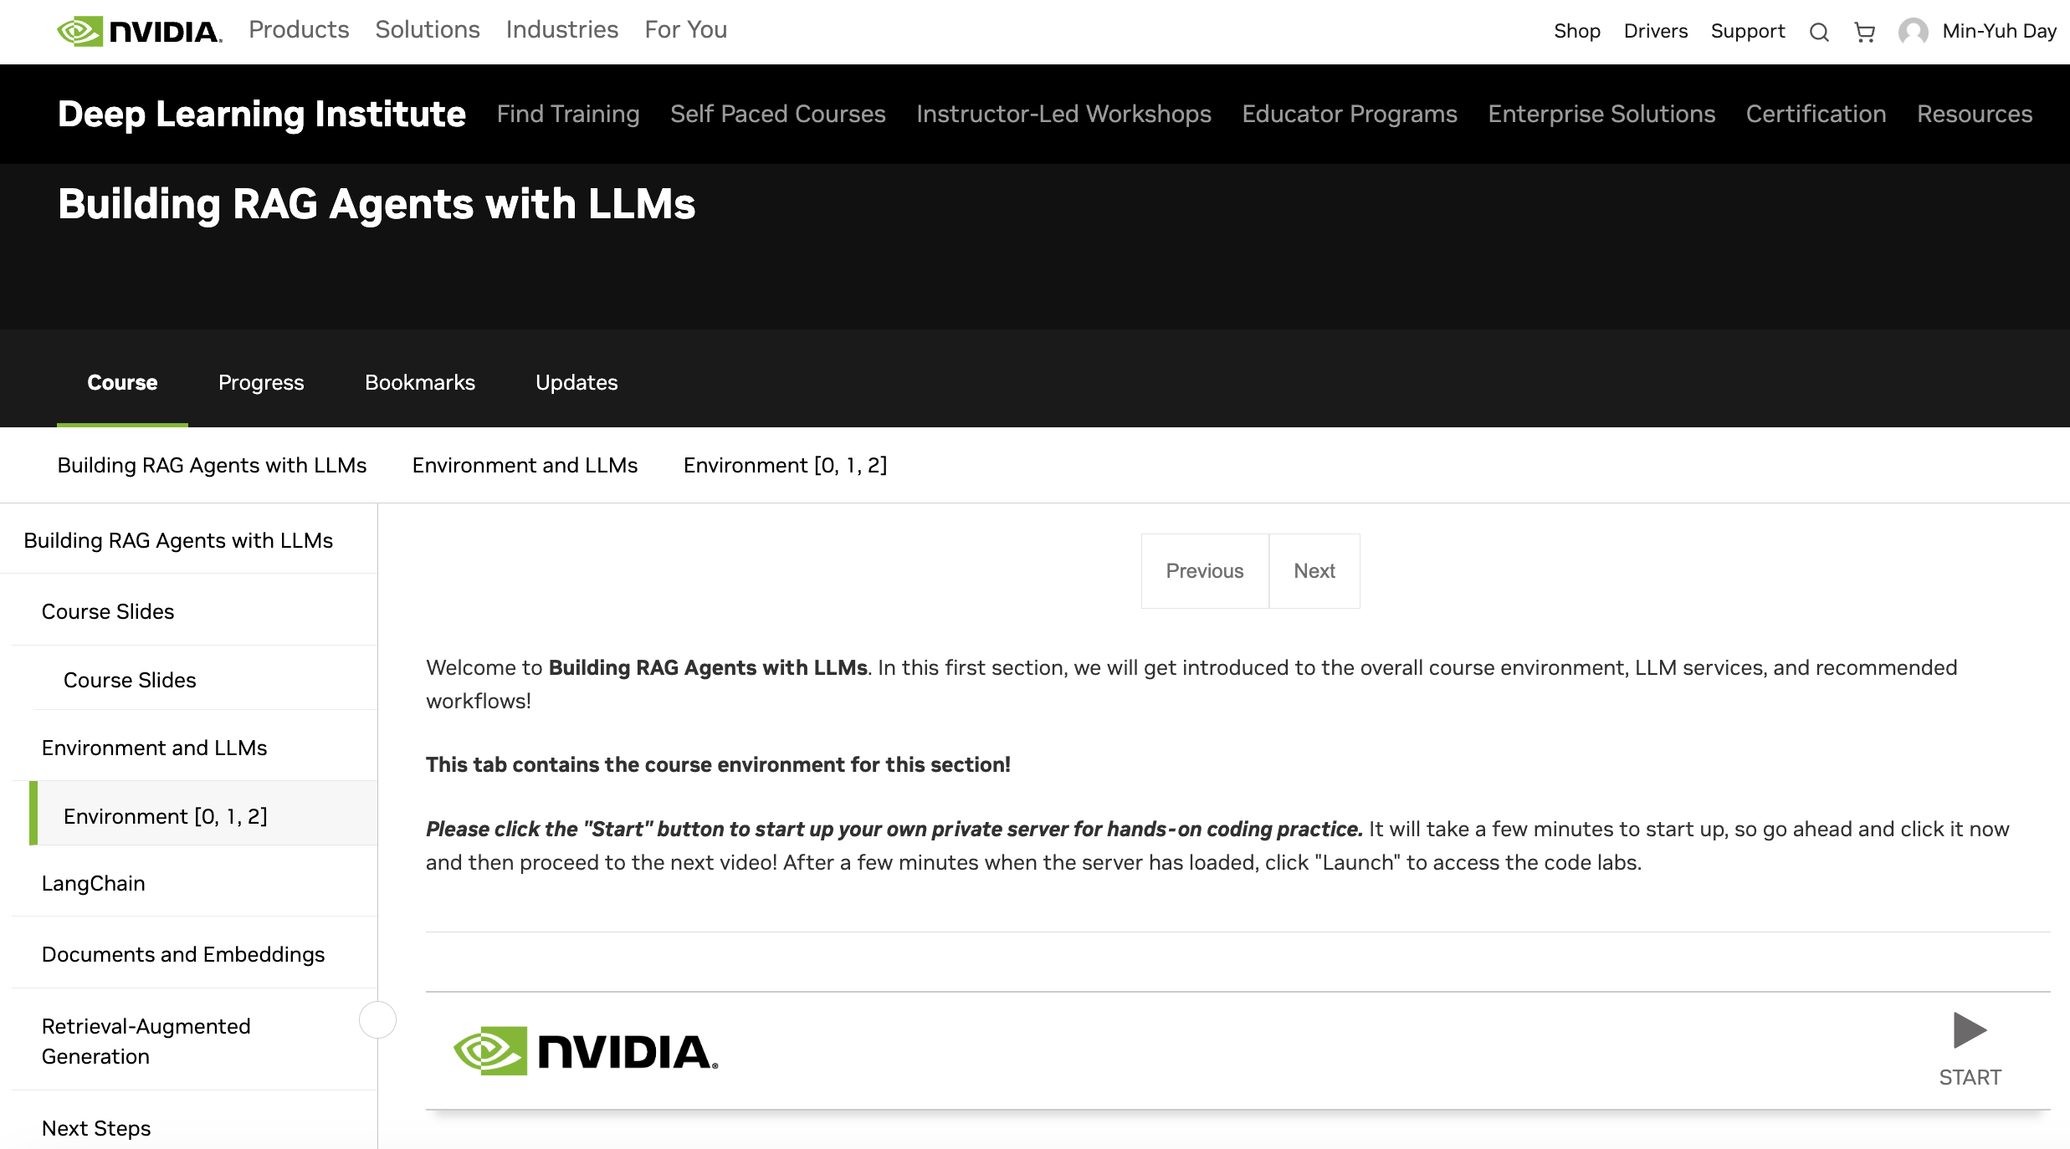
Building RAG Agents with LLMs
Workshop
https://learn.nvidia.com/courses/course?course_id=course-v1:DLI+C-FX-15+V1

Slide 22
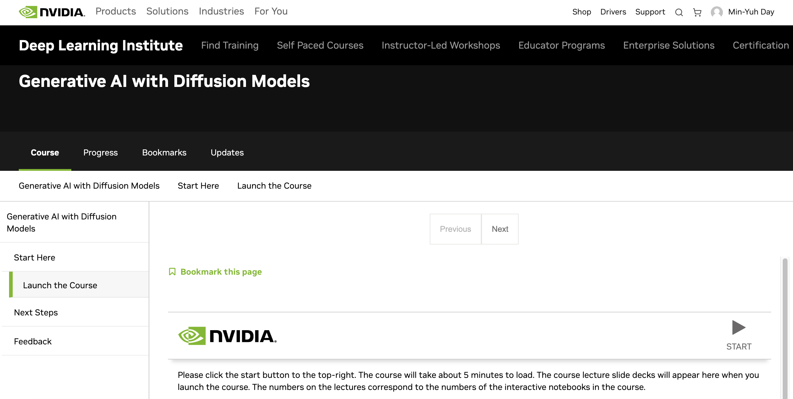
Generative AI with Diffusion Models
"Generative AI with Diffusion Models" workshop
Step 1. Visit https://learn.nvidia.com/dli-event
Step 2. Enter the event code: NTPU_GENAI_AMBASSADOR_NO25
https://learn.nvidia.com/courses/course?course_id=course-v1:DLI+C-FX-08+V1

Slide 23
NVIDIA Deep Learning Institute (DLI)
Building RAG Agents with LLMs
Workshop
Step 1.
Visit
https://learn.nvidia.com/dli-event
Step 2.
Enter the event code: NTPU_RAG_AMBASSADOR_OC25
Self-Paced Course
Building RAG Agents With LLMs
Certificate available
Free
8 hours
Instructor-Led Workshop
Building RAG Agents With LLMs
Certificate available
$500
8 hours
https://www.nvidia.com/en-us/learn/learning-path/generative-ai-llm/

Slide 24

Get NVIDIA Certificate
https://learn.nvidia.com/certificates?id=ed-qOCIMQaatzU8SNUNxgw

Slide 25

Join the NVIDIA Developer Program take one of the complimentary technical self-paced courses
(worth up to $90)
https://developer.nvidia.com/join-nvidia-developer-program

Slide 26
NVIDIA Deep Learning Institute (DLI)
Self-Paced Course
Generative AI Explained
Free
2 hours
Self-Paced Course
Getting Started With Deep Learning
Certificate available
$90
8 hours
Instructor-Led Workshop
Fundamentals of Deep Learning
Certificate available
$500
8 hours
Self-Paced Course
Introduction to Transformer-Based Natural Language Processing
Certificate available
$30
6 hours
Self-Paced Course
Building RAG Agents With LLMs
Certificate available
Free
8 hours
Instructor-Led Workshop
Building RAG Agents With LLMs
Certificate available
$500
8 hours
Self-Paced Course
Generative AI with Diffusion Models
Certificate available
$90
8 hours
Instructor-Led Workshop
Generative AI with Diffusion Models
Certificate available
$500
8 hours
https://www.nvidia.com/en-us/learn/learning-path/generative-ai-llm/

Slide 27

NVIDIA Deep Learning Institute (DLI)
Generative AI
https://learn.nvidia.com/en-us/training/find-training?q=Generative+AI

Slide 28

Building RAG Agents with LLMs
https://learn.nvidia.com/courses/course-detail?course_id=course-v1:DLI+S-FX-15+V1

Slide 29

Generative AI Explained
https://learn.nvidia.com/courses/course-detail?course_id=course-v1:DLI+S-FX-15+V1

Slide 30

Introduction to Transformer-Based
Natural Language Processing
https://learn.nvidia.com/courses/course-detail?course_id=course-v1:DLI+S-FX-08+V1

Slide 31

Generative AI with Diffusion Models
https://learn.nvidia.com/courses/course-detail?course_id=course-v1:DLI+S-FX-14+V1

Slide 32

Join the NVIDIA Developer Program take one of the complimentary technical self-paced courses (worth up to $90)
https://developer.nvidia.com/join-nvidia-developer-program

Slide 33

Join the NVIDIA Developer Program take one of the complimentary technical self-paced courses (worth up to $90)
https://developer.nvidia.com/join-nvidia-developer-program

Slide 34

Join the NVIDIA Developer Program take one of the complimentary technical self-paced courses (worth up to $90)
https://developer.nvidia.com/join-nvidia-developer-program

Slide 35

Join the NVIDIA Developer Program take one of the complimentary technical self-paced courses (worth up to $90)
https://developer.nvidia.com/join-nvidia-developer-program

Slide 36

Join the NVIDIA Developer Program take one of the complimentary technical self-paced courses (worth up to $90)
https://developer.nvidia.com/join-nvidia-developer-program

Slide 37

Join the NVIDIA Developer Program take one of the complimentary technical self-paced courses (worth up to $90)
https://developer.nvidia.com/join-nvidia-developer-program

Slide 38

NVIDIA Deep Learning Institute (DLI)
https://learn.nvidia.com/my-learning

Slide 39

NVIDIA Deep Learning Institute (DLI)
https://learn.nvidia.com/my-learning

Slide 40

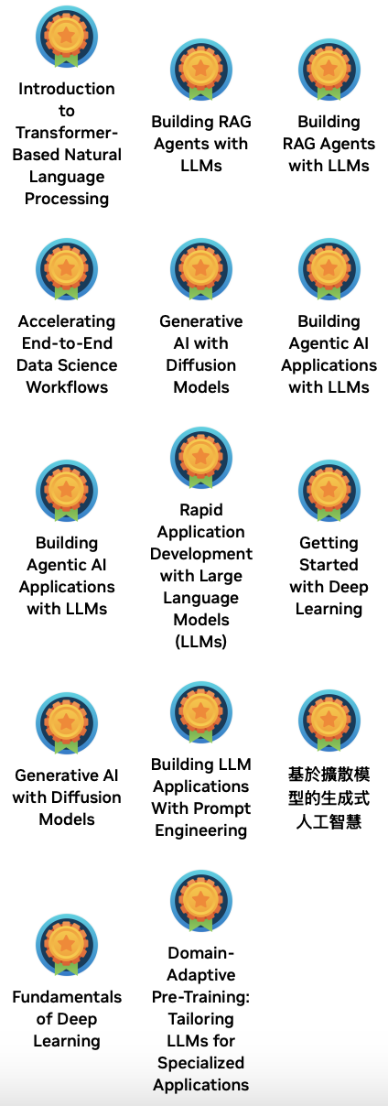

Deep Learning Institute (DLI)
https://learn.nvidia.com/my-learning

Slide 41
https://learn.nvidia.com/certificates?id=ed-qOCIMQaatzU8SNUNxgw

Slide 42

NVIDIA Deep Learning Institute (DLI)
https://learn.nvidia.com/en-us/training/self-paced-courses

Slide 43
Building RAG Agents with LLMs
https://learn.nvidia.com/courses/course-detail?course_id=course-v1:DLI+S-FX-15+V1

Slide 44

Building RAG Agents with LLMs
Source: NVIDIA DLI (2024), Building RAG Agents with LLMs, https://learn.nvidia.com/courses/course-detail?course_id=course-v1:DLI+S-FX-15+V1

Slide 45

Building RAG Agents with LLMs
https://learn.nvidia.com/my-learning

Slide 46

Building RAG Agents with LLMs
https://learn.nvidia.com/courses/course?course_id=course-v1:DLI+S-FX-15+V1

Slide 47

Building RAG Agents with LLMs
https://learn.nvidia.com/courses/course?course_id=course-v1:DLI+S-FX-15+V1

Slide 48

Building RAG Agents with LLMs
https://learn.nvidia.com/courses/course?course_id=course-v1:DLI+S-FX-15+V1

Slide 49

Building RAG Agents with LLMs
https://learn.nvidia.com/courses/course?course_id=course-v1:DLI+S-FX-15+V1

Slide 50

Building RAG Agents with LLMs
https://learn.nvidia.com/courses/course?course_id=course-v1:DLI+S-FX-15+V1

Slide 51

Building RAG Agents with LLMs
https://learn.nvidia.com/courses/course?course_id=course-v1:DLI+S-FX-15+V1

Slide 52

Building RAG Agents with LLMs
https://learn.nvidia.com/courses/course?course_id=course-v1:DLI+S-FX-15+V1

Slide 53
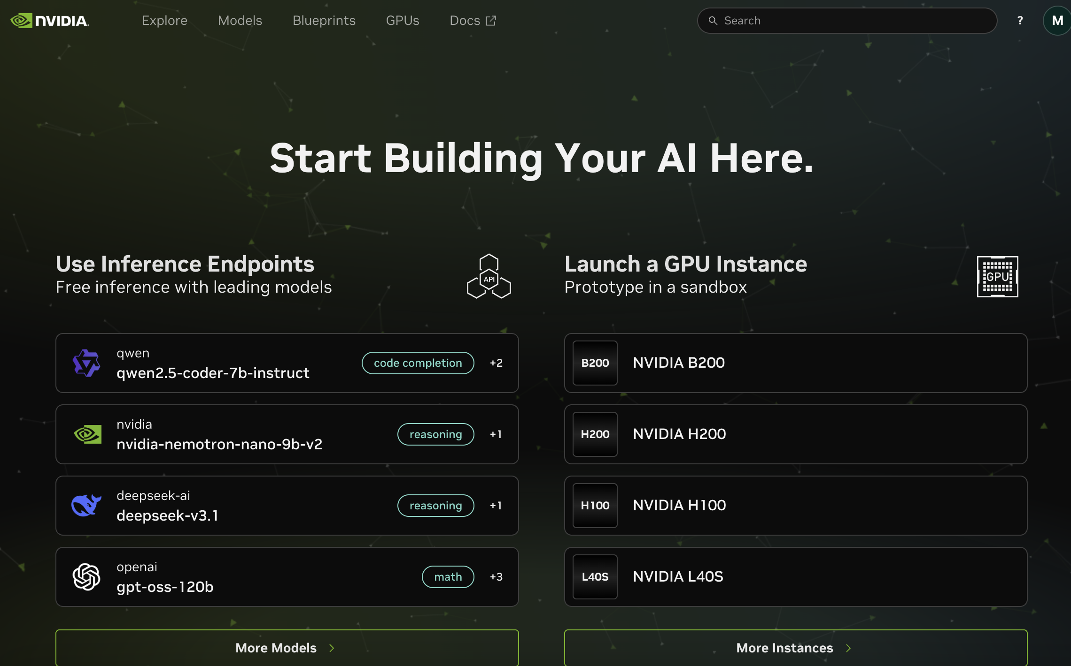
NIM (NVIDIA Inference Microservice)
https://build.nvidia.com/

Slide 54
Building RAG Agents with LLMs
Introduction
Source: NVIDIA DLI (2024), Building RAG Agents with LLMs, https://learn.nvidia.com/courses/course-detail?course_id=course-v1:DLI+S-FX-15+V1
Notes:
Welcome to our course on Building RAG Agents with LLMs!
REMIND STUDENTS TO START UP THEIR COURSE ENVIRONMENT!
LLMs: Large Language Models which take in, produce, or otherwise reason with text. We’ll learn to make more complex systems
Course Topics:
Creating chatbot applications capable of dialogue management and retrieval augmented generation.
Built from the ground up using foundation models which can be deployed on your own compute.
Leveraging current best practices from open-source frameworks like LangChain.

Slide 55
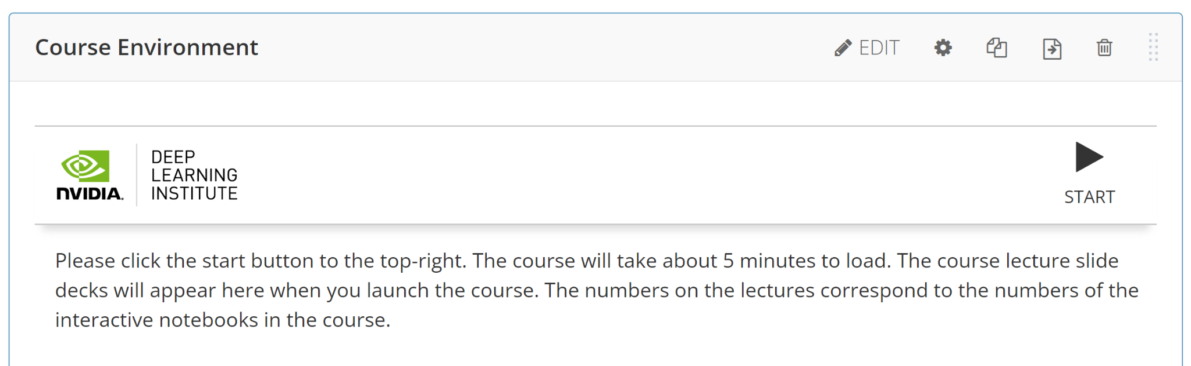
Building RAG Agents with LLMs
Introduction
Source: NVIDIA DLI (2024), Building RAG Agents with LLMs, https://learn.nvidia.com/courses/course-detail?course_id=course-v1:DLI+S-FX-15+V1
Notes:
Welcome to our course on Building RAG Agents with LLMs!
REMIND STUDENTS TO START UP THEIR COURSE ENVIRONMENT!
LLMs: Large Language Models which take in, produce, or otherwise reason with text. We’ll learn to make more complex systems
Course Topics:
Creating chatbot applications capable of dialogue management and retrieval augmented generation.
Built from the ground up using foundation models which can be deployed on your own compute.
Leveraging current best practices from open-source frameworks like LangChain.

Slide 56
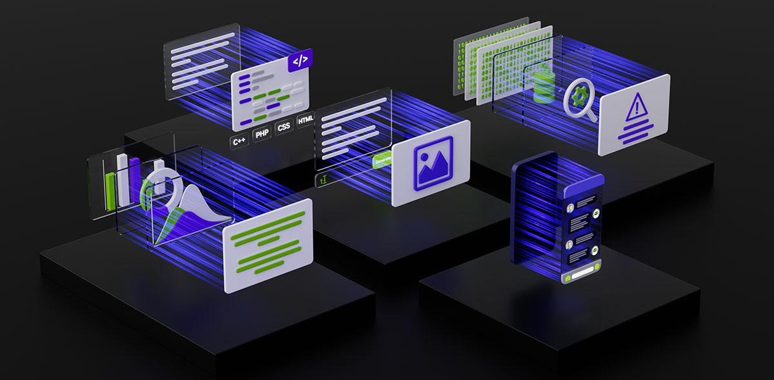
Large Language Models
Backbones for Language Understanding
Backbones for language tasks, including classification and generation.
https://www.nvidia.com/content/dam/en-zz/Solutions/lp/large-language-models-ebook/nvidia-llm-ebook-og.jpg
Source: NVIDIA DLI (2024), Building RAG Agents with LLMs, https://learn.nvidia.com/courses/course-detail?course_id=course-v1:DLI+S-FX-15+V1
Notes:
Welcome to our course on Building RAG Agents with LLMs!
LLMs: Large Language Models which take in, produce, or otherwise reason with text. We’ll learn to make more complex systems

Slide 57
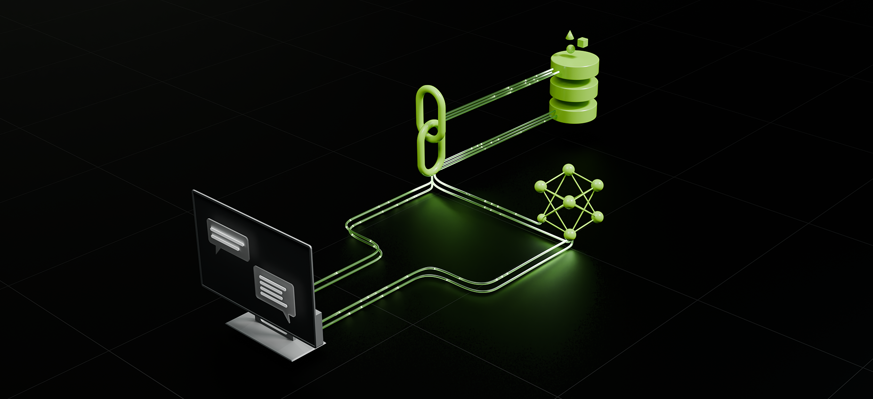
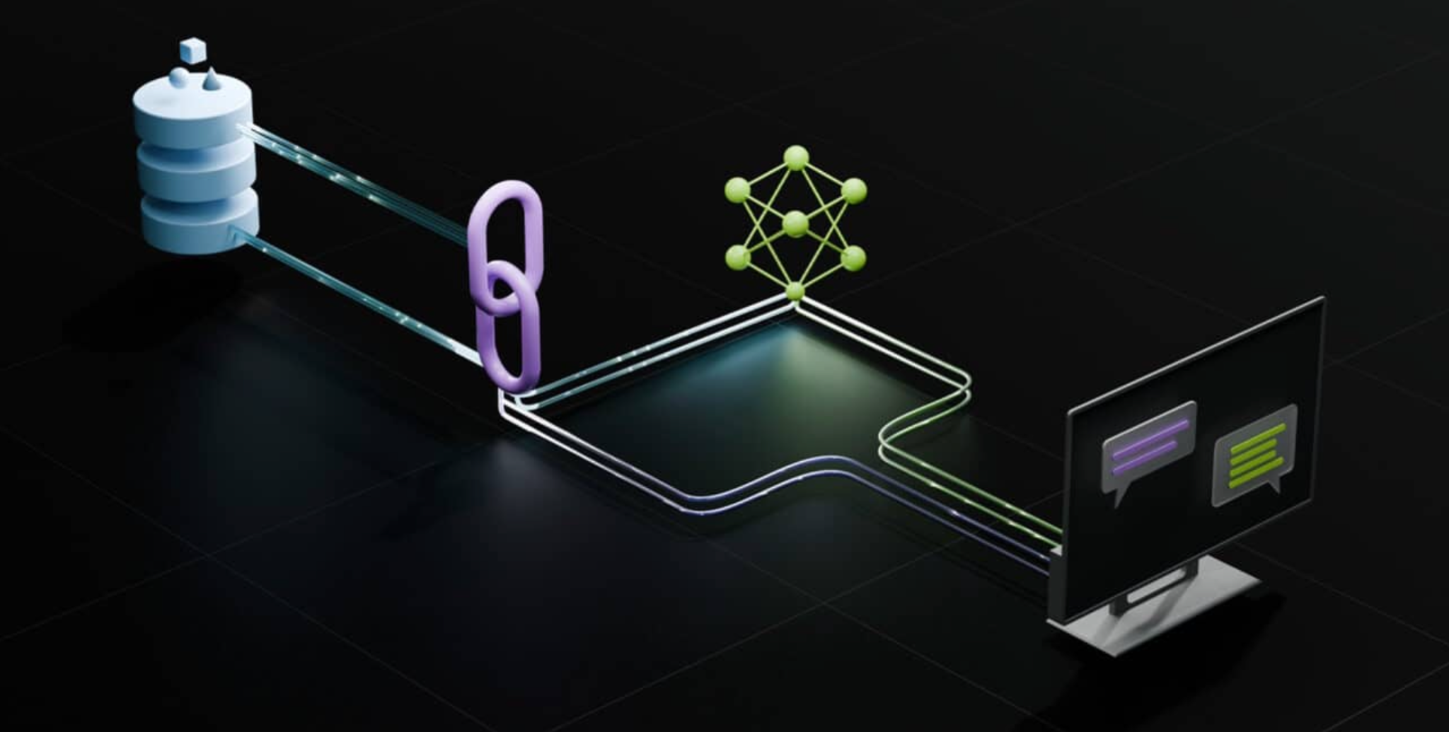
Dialog/Retrieval Agents
LLMs with Context and Control
User Asks Something
Agent Responds
https://www.nvidia.com/content/dam/en-zz/Solutions/lp/large-language-models-ebook/nvidia-llm-ebook-og.jpg
Source: NVIDIA DLI (2024), Building RAG Agents with LLMs, https://learn.nvidia.com/courses/course-detail?course_id=course-v1:DLI+S-FX-15+V1
Notes:
Welcome to our course on Building RAG Agents with LLMs!
Course Topics:
Creating chatbot applications capable of dialogue management and retrieval augmented generation.
Superficial: User sends message, and agent responds. But we want to bring our own data.
To achieve this, we need LLM Orchestration, so combining software practices and LLMs together.
Using this, we can Retrieve and synthesize data from a database or environment…
…create a new input that contains the grounding information (AKA augmenting our LLM’s behavior)…
…and then generating our response, having supplied our LLM with all the necessary info to make the decision.

Slide 58
Dialog/Retrieval Agents
LLMs with Context and Control
LLM Orchestration: Software + LLM helps to route to software and LLMs.
User Asks Something
Agent Responds
https://www.nvidia.com/content/dam/en-zz/Solutions/lp/large-language-models-ebook/nvidia-llm-ebook-og.jpg
Source: NVIDIA DLI (2024), Building RAG Agents with LLMs, https://learn.nvidia.com/courses/course-detail?course_id=course-v1:DLI+S-FX-15+V1
Notes:
Welcome to our course on Building RAG Agents with LLMs!
Course Topics:
Creating chatbot applications capable of dialogue management and retrieval augmented generation.
Superficial: User sends message, and agent responds. But we want to bring our own data.
To achieve this, we need LLM Orchestration, so combining software practices and LLMs together.
Using this, we can Retrieve and synthesize data from a database or environment…
…create a new input that contains the grounding information (AKA augmenting our LLM’s behavior)…
…and then generating our response, having supplied our LLM with all the necessary info to make the decision.

Slide 59
Dialog/Retrieval Agents
LLMs with Context and Control
Retrieval: Tool runs algorithms (database, code execution, semantic search, return a constant value, etc) to provide context
LLM Orchestration: Software + LLM helps to route to software and LLMs.
User Asks Something
Agent Responds
https://www.nvidia.com/content/dam/en-zz/Solutions/lp/large-language-models-ebook/nvidia-llm-ebook-og.jpg
Source: NVIDIA DLI (2024), Building RAG Agents with LLMs, https://learn.nvidia.com/courses/course-detail?course_id=course-v1:DLI+S-FX-15+V1
Notes:
Welcome to our course on Building RAG Agents with LLMs!
Course Topics:
Creating chatbot applications capable of dialogue management and retrieval augmented generation.
Superficial: User sends message, and agent responds. But we want to bring our own data.
To achieve this, we need LLM Orchestration, so combining software practices and LLMs together.
Using this, we can Retrieve and synthesize data from a database or environment…
…create a new input that contains the grounding information (AKA augmenting our LLM’s behavior)…
…and then generating our response, having supplied our LLM with all the necessary info to make the decision.

Slide 60
Dialog/Retrieval Agents
LLMs with Context and Control
Retrieval: Tool runs algorithms (database, code execution, semantic search, return a constant value, etc) to provide context
LLM Orchestration: Software + LLM helps to route to software and LLMs.
Augmented: Based on tool responses, the software pipeline synthesizes some “context”
to feed to LLM w/ question.
User Asks Something
Agent Responds
https://www.nvidia.com/content/dam/en-zz/Solutions/lp/large-language-models-ebook/nvidia-llm-ebook-og.jpg
Source: NVIDIA DLI (2024), Building RAG Agents with LLMs, https://learn.nvidia.com/courses/course-detail?course_id=course-v1:DLI+S-FX-15+V1
Notes:
Welcome to our course on Building RAG Agents with LLMs!
Course Topics:
Creating chatbot applications capable of dialogue management and retrieval augmented generation.
Superficial: User sends message, and agent responds. But we want to bring our own data.
To achieve this, we need LLM Orchestration, so combining software practices and LLMs together.
Using this, we can Retrieve and synthesize data from a database or environment…
…create a new input that contains the grounding information (AKA augmenting our LLM’s behavior)…
…and then generating our response, having supplied our LLM with all the necessary info to make the decision.

Slide 61
Dialog/Retrieval Agents
LLMs with Context and Control
Retrieval: Tool runs algorithms (database, code execution, semantic search, return a constant value, etc) to provide context
LLM Orchestration: Software + LLM helps to route to software and LLMs.
Augmented: Based on tool responses, the software pipeline synthesizes some “context”
to feed to LLM w/ question.
User Asks Something
Generation: Based on question, instructions, and enhanced context, the LLM returns a response.
Agent Responds
https://www.nvidia.com/content/dam/en-zz/Solutions/lp/large-language-models-ebook/nvidia-llm-ebook-og.jpg
Source: NVIDIA DLI (2024), Building RAG Agents with LLMs, https://learn.nvidia.com/courses/course-detail?course_id=course-v1:DLI+S-FX-15+V1
Notes:
Welcome to our course on Building RAG Agents with LLMs!
Course Topics:
Creating chatbot applications capable of dialogue management and retrieval augmented generation.
Superficial: User sends message, and agent responds. But we want to bring our own data.
To achieve this, we need LLM Orchestration, so combining software practices and LLMs together.
Using this, we can Retrieve and synthesize data from a database or environment…
…create a new input that contains the grounding information (AKA augmenting our LLM’s behavior)…
…and then generating our response, having supplied our LLM with all the necessary info to make the decision.
We’ll learn to build these pipelines from the ground up using foundation models which can be deployed on your own compute and at scale.

Slide 62
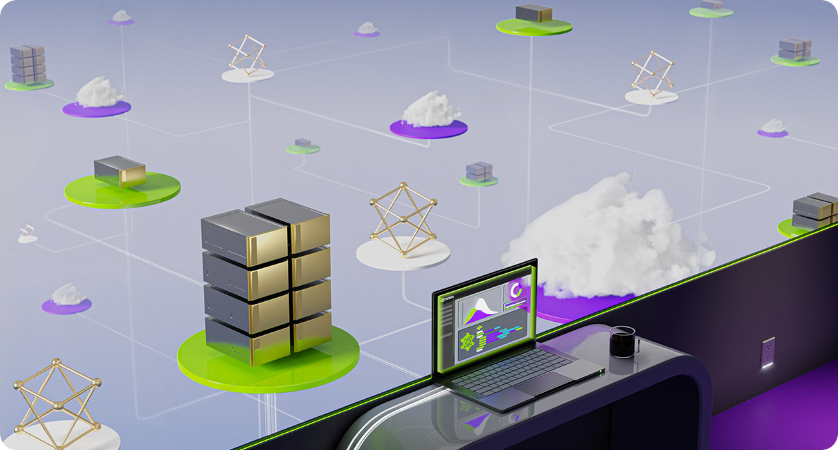
Chat Applications
Full Applications Build with LLMs
https://www.nvidia.com/content/dam/en-zz/Solutions/lp/large-language-models-ebook/nvidia-llm-ebook-og.jpg
Source: NVIDIA DLI (2024), Building RAG Agents with LLMs, https://learn.nvidia.com/courses/course-detail?course_id=course-v1:DLI+S-FX-15+V1
Notes:
Welcome to our course on Building RAG Agents with LLMs!
Course Topics:
Creating chatbot applications capable of dialogue management and retrieval augmented generation.
We’ll learn to build these pipelines from the ground up using foundation models which can be deployed on your own compute and at scale.
Leveraging current best practices from open-source frameworks like LangChain, as well as enterprise-grade microservice options like NVIDIA NIMs.

Slide 63
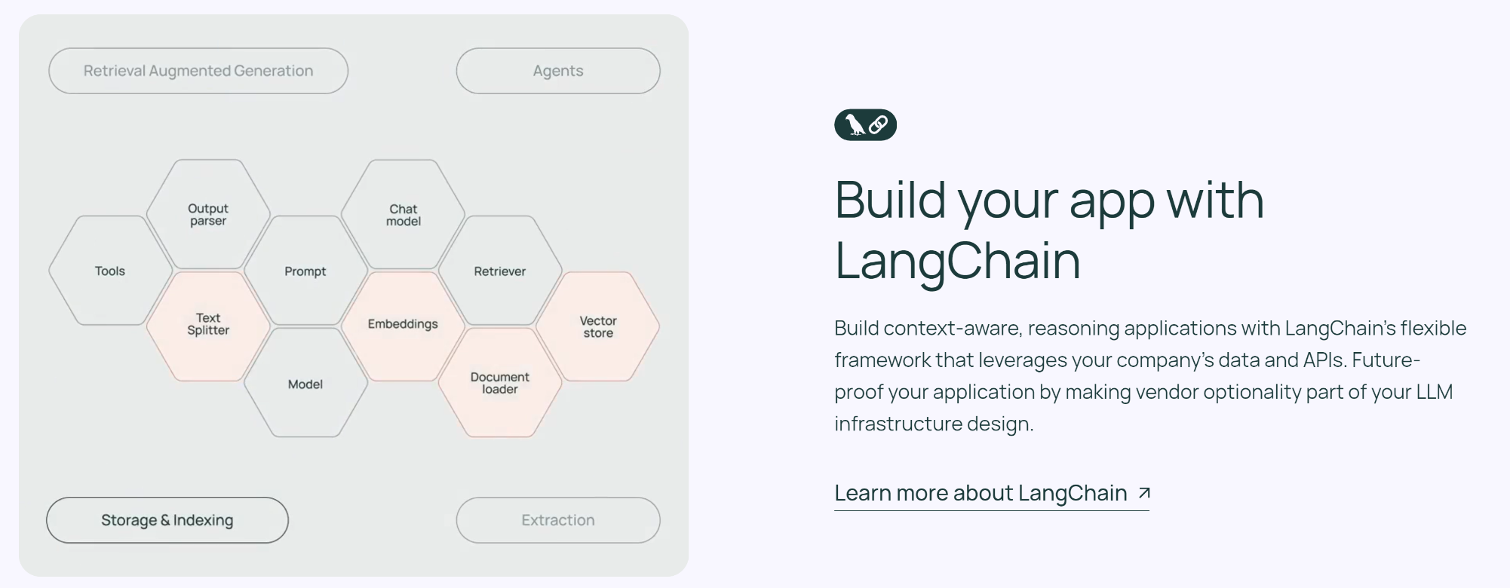
Chat Applications
Full Applications Build with LLMs
Production-Ready APIs That Run Anywhere | NVIDIA
Source: NVIDIA DLI (2024), Building RAG Agents with LLMs, https://learn.nvidia.com/courses/course-detail?course_id=course-v1:DLI+S-FX-15+V1
Notes:
Welcome to our course on Building RAG Agents with LLMs!
Course Topics:
Creating chatbot applications capable of dialogue management and retrieval augmented generation.
We’ll learn to build these pipelines from the ground up using foundation models which can be deployed on your own compute and at scale.
Leveraging current best practices from open-source frameworks like LangChain, as well as enterprise-grade microservice options like NVIDIA NIMs.

Slide 64
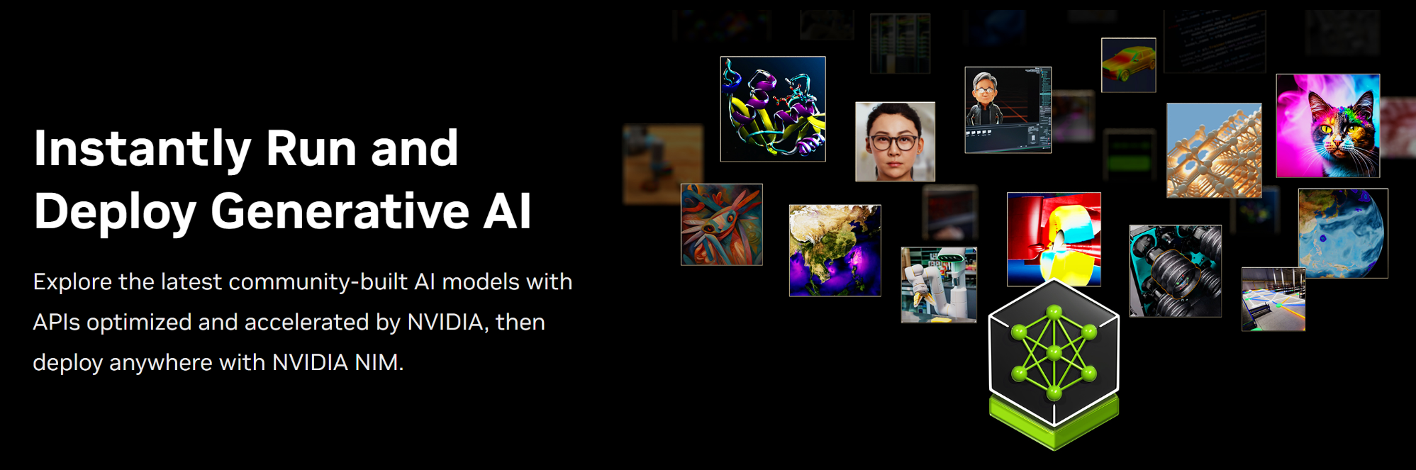
Chat Applications
Full Applications Build with LLMs
Production-Ready APIs That Run Anywhere | NVIDIA
Source: NVIDIA DLI (2024), Building RAG Agents with LLMs, https://learn.nvidia.com/courses/course-detail?course_id=course-v1:DLI+S-FX-15+V1
Notes:
Welcome to our course on Building RAG Agents with LLMs!
Course Topics:
Creating chatbot applications capable of dialogue management and retrieval augmented generation.
We’ll learn to build these pipelines from the ground up using foundation models which can be deployed on your own compute and at scale.
Leveraging current best practices from open-source frameworks like LangChain, as well as enterprise-grade microservice options like NVIDIA NIMs.
(Up Next: Prerequisites)
(After That: Course Objectives/Outline)
(Up Next: Section 1 Title)

Slide 65
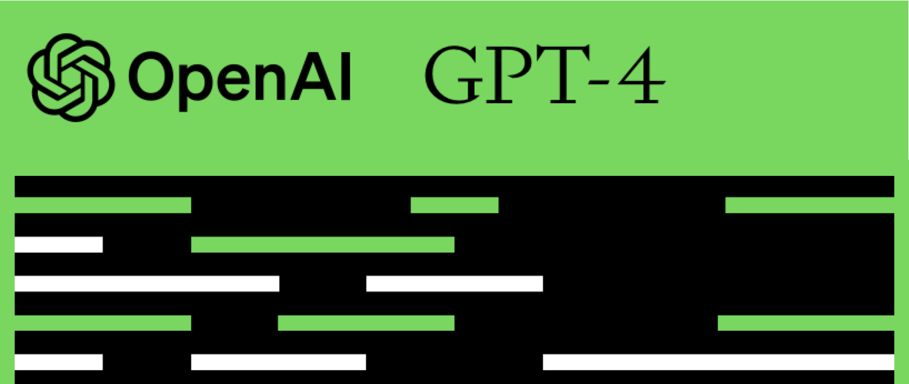
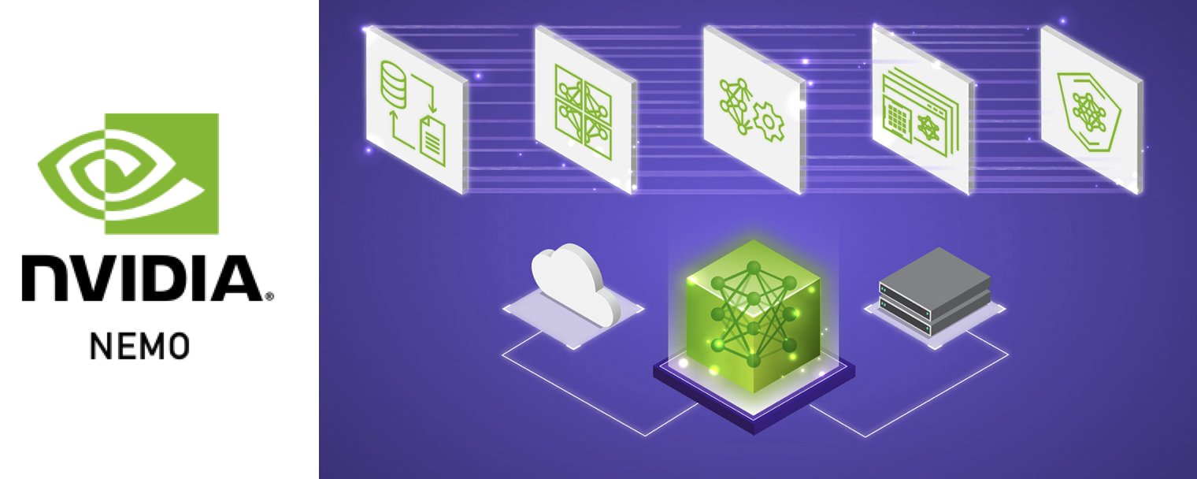
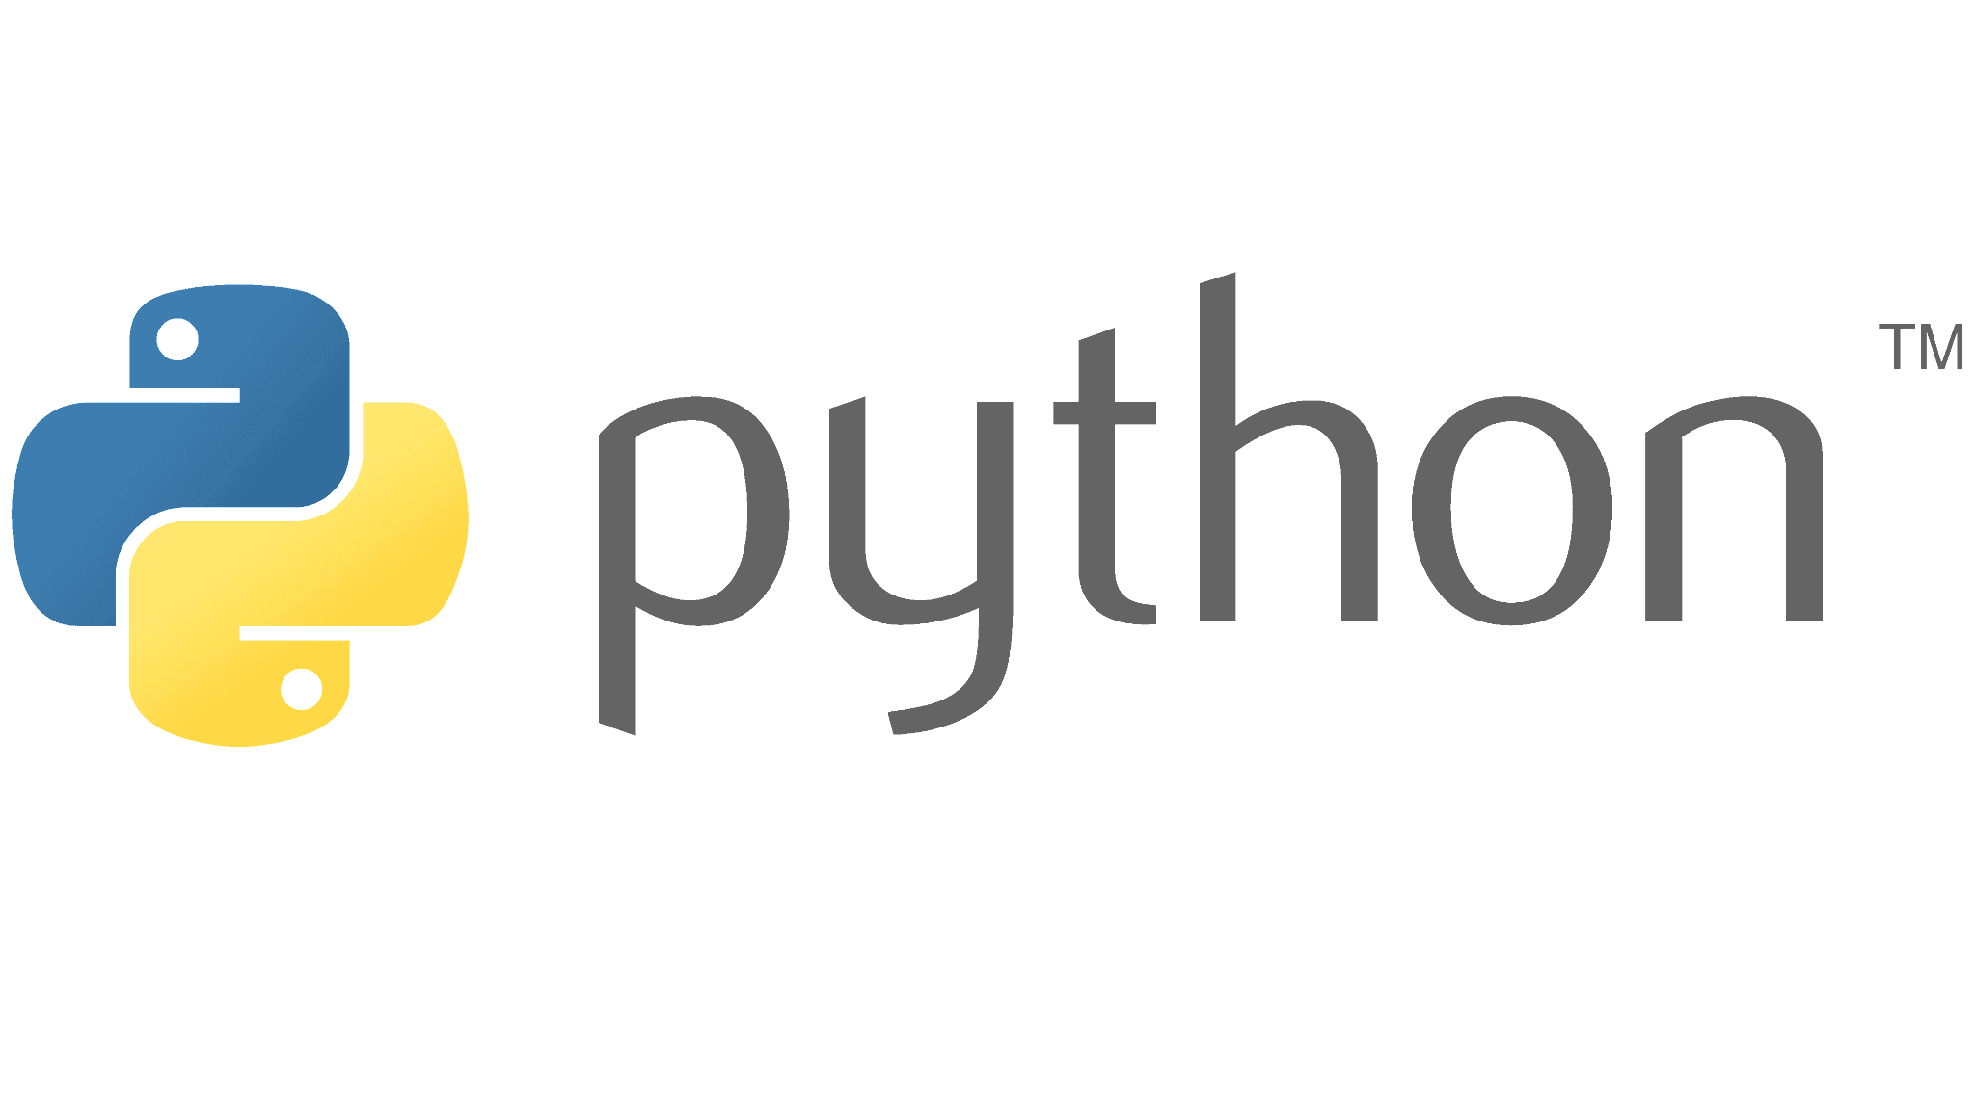
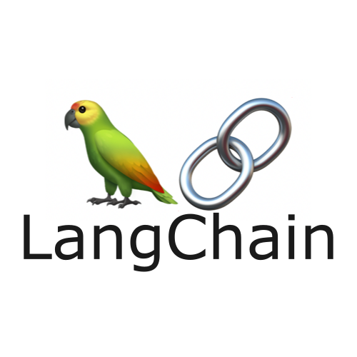
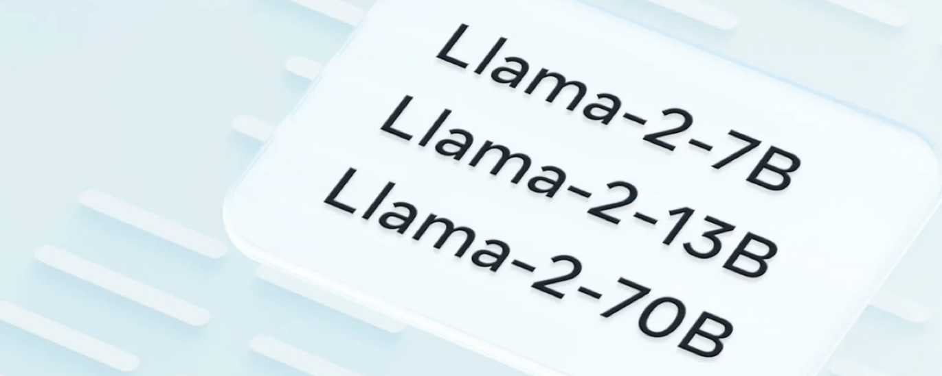

Prerequisites
RAG Agents in Production
Prior LLM/LangChain Exposure
Intermediate Python Experience
Exposure to Web Engineering
Source: NVIDIA DLI (2024), Building RAG Agents with LLMs, https://learn.nvidia.com/courses/course-detail?course_id=course-v1:DLI+S-FX-15+V1
Notes:
(Current: Prerequisites)
(Up Next: Course Objectives/Outline)
(After That: Section 1 Title)

Slide 66
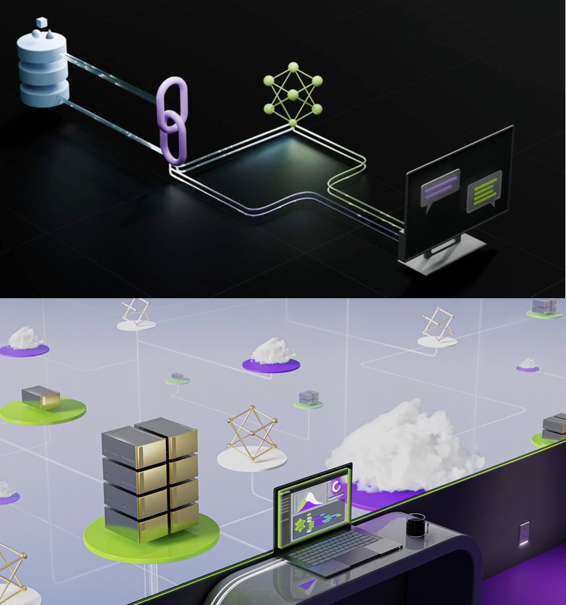
Course Objectives
RAG Agents in Production
Environment
LLM Services
Intro to LangChain (LCEL)
Running State Chains
Document Loading
Embeddings
Document Retrieval
RAG Evaluation
Source: NVIDIA DLI (2024), Building RAG Agents with LLMs, https://learn.nvidia.com/courses/course-detail?course_id=course-v1:DLI+S-FX-15+V1
Notes:
(Previous: Prerequisites)
(Current: Course Objectives/Outline)
(Up Next: Section 1: Your Course Environment)

Slide 67
NVIDIA
Building RAG Agents with LLMs
Part 1: Your Course Environment
Part 2: LLM Services
Part 3: Intro to LangChain
Part 4: Running State Chain
Part 5: Working with Documents
Part 6: Embedding Model for Retrieval
Part 7: Document Retrieval with Vector Databases
Part 8: RAG Evaluation

Slide 68
Building RAG Agents with LLMs
Part 1: Your Course Environment
Source: NVIDIA DLI (2024), Building RAG Agents with LLMs, https://learn.nvidia.com/courses/course-detail?course_id=course-v1:DLI+S-FX-15+V1

Slide 69
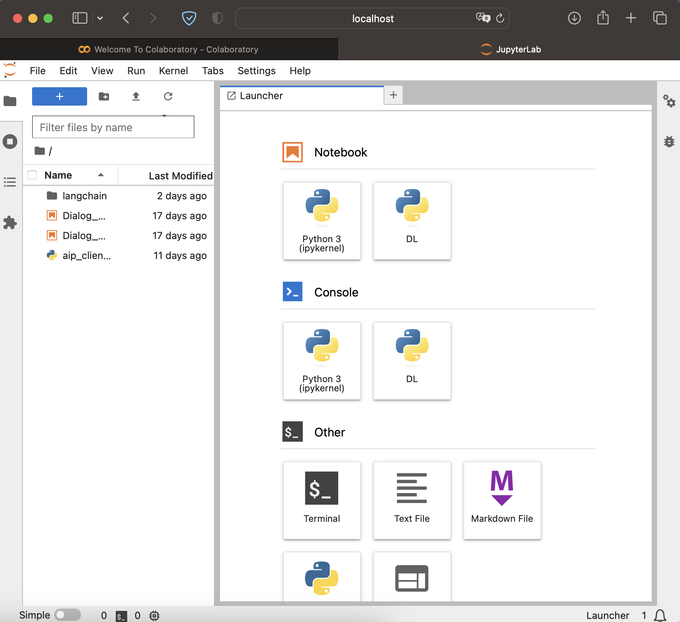
Typical Jupyter Labs Interface
jupyter lab . &; open -a Safari http://localhost:8888/lab
Source: NVIDIA DLI (2024), Building RAG Agents with LLMs, https://learn.nvidia.com/courses/course-detail?course_id=course-v1:DLI+S-FX-15+V1
Notes:
"Once you've launched the course environment, you'll be greeted with the JupyterLab interface.
Can be deployed locally from a system and using your resources. Rely on your hardware and access via your browser.
Can also be launched through a service like Google Colab! Allocates resources for you, and doesn’t rely on your compute!

Slide 70
Typical Jupyter Labs Interface
Your Device
Your Device
Web Browser
Files
Python
OS
C++
Hardware
jupyter lab . &; open -a Safari http://localhost:8888/lab
Source: NVIDIA DLI (2024), Building RAG Agents with LLMs, https://learn.nvidia.com/courses/course-detail?course_id=course-v1:DLI+S-FX-15+V1
Notes:
"Once you've launched the course environment, you'll be greeted with the JupyterLab interface.
Can be deployed locally from your system and using your resources. Rely on your hardware and access via your browser.
(Next slide adds in Jupyter Labs server, which probably stays within your local host scope.)
Can also be launched through a service like Google Colab! Allocates resources for you, and doesn’t rely on your compute!

Slide 71
Typical Jupyter Labs Interface
Your Device
Your Device
Web Browser
:8888
Files
Python
OS
Jupyter Labs
C++
Hardware
jupyter lab . &; open -a Safari http://localhost:8888/lab
Source: NVIDIA DLI (2024), Building RAG Agents with LLMs, https://learn.nvidia.com/courses/course-detail?course_id=course-v1:DLI+S-FX-15+V1
Notes:
"Once you've launched the course environment, you'll be greeted with the JupyterLab interface.
Can be deployed locally from your system and using your resources. Rely on your hardware and access via your browser.
Can also be launched through a service like Google Colab! Allocates resources for you, and doesn’t rely on your compute!

Slide 72
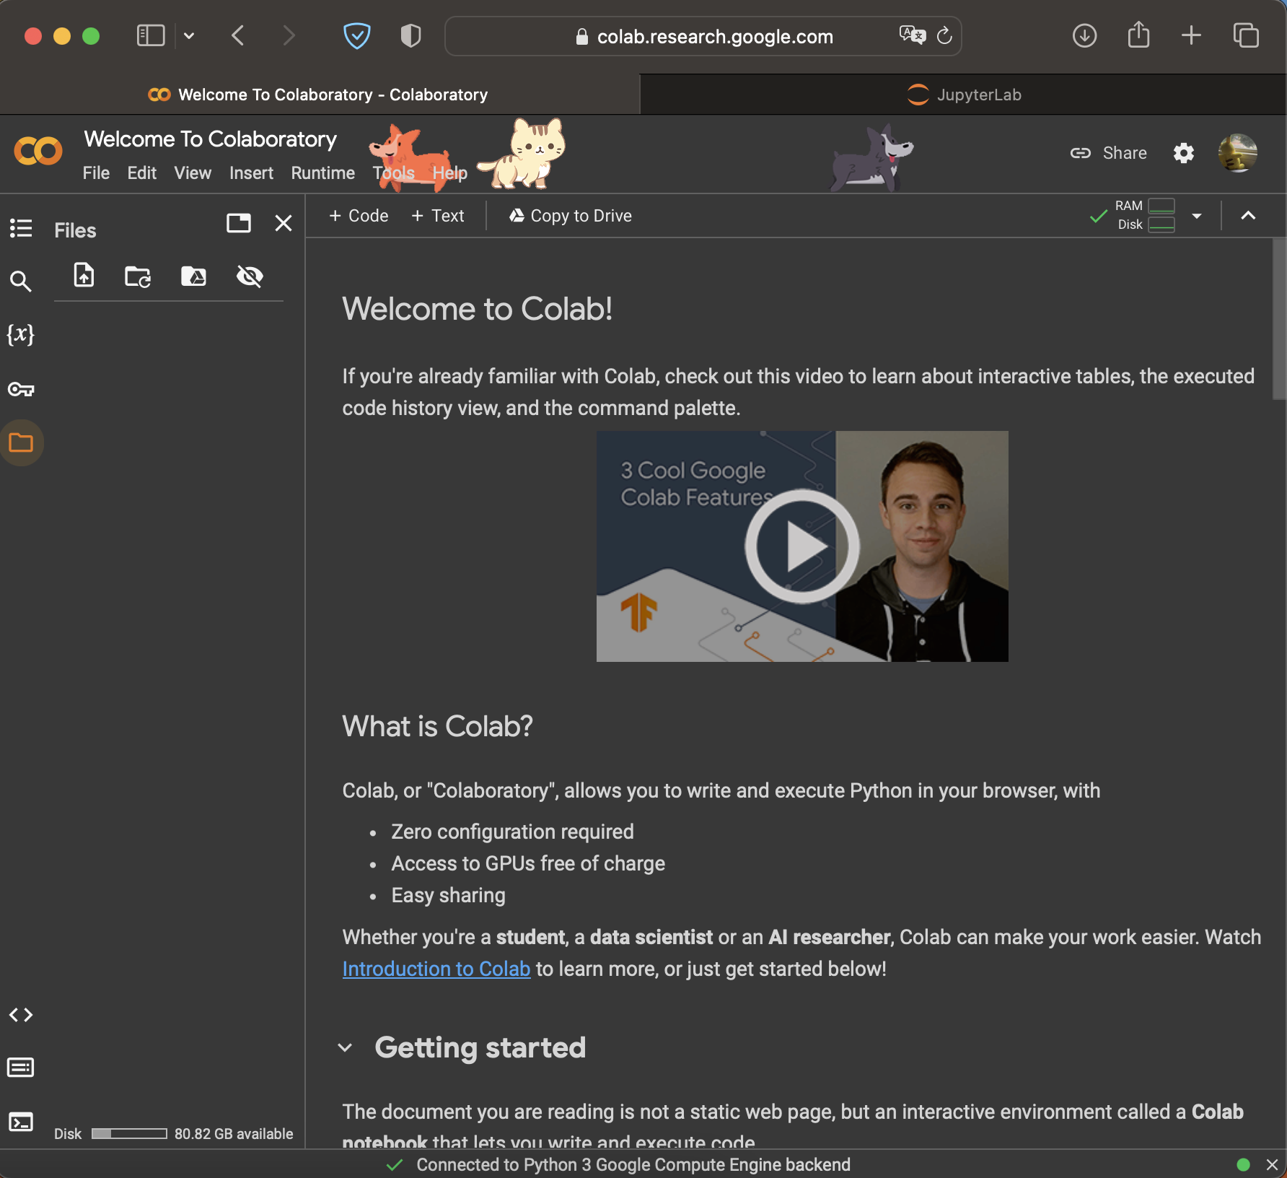
Typical Jupyter Labs Interface
Your Device
Your Device
Web Browser
:8888
Files
Python
OS
Jupyter Labs
C++
Hardware
jupyter lab . &; open -a Safari http://localhost:8888/lab
https://colab.research.google.com
Source: NVIDIA DLI (2024), Building RAG Agents with LLMs, https://learn.nvidia.com/courses/course-detail?course_id=course-v1:DLI+S-FX-15+V1
Notes:
"Once you've launched the course environment, you'll be greeted with the JupyterLab interface.
Can be deployed locally from your system and using your resources. Rely on your hardware and access via your browser.
Can also be launched through a service like Google Colab! Allocates resources for you, and doesn’t rely on your compute!
(Use your computer to coordinate with some allocation system)
(Get yourself access to a GPU-enabled resource from the cloud)

Slide 73
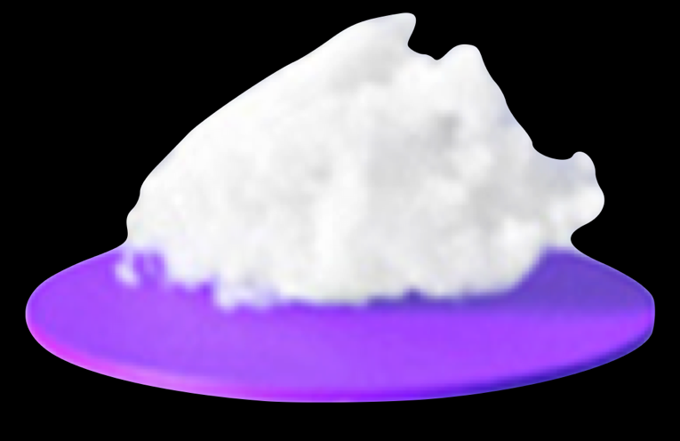
Typical Jupyter Labs Interface
Your Device
Your Device
Web Browser
Your Device
:8888
Web Browser
Files
Python
OS
Jupyter Labs
C++
Hardware
Files
Python
OS
C++
Hardware
jupyter lab . &; open -a Safari http://localhost:8888/lab
https://colab.research.google.com
Source: NVIDIA DLI (2024), Building RAG Agents with LLMs, https://learn.nvidia.com/courses/course-detail?course_id=course-v1:DLI+S-FX-15+V1
Notes:
"Once you've launched the course environment, you'll be greeted with the JupyterLab interface.
Can be deployed locally from your system and using your resources. Rely on your hardware and access via your browser.
Can also be launched through a service like Google Colab! Allocates resources for you, and doesn’t rely on your compute!
(Use your computer to coordinate with some allocation system)
(Get yourself access to a GPU-enabled resource from the cloud)

Slide 74

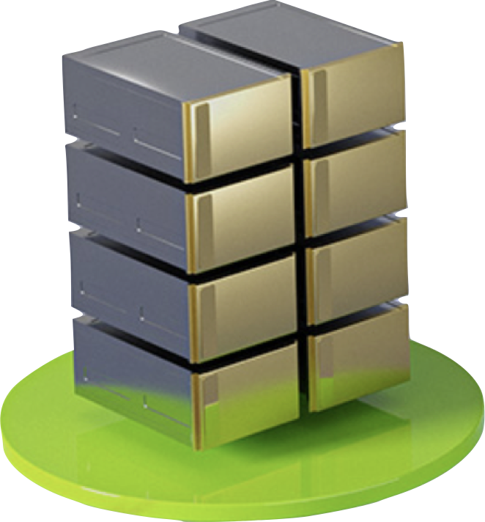
Typical Jupyter Labs Interface
Your Device
Your Device
Web Browser
Your Device
:8888
Web Browser
Files
Python
OS
Jupyter Labs
C++
Hardware
Files
Python
OS
C++
Hardware
jupyter lab . &; open -a Safari http://localhost:8888/lab
https://colab.research.google.com
Source: NVIDIA DLI (2024), Building RAG Agents with LLMs, https://learn.nvidia.com/courses/course-detail?course_id=course-v1:DLI+S-FX-15+V1
Notes:
"Once you've launched the course environment, you'll be greeted with the JupyterLab interface.
Can be deployed locally from your system and using your resources. Rely on your hardware and access via your browser.
Can also be launched through a service like Google Colab! Allocates resources for you, and doesn’t rely on your compute!
(Use your computer to coordinate with some allocation system)
(Get yourself access to a GPU-enabled resource from the cloud)

Slide 75
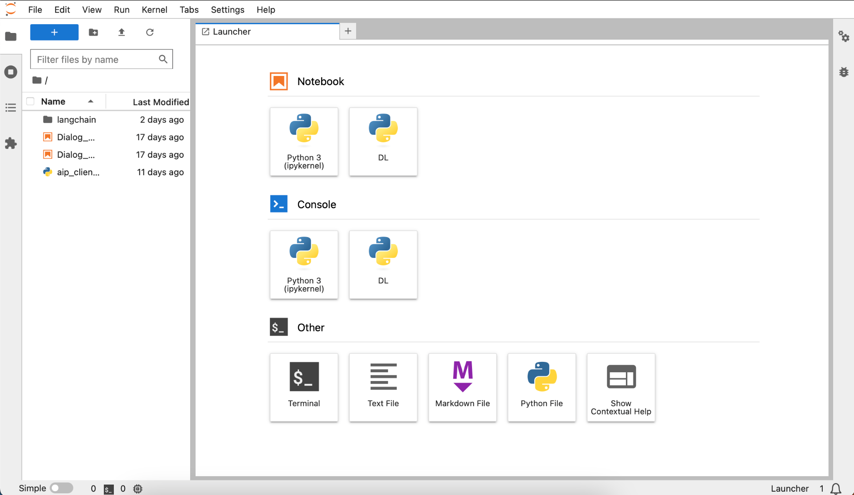
DLI Jupyter Labs Interface
Source: NVIDIA DLI (2024), Building RAG Agents with LLMs, https://learn.nvidia.com/courses/course-detail?course_id=course-v1:DLI+S-FX-15+V1
Notes:
How is this interface actually provided for you?
Compute allocated for you by cloud provider like AWS or Azure. Has some hardware, os, software, etc.
Good to go!!! Except there are other things happening in the background…
Maybe data loader? Maybe proxy server? Metadata tracker? Database connection? Need different software…
Maybe some of the other resources have different requirements? Volume space? Hardware allocation?...
TO HELP SOLVE THIS, WE CAN CONTAINERIZE INTO MICROSERVICES!

Slide 76
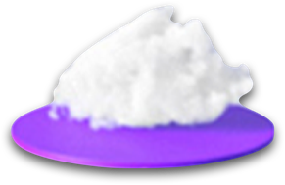

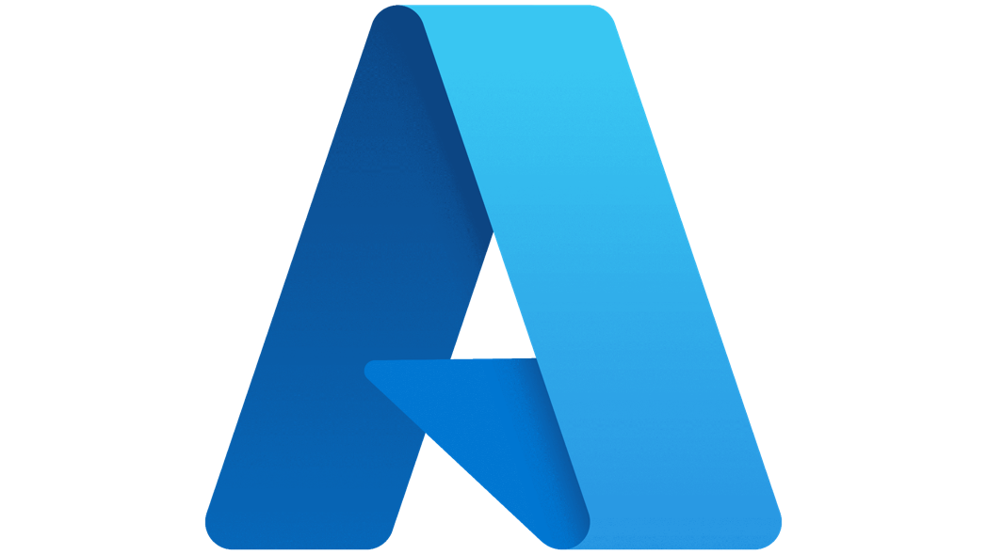
DLI Jupyter Labs Interface
Your Device
Remote Host
Files
Jupyter Labs
Python
OS
C++
Hardware
Your Device
Your Device
Web Browser
Source: NVIDIA DLI (2024), Building RAG Agents with LLMs, https://learn.nvidia.com/courses/course-detail?course_id=course-v1:DLI+S-FX-15+V1
Notes:
How is this interface actually provided for you?
Compute allocated for you by cloud provider like AWS or Azure. Has some hardware, os, software, etc.
Good to go!!! Except there are other things happening in the background…
Maybe data loader? Maybe proxy server? Metadata tracker? Database connection? Need different software…
Maybe some of the other resources have different requirements? Volume space? Hardware allocation?...
TO HELP SOLVE THIS, WE CAN CONTAINERIZE INTO MICROSERVICES!

Slide 77
DLI Jupyter Labs Interface
Your Device
Remote Host
Good to go!
… sort of …
Files
Jupyter Labs
Python
OS
C++
Hardware
Your Device
Your Device
Web Browser
Source: NVIDIA DLI (2024), Building RAG Agents with LLMs, https://learn.nvidia.com/courses/course-detail?course_id=course-v1:DLI+S-FX-15+V1
Notes:
How is this interface actually provided for you?
Compute allocated for you by cloud provider like AWS or Azure. Has some hardware, os, software, etc.
Good to go!!! Except there are other things happening in the background…
Maybe data loader? Maybe proxy server? Metadata tracker? Database connection? Need different software…
Maybe some of the other resources have different requirements? Volume space? Hardware allocation?...
TO HELP SOLVE THIS, WE CAN CONTAINERIZE INTO MICROSERVICES!

Slide 78
DLI Jupyter Labs Interface
Your Device
Remote Host
More Processes?
Python
Data Loader
Scheduler
Proxy Service
Node
Env
Shell
Python
Files
Jupyter Labs
OS
C++
Hardware
Your Device
Your Device
Web Browser
Source: NVIDIA DLI (2024), Building RAG Agents with LLMs, https://learn.nvidia.com/courses/course-detail?course_id=course-v1:DLI+S-FX-15+V1
Notes:
How is this interface actually provided for you?
Compute allocated for you by cloud provider like AWS or Azure. Has some hardware, os, software, etc.
Good to go!!! Except there are other things happening in the background…
Maybe data loader? Maybe proxy server? Metadata tracker? Database connection? Need different software…
Maybe some of the other resources have different requirements? Volume space? Hardware allocation?...
TO HELP SOLVE THIS, WE CAN CONTAINERIZE INTO MICROSERVICES!

Slide 79
DLI Jupyter Labs Interface
Your Device
Remote Host
More Processes?
Python
Data Loader
Scheduler
Proxy Service
Node
Env
Shell
Python
Files
Jupyter Labs
OS
C++
Hardware
Your Device
Your Device
Dividing Resources?
Web Browser
Source: NVIDIA DLI (2024), Building RAG Agents with LLMs, https://learn.nvidia.com/courses/course-detail?course_id=course-v1:DLI+S-FX-15+V1
Notes:
How is this interface actually provided for you?
Compute allocated for you by cloud provider like AWS or Azure. Has some hardware, os, software, etc.
Good to go!!! Except there are other things happening in the background…
Maybe data loader? Maybe proxy server? Metadata tracker? Database connection? Need different software…
Maybe some of the other resources have different requirements? Volume space? Hardware allocation?...
TO HELP SOLVE THIS, WE CAN CONTAINERIZE INTO MICROSERVICES!

Slide 80
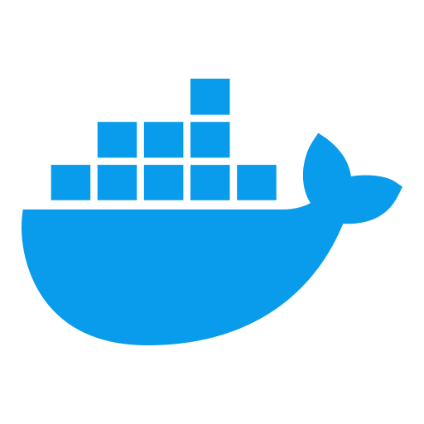
Containerization with Docker
Compartmentalizing Functionality Into Microservices
Your Device
Host
Python
Data Loader
Scheduler
Proxy Service
Node
Env
Shell
Your Device
Python
Files
Host
Jupyter Labs
OS
C++
Hardware
Python
Sh
Volume
:8070
:8888
Volume
Files
:88
Python
OS
Jupyter
GPU/2
C++
Hardware
Source: NVIDIA DLI (2024), Building RAG Agents with LLMs, https://learn.nvidia.com/courses/course-detail?course_id=course-v1:DLI+S-FX-15+V1
Notes:
How is this interface actually provided for you?
Compute allocated for you by cloud provider like AWS or Azure. Has some hardware, os, software, etc.
Good to go!!! Except there are other things happening in the background…
Maybe data loader? Maybe proxy server? Metadata tracker? Database connection? Need different software…
Maybe some of the other resources have different requirements? Volume space? Hardware allocation?...
TO HELP SOLVE THIS, WE CAN CONTAINERIZE INTO MICROSERVICES!
Avoid dependency conflict, allocate resources as necessary, provide connections through server ports!

Slide 81
Microservices Workflow
Your Device
Your Device
Web Browser
Source: NVIDIA DLI (2024), Building RAG Agents with LLMs, https://learn.nvidia.com/courses/course-detail?course_id=course-v1:DLI+S-FX-15+V1
Notes:
What does microservice orchestration look like in practice?
Let’s start with your device, which is telling a service (like DLI?) that you need compute.
DLI will ask AWS/Azure to ALLOCATE RESOURCES for the environment.
Then, DLI will DEFINE the microservices. What they are, how they’re made, what ports they can use. (i.e. docker-compose)
These microservices can then be CONSTRUCTED from a base image. Install packages, move files, download stuff, etc. (i.e. Dockerfile)
Then, perpetual services can be kickstarted in these containers, like servers or endpoints. We now have live microservices!

Slide 82
Microservices Workflow
Your Device
Remote Host
Allocate Resources
Define Services
Construct Containers
Start Processes
Files
Python
OS
C++
Hardware
Your Device
Your Device
Web Browser
Source: NVIDIA DLI (2024), Building RAG Agents with LLMs, https://learn.nvidia.com/courses/course-detail?course_id=course-v1:DLI+S-FX-15+V1
Notes:
What does microservice orchestration look like in practice?
Let’s start with your device, which is telling a service (like DLI?) that you need compute.
DLI will ask AWS/Azure to ALLOCATE RESOURCES for the environment.
Then, DLI will DEFINE the microservices. What they are, how they’re made, what ports they can use. (i.e. docker-compose)
These microservices can then be CONSTRUCTED from a base image. Install packages, move files, download stuff, etc. (i.e. Dockerfile)
Then, perpetual services can be kickstarted in these containers, like servers or endpoints. We now have live microservices!

Slide 83
Microservices Workflow
Your Device
Remote Host
Allocate Resources
Define Services
Construct Containers
Start Processes
Python
Sh
Volume
:8070
:8888
Volume
Files
:88
Python
OS
Jupyter
GPU/2
C++
Hardware
Your Device
Your Device
Web Browser
Source: NVIDIA DLI (2024), Building RAG Agents with LLMs, https://learn.nvidia.com/courses/course-detail?course_id=course-v1:DLI+S-FX-15+V1
Notes:
What does microservice orchestration look like in practice?
Let’s start with your device, which is telling a service (like DLI?) that you need compute.
DLI will ask AWS/Azure to ALLOCATE RESOURCES for the environment.
Then, DLI will DEFINE the microservices. What they are, how they’re made, what ports they can use. (i.e. docker-compose)
These microservices can then be CONSTRUCTED from a base image. Install packages, move files, download stuff, etc. (i.e. Dockerfile)
Then, perpetual services can be kickstarted in these containers, like servers or endpoints. We now have live microservices!

Slide 84
Microservices Workflow
Your Device
Remote Host
Allocate Resources
Define Services
Construct Containers
Start Processes
Database Environment
Data Loader
:8070
:8888
Jupyter Notebook Environment
Files
:88
Python
OS
C++
Hardware
Your Device
Your Device
Web Browser
Source: NVIDIA DLI (2024), Building RAG Agents with LLMs, https://learn.nvidia.com/courses/course-detail?course_id=course-v1:DLI+S-FX-15+V1
Notes:
What does microservice orchestration look like in practice?
Let’s start with your device, which is telling a service (like DLI?) that you need compute.
DLI will ask AWS/Azure to ALLOCATE RESOURCES for the environment.
Then, DLI will DEFINE the microservices. What they are, how they’re made, what ports they can use. (i.e. docker-compose)
These microservices can then be CONSTRUCTED from a base image. Install packages, move files, download stuff, etc. (i.e. Dockerfile)
Then, perpetual services can be kickstarted in these containers, like servers or endpoints. We now have live microservices!

Slide 85
Microservices Workflow
Your Device
Remote Host
Allocate Resources
Define Services
Construct Containers
Start Processes
Database Environment
Data Loader
:8070
:8888
Jupyter Notebook Environment
Files
:88
Python
OS
C++
Hardware
Your Device
Your Device
Web Browser
Source: NVIDIA DLI (2024), Building RAG Agents with LLMs, https://learn.nvidia.com/courses/course-detail?course_id=course-v1:DLI+S-FX-15+V1
Notes:
What does microservice orchestration look like in practice?
Let’s start with your device, which is telling a service (like DLI?) that you need compute.
DLI will ask AWS/Azure to ALLOCATE RESOURCES for the environment.
Then, DLI will DEFINE the microservices. What they are, how they’re made, what ports they can use. (i.e. docker-compose)
These microservices can then be CONSTRUCTED from a base image. Install packages, move files, download stuff, etc. (i.e. Dockerfile)
Then, perpetual services can be kickstarted in these containers, like servers or endpoints. We now have live microservices!
Why bother setting things up this way though?
…

Slide 86
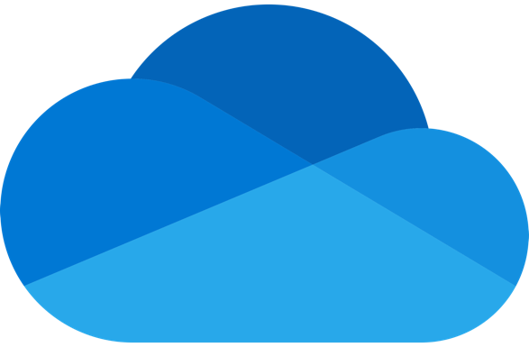
Scaling Containerized Applications
Company
Database
Your Device
GenAI
Service
Arbitrary Host
Database Environment
Data Loader
:8070
:8888
Jupyter Notebook Environment
Files
Python
OS
C++
Hardware
Your Device
Your Device
Web Browser
Your Device
Your Device
Other Devices
Your Device
Other Devices
Your Device
Web Browser
Other Devices
Web Browser
Other Devices
Web Browser
Web Browser
Source: NVIDIA DLI (2024), Building RAG Agents with LLMs, https://learn.nvidia.com/courses/course-detail?course_id=course-v1:DLI+S-FX-15+V1
Notes:
What does microservice orchestration look like in practice?
…
Why bother setting things up this way though?
Turns out, creating services that communicate over ports makes it simple to move stuff around! (next slide shows connections)
You can move services off your device and into the cloud, or can move processes towards edge devices without too much trouble!

Slide 87
Scaling Containerized Applications
Company
Database
Your Device
GenAI
Service
Arbitrary Host
Database Environment
Data Loader
:8070
:8888
Jupyter Notebook Environment
Files
Python
OS
C++
Hardware
Your Device
Your Device
Your Device
Your Device
Your Device
Web Browser
Your Device
Your Device
Other Devices
Your Device
Other Devices
Your Device
Web Browser
Other Devices
Web Browser
Other Devices
Web Browser
Web Browser
Source: NVIDIA DLI (2024), Building RAG Agents with LLMs, https://learn.nvidia.com/courses/course-detail?course_id=course-v1:DLI+S-FX-15+V1
Notes:
What does microservice orchestration look like in practice?
…
Why bother setting things up this way though?
Turns out, creating services that communicate over ports makes it simple to move stuff around! (next slide shows connections)
You can move services off your device and into the cloud, or move processes towards edge devices without too much trouble!
So, let’s get back to our own environment! So far, we know we have our Jupyter Labs interface, but what else?

Slide 88
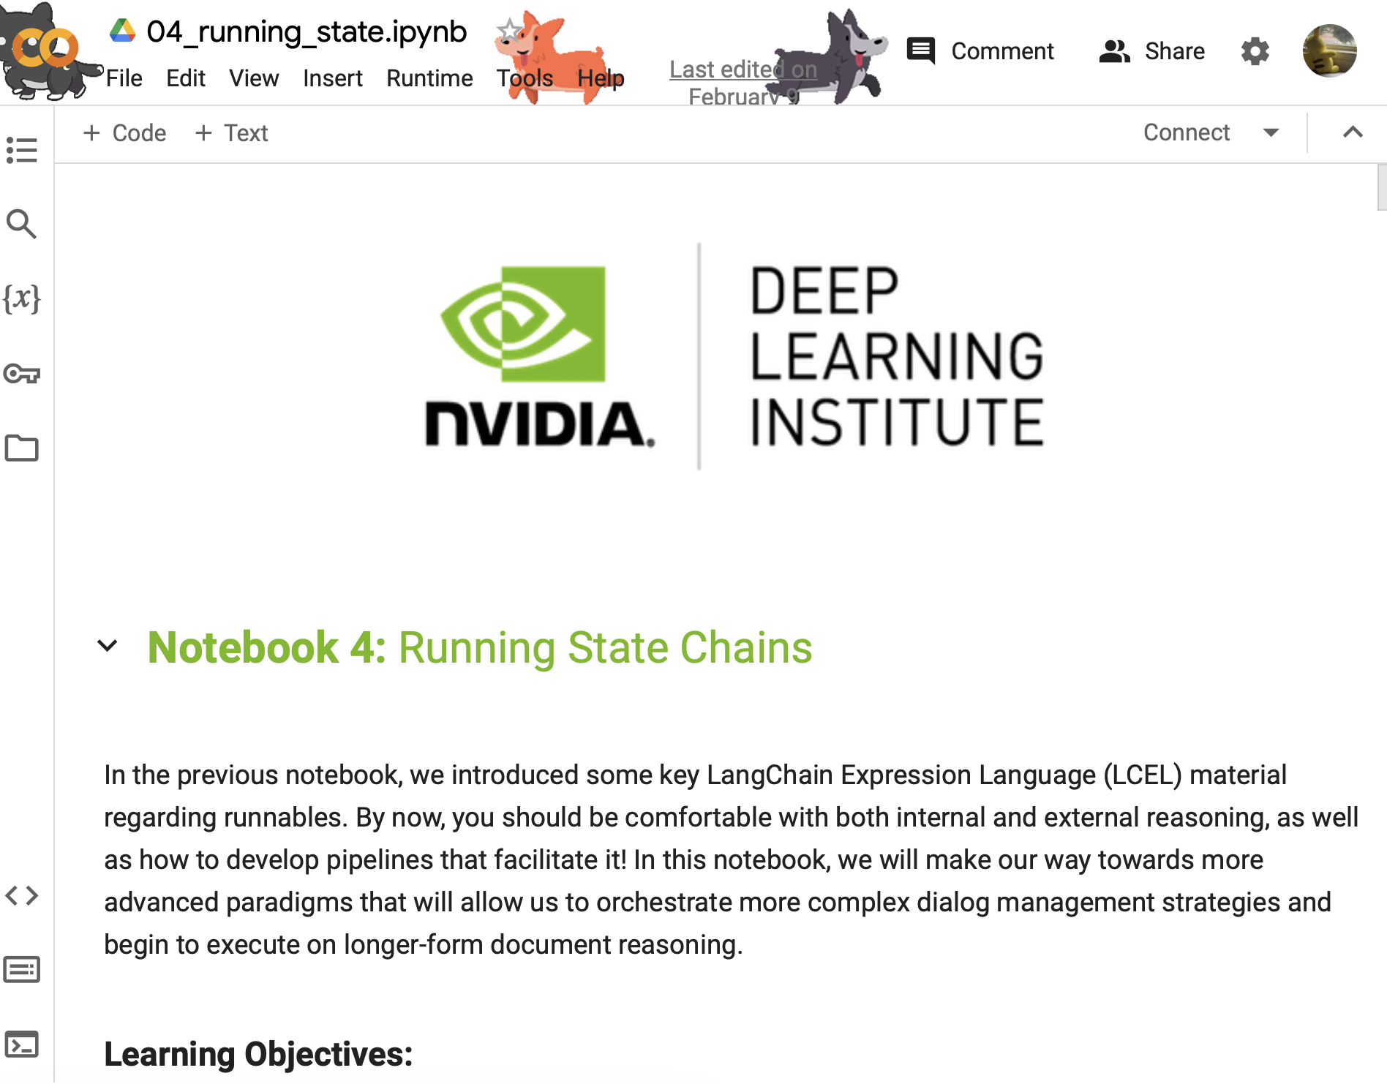
Our Environment
Jupyter Notebooks
Your Device
Remote Host
Docker
Router
Jupyter Notebook Server
:88
Source: NVIDIA DLI (2024), Building RAG Agents with LLMs, https://learn.nvidia.com/courses/course-detail?course_id=course-v1:DLI+S-FX-15+V1
Notes:
What does microservice orchestration look like in practice?
So, let’s get back to our own environment! So far, we know we have our Jupyter Labs interface, but what else?
In the lab, you’ll find out about the frontend microservice, which is already hosted on port 8090.

Slide 89
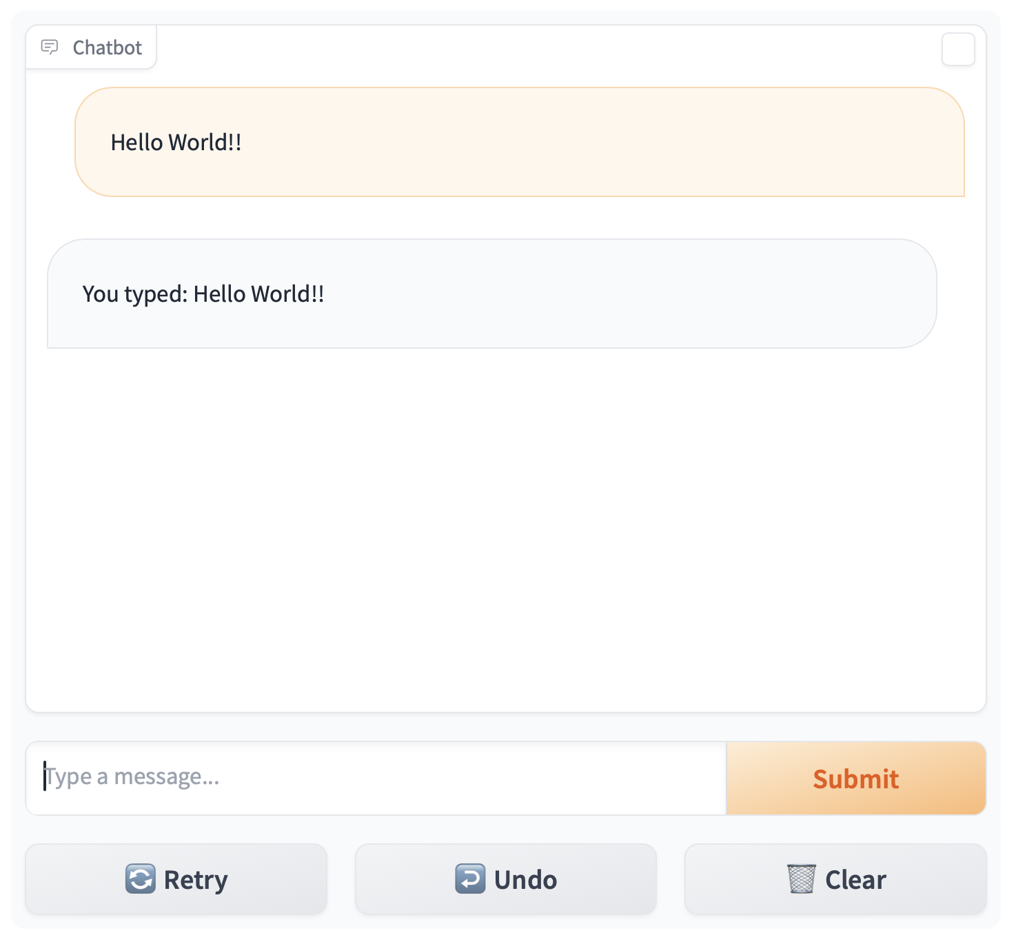
Our Environment
Jupyter Notebooks + Frontend
Your Device
Remote Host
:8090
Frontend
Docker
Router
Jupyter Notebook Server
:88
Source: NVIDIA DLI (2024), Building RAG Agents with LLMs, https://learn.nvidia.com/courses/course-detail?course_id=course-v1:DLI+S-FX-15+V1
Notes:
What does microservice orchestration look like in practice?
So, let’s get back to our own environment! So far, we know we have our Jupyter Labs interface, but what else?
In the lab, you’ll find out about the frontend microservice, which is already hosted on port 8090.
This frontend is hosted in Gradio, an open-source web interface design library well-suited for presenting AI models.

Slide 90
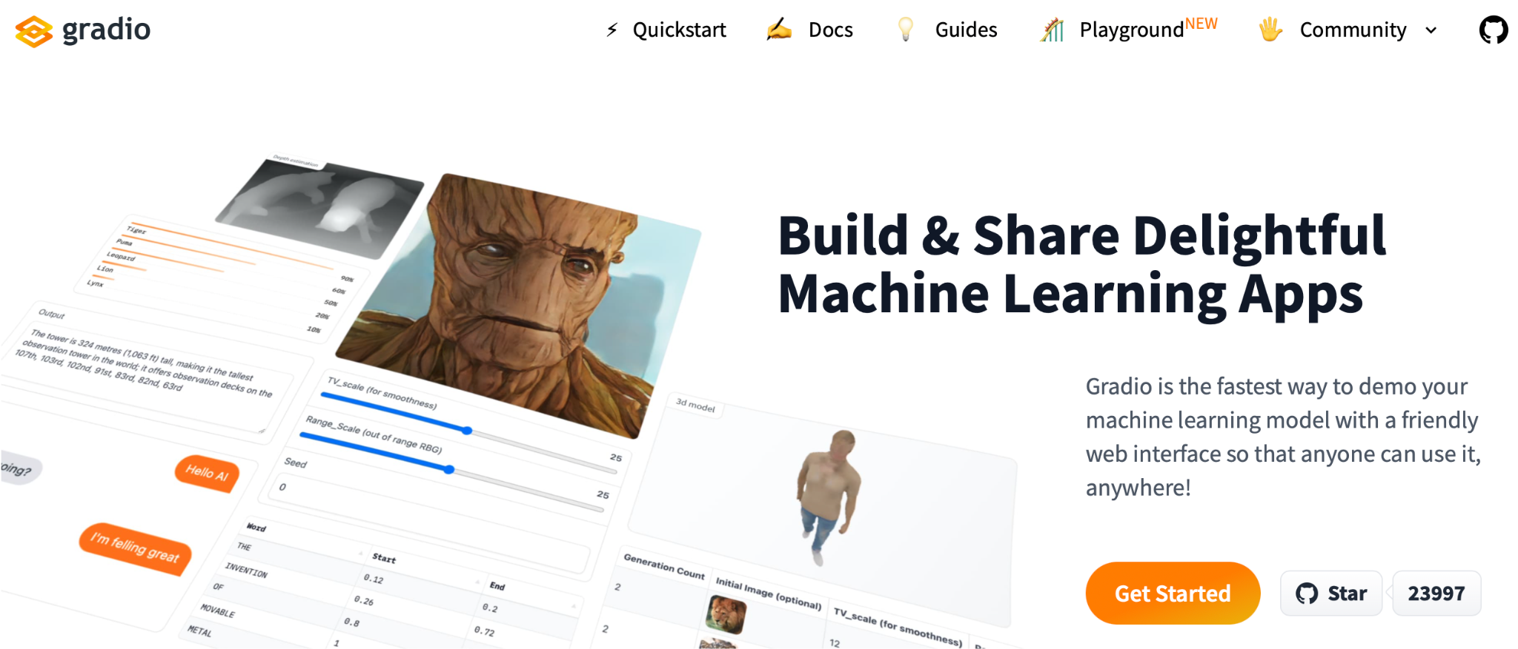
Gradio
Source: NVIDIA DLI (2024), Building RAG Agents with LLMs, https://learn.nvidia.com/courses/course-detail?course_id=course-v1:DLI+S-FX-15+V1
Notes:
What does microservice orchestration look like in practice?
So, let’s get back to our own environment! So far, we know we have our Jupyter Labs interface, but what else?
In the lab, you’ll find out about the frontend microservice, which is already hosted on port 8090.
This frontend is hosted in Gradio, an open-source web interface design library well-suited for presenting AI models.
1. Simple interface: slow_echo is being ran in a loop
2. More involved interface example from huggingface spaces, which anybody can contribute to
3. A more involved interface, which is closer to what is available/running in environment. See ./frontent/server_app.py

Slide 91
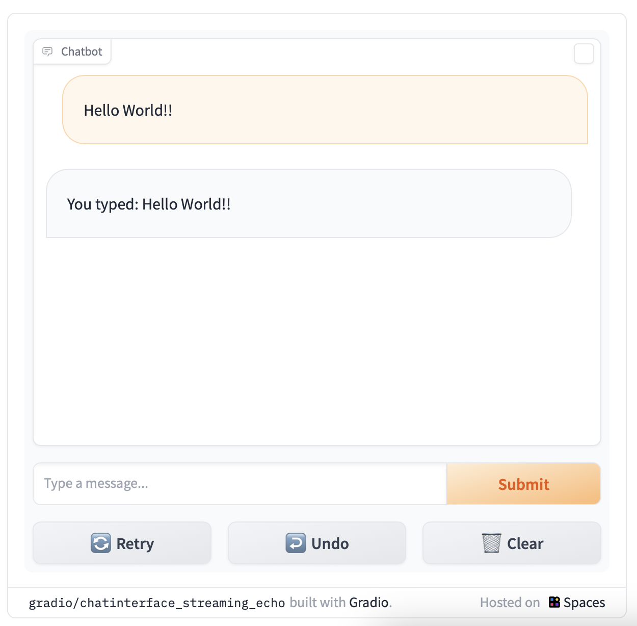
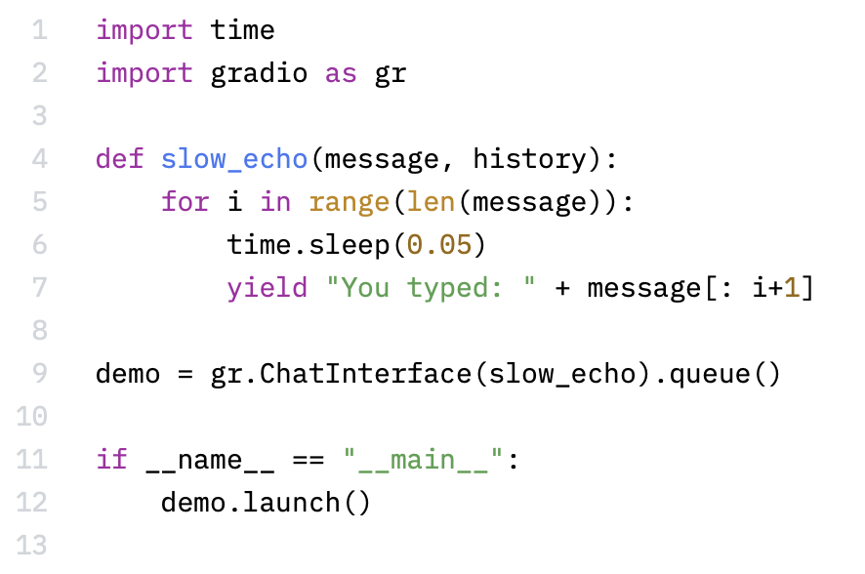
Simple Gradio ChatInterface
https://www.gradio.app/
https://huggingface.co/spaces/gradio/chatinterface_streaming_echo/blob/main/run.py
Source: NVIDIA DLI (2024), Building RAG Agents with LLMs, https://learn.nvidia.com/courses/course-detail?course_id=course-v1:DLI+S-FX-15+V1
Notes:
What does microservice orchestration look like in practice?
So, let’s get back to our own environment! So far, we know we have our Jupyter Labs interface, but what else?
In the lab, you’ll find out about the frontend microservice, which is already hosted on port 8090.
This frontend is hosted in Gradio, an open-source web interface design library well-suited for presenting AI models.
1. Simple interface: slow_echo is being ran in a loop
2. More involved interface example from huggingface spaces, which anybody can contribute to
3. A more involved interface, which is closer to what is available/running in environment. See ./frontent/server_app.py

Slide 92
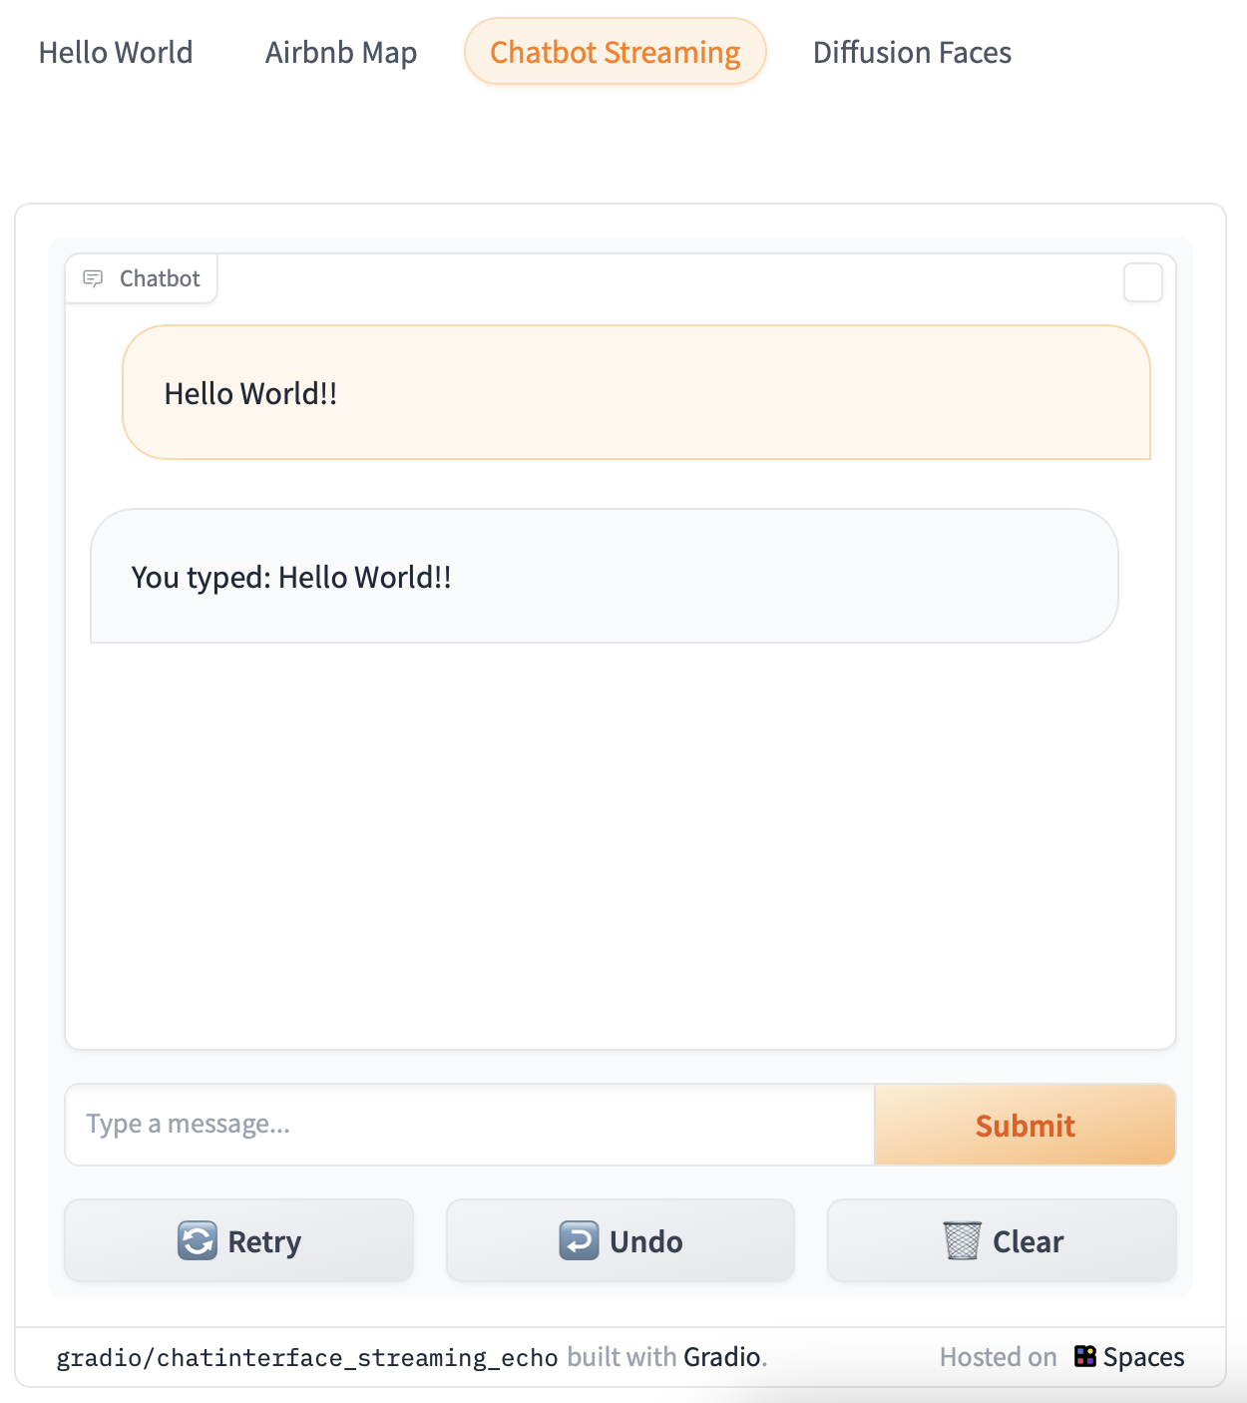
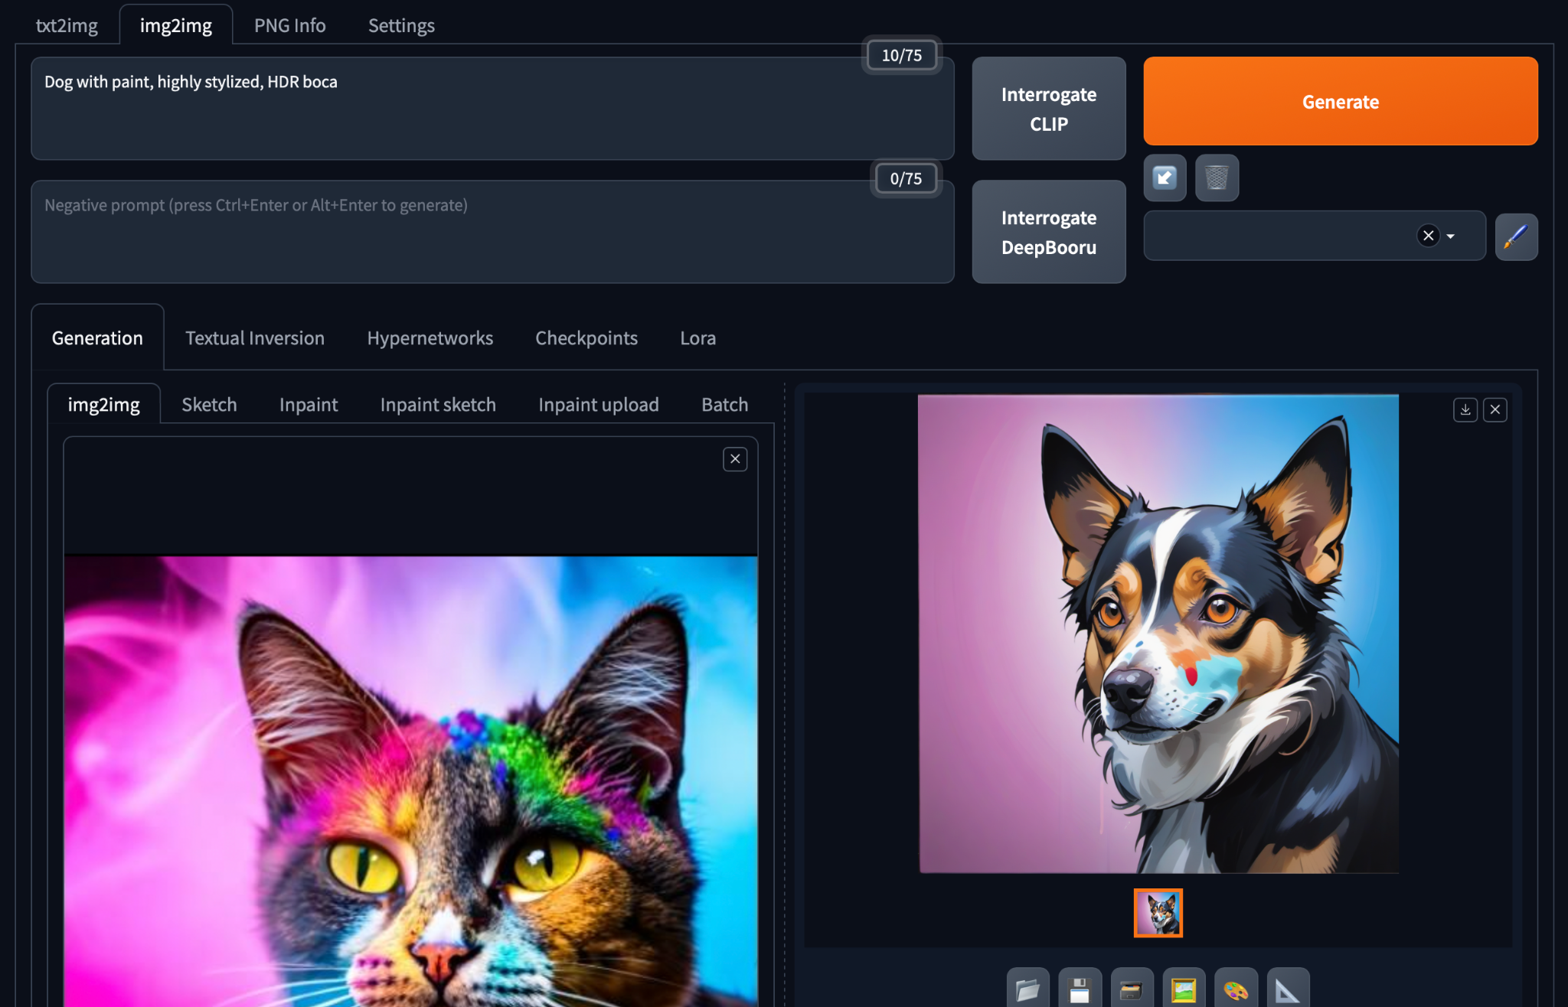
Gradio in HuggingFace Spaces
https://huggingface.co/spaces/camenduru-com/webui
Source: NVIDIA DLI (2024), Building RAG Agents with LLMs, https://learn.nvidia.com/courses/course-detail?course_id=course-v1:DLI+S-FX-15+V1
Notes:
What does microservice orchestration look like in practice?
So, let’s get back to our own environment! So far, we know we have our Jupyter Labs interface, but what else?
In the lab, you’ll find out about the frontend microservice, which is already hosted on port 8090.
This frontend is hosted in Gradio, an open-source web interface design library well-suited for presenting AI models.
1. Simple interface: slow_echo is being ran in a loop
2. More involved interface example from huggingface spaces, which anybody can contribute to
3. A more involved interface, which is closer to what is available/running in environment. See ./frontent/server_app.py

Slide 93
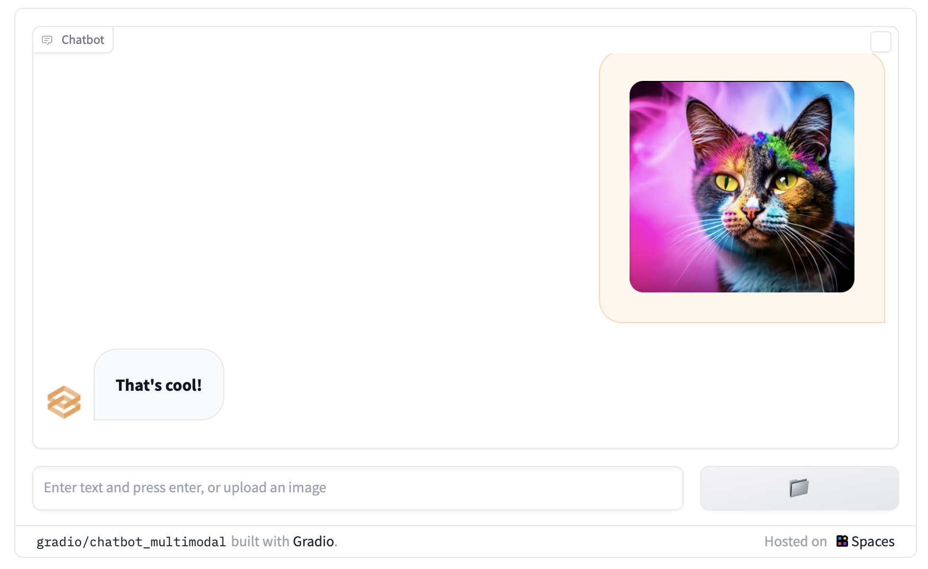
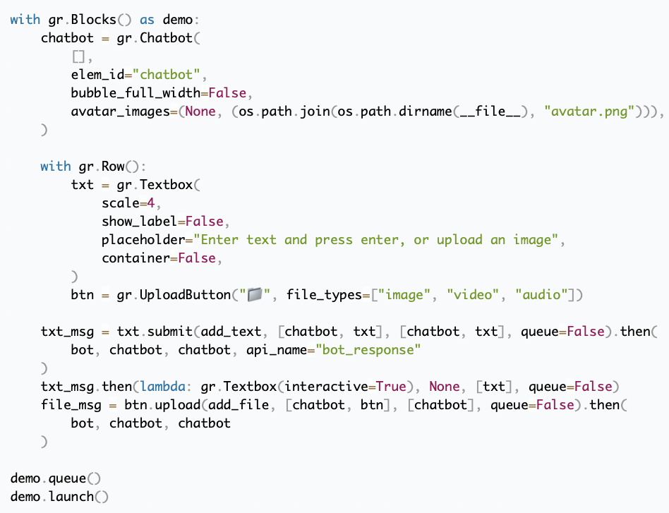
Custom Gradio Block Interface
https://www.gradio.app/guides/creating-a-custom-chatbot-with-blocks
Source: NVIDIA DLI (2024), Building RAG Agents with LLMs, https://learn.nvidia.com/courses/course-detail?course_id=course-v1:DLI+S-FX-15+V1
Notes:
What does microservice orchestration look like in practice?
So, let’s get back to our own environment! So far, we know we have our Jupyter Labs interface, but what else?
In the lab, you’ll find out about the frontend microservice, which is already hosted on port 8090.
This frontend is hosted in Gradio, an open-source web interface design library well-suited for presenting AI models.
1. Simple interface: slow_echo is being ran in a loop
2. More involved interface example from huggingface spaces, which anybody can contribute to
3. A more involved interface, which is closer to what is available/running in environment. See ./frontent/server_app.py

Slide 94
Our Environment
Jupyter Notebooks + Frontend
Your Device
Remote Host
:8090
Frontend
Docker
Router
Jupyter Notebook Server
:88
Source: NVIDIA DLI (2024), Building RAG Agents with LLMs, https://learn.nvidia.com/courses/course-detail?course_id=course-v1:DLI+S-FX-15+V1
Notes:
So that’s it!
Frontend interface already running on port :8090. To see details, check out ./frontend
Jupyter notebook running on port :88. To see details, check out ./composer
(Next Section: We’ll talk about the LLM-serving microservice)
Enjoy the lab!

Slide 95
NVIDIA
Building RAG Agents with LLMs
Part 1: Your Course Environment
Part 2: LLM Services
Part 3: Intro to LangChain
Part 4: Running State Chain
Part 5: Working with Documents
Part 6: Embedding Model for Retrieval
Part 7: Document Retrieval with Vector Databases
Part 8: RAG Evaluation

Slide 96
Building RAG Agents with LLMs
Part 2: LLM Services
Source: NVIDIA DLI (2024), Building RAG Agents with LLMs, https://learn.nvidia.com/courses/course-detail?course_id=course-v1:DLI+S-FX-15+V1

Slide 97
Our Environment
Jupyter Notebooks + Frontend
Your Device
Remote Host
:8090
Frontend
Docker
Router
Jupyter Notebook Server
:88
Source: NVIDIA DLI (2024), Building RAG Agents with LLMs, https://learn.nvidia.com/courses/course-detail?course_id=course-v1:DLI+S-FX-15+V1
Notes:
So we have our environment, and we can use it to run some Python…
but wasn’t the point of this course to learn about chatbots and agents and RAG?
So where’s the LLM?
Well, if we don’t have a microservice for it…
…perhaps we can just pull in an LLM directly into our Jupyter notebook session and go from there!

Slide 98
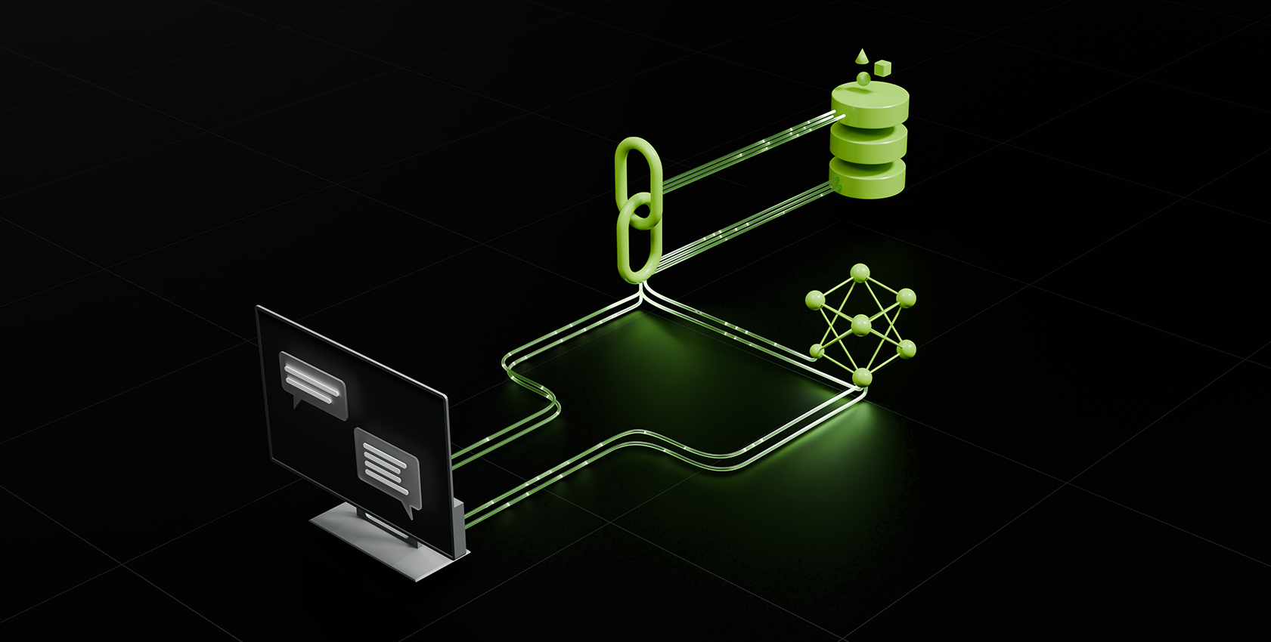
Dialog/Retrieval Agents
LLMs with Context and Control
Execute with dialog management and information retrieval in production
https://www.nvidia.com/content/dam/en-zz/Solutions/lp/large-language-models-ebook/nvidia-llm-ebook-og.jpg
Source: NVIDIA DLI (2024), Building RAG Agents with LLMs, https://learn.nvidia.com/courses/course-detail?course_id=course-v1:DLI+S-FX-15+V1
Notes:
So we have our environment, and we can use it to run some Python…
but wasn’t the point of this course to learn about chatbots and agents and RAG?
So where’s the LLM?
Well, if we don’t have a microservice for it…
…perhaps we can just pull in an LLM directly into our Jupyter notebook session and go from there!

Slide 99
Dialog/Retrieval Agents
LLMs with Context and Control
Execute with dialog management and information retrieval in production
https://www.nvidia.com/content/dam/en-zz/Solutions/lp/large-language-models-ebook/nvidia-llm-ebook-og.jpg
Source: NVIDIA DLI (2024), Building RAG Agents with LLMs, https://learn.nvidia.com/courses/course-detail?course_id=course-v1:DLI+S-FX-15+V1
Notes:
So we have our environment, and we can use it to run some Python…
but wasn’t the point of this course to learn about chatbots and agents and RAG?
So where’s the LLM?
Well, if we don’t have a microservice for it…
…perhaps we can just pull in an LLM directly into our Jupyter notebook session and go from there!

Slide 100
Standalone Environment LLM
Your Device
Remote Host
Frontend
Docker
Router
Jupyter Notebook Server
Source: NVIDIA DLI (2024), Building RAG Agents with LLMs, https://learn.nvidia.com/courses/course-detail?course_id=course-v1:DLI+S-FX-15+V1
Notes:
So we have our environment, and we can use it to run some Python…
but wasn’t the point of this course to learn about chatbots and agents and RAG?
So where’s the LLM?
Well, if we don’t have a microservice for it…
…perhaps we can just pull in an LLM directly into our Jupyter notebook session and go from there!

Slide 101
Standalone Environment LLM
Your Device
Remote Host
Frontend
Docker
Router
Jupyter Notebook Server
LLM
Source: NVIDIA DLI (2024), Building RAG Agents with LLMs, https://learn.nvidia.com/courses/course-detail?course_id=course-v1:DLI+S-FX-15+V1
Notes:
So we have our environment, and we can use it to run some Python…
but wasn’t the point of this course to learn about chatbots and agents and RAG?
So where’s the LLM?
Well, if we don’t have a microservice for it…
…perhaps we can just pull in an LLM directly into our Jupyter notebook session and go from there!

Slide 102
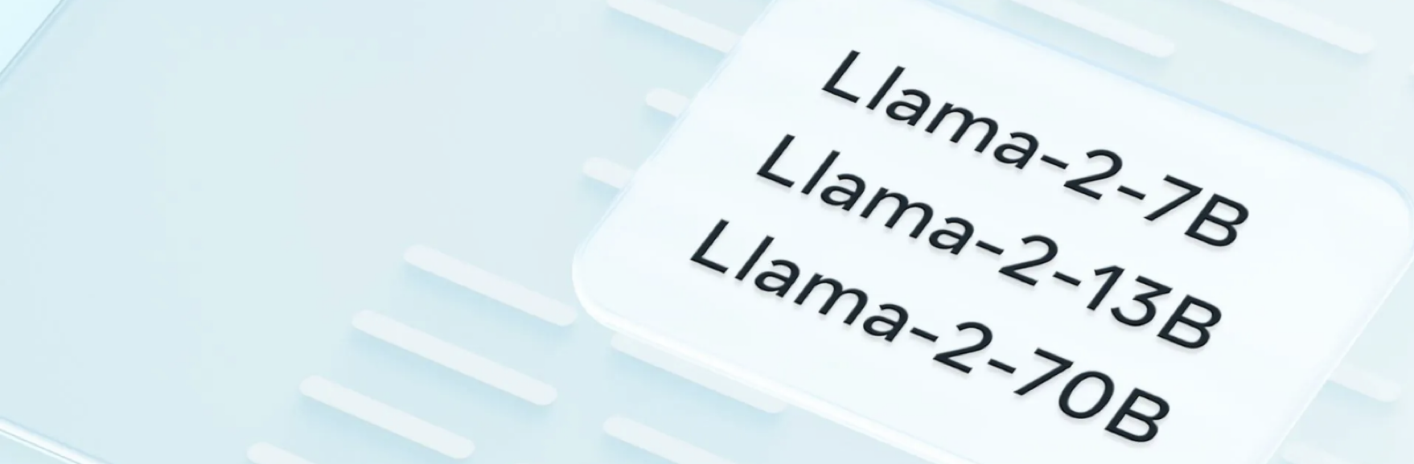
Standalone Environment LLM
Jupyter Notebook
H200
A100
Jupyter Notebook
A10
4070
<s>[INST]<<SYS>>
{{system_message}}
<</SYS>>
{{instruction}} [/INST] {{primer}}
Jupyter Notebook
<s>[INST]<<SYS>>
You are a code generator.
Please provide Python code
per the instruction.
<</SYS>>
Write a Fibonacci method [/INST] ```python
## Implementation of Fibonacci w/
VRAM-bound
CPU-only
Source: NVIDIA DLI (2024), Building RAG Agents with LLMs, https://learn.nvidia.com/courses/course-detail?course_id=course-v1:DLI+S-FX-15+V1
Notes:
Datacenter Compute Environment: We’d be able to pull in one or more large models and run them without too much compromises.
This kind of environment is great for exclusive access to models for experimentation and fine-tuning, and is also great for running instances perpetually for delivery to many users. Pretty costly on a per-user basis.
Lighter Datacenter/High-End Consumer Environment: We’d probably still be able to pull in some smaller models or maybe one large model to use with some compromises.
Would need to quantize and conserve resources, but can still scale to some users and have some access to the raw models.
Typical Consumer Device: Problematic to run large models without some severe compromises. Can still be done, but limited interfaces.
Good to follow minimum device spec assumption of “I can run stuff in a browser”

Slide 103
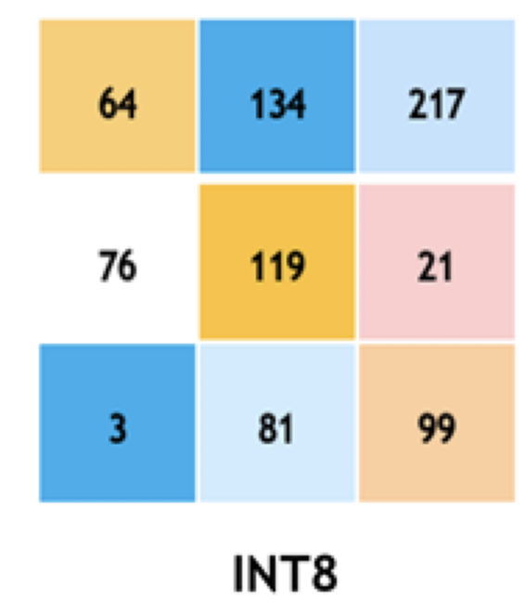
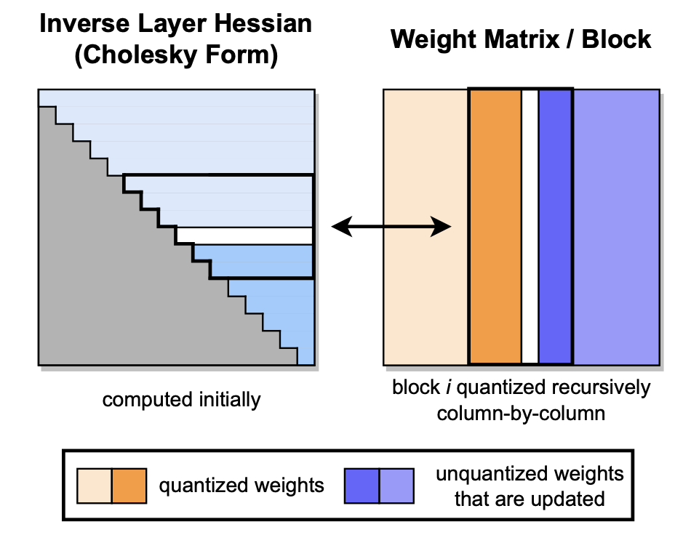
Standalone Environment LLM
Jupyter Notebook
H200
A100
Jupyter Notebook
A10
4070
Jupyter Notebook
VRAM-bound
CPU-only
Source: NVIDIA DLI (2024), Building RAG Agents with LLMs, https://learn.nvidia.com/courses/course-detail?course_id=course-v1:DLI+S-FX-15+V1
Notes:
Datacenter Compute Environment: We’d be able to pull in one or more large models and run them without too much compromises.
This kind of environment is great for exclusive access to models for experimentation and fine-tuning, and is also great for running instances perpetually for delivery to many users. Pretty costly on a per-user basis.
Lighter Datacenter/High-End Consumer Environment: We’d probably still be able to pull in some smaller models or maybe one large model to use with some compromises.
Would need to quantize and conserve resources, but can still scale to some users and have some access to the raw models.
Typical Consumer Device: Problematic to run large models without some severe compromises. Can still be done, but limited interfaces.
Good to follow minimum device spec assumption of “I can run stuff in a browser”

Slide 104
Standalone Environment LLM
Jupyter Notebook
H200
A100
Jupyter Notebook
A10
4070
Jupyter Notebook
VRAM-bound
CPU-only
Source: NVIDIA DLI (2024), Building RAG Agents with LLMs, https://learn.nvidia.com/courses/course-detail?course_id=course-v1:DLI+S-FX-15+V1
Notes:
Datacenter Compute Environment: We’d be able to pull in one or more large models and run them without too much compromises.
This kind of environment is great for exclusive access to models for experimentation and fine-tuning, and is also great for running instances perpetually for delivery to many users. Pretty costly on a per-user basis.
Lighter Datacenter/High-End Consumer Environment: We’d probably still be able to pull in some smaller models or maybe one large model to use with some compromises.
Would need to quantize and conserve resources, but can still scale to some users and have some access to the raw models.
Typical Consumer Device: Problematic to run large models without some severe compromises. Can still be done, but limited interfaces.
Good to follow minimum device spec assumption of “I can run stuff in a browser”
(Next Slide: Typical consumer device is our assumption, so what now?)

Slide 105

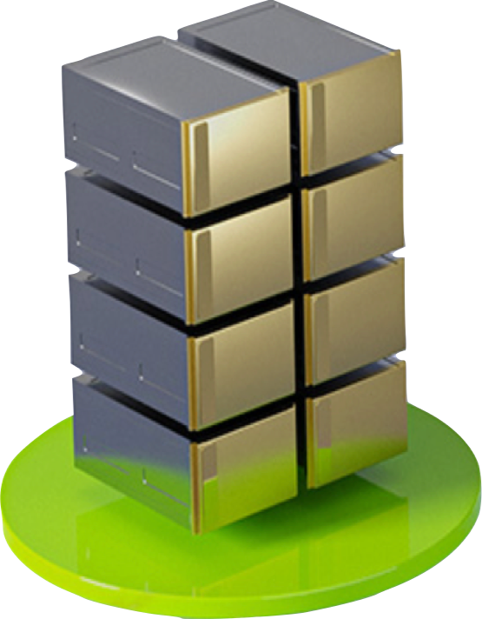
Remote LLM Access
<s>[INST]<<SYS>>
{{system_message}}
<</SYS>>
{{instruction}} [/INST] {{primer}}
Your Device
Remote Host
Llama
Frontend
<s>[INST]<<SYS>>
You are a code generator.
Please provide Python code
per the instruction.
<</SYS>>
Write a Fibonacci method [/INST] ```python
## Implementation of Fibonacci w/
Jupyter Notebook
VRAM-bound
CPU-only
Source: NVIDIA DLI (2024), Building RAG Agents with LLMs, https://learn.nvidia.com/courses/course-detail?course_id=course-v1:DLI+S-FX-15+V1
Notes:
Typical Consumer Device: Problematic to run large models without some severe compromises. Can still be done, but limited interfaces.
Good to follow minimum device spec assumption of “I can run stuff in a browser”
That’ll be our assumption, so what can we do?
Luckily, we can interface with large model hosting platforms that can provide the scalable inference services for us!
For now, we can use network requests like GET and POST to communicate to an external platform. Maybe someday these will be hosted by us as well, but for now let’s see what we can bank on from others!

Slide 106
Large Model Hosting Platforms
Your Device
NVIDIA
GPU CLOUD
Remote Host
Frontend
Jupyter Notebook
VRAM-bound
CPU-only
Source: NVIDIA DLI (2024), Building RAG Agents with LLMs, https://learn.nvidia.com/courses/course-detail?course_id=course-v1:DLI+S-FX-15+V1
Notes:
Typical Consumer Device: Problematic to run large models without some severe compromises. Can still be done, but limited interfaces.
Good to follow minimum device spec assumption of “I can run stuff in a browser”
That’ll be our assumption, so what can we do?
Luckily, we can interface with large model hosting platforms that can provide the scalable inference services for us!
We can use network requests like GET and POST to communicate to an external platform.
Maybe someday these will be hosted by you, but for now let’s see what we can work with from others!

Slide 107
Large Model Hosting Platforms
NVIDIA
GPU CLOUD
GPT4/3.5
Integrated Tools/Multimodal Support
Models/Query Router Internal
Path to Local Deployment Less Clear
Publicly Available Models
Models/Query Router Accessible
Path to Local Deployment/Self-Hosting
Pieces to Compose Complex Systems
Source: NVIDIA DLI (2024), Building RAG Agents with LLMs, https://learn.nvidia.com/courses/course-detail?course_id=course-v1:DLI+S-FX-15+V1
Notes:
OpenAI
Has GPT4/ChatGPT/Dalle/etc. Lots of under-the-hood bells and whistles (models/functions that get called automatically).
(NEXT SECTION: multi-slide tangent on how the models are hosted and provided from OpenAI)
(Later) No straightforward path to local deployment, but it is very easy to use! Great for easily making solutions that work.

Slide 108

Query Router Access
GPT4
Dalle-3
Embed
<s>[INST]<<SYS>>
{{system_message}}
<</SYS>>
{{instruction}} [/INST] {{primer}}????
Source: NVIDIA DLI (2024), Building RAG Agents with LLMs, https://learn.nvidia.com/courses/course-detail?course_id=course-v1:DLI+S-FX-15+V1
Notes:
How are these models provided:
Large model providers host models on allocated compute instances where they download the model and let it run perpetually.
From the end user perspective, these large models host endpoints which can be connected to by a variety of users and applications at any given time through a gateway service (more details to come).
Under the hood, these services generally use scaled deployment orchestrators like Kubernetes.

Slide 109

Query Router Access
{
"messages": [{
"content": "...",
"role": "system"
},{
"content": "...",
"role": "user"
}],
"model": ”gpt-4”,
"temperature": 0.2,
"top_p": 0.7,
"max_tokens": 1024,
"stream": True
}
GPT4
/chat/completions
Dalle-3
Facilitate
Monitor
Optimize
Load Balance
Embed
<s>[INST]<<SYS>>
{{system_message}}
<</SYS>>
{{instruction}} [/INST] {{primer}}????
https://kubernetes.io/
Source: NVIDIA DLI (2024), Building RAG Agents with LLMs, https://learn.nvidia.com/courses/course-detail?course_id=course-v1:DLI+S-FX-15+V1
Notes:
How are these models provided:
Large model providers host models on allocated compute instances where they download the model and let it run perpetually.
From the end user perspective, these large models host endpoints which can be connected to by a variety of users and applications at any given time through a gateway service (more details to come).
Under the hood, these services generally use scaled deployment orchestrators like Kubernetes.

Slide 110
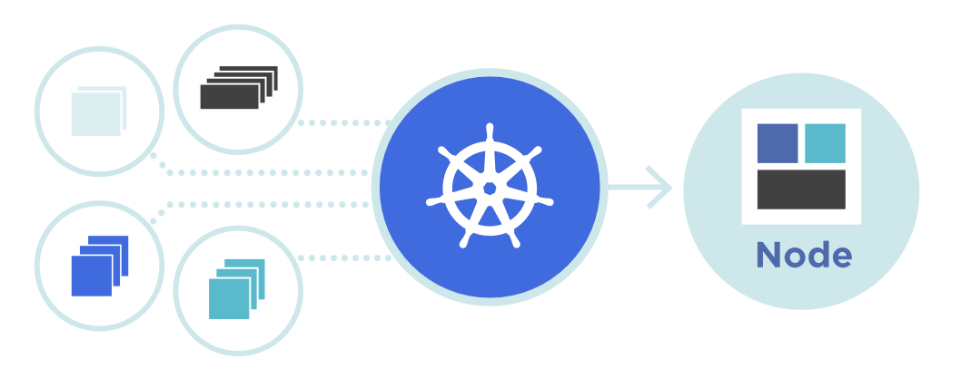
Query Router Access
{
"messages": [{
"content": "...",
"role": "system"
},{
"content": "...",
"role": "user"
}],
"model": ”gpt-4”,
"temperature": 0.2,
"top_p": 0.7,
"max_tokens": 1024,
"stream": True
}
GPT4
/chat/completions
Dalle-3
Facilitate
Monitor
Optimize
Load Balance
Embed
<s>[INST]<<SYS>>
{{system_message}}
<</SYS>>
{{instruction}} [/INST] {{primer}}????
https://kubernetes.io/
Source: NVIDIA DLI (2024), Building RAG Agents with LLMs, https://learn.nvidia.com/courses/course-detail?course_id=course-v1:DLI+S-FX-15+V1
Notes:
How are these models provided:
Large model providers host models on allocated compute instances where they download the model and let it run perpetually.
From the end user perspective, these large models host endpoints which can be connected to by a variety of users and applications at any given time through a gateway service (more details to come).
Under the hood, these services generally use scaled deployment orchestrators like Kubernetes.
(UP NEXT: How An OpenAPI-spec gateway server is structured)

Slide 111


Large Model Hosting Platforms - OpenAI
models
completion
chat/completion
embeddings
images/generate
OpenAI Gateway
GPT
(3.5/4)
embed-<>
Dalle-3
Source: NVIDIA DLI (2024), Building RAG Agents with LLMs, https://learn.nvidia.com/courses/course-detail?course_id=course-v1:DLI+S-FX-15+V1
Notes:
More details about the OpenAI gateway, which conforms to the OpenAPI standard.
Slide 1: It’s an abstraction layer over call functions that are deployed to run persistently and auto-scale.
Slide 2: Things like model name, messages, API keys, etc are ingested, gateway handles redirect and handling, and finally returns the response.
Slide 3: Using this interface as a building block, you can build applications on top of this, including custom microservices and end-user applications.

Slide 112
Large Model Hosting Platforms - OpenAI
models
completion
chat/completion
embeddings
images/generate
Messages
Model Name
Settings
API Key
OpenAI Gateway
Responses
GPT
(3.5/4)
embed-<>
Dalle-3
Source: NVIDIA DLI (2024), Building RAG Agents with LLMs, https://learn.nvidia.com/courses/course-detail?course_id=course-v1:DLI+S-FX-15+V1
Notes:
More details about the OpenAI gateway, which conforms to the OpenAPI standard.
Slide 1: It’s an abstraction layer over call functions that are deployed to run persistently and auto-scale.
Slide 2: Things like model name, messages, API keys, etc are ingested, gateway handles redirect and handling, and finally returns the response.
Slide 3: Using this interface as a building block, you can build applications on top of this, including custom microservices and end-user applications.

Slide 113
Large Model Hosting Platforms - OpenAI
End-User Application
Retriever Microservice
models
completion
chat/completion
embeddings
images/generate
Messages
Model Name
Settings
API Key
OpenAI Gateway
Responses
GPT
(3.5/4)
embed-<>
Dalle-3
Server Management
https://developer.nvidia.com/blog/simplifying-ai-inference-in-production-with-triton/
Source: NVIDIA DLI (2024), Building RAG Agents with LLMs, https://learn.nvidia.com/courses/course-detail?course_id=course-v1:DLI+S-FX-15+V1
Notes:
More details about the OpenAI gateway, which conforms to the OpenAPI standard.
Slide 1: It’s an abstraction layer over call functions that are deployed to run persistently and auto-scale.
Slide 2: Things like model name, messages, API keys, etc are ingested, gateway handles redirect and handling, and finally returns the response.
Slide 3: Using this interface as a building block, you can build applications on top of this, including custom microservices and end-user applications.
(Up Next) Limitations of OpenAI service with regard to privacy and cost ownership.

Slide 114
Large Model Hosting Platforms
NVIDIA
GPU CLOUD
GPT4/3.5
Integrated Tools/Multimodal Support
Models/Query Router Internal
Path to Local Deployment Less Clear
Publicly Available Models
Models/Query Router Accessible
Path to Local Deployment/Self-Hosting
Pieces to Compose Complex Systems
Source: NVIDIA DLI (2024), Building RAG Agents with LLMs, https://learn.nvidia.com/courses/course-detail?course_id=course-v1:DLI+S-FX-15+V1
Notes:
Now that we know what large model hosting platforms are, let’s look at some of our options!
OpenAI API
Has GPT4/ChatGPT/etc. Lots of under-the-hood bells and whistles (models/functions that get called automatically).
No straightforward path to local deployment (for cost and scale), cannot guarantee data security.
NVIDIA GPU Cloud
Allows you to access publicly-available models and set up systems that work directly on the optimized deployments. Straightforward path to local deployment, but it’s not quite as automatic as some systems. These are your own deployments, after all!

Slide 115
Large Model Hosting Platforms
NVIDIA
GPU CLOUD
GPT4/3.5
Integrated Tools/Multimodal Support
Models/Query Router Internal
Path to Local Deployment Less Clear
Publicly Available Models
Models/Query Router Accessible
Path to Local Deployment/Self-Hosting
Pieces to Compose Complex Systems
Source: NVIDIA DLI (2024), Building RAG Agents with LLMs, https://learn.nvidia.com/courses/course-detail?course_id=course-v1:DLI+S-FX-15+V1
Notes:
Now that we know what large model hosting platforms are, let’s look at some of our options!
OpenAI API
Has GPT4/ChatGPT/etc. Lots of under-the-hood bells and whistles (models/functions that get called automatically).
No straightforward path to local deployment (for cost and scale), cannot guarantee data security.
NVIDIA GPU Cloud
Allows you to access publicly-available models and set up systems that work directly on the optimized deployments. Straightforward path to local deployment, but it’s not quite as automatic as some systems. These are your own deployments, after all!

Slide 116


Query Router Access
GPT4
Dalle-3
Embed
{
"messages": [{
"content": "...",
"role": "system"
},{
"content": "...",
"role": "user"
}],
"model": ”mixtral”,
"temperature": 0.2,
"top_p": 0.7,
"max_tokens": 1024,
"stream": True
}
<s>[INST]<<SYS>>
{{system_message}}
<</SYS>>
{{instruction}} [/INST] {{primer}}
/chat/completions
Mixtral
SDXL
Facilitate
Monitor
Optimize
Load Balance
{
“context”:{{context}}
“model”:“query”/”doc”
}
E5
https://kubernetes.io/
Source: NVIDIA DLI (2024), Building RAG Agents with LLMs, https://learn.nvidia.com/courses/course-detail?course_id=course-v1:DLI+S-FX-15+V1
Notes:
1. Structured similar to OpenAI, so either service can be used.
2. Full GenAI deployment stack for those interested.
3. State of our environment (jupyter + frontend + service API)

Slide 117
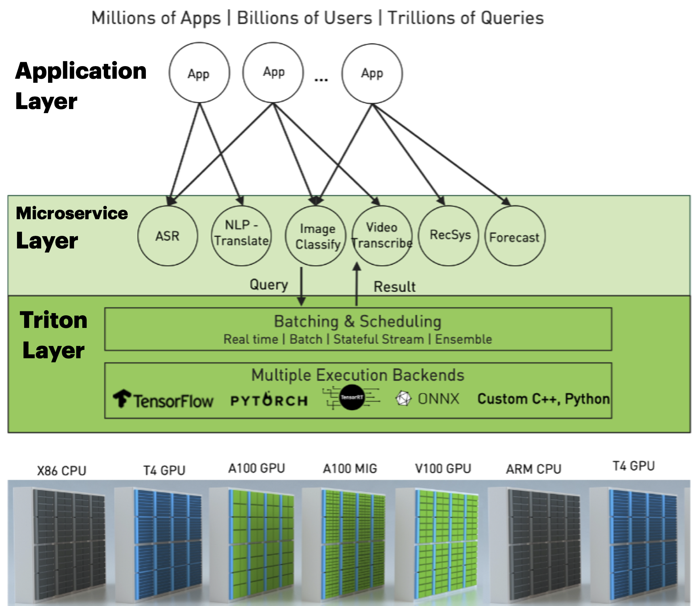
Full Deployment Stack
General Chatbot
Image Generator
Document
Copilot
Custom Server
NIMs
NeMo Retriever
Mixtral
E5
SDXL
VideoGen
RIVA
TensorRT-LLM / vLLM
K8s
Azure
/AWS
Org
Cluster
https://developer.nvidia.com/blog/simplifying-ai-inference-in-production-with-triton/
Source: NVIDIA DLI (2024), Building RAG Agents with LLMs, https://learn.nvidia.com/courses/course-detail?course_id=course-v1:DLI+S-FX-15+V1
Notes:
1. Structured similar to OpenAI, so either service can be used.
2. Full GenAI deployment stack for those interested.
3. State of our environment (jupyter + frontend + service API)

Slide 118
Our Environment
Jupyter Notebooks + Frontend
LLM Client
Your Device
Remote Host
:8090
Frontend
LLMs
Docker
Router
:9000
Jupyter Notebook Server
:88
Source: NVIDIA DLI (2024), Building RAG Agents with LLMs, https://learn.nvidia.com/courses/course-detail?course_id=course-v1:DLI+S-FX-15+V1
Notes:
1. Structured similar to OpenAI, so either service can be used.
2. Full GenAI deployment stack for those interested.
3. State of our environment (jupyter + frontend + service API)
(Next Slide: Talk about the LLM service)

Slide 119
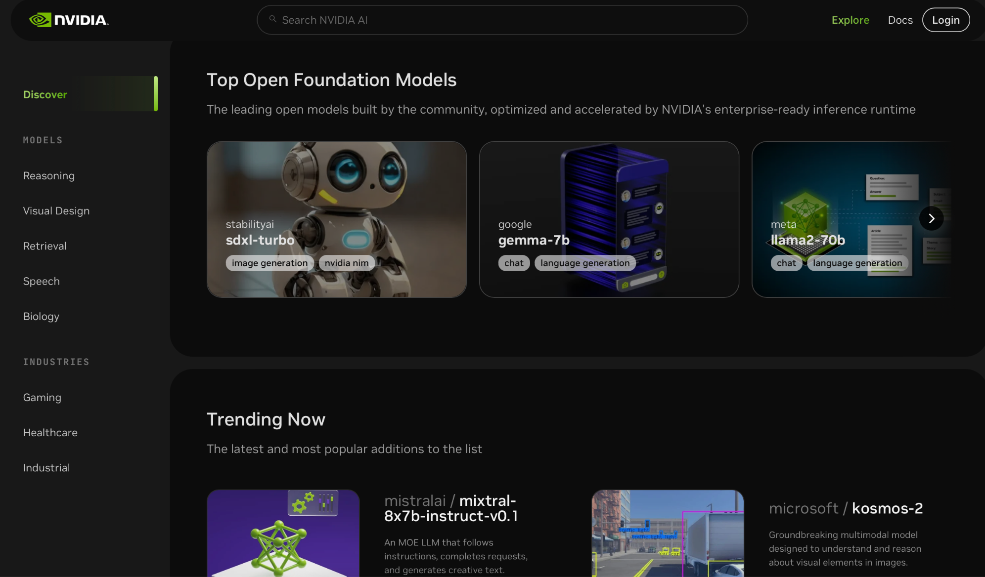
NVIDIA Foundation Model Endpoints
NVIDIA
GPU CLOUD
Source: NVIDIA DLI (2024), Building RAG Agents with LLMs, https://learn.nvidia.com/courses/course-detail?course_id=course-v1:DLI+S-FX-15+V1
Notes:
So what are we going to use to get started with some LLMs quickly?... NVIDIA Foundation Model Endpoints!
1. Free access to publicly-available models which can be deployed on your own infrastructure (i.e. with NIMs)!
2. Picture of Mixtral model hosted in API Catalog. Other options available in environment.
3. Picture of user interface and API specification

Slide 120
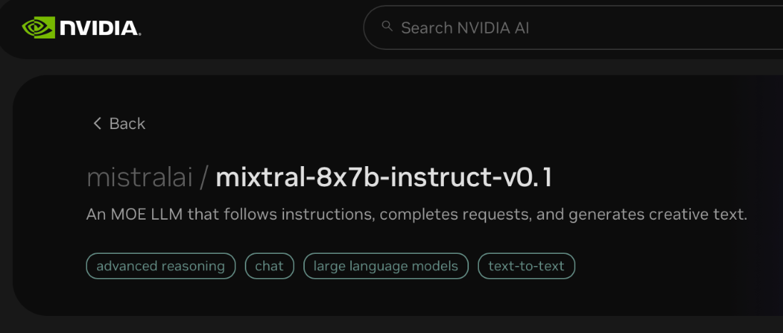
NVIDIA Foundation Model Endpoints
NVIDIA
GPU CLOUD
Source: NVIDIA DLI (2024), Building RAG Agents with LLMs, https://learn.nvidia.com/courses/course-detail?course_id=course-v1:DLI+S-FX-15+V1
Notes:
So what are we going to use to get started with some LLMs quickly?... NVIDIA Foundation Model Endpoints!
1. Free access to publicly-available models which can be deployed on your own infrastructure (i.e. with NIMs)!
2. Picture of Mixtral model hosted in API Catalog. Other options available in environment.
3. Picture of user interface and API specification

Slide 121
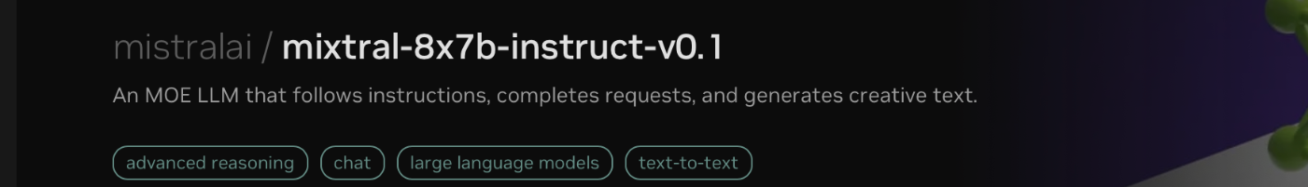

NVIDIA Foundation Model Endpoints
NVIDIA
GPU CLOUD
Source: NVIDIA DLI (2024), Building RAG Agents with LLMs, https://learn.nvidia.com/courses/course-detail?course_id=course-v1:DLI+S-FX-15+V1
Notes:
So what are we going to use to get started with some LLMs quickly?... NVIDIA Foundation Model Endpoints!
1. Free access to publicly-available models which can be deployed on your own infrastructure (i.e. with NIMs)!
2. Picture of Mixtral model hosted in API Catalog. Other options available in environment.
3. Picture of user interface and API specification. You can make your own apps with it!
(Next: But we need LangChain…)

Slide 122

NVIDIA Foundation Model Endpoints
NVIDIA
GPU CLOUD
Source: NVIDIA DLI (2024), Building RAG Agents with LLMs, https://learn.nvidia.com/courses/course-detail?course_id=course-v1:DLI+S-FX-15+V1
Notes:
So what are we going to use to get started with some LLMs quickly?... NVIDIA Foundation Model Endpoints!
1. Free access to publicly-available models which can be deployed on your own infrastructure (i.e. with NIMs)!
2. Picture of Mixtral model hosted in API Catalog. Other options available in environment.
3. Picture of user interface and API specification. You can make your own apps with it!

Slide 123

From Raw Requests to LangChain Model
Source: NVIDIA DLI (2024), Building RAG Agents with LLMs, https://learn.nvidia.com/courses/course-detail?course_id=course-v1:DLI+S-FX-15+V1
Notes:
For this course, we will use LangChain to orchestrate our large model endpoints into more complex software…
Our new API will need to change just a bit for it to play well. To be discussed in the notebook.
(Sequence) Final walkthrough of abstractions going from scaled deployment API -> to gateway API -> to language wrapper -> to framework wrapper.

Slide 124

From Raw Requests to LangChain Model
> llm(“Hello world”)
ChatMessage(content=”hello”)
> embedder(“Hello”)
[0.4535437, 0.0800435, ...]
<s>[INST]<<SYS>>
{{system_message}}
<</SYS>>
{{instruction}} [/INST] {{primer}}
Query Router
Llama
Mistral
Facilitate
Monitor
Optimize
{
“context”:{{context}}
“model”:“query”/”doc”
}
E5
Source: NVIDIA DLI (2024), Building RAG Agents with LLMs, https://learn.nvidia.com/courses/course-detail?course_id=course-v1:DLI+S-FX-15+V1
Notes:
For this course, we will use LangChain to orchestrate our large model endpoints into more complex software…
Our new API will need to change just a bit for it to play well. To be discussed in the notebook.
(Sequence) Final walkthrough of abstractions going from scaled deployment API -> to gateway API -> to language wrapper -> to framework wrapper.

Slide 125


LLM Interfaces
The Whole Stack
api.nvcf.
nvidia.com
/v2/nvcf
Scaled
Function Deployment Solution
Source: NVIDIA DLI (2024), Building RAG Agents with LLMs, https://learn.nvidia.com/courses/course-detail?course_id=course-v1:DLI+S-FX-15+V1
Notes:
For this course, we will use LangChain to orchestrate our large model endpoints into more complex software…
Our new API will need to change just a bit for it to play well. To be discussed in the notebook.
(Sequence) Final walkthrough of abstractions going from scaled deployment API -> to gateway API -> to language client->...-> to framework connector.

Slide 126
LLM Interfaces
The Whole Stack
health.api.nvidia.com/
ai.api.nvidia.com/
api.nvcf.
nvidia.com
/v2/nvcf
integrate.api.nvidia.com
v1/models
v1/completions
v1/chat/completions
v1/embeddings
Scaled
Function Deployment Solution
api.openai.com
v1/models
v1/completions
v1/chat/completions
v1/embeddings
Source: NVIDIA DLI (2024), Building RAG Agents with LLMs, https://learn.nvidia.com/courses/course-detail?course_id=course-v1:DLI+S-FX-15+V1
Notes:
For this course, we will use LangChain to orchestrate our large model endpoints into more complex software…
Our new API will need to change just a bit for it to play well. To be discussed in the notebook.
(Sequence) Final walkthrough of abstractions going from scaled deployment API -> to gateway API -> to language client->...-> to framework connector.

Slide 127
LLM Interfaces
The Whole Stack
health.api.nvidia.com/
ai.api.nvidia.com/
api.nvcf.
nvidia.com
/v2/nvcf
NVIDIABase
integrate.api.nvidia.com
v1/models
v1/completions
v1/chat/completions
v1/embeddings
Scaled
Function Deployment Solution
api.openai.com
v1/models
v1/completions
v1/chat/completions
v1/embeddings
OpenAI
Source: NVIDIA DLI (2024), Building RAG Agents with LLMs, https://learn.nvidia.com/courses/course-detail?course_id=course-v1:DLI+S-FX-15+V1
Notes:
For this course, we will use LangChain to orchestrate our large model endpoints into more complex software…
Our new API will need to change just a bit for it to play well. To be discussed in the notebook.
(Sequence) Final walkthrough of abstractions going from scaled deployment API -> to gateway API -> to language client->...-> to framework connector.

Slide 128

LLM Interfaces
The Whole Stack
health.api.nvidia.com/
ai.api.nvidia.com/
api.nvcf.
nvidia.com
/v2/nvcf
NVIDIABase
integrate.api.nvidia.com
v1/models
v1/completions
v1/chat/completions
v1/embeddings
Scaled
Function Deployment Solution
api.openai.com
v1/models
v1/completions
v1/chat/completions
v1/embeddings
OpenAI
Source: NVIDIA DLI (2024), Building RAG Agents with LLMs, https://learn.nvidia.com/courses/course-detail?course_id=course-v1:DLI+S-FX-15+V1
Notes:
For this course, we will use LangChain to orchestrate our large model endpoints into more complex software…
Our new API will need to change just a bit for it to play well. To be discussed in the notebook.
(Sequence) Final walkthrough of abstractions going from scaled deployment API -> to gateway API -> to language client->...-> to framework connector.

Slide 129
LLM Interfaces
The Whole Stack
health.api.nvidia.com/
ai.api.nvidia.com/
api.nvcf.
nvidia.com
/v2/nvcf
ChatNVIDIA
NVIDIABase
integrate.api.nvidia.com
v1/models
v1/completions
v1/chat/completions
v1/embeddings
Scaled
Function Deployment Solution
api.openai.com
ChatOpenAI
v1/models
v1/completions
v1/chat/completions
v1/embeddings
OpenAI
Source: NVIDIA DLI (2024), Building RAG Agents with LLMs, https://learn.nvidia.com/courses/course-detail?course_id=course-v1:DLI+S-FX-15+V1
Notes:
For this course, we will use LangChain to orchestrate our large model endpoints into more complex software…
Our new API will need to change just a bit for it to play well. To be discussed in the notebook.
(Sequence) Final walkthrough of abstractions going from scaled deployment API -> to gateway API -> to language client->...-> to framework connector.

Slide 130
NVIDIA Building RAG Agents with LLMs
Part I
[0, 1, 2]
Source: NVIDIA DLI (2024), Building RAG Agents with LLMs, https://learn.nvidia.com/courses/course-detail?course_id=course-v1:DLI+S-FX-15+V1

Slide 131
https://learn.nvidia.com/certificates?id=ed-qOCIMQaatzU8SNUNxgw

Slide 132
References
NVIDIA DLI (2025), Building RAG Agents with LLMs,
https://learn.nvidia.com/courses/course-detail?course_id=course-v1:DLI+S-FX-15+V1
NVIDIA DLI (2025), Generative AI with Diffusion Models, https://learn.nvidia.com/courses/course-detail?course_id=course-v1:DLI+S-FX-14+V1
NVIDIA DLI (2025), Getting Started with Deep Learning, https://learn.nvidia.com/courses/course-detail?course_id=course-v1:DLI+S-FX-01+V1

