Slide 1








Introduction to
Python for Accounting Applications
Python for Accounting Applications
1141PAA01
ACC2, NTPU (U2004) (Fall 2025)
Wed 6, 7, 8, (14:10-17:00) (9:10-12:00) (B3F10)
University Ambassador
Certified Instructor
Min-Yuh Day, Ph.D,
Professor and Director
Institute of Information Management, National Taipei University
https://web.ntpu.edu.tw/~myday
2025-09-10

Slide 2











Prof. Min-Yuh Day
University Ambassador
Certified Instructor
Director, Information Management, NTPU
Director, Intelligent Financial Innovation Technology, IFIT Lab, IM, NTPU
Director, Fintech and Green Finance Center (FGFC), NTPU
Division Director, Sustainable Development, Sustainability Office, NTPU
Visiting Scholar, IIS, Academia Sinica
Ph.D., Information Management, NTU
Artificial Intelligence, Agentic AI, ESG and Green Financial Technology,
Big Data Analytics, Electronic Commerce

Slide 3
Course Syllabus
National Taipei University
Academic Year 114, 1st Semester (Fall 2025)
Course Title: Python for Accounting Applications
Instructor: Min-Yuh Day
Course Class: ACC2, NTPU (3 Credits, Elective)
Details
  EMI Course
  (3 Credits, Elective, One Semester) (U2004)
Time & Place: Wed. 6, 7, 8, 14:10-17:00(B3F10)
Google Meet: https://meet.google.com/ofh-iosa-ehd

Slide 4
Course Objectives
Understand the fundamental concepts of
Python for Accounting Applications.
Equip with Hands-on practices of
Python for Accounting Applications.

Slide 5
Course Outline
This course introduces the fundamental concepts and hands-on practices of
Python for Accounting Applications.
Topics include
  Introduction to Python for Accounting Applications,
  Python Programming and Data Science,
  Foundations of Python Programming,
  Data Structures,
  Control Logic and Loops,
  Functions and Modules,
  Files and Exception Handling,
  Data Analytics and Visualization with Python,
  Obtaining Data From the Web with Python,
  Statistical Analysis with Python,
  Machine Learning with Python,
  Text Analytics with Generative AI and Python,
  Applications of Accounting Data Analytics with Python, and
  Applications of ESG Data Analytics with Python.

Slide 6
Syllabus
Week Date Subject/Topics
1 2025/09/10 Introduction to Python for Accounting Applications
2 2025/09/17 Python Programming and Data Science
3 2025/09/24 Foundations of Python Programming
4 2025/10/01 Data Structures
5 2025/10/08 Control Logic and Loops
6 2025/10/15 Functions and Modules; Files and Exception Handling
7 2025/10/22 Data Analytics and Visualization with Python
8 2025/10/29 Self-Learning

Slide 7
Syllabus
Week Date Subject/Topics
9 2025/11/05 Midterm Project Report
10 2025/11/12 Obtaining Data From the Web with Python
11 2025/11/19 Statistical Analysis with Python
12 2025/11/26 Machine Learning with Python
13 2025/12/03 Text Analytics with Generative AI and Python
14 2025/12/10 Applications of Accounting Data Analytics with Python
15 2025/12/17 Applications of ESG Data Analytics with Python
16 2025/12/24 Final Project Report

Slide 8
Teaching Methods and Activities
Lecture
Discussion
Practicum

Slide 9
Evaluation Methods
Individual Presentation 30 %
Group Presentation 30 %
Case Report 20 %
Class Participation 10 %
Assignment 10 %

Slide 10
Required Texts
Allen B. Downey (2016), Think Python: How to Think Like a Computer Scientist, 2nd Edition, O’Reilly Media

Slide 11
Reference Books
Frederick Kaefer and Paul Kaefer (2020), Introduction to Python Programming for Business and Social Science Applications, SAGE Publications
Abdullah Karasan (2021), Machine Learning for Financial Risk Management with Python: Algorithms for Modeling Risk, O’Reilly Media
Vic Anand, Khrystyna Bochkay, and Roman Chychyla (2020), Using Python for Text Analysis in Accounting Research, Now Publishers
Aurélien Géron (2022), Hands-On Machine Learning with Scikit-Learn, Keras, and TensorFlow: Concepts, Tools, and Techniques to Build Intelligent Systems, 3rd Edition, O’Reilly Media.
Numa Dhamani and Maggie Engler (2024), Introduction to Generative AI, Manning
Denis Rothman (2024), Transformers for Natural Language Processing and Computer Vision - Third Edition: Explore Generative AI and Large Language Models with Hugging Face, ChatGPT, GPT-4V, and DALL-E 3, 3rd ed. Edition, Packt Publishing
Ben Auffarth (2023), Generative AI with LangChain: Build large language model (LLM) apps with Python, ChatGPT and other LLMs, Packt Publishing.
Thomas R. Caldwell (2025), The Agentic AI Bible: The Complete and Up-to-Date Guide to Design, Build, and Scale Goal-Driven, LLM-Powered Agents that Think, Execute and Evolve, Independently published.

Slide 12
Other References
Python, https://www.python.org/
GRI (Global Report Initiative):
https://www.globalreporting.org/
CDP (Carbon Disclosure Project):
https://www.cdp.net/
SASB (Sustainability Accounting Standards Board):
https://sasb.org/
ISSB (International Sustainability Standards Board):
https://www.ifrs.org/groups/international-sustainability-standards-board/
TCFD (Task Force on Climate-related Financial Disclosures):
https://www.fsb-tcfd.org/

Slide 13

Python Ecosystem for Data Science
Source: https://medium.com/pyfinance/why-python-is-best-choice-for-financial-data-modeling-in-2019-c0d0d1858c45

Slide 14


Python Ecosystem for Data Science
Source:https://duchesnay.github.io/pystatsml/introduction/python_ecosystem.html

Slide 15


The Quant Finance PyData Stack
Source: http://nbviewer.jupyter.org/format/slides/github/quantopian/pyfolio/blob/master/pyfolio/examples/overview_slides.ipynb#/5

Slide 16

Python
Programming

Slide 17

Top Programming Languages
https://spectrum.ieee.org/the-top-programming-languages-2023

Slide 18
Python is an interpreted, object-oriented, high-level programming language with dynamic semantics.
Source: https://www.python.org/doc/essays/blurb/

Slide 19
Numpy
NumPy
Base
N-dimensional array package

Slide 20
Python matplotlib
Source: https://matplotlib.org/

Slide 21
Python Pandas
http://pandas.pydata.org/

Slide 22

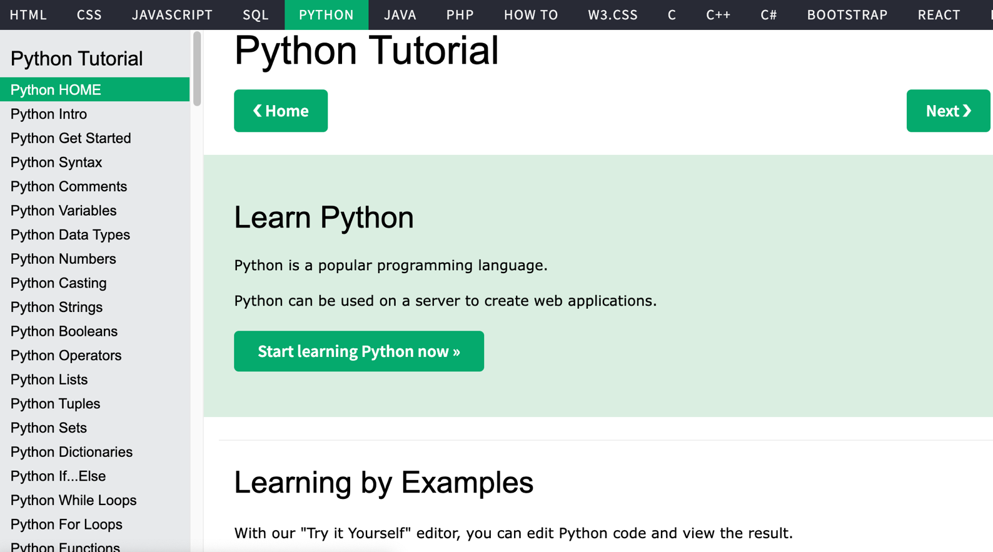
W3Schools Python
https://www.w3schools.com/python/

Slide 23

W3Schools Python: Try Python
https://www.w3schools.com/python/trypython.asp?filename=demo_default

Slide 24

LearnPython.org
https://www.learnpython.org/

Slide 25

Google’s Python Class
https://developers.google.com/edu/python

Slide 26

Google Colab
https://colab.research.google.com/notebooks/welcome.ipynb

Slide 27

Connect Google Colab in Google Drive

Slide 28

Google Colab

Slide 29

Google Colab

Slide 30

Connect Colaboratory to Google Drive

Slide 31

Google Colab

Slide 32

Google Colab

Slide 33

Google Colab

Slide 34

Run Jupyter Notebook
Python3 GPU
Google Colab

Slide 35

Google Colab Python Hello World print('Hello World')

Slide 36

Python in Google Colab (Python101)
https://colab.research.google.com/drive/1FEG6DnGvwfUbeo4zJ1zTunjMqf2RkCrT
https://tinyurl.com/aintpupython101

Slide 37
Anaconda
The Most Popular Python
Data Science Platform
Source: https://www.anaconda.com/

Slide 38


Download Anaconda
https://www.anaconda.com/download

Slide 39
Python
HelloWorld

Slide 40

Anaconda-Navigator
Launchpad

Slide 41

Anaconda Navigator

Slide 42

Jupyter Notebook

Slide 43

Jupyter Notebook
New Python 3

Slide 44

print("hello, world")
Notes:
print("hello, world")

Slide 45
Python
Programming

Slide 46
Foundations of Python Programming
Python Syntax
  Python Comments
Python Variables
Python Data Types
  Python Numbers
  Python Casting
  Python Strings
Python Operators
Python Booleans

Slide 47
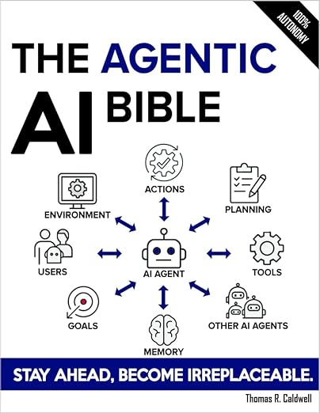
Thomas R. Caldwell (2025),
The Agentic AI Bible:
The Complete and Up-to-Date Guide to Design, Build, and Scale Goal-Driven,
LLM-Powered Agents that Think, Execute and Evolve,
Independently published
Source: https://www.amazon.com/Agentic-Bible-Up-Date-Goal-Driven/dp/B0FL21R86Q

Slide 48

Numa Dhamani and Maggie Engler (2024),
Introduction to Generative AI,
Manning
Source: Numa Dhamani and Maggie Engler (2024), Introduction to Generative AI, Manning
https://www.amazon.com/Introduction-Generative-AI-Numa-Dhamani/dp/1633437191/

Slide 49

Denis Rothman (2024),
Transformers for Natural Language Processing and Computer Vision:
Explore Generative AI and Large Language Models with Hugging Face, ChatGPT, GPT-4V, and DALL-E 3,
3rd Edition, Packt Publishing
Source: https://www.amazon.com/Transformers-Natural-Language-Processing-Computer/dp/1805128728

Slide 50
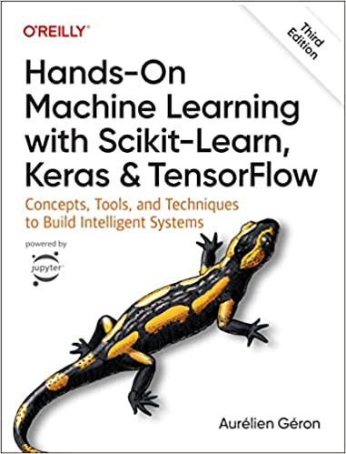
Aurélien Géron (2022),
Hands-On Machine Learning with Scikit-Learn, Keras, and TensorFlow: Concepts, Tools, and Techniques to Build Intelligent Systems,
3rd Edition, O’Reilly Media.
Source: https://www.amazon.com/Hands-Machine-Learning-Scikit-Learn-TensorFlow/dp/1098125975

Slide 51

SASB (Sustainability Accounting Standards Board)
https://sasb.org/

Slide 52

ISSB (International Sustainability Standards Board)
https://www.ifrs.org/groups/international-sustainability-standards-board/

Slide 53
Sustainability and
ESG Data Analytics

Slide 54


















Sustainable Development Goals (SDGs)
Source: https://sdgs.un.org/goals

Slide 55
Evolution of Sustainable Finance Research
Topic
SDGs:
Sustainable Development Goals
SDGs
Innovative Financial Instrument
Impact Investing
ESG: Environmental, Social, and Governance
CSR: Corporate Social Responsibility
Conscious Capitalism
Climate Financing
Carbon Financing
Green Financing
Ethical Investing
Socially Responsible Investing
1986
1995
2005
2015
2020
Source: Kumar, S., Sharma, D., Rao, S., Lim, W. M., & Mangla, S. K. (2022). Past, present, and future of sustainable finance:
Insights from big data analytics through machine learning of scholarly research. Annals of Operations Research, 1-44.

Slide 56
Green Finance and
Sustainable Finance

Slide 57
AI for
Environmental,
Social, and
Governance
(AI4ESG)
Source: Nenad Tomašev, Julien Cornebise, Frank Hutter, Shakir Mohamed, Angela Picciariello, Bec Connelly, Danielle Belgrave et al. (2020)
"AI for social good: unlocking the opportunity for positive impact." Nature Communications 11, no. 1: 1-6.

Slide 58
AI for
Social Good
(AI4SG)
Source: Nenad Tomašev, Julien Cornebise, Frank Hutter, Shakir Mohamed, Angela Picciariello, Bec Connelly, Danielle Belgrave et al. (2020)
"AI for social good: unlocking the opportunity for positive impact." Nature Communications 11, no. 1: 1-6.

Slide 59
Sustainability
SDGs
CSR
ESG

Slide 60

Sustainable Development Goals (SDGs) and 5P
Partnership
Peace
Prosperity
People
Planet
Source: Folke, Carl, Reinette Biggs, Albert V. Norström, Belinda Reyers, and Johan Rockström. "Social-ecological resilience and biosphere-based sustainability science.”Ecology and Society 21, no. 3 (2016).

Slide 61

ESG to 17 SDGs
Source: Henrik Skaug Sætra (2021) "A Framework for Evaluating and Disclosing the ESG Related Impacts of AI with the SDGs." Sustainability 13, no. 15 (2021): 8503.

Slide 62

ESG to 17 SDGs
Source: https://sustainometric.com/esg-to-sdgs-connected-paths-to-a-sustainable-future/

Slide 63

AI, ML, DL, Generative AI
Source: Jeong, Cheonsu. "A Study on the Implementation of Generative AI Services Using an Enterprise Data-Based LLM Application Architecture." arXiv preprint arXiv:2309.01105 (2023).

Slide 64
Generative AI, Agentic AI, Physical AI
Physical AI
Self-driving cars
General robotics
Agentic AI
Coding assistants
Customer service
Patient care
Generative AI
Digital marketing
Content creation
Perception AI
Speech recognition
Deep recommender systems
Medical imaging
2012 AlexNet
Deep learning breakthrough
Source: NVIDIA (2025), GTC March 2025 Keynote with NVIDIA CEO Jensen Huang, https://www.youtube.com/watch?v=_waPvOwL9Z8

Slide 65
Generative AI
Computing
Generative AI
Data
Algorithms

Slide 66

From Generative AI to Agentic AI
Source: Schneider, Johannes. "Generative to Agentic AI: Survey, Conceptualization, and Challenges." arXiv preprint arXiv:2504.18875 (2025).

Slide 67

Sustainable Productivity:
Finance ESG
Source: Huang, Ziqi, Yang Shen, Jiayi Li, Marcel Fey, and Christian Brecher (2021). "A survey on AI-driven digital twins in Industry 4.0: Smart manufacturing and advanced robotics." Sensors 21, no. 19: 6340.

Slide 68

Sustainable Resilient Manufacturing
ESG
Source: Huang, Ziqi, Yang Shen, Jiayi Li, Marcel Fey, and Christian Brecher (2021). "A survey on AI-driven digital twins in Industry 4.0: Smart manufacturing and advanced robotics." Sensors 21, no. 19: 6340.

Slide 69
ESG Indexes
MSCI ESG Index
Dow Jones Sustainability Indices (DJSI)
FTSE ESG Index

Slide 70

MSCI ESG Rating Framework
Source: https://www.msci.com/documents/1296102/21901542/ESG-Ratings-Methodology-Exec-Summary.pdf

Slide 71

MSCI ESG Key Issue Hierarchy
Source: https://www.msci.com/documents/1296102/21901542/ESG-Ratings-Methodology-Exec-Summary.pdf

Slide 72

MSCI Governance Model Structure
Source: https://www.msci.com/documents/1296102/21901542/ESG-Ratings-Methodology-Exec-Summary.pdf

Slide 73

MSCI Hierarchy of ESG Scores
Source: https://www.msci.com/documents/1296102/21901542/ESG-Ratings-Methodology-Exec-Summary.pdf

Slide 74

DJSI S&P Global ESG Score
Source: DJSI, S&P Global Corporate Sustainability Assessment (CSA), https://www.spglobal.com/esg/solutions/data-intelligence-esg-scores

Slide 75

FTSE Russell ESG Ratings
Source: https://www.ftserussell.com/data/sustainability-and-esg-data/esg-ratings

Slide 76


Sustainalytics
ESG Risk Ratings
Analyst-based
approach
Sustainalytics’ ESG Risk Ratings measure a company’s exposure to industry-specific material ESG risks and how well a company is managing those risks.
Source: https://www.sustainalytics.com/esg-data

Slide 77

Truvalue
ESG Ranks
TruValue Labs
Machine-based approach
Truvalue Labs applies AI to analyze over 100,000 sources and uncover ESG risks and opportunities hidden in unstructured text.
The ESG Ranks data service produces an overall company rank based on industry percentile leveraging the 26 ESG categories defined by the Sustainability Accounting Standards Board (SASB).
The data feed covers 20,000+ companies with more than 13 years of history.
Source: :https://developer.truvaluelabs.com/data/esg-ranks

Slide 78

Analyst-driven vs. AI-driven ESG
Sustainalytics
Truvalue Labs
Source: Mark Tulay (2020), Man vs. machine: A tale of two sustainability ratings systems, GreenBiz, https://www.greenbiz.com/article/man-vs-machine-tale-two-sustainability-ratings-systems

Slide 79

Analyst based
ESG Research
AI based
ESG Research
Source: https://www.esganalytics.io/insights/how-data-is-accelerating-esg

Slide 80

ESG Analytics: NLP Taxonomy
Source: https://www.esganalytics.io/insights/how-data-is-accelerating-esg

Slide 81

Top
ESG Reporting Software
Environmental, Social and Governance (ESG) Reporting software or Sustainability software helps organizations manage their operational data, evaluate their impact on the environment and provide reporting to perform audits.
Source: https://www.softwarereviews.com/categories/environmental-social-and-governance-reporting

Slide 82

Four Paradigms in NLP (LM)
Transfer Learning: Pre-training, Fine-Tuning (FT)
GAI: Pre-train, Prompt, and Predict (Prompting)
Source: Pengfei Liu, Weizhe Yuan, Jinlan Fu, Zhengbao Jiang, Hiroaki Hayashi, and Graham Neubig. (2023) "Pre-train, prompt, and predict: A systematic survey of prompting methods in natural language processing." ACM Computing Surveys 55, no. 9 (2023): 1-35.

Slide 83
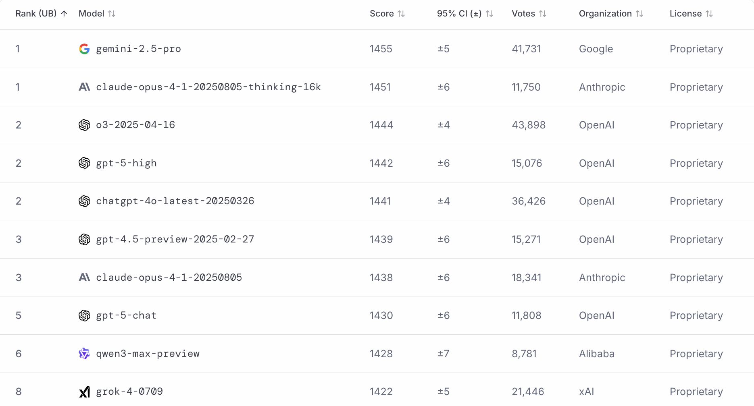
LMArena Leaderboard
https://lmarena.ai/

Slide 84
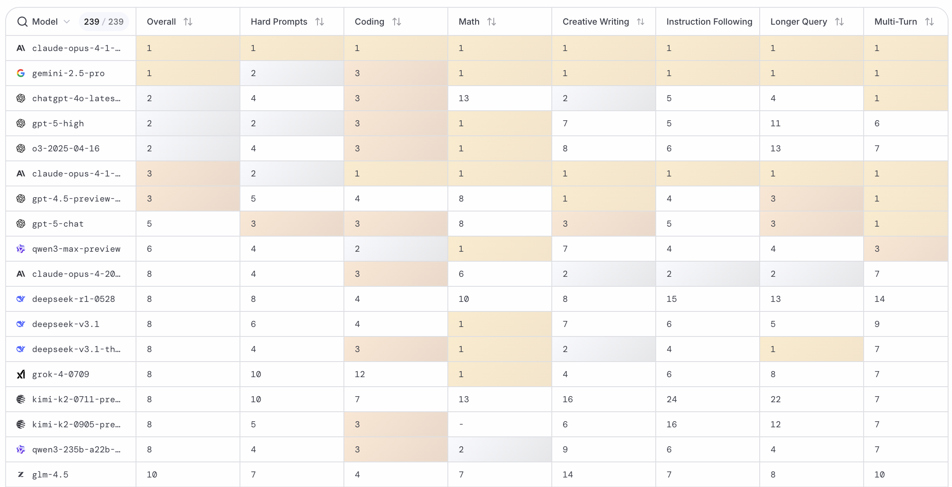
LMArena Leaderboard
https://huggingface.co/spaces/lmarena-ai/lmarena-leaderboard

Slide 85
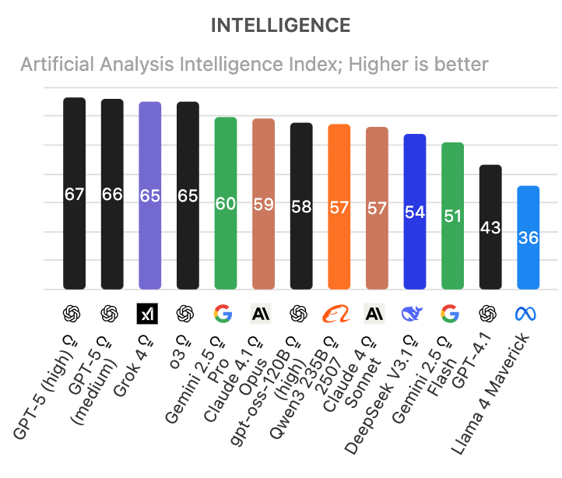
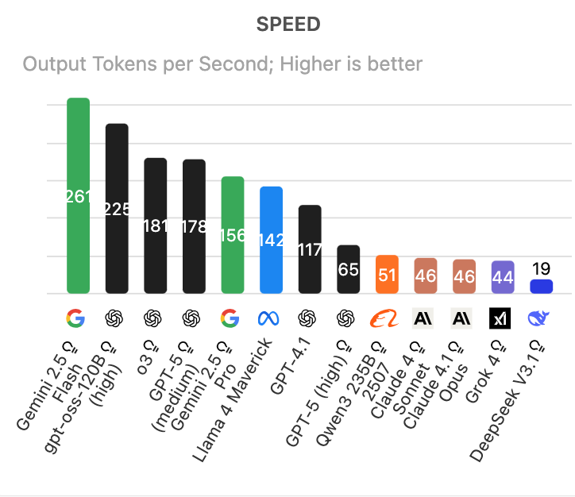
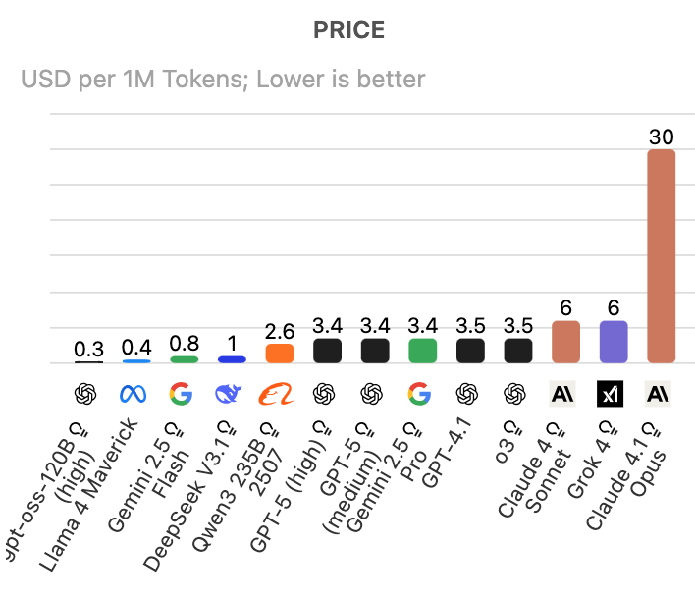
Artificial Analysis Intelligence Index
Intelligence, Speed, Price
Source: https://artificialanalysis.ai/

Slide 86
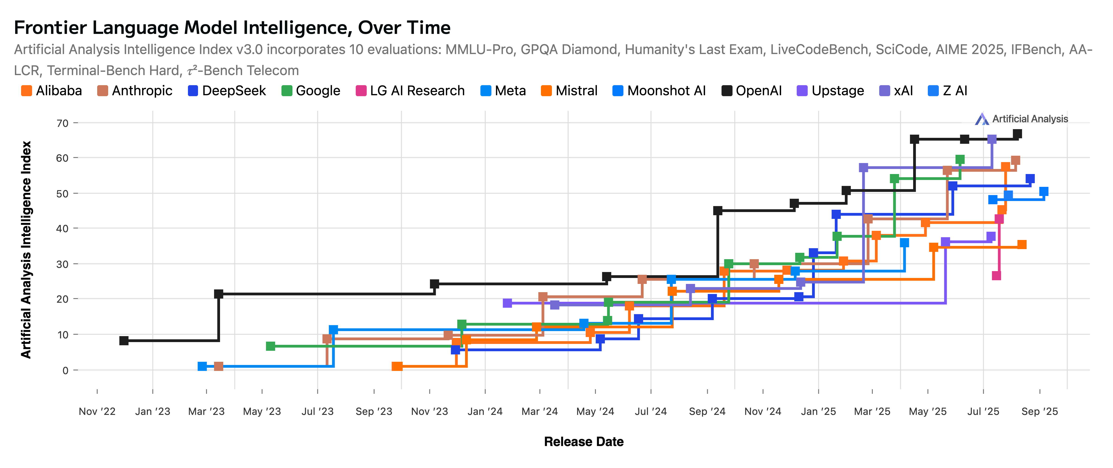
Artificial Analysis Intelligence Index
2022-2025
Source: https://artificialanalysis.ai/

Slide 87
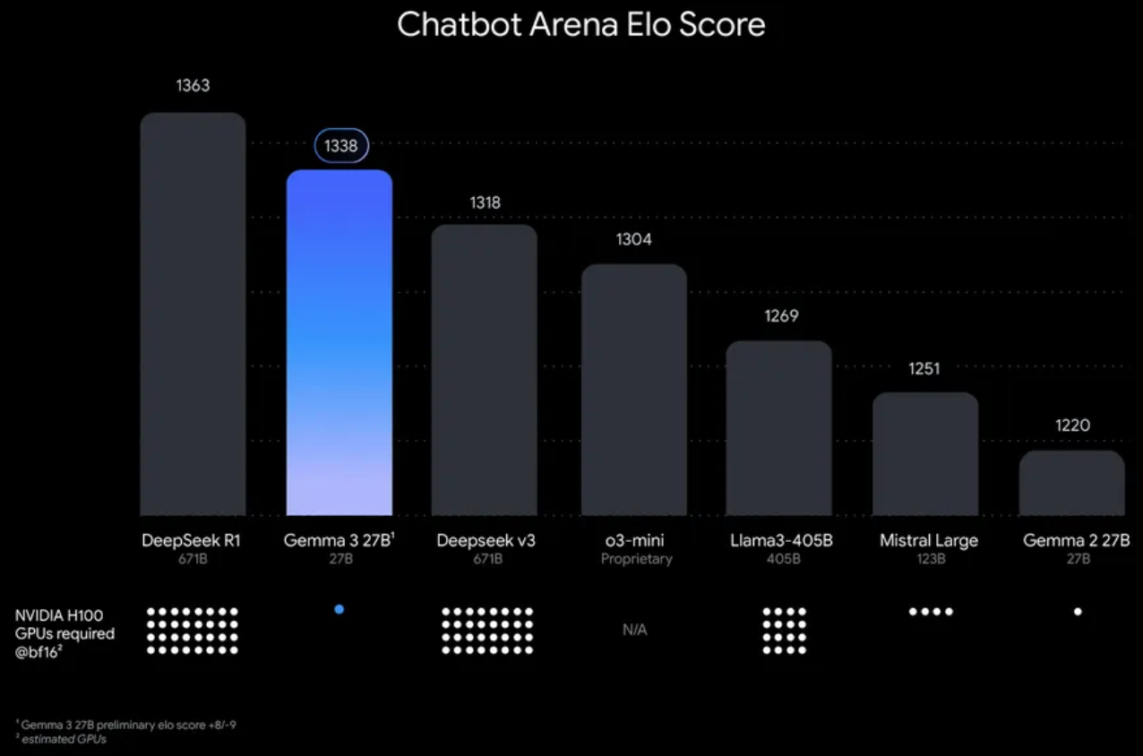
Google Gemma 3 27B
The most capable model you can run on a single GPU or TPU
Source: https://blog.google/technology/developers/gemma-3/

Slide 88
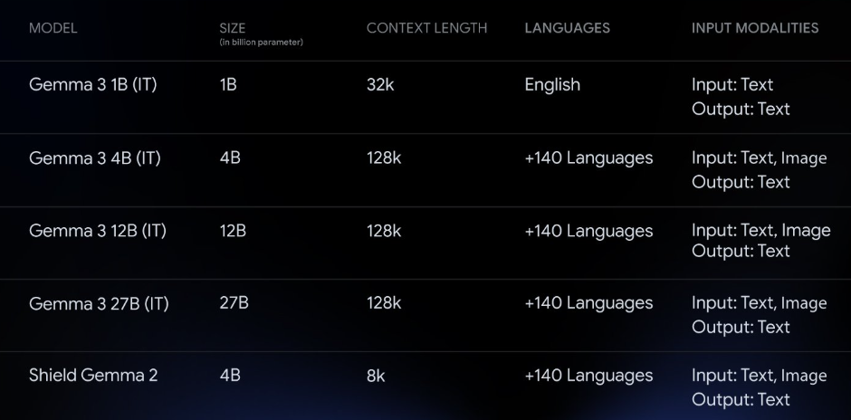
Google Gemma 3 Multimodality
(vision-language input and text outputs)
Source: https://developers.googleblog.com/en/introducing-gemma3/

Slide 89
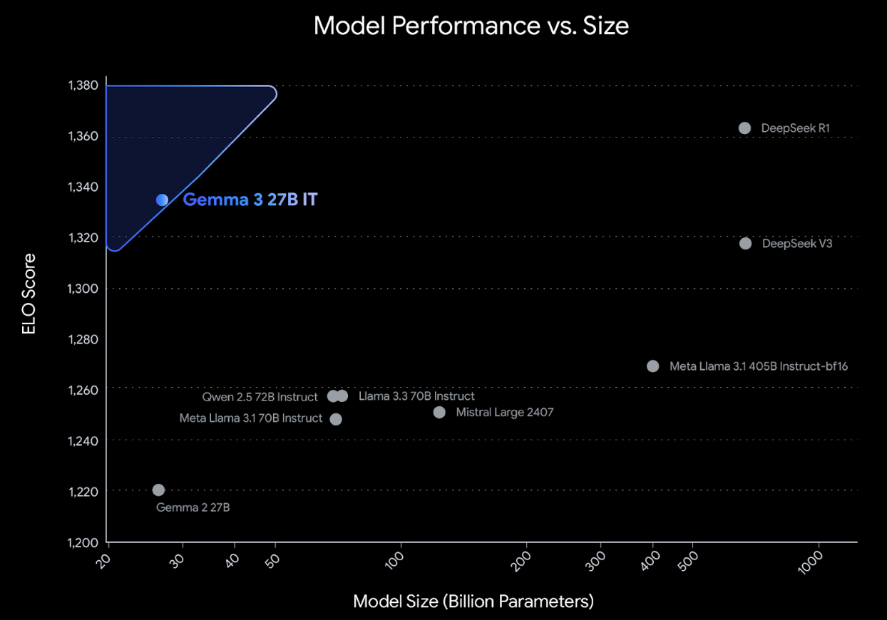
Google Gemma 3: Pre-training and Post-training
(distillation, reinforcement learning, and model merging)
Source: https://developers.googleblog.com/en/introducing-gemma3/

Slide 90
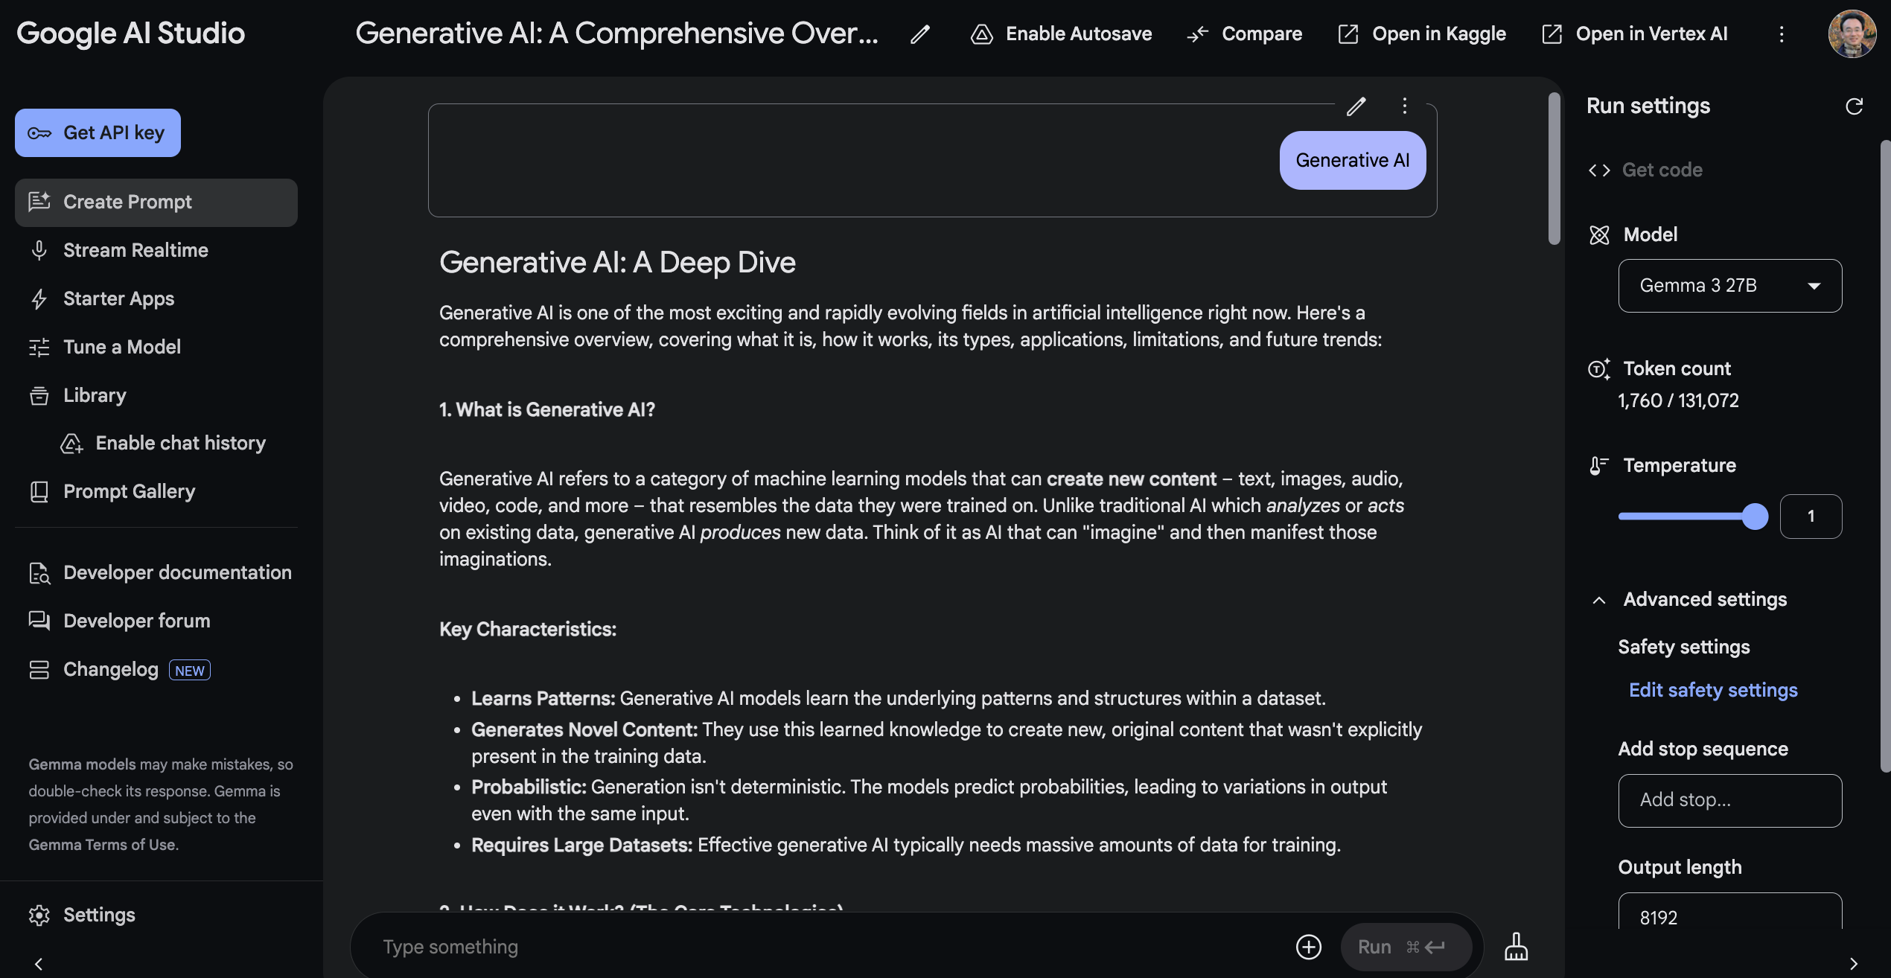
Google AI Studio (Gemma 3 27B)
Source: https://aistudio.google.com/

Slide 91
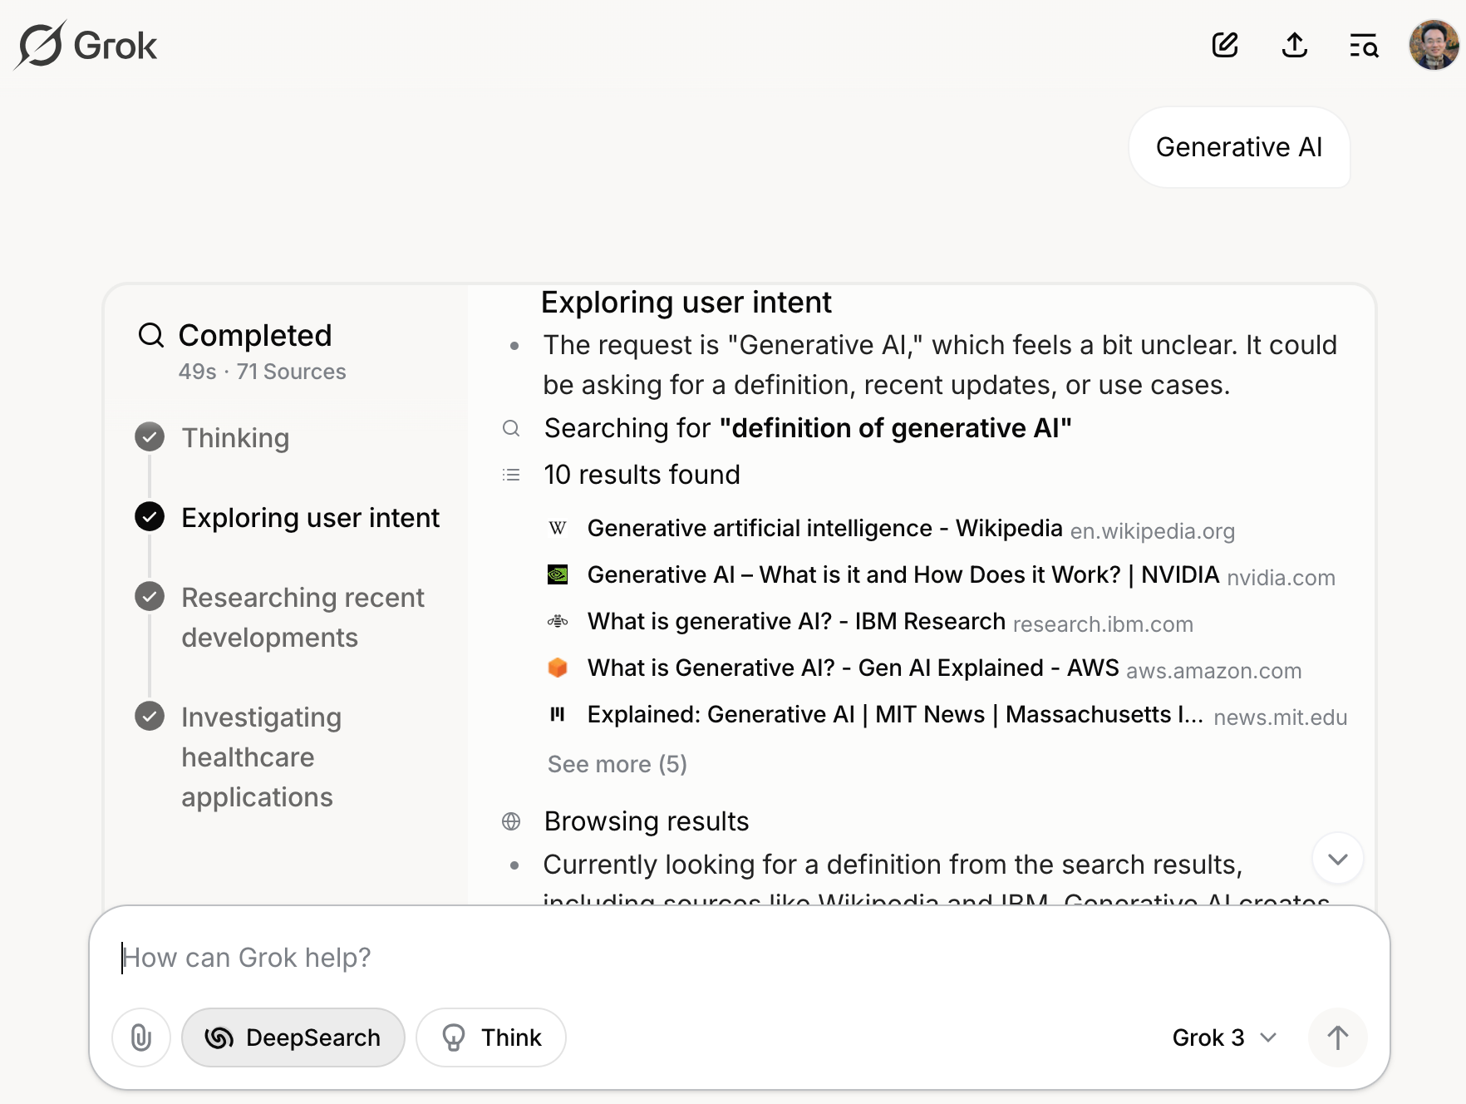
Grok 3 Deep Search
Source: https://grok.com/chat

Slide 92
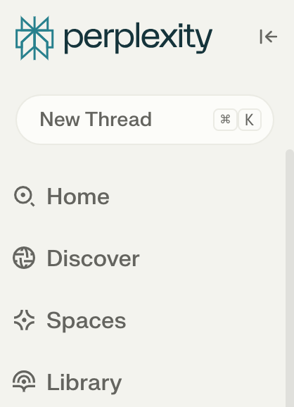
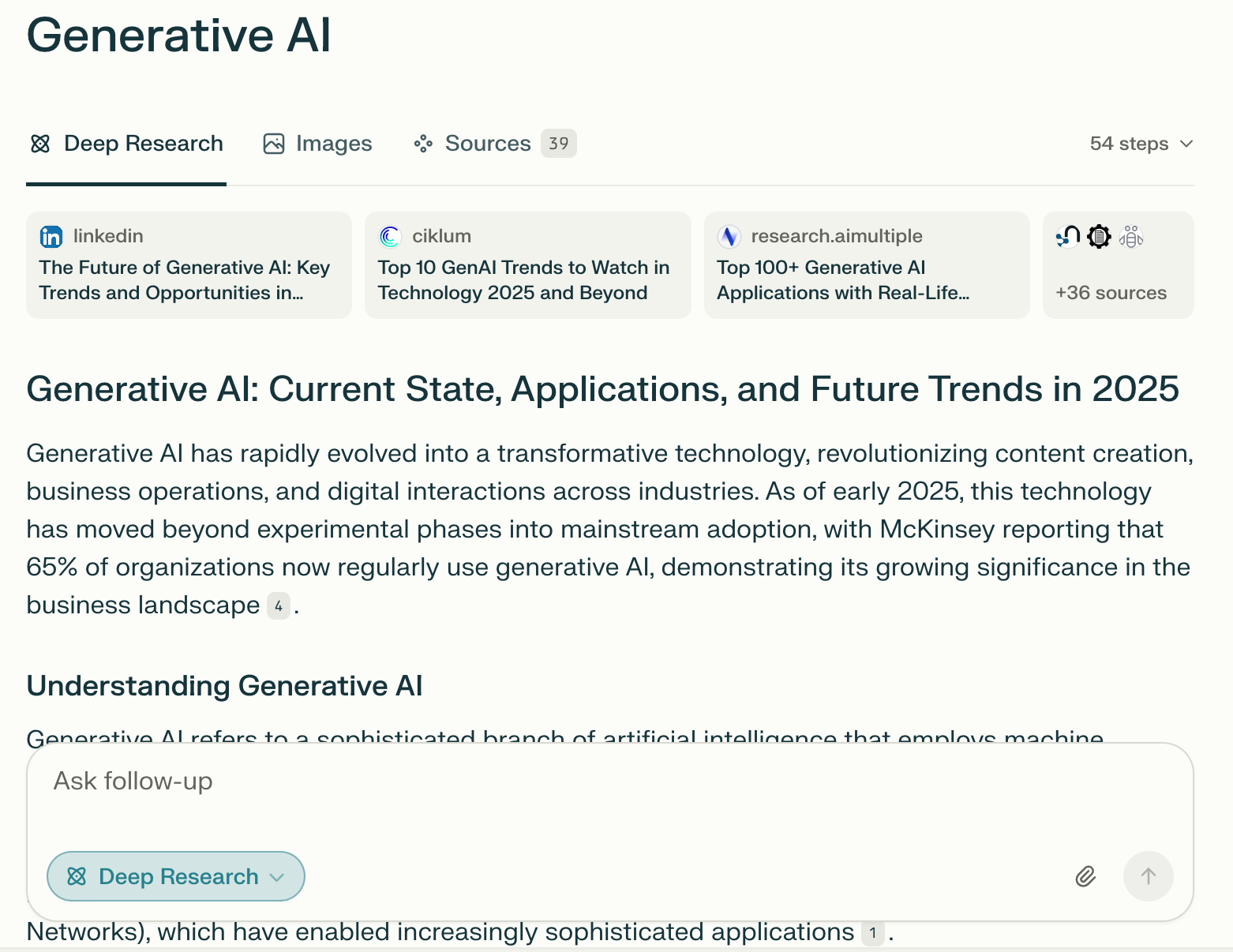
Perplexity.ai Deep Research
Source: https://www.perplexity.ai/

Slide 93
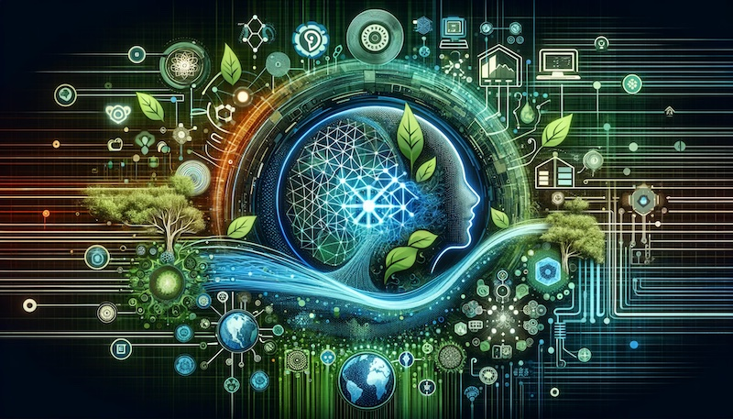
Generative AI and LLMs for Sustainability and
ESG Data Analytics

Slide 94
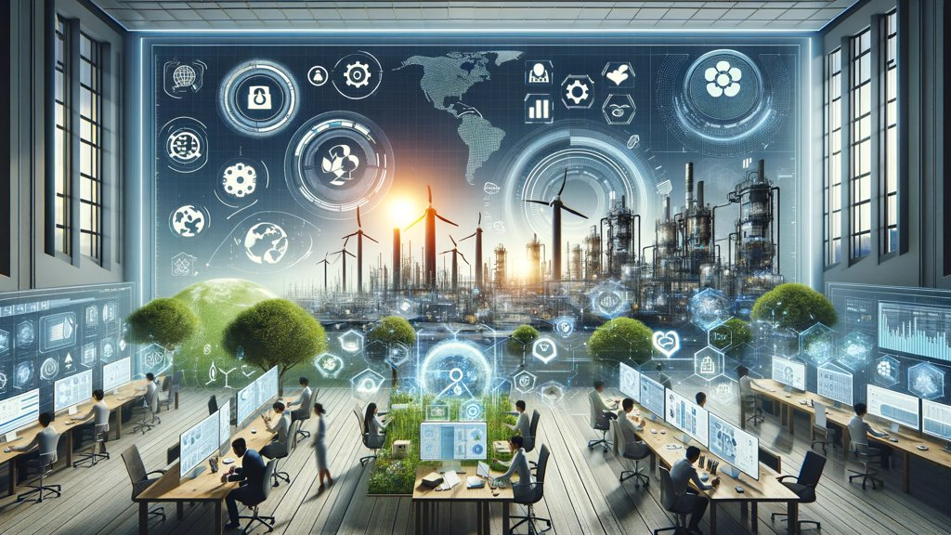
Sustainability and ESG Data Analytics

Slide 95
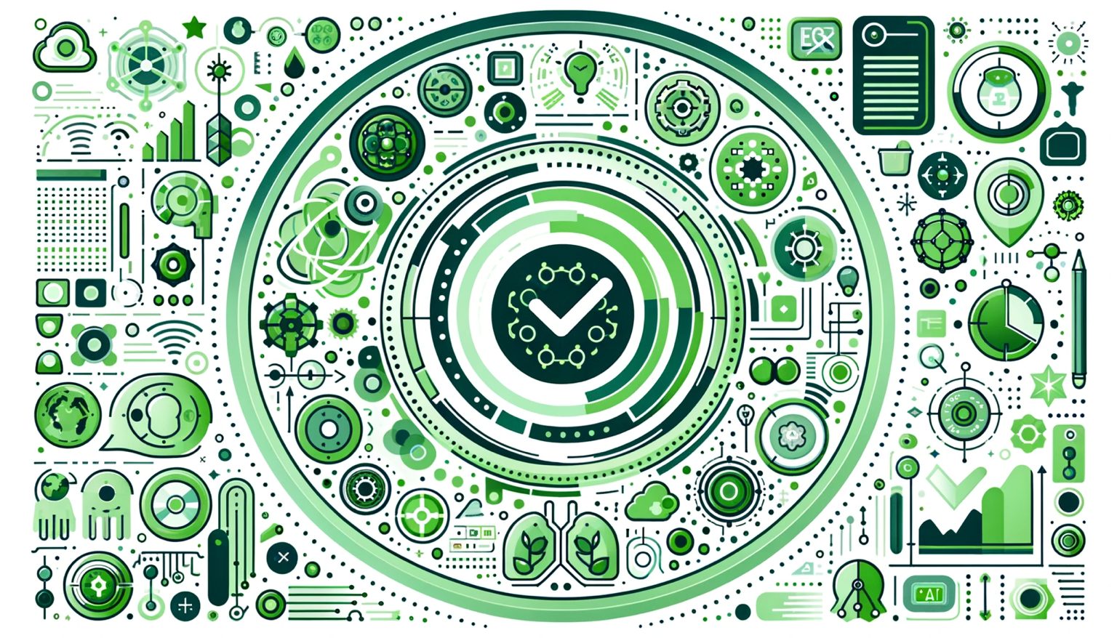
Generative AI for ESG Rating and Reporting Generation

Slide 96
Python in Google Colab (Python101)
https://colab.research.google.com/drive/1FEG6DnGvwfUbeo4zJ1zTunjMqf2RkCrT
https://tinyurl.com/aintpupython101

Slide 97



Teaching
Artificial Intelligence
  Spring 2021, Fall 2022, Fall 2024, Fall 2025
Sustainability and ESG Data Analytics
  Spring 2024, Fall 2024, Fall 2025
Software Engineering
  Fall 2020, Fall, 2021, Spring 2022, Spring 2023, Spring 2024, Spring 2025
Generative AI Innovative Applications
  Spring 2025
Artificial Intelligence in Finance and Quantitative
  Fall 2021, Fall 2022, Fall 2023, Spring 2025
Big Data Analytics
  Fall 2020, Spring 2023, Spring 2024
Artificial Intelligence for Text Analytics
  Spring 2022, Fall 2023
Python for Accounting Applications
  Fall 2023, Fall 2024, ,Fall 2025
Foundation of Business Cloud Computing
  Spring 2021, Spring 2022, Spring 2023, Spring 2024
https://web.ntpu.edu.tw/~myday/teaching.htm

Slide 98
Research Projects
Generative AI Multi-Agent Systems with LLM-Based RAG for ESG Reporting Automation
  NSTC (E4104), NSTC 114-2221-E-305-002-, 2025/08/01~2026/07/31
Innovative Agentic AI Technology for Autonomous ESG Report Generation
  Industrial Technology Research Institute (ITRI), Fintech and Green Finance Center (FGFC, NTPU), NTPU-114A513E01, 2025/03/01~2025/12/31
Digital Support, Unimpeded Communication: The Development, Support and Promotion of AI-assisted Communication Assistive Devices for Speech Impairment(3/3), Sub-project 3: Multimodal Cross-lingual Task-Oriented Dialogue System for Inclusive Communication Support,
  NSTC (HZZ22), NSTC 114-2425-H-305-003-, 3 Years (2023/05/01-2026/04/30) Year 3: 2025/05/01~2026/04/30
Research on speech processing, synthesis, recognition, and sentence construction of people with language disabilities, Sub-project 3: Multimodal Cross-lingual Task-Oriented Dialogue System
  NTPU, 114-NTPU_ORDA-F-004, 3 Years (2023/01/01-2025/12/31) Year 3: 2025/01/01~2025/12/31
Development of a Deep Learning for Dental Implant Detection in Panoramic Radiographs,
  University System of Taipei Joint Research Program (NTPU, TMU), USTP-NTPU-TMU-114-02, 2025/01/01~2025/12/31
https://web.ntpu.edu.tw/~myday/cindex.htm#projects

Slide 99
Summary
This course introduces the fundamental concepts and hands-on practices of
Python for Accounting Applications.
Topics include
  Introduction to Python for Accounting Applications,
  Python Programming and Data Science,
  Foundations of Python Programming,
  Data Structures,
  Control Logic and Loops,
  Functions and Modules,
  Files and Exception Handling,
  Data Analytics and Visualization with Python,
  Obtaining Data From the Web with Python,
  Statistical Analysis with Python,
  Machine Learning with Python,
  Text Analytics with Generative AI and Python,
  Applications of Accounting Data Analytics with Python, and
  Applications of ESG Data Analytics with Python.

Slide 100

Python for Accounting Applications
Contact Information
University Ambassador
Certified Instructor
Min-Yuh Day, Ph.D.
Professor and Director
Institute of Information Management, National Taipei University
Tel: 02-86741111 ext. 66873
Office: B8F12
Address: 151, University Rd., San Shia District, New Taipei City, 23741 Taiwan
Email: myday@gm.ntpu.edu.tw
Web: http://web.ntpu.edu.tw/~myday/

