Slide 1








Python Programming and
Data Science
Python for Accounting Applications
1141PAA02
ACC2, NTPU (U2004) (Fall 2025)
Wed 6, 7, 8, (14:10-17:00) (9:10-12:00) (B3F10)
University Ambassador
Certified Instructor
Min-Yuh Day, Ph.D,
Professor and Director
Institute of Information Management, National Taipei University
https://web.ntpu.edu.tw/~myday
2025-09-17

Slide 2
Syllabus
Week Date Subject/Topics
1 2025/09/10 Introduction to Python for Accounting Applications
2 2025/09/17 Python Programming and Data Science
3 2025/09/24 Foundations of Python Programming
4 2025/10/01 Data Structures
5 2025/10/08 Control Logic and Loops
6 2025/10/15 Functions and Modules; Files and Exception Handling
7 2025/10/22 Data Analytics and Visualization with Python
8 2025/10/29 Self-Learning

Slide 3
Syllabus
Week Date Subject/Topics
9 2025/11/05 Midterm Project Report
10 2025/11/12 Obtaining Data From the Web with Python
11 2025/11/19 Statistical Analysis with Python
12 2025/11/26 Machine Learning with Python
13 2025/12/03 Text Analytics with Generative AI and Python
14 2025/12/10 Applications of Accounting Data Analytics with Python
15 2025/12/17 Applications of ESG Data Analytics with Python
16 2025/12/24 Final Project Report

Slide 4
Python Programming and
Data Science

Slide 5
Outline
Python Programming
Data Science

Slide 6

Python
Programming

Slide 7

Top Programming Languages
https://spectrum.ieee.org/the-top-programming-languages-2023

Slide 8
Python is an interpreted, object-oriented, high-level programming language with dynamic semantics.
Source: https://www.python.org/doc/essays/blurb/

Slide 9

Python Ecosystem for Data Science
Source: https://medium.com/pyfinance/why-python-is-best-choice-for-financial-data-modeling-in-2019-c0d0d1858c45

Slide 10


Python Ecosystem for Data Science
Source:https://duchesnay.github.io/pystatsml/introduction/python_ecosystem.html

Slide 11


The Quant Finance PyData Stack
Source: http://nbviewer.jupyter.org/format/slides/github/quantopian/pyfolio/blob/master/pyfolio/examples/overview_slides.ipynb#/5

Slide 12
Numpy
NumPy
Base
N-dimensional array package

Slide 13
Python matplotlib
Source: https://matplotlib.org/

Slide 14
Python Pandas
http://pandas.pydata.org/

Slide 15

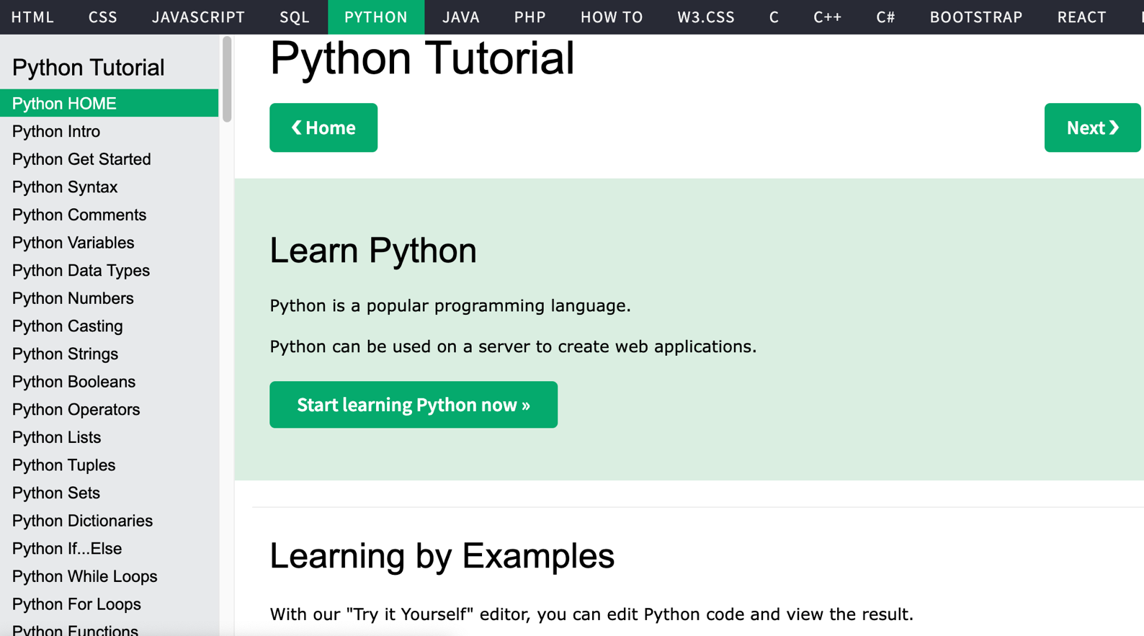
W3Schools Python
https://www.w3schools.com/python/

Slide 16

W3Schools Python: Try Python
https://www.w3schools.com/python/trypython.asp?filename=demo_default

Slide 17

LearnPython.org
https://www.learnpython.org/

Slide 18

Google’s Python Class
https://developers.google.com/edu/python

Slide 19

Google Colab
https://colab.research.google.com/notebooks/welcome.ipynb

Slide 20

Connect Google Colab in Google Drive

Slide 21

Google Colab

Slide 22

Google Colab

Slide 23

Connect Colaboratory to Google Drive

Slide 24

Google Colab

Slide 25

Google Colab

Slide 26

Google Colab

Slide 27

Run Jupyter Notebook
Python3 GPU
Google Colab

Slide 28

Google Colab Python Hello World print('Hello World')

Slide 29

Python in Google Colab (Python101)
https://colab.research.google.com/drive/1FEG6DnGvwfUbeo4zJ1zTunjMqf2RkCrT
https://tinyurl.com/aintpupython101

Slide 30
Anaconda
The Most Popular Python
Data Science Platform
Source: https://www.anaconda.com/

Slide 31


Download Anaconda
https://www.anaconda.com/download

Slide 32
Python
HelloWorld

Slide 33

Anaconda-Navigator
Launchpad

Slide 34

Anaconda Navigator

Slide 35

Jupyter Notebook

Slide 36

Jupyter Notebook
New Python 3

Slide 37

print("hello, world")
Notes:
print("hello, world")

Slide 38
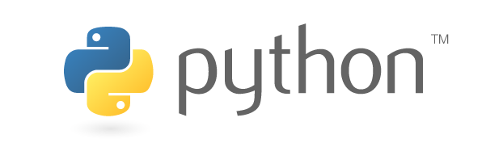
Source: https://www.python.org/community/logos/

Slide 39
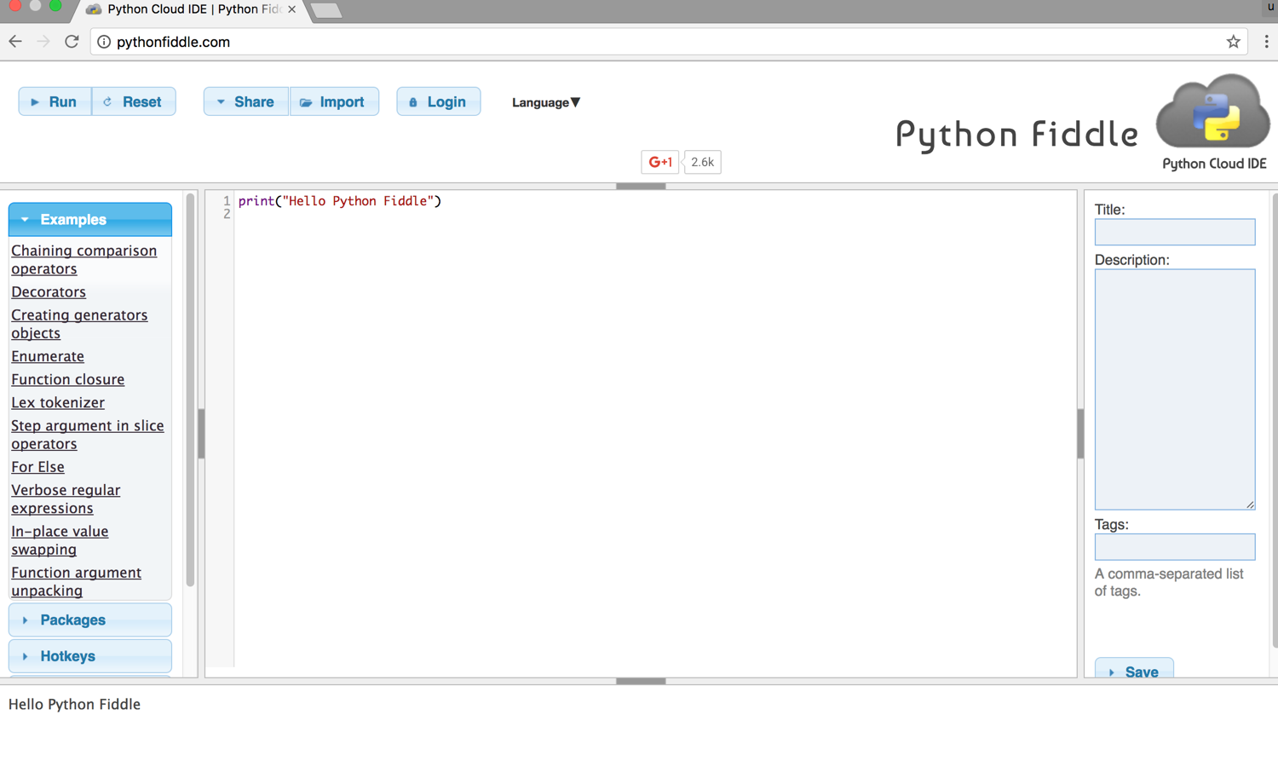
Python Fiddle
http://pythonfiddle.com/

Slide 40
Text input and output
print("Hello World")
print("Hello World\nThis is a message")
x = 3
print(x)
x = 2
y = 3
print(x, ' ', y)
name = input("Enter a name: ")
x = int(input("What is x? "))
x = float(input("Write a number "))
Source: http://pythonprogramminglanguage.com/text-input-and-output/
Notes:
print("Hello World")
print("Hello World\nThis is a message")
x = 3
print(x)
x = 2
y = 3
print(x, ' ', y)
name = input("Enter a name: ")
x = int(input("What is x? "))
x = float(input("Write a number "))

Slide 41
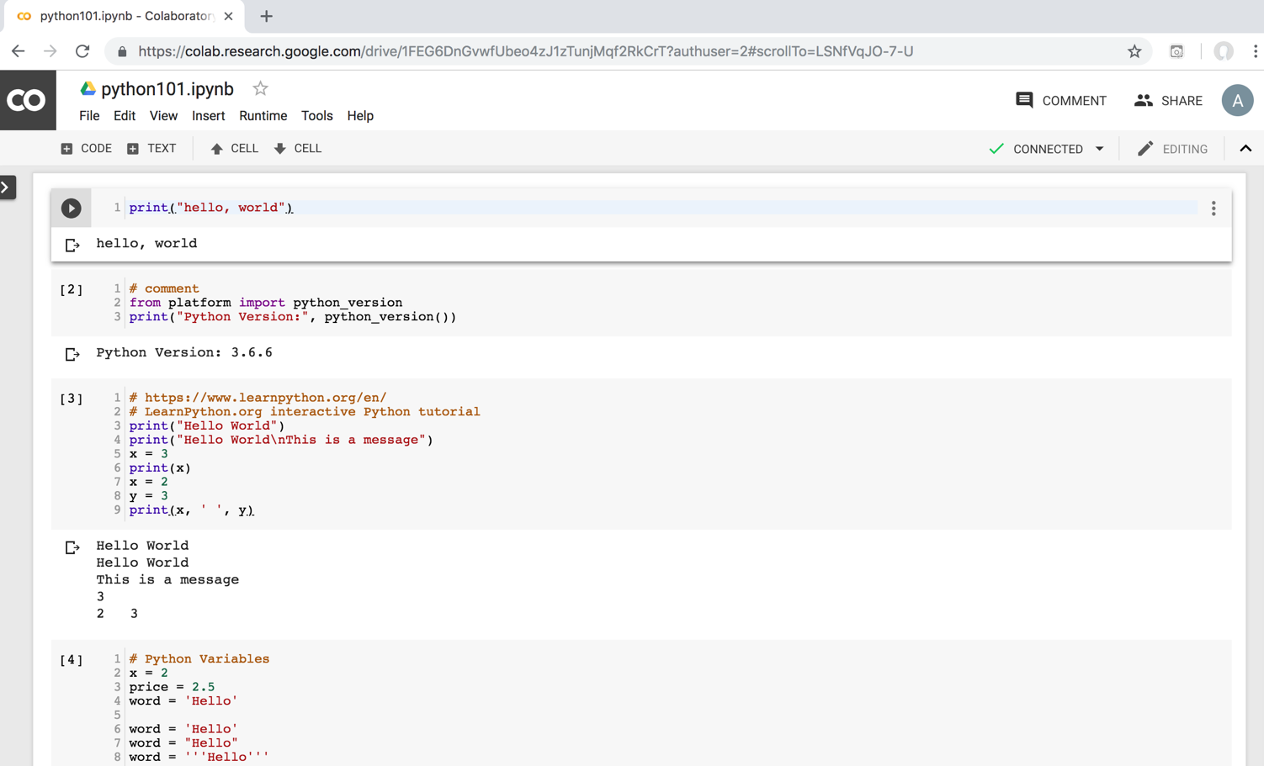
Python in Google Colab
https://colab.research.google.com/drive/1FEG6DnGvwfUbeo4zJ1zTunjMqf2RkCrT
https://tinyurl.com/aintpupython101

Slide 42
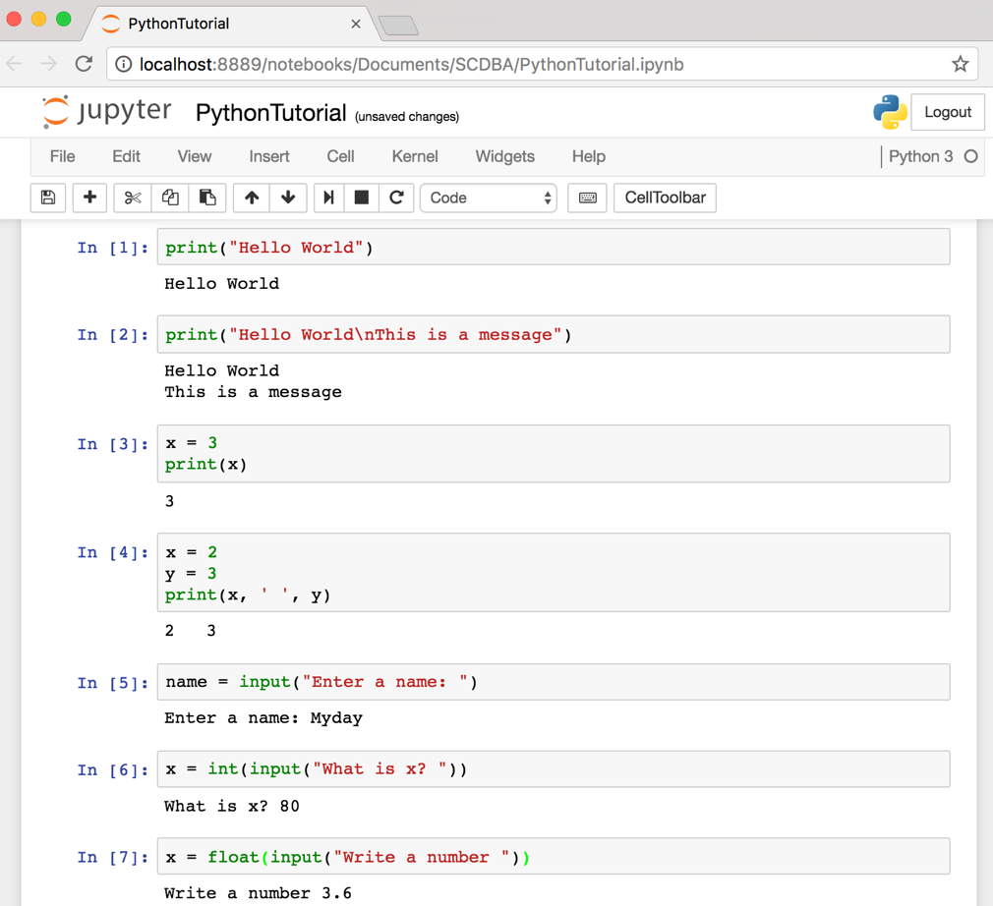
Text input and output
Source: http://pythonprogramminglanguage.com/text-input-and-output/
Notes:
print("Hello World")
print("Hello World\nThis is a message")
x = 3
print(x)
x = 2
y = 3
print(x, ' ', y)
name = input("Enter a name: ")
x = int(input("What is x? "))
x = float(input("Write a number "))

Slide 43
Data Science

Slide 44
AI, Big Data, Cloud Computing
Evolution of Decision Support, Business Intelligence, and Analytics
AI
AI
Cloud Computing
Big Data
DM
BI
Source: Ramesh Sharda, Dursun Delen, and Efraim Turban (2017),
Business Intelligence, Analytics, and Data Science: A Managerial Perspective, 4th Edition, Pearson

Slide 45
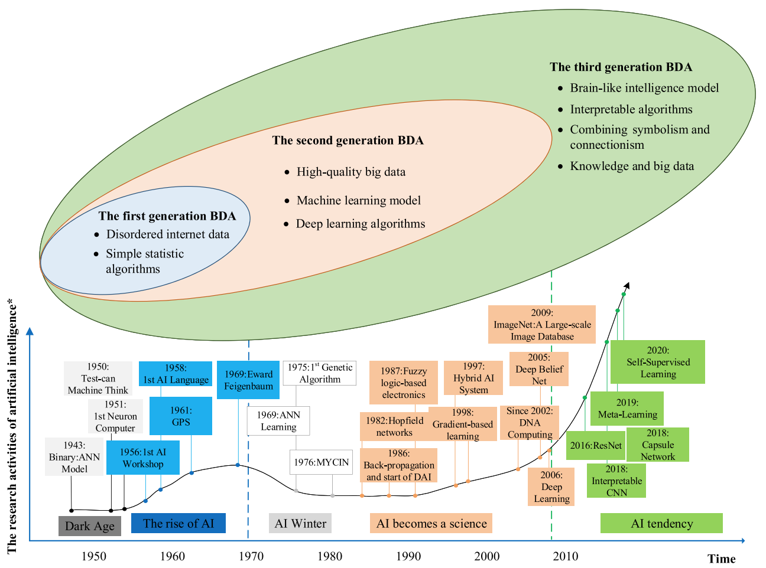
The Development of Big Data Analytics
Source: Wang, Junliang, Chuqiao Xu, Jie Zhang, and Ray Zhong (2022). "Big data analytics for intelligent manufacturing systems: A review." Journal of Manufacturing Systems 62 (2022): 738-752.

Slide 46
Data Analyst
Data analyst is just another term for professionals who were doing BI in the form of data compilation, cleaning, reporting, and perhaps some visualization.
Their skill sets included Excel, some SQL knowledge, and reporting.
You would recognize those capabilities as descriptive or reporting analytics.
Source: Ramesh Sharda, Dursun Delen, and Efraim Turban (2017), Business Intelligence, Analytics, and Data Science: A Managerial Perspective, 4th Edition, Pearson

Slide 47
Data Scientist
Data scientist is responsible for predictive analysis, statistical analysis, and more advanced analytical tools and algorithms.
They may have a deeper knowledge of algorithms and may recognize them under various labels—data mining, knowledge discovery, or machine learning.
Some of these professionals may also need deeper programming knowledge to be able to write code for data cleaning/analysis in current Web-oriented languages such as Java or Python and statistical languages such as R.
Many analytics professionals also need to build significant expertise in statistical modeling, experimentation, and analysis.
Source: Ramesh Sharda, Dursun Delen, and Efraim Turban (2017), Business Intelligence, Analytics, and Data Science: A Managerial Perspective, 4th Edition, Pearson

Slide 48
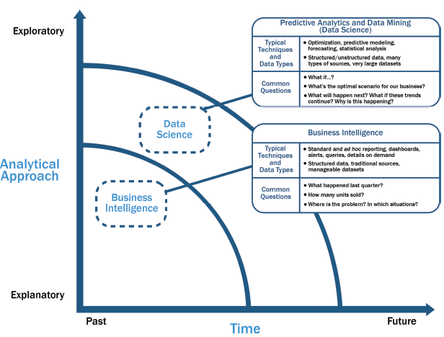
Data Science and
Business Intelligence
Source: EMC Education Services, Data Science and Big Data Analytics: Discovering, Analyzing, Visualizing and Presenting Data, Wiley, 2015

Slide 49
Data Science and
Business Intelligence
Predictive Analytics
and Data Mining
(Data Science)
Source: EMC Education Services, Data Science and Big Data Analytics: Discovering, Analyzing, Visualizing and Presenting Data, Wiley, 2015

Slide 50
Data Science and
Business Intelligence
Predictive Analytics
and Data Mining
(Data Science)
Structured/unstructured data, many types of sources,
very large datasets
Optimization, predictive modeling, forecasting statistical analysis
What if…?
What’s the optimal scenario for our business?
What will happen next?
What if these trends countinue?
Why is this happening?
Source: EMC Education Services, Data Science and Big Data Analytics: Discovering, Analyzing, Visualizing and Presenting Data, Wiley, 2015

Slide 51
Profile of a Data Scientist
Quantitative
  mathematics or statistics
Technical
  software engineering,
  machine learning,
  and programming skills
Skeptical mind-set and critical thinking
Curious and creative
Communicative and collaborative
Source: EMC Education Services, Data Science and Big Data Analytics: Discovering, Analyzing, Visualizing and Presenting Data, Wiley, 2015

Slide 52
Data Scientist Profile
Quantitative
Technical
Curious
and
Creative
Data Scientist
Skeptical
Communicative
and
Collaborative
Source: EMC Education Services, Data Science and Big Data Analytics: Discovering, Analyzing, Visualizing and Presenting Data, Wiley, 2015

Slide 53
Big Data Analytics Lifecycle

Slide 54
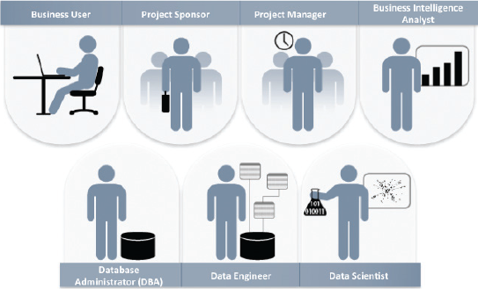
Key Roles for a
Successful Analytics Project
Source: EMC Education Services, Data Science and Big Data Analytics: Discovering, Analyzing, Visualizing and Presenting Data, Wiley, 2015

Slide 55
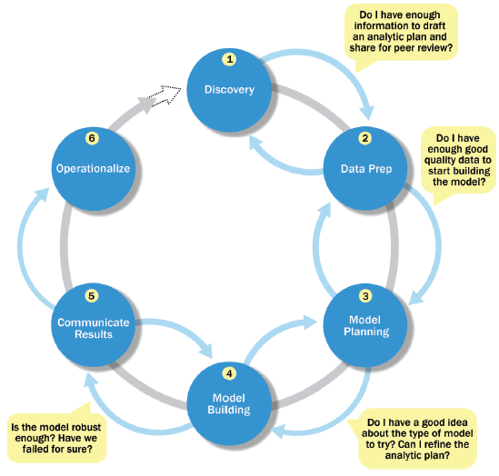
Overview of Data Analytics Lifecycle
Source: EMC Education Services, Data Science and Big Data Analytics: Discovering, Analyzing, Visualizing and Presenting Data, Wiley, 2015

Slide 56
Overview of Data Analytics Lifecycle
1. Discovery
2. Data preparation
3. Model planning
4. Model building
5. Communicate results
6. Operationalize
Source: EMC Education Services, Data Science and Big Data Analytics: Discovering, Analyzing, Visualizing and Presenting Data, Wiley, 2015

Slide 57
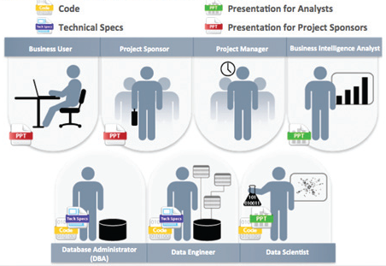
Key Outputs from a
Successful Analytics Project
Source: EMC Education Services, Data Science and Big Data Analytics: Discovering, Analyzing, Visualizing and Presenting Data, Wiley, 2015

Slide 58
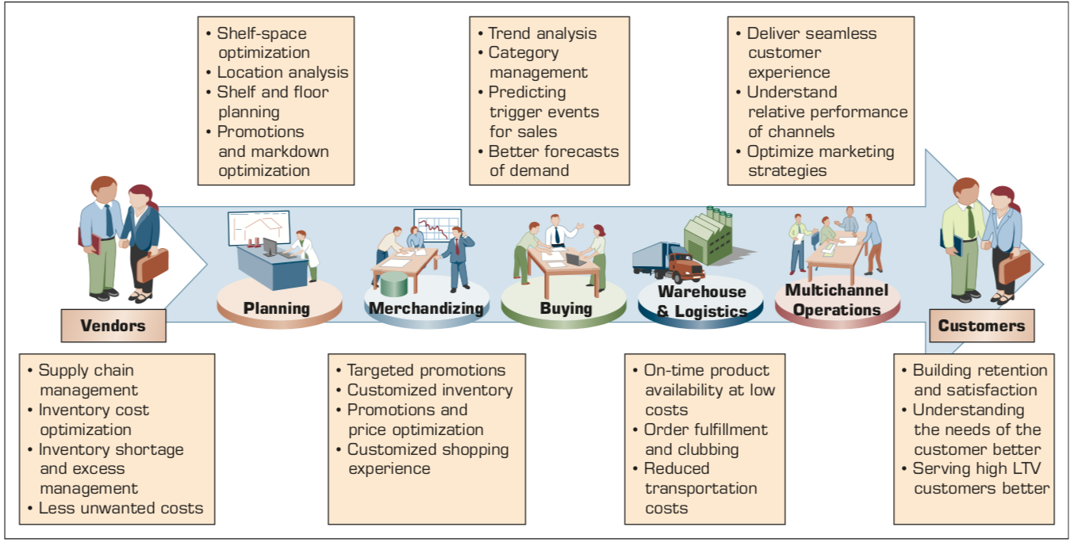
Example of Analytics Applications in a Retail Value Chain
Retail Value Chain
Critical needs at every touch point of the Retail Value Chain
Source: Ramesh Sharda, Dursun Delen, and Efraim Turban (2017), Business Intelligence, Analytics, and Data Science: A Managerial Perspective, 4th Edition, Pearson

Slide 59
Analytics Ecosystem
Source: Ramesh Sharda, Dursun Delen, and Efraim Turban (2017), Business Intelligence, Analytics, and Data Science: A Managerial Perspective, 4th Edition, Pearson

Slide 60
Job Titles of Analytics
Source: Ramesh Sharda, Dursun Delen, and Efraim Turban (2017), Business Intelligence, Analytics, and Data Science: A Managerial Perspective, 4th Edition, Pearson

Slide 61
Three Types of Analytics
Source: Ramesh Sharda, Dursun Delen, and Efraim Turban (2017), Business Intelligence, Analytics, and Data Science: A Managerial Perspective, 4th Edition, Pearson

Slide 62
A Data to Knowledge Continuum
Source: Ramesh Sharda, Dursun Delen, and Efraim Turban (2017), Business Intelligence, Analytics, and Data Science: A Managerial Perspective, 4th Edition, Pearson

Slide 63
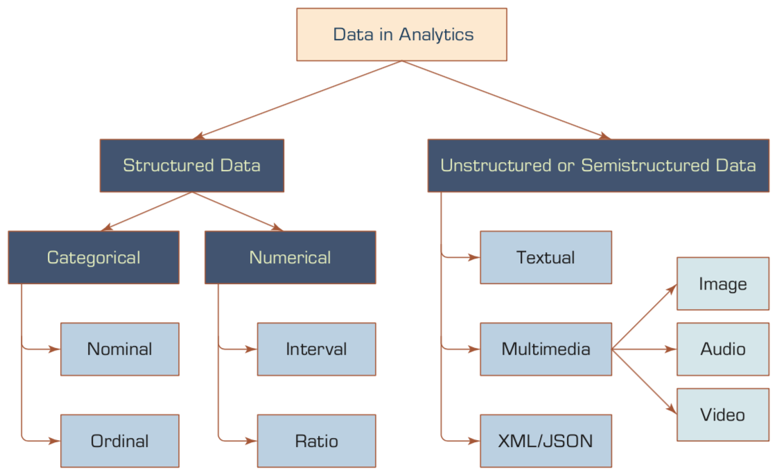
A Simple Taxonomy of Data
Source: Ramesh Sharda, Dursun Delen, and Efraim Turban (2017), Business Intelligence, Analytics, and Data Science: A Managerial Perspective, 4th Edition, Pearson

Slide 64
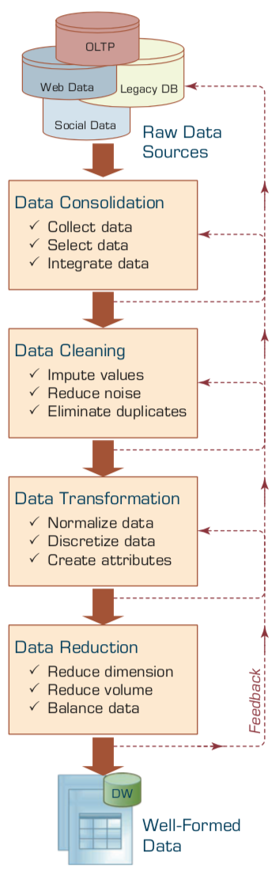
Data Preprocessing Steps
Source: Ramesh Sharda, Dursun Delen, and Efraim Turban (2017), Business Intelligence, Analytics, and Data Science: A Managerial Perspective, 4th Edition, Pearson

Slide 65
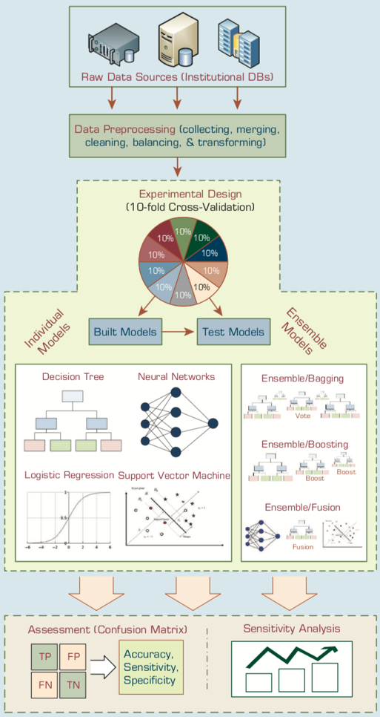
An Analytics Approach to Predicting Student Attrition
Source: Ramesh Sharda, Dursun Delen, and Efraim Turban (2017), Business Intelligence, Analytics, and Data Science: A Managerial Perspective, 4th Edition, Pearson

Slide 66
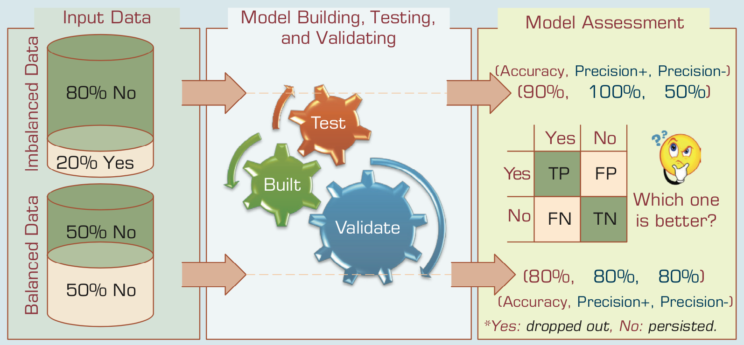
A Graphical Depiction of the
Class Imbalance Problem
Source: Ramesh Sharda, Dursun Delen, and Efraim Turban (2017), Business Intelligence, Analytics, and Data Science: A Managerial Perspective, 4th Edition, Pearson

Slide 67
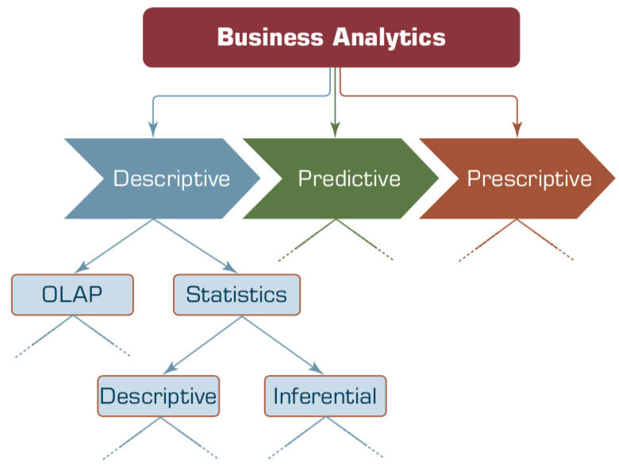
Relationship between Statistics and Descriptive Analytics
Source: Ramesh Sharda, Dursun Delen, and Efraim Turban (2017), Business Intelligence, Analytics, and Data Science: A Managerial Perspective, 4th Edition, Pearson

Slide 68
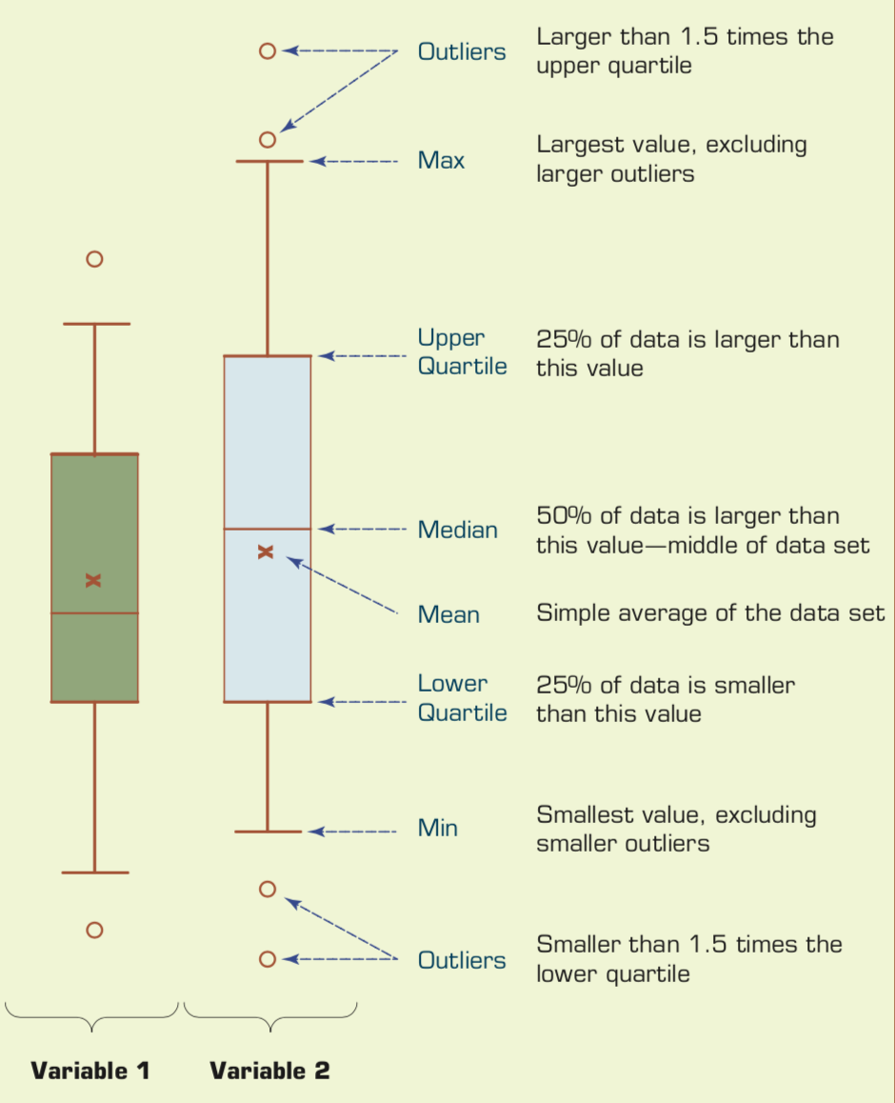
Understanding the Specifics about
Box-and-Whiskers Plots
Source: Ramesh Sharda, Dursun Delen, and Efraim Turban (2017), Business Intelligence, Analytics, and Data Science: A Managerial Perspective, 4th Edition, Pearson

Slide 69

Estimation Methodologies for
Machine Learning Classification Tasks
Simple split (or holdout or test sample estimation)
  Split the data into 2 mutually exclusive sets
  training (~70%) and testing (30%)
  For ANN, the data is split into three sub-sets
  (training [~60%], validation [~20%], testing [~20%])
Source: Ramesh Sharda, Dursun Delen, and Efraim Turban (2017), Business Intelligence, Analytics, and Data Science: A Managerial Perspective, 4th Edition, Pearson

Slide 70

k-Fold Cross-Validation:
Machine Learning Data Splitting and Model Assessment
Source: Ramesh Sharda, Dursun Delen, and Efraim Turban (2017), Business Intelligence, Analytics, and Data Science: A Managerial Perspective, 4th Edition, Pearson

Slide 71
Data Science for
Sustainability and ESG

Slide 72
Data Science for
Sustainability and ESG
Data Science and Sustainability
Data Collection and Analysis for Sustainability
Implementing Data-Driven Sustainability Strategies

Slide 73
Fundamentals of Data Science
Definition of Data Science:
  Interdisciplinary field using scientific methods, processes, algorithms and systems to
  extract knowledge and insights
  from structured and unstructured data.
Key components:
  Statistics, Machine Learning, Data Engineering

Slide 74
Data Science Process
Business Understanding
Data Understanding
Data Preparation
Modeling
Evaluation
Deployment

Slide 75
Sustainability and ESG
Sustainability: Meeting present needs without compromising future generations
ESG: Environmental, Social, and Governance
  Environmental: Climate change, resource depletion, waste, pollution, deforestation
  Social: Human rights, labor standards, workplace safety, community relations
  Governance: Board diversity, executive compensation, ethics, transparency

Slide 76
Sustainability and ESG: Business case
Risk management
Cost savings
Innovation
Brand value
Investor attraction

Slide 77
Intersection of Data Science with Sustainability and ESG
Data-driven decision making for sustainability initiatives
Predictive analytics for environmental impact
Machine learning for optimizing resource usage
Big data analysis for social impact assessment
AI-powered governance risk management

Slide 78
The Interconnectedness of
Data, Sustainability & ESG
Sustainability encompasses environmental, social, and governance concerns.
ESG provides a framework for measuring and reporting sustainability performance.
Data science offers the tools to collect, analyze, and use ESG data for decision-making.

Slide 79
ESG:
Environmental
Social
Governance

Slide 80


















Sustainable Development Goals (SDGs)
Source: https://sdgs.un.org/goals

Slide 81

Sustainable Development Goals (SDGs) and 5P
Partnership
Peace
Prosperity
People
Planet
Source: Folke, Carl, Reinette Biggs, Albert V. Norström, Belinda Reyers, and Johan Rockström. "Social-ecological resilience and biosphere-based sustainability science.”Ecology and Society 21, no. 3 (2016).

Slide 82

ESG to 17 SDGs
Source: Henrik Skaug Sætra (2021) "A Framework for Evaluating and Disclosing the ESG Related Impacts of AI with the SDGs." Sustainability 13, no. 15 (2021): 8503.

Slide 83

ESG to 17 SDGs
Source: https://sustainometric.com/esg-to-sdgs-connected-paths-to-a-sustainable-future/

Slide 84
ESG Reporting Frameworks and Standards
GRI (Global Report Initiative):
https://www.globalreporting.org/
CDP (Carbon Disclosure Project):
https://www.cdp.net/
SASB (Sustainability Accounting Standards Board):
https://sasb.org/
ISSB (International Sustainability Standards Board):
https://www.ifrs.org/groups/international-sustainability-standards-board/
TCFD (Task Force on Climate-related Financial Disclosures):
https://www.fsb-tcfd.org/

Slide 85
Summary
Python Programming
Data Science

Slide 86
References
Wes McKinney (2022), "Python for Data Analysis: Data Wrangling with pandas, NumPy, and Jupyter", 3rd Edition, O'Reilly Media.
Aurélien Géron (2023), Hands-On Machine Learning with Scikit-Learn, Keras, and TensorFlow: Concepts, Tools, and Techniques to Build Intelligent Systems, 3rd Edition, O’Reilly Media.
Steven D'Ascoli (2022), Artificial Intelligence and Deep Learning with Python: Every Line of Code Explained For Readers New to AI and New to Python, Independently published.
Stuart Russell and Peter Norvig (2020), Artificial Intelligence: A Modern Approach, 4th Edition, Pearson.
Denis Rothman (2024), Transformers for Natural Language Processing and Computer Vision - Third Edition: Explore Generative AI and Large Language Models with Hugging Face, ChatGPT, GPT-4V, and DALL-E 3, 3rd ed. Edition, Packt Publishing
Ben Auffarth (2023), Generative AI with LangChain: Build large language model (LLM) apps with Python, ChatGPT and other LLMs, Packt Publishing.
Varun Grover, Roger HL Chiang, Ting-Peng Liang, and Dongsong Zhang (2018), "Creating Strategic Business Value from Big Data Analytics: A Research Framework", Journal of Management Information Systems, 35, no. 2, pp. 388-423.
Junliang Wang, Chuqiao Xu, Jie Zhang, and Ray Zhong (2022). "Big data analytics for intelligent manufacturing systems: A review." Journal of Manufacturing Systems 62 (2022): 738-752.
Ramesh Sharda, Dursun Delen, and Efraim Turban (2017), Business Intelligence, Analytics, and Data Science: A Managerial Perspective, 4th Edition, Pearson
Thomas R. Caldwell (2025), The Agentic AI Bible: The Complete and Up-to-Date Guide to Design, Build, and Scale Goal-Driven, LLM-Powered Agents that Think, Execute and Evolve, Independently published.
Python Programming, https://pythonprogramming.net/
Python, https://www.python.org/
Python Programming Language, http://pythonprogramminglanguage.com/
Numpy, http://www.numpy.org/
Pandas, http://pandas.pydata.org/
Skikit-learn, http://scikit-learn.org/
W3Schools Python, https://www.w3schools.com/python/
Learn Python, https://www.learnpython.org/
Google’s Python Class, https://developers.google.com/edu/python
Min-Yuh Day (2025), Python 101, https://tinyurl.com/aintpupython101

