Slide 1




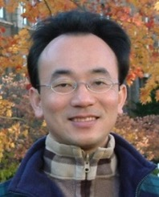



Data Structures
Python for Accounting Applications
1141PAA04
ACC2, NTPU (U2004) (Fall 2025)
Wed 6, 7, 8, (14:10-17:00) (9:10-12:00) (B3F10)
University Ambassador
Certified Instructor
Min-Yuh Day, Ph.D,
Professor and Director
Institute of Information Management, National Taipei University
https://web.ntpu.edu.tw/~myday
2025-10-01

Slide 2
Syllabus
Week Date Subject/Topics
1 2025/09/10 Introduction to Python for Accounting Applications
2 2025/09/17 Python Programming and Data Science
3 2025/09/24 Foundations of Python Programming
4 2025/10/01 Data Structures
5 2025/10/08 Control Logic and Loops
6 2025/10/15 Functions and Modules; Files and Exception Handling
7 2025/10/22 Data Analytics and Visualization with Python
8 2025/10/29 Self-Learning

Slide 3
Syllabus
Week Date Subject/Topics
9 2025/11/05 Midterm Project Report
10 2025/11/12 Obtaining Data From the Web with Python
11 2025/11/19 Statistical Analysis with Python
12 2025/11/26 Machine Learning with Python
13 2025/12/03 Text Analytics with Generative AI and Python
14 2025/12/10 Applications of Accounting Data Analytics with Python
15 2025/12/17 Applications of ESG Data Analytics with Python
16 2025/12/24 Final Project Report

Slide 4
Python
Data Structures

Slide 5
Outline
  Python Lists []
  Python Tuples ()
  Python Sets {}
  Python Dictionaries {k:v}

Slide 6

Python
Programming

Slide 7
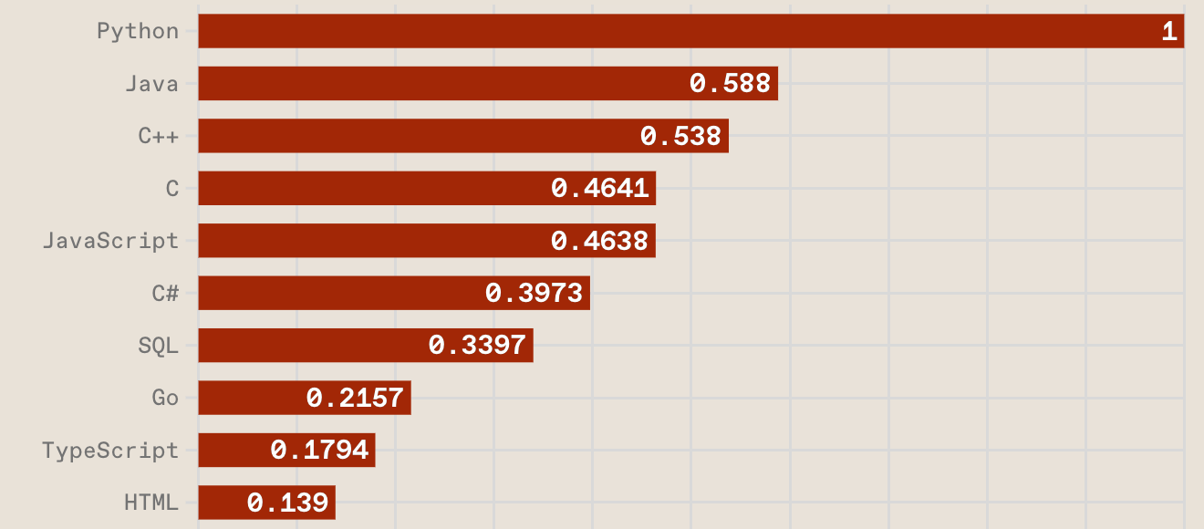
Top Programming Languages
https://spectrum.ieee.org/the-top-programming-languages-2023

Slide 8
Python is an interpreted, object-oriented, high-level programming language with dynamic semantics.
Source: https://www.python.org/doc/essays/blurb/

Slide 9
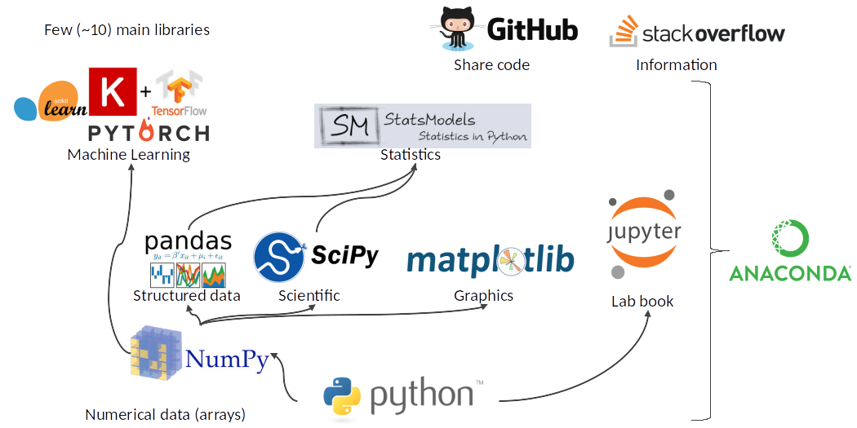
Python Ecosystem for Data Science
Source: https://medium.com/pyfinance/why-python-is-best-choice-for-financial-data-modeling-in-2019-c0d0d1858c45

Slide 10
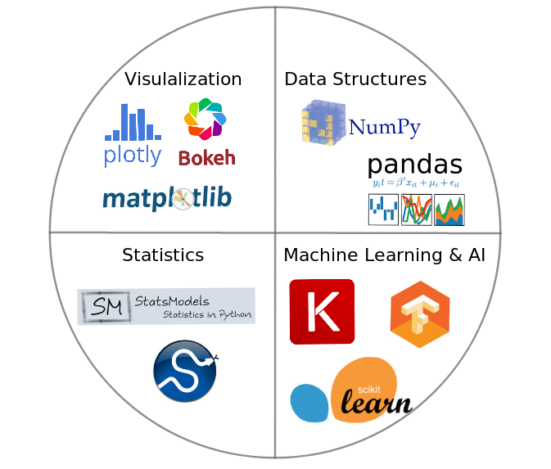

Python Ecosystem for Data Science
Source:https://duchesnay.github.io/pystatsml/introduction/python_ecosystem.html

Slide 11
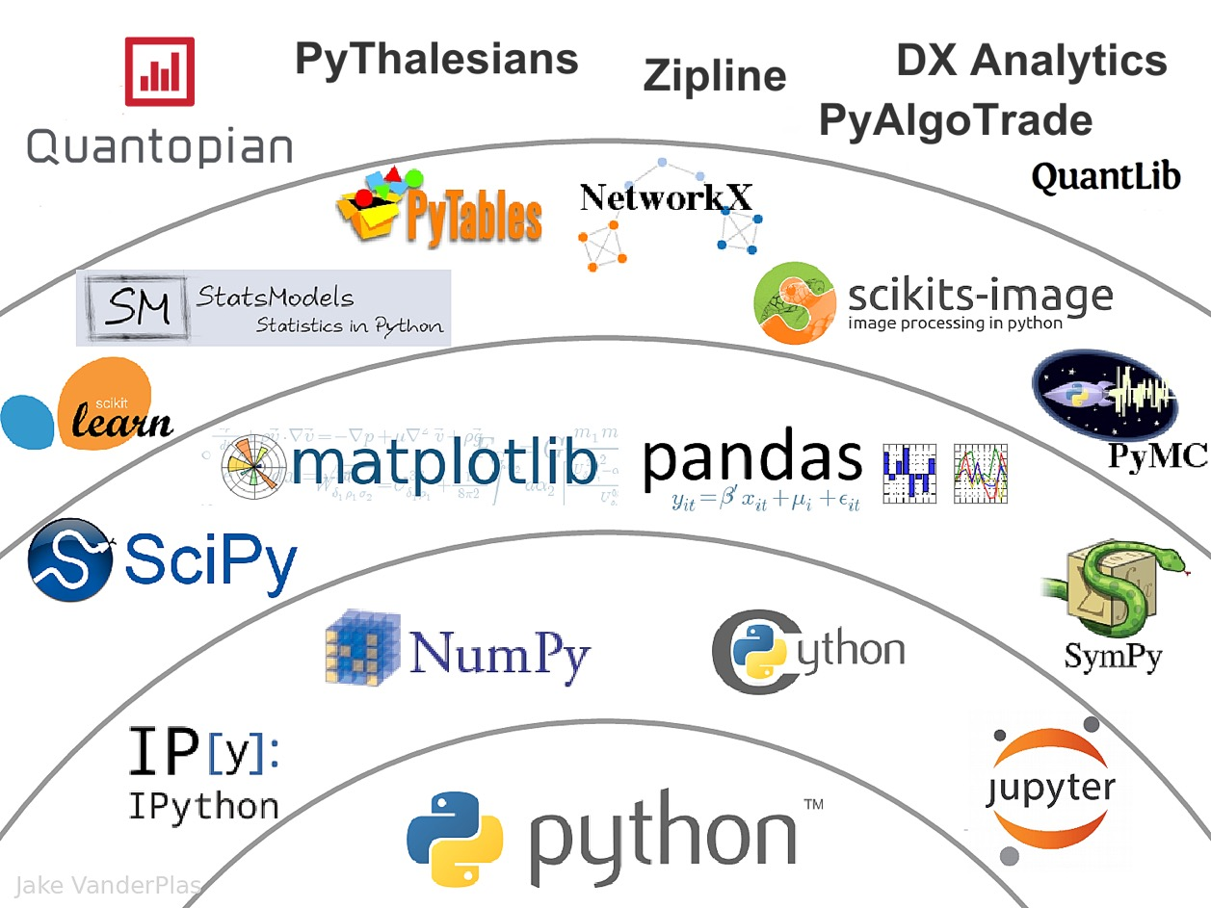

The Quant Finance PyData Stack
Source: http://nbviewer.jupyter.org/format/slides/github/quantopian/pyfolio/blob/master/pyfolio/examples/overview_slides.ipynb#/5

Slide 12
Numpy
NumPy
Base
N-dimensional array package

Slide 13
Python matplotlib
Source: https://matplotlib.org/

Slide 14
Python Pandas
http://pandas.pydata.org/

Slide 15

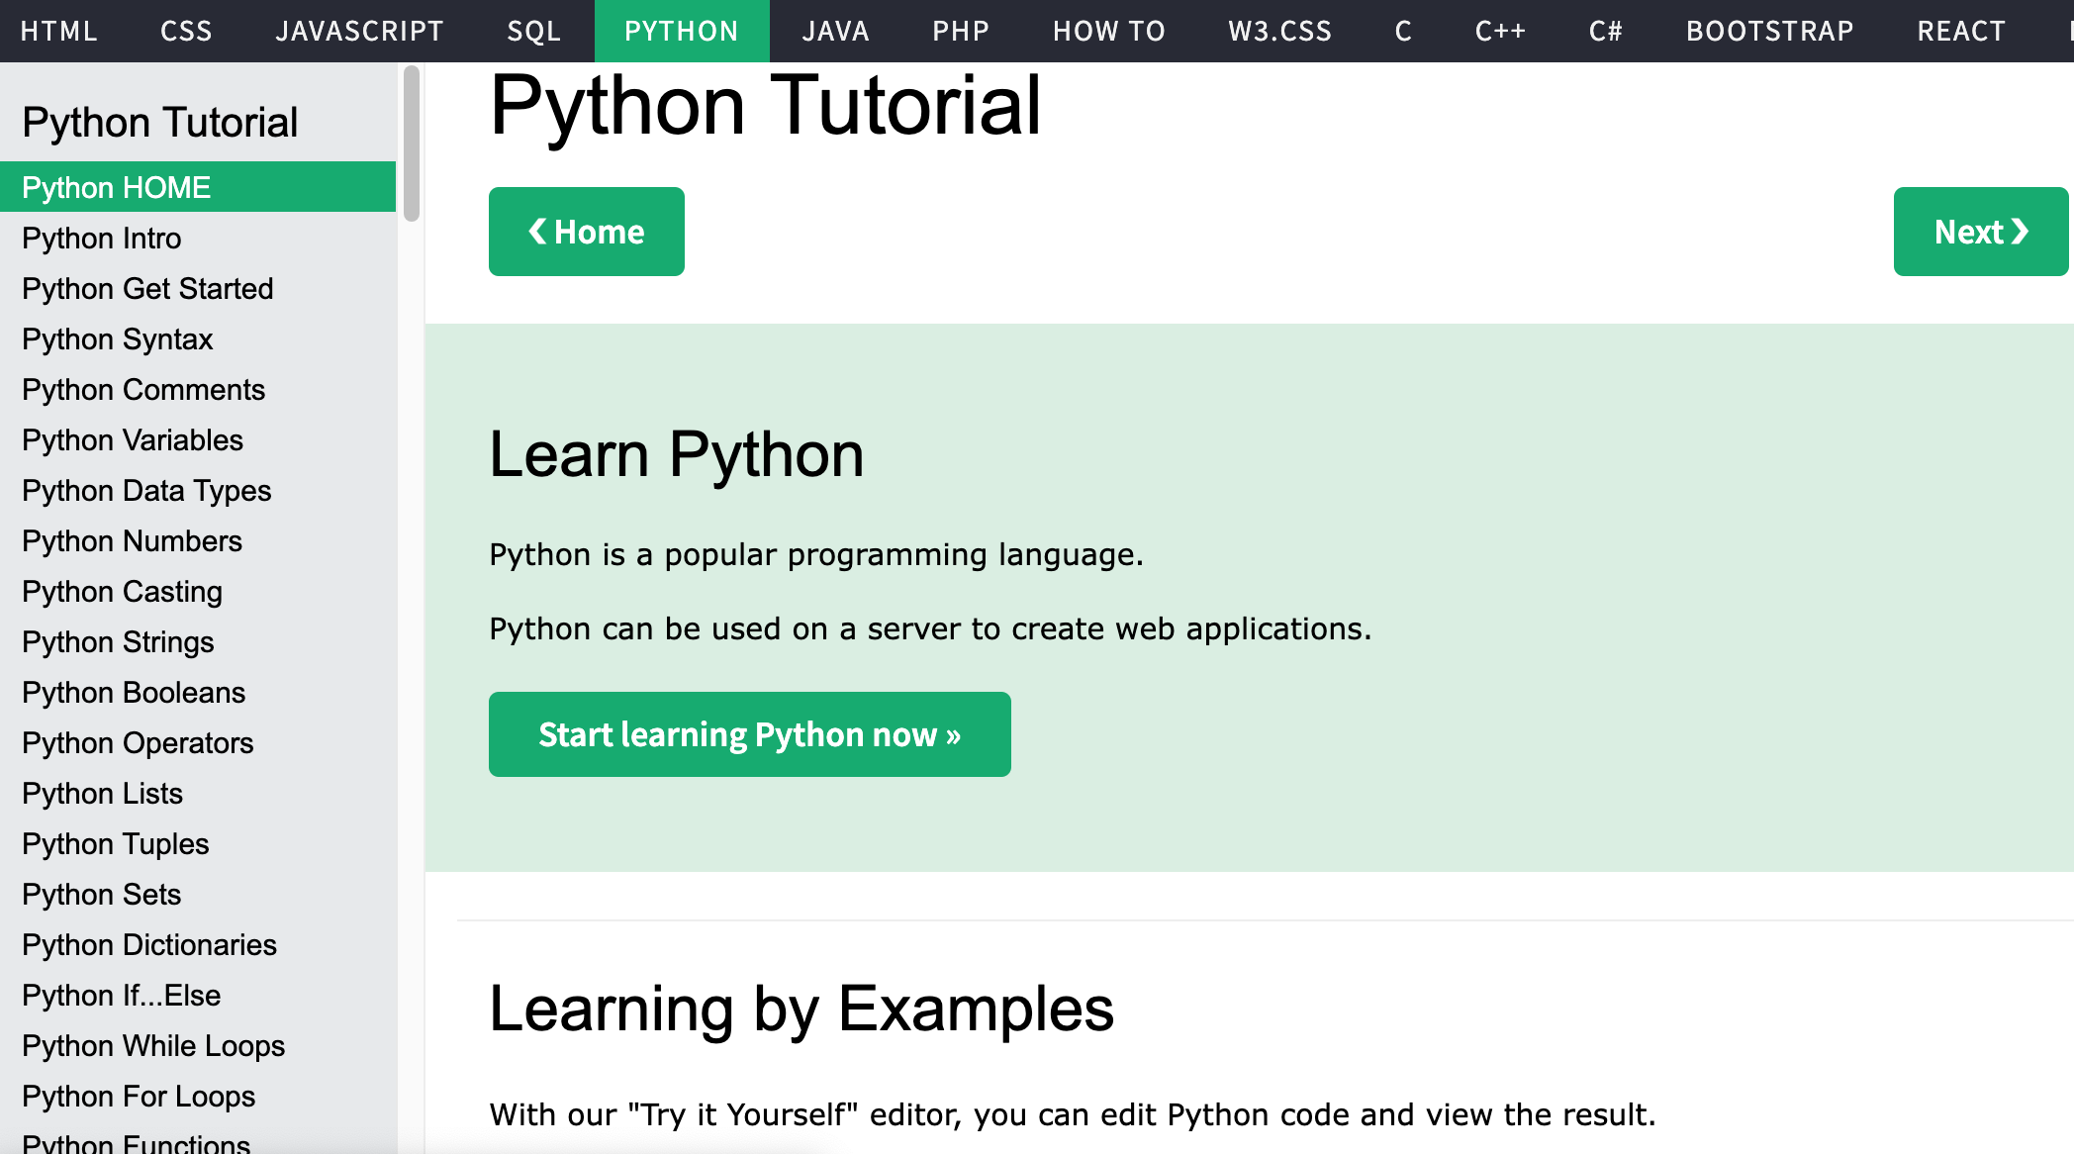
W3Schools Python
https://www.w3schools.com/python/

Slide 16
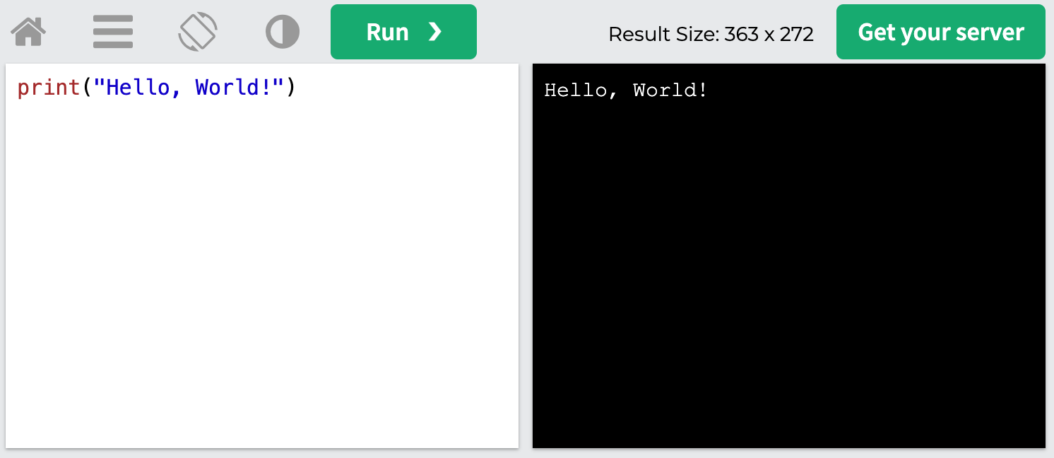
W3Schools Python: Try Python
https://www.w3schools.com/python/trypython.asp?filename=demo_default

Slide 17
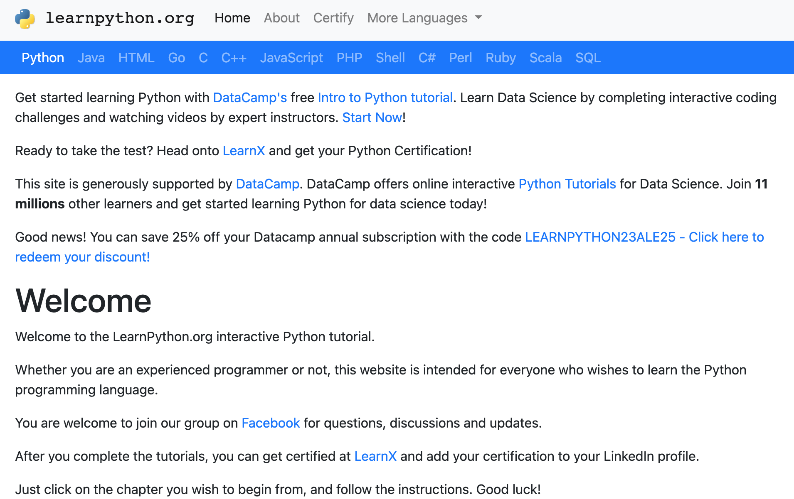
LearnPython.org
https://www.learnpython.org/

Slide 18
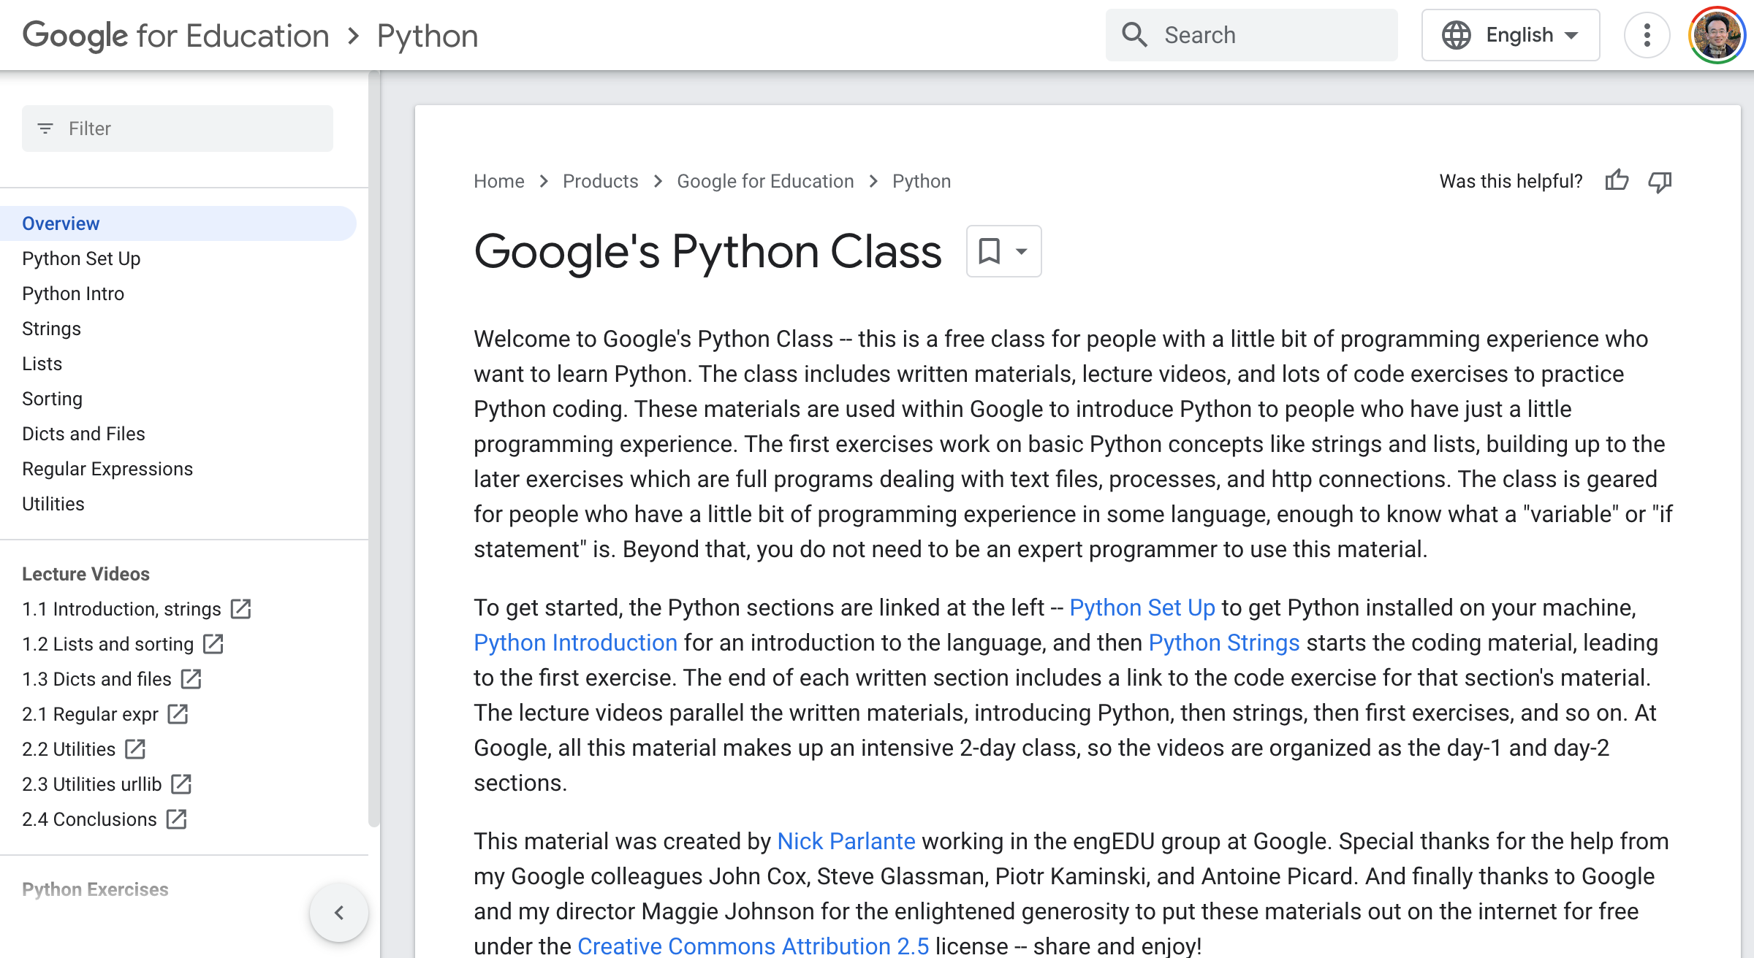
Google’s Python Class
https://developers.google.com/edu/python

Slide 19
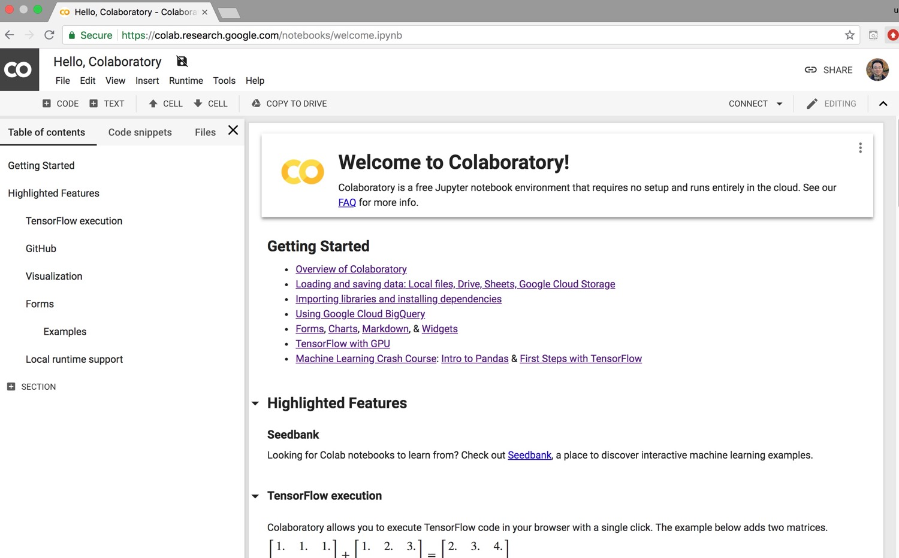
Google Colab
https://colab.research.google.com/notebooks/welcome.ipynb

Slide 20
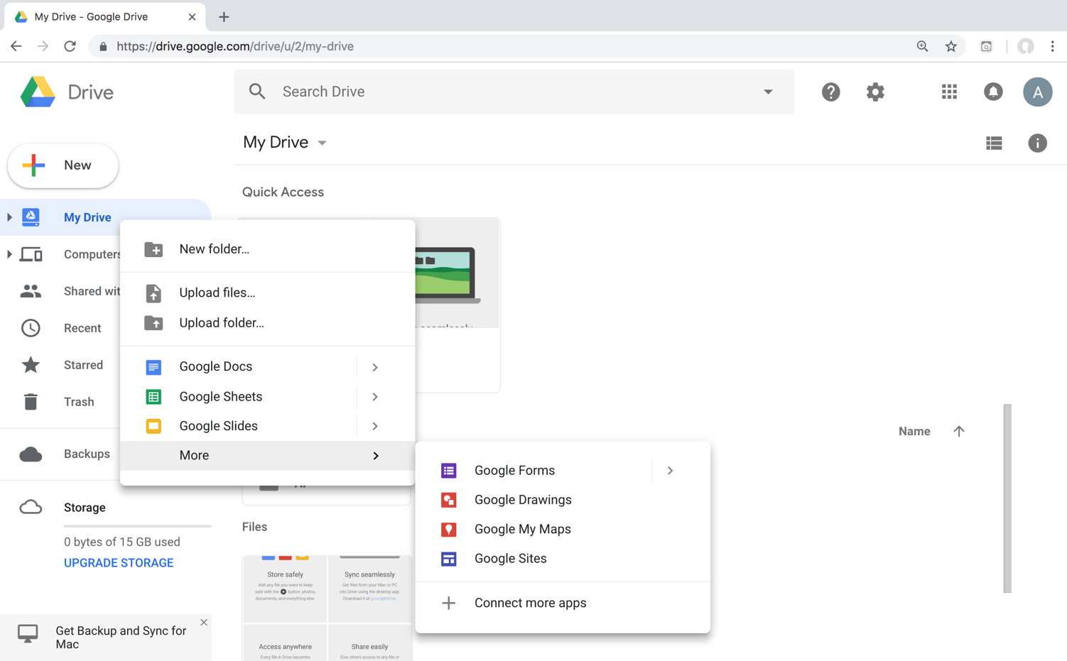
Connect Google Colab in Google Drive

Slide 21
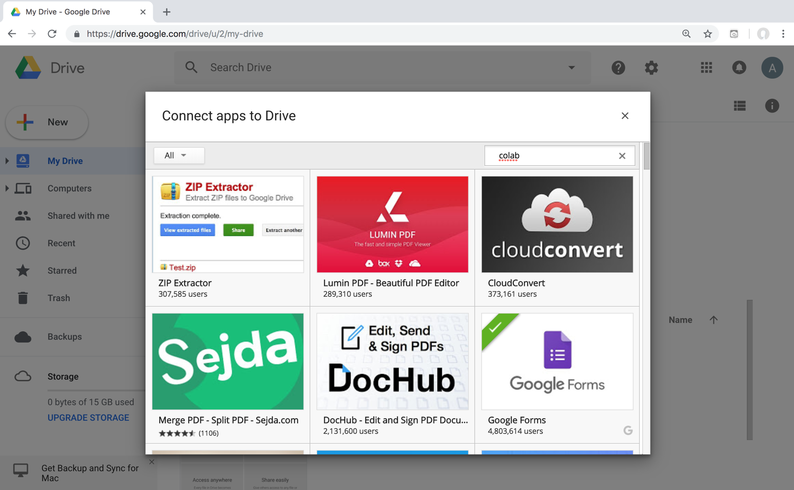
Google Colab

Slide 22
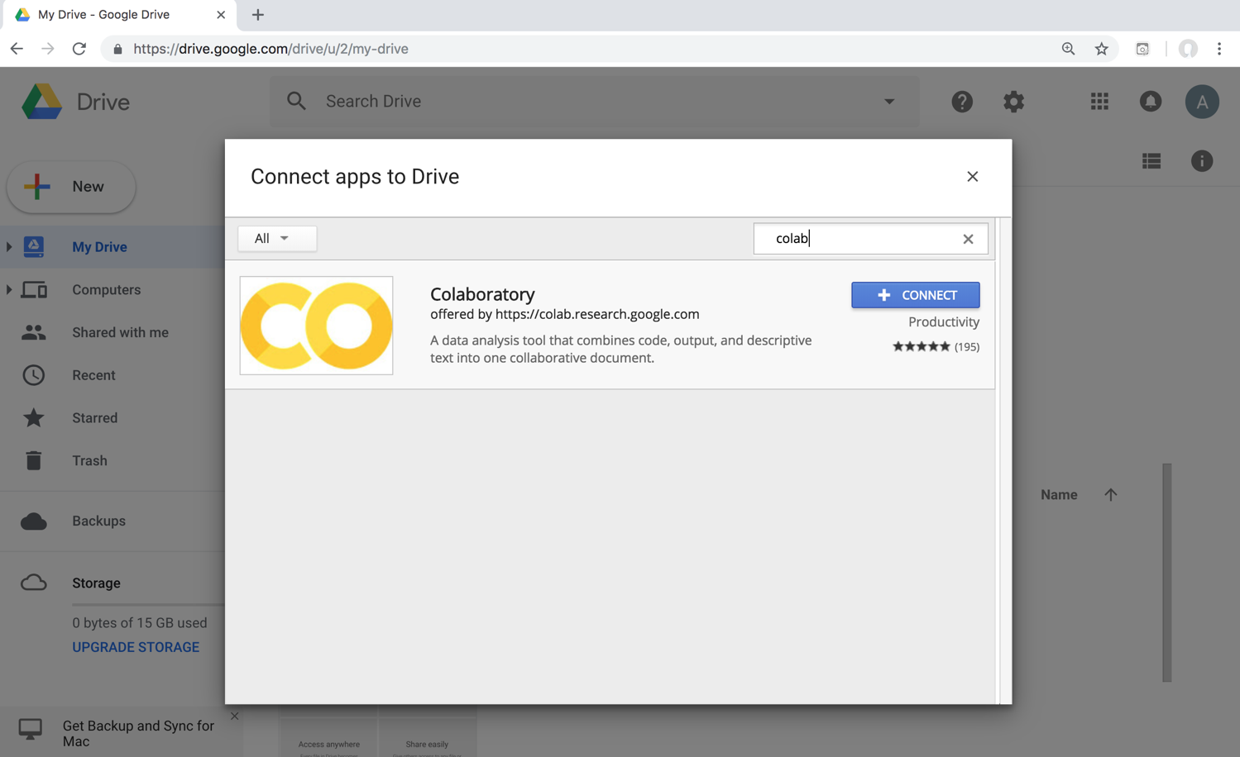
Google Colab

Slide 23
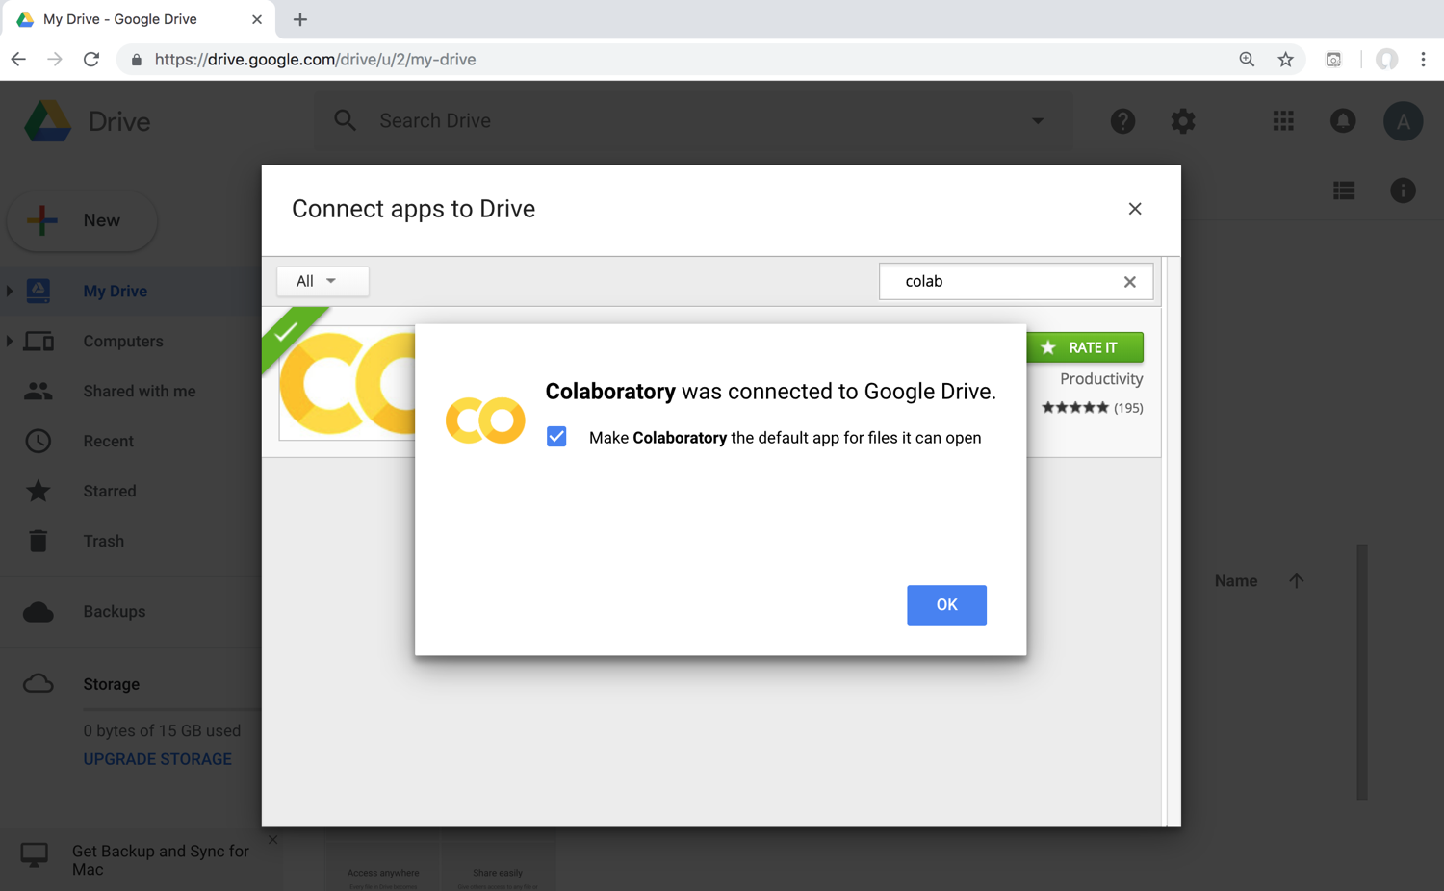
Connect Colaboratory to Google Drive

Slide 24
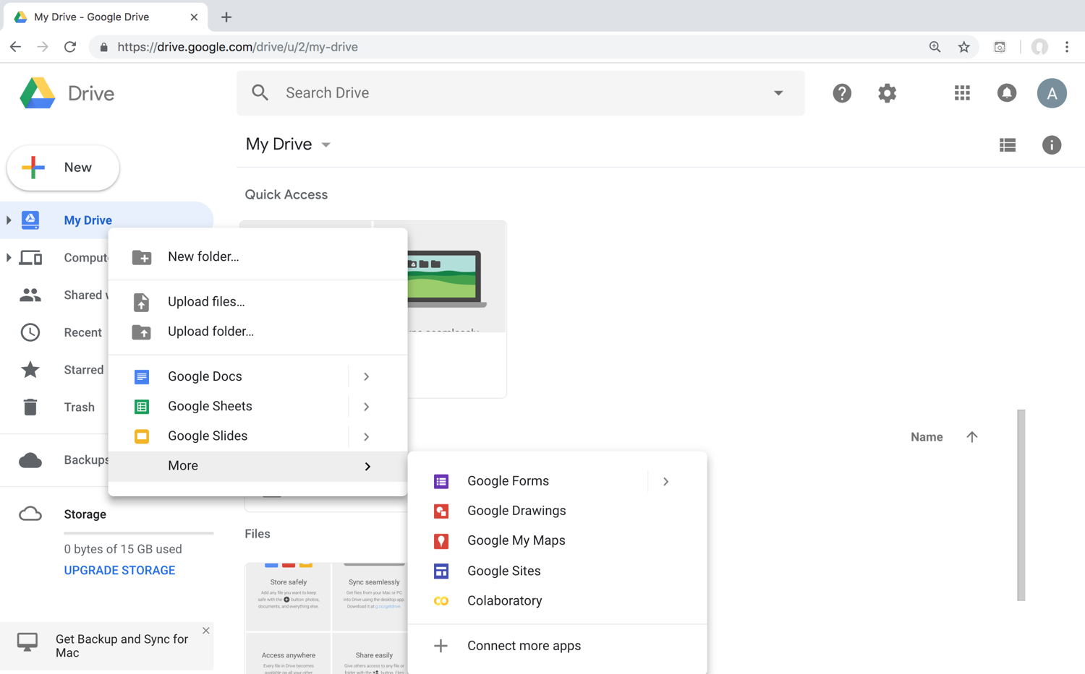
Google Colab

Slide 25
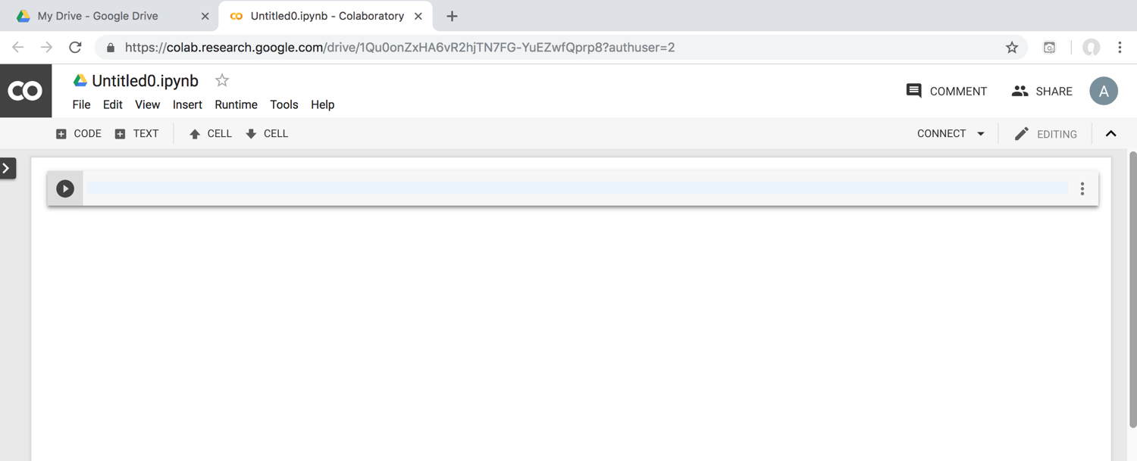
Google Colab

Slide 26
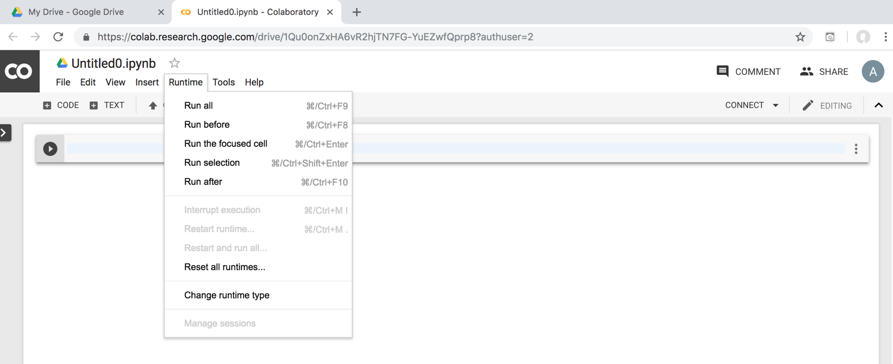
Google Colab

Slide 27
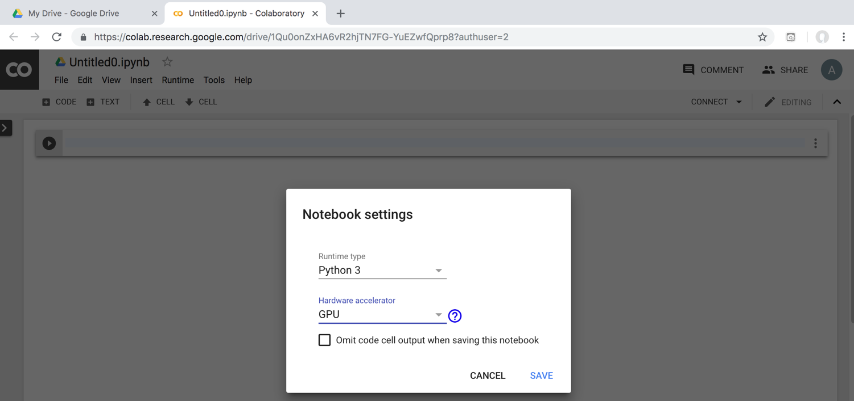
Run Jupyter Notebook
Python3 GPU
Google Colab

Slide 28
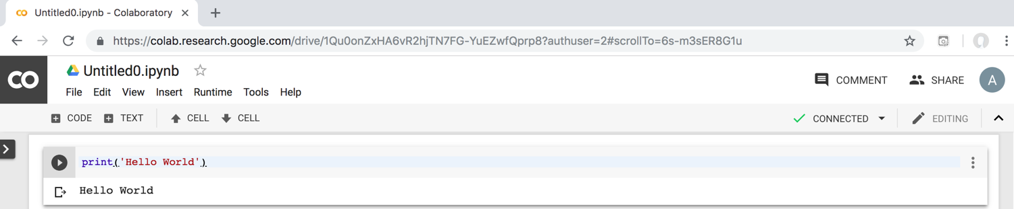
Google Colab Python Hello World print('Hello World')

Slide 29
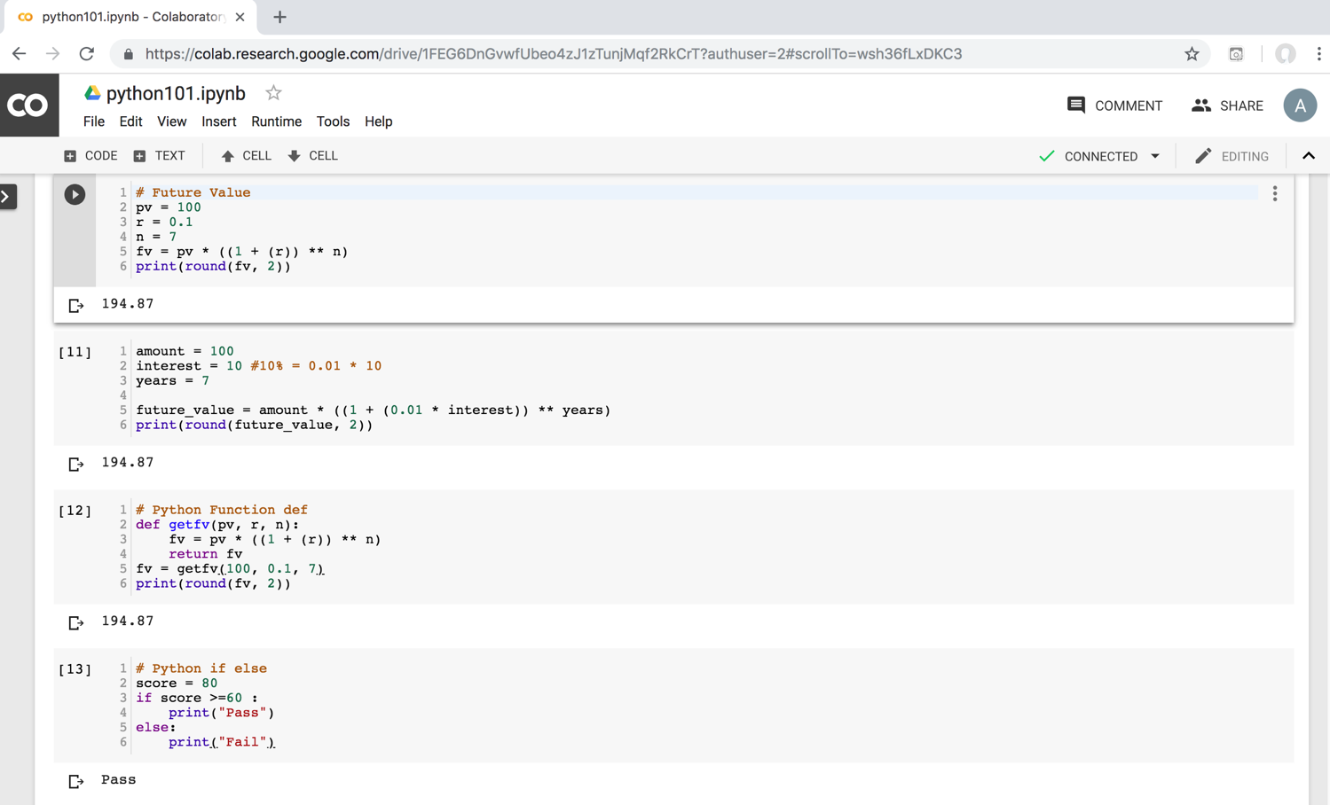
Python in Google Colab (Python101)
https://colab.research.google.com/drive/1FEG6DnGvwfUbeo4zJ1zTunjMqf2RkCrT
https://tinyurl.com/aintpupython101

Slide 30
Anaconda
The Most Popular Python
Data Science Platform
Source: https://www.anaconda.com/

Slide 31
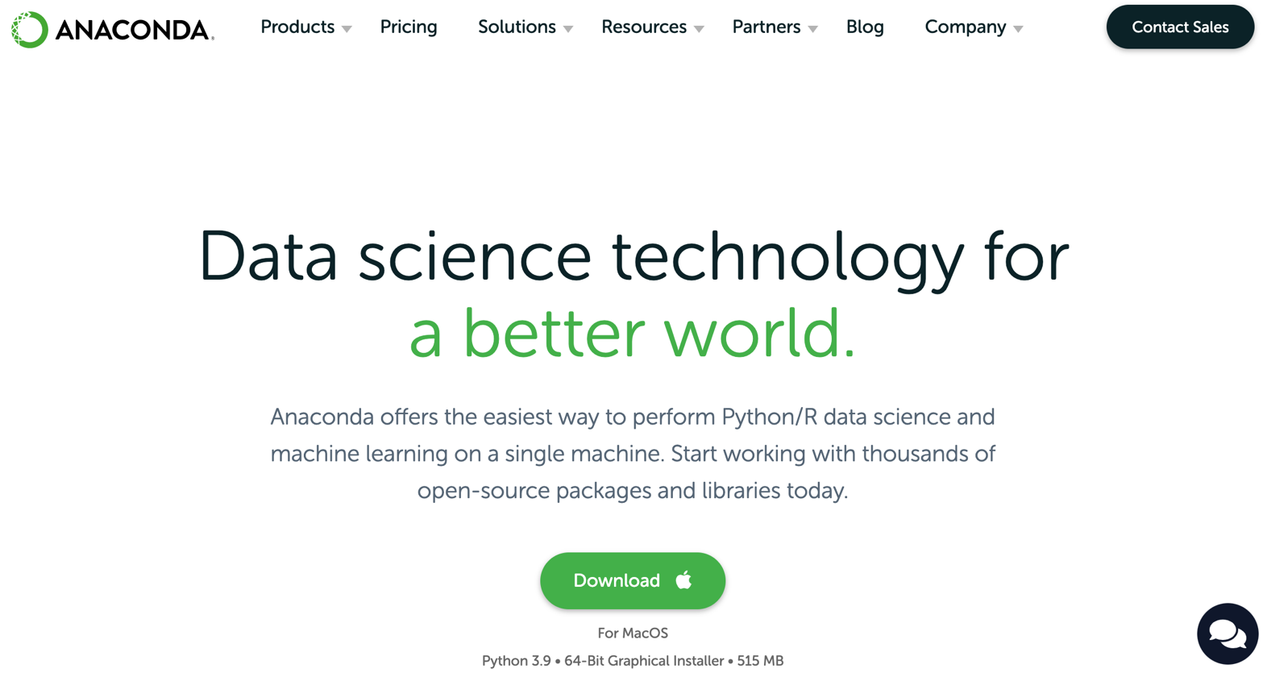
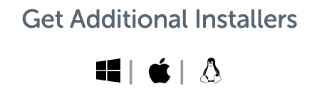
Download Anaconda
https://www.anaconda.com/download

Slide 32
Python
HelloWorld

Slide 33
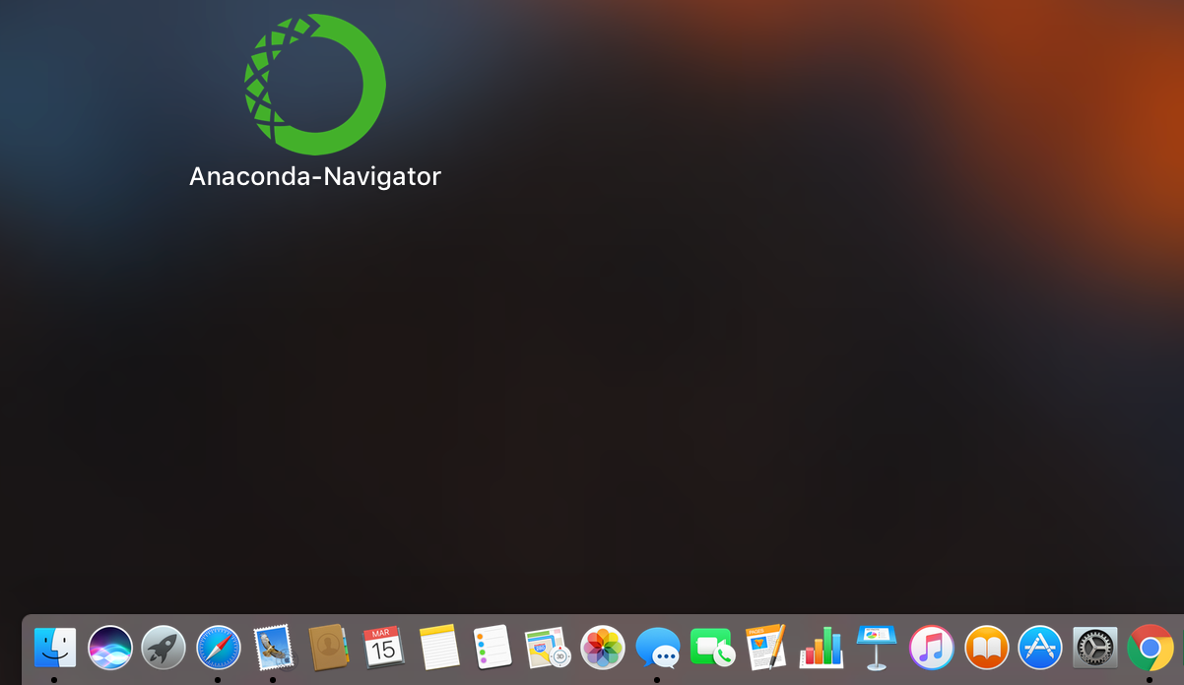
Anaconda-Navigator
Launchpad

Slide 34
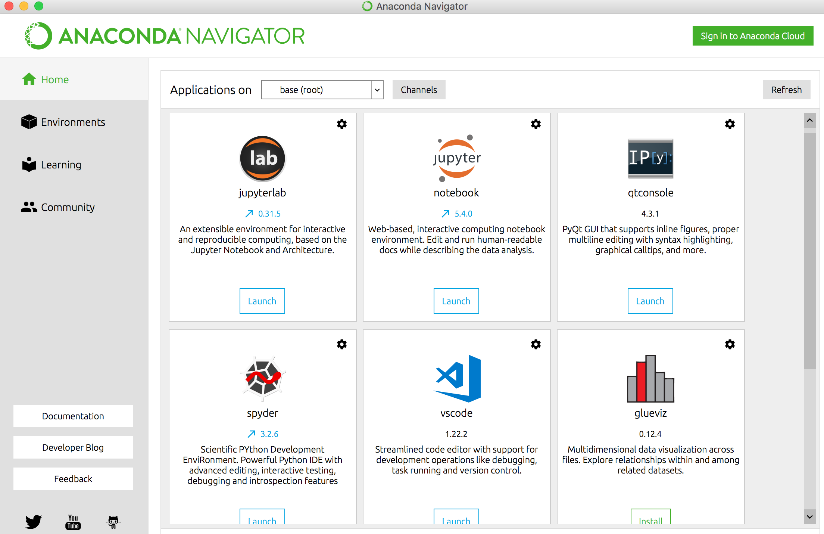
Anaconda Navigator

Slide 35
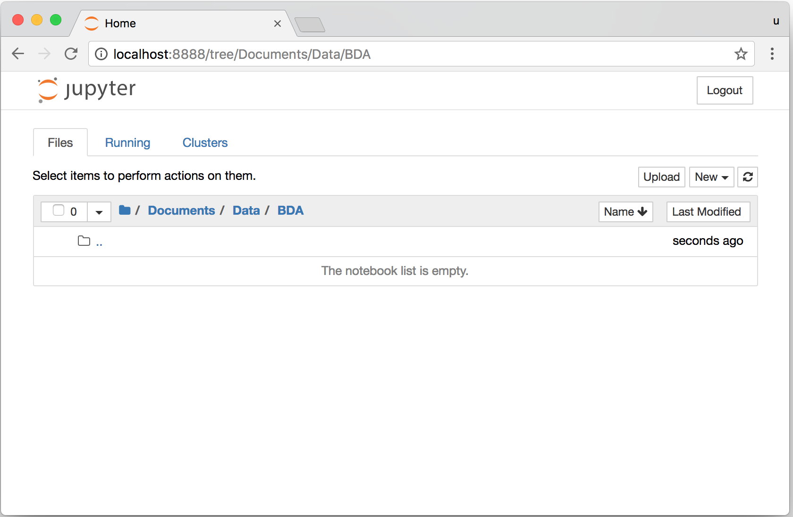
Jupyter Notebook

Slide 36
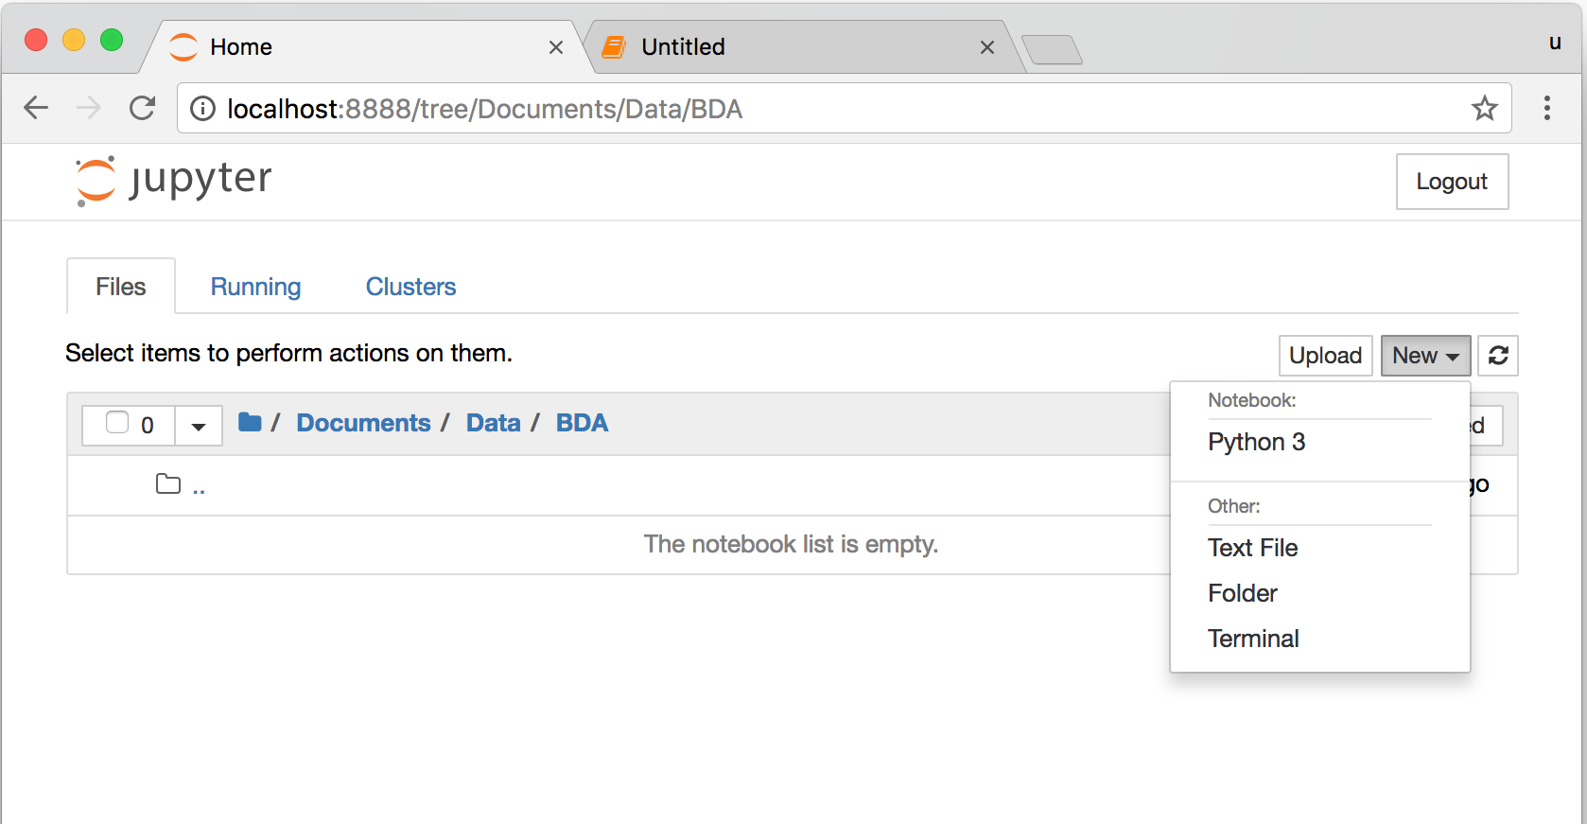
Jupyter Notebook
New Python 3

Slide 37
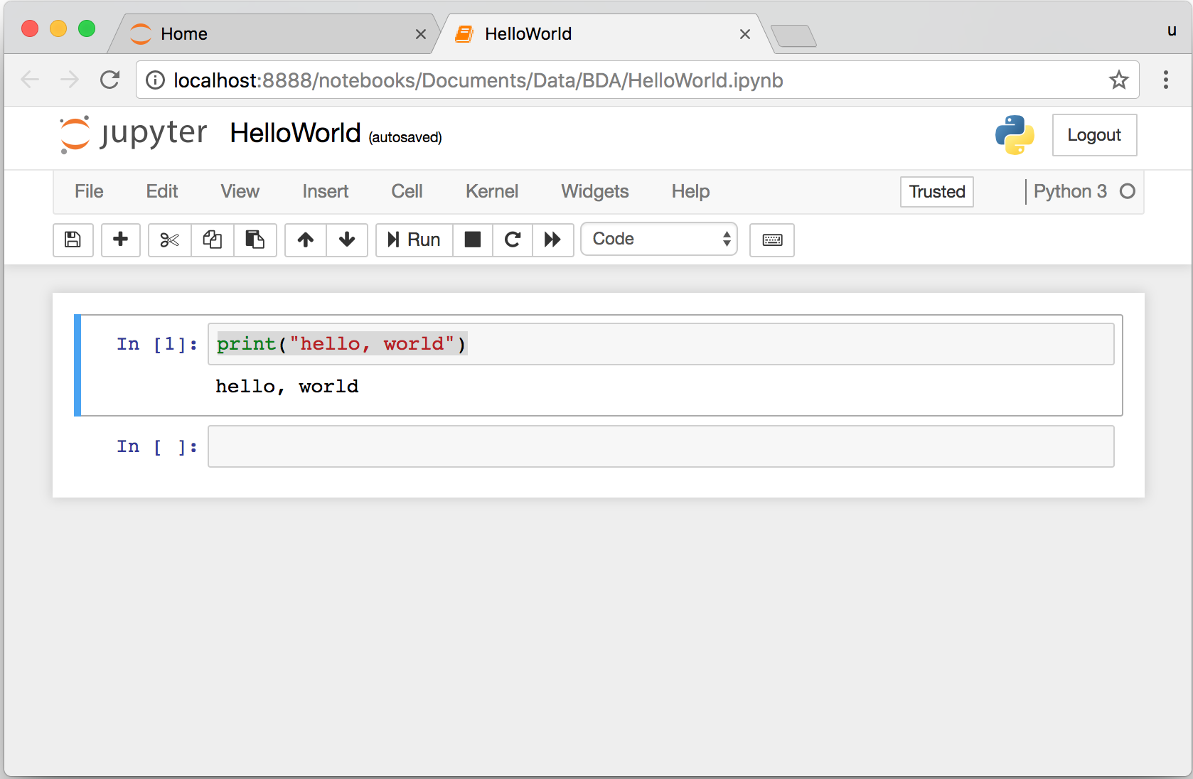
print("hello, world")
Notes:
print("hello, world")

Slide 38
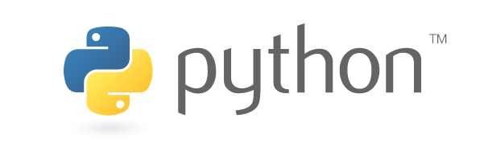
Source: https://www.python.org/community/logos/

Slide 39
Python
Programming

Slide 40
Python Hello World print("Hello World")
print("Hello World")

Slide 41
Python Syntax
# comment
# comment

Slide 42
Python Syntax
Indentation the spaces at the beginning of a code line
4 spaces
score = 80
if score >=60 :
print("Pass")

Slide 43
Python Variables
# Python Variables
x = 2
price = 2.5
word = 'Hello'
word = 'Hello'
word = "Hello"
word = '''Hello'''

Slide 44
Python Variables
x = 2
y = x + 1

Slide 45
python_version()
# comment
from platform import python_version
print("Python Version:", python_version())
Python Version: 3.10.12

Slide 46
Python Data Types
x = "Hello World" #str
x = 2 #int
x = 2.5 #float
x = 7j #complex

Slide 47
Python Data Types
x = ["apple", "banana", "cherry"] #list
x = ("apple", "banana", "cherry") #tuple
x = range(6) #range
x = {"name" : "Tom", "age" : 20} #dict
x = {"apple", "banana", "cherry"} #set
x = frozenset({"apple", "banana", "cherry"}) #frozenset

Slide 48
Python Data Types
x = True #bool
x = b"Hello" #bytes
x = bytearray(5) #bytearray
x = memoryview(bytes(5)) #memoryview
x = None #NoneType

Slide 49
Python Casting
x = str(3) # x will be '3'
y = int(3) # y will be 3
z = float(3) # z will be 3.0
print(x, type(x))
print(y, type(y))
print(z, type(z))
3 <class 'str’>
3 <class 'int’>
3.0 <class 'float'>

Slide 50
Python Numbers
x = 2 # int
y = 3.4 # float
z = 7j #complex
print(x, type(x))
print(y, type(y))
print(z, type(z))
2 <class 'int’>
3.4 <class 'float’>
7j <class 'complex'>

Slide 51
Python Arithmetic Operators
Operator Name Example
+ Addition 7 + 2 = 9
- Subtraction 7 - 2 = 5
* Multiplication 7 * 2 = 14
/ Division 7 / 2 = 3.5
// Floor division 7 // 2 = 3 (Quotient)
% Modulus 7 % 2 = 1 (Remainder)
** Exponentiation 7 ** 2 = 49

Slide 52
Python Basic Operators
print('7 + 2 =', 7 + 2)
print('7 - 2 =', 7 - 2)
print('7 * 2 =', 7 * 2)
print('7 / 2 =', 7 / 2)
print('7 // 2 =', 7 // 2)
print('7 % 2 =', 7 % 2)
print('7 ** 2 =', 7 ** 2)
7 + 2 = 9
7 - 2 = 5
7 * 2 = 14
7 / 2 = 3.5
7 // 2 = 3
7 % 2 = 1
7 ** 2 = 49

Slide 53
Python Booleans:
True or False
# Python Booleans: True or False
print(3 > 2)
print(3 == 2)
print(3 < 2)

Slide 54
Python BMI Calculator
# BMI Calculator in Python
height_cm = 170
weight_kg = 60
height_m = height_cm/100
BMI = (weight_kg/(height_m**2))
print("Your BMI is: " + str(round(BMI,1)))
Your BMI is: 20.8

Slide 55
Future value of a specified principal amount, rate of interest, and a number of years
Source: https://www.w3resource.com/python-exercises/python-basic-exercise-39.php

Slide 56
How much is your $100 worth after 7 years?
# How much is your $100 worth after 7 years?
fv = 100 * 1.1 ** 7
print('fv = ', round(fv, 2))
# output = 194.87
fv = 194.87

Slide 57
Future Value
# Future Value
pv = 100
r = 0.1
n = 7
fv = pv * ((1 + (r)) ** n)
print(round(fv, 2))
194.87

Slide 58
Future Value
# Future Value
amount = 100
interest = 10 #10% = 0.01 * 10
years = 7
future_value = amount * ((1 + (0.01 * interest)) ** years)
print(round(future_value, 2))
194.87

Slide 59
Python
Data Structures

Slide 60
Python Data Structures
  Python Lists []
  Python Tuples ()
  Python Sets {}
  Python Dictionaries {k:v}

Slide 61
Python Data Structures
fruits = ["apple", "banana", "cherry"] #lists []
colors = ("red", "green", "blue") #tuples ()
animals = {'cat', 'dog'} #sets {}
person = {"name" : "Tom", "age" : 20} #dictionaries {}

Slide 62
Python Data Types
x = ["apple", "banana", "cherry"] #list
x = ("apple", "banana", "cherry") #tuple
x = {"name" : "Tom", "age" : 20} #dict
x = {"apple", "banana", "cherry"} #set

Slide 63
Python Collections
There are four collection data types in the Python programming language
List []
  a collection which is ordered and changeable. Allows duplicate members.
Tuple ()
  a collection which is ordered and unchangeable. Allows duplicate members.
Set {}
  a collection which is unordered, unchangeable, and unindexed. No duplicate members.
Dictionary {k:v}
  a collection which is ordered and changeable. No duplicate members.

Slide 64
Python Dictionaries {k:v}
As of Python version 3.7, dictionaries are ordered.
In Python 3.6 and earlier, dictionaries are unordered.

Slide 65
Lists []
x = [60, 70, 80, 90]
print(len(x))
print(x[0])
print(x[1])
print(x[-1])
4
60
70
90

Slide 66
Lists []
len(): how many items
type(): data type
list() constructor: creating a new list

Slide 67
Python List Methods
Method Description
append() Adds an element at the end of the list
clear() Removes all the elements from the list
copy() Returns a copy of the list
count() Returns the number of elements with the specified value
extend() Add the elements of a list (or any iterable), to the end of the current list
index() Returns the index of the first element with the specified value
insert() Adds an element at the specified position
pop() Removes the element at the specified position
remove() Removes the item with the specified value
reverse() Reverses the order of the list
sort() Sorts the list
https://www.w3schools.com/python/python_lists_methods.asp

Slide 68
Tuples ()
A tuple in Python is a collection that cannot be modified.
A tuple is defined using parenthesis.
x = (10, 20, 30, 40, 50)
print(x[0])
print(x[1])
print(x[2])
print(x[-1])
10
20
30
50
Source: http://pythonprogramminglanguage.com/tuples/

Slide 69
Sets {}
animals = {'cat', 'dog'}
print('cat' in animals)
print('fish' in animals)
animals.add('fish')
print('fish' in animals) print(len(animals))
animals.add('cat’)
print(len(animals))
animals.remove('cat')
print(len(animals))
True
False
True
3
3
2
Source: http://cs231n.github.io/python-numpy-tutorial/

Slide 70
Dictionary {key : value}
Python Dictionary
Key → Value
'EN’ → 'English’
'FR’ → 'French'
k = { 'EN':'English', 'FR':'French' }
print(k['EN'])
English
Source: http://pythonprogramminglanguage.com/dictionary/

Slide 71
Python Data Structures
fruits = ["apple", "banana", "cherry"] #lists []
colors = ("red", "green", "blue") #tuples ()
animals = {'cat', 'dog'} #sets {}
person = {"name" : "Tom", "age" : 20} #dictionaries {}
https://tinyurl.com/aintpupython101

Slide 72
Summary
  Python Lists []
  Python Tuples ()
  Python Sets {}
  Python Dictionaries {k:v}

Slide 73
References
Wes McKinney (2022), "Python for Data Analysis: Data Wrangling with pandas, NumPy, and Jupyter", 3rd Edition, O'Reilly Media.
Aurélien Géron (2023), Hands-On Machine Learning with Scikit-Learn, Keras, and TensorFlow: Concepts, Tools, and Techniques to Build Intelligent Systems, 3rd Edition, O’Reilly Media.
Steven D'Ascoli (2022), Artificial Intelligence and Deep Learning with Python: Every Line of Code Explained For Readers New to AI and New to Python, Independently published.
Stuart Russell and Peter Norvig (2020), Artificial Intelligence: A Modern Approach, 4th Edition, Pearson.
Denis Rothman (2024), Transformers for Natural Language Processing and Computer Vision - Third Edition: Explore Generative AI and Large Language Models with Hugging Face, ChatGPT, GPT-4V, and DALL-E 3, 3rd ed. Edition, Packt Publishing
Ben Auffarth (2023), Generative AI with LangChain: Build large language model (LLM) apps with Python, ChatGPT and other LLMs, Packt Publishing.
Varun Grover, Roger HL Chiang, Ting-Peng Liang, and Dongsong Zhang (2018), "Creating Strategic Business Value from Big Data Analytics: A Research Framework", Journal of Management Information Systems, 35, no. 2, pp. 388-423.
Junliang Wang, Chuqiao Xu, Jie Zhang, and Ray Zhong (2022). "Big data analytics for intelligent manufacturing systems: A review." Journal of Manufacturing Systems 62 (2022): 738-752.
Ramesh Sharda, Dursun Delen, and Efraim Turban (2017), Business Intelligence, Analytics, and Data Science: A Managerial Perspective, 4th Edition, Pearson
Thomas R. Caldwell (2025), The Agentic AI Bible: The Complete and Up-to-Date Guide to Design, Build, and Scale Goal-Driven, LLM-Powered Agents that Think, Execute and Evolve, Independently published.
Python Programming, https://pythonprogramming.net/
Python, https://www.python.org/
Python Programming Language, http://pythonprogramminglanguage.com/
Numpy, http://www.numpy.org/
Pandas, http://pandas.pydata.org/
Skikit-learn, http://scikit-learn.org/
W3Schools Python, https://www.w3schools.com/python/
Learn Python, https://www.learnpython.org/
Google’s Python Class, https://developers.google.com/edu/python
Min-Yuh Day (2025), Python 101, https://tinyurl.com/aintpupython101

