Slide 1
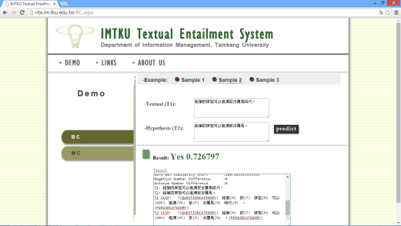
IMTKU Textual Entailment System for Recognizing Inference in Text at NTCIR-11 RITE-VAL Demo
Tamkang University
http://rite.im.tku.edu.tw
Min-Yuh Day *, Ya-Jung Wang, Che-Wei Hsu, En-Chun Tu, Shang-Yu Wu, Huai-Wen Hsu,
Yu-An Lin, Yu-Hsuan Tai, Cheng-Chia Tsai
myday@mail.tku.edu.tw
2014.12.11
NTCIR-11 Conference, December 8-12, 2014, Tokyo, Japan

Slide 2
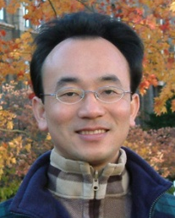
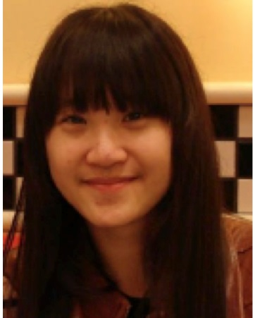
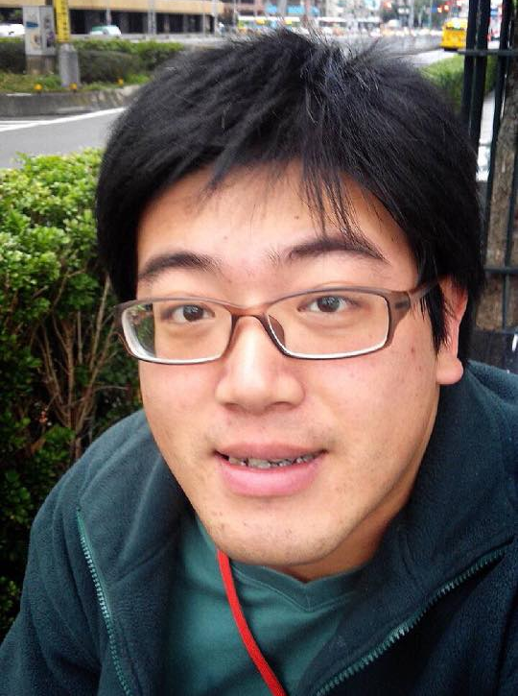
IMTKU Textual Entailment System for Recognizing Inference in Text at NTCIR-11 RITE-VAL Demo
Tamkang University
Min-Yuh Day
Ya-Jung Wang
Che-Wei Hsu
En-Chun Tu
Huai-Wen Hsu
Yu-An Lin
Shang-Yu Wu
Yu-Hsuan Tai
Cheng-Chia Tsai
NTCIR-11 Conference, December 8-12, 2014, Tokyo, Japan

Slide 3
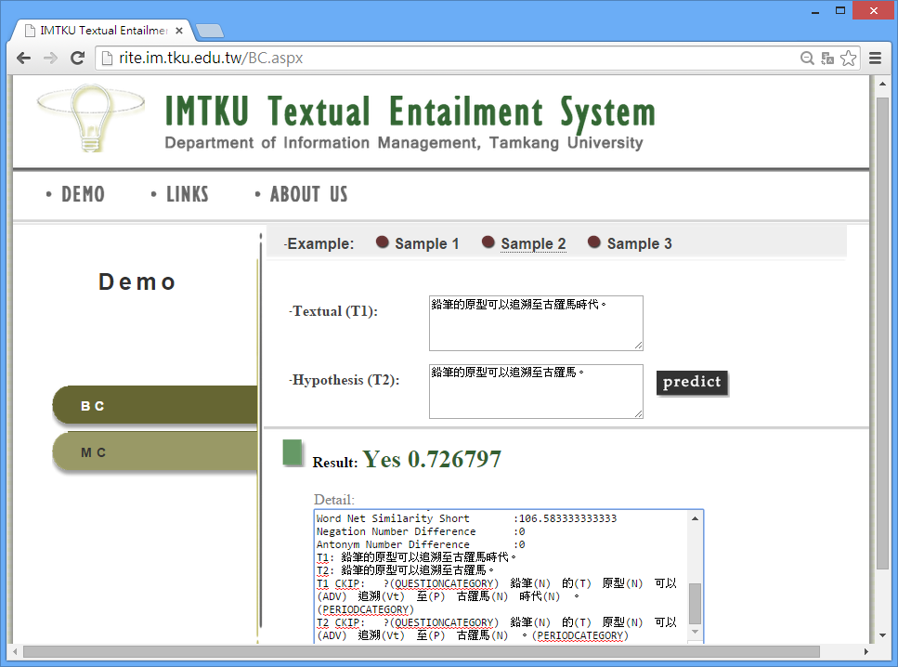
Tamkang University
IMTKU Demo
http://rite.im.tku.edu.tw
NTCIR-11 Conference, December 8-12, 2014, Tokyo, Japan

Slide 4
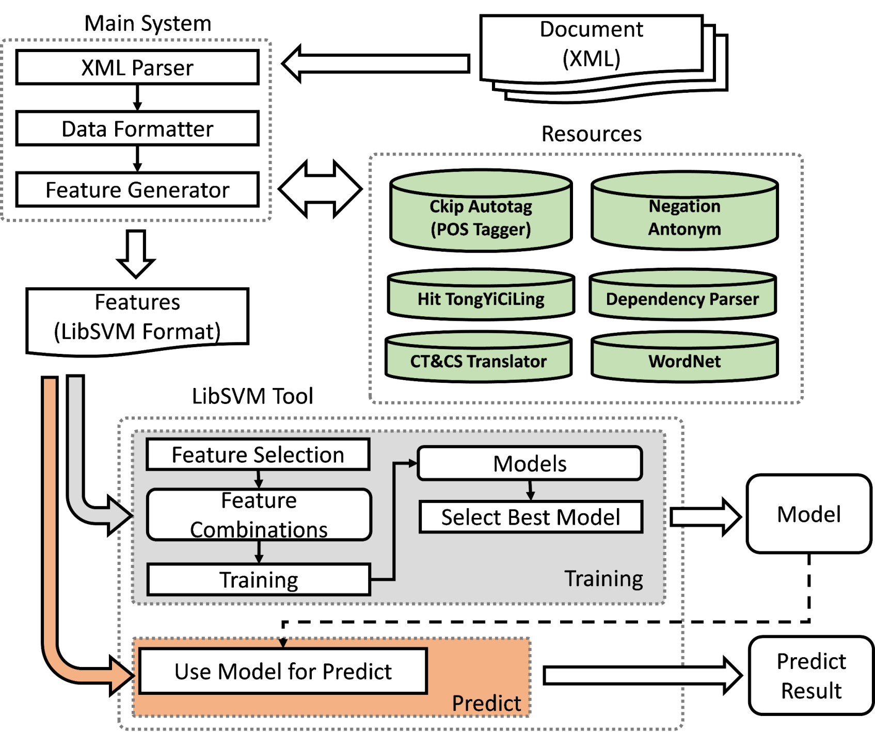
IMTKU System Framework for NTCIR -11 RITE-VAL
NTCIR-11 Conference, December 8-12, 2014, Tokyo, Japan

Slide 5
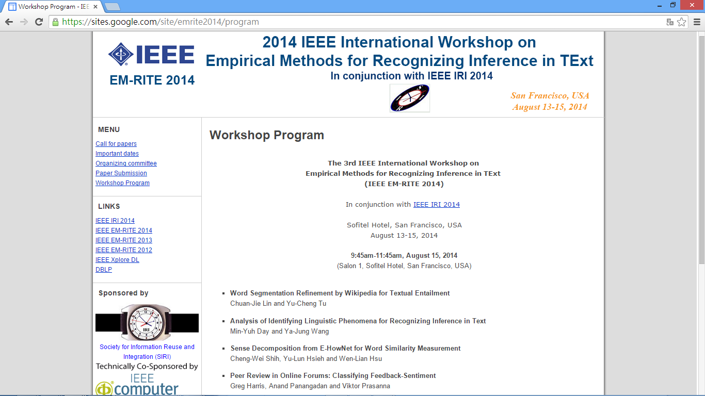
NTCIR-11 Conference, December 8-12, 2014, Tokyo, Japan

