Slide 1
Tamkang University
Tamkang University
李御璽 教授
銘傳大學資訊工程學系
Big Data Analytics on Social Media
(社群媒體大數據分析)
Time: 2015/12/25 (14:00-15:30) Place: S402, Ming Chuan University
Min-Yuh Day
戴敏育
Assistant Professor
專任助理教授
Dept. of Information Management, Tamkang University
淡江大學 資訊管理學系
http://mail. tku.edu.tw/myday/
2015-12-25

Slide 2
戴敏育 博士 (Min-Yuh Day, Ph.D.)
淡江大學資管系專任助理教授
中央研究院資訊科學研究所訪問學人
國立台灣大學資訊管理博士
Publications Co-Chairs, IEEE/ACM International Conference on Advances in Social Networks Analysis and Mining (ASONAM 2013- )
Program Co-Chair, IEEE International Workshop on Empirical Methods for Recognizing Inference in TExt (IEEE EM-RITE 2012- )
Workshop Chair, The IEEE International Conference on Information Reuse and Integration (IEEE IRI)

Slide 3
Outline
Big Data Analytics on Social Media
Analyzing the Social Web: Social Network Analysis
NTCIR 12 QALab-2 Task

Slide 4
Social Media
Source: http://www.dreamstime.com/royalty-free-stock-images-christmas-tree-social-media-icons-image21457239

Slide 5
Social Media
Source: http://hungrywolfmarketing.com/2013/09/09/what-are-your-social-marketing-goals/

Slide 6
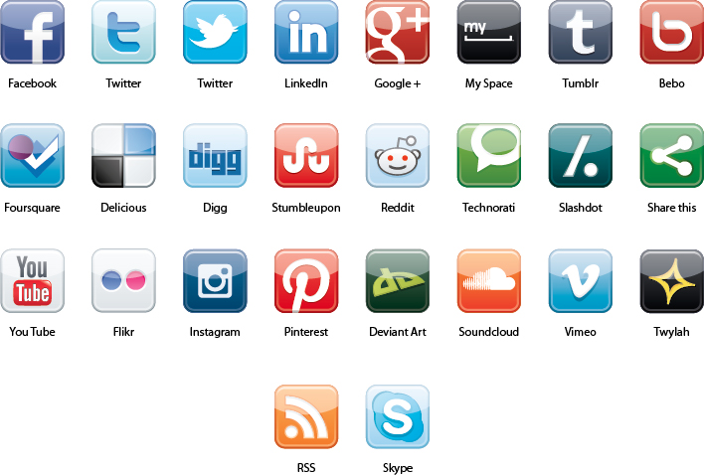
Social Media
Line
Source: http://blog.contentfrog.com/wp-content/uploads/2012/09/New-Social-Media-Icons.jpg

Slide 7
Source: http://line.me/en/

Slide 8
Socialnomics
Source: http://www.amazon.com/Socialnomics-Social-Media-Transforms-Business/dp/1118232658

Slide 9
Emotions
Love
Anger
Joy
Sadness
Surprise
Fear
Source: Bing Liu (2011) , “Web Data Mining: Exploring Hyperlinks, Contents, and Usage Data,” Springer, 2nd Edition,

Slide 10
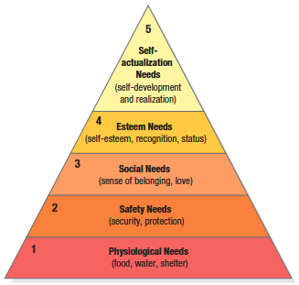
Maslow’s Hierarchy of Needs
Source: Philip Kotler & Kevin Lane Keller, Marketing Management, 14th ed., Pearson, 2012

Slide 11
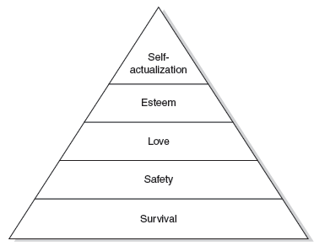
Maslow’s hierarchy of human needs (Maslow, 1943)

Slide 12
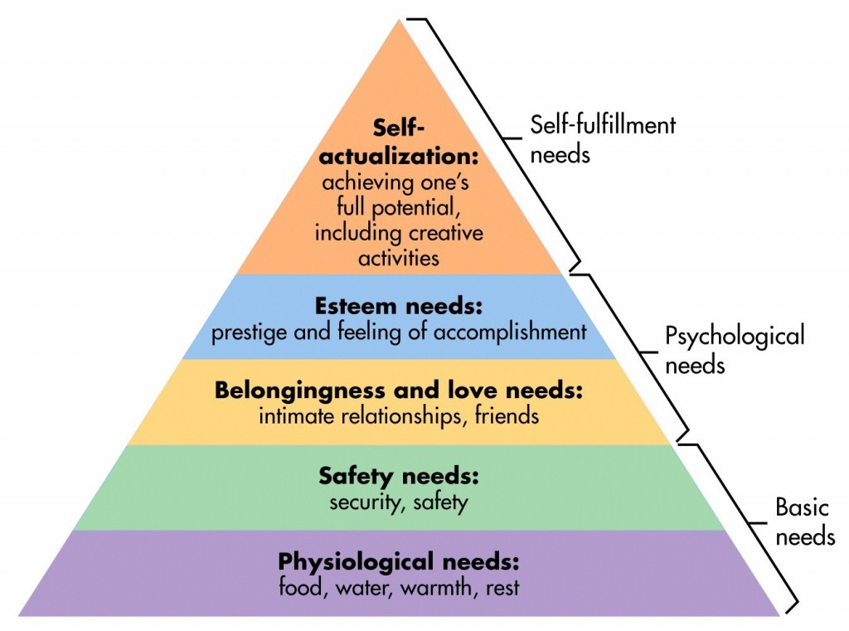
Maslow’s Hierarchy of Needs
Source: http://sixstoriesup.com/social-psyche-what-makes-us-go-social/

Slide 13
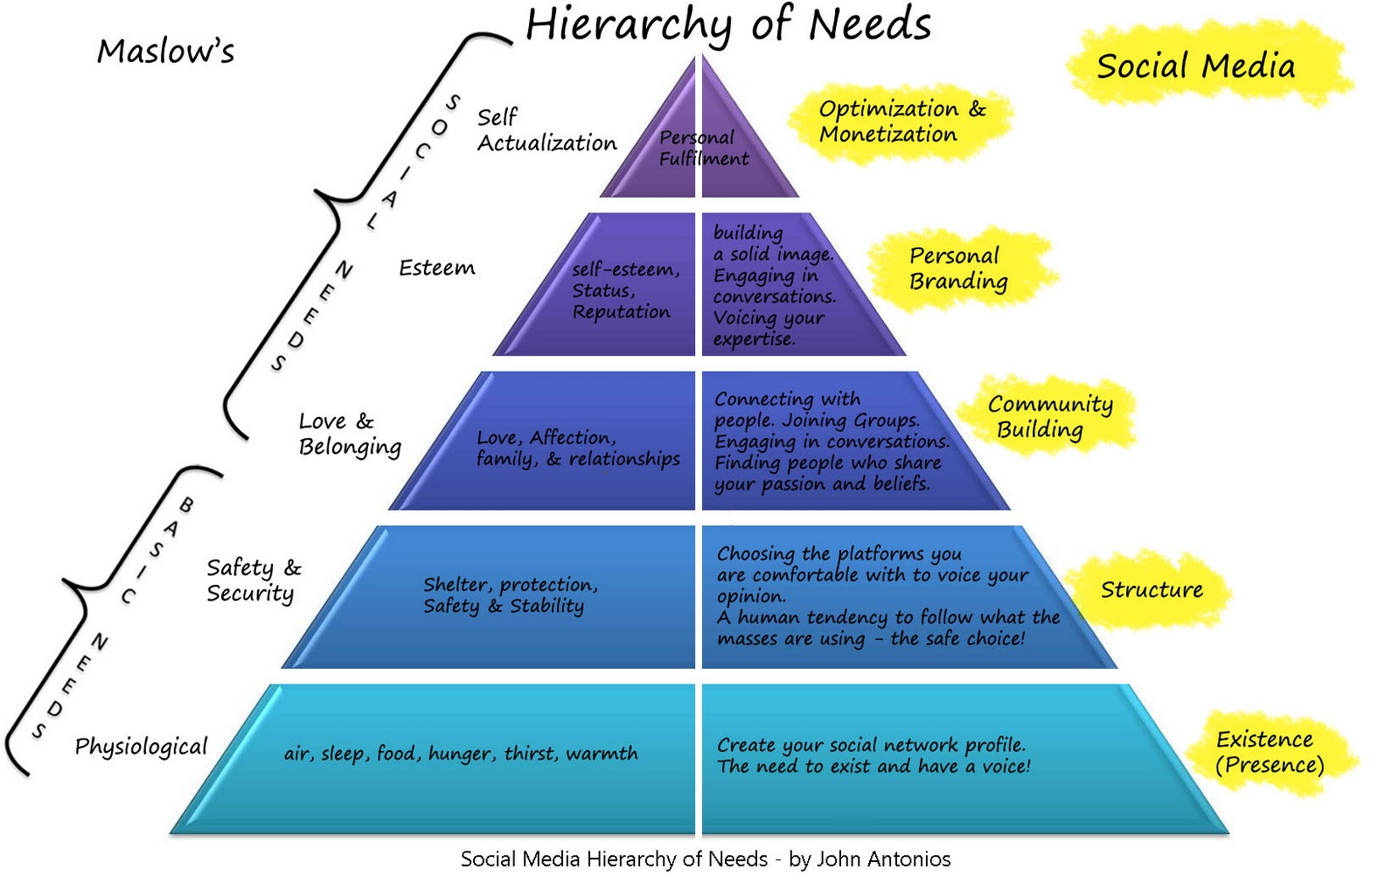
Social Media Hierarchy of Needs
Source: http://2.bp.blogspot.com/_Rta1VZltiMk/TPavcanFtfI/AAAAAAAAACo/OBGnRL5arSU/s1600/social-media-heirarchy-of-needs1.jpg

Slide 14
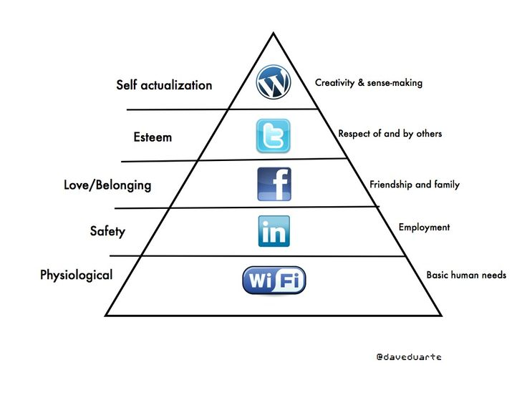
Social Media Hierarchy of Needs
Source: http://www.pinterest.com/pin/18647785930903585/

Slide 15
The Social Feedback Cycle Consumer Behavior on Social Media
Marketer-Generated
User-Generated
Form Opinion
Awareness
Consideration
Purchase
Use
Talk
Source: Evans et al. (2010), Social Media Marketing: The Next Generation of Business Engagement

Slide 16
The New Customer Influence Path
Awareness
Consideration
Purchase
Source: Evans et al. (2010), Social Media Marketing: The Next Generation of Business Engagement

Slide 17
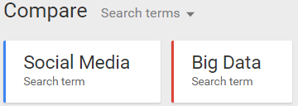
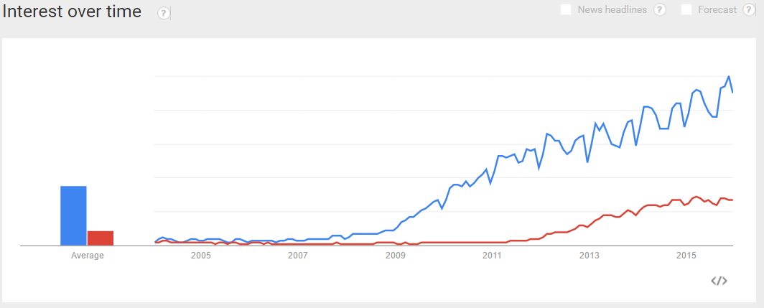
Google Trends on Social Media
Source: http://www.google.com.tw/trends/explore#q=Social%20Media%2C%20Big%20Data

Slide 18
Internet Evolution Internet of People (IoP): Social Media Internet of Things (IoT): Machine to Machine
Source: Marc Jadoul (2015), The IoT: The next step in internet evolution, March 11, 2015 http://www2.alcatel-lucent.com/techzine/iot-internet-of-things-next-step-evolution/

Slide 19
Business Insights with Social Analytics

Slide 20
Big Data Analytics and Data Mining

Slide 21
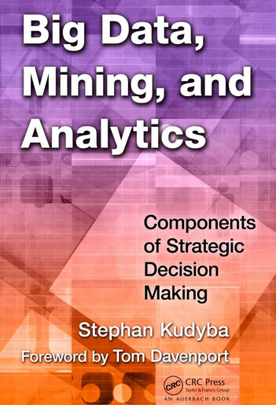
Stephan Kudyba (2014), Big Data, Mining, and Analytics: Components of Strategic Decision Making, Auerbach Publications
Source: http://www.amazon.com/gp/product/1466568704

Slide 22
Architecture of Big Data Analytics
Big Data Analytics Applications
Big Data Sources
Big Data Transformation
Big Data Platforms & Tools
* Internal
* External
* Multiple formats
* Multiple locations
* Multiple applications
Middleware
Hadoop
MapReduce
Pig
Hive
Jaql
Zookeeper
Hbase
Cassandra
Oozie
Avro
Mahout
Others
Queries
Raw Data
Transformed Data
Big Data Analytics
Extract Transform Load
Reports
Data Warehouse
OLAP
Traditional Format CSV, Tables
Data Mining
Source: Stephan Kudyba (2014), Big Data, Mining, and Analytics: Components of Strategic Decision Making, Auerbach Publications

Slide 23
Architecture of Big Data Analytics
Big Data Analytics Applications
Big Data Sources
Big Data Transformation
Big Data Platforms & Tools
* Internal
* External
* Multiple formats
* Multiple locations
* Multiple applications
Data Mining
Big Data Analytics Applications
Middleware
Hadoop
MapReduce
Pig
Hive
Jaql
Zookeeper
Hbase
Cassandra
Oozie
Avro
Mahout
Others
Queries
Raw Data
Transformed Data
Big Data Analytics
Extract Transform Load
Reports
Data Warehouse
OLAP
Traditional Format CSV, Tables
Data Mining
Source: Stephan Kudyba (2014), Big Data, Mining, and Analytics: Components of Strategic Decision Making, Auerbach Publications

Slide 24
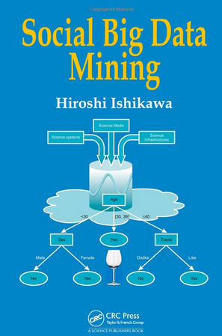
Social Big Data Mining (Hiroshi Ishikawa, 2015)
Source: http://www.amazon.com/Social-Data-Mining-Hiroshi-Ishikawa/dp/149871093X

Slide 25
Architecture for Social Big Data Mining (Hiroshi Ishikawa, 2015)
Enabling Technologies
Analysts
Integrated analysis
Integrated analysis model
Model Construction
Explanation by Model
Conceptual Layer
Natural Language Processing
Information Extraction
Anomaly Detection
Discovery of relationships among heterogeneous data
Large-scale visualization
Construction and confirmation of individual hypothesis
Description and execution of application-specific task
Data Mining
Multivariate analysis
Application specific task
Logical Layer
Parallel distrusted processing
Software
Social Data
Hardware
Physical Layer
Source: Hiroshi Ishikawa (2015), Social Big Data Mining, CRC Press

Slide 26
Business Intelligence (BI) Infrastructure

Slide 27
Data Mining
Source: http://www.amazon.com/Data-Mining-Concepts-Techniques-Management/dp/0123814790

Slide 28
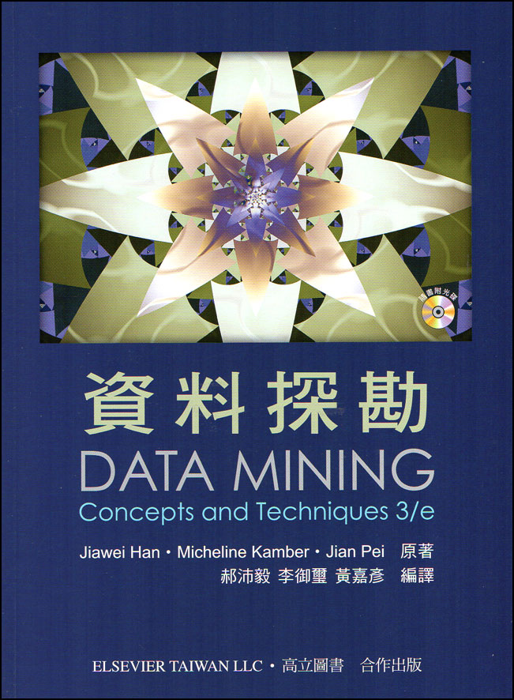
郝沛毅, 李御璽, 黃嘉彥 編譯, 資料探勘 (Jiawei Han, Micheline Kamber, Jian Pei, Data Mining - Concepts and Techniques 3/e), 高立圖書, 2014
Source: http://www.books.com.tw/products/0010646676

Slide 29
Data Warehouse Data Mining and Business Intelligence
Increasing potential
to support
business decisions
End User
Decision Making
Data Presentation
Business
Analyst
Visualization Techniques
Data Mining
Data
Analyst
Information Discovery
Data Exploration
Statistical Summary, Querying, and Reporting
Data Preprocessing/Integration, Data Warehouses
Data Sources
DBA
Paper, Files, Web documents, Scientific experiments, Database Systems
Source: Jiawei Han and Micheline Kamber (2006), Data Mining: Concepts and Techniques, Second Edition, Elsevier

Slide 30
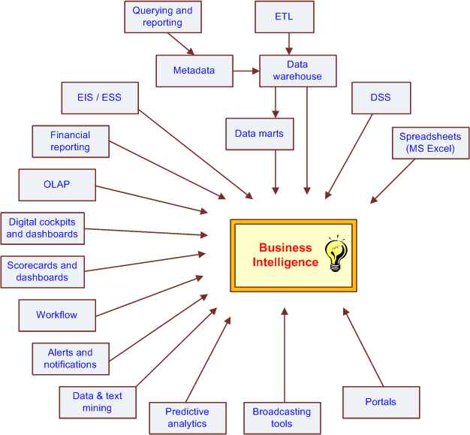
The Evolution of BI Capabilities
Source: Turban et al. (2011), Decision Support and Business Intelligence Systems

Slide 31
Source: http://www.amazon.com/Data-Mining-Machine-Learning-Practitioners/dp/1118618041

Slide 32
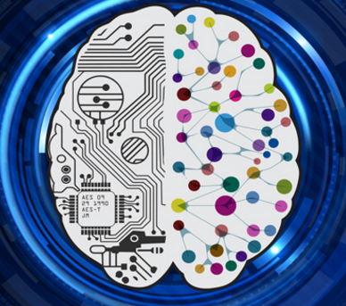
Deep Learning Intelligence from Big Data
Source: https://www.vlab.org/events/deep-learning/

Slide 33
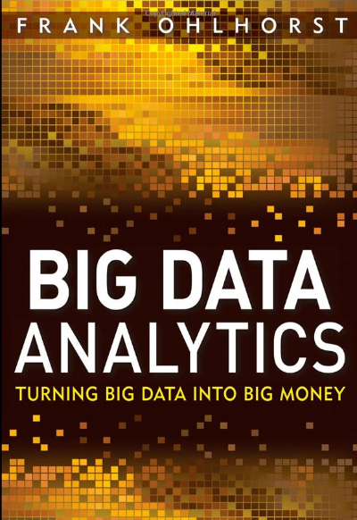
Source: http://www.amazon.com/Big-Data-Analytics-Turning-Money/dp/1118147596

Slide 34
Source: http://www.amazon.com/Big-Data-Revolution-Transform-Mayer-Schonberger/dp/B00D81X2YE

Slide 35
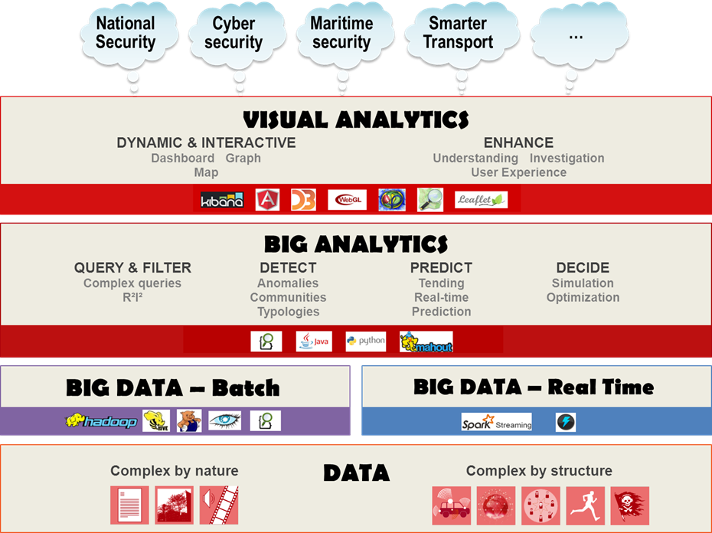
Source: https://www.thalesgroup.com/en/worldwide/big-data/big-data-big-analytics-visual-analytics-what-does-it-all-mean

Slide 36
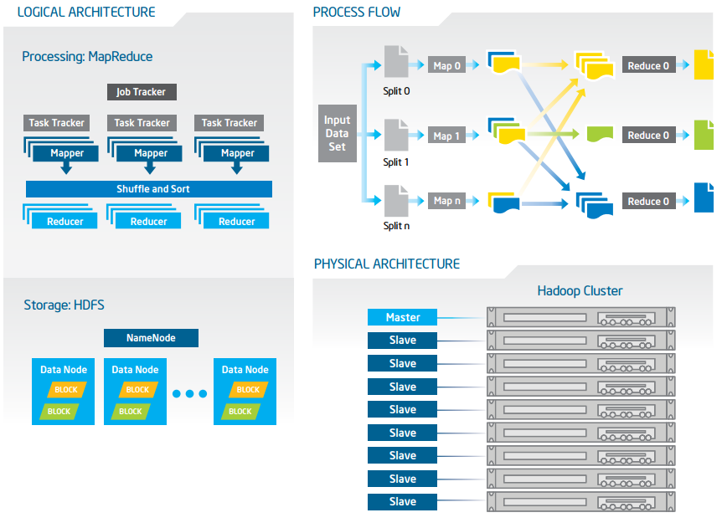
Big Data with Hadoop Architecture
Source: https://software.intel.com/sites/default/files/article/402274/etl-big-data-with-hadoop.pdf

Slide 37
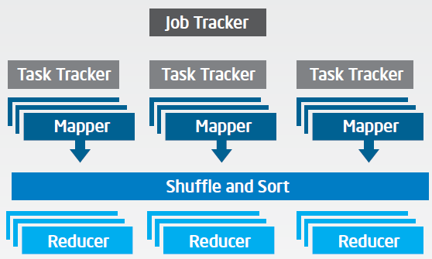
Big Data with Hadoop Architecture Logical Architecture Processing: MapReduce
Source: https://software.intel.com/sites/default/files/article/402274/etl-big-data-with-hadoop.pdf

Slide 38
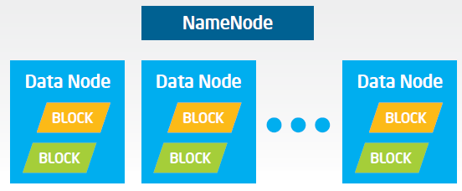
Big Data with Hadoop Architecture Logical Architecture Storage: HDFS
Source: https://software.intel.com/sites/default/files/article/402274/etl-big-data-with-hadoop.pdf

Slide 39
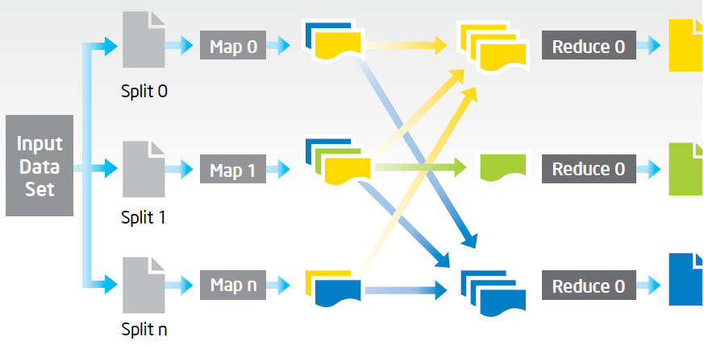
Big Data with Hadoop Architecture Process Flow
Source: https://software.intel.com/sites/default/files/article/402274/etl-big-data-with-hadoop.pdf

Slide 40
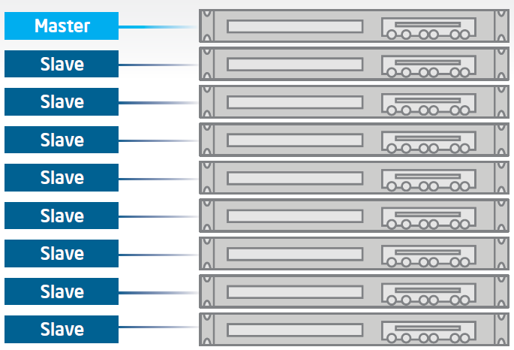
Big Data with Hadoop Architecture Hadoop Cluster
Source: https://software.intel.com/sites/default/files/article/402274/etl-big-data-with-hadoop.pdf

Slide 41
Traditional ETL Architecture
Source: https://software.intel.com/sites/default/files/article/402274/etl-big-data-with-hadoop.pdf

Slide 42
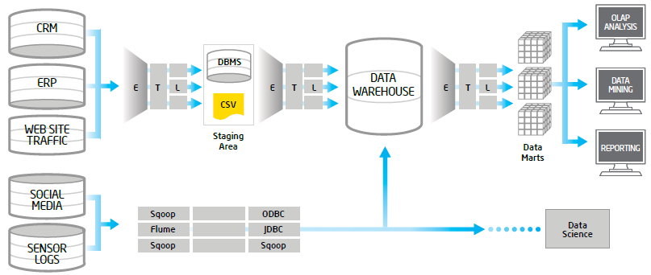
Offload ETL with Hadoop (Big Data Architecture)
Source: https://software.intel.com/sites/default/files/article/402274/etl-big-data-with-hadoop.pdf

Slide 43
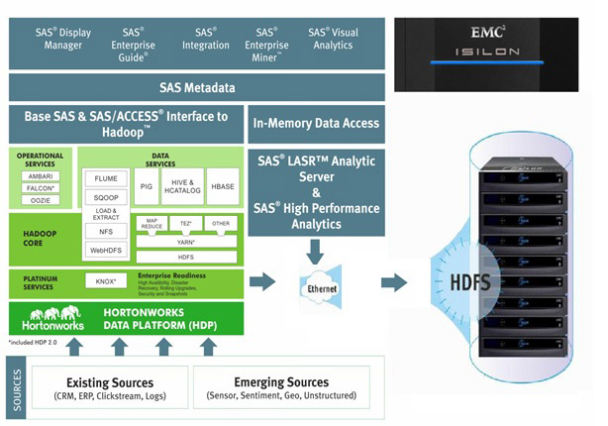
Big Data Solution
Source: http://www.newera-technologies.com/big-data-solution.html

Slide 44
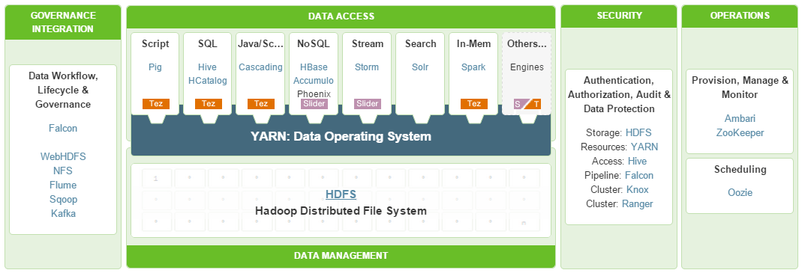
HDP A Complete Enterprise Hadoop Data Platform
Source: http://hortonworks.com/hdp/

Slide 45
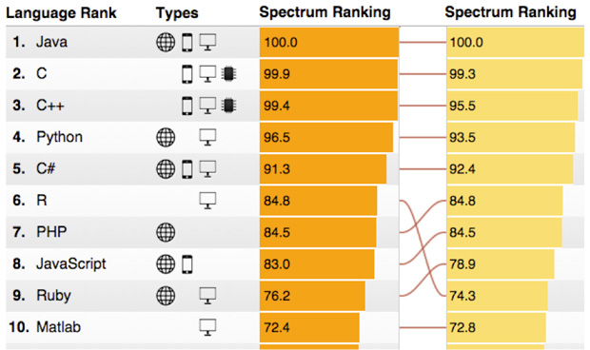
Python for Big Data Analytics
(The column on the left is the 2015 ranking; the column on the right is the 2014 ranking for comparison
2015
2014
Source: http://spectrum.ieee.org/computing/software/the-2015-top-ten-programming-languages

Slide 46
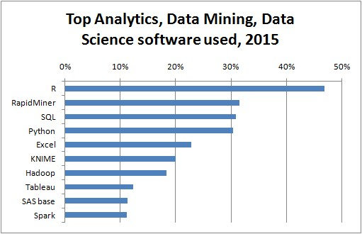
Source: http://www.kdnuggets.com/2015/05/poll-r-rapidminer-python-big-data-spark.html

Slide 47
Yves Hilpisch, Python for Finance: Analyze Big Financial Data, O'Reilly, 2014
Source: http://www.amazon.com/Python-Finance-Analyze-Financial-Data/dp/1491945281

Slide 48
Analyzing the Social Web: Social Network Analysis

Slide 49
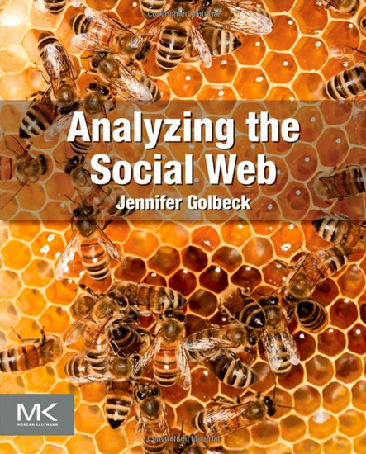
Jennifer Golbeck (2013), Analyzing the Social Web, Morgan Kaufmann
Source: http://www.amazon.com/Analyzing-Social-Web-Jennifer-Golbeck/dp/0124055311

Slide 50
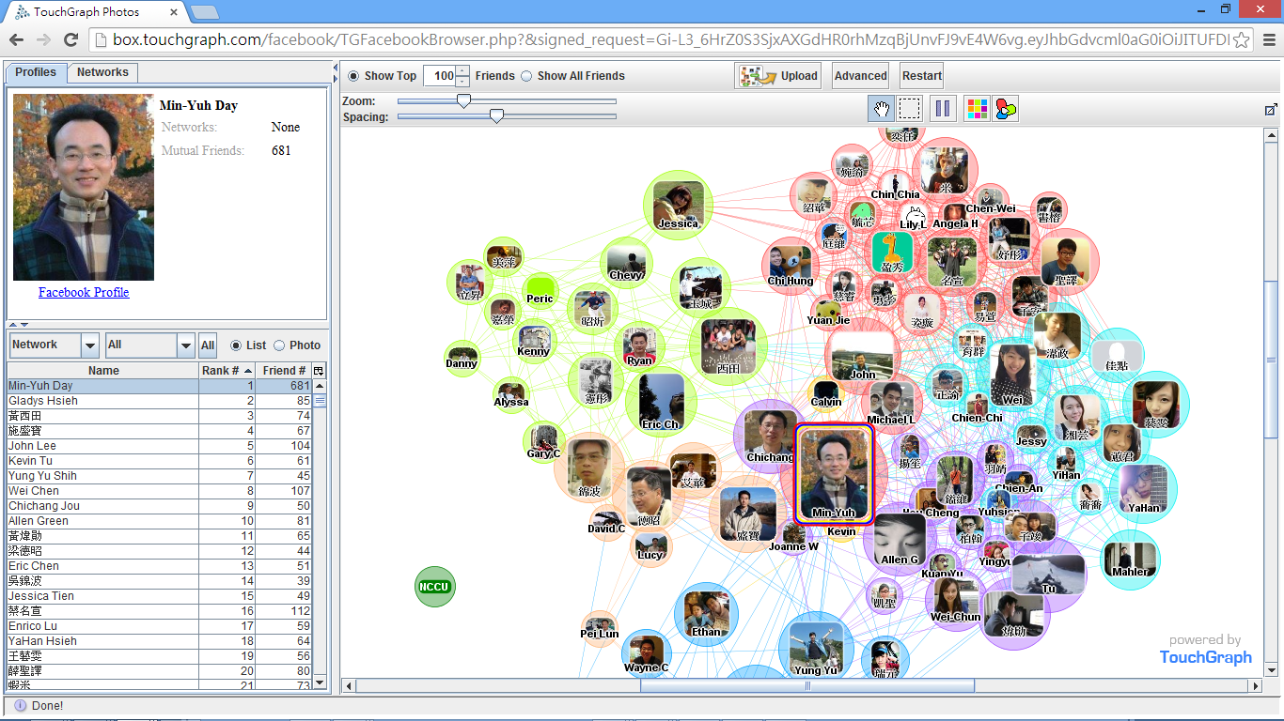
Social Network Analysis (SNA) Facebook TouchGraph

Slide 51
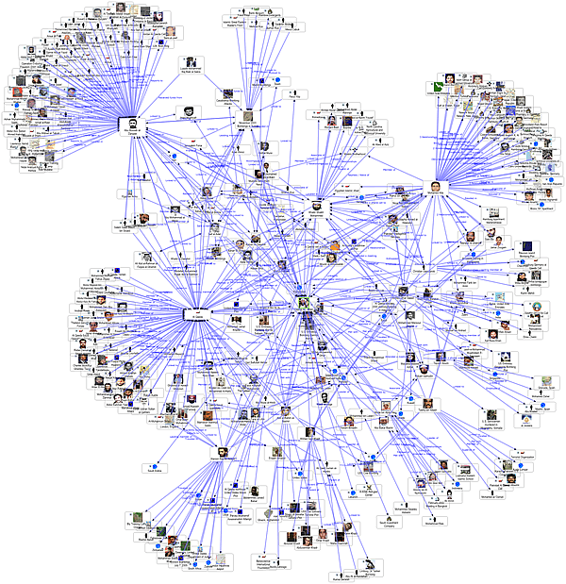
Social Network Analysis
Source: http://www.fmsasg.com/SocialNetworkAnalysis/

Slide 52
Social Network Analysis
A social network is a social structure of people, related (directly or indirectly) to each other through a common relation or interest
Social network analysis (SNA) is the study of social networks to understand their structure and behavior

Slide 53
Centrality Prestige
Social Network Analysis (SNA)

Slide 54
Degree
C
A
D
B
E
Source: https://www.youtube.com/watch?v=89mxOdwPfxA

Slide 55
Degree
C
A: 2
B: 4
C: 2
D:1
E: 1
A
D
B
E
Source: https://www.youtube.com/watch?v=89mxOdwPfxA

Slide 56
Density
C
A
D
B
E
Source: https://www.youtube.com/watch?v=89mxOdwPfxA

Slide 57
Density
Edges (Links): 5
Total Possible Edges: 10
Density: 5/10 = 0.5
C
A
D
B
E
Source: https://www.youtube.com/watch?v=89mxOdwPfxA

Slide 58
Density
A
E
I
C
G
H
B
J
D
F
Nodes (n): 10
Edges (Links): 13
Total Possible Edges: (n * (n-1)) / 2 = (10 * 9) / 2 = 45
Density: 13/45 = 0.29

Slide 59
Which Node is Most Important?
A
E
I
C
G
H
B
J
D
F

Slide 60
Centrality
Important or prominent actors are those that are linked or involved with other actors extensively.
A person with extensive contacts (links) or communications with many other people in the organization is considered more important than a person with relatively fewer contacts.
The links can also be called ties. A central actor is one involved in many ties.
Source: Bing Liu (2011) , “Web Data Mining: Exploring Hyperlinks, Contents, and Usage Data”

Slide 61
Social Network Analysis (SNA)
Degree Centrality
Betweenness Centrality
Closeness Centrality

Slide 62
Degree Centrality

Slide 63
Social Network Analysis: Degree Centrality
A
E
I
C
G
H
B
J
D
F

Slide 64
Social Network Analysis: Degree Centrality
Node | Score | Standardized Score
A | 2 | 2/10 = 0.2
B | 2 | 2/10 = 0.2
C | 5 | 5/10 = 0.5
D | 3 | 3/10 = 0.3
E | 3 | 3/10 = 0.3
F | 2 | 2/10 = 0.2
G | 4 | 4/10 = 0.4
H | 3 | 3/10 = 0.3
I | 1 | 1/10 = 0.1
J | 1 | 1/10 = 0.1
A
E
I
C
G
H
B
J
D
F

Slide 65
Betweenness Centrality

Slide 66
Betweenness centrality:
Connectivity
Number of shortest paths going through the actor

Slide 67
Betweenness Centrality
Where g_{jk} = the number of shortest paths connecting jk
g_{jk}(i) = the number that actor i is on.
Normalized Betweenness Centrality
Number of pairs of vertices excluding the vertex itself
Source: https://www.youtube.com/watch?v=RXohUeNCJiU

Slide 68
Betweenness Centrality
C
A:
B→C: 0/1 = 0
B→D: 0/1 = 0
B→E: 0/1 = 0
C→D: 0/1 = 0
C→E: 0/1 = 0
D→E: 0/1 = 0
Total: 0
A
D
B
E
A: Betweenness Centrality = 0

Slide 69
Betweenness Centrality
C
B:
A→C: 0/1 = 0
A→D: 1/1 = 1
A→E: 1/1 = 1
C→D: 1/1 = 1
C→E: 1/1 = 1
D→E: 1/1 = 1
Total: 5
A
D
B
E
B: Betweenness Centrality = 5

Slide 70
Betweenness Centrality
C
C:
A→B: 0/1 = 0
A→D: 0/1 = 0
A→E: 0/1 = 0
B→D: 0/1 = 0
B→E: 0/1 = 0
D→E: 0/1 = 0
Total: 0
A
D
B
E
C: Betweenness Centrality = 0

Slide 71
Betweenness Centrality
C
A: 0
B: 5
C: 0
D: 0
E: 0
A
D
B
E

Slide 72
Which Node is Most Important?
F
G
H
B
E
A
C
I
D
J
F
H
B
E
A
C
D
J

Slide 73
Which Node is Most Important?
F
G
H
B
E
A
C
I
D
J
F
G
H
E
A
I
D
J

Slide 74
Betweenness Centrality
B
E
A
C
D

Slide 75
Betweenness Centrality
C
A:
B→C: 0/1 = 0
B→D: 0/1 = 0
B→E: 0/1 = 0
C→D: 0/1 = 0
C→E: 0/1 = 0
D→E: 0/1 = 0
Total: 0
A
D
B
E
A: Betweenness Centrality = 0

Slide 76
Closeness Centrality

Slide 77
Social Network Analysis: Closeness Centrality
C→A: 1
C→B: 1
C→D: 1
C→E: 1
C→F: 2
C→G: 1
C→H: 2
C→I: 3
C→J: 3
Total=15
A
E
I
C
G
H
B
J
D
F
C: Closeness Centrality = 15/9 = 1.67

Slide 78
Social Network Analysis: Closeness Centrality
G→A: 2
G→B: 2
G→C: 1
G→D: 2
G→E: 1
G→F: 1
G→H: 1
G→I: 2
G→J: 2
Total=14
A
E
I
C
G
H
B
J
D
F
G: Closeness Centrality = 14/9 = 1.56

Slide 79
Social Network Analysis: Closeness Centrality
H→A: 3
H→B: 3
H→C: 2
H→D: 2
H→E: 2
H→F: 2
H→G: 1
H→I: 1
H→J: 1
Total=17
A
E
I
C
G
H
B
J
D
F
H: Closeness Centrality = 17/9 = 1.89

Slide 80
Social Network Analysis: Closeness Centrality
A
E
I
C
G
H
B
J
D
F
G: Closeness Centrality = 14/9 = 1.56
1
C: Closeness Centrality = 15/9 = 1.67
2
H: Closeness Centrality = 17/9 = 1.89
3

Slide 81
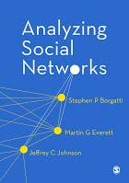
Social Network Analysis (SNA) Tools
UCINet
Pajek

Slide 82
Application of SNA
Social Network Analysis of Research Collaboration in Information Reuse and Integration
Source: Min-Yuh Day, Sheng-Pao Shih, Weide Chang (2011), "Social Network Analysis of Research Collaboration in Information Reuse and Integration"

Slide 83
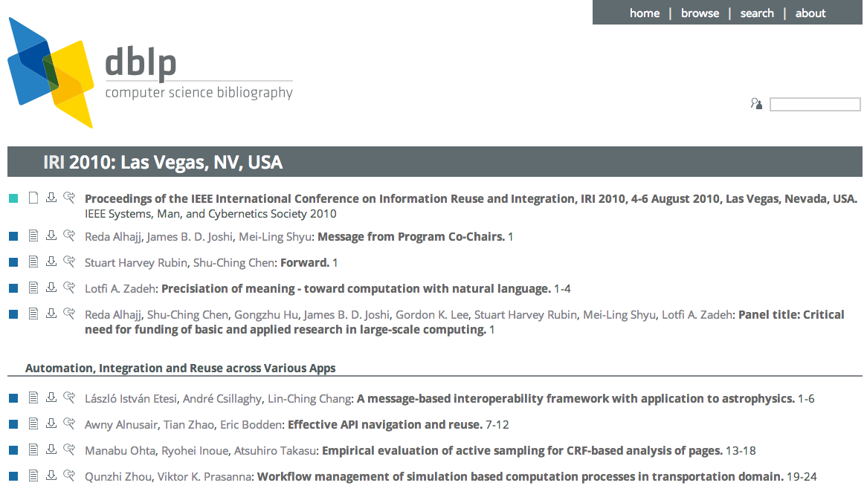
Example of SNA Data Source
Source: http://www.informatik.uni-trier.de/~ley/db/conf/iri/iri2010.html

Slide 84
Research Question
RQ1: What are the scientific collaboration patterns in the IRI research community?
RQ2: Who are the prominent researchers in the IRI community?
Source: Min-Yuh Day, Sheng-Pao Shih, Weide Chang (2011), "Social Network Analysis of Research Collaboration in Information Reuse and Integration"

Slide 85
Methodology
Developed a simple web focused crawler program to download literature information about all IRI papers published between 2003 and 2010 from IEEE Xplore and DBLP.
767 paper
1599 distinct author
Developed a program to convert the list of coauthors into the format of a network file which can be readable by social network analysis software.
UCINet and Pajek were used in this study for the social network analysis.
Source: Min-Yuh Day, Sheng-Pao Shih, Weide Chang (2011), "Social Network Analysis of Research Collaboration in Information Reuse and Integration"

Slide 86
Top10 prolific authors (IRI 2003-2010)
Stuart Harvey Rubin
Taghi M. Khoshgoftaar
Shu-Ching Chen
Mei-Ling Shyu
Mohamed E. Fayad
Reda Alhajj
Du Zhang
Wen-Lian Hsu
Jason Van Hulse
Min-Yuh Day
Source: Min-Yuh Day, Sheng-Pao Shih, Weide Chang (2011), "Social Network Analysis of Research Collaboration in Information Reuse and Integration"

Slide 87
Data Analysis and Discussion
Closeness Centrality
Collaborated widely
Betweenness Centrality
Collaborated diversely
Degree Centrality
Collaborated frequently
Visualization of Social Network Analysis
Insight into the structural characteristics of research collaboration networks
Source: Min-Yuh Day, Sheng-Pao Shih, Weide Chang (2011), "Social Network Analysis of Research Collaboration in Information Reuse and Integration"

Slide 88
Top 20 authors with the highest closeness scores
Rank | ID | Closeness | Author
1 | 3 | 0.024675 | Shu-Ching Chen
2 | 1 | 0.022830 | Stuart Harvey Rubin
3 | 4 | 0.022207 | Mei-Ling Shyu
4 | 6 | 0.020013 | Reda Alhajj
5 | 61 | 0.019700 | Na Zhao
6 | 260 | 0.018936 | Min Chen
7 | 151 | 0.018230 | Gordon K. Lee
8 | 19 | 0.017962 | Chengcui Zhang
9 | 1043 | 0.017962 | Isai Michel Lombera
10 | 1027 | 0.017962 | Michael Armella
11 | 443 | 0.017448 | James B. Law
12 | 157 | 0.017082 | Keqi Zhang
13 | 253 | 0.016731 | Shahid Hamid
14 | 1038 | 0.016618 | Walter Z. Tang
15 | 959 | 0.016285 | Chengjun Zhan
16 | 957 | 0.016285 | Lin Luo
17 | 956 | 0.016285 | Guo Chen
18 | 955 | 0.016285 | Xin Huang
19 | 943 | 0.016285 | Sneh Gulati
20 | 960 | 0.016071 | Sheng-Tun Li
Source: Min-Yuh Day, Sheng-Pao Shih, Weide Chang (2011), "Social Network Analysis of Research Collaboration in Information Reuse and Integration"

Slide 89
Top 20 authors with the highest betweeness scores
Rank | ID | Betweenness | Author
1 | 1 | 0.000752 | Stuart Harvey Rubin
2 | 3 | 0.000741 | Shu-Ching Chen
3 | 2 | 0.000406 | Taghi M. Khoshgoftaar
4 | 66 | 0.000385 | Xingquan Zhu
5 | 4 | 0.000376 | Mei-Ling Shyu
6 | 6 | 0.000296 | Reda Alhajj
7 | 65 | 0.000256 | Xindong Wu
8 | 19 | 0.000194 | Chengcui Zhang
9 | 39 | 0.000185 | Wei Dai
10 | 15 | 0.000107 | Narayan C. Debnath
11 | 31 | 0.000094 | Qianhui Althea Liang
12 | 151 | 0.000094 | Gordon K. Lee
13 | 7 | 0.000085 | Du Zhang
14 | 30 | 0.000072 | Baowen Xu
15 | 41 | 0.000067 | Hongji Yang
16 | 270 | 0.000060 | Zhiwei Xu
17 | 5 | 0.000043 | Mohamed E. Fayad
18 | 110 | 0.000042 | Abhijit S. Pandya
19 | 106 | 0.000042 | Sam Hsu
20 | 8 | 0.000042 | Wen-Lian Hsu
Source: Min-Yuh Day, Sheng-Pao Shih, Weide Chang (2011), "Social Network Analysis of Research Collaboration in Information Reuse and Integration"

Slide 90
Top 20 authors with the highest degree scores
Rank | ID | Degree | Author
1 | 3 | 0.035044 | Shu-Ching Chen
2 | 1 | 0.034418 | Stuart Harvey Rubin
3 | 2 | 0.030663 | Taghi M. Khoshgoftaar
4 | 6 | 0.028786 | Reda Alhajj
5 | 8 | 0.028786 | Wen-Lian Hsu
6 | 10 | 0.024406 | Min-Yuh Day
7 | 4 | 0.022528 | Mei-Ling Shyu
8 | 17 | 0.021277 | Richard Tzong-Han Tsai
9 | 14 | 0.017522 | Eduardo Santana de Almeida
10 | 16 | 0.017522 | Roumen Kountchev
11 | 40 | 0.016896 | Hong-Jie Dai
12 | 15 | 0.015645 | Narayan C. Debnath
13 | 9 | 0.015019 | Jason Van Hulse
14 | 25 | 0.013767 | Roumiana Kountcheva
15 | 28 | 0.013141 | Silvio Romero de Lemos Meira
16 | 24 | 0.013141 | Vladimir Todorov
17 | 23 | 0.013141 | Mariofanna G. Milanova
18 | 5 | 0.013141 | Mohamed E. Fayad
19 | 19 | 0.012516 | Chengcui Zhang
20 | 18 | 0.011890 | Waleed W. Smari
Source: Min-Yuh Day, Sheng-Pao Shih, Weide Chang (2011), "Social Network Analysis of Research Collaboration in Information Reuse and Integration"

Slide 91
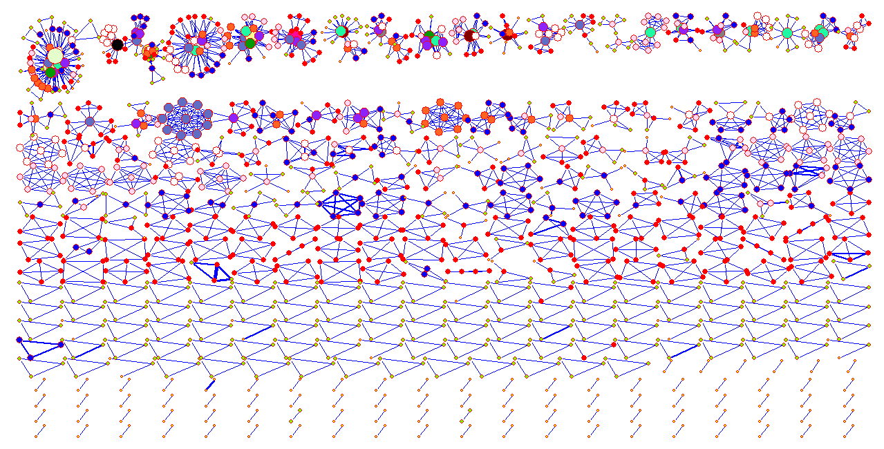
Visualization of IRI (IEEE IRI 2003-2010) co-authorship network (global view)
Source: Min-Yuh Day, Sheng-Pao Shih, Weide Chang (2011), "Social Network Analysis of Research Collaboration in Information Reuse and Integration"

Slide 92
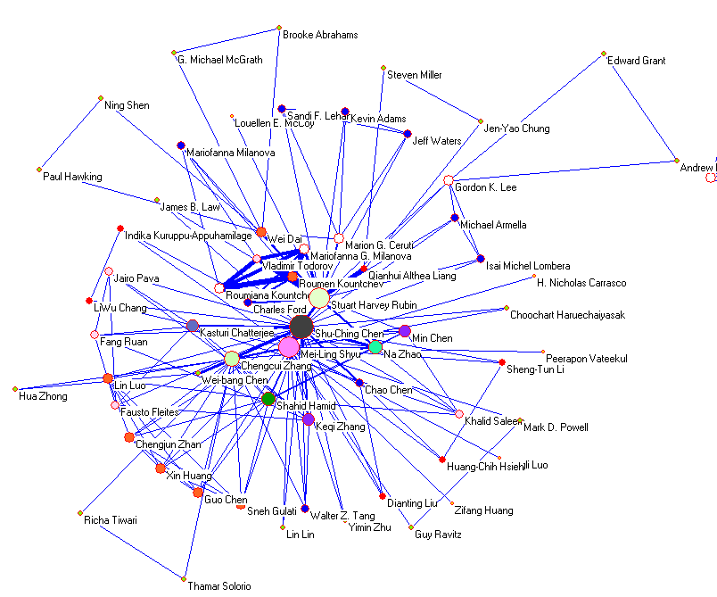
Source: Min-Yuh Day, Sheng-Pao Shih, Weide Chang (2011), "Social Network Analysis of Research Collaboration in Information Reuse and Integration"

Slide 93
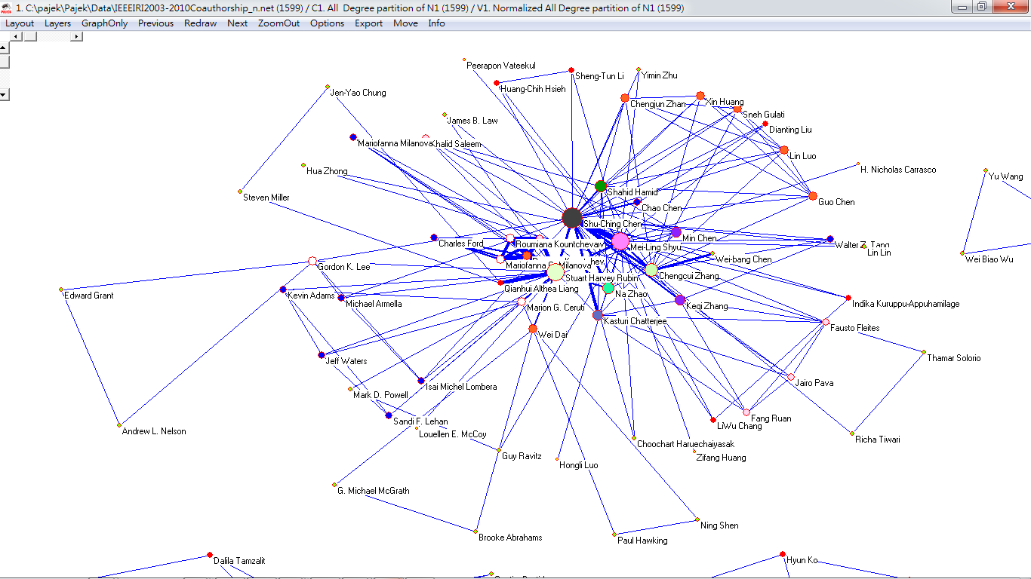
Visualization of Social Network Analysis
Source: Min-Yuh Day, Sheng-Pao Shih, Weide Chang (2011), "Social Network Analysis of Research Collaboration in Information Reuse and Integration"

Slide 94
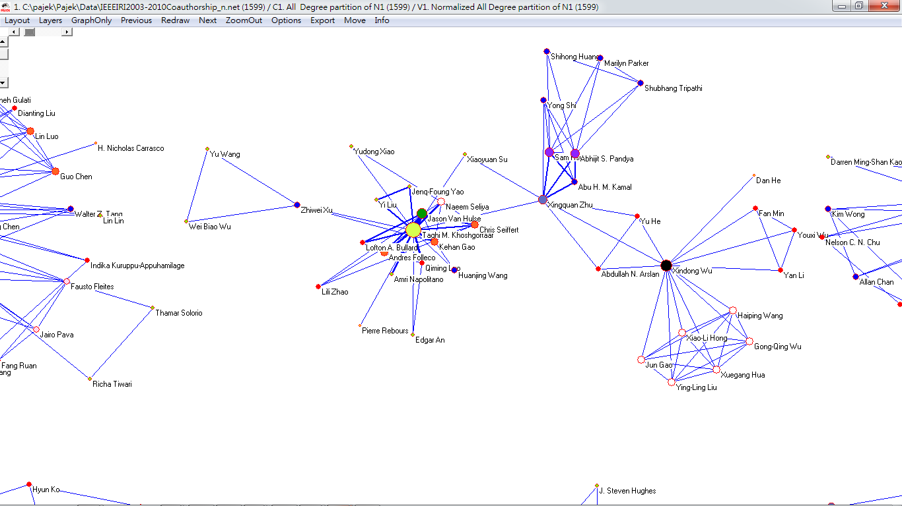
Visualization of Social Network Analysis
Source: Min-Yuh Day, Sheng-Pao Shih, Weide Chang (2011), "Social Network Analysis of Research Collaboration in Information Reuse and Integration"

Slide 95
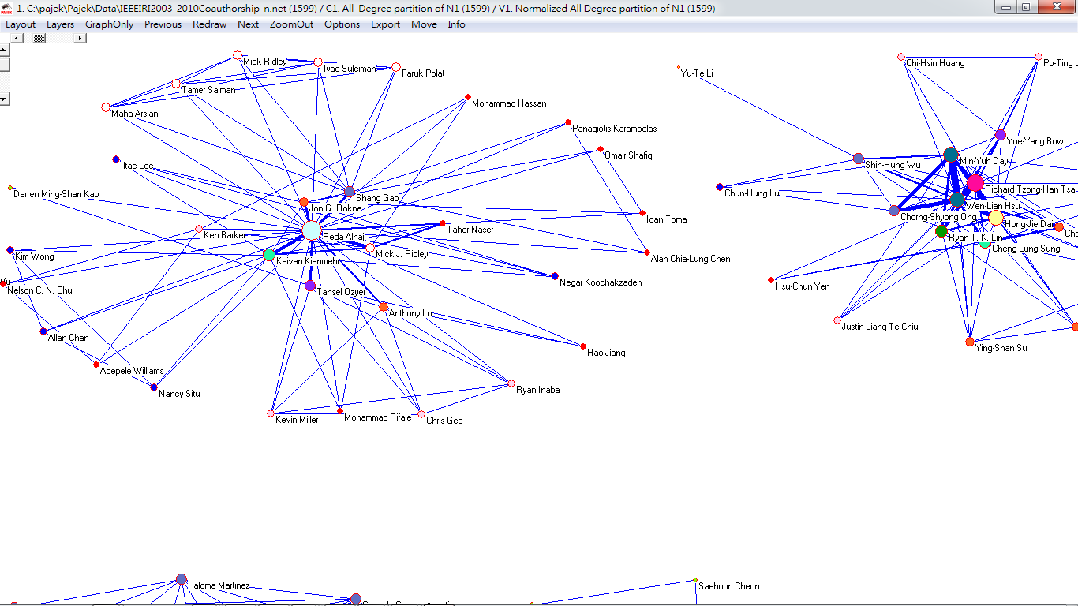
Visualization of Social Network Analysis
Source: Min-Yuh Day, Sheng-Pao Shih, Weide Chang (2011), "Social Network Analysis of Research Collaboration in Information Reuse and Integration"

Slide 96
NTCIR 12 QALab-2 Task
http://research.nii.ac.jp/qalab/

Slide 97
Overview of NTCIR Evaluation Activities

Slide 98
NTCIR
NII Testbeds and Community for Information access Research
http://research.nii.ac.jp/ntcir/index-en.html

Slide 99
NII: National Institute of Informatics
http://www.nii.ac.jp/en/

Slide 100
NII Testbeds and Community for Information access Research
NTCIR
Research Infrastructure for Evaluating Information Access
A series of evaluation workshops designed to enhance research in information-access technologies by providing an infrastructure for large-scale evaluations.
Data sets, evaluation methodologies, forum
Source: Kando et al., 2013

Slide 101
NTCIR
NII Testbeds and Community for Information access Research
Project started in late 1997
18 months Cycle
Source: Kando et al., 2013

Slide 102
The 12th NTCIR (2015 - 2016) Evaluation of Information Access Technologies January 2015 - June 2016 Conference: June 7-10, 2016, NII, Tokyo, Japan
NII Testbeds and Community for Information access Research
http://research.nii.ac.jp/ntcir/ntcir-12/index.html

Slide 103
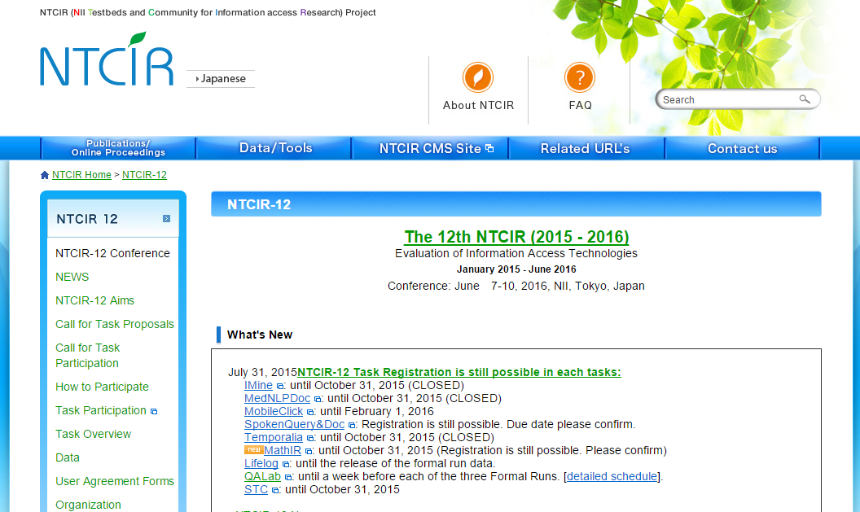
http://research.nii.ac.jp/ntcir/ntcir-12/index.html

Slide 104
NTCIR 12 (2015-2016) Tasks
NII Testbeds and Community for Information access Research
IMine
MedNLPDoc
MobileClick
SpokenQuery&Doc
Temporalia
MathIRNEW
Lifelog
QA Lab (QA Lab for Entrance Exam; QALab-2)
STC
http://research.nii.ac.jp/ntcir/ntcir-12/tasks.html

Slide 105
NTCIR 12 (2015-2016) Schedule
NII Testbeds and Community for Information access Research
31/July302015: Task Registration Due (extended deadline. Registration is still possible in each task. Please see here.)
01/July/2015: Document Set Release *
July-Dec./2015: Dry Run *
Sep./2015-Feb./2016:Formal Run *
01/Feb./2016: Evaluation Results Return
01/Feb./2016: Early draft Task Overview Release
01/Mar./2016: Draft participant paper submission Due
01/May/2016: All camera-ready paper for the Proceedings Due
07-10/June/2016:NTCIR-12 Conference & EVIA 2016 in NII, Tokyo, Japan
http://research.nii.ac.jp/ntcir/ntcir-12/dates.html

Slide 106
QA Lab for Entrance Exam (QALab-2)(2015-2016)
The goal is investigate the real-world complex Question Answering (QA) technologies using Japanese university entrance exams and their English translation on the subject of "World History (世界史)".
The questions were selected from two different stages - The National Center Test for University Admissions (センター試験, multiple choice-type questions) and from secondary exams at multiple universities (二次試験, complex questions including essays).
http://research.nii.ac.jp/ntcir/ntcir-12/tasks.html

Slide 107
RITE (Recognizing Inference in Text) NTCIR-9 RITE (2010-2011) NTCIR-10 RITE-2 (2012-2013) NTCIR-11 RITE-VAL (2013-2014)

Slide 108
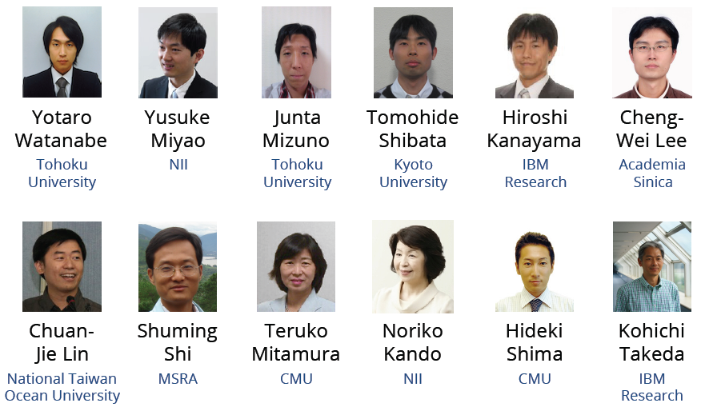
Overview of the Recognizing Inference in TExt (RITE-2) at NTCIR-10
Source: Yotaro Watanabe, Yusuke Miyao, Junta Mizuno, Tomohide Shibata, Hiroshi Kanayama, Cheng-Wei Lee, Chuan-Jie Lin, Shuming Shi, Teruko Mitamura, Noriko Kando, Hideki Shima and Kohichi Takeda, Overview of the Recognizing Inference in Text (RITE-2) at NTCIR-10, Proceedings of NTCIR-10, 2013, http://research.nii.ac.jp/ntcir/workshop/OnlineProceedings10/pdf/NTCIR/RITE/01-NTCIR10-RITE2-overview-slides.pdf

Slide 109
Overview of RITE-2
RITE-2 is a generic benchmark task that addresses a common semantic inference required in various NLP/IA applications
t₁: Yasunari Kawabata won the Nobel Prize in Literature for his novel “Snow Country.”
Can t₂ be inferred from t₁ ?
(entailment?)
t₂: Yasunari Kawabata is the writer of “Snow Country.”
Source: Watanabe et al., 2013

Slide 110
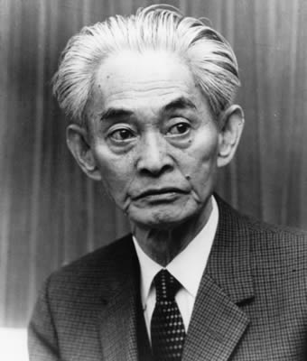
Yasunari Kawabata
Writer
Yasunari Kawabata was a Japanese short story writer and novelist whose spare, lyrical, subtly-shaded prose works won him the Nobel Prize for Literature in 1968, the first Japanese author to receive the award.
http://en.wikipedia.org/wiki/Yasunari_Kawabata

Slide 111
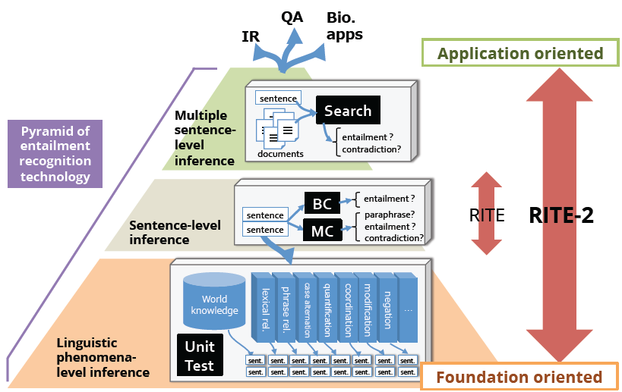
RITE vs. RITE-2
Source: Watanabe et al., 2013

Slide 112
Motivation of RITE-2
Natural Language Processing (NLP) / Information Access (IA) applications
Question Answering, Information Retrieval, Information Extraction, Text Summarization, Automatic evaluation for Machine Translation, Complex Question Answering
The current entailment recognition systems have not been mature enough
The highest accuracy on Japanese BC subtask in NTCIR-9 RITE was only 58%
There is still enough room to address the task to advance entailment recognition technologies
Source: Watanabe et al., 2013

Slide 113
BC and MC subtasks in RITE-2
t₁: Yasunari Kawabata won the Nobel Prize in Literature for his novel “Snow Country.”
t₂: Yasunari Kawabata is the writer of “Snow Country.”
BC
YES
No
BC subtask
Entailment (t₁ entails t₂) or Non-Entailment (otherwise)
MC subtask
Bi-directional Entailment (t₁ entails t₂ & t₂ entails t₁)
Forward Entailment (t₁ entails t₂ & t₂ does not entail t₁)
Contradiction (t₁ contradicts t₂ or cannot be true at the same time)
Independence (otherwise)
MC
B
F
C
I
Source: Watanabe et al., 2013

Slide 114
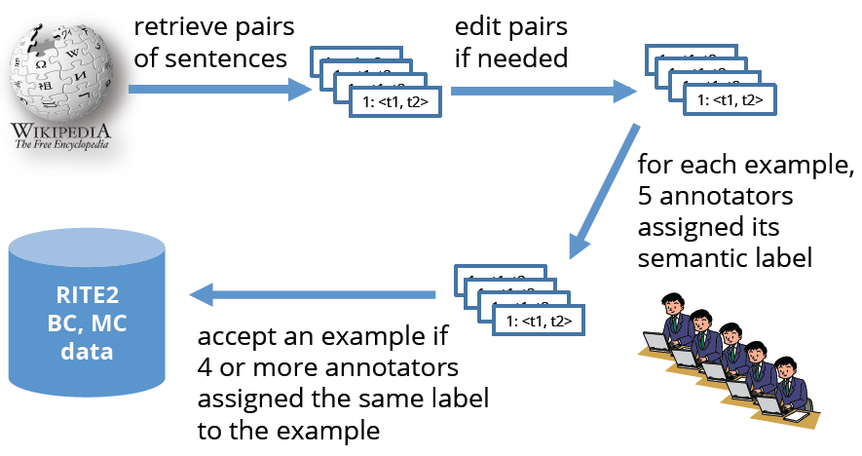
Development of BC and MC data
Source: Watanabe et al., 2013

Slide 115
Entrance Exam subtasks (Japanese only)
Source: Watanabe et al., 2013

Slide 116
Entrance Exam subtask: BC and Search
Entrance Exam BC
Binary-classification problem ( Entailment or Nonentailment)
t1 and t2 are given
Entrance Exam Search
Binary-classification problem ( Entailment or Nonentailment)
t2 and a set of documents are given
Systems are required to search sentences in Wikipedia and textbooks to decide semantic labels
Source: Watanabe et al., 2013

Slide 117
UnitTest ( Japanese only)
Motivation
Evaluate how systems can handle linguistic
phenomena that affects entailment relations
Task definition
Binary classification problem (same as BC subtask)
Source: Watanabe et al., 2013

Slide 118
RITE4QA (Chinese only)
Motivation
Can an entailment recognition system rank a set of unordered answer candidates in QA?
Dataset
Developed from NTCIR-7 and NTCIR-8 CLQA data
t1: answer-candidate-bearing sentence
t2: a question in an affirmative form
Requirements
Generate confidence scores for ranking process
Source: Watanabe et al., 2013

Slide 119
Evaluation Metrics
Macro F1 and Accuracy (BC, MC, ExamBC, ExamSearch and UnitTest)
Correct Answer Ratio (Entrance Exam)
Y/N labels are mapped into selections of answers and calculate accuracy of the answers
Top1 and MRR (RITE4QA)
Source: Watanabe et al., 2013

Slide 120
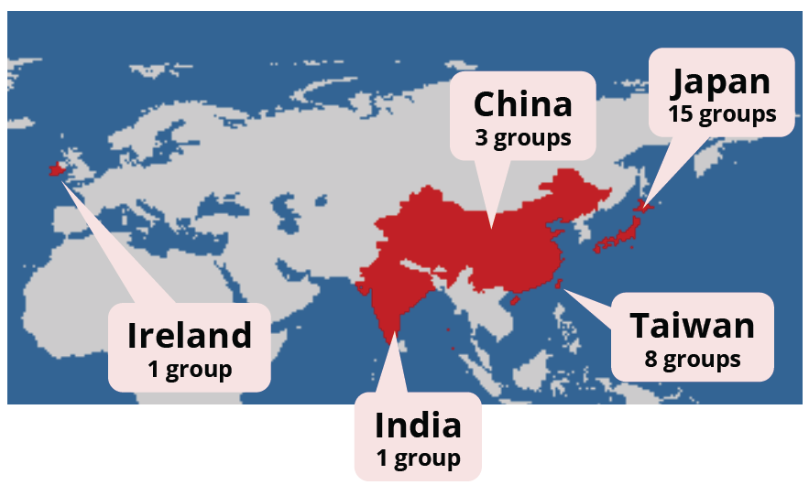
Countries/Regions of Participants
Source: Watanabe et al., 2013

Slide 121
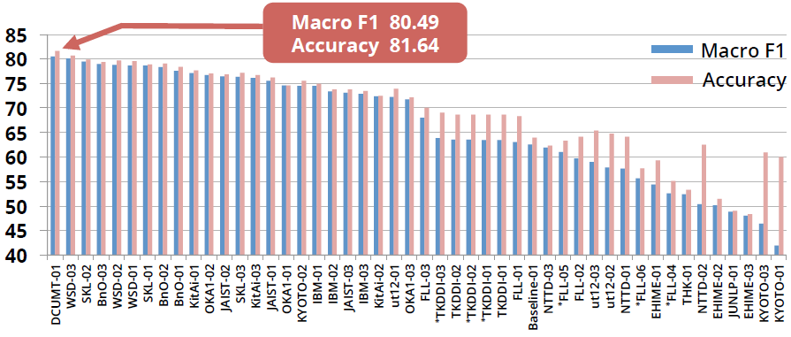
Formal Run Results: BC (Japanese)
The best system achieved over 80% of accuracy (The highest score in BC subtask at RITE was 58%)
The difference is caused by
Advancement of entailment recognition technologies
Strict data filtering in the data development
Source: Watanabe et al., 2013

Slide 122
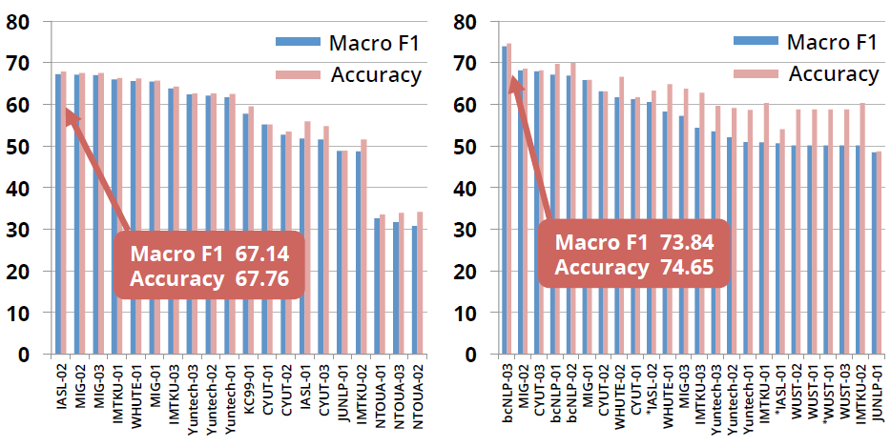
BC (Traditional/Simplified Chinese)
The top scores are almost the same as those in NTCIR-9 RITE
Source: Watanabe et al., 2013

Slide 123
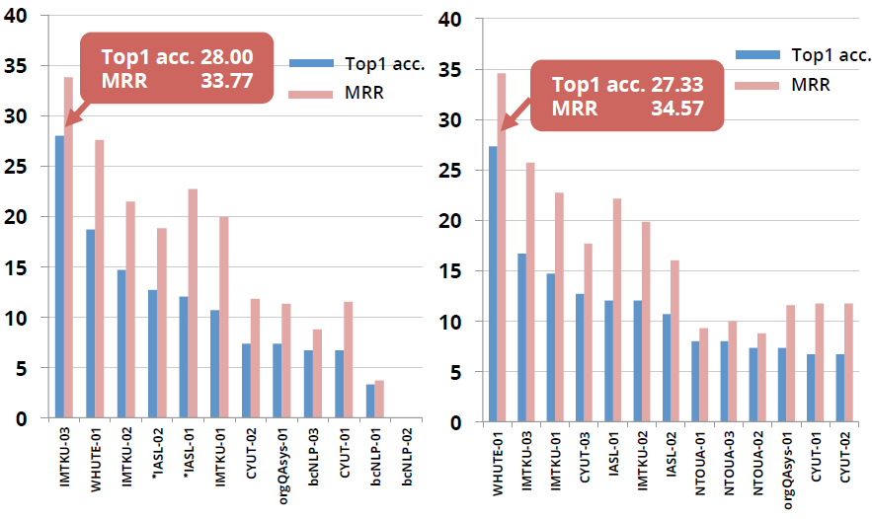
RITE4QA (Traditional/Simplified Chinese)
Source: Watanabe et al., 2013

Slide 124
Participant’s approaches in RITE-2
Category
Statistical (50%)
Hybrid (27%)
Rule-based (23%)
Fundamental approach
Overlap-based (77%)
Alignment-based (63%)
Transformation-based (23%)
Source: Watanabe et al., 2013

Slide 125
Summary of types of information explored in RITE-2
Character/word overlap (85%)
Syntactic information (67%)
Temporal/numerical information (63%)
Named entity information (56%)
Predicate-argument structure (44%)
Entailment relations (30%)
Polarity information (7%)
Modality information (4%)
Source: Watanabe et al., 2013

Slide 126
Summary of Resources Explored in RITE-2
Japanese
Wikipedia (10)
Japanese WordNet (9)
ALAGIN Entailment DB (5)
Nihongo Goi-Taikei (2)
Bunruigoihyo (2)
Iwanami Dictionary (2)
Chinese
Chinese WordNet (3)
TongYiCi CiLin (3)
HowNet (2)
Source: Watanabe et al., 2013

Slide 127
Advanced approaches in RITE-2
Logical approaches
Dependency-based Compositional Semantics (DCS) [BnO], Markov Logic [EHIME], Natural Logic [THK]
Alignment
GIZA [CYUT], ILP [FLL], Labeled Alignment [bcNLP, THK]
Search Engine
Google and Yahoo [DCUMT]
Deep Learning
RNN language models [DCUMT]
Probabilistic Models
N-gram HMM [DCUMT], LDA [FLL]
Machine Translation
[ JUNLP, JAIST, KC99]
Source: Watanabe et al., 2013

Slide 128
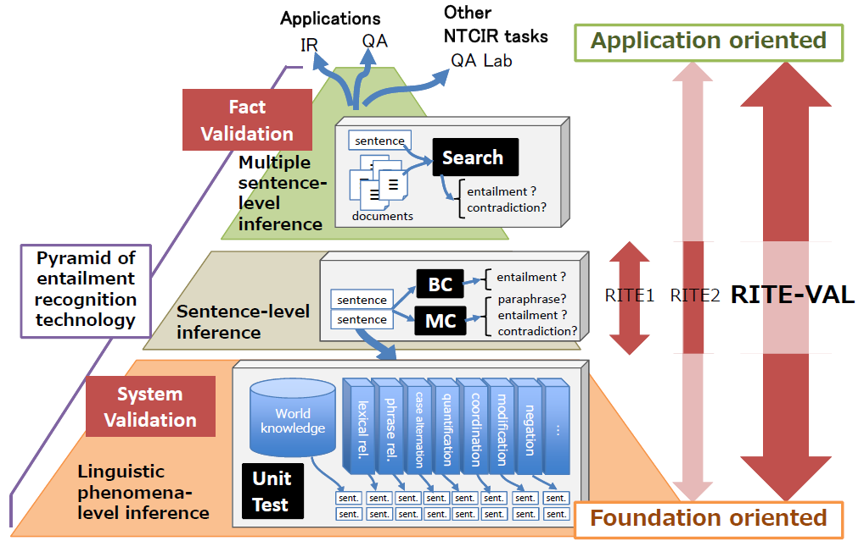
RITE-VAL
Source: Matsuyoshi et al., 2013

Slide 129
Main two tasks of RITE-VAL
Source: Matsuyoshi et al., 2013

Slide 130
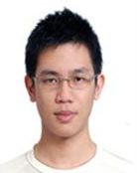
Tamkang University
2011
Tamkang University
IMTKU Textual Entailment System for Recognizing Inference in Text at NTCIR-9 RITE
Department of Information Management Tamkang University, Taiwan
Min-Yuh Day
Chun Tu
myday@mail.tku.edu.tw
NTCIR-9 Workshop, December 6-9, 2011, Tokyo, Japan

Slide 131
IMTKU Textual Entailment System for Recognizing Inference in Text at NTCIR-10 RITE-2
Tamkang University
2013
Tamkang University
Department of Information Management Tamkang University, Taiwan
Min-Yuh Day
Chun Tu
Hou-Cheng Vong
Shih-Wei Wu
Shih-Jhen Huang
myday@mail.tku.edu.tw
NTCIR-10 Conference, June 18-21, 2013, Tokyo, Japan

Slide 132
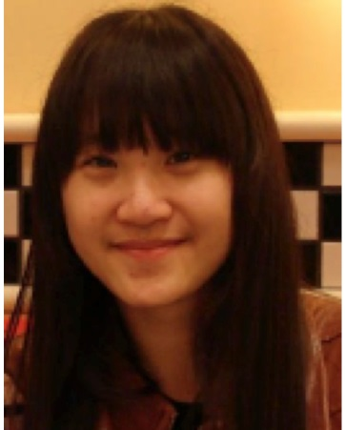
IMTKU Textual Entailment System for Recognizing Inference in Text at NTCIR-11 RITE-VAL 2014
Tamkang University
Min-Yuh Day
Ya-Jung Wang
Che-Wei Hsu
En-Chun Tu
Huai-Wen Hsu
Yu-An Lin
Shang-Yu Wu
Yu-Hsuan Tai
Cheng-Chia Tsai
NTCIR-11 Conference, December 8-12, 2014, Tokyo, Japan

Slide 133
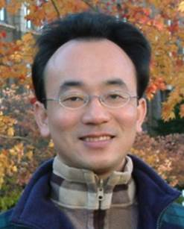
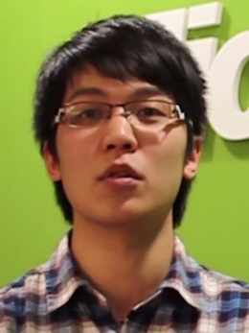
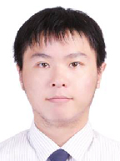
IMTKU Question Answering System for Entrance Exam at NTCIR-12 QALab-2 2016
Tamkang University
Min-Yuh Day
Cheng-Chia Tsai
Wei-Chun Chung
Hsiu-Yuan Chang
Lin-Jin Kun
Yuan-Jie Tsai
Tzu-Jui Sun
Yu-Ming Guo
Yue-Da Lin
Wei-Ming Chen
Yun-Da Tsai
Cheng-Jhih Han
Yi-Jing Lin
Yi-Heng Chiang
Ching-Yuan Chien
NTCIR-12 Conference, June 7-10, 2016, Tokyo, Japan

Slide 134
IMTKU System Architecture for NTCIR-9 RITE

Slide 135
IMTKU System Architecture for NTCIR-10 RITE-2
Train
Predict
IEEE EM-RITE 2013, IEEE IRI 2013, August 14-16, 2013, San Francisco, California, USA

Slide 136
IMTKU System Framework for NTCIR -11 RITE-VAL
NTCIR-11 Conference, December 8-12, 2014, Tokyo, Japan

Slide 137
IMTKU at NTCIR
The first place in the CS-RITE4QA subtask of the NTCIR-10 Recognizing Inference in TExt (RITE) task. (2013)
The second place in the CT-RITE4QA subtask of the NTCIR-10 Recognizing Inference in TExt (RITE) task. (2013)
The first place in the CT-RITE4QA subtask of the NTCIR-9 Recognizing Inference in TExt (RITE) task. (2011)
The first place in the CS-RITE4QA subtask of the NTCIR-9 Recognizing Inference in TExt (RITE) task. (2011)
The second place in the CT-MC subtask of the NTCIR-9 Recognizing Inference in TExt (RITE) task. (2011)

Slide 138
Summary
Big Data Analytics on Social Media
Analyzing the Social Web: Social Network Analysis
NTCIR 12 QALab-2 Task

Slide 139
References
Jiawei Han and Micheline Kamber (2011), Data Mining: Concepts and Techniques, Third Edition, Elsevier
Jennifer Golbeck (2013), Analyzing the Social Web, Morgan Kaufmann
Stephan Kudyba (2014), Big Data, Mining, and Analytics: Components of Strategic Decision Making, Auerbach Publications
Hiroshi Ishikawa (2015), Social Big Data Mining, CRC Press

Slide 140
Tamkang University
Tamkang University
Q & A
Big Data Analytics on Social Media
(社群媒體大數據分析)
Time: 2015/12/25 (14:00-15:30) Place: S402, Ming Chuan University
Min-Yuh Day
戴敏育
Assistant Professor
專任助理教授
Dept. of Information Management, Tamkang University
淡江大學 資訊管理學系
http://mail. tku.edu.tw/myday/
2015-12-25

