Slide 1



大數據分析
Big Data Analysis (IM EMBA, TKU)
鄭啟斌 教授
Tamkang
University
資料探勘介紹
(Introduction to Data Mining)
Time: 2015/10/12 (19:20-22:10)
Place: D325
Min-Yuh Day
戴敏育
Assistant Professor
專任助理教授
Dept. of Information Management, Tamkang University
淡江大學 資訊管理學系
http://mail. tku.edu.tw/myday/
2015-10-12

Slide 2
Outline
Data Mining and Big Data Analytics
Data Mining Process
Data Mining Tasks
Data Mining Evaluation
Social Network Analysis
Source: Han & Kamber (2006)

Slide 3
Data Mining and
Big Data Analytics

Slide 4
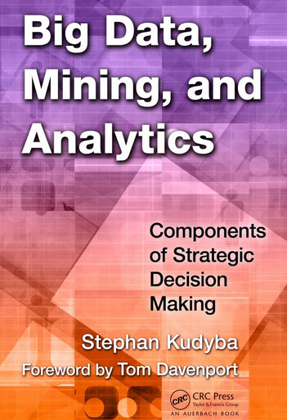
Stephan Kudyba (2014),
Big Data, Mining, and Analytics:
Components of Strategic Decision Making, Auerbach Publications
Source: http://www.amazon.com/gp/product/1466568704

Slide 5
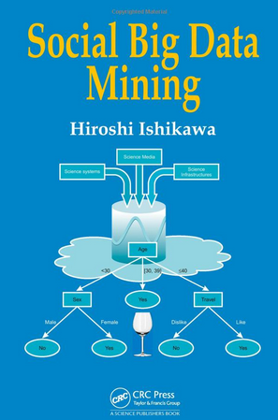
Social Big Data Mining
(Hiroshi Ishikawa, 2015)
Source: http://www.amazon.com/Social-Data-Mining-Hiroshi-Ishikawa/dp/149871093X

Slide 6

Source: http://www.amazon.com/Data-Mining-Machine-Learning-Practitioners/dp/1118618041

Slide 7

Data Mining
Source: http://www.amazon.com/Data-Mining-Concepts-Techniques-Management/dp/0123814790

Slide 8

Text Mining
Source: http://www.amazon.com/Text-Mining-Applications-Michael-Berry/dp/0470749822/

Slide 9

Web Mining and
Social Networking
Source: http://www.amazon.com/Web-Mining-Social-Networking-Applications/dp/1441977341

Slide 10

Mining the Social Web:
Analyzing Data from Facebook, Twitter, LinkedIn, and Other Social Media Sites
Source: http://www.amazon.com/Mining-Social-Web-Analyzing-Facebook/dp/1449388345

Slide 11
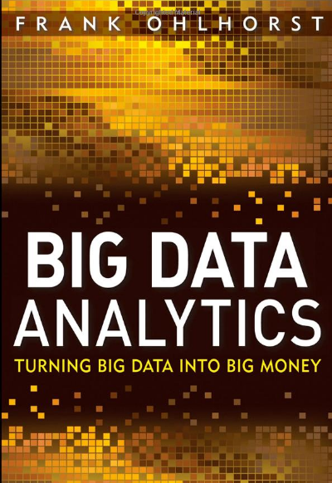
Source: http://www.amazon.com/Big-Data-Analytics-Turning-Money/dp/1118147596

Slide 12

Source: http://www.amazon.com/Predictive-Analytics-Power-Predict-Click/dp/1118356853

Slide 13

Source: http://www.amazon.com/Big-Data-Revolution-Transform-Mayer-Schonberger/dp/B00D81X2YE

Slide 14
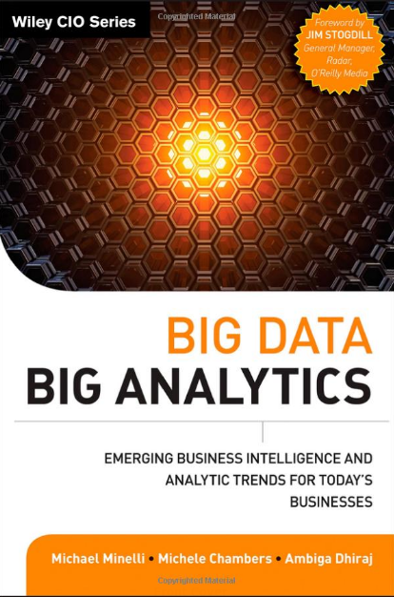
Source: http://www.amazon.com/Big-Data-Analytics-Intelligence-Businesses/dp/111814760X

Slide 15
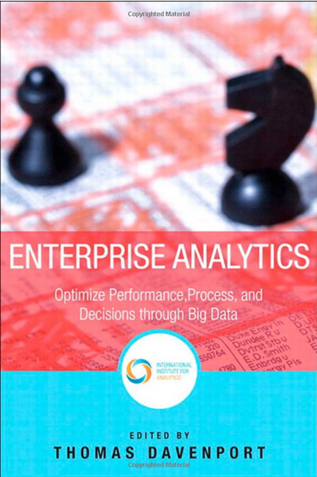
Source: http://www.amazon.com/Enterprise-Analytics-Performance-Operations-Management/dp/0133039439

Slide 16
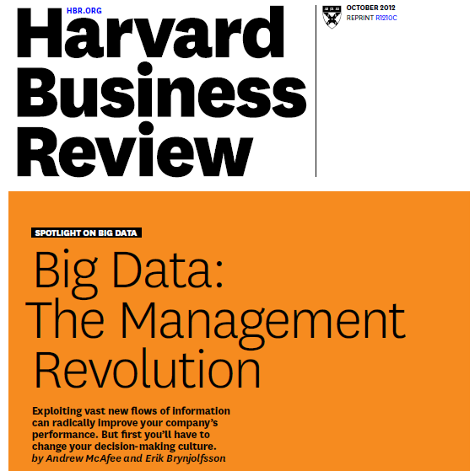
Source: McAfee, A., & Brynjolfsson, E. (2012). Big data: the management revolution.Harvard business review.

Slide 17
Architecture of Big Data Analytics
Big Data
Analytics
Applications
Big Data
Sources
Big Data
Transformation
Big Data
Platforms & Tools
* Internal
* External
* Multiple formats
* Multiple
locations
* Multiple applications
Middleware
Hadoop
MapReduce
Pig
Hive
Jaql
Zookeeper
Hbase
Cassandra
Oozie
Avro
Mahout
Others
Queries
Raw
Data
Transformed
Data
Big Data
Analytics
Extract Transform Load
Reports
Data Warehouse
OLAP
Traditional Format
CSV, Tables
Data Mining
Source: Stephan Kudyba (2014), Big Data, Mining, and Analytics: Components of Strategic Decision Making, Auerbach Publications

Slide 18
Architecture of Big Data Analytics
Big Data
Analytics
Applications
Big Data
Sources
Big Data
Transformation
Big Data
Platforms & Tools
* Internal
* External
* Multiple formats
* Multiple
locations
* Multiple applications
Data Mining
Big Data Analytics Applications
Middleware
Hadoop
MapReduce
Pig
Hive
Jaql
Zookeeper
Hbase
Cassandra
Oozie
Avro
Mahout
Others
Queries
Raw
Data
Transformed
Data
Big Data
Analytics
Extract Transform Load
Reports
Data Warehouse
OLAP
Traditional Format
CSV, Tables
Data Mining
Source: Stephan Kudyba (2014), Big Data, Mining, and Analytics: Components of Strategic Decision Making, Auerbach Publications

Slide 19
Architecture for
Social Big Data Mining
(Hiroshi Ishikawa, 2015)
Enabling Technologies
Analysts
Integrated analysis
Integrated analysis model
Model Construction
Explanation by Model
Conceptual Layer
Natural Language Processing
Information Extraction
Anomaly Detection
Discovery of relationships
among heterogeneous data
Large-scale visualization
Construction and
confirmation
of individual
hypothesis
Description and
execution of
application-specific
task
Data
Mining
Multivariate analysis
Application specific task
Logical Layer
Parallel distrusted processing
Software
Social Data
Hardware
Physical Layer
Source: Hiroshi Ishikawa (2015), Social Big Data Mining, CRC Press

Slide 20
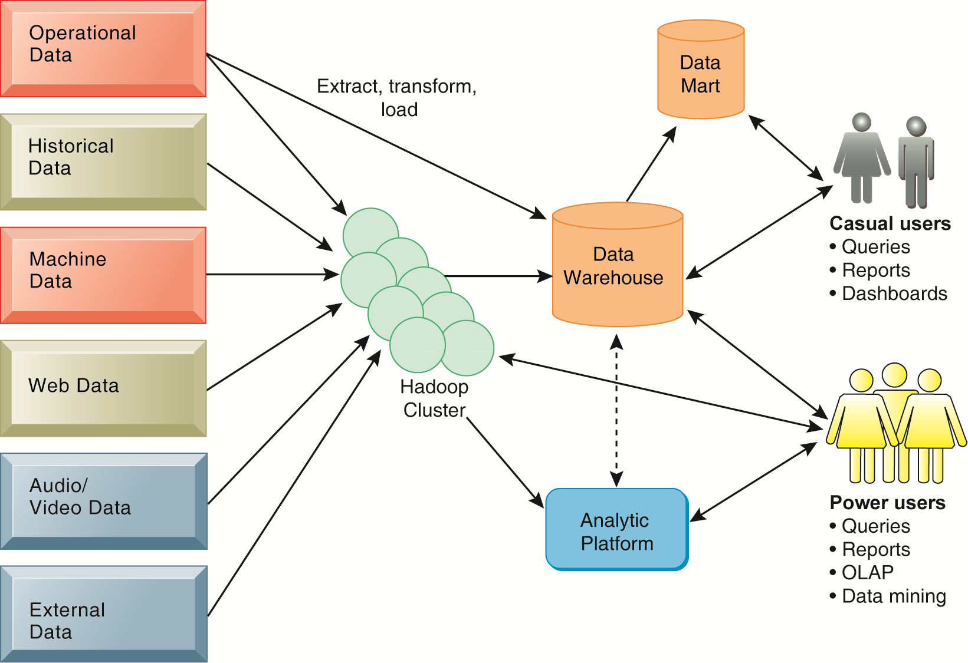
Business Intelligence (BI) Infrastructure

Slide 21
Data Warehouse
Data Mining and Business Intelligence
Increasing potential
to support
business decisions
End User
Decision Making
Data Presentation
Business
Analyst
Visualization Techniques
Data Mining
Data
Analyst
Information Discovery
Data Exploration
Statistical Summary, Querying, and Reporting
Data Preprocessing/Integration, Data Warehouses
Data Sources
DBA
Paper, Files, Web documents, Scientific experiments, Database Systems
Source: Jiawei Han and Micheline Kamber (2006), Data Mining: Concepts and Techniques, Second Edition, Elsevier

Slide 22
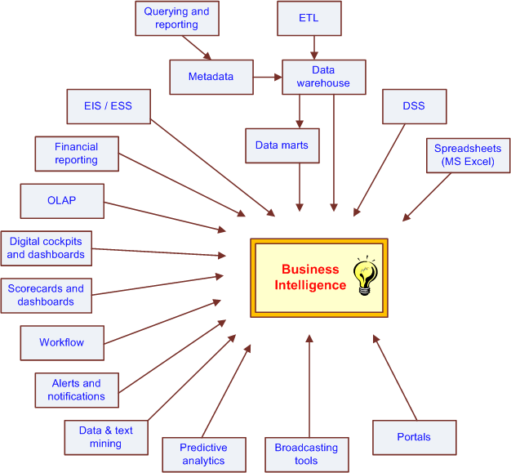
The Evolution of BI Capabilities
Source: Turban et al. (2011), Decision Support and Business Intelligence Systems

Slide 23
Business Intelligence and Analytics
Business Intelligence 2.0 (BI 2.0)
  Web Intelligence
  Web Analytics
  Web 2.0
  Social Networking and Microblogging sites
Data Trends
  Big Data
Platform Technology Trends
  Cloud computing platform
Source: Lim, E. P., Chen, H., & Chen, G. (2013). Business Intelligence and Analytics: Research Directions.
ACM Transactions on Management Information Systems (TMIS), 3(4), 17

Slide 24
Business Intelligence and Analytics: Research Directions
1. Big Data Analytics
  Data analytics using Hadoop / MapReduce framework
2. Text Analytics
  From Information Extraction to Question Answering
  From Sentiment Analysis to Opinion Mining
3. Network Analysis
  Link mining
  Community Detection
  Social Recommendation
Source: Lim, E. P., Chen, H., & Chen, G. (2013). Business Intelligence and Analytics: Research Directions.
ACM Transactions on Management Information Systems (TMIS), 3(4), 17

Slide 25
Big Data,
Big Analytics:
Emerging Business Intelligence and Analytic Trends for Today's Businesses

Slide 26
Big Data,
Prediction vs.
Explanation
Source: Agarwal, R., & Dhar, V. (2014). Editorial—Big Data, Data Science, and Analytics: The Opportunity and Challenge for IS Research. Information Systems Research, 25(3), 443-448.

Slide 27
Big Data:
The Management Revolution
Source: McAfee, A., & Brynjolfsson, E. (2012). Big data: the management revolution.Harvard business review.

Slide 28
Business Intelligence and Enterprise Analytics
Predictive analytics
Data mining
Business analytics
Web analytics
Big-data analytics
Source: Thomas H. Davenport, "Enterprise Analytics: Optimize Performance, Process, and Decisions Through Big Data", FT Press, 2012

Slide 29
Three Types of Business Analytics
Prescriptive Analytics
Predictive Analytics
Descriptive Analytics
Source: Thomas H. Davenport, "Enterprise Analytics: Optimize Performance, Process, and Decisions Through Big Data", FT Press, 2012

Slide 30
Three Types of Business Analytics
Optimization
“What’s the best that can happen?”
Prescriptive Analytics
Randomized Testing
“What if we try this?”
Predictive Modeling / Forecasting
“What will happen next?”
Predictive Analytics
Statistical Modeling
“Why is this happening?”
Alerts
“What actions are needed?”
Query / Drill Down
“What exactly is the problem?”
Descriptive Analytics
Ad hoc Reports / Scorecards
“How many, how often, where?”
Standard Report
“What happened?”
Source: Thomas H. Davenport, "Enterprise Analytics: Optimize Performance, Process, and Decisions Through Big Data", FT Press, 2012

Slide 31
Big-Data Analysis
Too Big,
too Unstructured,
too many different source
to be manageable through traditional databases

Slide 32
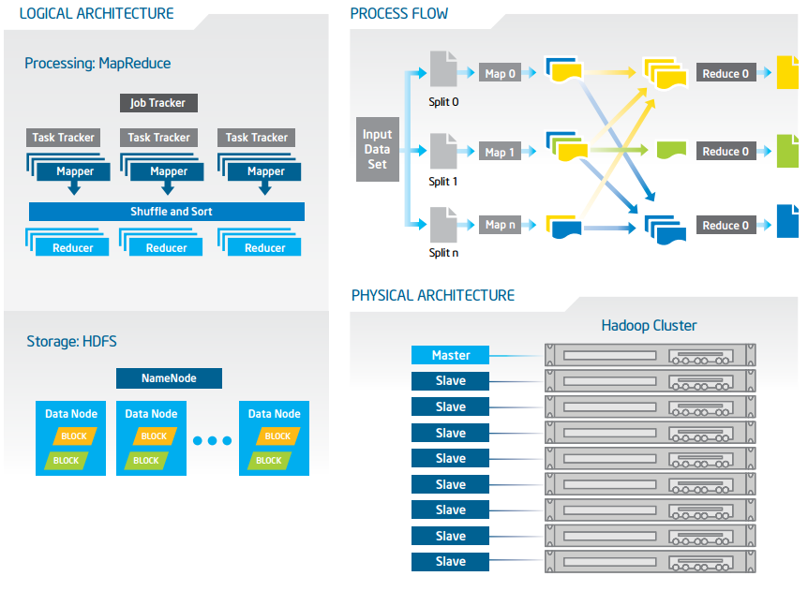
Big Data with Hadoop Architecture
Source: https://software.intel.com/sites/default/files/article/402274/etl-big-data-with-hadoop.pdf

Slide 33
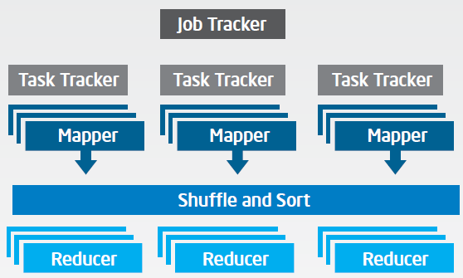
Big Data with Hadoop Architecture
Logical Architecture
Processing: MapReduce
Source: https://software.intel.com/sites/default/files/article/402274/etl-big-data-with-hadoop.pdf

Slide 34
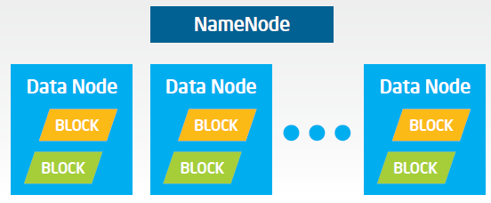
Big Data with Hadoop Architecture
Logical Architecture
Storage: HDFS
Source: https://software.intel.com/sites/default/files/article/402274/etl-big-data-with-hadoop.pdf

Slide 35
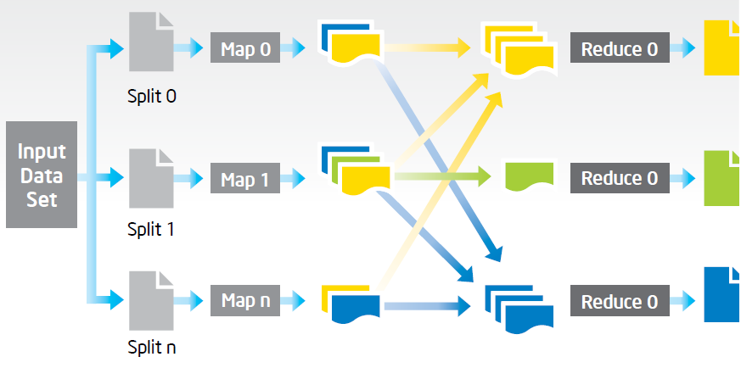
Big Data with Hadoop Architecture
Process Flow
Source: https://software.intel.com/sites/default/files/article/402274/etl-big-data-with-hadoop.pdf

Slide 36
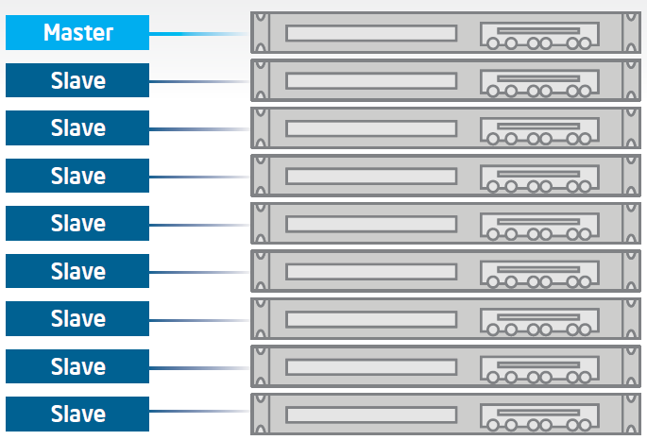
Big Data with Hadoop Architecture
Hadoop Cluster
Source: https://software.intel.com/sites/default/files/article/402274/etl-big-data-with-hadoop.pdf

Slide 37
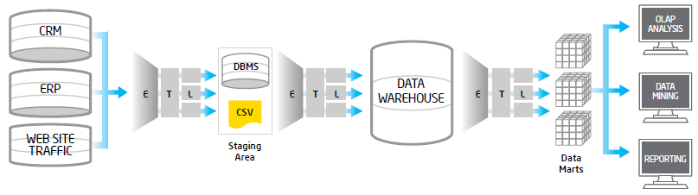
Traditional ETL Architecture
Source: https://software.intel.com/sites/default/files/article/402274/etl-big-data-with-hadoop.pdf

Slide 38
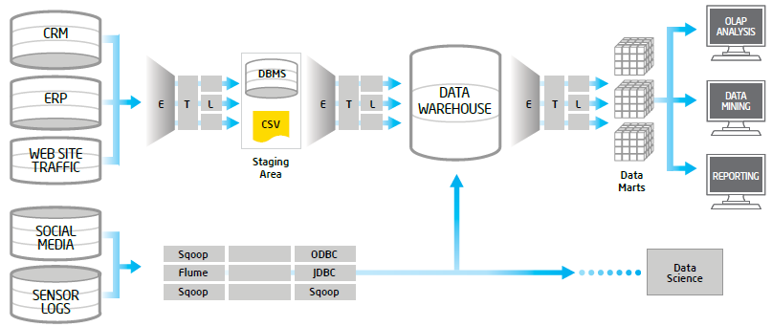
Offload ETL with Hadoop
(Big Data Architecture)
Source: https://software.intel.com/sites/default/files/article/402274/etl-big-data-with-hadoop.pdf

Slide 39
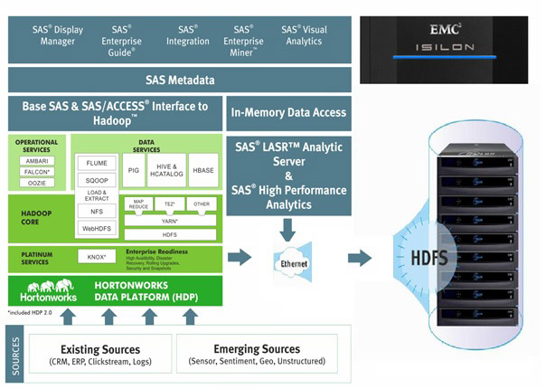
Big Data Solution
Source: http://www.newera-technologies.com/big-data-solution.html

Slide 40
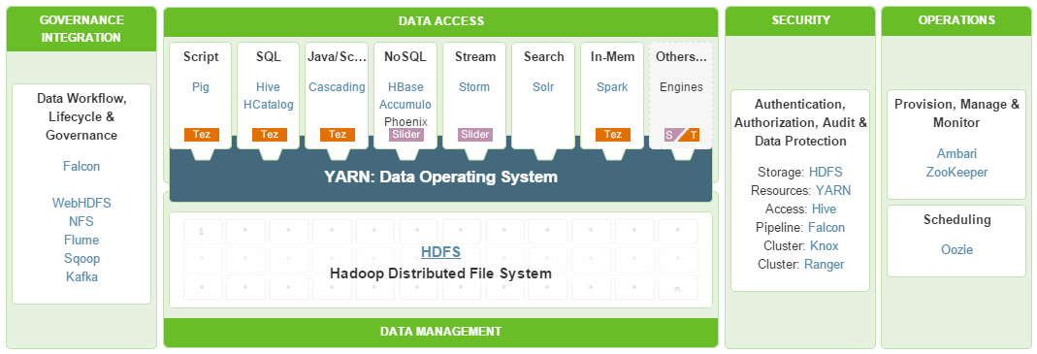
HDP
A Complete Enterprise Hadoop Data Platform
Source: http://hortonworks.com/hdp/

Slide 41
Data Mining
Advanced Data Analysis
Evolution of
Database System Technology

Slide 42
Evolution of Database System Technology
Data Collection and Database Creation
(1960s and earlier)
• Primitive file processing
Database Management Systems
(1970s–early 1980s)
• Hierarchical and network database systems
• Relational database systems
• Query languages: SQL, etc.
• Transactions, concurrency control and recovery
• On-line transaction processing (OLTP)
Advanced Database Systems
(mid-1980s–present)
• Advanced data models: extended relational, object-relational, etc.
• Advanced applications: spatial, temporal,
multimedia, active, stream and sensor, scientific and
engineering, knowledge-based
• XML-based database systems
• Integration with information retrieval
• Data and information integration
Advanced Data Analysis:
(late 1980s–present)
• Data warehouse and OLAP
• Data mining and knowledge discovery:
generalization, classification, association, clustering
• Advanced data mining applications:
stream data mining, bio-data mining,
time-series analysis, text mining,
Web mining, intrusion detection, etc.
• Data mining applications
• Data mining and society
New Generation of Information Systems
(present–future)
Source: Jiawei Han and Micheline Kamber (2011), Data Mining: Concepts and Techniques, Third Edition, Elsevier

Slide 43
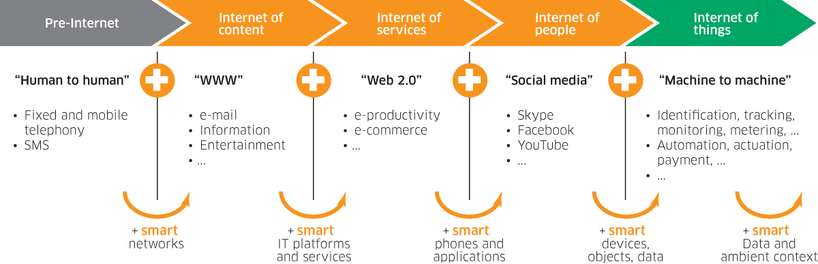
Internet Evolution
Internet of People (IoP): Social Media
Internet of Things (IoT): Machine to Machine
Source: Marc Jadoul (2015), The IoT: The next step in internet evolution, March 11, 2015 http://www2.alcatel-lucent.com/techzine/iot-internet-of-things-next-step-evolution/

Slide 44
Data Mining at the
Intersection of Many Disciplines
Source: Turban et al. (2011), Decision Support and Business Intelligence Systems

Slide 45
Data Mining Technologies
Statistics
Machine Learning
Pattern Recognition
Database Systems
Visualization
Data Mining
Data Warehouse
Algorithms
Information Retrieval
Applications
High-performance Computing
Source: Jiawei Han and Micheline Kamber (2011), Data Mining: Concepts and Techniques, Third Edition, Elsevier

Slide 46
Data Mining Process

Slide 47
Data Mining Process
A manifestation of best practices
A systematic way to conduct DM projects
Different groups has different versions
Most common standard processes:
  CRISP-DM
  (Cross-Industry Standard Process for Data Mining)
  SEMMA
  (Sample, Explore, Modify, Model, and Assess)
  KDD
  (Knowledge Discovery in Databases)
Source: Turban et al. (2011), Decision Support and Business Intelligence Systems

Slide 48
Data Mining Process
(SOP of DM)
What main methodology
are you using for your
analytics,
data mining,
or data science projects ?
Source: http://www.kdnuggets.com/polls/2014/analytics-data-mining-data-science-methodology.html

Slide 49
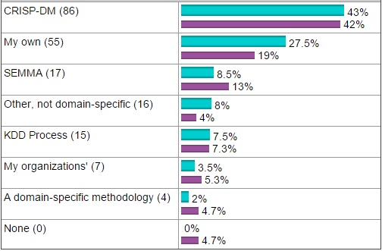
Data Mining Process
Source: http://www.kdnuggets.com/polls/2014/analytics-data-mining-data-science-methodology.html

Slide 50


Data Mining:
Core Analytics Process
The KDD Process for
Extracting Useful Knowledge from Volumes of Data
Source: Fayyad, U., Piatetsky-Shapiro, G., & Smyth, P. (1996). The KDD Process for Extracting Useful Knowledge from Volumes of Data. Communications of the ACM, 39(11), 27-34.

Slide 51
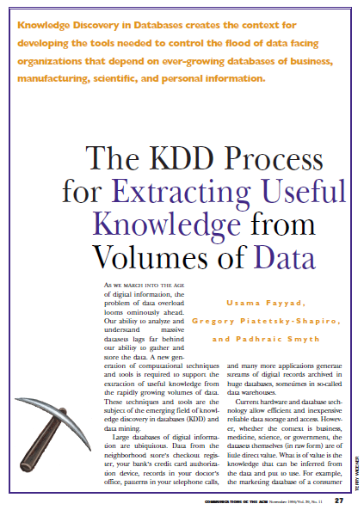
Fayyad, U., Piatetsky-Shapiro, G., & Smyth, P. (1996).
The KDD Process for
Extracting Useful Knowledge from Volumes of Data.
Communications of the ACM, 39(11), 27-34.

Slide 52
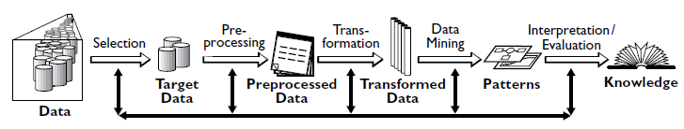
Data Mining
Knowledge Discovery in Databases (KDD) Process
(Fayyad et al., 1996)
Source: Fayyad, U., Piatetsky-Shapiro, G., & Smyth, P. (1996). The KDD Process for Extracting Useful Knowledge from Volumes of Data. Communications of the ACM, 39(11), 27-34.

Slide 53
Knowledge Discovery in Databases (KDD) Process
Data mining:
core of knowledge discovery process
Knowledge
Evaluation and
Presentation
Data Mining
Patterns
Selection and
Transformation
Task-relevant
Data
Data
Warehouse
Cleaning and
Integration
Databases
Flat files
Source: Jiawei Han and Micheline Kamber (2006), Data Mining: Concepts and Techniques, Second Edition, Elsevier

Slide 54
Data Mining Process:
CRISP-DM
Source: Turban et al. (2011), Decision Support and Business Intelligence Systems

Slide 55
Data Mining Process:
CRISP-DM
Step 1: Business Understanding
Step 2: Data Understanding
Step 3: Data Preparation (!)
Step 4: Model Building
Step 5: Testing and Evaluation
Step 6: Deployment
The process is highly repetitive and experimental
(DM: art versus science?)
Accounts for ~85% of total project time
Source: Turban et al. (2011), Decision Support and Business Intelligence Systems

Slide 56
Data Preparation –
A Critical DM Task
Source: Turban et al. (2011), Decision Support and Business Intelligence Systems

Slide 57
Data Mining Process:
SEMMA
Source: Turban et al. (2011), Decision Support and Business Intelligence Systems

Slide 58
Data Mining Processing Pipeline
(Charu Aggarwal, 2015)
Data Collection
Data Preprocessing
Analytical Processing
Output
for
Analyst
Feature Extraction
Cleaning
and
Integration
Building
Block 1
Building
Block 2
Feedback (Optional)
Feedback (Optional)
Source: Charu Aggarwal (2015), Data Mining: The Textbook Hardcover, Springer

Slide 59
Using Databases to Improve Business Performance and Decision Making
Big data
  Massive sets of unstructured/semi-structured data from Web traffic, social media, sensors, and so on
  Petabytes, exabytes of data
    Volumes too great for typical DBMS
  Can reveal more patterns and anomalies

Slide 60
Using Databases to Improve Business Performance and Decision Making
Business intelligence infrastructure
  Today includes an array of tools for separate systems, and big data
Contemporary tools:
  Data warehouses
  Data marts
  Hadoop
  In-memory computing
  Analytical platforms

Slide 61
Data Warehouse vs.
Data Marts
Data warehouse:
  Stores current and historical data from many core operational transaction systems
  Consolidates and standardizes information for use across enterprise, but data cannot be altered
  Provides analysis and reporting tools
Data marts:
  Subset of data warehouse
  Summarized or focused portion of data for use by specific population of users
  Typically focuses on single subject or line of business

Slide 62
Hadoop
Enables distributed parallel processing of
big data across inexpensive computers
Key services
  Hadoop Distributed File System (HDFS): data storage
  MapReduce: breaks data into clusters for work
  Hbase: NoSQL database
Used by Facebook, Yahoo, NextBio

Slide 63
In-memory computing
Used in big data analysis
Use computers main memory (RAM) for data storage to avoid delays in retrieving data from disk storage
Can reduce hours/days of processing to seconds
Requires optimized hardware

Slide 64
Analytic platforms
High-speed platforms using both relational and non-relational tools optimized for large datasets
Examples:
  IBM Netezza
  Oracle Exadata

Slide 65
Analytical tools:
Relationships, patterns, trends
Business Intelligence Analytics and Applications
Tools for consolidating, analyzing, and providing access to vast amounts of data to help users make better business decisions
  Multidimensional data analysis (OLAP)
  Data mining
  Text mining
  Web mining

Slide 66
Online analytical processing (OLAP)
Supports multidimensional data analysis
  Viewing data using multiple dimensions
  Each aspect of information (product, pricing, cost, region, time period) is different dimension
  Example: How many washers sold in East in June compared with other regions?
OLAP enables rapid, online answers to ad hoc queries

Slide 67
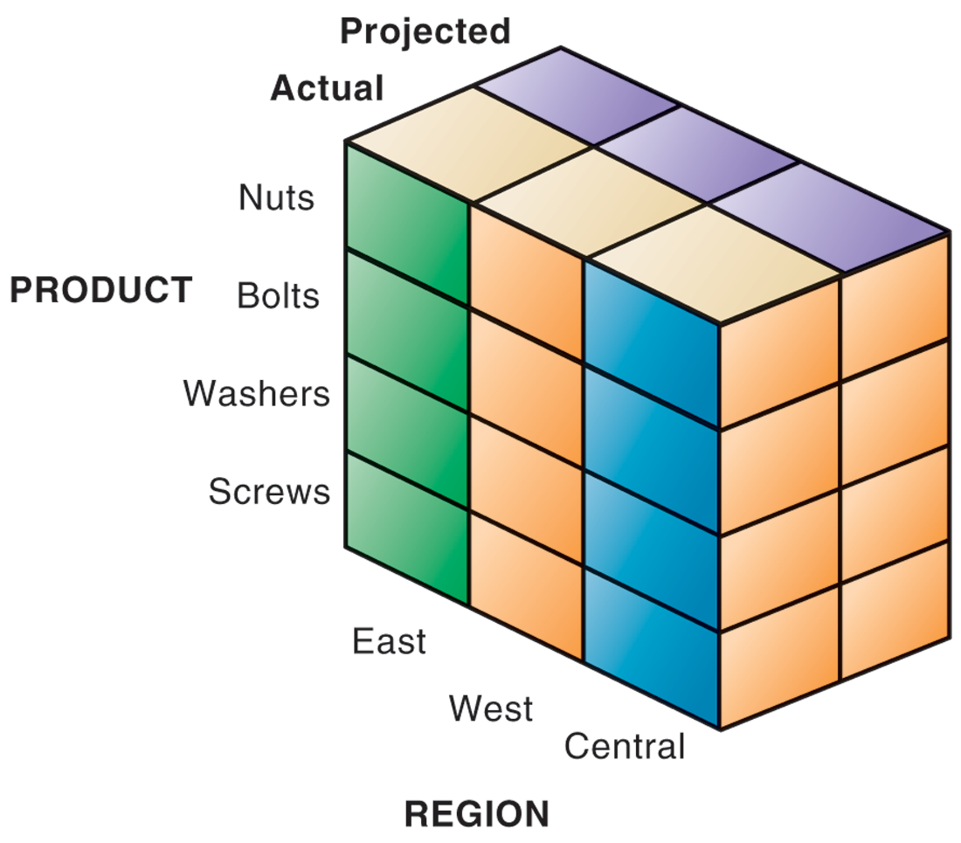
MULTIDIMENSIONAL DATA MODEL

Slide 68
Data mining
Finds hidden patterns, relationships in datasets
  Example: customer buying patterns
Infers rules to predict future behavior
  Data mining provides insights into data that cannot be discovered through OLAP, by inferring rules from patterns in data.

Slide 69
Types of Information Obtained from Data Mining
Associations: Occurrences linked to single event
Sequences: Events linked over time
Classification: Recognizes patterns that describe group to which item belongs
Clustering: Similar to classification when no groups have been defined; finds groupings within data
Forecasting: Uses series of existing values to forecast what other values will be

Slide 70
Text mining
Extracts key elements from large unstructured data sets
  Stored e-mails
  Call center transcripts
  Legal cases
  Patent descriptions
  Service reports, and so on
Sentiment analysis software
  Mines e-mails, blogs, social media to detect opinions

Slide 71
Web mining
Discovery and analysis of useful patterns and information from Web
  Understand customer behavior
  Evaluate effectiveness of Web site, and so on
3 Tasks of Web Mining
  Web content mining
    Mines content of Web pages
  Web structure mining
    Analyzes links to and from Web page
  Web usage mining
    Mines user interaction data recorded by Web server

Slide 72
Web Mining
Web mining (or Web data mining) is the process of discovering intrinsic relationships from Web data (textual, linkage, or usage)
Source: Turban et al. (2011), Decision Support and Business Intelligence Systems

Slide 73
Databases and the Web
Many companies use Web to make some internal databases available to customers or partners
Typical configuration includes:
  Web server
  Application server/middleware/CGI scripts
  Database server (hosting DBMS)
Advantages of using Web for database access:
  Ease of use of browser software
  Web interface requires few or no changes to database
  Inexpensive to add Web interface to system

Slide 74
Web Content/Structure Mining
Mining of the textual content on the Web
Data collection via Web crawlers
Web pages include hyperlinks
  Authoritative pages
  Hubs
  hyperlink-induced topic search (HITS) alg
Source: Turban et al. (2011), Decision Support and Business Intelligence Systems

Slide 75
Web Usage Mining
Extraction of information from data generated through Web page visits and transactions…
  data stored in server access logs, referrer logs, agent logs, and client-side cookies
  user characteristics and usage profiles
  metadata, such as page attributes, content attributes, and usage data
Clickstream data
Clickstream analysis
Source: Turban et al. (2011), Decision Support and Business Intelligence Systems

Slide 76
Web Usage Mining
Web usage mining applications
  Determine the lifetime value of clients
  Design cross-marketing strategies across products.
  Evaluate promotional campaigns
  Target electronic ads and coupons at user groups based on user access patterns
  Predict user behavior based on previously learned rules and users' profiles
  Present dynamic information to users based on their interests and profiles…
Source: Turban et al. (2011), Decision Support and Business Intelligence Systems

Slide 77
Web Usage Mining
(clickstream analysis)
Source: Turban et al. (2011), Decision Support and Business Intelligence Systems

Slide 78
Web Mining Success Stories
Amazon.com, Ask.com, Scholastic.com, …
Website Optimization Ecosystem
Source: Turban et al. (2011), Decision Support and Business Intelligence Systems

Slide 79
Data Mining Tasks

Slide 80
A Taxonomy for Data Mining Tasks
Source: Turban et al. (2011), Decision Support and Business Intelligence Systems

Slide 81
Why Data Mining?
More intense competition at the global scale
Recognition of the value in data sources
Availability of quality data on customers, vendors, transactions, Web, etc.
Consolidation and integration of data repositories into data warehouses
The exponential increase in data processing and storage capabilities; and decrease in cost
Movement toward conversion of information resources into nonphysical form
Source: Turban et al. (2011), Decision Support and Business Intelligence Systems

Slide 82
Definition of Data Mining
The nontrivial process of identifying valid, novel, potentially useful, and ultimately understandable patterns in data stored in structured databases. - Fayyad et al., (1996)
Keywords in this definition: Process, nontrivial, valid, novel, potentially useful, understandable.
Data mining: a misnomer?
Other names:
  knowledge extraction, pattern analysis,
  knowledge discovery, information harvesting,
  pattern searching, data dredging,…
Source: Turban et al. (2011), Decision Support and Business Intelligence Systems

Slide 83
Data Mining Characteristics/Objectives
Source of data for DM is often a consolidated data warehouse (not always!)
DM environment is usually a client-server or a Web-based information systems architecture
Data is the most critical ingredient for DM which may include soft/unstructured data
The miner is often an end user
Striking it rich requires creative thinking
Data mining tools’ capabilities and ease of use are essential (Web, Parallel processing, etc.)
Source: Turban et al. (2011), Decision Support and Business Intelligence Systems

Slide 84
Data in Data Mining
Data: a collection of facts usually obtained as the result of experiences, observations, or experiments
Data may consist of numbers, words, images, …
Data: lowest level of abstraction (from which information and knowledge are derived)
DM with different data types?
- Other data types?
Source: Turban et al. (2011), Decision Support and Business Intelligence Systems

Slide 85
What Does DM Do?
DM extract patterns from data
  Pattern?
  A mathematical (numeric and/or symbolic) relationship among data items
Types of patterns
  Association
  Prediction
  Cluster (segmentation)
  Sequential (or time series) relationships
Source: Turban et al. (2011), Decision Support and Business Intelligence Systems

Slide 86
Data Mining Applications
Customer Relationship Management
  Maximize return on marketing campaigns
  Improve customer retention (churn analysis)
  Maximize customer value (cross-, up-selling)
  Identify and treat most valued customers
Banking and Other Financial
  Automate the loan application process
  Detecting fraudulent transactions
  Optimizing cash reserves with forecasting
Source: Turban et al. (2011), Decision Support and Business Intelligence Systems

Slide 87
Data Mining Applications (cont.)
Retailing and Logistics
  Optimize inventory levels at different locations
  Improve the store layout and sales promotions
  Optimize logistics by predicting seasonal effects
  Minimize losses due to limited shelf life
Manufacturing and Maintenance
  Predict/prevent machinery failures
  Identify anomalies in production systems to optimize the use manufacturing capacity
  Discover novel patterns to improve product quality
Source: Turban et al. (2011), Decision Support and Business Intelligence Systems

Slide 88
Data Mining Applications (cont.)
Brokerage and Securities Trading
  Predict changes on certain bond prices
  Forecast the direction of stock fluctuations
  Assess the effect of events on market movements
  Identify and prevent fraudulent activities in trading
Insurance
  Forecast claim costs for better business planning
  Determine optimal rate plans
  Optimize marketing to specific customers
  Identify and prevent fraudulent claim activities
Source: Turban et al. (2011), Decision Support and Business Intelligence Systems

Slide 89
Data Mining Applications (cont.)
Computer hardware and software
Science and engineering
Government and defense
Homeland security and law enforcement
Travel industry
Healthcare
Medicine
Entertainment industry
Sports
Etc.
Highly popular application areas for data mining
Source: Turban et al. (2011), Decision Support and Business Intelligence Systems

Slide 90
A Taxonomy for Data Mining Tasks
Source: Turban et al. (2011), Decision Support and Business Intelligence Systems

Slide 91
Association Analysis:
Mining Frequent Patterns,
Association and Correlations
Association Analysis
Mining Frequent Patterns
Association and Correlations
Apriori Algorithm
Source: Han & Kamber (2006)

Slide 92
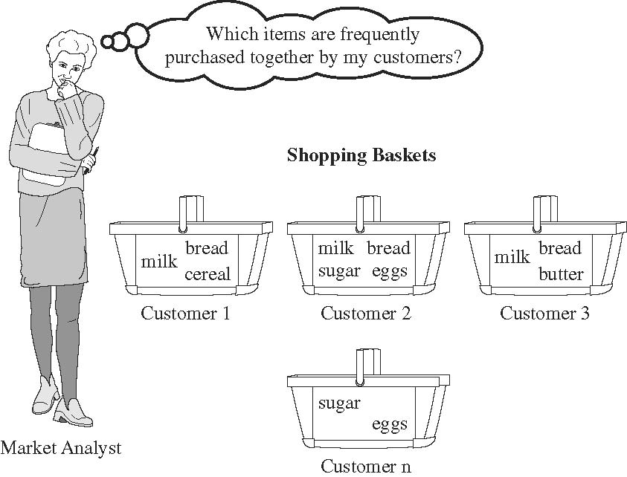
Market Basket Analysis
Source: Han & Kamber (2006)

Slide 93
Association Rule Mining
Apriori Algorithm
Source: Turban et al. (2011), Decision Support and Business Intelligence Systems

Slide 94
Association Rule Mining
A very popular DM method in business
Finds interesting relationships (affinities) between variables (items or events)
Part of machine learning family
Employs unsupervised learning
There is no output variable
Also known as market basket analysis
Often used as an example to describe DM to ordinary people, such as the famous “relationship between diapers and beers!”
Source: Turban et al. (2011), Decision Support and Business Intelligence Systems

Slide 95
Association Rule Mining
Input: the simple point-of-sale transaction data
Output: Most frequent affinities among items
Example: according to the transaction data…
“Customer who bought a laptop computer and a virus protection software, also bought extended service plan 70 percent of the time."
How do you use such a pattern/knowledge?
  Put the items next to each other for ease of finding
  Promote the items as a package (do not put one on sale if the other(s) are on sale)
  Place items far apart from each other so that the customer has to walk the aisles to search for it, and by doing so potentially seeing and buying other items
Source: Turban et al. (2011), Decision Support and Business Intelligence Systems

Slide 96
Association Rule Mining
A representative applications of association rule mining include
  In business: cross-marketing, cross-selling, store design, catalog design, e-commerce site design, optimization of online advertising, product pricing, and sales/promotion configuration
  In medicine: relationships between symptoms and illnesses; diagnosis and patient characteristics and treatments (to be used in medical DSS); and genes and their functions (to be used in genomics projects)…
Source: Turban et al. (2011), Decision Support and Business Intelligence Systems

Slide 97
Association Rule Mining
Are all association rules interesting and useful?
  A Generic Rule: X ⇒ Y [S%, C%]
  X, Y: products and/or services
  X: Left-hand-side (LHS)
  Y: Right-hand-side (RHS)
  S: Support: how often X and Y go together
  C: Confidence: how often Y go together with the X
  Example: {Laptop Computer, Antivirus Software} ⇒ {Extended Service Plan} [30%, 70%]
Source: Turban et al. (2011), Decision Support and Business Intelligence Systems

Slide 98
Association Rule Mining
Algorithms are available for generating association rules
  Apriori
  Eclat
  FP-Growth
  + Derivatives and hybrids of the three
The algorithms help identify the frequent item sets, which are, then converted to association rules
Source: Turban et al. (2011), Decision Support and Business Intelligence Systems

Slide 99
Association Rule Mining
Apriori Algorithm
  Finds subsets that are common to at least a minimum number of the itemsets
  uses a bottom-up approach
    frequent subsets are extended one item at a time (the size of frequent subsets increases from one-item subsets to two-item subsets, then three-item subsets, and so on), and
    groups of candidates at each level are tested against the data for minimum
Source: Turban et al. (2011), Decision Support and Business Intelligence Systems

Slide 100
Basic Concepts: Frequent Patterns and Association Rules
Transaction-id | Items bought
10 | A, B, D
20 | A, C, D
30 | A, D, E
40 | B, E, F
50 | B, C, D, E, F
Itemset X = {x₁, …, x_{k}}
Find all the rules X → Y with minimum support and confidence
  support, s, probability that a transaction contains X ∪ Y
  confidence, c, conditional probability that a transaction having X also contains Y
Customer
buys both
Customer
buys diaper
Let sup_{min} = 50%, conf_{min} = 50%
Freq. Pat.: {A:3, B:3, D:4, E:3, AD:3}
Association rules:
  A → D (60%, 100%)
  D → A (60%, 75%)
Customer
buys beer
A → D (support = 3/5 = 60%, confidence = 3/3 =100%)
D → A (support = 3/5 = 60%, confidence = 3/4 = 75%)
Source: Han & Kamber (2006)

Slide 101
Market basket analysis
Example
  Which groups or sets of items are customers likely to purchase on a given trip to the store?
Association Rule
  Computer → antivirus_software
  [support = 2%; confidence = 60%]
    A support of 2% means that 2% of all the transactions under analysis show that computer and antivirus software are purchased together.
    A confidence of 60% means that 60% of the customers who purchased a computer also bought the software.
Source: Han & Kamber (2006)

Slide 102
Association rules
Association rules are considered interesting if they satisfy both
  a minimum support threshold and
  a minimum confidence threshold.
Source: Han & Kamber (2006)

Slide 103
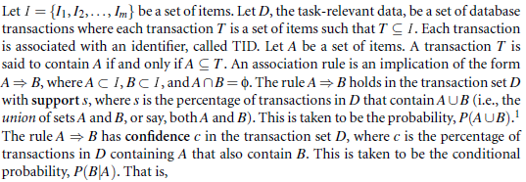
Frequent Itemsets,
Closed Itemsets, and
Association Rules
Support (A→ B) = P(A ∪ B)
Confidence (A→ B) = P(B|A)
Source: Han & Kamber (2006)

Slide 104
Support (A→ B) = P(A ∪ B)
Confidence (A→ B) = P(B|A)
The notation P(A ∪ B) indicates the probability that a transaction contains the union of set A and set B
  (i.e., it contains every item in A and in B).
This should not be confused with P(A or B), which indicates the probability that a transaction contains either A or B.
Source: Han & Kamber (2006)

Slide 105
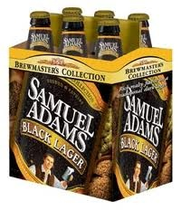



Does diaper purchase predict beer purchase?
Contingency tables
Beer
Yes No
Beer
Yes No
6 | 94
40 | 60
100
100
23 | 77
23 | 77
No diapers
diapers
DEPENDENT (yes)
INDEPENDENT (no predictability)
Source: Dickey (2012) http://www4.stat.ncsu.edu/~dickey/SAScode/Encore_2012.ppt

Slide 106
Support (A→ B) = P(A ∪ B)
Confidence (A→ B) = P(B|A)
Conf (A → B) = Supp (A ∪ B)/ Supp (A)
Lift (A → B) = Supp (A ∪ B) / (Supp (A) x Supp (B))
Lift (Correlation)
Lift (A→B) = Confidence (A→B) / Support(B)
Source: Dickey (2012) http://www4.stat.ncsu.edu/~dickey/SAScode/Encore_2012.ppt

Slide 107
Lift
Lift = Confidence / Expected Confidence if Independent
Checking Saving | No (1500) | Yes (8500) | (10000)
No | 500 | 3500 | 4000
Yes | 1000 | 5000 | 6000
SVG=>CHKG Expect 8500/10000 = 85% if independent
Observed Confidence is 5000/6000 = 83%
Lift = 83/85 < 1.
Savings account holders actually LESS likely than others to have checking account !!!
Source: Dickey (2012) http://www4.stat.ncsu.edu/~dickey/SAScode/Encore_2012.ppt

Slide 108
Rules that satisfy both a minimum support threshold (min_sup) and a minimum confidence threshold (min_conf) are called strong.
By convention, we write support and confidence values so as to occur between 0% and 100%, rather than 0 to 1.0.
Source: Han & Kamber (2006)

Slide 109
itemset
  A set of items is referred to as an itemset.
K-itemset
  An itemset that contains k items is a k-itemset.
Example:
  The set {computer, antivirus software} is a 2-itemset.
Source: Han & Kamber (2006)

Slide 110
Absolute Support and
Relative Support
Absolute Support
  The occurrence frequency of an itemset is the number of transactions that contain the itemset
    frequency, support count, or count of the itemset
  Ex: 3
Relative support
  Ex: 60%
Source: Han & Kamber (2006)

Slide 111
If the relative support of an itemset I satisfies a prespecified minimum support threshold, then I is a frequent itemset.
  i.e., the absolute support of I satisfies the corresponding minimum support count threshold
The set of frequent k-itemsets is commonly denoted by L_{K}
Source: Han & Kamber (2006)

Slide 112

the confidence of rule A→ B can be easily derived from the support counts of A and A ∪ B.
once the support counts of A, B, and A ∪ B are found, it is straightforward to derive the corresponding association rules A→B and B→A and check whether they are strong.
Thus the problem of mining association rules can be reduced to that of mining frequent itemsets.
Source: Han & Kamber (2006)

Slide 113
Association rule mining:
Two-step process
1. Find all frequent itemsets
  By definition, each of these itemsets will occur at least as frequently as a predetermined minimum support count, min_sup.
2. Generate strong association rules from the frequent itemsets
  By definition, these rules must satisfy minimum support and minimum confidence.
Source: Han & Kamber (2006)

Slide 114
Efficient and Scalable
Frequent Itemset Mining Methods
The Apriori Algorithm
  Finding Frequent Itemsets Using Candidate Generation
Source: Han & Kamber (2006)

Slide 115
Apriori Algorithm
Apriori is a seminal algorithm proposed by R. Agrawal and R. Srikant in 1994 for mining frequent itemsets for Boolean association rules.
The name of the algorithm is based on the fact that the algorithm uses prior knowledge of frequent itemset properties, as we shall see following.
Source: Han & Kamber (2006)

Slide 116
Apriori Algorithm
Apriori employs an iterative approach known as a level-wise search, where k-itemsets are used to explore (k+1)-itemsets.
First, the set of frequent 1-itemsets is found by scanning the database to accumulate the count for each item, and collecting those items that satisfy minimum support. The resulting set is denoted L₁.
Next, L₁ is used to find L₂, the set of frequent 2-itemsets, which is used to find L₃, and so on, until no more frequent k-itemsets can be found.
The finding of each L_{k} requires one full scan of the database.
Source: Han & Kamber (2006)

Slide 117
Apriori Algorithm
To improve the efficiency of the level-wise generation of frequent itemsets, an important property called the Apriori property.
Apriori property
  All nonempty subsets of a frequent itemset must also be frequent.
Source: Han & Kamber (2006)

Slide 118
Apriori algorithm
(1) Frequent Itemsets
(2) Association Rules

Slide 119
Transaction Database
Transaction ID | Items bought
T01 | A, B, D
T02 | A, C, D
T03 | B, C, D, E
T04 | A, B, D
T05 | A, B, C, E
T06 | A, C
T07 | B, C, D
T08 | B, D
T09 | A, C, E
T10 | B, D

Slide 120
Table 1 shows a database with 10 transactions.
Let minimum support = 20% and minimum confidence = 80%.
Please use Apriori algorithm for generating association rules from frequent itemsets.
Table 1: Transaction Database
Transaction ID | Items bought
T01 | A, B, D
T02 | A, C, D
T03 | B, C, D, E
T04 | A, B, D
T05 | A, B, C, E
T06 | A, C
T07 | B, C, D
T08 | B, D
T09 | A, C, E
T10 | B, D

Slide 121
Transaction ID | Items bought
T01 | A, B, D
T02 | A, C, D
T03 | B, C, D, E
T04 | A, B, D
T05 | A, B, C, E
T06 | A, C
T07 | B, C, D
T08 | B, D
T09 | A, C, E
T10 | B, D
Apriori Algorithm
C₁ → L₁
Step 1-1
C₁
L₁
Itemset | Support Count
A | 6
B | 7
C | 6
D | 7
E | 3
minimum
support = 20%
= 2 / 10
Min. Support
Count = 2
Itemset | Support Count
A | 6
B | 7
C | 6
D | 7
E | 3

Slide 122
Transaction ID | Items bought
T01 | A, B, D
T02 | A, C, D
T03 | B, C, D, E
T04 | A, B, D
T05 | A, B, C, E
T06 | A, C
T07 | B, C, D
T08 | B, D
T09 | A, C, E
T10 | B, D
Apriori Algorithm
C₂ → L₂
Step 1-2
C₂
L₂
Itemset | Support Count
A, B | 3
A, C | 4
A, D | 3
A, E | 2
B, C | 3
B, D | 6
B, E | 2
C, D | 3
C, E | 3
D, E | 1
Itemset | Support Count
A, B | 3
A, C | 4
A, D | 3
A, E | 2
B, C | 3
B, D | 6
B, E | 2
C, D | 3
C, E | 3
L₁
minimum
support = 20%
= 2 / 10
Min. Support
Count = 2
Itemset | Support Count
A | 6
B | 7
C | 6
D | 7
E | 3

Slide 123
Transaction ID | Items bought
T01 | A, B, D
T02 | A, C, D
T03 | B, C, D, E
T04 | A, B, D
T05 | A, B, C, E
T06 | A, C
T07 | B, C, D
T08 | B, D
T09 | A, C, E
T10 | B, D
Apriori Algorithm
C₃ → L₃
Step 1-3
C₃
L₃
Itemset | Support Count
A, B, C | 1
A, B, D | 2
A, B, E | 1
A, C, D | 1
A, C, E | 2
B, C, D | 2
B, C, E | 2
minimum
support = 20%
= 2 / 10
Min. Support
Count = 2
Itemset | Support Count
A, B, D | 2
A, C, E | 2
B, C, D | 2
B, C, E | 2
L₂
Itemset | Support Count
A, B | 3
A, C | 4
A, D | 3
A, E | 2
B, C | 3
B, D | 6
B, E | 2
C, D | 3
C, E | 3

Slide 124
Transaction ID | Items bought
T01 | A, B, D
T02 | A, C, D
T03 | B, C, D, E
T04 | A, B, D
T05 | A, B, C, E
T06 | A, C
T07 | B, C, D
T08 | B, D
T09 | A, C, E
T10 | B, D
Generating Association Rules
Step 2-1
minimum confidence = 80%
L₂
Association Rules
Generated from L₂
L₁
Itemset | Support Count
A, B | 3
A, C | 4
A, D | 3
A, E | 2
B, C | 3
B, D | 6
B, E | 2
C, D | 3
C, E | 3
A→B: 3/6 | B→A: 3/7
A→C: 4/6 | C→A: 4/6
A→D: 3/6 | D→A: 3/7
A→E: 2/6 | E→A: 2/3
B→C: 3/7 | C→B: 3/6
B→D: 6/7=85.7% * | D→B: 6/7=85.7% *
B→E: 2/7 | E→B: 2/3
C→D: 3/6 | D→C: 2/7
C→E: 3/6 | E→C: 3/3=100% *
Itemset | Support Count
A | 6
B | 7
C | 6
D | 7
E | 3

Slide 125
Transaction ID | Items bought
T01 | A, B, D
T02 | A, C, D
T03 | B, C, D, E
T04 | A, B, D
T05 | A, B, C, E
T06 | A, C
T07 | B, C, D
T08 | B, D
T09 | A, C, E
T10 | B, D
Generating Association Rules
Step 2-2
minimum confidence = 80%
Association Rules
Generated from L₃
A→BD: 2/6 | B→CD: 2/7
B→AD: 2/7 | C→BD: 2/6
D→AB: 2/7 | D→BC: 2/7
AB→D: 2/3 | BC→D: 2/3
AD→B: 2/3 | BD→C: 2/6
BD→A: 2/6 | CD→B: 2/3
A→CE: 2/6 | B→CE: 2/7
C→AE: 2/6 | C→BE: 2/6
E→AC: 2/3 | E→BC: 2/3
AC→E: 2/4 | BC→E: 2/3
AE→C: 2/2=100%* | BE→C: 2/2=100%*
CE→A: 2/3 | CE→B: 2/3
L₁
L₂
L₃
Itemset | Support Count
A | 6
B | 7
C | 6
D | 7
E | 3
Itemset | Support Count
A, B | 3
A, C | 4
A, D | 3
A, E | 2
B, C | 3
B, D | 6
B, E | 2
C, D | 3
C, E | 3
Itemset | Support Count
A, B, D | 2
A, C, E | 2
B, C, D | 2
B, C, E | 2

Slide 126
Transaction ID | Items bought
T01 | A, B, D
T02 | A, C, D
T03 | B, C, D, E
T04 | A, B, D
T05 | A, B, C, E
T06 | A, C
T07 | B, C, D
T08 | B, D
T09 | A, C, E
T10 | B, D
Frequent Itemsets and Association Rules
L₁
L₂
L₃
Itemset | Support Count
A | 6
B | 7
C | 6
D | 7
E | 3
Itemset | Support Count
A, B | 3
A, C | 4
A, D | 3
A, E | 2
B, C | 3
B, D | 6
B, E | 2
C, D | 3
C, E | 3
Itemset | Support Count
A, B, D | 2
A, C, E | 2
B, C, D | 2
B, C, E | 2
minimum support = 20%
minimum confidence = 80%
Association Rules:
B→D (60%, 85.7%) (Sup.: 6/10, Conf.: 6/7)
D→B (60%, 85.7%) (Sup.: 6/10, Conf.: 6/7)
E→C (30%, 100%) (Sup.: 3/10, Conf.: 3/3)
AE→C (20%, 100%) (Sup.: 2/10, Conf.: 2/2)
BE→C (20%, 100%) (Sup.: 2/10, Conf.: 2/2)

Slide 127
Table 1 shows a database with 10 transactions.
Let minimum support = 20% and minimum confidence = 80%.
Please use Apriori algorithm for generating association rules from frequent itemsets.
Transaction ID | Items bought
T01 | A, B, D
T02 | A, C, D
T03 | B, C, D, E
T04 | A, B, D
T05 | A, B, C, E
T06 | A, C
T07 | B, C, D
T08 | B, D
T09 | A, C, E
T10 | B, D
Association Rules:
B→D (60%, 85.7%) (Sup.: 6/10, Conf.: 6/7)
D→B (60%, 85.7%) (Sup.: 6/10, Conf.: 6/7)
E→C (30%, 100%) (Sup.: 3/10, Conf.: 3/3)
AE→C (20%, 100%) (Sup.: 2/10, Conf.: 2/2)
BE→C (20%, 100%) (Sup.: 2/10, Conf.: 2/2)

Slide 128
A Taxonomy for Data Mining Tasks
Source: Turban et al. (2011), Decision Support and Business Intelligence Systems

Slide 129
Classification vs. Prediction
Classification
  predicts categorical class labels (discrete or nominal)
  classifies data (constructs a model) based on the training set and the values (class labels) in a classifying attribute and uses it in classifying new data
Prediction
  models continuous-valued functions
    i.e., predicts unknown or missing values
Typical applications
  Credit approval
  Target marketing
  Medical diagnosis
  Fraud detection
Source: Han & Kamber (2006)

Slide 130
Data Mining Methods: Classification
Most frequently used DM method
Part of the machine-learning family
Employ supervised learning
Learn from past data, classify new data
The output variable is categorical
(nominal or ordinal) in nature
Classification versus regression?
Classification versus clustering?
Source: Turban et al. (2011), Decision Support and Business Intelligence Systems

Slide 131
Classification Techniques
Decision tree analysis
Statistical analysis
Neural networks
Support vector machines
Case-based reasoning
Bayesian classifiers
Genetic algorithms
Rough sets
Source: Turban et al. (2011), Decision Support and Business Intelligence Systems

Slide 132
Example of Classification
Loan Application Data
  Which loan applicants are “safe” and which are “risky” for the bank?
  “Safe” or “risky” for load application data
Marketing Data
  Whether a customer with a given profile will buy a new computer?
  “yes” or “no” for marketing data
Classification
  Data analysis task
  A model or Classifier is constructed to predict categorical labels
    Labels: “safe” or “risky”; “yes” or “no”;
    “treatment A”, “treatment B”, “treatment C”
Source: Han & Kamber (2006)

Slide 133
What Is Prediction?
(Numerical) prediction is similar to classification
  construct a model
  use model to predict continuous or ordered value for a given input
Prediction is different from classification
  Classification refers to predict categorical class label
  Prediction models continuous-valued functions
Major method for prediction: regression
  model the relationship between one or more independent or predictor variables and a dependent or response variable
Regression analysis
  Linear and multiple regression
  Non-linear regression
  Other regression methods: generalized linear model, Poisson regression, log-linear models, regression trees
Source: Han & Kamber (2006)

Slide 134
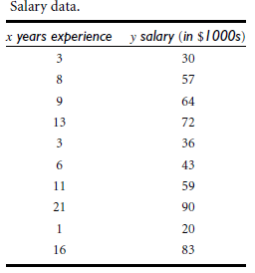
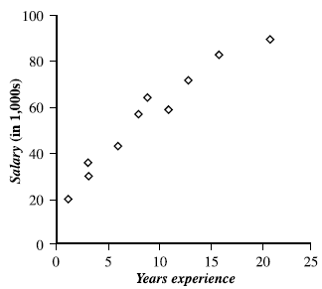
Prediction Methods
Linear Regression
Nonlinear Regression
Other Regression Methods
Source: Han & Kamber (2006)

Slide 135
Classification and Prediction
Classification and prediction are two forms of data analysis that can be used to extract models describing important data classes or to predict future data trends.
Classification
  Effective and scalable methods have been developed for decision trees induction, Naive Bayesian classification, Bayesian belief network, rule-based classifier, Backpropagation, Support Vector Machine (SVM), associative classification, nearest neighbor classifiers, and case-based reasoning, and other classification methods such as genetic algorithms, rough set and fuzzy set approaches.
Prediction
  Linear, nonlinear, and generalized linear models of regression can be used for prediction. Many nonlinear problems can be converted to linear problems by performing transformations on the predictor variables. Regression trees and model trees are also used for prediction.
Source: Han & Kamber (2006)

Slide 136
Classification—A Two-Step Process
Model construction: describing a set of predetermined classes
  Each tuple/sample is assumed to belong to a predefined class, as determined by the class label attribute
  The set of tuples used for model construction is training set
  The model is represented as classification rules, decision trees, or mathematical formulae
Model usage: for classifying future or unknown objects
  Estimate accuracy of the model
    The known label of test sample is compared with the classified result from the model
    Accuracy rate is the percentage of test set samples that are correctly classified by the model
    Test set is independent of training set, otherwise over-fitting will occur
  If the accuracy is acceptable, use the model to classify data tuples whose class labels are not known
Source: Han & Kamber (2006)

Slide 137
Supervised vs. Unsupervised Learning
Supervised learning (classification)
  Supervision: The training data (observations, measurements, etc.) are accompanied by labels indicating the class of the observations
  New data is classified based on the training set
Unsupervised learning (clustering)
  The class labels of training data is unknown
  Given a set of measurements, observations, etc. with the aim of establishing the existence of classes or clusters in the data
Source: Han & Kamber (2006)

Slide 138
Issues Regarding Classification and Prediction:
Data Preparation
Data cleaning
  Preprocess data in order to reduce noise and handle missing values
Relevance analysis (feature selection)
  Remove the irrelevant or redundant attributes
  Attribute subset selection
    Feature Selection in machine learning
Data transformation
  Generalize and/or normalize data
  Example
    Income: low, medium, high
Source: Han & Kamber (2006)

Slide 139
Issues:
Evaluating Classification and Prediction Methods
Accuracy
  classifier accuracy: predicting class label
  predictor accuracy: guessing value of predicted attributes
  estimation techniques: cross-validation and bootstrapping
Speed
  time to construct the model (training time)
  time to use the model (classification/prediction time)
Robustness
  handling noise and missing values
Scalability
  ability to construct the classifier or predictor efficiently given large amounts of data
Interpretability
  understanding and insight provided by the model
Source: Han & Kamber (2006)

Slide 140
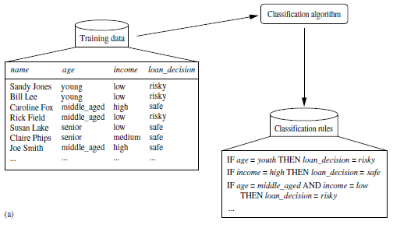
Data Classification Process 1: Learning (Training) Step
(a) Learning: Training data are analyzed by classification algorithm
y= f(X)
Source: Han & Kamber (2006)

Slide 141
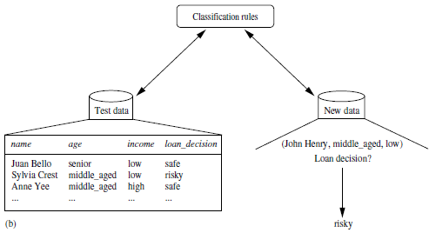
Data Classification Process 2
(b) Classification: Test data are used to estimate the accuracy of the classification rules.
Source: Han & Kamber (2006)

Slide 142
Process (1): Model Construction
Classification
Algorithms
Training
Data
Classifier
(Model)
IF rank = ‘professor’
OR years > 6
THEN tenured = ‘yes’
Source: Han & Kamber (2006)

Slide 143
Process (2): Using the Model in Prediction
Classifier
Testing
Data
Unseen Data
(Jeff, Professor, 4)
Tenured?
Source: Han & Kamber (2006)

Slide 144
Decision Trees

Slide 145
Decision Trees
A general algorithm for decision tree building
Employs the divide and conquer method
Recursively divides a training set until each division consists of examples from one class
  Create a root node and assign all of the training data to it
  Select the best splitting attribute
  Add a branch to the root node for each value of the split. Split the data into mutually exclusive subsets along the lines of the specific split
  Repeat the steps 2 and 3 for each and every leaf node until the stopping criteria is reached
Source: Turban et al. (2011), Decision Support and Business Intelligence Systems

Slide 146
Decision Trees
DT algorithms mainly differ on
  Splitting criteria
    Which variable to split first?
    What values to use to split?
    How many splits to form for each node?
  Stopping criteria
    When to stop building the tree
  Pruning (generalization method)
    Pre-pruning versus post-pruning
Most popular DT algorithms include
  ID3, C4.5, C5; CART; CHAID; M5
Source: Turban et al. (2011), Decision Support and Business Intelligence Systems

Slide 147
Decision Trees
Alternative splitting criteria
  Gini index determines the purity of a specific class as a result of a decision to branch along a particular attribute/value
    Used in CART
  Information gain uses entropy to measure the extent of uncertainty or randomness of a particular attribute/value split
    Used in ID3, C4.5, C5
  Chi-square statistics (used in CHAID)
Source: Turban et al. (2011), Decision Support and Business Intelligence Systems

Slide 148
Classification by Decision Tree Induction
Training Dataset
This follows an example of Quinlan’s ID3 (Playing Tennis)
Source: Han & Kamber (2006)

Slide 149
Output: A Decision Tree for “buys_computer”
Classification by Decision Tree Induction
age?
youth
<=30
middle_aged
31..40
senior
>40
student?
yes
credit rating?
no
yes
fair
excellent
no
yes
no
yes
buys_computer=“yes” or buys_computer=“no”
Source: Han & Kamber (2006)

Slide 150
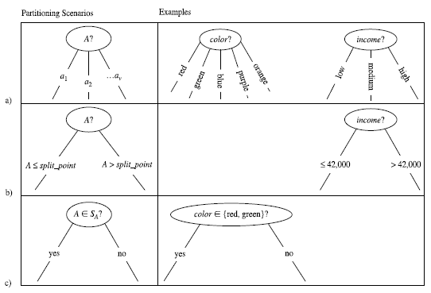
Three possibilities for partitioning tuples based on the splitting Criterion
Source: Han & Kamber (2006)

Slide 151
Algorithm for Decision Tree Induction
Basic algorithm (a greedy algorithm)
  Tree is constructed in a top-down recursive divide-and-conquer manner
  At start, all the training examples are at the root
  Attributes are categorical (if continuous-valued, they are discretized in advance)
  Examples are partitioned recursively based on selected attributes
  Test attributes are selected on the basis of a heuristic or statistical measure (e.g., information gain)
Conditions for stopping partitioning
  All samples for a given node belong to the same class
  There are no remaining attributes for further partitioning –
  majority voting is employed for classifying the leaf
  There are no samples left
Source: Han & Kamber (2006)

Slide 152
Attribute Selection Measure
Notation: Let D, the data partition, be a training set of class-labeled tuples.
Suppose the class label attribute has m distinct values defining m distinct classes, C_{i} (for i = 1, … , m).
Let C_{i,D} be the set of tuples of class C_{i} in D.
Let |D| and | C_{i,D} | denote the number of tuples in D and C_{i,D} , respectively.
Example:
  Class: buys_computer= “yes” or “no”
  Two distinct classes (m=2)
    Class C_{i} (i=1,2):
    C₁ = “yes”,
    C₂ = “no”
Source: Han & Kamber (2006)

Slide 153
Attribute Selection Measure:
Information Gain (ID3/C4.5)
Select the attribute with the highest information gain
Let p_{i} be the probability that an arbitrary tuple in D belongs to class C_{i}, estimated by |C_{i, D}|/|D|
Expected information (entropy) needed to classify a tuple in D:
Information needed (after using A to split D into v partitions) to classify D:
Information gained by branching on attribute A
Source: Han & Kamber (2006)
Notes:
I : the expected information needed to classify a given sample
E (entropy) : expected information based on the partitioning into subsets by A

Slide 154
Decision Tree
Information Gain

Slide 155
Customer database
ID | age | income | student | credit_rating | Class: buys_computer
1 | youth | high | no | fair | no
2 | middle_aged | high | no | fair | yes
3 | youth | high | no | excellent | no
4 | senior | medium | no | fair | yes
5 | senior | high | yes | fair | yes
6 | senior | low | yes | excellent | no
7 | middle_aged | low | yes | excellent | yes
8 | youth | medium | no | fair | no
9 | youth | low | yes | fair | yes
10 | senior | medium | yes | excellent | yes

Slide 156
Table 2 shows the class-labeled training tuples from customer database.
Please calculate and illustrate the final decision tree returned by decision tree induction using information gain.
(1) What is the Information Gain of “age”?
(2) What is the Information Gain of “income”?
(3) What is the Information Gain of “student”?
(4) What is the Information Gain of “credit_rating”?
(5) What is the class (buys_computer = “yes” or buys_computer = “no”) for a customer (age=youth, income=low, student =yes, credit= fair ) based on the classification result by decision three induction?
ID | age | income | student | credit_rating | Class: buys_computer
1 | youth | high | no | fair | no
2 | middle_aged | high | no | fair | yes
3 | youth | high | no | excellent | no
4 | senior | medium | no | fair | yes
5 | senior | high | yes | fair | yes
6 | senior | low | yes | excellent | no
7 | middle_aged | low | yes | excellent | yes
8 | youth | medium | no | fair | no
9 | youth | low | yes | fair | yes
10 | senior | medium | yes | excellent | yes

Slide 157
Attribute Selection Measure:
Information Gain (ID3/C4.5)
Select the attribute with the highest information gain
Let p_{i} be the probability that an arbitrary tuple in D belongs to class C_{i}, estimated by |C_{i, D}|/|D|
Expected information (entropy) needed to classify a tuple in D:
Information needed (after using A to split D into v partitions) to classify D:
Information gained by branching on attribute A
Source: Han & Kamber (2006)
Notes:
I : the expected information needed to classify a given sample
E (entropy) : expected information based on the partitioning into subsets by A

Slide 158
ID | age | income | student | credit_rating | Class: buys_computer
1 | youth | high | no | fair | no
2 | middle_aged | high | no | fair | yes
3 | youth | high | no | excellent | no
4 | senior | medium | no | fair | yes
5 | senior | high | yes | fair | yes
6 | senior | low | yes | excellent | no
7 | middle_aged | low | yes | excellent | yes
8 | youth | medium | no | fair | no
9 | youth | low | yes | fair | yes
10 | senior | medium | yes | excellent | yes
Class P (Positive): buys_computer = “yes”
Class N (Negative): buys_computer = “no”
P(buys = yes) = P_{i=1} = P₁ = 6/10 = 0.6
P(buys = no) = P_{i=2} = P₂ = 4/10 = 0.4
log₂ (0.1) = -3.3219
log₂ (0.2) = -2.3219
log₂ (0.3) = -1.7370
log₂ (0.4) = -1.3219
log₂ (0.5) = -1
log₂ (0.6) = -0.7370
log₂ (0.7) = -0.5146
log₂ (0.8) = -0.3219
log₂ (0.9) = -0.1520
log₂ (1) = 0
log₂ (1) = 0
log₂ (2) = 1
log₂ (3) = 1.5850
log₂ (4) = 2
log₂ (5) = 2.3219
log₂ (6) = 2.5850
log₂ (7) = 2.8074
log₂ (8) = 3
log₂ (9) = 3.1699
log₂ (10) = 3.3219
Step 1: Expected information
Info(D) = I(6,4) = 0.971

Slide 159
ID | age | income | student | credit_rating | Class: buys_computer
1 | youth | high | no | fair | no
2 | middle_aged | high | no | fair | yes
3 | youth | high | no | excellent | no
4 | senior | medium | no | fair | yes
5 | senior | high | yes | fair | yes
6 | senior | low | yes | excellent | no
7 | middle_aged | low | yes | excellent | yes
8 | youth | medium | no | fair | no
9 | youth | low | yes | fair | yes
10 | senior | medium | yes | excellent | yes
student | p_{i} | n_{i} | total
yes | 4 | 1 | 5
no | 2 | 3 | 5
age | p_{i} | n_{i} | total
youth | 1 | 3 | 4
middle_aged | 2 | 0 | 2
senior | 3 | 1 | 4
income | p_{i} | n_{i} | total
high | 2 | 2 | 4
midium | 2 | 1 | 3
low | 2 | 1 | 3
credit_ rating | p_{i} | n_{i} | total
excellent | 2 | 2 | 4
fair | 4 | 2 | 6

Slide 160
Step 2: Information
Step 3: Information Gain
age | p_{i} | n_{i} | total | I(p_{i}, n_{i}) | I(p_{i}, n_{i})
youth | 1 | 3 | 4 | I(1,3) | 0.8112
middle_aged | 2 | 0 | 2 | I(2,0) | 0
senior | 3 | 1 | 4 | I(3,1) | 0.8112
Info(D) = I(6,4) = 0.971
(1) Gain(age)= 0.3221

Slide 161
income | p_{i} | n_{i} | total | I(p_{i}, n_{i}) | I(p_{i}, n_{i})
high | 2 | 2 | 4 | I(2,2) | 1
midium | 2 | 1 | 3 | I(2,1) | 0.9182
low | 2 | 1 | 3 | I(2,1) | 0.9182
Info(D) = I(6,4) = 0.971
(2) Gain(income)= 0.02

Slide 162
student | p_{i} | n_{i} | total | I(p_{i}, n_{i}) | I(p_{i}, n_{i})
yes | 4 | 1 | 5 | I(4,1) | 0.7219
no | 2 | 3 | 5 | I(2,3) | 0.971
Info(D) = I(6,4) = 0.971
(3) Gain(student)= 0.1245

Slide 163
credit | p_{i} | n_{i} | total | I(p_{i}, n_{i}) | I(p_{i}, n_{i})
excellent | 2 | 2 | 4 | I(2,2) | 1
fair | 4 | 2 | 6 | I(4,2) | 0.9183
Info(D) = I(6,4) = 0.971
(4) Gain(credit)= 0.019

Slide 164
income | p_{i} | n_{i} | total
high | 2 | 2 | 4
midium | 2 | 1 | 3
low | 2 | 1 | 3
age | p_{i} | n_{i} | total
youth | 1 | 3 | 4
middle_aged | 2 | 0 | 2
senior | 3 | 1 | 4
student | p_{i} | n_{i} | total
yes | 4 | 1 | 5
no | 2 | 3 | 5
credit_ rating | p_{i} | n_{i} | total
excellent | 2 | 2 | 4
fair | 4 | 2 | 6
(5) What is the class (buys_computer = “yes” or buys_computer = “no”) for a customer (age=youth, income=low, student =yes, credit= fair ) based on the classification result by decision three induction?
(5) Yes =0.0889 (No=0.0167)
age (0.3221) > student (0.1245) > income (0.02) > credit (0.019)
buys_computer = “yes”
age:youth (1/4) x student:yes (4/5) x income:low (2/3) x credit:fair (4/6)
Yes: 1/4 x 4/5 x 2/3 x 4/6 = 4/45 = 0.0889
buys_computer = “no”
age:youth (3/4) x student:yes (1/5) x income:low (1/3) x credit:fair (2/6)
No: 3/4 x 1/5 x 1/3 x 2/6 = 0.01667

Slide 165
A Taxonomy for Data Mining Tasks
Source: Turban et al. (2011), Decision Support and Business Intelligence Systems

Slide 166
Cluster Analysis
Used for automatic identification of
natural groupings of things
Part of the machine-learning family
Employ unsupervised learning
Learns the clusters of things from past data, then assigns new instances
There is not an output variable
Also known as segmentation
Source: Turban et al. (2011), Decision Support and Business Intelligence Systems

Slide 167
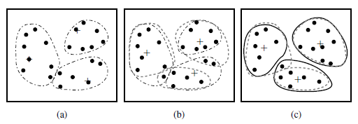
Cluster Analysis
Clustering of a set of objects based on the k-means method.
(The mean of each cluster is marked by a “+”.)
Source: Han & Kamber (2006)

Slide 168
Cluster Analysis
Clustering results may be used to
  Identify natural groupings of customers
  Identify rules for assigning new cases to classes for targeting/diagnostic purposes
  Provide characterization, definition, labeling of populations
  Decrease the size and complexity of problems
  for other data mining methods
  Identify outliers in a specific domain
  (e.g., rare-event detection)
Source: Turban et al. (2011), Decision Support and Business Intelligence Systems

Slide 169
Example of Cluster Analysis
Point | P | P(x,y)
p01 | a | (3, 4)
p02 | b | (3, 6)
p03 | c | (3, 8)
p04 | d | (4, 5)
p05 | e | (4, 7)
p06 | f | (5, 1)
p07 | g | (5, 5)
p08 | h | (7, 3)
p09 | i | (7, 5)
p10 | j | (8, 5)

Slide 170
Cluster Analysis for Data Mining
Analysis methods
  Statistical methods
  (including both hierarchical and nonhierarchical),
  such as k-means, k-modes, and so on
  Neural networks
  (adaptive resonance theory [ART],
  self-organizing map [SOM])
  Fuzzy logic (e.g., fuzzy c-means algorithm)
  Genetic algorithms
Divisive versus Agglomerative methods
Source: Turban et al. (2011), Decision Support and Business Intelligence Systems

Slide 171
Cluster Analysis for Data Mining
How many clusters?
  There is not a “truly optimal” way to calculate it
  Heuristics are often used
    Look at the sparseness of clusters
    Number of clusters = (n/2)^{1/2} (n: no of data points)
    Use Akaike information criterion (AIC)
    Use Bayesian information criterion (BIC)
Most cluster analysis methods involve the use of a distance measure to calculate the closeness between pairs of items
  Euclidian versus Manhattan (rectilinear) distance
Source: Turban et al. (2011), Decision Support and Business Intelligence Systems

Slide 172
k-Means Clustering Algorithm
k : pre-determined number of clusters
Algorithm (Step 0: determine value of k)
Step 1: Randomly generate k random points as initial cluster centers
Step 2: Assign each point to the nearest cluster center
Step 3: Re-compute the new cluster centers
Repetition step: Repeat steps 2 and 3 until some convergence criterion is met (usually that the assignment of points to clusters becomes stable)
Source: Turban et al. (2011), Decision Support and Business Intelligence Systems

Slide 173
Cluster Analysis for Data Mining - k-Means Clustering Algorithm
Source: Turban et al. (2011), Decision Support and Business Intelligence Systems

Slide 174
Similarity and Dissimilarity Between Objects
Distances are normally used to measure the similarity or dissimilarity between two data objects
Some popular ones include: Minkowski distance:
  where i = (x_{i1}, x_{i2}, …, x_{ip}) and j = (x_{j1}, x_{j2}, …, x_{jp}) are two p-dimensional data objects, and q is a positive integer
If q = 1, d is Manhattan distance
Source: Han & Kamber (2006)

Slide 175
Similarity and Dissimilarity Between Objects (Cont.)
If q = 2, d is Euclidean distance:
  Properties
    d(i,j) ≥ 0
    d(i,i) = 0
    d(i,j) = d(j,i)
    d(i,j) ≤ d(i,k) + d(k,j)
Also, one can use weighted distance, parametric Pearson product moment correlation, or other disimilarity measures
Source: Han & Kamber (2006)

Slide 176
Euclidean distance vs
Manhattan distance
Distance of two point x₁ = (1, 2) and x₂ (3, 5)
Euclidean distance:
= ((3-1)² + (5-2)² )^{1/2}
= (2² + 3²)^{1/2}
= (4 + 9)^{1/2}
= (13)^{1/2}
= 3.61
5
x₂ (3, 5)
4
3
3.61
3
2
2
x₁ = (1, 2)
1
Manhattan distance:
= (3-1) + (5-2)
= 2 + 3
= 5
1
2
3

Slide 177
The K-Means Clustering Method
Example
10
10
9
9
8
8
7
7
6
6
5
5
4
Assign each objects to most similar center
Update the cluster means
4
3
3
2
2
1
1
0
0
0
1
2
3
4
5
6
7
8
9
10
0
1
2
3
4
5
6
7
8
9
10
reassign
reassign
K=2
Arbitrarily choose K object as initial cluster center
Update the cluster means
Source: Han & Kamber (2006)

Slide 178
K-Means Clustering
Step by Step
Point | P | P(x,y)
p01 | a | (3, 4)
p02 | b | (3, 6)
p03 | c | (3, 8)
p04 | d | (4, 5)
p05 | e | (4, 7)
p06 | f | (5, 1)
p07 | g | (5, 5)
p08 | h | (7, 3)
p09 | i | (7, 5)
p10 | j | (8, 5)

Slide 179
K-Means Clustering
Step 1: K=2, Arbitrarily choose K object as initial cluster center
Point | P | P(x,y)
p01 | a | (3, 4)
p02 | b | (3, 6)
p03 | c | (3, 8)
p04 | d | (4, 5)
p05 | e | (4, 7)
p06 | f | (5, 1)
p07 | g | (5, 5)
p08 | h | (7, 3)
p09 | i | (7, 5)
p10 | j | (8, 5)
Initial | m1 | (3, 4)
Initial | m2 | (8, 5)
M₂ = (8, 5)
m₁ = (3, 4)

Slide 180
Step 2: Compute seed points as the centroids of the clusters of the current partition
Step 3: Assign each objects to most similar center
Point | P | P(x,y) | m1 distance | m2 distance | Cluster
p01 | a | (3, 4) | 0.00 | 5.10 | Cluster1
p02 | b | (3, 6) | 2.00 | 5.10 | Cluster1
p03 | c | (3, 8) | 4.00 | 5.83 | Cluster1
p04 | d | (4, 5) | 1.41 | 4.00 | Cluster1
p05 | e | (4, 7) | 3.16 | 4.47 | Cluster1
p06 | f | (5, 1) | 3.61 | 5.00 | Cluster1
p07 | g | (5, 5) | 2.24 | 3.00 | Cluster1
p08 | h | (7, 3) | 4.12 | 2.24 | Cluster2
p09 | i | (7, 5) | 4.12 | 1.00 | Cluster2
p10 | j | (8, 5) | 5.10 | 0.00 | Cluster2
Initial | m1 | (3, 4)
Initial | m2 | (8, 5)
M₂ = (8, 5)
m₁ = (3, 4)
K-Means Clustering

Slide 181
Step 2: Compute seed points as the centroids of the clusters of the current partition
Step 3: Assign each objects to most similar center
Point | P | P(x,y) | m1 distance | m2 distance | Cluster
p01 | a | (3, 4) | 0.00 | 5.10 | Cluster1
p02 | b | (3, 6) | 2.00 | 5.10 | Cluster1
p03 | c | (3, 8) | 4.00 | 5.83 | Cluster1
p04 | d | (4, 5) | 1.41 | 4.00 | Cluster1
p05 | e | (4, 7) | 3.16 | 4.47 | Cluster1
p06 | f | (5, 1) | 3.61 | 5.00 | Cluster1
p07 | g | (5, 5) | 2.24 | 3.00 | Cluster1
p08 | h | (7, 3) | 4.12 | 2.24 | Cluster2
p09 | i | (7, 5) | 4.12 | 1.00 | Cluster2
p10 | j | (8, 5) | 5.10 | 0.00 | Cluster2
Initial | m1 | (3, 4)
Initial | m2 | (8, 5)
M₂ = (8, 5)
Euclidean distance b(3,6) ←→m2(8,5)
= ((8-3)² + (5-6)² )^{1/2}
= (5² + (-1)²)^{1/2}
= (25 + 1)^{1/2}
= (26)^{1/2}
= 5.10
m₁ = (3, 4)
Euclidean distance b(3,6) ←→m1(3,4)
= ((3-3)² + (4-6)² )^{1/2}
= (0² + (-2)²)^{1/2}
= (0 + 4)^{1/2}
= (4)^{1/2}
= 2.00
K-Means Clustering

Slide 182
Step 4: Update the cluster means,
Repeat Step 2, 3,
stop when no more new assignment
Point | P | P(x,y) | m1 distance | m2 distance | Cluster
p01 | a | (3, 4) | 1.43 | 4.34 | Cluster1
p02 | b | (3, 6) | 1.22 | 4.64 | Cluster1
p03 | c | (3, 8) | 2.99 | 5.68 | Cluster1
p04 | d | (4, 5) | 0.20 | 3.40 | Cluster1
p05 | e | (4, 7) | 1.87 | 4.27 | Cluster1
p06 | f | (5, 1) | 4.29 | 4.06 | Cluster2
p07 | g | (5, 5) | 1.15 | 2.42 | Cluster1
p08 | h | (7, 3) | 3.80 | 1.37 | Cluster2
p09 | i | (7, 5) | 3.14 | 0.75 | Cluster2
p10 | j | (8, 5) | 4.14 | 0.95 | Cluster2
 | m1 | (3.86, 5.14)
 | m2 | (7.33, 4.33)
m₁ = (3.86, 5.14)
M₂ = (7.33, 4.33)
K-Means Clustering

Slide 183
Step 4: Update the cluster means,
Repeat Step 2, 3,
stop when no more new assignment
Point | P | P(x,y) | m1 distance | m2 distance | Cluster
p01 | a | (3, 4) | 1.95 | 3.78 | Cluster1
p02 | b | (3, 6) | 0.69 | 4.51 | Cluster1
p03 | c | (3, 8) | 2.27 | 5.86 | Cluster1
p04 | d | (4, 5) | 0.89 | 3.13 | Cluster1
p05 | e | (4, 7) | 1.22 | 4.45 | Cluster1
p06 | f | (5, 1) | 5.01 | 3.05 | Cluster2
p07 | g | (5, 5) | 1.57 | 2.30 | Cluster1
p08 | h | (7, 3) | 4.37 | 0.56 | Cluster2
p09 | i | (7, 5) | 3.43 | 1.52 | Cluster2
p10 | j | (8, 5) | 4.41 | 1.95 | Cluster2
 | m1 | (3.67, 5.83)
 | m2 | (6.75, 3.50)
m₁ = (3.67, 5.83)
M₂ = (6.75., 3.50)
K-Means Clustering

Slide 184
stop when no more new assignment
Point | P | P(x,y) | m1 distance | m2 distance | Cluster
p01 | a | (3, 4) | 1.95 | 3.78 | Cluster1
p02 | b | (3, 6) | 0.69 | 4.51 | Cluster1
p03 | c | (3, 8) | 2.27 | 5.86 | Cluster1
p04 | d | (4, 5) | 0.89 | 3.13 | Cluster1
p05 | e | (4, 7) | 1.22 | 4.45 | Cluster1
p06 | f | (5, 1) | 5.01 | 3.05 | Cluster2
p07 | g | (5, 5) | 1.57 | 2.30 | Cluster1
p08 | h | (7, 3) | 4.37 | 0.56 | Cluster2
p09 | i | (7, 5) | 3.43 | 1.52 | Cluster2
p10 | j | (8, 5) | 4.41 | 1.95 | Cluster2
 | m1 | (3.67, 5.83)
 | m2 | (6.75, 3.50)
K-Means Clustering

Slide 185
K-Means Clustering (K=2, two clusters)
stop when no more new assignment
Point | P | P(x,y) | m1 distance | m2 distance | Cluster
p01 | a | (3, 4) | 1.95 | 3.78 | Cluster1
p02 | b | (3, 6) | 0.69 | 4.51 | Cluster1
p03 | c | (3, 8) | 2.27 | 5.86 | Cluster1
p04 | d | (4, 5) | 0.89 | 3.13 | Cluster1
p05 | e | (4, 7) | 1.22 | 4.45 | Cluster1
p06 | f | (5, 1) | 5.01 | 3.05 | Cluster2
p07 | g | (5, 5) | 1.57 | 2.30 | Cluster1
p08 | h | (7, 3) | 4.37 | 0.56 | Cluster2
p09 | i | (7, 5) | 3.43 | 1.52 | Cluster2
p10 | j | (8, 5) | 4.41 | 1.95 | Cluster2
 | m1 | (3.67, 5.83)
 | m2 | (6.75, 3.50)
K-Means Clustering

Slide 186
Data Mining Evaluation

Slide 187
Evaluation
(Accuracy of Classification Model)

Slide 188
Assessment Methods for Classification
Predictive accuracy
  Hit rate
Speed
  Model building; predicting
Robustness
Scalability
Interpretability
  Transparency, explainability
Source: Turban et al. (2011), Decision Support and Business Intelligence Systems

Slide 189
Accuracy
Precision
Validity
Reliability

Slide 191
Accuracy vs. Precision
A
B
High Accuracy
High Precision
Low Accuracy
High Precision
C
D
High Accuracy
Low Precision
Low Accuracy
Low Precision

Slide 192
Accuracy vs. Precision
A
B
High Accuracy
High Precision
Low Accuracy
High Precision
High Validity
High Reliability
Low Validity
High Reliability
C
D
High Accuracy
Low Precision
Low Accuracy
Low Precision
High Validity
Low Reliability
Low Validity
Low Reliability

Slide 193
Accuracy vs. Precision
A
B
High Accuracy
High Precision
Low Accuracy
High Precision
High Validity
High Reliability
Low Validity
High Reliability
C
D
High Accuracy
Low Precision
Low Accuracy
Low Precision
High Validity
Low Reliability
Low Validity
Low Reliability

Slide 194
Accuracy of Classification Models
In classification problems, the primary source for accuracy estimation is the confusion matrix
Source: Turban et al. (2011), Decision Support and Business Intelligence Systems

Slide 195
Estimation Methodologies for Classification
Simple split (or holdout or test sample estimation)
  Split the data into 2 mutually exclusive sets
  training (~70%) and testing (30%)
  For ANN, the data is split into three sub-sets
  (training [~60%], validation [~20%], testing [~20%])
Source: Turban et al. (2011), Decision Support and Business Intelligence Systems

Slide 196
Estimation Methodologies for Classification
k-Fold Cross Validation (rotation estimation)
  Split the data into k mutually exclusive subsets
  Use each subset as testing while using the rest of the subsets as training
  Repeat the experimentation for k times
  Aggregate the test results for true estimation of prediction accuracy training
Other estimation methodologies
  Leave-one-out, bootstrapping, jackknifing
  Area under the ROC curve
Source: Turban et al. (2011), Decision Support and Business Intelligence Systems

Slide 197
Estimation Methodologies for Classification – ROC Curve
Source: Turban et al. (2011), Decision Support and Business Intelligence Systems

Slide 198
Sensitivity
Specificity
=True Positive Rate
=True Negative Rate

Slide 199
True Class
(actual value)
Positive
Negative
total
True
Positive
(TP)
False
Positive
(FP)
Positive
P’
Predictive Class
(prediction outcome)
False
Negative
(FN)
True
Negative
(TN)
Negative
N’
total
P
N
Source: http://en.wikipedia.org/wiki/Receiver_operating_characteristic

Slide 200
True Class
(actual value)
Positive
Negative
total
True
Positive
(TP)
False
Positive
(FP)
Positive
P’
Predictive Class
(prediction outcome)
False
Negative
(FN)
True
Negative
(TN)
Negative
N’
total
P
N
Sensitivity
= True Positive Rate
= Recall
= Hit rate
= TP / (TP + FN)
Source: http://en.wikipedia.org/wiki/Receiver_operating_characteristic

Slide 201
True Class
(actual value)
Positive
Negative
total
True
Positive
(TP)
False
Positive
(FP)
Positive
P’
Predictive Class
(prediction outcome)
False
Negative
(FN)
True
Negative
(TN)
Negative
N’
total
P
N
Specificity
= True Negative Rate
= TN / N
= TN / (TN+ FP)
Source: http://en.wikipedia.org/wiki/Receiver_operating_characteristic

Slide 202
True Class
(actual value)
Precision
= Positive Predictive Value (PPV)
Positive
Negative
total
True
Positive
(TP)
False
Positive
(FP)
Positive
P’
Recall
= True Positive Rate (TPR)
= Sensitivity
= Hit Rate
Predictive Class
(prediction outcome)
False
Negative
(FN)
True
Negative
(TN)
Negative
N’
total
P
N
F1 score (F-score)(F-measure)
is the harmonic mean of precision and recall
= 2TP / (P + P’)
= 2TP / (2TP + FP + FN)
Source: http://en.wikipedia.org/wiki/Receiver_operating_characteristic

Slide 203
A
63
(TP)
28
(FP)
Recall
= True Positive Rate (TPR)
= Sensitivity
= Hit Rate
= TP / (TP + FN)
Specificity
= True Negative Rate
= TN / N
= TN / (TN + FP)
91
37
(FN)
72
(TN)
109
100
100
200
TPR = 0.63
FPR = 0.28
PPV = 0.69
=63/(63+28)
=63/91
Precision
= Positive Predictive Value (PPV)
F1 = 0.66
= 2*(0.63*0.69)/(0.63+0.69)
= (2 * 63) /(100 + 91)
= (0.63 + 0.69) / 2 =1.32 / 2 =0.66
F1 score (F-score)
(F-measure)
is the harmonic mean of precision and recall
= 2TP / (P + P’)
= 2TP / (2TP + FP + FN)
ACC = 0.68
= (63 + 72) / 200
= 135/200 = 67.5
Source: http://en.wikipedia.org/wiki/Receiver_operating_characteristic

Slide 204
A
B
63
(TP)
28
(FP)
77
(TP)
77
(FP)
91
154
37
(FN)
72
(TN)
109
23
(FN)
23
(TN)
46
100
100
200
100
100
200
TPR = 0.63
TPR = 0.77
FPR = 0.77
PPV = 0.50
F1 = 0.61
ACC = 0.50
FPR = 0.28
PPV = 0.69
=63/(63+28)
=63/91
F1 = 0.66
= 2*(0.63*0.69)/(0.63+0.69)
= (2 * 63) /(100 + 91)
= (0.63 + 0.69) / 2 =1.32 / 2 =0.66
Recall
= True Positive Rate (TPR)
= Sensitivity
= Hit Rate
ACC = 0.68
= (63 + 72) / 200
= 135/200 = 67.5
Precision
= Positive Predictive Value (PPV)
Source: http://en.wikipedia.org/wiki/Receiver_operating_characteristic

Slide 205
C
C’
24
(TP)
88
(FP)
76
(TP)
12
(FP)
112
88
76
(FN)
12
(TN)
88
24
(FN)
88
(TN)
112
100
100
200
100
100
200
TPR = 0.24
FPR = 0.88
PPV = 0.21
F1 = 0.22
ACC = 0.18
TPR = 0.76
FPR = 0.12
PPV = 0.86
F1 = 0.81
ACC = 0.82
Recall
= True Positive Rate (TPR)
= Sensitivity
= Hit Rate
Precision
= Positive Predictive Value (PPV)
Source: http://en.wikipedia.org/wiki/Receiver_operating_characteristic

Slide 206
Social Network Analysis

Slide 207
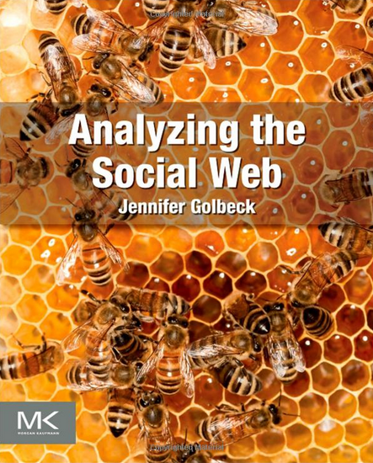
Jennifer Golbeck (2013), Analyzing the Social Web, Morgan Kaufmann
Source: http://www.amazon.com/Analyzing-Social-Web-Jennifer-Golbeck/dp/0124055311

Slide 208
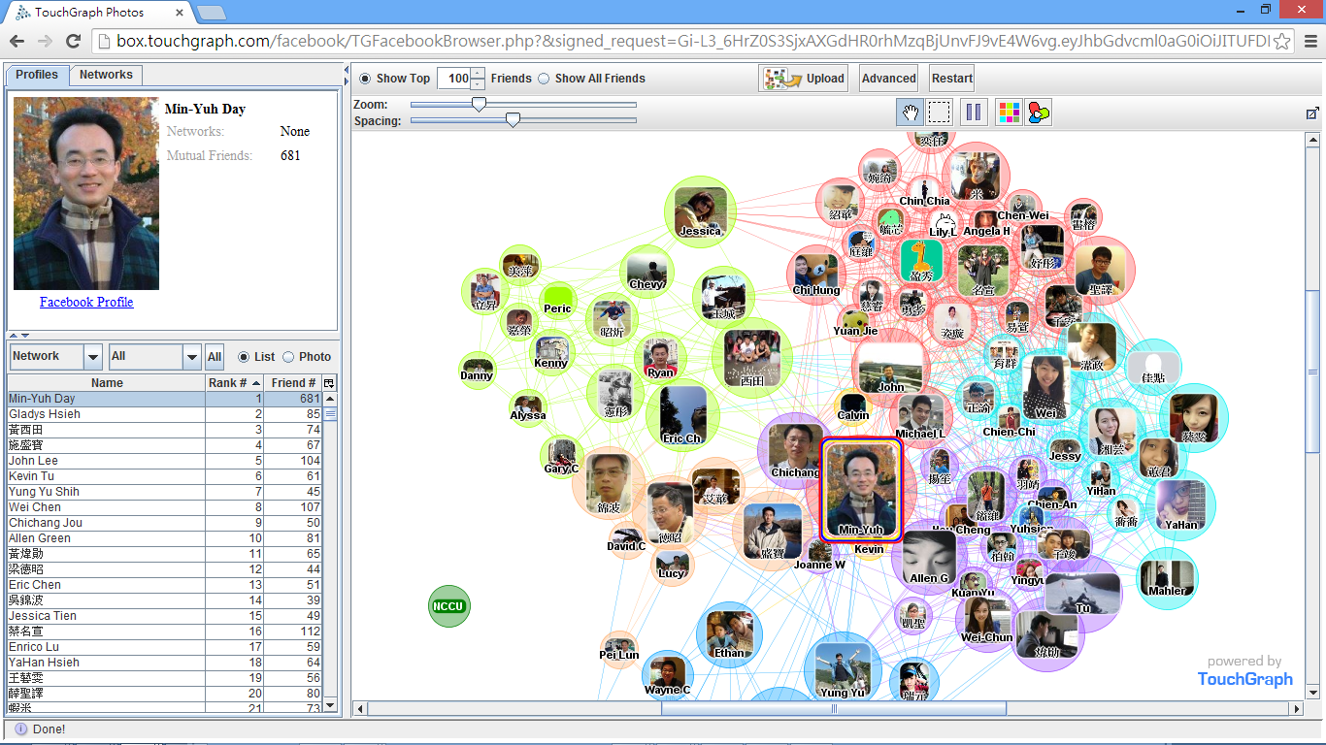
Social Network Analysis (SNA)
Facebook TouchGraph

Slide 209
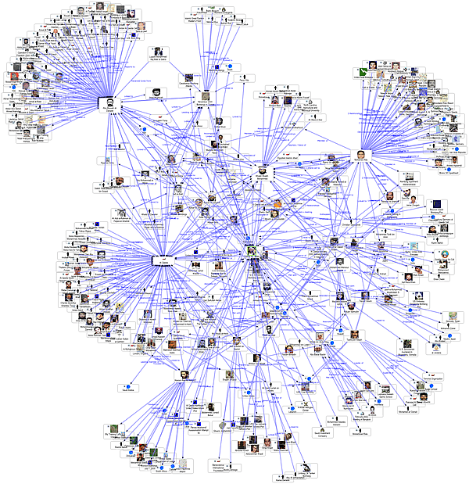
Social Network Analysis
Source: http://www.fmsasg.com/SocialNetworkAnalysis/

Slide 210
Social Network Analysis
A social network is a social structure of people, related (directly or indirectly) to each other through a common relation or interest
Social network analysis (SNA) is the study of social networks to understand their structure and behavior

Slide 211
Social Network Analysis
Using Social Network Analysis, you can get answers to questions like:
  How highly connected is an entity within a network?
  What is an entity's overall importance in a network?
  How central is an entity within a network?
  How does information flow within a network?
Source: http://www.fmsasg.com/SocialNetworkAnalysis/

Slide 212
Social Network Analysis
Social network is the study of social entities (people in an organization, called actors), and their interactions and relationships.
The interactions and relationships can be represented with a network or graph,
  each vertex (or node) represents an actor and
  each link represents a relationship.
From the network, we can study the properties of its structure, and the role, position and prestige of each social actor.
We can also find various kinds of sub-graphs, e.g., communities formed by groups of actors.
Source: Bing Liu (2011) , “Web Data Mining: Exploring Hyperlinks, Contents, and Usage Data”

Slide 213
Social Network and the Web
Social network analysis is useful for the Web because the Web is essentially a virtual society, and thus a virtual social network,
  Each page: a social actor and
  each hyperlink: a relationship.
Many results from social network can be adapted and extended for use in the Web context.
Two types of social network analysis,
  Centrality
  Prestige
  closely related to hyperlink analysis and search on the Web
Source: Bing Liu (2011) , “Web Data Mining: Exploring Hyperlinks, Contents, and Usage Data”

Slide 214
Centrality
Prestige
Social Network Analysis (SNA)

Slide 215
Degree
C
A
D
B
E
Source: https://www.youtube.com/watch?v=89mxOdwPfxA

Slide 216
Degree
C
A: 2
B: 4
C: 2
D:1
E: 1
A
D
B
E
Source: https://www.youtube.com/watch?v=89mxOdwPfxA

Slide 217
Density
C
A
D
B
E
Source: https://www.youtube.com/watch?v=89mxOdwPfxA

Slide 218
Density
Edges (Links): 5
Total Possible Edges: 10
Density: 5/10 = 0.5
C
A
D
B
E
Source: https://www.youtube.com/watch?v=89mxOdwPfxA

Slide 219
Density
A
E
I
C
G
H
B
J
D
F
Nodes (n): 10
Edges (Links): 13
Total Possible Edges: (n * (n-1)) / 2 = (10 * 9) / 2 = 45
Density: 13/45 = 0.29

Slide 220
Which Node is Most Important?
A
E
I
C
G
H
B
J
D
F

Slide 221
Centrality
Important or prominent actors are those that are linked or involved with other actors extensively.
A person with extensive contacts (links) or communications with many other people in the organization is considered more important than a person with relatively fewer contacts.
The links can also be called ties.
A central actor is one involved in many ties.
Source: Bing Liu (2011) , “Web Data Mining: Exploring Hyperlinks, Contents, and Usage Data”

Slide 222
Social Network Analysis (SNA)
Degree Centrality
Betweenness Centrality
Closeness Centrality

Slide 223
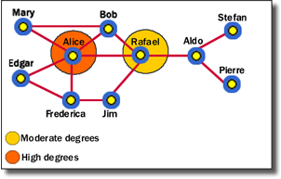
Social Network Analysis:
Degree Centrality
Alice has the highest degree centrality, which means that she is quite active in the network. However, she is not necessarily the most powerful person because she is only directly connected within one degree to people in her clique—she has to go through Rafael to get to other cliques.
Source: http://www.fmsasg.com/SocialNetworkAnalysis/

Slide 224
Social Network Analysis:
Degree Centrality
Degree centrality is simply the number of direct relationships that an entity has.
An entity with high degree centrality:
  Is generally an active player in the network.
  Is often a connector or hub in the network.
  s not necessarily the most connected entity in the network (an entity may have a large number of relationships, the majority of which point to low-level entities).
  May be in an advantaged position in the network.
  May have alternative avenues to satisfy organizational needs, and consequently may be less dependent on other individuals.
  Can often be identified as third parties or deal makers.
Source: http://www.fmsasg.com/SocialNetworkAnalysis/

Slide 225
Social Network Analysis:
Degree Centrality
A
E
I
C
G
H
B
J
D
F

Slide 226
Social Network Analysis:
Degree Centrality
Node | Score | Standardized Score
A | 2 | 2/10 = 0.2
B | 2 | 2/10 = 0.2
C | 5 | 5/10 = 0.5
D | 3 | 3/10 = 0.3
E | 3 | 3/10 = 0.3
F | 2 | 2/10 = 0.2
G | 4 | 4/10 = 0.4
H | 3 | 3/10 = 0.3
I | 1 | 1/10 = 0.1
J | 1 | 1/10 = 0.1
A
E
I
C
G
H
B
J
D
F

Slide 227
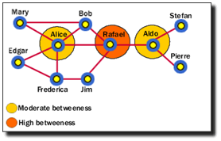
Social Network Analysis:
Betweenness Centrality
Rafael has the highest betweenness because he is between Alice and Aldo, who are between other entities. Alice and Aldo have a slightly lower betweenness because they are essentially only between their own cliques. Therefore, although Alice has a higher degree centrality, Rafael has more importance in the network in certain respects.
Source: http://www.fmsasg.com/SocialNetworkAnalysis/

Slide 228
Social Network Analysis:
Betweenness Centrality
Betweenness centrality identifies an entity's position within a network in terms of its ability to make connections to other pairs or groups in a network.
An entity with a high betweenness centrality generally:
  Holds a favored or powerful position in the network.
  Represents a single point of failure—take the single betweenness spanner out of a network and you sever ties between cliques.
  Has a greater amount of influence over what happens in a network.
Source: http://www.fmsasg.com/SocialNetworkAnalysis/

Slide 229
Betweenness centrality:
Connectivity
Number of shortest paths
going through the actor

Slide 230
Betweenness Centrality
Where g_{jk} = the number of shortest paths connecting jk
g_{jk}(i) = the number that actor i is on.
Normalized Betweenness Centrality
Number of pairs of vertices
excluding the vertex itself
Source: https://www.youtube.com/watch?v=RXohUeNCJiU

Slide 231
Betweenness Centrality
C
A:
B→C: 0/1 = 0
B→D: 0/1 = 0
B→E: 0/1 = 0
C→D: 0/1 = 0
C→E: 0/1 = 0
D→E: 0/1 = 0
Total: 0
A
D
B
E
A: Betweenness Centrality = 0

Slide 232
Betweenness Centrality
C
B:
A→C: 0/1 = 0
A→D: 1/1 = 1
A→E: 1/1 = 1
C→D: 1/1 = 1
C→E: 1/1 = 1
D→E: 1/1 = 1
Total: 5
A
D
B
E
B: Betweenness Centrality = 5

Slide 233
Betweenness Centrality
C
C:
A→B: 0/1 = 0
A→D: 0/1 = 0
A→E: 0/1 = 0
B→D: 0/1 = 0
B→E: 0/1 = 0
D→E: 0/1 = 0
Total: 0
A
D
B
E
C: Betweenness Centrality = 0

Slide 234
Betweenness Centrality
C
A: 0
B: 5
C: 0
D: 0
E: 0
A
D
B
E

Slide 235
Which Node is Most Important?
F
G
H
B
E
A
C
I
D
J
F
H
B
E
A
C
D
J

Slide 236
Which Node is Most Important?
F
G
H
B
E
A
C
I
D
J
F
G
H
E
A
I
D
J

Slide 237
Betweenness Centrality
B
E
A
C
D

Slide 238
Betweenness Centrality
C
A:
B→C: 0/1 = 0
B→D: 0/1 = 0
B→E: 0/1 = 0
C→D: 0/1 = 0
C→E: 0/1 = 0
D→E: 0/1 = 0
Total: 0
A
D
B
E
A: Betweenness Centrality = 0

Slide 239
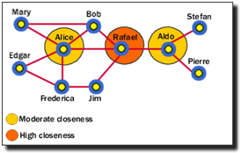
Social Network Analysis:
Closeness Centrality
Rafael has the highest closeness centrality because he can reach more entities through shorter paths. As such, Rafael's placement allows him to connect to entities in his own clique, and to entities that span cliques.
Source: http://www.fmsasg.com/SocialNetworkAnalysis/

Slide 240
Social Network Analysis:
Closeness Centrality
Closeness centrality measures how quickly an entity can access more entities in a network.
An entity with a high closeness centrality generally:
  Has quick access to other entities in a network.
  Has a short path to other entities.
  Is close to other entities.
  Has high visibility as to what is happening in the network.
Source: http://www.fmsasg.com/SocialNetworkAnalysis/

Slide 241
Social Network Analysis:
Closeness Centrality
C→A: 1
C→B: 1
C→D: 1
C→E: 1
C→F: 2
C→G: 1
C→H: 2
C→I: 3
C→J: 3
Total=15
A
E
I
C
G
H
B
J
D
F
C: Closeness Centrality = 15/9 = 1.67

Slide 242
Social Network Analysis:
Closeness Centrality
G→A: 2
G→B: 2
G→C: 1
G→D: 2
G→E: 1
G→F: 1
G→H: 1
G→I: 2
G→J: 2
Total=14
A
E
I
C
G
H
B
J
D
F
G: Closeness Centrality = 14/9 = 1.56

Slide 243
Social Network Analysis:
Closeness Centrality
H→A: 3
H→B: 3
H→C: 2
H→D: 2
H→E: 2
H→F: 2
H→G: 1
H→I: 1
H→J: 1
Total=17
A
E
I
C
G
H
B
J
D
F
H: Closeness Centrality = 17/9 = 1.89

Slide 244
Social Network Analysis:
Closeness Centrality
A
E
I
C
G
H
B
J
D
F
G: Closeness Centrality = 14/9 = 1.56
1
C: Closeness Centrality = 15/9 = 1.67
2
H: Closeness Centrality = 17/9 = 1.89
3

Slide 245
Social Network Analysis:
Closeness Centrality
Sum of the reciprocal distances
where d(p_{j}, p_{k}) is the geodesic distance (shortest paths) linking p_{j}, p_{k}

Slide 246
Social Network Analysis:
Betweenness Centrality
where g_{ij} is the geodesic distance (shortest paths) linking p_{i} and p_{j}
and g_{ij} (p_{k} ) is the geodesic distance linking p_{i} and p_{j} that contains p_{k}.
Source: Abbasi, A., Hossain, L., & Leydesdorff, L. (2012). Betweenness centrality as a driver of preferential attachment in the evolution of research collaboration networks. Journal of Informetrics, 6(3), 403-412.

Slide 247
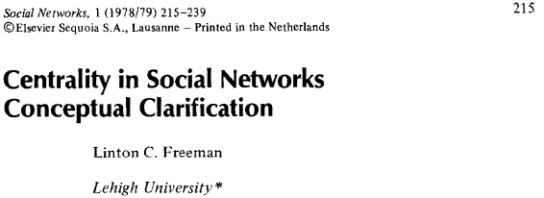
Social Network Analysis:
Degree Centrality
where a(p_{i}, p_{k}) = 1 if and only if p_{i} and p_{k} are connected by a line
0 otherwise

Slide 248
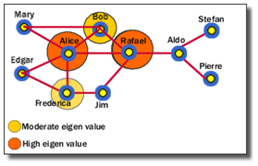
Social Network Analysis:
Eigenvalue
Alice and Rafael are closer to other highly close entities in the network. Bob and Frederica are also highly close, but to a lesser value.
Source: http://www.fmsasg.com/SocialNetworkAnalysis/

Slide 249
Social Network Analysis:
Eigenvalue
Eigenvalue measures how close an entity is to other highly close entities within a network. In other words, Eigenvalue identifies the most central entities in terms of the global or overall makeup of the network.
A high Eigenvalue generally:
  Indicates an actor that is more central to the main pattern of distances among all entities.
  Is a reasonable measure of one aspect of centrality in terms of positional advantage.
Source: http://www.fmsasg.com/SocialNetworkAnalysis/

Slide 250
Eigenvector centrality:
Importance of a node
depends on
the importance of its neighbors

Slide 251
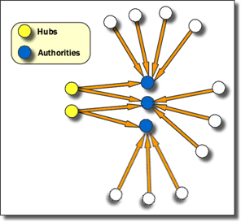
Social Network Analysis:
Hub and Authority
Hubs are entities that point to a relatively large number of authorities. They are essentially the mutually reinforcing analogues to authorities. Authorities point to high hubs. Hubs point to high authorities. You cannot have one without the other.
Source: http://www.fmsasg.com/SocialNetworkAnalysis/

Slide 252
Social Network Analysis:
Hub and Authority
Entities that many other entities point to are called Authorities. In Sentinel Visualizer, relationships are directional—they point from one entity to another.
If an entity has a high number of relationships pointing to it, it has a high authority value, and generally:
  Is a knowledge or organizational authority within a domain.
  Acts as definitive source of information.
Source: http://www.fmsasg.com/SocialNetworkAnalysis/

Slide 253
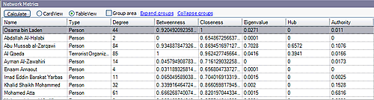
Social Network Analysis
Source: http://www.fmsasg.com/SocialNetworkAnalysis/

Slide 254
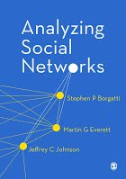

Social Network Analysis (SNA) Tools
UCINet
Pajek

Slide 255
Summary
Data Mining and Big Data Analytics
Data Mining Process
Tasks of Data Mining
Evaluation of Data Mining
Social Network Analysis
Source: Han & Kamber (2006)

Slide 256
References
Jiawei Han and Micheline Kamber (2011),
Data Mining: Concepts and Techniques, Third Edition, Elsevier
Jennifer Golbeck (2013),
Analyzing the Social Web, Morgan Kaufmann
Stephan Kudyba (2014),
Big Data, Mining, and Analytics: Components of Strategic Decision Making, Auerbach Publications
Hiroshi Ishikawa (2015),
Social Big Data Mining, CRC Press

