Slide 1








Artificial Intelligence for Fintech,
Green Finance, and ESG
Time: 2022/12/12 (Mon) 14:00-16:00
Place: Room 106, New Building, Institute of Information Science, Academia Sinica
Host: Prof. Yu Tsao, TIGP (SNHCC), Academia Sinica
Min-Yuh Day, Ph.D,
Associate Professor
Institute of Information Management, National Taipei University
https://web.ntpu.edu.tw/~myday
2022-12-12

Slide 2









Min-Yuh Day, Ph.D.
1
Associate Professor, Information Management, NTPU
Visiting Scholar, IIS, Academia Sinica
Ph.D., Information Management, NTU
Director, Intelligent Financial Innovation Technology, IFIT Lab, IM, NTPU
Director, Fintech and Green Finance Center, NTPU
Publications Co-Chairs, IEEE/ACM International Conference on
Advances in Social Networks Analysis and Mining (ASONAM 2013- )
Program Co-Chair, IEEE International Workshop on
Empirical Methods for Recognizing Inference in TExt (IEEE EM-RITE 2012- )
Publications Chair, The IEEE International Conference on
Information Reuse and Integration for Data Science (IEEE IRI 2007- )

Slide 3
Outline
AI in FinTech
  Metaverse, Web3, DeFi, NFT
  Financial Services Innovation and Applications
  Technology-driven Financial Industry Development
Green Finance and ESG
  SDGs: Sustainable Development Goals
  ESG: Environmental, Social, and Governance
  CSR: Corporate Social Responsibility
AI for Social Good (AI4SG)

Slide 4
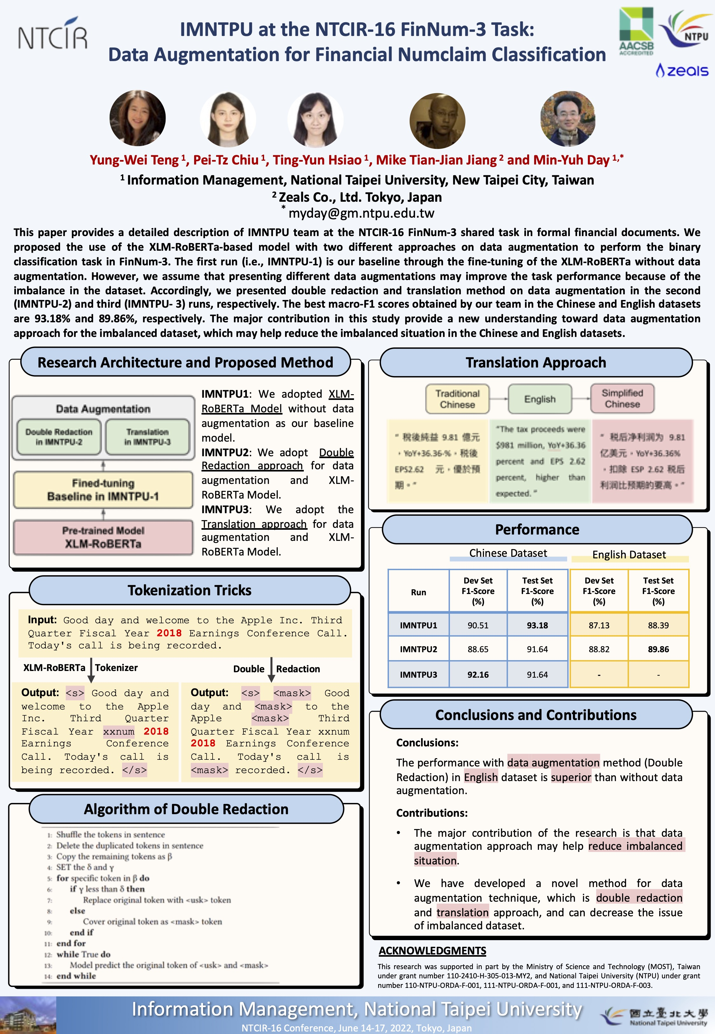

2022
NTCIR-16
Best Oral Presentation Award
Best Poster Presentation Award

Slide 5





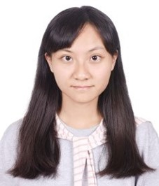

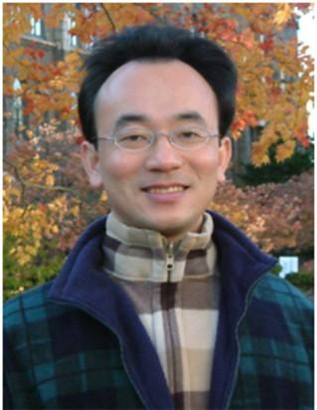
2022
IMNTPU at the NTCIR-16 FinNum-3 Task:
Data Augmentation for Financial Numclaim Classification
¹ Information Management, National Taipei University, New Taipei City, Taiwan
² Zeals Co., Ltd. Tokyo, Japan
Yung-Wei Teng ¹
Pei-Tz Chiu ¹
Ting-Yun Hsiao ¹
Mike Tian-Jian Jiang ²
Min-Yuh Day ^{1,*}
myday@gm.ntpu.edu.tw

Slide 6
2022
IMNTPU Dialogue System Evaluation
at the NTCIR-16 DialEval-2
Dialogue Quality and Nugget Detection
¹ Information Management, National Taipei University, New Taipei City, Taiwan
² Zeals Co., Ltd. Tokyo, Japan
Ting-Yun Hsiao ¹
Yung-Wei Teng ¹
Pei-Tz Chiu ¹
Mike Tian-Jian Jiang ²
Min-Yuh Day ^{1,*}
myday@gm.ntpu.edu.tw

Slide 7
AI for
Social Good
(AI4SG)
Source: Nenad Tomašev, Julien Cornebise, Frank Hutter, Shakir Mohamed, Angela Picciariello, Bec Connelly, Danielle Belgrave et al. (2020)
"AI for social good: unlocking the opportunity for positive impact." Nature Communications 11, no. 1: 1-6.

Slide 8
AI in FinTech:
Metaverse,
Web3, DeFi, NFT,
Financial Services
Innovation and Applications

Slide 9
AI in
FinTech

Slide 10
FinTech ABCD
AI
Block Chain
Cloud Computing
Big Data

Slide 11
Decentralized Finance (DeFi)
Block Chain Financial Technology
Block Chain & Bitcoin
(BTC)
Smart Contract & Ethereum
(ETH)
Decentralized Application
(DApp)

Slide 12
Artificial Intelligence
(AI)

Slide 13
AI, Big Data, Cloud Computing
Evolution of Decision Support, Business Intelligence, and Analytics
AI
AI
Cloud Computing
Big Data
DM
BI
Source: Ramesh Sharda, Dursun Delen, and Efraim Turban (2017),
Business Intelligence, Analytics, and Data Science: A Managerial Perspective, 4th Edition, Pearson

Slide 14
AI, ML, DL
Artificial Intelligence (AI)
Machine Learning (ML)
Supervised
Learning
Unsupervised Learning
Deep Learning (DL)
CNN
RNN LSTM GRU
GAN
Semi-supervised Learning
Reinforcement Learning
Source: https://leonardoaraujosantos.gitbooks.io/artificial-inteligence/content/deep_learning.html

Slide 15
Definition of
Artificial Intelligence (A.I.)

Slide 16
Artificial Intelligence
“… the science and engineering of making intelligent machines”
(John McCarthy, 1955)
Source: https://digitalintelligencetoday.com/artificial-intelligence-defined-useful-list-of-popular-definitions-from-business-and-science/

Slide 17
Artificial Intelligence
“… technology that thinks and acts like humans”
Source: https://digitalintelligencetoday.com/artificial-intelligence-defined-useful-list-of-popular-definitions-from-business-and-science/

Slide 18
Artificial Intelligence
“… intelligence exhibited by machines or software”
Source: https://digitalintelligencetoday.com/artificial-intelligence-defined-useful-list-of-popular-definitions-from-business-and-science/

Slide 19
4 Approaches of AI
Thinking Humanly | Thinking Rationally
Acting Humanly | Acting Rationally
Source: Stuart Russell and Peter Norvig (2020), Artificial Intelligence: A Modern Approach, 4th Edition, Pearson

Slide 20
4 Approaches of AI
2. Thinking Humanly: The Cognitive Modeling Approach | 3. Thinking Rationally: The “Laws of Thought” Approach
1. Acting Humanly: The Turing Test Approach (1950) | 4. Acting Rationally: The Rational Agent Approach
Source: Stuart Russell and Peter Norvig (2020), Artificial Intelligence: A Modern Approach, 4th Edition, Pearson

Slide 21
AI Acting Humanly:
The Turing Test Approach
(Alan Turing, 1950)
Knowledge Representation
Automated Reasoning
Machine Learning (ML)
  Deep Learning (DL)
Computer Vision (Image, Video)
Natural Language Processing (NLP)
Robotics
Source: Stuart Russell and Peter Norvig (2020), Artificial Intelligence: A Modern Approach, 4th Edition, Pearson

Slide 22
FinTech

Slide 23
Financial Technology
FinTech
“providing
financial services
by making use of software and
modern technology”
Source: https://www.fintechweekly.com/fintech-definition

Slide 24
Financial Technology

Slide 25
Financial Services

Slide 26
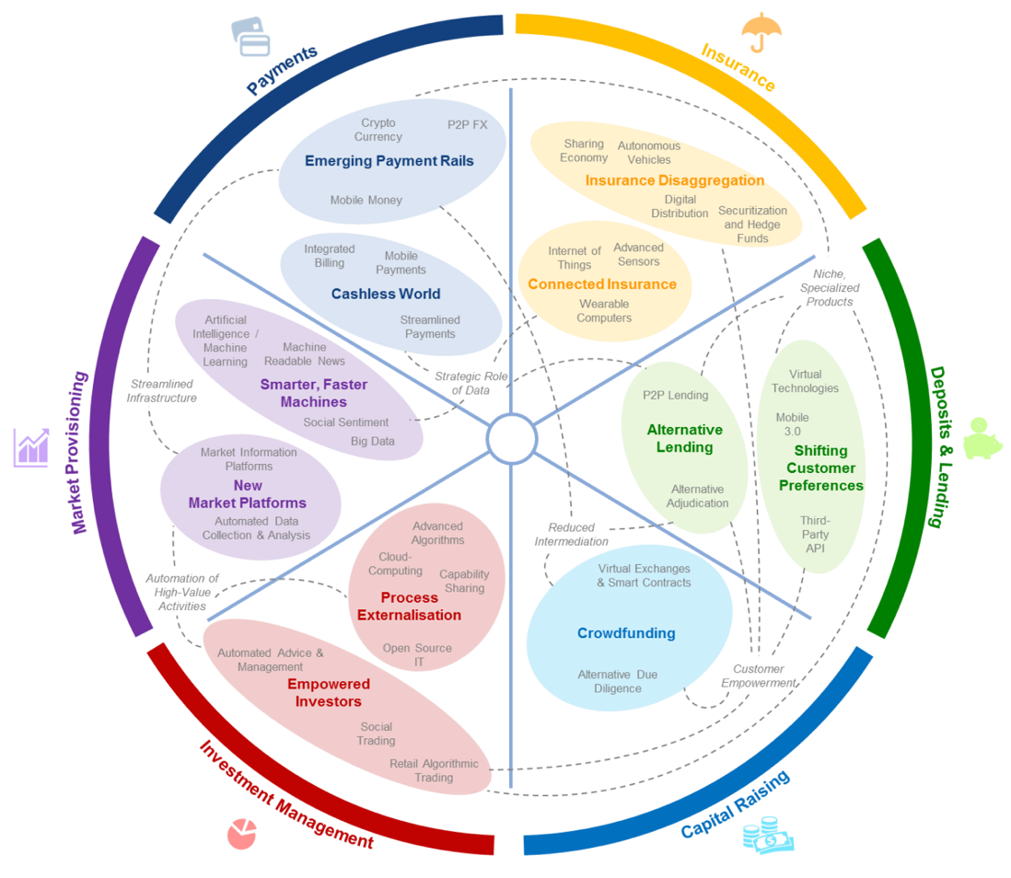
FinTech: Financial Services Innovation
Source: http://www3.weforum.org/docs/WEF_The_future__of_financial_services.pdf

Slide 27
FinTech:
Financial Services Innovation
1. Payments
2. Insurance
3. Deposits & Lending
4. Capital Raising
5. Investment Management
6. Market Provisioning
Source: http://www3.weforum.org/docs/WEF_The_future__of_financial_services.pdf

Slide 28
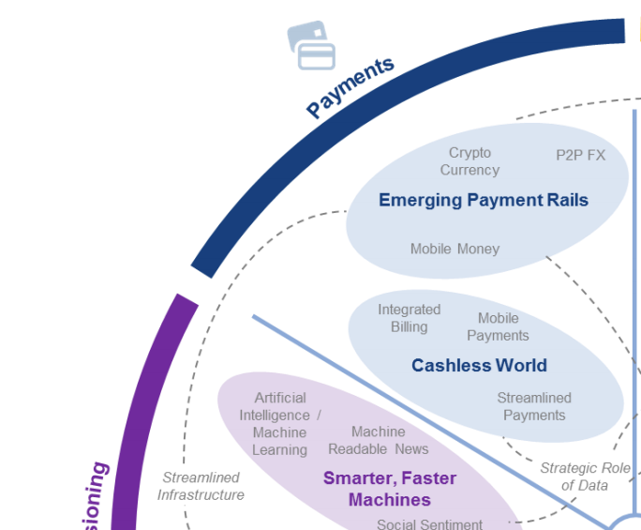
FinTech: Payment
1
Source: http://www3.weforum.org/docs/WEF_The_future__of_financial_services.pdf

Slide 29
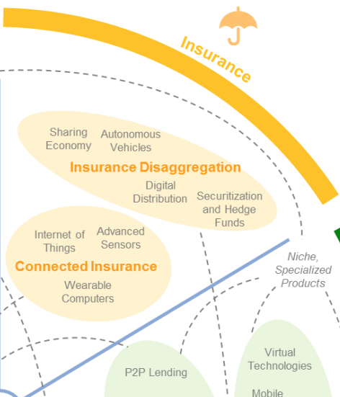
FinTech: Insurance
2
Source: http://www3.weforum.org/docs/WEF_The_future__of_financial_services.pdf

Slide 30
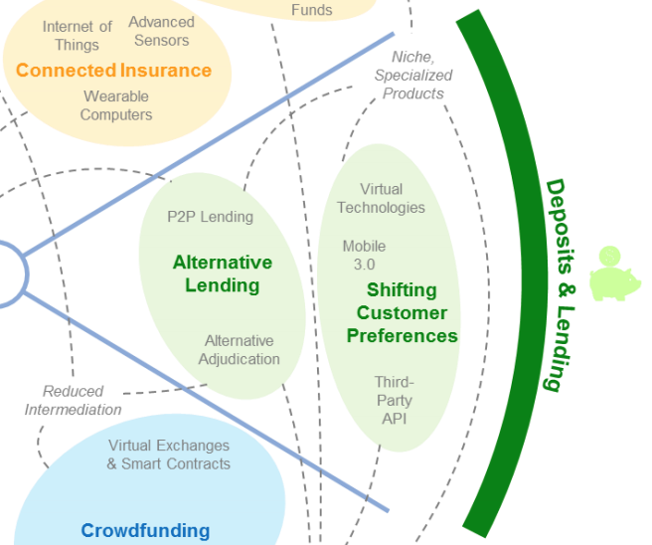
FinTech: Deposits & Lending
3
Source: http://www3.weforum.org/docs/WEF_The_future__of_financial_services.pdf

Slide 31
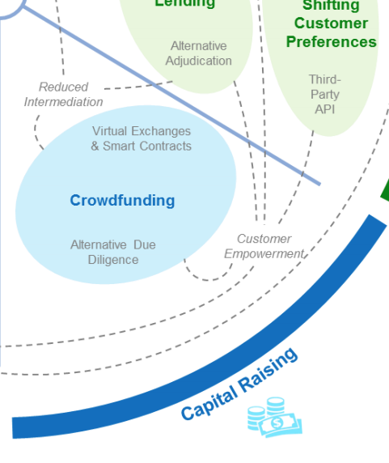
FinTech: Capital Raising
4
Source: http://www3.weforum.org/docs/WEF_The_future__of_financial_services.pdf

Slide 32
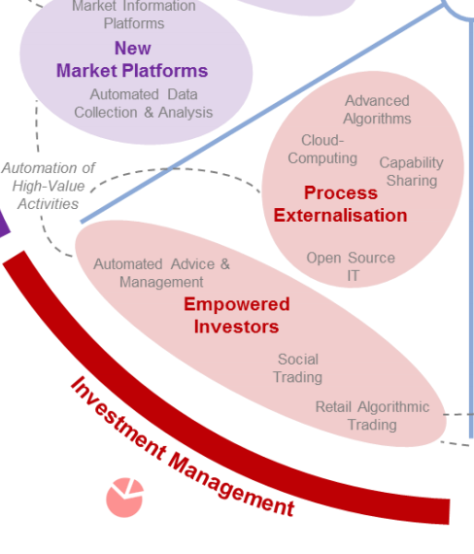
FinTech: Investment Management
5
Source: http://www3.weforum.org/docs/WEF_The_future__of_financial_services.pdf

Slide 33
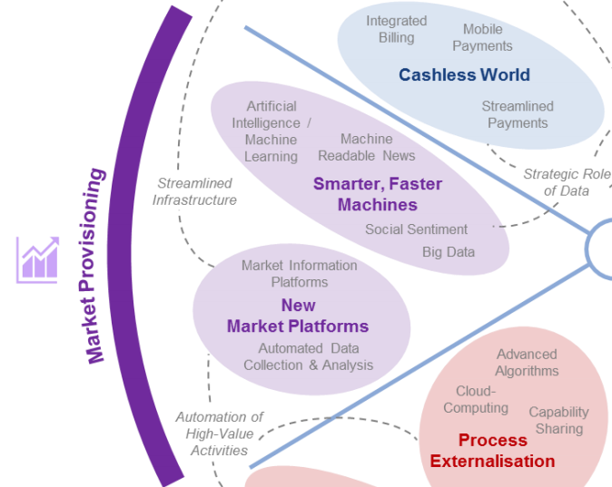
FinTech: Market Provisioning
6
Source: http://www3.weforum.org/docs/WEF_The_future__of_financial_services.pdf

Slide 34
Deep learning for financial applications: Topic-Model Heatmap
Source: Ahmet Murat Ozbayoglu, Mehmet Ugur Gudelek, and Omer Berat Sezer (2020). "Deep learning for financial applications: A survey." Applied Soft Computing (2020): 106384.

Slide 35
Deep learning for financial applications: Topic-Feature Heatmap
Source: Ahmet Murat Ozbayoglu, Mehmet Ugur Gudelek, and Omer Berat Sezer (2020). "Deep learning for financial applications: A survey." Applied Soft Computing (2020): 106384.

Slide 36
Deep learning for financial applications: Topic-Dataset Heatmap
Source: Ahmet Murat Ozbayoglu, Mehmet Ugur Gudelek, and Omer Berat Sezer (2020). "Deep learning for financial applications: A survey." Applied Soft Computing (2020): 106384.

Slide 37
Metaverse
Web3
DeFi
NFT

Slide 38
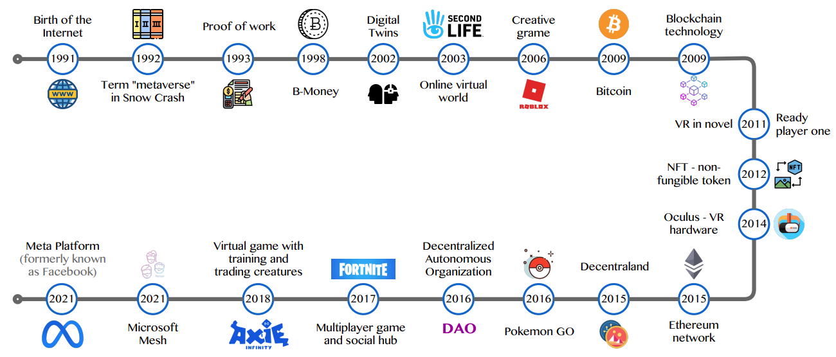
Metaverse Development from 1991 to 2021
Source: Huynh-The, Thien, Quoc-Viet Pham, Xuan-Qui Pham, Thanh Thi Nguyen, Zhu Han, and Dong-Seong Kim (2022).
"Artificial Intelligence for the Metaverse: A Survey." arXiv preprint arXiv:2202.10336.

Slide 39
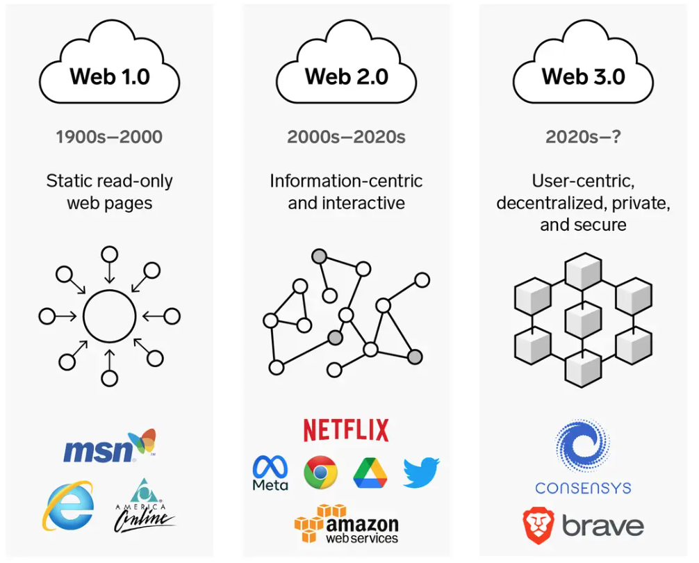
Web3: Decentralized Web
Internet Evolution
1990
2000
2020
Source: https://www.businessinsider.com/personal-finance/what-is-web3

Slide 40
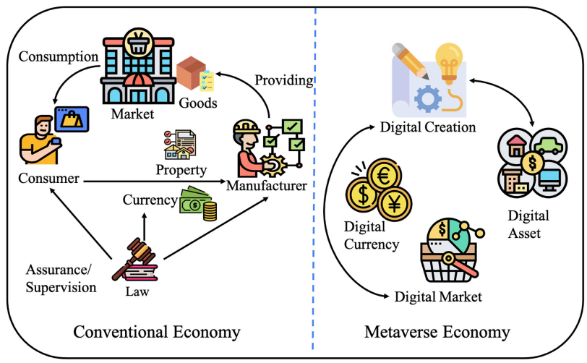
Metaverse Economy
Source: Yang, Qinglin, Yetong Zhao, Huawei Huang, Zehui Xiong, Jiawen Kang, and Zibin Zheng (2022).
"Fusing blockchain and AI with metaverse: A survey." IEEE Open Journal of the Computer Society 3 : 122-136.

Slide 41
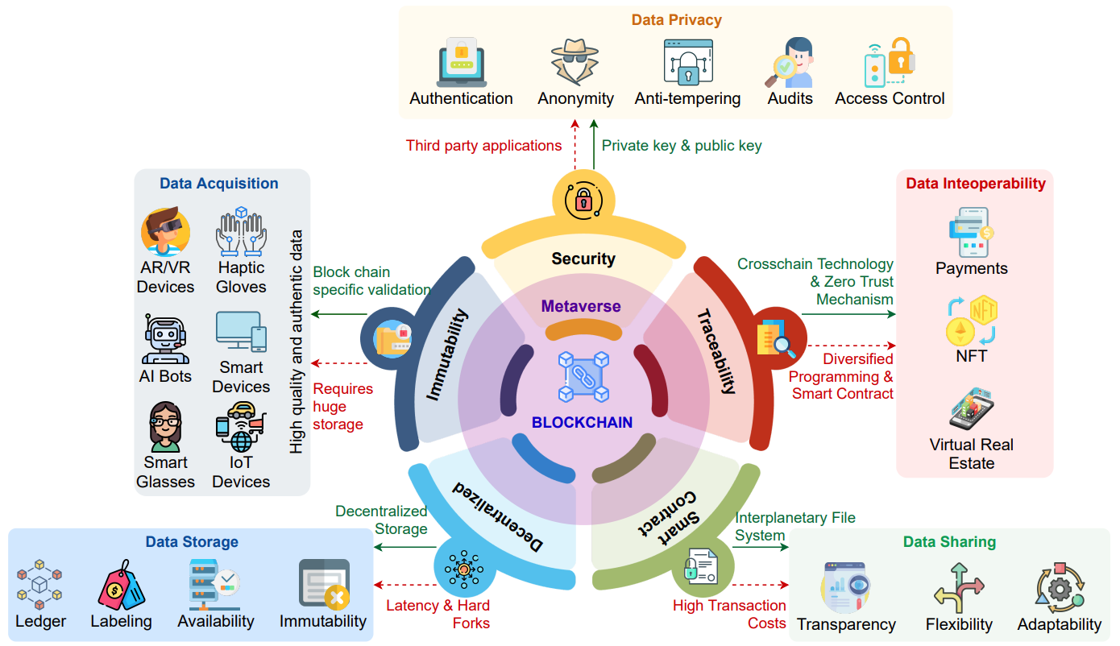
Blockchain in the Metaverse
Source: Gadekallu, Thippa Reddy, Thien Huynh-The, Weizheng Wang, Gokul Yenduri, Pasika Ranaweera, Quoc-Viet Pham, Daniel Benevides da Costa, and Madhusanka Liyanage (2022).
"Blockchain for the Metaverse: A Review." arXiv preprint arXiv:2203.09738..

Slide 42
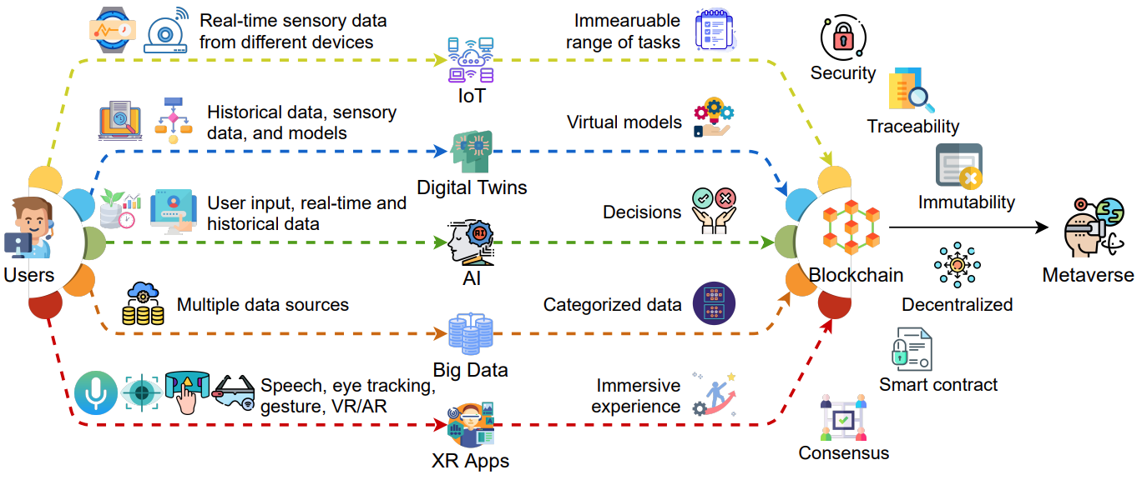
Blockchain for Key Enabling Technologies of the Metaverse
Source: Gadekallu, Thippa Reddy, Thien Huynh-The, Weizheng Wang, Gokul Yenduri, Pasika Ranaweera, Quoc-Viet Pham, Daniel Benevides da Costa, and Madhusanka Liyanage (2022).
"Blockchain for the Metaverse: A Review." arXiv preprint arXiv:2203.09738..

Slide 43
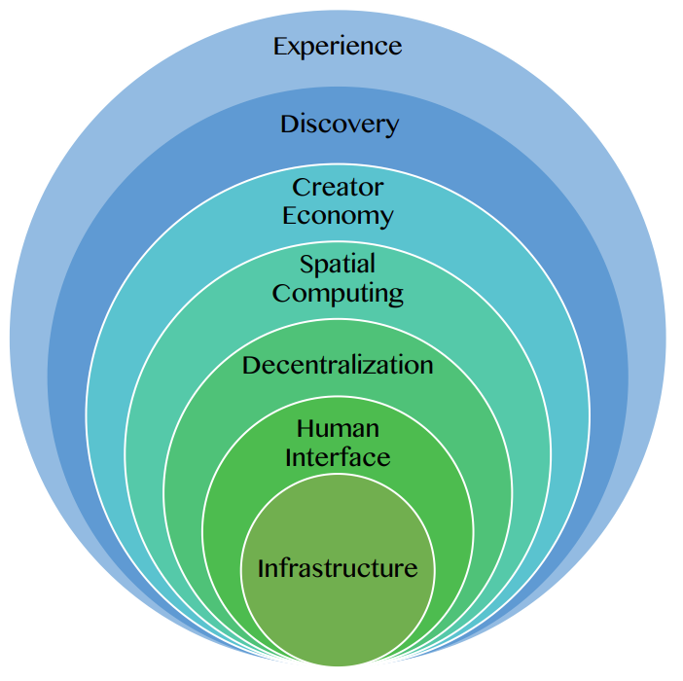
Seven Layers of a Metaverse Platform
Source: Huynh-The, Thien, Quoc-Viet Pham, Xuan-Qui Pham, Thanh Thi Nguyen, Zhu Han, and Dong-Seong Kim (2022).
"Artificial Intelligence for the Metaverse: A Survey." arXiv preprint arXiv:2202.10336.

Slide 44
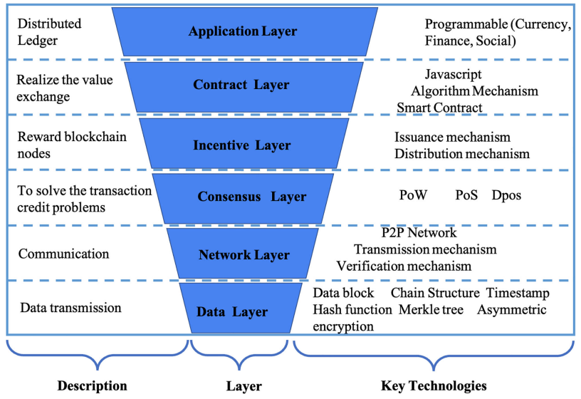
Layered Architecture of Blockchain
Source: Yang, Qinglin, Yetong Zhao, Huawei Huang, Zehui Xiong, Jiawen Kang, and Zibin Zheng (2022).
"Fusing blockchain and AI with metaverse: A survey." IEEE Open Journal of the Computer Society 3 : 122-136.

Slide 45
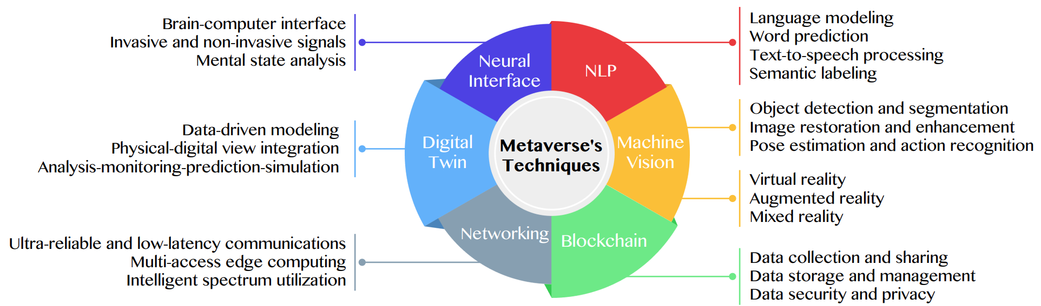
Primary Technical Aspects in the Metaverse
AI with ML algorithms and DL architectures is advancing the user experience in the virtual world
Source: Huynh-The, Thien, Quoc-Viet Pham, Xuan-Qui Pham, Thanh Thi Nguyen, Zhu Han, and Dong-Seong Kim (2022).
"Artificial Intelligence for the Metaverse: A Survey." arXiv preprint arXiv:2202.10336.

Slide 46
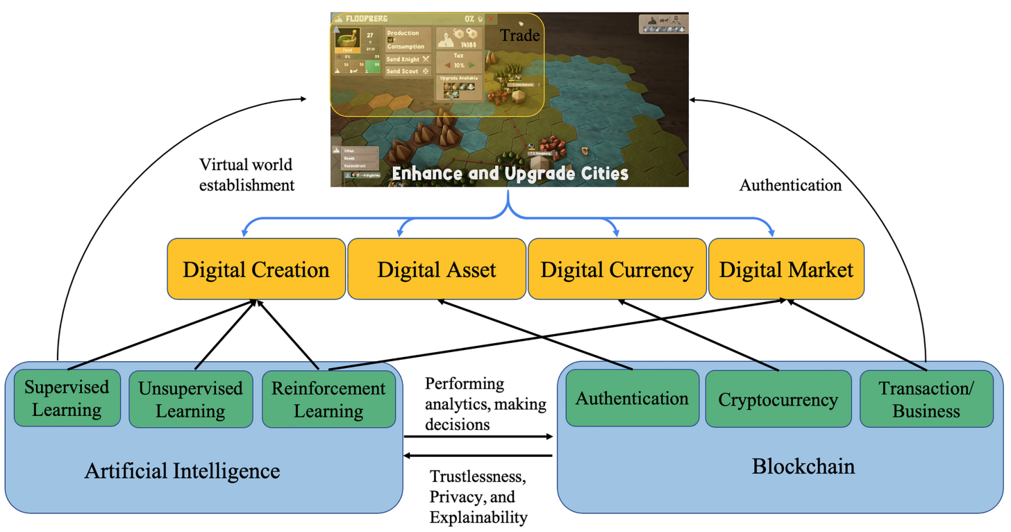
Fusion of AI and Blockchain in Metaverse
Source: Yang, Qinglin, Yetong Zhao, Huawei Huang, Zehui Xiong, Jiawen Kang, and Zibin Zheng (2022).
"Fusing blockchain and AI with metaverse: A survey." IEEE Open Journal of the Computer Society 3 : 122-136.

Slide 47
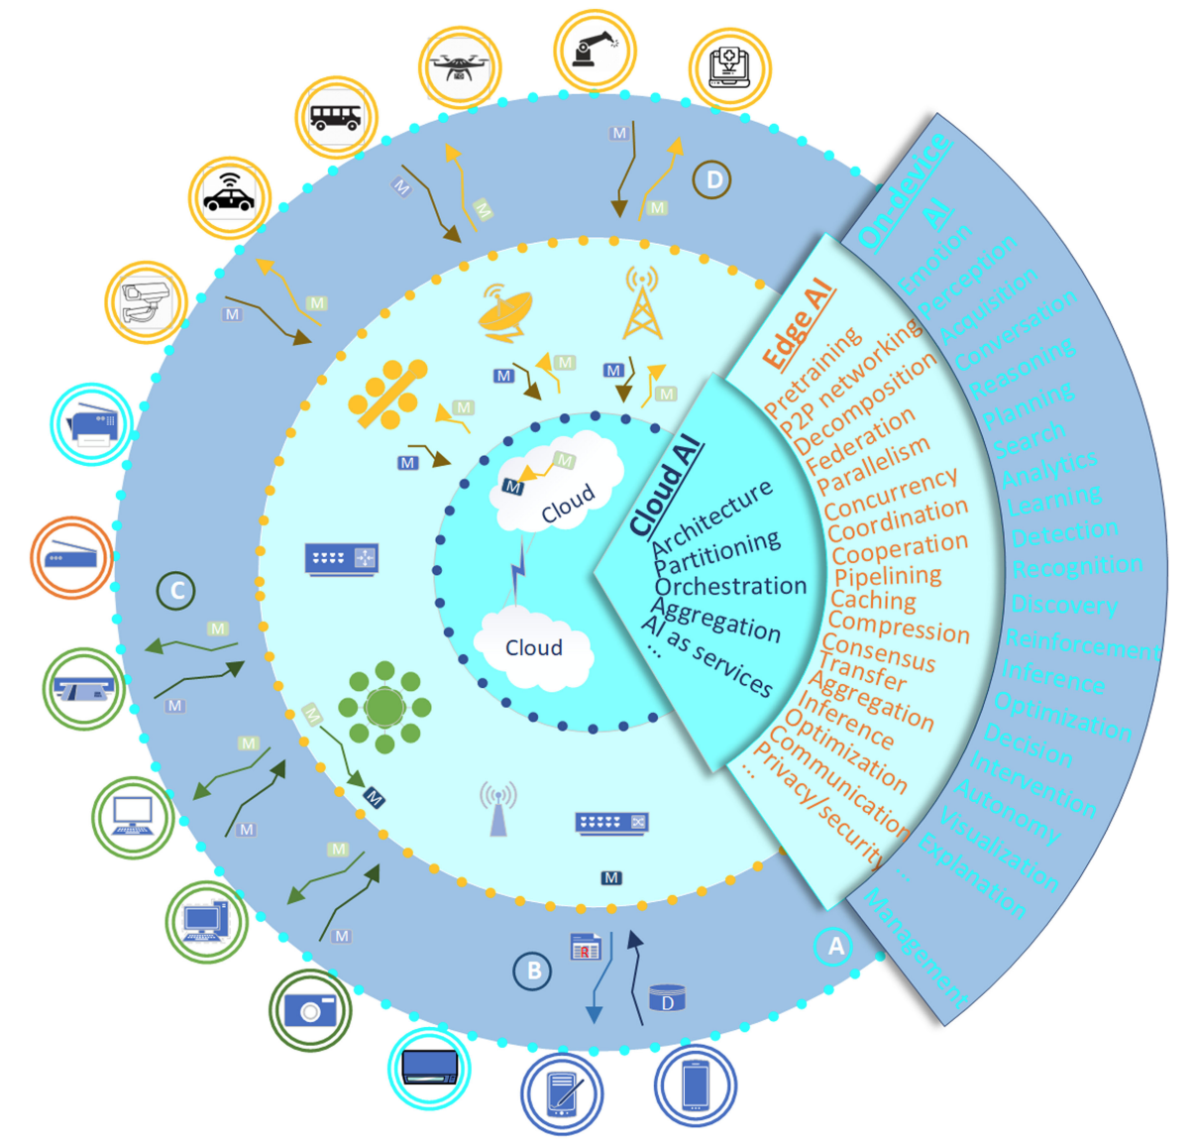
DeAI:
Synthesizing On-device AI, Edge AI, and Cloud AI
Source: Cao, Longbing (2022). "Decentralized ai: Edge intelligence and smart blockchain, metaverse, web3, and desci." IEEE Intelligent Systems 37, no. 3: 6-19.

Slide 48
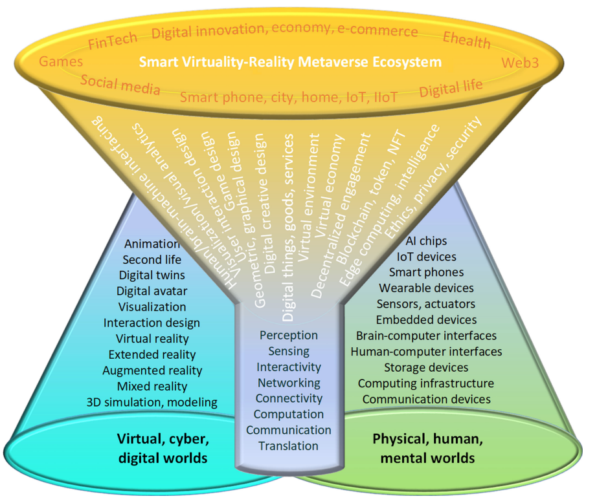
Smart Virtuality-Reality Metaverse Ecosystem: Metasynthesizing DeAI, Metaverse, Blockchain, Web3
Source: Cao, Longbing (2022). "Decentralized ai: Edge intelligence and smart blockchain, metaverse, web3, and desci." IEEE Intelligent Systems 37, no. 3: 6-19.

Slide 49
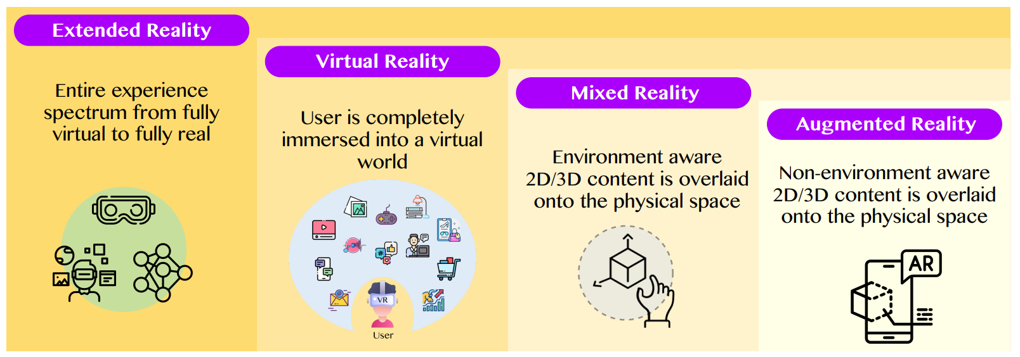
The difference between AR, MR, and VR under the umbrella of XR
XR
VR
MR
AR
Source: Huynh-The, Thien, Quoc-Viet Pham, Xuan-Qui Pham, Thanh Thi Nguyen, Zhu Han, and Dong-Seong Kim (2022).
"Artificial Intelligence for the Metaverse: A Survey." arXiv preprint arXiv:2202.10336.

Slide 50
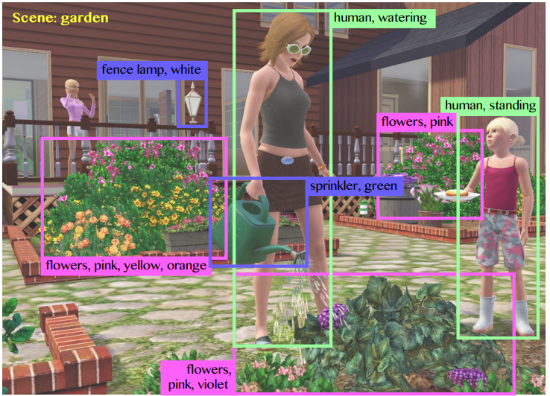
Computer vision in the metaverse with scene understanding, object detection, and human action/activity recognition
Source: Huynh-The, Thien, Quoc-Viet Pham, Xuan-Qui Pham, Thanh Thi Nguyen, Zhu Han, and Dong-Seong Kim (2022).
"Artificial Intelligence for the Metaverse: A Survey." arXiv preprint arXiv:2202.10336.

Slide 51
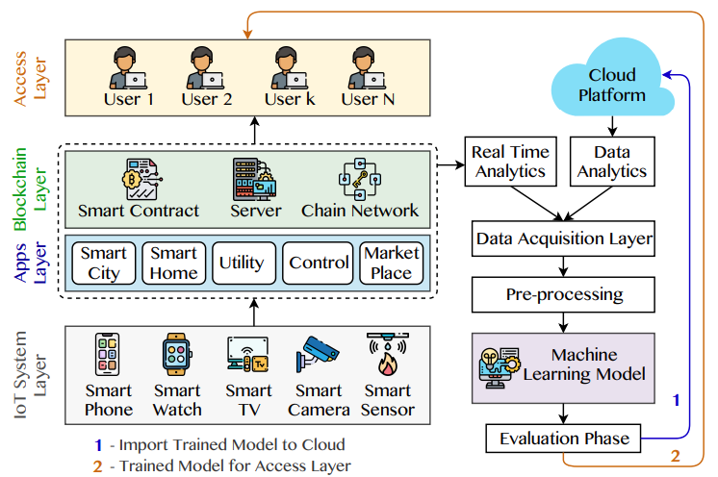
A Blockchain-based IoT Framework with ML to enhance security and privacy
Source: Huynh-The, Thien, Quoc-Viet Pham, Xuan-Qui Pham, Thanh Thi Nguyen, Zhu Han, and Dong-Seong Kim (2022).
"Artificial Intelligence for the Metaverse: A Survey." arXiv preprint arXiv:2202.10336.

Slide 52
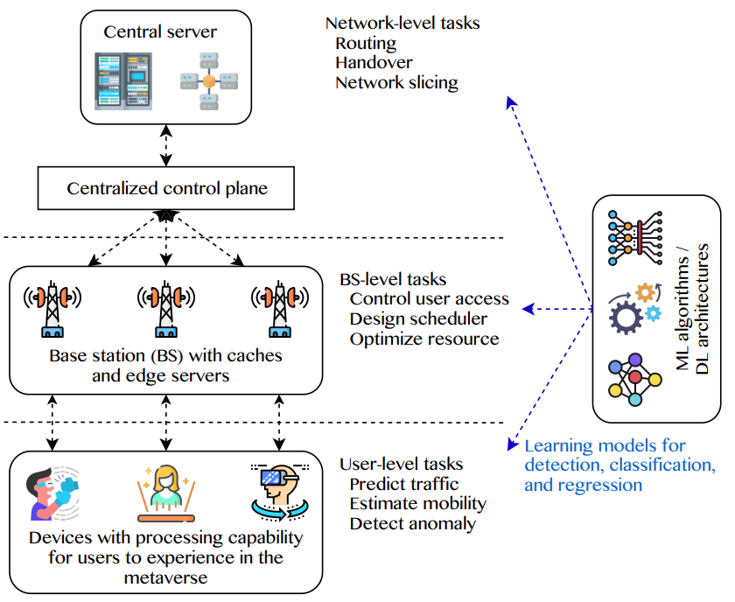
5G and beyond for Metaverse Services
AI with ML algorithms and DL models contribute in multi-level tasks
Source: Huynh-The, Thien, Quoc-Viet Pham, Xuan-Qui Pham, Thanh Thi Nguyen, Zhu Han, and Dong-Seong Kim (2022).
"Artificial Intelligence for the Metaverse: A Survey." arXiv preprint arXiv:2202.10336.

Slide 53
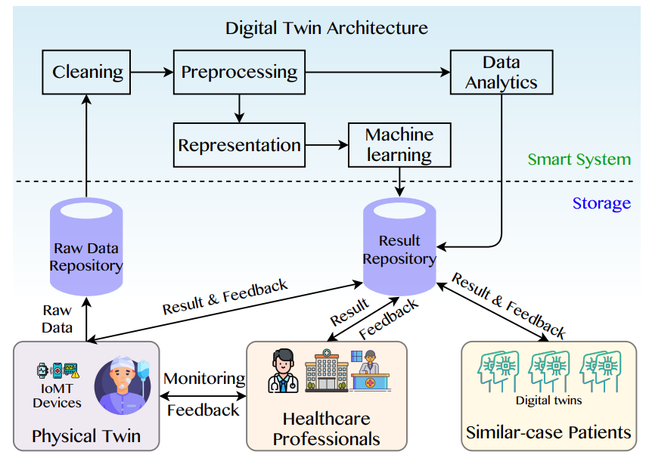
A Data-Driven Digital Twin Architecture for intelligent healthcare systems using ML to process raw data of IoMedicalThings devices
Source: Huynh-The, Thien, Quoc-Viet Pham, Xuan-Qui Pham, Thanh Thi Nguyen, Zhu Han, and Dong-Seong Kim (2022).
"Artificial Intelligence for the Metaverse: A Survey." arXiv preprint arXiv:2202.10336.

Slide 54
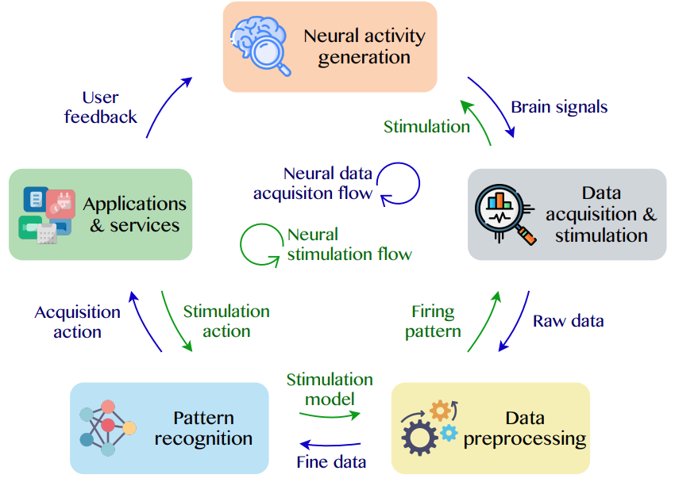
Brain-Machine Interfaces (BMIs) for processing neural signals and responding neural stimulations
Source: Huynh-The, Thien, Quoc-Viet Pham, Xuan-Qui Pham, Thanh Thi Nguyen, Zhu Han, and Dong-Seong Kim (2022).
"Artificial Intelligence for the Metaverse: A Survey." arXiv preprint arXiv:2202.10336.

Slide 55
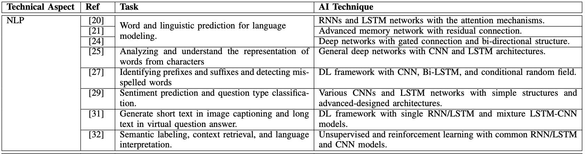
AI for the Metaverse
Source: Huynh-The, Thien, Quoc-Viet Pham, Xuan-Qui Pham, Thanh Thi Nguyen, Zhu Han, and Dong-Seong Kim (2022).
"Artificial Intelligence for the Metaverse: A Survey." arXiv preprint arXiv:2202.10336.

Slide 56
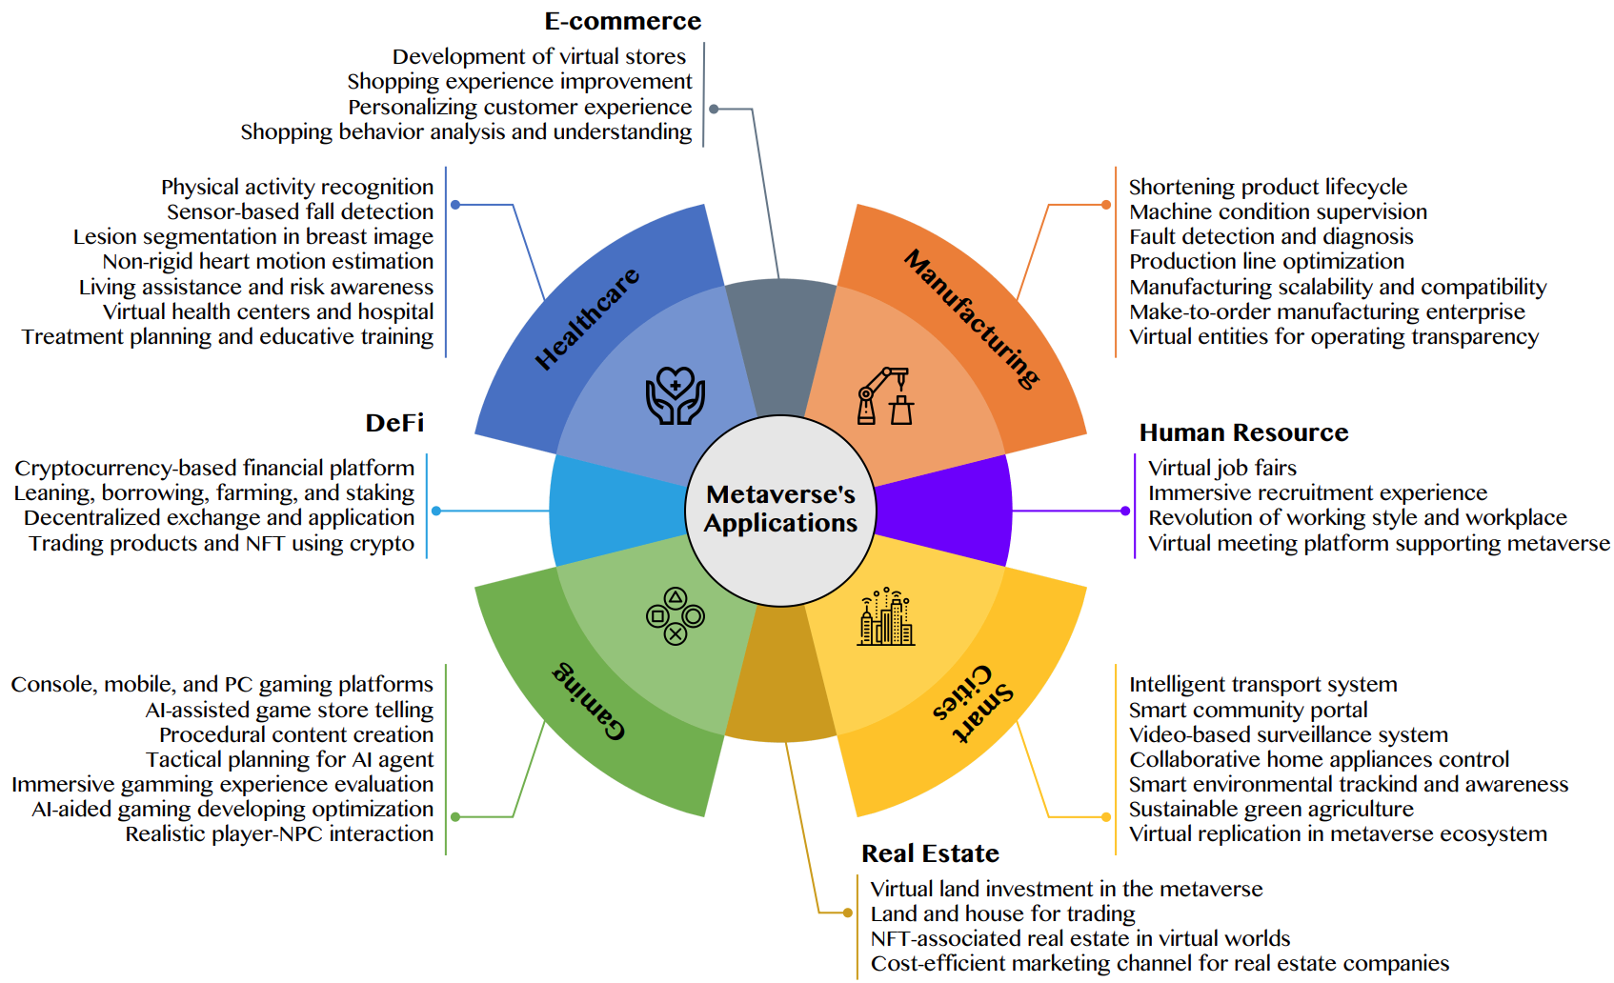
AI for the Metaverse in the Application Aspects healthcare, manufacturing, smart cities, gaming
E-commerce, human resources, real estate, and DeFi
Source: Huynh-The, Thien, Quoc-Viet Pham, Xuan-Qui Pham, Thanh Thi Nguyen, Zhu Han, and Dong-Seong Kim (2022).
"Artificial Intelligence for the Metaverse: A Survey." arXiv preprint arXiv:2202.10336.

Slide 57
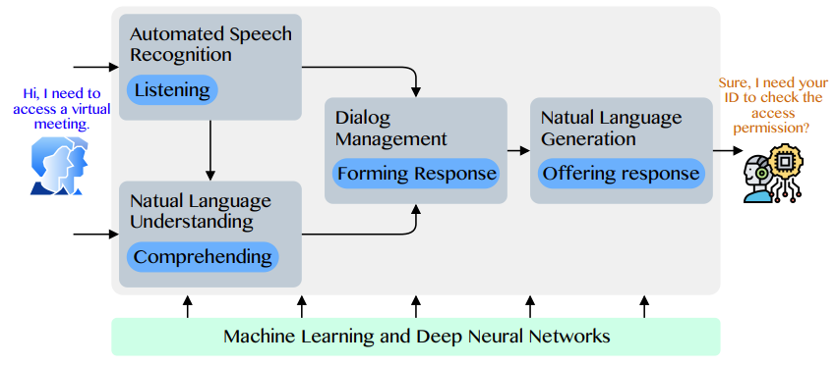
Conversational AI to deliver contextual and personal experience to users
Source: Huynh-The, Thien, Quoc-Viet Pham, Xuan-Qui Pham, Thanh Thi Nguyen, Zhu Han, and Dong-Seong Kim (2022).
"Artificial Intelligence for the Metaverse: A Survey." arXiv preprint arXiv:2202.10336.

Slide 58
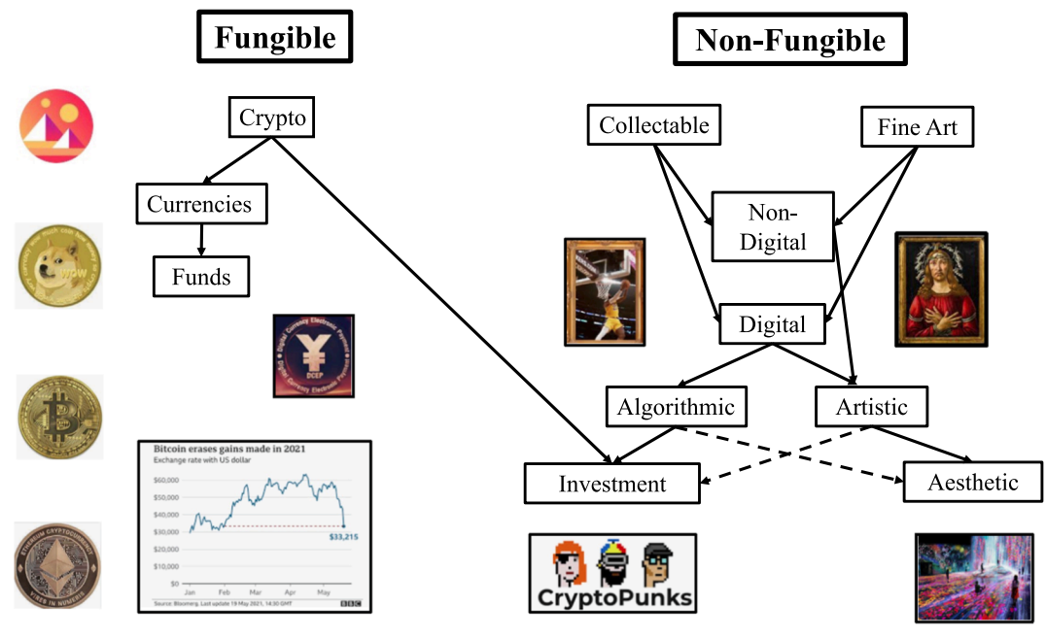
Blockchain-Registered:
Crypto, Collectables, and Art.
Source: Belk, Russell, Mariam Humayun, and Myriam Brouard. (2022)
"Money, possessions, and ownership in the Metaverse: NFTs, cryptocurrencies, Web3 and Wild Markets." Journal of Business Research 153: 198-205.

Slide 59
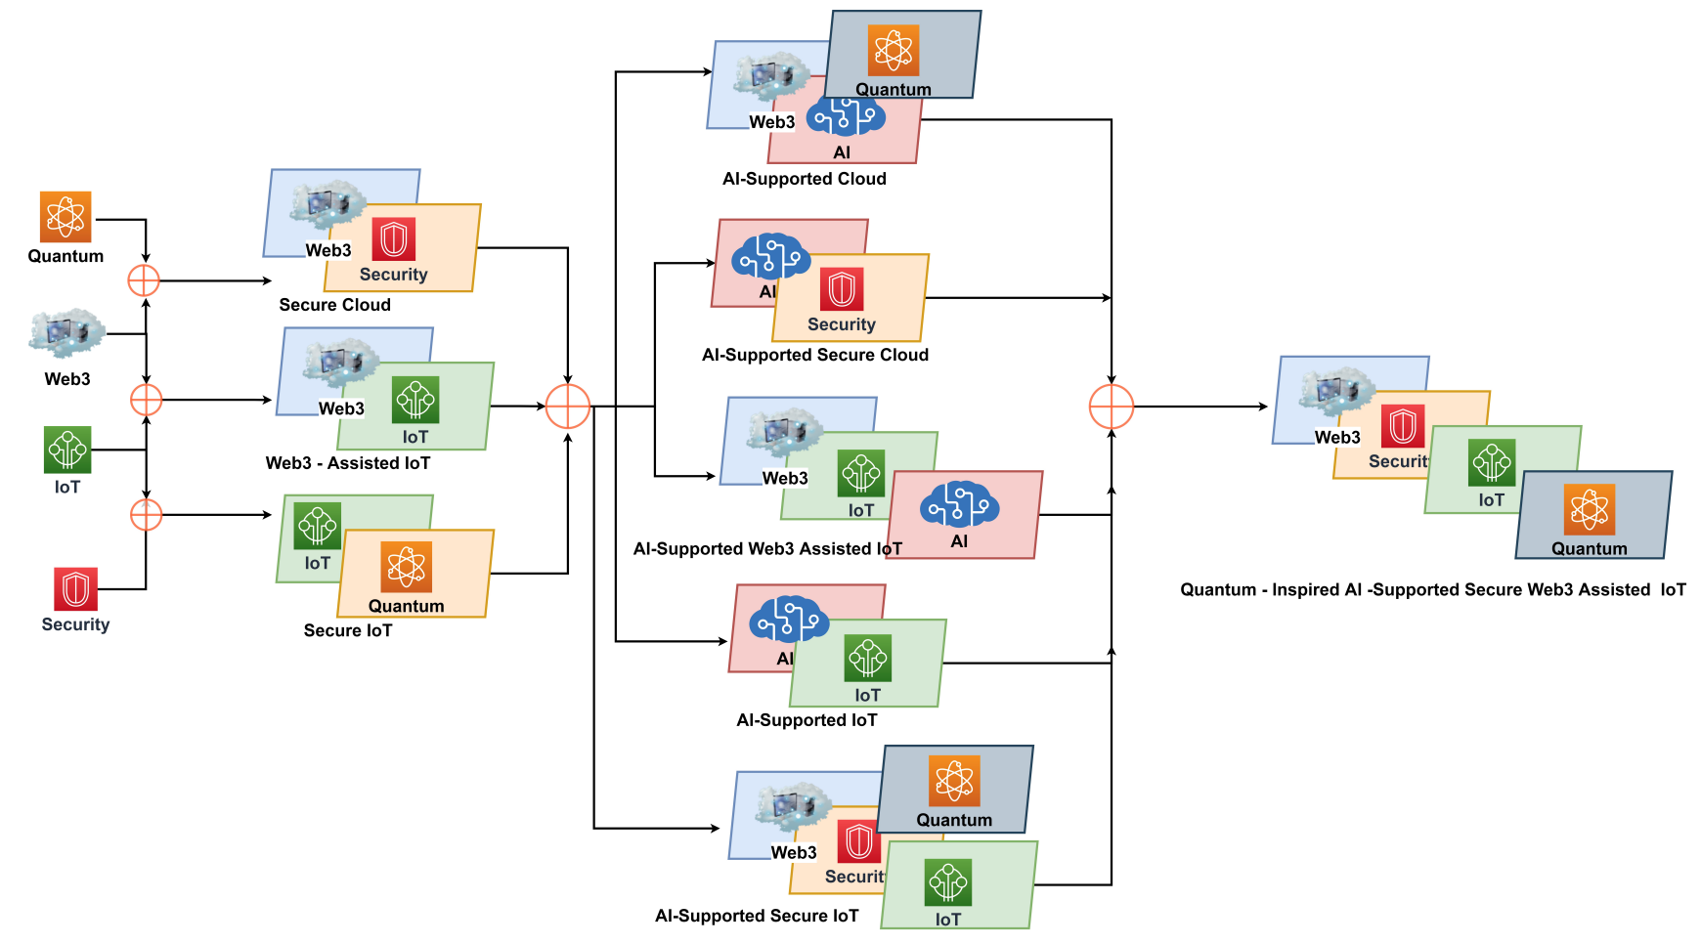
Combination of Web3 with other Technologies
Source: Sheridan, Dan, James Harris, Frank Wear, Jerry Cowell Jr, Easton Wong, and Abbas Yazdinejad. (2022)
"Web3 Challenges and Opportunities for the Market." arXiv preprint arXiv:2209.02446.

Slide 60
Decentralized Finance
(DeFi)
Block Chain FinTech

Slide 61
Decentralized Finance (DeFi)
A global, open alternative to the current financial system.
Products that let you borrow, save, invest, trade, and more.
Based on open-source technology that anyone can program with.
Source: https://ethereum.org/en/defi/

Slide 62
Traditional Finance
Centralized Finance (CeFi)
Some people aren't granted access to set up a bank account or use financial services.
Lack of access to financial services can prevent people from being employable.
Financial services can block you from getting paid.
A hidden charge of financial services is your personal data.
Governments and centralized institutions can close down markets at will.
Trading hours often limited to business hours of specific time zone.
Money transfers can take days due to internal human processes.
There's a premium to financial services because intermediary institutions need their cut.
Source: https://ethereum.org/en/defi/

Slide 63
DeFi vs. CeFi
Decentralized Finance (DeFi) | Traditional Finance (Centralized Finance; CeFi)
You hold your money. | Your money is held by companies.
You control where your money goes and how it's spent. | You have to trust companies not to mismanage your money, like lend to risky borrowers.
Transfers of funds happen in minutes. | Payments can take days due to manual processes.
Transaction activity is pseudonymous. | Financial activity is tightly coupled with your identity.
DeFi is open to anyone. | You must apply to use financial services.
The markets are always open. | Markets close because employees need breaks.
It's built on transparency – anyone can look at a product's data and inspect how the system works. | Financial institutions are closed books: you can't ask to see their loan history, a record of their managed assets, and so on.
Source: https://ethereum.org/en/defi/

Slide 64
(DeFi)
Decentralized Applications (Dapps)
Ethereum-powered tools and services
Dapps are a growing movement of applications that use Ethereum to disrupt business models or invent new ones
Source: https://ethereum.org/en/defi/

Slide 65
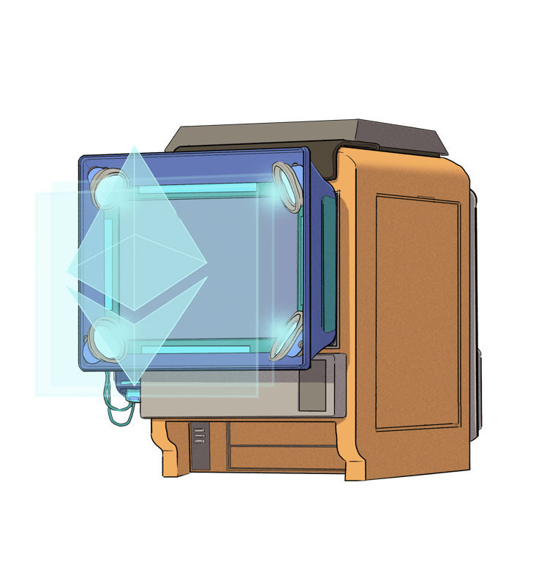
The Internet of Assets
Ethereum isn't just for
digital money.
Anything you can own can be represented,
traded and
put to use as
non-fungible tokens (NFTs).
Source: https://ethereum.org/en/defi/

Slide 66
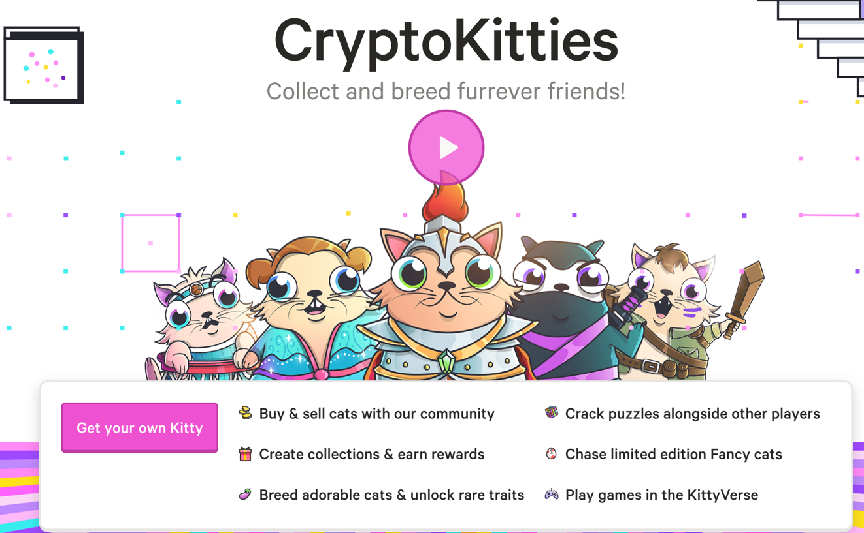
Non-Fungible Tokens (NFT)
CryptoKitties
https://www.cryptokitties.co/
Source: Matt Fortnow and QuHarrison Terry (2021), The NFT Handbook - How to Create, Sell and Buy Non-Fungible Tokens, Wiley

Slide 67
Financial Stability Challenges
Crypto Ecosystem
Operational, cyber, and governance risks
Integrity (market and AML/CFT)
(Anti–Money Laundering / Combating the Financing of Terrorism)
Data availability / reliability
Challenges from cross-boarder activites
Stablecoins
How stable are stablecoins?
Domestic and global regulatory and supervisory
approaches
Macro-Financial
Cryptoization, capital flows, and restrictions
Monetary policy transmission
Bank disintermediation
Source: Parma Bains, Mohamed Diaby, Dimitris Drakopoulos, Julia Faltermeier, Federico Grinberg, Evan Papageorgiou, Dmitri Petrov, Patrick Schneider, and Nobu Sugimoto (2021),
The Crypto Ecosystem and Financial Stability Challenges, International Monetary Fund, October 2021

Slide 68
Financial Services

Slide 69
Technology
Innovation

Slide 70
FinTech Innovation
FinTech high-level classification
Lending
Payments
Robo Advisors
Analytics
Others
Profile
Advice
Re-Balance
Indexing
Source: Paolo Sironi (2016), “FinTech Innovation: From Robo-Advisors to Goal Based Investing and Gamification”, Wiley.

Slide 71
Technology-driven
Financial Industry Development

Slide 72
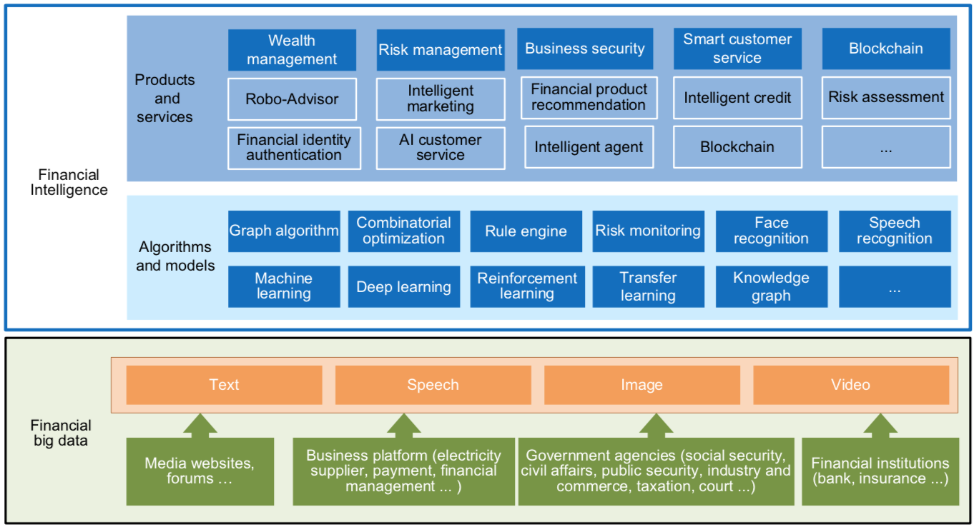
FinBrain: when Finance meets AI 2.0
(Zheng et al., 2019)
Source: Xiao-lin Zheng, Meng-ying Zhu, Qi-bing Li, Chao-chao Chen, and Yan-chao Tan (2019), "Finbrain: When finance meets AI 2.0." Frontiers of Information Technology & Electronic Engineering 20, no. 7, pp. 914-924

Slide 73
AI 2.0
a new generation of AI
based on the
novel information environment of
major changes and
the development of
new goals.
Yunhe Pan (2016), "Heading toward artificial intelligence 2.0." Engineering 2, no. 4, 409-413.

Slide 74
Technology-driven
Financial Industry Development
Development stage | Driving technology | Main landscape | Inclusive finance | Relationship between technology and finance
Fintech 1.0 (financial IT) | Computer | Credit card, ATM, and CRMS | Low | Technology as a tool
Fintech 2.0 (Internet finance) | Mobile Internet | Marketplace lending, third-party payment, crowdfunding, and Internet insurance | Medium | Technology-driven change
Fintech 3.0 (financial intelligence) | AI, Big Data, Cloud Computing, Blockchain | Intelligent finance | High | Deep fusion
Source: Xiao-lin Zheng, Meng-ying Zhu, Qi-bing Li, Chao-chao Chen, and Yan-chao Tan (2019), "Finbrain: When finance meets AI 2.0." Frontiers of Information Technology & Electronic Engineering 20, no. 7, pp. 914-924

Slide 75
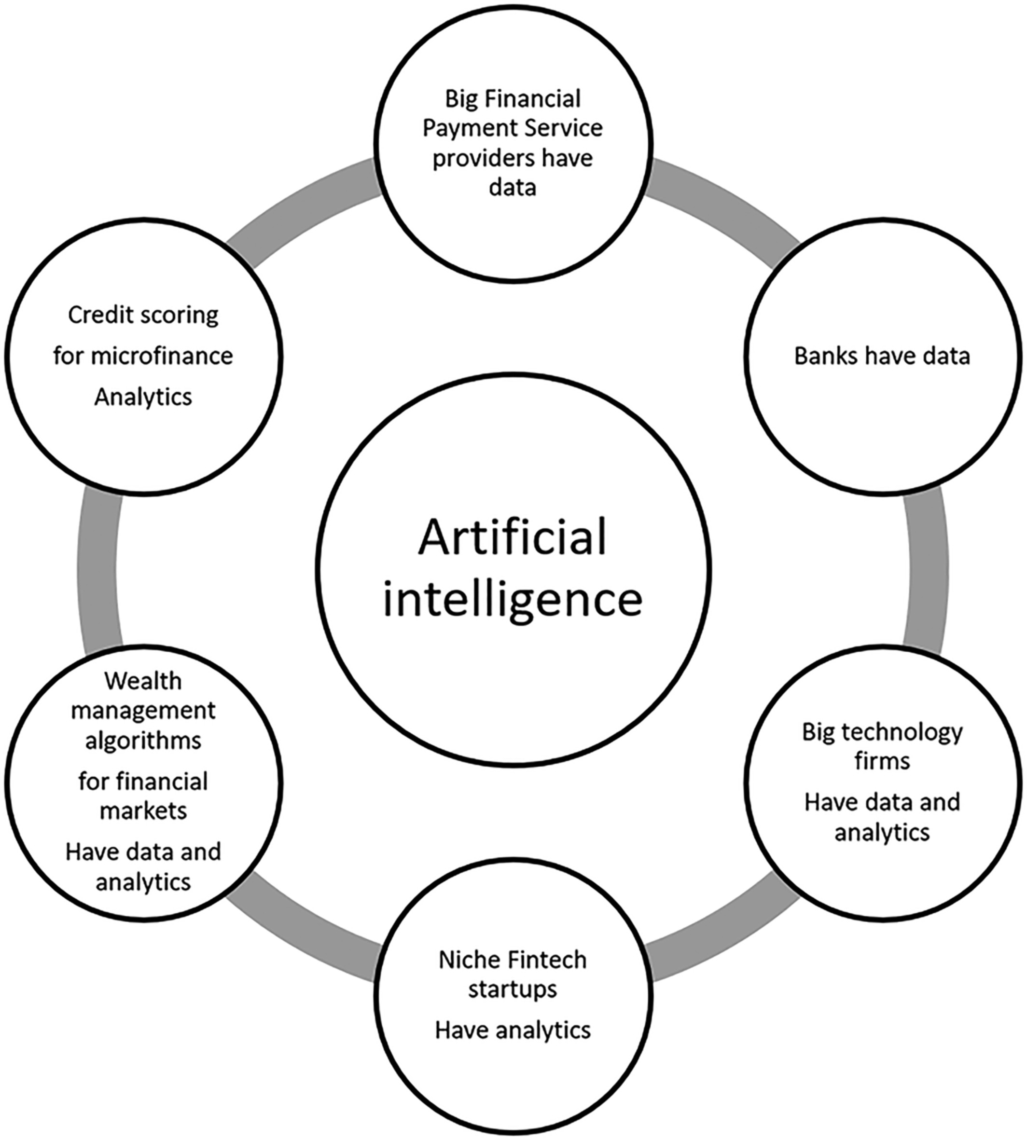
Artificial Intelligence in the Financial Markets
Source: Ashta, Arvind, and Heinz Herrmann (2021). "Artificial intelligence and fintech: An overview of opportunities and risks for banking, investments, and microfinance." Strategic Change 30, no. 3 (2021): 211-222.

Slide 76
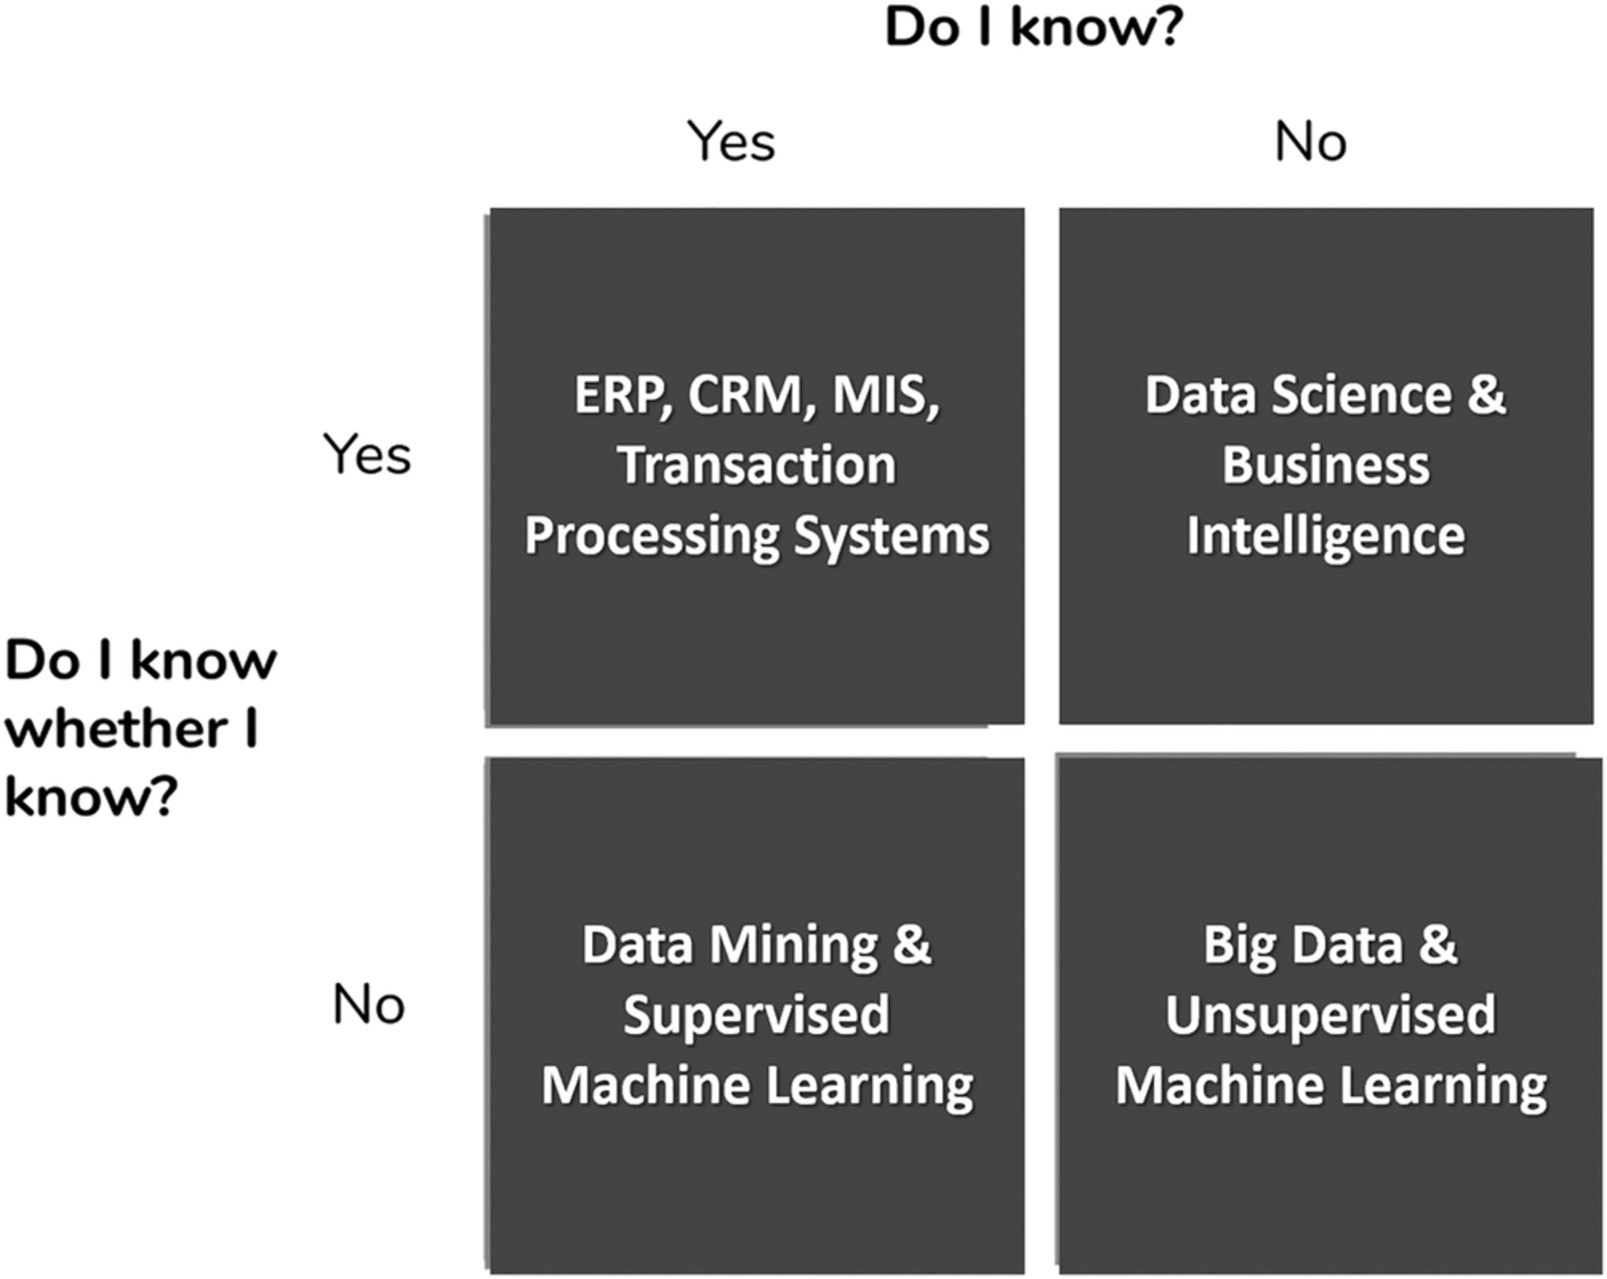
AI in Managerial Blind Spots:
Unknown Knowns and Unknown Unknowns
Source: Ashta, Arvind, and Heinz Herrmann (2021). "Artificial intelligence and fintech: An overview of opportunities and risks for banking, investments, and microfinance." Strategic Change 30, no. 3 (2021): 211-222.

Slide 77
Green Finance
ESG
(Environmental, Social, Governance)

Slide 78
Sustainability
SDGs
CSR
ESG

Slide 79














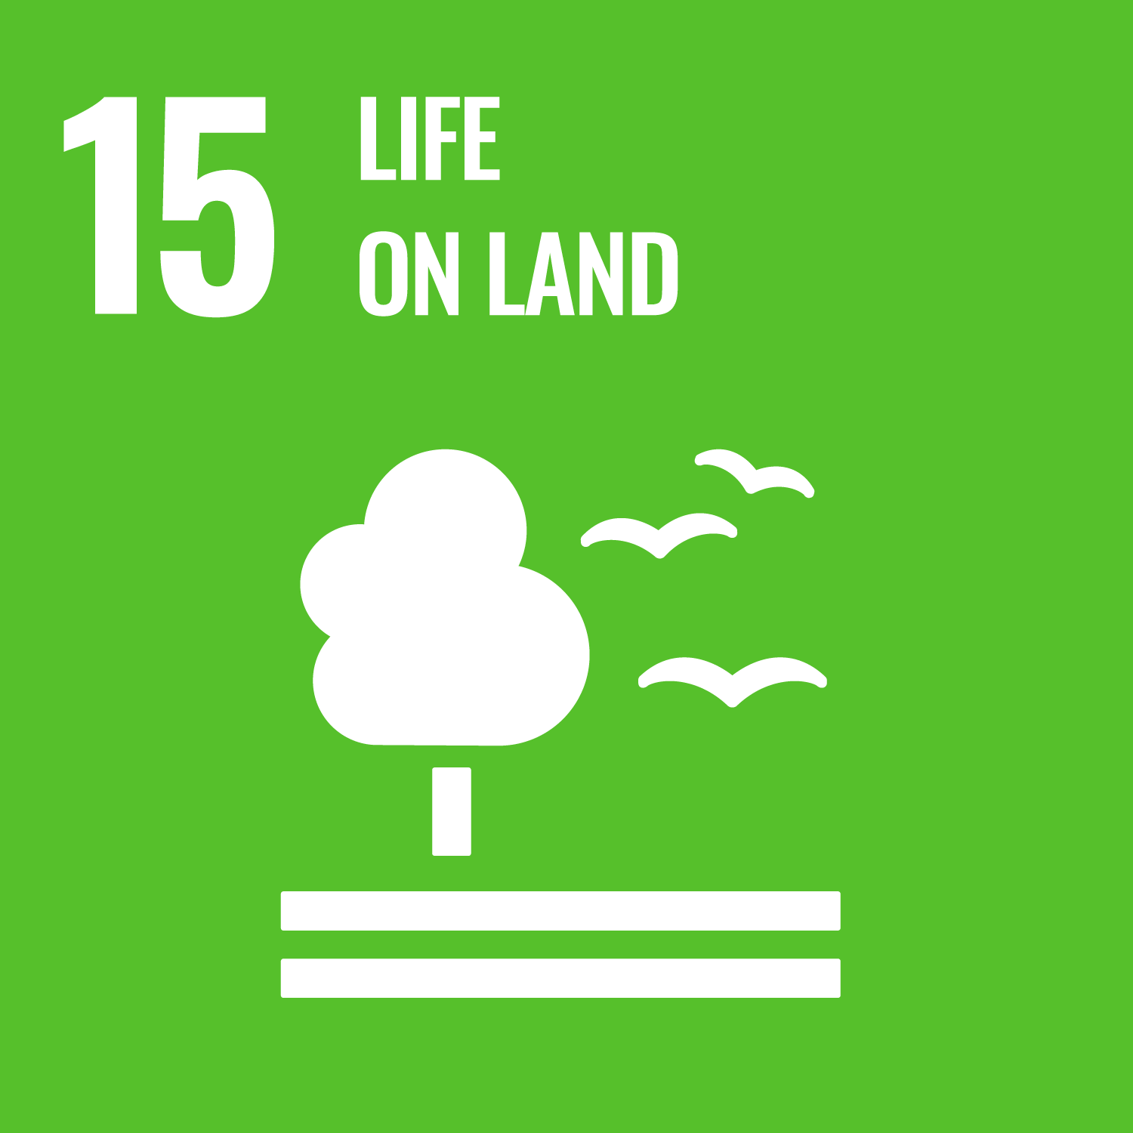



Sustainable Development Goals (SDGs)
Source: https://sdgs.un.org/goals

Slide 80
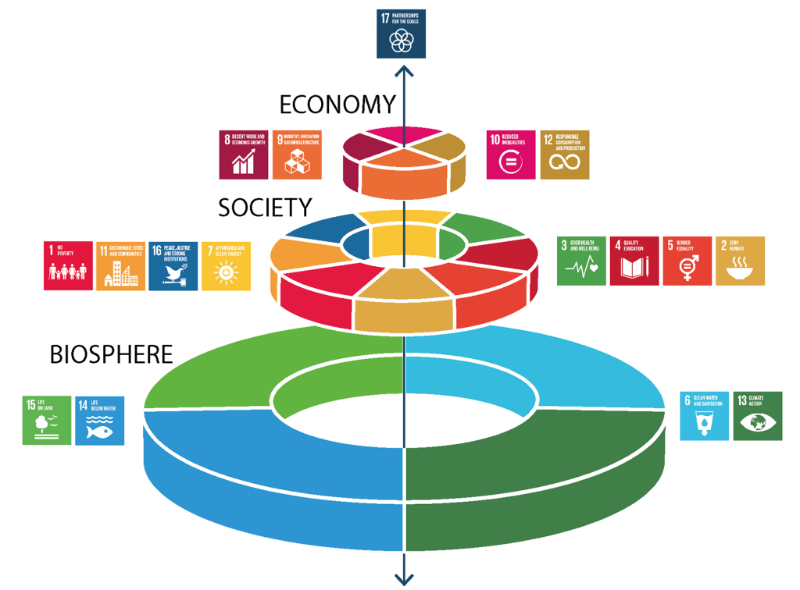
Sustainable Development Goals (SDGs) and 5P
Partnership
Peace
Prosperity
People
Planet
Source: Folke, Carl, Reinette Biggs, Albert V. Norström, Belinda Reyers, and Johan Rockström. "Social-ecological resilience and biosphere-based sustainability science.”Ecology and Society 21, no. 3 (2016).

Slide 81
Green Finance
Generic term implying use or diversion of financial resources to deploy and support projects with long term positive impact on the environment
Source: Bhattacharyya, Rupsha. "Green finance for energy transition, climate action and sustainable development: overview of concepts, applications, implementation and challenges." Green Finance 4, no. 1 (2022): 1-35.

Slide 82
Sustainable Finance
Finances deployed in support of projects that ensure just, sustainable and inclusive growth or attainment of one or more sustainable development goals
Source: Bhattacharyya, Rupsha. "Green finance for energy transition, climate action and sustainable development: overview of concepts, applications, implementation and challenges." Green Finance 4, no. 1 (2022): 1-35.

Slide 83
Carbon Finance
  Financial instruments
  based on
  economic value of carbon emissions
  which an organization cannot avoid but which
  it offsets by funding other compensatory projects that contribute to carbon emissions reduction
Source: Bhattacharyya, Rupsha. "Green finance for energy transition, climate action and sustainable development: overview of concepts, applications, implementation and challenges." Green Finance 4, no. 1 (2022): 1-35.

Slide 84
Climate Finance
  Finances deployed
  in support of low carbon and
  climate resilient projects
  that help in climate change mitigation and adaptation efforts,
  particularly in the
  energy and infrastructure sectors
Source: Bhattacharyya, Rupsha. "Green finance for energy transition, climate action and sustainable development: overview of concepts, applications, implementation and challenges." Green Finance 4, no. 1 (2022): 1-35.

Slide 85
ESG Investing
  Investments considering the broad range of
  environmental (e.g. climate change,
  pollution biodiversity loss),
  social (e.g. working conditions, human rights, salary or compensation structures)
  and governance (e.g. board composition, diversity and inclusion, taxes)
  characteristics of the projects or companies being invested in; ethical and business sustainability considerations are
  integral part of financing
Source: Bhattacharyya, Rupsha. "Green finance for energy transition, climate action and sustainable development: overview of concepts, applications, implementation and challenges." Green Finance 4, no. 1 (2022): 1-35.

Slide 86
Impact Investing
  Investing in projects
  that solve a social or environmental problem;
  the focus is on the positive impact
  rather than the
  means used to produce that impact
Source: Bhattacharyya, Rupsha. "Green finance for energy transition, climate action and sustainable development: overview of concepts, applications, implementation and challenges." Green Finance 4, no. 1 (2022): 1-35.

Slide 87
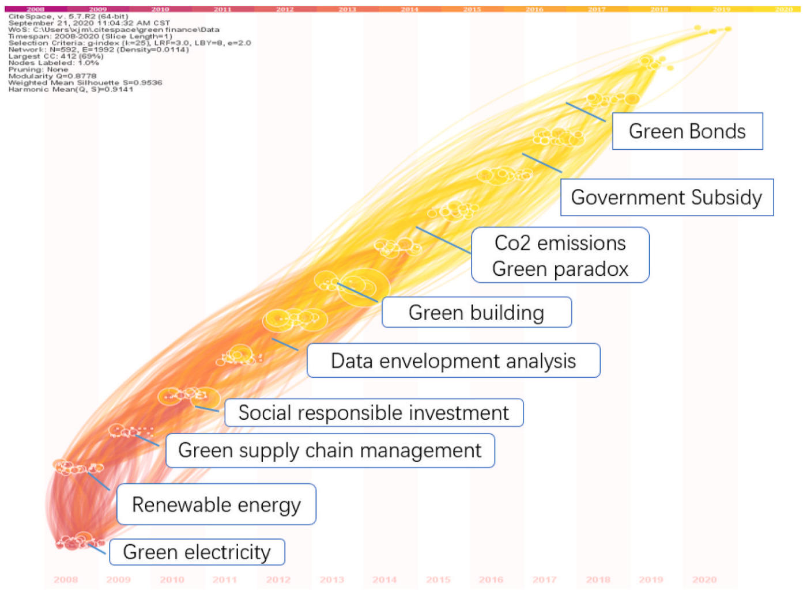
Dynamic Trends of Green Finance and Energy Policy
Source: Wang, Moran, Xuerong Li, and Shouyang Wang. (2021) "Discovering research trends and opportunities of green finance and energy policy: A data-driven scientometric analysis." Energy Policy 154 (2021): 112295.

Slide 88
ESG:
Environmental
Social
Governance

Slide 89
CSR:
Corporate
Social
Responsibility

Slide 90
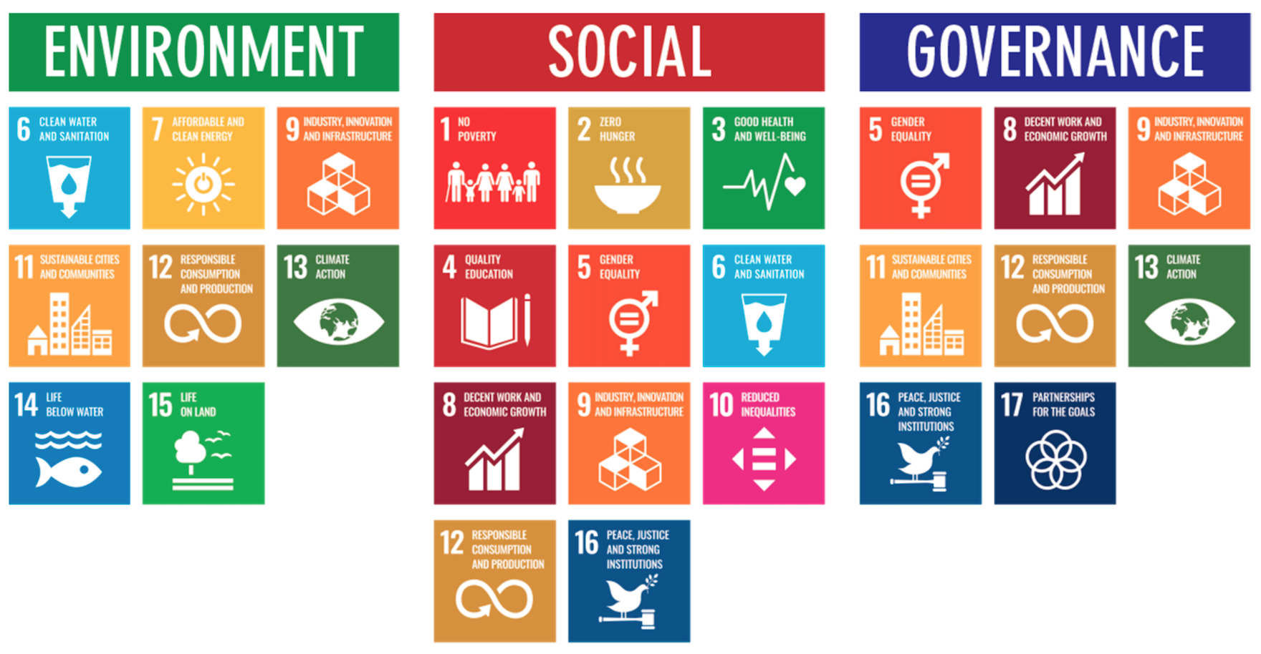
ESG to 17 SDGs
Source: Henrik Skaug Sætra (2021) "A Framework for Evaluating and Disclosing the ESG Related Impacts of AI with the SDGs." Sustainability 13, no. 15 (2021): 8503.

Slide 91
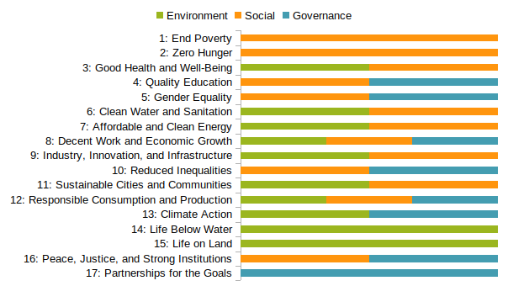
ESG to 17 SDGs
Source: https://sustainometric.com/esg-to-sdgs-connected-paths-to-a-sustainable-future/

Slide 92
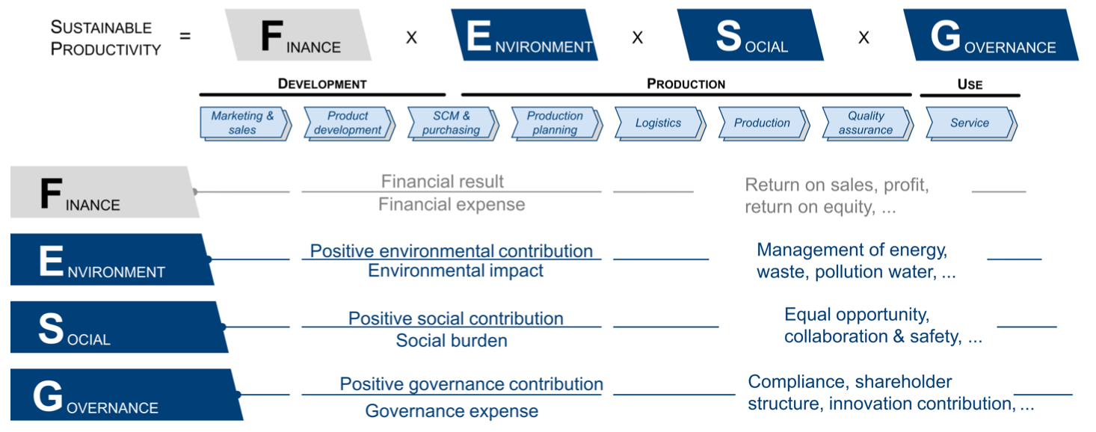
Sustainable Productivity:
Finance ESG
Source: Huang, Ziqi, Yang Shen, Jiayi Li, Marcel Fey, and Christian Brecher (2021). "A survey on AI-driven digital twins in Industry 4.0: Smart manufacturing and advanced robotics." Sensors 21, no. 19: 6340.

Slide 93
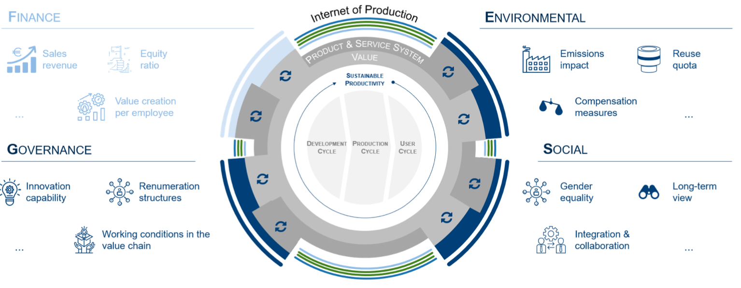
Sustainable Resilient Manufacturing
ESG
Source: Huang, Ziqi, Yang Shen, Jiayi Li, Marcel Fey, and Christian Brecher (2021). "A survey on AI-driven digital twins in Industry 4.0: Smart manufacturing and advanced robotics." Sensors 21, no. 19: 6340.

Slide 94
ESG Indexes
MSCI ESG Index
Dow Johns Sustainability Indices (DJSI)
FTSE ESG Index

Slide 95
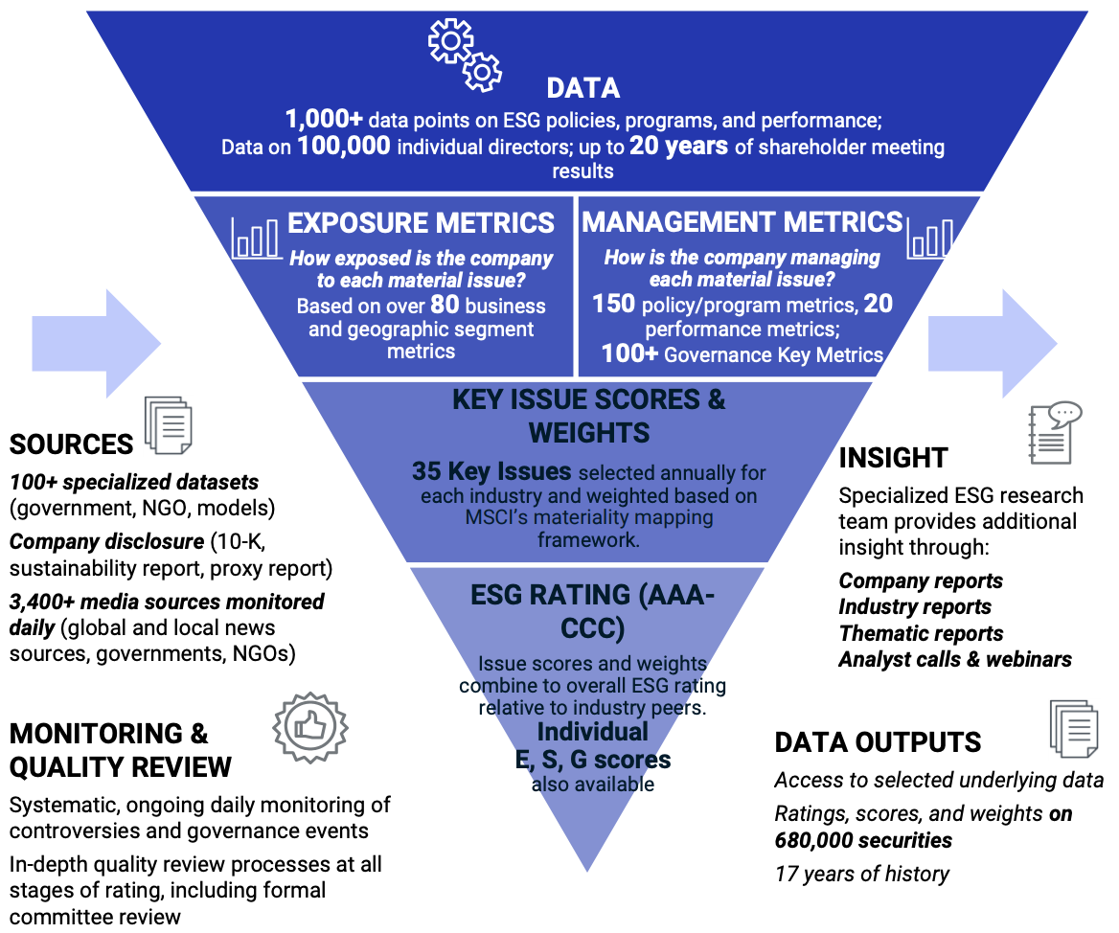
MSCI ESG Rating Framework
Source: https://www.msci.com/documents/1296102/21901542/ESG-Ratings-Methodology-Exec-Summary.pdf

Slide 96
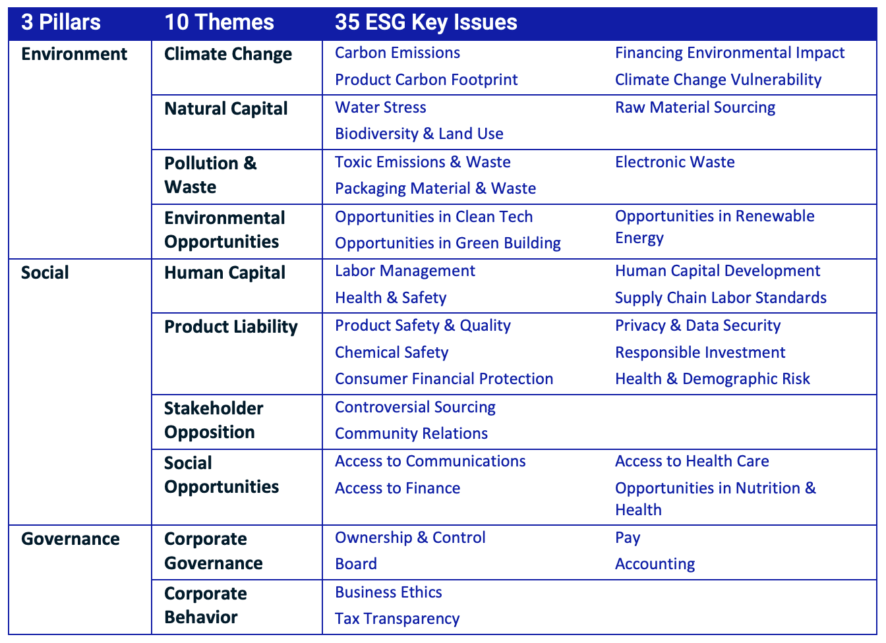
MSCI ESG Key Issue Hierarchy
Source: https://www.msci.com/documents/1296102/21901542/ESG-Ratings-Methodology-Exec-Summary.pdf

Slide 97
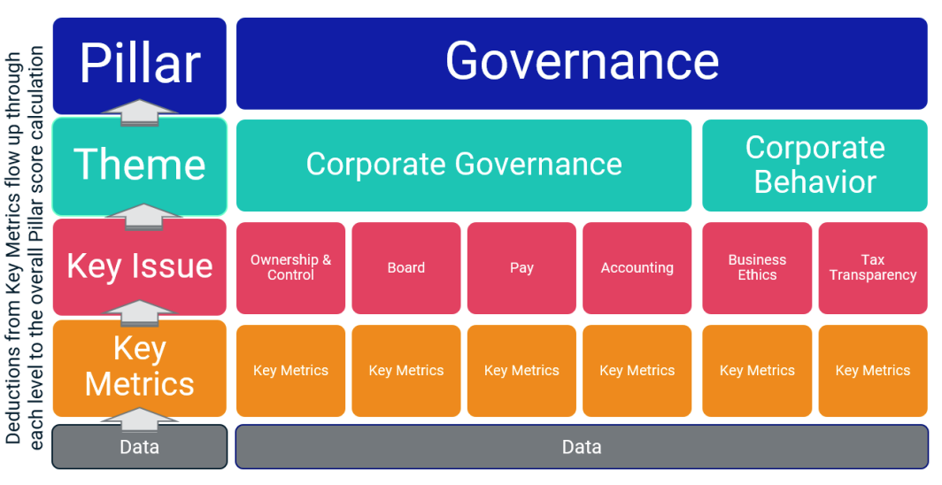
MSCI Governance Model Structure
Source: https://www.msci.com/documents/1296102/21901542/ESG-Ratings-Methodology-Exec-Summary.pdf

Slide 98
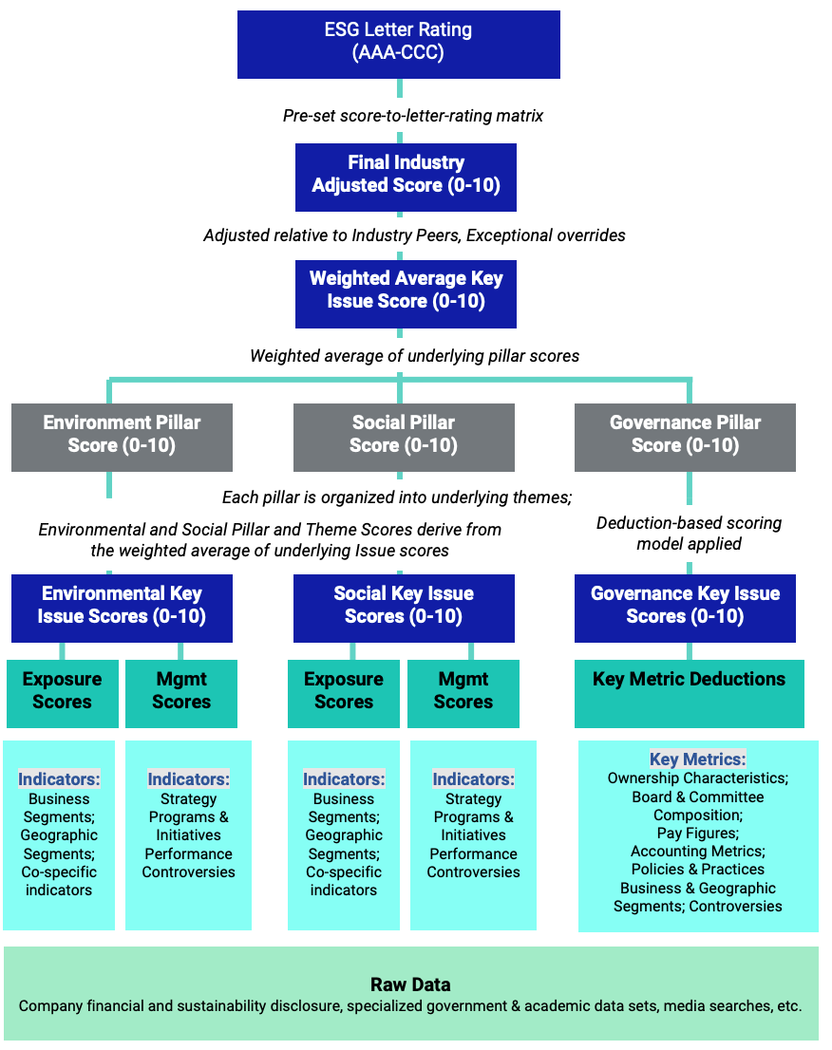
MSCI Hierarchy of ESG Scores
Source: https://www.msci.com/documents/1296102/21901542/ESG-Ratings-Methodology-Exec-Summary.pdf

Slide 99
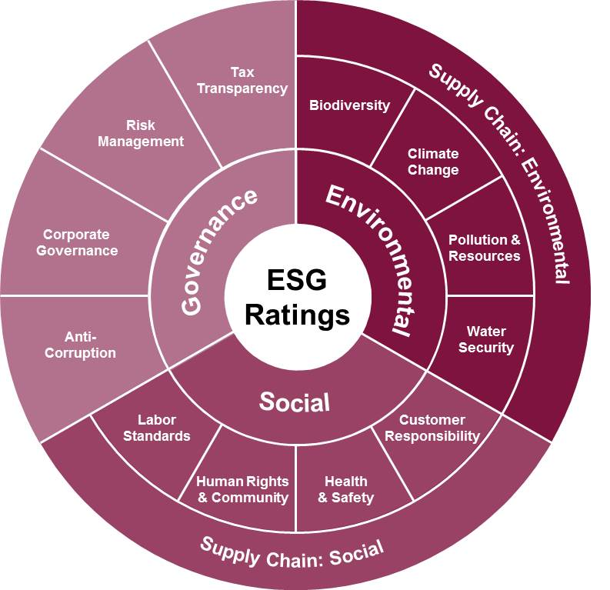
FTSE Russell ESG Ratings
Source: https://www.ftserussell.com/data/sustainability-and-esg-data/esg-ratings

Slide 100

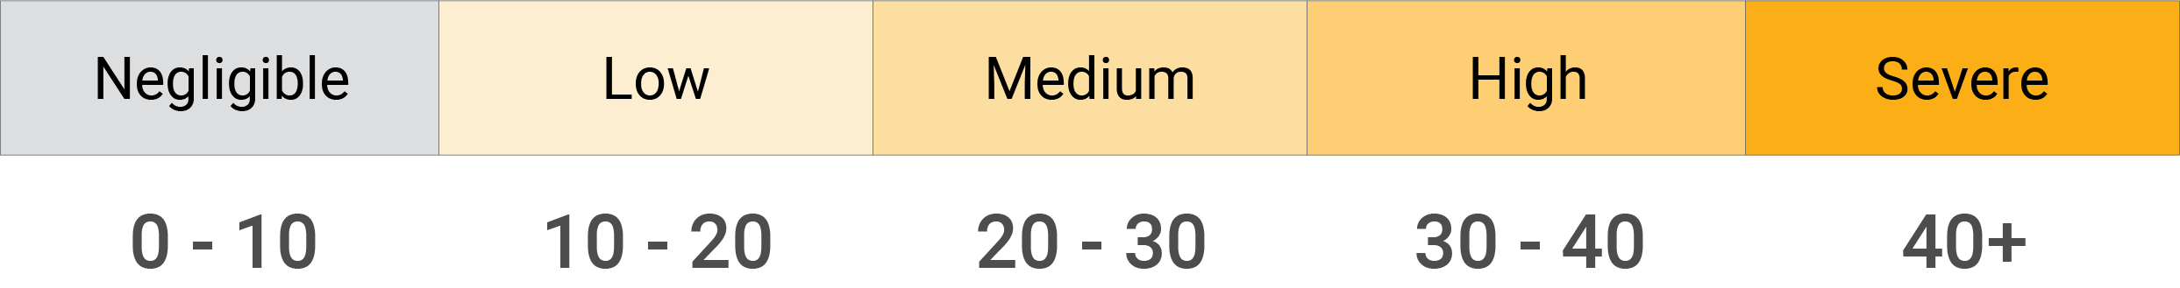
Sustainalytics
ESG Risk Ratings
Sustainalytics’ ESG Risk Ratings measure a company’s exposure to industry-specific material ESG risks and how well a company is managing those risks.
Source: https://www.sustainalytics.com/esg-data

Slide 101

Truvalue
ESG Ranks
TruValue Labs
Truvalue Labs applies AI to analyze over 100,000 sources and uncover ESG risks and opportunities hidden in unstructured text.
The ESG Ranks data service produces an overall company rank based on industry percentile leveraging the 26 ESG categories defined by the Sustainability Accounting Standards Board (SASB).
The data feed covers 20,000+ companies with more than 13 years of history.
Source: :https://developer.truvaluelabs.com/data/esg-ranks

Slide 102
AI for
Social Good
(AI4SG)
Source: Nenad Tomašev, Julien Cornebise, Frank Hutter, Shakir Mohamed, Angela Picciariello, Bec Connelly, Danielle Belgrave et al. (2020)
"AI for social good: unlocking the opportunity for positive impact." Nature Communications 11, no. 1: 1-6.

Slide 103
AI for Social Good (AI4SG)
AI for Sustainable Development
AI4SG 10 Guidelines
AI Technology (G1, G2, G3)
Applications (G4, G5, G6, G7, G8)
Data Handling (G9, G10)
Source: Nenad Tomašev, Julien Cornebise, Frank Hutter, Shakir Mohamed, Angela Picciariello, Bec Connelly, Danielle Belgrave et al. (2020)
"AI for social good: unlocking the opportunity for positive impact." Nature Communications 11, no. 1: 1-6.

Slide 104
AI4SG 10 Guidelines
AI Technology (G1, G2, G3)
G1: Expectations of what is possible with AI need to be well-grounded.
G2: There is value in simple solutions.
G3: Applications of AI need to be inclusive and accessible, and reviewed at every stage for ethics and human rights compliance.
Source: Nenad Tomašev, Julien Cornebise, Frank Hutter, Shakir Mohamed, Angela Picciariello, Bec Connelly, Danielle Belgrave et al. (2020)
"AI for social good: unlocking the opportunity for positive impact." Nature Communications 11, no. 1: 1-6.

Slide 105
AI4SG 10 Guidelines
Applications (G4, G5, G6, G7, G8)
G4: Goals and use cases should be clear and well-defined.
G5: Deep, long-term partnerships are required to solve large problems successfully.
G6: Planning needs to align incentives, and factor in the limitations of both communities.
G7: Establishing and maintaining trust is key to overcoming organisational barriers.
G8: Options for reducing the development cost of AI solutions should be explored.
Source: Nenad Tomašev, Julien Cornebise, Frank Hutter, Shakir Mohamed, Angela Picciariello, Bec Connelly, Danielle Belgrave et al. (2020)
"AI for social good: unlocking the opportunity for positive impact." Nature Communications 11, no. 1: 1-6.

Slide 106
AI4SG 10 Guidelines
Data Handling (G9, G10)
G9: Improving data readiness is key.
G10: Data must be processed securely, with utmost respect for human rights and privacy.
Source: Nenad Tomašev, Julien Cornebise, Frank Hutter, Shakir Mohamed, Angela Picciariello, Bec Connelly, Danielle Belgrave et al. (2020)
"AI for social good: unlocking the opportunity for positive impact." Nature Communications 11, no. 1: 1-6.

Slide 107

AI for Social Good (AI4SG)
Domains and Techniques
Source: Zheyuan Shi, Ryan, Claire Wang, and Fei Fang (2020). "Artificial intelligence for social good: A survey." arXiv preprint arXiv:2001.01818.

Slide 108

NLP for Social Good (NLP4SG)
Source: Fernando Gonzalez, Zhijing Jin, Jad Beydoun, Bernhard Schölkopf, Tom Hope, Rada Mihalcea, and Mrinmaya Sachan (2022).
"How Is NLP Addressing the 17 UN Sustainability Goals? A Challenge Set of Social Good Paper Classification and Information Extraction."

Slide 109

NLP for Social Good (NLP4SG)
Visualization
Source: Fernando Gonzalez, Zhijing Jin, Jad Beydoun, Bernhard Schölkopf, Tom Hope, Rada Mihalcea, and Mrinmaya Sachan (2022).
"How Is NLP Addressing the 17 UN Sustainability Goals? A Challenge Set of Social Good Paper Classification and Information Extraction."

Slide 110
Summary
AI in FinTech
  Metaverse, Web3, DeFi, NFT
  Financial Services Innovation and Applications
  Technology-driven Financial Industry Development
Green Finance and ESG
  SDGs: Sustainable Development Goals
  ESG: Environmental, Social, and Governance
  CSR: Corporate Social Responsibility
AI for Social Good (AI4SG)

Slide 111
Acknowledgments: Research Projects
Applying AI technology to construct knowledge graphs of cryptocurrency anti-money laundering: a few-shot learning model
  MOST, 110-2410-H-305-013-MY2, 2021/08/01~2023/07/31
Deepen Corporate Sustainability: Enhance the Performance of Corporate Sustainability from AI, Financial, and Strategic Perspectives. AI for Corporate Sustainability Assessment and Cross Language Corporate Sustainability Reports Generative Mode
  NTPU, 111-NTPU_ORDA-F-001，2022/01/01~2022/12/31
Artificial intelligence methods applied for analyzing the introduction of technological innovation: Patent text analysis and image analysis. Artificial Intelligence for FinTech Knowledge Graph from Patent Textual Analytics
  NTPU, 111-NTPU_ORDA-F-003, 2022/01/01~2022/12/31
Establishment and Implement of Smart Assistive Technology for Dementia Care and Its Socio-Economic Impacts. Intelligent, individualized and precise care with smart AT and system integration
  MOST, 111-2627-M-038-001-, 2022/08/01~2023/07/31

Slide 112
Artificial Intelligence for Fintech,
Green Finance, and ESG
Q & A
Time: 2022/12/12 (Mon) 14:00-16:00
Place: Room 106, New Building, Institute of Information Science, Academia Sinica
Host: Prof. Yu Tsao, TIGP (SNHCC), Academia Sinica
Min-Yuh Day, Ph.D,
Associate Professor
Institute of Information Management, National Taipei University
https://web.ntpu.edu.tw/~myday
2022-12-12

Slide 113
References
Longbing Cao (2022). "Decentralized ai: Edge intelligence and smart blockchain, metaverse, web3, and desci." IEEE Intelligent Systems 37, no. 3: 6-19.
Qinglin Yang, Yetong Zhao, Huawei Huang, Zehui Xiong, Jiawen Kang, and Zibin Zheng (2022). "Fusing blockchain and AI with metaverse: A survey." IEEE Open Journal of the Computer Society 3 : 122-136.
Russell Belk, Mariam Humayun, and Myriam Brouard (2022). "Money, possessions, and ownership in the Metaverse: NFTs, cryptocurrencies, Web3 and Wild Markets." Journal of Business Research 153: 198-205.
Thien Huynh-The, Quoc-Viet Pham, Xuan-Qui Pham, Thanh Thi Nguyen, Zhu Han, and Dong-Seong Kim (2022). "Artificial Intelligence for the Metaverse: A Survey." arXiv preprint arXiv:2202.10336.
Thippa Reddy Gadekallu, Thien Huynh-The, Weizheng Wang, Gokul Yenduri, Pasika Ranaweera, Quoc-Viet Pham, Daniel Benevides da Costa, and Madhusanka Liyanage (2022). "Blockchain for the Metaverse: A Review." arXiv preprint arXiv:2203.09738.
Dan Sheridan, James Harris, Frank Wear, Jerry Cowell Jr, Easton Wong, and Abbas Yazdinejad (2022). "Web3 Challenges and Opportunities for the Market." arXiv preprint arXiv:2209.02446.
Yves Hilpisch (2020), Artificial Intelligence in Finance: A Python-Based Guide, O’Reilly Media.
Aurélien Géron (2019), Hands-On Machine Learning with Scikit-Learn, Keras, and TensorFlow: Concepts, Tools, and Techniques to Build Intelligent Systems, 2nd Edition, O’Reilly Media.
Yves Hilpisch (2018), Python for Finance: Mastering Data-Driven Finance, 2nd Edition, O'Reilly Media.
Paolo Sironi (2016), FinTech Innovation: From Robo-Advisors to Goal Based Investing and Gamification, Wiley.
Yuxing Yan (2017), Python for Finance: Apply powerful finance models and quantitative analysis with Python, Second Edition, Packt Publishing
Campbell R. Harvey, Ashwin Ramachandran, Joey Santoro, Fred Ehrsam (2021), DeFi and the Future of Finance, Wiley
Matt Fortnow and QuHarrison Terry (2021), The NFT Handbook - How to Create, Sell and Buy Non-Fungible Tokens, Wiley
Parma Bains, Mohamed Diaby, Dimitris Drakopoulos, Julia Faltermeier, Federico Grinberg, Evan Papageorgiou, Dmitri Petrov, Patrick Schneider, and Nobu Sugimoto (2021),
The Crypto Ecosystem and Financial Stability Challenges, International Monetary Fund, October 2021
Henrik Skaug Sætra (2021) "A Framework for Evaluating and Disclosing the ESG Related Impacts of AI with the SDGs." Sustainability 13, no. 15: 8503
Nenad Tomašev, Julien Cornebise, Frank Hutter, Shakir Mohamed, Angela Picciariello, Bec Connelly, Danielle Belgrave et al. (2020) "AI for social good: unlocking the opportunity for positive impact." Nature Communications 11, no. 1: 1-6.
Zheyuan Shi, Ryan, Claire Wang, and Fei Fang (2020). "Artificial intelligence for social good: A survey." arXiv preprint arXiv:2001.01818.
Fernando Gonzalez, Zhijing Jin, Jad Beydoun, Bernhard Schölkopf, Tom Hope, Rada Mihalcea, and Mrinmaya Sachan (2022). "How Is NLP Addressing the 17 UN Sustainability Goals? A Challenge Set of Social Good Paper Classification and Information Extraction."
Ramesh Sharda, Dursun Delen, and Efraim Turban (2017), “Business Intelligence, Analytics, and Data Science: A Managerial Perspective”, 4th Edition, Pearson
Frederic S. Mishkin (2015), “The Economics of Money, Banking and Financial Markets”, 11th Edition, Pearson
Susanne Chishti and Janos Barberis (2016), “The FINTECH Book: The Financial Technology Handbook for Investors, Entrepreneurs and Visionaries”, Wiley.
Paolo Sironi (2016), “FinTech Innovation: From Robo-Advisors to Goal Based Investing and Gamification”, Wiley.
Brett King (2014), “Breaking Banks: The Innovators, Rogues, and Strategists Rebooting Banking”, Wiley.
Brett King (2012), “Bank 3.0: Why banking is no longer somewhere you go, but something you do”, John Wiley & Sons
Gopalakrishnan, Shanti, and Fariborz Damanpour (1997). "A review of innovation research in economics, sociology and technology management." Omega 25, no. 1 : 15-28.

