Slide 1
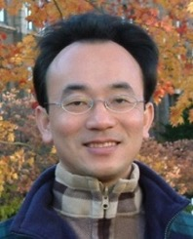
ChatGPT and Conversational AI with Reinforcement Learning from Human Feedback (RLHF)
Time: 2023/02/17 (Fri) 17:50-19:30
Place: R5117, Soochow University, Taiwan
Host: Prof. Shih-Wei Liao, NTU and Inclusion Technology, NSTC, Taiwan
Min-Yuh Day, Ph.D, Associate Professor
Institute of Information Management, National Taipei University
https://web.ntpu.edu.tw/~myday
2023-02-17

Slide 2
Min-Yuh Day, Ph.D.
1
Associate Professor, Information Management, NTPU
Visiting Scholar, IIS, Academia Sinica
Ph.D., Information Management, NTU
Director, Intelligent Financial Innovation Technology, IFIT Lab, IM, NTPU
Associate Director, Fintech and Green Finance Center, NTPU
Publications Co-Chairs, IEEE/ACM International Conference on Advances in Social Networks Analysis and Mining (ASONAM 2013- )
Program Co-Chair, IEEE International Workshop on Empirical Methods for Recognizing Inference in TExt (IEEE EM-RITE 2012- )
Publications Chair, The IEEE International Conference on Information Reuse and Integration for Data Science (IEEE IRI 2007- )

Slide 3
Outline
ChatGPT and Conversational AI
Generative Pre-trained Transformer (GPT)
Large Language Model (LLM)
Reinforcement Learning from Human Feedback (RLHF)
Generative AI
AI for Social Good (AI4SG)

Slide 4
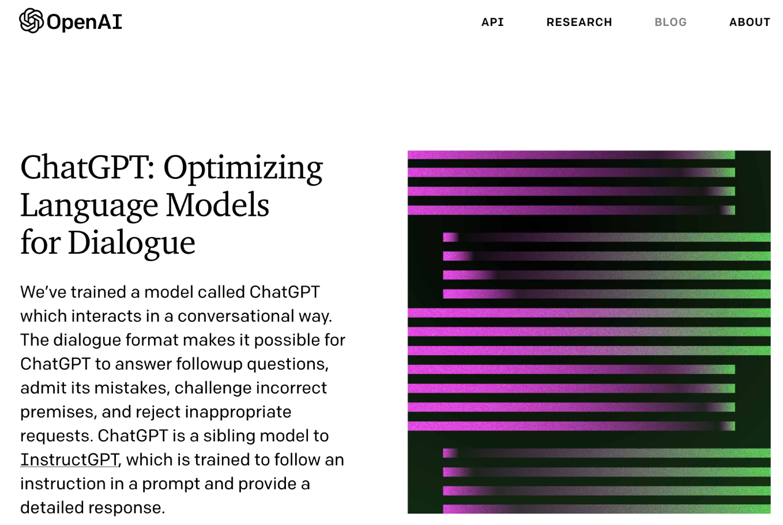
OpenAI ChatGPT
Source: https://openai.com/blog/chatgpt/

Slide 5
Conversational AI to deliver contextual and personal experience to users
Source: Huynh-The, Thien, Quoc-Viet Pham, Xuan-Qui Pham, Thanh Thi Nguyen, Zhu Han, and Dong-Seong Kim (2022). "Artificial Intelligence for the Metaverse: A Survey." arXiv preprint arXiv:2202.10336.

Slide 6
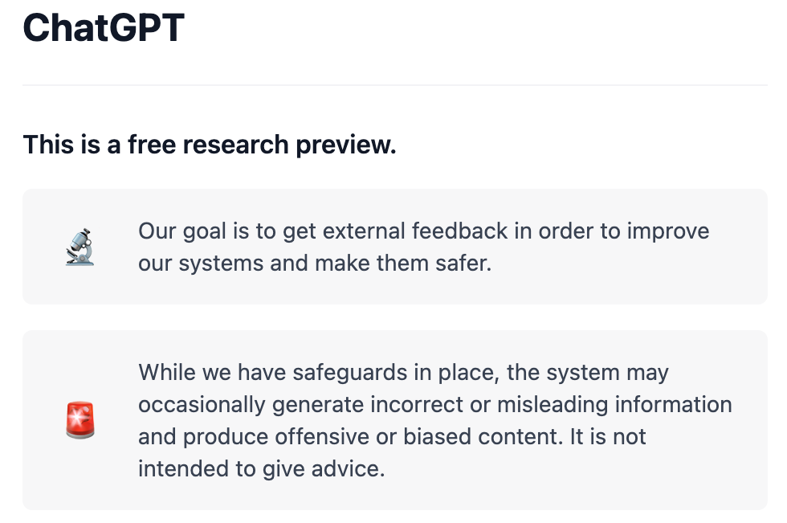
OpenAI ChatGPT
Source: https://chat.openai.com/chat

Slide 7
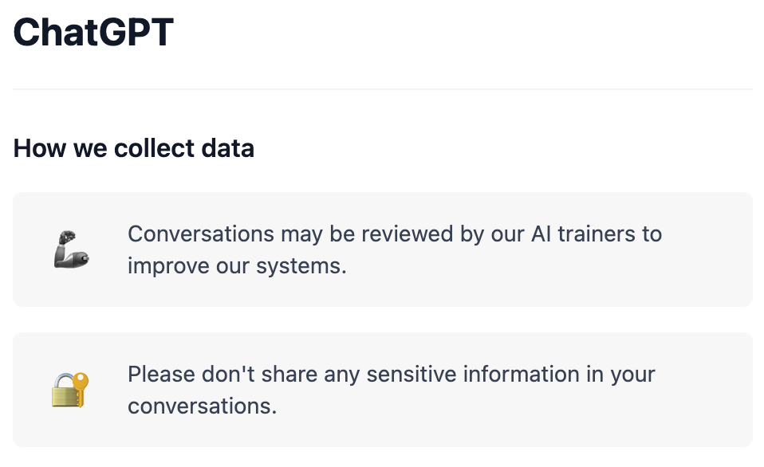
OpenAI ChatGPT
Source: https://chat.openai.com/chat

Slide 8
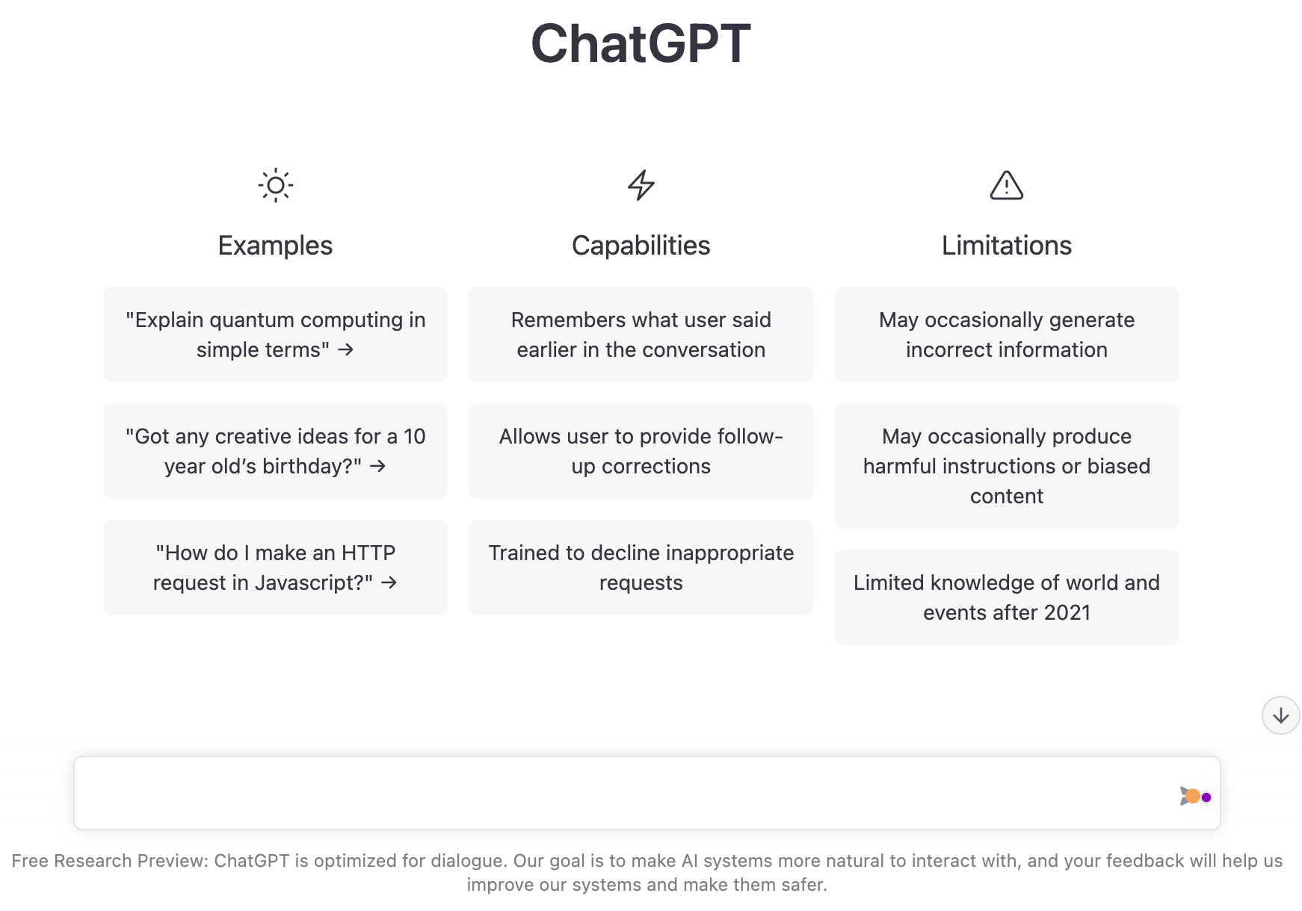
OpenAI ChatGPT
Source: https://chat.openai.com/chat

Slide 9
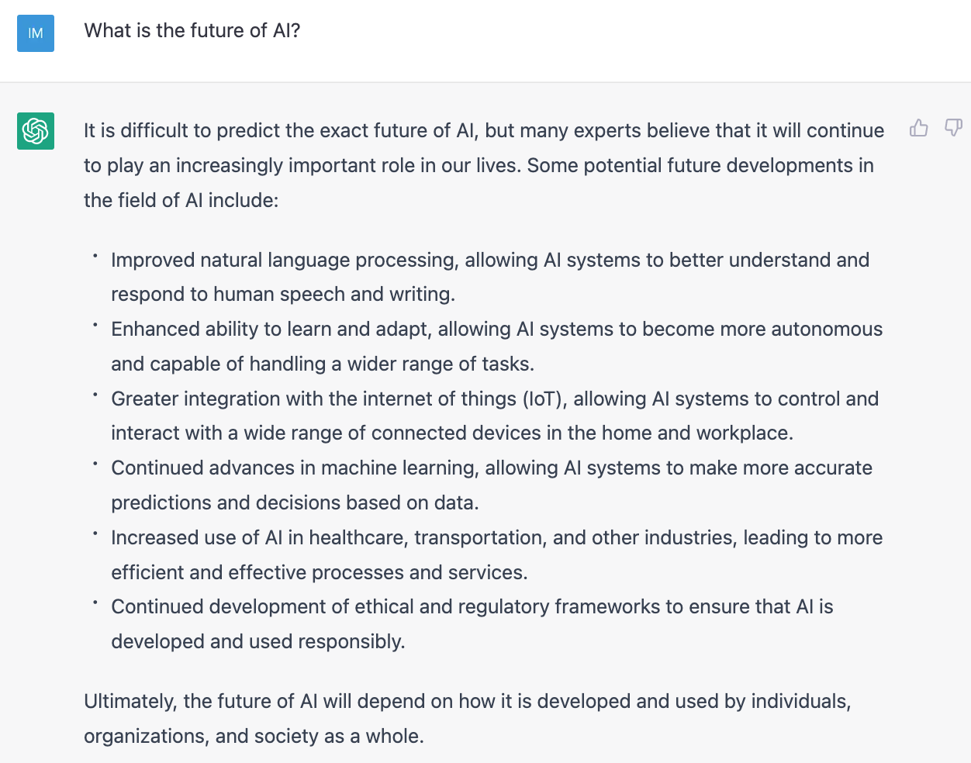
OpenAI ChatGPT
Source: https://chat.openai.com/chat

Slide 10
The Transformers Timeline
ULMFit
BERT
RoBERTa
XLM-R
DeBERTa
GPT-Neo
BLOOM
DistrilBERT
T5
PaLM
ChatGPT
Transformer
GPT
GPT-2
GPT-3
GPT-J
OPT-175B
2017
2018
2019
2020
2021
2022
2023
Source: Lewis Tunstall, Leandro von Werra, and Thomas Wolf (2022), Natural Language Processing with Transformers: Building Language Applications with Hugging Face, O'Reilly Media.

Slide 11
Transformer Models
Transformer
Encoder
Decoder
DistilBERT
BERT
T5
GPT
RoBERTa
BART
GPT-2
CTRL
XLM-R
XLM
M2M-100
GPT-3
ALBERT
BigBird
GPT-Neo
GPT-J
ELECTRA
mT0
BLOOM
BLOOMZ
DeBERTa
ChatGPT
Source: Lewis Tunstall, Leandro von Werra, and Thomas Wolf (2022), Natural Language Processing with Transformers: Building Language Applications with Hugging Face, O'Reilly Media.

Slide 12
Language Models Sizes (GPT-3, PaLM, BLOOM)
Source: https://lifearchitect.ai/models/

Slide 13
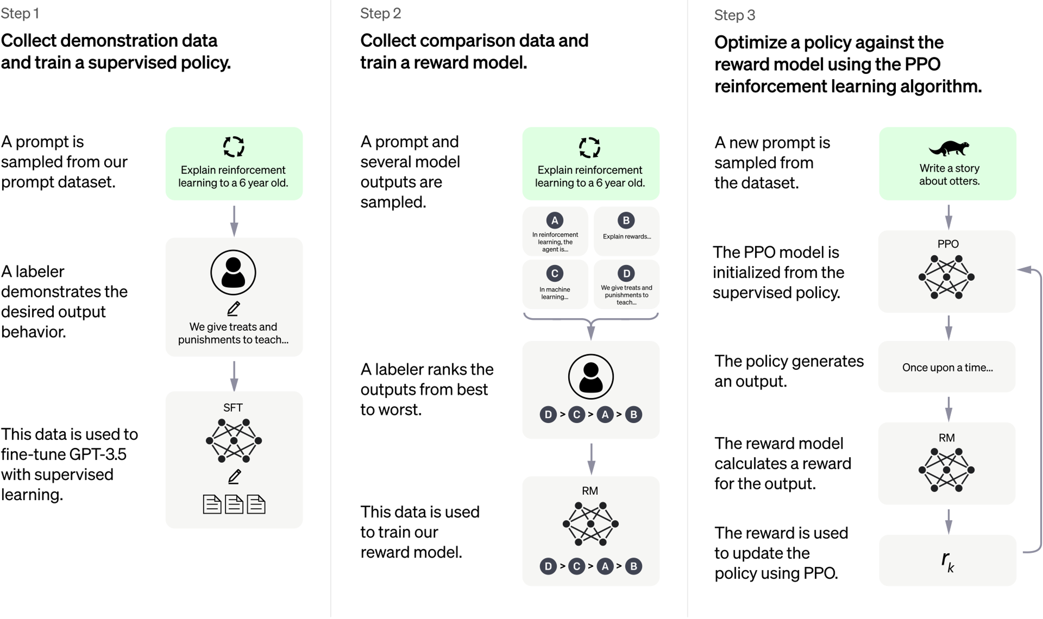
ChatGPT: Optimizing Language Models for Dialogue
Source: https://openai.com/blog/chatgpt/

Slide 14
Training language models to follow instructions with human feedback
InstructGPT and GPT 3.5
Source: Ouyang, L., Wu, J., Jiang, X., Almeida, D., Wainwright, C. L., Mishkin, P., ... & Lowe, R. (2022). Training language models to follow instructions with human feedback. arXiv preprint arXiv:2203.02155.

Slide 15
Reinforcement Learning from Human Feedback (RLHF)
Pretraining a Language Model (LM)
Gathering Data and Training a Reward Model
Fine-tuning the LM with Reinforcement Learning
Source: https://huggingface.co/blog/rlhf

Slide 16
Reinforcement Learning from Human Feedback (RLHF) Step 1. Pretraining a Language Model (LM)
Source: https://huggingface.co/blog/rlhf

Slide 17
Reinforcement Learning from Human Feedback (RLHF) Step 2. Gathering Data and Training a Reward Model
Source: https://huggingface.co/blog/rlhf

Slide 18
Reinforcement Learning from Human Feedback (RLHF) Step 3. Fine-tuning the LM with Reinforcement Learning
Source: https://huggingface.co/blog/rlhf

Slide 19
4 Approaches of AI
2. Thinking Humanly: The Cognitive Modeling Approach | 3. Thinking Rationally: The “Laws of Thought” Approach
1. Acting Humanly: The Turing Test Approach (1950) | 4. Acting Rationally: The Rational Agent Approach
Source: Stuart Russell and Peter Norvig (2020), Artificial Intelligence: A Modern Approach, 4th Edition, Pearson

Slide 20
AI Acting Humanly: The Turing Test Approach (Alan Turing, 1950)
Knowledge Representation
Automated Reasoning
Machine Learning (ML)
Deep Learning (DL)
Computer Vision (Image, Video)
Natural Language Processing (NLP)
Robotics
Source: Stuart Russell and Peter Norvig (2020), Artificial Intelligence: A Modern Approach, 4th Edition, Pearson

Slide 21
Can machines think?
Alan Turing rejected the question “Can machines think?” and replaced it with a behavioral test.
Alan Turing anticipated many objections to the possibility of thinking machines.
Concentrate on their systems’ performance on practical tasks
rather than the ability to imitate humans.
Consciousness remains a mystery.
Source: Stuart Russell and Peter Norvig (2020), Artificial Intelligence: A Modern Approach, 4th Edition, Pearson

Slide 22
Generative AI Gen AI

Slide 23
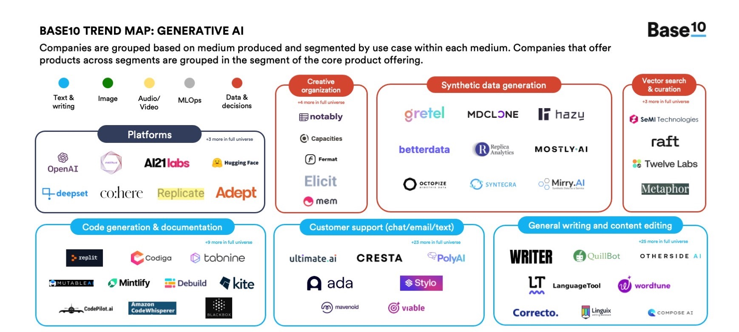
Generative AI
Source: https://base10.vc/post/generative-ai-mission-critical/

Slide 24
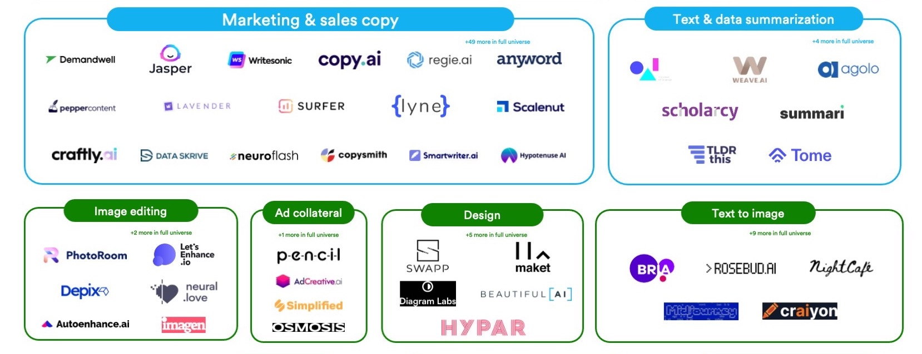
Generative AI
Source: https://base10.vc/post/generative-ai-mission-critical/

Slide 25
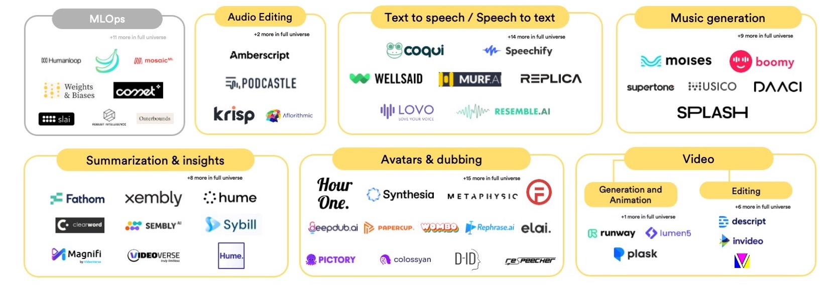
Generative AI
Source: https://base10.vc/post/generative-ai-mission-critical/

Slide 26
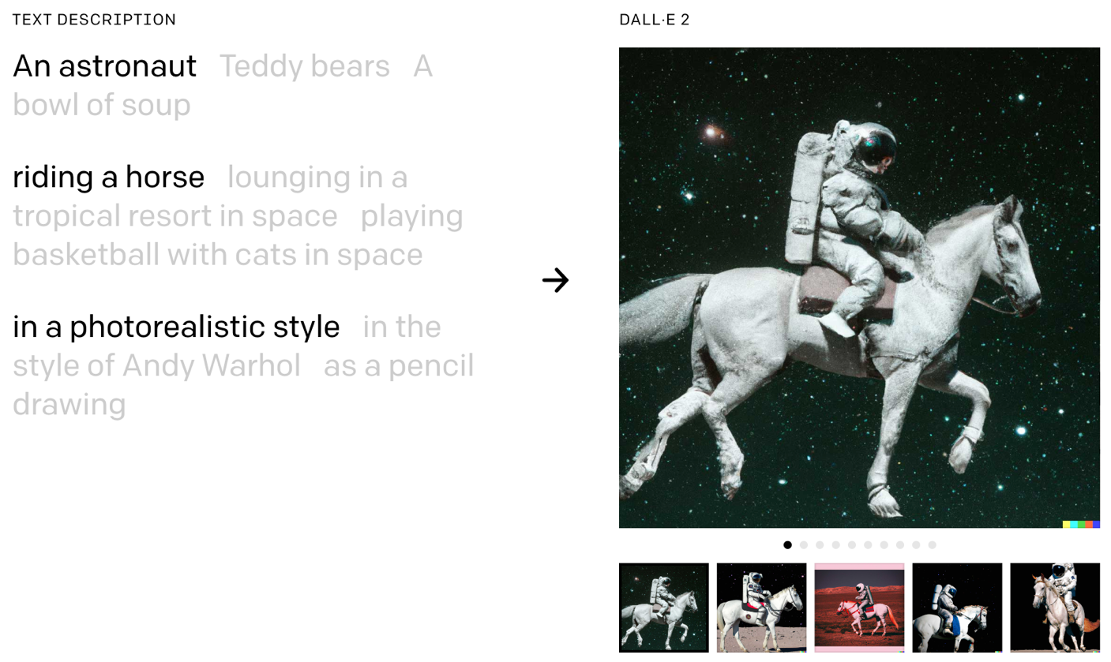
DALL·E 2 Create original, realistic images and art from a text description. It can combine concepts, attributes, and styles.
https://openai.com/dall-e-2/

Slide 27
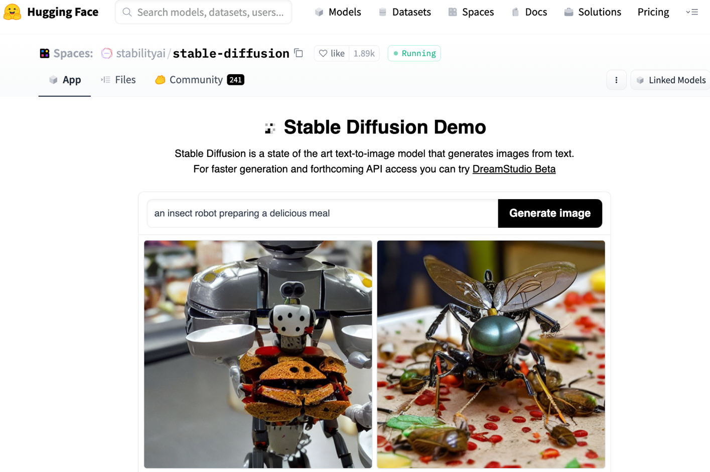
Stable Diffusion
https://huggingface.co/spaces/stabilityai/stable-diffusion

Slide 28
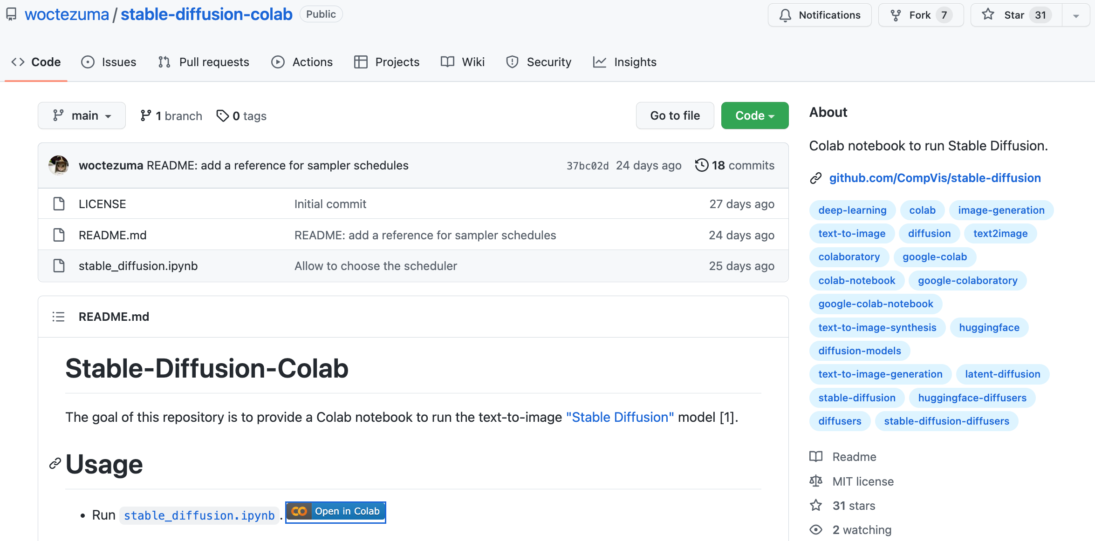
Stable Diffusion Colab
https://github.com/woctezuma/stable-diffusion-colab

Slide 29
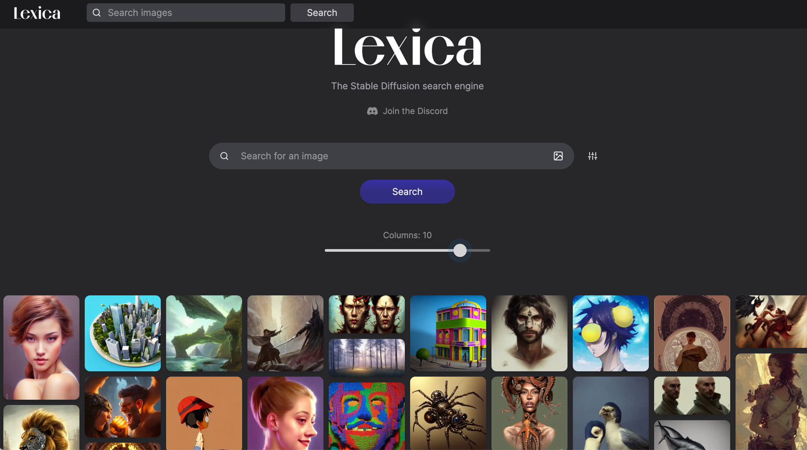
Lexica Art: Search Stable Diffusion images and prompts
https://lexica.art/

Slide 30
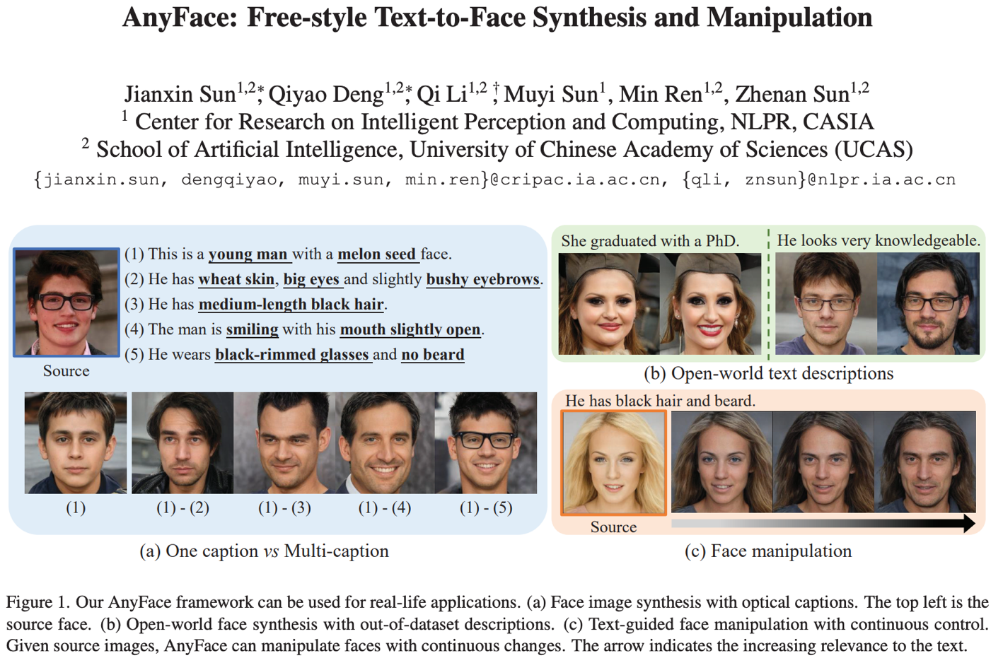
AnyFace: Free-style Text-to-Face Synthesis and Manipulation
Source: Sun, Jianxin, Qiyao Deng, Qi Li, Muyi Sun, Min Ren, and Zhenan Sun. (2022) "AnyFace: Free-style Text-to-Face Synthesis and Manipulation." In Proceedings of the IEEE/CVF Conference on Computer Vision and Pattern Recognition, pp. 18687-18696.

Slide 31
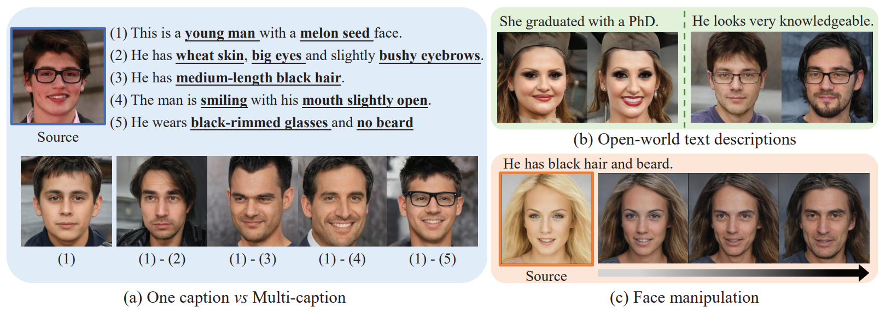
AnyFace: Free-style Text-to-Face Synthesis and Manipulation
Source: Sun, Jianxin, Qiyao Deng, Qi Li, Muyi Sun, Min Ren, and Zhenan Sun. (2022) "AnyFace: Free-style Text-to-Face Synthesis and Manipulation." In Proceedings of the IEEE/CVF Conference on Computer Vision and Pattern Recognition, pp. 18687-18696.

Slide 32
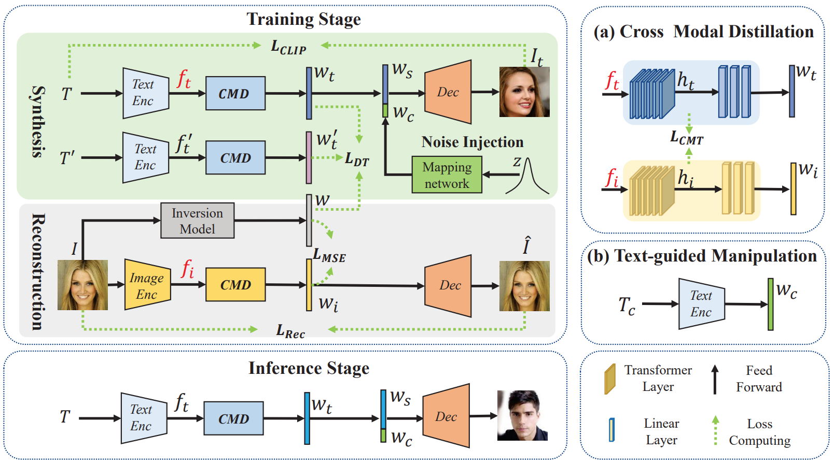
AnyFace: Free-style Text-to-Face Synthesis and Manipulation
Source: Sun, Jianxin, Qiyao Deng, Qi Li, Muyi Sun, Min Ren, and Zhenan Sun. (2022) "AnyFace: Free-style Text-to-Face Synthesis and Manipulation." In Proceedings of the IEEE/CVF Conference on Computer Vision and Pattern Recognition, pp. 18687-18696.

Slide 33
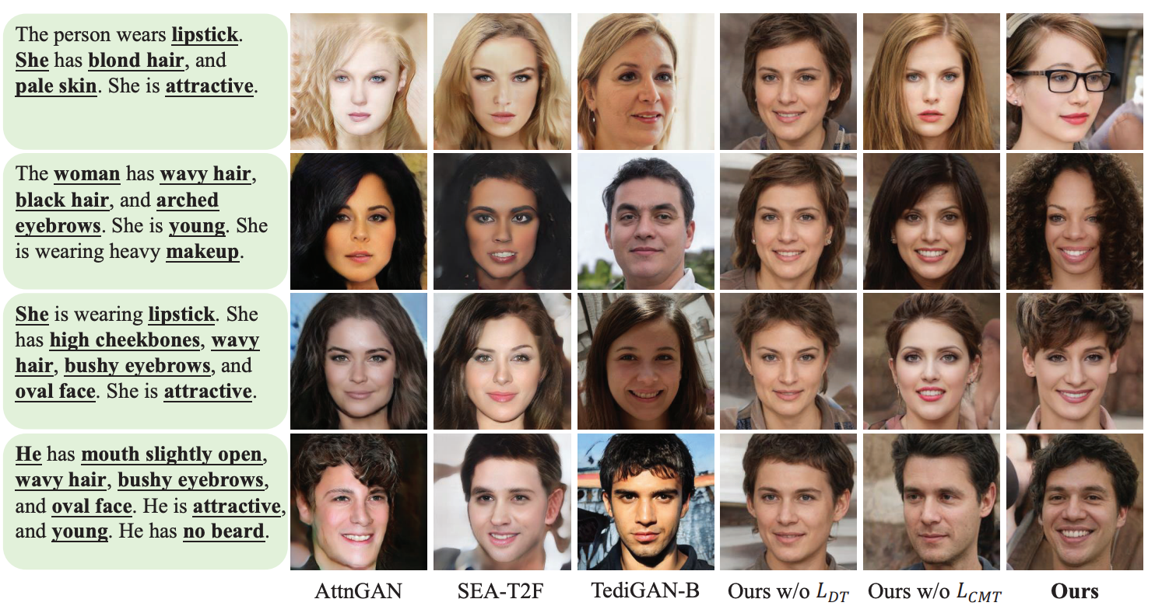
AnyFace: Free-style Text-to-Face Synthesis and Manipulation
Source: Sun, Jianxin, Qiyao Deng, Qi Li, Muyi Sun, Min Ren, and Zhenan Sun. (2022) "AnyFace: Free-style Text-to-Face Synthesis and Manipulation." In Proceedings of the IEEE/CVF Conference on Computer Vision and Pattern Recognition, pp. 18687-18696.

Slide 34
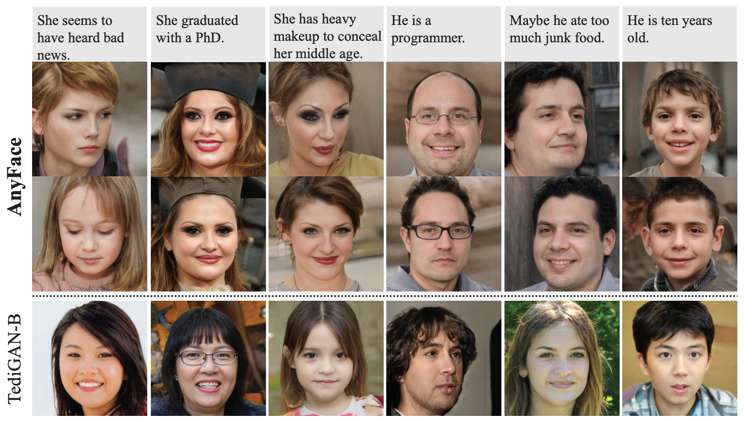
AnyFace: Free-style Text-to-Face Synthesis and Manipulation
Source: Sun, Jianxin, Qiyao Deng, Qi Li, Muyi Sun, Min Ren, and Zhenan Sun. (2022) "AnyFace: Free-style Text-to-Face Synthesis and Manipulation." In Proceedings of the IEEE/CVF Conference on Computer Vision and Pattern Recognition, pp. 18687-18696.

Slide 35
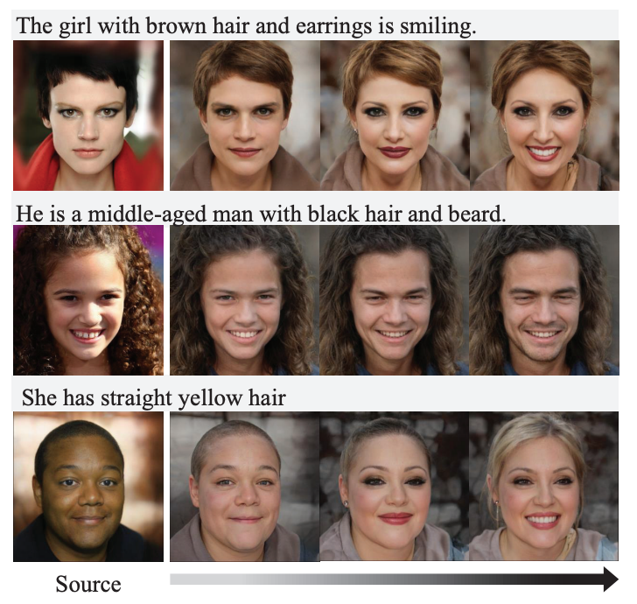
AnyFace: Free-style Text-to-Face Synthesis and Manipulation
Text-guided Face Manipulation
Source: Sun, Jianxin, Qiyao Deng, Qi Li, Muyi Sun, Min Ren, and Zhenan Sun. (2022) "AnyFace: Free-style Text-to-Face Synthesis and Manipulation." In Proceedings of the IEEE/CVF Conference on Computer Vision and Pattern Recognition, pp. 18687-18696.

Slide 36
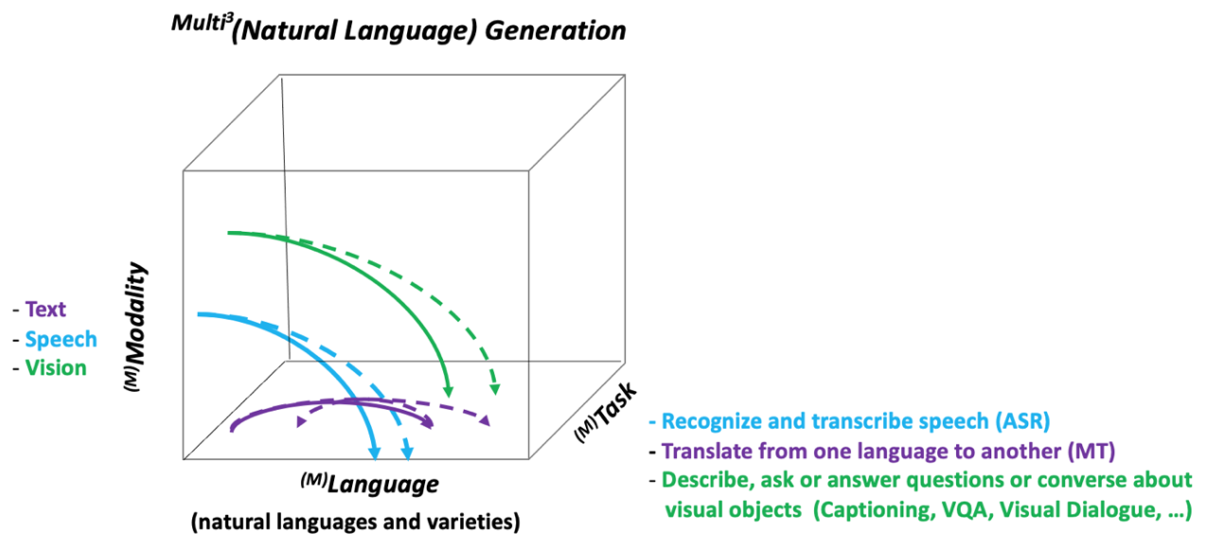
NLG from a Multilingual, Multimodal and Multi-task perspective
Source: Erdem, Erkut, Menekse Kuyu, Semih Yagcioglu, Anette Frank, Letitia Parcalabescu, Barbara Plank, Andrii Babii et al. "Neural Natural Language Generation: A Survey on Multilinguality, Multimodality, Controllability and Learning." Journal of Artificial Intelligence Research 73 (2022): 1131-1207.

Slide 37
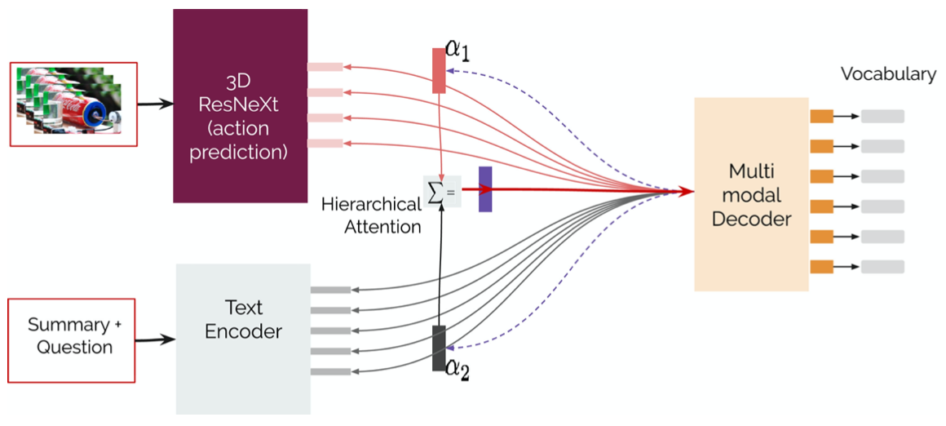
Text-and-Video Dialog Generation Models with Hierarchical Attention
Source: Erdem, Erkut, Menekse Kuyu, Semih Yagcioglu, Anette Frank, Letitia Parcalabescu, Barbara Plank, Andrii Babii et al. "Neural Natural Language Generation: A Survey on Multilinguality, Multimodality, Controllability and Learning." Journal of Artificial Intelligence Research 73 (2022): 1131-1207.

Slide 38
Multimodal Few-Shot Learning with Frozen Language Models
Curated samples with about five seeds required to get past well-known language model failure modes of either repeating text for the prompt or emitting text that does not pertain to the image.
These samples demonstrate the ability to generate open-ended outputs that adapt to both images and text, and to make use of facts that it has learned during language-only pre-training.
Source: Maria Tsimpoukelli, Jacob L. Menick, Serkan Cabi, S. M. Eslami, Oriol Vinyals, and Felix Hill (2021). "Multimodal few-shot learning with frozen language models." Advances in Neural Information Processing Systems 34 (2021): 200-212.

Slide 39
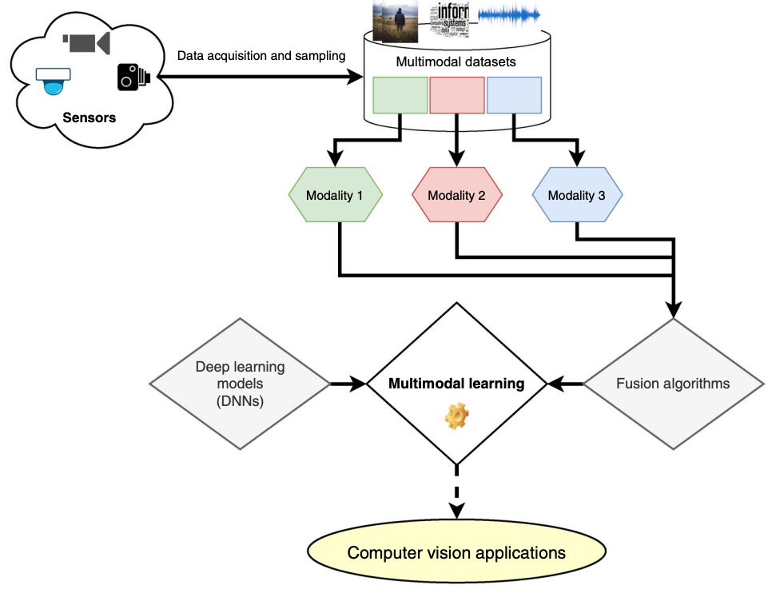
Multimodal Pipeline that includes three different modalities (Image, Text. Audio)
Source: Bayoudh, Khaled, Raja Knani, Fayçal Hamdaoui, and Abdellatif Mtibaa (2022). "A survey on deep multimodal learning for computer vision: advances, trends, applications, and datasets." The Visual Computer 38, no. 8: 2939-2970.

Slide 40
Video and Audio Multimodal Fusion
Source: Bayoudh, Khaled, Raja Knani, Fayçal Hamdaoui, and Abdellatif Mtibaa (2022). "A survey on deep multimodal learning for computer vision: advances, trends, applications, and datasets." The Visual Computer 38, no. 8: 2939-2970.

Slide 41
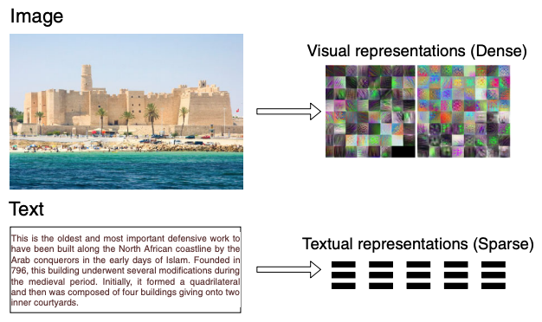
Visual and Textual Representation
Source: Bayoudh, Khaled, Raja Knani, Fayçal Hamdaoui, and Abdellatif Mtibaa (2022). "A survey on deep multimodal learning for computer vision: advances, trends, applications, and datasets." The Visual Computer 38, no. 8: 2939-2970.

Slide 42
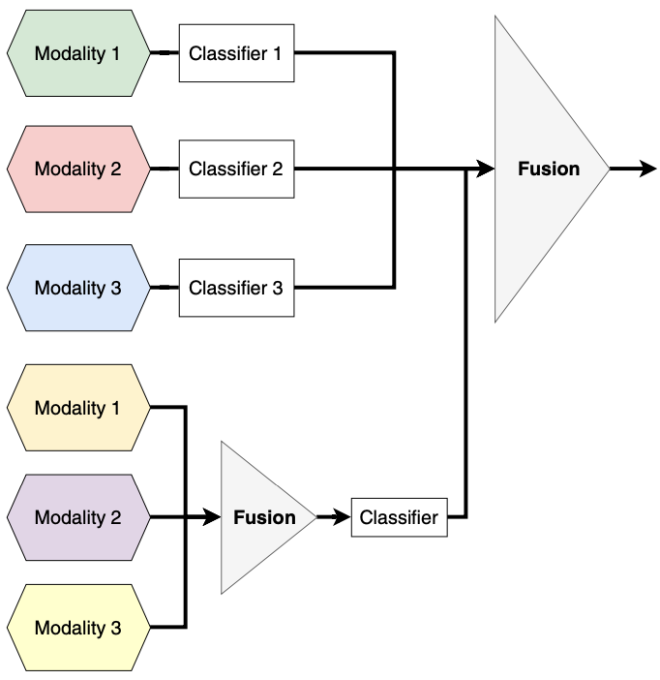
Hybrid Multimodal Data Fusion
Text
Audio
Image
Text
Speech
Video
Source: Bayoudh, Khaled, Raja Knani, Fayçal Hamdaoui, and Abdellatif Mtibaa (2022). "A survey on deep multimodal learning for computer vision: advances, trends, applications, and datasets." The Visual Computer 38, no. 8: 2939-2970.

Slide 43
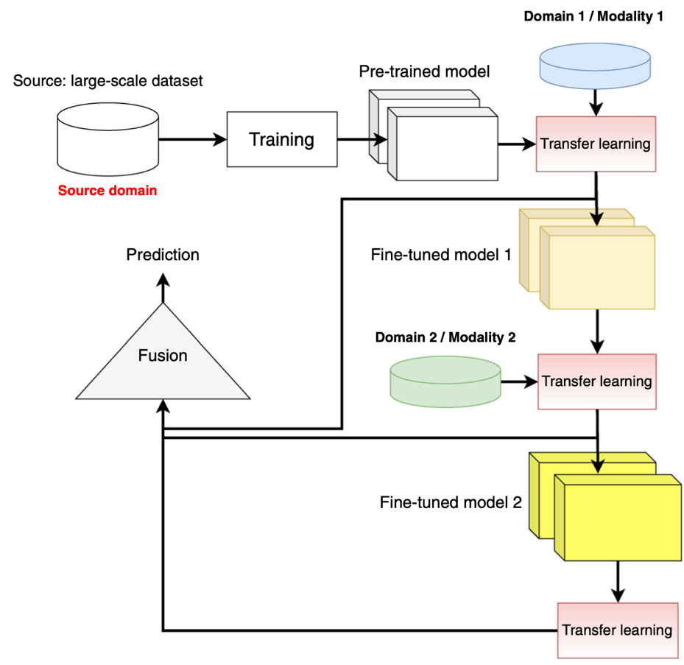
Multimodal Transfer Learning
Source: Bayoudh, Khaled, Raja Knani, Fayçal Hamdaoui, and Abdellatif Mtibaa (2022). "A survey on deep multimodal learning for computer vision: advances, trends, applications, and datasets." The Visual Computer 38, no. 8: 2939-2970.

Slide 44
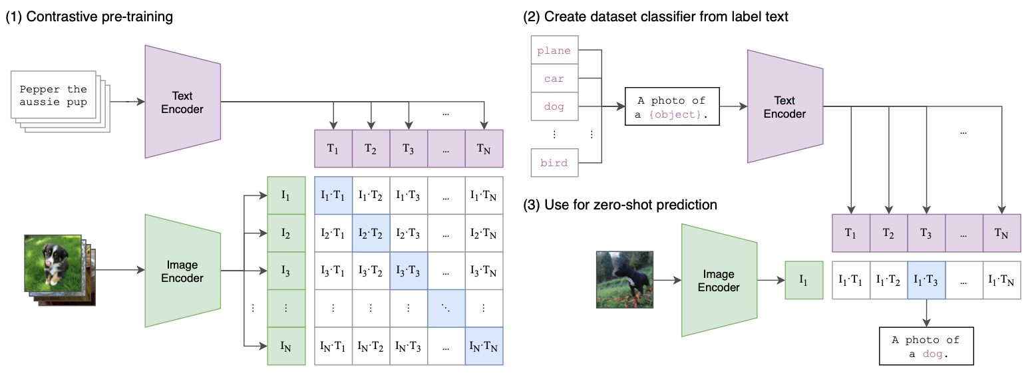
CLIP: Learning Transferable Visual Models From Natural Language Supervision
Source: Radford, Alec, Jong Wook Kim, Chris Hallacy, Aditya Ramesh, Gabriel Goh, Sandhini Agarwal, Girish Sastry et al. (2021) "Learning transferable visual models from natural language supervision." In International Conference on Machine Learning, pp. 8748-8763. PMLR.

Slide 45
ViLT: Vision-and-Language Transformer Without Convolution or Region Supervision
Source: Kim, Wonjae, Bokyung Son, and Ildoo Kim (2021). "Vilt: Vision-and-language transformer without convolution or region supervision." In International Conference on Machine Learning, pp. 5583-5594. PMLR.

Slide 46
wav2vec 2.0: A framework for self-supervised learning of speech representations
Source: Baevski, Alexei, Yuhao Zhou, Abdelrahman Mohamed, and Michael Auli. "wav2vec 2.0: A framework for self-supervised learning of speech representations." Advances in Neural Information Processing Systems 33 (2020): 12449-12460.

Slide 47
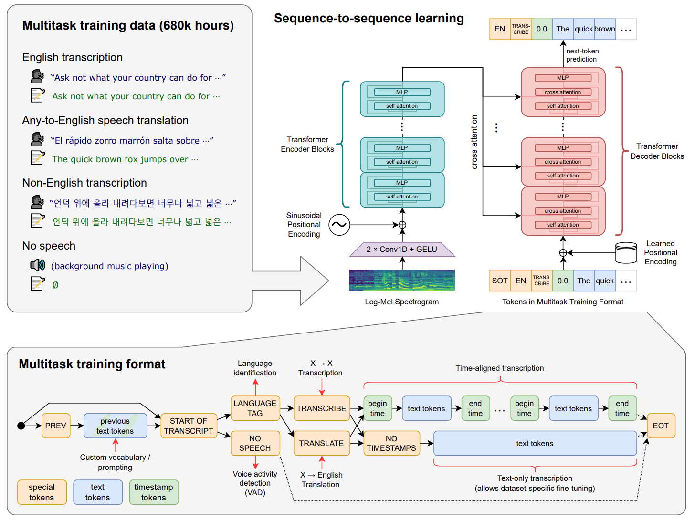
Whisper: Robust Speech Recognition via Large-Scale Weak Supervision
Source: Radford, Alec, Jong Wook Kim, Tao Xu, Greg Brockman, Christine McLeavey, and Ilya Sutskever. Robust speech recognition via large-scale weak supervision. Tech. Rep., Technical report, OpenAI, 2022.

Slide 48
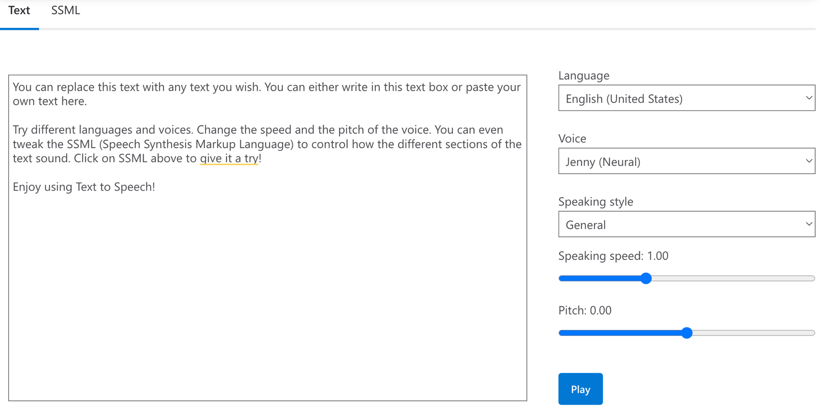
Microsoft Azure Text to Speech (TTS)
Source: https://azure.microsoft.com/en-gb/products/cognitive-services/text-to-speech/

Slide 49
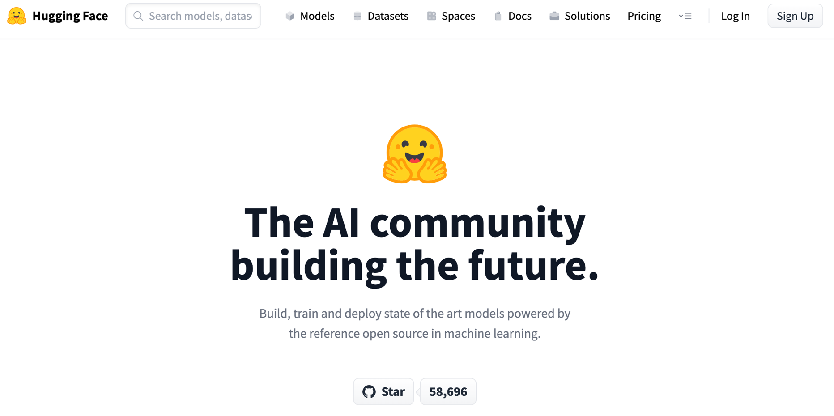
Hugging Face
https://huggingface.co/

Slide 50
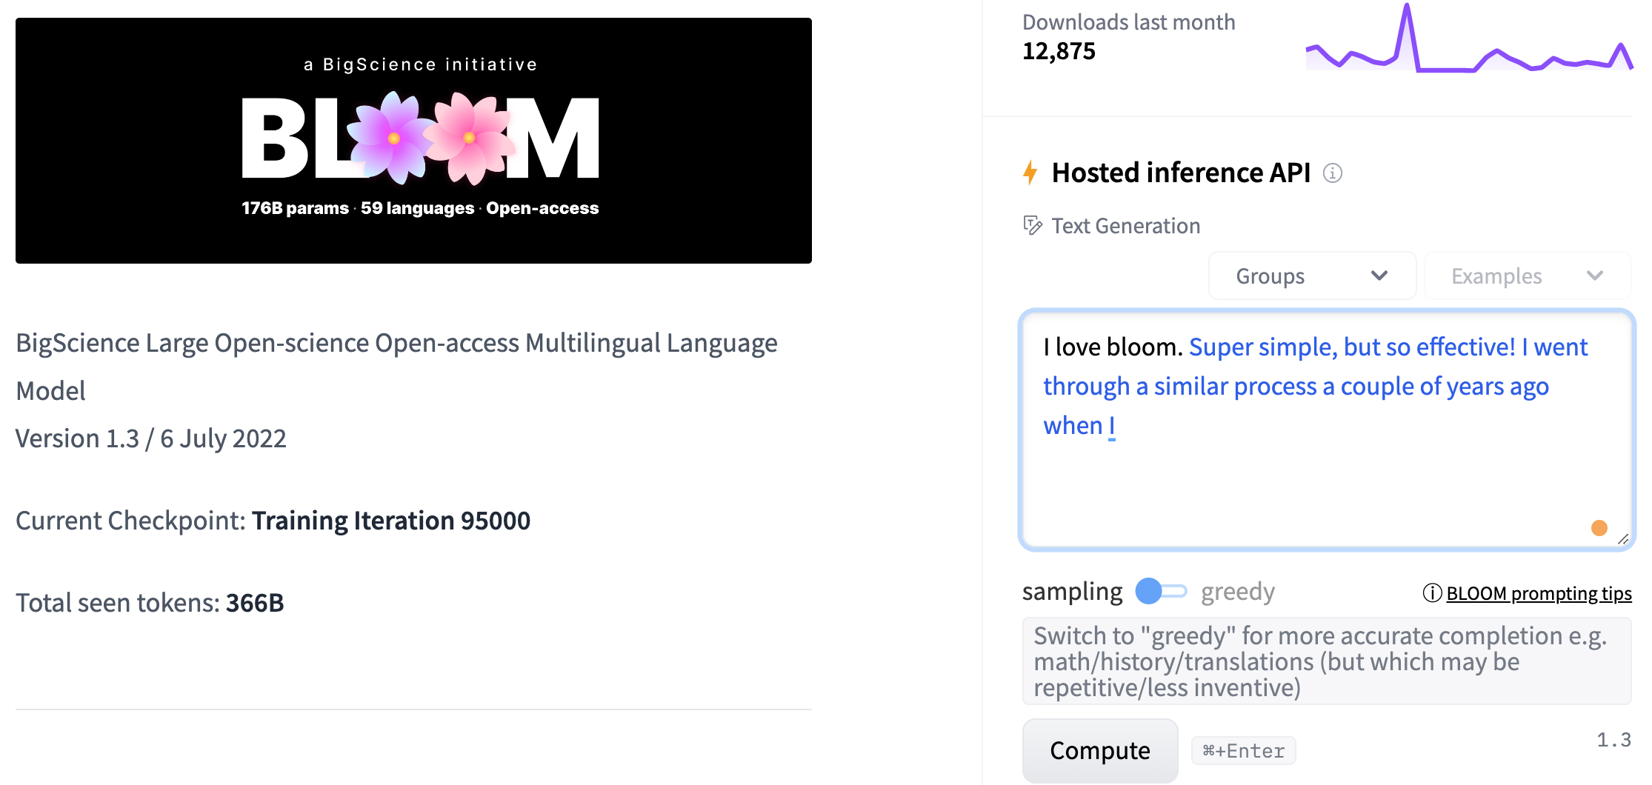
BLOOM BigScience Large Open-science Open-access Multilingual Language Model
Source: https://huggingface.co/bigscience/bloom

Slide 51
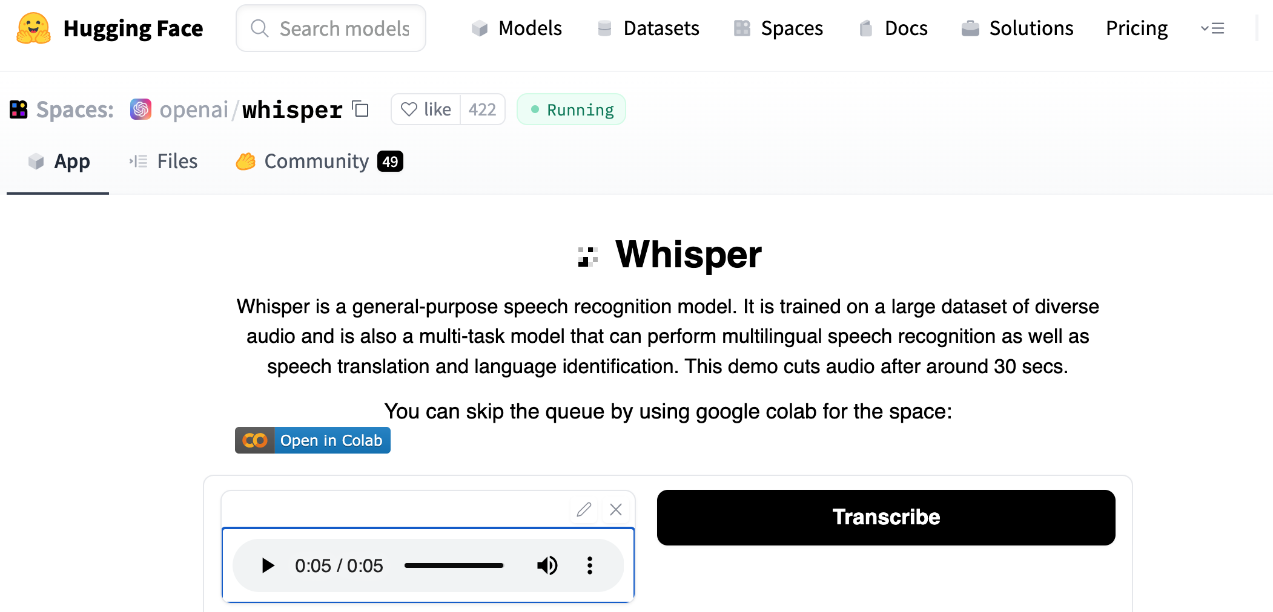
OpenAI Whisper
Source: https://huggingface.co/spaces/openai/whisper

Slide 52
Computer vision in the metaverse with scene understanding, object detection, and human action/activity recognition
Source: Huynh-The, Thien, Quoc-Viet Pham, Xuan-Qui Pham, Thanh Thi Nguyen, Zhu Han, and Dong-Seong Kim (2022). "Artificial Intelligence for the Metaverse: A Survey." arXiv preprint arXiv:2202.10336.

Slide 53
AI for Social Good (AI4SG)
Source: Nenad Tomašev, Julien Cornebise, Frank Hutter, Shakir Mohamed, Angela Picciariello, Bec Connelly, Danielle Belgrave et al. (2020) "AI for social good: unlocking the opportunity for positive impact." Nature Communications 11, no. 1: 1-6.

Slide 54
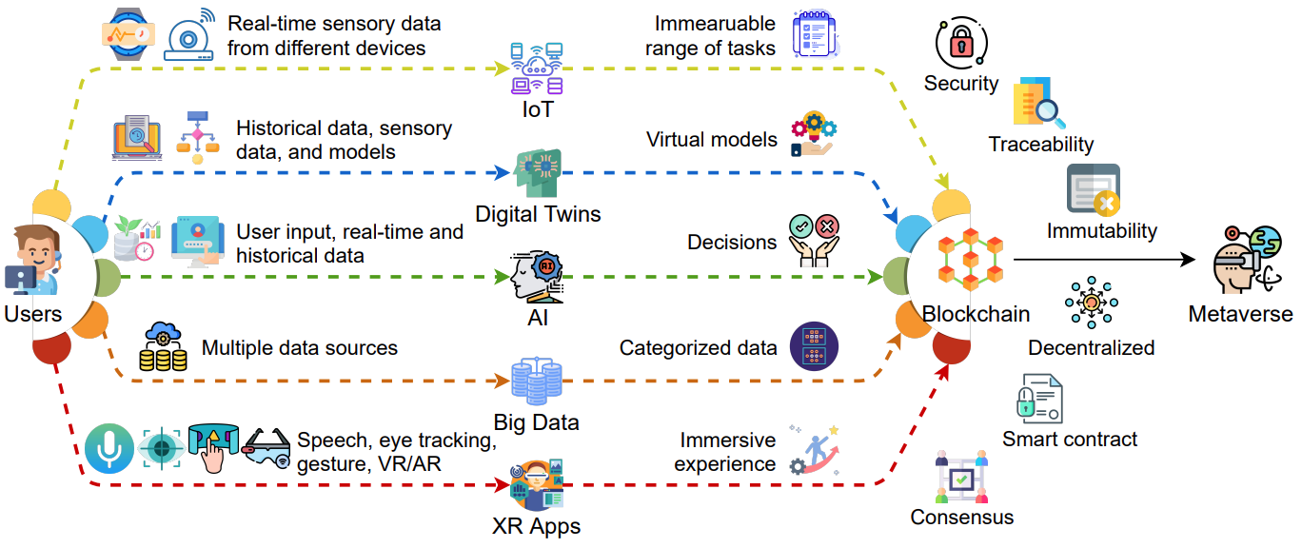
Key Enabling Technologies of the Metaverse
Source: Gadekallu, Thippa Reddy, Thien Huynh-The, Weizheng Wang, Gokul Yenduri, Pasika Ranaweera, Quoc-Viet Pham, Daniel Benevides da Costa, and Madhusanka Liyanage (2022). "Blockchain for the Metaverse: A Review." arXiv preprint arXiv:2203.09738..

Slide 55
Primary Technical Aspects in the Metaverse AI with ML algorithms and DL architectures is advancing the user experience in the virtual world
Source: Huynh-The, Thien, Quoc-Viet Pham, Xuan-Qui Pham, Thanh Thi Nguyen, Zhu Han, and Dong-Seong Kim (2022). "Artificial Intelligence for the Metaverse: A Survey." arXiv preprint arXiv:2202.10336.

Slide 56
AI for the Metaverse in the Application Aspects healthcare, manufacturing, smart cities, gaming E-commerce, human resources, real estate, and DeFi
Source: Huynh-The, Thien, Quoc-Viet Pham, Xuan-Qui Pham, Thanh Thi Nguyen, Zhu Han, and Dong-Seong Kim (2022). "Artificial Intelligence for the Metaverse: A Survey." arXiv preprint arXiv:2202.10336.

Slide 57
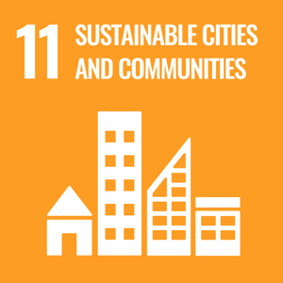
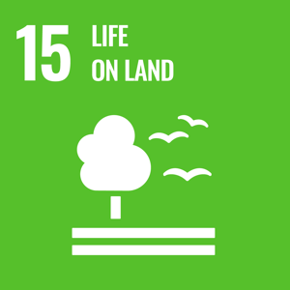
Sustainable Development Goals (SDGs)
Source: https://sdgs.un.org/goals

Slide 58
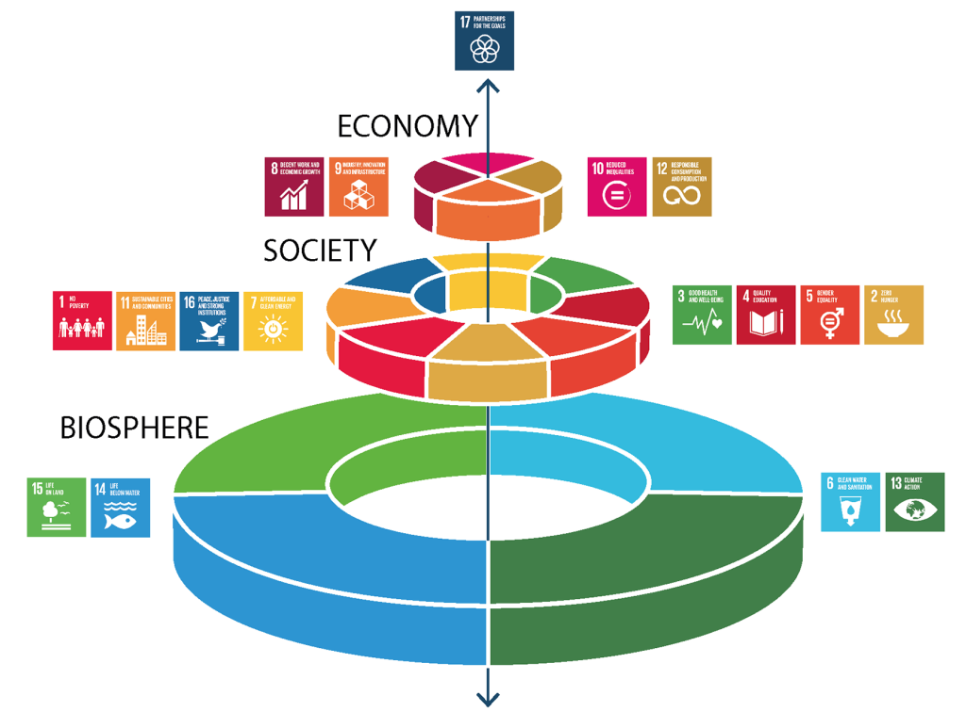
Sustainable Development Goals (SDGs) and 5P
Partnership
Peace
Prosperity
People
Planet
Source: Folke, Carl, Reinette Biggs, Albert V. Norström, Belinda Reyers, and Johan Rockström. "Social-ecological resilience and biosphere-based sustainability science.”Ecology and Society 21, no. 3 (2016).

Slide 59
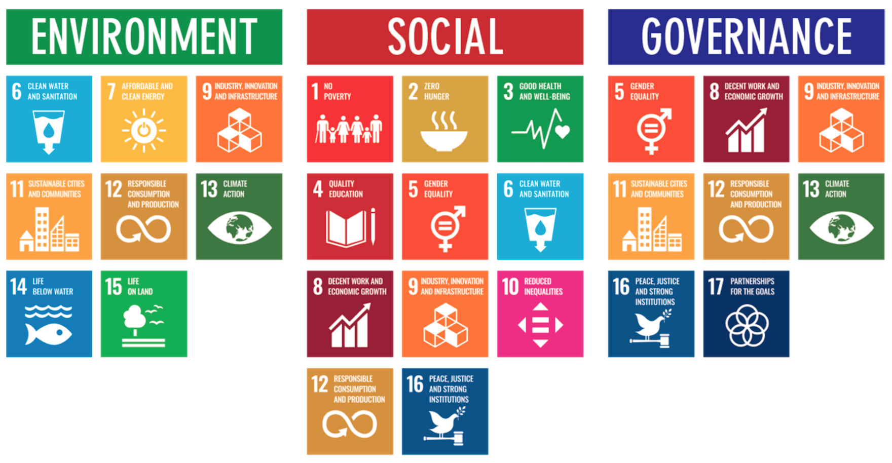
ESG to 17 SDGs
Source: Henrik Skaug Sætra (2021) "A Framework for Evaluating and Disclosing the ESG Related Impacts of AI with the SDGs." Sustainability 13, no. 15 (2021): 8503.

Slide 60
ESG to 17 SDGs
Source: https://sustainometric.com/esg-to-sdgs-connected-paths-to-a-sustainable-future/

Slide 61
AI for Social Good (AI4SG) AI for Sustainable Development AI4SG 10 Guidelines
AI Technology (G1, G2, G3)
Applications (G4, G5, G6, G7, G8)
Data Handling (G9, G10)
Source: Nenad Tomašev, Julien Cornebise, Frank Hutter, Shakir Mohamed, Angela Picciariello, Bec Connelly, Danielle Belgrave et al. (2020) "AI for social good: unlocking the opportunity for positive impact." Nature Communications 11, no. 1: 1-6.

Slide 62
AI4SG 10 Guidelines AI Technology (G1, G2, G3)
G1: Expectations of what is possible with AI need to be well-grounded.
G2: There is value in simple solutions.
G3: Applications of AI need to be inclusive and accessible, and reviewed at every stage for ethics and human rights compliance.
Source: Nenad Tomašev, Julien Cornebise, Frank Hutter, Shakir Mohamed, Angela Picciariello, Bec Connelly, Danielle Belgrave et al. (2020) "AI for social good: unlocking the opportunity for positive impact." Nature Communications 11, no. 1: 1-6.

Slide 63
AI4SG 10 Guidelines Applications (G4, G5, G6, G7, G8)
G4: Goals and use cases should be clear and well-defined.
G5: Deep, long-term partnerships are required to solve large problems successfully.
G6: Planning needs to align incentives, and factor in the limitations of both communities.
G7: Establishing and maintaining trust is key to overcoming organisational barriers.
G8: Options for reducing the development cost of AI solutions should be explored.
Source: Nenad Tomašev, Julien Cornebise, Frank Hutter, Shakir Mohamed, Angela Picciariello, Bec Connelly, Danielle Belgrave et al. (2020) "AI for social good: unlocking the opportunity for positive impact." Nature Communications 11, no. 1: 1-6.

Slide 64
AI4SG 10 Guidelines Data Handling (G9, G10)
G9: Improving data readiness is key.
G10: Data must be processed securely, with utmost respect for human rights and privacy.
Source: Nenad Tomašev, Julien Cornebise, Frank Hutter, Shakir Mohamed, Angela Picciariello, Bec Connelly, Danielle Belgrave et al. (2020) "AI for social good: unlocking the opportunity for positive impact." Nature Communications 11, no. 1: 1-6.

Slide 65
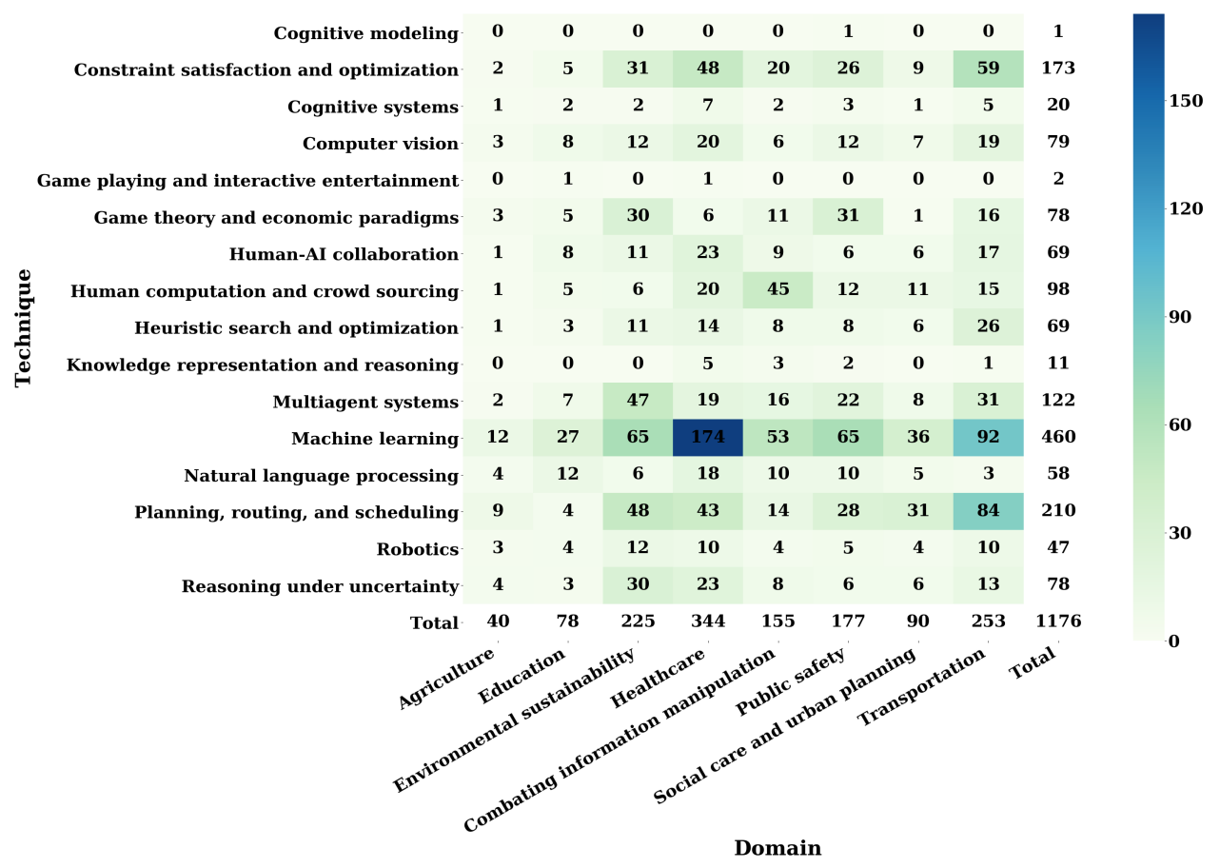
AI for Social Good (AI4SG) Domains and Techniques
Source: Zheyuan Shi, Ryan, Claire Wang, and Fei Fang (2020). "Artificial intelligence for social good: A survey." arXiv preprint arXiv:2001.01818.

Slide 66
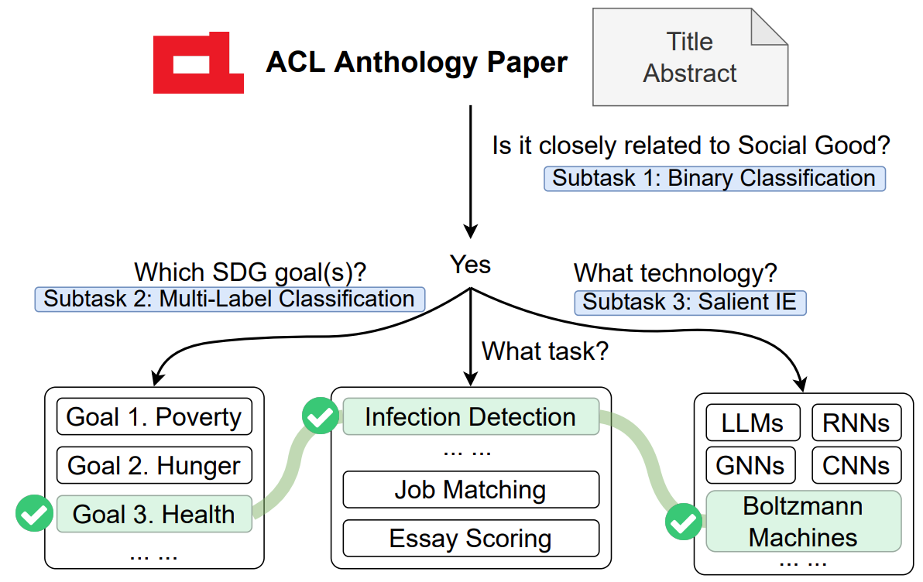
NLP for Social Good (NLP4SG)
Source: Fernando Gonzalez, Zhijing Jin, Jad Beydoun, Bernhard Schölkopf, Tom Hope, Rada Mihalcea, and Mrinmaya Sachan (2022). "How Is NLP Addressing the 17 UN Sustainability Goals? A Challenge Set of Social Good Paper Classification and Information Extraction."

Slide 67
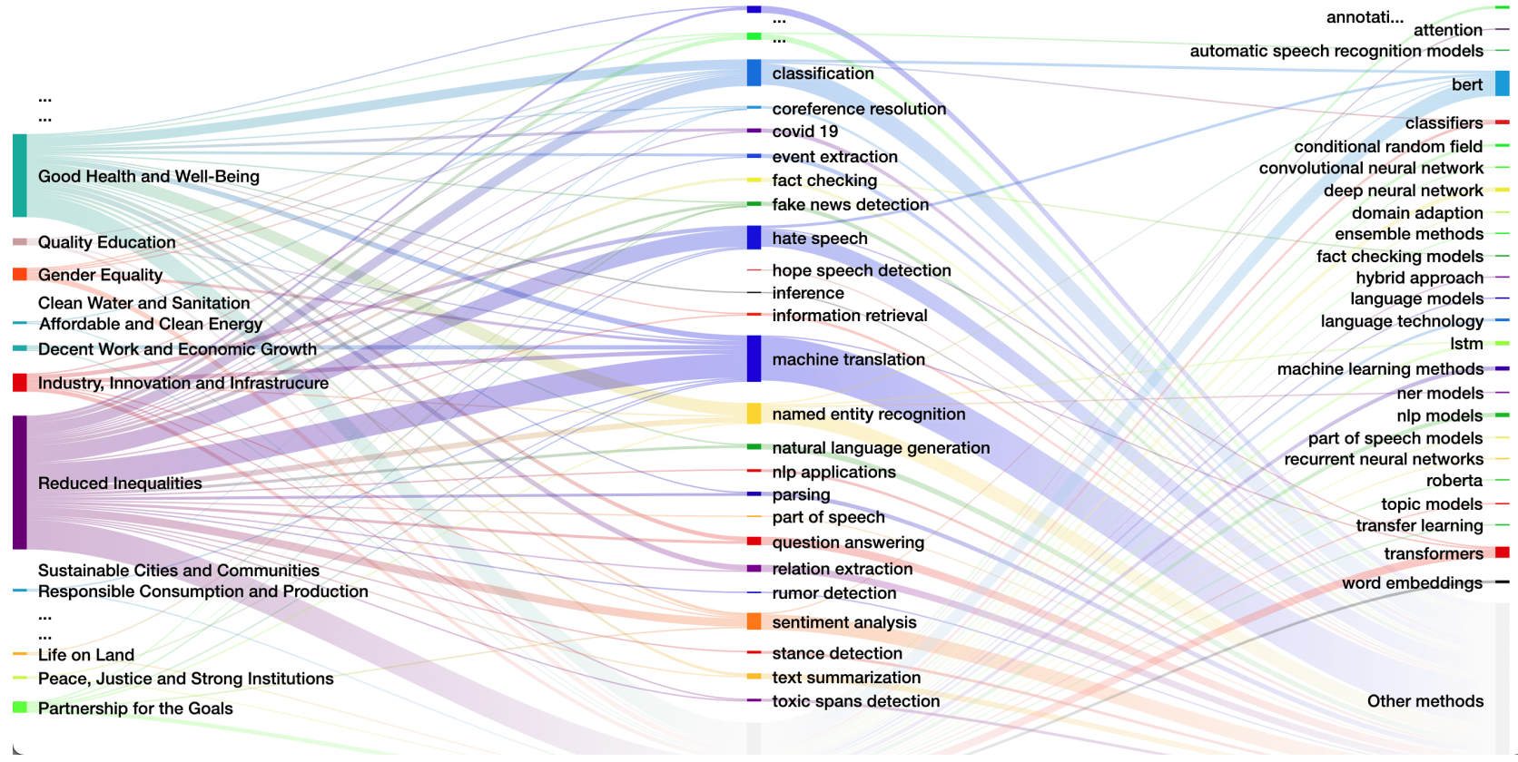
NLP for Social Good (NLP4SG) Visualization
Source: Fernando Gonzalez, Zhijing Jin, Jad Beydoun, Bernhard Schölkopf, Tom Hope, Rada Mihalcea, and Mrinmaya Sachan (2022). "How Is NLP Addressing the 17 UN Sustainability Goals? A Challenge Set of Social Good Paper Classification and Information Extraction."

Slide 68
Summary
ChatGPT and Conversational AI
Generative Pre-trained Transformer (GPT)
Large Language Model (LLM)
Reinforcement Learning from Human Feedback (RLHF)
Generative AI
AI for Social Good (AI4SG)

Slide 69
Acknowledgments: Research Projects
Applying AI technology to construct knowledge graphs of cryptocurrency anti-money laundering: a few-shot learning model
MOST, 110-2410-H-305-013-MY2, 2021/08/01~2023/07/31
Fintech Green Finance for Carbon Market Index, Corporate Finance, and Environmental Policies. Carbon Emission Sentiment Index with AI Text Analytics
NTPU, 112-NTPU_ORDA-F-003，2023/01/01~2024/12/31
Research on speech processing, synthesis, recognition, and sentence construction of people with language disabilities. Multimodal Cross-lingual Task-Oriented Dialogue System
NTPU, 112-NTPU_ORDA-F-004, 2023/01/01~2025/12/31
Use deep learning to identify commercially dental implant systems - observational study
USTP-NTPU-TMU, USTP-NTPU-TMU-112-01, 2023/01/01~2023/12/31
Metaverse Avatar Automatic Metadata Generation Module
FormosaVerse x NTPU, NTPU-111A413E01, 2022/12/01~2023/11/30
Establishment and Implement of Smart Assistive Technology for Dementia Care and Its Socio-Economic Impacts. Intelligent, individualized and precise care with smart AT and system integration
MOST, 111-2627-M-038-001-, 2022/08/01~2023/07/31

Slide 70
ChatGPT and Conversational AI with Reinforcement Learning from Human Feedback (RLHF)
Q & A
Time: 2023/02/17 (Fri) 17:50-19:30
Place: R5117, Soochow University, Taiwan
Host: Host: Prof. Shih-Wei Liao, NTU and Inclusion Technology, NSTC, Taiwan
Min-Yuh Day, Ph.D, Associate Professor
Institute of Information Management, National Taipei University
https://web.ntpu.edu.tw/~myday
2023-02-17

Slide 71
References
Longbing Cao (2022). "Decentralized ai: Edge intelligence and smart blockchain, metaverse, web3, and desci." IEEE Intelligent Systems 37, no. 3: 6-19.
Qinglin Yang, Yetong Zhao, Huawei Huang, Zehui Xiong, Jiawen Kang, and Zibin Zheng (2022). "Fusing blockchain and AI with metaverse: A survey." IEEE Open Journal of the Computer Society 3 : 122-136.
Russell Belk, Mariam Humayun, and Myriam Brouard (2022). "Money, possessions, and ownership in the Metaverse: NFTs, cryptocurrencies, Web3 and Wild Markets." Journal of Business Research 153: 198-205.
Thien Huynh-The, Quoc-Viet Pham, Xuan-Qui Pham, Thanh Thi Nguyen, Zhu Han, and Dong-Seong Kim (2022). "Artificial Intelligence for the Metaverse: A Survey." arXiv preprint arXiv:2202.10336.
Thippa Reddy Gadekallu, Thien Huynh-The, Weizheng Wang, Gokul Yenduri, Pasika Ranaweera, Quoc-Viet Pham, Daniel Benevides da Costa, and Madhusanka Liyanage (2022). "Blockchain for the Metaverse: A Review." arXiv preprint arXiv:2203.09738.
Dan Sheridan, James Harris, Frank Wear, Jerry Cowell Jr, Easton Wong, and Abbas Yazdinejad (2022). "Web3 Challenges and Opportunities for the Market." arXiv preprint arXiv:2209.02446.
Yves Hilpisch (2020), Artificial Intelligence in Finance: A Python-Based Guide, O’Reilly Media.
Aurélien Géron (2019), Hands-On Machine Learning with Scikit-Learn, Keras, and TensorFlow: Concepts, Tools, and Techniques to Build Intelligent Systems, 2nd Edition, O’Reilly Media.
Yves Hilpisch (2018), Python for Finance: Mastering Data-Driven Finance, 2nd Edition, O'Reilly Media.
Paolo Sironi (2016), FinTech Innovation: From Robo-Advisors to Goal Based Investing and Gamification, Wiley.
Yuxing Yan (2017), Python for Finance: Apply powerful finance models and quantitative analysis with Python, Second Edition, Packt Publishing
Campbell R. Harvey, Ashwin Ramachandran, Joey Santoro, Fred Ehrsam (2021), DeFi and the Future of Finance, Wiley
Matt Fortnow and QuHarrison Terry (2021), The NFT Handbook - How to Create, Sell and Buy Non-Fungible Tokens, Wiley
Parma Bains, Mohamed Diaby, Dimitris Drakopoulos, Julia Faltermeier, Federico Grinberg, Evan Papageorgiou, Dmitri Petrov, Patrick Schneider, and Nobu Sugimoto (2021), The Crypto Ecosystem and Financial Stability Challenges, International Monetary Fund, October 2021
Henrik Skaug Sætra (2021) "A Framework for Evaluating and Disclosing the ESG Related Impacts of AI with the SDGs." Sustainability 13, no. 15: 8503
Nenad Tomašev, Julien Cornebise, Frank Hutter, Shakir Mohamed, Angela Picciariello, Bec Connelly, Danielle Belgrave et al. (2020) "AI for social good: unlocking the opportunity for positive impact." Nature Communications 11, no. 1: 1-6.
Zheyuan Shi, Ryan, Claire Wang, and Fei Fang (2020). "Artificial intelligence for social good: A survey." arXiv preprint arXiv:2001.01818.
Fernando Gonzalez, Zhijing Jin, Jad Beydoun, Bernhard Schölkopf, Tom Hope, Rada Mihalcea, and Mrinmaya Sachan (2022). "How Is NLP Addressing the 17 UN Sustainability Goals? A Challenge Set of Social Good Paper Classification and Information Extraction.”
Ouyang, L., Wu, J., Jiang, X., Almeida, D., Wainwright, C. L., Mishkin, P., ... & Lowe, R. (2022). Training language models to follow instructions with human feedback. arXiv preprint arXiv:2203.02155.

