Slide 1
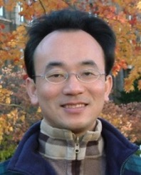
生成式AI在企業永續發展的應用 Generative AI for Corporate ESG and Sustainable Development
新北市教育局與國立臺北大學 共創學習假日講座
Time: 15:00-17:00, Saturday, December 2, 2023
Place: NTPU USR Hub
https://learningcollaboration.org/index.php/2023/09/21/collegeco1120103/
戴敏育 副教授
Min-Yuh Day, Ph.D, Associate Professor
Institute of Information Management, National Taipei University
https://web.ntpu.edu.tw/~myday
2023-12-02

Slide 2
戴敏育 博士 Min-Yuh Day, Ph.D.
1
Associate Professor, Information Management, NTPU
Visiting Scholar, IIS, Academia Sinica
Ph.D., Information Management, NTU
Director, Intelligent Financial Innovation Technology, IFIT Lab, IM, NTPU
Associate Director, Fintech and Green Finance Center, NTPU
Publications Co-Chairs, IEEE/ACM International Conference on Advances in Social Networks Analysis and Mining (ASONAM 2013- )
Program Co-Chair, IEEE International Workshop on Empirical Methods for Recognizing Inference in TExt (IEEE EM-RITE 2012- )
Publications Chair, The IEEE International Conference on Information Reuse and Integration for Data Science (IEEE IRI 2007- )

Slide 3
Outline
1. Generative AI
2. ChatGPT and Large Language Models (LLMs)
3. Popular Generative AI and Applications
4. Generative AI for Corporate ESG and Sustainable Development

Slide 4
衡量企業永續關鍵指標 臺北大學獨創ESG永續評鑑系統
Source: https://www.aacsb.ntpu.edu.tw/twsvi/view.php?id=Nzc=

Slide 5
Generative AI (Gen AI) AI Generated Content (AIGC)

Slide 6
Generative AI (Gen AI) AI Generated Content (AIGC)
Image Generation
Source: Yihan Cao, Siyu Li, Yixin Liu, Zhiling Yan, Yutong Dai, Philip S. Yu, and Lichao Sun (2023). "A Comprehensive Survey of AI-Generated Content (AIGC): A History of Generative AI from GAN to ChatGPT." arXiv preprint arXiv:2303.04226.

Slide 7
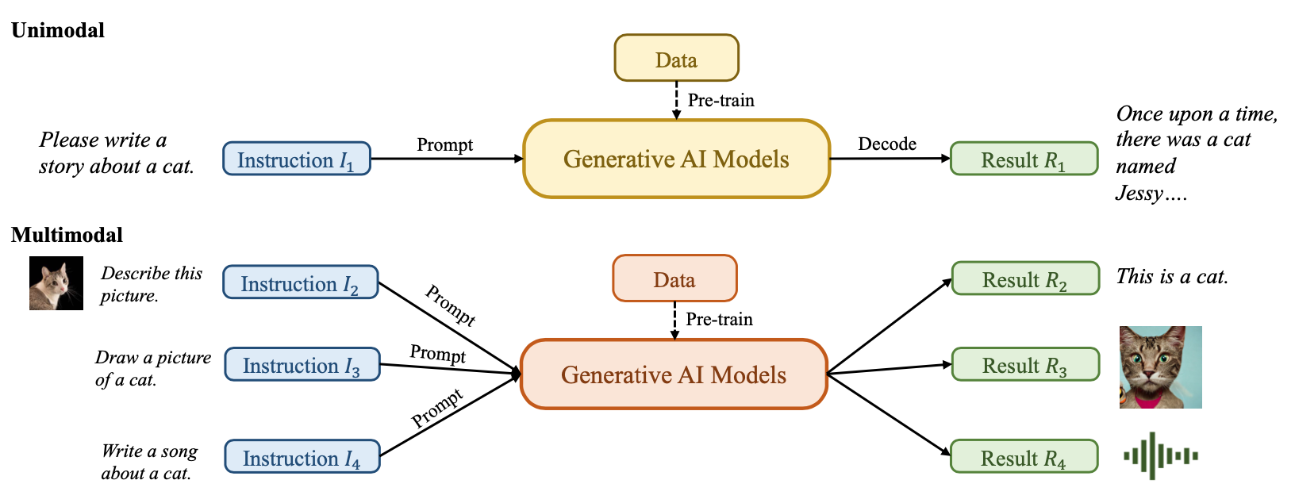
Generative AI (Gen AI) AI Generated Content (AIGC)
Source: Yihan Cao, Siyu Li, Yixin Liu, Zhiling Yan, Yutong Dai, Philip S. Yu, and Lichao Sun (2023). "A Comprehensive Survey of AI-Generated Content (AIGC): A History of Generative AI from GAN to ChatGPT." arXiv preprint arXiv:2303.04226.

Slide 8
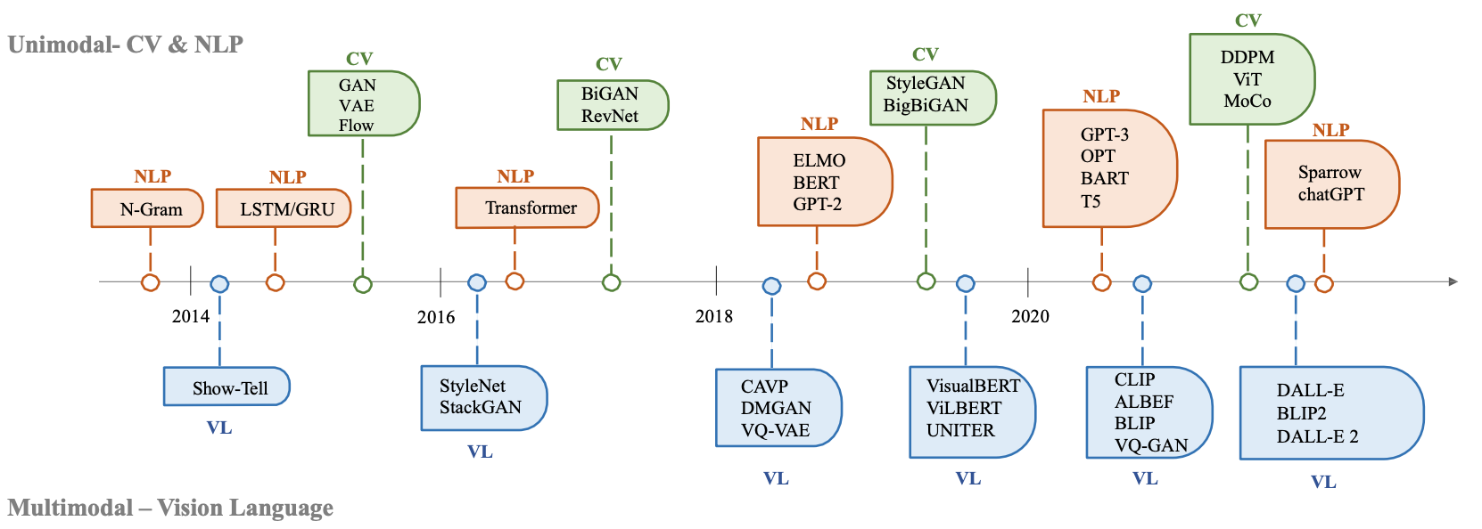
The history of Generative AI in CV, NLP and VL
Source: Yihan Cao, Siyu Li, Yixin Liu, Zhiling Yan, Yutong Dai, Philip S. Yu, and Lichao Sun (2023). "A Comprehensive Survey of AI-Generated Content (AIGC): A History of Generative AI from GAN to ChatGPT." arXiv preprint arXiv:2303.04226.

Slide 9
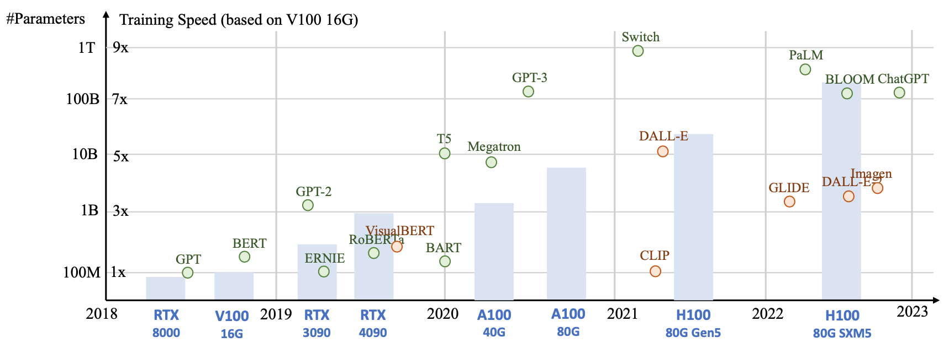
Generative AI Foundation Models
Source: Yihan Cao, Siyu Li, Yixin Liu, Zhiling Yan, Yutong Dai, Philip S. Yu, and Lichao Sun (2023). "A Comprehensive Survey of AI-Generated Content (AIGC): A History of Generative AI from GAN to ChatGPT." arXiv preprint arXiv:2303.04226.

Slide 10
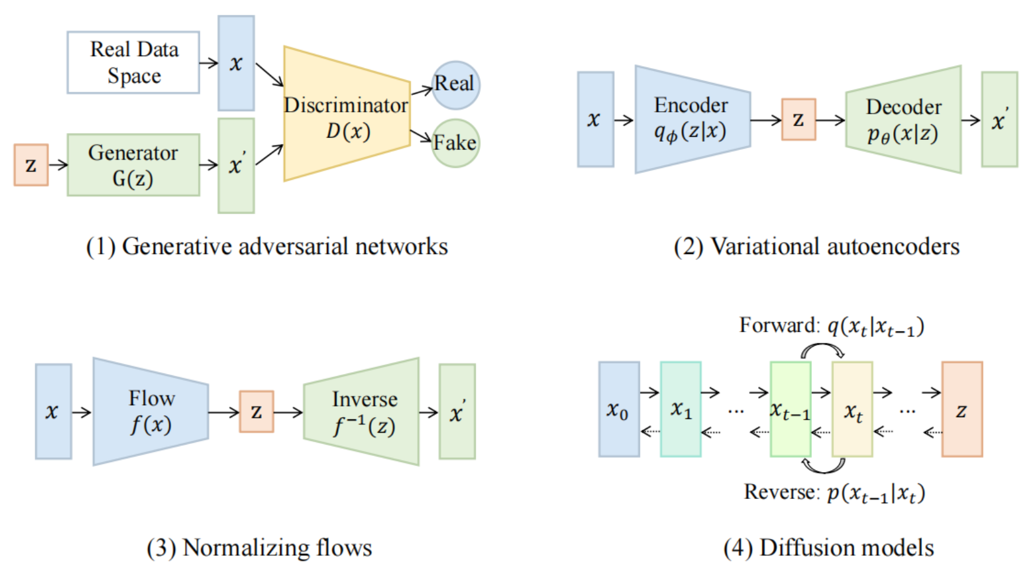
Categories of Vision Generative Models
Source: Yihan Cao, Siyu Li, Yixin Liu, Zhiling Yan, Yutong Dai, Philip S. Yu, and Lichao Sun (2023). "A Comprehensive Survey of AI-Generated Content (AIGC): A History of Generative AI from GAN to ChatGPT." arXiv preprint arXiv:2303.04226.

Slide 11
The General Structure of Generative Vision Language
Source: Yihan Cao, Siyu Li, Yixin Liu, Zhiling Yan, Yutong Dai, Philip S. Yu, and Lichao Sun (2023). "A Comprehensive Survey of AI-Generated Content (AIGC): A History of Generative AI from GAN to ChatGPT." arXiv preprint arXiv:2303.04226.

Slide 12
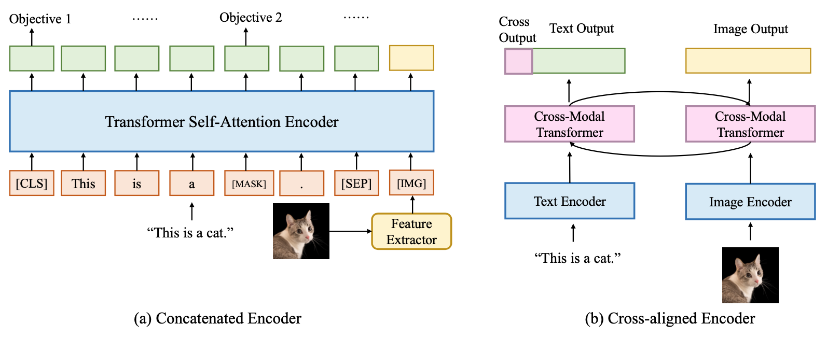
Two Types of Vision Language Encoders: Concatenated Encoders and Cross-aligned Encoders
Source: Yihan Cao, Siyu Li, Yixin Liu, Zhiling Yan, Yutong Dai, Philip S. Yu, and Lichao Sun (2023). "A Comprehensive Survey of AI-Generated Content (AIGC): A History of Generative AI from GAN to ChatGPT." arXiv preprint arXiv:2303.04226.

Slide 13
Two Types of to-language Decoder Models: Jointly-trained Models and Frozen Models
Source: Yihan Cao, Siyu Li, Yixin Liu, Zhiling Yan, Yutong Dai, Philip S. Yu, and Lichao Sun (2023). "A Comprehensive Survey of AI-Generated Content (AIGC): A History of Generative AI from GAN to ChatGPT." arXiv preprint arXiv:2303.04226.

Slide 14
ChatGPT Large Language Models (LLMs) Foundation Models

Slide 15
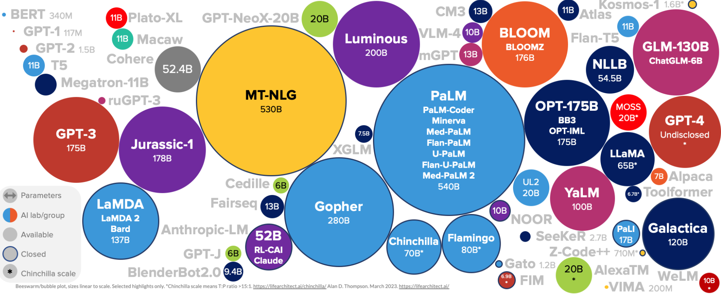
Large Language Models (LLM) (GPT-3, ChatGPT, PaLM, BLOOM, OPT-175B, LLaMA)
ChatGPT
175B
Source: https://lifearchitect.ai/models/

Slide 16
The Transformers Timeline
ULMFit
BERT
RoBERTa
XLM-R
DeBERTa
GPT-Neo
BLOOM
Alpaca
DistrilBERT
T5
PaLM
ChatGPT
Llama2
Transformer
GPT
GPT-2
GPT-3
GPT-J
OPT-175B
Llama
2017
2018
2019
2020
2021
2022
2023
Source: Lewis Tunstall, Leandro von Werra, and Thomas Wolf (2022), Natural Language Processing with Transformers: Building Language Applications with Hugging Face, O'Reilly Media.

Slide 17
Transformer Models
Transformer
Encoder
Decoder
DistilBERT
BERT
T5
GPT
RoBERTa
BART
GPT-2
CTRL
XLM-R
XLM
M2M-100
GPT-3
ALBERT
BigBird
GPT-Neo
GPT-J
ELECTRA
mT0
BLOOM
BLOOMZ
DeBERTa
ChatGPT
GPT-4
Source: Lewis Tunstall, Leandro von Werra, and Thomas Wolf (2022), Natural Language Processing with Transformers: Building Language Applications with Hugging Face, O'Reilly Media.

Slide 18
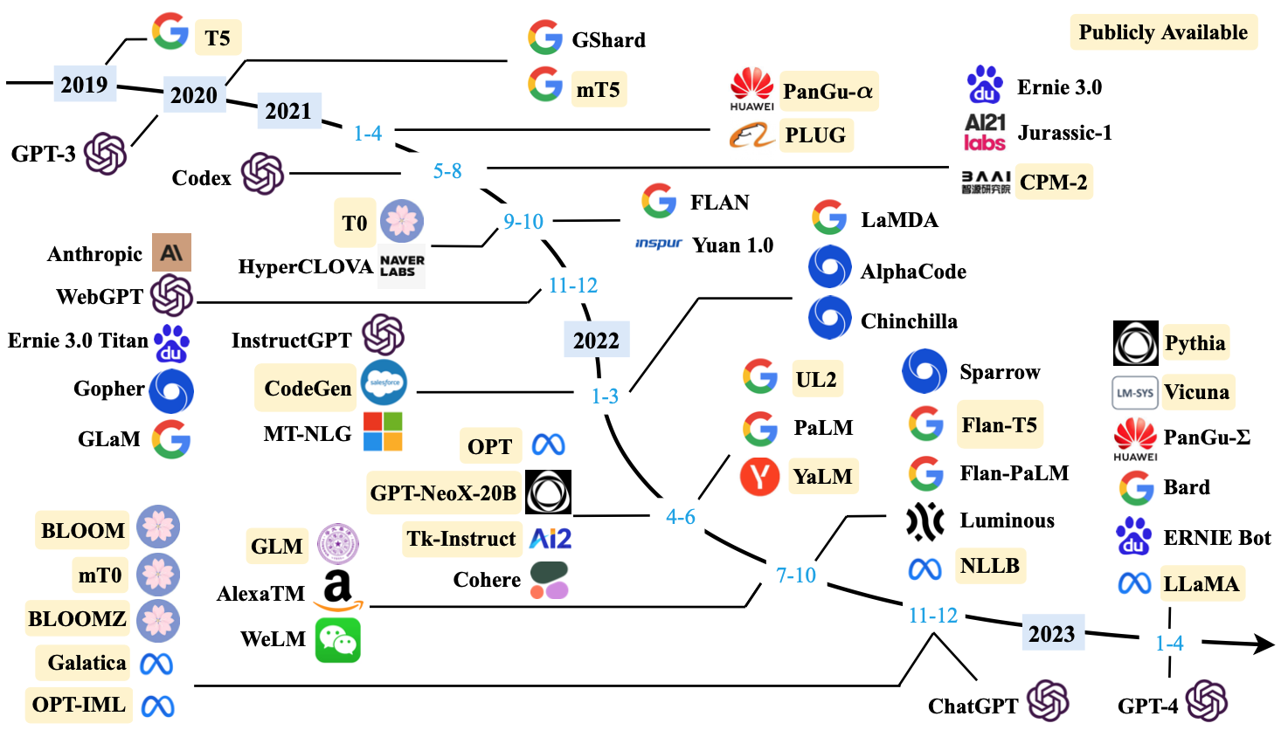
Large Language Models (LLMs) (larger than 10B)
Source: Wayne Xin Zhao, Kun Zhou, Junyi Li, Tianyi Tang, Xiaolei Wang, Yupeng Hou, Yingqian Min et al. (2023) "A Survey of Large Language Models." arXiv preprint arXiv:2303.18223.

Slide 19
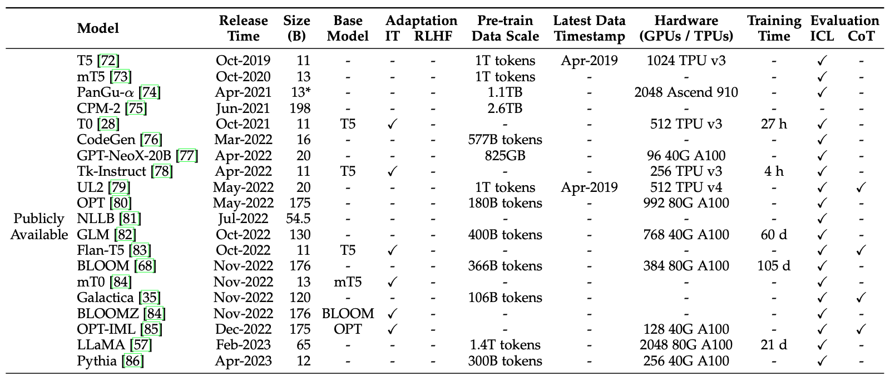
Large Language Models (LLMs) (larger than 10B)
Source: Wayne Xin Zhao, Kun Zhou, Junyi Li, Tianyi Tang, Xiaolei Wang, Yupeng Hou, Yingqian Min et al. (2023) "A Survey of Large Language Models." arXiv preprint arXiv:2303.18223.

Slide 20
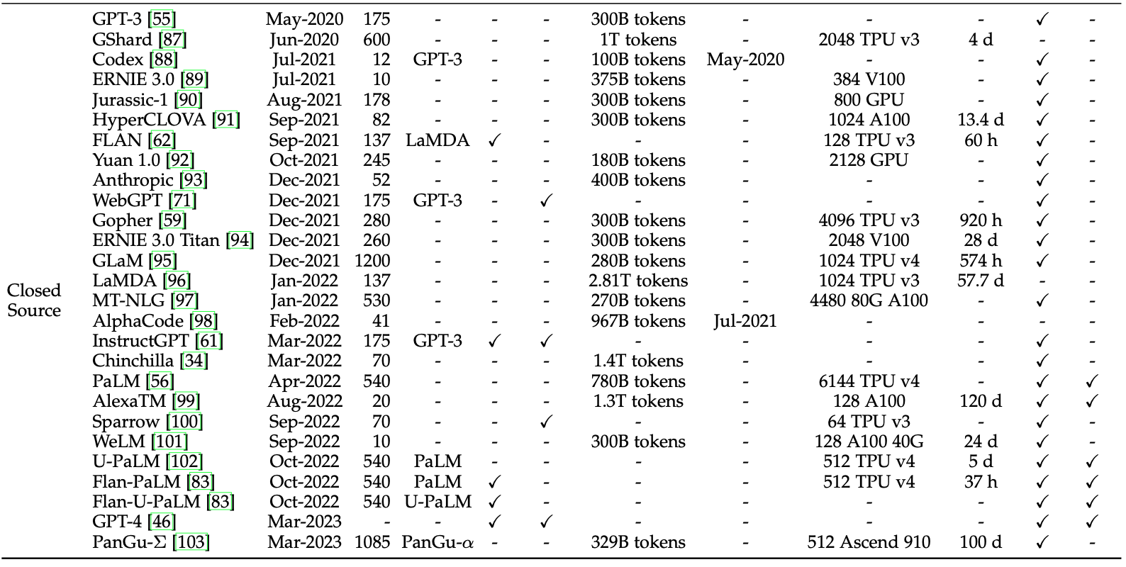
Large Language Models (LLMs) (larger than 10B)
Source: Wayne Xin Zhao, Kun Zhou, Junyi Li, Tianyi Tang, Xiaolei Wang, Yupeng Hou, Yingqian Min et al. (2023) "A Survey of Large Language Models." arXiv preprint arXiv:2303.18223.

Slide 21
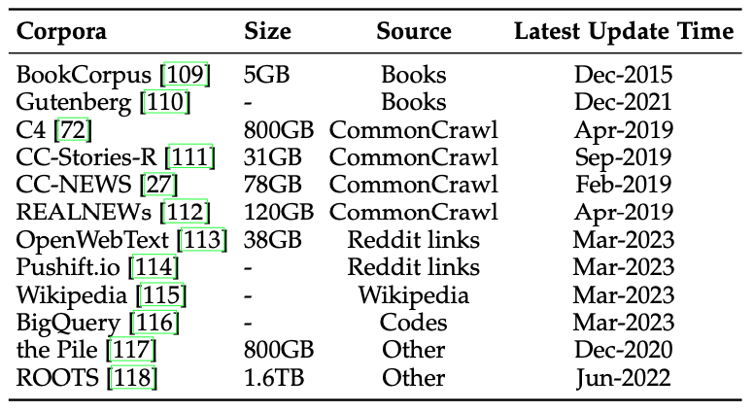
Statistics of Commonly-used Data Sources for LLMs
Source: Wayne Xin Zhao, Kun Zhou, Junyi Li, Tianyi Tang, Xiaolei Wang, Yupeng Hou, Yingqian Min et al. (2023) "A Survey of Large Language Models." arXiv preprint arXiv:2303.18223.

Slide 22
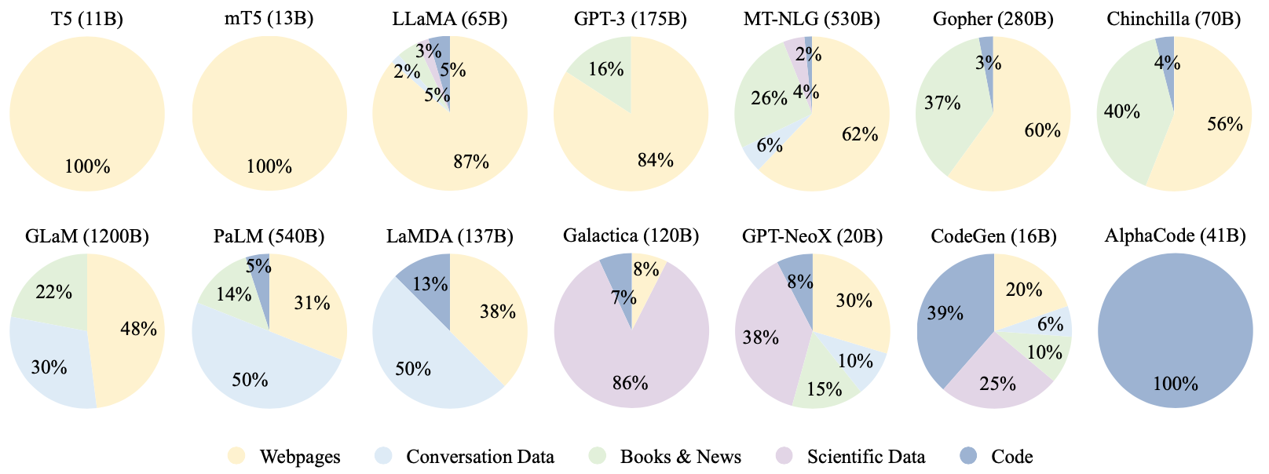
Ratios of various data sources in the pre-training data for existing LLMs
Source: Wayne Xin Zhao, Kun Zhou, Junyi Li, Tianyi Tang, Xiaolei Wang, Yupeng Hou, Yingqian Min et al. (2023) "A Survey of Large Language Models." arXiv preprint arXiv:2303.18223.

Slide 23
Typical Data Preprocessing Pipeline for Pre-training Large Language Models (LLMs)
Source: Wayne Xin Zhao, Kun Zhou, Junyi Li, Tianyi Tang, Xiaolei Wang, Yupeng Hou, Yingqian Min et al. (2023) "A Survey of Large Language Models." arXiv preprint arXiv:2303.18223.

Slide 24
Generative AI Text, Image, Video, Audio Applications

Slide 25
Popular Generative AI
OpenAI ChatGPT (GPT-3.5, GPT-4)
OpenAI DALL·E 3
Perplexity.ai
Chat.LMSys.org
Llama 2, Mistral, Zephyr, Vicuna, MPT, Falcon
ChatPDF
Stable Diffusion
Video: D-ID, Synthesia
Audio: Speechify

Slide 26
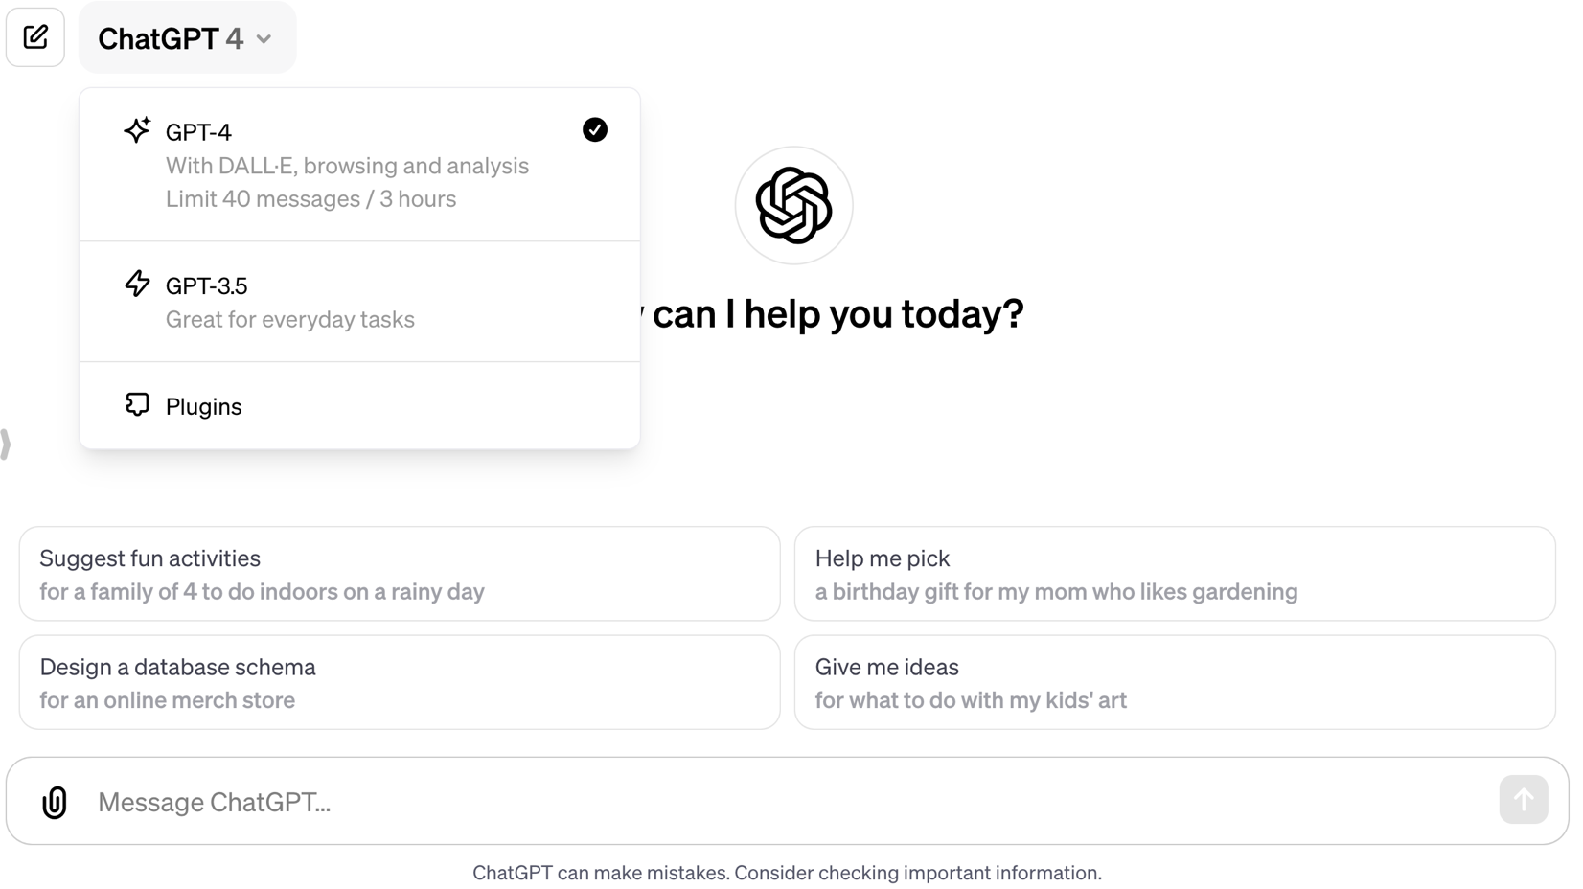
OpenAI ChatGPT (GPT-4, GPT-3.5)
https://chat.openai.com/

Slide 27
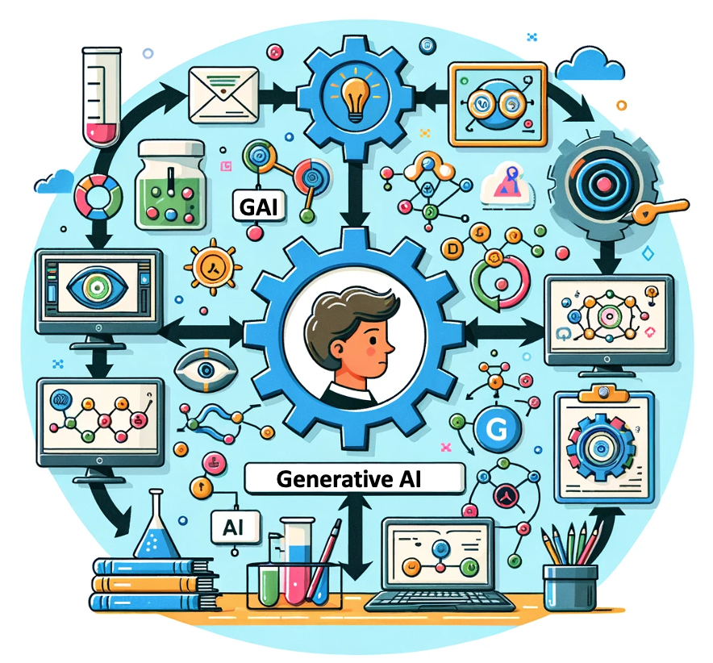
OpenAI ChatGPT (GPT-4) DALL·E 3
Vector graphic of a flowchart depicting the integration of generative AI in the education process, from content creation to virtual experiments, personalized learning, and innovative learning.
https://chat.openai.com/

Slide 28
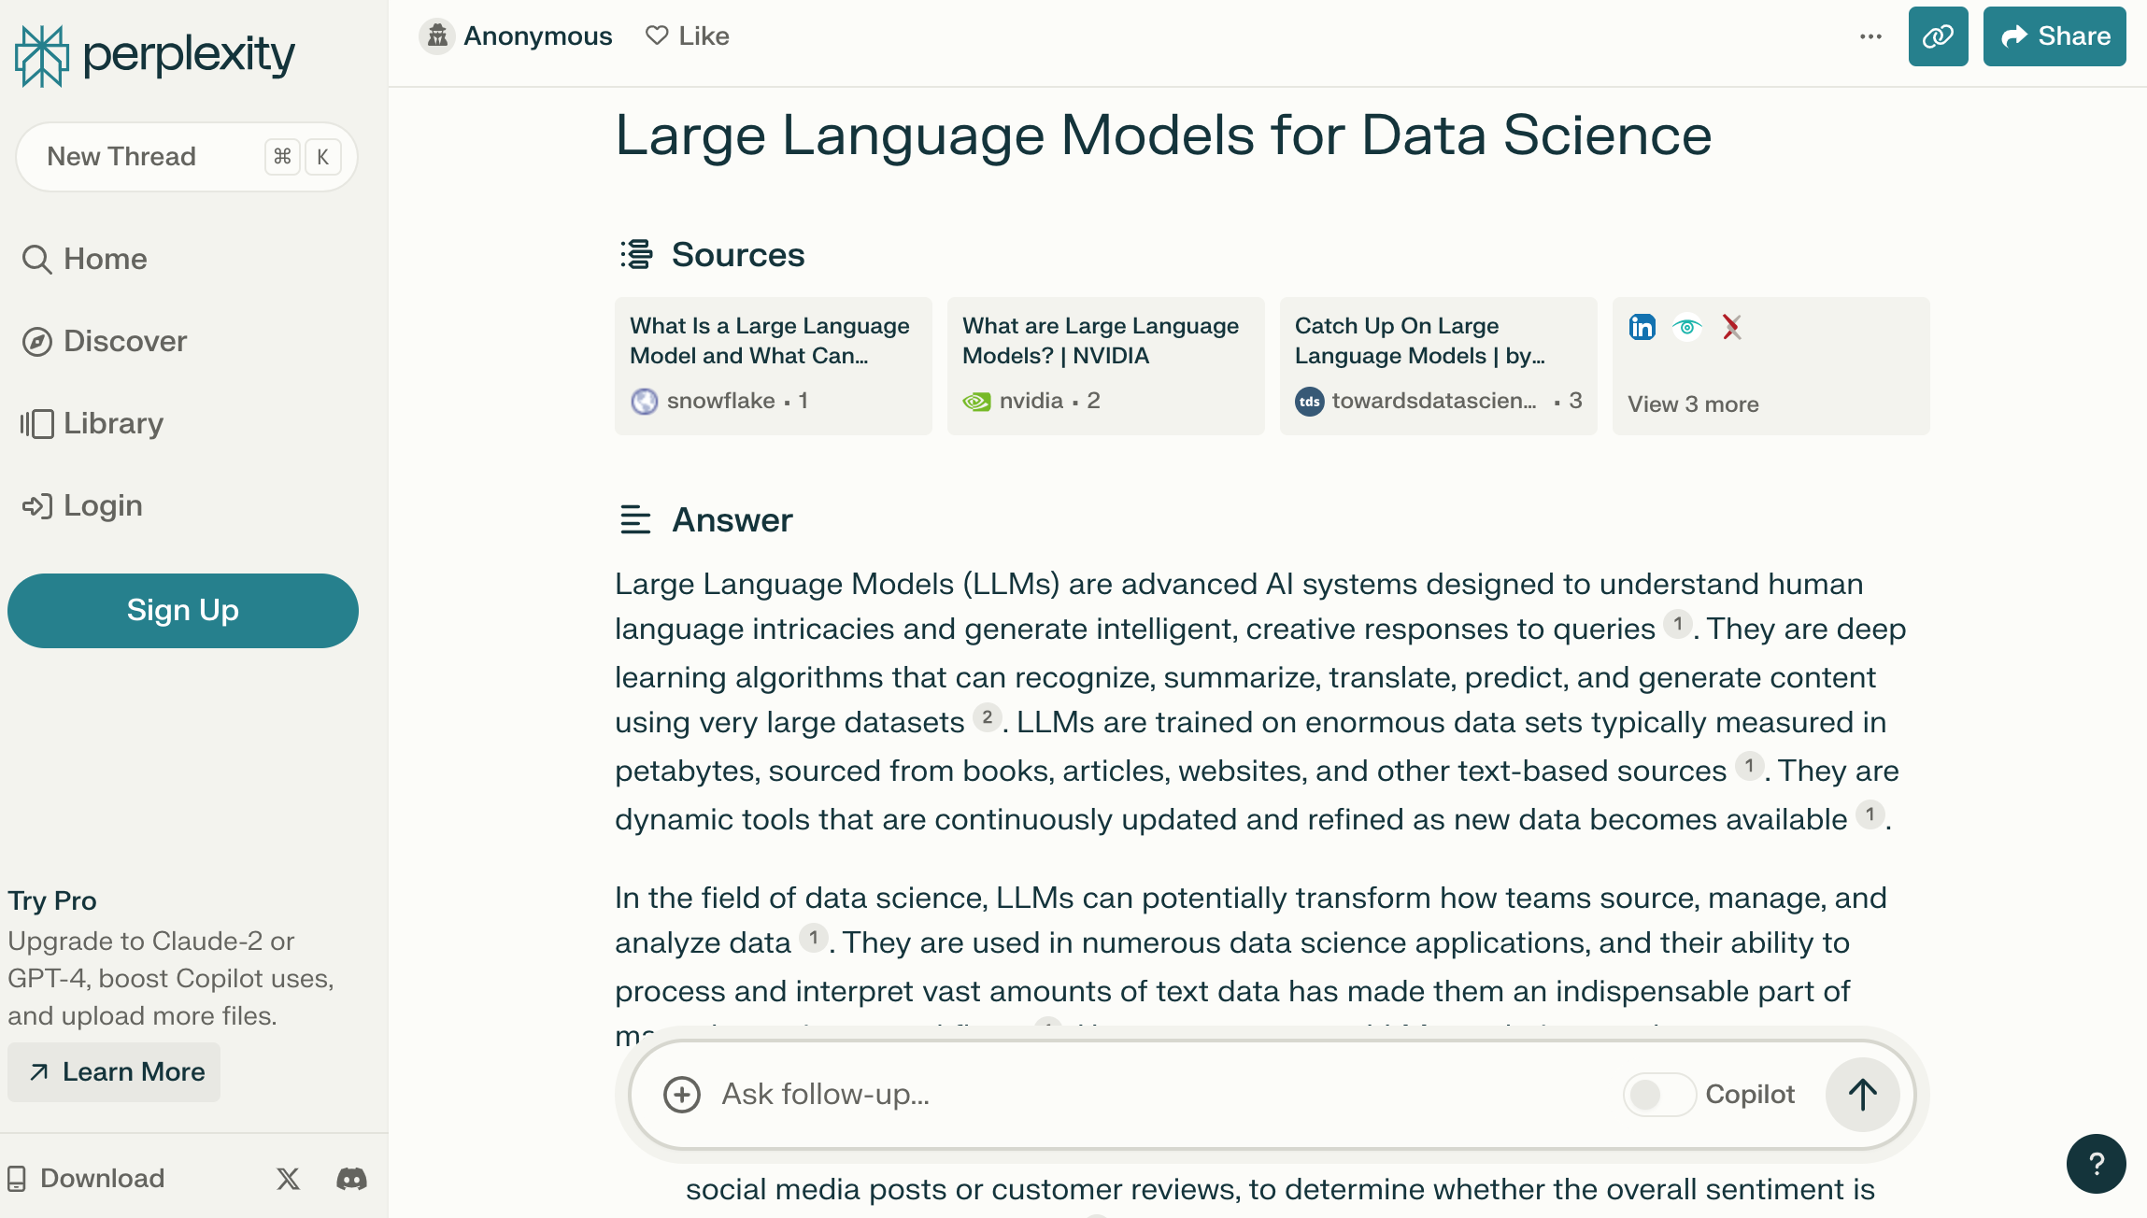
Perplexity.ai
https://www.perplexity.ai/

Slide 29
Chat with Open Large Language Models:
https://chat.lmsys.org/
Llama 2: open foundation and fine-tuned chat models by Meta
Mistral: a large language model by Mistral AI team
WizardLM: an instruction-following LLM using evol-instruct by Microsoft
Zephyr: a chatbot fine-tuned from Mistral by Hugging Face
Code Llama: open foundation models for code by Meta
ChatGLM: an open bilingual dialogue language model by Tsinghua University
Qwen: a large language model by Alibaba Cloud
Vicuna: a chat assistant fine-tuned on user-shared conversations by LMSYS
Falcon: TII’s flagship series of large language models

Slide 30
Chat with Open Large Language Models
chat.lmsys.org
⚔️ Chatbot Arena ⚔️ : Benchmarking LLMs in the Wild
GPT-3.5: GPT-3.5 by OpenAI | GPT-3.5-Turbo-1106: GPT-3.5-Turbo-1106 by OpenAI | GPT-4-Turbo: GPT-4-Turbo by OpenAI
GPT-4: ChatGPT-4 by OpenAI | Claude: Claude 2 by Anthropic | Claude Instant: Claude Instant by Anthropic
Vicuna: a chat assistant fine-tuned on user-shared conversations by LMSYS | Llama 2: open foundation and fine-tuned chat models by Meta | ChatGLM: an open bilingual dialogue language model by Tsinghua University
OpenChat 3.5: OpenChat 3.5 is a versatile, open-source language model fine-tuned using C-RLFT | Mistral: a large language model by Mistral AI team | Zephyr: a chatbot fine-tuned from Mistral by Hugging Face
Qwen: a large language model by Alibaba Cloud | Code Llama: open foundation models for code by Meta | WizardLM: an instruction-following LLM using evol-instruct by Microsoft
PaLM 2 Chat: PaLM 2 for Chat (chat-bison@001) by Google | Falcon: TII’s flagship series of large language models
https://chat.lmsys.org/

Slide 31
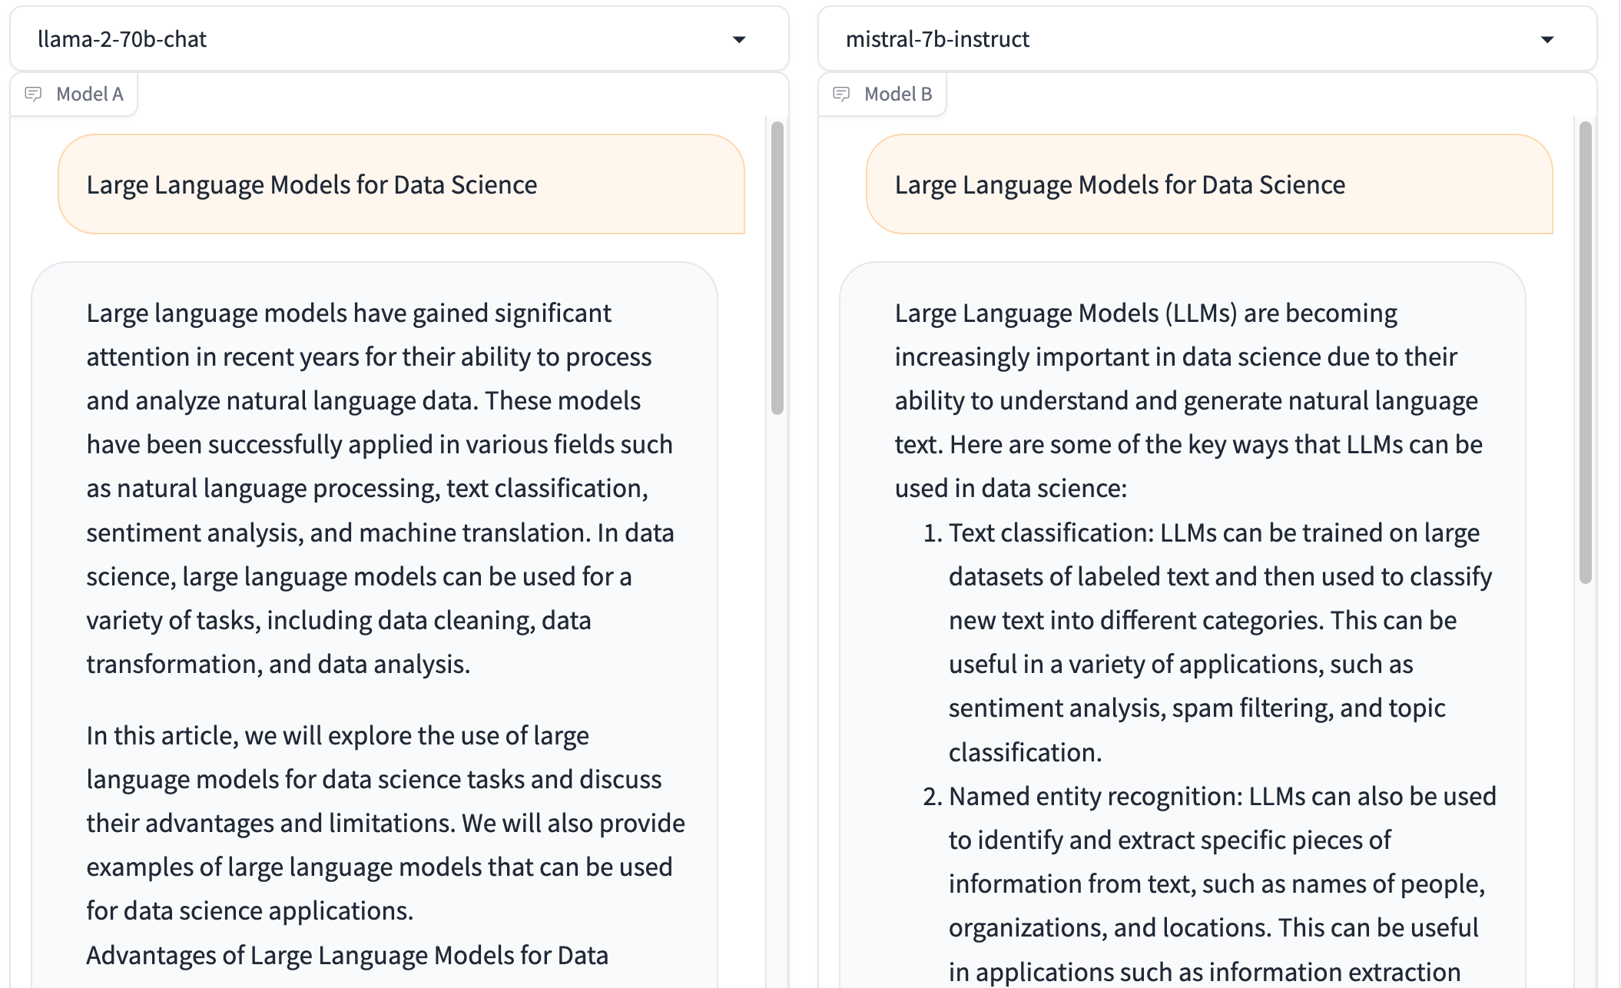
Chat with Open Large Language Models: Chatbot Arena
Large Language Models for Data Science
Llama 2-70b-chat
Mistral-7b-instruct
https://chat.lmsys.org/

Slide 32
Chatbot Arena Leaderboard LLM Leaderboard
Model | ⭐ Arena Elo rating | 📈 MT-bench (score) | MMLU | License
GPT-4-Turbo | 1210 | 9.32 |  | Proprietary
GPT-4 | 1159 | 8.99 | 86.4 | Proprietary
Claude-1 | 1146 | 7.9 | 77 | Proprietary
Claude-2 | 1125 | 8.06 | 78.5 | Proprietary
Claude-instant-1 | 1106 | 7.85 | 73.4 | Proprietary
GPT-3.5-turbo | 1103 | 7.94 | 70 | Proprietary
WizardLM-70b-v1.0 | 1093 | 7.71 | 63.7 | Llama 2 Community
Vicuna-33B | 1090 | 7.12 | 59.2 | Non-commercial
OpenChat-3.5 | 1070 | 7.81 | 64.3 | Apache-2.0
Llama-2-70b-chat | 1065 | 6.86 | 63 | Llama 2 Community
WizardLM-13b-v1.2 | 1047 | 7.2 | 52.7 | Llama 2 Community
zephyr-7b-beta | 1042 | 7.34 | 61.4 | MIT
MPT-30B-chat | 1031 | 6.39 | 50.4 | CC-BY-NC-SA-4.0
Vicuna-13B | 1031 | 6.57 | 55.8 | Llama 2 Community
QWen-Chat-14B | 1030 | 6.96 | 66.5 | Qianwen LICENSE
https://chat.lmsys.org/

Slide 33
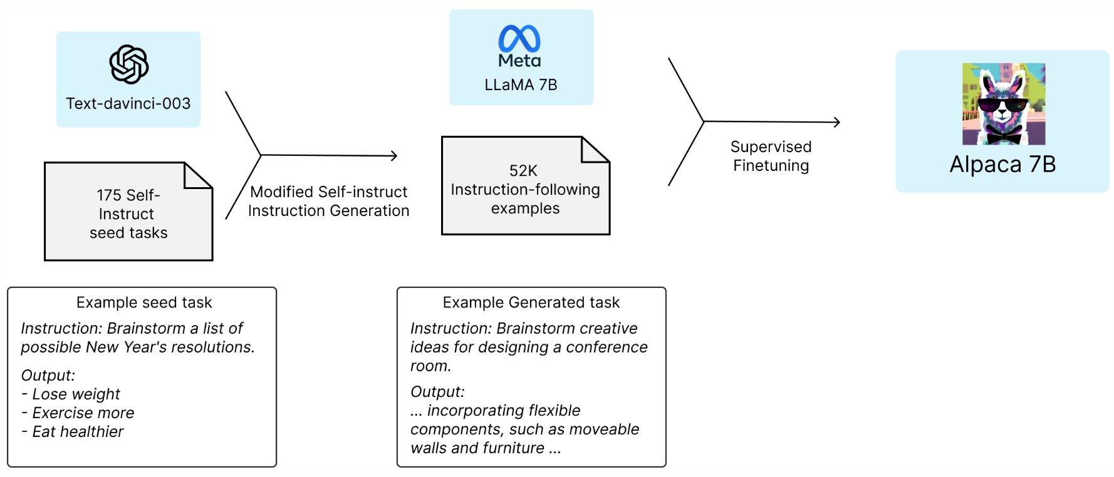
Stanford Alpaca: A Strong, Replicable Instruction-Following Model
Source: https://crfm.stanford.edu/2023/03/13/alpaca.html

Slide 34
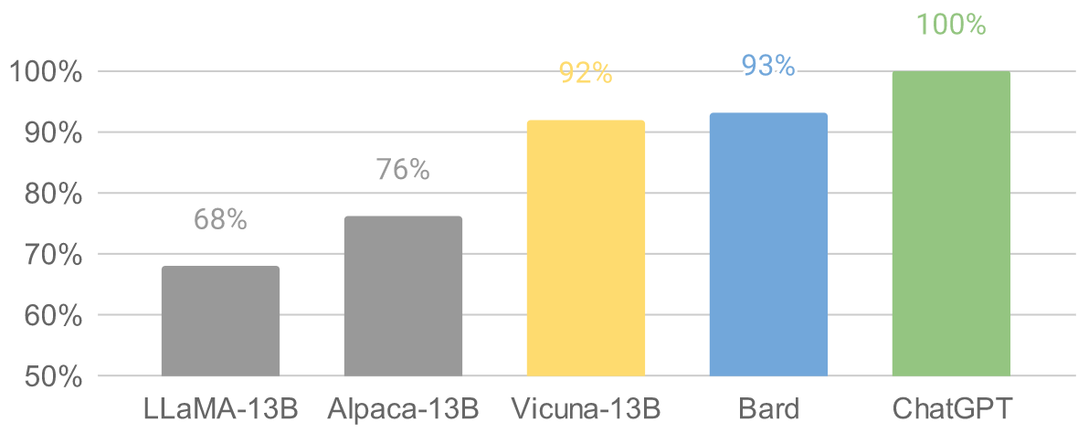
Vicuna: An Open-Source Chatbot Impressing GPT-4 with 90%* ChatGPT Quality by the Team with members from UC Berkeley, CMU, Stanford, and UC San Diego
Vicuna-13B: an open-source chatbot trained by fine-tuning LLaMA on user-shared conversations collected from ShareGPT.
The cost of training Vicuna-13B is around $300.
Source: https://vicuna.lmsys.org/

Slide 35
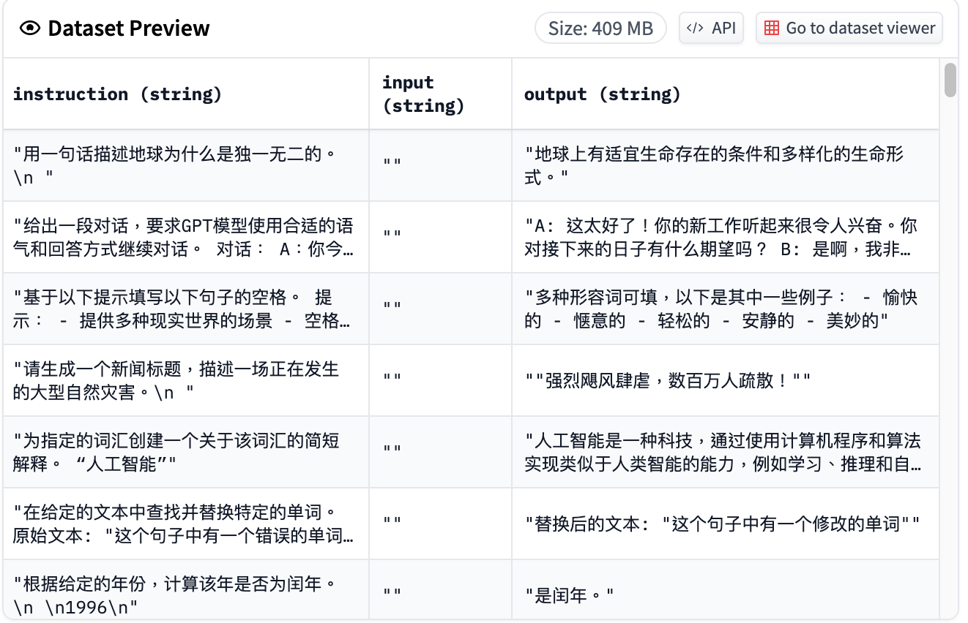
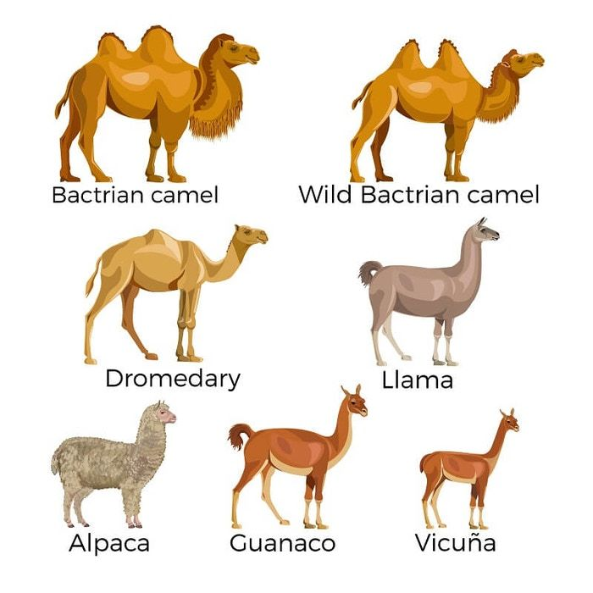
Chinese-Vicuna: A Chinese Instruction-following LLaMA-based Model 一個中文低資源的 llama+lora方案
Chinese-Vicuna based on Guanaco Dataset and Belle Dataset
Source: https://huggingface.co/datasets/Chinese-Vicuna/guanaco_belle_merge_v1.0
Source: https://github.com/Facico/Chinese-Vicuna

Slide 36
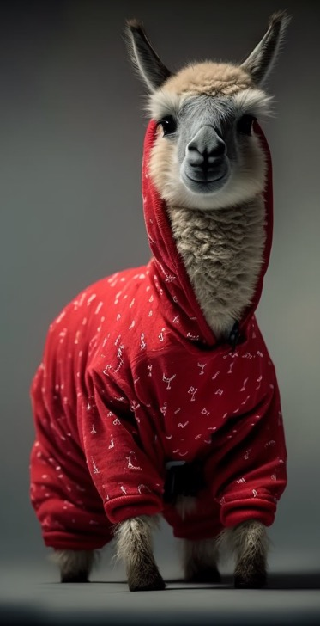
RedPajama a project to create leading open-source models, starts by reproducing LLaMA training dataset of over 1.2 trillion tokens
Dataset | RedPajama | LLaMA*
CommonCrawl | 878 billion | 852 billion
C4 | 175 billion | 190 billion
Github | 59 billion | 100 billion
Books | 26 billion | 25 billion
ArXiv | 28 billion | 33 billion
Wikipedia | 24 billion | 25 billion
StackExchange | 20 billion | 27 billion
Total Tokens | 1.2 trillion | 1.25 trillion
Source: https://github.com/togethercomputer/RedPajama-Data

Slide 37
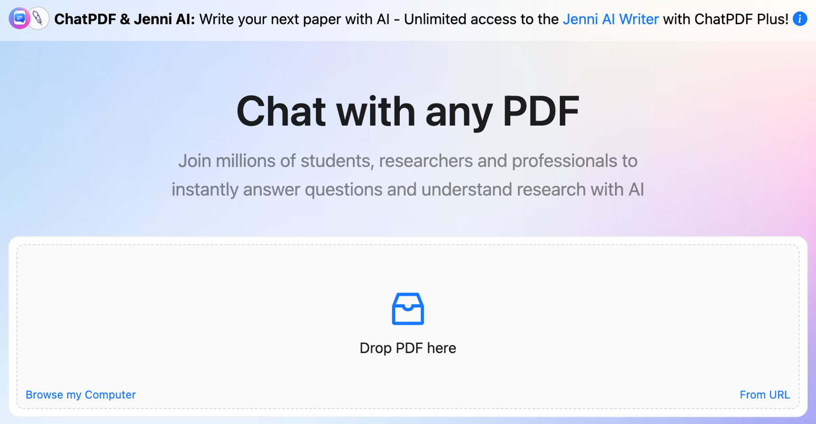
ChatPDF
www.chatpdf.com
https://www.chatpdf.com/

Slide 38
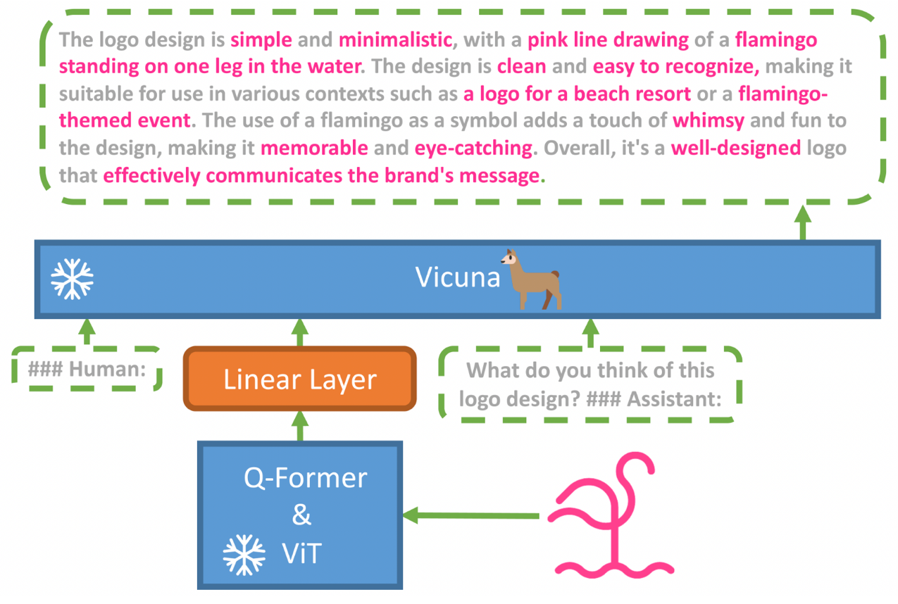
MiniGPT-4: Enhancing Vision-language Understanding with Advanced Large Language Models
Source: https://minigpt-4.github.io/

Slide 39
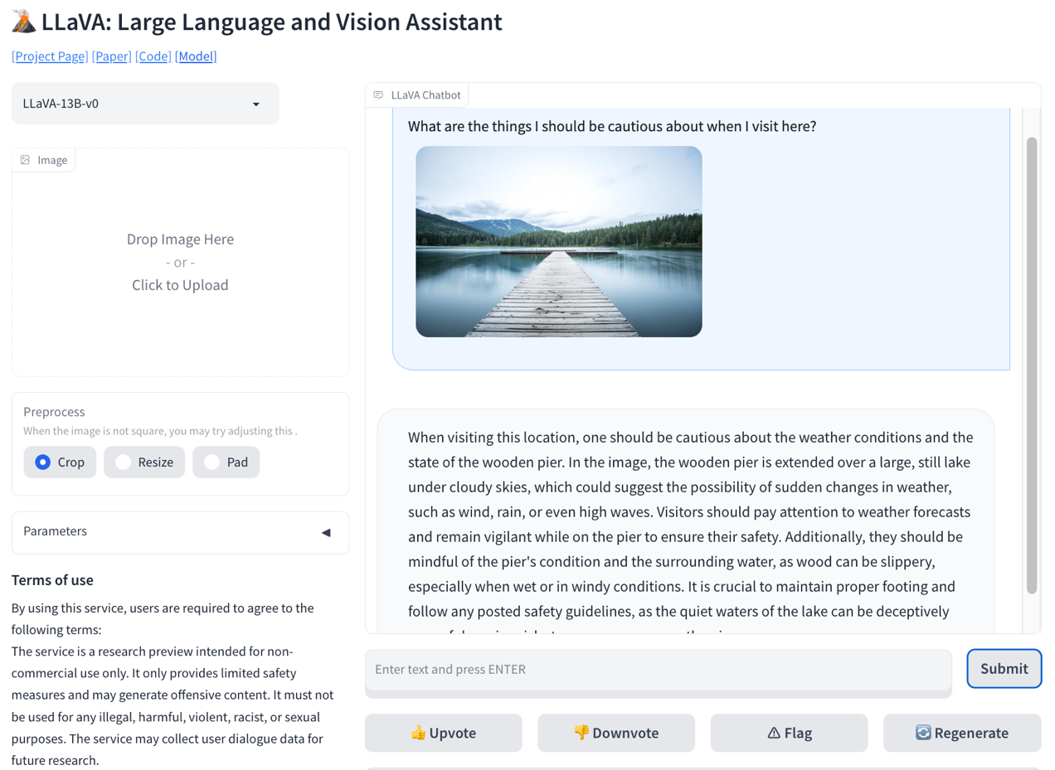
LLaVA: Large Language and Vision Assistant
llava-vl.github.io
Source: https://llava-vl.github.io/

Slide 40
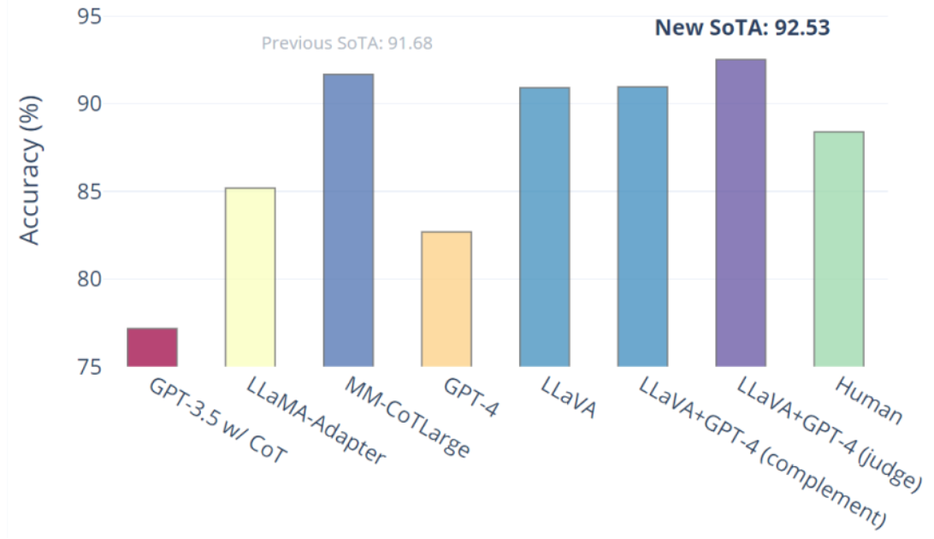
Visual Instruction Tuning LLaVA: Large Language and Vision Assistant University of Wisconsin-Madison, Microsoft Research, Columbia University
Science QA: New SoTA with the synergy of LLaVA with GPT-4
LLaVA represents a novel end-to-end trained large multimodal model that combines a vision encoder and Vicuna for general-purpose visual and language understanding, achieving impressive chat capabilities mimicking spirits of the multimodal GPT-4 and setting a new state-of-the-art accuracy on Science QA.
Source: https://llava-vl.github.io/

Slide 41
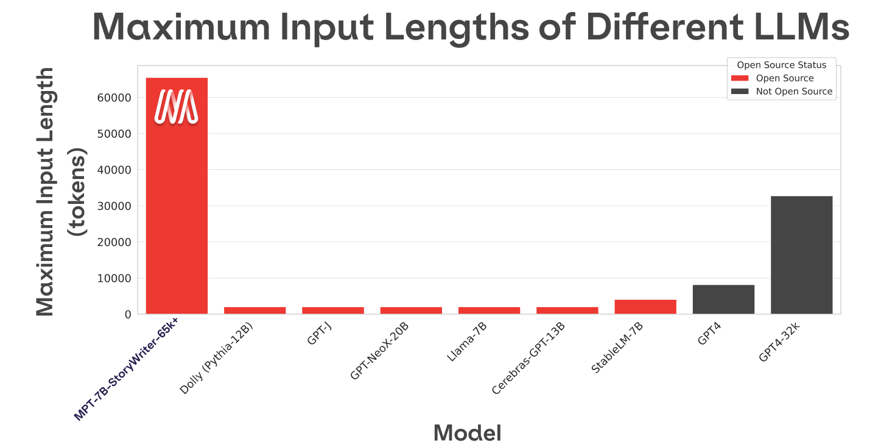
MPT-7B-StoryWriter-65k+
Source: https://www.mosaicml.com/blog/mpt-7b

Slide 42
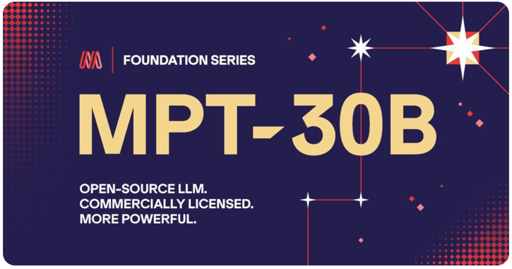
MPT-30B, MPT-7B LLaMa-30B, LLaMa-7B
Source: https://www.mosaicml.com/blog/mpt-30b

Slide 43
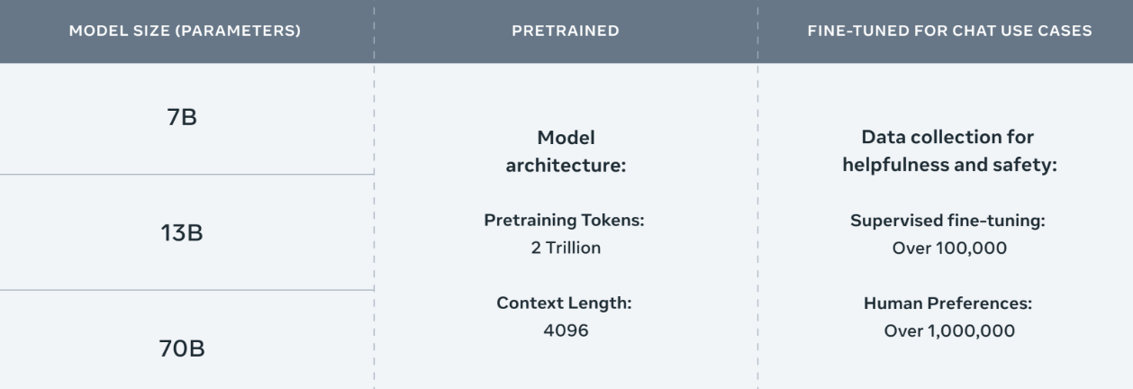
Meta Llama-2 70B: Best Open Source and Commercial LLM (Llama-2, Falcon, MPT)
Llama 2 pretrained models are trained on 2 trillion tokens, and have double the context length than Llama 1. Its fine-tuned models have been trained on over 1 million human annotations.
Source: https://ai.meta.com/llama/

Slide 44
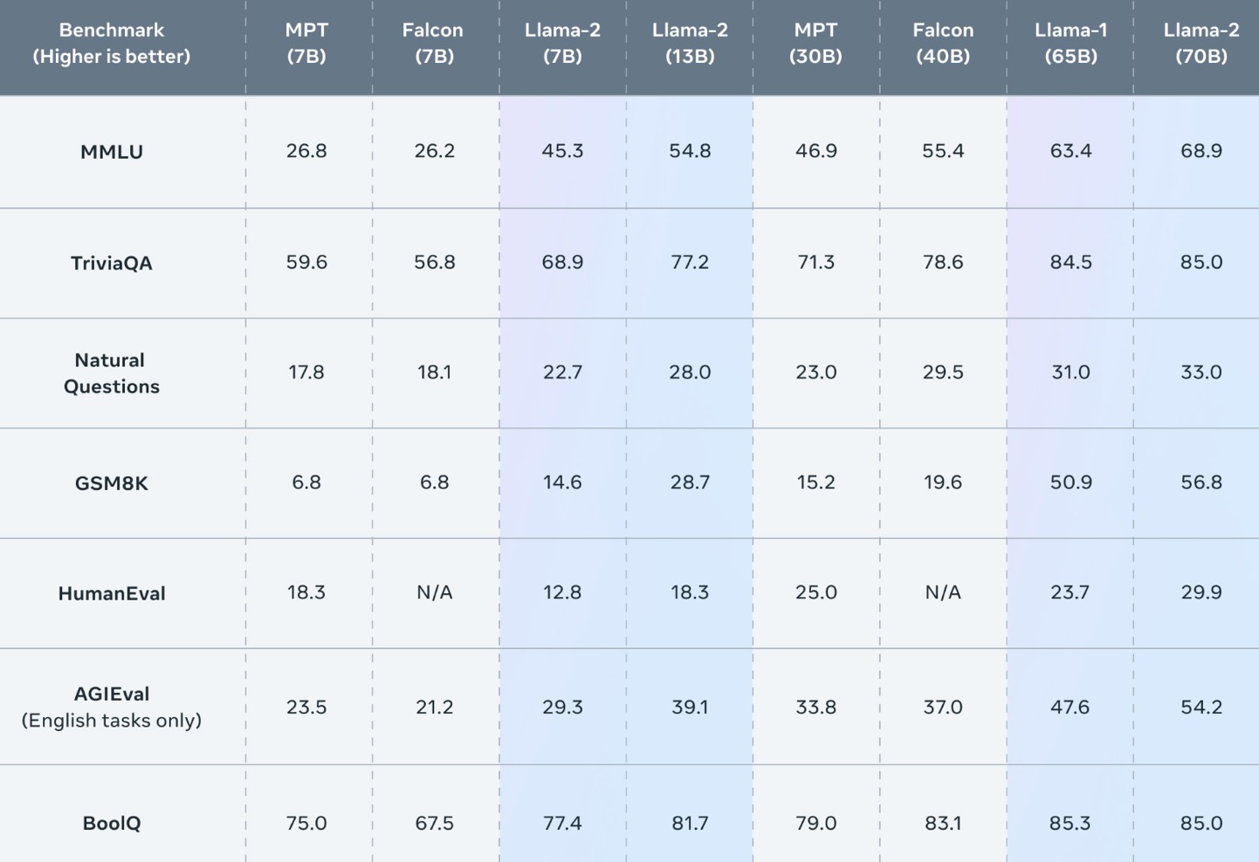
Meta Llama-2 70B: Best Open Source and Commercial LLM (Llama-2, Falcon, MPT)
Llama 2 outperforms other open source language models on many external benchmarks, including reasoning, coding, proficiency, and knowledge tests.
Source: https://ai.meta.com/llama/

Slide 45
Llama-2: Comparison to closed-source models (GPT-3.5, GPT-4, PaLM) on academic benchmarks
Results for GPT-3.5 and GPT-4 are from OpenAI (2023).
Results for the PaLM model are from Chowdhery et al. (2022).
Results for the PaLM-2-L are from Anil et al. (2023).
Source: Touvron, Hugo, Louis Martin, Kevin Stone, Peter Albert, Amjad Almahairi, Yasmine Babaei, Nikolay Bashlykov et al. (2023) "Llama 2: Open Foundation and Fine-Tuned Chat Models." arXiv preprint arXiv:2307.09288 (2023).

Slide 46
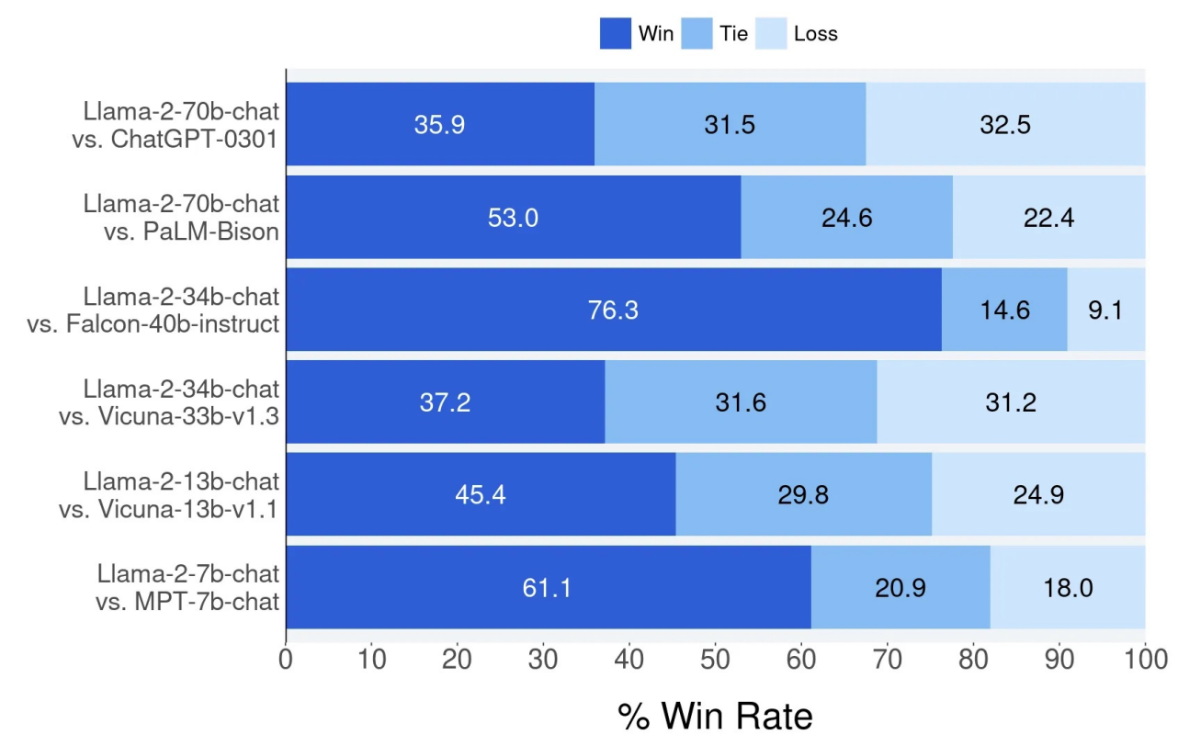
Llama-2 Chat: Helpfulness Human Evaluation
Source: Touvron, Hugo, Louis Martin, Kevin Stone, Peter Albert, Amjad Almahairi, Yasmine Babaei, Nikolay Bashlykov et al. (2023) "Llama 2: Open Foundation and Fine-Tuned Chat Models." arXiv preprint arXiv:2307.09288 (2023).

Slide 47
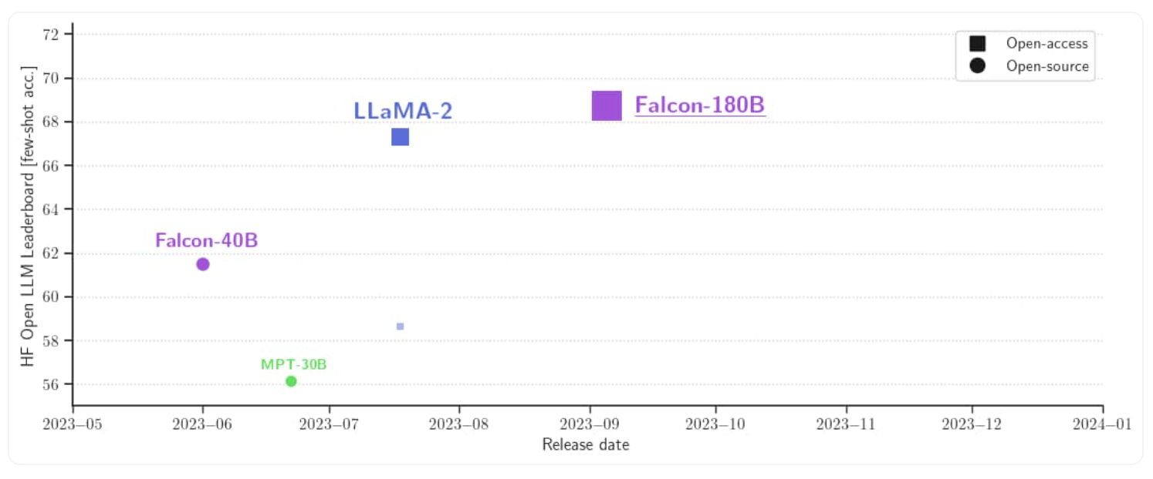
Falcon 180B
Source: https://huggingface.co/blog/falcon-180b

Slide 48
Falcon 180B, LLaMA 65B, MPT 30B
Source: https://huggingface.co/blog/falcon-180b

Slide 49
Falcon 180B Hardware requirements
NVIDIA A100 80 GB: $16,135
Source: https://huggingface.co/blog/falcon-180b

Slide 50
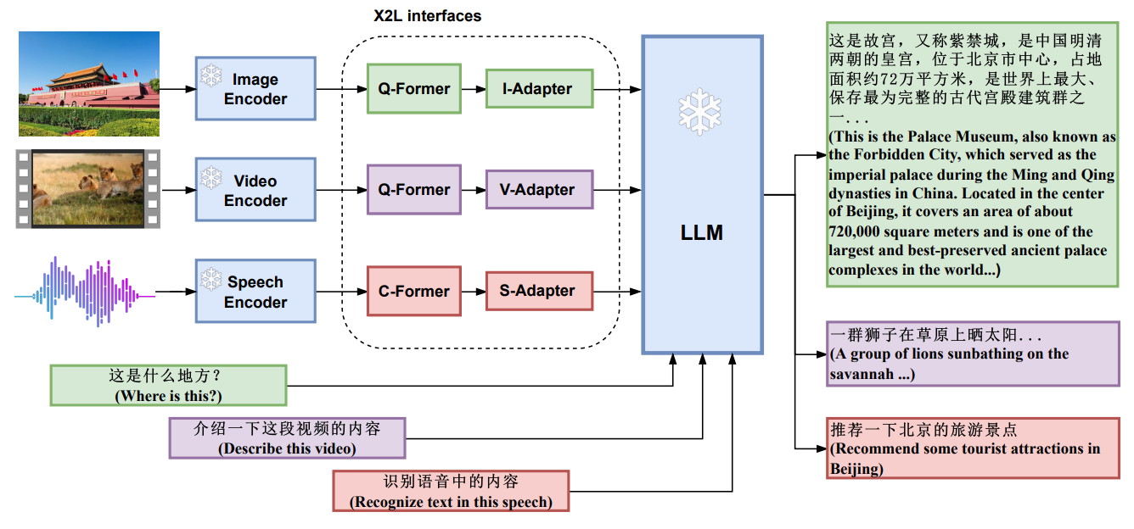
X-LLM: Bootstrapping Advanced Large Language Models by Treating Multi-Modalities as Foreign Languages
Source: Chen, Feilong, Minglun Han, Haozhi Zhao, Qingyang Zhang, Jing Shi, Shuang Xu, and Bo Xu. "X-LLM: Bootstrapping Advanced Large Language Models by Treating Multi-Modalities as Foreign Languages." arXiv preprint arXiv:2305.04160 (2023).

Slide 51
Zephyr-7B-β, Llama2-Chat-70B, GPT-4
Model | Size | Alignment | MT-Bench (score) | AlpacaEval (win rate %)
StableLM-Tuned-α | 7B | dSFT | 2.75 | -
MPT-Chat | 7B | dSFT | 5.42 | -
Xwin-LMv0.1 | 7B | dPPO | 6.19 | 87.83
Mistral-Instructv0.1 | 7B | - | 6.84 | -
Zephyr-7b-α | 7B | dDPO | 6.88 | -
Zephyr-7b-β 🪁 | 7B | dDPO | 7.34 | 90.60
Falcon-Instruct | 40B | dSFT | 5.17 | 45.71
Guanaco | 65B | SFT | 6.41 | 71.80
Llama2-Chat | 70B | RLHF | 6.86 | 92.66
Vicuna v1.3 | 33B | dSFT | 7.12 | 88.99
WizardLM v1.0 | 70B | dSFT | 7.71 | -
Xwin-LM v0.1 | 70B | dPPO | - | 95.57
GPT-3.5-turbo | - | RLHF | 7.94 | 89.37
Claude 2 | - | RLHF | 8.06 | 91.36
GPT-4 | - | RLHF | 8.99 | 95.28
Source: https://huggingface.co/HuggingFaceH4/zephyr-7b-beta

Slide 52
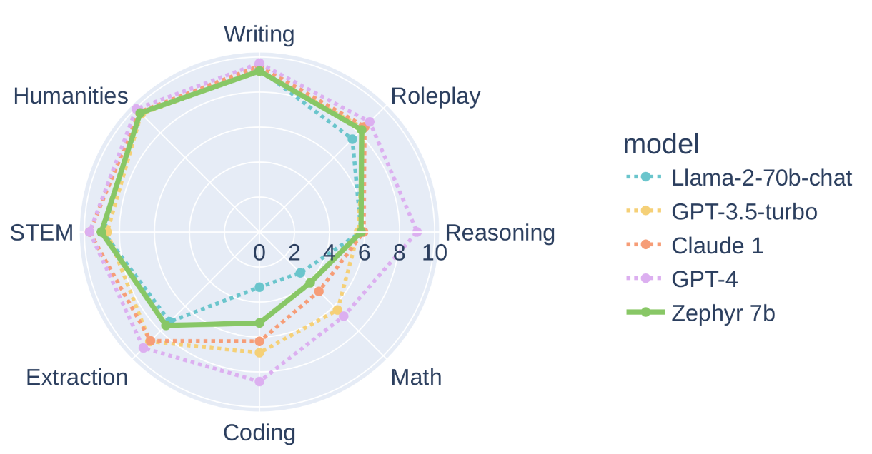
Zephyr-7B-β, Llama2-Chat-70B, GPT-4
Source: https://huggingface.co/HuggingFaceH4/zephyr-7b-beta

Slide 53
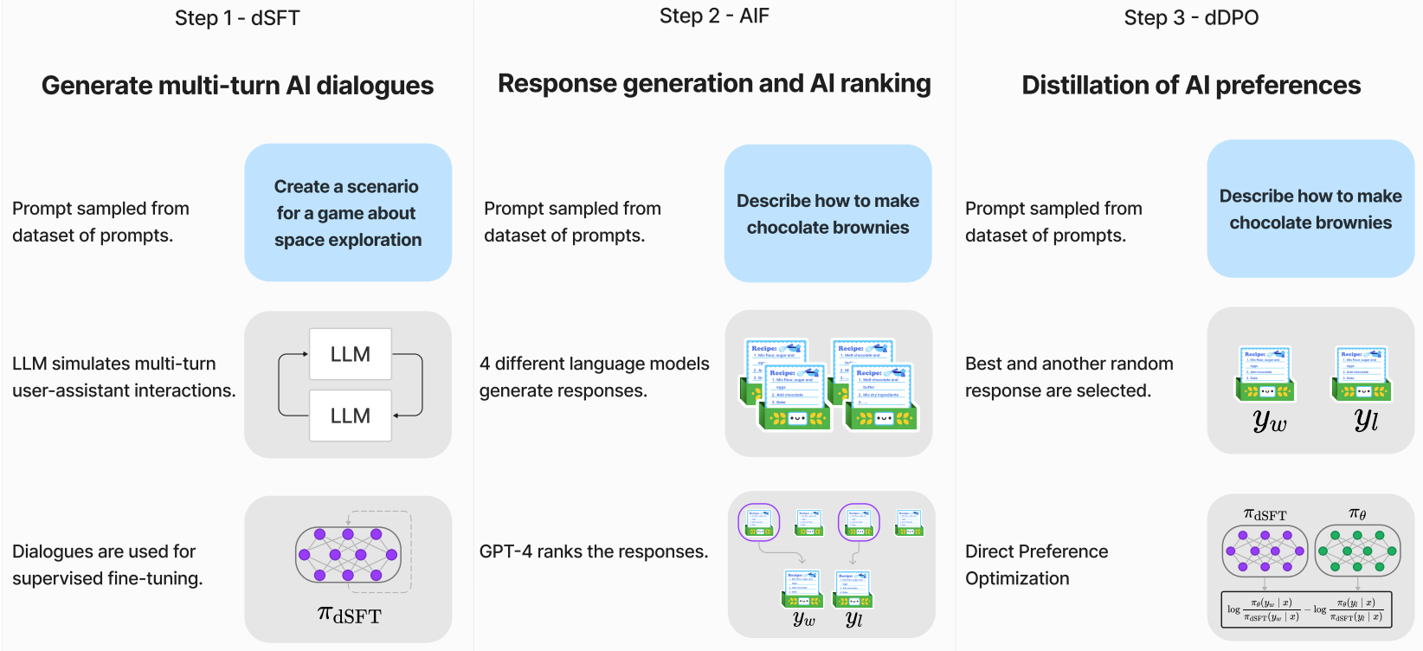
Zephyr: Direct Distillation of LM Alignment
distilled supervised fine-tuning (dSFT)
AI Feedback (AIF)
distilled Direct Preference Optimization (dDPO)
Source: Tunstall, L., Beeching, E., Lambert, N., Rajani, N., Rasul, K., Belkada, Y., ... & Wolf, T. (2023). Zephyr: Direct Distillation of LM Alignment. arXiv preprint arXiv:2310.16944.

Slide 54
Zephyr: Direct Distillation of LM Alignment
The three steps of Zephyr:
(1) large scale, self-instruct-style dataset construction
(UltraChat), followed by distilled supervised fine-tuning (dSFT),
(2) AI Feedback (AIF) collection
via an ensemble of chat model completions, followed by scoring by GPT-4 (UltraFeedback) and
binarization into preferences, and
(3) distilled direct preference optimization (dDPO) of the dSFT
model utilizing the feedback data.
Source: Tunstall, L., Beeching, E., Lambert, N., Rajani, N., Rasul, K., Belkada, Y., ... & Wolf, T. (2023). Zephyr: Direct Distillation of LM Alignment. arXiv preprint arXiv:2310.16944.

Slide 55
DPO optimizes for human preferences while avoiding reinforcement learning
Source: Rafailov, R., Sharma, A., Mitchell, E., Ermon, S., Manning, C. D., & Finn, C. (2023). Direct preference optimization: Your language model is secretly a reward model. arXiv preprint arXiv:2305.18290.

Slide 56
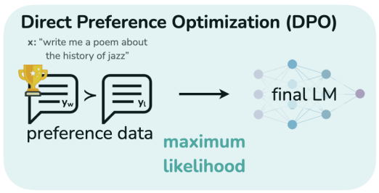
Direct Preference Optimization (DPO)
Source: Rafailov, R., Sharma, A., Mitchell, E., Ermon, S., Manning, C. D., & Finn, C. (2023). Direct preference optimization: Your language model is secretly a reward model. arXiv preprint arXiv:2305.18290.

Slide 57
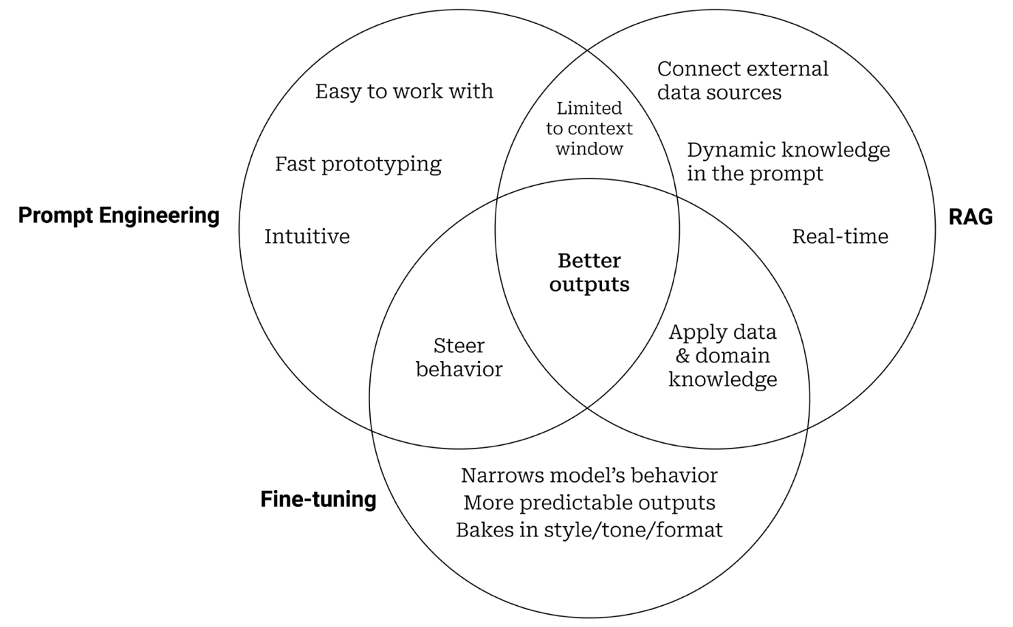
Prompt Engineering, Fine-tuning, and RAG
Source: https://www.entrypointai.com/blog/approaches-to-ai-prompt-engineering-embeddings-or-fine-tuning/

Slide 58
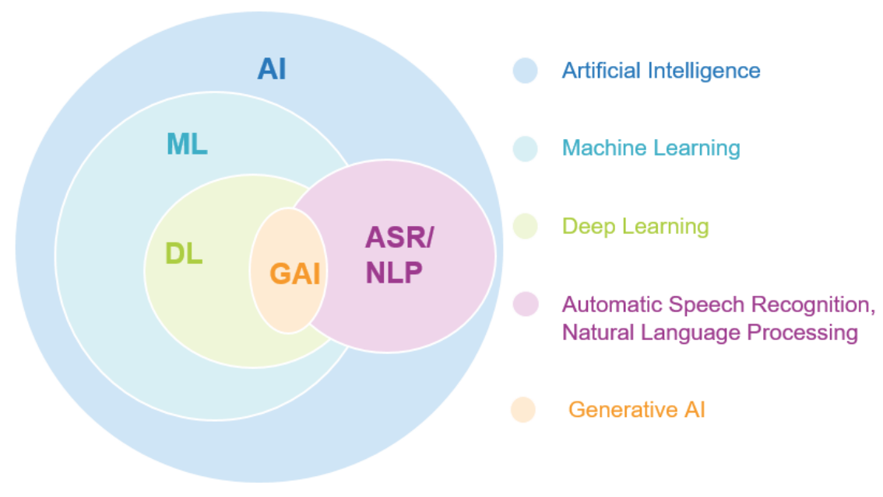
Generative AI
Source: Jeong, Cheonsu. "A Study on the Implementation of Generative AI Services Using an Enterprise Data-Based LLM Application Architecture." arXiv preprint arXiv:2309.01105 (2023).

Slide 59
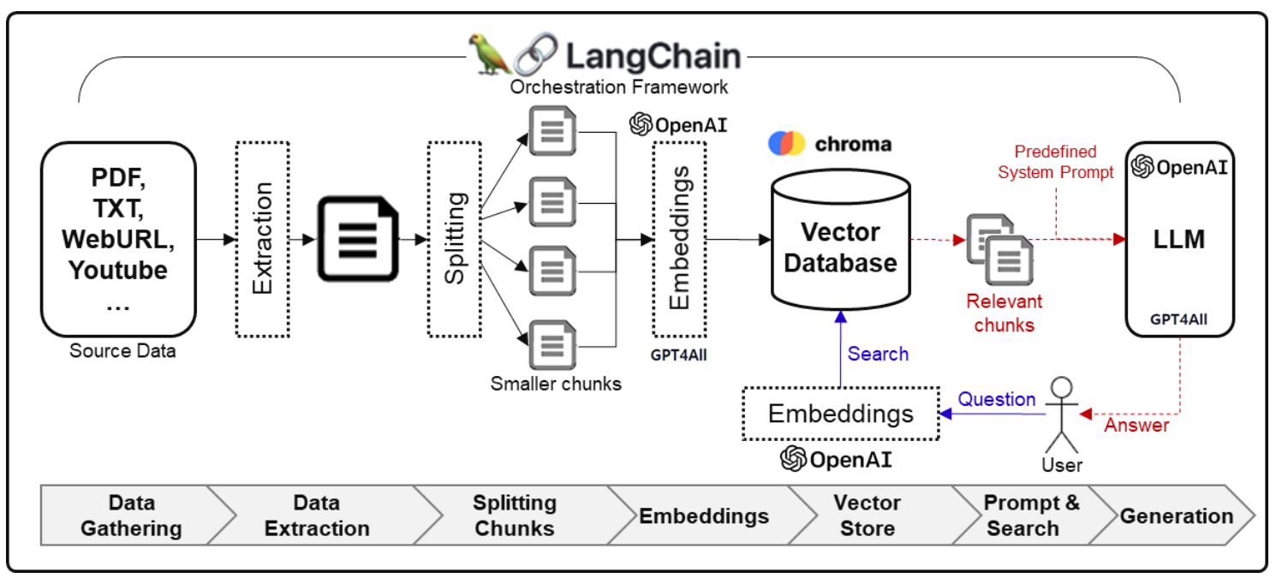
Framework for Implementing Generative AI Services using RAG Model
Source: Jeong, Cheonsu. "A Study on the Implementation of Generative AI Services Using an Enterprise Data-Based LLM Application Architecture." arXiv preprint arXiv:2309.01105 (2023).

Slide 60
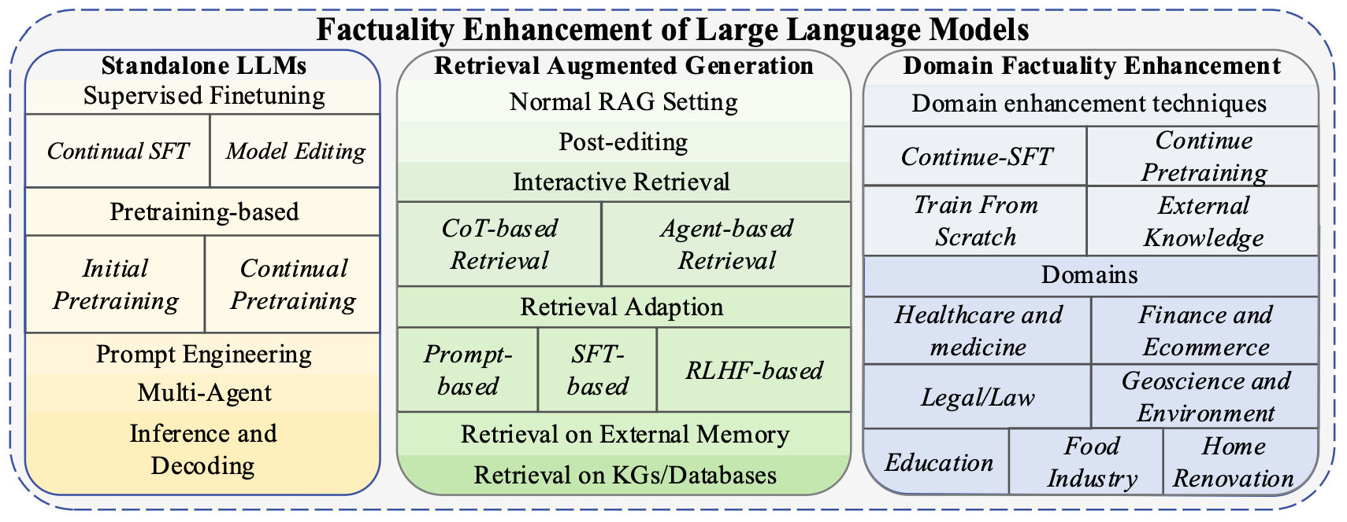
Factuality Enhancement of Large Language Models (LLMs)
Source: Wang, Cunxiang, Xiaoze Liu, Yuanhao Yue, Xiangru Tang, Tianhang Zhang, Cheng Jiayang, Yunzhi Yao et al. "Survey on factuality in large language models: Knowledge, retrieval and domain-specificity." arXiv preprint arXiv:2310.07521 (2023).

Slide 61
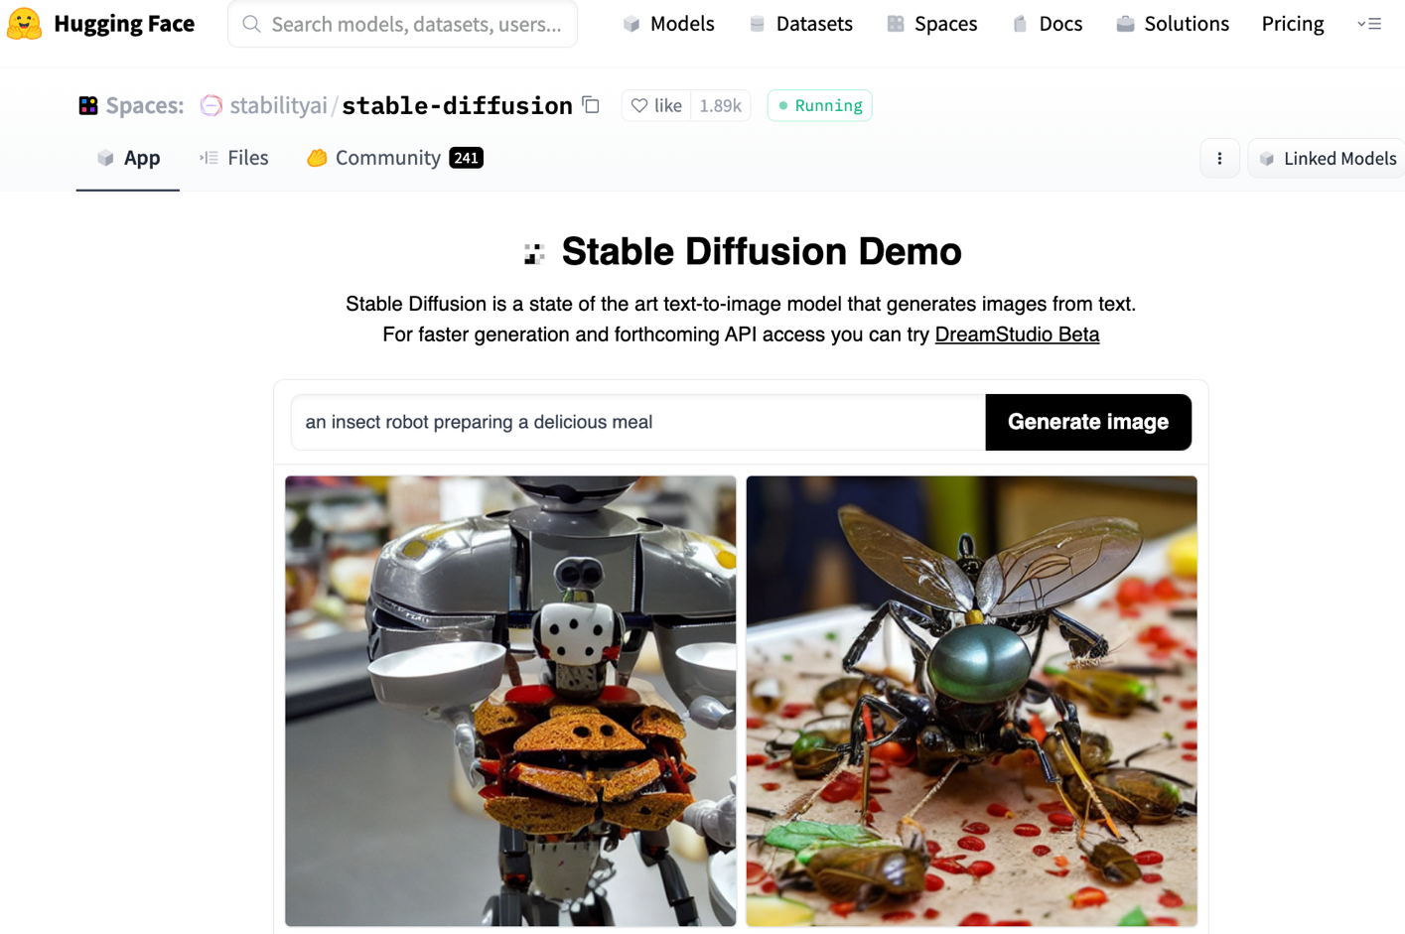
Stable Diffusion
https://huggingface.co/spaces/stabilityai/stable-diffusion

Slide 62
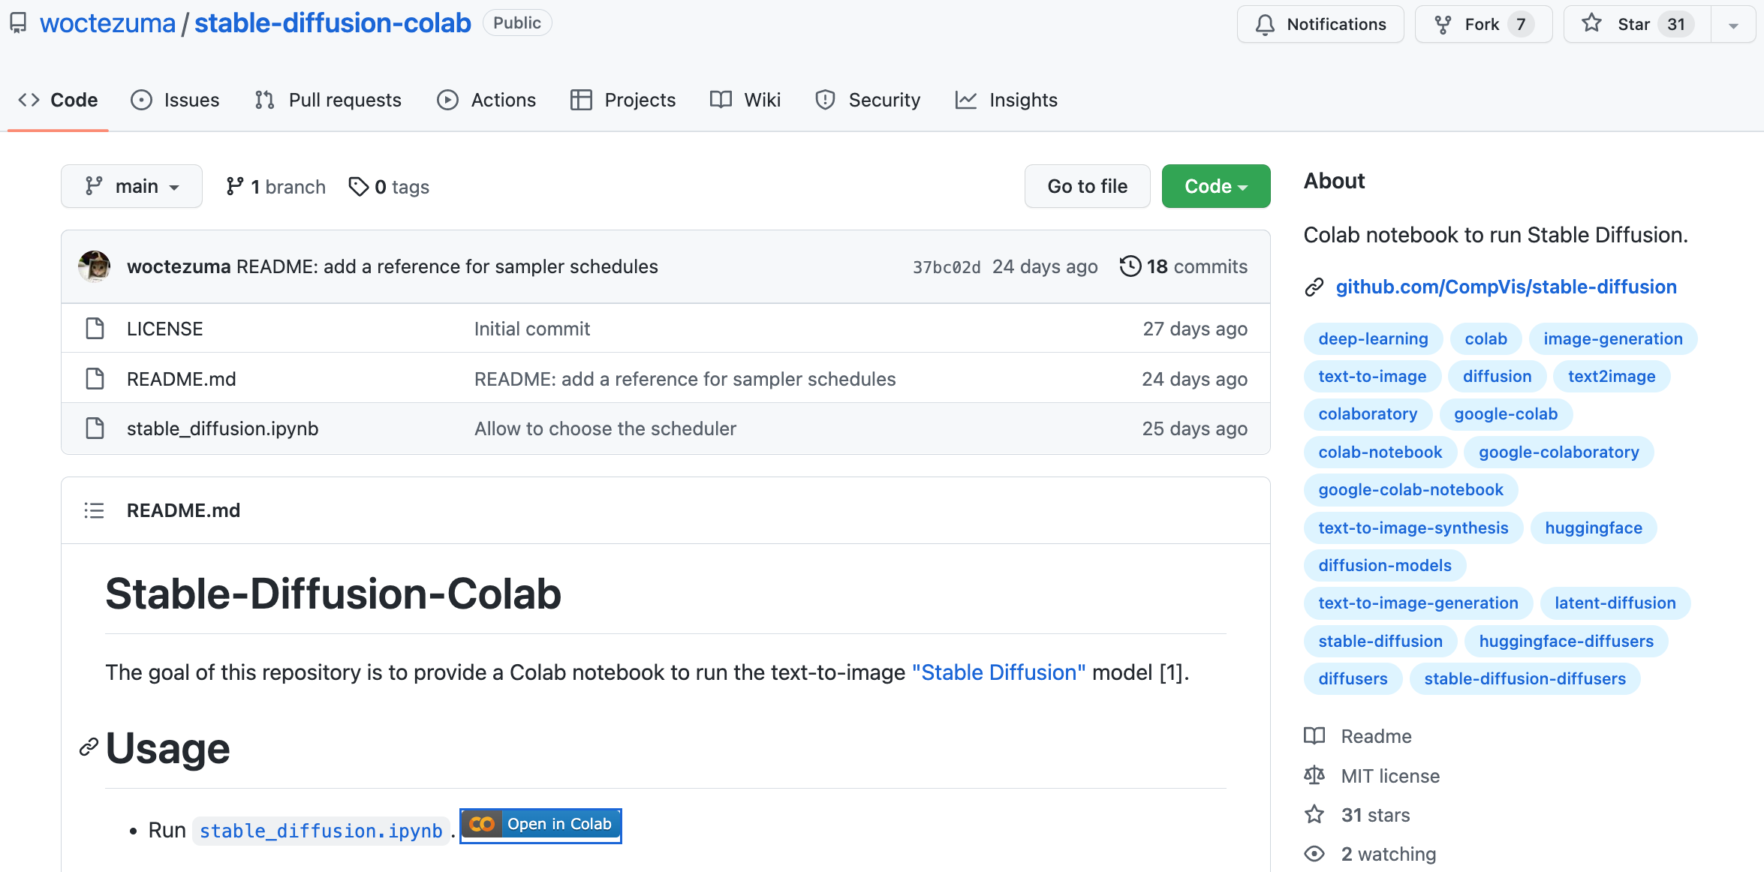
Stable Diffusion Colab
https://github.com/woctezuma/stable-diffusion-colab

Slide 63
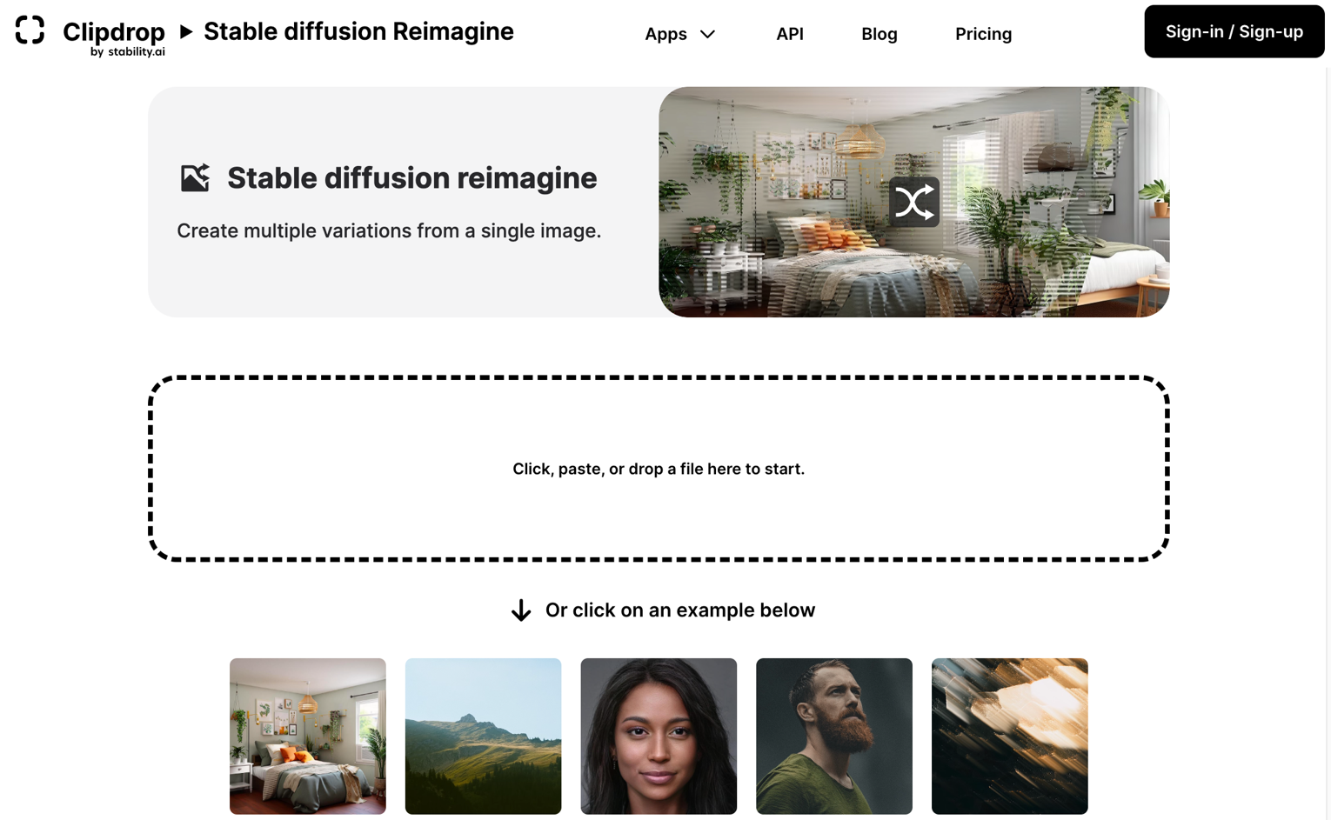
Stable Diffusion Reimagine
https://clipdrop.co/stable-diffusion-reimagine

Slide 64
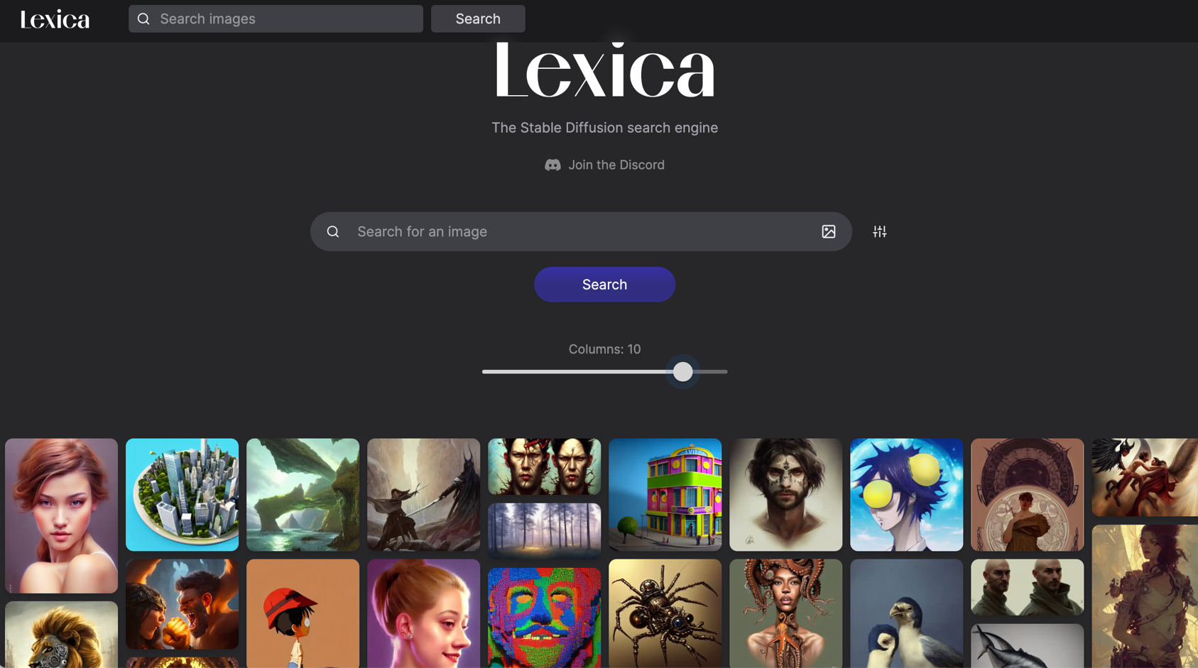
Lexica Art: Search Stable Diffusion images and prompts
https://lexica.art/

Slide 65
Civitai: Stable Diffusion AI Art Models
https://civitai.com/

Slide 66
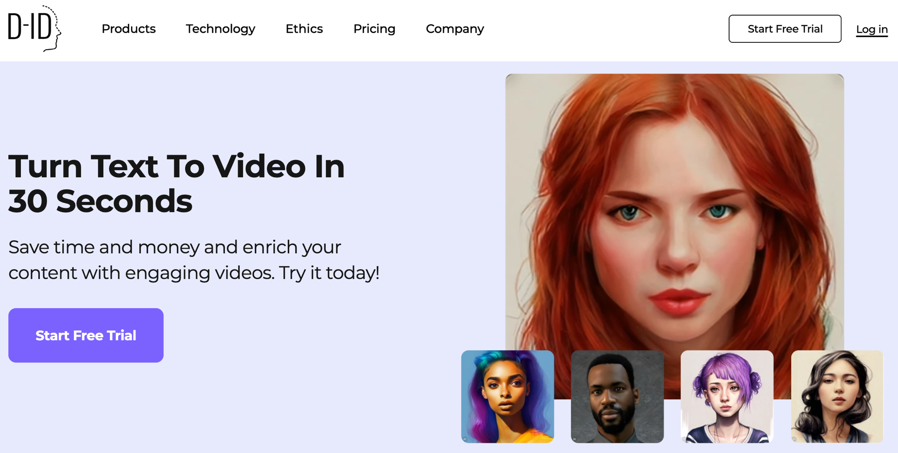
D-ID Text to Video
https://www.d-id.com/text-to-video/

Slide 67
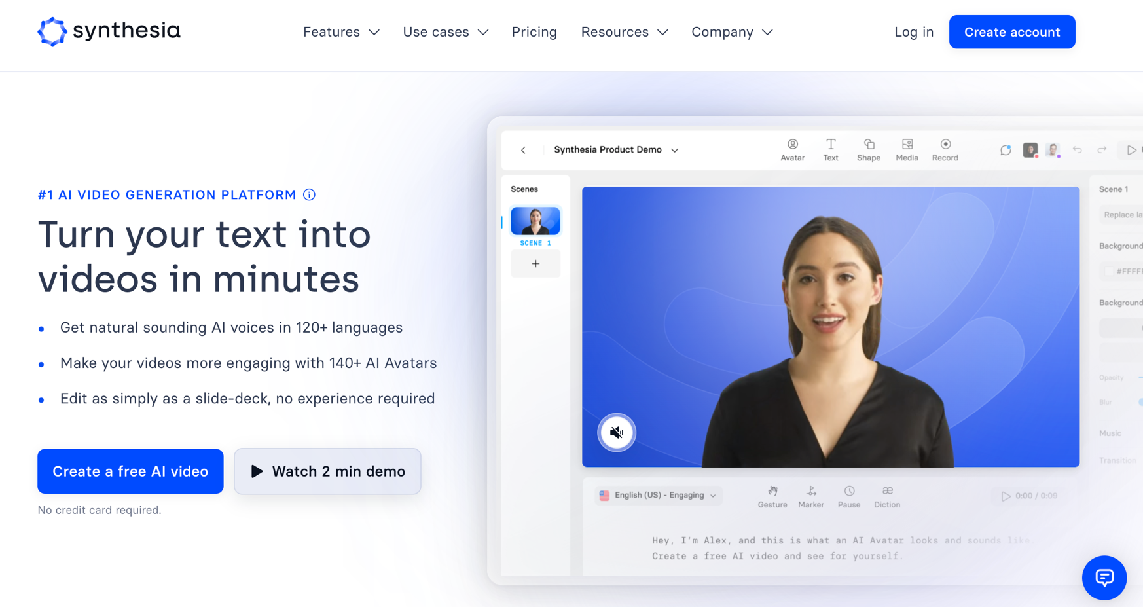
Synthesia: #1 AI Video Generation
https://www.synthesia.io/

Slide 68
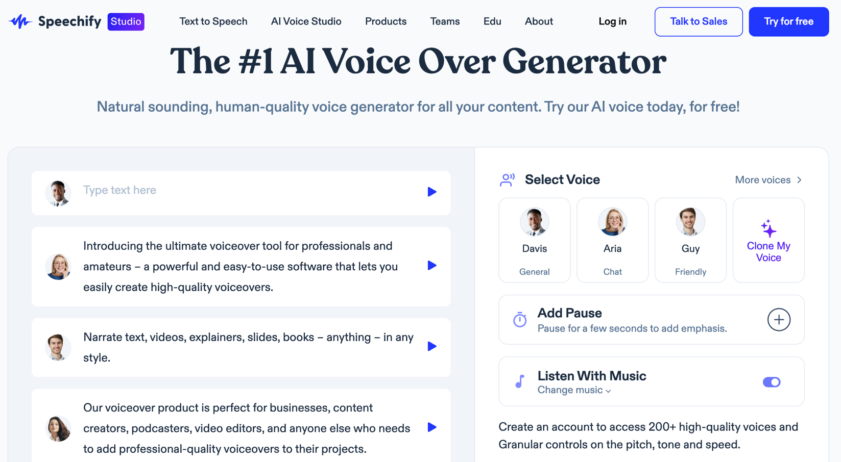
Speechify: #1 AI Voice Over Generator
https://speechify.com/voiceover/

Slide 69
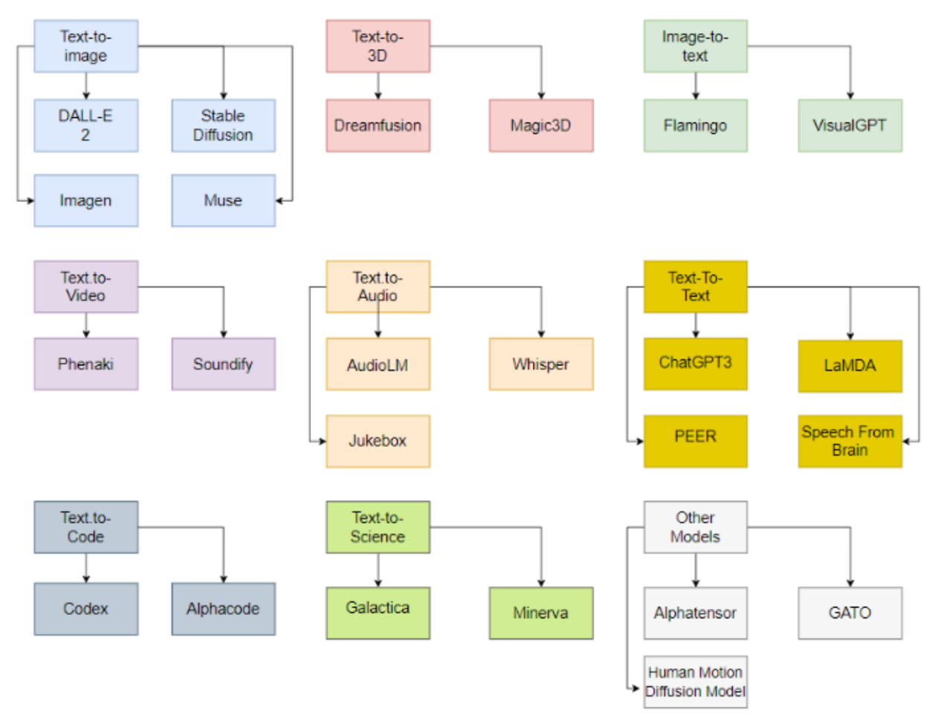
Generative AI Models
ChatGPT is not all you need
Attention is all you need
Source: Gozalo-Brizuela, Roberto, and Eduardo C. Garrido-Merchan (2023). "ChatGPT is not all you need. A State of the Art Review of large Generative AI models." arXiv preprint arXiv:2301.04655 (2023).

Slide 70
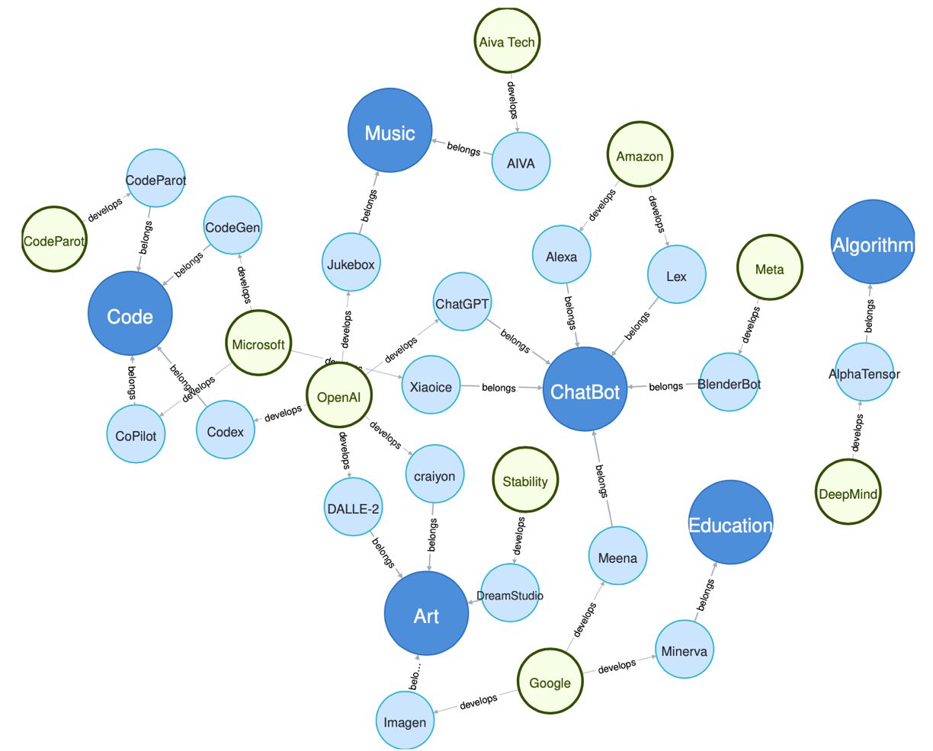
Generative AI Research Areas, Applications and Companies
Source: Yihan Cao, Siyu Li, Yixin Liu, Zhiling Yan, Yutong Dai, Philip S. Yu, and Lichao Sun (2023). "A Comprehensive Survey of AI-Generated Content (AIGC): A History of Generative AI from GAN to ChatGPT." arXiv preprint arXiv:2303.04226.

Slide 71
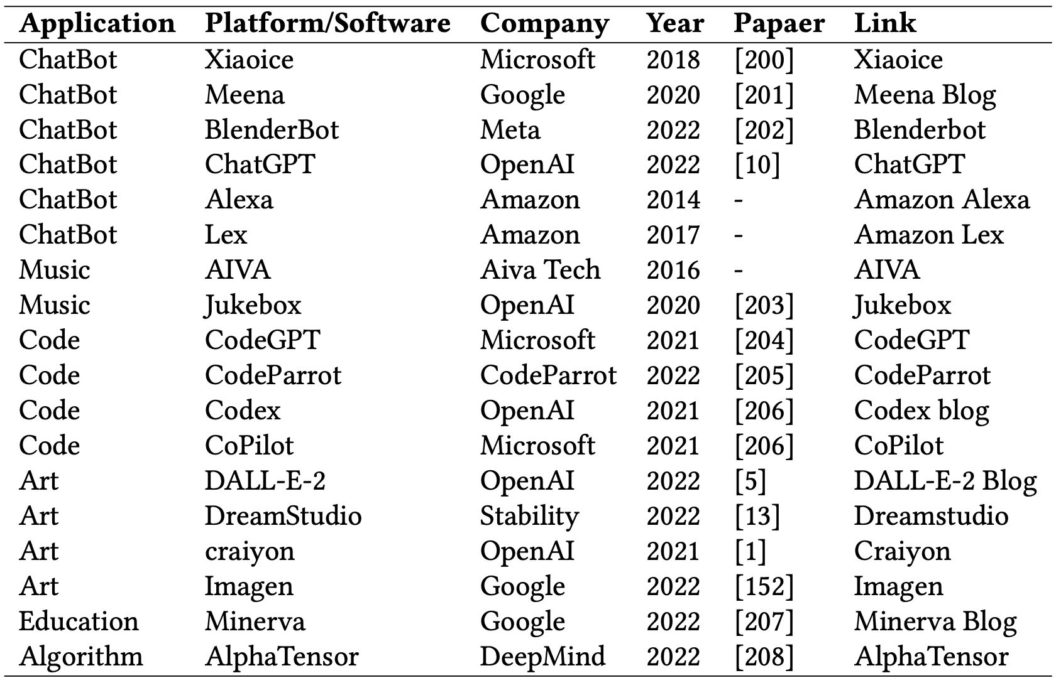
Applications of Generative AI Models
Source: Yihan Cao, Siyu Li, Yixin Liu, Zhiling Yan, Yutong Dai, Philip S. Yu, and Lichao Sun (2023). "A Comprehensive Survey of AI-Generated Content (AIGC): A History of Generative AI from GAN to ChatGPT." arXiv preprint arXiv:2303.04226.

Slide 72
Generative AI for Corporate ESG and Sustainable Development

Slide 73
ESG: Environmental Social Governance

Slide 74
CSR: Corporate Social Responsibility

Slide 75
Sustainable Development Goals (SDGs)
Source: https://sdgs.un.org/goals

Slide 76
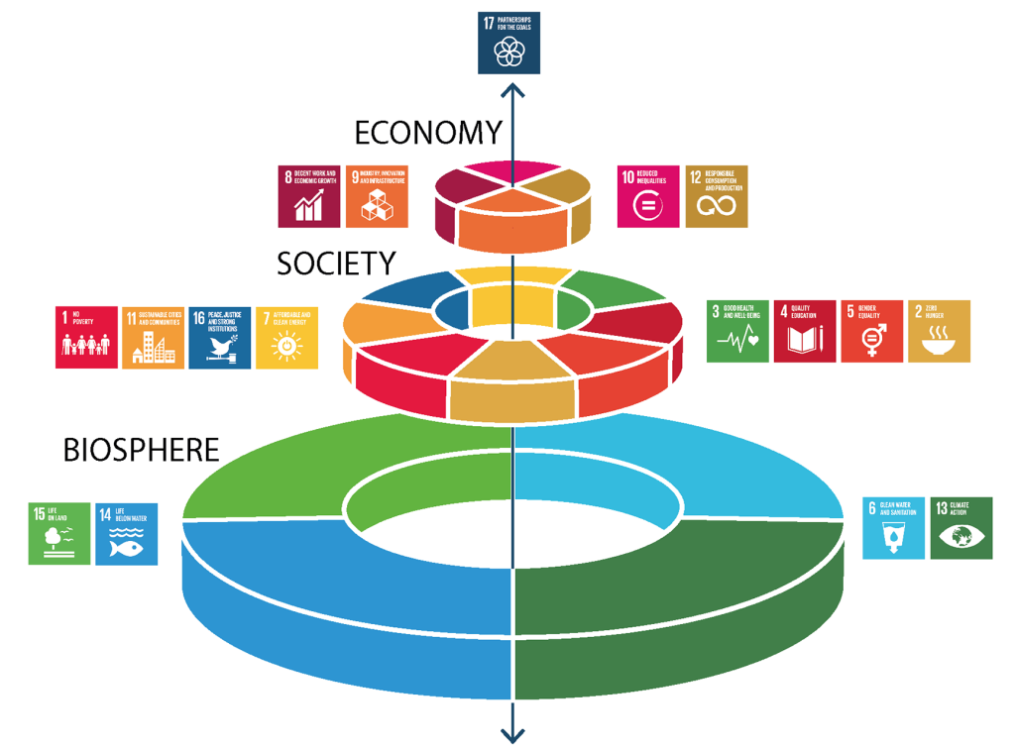
Sustainable Development Goals (SDGs) and 5P
Partnership
Peace
Prosperity
People
Planet
Source: Folke, Carl, Reinette Biggs, Albert V. Norström, Belinda Reyers, and Johan Rockström. "Social-ecological resilience and biosphere-based sustainability science.”Ecology and Society 21, no. 3 (2016).

Slide 77
Evolution of Sustainable Finance Research
Topic
SDGs: Sustainable Development Goals
SDGs
Innovative Financial Instrument
Impact Investing
ESG: Environmental, Social, and Governance
CSR: Corporate Social Responsibility
Conscious Capitalism
Climate Financing
Carbon Financing
Green Financing
Ethical Investing
Socially Responsible Investing
1986
1995
2005
2015
2020
Source: Kumar, S., Sharma, D., Rao, S., Lim, W. M., & Mangla, S. K. (2022). Past, present, and future of sustainable finance: Insights from big data analytics through machine learning of scholarly research. Annals of Operations Research, 1-44.

Slide 78
ESG to 17 SDGs
Source: https://sustainometric.com/esg-to-sdgs-connected-paths-to-a-sustainable-future/

Slide 79
Generative AI and LLMs for Sustainability and ESG Data Analytics

Slide 80
Sustainability and ESG Data Analytics

Slide 81
Generative AI for ESG Rating and Reporting Generation

Slide 82
Modelling Strategy to Forecast Carbon Emissions with AI
Source: Brière, M., Keip, M., & Le Berthe, T. (2022). Artificial Intelligence for Sustainable Finance: Why it May Help. Available at SSRN 4252329.
Notes:
Modelling strategy to forecast carbon emisisons with Machine Learning methods
This figure illustrates the modelling framework that is used to train and evaluate the proposed machine learning approach. Block: Data shows the sample selection and data pre-processing process. Block: Prediction Model implements (1) Predictor Selection, where the optimal set of predictors from the listed alternative choices is selected based on OLS regression. (2): Build Base-Learners, where three groups of base-learners are tested, namely linear models, non-linear models, and decision ensembles, and (3) Building Meta-Learners, where predictions are combined using a simple combination or stacked generalization. Finally, block: Model Evaluation: describes the model evaluation with mean absolute error and a set of robustness tests via double-K fold validation.
Source: Nguyen, Diaz-Rainez and Kuruppuarachchi (2021)

Slide 83
Sustainable Productivity: Finance ESG
Source: Huang, Ziqi, Yang Shen, Jiayi Li, Marcel Fey, and Christian Brecher (2021). "A survey on AI-driven digital twins in Industry 4.0: Smart manufacturing and advanced robotics." Sensors 21, no. 19: 6340.

Slide 84
Sustainable Resilient Manufacturing ESG
Source: Huang, Ziqi, Yang Shen, Jiayi Li, Marcel Fey, and Christian Brecher (2021). "A survey on AI-driven digital twins in Industry 4.0: Smart manufacturing and advanced robotics." Sensors 21, no. 19: 6340.

Slide 85
ESG Indexes
MSCI ESG Index
Dow Johns Sustainability Indices (DJSI)
FTSE ESG Index

Slide 86
MSCI ESG Rating Framework
Source: https://www.msci.com/documents/1296102/21901542/ESG-Ratings-Methodology-Exec-Summary.pdf

Slide 87
MSCI ESG Key Issue Hierarchy
Source: https://www.msci.com/documents/1296102/21901542/ESG-Ratings-Methodology-Exec-Summary.pdf

Slide 88
MSCI Governance Model Structure
Source: https://www.msci.com/documents/1296102/21901542/ESG-Ratings-Methodology-Exec-Summary.pdf

Slide 89
MSCI Hierarchy of ESG Scores
Source: https://www.msci.com/documents/1296102/21901542/ESG-Ratings-Methodology-Exec-Summary.pdf

Slide 90
FTSE Russell ESG Ratings
Source: https://www.ftserussell.com/data/sustainability-and-esg-data/esg-ratings

Slide 91
Sustainalytics ESG Risk Ratings
Sustainalytics’ ESG Risk Ratings measure a company’s exposure to industry-specific material ESG risks and how well a company is managing those risks.
Source: https://www.sustainalytics.com/esg-data

Slide 92
Truvalue ESG Ranks
TruValue Labs
Truvalue Labs applies AI to analyze over 100,000 sources and uncover ESG risks and opportunities hidden in unstructured text.
The ESG Ranks data service produces an overall company rank based on industry percentile leveraging the 26 ESG categories defined by the Sustainability Accounting Standards Board (SASB).
The data feed covers 20,000+ companies with more than 13 years of history.
Source: :https://developer.truvaluelabs.com/data/esg-ranks

Slide 93
Analyst-driven vs. AI-driven ESG
Sustainalytics
Truvalue Labs
Source: Mark Tulay (2020), Man vs. machine: A tale of two sustainability ratings systems, GreenBiz, https://www.greenbiz.com/article/man-vs-machine-tale-two-sustainability-ratings-systems

Slide 94
Analyst based ESG Research AI based ESG Research
Source: https://www.esganalytics.io/insights/how-data-is-accelerating-esg

Slide 95
ESG Analytics: NLP Taxonomy
Source: https://www.esganalytics.io/insights/how-data-is-accelerating-esg

Slide 96
Top ESG Reporting Software
Environmental, Social and Governance (ESG) Reporting software or Sustainability software helps organizations manage their operational data, evaluate their impact on the environment and provide reporting to perform audits.
Source: https://www.softwarereviews.com/categories/environmental-social-and-governance-reporting

Slide 97
Summary
1. Generative AI
2. ChatGPT and Large Language Models (LLMs)
3. Popular Generative AI and Applications
4. Generative AI for Corporate ESG and Sustainable Development

Slide 98
Acknowledgments: Research Projects
Applying AI technology to construct knowledge graphs of cryptocurrency anti-money laundering: a few-shot learning model
MOST, 110-2410-H-305-013-MY2, 2021/08/01~2023/07/31
Fintech Green Finance for Carbon Market Index, Corporate Finance, and Environmental Policies. Carbon Emission Sentiment Index with AI Text Analytics
NTPU, 112-NTPU_ORDA-F-003，2023/01/01~2024/12/31
Digital Support, Unimpeded Communication: The Development, Support and Promotion of AI-assisted Communication Assistive Devices for Speech Impairment. Multimodal Cross-lingual Task-Oriented Dialogue System for Inclusive Communication Support
NSTC 112-2425-H-305-002-, 2023/05/01-2026/04/30
Establishment and Implement of Smart Assistive Technology for Dementia Care and Its Socio-Economic Impacts. Intelligent, individualized and precise care with smart AT and system integration
NSTC, NSTC, 112-2627-M-038-001-, 2023/08/01~2024/07/31
Use deep learning to identify commercially dental implant systems - observational study
USTP-NTPU-TMU, USTP-NTPU-TMU-112-01, 2023/01/01~2023/12/31
Metaverse AI Multimodal Cross-Language Task-Oriented Dialogue System
ATEC Group x NTPU, NTPU-112A413E01, 2023/05/01~2026/04/30
Metaverse Avatar Automatic Metadata Generation Module
FormosaVerse x NTPU, NTPU-111A413E01, 2022/12/01~2023/11/30
Pilot Study on Universal Data Processing for Code Generation Engine
III x NTPU, NTPU-112A513E01, 2023/08/01~2023/12/22
https://web.ntpu.edu.tw/~myday/cindex.htm#projects

Slide 99
References
Yihan Cao, Siyu Li, Yixin Liu, Zhiling Yan, Yutong Dai, Philip S. Yu, and Lichao Sun (2023). "A Comprehensive Survey of AI-Generated Content (AIGC): A History of Generative AI from GAN to ChatGPT." arXiv preprint arXiv:2303.04226.
Pengfei Liu, Weizhe Yuan, Jinlan Fu, Zhengbao Jiang, Hiroaki Hayashi, and Graham Neubig. (2023) "Pre-train, prompt, and predict: A systematic survey of prompting methods in natural language processing." ACM Computing Surveys 55, no. 9 (2023): 1-35.
Wayne Xin Zhao, Kun Zhou, Junyi Li, Tianyi Tang, Xiaolei Wang, Yupeng Hou, Yingqian Min et al. (2023) "A Survey of Large Language Models." arXiv preprint arXiv:2303.18223.
Touvron, Hugo, Louis Martin, Kevin Stone, Peter Albert, Amjad Almahairi, Yasmine Babaei, Nikolay Bashlykov et al. (2023) "Llama 2: Open Foundation and Fine-Tuned Chat Models." arXiv preprint arXiv:2307.09288 (2023).
Rafailov, R., Sharma, A., Mitchell, E., Ermon, S., Manning, C. D., & Finn, C. (2023). Direct preference optimization: Your language model is secretly a reward model. arXiv preprint arXiv:2305.18290.
Tunstall, Lewis, Edward Beeching, Nathan Lambert, Nazneen Rajani, Kashif Rasul, Younes Belkada, Shengyi Huang et al. "Zephyr: Direct Distillation of LM Alignment." arXiv preprint arXiv:2310.16944 (2023).
Ouyang, L., Wu, J., Jiang, X., Almeida, D., Wainwright, C. L., Mishkin, P., ... & Lowe, R. (2022). Training language models to follow instructions with human feedback. arXiv preprint arXiv:2203.02155.
Gozalo-Brizuela, Roberto, and Eduardo C. Garrido-Merchan (2023). "ChatGPT is not all you need. A State of the Art Review of large Generative AI models." arXiv preprint arXiv:2301.04655 (2023).
Wenliang Dai, Junnan Li, Dongxu Li, Anthony Meng Huat Tiong, Junqi Zhao, Weisheng Wang, Boyang Li, Pascale Fung, and Steven Hoi. (2023) "InstructBLIP: Towards General-purpose Vision-Language Models with Instruction Tuning." arXiv preprint arXiv:2305.06500 (2023).
Shahab Saquib Sohail, Faiza Farhat, Yassine Himeur, Mohammad Nadeem, Dag Øivind Madsen, Yashbir Singh, Shadi Atalla, and Wathiq Mansoor (2023). "The Future of GPT: A Taxonomy of Existing ChatGPT Research, Current Challenges, and Possible Future Directions." Current Challenges, and Possible Future Directions (April 8, 2023) (2023).
Longbing Cao (2022). "Decentralized ai: Edge intelligence and smart blockchain, metaverse, web3, and desci." IEEE Intelligent Systems 37, no. 3: 6-19.
Qinglin Yang, Yetong Zhao, Huawei Huang, Zehui Xiong, Jiawen Kang, and Zibin Zheng (2022). "Fusing blockchain and AI with metaverse: A survey." IEEE Open Journal of the Computer Society 3 : 122-136.
Ouyang, L., Wu, J., Jiang, X., Almeida, D., Wainwright, C. L., Mishkin, P., ... & Lowe, R. (2022). Training language models to follow instructions with human feedback. arXiv preprint arXiv:2203.02155.

Slide 100
生成式AI在企業永續發展的應用 Generative AI for Corporate ESG and Sustainable Development
新北市教育局與國立臺北大學 共創學習假日講座
Q & A
Time: 15:00-17:00, Saturday, December 2, 2023
Place: NTPU USR Hub
https://learningcollaboration.org/index.php/2023/09/21/collegeco1120103/
戴敏育 副教授
Min-Yuh Day, Ph.D, Associate Professor
Institute of Information Management, National Taipei University
https://web.ntpu.edu.tw/~myday
2023-12-02

