Slide 1
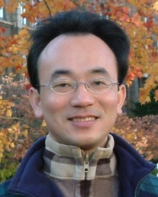
生成式AI與永續發展的應用 Generative AI and Sustainable Development Applications
台南應用科技大學
永續發展暨大學社會責任(USR)系列講座
2024/06/26 (Wed) 10:30 - 12:00
L703, Tainan University of Technology (TUT), Tainan, Taiwan
No.529, Zhongzheng Rd., Yongkang District, Tainan City 710302, Taiwan (R.O.C.)
戴敏育 教授 (Prof. Min-Yuh Day)
國立臺北大學 資訊管理研究所 教授
金融科技暨綠色金融研究中心 副主任
永續辦公室 永續發展組 組長
https://web.ntpu.edu.tw/~myday
2024-06-26

Slide 2
戴敏育 教授 Professor Min-Yuh Day
1
Professor, Information Management, NTPU
Visiting Scholar, IIS, Academia Sinica
Ph.D., Information Management, NTU
Director, Intelligent Financial Innovation Technology, IFIT Lab, IM, NTPU
Associate Director, Fintech and Green Finance Center, NTPU
Publications Co-Chairs, IEEE/ACM International Conference on Advances in Social Networks Analysis and Mining (ASONAM 2013- )
Program Co-Chair, IEEE International Workshop on Empirical Methods for Recognizing Inference in TExt (IEEE EM-RITE 2012- )
Publications Chair, The IEEE International Conference on Information Reuse and Integration for Data Science (IEEE IRI 2007- )

Slide 3
Outline
1. Generative AI: Powering Digital Sustainability Transformation
2. Generative AI and Large Language Models (LLMs): Popular Generative AI Applications 3. Generative AI for Sustainable Development Innovative Applications

Slide 4
衡量企業永續關鍵指標 臺北大學獨創ESG永續評鑑系統
Source: https://www.aacsb.ntpu.edu.tw/twsvi/view.php?id=Nzc=

Slide 5
台灣永續評鑑
國立臺北大學商學院企業永續發展研究團隊

Slide 6
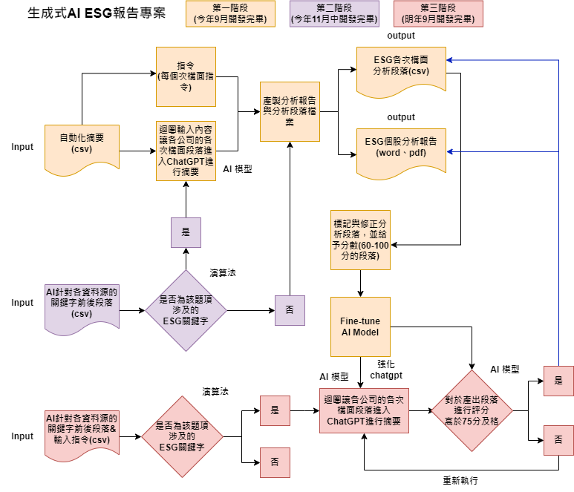
透過 AI SEED 提升評鑑效率
為使評鑑效率提升，與國立臺北大學資管所及資工所合作，開發相關程式， 已有25%題項自動或半自動化，大幅提升評鑑效率，並持續開發機械學習，持續透過AI 輔助評鑑進行。
另也透過AI SEED團隊持續將部分流程自動化，提升評鑑正確性，減少人力出錯可能。
題號 | 題目關鍵字 | 完成度
2-1-15 | 僅分派董監酬勞未分派股利 | 100%
2-2-3 | 獨董達董事席次1/2以上 | 100%
2-2-4 | 至少兩名獨董任期不超過9年 | 100%
2-2-14 | 設提名委員會且半數以上為獨董 | 100%
2-2-30 | 董事長兼任總經理 | 100%
2-2-31 | 1/3以上董事任期超過15年 | 100%
2-3-8 | 破產／面臨下市 | 100%
2-3-15 | 資安長或資訊安全委員會 | 100%
2-4-7 | 無保留意見 | 100%

Slide 7
Generative AI Powering Digital Sustainability Transformation

Slide 8
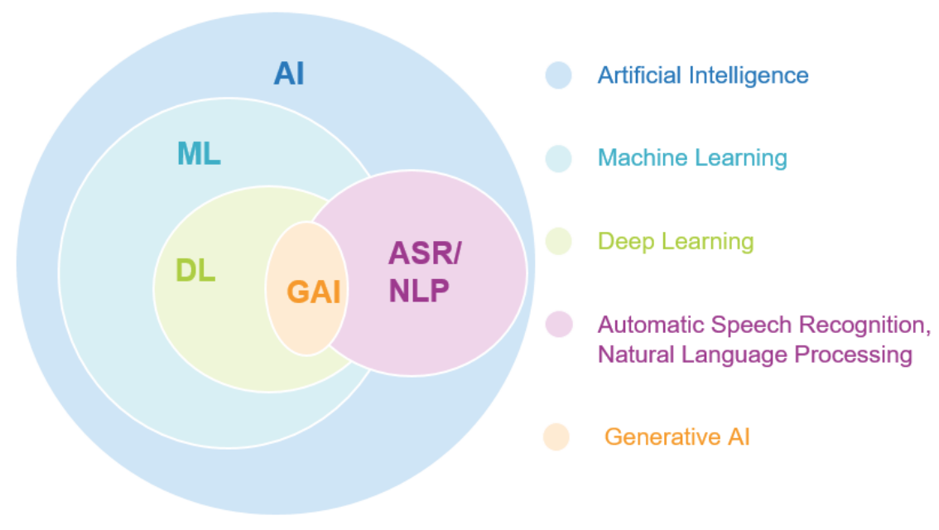
Generative AI
Source: Jeong, Cheonsu. "A Study on the Implementation of Generative AI Services Using an Enterprise Data-Based LLM Application Architecture." arXiv preprint arXiv:2309.01105 (2023).

Slide 9
Generative AI-Driven ESG Report Generation Technology Industrial Technology Research Institute (ITRI), Fintech and Green Finance Center (FGFC, NTPU), NTPU-113A513E01, 2024/03/01~2024/12/31

Slide 10
Sustainability and ESG Data Analytics

Slide 11
Generative AI and LLMs for Sustainability and ESG Data Analytics

Slide 12
Generative AI for ESG Rating and Reporting Generation

Slide 13
Net-Zero Transformation
Ambition
Aligned to achieving global net zero by no later than 2050 & to limit warming to 1.5°C
Governance
Accountability driven from the top
Strategy
Embedded and aligned net zero into company strategy
Enterprise
Key operating model changes in support of transformation
Supply chains
Transformed net zero supply chains
Innovation
Developed innovation and technologies to deliver net zero
Finance
Financing the net zero transformation
Transparency
Communicating action
Engagement
Enhancing the pace and scale of net zero action
Source: https://www.pwc.com/us/en/services/esg/library/building-blocks-for-net-zero-transformation.html

Slide 14
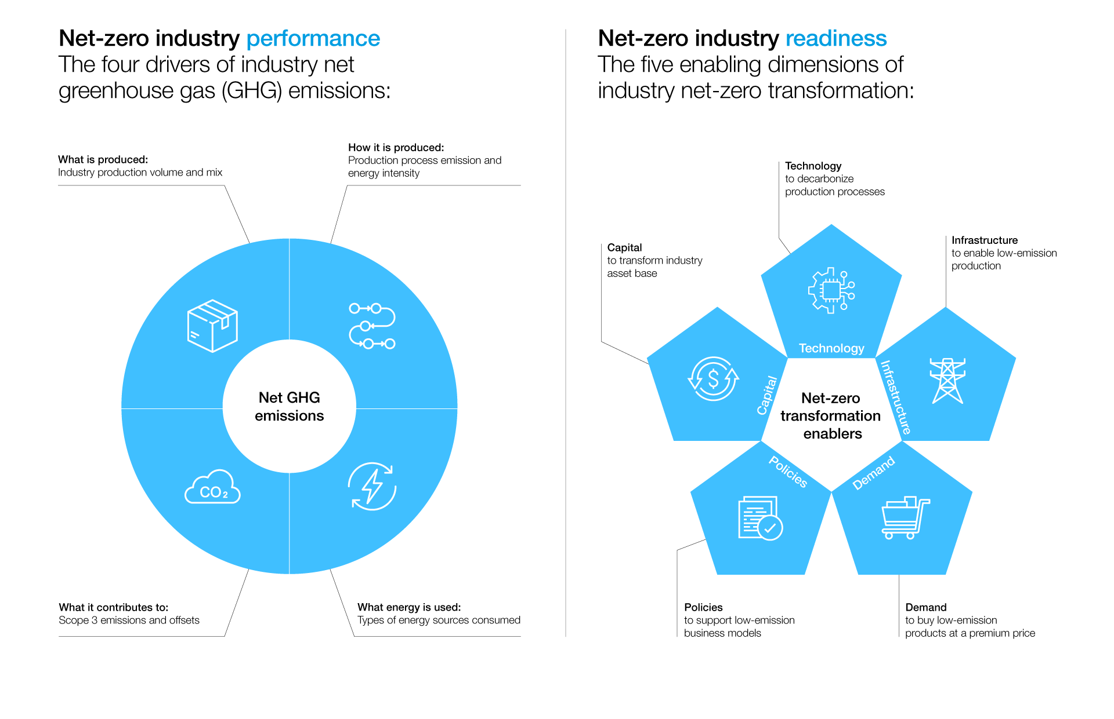
Net-Zero Transformation Enablers
Source: https://www.weforum.org/agenda/2022/07/net-zero-tracker/

Slide 15
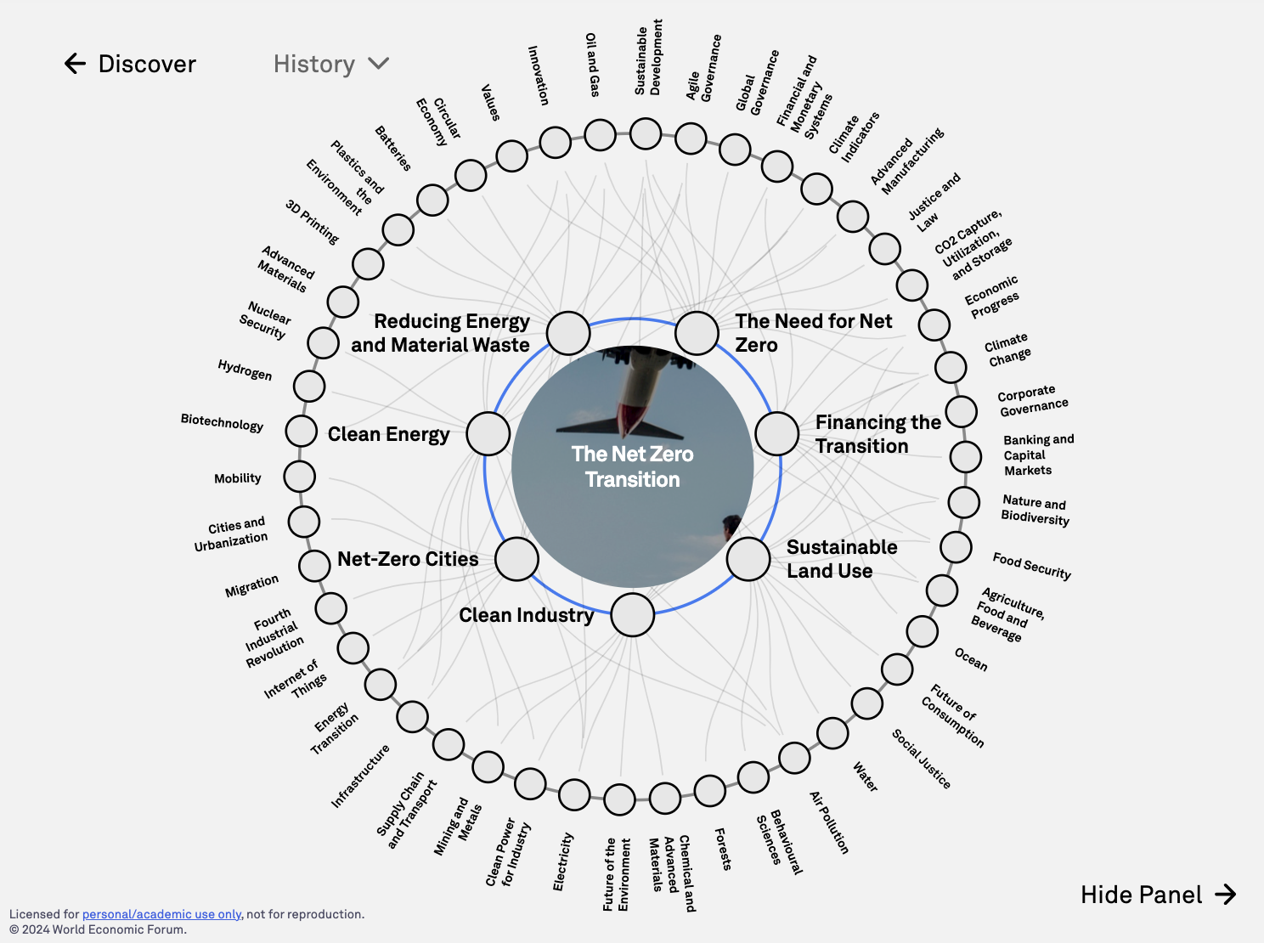
The Net Zero Transition
Source: https://intelligence.weforum.org/topics/a1G680000004C93EAE

Slide 16
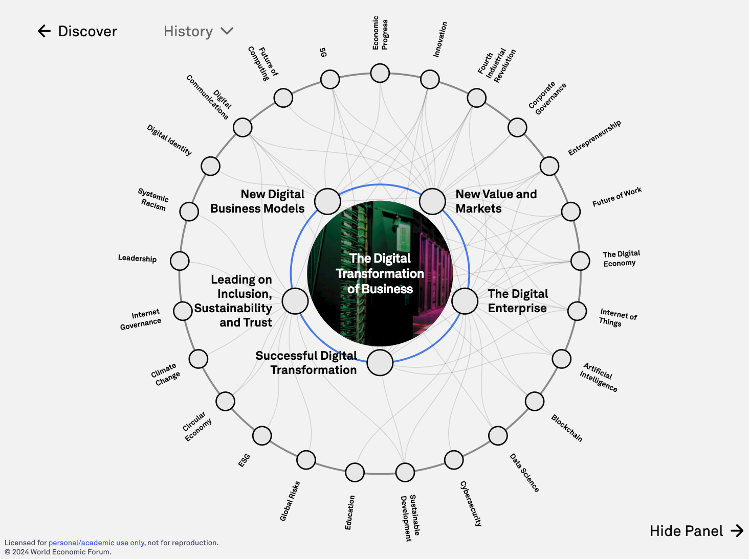
The Digital Transformation of Business
Source: https://intelligence.weforum.org/topics/a1G0X000006DIDZUA4

Slide 17
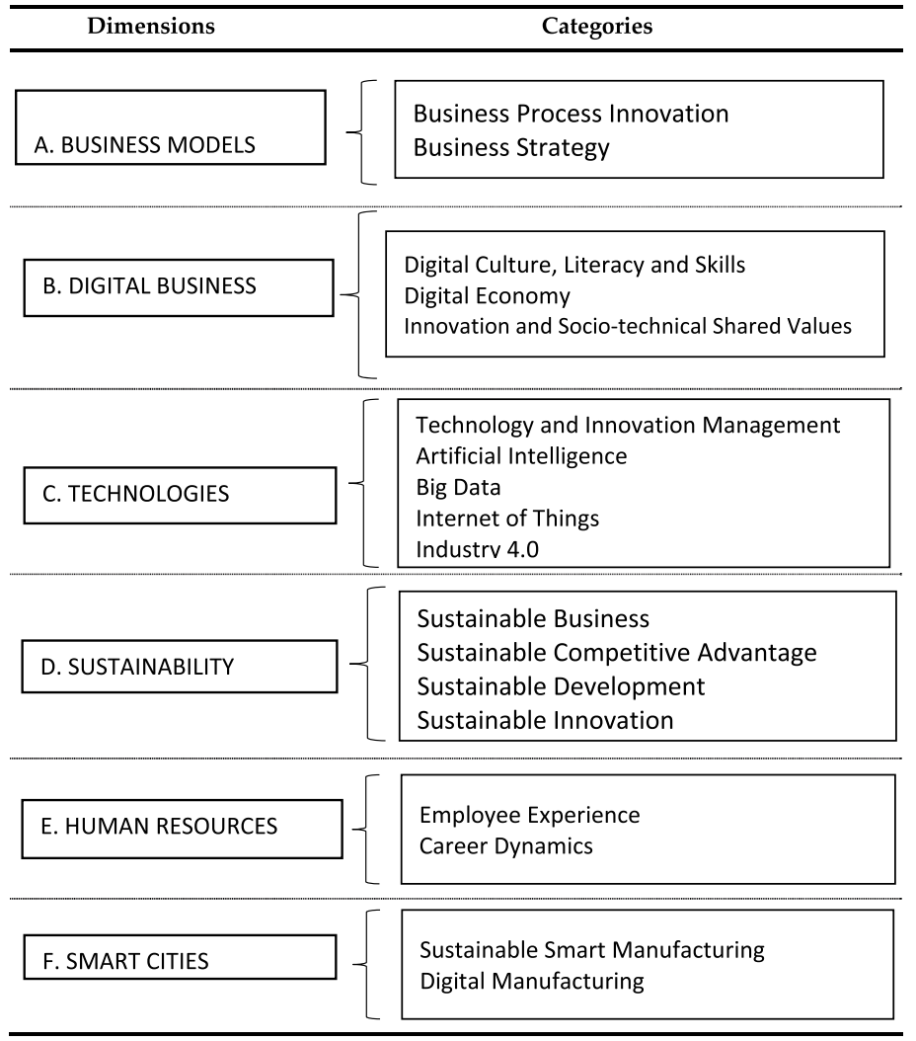
Digital Transformation
Source: Reis, João, and Nuno Melão (2023). "Digital transformation: A meta-review and guidelines for future research." Heliyon (2023).

Slide 18
Generative AI and Large Language Models (LLMs): Popular Generative AI Applications

Slide 19
Generative AI Text, Image, Video, Audio Applications

Slide 20
Popular Generative AI
OpenAI ChatGPT (GPT-4o, GPT-4)
Claude.ai (Claude 3.5)
Google Gemini
Chat.LMSys.org
Perplexity.ai
ChatPDF
Stable Diffusion
Video: D-ID, Synthesia
Audio: Speechify

Slide 21
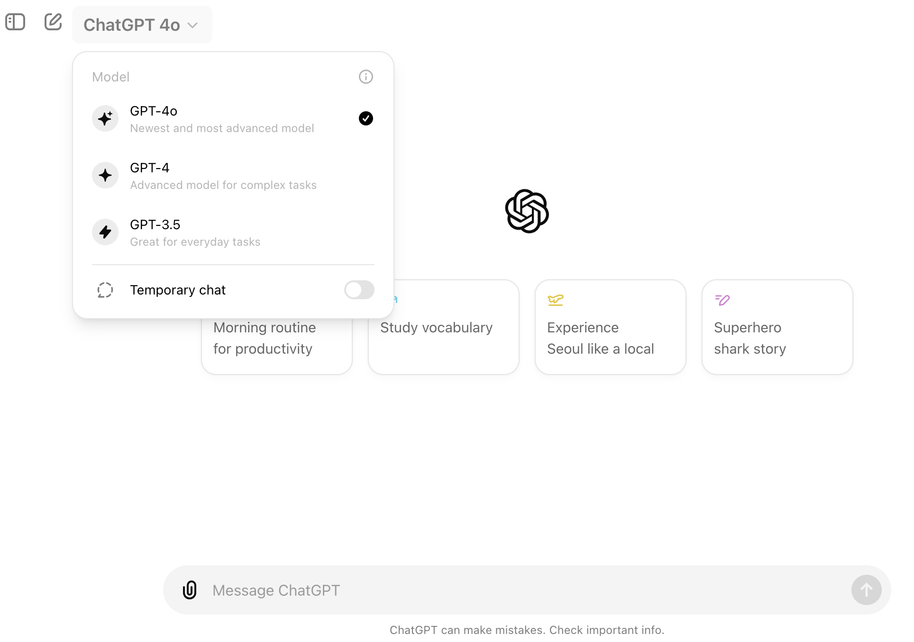
OpenAI ChatGPT (GPT-4o, GPT-4)
https://chat.openai.com/

Slide 22
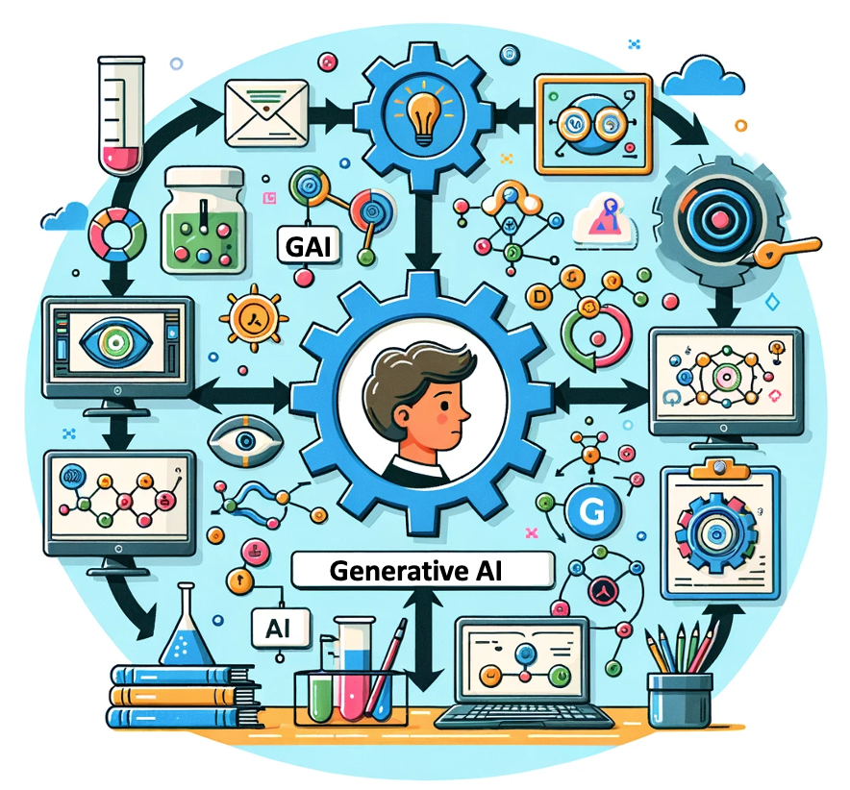
OpenAI ChatGPT (GPT-4) DALL·E 3
Vector graphic of a flowchart depicting the integration of generative AI in the education process, from content creation to virtual experiments, personalized learning, and innovative learning.
https://chat.openai.com/

Slide 23
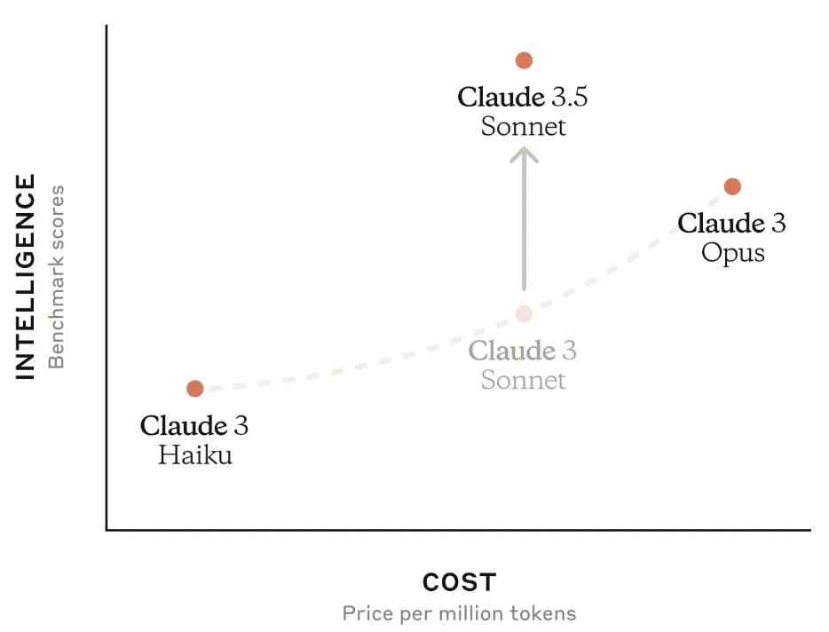
Claude 3.5 Sonnet
Source: https://www.anthropic.com/news/claude-3-5-sonnet

Slide 24
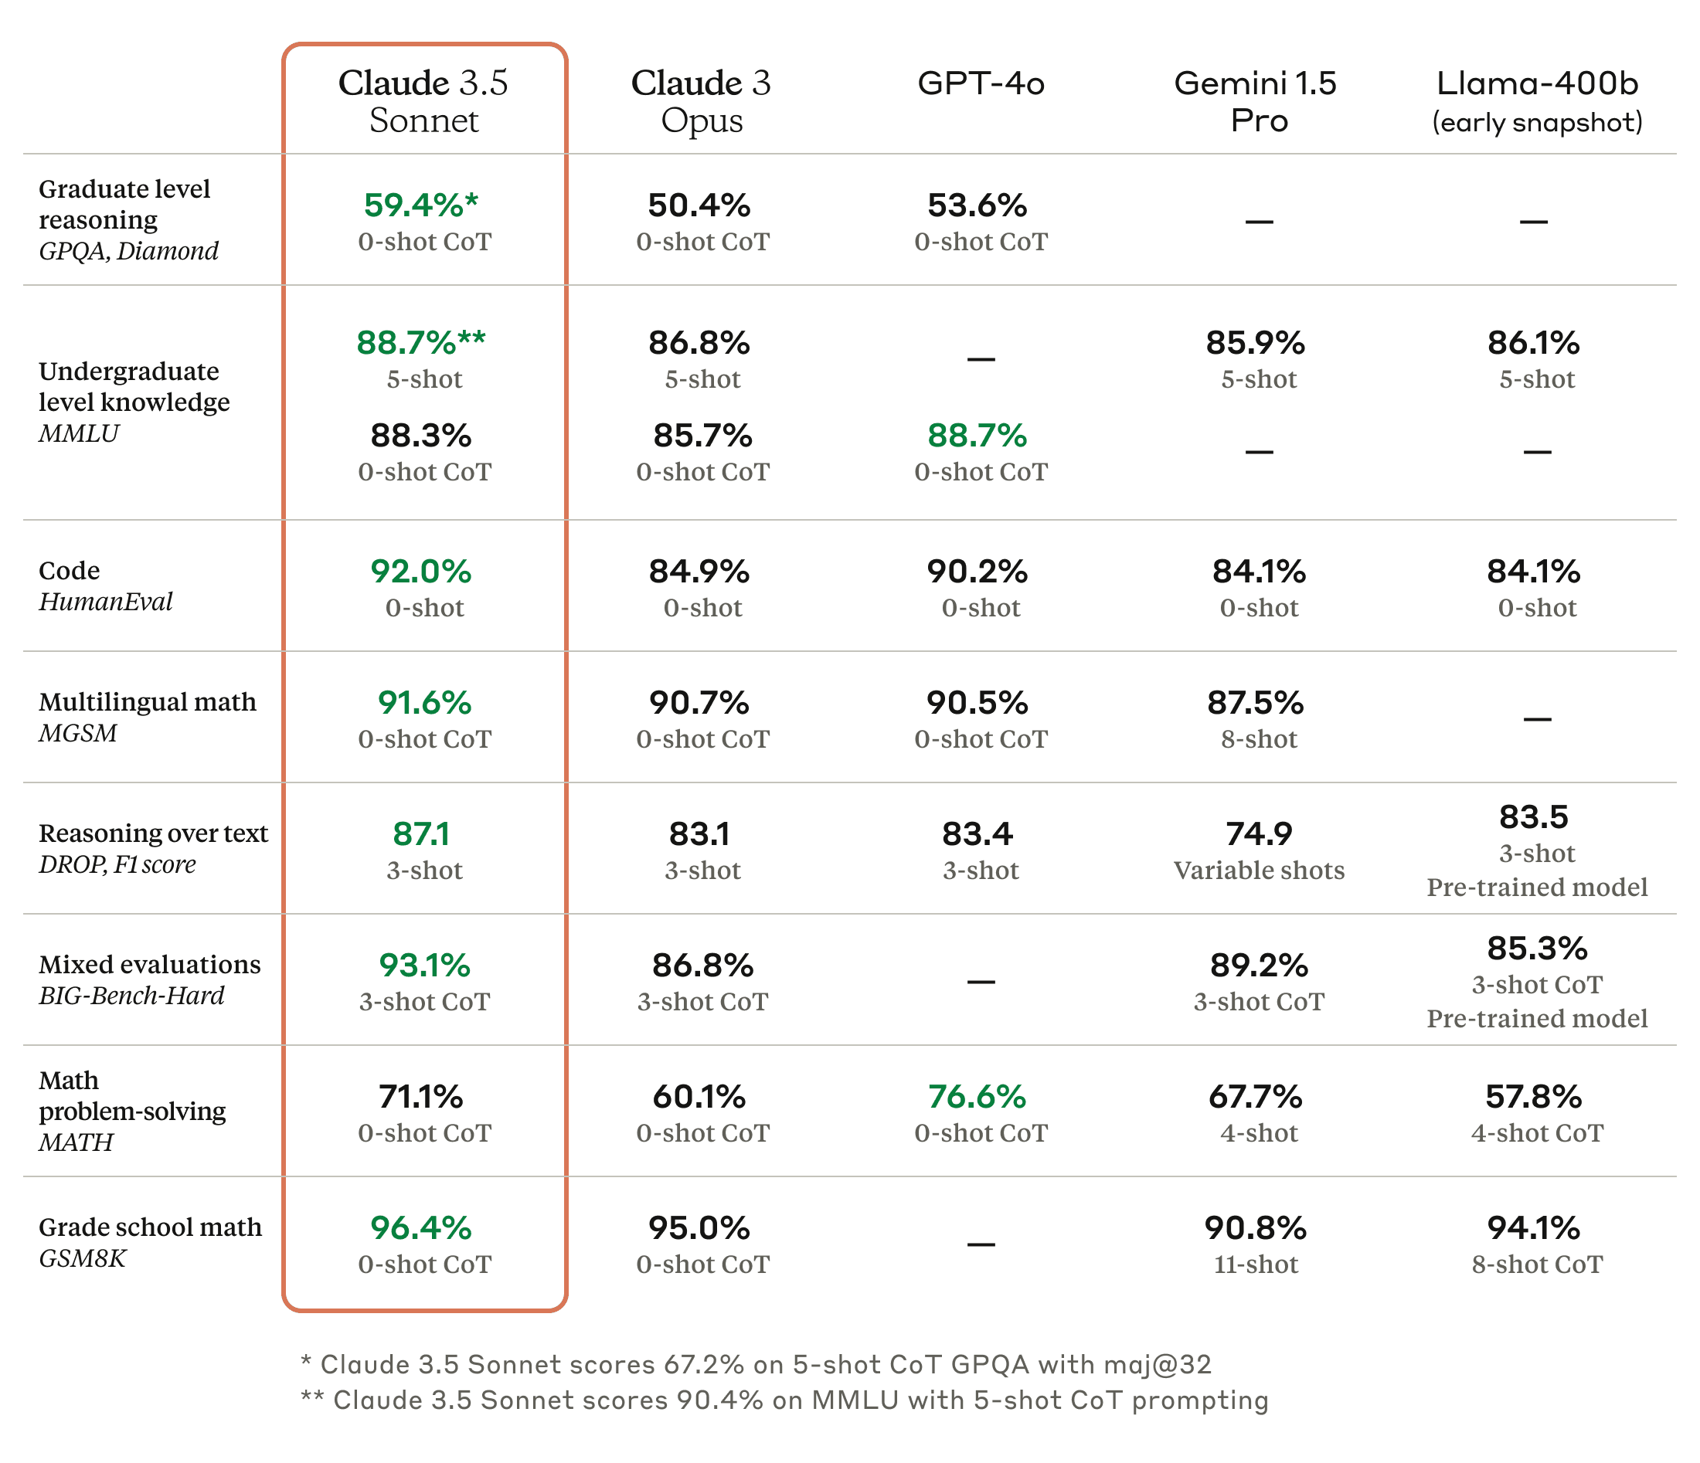
Claude 3.5, GPT-4o, Gemini 1.5 Pro
Source: https://www.anthropic.com/news/claude-3-5-sonnet

Slide 25
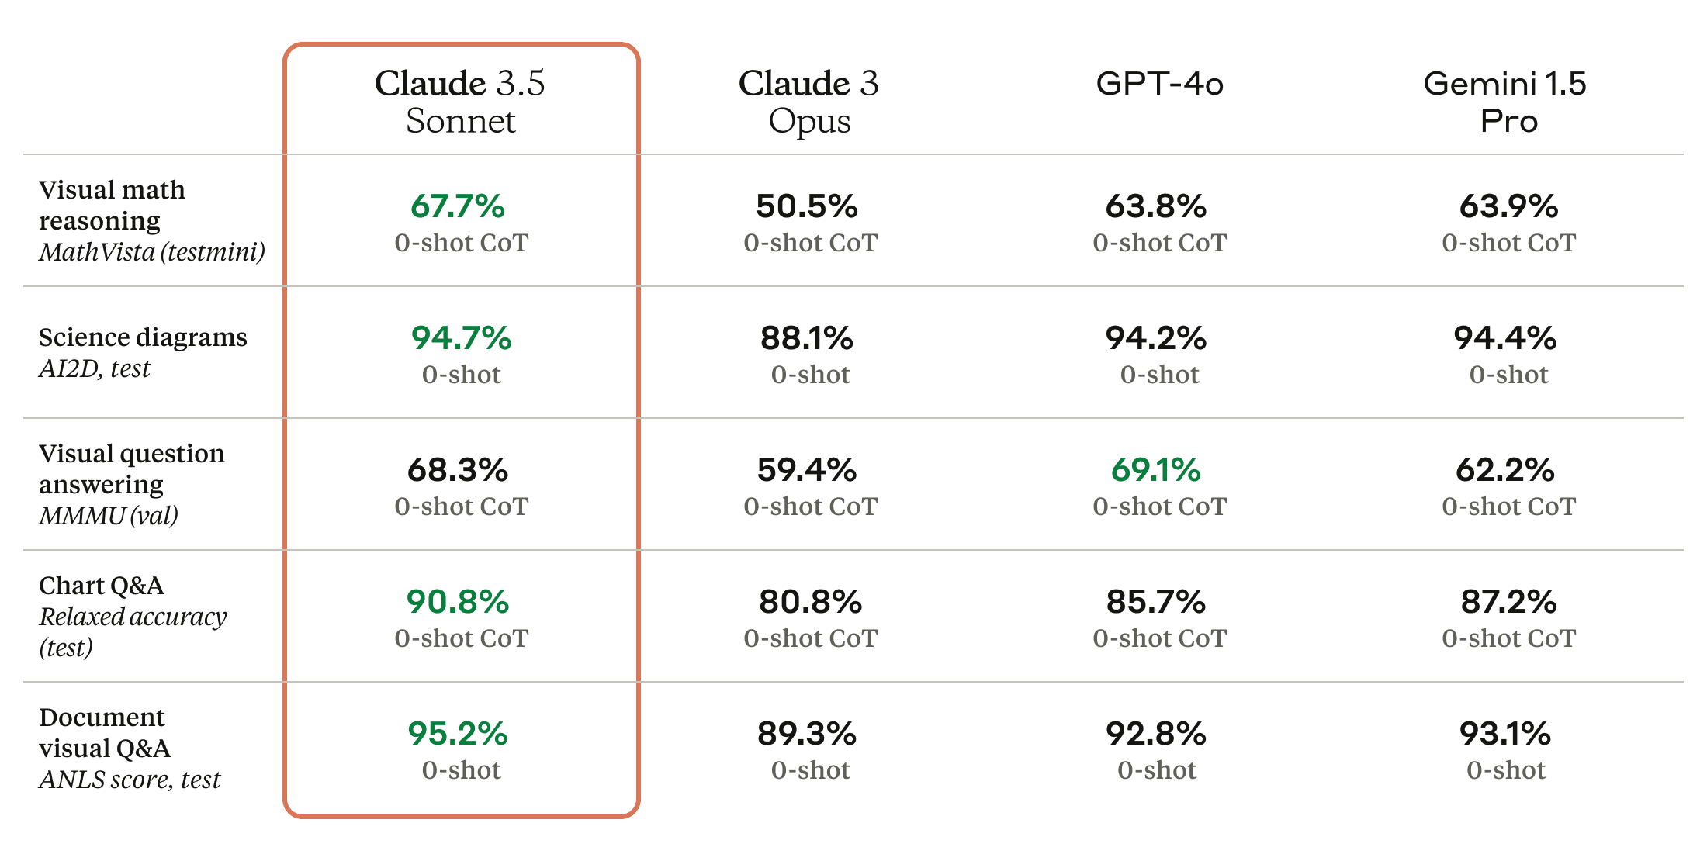
Claude 3.5 Sonnet State-of-the-art vision
Source: https://www.anthropic.com/news/claude-3-5-sonnet

Slide 26
Google Gemini Largest and most capable AI model Making AI more helpful for everyone
Source: https://blog.google/technology/ai/google-gemini-ai

Slide 27
Chat with Open Large Language Models
chat.lmsys.org
⚔️ Chatbot Arena ⚔️ : Benchmarking LLMs in the Wild
Mixtral of experts: A Mixture-of-Experts model by Mistral AI | Qwen 1.5: A large language model by Alibaba Cloud | Bard: Bard by Google
Gemini: Gemini by Google | DeepSeek LLM: An advanced language model by DeepSeek | StripedHyena-Nous: A chat model developed by Together Research and Nous Research.
GPT-4-Turbo: GPT-4-Turbo by OpenAI | GPT-3.5: GPT-3.5-Turbo by OpenAI | Claude: Claude 2 by Anthropic
Claude Instant: Claude Instant by Anthropic | Nous-Hermes-2-Mixtral-8x7B-DPO: Nous Hermes finetuned from Mixtral 8x7B | OpenChat 3.5: An open model fine-tuned on Mistral-7B using C-RLFT
Llama2-70B-SteerLM-Chat: A Llama fine-tuned with SteerLM method by NVIDIA | pplx-online-llms: Online LLM API by Perplexity AI | OpenHermes-2.5-Mistral-7B: A mistral-based model fine-tuned on 1M GPT-4 outputs
Starling-LM-7B-alpha: An open model trained using RLAIF by Berkeley | Tulu 2: An instruction and RLHF model by UW/AllenAI | Yi-Chat: A large language model by 01 AI
Llama 2: Open foundation and fine-tuned chat models by Meta | Vicuna: A chat assistant fine-tuned on user-shared conversations by LMSYS | Zephyr: A chatbot fine-tuned from Mistral by Hugging Face
Code Llama: Open foundation models for code by Meta | WizardLM: An instruction-following LLM using evol-instruct by Microsoft
https://chat.lmsys.org/

Slide 28
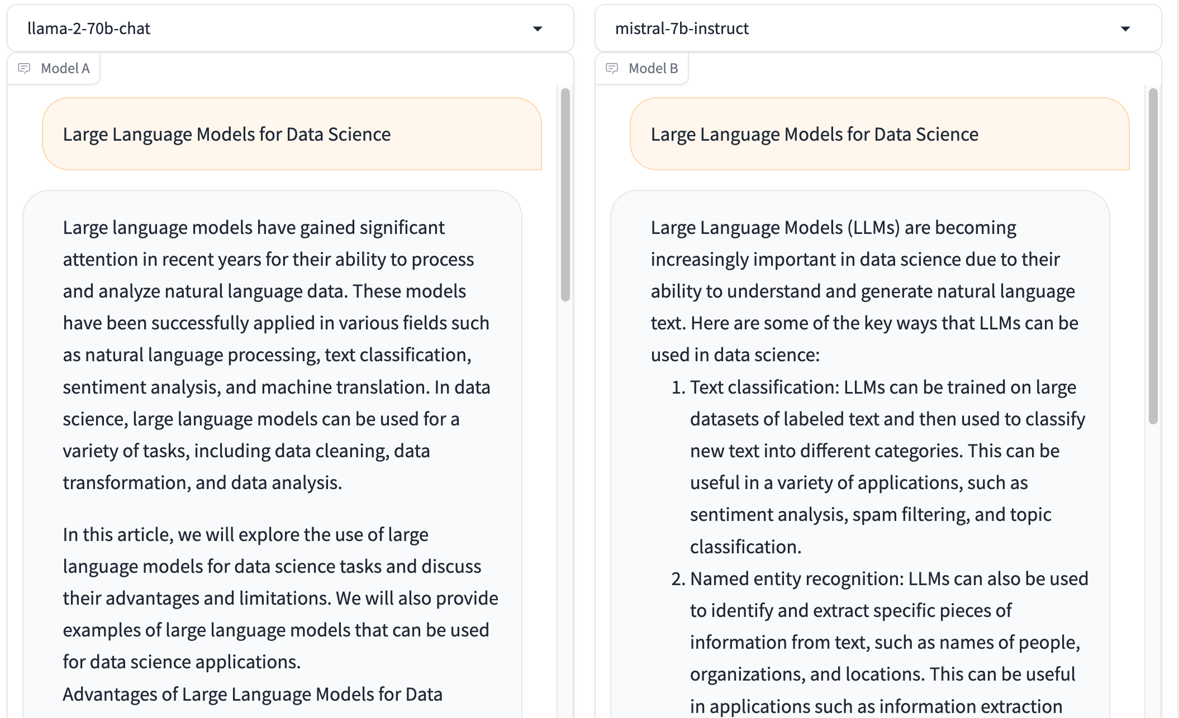
Chat with Open Large Language Models: Chatbot Arena
Large Language Models for Data Science
Llama 2-70b-chat
Mistral-7b-instruct
https://chat.lmsys.org/

Slide 29
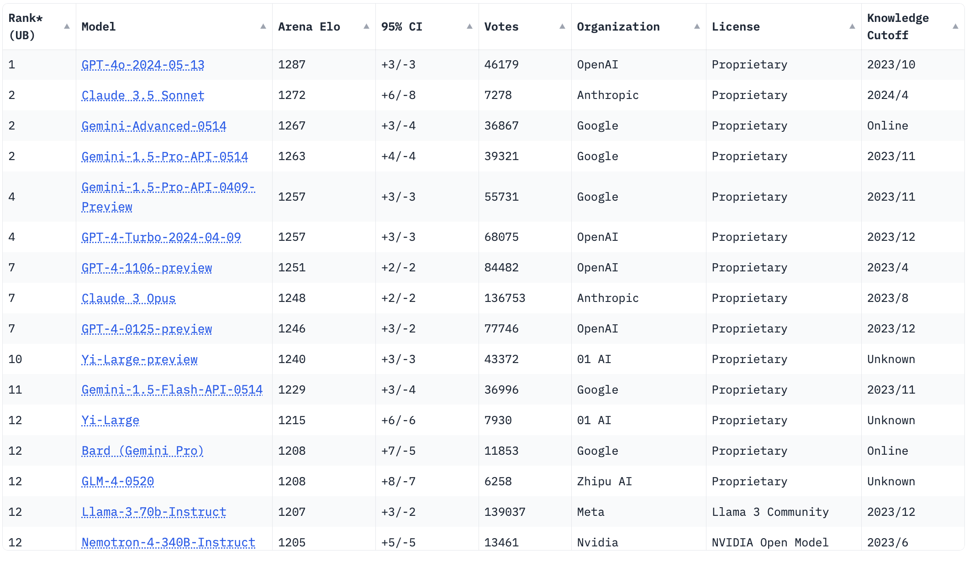
Chatbot Arena Leaderboard LLM Leaderboard
https://chat.lmsys.org/

Slide 30
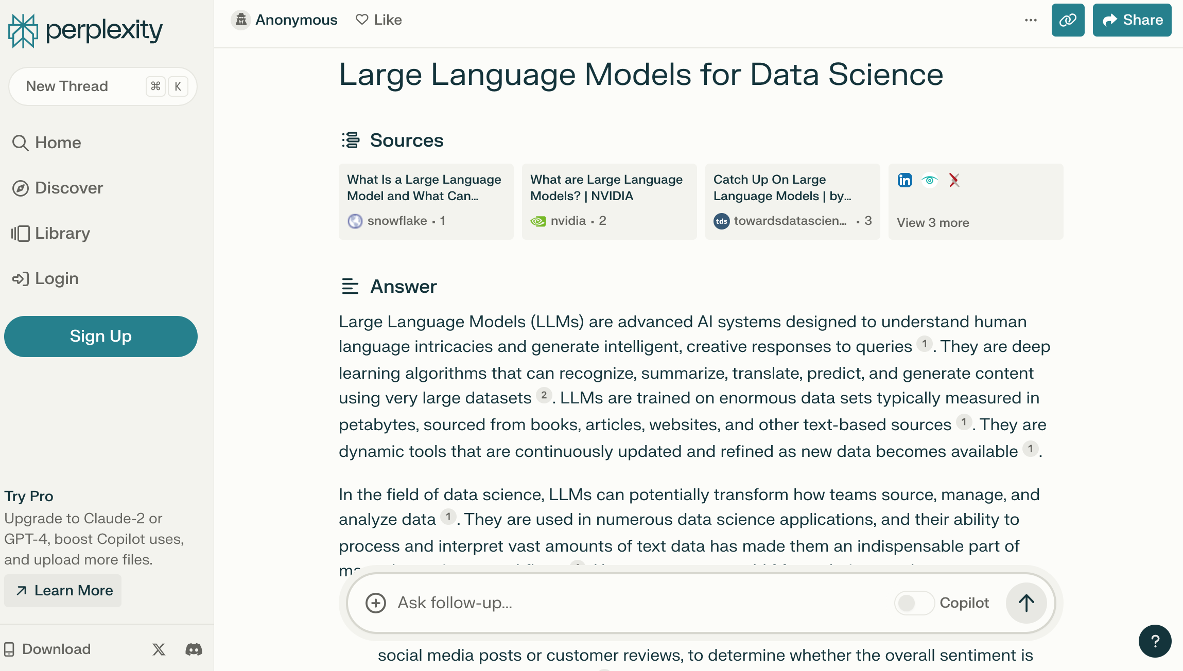
Perplexity.ai
https://www.perplexity.ai/

Slide 31
Generative AI for Sustainable Development Innovative Applications

Slide 32
Sustainable Development Goals (SDGs)
Source: https://sdgs.un.org/goals

Slide 33
Evolution of Sustainable Finance Research
Topic
SDGs: Sustainable Development Goals
SDGs
Innovative Financial Instrument
Impact Investing
ESG: Environmental, Social, and Governance
CSR: Corporate Social Responsibility
Conscious Capitalism
Climate Financing
Carbon Financing
Green Financing
Ethical Investing
Socially Responsible Investing
1986
1995
2005
2015
2020
Source: Kumar, S., Sharma, D., Rao, S., Lim, W. M., & Mangla, S. K. (2022). Past, present, and future of sustainable finance: Insights from big data analytics through machine learning of scholarly research. Annals of Operations Research, 1-44.

Slide 34
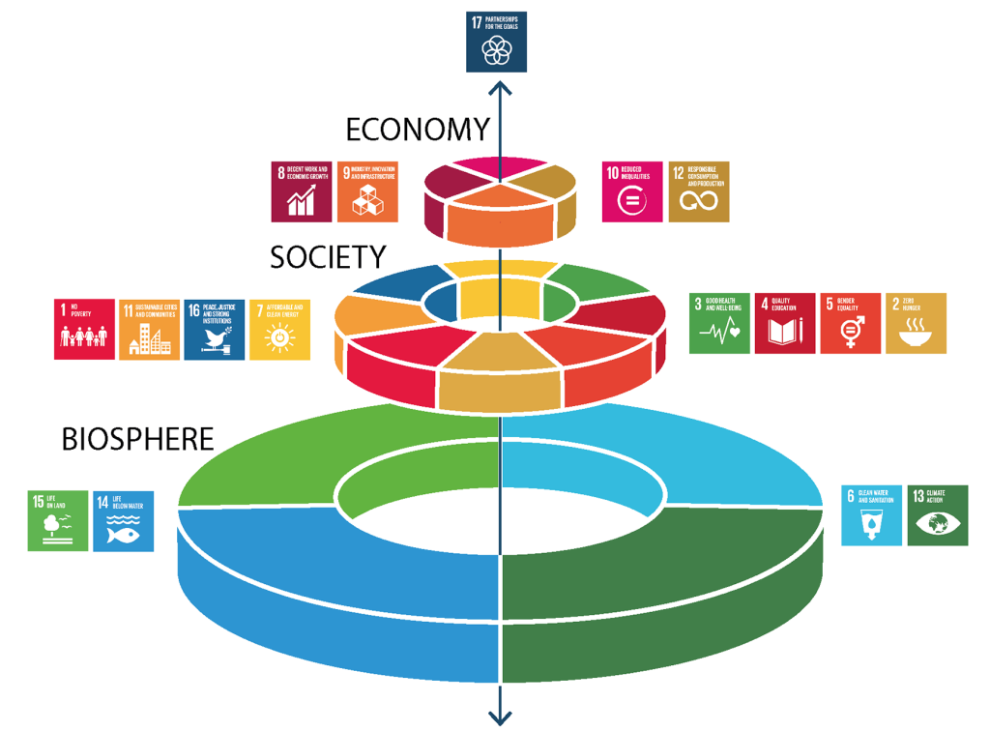
Sustainable Development Goals (SDGs) and 5P
Partnership
Peace
Prosperity
People
Planet
Source: Folke, Carl, Reinette Biggs, Albert V. Norström, Belinda Reyers, and Johan Rockström. "Social-ecological resilience and biosphere-based sustainability science.”Ecology and Society 21, no. 3 (2016).

Slide 35
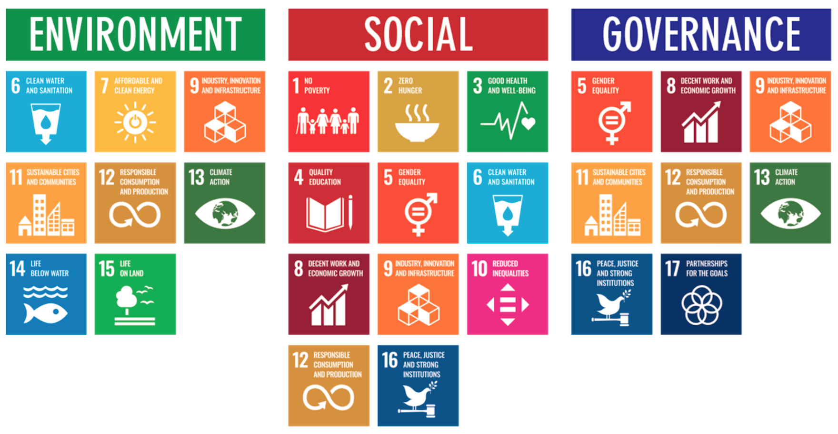
ESG to 17 SDGs
Source: Henrik Skaug Sætra (2021) "A Framework for Evaluating and Disclosing the ESG Related Impacts of AI with the SDGs." Sustainability 13, no. 15 (2021): 8503.

Slide 36
ESG to 17 SDGs
Source: https://sustainometric.com/esg-to-sdgs-connected-paths-to-a-sustainable-future/

Slide 37
Digital Transformation: Enabler and Challenge
Enabler
Data-driven decision-making, efficiency gains, new business models, collaboration
AI optimizing renewable energy
Challenge
Energy consumption, e-waste, planned obsolescence, AI ethics
AI servers representing increased energy use

Slide 38
Mapping the ESG Standards Landscape
The most prevalent ESG reporting frameworks
GRI (Global Report Initiative)
CDP (Carbon Disclosure Project)
SASB (Sustainability Accounting Standards Board
ISSB (International Sustainability Standards Board)
TCFD (Task Force on Climate-related Financial Disclosures
How companies choose
Materiality, industry-specific standards, investor alignment

Slide 39
GRI (Global Report Initiative)
https://www.globalreporting.org/

Slide 40
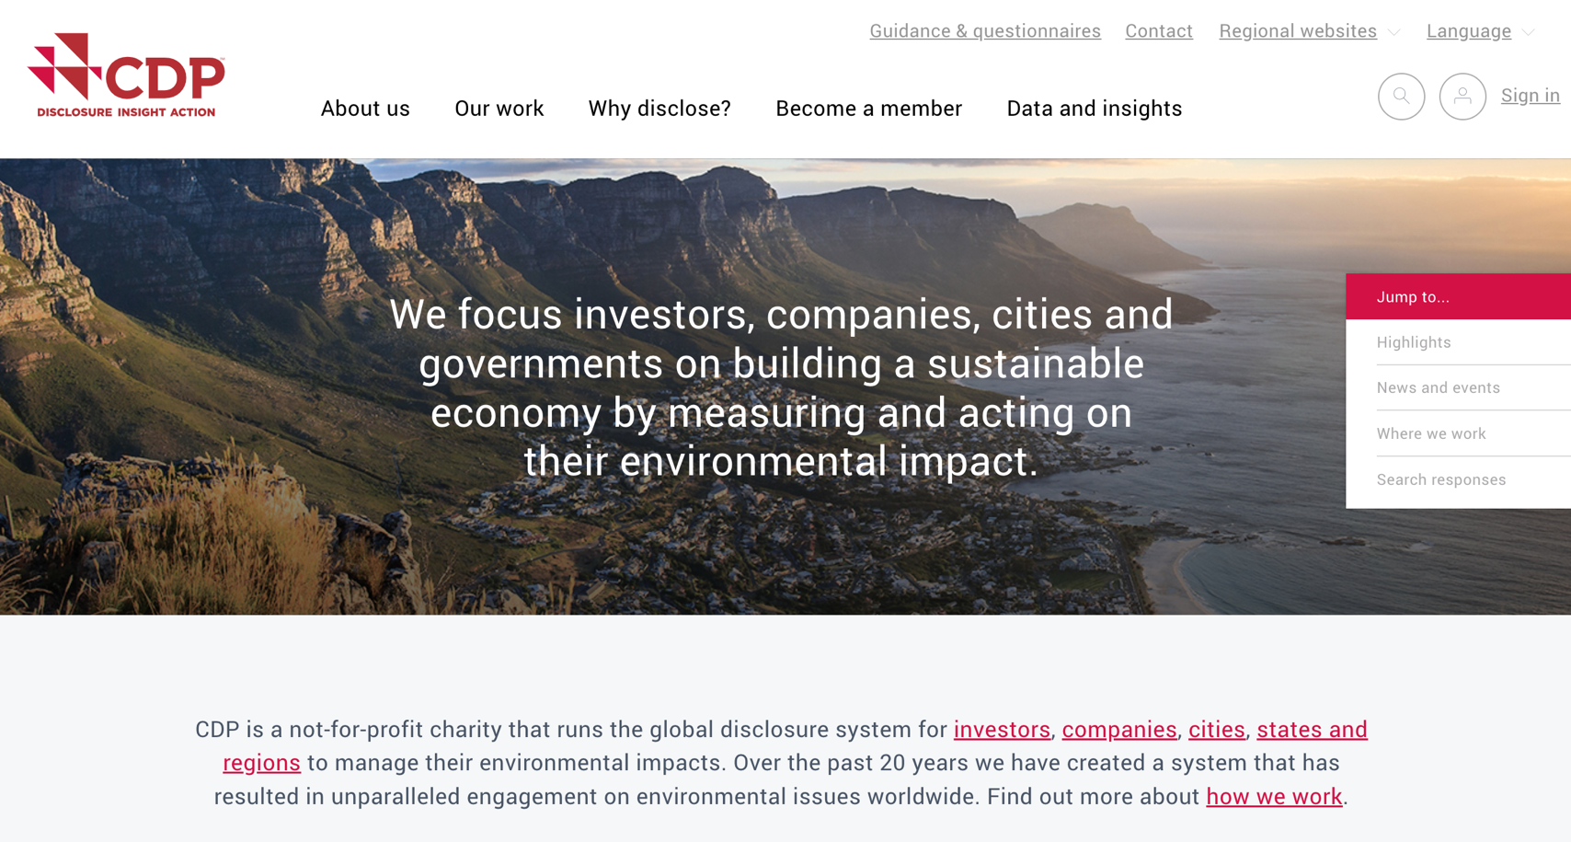
CDP (Carbon Disclosure Project)
https://www.cdp.net/

Slide 41
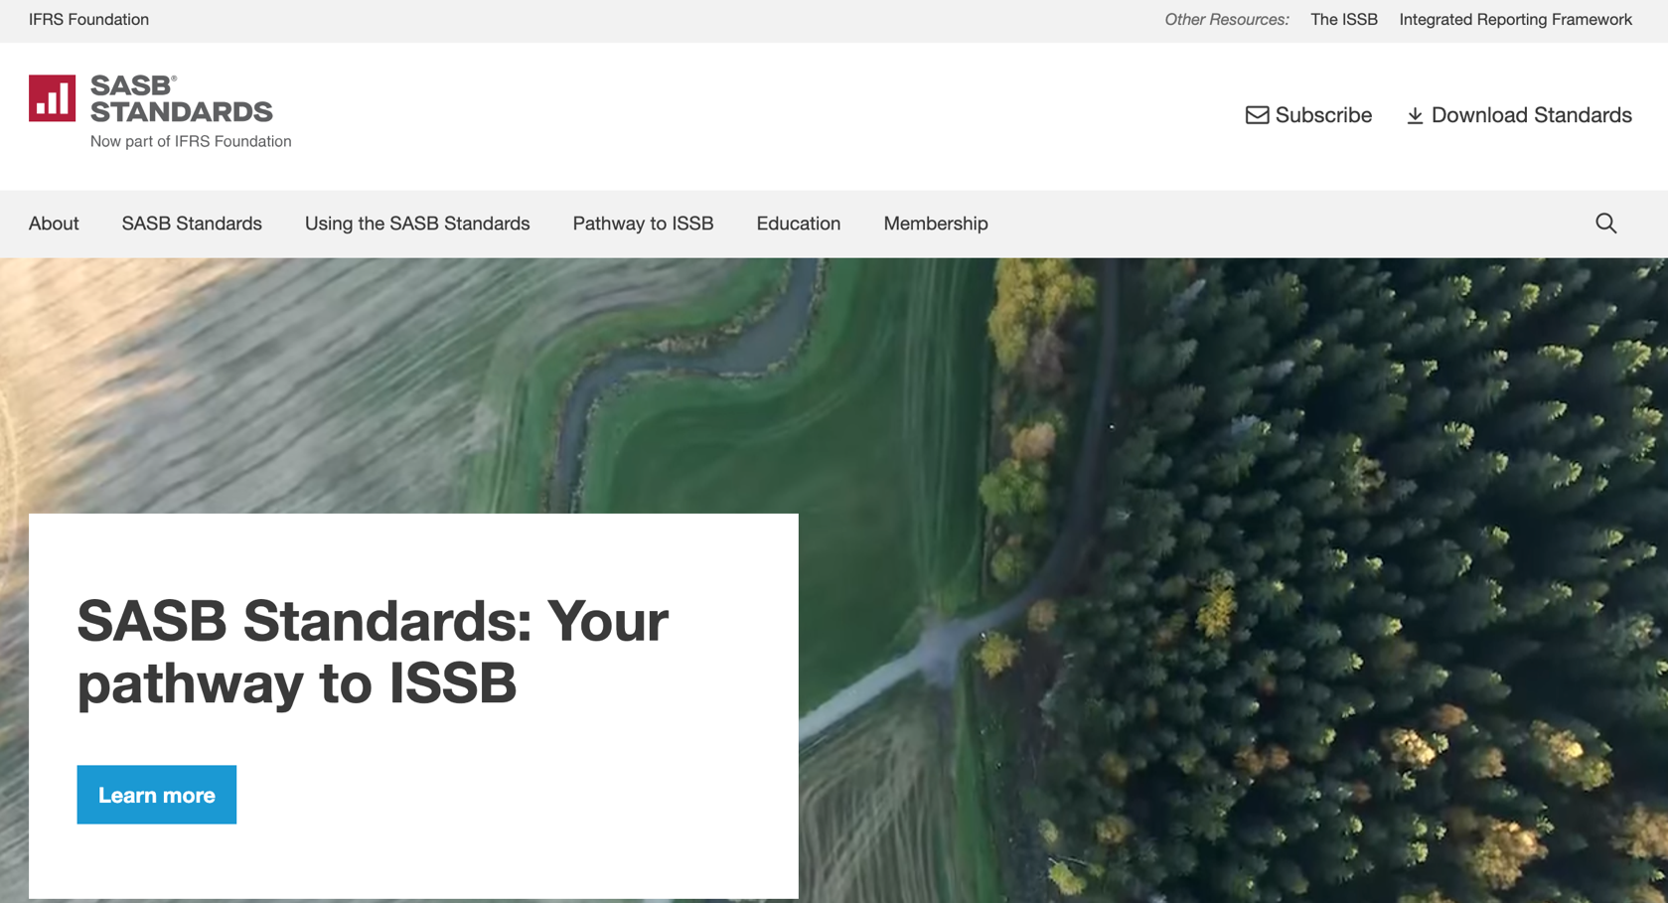
SASB (Sustainability Accounting Standards Board)
https://sasb.org/

Slide 42
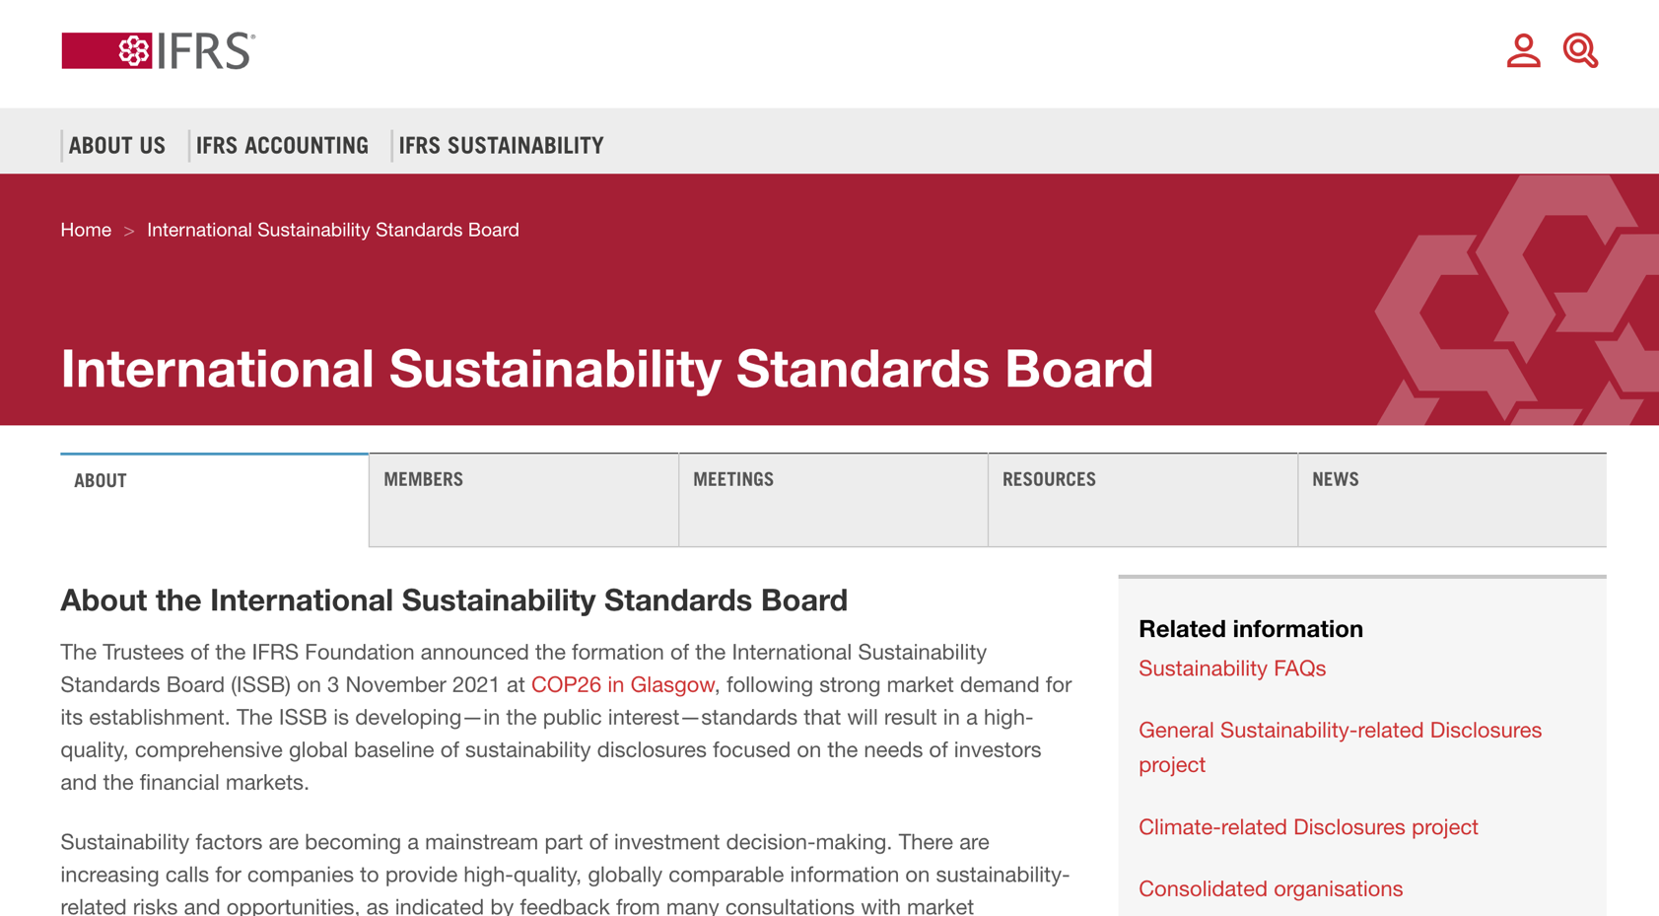
ISSB (International Sustainability Standards Board)
https://www.ifrs.org/groups/international-sustainability-standards-board/

Slide 43
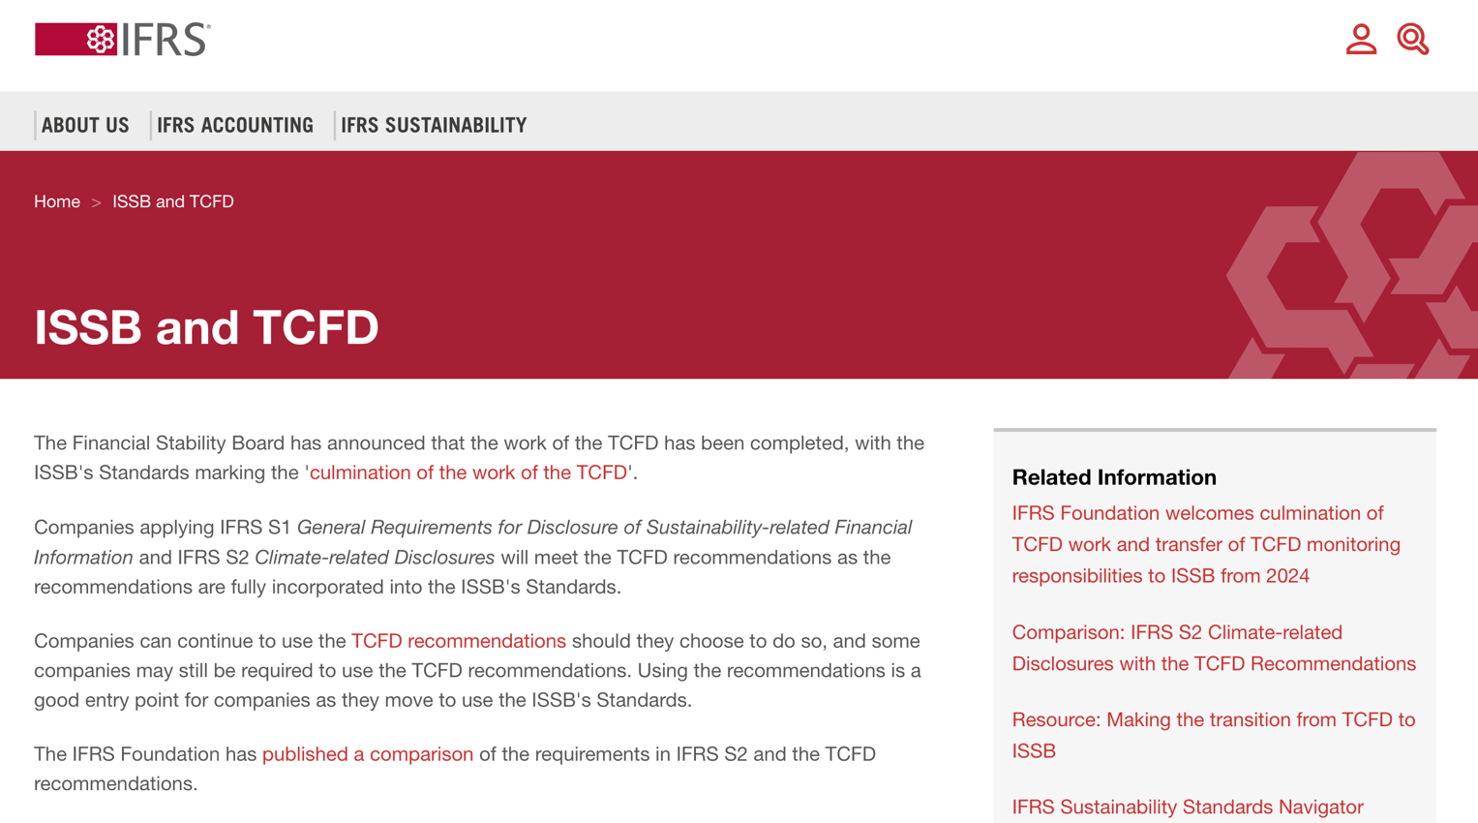
TCFD (Task Force on Climate-related Financial Disclosures)
https://www.ifrs.org/sustainability/tcfd/
https://www.fsb-tcfd.org/

Slide 44
The En-ROADS Climate Solutions Simulator
https://www.climateinteractive.org/en-roads/

Slide 45
The Human Impact of ESG Choices
Digital Initiatives
This isn't abstract, it's about improving lives
Positive potential when ESG is prioritized

Slide 46
Sustainable Productivity: Finance ESG
Source: Huang, Ziqi, Yang Shen, Jiayi Li, Marcel Fey, and Christian Brecher (2021). "A survey on AI-driven digital twins in Industry 4.0: Smart manufacturing and advanced robotics." Sensors 21, no. 19: 6340.

Slide 47
Sustainable Resilient Manufacturing ESG
Source: Huang, Ziqi, Yang Shen, Jiayi Li, Marcel Fey, and Christian Brecher (2021). "A survey on AI-driven digital twins in Industry 4.0: Smart manufacturing and advanced robotics." Sensors 21, no. 19: 6340.

Slide 48
ESG Indexes
MSCI ESG Index
Dow Jones Sustainability Indices (DJSI)
FTSE ESG Index

Slide 49
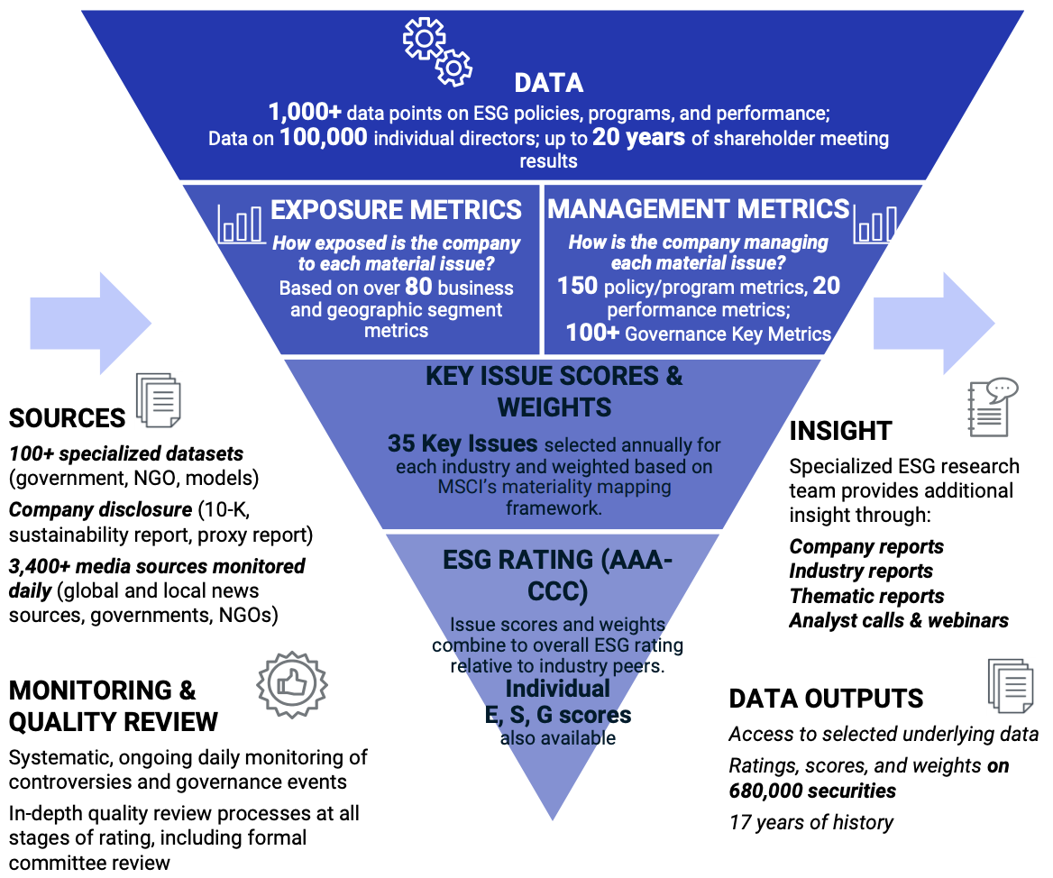
MSCI ESG Rating Framework
Source: https://www.msci.com/documents/1296102/21901542/ESG-Ratings-Methodology-Exec-Summary.pdf

Slide 50
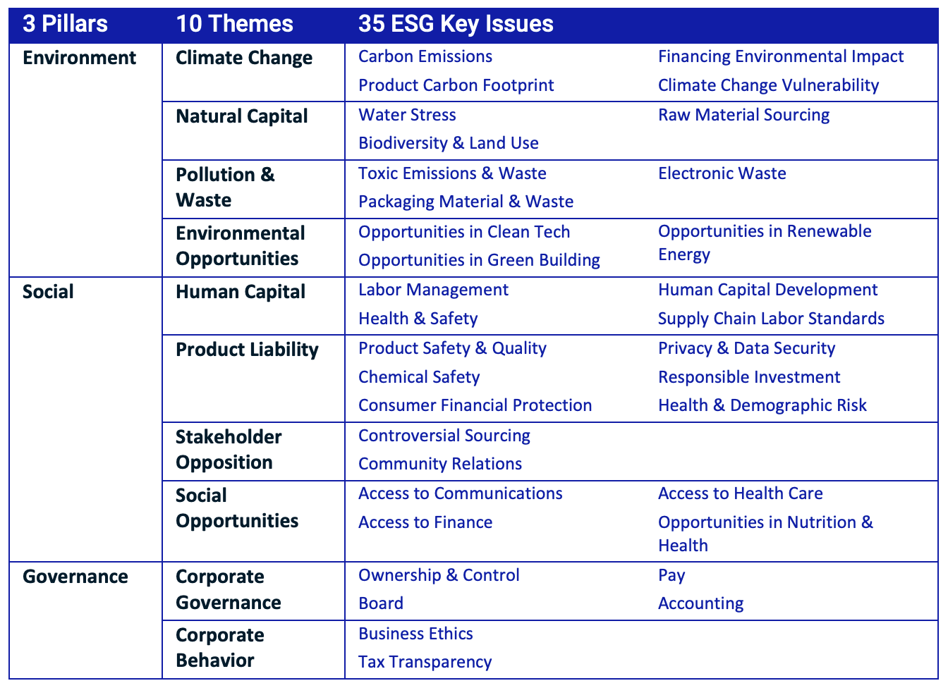
MSCI ESG Key Issue Hierarchy
Source: https://www.msci.com/documents/1296102/21901542/ESG-Ratings-Methodology-Exec-Summary.pdf

Slide 51
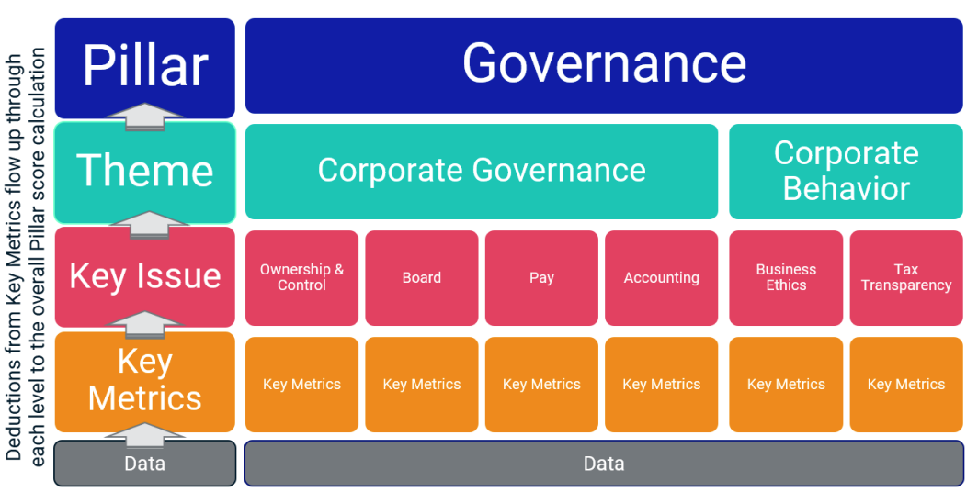
MSCI Governance Model Structure
Source: https://www.msci.com/documents/1296102/21901542/ESG-Ratings-Methodology-Exec-Summary.pdf

Slide 52
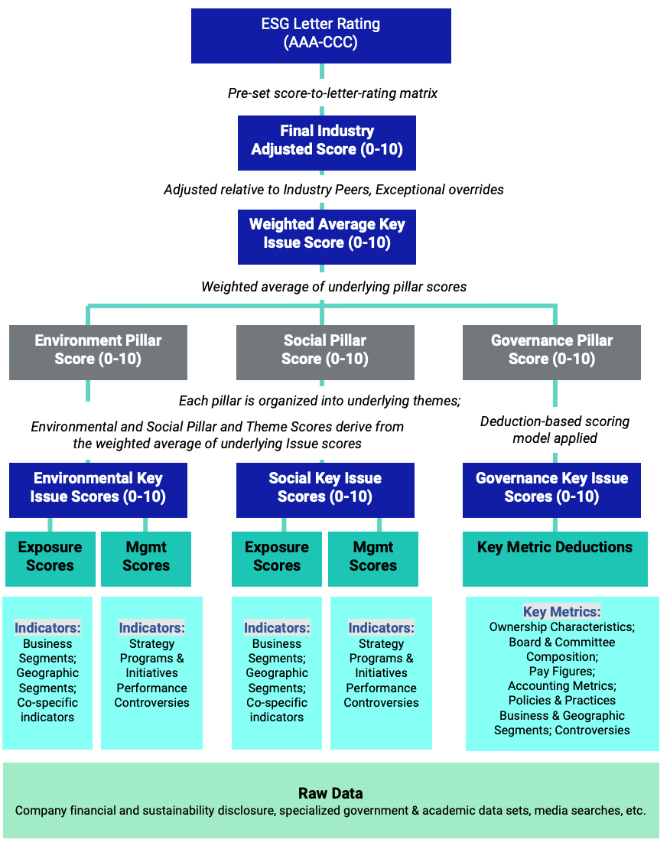
MSCI Hierarchy of ESG Scores
Source: https://www.msci.com/documents/1296102/21901542/ESG-Ratings-Methodology-Exec-Summary.pdf

Slide 53
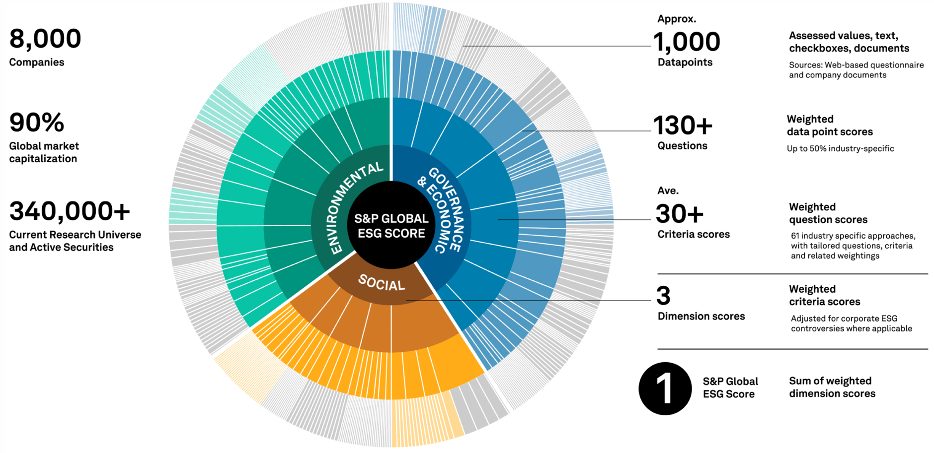
DJSI S&P Global ESG Score
Source: DJSI, S&P Global Corporate Sustainability Assessment (CSA), https://www.spglobal.com/esg/solutions/data-intelligence-esg-scores

Slide 54
FTSE Russell ESG Ratings
Source: https://www.ftserussell.com/data/sustainability-and-esg-data/esg-ratings

Slide 55
Sustainalytics ESG Risk Ratings
Analyst-based approach
Sustainalytics’ ESG Risk Ratings measure a company’s exposure to industry-specific material ESG risks and how well a company is managing those risks.
Source: https://www.sustainalytics.com/esg-data

Slide 56
Truvalue ESG Ranks
TruValue Labs
Machine-based approach
Truvalue Labs applies AI to analyze over 100,000 sources and uncover ESG risks and opportunities hidden in unstructured text.
The ESG Ranks data service produces an overall company rank based on industry percentile leveraging the 26 ESG categories defined by the Sustainability Accounting Standards Board (SASB).
The data feed covers 20,000+ companies with more than 13 years of history.
Source: :https://developer.truvaluelabs.com/data/esg-ranks

Slide 57
Analyst-driven vs. AI-driven ESG
Sustainalytics
Truvalue Labs
Source: Mark Tulay (2020), Man vs. machine: A tale of two sustainability ratings systems, GreenBiz, https://www.greenbiz.com/article/man-vs-machine-tale-two-sustainability-ratings-systems

Slide 58
Analyst based ESG Research AI based ESG Research
Source: https://www.esganalytics.io/insights/how-data-is-accelerating-esg

Slide 59
ESG Analytics: NLP Taxonomy
Source: https://www.esganalytics.io/insights/how-data-is-accelerating-esg

Slide 60
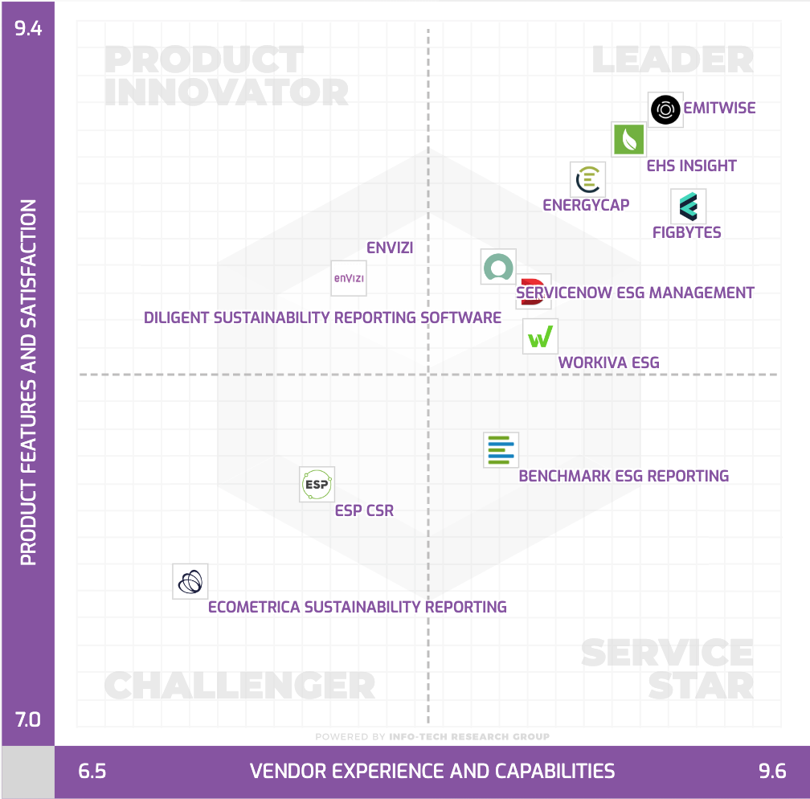
Top ESG Reporting Software
Environmental, Social and Governance (ESG) Reporting software or Sustainability software helps organizations manage their operational data, evaluate their impact on the environment and provide reporting to perform audits.
Source: https://www.softwarereviews.com/categories/environmental-social-and-governance-reporting

Slide 61
Modelling Strategy to Forecast Carbon Emissions with AI
Source: Brière, M., Keip, M., & Le Berthe, T. (2022). Artificial Intelligence for Sustainable Finance: Why it May Help. Available at SSRN 4252329.
Notes:
Modelling strategy to forecast carbon emisisons with Machine Learning methods
This figure illustrates the modelling framework that is used to train and evaluate the proposed machine learning approach. Block: Data shows the sample selection and data pre-processing process. Block: Prediction Model implements (1) Predictor Selection, where the optimal set of predictors from the listed alternative choices is selected based on OLS regression. (2): Build Base-Learners, where three groups of base-learners are tested, namely linear models, non-linear models, and decision ensembles, and (3) Building Meta-Learners, where predictions are combined using a simple combination or stacked generalization. Finally, block: Model Evaluation: describes the model evaluation with mean absolute error and a set of robustness tests via double-K fold validation.
Source: Nguyen, Diaz-Rainez and Kuruppuarachchi (2021)

Slide 62
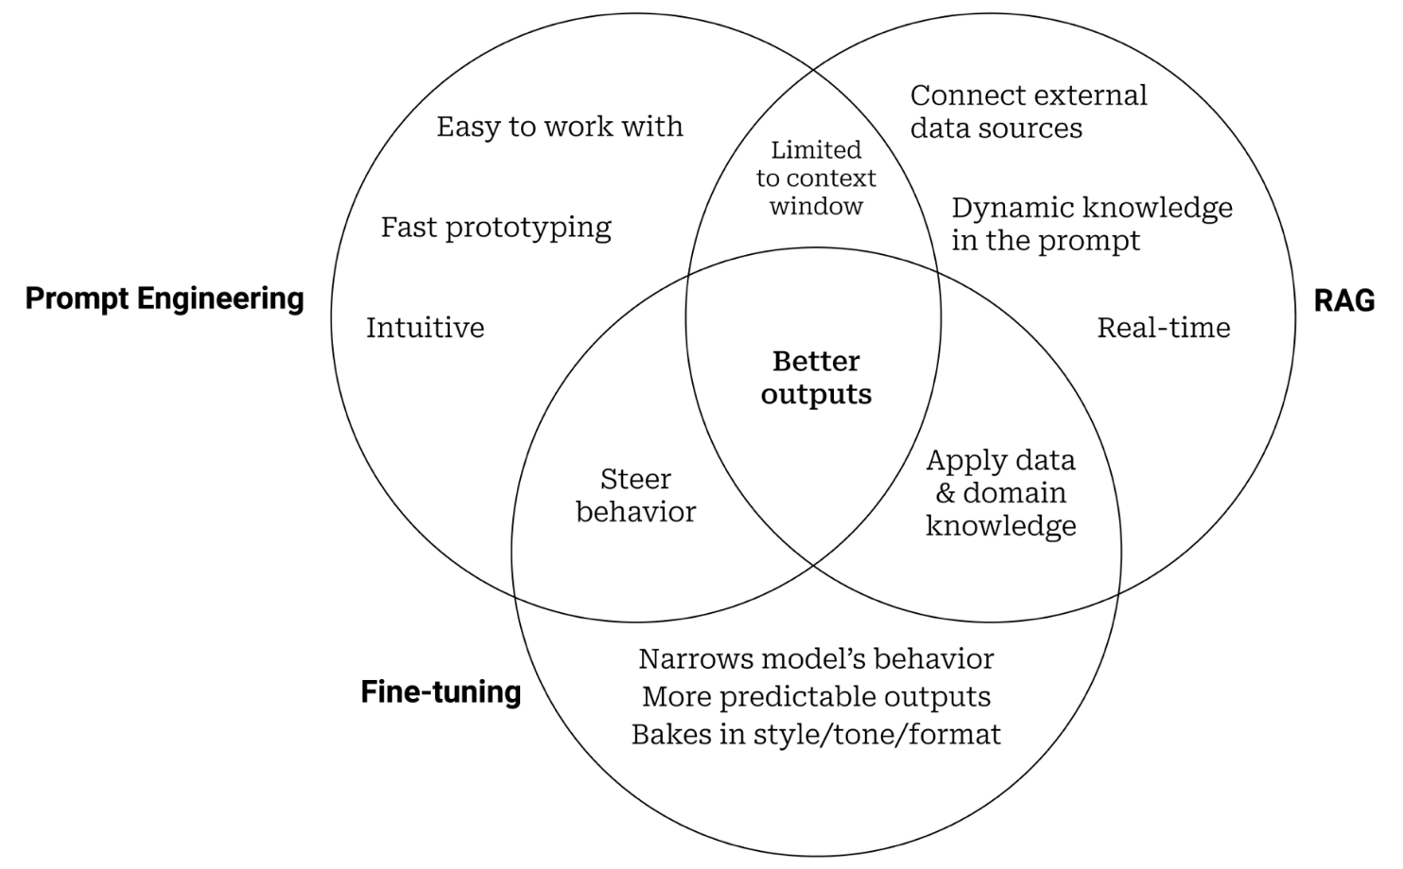
Prompt Engineering, Fine-tuning, and RAG
Source: https://www.entrypointai.com/blog/approaches-to-ai-prompt-engineering-embeddings-or-fine-tuning/

Slide 63
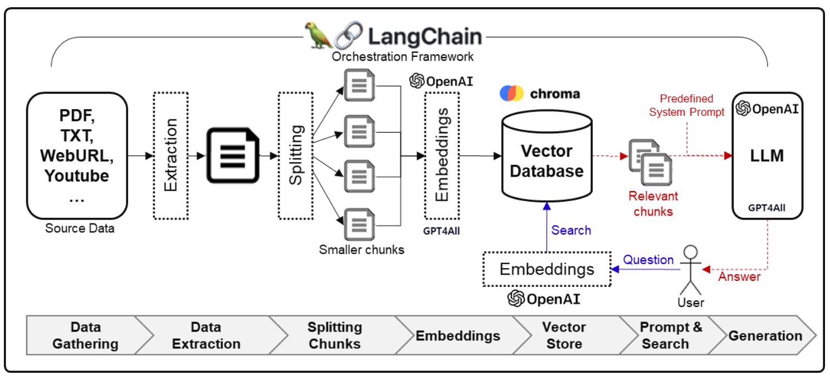
Framework for Implementing Generative AI Services using RAG Model
Source: Jeong, Cheonsu. "A Study on the Implementation of Generative AI Services Using an Enterprise Data-Based LLM Application Architecture." arXiv preprint arXiv:2309.01105 (2023).

Slide 64
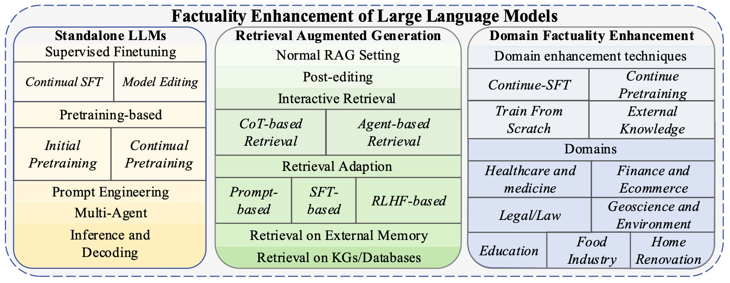
Factuality Enhancement of Large Language Models (LLMs)
Source: Wang, Cunxiang, Xiaoze Liu, Yuanhao Yue, Xiangru Tang, Tianhang Zhang, Cheng Jiayang, Yunzhi Yao et al. "Survey on factuality in large language models: Knowledge, retrieval and domain-specificity." arXiv preprint arXiv:2310.07521 (2023).

Slide 65
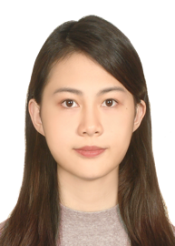
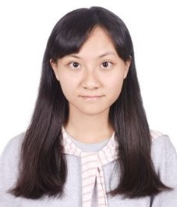
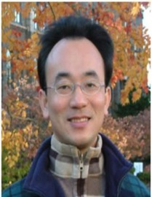
2022
IMNTPU at the NTCIR-16 FinNum-3 Task: Data Augmentation for Financial Numclaim Classification
¹ Information Management, National Taipei University, New Taipei City, Taiwan
² Zeals Co., Ltd. Tokyo, Japan
Yung-Wei Teng ¹
Pei-Tz Chiu ¹
Ting-Yun Hsiao ¹
Mike Tian-Jian Jiang ²
Min-Yuh Day ^{1,*}
myday@gm.ntpu.edu.tw

Slide 66
2022
IMNTPU Dialogue System Evaluation
at the NTCIR-16 DialEval-2
Dialogue Quality and Nugget Detection
¹ Information Management, National Taipei University, New Taipei City, Taiwan
² Zeals Co., Ltd. Tokyo, Japan
Ting-Yun Hsiao ¹
Yung-Wei Teng ¹
Pei-Tz Chiu ¹
Mike Tian-Jian Jiang ²
Min-Yuh Day ^{1,*}
myday@gm.ntpu.edu.tw

Slide 67
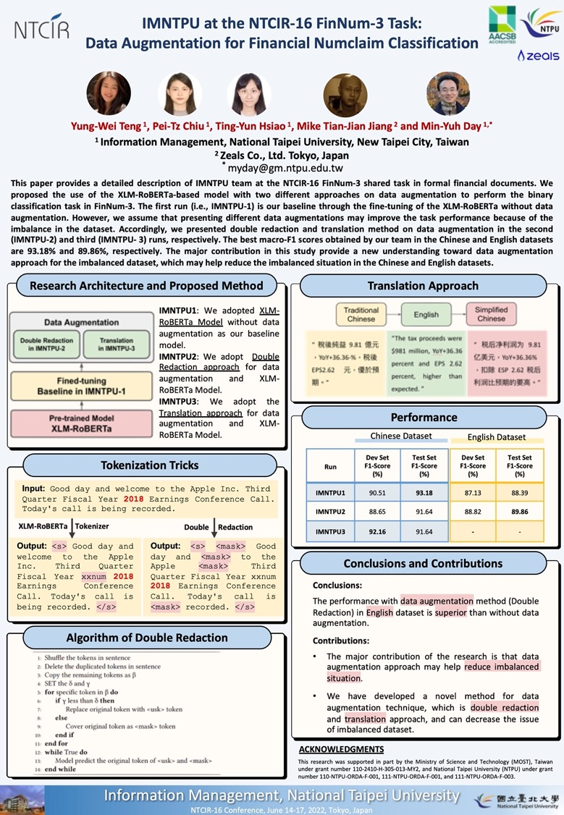
NTCIR-16 FinNum-3
2022
NTCIR-16 Best Poster Presentation Award

Slide 68
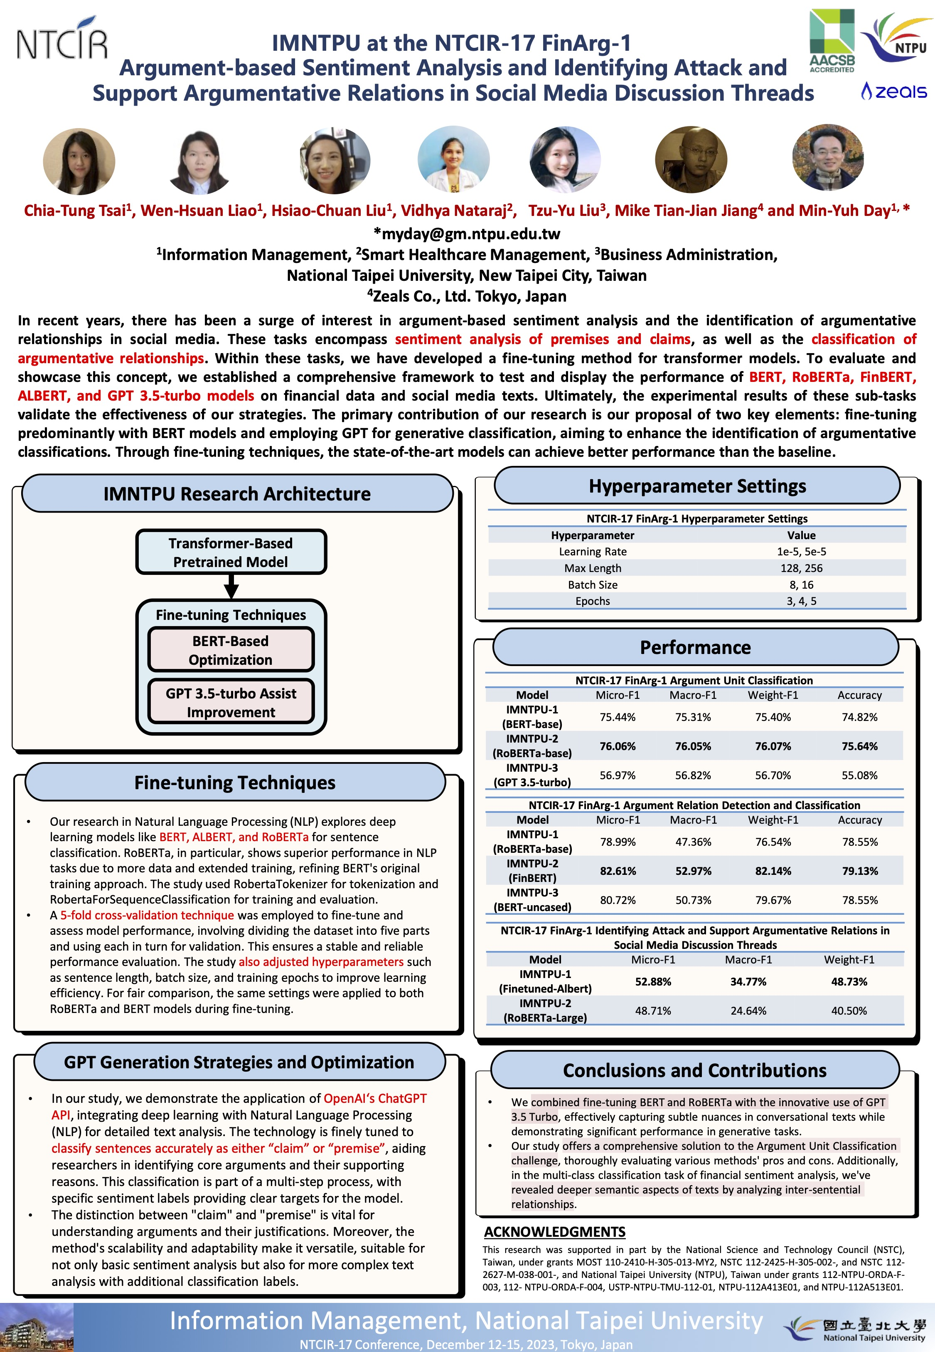
NTCIR-17 FinArg-1
1
2023
NTCIR-17 Best Poster Presentation Award

Slide 69
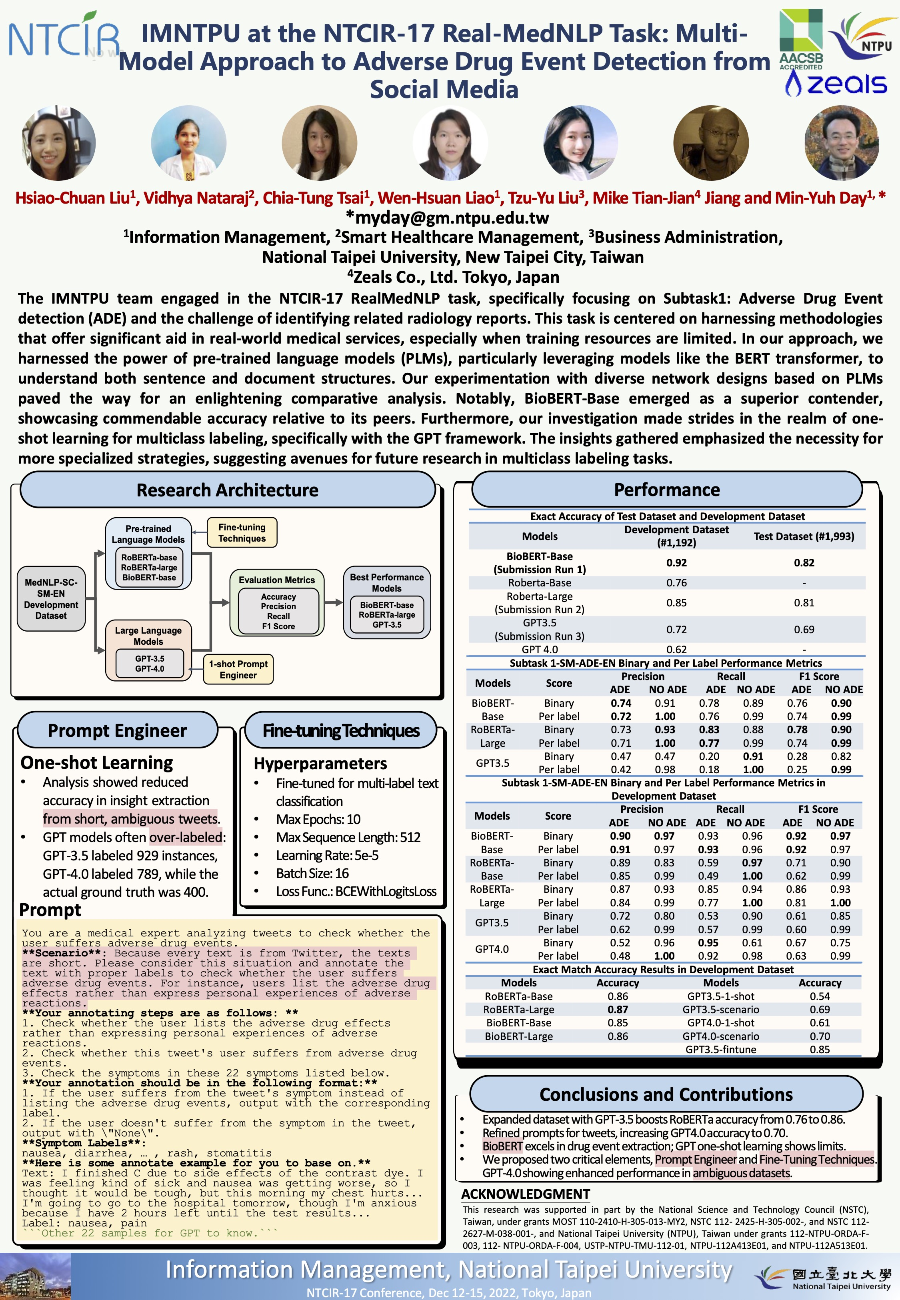
NTCIR-17 Real MedNLP
2
2023
NTCIR-17 Best Poster Presentation Award

Slide 70
Summary
1. Generative AI: Powering Digital Sustainability Transformation
2. Generative AI and Large Language Models (LLMs): Popular Generative AI Applications 3. Generative AI for Sustainable Development Innovative Applications

Slide 71
Acknowledgments: Research Projects
Fintech Green Finance for Carbon Market Index, Corporate Finance, and Environmental Policies. Carbon Emission Sentiment Index with AI Text Analytics
NTPU, 113-NTPU_ORDA-F-003, 2023/01/01~2024/12/31
Digital Support, Unimpeded Communication: The Development, Support and Promotion of AI-assisted Communication Assistive Devices for Speech Impairment (1/3). Multimodal Cross-lingual Task-Oriented Dialogue System for Inclusive Communication Support
NSTC 112-2425-H-305-002-, 3 Years (2023/05/01-2026/04/30) Year 1: 2023/05/01~2024/04/30
Research on speech processing, synthesis, recognition, and sentence construction of people with language disabilities. Multimodal Cross-lingual Task-Oriented Dialogue System
NTPU, 113-NTPU_ORDA-F-004, 2023/01/01~2025/12/31
Metaverse AI Multimodal Cross-Language Task-Oriented Dialogue System
ATEC Group, Fintech and Green Finance Center (FGFC, NTPU), NTPU-112A413E01, 3 Years (2023/05/01~2026/04/30)
Generative AI-Driven ESG Report Generation Technology
Industrial Technology Research Institute (ITRI), Fintech and Green Finance Center (FGFC, NTPU), NTPU-113A513E01, 2024/03/01~2024/12/31
Establishment and Implement of Smart Assistive Technology for Dementia Care and Its Socio-Economic Impacts (2/3). Intelligent, individualized and precise care with smart AT and system integration
NSTC, 112-2627-M-038-001-, 2023/08/01~2024/07/31
Prospective longitudinal study on peri-implant bone loss associated with peri-implantitis
USTP (NTPU, TMU), USTP-NTPU-TMU-113-03, 2024/01/01~2024/12/31
https://web.ntpu.edu.tw/~myday/cindex.htm#projects

Slide 72
References
Cino Robin Castelli, Cyril Shmatov (2022), Quantitative Methods for ESG Finance, Wiley
Simon Thompson (2023), Green and Sustainable Finance: Principles and Practice in Banking, Investment and Insurance, 2nd Edition, Kogan Page.
Chrissa Pagitsas (2023), Chief Sustainability Officers At Work: How CSOs Build Successful Sustainability and ESG Strategies, Apress.
Yihan Cao, Siyu Li, Yixin Liu, Zhiling Yan, Yutong Dai, Philip S. Yu, and Lichao Sun (2023). "A Comprehensive Survey of AI-Generated Content (AIGC): A History of Generative AI from GAN to ChatGPT." arXiv preprint arXiv:2303.04226.
Pengfei Liu, Weizhe Yuan, Jinlan Fu, Zhengbao Jiang, Hiroaki Hayashi, and Graham Neubig. (2023) "Pre-train, prompt, and predict: A systematic survey of prompting methods in natural language processing." ACM Computing Surveys 55, no. 9 (2023): 1-35.
Wayne Xin Zhao, Kun Zhou, Junyi Li, Tianyi Tang, Xiaolei Wang, Yupeng Hou, Yingqian Min et al. (2023) "A Survey of Large Language Models." arXiv preprint arXiv:2303.18223.
Touvron, Hugo, Louis Martin, Kevin Stone, Peter Albert, Amjad Almahairi, Yasmine Babaei, Nikolay Bashlykov et al. (2023) "Llama 2: Open Foundation and Fine-Tuned Chat Models." arXiv preprint arXiv:2307.09288 (2023).
Rafailov, R., Sharma, A., Mitchell, E., Ermon, S., Manning, C. D., & Finn, C. (2023). Direct preference optimization: Your language model is secretly a reward model. arXiv preprint arXiv:2305.18290.
Tunstall, Lewis, Edward Beeching, Nathan Lambert, Nazneen Rajani, Kashif Rasul, Younes Belkada, Shengyi Huang et al. "Zephyr: Direct Distillation of LM Alignment." arXiv preprint arXiv:2310.16944 (2023).
Ouyang, L., Wu, J., Jiang, X., Almeida, D., Wainwright, C. L., Mishkin, P., ... & Lowe, R. (2022). Training language models to follow instructions with human feedback. arXiv preprint arXiv:2203.02155.
Gozalo-Brizuela, Roberto, and Eduardo C. Garrido-Merchan (2023). "ChatGPT is not all you need. A State of the Art Review of large Generative AI models." arXiv preprint arXiv:2301.04655 (2023).
Wenliang Dai, Junnan Li, Dongxu Li, Anthony Meng Huat Tiong, Junqi Zhao, Weisheng Wang, Boyang Li, Pascale Fung, and Steven Hoi. (2023) "InstructBLIP: Towards General-purpose Vision-Language Models with Instruction Tuning." arXiv preprint arXiv:2305.06500 (2023).
Shahab Saquib Sohail, Faiza Farhat, Yassine Himeur, Mohammad Nadeem, Dag Øivind Madsen, Yashbir Singh, Shadi Atalla, and Wathiq Mansoor (2023). "The Future of GPT: A Taxonomy of Existing ChatGPT Research, Current Challenges, and Possible Future Directions." Current Challenges, and Possible Future Directions (April 8, 2023) (2023).
Longbing Cao (2022). "Decentralized ai: Edge intelligence and smart blockchain, metaverse, web3, and desci." IEEE Intelligent Systems 37, no. 3: 6-19.
Qinglin Yang, Yetong Zhao, Huawei Huang, Zehui Xiong, Jiawen Kang, and Zibin Zheng (2022). "Fusing blockchain and AI with metaverse: A survey." IEEE Open Journal of the Computer Society 3 : 122-136.
Ouyang, L., Wu, J., Jiang, X., Almeida, D., Wainwright, C. L., Mishkin, P., ... & Lowe, R. (2022). Training language models to follow instructions with human feedback. arXiv preprint arXiv:2203.02155.

Slide 73
生成式AI與永續發展的應用 Generative AI and Sustainable Development Applications
台南應用科技大學
永續發展暨大學社會責任(USR)系列講座
Q & A
2024/06/26 (Wed) 10:30 - 12:00
L703, Tainan University of Technology (TUT), Tainan, Taiwan
No.529, Zhongzheng Rd., Yongkang District, Tainan City 710302, Taiwan (R.O.C.)
戴敏育 教授 (Prof. Min-Yuh Day)
國立臺北大學 資訊管理研究所 教授
金融科技暨綠色金融研究中心 副主任
永續辦公室 永續發展組 組長
https://web.ntpu.edu.tw/~myday
2024-06-26

