Slide 1










代理式 AI 於 ESG 跨域創新應用
Agentic AI for ESG Cross-disciplinary Innovative Applications
跨領域特色發展中心
創新教學交流會
Time: 10:00-12:00, Wedenesday, June 17, 2026
Host: 國立屏東科技大學 跨領域特色發展中心
Webex: https//npust-ifdc.webex.com/npust-ifdc-tc/j.php?MTID=m5f0d0e0530fad4c554b5b45dd442e4ff
University Ambassador
戴敏育 教授 (Prof. Min-Yuh Day)
國立臺北大學 資訊管理研究所 所長
金融科技暨綠色金融研究中心 主任
Certified Instructor
2026-06-17

Slide 2









戴敏育 教授
Prof. Min-Yuh Day
Director, Information Management, NTPU
Director, Intelligent Financial Innovation Technology, IFIT Lab, IM, NTPU
Director, Fintech and Green Finance Center (FGFC), NTPU
Visiting Scholar, IIS, Academia Sinica
Ph.D., Information Management, NTU
Artificial Intelligence, Agentic AI, ESG and Green Financial Technology,
Big Data Analytics, Electronic Commerce
University Ambassador
Certified Instructor

Slide 3
Outline
1. 代理人AI技術趨勢
(Trends in Agentic AI)
2. ESG 跨域創新應用
(ESG Cross-disciplinary Innovative Applications)
3. AI 永續教育課程設計與人才培育
(AI in Sustainable Education and Talent Cultivation)

Slide 4

1
代理人AI技術趨勢
Trends in Agentic AI
4

Slide 5
Generative AI, Agentic AI, Physical AI
Physical AI
Self-driving cars
General robotics
Agentic AI
Coding assistants
Customer service
Patient care
Generative AI
Digital marketing
Content creation
Perception AI
Speech recognition
Deep recommender systems
Medical imaging
2012 AlexNet
Deep learning breakthrough
Source: NVIDIA (2025), GTC March 2025 Keynote with NVIDIA CEO Jensen Huang, https://www.youtube.com/watch?v=_waPvOwL9Z8

Slide 6


Innovative Agentic AI Technology for Autonomous
ESG Report Generation
Industrial Technology Research Institute (ITRI),
Fintech and Green Finance Center (FGFC, NTPU),
NTPU-114A513E01, 2025/03/01~2025/12/31

Slide 7
Generative AI-Driven ESG Report
Generation Technology
Industrial Technology Research Institute (ITRI),
Fintech and Green Finance Center (FGFC, NTPU),
NTPU-113A513E01, 2024/03/01~2024/12/31

Slide 8
Generative AI
Computing
Generative AI
Data
Algorithms

Slide 9
Generative AI, Agentic AI, Physical AI
New Economic
Paradigm Shift:
From Creation
to Execution
Physical AI
(Actuation)
Real-world
Interaction & Execution
Autonomous
Synergy
Generative AI
(Creation)
Content & Idea
Synthesis
Agentic AI
(Orchestration)
Workflow &
Decision
Automation

Slide 10
The Future of AI
From Tools to Agents:
The Rise and Autonomy of Agentic AI
Narrow AI
(Tool)
Agentic AI
(Autonomous System)
AGI
(Artificial General Intelligence)
Goal-Oriented Behavior,
Autonomous Decision-Making,
Multi-Step Workflows,
Self-Improvement within Parameters
Executes Specific Tasks, Content Generation
Connecting Multimodal GenAl
to Future AGI

Slide 11
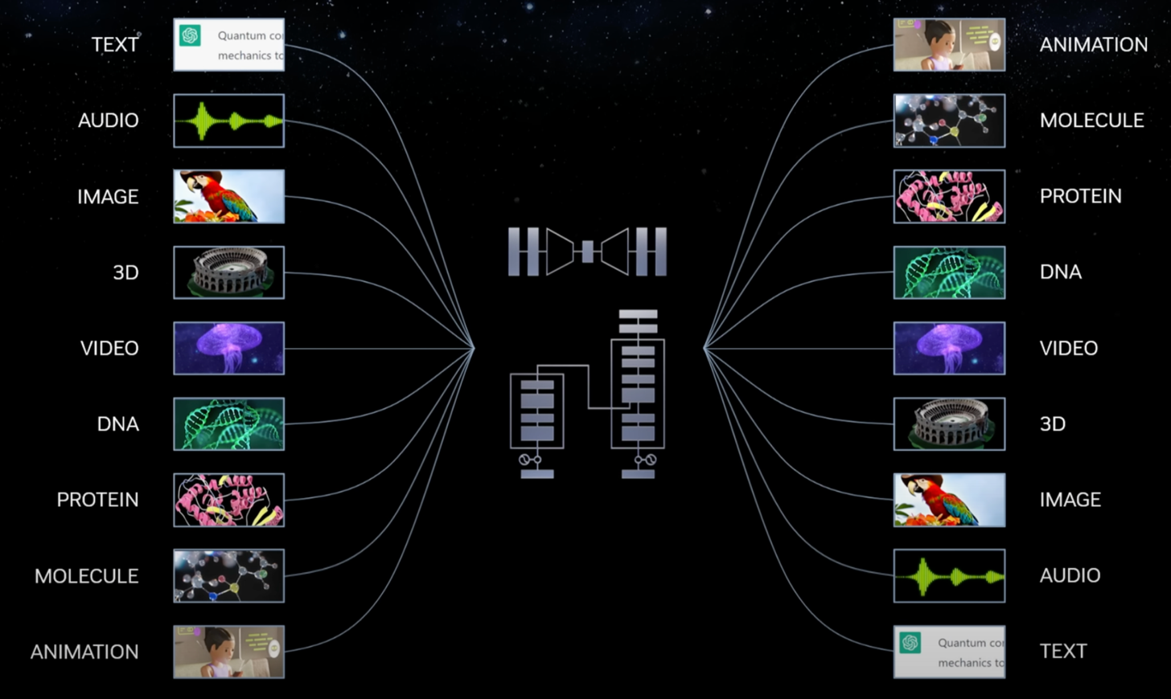
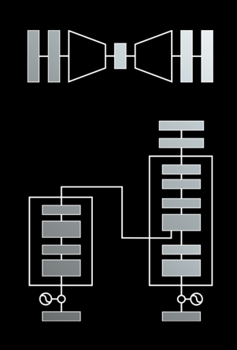
Modular Modalities
Where Can The Transformer Fit?
Source: NVIDIA DLI (2025), Rapid Application Development with Large Language Models (LLMs), https://learn.nvidia.com/courses/course-detail?course_id=course-v1:DLI+S-FX-26+V1
11

Slide 12
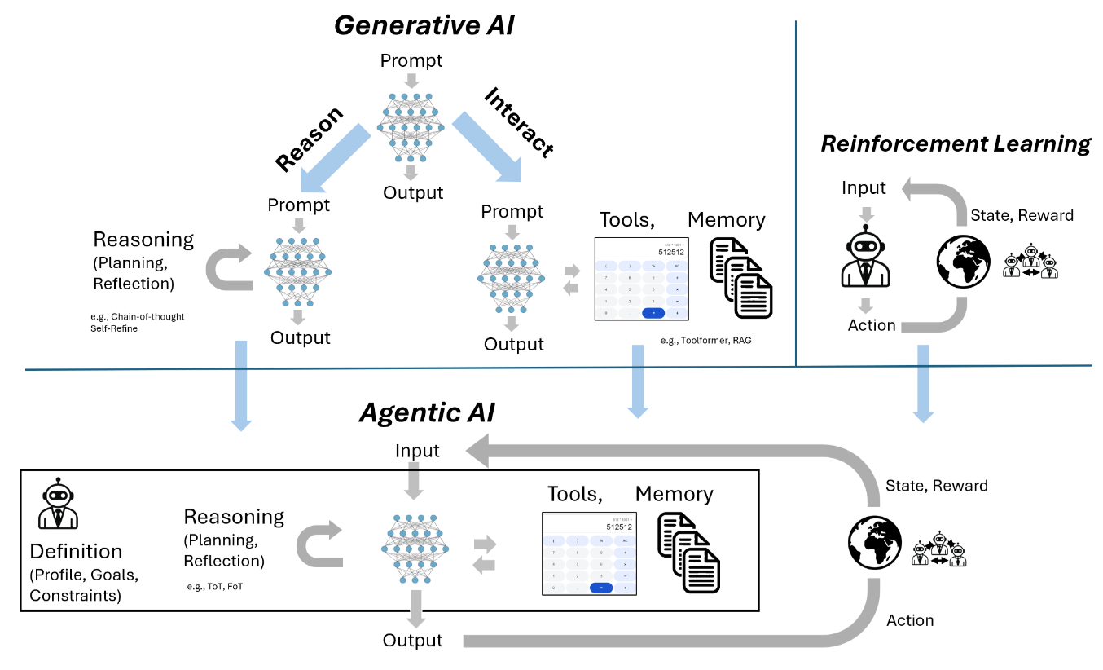
From Generative AI to Agentic AI
Source: Schneider, Johannes. "Generative to Agentic AI: Survey, Conceptualization, and Challenges." arXiv preprint arXiv:2504.18875 (2025).

Slide 13
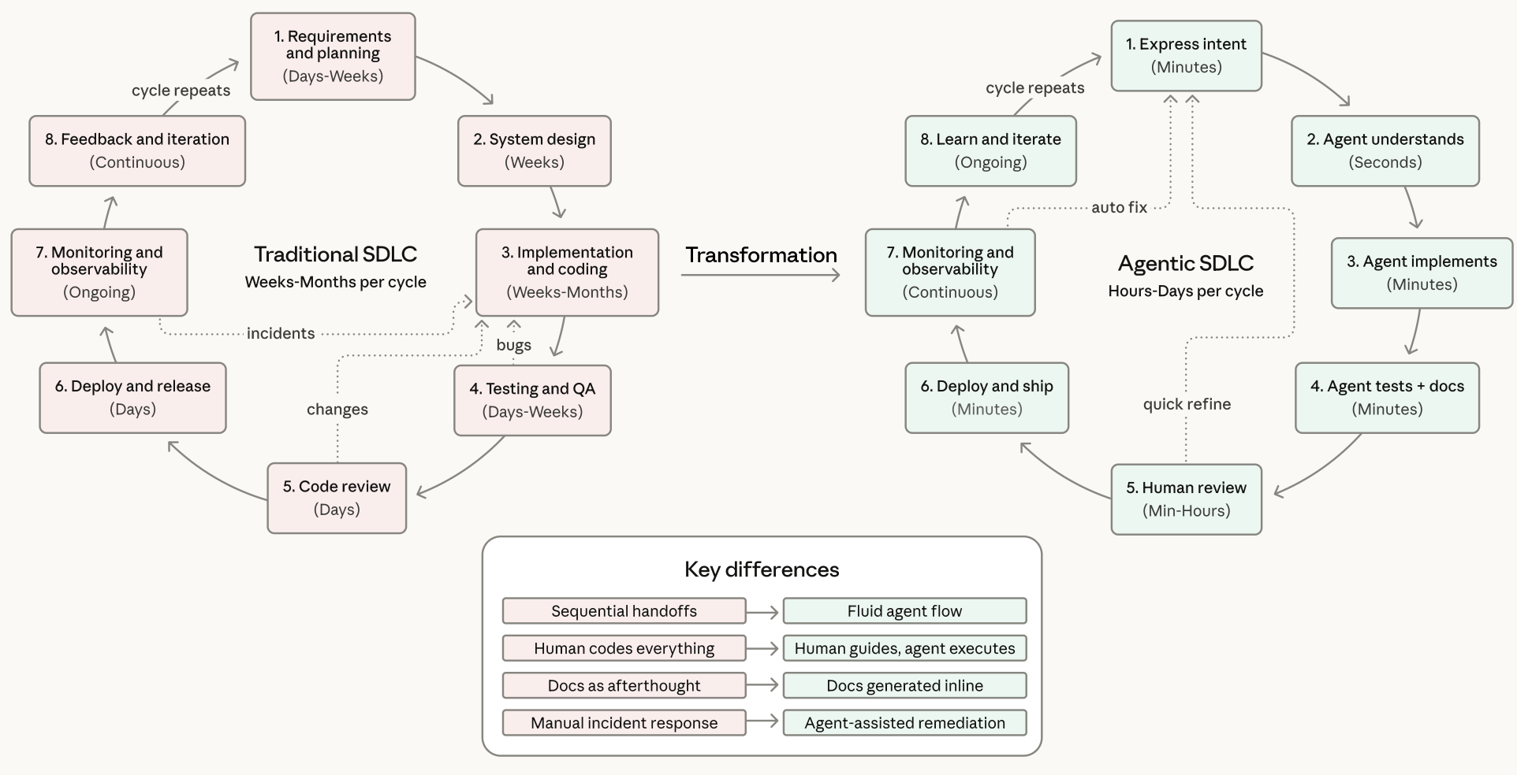
Agentic Coding Software Development Lifecycle

Slide 14
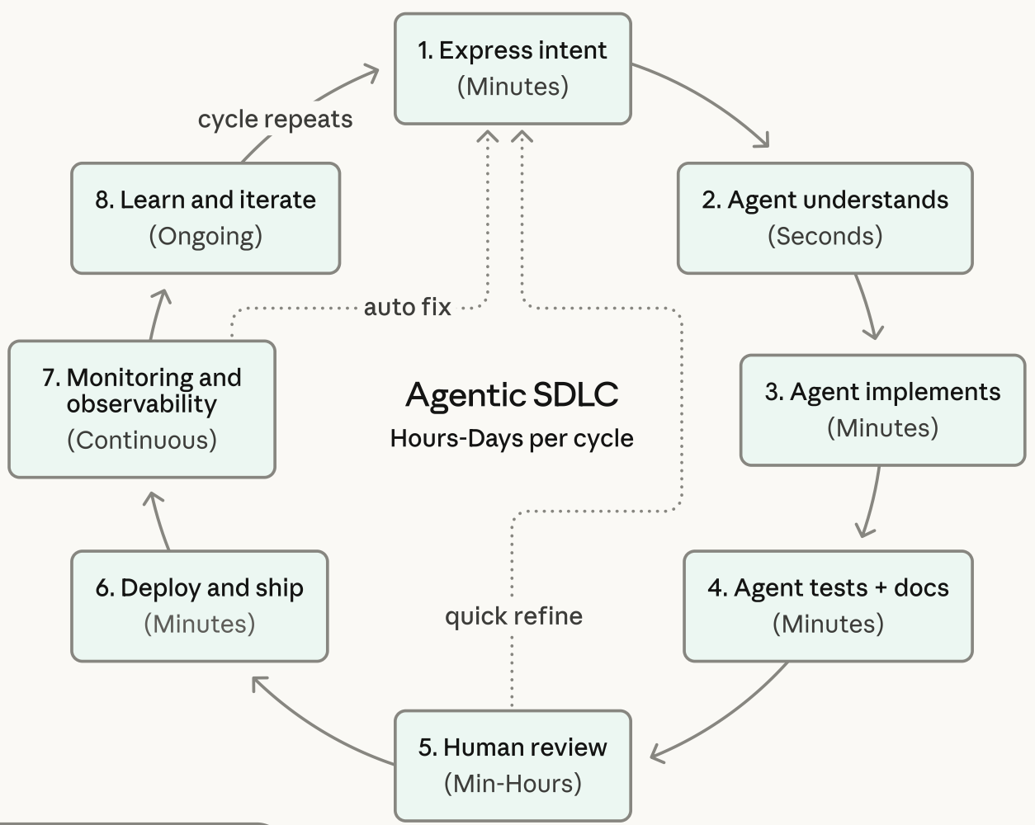
Agentic Coding Software Development Lifecycle

Slide 15
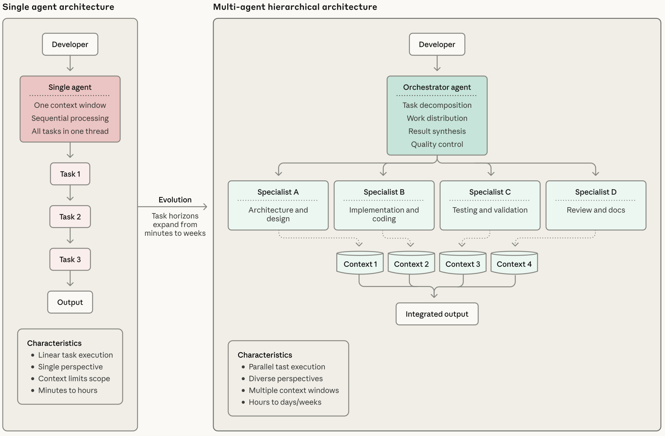
Coding Agent Architectures:
From Single Agents to Coordinated Teams

Slide 16
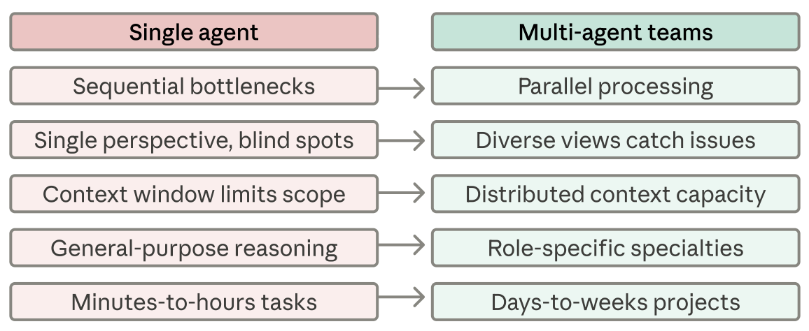
Coding Agent Architectures:
Single Agent to Multi-Agent Teams
Performance Impact

Slide 17
Agentic AI

Slide 18
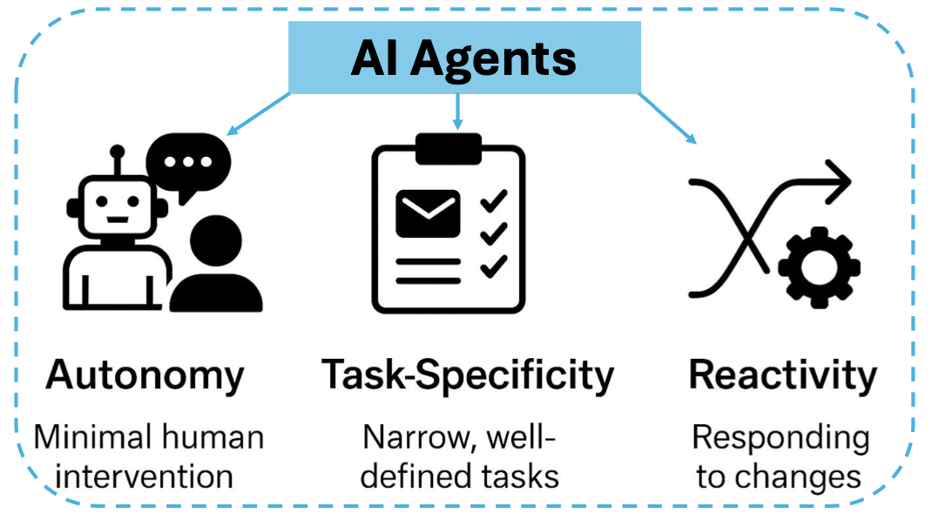
AI Agents
Source: Ranjan Sapkota, Konstantinos I. Roumeliotis, and Manoj Karkee. (2025) "Ai agents vs. agentic ai: A conceptual taxonomy, applications and challenges." arXiv preprint arXiv:2505.10468 (2025).

Slide 19
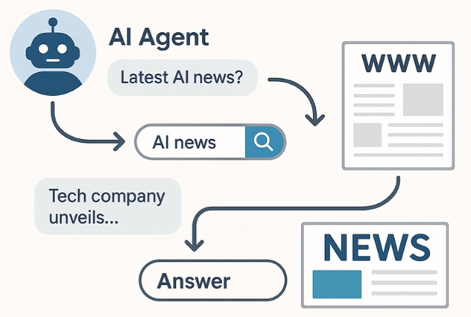
AI Agents
Source: Ranjan Sapkota, Konstantinos I. Roumeliotis, and Manoj Karkee. (2025) "Ai agents vs. agentic ai: A conceptual taxonomy, applications and challenges." arXiv preprint arXiv:2505.10468 (2025).

Slide 20
AI Agent / Agentic AI, Generative AI, Traditional AI
Feature | AI Agent / Agentic AI | Generative AI | Traditional AI
Core Concept | To autonomously perceive its environment, make decisions, and take actions to achieve specific goals. | To create new, original content (text, images, code, etc.) that resembles its training data. | To execute specific tasks based on pre-programmed rules or statistical patterns.
Primary Function | Action & Goal Achievement. Executes a series of tasks to complete an objective (e.g., "Book me a flight to Taipei next Tuesday."). | Creation & Synthesis. Creates novel outputs in response to a prompt (e.g., "Write a poem about rain."). | Classification & Prediction. Answers questions with a known range of outcomes (e.g., "Is this spam?").
Decision Making | Based on a continuous loop: Perceive -> Plan -> Act. It reasons about its goal, breaks it down, and executes steps. | Based on probabilistic patterns learned from massive, unstructured datasets. It predicts the next most likely word, pixel, or note. | Based on explicitly programmed logic (if-then rules) or learned patterns from structured data.
Key Characteristic | Autonomous & Goal-Oriented. Proactively takes steps and can adapt its plan based on new information. | Creative & Probabilistic. Can produce a wide variety of unique outputs from the same prompt. | Deterministic & Logic-Based. Given the same input, it will almost always produce the same output.

Slide 21
AI Agent / Agentic AI, Generative AI, Traditional AI
Feature | AI Agent / Agentic AI | Generative AI | Traditional AI
Interaction Model | Proactive & Interactive. Actively observes its environment (digital or physical) and takes actions to change it. | Responsive. Engages in a dialogue or responds to a user's prompt to generate content. | Reactive. Responds to a direct input or query. It doesn't act on its own.
Example Technologies | Architectural frameworks like ReAct (Reason + Act), and systems that combine LLMs with tools and memory. | Large Language Models (LLMs) like GPT-4, Diffusion Models (for images), Generative Adversarial Networks (GANs). | Expert systems, decision trees, linear regression, traditional machine learning (ML) models.
Common Use Cases | Self-driving cars, autonomous trading bots, smart assistants that manage calendars, customer service agents that process refunds. | ChatGPT, Google Gemini, Midjourney (image generation), Copilot (code generation), music composition. | Spam filters, chess engines, recommendation systems (e.g., Netflix), credit scoring, medical diagnosis from scans.
Relationship to Others | An architecture or system that often uses Generative AI to reason and Traditional AI for specific sub-tasks to accomplish a goal. | Can serve as the "brain" or reasoning engine for an AI Agent, enabling it to understand, plan, and generate actions. | The foundation for modern AI. Its techniques can be components within larger AI systems.

Slide 22
AI Agents vs Agentic AI
Feature | AI Agents | Agentic AI
Definition | Autonomous software programs that perform specific tasks. | Systems of multiple AI agents collaborating to achieve complex goals.
Autonomy Level | High autonomy within specific tasks. | Broad level of autonomy with the ability to manage multi-step, complex tasks and systems.
Task Complexity | Typically handle single, specific tasks. | Handle complex, multi-step tasks requiring coordination.
Collaboration | Operate independently. | Involve multi-agent information sharing, collaboration and cooperation.
Learning and Adaptation | Learn and adapt within their specific domain. | Learn and adapt across a wider range of tasks and environments.
Applications | Customer service chatbots, virtual assistants, automated workflows. | Supply chain management, business process optimization, virtual project managers.
Source: Ranjan Sapkota, Konstantinos I. Roumeliotis, and Manoj Karkee. (2025) "Ai agents vs. agentic ai: A conceptual taxonomy, applications and challenges." arXiv preprint arXiv:2505.10468 (2025).

Slide 23
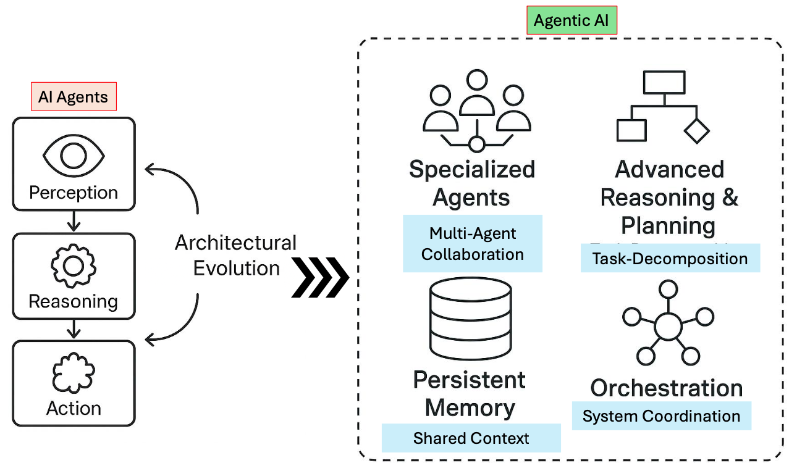
AI Agents vs Agentic AI
Source: Ranjan Sapkota, Konstantinos I. Roumeliotis, and Manoj Karkee. (2025) "Ai agents vs. agentic ai: A conceptual taxonomy, applications and challenges." arXiv preprint arXiv:2505.10468 (2025).

Slide 24
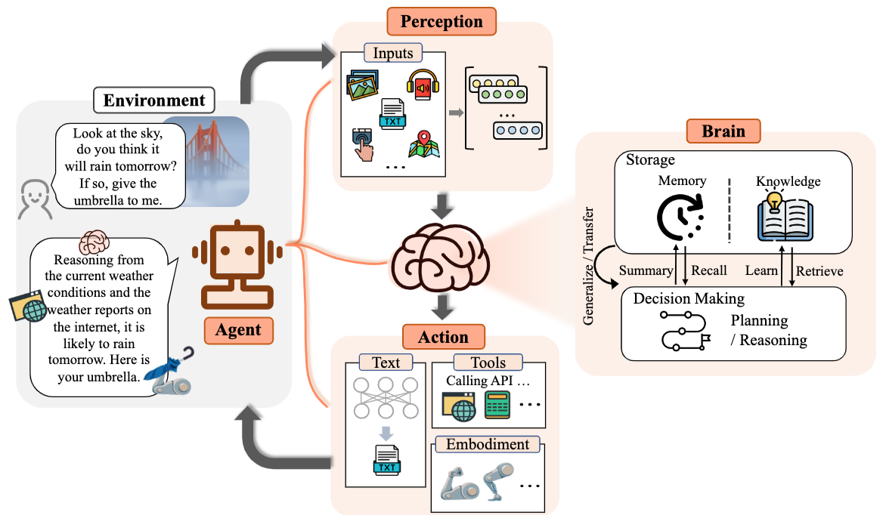
Large Language Model (LLM) based Agents
Source: Xi, Z., Chen, W., Guo, X., He, W., Ding, Y., Hong, B., ... & Gui, T. (2023). The rise and potential of large language model based agents: A survey. arXiv preprint arXiv:2309.07864.

Slide 25
Loop Engineering
Harness Engineering
Skill Engineering
Context Engineering Prompt Engineering

Slide 26









Loop Engineering, Harness Engineering, Skill Engineering, Context Engineering, Prompt Engineering
1
2
3
4
5
Prompt Engineering
Context Engineering
Skill Engineering
Harness Engineering
Loop Engineering
Design prompts and
questions to guide how
the model responds.
Organize the information
the model can access,
including memory and
file context.
Provide tools, formulas,
and capabilities the
model can use as skills.
Design evaluation and
control flows so
multi-step interactions
are more stable.
Let agents iterate
through observe, think,
act, and reflect.
Language function:
Language function:
Language function:
Language function:
Language function:
instruction
memory
capability
institution
process
role / task / few-shot
RAG / history / memory
tools / APIs / functions
planner / critic / verifier
observe / think / act / reflect
Although each engineering paradigm emphasizes a different angle,
they all use language to organize thinking, memory, capability, governance, and coordination.
Source:Shu-Kai Hsieh (2026), How Language Enables Thinking and Coordination in Agent Systems, https://canva.link/7mz42hxpd803d0u

Slide 27
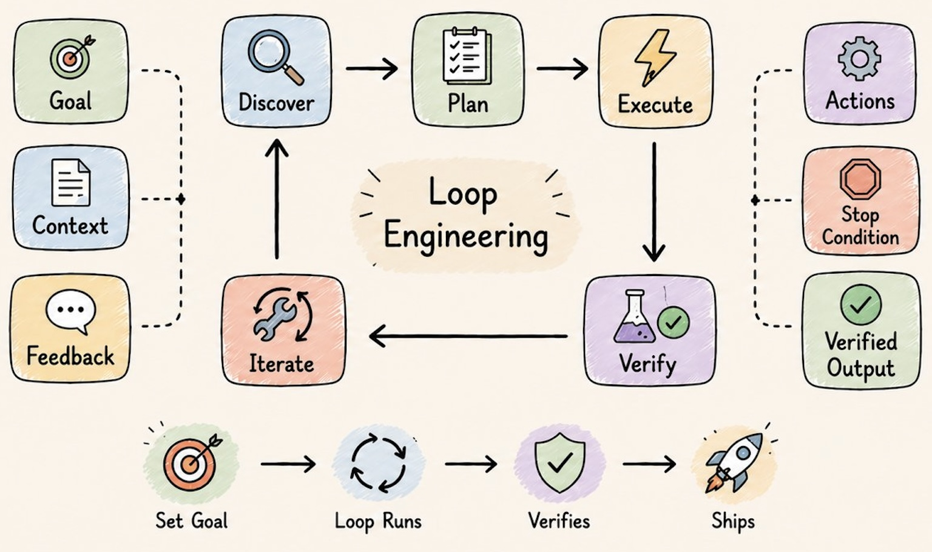
Loop Engineering
Source: Rahul @sairahul1 (2026), Loops: What Every AI Engineer Needs to Know in 2026, https://x.com/sairahul1/article/2064277888216555684

Slide 28
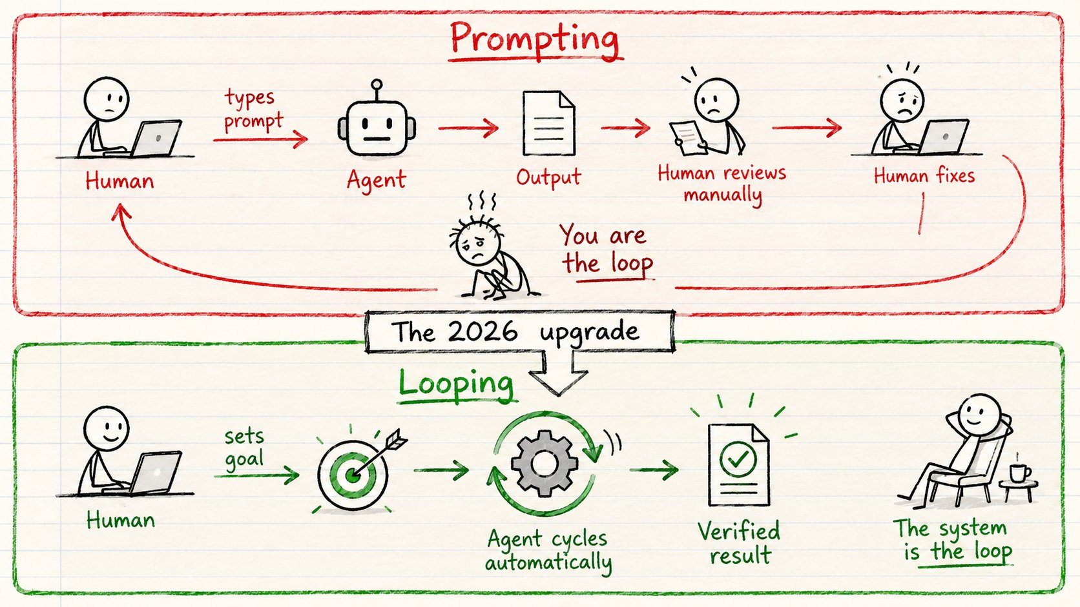
Loop Engineering
Source: Rahul @sairahul1 (2026), Loops: What Every AI Engineer Needs to Know in 2026, https://x.com/sairahul1/article/2064277888216555684

Slide 29
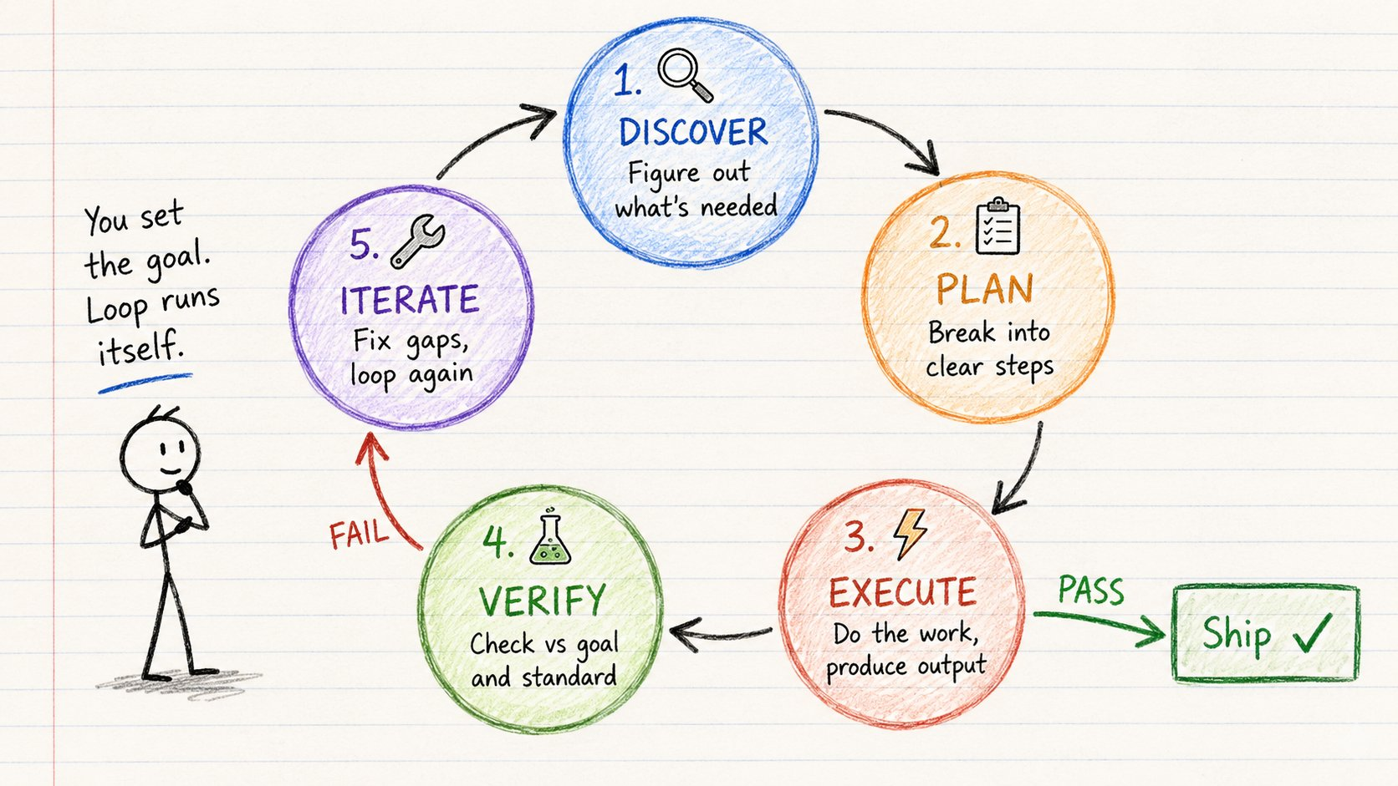
Loop Engineering
Source: Rahul @sairahul1 (2026), Loops: What Every AI Engineer Needs to Know in 2026, https://x.com/sairahul1/article/2064277888216555684

Slide 30
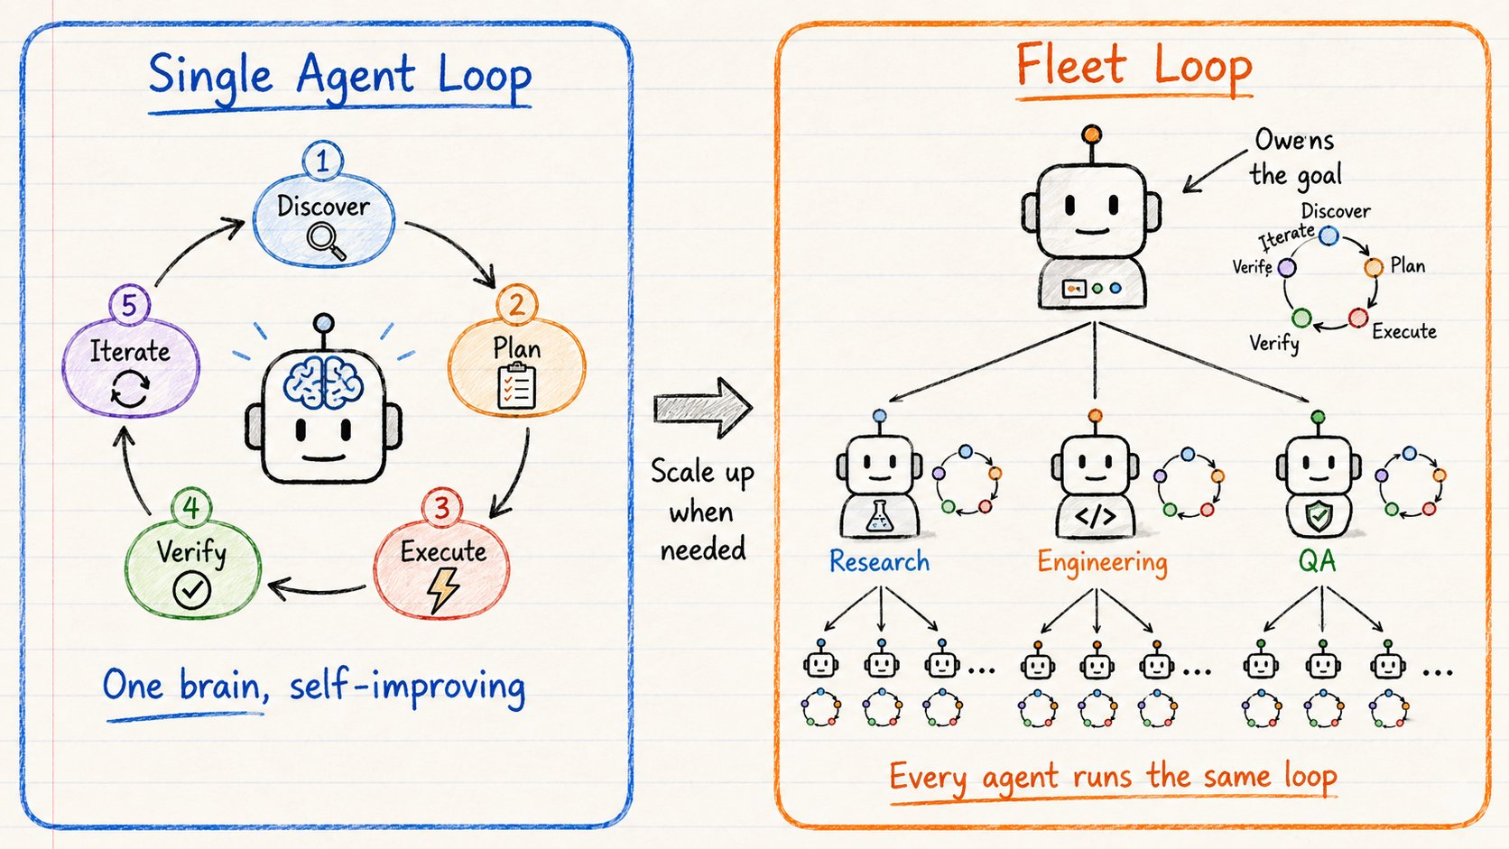
Loop Engineering
Source: Rahul @sairahul1 (2026), Loops: What Every AI Engineer Needs to Know in 2026, https://x.com/sairahul1/article/2064277888216555684

Slide 31
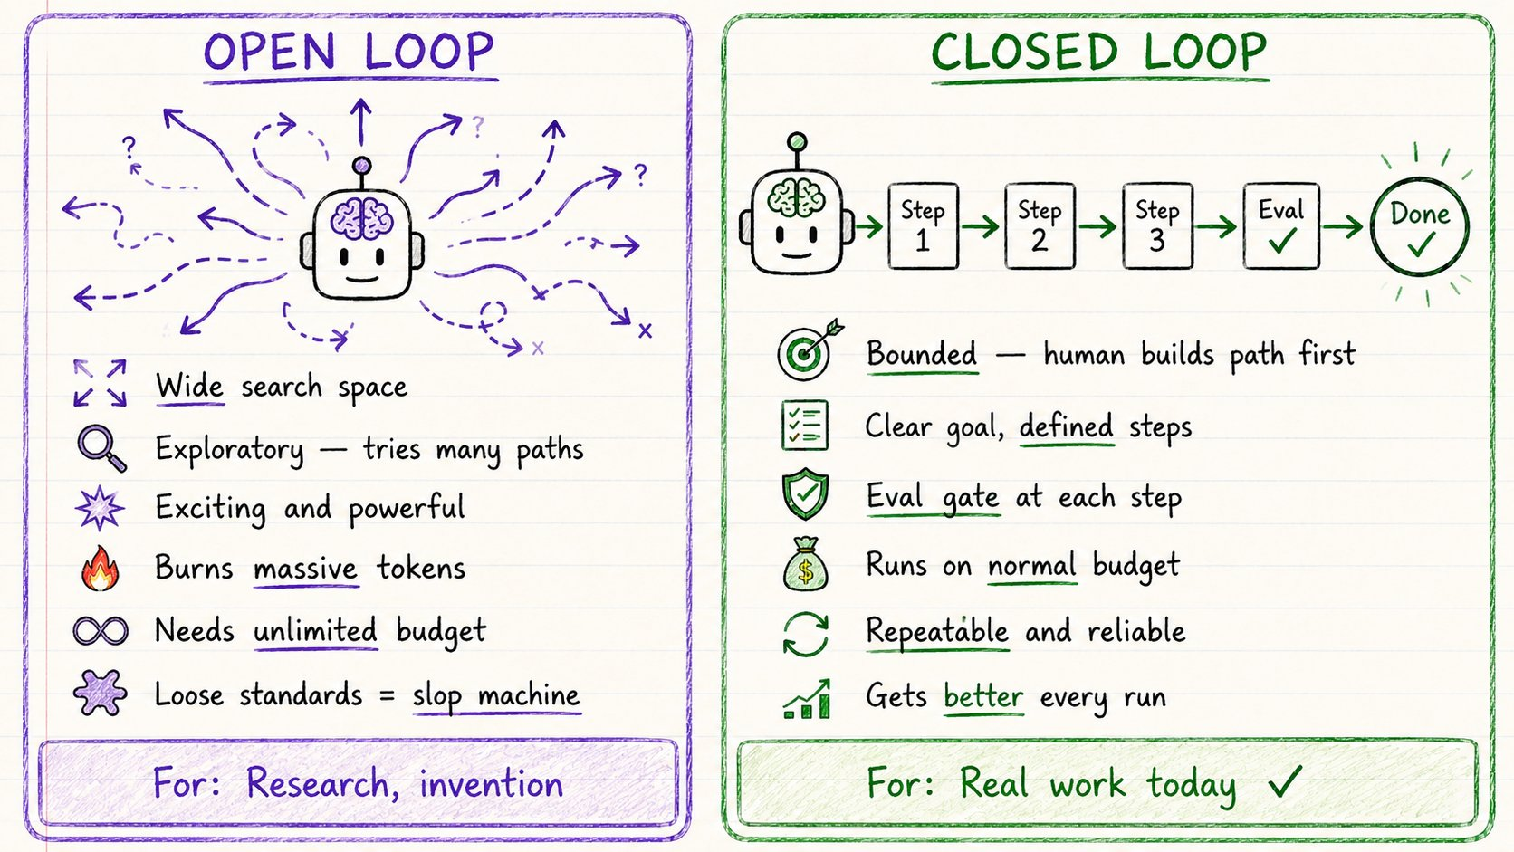
Loop Engineering
Source: Rahul @sairahul1 (2026), Loops: What Every AI Engineer Needs to Know in 2026, https://x.com/sairahul1/article/2064277888216555684

Slide 32
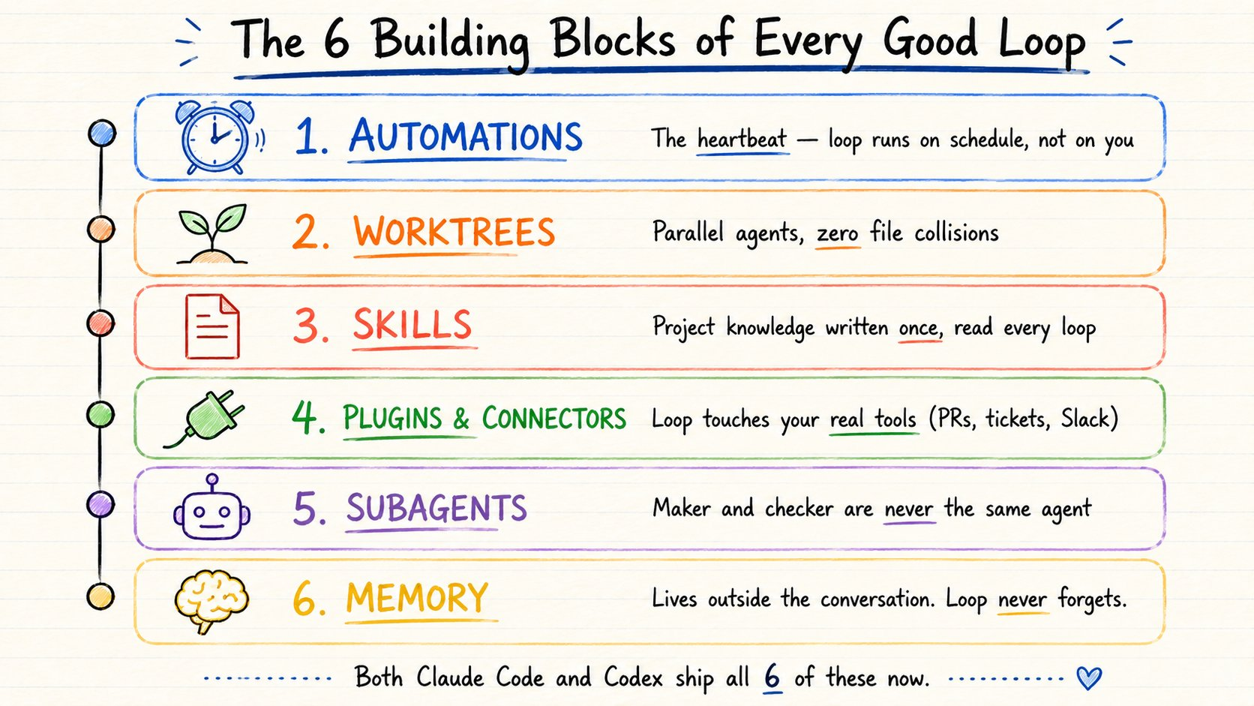
Loop Engineering
Source: Rahul @sairahul1 (2026), Loops: What Every AI Engineer Needs to Know in 2026, https://x.com/sairahul1/article/2064277888216555684

Slide 33
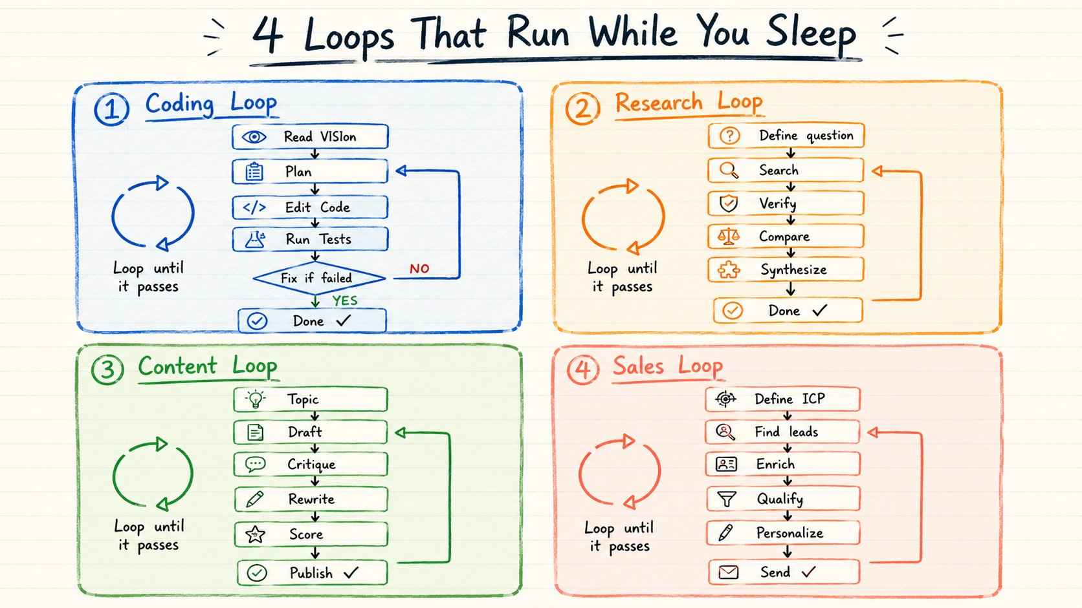
Loop Engineering
Source: Rahul @sairahul1 (2026), Loops: What Every AI Engineer Needs to Know in 2026, https://x.com/sairahul1/article/2064277888216555684

Slide 34
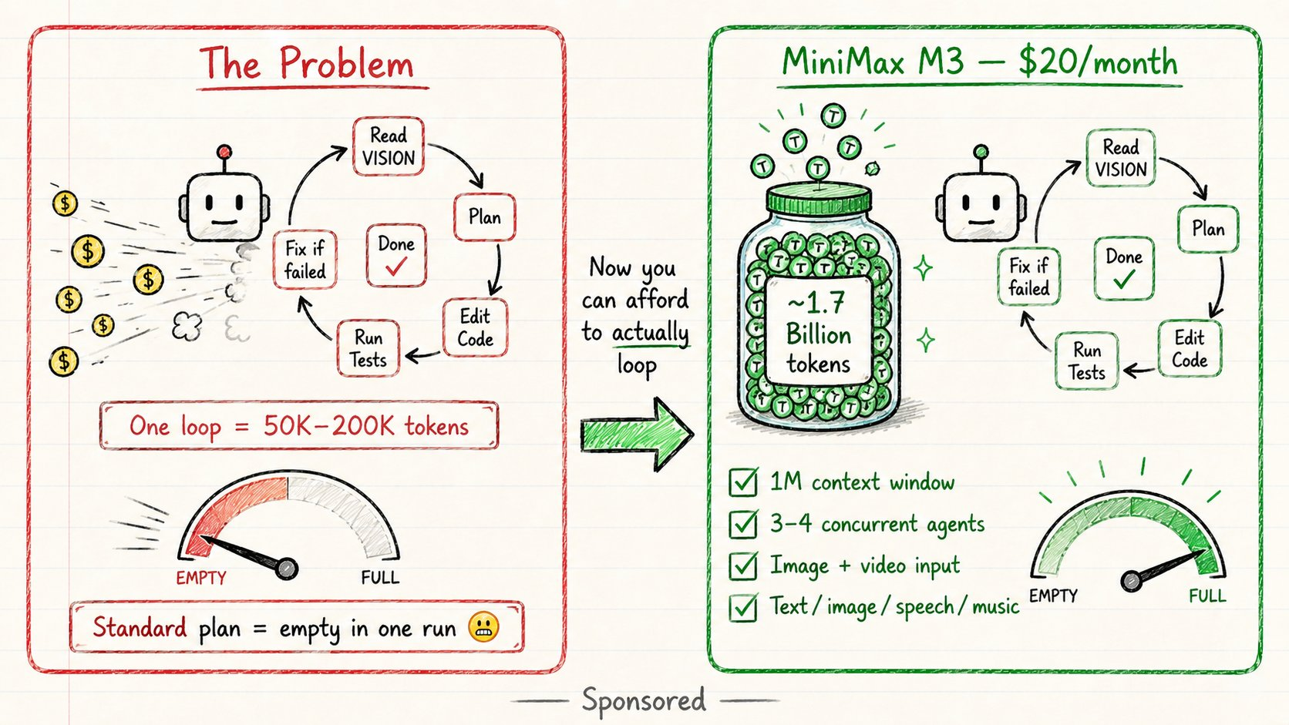
Loop Engineering
Source: Rahul @sairahul1 (2026), Loops: What Every AI Engineer Needs to Know in 2026, https://x.com/sairahul1/article/2064277888216555684

Slide 35
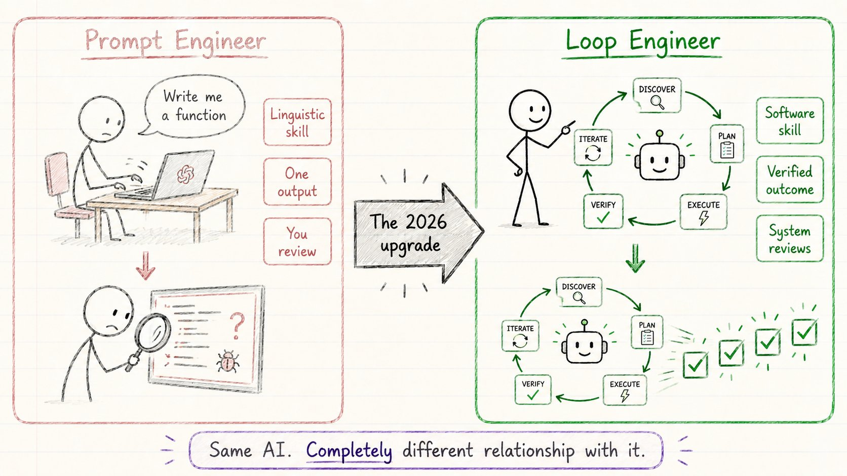
Loop Engineering
Source: Rahul @sairahul1 (2026), Loops: What Every AI Engineer Needs to Know in 2026, https://x.com/sairahul1/article/2064277888216555684

Slide 36
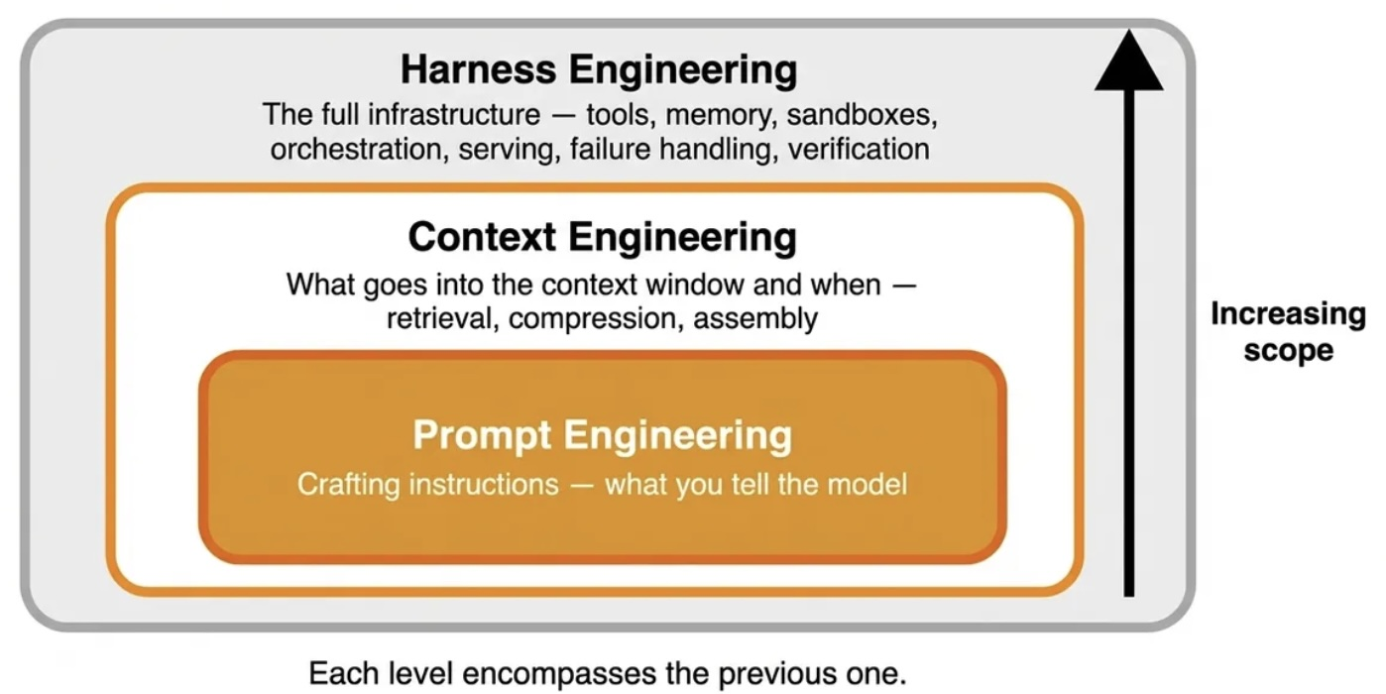
Harness Engineering
Context Engineering, Prompt Engineering
Source: https://www.decodingai.com/p/agentic-harness-engineering

Slide 37
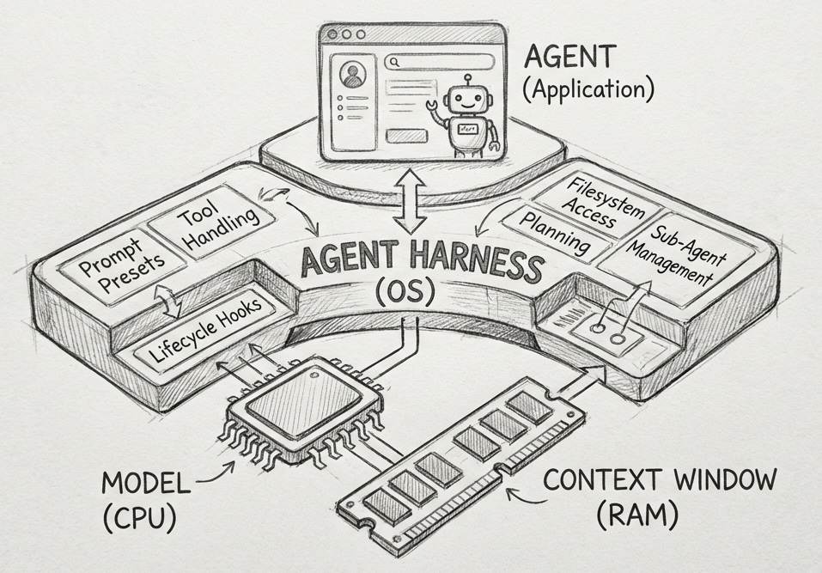
Harness Engineering
Source: https://www.philschmid.de/agent-harness-2026

Slide 38
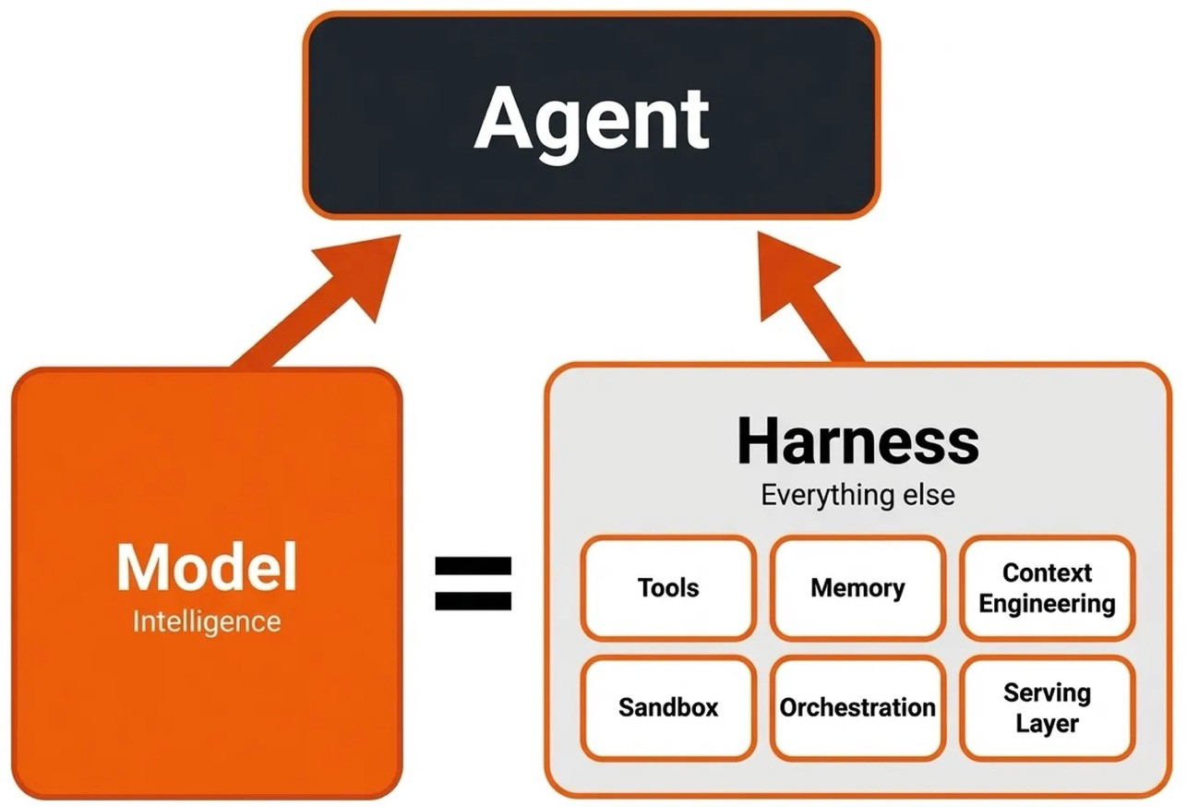
Agentic AI Harness Engineering
Building systems that transform the LLM into the new operating system
Source: https://www.decodingai.com/p/agentic-harness-engineering

Slide 39
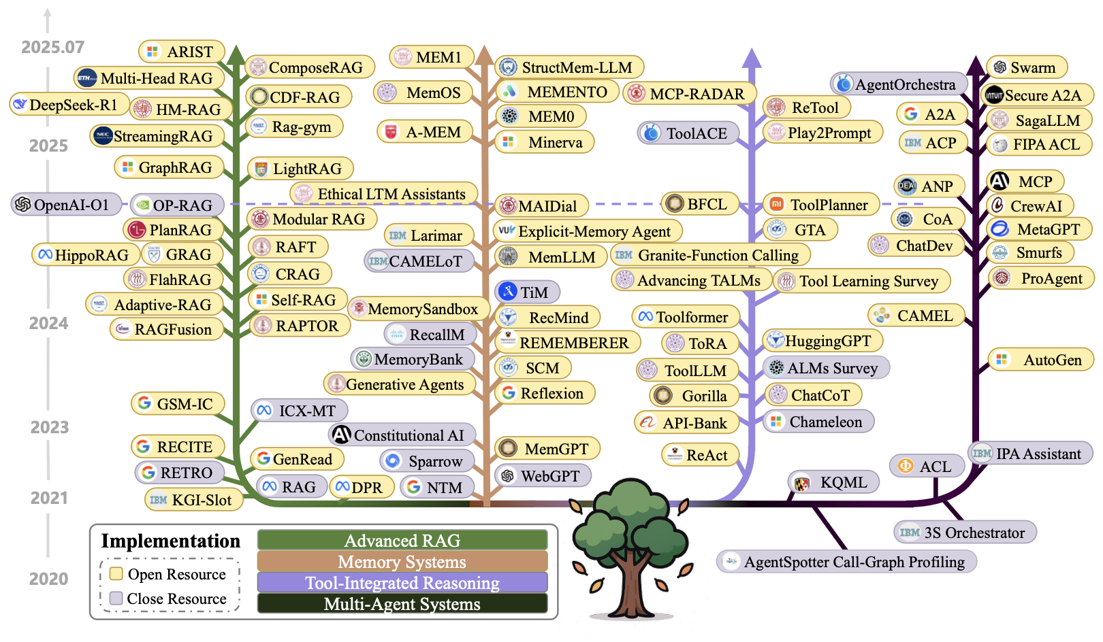
Context Engineering

Slide 40
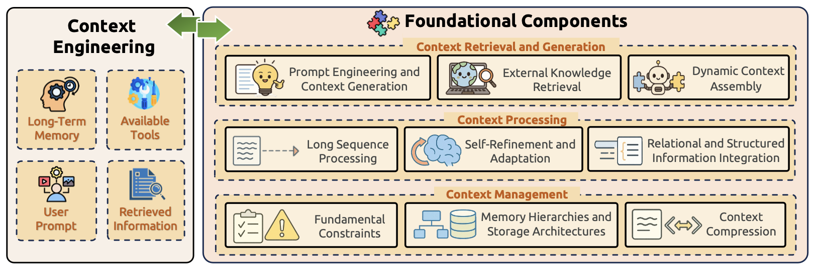
Context Engineering Framework

Slide 41

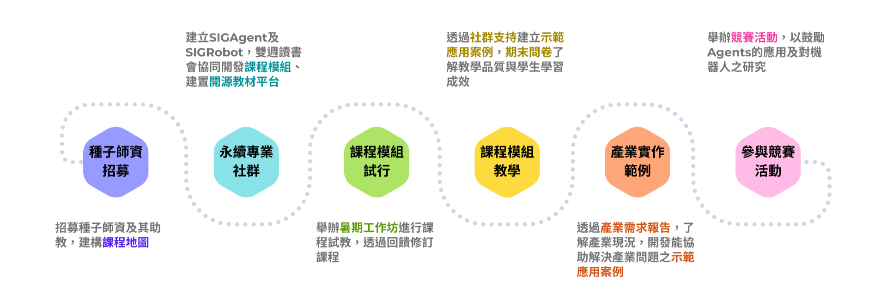
前瞻AI技術人才培育計畫
智慧代理與實體AI機器人課程推動計畫
National Agentic & Physical AI Initiative
https://napaincu.github.io/

Slide 42




什麼是代理式AI？
What is Agentic AI?
代理式AI (Agentic AI) 是指具備自主規劃、推理、工具使用和記憶能力的AI系統。它不僅能生成內容，更能自主完成複雜的多步驟任務。
自主規劃
推理思考
工具使用
記憶管理
Planning
Reasoning
Tool Use
Memory
分解複雜任務
制定執行策略
邏輯推理
情境分析判斷
呼叫API、搜尋
執行程式碼
上下文記憶
長期知識存儲

Slide 43
代理式AI框架與方法論
Agentic AI Frameworks and Approaches
ReAct
推理+行動交替進行
Reasoning + Acting
思考 → 行動 → 觀察 → 再思考
Tool Use
函數呼叫與工具整合
Function Calling & APIs
搜尋、計算、程式執行、資料庫查詢
Multi-Agent
多代理人協作系統
Collaborative Agent Systems
分工合作、角色扮演、辯論機制
MCP
模型上下文協議
Model Context Protocol
標準化工具接入、跨平台互通

Slide 44


AI代理人實務應用範例
AI Agents in Practice
Claude Code
Perplexity
自主撰寫、除錯、測試程式碼
Autonomous coding agent
深度搜尋與研究代理人
Deep research agent
Devin
AutoGPT / CrewAI
AI軟體工程師
AI software engineer
自主任務執行框架
Autonomous task frameworks

Slide 45




AI關鍵技術趨勢
Key AI Technology Trends
RAG 檢索增強生成
微調與對齊
小型語言模型
Retrieval-Augmented Generation
Fine-tuning & Alignment
Small Language Models
結合外部知識庫，提升回答準確性
針對特定任務優化模型表現
Phi、Gemma 等輕量化模型，可邊緣部署
端側AI
多代理人協作
AI安全與治理
On-device AI
Multi-Agent Collaboration
AI Safety & Governance
手機、筆電本地運行AI，隱私保護
多個Agent分工合作完成複雜任務
負責任AI、可解釋性、偏見消除

Slide 46
生成式AI vs 代理式AI
Generative AI vs Agentic AI
比較面向 | 生成式AI Generative AI | 代理式AI Agentic AI
核心功能 | 生成內容（文字、圖像） | 自主規劃與執行任務
互動方式 | 單次輸入→輸出 | 多輪迭代、自主循環
工具使用 | 有限或無 | 主動呼叫多種工具
記憶能力 | 有限上下文 | 短期+長期記憶
自主程度 | 被動回應 | 主動規劃與決策
典型應用 | 寫作、翻譯、程式輔助 | 自動化工作流、研究分析
代表系統 | ChatGPT、Claude Chat | Claude Code、Devin

Slide 47
第一部分 重點回顧
Section 1 Key Takeaways
生成式AI正從「內容生成」演進到「自主行動」的代理式AI
Agentic AI具備規劃、推理、工具使用、記憶四大核心能力
MCP、Multi-Agent等框架正推動AI代理人生態系統發展
RAG、小型模型、端側AI等趨勢降低AI應用門檻
企業AI採用率持續攀升，Agentic AI是下一波成長引擎
💡 接下來：AI如何驅動ESG與永續發展的數位創新？

Slide 48

2
ESG 跨域創新應用
ESG Cross-disciplinary Innovative Applications

Slide 49
ESG概述：三大支柱
ESG Overview: Three Pillars
E
S
G
環境
社會
治理
Environmental
Social
Governance
氣候變遷
碳排放管理
能源效率
生物多樣性
廢棄物管理
勞工權益
多元共融(DEI)
社區關係
供應鏈管理
資料隱私
董事會結構
商業倫理
風險管理
資訊揭露
反貪腐

Slide 50
聯合國永續發展目標 (SDGs)
UN Sustainable Development Goals
人 People
SDG 1 消除貧窮 | SDG 2 消除飢餓 | SDG 3 健康福祉
SDG 4 優質教育 | SDG 5 性別平等
繁榮 Prosperity
SDG 7 可負擔能源 | SDG 8 經濟成長 | SDG 9 工業創新
SDG 10 減少不平等 | SDG 11 永續城市
地球 Planet
SDG 6 潔淨水源 | SDG 12 負責消費 | SDG 13 氣候行動
SDG 14 海洋生態 | SDG 15 陸域生態
和平與夥伴 Peace & Partnership
SDG 16 和平正義制度 | SDG 17 全球夥伴關係
17項永續發展目標 — 2030年全球共同願景
50

Slide 51
Evolution of Sustainable Finance Research
Topic
SDGs:
Sustainable Development Goals
SDGs
Innovative Financial Instrument
Impact Investing
ESG: Environmental, Social, and Governance
CSR: Corporate Social Responsibility
Conscious Capitalism
Climate Financing
Carbon Financing
Green Financing
Ethical Investing
Socially Responsible Investing
1986
1995
2005
2015
2020
Source: Kumar, S., Sharma, D., Rao, S., Lim, W. M., & Mangla, S. K. (2022). Past, present, and future of sustainable finance:
Insights from big data analytics through machine learning of scholarly research. Annals of Operations Research, 1-44.

Slide 52


















Sustainable Development Goals (SDGs)
Source: https://sdgs.un.org/goals

Slide 53
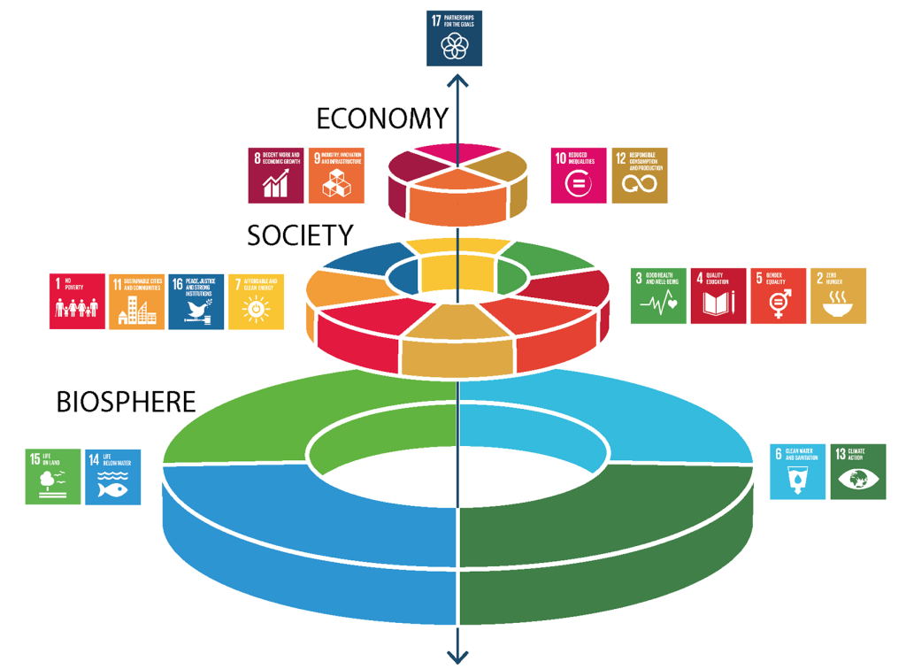
Sustainable Development Goals (SDGs) and 5P
Partnership
Peace
Prosperity
People
Planet
Source: Folke, Carl, Reinette Biggs, Albert V. Norström, Belinda Reyers, and Johan Rockström. "Social-ecological resilience and biosphere-based sustainability science.”Ecology and Society 21, no. 3 (2016).

Slide 54
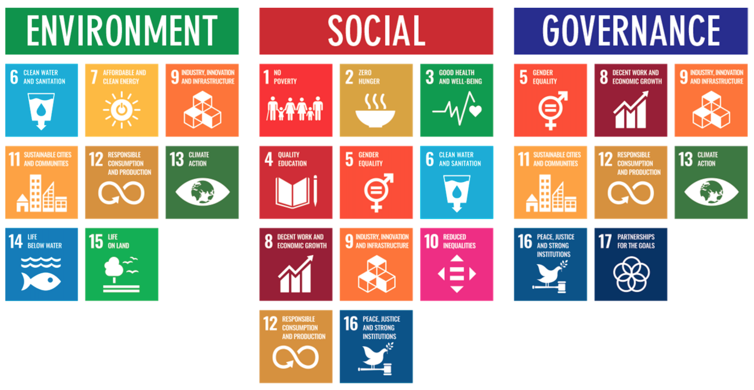
ESG to 17 SDGs
Source: Henrik Skaug Sætra (2021) "A Framework for Evaluating and Disclosing the ESG Related Impacts of AI with the SDGs." Sustainability 13, no. 15 (2021): 8503.

Slide 55
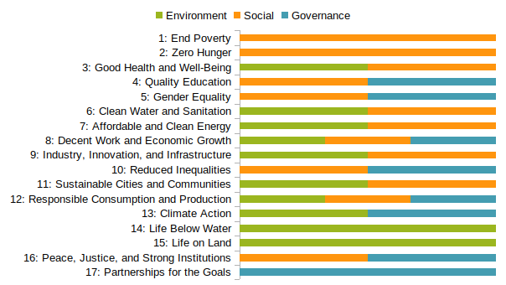
ESG to 17 SDGs
Source: https://sustainometric.com/esg-to-sdgs-connected-paths-to-a-sustainable-future/

Slide 56
永續發展的數位轉型
Digital Transformation for Sustainability
傳統挑戰
數位創新解方
✗ ESG數據收集耗時費力，缺乏自動化
AI自動化數據收集與分析
✗ 報告編制依賴人工，效率低、易出錯
GenAI輔助ESG報告撰寫
✗ 缺乏即時監測，風險預警不足
IoT + AI即時環境監測
✗ 利害關係人溝通不夠透明
區塊鏈確保數據透明可信
數位永續雙軸轉型 (Twin Transition)
數位轉型 × 永續轉型 = 企業競爭力新基石。AI是加速器。
56

Slide 57



AI × 環境 (Environmental)
AI Applications for Environmental Sustainability
碳足跡追蹤
Carbon Footprint Tracking
氣候風險建模
Climate Risk Modeling
AI自動計算供應鏈碳排放，即時監測企業碳足跡
機器學習預測極端氣候事件，評估實體與轉型風險
能源優化
Energy Optimization
衛星影像分析
Satellite Imagery Analysis
智慧電網、建築能源管理、再生能源預測
監測森林砍伐、土地利用變化、海洋污染
57
Notes:
AI在環境面向的四大應用：碳足跡追蹤（自動化Scope 1/2/3計算）、氣候風險建模（TCFD框架）、能源優化（智慧建築、電網）、衛星影像分析（遙感監測）。

Slide 58


AI × 社會 (Social)
AI Applications for Social Impact
供應鏈透明度
Supply Chain Transparency
多元共融分析
DEI Analytics
AI追蹤供應鏈風險，確保勞動條件與人權保障
自然語言處理分析招聘偏見、薪酬差距，推動公平職場
社區影響評估
Community Impact Assessment
健康與安全
Health & Safety
分析企業營運對周邊社區的社會與經濟影響
預測性維護減少工安事故，AI監測工作環境品質
58
Notes:
AI在社會面向的應用：供應鏈透明度（追蹤人權風險）、DEI分析（消除偏見）、社區影響評估、健康安全預測。AI不僅提升效率，更能促進社會公平。

Slide 59

AI × 治理 (Governance)
AI Applications for Corporate Governance
ESG報告自動化
ESG Reporting Automation
合規監測
Compliance Monitoring
AI生成符合GRI、SASB、
IFRS S1/S2標準的報告
即時監測法規變動，
自動評估合規狀態
漂綠偵測
Greenwashing Detection
風險預警
Risk Early Warning
NLP分析企業ESG聲明，
識別不實或誇大宣稱
AI分析多源數據，
提前預警ESG相關風險
59
Notes:
AI在治理面向的應用：報告自動化（GRI、SASB等框架）、合規監測（即時追蹤法規變動）、漂綠偵測（用NLP識別不實聲明）、風險預警。AI讓治理更透明、高效。

Slide 60
生成式AI於ESG的應用
Generative AI for ESG
生成式AI正在革新ESG管理的每一個環節
ESG報告生成
根據數據自動產生符合國際框架的永續報告草稿，
大幅縮短編制時間
Automated ESG Report Generation
永續敘事撰寫
將複雜ESG數據轉化為易理解的故事，
提升利害關係人溝通效果
Sustainability Narrative Creation
政策文件分析
快速分析法規文件、競爭對手報告，
提取關鍵資訊與趨勢
Policy Document Analysis
多語言溝通
即時翻譯ESG報告與溝通材料，
促進全球利害關係人參與
Multilingual Communication
60

Slide 61

代理式AI於ESG的應用
Agentic AI for ESG
從「被動生成」到「主動管理」— Agentic AI帶來的範式轉移
自主數據收集代理
即時監測代理
Autonomous Data Collection Agent
Real-time Monitoring Agent
自動搜集、清洗、整合來自多個來源的ESG數據
24/7監測碳排放、能源使用、合規狀態，異常自動告警
多代理人分析系統
利害關係人互動代理
Multi-Agent ESG Analysis
Stakeholder Engagement Agent
E/S/G各由專業Agent分析，最後由協調Agent整合報告
自動回應投資人ESG查詢，產生客製化分析報告
61
Notes:
Agentic AI在ESG的四大應用場景。關鍵差異：代理式AI能自主運行、持續監測、主動行動，不需要人類逐步指令。Multi-Agent系統讓E/S/G各有專責Agent。

Slide 62
綠色金融與AI
Green Finance and AI
AI驅動的綠色金融應用
ESG 評分模型
AI分析多維度數據，生成更準確的ESG評分
綠色債券分析
自動評估綠色債券的環境效益與合規性
永續投資組合
AI優化投資組合，平衡財務收益與ESG目標
氣候壓力測試
模擬氣候情境對金融資產的影響
62
Notes:
綠色金融研究 AI在綠色金融的應用。ESG評分、綠色債券分析、永續投資組合優化、氣候壓力測試。AI提升綠色金融的精確度和效率。

Slide 63
AI × ESG 創新案例
AI + ESG Innovation Case Studies
Microsoft
AI優化數據中心能源效率，追蹤全球碳足跡
減少30%能源消耗
碳負排放目標
Bloomberg
AI驅動的ESG數據收集與分析，服務全球投資人
覆蓋50萬+企業
ESG數據平台
Salesforce
AI輔助碳排放追蹤，自動化永續報告
95%報告效率提升
Net Zero Cloud
台積電 TSMC
AI優化半導體製程，減少水資源與能源消耗
能源效率提升25%
綠色製造
63
Notes:
四個AI+ESG的實際案例。Microsoft碳負排放、Bloomberg ESG數據平台、Salesforce Net Zero Cloud、台積電綠色製造。這些不是未來願景，而是正在發生的創新。

Slide 64


挑戰與省思
Challenges and Reflections
數據品質
AI偏見
透明度
Data Quality
AI Bias
Transparency
ESG數據缺乏統一標準，來源分散、品質不一
訓練數據偏見可能導致不公平的ESG評估結果
AI決策的可解釋性不足，影響利害關係人信任
AI碳足跡
人才缺口
倫理考量
AI's Carbon Footprint
Talent Gap
Ethical Concerns
大型模型訓練與推論的高能耗本身是永續議題
同時具備AI與ESG專業的跨域人才嚴重不足
自動化決策的責任歸屬、隱私保護等議題
64
Notes:
坦誠面對挑戰：數據品質不一、AI偏見、透明度不足、AI自身的碳足跡、人才缺口、倫理考量。這些挑戰正是需要跨域人才來解決的原因。

Slide 65













AI CUP 2 0 2 6
教育部大專校院人工智慧競賽
VeriPromiseESG 2026 ESG 永續承諾驗證競賽
計畫主持人： 戴敏育 教授 , 國立臺北大學資訊管理研究所
協同主持人： 陳重吉 助理教授 , 國立情報學研究所 (NII) , 日本
Prof. Yohei Seki , 筑波大學圖書情報與媒體科學研究所, 日本
計畫助理： 盧信廷 黃暐宸 陳文澤 黃雨涵
veripromiseesg.github.io
競賽官網

Slide 66

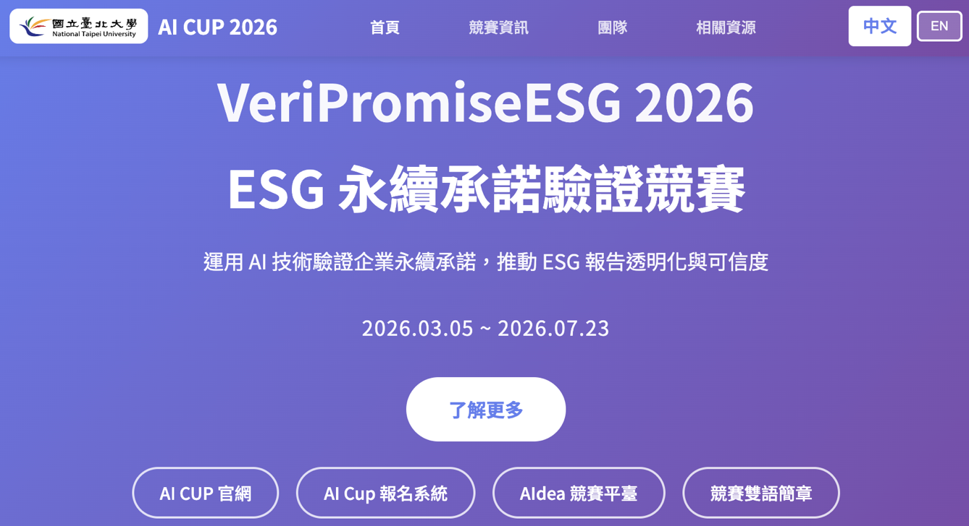
AI Cup 2026
VeriPromiseESG 2026 ESG 永續承諾驗證競賽
競賽目標： 開發能夠自動識別、分析和驗證企業永續承諾的 AI 系統，
透過四大核心任務（承諾識別、證據支持、清晰度評估、時機預測）完整評估 ESG 報告的真實性與可信度。
https://veripromiseesg.github.io/

Slide 67


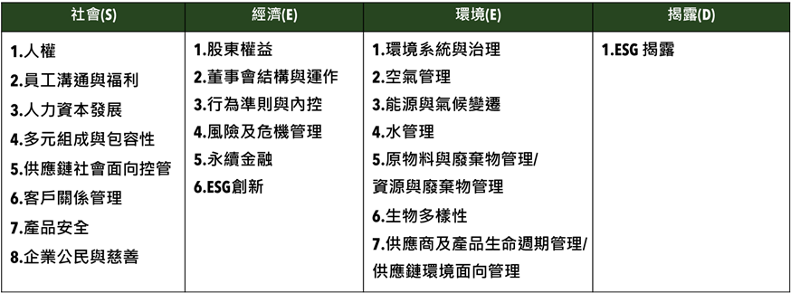
衡量企業永續關鍵指標
臺北大學獨創ESG永續評鑑系統
Source: https://www.aacsb.ntpu.edu.tw/twsvi/view.php?id=Nzc=

Slide 68







台灣永續評鑑
國立臺北大學商學院企業永續發展研究團隊

Slide 69
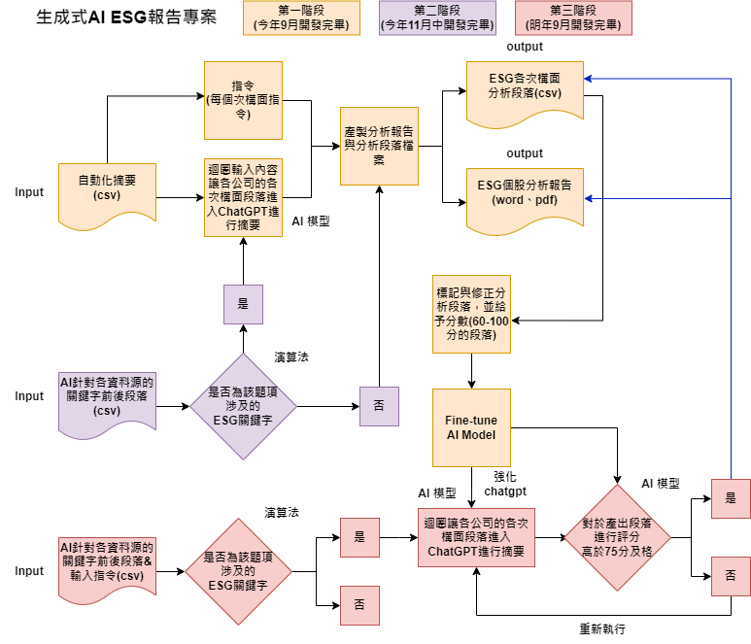
透過 AI SEED 提升評鑑效率
為使評鑑效率提升，與國立臺北大學資管所及資工所合作，開發相關程式，
已有25%題項自動或半自動化，大幅提升評鑑效率，並持續開發機械學習，持續透過AI 輔助評鑑進行。
另也透過AI SEED團隊持續將部分流程自動化，提升評鑑正確性，減少人力出錯可能。
題號 | 題目關鍵字 | 完成度
2-1-15 | 僅分派董監酬勞未分派股利 | 100%
2-2-3 | 獨董達董事席次1/2以上 | 100%
2-2-4 | 至少兩名獨董任期不超過9年 | 100%
2-2-14 | 設提名委員會且半數以上為獨董 | 100%
2-2-30 | 董事長兼任總經理 | 100%
2-2-31 | 1/3以上董事任期超過15年 | 100%
2-3-8 | 破產／面臨下市 | 100%
2-3-15 | 資安長或資訊安全委員會 | 100%
2-4-7 | 無保留意見 | 100%

Slide 70
綠色與轉型金融
智慧代理AI平台
Agentic AI Platform for
Green and Transformation Finance
01
70

Slide 71

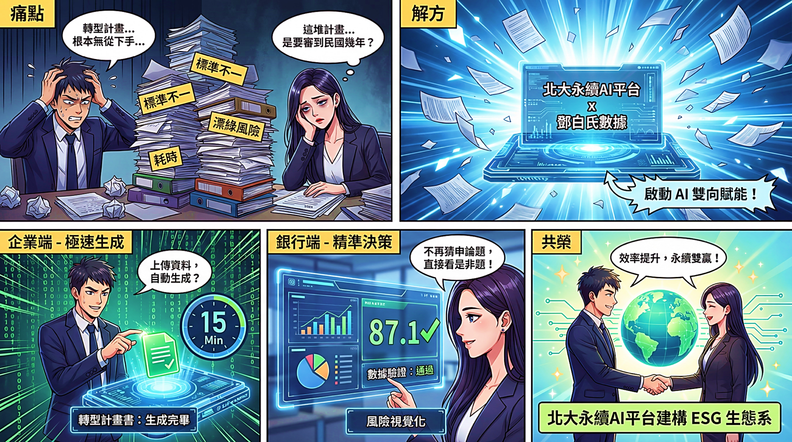
綠色與轉型金融智慧代理AI平台
71

Slide 72
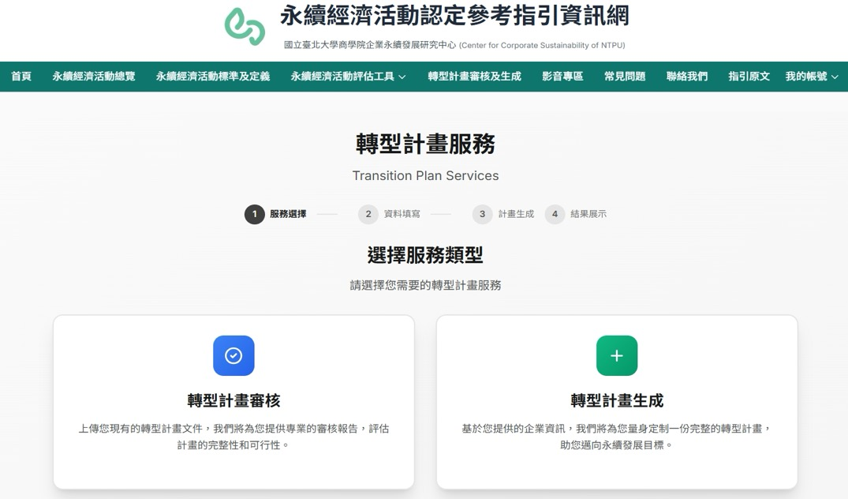

轉型計畫相關平台介紹-提供企業透過AI產製自身轉型計劃
轉型計畫生成
企業上傳公司資訊，由平台自動生成一版轉型計劃，再由企業進行內容調整，減少人工從頭製作計劃時間。
AI輔助判讀內容
AI 輔助判讀計劃，將人工作業降低8成。賦能金融專家聚焦核心判斷，確保決策的一致性與品質。
For 金融業審核
For 企業端填寫
25-35分鐘產出
15-20分鐘產出
數據賦能
24小時持續處理資料，強化監管可視性。 支援海量數據分析，提供宏觀數據洞察，有效辨識市場風險。
數據驗證
(金融業可選擇使用、輔助審查)
導入鄧白氏ESG資料庫（例如：中小企業ESG資料），減少人工驗證時間（未來逐步導入）。
72

Slide 73

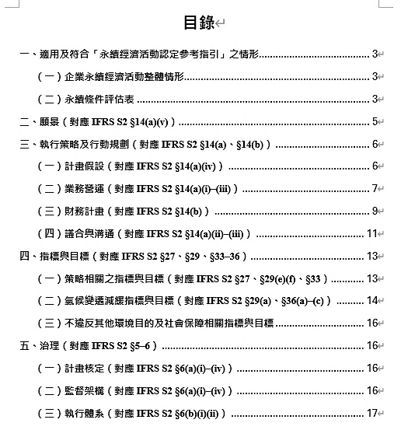
轉型計畫相關平台介紹：轉型計畫生成案例
平台整合公開資訊來源（如永續報告書、年報及 TCFD 報告等），透過代理AI 進行資料蒐集與分析，
自動生成結構完整且排版完成的企業轉型計畫。
引用資料源
自動排版+代理AI 生成
融入IFRS S2條文
永續報告書
TCFD報告書
年報
73

Slide 74
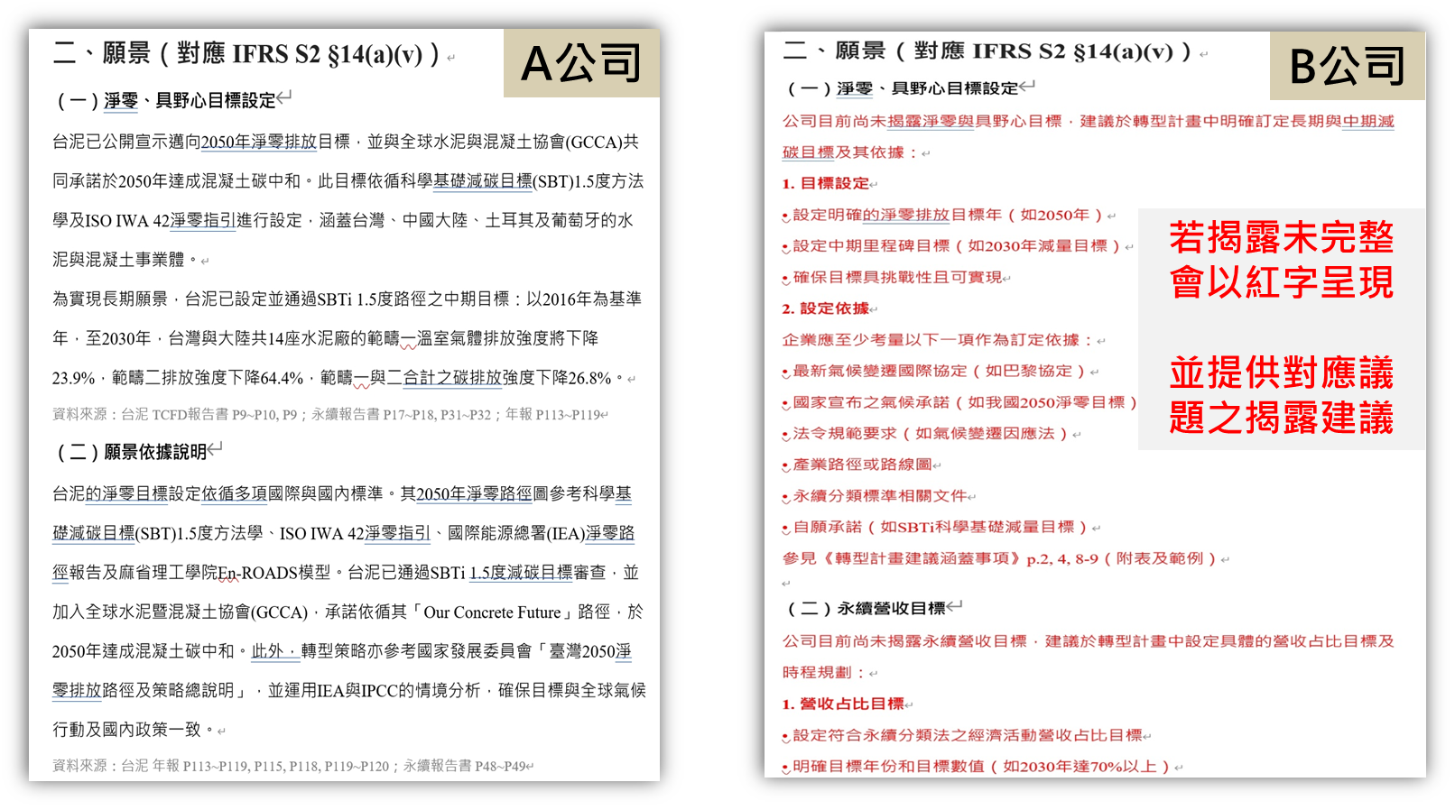
轉型計畫相關平台介紹：轉型計畫生成案例_內文摘要說明
水泥產業為例：相同議題，依公司提供ESG數據完整性產出略有差異
74

Slide 75
第二部分 重點回顧
Section 2 Key Takeaways
AI正全面滲透ESG三大支柱（環境、社會、治理）的管理實務
生成式AI降低ESG報告與溝通的時間成本
代理式AI實現ESG數據的自主收集、即時監測與智慧分析
綠色金融與AI結合，提升ESG投資決策品質
數據品質、AI偏見、碳足跡等挑戰需要跨域合作解決
💡 接下來：如何培育AI × ESG跨域人才？
75
Notes:
回顧第二部分。既然AI+ESG有這麼大的潛力，但也面臨人才缺口的挑戰，第三部分就來談如何透過教育培育跨域人才。

Slide 76

3
AI永續教育課程設計與人才培育
AI in Sustainable Education and Talent Cultivation
76

Slide 77
為什麼要在高等教育融入AI與SDGs？
Why Integrate AI & SDGs in Higher Education?
產業需求
政策驅動
企業需要具備AI+永續能力的人才
歐盟CSRD、台灣上市櫃永續報告要求持續擴大
跨域能力
學生期待
未來人才需同時理解技術、商業與永續議題
Z世代高度關注永續議題，期待有意義的學習
77
Notes:
四大理由：產業需求驅動、政策法規要求、跨域能力需求、學生期待。這不是「錦上添花」，而是教育的必要轉型。

Slide 78
SDGs融入課程設計框架
Framework for SDGs-Integrated Curriculum Design
願景層
Vision
對應SDGs目標，定義課程永續發展方向
能力層
Competency
AI素養 + 永續素養 + 批判思考 + 跨域溝通
內容層
Content
AI技術模組 + ESG知識模組 + 實務案例模組
實踐層
Practice
專題製作 + 企業合作 + 社會影響力評估
由上而下：從SDGs願景出發，逐層落實到課堂實踐
78
Notes:
四層框架：願景層（連結SDGs）→ 能力層（定義核心素養）→ 內容層（設計教材）→ 實踐層（動手做）。由上而下的設計邏輯，確保課程有系統性。

Slide 79

AI驅動的教學創新
AI-Powered Pedagogical Innovations
個人化學習
Personalized Learning
AI助教
AI Tutors & TAs
GenAI根據學生程度自動調整學習內容與進度
每位學生都有專屬的學習路徑
24/7即時回答學生問題，提供額外解說
減輕教師負擔，提升教學品質
自動化評量
Automated Assessment
沉浸式學習
Immersive Learning
AI批改作業、提供即時回饋
分析學習成效，早期預警學習困難
AI模擬ESG情境，讓學生在虛擬環境中
體驗永續決策的真實影響
79
Notes:
四種AI驅動的教學創新：個人化學習、AI助教、自動化評量、沉浸式學習。AI不是取代教師，而是賦能教師，讓教學更有效率、更有深度。

Slide 80
課程設計範例：AI與永續發展概論
Course Example: AI for Sustainability
週次 | 主題 | 實作活動 | 對應SDGs
1-3 | AI基礎與GenAI工具 | 使用Claude分析ESG報告 | SDG 4, 9
4-6 | ESG框架與數據分析 | Python爬取ESG數據 | SDG 12, 13
7-9 | AI × 環境永續 | 碳足跡計算器開發 | SDG 7, 13
10-12 | AI × 社會影響 | 供應鏈風險分析Agent | SDG 8, 10
13-15 | AI × 公司治理 | 漂綠偵測NLP專案 | SDG 16
16-18 | 期末專題發表 | 團隊AI+ESG解決方案 | 多項SDGs
80
Notes:
18週課程設計範例。前3週AI基礎、4-6週ESG框架、7-15週分別對應E/S/G三面向、最後3週期末專題。每週都有對應的SDGs和實作活動。

Slide 81
專題式學習 (PBL) 範例
Project-Based Learning Examples
校園碳足跡追蹤器
SDG 13
ESG新聞情緒分析
SDG 12, 16
學生開發AI工具，自動收集校園用電、用水、交通數據，計算碳足跡並提出減碳建議
建構AI Agent自動收集ESG新聞，分析企業永續表現的輿情趨勢
技術: Python, API, GenAI
技術: NLP, Agentic AI, Web Scraping
永續投資模擬平台
SDG 8, 9
社區永續影響評估
SDG 11
模擬ESG投資決策，AI分析投資組合的財務與永續績效
運用AI分析在地社區數據，評估永續發展現況並提出建議
技術: Python, LLM API, 資料視覺化
技術: GIS, Data Analysis, GenAI
81
Notes:
四個PBL專題範例：校園碳足跡、ESG新聞分析、永續投資模擬、社區影響評估。每個專題都結合AI技術與真實ESG議題，讓學生學以致用。

Slide 82
跨領域協作教學模式
Cross-Disciplinary Collaboration Model
商管金融
Business &
Finance
協作模式
共同授課
Co-Teaching
跨系專題
Cross-Dept Projects
AI × ESG
跨域人才
業師參與
Industry Mentors
資訊科技
Information
Technology
環境科學
Environmental
Science
國際交流
Global Exchange
82
Notes:
跨領域協作是培育AI×ESG人才的關鍵。三個學科領域的交集就是我們要培育的跨域人才。四種協作模式：共同授課、跨系專題、業師參與、國際交流。

Slide 83
實作工作坊設計
Hands-on Workshop Ideas
工作坊 1：GenAI × ESG報告分析
2小時
工作坊 2：建構ESG數據Agent
3小時
使用ChatGPT/Claude分析企業永續報告
提取關鍵指標、比較不同企業表現
使用Python建構簡單的AI Agent
自動收集特定產業的ESG數據
工具: Claude, ChatGPT, PDF Reader
工具: Python, LangChain, Claude API
工作坊 3：永續敘事生成
2小時
工作坊 4：漂綠偵測實戰
3小時
運用Prompt Engineering技巧
將ESG數據轉化為有說服力的永續故事
訓練NLP模型識別企業ESG聲明中的
漂綠（Greenwashing）跡象
工具: Claude, Prompt Templates
工具: Python, NLP, Claude
83
Notes:
四個工作坊設計：ESG報告分析、數據Agent建構、永續敘事生成、漂綠偵測。

Slide 84
AI × 永續人才培育策略
Talent Cultivation Strategy
跨域人才能力框架
培育路徑
AI素養
Prompt Engineering | AI工具應用
程式設計基礎 | 數據分析能力
1
入門
AI工具體驗
SDGs認識
永續素養
ESG框架理解 | SDGs知識
永續報告閱讀 | 綠色金融概念
程式實作
ESG分析
2
進階
思辨能力
批判思考 | 倫理判斷
系統性思維 | 問題解決
3
專精
Agent開發
專題研究
溝通協作
跨域溝通 | 團隊合作
利害關係人互動 | 專案管理
4
實踐
企業實習
社會影響
84
Notes:
提出四大能力面向的培育框架（AI素養、永續素養、思辨能力、溝通協作），以及四階段培育路徑（入門→進階→專精→實踐）。

Slide 85

學習成效評量方法
Student Outcomes and Assessment
專題作品集
Project Portfolio
40%
AI+ESG專題成果、過程文件、反思報告
同儕評量
Peer Assessment
15%
團隊合作、溝通能力、跨域貢獻度
AI素養測驗
AI Literacy Test
20%
AI工具操作、Prompt設計、倫理判斷
永續影響力報告
Impact Report
25%
專題對SDGs的實際或潛在貢獻分析
85
Notes:
評量設計：專題作品集(40%)、同儕評量(15%)、AI素養測驗(20%)、永續影響力報告(25%)。多元評量確保學生不只學會技術，更能展現對永續的理解和影響力。

Slide 86
Prompt Engineering 實戰示範
Prompt Engineering for ESG Analysis
# Prompt 範例：ESG報告分析
你是一位ESG分析專家。請分析以下企業永續報告，
並完成以下任務：
1. 識別該企業在E/S/G三面向的關鍵績效指標(KPIs)
2. 比較與同業的表現差異
3. 偵測可能的漂綠(Greenwashing)跡象
4. 提出三項改善建議，對應具體SDGs
請以結構化格式輸出，包含數據支持。
💡 教學重點：角色設定、任務分解、輸出格式指定、漂綠偵測思維
86
Notes:
實戰示範：展示如何設計ESG分析的Prompt。教學重點：角色設定、任務分解、輸出格式指定。

Slide 87
ESG Agent 建構示範
Building a Simple ESG Agent
# ESG Agent 概念架構（Python 虛擬碼）
class ESGAgent:
tools = [搜尋ESG數據, 分析報告, 計算碳排放, 生成報告]
def run(self, query):
plan = self.llm.plan(query) # 1. 規劃任務
for step in plan:
result = self.execute(step) # 2. 執行步驟
self.memory.store(result) # 3. 儲存記憶
plan = self.llm.replan(result) # 4. 動態調整
return self.llm.summarize() # 5. 彙整報告
Agent = LLM + 工具 + 記憶 + 規劃迴圈
87
Notes:
用簡化的Python虛擬碼展示ESG Agent的核心邏輯。Agent的四個關鍵步驟：規劃→執行→記憶→重新規劃。Agent不是魔法，而是結構化的流程。

Slide 88


未來展望：終身學習與產學合作
Future Outlook: Lifelong Learning & Industry-Academia
終身學習 Lifelong Learning
產學合作 Industry-Academia
微學分/微證書制度
企業ESG數據開放合作
線上線下混合學習模式
業界導師指導專題製作
AI個人化學習路徑推薦
產學共構課程內容
產業需求導向的課程更新
實習與就業銜接
社區學習與知識共享平台
研究成果產業化應用
88
Notes:
展望未來：終身學習（微學分、混合學習、AI個人化）和產學合作（數據開放、業界導師、共構課程、實習銜接）。教育不是一次性的，需要持續更新。

Slide 89
第三部分 重點回顧
Section 3 Key Takeaways
AI × SDGs融入課程是高等教育轉型的必要方向
四層框架：願景→能力→內容→實踐，系統化課程設計
AI是教學創新的加速器：個人化學習、AI助教、沉浸式體驗
PBL專題讓學生實際運用AI解決永續問題
跨域能力（AI素養+永續素養+思辨+溝通）是未來人才關鍵
89
Notes:
回顧第三部分：課程設計框架、教學創新方法、PBL範例、人才培育策略。準備進入總結。

Slide 90
總結與展望
Summary & Future Outlook
1
技術趨勢
AI正從「生成內容」演進為「自主代理」
2
ESG創新
AI全面提升ESG管理的效率與精確度
3
教育培育
跨域人才是實現AI永續願景的關鍵
AI × ESG × Education = 永續未來的三角引擎
90
Notes:
三大部分的核心觀點整合：技術趨勢（工具→代理人）、ESG創新（AI賦能永續）、教育培育（跨域人才）。三者形成正向循環。

Slide 91



行動呼籲
What Can We Do?
教師
嘗試將AI工具融入現有課程，從一個模組開始
學校
建立跨院系合作機制，支持SDGs融入課程
學生
主動學習AI工具，思考如何解決永續問題
產業
開放ESG數據合作，參與人才培育
91
Notes:
行動呼籲：從教師、學校、學生、產業四個角色提出具體建議。從小規模開始嘗試，不需要一步到位。

Slide 92
推薦資源
Recommended Resources
AI學習
ESG框架
• Anthropic Claude Docs (claude.ai)
• OpenAI Cookbook (github.com)
• Hugging Face Courses
• GRI Standards (globalreporting.org)
• SASB Standards (sasb.org)
• TCFD Recommendations
SDGs教育
研究與實務
• UN SDGs (sdgs.un.org)
• SDSN Education Hub
• UNESCO ESD Toolbox
• AI for Good (ITU)
• Climate Change AI
• 台灣永續能源研究基金會
92
Notes:
提供四類推薦資源：AI學習、ESG框架、SDGs教育、研究與實務。可以從這些資源開始深入學習。

Slide 93
代理式 AI 於 ESG 跨域創新應用
Agentic AI for ESG Cross-disciplinary Innovative Applications
跨領域特色發展中心
創新教學交流會
Q & A
Time: 10:00-12:00, Wedenesday, June 17, 2026
Host: 國立屏東科技大學 跨領域特色發展中心
Webex: https//npust-ifdc.webex.com/npust-ifdc-tc/j.php?MTID=m5f0d0e0530fad4c554b5b45dd442e4ff
University Ambassador
戴敏育 教授 (Prof. Min-Yuh Day)
國立臺北大學 資訊管理研究所 所長
金融科技暨綠色金融研究中心 主任
Certified Instructor
2026-06-17

