Slide 1
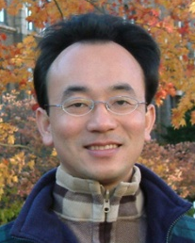
人工智慧文本分析 (AI for Text Analytics)
Tamkang University
Python自然語言處理 (Python for Natural Language Processing)
1091AITA03
MBA, IMTKU (M2455) (8418) (Fall 2020) Thu 3, 4 (10:10-12:00) (B206)
Min-Yuh Day
戴敏育
Associate Professor
副教授
Institute of Information Management, National Taipei University
國立臺北大學 資訊管理研究所
https://web.ntpu.edu.tw/~myday
2020-10-08

Slide 2
課程大綱 (Syllabus)
週次 (Week) 日期 (Date) 內容 (Subject/Topics)
1 2020/09/17 人工智慧文本分析課程介紹 (Course Orientation on Artificial Intelligence for Text Analytics)
2 2020/09/24 文本分析的基礎：自然語言處理 (Foundations of Text Analytics: Natural Language Processing; NLP)
3 2020/10/01 中秋節 (Mid-Autumn Festival) 放假一天 (Day off)
4 2020/10/08 Python自然語言處理 (Python for Natural Language Processing)
5 2020/10/15 處理和理解文本 (Processing and Understanding Text)
6 2020/10/22 文本表達特徵工程 (Feature Engineering for Text Representation)

Slide 3
課程大綱 (Syllabus)
週次 (Week) 日期 (Date) 內容 (Subject/Topics)
7 2020/10/29 人工智慧文本分析個案研究 I (Case Study on Artificial Intelligence for Text Analytics I)
8 2020/11/05 文本分類 (Text Classification)
9 2020/11/12 文本摘要和主題模型 (Text Summarization and Topic Models)
10 2020/11/19 期中報告 (Midterm Project Report)
11 2020/11/26 文本相似度和分群 (Text Similarity and Clustering)
12 2020/12/03 語意分析和命名實體識別 (Semantic Analysis and Named Entity Recognition; NER)

Slide 4
課程大綱 (Syllabus)
週次 (Week) 日期 (Date) 內容 (Subject/Topics)
13 2020/12/10 情感分析 (Sentiment Analysis)
14 2020/12/17 人工智慧文本分析個案研究 II (Case Study on Artificial Intelligence for Text Analytics II)
15 2020/12/24 深度學習和通用句子嵌入模型 (Deep Learning and Universal Sentence-Embedding Models)
16 2020/12/31 問答系統與對話系統 (Question Answering and Dialogue Systems)
17 2021/01/07 期末報告 I (Final Project Presentation I)
18 2021/01/14 期末報告 II (Final Project Presentation II)

Slide 5
Outline
Python for Natural Language Processing

Slide 6
Python for Natural Language Processing

Slide 7
Source: https://www.python.org/community/logos/

Slide 8
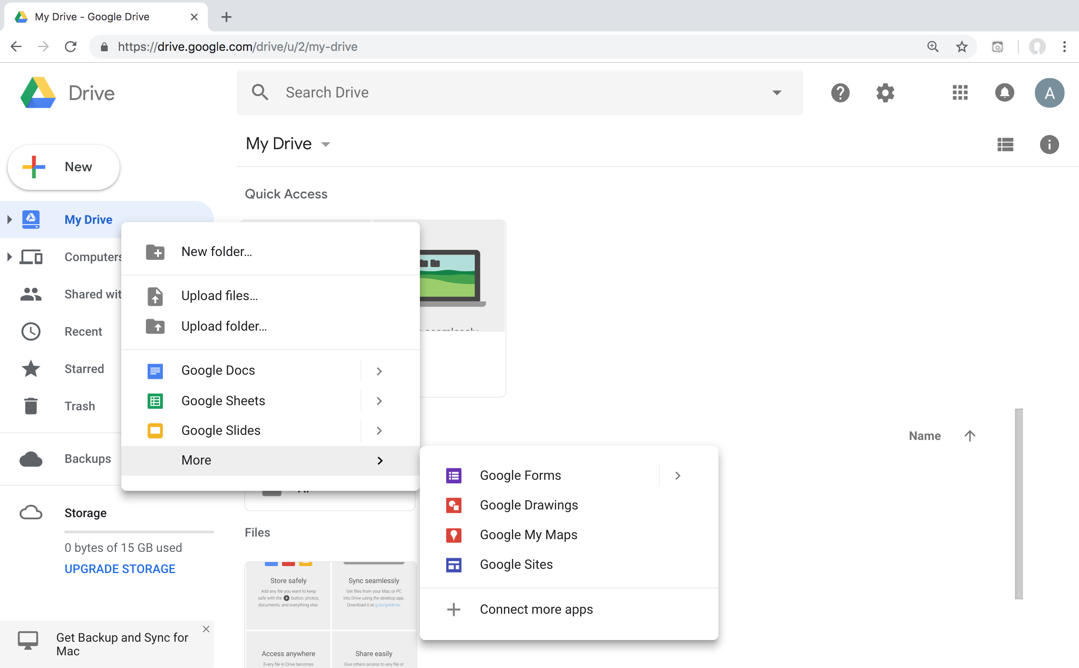
Connect Google Colab in Google Drive

Slide 9
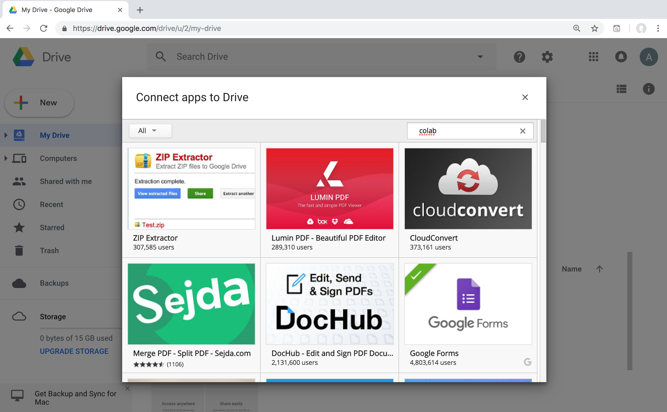
Google Colab

Slide 10
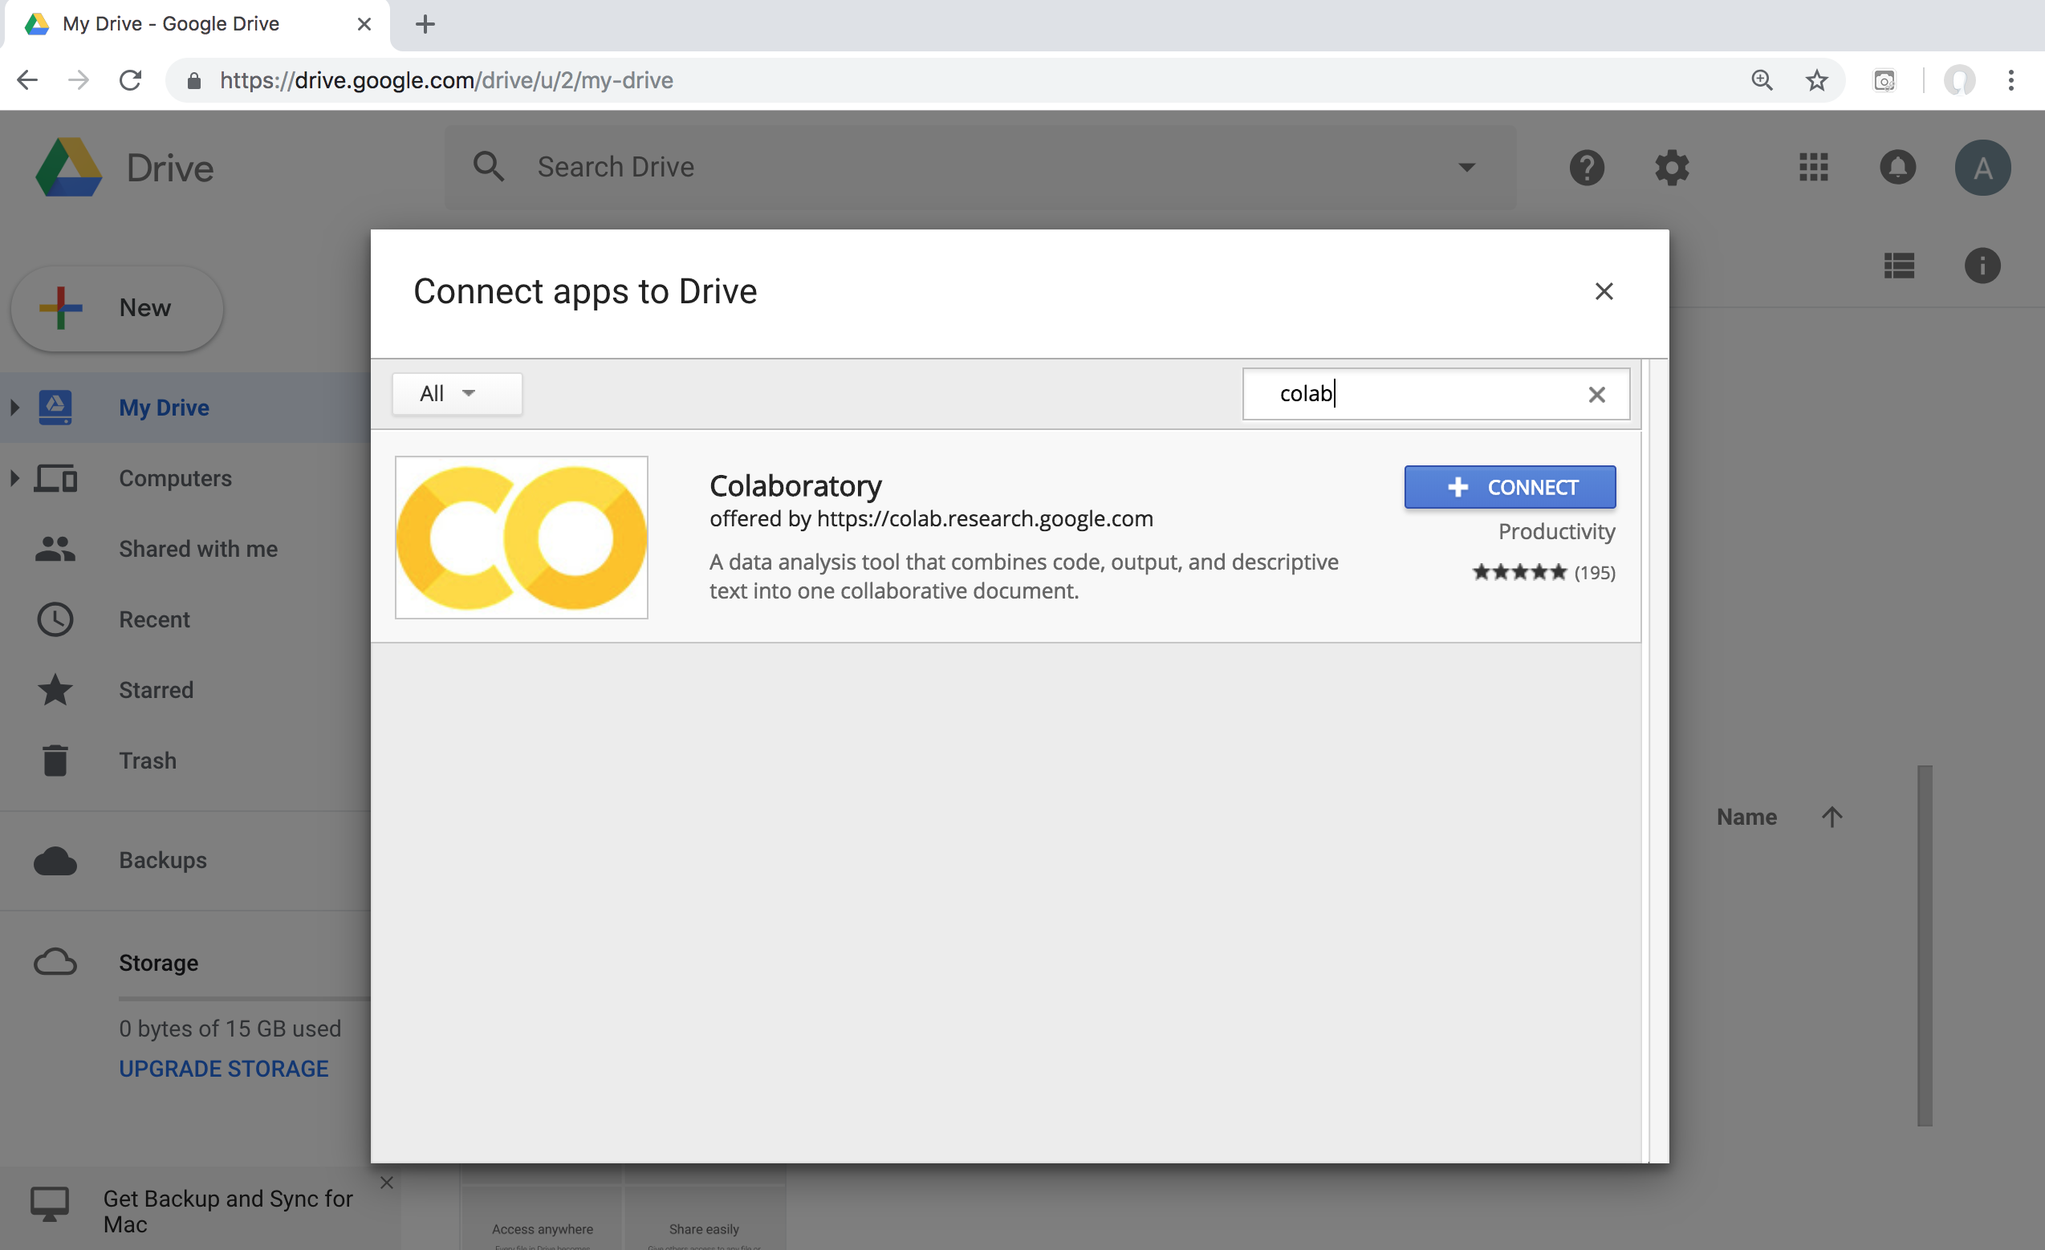
Google Colab

Slide 11
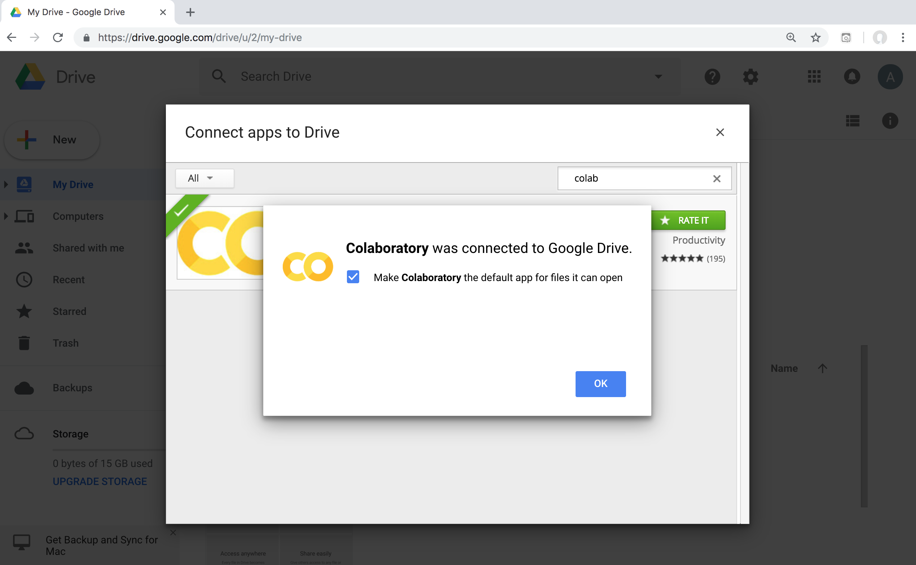
Connect Colaboratory to Google Drive

Slide 12
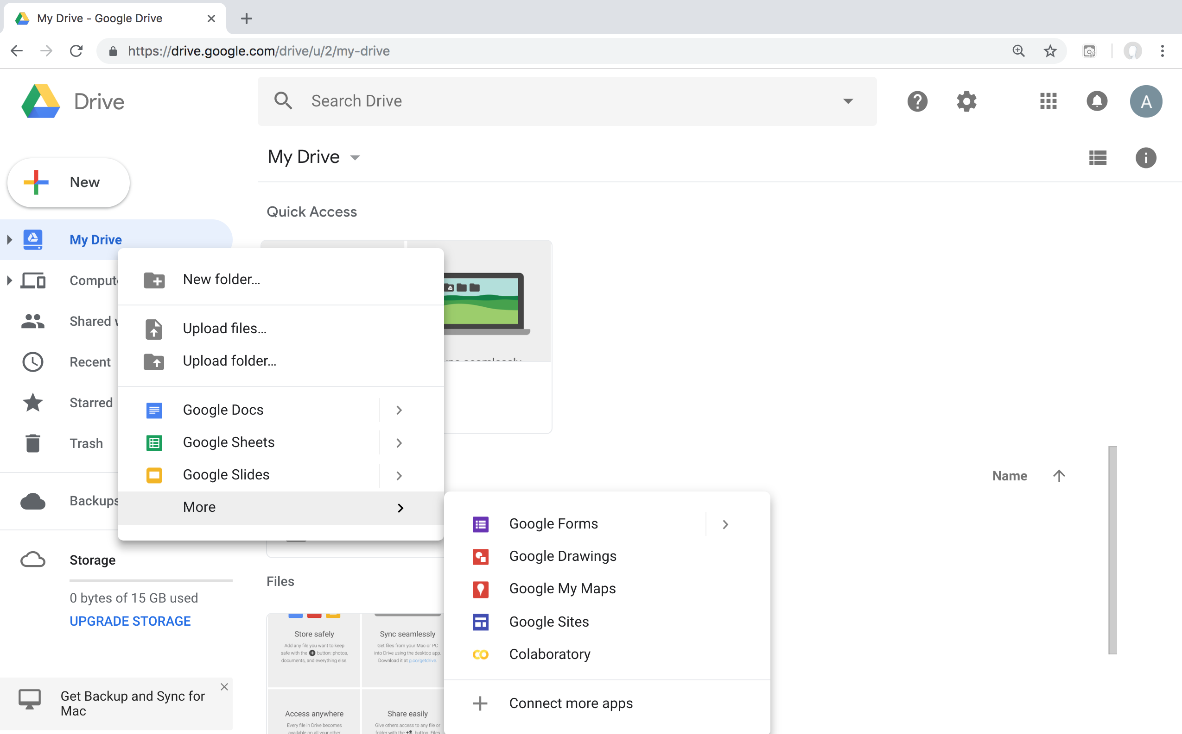
Google Colab

Slide 13
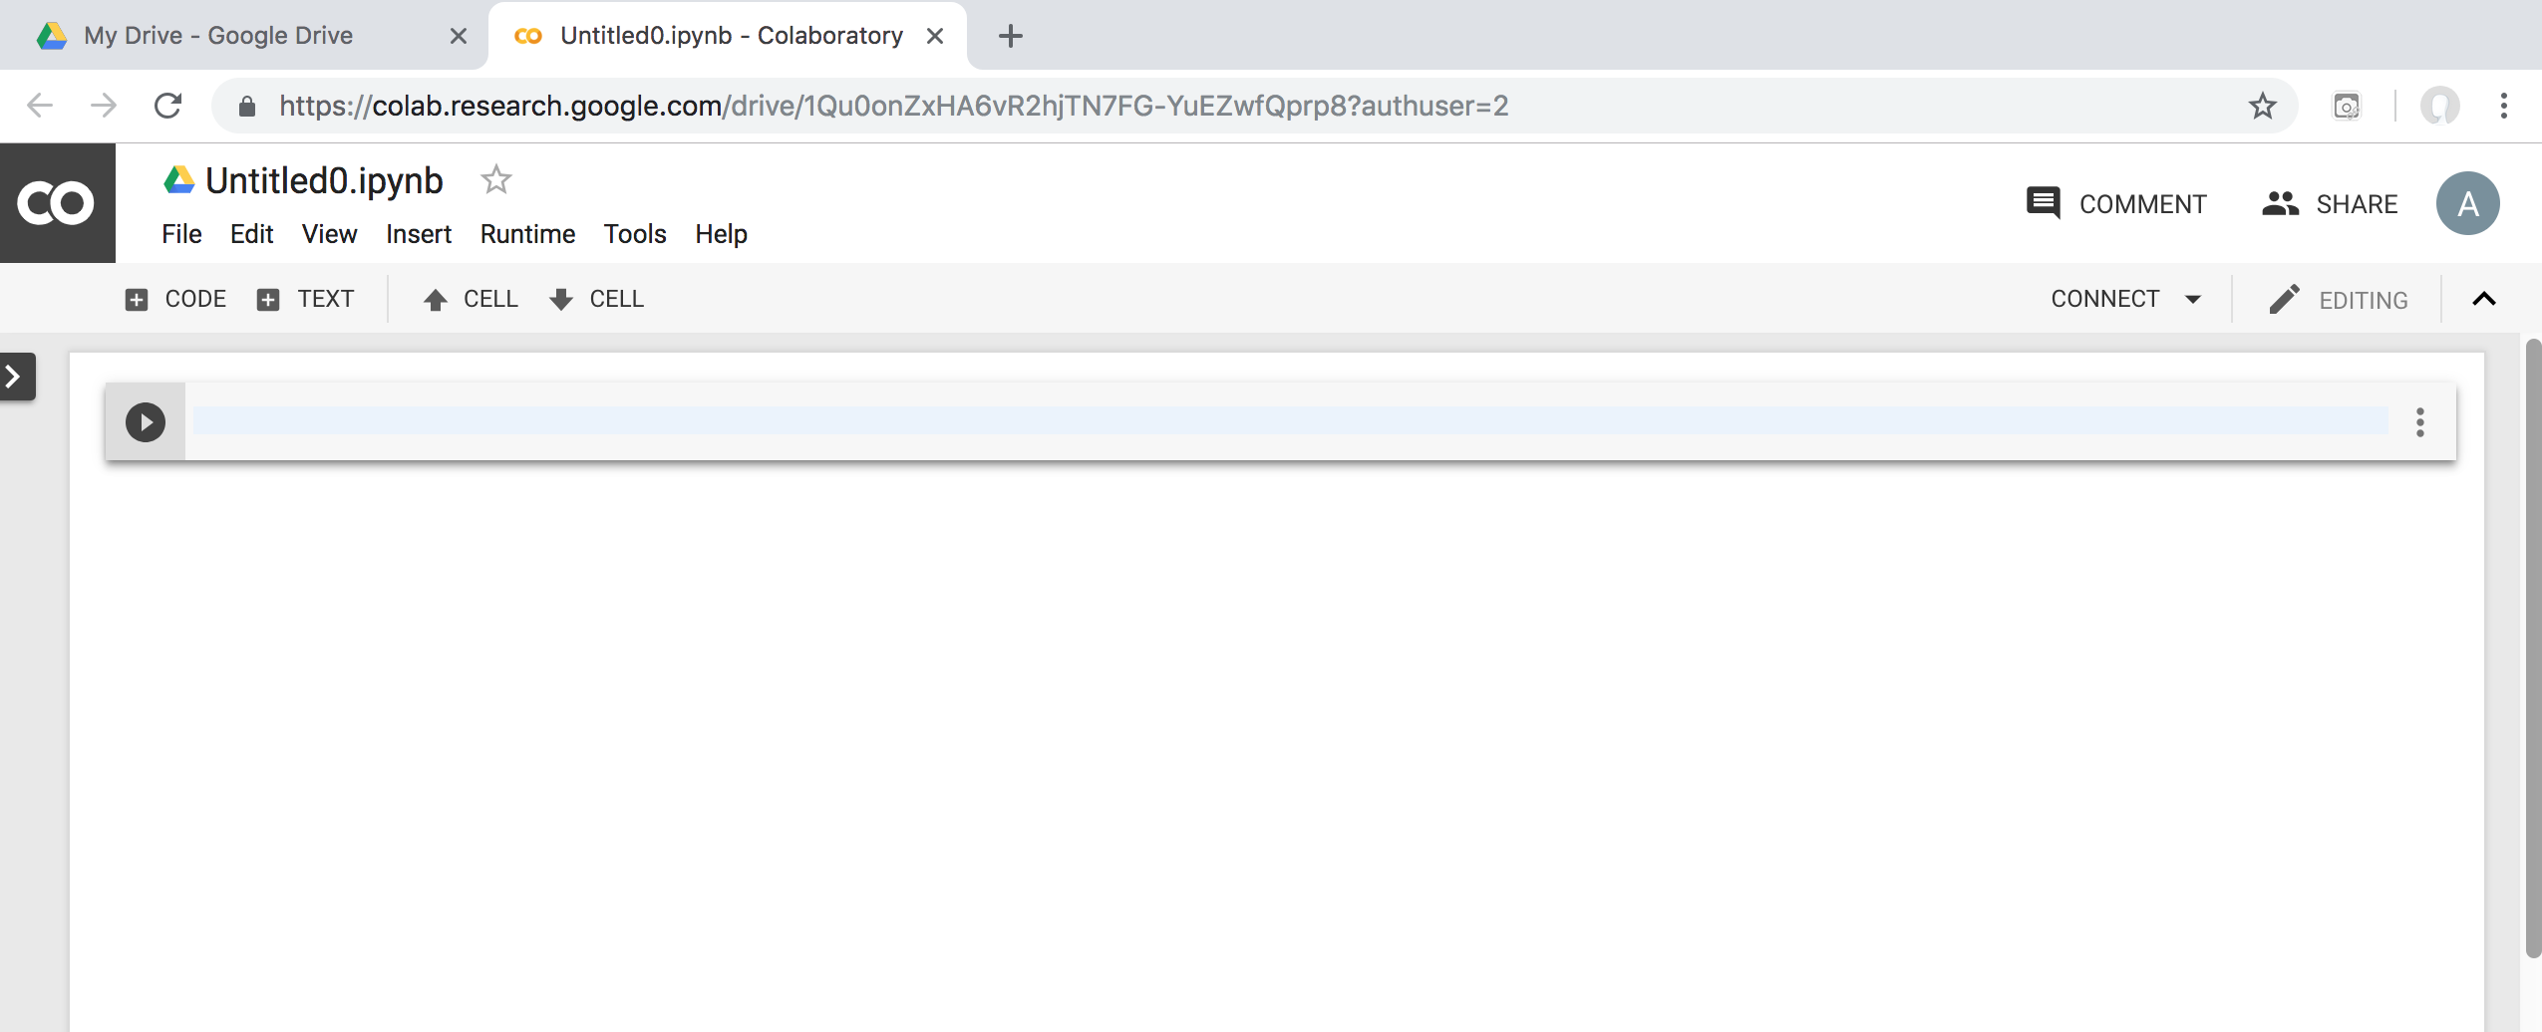
Google Colab

Slide 14
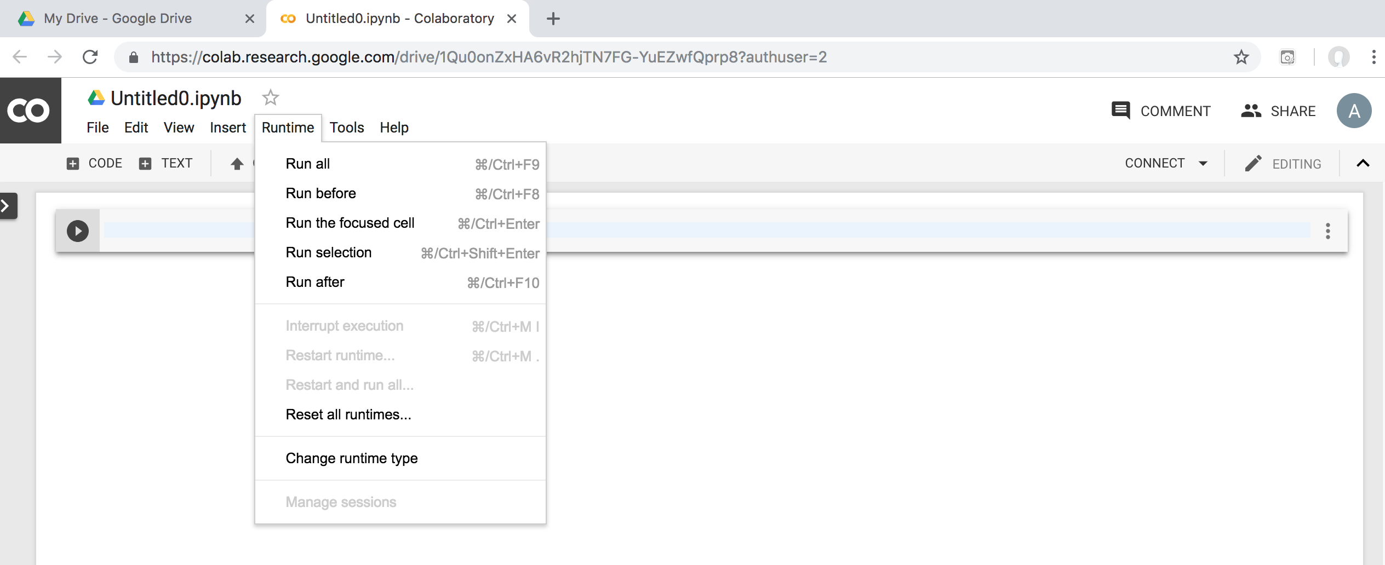
Google Colab

Slide 15
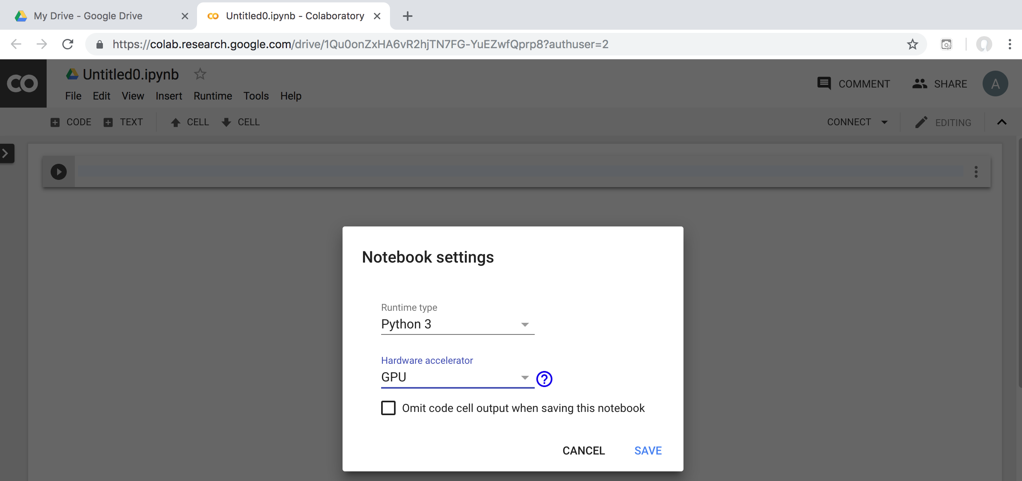
Run Jupyter Notebook Python3 GPU Google Colab

Slide 16
Google Colab Python Hello World print('Hello World')

Slide 17
Natural Language Processing (NLP) and Text Mining
Raw text
Sentence Segmentation
Tokenization
Part-of-Speech (POS)
Stop word removal
word’s stem
am → am
having → hav
word’s lemma
am → be
having → have
Stemming / Lemmatization
Dependency Parser
String Metrics & Matching
Source: Nitin Hardeniya (2015), NLTK Essentials, Packt Publishing; Florian Leitner (2015), Text mining - from Bayes rule to dependency parsing

Slide 18
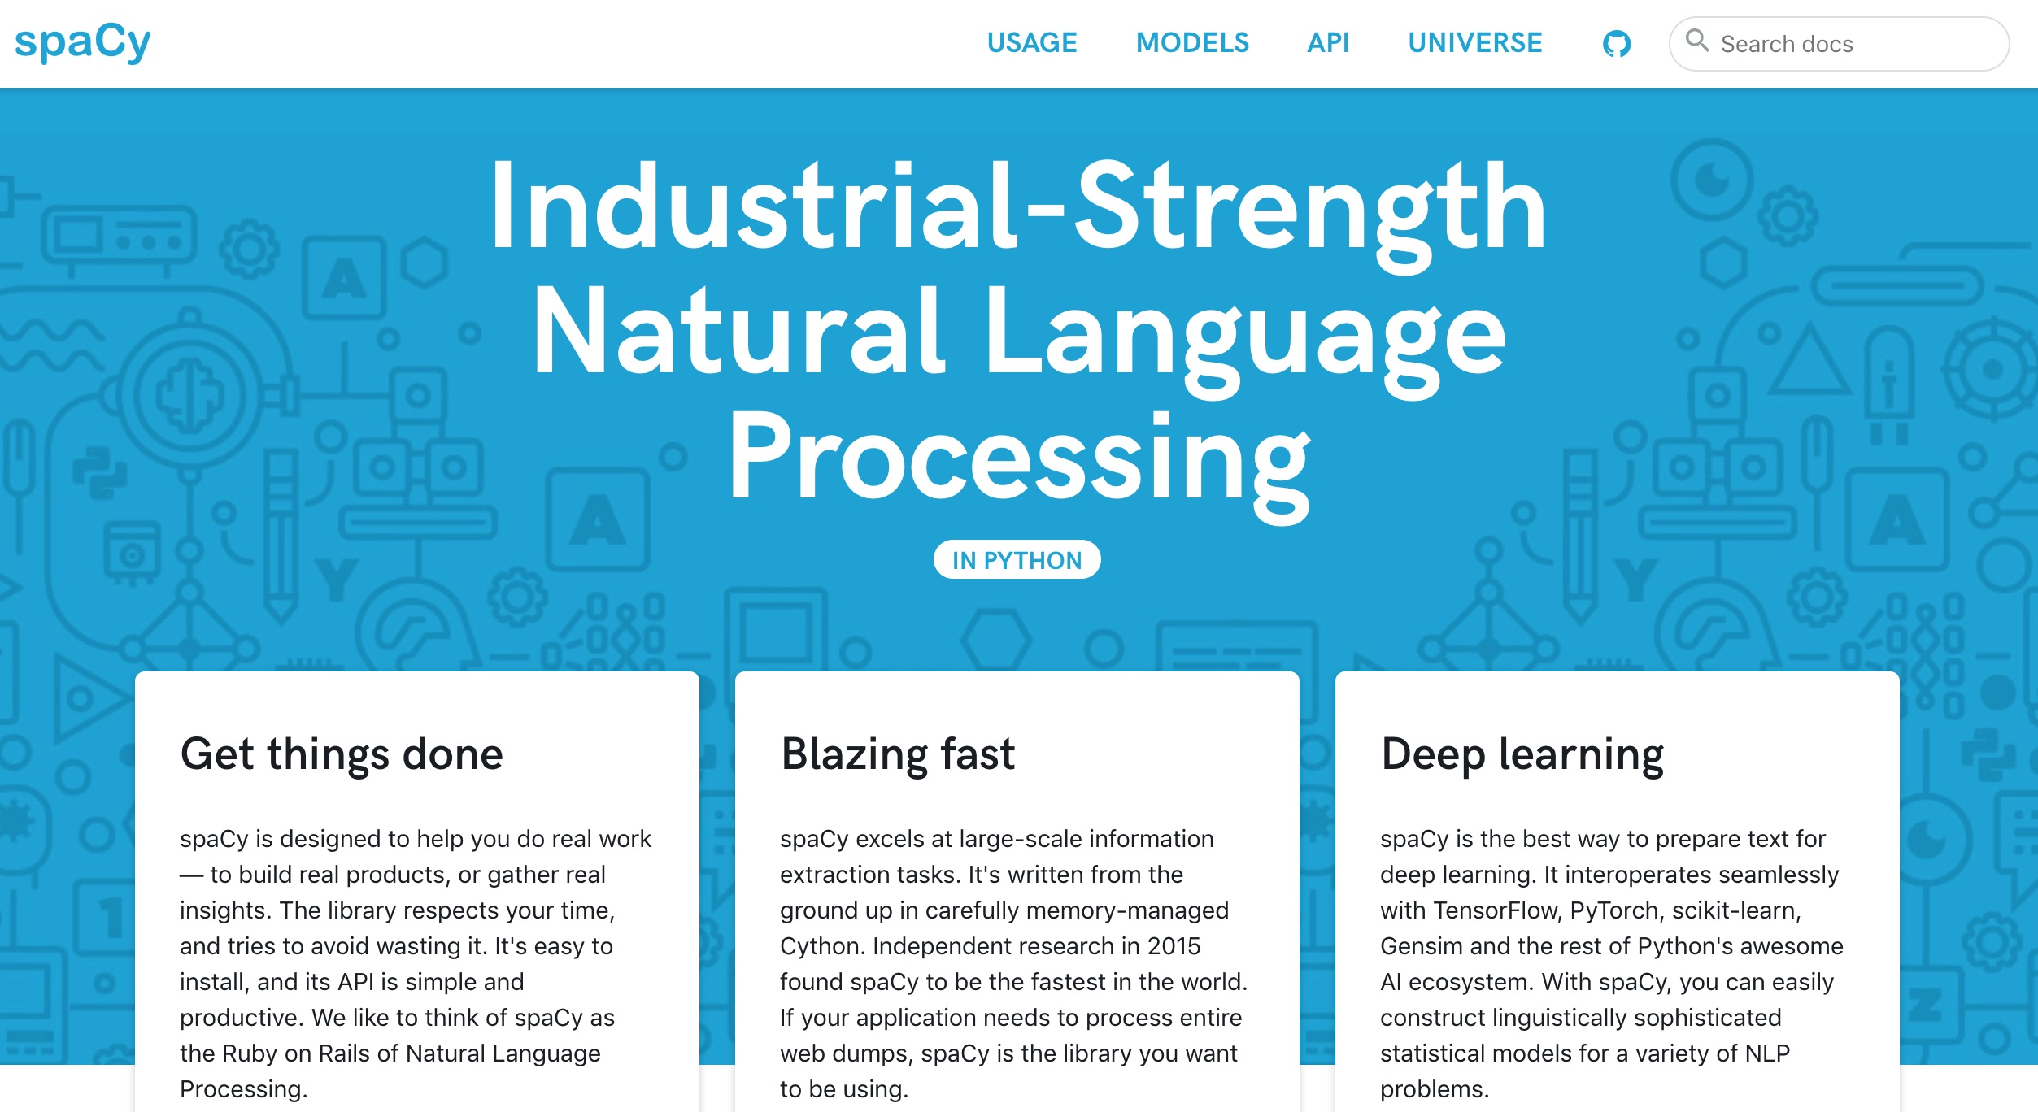
spaCy: Natural Language Processing
https://spacy.io/

Slide 19
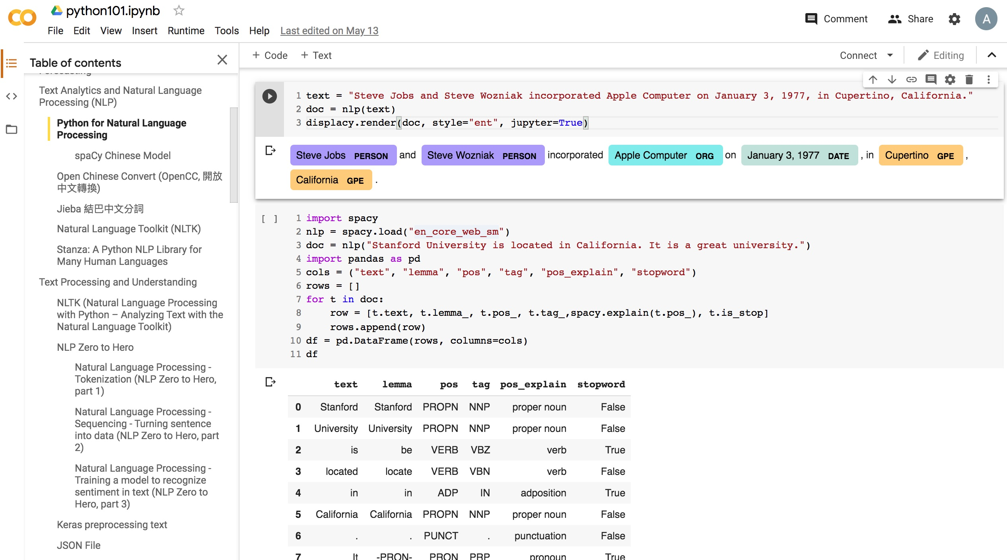
Python in Google Colab (Python101)
https://colab.research.google.com/drive/1FEG6DnGvwfUbeo4zJ1zTunjMqf2RkCrT
https://tinyurl.com/aintpupython101

Slide 20
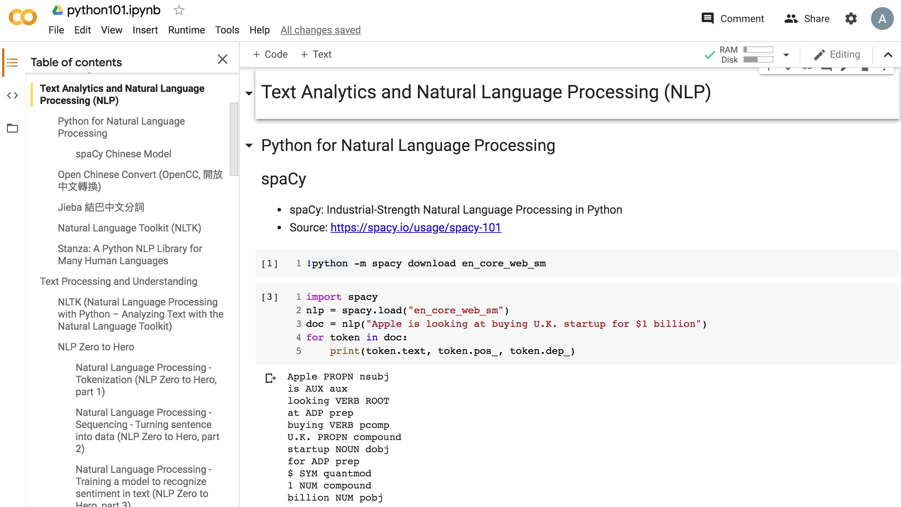
Python in Google Colab (Python101)
https://colab.research.google.com/drive/1FEG6DnGvwfUbeo4zJ1zTunjMqf2RkCrT
https://tinyurl.com/aintpupython101

Slide 21
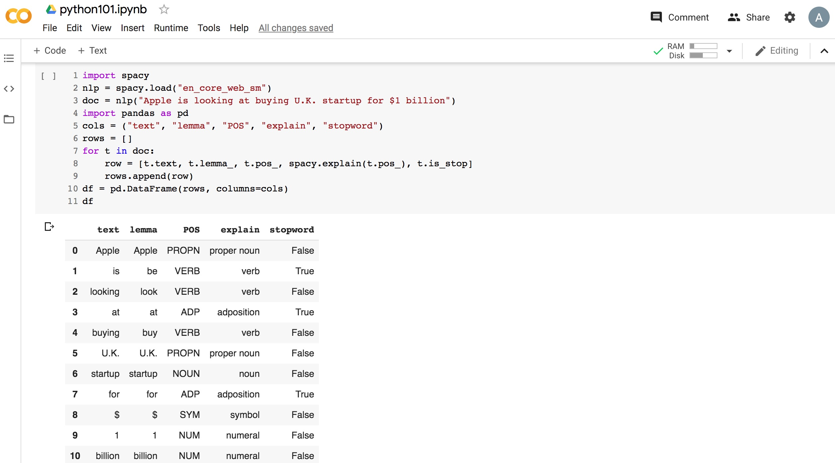
Python in Google Colab (Python101)
https://colab.research.google.com/drive/1FEG6DnGvwfUbeo4zJ1zTunjMqf2RkCrT
https://tinyurl.com/aintpupython101

Slide 22
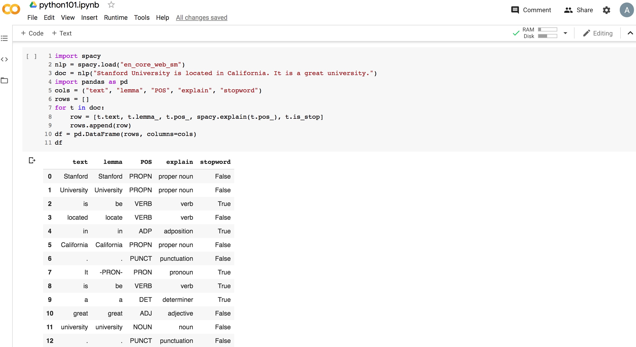
Python in Google Colab (Python101)
https://colab.research.google.com/drive/1FEG6DnGvwfUbeo4zJ1zTunjMqf2RkCrT
https://tinyurl.com/aintpupython101

Slide 23
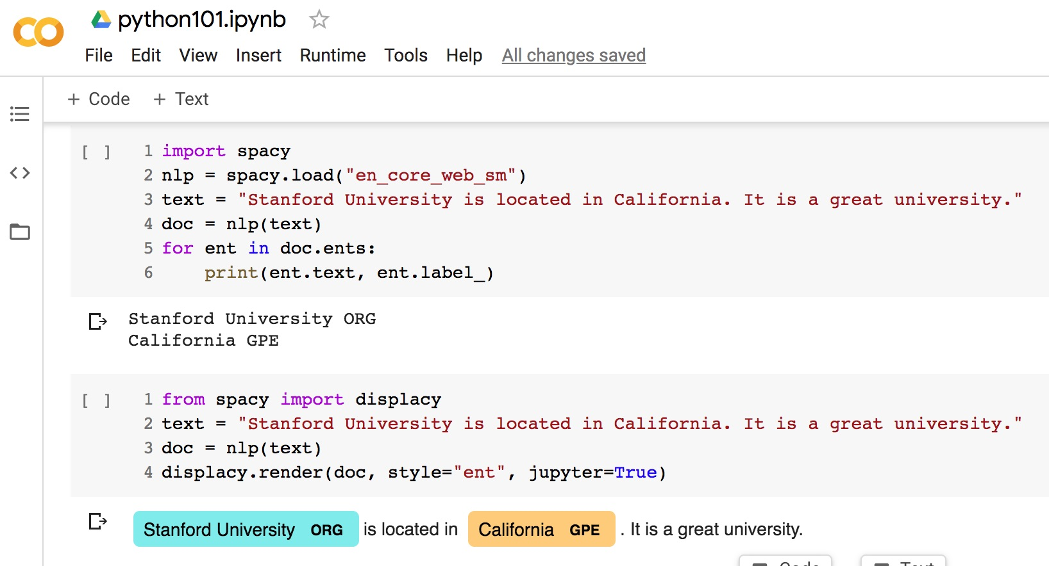
Python in Google Colab (Python101)
https://colab.research.google.com/drive/1FEG6DnGvwfUbeo4zJ1zTunjMqf2RkCrT
https://tinyurl.com/aintpupython101

Slide 24
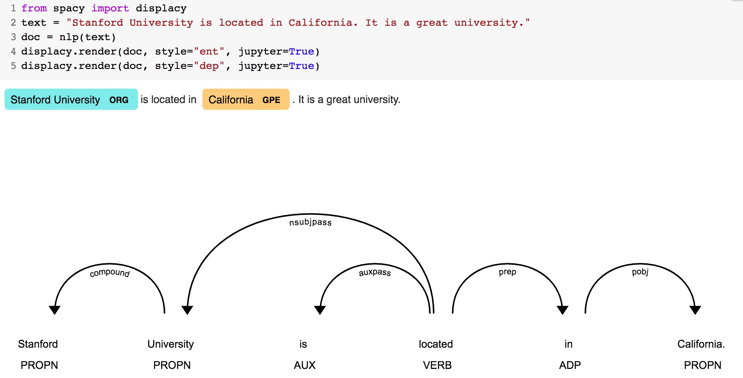
Python in Google Colab (Python101)
https://colab.research.google.com/drive/1FEG6DnGvwfUbeo4zJ1zTunjMqf2RkCrT
https://tinyurl.com/aintpupython101

Slide 25
Python in Google Colab
https://colab.research.google.com/drive/1FEG6DnGvwfUbeo4zJ1zTunjMqf2RkCrT
https://tinyurl.com/aintpupython101

Slide 26
Python in Google Colab (Python101)
https://colab.research.google.com/drive/1FEG6DnGvwfUbeo4zJ1zTunjMqf2RkCrT
https://tinyurl.com/aintpupython101

Slide 27
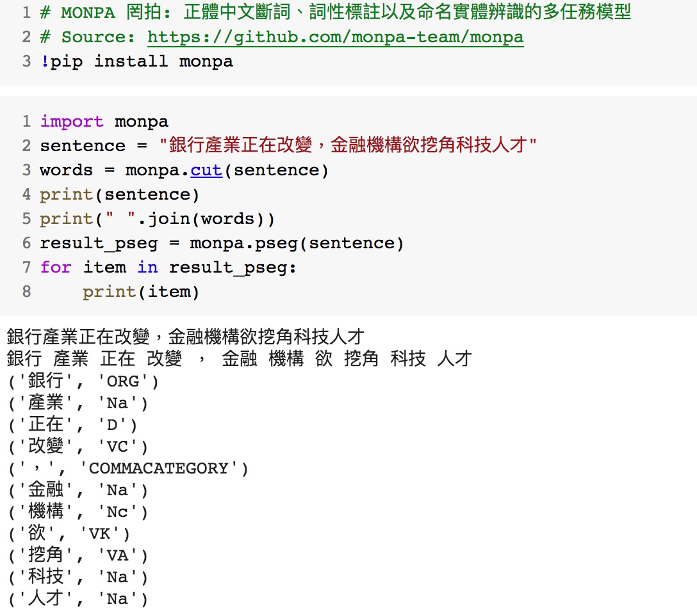
MONPA 罔拍： 正體中文斷詞、詞性標註以及命名實體辨識的多任務模型
https://tinyurl.com/aintpupython101

Slide 28
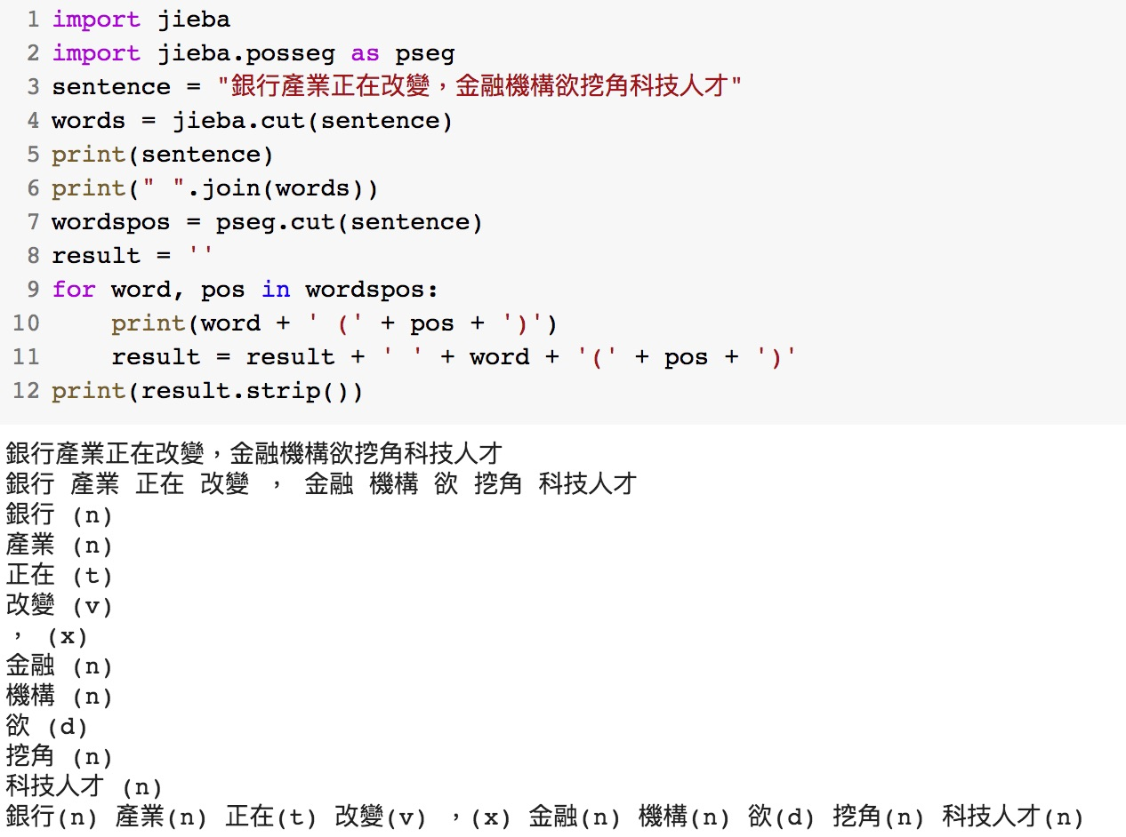
jieba words = jieba.cut(sentence)
https://tinyurl.com/aintpupython101

Slide 29
Python Jieba “结巴”中文分词
https://github.com/fxsjy/jieba
jieba.set_dictionary('data/dict.txt.big')
#/anaconda/lib/python3.5/site-packages/jieba
dict.txt (5.4MB)(349,046)
dict.txt.big.txt (8.6MB)(584,429)
dict.txt.small.txt (1.6MB)(109,750)
dict.tw.txt (4.2MB)(308,431)
https://github.com/ldkrsi/jieba-zh_TW
結巴中文斷詞台灣繁體版本

Slide 30
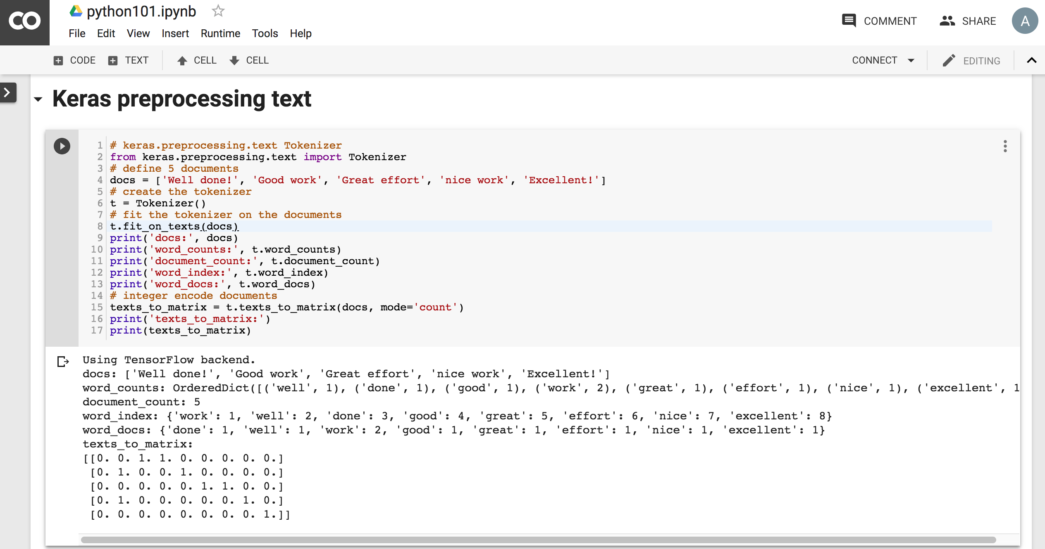
Python in Google Colab
https://colab.research.google.com/drive/1FEG6DnGvwfUbeo4zJ1zTunjMqf2RkCrT

Slide 31
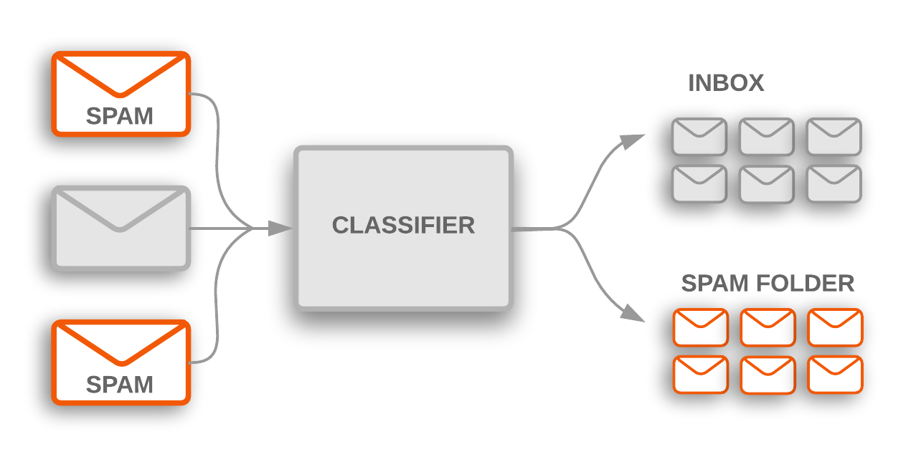
Text Classification
Source: https://developers.google.com/machine-learning/guides/text-classification/

Slide 32
Text Classification Workflow
Step 1: Gather Data
Step 2: Explore Your Data
Step 2.5: Choose a Model*
Step 3: Prepare Your Data
Step 4: Build, Train, and Evaluate Your Model
Step 5: Tune Hyperparameters
Step 6: Deploy Your Model
Source: https://developers.google.com/machine-learning/guides/text-classification/

Slide 33
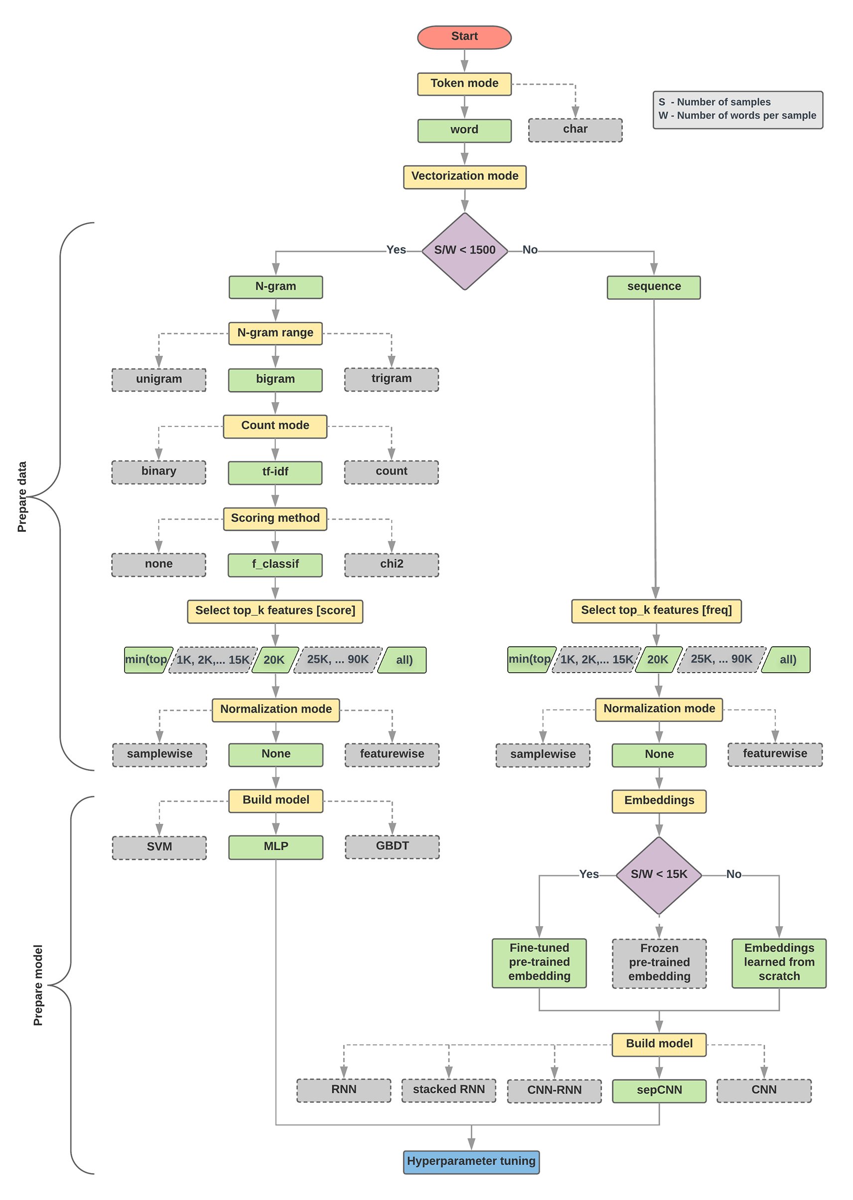
Text Classification Flowchart
Source: https://developers.google.com/machine-learning/guides/text-classification/step-2-5

Slide 34
Text Classification S/W<1500: N-gram
Source: https://developers.google.com/machine-learning/guides/text-classification/step-2-5

Slide 35
Text Classification S/W>=1500: Sequence
Source: https://developers.google.com/machine-learning/guides/text-classification/step-2-5

Slide 36
Step 2.5: Choose a Model Samples/Words < 1500 150,000/100 = 1500
IMDb review dataset, the samples/words-per-sample ratio is ~ 144
Source: https://developers.google.com/machine-learning/guides/text-classification/step-2-5

Slide 37
Step 2.5: Choose a Model Samples/Words < 15,000 1,500,000/100 = 15,000
Source: https://developers.google.com/machine-learning/guides/text-classification/step-2-5

Slide 38
Step 3: Prepare Your Data
Texts: T1: ’The mouse ran up the clock' T2: ’The mouse ran down’
Token Index:
{'the': 1, 'mouse’: 2, 'ran': 3, 'up': 4, 'clock': 5, 'down': 6,}.
NOTE: 'the' occurs most frequently, so the index value of 1 is assigned to it.
Some libraries reserve index 0 for unknown tokens, as is the case here.
Sequence of token indexes: T1: ‘The mouse ran up the clock’ = [1, 2, 3, 4, 1, 5]
T1: ’The mouse ran down’ = [1, 2, 3, 6]
Source: https://developers.google.com/machine-learning/guides/text-classification/step-3

Slide 39
One-hot encoding
'The mouse ran up the clock’ =
[ [0, 1, 0, 0, 0, 0, 0], [0, 0, 1, 0, 0, 0, 0], [0, 0, 0, 1, 0, 0, 0], [0, 0, 0, 0, 1, 0, 0], [0, 1, 0, 0, 0, 0, 0], [0, 0, 0, 0, 0, 1, 0] ]
The mouse ran up the clock
1 2 3 4
1
5
[0, 1, 2, 3, 4, 5, 6]
Source: https://developers.google.com/machine-learning/guides/text-classification/step-3

Slide 40
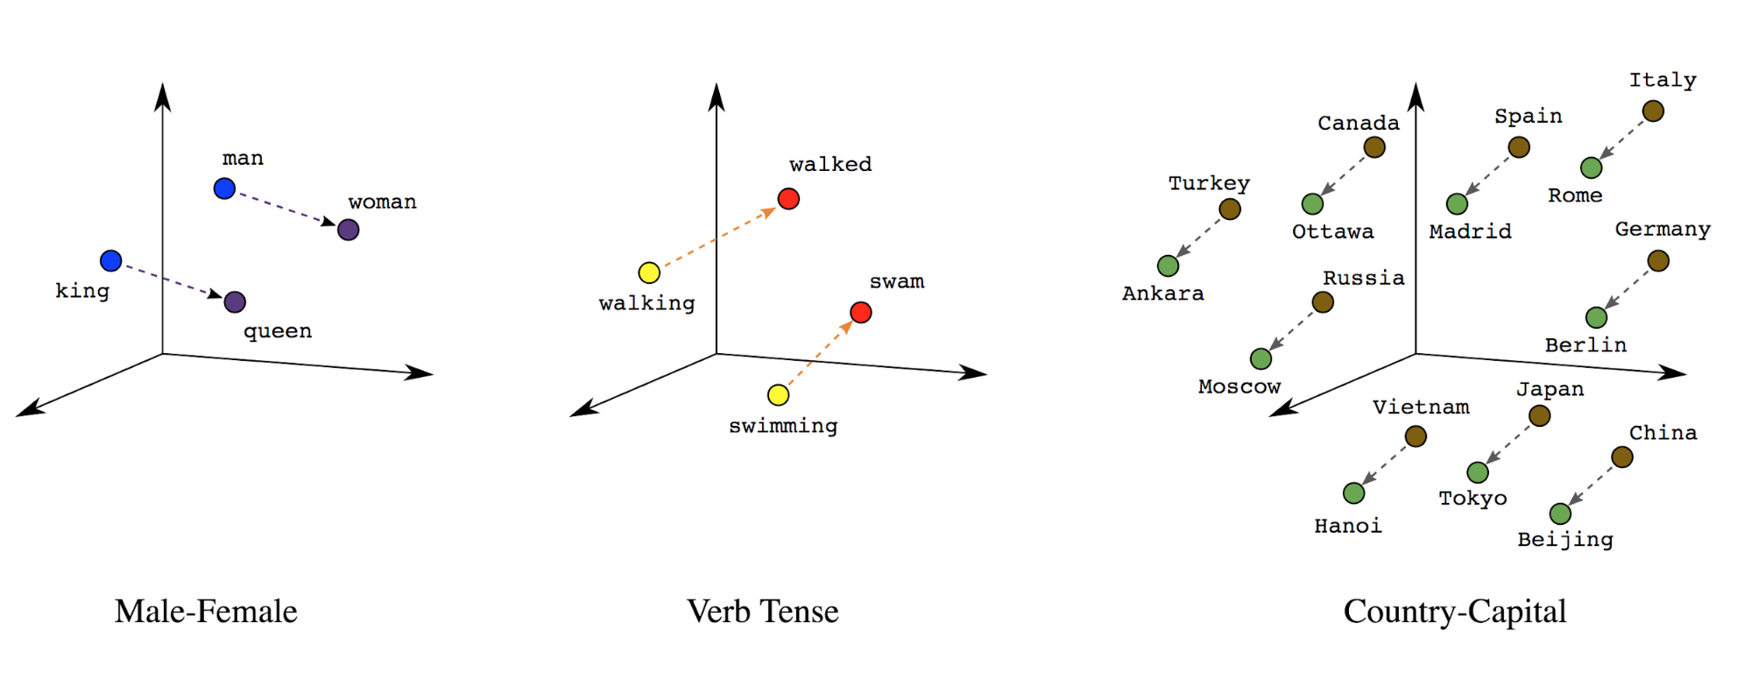
Word embeddings
Source: https://developers.google.com/machine-learning/guides/text-classification/step-3

Slide 41
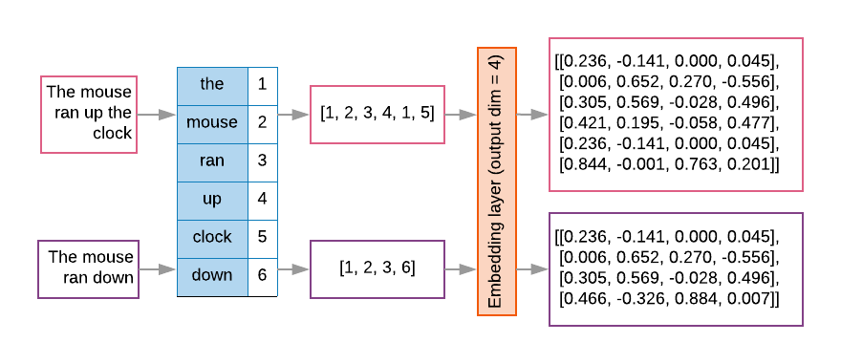
Word embeddings
Source: https://developers.google.com/machine-learning/guides/text-classification/step-3

Slide 42
t1 = 'The mouse ran up the clock'
t2 = 'The mouse ran down'
s1 = t1.lower().split(' ')
s2 = t2.lower().split(' ')
terms = s1 + s2
sortedset = sorted(set(terms))
print('terms =', terms)
print('sortedset =', sortedset)
https://colab.research.google.com/drive/1FEG6DnGvwfUbeo4zJ1zTunjMqf2RkCrT
Notes:
t1 = 'The mouse ran up the clock'
t2 = 'The mouse ran down'
s1 = t1.lower().split(' ')
s2 = t2.lower().split(' ')
terms = s1 + s2
sortedset = sorted(set(terms))
print('terms =', terms)
print('sortedset =', sortedset)

Slide 43
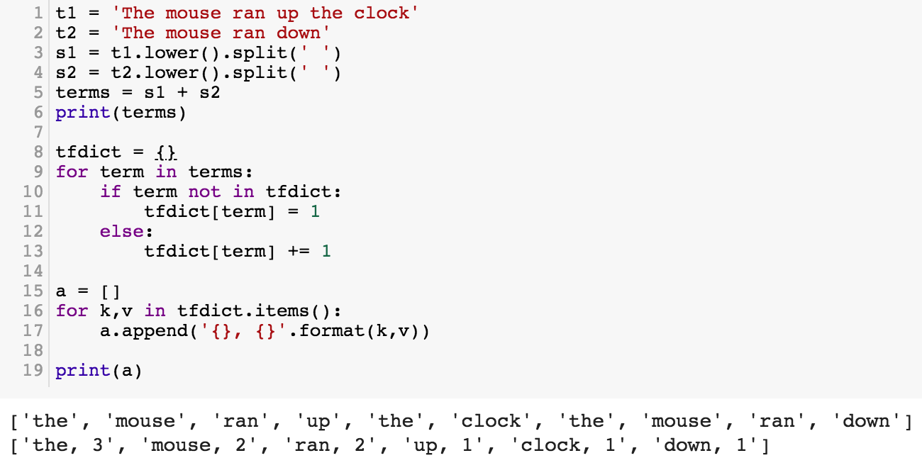
t1 = 'The mouse ran up the clock'
t2 = 'The mouse ran down'
s1 = t1.lower().split(' ')
s2 = t2.lower().split(' ')
terms = s1 + s2
print(terms)
tfdict = {}
for term in terms:
if term not in tfdict:
tfdict[term] = 1
else:
tfdict[term] += 1
a = []
for k,v in tfdict.items():
a.append('{}, {}'.format(k,v))
print(a)
https://colab.research.google.com/drive/1FEG6DnGvwfUbeo4zJ1zTunjMqf2RkCrT

Slide 44
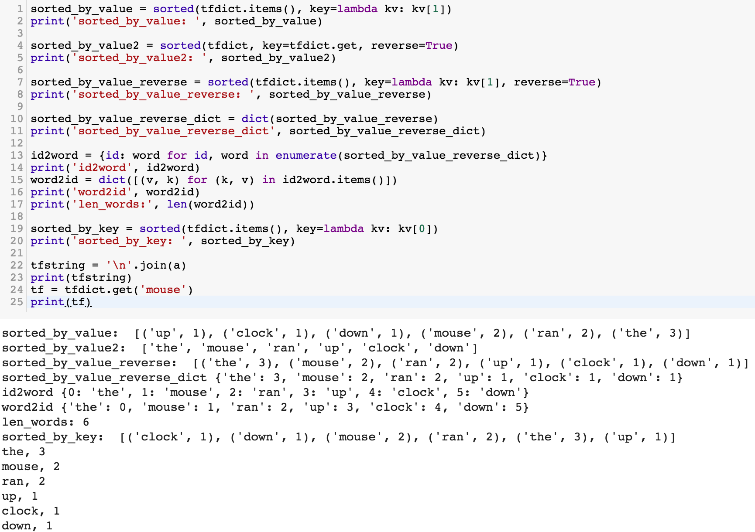
sorted_by_value_reverse = sorted(tfdict.items(), key=lambda kv: kv[1], reverse=True)
sorted_by_value_reverse_dict = dict(sorted_by_value_reverse)
id2word = {id: word for id, word in enumerate(sorted_by_value_reverse_dict)}
word2id = dict([(v, k) for (k, v) in id2word.items()])
https://colab.research.google.com/drive/1FEG6DnGvwfUbeo4zJ1zTunjMqf2RkCrT

Slide 45
sorted_by_value = sorted(tfdict.items(), key=lambda kv: kv[1])
print('sorted_by_value: ', sorted_by_value)
sorted_by_value2 = sorted(tfdict, key=tfdict.get, reverse=True)
print('sorted_by_value2: ', sorted_by_value2)
sorted_by_value_reverse = sorted(tfdict.items(), key=lambda kv: kv[1], reverse=True)
print('sorted_by_value_reverse: ', sorted_by_value_reverse)
sorted_by_value_reverse_dict = dict(sorted_by_value_reverse)
print('sorted_by_value_reverse_dict', sorted_by_value_reverse_dict)
id2word = {id: word for id, word in enumerate(sorted_by_value_reverse_dict)}
print('id2word', id2word)
word2id = dict([(v, k) for (k, v) in id2word.items()])
print('word2id', word2id)
print('len_words:', len(word2id))
sorted_by_key = sorted(tfdict.items(), key=lambda kv: kv[0])
print('sorted_by_key: ', sorted_by_key)
tfstring = '\n'.join(a)
print(tfstring)
tf = tfdict.get('mouse')
print(tf)
https://colab.research.google.com/drive/1FEG6DnGvwfUbeo4zJ1zTunjMqf2RkCrT

Slide 46
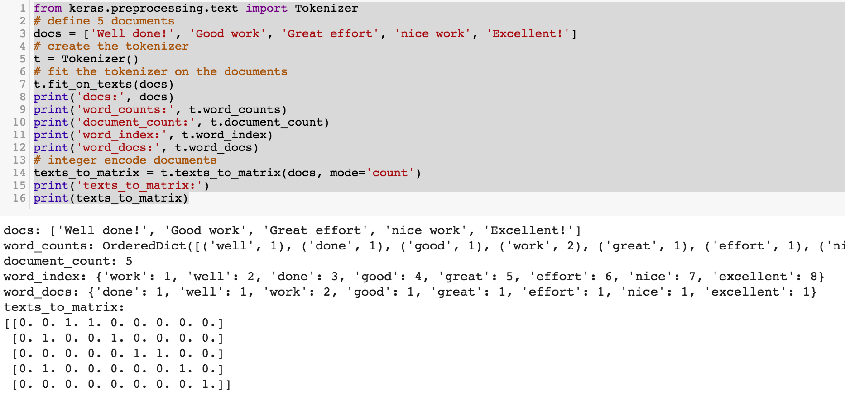
from keras.preprocessing.text import Tokenizer
Source: https://machinelearningmastery.com/prepare-text-data-deep-learning-keras/
Notes:
from keras.preprocessing.text import Tokenizer
# define 5 documents
docs = ['Well done!', 'Good work', 'Great effort', 'nice work', 'Excellent!']
# create the tokenizer
t = Tokenizer()
# fit the tokenizer on the documents
t.fit_on_texts(docs)
print('docs:', docs)
print('word_counts:', t.word_counts)
print('document_count:', t.document_count)
print('word_index:', t.word_index)
print('word_docs:', t.word_docs)
# integer encode documents
texts_to_matrix = t.texts_to_matrix(docs, mode='count')
print('texts_to_matrix:')
print(texts_to_matrix)

Slide 47
from keras.preprocessing.text import Tokenizer
from keras.preprocessing.text import Tokenizer
# define 5 documents
docs = ['Well done!', 'Good work', 'Great effort', 'nice work', 'Excellent!']
# create the tokenizer
t = Tokenizer()
# fit the tokenizer on the documents
t.fit_on_texts(docs)
print('docs:', docs)
print('word_counts:', t.word_counts)
print('document_count:', t.document_count)
print('word_index:', t.word_index)
print('word_docs:', t.word_docs)
# integer encode documents
texts_to_matrix = t.texts_to_matrix(docs, mode='count')
print('texts_to_matrix:')
print(texts_to_matrix)
Source: https://machinelearningmastery.com/prepare-text-data-deep-learning-keras/

Slide 48
texts_to_matrix = t.texts_to_matrix(docs, mode='count')
docs: ['Well done!', 'Good work', 'Great effort’, 'nice work', 'Excellent!’]
word_counts: OrderedDict([('well', 1), ('done', 1), ('good', 1), ('work', 2), ('great', 1), ('effort', 1), ('nice', 1), ('excellent', 1)])
document_count: 5
word_index: {'work': 1, 'well': 2, 'done': 3, 'good': 4, 'great': 5, 'effort': 6, 'nice': 7, 'excellent': 8}
word_docs: {'done': 1, 'well': 1, 'work': 2, 'good': 1, 'great': 1, 'effort': 1, 'nice': 1, 'excellent': 1}
texts_to_matrix: [[0. 0. 1. 1. 0. 0. 0. 0. 0.] [0. 1. 0. 0. 1. 0. 0. 0. 0.] [0. 0. 0. 0. 0. 1. 1. 0. 0.] [0. 1. 0. 0. 0. 0. 0. 1. 0.] [0. 0. 0. 0. 0. 0. 0. 0. 1.]]
Source: https://machinelearningmastery.com/prepare-text-data-deep-learning-keras/
Notes:
from keras.preprocessing.text import Tokenizer
# define 5 documents
docs = ['Well done!', 'Good work', 'Great effort', 'nice work', 'Excellent!']
# create the tokenizer
t = Tokenizer()
# fit the tokenizer on the documents
t.fit_on_texts(docs)
print('docs:', docs)
print('word_counts:', t.word_counts)
print('document_count:', t.document_count)
print('word_index:', t.word_index)
print('word_docs:', t.word_docs)
# integer encode documents
texts_to_matrix = t.texts_to_matrix(docs, mode='count')
print('texts_to_matrix:')
print(texts_to_matrix)

Slide 49
t.texts_to_matrix(docs, mode='tfidf')
from keras.preprocessing.text import Tokenizer
# define 5 documents
docs = ['Well done!', 'Good work', 'Great effort', 'nice work', 'Excellent!']
# create the tokenizer
t = Tokenizer()
# fit the tokenizer on the documents
t.fit_on_texts(docs)
print('docs:', docs)
print('word_counts:', t.word_counts)
print('document_count:', t.document_count)
print('word_index:', t.word_index)
print('word_docs:', t.word_docs)
# integer encode documents
texts_to_matrix = t.texts_to_matrix(docs, mode='tfidf')
print('texts_to_matrix:')
print(texts_to_matrix)
texts_to_matrix: [[0. 0. 1.25276297 1.25276297 0. 0. 0. 0. 0. ] [0. 0.98082925 0. 0. 1.25276297 0. 0. 0. 0. ] [0. 0. 0. 0. 0. 1.25276297 1.25276297 0. 0. ] [0. 0.98082925 0. 0. 0. 0. 0. 1.25276297 0. ] [0. 0. 0. 0. 0. 0. 0. 0. 1.25276297]]
Source: https://machinelearningmastery.com/prepare-text-data-deep-learning-keras/
Notes:
from keras.preprocessing.text import Tokenizer
# define 5 documents
docs = ['Well done!', 'Good work', 'Great effort', 'nice work', 'Excellent!']
# create the tokenizer
t = Tokenizer()
# fit the tokenizer on the documents
t.fit_on_texts(docs)
print('docs:', docs)
print('word_counts:', t.word_counts)
print('document_count:', t.document_count)
print('word_index:', t.word_index)
print('word_docs:', t.word_docs)
# integer encode documents
texts_to_matrix = t.texts_to_matrix(docs, mode='tfidf')
print('texts_to_matrix:')
print(texts_to_matrix)
###########
‘’’
docs: ['Well done!', 'Good work', 'Great effort', 'nice work', 'Excellent!'] word_counts: OrderedDict([('well', 1), ('done', 1), ('good', 1), ('work', 2), ('great', 1), ('effort', 1), ('nice', 1), ('excellent', 1)]) document_count: 5 word_index: {'work': 1, 'well': 2, 'done': 3, 'good': 4, 'great': 5, 'effort': 6, 'nice': 7, 'excellent': 8} word_docs: {'done': 1, 'well': 1, 'work': 2, 'good': 1, 'great': 1, 'effort': 1, 'nice': 1, 'excellent': 1} texts_to_matrix: [[0. 0. 1.25276297 1.25276297 0. 0. 0. 0. 0. ] [0. 0.98082925 0. 0. 1.25276297 0. 0. 0. 0. ] [0. 0. 0. 0. 0. 1.25276297 1.25276297 0. 0. ] [0. 0.98082925 0. 0. 0. 0. 0. 1.25276297 0. ] [0. 0. 0. 0. 0. 0. 0. 0. 1.25276297]]
‘’’

Slide 50
NLTK (Natural Language Toolkit)
http://www.nltk.org/

Slide 51
TensorFlow NLP Examples
Basic Text Classification (Text Classification) (46 Seconds)
https://colab.research.google.com/github/tensorflow/docs/blob/master/site/en/tutorials/keras/basic_text_classification.ipynb
NMT with Attention (20-30 minutes)
https://colab.research.google.com/github/tensorflow/tensorflow/blob/master/tensorflow/contrib/eager/python/examples/nmt_with_attention/nmt_with_attention.ipynb

Slide 52
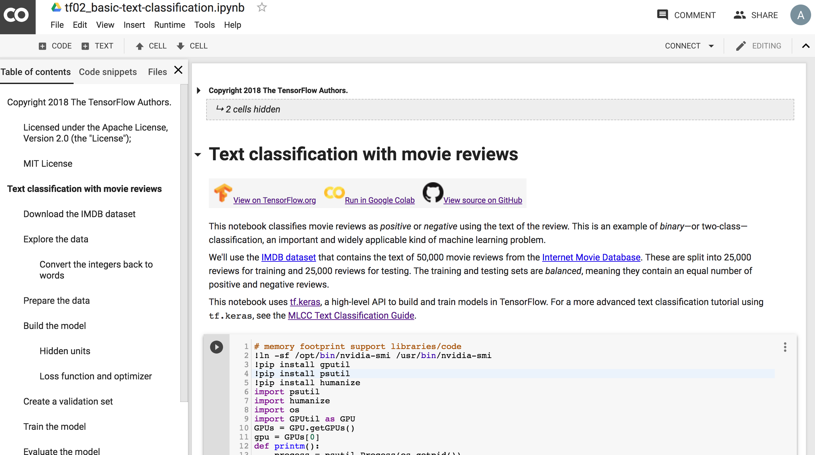
Text Classification IMDB Movie Reviews
https://colab.research.google.com/drive/1x16h1GhHsLIrLYtPCvCHaoO1W-i_gror
Source: https://colab.research.google.com/github/tensorflow/docs/blob/master/site/en/tutorials/keras/basic_text_classification.ipynb

Slide 53
Summary
Python for Natural Language Processing

Slide 54
References
Ramesh Sharda, Dursun Delen, and Efraim Turban (2017), Business Intelligence, Analytics, and Data Science: A Managerial Perspective, 4th Edition, Pearson.
Rajesh Arumugam (2018), Hands-On Natural Language Processing with Python: A practical guide to applying deep learning architectures to your NLP applications, Packt.
Devlin, Jacob, Ming-Wei Chang, Kenton Lee, and Kristina Toutanova (2018). "BERT: Pre-training of Deep Bidirectional Transformers for Language Understanding." arXiv preprint arXiv:1810.04805.
Christopher D. Manning and Hinrich Schütze (1999), Foundations of Statistical Natural Language Processing, The MIT Press.
Dipanjan Sarkar (2016), Text Analytics with Python: A Practical Real-World Approach to Gaining Actionable Insights from your Data, Apress.
Jake VanderPlas (2016), Python Data Science Handbook: Essential Tools for Working with Data, O'Reilly Media.
Steven Bird, Ewan Klein and Edward Loper (2009), Natural Language Processing with Python, O'Reilly Media, http://www.nltk.org/book/ , http://www.nltk.org/book_1ed/
Nitin Hardeniya (2015), NLTK Essentials, Packt.
Bing Liu (2009), Web Data Mining: Exploring Hyperlinks, Contents, and Usage Data, Springer.

