Slide 1
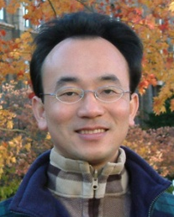
人工智慧文本分析 (AI for Text Analytics)
Tamkang University
處理和理解文本 (Processing and Understanding Text)
1091AITA04
MBA, IMTKU (M2455) (8418) (Fall 2020) Thu 3, 4 (10:10-12:00) (B206)
Min-Yuh Day
戴敏育
Associate Professor
副教授
Institute of Information Management, National Taipei University
國立臺北大學 資訊管理研究所
https://web.ntpu.edu.tw/~myday
2020-10-15

Slide 2
課程大綱 (Syllabus)
週次 (Week) 日期 (Date) 內容 (Subject/Topics)
1 2020/09/17 人工智慧文本分析課程介紹 (Course Orientation on Artificial Intelligence for Text Analytics)
2 2020/09/24 文本分析的基礎：自然語言處理 (Foundations of Text Analytics: Natural Language Processing; NLP)
3 2020/10/01 中秋節 (Mid-Autumn Festival) 放假一天 (Day off)
4 2020/10/08 Python自然語言處理 (Python for Natural Language Processing)
5 2020/10/15 處理和理解文本 (Processing and Understanding Text)
6 2020/10/22 文本表達特徵工程 (Feature Engineering for Text Representation)

Slide 3
課程大綱 (Syllabus)
週次 (Week) 日期 (Date) 內容 (Subject/Topics)
7 2020/10/29 人工智慧文本分析個案研究 I (Case Study on Artificial Intelligence for Text Analytics I)
8 2020/11/05 文本分類 (Text Classification)
9 2020/11/12 文本摘要和主題模型 (Text Summarization and Topic Models)
10 2020/11/19 期中報告 (Midterm Project Report)
11 2020/11/26 文本相似度和分群 (Text Similarity and Clustering)
12 2020/12/03 語意分析和命名實體識別 (Semantic Analysis and Named Entity Recognition; NER)

Slide 4
課程大綱 (Syllabus)
週次 (Week) 日期 (Date) 內容 (Subject/Topics)
13 2020/12/10 情感分析 (Sentiment Analysis)
14 2020/12/17 人工智慧文本分析個案研究 II (Case Study on Artificial Intelligence for Text Analytics II)
15 2020/12/24 深度學習和通用句子嵌入模型 (Deep Learning and Universal Sentence-Embedding Models)
16 2020/12/31 問答系統與對話系統 (Question Answering and Dialogue Systems)
17 2021/01/07 期末報告 I (Final Project Presentation I)
18 2021/01/14 期末報告 II (Final Project Presentation II)

Slide 5
Outline
Processing Text
Understanding Text

Slide 6
Processing and Understanding Text

Slide 7
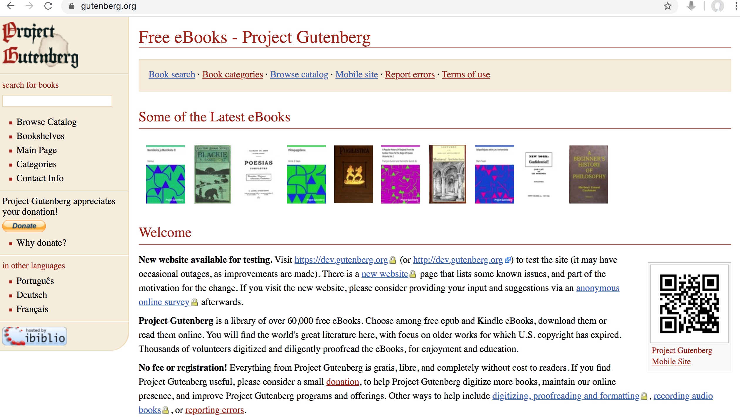
Free eBooks - Project Gutenberg
https://www.gutenberg.org/

Slide 8
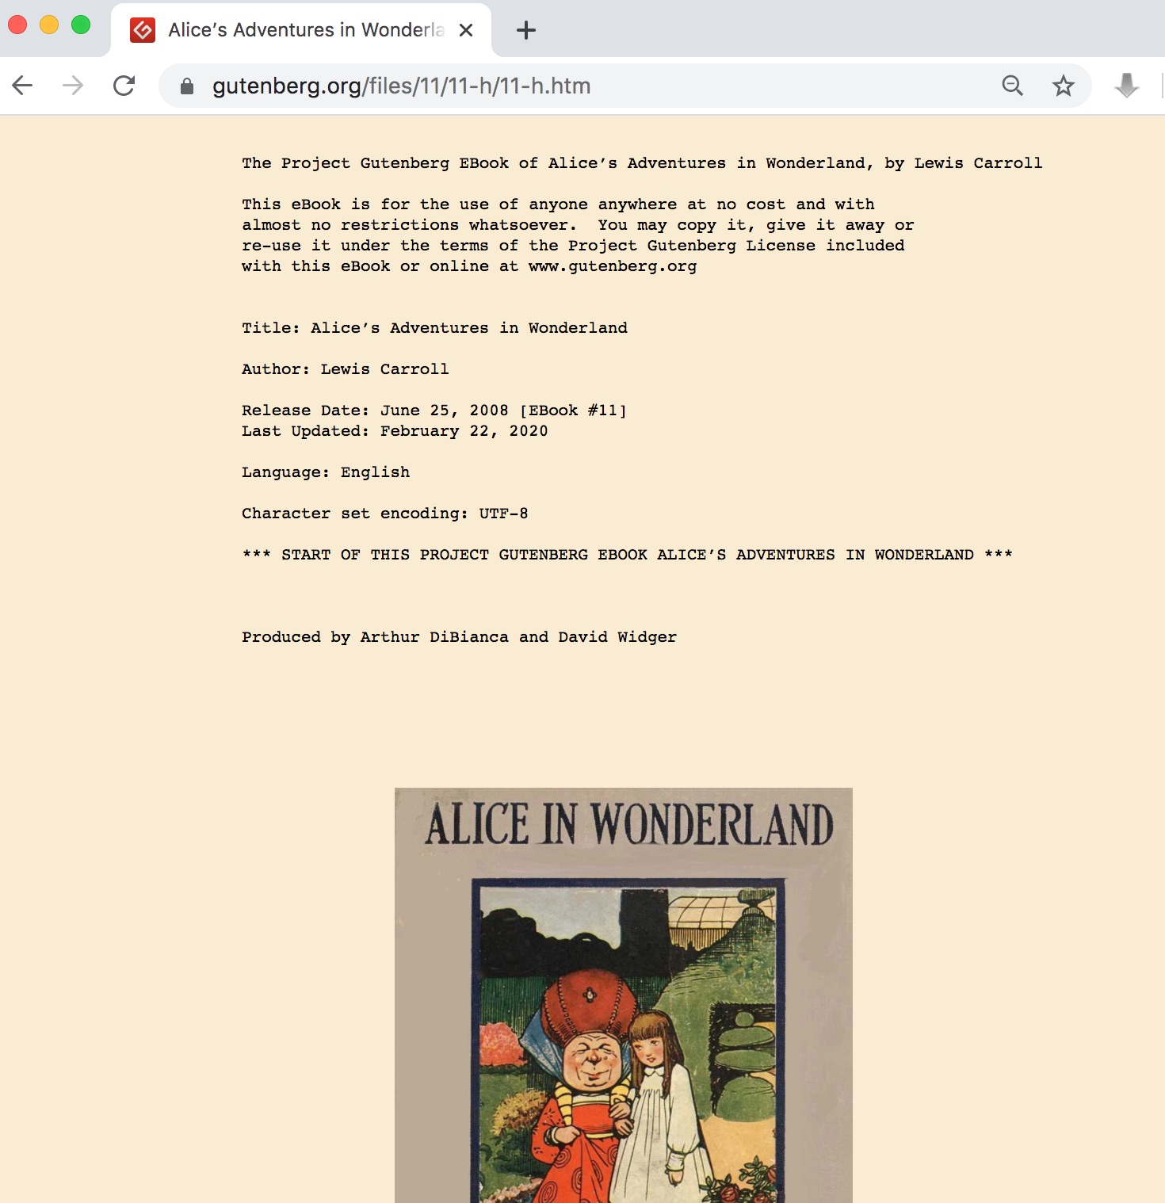
Free eBooks - Project Gutenberg Alice in Wonderland
https://www.gutenberg.org/files/11/11-h/11-h.htm

Slide 9
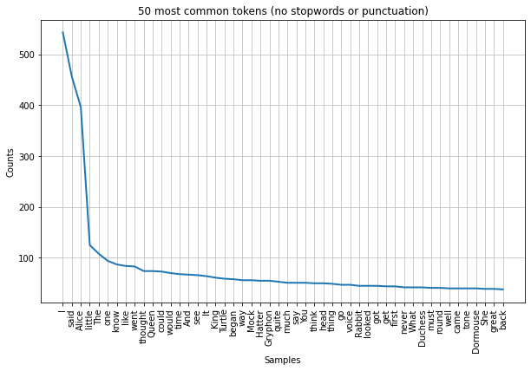
Alice Top 50 Tokens
https://tinyurl.com/aintpupython101

Slide 10
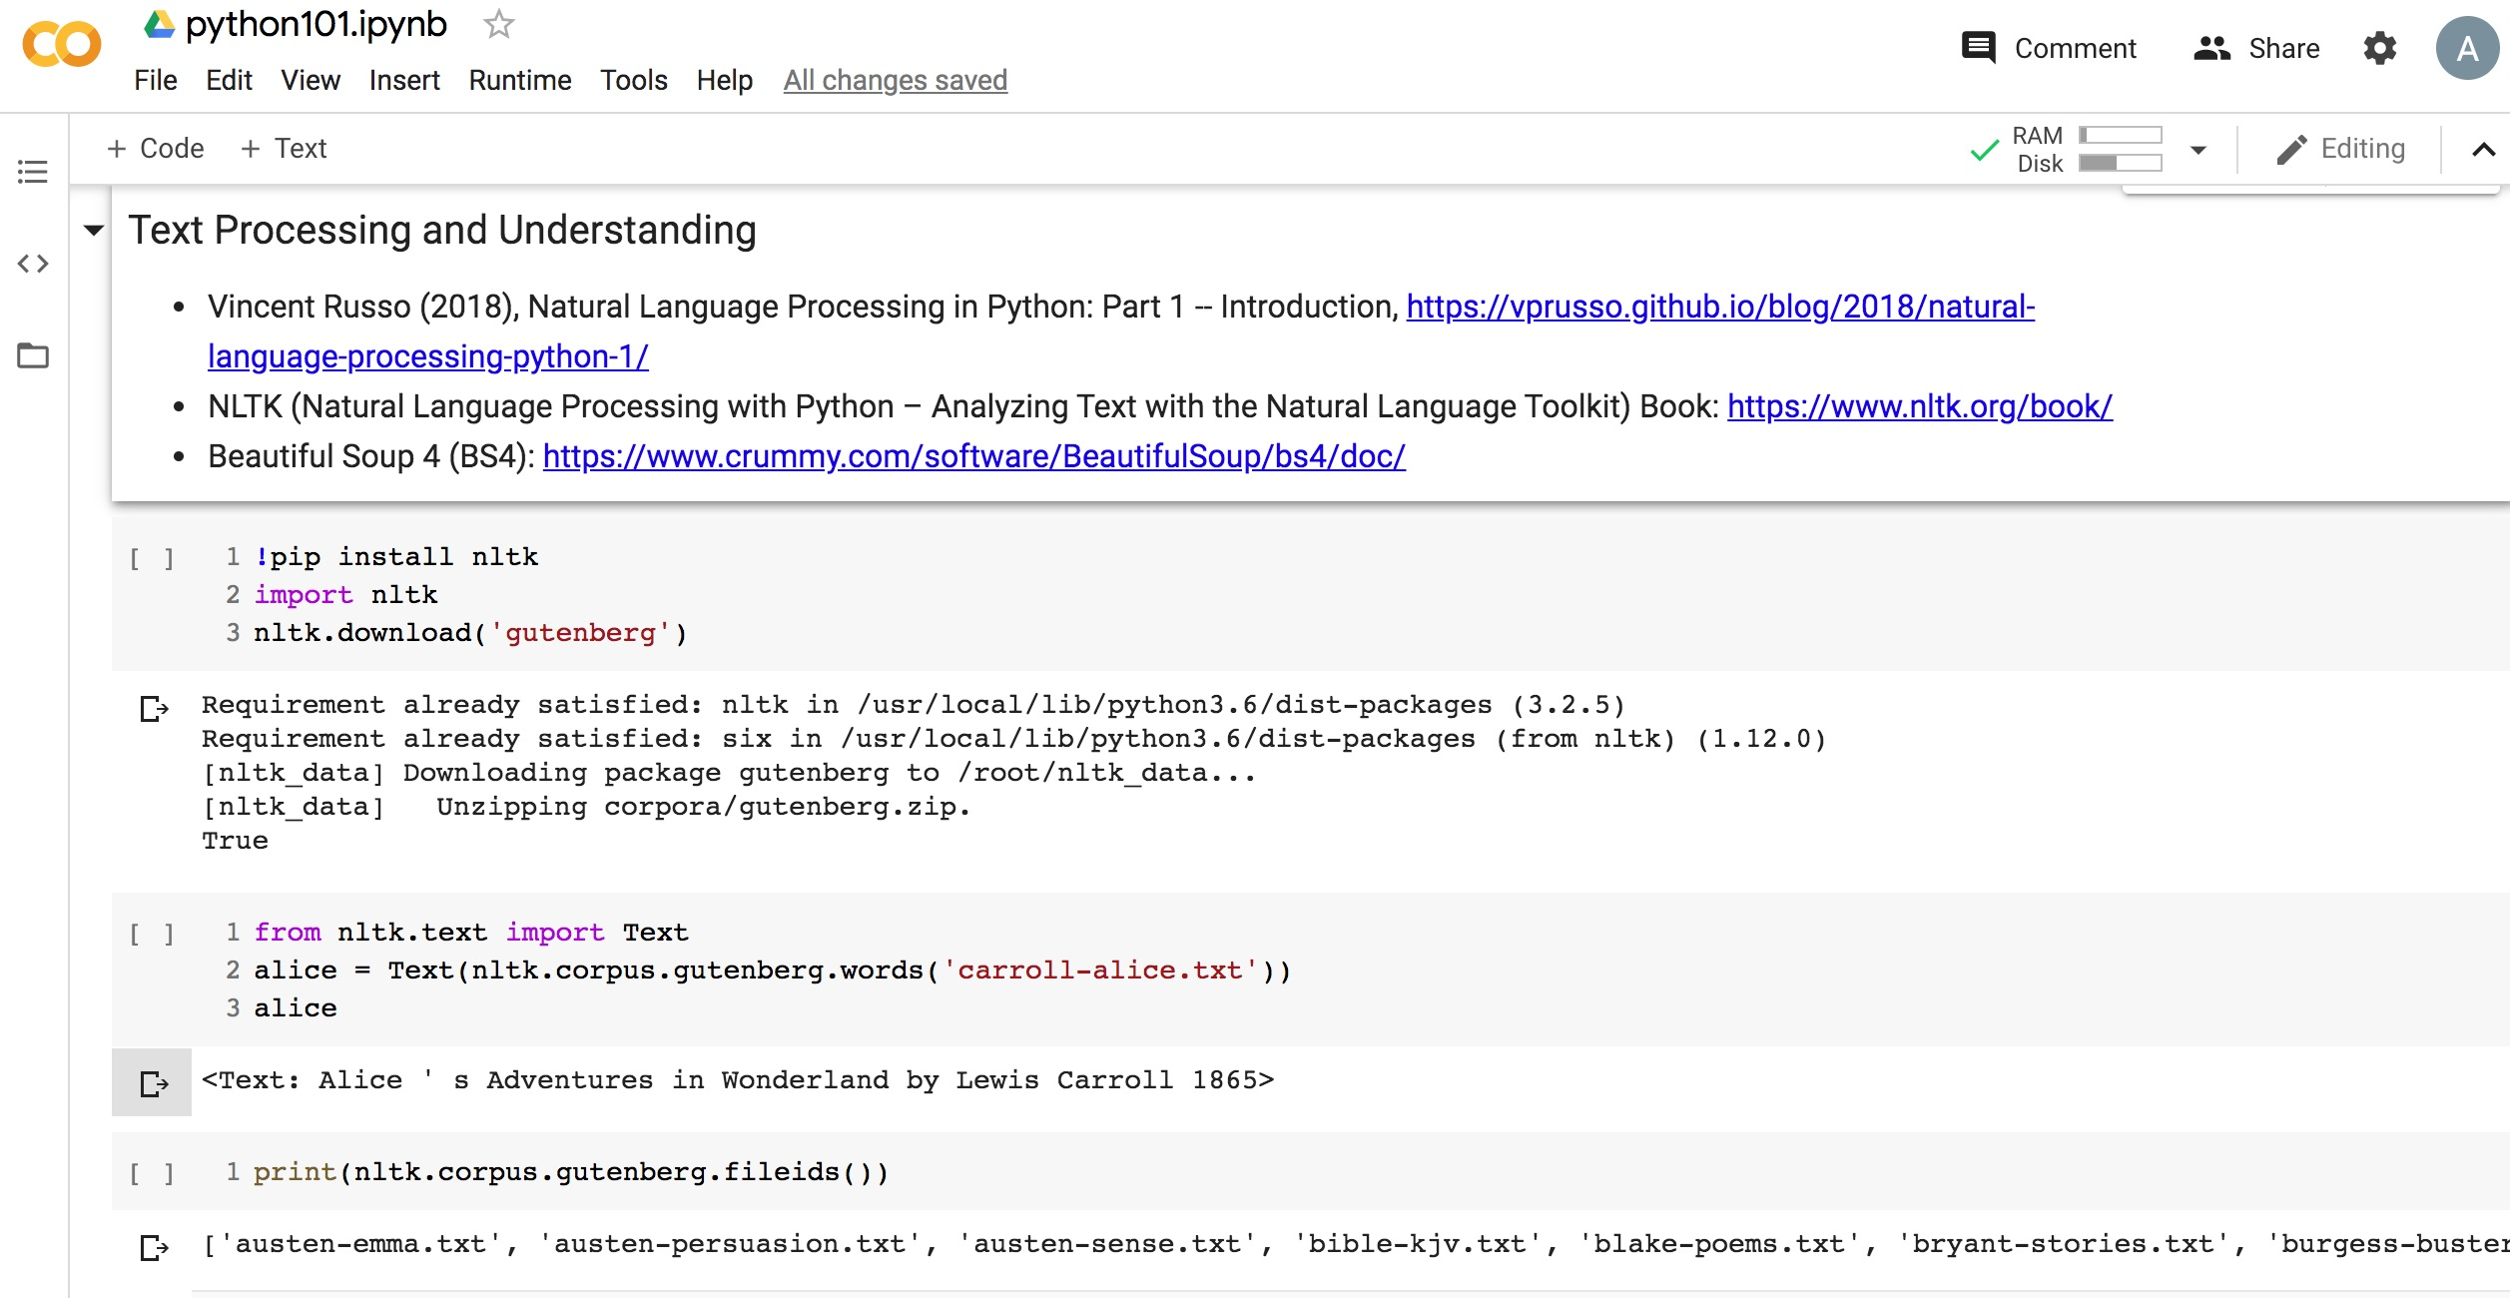
Python in Google Colab (Python101)
https://colab.research.google.com/drive/1FEG6DnGvwfUbeo4zJ1zTunjMqf2RkCrT
nltk.download('gutenberg')
alice = Text(nltk.corpus.gutenberg.words('carroll-alice.txt'))
https://tinyurl.com/aintpupython101
Notes:
!pip install nltk
import nltk
nltk.download('gutenberg')
from nltk.text import Text
alice = Text(nltk.corpus.gutenberg.words('carroll-alice.txt'))
alice

Slide 11
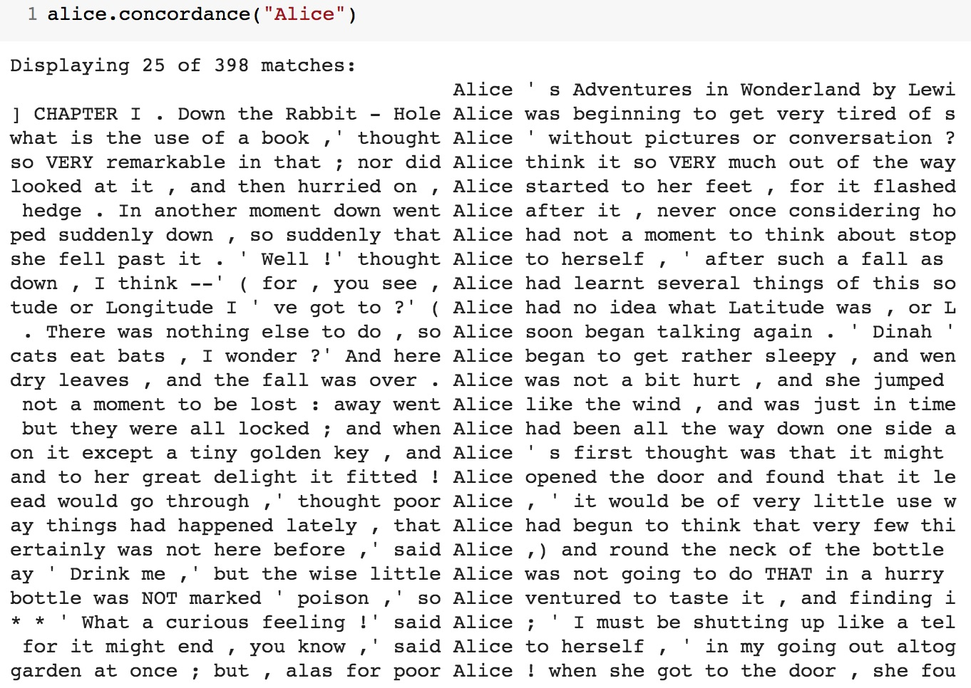
alice.concordance("Alice")
https://tinyurl.com/aintpupython101

Slide 12
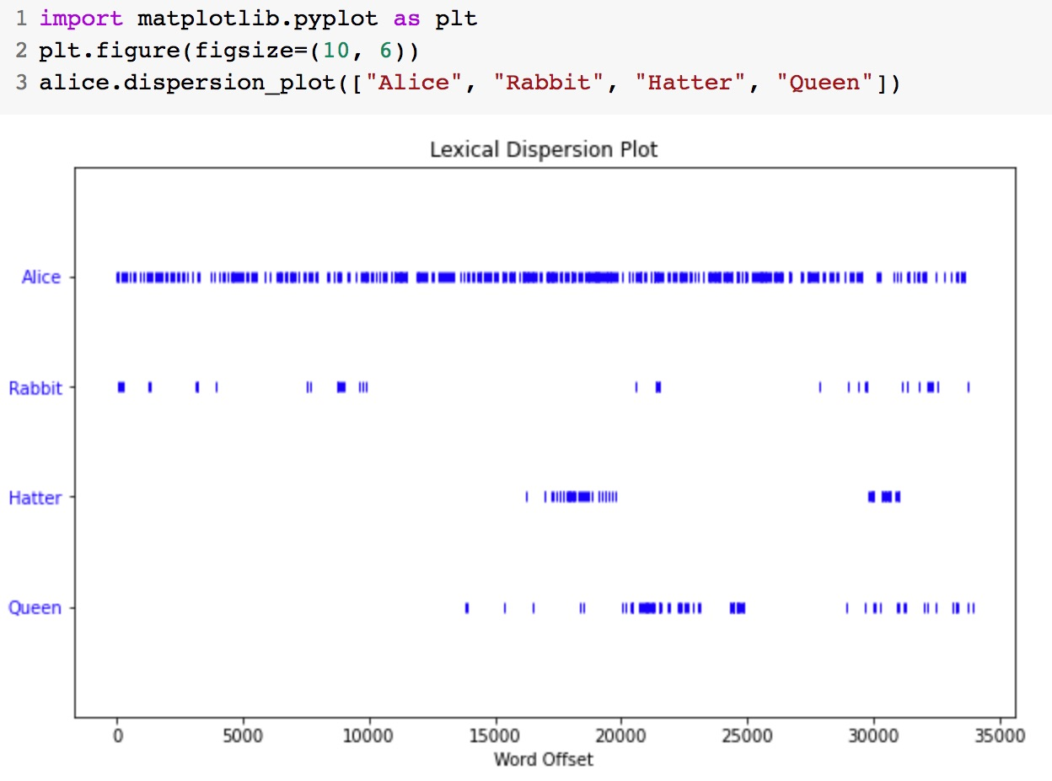
alice.dispersion_plot(["Alice", "Rabbit", "Hatter", "Queen"])
https://tinyurl.com/aintpupython101

Slide 13
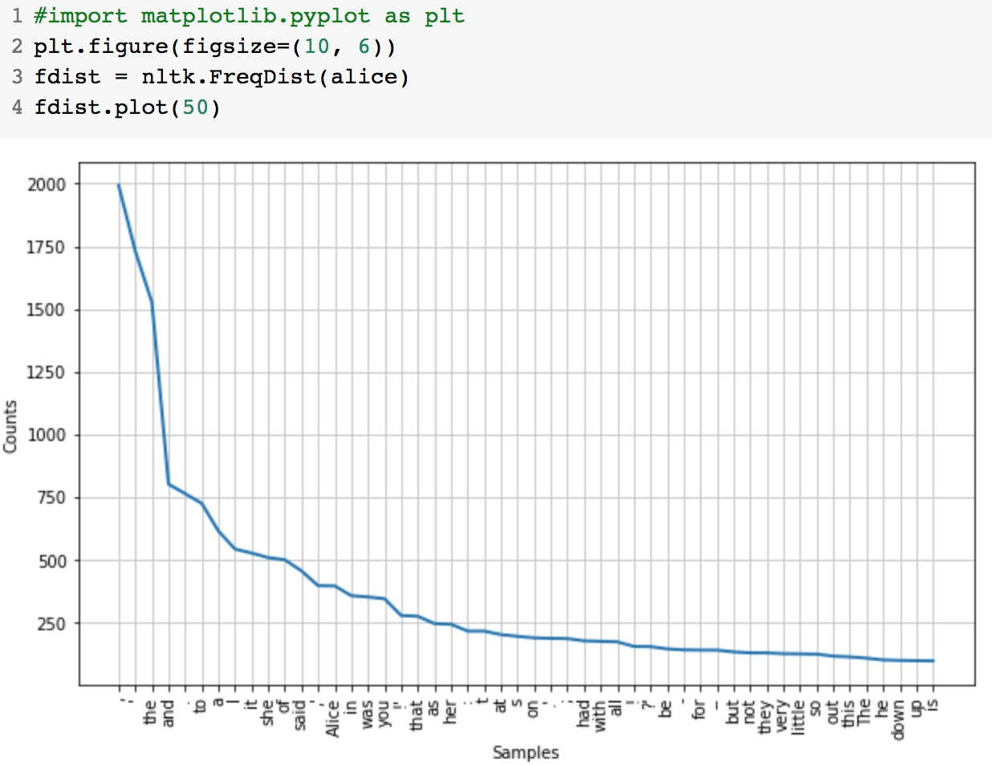
fdist = nltk.FreqDist(alice)
fdist.plot(50)
https://tinyurl.com/aintpupython101

Slide 14
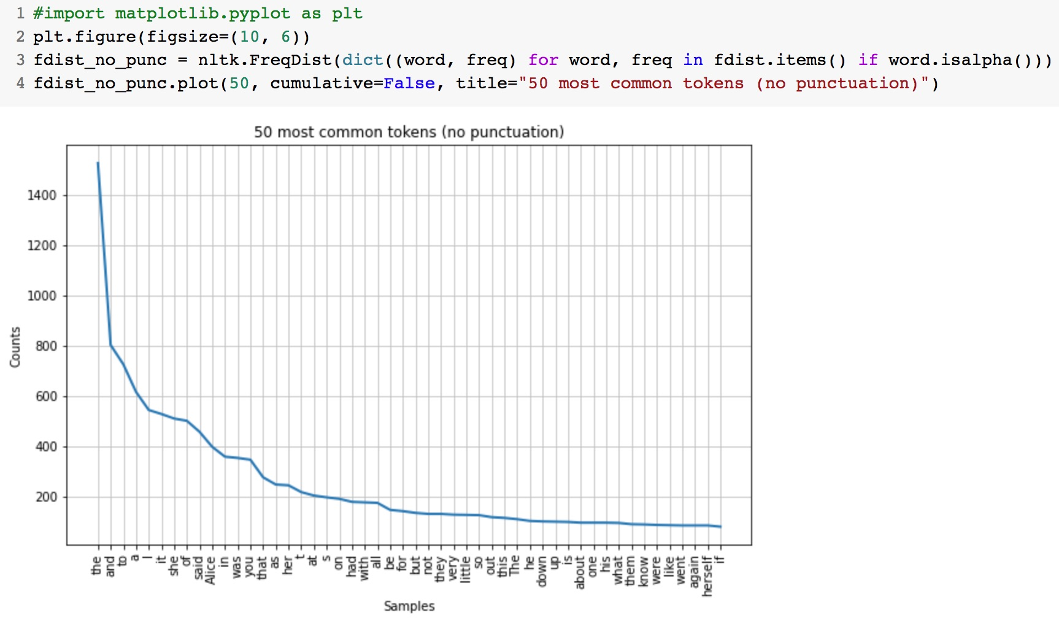
for word, freq in fdist.items() if word.isalpha()
https://tinyurl.com/aintpupython101

Slide 15
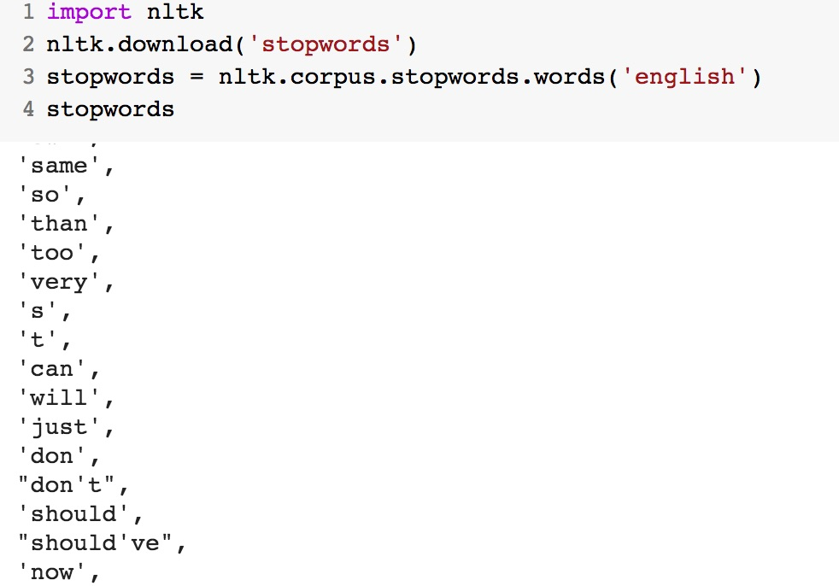
nltk.download('stopwords')
stopwords = nltk.corpus.stopwords.words('english')
https://tinyurl.com/aintpupython101

Slide 16
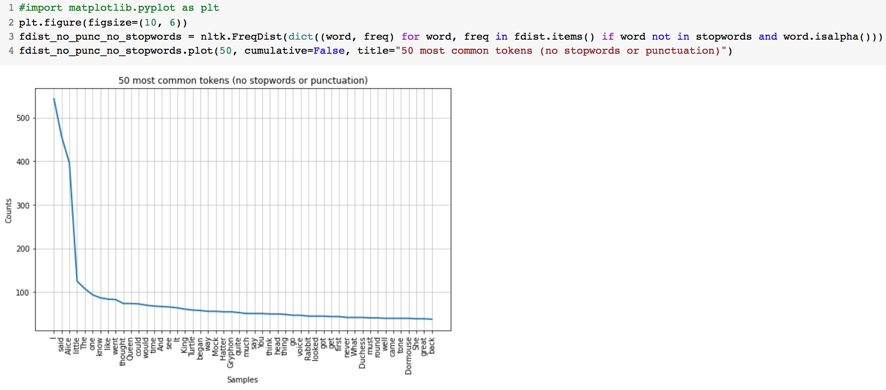
for word, freq in fdist.items() if word not in stopwords and word.isalpha()
https://tinyurl.com/aintpupython101

Slide 17
Alice Top 50 Tokens
https://tinyurl.com/aintpupython101

Slide 18
BeautifulSoup
import requests
from bs4 import BeautifulSoup
url = 'https://www.gutenberg.org/files/11/11-h/11-h.htm'
reqs = requests.get(url)
html_doc = reqs.text
soup = BeautifulSoup(html_doc, 'html.parser')
text = soup.get_text()
https://tinyurl.com/aintpupython101

Slide 19
tensorflow.keras.preprocessing.text
from tensorflow.keras.preprocessing.text import Tokenizer
sentences = [
'i love my dog',
'I, love my cat',
'You love my dog!'
]
tokenizer = Tokenizer(num_words = 100)
tokenizer.fit_on_texts(sentences)
word_index = tokenizer.word_index
print('sentences:', sentences)
print('word index:', word_index)
sentences: ['i love my dog', 'I, love my cat', 'You love my dog!’]
word index: {'love': 1, 'my': 2, 'i': 3, 'dog': 4, 'cat': 5, 'you': 6}
https://tinyurl.com/aintpupython101

Slide 20
tensorflow.keras.preprocessing.sequence import pad_sequences
import tensorflow as tf
from tensorflow import keras
from tensorflow.keras.preprocessing.text import Tokenizer
from tensorflow.keras.preprocessing.sequence import pad_sequences
sentences = [
'I love my dog',
'I love my cat',
'You love my dog!',
'Do you think my dog is amazing?’
]
tokenizer = Tokenizer(num_words = 100, oov_token="<OOV>")
tokenizer.fit_on_texts(sentences)
word_index = tokenizer.word_index sequences = tokenizer.texts_to_sequences(sentences) padded = pad_sequences(sequences, maxlen=5)
print("sentences = ", sentences)
print("Word Index = " , word_index)
print("Sequences = " , sequences)
print("Padded Sequences:")
print(padded)
https://tinyurl.com/aintpupython101

Slide 21
tensorflow.keras.preprocessing.sequence import pad_sequences
sentences = ['I love my dog', 'I love my cat', 'You love my dog!', 'Do you think my dog is amazing?’]
Word Index = {'<OOV>': 1, 'my': 2, 'love': 3, 'dog': 4, 'i': 5, 'you': 6, 'cat': 7, 'do': 8, 'think': 9, 'is': 10, 'amazing': 11}
Sequences = [[5, 3, 2, 4], [5, 3, 2, 7], [6, 3, 2, 4], [8, 6, 9, 2, 4, 10, 11]]
Padded Sequences: [[ 0 5 3 2 4] [ 0 5 3 2 7] [ 0 6 3 2 4] [ 9 2 4 10 11]]
https://tinyurl.com/aintpupython101

Slide 22
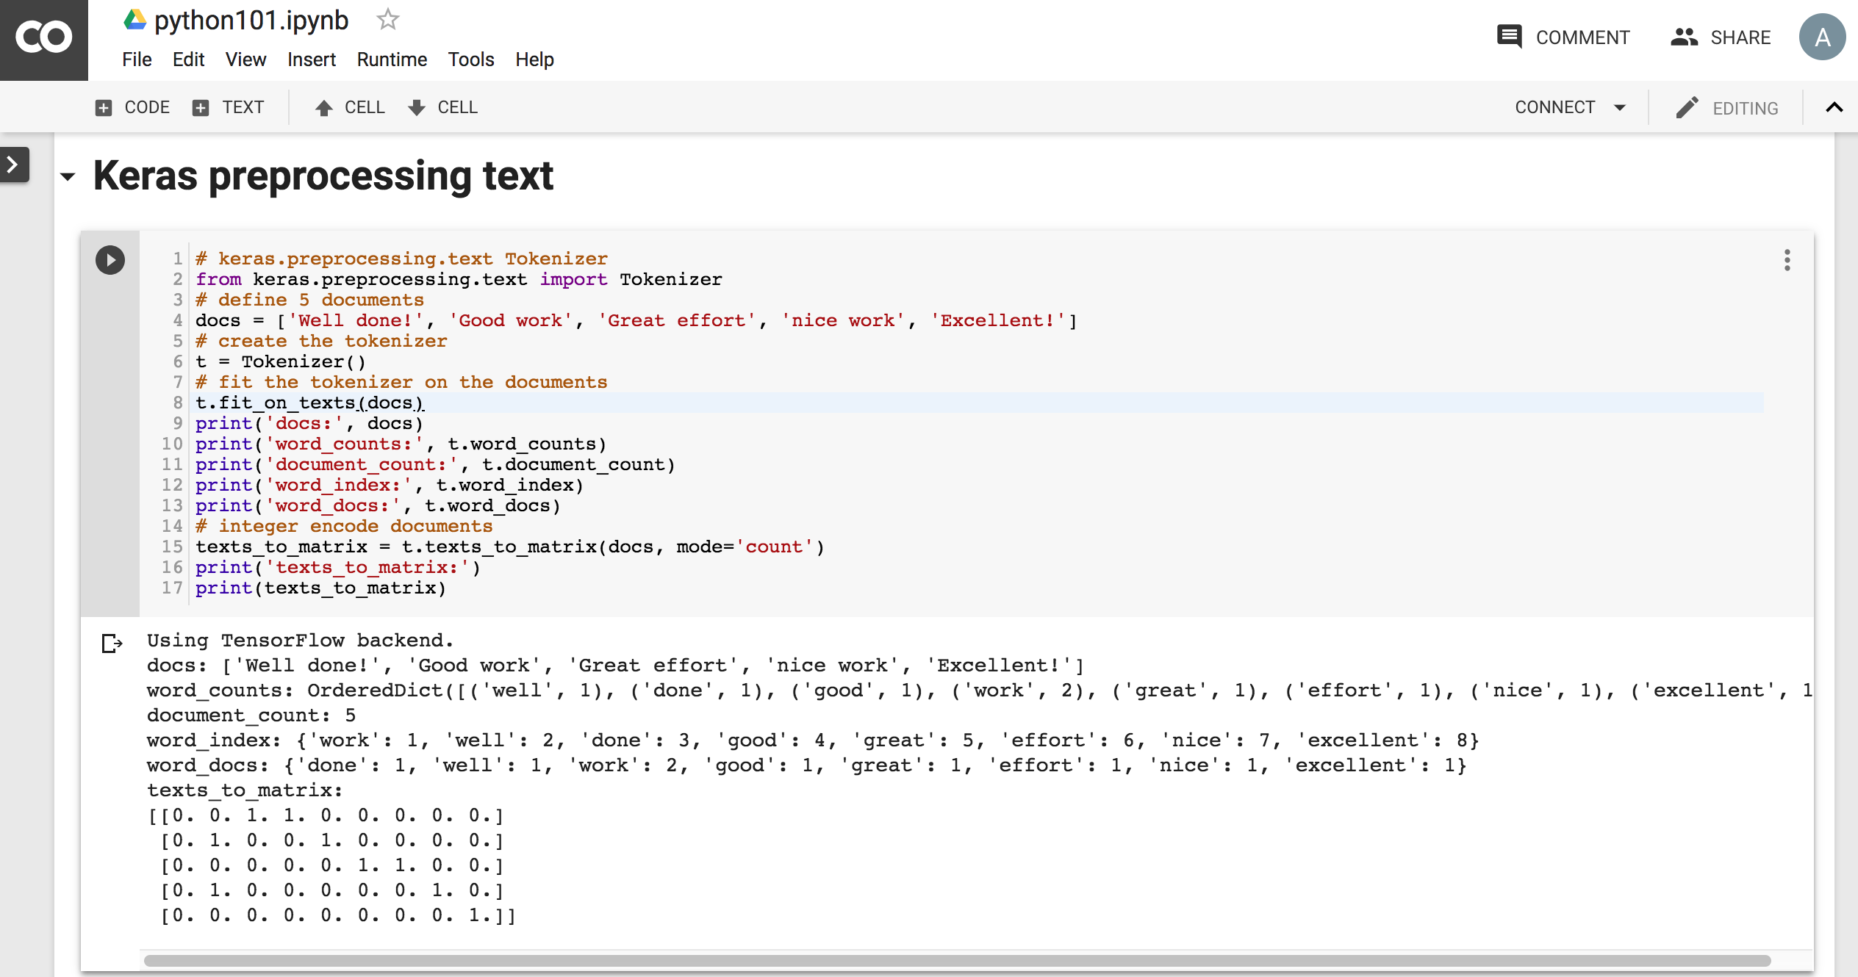
Python in Google Colab
https://colab.research.google.com/drive/1FEG6DnGvwfUbeo4zJ1zTunjMqf2RkCrT
https://tinyurl.com/aintpupython101

Slide 23
One-hot encoding
'The mouse ran up the clock’ =
[ [0, 1, 0, 0, 0, 0, 0], [0, 0, 1, 0, 0, 0, 0], [0, 0, 0, 1, 0, 0, 0], [0, 0, 0, 0, 1, 0, 0], [0, 1, 0, 0, 0, 0, 0], [0, 0, 0, 0, 0, 1, 0] ]
The mouse ran up the clock
1 2 3 4
1
5
[0, 1, 2, 3, 4, 5, 6]
Source: https://developers.google.com/machine-learning/guides/text-classification/step-3

Slide 24
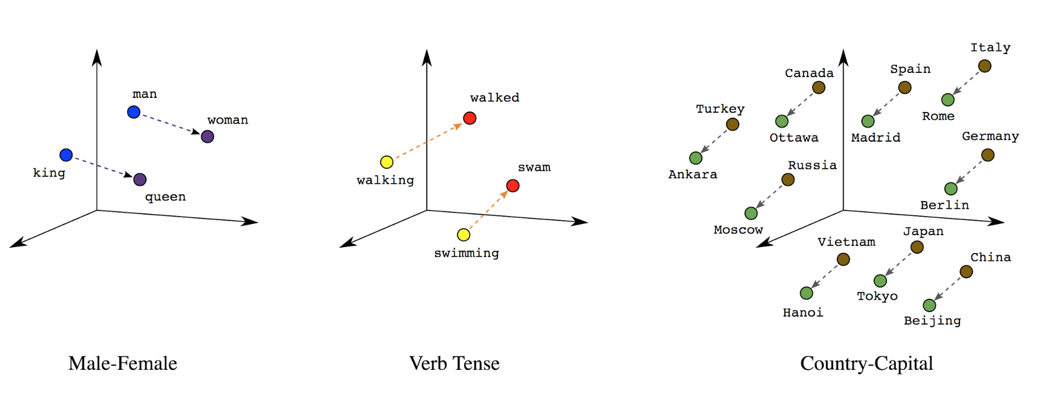
Word embeddings
Source: https://developers.google.com/machine-learning/guides/text-classification/step-3

Slide 25
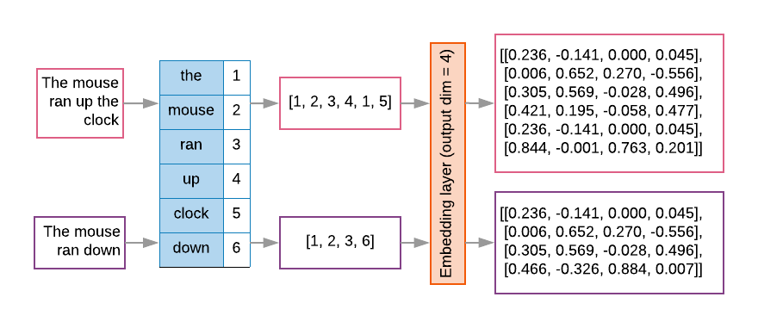
Word embeddings
Source: https://developers.google.com/machine-learning/guides/text-classification/step-3

Slide 26
t1 = 'The mouse ran up the clock'
t2 = 'The mouse ran down'
s1 = t1.lower().split(' ')
s2 = t2.lower().split(' ')
terms = s1 + s2
sortedset = sorted(set(terms))
print('terms =', terms)
print('sortedset =', sortedset)
https://tinyurl.com/aintpupython101
Notes:
t1 = 'The mouse ran up the clock'
t2 = 'The mouse ran down'
s1 = t1.lower().split(' ')
s2 = t2.lower().split(' ')
terms = s1 + s2
sortedset = sorted(set(terms))
print('terms =', terms)
print('sortedset =', sortedset)

Slide 27
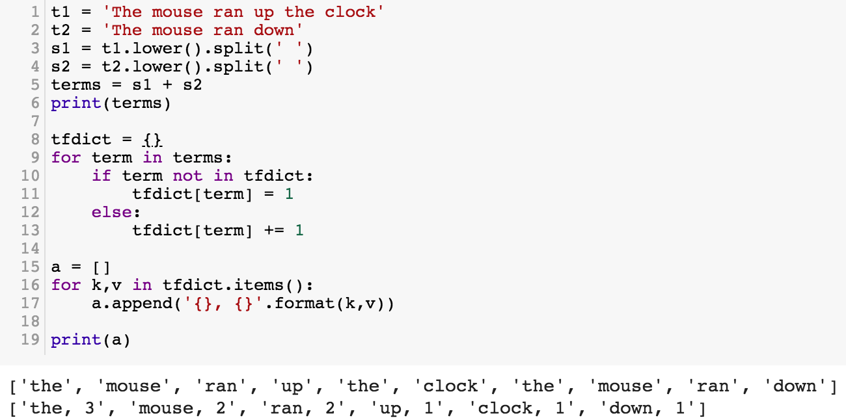
t1 = 'The mouse ran up the clock'
t2 = 'The mouse ran down'
s1 = t1.lower().split(' ')
s2 = t2.lower().split(' ')
terms = s1 + s2
print(terms)
tfdict = {}
for term in terms:
if term not in tfdict:
tfdict[term] = 1
else:
tfdict[term] += 1
a = []
for k,v in tfdict.items():
a.append('{}, {}'.format(k,v))
print(a)
https://tinyurl.com/aintpupython101

Slide 28
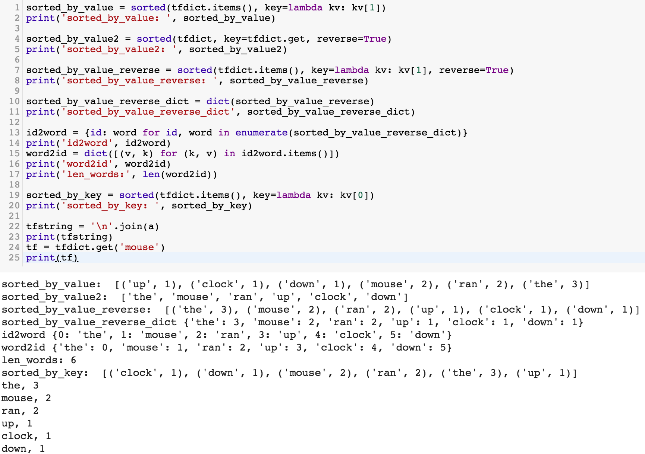
sorted_by_value_reverse = sorted(tfdict.items(), key=lambda kv: kv[1], reverse=True)
sorted_by_value_reverse_dict = dict(sorted_by_value_reverse)
id2word = {id: word for id, word in enumerate(sorted_by_value_reverse_dict)}
word2id = dict([(v, k) for (k, v) in id2word.items()])
https://tinyurl.com/aintpupython101

Slide 29
sorted_by_value = sorted(tfdict.items(), key=lambda kv: kv[1])
print('sorted_by_value: ', sorted_by_value)
sorted_by_value2 = sorted(tfdict, key=tfdict.get, reverse=True)
print('sorted_by_value2: ', sorted_by_value2)
sorted_by_value_reverse = sorted(tfdict.items(), key=lambda kv: kv[1], reverse=True)
print('sorted_by_value_reverse: ', sorted_by_value_reverse)
sorted_by_value_reverse_dict = dict(sorted_by_value_reverse)
print('sorted_by_value_reverse_dict', sorted_by_value_reverse_dict)
id2word = {id: word for id, word in enumerate(sorted_by_value_reverse_dict)}
print('id2word', id2word)
word2id = dict([(v, k) for (k, v) in id2word.items()])
print('word2id', word2id)
print('len_words:', len(word2id))
sorted_by_key = sorted(tfdict.items(), key=lambda kv: kv[0])
print('sorted_by_key: ', sorted_by_key)
tfstring = '\n'.join(a)
print(tfstring)
tf = tfdict.get('mouse')
print(tf)
https://tinyurl.com/aintpupython101

Slide 30
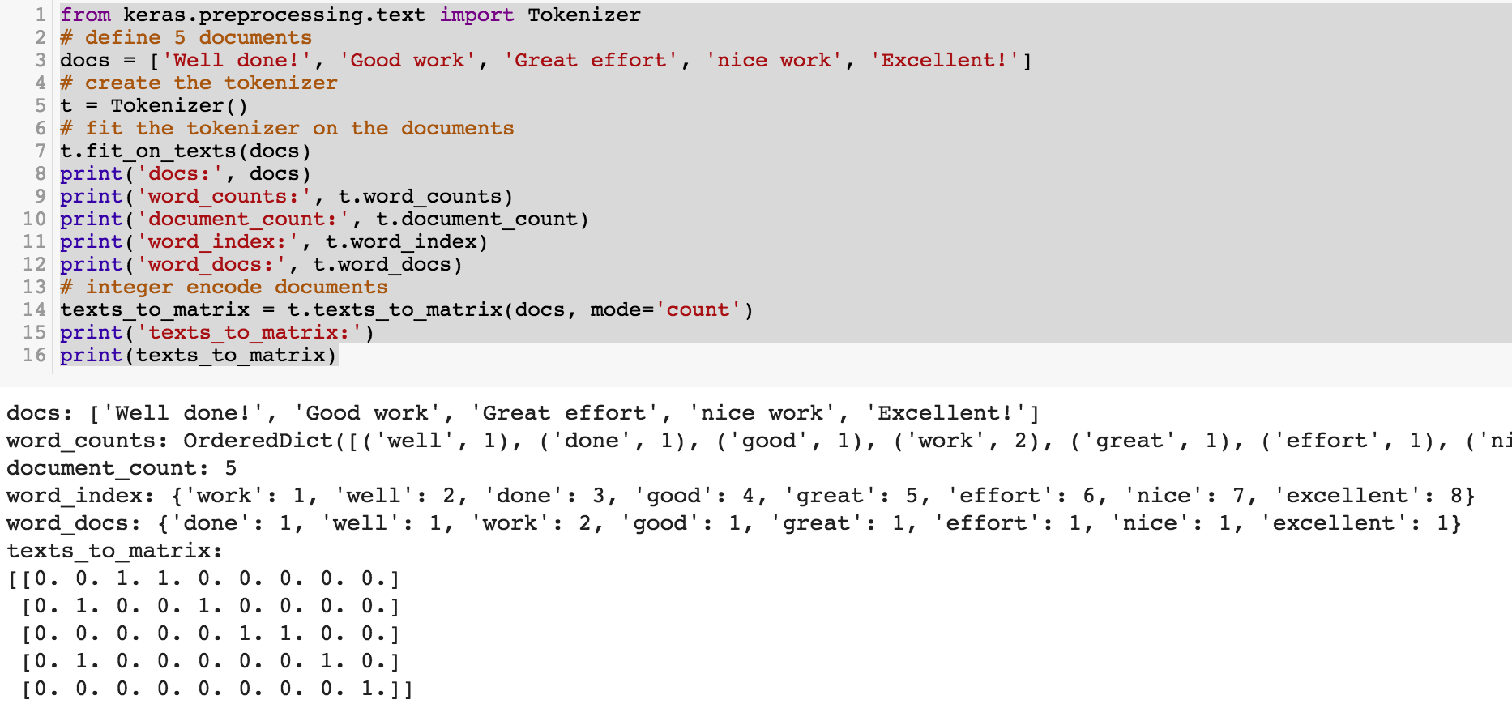
from keras.preprocessing.text import Tokenizer
Source: https://machinelearningmastery.com/prepare-text-data-deep-learning-keras/
Notes:
from keras.preprocessing.text import Tokenizer
# define 5 documents
docs = ['Well done!', 'Good work', 'Great effort', 'nice work', 'Excellent!']
# create the tokenizer
t = Tokenizer()
# fit the tokenizer on the documents
t.fit_on_texts(docs)
print('docs:', docs)
print('word_counts:', t.word_counts)
print('document_count:', t.document_count)
print('word_index:', t.word_index)
print('word_docs:', t.word_docs)
# integer encode documents
texts_to_matrix = t.texts_to_matrix(docs, mode='count')
print('texts_to_matrix:')
print(texts_to_matrix)

Slide 31
from keras.preprocessing.text import Tokenizer
from keras.preprocessing.text import Tokenizer
# define 5 documents
docs = ['Well done!', 'Good work', 'Great effort', 'nice work', 'Excellent!']
# create the tokenizer
t = Tokenizer()
# fit the tokenizer on the documents
t.fit_on_texts(docs)
print('docs:', docs)
print('word_counts:', t.word_counts)
print('document_count:', t.document_count)
print('word_index:', t.word_index)
print('word_docs:', t.word_docs)
# integer encode documents
texts_to_matrix = t.texts_to_matrix(docs, mode='count')
print('texts_to_matrix:')
print(texts_to_matrix)
Source: https://machinelearningmastery.com/prepare-text-data-deep-learning-keras/

Slide 32
texts_to_matrix = t.texts_to_matrix(docs, mode='count')
docs: ['Well done!', 'Good work', 'Great effort’, 'nice work', 'Excellent!’]
word_counts: OrderedDict([('well', 1), ('done', 1), ('good', 1), ('work', 2), ('great', 1), ('effort', 1), ('nice', 1), ('excellent', 1)])
document_count: 5
word_index: {'work': 1, 'well': 2, 'done': 3, 'good': 4, 'great': 5, 'effort': 6, 'nice': 7, 'excellent': 8}
word_docs: {'done': 1, 'well': 1, 'work': 2, 'good': 1, 'great': 1, 'effort': 1, 'nice': 1, 'excellent': 1}
texts_to_matrix: [[0. 0. 1. 1. 0. 0. 0. 0. 0.] [0. 1. 0. 0. 1. 0. 0. 0. 0.] [0. 0. 0. 0. 0. 1. 1. 0. 0.] [0. 1. 0. 0. 0. 0. 0. 1. 0.] [0. 0. 0. 0. 0. 0. 0. 0. 1.]]
Source: https://machinelearningmastery.com/prepare-text-data-deep-learning-keras/
Notes:
from keras.preprocessing.text import Tokenizer
# define 5 documents
docs = ['Well done!', 'Good work', 'Great effort', 'nice work', 'Excellent!']
# create the tokenizer
t = Tokenizer()
# fit the tokenizer on the documents
t.fit_on_texts(docs)
print('docs:', docs)
print('word_counts:', t.word_counts)
print('document_count:', t.document_count)
print('word_index:', t.word_index)
print('word_docs:', t.word_docs)
# integer encode documents
texts_to_matrix = t.texts_to_matrix(docs, mode='count')
print('texts_to_matrix:')
print(texts_to_matrix)

Slide 33
t.texts_to_matrix(docs, mode='tfidf')
from keras.preprocessing.text import Tokenizer
# define 5 documents
docs = ['Well done!', 'Good work', 'Great effort', 'nice work', 'Excellent!']
# create the tokenizer
t = Tokenizer()
# fit the tokenizer on the documents
t.fit_on_texts(docs)
print('docs:', docs)
print('word_counts:', t.word_counts)
print('document_count:', t.document_count)
print('word_index:', t.word_index)
print('word_docs:', t.word_docs)
# integer encode documents
texts_to_matrix = t.texts_to_matrix(docs, mode='tfidf')
print('texts_to_matrix:')
print(texts_to_matrix)
texts_to_matrix: [[0. 0. 1.25276297 1.25276297 0. 0. 0. 0. 0. ] [0. 0.98082925 0. 0. 1.25276297 0. 0. 0. 0. ] [0. 0. 0. 0. 0. 1.25276297 1.25276297 0. 0. ] [0. 0.98082925 0. 0. 0. 0. 0. 1.25276297 0. ] [0. 0. 0. 0. 0. 0. 0. 0. 1.25276297]]
Source: https://machinelearningmastery.com/prepare-text-data-deep-learning-keras/
Notes:
from keras.preprocessing.text import Tokenizer
# define 5 documents
docs = ['Well done!', 'Good work', 'Great effort', 'nice work', 'Excellent!']
# create the tokenizer
t = Tokenizer()
# fit the tokenizer on the documents
t.fit_on_texts(docs)
print('docs:', docs)
print('word_counts:', t.word_counts)
print('document_count:', t.document_count)
print('word_index:', t.word_index)
print('word_docs:', t.word_docs)
# integer encode documents
texts_to_matrix = t.texts_to_matrix(docs, mode='tfidf')
print('texts_to_matrix:')
print(texts_to_matrix)
###########
‘’’
docs: ['Well done!', 'Good work', 'Great effort', 'nice work', 'Excellent!'] word_counts: OrderedDict([('well', 1), ('done', 1), ('good', 1), ('work', 2), ('great', 1), ('effort', 1), ('nice', 1), ('excellent', 1)]) document_count: 5 word_index: {'work': 1, 'well': 2, 'done': 3, 'good': 4, 'great': 5, 'effort': 6, 'nice': 7, 'excellent': 8} word_docs: {'done': 1, 'well': 1, 'work': 2, 'good': 1, 'great': 1, 'effort': 1, 'nice': 1, 'excellent': 1} texts_to_matrix: [[0. 0. 1.25276297 1.25276297 0. 0. 0. 0. 0. ] [0. 0.98082925 0. 0. 1.25276297 0. 0. 0. 0. ] [0. 0. 0. 0. 0. 1.25276297 1.25276297 0. 0. ] [0. 0.98082925 0. 0. 0. 0. 0. 1.25276297 0. ] [0. 0. 0. 0. 0. 0. 0. 0. 1.25276297]]
‘’’

Slide 34
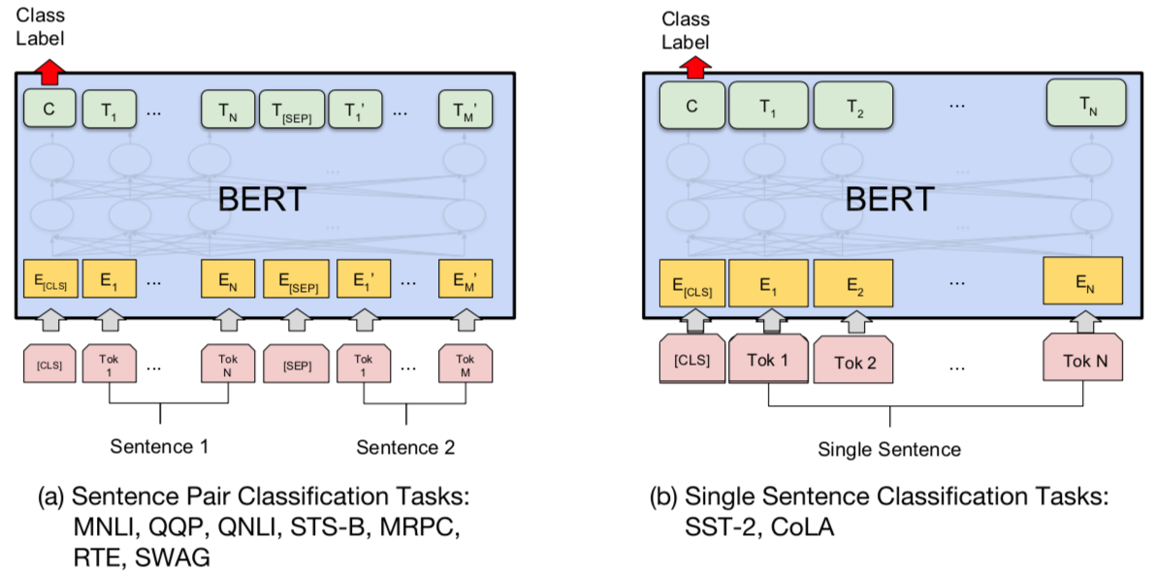
BERT Sequence-level tasks
Source: Devlin, Jacob, Ming-Wei Chang, Kenton Lee, and Kristina Toutanova (2018). "BERT: Pre-training of Deep Bidirectional Transformers for Language Understanding." arXiv preprint arXiv:1810.04805

Slide 35
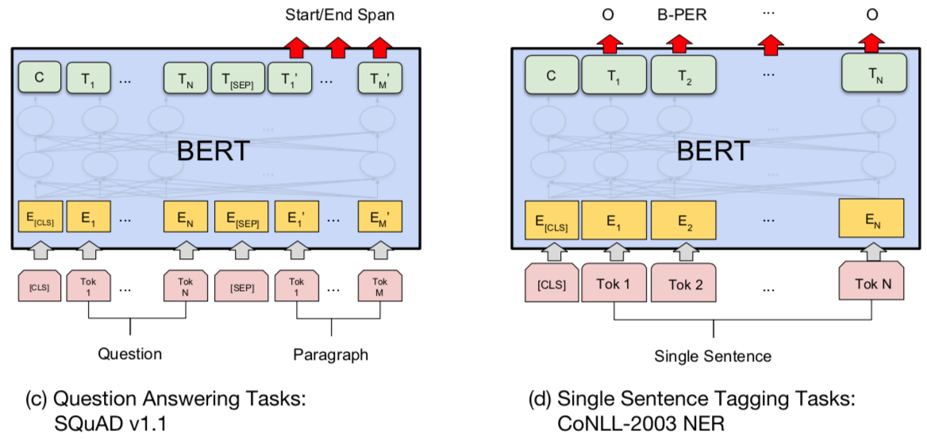
BERT Token-level tasks
Source: Devlin, Jacob, Ming-Wei Chang, Kenton Lee, and Kristina Toutanova (2018). "BERT: Pre-training of Deep Bidirectional Transformers for Language Understanding." arXiv preprint arXiv:1810.04805

Slide 36
Sentiment Analysis: Single Sentence Classification
Source: Devlin, Jacob, Ming-Wei Chang, Kenton Lee, and Kristina Toutanova (2018). "BERT: Pre-training of Deep Bidirectional Transformers for Language Understanding." arXiv preprint arXiv:1810.04805

Slide 37
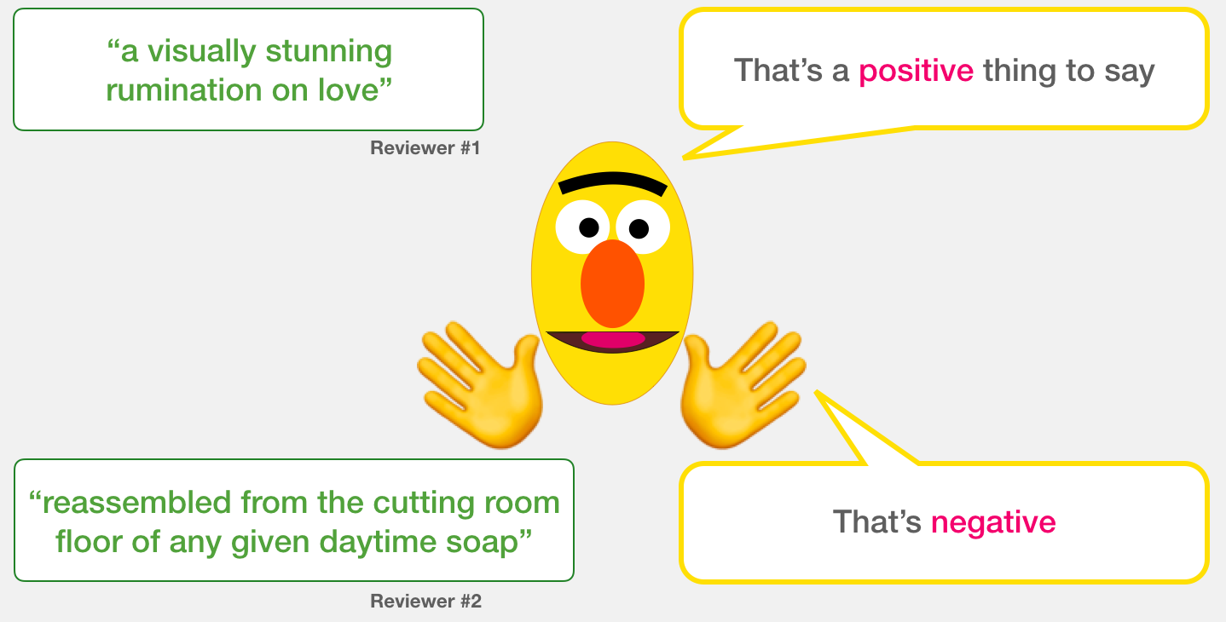
A Visual Guide to Using BERT for the First Time (Jay Alammar, 2019)
Source: Jay Alammar (2019), A Visual Guide to Using BERT for the First Time, http://jalammar.github.io/a-visual-guide-to-using-bert-for-the-first-time/

Slide 38
Sentiment Classification: SST2 Sentences from movie reviews
sentence | label
a stirring , funny and finally transporting re imagining of beauty and the beast and 1930s horror films | 1
apparently reassembled from the cutting room floor of any given daytime soap | 0
they presume their audience won't sit still for a sociology lesson | 0
this is a visually stunning rumination on love , memory , history and the war between art and commerce | 1
jonathan parker 's bartleby should have been the be all end all of the modern office anomie films | 1
Source: Jay Alammar (2019), A Visual Guide to Using BERT for the First Time, http://jalammar.github.io/a-visual-guide-to-using-bert-for-the-first-time/

Slide 39
Movie Review Sentiment Classifier
Source: Jay Alammar (2019), A Visual Guide to Using BERT for the First Time, http://jalammar.github.io/a-visual-guide-to-using-bert-for-the-first-time/

Slide 40
Movie Review Sentiment Classifier
Source: Jay Alammar (2019), A Visual Guide to Using BERT for the First Time, http://jalammar.github.io/a-visual-guide-to-using-bert-for-the-first-time/

Slide 41
Movie Review Sentiment Classifier Model Training
Source: Jay Alammar (2019), A Visual Guide to Using BERT for the First Time, http://jalammar.github.io/a-visual-guide-to-using-bert-for-the-first-time/

Slide 42
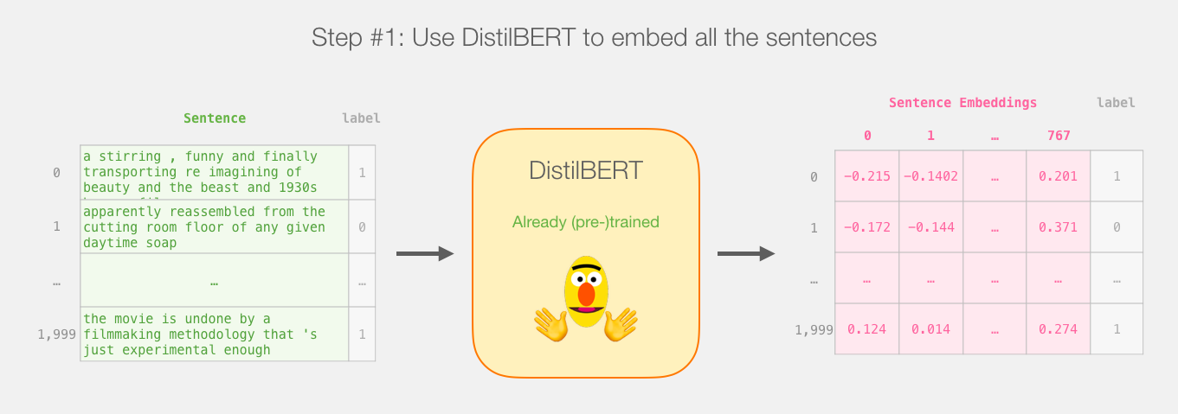
Step # 1 Use distilBERT to Generate Sentence Embeddings
Source: Jay Alammar (2019), A Visual Guide to Using BERT for the First Time, http://jalammar.github.io/a-visual-guide-to-using-bert-for-the-first-time/

Slide 43
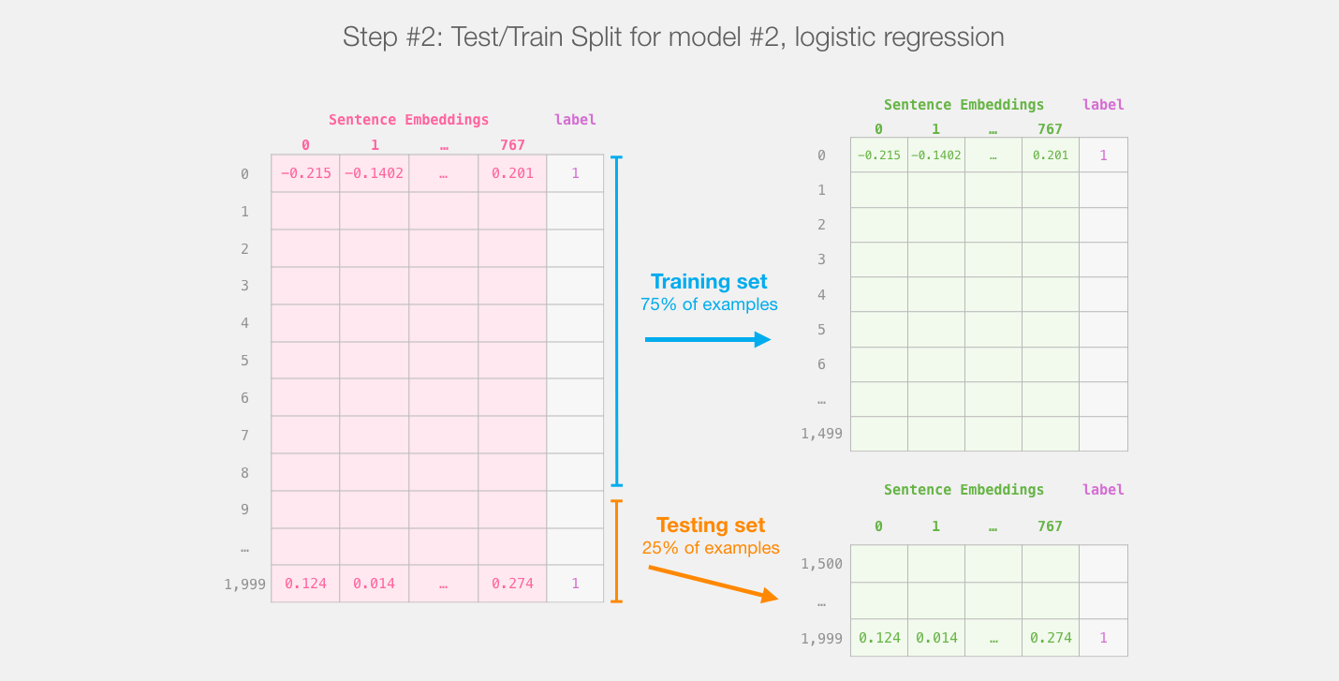
Step #2:Test/Train Split for Model #2, Logistic Regression
Source: Jay Alammar (2019), A Visual Guide to Using BERT for the First Time, http://jalammar.github.io/a-visual-guide-to-using-bert-for-the-first-time/

Slide 44
Step #3 Train the logistic regression model using the training set
Source: Jay Alammar (2019), A Visual Guide to Using BERT for the First Time, http://jalammar.github.io/a-visual-guide-to-using-bert-for-the-first-time/

Slide 45
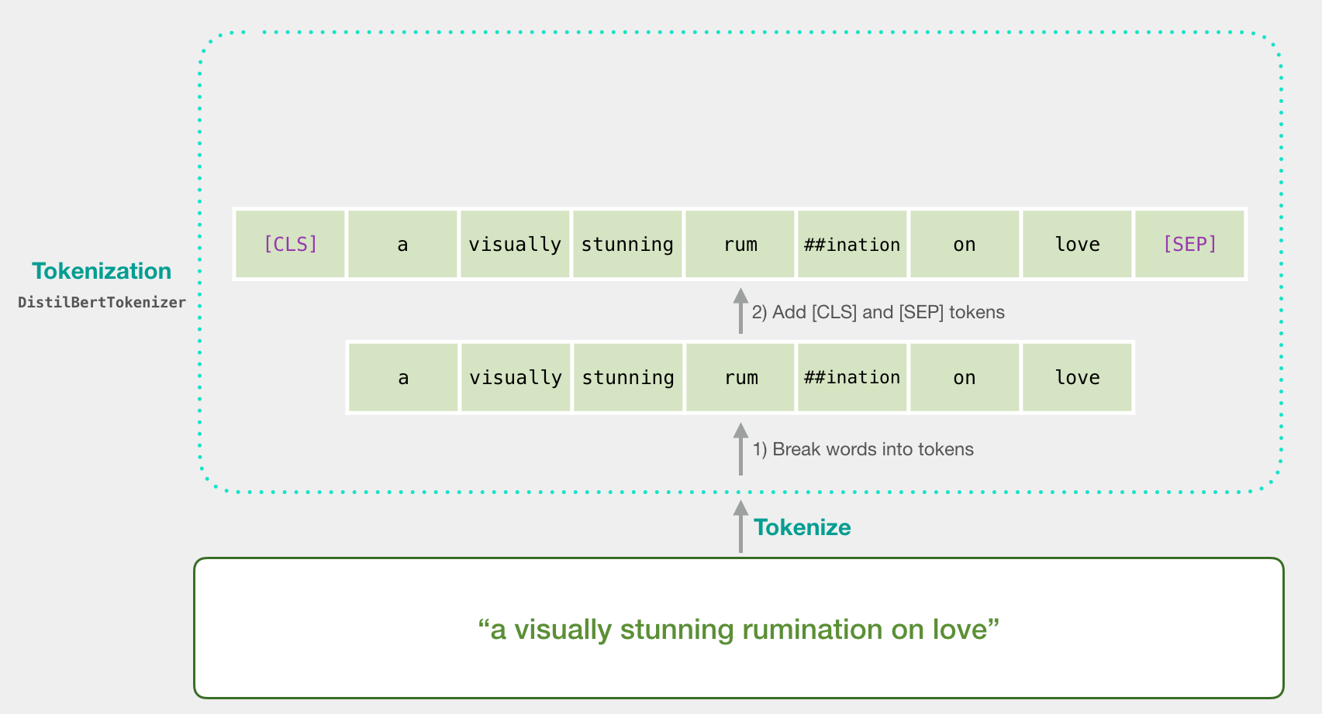
Tokenization
[CLS] a visually stunning rum ##ination on love [SEP]
a visually stunning rumination on love
Source: Jay Alammar (2019), A Visual Guide to Using BERT for the First Time, http://jalammar.github.io/a-visual-guide-to-using-bert-for-the-first-time/

Slide 46
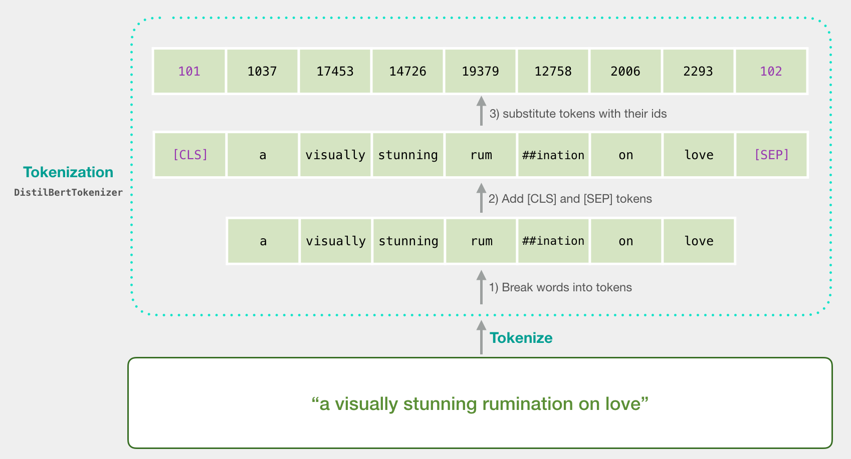
Tokenization
tokenizer.encode("a visually stunning rumination on love", add_special_tokens=True)
Source: Jay Alammar (2019), A Visual Guide to Using BERT for the First Time, http://jalammar.github.io/a-visual-guide-to-using-bert-for-the-first-time/

Slide 47
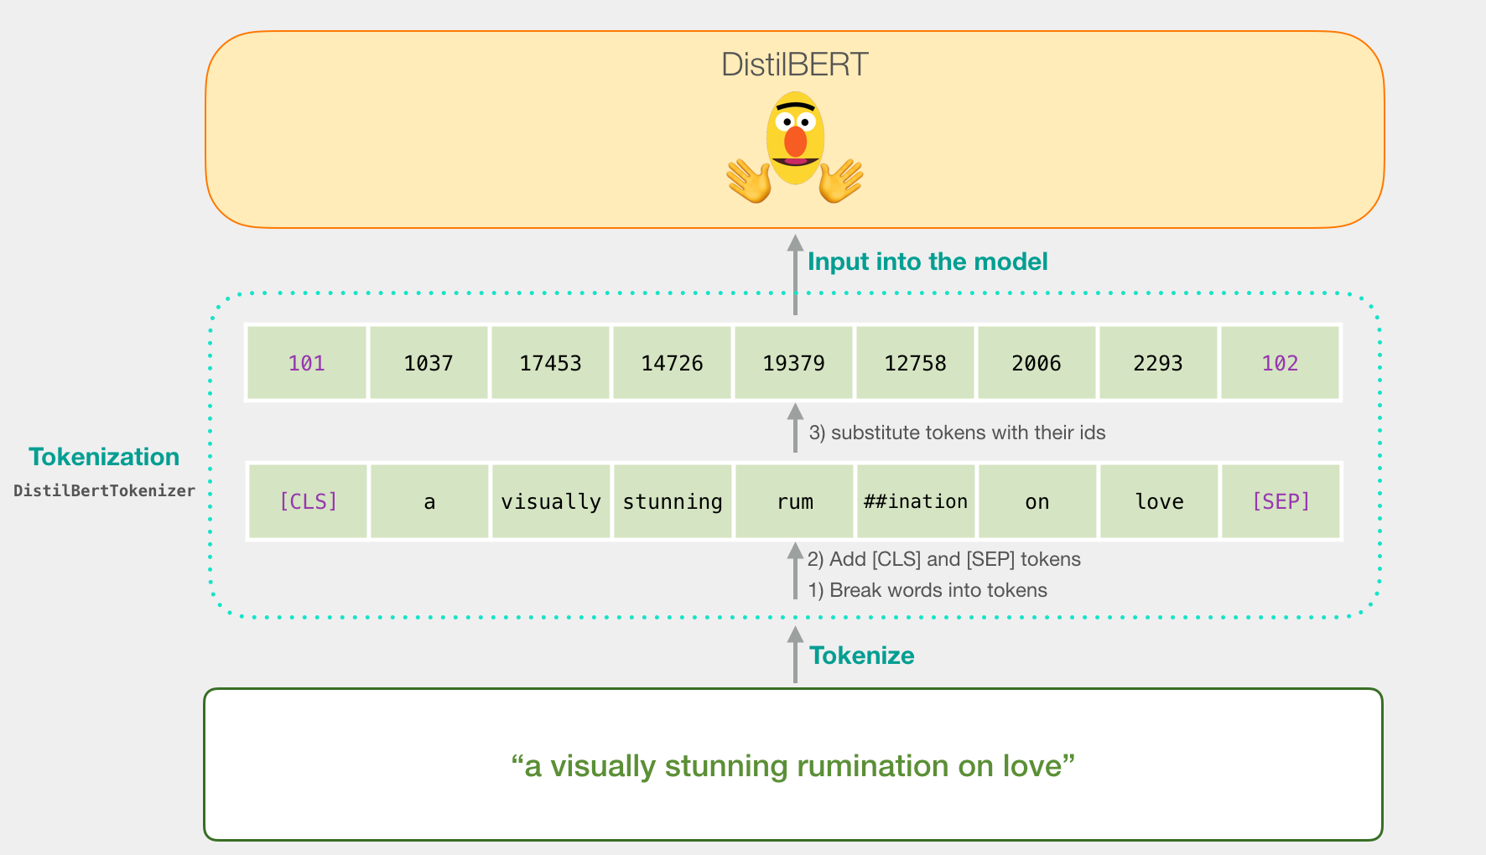
Tokenization for BERT Model
Source: Jay Alammar (2019), A Visual Guide to Using BERT for the First Time, http://jalammar.github.io/a-visual-guide-to-using-bert-for-the-first-time/

Slide 48
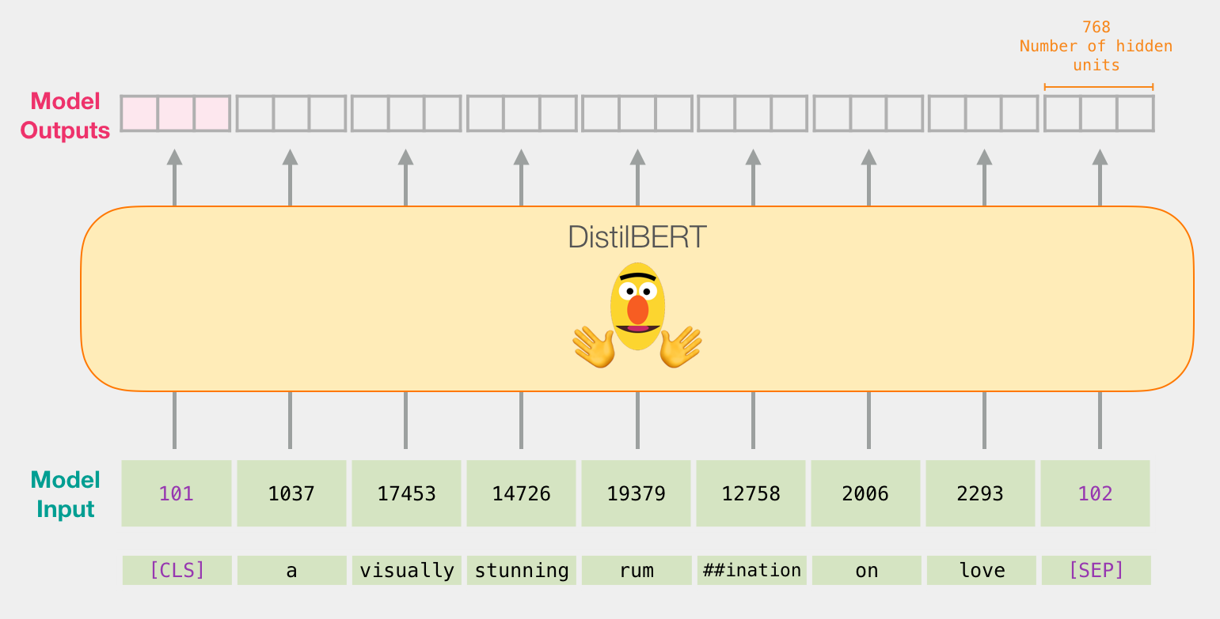
Flowing Through DistilBERT (768 features)
Source: Jay Alammar (2019), A Visual Guide to Using BERT for the First Time, http://jalammar.github.io/a-visual-guide-to-using-bert-for-the-first-time/

Slide 49
Model #1 Output Class vector as Model #2 Input
Source: Jay Alammar (2019), A Visual Guide to Using BERT for the First Time, http://jalammar.github.io/a-visual-guide-to-using-bert-for-the-first-time/

Slide 50
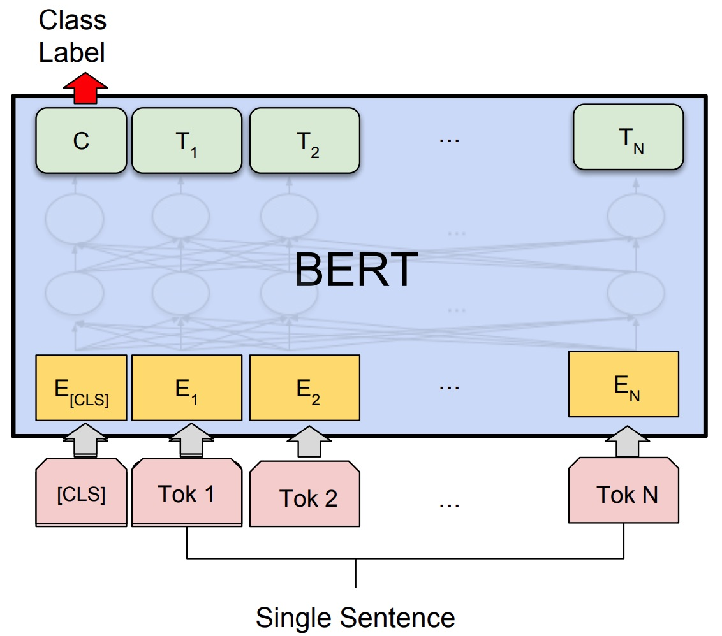
Fine-tuning BERT on Single Sentence Classification Tasks
Source: Devlin, Jacob, Ming-Wei Chang, Kenton Lee, and Kristina Toutanova (2018). "Bert: Pre-training of deep bidirectional transformers for language understanding." arXiv preprint arXiv:1810.04805.

Slide 51
Model #1 Output Class vector as Model #2 Input
Source: Jay Alammar (2019), A Visual Guide to Using BERT for the First Time, http://jalammar.github.io/a-visual-guide-to-using-bert-for-the-first-time/

Slide 52
Logistic Regression Model to classify Class vector
Source: Jay Alammar (2019), A Visual Guide to Using BERT for the First Time, http://jalammar.github.io/a-visual-guide-to-using-bert-for-the-first-time/

Slide 53
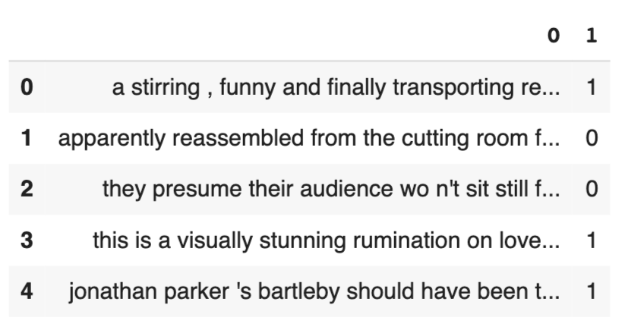
df = pd.read_csv('https://github.com/clairett/pytorch-sentiment-classification/raw/master/data/SST2/train.tsv', delimiter='\t', header=None)
df.head()
Source: Jay Alammar (2019), A Visual Guide to Using BERT for the First Time, http://jalammar.github.io/a-visual-guide-to-using-bert-for-the-first-time/

Slide 54
Tokenization
tokenized = df[0].apply((lambda x: tokenizer.encode(x, add_special_tokens=True)))
Source: Jay Alammar (2019), A Visual Guide to Using BERT for the First Time, http://jalammar.github.io/a-visual-guide-to-using-bert-for-the-first-time/

Slide 55
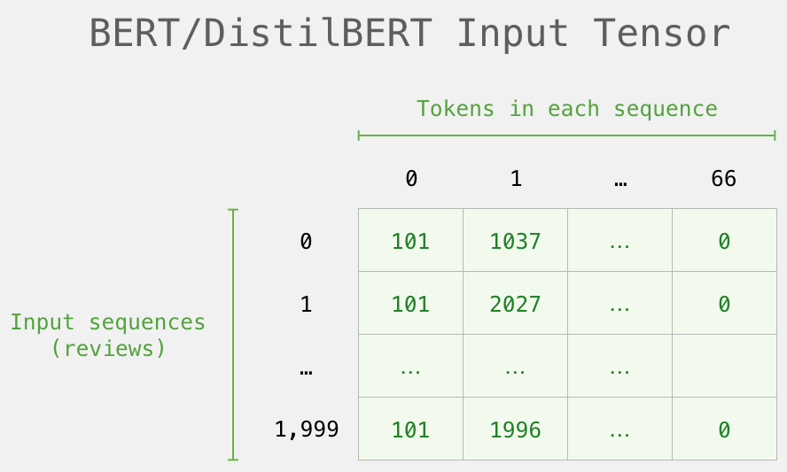
BERT Input Tensor
Source: Jay Alammar (2019), A Visual Guide to Using BERT for the First Time, http://jalammar.github.io/a-visual-guide-to-using-bert-for-the-first-time/

Slide 56
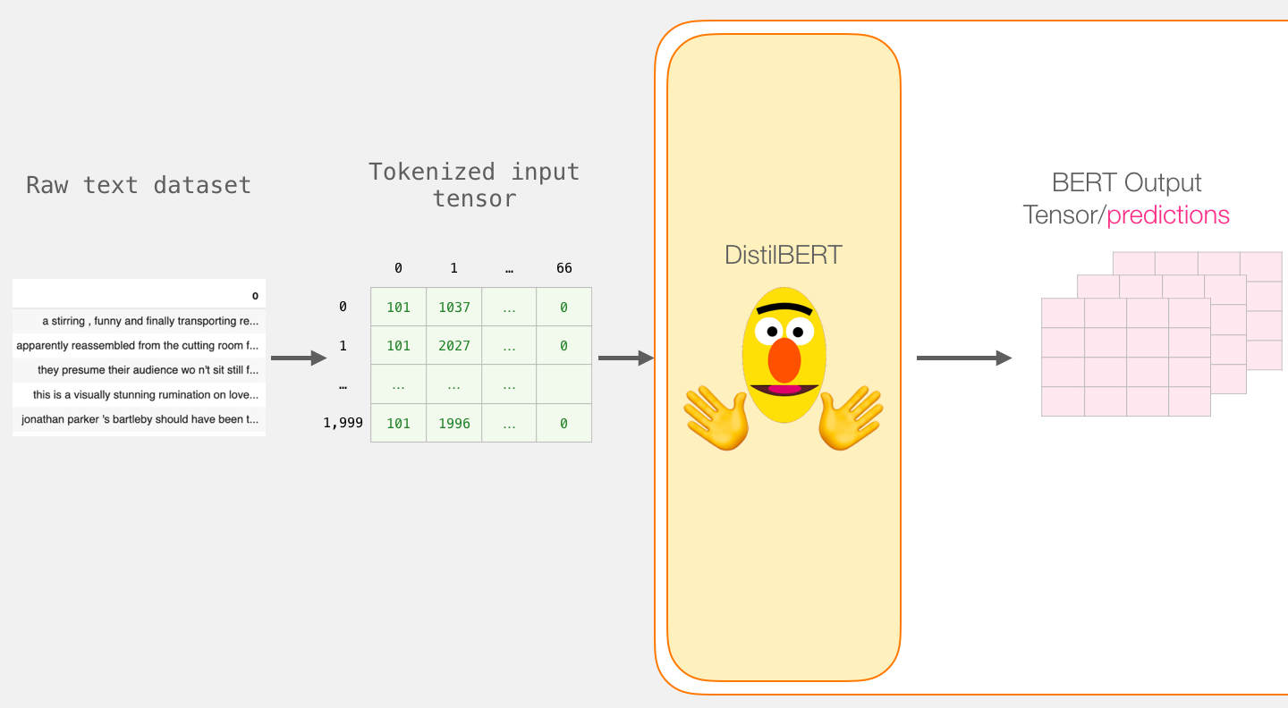
Processing with DistilBERT
input_ids = torch.tensor(np.array(padded))
last_hidden_states = model(input_ids)
Source: Jay Alammar (2019), A Visual Guide to Using BERT for the First Time, http://jalammar.github.io/a-visual-guide-to-using-bert-for-the-first-time/

Slide 57
Unpacking the BERT output tensor
Source: Jay Alammar (2019), A Visual Guide to Using BERT for the First Time, http://jalammar.github.io/a-visual-guide-to-using-bert-for-the-first-time/

Slide 58
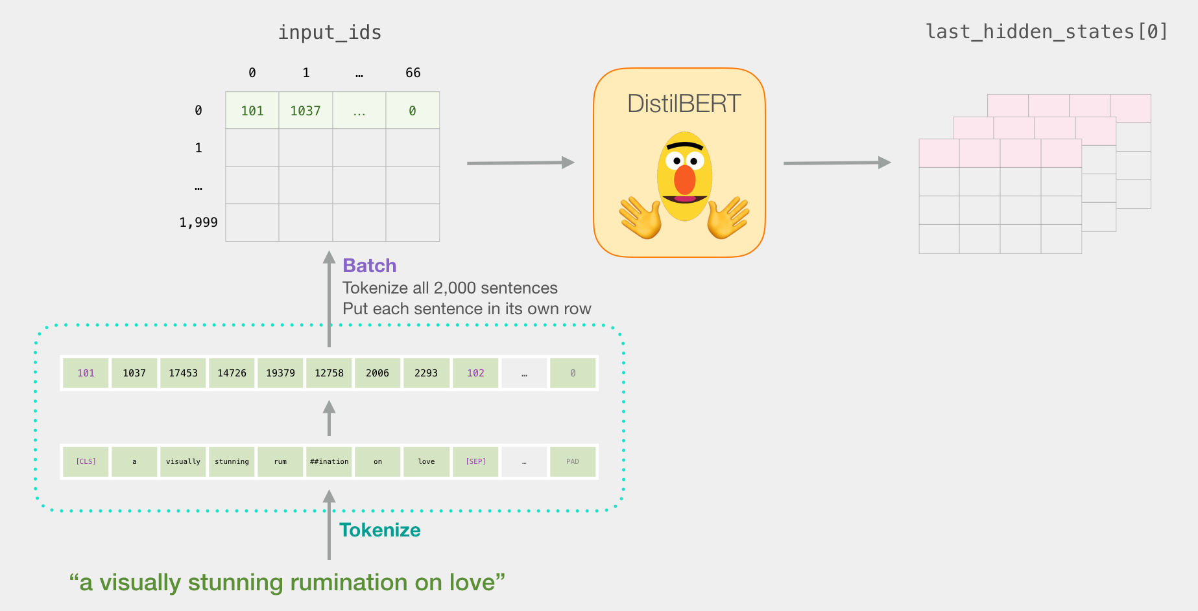
Sentence to last_hidden_state[0]
Source: Jay Alammar (2019), A Visual Guide to Using BERT for the First Time, http://jalammar.github.io/a-visual-guide-to-using-bert-for-the-first-time/

Slide 59
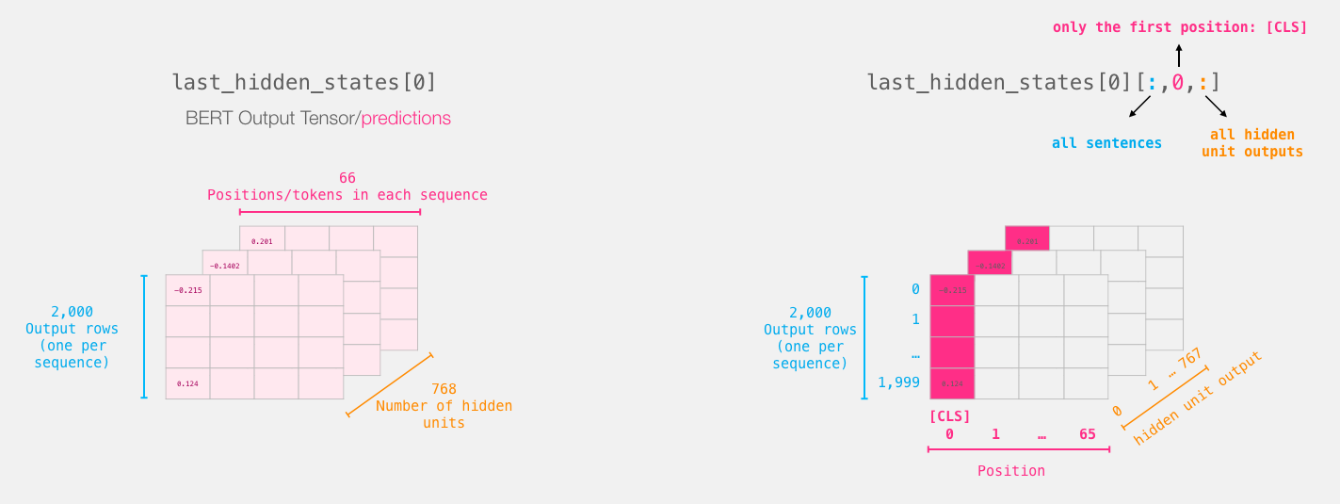
BERT’s output for the [CLS] tokens
# Slice the output for the first position for all the sequences, take all hidden unit outputs
features = last_hidden_states[0][:,0,:].numpy()
Source: Jay Alammar (2019), A Visual Guide to Using BERT for the First Time, http://jalammar.github.io/a-visual-guide-to-using-bert-for-the-first-time/

Slide 60
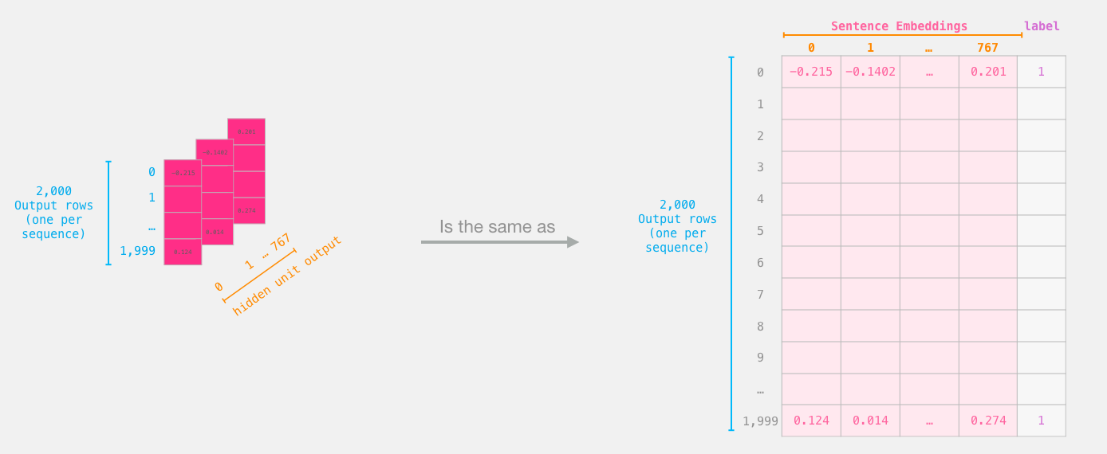
The tensor sliced from BERT's output Sentence Embeddings
Source: Jay Alammar (2019), A Visual Guide to Using BERT for the First Time, http://jalammar.github.io/a-visual-guide-to-using-bert-for-the-first-time/

Slide 61
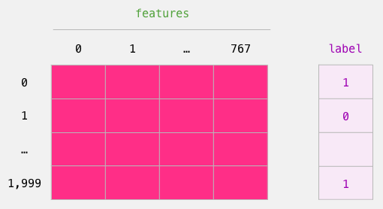
Dataset for Logistic Regression (768 Features)
The features are the output vectors of BERT for the [CLS] token (position #0)
Source: Jay Alammar (2019), A Visual Guide to Using BERT for the First Time, http://jalammar.github.io/a-visual-guide-to-using-bert-for-the-first-time/

Slide 62
labels = df[1]
train_features, test_features, train_labels, test_labels = train_test_split(features, labels)
Source: Jay Alammar (2019), A Visual Guide to Using BERT for the First Time, http://jalammar.github.io/a-visual-guide-to-using-bert-for-the-first-time/

Slide 63
Score Benchmarks Logistic Regression Model on SST-2 Dataset
# Training
lr_clf = LogisticRegression()
lr_clf.fit(train_features, train_labels)
#Testing
lr_clf.score(test_features, test_labels)
# Accuracy: 81%
# Highest accuracy: 96.8%
# Fine-tuned DistilBERT: 90.7%
# Full size BERT model: 94.9%
Source: Jay Alammar (2019), A Visual Guide to Using BERT for the First Time, http://jalammar.github.io/a-visual-guide-to-using-bert-for-the-first-time/

Slide 64
Sentiment Classification: SST2 Sentences from movie reviews
sentence | label
a stirring , funny and finally transporting re imagining of beauty and the beast and 1930s horror films | 1
apparently reassembled from the cutting room floor of any given daytime soap | 0
they presume their audience won't sit still for a sociology lesson | 0
this is a visually stunning rumination on love , memory , history and the war between art and commerce | 1
jonathan parker 's bartleby should have been the be all end all of the modern office anomie films | 1
Source: Jay Alammar (2019), A Visual Guide to Using BERT for the First Time, http://jalammar.github.io/a-visual-guide-to-using-bert-for-the-first-time/

Slide 65
A Visual Notebook to Using BERT for the First Time
https://colab.research.google.com/github/jalammar/jalammar.github.io/blob/master/notebooks/bert/A_Visual_Notebook_to_Using_BERT_for_the_First_Time.ipynb

Slide 66
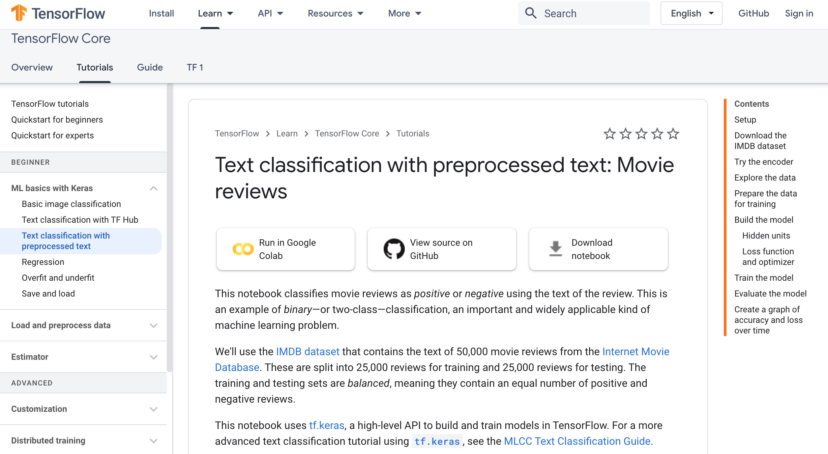
Text classification with preprocessed text: Movie reviews
https://www.tensorflow.org/tutorials/keras/text_classification

Slide 67
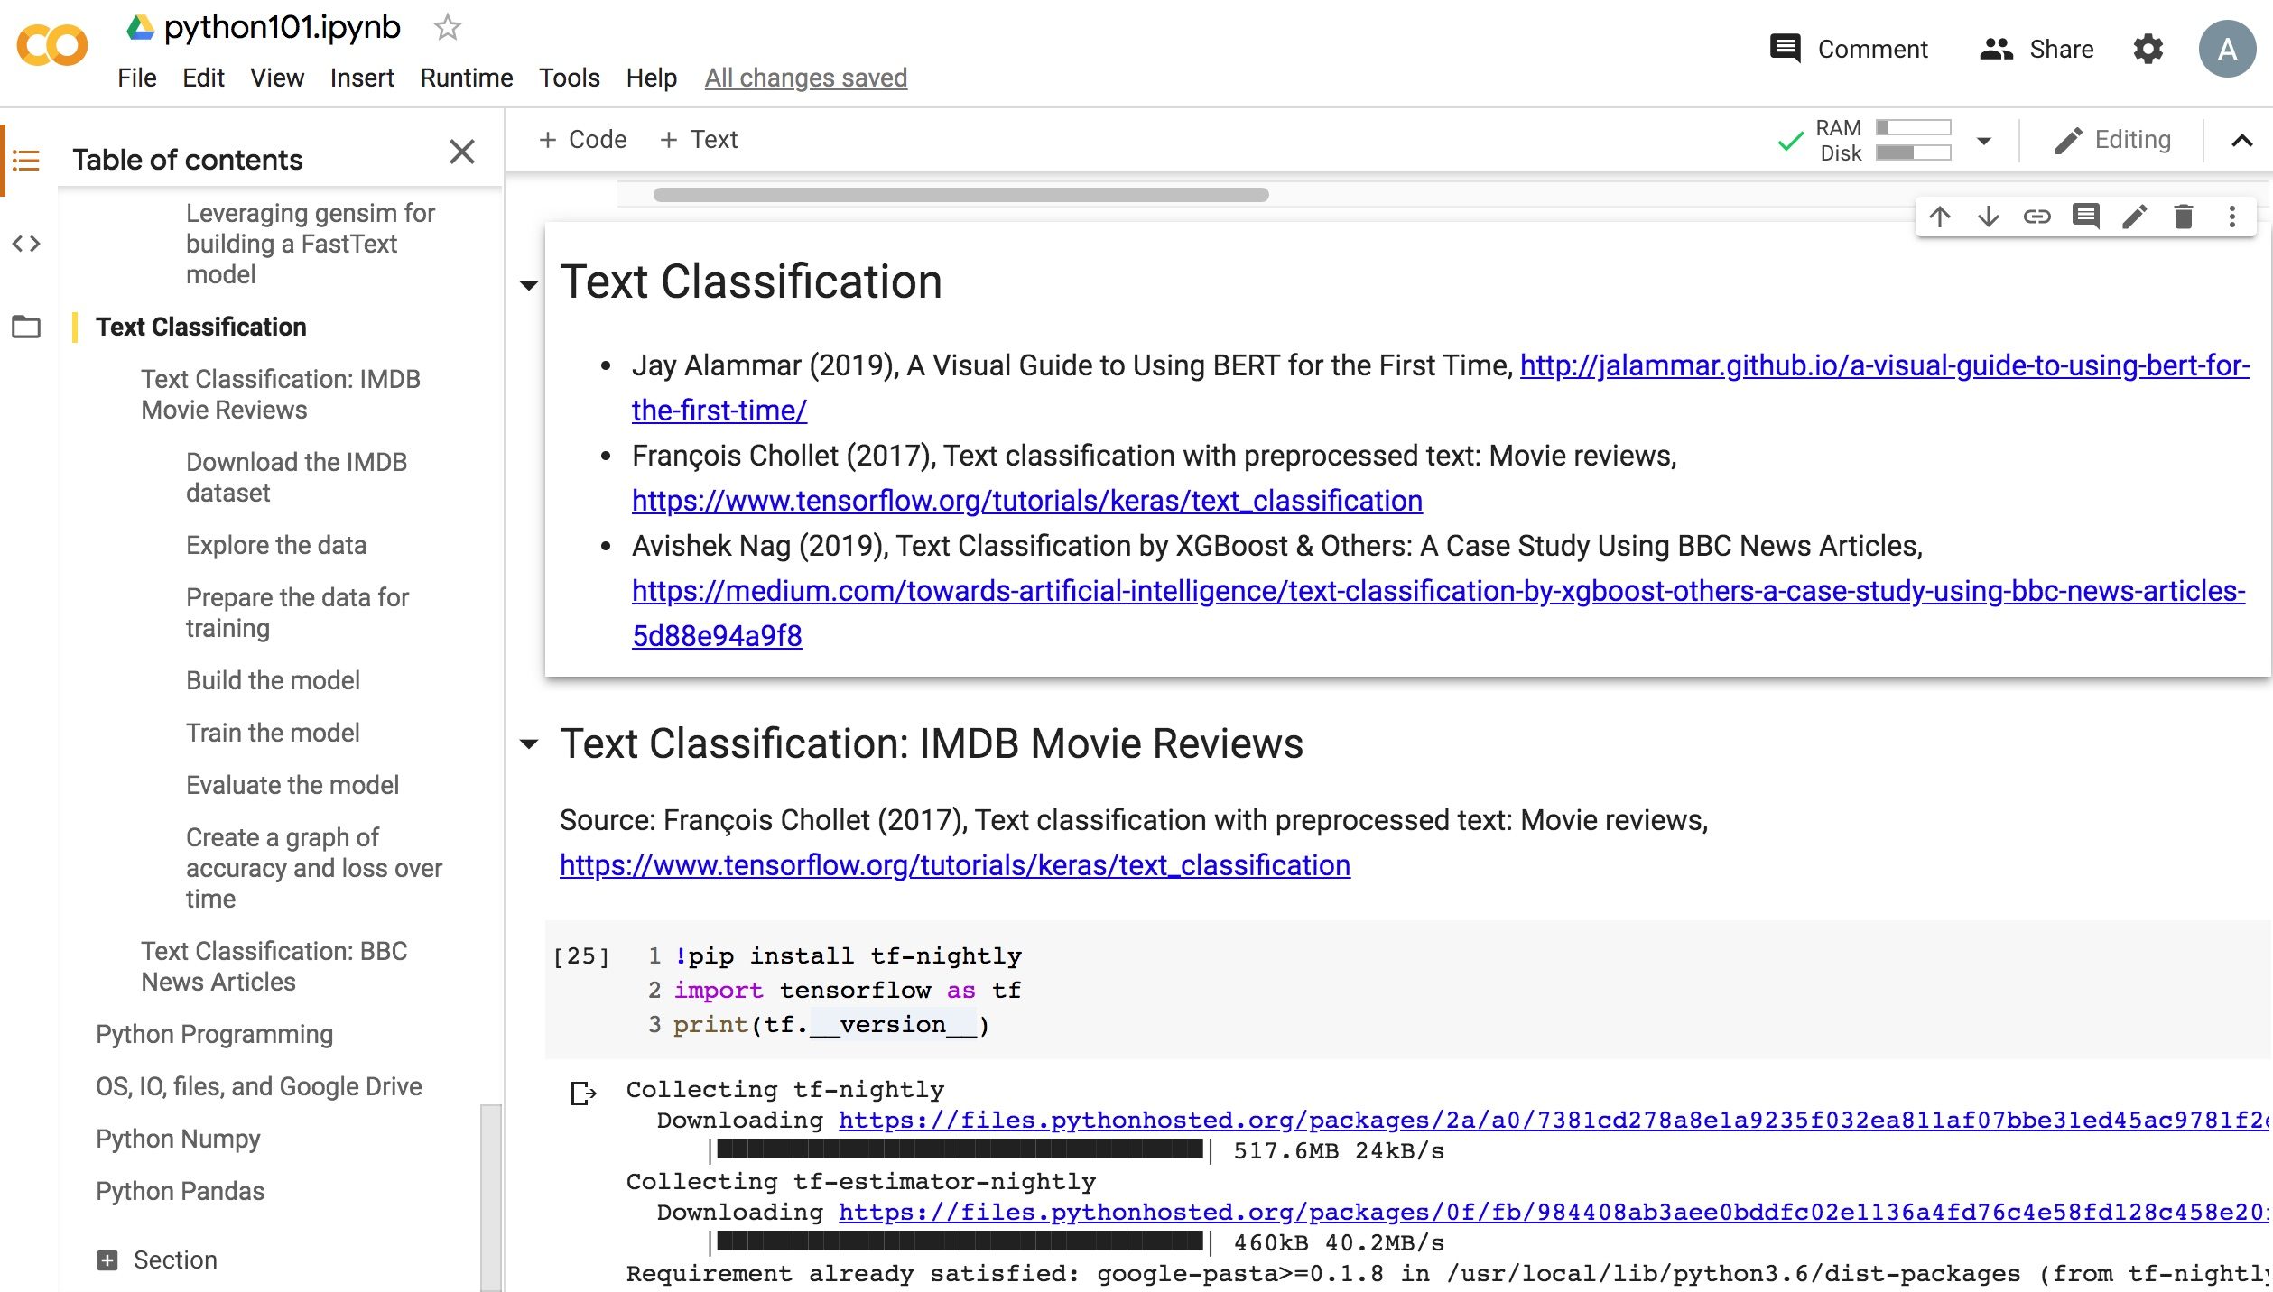
Python in Google Colab (Python101)
https://colab.research.google.com/drive/1FEG6DnGvwfUbeo4zJ1zTunjMqf2RkCrT
https://tinyurl.com/aintpupython101

Slide 68
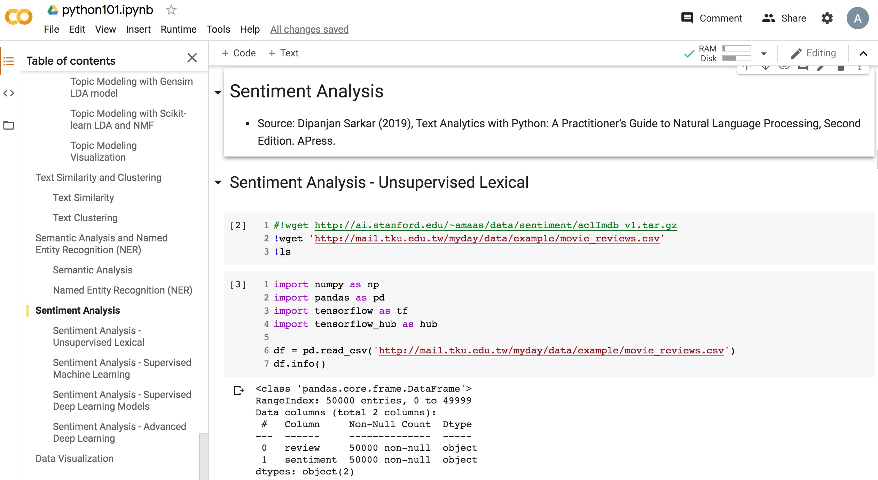
Python in Google Colab (Python101)
https://colab.research.google.com/drive/1FEG6DnGvwfUbeo4zJ1zTunjMqf2RkCrT
https://tinyurl.com/aintpupython101

Slide 69
Summary
Processing Text
Understanding Text

Slide 70
References
Ramesh Sharda, Dursun Delen, and Efraim Turban (2017), Business Intelligence, Analytics, and Data Science: A Managerial Perspective, 4th Edition, Pearson.
Dipanjan Sarkar (2019), Text Analytics with Python: A Practitioner’s Guide to Natural Language Processing, Second Edition. APress.
Benjamin Bengfort, Rebecca Bilbro, and Tony Ojeda (2018), Applied Text Analysis with Python: Enabling Language-Aware Data Products with Machine Learning, O’Reilly.
Gabe Ignatow and Rada F. Mihalcea (2017), An Introduction to Text Mining: Research Design, Data Collection, and Analysis, SAGE Publications.
Rajesh Arumugam (2018), Hands-On Natural Language Processing with Python: A practical guide to applying deep learning architectures to your NLP applications, Packt.
Devlin, Jacob, Ming-Wei Chang, Kenton Lee, and Kristina Toutanova (2018). "BERT: Pre-training of Deep Bidirectional Transformers for Language Understanding." arXiv preprint arXiv:1810.04805.
Steven Bird, Ewan Klein and Edward Loper (2009), Natural Language Processing with Python, O'Reilly Media, http://www.nltk.org/book/ , http://www.nltk.org/book_1ed/
Jay Alammar (2019), A Visual Guide to Using BERT for the First Time, http://jalammar.github.io/a-visual-guide-to-using-bert-for-the-first-time/
François Chollet (2017), Text classification with preprocessed text: Movie reviews, https://www.tensorflow.org/tutorials/keras/text_classification
Google Developers (2020), Machine Learning Guides: Text Classification, https://developers.google.com/machine-learning/guides/text-classification
Avishek Nag (2019), Text Classification by XGBoost & Others: A Case Study Using BBC News Articles, https://medium.com/towards-artificial-intelligence/text-classification-by-xgboost-others-a-case-study-using-bbc-news-articles-5d88e94a9f8
The Super Duper NLP Repo, https://notebooks.quantumstat.com/
Min-Yuh Day (2020), Python 101, https://tinyurl.com/aintpupython101

