Slide 1
人工智慧文本分析 (AI for Text Analytics)
Tamkang University
情感分析 (Sentiment Analysis)
1091AITA10
MBA, IMTKU (M2455) (8418) (Fall 2020) Thu 3, 4 (10:10-12:00) (B206)
Min-Yuh Day
戴敏育
Associate Professor
副教授
Institute of Information Management, National Taipei University
國立臺北大學 資訊管理研究所
https://web.ntpu.edu.tw/~myday
2020-12-10

Slide 2
課程大綱 (Syllabus)
週次 (Week) 日期 (Date) 內容 (Subject/Topics)
1 2020/09/17 人工智慧文本分析課程介紹 (Course Orientation on Artificial Intelligence for Text Analytics)
2 2020/09/24 文本分析的基礎：自然語言處理 (Foundations of Text Analytics: Natural Language Processing; NLP)
3 2020/10/01 中秋節 (Mid-Autumn Festival) 放假一天 (Day off)
4 2020/10/08 Python自然語言處理 (Python for Natural Language Processing)
5 2020/10/15 處理和理解文本 (Processing and Understanding Text)
6 2020/10/22 文本表達特徵工程 (Feature Engineering for Text Representation)

Slide 3
課程大綱 (Syllabus)
週次 (Week) 日期 (Date) 內容 (Subject/Topics)
7 2020/10/29 人工智慧文本分析個案研究 I (Case Study on Artificial Intelligence for Text Analytics I)
8 2020/11/05 文本分類 (Text Classification)
9 2020/11/12 文本摘要和主題模型 (Text Summarization and Topic Models)
10 2020/11/19 期中報告 (Midterm Project Report)
11 2020/11/26 文本相似度和分群 (Text Similarity and Clustering)
12 2020/12/03 語意分析和命名實體識別 (Semantic Analysis and Named Entity Recognition; NER)

Slide 4
課程大綱 (Syllabus)
週次 (Week) 日期 (Date) 內容 (Subject/Topics)
13 2020/12/10 情感分析 (Sentiment Analysis)
14 2020/12/17 人工智慧文本分析個案研究 II (Case Study on Artificial Intelligence for Text Analytics II)
15 2020/12/24 深度學習和通用句子嵌入模型 (Deep Learning and Universal Sentence-Embedding Models)
16 2020/12/31 問答系統與對話系統 (Question Answering and Dialogue Systems)
17 2021/01/07 期末報告 I (Final Project Presentation I)
18 2021/01/14 期末報告 II (Final Project Presentation II)

Slide 5
Sentiment Analysis

Slide 6
Outline
Unsupervised lexicon-based models
Traditional supervised machine learning models
Supervised deep learning models
Advanced supervised deep learning models

Slide 7
NLP
Source: http://blog.aylien.com/leveraging-deep-learning-for-multilingual/

Slide 8
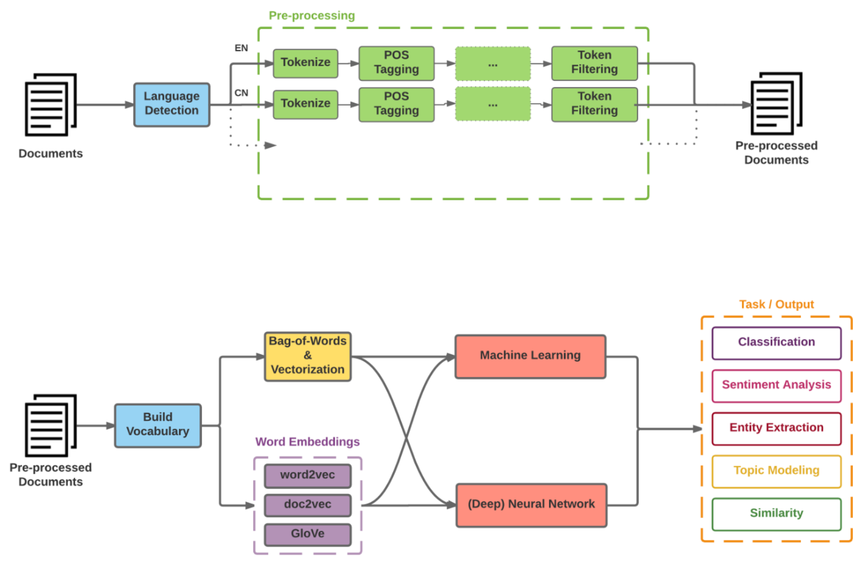
Modern NLP Pipeline
Source: https://github.com/fortiema/talks/blob/master/opendata2016sh/pragmatic-nlp-opendata2016sh.pdf

Slide 9
Modern NLP Pipeline
Source: http://mattfortier.me/2017/01/31/nlp-intro-pt-1-overview/

Slide 10
Deep Learning NLP
Source: http://mattfortier.me/2017/01/31/nlp-intro-pt-1-overview/

Slide 11
Natural Language Processing (NLP) and Text Mining
Raw text
Sentence Segmentation
Tokenization
Part-of-Speech (POS)
Stop word removal
word’s stem
am → am
having → hav
word’s lemma
am → be
having → have
Stemming / Lemmatization
Dependency Parser
String Metrics & Matching
Source: Nitin Hardeniya (2015), NLTK Essentials, Packt Publishing; Florian Leitner (2015), Text mining - from Bayes rule to dependency parsing

Slide 12
Large Movie Review Dataset
Large Movie Review Dataset v1.0
Andrew L. Maas, Raymond E. Daly, Peter T. Pham, Dan Huang, Andrew Y. Ng, and Christopher Potts. (2011). Learning Word Vectors for Sentiment Analysis. The 49th Annual Meeting of the Association for Computational Linguistics (ACL 2011).
http://ai.stanford.edu/~amaas/data/sentiment/
http://ai.stanford.edu/~amaas/data/sentiment/aclImdb_v1.tar.gz

Slide 13
Sentiment Analysis: Unsupervised Lexicon-Based Models
Bing Liu’s lexicon
TextBlob lexicon
SentiWordNet lexicon
VADER lexicon
MPQA subjectivity lexicon
Pattern lexicon
AFINN lexicon
Source: Dipanjan Sarkar (2019), Text Analytics with Python: A Practitioner’s Guide to Natural Language Processing, Second Edition. APress.

Slide 14
Bing Liu (2015), Sentiment Analysis: Mining Opinions, Sentiments, and Emotions, Cambridge University Press
http://www.amazon.com/Sentiment-Analysis-Opinions-Sentiments-Emotions/dp/1107017890

Slide 15
Emotions
Love
Anger
Joy
Sadness
Surprise
Fear
Source: Bing Liu (2011) , “Web Data Mining: Exploring Hyperlinks, Contents, and Usage Data,” Springer, 2nd Edition,

Slide 16
Example of Opinion: review segment on iPhone
“I bought an iPhone a few days ago.
It was such a nice phone.
The touch screen was really cool.
The voice quality was clear too.
However, my mother was mad with me as I did not tell her before I bought it.
She also thought the phone was too expensive, and wanted me to return it to the shop. … ”
Source: Bing Liu (2011) , “Web Data Mining: Exploring Hyperlinks, Contents, and Usage Data,” Springer, 2nd Edition,

Slide 17
Example of Opinion: review segment on iPhone
“(1) I bought an iPhone a few days ago.
(2) It was such a nice phone.
(3) The touch screen was really cool.
(4) The voice quality was clear too.
(5) However, my mother was mad with me as I did not tell her before I bought it.
(6) She also thought the phone was too expensive, and wanted me to return it to the shop. … ”
+Positive Opinion
-Negative Opinion
Source: Bing Liu (2011) , “Web Data Mining: Exploring Hyperlinks, Contents, and Usage Data,” Springer, 2nd Edition,

Slide 18
Sentiment Analysis and Opinion Mining
Computational study of opinions, sentiments, subjectivity, evaluations, attitudes, appraisal, affects, views, emotions, ets., expressed in text.
Reviews, blogs, discussions, news, comments, feedback, or any other documents
Source: Bing Liu (2011) , “Web Data Mining: Exploring Hyperlinks, Contents, and Usage Data,” Springer, 2nd Edition,

Slide 19
Research Area of Opinion Mining
Many names and tasks with difference objective and models
Sentiment analysis
Opinion mining
Sentiment mining
Subjectivity analysis
Affect analysis
Emotion detection
Opinion spam detection
Source: Bing Liu (2011) , “Web Data Mining: Exploring Hyperlinks, Contents, and Usage Data,” Springer, 2nd Edition,

Slide 20
Sentiment Analysis
Sentiment
A thought, view, or attitude, especially one based mainly on emotion instead of reason
Sentiment Analysis
opinion mining
use of natural language processing (NLP) and computational techniques to automate the extraction or classification of sentiment from typically unstructured text

Slide 21
Applications of Sentiment Analysis
Consumer information
Product reviews
Marketing
Consumer attitudes
Trends
Politics
Politicians want to know voters’ views
Voters want to know policitians’ stances and who else supports them
Social
Find like-minded individuals or communities

Slide 22
Sentiment detection
How to interpret features for sentiment detection?
Bag of words (IR)
Annotated lexicons (WordNet, SentiWordNet)
Syntactic patterns
Which features to use?
Words (unigrams)
Phrases/n-grams
Sentences

Slide 23
Problem statement of Opinion Mining
Two aspects of abstraction
Opinion definition
What is an opinion?
What is the structured definition of opinion?
Opinion summarization
Opinion are subjective
An opinion from a single person (unless a VIP) is often not sufficient for action
We need opinions from many people, and thus opinion summarization.
Source: Bing Liu (2011) , “Web Data Mining: Exploring Hyperlinks, Contents, and Usage Data,” Springer, 2nd Edition,

Slide 24
What is an opinion?
Id: Abc123 on 5-1-2008 “I bought an iPhone a few days ago. It is such a nice phone. The touch screen is really cool. The voice quality is clear too. It is much better than my old Blackberry, which was a terrible phone and so difficult to type with its tiny keys. However, my mother was mad with me as I did not tell her before I bought the phone. She also thought the phone was too expensive, …”
One can look at this review/blog at the
Document level
Is this review + or -?
Sentence level
Is each sentence + or -?
Entity and feature/aspect level
Source: Bing Liu (2011) , “Web Data Mining: Exploring Hyperlinks, Contents, and Usage Data,” Springer, 2nd Edition,

Slide 25
Entity and aspect/feature level
Id: Abc123 on 5-1-2008 “I bought an iPhone a few days ago. It is such a nice phone. The touch screen is really cool. The voice quality is clear too. It is much better than my old Blackberry, which was a terrible phone and so difficult to type with its tiny keys. However, my mother was mad with me as I did not tell her before I bought the phone. She also thought the phone was too expensive, …”
What do we see?
Opinion targets: entities and their features/aspects
Sentiments: positive and negative
Opinion holders: persons who hold the opinions
Time: when opinion are expressed
Source: Bing Liu (2011) , “Web Data Mining: Exploring Hyperlinks, Contents, and Usage Data,” Springer, 2nd Edition,

Slide 26
Two main types of opinions
Regular opinions: Sentiment/Opinion expressions on some target entities
Direct opinions: sentiment expressions on one object:
“The touch screen is really cool.”
“The picture quality of this camera is great”
Indirect opinions: comparisons, relations expressing similarities or differences (objective or subjective) of more than one object
“phone X is cheaper than phone Y.” (objective)
“phone X is better than phone Y.” (subjective)
Comparative opinions: comparisons of more than one entity.
“iPhone is better than Blackberry.”
Source: Bing Liu (2011) , “Web Data Mining: Exploring Hyperlinks, Contents, and Usage Data,” Springer, 2nd Edition,

Slide 27
Subjective and Objective
Objective
An objective sentence expresses some factual information about the world.
“I returned the phone yesterday.”
Objective sentences can implicitly indicate opinions
“The earphone broke in two days.”
Subjective
A subjective sentence expresses some personal feelings or beliefs.
“The voice on my phone was not so clear”
Not every subjective sentence contains an opinion
“I wanted a phone with good voice quality”
➔ Subjective analysis
Source: Bing Liu (2011) , “Web Data Mining: Exploring Hyperlinks, Contents, and Usage Data,” Springer, 2nd Edition,

Slide 28
Sentiment Analysis vs. Subjectivity Analysis
Sentiment Analysis
Subjectivity Analysis
Positive
Subjective
Negative
Neutral
Objective

Slide 29
A (regular) opinion
Opinion (a restricted definition)
An opinion (regular opinion) is simply a positive or negative sentiment, view, attitude, emotion, or appraisal about an entity or an aspect of the entity from an opinion holder.
Sentiment orientation of an opinion
Positive, negative, or neutral (no opinion)
Also called:
Opinion orientation
Semantic orientation
Sentiment polarity
Source: Bing Liu (2011) , “Web Data Mining: Exploring Hyperlinks, Contents, and Usage Data,” Springer, 2nd Edition,

Slide 30
Entity and aspect
Definition of Entity:
An entity e is a product, person, event, organization, or topic.
e is represented as
A hierarchy of components, sub-components.
Each node represents a components and is associated with a set of attributes of the components
An opinion can be expressed on any node or attribute of the node
Aspects(features)
represent both components and attribute
Source: Bing Liu (2011) , “Web Data Mining: Exploring Hyperlinks, Contents, and Usage Data,” Springer, 2nd Edition,

Slide 31
Opinion Definition
An opinion is a quintuple (e_{j}, a_{jk}, so_{ijkl}, h_{i}, t_{l}) where
e_{j} is a target entity.
a_{jk} is an aspect/feature of the entity e_{j} .
so_{ijkl} is the sentiment value of the opinion from the opinion holder on feature of entity at time. so_{ijkl} is +ve, -ve, or neu, or more granular ratings
h_{i} is an opinion holder.
t_{l} is the time when the opinion is expressed.
(e_{j}, a_{jk}) is also called opinion target
Source: Bing Liu (2011) , “Web Data Mining: Exploring Hyperlinks, Contents, and Usage Data,” Springer, 2nd Edition,

Slide 32
Terminologies
Entity: object
Aspect: feature, attribute, facet
Opinion holder: opinion source
Topic: entity, aspect
Product features, political issues
Source: Bing Liu (2011) , “Web Data Mining: Exploring Hyperlinks, Contents, and Usage Data,” Springer, 2nd Edition,

Slide 33
Subjectivity and Emotion
Sentence subjectivity
An objective sentence presents some factual information, while a subjective sentence expresses some personal feelings, views, emotions, or beliefs.
Emotion
Emotions are people’s subjective feelings and thoughts.
Source: Bing Liu (2011) , “Web Data Mining: Exploring Hyperlinks, Contents, and Usage Data,” Springer, 2nd Edition,

Slide 34
Classification Based on Supervised Learning
Sentiment classification
Supervised learning Problem
Three classes
Positive
Negative
Neutral
Source: Bing Liu (2011) , “Web Data Mining: Exploring Hyperlinks, Contents, and Usage Data,” Springer, 2nd Edition,

Slide 35
Opinion words in Sentiment classification
topic-based classification
topic-related words are important
e.g., politics, sciences, sports
Sentiment classification
topic-related words are unimportant
opinion words (also called sentiment words)
that indicate positive or negative opinions are important, e.g., great, excellent, amazing, horrible, bad, worst
Source: Bing Liu (2011) , “Web Data Mining: Exploring Hyperlinks, Contents, and Usage Data,” Springer, 2nd Edition,

Slide 36
Features in Opinion Mining
Terms and their frequency
TF-IDF
Part of speech (POS)
Adjectives
Opinion words and phrases
beautiful, wonderful, good, and amazing are positive opinion words
bad, poor, and terrible are negative opinion words.
opinion phrases and idioms, e.g., cost someone an arm and a leg
Rules of opinions
Negations
Syntactic dependency
Source: Bing Liu (2011) , “Web Data Mining: Exploring Hyperlinks, Contents, and Usage Data,” Springer, 2nd Edition,

Slide 37
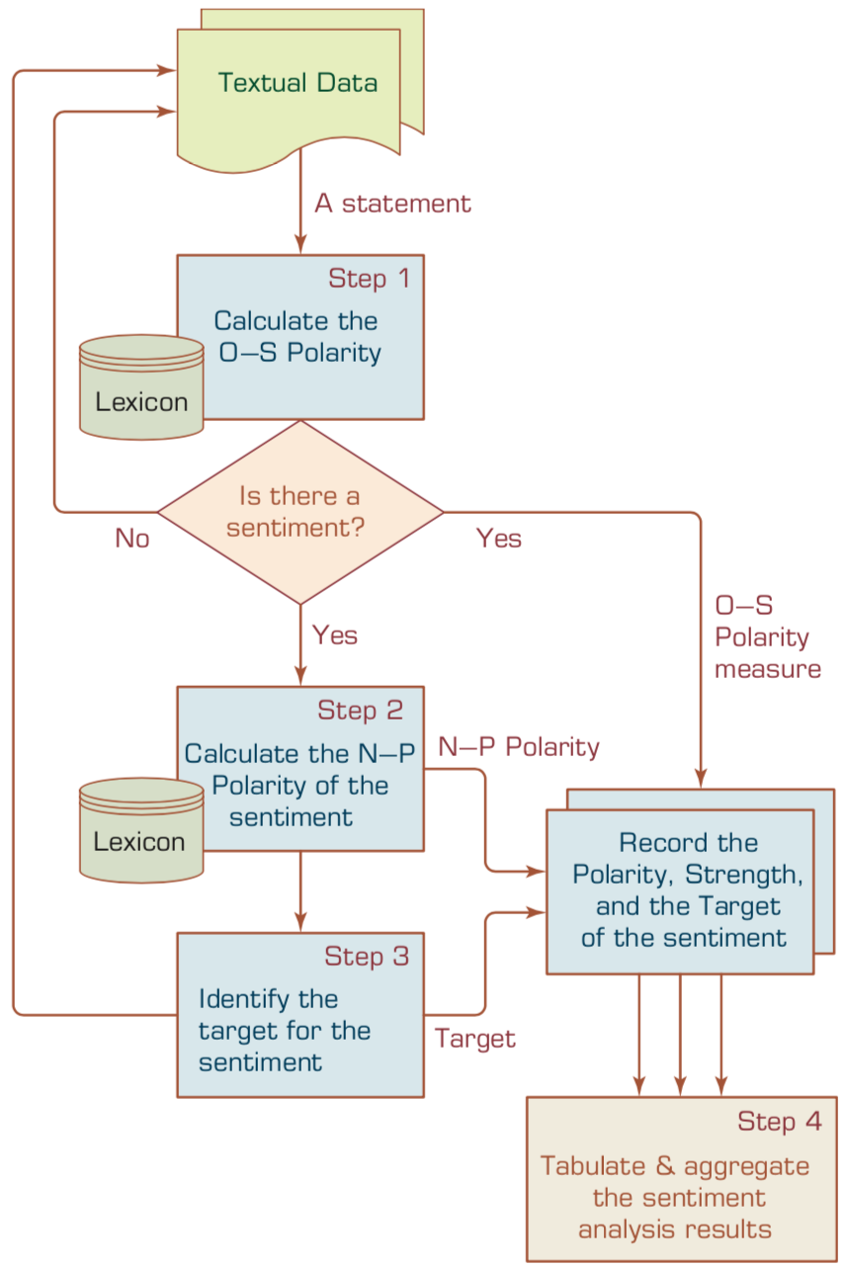
A Multistep Process to Sentiment Analysis
Source: Ramesh Sharda, Dursun Delen, and Efraim Turban (2017), Business Intelligence, Analytics, and Data Science: A Managerial Perspective, 4th Edition, Pearson

Slide 38
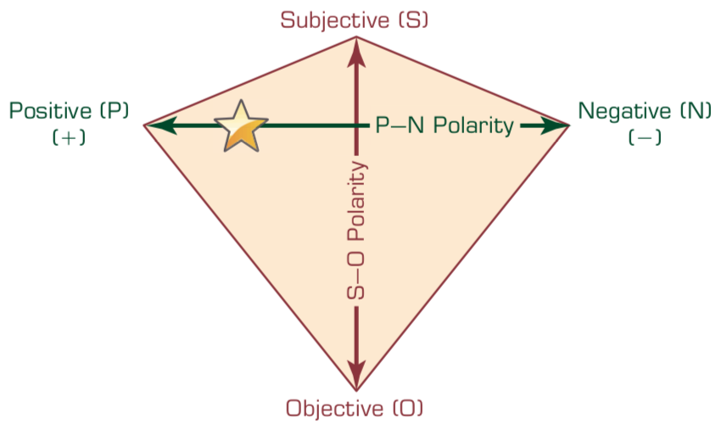
P–N Polarity and S–O Polarity Relationship
Source: Ramesh Sharda, Dursun Delen, and Efraim Turban (2017), Business Intelligence, Analytics, and Data Science: A Managerial Perspective, 4th Edition, Pearson

Slide 39
Sentiment Analysis
Subjectivity Classification
Polarity Determination
Approaches
Machine Learning based
Sentiment Classification
Vagueness resolution in opinionated text
Lexicon based
Sentiment Analysis
Review Usefulness Measurement
Multi- & Cross- Lingual SC
Hybrid approaches
Opinion Spam Detection
Cross-domain SC
Lexicon Creation
Ontology based
Tasks
Non-Ontology based
Aspect Extraction
Application
Source: Kumar Ravi and Vadlamani Ravi (2015), "A survey on opinion mining and sentiment analysis: tasks, approaches and applications." Knowledge-Based Systems, 89, pp.14-46.

Slide 40
Sentiment Classification Techniques
Decision Tree Classifiers
Support Vector Machine (SVM)
Supervised Learning
Neural Network (NN)
Machine Learning Approach
Linear Classifiers
Deep Learning (DL)
Rule-based Classifiers
Naïve Bayes (NB)
Sentiment Analysis
Unsupervised Learning
Probabilistic Classifiers
Bayesian Network (BN)
Dictionary-based Approach
Maximum Entropy (ME)
Lexicon-based Approach
Statistical
Corpus-based Approach
Semantic
Source: Jesus Serrano-Guerrero, Jose A. Olivas, Francisco P. Romero, and Enrique Herrera-Viedma (2015), "Sentiment analysis: A review and comparative analysis of web services," Information Sciences, 311, pp. 18-38.

Slide 41
Sentiment Analysis Architecture
Positive tweets
Negative tweets
Word features
Training set
Features
extractor
Classifier
Features
extractor
Tweet
Positive
Negative
Vishal Kharde and Sheetal Sonawane (2016), "Sentiment Analysis of Twitter Data: A Survey of Techniques," International Journal of Computer Applications, Vol 139, No. 11, 2016. pp.5-15

Slide 42
Sentiment Classification Based on Emoticons
Tweeter
Tweeter Streaming API 1.1
Tweet preprocessing
Based on Positive Emotions
Based on Negative Emotions
Generate Training Dataset for Tweet
Positive tweets
Negative tweets
Test Dataset
Training Dataset
Classifier
Feature Extraction
Positive
Negative
Vishal Kharde and Sheetal Sonawane (2016), "Sentiment Analysis of Twitter Data: A Survey of Techniques," International Journal of Computer Applications, Vol 139, No. 11, 2016. pp.5-15

Slide 43
Lexicon-Based Model
Tokenized Document Collection
Preassembled Word Lists
Sentiment Scoring and Classification:
Polarity
Merged Lexicon
Generic Word Lists
Sentiment Polarity
Vishal Kharde and Sheetal Sonawane (2016), "Sentiment Analysis of Twitter Data: A Survey of Techniques," International Journal of Computer Applications, Vol 139, No. 11, 2016. pp.5-15

Slide 44
Sentiment Analysis Tasks
Object/Feature extraction
Opinionated Document
Subjectivity Classification
Sentiment Classification
Opinion holder extraction
Vishal Kharde and Sheetal Sonawane (2016), "Sentiment Analysis of Twitter Data: A Survey of Techniques," International Journal of Computer Applications, Vol 139, No. 11, 2016. pp.5-15

Slide 45
Levels of Sentiment Analysis
Sentiment Analysis
Word level
Sentiment Analysis
Sentence level
Sentiment Analysis
Document level
Sentiment Analysis
Feature level
Sentiment Analysis
Vishal Kharde and Sheetal Sonawane (2016), "Sentiment Analysis of Twitter Data: A Survey of Techniques," International Journal of Computer Applications, Vol 139, No. 11, 2016. pp.5-15

Slide 46
Levels of Sentiment Analysis
Document level
73
Word level
25
Granularity
Aspect level
23
Sentence level
20
Concept level
9
Source: Kumar Ravi and Vadlamani Ravi (2015), "A survey on opinion mining and sentiment analysis: tasks, approaches and applications." Knowledge-Based Systems, 89, pp.14-46.

Slide 47
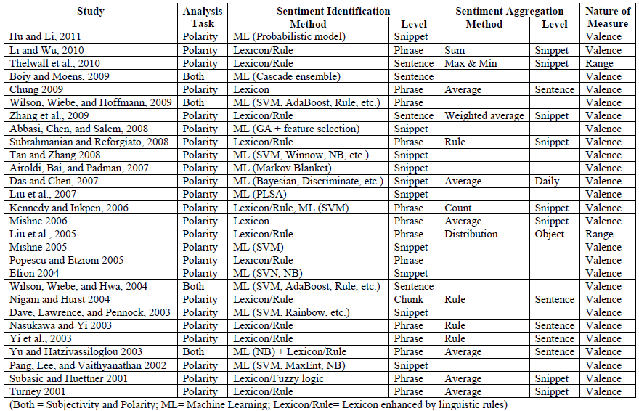
A Brief Summary of Sentiment Analysis Methods
Source: Zhang, Z., Li, X., and Chen, Y. (2012), "Deciphering word-of-mouth in social media: Text-based metrics of consumer reviews," ACM Trans. Manage. Inf. Syst. (3:1) 2012, pp 1-23.,

Slide 48
Word-of-Mouth (WOM)
“This book is the best written documentary thus far, yet sadly, there is no soft cover edition.”
“This book is the best written documentary thus far, yet sadly, there is no soft cover edition.”
Source: Zhang, Z., Li, X., and Chen, Y. (2012), "Deciphering word-of-mouth in social media: Text-based metrics of consumer reviews," ACM Trans. Manage. Inf. Syst. (3:1) 2012, pp 1-23.,

Slide 49
Word | POS
This | DT
book | NN
is | VBZ
the | DT
best | JJS
written | VBN
documentary | NN
thus | RB
far | RB
, | ,
yet | RB
sadly | RB
, | ,
there | EX
is | VBZ
no | DT
soft | JJ
cover | NN
edition | NN
. | .
This
book
is
the
best
written
documentary
thus
far
,
yet
sadly
,
there
is
no
soft
cover
edition
.
Source: Zhang, Z., Li, X., and Chen, Y. (2012), "Deciphering word-of-mouth in social media: Text-based metrics of consumer reviews," ACM Trans. Manage. Inf. Syst. (3:1) 2012, pp 1-23.,

Slide 50
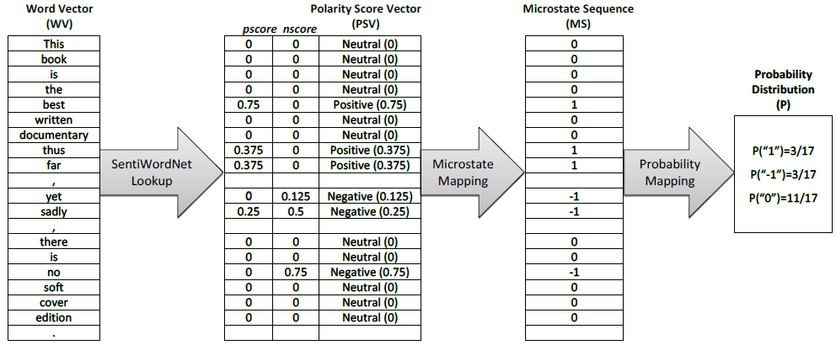
Conversion of text representation
Source: Zhang, Z., Li, X., and Chen, Y. (2012), "Deciphering word-of-mouth in social media: Text-based metrics of consumer reviews," ACM Trans. Manage. Inf. Syst. (3:1) 2012, pp 1-23.,

Slide 51
Example of SentiWordNet
POS ID PosScore NegScore SynsetTerms Gloss
a 00217728 0.75 0 beautiful#1 delighting the senses or exciting intellectual or emotional admiration; "a beautiful child"; "beautiful country"; "a beautiful painting"; "a beautiful theory"; "a beautiful party“
a 00227507 0.75 0 best#1 (superlative of `good') having the most positive qualities; "the best film of the year"; "the best solution"; "the best time for planting"; "wore his best suit“
r 00042614 0 0.625 unhappily#2 sadly#1 in an unfortunate way; "sadly he died before he could see his grandchild“
r 00093270 0 0.875 woefully#1 sadly#3 lamentably#1 deplorably#1 in an unfortunate or deplorable manner; "he was sadly neglected"; "it was woefully inadequate“
r 00404501 0 0.25 sadly#2 with sadness; in a sad manner; "`She died last night,' he said sadly"

Slide 52
SenticNet
The car is very old but it is rather not expensive.
The car is very old but it is rather not expensive.
The car is very old but it is rather not expensive.
Source: Cambria, Erik, Soujanya Poria, Rajiv Bajpai, and Björn Schuller. "SenticNet 4: A semantic resource for sentiment analysis based on conceptual primitives." In the 26th International Conference on Computational Linguistics (COLING), Osaka. 2016.

Slide 53
Polarity Detection with SenticNet
The car is very old but it is rather not expensive.
The car is very old but it is rather not expensive.
Source: Cambria, Erik, Soujanya Poria, Rajiv Bajpai, and Björn Schuller. "SenticNet 4: A semantic resource for sentiment analysis based on conceptual primitives." In the 26th International Conference on Computational Linguistics (COLING), Osaka. 2016.

Slide 54
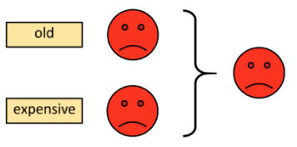
Polarity Detection with SenticNet
Source: Cambria, Erik, Soujanya Poria, Rajiv Bajpai, and Björn Schuller. "SenticNet 4: A semantic resource for sentiment analysis based on conceptual primitives." In the 26th International Conference on Computational Linguistics (COLING), Osaka. 2016.

Slide 55
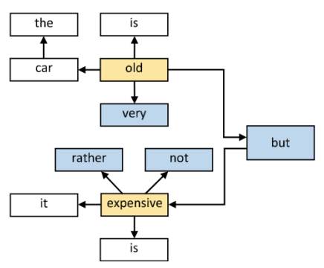
Polarity Detection with SenticNet
Source: Cambria, Erik, Soujanya Poria, Rajiv Bajpai, and Björn Schuller. "SenticNet 4: A semantic resource for sentiment analysis based on conceptual primitives." In the 26th International Conference on Computational Linguistics (COLING), Osaka. 2016.

Slide 56
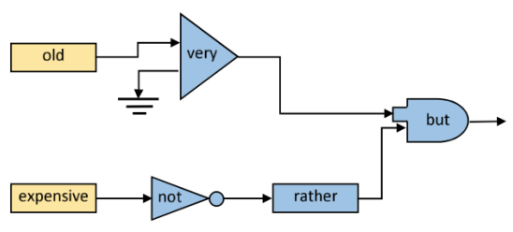
Polarity Detection with SenticNet
Source: Cambria, Erik, Soujanya Poria, Rajiv Bajpai, and Björn Schuller. "SenticNet 4: A semantic resource for sentiment analysis based on conceptual primitives." In the 26th International Conference on Computational Linguistics (COLING), Osaka. 2016.

Slide 57
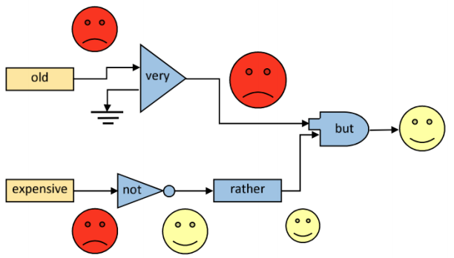
Polarity Detection with SenticNet
Source: Cambria, Erik, Soujanya Poria, Rajiv Bajpai, and Björn Schuller. "SenticNet 4: A semantic resource for sentiment analysis based on conceptual primitives." In the 26th International Conference on Computational Linguistics (COLING), Osaka. 2016.

Slide 58
Evaluation of Text Mining and Sentiment Analysis
Evaluation of Information Retrieval
Evaluation of Classification Model (Prediction)
Accuracy
Precision
Recall
F-score

Slide 59
Deep Learning for Sentiment Analytics

Slide 60
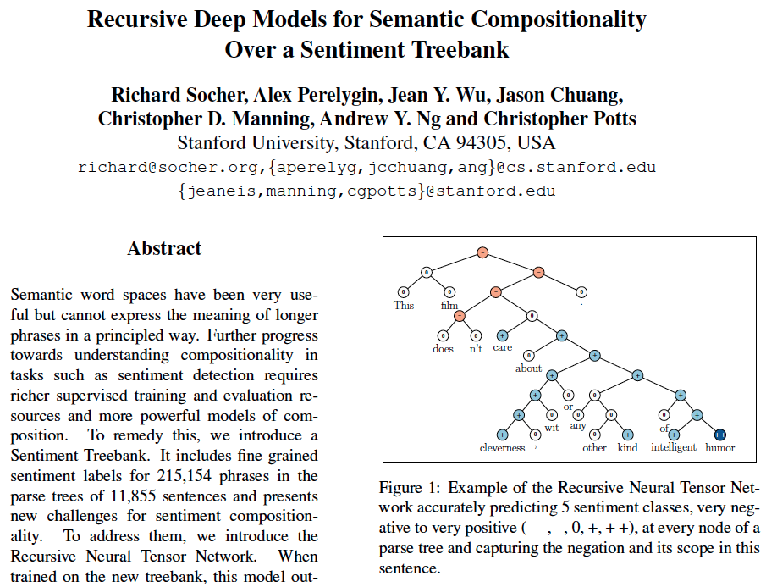
Recursive Deep Models for Semantic Compositionality Over a Sentiment Treebank
Source: Richard Socher et al. (2013) "Recursive Deep Models for Semantic Compositionality Over a Sentiment Treebank", EMNLP 2013

Slide 61
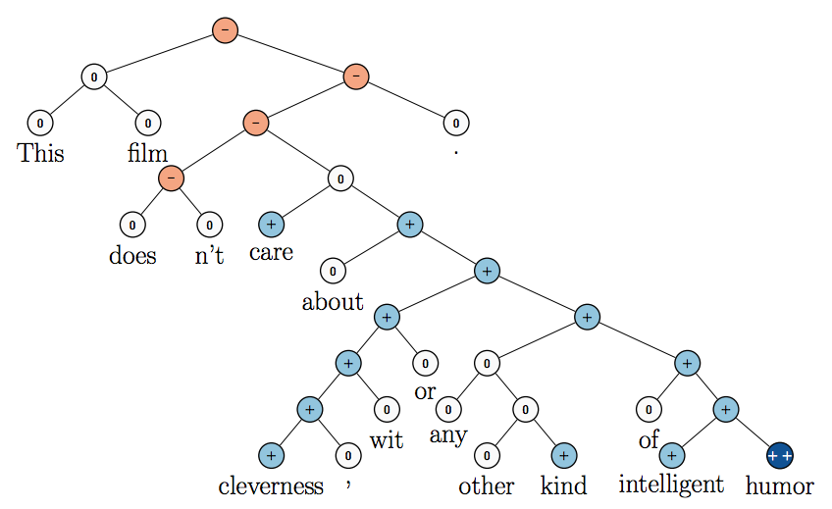
Recursive Neural Tensor Network (RNTN)
Source: Richard Socher et al. (2013) "Recursive Deep Models for Semantic Compositionality Over a Sentiment Treebank", EMNLP 2013

Slide 62
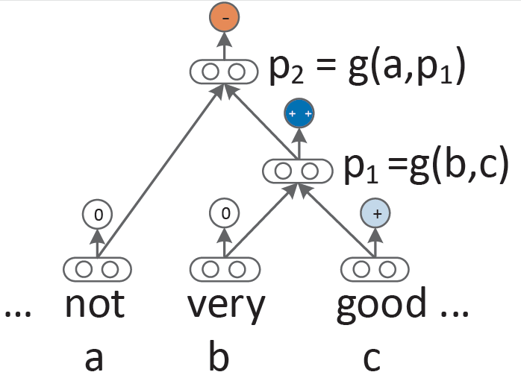
Recursive Neural Network (RNN) models for sentiment
Source: Richard Socher et al. (2013) "Recursive Deep Models for Semantic Compositionality Over a Sentiment Treebank", EMNLP 2013

Slide 63
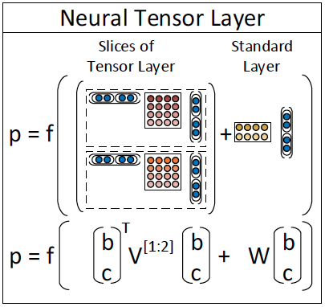
Recursive Neural Tensor Network (RNTN)
Source: Richard Socher et al. (2013) "Recursive Deep Models for Semantic Compositionality Over a Sentiment Treebank", EMNLP 2013

Slide 64
Roger Dodger is one of the most compelling variations on this theme. Roger Dodger is one of the least compelling variations on this theme.
Source: Richard Socher et al. (2013) "Recursive Deep Models for Semantic Compositionality Over a Sentiment Treebank", EMNLP 2013

Slide 65
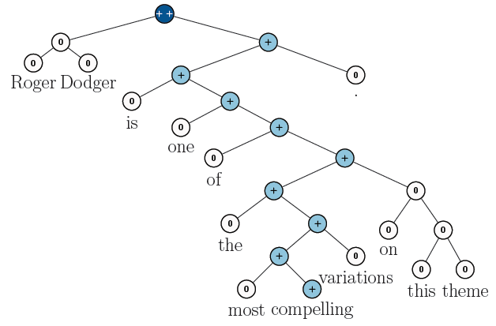
RNTN for Sentiment Analysis
Roger Dodger is one of the most compelling variations on this theme.
Source: Richard Socher et al. (2013) "Recursive Deep Models for Semantic Compositionality Over a Sentiment Treebank", EMNLP 2013

Slide 66
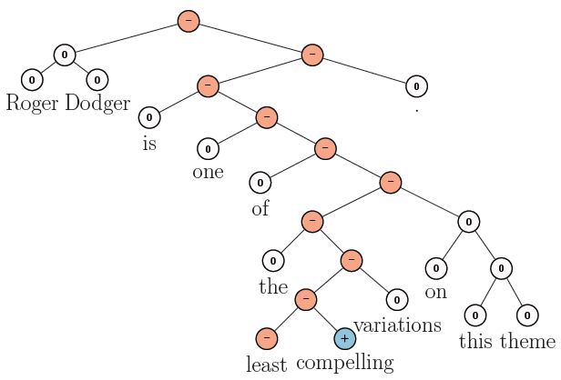
RNTN for Sentiment Analysis
Roger Dodger is one of the least compelling variations on this theme.
Source: Richard Socher et al. (2013) "Recursive Deep Models for Semantic Compositionality Over a Sentiment Treebank", EMNLP 2013

Slide 67
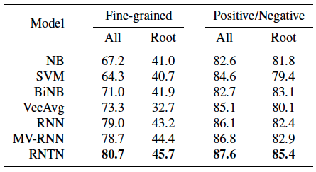
Accuracy for fine grained (5-class) and binary predictions at the sentence level (root) and for all nodes
Source: Richard Socher et al. (2013) "Recursive Deep Models for Semantic Compositionality Over a Sentiment Treebank", EMNLP 2013

Slide 68
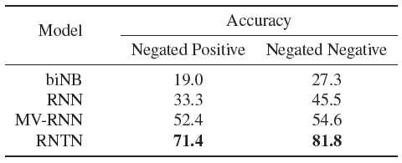
Accuracy of negation detection
Source: Richard Socher et al. (2013) "Recursive Deep Models for Semantic Compositionality Over a Sentiment Treebank", EMNLP 2013

Slide 69
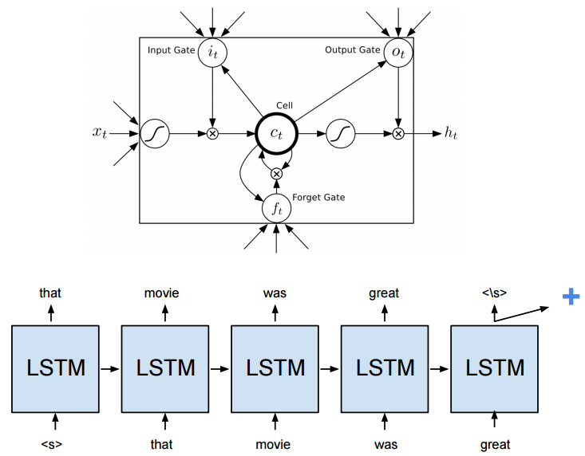
Long Short-Term Memory (LSTM)
Source: https://cs224d.stanford.edu/reports/HongJames.pdf

Slide 70
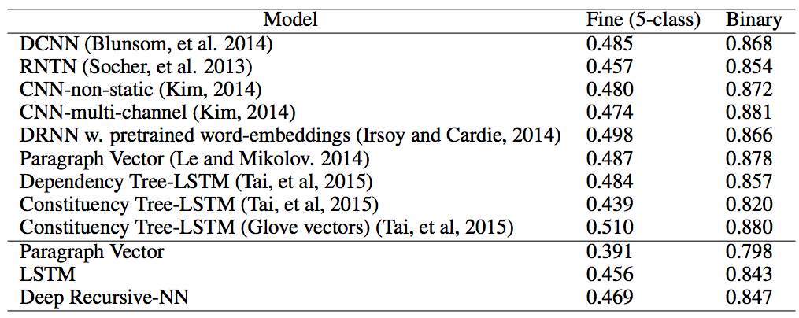
Deep Learning for Sentiment Analysis CNN RNTN LSTM
Source: https://cs224d.stanford.edu/reports/HongJames.pdf

Slide 71
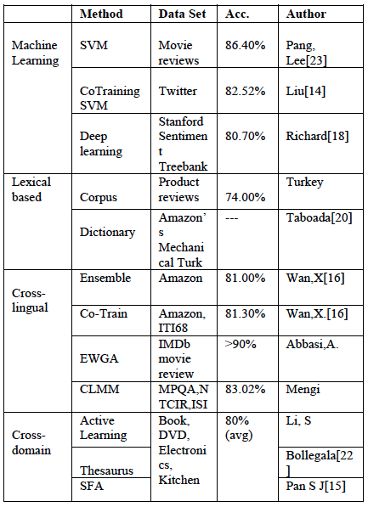
Performance Comparison of Sentiment Analysis Methods
Vishal Kharde and Sheetal Sonawane (2016), "Sentiment Analysis of Twitter Data: A Survey of Techniques," International Journal of Computer Applications, Vol 139, No. 11, 2016. pp.5-15

Slide 72
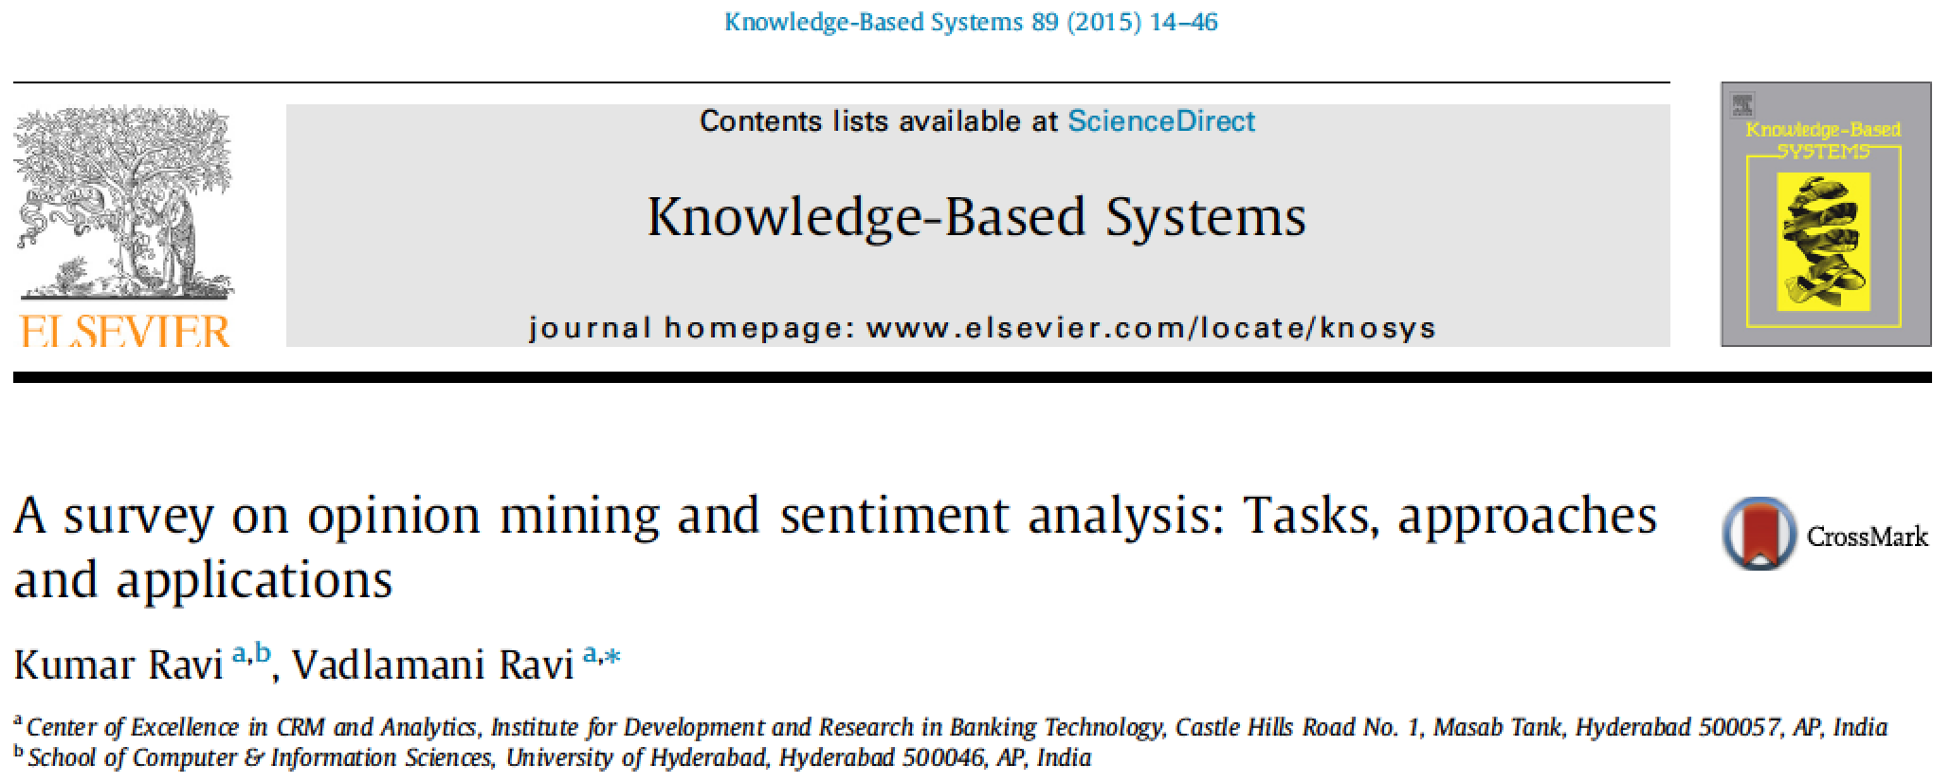
Kumar Ravi and Vadlamani Ravi (2015), "A survey on opinion mining and sentiment analysis: tasks, approaches and applications." Knowledge-Based Systems, 89, pp.14-46

Slide 73
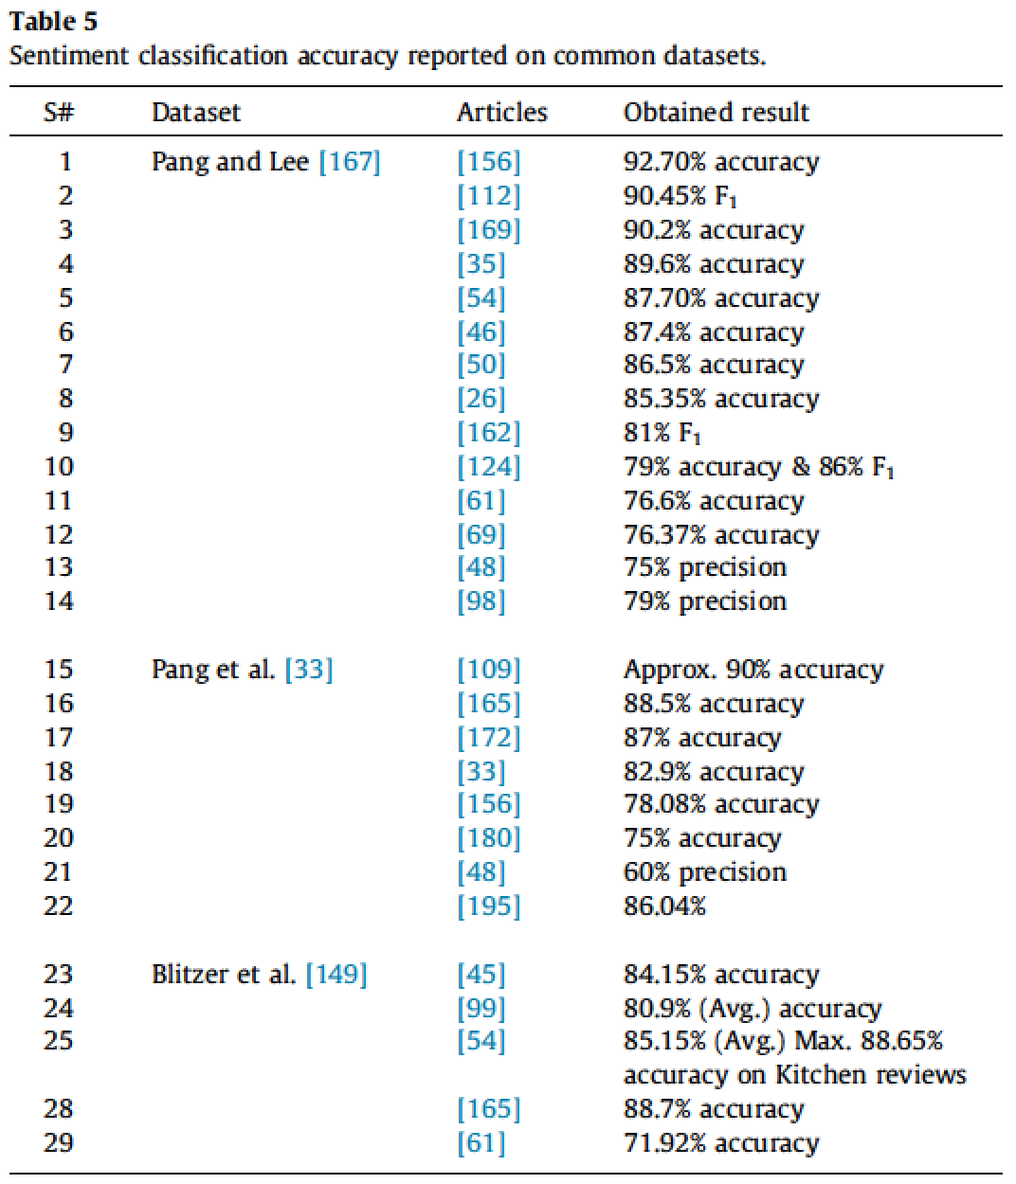
Source: Kumar Ravi and Vadlamani Ravi (2015), "A survey on opinion mining and sentiment analysis: tasks, approaches and applications." Knowledge-Based Systems, 89, pp.14-46.

Slide 74
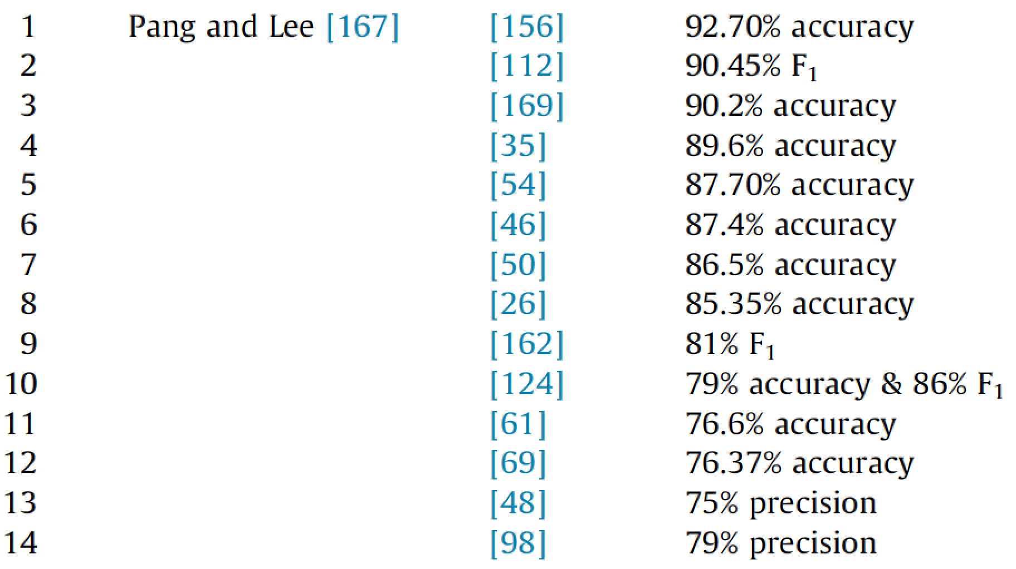
Sentiment Classification Accuracy
B. Pang, L. Lee, A sentiment education: sentiment analysis using subjectivity summarization based on minimum cuts, in: Proceedings of the 42nd Annual Meeting on Association for Computational Linguistics, July 2004, p. 271
Source: Kumar Ravi and Vadlamani Ravi (2015), "A survey on opinion mining and sentiment analysis: tasks, approaches and applications." Knowledge-Based Systems, 89, pp.14-46.

Slide 75
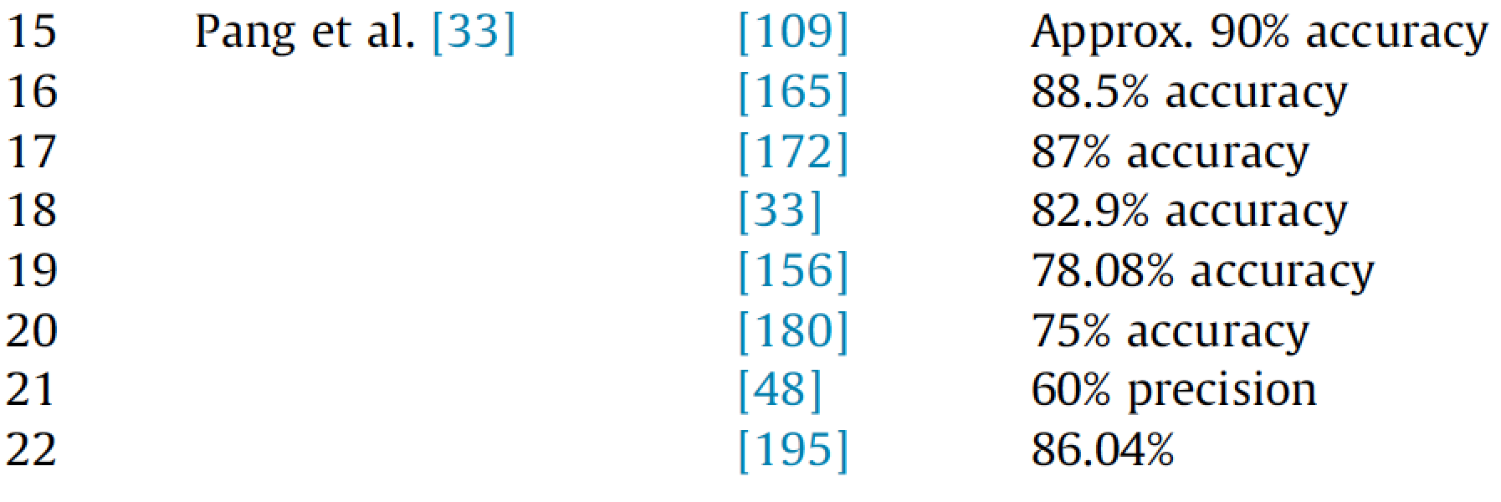
Sentiment Classification Accuracy
B. Pang, L. Lee, S. Vaithyanathan, Thumbs up? Sentiment classification using machine learning techniques, Proceedings of the ACL-02 Conference on Empirical Methods in Natural Language Processing, vol. 10, Association for Computational Linguistics, 2002, pp. 79–86.
Source: Kumar Ravi and Vadlamani Ravi (2015), "A survey on opinion mining and sentiment analysis: tasks, approaches and applications." Knowledge-Based Systems, 89, pp.14-46.

Slide 76
Sentiment Classification Accuracy
J. Blitzer, M. Dredze, F. Pereira, Biographies, bollywood, boom-boxes and blenders: domain adaptation for sentiment classification, in: Proceedings of the 45th Annual Meeting of the Association for Computational Linguistics, ACL’07, vol. 7, 2007, pp. 187–205 (13, 29).
Source: Kumar Ravi and Vadlamani Ravi (2015), "A survey on opinion mining and sentiment analysis: tasks, approaches and applications." Knowledge-Based Systems, 89, pp.14-46.

Slide 77
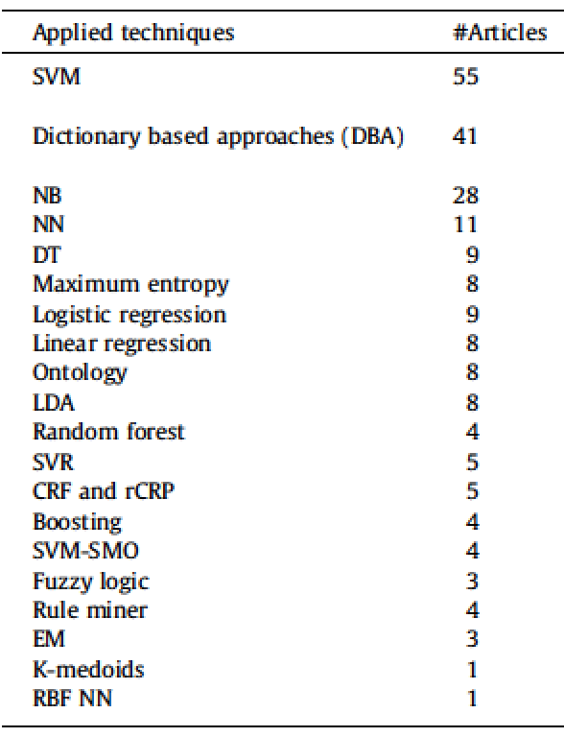
Techniques for Sentiment Analysis
Source: Kumar Ravi and Vadlamani Ravi (2015), "A survey on opinion mining and sentiment analysis: tasks, approaches and applications." Knowledge-Based Systems, 89, pp.14-46.

Slide 78
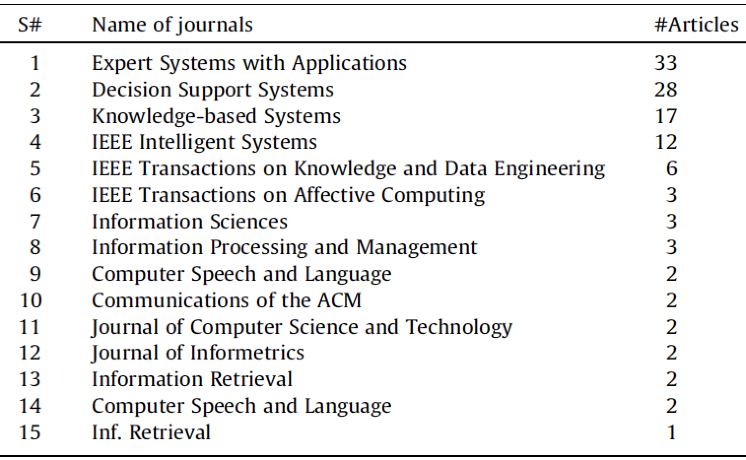
Sentiment Analysis Articles in Journals (2002-2014)
Source: Kumar Ravi and Vadlamani Ravi (2015), "A survey on opinion mining and sentiment analysis: tasks, approaches and applications." Knowledge-Based Systems, 89, pp.14-46.

Slide 79
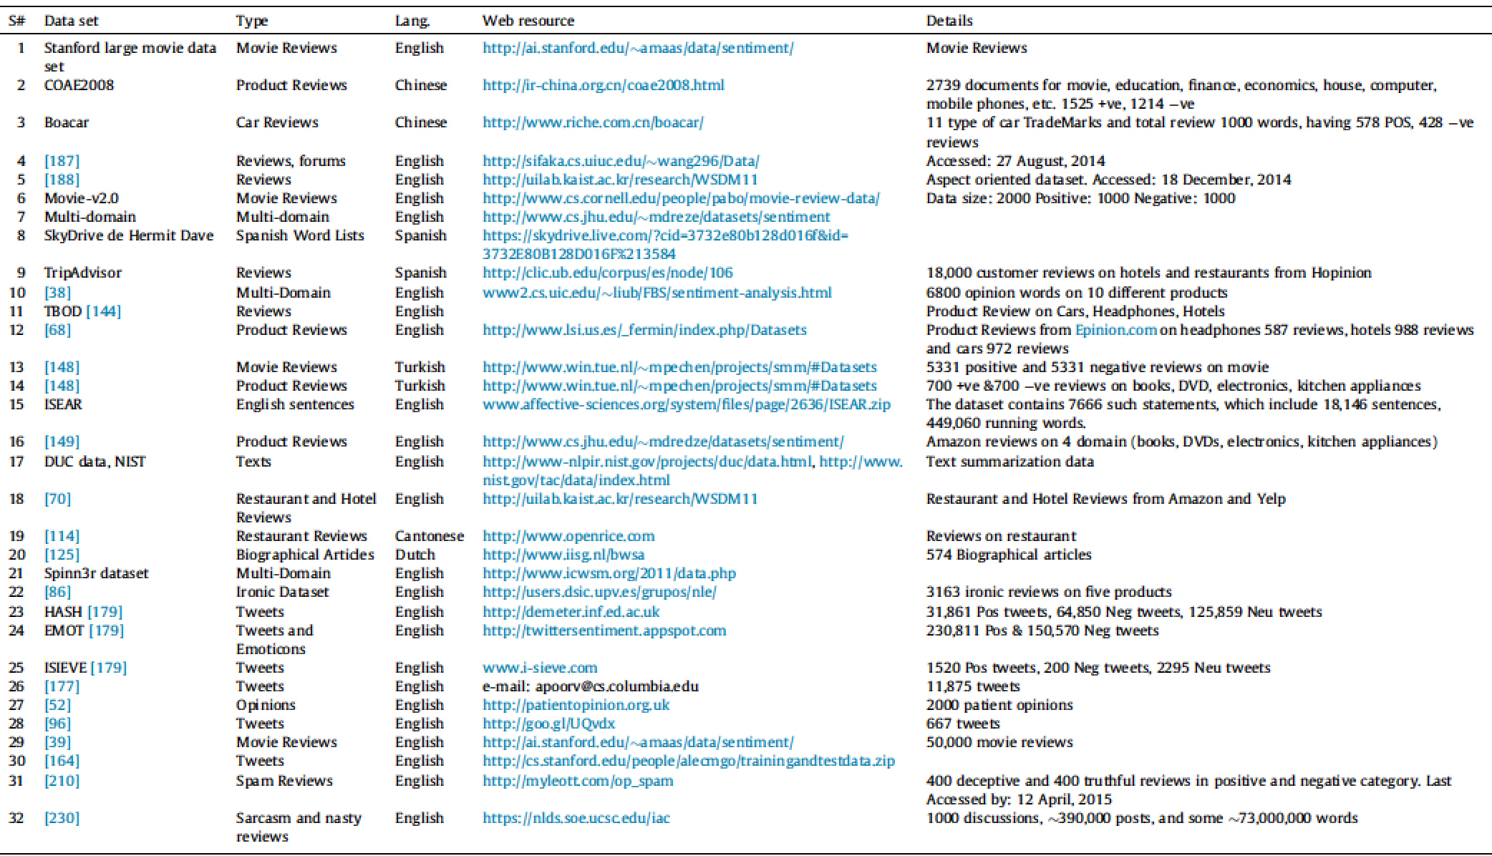
Publicly Available Datasets for Sentiment Analysis
Source: Kumar Ravi and Vadlamani Ravi (2015), "A survey on opinion mining and sentiment analysis: tasks, approaches and applications." Knowledge-Based Systems, 89, pp.14-46.

Slide 80
Sentiment Analysis Datasets
Product Reviews (PR)
Movie Reviews (MR)
Restaurant Reviews (RR)
Micro-blog (MB)
Global domain (G)
Source: Kumar Ravi and Vadlamani Ravi (2015), "A survey on opinion mining and sentiment analysis: tasks, approaches and applications." Knowledge-Based Systems, 89, pp.14-46.

Slide 81
Sentiment Analysis Dictionary
SenticNet (SN)
WordNet (WN)
ConceptNet (CN)
WordNet-Affect (WNA)
Bing Liu Opinion Lexicon (OL)
Source: Kumar Ravi and Vadlamani Ravi (2015), "A survey on opinion mining and sentiment analysis: tasks, approaches and applications." Knowledge-Based Systems, 89, pp.14-46.

Slide 82
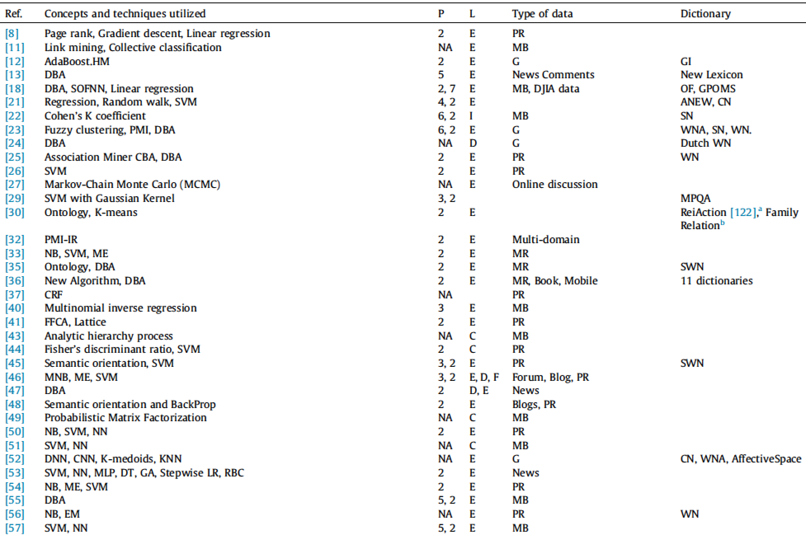
Summary of reviewed articles
Source: Kumar Ravi and Vadlamani Ravi (2015), "A survey on opinion mining and sentiment analysis: tasks, approaches and applications." Knowledge-Based Systems, 89, pp.14-46.

Slide 83
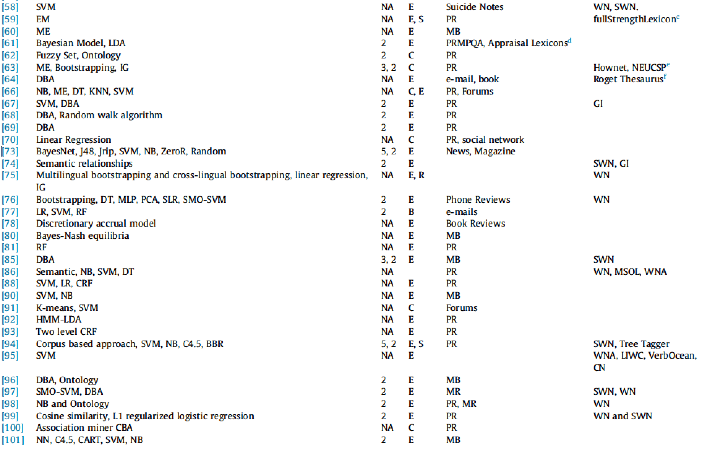
Summary of reviewed articles
Source: Kumar Ravi and Vadlamani Ravi (2015), "A survey on opinion mining and sentiment analysis: tasks, approaches and applications." Knowledge-Based Systems, 89, pp.14-46.

Slide 84
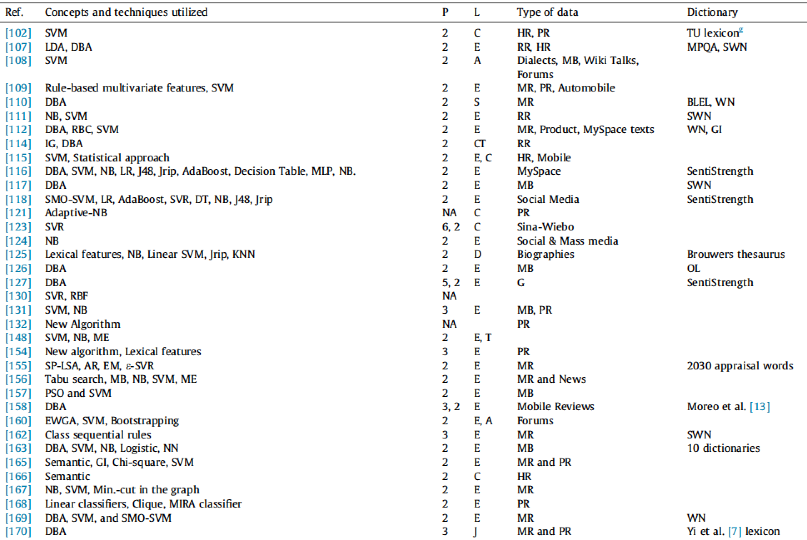
Summary of reviewed articles
Source: Kumar Ravi and Vadlamani Ravi (2015), "A survey on opinion mining and sentiment analysis: tasks, approaches and applications." Knowledge-Based Systems, 89, pp.14-46.

Slide 85
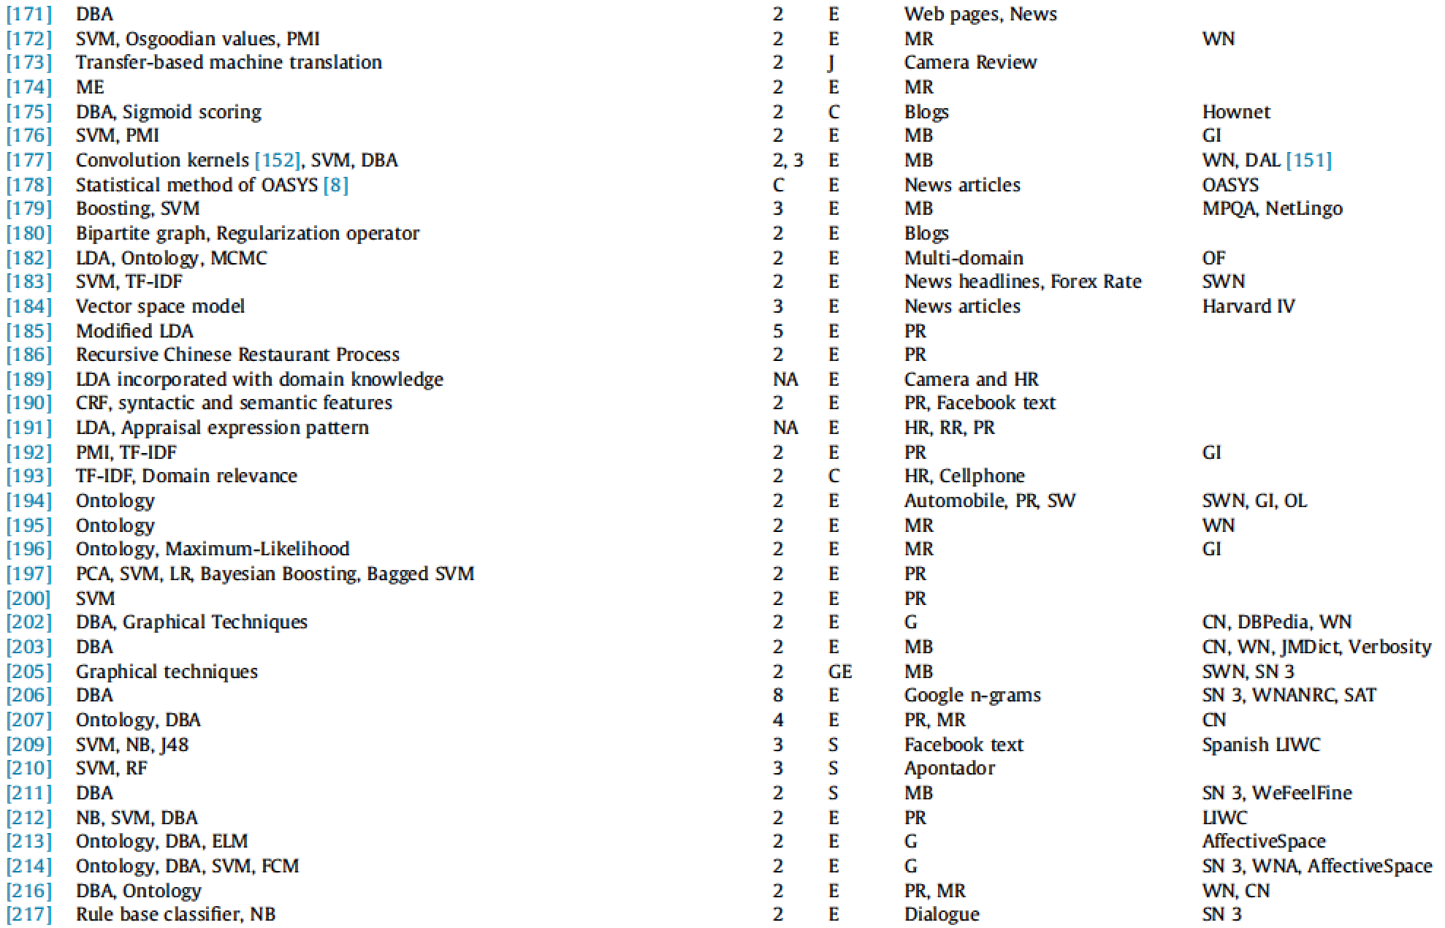
Summary of reviewed articles
Source: Kumar Ravi and Vadlamani Ravi (2015), "A survey on opinion mining and sentiment analysis: tasks, approaches and applications." Knowledge-Based Systems, 89, pp.14-46.

Slide 86
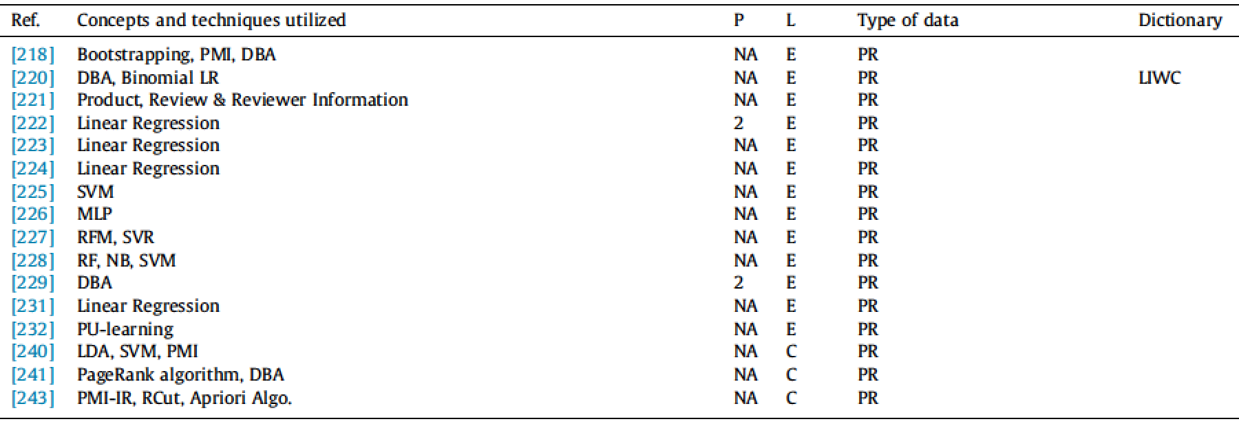
Summary of reviewed articles
Source: Kumar Ravi and Vadlamani Ravi (2015), "A survey on opinion mining and sentiment analysis: tasks, approaches and applications." Knowledge-Based Systems, 89, pp.14-46.

Slide 87
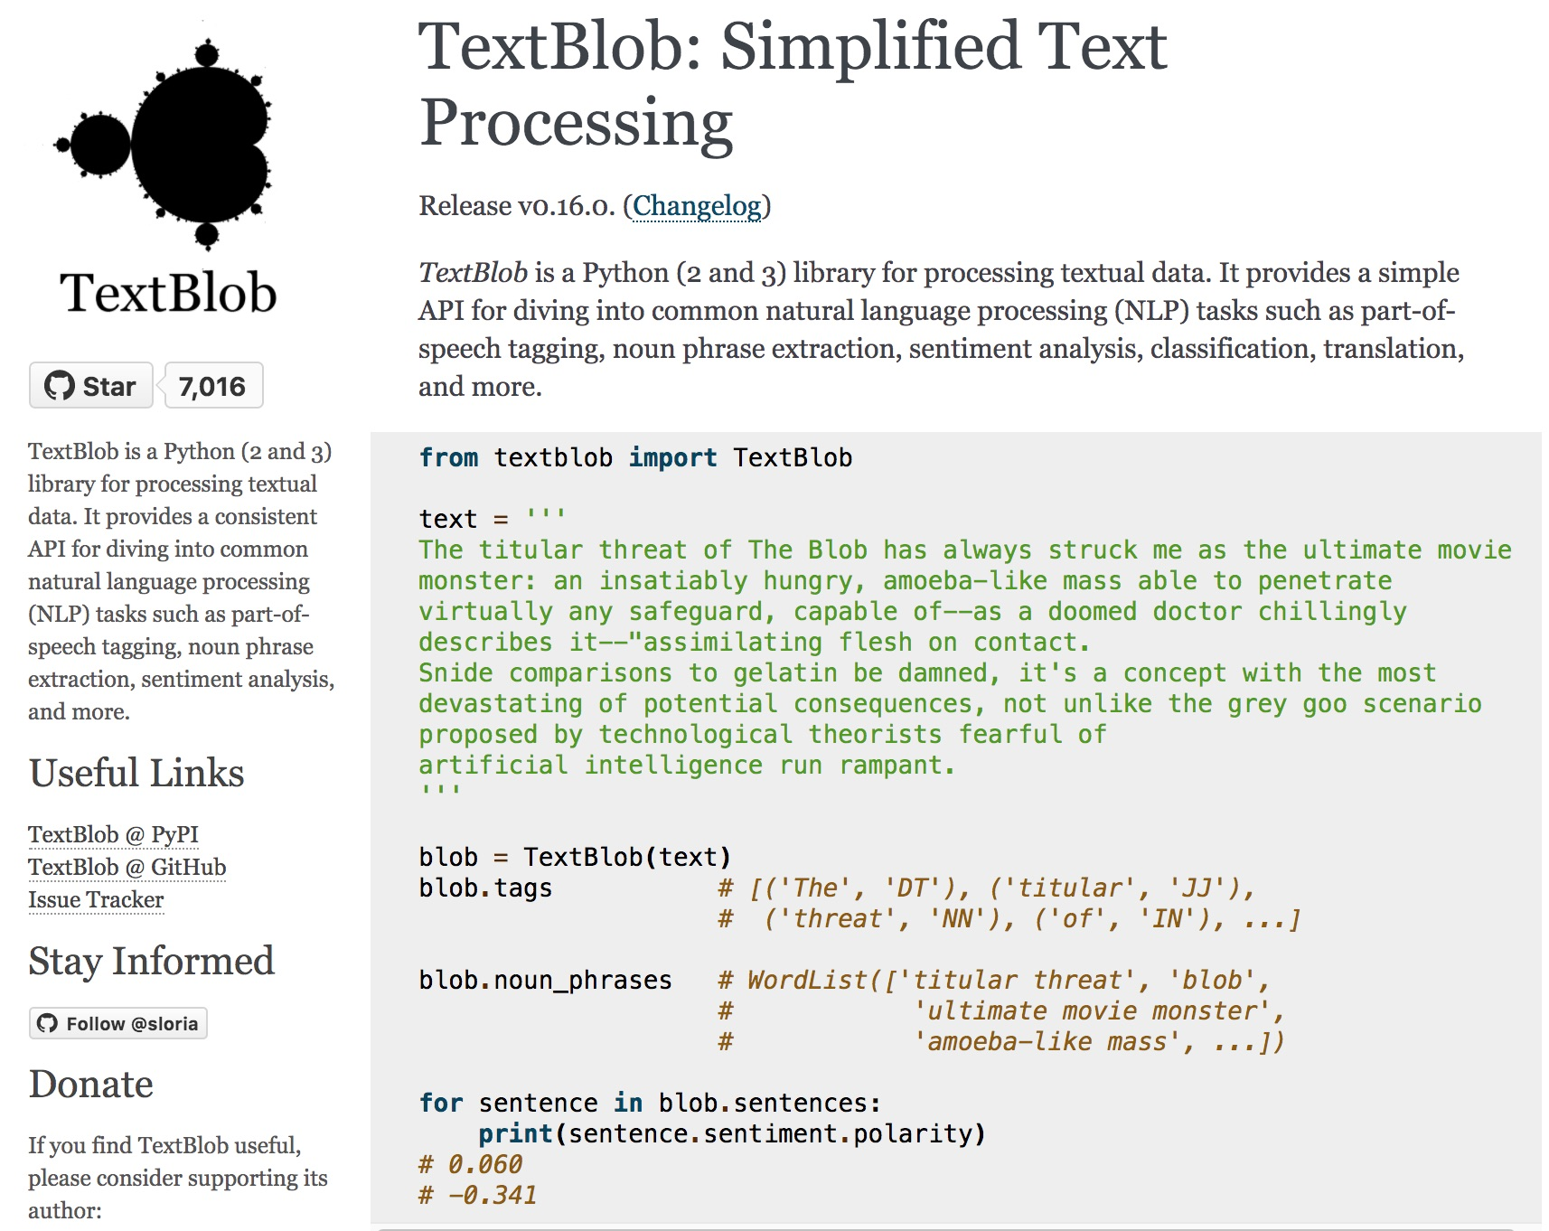
TextBlob
https://textblob.readthedocs.io

Slide 88
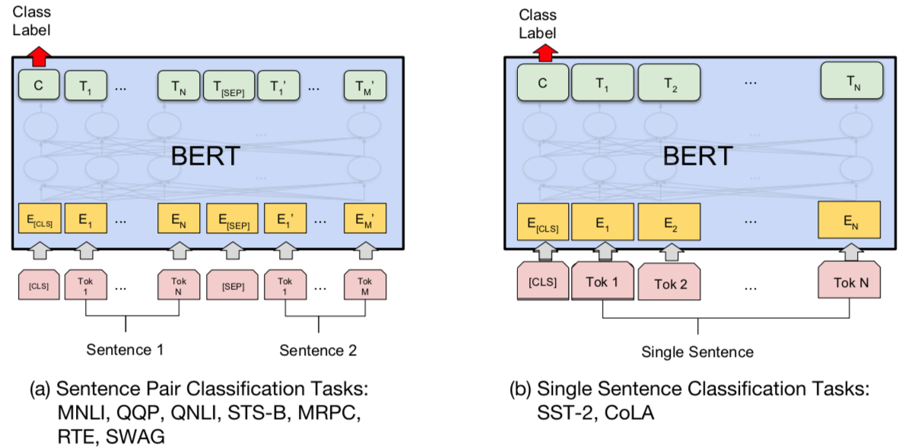
BERT Sequence-level tasks
Source: Devlin, Jacob, Ming-Wei Chang, Kenton Lee, and Kristina Toutanova (2018). "BERT: Pre-training of Deep Bidirectional Transformers for Language Understanding." arXiv preprint arXiv:1810.04805

Slide 89
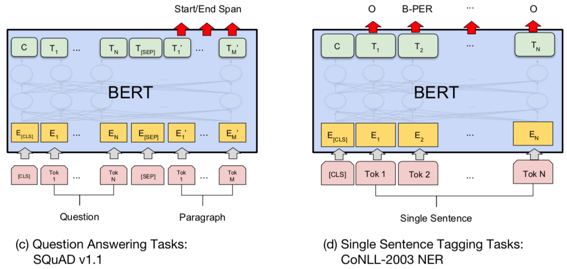
BERT Token-level tasks
Source: Devlin, Jacob, Ming-Wei Chang, Kenton Lee, and Kristina Toutanova (2018). "BERT: Pre-training of Deep Bidirectional Transformers for Language Understanding." arXiv preprint arXiv:1810.04805

Slide 90
Sentiment Analysis: Single Sentence Classification
Source: Devlin, Jacob, Ming-Wei Chang, Kenton Lee, and Kristina Toutanova (2018). "BERT: Pre-training of Deep Bidirectional Transformers for Language Understanding." arXiv preprint arXiv:1810.04805

Slide 91
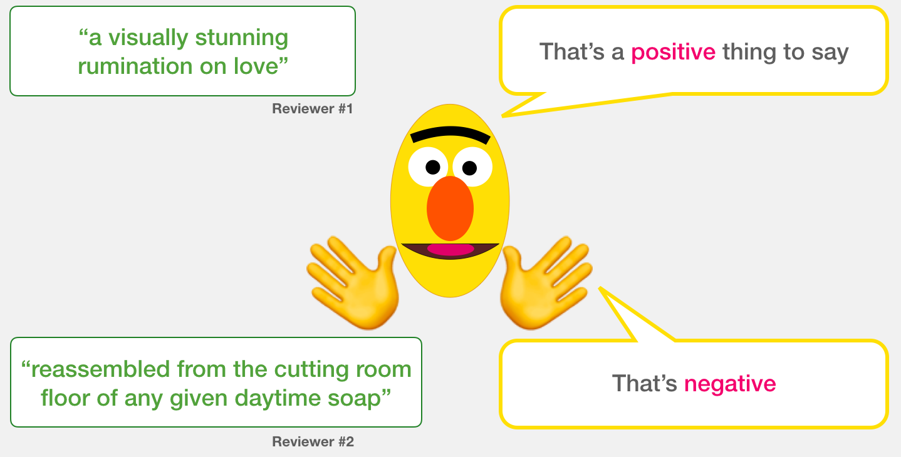
A Visual Guide to Using BERT for the First Time (Jay Alammar, 2019)
Source: Jay Alammar (2019), A Visual Guide to Using BERT for the First Time, http://jalammar.github.io/a-visual-guide-to-using-bert-for-the-first-time/

Slide 92
Sentiment Classification: SST2 Sentences from movie reviews
sentence | label
a stirring , funny and finally transporting re imagining of beauty and the beast and 1930s horror films | 1
apparently reassembled from the cutting room floor of any given daytime soap | 0
they presume their audience won't sit still for a sociology lesson | 0
this is a visually stunning rumination on love , memory , history and the war between art and commerce | 1
jonathan parker 's bartleby should have been the be all end all of the modern office anomie films | 1
Source: Jay Alammar (2019), A Visual Guide to Using BERT for the First Time, http://jalammar.github.io/a-visual-guide-to-using-bert-for-the-first-time/

Slide 93
Movie Review Sentiment Classifier
Source: Jay Alammar (2019), A Visual Guide to Using BERT for the First Time, http://jalammar.github.io/a-visual-guide-to-using-bert-for-the-first-time/

Slide 94
Movie Review Sentiment Classifier
Source: Jay Alammar (2019), A Visual Guide to Using BERT for the First Time, http://jalammar.github.io/a-visual-guide-to-using-bert-for-the-first-time/

Slide 95
Movie Review Sentiment Classifier Model Training
Source: Jay Alammar (2019), A Visual Guide to Using BERT for the First Time, http://jalammar.github.io/a-visual-guide-to-using-bert-for-the-first-time/

Slide 96
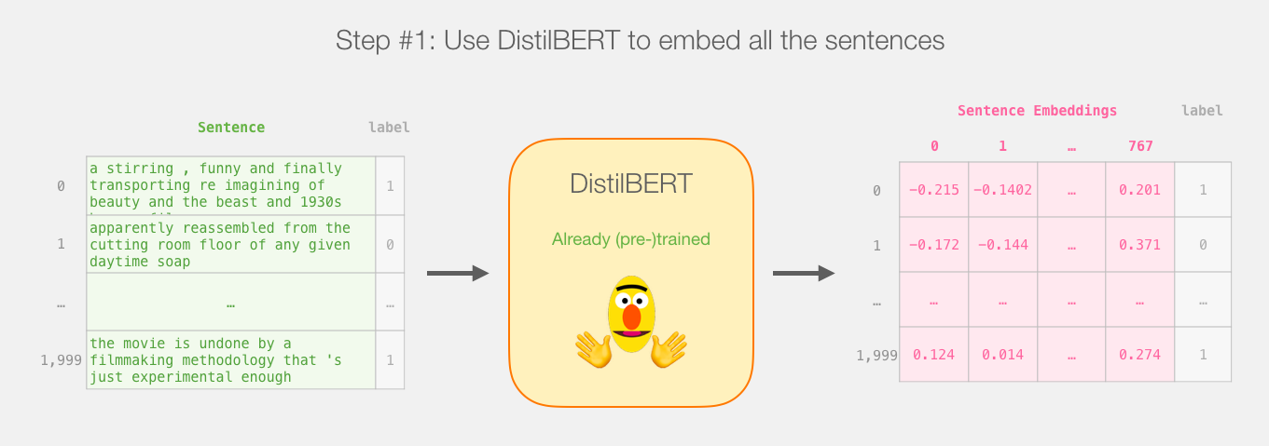
Step # 1 Use distilBERT to Generate Sentence Embeddings
Source: Jay Alammar (2019), A Visual Guide to Using BERT for the First Time, http://jalammar.github.io/a-visual-guide-to-using-bert-for-the-first-time/

Slide 97
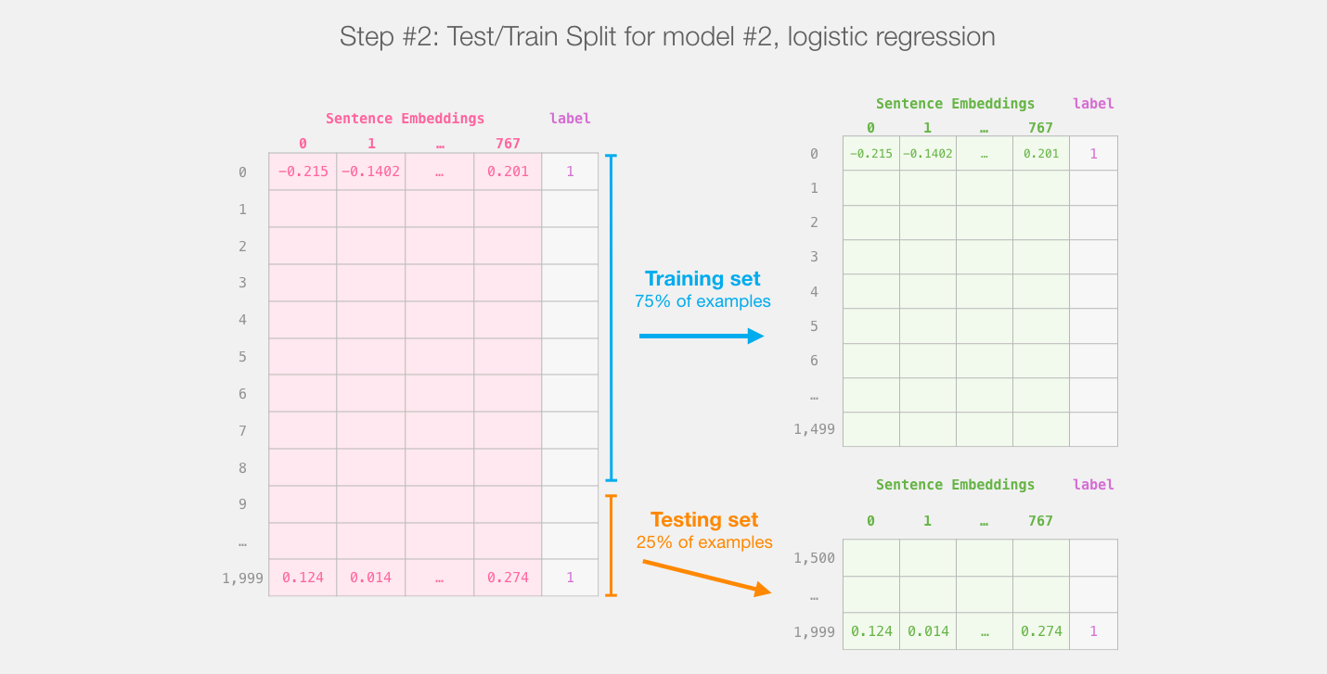
Step #2:Test/Train Split for Model #2, Logistic Regression
Source: Jay Alammar (2019), A Visual Guide to Using BERT for the First Time, http://jalammar.github.io/a-visual-guide-to-using-bert-for-the-first-time/

Slide 98
Step #3 Train the logistic regression model using the training set
Source: Jay Alammar (2019), A Visual Guide to Using BERT for the First Time, http://jalammar.github.io/a-visual-guide-to-using-bert-for-the-first-time/

Slide 99
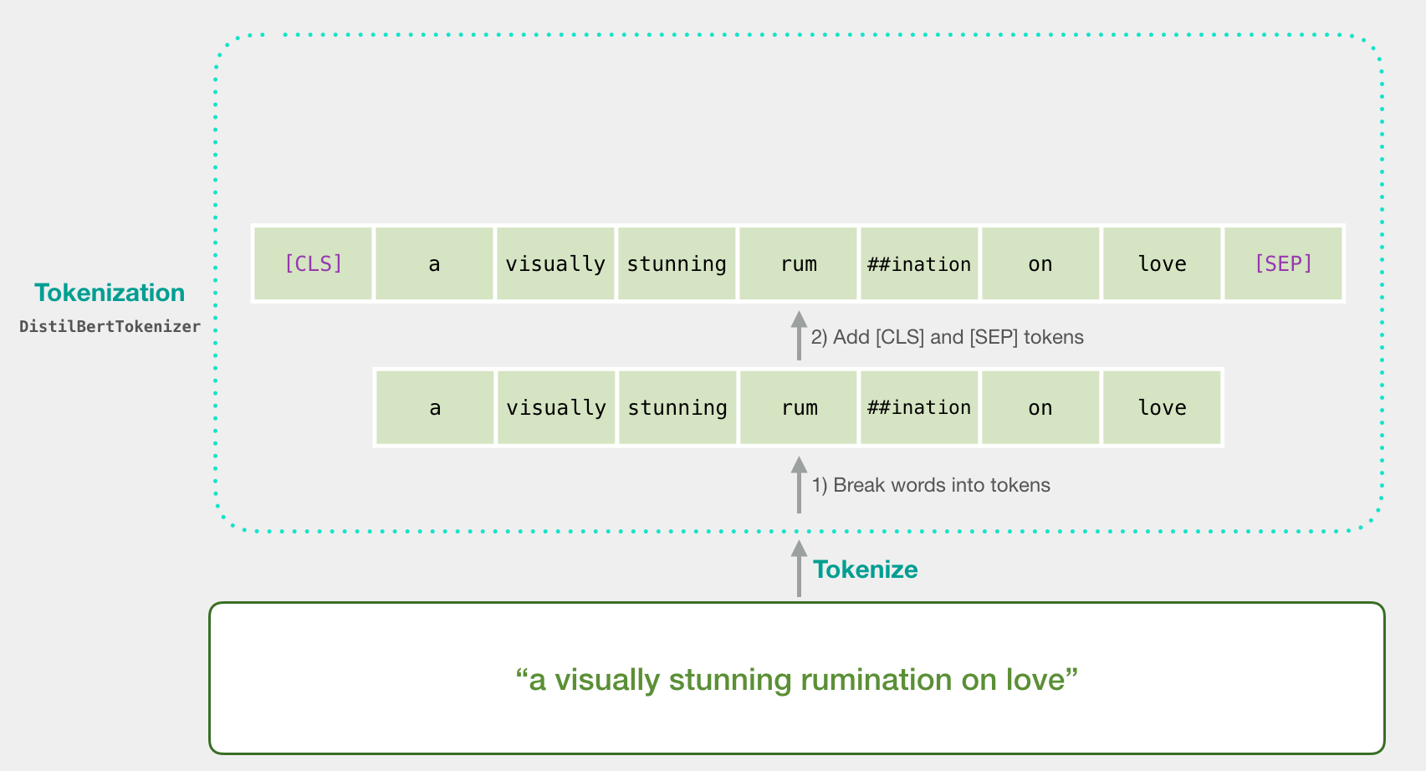
Tokenization
[CLS] a visually stunning rum ##ination on love [SEP]
a visually stunning rumination on love
Source: Jay Alammar (2019), A Visual Guide to Using BERT for the First Time, http://jalammar.github.io/a-visual-guide-to-using-bert-for-the-first-time/

Slide 100
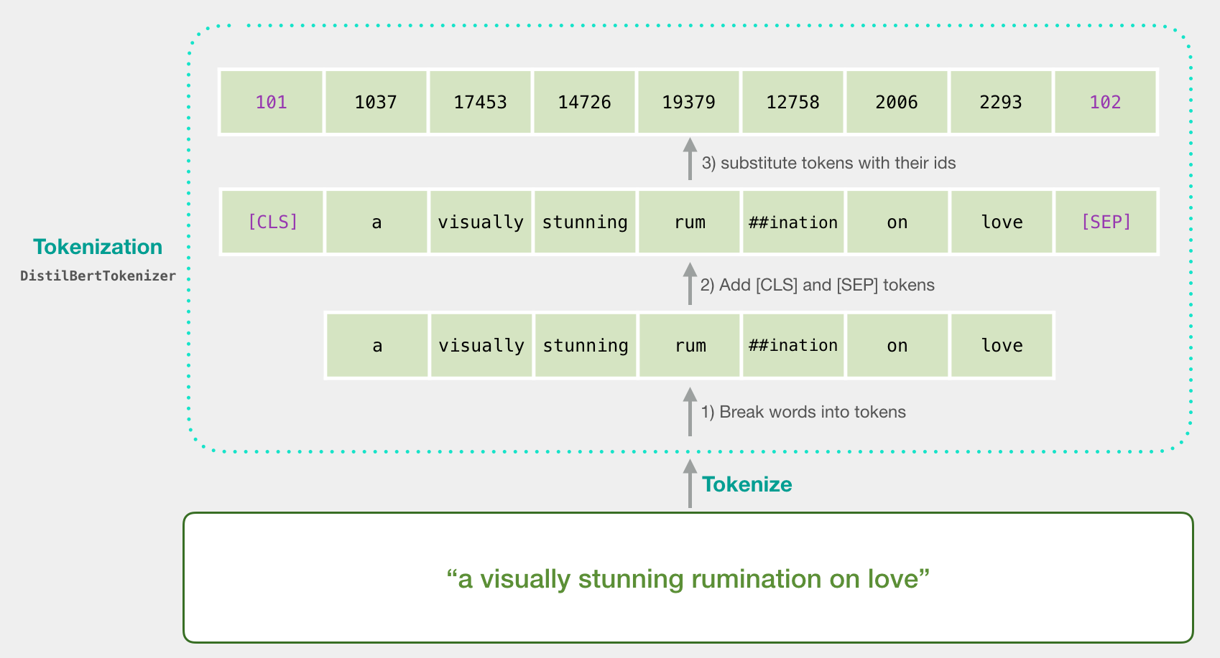
Tokenization
tokenizer.encode("a visually stunning rumination on love", add_special_tokens=True)
Source: Jay Alammar (2019), A Visual Guide to Using BERT for the First Time, http://jalammar.github.io/a-visual-guide-to-using-bert-for-the-first-time/

Slide 101
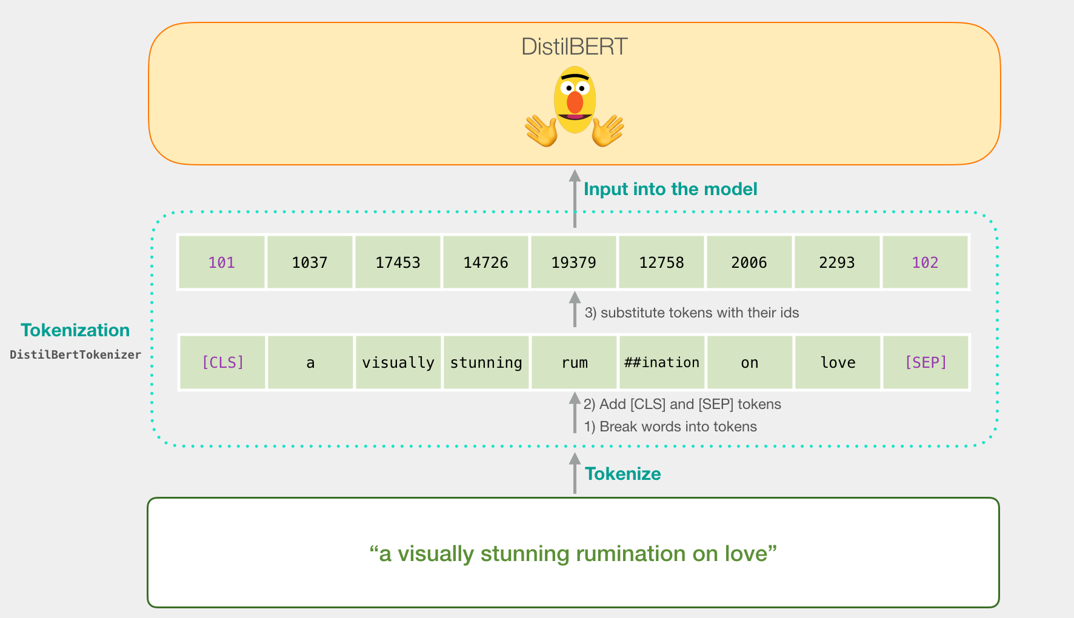
Tokenization for BERT Model
Source: Jay Alammar (2019), A Visual Guide to Using BERT for the First Time, http://jalammar.github.io/a-visual-guide-to-using-bert-for-the-first-time/

Slide 102
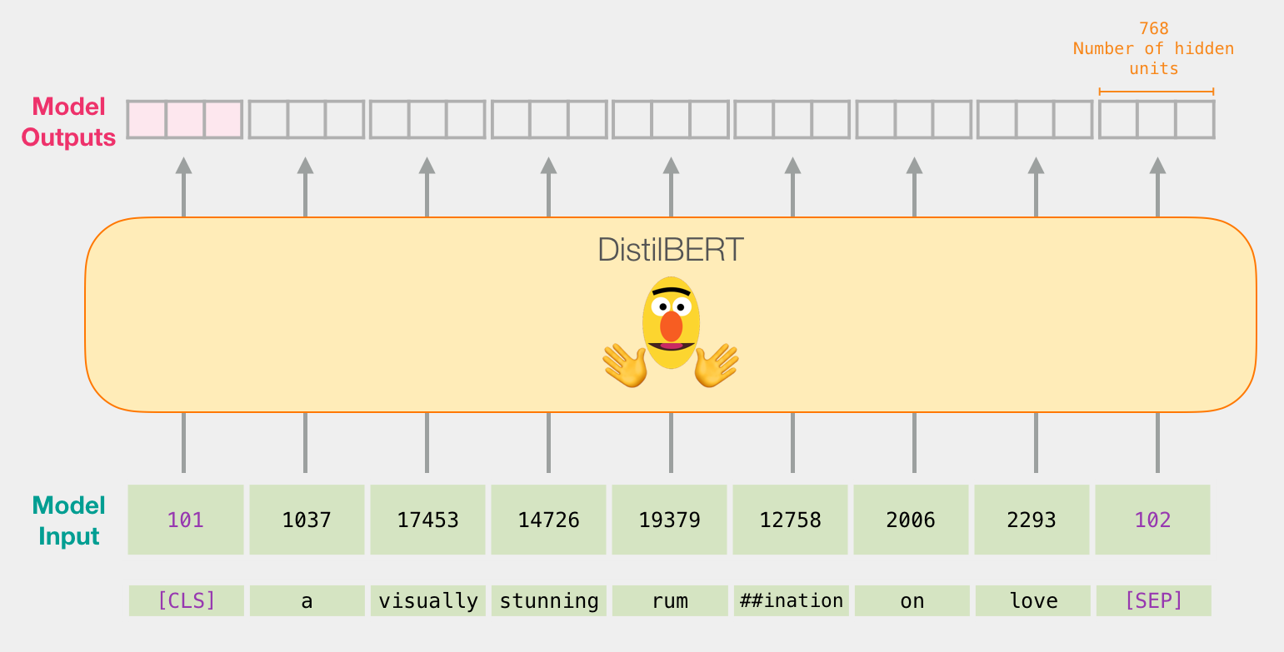
Flowing Through DistilBERT (768 features)
Source: Jay Alammar (2019), A Visual Guide to Using BERT for the First Time, http://jalammar.github.io/a-visual-guide-to-using-bert-for-the-first-time/

Slide 103
Model #1 Output Class vector as Model #2 Input
Source: Jay Alammar (2019), A Visual Guide to Using BERT for the First Time, http://jalammar.github.io/a-visual-guide-to-using-bert-for-the-first-time/

Slide 104
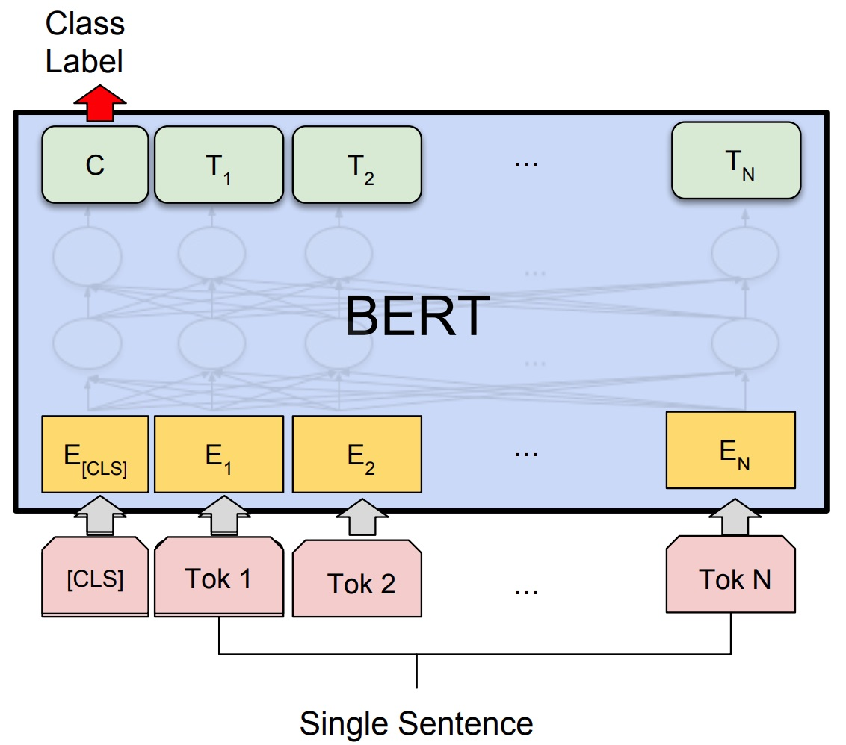
Fine-tuning BERT on Single Sentence Classification Tasks
Source: Devlin, Jacob, Ming-Wei Chang, Kenton Lee, and Kristina Toutanova (2018). "Bert: Pre-training of deep bidirectional transformers for language understanding." arXiv preprint arXiv:1810.04805.

Slide 105
Model #1 Output Class vector as Model #2 Input
Source: Jay Alammar (2019), A Visual Guide to Using BERT for the First Time, http://jalammar.github.io/a-visual-guide-to-using-bert-for-the-first-time/

Slide 106
Logistic Regression Model to classify Class vector
Source: Jay Alammar (2019), A Visual Guide to Using BERT for the First Time, http://jalammar.github.io/a-visual-guide-to-using-bert-for-the-first-time/

Slide 107
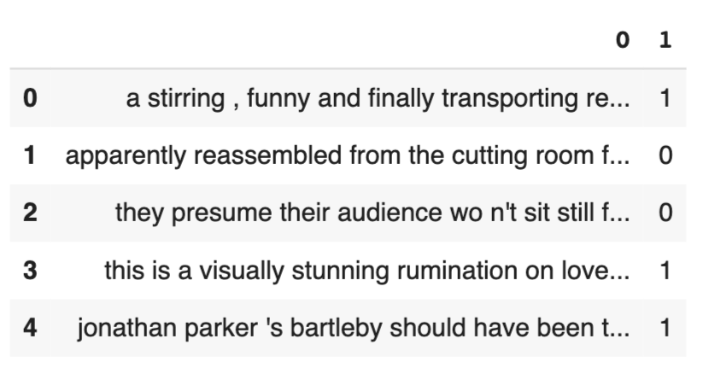
df = pd.read_csv('https://github.com/clairett/pytorch-sentiment-classification/raw/master/data/SST2/train.tsv', delimiter='\t', header=None)
df.head()
Source: Jay Alammar (2019), A Visual Guide to Using BERT for the First Time, http://jalammar.github.io/a-visual-guide-to-using-bert-for-the-first-time/

Slide 108
Tokenization
tokenized = df[0].apply((lambda x: tokenizer.encode(x, add_special_tokens=True)))
Source: Jay Alammar (2019), A Visual Guide to Using BERT for the First Time, http://jalammar.github.io/a-visual-guide-to-using-bert-for-the-first-time/

Slide 109
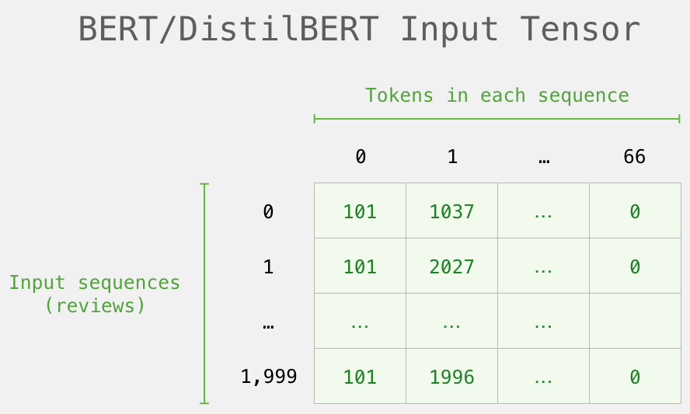
BERT Input Tensor
Source: Jay Alammar (2019), A Visual Guide to Using BERT for the First Time, http://jalammar.github.io/a-visual-guide-to-using-bert-for-the-first-time/

Slide 110
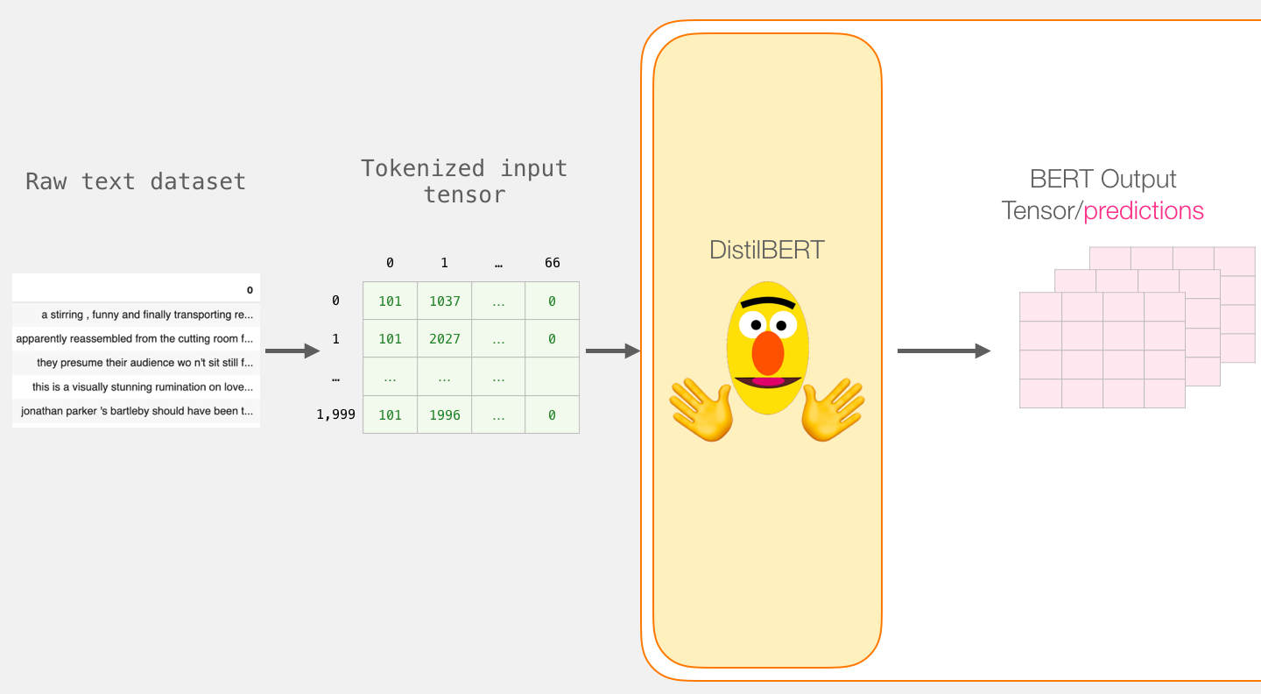
Processing with DistilBERT
input_ids = torch.tensor(np.array(padded))
last_hidden_states = model(input_ids)
Source: Jay Alammar (2019), A Visual Guide to Using BERT for the First Time, http://jalammar.github.io/a-visual-guide-to-using-bert-for-the-first-time/

Slide 111
Unpacking the BERT output tensor
Source: Jay Alammar (2019), A Visual Guide to Using BERT for the First Time, http://jalammar.github.io/a-visual-guide-to-using-bert-for-the-first-time/

Slide 112
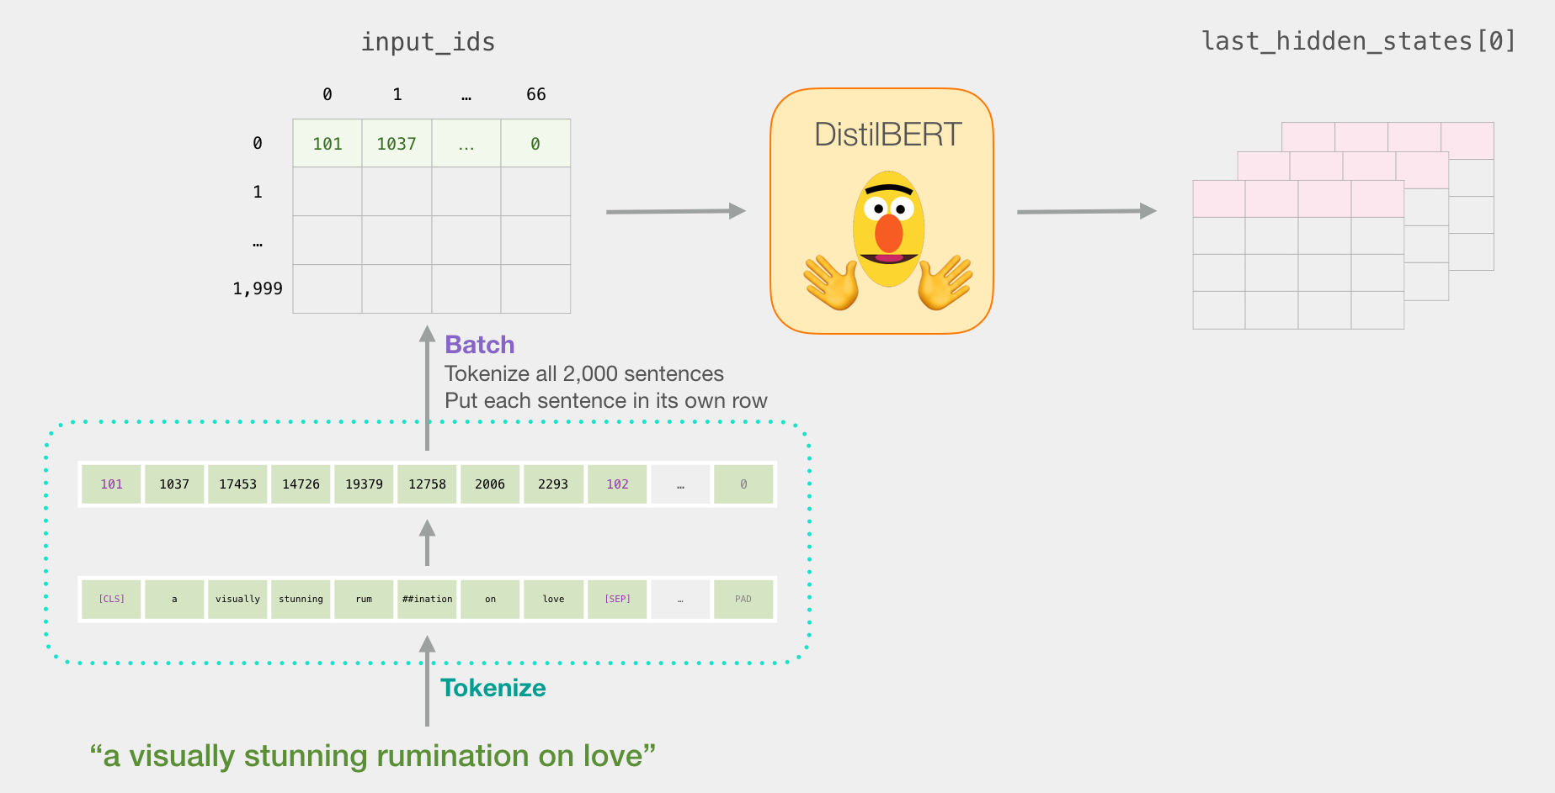
Sentence to last_hidden_state[0]
Source: Jay Alammar (2019), A Visual Guide to Using BERT for the First Time, http://jalammar.github.io/a-visual-guide-to-using-bert-for-the-first-time/

Slide 113
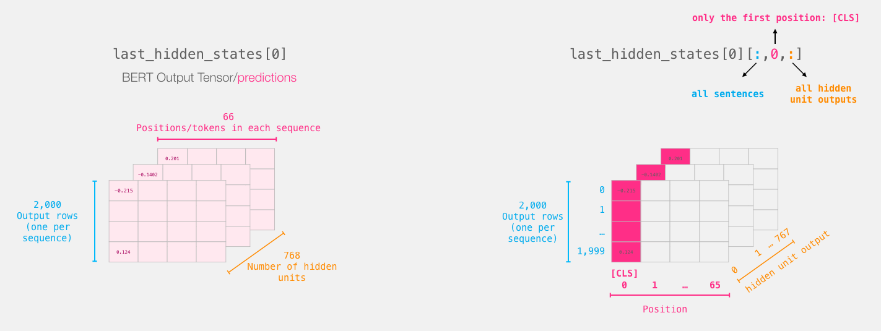
BERT’s output for the [CLS] tokens
# Slice the output for the first position for all the sequences, take all hidden unit outputs
features = last_hidden_states[0][:,0,:].numpy()
Source: Jay Alammar (2019), A Visual Guide to Using BERT for the First Time, http://jalammar.github.io/a-visual-guide-to-using-bert-for-the-first-time/

Slide 114
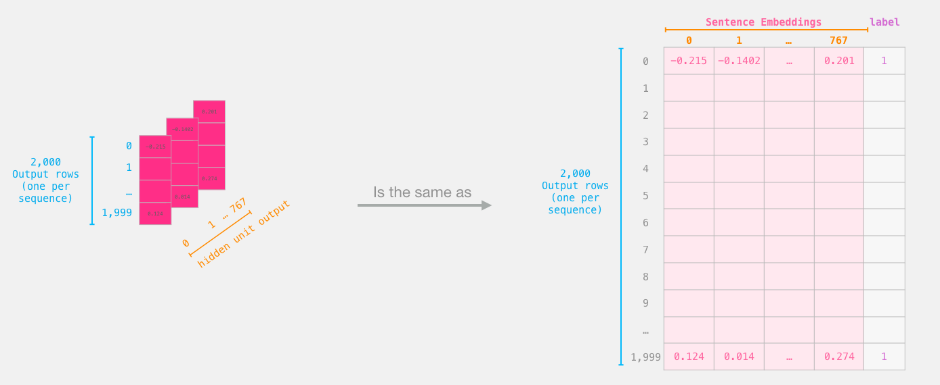
The tensor sliced from BERT's output Sentence Embeddings
Source: Jay Alammar (2019), A Visual Guide to Using BERT for the First Time, http://jalammar.github.io/a-visual-guide-to-using-bert-for-the-first-time/

Slide 115
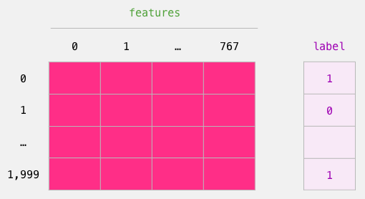
Dataset for Logistic Regression (768 Features)
The features are the output vectors of BERT for the [CLS] token (position #0)
Source: Jay Alammar (2019), A Visual Guide to Using BERT for the First Time, http://jalammar.github.io/a-visual-guide-to-using-bert-for-the-first-time/

Slide 116
labels = df[1]
train_features, test_features, train_labels, test_labels = train_test_split(features, labels)
Source: Jay Alammar (2019), A Visual Guide to Using BERT for the First Time, http://jalammar.github.io/a-visual-guide-to-using-bert-for-the-first-time/

Slide 117
Score Benchmarks Logistic Regression Model on SST-2 Dataset
# Training
lr_clf = LogisticRegression()
lr_clf.fit(train_features, train_labels)
#Testing
lr_clf.score(test_features, test_labels)
# Accuracy: 81%
# Highest accuracy: 96.8%
# Fine-tuned DistilBERT: 90.7%
# Full size BERT model: 94.9%
Source: Jay Alammar (2019), A Visual Guide to Using BERT for the First Time, http://jalammar.github.io/a-visual-guide-to-using-bert-for-the-first-time/

Slide 118
Sentiment Classification: SST2 Sentences from movie reviews
sentence | label
a stirring , funny and finally transporting re imagining of beauty and the beast and 1930s horror films | 1
apparently reassembled from the cutting room floor of any given daytime soap | 0
they presume their audience won't sit still for a sociology lesson | 0
this is a visually stunning rumination on love , memory , history and the war between art and commerce | 1
jonathan parker 's bartleby should have been the be all end all of the modern office anomie films | 1
Source: Jay Alammar (2019), A Visual Guide to Using BERT for the First Time, http://jalammar.github.io/a-visual-guide-to-using-bert-for-the-first-time/

Slide 119
A Visual Notebook to Using BERT for the First Time
https://colab.research.google.com/github/jalammar/jalammar.github.io/blob/master/notebooks/bert/A_Visual_Notebook_to_Using_BERT_for_the_First_Time.ipynb

Slide 120
Text classification with preprocessed text: Movie reviews
https://www.tensorflow.org/tutorials/keras/text_classification

Slide 121
Python in Google Colab (Python101)
https://colab.research.google.com/drive/1FEG6DnGvwfUbeo4zJ1zTunjMqf2RkCrT
https://tinyurl.com/aintpupython101

Slide 122
Python in Google Colab (Python101)
https://colab.research.google.com/drive/1FEG6DnGvwfUbeo4zJ1zTunjMqf2RkCrT
https://tinyurl.com/aintpupython101

Slide 123
NLP Benchmark Datasets
Source: Amirsina Torfi, Rouzbeh A. Shirvani, Yaser Keneshloo, Nader Tavvaf, and Edward A. Fox (2020). "Natural Language Processing Advancements By Deep Learning: A Survey." arXiv preprint arXiv:2003.01200.

Slide 124
Summary
Unsupervised lexicon-based models
Traditional supervised machine learning models
Supervised deep learning models
Advanced supervised deep learning models

Slide 125
References
Dipanjan Sarkar (2019), Text Analytics with Python: A Practitioner’s Guide to Natural Language Processing, Second Edition. APress. https://github.com/Apress/text-analytics-w-python-2e
Benjamin Bengfort, Rebecca Bilbro, and Tony Ojeda (2018), Applied Text Analysis with Python, O'Reilly Media. https://www.oreilly.com/library/view/applied-text-analysis/9781491963036/
Kumar Ravi and Vadlamani Ravi (2015), "A survey on opinion mining and sentiment analysis: tasks, approaches and applications." Knowledge-Based Systems, 89, pp.14-46.
HuggingFace (2020), Transformers Notebook, https://huggingface.co/transformers/notebooks.html
The Super Duper NLP Repo, https://notebooks.quantumstat.com/
Min-Yuh Day (2020), Python 101, https://tinyurl.com/aintpupython101

