Slide 1



人工智慧
(Artificial Intelligence)
不確定知識和推理
(Uncertain Knowledge and Reasoning)
1092AI05
MBA, IM, NTPU (M5010) (Spring 2021)
Wed 2, 3, 4 (9:10-12:00) (B8F40)
Min-Yuh Day
戴敏育
Associate Professor
副教授
Institute of Information Management, National Taipei University
國立臺北大學 資訊管理研究所
https://web.ntpu.edu.tw/~myday
2021-03-24

Slide 2
課程大綱 (Syllabus)
週次 (Week) 日期 (Date) 內容 (Subject/Topics)
1 2021/02/24 人工智慧概論
(Introduction to Artificial Intelligence)
2 2021/03/03 人工智慧和智慧代理人
(Artificial Intelligence and Intelligent Agents)
3 2021/03/10 問題解決
(Problem Solving)
4 2021/03/17 知識推理和知識表達
(Knowledge, Reasoning and Knowledge Representation)
5 2021/03/24 不確定知識和推理
(Uncertain Knowledge and Reasoning)
6 2021/03/31 人工智慧個案研究 I
(Case Study on Artificial Intelligence I)

Slide 3
課程大綱 (Syllabus)
週次 (Week) 日期 (Date) 內容 (Subject/Topics)
7 2021/04/07 放假一天 (Day off)
8 2021/04/14 機器學習與監督式學習
(Machine Learning and Supervised Learning)
9 2021/04/21 期中報告
(Midterm Project Report)
10 2021/04/28 學習理論與綜合學習
(The Theory of Learning and Ensemble Learning)
11 2021/05/05 深度學習
(Deep Learning)
12 2021/05/12 人工智慧個案研究 II
(Case Study on Artificial Intelligence II)

Slide 4
課程大綱 (Syllabus)
週次 (Week) 日期 (Date) 內容 (Subject/Topics)
13 2021/05/19 強化學習
(Reinforcement Learning)
14 2021/05/26 深度學習自然語言處理
(Deep Learning for Natural Language Processing)
15 2021/06/02 機器人技術
(Robotics)
16 2021/06/09 人工智慧哲學與倫理，人工智慧的未來
(Philosophy and Ethics of AI, The Future of AI)
17 2021/06/16 期末報告 I
(Final Project Report I)
18 2021/06/23 期末報告 II
(Final Project Report II)

Slide 5
Uncertain Knowledge and Reasoning

Slide 6
Outline
Quantifying Uncertainty
Probabilistic Reasoning
Probabilistic Reasoning over Time
Probabilistic Programming
Making Simple Decisions
Making Complex Decisions

Slide 7
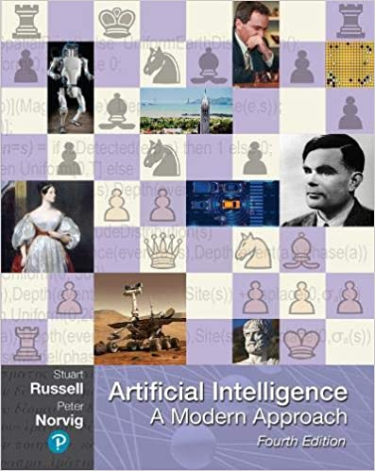
Stuart Russell and Peter Norvig (2020),
Artificial Intelligence: A Modern Approach,
4th Edition, Pearson
Source: Stuart Russell and Peter Norvig (2020), Artificial Intelligence: A Modern Approach, 4th Edition, Pearson
https://www.amazon.com/Artificial-Intelligence-A-Modern-Approach/dp/0134610997/

Slide 8
Artificial Intelligence:
A Modern Approach
Artificial Intelligence
Problem Solving
Knowledge and Reasoning
Uncertain Knowledge and Reasoning
Machine Learning
Communicating, Perceiving, and Acting
Philosophy and Ethics of AI
Source: Stuart Russell and Peter Norvig (2020), Artificial Intelligence: A Modern Approach, 4th Edition, Pearson

Slide 9
Artificial Intelligence:
Uncertain Knowledge and Reasoning
Source: Stuart Russell and Peter Norvig (2020), Artificial Intelligence: A Modern Approach, 4th Edition, Pearson

Slide 10
Artificial Intelligence:
4. Uncertain Knowledge and Reasoning
Quantifying Uncertainty
Probabilistic Reasoning
Probabilistic Reasoning over Time
Probabilistic Programming
Making Simple Decisions
Making Complex Decisions
Multiagent Decision Making
Source: Stuart Russell and Peter Norvig (2020), Artificial Intelligence: A Modern Approach, 4th Edition, Pearson

Slide 11
Intelligent Agents
Source: Stuart Russell and Peter Norvig (2020), Artificial Intelligence: A Modern Approach, 4th Edition, Pearson

Slide 12
4 Approaches of AI
2. Thinking Humanly: The Cognitive Modeling Approach | 3. Thinking Rationally: The “Laws of Thought” Approach
1. Acting Humanly: The Turing Test Approach (1950) | 4. Acting Rationally: The Rational Agent Approach
Source: Stuart Russell and Peter Norvig (2020), Artificial Intelligence: A Modern Approach, 4th Edition, Pearson

Slide 13
Reinforcement Learning (DL)
Agent
Environment
Source: Richard S. Sutton & Andrew G. Barto (2018), Reinforcement Learning: An Introduction, 2nd Edition, A Bradford Book.

Slide 14
Reinforcement Learning (DL)
1
2
observation
Agent
action
3
reward
Environment
Source: Richard S. Sutton & Andrew G. Barto (2018), Reinforcement Learning: An Introduction, 2nd Edition, A Bradford Book.

Slide 15
Reinforcement Learning (DL)
1
2
observation
Agent
action
O_{t}
A_{t}
3
reward
R_{t}
Environment
Source: Richard S. Sutton & Andrew G. Barto (2018), Reinforcement Learning: An Introduction, 2nd Edition, A Bradford Book.

Slide 16
Agents interact with environments through sensors and actuators
Source: Stuart Russell and Peter Norvig (2020), Artificial Intelligence: A Modern Approach, 4th Edition, Pearson

Slide 17
Quantifying Uncertainty
Source: Stuart Russell and Peter Norvig (2020), Artificial Intelligence: A Modern Approach, 4th Edition, Pearson

Slide 18
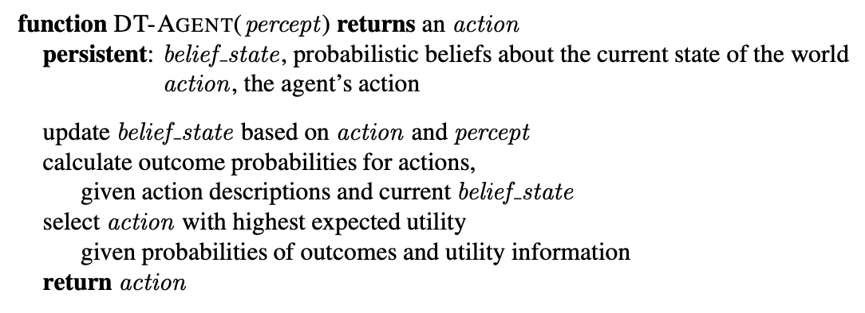
DT-Agent
A Decision-Theoretic Agent that Selects Rational Actions
Source: Stuart Russell and Peter Norvig (2020), Artificial Intelligence: A Modern Approach, 4th Edition, Pearson

Slide 19
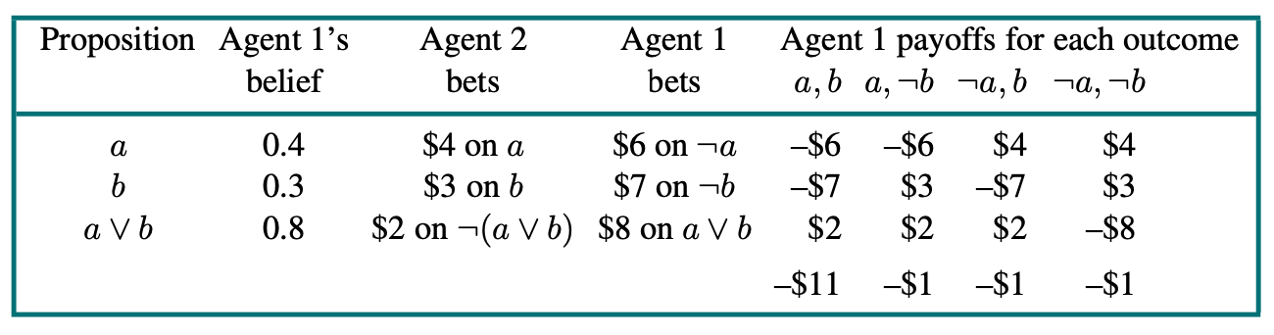
Agent 1 has inconsistent beliefs
Source: Stuart Russell and Peter Norvig (2020), Artificial Intelligence: A Modern Approach, 4th Edition, Pearson

Slide 20
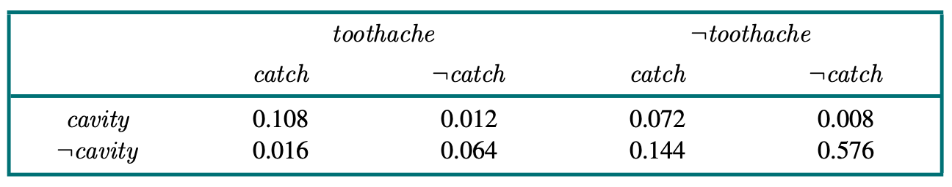
A full joint distribution for the Toothache, Cavity, Catch world
Source: Stuart Russell and Peter Norvig (2020), Artificial Intelligence: A Modern Approach, 4th Edition, Pearson

Slide 21
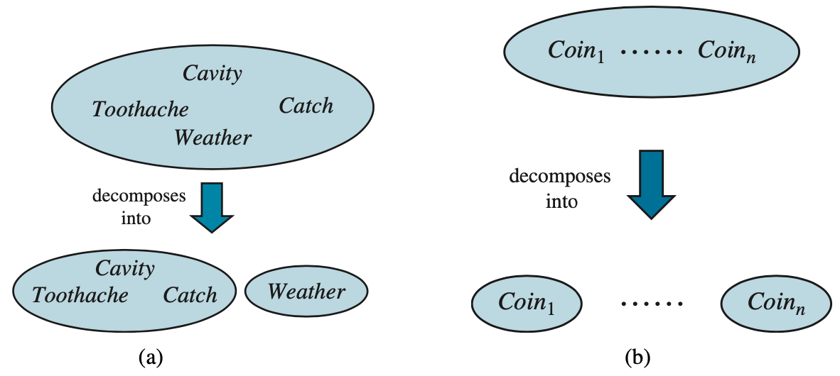
Weather and Dental problems are independent
Source: Stuart Russell and Peter Norvig (2020), Artificial Intelligence: A Modern Approach, 4th Edition, Pearson

Slide 22
Coin flips are independent
Source: Stuart Russell and Peter Norvig (2020), Artificial Intelligence: A Modern Approach, 4th Edition, Pearson

Slide 23
Probabilistic Reasoning
Source: Stuart Russell and Peter Norvig (2020), Artificial Intelligence: A Modern Approach, 4th Edition, Pearson

Slide 24
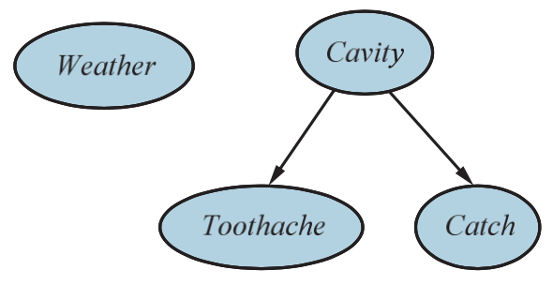
A Simple Bayesian Network
Weather is independent to the other three variables.
Toothache and Catch are conditionally independent, given Cavity.
Source: Stuart Russell and Peter Norvig (2020), Artificial Intelligence: A Modern Approach, 4th Edition, Pearson

Slide 25
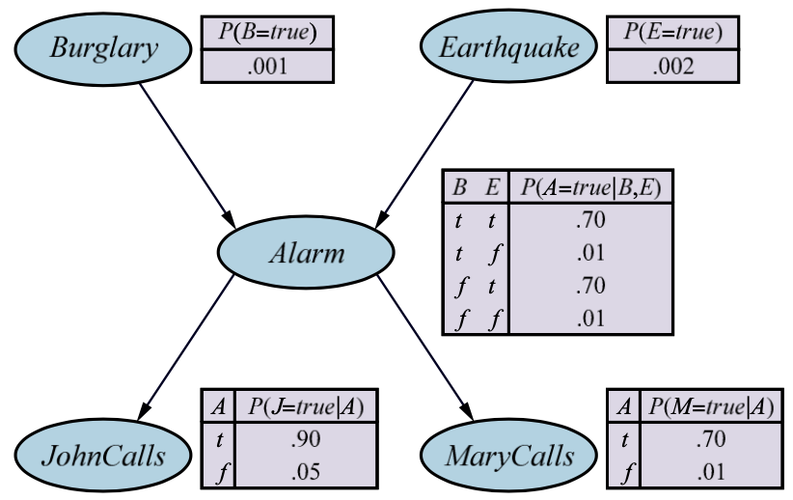
A Typical Bayesian Network
Topology and the Conditional Probability Tables (CPTs)
Source: Stuart Russell and Peter Norvig (2020), Artificial Intelligence: A Modern Approach, 4th Edition, Pearson

Slide 26
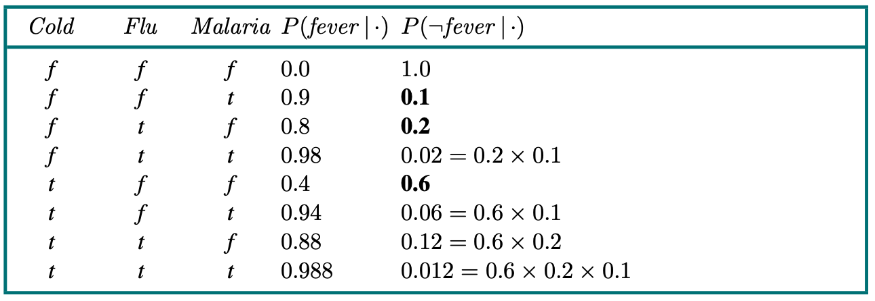
Conditional Probability Table for P(Fever |Cold, Flu, Malaria)
Source: Stuart Russell and Peter Norvig (2020), Artificial Intelligence: A Modern Approach, 4th Edition, Pearson

Slide 27
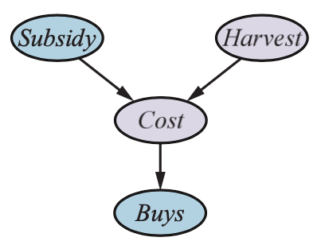
A Simple Network with discrete variables (Subsidy and Buys) and continuous variables (Harvest and Cost )
Source: Stuart Russell and Peter Norvig (2020), Artificial Intelligence: A Modern Approach, 4th Edition, Pearson

Slide 28
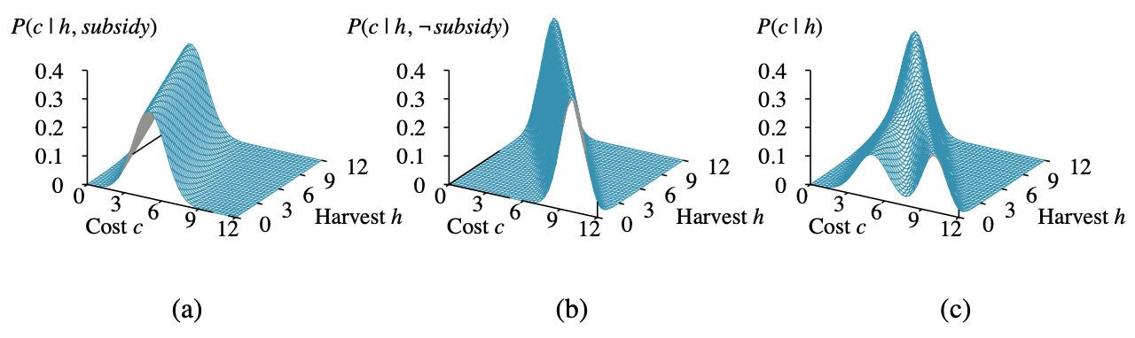
Probability distribution over Cost as a function of Harvest size
distribution P (Cost | Harvest ),
obtained by summing over the two subsidy cases.
Source: Stuart Russell and Peter Norvig (2020), Artificial Intelligence: A Modern Approach, 4th Edition, Pearson

Slide 29
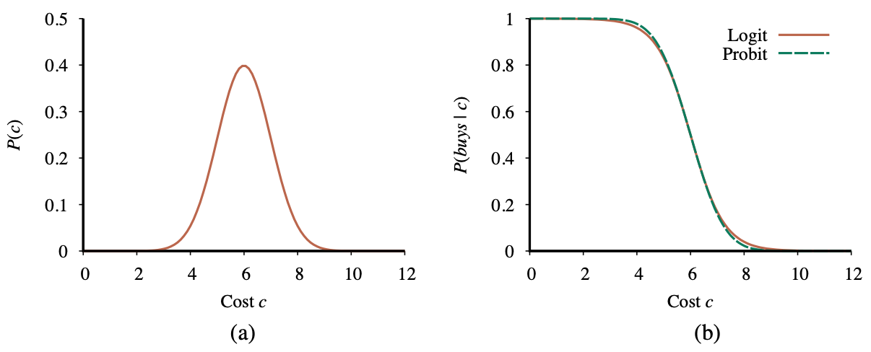
A normal (Gaussian) distribution for the cost threshold
Expit and Probit models for the probability of buys given cost
Source: Stuart Russell and Peter Norvig (2020), Artificial Intelligence: A Modern Approach, 4th Edition, Pearson

Slide 30
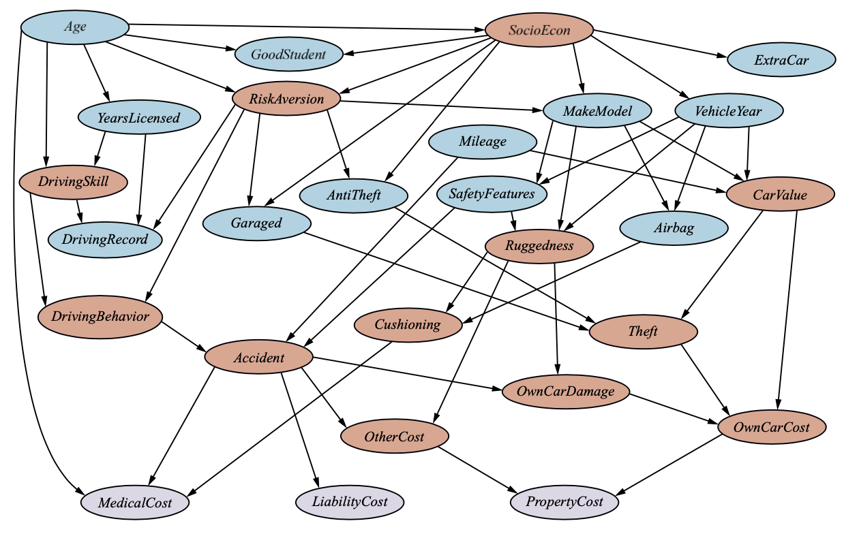
A Bayesian Network for evaluating car insurance applications
Source: Stuart Russell and Peter Norvig (2020), Artificial Intelligence: A Modern Approach, 4th Edition, Pearson

Slide 31
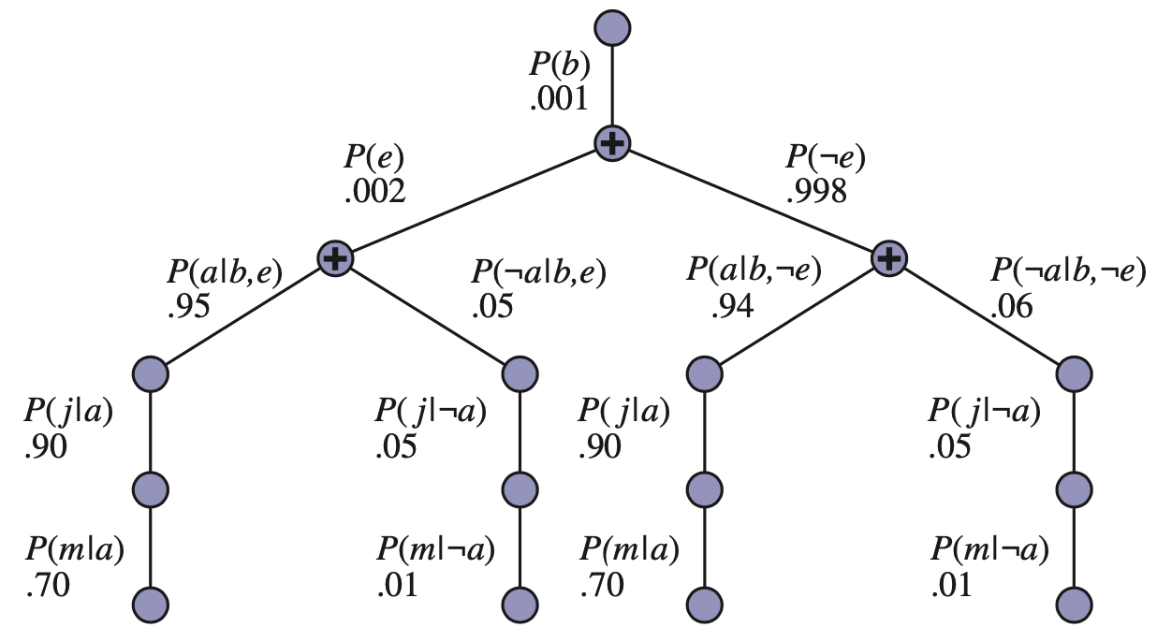
The structure of the expression
Source: Stuart Russell and Peter Norvig (2020), Artificial Intelligence: A Modern Approach, 4th Edition, Pearson

Slide 32
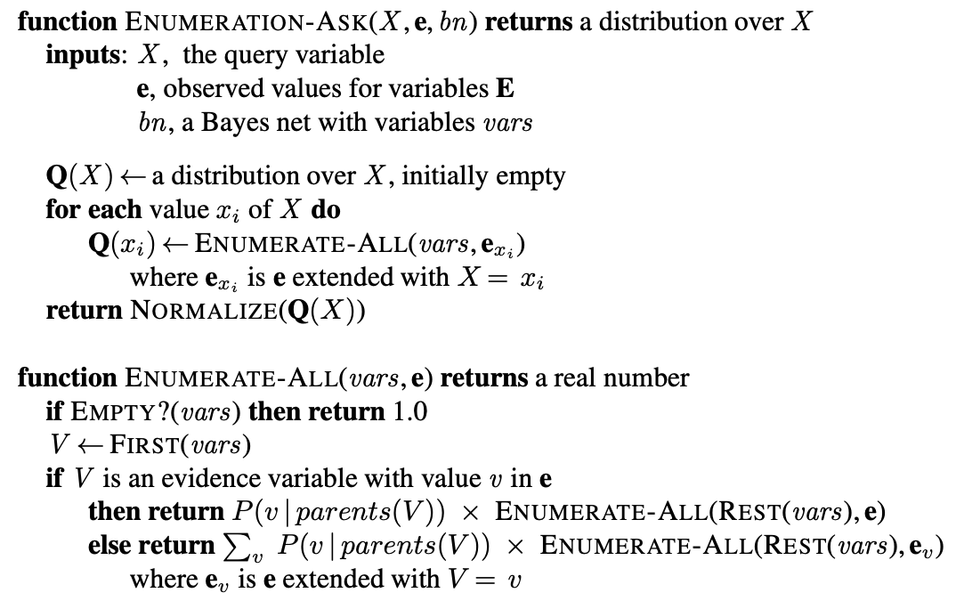
The Enumeration Algorithm for Exact Inference in Bayes Nets
Source: Stuart Russell and Peter Norvig (2020), Artificial Intelligence: A Modern Approach, 4th Edition, Pearson

Slide 33
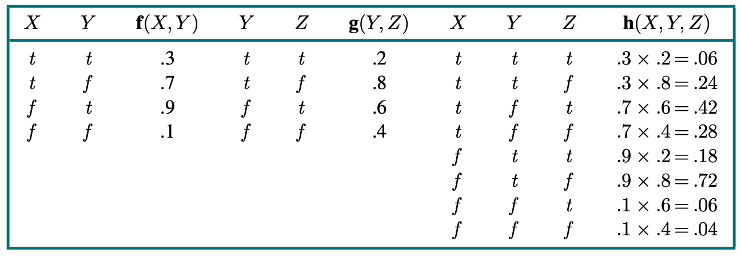
Pointwise Multiplication f(X,Y) × g(Y,Z) = h(X,Y,Z)
Source: Stuart Russell and Peter Norvig (2020), Artificial Intelligence: A Modern Approach, 4th Edition, Pearson

Slide 34
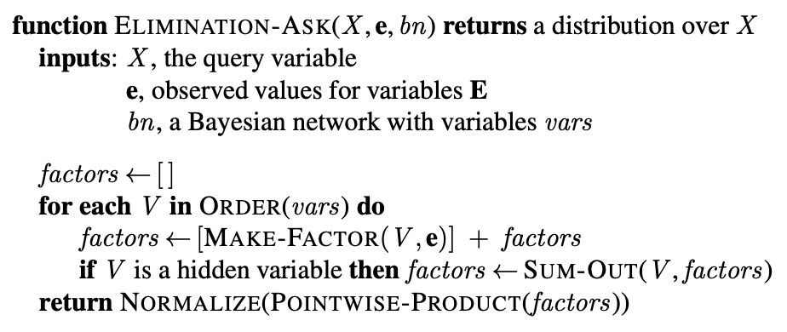
The Variable Elimination Algorithm for Exact Inference in Bayes Nets
Source: Stuart Russell and Peter Norvig (2020), Artificial Intelligence: A Modern Approach, 4th Edition, Pearson

Slide 35
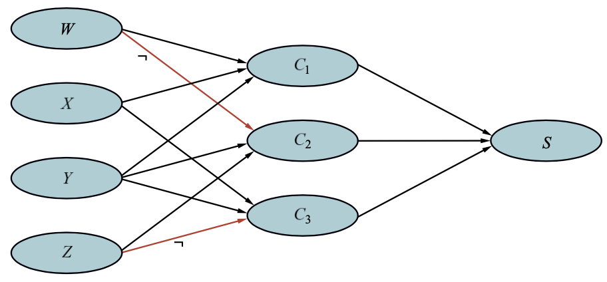
Bayes Net Encoding of the 3-CNF (Conjunctive Normal Form) Sentence
(W ∨X ∨Y) ∧ (¬W ∨Y ∨Z) ∧ (X ∨Y ∨¬Z)
Source: Stuart Russell and Peter Norvig (2020), Artificial Intelligence: A Modern Approach, 4th Edition, Pearson

Slide 36
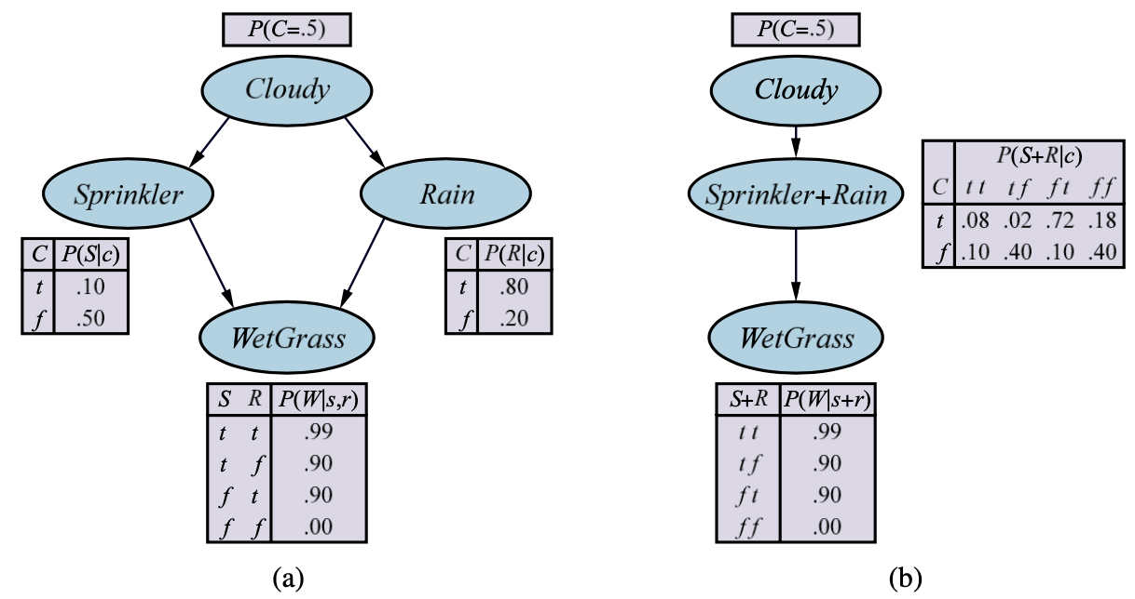
Multiply Connected Network
(b) A clustered equivalent
Source: Stuart Russell and Peter Norvig (2020), Artificial Intelligence: A Modern Approach, 4th Edition, Pearson

Slide 37
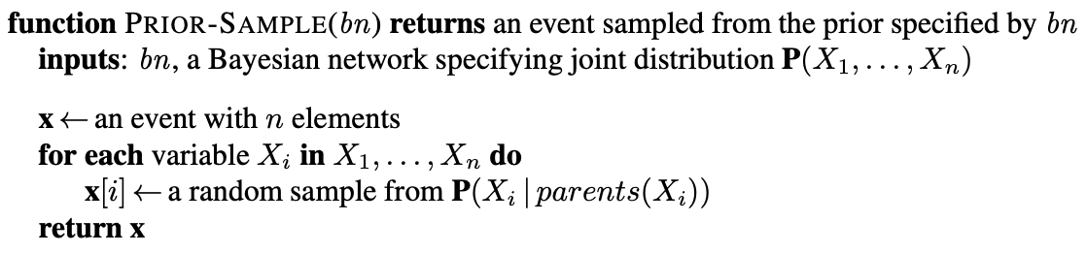
A Sampling Algorithm that generates events from a Bayesian network
Source: Stuart Russell and Peter Norvig (2020), Artificial Intelligence: A Modern Approach, 4th Edition, Pearson

Slide 38
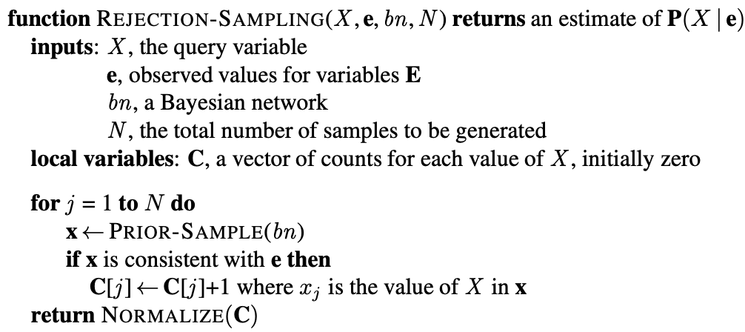
The Rejection-Sampling Algorithm for answering queries given evidence in a Bayesian network
Source: Stuart Russell and Peter Norvig (2020), Artificial Intelligence: A Modern Approach, 4th Edition, Pearson

Slide 39
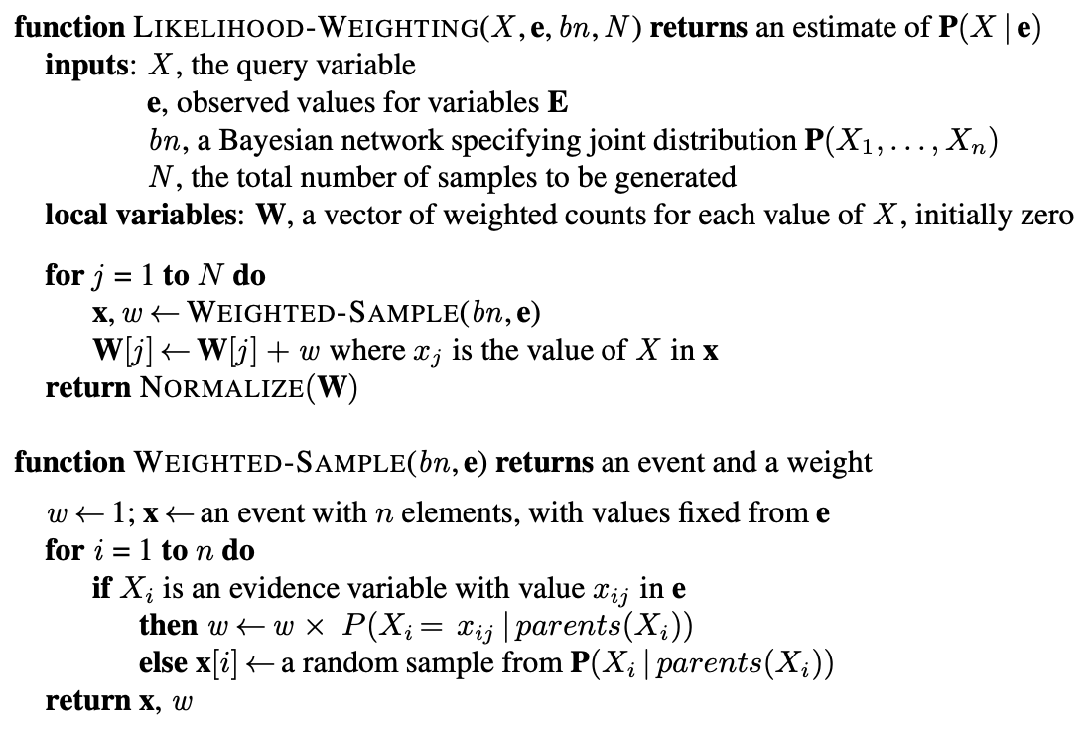
The Likelihood-Weighting Algorithm for inference in Bayesian networks
Source: Stuart Russell and Peter Norvig (2020), Artificial Intelligence: A Modern Approach, 4th Edition, Pearson

Slide 40
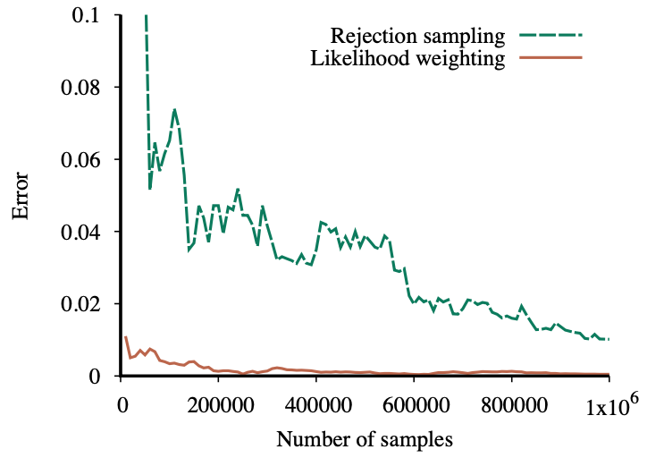
Performance of rejection sampling and likelihood weighting on the insurance network
Source: Stuart Russell and Peter Norvig (2020), Artificial Intelligence: A Modern Approach, 4th Edition, Pearson

Slide 41
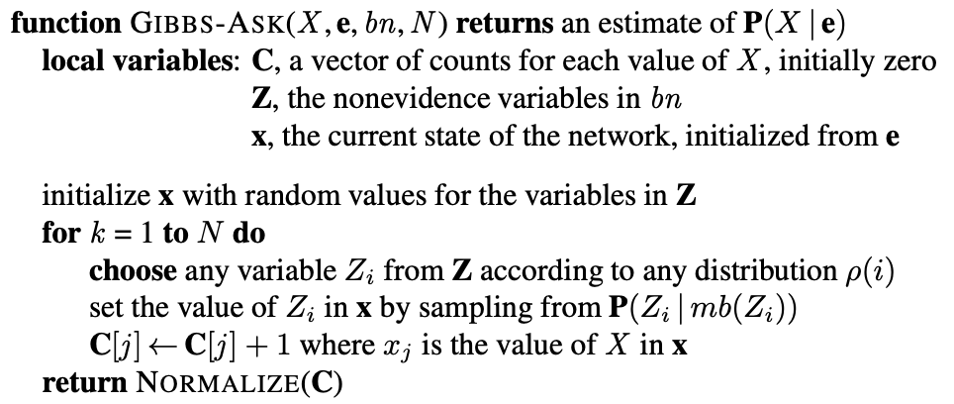
The Gibbs Sampling Algorithm for approximate inference in Bayes nets
Source: Stuart Russell and Peter Norvig (2020), Artificial Intelligence: A Modern Approach, 4th Edition, Pearson

Slide 42
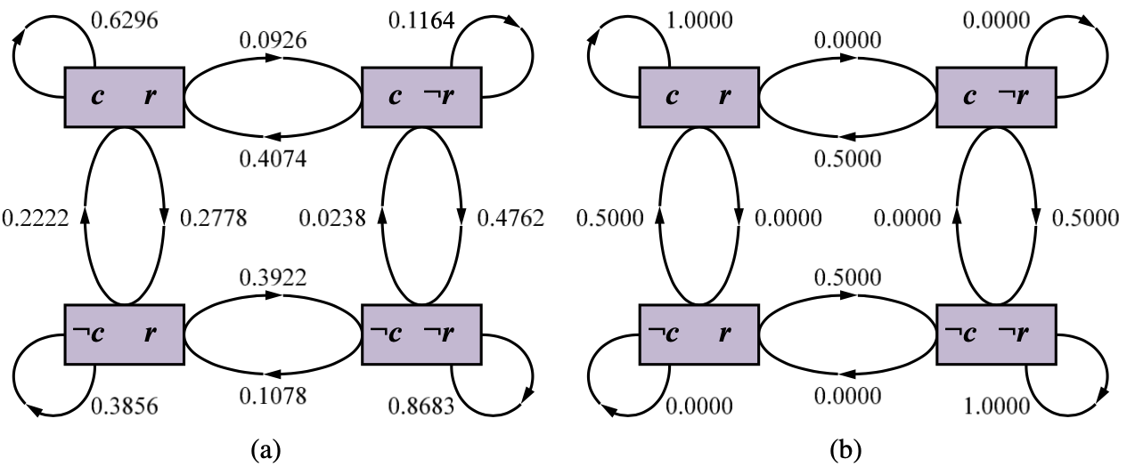
The States and Transition Probabilities of the Markov Chain for the query P(Rain | Sprinkler = true, WetGrass = true)
Transition Probabilities
when the CPT for Rain constrains it
to have the same value as Cloudy
Source: Stuart Russell and Peter Norvig (2020), Artificial Intelligence: A Modern Approach, 4th Edition, Pearson

Slide 43
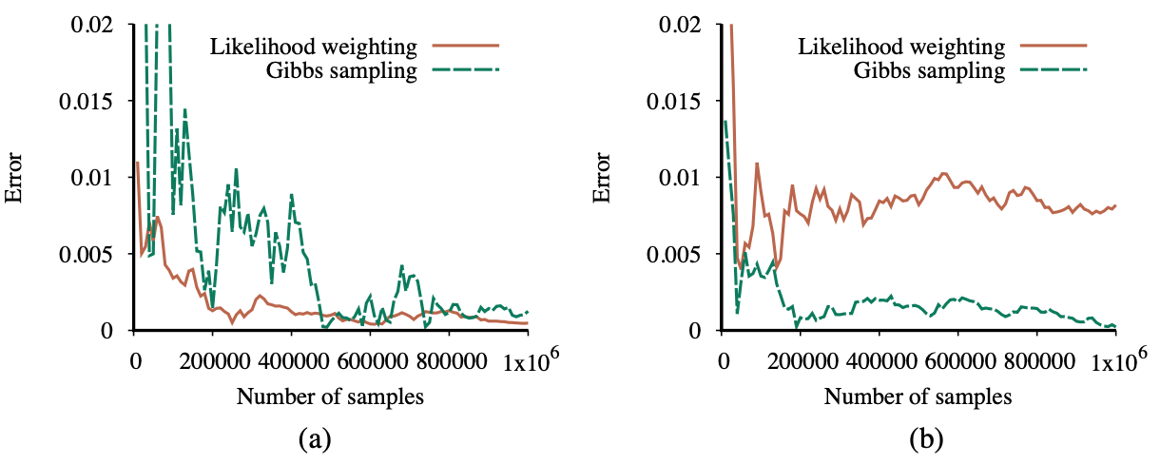
Performance of Gibbs sampling compared to likelihood weighting on the car insurance network
for the standard query on PropertyCost
for the case where the output variables
are observed and Age is the query variable
Source: Stuart Russell and Peter Norvig (2020), Artificial Intelligence: A Modern Approach, 4th Edition, Pearson

Slide 44
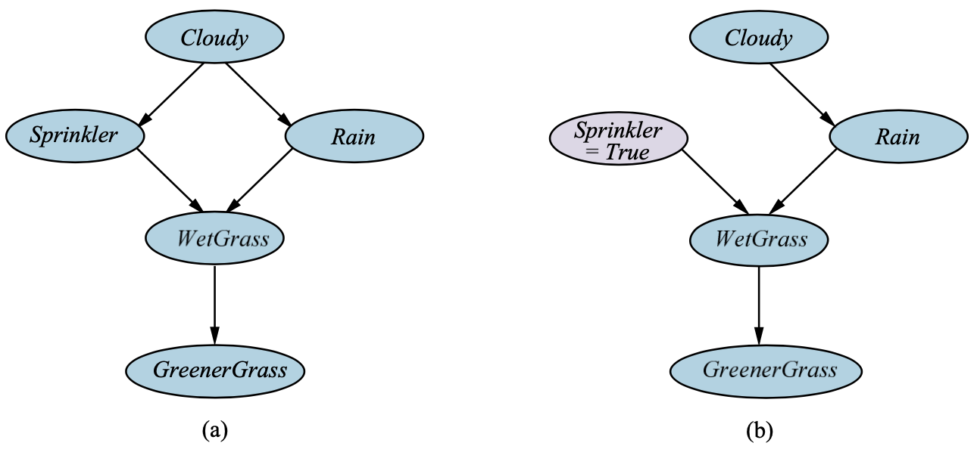
A Causal Bayesian Network representing cause-effect relations among five variables
The network after performing the action
“turn Sprinkler on.”
Source: Stuart Russell and Peter Norvig (2020), Artificial Intelligence: A Modern Approach, 4th Edition, Pearson

Slide 45
Probabilistic Reasoning over Time
Source: Stuart Russell and Peter Norvig (2020), Artificial Intelligence: A Modern Approach, 4th Edition, Pearson

Slide 46
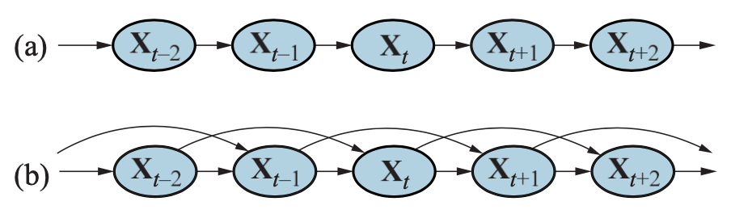
Bayesian network structure corresponding to a First-order Markov Process with state defined by the variables Xt.
A Second-order Markov Process
Source: Stuart Russell and Peter Norvig (2020), Artificial Intelligence: A Modern Approach, 4th Edition, Pearson

Slide 47
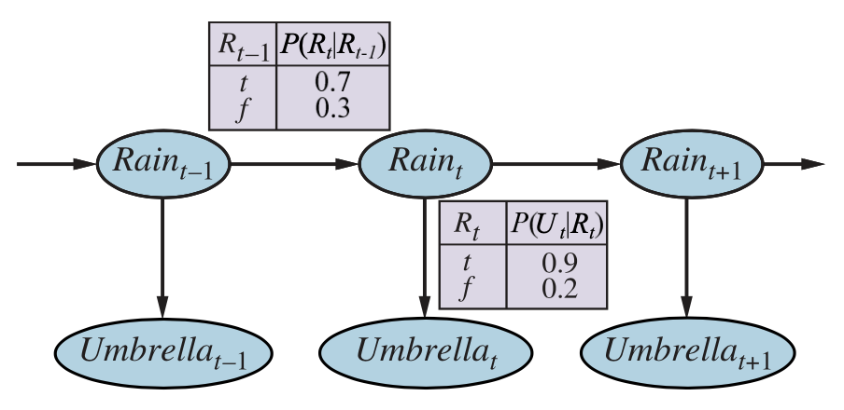
Bayesian Network Structure and Conditional Distributions describing the umbrella world
Source: Stuart Russell and Peter Norvig (2020), Artificial Intelligence: A Modern Approach, 4th Edition, Pearson

Slide 48
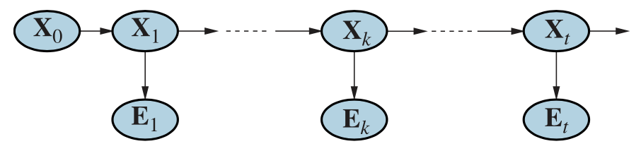
Smoothing computes P(X_{k} | e_{1:t}), the posterior distribution of the state at some past time k given a complete sequence of observations from 1 to t.
Source: Stuart Russell and Peter Norvig (2020), Artificial Intelligence: A Modern Approach, 4th Edition, Pearson

Slide 49
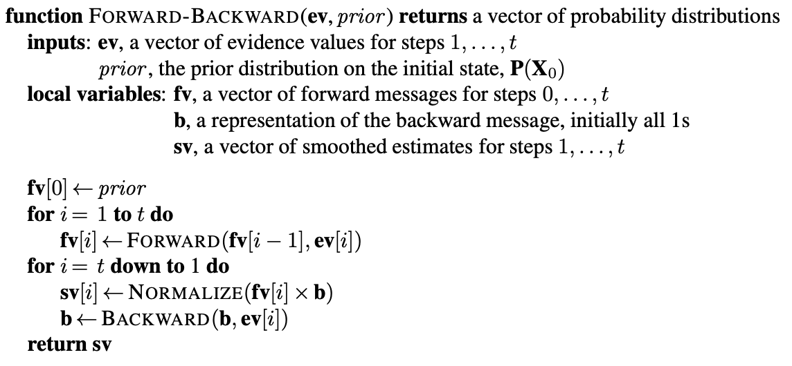
The Forward–Backward Algorithm for Smoothing
Source: Stuart Russell and Peter Norvig (2020), Artificial Intelligence: A Modern Approach, 4th Edition, Pearson

Slide 50
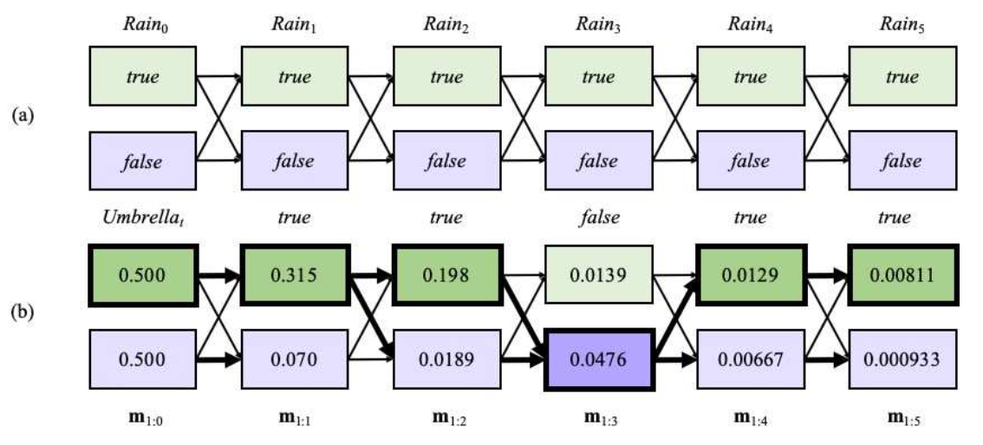
Possible state sequences for Rain _{t} can be viewed as paths through a graph of the possible states at each time step
Operation of the Viterbi algorithm
for the umbrella observation sequence [true, true, false, true, true]
Source: Stuart Russell and Peter Norvig (2020), Artificial Intelligence: A Modern Approach, 4th Edition, Pearson

Slide 51
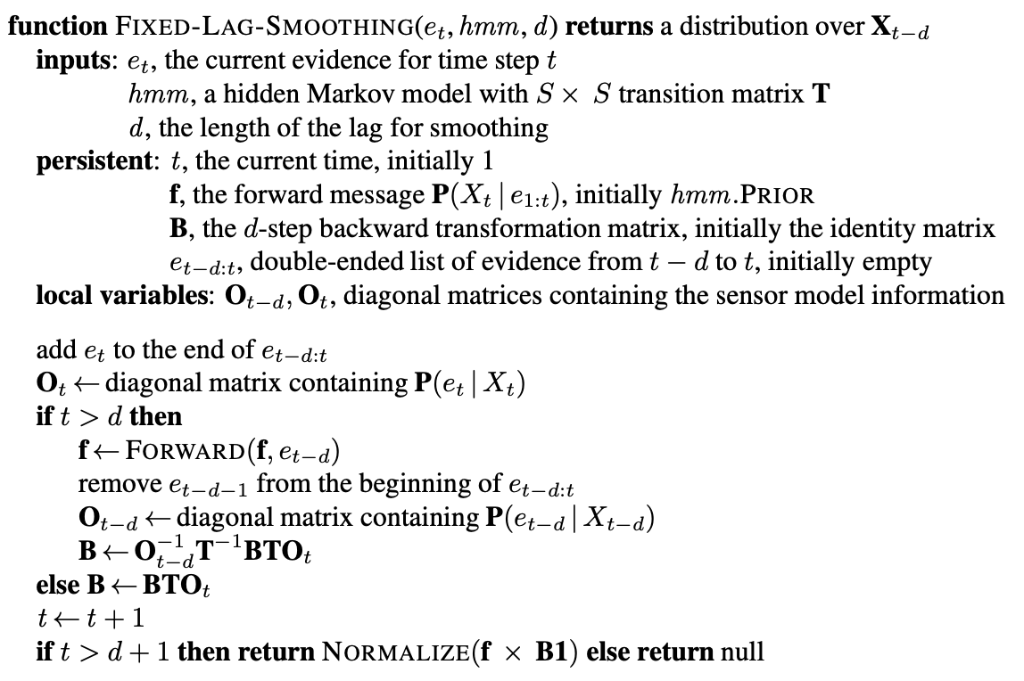
Algorithm for Smoothing with a Fixed Time Lag of d Step
Source: Stuart Russell and Peter Norvig (2020), Artificial Intelligence: A Modern Approach, 4th Edition, Pearson

Slide 52
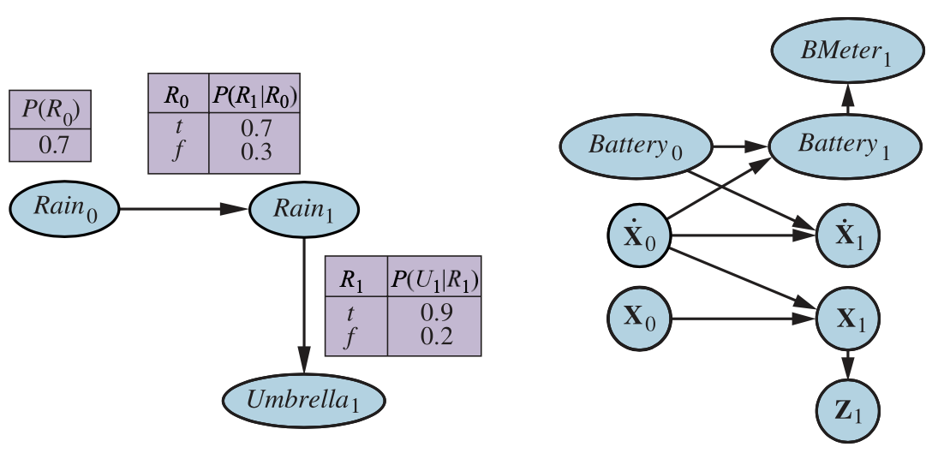
Specification of the prior, transition model, and sensor model for the umbrella DBN
Source: Stuart Russell and Peter Norvig (2020), Artificial Intelligence: A Modern Approach, 4th Edition, Pearson

Slide 53
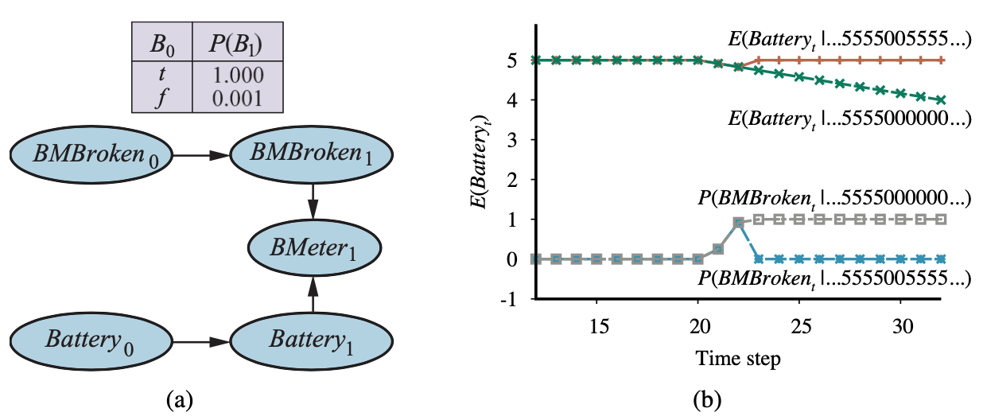
A DBN fragment the sensor status variable required for modeling persistent failure of the battery sensor
Source: Stuart Russell and Peter Norvig (2020), Artificial Intelligence: A Modern Approach, 4th Edition, Pearson

Slide 54
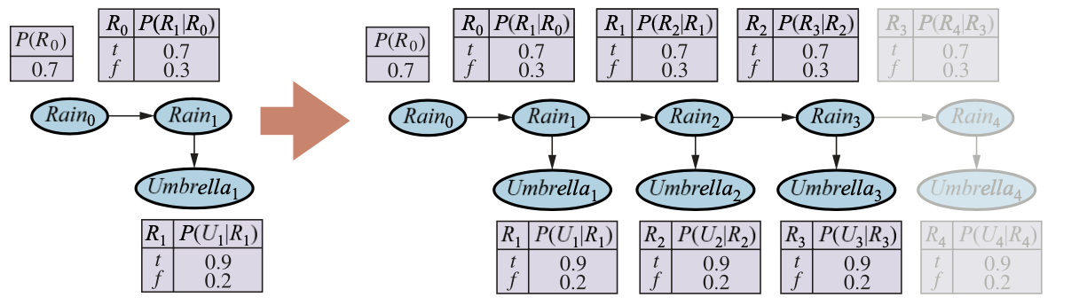
Unrolling a
Dynamic Bayesian Network
Source: Stuart Russell and Peter Norvig (2020), Artificial Intelligence: A Modern Approach, 4th Edition, Pearson

Slide 55
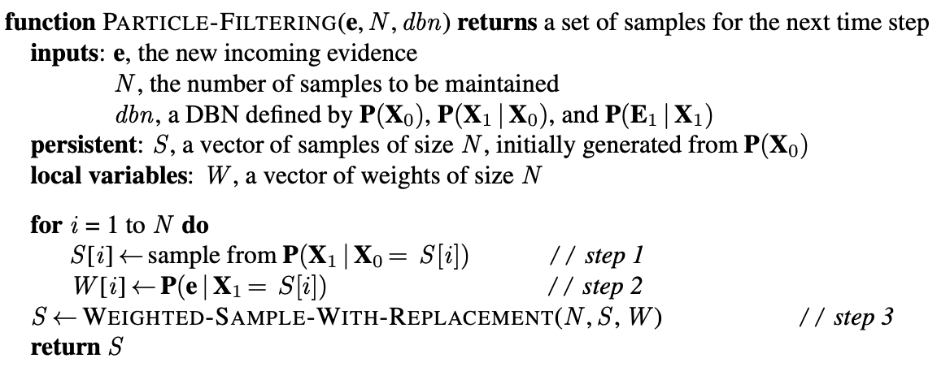
The Particle Filtering Algorithm
Source: Stuart Russell and Peter Norvig (2020), Artificial Intelligence: A Modern Approach, 4th Edition, Pearson

Slide 56
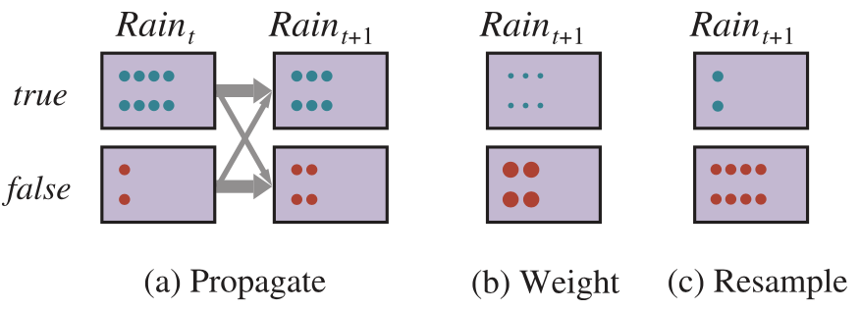
The Particle Filtering Update Cycle for the Umbrella DBN
Source: Stuart Russell and Peter Norvig (2020), Artificial Intelligence: A Modern Approach, 4th Edition, Pearson

Slide 57
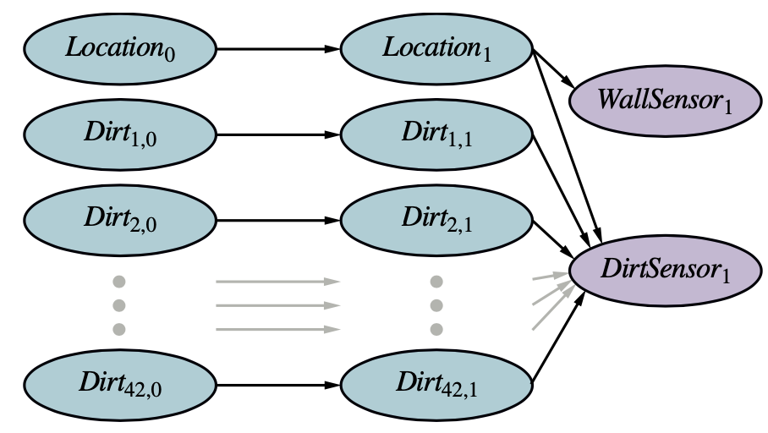
A Dynamic Bayes Net for simultaneous localization and mapping in the stochastic-dirt vacuum world
Source: Stuart Russell and Peter Norvig (2020), Artificial Intelligence: A Modern Approach, 4th Edition, Pearson

Slide 58
Probabilistic Programming
Source: Stuart Russell and Peter Norvig (2020), Artificial Intelligence: A Modern Approach, 4th Edition, Pearson

Slide 59
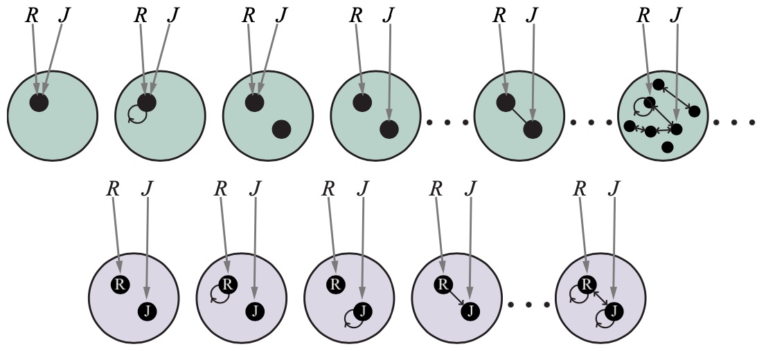
Possible Worlds for a language with two constant symbols, R and J
Source: Stuart Russell and Peter Norvig (2020), Artificial Intelligence: A Modern Approach, 4th Edition, Pearson

Slide 60
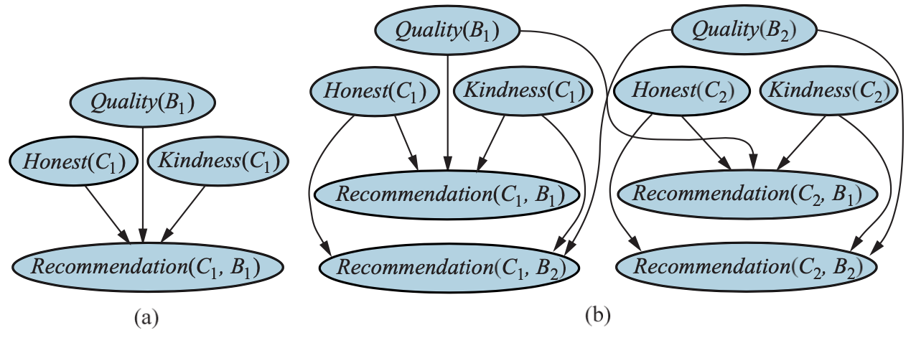
Bayes Net for a Single customer C1 recommending a single book B1. Honest(C1) is Boolean
Bayes net with two customers and two books
Source: Stuart Russell and Peter Norvig (2020), Artificial Intelligence: A Modern Approach, 4th Edition, Pearson

Slide 61
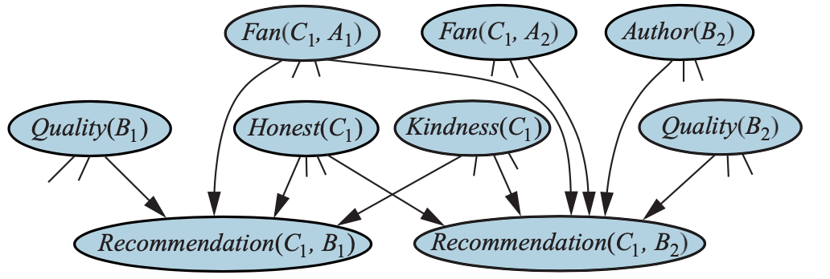
Bayes Net for the book recommendation when Author(B2) is unknown
Source: Stuart Russell and Peter Norvig (2020), Artificial Intelligence: A Modern Approach, 4th Edition, Pearson

Slide 62
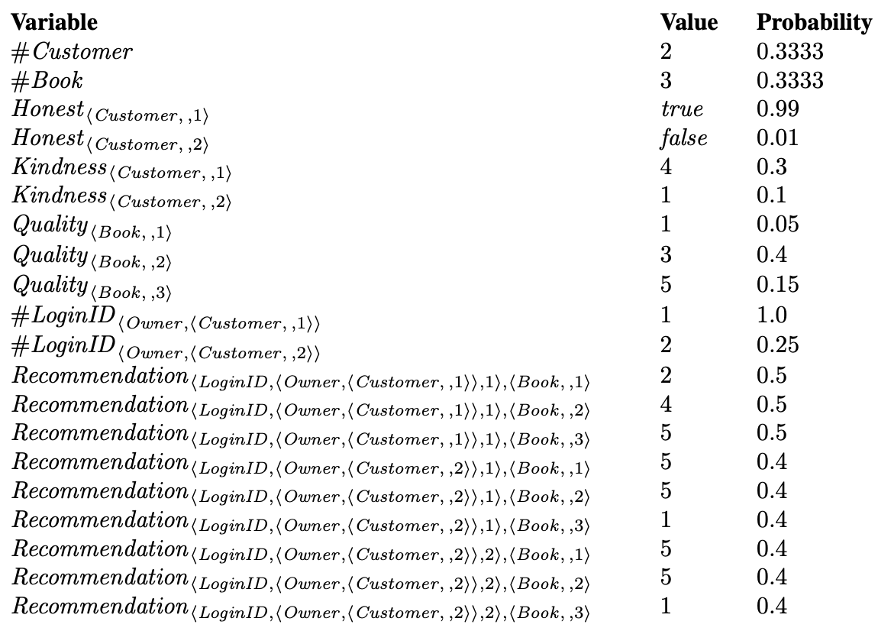
One particular world for the book recommendation OUPM
Source: Stuart Russell and Peter Norvig (2020), Artificial Intelligence: A Modern Approach, 4th Edition, Pearson

Slide 63
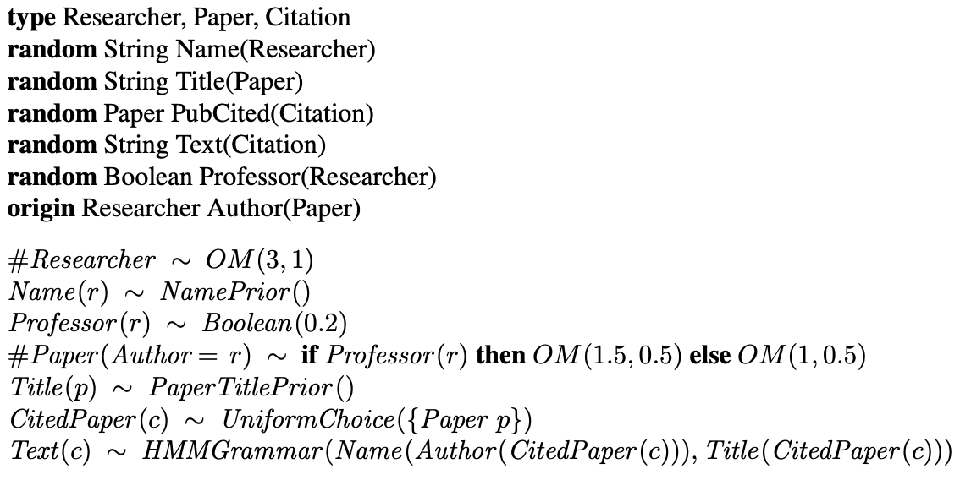
An OUPM for
Citation Information Extraction
Source: Stuart Russell and Peter Norvig (2020), Artificial Intelligence: A Modern Approach, 4th Edition, Pearson

Slide 64
Making
Simple
Decisions
Source: Stuart Russell and Peter Norvig (2020), Artificial Intelligence: A Modern Approach, 4th Edition, Pearson

Slide 65
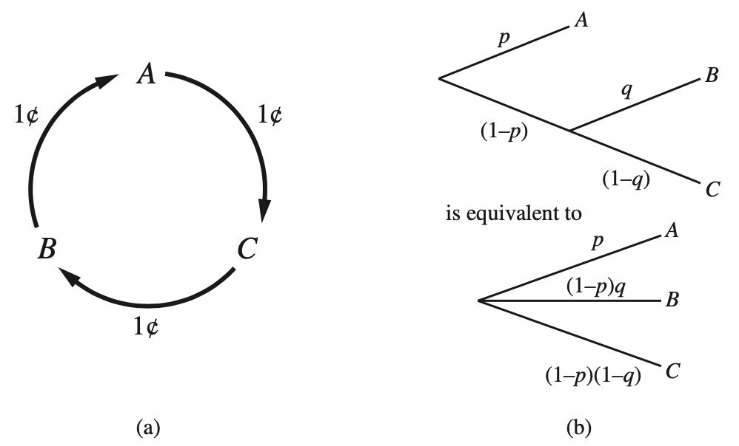
Nontransitive preferences A ≻ B ≻ C ≻ A can result in irrational behavior: a cycle of exchanges each costing one cent
The decomposability axiom
Source: Stuart Russell and Peter Norvig (2020), Artificial Intelligence: A Modern Approach, 4th Edition, Pearson

Slide 66
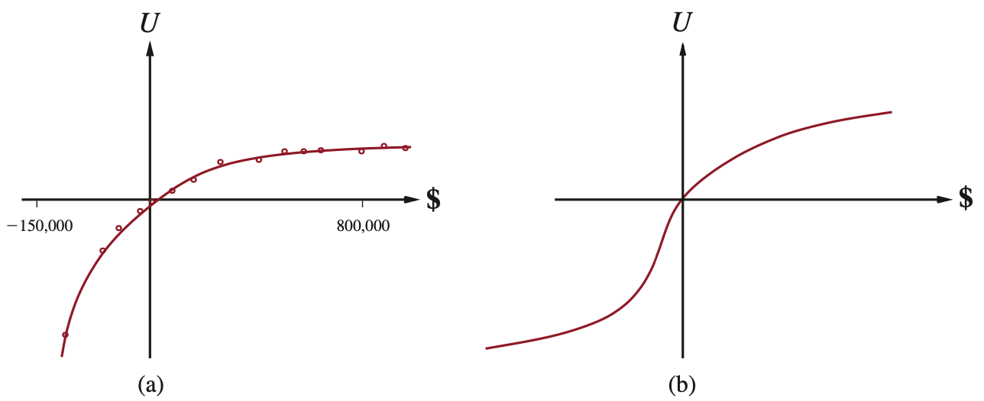
The Utility of Money
Source: Stuart Russell and Peter Norvig (2020), Artificial Intelligence: A Modern Approach, 4th Edition, Pearson

Slide 67
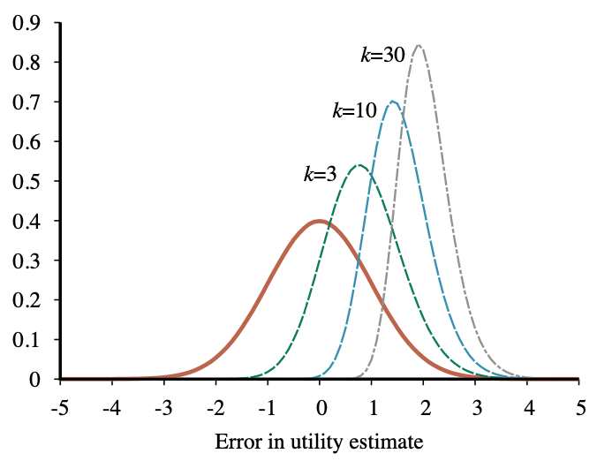
Unjustified optimism caused by choosing the best of k options
Source: Stuart Russell and Peter Norvig (2020), Artificial Intelligence: A Modern Approach, 4th Edition, Pearson

Slide 68
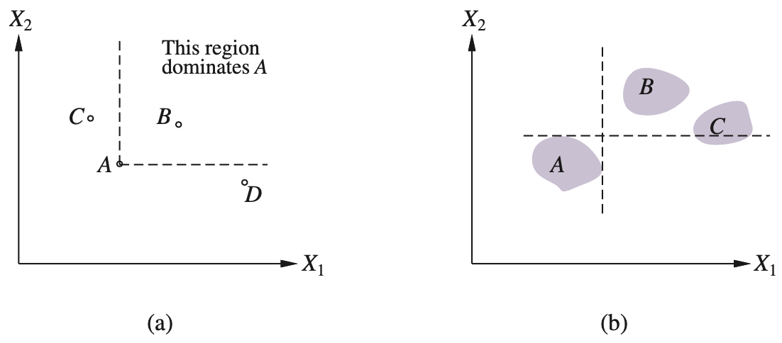
Strict dominance
(a) Deterministic (b) Uncertain
Source: Stuart Russell and Peter Norvig (2020), Artificial Intelligence: A Modern Approach, 4th Edition, Pearson

Slide 69
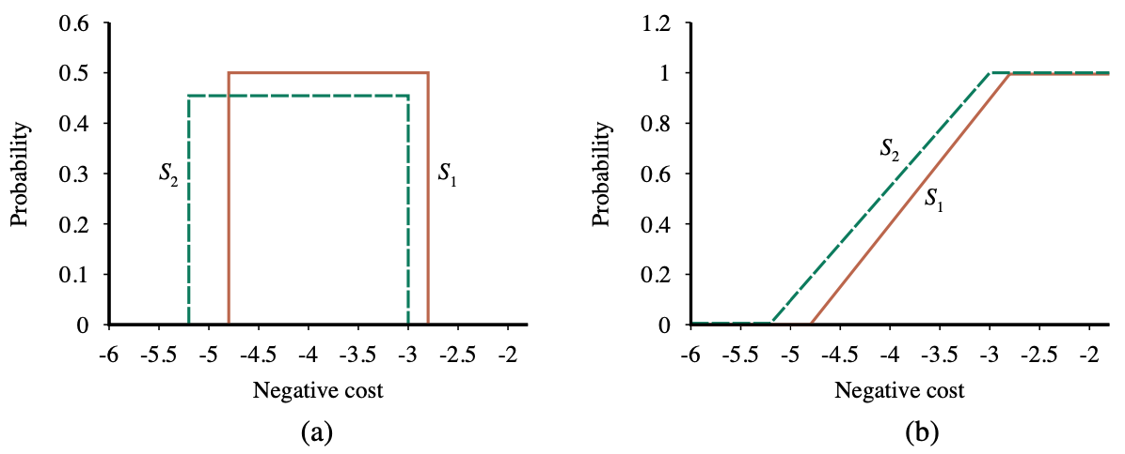
Stochastic dominance
Cumulative distributions for the
frugality of S1 and S2.
Source: Stuart Russell and Peter Norvig (2020), Artificial Intelligence: A Modern Approach, 4th Edition, Pearson

Slide 70
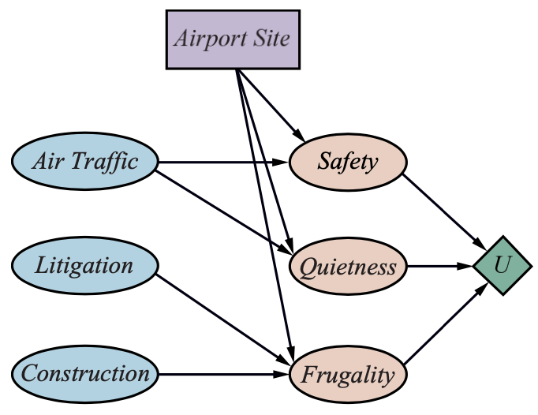
A decision network for the airport-siting problem
Source: Stuart Russell and Peter Norvig (2020), Artificial Intelligence: A Modern Approach, 4th Edition, Pearson

Slide 71
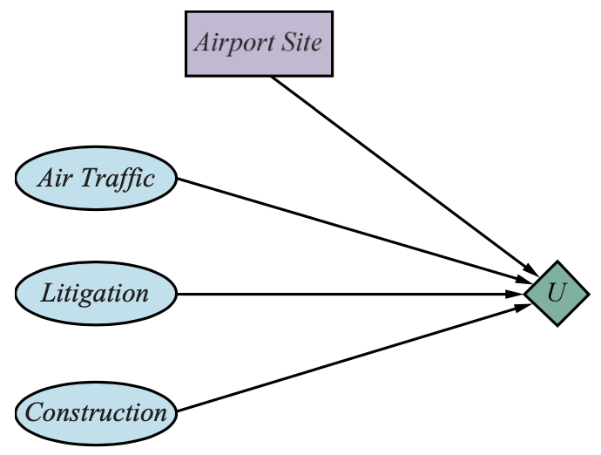
A simplified representation of the airport-siting problem
Source: Stuart Russell and Peter Norvig (2020), Artificial Intelligence: A Modern Approach, 4th Edition, Pearson

Slide 72
Making Complex Decisions
Source: Stuart Russell and Peter Norvig (2020), Artificial Intelligence: A Modern Approach, 4th Edition, Pearson

Slide 73

A dynamic decision network for a mobile robot with state variables for battery level, charging status, location, and velocity, and action variables for the left and right wheel motors and for charging.
Source: Stuart Russell and Peter Norvig (2020), Artificial Intelligence: A Modern Approach, 4th Edition, Pearson

Slide 74

The game of Tetris
The DDN for the Tetris MDP
Source: Stuart Russell and Peter Norvig (2020), Artificial Intelligence: A Modern Approach, 4th Edition, Pearson

Slide 75

The Value Iteration Algorithm for calculating utilities of states
Source: Stuart Russell and Peter Norvig (2020), Artificial Intelligence: A Modern Approach, 4th Edition, Pearson

Slide 76
AIMA Python
Artificial Intelligence: A Modern Approach (AIMA)
  http://aima.cs.berkeley.edu/
AIMA Python
  http://aima.cs.berkeley.edu/python/readme.html
  https://github.com/aimacode/aima-python
Probability Models (DTAgent)
  http://aima.cs.berkeley.edu/python/probability.html
Markov Decision Processes (MDP)
  http://aima.cs.berkeley.edu/python/mdp.html
Source: Stuart Russell and Peter Norvig (2020), Artificial Intelligence: A Modern Approach, 4th Edition, Pearson

Slide 77

Python in Google Colab (Python101)
https://colab.research.google.com/drive/1FEG6DnGvwfUbeo4zJ1zTunjMqf2RkCrT
https://tinyurl.com/aintpupython101

Slide 78
Summary
Quantifying Uncertainty
Probabilistic Reasoning
Probabilistic Reasoning over Time
Probabilistic Programming
Making Simple Decisions
Making Complex Decisions

Slide 79
References
Stuart Russell and Peter Norvig (2020), Artificial Intelligence: A Modern Approach, 4th Edition, Pearson.
Aurélien Géron (2019), Hands-On Machine Learning with Scikit-Learn, Keras, and TensorFlow: Concepts, Tools, and Techniques to Build Intelligent Systems, 2nd Edition, O’Reilly Media.

