Slide 1



人工智慧
(Artificial Intelligence)
學習理論與綜合學習
(The Theory of Learning and
Ensemble Learning)
1092AI07
MBA, IM, NTPU (M5010) (Spring 2021)
Wed 2, 3, 4 (9:10-12:00) (B8F40)
Min-Yuh Day
戴敏育
Associate Professor
副教授
Institute of Information Management, National Taipei University
國立臺北大學 資訊管理研究所
https://web.ntpu.edu.tw/~myday
2021-04-28

Slide 2
課程大綱 (Syllabus)
週次 (Week) 日期 (Date) 內容 (Subject/Topics)
1 2021/02/24 人工智慧概論
(Introduction to Artificial Intelligence)
2 2021/03/03 人工智慧和智慧代理人
(Artificial Intelligence and Intelligent Agents)
3 2021/03/10 問題解決
(Problem Solving)
4 2021/03/17 知識推理和知識表達
(Knowledge, Reasoning and Knowledge Representation)
5 2021/03/24 不確定知識和推理
(Uncertain Knowledge and Reasoning)
6 2021/03/31 人工智慧個案研究 I
(Case Study on Artificial Intelligence I)

Slide 3
課程大綱 (Syllabus)
週次 (Week) 日期 (Date) 內容 (Subject/Topics)
7 2021/04/07 放假一天 (Day off)
8 2021/04/14 機器學習與監督式學習
(Machine Learning and Supervised Learning)
9 2021/04/21 期中報告
(Midterm Project Report)
10 2021/04/28 學習理論與綜合學習
(The Theory of Learning and Ensemble Learning)
11 2021/05/05 深度學習
(Deep Learning)
12 2021/05/12 人工智慧個案研究 II
(Case Study on Artificial Intelligence II)

Slide 4
課程大綱 (Syllabus)
週次 (Week) 日期 (Date) 內容 (Subject/Topics)
13 2021/05/19 強化學習
(Reinforcement Learning)
14 2021/05/26 深度學習自然語言處理
(Deep Learning for Natural Language Processing)
15 2021/06/02 機器人技術
(Robotics)
16 2021/06/09 人工智慧哲學與倫理，人工智慧的未來
(Philosophy and Ethics of AI, The Future of AI)
17 2021/06/16 期末報告 I
(Final Project Report I)
18 2021/06/23 期末報告 II
(Final Project Report II)

Slide 5
The Theory of Learning and
Ensemble Learning

Slide 6
Outline
The Theory of Learning
Ensemble Learning

Slide 7
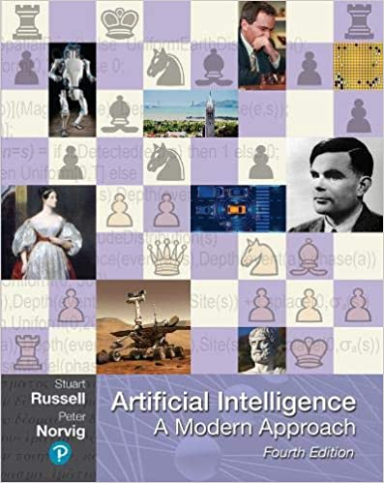
Stuart Russell and Peter Norvig (2020),
Artificial Intelligence: A Modern Approach,
4th Edition, Pearson
Source: Stuart Russell and Peter Norvig (2020), Artificial Intelligence: A Modern Approach, 4th Edition, Pearson
https://www.amazon.com/Artificial-Intelligence-A-Modern-Approach/dp/0134610997/

Slide 8
Artificial Intelligence:
A Modern Approach
Artificial Intelligence
Problem Solving
Knowledge and Reasoning
Uncertain Knowledge and Reasoning
Machine Learning
Communicating, Perceiving, and Acting
Philosophy and Ethics of AI
Source: Stuart Russell and Peter Norvig (2020), Artificial Intelligence: A Modern Approach, 4th Edition, Pearson

Slide 9
Artificial Intelligence:
Machine Learning
Source: Stuart Russell and Peter Norvig (2020), Artificial Intelligence: A Modern Approach, 4th Edition, Pearson

Slide 10
Artificial Intelligence:
5. Machine Learning
Learning from Examples
Learning Probabilistic Models
Deep Learning
Reinforcement Learning
Source: Stuart Russell and Peter Norvig (2020), Artificial Intelligence: A Modern Approach, 4th Edition, Pearson

Slide 11
Reinforcement Learning (DL)
Agent
Environment
Source: Richard S. Sutton & Andrew G. Barto (2018), Reinforcement Learning: An Introduction, 2nd Edition, A Bradford Book.

Slide 12
Reinforcement Learning (DL)
1
2
observation
Agent
action
3
reward
Environment
Source: Richard S. Sutton & Andrew G. Barto (2018), Reinforcement Learning: An Introduction, 2nd Edition, A Bradford Book.

Slide 13
Reinforcement Learning (DL)
1
2
observation
Agent
action
O_{t}
A_{t}
3
reward
R_{t}
Environment
Source: Richard S. Sutton & Andrew G. Barto (2018), Reinforcement Learning: An Introduction, 2nd Edition, A Bradford Book.

Slide 14
Agents interact with environments through sensors and actuators
Source: Stuart Russell and Peter Norvig (2020), Artificial Intelligence: A Modern Approach, 4th Edition, Pearson

Slide 15
Machine Learning
Supervised Learning (Classification)
Learning from Examples
y = f(x)
x
y

Slide 16
Machine Learning
Supervised Learning (Classification)
Learning from Examples
y = f(x)
5.1,3.5,1.4,0.2,Iris-setosa 4.9,3.0,1.4,0.2,Iris-setosa 4.7,3.2,1.3,0.2,Iris-setosa 7.0,3.2,4.7,1.4,Iris-versicolor 6.4,3.2,4.5,1.5,Iris-versicolor 6.9,3.1,4.9,1.5,Iris-versicolor 6.3,3.3,6.0,2.5,Iris-virginica 5.8,2.7,5.1,1.9,Iris-virginica 7.1,3.0,5.9,2.1,Iris-virginica
y
x

Slide 17

Aurélien Géron (2019),
Hands-On Machine Learning with Scikit-Learn, Keras, and TensorFlow: Concepts, Tools, and Techniques to Build Intelligent Systems, 2nd Edition
O’Reilly Media, 2019
https://github.com/ageron/handson-ml2
Source: https://www.amazon.com/Hands-Machine-Learning-Scikit-Learn-TensorFlow/dp/1492032646/

Slide 18

Hands-On Machine Learning with
Scikit-Learn, Keras, and TensorFlow
Notebooks
The Machine Learning landscape
End-to-end Machine Learning project
Classification
Training Models
Support Vector Machines
Decision Trees
Ensemble Learning and Random Forests
Dimensionality Reduction
Unsupervised Learning Techniques
Artificial Neural Nets with Keras
Training Deep Neural Networks
Custom Models and Training with TensorFlow
Loading and Preprocessing Data
Deep Computer Vision Using Convolutional Neural Networks
Processing Sequences Using RNNs and CNNs
Natural Language Processing with RNNs and Attention
Representation Learning Using Autoencoders
Reinforcement Learning
Training and Deploying TensorFlow Models at Scale
https://github.com/ageron/handson-ml2

Slide 19
AI, ML, DL
Artificial Intelligence (AI)
Machine Learning (ML)
Supervised
Learning
Unsupervised Learning
Deep Learning (DL)
CNN
RNN LSTM GRU
GAN
Semi-supervised Learning
Reinforcement Learning
Source: https://leonardoaraujosantos.gitbooks.io/artificial-inteligence/content/deep_learning.html

Slide 20
Machine Learning Models
Deep Learning
Kernel
Association rules
Ensemble
Decision tree
Dimensionality reduction
Clustering
Regression Analysis
Bayesian
Instance based
Source: Sunila Gollapudi (2016), Practical Machine Learning, Packt Publishing

Slide 21
Machine Learning (ML) / Deep Learning (DL)
Decision Tree Classifiers
Support Vector Machine (SVM)
Supervised Learning
Neural Network (NN)
Linear Classifiers
Deep Learning (DL)
Machine Learning
(ML)
Rule-based Classifiers
Naïve Bayes
(NB)
Unsupervised Learning
Probabilistic Classifiers
Bayesian Network (BN)
Maximum Entropy (ME)
Reinforcement Learning
Source: Jesus Serrano-Guerrero, Jose A. Olivas, Francisco P. Romero, and Enrique Herrera-Viedma (2015),
"Sentiment analysis: A review and comparative analysis of web services," Information Sciences, 311, pp. 18-38.

Slide 22
The
Theory of Learning

Slide 23
The Theory of Learning
Computational Learning Theory
Probably approximately correct (PAC)
Source: Stuart Russell and Peter Norvig (2020), Artificial Intelligence: A Modern Approach, 4th Edition, Pearson

Slide 24
Computational Learning Theory
Intersection of AI, statistics, and
theoretical computer science.
Any hypothesis that is seriously wrong will almost certainly be “found out” with high probability after a small number of examples.
Source: Stuart Russell and Peter Norvig (2020), Artificial Intelligence: A Modern Approach, 4th Edition, Pearson

Slide 25
Probably approximately correct (PAC)
Any hypothesis that is consistent with a sufficiently large set of training examples is unlikely to be seriously wrong.
PAC learning algorithm:
  Any learning algorithm that returns hypotheses that are probably approximately correct
Source: Stuart Russell and Peter Norvig (2020), Artificial Intelligence: A Modern Approach, 4th Edition, Pearson

Slide 26
Linear function
y = f(x)
y = w₁x + w₀
h_{w}(x) = w₁x + w₀
Source: Stuart Russell and Peter Norvig (2020), Artificial Intelligence: A Modern Approach, 4th Edition, Pearson

Slide 27
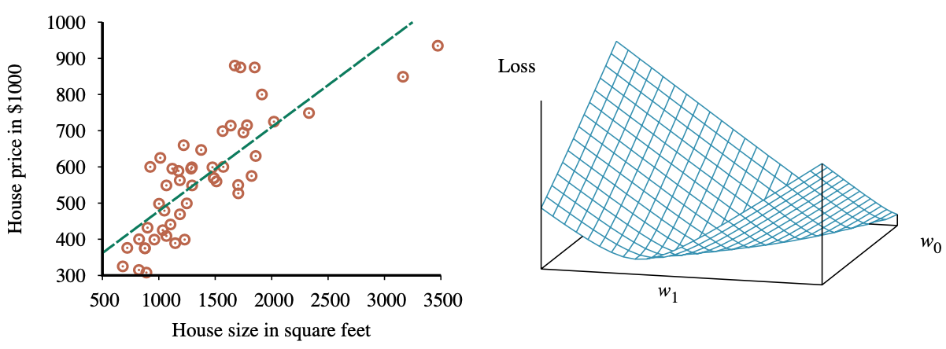
Linear Regression Weight Space
h_{w}(x) = w₁x + w₀
w* = argmin_{w} Loss(h_{w})
y = 0.232 x + 246
Loss function for Weights (w₁, w₀)
Source: Stuart Russell and Peter Norvig (2020), Artificial Intelligence: A Modern Approach, 4th Edition, Pearson

Slide 28
Ensemble Learning

Slide 29
Ensemble Learning
Select a collection, or ensemble, of hypotheses, h₁, h₂, …, h_{n}
, and combine their predictions by averaging, voting, or by another level of machine learning.
Source: Stuart Russell and Peter Norvig (2020), Artificial Intelligence: A Modern Approach, 4th Edition, Pearson

Slide 30
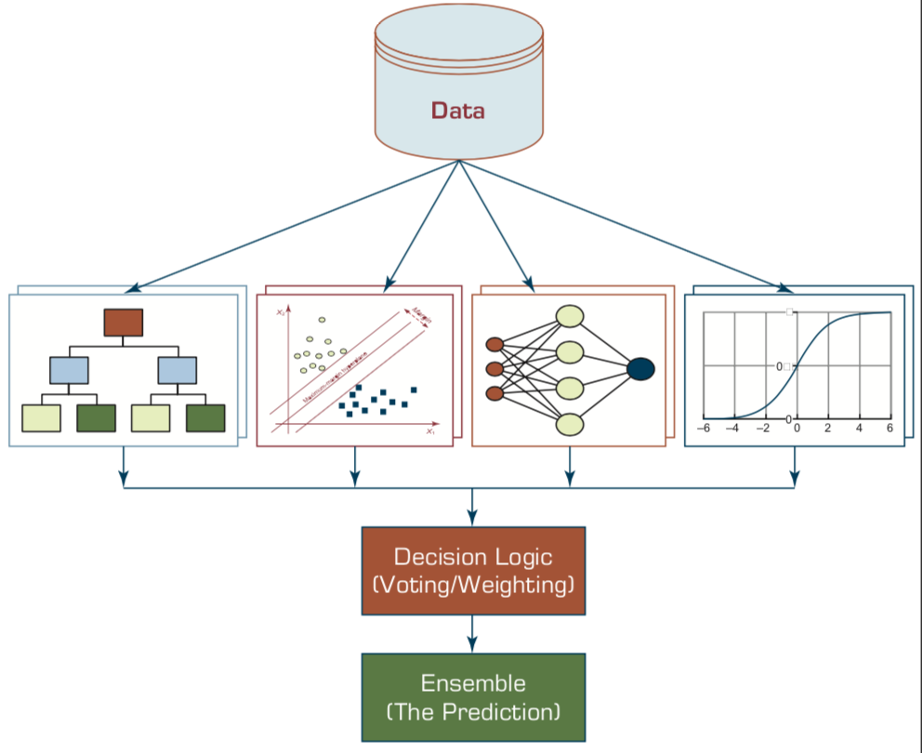
Ensemble Models
Heterogeneous Ensemble
Source: Ramesh Sharda, Dursun Delen, and Efraim Turban (2017), Business Intelligence, Analytics, and Data Science: A Managerial Perspective, 4th Edition, Pearson

Slide 31
Ensemble Learning
Base model
  individual hypotheses
  h₁, h₂, …, h_{n}
Ensemble model
  hypotheses combination
Source: Stuart Russell and Peter Norvig (2020), Artificial Intelligence: A Modern Approach, 4th Edition, Pearson

Slide 32
Why Ensemble Learning
Reduce bias
Reduce variance
Source: Stuart Russell and Peter Norvig (2020), Artificial Intelligence: A Modern Approach, 4th Edition, Pearson

Slide 33
Ensemble Learning
Bagging
Random forests
Stacking
Boosting
Gradient boosting
Online learning
Source: Stuart Russell and Peter Norvig (2020), Artificial Intelligence: A Modern Approach, 4th Edition, Pearson

Slide 34
Ensemble Learning: Bagging
Bagging
  Generate distinct training sets by sampling with replacement from the original training set.
Classification:
  Plurality Vote (Majority Vote)
Regression:
  Average
Source: Stuart Russell and Peter Norvig (2020), Artificial Intelligence: A Modern Approach, 4th Edition, Pearson

Slide 35
Ensemble Learning: Random forests
Random forest model is a form of decision tree bagging in which we take extra steps to make the ensemble of trees more diverse, to reduce variance.
The key idea is to randomly vary the attribute choices (rather than the training examples)
Source: Stuart Russell and Peter Norvig (2020), Artificial Intelligence: A Modern Approach, 4th Edition, Pearson

Slide 36
Ensemble Learning: Random forests
Extremely randomized trees (ExtraTrees)
  Use randomness in selecting the split point value
  for each selected attribute, we randomly sample several candidate values from a uniform distribution over the attribute’s range
Source: Stuart Russell and Peter Norvig (2020), Artificial Intelligence: A Modern Approach, 4th Edition, Pearson

Slide 37
Ensemble Learning: Stacking
Staking
  Stacked generalization combines multiple base models from different model classes trained on the same data.
Bagging
  Combines multiple base models of the same model class trained on different data.
Source: Stuart Russell and Peter Norvig (2020), Artificial Intelligence: A Modern Approach, 4th Edition, Pearson

Slide 38
Ensemble Learning: Boosting
Boosting
  The most popular ensemble method
Weighted training set
Source: Stuart Russell and Peter Norvig (2020), Artificial Intelligence: A Modern Approach, 4th Edition, Pearson

Slide 39
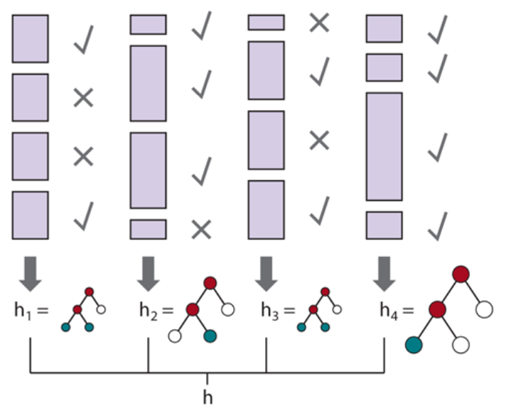
Ensemble Learning: Boosting
Source: Stuart Russell and Peter Norvig (2020), Artificial Intelligence: A Modern Approach, 4th Edition, Pearson

Slide 40
Ensemble Learning:
Gradient boosting
Gradient boosting
  Gradient boosting is a form of boosting using gradient descent
Gradient boosting machines (GBM)
Gradient boosted regression trees (GBRT)
Popular method for regression and classification of factored tabular data
Source: Stuart Russell and Peter Norvig (2020), Artificial Intelligence: A Modern Approach, 4th Edition, Pearson

Slide 41
Ensemble Learning:
Online learning
Online learning
  Data are not i.i.d.
  (independent and identically distributed)
  An agent receives an input x_{i} from nature, predicts the corresponding y_{i} and then is told the correct answer.
Source: Stuart Russell and Peter Norvig (2020), Artificial Intelligence: A Modern Approach, 4th Edition, Pearson

Slide 42
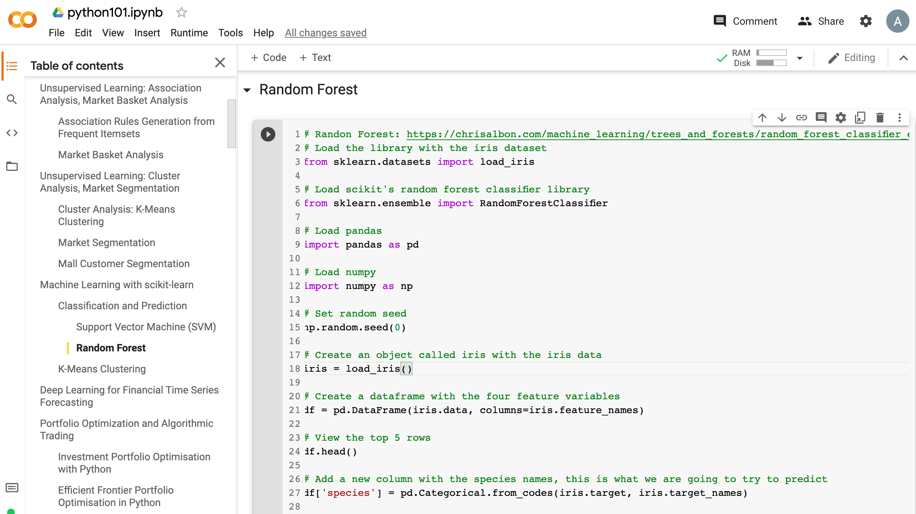
Machine Learning: Ensemble Learning
Random Forest
https://tinyurl.com/aintpupython101

Slide 43
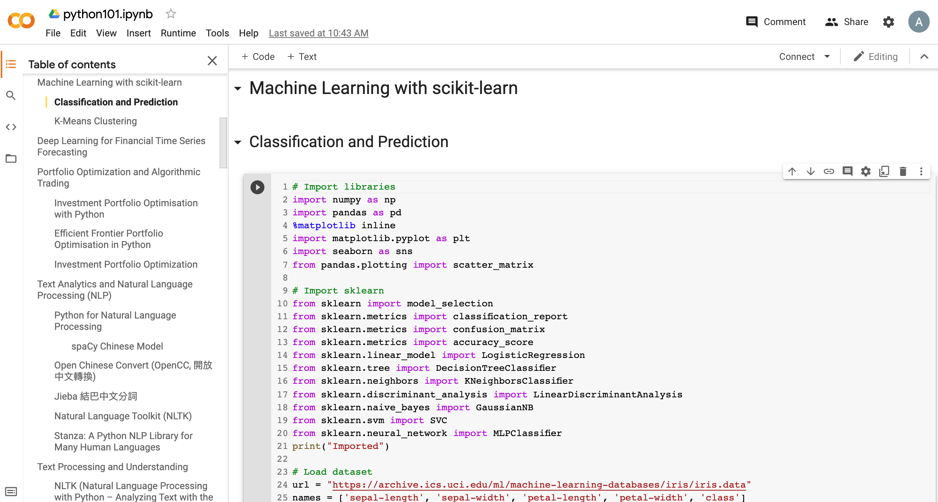
Machine Learning: Supervised Learning
Classification and Prediction
https://tinyurl.com/aintpupython101

Slide 44
# Import sklearn
from sklearn import model_selection
from sklearn.metrics import classification_report
from sklearn.metrics import confusion_matrix
from sklearn.metrics import accuracy_score
from sklearn.linear_model import LogisticRegression
from sklearn.tree import DecisionTreeClassifier
from sklearn.neighbors import KNeighborsClassifier
from sklearn.discriminant_analysis import LinearDiscriminantAnalysis
from sklearn.naive_bayes import GaussianNB
from sklearn.svm import SVC
from sklearn.neural_network import MLPClassifier
print("Imported")
https://tinyurl.com/aintpupython101

Slide 45
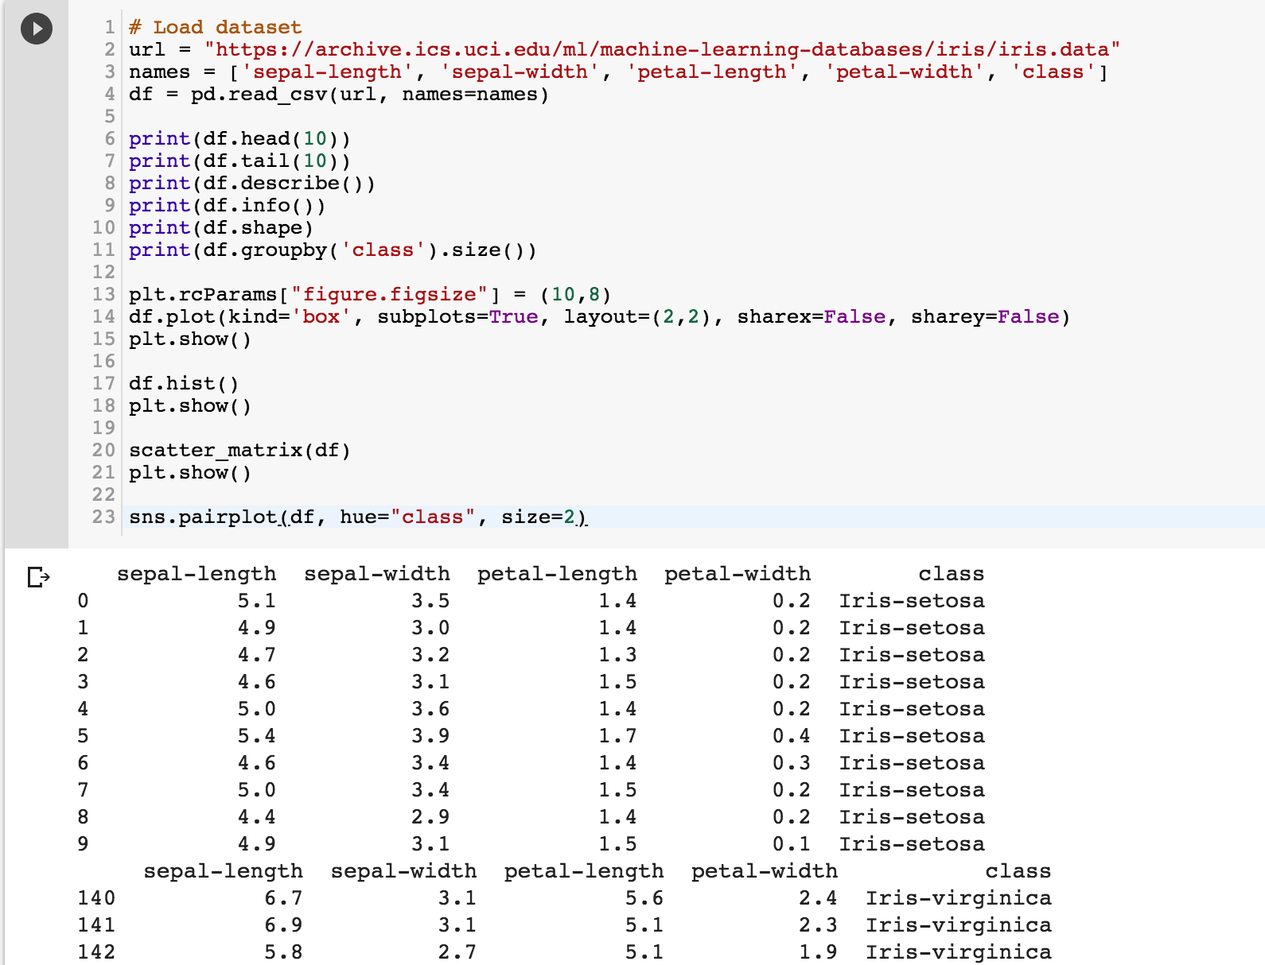
https://tinyurl.com/aintpupython101

Slide 46
https://tinyurl.com/aintpupython101

Slide 47
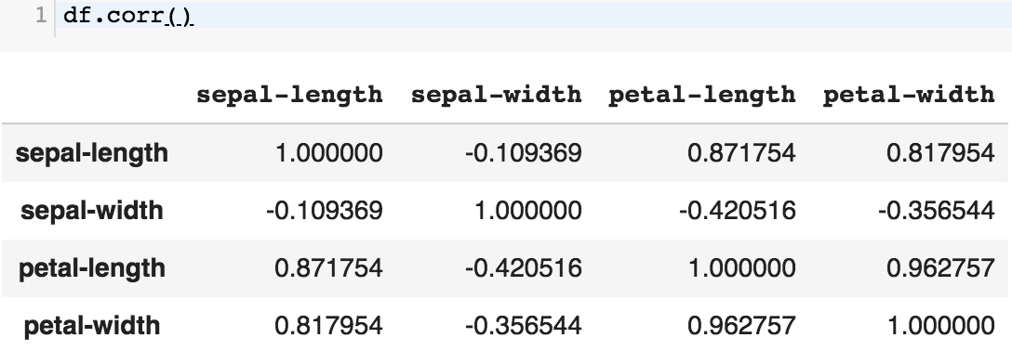
df.corr()
https://tinyurl.com/aintpupython101

Slide 48
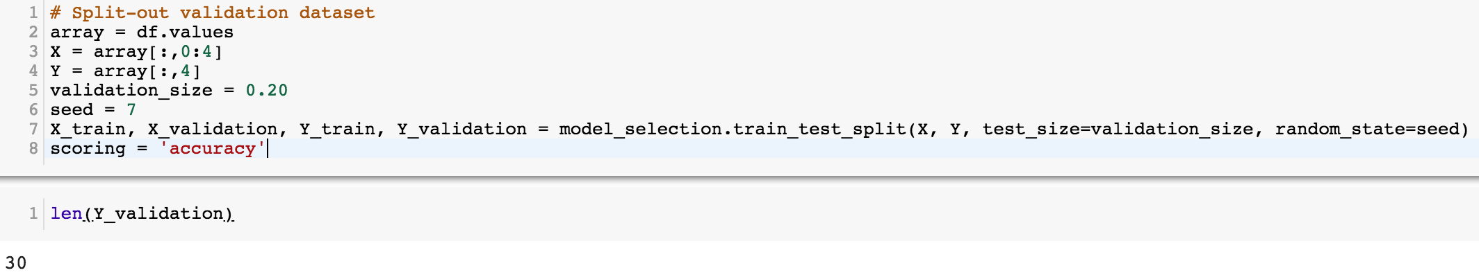
# Split-out validation dataset
array = df.values
X = array[:,0:4]
Y = array[:,4]
validation_size = 0.20
seed = 7
X_train, X_validation, Y_train, Y_validation = model_selection.train_test_split(X, Y, test_size=validation_size, random_state=seed)
scoring = 'accuracy'
https://tinyurl.com/aintpupython101

Slide 49
# Models
models = []
models.append(('LR', LogisticRegression()))
models.append(('LDA', LinearDiscriminantAnalysis()))
models.append(('KNN', KNeighborsClassifier()))
models.append(('DT', DecisionTreeClassifier()))
models.append(('NB', GaussianNB()))
models.append(('SVM', SVC()))
https://tinyurl.com/aintpupython101

Slide 50
# evaluate each model in turn
results = []
names = []
for name, model in models:
kfold = model_selection.KFold(n_splits=10, random_state=seed)
cv_results = model_selection.cross_val_score(model, X_train, Y_train, cv=kfold, scoring=scoring)
results.append(cv_results)
names.append(name)
msg = "%s: %.4f (%.4f)" % (name, cv_results.mean(), cv_results.std())
print(msg)
https://tinyurl.com/aintpupython101

Slide 51
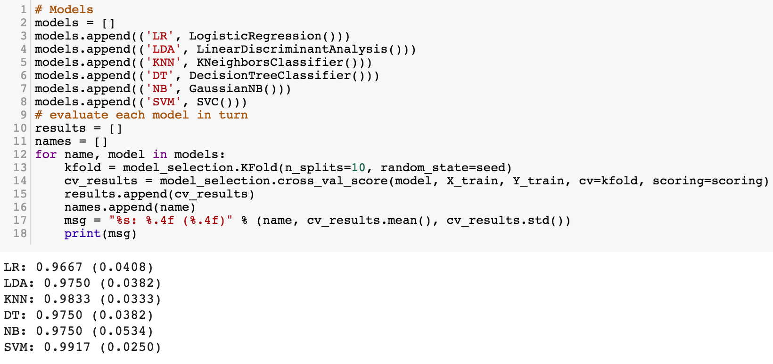
https://tinyurl.com/aintpupython101

Slide 52
# Make predictions on validation dataset
model = KNeighborsClassifier()
model.fit(X_train, Y_train)
predictions = model.predict(X_validation)
print("%.4f" % accuracy_score(Y_validation, predictions))
print(confusion_matrix(Y_validation, predictions))
print(classification_report(Y_validation, predictions))
print(model)
https://tinyurl.com/aintpupython101

Slide 53
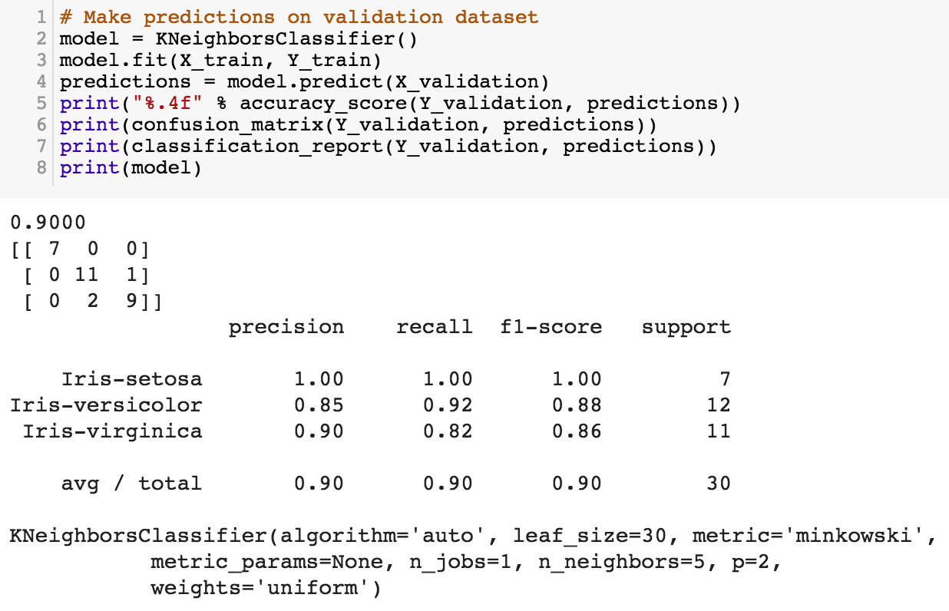
https://tinyurl.com/aintpupython101

Slide 54
# Make predictions on validation dataset
model = SVC()
model.fit(X_train, Y_train)
predictions = model.predict(X_validation)
print("%.4f" % accuracy_score(Y_validation, predictions))
print(confusion_matrix(Y_validation, predictions))
print(classification_report(Y_validation, predictions))
print(model)
https://tinyurl.com/aintpupython101

Slide 55
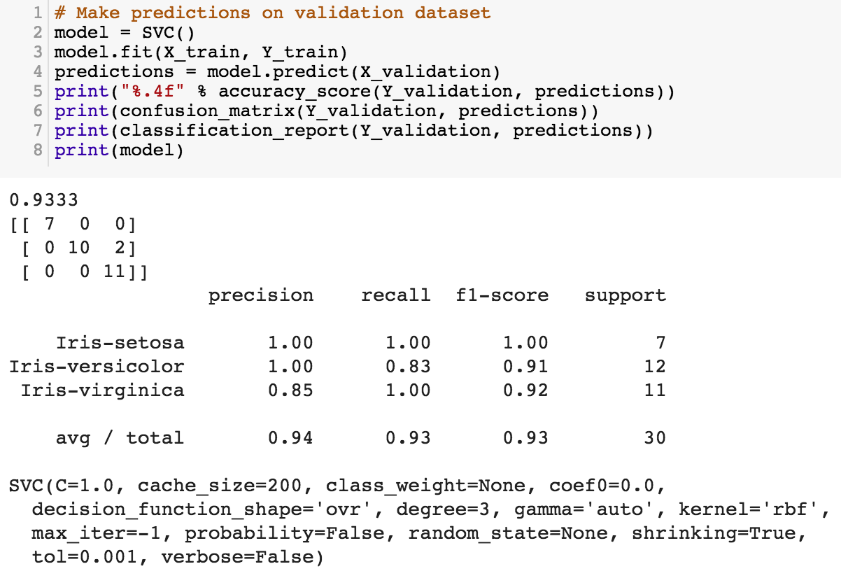
model = SVC()
model.fit(X_train, Y_train)
predictions = model.predict(X_validation)
https://tinyurl.com/aintpupython101

Slide 56
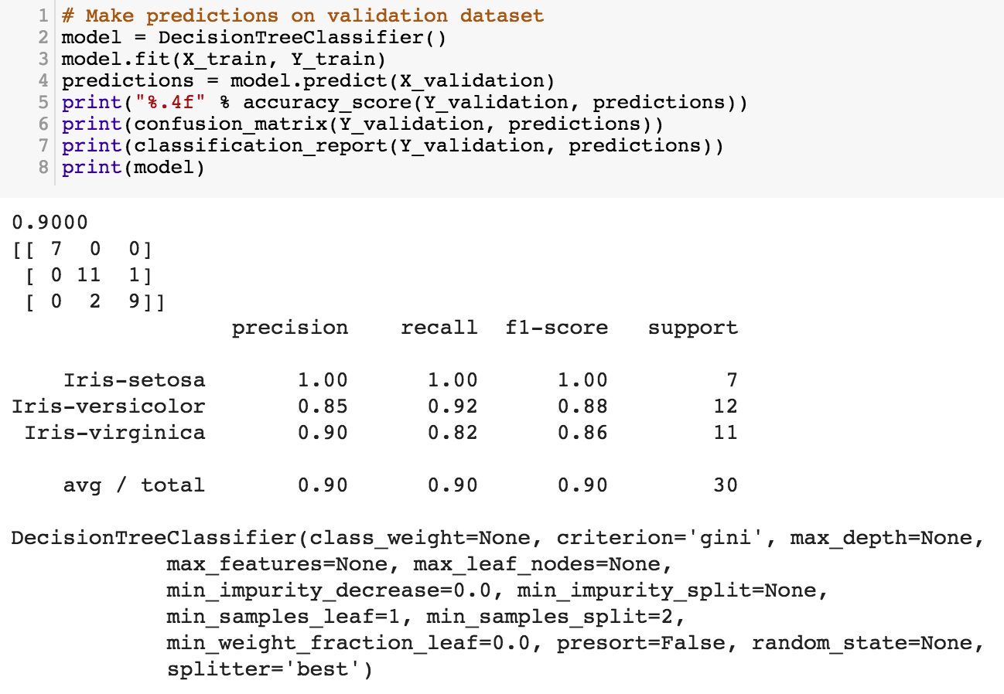
https://tinyurl.com/aintpupython101

Slide 57
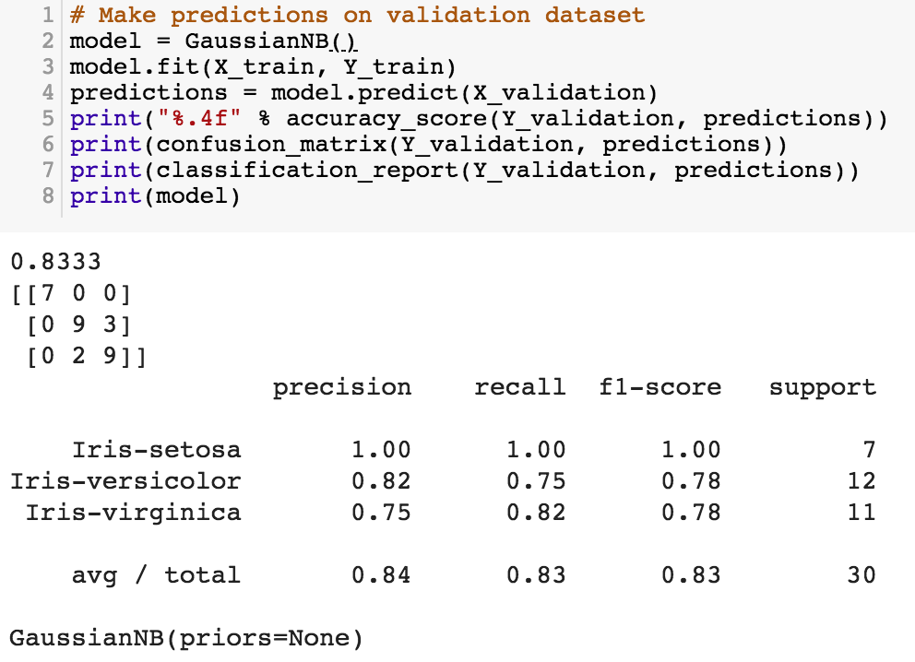
https://tinyurl.com/aintpupython101

Slide 58
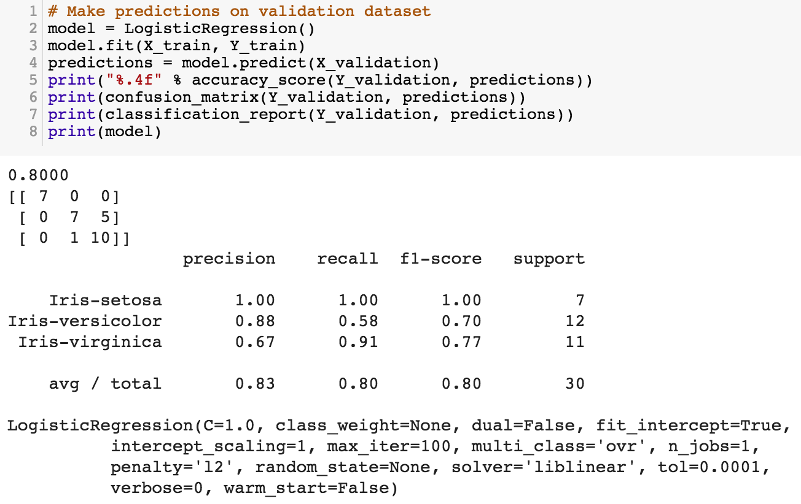
https://tinyurl.com/aintpupython101

Slide 59
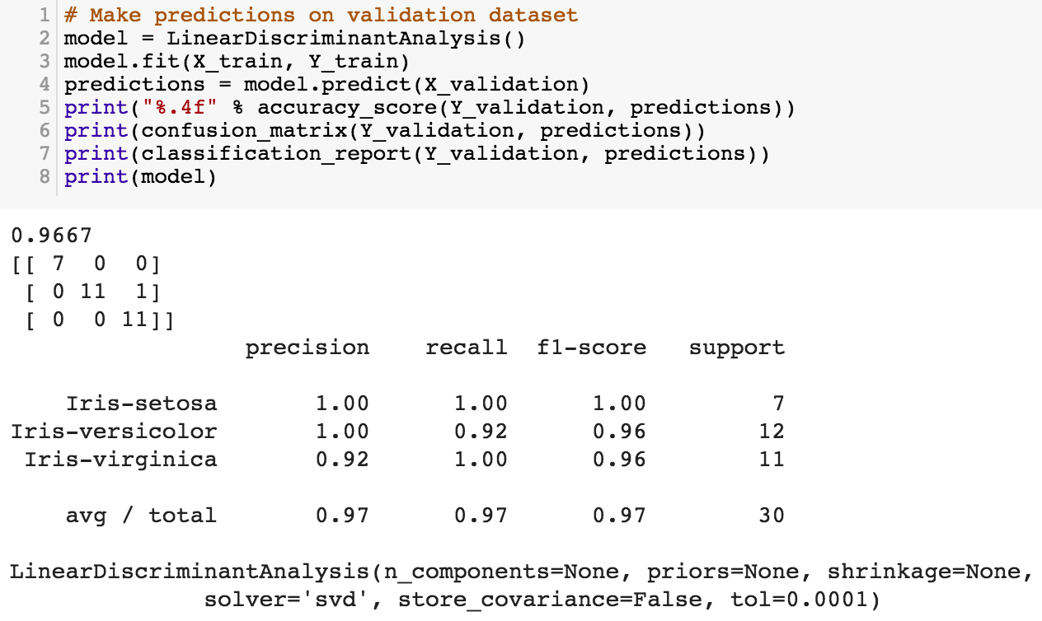
https://tinyurl.com/aintpupython101

Slide 60
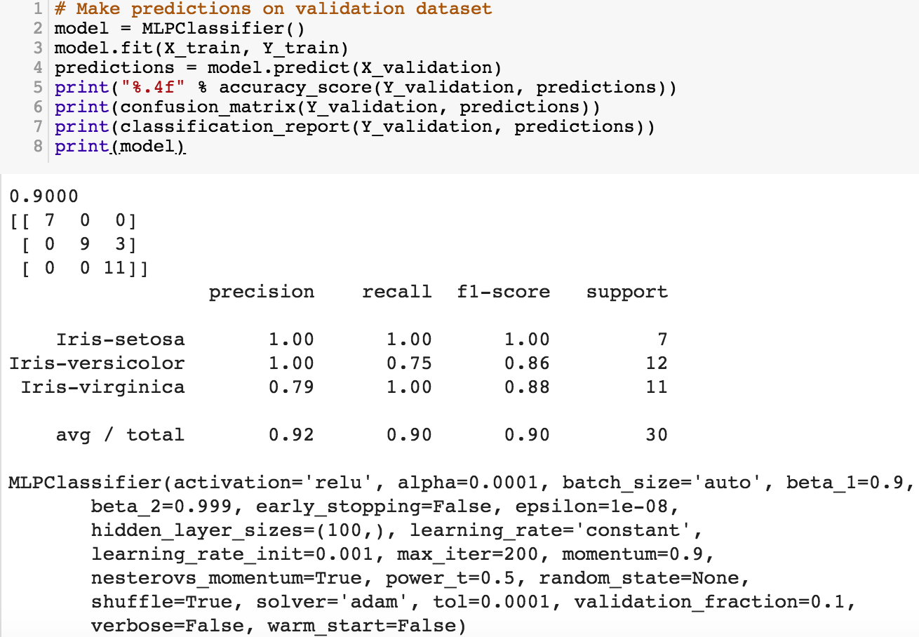
https://tinyurl.com/aintpupython101

Slide 61
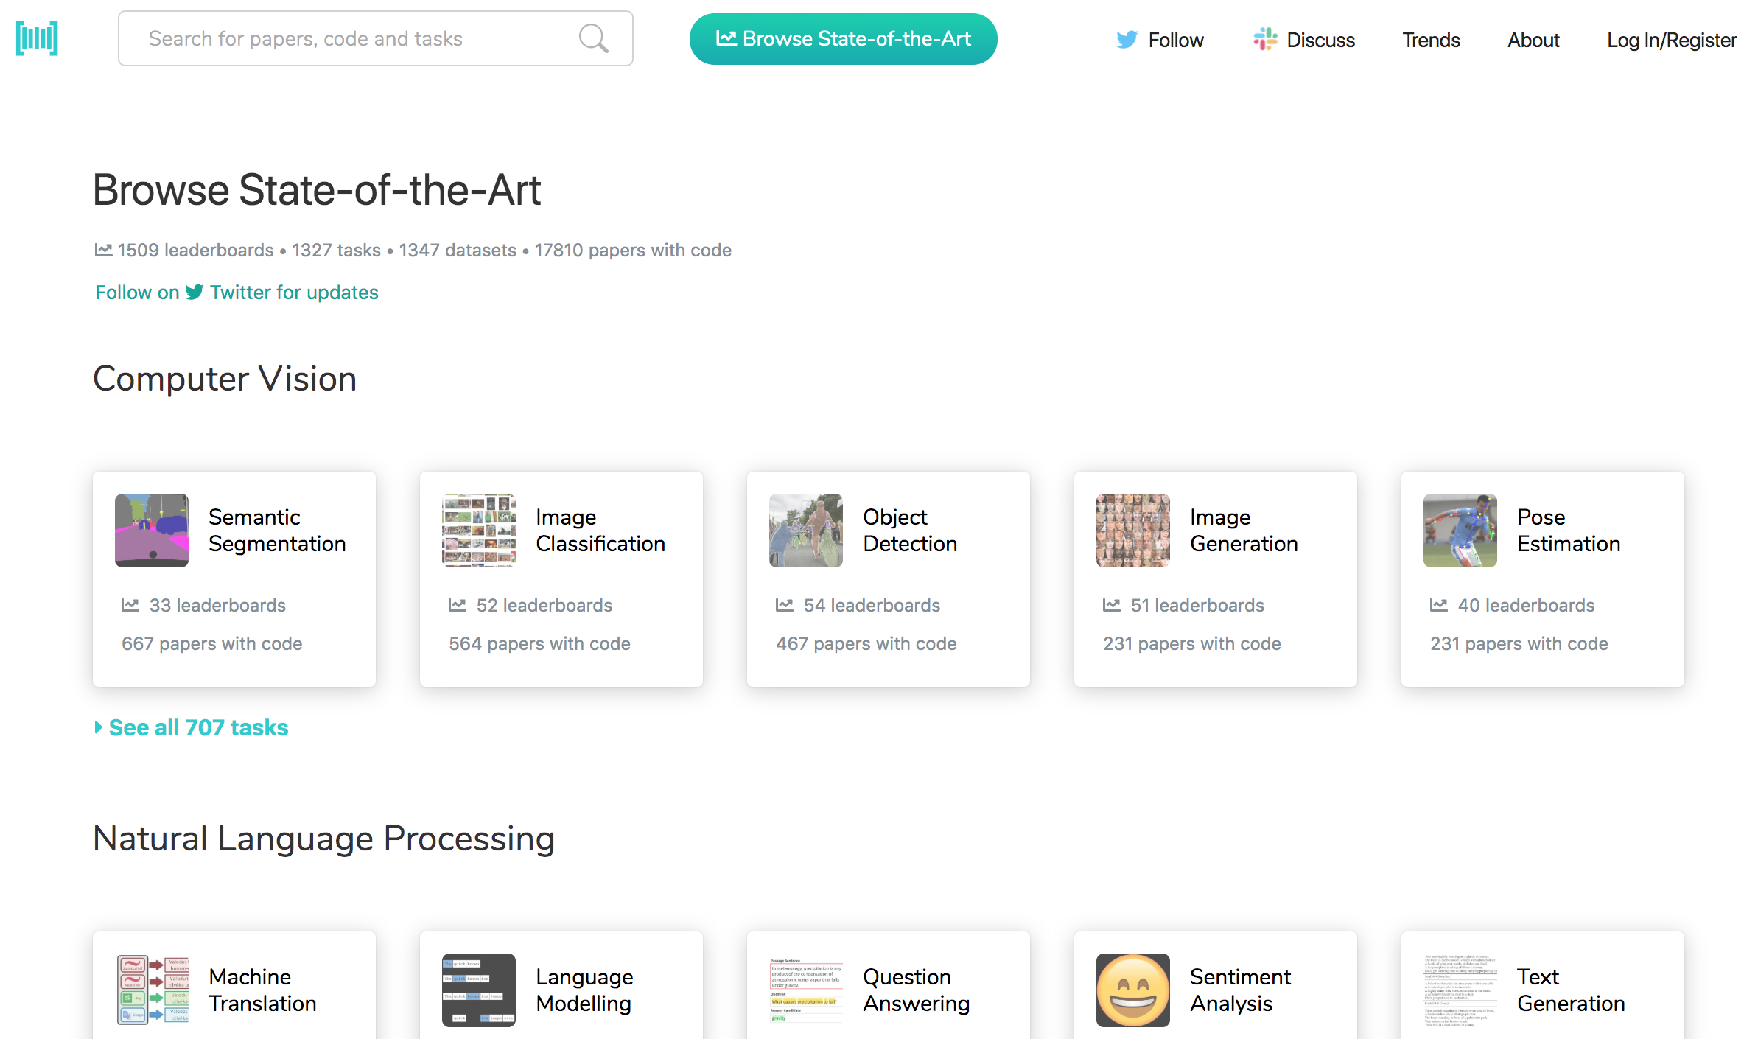
Papers with Code
State-of-the-Art (SOTA)
https://paperswithcode.com/sota

Slide 62
Aurélien Géron (2019),
Hands-On Machine Learning with Scikit-Learn, Keras, and TensorFlow: Concepts, Tools, and Techniques to Build Intelligent Systems, 2nd Edition
O’Reilly Media, 2019
https://github.com/ageron/handson-ml2
Source: https://www.amazon.com/Hands-Machine-Learning-Scikit-Learn-TensorFlow/dp/1492032646/

Slide 63
Hands-On Machine Learning with
Scikit-Learn, Keras, and TensorFlow
Notebooks
The Machine Learning landscape
End-to-end Machine Learning project
Classification
Training Models
Support Vector Machines
Decision Trees
Ensemble Learning and Random Forests
Dimensionality Reduction
Unsupervised Learning Techniques
Artificial Neural Nets with Keras
Training Deep Neural Networks
Custom Models and Training with TensorFlow
Loading and Preprocessing Data
Deep Computer Vision Using Convolutional Neural Networks
Processing Sequences Using RNNs and CNNs
Natural Language Processing with RNNs and Attention
Representation Learning Using Autoencoders
Reinforcement Learning
Training and Deploying TensorFlow Models at Scale
https://github.com/ageron/handson-ml2

Slide 64
Python in Google Colab (Python101)
https://colab.research.google.com/drive/1FEG6DnGvwfUbeo4zJ1zTunjMqf2RkCrT
https://tinyurl.com/aintpupython101

Slide 65
Summary
The Theory of Learning
Ensemble Learning

Slide 66
References
Stuart Russell and Peter Norvig (2020), Artificial Intelligence: A Modern Approach, 4th Edition, Pearson.
Aurélien Géron (2019), Hands-On Machine Learning with Scikit-Learn, Keras, and TensorFlow: Concepts, Tools, and Techniques to Build Intelligent Systems, 2nd Edition, O’Reilly Media.

