Slide 1



人工智慧
(Artificial Intelligence)
機器人技術
(Robotics)
1092AI11
MBA, IM, NTPU (M5010) (Spring 2021)
Wed 2, 3, 4 (9:10-12:00) (B8F40)
Min-Yuh Day
戴敏育
Associate Professor
副教授
Institute of Information Management, National Taipei University
國立臺北大學 資訊管理研究所
https://web.ntpu.edu.tw/~myday
2021-06-02

Slide 2
課程大綱 (Syllabus)
週次 (Week) 日期 (Date) 內容 (Subject/Topics)
1 2021/02/24 人工智慧概論
(Introduction to Artificial Intelligence)
2 2021/03/03 人工智慧和智慧代理人
(Artificial Intelligence and Intelligent Agents)
3 2021/03/10 問題解決
(Problem Solving)
4 2021/03/17 知識推理和知識表達
(Knowledge, Reasoning and Knowledge Representation)
5 2021/03/24 不確定知識和推理
(Uncertain Knowledge and Reasoning)
6 2021/03/31 人工智慧個案研究 I
(Case Study on Artificial Intelligence I)

Slide 3
課程大綱 (Syllabus)
週次 (Week) 日期 (Date) 內容 (Subject/Topics)
7 2021/04/07 放假一天 (Day off)
8 2021/04/14 機器學習與監督式學習
(Machine Learning and Supervised Learning)
9 2021/04/21 期中報告
(Midterm Project Report)
10 2021/04/28 學習理論與綜合學習
(The Theory of Learning and Ensemble Learning)
11 2021/05/05 深度學習
(Deep Learning)
12 2021/05/12 人工智慧個案研究 II
(Case Study on Artificial Intelligence II)

Slide 4
課程大綱 (Syllabus)
週次 (Week) 日期 (Date) 內容 (Subject/Topics)
13 2021/05/19 強化學習
(Reinforcement Learning)
14 2021/05/26 深度學習自然語言處理
(Deep Learning for Natural Language Processing)
15 2021/06/02 機器人技術
(Robotics)
16 2021/06/09 人工智慧哲學與倫理，人工智慧的未來
(Philosophy and Ethics of AI, The Future of AI)
17 2021/06/16 期末報告 I
(Final Project Report I)
18 2021/06/23 期末報告 II
(Final Project Report II)

Slide 5
Robotics

Slide 6
Outline
Robots
Robotic Perception
Planning and Control
Planning Uncertain Movements
Reinforcement Learning in Robotics
Humans and Robots

Slide 7
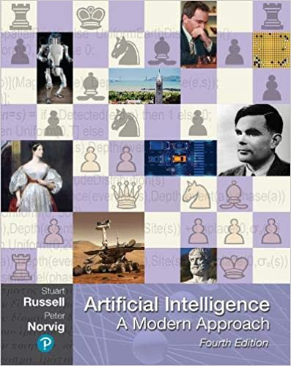
Stuart Russell and Peter Norvig (2020),
Artificial Intelligence: A Modern Approach,
4th Edition, Pearson
Source: Stuart Russell and Peter Norvig (2020), Artificial Intelligence: A Modern Approach, 4th Edition, Pearson
https://www.amazon.com/Artificial-Intelligence-A-Modern-Approach/dp/0134610997/

Slide 8
Artificial Intelligence:
A Modern Approach
Artificial Intelligence
Problem Solving
Knowledge and Reasoning
Uncertain Knowledge and Reasoning
Machine Learning
Communicating, Perceiving, and Acting
Philosophy and Ethics of AI
Source: Stuart Russell and Peter Norvig (2020), Artificial Intelligence: A Modern Approach, 4th Edition, Pearson

Slide 9
Artificial Intelligence:
Communicating, perceiving, and acting
Source: Stuart Russell and Peter Norvig (2020), Artificial Intelligence: A Modern Approach, 4th Edition, Pearson

Slide 10
Artificial Intelligence:
6. Communicating, Perceiving, and Acting
Natural Language Processing
Deep Learning for Natural Language Processing
Computer Vision
Robotics
Source: Stuart Russell and Peter Norvig (2020), Artificial Intelligence: A Modern Approach, 4th Edition, Pearson

Slide 11
Artificial Intelligence:
Robotics
Robots
Robot Hardware
What kind of problem is robotics solving?
Robotic Perception
Planning and Control
Planning Uncertain Movements
Reinforcement Learning in Robotics
Humans and Robots
Alternative Robotic Frameworks
Application Domains
Source: Stuart Russell and Peter Norvig (2020), Artificial Intelligence: A Modern Approach, 4th Edition, Pearson

Slide 12
Reinforcement Learning (DL)
Agent
Environment
Source: Richard S. Sutton & Andrew G. Barto (2018), Reinforcement Learning: An Introduction, 2nd Edition, A Bradford Book.

Slide 13
Reinforcement Learning (DL)
1
2
observation
Agent
action
3
reward
Environment
Source: Richard S. Sutton & Andrew G. Barto (2018), Reinforcement Learning: An Introduction, 2nd Edition, A Bradford Book.

Slide 14
Reinforcement Learning (DL)
1
2
observation
Agent
action
O_{t}
A_{t}
3
reward
R_{t}
Environment
Source: Richard S. Sutton & Andrew G. Barto (2018), Reinforcement Learning: An Introduction, 2nd Edition, A Bradford Book.

Slide 15
Agents interact with environments through sensors and actuators
Source: Stuart Russell and Peter Norvig (2020), Artificial Intelligence: A Modern Approach, 4th Edition, Pearson

Slide 16
Robotics

Slide 17
Artificial Intelligence:
Robotics
Agents are endowed with
sensors and physical effectors
with which to move about and
make mischief in the real world.
Source: Stuart Russell and Peter Norvig (2020), Artificial Intelligence: A Modern Approach, 4th Edition, Pearson

Slide 18
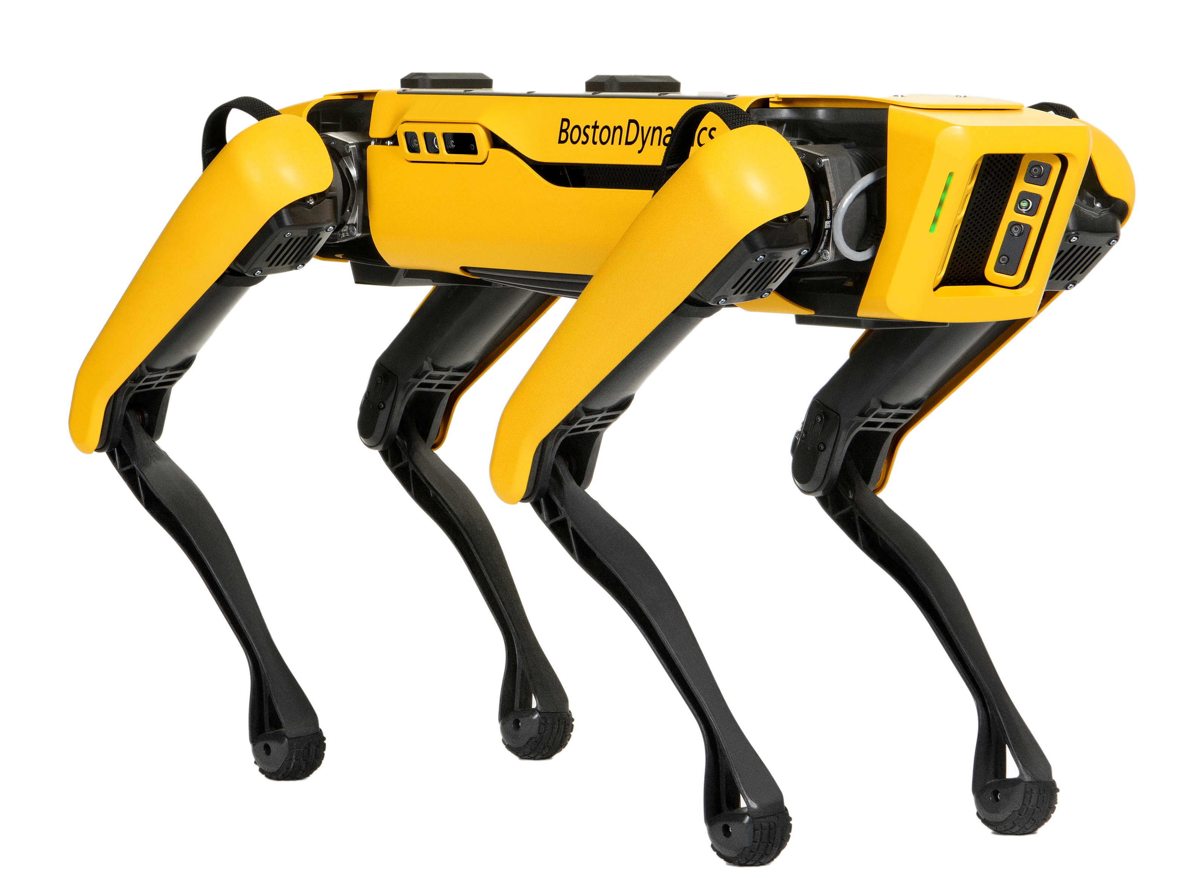
Boston Dynamics: Spot
Automate sensing and inspection, capture limitless data, and explore without boundaries.
Source: https://www.bostondynamics.com/spot

Slide 19
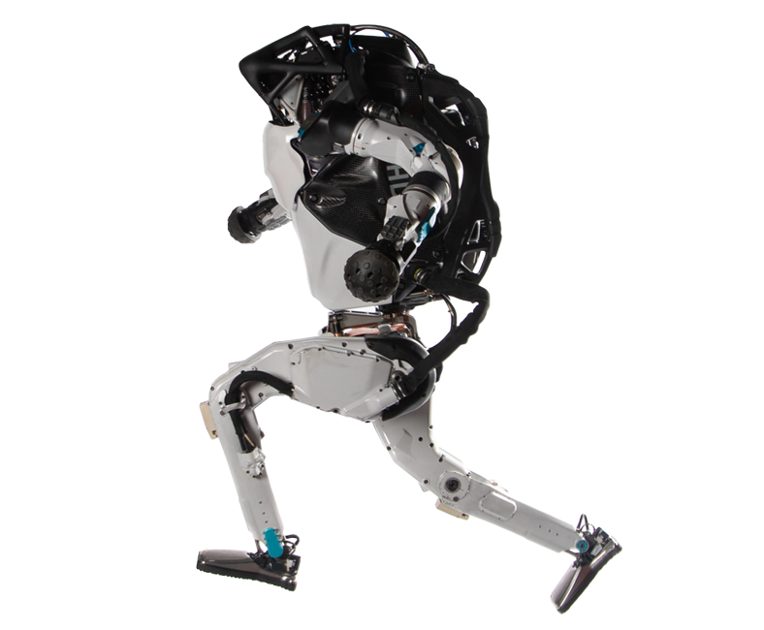
Boston Dynamics: Atlas
The world’s most dynamic humanoid robot
Atlas is a research platform designed to push the limits of whole-body mobility
Source: https://www.bostondynamics.com/atlas

Slide 20
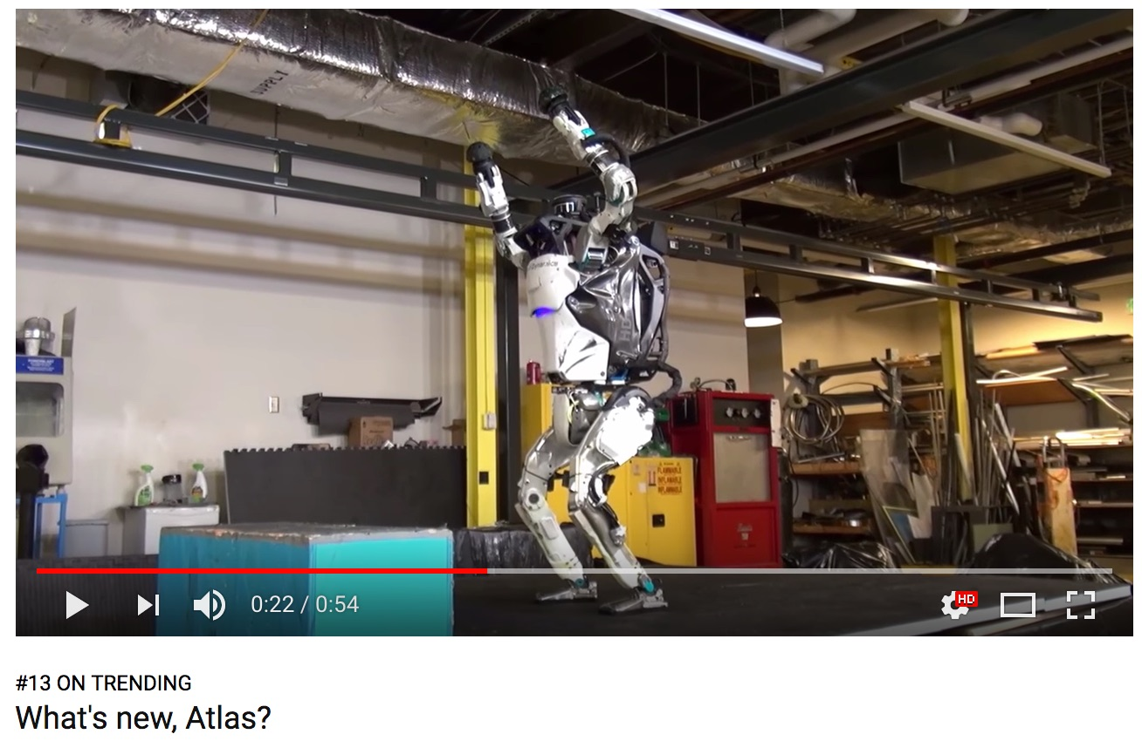
Boston Dynamics: Atlas
https://www.youtube.com/watch?v=fRj34o4hN4I

Slide 21
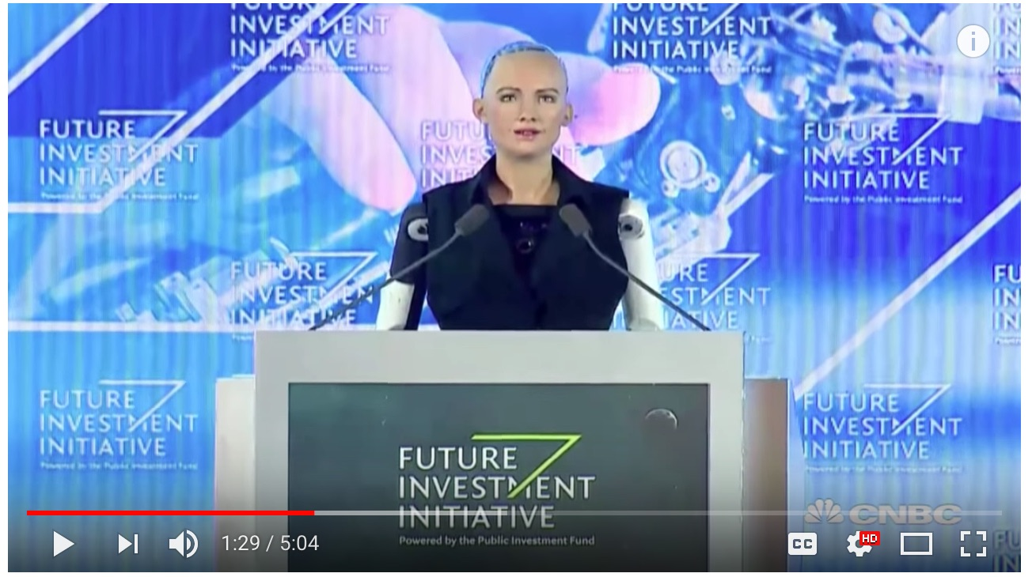
Humanoid Robot: Sophia
https://www.youtube.com/watch?v=S5t6K9iwcdw

Slide 22

Can a robot pass a university entrance exam?
Noriko Arai at TED2017
https://www.ted.com/talks/noriko_arai_can_a_robot_pass_a_university_entrance_exam
https://www.youtube.com/watch?v=XQZjkPyJ8KU

Slide 23
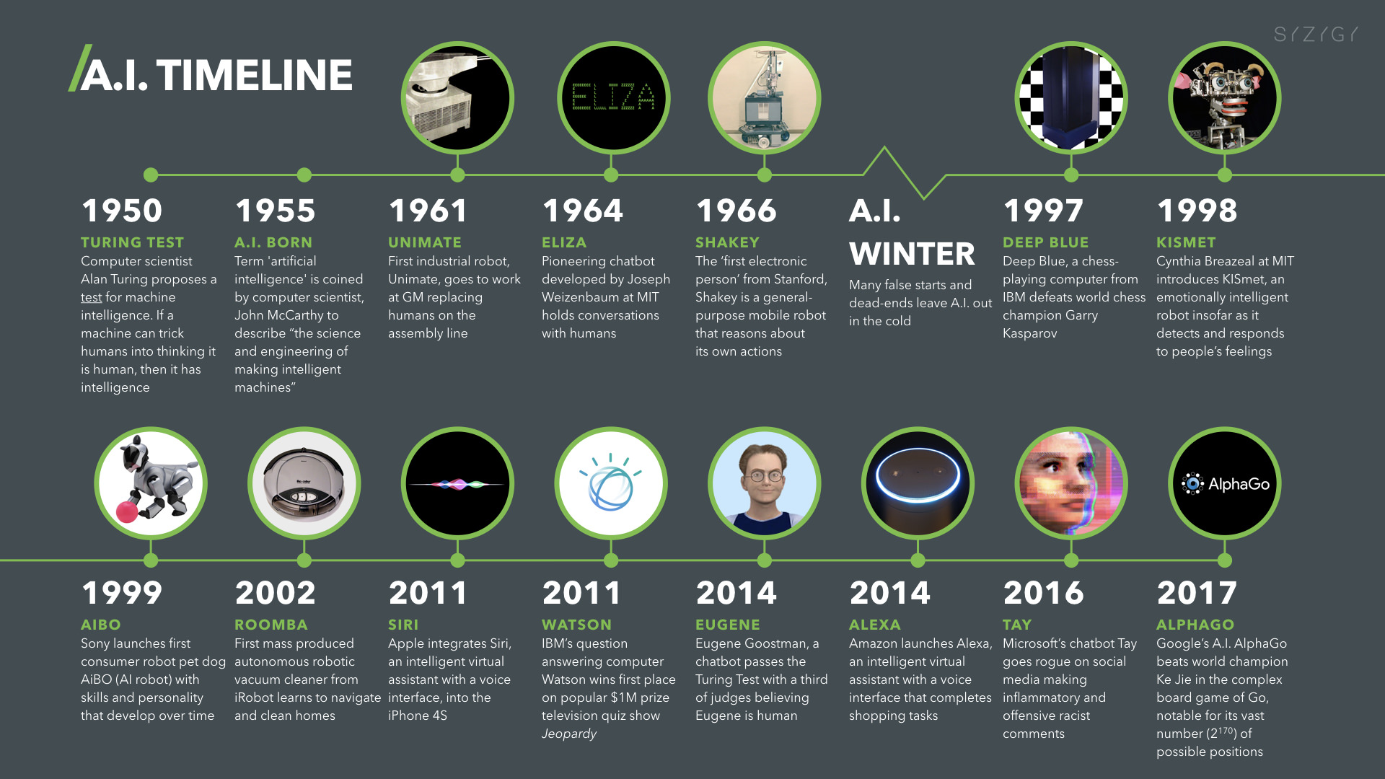
Artificial Intelligence (A.I.) Timeline
Source: https://digitalintelligencetoday.com/artificial-intelligence-timeline-infographic-from-eliza-to-tay-and-beyond/

Slide 24
Robots
Robots are physical agents that perform tasks by manipulating the physical world.
  To do so, they are equipped with effectors such as legs, wheels, joints, and grippers.
Effectors are designed to assert physical forces on the environment.
Source: Stuart Russell and Peter Norvig (2020), Artificial Intelligence: A Modern Approach, 4th Edition, Pearson

Slide 25
Robots and Effectors
When they do this, a few things may happen:
  the robot’s state might change
  the state of the environment might change
  the state of the people around the robot might change
Source: Stuart Russell and Peter Norvig (2020), Artificial Intelligence: A Modern Approach, 4th Edition, Pearson

Slide 26
Robots
The most common types of robots are manipulators (robot arms) and mobile robots.
They have sensors for perceiving the world and actuators that produce motion, which then affects the world via effectors.
Source: Stuart Russell and Peter Norvig (2020), Artificial Intelligence: A Modern Approach, 4th Edition, Pearson

Slide 27
Robotics Problem
The general robotics problem involves
  stochasticity
  (which can be handled by MDPs)
  partial observability
  (which can be handled by POMDPs)
  acting with and around other agents
  (which can be handled with game theory)
Source: Stuart Russell and Peter Norvig (2020), Artificial Intelligence: A Modern Approach, 4th Edition, Pearson

Slide 28
Robotic Perception
We typically separate
perception (estimation) from
action (motion generation).
Perception in robotics involves
computer vision
to recognize the surroundings
through cameras,
but also localization and mapping.
Source: Stuart Russell and Peter Norvig (2020), Artificial Intelligence: A Modern Approach, 4th Edition, Pearson

Slide 29
Robotic Perception
Robotic perception concerns itself with estimating decision-relevant quantities from sensor data.
  To do so, we need an internal representation and a method for updating this internal representation over time.
Source: Stuart Russell and Peter Norvig (2020), Artificial Intelligence: A Modern Approach, 4th Edition, Pearson

Slide 30
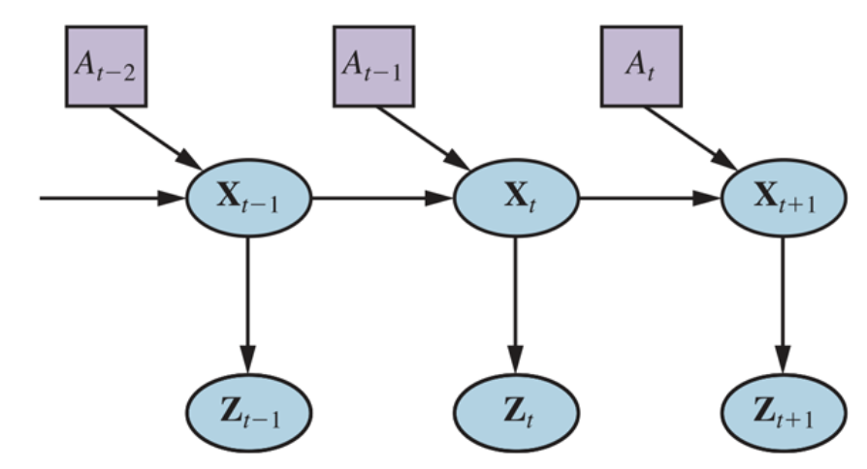
Robot Perception can be viewed as temporal inference from sequences of actions and measurements
Dynamic Decision network
Source: Stuart Russell and Peter Norvig (2020), Artificial Intelligence: A Modern Approach, 4th Edition, Pearson

Slide 31
Probabilistic Filtering Algorithms
Probabilistic filtering algorithms such as particle filters and Kalman filters are useful for robot perception.
  These techniques maintain the belief state, a posterior distribution over state variables.
Source: Stuart Russell and Peter Norvig (2020), Artificial Intelligence: A Modern Approach, 4th Edition, Pearson

Slide 32
Configuration Spaces
For generating motion, we use configuration spaces, where a point specifies everything we need to know to locate every body point on the robot.
  For instance, for a robot arm with two joints, a configuration consists of the two joint angles.
Source: Stuart Russell and Peter Norvig (2020), Artificial Intelligence: A Modern Approach, 4th Edition, Pearson

Slide 33
Motion Generation
We typically decouple the motion generation problem into
  motion planning, concerned with producing a plan, and
  trajectory tracking control, concerned with producing a policy for control inputs (actuator commands) that results in executing the plan.
Source: Stuart Russell and Peter Norvig (2020), Artificial Intelligence: A Modern Approach, 4th Edition, Pearson

Slide 34
Motion Planning
Motion planning can be solved via graph search
  using cell decomposition
  using randomized motion planning algorithms, which sample milestones in the continuous configuration space
  using trajectory optimization, which can iteratively push a straight-line path out of collision by leveraging a signed distance field.
Source: Stuart Russell and Peter Norvig (2020), Artificial Intelligence: A Modern Approach, 4th Edition, Pearson

Slide 35
Planning and Control
Optimal control unites
motion planning and trajectory tracking by computing an
optimal trajectory directly
over control inputs.
Source: Stuart Russell and Peter Norvig (2020), Artificial Intelligence: A Modern Approach, 4th Edition, Pearson

Slide 36
Planning Uncertain Movements
Planning under uncertainty unites perception and action by
  online replanning (such as model predictive control) and
  information gathering actions that aid perception.
Source: Stuart Russell and Peter Norvig (2020), Artificial Intelligence: A Modern Approach, 4th Edition, Pearson

Slide 37
Reinforcement learning in robotics
Reinforcement learning is applied in robotics, with techniques striving to reduce the required number of interactions with the real world.
Such techniques tend to exploit models, be it estimating models and using them to plan, or training policies that are robust with respect to different possible model parameters.
Source: Stuart Russell and Peter Norvig (2020), Artificial Intelligence: A Modern Approach, 4th Edition, Pearson

Slide 38
Humans and Robots
Interaction with humans requires the ability to coordinate the robot’s actions with theirs, which can be formulated as a game.
We usually decompose the solution into prediction, in which we use the person’s ongoing actions to estimate what they will do in the future, and action, in which we use the predictions to compute the optimal motion for the robot.
Source: Stuart Russell and Peter Norvig (2020), Artificial Intelligence: A Modern Approach, 4th Edition, Pearson

Slide 39
Humans and Robots
Helping humans also requires the ability to learn or infer what they want.
Robots can approach this by learning the desired cost function they should optimize from human input, such as demonstrations, corrections, or instruction in natural language.
Alternatively, robots can imitate human behavior, and use reinforcement learning to help tackle the challenge of generalization to new states.
Source: Stuart Russell and Peter Norvig (2020), Artificial Intelligence: A Modern Approach, 4th Edition, Pearson

Slide 40

Papers with Code
State-of-the-Art (SOTA)
https://paperswithcode.com/sota

Slide 41

Aurélien Géron (2019),
Hands-On Machine Learning with Scikit-Learn, Keras, and TensorFlow: Concepts, Tools, and Techniques to Build Intelligent Systems, 2nd Edition
O’Reilly Media, 2019
https://github.com/ageron/handson-ml2
Source: https://www.amazon.com/Hands-Machine-Learning-Scikit-Learn-TensorFlow/dp/1492032646/

Slide 42

Hands-On Machine Learning with
Scikit-Learn, Keras, and TensorFlow
Notebooks
The Machine Learning landscape
End-to-end Machine Learning project
Classification
Training Models
Support Vector Machines
Decision Trees
Ensemble Learning and Random Forests
Dimensionality Reduction
Unsupervised Learning Techniques
Artificial Neural Nets with Keras
Training Deep Neural Networks
Custom Models and Training with TensorFlow
Loading and Preprocessing Data
Deep Computer Vision Using Convolutional Neural Networks
Processing Sequences Using RNNs and CNNs
Natural Language Processing with RNNs and Attention
Representation Learning Using Autoencoders
Reinforcement Learning
Training and Deploying TensorFlow Models at Scale
https://github.com/ageron/handson-ml2

Slide 43
Summary
Robots
Robotic Perception
Planning and Control
Planning Uncertain Movements
Reinforcement Learning in Robotics
Humans and Robots

Slide 44
References
Stuart Russell and Peter Norvig (2020), Artificial Intelligence: A Modern Approach, 4th Edition, Pearson.
Aurélien Géron (2019), Hands-On Machine Learning with Scikit-Learn, Keras, and TensorFlow: Concepts, Tools, and Techniques to Build Intelligent Systems, 2nd Edition, O’Reilly Media.
Min-Yuh Day (2021), Python 101, https://tinyurl.com/aintpupython101

