Slide 1



資料探勘
(Data Mining)
ABC：人工智慧，大數據，雲端運算
(ABC: AI, Big Data, Cloud Computing)
1092DM02
MBA, IM, NTPU (M5026) (Spring 2021)
Tue 2, 3, 4 (9:10-12:00) (B8F40)
Min-Yuh Day
戴敏育
Associate Professor
副教授
Institute of Information Management, National Taipei University
國立臺北大學 資訊管理研究所
https://web.ntpu.edu.tw/~myday
2021-03-02

Slide 2
課程大綱 (Syllabus)
週次 (Week) 日期 (Date) 內容 (Subject/Topics)
1 2021/02/23 資料探勘介紹 (Introduction to data mining)
2 2021/03/02 ABC：人工智慧，大數據，雲端運算
(ABC: AI, Big Data, Cloud Computing)
3 2021/03/09 Python資料探勘的基礎
(Foundations of Data Mining in Python)
4 2021/03/16 資料科學與資料探勘：發現，分析，可視化和呈現數據
(Data Science and Data Mining:
Discovering, Analyzing, Visualizing and Presenting Data)
5 2021/03/23 非監督學習：關聯分析，購物籃分析
(Unsupervised Learning: Association Analysis,
Market Basket Analysis)
6 2021/03/30 資料探勘個案研究 I
(Case Study on Data Mining I)

Slide 3
課程大綱 (Syllabus)
週次 (Week) 日期 (Date) 內容 (Subject/Topics)
7 2021/04/06 非監督學習：集群分析，行銷市場區隔
(Unsupervised Learning: Cluster Analysis, Market Segmentation)
8 2021/04/13 監督學習：分類和預測
(Supervised Learning: Classification and Prediction)
9 2021/04/20 期中報告 (Midterm Project Report)
10 2021/04/27 監督學習：分類和預測
(Supervised Learning: Classification and Prediction)
11 2021/05/04 機器學習和深度學習
(Machine Learning and Deep Learning)
12 2021/05/11 卷積神經網絡
(Convolutional Neural Networks)

Slide 4
課程大綱 (Syllabus)
週次 (Week) 日期 (Date) 內容 (Subject/Topics)
13 2021/05/18 資料探勘個案研究 II
(Case Study on Data Mining II)
14 2021/05/25 遞歸神經網絡
(Recurrent Neural Networks)
15 2021/06/01 強化學習
(Reinforcement Learning)
16 2021/06/08 社交網絡分析
(Social Network Analysis)
17 2021/06/15 期末報告 I (Final Project Report I)
18 2021/06/22 期末報告 II (Final Project Report II)

Slide 5
ABC:
AI,
Big Data,
Cloud Computing

Slide 6
Outline
AI
Big Data
Cloud Computing

Slide 7
FinTech ABCD
AI
Block Chain
Cloud Computing
Big Data

Slide 8
AI, Big Data, Cloud Computing
Evolution of Decision Support, Business Intelligence, and Analytics
AI
AI
Cloud Computing
Big Data
DM
BI
Source: Ramesh Sharda, Dursun Delen, and Efraim Turban (2017),
Business Intelligence, Analytics, and Data Science: A Managerial Perspective, 4th Edition, Pearson

Slide 9
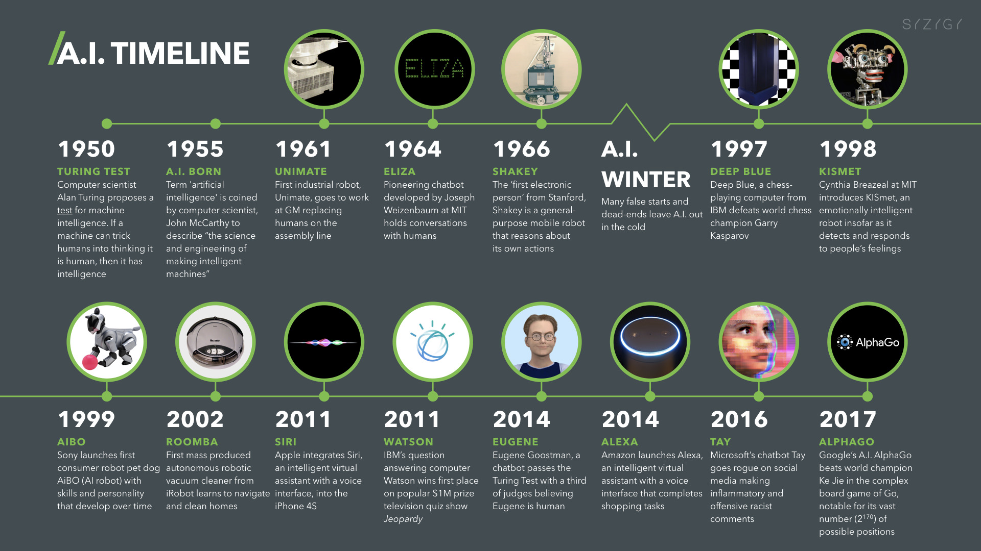
Artificial Intelligence (A.I.) Timeline
Source: https://digitalintelligencetoday.com/artificial-intelligence-timeline-infographic-from-eliza-to-tay-and-beyond/

Slide 10
The Rise of AI
Source: DHL (2018), Artificial Intelligence in Logistics,
http://www.globalhha.com/doclib/data/upload/doc_con/5e50c53c5bf67.pdf/

Slide 11
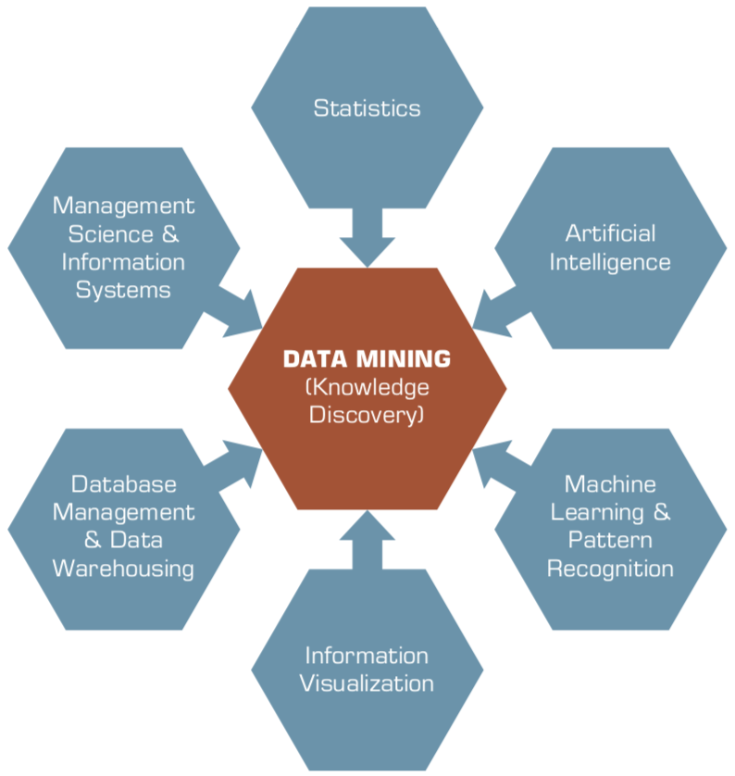
Data Mining
Is a Blend of Multiple Disciplines
Source: Ramesh Sharda, Dursun Delen, and Efraim Turban (2017), Business Intelligence, Analytics, and Data Science: A Managerial Perspective, 4th Edition, Pearson

Slide 12
Data Mining at the
Intersection of Many Disciplines
Source: Turban et al. (2011), Decision Support and Business Intelligence Systems

Slide 13
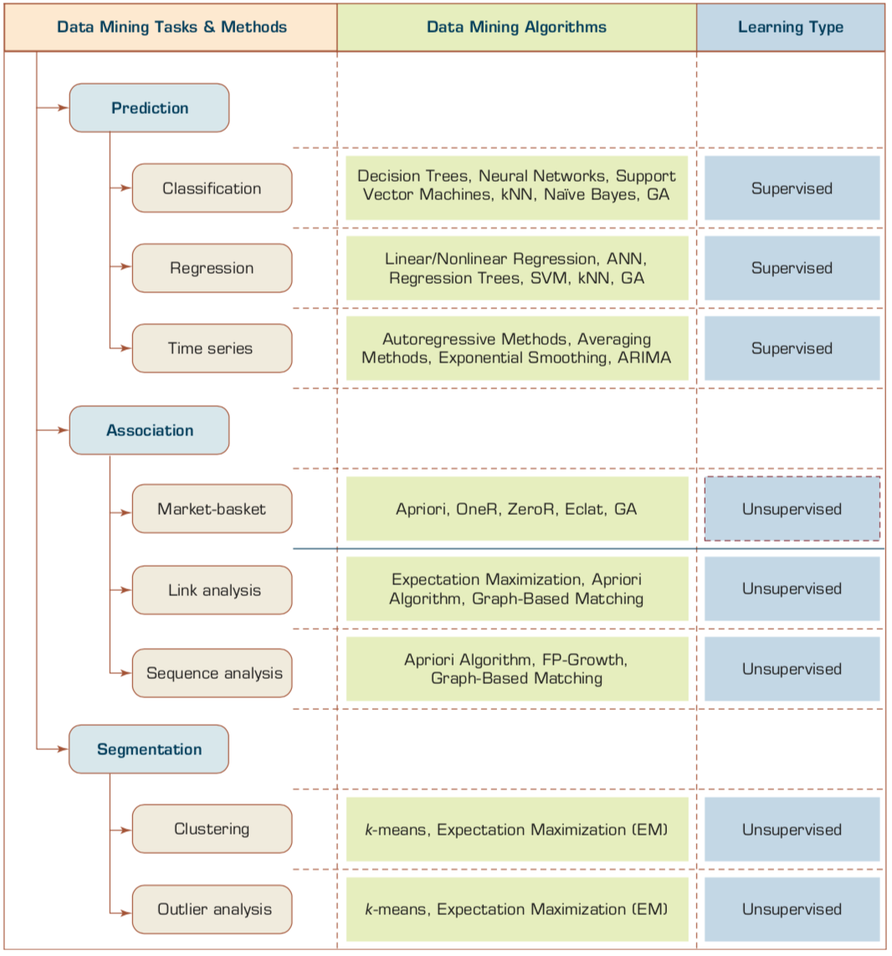
Data Mining Tasks & Methods
Prediction
Association
Segmentation
Source: Ramesh Sharda, Dursun Delen, and Efraim Turban (2017), Business Intelligence, Analytics, and Data Science: A Managerial Perspective, 4th Edition, Pearson

Slide 14
AI 2.0
a new generation of AI
based on the
novel information environment of
major changes and
the development of
new goals.
Yunhe Pan (2016), "Heading toward artificial intelligence 2.0." Engineering 2, no. 4, 409-413.

Slide 15
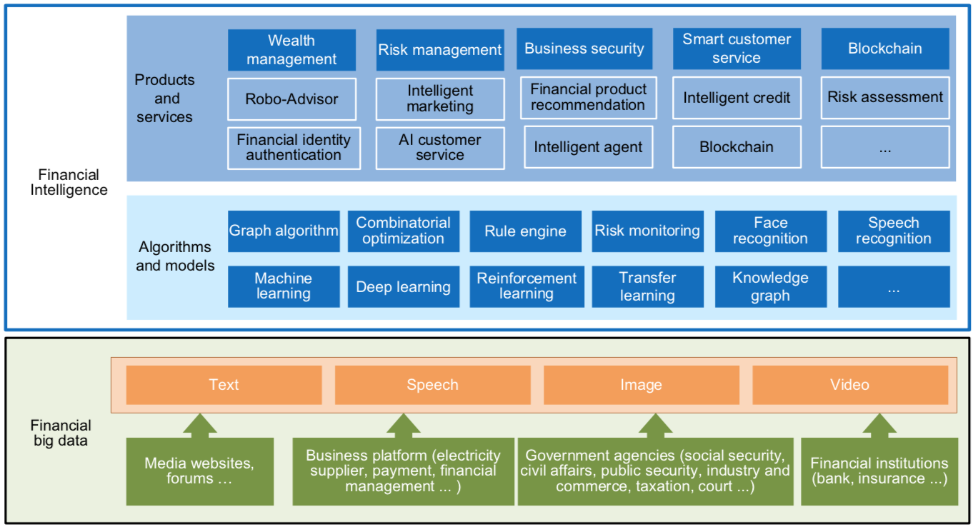
FinBrain: when Finance meets AI 2.0
(Zheng et al., 2019)
Source: Xiao-lin Zheng, Meng-ying Zhu, Qi-bing Li, Chao-chao Chen, and Yan-chao Tan (2019), "Finbrain: When finance meets AI 2.0." Frontiers of Information Technology & Electronic Engineering 20, no. 7, pp. 914-924

Slide 16
Technology-driven
Financial Industry Development
Development stage | Driving technology | Main landscape | Inclusive finance | Relationship between technology and finance
Fintech 1.0 (financial IT) | Computer | Credit card, ATM, and CRMS | Low | Technology as a tool
Fintech 2.0 (Internet finance) | Mobile Internet | Marketplace lending, third-party payment, crowdfunding, and Internet insurance | Medium | Technology-driven change
Fintech 3.0 (financial intelligence) | AI, Big Data, Cloud Computing, Blockchain | Intelligent finance | High | Deep fusion
Source: Xiao-lin Zheng, Meng-ying Zhu, Qi-bing Li, Chao-chao Chen, and Yan-chao Tan (2019), "Finbrain: When finance meets AI 2.0." Frontiers of Information Technology & Electronic Engineering 20, no. 7, pp. 914-924

Slide 17
AI-driven Marketing
(Ma and Sun, 2020)
Interactive &
media-rich
Personalization
Real-time
automation
Customer-
journey
focus
Industry Trends
Marketing
Mix
Engagement
Search
Recommendation
Attribution
Marketing Actions
AI & Machine Learning
Source: Liye Ma and Baohong Sun (2020), "Machine learning and AI in marketing – Connecting computing power to human insights." International Journal of Research in Marketing, 37, no. 3, 481-504.

Slide 18
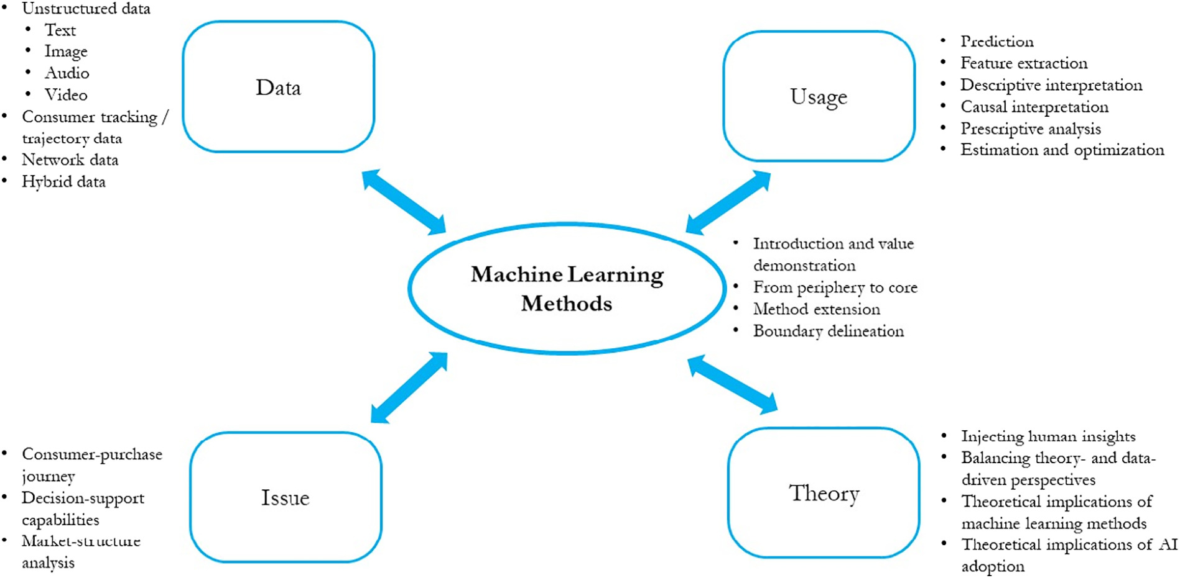
Machine Learning in Marketing Research
(Ma and Sun, 2020)
Source: Liye Ma and Baohong Sun (2020), "Machine learning and AI in marketing – Connecting computing power to human insights." International Journal of Research in Marketing, 37, no. 3, 481-504.

Slide 19
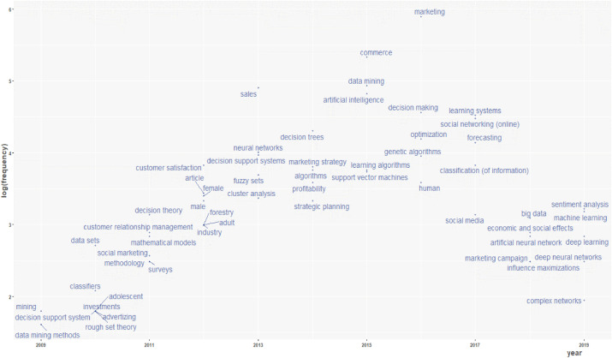
Artificial Intelligence in Marketing
(Verma et al., 2021)
M
DM
AI
BD
ML
DL
Source: Sanjeev Verma, Rohit Sharma, Subhamay Deb, and Debojit Maitra (2021),. "Artificial intelligence in marketing: Systematic review and future research direction." International Journal of Information Management Data Insights (2021): 100002.

Slide 20
Value Creation by Big Data Analytics
(Grover et al., 2018)
Source: Varun Grover, Roger HL Chiang, Ting-Peng Liang, and Dongsong Zhang (2018), "Creating Strategic Business Value from Big Data Analytics: A Research Framework", Journal of Management Information Systems, 35, no. 2, pp. 388-423.

Slide 21
Evolution of top keywords in
“BD & BI” publications
2014
2015
2016
2017
Management
Text Mining
Data Mining
Data Science
Big Data Analytics
Social Media
Business Analytics
Information System
Cloud Computing
Data Warehouse
Knowledge Management
Source: Ting-Peng Liang and Yu-Hsi Liu (2018), "Research Landscape of Business Intelligence and Big Data analytics: A bibliometrics study”,
Expert Systems with Applications, Volume 111, 30, 2018, pp. 2-10

Slide 22
Framework for BD and BI Research
Data Collection
Data Storage
Data Analytics
Infrastructure
Business
Medicate
Supply Chain
Engineering
Services
Technology
Application
Impact
Management
Value Creation
Individual Impact
Organizational Impact
Social Impact
Adoption of BD/BI
Cost Benefit
Security/Privacy
Human Resource
Source: Ting-Peng Liang and Yu-Hsi Liu (2018), "Research Landscape of Business Intelligence and Big Data analytics: A bibliometrics study”,
Expert Systems with Applications, Volume 111, 30, 2018, pp. 2-10

Slide 23
Business Intelligence and Big Data analytics
Source: Ting-Peng Liang and Yu-Hsi Liu (2018), "Research Landscape of Business Intelligence and Big Data analytics: A bibliometrics study”,
Expert Systems with Applications, Volume 111, 30, 2018, pp. 2-10

Slide 24
AI

Slide 25
Definition of
Artificial Intelligence (A.I.)

Slide 26
Artificial Intelligence
“… the science and engineering of making intelligent machines”
(John McCarthy, 1955)
Source: https://digitalintelligencetoday.com/artificial-intelligence-defined-useful-list-of-popular-definitions-from-business-and-science/

Slide 27
Artificial Intelligence
“… technology that thinks and acts like humans”
Source: https://digitalintelligencetoday.com/artificial-intelligence-defined-useful-list-of-popular-definitions-from-business-and-science/

Slide 28
Artificial Intelligence
“… intelligence exhibited by machines or software”
Source: https://digitalintelligencetoday.com/artificial-intelligence-defined-useful-list-of-popular-definitions-from-business-and-science/

Slide 29
4 Approaches of AI
Thinking Humanly | Thinking Rationally
Acting Humanly | Acting Rationally
Source: Stuart Russell and Peter Norvig (2020), Artificial Intelligence: A Modern Approach, 4th Edition, Pearson

Slide 30
4 Approaches of AI
2. Thinking Humanly: The Cognitive Modeling Approach | 3. Thinking Rationally: The “Laws of Thought” Approach
1. Acting Humanly: The Turing Test Approach (1950) | 4. Acting Rationally: The Rational Agent Approach
Source: Stuart Russell and Peter Norvig (2020), Artificial Intelligence: A Modern Approach, 4th Edition, Pearson

Slide 31
AI Acting Humanly:
The Turing Test Approach
(Alan Turing, 1950)
Knowledge Representation
Automated Reasoning
Machine Learning (ML)
  Deep Learning (DL)
Computer Vision (Image, Video)
Natural Language Processing (NLP)
Robotics
Source: Stuart Russell and Peter Norvig (2020), Artificial Intelligence: A Modern Approach, 4th Edition, Pearson

Slide 32
Artificial Intelligence:
A Modern Approach
Artificial Intelligence
Problem Solving
Knowledge and Reasoning
Uncertain Knowledge and Reasoning
Learning
Communicating, Perceiving, and Acting
Philosophy and Ethics of AI
Source: Stuart Russell and Peter Norvig (2020), Artificial Intelligence: A Modern Approach, 4th Edition, Pearson

Slide 33
Artificial Intelligence
Machine Learning & Deep Learning
Source: https://blogs.nvidia.com/blog/2016/07/29/whats-difference-artificial-intelligence-machine-learning-deep-learning-ai/

Slide 34
AI, ML, DL
Artificial Intelligence (AI)
Machine Learning (ML)
Supervised
Learning
Unsupervised Learning
Deep Learning (DL)
CNN
RNN LSTM GRU
GAN
Semi-supervised Learning
Reinforcement Learning
Source: https://leonardoaraujosantos.gitbooks.io/artificial-inteligence/content/deep_learning.html

Slide 35
3 Machine Learning Algorithms
Source: Enrico Galimberti, http://blogs.teradata.com/data-points/tree-machine-learning-algorithms/

Slide 36
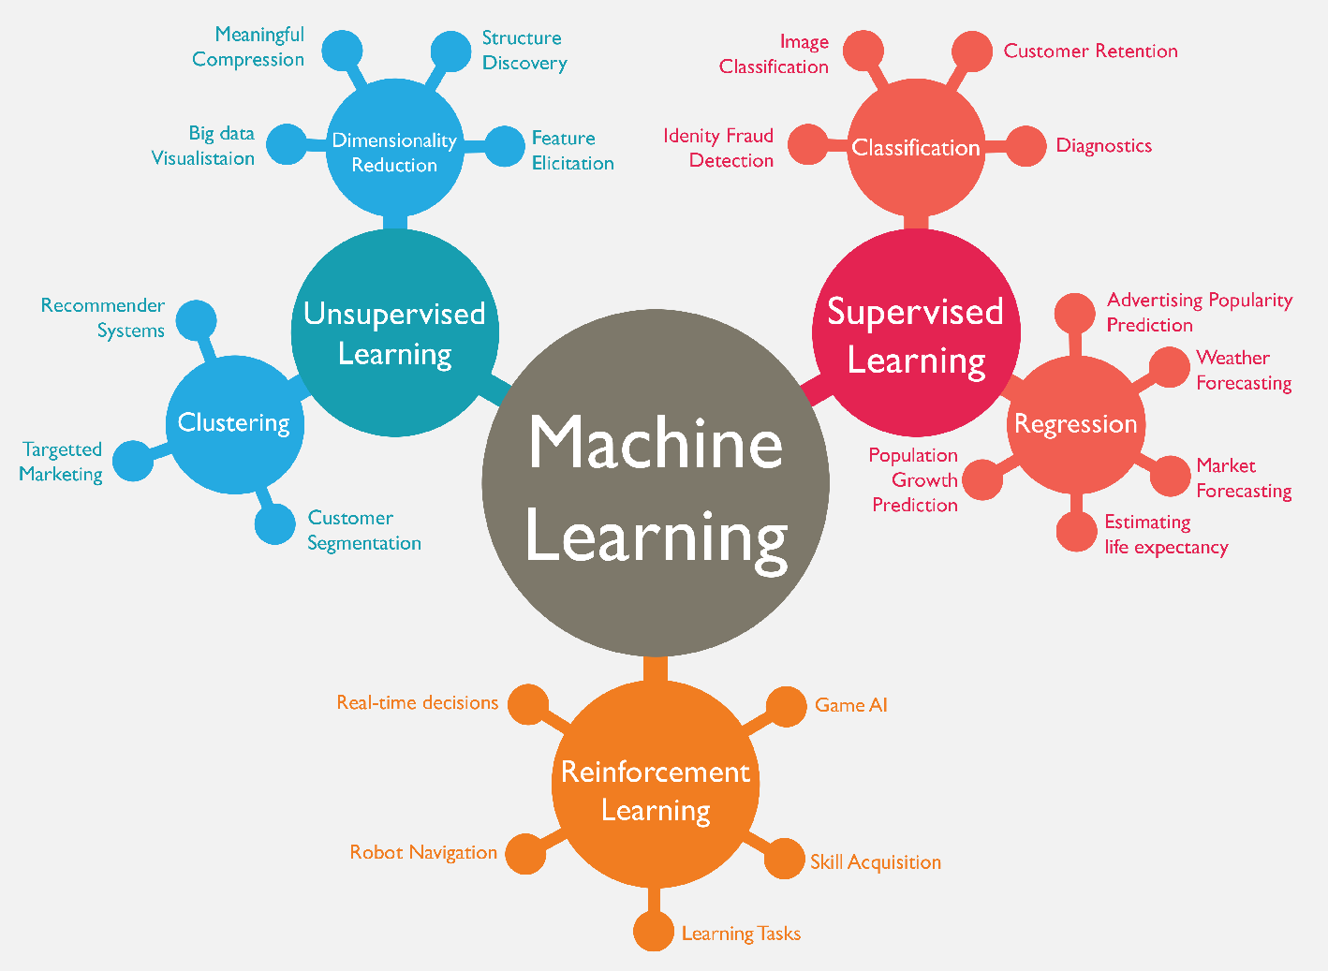
Machine Learning (ML)
Source: https://www.mactores.com/services/aws-big-data-machine-learning-cognitive-services/

Slide 37
Machine Learning (ML) / Deep Learning (DL)
Decision Tree Classifiers
Support Vector Machine (SVM)
Supervised Learning
Neural Network (NN)
Linear Classifiers
Deep Learning (DL)
Machine Learning
(ML)
Rule-based Classifiers
Naïve Bayes
(NB)
Unsupervised Learning
Probabilistic Classifiers
Bayesian Network (BN)
Maximum Entropy (ME)
Reinforcement Learning
Source: Jesus Serrano-Guerrero, Jose A. Olivas, Francisco P. Romero, and Enrique Herrera-Viedma (2015),
"Sentiment analysis: A review and comparative analysis of web services," Information Sciences, 311, pp. 18-38.

Slide 38
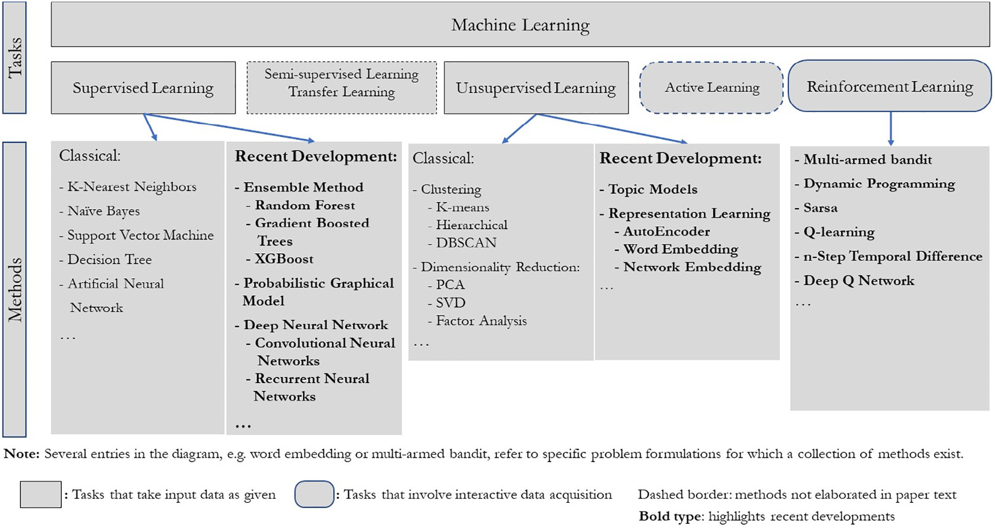
Machine Learning Tasks and Methods
Source: Liye Ma and Baohong Sun (2020), "Machine learning and AI in marketing – Connecting computing power to human insights." International Journal of Research in Marketing, 37, no. 3, 481-504.

Slide 39
Machine Learning Methods in Marketing
High
Causal
interpretation
Prescriptive
analysis
Descriptive
interpretation
Marketing
Theory
Connection
Feature
extraction
Underexplored area
Prediction
Optimization
Low
Black box/Standalone
White box/Integration
Method Transparency
Source: Liye Ma and Baohong Sun (2020), "Machine learning and AI in marketing – Connecting computing power to human insights." International Journal of Research in Marketing, 37, no. 3, 481-504.

Slide 40
Big Data

Slide 41
Big Data Analytics and
Data Mining

Slide 42
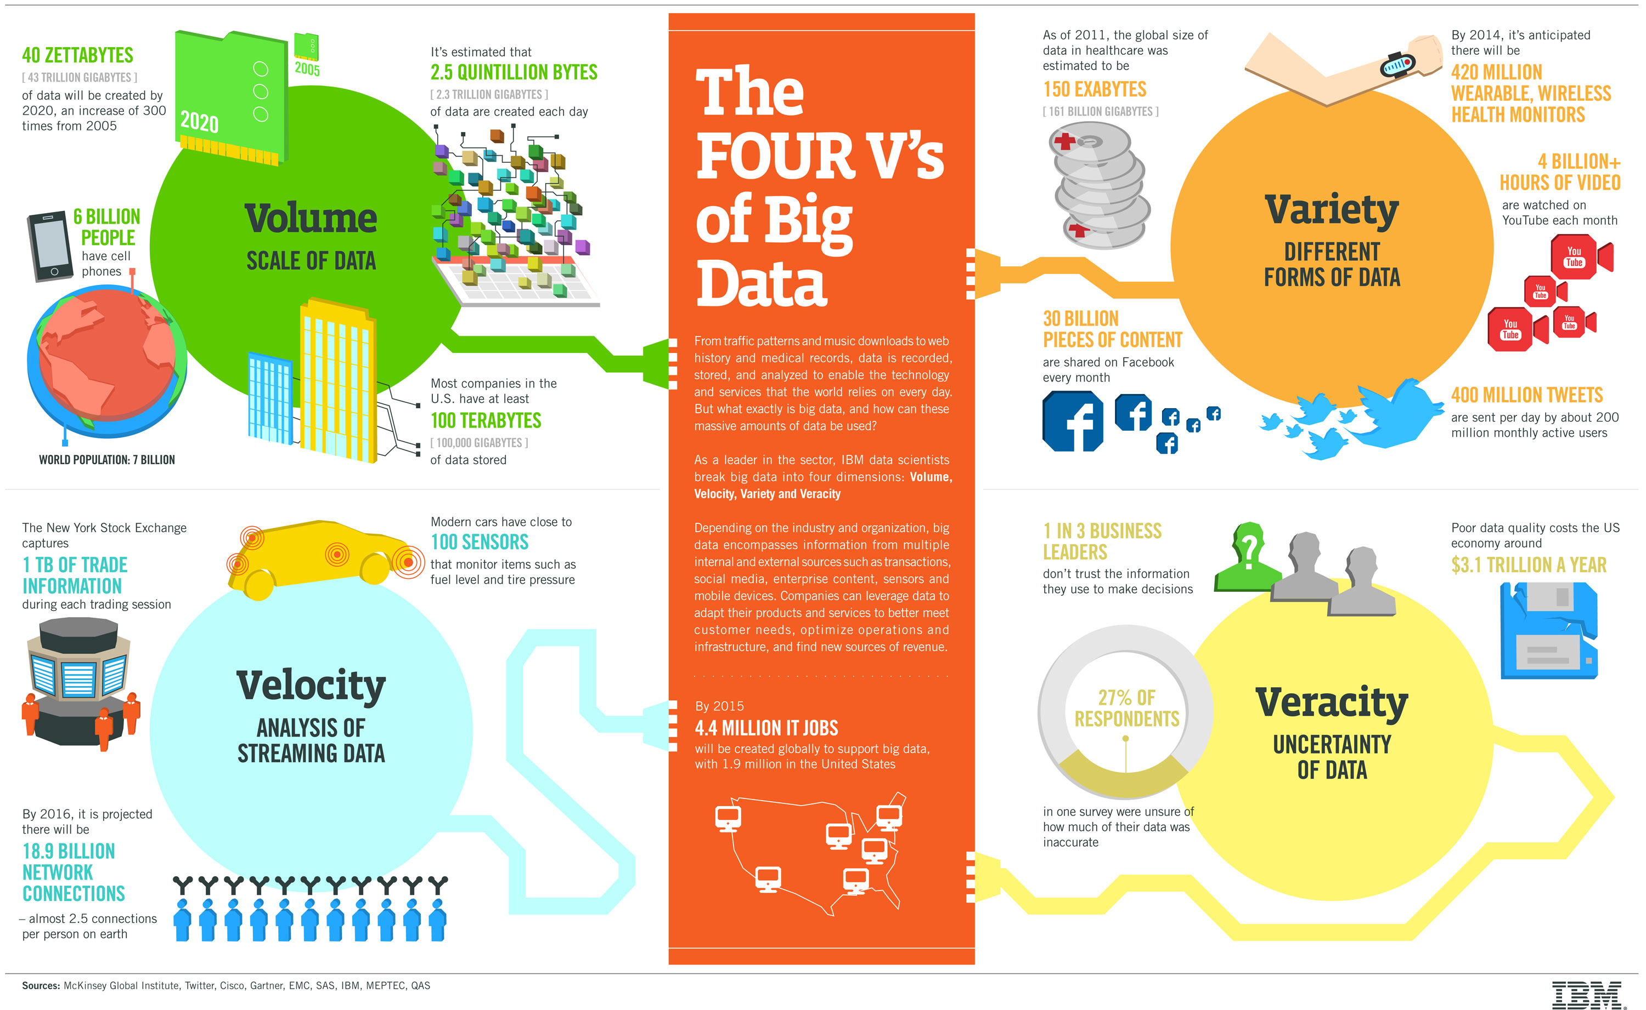
Big Data 4 V
Source: https://www-01.ibm.com/software/data/bigdata/

Slide 43
Value

Slide 44
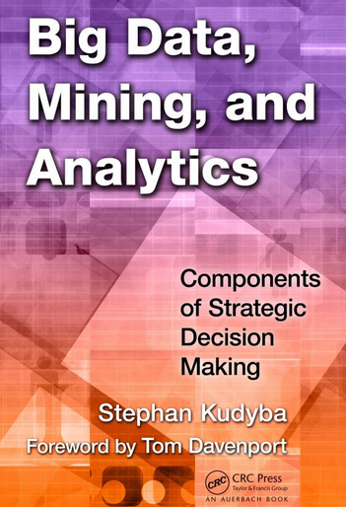
Stephan Kudyba (2014),
Big Data, Mining, and Analytics:
Components of Strategic Decision Making, Auerbach Publications
Source: http://www.amazon.com/gp/product/1466568704

Slide 45
Architecture of Big Data Analytics
Big Data
Analytics
Applications
Big Data
Sources
Big Data
Transformation
Big Data
Platforms & Tools
* Internal
* External
* Multiple formats
* Multiple
locations
* Multiple applications
Middleware
Hadoop
MapReduce
Pig
Hive
Jaql
Zookeeper
Hbase
Cassandra
Oozie
Avro
Mahout
Others
Queries
Raw
Data
Transformed
Data
Big Data
Analytics
Extract Transform Load
Reports
Data Warehouse
OLAP
Traditional Format
CSV, Tables
Data Mining
Source: Stephan Kudyba (2014), Big Data, Mining, and Analytics: Components of Strategic Decision Making, Auerbach Publications

Slide 46
Architecture of Big Data Analytics
Big Data
Analytics
Applications
Big Data
Sources
Big Data
Transformation
Big Data
Platforms & Tools
* Internal
* External
* Multiple formats
* Multiple
locations
* Multiple applications
Data Mining
Big Data Analytics Applications
Middleware
Hadoop
MapReduce
Pig
Hive
Jaql
Zookeeper
Hbase
Cassandra
Oozie
Avro
Mahout
Others
Queries
Raw
Data
Transformed
Data
Big Data
Analytics
Extract Transform Load
Reports
Data Warehouse
OLAP
Traditional Format
CSV, Tables
Data Mining
Source: Stephan Kudyba (2014), Big Data, Mining, and Analytics: Components of Strategic Decision Making, Auerbach Publications

Slide 47
Data Mining
Is a Blend of Multiple Disciplines
Source: Ramesh Sharda, Dursun Delen, and Efraim Turban (2017), Business Intelligence, Analytics, and Data Science: A Managerial Perspective, 4th Edition, Pearson

Slide 48
Data Mining at the
Intersection of Many Disciplines
Source: Turban et al. (2011), Decision Support and Business Intelligence Systems

Slide 49
Data Mining Tasks & Methods
Prediction
Association
Segmentation
Source: Ramesh Sharda, Dursun Delen, and Efraim Turban (2017), Business Intelligence, Analytics, and Data Science: A Managerial Perspective, 4th Edition, Pearson

Slide 50
Evolution of Business Intelligence (BI)
Source: Ramesh Sharda, Dursun Delen, and Efraim Turban (2017),
Business Intelligence, Analytics, and Data Science: A Managerial Perspective, 4th Edition, Pearson

Slide 51
A High-Level Architecture of BI
Source: Ramesh Sharda, Dursun Delen, and Efraim Turban (2017),
Business Intelligence, Analytics, and Data Science: A Managerial Perspective, 4th Edition, Pearson

Slide 52
Three Types of Analytics
Source: Ramesh Sharda, Dursun Delen, and Efraim Turban (2017),
Business Intelligence, Analytics, and Data Science: A Managerial Perspective, 4th Edition, Pearson

Slide 53
Analytics Ecosystem
Source: Ramesh Sharda, Dursun Delen, and Efraim Turban (2017),
Business Intelligence, Analytics, and Data Science: A Managerial Perspective, 4th Edition, Pearson

Slide 54
Job Titles of Analytics
Source: Ramesh Sharda, Dursun Delen, and Efraim Turban (2017),
Business Intelligence, Analytics, and Data Science: A Managerial Perspective, 4th Edition, Pearson

Slide 55
A Data to Knowledge Continuum
Source: Ramesh Sharda, Dursun Delen, and Efraim Turban (2017),
Business Intelligence, Analytics, and Data Science: A Managerial Perspective, 4th Edition, Pearson

Slide 56
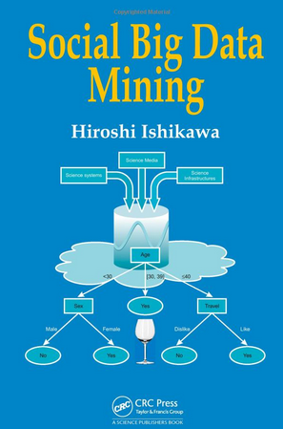
Social Big Data Mining
(Hiroshi Ishikawa, 2015)
Source: http://www.amazon.com/Social-Data-Mining-Hiroshi-Ishikawa/dp/149871093X

Slide 57
Architecture for
Social Big Data Mining
(Hiroshi Ishikawa, 2015)
Enabling Technologies
Analysts
Integrated analysis
Integrated analysis model
Model Construction
Explanation by Model
Conceptual Layer
Natural Language Processing
Information Extraction
Anomaly Detection
Discovery of relationships
among heterogeneous data
Large-scale visualization
Construction and
confirmation
of individual
hypothesis
Description and
execution of
application-specific
task
Data
Mining
Multivariate analysis
Application specific task
Logical Layer
Parallel distrusted processing
Software
Social Data
Hardware
Physical Layer
Source: Hiroshi Ishikawa (2015), Social Big Data Mining, CRC Press

Slide 58
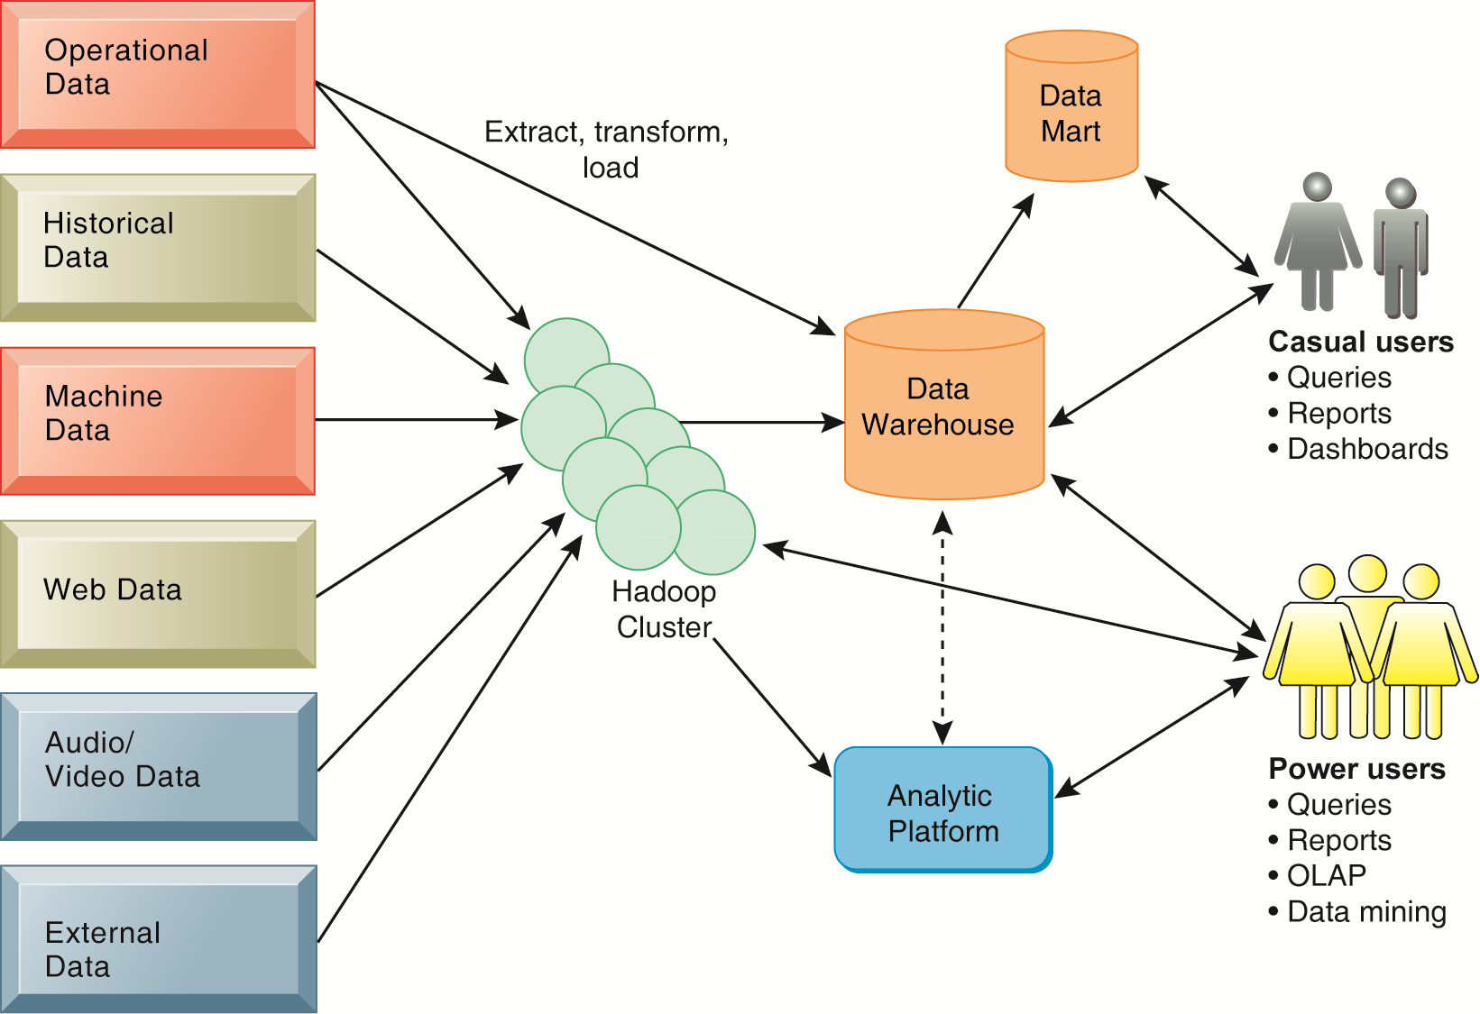
Business Intelligence (BI) Infrastructure

Slide 59
Business Intelligence and Data Mining
Increasing potential
to support
business decisions
End User
Decision Making
Data Presentation
Business
Analyst
Visualization Techniques
Data Mining
Data
Analyst
Information Discovery
Data Exploration
Statistical Summary, Querying, and Reporting
Data Preprocessing/Integration, Data Warehouses
Data Sources
DBA
Paper, Files, Web documents, Scientific experiments, Database Systems
Source: Jiawei Han and Micheline Kamber (2006), Data Mining: Concepts and Techniques, Second Edition, Elsevier

Slide 60


Data Mining:
Core Analytics Process
The KDD Process for
Extracting Useful Knowledge from Volumes of Data
Source: Fayyad, U., Piatetsky-Shapiro, G., & Smyth, P. (1996). The KDD Process for Extracting Useful Knowledge from Volumes of Data. Communications of the ACM, 39(11), 27-34.

Slide 61
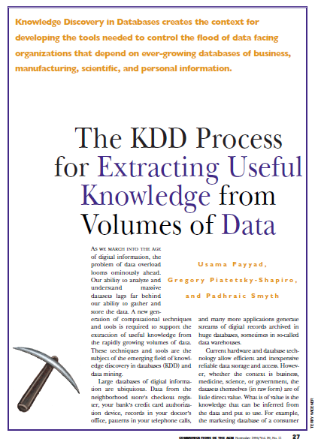
Fayyad, U., Piatetsky-Shapiro, G., & Smyth, P. (1996).
The KDD Process for
Extracting Useful Knowledge from Volumes of Data.
Communications of the ACM, 39(11), 27-34.

Slide 62
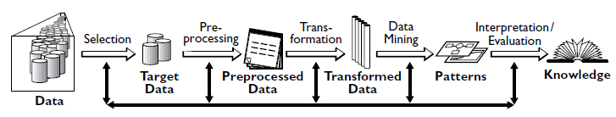
Data Mining
Knowledge Discovery in Databases (KDD) Process
(Fayyad et al., 1996)
Source: Fayyad, U., Piatetsky-Shapiro, G., & Smyth, P. (1996). The KDD Process for Extracting Useful Knowledge from Volumes of Data. Communications of the ACM, 39(11), 27-34.

Slide 63
Knowledge Discovery (KDD) Process
Knowledge
Data mining:
core of knowledge discovery process
Pattern Evaluation
Data Mining
Task-relevant Data
Data Warehouse
Selection
Data Cleaning
Data Integration
Databases
Source: Han & Kamber (2006)

Slide 64
Data Mining Processing Pipeline
(Charu Aggarwal, 2015)
Data Collection
Data Preprocessing
Analytical Processing
Output
for
Analyst
Feature Extraction
Cleaning
and
Integration
Building
Block 1
Building
Block 2
Feedback (Optional)
Feedback (Optional)
Source: Charu Aggarwal (2015), Data Mining: The Textbook Hardcover, Springer

Slide 65
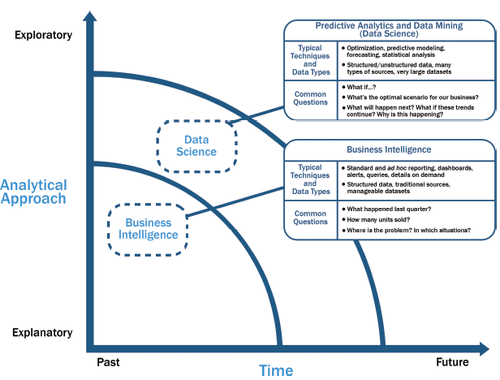
Data Science and
Business Intelligence
Source: EMC Education Services, Data Science and Big Data Analytics: Discovering, Analyzing, Visualizing and Presenting Data, Wiley, 2015

Slide 66
Data Science and
Business Intelligence
Predictive Analytics
and Data Mining
(Data Science)
Source: EMC Education Services, Data Science and Big Data Analytics: Discovering, Analyzing, Visualizing and Presenting Data, Wiley, 2015

Slide 67
Data Science and
Business Intelligence
Predictive Analytics
and Data Mining
(Data Science)
Structured/unstructured data, many types of sources,
very large datasets
Optimization, predictive modeling, forecasting statistical analysis
What if…?
What’s the optimal scenario for our business?
What will happen next?
What if these trends countinue?
Why is this happening?
Source: EMC Education Services, Data Science and Big Data Analytics: Discovering, Analyzing, Visualizing and Presenting Data, Wiley, 2015

Slide 68
Cloud Computing

Slide 69

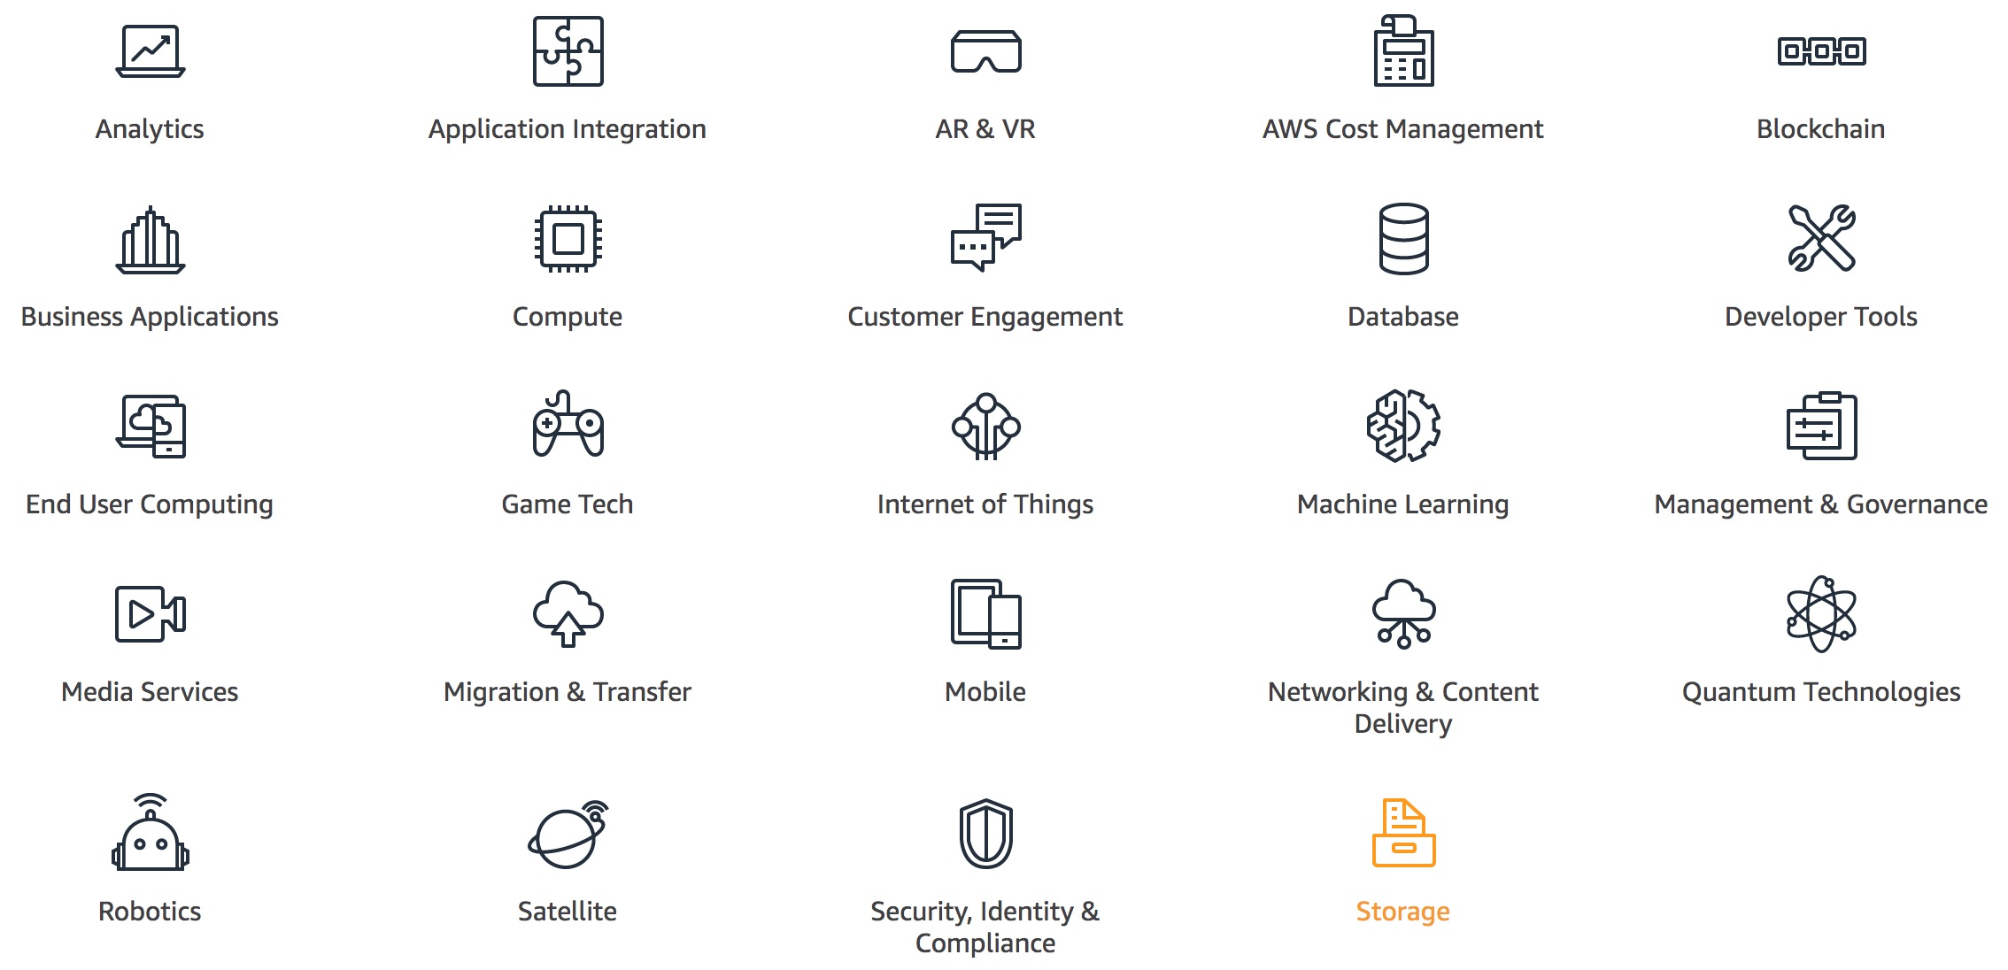
Cloud Computing
AWS
Amazon Web Services
Source: https://aws.amazon.com/

Slide 70
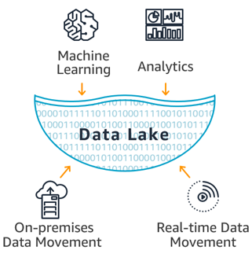
Data Lakes and Analytics on AWS
Data Movement
Import your data from on-premises, and in real-time.
Data Lake
Store any type of data securely, from gigabytes to exabytes.
Analytics
Analyze your data with a broad selection of analytic tools and engines.
Machine Learning
Forecast future outcomes, and prescribe actions.
Source: https://aws.amazon.com/big-data/datalakes-and-analytics/

Slide 71
AWS Products
Analytics
Amazon Athena
  Query data in S3 using SQL
Amazon CloudSearch
  Managed search service
Amazon EMR
  Hosted Hadoop framework
Amazon Elasticsearch Service
  Run and scale Elasticsearch clusters
Amazon Kinesis
  Analyze real-time video and data streams
Amazon Redshift
  Fast, simple, cost-effective data warehousing
Amazon QuickSight
  Fast business analytics service
AWS Data Pipeline
  Orchestration service for periodic, data-driven workflows
AWS Glue
  Prepare and load data
Source: https://aws.amazon.com/

Slide 72
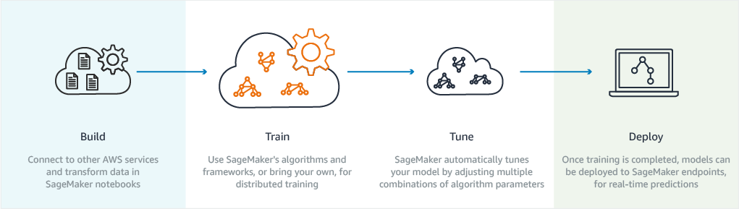
Machine Learning on AWS
Machine learning in the hands of every developer and data scientist
Source: https://aws.amazon.com/machine-learning/

Slide 73
AWS Certified Cloud Practitioner
AWS Certified Solutions Architect
AWS Certified Big Data Specialty
AWS Certified Machine Learning Specialty
BD
SAA
ML
CLF
Source: https://aws.amazon.com/certification/

Slide 74





Slide 75


Slide 76
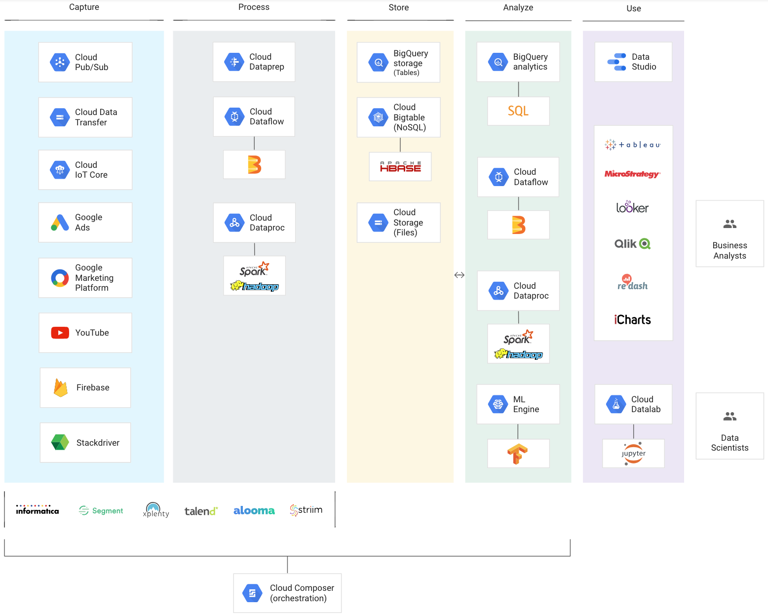
Google Cloud Big Data Analytics
Source: https://cloud.google.com/solutions/big-data/

Slide 77
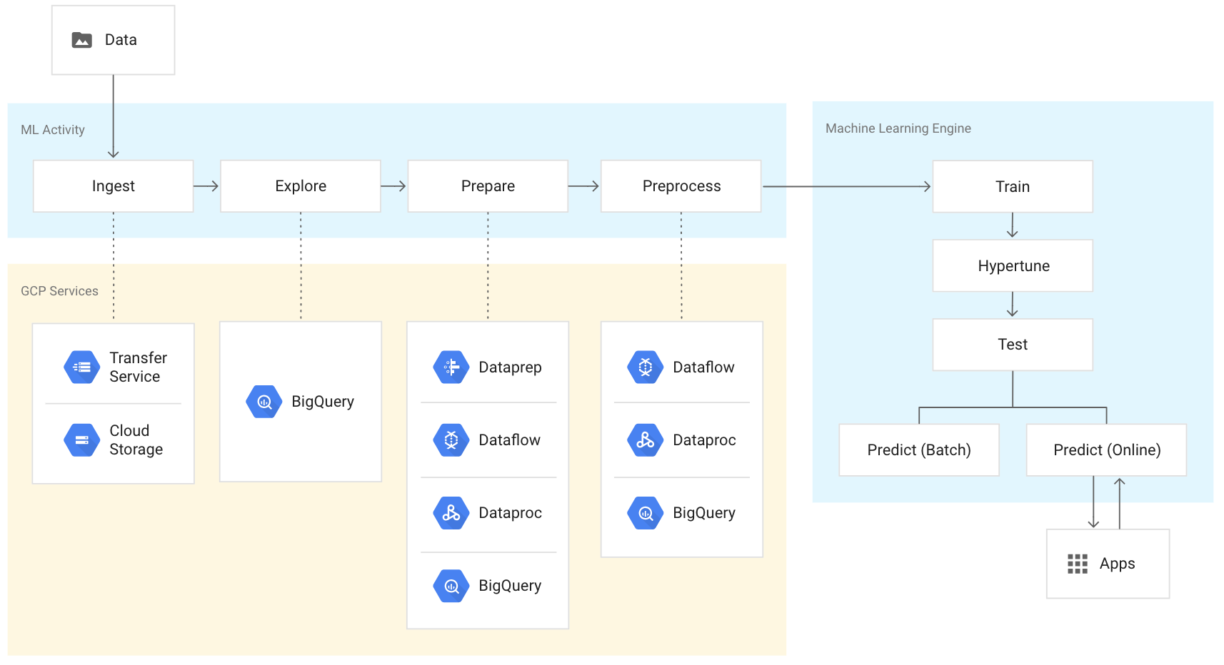
Google Cloud
Machine learning and Cloud AI
Source: https://cloud.google.com/solutions/big-data/overview/machine-learning-cloud-ai/

Slide 78
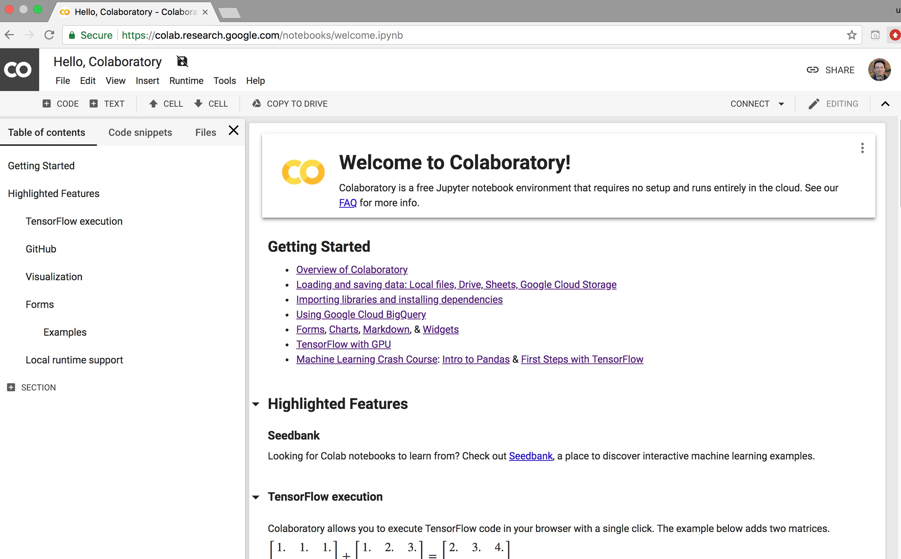
Google Colab
https://colab.research.google.com/notebooks/welcome.ipynb

Slide 79

Python in Google Colab (Python101)
https://colab.research.google.com/drive/1FEG6DnGvwfUbeo4zJ1zTunjMqf2RkCrT
https://tinyurl.com/aintpupython101

Slide 80
Summary
AI
Big Data
Cloud Computing

Slide 81
References
Stuart Russell and Peter Norvig (2020), Artificial Intelligence: A Modern Approach, 4th Edition, Pearson.
Aurélien Géron (2019), Hands-On Machine Learning with Scikit-Learn, Keras, and TensorFlow: Concepts, Tools, and Techniques to Build Intelligent Systems, 2nd Edition, O’Reilly Media.
Robert Layton (2017), Learning Data Mining with Python - Second Edition, Packt Publishing.
Jiawei Han, MichelineKamber and Jian Pei (2011), Data Mining: Concepts and Techniques, Third Edition, Morgan Kaufmann.
Sanjeev Verma, Rohit Sharma, Subhamay Deb, and Debojit Maitra (2021),. "Artificial intelligence in marketing: Systematic review and future research direction." International Journal of Information Management Data Insights, 100002.
Liye Ma and Baohong Sun (2020), "Machine learning and AI in marketing – Connecting computing power to human insights." International Journal of Research in Marketing, 37, no. 3, 481-504.
Ramesh Sharda, Dursun Delen, and Efraim Turban (2017), Business Intelligence, Analytics, and Data Science: A Managerial Perspective, 4th Edition, Pearson.
Xiao-lin Zheng, Meng-ying Zhu, Qi-bing Li, Chao-chao Chen, and Yan-chao Tan (2019), "Finbrain: When finance meets AI 2.0." Frontiers of Information Technology & Electronic Engineering 20, no. 7, pp. 914-924.
Ting-Peng Liang and Yu-Hsi Liu (2018), "Research Landscape of Business Intelligence and Big Data analytics: A bibliometrics study”, Expert Systems with Applications, 111, no. 30, pp. 2-10.
Jared Dean (2014), Big Data, Data Mining, and Machine Learning: Value Creation for Business Leaders and Practitioners, Wiley.
Mehmet Kaya, Jalal Kawash, Suheil Khoury, and Min-Yuh Day (2018), Social Network Based Big Data Analysis and Applications, Lecture Notes in Social Networks, Springer International Publishing.
Varun Grover, Roger HL Chiang, Ting-Peng Liang, and Dongsong Zhang (2018), "Creating Strategic Business Value from Big Data Analytics: A Research Framework", Journal of Management Information Systems, 35, no. 2, pp. 388-423.
Stephan Kudyba (2014), Big Data, Mining, and Analytics: Components of Strategic Decision Making, Auerbach Publications.

