Slide 1
資料探勘 (Data Mining)
Python資料探勘的基礎 (Foundations of Data Mining in Python)
1092DM03
MBA, IM, NTPU (M5026) (Spring 2021) Tue 2, 3, 4 (9:10-12:00) (B8F40)
Min-Yuh Day
戴敏育
Associate Professor
副教授
Institute of Information Management, National Taipei University
國立臺北大學 資訊管理研究所
https://web.ntpu.edu.tw/~myday
2021-03-09

Slide 2
課程大綱 (Syllabus)
週次 (Week) 日期 (Date) 內容 (Subject/Topics)
1 2021/02/23 資料探勘介紹 (Introduction to data mining)
2 2021/03/02 ABC：人工智慧，大數據，雲端運算 (ABC: AI, Big Data, Cloud Computing)
3 2021/03/09 Python資料探勘的基礎 (Foundations of Data Mining in Python)
4 2021/03/16 資料科學與資料探勘：發現，分析，可視化和呈現數據 (Data Science and Data Mining: Discovering, Analyzing, Visualizing and Presenting Data)
5 2021/03/23 非監督學習：關聯分析，購物籃分析 (Unsupervised Learning: Association Analysis, Market Basket Analysis)
6 2021/03/30 資料探勘個案研究 I (Case Study on Data Mining I)

Slide 3
課程大綱 (Syllabus)
週次 (Week) 日期 (Date) 內容 (Subject/Topics)
7 2021/04/06 非監督學習：集群分析，行銷市場區隔 (Unsupervised Learning: Cluster Analysis, Market Segmentation)
8 2021/04/13 監督學習：分類和預測 (Supervised Learning: Classification and Prediction)
9 2021/04/20 期中報告 (Midterm Project Report)
10 2021/04/27 監督學習：分類和預測 (Supervised Learning: Classification and Prediction)
11 2021/05/04 機器學習和深度學習 (Machine Learning and Deep Learning)
12 2021/05/11 卷積神經網絡 (Convolutional Neural Networks)

Slide 4
課程大綱 (Syllabus)
週次 (Week) 日期 (Date) 內容 (Subject/Topics)
13 2021/05/18 資料探勘個案研究 II (Case Study on Data Mining II)
14 2021/05/25 遞歸神經網絡 (Recurrent Neural Networks)
15 2021/06/01 強化學習 (Reinforcement Learning)
16 2021/06/08 社交網絡分析 (Social Network Analysis)
17 2021/06/15 期末報告 I (Final Project Report I)
18 2021/06/22 期末報告 II (Final Project Report II)

Slide 5
Foundations of Data Mining in Python

Slide 6
Outline
Foundations of Data Mining in Python
Python
Programming language
Numpy
Scientific computing

Slide 7
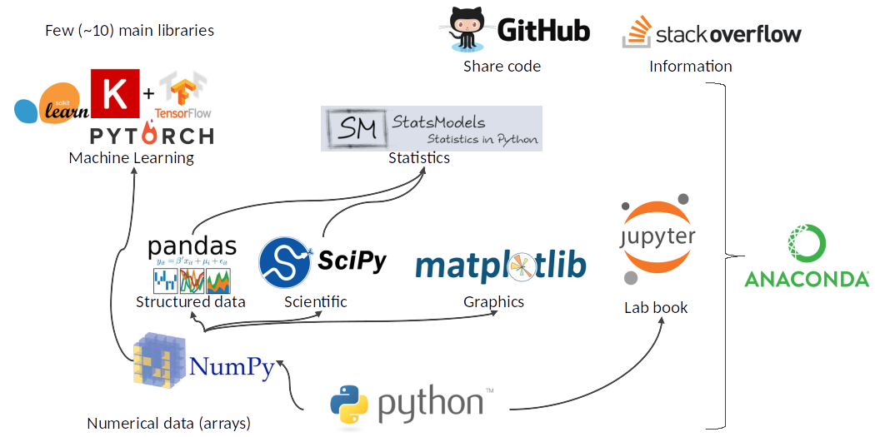
Python Ecosystem for Data Science
Source: https://medium.com/pyfinance/why-python-is-best-choice-for-financial-data-modeling-in-2019-c0d0d1858c45

Slide 8
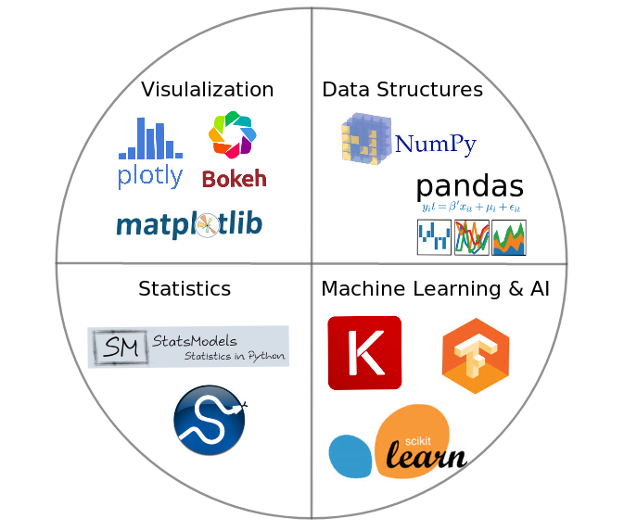
Python Ecosystem for Data Science
Source:https://duchesnay.github.io/pystatsml/introduction/python_ecosystem.html

Slide 9
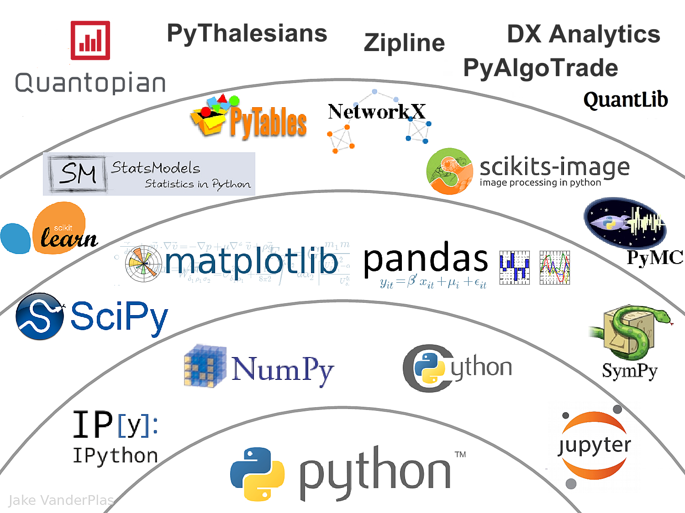
The Quant Finance PyData Stack
Source: http://nbviewer.jupyter.org/format/slides/github/quantopian/pyfolio/blob/master/pyfolio/examples/overview_slides.ipynb#/5

Slide 10
Python

Slide 11
Python is an interpreted, object-oriented, high-level programming language with dynamic semantics.
Source: https://www.python.org/doc/essays/blurb/

Slide 12
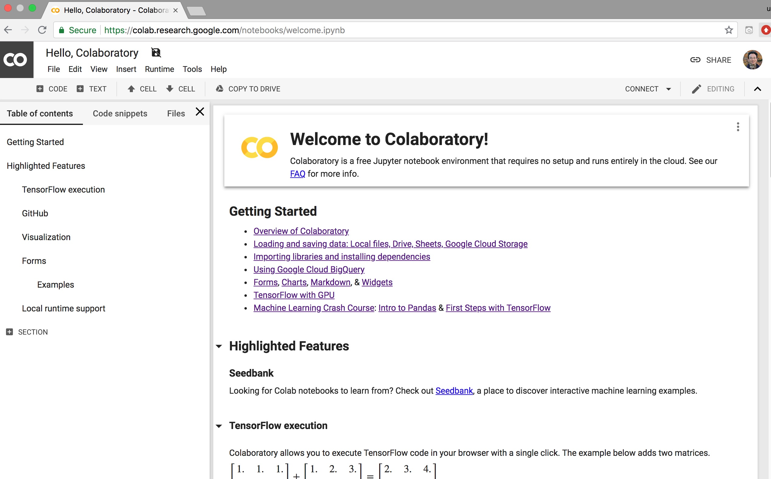
Google Colab
https://colab.research.google.com/notebooks/welcome.ipynb

Slide 13
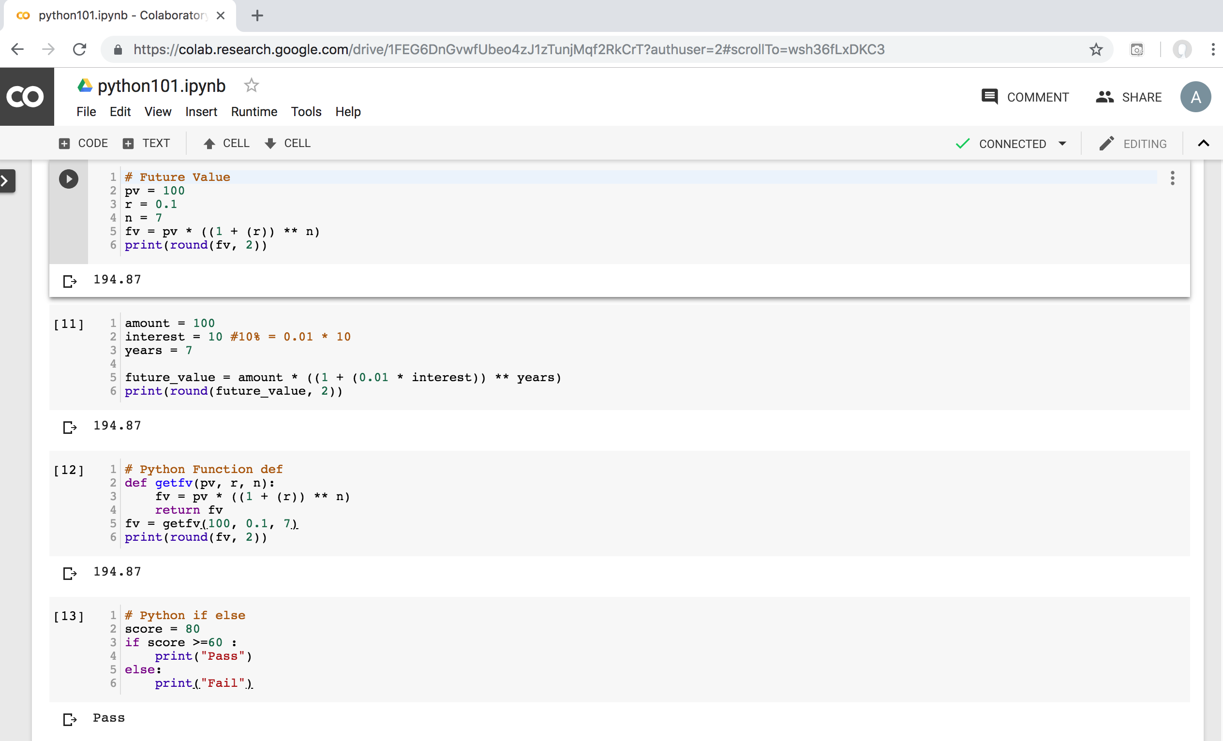
Python in Google Colab (Python101)
https://colab.research.google.com/drive/1FEG6DnGvwfUbeo4zJ1zTunjMqf2RkCrT
https://tinyurl.com/aintpupython101

Slide 14
Numpy
NumPy
Base N-dimensional array package

Slide 15
Python matplotlib
Source: https://matplotlib.org/

Slide 16
Python Pandas
http://pandas.pydata.org/

Slide 17
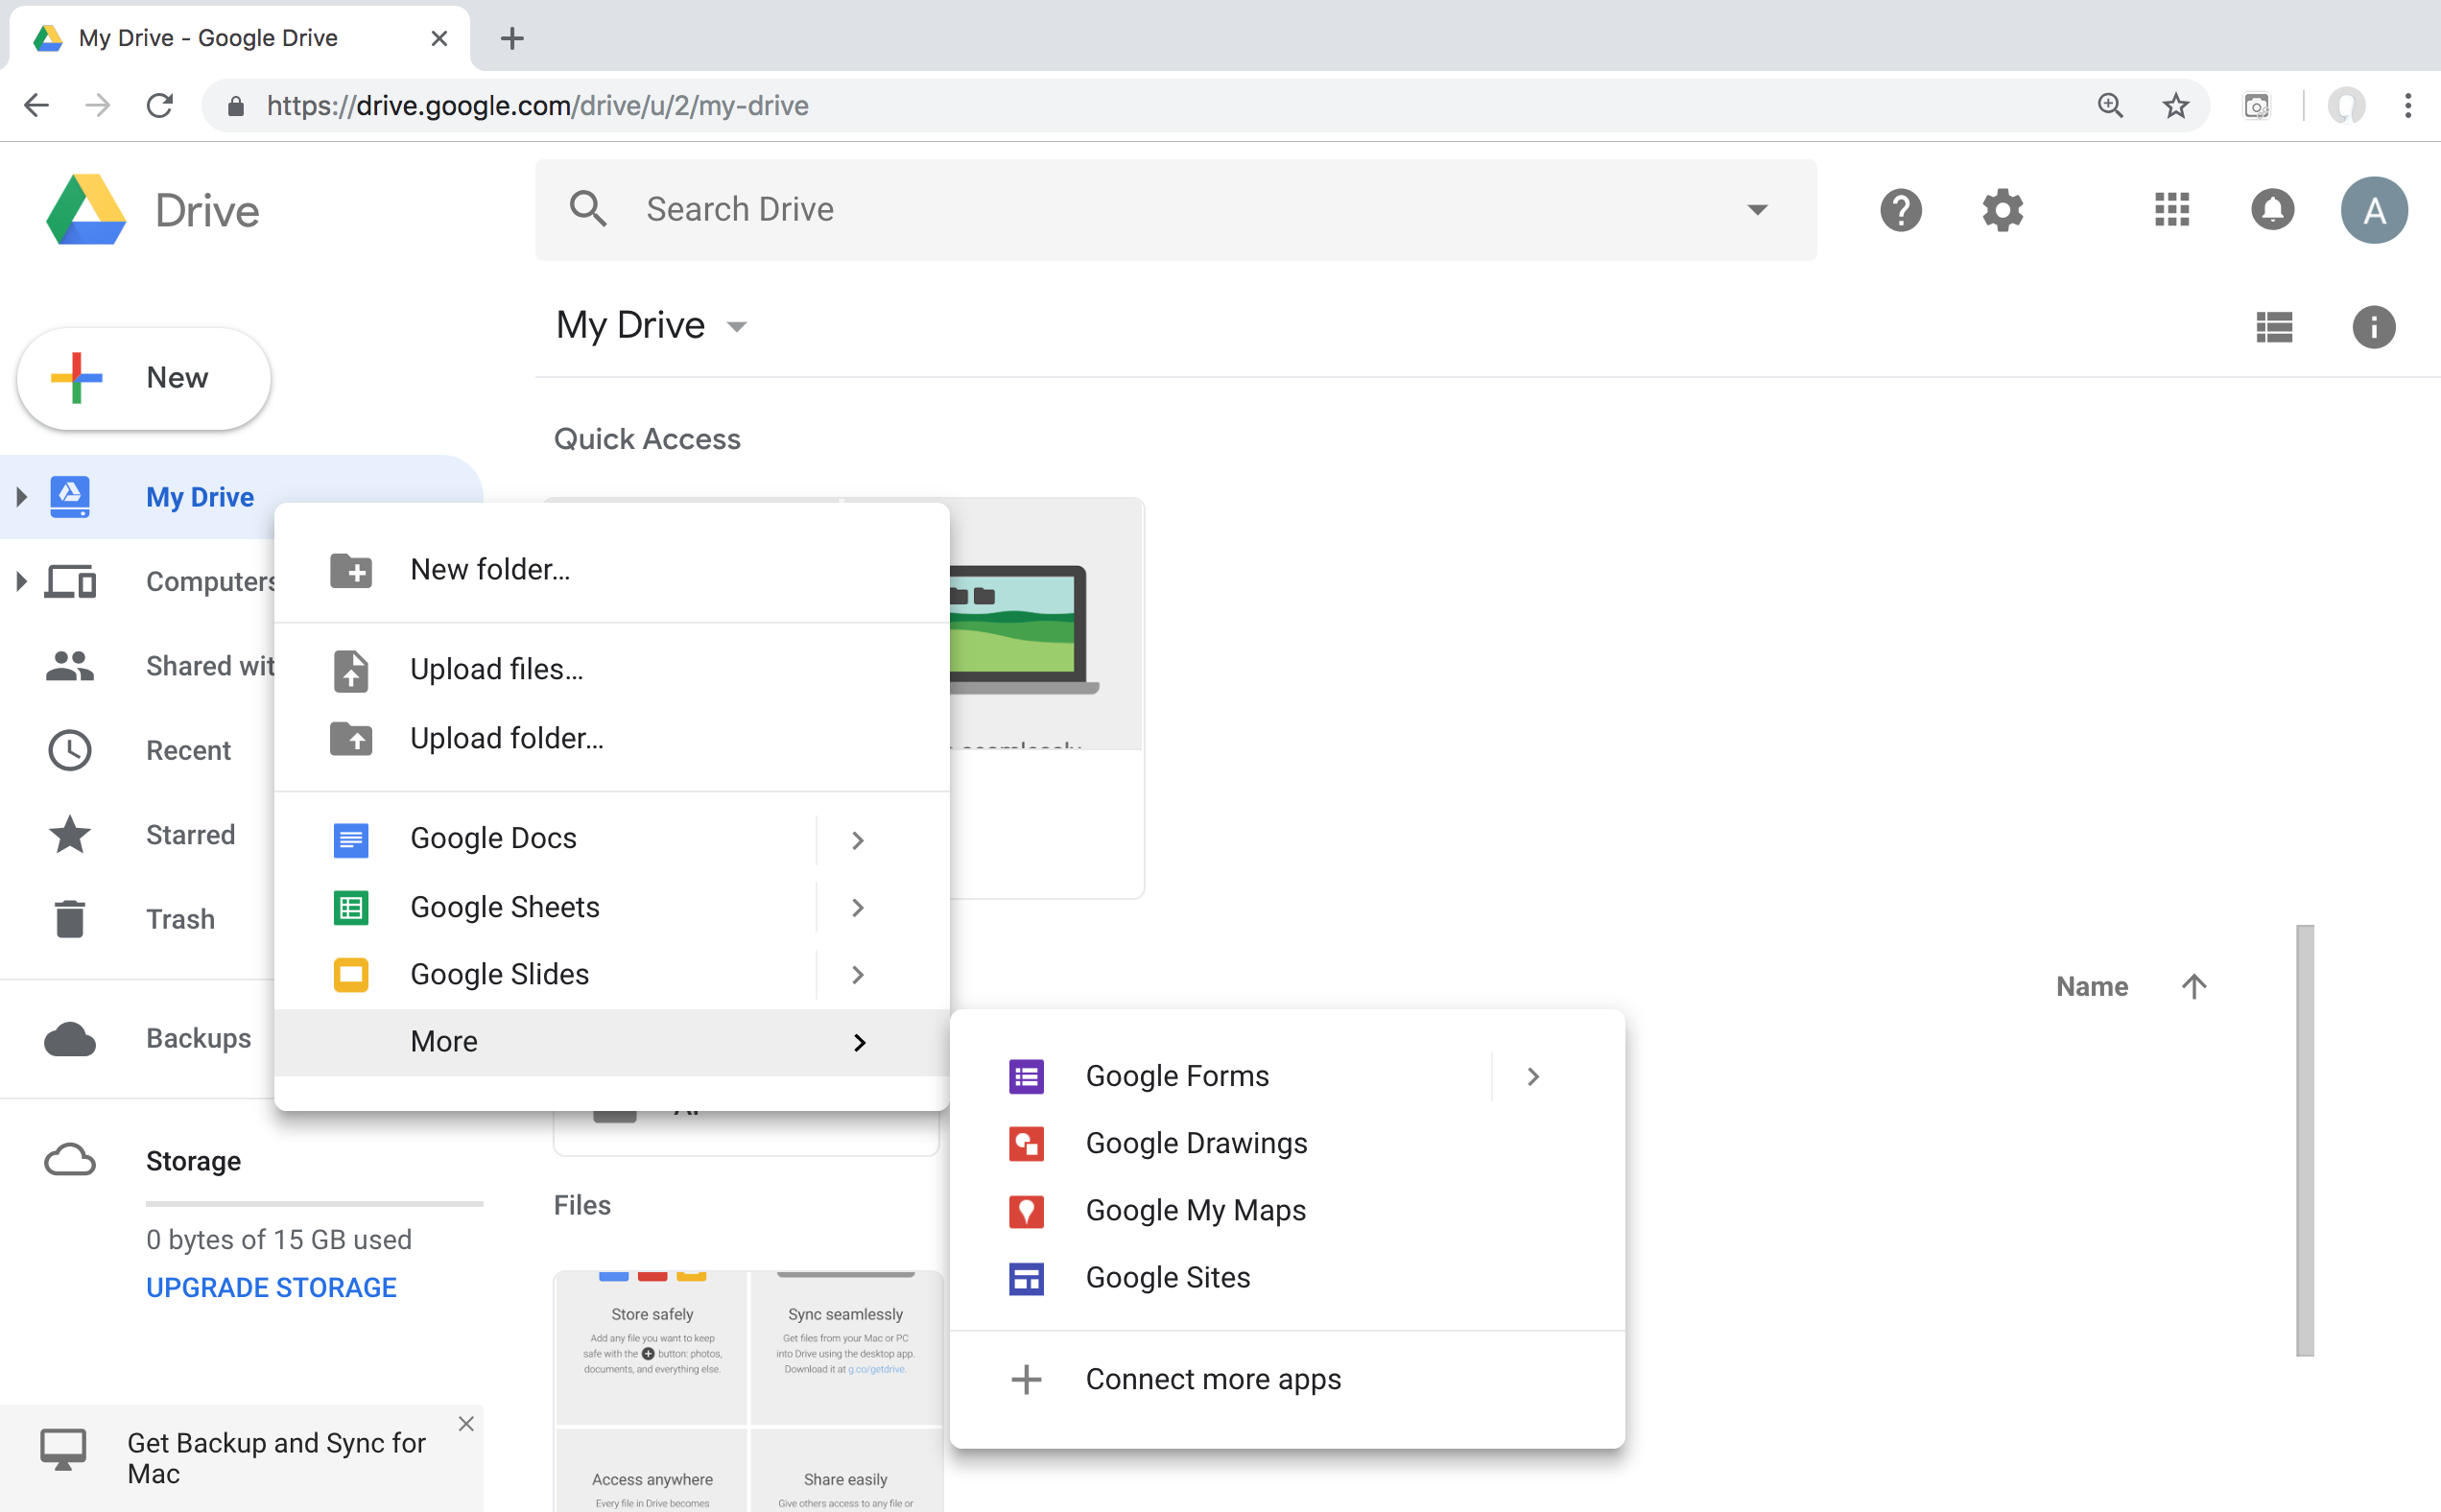
Connect Google Colab in Google Drive

Slide 18
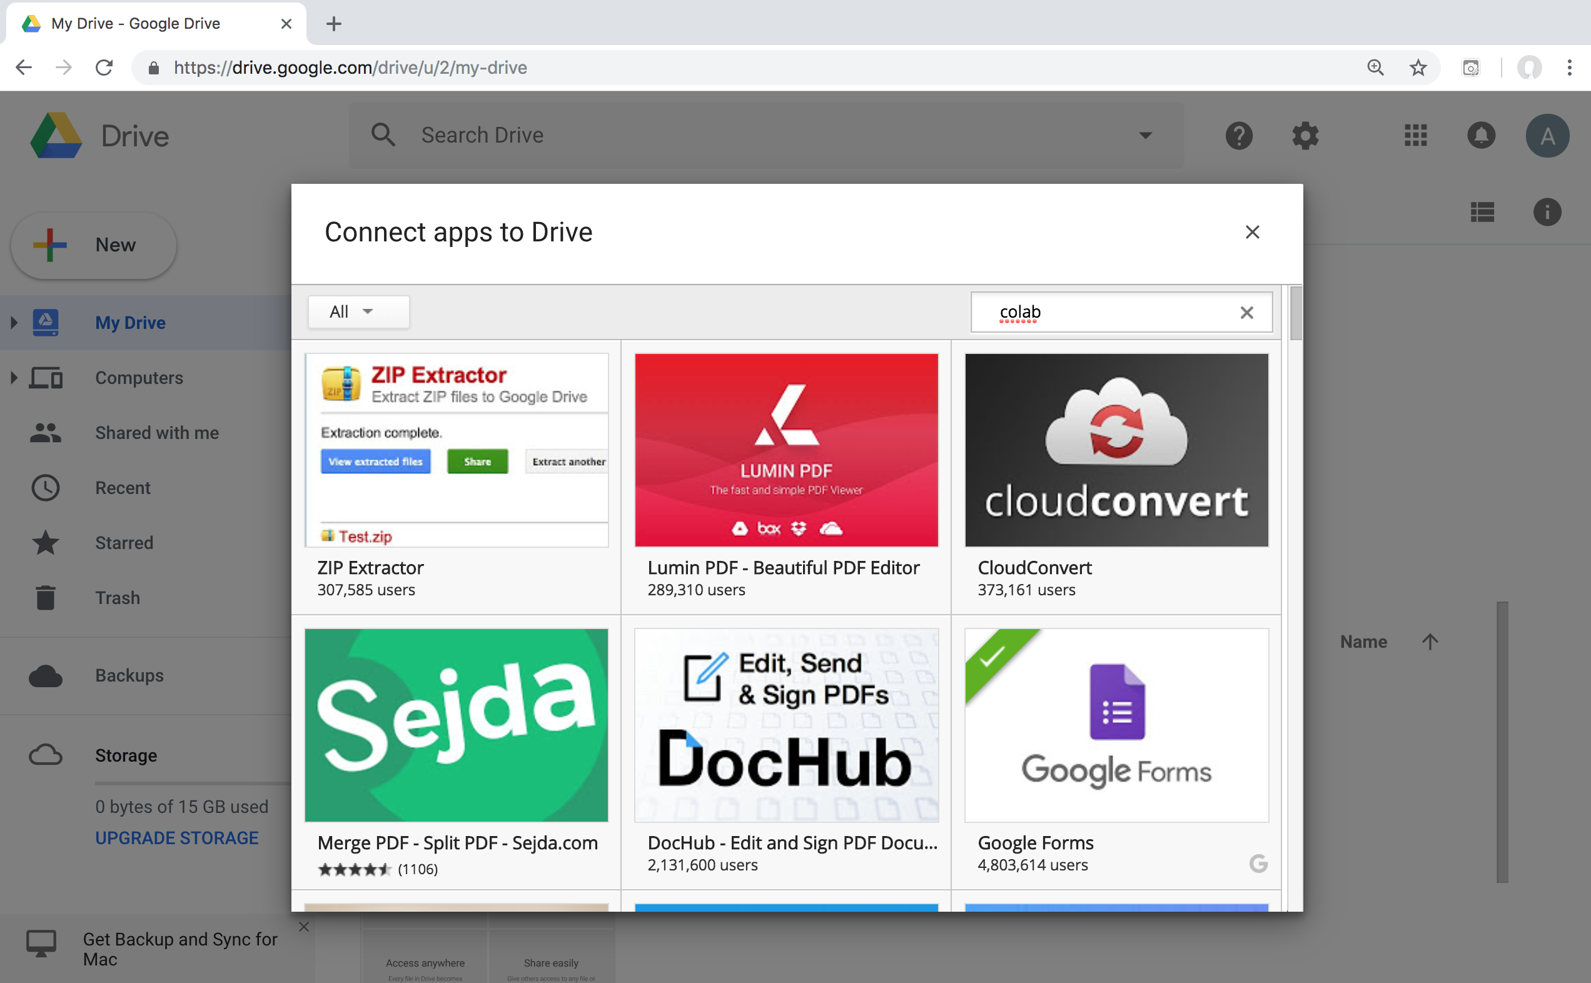
Google Colab

Slide 19
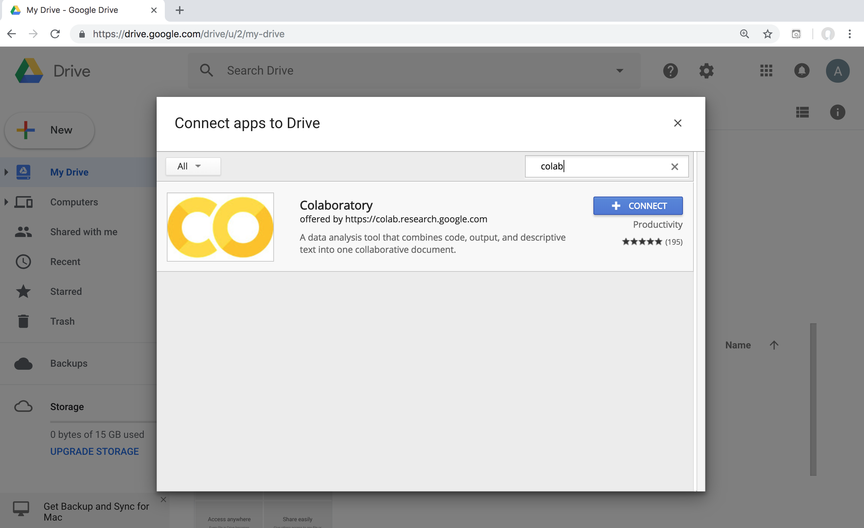
Google Colab

Slide 20
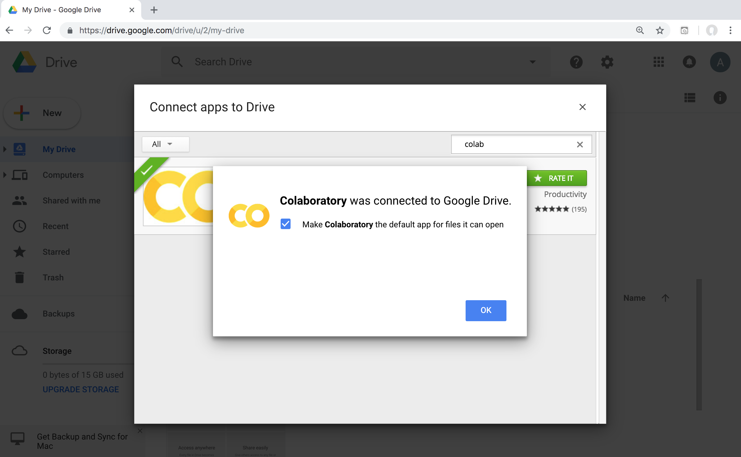
Connect Colaboratory to Google Drive

Slide 21
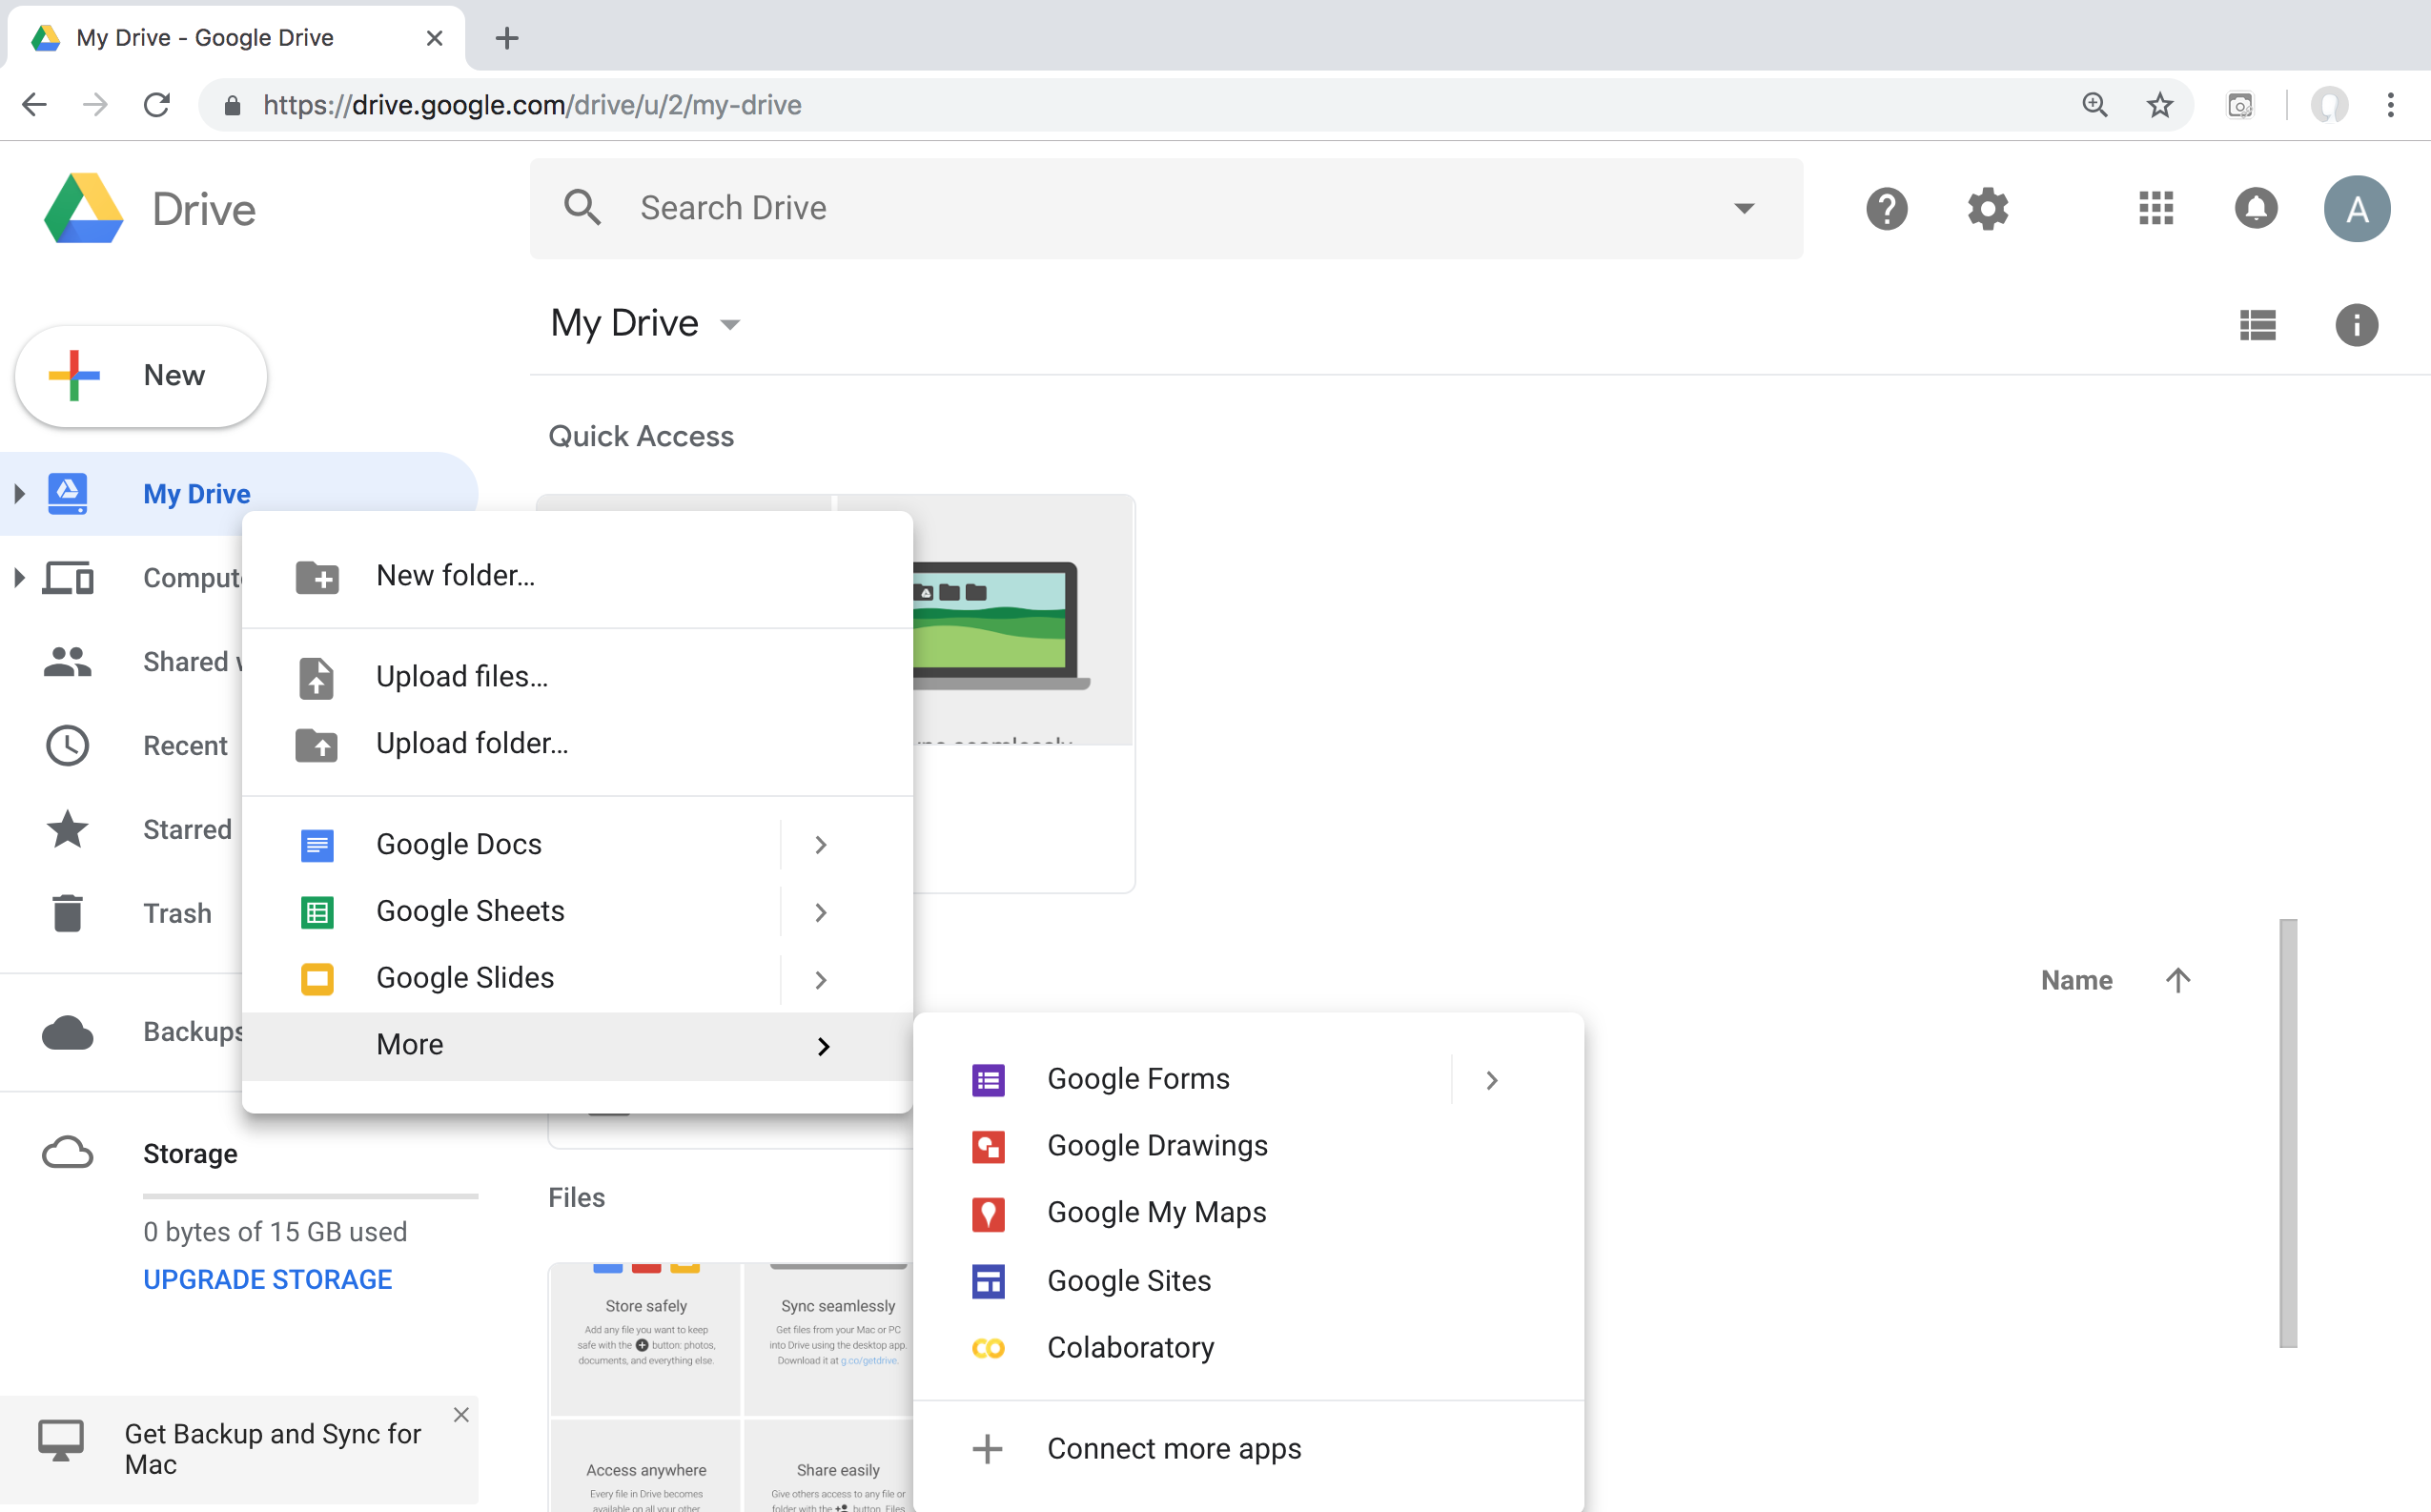
Google Colab

Slide 22
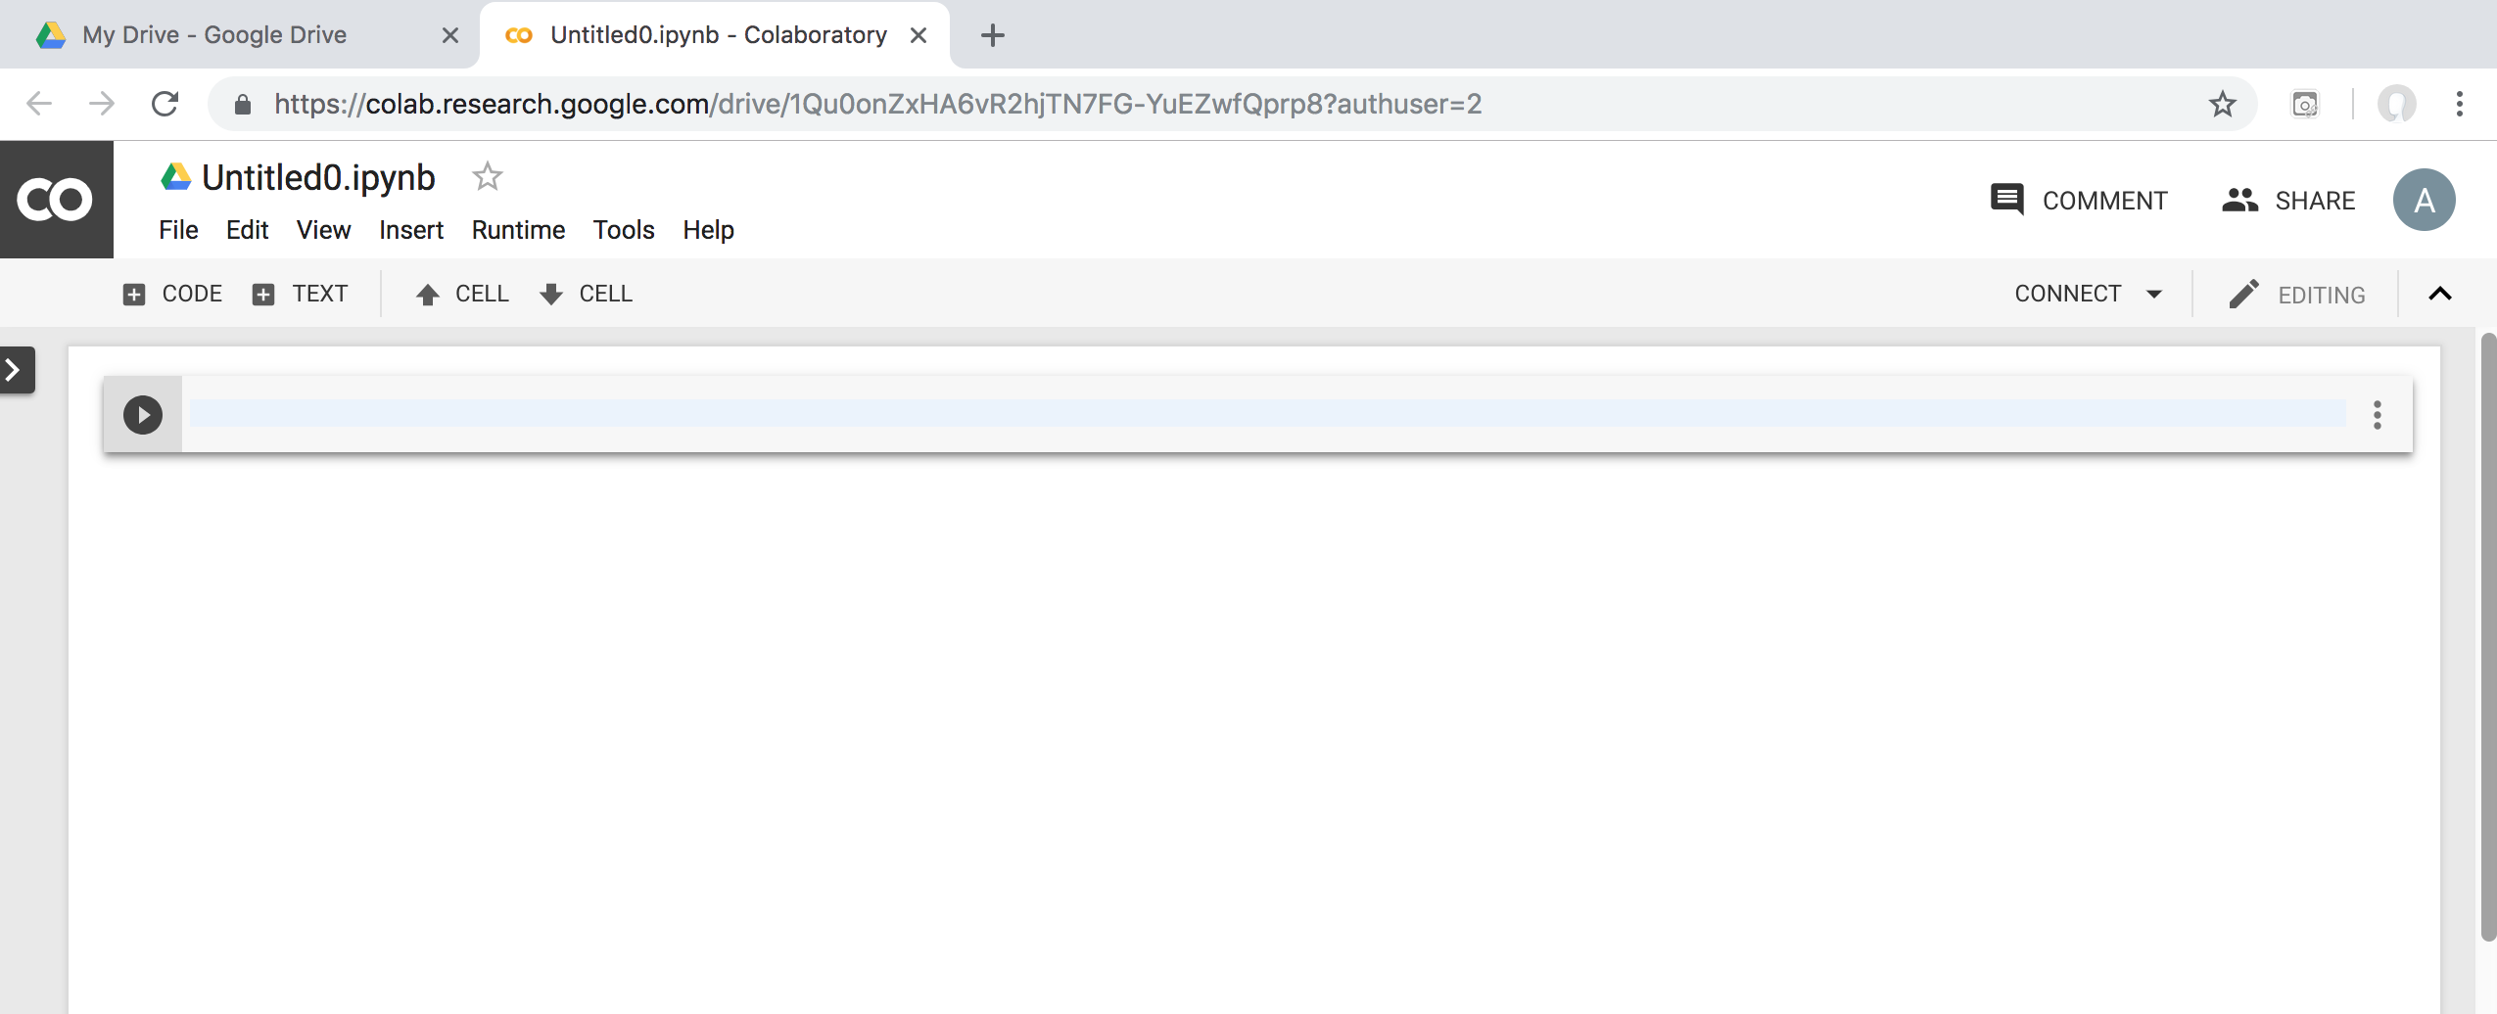
Google Colab

Slide 23
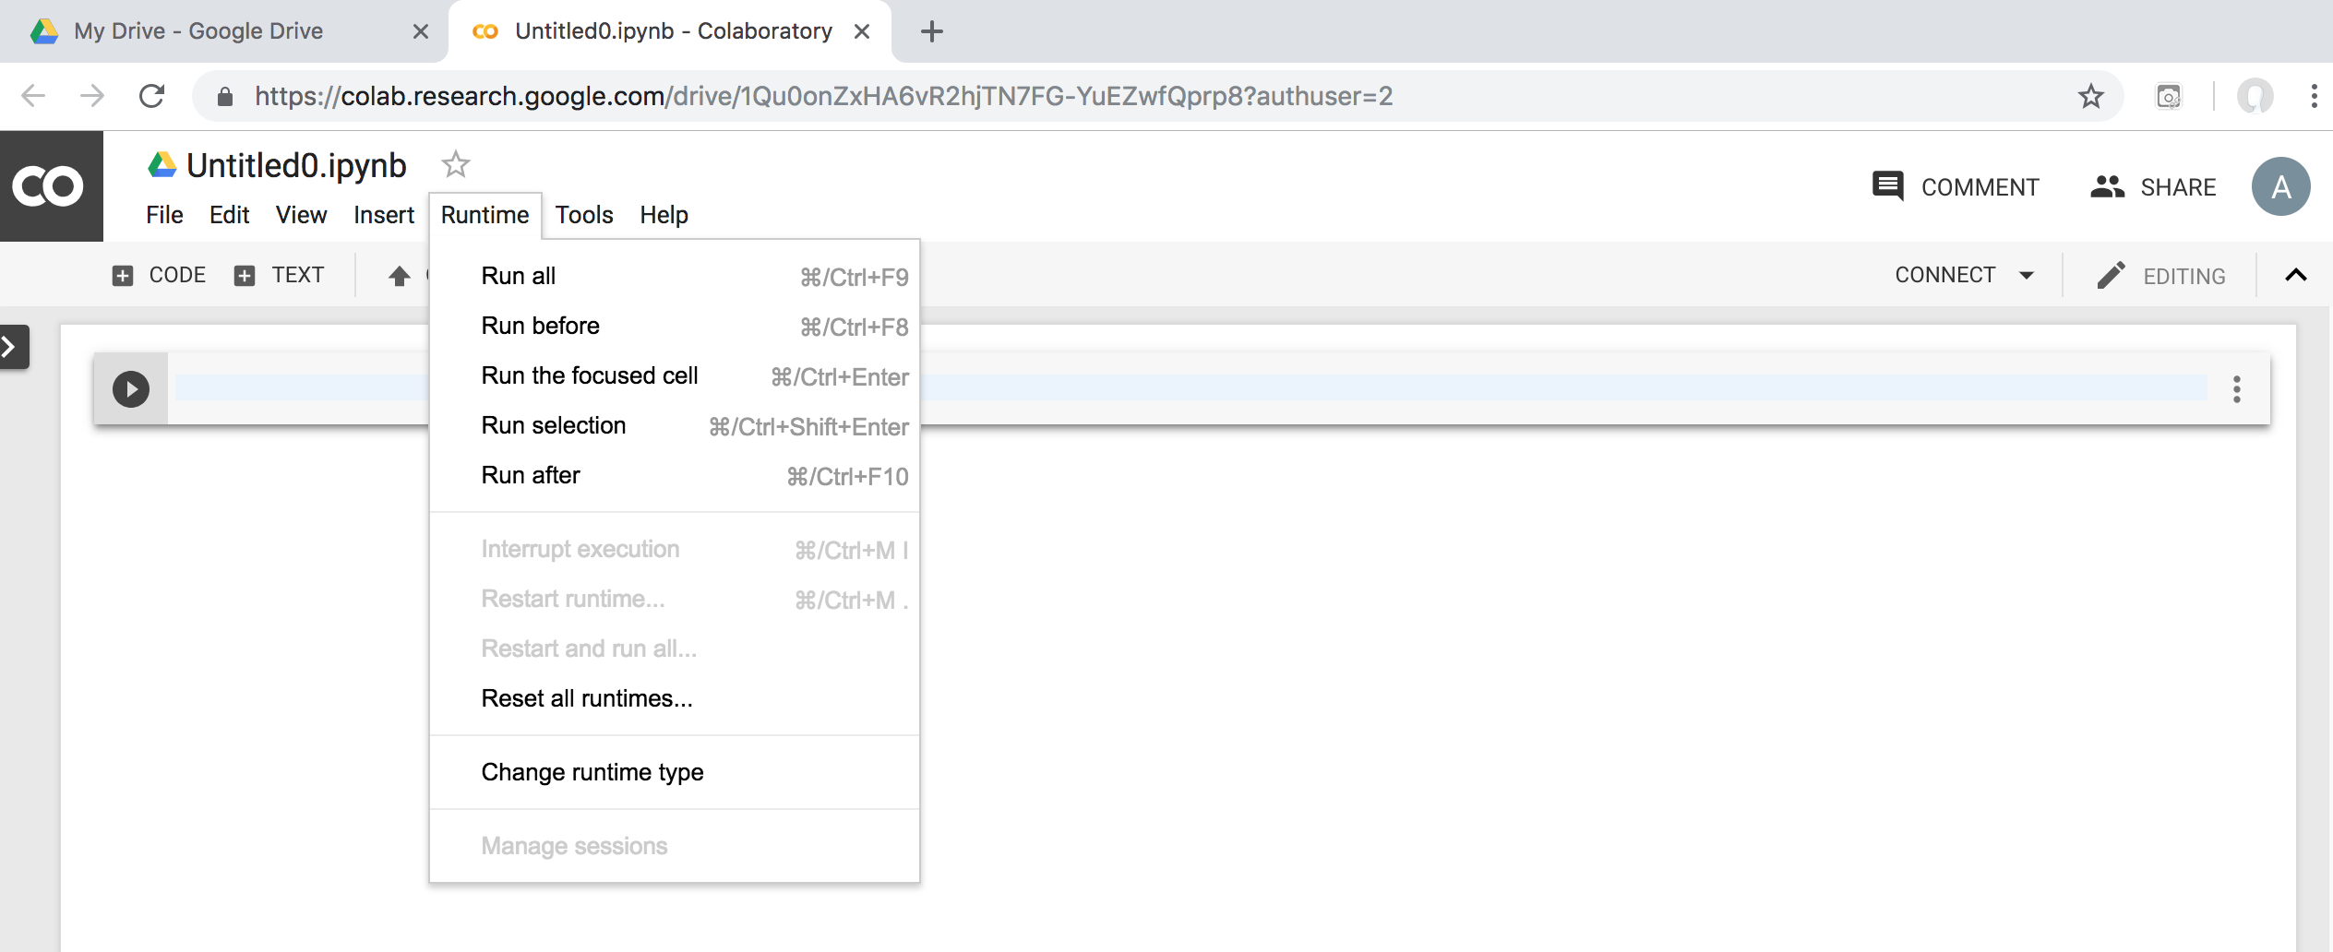
Google Colab

Slide 24
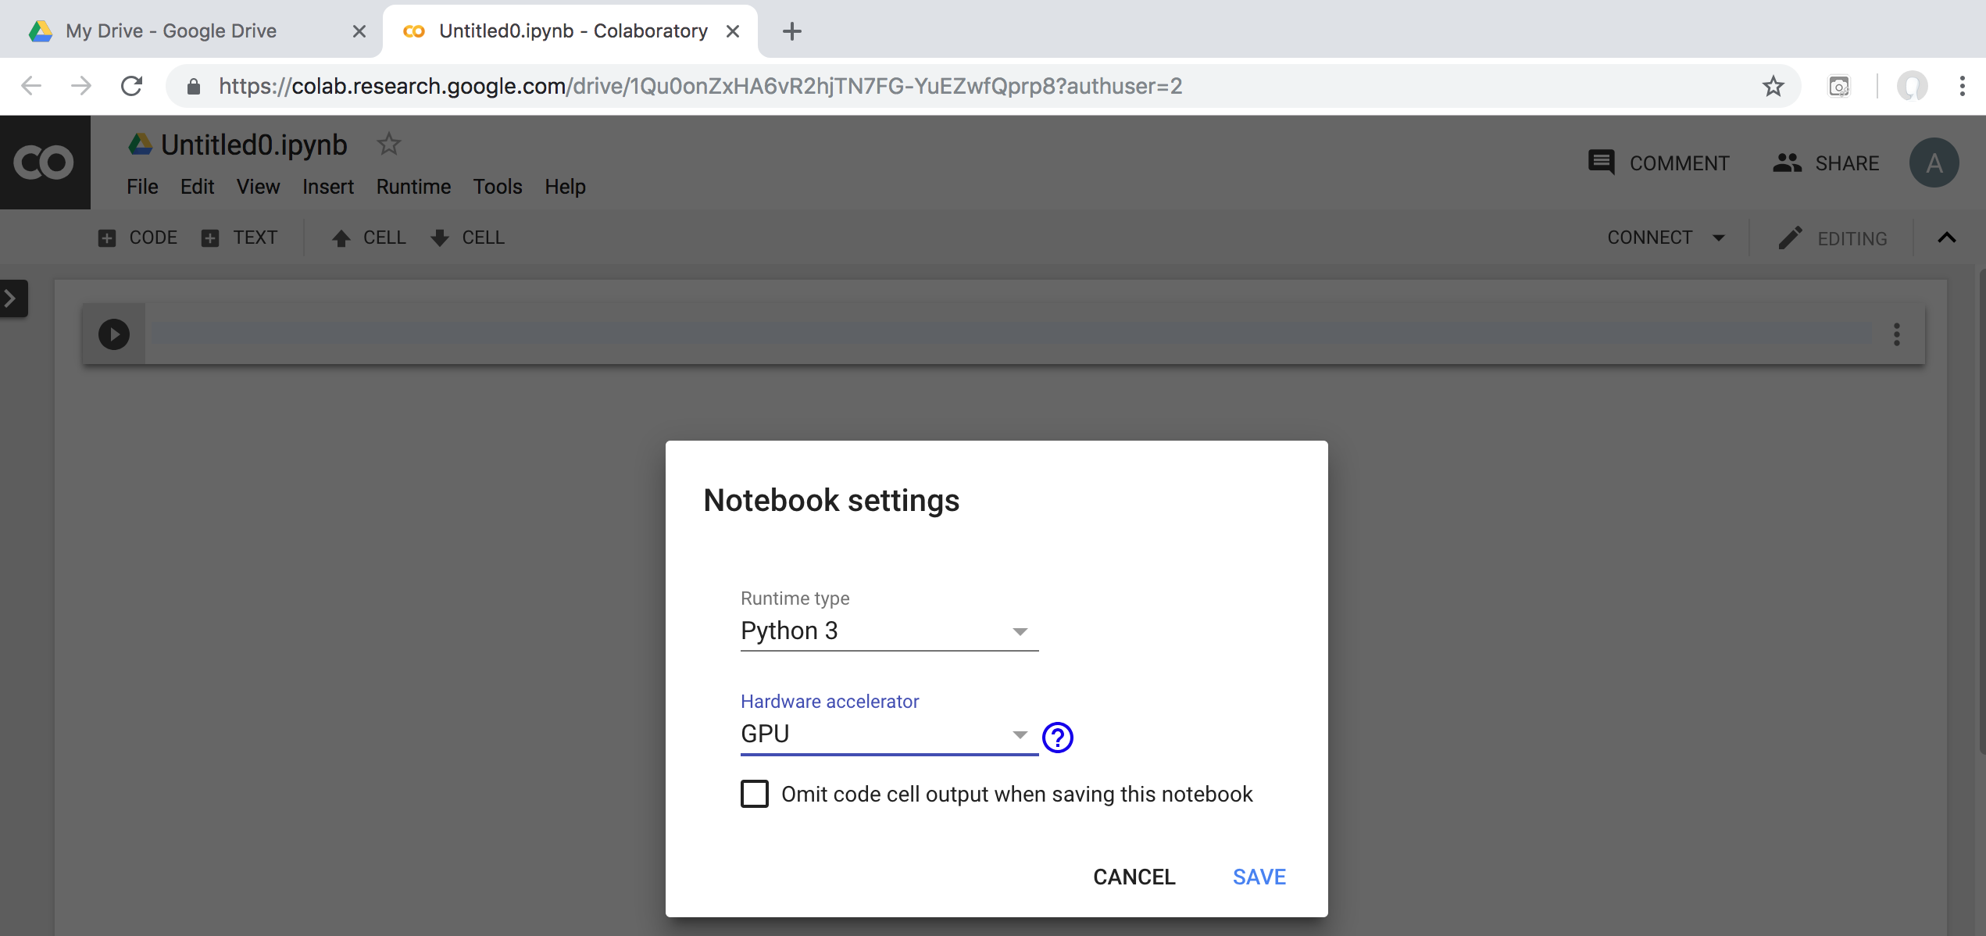
Run Jupyter Notebook Python3 GPU Google Colab

Slide 25
Google Colab Python Hello World print('Hello World')

Slide 26
Anaconda The Most Popular Python Data Science Platform
Source: https://www.anaconda.com/

Slide 27
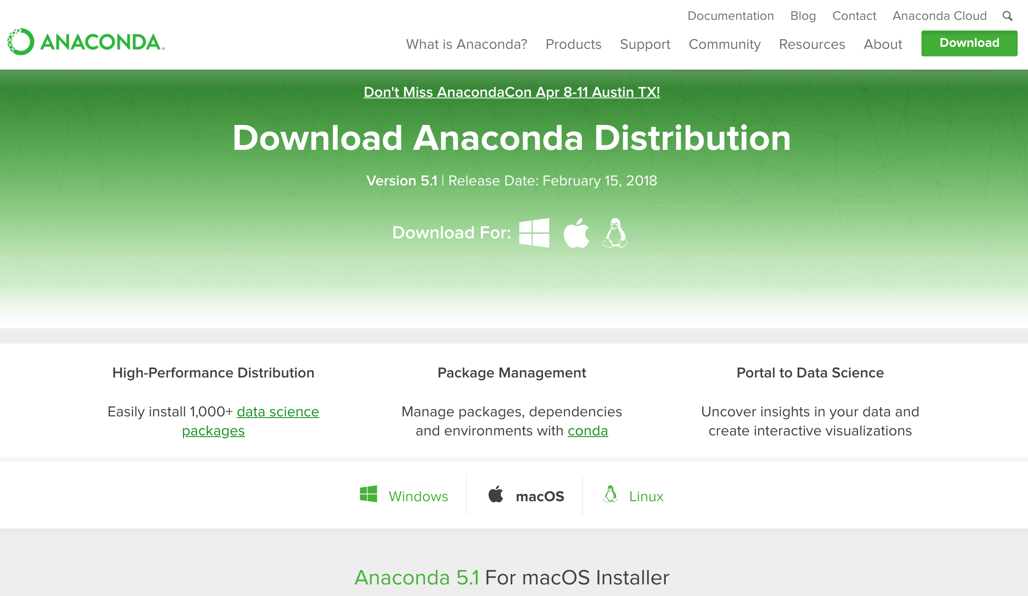
Download Anaconda
https://www.anaconda.com/download

Slide 28
Python HelloWorld

Slide 29
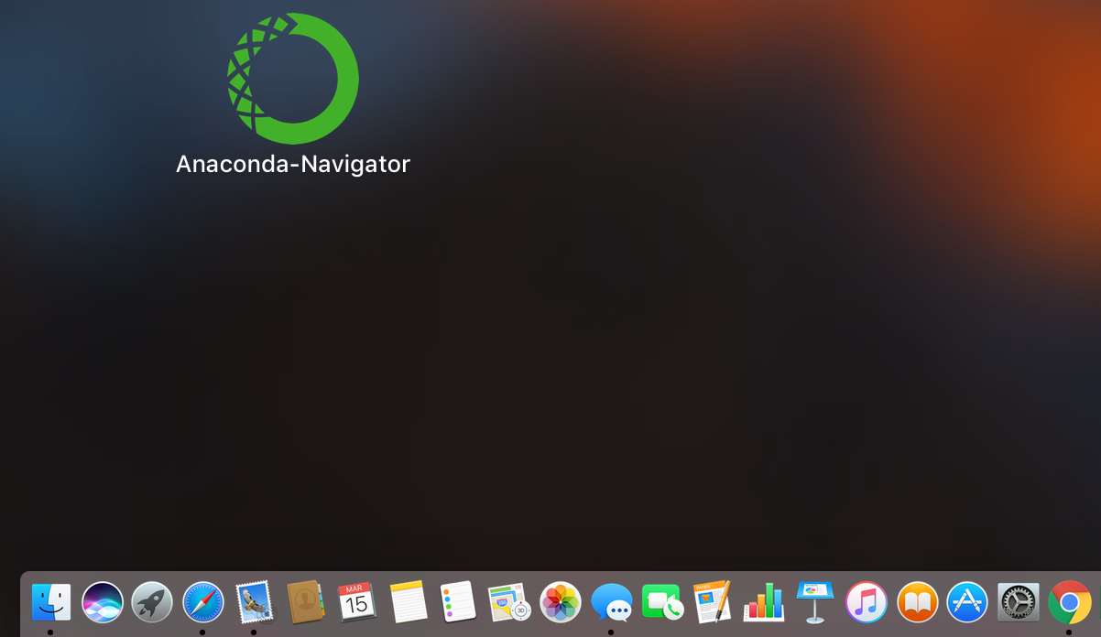
Anaconda-Navigator
Launchpad

Slide 30
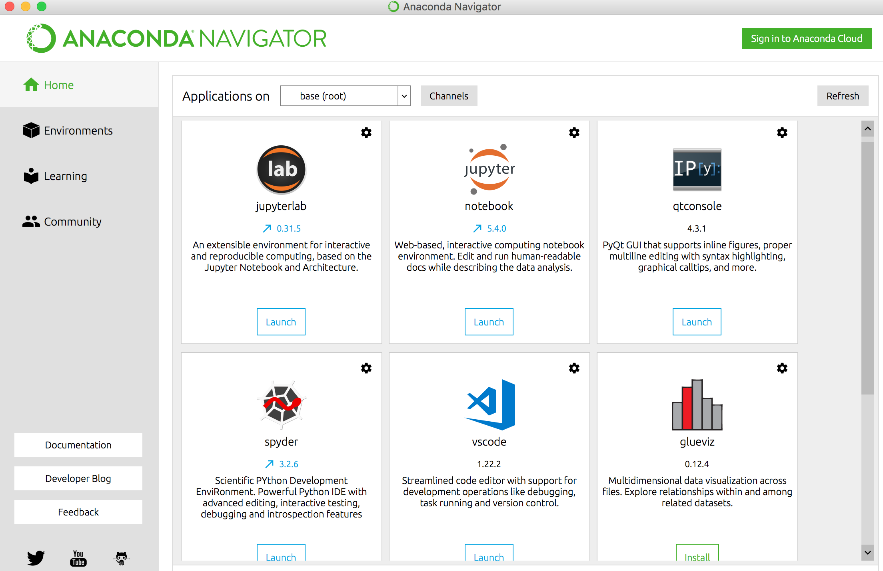
Anaconda Navigator

Slide 31
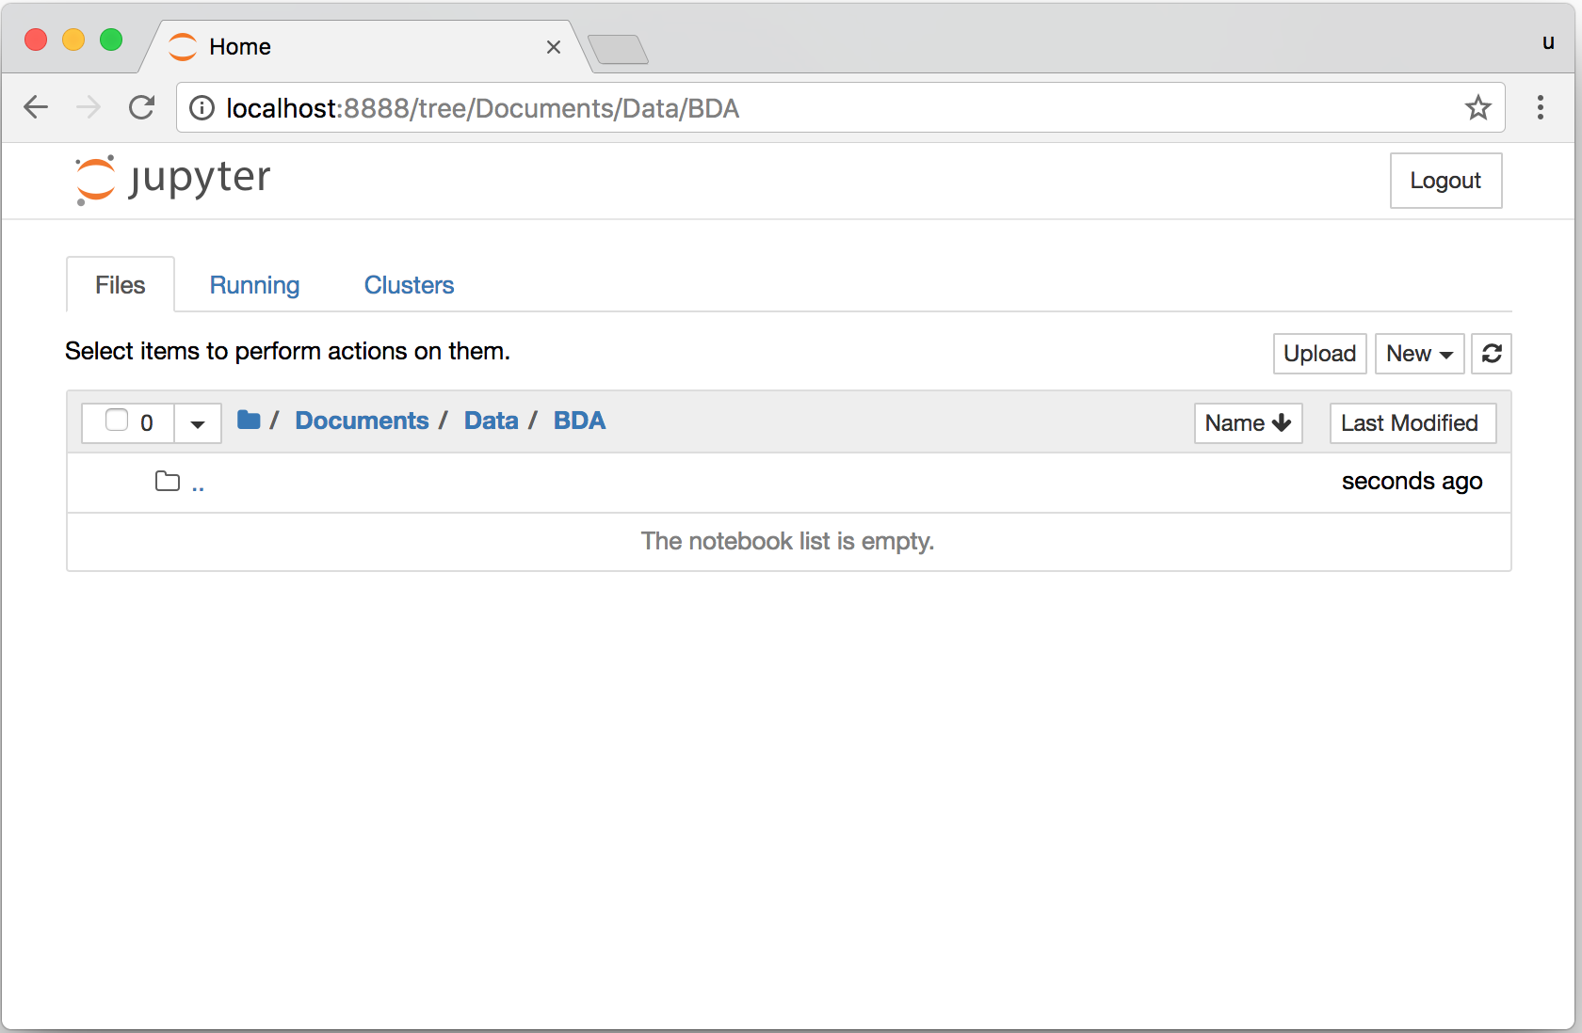
Jupyter Notebook

Slide 32
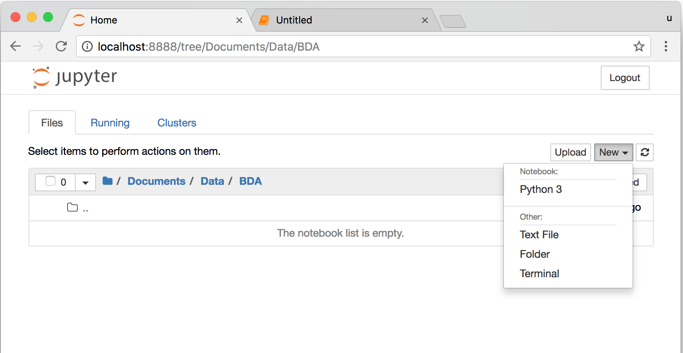
Jupyter Notebook New Python 3

Slide 33
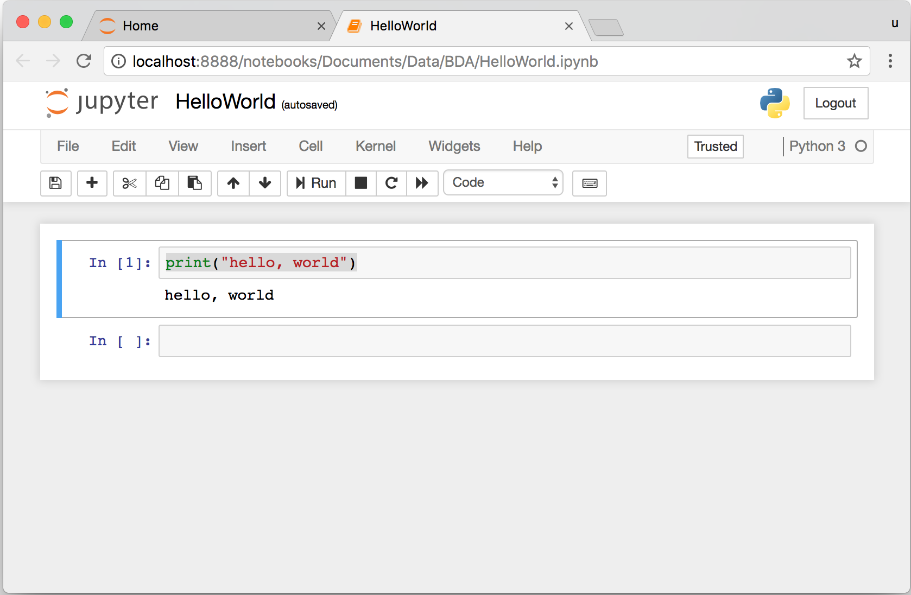
print("hello, world")
Notes:
print("hello, world")

Slide 34
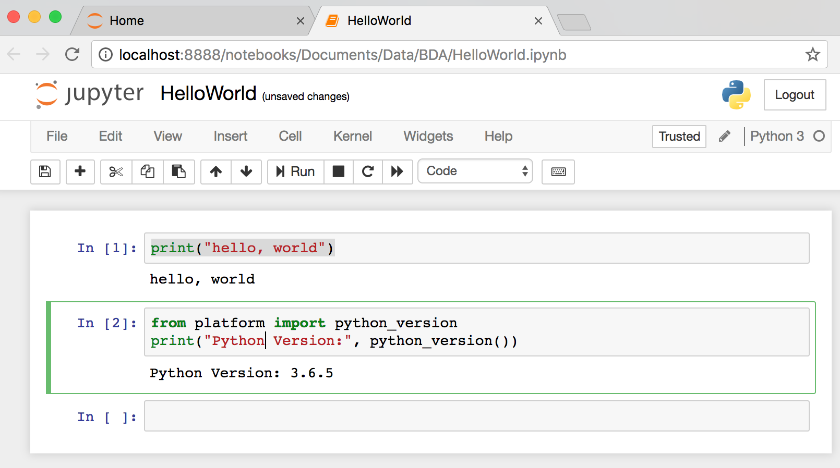
from platform import python_version
print("Python Version:", python_version())
Notes:
from platform import python_version
print("Python Version:", python_version())

Slide 35
Python Programming

Slide 36
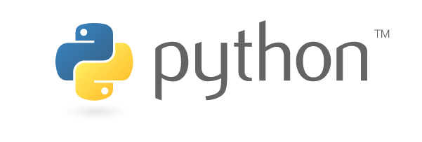
Source: https://www.python.org/community/logos/

Slide 37
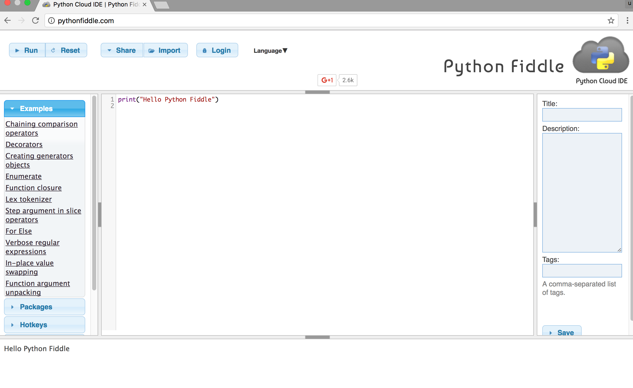
Python Fiddle
http://pythonfiddle.com/

Slide 38
Text input and output
print("Hello World")
print("Hello World\nThis is a message")
x = 3
print(x)
x = 2
y = 3
print(x, ' ', y)
name = input("Enter a name: ")
x = int(input("What is x? "))
x = float(input("Write a number "))
Source: http://pythonprogramminglanguage.com/text-input-and-output/
Notes:
print("Hello World")
print("Hello World\nThis is a message")
x = 3
print(x)
x = 2
y = 3
print(x, ' ', y)
name = input("Enter a name: ")
x = int(input("What is x? "))
x = float(input("Write a number "))

Slide 39
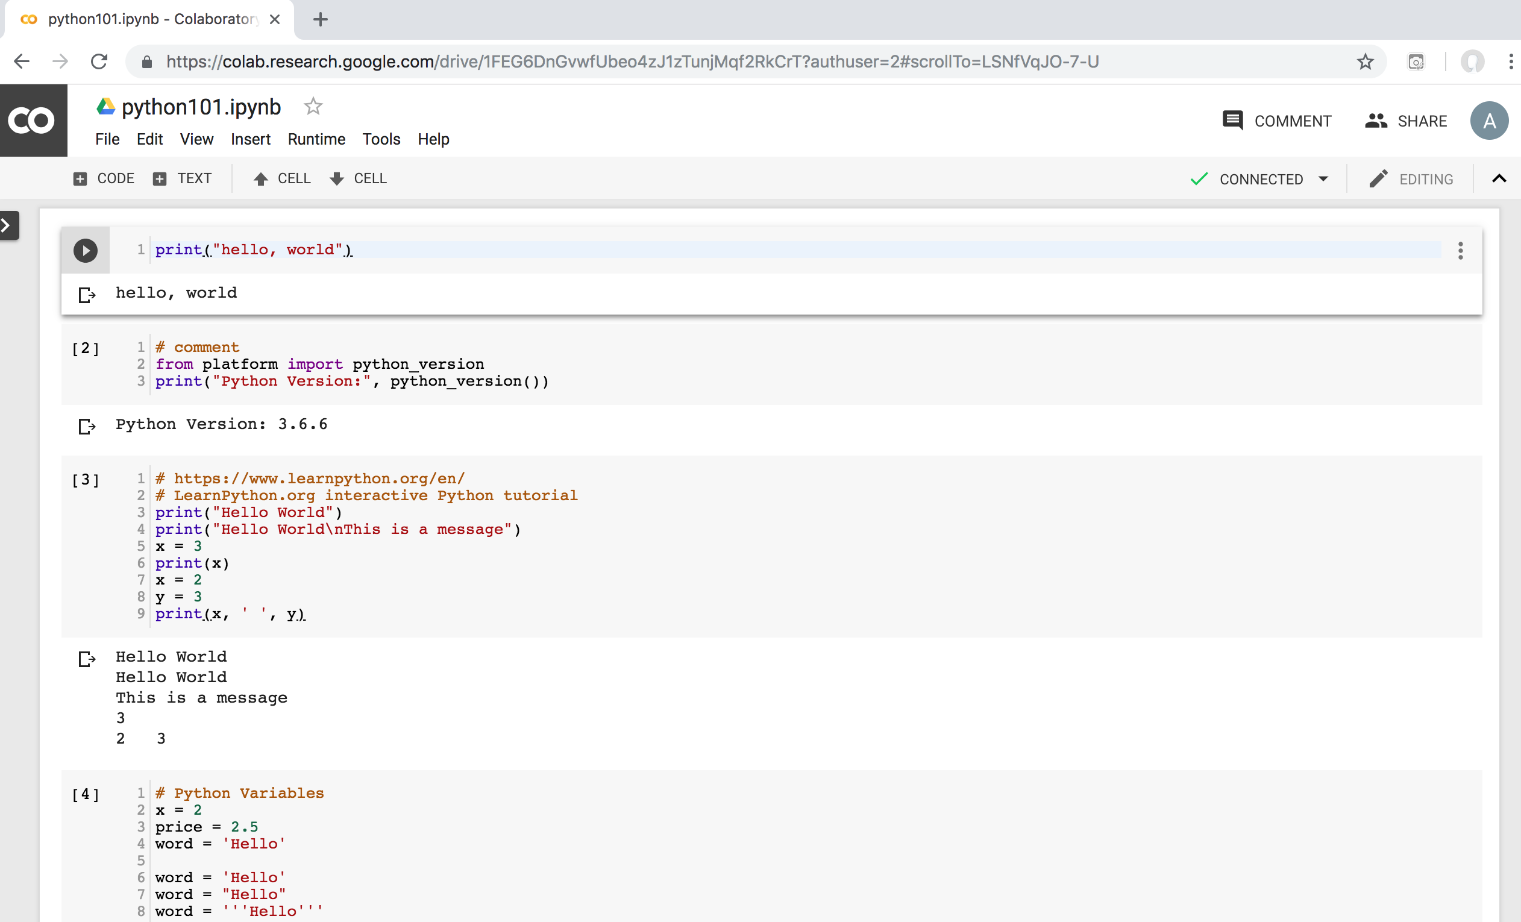
Python in Google Colab
https://colab.research.google.com/drive/1FEG6DnGvwfUbeo4zJ1zTunjMqf2RkCrT
https://tinyurl.com/aintpupython101

Slide 40
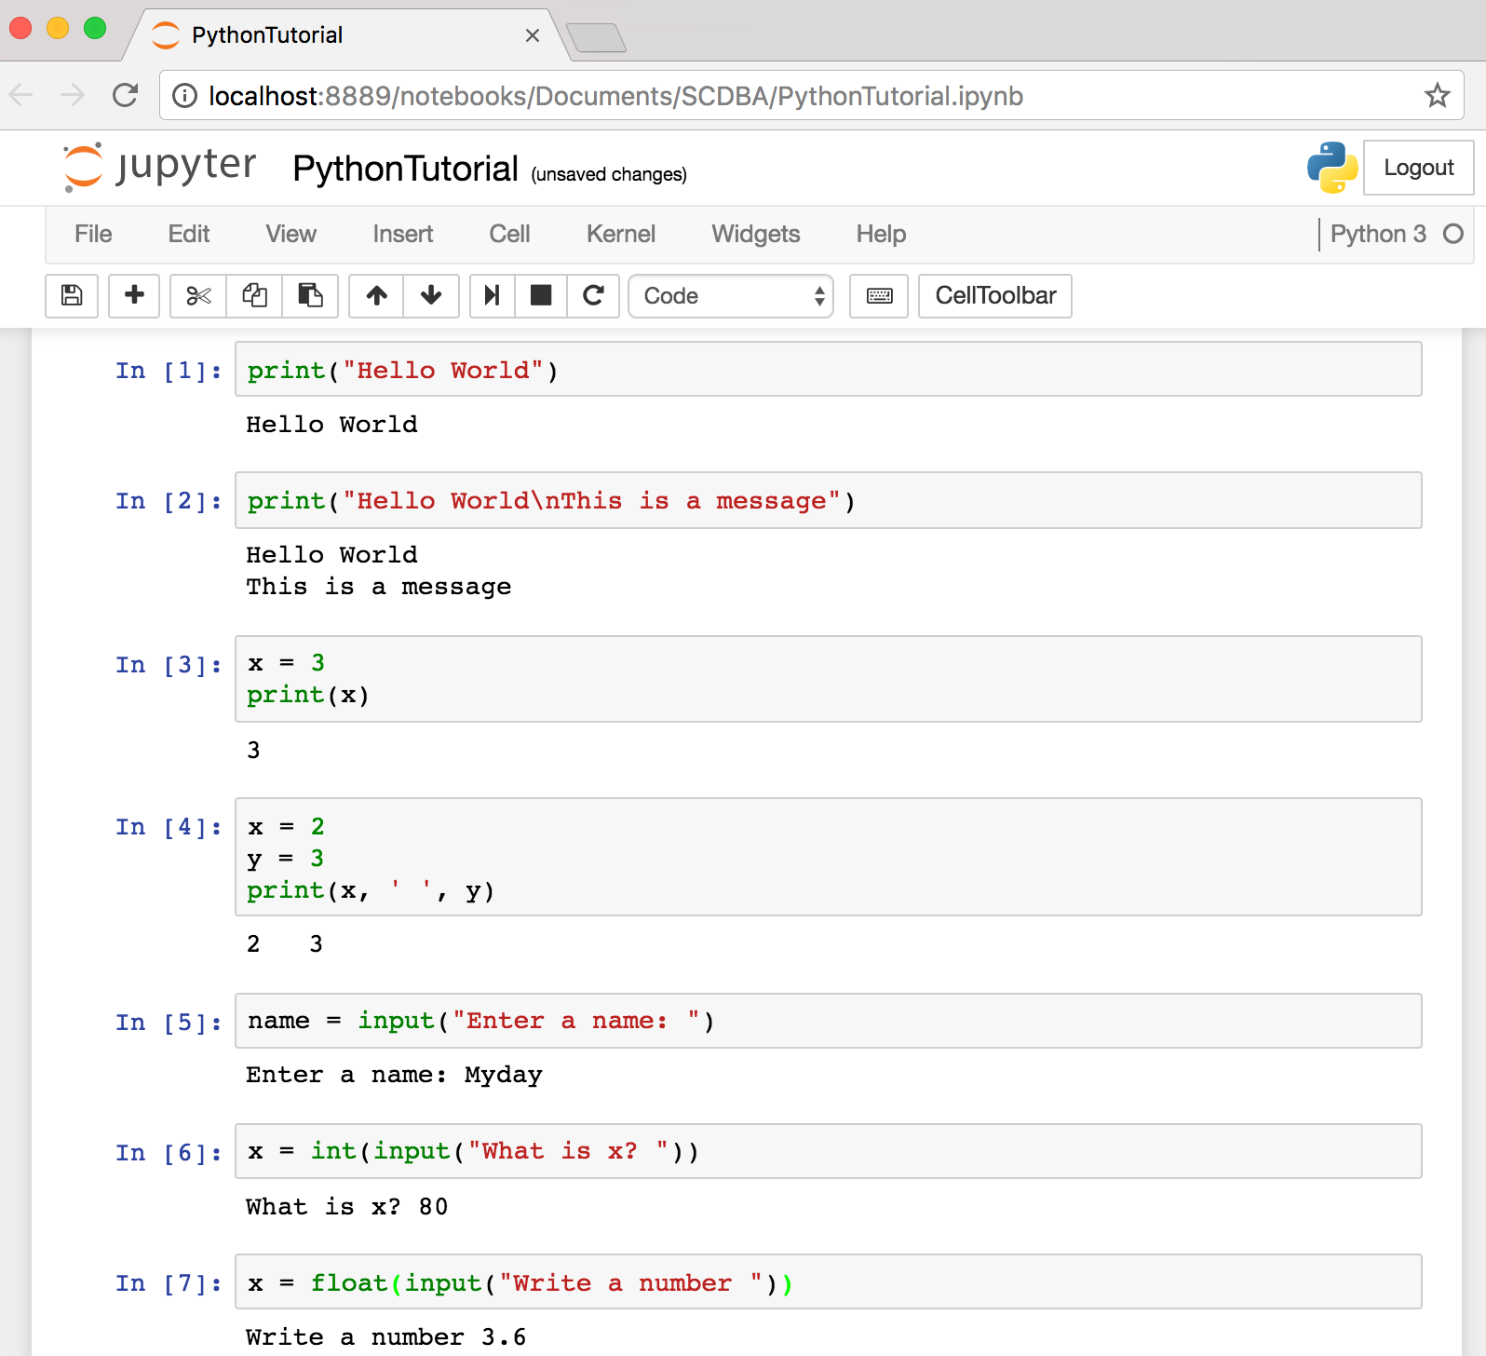
Text input and output
Source: http://pythonprogramminglanguage.com/text-input-and-output/
Notes:
print("Hello World")
print("Hello World\nThis is a message")
x = 3
print(x)
x = 2
y = 3
print(x, ' ', y)
name = input("Enter a name: ")
x = int(input("What is x? "))
x = float(input("Write a number "))

Slide 41
Variables
x = 2
price = 2.5
word = 'Hello'
word = 'Hello'
word = "Hello"
word = '''Hello'''
x = 2
x = x + 1
x = 5
Source: http://pythonprogramminglanguage.com/

Slide 42
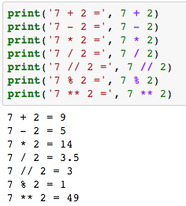
Python Basic Operators
print('7 + 2 =', 7 + 2)
print('7 - 2 =', 7 - 2)
print('7 * 2 =', 7 * 2)
print('7 / 2 =', 7 / 2)
print('7 // 2 =', 7 // 2)
print('7 % 2 =', 7 % 2)
print('7 ** 2 =', 7 ** 2)

Slide 43
BMI Calculator in Python
height_cm = float(input("Enter your height in cm: "))
weight_kg = float(input("Enter your weight in kg: "))
height_m = height_cm/100
BMI = (weight_kg/(height_m**2))
print("Your BMI is: " + str(round(BMI,1)))
Source: http://code.activestate.com/recipes/580615-bmi-code/

Slide 44
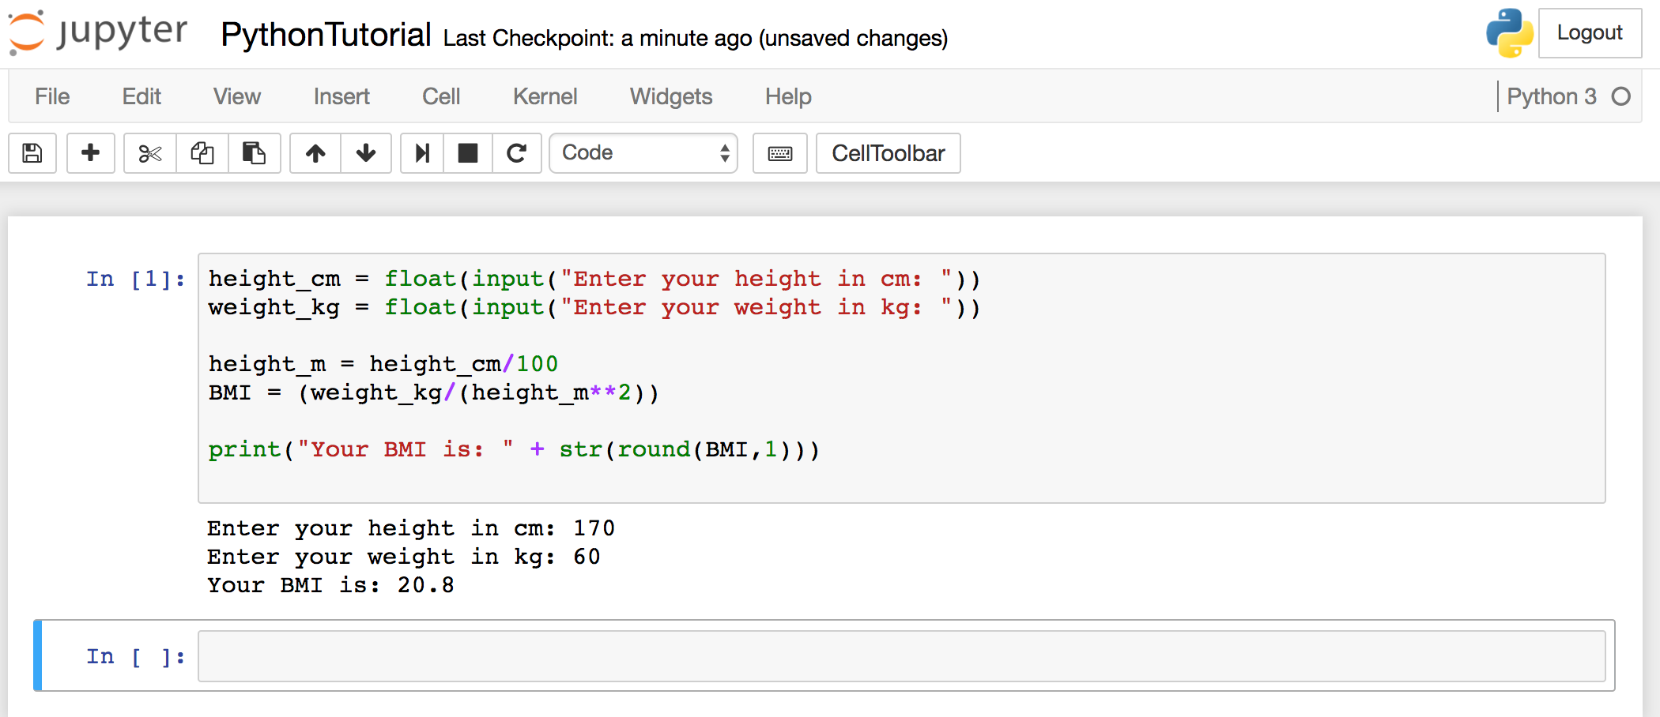
BMI Calculator in Python
Source: http://code.activestate.com/recipes/580615-bmi-code/
Notes:
height_cm = float(input("Enter your height in cm: "))
weight_kg = float(input("Enter your weight in kg: "))
height_m = height_cm/100
BMI = (weight_kg/(height_m**2))
print("Your BMI is: " + str(round(BMI,1)))

Slide 45
Future value of a specified principal amount, rate of interest, and a number of years
Source: https://www.w3resource.com/python-exercises/python-basic-exercise-39.php

Slide 46
Future Value (FV)
# How much is your $100 worth after 7 years?
print(100 * 1.1 ** 7)
# output = 194.87
Source: https://www.w3resource.com/python-exercises/python-basic-exercise-39.php

Slide 47
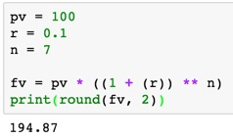
Future Value (FV)
pv = 100
r = 0.1
n = 7
fv = pv * ((1 + (r)) ** n)
print(round(fv, 2))

Slide 48
Future Value (FV)
amount = 100
interest = 10 #10% = 0.01 * 10
years = 7
future_value = amount * ((1 + (0.01 * interest)) ** years)
print(round(future_value, 2))
Source: https://www.w3resource.com/python-exercises/python-basic-exercise-39.php
Notes:
amount = 100
interest = 10 #10% = 0.01 * 10
years = 7
future_value = amount * ((1 + (0.01 * interest)) ** years)
print(round(future_value, 2))

Slide 49
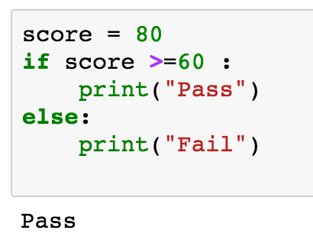
if statements
> greater than
< smaller than
== equals
!= is not
score = 80
if score >=60 :
print("Pass")
else:
print("Fail")
Source: http://pythonprogramminglanguage.com/

Slide 50
if elif else
score = 90
grade = ""
if score >=90:
grade = "A"
elif score >= 80:
grade = "B"
elif score >= 70:
grade = "C"
elif score >= 60:
grade = "D"
else:
grade = "E"
print(grade)
# grade = ”A”
A
http://pythontutor.com/visualize.html
https://goo.gl/E6w5ph
Source: http://pythonprogramminglanguage.com/
Notes:
http://pythontutor.com/visualize.html
https://goo.gl/E6w5ph

Slide 51
for loops
for i in range(1,11):
print(i)
1
2
3
4
5
6
7
8
9
10
Source: http://pythonprogramminglanguage.com/
Notes:
https://goo.gl/YpxMYo

Slide 52
for loops
for i in range(1,10):
for j in range(1,10):
print(i, ' * ' , j , ' = ', i*j)
9 * 1 = 9
9 * 2 = 18
9 * 3 = 27
9 * 4 = 36
9 * 5 = 45
9 * 6 = 54
9 * 7 = 63
9 * 8 = 72
9 * 9 = 81
Source: http://pythonprogramminglanguage.com/
Notes:
for i in range(1,10):
for j in range(1,10):
print(i, ' * ' , j , ' = ', i*j)

Slide 53
while loops
age = 10
while age < 20:
print(age)
age = age + 1
10
11
12
13
14
15
16
17
18
19
Source: https://learnpython.trinket.io/learn-python-part-8-loops#/while-loops/about-while-loops
Notes:
age = 10
while age < 20:
print(age)
age = age + 1

Slide 54
def Functions
def convertCMtoM(xcm):
m = xcm/100
return m
cm = 180
m = convertCMtoM(cm)
print(str(m))
1.8
Notes:
https://goo.gl/6K5qUn

Slide 55
Lists []
x = [60, 70, 80, 90]
print(len(x))
print(x[0])
print(x[1])
print(x[-1])
4
60
70
90

Slide 56
Tuples ()
A tuple in Python is a collection that cannot be modified. A tuple is defined using parenthesis.
x = (10, 20, 30, 40, 50)
print(x[0])
print(x[1])
print(x[2])
print(x[-1])
10
20
30
50
Source: http://pythonprogramminglanguage.com/tuples/

Slide 57
Dictionary {key : value}
k = { 'EN':'English', 'FR':'French' }
print(k['EN'])
English
Source: http://pythonprogramminglanguage.com/dictionary/

Slide 58
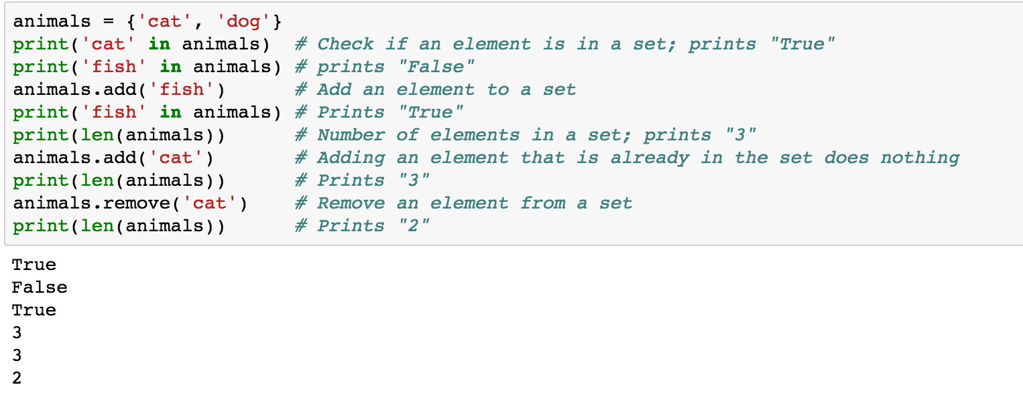
Sets {}
animals = {'cat', 'dog'}
animals = {'cat', 'dog'}
print('cat' in animals)
print('fish' in animals)
animals.add('fish')
print('fish' in animals)
print(len(animals))
animals.add('cat')
print(len(animals))
animals.remove('cat')
print(len(animals))
Source: http://cs231n.github.io/python-numpy-tutorial/
Notes:
#Sets
animals = {'cat', 'dog'}
print('cat' in animals) # Check if an element is in a set; prints "True"
print('fish' in animals) # prints "False"
animals.add('fish') # Add an element to a set
print('fish' in animals) # Prints "True"
print(len(animals)) # Number of elements in a set; prints "3"
animals.add('cat') # Adding an element that is already in the set does nothing
print(len(animals)) # Prints "3"
animals.remove('cat') # Remove an element from a set
print(len(animals)) # Prints "2”
Source: http://cs231n.github.io/python-numpy-tutorial/

Slide 59
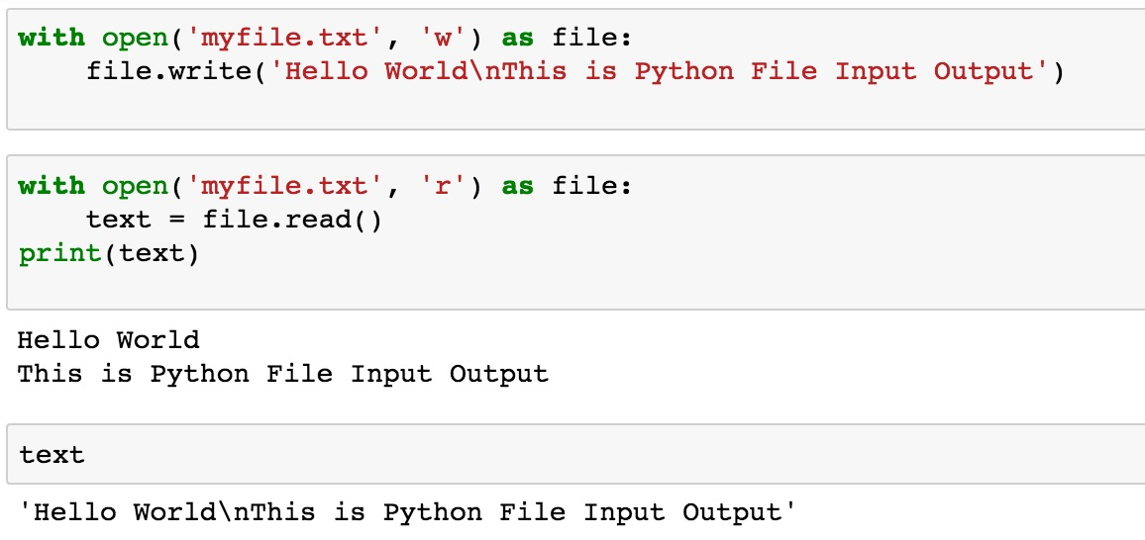
File Input / Output
with open('myfile.txt', 'w') as file:
file.write('Hello World\nThis is Python File Input Output')
with open('myfile.txt', 'r') as file:
text = file.read()
print(text)
Source: https://github.com/TiesdeKok/LearnPythonforResearch/blob/master/0_python_basics.ipynb
Notes:
with open('myfile.txt', 'w') as file:
file.write('Hello World\nThis is Python File Input Output')
with open('myfile.txt', 'r') as file:
text = file.read()
print(text)
with open('myfile.txt', 'a+') as file:
file.write('\n' + 'New line')
with open('myfile.txt', 'r') as file:
text = file.read()
print(text)

Slide 60
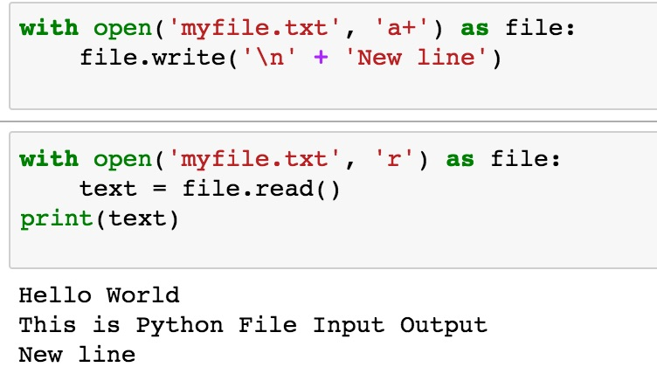
File Input / Output
with open('myfile.txt', 'a+') as file:
file.write('\n' + 'New line')
with open('myfile.txt', 'r') as file:
text = file.read()
print(text)
Source: https://github.com/TiesdeKok/LearnPythonforResearch/blob/master/0_python_basics.ipynb
Notes:
with open('myfile.txt', 'w') as file:
file.write('Hello World\nThis is Python File Input Output')
with open('myfile.txt', 'r') as file:
text = file.read()
print(text)
with open('myfile.txt', 'a+') as file:
file.write('\n' + 'New line')
with open('myfile.txt', 'r') as file:
text = file.read()
print(text)

Slide 61
try except finally
try:
file = open("myfile.txt")
#file = open("myfile.txt", 'w')
file.write("Python write file")
print("file saved")
except:
print("Exception file Error")
finally:
file.close()
print("finally process")
Exception file Error
finally process
Source: https://pythonbasics.org/try-except/
Notes:
try:
file = open("myfile.txt")
#file = open("myfile.txt", 'w')
file.write("Python write file")
print("file saved")
except:
print("Exception file Error")
finally:
file.close()
print("finally process")

Slide 62
class
class Person:
def __init__(self, name, age):
self.name = name
self.age = age
def myfunc(self):
print("Hello my name is " + self.name)
p1 = Person("Alan", 20)
p1.myfunc()
print(p1.name)
print(p1.age)
Hello my name is Alan
Alan
20
Source: https://www.w3schools.com/python/python_classes.asp
Notes:
class Person:
def __init__(self, name, age):
self.name = name
self.age = age
def myfunc(self):
print("Hello my name is " + self.name)
p1 = Person("Alan", 20)
p1.myfunc()
print(p1.name)
print(p1.age)

Slide 63
Big Data Analytics with Numpy in Python

Slide 64
Numpy
NumPy
Base N-dimensional array package

Slide 65
NumPy is the fundamental package for scientific computing with Python.
Source: http://www.numpy.org/

Slide 66
NumPy
NumPy
NumPy provides a multidimensional array object to store homogenous or heterogeneous data; it also provides optimized functions/methods to operate on this array object.
Source: Yves Hilpisch (2014), Python for Finance: Analyze Big Financial Data, O'Reilly

Slide 67
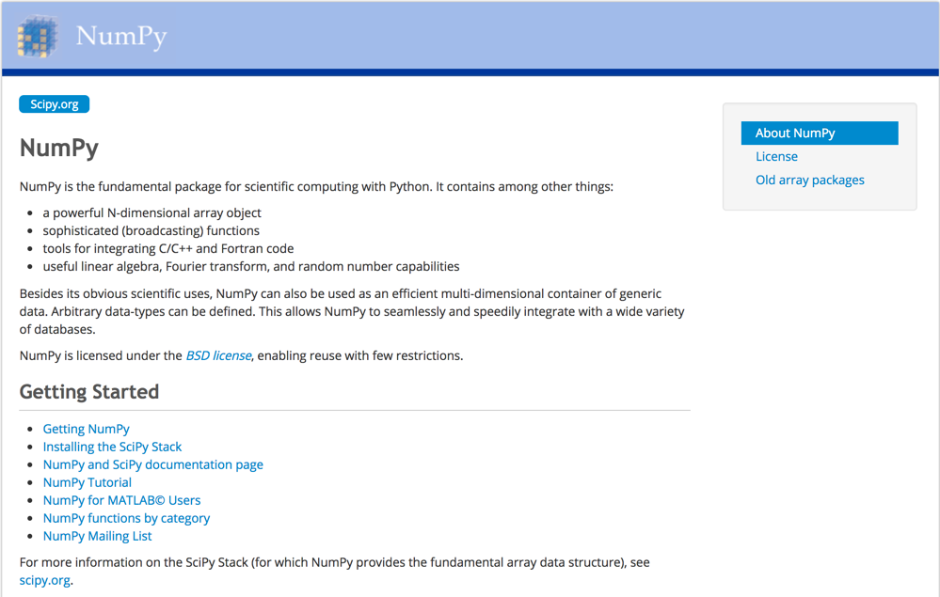
NumPy
http://www.numpy.org/

Slide 68
NumPy ndarray
NumPy
One-dimensional Array (1-D Array)
0 | 1 |  |  | n-1
1 | 2 | 3 | 4 | 5
Two-dimensional Array (2-D Array)
 | 0 | 1 |  |  | n-1
0 | 1 | 2 | 3 | 4 | 5
1 | 6 | 7 | 8 | 9 | 10
 | 11 | 12 | 13 | 14 | 15
m-1 | 16 | 17 | 18 | 19 | 20

Slide 69
v = list(range(1, 6)) v 2 * v import numpy as np v = np.arange(1, 6) v 2 * v
NumPy
NumPy
Source: Yves Hilpisch (2014), Python for Finance: Analyze Big Financial Data, O'Reilly
Notes:
# pip3 install numpy
# pip install numpy
# sudo pip3 install numpy
import numpy as np

Slide 70
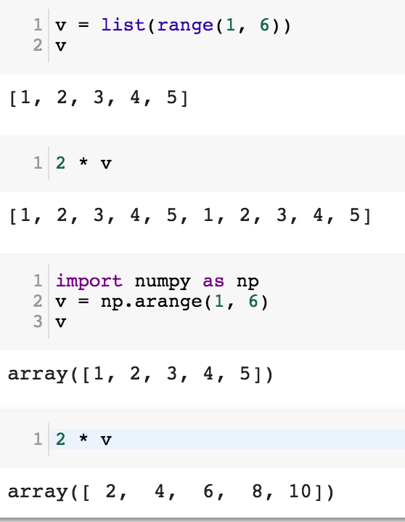
NumPy
Base N-dimensional array package

Slide 71
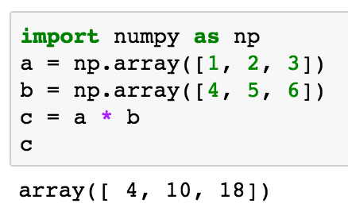
import numpy as np a = np.array([1, 2, 3]) b = np.array([4, 5, 6]) c = a * b c
NumPy Create Array
NumPy
Source: Yves Hilpisch (2014), Python for Finance: Analyze Big Financial Data, O'Reilly

Slide 72
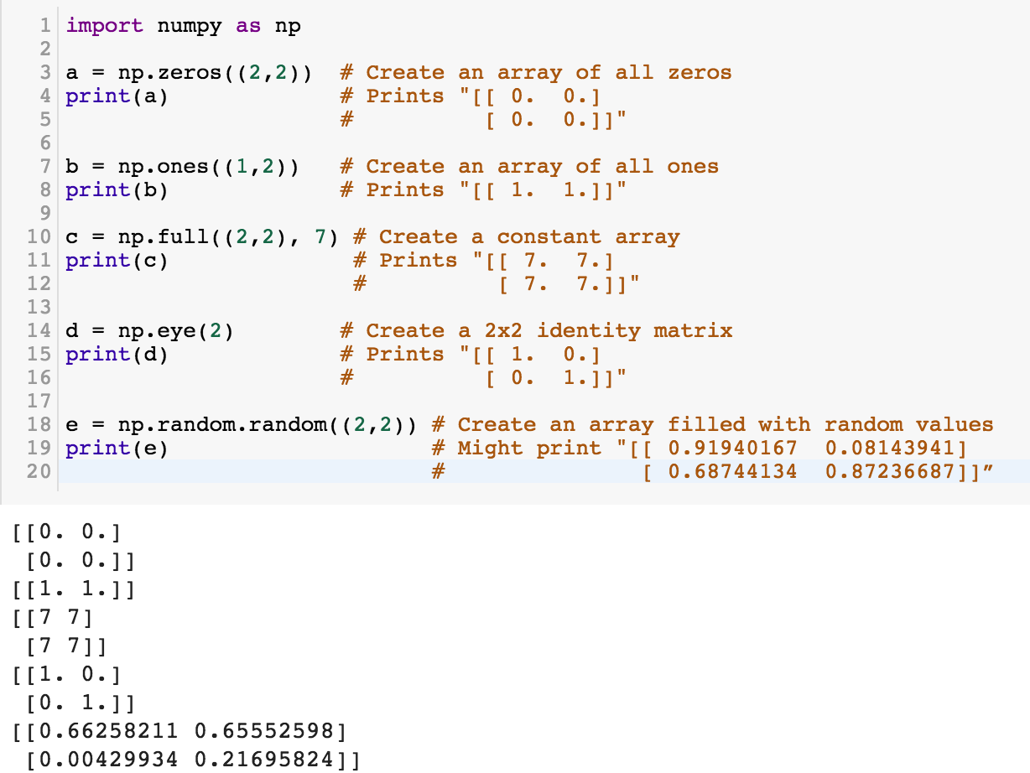
NumPy
NumPy
Source: http://cs231n.github.io/python-numpy-tutorial/
Notes:
import numpy as np
a = np.zeros((2,2)) # Create an array of all zeros
print(a) # Prints "[[ 0. 0.]
# [ 0. 0.]]"
b = np.ones((1,2)) # Create an array of all ones
print(b) # Prints "[[ 1. 1.]]"
c = np.full((2,2), 7) # Create a constant array
print(c) # Prints "[[ 7. 7.]
# [ 7. 7.]]"
d = np.eye(2) # Create a 2x2 identity matrix
print(d) # Prints "[[ 1. 0.]
# [ 0. 1.]]"
e = np.random.random((2,2)) # Create an array filled with random values
print(e) # Might print "[[ 0.91940167 0.08143941]
# [ 0.68744134 0.87236687]]”
Source: http://cs231n.github.io/python-numpy-tutorial/

Slide 73
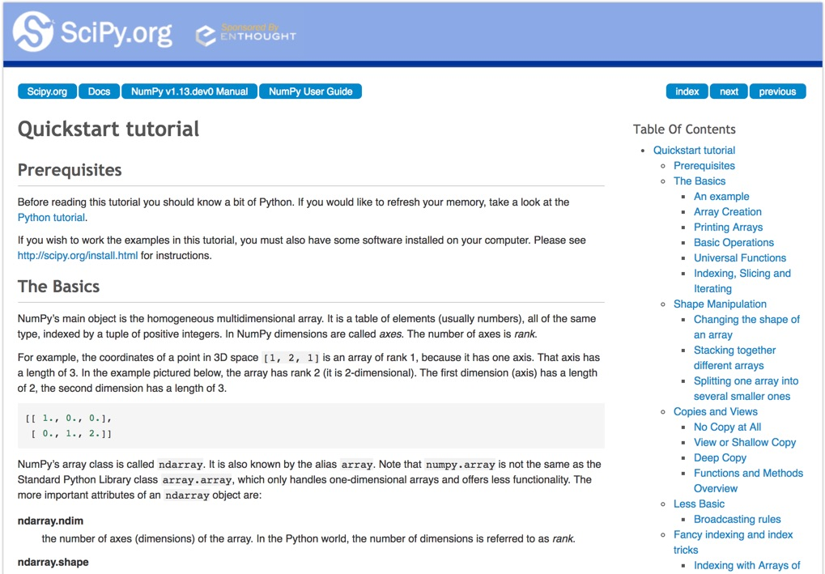
Numpy Quickstart Tutorial
https://docs.scipy.org/doc/numpy-dev/user/quickstart.html

Slide 74
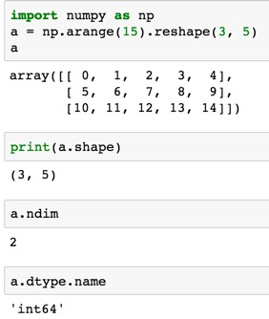
import numpy as np
a = np.arange(15).reshape(3, 5)
a.shape
a.ndim
a.dtype.name
Source: https://docs.scipy.org/doc/numpy-dev/user/quickstart.html
Notes:
Numpy Tutorial
Source: https://docs.scipy.org/doc/numpy-dev/user/quickstart.html
In [1]:
import numpy as np
a = np.arange(15).reshape(3, 5)
a
Out[1]:
array([[ 0, 1, 2, 3, 4],
[ 5, 6, 7, 8, 9],
[10, 11, 12, 13, 14]])
In [2]:
print(a.shape)
(3, 5)
In [3]:
a.ndim
Out[3]:
2
In [4]:
a.dtype.name
Out[4]:
'int64'
In [5]:
a.itemsize
Out[5]:
8
In [6]:
a.size
Out[6]:
15
In [7]:
type(a)
Out[7]:
numpy.ndarray
In [8]:
b = np.array([1, 2, 3])
In [9]:
b
Out[9]:
array([1, 2, 3])
In [10]:
type(b)
Out[10]:
numpy.ndarray

Slide 75
Matrix
Source: https://simple.wikipedia.org/wiki/Matrix_(mathematics)

Slide 76
NumPy ndarray: Multidimensional Array Object

Slide 77
NumPy ndarray
One-dimensional Array (1-D Array)
0 | 1 |  |  | n-1
1 | 2 | 3 | 4 | 5
Two-dimensional Array (2-D Array)
 | 0 | 1 |  |  | n-1
0 | 1 | 2 | 3 | 4 | 5
1 | 6 | 7 | 8 | 9 | 10
 | 11 | 12 | 13 | 14 | 15
m-1 | 16 | 17 | 18 | 19 | 20

Slide 78
import numpy as np a = np.array([1,2,3,4,5])
One-dimensional Array (1-D Array)
0 | 1 |  |  | n-1
1 | 2 | 3 | 4 | 5

Slide 79
a = np.array([[1,2,3,4,5],[6,7,8,9,10],[11,12,13,14,15],[16,17,18,19,20]])
Two-dimensional Array (2-D Array)
 | 0 | 1 |  |  | n-1
0 | 1 | 2 | 3 | 4 | 5
1 | 6 | 7 | 8 | 9 | 10
 | 11 | 12 | 13 | 14 | 15
m-1 | 16 | 17 | 18 | 19 | 20

Slide 80
import numpy as np a = np.array([[0, 1, 2, 3], [10, 11, 12, 13], [20, 21, 22, 23]])
a
0 | 1 | 2 | 3
10 | 11 | 12 | 13
20 | 21 | 22 | 23
Notes:
import numpy as np a = np.array([[0, 1, 2, 3], [10, 11, 12, 13], [20, 21, 22, 23]])
a

Slide 81
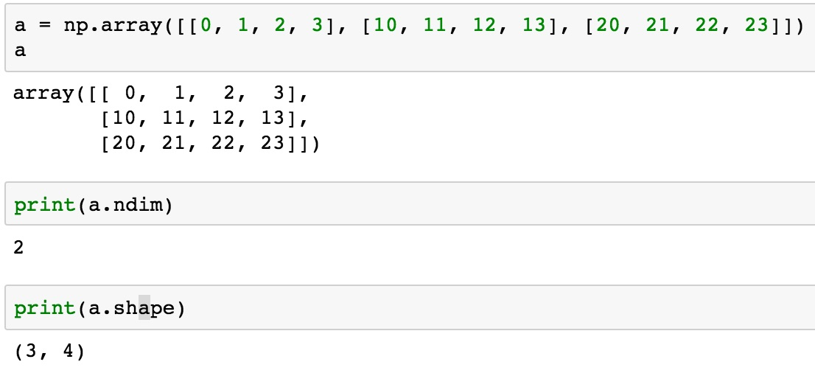
a = np.array([[0, 1, 2, 3], [10, 11, 12, 13], [20, 21, 22, 23]])
0 | 1 | 2 | 3
10 | 11 | 12 | 13
20 | 21 | 22 | 23

Slide 82
NumPy Basics: Arrays and Vectorized Computation
Source: https://www.safaribooksonline.com/library/view/python-for-data/9781449323592/ch04.html

Slide 83
NumPy Array
Source: https://www.safaribooksonline.com/library/view/python-for-data/9781449323592/ch04.html

Slide 84
Numpy Array
Source: https://www.safaribooksonline.com/library/view/python-for-data/9781449323592/ch04.html

Slide 85
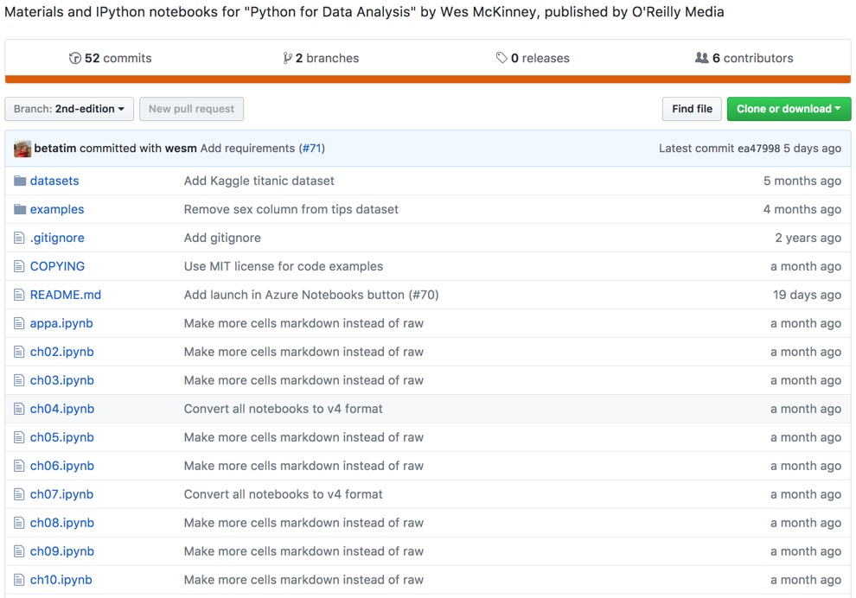
Wes McKinney (2017), "Python for Data Analysis: Data Wrangling with Pandas, NumPy, and IPython", 2nd Edition, O'Reilly Media.
https://github.com/wesm/pydata-book

Slide 86
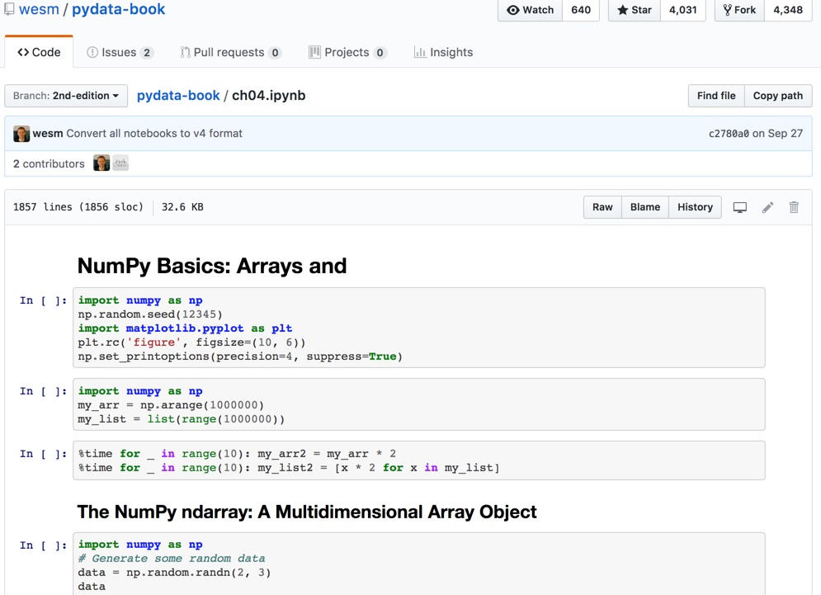
Wes McKinney (2017), "Python for Data Analysis: Data Wrangling with Pandas, NumPy, and IPython", 2nd Edition, O'Reilly Media.
Source: https://github.com/wesm/pydata-book/blob/2nd-edition/ch04.ipynb

Slide 87
Python in Google Colab (Python101)
https://colab.research.google.com/drive/1FEG6DnGvwfUbeo4zJ1zTunjMqf2RkCrT
https://tinyurl.com/aintpupython101

Slide 88
Summary
Foundations of Data Mining in Python
Python
Programming language
Numpy
Scientific computing

Slide 89
References
Robert Layton (2017), Learning Data Mining with Python - Second Edition, Packt Publishing.
Wes McKinney (2017), "Python for Data Analysis: Data Wrangling with Pandas, NumPy, and IPython", 2nd Edition, O'Reilly Media. https://github.com/wesm/pydata-book
Ties de Kok (2017), Learn Python for Research, https://github.com/TiesdeKok/LearnPythonforResearch
Avinash Jain (2017), Introduction To Python Programming, Udemy, https://www.udemy.com/pythonforbeginnersintro/
Python Programming, https://pythonprogramming.net/
Python, https://www.python.org/
Python Programming Language, http://pythonprogramminglanguage.com/
Numpy, http://www.numpy.org/
Pandas, http://pandas.pydata.org/
Skikit-learn, http://scikit-learn.org/
Min-Yuh Day (2021), Python 101, https://tinyurl.com/aintpupython101

